Slide 1
Mission in Macedonia
Acts 16:11–18:22
Preached by Matthew Lyle at Crossroads International Church Singapore • CICFamily.com Uploaded by Dr. Rick Griffith • Singapore Bible College Files in many languages for free download at BibleStudyDownloads.org

Slide 2
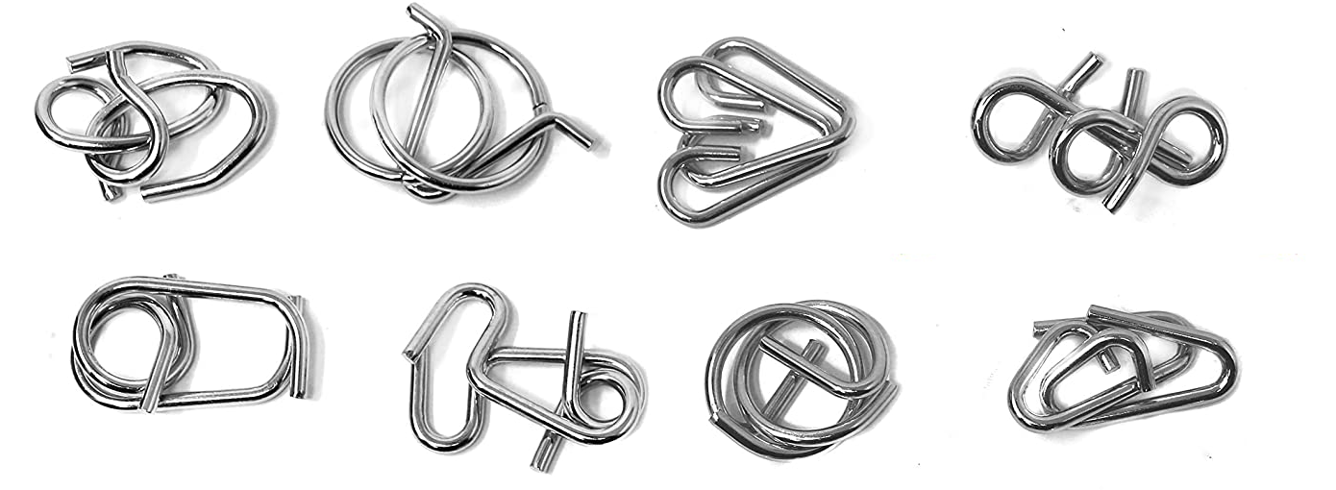

Slide 3
God is more complex than a metal puzzle

Slide 4
Mission in Macedonia
Acts 16:11–18:22

Slide 5
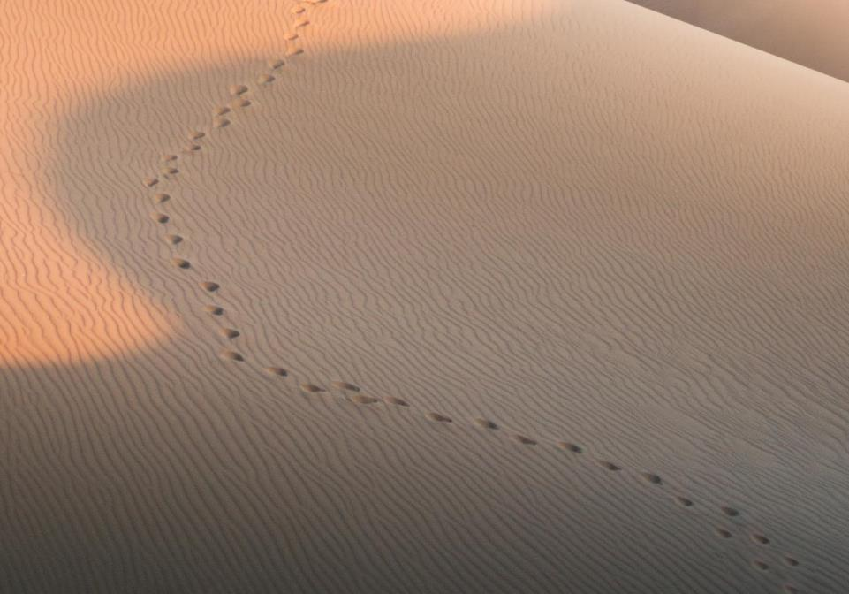
GOOD NE WS
ON THE MO VE
God’s work through the early church in
Acts

Slide 6
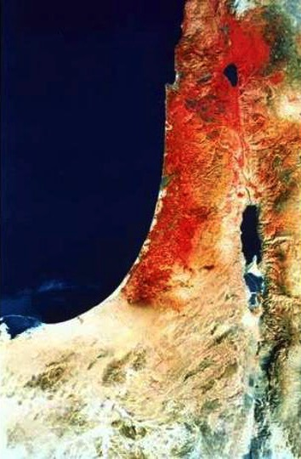
“ends of the earth"
Acts 1:8 NLT
"But you will receive power when the Holy Spirit comes upon you. And you will be my witnesses, telling people about me everywhere
Samaria
Jerusalem
Judea
—in Jerusalem
throughout Judea,
in Samaria,
and to the
ends of the earth.”

Slide 7
Church Growth
Persecution

Slide 8
Antioch
Jerusalem

Slide 9
Church Growth
Persecution
Missions

Slide 10
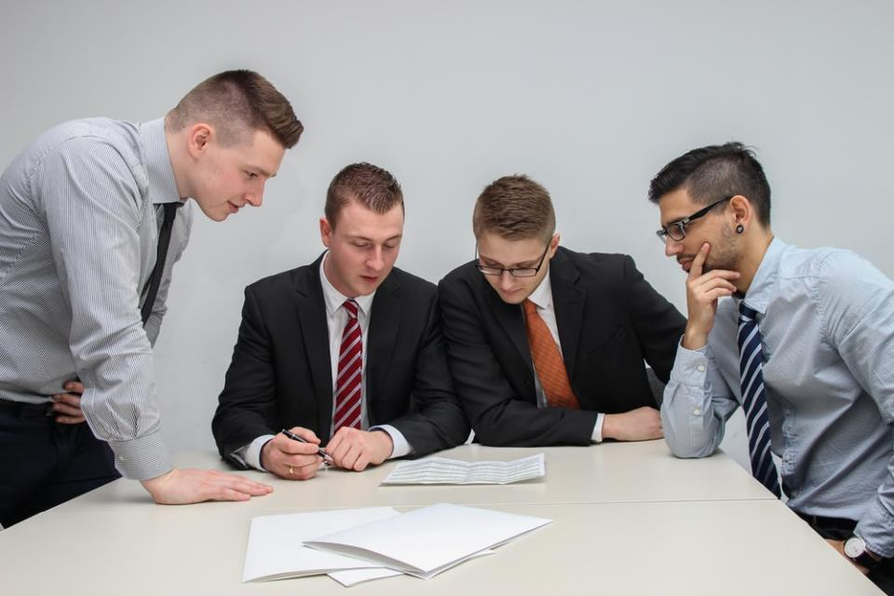
God who Reveals
“One day as these men were worshiping the Lord and fasting…” (Acts 13:1)

Slide 11
Antioch
Jerusalem
1st Missionary Journey
Acts 13–14

Slide 12
Paul & Silas
Antioch
Barnabas & Mark
Disagreement leading to separation may be God's way to expand his work
Jerusalem
2nd Missionary Journey
Part 1: Disagreement
(Acts 15:39b–16:10)

Slide 13
Macedonia
Bithynia
Troas
Paul & Silas
Asia
Antioch
Jerusalem
2nd Missionary Journey
Part 2: Macedonian Mission
(Acts 16:11–18:22)

Slide 14
Philippi
Thessalonica
Berea
Troas
Athens
Corinth

Slide 15
Philippi
People
Paul / Silas / Timothy
Luke
1. ???
2. ???
3. ???
Places
Samothrace
Neapolis
Philippi
Macedonia

Slide 16
Philippi
¹³ On the Sabbath we went a little way outside the city to a riverbank,
where we thought people would be meeting for prayer…

Slide 17
Lydia
from Thyatira
a merchant of expensive purple cloth
worshiped God
We sat down to speak with some women who had gathered there.

Slide 18
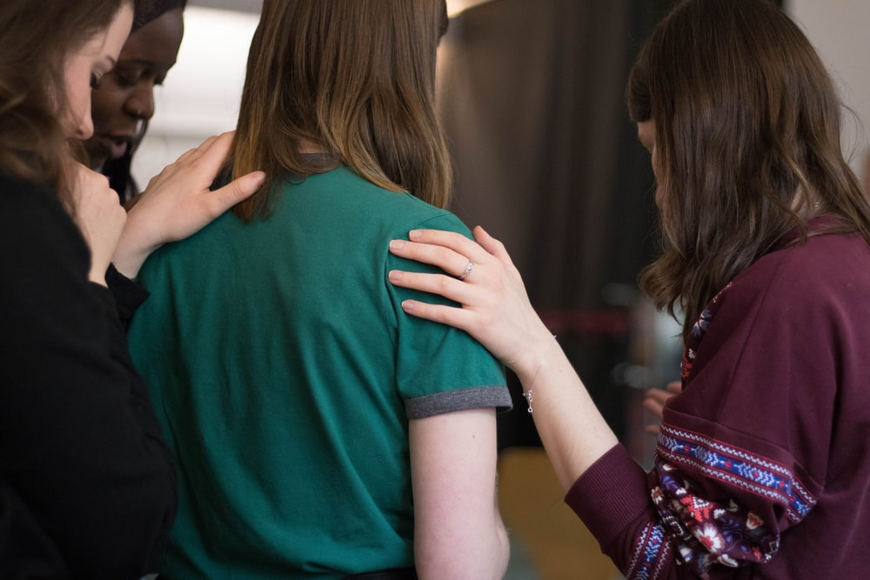
What was Lydia and her group praying for?

Slide 19
Open the eyes of my heart Lord
Open the eyes of my heart
I want to see You
I want to see You

Slide 20
God who Reveals
As she listened to us, the Lord opened her heart, and she accepted what Paul was saying

Slide 21
She and her household were baptized

Slide 22
God reveals himself
(through Paul and others)
to those who seek and worship him

Slide 23
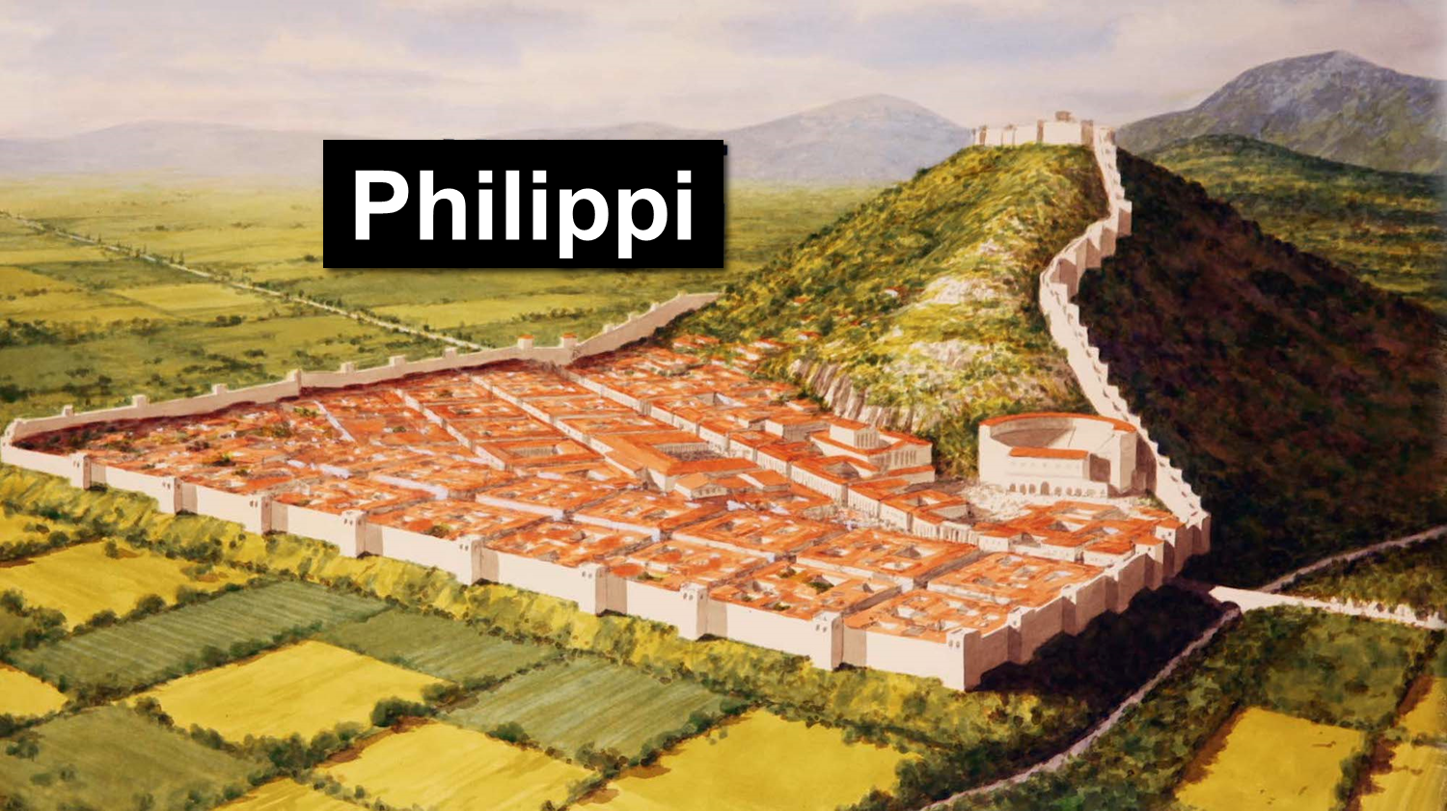
Philippi
“These men are servants of the Most High God, and they have come to tell you how to be saved” (Acts 16:17 NLT).

Slide 24
God reveals himself
(not through testimony of demons)
to those who seek
and worship him

Slide 25
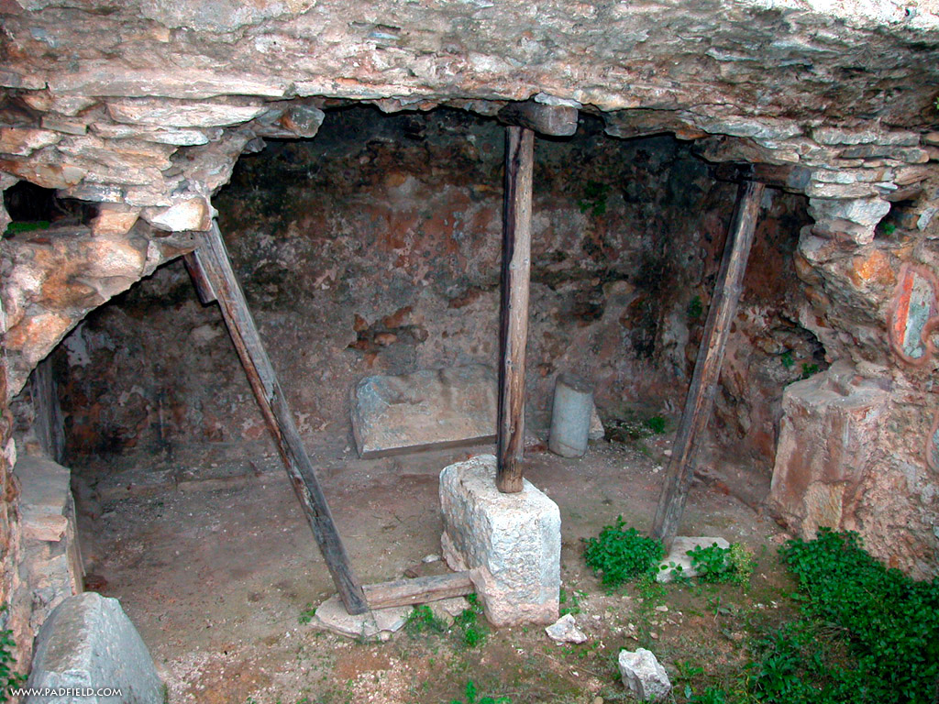
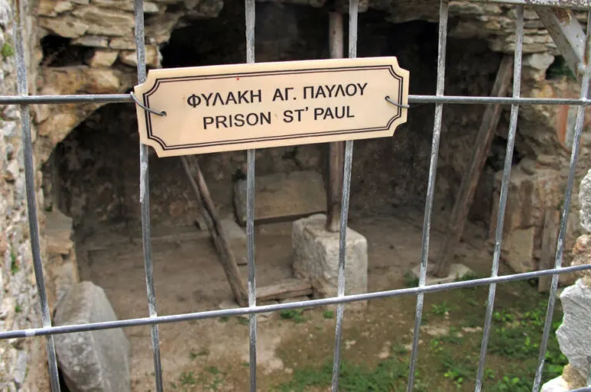
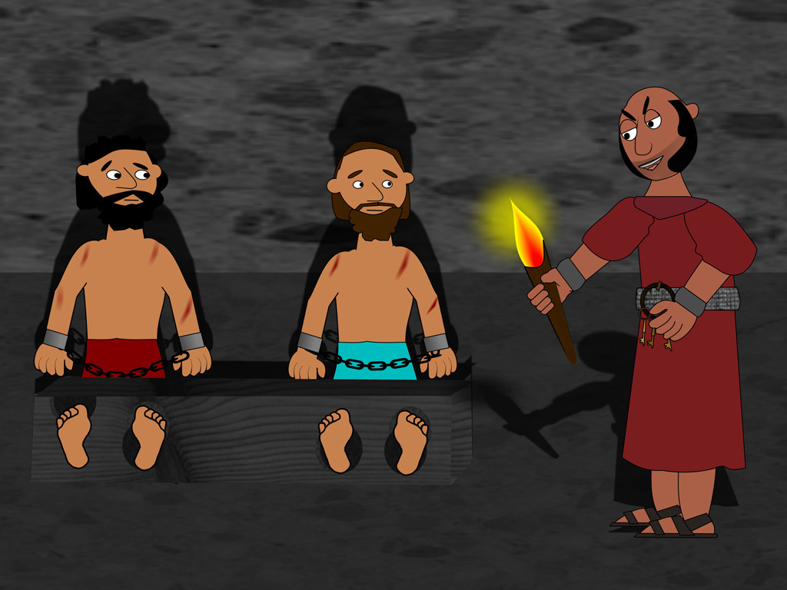
Jail in Philippi
Sue Bentley / FreeBibleimages.org

Slide 26
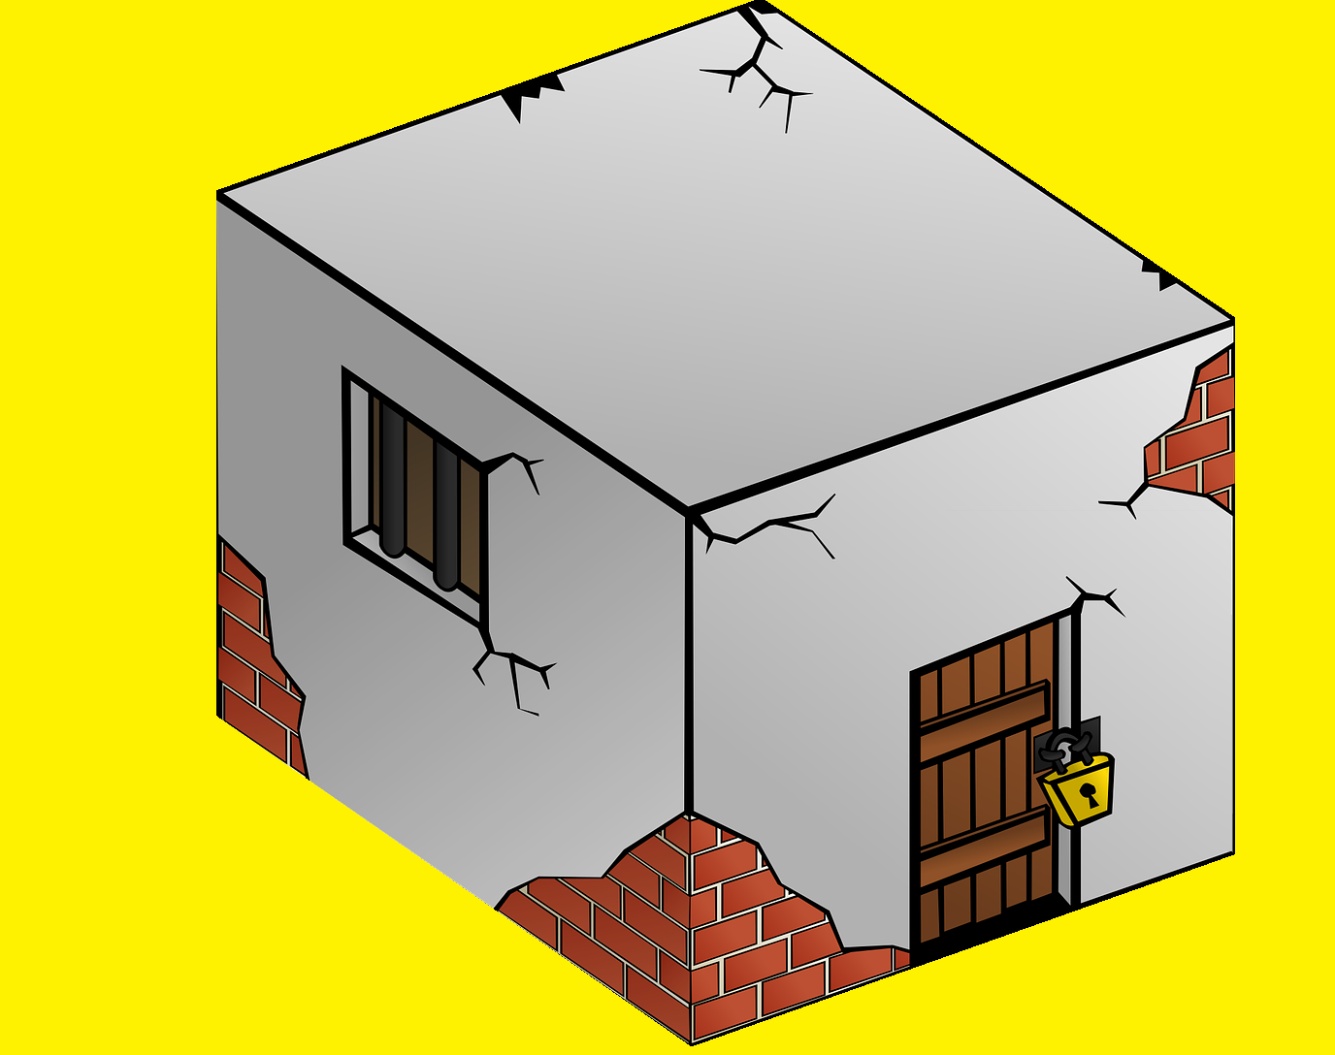
In and Out of Jail
Inner dungeon & stocks
Acts 16
Chained to soldiers
Acts 12
Locked room,
Guards outside
Acts 5
Jerusalem
Arrested
Acts 4
Ends of the Earth

Slide 27
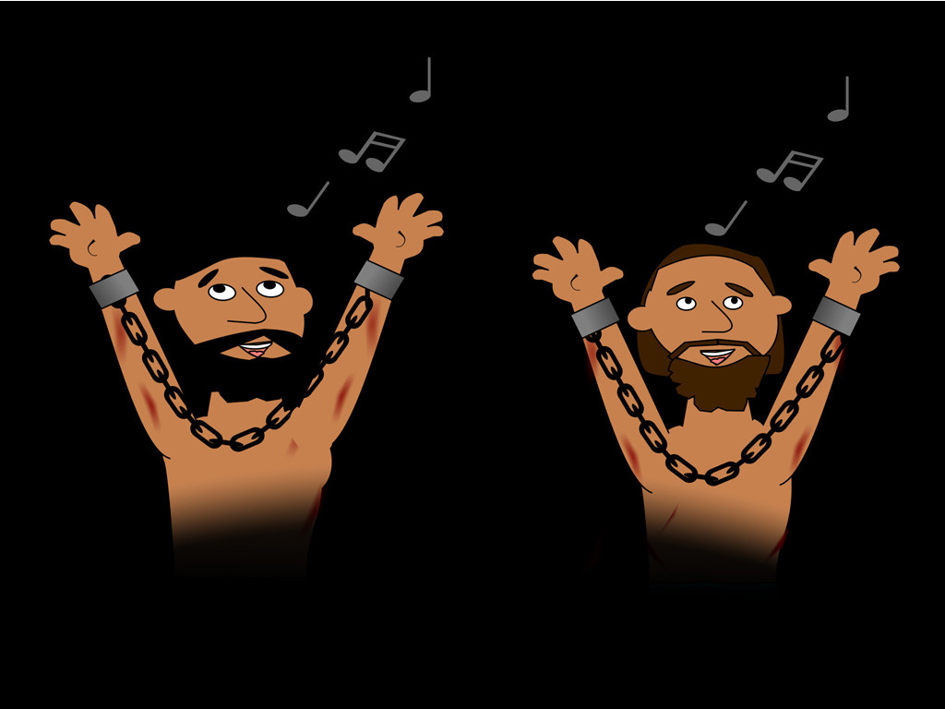
In and Out of Jail
²⁵ Around midnight Paul and Silas were praying and singing hymns to God, and the other prisoners were listening.
Sue Bentley / FreeBibleimages.org

Slide 28
I believe in God our Father
I believe in Christ the Son
I believe in the Holy Spirit
Our God is three in One
I believe in the resurrection
That we will rise again
For I believe in the Name of Jesus

Slide 29
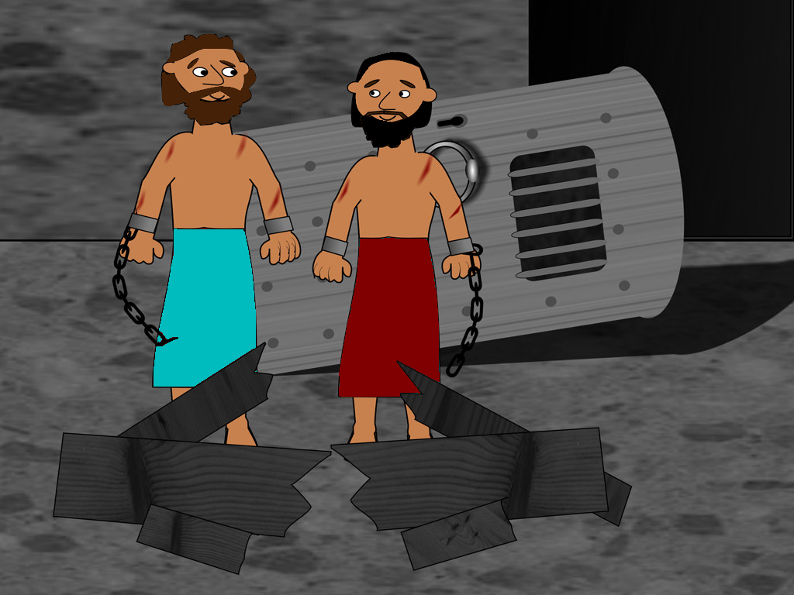
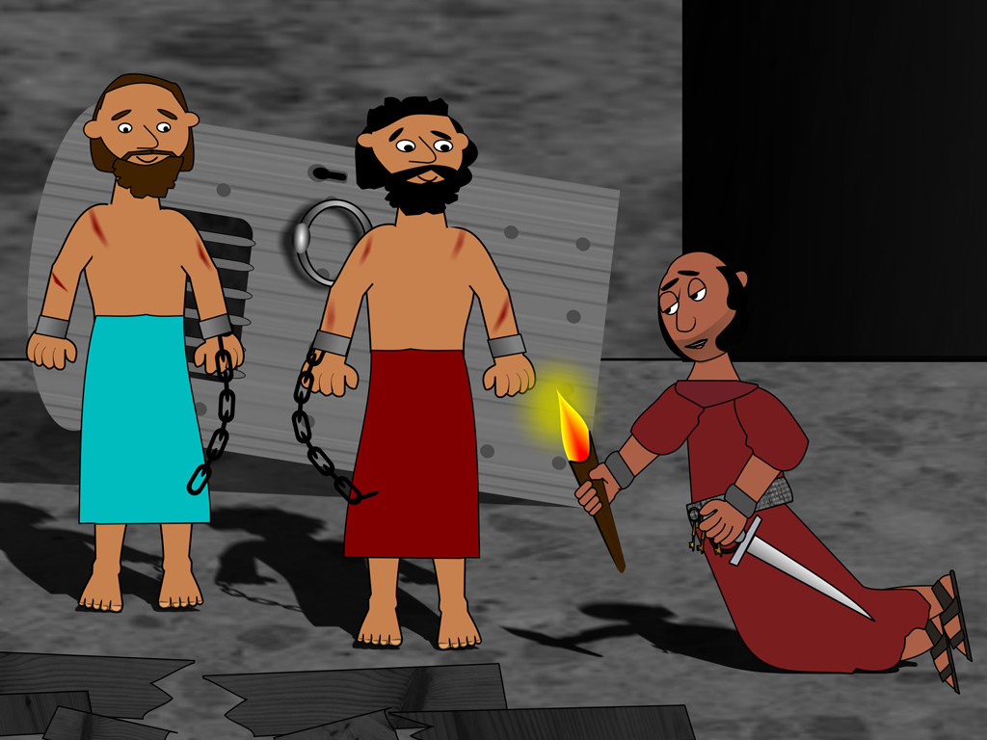
In and Out of Jail
Sue Bentley / FreeBibleimages.org

Slide 30
What was jailer afraid of?
²⁷ The jailer woke up to see the prison doors wide open. He assumed the prisoners had escaped, so he drew his sword to kill himself.
Authorities

Slide 31
What was jailer afraid of?
²⁸ But Paul shouted to him, “Stop! Don’t kill yourself! We are all here!”
²⁹ The jailer called for lights and ran to the dungeon and fell down trembling before Paul and Silas.
GOD
What must I do to be saved?

Slide 32
God reveals himself
(through actions of his disciples)
to those who seek
and worship him

Slide 33
What must I do?
³¹ . . . “Believe in the Lord Jesus and you will be saved, along with everyone in your household.”
Acts 8:36 “Why can’t I be baptized?”
³⁷ “You can,” Philip answered, “if you believe with all your heart.” And the eunuch replied, “I believe that Jesus Christ is the Son of God.”

Slide 34
God reveals himself
to those who seek
and worship him
Lydia
Slave Girl
Jailer
through Paul and others called to minister
not through the testimony of demons
through actions of his disciples

Slide 35
Turn the Other Cheek
³⁵ The next morning the city officials sent the police to tell the jailer, “Let those men go!” ³⁶ So the jailer told Paul, “The city officials have said you and Silas are free to leave. Go in peace.”

Slide 36
Turn the Other Cheek
Matt 5:39 But I say, do not resist an evil person! If someone slaps you on the right cheek, offer the other cheek also.

Slide 37
Thessalonica
Short period of time (3 weeks)
Preached in synagogue (resurrection)
Some Jews / Many devout (God-fearing) Greek men believed
Opposed by Jews

Slide 38
Berea
Short period of time
Preached in Synagogue
Many Jews / Many prominent Greek men and women believed
Opposed by Jews from Thessalonica

Slide 39
Thessalonica Berea
Some Jews Believed
Many Jews Believed
¹¹ And the people of Berea were more open-minded than those in Thessalonica, and they listened eagerly to Paul’s message. They searched the Scriptures day after day to see if Paul and Silas were teaching the truth.

Slide 40
God reveals himself
(through his word)
to those who seek
and worship him

Slide 41
Philippi
Thessalonica
Berea
Troas
Athens
Corinth

Slide 42
Athens
Short Period of Time
Preached in Synagogue
Troubled by all the idols
Debated philosophers
Sermon for Gentiles

Slide 43
Sermon for Gentiles
22-23
Gentiles are seeking God
24-26
Who God is
27-29
What God is doing
22-23
God’s Expectations

Slide 44
God reveals himself
(even to Gentiles)
to those who seek
and worship him

Slide 45
Prince of Peace

Slide 46
Corinth
Preached in synagogue
How many believed?
Opposed by Jews
Preached to Gentiles
Who was first convert?
God gave guidance via a dream

Slide 47
When God reveals his plans for you
expect him to fulfill those plans

Slide 48
The Return Trip
Acts 18:18-22
Cenchreae
Ephesus
Corinth
Antioch
Caesarea
Jerusalem
Why did Paul go to Jerusalem?

Slide 49
CIC is an independent church body that shall not be accountable to any other ecclesiastical or denominational body.
The elders are a group of biblically qualified men who are charged with leading the church under the leadership of Christ Jesus.
The congregation shall have highest authority in the life of the church.

Slide 50
God reveals himself
to those who seek
and worship him
through Paul and others called to minister
not through testimony of demons
through actions of his disciples
through his Word
even to Gentiles

Slide 51
Black

Slide 52
NT Preaching link at BibleStudyDownloads.org
Get this presentation for free!
Notes:
The Bible…Basically (bb)

