Slide 1
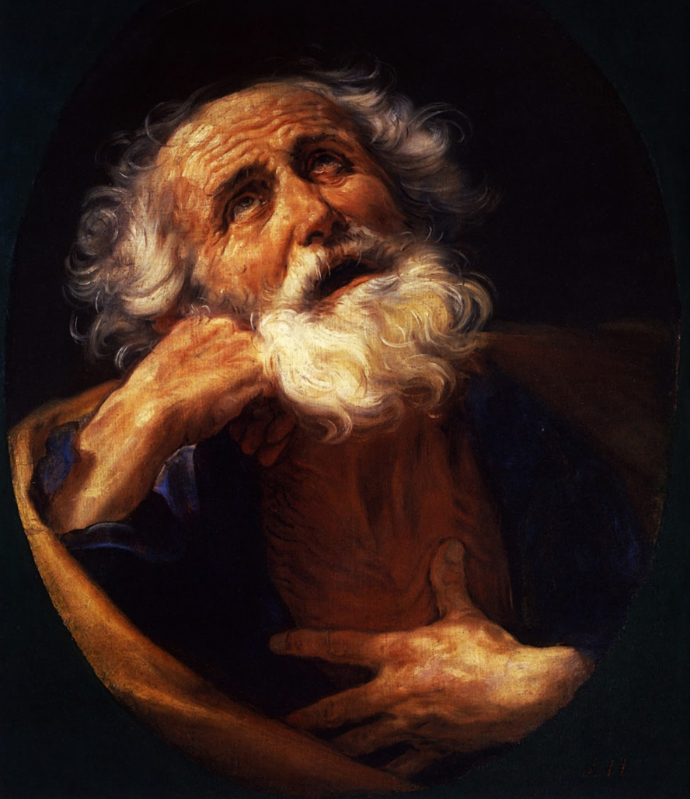
彼得后书 1:1～11
What to Know, What to Do
当知当行之事
2 Peter 1:1-11
Dr. Rick Griffith • Singapore Bible College • BibleStudyDownloads.org

Slide 2

Do you want more knowledge?
你希望汲取更多知识吗？
Notes:
Who here wants more knowledge? Raise your hand.

Slide 3

Knowledge 知识
Notes:
Students, what do you think of your education so far? By this time in the semester, some students are just getting going, while for others, May (or graduation) can't come soon enough.

Slide 4
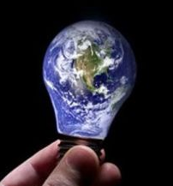
Knowledge is Infinite
学海无涯
Notes:
Prospective students, you certainly already know that knowledge is infinite.
This was made clear to me by one of my teachers. He told me, "We are giving you your PhD because we've educated you beyond your intelligence!"
I wasn’t smart enough to know what he meant.
In any case, people have various opinions about education.

Slide 5

Pride of Knowledge
因知识而心高气傲
Notes:
Some love learning so they can pride their knowledge over others. If you're thinking about coming to SBC to show off your knowledge, you will be disappointed.

Slide 6
Anti-Intellectual 知识无用论
Notes:
Others are at the other end of the spectrum and are anti-intellectual, thinking that education is a waste of time. Well, I wouldn't encourage such people to come either!

Slide 7
287
2 Peter
彼得后书
Problem问题本质
False Teaching (Heresy)
假教导 (异端)
Source of Problem问题来源
Internal
内部
Key Word 关键词
"knowledge"
(16 times)
"知识"
(16 次)
Date日期
公元 64 年早春
Early spring
AD 64
Notes:
Peter avoids both of these extremes in 2 Peter. He wrote to his readers facing an internal problem of heresy, so he uses the words for "knowledge" 16 times in this short letter of three brief chapters—and he presents knowledge in a positive sense.

Slide 8
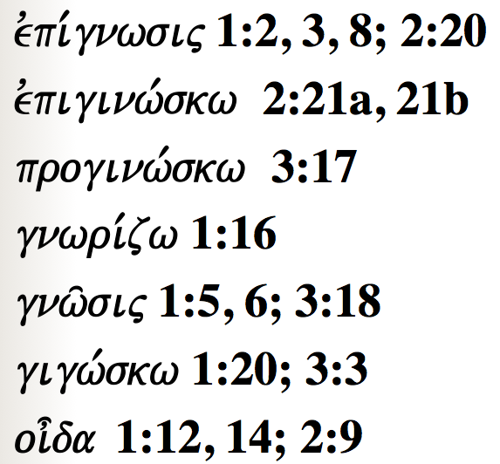
Peter uses many words to show how knowledge is vital for believers…
287
彼得用下列各词指出知识对信徒至关重要…
evpi,gnwsij 1:2, 3, 8; 2:20
evpiginw,skw 2:21a, 21b
proginw,skw 3:17
gnwri,zw 1:16
gnw/sij 1:5, 6; 3:18
gigw,skw 1:20; 3:3
oi=da 1:12, 14; 2:9
Notes:
Today we will see words for "knowledge" five times in the first 11 verses!

Slide 9
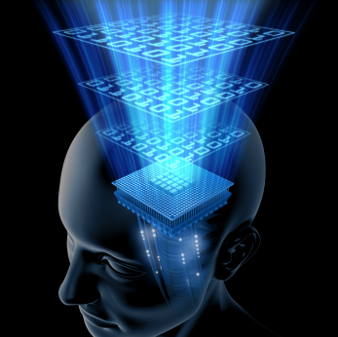
What do you really need to know?
你真需要知道的是什么呢？
Notes:
However, while knowledge is important, we can't learn everything—so what do you really need to know? What'll be on the test?

Slide 10

What do you really need to know?
你真需要知道的为何？
Notes:
When you consider how many things there are to know, it can be daunting. You seminary students came to SBC to get answers to your questions, but now your list of questions has grown! So what are the essentials that we really need to know?
You've come to the right place, because Peter has an answer for you in today's text.

Slide 11
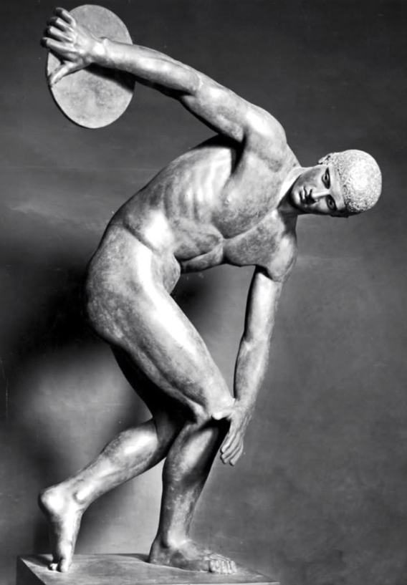
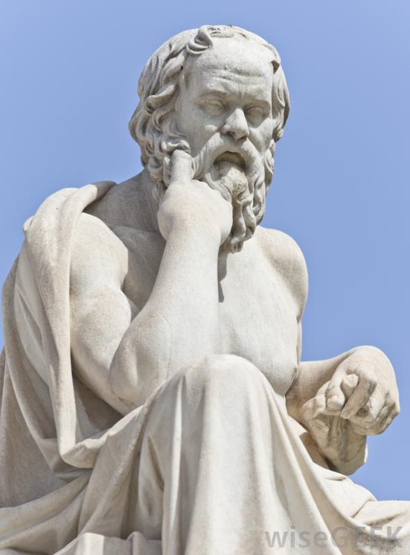
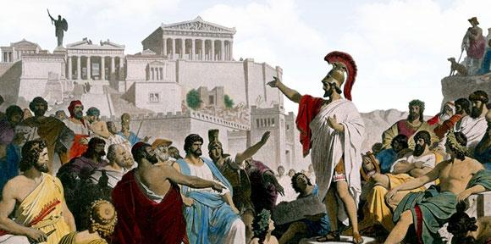
Greek Ideas
希腊人的想法
Notes:
Greeks sought ideals perhaps more than any society at that time—looking for the perfect society (deemed to be Greek democracy), the perfect mind (thought to be Greek philosophy), and the perfect body (thus the Greek Olympics).

Slide 12

Perfect Knowledge 完美的知识
Notes:
In this context, Peter gives the divinely inspired version of perfect knowledge based on Jesus Christ.

Slide 13

What do we need to know?
What do we need to
do?
2 Peter 1:1-11
彼得后书 1:1～11
我们当知为何?
我们当行何事?
Notes:
Today we'll see the knowledge that gives usgives us, and then what we should do with that knowledge. The title of this message is "What to Know, What to Do." These are our two main points. What we need to know—and then do—are in the first eleven verses of 2 Peter.

Slide 14
What do we need to know?
我们当知为何?
Notes:
So, first, know that…

Slide 15
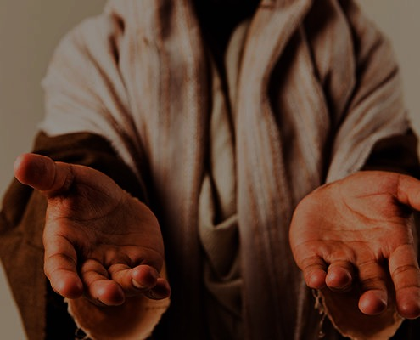
I. You are complete in Christ as God (1-4).
I. 因基督是神，
在祂里面你得以完全
(1～4).
Notes:
God gives you all you need in your knowledge and faith in Jesus as deity.

Slide 16
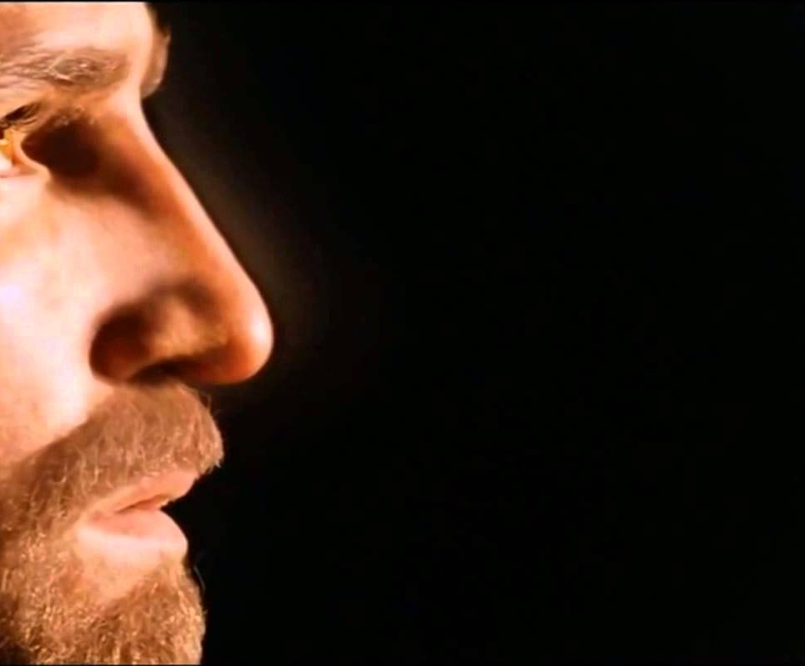
1. God gives you the same faith as the apostles due to Christ's deity. 因着基督的神性，神赐给我们与使徒们一样的信心
You're complete in Christ as God (1:1-4)
因基督是神，在祂里面你得以完全 (1:1-4)

Slide 17

"This letter is from Simon Peter, a slave and apostle of Jesus Christ. I am writing to you who share the same precious faith we have. This faith was given to you because of the justice and fairness of Jesus Christ, our God and Savior"
(2 Peter 1:1 NLT).
“耶稣基督的仆人和使徒西门 • 彼得，写信给那靠着我们的神和救主耶稣基督的义，得着和我们同样宝贵信心的人"
(彼得后书 1:1 新译本)
Notes:
Peter notes that his readers had the same faith as "ours" (1a).
There is a great sense of humility here where the great apostle puts himself on the same level as his meek readers.
In this pre-Gnostic world, teachers prided themselves with their privileged, so-called "secret knowledge."
Yet Peter says the righteousness provided by Jesus Christ gives us all the "same faith"! Wow!
The phrase "our God and Savior" also teaches Christ's deity (1b).
"The grammar here clearly indicates that 'God and Savior' are one Person, not two (i.e., there is one Gr. article with two substantives). This passage ranks with the great Christological passages of the New Testament which plainly teach that Jesus Christ is coequal in nature with God the Father" (Gangel, BKC, 2:863-64).
We need to understand that our faith is in Jesus as God, not just some teacher of knowledge.

Slide 18
1. God gives you the same faith as the apostles due to Christ's deity. 因着基督的神性，神赐给我们与使徒们一样的信心
You're complete in Christ as God (1:1-4)
因基督是神，在祂里面你得以完全 (1:1-4)
2. God shows us Christ's person for grace and peace. 神借着基督的
位格向我们显明恩惠与平安

Slide 19
"May God give you more and more grace and peace as you grow in your knowledge of God and Jesus our Lord"
(2 Peter 1:2 NLT).
"愿恩惠平安，因你们确实认识神和我们的主耶稣，多多加给你们"
(彼得后书 1:2 新译本)
Notes:
God shows us Christ's person for grace and peace (2).
The word for "knowledge" here implies an intimate, personal relationship.
We need to know that grace is in Christ (2a).
We need to know that Christ alone gives us peace (2b).

Slide 20
1. God gives you the same faith as the apostles due to Christ's deity. 因着基督的神性，神赐给我们与使徒们一样的信心
You're complete in Christ as God (1:1-4)
因基督是神，在祂里面你得以完全 (1:1-4)
2. God shows us Christ's person for grace and peace. 神借着基督的
位格向我们显明恩惠与平安
3. God gives you Christ's power to live a godly life. 神将基督的能力赐予我们，
以致我们得以活出敬虔生命

Slide 21
"By his divine power, God has given us everything we need for living a godly life. We have received all of this by coming to know him, the one who called us to himself by means of his marvelous glory and excellence" (2 Peter 1:3 NLT).
"神以他神圣的能力，因着我们确实认识那位用自己的荣耀和美善呼召我们的，把一切有关生命和敬虔的事，都赐给了我们”"
(彼得后书 1:3 新译本)
Notes:
God gives you Christ's power to live a godly life (3).
Too often we think that we're missing some great secret to godliness.
Peter says that we already have all we need!
If we already have everything we need for a godly life (3), then why does Peter wish his readers more grace and peace (2)?
Evidently we don't apply or access all that God has in store for us!

Slide 22
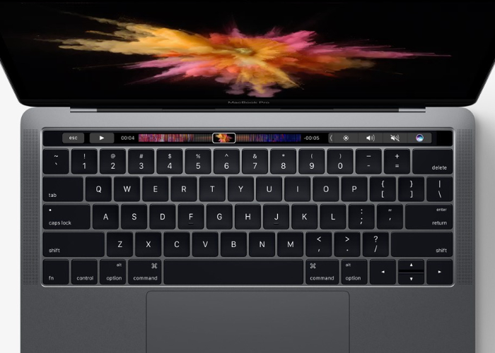
Computer
Notes:
We are like a computer that has immense capabilities, but the user doesn't know how to use them.

Slide 23
1. God gives you the same faith as the apostles due to Christ's deity. 因着基督的神性，神赐给我们与使徒们一样的信心
You're complete in Christ as God (1:1-4)
因基督是神，在祂里面你得以完全 (1:1-4)
2. God shows us Christ's person for grace and peace. 神借着基督的
位格向我们显明恩惠与平安
3. God gives you Christ's power to live a godly life. 神将基督的能力赐予我们，
以致我们得以活出敬虔生命
4. God gives you Christ's promises to live a godly life. 神赐我们基督的
应许使我们活出敬虔生命

Slide 24
"And because of his glory and excellence, he has given us great and precious promises. These are the promises that enable you to share his divine nature and escape the world's corruption caused by human desires"
(2 Peter 1:4 NLT).
"藉着这些，他把又宝贵又极大的应许赐给了我们，好叫你们既然逃脱世上因私慾而来的败坏，就可以分享神的本性"
(彼得后书 1:4 新译本)
Notes:
God gives you Christ's promises to live a godly life (4).
What specific promises does God give to help us be like Christ (4)?

Slide 25

Five Promises五大应许
      We have everything we need to live a godly life (3). 我们有了活出敬虔生命所需的一切（3）
      We share "his divine nature" where we will eventually become like Christ (4b). 我们分享"祂神圣的本质"，我们终将变成像基督一样（4b）
      We can escape any sin (4c). 我们能够逃脱任何的罪（4c）
      We are elected and promised salvation (10). 我们蒙神拣选并有那所应许的救恩（10）
      If we're consistent in character (5-9), then we will be richly rewarded (10-11). 如果我们在品格上与此恩典相称（5-9），我们将得极大的赏赐（10～11）

Slide 26
I. You are complete in Christ as God (1-4).
I. 因基督是神，
在祂里面你得以完全
(1～4).
Notes:
So what do you really need to know about Christ? Verses 1-4 tell us what God has done—We need to know that Christ’s deity makes us complete in Him. Our faith in his person gives us power and promises. But what do we do with this knowledge? We need to…

Slide 27
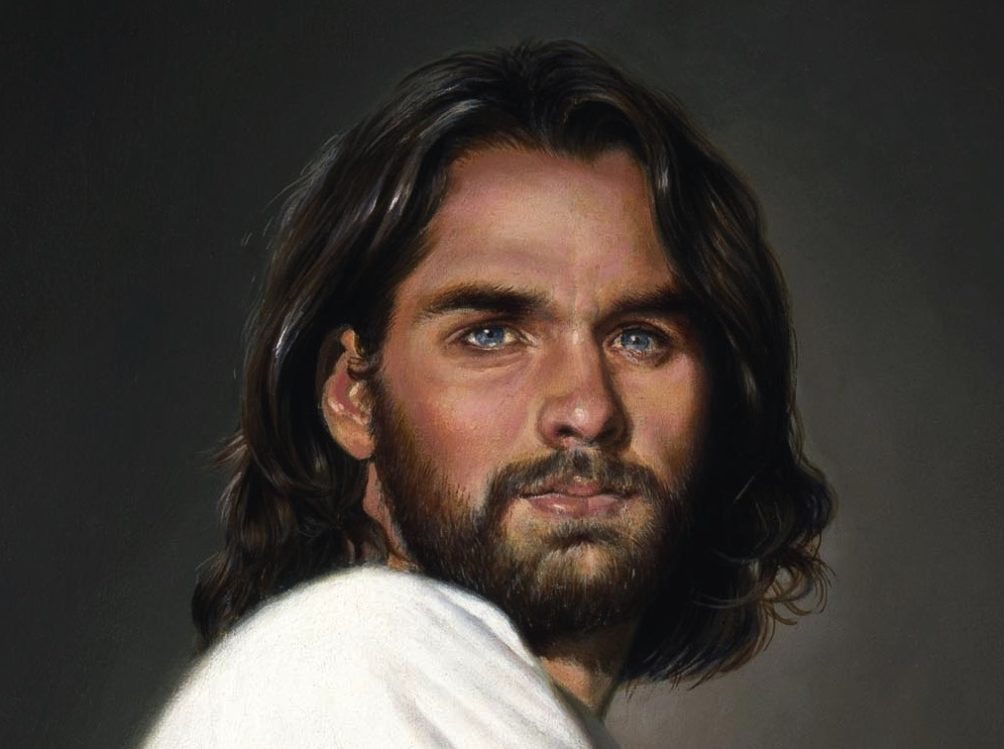
II. Become increasingly like Christ (5-11).
II. 越来越像
基督
(1:5～11).
Notes:
Use your knowledge to grow in Christ-likeness.

Slide 28


Grow step-by-step in Christ-likeness (5-7)
一步一步长成基督的样式
(5～7)

Slide 29
"In view of all this, make every effort to respond to God's promises. Supplement your faith with a generous provision of moral excellence, and moral excellence with knowledge" (2 Peter 1:5 NLT).
"正因这缘故，你们要多多努力：有了信心，又要增添美德；有了美德，又要增添知识"
(彼得后书 1:5 新译本)

Slide 30
"and knowledge with self-control, and self-control with patient endurance, and patient endurance with godliness"
(2 Peter 1:6 NLT).
"有了知识，又要增添节制；有了节制，又要增添忍耐；有了忍耐，又要增添敬虔"
(彼得后书 1:6 新译本)

Slide 31
"and godliness with brotherly affection, and brotherly affection with love for everyone" (2 Peter 1:7 NLT).
"有了敬虔，又要增添弟兄的爱；有了弟兄的爱，还要增添神圣的爱"
(彼得后书 1:7 新译本).

Slide 32
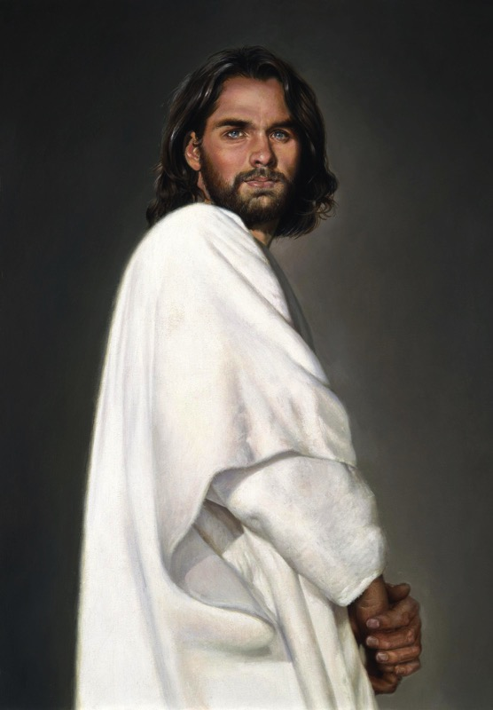
2 Peter 1
Effective & Productive Christian Life (1:5-7)
有效多结果子的基督徒生命
289
Pure & Christ-like ("participate in the divine nature," v. 4)
Love 爱众人的心
Bro. Kindness 爱弟兄的心
Godliness 虔敬
Perseverance 忍耐
Self Control节制
Knowledge 知识
Goodness 德行
圣洁并效法基督 ("与神的性情有分," 第4节)
Faith 信心
Notes:
Faith in Christ justifies us and starts our growth in character (5a).
Goodness (moral excellence) results from sins forgiven (5b).
Knowledge helps our goodness expand (5c).
Self-control comes from knowing Christ's own self-control (6a).
Perseverance is self-control over the long haul (6b).
Godliness results from persevering over the long haul (6c).
Brotherly kindness results since godliness is relational (7a).
Love is the climax as the highest character trait (7b).
These traits explain how we should show the divine nature in verse 4.

Slide 33
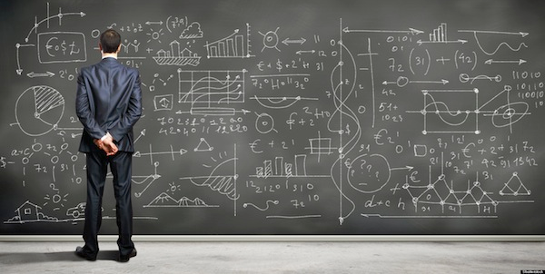
We don't always grow in Christ-likeness (8-9).
我们不都总是在基督的样式方面成长（8～9）

Slide 34
"The more you grow like this, the more productive and useful you will be in your knowledge of our Lord Jesus Christ"
(2 Peter 1:8 NLT).
"因为你们有了这几样，并且继续增长，就必叫你们在确实认识我们的主耶稣基督
上，不至于闲懒不结果子"
(彼得后书 1:8 新译本).
Notes:
Some believers continue to grow and become more effective (8).

Slide 35
"But those who fail to develop in this way are shortsighted or blind, forgetting that they have been cleansed from their old sins" (2 Peter 1:9 NLT).
"人若没有这几样，就是近视，简直是瞎眼的，忘记他过去的罪已经得了洁净"
(彼得后书 1:9 新译本).
Notes:
Others stop character growth by forgetting they're forgiven (9).
In fact, most of the NT addresses believers who are not living up to God's standards. This is why God moved authors like Peter and Paul and James and others to write!

Slide 36

Knowledge 知识
Notes:
At chapel in my first year of seminary one student saw another student sitting by himself and exclaimed, "Wow! Look at that! A guy reading his Bible! Must be a first-year student!" Everyone laughed—sadly.

Slide 37

First Year Student
第一年的新生
Final Year Student
最后一年的
毕业生
"All zeal,
no knowledge"
"All knowledge,
no zeal"
满腔热血
不学无术
学富五车
心如死灰
Notes:
That same year, a friend asked me, "Do you know how to tell the difference between a first-year student and a final-year student?" I didn't know. So he said, "The first-year student is all zeal, no knowledge. The final-year student is all knowledge, no zeal."

Slide 38
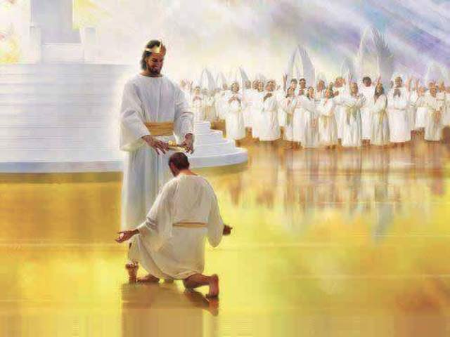
When we work hard, we'll be rewarded instead of falling away (10-11).
当我们竭力追求，我们必不会跌倒，至终必得奖赏 (10～11).

Slide 39
"So, dear brothers and sisters, work hard to prove that you really are among those God has called and chosen. Do these things, and you will never fall away" (2 Peter 1:10 NLT).
"所以弟兄们，要更加努力，使你们所蒙的呼召和拣选坚定不移；你们若实行这几样，就决不会跌倒" (彼得后书 1:10 新译本)
Notes:
When we work hard to show we're saved, we won't fall away (10).
Does "make your calling and election sure" (10) mean that we can add anything to Christ's work to be saved? No. It means we should live consistent with that salvation.
The NLT captures the idea well: "Work hard to prove that you really are among those God has called and chosen." When you seek to be more like Christ, you won't fall back. Instead…

Slide 40
"Then God will give you a grand entrance into the eternal Kingdom of our Lord and Savior Jesus Christ"
(2 Peter 1:11 NLT).
“这样，你们就得着充分的装备，可以进入我们的主和救主耶稣基督永远的国”
(彼得后书 1:11 新译本).
Notes:
God will reward us when we live consistent to our calling (11).
Does receiving "a rich welcome into the eternal kingdom…" refer to a person as being saved (11)?
No, this refers to being fully rewarded like the person in verse 8 who keeps growing in character.
It means you do not "fall" (10b) like the person in verse 9 who has forgotten about his forgiveness.

Slide 41
What do we need to know?
What do we need to
do?
我们当知为何?
我们当行何事?
Notes:
So what do you really need to know? And, more importantly, what do you do with this knowledge?

Slide 42
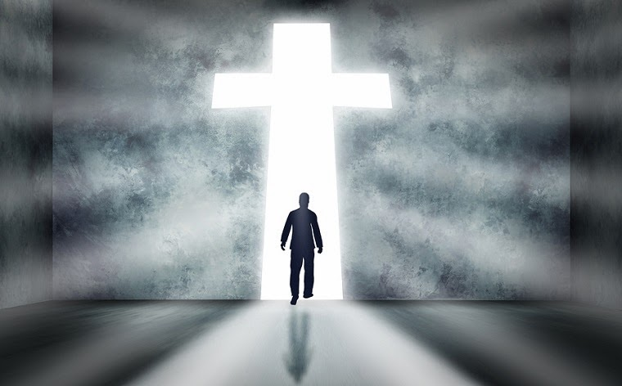
Main Idea主要概念
Know you're complete in Christ to be more like Christ.
知道在基督里
你已经完全了，
因此你能够
更像基督
Notes:
Have your knowledge of Christ lead you to be Christ-like (restated MI).

Slide 43
I. You are complete in Christ as God (1-4).
I. 因基督是神，
在祂里面你得以完全
(1～4).
Notes:
God gives you all you need in your knowledge and faith in Jesus as deity.

Slide 44
II. Become increasingly like Christ (5-11).
II. 越来越像
基督
(1:5～11).
Notes:
Use your knowledge to grow in Christ-likeness.

Slide 45
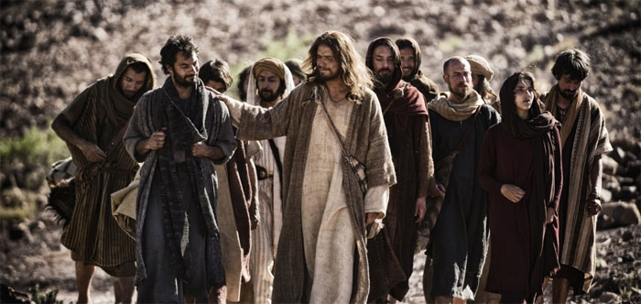
What do you need to know or do?
什么是你当知或当行之事呢？
Know?
当知？
Do?
当行？
Notes:
Now what do you need to know or do?
How can you better know Christ?
• Do you need to grasp Christ's person, power or promises most (2-4)?
How can you do this?
• How can you better imitate Christ?
Are you more like Jesus this year than last year?
How will you be more like Christ next year?
Which quality in verses 5-7 do you need to imitate? How?

Slide 46
Black

Slide 47


NT Sermons link at BibleStudyDownloads.org
Get this presentation and script for free!
免费获得该讲解!
圣经学习下载
新约全书讲章 • BibleStudyDownloads.org

