Slide 1
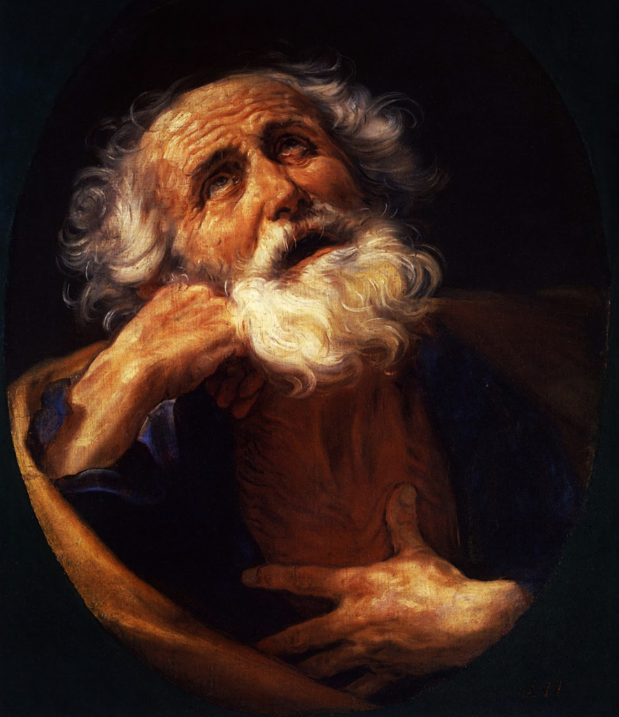
What to Know, What to Do
2 Peter 1:1-11
Dr. Rick Griffith • Singapore Bible College • BibleStudyDownloads.org

Slide 2

Do you want more knowledge?
Notes:
Who here wants more knowledge? Raise your hand.

Slide 3

Knowledge 知识
Notes:
Students, what do you think of your education so far? By this time in your studies, some students are just getting going, while for others, graduation just can't come soon enough!

Slide 4
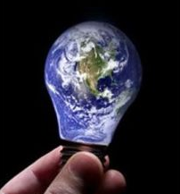
Knowledge is Infinite
Notes:
We all know that knowledge is infinite.
This was made clear to me by one of my teachers. He told me, "We are giving you your PhD because we've educated you beyond your intelligence!"
In any case, people have various opinions about education.

Slide 5

Pride of Knowledge
Notes:
Some love learning so they can display their knowledge over others. If you're thinking about coming to seminary to show off your knowledge, you will be disappointed.

Slide 6
Anti-Intellectual
Notes:
Others are at the other end of the spectrum and are anti-intellectual, thinking that education is a waste of time. Well, I wouldn't encourage such people to come either!

Slide 7
287
2 Peter
Problem
False Teaching (Heresy)
Source of Problem
Internal
Key Word
"knowledge"
(16 times)
Date
Early spring
AD 64
Notes:
Peter avoids both of these extremes in 2 Peter. He wrote to his readers facing an internal problem of heresy, so he uses the words for "knowledge" 16 times in this short letter of three brief chapters—and he presents knowledge in a positive sense.

Slide 8
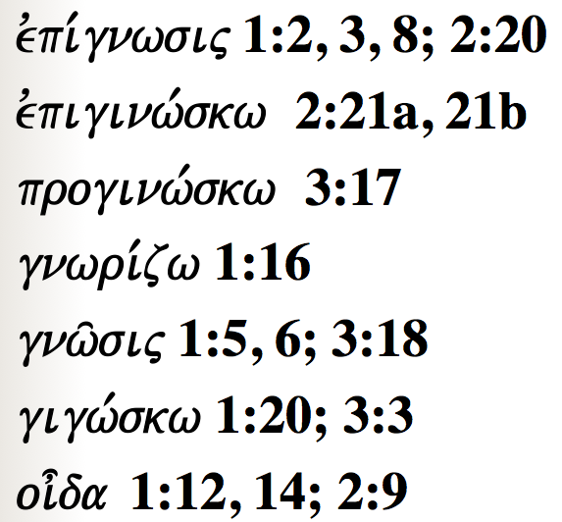
Peter uses many words to show how knowledge is vital for believers…
287
evpi,gnwsij 1:2, 3, 8; 2:20
evpiginw,skw 2:21a, 21b
proginw,skw 3:17
gnwri,zw 1:16
gnw/sij 1:5, 6; 3:18
gigw,skw 1:20; 3:3
oi=da 1:12, 14; 2:9
Notes:
Today we will see words for "knowledge" five times in the first 11 verses!

Slide 9
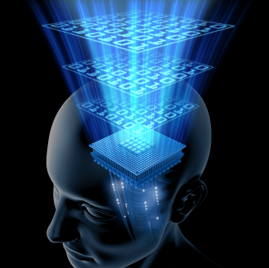
What do you really need to know?
Notes:
But while knowledge is important, we can't learn everything—so what do you REALLY need to know? What'll be on the test?

Slide 10

What do you really need to know?
Notes:
When you consider how many things there are to know, it can be daunting. You probably came to seminary to get answers to your questions, but now your list of questions has grown! So what are the essentials that we REALLY need to know?
You've come to the right place because Peter has an answer for you in today's text.

Slide 11
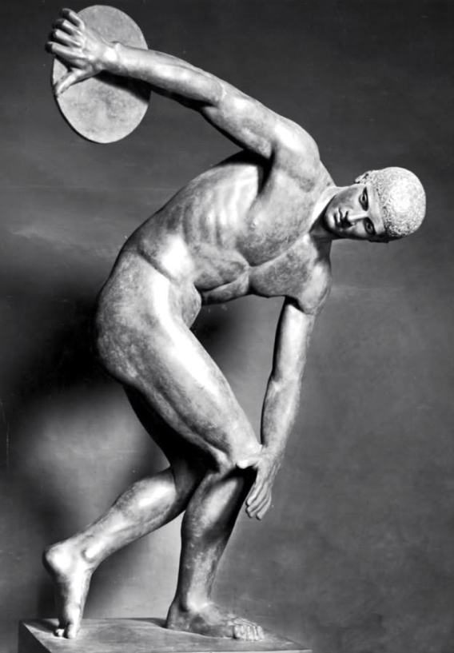
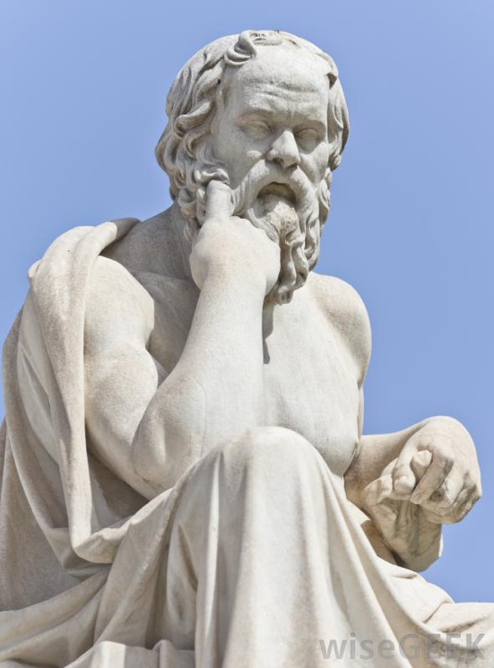
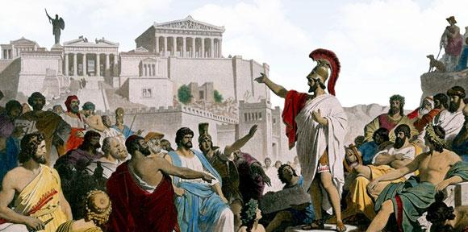
Greek Ideas
Notes:
Greeks sought ideals perhaps more than any society at that time—looking for the perfect society (deemed to be Greek democracy), the perfect mind (thought to be Greek philosophy), and the perfect body (thus the Greek Olympics).

Slide 12

Perfect Knowledge
Notes:
In this context, Peter gives the divinely inspired version of perfect knowledge based on Jesus Christ.

Slide 13

What do we need to know?
What do we need to
do?
2 Peter 1:1-11
Notes:
Today we'll see the knowledge that God gives you, and then what we should do with that knowledge. The title of this message is "What to Know, What to Do." These are our two main points. What we need to know—and then do—are in the first eleven verses of 2 Peter.

Slide 14
What do we need to know?
Notes:
So, first, know that…

Slide 15
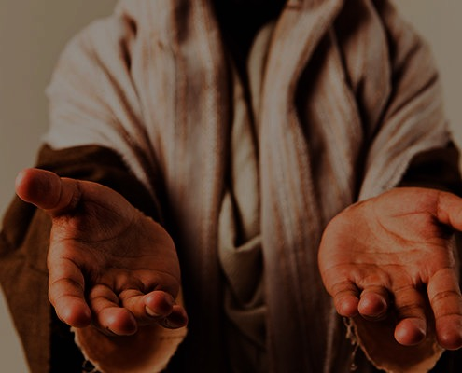
I. You are complete in Christ as God (1-4).
Notes:
God gives you all you need in your knowledge and faith in Jesus as deity.

Slide 16
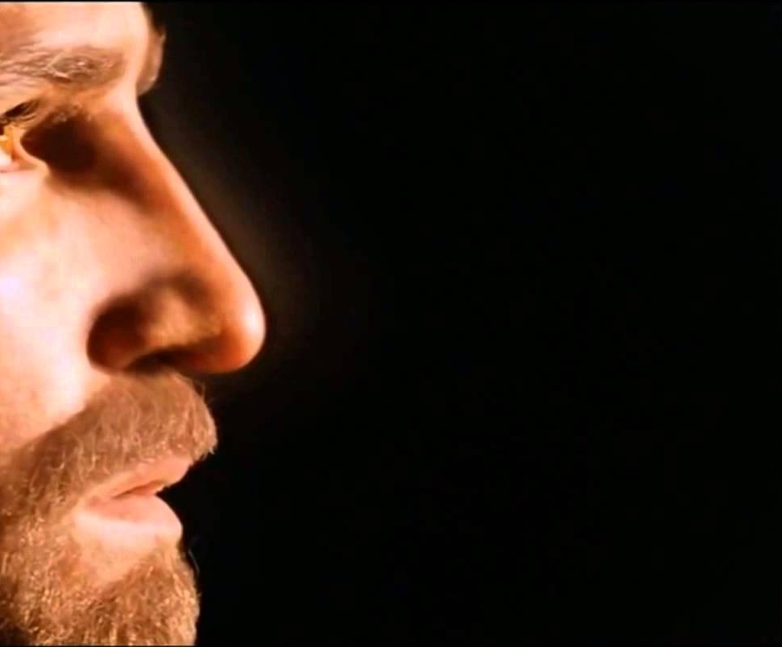
1. God gives you the same faith as the apostles due to Christ's deity.
You're complete in Christ as God (1:1-4)

Slide 17

"This letter is from Simon Peter, a slave and apostle of Jesus Christ. I am writing to you who share the same precious faith we have. This faith was given to you because of the justice and fairness of Jesus Christ, our God and Savior"
(2 Peter 1:1 NLT).
Notes:
Peter notes that his readers had the same faith as "ours" (1a).
There is a great sense of humility here where the great apostle puts himself on the same level as his meek readers.
In this pre-Gnostic world, teachers prided themselves with their privileged, so-called "secret knowledge."
Yet Peter says the righteousness provided by Jesus Christ gives us all the "same faith"! Wow!
The phrase "our God and Savior" also teaches Christ's deity (1b).
One scholar notes, "The grammar here clearly indicates that 'God and Savior' are one Person, not two (i.e., there is one Gr. article with two substantives). This passage ranks with the great Christological passages of the New Testament which plainly teach that Jesus Christ is coequal in nature with God the Father" (Gangel, BKC, 2:863-64).
We need to understand that our faith is in Jesus as God, not just some teacher of knowledge.

Slide 18
1. God gives you the same faith as the apostles due to Christ's deity.
You're complete in Christ as God (1:1-4)
2. God shows us Christ's person for grace and peace.

Slide 19
"May God give you more and more grace and peace as you grow in your knowledge of God and Jesus our Lord"
(2 Peter 1:2 NLT).
Notes:
God shows us Christ's person for grace and peace (2).
The word for "knowledge" here implies an intimate, personal relationship.
We need to know that grace is in Christ (2a).
We need to know that Christ alone gives us peace (2b).

Slide 20
1. God gives you the same faith as the apostles due to Christ's deity.
You're complete in Christ as God (1:1-4)
2. God shows us Christ's person for grace and peace.
3. God gives you Christ's power to live a godly life.

Slide 21
"By his divine power, God has given us everything we need for living a godly life. We have received all of this by coming to know him, the one who called us to himself by means of his marvelous glory and excellence" (2 Peter 1:3 NLT).
Notes:
God gives you Christ's power to live a godly life (3).
Too often we think that we're missing some great secret to godliness.
Peter says that we already have all we need!
If we already have everything we need for a godly life (3), then why does Peter wish his readers more grace and peace (2)?
Evidently we don't apply or access all that God has in store for us!

Slide 22
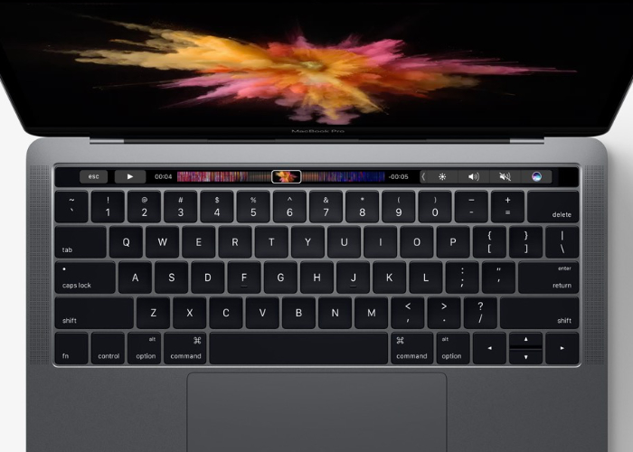
Computer
Notes:
We are like a computer that has immense capabilities, but the user doesn't know how to use them.

Slide 23
1. God gives you the same faith as the apostles due to Christ's deity.
You're complete in Christ as God (1:1-4)
2. God shows us Christ's person for grace and peace.
3. God gives you Christ's power to live a godly life.
4. God gives you Christ's promises to live a godly life.

Slide 24
"And because of his glory and excellence, he has given us great and precious promises. These are the promises that enable you to share his divine nature and escape the world's corruption caused by human desires"
(2 Peter 1:4 NLT).
Notes:
God gives you Christ's promises to live a godly life (4).
What specific promises does God give to help us be like Christ (4)?

Slide 25

Five Promises
      We have everything we need to live a godly life (3).
      We share "his divine nature" where we will eventually become like Christ (4b).
      We can escape any sin (4c).
      We are elected and promised salvation (10).
      If we're consistent in character (5-9), then we will be richly rewarded (10-11).
Notes:
(Translator read without English)

Slide 26
I. You are complete in Christ as God (1-4).
Notes:
So what do you REALLY need to know about Christ? Verses 1-4 tell us what God has done—We need to know that Christ’s deity makes us complete in Him. Our faith in his person gives us power and promises. But what do we do with this knowledge? We need to…

Slide 27
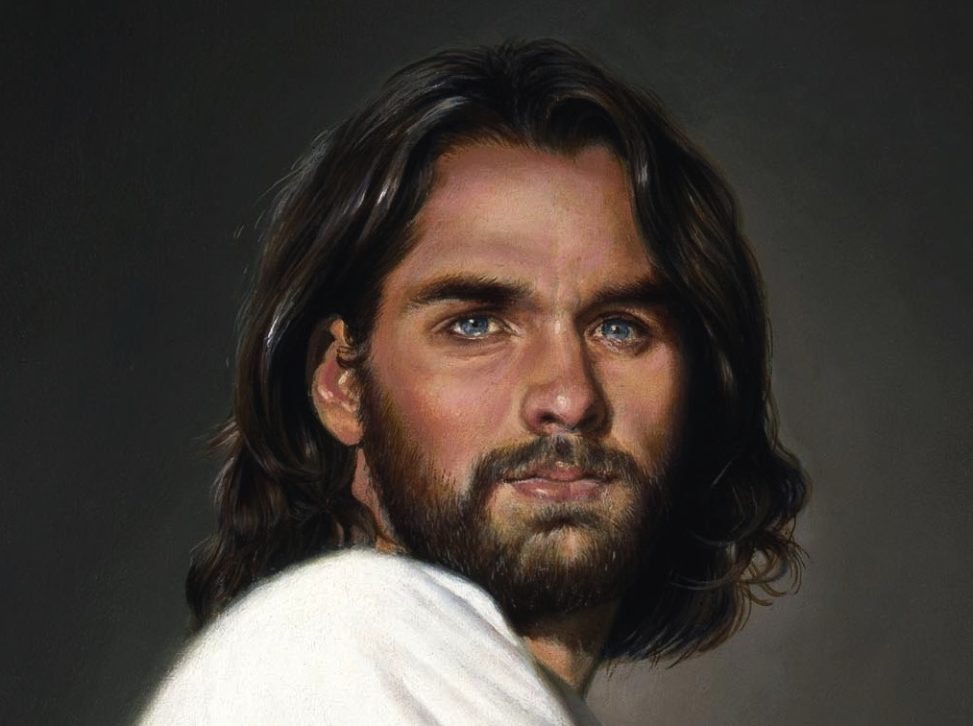
II. Become increasingly like Christ
(5-11).
Notes:
Use your knowledge to grow in Christ-likeness.

Slide 28


Grow step-by-step in Christ-likeness (5-7)

Slide 29
"In view of all this, make every effort to respond to God's promises. Supplement your faith with a generous provision of moral excellence, and moral excellence with knowledge" (2 Peter 1:5 NLT).

Slide 30
"and knowledge with self-control, and self-control with patient endurance, and patient endurance with godliness"
(2 Peter 1:6 NLT).

Slide 31
"and godliness with brotherly affection, and brotherly affection with love for everyone" (2 Peter 1:7 NLT).

Slide 32
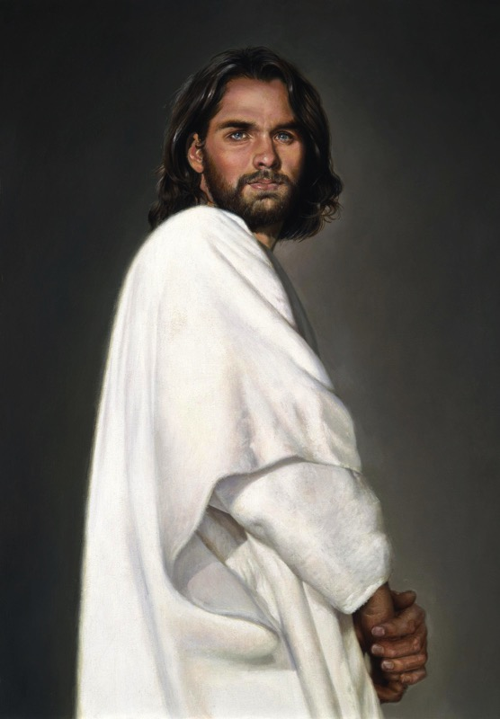
2 Peter 1
Effective & Productive Christian Life (1:5-7)
289
Pure & Christ-like ("participate in the divine nature," v. 4)
Love
Brotherly Kindness
Godliness
Perseverance
Self-Control
Knowledge
Goodness
Faith
Notes:
Faith in Christ justifies us and starts our growth in character (5a).
Goodness (moral excellence) results from sins forgiven (5b).
Knowledge helps our goodness expand (5c).
Self-control comes from knowing Christ's self-control (6a).
Perseverance is self-control over the long haul (6b).
Godliness results from persevering over the long haul (6c).
Brotherly kindness results since godliness is relational (7a).
Love is the climax as the highest character trait (7b).
These traits explain how we should show the divine nature in verse 4.

Slide 33
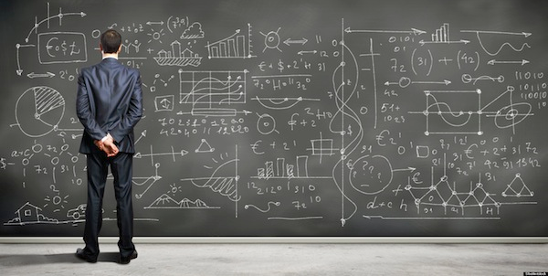
We don't always grow in
Christ-likeness (8-9).
Notes:
But…

Slide 34
"The more you grow like this, the more productive and useful you will be in your knowledge of our Lord Jesus Christ"
(2 Peter 1:8 NLT).
Notes:
Some believers continue to grow and become more effective (8).

Slide 35
"But those who fail to develop in this way are shortsighted or blind, forgetting that they have been cleansed from their old sins" (2 Peter 1:9 NLT).
Notes:
Others stop character growth by forgetting they're forgiven (9).
Most of the NT addresses believers who are not living up to God's standards. This is why God moved authors like Peter and Paul and James and others to write!

Slide 36

Knowledge 知识
Notes:
At chapel in my first year of seminary one student saw another student sitting by himself and exclaimed, "Wow! Look at that! A guy reading his Bible! Must be a first-year student!" Everyone laughed—sadly.

Slide 37

First Year Student
Final Year Student
"All zeal,
no knowledge"
"All knowledge,
no zeal"
Notes:
That same year, a friend asked me, "Do you know how to tell the difference between a first-year student and a final-year student?" I didn't know. So he said, "The first-year student is all zeal, no knowledge. The final-year student is all knowledge, no zeal."

Slide 38
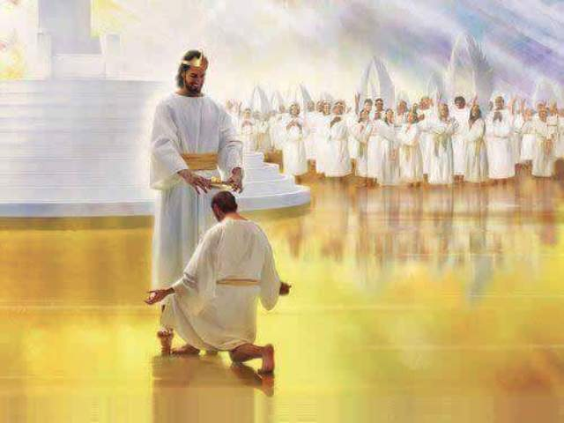
When we work hard, we'll be rewarded instead of falling away (10-11).

Slide 39
"So, dear brothers and sisters, work hard to prove that you really are among those God has called and chosen. Do these things, and you will never fall away" (2 Peter 1:10 NLT).
Notes:
When we work hard to show we're saved, we won't fall away (10).
Does "make your calling and election sure" (10) mean that we can add anything to Christ's work to be saved?
No. It means we should live consistent with that salvation.
The NLT captures the idea well: "Work hard to prove that you REALLY are among those God has called and chosen." When you seek to be more like Christ, you won't fall back. Instead…

Slide 40
"Then God will give you a grand entrance into the eternal Kingdom of our Lord and Savior Jesus Christ"
(2 Peter 1:11 NLT).
Notes:
God will reward us when we live consistent to our calling (11).
Does receiving "a rich welcome into the eternal kingdom…" refer to a person as being saved (11)?
No, this refers to being fully rewarded like the person in verse 8 who keeps growing in character.
It means you do not "fall" (10b) like the person in verse 9 who has forgotten about his forgiveness.

Slide 41
What do we need to know?
What do we need to
do?
Notes:
So what do you really need to know? And, more importantly, what do you do with this knowledge?
Let's sum up these eleven verses in one sentence…

Slide 42
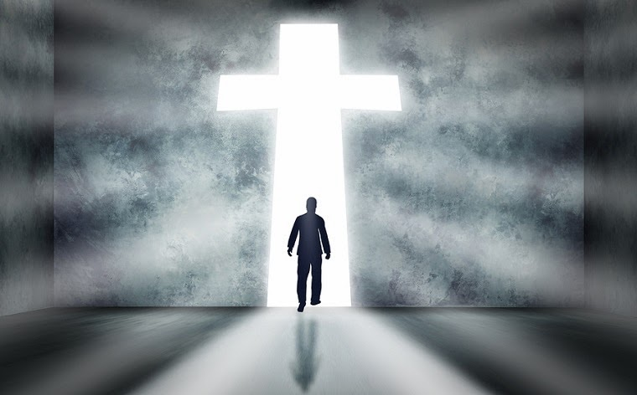
Main Idea
Know you're complete in Christ to be more like Christ.
Notes:
Have your knowledge of Christ lead you to be Christ-like (restated MI).

Slide 43
I. You are complete in Christ as God (1-4).
Notes:
God gives you all you need in your knowledge and faith in Jesus as deity.

Slide 44
II. Become increasingly like Christ
(5-11).
Notes:
Use your knowledge to grow in Christ-likeness.

Slide 45
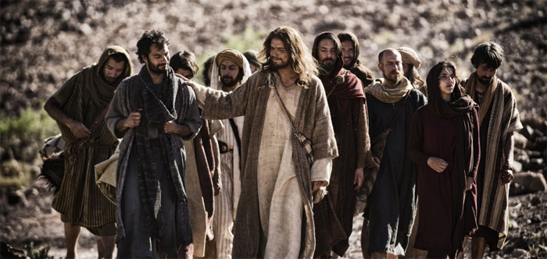
What do you need to know or do?
Know?
Do?
Notes:
Now, what do you need to know or do?
How can you better KNOW Christ?
• Do you need to grasp Christ's person, power or promises most (2-4)?
How can you do this?
• How can you better imitate Christ? What to DO?
Are you more like Jesus this year than last year?
How will you be more like Christ next year?
Which quality in verses 5-7 do you need to imitate? How?

Slide 46
Black

Slide 47


NT Preaching link at BibleStudyDownloads.org
Get this presentation and script for free!

