Slide 1
Preached by Manik Corea at Crossroads International Church Singapore • CICFamily.com Uploaded by Dr. Rick Griffith • Jordan Evangelical Theological Seminary Files in many languages for free download at BibleStudyDownloads.org

Slide 2
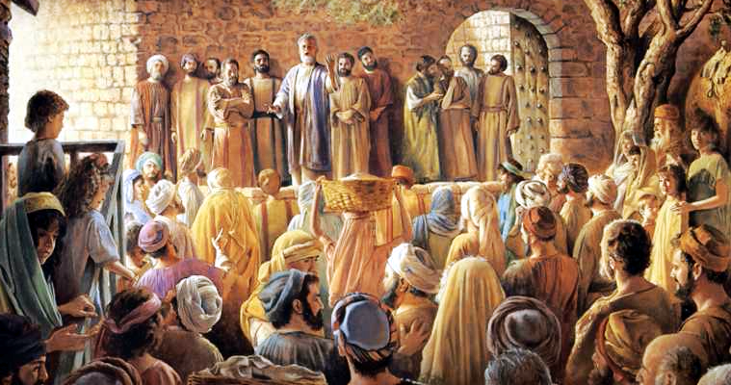
The Church at Thessalonica

Slide 3
1 Thessalonians
A Summary of the letter:
1. Their receptivity to the message of the Gospel (Chapter 1)
2. Paul's integrity as A messenger of the Gospel (Chapters 2-3)
3. Their maturity, growing in holiness, and HOPE through the MEANS of the Gospel (Chapters 4-5).

Slide 4
1 Thessalonians
Some Themes/topics we have covered in past weeks:
1:1-4 – Pray for each other
1:5-10 – make a difference to those around us, by word, action and lifestyle.
2:13-20 – God’s active Word helps us endure suffering and persevere in hope.
3:1-10 – our faith builds up the faith of others.
4:1-8 – God calls us to walk in sexual purity and holiness.
4:13-5:11 – we have the hope of Christ’s return – of resurrection and eternal life in Christ.

Slide 5
1 Thessalonians 5:23-28
Two Parts:
A Benediction (vs 23-24).
Final instructions and farewell (vs 25-28)

Slide 6
1 Thessalonians 5:23-28
A Benediction (vs 23-24).
blessed in Christ to be a blessing (Gen 12:1-3)
Our God is a God of True peace (Romans 15:33; 16:20; Philippians 4:9 – see also 1 Corinthians 14:33; 2 Corinthians 13:11 and Hebrews 13:20.)
GREEK WORD For Peace is the Hebrew word “shalom”

Slide 8
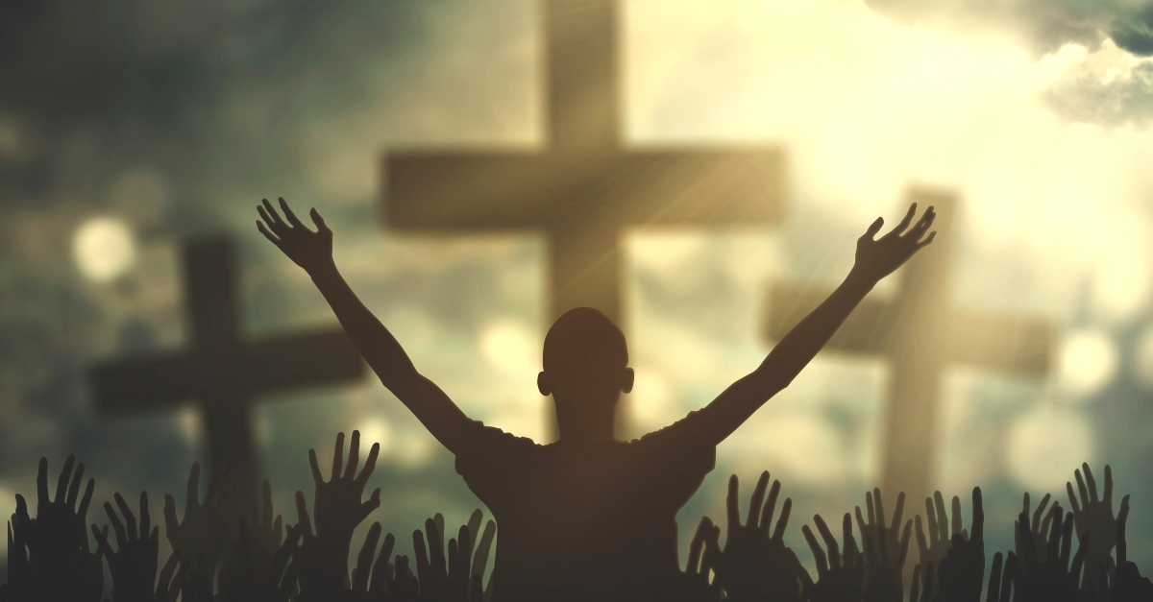
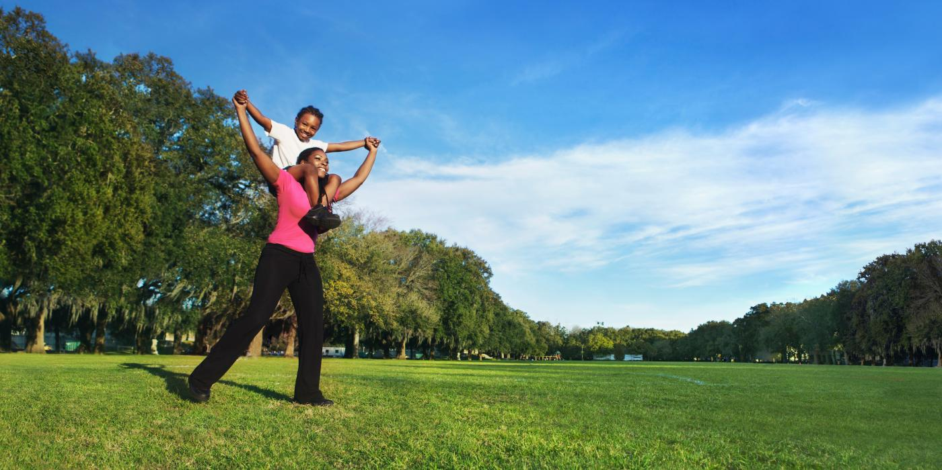
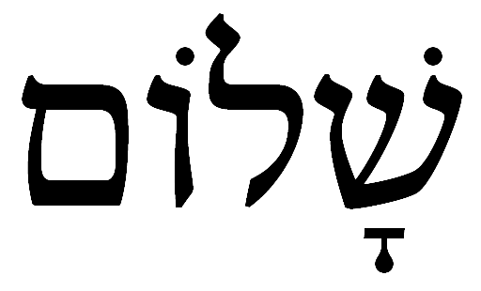
“A psycho-somatic-relational-racial-economic-spiritual wholeness.”
Darrel Johnson,
as quoted in Christianity Today Advent Devotional 2022 ”The Prince of Shalom” by Carolyn Arends.
SHALOM

Slide 10
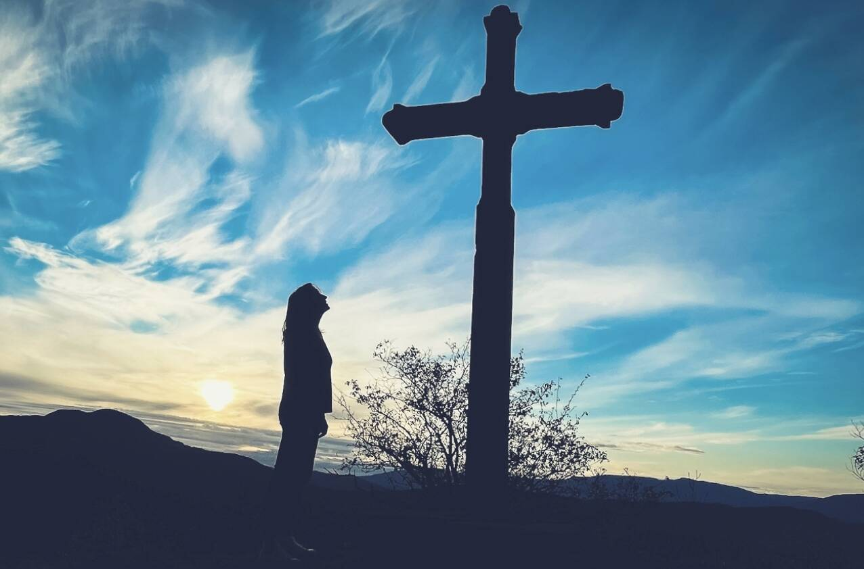

Slide 12
1 Thessalonians 5:23-28
A Benediction (vs 23-24).
blessed in Christ to be a blessing (Gen 12:1-3)
Our God is a God of True peace (Romans 15:33; 16:20; Philippians 4:9 – see also 1 Corinthians 14:33; 2 Corinthians 13:11 and Hebrews 13:20.)
GREEK WORD For Peace is the Hebrew word “shalom”
Verse 24 - God who calls us is ever faithful!

Slide 13
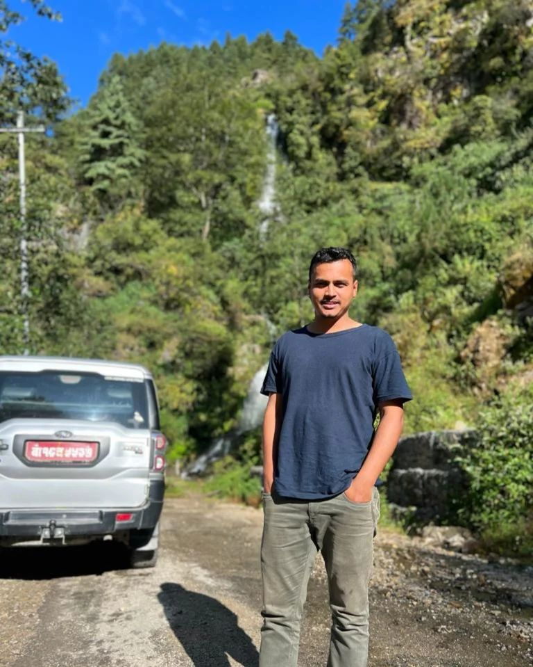
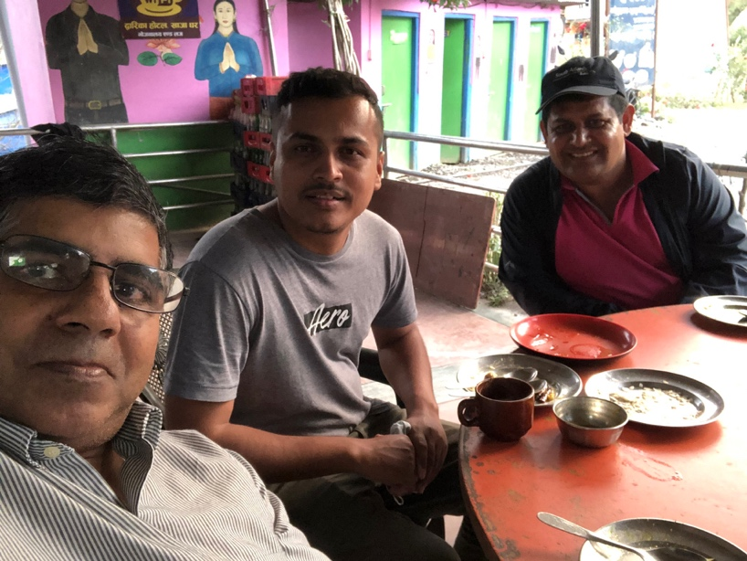
Pankaj Neupane, Pastor in Kathmandu, Nepal

Slide 14
1 Thessalonians 5:23-28
Final instructions and farewell (vs 25-28)
Pray for us (vs 25)
Greet one another (vs 26)
Read letter to everyone (vs 27)
The Grace of Jesus be with you (vs 28)

Slide 15
1 Thessalonians 5:23-28
ACTION STEPS:
Call out to our GOD for TRUE PEACE.
PRAY FOR THOSE WHO DON’t KNOW GOD’s GRACE AND PEACE TODAY.

Slide 16
Black

Slide 17
NT Preaching link at BibleStudyDownloads.org
Get this presentation and notes for free!
Notes:
NT Preaching (np)

