Slide 1
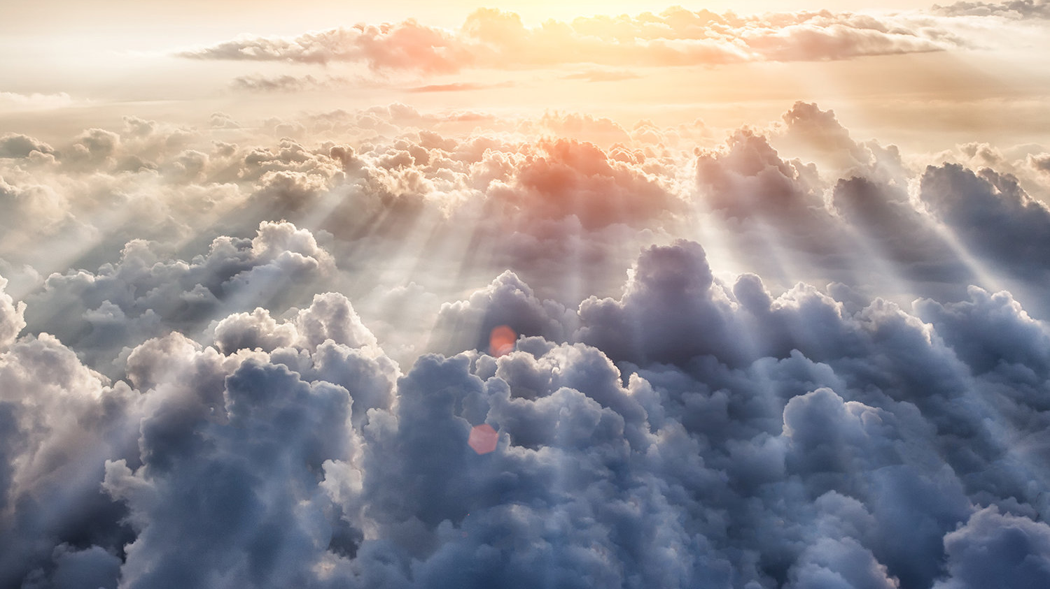
Future Fellowship
Certain hope when grieving for loved ones in Christ
(1 Thessalonians 4:13-18)
Preached by Dr. Jim Harmeling at Crossroads International Church Singapore • CICFamily.com Uploaded by Dr. Rick Griffith • Jordan Evangelical Theological Seminary Files in many languages for free download at BibleStudyDownloads.org

Slide 3
Future Fellowship
Certain hope when grieving for loved ones in Christ
(1 Thessalonians 4:13-18)

Slide 4
God provides answers about the afterlife and Christ’s return (v. 13)

Slide 5
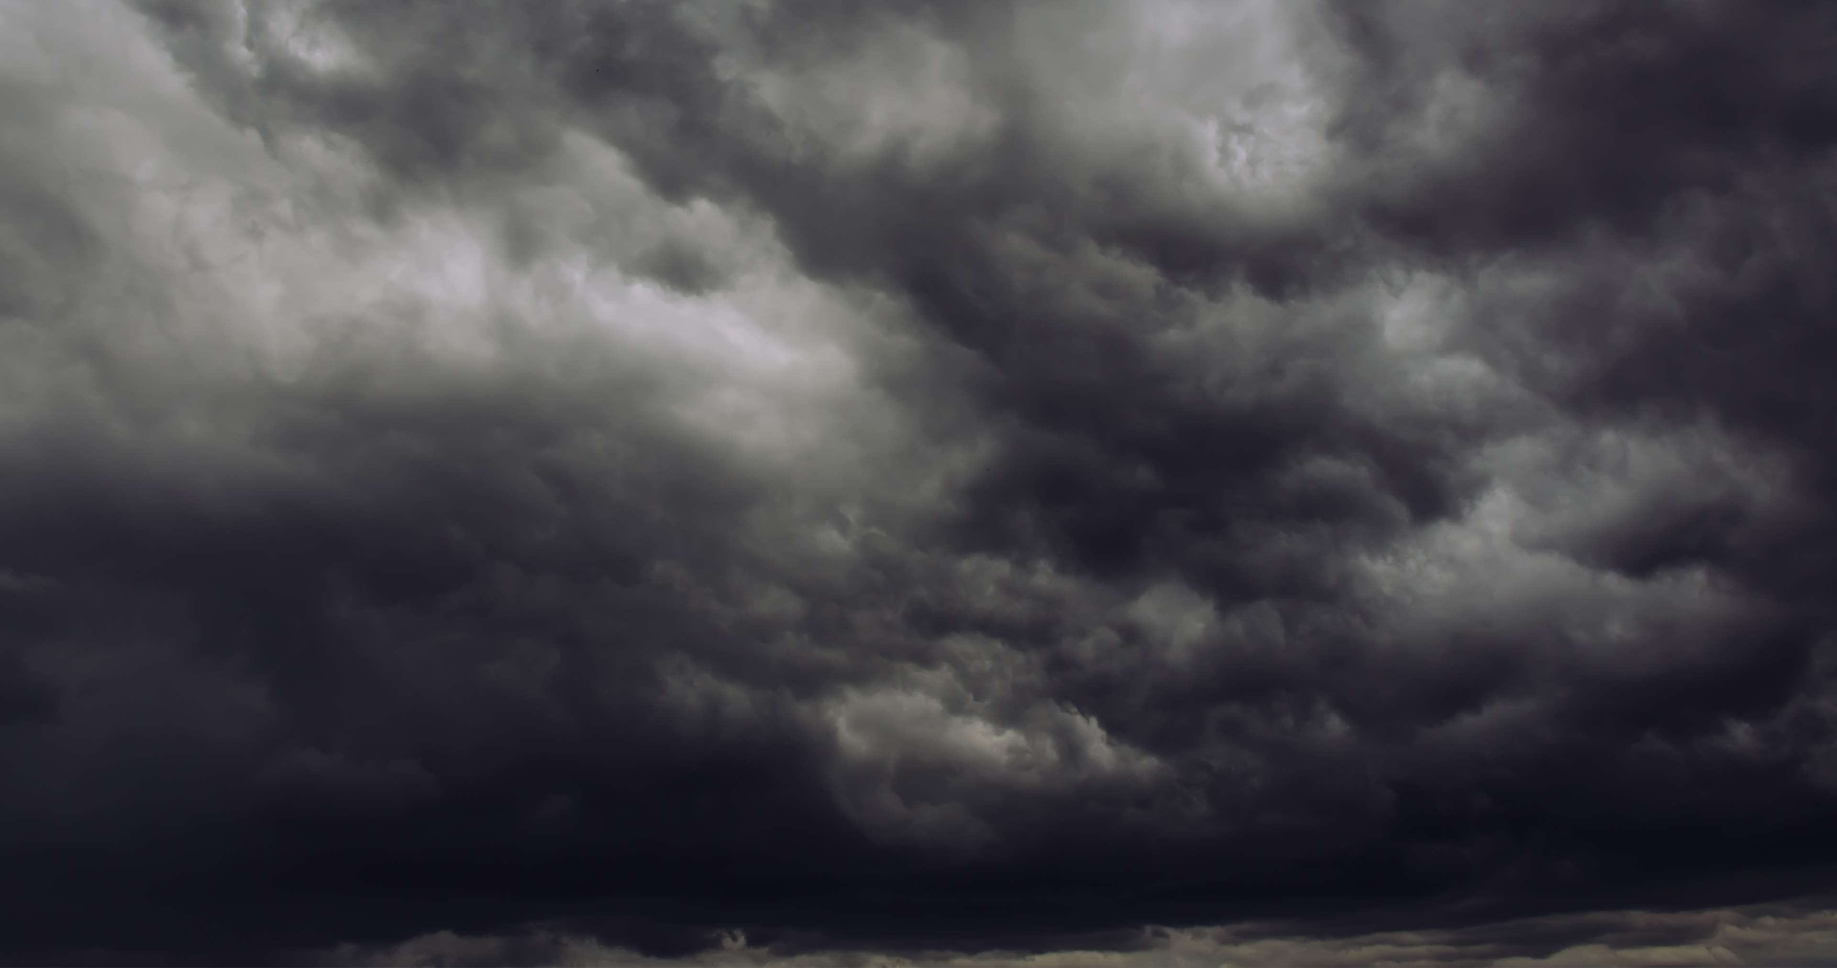
Unclear ideas about afterlife
Reincarnation?
Non-existence?
Shadowy figures wandering around?

Slide 6
God provides answers about the afterlife and Christ’s return (v. 13)
Dead believers will rise in a resurrected body because Jesus rose after death (vs. 14-16)

Slide 7
Romans 5:6
For if we have been united with him in a death like his, we shall certainly be united with him in a resurrection like his.
Philippians 3:20-21
²⁰ But our citizenship is in heaven, and from it we await a Savior, the Lord Jesus Christ, ²¹ who will transform our lowly body to be like his glorious body, by the power that enables him even to subject all things to himself.

Slide 8
1 John 3:2-3
² Beloved, we are God's children now, and what we will be has not yet appeared; but we know that when he appears we shall be like him, because we shall see him as he is. ³ And everyone who thus hopes in him purifies himself as he is pure.

Slide 9
2 Corinthians 5:6-9
⁶ So we are always of good courage. We know that while we are at home in the body we are away from the Lord, ⁷ For we walk by faith, not by sight ⁸ Yes, we are of good courage, and we would rather be away from the body and at home with the Lord ⁹ So whether we are at home or away, we make it our aim to please him.

Slide 10
God provides answers about the afterlife and Christ’s return (v. 13)
Dead believers will rise in a resurrected body because Jesus rose after death (vs. 14-16)
Living believers will be instantly transformed and caught up with the resurrected saints (v. 17)

Slide 11
Acts 8:39-40
³⁹ And when they came up out of the water, the Spirit of the Lord carried Philip away, and the eunuch saw him no more, and went on his way rejoicing. ⁴⁰ But Philip found himself at Azotus, and as he passed through he preached the gospel to all the towns until he came to Caesarea.

Slide 12
God provides answers about the afterlife and Christ’s return (v. 13)
Dead believers will rise in a resurrected body because Jesus rose after death (vs. 14-16)
Living believers will be instantly transformed and caught up with the resurrected saints (v. 17)
Use prophecy to bring encouragement during times of grief and struggle (v. 18)

Slide 13
Black

Slide 14
NT Preaching link at BibleStudyDownloads.org
Get this presentation and notes for free!
Notes:
NT Preaching (np)

