Slide 1

How to Strengthen Others
1 Thessalonians 2:17–3:13
Dr. Rick Griffith • Crossroads International Church Singapore
CICFamily.com • BibleStudyDownloads.org

Slide 2
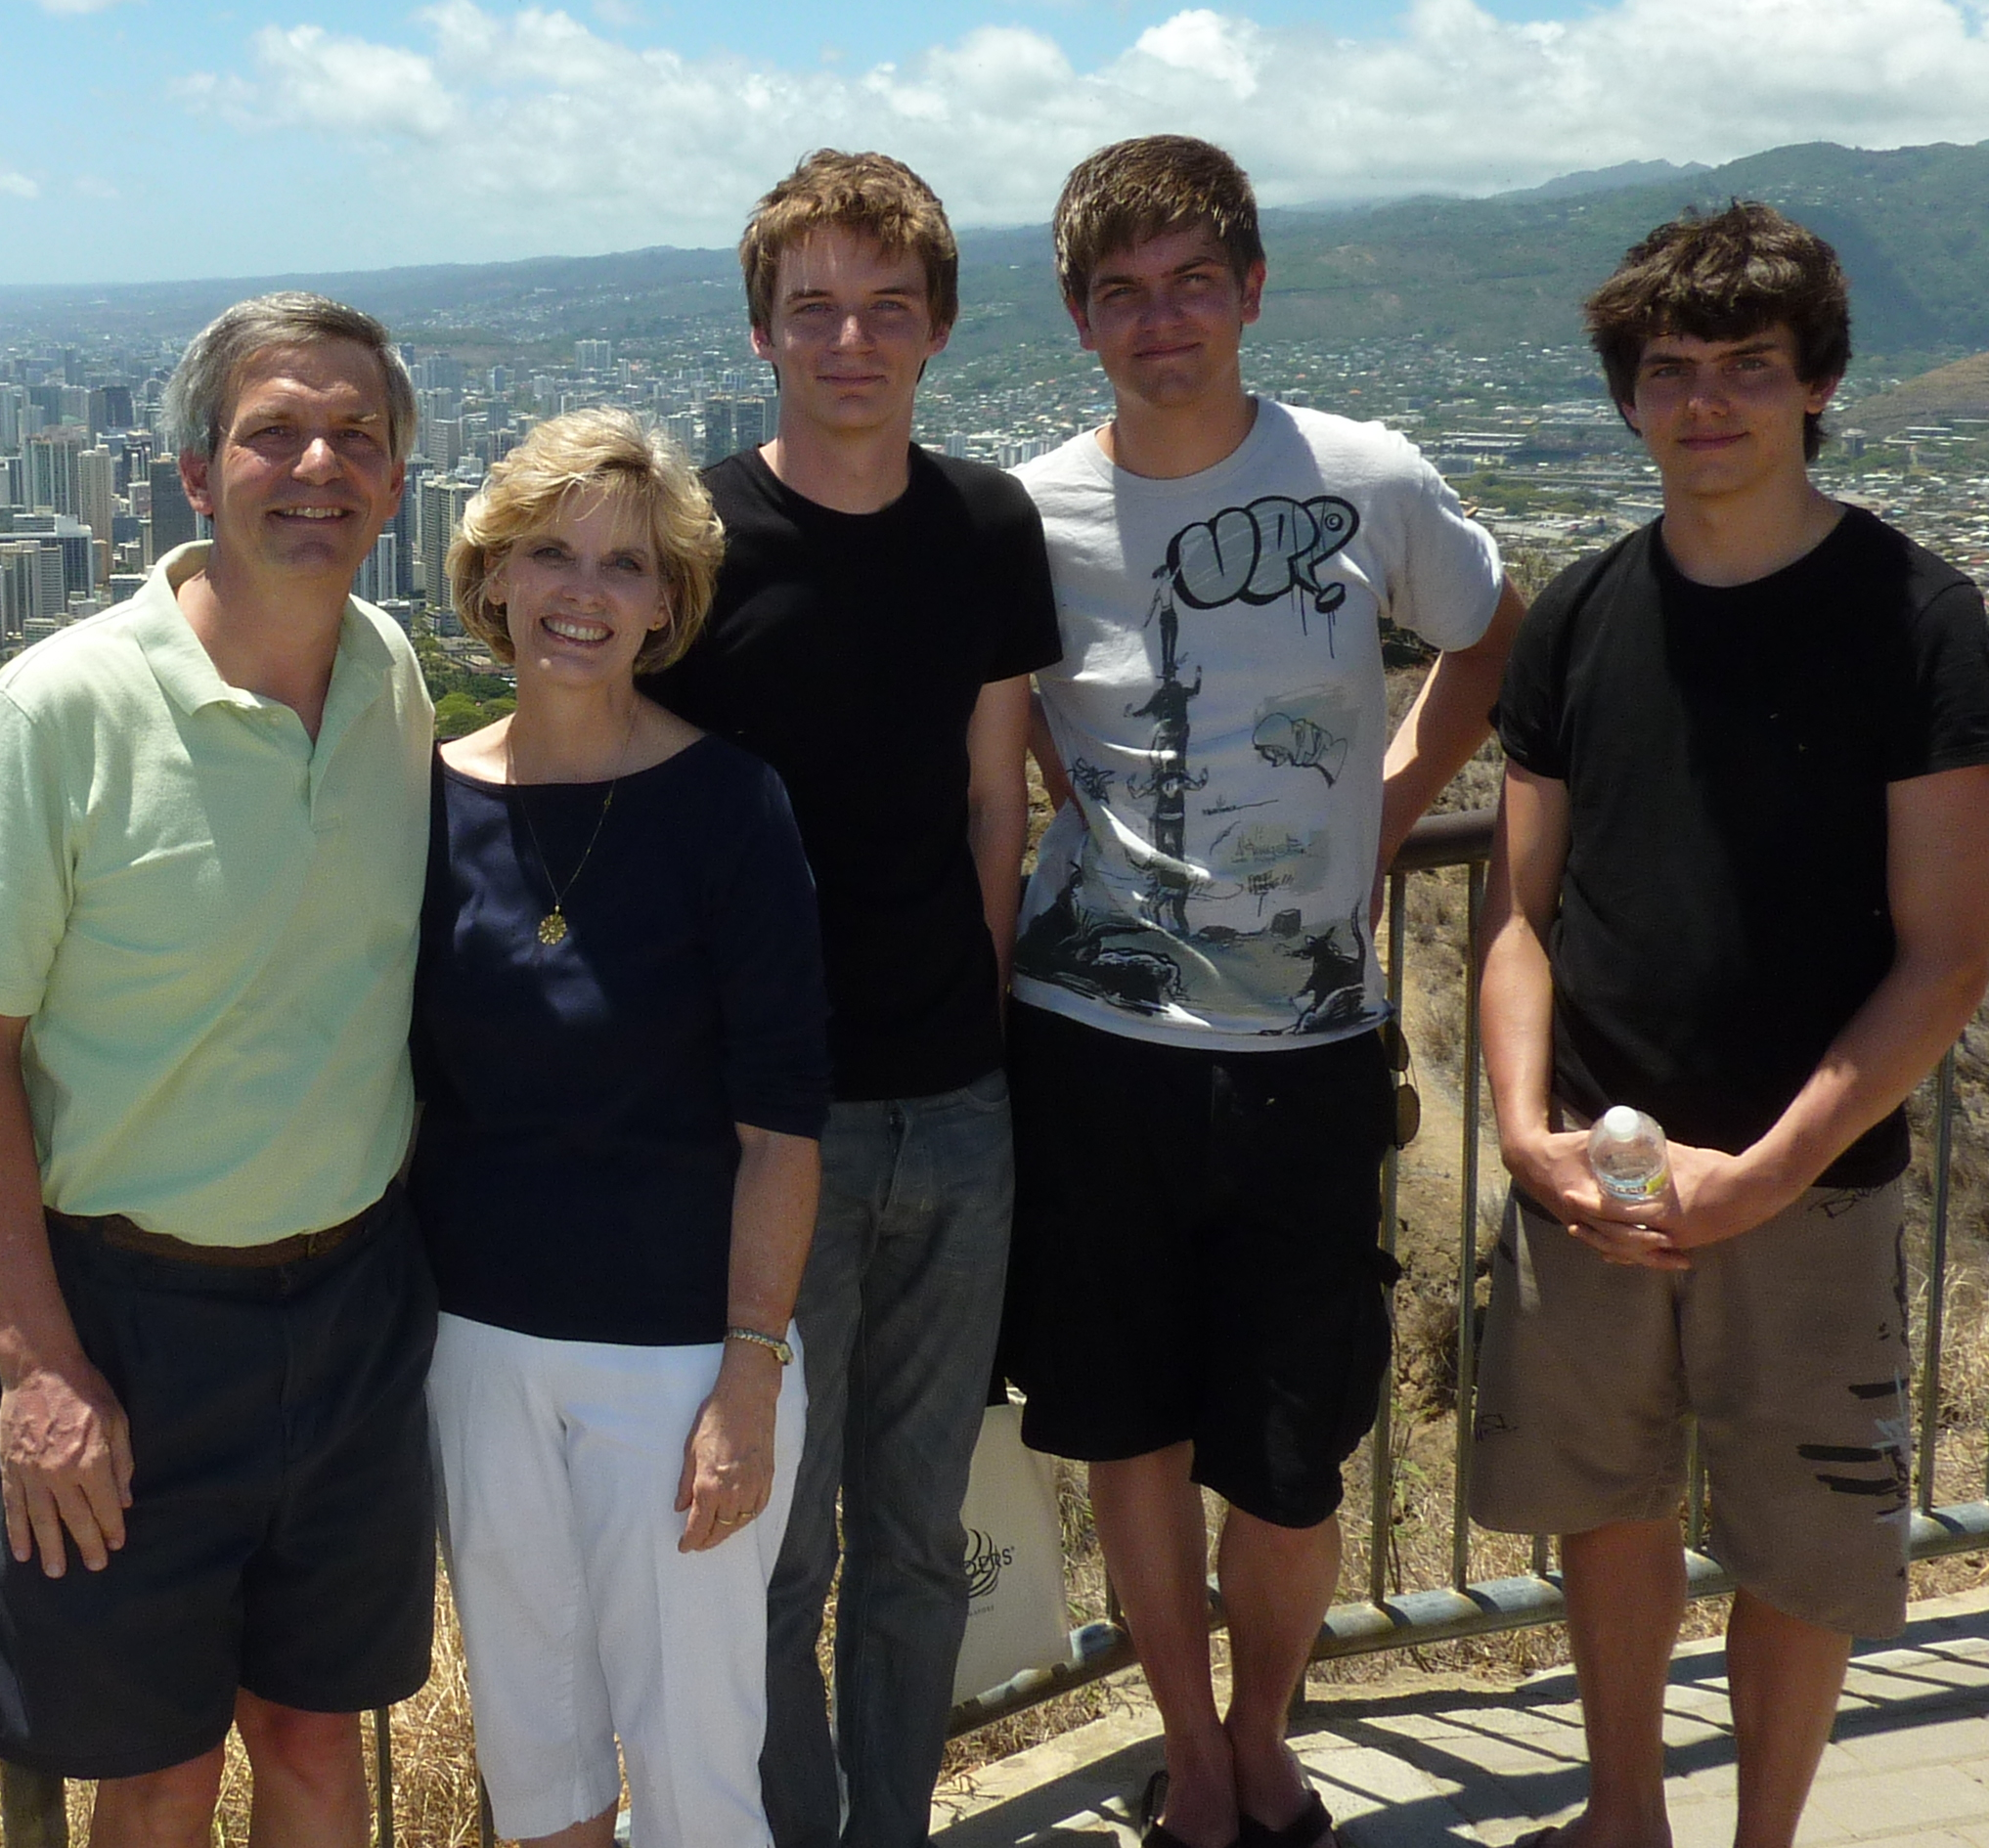
The Griffith Family June 2010

Slide 3
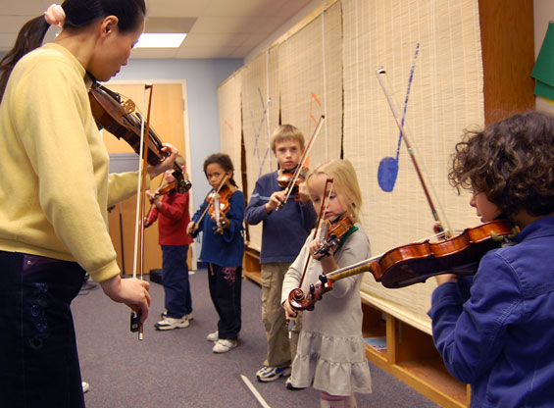
The Suzuki Method

Slide 4
Black
Black
Notes:
Need: Adults need applause too.
Affirmation makes us feel wonderful because we all need encouraging. Don’t you need encoragement?
Mark Twain said, “I can go for three months on one genuine compliment.”
I need encouragement and you need encouragement—so how can we do it better?

Slide 5
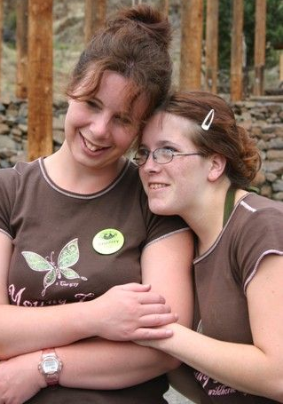
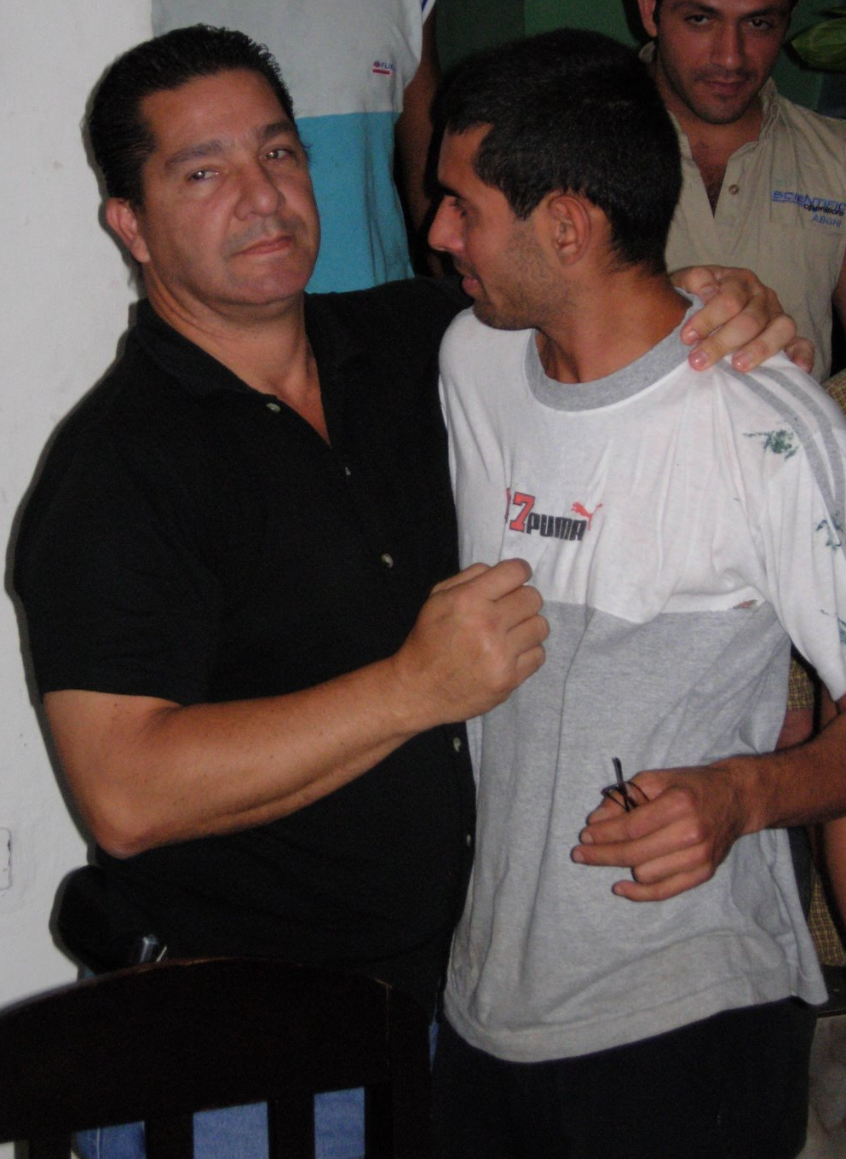
How can we strengthen others?

Slide 6
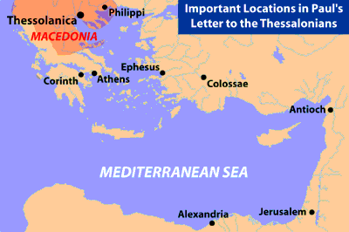
Some Geographical Perspective
139
Thessalonica

Slide 7
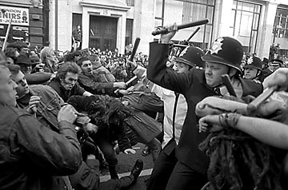
Throw him
in jail!
Down with
Paul!
What to do?...

Slide 8
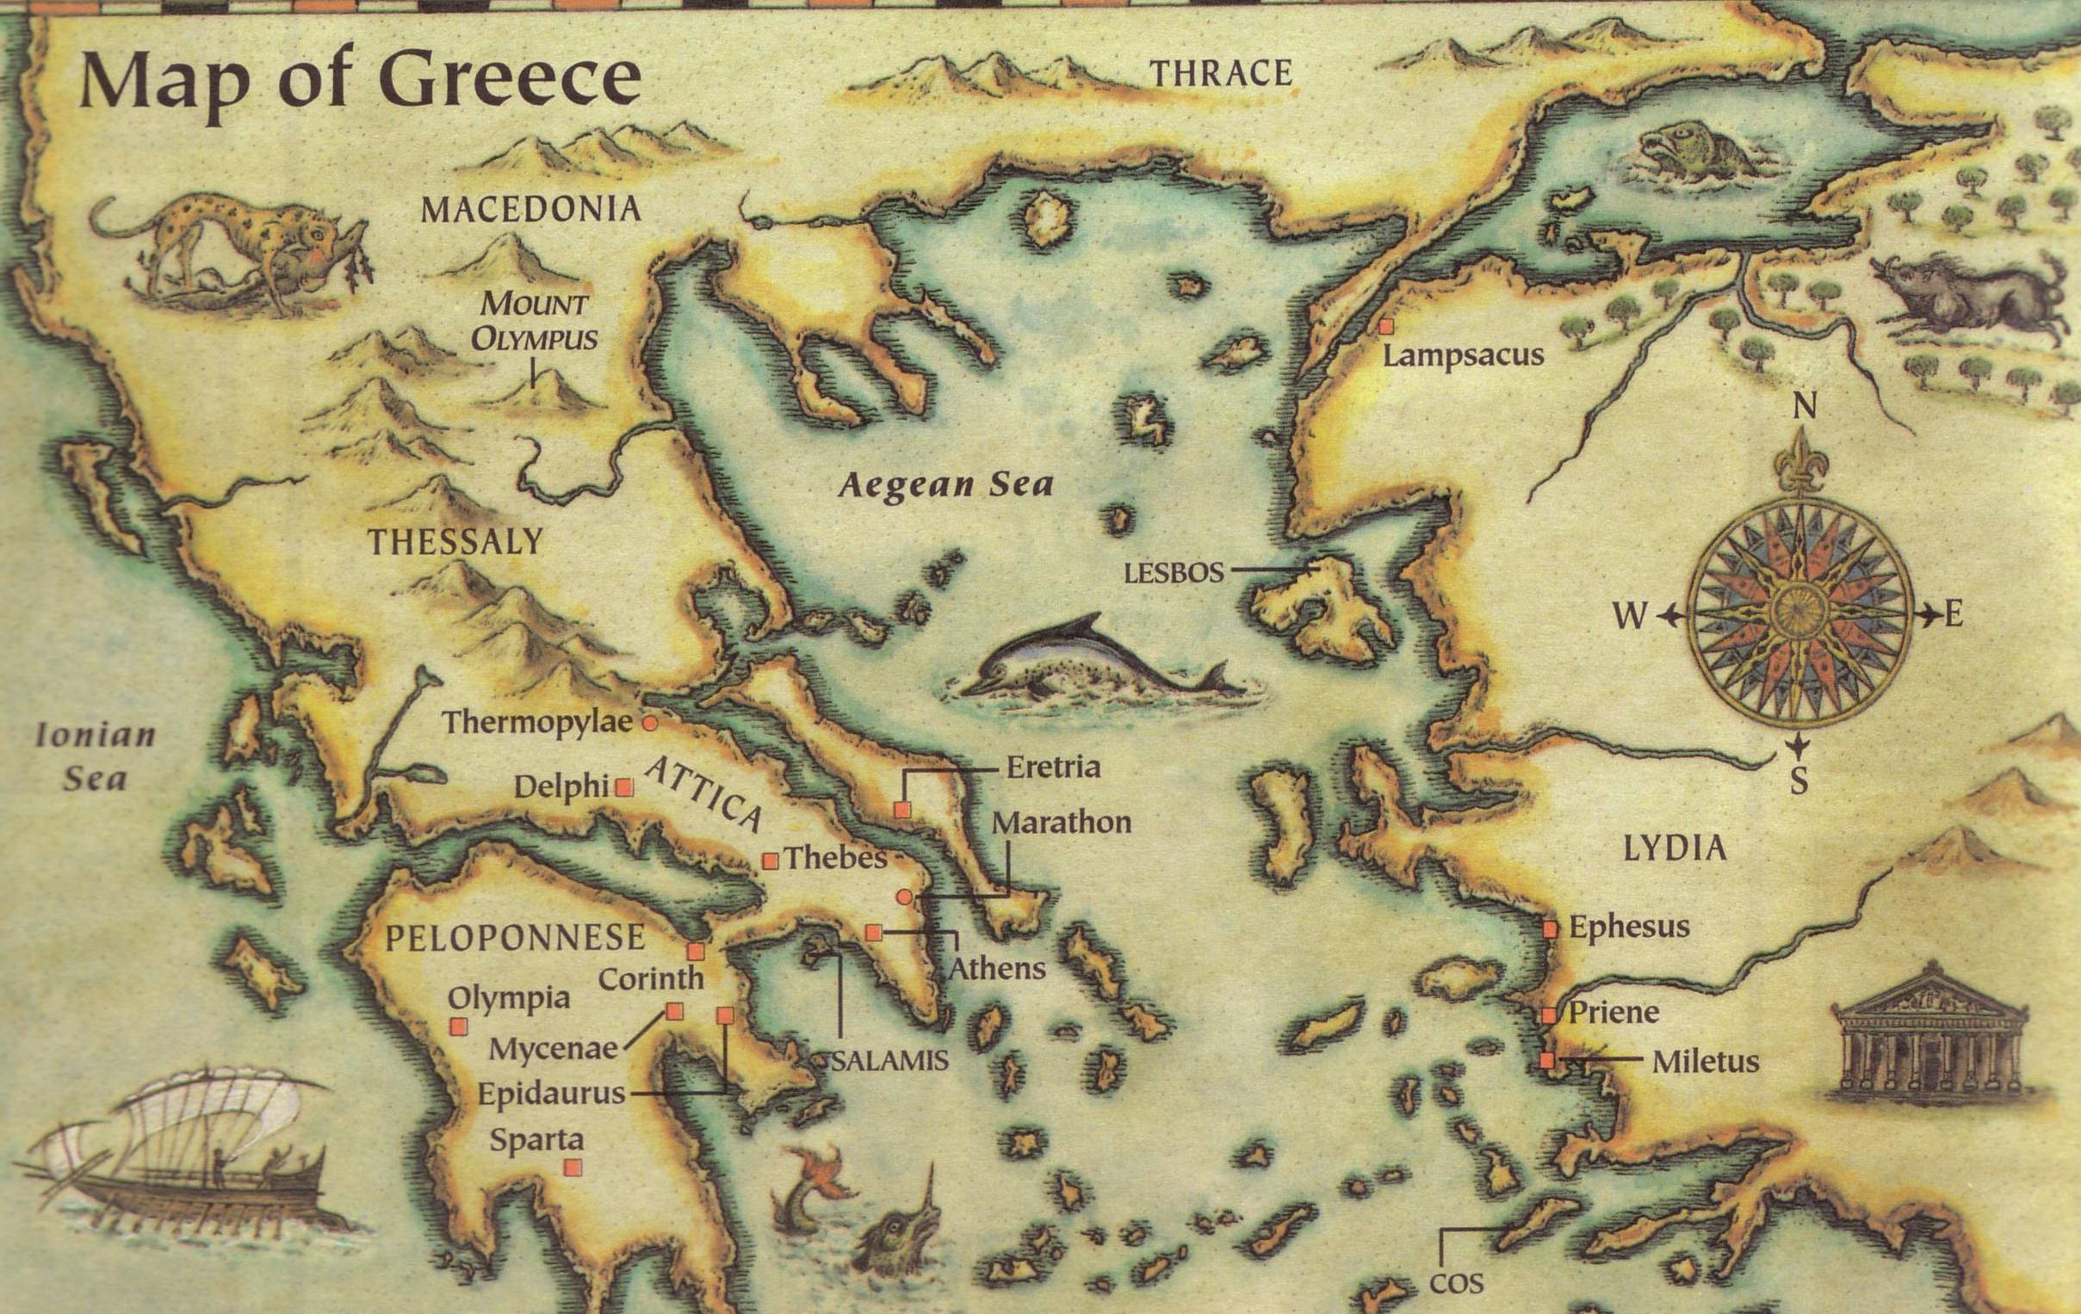
This epistle was written in AD 51
Thessalonica
Berea
Athens
Corinth
Three ways we can encourage others...
Written in Corinth after hearing Tim’s report

Slide 9
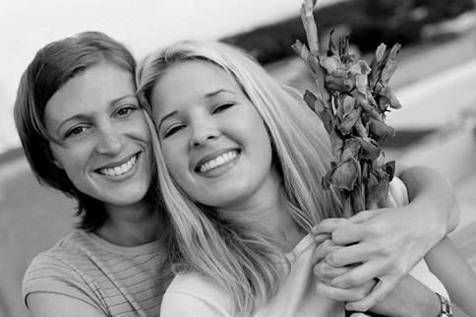
I. Go in person (2:17-20).
How can we strengthen others?
Black

Slide 10
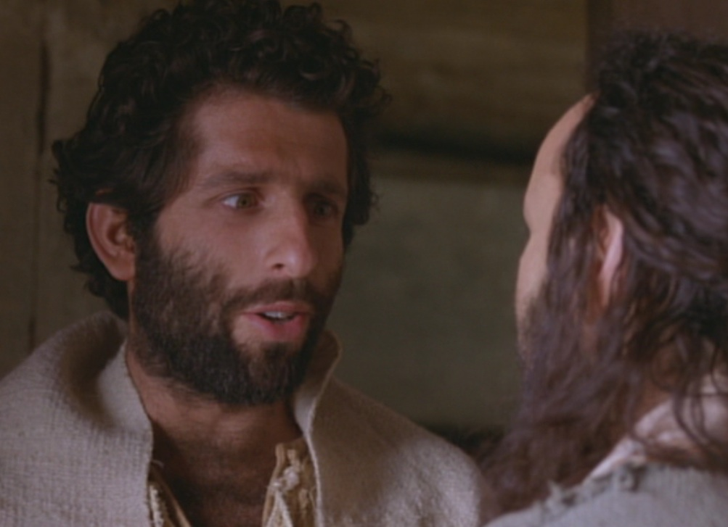
Paul Tried to Go in Person
But, brothers, when we were torn away from you for a short time (in person, not in thought), out of our intense longing we made every effort to see you. ¹⁸For we wanted to come to you—certainly I, Paul, did, again and again—but Satan stopped us” (1 Thess 2:17-18 NIV)

Slide 11
Paul’s greatest blessing = People!
“For what is our hope, our joy, or the crown in which we will glory in the presence of our Lord Jesus when he comes? Is it not you? ²⁰Indeed, you are our glory and joy”
(1 Thess 2:19-20 NIV)
Notes:
Paul was a people person who saw these new believers as
his hope (his future, like a parent lives to see his kids grow into maturity),
his joy (what greater satisfaction is there than seeing people become all God wants them to be?), and his crown (the symbol of God’s blessing on his life).

Slide 12

The best way to show people how valuable they are is in person

Slide 13
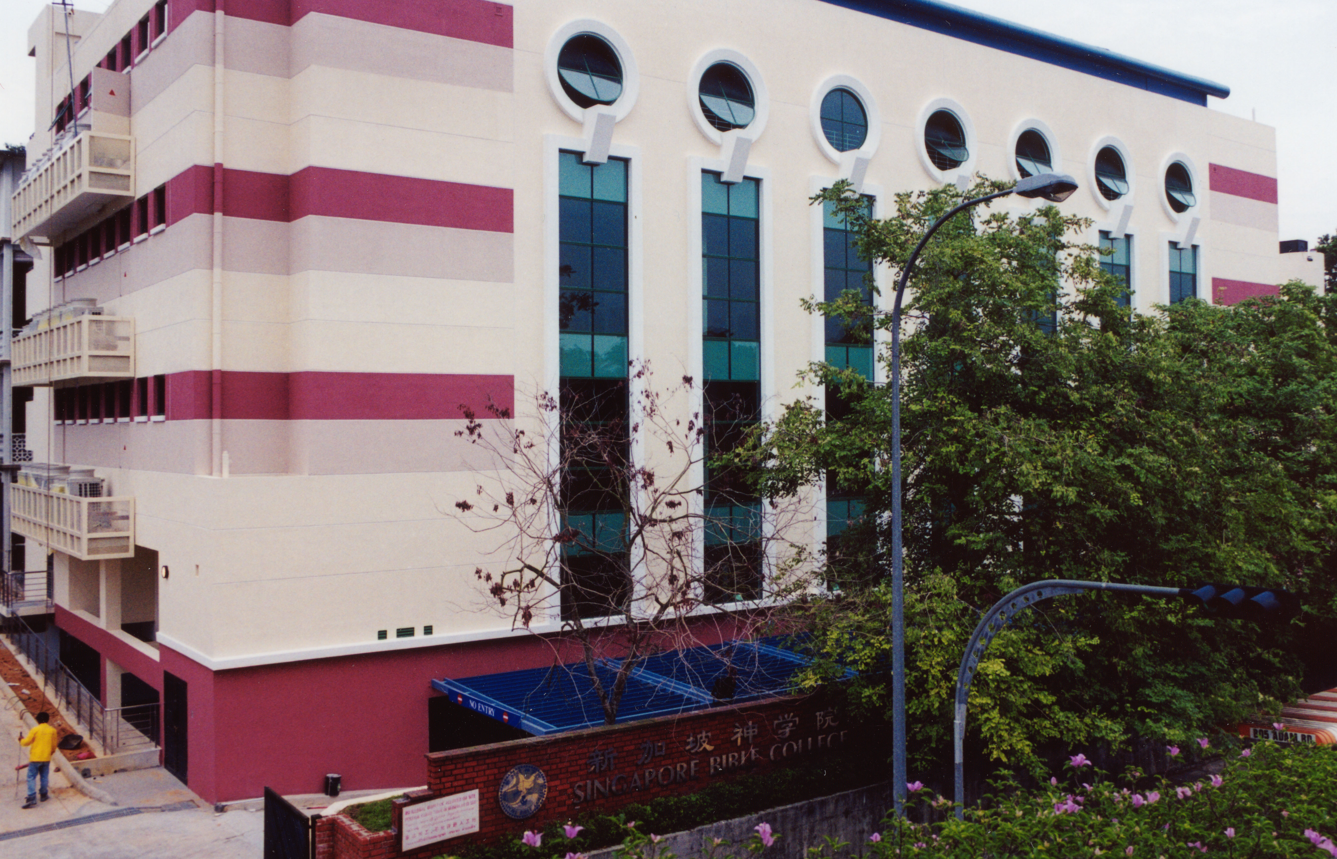
SINGAPORE BIBLE COLLEGE
Notes:
I’ve served as a seminary professor with 30 other faculty at Singapore’s largest training school: Singapore Bible College

Slide 14
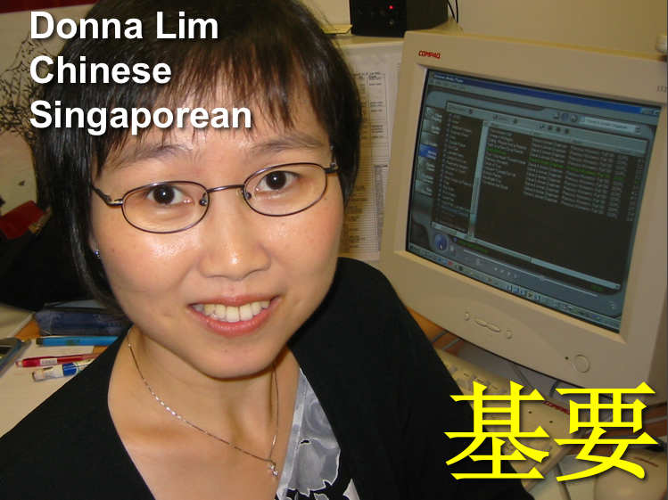
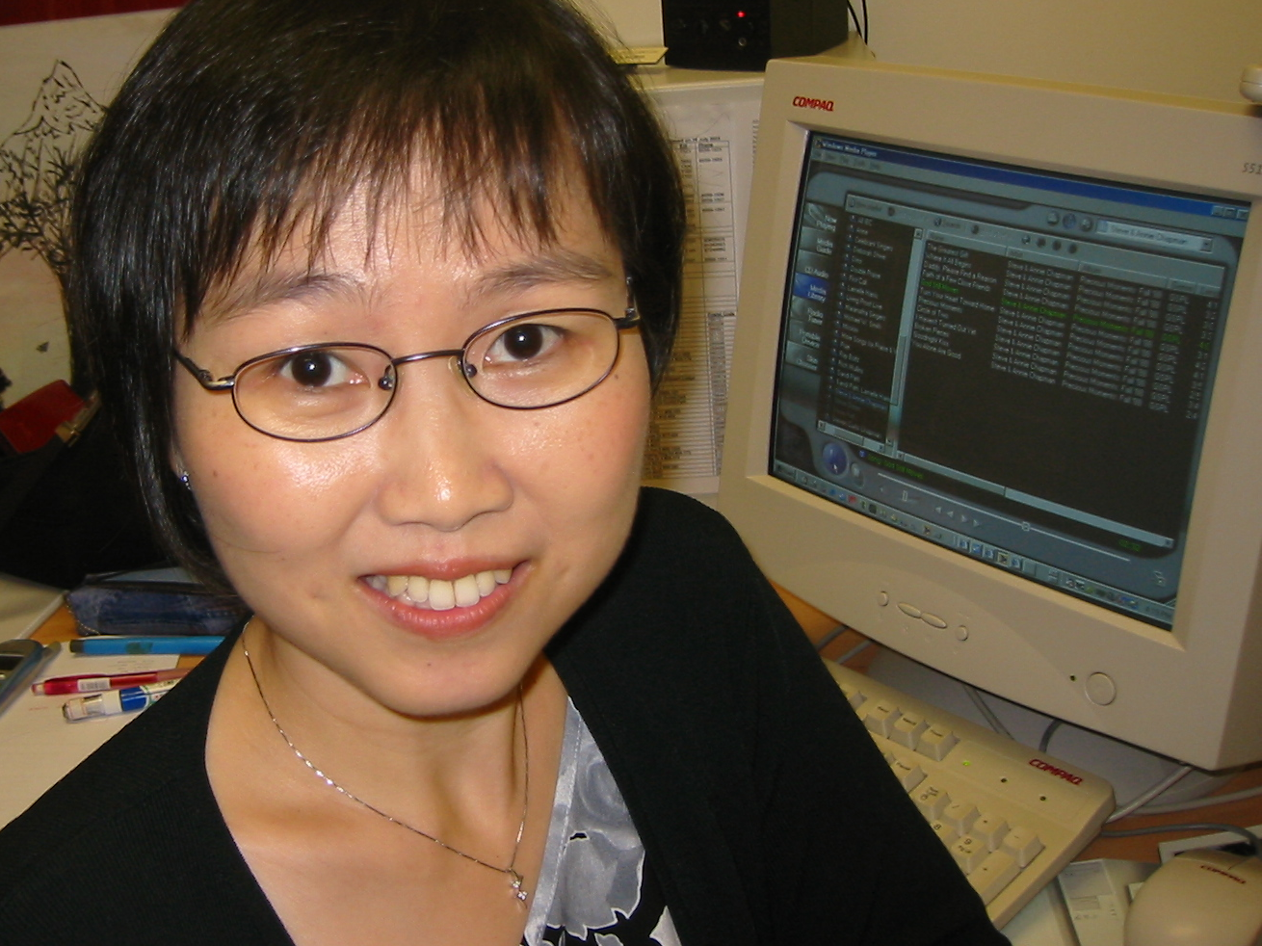
Chinese
Donna Lim
Chinese
Singaporean
基要
Notes:
What I teach in English, these key leaders then translate and improve in the native languages of their countries, be it Chinese, Korean, Burmese, Cambodian, Swahili, or Mongolian.

Slide 15
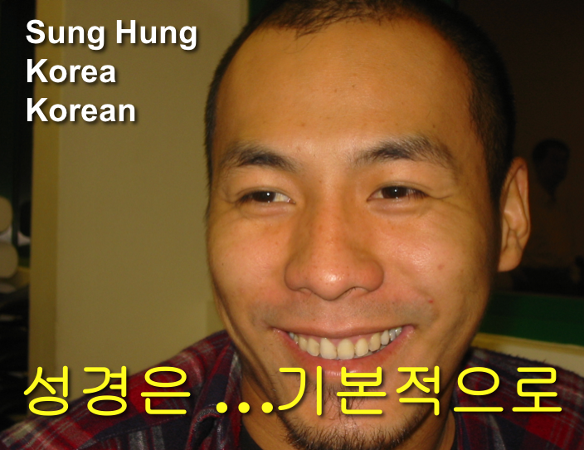

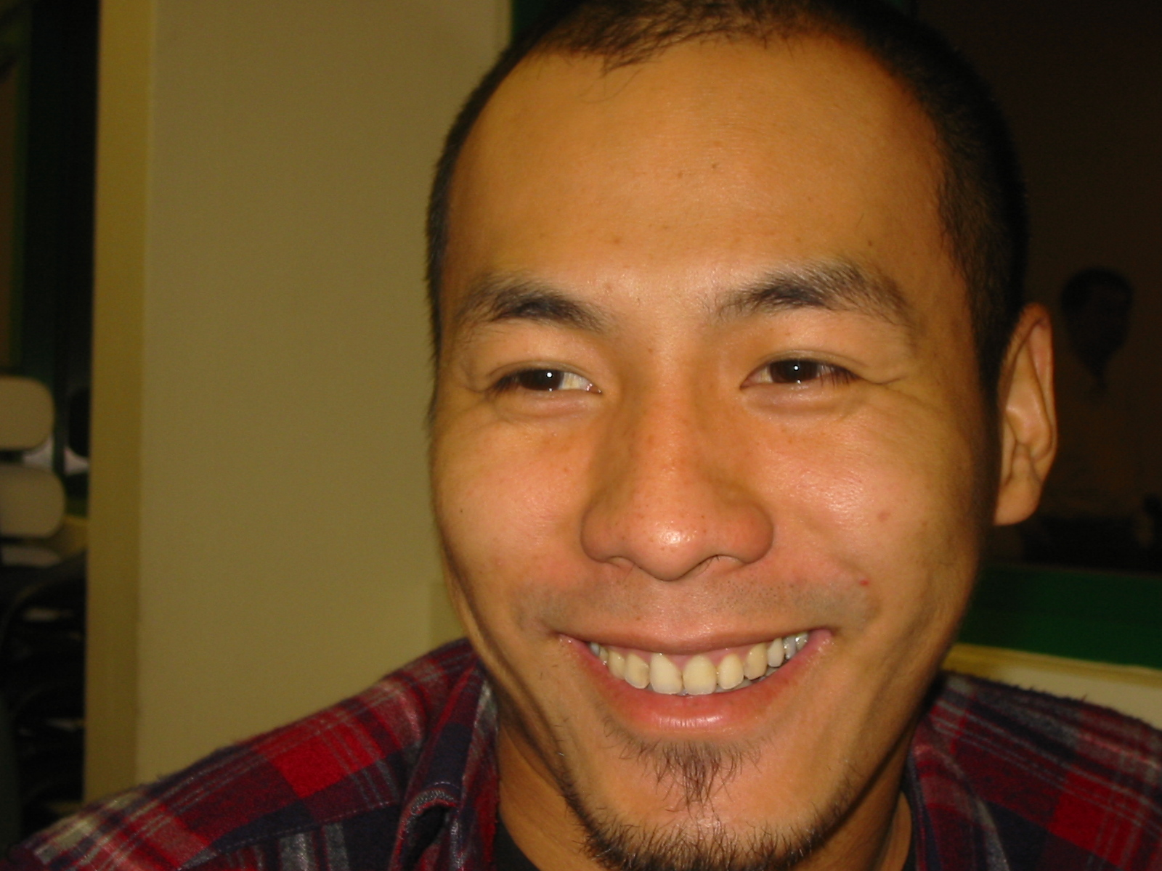
Korean
Sung Hung
Korea
Korean
성경은 …기본적으로

Slide 16
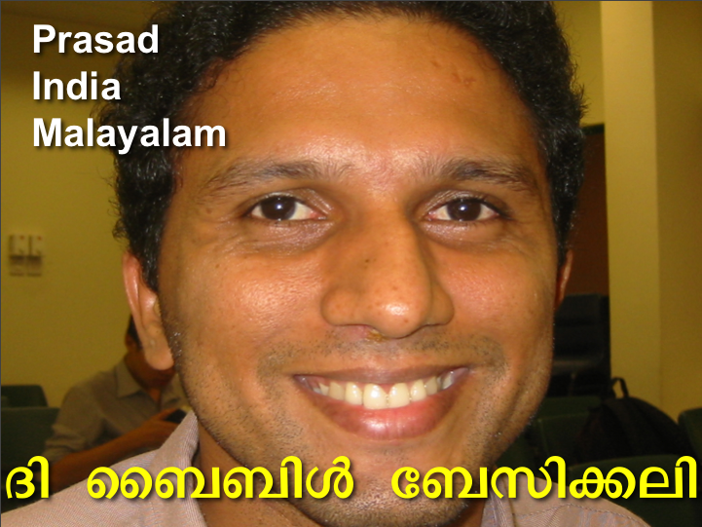
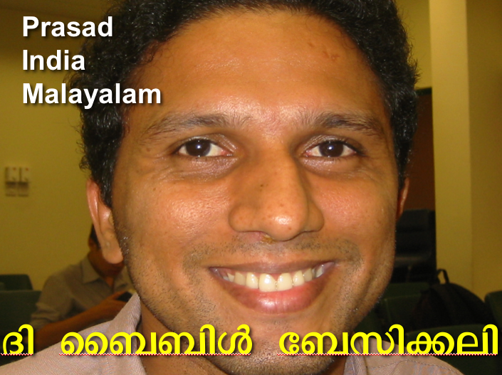
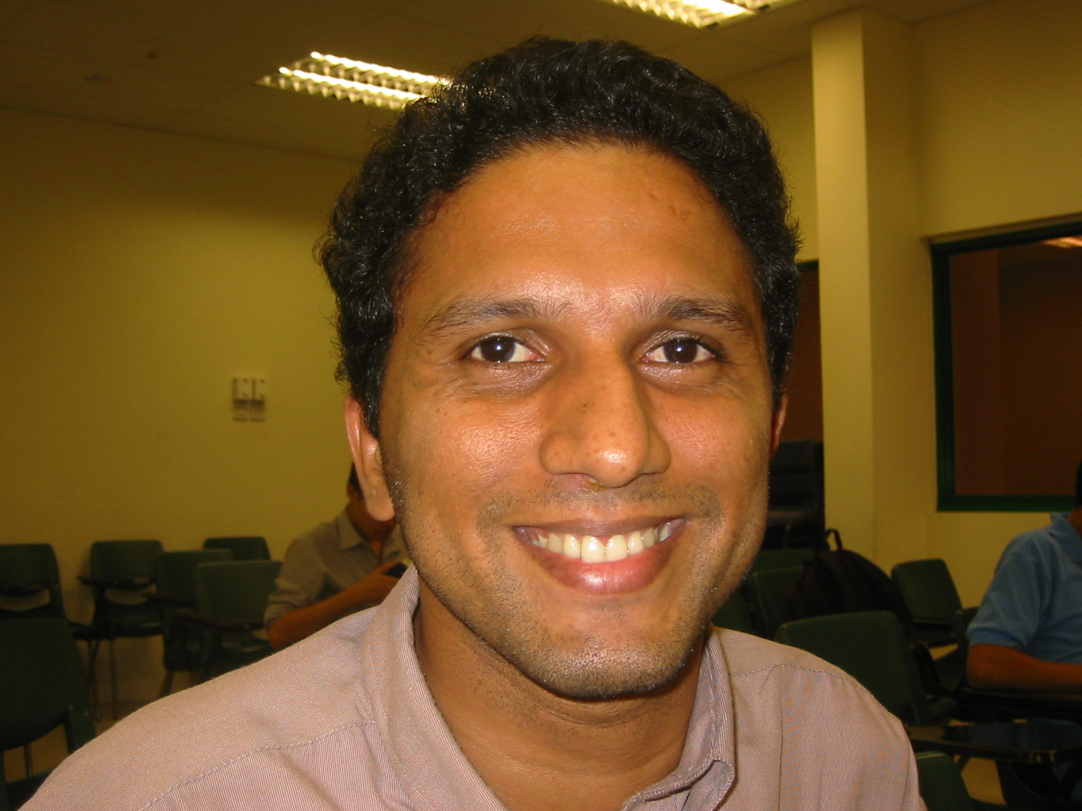
Malayalam
Prasad
India
Malayalam
Æß èÌÌßZ çÌØßAÜß

Slide 17
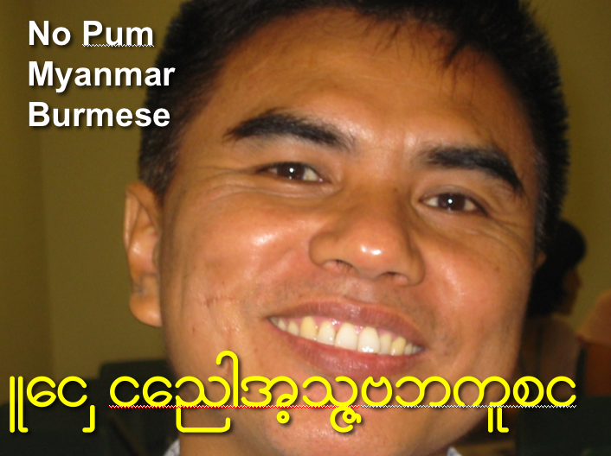
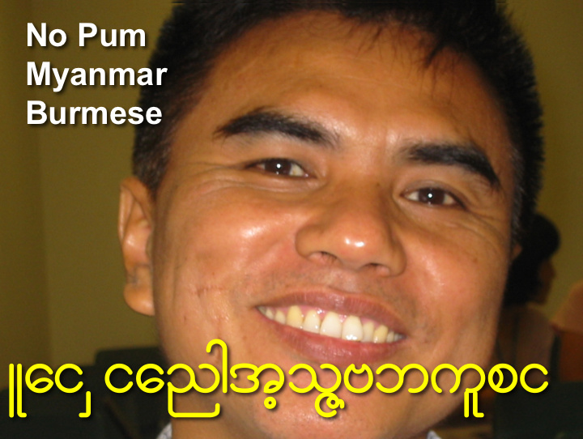
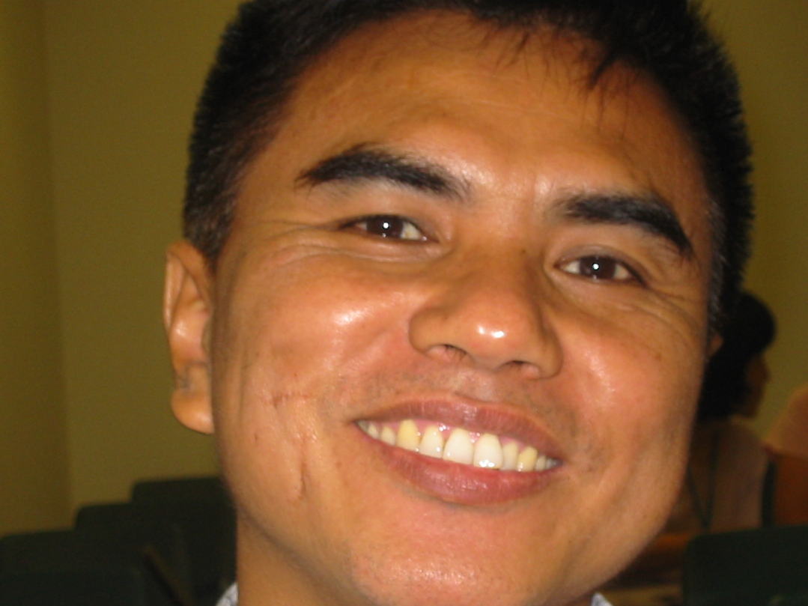
Burmese
No Pum
Myanmar
Burmese
Lai Siangtho…Abulpi

Slide 18
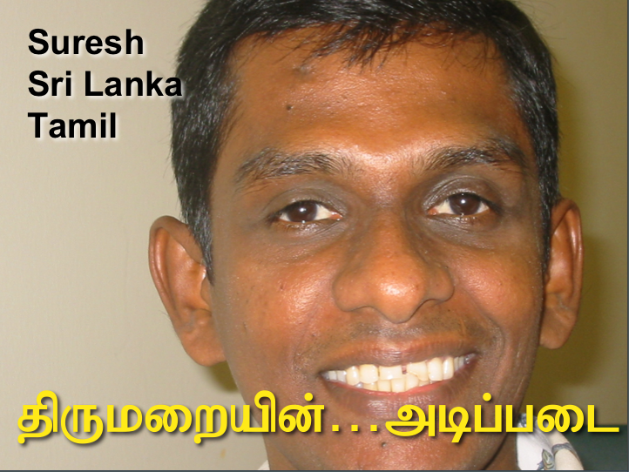
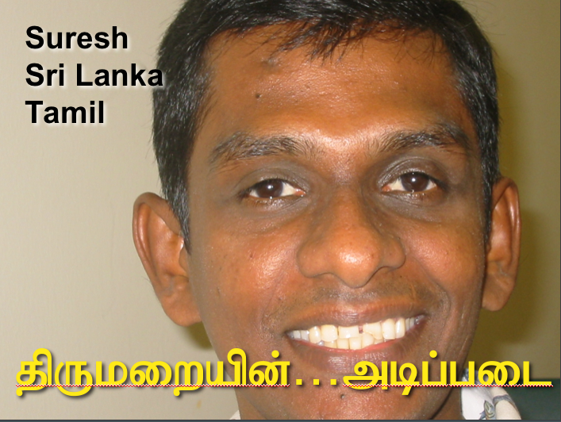
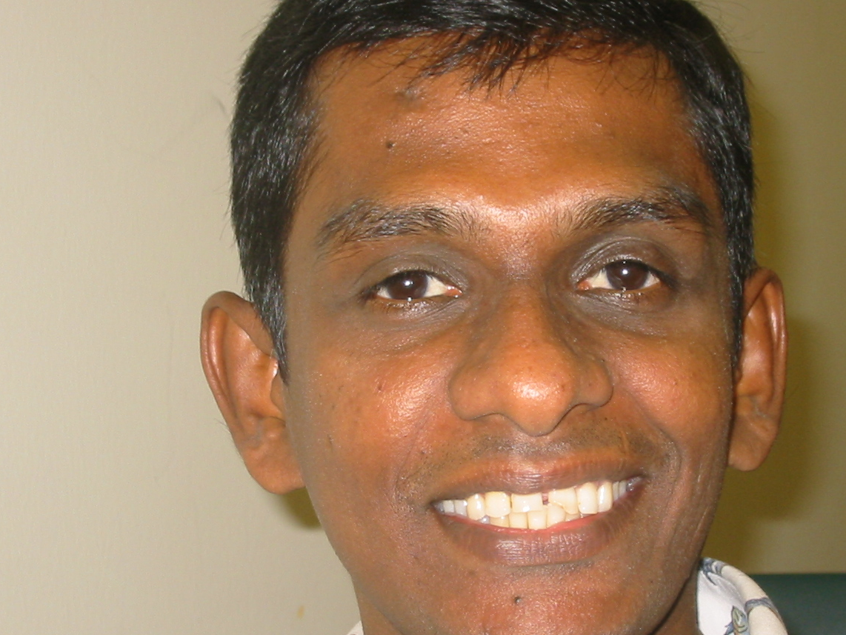
Tamil
Suresh
Sri Lanka
Tamil
jpUkiwapd;…mbg;gil

Slide 19

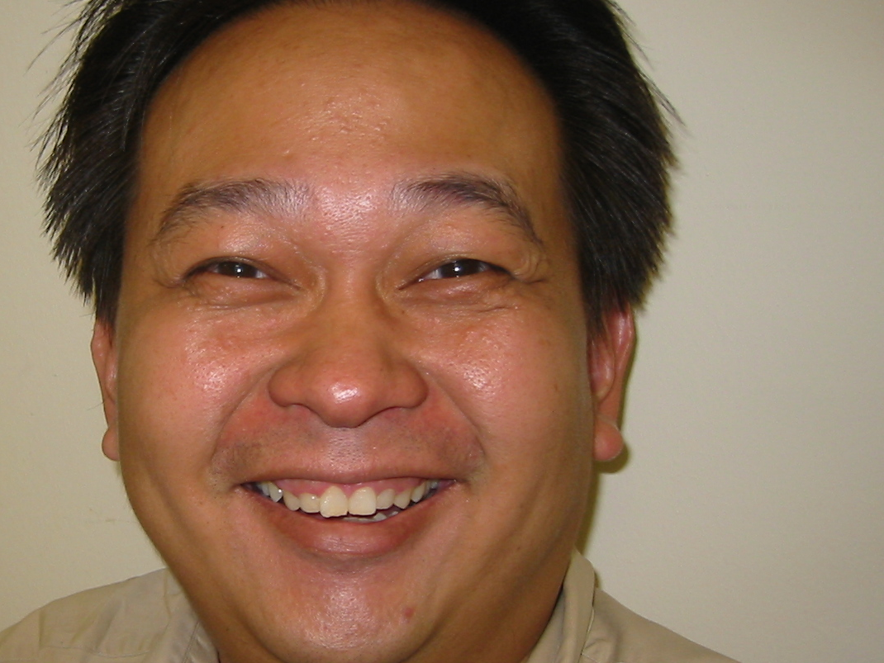

Dutch
Hans
Netherlands
Dutch
La Biblia…Abulpi

Slide 20
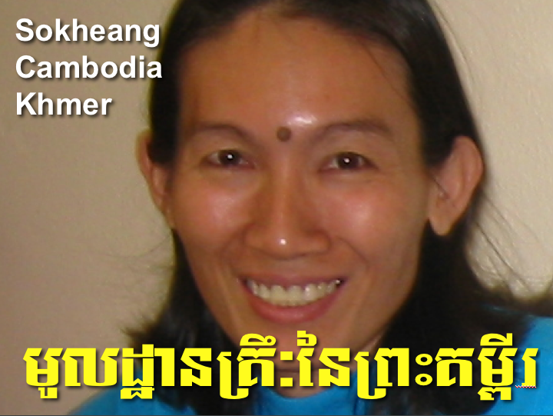
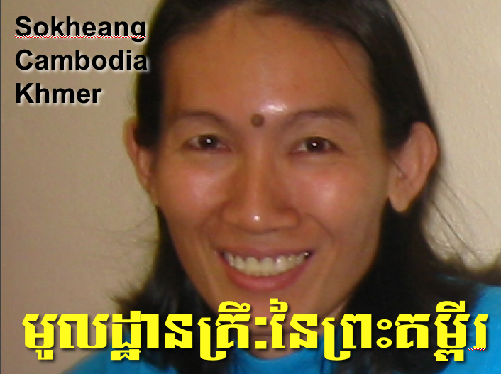
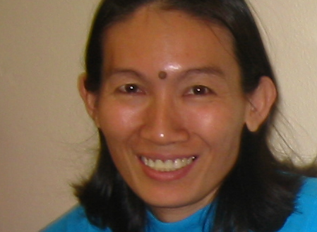
Cambodian
Sokheang
Cambodia
Khmer
mUldæanRKw³énRBHKm<Ir

Slide 21
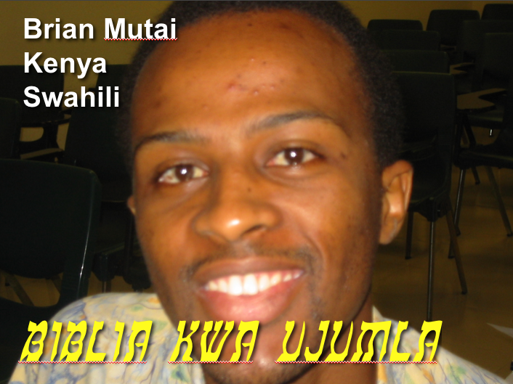
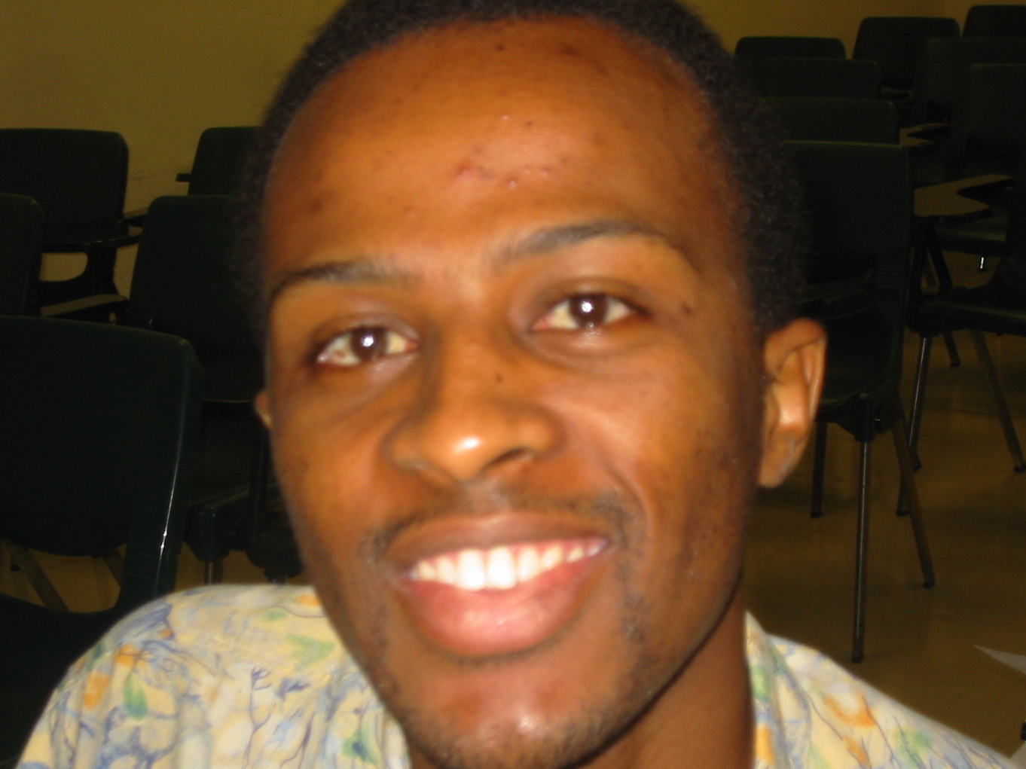
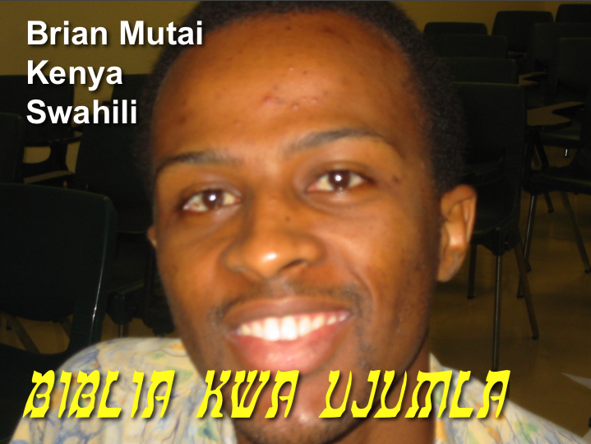
Swahili
Brian Mutai
Kenya
Swahili
biblia kwa ujumla

Slide 22
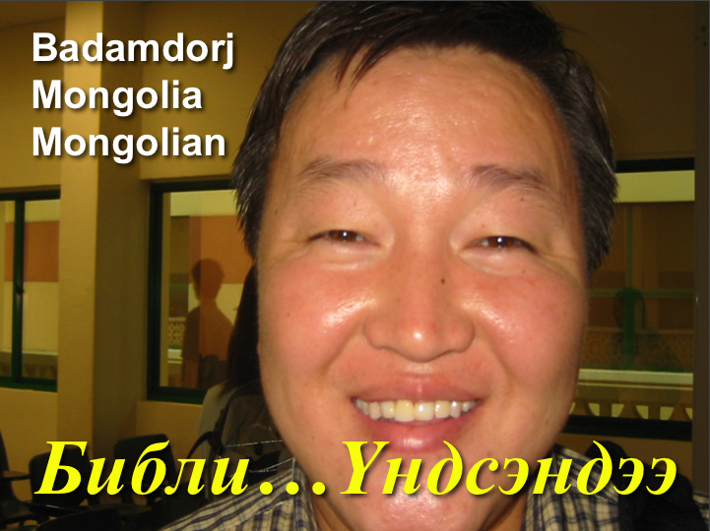

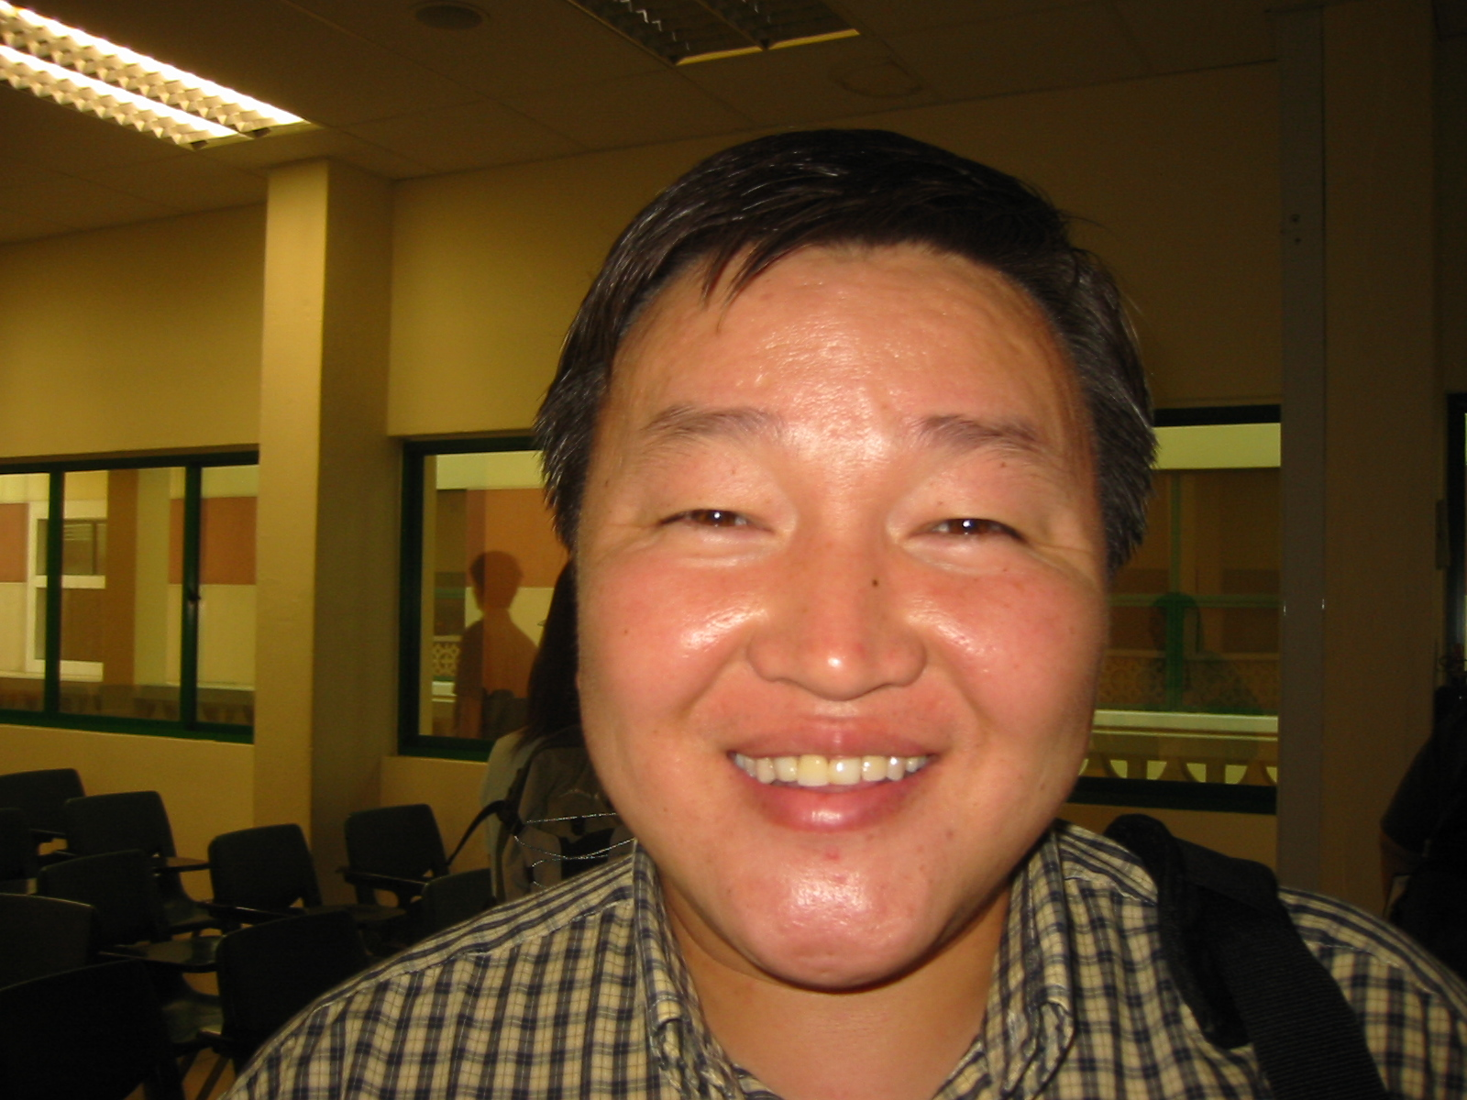
Mongolian
Badamdorj
Mongolia
Mongolian
Библи…Үндсэндээ

Slide 23
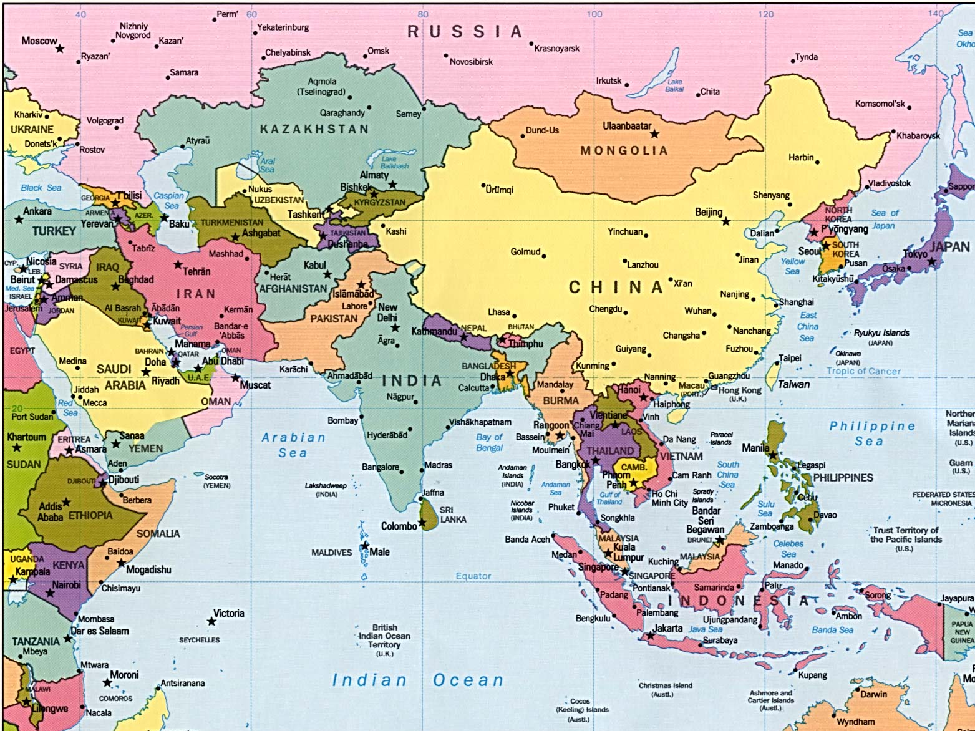
Nations Where I Teach
MONGOLIA
CHINA
JORDAN
NEPAL
INDIA
MYANMAR
THAILAND
VIETNAM
SRI LANKA
MALAYSIA
SINGAPORE
INDONESIA
Notes:
23
Located at the equator, SBC has trained pastors, missionaries, teachers, musicians, counselors, and other full-time workers from about 25 countries, mostly in Asia. Many of these lie within the 10-40 Window, the area between 10 and 40 degrees which is the poorest and most spiritually needy area of the world. We have about 500 students studying in English and Chinese.

Slide 24
Black
Black
Notes:
We visit you every two years to try to strengthen you too.
In our increasingly impersonal age where we are tempted to use email, facebook, Twitter, or any other connection method besides a personal visit, let’s not forget to just simply “be there”!

Slide 25
I. Go in person (2:17-20).
How can we strengthen others?
Black

Slide 26

II. Bring others into their lives (3:1-9).
How can we strengthen others?

Slide 27
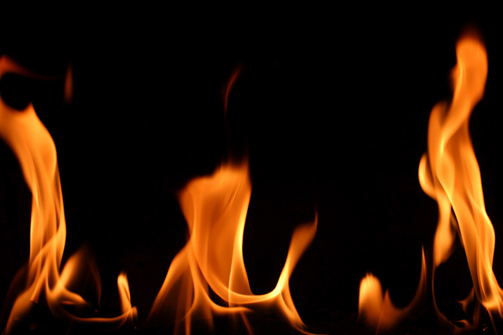
Paul sent Timothy to strengthen the church (3:1-5)
So when we could stand it no longer, we thought it best to be left by ourselves in Athens. ²We sent Timothy, who is our brother and God’s fellow worker in spreading the gospel of Christ, to strengthen and encourage you in your faith, ³so that no one would be unsettled by these trials. You know quite well that we were destined for them.

Slide 28
Paul sent Timothy to strengthen the church (3:1-5)
⁴In fact, when we were with you, we kept telling you that we would be persecuted. And it turned out that way, as you well know. ⁵For this reason, when I could stand it no longer, I sent to find out about your faith. I was afraid that in some way the tempter might have tempted you and our efforts might have been useless.
Notes:
Paul could have just written a letter, which he was obviously doing in this epistle, but he always carefully chose the men who carried the letter.
Not “just anybody” could accomplish a mission such as this one to encourage these suffering Christians—but Timothy fit the bill.
Timothy was with Paul when they planted the church.
Timothy was also a sensitive man who could genuinely feel for these persecuted believers.

Slide 29
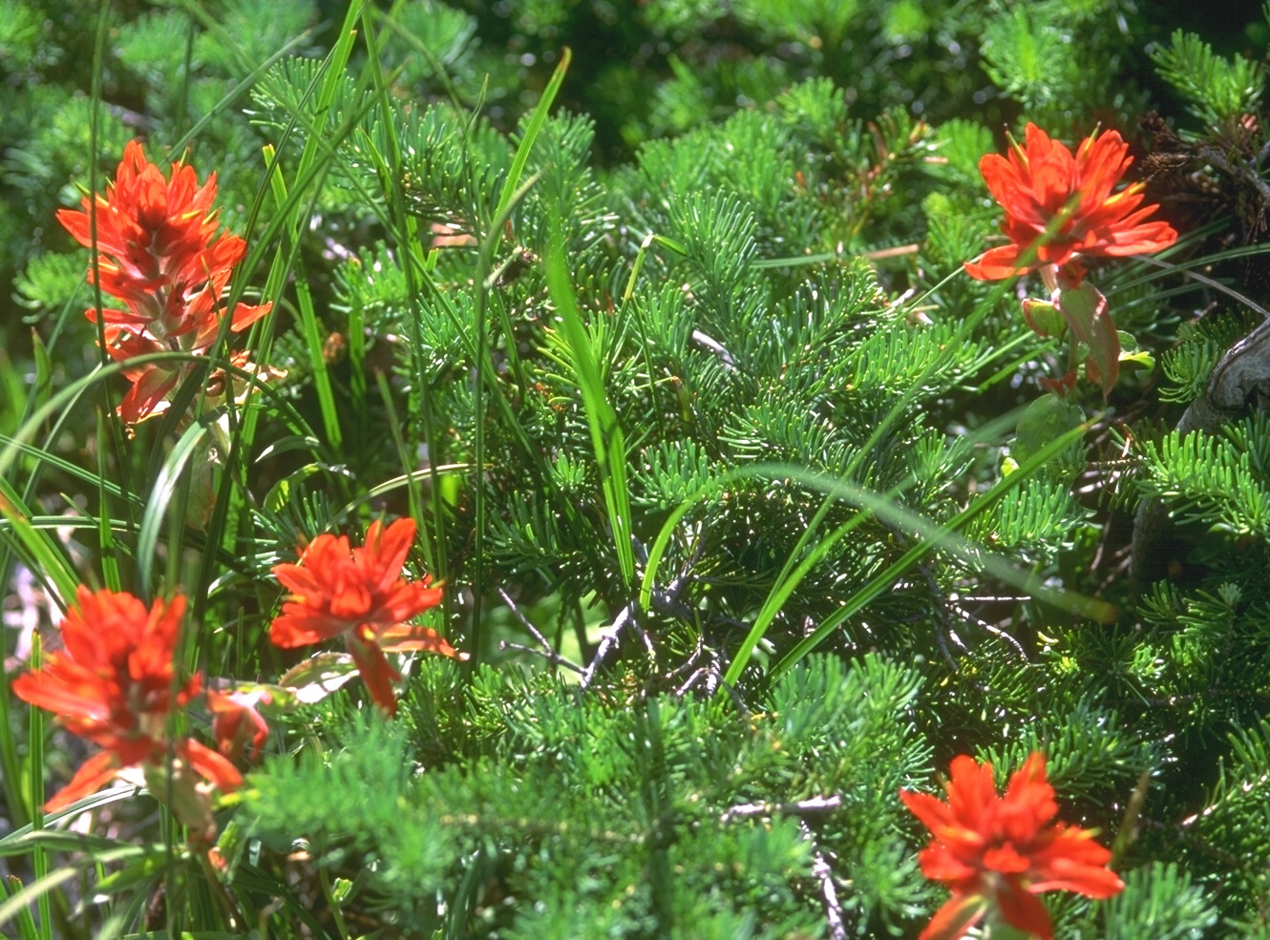
Paul was encouraged (3:6-9)
⁶But Timothy has just now come to us from you and has brought good news about your faith and love. He has told us that you always have pleasant memories of us and that you long to see us, just as we also long to see you. ⁷Therefore, brothers, in all our distress and persecution we were encouraged about you because of your faith. ⁸For now we really live, since you are standing firm in the Lord. ⁹How can we thank God enough for you in return for all the joy we have in the presence of our God because of you?
⁶But Timothy has just now come to us from you and has brought good news about your faith and love. He has told us that you always have pleasant memories of us and that you long to see us, just as we also long to see you. ⁷Therefore, brothers, in all our distress and persecution we were encouraged about you because of your faith. ⁸For now we really live, since you are standing firm in the Lord. ⁹How can we thank God enough for you in return for all the joy we have in the presence of our God because of you?

Slide 30
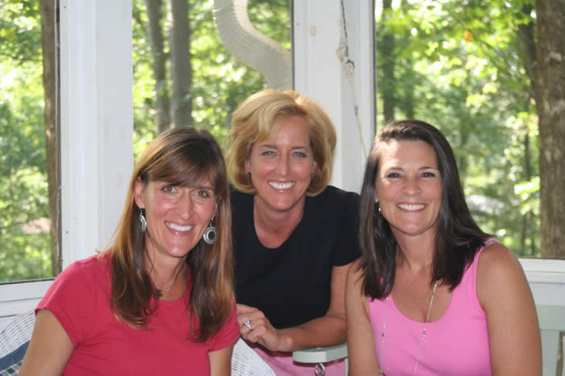
Send others when you can’t go

Slide 31

Send Others Through Good Books
Notes:
31

Slide 32
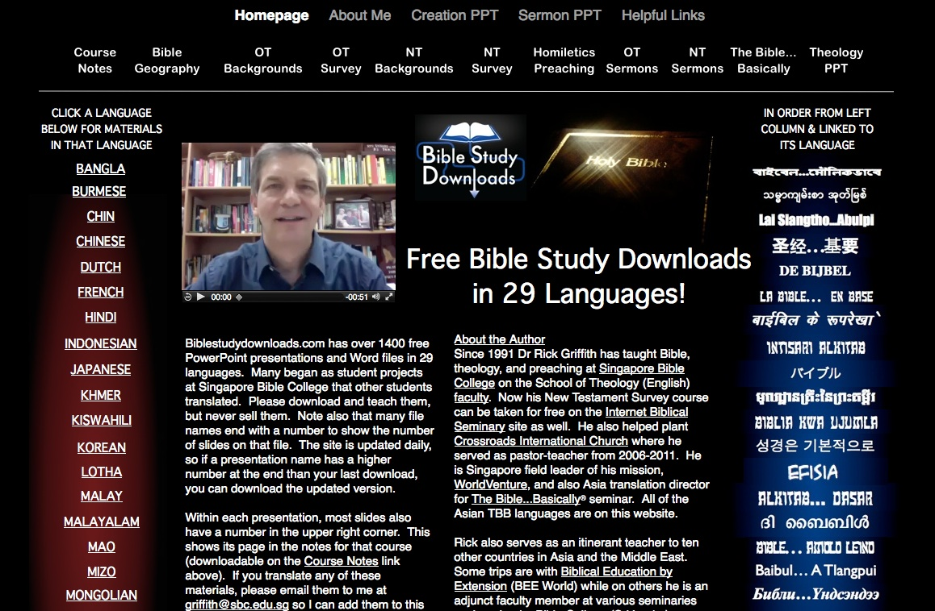
biblestudydownloads.com

Slide 33
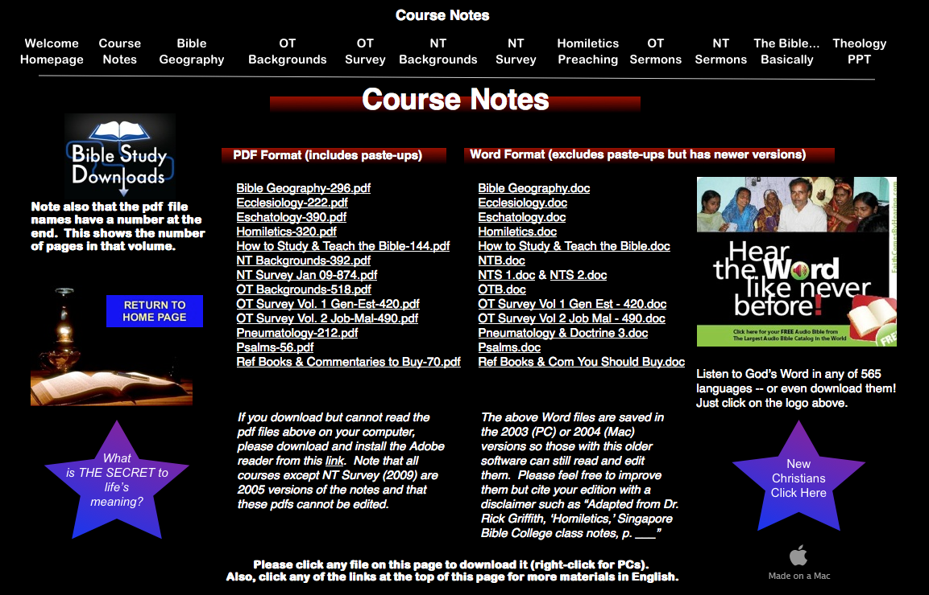
Class Notes Link
biblestudydownloads.com

Slide 34
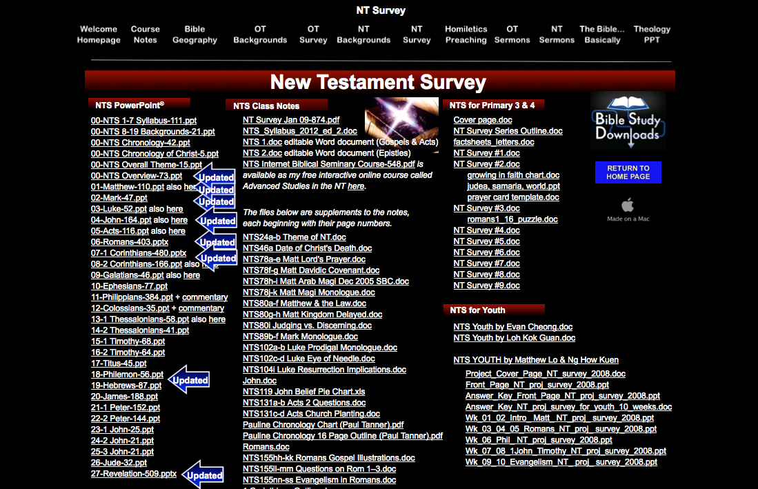
TBB NTS Link
biblestudydownloads.com

Slide 35
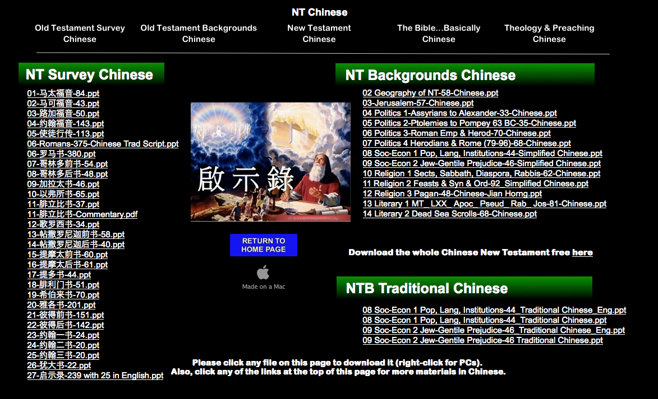
TBB NTS Link
biblestudydownloads.com

Slide 36
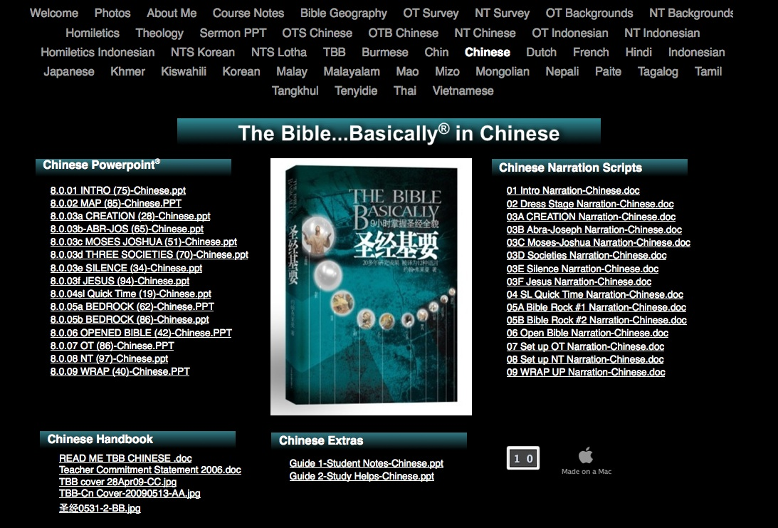
TBB Chinese Link
biblestudydownloads.com

Slide 37
I. Go in person (2:17-20).
How can we strengthen others?
Black

Slide 38
II. Bring others into their lives (3:1-9).
How can we strengthen others?

Slide 39
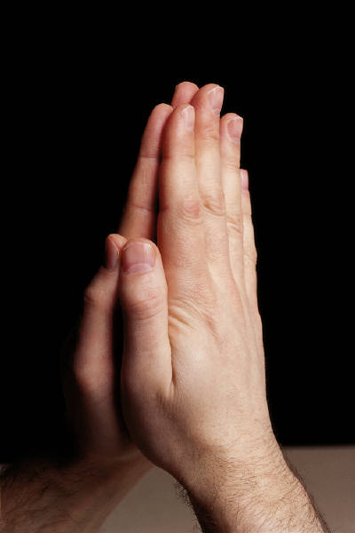
III. Pray for them (3:10-13).
How can we strengthen others?
¹⁰ Night and day we pray most earnestly that we may see you again and supply what is lacking in your faith.
¹¹ Now may our God and Father himself and our Lord Jesus clear the way for us to come to you.

Slide 40
III. Pray for them (3:10-13).
How can we strengthen others?
¹² May the Lord make your love increase and overflow for each other and for everyone else, just as ours does for you.
¹³ May he strengthen your hearts so that you will be blameless and holy in the presence of our God and Father when our Lord Jesus comes with all his holy ones.

Slide 41

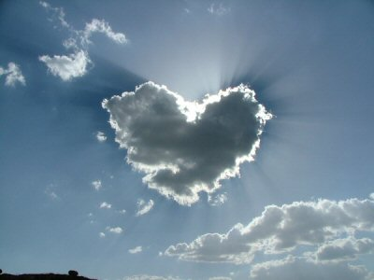

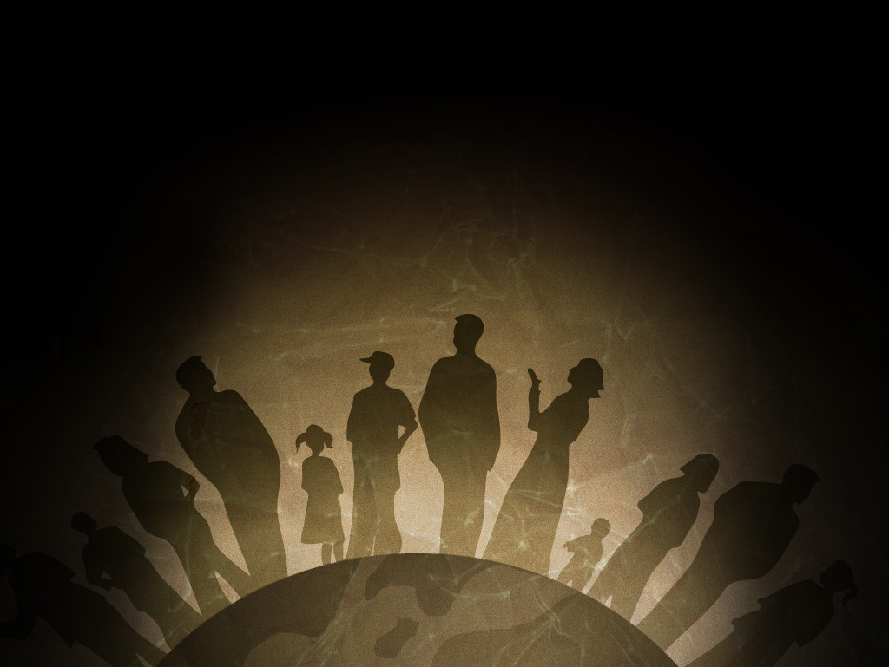
Our Vision is to…
Love God
Love the Church
Love the Nations
Notes:
“The greatest of these is love” (1 Cor. 13:13). Love should be our highest goal, so we made love our mission statement for our church that we planted in 2006 in Singapore: to love God, to love the church, and to love the nations.
41

Slide 42
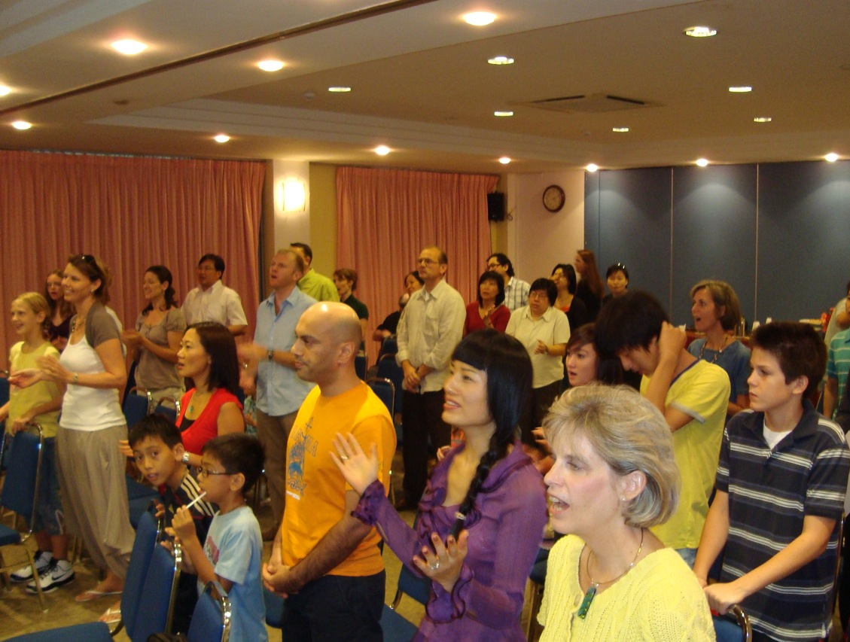

Purity Priority
60 saints from 13 nations

Slide 43
Black
Black
Notes:
Never neglect to build others up through prayer!
Prayer has no boundaries. It works anywhere, anytime. When you can’t encourage others in person yourself, when you can’t send someone else, and when any hindrance comes—prayer is your best method of encouragement.

Slide 44
The Griffith Family June 2010

Slide 45
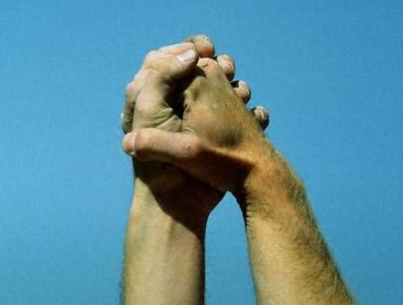
Main Idea:
Strengthen others to show you care for them
Main Idea:
Strengthen others to show you care for them
How?
How?
• Visits: Go in person (2:17-20)
• Visits: Go in person (2:17-20)
• Co-laborers: Bring others (3:1-9)
• Co-laborers: Bring others (3:1-9)
• Prayer: Pray for them (3:10-13)
• Prayer: Pray for them (3:10-13)
Notes:
Application: Who do you know that needs encouragement today?
Which of these three ways can you infuse strength into that person?

Slide 46

The Mark Eklund Story
By Sister Helen P. Mrosla
Notes:
A Catholic nun named Sister Helen P. Mrosla shares this story about one of her students named Mark Eklund:
He was in the first third grade class I taught at Saint Mary's School in Morris, Minn. All 34 of my students were dear to me, but Mark Eklund was one in a million. Very neat in appearance, but had that happy-to-be-alive attitude that made even his occasional mischievousness delightful.
Mark talked incessantly. I had to remind him again and again that talking without permission was not acceptable. What impressed me so much, though, was his sincere response every time I had to correct him for misbehaving - "Thank you for correcting me, Sister!" I didn't know what to make of it at first, but before long I became accustomed to hearing it many times a day.
One morning my patience was growing thin when Mark talked once too often, and then I made a novice-teacher's mistake. I looked at Mark and said, "If you say one more word, I am going to tape your mouth shut!"
It wasn't ten seconds later when Chuck blurted out, "Mark is talking again." I hadn't asked any of the students to help me watch Mark, but since I had stated the punishment in front of the class, I had to act on it.
I remember the scene as if it had occurred this morning. I walked to my desk, very deliberately opened my drawer and took out a roll of masking tape. Without saying a word, I proceeded to Mark's desk, tore off two pieces of tape and made a big X with them over his mouth. I then returned to the front of the room. As I glanced at Mark to see how he was doing, he winked at me. That did it!! I started laughing. The class cheered as I walked back to Mark's desk, removed the tape, and shrugged my shoulders. His first words were, "Thank you for correcting me, Sister."
At the end of the year I was asked to teach junior-high math. The years flew by, and before I knew it Mark was in my classroom again. He was more handsome than ever and just as polite. Since he had to listen carefully to my instructions in the "new math," he did not talk as much in ninth grade as he had in third.
One Friday, things just didn't feel right. We had worked hard on a new concept all week, and I sensed that the students were frowning, frustrated with themselves—and edgy with one another. I had to stop this crankiness before it got out of hand. So I asked them to list the names of the other students in the room on two sheets of paper, leaving a space between each name. Then I told them to think of the nicest thing they could say about each of their classmates and write it down.
It took the remainder of the class period to finish the assignment, and as the students left the room, each one handed me the papers. Charlie smiled. Mark said, "Thank you for teaching me, Sister. Have a good weekend."
That Saturday, I wrote down the name of each student on a separate sheet of paper, and I listed what everyone else had said about that individual. On Monday I gave each student his or her list. Before long, the entire class was smiling. "Really?" I heard whispered. "I never knew that meant anything to anyone!" "I didn't know others liked me so much!"
No one ever mentioned those papers in class again. I never knew if they discussed them after class or with their parents, but it didn't matter. The exercise had accomplished its purpose. The students were happy with themselves and one another again.
That group of students moved on. Several years later, after I returned from vacation, my parents met me at the airport. As we were driving home, Mother asked me the usual questions about the trip - the weather, my experiences in general. There was a slight lull in the conversation. Mother gave Dad a side-ways glance and simply says, "Dad?" My father cleared his throat as he usually did before something important. "The Eklunds called last night," he began. "Really?" I said. "I haven't heard from them in years. I wonder how Mark is."
Dad responded quietly. "Mark was killed in Vietnam," he said. "The funeral is tomorrow, and his parents would like if it you could attend." To this day I can still point to the exact spot on I-494 where Dad told me about Mark.
I had never seen a serviceman in a military coffin before. Mark looked so handsome, so mature. All I could think at that moment was, Mark, I would give all the masking tape in the world if only you would talk to me.
The church was packed with Mark's friends. Chuck's sister sang "The Battle Hymn of the Republic." Why did it have to rain on the day of the funeral? It was difficult enough at the graveside. The pastor said the usual prayers, and the bugler played taps. One by one those who loved Mark took a last walk by the coffin and sprinkled it with holy water. I was the last one to bless the coffin. As I stood there, one of the soldiers who had acted as pallbearer came up to me. "Were you Mark's math teacher?" he asked. I nodded as I continued to stare at the coffin. "Mark talked about you a lot," he said.
After the funeral, most of Mark's former classmates headed to Chuck's farmhouse for lunch. Mark's mother and father were there, obviously waiting for me. "We want to show you something," his father said, taking a wallet out of his pocket. "They found this on Mark when he was killed. We thought you might recognize it." Opening the billfold, he carefully removed two worn pieces of notebook paper that had obviously been taped, folded and refolded many times. I knew without looking that the papers were the ones on which I had listed all the good things each of Mark's classmates had said about him.
"Thank you so much for doing that," Mark's mother said. "As you can see, Mark treasured it."
Mark's classmates started to gather around us. Charlie smiled rather sheepishly and said, "I still have my list. It's in the top drawer of my desk at home." Chuck's wife said, "Chuck asked me to put this in our wedding album." "I have mine too," Marilyn said. "It's in my diary." Then Vicki, another classmate, reached into her pocketbook, took out her wallet and showed her worn and frazzled list to the group. "I carry this with me at all times," Vicki said without batting an eyelash. "I think we all saved our lists." That's when I finally sat down and cried.
Prayer
“Father, how much we need to strengthen the people we love and care about. We often tend to forget the importance of showing our affections and love. Sometimes the smallest of things could mean the most to another. Help us to respond to your promptings today. For Jesus’ sake, Amen.”

Slide 47
Black
Black

Slide 48


OT Preaching link at BibleStudyDownloads.org
Get this presentation and script for free!

