Slide 1
Preached by Dr. Jim Harmeling at Crossroads International Church Singapore • CICFamily.com Uploaded by Dr. Rick Griffith • Jordan Evangelical Theological Seminary Files in many languages for free download at BibleStudyDownloads.org

Slide 2
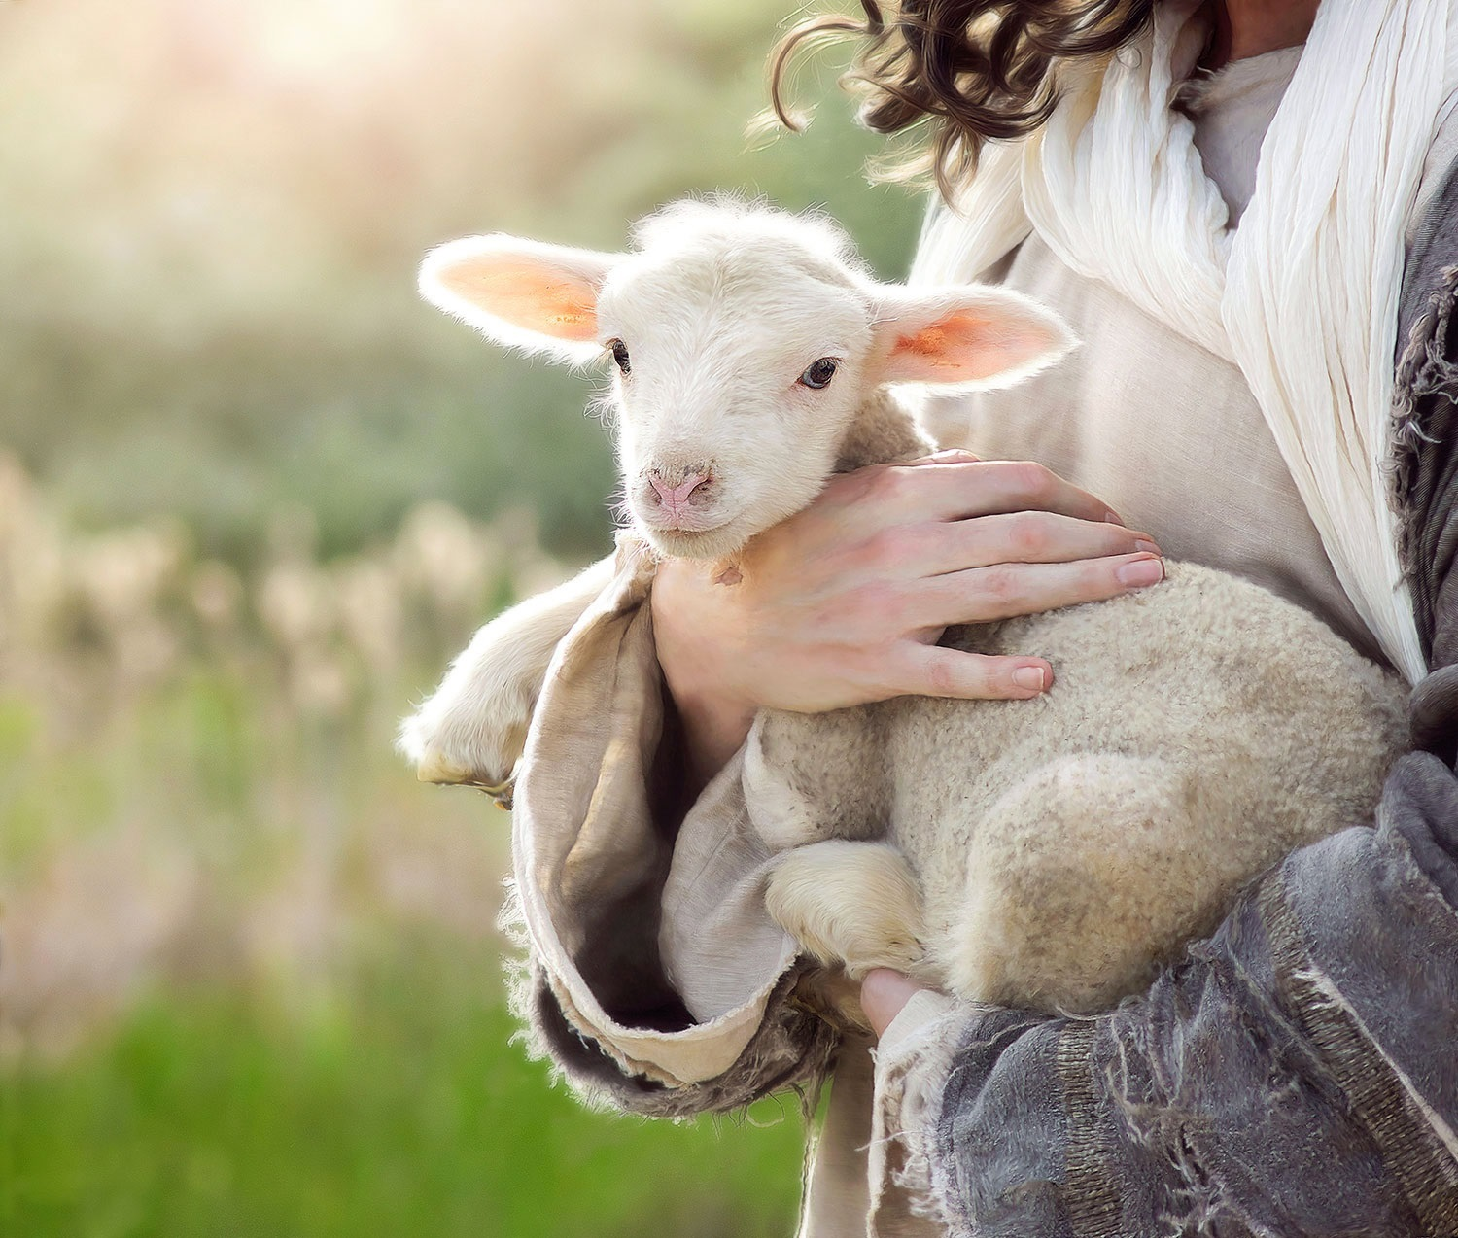
How do I know if I am chosen by God for salvation?
(1 Thessalonians 1:4-10)

Slide 3
You are convinced of God’s truth (v. 5)
You are eager to imitate godliness despite difficulties (v. 6)
You show the power of the gospel by applying its truths (vs. 7-9a)
You reveal genuine repentance of sin (v. 9b)
You live for the return of Christ instead of this life alone (v. 10)

Slide 4
Black

Slide 5
NT Preaching link at BibleStudyDownloads.org
Get this presentation and script for free!
Notes:
NT Preaching (np)

