Slide 1
1 Peter 2:11-25 “BE SUBJECT FOR THE LORD’S SAKE”
Preached by Manik Corea at Crossroads International Church Singapore • CICFamily.com Uploaded by Dr. Rick Griffith • Jordan Evangelical Theological Seminary Files in many languages for free download at BibleStudyDownloads.org

Slide 2
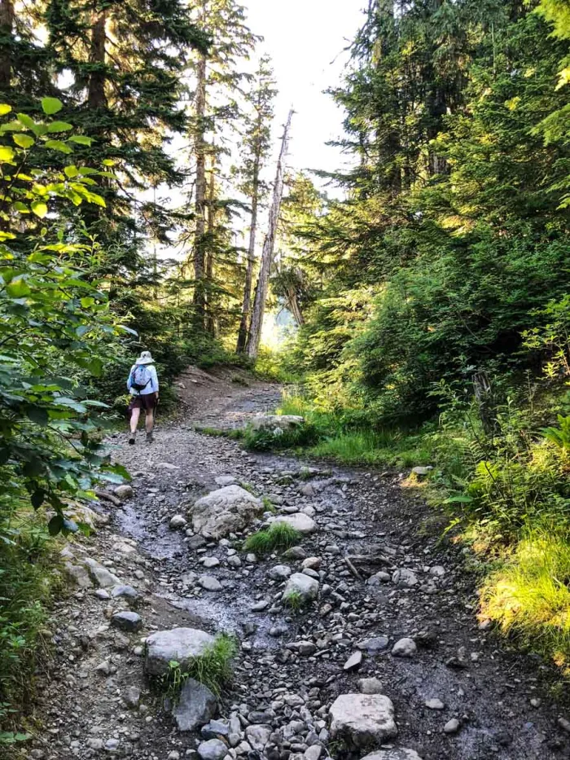
1 Peter
The Sojourner’s Life
Living effectively for the Lord in an unbelieving world

Slide 3
1 Peter 2:11-25 “BE SUBJECT FOR THE LORD’S SAKE”

Slide 4
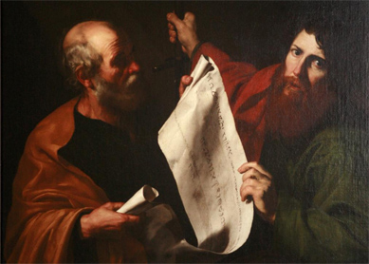
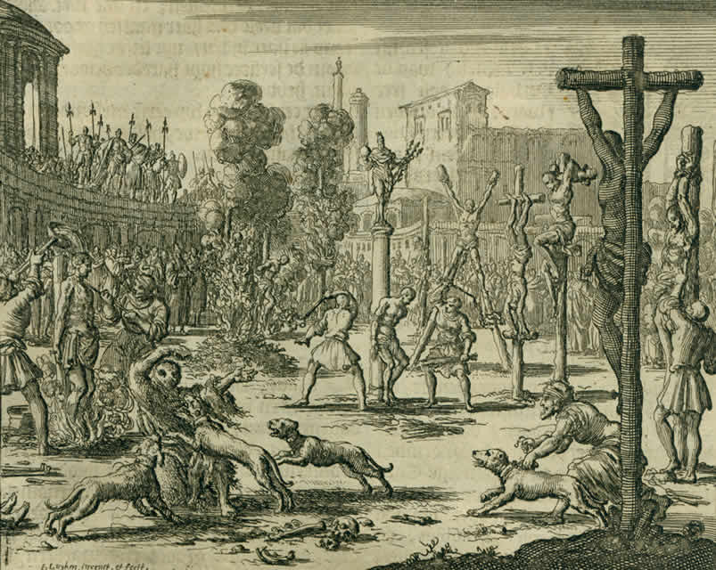
The World of 1 Peter

Slide 5
The LETTER OF 1 PETER
“What God has done for you in Christ” (Indicative)
TO
”How you must live for God in Christ” (Imperative)
1 Peter 2:11-12 marks a transition point in the letter.

Slide 6
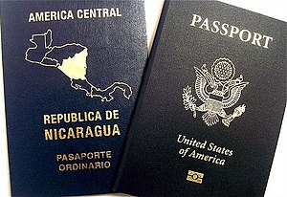
1 PETer – Sojourners and Pilgrims in a foreign Land
We have dual citizenship – at once, we belong to God’s kingdom and an earthly one.

Slide 7
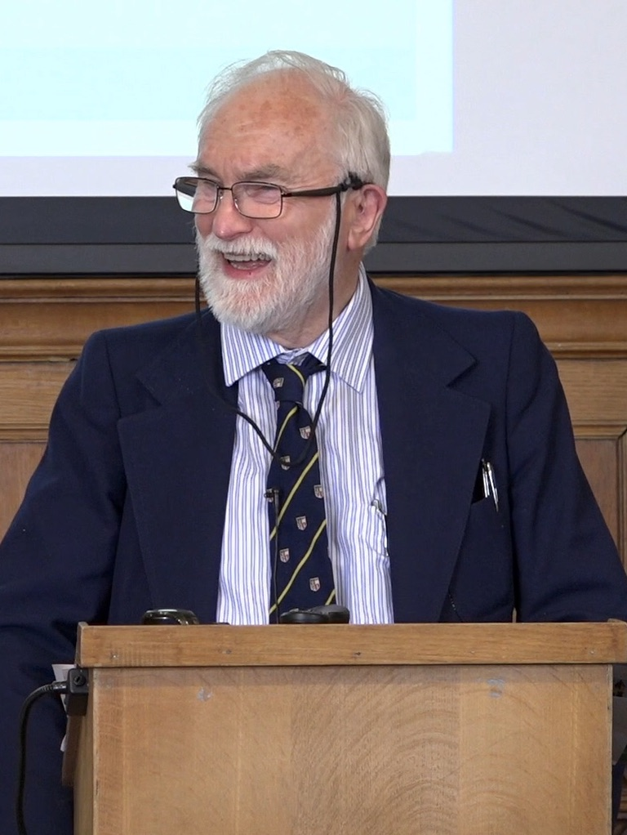
ANDREW WALLS – the ‘pilgrim’ & ‘indigenizing’ principles
Indigenous principle:
WE ALL BELONG SOMEWHERE ON EARTH.
Jesus Christ became incarnate in history to reach
you where you are. We are to identify with
others in mission and be subject to earthly
authorities (1 Cor 9:22, Romans 13:1-7;
Acts 17:26-27, 30).

Slide 9
ANDREW WALLS – the ‘pilgrim’ & ‘indigenizing’ principles
Indigenous principle:
WE ALL BELONG SOMEWHERE ON EARTH.
Jesus Christ became incarnate in history to reach
you where you are. We are to identify with
others in mission and be subject to earthly
authorities (1 Cor 9:22, Romans 13:1-7;
Acts 17:26-27, 30).

Slide 10
ANDREW WALLS – the ‘pilgrim’ & ‘indigenizing’ principles
Pilgrim principle:
WE ALL BELONG NOWHERE ON EARTH
We are God’s people in His kingdom, reflecting
His will, purposes and glory (1 Pet 2:9-11; Phil 3:20;
Rom 12:1-2).

Slide 11
1 Peter 2:11-12
2 Ultimate things we must do (vs 11-12)
1) protect your soul (vs 11)
2) live in such a way in the world as to glorify God (vs 12)

Slide 12
1 Peter 2:13-17
Be Subject for the Lord’s Sake
We are to submit to human institutions as God’s people (vs 13-14). The key is “for the Lord’s sake.”
Silence accusations by your actions (vs 15)
Live as ‘free’ servants of God (vs 16)
Honour all Love Christians Fear God Honour Ruler/s (vs 17)

Slide 13
1 Peter 2:18-25
Endure unjust suffering like Christ
Household code of 1 Pet 2:18-3:7 – see also Ephesians 5:21-6:9; Colossians 3:18-4:1.

Slide 14
“The NT versions of the household codes reflect attempts to use a common rhetorical form to address Christian behavior within a non-Christian society. The goal is for the believers to have the most effective witness among their neighbors without conforming to secular values and expectations.”
Dennis R. Edwards, 1 Peter (Grand Rapids, MI: Zondervan Academic, 2017), 114.

Slide 15
1 Peter 2:18-25
Endure unjust suffering like Christ
Household code of 1 Pet 2:18-3:7 – see also Ephesians 5:21-6:9; Colossians 3:18-4:1.
“Suffering for doing good” is a main theme in the letter (see also 1 Peter 3:17; 4:15 and 5:10).

Slide 16
1 Peter 2:18-25
Endure unjust suffering like Christ
Peter addresses ‘household slaves’ (oiketēs) – vs 18.
It is a gracious thing in God’s eyes to endure unjust suffering (vs 19 and 20).
Jesus is our PRIME example (vs 21-23).
Jesus is our our PERFECT substitute and shepherd (vs 24-25)

Slide 17
LET US PRAY - 1 Peter 1:3-6
Blessed be the God and Father of our Lord Jesus Christ! According to his great mercy, he has caused us to be born again to a living hope through the resurrection of Jesus Christ from the dead, to an inheritance that is imperishable, undefiled, and unfading, kept in heaven for you, who by God's power are being guarded through faith for a salvation ready to be revealed in the last time. In this you rejoice, though now for a little while, if necessary, you have been grieved by various trials…..

Slide 18
Black

Slide 19
NT Preaching link at BibleStudyDownloads.org
Get this presentation and script for free!
Notes:
NT Preaching (np)

