Slide 1
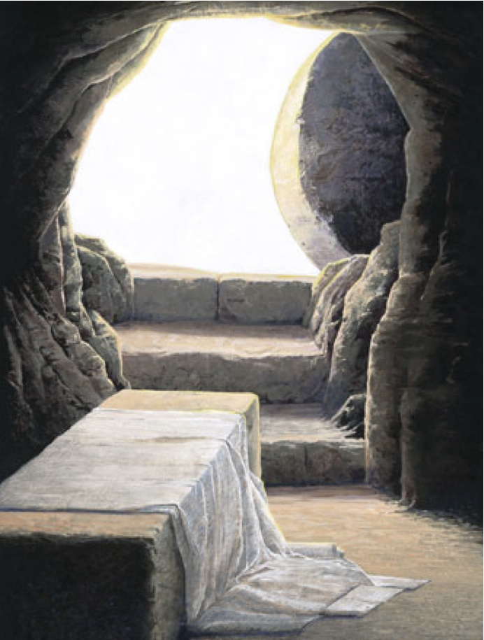
What is a resurrected body?​
1 Corinthians 15:35-49​
Preached by Dr. Jim Harmeling at Crossroads International Church Singapore • CICFamily.com Uploaded by Dr. Rick Griffith • Jordan Evangelical Theological Seminary Files in many languages for free download at BibleStudyDownloads.org

Slide 2
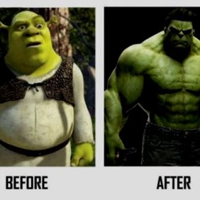

Slide 3
What is a resurrected body?​
1 Corinthians 15:35-49​

Slide 4
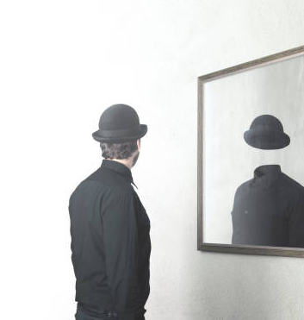
Our present body
a tent (2 Cor 5:2)
a clay pot (2 Cor 4:7)
fading grass (Isa 40:6-8)
flowers (James 1:9-11)
morning mist (James 4:14)

Slide 5
Philippians 3:20
²⁰ But our citizenship is in heaven, and from it we await a Savior, the Lord Jesus Christ, ²¹ who will transform our lowly body to be like his glorious body, by the power that enables him even to subject all things to himself.

Slide 6
Colossians 3:4
When Christ who is your life appears, then you also will appear with him in glory.

Slide 7
1 John 3:2
Beloved, we are God’s children now, and what we will be has not yet appeared; but we know that when he appears we shall be like him, because we shall see him as he is.

Slide 8
1 Corinthians 15:20-23
²⁰ But in fact Christ has been raised from the dead, the firstfruits of those who have fallen asleep. ²¹ For as by a man came death, by a man has come also the resurrection of the dead. ²² For as in Adam all die, so also in Christ shall all be made alive. ²³ But each in his own order: Christ the firstfruits, then at his coming those who belong to Christ.

Slide 9
The spiritual body is a superior replacement for the natural body (vs. 35-37)
God designs the nature of the spiritual body (vs. 38-42a)
The spiritual body is permanently fixed (v. 42)
Jude 1:24
Now to him who is able to keep you from stumbling and to present you blameless before the presence of his glory with great joy

Slide 10
The spiritual body is a superior replacement for the natural body (vs. 35-37)
God designs the nature of the spiritual body (vs. 38-42a)
The spiritual body is permanently fixed (v. 42b)
The spiritual body radiates brilliant light (v. 43a)

Slide 11
Revelation 1:12-18
¹² Then I turned to see the voice that was speaking to me, and on turning I saw seven golden lampstands, ¹³ and in the midst of the lampstands one like a son of man, clothed with a long robe and with a golden sash around his chest. ¹⁴ The hairs of his head were white, like white wool, like snow. His eyes were like a flame of fire, ¹⁵ his feet were like burnished bronze, refined in a furnace, and his voice was like the roar of many waters. ¹⁶ In his right hand he held seven stars, from his mouth came a sharp two-edged sword, and his face was like the sun shining in full strength.

Slide 12
Revelation 1:12-18
¹⁷ When I saw him, I fell at his feet as though dead. But he laid his right hand on me, saying, “Fear not, I am the first and the last, ¹⁸ and the living one. I died, and behold I am alive forevermore, and I have the keys of Death and Hades.
Matthew 13:43
Then the righteous will shine like the sun in the kingdom of their Father. He who has ears to hear, let him hear.

Slide 13
The spiritual body is a superior replacement for the natural body (vs. 35-37)
God designs the nature of the spiritual body (vs. 38-42a)
The spiritual body is permanently fixed (v. 42b)
The spiritual body radiates brilliant light (v. 43a)
The spiritual body possesses power
(v. 43b)
The spiritual body is guaranteed (v. 44)

Slide 14
Black

Slide 15
NT Preaching link at BibleStudyDownloads.org
Get this presentation and script for free!
Notes:
NT Preaching (np)

