Slide 1

Be Orderly
1 Timothy
Dr. Rick Griffith • Crossroads International Church Singapore
BibleStudyDownloads.org

Slide 2

False Teaching
Notes:
False teaching is all around us. Beware!
The world has never had more “isms” than today. They don’t seem to die out. Like a cancer or virus, false teaching just seems to morph and replicate to attack in new ways.

Slide 3
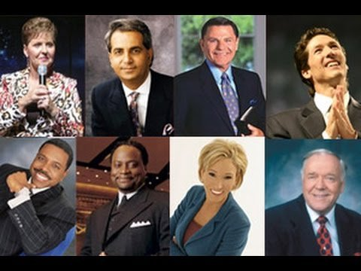
False Teaching
Notes:
Heresies have never been more accessible. You could find me 100 false theologies right there in your seat on your smart phone before you stand up!

Slide 4

But can we defeat heresy?

Slide 5

Order
Notes:
Should we just buy a book on it?
Or should we just live and let live?

Slide 6
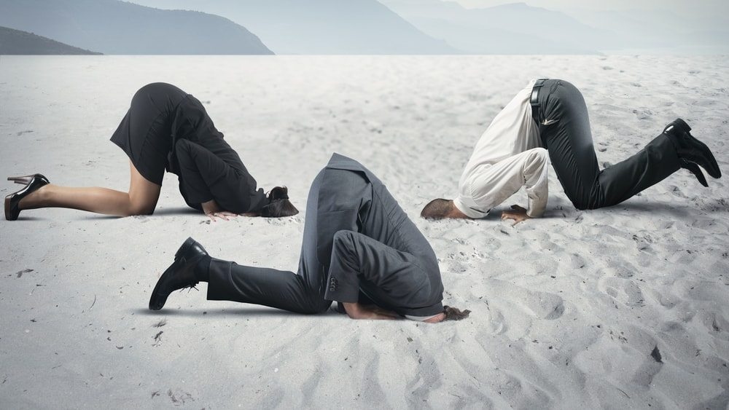
Should we put our heads in the sand?

Slide 7
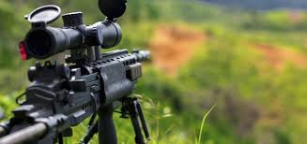
Should we have an all-out assault?

Slide 8
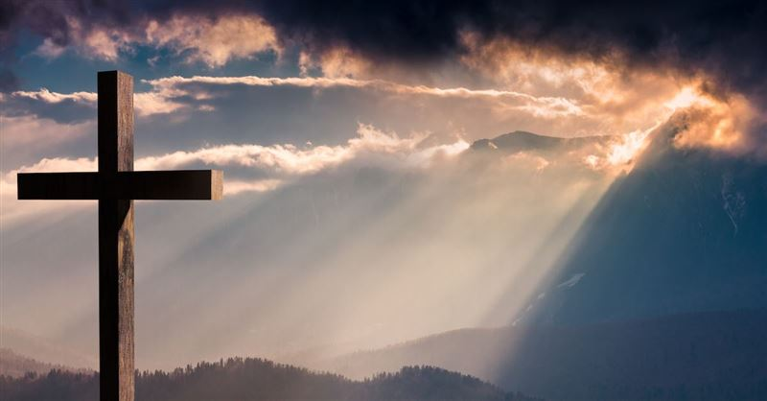
Should we see how God says to defeat heresy?
Notes:
This seems the best strategy to me! Here is what he says…

Slide 9
Key Verse
217
“… I am writing you these instructions so that…you will know how people ought to conduct themselves in God's household, which is the church of the living God, the pillar and foundation of truth”
(3:14-15).
1 Timothy

Slide 10

Main Idea
We can defeat heresy by obeying God’s priorities for church order.
1 Timothy

Slide 11

What are God’s priorities for church order?

Slide 12
Theme
23
Church Order Priorities
1 Timothy

Slide 13

Orderly means…
Manage, control, direct, act correctly, act with decorum, be civil, be good, be nice, be on best behavior
What are other words for
be orderly?

Slide 14
NT Overview (Paul's Letters)
38
124
39-41
“To the remotest part of the earth” (Acts 1:8)
Acts 9 13 14 15 16 18 21 27 28
Apr 48-
Sep 49
1
Galatia
Apr 50-
Sep 52
2
Aegean
Spr 53-
May 57
3
Asia
Feb 60-
Mar 62
1
Rome
Spr 62-
Fall 67
4
Spain
Aut 67-
Spr 68
2
Rome
Summer 35-
37
Damascus
Antioch
May 57-
Aug 59
Trials
Fall 49
The
Council
Spring 68
Expansion of Church
35 48 49 50 52 53 57 60 62 67 68 95
Matt
Luke
Acts
Mark
John
Gal
1 Thess
1 Cor
Eph
1 Tim
2 Tim
2 Thess
2 Cor
Col
Titus
Missionary
Pastoral
Romans
Philem
Gospels & Acts
Phil
Pauline Epistles
1234
Journeys
Prison
Rome
Imprisonments
Pauline
Notes:
Background: Paul left Timothy at the second-generation church of Ephesus which was facing serious heretics.
Timing: When did Paul write 1 Timothy?
Paul’s last letters before writing 1 Timothy were his Prison Epistles that ended with Philippians.
Now he turns his attention to writing individuals, including Philemon.
Historical Context: What was happening at this time?
Of Paul’s 13 NT letters, at least 10 of them are written to defeat heresy!
Paul left Timothy at the second-generation church of Ephesus which was facing serious heretics. He pens here what Timothy is to do—with important parallels to us today.

Slide 15
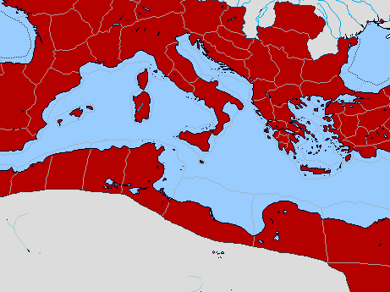
Bible Lands Blank Map
Paul’s Post-Acts Journey
142
Rome
Macedonia
Spain
Ephesus
1 Timothy
Crete
© https://www.deviantart.com/sharklord1/art/Alt-Roman-Empire-Provinces-701148110

Slide 16

You cannot make everything priority
Notes:
Purpose: Why is this letter in the Bible?
It is not enough just to know the importance of combating heresy. We need to know how to do it!
This letter is not the only solution, as other letters also address how to fight false teachers. But it does give us five important handles on to be victorious in maintaining church order in an environment of false teaching.

Slide 17

…for Order
Notes:
Paul gives five priorities to maintain church order so the heretics will be defeated.

Slide 18

I. Balance law and grace in your life
(1 Tim 1).
Notes:
Avoid the extremes of too many rules and too few rules.

Slide 19
Slides on
1 Timothy 1

Slide 20

¹ Paul, an apostle of Christ Jesus by the command of God our Savior and of Christ Jesus our hope,
² To Timothy my true son in the faith:
Grace, mercy and peace from God the Father and Christ Jesus our Lord.
³ As I urged you when I went into Macedonia, stay there in Ephesus so that you may command certain people not to teach false doctrines any longer
⁴ or to devote themselves to myths and endless genealogies. Such things promote controversial speculations rather than advancing God’s work—which is by faith.
1 Timothy 1

Slide 21
⁵ The goal of this command is love, which comes from a pure heart and a good conscience and a sincere faith. ⁶ Some have departed from these and have turned to meaningless talk. ⁷ They want to be teachers of the law, but they do not know what they are talking about or what they so confidently affirm.
⁸ We know that the law is good if one uses it properly. ⁹ We also know that the law is made not for the righteous but for lawbreakers and rebels, the ungodly and sinful, the unholy and irreligious, for those who kill their fathers or mothers, for murderers,
1 Timothy 1

Slide 22
¹⁰ for the sexually immoral, for those practicing homosexuality, for slave traders and liars and perjurers—and for whatever else is contrary to the sound doctrine ¹¹ that conforms to the gospel concerning the glory of the blessed God, which he entrusted to me. ¹² I thank Christ Jesus our Lord, who has given me strength, that he considered me trustworthy, appointing me to his service. ¹³ Even though I was once a blasphemer and a persecutor and a violent man, I was shown mercy because I acted in ignorance and unbelief. ¹⁴ The grace of our Lord was poured out on me abundantly, along with the faith and love that are in Christ Jesus.
1 Timothy 1

Slide 23
¹⁵ Here is a trustworthy saying that deserves full acceptance: Christ Jesus came into the world to save sinners—of whom I am the worst. ¹⁶ But for that very reason I was shown mercy so that in me, the worst of sinners, Christ Jesus might display his immense patience as an example for those who would believe in him and receive eternal life. ¹⁷ Now to the King eternal, immortal, invisible, the only God, be honor and glory for ever and ever. Amen.
1 Timothy 1

Slide 24
¹⁸ Timothy, my son, I am giving you this command in keeping with the prophecies once made about you, so that by recalling them you may fight the battle well, ¹⁹ holding on to faith and a good conscience, which some have rejected and so have suffered shipwreck with regard to the faith. ²⁰ Among them are Hymenaeus and Alexander, whom I have handed over to Satan to be taught not to blaspheme.
1 Timothy 1

Slide 25
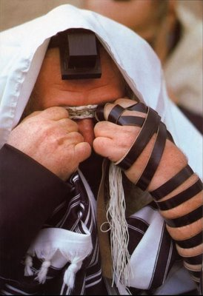
Legalism

Slide 26
What are God’s priorities for church order?

Slide 27
I. Balance law and grace in your life
(1 Tim 1).
Notes:
Avoid the extremes of too many rules and too few rules.

Slide 28

II. Require proper public worship led by godly leaders (1 Tim 2–3).
Notes:
Our church services must main order by not just letting anyone lead.

Slide 29
Slides on
1 Timothy 2

Slide 30

I Timothy 2
222i
Controversy:
The role of women in public worship

Slide 31
Avoid the 2 Extremes
Avoid the 2 Extremes
Literalism
Enthroning Truth+Culture
2:8 Men must always lift up their hands when they pray.
2:9-10 Women must never plait their hair or wear jewelry.
2:11-12 In no circumstances may women teach men.
Liberalism
Dismissing Truth+Culture
All the things in this chapter are out of date and irrelevant, merely temporary regulations to meet a given situation.

Slide 32
Distinguish Between Culture and Truth
Distinguish between Culture and Truth
Culture
Changeable
Time bound to biblical author and audience
Provides analytical details
Concrete and Specific
Truth
Changeless
Timeless
Provides integrated truth
Universal and General

Slide 33
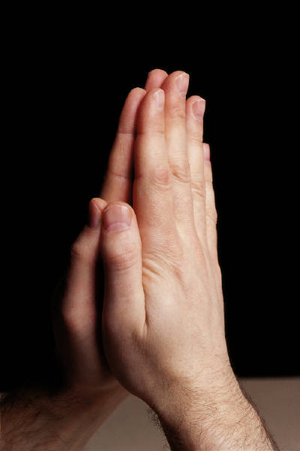
Men's Prayer 2:8
Duties of men in relation to prayer

Slide 34
Women's Adornment (2:9-10)
Dress
Hairstyle
Jewelry

Slide 35
Women's Adornment 2:9-10
Application 2:
Culture
Their clothing, hairstyle and jewelry may vary according to culture
Truth
Always and everywhere women must adorn themselves with modesty, decency, propriety, and good deeds

Slide 36
“¹¹A woman should learn in quietness and full submission.
¹²I do not permit a woman to teach or to have authority over a man; she must be silent.”
- 1 Timothy 2:11-12

Slide 37
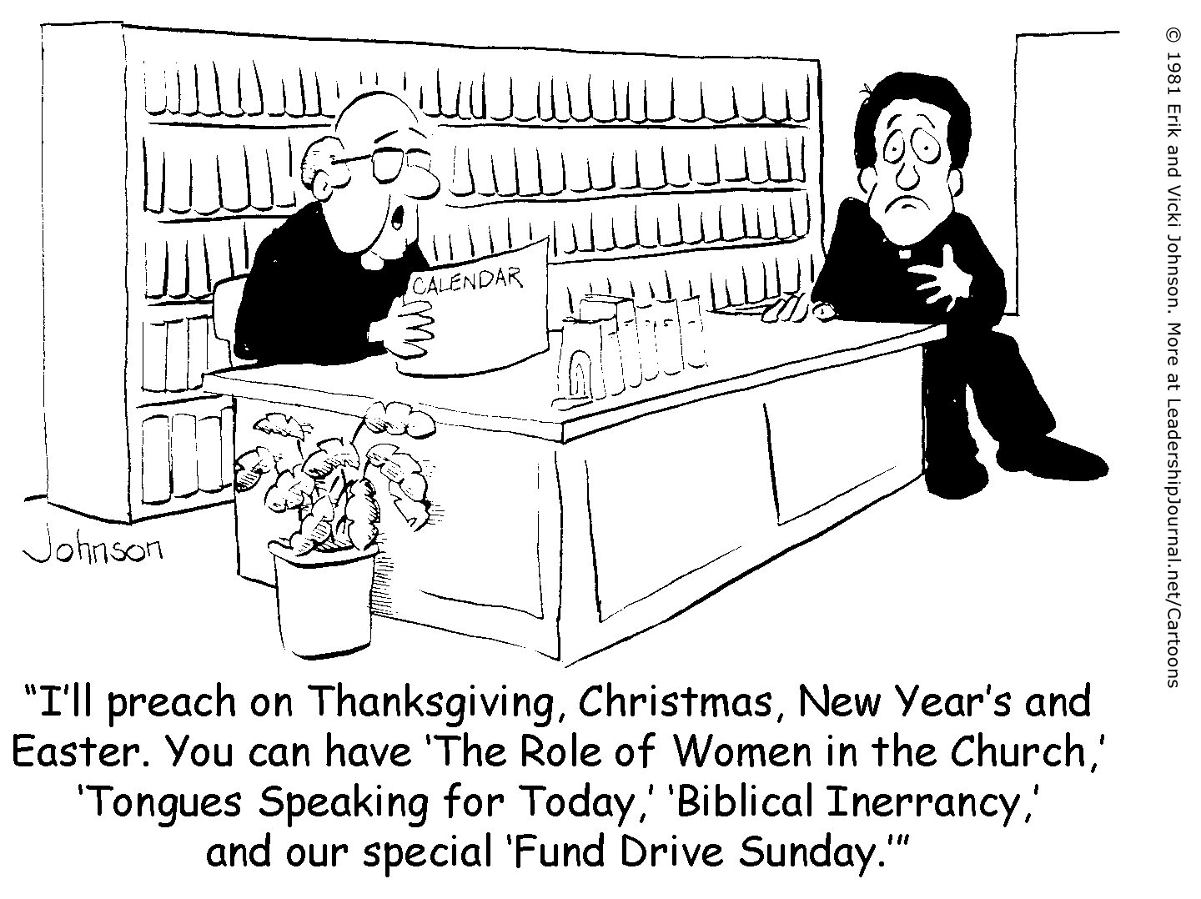
Who wants to address this?
“I’ll preach on Thanksgiving, Christmas, New Year’s and Easter. You can have ‘The Role of Women in the Church,’ ‘Tongues Speaking for Today,’ ‘Biblical Inerrancy,’ and our special ‘Fund Drive Sunday.’”

Slide 38

Egalitarians
Complementarians
NT Wright
Ben Witherington III
Gordon Fee
Scot McKnight
Ruth A. Tucker
Walter C. Kaiser
Jim Wallis
Rachel Held Evans
Gilbert Bilezikian
J.I. Packer
Tim Keller
John F. MacArthur
C.S. Lewis
John Piper
John Wimber
Mark Driscoll
Elisabeth Elliot
Douglas Wilson
vs
Notes:
Egalitarians see no difference between men and women in their roles in the church so that women may serve equally as pastors, elders, etc.
Complementarians see women as complementing man's leadership roles as elders/pastors but not holding these positions themselves.

Slide 39

Common Ground
This isn't as fundamental as the virgin birth, deity of Christ, salvation by grace…
We all agree to disagree in love
We all learn from God's Word through others in public settings

Slide 40
“¹¹A woman should learn in quietness and full submission.
¹²I do not permit a woman to teach or to have authority over a man; she must be silent.”
1 Timothy 2:11-12

Slide 41

Learn peacefully and respectfully

Slide 42
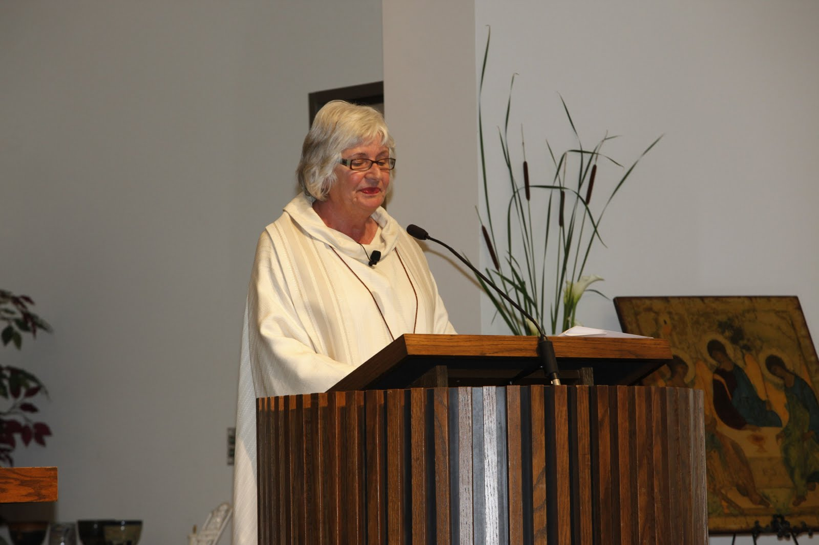
Q: But why did Paul prohibit women from teaching men in public worship?
A: Because they were less educated?

Slide 43

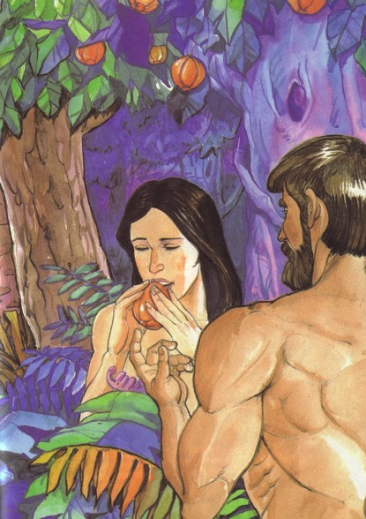
1 Timothy 2:11-15 NIV
¹¹A woman should learn in quietness and full submission. ¹²I do not permit a woman to teach or to have authority over a man; she must be silent.
¹³For Adam was formed first, then Eve. ¹⁴And Adam was not the one deceived; it was the woman who was deceived and became a sinner. ¹⁵But women {Gr. she} will be saved {or restored} through childbearing-- if they continue in faith, love and holiness with propriety.

Slide 44
Truth: Authority-Submission
Basis for women's submission: The Fall 2:14
Misconception: Women were shown in the Fall as prone to deception and so should not teach men.
Objection: If women are by nature gullible, they ought to be disqualified from teaching anyone, not just men, whereas Paul refers to the special role of women in teaching both children and younger women (Titus 2:4).
Truth: Eve's sin in the fall was not only that she was deceived, but that she usurped Adam's authority and thus reversed their respective roles.

Slide 45
1 Timothy 2:11-14
Conclusion:
Can Women Teach in Public Worship?
God’s creation order shows male leadership (13)
Eve’s deception (14)
Family order (15)

Slide 46
Slides on
1 Timothy 3

Slide 47

How Do We Pick Leaders for the Local Church?
223
P
Popularity
Past
Politics
Pocketbook
Profession
Chuck Swindoll, Excellence in Ministry (Fullerton, CA; Insight for Living, 1985), 39

Slide 48
How Should Churches Select Leaders?
223
INTRODUCTION
Scriptural Examples:
Congregation decides/nominates
  APOSTLES
  Acts 1:12-26 – congregational selection, apostolic appointment
  DEACONS
  Acts 6:3 – congregational selection, apostolic appointment
BODY

Slide 49
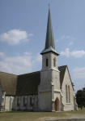
Appointment of church officers:
223
INTRODUCTION
An apostle (e.g., Paul) or his assistants ordained the elders
  Acts 14:23
  Titus 1:5
BODY

Slide 50


What about Elder Qualifications?
224

Slide 51
Required Qualities of an
Overseer (O) or Deacon (D)
224
General reputation
    (Perceived character)
  Above reproach (O)
  Good reputation with outsiders (O)
  Respectable (O & D)

Slide 52
Required Qualities of an
Overseer (O) or Deacon (D)
225
II. Family life (if married)
  Having 1 wife (O & D)
  Wife must be worthy of respect, not malicious talkers but temperate and trustworthy in everything (D)
  See that his children obey
    (O & D)

Slide 53
Required Qualities of an
Overseer (O) or Deacon (D)
225
III. Negative characteristics
  Not quick tempered (O)
  Not violent (O)
  Not quarrelsome (O)
  Not a new convert (O)
  Not pursuing dishonest gain (O & D)
  Not addicted to wine; temperate (O & D)

Slide 54
Required Qualities of an
Overseer (O) or Deacon (D)
226
IV. Positive characteristics
  Hospitable (O)
  Sensible (O)
  Tested (D)
  Sincere (D)
Able to Teach (O)

Slide 55
Scriptural Principles
223
1 Qualifications relate only to men
2 All qualifications are essential and of equal importance
Qualifications refer to present life of the leader
Who are they? Overseers (Elders, Bishops, Pastors) and Deacons
If the leader fails, he must step down
Qualifications emphasize character over abilities (only 2 traits involve ability)
Emphasize managing of home over work
Must be qualified so that:
  1. they can give godly direction
  2. the church can avoid problems that come from bad or inept leaders

Slide 56

Elders led from the time of Moses
48
Elders
led with
Moses
1400 BC
“Go, assemble the elders of Israel and say to them…”
(Exod. 3:16)

Slide 57

Who Led the Synagogue?
51
Elders
led with
Moses
1400 BC
Elders
led
Synagogues
600 BC

Slide 58
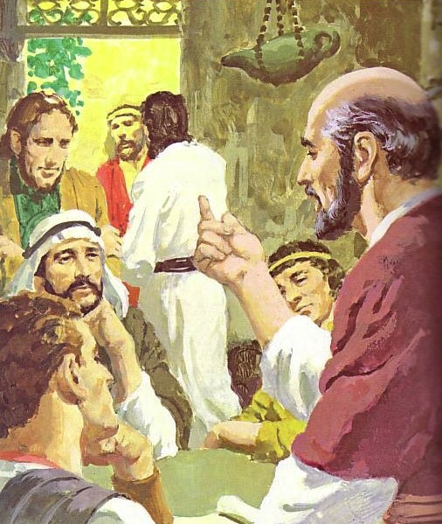
God has advocated group leadership through the ages
55
Elders
led with
Moses
1400 BC
Elders
led
Synagogues
600 BC
NT
Elders

Slide 59

Places Mentioning Elders
elders = overseers = bishops = pastors
55
Jerusalem (AD 47):
NIV Acts 11:30 This they did, sending their gift to the elders by Barnabas and Saul.
Ephesus (AD 57):
NIV Acts 20:17 From Miletus, Paul sent to Ephesus for the elders of the church.
Galatia (AD 48):
NIV Acts 14:23 Paul and Barnabas appointed elders {or Barnabas ordained elders; or Barnabas had elders elected} for them in each church
Crete (AD 66):
NIV Titus 1:5 The reason I left you in Crete was that you might straighten out what was left unfinished and appoint {or ordain} elders in every town, as I directed you.
Philippi (AD 62):
NIV Philippians 1:1 Paul and Timothy, servants of Christ Jesus, To all the saints in Christ Jesus at Philippi, together with the overseers and deacons:
Pontus, Galatia, Cappadocia, Asia & Bithynia (AD 64)
NIV 1 Peter 5:1 To the elders among you, I appeal as a fellow elder… (cf. 1:1)

Slide 60
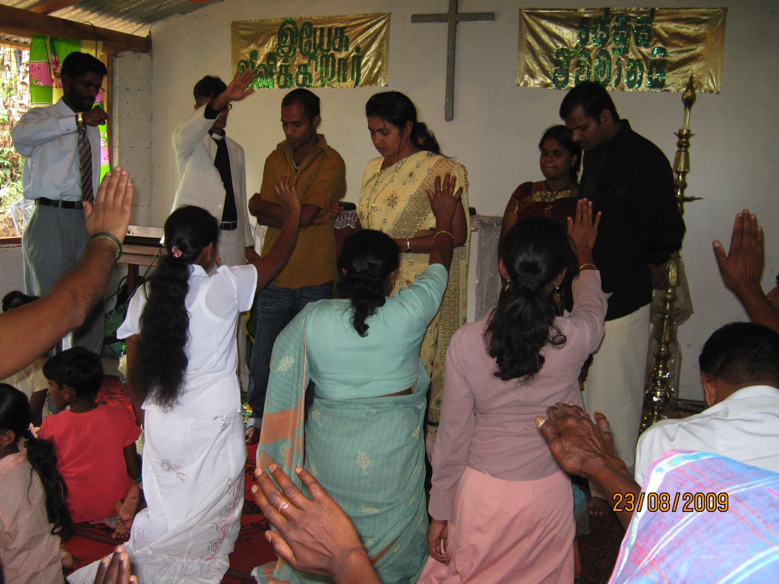
What should elders do?
236a

Slide 61
Pastoral Leadership of an Elder:
236a
(a) Elders teach:
INTRODUCTION
“Shepherd the flock” (Acts 20:28)
“Able to teach” (1 Thess. 5:12; 1 Tim. 3:2; Titus 1:9b)
Scriptural foundation (Tit. 1:9a)
Teach God's plan (Acts 20:20, 27)
Get paid for teaching (1 Tim. 5:17)
BODY

Slide 62
Three Shepherd Tasks of Elders
236c1
Teaching
1 Tim. 3:2; 5:17

Slide 63
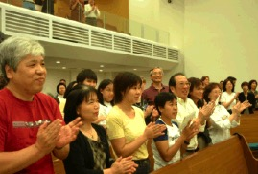
How Elders Relate to Deacons
236a 6b
Model 1: Senior Pastor over Deacons
Senior Pastor
Deacons
Unbiblical

Slide 64
How Elders Relate to Deacons
236a 6b
Model 2: Senior Pastor alongside Deacons
Senior Pastor
Deacons
Unbiblical

Slide 65
How Elders Relate to Deacons
236a 6b
Model 3: Deacons lead elders/pastors
Deacons
Unbiblical
Pastors

Slide 66
How Elders Relate to Deacons
236a 6b
Model 4: Elder Board leads Deacon Board
Elders
Deacons

Slide 67
How Elders Relate to Deacons
236a 6b
Apostles over “The Seven”
Apostles
DDDDDDD
DDDD
DDDDD
“The Seven”
Acts 21:8

Slide 68
How Elders Relate to Deacons
236a 6b
Model 5: Elders with Deacon Committees
Elders
DDDDDDD
DDDD
DDDDD

Slide 69
Three Shepherd Tasks of Elders
236c1
Teaching
1 Tim. 3:2; 5:17
Pastor-Teacher
Eph. 4:11
Pastoring
(Protect & Lead)
1 Pet. 5:1-4
Acts 20:29, 35
1 Thess. 5:12

Slide 70
Three Shepherd Tasks of Elders
236c1
Administration
(Serve, care for & testify)
Teaching
1 Tim. 3:2; 5:17
1 Tim. 3:1, 4-5; 5:17
Pastor-Teacher
Episkopos =
Epi “over” +
skopos “look” =
“watch over”
Eph. 4:11
Pastoring
(Protect & Lead)
1 Pet. 5:1-4
Acts 20:29, 35
1 Thess. 5:12

Slide 71
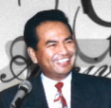







Shared Leadership
236c
Scriptural support for a plurality of elders:
plurality
plurality
  Not One Elder…
  But Many…

Slide 72
Summary on Elders
INTRODUCTION
Therefore, the New Testament presents an elder whose functions are to teach, pastor and administer.
BODY

Slide 73
Slides on
1 Timothy 4

Slide 74

III. Guard your personal life and doctrine closely (1 Tim 4).
Notes:
Your beliefs affect everything about you—privately and publicly. Watch them!

Slide 75
Response to False Teachers and Teachings
Discipline: Deliver the false teachers over to Satan "to be taught not to blaspheme" (1:20)
Constructive teaching: Combat false asceticism by teaching that everything God created is good, and so should be received with thanksgiving (4:4-6)

Slide 76
Response to False Teachers and Teachings
Godly living: Train yourself to be godly (4:7)
Faithful Work: Turn away from godless chatter and pointless controversies (6:20) and further the work of God (1:4, 5)

Slide 77

IV. Meet the needs of various church groups (5:1–6:10).
Notes:
Our church’s different subgroups must not be vulnerable to enemy attack.

Slide 78
Slides on
1 Timothy 5

Slide 79
Three Types of Elders
236b
“The elders who direct the affairs of the church well are worthy of double honor, especially those whose work is preaching and teaching”
(1 Tim. 5:17 NIV).
ALL ELDERS
Teach, protect, lead, serve, testify
Unpaid or $
if Needed
PAID MANAGERS
$
PREACHERS
&
TEACHERS
$$

Slide 80

Paul Called Luke's Gospel “Scripture” within 5 years!
For the Scripture says, “Do not muzzle the ox while it is treading out the grain,” and “The worker deserves his wages” (1 Timothy 5:18).
Macedonia
Paul Wrote 1 Timothy
AD 62
Caesarea
Luke Written
AD 57-59
Stay in that house, eating and drinking whatever
they give you, for
the worker deserves his wages… (Luke 10:7)
Notes:
Look how EARLY certain books were deemed to be Scripture!

Slide 81
Slides on
1 Timothy 6

Slide 82

V. Don’t let the love of money ruin your spiritual life (6:11-21).
Notes:
Resist materialism that replaces godliness with apostasy.

Slide 83
Effects of False Teachings
Promote controversies and fruitless discussions rather than God's work (1:4-6)
Result in envy, strife, malicious talk, evil suspicions and constant friction (6: 4,5)
People wander away from the faith (6:21)

Slide 84
$$ Money $$
One of the false teachings: “Men who have been robbed of the truth think that godliness is a means to financial gain” (6:5)
They were exploiting the church

Slide 85
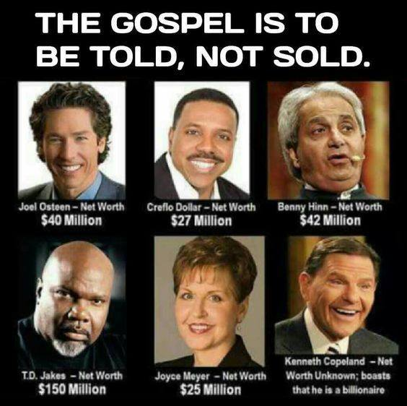
THE GOSPEL IS TO BE TOLD, NOT SOLD

Slide 86
Godliness with Contentment
False teachers are warned who use godliness as a means to financial gain (6:5).
  The love of money is the root of all kinds of evil (6:10).
  People who want to get rich fall into temptation and a trap (6:9).

Slide 87
Godliness with Contentment
Job's example (Job 1:21):
“For we brought
nothing into the world,
and we can take nothing out of it”
(1 Tim. 6:7)

Slide 88

"Scripture" (6: NLT).

Slide 89
Godliness with Contentment
Paul's example:
  Pharisee from a prominent family
  Gave up wealth and security when he went into the ministry
“But if we have food and clothing, we will be content with these (6:8).”
  Greek word for clothing is general enough to include shelter
  Needs: Food, water, clothing and shelter

Slide 90
Main Idea
We can defeat heresy by obeying God’s priorities for church order.
1 Timothy

Slide 91
What are God’s priorities for church order?

Slide 92
I. Balance law and grace in your life
(1 Tim 1).
Notes:
Avoid the extremes of too many rules and too few rules.

Slide 93
II. Require proper public worship led by godly leaders (1 Tim 2–3).
Notes:
Our church services must main order by not just letting anyone lead.

Slide 94
III. Guard your personal life and doctrine closely (1 Tim 4).
Notes:
Your beliefs affect everything about you—privately and publicly. Watch them!

Slide 95
IV. Meet the needs of various church groups (5:1–6:10).
Notes:
Our church’s different subgroups must not be vulnerable to enemy attack.

Slide 96
V. Don’t let the love of money ruin your spiritual life (6:11-21).
Notes:
Resist materialism that replaces godliness with apostasy.

Slide 97
Church Order
(is maintained by giving priority to…)
Combat False Teachers | Uphold Church Life | Guard Life & Doctrine | Advise Church Groups | Resist Materialism
Chapter 1 | Chapters 2–3 | Chapter 4 | 5:1–6:10 | 6:11-21
Doctrine | Worship | Example | Respect | Priorities
Warning | People | Warning | People | Warning
Salutation Fight heresies God’s grace Charge | Prayer Gender Roles Leader Qualities Purpose of Epistle | Future heresy Watch life Watch doctrine | Respect everyone Widows Elders Slaves False teachers | Spiritual goals Wealthy must give Closing charge
Practical Exhortations Throughout
Sent from Macedonia to Ephesus
Autumn AD 62
1 Timothy
217

Slide 98
Black

Slide 99


NT Preaching • BibleStudyDownloads.org
Get this presentation and script for free!

