Slide 1
Healthy Churches avoid worldliness
(PART 2)
1 Timothy 6:11-21
Preached by Dr. Jim Harmeling at Crossroads International Church Singapore • cicfamily.com Uploaded by Dr. Rick Griffith • Singapore Bible College Thousands of files in 49 languages for free at BibleStudyDownloads.org

Slide 5
Healthy Church Life
Studies in 1 Timothy

Slide 6
Healthy Churches avoid worldliness
1 Timothy 6:3-21

Slide 7
They are content with the Lord’s provision
(1 Timothy 6:3-10)

Slide 8
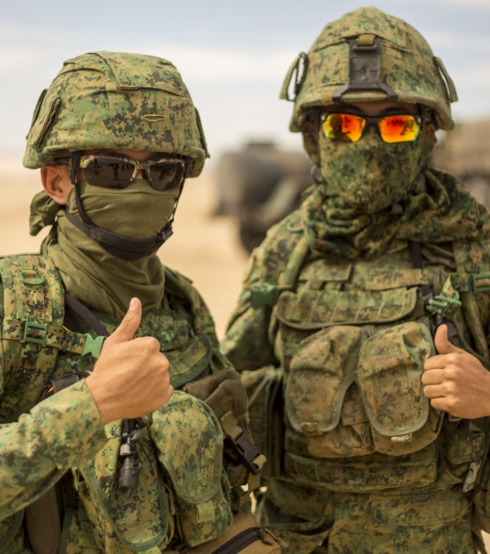
They persevere in the battle against worldliness
(1 Timothy 6:11-16)

Slide 9
“flee”
“pursue”
“fight”
“take hold”
“keep”
Action Words

Slide 10
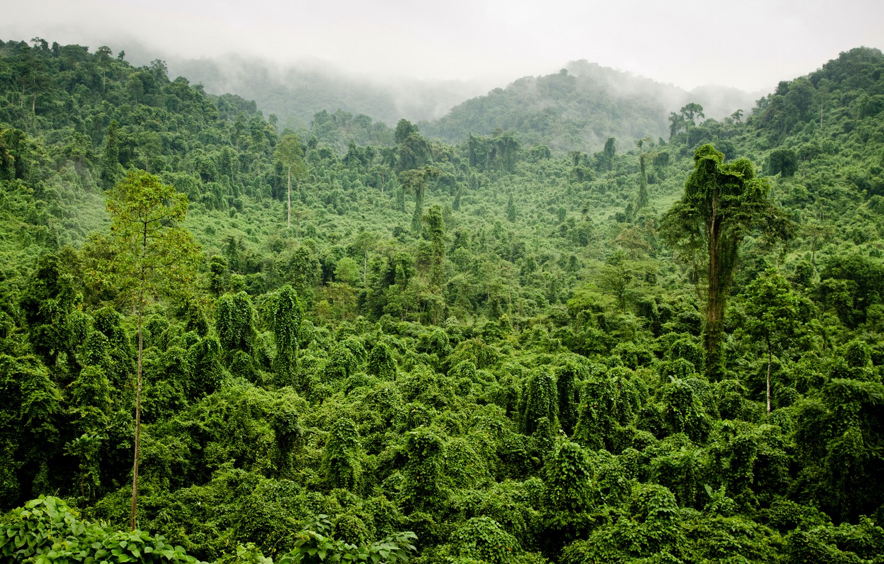
2 Timothy 4:10
“For Demas, in love with this present world, has deserted me and gone to Thessalonica.”

Slide 11
Resist worldly temptations (6:11-12)
Flee temptation zones (v. 11a)
Pursue virtues that counter worldliness (v. 11b)

Slide 12
Righteousness
= standards of right and wrong
Godliness
= personal character
Faith
= trust in God
Love
= caring and sacrificial treatment
towards others
Steadfastness
= consistency under pressure
Gentleness
= manner of treating people

Slide 13
Righteousness
Godliness
Love of the world
Faith
Love
Steadfastness
Gentleness
Flee Pursue

Slide 14
Resist worldly temptations (6:11-12)
Flee temptation zones (v. 11a)
Pursue virtues that counter worldliness (v. 11b)
Fight for truth (v. 12a)
2 Timothy 4:7
“I have fought the good fight,
I have finished the race,
I have kept the faith.”

Slide 15
Resist worldly temptations (6:11-12)
Flee temptation zones (v. 11a)
Pursue virtues that counter worldliness (v. 11b)
Fight for truth (v. 12a)
Hold on in the fight against worldliness (v. 12b)

Slide 16
“There is only one thing I know I can do well. I cannot lead, but I can truthfully say that I am able to hang on. It may arise from natural stubbornness, but I know that popular religious movements which, despite their lack of scriptural support, carry away so many good people, leave me entirely unaffected. I believe that I can set my teeth and hold on, but that is all I am good for.”
Kenneth McRae
19th century Scottish pastor

Slide 17
Resist worldly temptations (6:11-12)
Persevere in godliness (6:13-16)

Slide 18
2 Timothy 1:5
“I am reminded of your sincere faith, a faith that dwelt first in your grandmother Lois and your mother Eunice and now, I am sure, dwells in you as well.”
Philippians 2:19-20
“I hope in the Lord Jesus to send Timothy to you soon, so that I too may be cheered by news of you. ²⁰ For I have no one like him, who will be genuinely concerned for your welfare.”

Slide 19
2 Timothy 1:7
“for God gave us a spirit not of fear but of power and love and self-control.”
1 Corinthians 16:10-11
“When Timothy comes, see that you put him at ease among you, for he is doing the work of the Lord, as I am. ¹¹ So let no one despise him. Help him on his way in peace, that he may return to me, for I am expecting him with the brothers.”

Slide 20
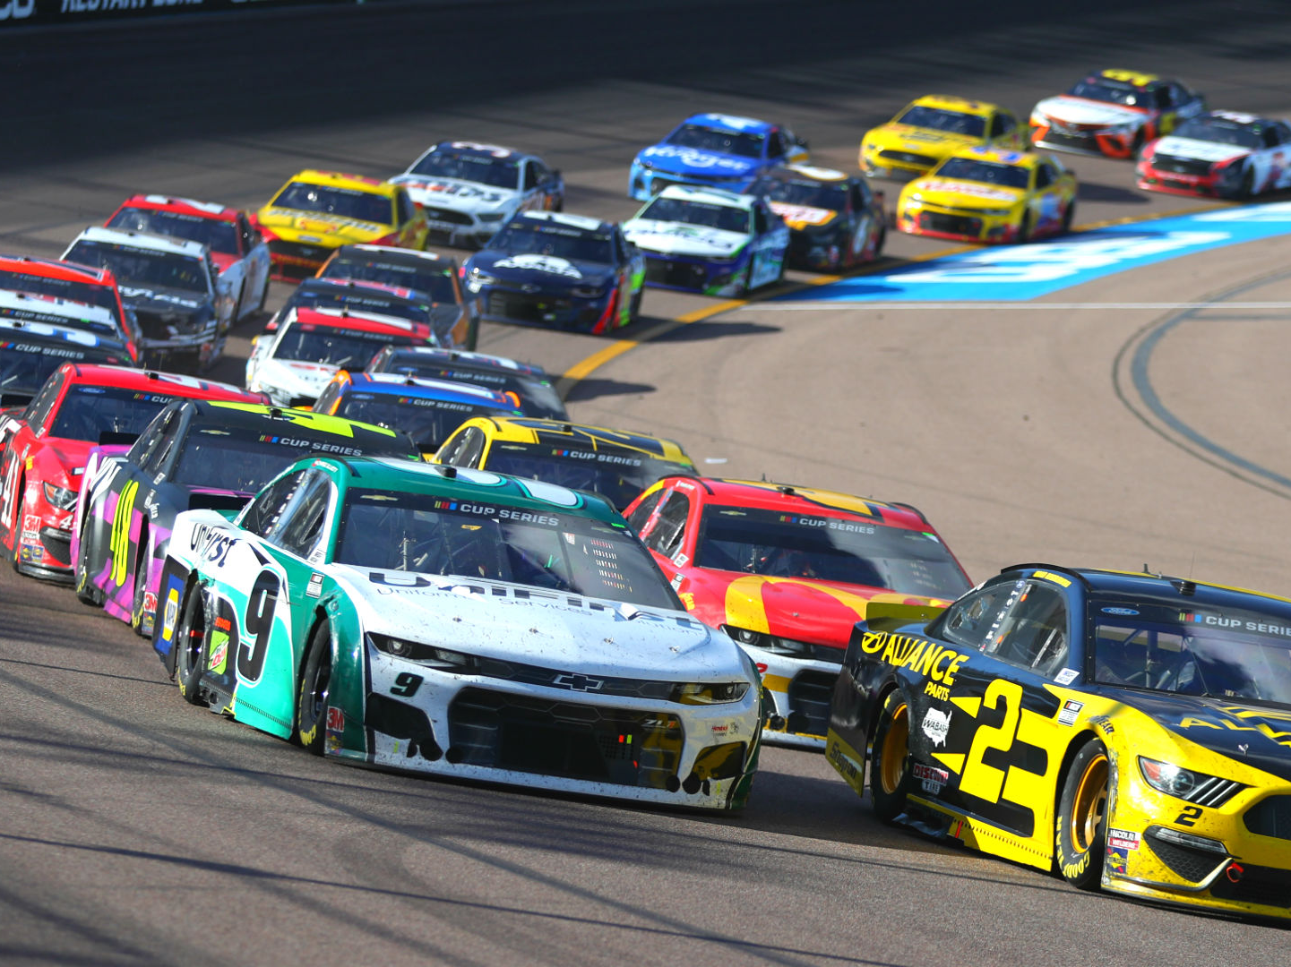

Slide 21
Resist worldly temptations (6:11-12)
Persevere in godliness (6:13-16)
Persevere because God gives and sustains life (v. 13a)
Persevere because Christ persevered (v. 13b)
Persevere because Christ will return and reward (v. 14)
Persevere because God is sovereignly in control (vs. 15-16)

Slide 23
NT Preaching • BibleStudyDownloads.org
Get this presentation for free!

