Slide 1
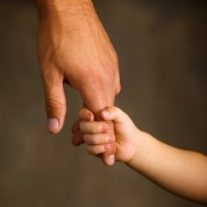
Follow the Leader
1 Corinthians 1:10–2:5
Rick Griffith, Crossroads International Church
BibleStudyDownloads.org

Slide 2
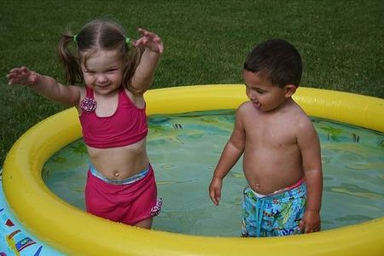


One day at the kiddy pool…

Slide 3
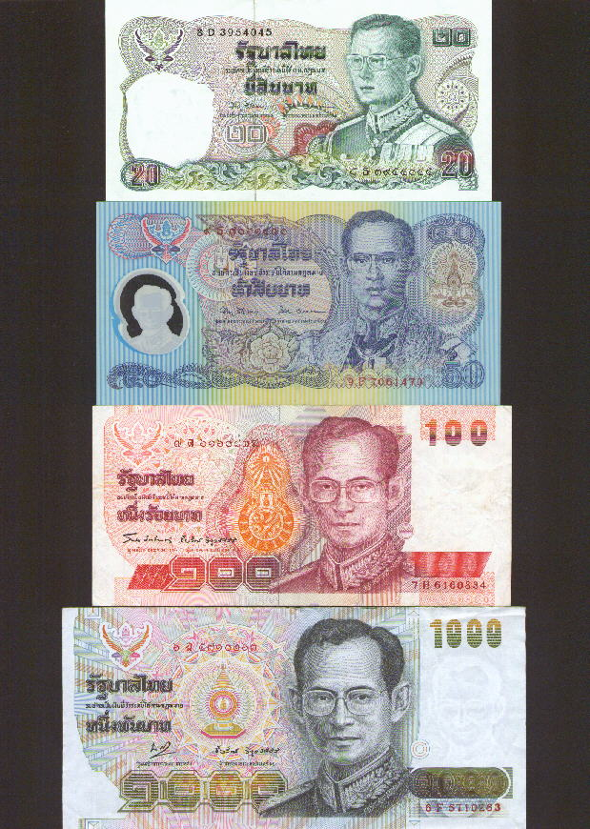











Denominations

Slide 4

The leader always sets the trail for others to follow.
Oh, oh! Why a sermon on leadership and unity?

Slide 5
1 Corinthians Characteristics
157
The most troublesome NT church
The most teaching on several topics:
Role of Women
Marriage
Church discipline
Spiritual Gifts
Love
Christian liberty
Gospel
Resurrection
lawsuits
Lord's Supper
Probably Paul's second letter to Corinth (5:9)
  He also wrote another letter between our 1 and 2 Cor
  So 1 Cor is actually 2 Cor and 2 Cor is actually 4 Cor

Slide 6
1 Corinthians
156
Proper Functioning of the Church
Divisions |  | Disorders |  |  | Doctrine
Answers Report from Chloe (1:11) |  | Answers Report from Chloe (1:11; 5:1) |  |  | Answers Letter from the Church (7:1; 8:1; 12:1; 15:1; 16:1)
Leadership |  | Relationships |  |  | Theology
Pride |  | Immorality |  |  | Selfishness
Greeting & Problem | Misunder-standings | Incest | Lawsuits | Prosti-tution | Marri-age | Liberty | Head Coverings | Lord's Supper | Gifts | Resur-rection | Gospel Advance
1:1-17 | 1:18–4:21 | 5 | 6:1-11 | 6:12-20 | 7 | 8:1–11:1 | 11:2-16 | 11:17-34 | 12–14 | 15 | 16
Ephesus
May AD 56 (third missionary journey)

Slide 7
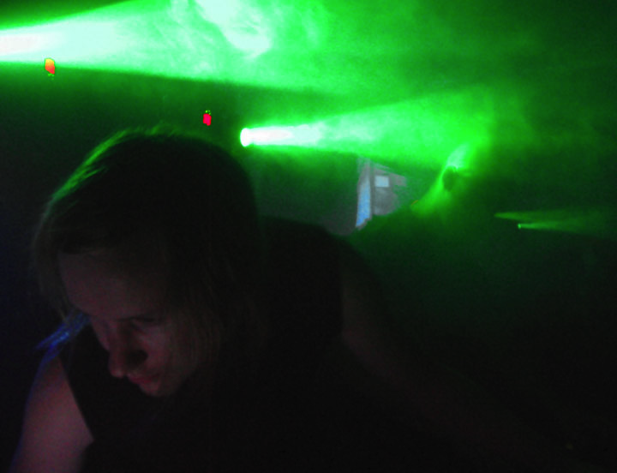
Which church leader should we follow?
A key question asked at Corinth

Slide 8

How can Crossroads maintain the unity we already have?

Slide 9

Don't divide over favorite leaders
(1:10-17)

Slide 10
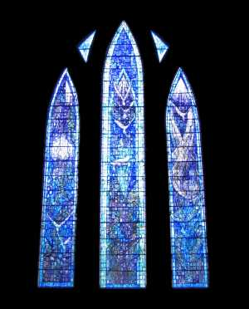
1 Corinthians 1:10-12

Slide 11
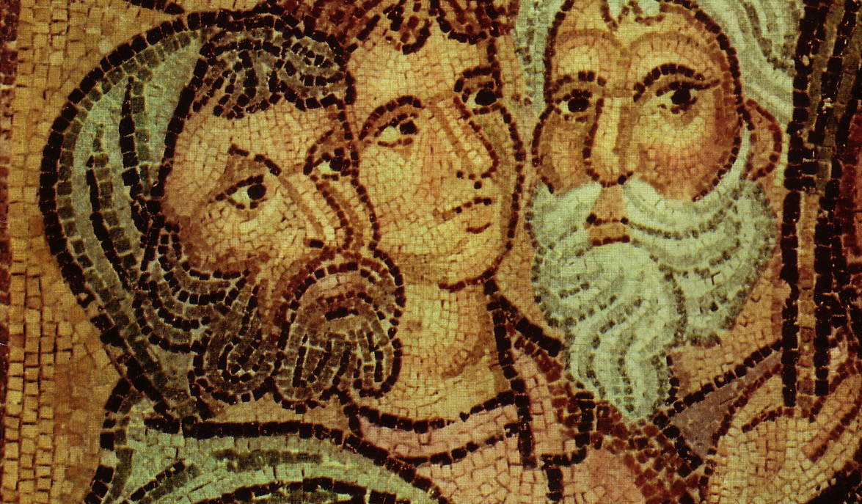
Parties at Corinth
Paul
Action
Party
P
A
P
Apollos
Yippee
Esquire
A
Y
E
Cephas
Triumph
Esquire
C
T
E
Savior
Dvlpmnt
Party
S
D
P
The Majority?

Slide 12
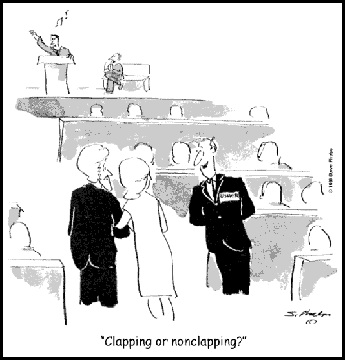
"Clapping or non-clapping?"

Slide 13
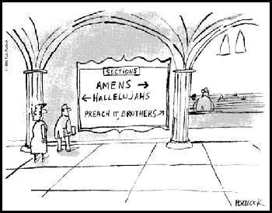
Sections

Slide 14

2. The church isn't about competing leaders "outperforming" other leaders (1:13-17)

Slide 15

B. We shouldn't rally around certain church leaders.

Slide 16

Which Party?

Slide 17

Social Security

Slide 18
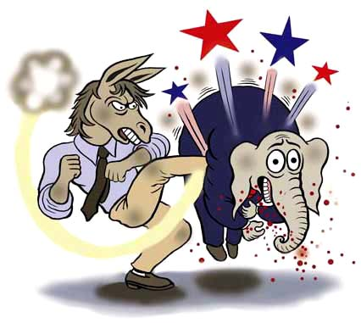
Democrats win

Slide 19

God is Not

Slide 20
A Newspaper Slip…
"What Jesus Saw in a Publican"
"What Jesus Saw in a Republican"

Slide 21
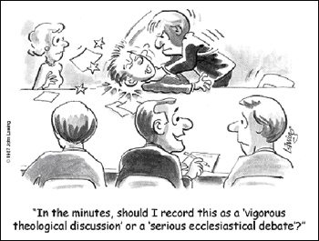
"In the minutes, should I record this as a 'vigorous theological discussion' or a 'serious ecclesiastical debate'?"

Slide 22

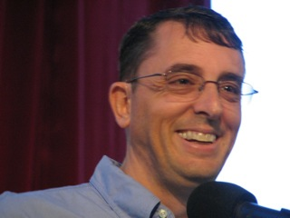
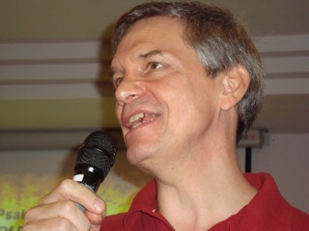
Parties You Don't Want to Attend!
"Lewisocrat"
"Rickpublican"

Slide 23
Another Newspaper Slip…
"T-Shirt Appreciation Day"
"Teacher Appreciation Day"

Slide 24
Parties at Corinth
Paul
Action
Party
P
A
P
Apollos
Yippee
Esquire
A
Y
E
Cephas
Triumph
Esquire
C
T
E
Savior
Dvlpmnt
Party
S
D
P

Slide 25

Why not?

Slide 26
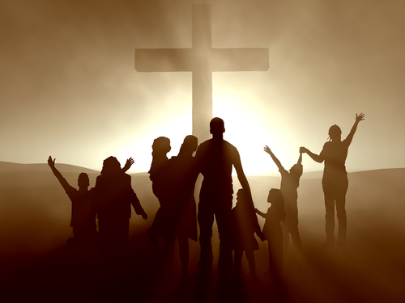
Unity is based on the cross—not human leaders
(1:18–2:5)

Slide 27
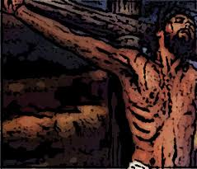
1 Corinthians 1:18-25
"For the message of the cross is foolishness to those who are perishing, but to us who are being saved it is the power of God" (1:18 NIV)

Slide 28
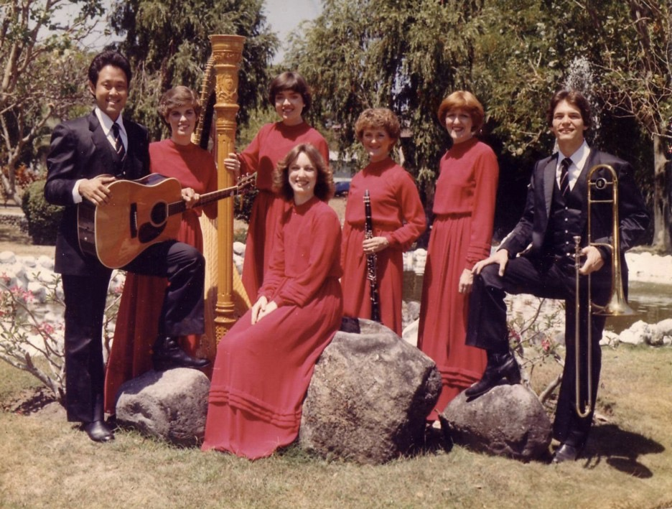
The Crossroads (1981-83)
Notes:
After college it seemed the natural thing to do to join Campus Crusade staff in the Philippines on a seven-member music team.

Slide 29
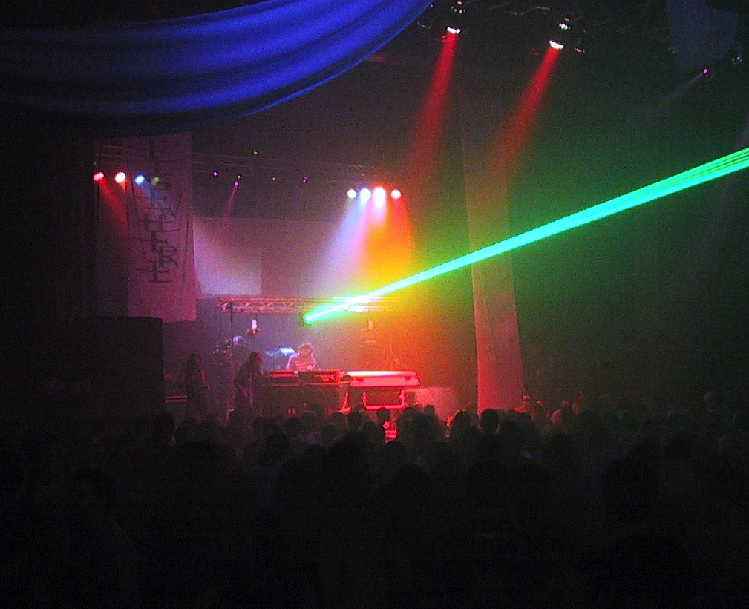
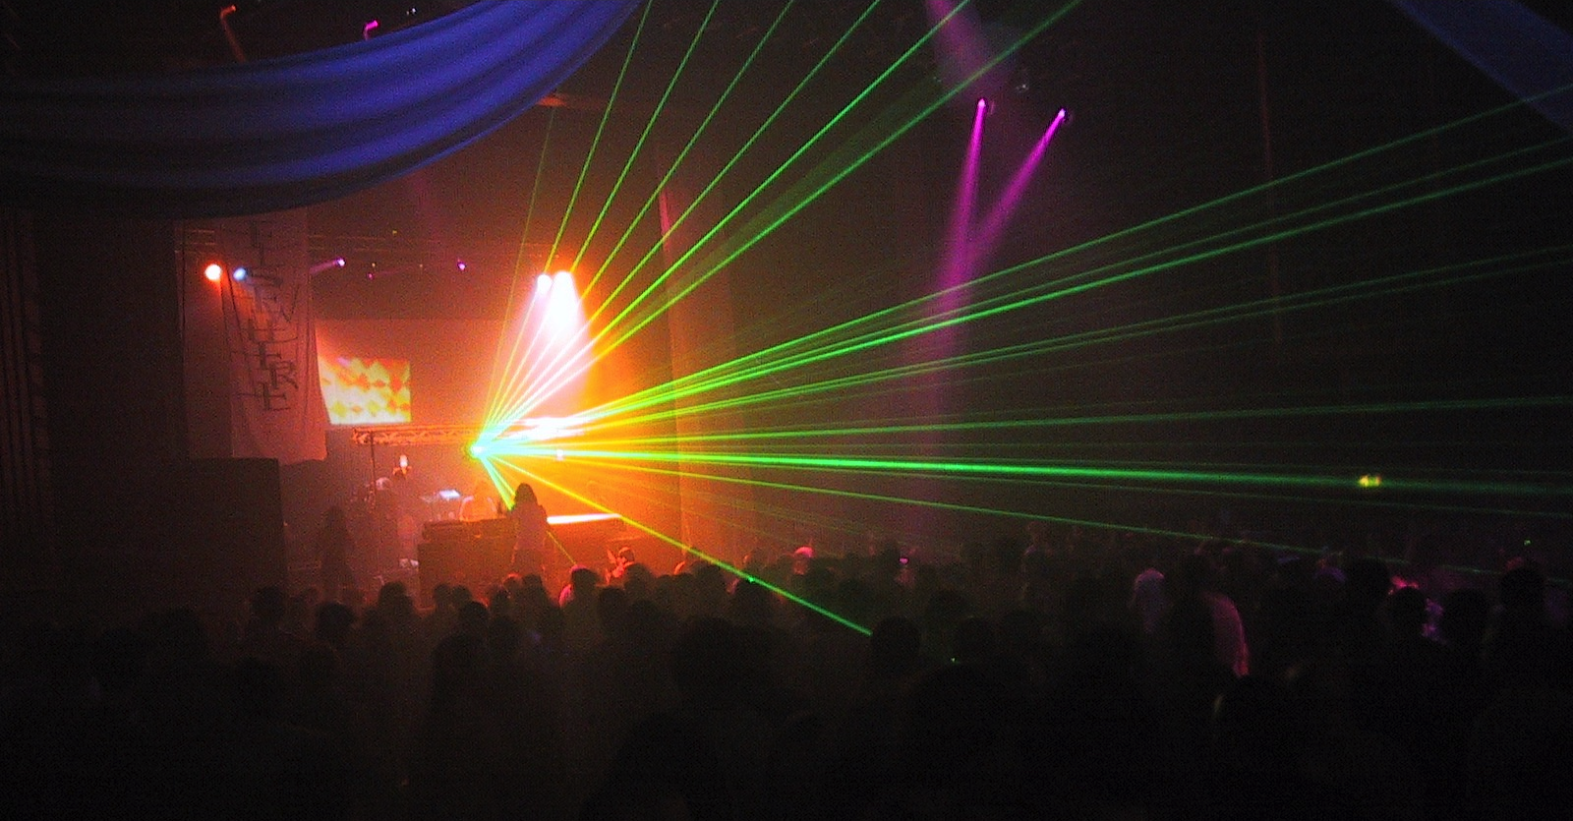
Unity needs a focal point

Slide 30

Detroit Red Wings
Sports teams without unity lose

Slide 31
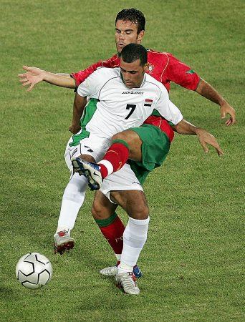
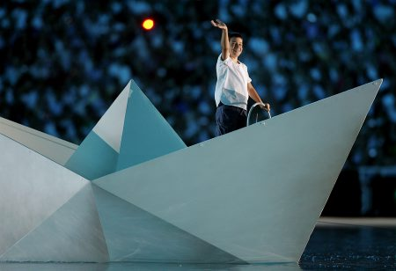
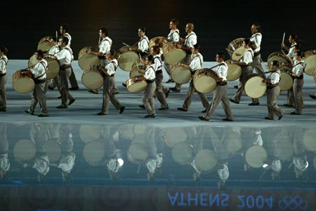
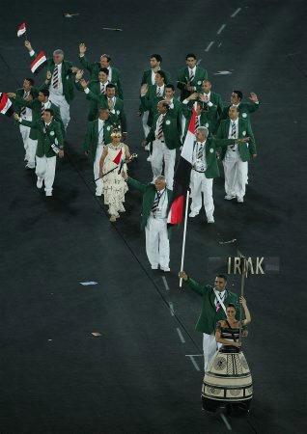
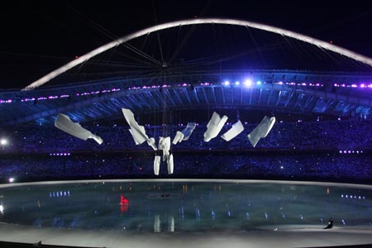
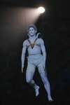

Unity & Competition

Slide 32
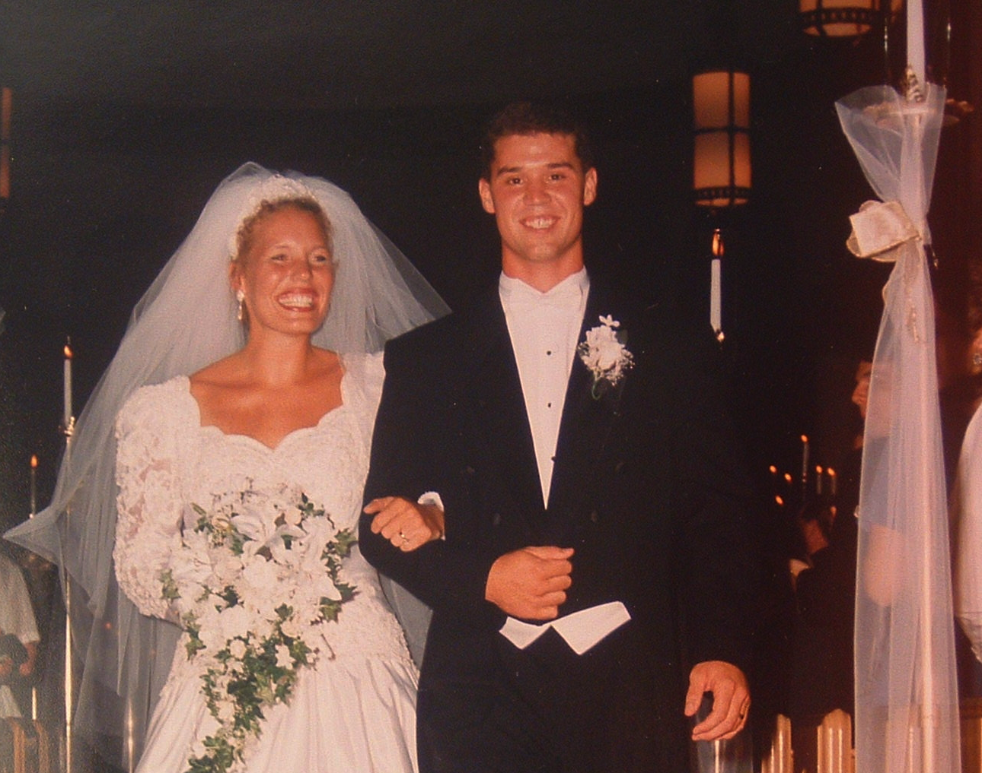
Marriage Unity

Slide 33
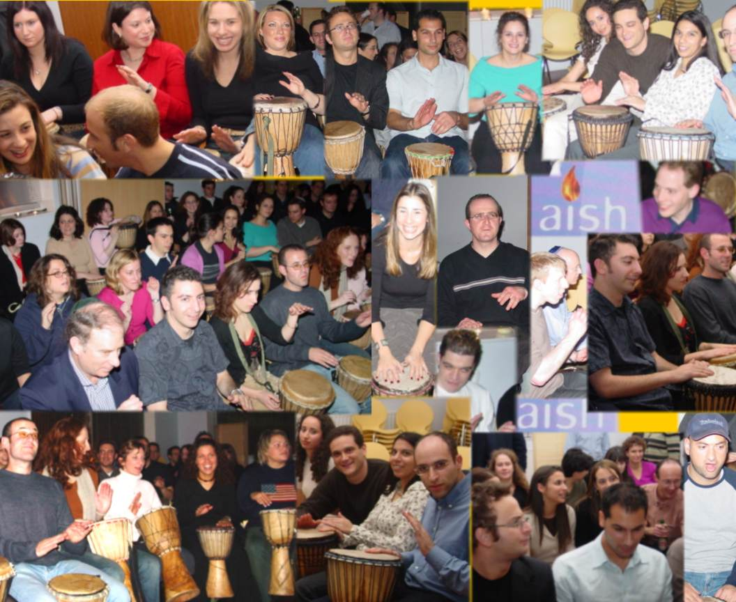
But what's the source of unity among God's people?
The Drum Café (UK teambuilding organization)
Notes:
The Drum Café (UK teambuilding orgainzation)

Slide 34
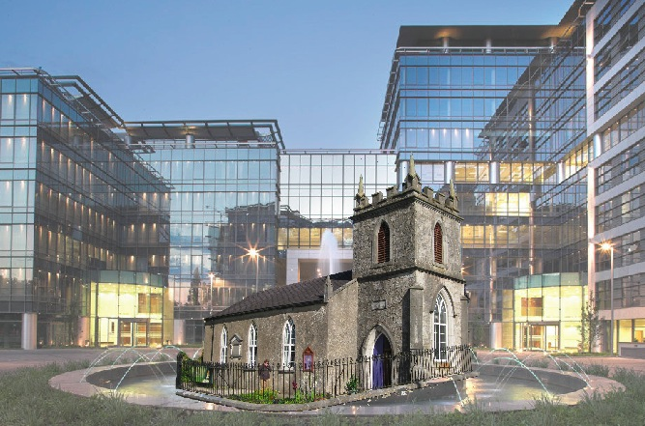
Relevance

Slide 35

Our unity is based on the cross—not human leaders
(1:18–2:5) or anything else!

Slide 36

Why does the cross seem like foolishness?
Because people generally seek power and intellect.

Slide 37
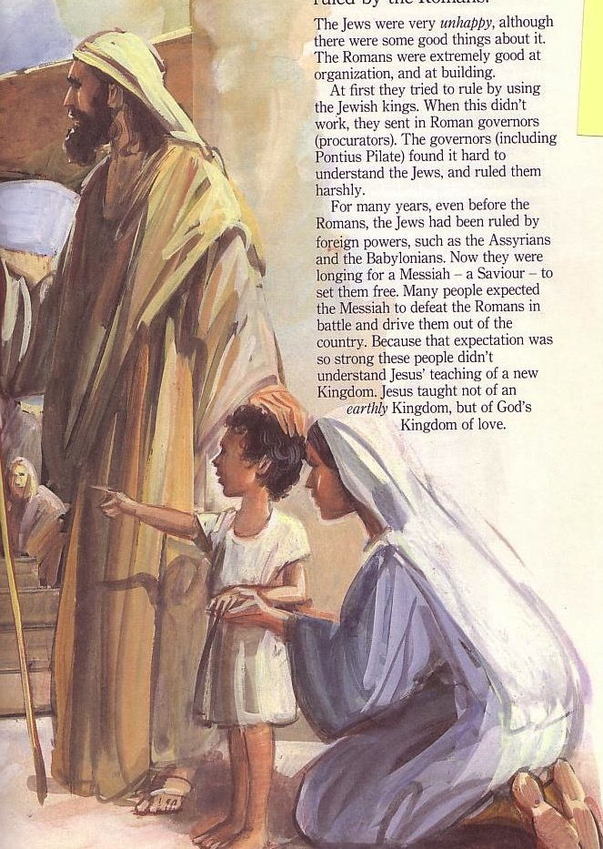
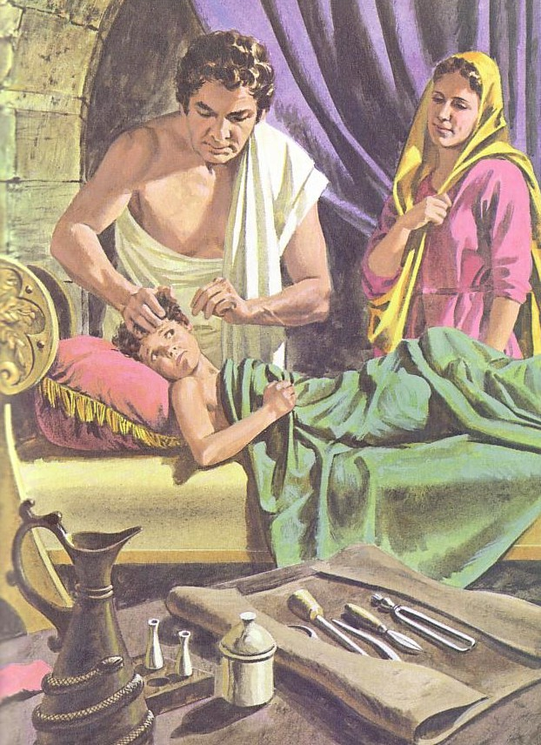
What's the Difference?
Jews
Gentiles
One God
Many taboos
Many Gods
Few taboos

Slide 38


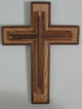
East Meets West
Jews
Power!
Greeks
Experiential
Truth is unfolding and relative
Scientific & rational
Truth is static and unchanging
"Need a Sign"
"Need Wisdom"
Offensive
Foolish
Notes:
Adapted from Lynne M. Thompson, "Christmas: The Real Deal," interview with Ray Vander Laan, Breakaway magazine (Dec 2003): 7-9.

Slide 39
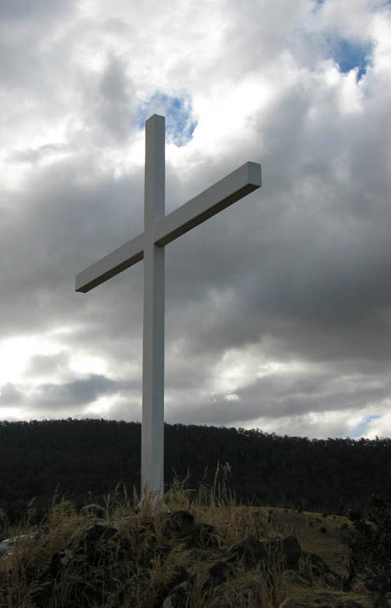
Our Unity is in the Cross Alone

Slide 40
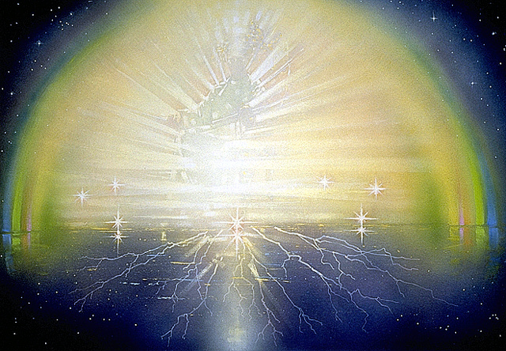
The Gospel Changes Lives!
Two examples how lives are changed:
God chose lowly Corinthians (1:26-31)
God used Paul's simple preaching (2:1-5)

Slide 41
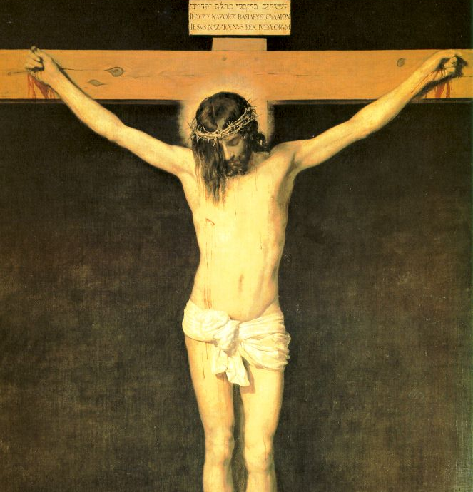

Paul preached a simple rather than eloquent message of forgiveness in the cross (2:1-5)
X

Slide 42
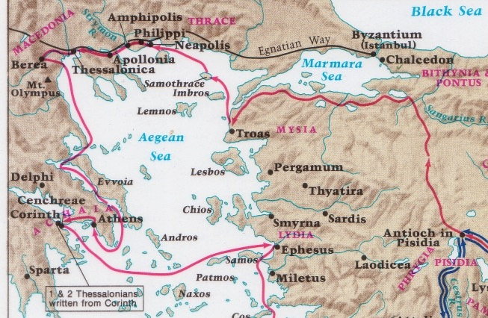
Paul's Second Missionary Journey
"Failure" in Athens
Weakness in Corinth

Slide 43

My Preaching Inadequacy

Slide 44
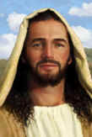
Our unity is in Christ alone––not any human leader

Slide 45
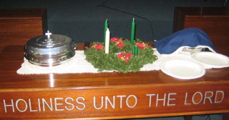
What is the source of our unity at Crossroads?

Slide 46
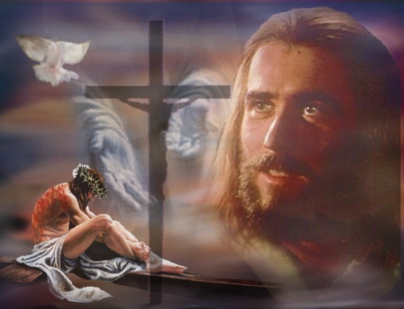
Paul's Key Point:
Don't divide over leaders because the gospel is based on a crucified man.

Slide 47
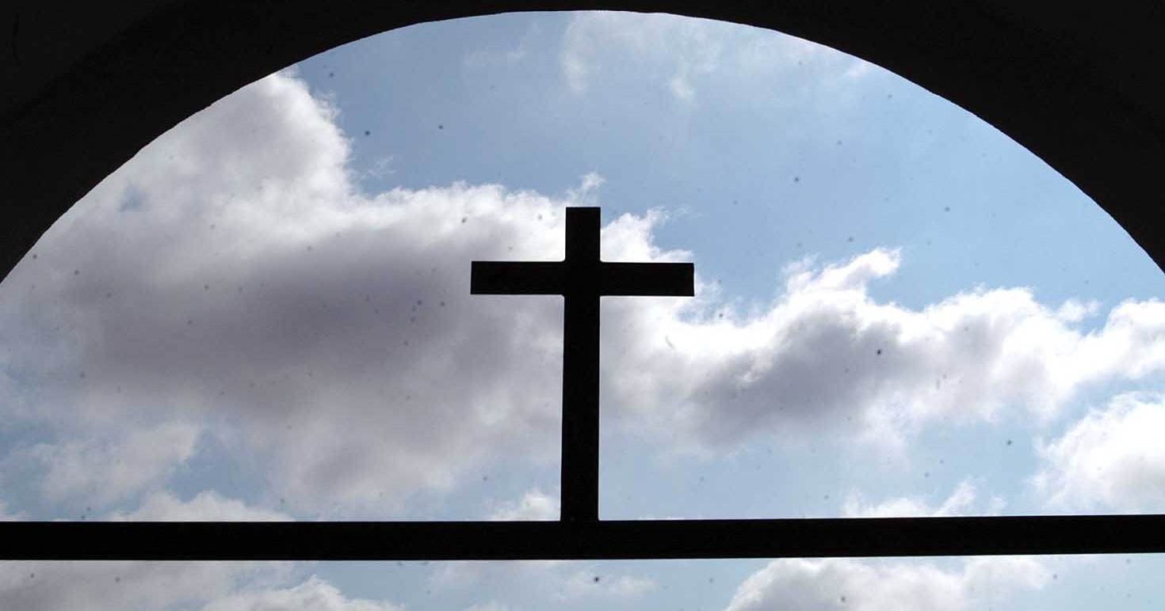
How can we put the cross first?
Don't idolize Christian leaders
Speak positively of leaders
Compliment without comparing
Submit to the elders

Slide 48

Hebrews 13:17
Obey your leaders and submit to their authority. They keep watch over you as men who must give an account. Obey them so that their work will be a joy, not a burden, for that would be of no advantage to you.

Slide 49
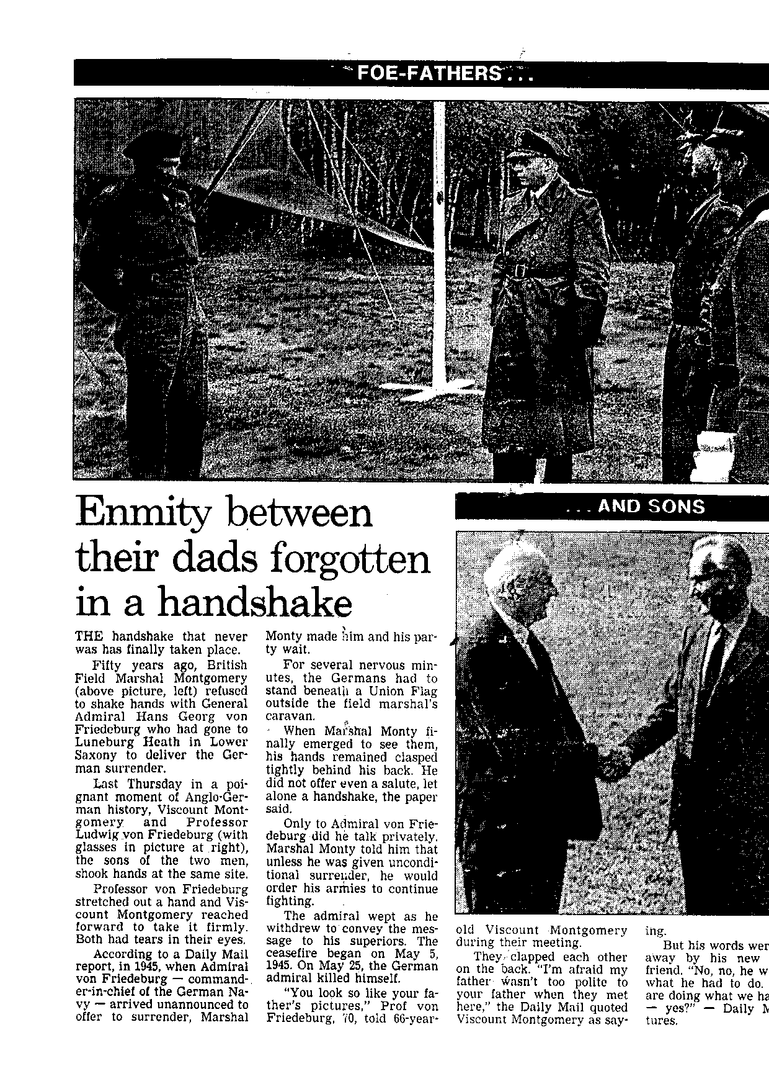
Past Sins Forgiven

Slide 50
Past Sins Forgiven

Slide 51
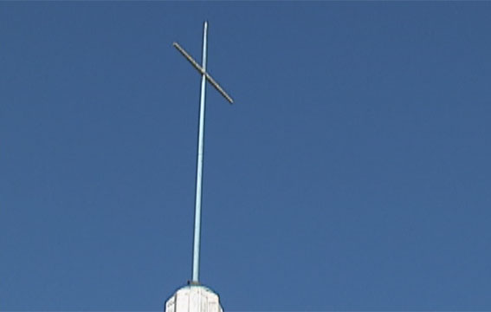
Focus on the Cross

Slide 52
Black

Slide 53
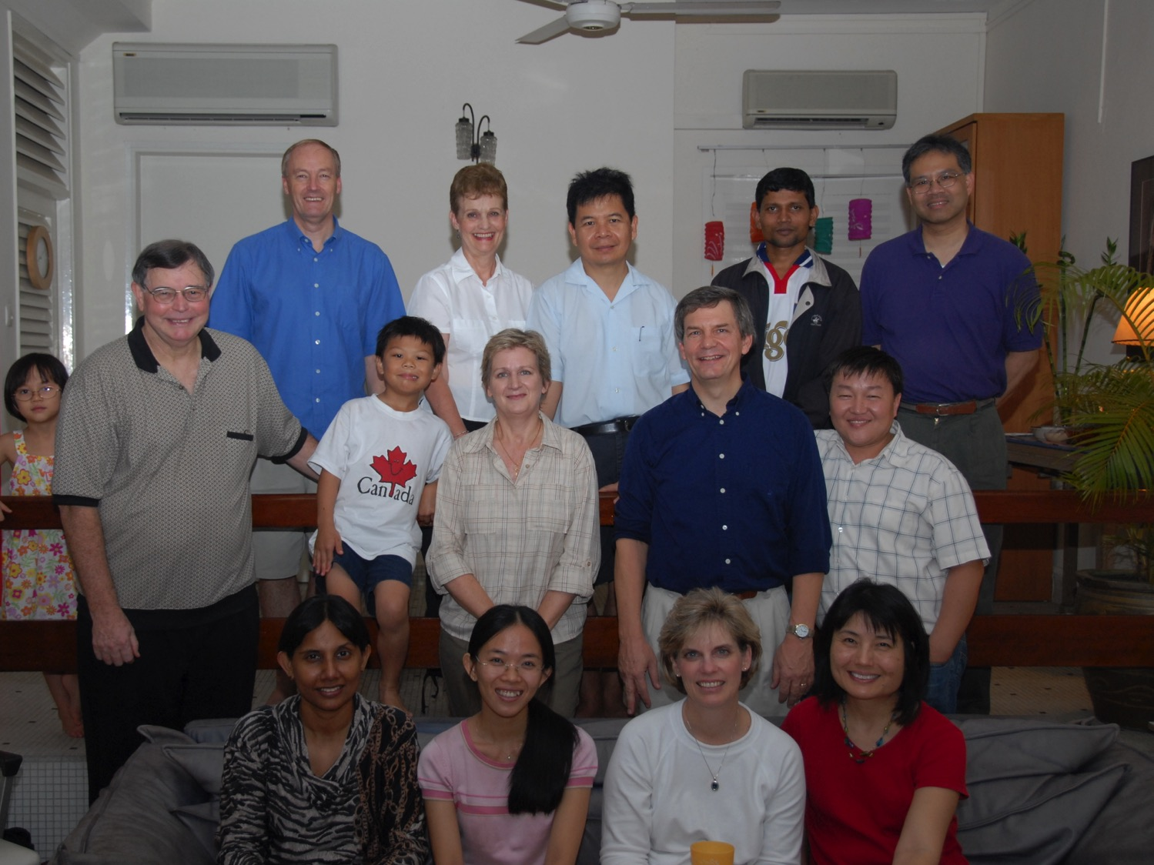
First Prayer Gathering
6 Oct 09

Slide 54
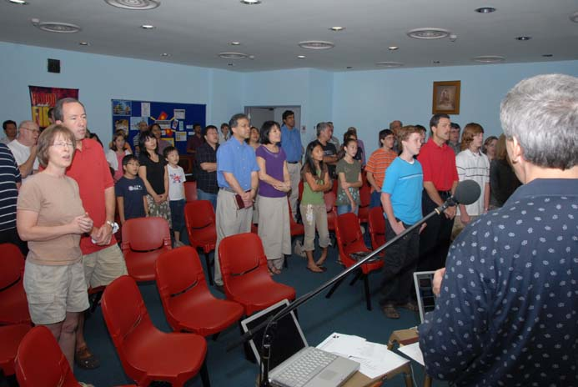
Our first service on 19 Nov 06

Slide 55
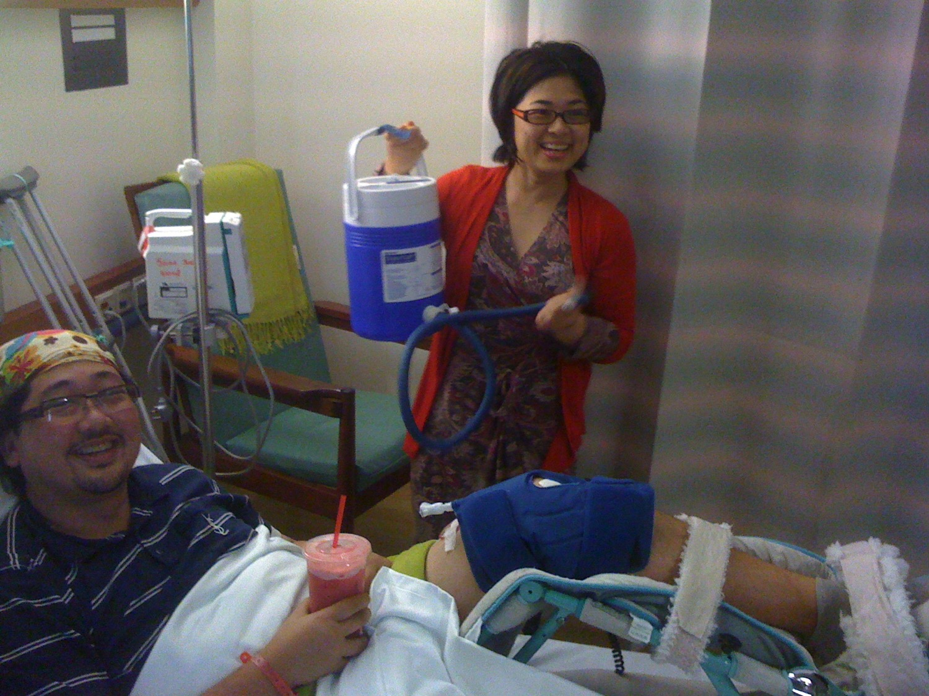
This Must Be the Place
By Steve Amerson

Slide 56

Souls on the street
Addicted to sin
Selling themselves to survive,
Not understanding
the hope they could find

Slide 57
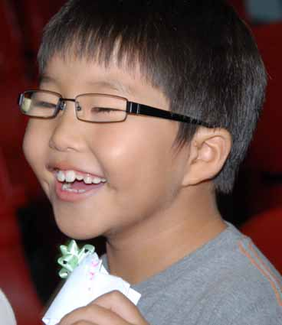
This Must Be the Place
…in a place where God's love is alive

Slide 58

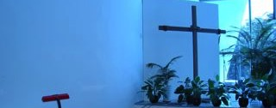
This Must Be the Place
They doubt that they could meet the standards necessary
And fear that they'd find judgment
rather than a sanctuary

Slide 59
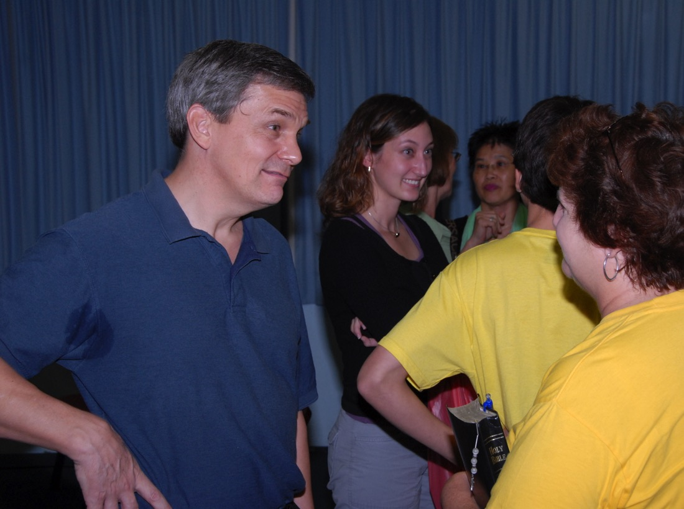
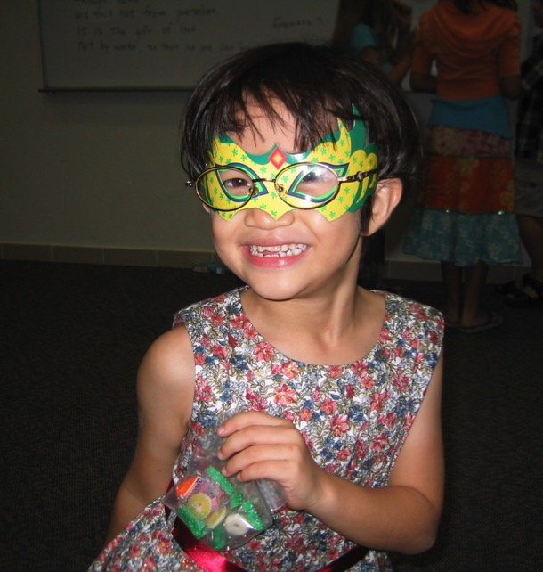
This Must Be the Place
This must be a place
where a broken heart can mend

Slide 60
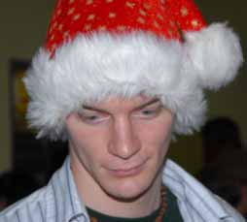
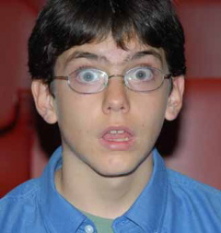
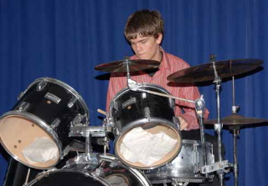
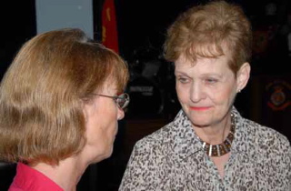
This Must Be the Place
This must be a place where the outcast finds a friend

Slide 61

This Must Be the Place
For we cannot lift the fallen if our hand still holds a stone

Slide 62



This Must Be the Place
And their sin that seems so great to us is no greater than our own

Slide 63

This Must Be the Place
There must be a point
where shame meets grace

Slide 64



This Must Be the Place
And this must be the place

Slide 65

This Must Be the Place
The neighbor next door
keeps the house looking good
but the home is collapsing within

Slide 66


This Must Be the Place
Pressures of life pull a family apart
and temptation's destruction begins

Slide 67




This Must Be the Place
They doubt the church could have the answers necessary

Slide 68

This Must Be the Place
And fear they'd find rejection rather than a sanctuary

Slide 69


This Must Be the Place
This must be a place
where a broken heart can mend

Slide 70

This Must Be the Place
This must be a place
where the outcast finds a friend

Slide 71

This Must Be the Place
For we cannot lift the fallen if our hand still holds a stone

Slide 72

This Must Be the Place
And their sin that seems so great to us
is no greater than our own

Slide 73

This Must Be the Place
There must be a point
where shame meets grace

Slide 74






This Must Be the Place
And the church must be the arms of God reaching out to bring them in

Slide 75

This Must Be the Place
…to a place where thy can find His love regardless of their sin.

Slide 76


This Must Be the Place
This must be a place
Where a broken heart can mend

Slide 77



This Must Be the Place
This must be a place
where the outcast finds a friend

Slide 78

This Must Be the Place
For we cannot lift the fallen
if our hand still holds a stone

Slide 79


This Must Be the Place
And their sin that seems so great to us
is no greater than our own

Slide 80


There must be a point where shame meets grace

Slide 81



This Must Be the Place
And this must be the place.

Slide 82


This Must Be the Place
This must be the place.

Slide 83

This Must Be the Place
This must be the place.

Slide 84
Black

Slide 85


NT Preaching link at BibleStudyDownloads.org
Get this presentation and script for free!
Notes:
NT Preaching (np)

