Slide 1

The Serving Gifts
1 Pet. 4:11b; 1 Cor. 12:9, 28; Rom. 12:7-8
Dr. Rick Griffith • Crossroads International Church Singapore
cicfamily.com & BibleStudyDownloads.org

Slide 2
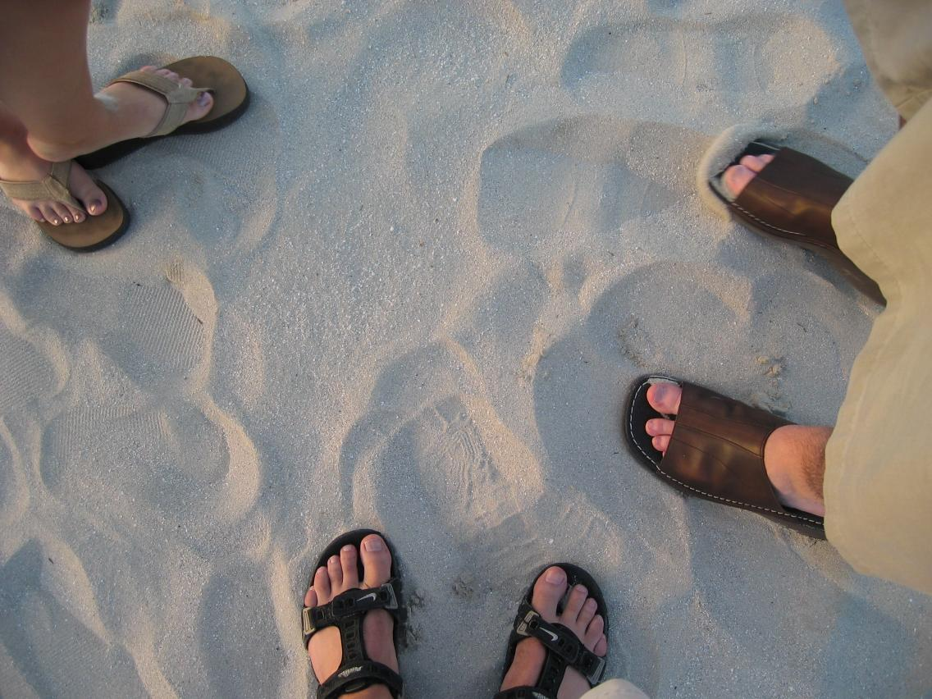
What do you think of when you think of feet?
Notes:
2

Slide 3

The Body of Christ

Slide 4

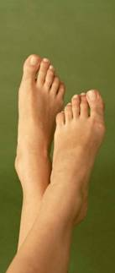
What do you think of when you think of feet?
“Unfragrant?”
“Unattractive?”
“Unenvied?”
“Unneeded?”
Notes:
4

Slide 5
Black
Notes:
5

Slide 6

1 Peter 4:11 (NIV)
47
“If anyone speaks, he should do it as one speaking the very words of God. If anyone serves, he should do it with the strength God provides, so that in all things God may be praised through Jesus Christ. To him be glory forever and ever. Amen.”
Notes:
6

Slide 7
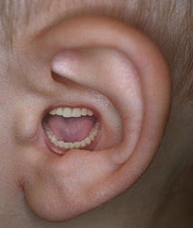
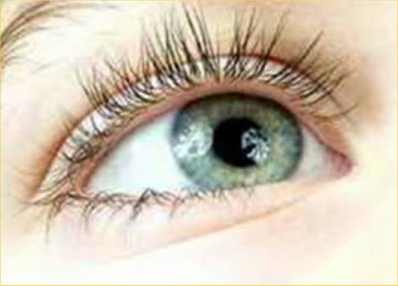
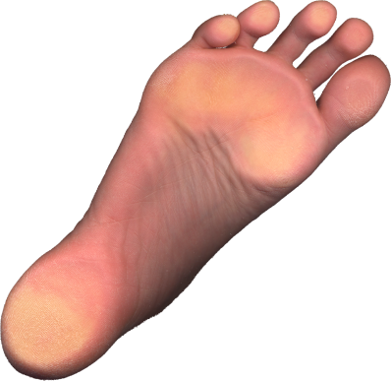
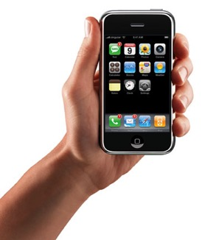

Believers with less honored gifts shouldn't feel unneeded (1 Cor. 12:15-16).
¹⁵ If the foot should say,
"Because I am not a hand, I do not belong to the body,"
it would not for that reason cease to be part of the body.
¹⁶ And if the ear should say,
"Because I am not an eye, I do not belong to the body,"
it would not for that reason cease to be part of the body.

Slide 8
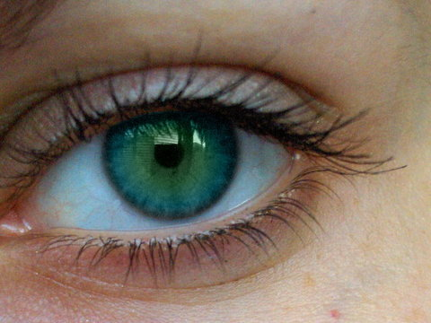
Diversity in the church makes it more effective (1 Cor. 12:17-20).
¹⁷If the whole body were an eye, where would the sense of hearing be? If the whole body were an ear, where would the sense of smell be? ¹⁸But in fact God has arranged the parts in the body, every one of them, just as he wanted them to be. ¹⁹If they were all one part, where would the body be? ²⁰As it is, there are many parts, but one body.

Slide 9

Categories of Gifts
(1 Peter 4:11)
Get
words
from
God
47
Speaking | Serving
Teaching | Administering
Evangelism | Faith
Pastor-Teacher | Giving
Encouraging | Service
 | Mercy
Notes:
9

Slide 10

Speaking Gifts Contrasted
47
 | Teaching | Evangelism | Pastor-Teacher | Exhortation
Shares | Biblical Learning | Faith & Testimony | Heart & Bible | Optimism
Recipient Need Met | Scriptural Truth | Salvation & Equipping for Evangelism | Shepherding | Encouragement
Sensitive to Needs | Doctrinally | For Conversion | Spiritually (overall needs) | Spiritually (specific needs)
Ministers to Those Needing | Instruction | Saving Faith | General Spiritual Direction | Urging in Practical Steps
General Trait | Accuracy in the Word | Heart for the Lost | Shepherd Heart | Uplifts Others
Notes:
10

Slide 11
Categories of Gifts
(1 Peter 4:11)
Get
words
from
God
Get
strength
from
God
47
Speaking | Serving
Teaching | Administering
Evangelism | Faith
Pastor-Teacher | Giving
Encouraging | Service
 | Mercy
Notes:
11

Slide 12
1 Peter 4:11 Main Idea
“If anyone serves, he should do it with the strength God provides, so that in all things God may be praised through Jesus Christ. To him be glory forever and ever. Amen.”
Those with a serving gift should serve in God's strength for God's glory
How?
Notes:
12

Slide 13
What do you think of when you think of feet?
“Unfragrant?”
“Unattractive?”
“Unenvied?”
“Unneeded?”
Administrations
Faith
Giving
Service
Showing Mercy
1 Cor. 12:15, 20-22
Rom. 12:6-8
Notes:
13

Slide 14


Administrations
55
Meets organizational needs
Also called:
Administration
Government(s)
Leadership
Leading
Ruling
Management
Organization
Notes:
14

Slide 15
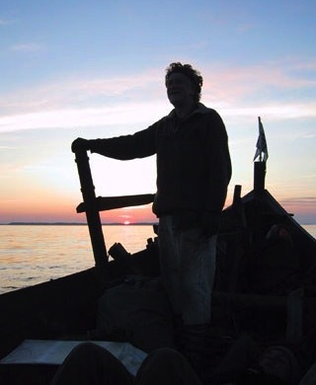


Administrations
55
1 Corinthians 12:28
kubernesis kubernh,sij
“a governing, government” (Thayer)
Related to kubernetes kubernh,tej (noun)
“captain, steersman, pilot” (Acts 27:11; Rev. 18:17; BAGD)
Notes:
15

Slide 16
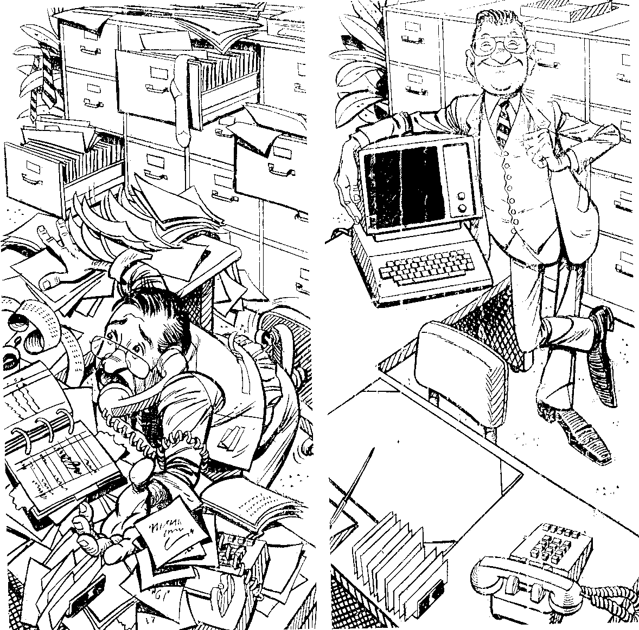
Wrong Admin View
Notes:
16

Slide 17

Two Gifts or One?
55
Leadership
Administrations
Romans 12:8
proistemi proi[sthmi
pro “before” +
histemi “to stand”
“to stand before…
be at the head (of),
rule, direct…
manage, conduct”
(BAGD)
1 Corinthians 12:28
kubernesis kubernh,sij
“a governing, government” (Thayer)
Related to kubernetes kubernh,tej (noun)
“captain, steersman, pilot” (Acts 27:11; Rev. 18:17; BAGD)
Notes:
17

Slide 18
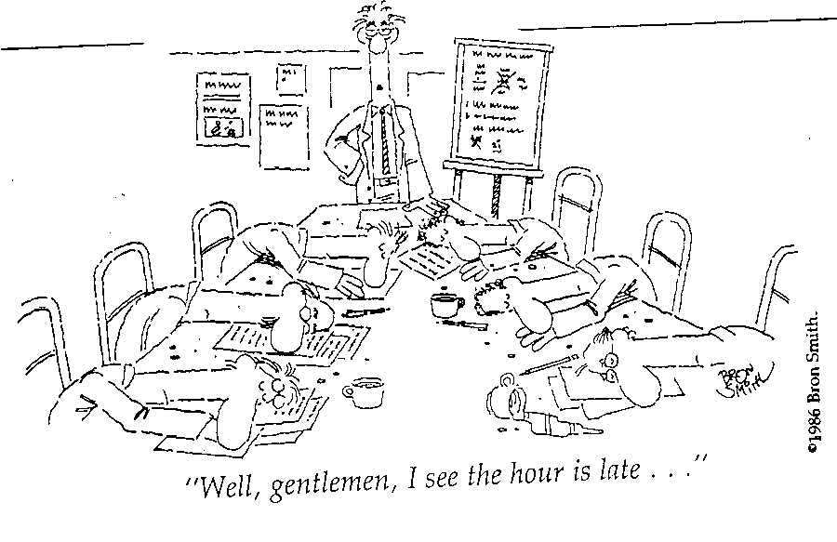
Meetings Led by the Ungifted
"Well, gentlemen, I see the hour is late…"
Notes:
18

Slide 19
Black

Slide 20
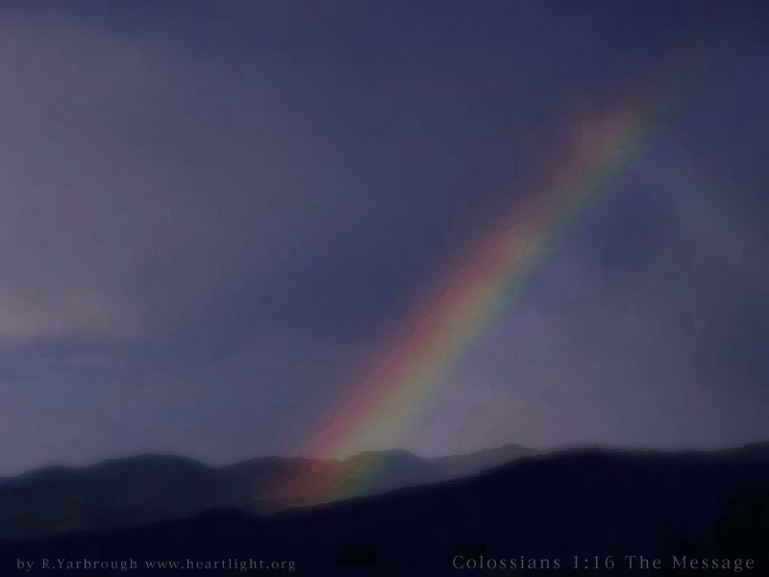
Faith
56
Providing vision
for the saints

Slide 21
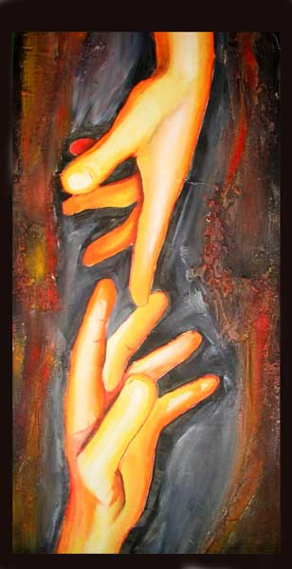
What is faith?
"Faith is believing that something is so,
when it isn't so,
so it will be so!"

Slide 22

What are those with faith like?
• Trust God
• Dreams dreams
• Not distracted by details
• Prayerful

Slide 23
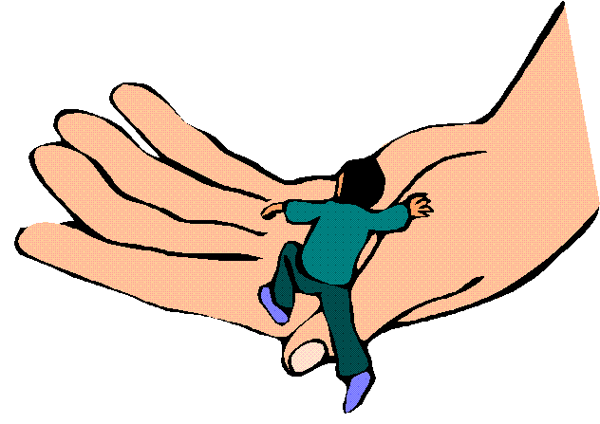
Who has the faith gift?
Notes:
23

Slide 24

Giving
57
Meets material needs
Notes:
24

Slide 25

“…if it is contributing to the needs of others, let him give generously…”
(Romans 12:8 NIV)

Slide 26
Black
Notes:
26

Slide 27
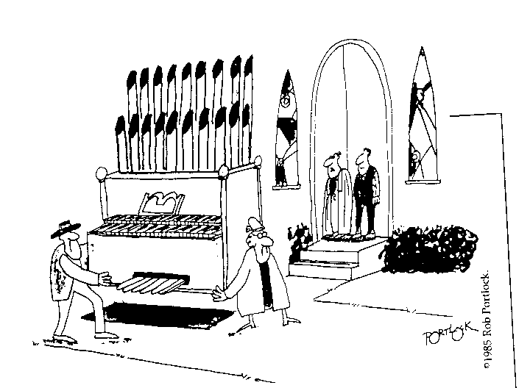
Selfish Giving
“They donated it, but they didn't care for the offertory today.”
Notes:
27

Slide 28
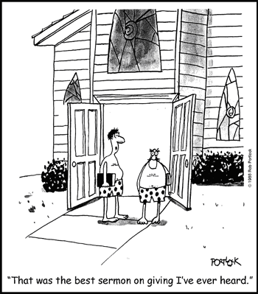
Great Preaching on Giving!
“That was the best sermon on giving I've ever heard.”
Notes:
28

Slide 29
Black
Notes:
29

Slide 30

Service
= Helps
58
Meets practical needs
Notes:
30

Slide 31
Black
Notes:
31

Slide 32

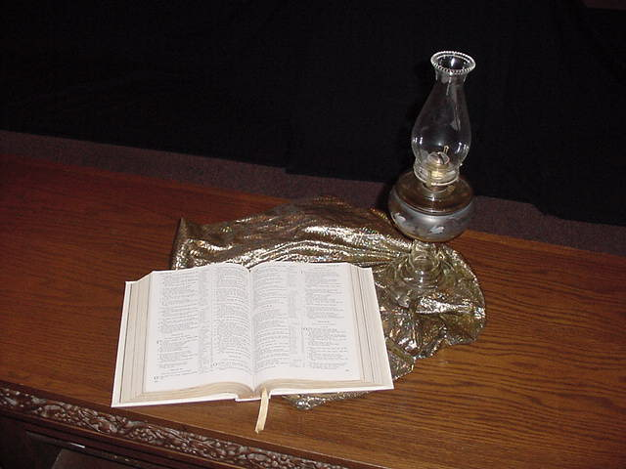
2 Timothy 1:16-18
58
“May the Lord show mercy to the household of Onesiphorus, because he often refreshed me and was not ashamed of my chains. On the contrary, when he was in Rome, he searched hard for me until he found me. May the Lord grant that he will find mercy from the Lord on that day! You know very well in how many ways he helped me in Ephesus.”

Slide 33

1 Corinthians 16:17-18
58
“I was glad when Stephanas, Fortunatus, and Achaicus arrived, because they have supplied what was lacking in you. For they refreshed my spirit and yours also. Such men deserve recognition.”

Slide 34

Servers are Vital
58
“These ministries, though often missed by the public eye, form the backbone of an effective local church. They guard the public declaration of the Word from interruption, delay and unnecessary demands. It is to be noted that all Christians are to be available to help and assist, but not all are able to do it with unending joy, ease, and efficiency.

Slide 35
Servers are Vital
58
“Most often, these folk are very observant, able to notice needs and take care of them without others having to call their attention to them. They usually loathe the limelight”
(Swindoll, 4)

Slide 36
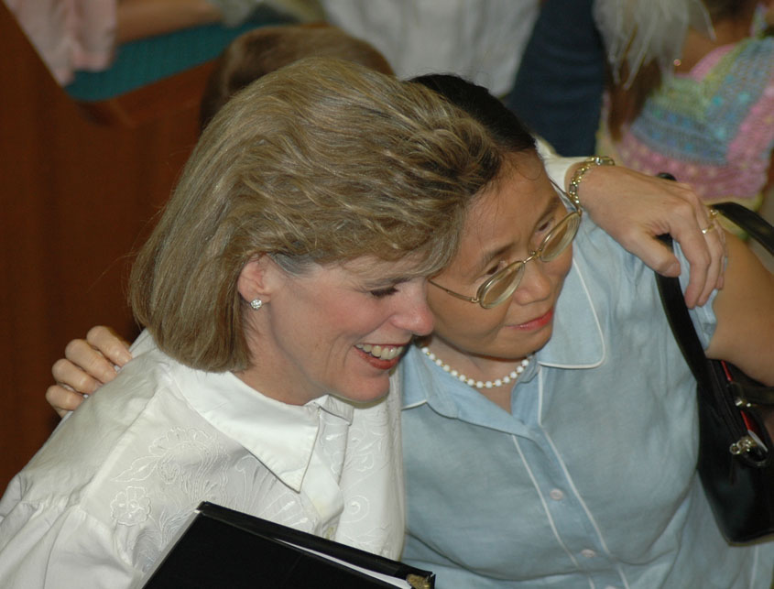
Susan
Notes:
36

Slide 37
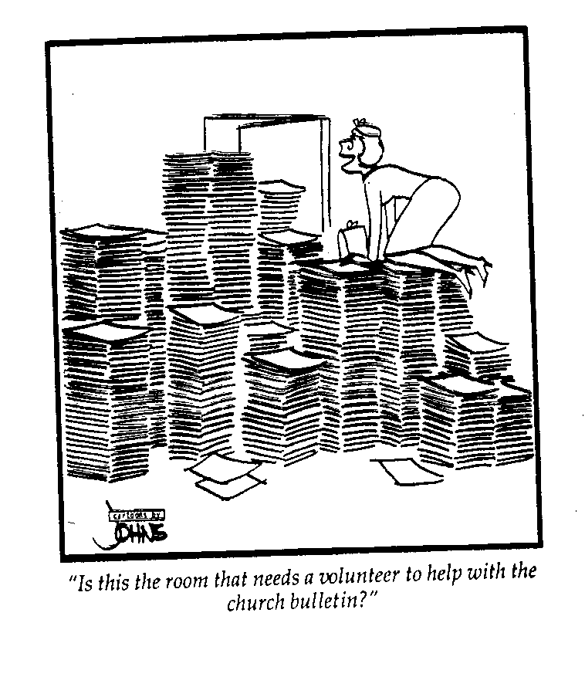
Service is Greatly Needed
"Is this the room that needs a volunteer to help with the church bulletin?"
Notes:
37

Slide 38
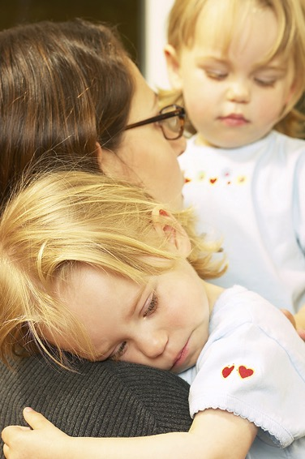
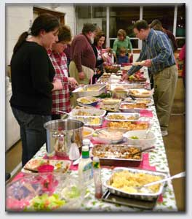
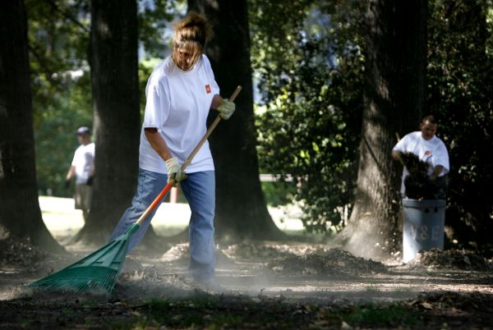
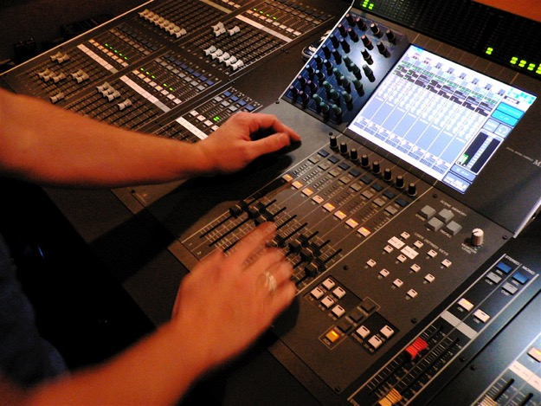

How
&
Who?
58

Slide 39
Black
Notes:
39

Slide 40
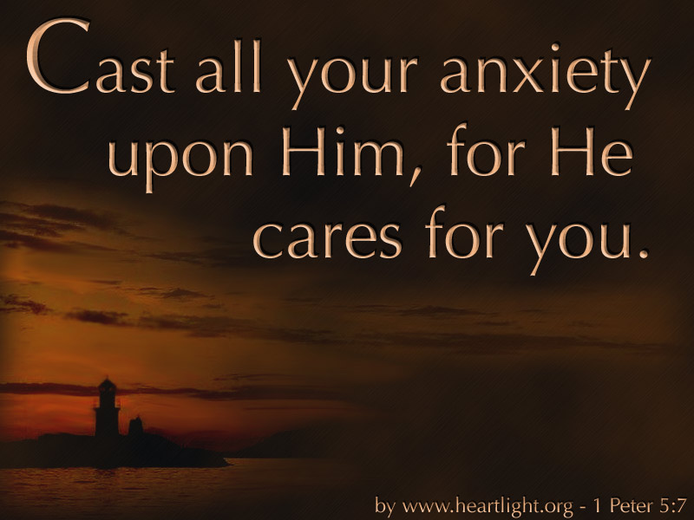
Showing Mercy
59
…meets emotional needs
Notes:
40

Slide 41
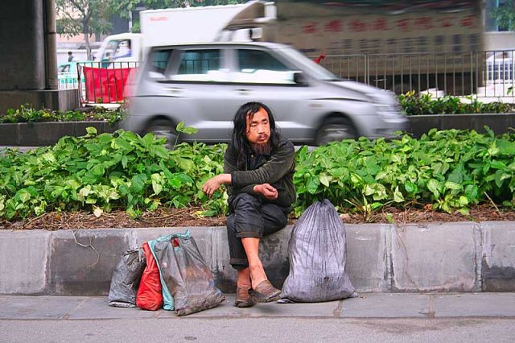
Most of us avoid "down & outers"…

Slide 42
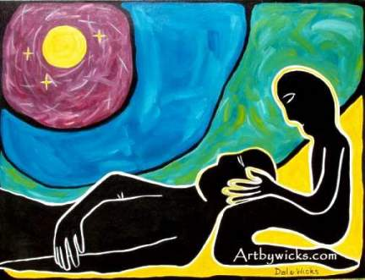
Mercy

Slide 43
Black
Notes:
43

Slide 44
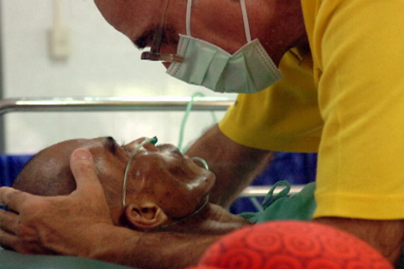
“… if it is showing mercy, let him do it cheerfully”
(Romans 12:8)
59

Slide 45
1 Peter 4:11 (NIV)
47
“If anyone speaks, he should do it as one speaking the very words of God. If anyone serves, he should do it with the strength God provides, so that in all things God may be praised through Jesus Christ. To him be glory forever and ever. Amen.”
Notes:
45

Slide 46
1 Peter 4:11 Main Idea
“If anyone serves, he should do it with the strength God provides, so that in all things God may be praised through Jesus Christ. To him be glory forever and ever. Amen.”
If you have a serving gift then serve others in God's strength for God's glory
Notes:
46

Slide 47
Categories of Gifts
(1 Peter 4:11)
Get
words
from
God
Get
strength
from
God
47
Speaking | Serving
Teaching | Administering
Evangelism | Faith
Pastor-Teacher | Giving
Encouraging | Service
 | Mercy
Notes:
47

Slide 48

Serving Gifts Contrasted
54
 | Adminis- trations | Faith | Giving | Service | Showing Mercy
Shares | Organizing Ability | Vision | Possessions | Abilities | Concern
Recipient Need Met | Leadership | Belief | Monetary | Assistance | Understand-ing
Sensitive to Needs | Managerially | Visually | Materially | Practically | Emotionally
Ministers to Those Needing | Structure | Hope | Finances & Material Things | Aid in Everyday Tasks | Comfort
General Trait | Orderliness | Confi-dence in God | Generosity | Availability | Compassion
Notes:
48

Slide 49

Which piece are you?
God wants me to…
Notes:
49

Slide 50
Black
Notes:
50

Slide 51


NT Preaching link at BibleStudyDownloads.org
Get this presentation and script for free!
Notes:
NT Preaching (np)

