Slide 1
Biblical Archaeology
What does it have to do with you?
Dr. Rick Griffith • Jordan Evangelical Theological Seminary • BibleStudyDownloads.org

Slide 2

Shout to the Lord 1/12
My Jesus, my Savior,
Lord there is none like You;
All of my days I want to praise
the wonders of Your mighty love.

Slide 3
Shout to the Lord 2/12
My comfort, my shelter,
Tower of refuge and strength;
Let every breath, all that I am,
never cease to worship You.

Slide 4
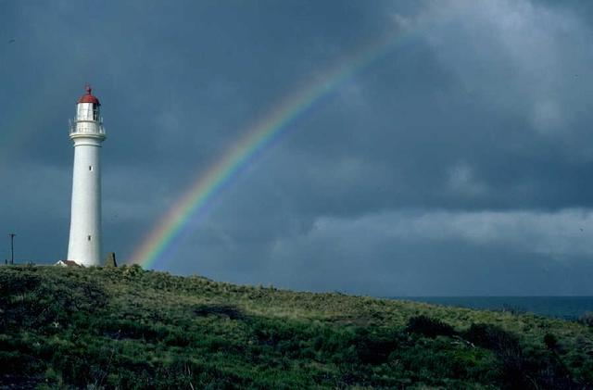
Shout to the Lord 3/12
Shout to the Lord,
all the earth, let us sing
power and majesty,
praise to the King.

Slide 5
Shout to the Lord 4/12
Mountains bow down
and the seas will roar
at the sound of Your name.

Slide 6
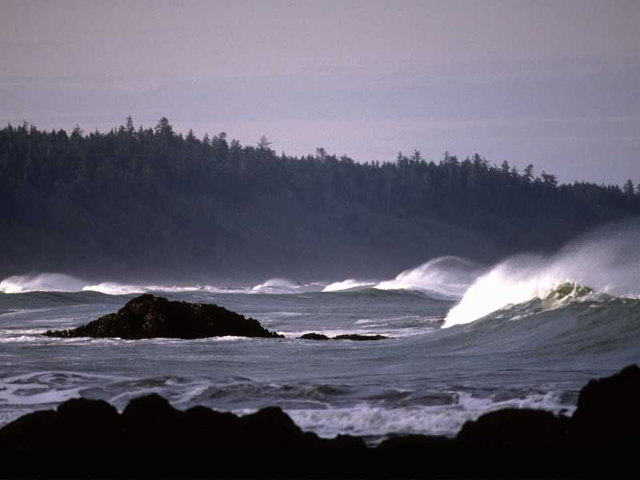
Shout to the Lord 5/12
I sing for joy
At the work of Your hands,
Forever I'll love You
Forever I'll stand,

Slide 7
Shout to the Lord 6/12
Nothing compares
to the promise I have in You.

Slide 8
Shout to the Lord 7/12
My Jesus, my Savior,
Lord there is none like You;
All of my days I want to praise
the wonders of Your mighty love.

Slide 9
Shout to the Lord 8/12
My comfort, my shelter,
Tower of refuge and strength;
Let every breath, all that I am,
never cease to worship You.

Slide 10
Shout to the Lord 9/12
Shout to the Lord,
all the earth, let us sing
power and majesty,
praise to the King.

Slide 11
Shout to the Lord 10/12
Mountains bow down
and the seas will roar
at the sound of Your name.

Slide 12
Shout to the Lord 11/12
I sing for joy
At the work of Your hands,
Forever I'll love You
Forever I'll stand,

Slide 13
Shout to the Lord 12/12
Nothing compares
to the promise I have in You.

Slide 14
Black

Slide 15
Biblical Archaeology
What does it have to do with you?

Slide 16
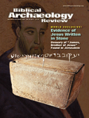
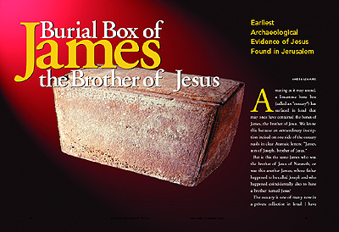
A Key Recent Discovery (BAR Nov/Dec 02)…
205a
Deemed a forgery by the Israeli Antiquities Authority
(June 2003)
Earliest Archaeological Evidence of Jesus
Found in Jerusalem
Reads:
“James, son of Joseph, brother of Jesus.”
This is the earliest reference to Jesus outside the Bible!

Slide 17
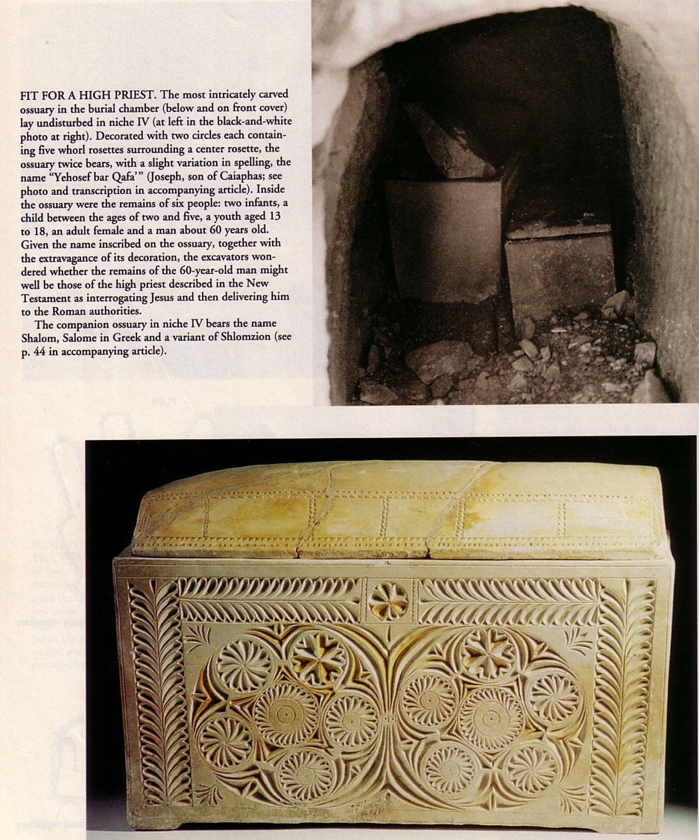
Caiaphas Ossuary
(BAR Sept/Oct 1992)
Before this discovery there was no evidence for his existence outside the Bible

Slide 18
What is Archaeology?
196
The word itself
  Greek Meaning: arche (old) + logos (word)
  Archaeology = “old words”
Some definitions
  “The science or study of history from the remains of early human cultures as discovered chiefly by systematic excavations” (Funk & Wagnall's)
  “The scientific study of material remains (as fossil relics, artifacts, monuments) of past human life and activities” (Webster's)

Slide 19
What is Biblical Archaeology?
196
“'Biblical Archaeology' selects those material remains of Palestine and its neighboring countries which relate to the biblical period and narrative. These include the remains of buildings, art, inscriptions and every artifact which helps the understanding of the history, life and customs of the Hebrews and those peoples who, like the Egyptians, Phoenicians, Syrians, Assyrians and Babylonians, came into contact and influenced them.”
D. J. Wiseman, “Archaeology,” New Bible Dictionary, 2d ed. (Wheaton: Tyndale, 1982), 70
Notes:
The goal is to understand the biblical text better—not to prove or disprove the Bible.
It studies the regions, periods and cultures in which the Bible appeared, and their background.

Slide 20
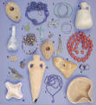
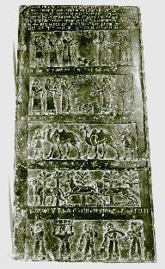
Archaeological Terms
196
Classification of Objects
  Artifacts (e.g., Herodian lamp)
  Epigraphs
Black Obelisk of Shalmaneser

Slide 21

Archaeological Terms
199
Excavation Terminology
  Tell
  Stratum
Schematic drawing of an ancient Palestinian tell showing methods of excavation and levels (strata) of occupation

Slide 22
History of Biblical Archaeology
197
Accident: Rosetta Stone discovery (1799)

Slide 23
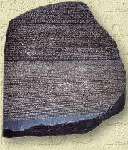
The Rosetta Stone
87c
The Rosetta Stone was unique in that three languages were inscribed upon it, telling the same story. The languages were Demotic Egyptian, Greek, and Hieroglyphics.

Slide 24
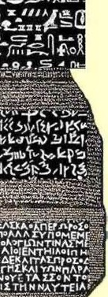

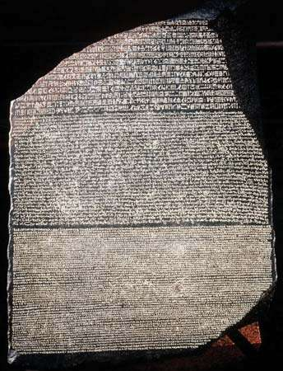
The Rosetta Stone
87c-d
Top:
Hieroglyphics
The key to understanding Egyptian hieroglyphics
Middle:
Egyptian Demotic
Bottom: Greek

Slide 25
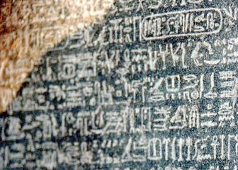
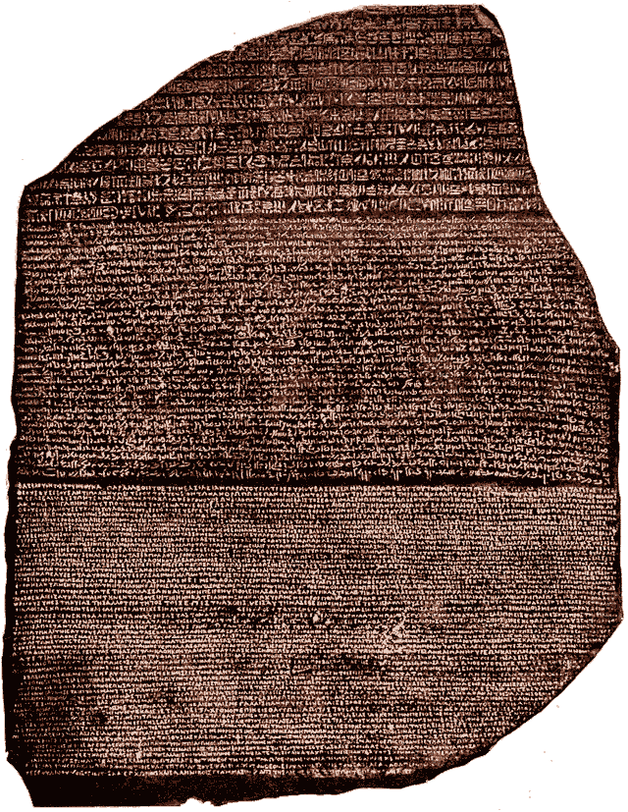


The Rosetta Stone
87d
Top:
Hieroglyphics
The key to understanding Egyptian hieroglyphics
Middle:
Egyptian Demotic
Bottom: Greek

Slide 26
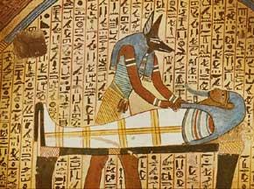
Hieroglyphs
87c
The word hieroglyph literally means "sacred carving." The Egyptians first used hieroglyphs exclusively for inscriptions carved or painted on temple walls. This form of pictorial writing was also used on tombs, sheets of papyrus, wooden boards covered with a stucco wash, potsherds and fragments of limestone.

Slide 27
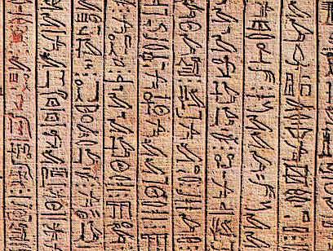
Hieroglyph Types
Hieroglyphics are an original form of writing out of which all other forms developed. Two of the newer forms were called hieratic and demotic:
87d
Hieratic was a simplified form of hieroglyphics for administrative and business purposes, as well as for literary, scientific and religious texts.
Demotic, a Greek word meaning "popular script," was in general use for the daily requirements of the society.
In the third century A.D., hieroglyphics began to be replaced by Coptic, a form of Greek writing. The last hieroglyphic text was written at the Temple of Philae in AD 450. The spoken Egyptian language was superseded by Arabic in the Middle Ages.

Slide 28
How Hieroglyphs Were Deciphered
87d
It was not until the nineteenth century that Egyptian hieroglyphs were deciphered. Several people had been trying to crack the code when the brilliant young Frenchman, Jean-François Champollion discovered the secret to this ancient writing.
HOW DID HE DO IT?
A decree issued at Memphis, Egypt, on March 27, 196 B.C. was inscribed on the Rosetta Stone in three scripts: hieroglyphics, demotic and Greek.
After Thomas Young deciphered the demotic text, Champollion used the information to break the code of the hieroglyphic text in 1822. In 1828, he published the famous "Précis" that marked the first real breakthrough in reading hieroglyphs.

Slide 29
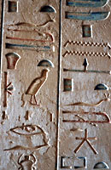
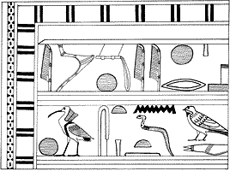
Hieroglyphs and their cursive equivalents
Taken from: G. Steindorff and K. Seele, When Egypt Ruled the East, Chicago: 1942, p.122

Slide 30
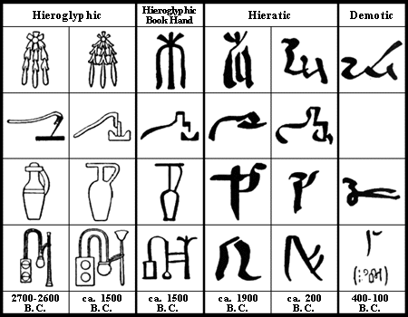

Slide 31
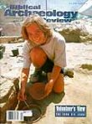






History of Biblical Archaeology
197
Accident: Rosetta Stone discovery (1799)
Surface: Edward Robinson & Eli Smith (1838)
Digs: DeSaulcy in Jerusalem (1863)
Popularizing: Biblical Archaeology Review (1975)

Slide 32
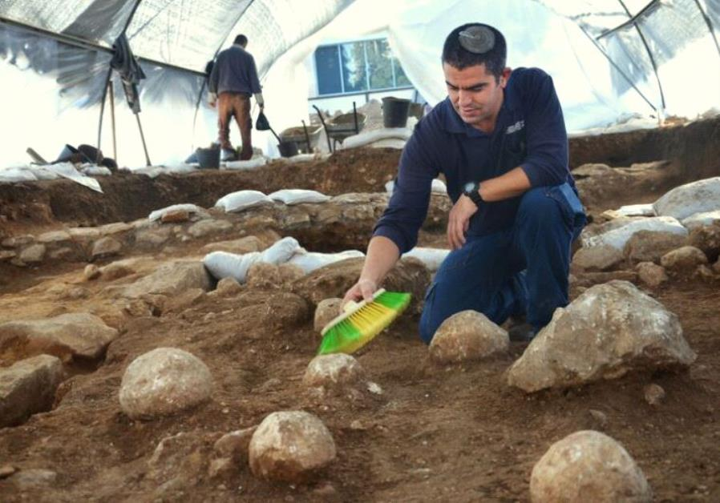

Excavation Sites
Siloam Inscription

Slide 33
Methods
197-198
Sounding (vertical)
Stepped trench (portion of tell)
Stratification (entire side)
Carbon-14 testing
Schematic drawing of an ancient Palestinian tell showing methods of excavation and levels (strata) of occupation

Slide 34
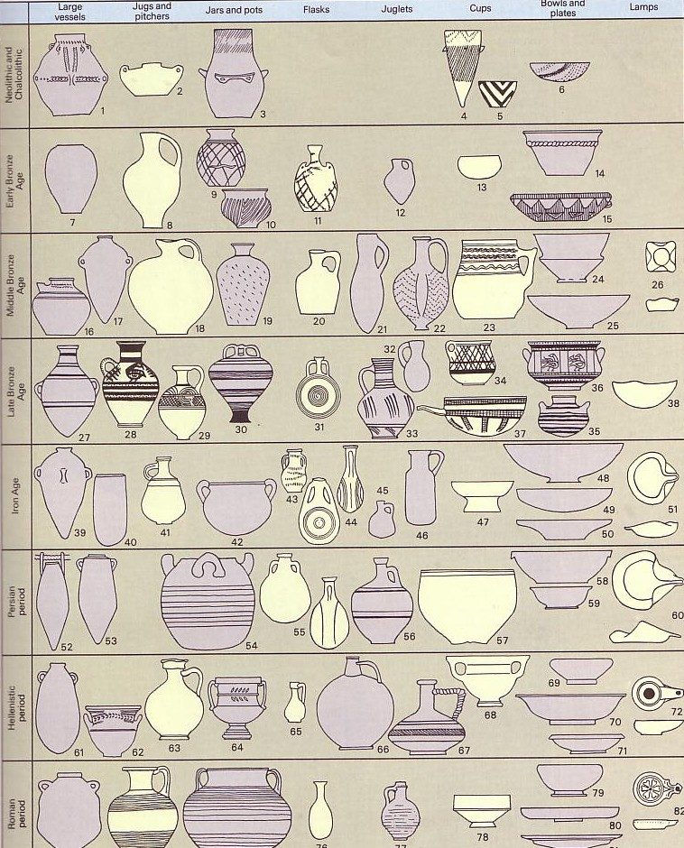



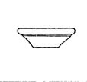


Pottery Analysis
199

Slide 35
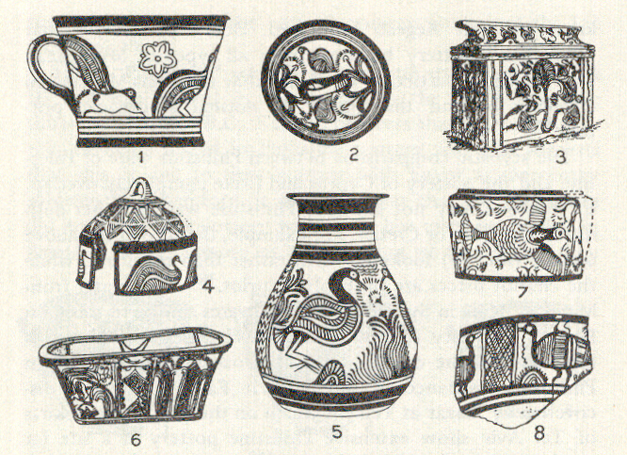
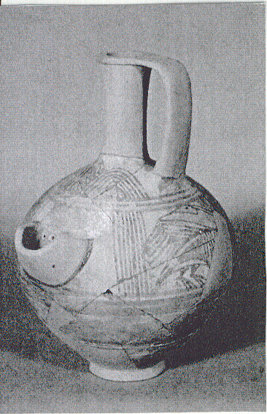
Philistine Pottery
106

Slide 36
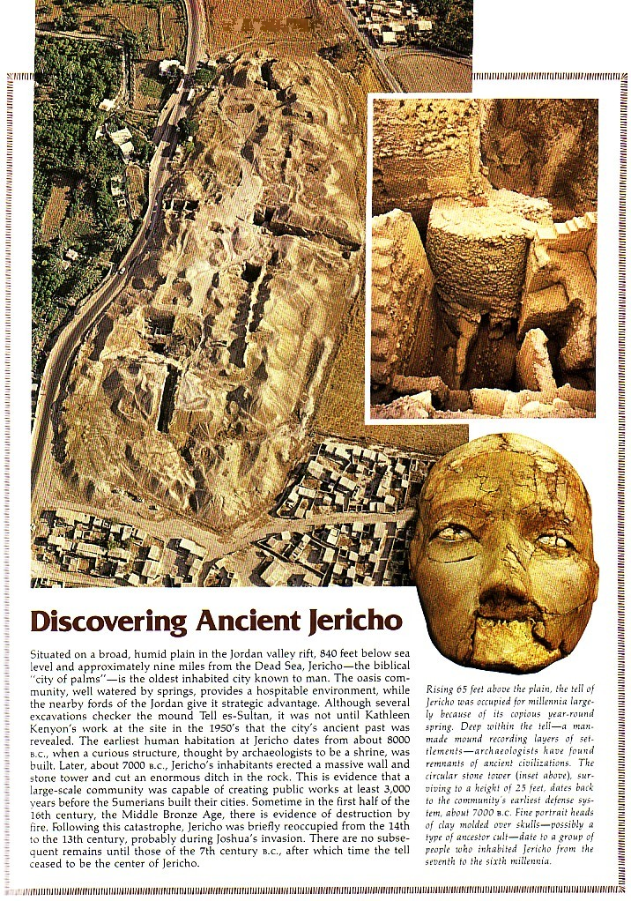
Discovering Ancient Jericho

Slide 37
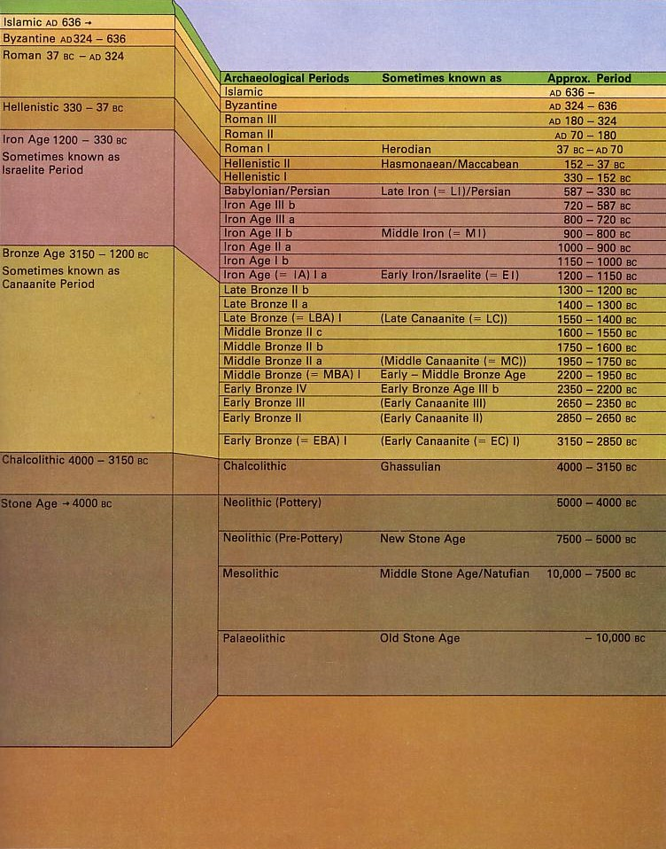
Value of Biblical Archaeology
200, 206
Confirmation of Biblical History (cf. OTB, 201-4)

Slide 38
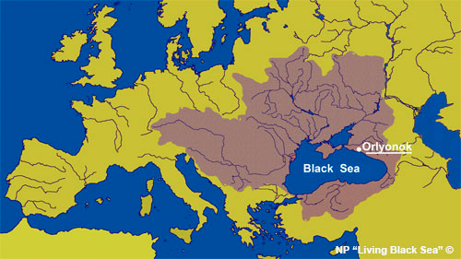
Confirmation of Biblical History
206
The Flood
Black Sea habitation (OTB, 211a)

Slide 39
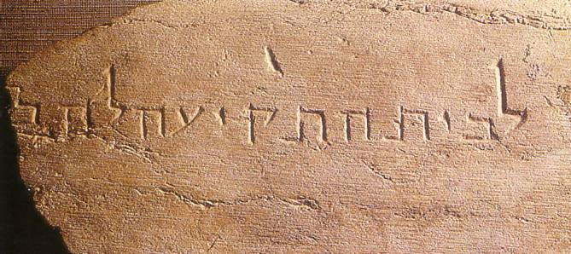
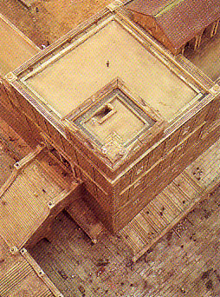
Confirmation of Biblical History
206
Jerusalem
Place of trumpeting (OTB, 211)
Gihon Spring wall and gate (AD 1999; OTB, 33-34)

Slide 40
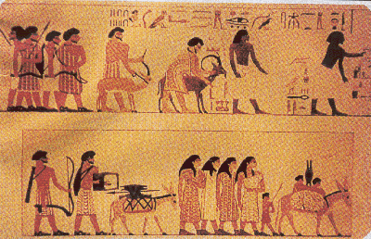
Confirmation of Biblical History
206
Jerusalem
Black Sea habitation (OTB, 211a)
Place of trumpeting (OTB, 211)
Gihon Spring wall and gate (1999, OTB, 33-34)
Hezekiah's tunnel and Warren's Shaft (OTB, 31)
Beni Hasan Tomb Painting

Slide 41
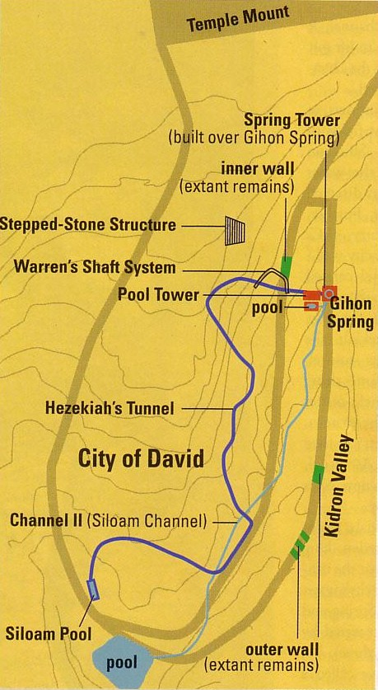

Hezekiah's Tunnel
30

Slide 42
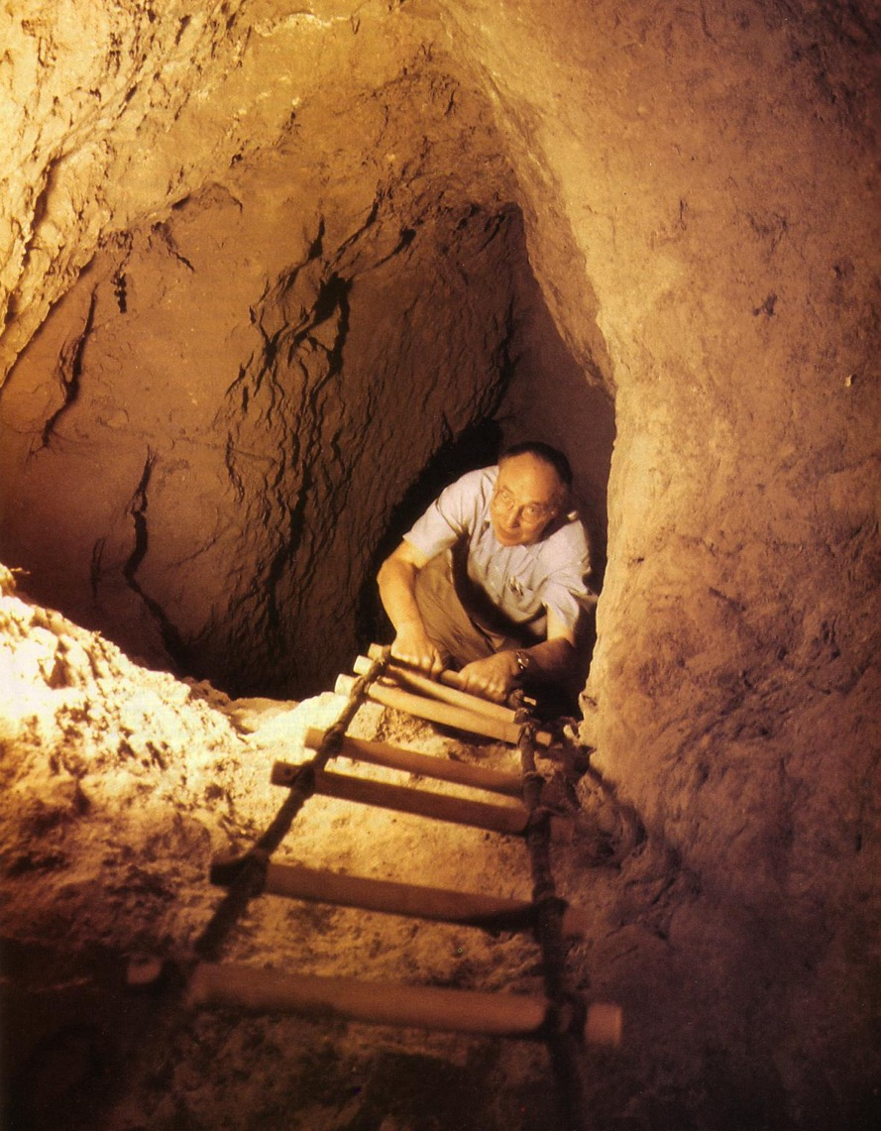
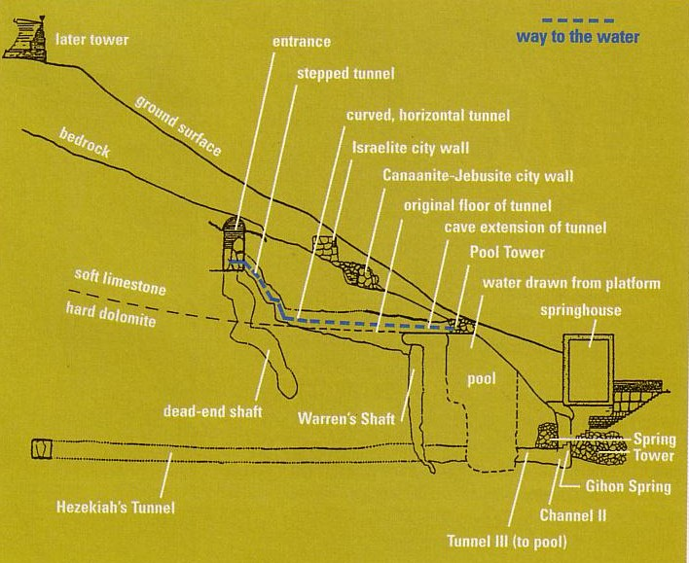
Warren's Shaft
31-34
Notes:
BAR Nov/Dec 1999

Slide 43



Transmission of Scripture
207
Masoretic Isaiah Scroll
Isaiah AD 1000
1200 years earlier!
Isaiah 200 BC
Dead Sea Isaiah Scroll

Slide 44
ISAIAH: QUMRAN v. THE MASORETES
200 BC
AD 1000
Of the 166 Hebrew words in Isaiah 53, only seventeen letters in Dead Sea Scroll 1QIsb differ from the Masoretic Text:
10 letters = spelling differences
4 letters = stylistic changes
3 letters = added word for "light" (vs. 11)
17 letters = no affect on biblical teachings
Geisler & Nix, Intro to the NT, 382

Slide 45


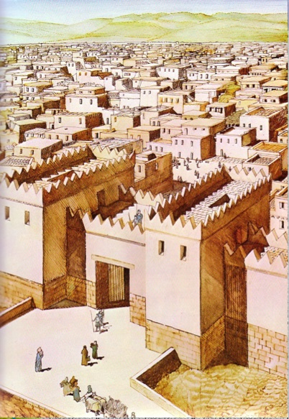
Better Interpretation of Scripture
208 (b) 3
Better Interpretation of Scripture
Hazor

Slide 46

Value of Biblical Archaeology
206-8
Value of Biblical Archaeology
Confirmation of Biblical History (cf. OTB, 201-4)
Confirmation of Transmission of Scripture
Insight into Interpreting Scripture
Source of Revenue for Israel & Her Neighbors

Slide 47

Dangers of Biblical Archaeology
209-210
Priority: Will one first accept the Bible or archaeology?
Subjectivity: Bias is a problem for liberal and conservative alike
Incomplete Record: Most of the Bible cannot be proven by archaeology

Slide 48
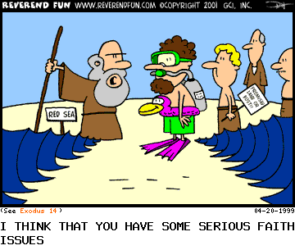
The Exodus Took Faith!
I think you have some serious faith issues.

Slide 49
Dangers of Biblical Archaeology
211
Priority: Will one first accept the Bible or archaeology?
Subjectivity: Bias is a problem for liberal and conservative alike
Incomplete Record: Most of the Bible cannot be proven by archaeology
Complexity: Biblical archaeology is the oldest, most complicated, most stratified, least substantiated type

Slide 50
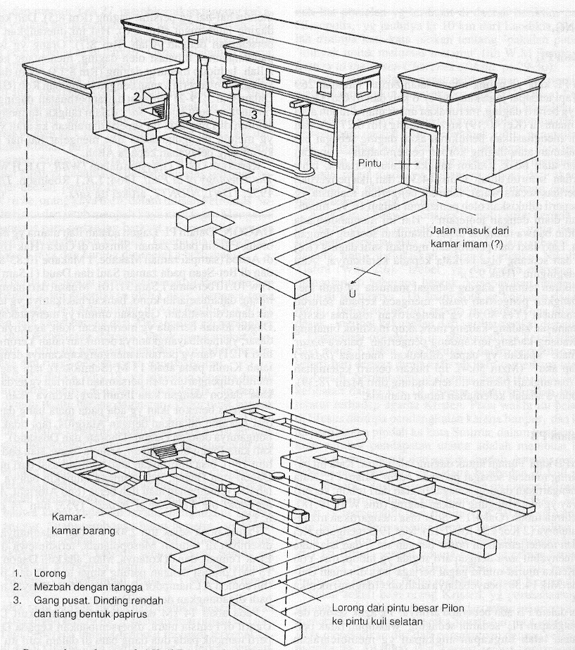
The Temple of Dagan

Slide 51

Dangers of Biblical Archaeology
211
Priority: Will one first accept the Bible or archaeology?
Subjectivity: Bias is a problem for liberal and conservative alike
Incomplete Record: Most of the Bible cannot be proven by archaeology
Complexity: Biblical archaeology is the oldest, most complicated, most stratified, least substantiated type
Limited Apologetic Value: It cannot prove God's existence or create faith in Christ

Slide 52
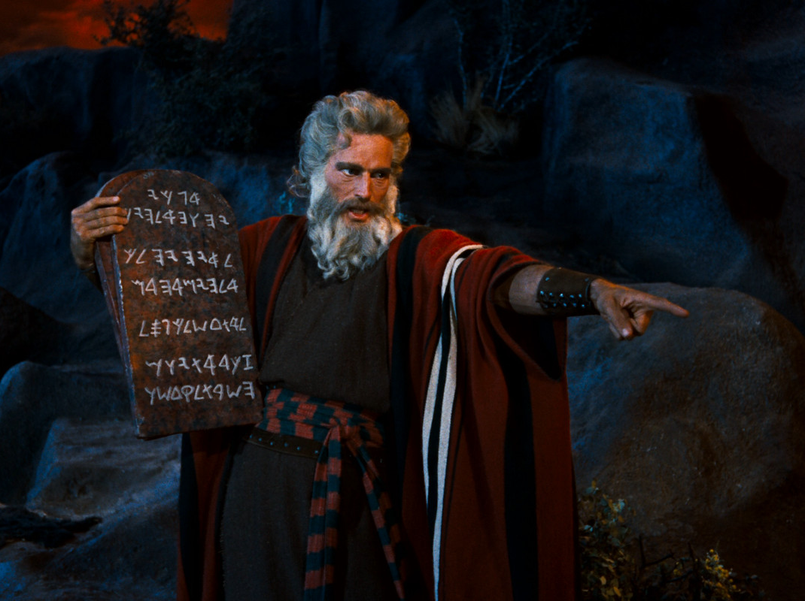
Can archaeology prove Moses received the Ten Commandments?

Slide 53
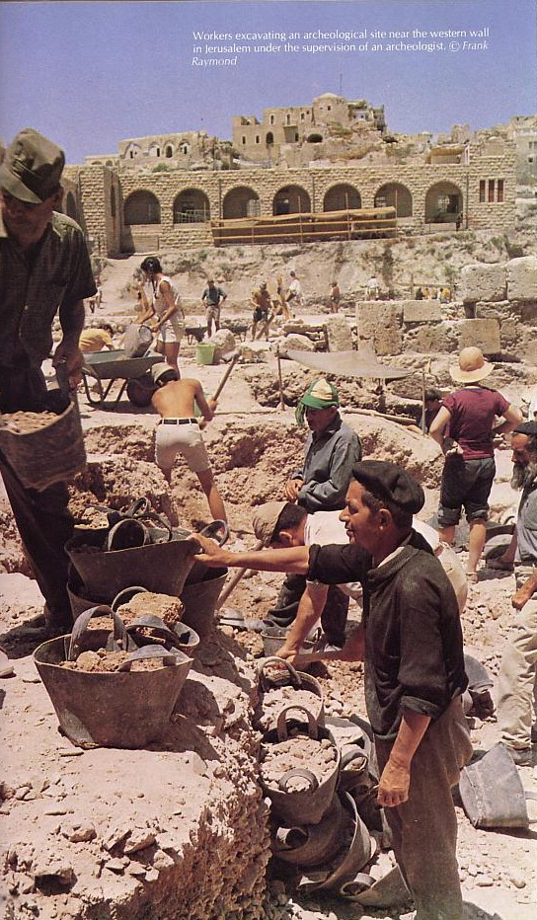
The Future of Biblical Archaeology
Excavating Jerusalem's Western Wall
Archaeology will never end

Slide 54
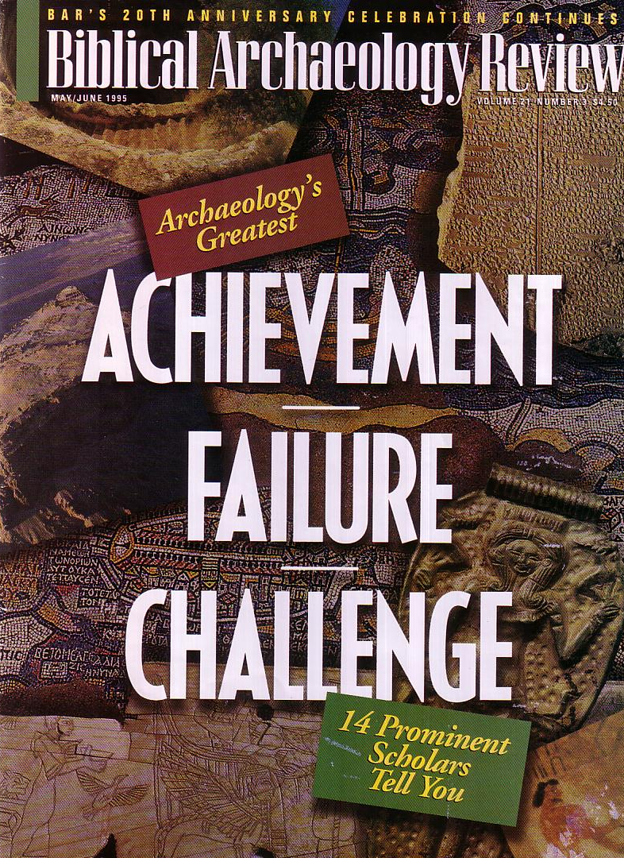
BAR
216
The most popular archaeology magazine began in 1975

Slide 55
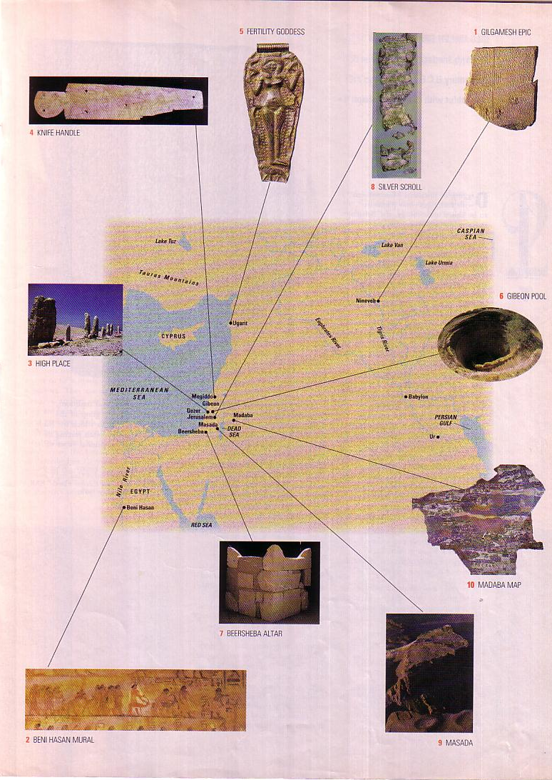
10 Great Finds
216
This BAR article by Michael D. Coogan highlights the ten most significant artifacts throughout the Middle East (May/June 1995)

Slide 56
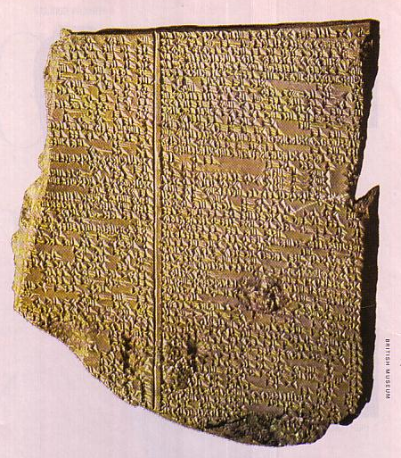
#1 Gilgamesh Epic Tablet XI
218
Nineveh, Iraq
650 BC
Flood story similar to Gen. 6–9

Slide 57
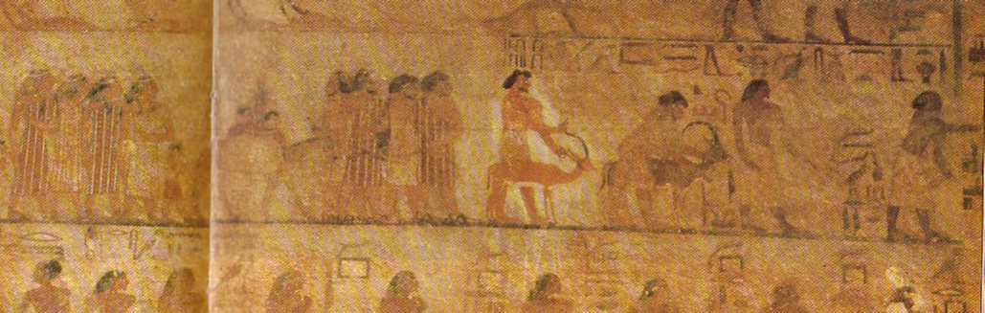
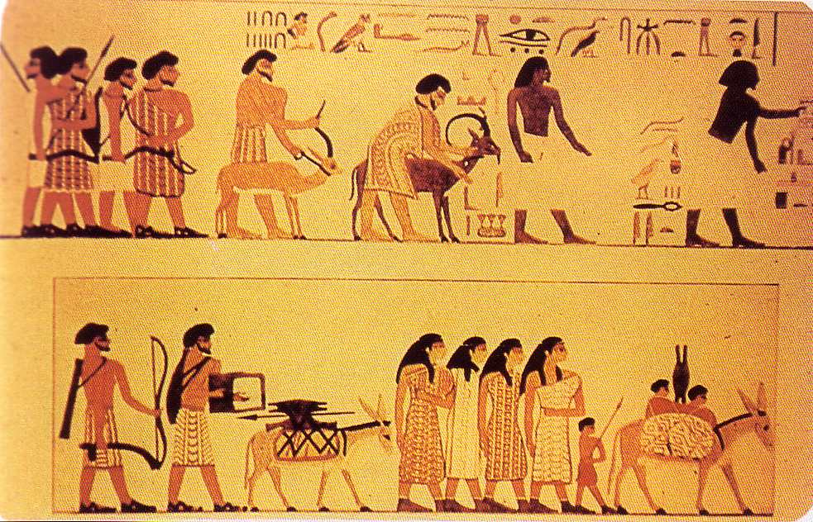
#2 Beni Hasan Mural
Two Egyptians lead the procession
(no beards)
219
Egypt
1850 BC
Attests to Israelites trading in Egypt
  Joseph story (Gen. 37–50)
  Solomon's wife (1 Kings 9:16), etc.
8 wealthy Asiatic men & 4 women follow
(note beards)

Slide 58
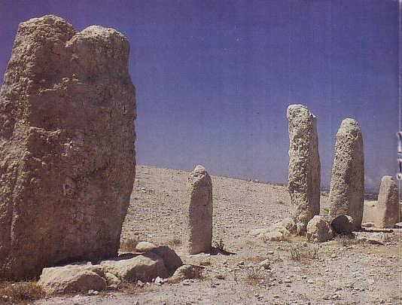
#3 Gezer High Place
220
Near Tel Aviv, Israel
1600 BC
Covenant made with stones
  Jacob & Laban (Gen. 31:43-54)
  Joshua at covenant renewal (Josh. 24:25-27)

Slide 59
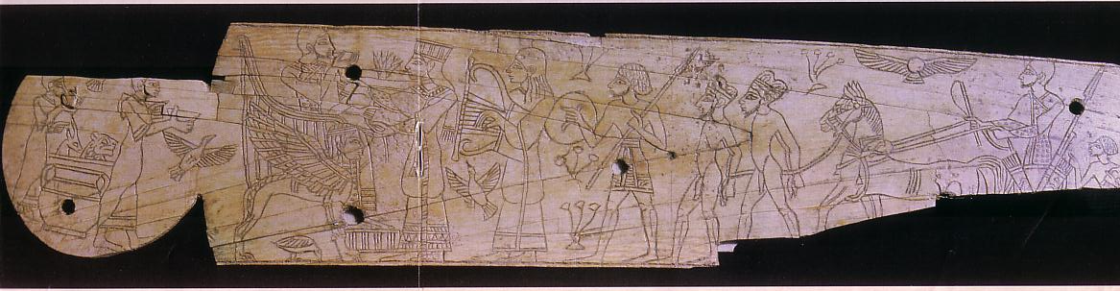
#4 Knife handle
221
Megiddo, Israel
1250 BC
Shows Egyptian control over Megiddo as well as the luxury of Canaanite royal courts akin to Solomon's (1 Kings 6:23-28; Exod. 25:17-22)

Slide 60
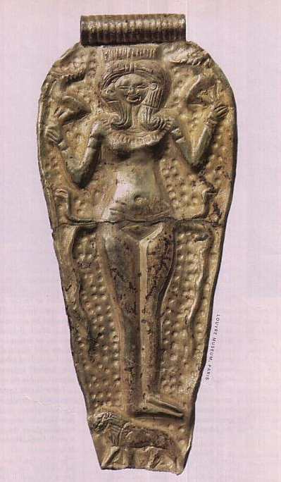
#5 Fertility Goddess Pendant
222
Ras Shamra, Syria (ancient Ugarit)
1300 BC
Ugaritic discovery in 1928 shows close linkage of Northwest Semitic cultures
Ashtart (holiness goddess) called “queen of heaven” worshipped in Israel (Jer. 7:18; 44:17-19)

Slide 61
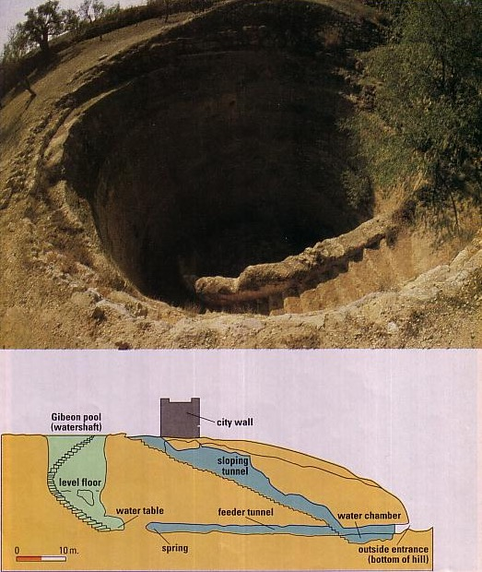
#6 Gibeon Pool
223
10 km north of Jerusalem
1050 BC
Pool noted in 2 Sam. 2:13; Jer. 41:12
Shows advanced Gibeonite engineering

Slide 62
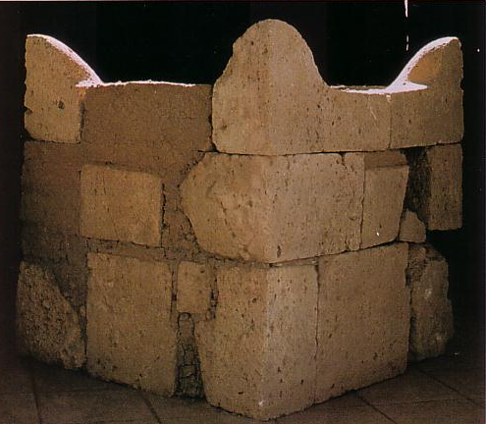
#7 Beersheba Altar
224
Near Beer-Sheba in ancient Israel's far south
750 BC
Huge (63” x 63”) altar with horns (cf. Exod. 29:12; 1 Kings 1:51; 2:28)
Pagan altar of hewn stones prohibited by Exodus 20:25

Slide 63
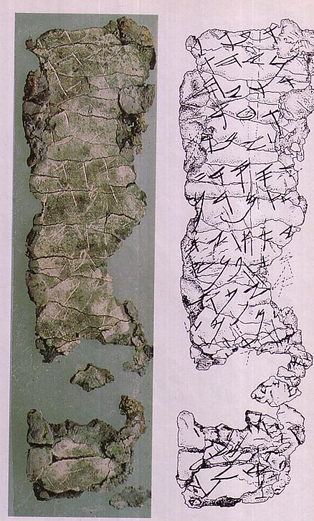
#8 Silver Scroll Amulet
225
Then the LORD spoke to Moses, saying,
"Speak to Aaron and to his sons, saying, 'Thus you shall bless the sons of Israel. You shall say to them:
The LORD bless you, and keep you;
The LORD make His face shine on you, And be gracious to you;
The LORD lift up His countenance on you, And give you peace.'
"So they shall invoke My name on the sons of Israel, and I then will bless them."
(Numbers 6:22-27)
Ketef Hinnom, near Jerusalem
650-400 BC
Earliest inscription of a biblical text
Notes:
This tells us that this section of the biblical text was used in objects prior to phylacteries of NT times.
This comes from an actual archaeological site so we know it is genuine.

Slide 64
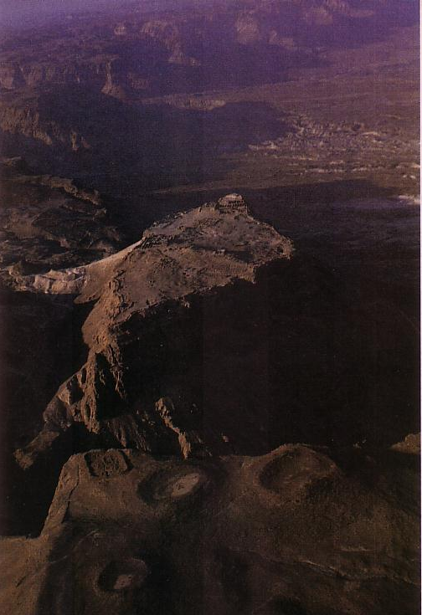
#9 Masada
226
Southwest shore of Dead Sea
150 BC
Probably David's stronghold
(1 Sam. 22:4-5)

Slide 65
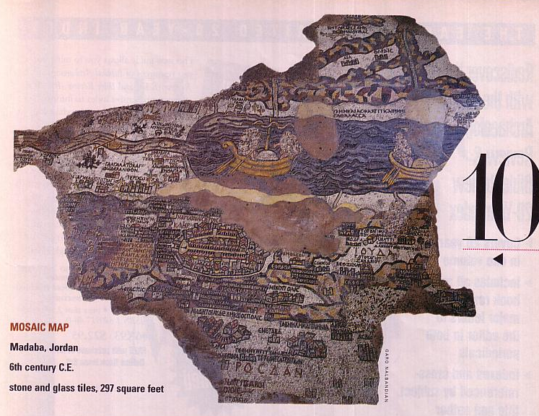

#10 Mosaic Map
227
Madaba, Jordan
AD 550
Largest & oldest map of Jerusalem, with Cardo

Slide 66


OT Backgrounds link at BibleStudyDownloads.org
Get this presentation for free!
Notes:
OT Backgrounds (ob)

Slide 67
Black

