Slide 1
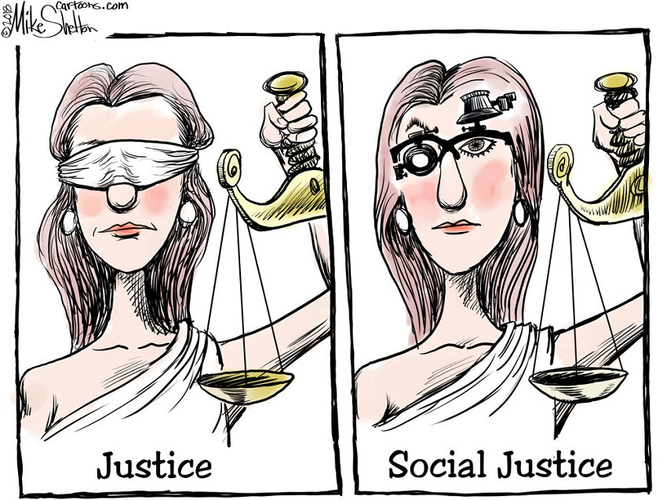
Social Justice
Justice
Social Justice
Dr. Rick Griffith • Jordan Evangelical Theological Seminary • BibleStudyDownloads.org
Notes:
The OT prophets like Amos and Isaiah and Micah and others did not prescribe a different form of “justice” based on ethnicity or wealth. Justice is blind and applies equally to all.

Slide 2
Black Lives Matter
Of course they do.
Notes:
This sequence of 16 slides appear in three OT Survey presentations:
23-Isaiah 1–23 slides 31-46
30-Amos slides 25-40
33-Micah slides 32-47

Slide 3
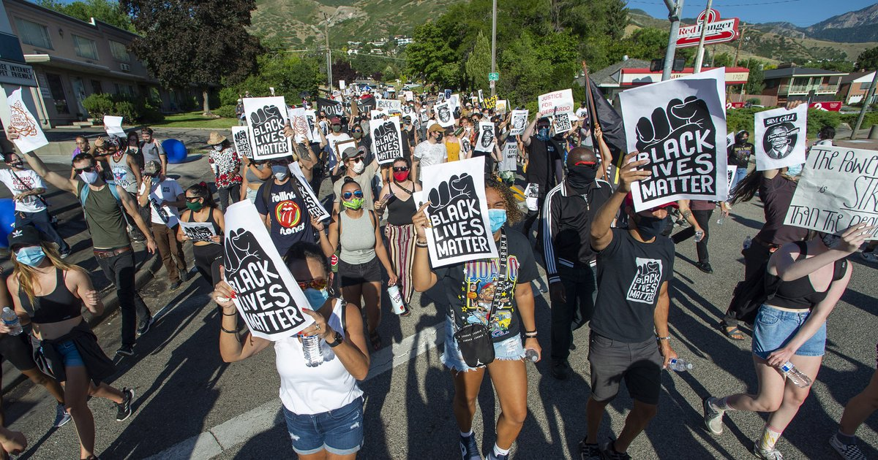
BLM on the Streets
Justice
Social Justice
Why all the protests and riots in 2020?

Slide 4
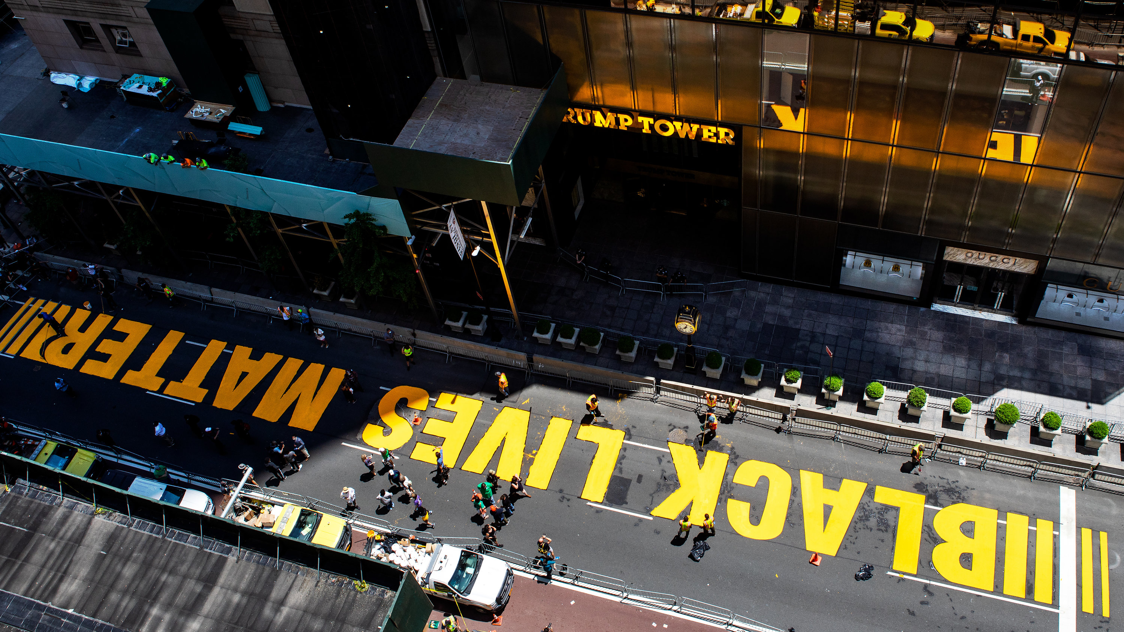
At Trump Tower, New York City
Justice
Social Justice

Slide 5
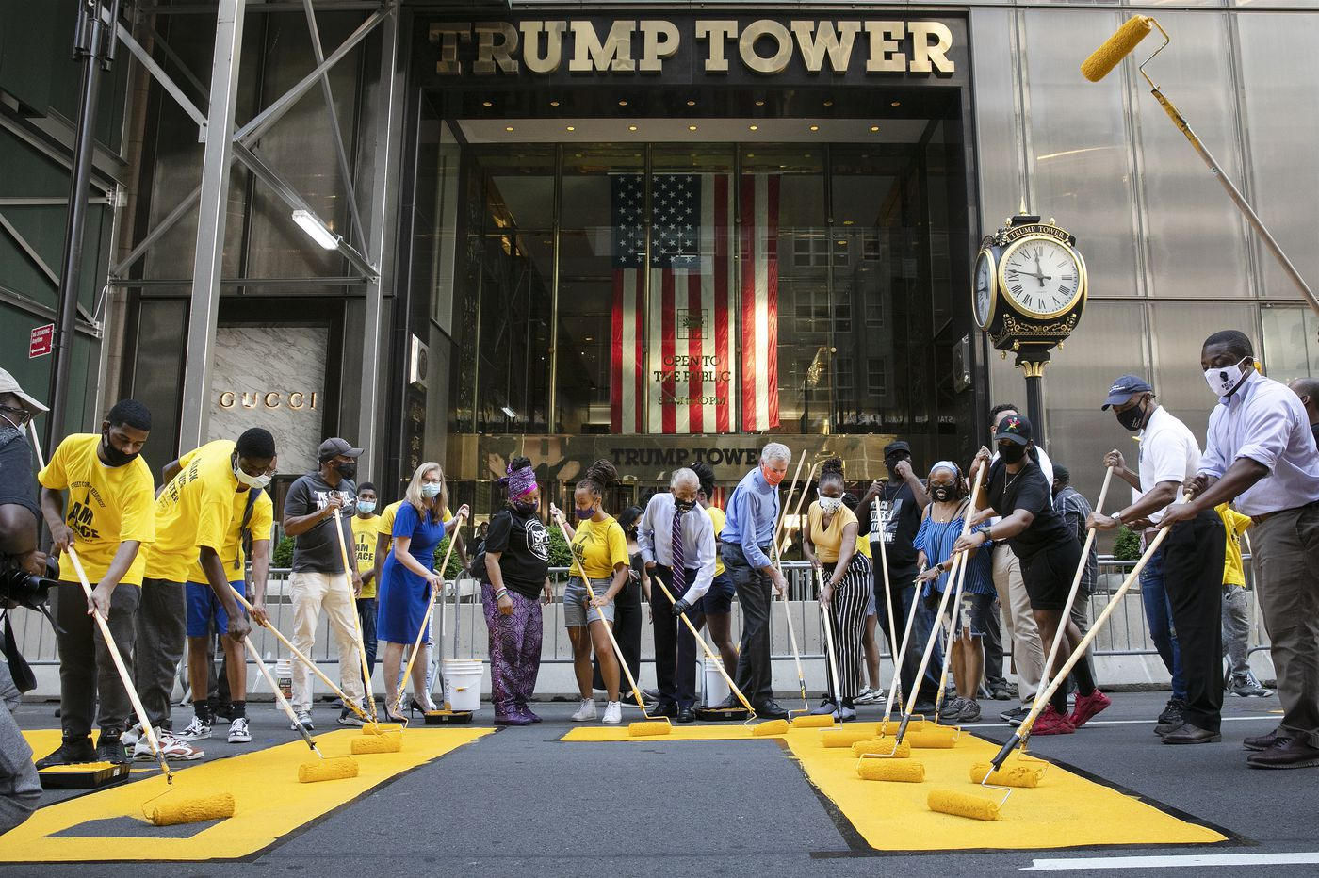
Politicians Joined the Protests
Justice
Social Justice
NYC Mayor DeBlasio

Slide 6
The Former BLM Website
We disrupt the Western-prescribed nuclear family structure requirement by supporting each other as extended families and “villages” that collectively care for one another, especially our children, to the degree that mothers, parents, and children are comfortable.
We foster a queer‐affirming network. When we gather, we do so with the intention of freeing ourselves from the tight grip of heteronormative thinking, or rather, the belief that all in the world are heterosexual (unless s/he or they disclose otherwise).
https://blacklivesmatter.com/about/ on 25 July 2020 (but boxes above deleted in Aug 2020)
Notes:
Here is the BLM website in July 2020 when the USA thought that it was a peaceful movement highlighting injustice to black people.
• Few people actually looked at this BLM website to see the boxed texts above arguing that a family with a father and mother was “Western” and not comfortable—nor normal as homosexuality is just as normal.
But once evangelical teachers actually accessed the site, the boxes disappeared along with many other disturbing tenants of the movement.

Slide 7
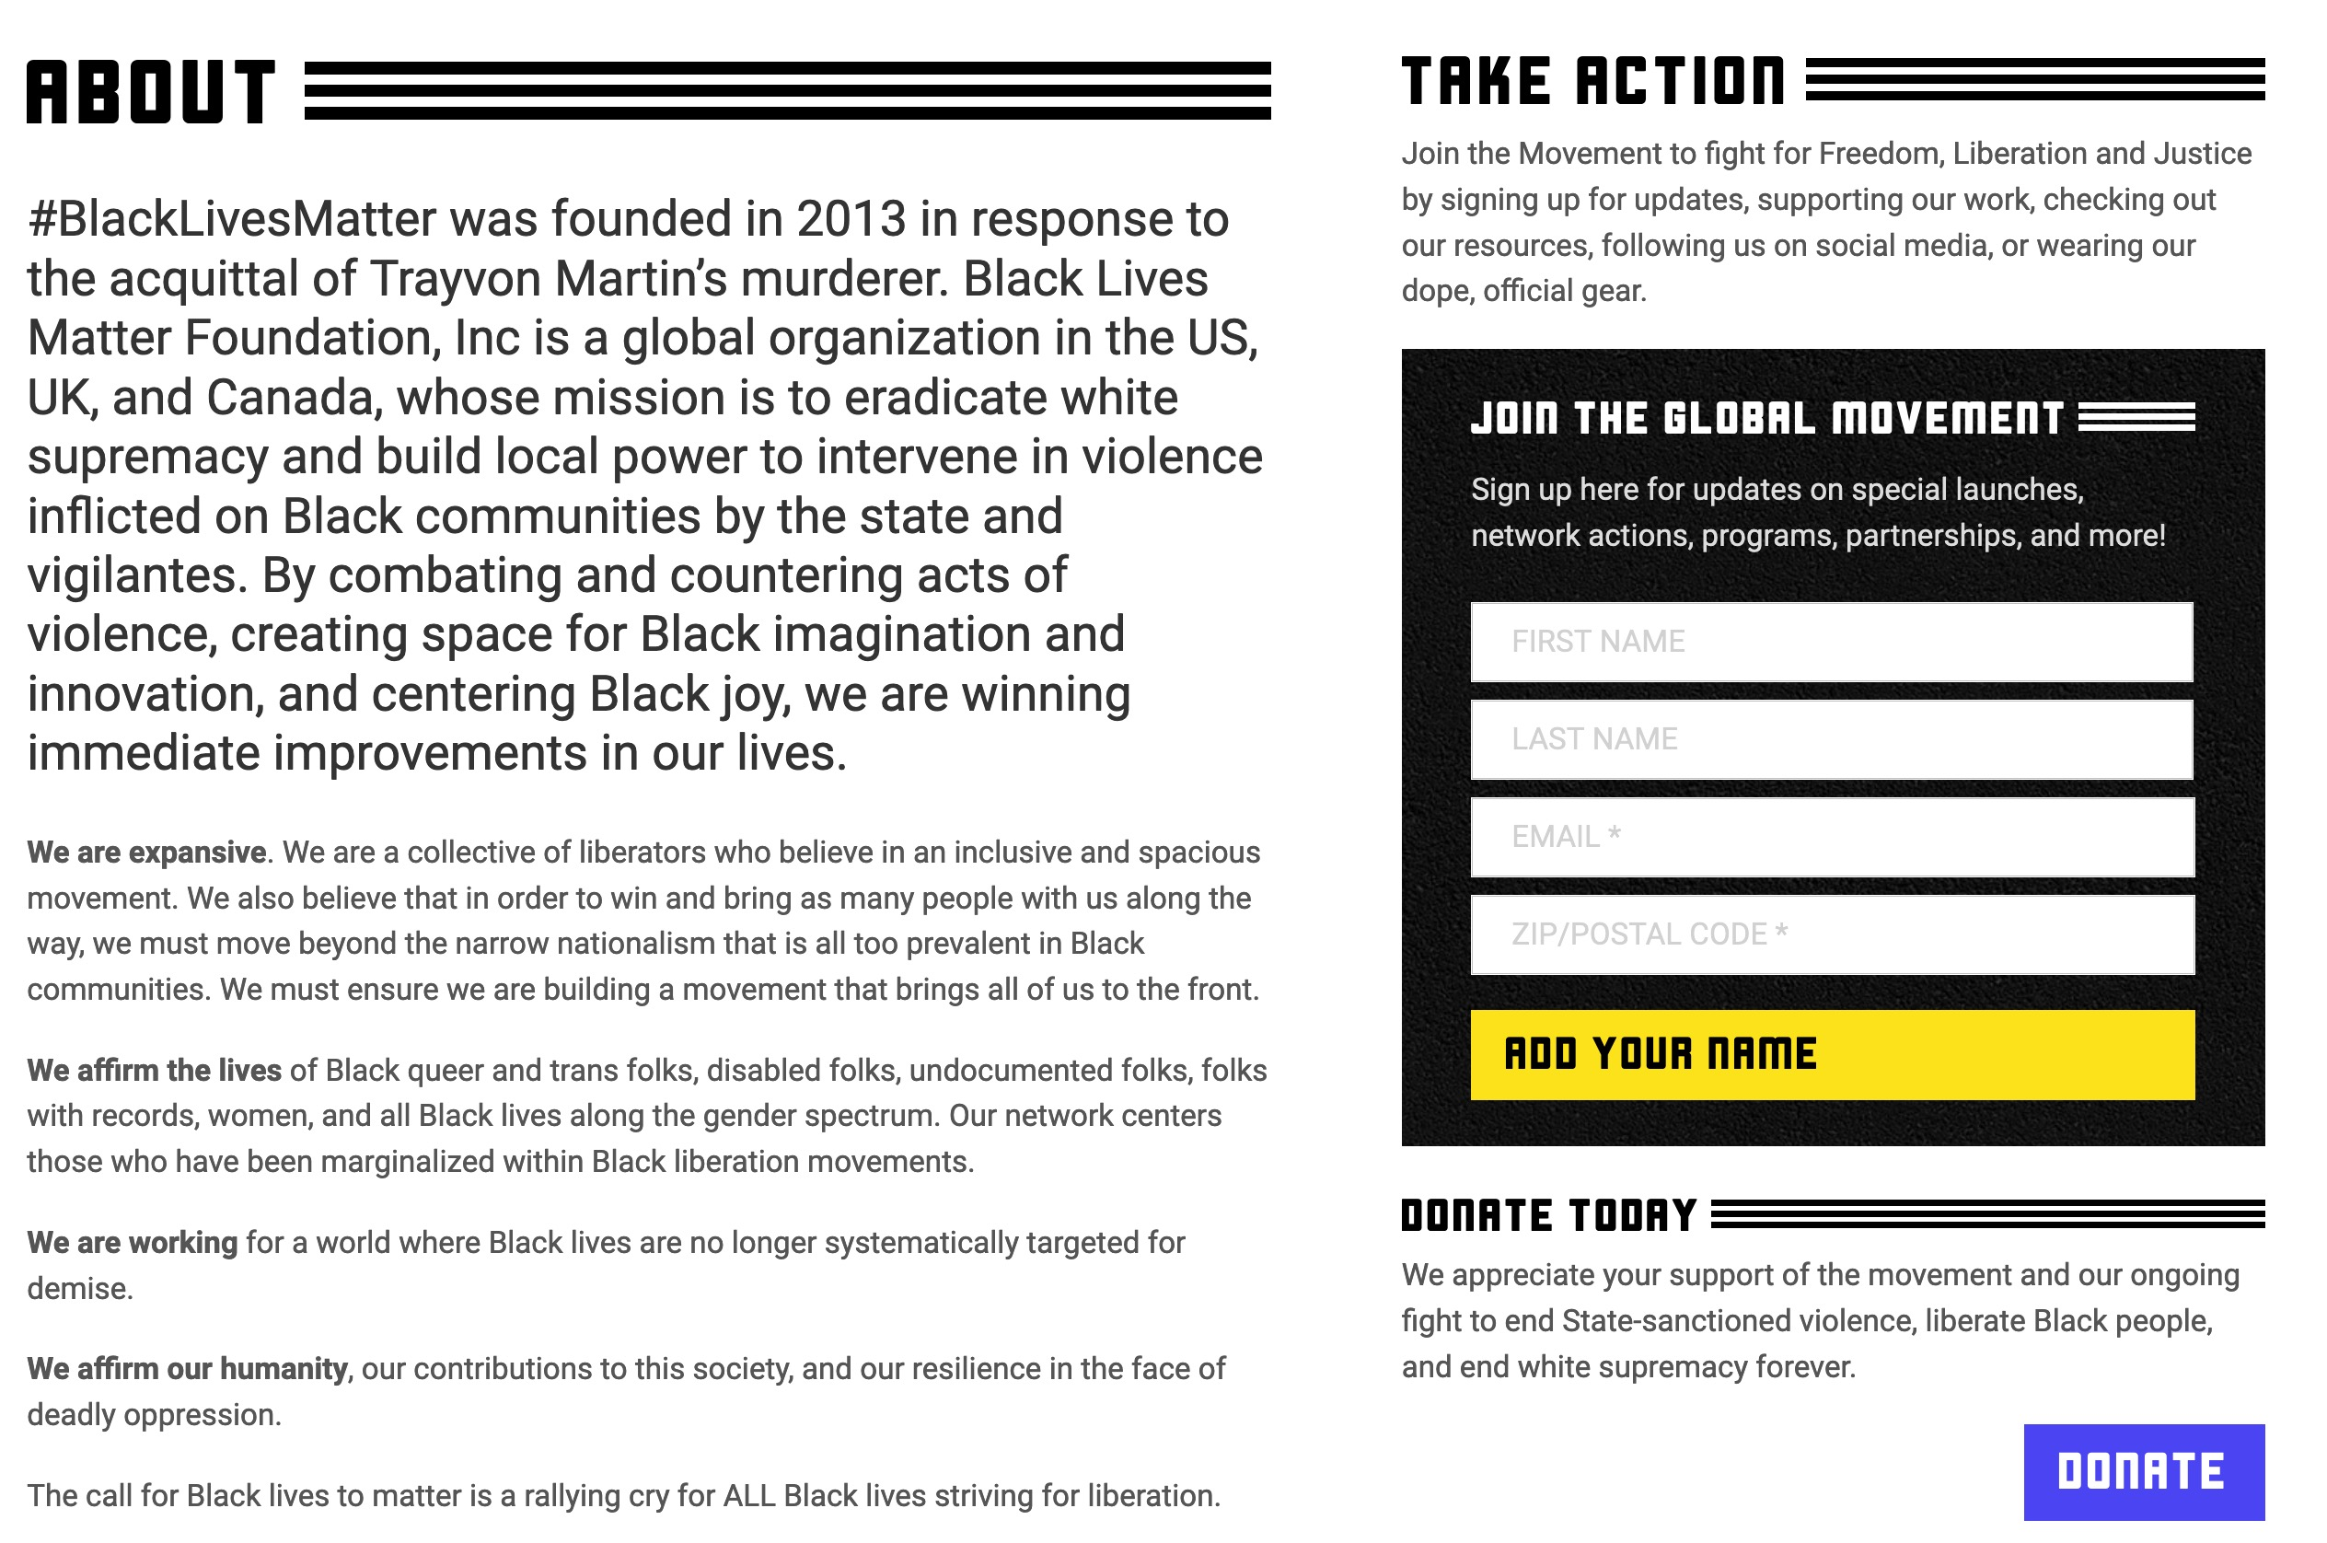
Black Lives Matter Website Updated
BLM is “combating and countering acts of violence” as BLM protests burn down the cities of America!
“We are expansive…beyond the narrow nationalism…in Black communities” says they should not be patriotic Americans.
“We affirm the lives of Black queer and trans folks…and all Black lives along the gender spectrum.”
“We are working for a world where Black lives are no longer systematically targeted for demise.”
https://blacklivesmatter.com/about/ on 3 Oct 2020
Notes:
The BLM website was thus scrubbed to affirm that
• BLM is “combating and countering acts of violence” as BLM protests burn down the cities of America!
Now only four tenants exist, though even these are problematic.
• “We are expansive…beyond the narrow nationalism…in Black communities” says they should not be patriotic Americans.
• “We affirm the lives of Black queer and trans folks…and all Black lives along the gender spectrum.”
• “We are working for a world where Black lives are no longer systematically targeted for demise.”

Slide 8
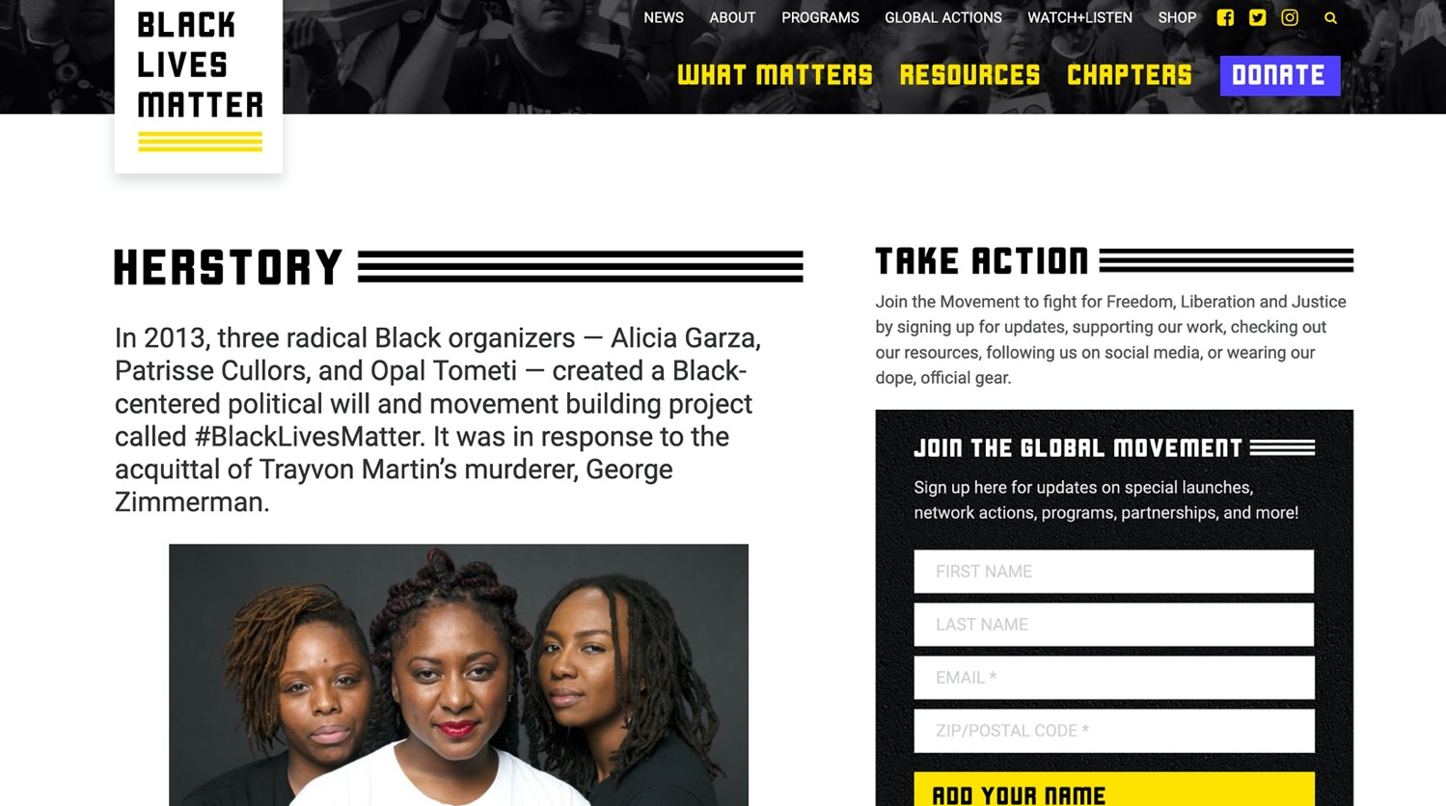
BLM Founders
In 2013, three radical Black organizers — Alicia Garza, Patrisse Cullors, and Opal Tometi — created a Black-centered political will and movement building project called #BlackLivesMatter. It was in response to the acquittal of Trayvon Martin’s murderer, George Zimmerman.
Alicia Garza
Patrisse Cullors
Opal Tometi
Lesbian
Lesbian
https://blacklivesmatter.com/about/ on 25 July 2020
Notes:
https://www.momsrising.org/blog/users/patrisse-cullors
Accessed 25 July 2020
Patrisse Cullors
Senior Fellow for Maternal Mortality
Patrisse Cullors is an artist, organizer, and freedom fighter living and working in Los Angeles, CA. Internationally known as a co-founder of Black Lives Matter, Patrisse is also the founder and a board member of Los Angeles based organization Dignity and Power Now, and the director for truth and reinvestment at the Ella Baker Center for Human Rights. She is also active in many other social justice organizations including Black Organizing for Leadership and Dignity.
A self-described wife of Harriet Tubman, Patrisse Cullors has always been traveling on the path to freedom. Growing up with several of her loved ones experiencing incarceration and brutality at the hands of the state and coming out as queer at an early age, she has since worked tirelessly promoting law enforcement accountability across the world while focusing on addressing trauma and building on the resilience and health of the communities most affected.
When Patrisse was 16 years old, she came out as queer and moved out of her home in the Valley. She formed close connections with other young, queer, women who were dealing with the challenges of poverty and being Black and Brown in the USA.
————————
https://qz.com/1391762/black-lives-matter-co-founder-alicia-garzas-definition-of-power/
How the leader of Black Lives Matter defines “power”
September 16, 2018
By Leah FesslerReporter, Quartz at Work
Alicia Garza did not intend to start the Black Lives Matter movement when she posted on Facebook after George Zimmerman, a 34-year-old mixed race man, was acquitted for murdering Trayvon Martin, a 17-year-old black child, in Sanford Florida, in February 2012. Martin was unarmed, carrying only Skittles and an ice tea.
“When George Zimmerman was acquitted… I wrote a post on Facebook that we later called ‘A Love Letter to Black People,'” said Garza, the co-founder of Black Lives Matter, while speaking at the Lesbians Who Tech Summit in New York on Sept. 13.
Garza, a black queer woman, is an Oakland-based organizer, writer, and public speaker who is currently the special projects director for the National Domestic Workers Alliance, the nation’s leading voice for dignity and fairness for the millions of domestic workers in the United States.

Slide 9
Is God Concerned for Social Justice?
“The LORD is a God of social justice.” That’s the message in maybe most churches and synagogues in America and the West today. But here’s the problem. The Bible doesn’t actually say that. It says in Isaiah, “The LORD [is a God of] justice” [Isa 5:16]. You’ll find a lot of references to justice in the Bible. But you’ll never find it preceded by the word “social.” But you’re probably thinking, “What’s the difference? Isn’t God the God of justice and social justice?” Well, not if he is consistent.
You see, God cannot be the God of “justice” and “social justice” because social justice is not just.
Justice is getting what you deserve without favor.
Social justice is getting what you don’t deserve because you are favored.
Justice is blind.
Social justice is not.
Jan Markel, “The Church: Hijacked and Infiltrated,” podcast 25 July 2020
https://www.oneplace.com/ministries/understanding-the-times/ accessed 25 July 2020
Notes:
“Let’s say a man robs a store. Justice demands but one thing—that he be tried in a court of justice and, if he is found guilty, punished.
That is not how social justice works. Social justice doesn’t only ask if the person is guilty. It asks about his economic condition. Is he poor or wealthy? About his upbringing: What kind of childhood did he have? About his race or ethnicity: Is he a member of a group that has been historically oppressed?
Justice demands that everyone be equal under the law. Social justice demands that everyone be equal—period—economically, socially, and in every other possible way. Justice asks, “Who did it?” Social justice asks, “Why did he do it?”

Slide 10
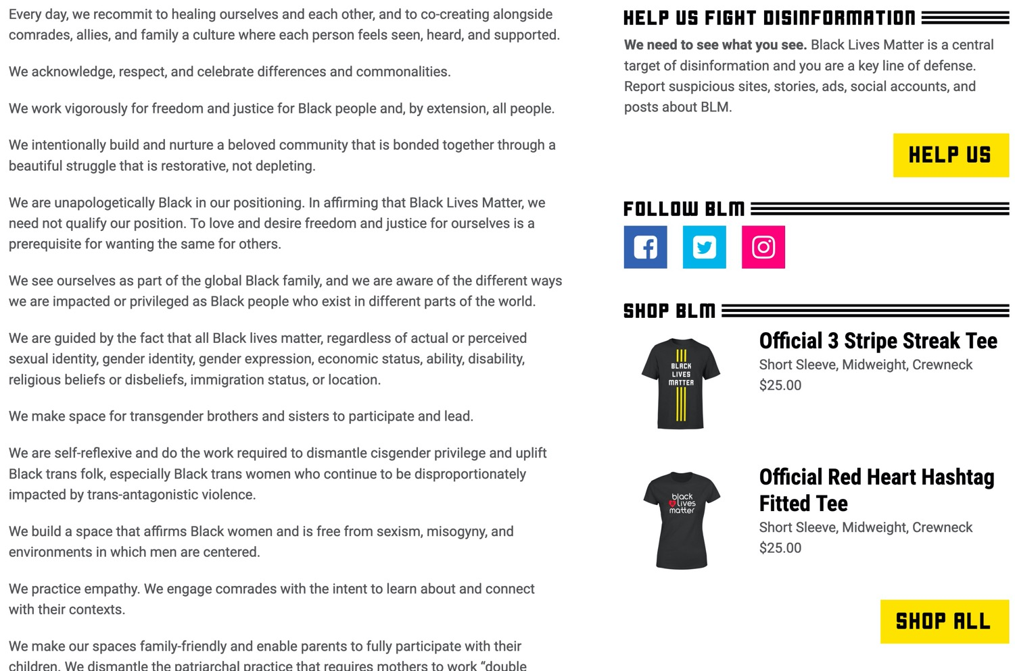
Black Lives Matter
HELP US FIGHT DISINFORMATION
We need to see what you see. Black Lives Matter is a central target of disinformation and you are a key line of defense. Report suspicious sites, stories, ads, social accounts, and posts about BLM.
Notes:
BLM knows that they must control the narrative, so they shut down all forms of opposition. Those who disagree get protesters outside their homes to threaten the families of people who expose their Marxist agenda, and they find out about such people through this link on their website.

Slide 11
Types of Justice
Justice
Social Justice
Notes:
The OT prophets like Amos and Isaiah and Micah and others did not prescribe a different form of “justice” based on ethnicity or wealth. Justice is blind and applies equally to all.

Slide 12
Distinguishing Terms
Inequality
Unequal access to opportunities
Equality?
Evenly distributed tools and assistance
Justice
Fixing the system to offer equal access to both tools and opportunities
Equity
Custom tools that identify and address inequality
Tony Ruth cited by John Maeda, “2019 Design in Tech Report” (https://designintech.report/2019/03/11/%F0%9F%93%B1design-in-tech-report-2019-section-6-addressing-imbalance/)
Notes:
How we define terms is very important. Here is one depiction popular in 2020. Some USA examples:
• INEQUALITY: Blacks were slaves until 1865 and could not go to evangelical seminaries until the 1960s.
• EQUALITY: Laws in the 1960s allowed blacks into all schools—but they didn't have the money so the system (tree) still tilted towards whites.
• EQUITY: Scholarships were then offered to blacks for schooling—but the system (tree) still tilted towards whites, who had a better education before seminary.
• JUSTICE: Schools do not even know the ethnicity of applicants are thus are blind to any favoritism.

Slide 13
Critiquing the Inequality Tree
Inequality
Unequal access to opportunities
Richard Leong, “The problem with that new equity vs. equality cartoon you’re sharing,” 26 May 2020 (https://medium.com/@leong.richard212/the-problem-with-that-new-equity-vs-equality-cartoon-youre-sharing-f1ebdfc793e8)
Notes:
“In this first panel, inequality is shown as a bent over tree with the apples growing on only one side. The figure on the right stands questioning while the one on the left effortlessly waits to catch falling apples. My first issue here is that using a bent tree as a metaphor for inequality suggests that today’s staggering levels of inequality are at some level natural and to be expected, just as one expects a tree to grow naturally, when nothing could be further from the truth. As I write this in May of 2020, the coronavirus has killed three black Americans for every one white American, a disparity that goes back to redlining and the exclusion of black WWII veterans from the benefits of the GI Bill. There is nothing accidental about today’s inequality. It is a reflection of intentional systems of oppression established in the past that continue today to privilege rich white men.”

Slide 14
Critiquing the Justice Tree
Justice
Fixing the system to offer equal access to both tools and opportunities
Richard Leong, “The problem with that new equity vs. equality cartoon you’re sharing,” 26 May 2020 (https://medium.com/@leong.richard212/the-problem-with-that-new-equity-vs-equality-cartoon-youre-sharing-f1ebdfc793e8)
Notes:
“Armed with our understanding that this tree didn’t just grow this way, that somebody (probably the ancestors of the one on the left) must have manipulated the tree to grow to one side, we can extend this critique to how justice is depicted. With braces and a pulley, the tree has now been balanced out and both figures can access an equal distribution of fruit. This is lovely, but I’m confused as to why the ladders would be necessary at all if the system is truly bent towards justice? Moreover, I’m most concerned with how this depiction implies that broken and unjust systems are salvageable — that with a little bit of push and pull they can be “fixed” as the caption relates.
This simply isn’t true. Driving equity and justice isn’t about tinkering with systems that just ended up being imbalanced, it’s about dismantling oppressive systems that are working exactly as they were designed. I often tell people, we are building a world that has never existed before. To achieve justice we must be open to change that can be deeply radical and transformative.
This is why I begin DEI work not with statistics and strategic plans, but with individual conversations. If they are to take the challenge of equity work seriously, leaders must exemplify self-awareness, open-mindedness, and the courage to listen and change when challenged.
There are a host of other questions we could discuss about these cartoons. What should it look like if not a tree? What does it look like when there are not two people trying to pick apples, but two entire communities? Thinking about history and restorative justice, where was this tree planted and should it be moved?
If it feels like I’m making this incredibly complicated, that’s because it really is that complicated.”

Slide 15
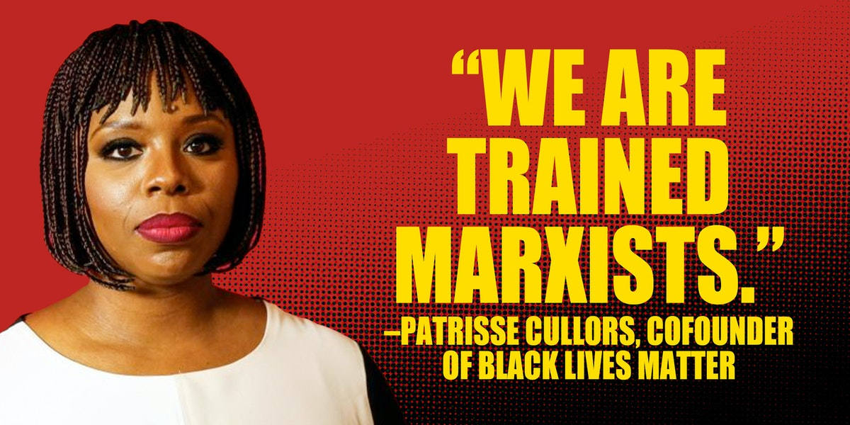
Communist Ideology
Justice
Social Justice
Notes:
In Racial Reconciliation, What Matters Is Truth
Black Lives Matter has roots in radical Marxism and "fundamental transformation."
Robin Smith • Jun. 22, 2020 • The Patriot Post
https://patriotpost.us/articles/71566-in-racial-reconciliation-what-matters-is-truth-2020-06-22
Accessed 4 October 2020
"Last week, a prominent black supremacist declared that she and her colleague “are trained organizers.” In fact, she said, “We are trained Marxists. We are super versed on ideological theories.”
In Marxism, capitalism is framed to be an exploitive, oppressive societal problem. A communist economy, the goal of Marxism, emphasizes cooperative ownership of property with no private-property rights or personal wealth. The popular slogan of Karl Marx sums it up: “From each according to his ability, to each according to his needs.” But that doesn’t fully reflect the fact that the German economist, along with his comrade, Friedrich Engels, coauthor of The Communist Manifesto, taught that socialism was the necessary first step to communism where all divisions of class would be erased.
Patrisse Cullors, one of the two cofounders of the so-called “Black Lives Matter” movement, made clear their Marxist foundation. The other founder, Alicia Garza, in a 2018 feature on Blackpast.org, has already identified herself as “a queer social justice activist and a Marxist.”
Thinking they are aiding racial and social justice, corporate giants and the political left are now carelessly funding these “trained Marxists” who lead 16 chapters of BLM in the U.S. and Canada in the disruption of commerce and the destruction of small and large businesses. No one is defending racism or the deaths of innocent black men, but BLM and antifa have hijacked the emotions stirred by select recent deaths to promote the very behaviors and practices that keep minorities trapped in government dependency.
Andrew Klavan of The Daily Wire wrote in an analysis of the Black Lives Matter movement that “The Racial Matrix” is “an entirely false narrative in which just those very prescriptions that will make black lives worse provide whites a sense of virtue while continuing the Democrat destruction of actual black lives.”
Neither BLM tactics of anger-baiting nor the virtue signaling of guilty whites will help. We should instead be identifying problems, working with leaders for solutions, and moving the underprivileged toward independence.
BLM as an organized movement has a Marxist devotion to a new world order destroying America’s economic freedom and, even more contemptibly, the freedoms of individual Americans. Its own website uses the word “comrades” to describe a new order where “we disrupt the Western-prescribed nuclear family structure requirement by supporting each other as extended families and villages that collectively care for one another.” BLM makes it clear that encouraging self-reliance and freedom from government dependency is not at all a priority. These radicals have no belief that an intact family, personal property, personal wealth, and achievement are healthy rights. And because of this, they do not promote a sense of personal accomplishment or greater attainment in the next generation. Our government housing projects are, in many cases, now full of third- and fourth-generation residents.
Many blacks are tired of BLM’s leftist political agenda because it will only lead to harm for their community. Niger Innis recently exploded, “I’ll be g-dd-mned if you use the suffering and misery of black Americans and our legacy to the United States of America as your shield and use us as cannon fodder when your agenda really has not a d—n thing to do with saving black lives.” Leo Terrell, racial activist and lawyer, insisted that a “criminal element” has taken over the protest movement that began with the death of George Floyd.
Ultimately, what will succeed in healing the racial divide is not the Marxist lies being peddled. It’s authentic truth that withstands subjective opinion and bias.”

Slide 16
Marxists Need Capitalists
MY, WHAT BIG TEETH YOU HAVE
Justice
Social Justice
Notes:
BLM needs the business community but corporate America does NOT need any more looting of their businesses, scaring away customers, and destruction of the livelihood of small business owners who are both white and black.

Slide 17
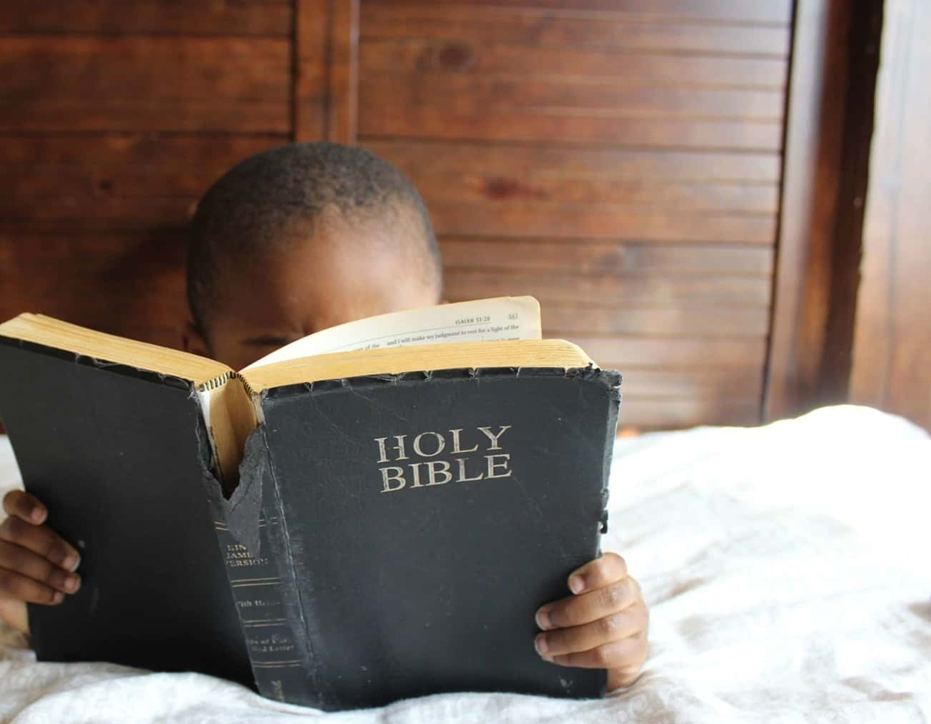
Evaluating BLM Biblically
BLM rejects God like all Marxist philosophies
BLM rejects the family
BLM rejects country
BLM disrespects property
God says to live in peace—not riot against others (1 Tim 2:24)
Notes:
Who cares what you and I think of the BLM Movement? What really matters is what God says.

Slide 18
Black

Slide 19
NT Criticism link at BibleStudyDownloads.org
Get this presentation for free!
Notes:
NC Criticism (nc)

