Slide 1
The Role of Women in the Church
Dr. Rick Griffith • Jordan Evangelical Theological Seminary • BibleStudyDownloads.org

Slide 2
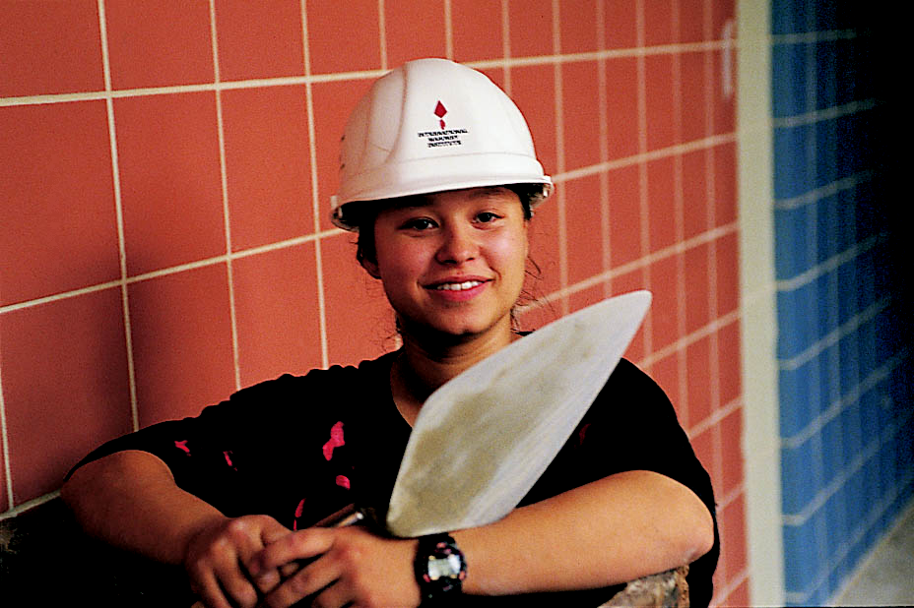
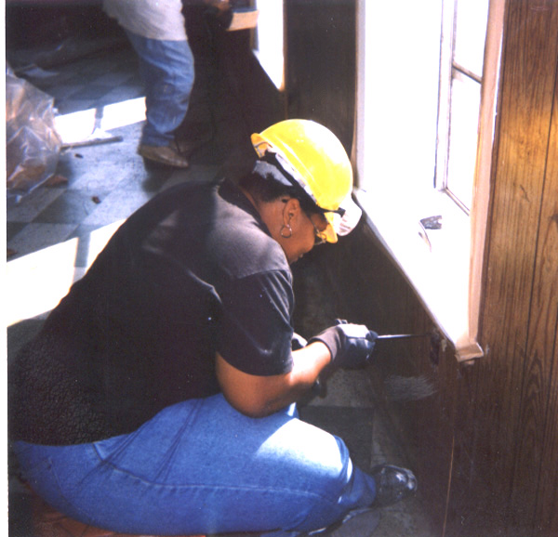
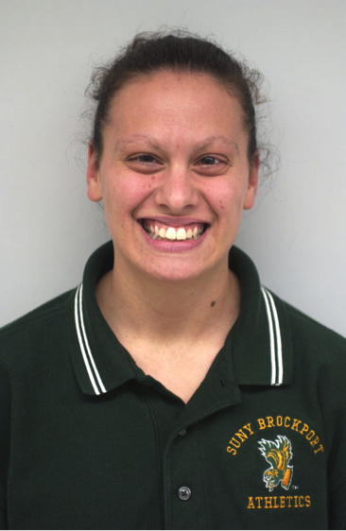
WOW
Bricklayer
(Wider Opportunities for Women)
Electrician
Carpenter
Coach
Notes:
2
www.work4women.org/multimedia/ photos.cfm

Slide 3
in the society
…there are more and more women leaders !

Slide 4
in the church
… we also have many women leaders!

Slide 5
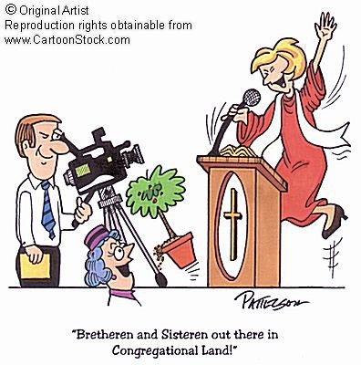
"Brethren and Sisteren out there in Congregational Land!"

Slide 6
Do men and women have the same roles in the church?

Slide 7
Androgyny
In Corinth and many nations today
Should men and women have different roles in the church and society?
Notes:
Buddhism diminishes the differences between men and women to the extent that we cannot tell the sex of some of their teachers.

Slide 8
My, how language has changed…
Mankind
Humankind
Stewardess
Flight Attendant
Fireman
Fire Fighter
The Past
The Present
Policeman
Police Officer
Boss
Bosset

Slide 9
What's a Woman to Do?
138
Note: The context of all three passages below is public worship.
It looks like 1 Cor. 11 contradicts 1 Cor. 14 and 1 Tim. 2.
1 Cor. 11 | 1 Cor. 14 | 1 Tim. 2
Can pray publicly (11:5, 13) |  | Public prayer for men only (2:8)
Can prophesy (11:5) | Speaking is prohibited (14:34) | Must be silent (2:12c)
Speaking is OK (implied) | Speaking is disgraceful (14:35)
 |  | Can't teach men (2:12a)
 |  | Can't have authority over men (2:12b)
Veils universal practice (11:16) | Silence universal practice (14:33) | Men praying universal practice (2:8)
Which text is the general rule (norm) and which is the exception?
To see how people have tried to solve these apparent contradictions, see the next 7 pages of the notes!

Slide 10
1 Tim. 2:12

Slide 11
"I do not permit a woman to teach or to have authority over a man; she must be silent."
1 Tim. 2:12 NIV

Slide 12
1 Cor. 14:33-34

Slide 13
"As in all the congregations of the saints, ﻿ women should remain silent in the churches. They are not allowed to speak, but must be in submission, as the Law says."
1 Cor. 14:33-34 NIV

Slide 14
"My own conclusion… the Bible does not permit women to function in the role of pastor or elder within a church."
Wayne Grudem, Systematic Theology, Inter-Varsity Press, 937

Slide 15
Egalitarians
Complementarians
NT Wright
Ben Witherington III
Gordon Fee
Scot McKnight
Ruth A. Tucker
Walter C. Kaiser
Jim Wallis
Rachel Held Evans
Gilbert Bilezikian
J.I. Packer
Tim Keller
John F. MacArthur
C.S. Lewis
John Piper
John Wimber
Mark Driscoll
Elisabeth Elliot
Wayne Grudem
vs
Notes:
Egalitarians see no difference between men and women in their roles in the church so that women may serve equally as pastors, elders, etc.
Complementarians see women as complementing man's leadership roles as elders/pastors but not holding these positions themselves.

Slide 16
Common Ground
This isn't as fundamental as the virgin birth, deity of Christ, salvation by grace…
We all agree to disagree in love
We all learn from God's Word through others in public settings

Slide 17
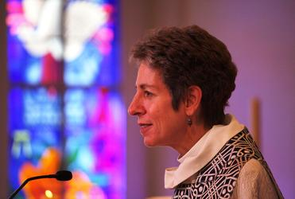
"Beyond the Politics of Pandora's Pulpit"

Slide 18
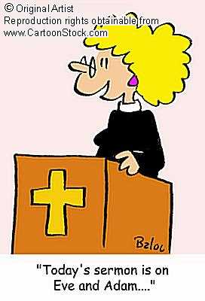
A look at two sides…
Women can and should take the key leadership role in the church
?
Women should not take the key leadership role in the church

Slide 19
Women can and should take the key leadership role in the church
Basis
Strengths
Weaknesses
Implications

Slide 20
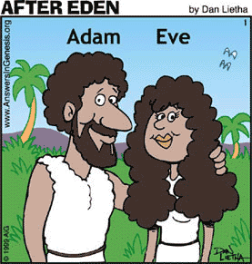
Women can and should take the key leadership role in the church
In the beginning ….
God created man and woman equal.
Genesis 1:27
Basis

Slide 21
Women can and should take the key leadership role in the church
God commanded ….
man and woman to rule over the earth.
Genesis 1:26
Basis

Slide 22
Women can and should take the key leadership role in the church
When man sinned ….
there was a change
in relationship,
but not in authority.
Genesis 3:16
Basis

Slide 23
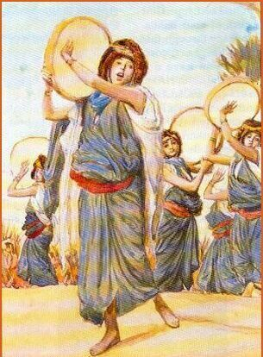
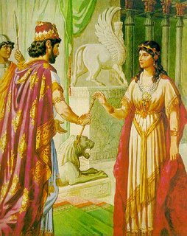
Women can and should take the key leadership role in the church
In the Old Testament…
there were
women leaders
(e.g., Miriam,
Deborah, Esther)
Basis

Slide 24
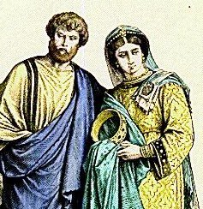
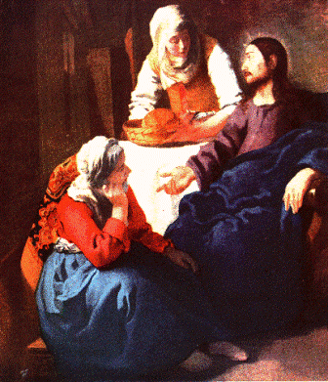
Women can and should take the key leadership role in the church
In the New Testament…
there are
women leaders
(e.g. Mary, Priscilla,
Junia)
Basis

Slide 25
Women can and should take the key leadership role in the church
Father – Jesus relationship …
= man – woman relationship.
Basis

Slide 26
Women can and should take the key leadership role in the church
Church can benefit from many gifted women.
+ women leaders show:
endurance
caring
intuition
Strengths

Slide 27
Women can and should take the key leadership role in the church
Paul opposed women's leadership in the church.
1 Corinthians 14:34-35
1 Timothy 2:11-14
They lacked biblical instruction?
Too emotional?
No public acceptance?
Weaknesses

Slide 28
Women can and should take the key leadership role in the church
Women can become :
Worship Leader
Pastor/Teacher
Elder
Deacon
Implications

Slide 29
Women should not take the key leadership role in the church
Basis
Strengths
Weaknesses
Implications

Slide 30
Women should not take the key leadership role in the church
In the beginning ….
God created Adam first, then Eve.
God created woman from man and for man
Genesis 2:18, 21 1 Tim. 2:13, 1 Cor. 11:8-9
Basis

Slide 31
Women should not take the key leadership role in the church
God commanded…
man and woman
to rule over the earth,
but it does not imply
that they have the same roles.
Genesis 1:26
Basis

Slide 32
Women should not take the key leadership role in the church
In the beginning…
women was deceived by Satan first, not man.
1 Timothy 2:14
Basis

Slide 33
1 Timothy 2:11-15
142
¹¹A woman should learn in quietness and full submission. ¹²I do not permit a woman to teach or to have authority over a man; she must be silent.
¹³For Adam was formed first, then Eve. ¹⁴And Adam was not the one deceived; it was the woman who was deceived and became a sinner. ¹⁵But women {Gr. she} will be saved {or restored} through childbearing-- if they continue in faith, love and holiness with propriety.

Slide 34
Women should not take the key leadership role in the church
When man and woman sinned…
God asked
the man first
(assuming man
as the leader)
Genesis 3:9
Basis

Slide 35
Women should not take the key leadership role in the church
In the Old Testament…
women took
the main leadership role only for
special cases.
Basis

Slide 36
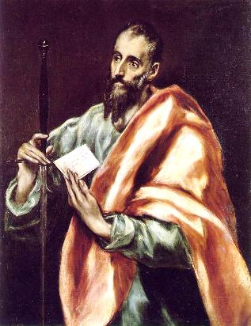
Women should not take the key leadership role in the church
In the New Testament…
Paul did not allow
women teachers in the congregational worship or women elders.
1 Corinthians 14:34-35
1 Timothy 2:11-15–3:2
Basis

Slide 37
Women should not take the key leadership role in the church
Another reason might be…
Woman can also be enticers or enticed to evil, but men can be equally enticed.
Isaiah 3:16 Acts 13:50
Basis

Slide 38
Women should not take the key leadership role in the church
… in a marriage
husband (man)
is the head
of the wife (woman).
Ephesians 5:22-23
Basis

Slide 39
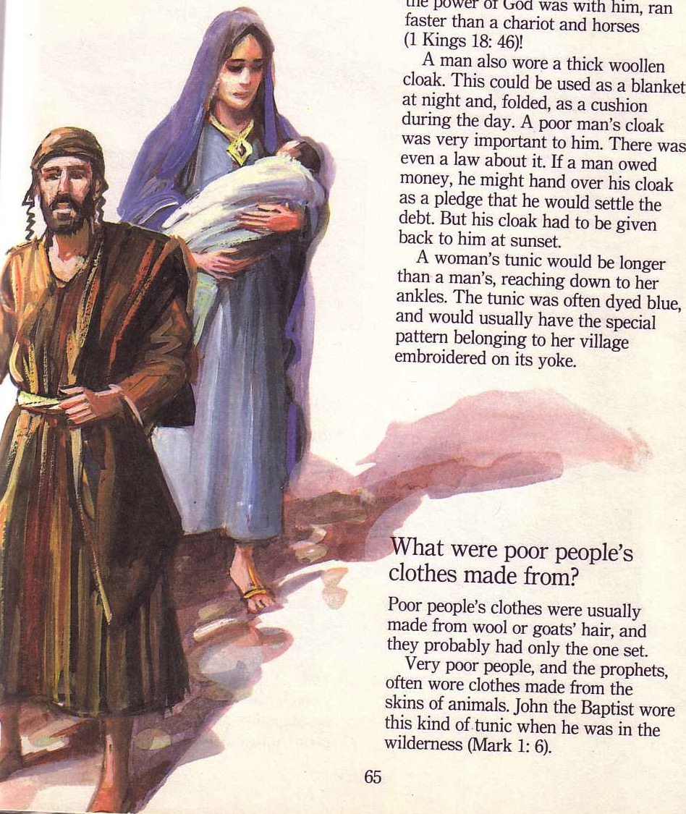
Paul's Teaching...
Men and women are equal but different--so the church must maintain these sexual distinctions.
But why?
1 Corinthians 11

Slide 40
Resisting sex distinctions shames our authorities.
Why maintain distinctions?

Slide 41
Why maintain distinctions?
Wrong use of a head covering at the church of Corinth shamed their authorities (1 Cor. 11:3-6).

Slide 42
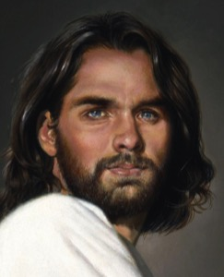
God's Authority Structure
God
Christ
"The head of every man is Christ, the head of woman is man, and the head of Christ is God" (1 Cor. 11:3 NLT)
Husband
Wife

Slide 43
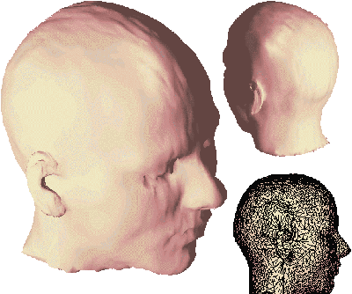
What does "head" mean?
Notes:
43

Slide 44
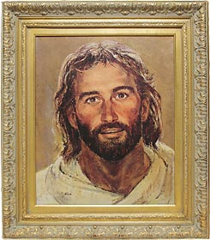
What does "head" mean?
"source"?
"authority"?
But no Greek lexicons support the meaning of "source without authority" in the 2,336 occurences of this word in all Greek literature! The consistent meaning is "authority over, ruler, leader."
Notes:
44

Slide 45
1 Corinthians 11:5-6 NLT
"But a woman dishonors her head if she prays or prophesies without a covering on her head, for this is the same as shaving her head. ⁶Yes, if she refuses to wear a head covering, she should cut off all her hair! But since it is shameful for a woman to have her hair cut or her head shaved, she should wear a covering."
Notes:
45

Slide 46
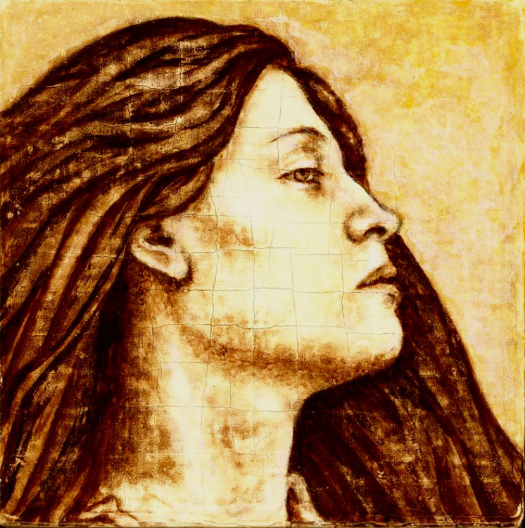
Flowing Hair
Notes:
46

Slide 47
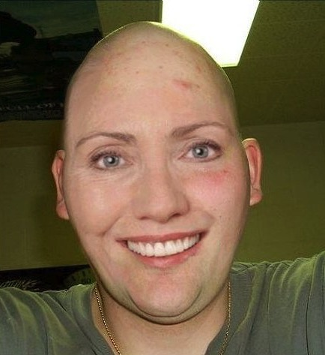
Bald Hair
Notes:
47

Slide 48
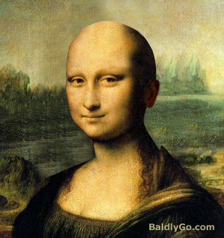
Bald Mona Lisa
Notes:
48

Slide 49
Women should not take the key leadership role in the church
Based on the practice in the Bible...
...women can support the leadership more effectively...
...and this is more accepted by the people
Strengths

Slide 50
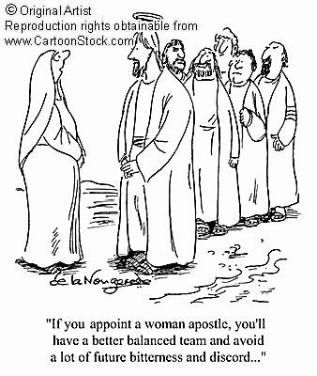
Women should not take the key leadership role in the church
It can have an imbalanced leadership
"If you appoint a woman apostle, you'll have a better-balanced team and avoid a lot of future bitterness and discord…"
Weaknesses

Slide 51
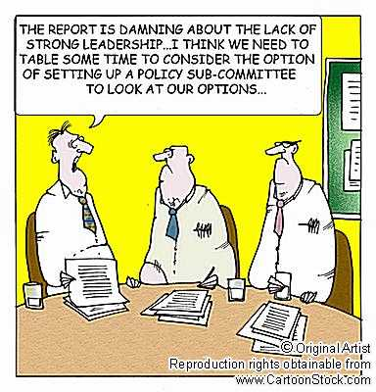
Women should not take the key leadership role in the church
The report is damning about the lack of strong leadership… I think we need a policy sub-committee to look at our options…
The church lacks capable male leaders
Weaknesses

Slide 52
Women should not take the key leadership role in the church
Women shall not take initiative to be:
pastor
(esp. senior pastor!)
preacher
elder
worship leader
Implications

Slide 53
Women should not take the key leadership role in the church
For special cases:
women can take the key leadership role temporarily…
…while training capable male leaders
Implications

Slide 54
140
Women should not take the key leadership role in the church
"When there are simply no men to do the work… However, women must be cautioned against continuing in such work after there are trained men available for the job"
Charles Ryrie, The Role of Women in the Church, 80
Implications

Slide 55
Women should not take the key leadership role in the church
In church, the main leadership roles are assigned to men.
Supportive roles are delegated to women.
Implications

Slide 56
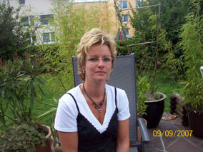
Quellendorf, Germany
Mr. Michaela Lindner
Mr. Norbert Lindner
Notes:
56
In 1998 a German town threw out their mayor [Read 1 Dec 98 Straits Times article].
• Michaela
• Norbert
The article pictures him with long hair and a dress, looking somewhat masculine and feminine at the same time. Later he had a so-called "sex change" operation.
They simply voted what we all know—there is no such thing as a sex change! God made us male or female. Sure, we can take some hormones and undergo surgeries to convincingly change outward features, but every cell of our bodies tells us our sex. For a real sex change, you need to change every second X or Y chromosome!

Slide 57
Conclusion
?
Leadership
in the
church …
?

Slide 58
Leadership in the church …
Conclusion
…is not to show who has more authority (men or women)
Each of you should look not only to your own interests, but also to the interests of others.
Philippians 2:3

Slide 59
Leadership in the church …
Conclusion
…should not destroy the church unity
Make every effort to keep the unity of the Spirit through the bond of peace
Ephesians 4:3

Slide 60
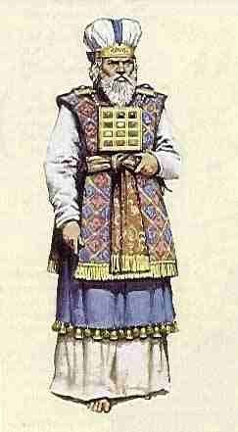
Leadership in the church …
Conclusion
…is not necessary to serve God
Whatever you do, work at it with all your heart, as working for the Lord, not for men.
Colossians 3:23

Slide 61
Application
What can women do in the church?
women's ministry children's ministry
administration youth ministry visitation church bulletin choir music cell-group mission-team counselling prayer meeting preparing teaching materials
… a lot !!!

Slide 62
This is what women should not do … ☺
"But I suffer not a woman to teach, nor to usurp authority over the man, but to be in silence"
1 Tim. 2:12 KJV 1769 ed.

Slide 63
There is neither Jew nor Greek,
slave nor free, male nor female,
for you are all one in Christ Jesus.
Galatians 3:28 NIV

Slide 64
Whatever role you have in the church,
we are to serve the LORD !!!

Slide 65
To GOD be the glory…

Slide 66
Adapted from:
William Siew Tran Thi Xuan Thuy Chumbeni Odyuo Elisabeth Chandra
The Role of Women in the Church

Slide 67
The Role of Women
Bibliography
Barclay, Oliver R. The Role Of Women: Leceister, England. IVP, 1984
Grudem, Wayne. Systematic Theology – An Introduction to Biblical Doctrine. IVP
Husbands, Mark and Timothy Larsen. Women, Ministry and the Gospel – Exploring New Paradigms. IVP, 2007
Jewett, Paul K. The Ordination of Women. Grand Rapids, Eerdmans, 1980
Ryrie, Charles C. The Role of Women in the Church. Chicago, Moody.

Slide 68
Black

Slide 69
Church (Ecclesiology) link at BibleStudyDownloads.org
Get this presentation for free!
Notes:
Church (ch)

