Slide 1
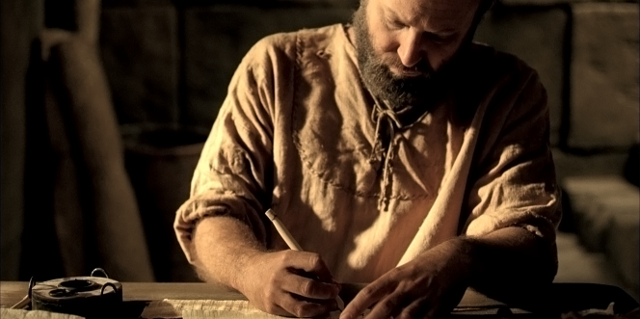
Pauline Authorship
Dr. Rick Griffith • Jordan Evangelical Theological Seminary BibleStudyDownloads.org

Slide 2
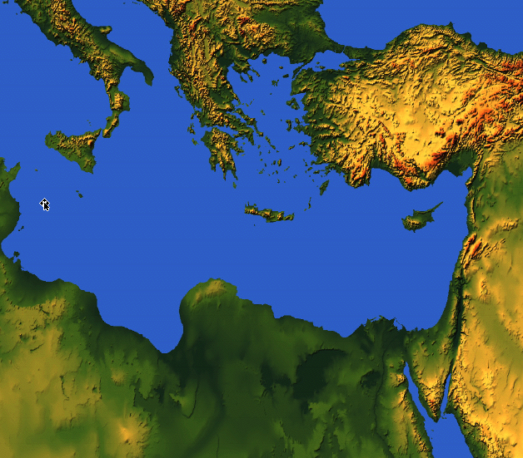
175
Rome
EPHESIANS
Ephesus
"This letter is from Paul, chosen by the will of God to be an apostle of Christ Jesus. I am writing to God’s holy people in Ephesus [“To the saints in Ephesus” NIV], who are faithful followers of Christ Jesus.” (Ephesians 1:1 NIV).
Notes:
God made each of us a “saint” in Christ (1:1-2).

Slide 3
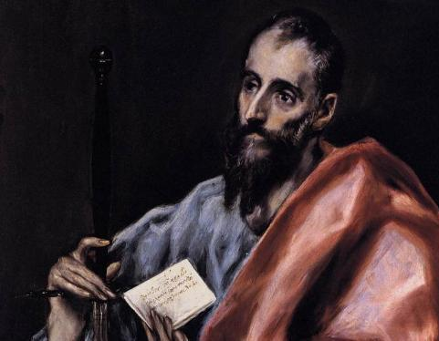
Paul's Biographical Argument (Gal. 1–2)
Paul defends apostleship

Slide 4
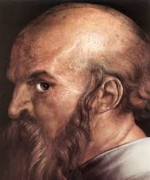
A Different Type of Salutation (1:1 NLT)
"This letter is from Paul, an apostle. I was not appointed by any group of people or any human authority, but by Jesus Christ himself and by God the Father, who raised Jesus from the dead."

Slide 5
Black

Slide 6
NT Critical Studies • BibleStudyDownloads.org
Get this presentation for free!
Notes:
NT Survey (ns)

