Slide 1
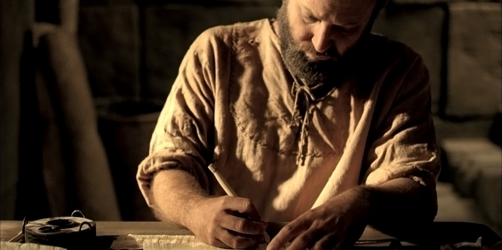
Pauline Authorship
Dr. Rick Griffith • Jordan Evangelical Theological Seminary BibleStudyDownloads.org

Slide 2
Paul's Epistles in Mostly Scriptural Order
Foundational | Prophetic | Prison | Pastoral
Romans 1 Corinthians 2 Corinthians Galatians | 1 Thessalonians 2 Thessalonians | Ephesians Philippians Colossians Philemon | 1 Timothy 2 Timothy Titus
Christ & the Cross | Christ & the Second Coming | Christ & the Church | Christ & the Congregation
Soteriology | Eschatology | Christology | Ecclesiology
TEXT
Adapted from The Pastoral Epistles © John Stevenson 2010 • https://slideplayer.com/slide/6106093/
Notes:
This chart shows that Paul addressed theology to churches in this order: Soteriology, Eschatology, Christology, and Ecclesiology. This contrasts with how most follow-up today postpones eschatology too late.
This order follows the NT except Philemon is moved from the end of the Pauline Epistles after Titus to complete the Prison Epistles after Colossians.
But one could argue that Philemon is a pastoral letter, since it addresses a situation that required reconciliation.
On the other hand, Paul wrote Philemon in Rome during Paul's first imprisonment, so it is a Prison Epistle in this sense.
In the end, I do not know who has explained the reasoning for the order of Paul's letters.
Note that combining the four Foundational and two Prophetic Epistles gives us the six Missionary Epistles.
___________
Common-440
NS-00-NT Introduction-105
NS-06-Pauline Epistles-4
NS-06-Missionary Epistles-10
NS-10-Prison Epistles-3
NS-15-Pastoral Epistles-15

Slide 3

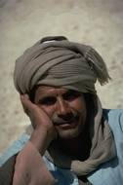
Support for Paul as Author
146
The letter claims to be from Paul (Romans 1:1).
No opposition to his authorship was ever raised in the early church.
Historical notes in the epistle agree with known facts of Paul's life.
The book's doctrine is typical of Paul compared to other letters he wrote.

Slide 4

AUTHORSHIP
Internal Evidence
146
External Evidence
Upheld by Church Fathers:
Clement of Rome (AD 95)
Ignatius (ca. AD 115)
Polycarp (ca. AD 115)
Romans was included among Paul's letters in all extant NT book lists before AD 200, even that of the heretic Marcion.
Even all radical modern critics agree on Pauline authorship of Romans except Baur.
Consistent with all other Pauline's writings in the following:
vocabulary
style
logic
theological development
Romans, 1-2 Corinthians, and Galatians are the standard to judge other books as Pauline.
Tertius (likely Paul's scribe) penned the letter (16:22).

Slide 5
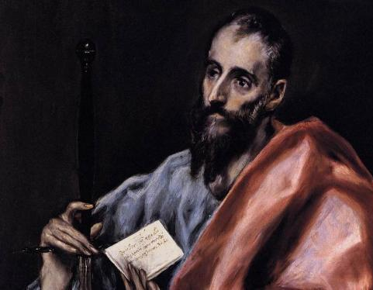
Paul's Biographical Argument (Gal. 1–2)
Paul defends apostleship

Slide 6
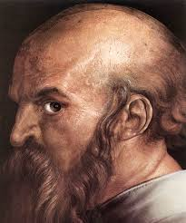
A Different Type of Salutation (1:1 NLT)
"This letter is from Paul, an apostle. I was not appointed by any group of people or any human authority, but by Jesus Christ himself and by God the Father, who raised Jesus from the dead."

Slide 7
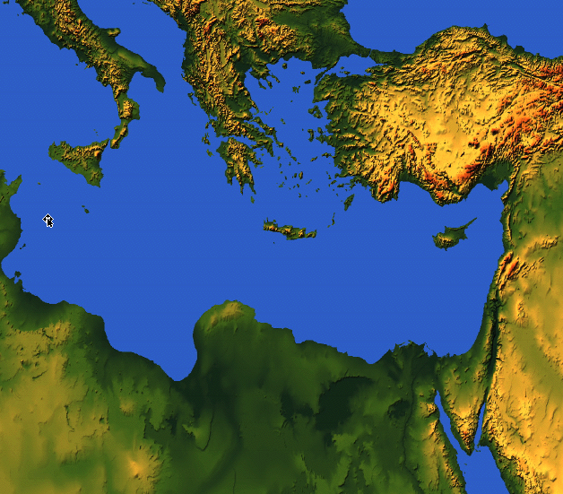

175
Rome
EPHESIANS
Ephesus
"This letter is from Paul, chosen by the will of God to be an apostle of Christ Jesus. I am writing to God’s holy people in Ephesus [“To the saints in Ephesus” NIV], who are faithful followers of Christ Jesus.” (Ephesians 1:1 NIV).
Notes:
God made each of us a “saint” in Christ (1:1-2).

Slide 8
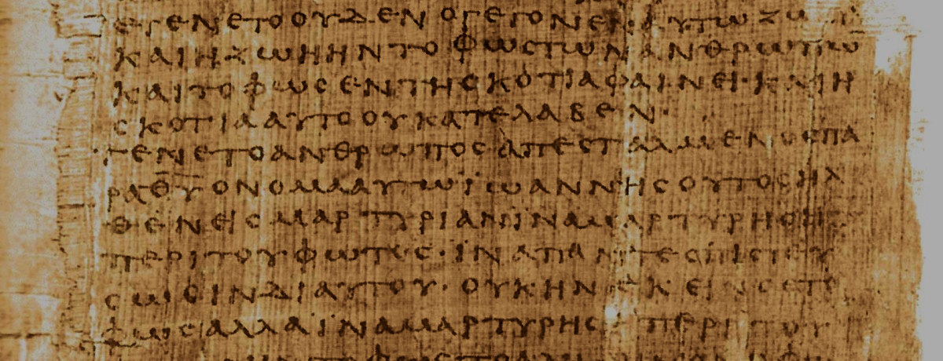
How do the Pastorals differ from Paul's earlier letters?
Pastorals:
Address leaders instead of churches
Focus on church issues from a leader's view
Use different words than the earlier letters
Show a more developed church leadership
Have a different style
Early Letters:
Pastorals:
Doctrine
Practice
Doctrine & Practice
Notes:
Regarding #3 above on the different words in the Pastorals:
Only they give the lists of elder and deacon qualifications (1 Tim 3; Tit 1).
They "describe the heretical threat as both present (1 Tim 1:3, 20; 2 Tim 2:20; Titus 1:10-16) and future (1 Tim 4:1; 2 Tim 3:1)" (Mark Bailey, "A Biblical Theology of Paul's Pastoral Epistles," in A Biblical Theology of the NT eds. Roy B. Zuck and Darrell L. Bock [Chicago: Moody, 1994], 335).
The term kekausteriasmenon for "seared" appears only in 1 Timothy 4:2 in the NT. Likewise, antilytron ("ransom") is used only in 1 Timothy 2:6 in the NT. But note that Colossians has many words used only there as it addresses a unique situation and thus required a unique vocabulary. Its 35 unique words include “visible” (1:16), “supremacy” (1:18), “fill up” (1:24), “philosophy” (2:8), and “deity” (2:9; Kubo, A Reader's Greek-English Lexicon of the New Testament, 193-97).
These epistles lack mention of Jesus as the Son of God or subordinate to the Father—but they still have an exalted view of "Christ Jesus" (used in the Pastorals in 25 of the 32 NT references). See Bailey, 343.

Slide 9

What concerns scholars on the authorship of the Pastorals?
Marcion's Canon (AD 170) had only 10 Pauline letters (but Marcion was a heretic).
They are absent from p⁴⁶—one of the earliest Pauline manuscripts (but we don't know why).
Paul's authorship of the Pastorals wasn't doubted until 1800s (when critics superseded the text).

Slide 10
Black

Slide 11


NT Critical Studies • BibleStudyDownloads.org
Get this presentation for free!
Notes:
NT Survey (ns)

