Slide 1
The Reliability of the Gospels
Are they trustworthy?
Adapted from a 2006 Class Presentation by Anna Lee for Dr. Rick Griffith • Singapore Bible College • BibleStudyDownloads.org

Slide 2
Areas of Concern Regarding the Gospels
Textual criticism
Authorship and date
Questions of intention and genre
Criteria of authenticity

Slide 3
Addressed in This Presentation
Archaeology
Non-Christian Writers
Post-New Testament Christian Writers
The Rest of the New Testament
Conclusion

Slide 4
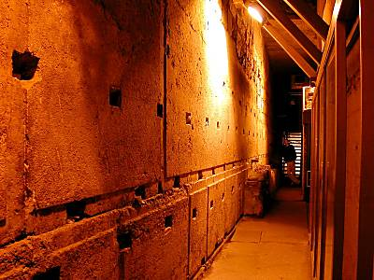
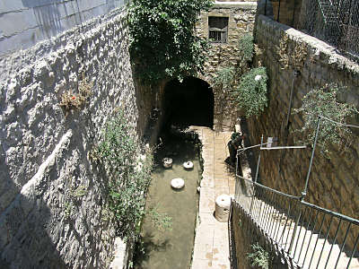
Archaeology

Slide 5
Non-Christian Writers

Slide 6
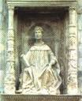
Greco-Roman Sources
Julius Africanus
Pliny the Younger
Suetonius
Tacitus
Lucian of Samosata

Slide 7
Julius Africanus
Lucian of Samosata
Thallus attributed the darkness that occurred during the crucifixion to an eclipse of the sun.
Christians met regularly and sang hymns.
Peregrinus worshiped the man who was crucified at Palestine…
Christians received their name from “Christ who had been executed by sentence of the procurator Pontius Pilate in the reign of Tiberius.”
Pliny the Younger
Tacitus

Slide 8
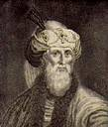
Jewish Sources
OT Apocrypha
Rabbinic Literature
Rabbinic commentaries
Rabbinic traditions
Josephus

Slide 9
Josephus
1st Century Pharisee and defeated freedom-fighter-turned-historian
“There lived Jesus, a wise man” (Antiquities 18.3.3)
Described the martyrdom of James “the brother of Jesus – the one called Christ” (Antiquities 20.9.1)

Slide 10
Post-NT Christian Writers
Unorthodox Sources
Coptic Gospel of Thomas
Apocryphon of James
Gospel of Philip
Gospel of Truth
Other Apocrypha
Gospel of Peter
The Unknown Gospel
Infancy Gospel of Thomas

Slide 11
Post-NT Christian Writers
Jewish-Christian Gospels
Ebionite Gospel
Gospel of Nazoreans
Egyptian Gospel of the Hebrews
Later Legends
Gospel of Barnabas
The Apostolic Fathers
Polycarp
Ignatius
Clement
Didachē
Authentic Agrapha
“Unwritten things”

Slide 12
The Rest of the New Testament

Slide 13
Acts
Not much is said about the life of Jesus
However, in Acts 10:36-41 Peter sums up Jesus' life in his words to Cornelius

Slide 14
Paul
Paul wrote his letters while the Gospels were also being written
Noted about Jesus:
Descended from Abraham and David (Gal 3:16; Rom 1:3)
Upbringing in Jewish law (Gal 4:4)
Gathered disciples together (Gal 1:19; 2:9)

Slide 15
Paul (continued)
Noted about Jesus (continued):
Impeccable character and exemplary life (Phil 2:6-8; 2 Cor 8:9; Rom 15:3, 8)
Last supper and betrayal (1 Cor 11:23-25)
Details of death and resurrection (Gal 3:1; 1 Thess. 2:15; 1 Cor 15:4-8)

Slide 16
General Epistles
James
Numerous allusions
Sermon on the Mount parallels
1 Peter
Born anew aludes to John 3:5
Readers love Jesus without seeing Him
Called out of darkness into light

Slide 17
Early Christian Creeds
Various passages in Epistles that have been identified as poetic, hymnic in structure and form
Filled with Christological teaching in a style reminiscent of later Christian creeds

Slide 18
Conclusion

Slide 19
Conclusion
All of these evidences (within and outside the Gospels) can't prove total trustworthiness
They support but do not show inspiration or inerrancy
Those who believed deduced from other convictions about the nature of God and His revelation

Slide 20
Conclusion (cont'd)
Based on sheer historical grounds…
There is substantial reason to believe in the general trustworthiness of the Gospels

Slide 21
The Historical Trustworthiness of the Gospels
Are they reliable?

Slide 22
Black

Slide 23
NT Criticism link at BibleStudyDownloads.org
Get this presentation for free!
Notes:
NC Criticism (nc)

