Slide 1
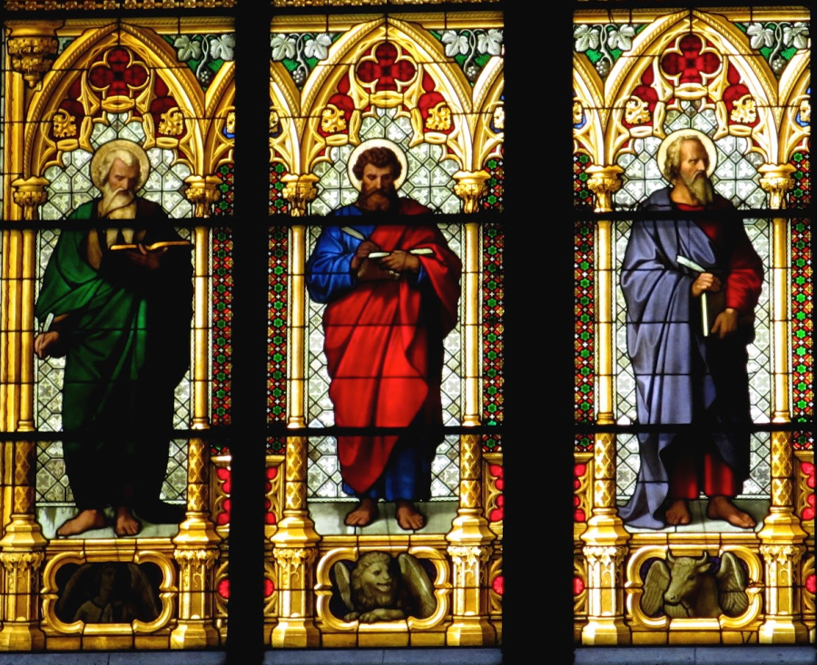
The Synoptic Problem
Dr. Rick Griffith • Jordan Evangelical Theological Seminary BibleStudyDownloads.org

Slide 2

The Synoptic Problem

Slide 3


THAT STRANGE SOUNDING WORD…
51a
SYNOPTIC:
1
MATTHEW
2
MARK
TO:
JEWS
TO:
ROMANS
AS:
KING
AS:
SERVANT
WHAT
HE:
SAID
WHAT
HE:
DID
SYNOPTIC:
"TO SEE TOGETHER"
"TO
SEE TOGETHER"
3
LUKE
TO:
GREEKS
AS:
GOD/MAN
WHAT
HE:
FELT
20
3
Notes:
Now comes that word that's a strange one to many...
//// SYNOPTIC…meaning…
//// … "TO SEE TOGETHER"…add these words to that triangle shape on your study help.
//// It is a term from Greek roots that means seeing a group of things together... from the same general perspective. One word that, again, helps organize and categorize the enormous factual base that makes up our Bible.

Slide 4
THE SYNOPTICS: "TO SEE TOGETHER"
51a
1
MATTHEW
2
MARK
TO:
JEWS
TO:
ROMANS
AS:
KING
AS:
SERVANT
WHAT
HE:
SAID
WHAT
HE:
DID
∑
3
LUKE
4
JOHN
TO:
GREEKS
CHURCH
TO:
AS:
GOD/MAN
AS:
GOD
WHAT
HE:
FELT
WHAT
HE:
MEANT
21
1
Notes:
Follow the arrows as they link together the gospels of MATTHEW, MARK and LUKE. Again…you'll notice that JOHN is not among them. Those three are the so-called SYNOPTIC Gospels...THEY ARE SEEN TOGETHER...in that these works take on that ground-level view of the human history of Jesus Christ just as he walked about Palestine in the days of his ministry. The Man…and his Mission among his People.
//// On the other hand…the Gospel of John –– seen here with the familiar mathematical SUMMA sign –– represents the summation of all that Jesus Christ MEANT –– the sum of all that he preached and demonstrated –– both publicly and privately. Seeing the Lord clearly as God Himself, John raises our spiritual horizon in ways that the first three gospels do not.

Slide 5
OVERLAPS IN THE GOSPELS
51b
1
MATTHEW
2
MARK
7% unique!
Baptism
Lord's Supper
Birth
Genealogy
5000 fed
Passion
3
LUKE
4
JOHN
92% unique!
16
Notes:
Each of the Gospels say things that the others don't...
//// MATTHEW was believed by the early church to have written first...
//// MARK shares a lot of material with Matthew, such as Christ's baptism and supper...
//// LUKE also has much overlap with Matthew and Mark, such as Christ's baptism and supper—but only Matthew and Luke record Christ's birth and genealogy. However, the fourth…
//// JOHN, stands alone in terms of its material. Only 8% of it repeats stories from the others—such as the feeding of the 5000, and, of course, His death and resurrection.
//// But the remaining 92% of JOHN you will find only in JOHN.

Slide 6
JOHN: SUMMING UP THE MESSAGE
51a
1
MATTHEW
2
MARK
TO:
JEWS
TO:
ROMANS
AS:
KING
AS:
SERVANT
WHAT
HE:
SAID
∑
WHAT
HE:
DID
3
LUKE
4
JOHN
TO:
GREEKS
TO:
CHURCH
AS:
GOD/MAN
AS:
GOD
WHAT
HE:
FELT
WHAT
HE:
MEANT
22
Notes:
So, in summation, then…John wrote to UNBELIEVERS THROUGH THAT NEW ORGANISM, THE CHURCH, envisioning Christ as God Himself…
But what did John SAY that Jesus meant in his preaching?

Slide 7
The Gospels
48
Matthew
Mark
Luke
John
Bible Visual Resource Book, 177
The word "Gospel" comes from the Old English "God-spell." It translates the Greek word for "good news."
In antiquity king's heralds announced "glad tidings" of the king's birthday throughout the cities of the realm.
It has the same meaning in our New Testament. The four Gospels announce the glad tidings about Jesus.
The ancient world knew of history, poetry, prophecy and letters. But a "gospel" was new to them.
Here, inspired writers gave more than just history. They also created faith (John 20:30-31) by proclaiming the good news that, just as the OT had promised, God had sent His Messiah to the world.

Slide 8
Synoptic Similarities
49
NIV Study Bible, 1471
Matthew, Mark and Luke are noticeably similar, while John is quite different.
How do the first three Gospels agree?
  Language
  Material they include
  General order of the events and sayings from Christ's life
The math facts:
  91 percent of Mark is found in Matthew
  53 percent of Mark is found in Luke
Such agreement raises questions as to the origin of the Synoptic Gospels. Did the authors rely on a common source? Were they interdependent?

Slide 9

The Synoptic Problem
49
Matthew, Mark & Luke in a nutshell:
How do we explain their similarities?
How do we explain their differences?

Slide 10
Marcan Priority Diagrammed
51
51
Mark
661
1068
1149
500
350
Matthew
Luke
Numbers indicate the verses in each proposed source
235
333
Q
564
M
L

Slide 11

Dating the Synoptic Gospels
49
Adapted from the NIV Study Bible, 1431
MARK
MATTHEW
LUKE
MARK
MATTHEW
LUKE
ASSUMPTION A:
ASSUMPTION B:
Matthew and Luke used Mark as a source
Matthew and Luke did not use Mark as a source
View #1
View #1
Mark written in the 50s or early 60s
Mark could have been written anytime between 50 and 70
(1) Matthew written in late 50s or the 60s
View #2
(2) Luke written 59-63
Mark written 65-70
View #2
(1) Matthew written early 50s (see Matthew notes)
Mark written 65-70
(1) Matthew written in the 70s
(2) Luke written 59-63 (see Luke notes)
(2) Luke written in the 70s
Taught in this class

Slide 12
Solutions to the Synoptic Problem
49
Questions like these constitute what is known as the Synoptic Problem. Several solutions have been advanced:
The use of oral tradition. Some have thought that tradition had become so stereotyped that it provided a common source from which all the Gospel writers drew.
The use of an early Gospel. Some have postulated that the Synoptic authors all had access to an earlier Gospel, now lost.
The use of written fragments. Some have assumed that written fragments had been composed concerning various events from the life of Christ and that these were used by the Synoptic authors.
Mutual dependence. Some have suggested that the Synoptic writers drew from each other with the result that what they wrote was often very similar.
NIV Study Bible, 1431

Slide 13
Solutions to the Synoptic Problem
49
The use of two major sources. The most common view currently is that Mark and a hypothetical document, called Quelle (German for "source") or Q, were used by Matthew and Luke as sources for most of the materials included in their Gospels.
The priority and use of Matthew. Another view suggests that the other two Synoptics drew from Matthew as their main source.
A combination of most of the above. This theory assumes that the authors of the Synoptic Gospels made use of oral tradition, written fragments, mutual dependence on other Synoptic writers or on their Gospels, and the testimony of eyewitnesses.
NIV Study Bible, 1431

Slide 14
Two-Source Hypothesis
50
Q
AD 50
Mark
AD 65
Matthew
Luke

Slide 15
Four-Source Hypothesis
50
M
Jerusalem
AD 60-65
Mark
Rome
AD 65
Q
Antioch
AD 50
L
Caesarea
Proto-Luke
Matthew
Antioch
AD 85
Luke
Caesarea, Corinth?
AD 60, AD 80
Antiochene
Tradition
Source of
Luke 1-2

Slide 16
When I Think They Were Written…
52
1
MATTHEW
2
MARK
TO:
JEWS
TO:
ROMANS
The A.D.40s
A.D. 64-68
AS:
KING
AS:
SERVANT
WHAT
HE:
WHAT
HE:
SAID
DID
3
LUKE
4
JOHN
GREEKS
CHURCH
A.D. 57-59
A.D. 69 AFTER THE SYNOPTICS
TO:
TO:
AS:
GOD/MAN
AS:
GOD
WHAT
HE:
WHAT
HE:
FELT
MEANT
27
4
Notes:
Now…what about the dates of the writing of these crucial documents? And here we are left to our best scholarly guesses. There will ALWAYS be argument here. But some of the best guesses, based on decades of academic research and study are these – in suggested order…
//// MATTHEW…composed sometime during the A.D. 40s…
//// LUKE is suggested as next, between the years A.D. 57 and 59 A.D…
//// Mark…in the next decade…between 64 and 68…
//// and finally…John's Gospel…around A.D. 69….but certainly after the Synoptics were set down. Again, you will always find disagreement on these dates. However, these dates are from the research of well-known Christian scholars and teachers.

Slide 17
Black

Slide 18


NT Critical Studies • BibleStudyDownloads.org
Get this presentation for free!
Notes:
NT Survey (ns)

