Slide 1
Biblical Archaeology
What does it have to do with you?
Dr. Rick Griffith • Jordan Evangelical Theological Seminary • BibleStudyDownloads.org

Slide 2

Shout to the Lord 1/12
My Jesus, my Savior,
Lord there is none like You;
All of my days I want to praise
the wonders of Your mighty love.

Slide 3
Shout to the Lord 2/12
My comfort, my shelter,
Tower of refuge and strength;
Let every breath, all that I am,
never cease to worship You.

Slide 4
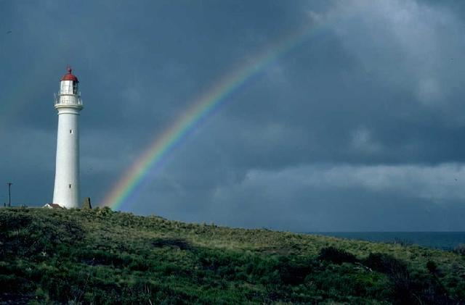
Shout to the Lord 3/12
Shout to the Lord,
all the earth, let us sing
power and majesty,
praise to the King.

Slide 5
Shout to the Lord 4/12
Mountains bow down
and the seas will roar
at the sound of Your name.

Slide 6
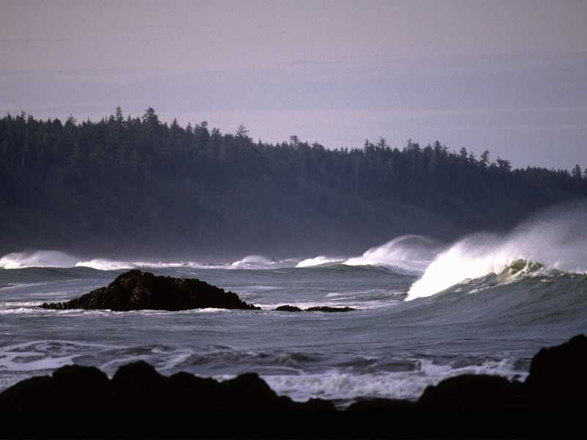
Shout to the Lord 5/12
I sing for joy
At the work of Your hands,
Forever I'll love You
Forever I'll stand,

Slide 7
Shout to the Lord 6/12
Nothing compares
to the promise I have in You.

Slide 8
Shout to the Lord 7/12
My Jesus, my Savior,
Lord there is none like You;
All of my days I want to praise
the wonders of Your mighty love.

Slide 9
Shout to the Lord 8/12
My comfort, my shelter,
Tower of refuge and strength;
Let every breath, all that I am,
never cease to worship You.

Slide 10
Shout to the Lord 9/12
Shout to the Lord,
all the earth, let us sing
power and majesty,
praise to the King.

Slide 11
Shout to the Lord 10/12
Mountains bow down
and the seas will roar
at the sound of Your name.

Slide 12
Shout to the Lord 11/12
At the work of Your hands,
Forever I'll love You
Forever I'll stand,

Slide 13
Shout to the Lord 12/12
Nothing compares
to the promise I have in You.

Slide 15
Biblical Archaeology
What does it have to do with you?

Slide 16
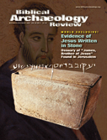
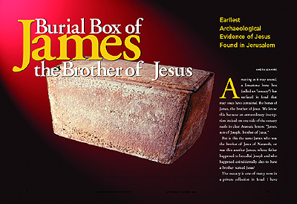
A Key Recent Discovery (BAR Nov/Dec 02)…
205a
Deemed a forgery by the Israeli Antiquities Authority
(June 2003)
Reads:
“James, son of Joseph, brother of Jesus.”
This is the earliest reference to Jesus outside the Bible!

Slide 17
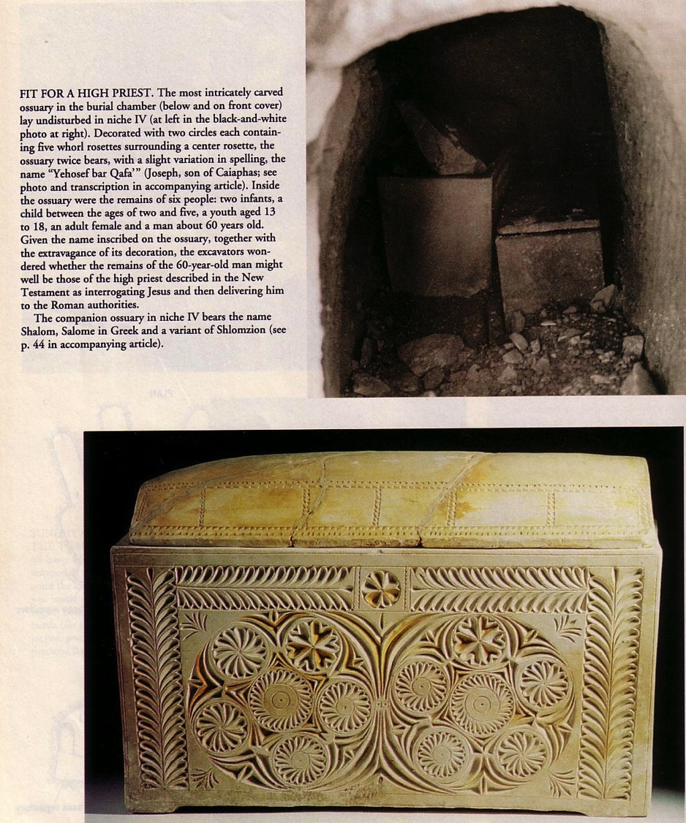
Caiaphas Ossuary
(BAR Sept/Oct 1992)
Before this discovery there was no evidence for his existence outside the Bible

Slide 18
What is Archaeology?
196
The word itself
  Greek Meaning: arche (old) + logos (word)
  Archaeology = “old words”
Some definitions
  “The science or study of history from the remains of early human cultures as discovered chiefly by systematic excavations” (Funk & Wagnall's)
  “The scientific study of material remains (as fossil relics, artifacts, monuments) of past human life and activities” (Webster's)

Slide 19
What is Biblical Archaeology?
196
“'Biblical Archaeology' selects those material remains of Palestine and its neighboring countries which relate to the biblical period and narrative. These include the remains of buildings, art, inscriptions and every artifact which helps the understanding of the history, life and customs of the Hebrews and those peoples who, like the Egyptians, Phoenicians, Syrians, Assyrians and Babylonians, came into contact and influenced them.”
--D. J. Wiseman, “Archaeology,” New Bible Dictionary, 2d ed. (Wheaton: Tyndale, 1982), 70

Slide 20
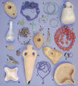
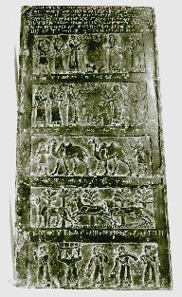
Archaeological Terms
196
Classification of Objects
  Artifacts (e.g., Herodian lamp)
  Epigraphs
Black Obelisk of Shalmaneser

Slide 21

Archaeological Terms
196
Excavation Terminology
  Tell
  Stratum
Schematic drawing of an ancient Palestinian tell showing methods of excavation and levels (strata) of occupation

Slide 22
History of Biblical Archaeology
197
Accident: Rosetta Stone discovery (1799)

Slide 23

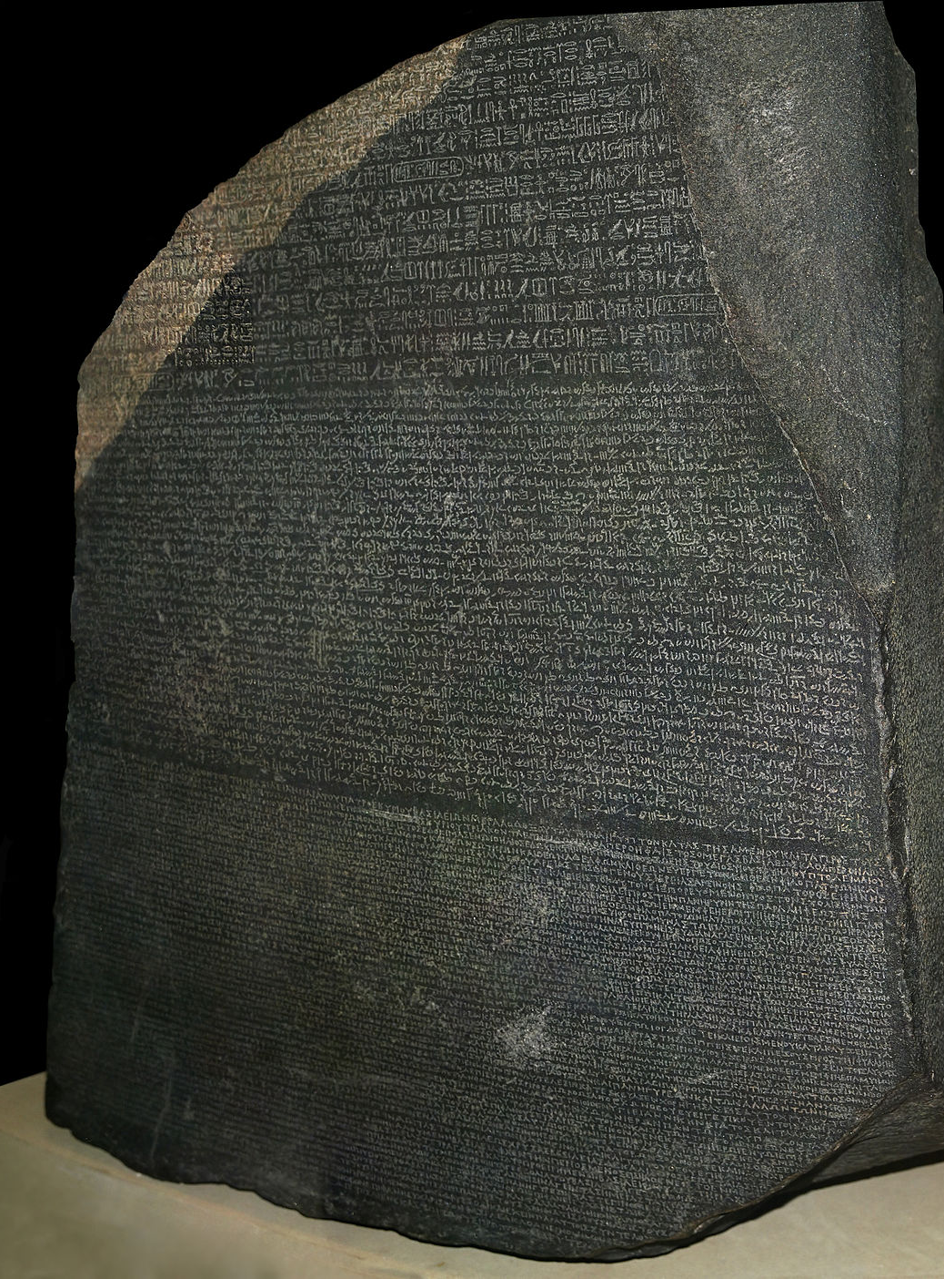
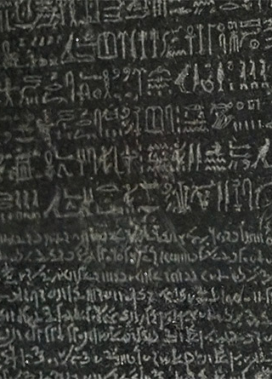
The Rosetta Stone
87c-d
Top:
Hieroglyphics
The key to understanding Egyptian hieroglyphics
Middle:
Egyptian Demotic
Bottom: Greek

Slide 24
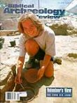






History of Biblical Archaeology
197
Accident: Rosetta Stone discovery (1799)
Surface: Edward Robinson & Eli Smith (1838)
Digs: DeSaulcy in Jerusalem (1863)
Popularizing: Biblical Archaeology Review (1975)

Slide 25

Excavation Sites
Siloam Inscription

Slide 26
Methods
197-198
Sounding (vertical)
Stepped trench (tell portion)
Stratification (entire side)
Carbon-14 testing
Schematic drawing of an ancient Palestinian tell showing methods of excavation and levels (strata) of occupation

Slide 27
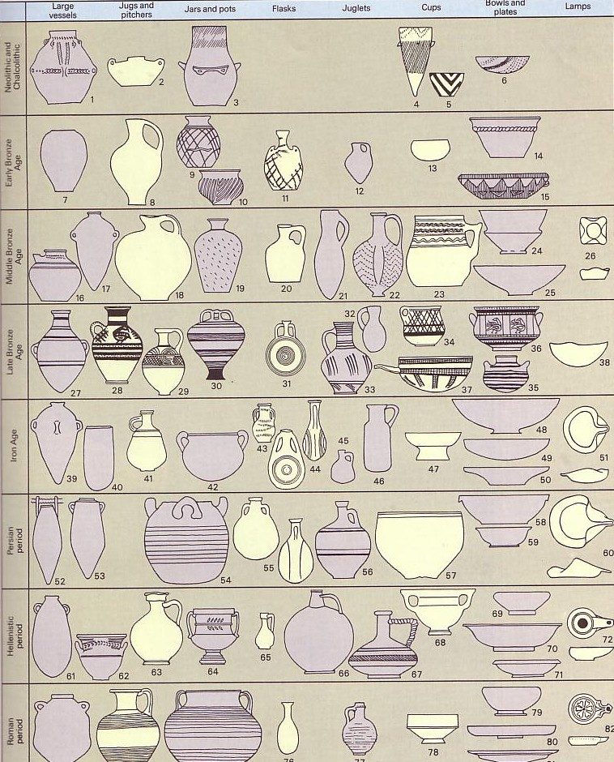



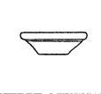


Pottery Analysis
199

Slide 28
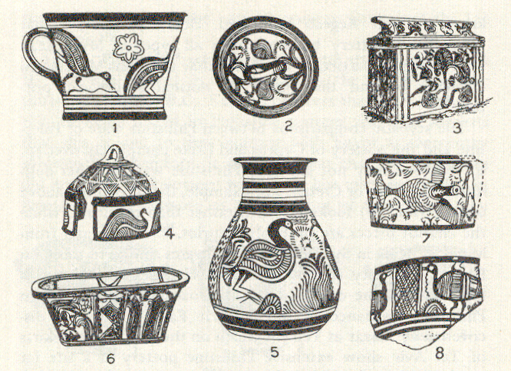
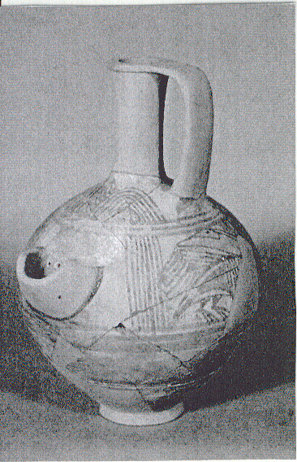
Philistine Pottery
106

Slide 29
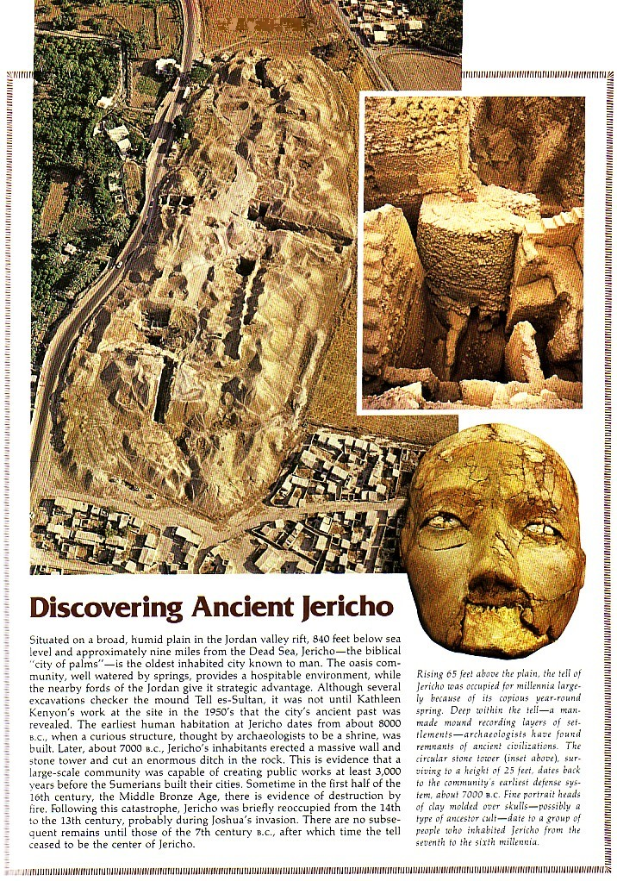
Discovering Ancient Jericho

Slide 30
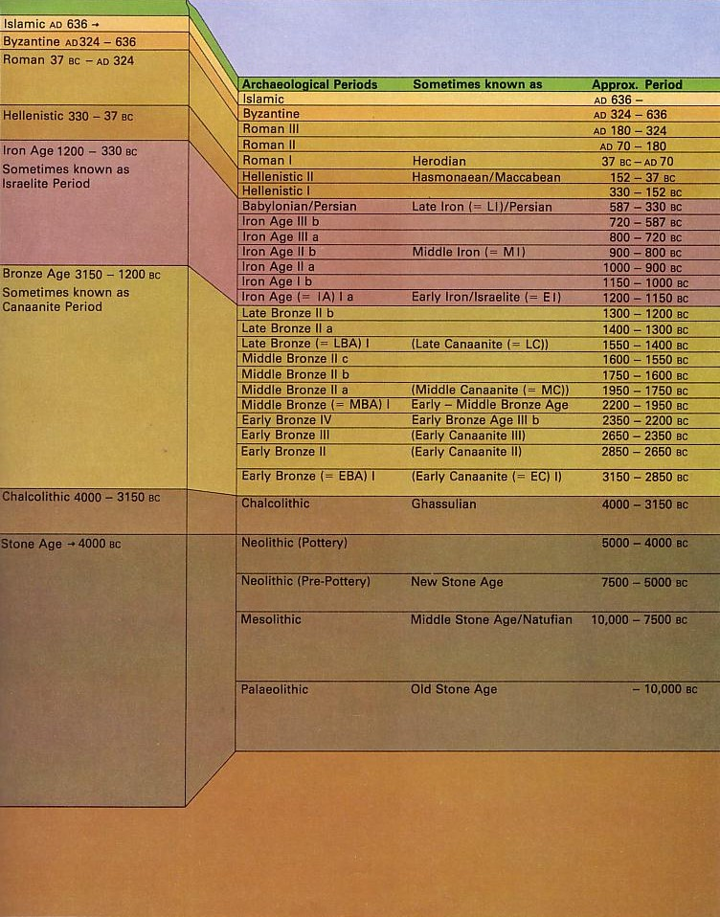
Value of Biblical Archaeology
200, 206
Confirmation of Biblical History (cf. OTB, 201-4)

Slide 31
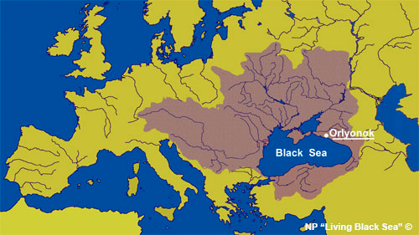
Confirmation of Biblical History
206
The Flood
Black Sea habitation (OTB, 211a)

Slide 32
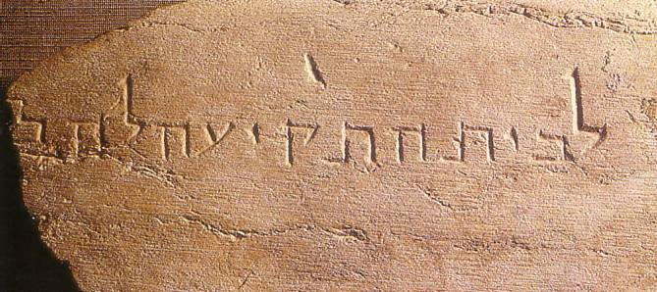
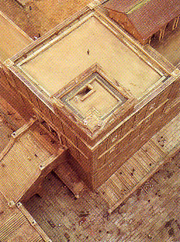
Confirmation of Biblical History
206
Jerusalem
Place of trumpeting (OTB, 211)
Gihon Spring wall and gate (AD 1999; OTB, 33-34)

Slide 33
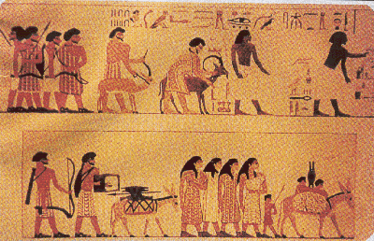
Confirmation of Biblical History
206
Jerusalem
Black Sea habitation (OTB, 211a)
Place of trumpeting (OTB, 211)
Gihon Spring wall and gate (1999, OTB, 33-34)
Hezekiah's tunnel and Warren's Shaft (OTB, 31)
Beni Hasan Tomb Painting

Slide 34
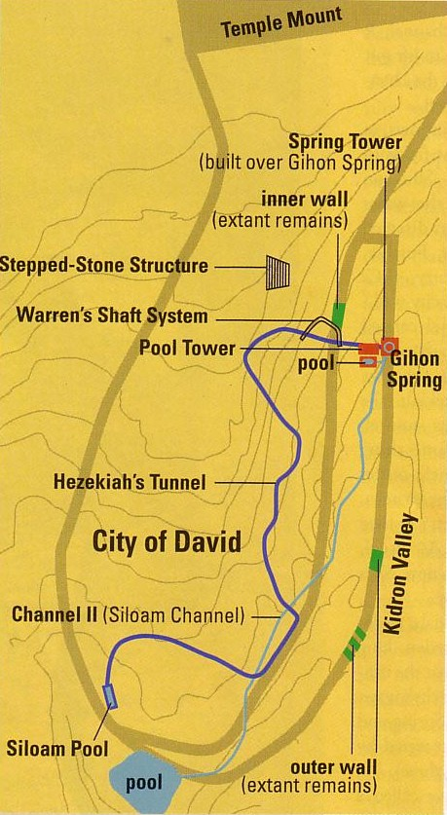

Hezekiah's Tunnel
30

Slide 35
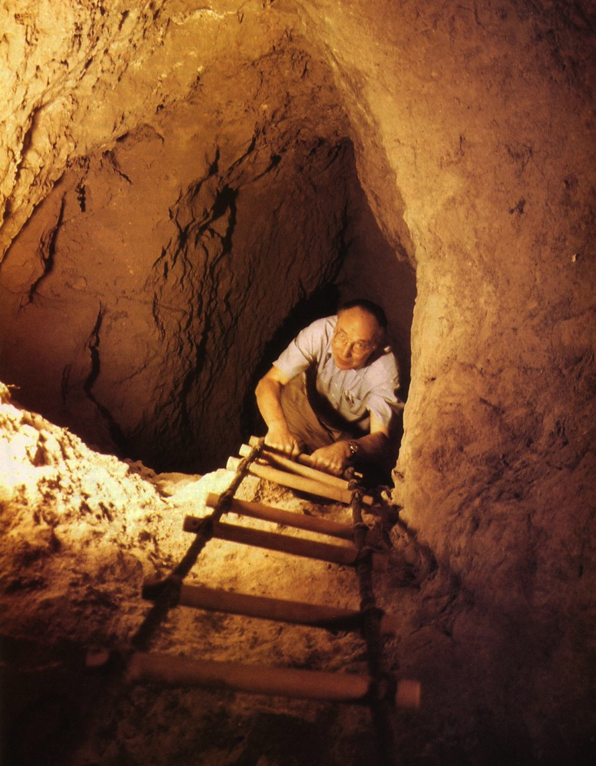
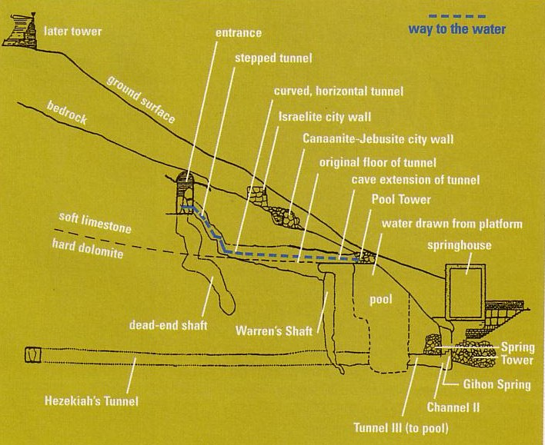
Warren's Shaft
31-34
Notes:
BAR Nov/Dec 1999

Slide 36



Transmission of Scripture
207
Masoretic Isaiah Scroll
Isaiah AD 1000
1200 years earlier!
Isaiah 200 BC
Dead Sea Isaiah Scroll

Slide 37
ISAIAH: QUMRAN v. THE MASORETES
200 BC
AD 1000
Of the 166 Hebrew words in Isaiah 53, only seventeen letters in Dead Sea Scroll 1QIsb differ from the Masoretic Text:
10 letters = spelling differences
4 letters = stylistic changes
3 letters = added word for "light" (vs. 11)
17 letters = no affect on biblical teachings
Geisler & Nix, Intro to the NT, 382

Slide 38


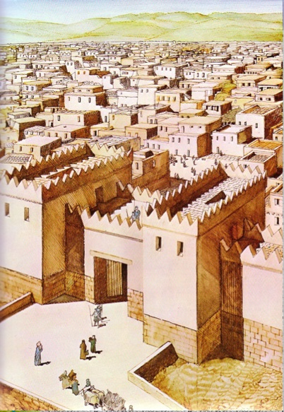
Better Interpretation of Scripture
208 (b) 3
Better Interpretation of Scripture
Hazor

Slide 39

Value of Biblical Archaeology
206-8
1. Confirmation of Biblical History (cf. OTB, 201-4)
2. Confirmation of Transmission of Scripture
3. Insight into Interpreting Scripture
4. Source of Revenue for Israel & Her Neighbors

Slide 40
Dangers of Biblical Archaeology
209-210
Priority: Will one first accept the Bible or archaeology?
Subjectivity: Bias is a problem for liberal and conservative alike
Incomplete Record: Most of the Bible cannot be proven by archaeology

Slide 41
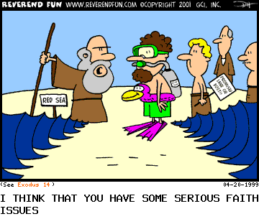
Faith Issues

Slide 42
Dangers of Biblical Archaeology
211
Priority: Will one first accept the Bible or archaeology?
Subjectivity: Bias is a problem for liberal and conservative alike
Incomplete Record: Most of the Bible cannot be proven by archaeology
Complexity: Biblical archaeology is the oldest, most complicated, most stratified, least substantiated type

Slide 43
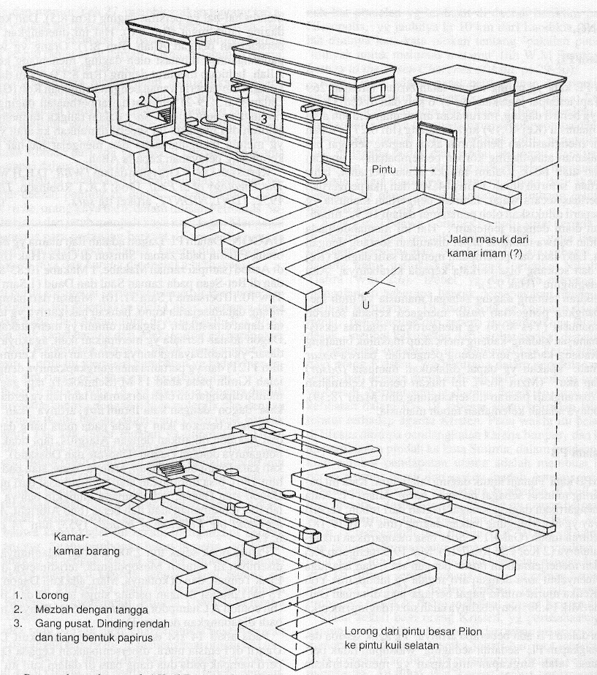
The Temple of Dagan

Slide 44
Dangers of Biblical Archaeology
211
Priority: Will one first accept the Bible or archaeology?
Subjectivity: Bias is a problem for liberal and conservative alike
Incomplete Record: Most of the Bible cannot be proven by archaeology
Complexity: Biblical archaeology is the oldest, most complicated, most stratified, least substantiated type
Limited Apologetic Value: It cannot prove God's existence or create faith in Christ

Slide 45

Can archaeology prove Moses received the Ten Commandments?

Slide 46
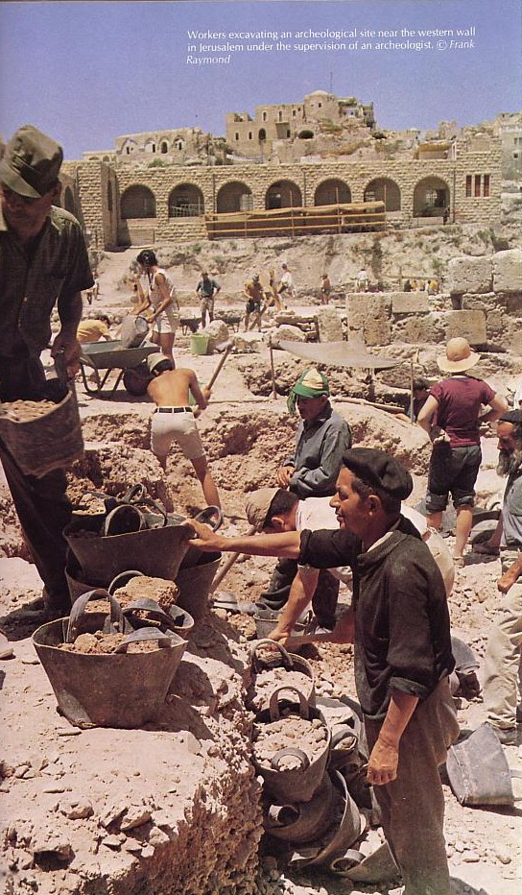
The Future of
Biblical Archaeology
Excavating Jerusalem's Western Wall
Archaeology will never end

Slide 47
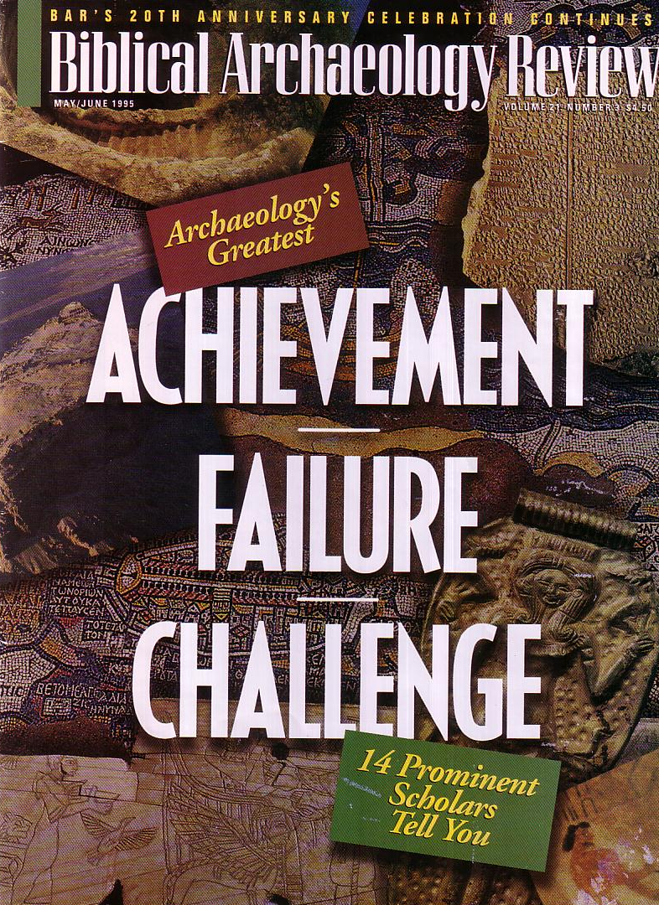
BAR
216
The most popular archaeology magazine began in 1975

Slide 48
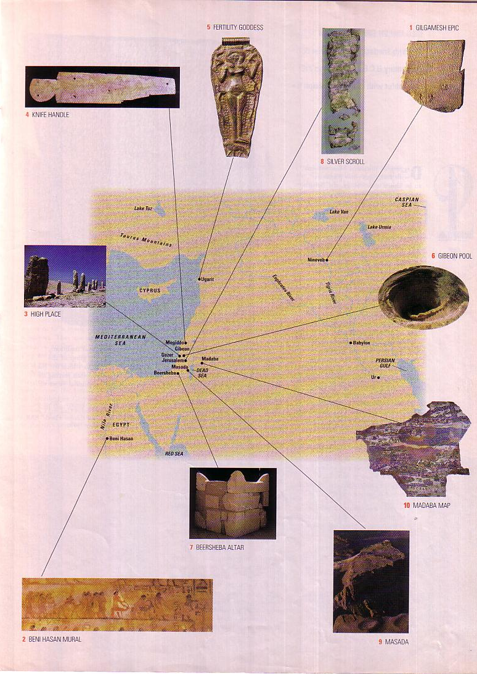
10 Great Finds
216
This BAR article by Michael D. Coogan highlights the ten most significant artifacts throughout the Middle East (May/June 1995)

Slide 49
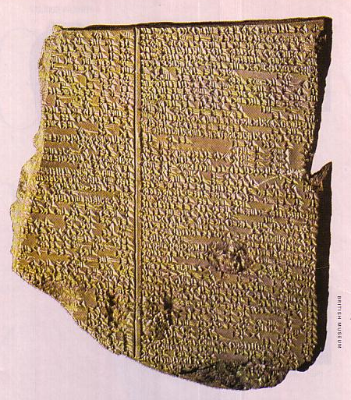
#1 Gilgamesh Epic Tablet XI
218
Nineveh, Iraq
650 BC
Flood story similar to Gen. 6–9

Slide 50
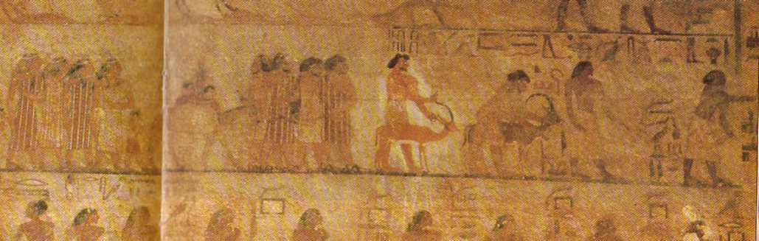
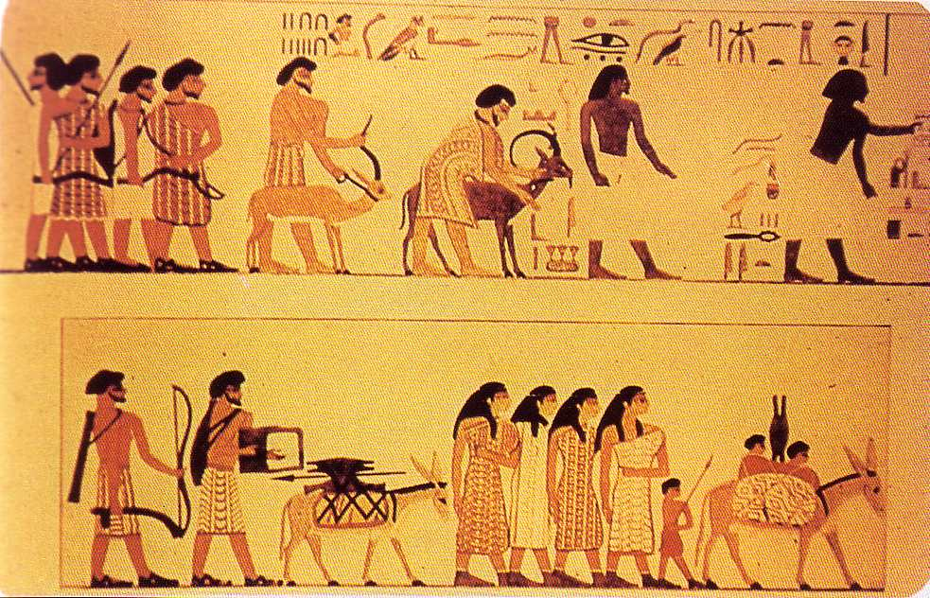
#2 Beni Hasan Mural
Two Egyptians lead the procession
(no beards)
219
Egypt
1850 BC
Attests to Israelites trading in Egypt
  Joseph story (Gen. 37–50)
  Solomon's wife (1 Kings 9:16), etc.
8 wealthy Asiatic men & 4 women follow
(note beards)

Slide 51
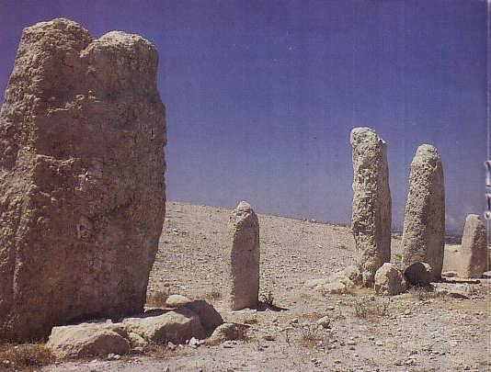
#3 Gezer High Place
220
Near Tel Aviv, Israel
1600 BC
Covenant made with stones
  Jacob & Laban (Gen. 31:43-54)
  Joshua at covenant renewal (Josh. 24:25-27)

Slide 52
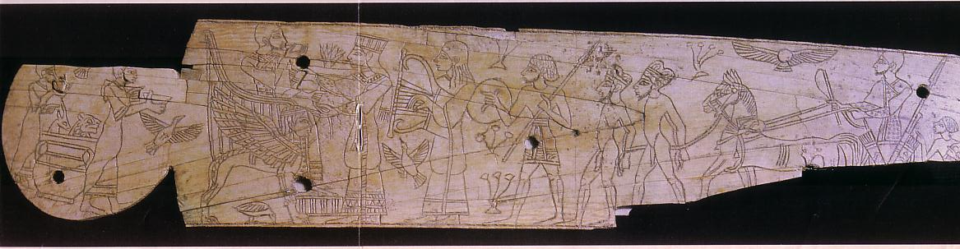
#4 Knife handle
221
Megiddo, Israel
1250 BC
Shows Egyptian control over Megiddo as well as the luxury of Canaanite royal courts akin to Solomon's (1 Kings 6:23-28; Exod. 25:17-22)

Slide 53
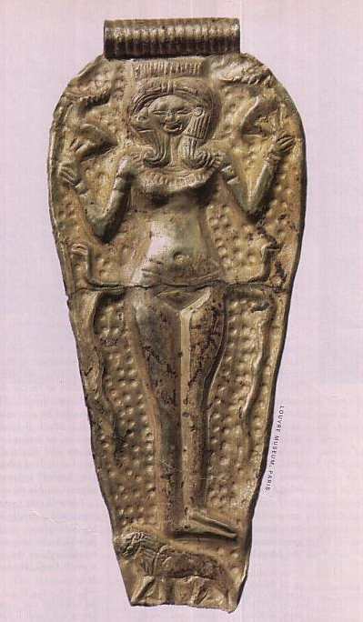
#5 Fertility Goddess Pendant
222
Ras Shamra, Syria (ancient Ugarit)
1300 BC
Ugaritic discovery in 1928 shows close linkage of Northwest Semitic cultures
Ashtart (holiness goddess) called “queen of heaven” worshipped in Israel (Jer. 7:18; 44:17-19)

Slide 54
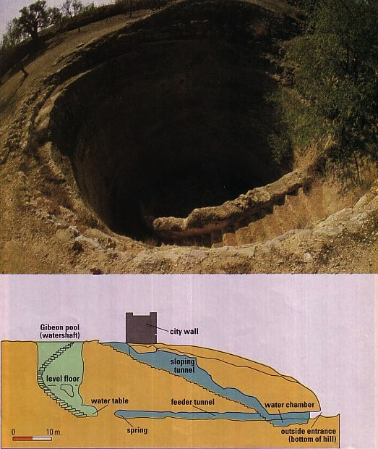
#6 Gibeon Pool
223
10 km north of Jerusalem
1050 BC
Pool noted in 2 Sam. 2:13; Jer. 41:12
Shows advanced Gibeonite engineering

Slide 55
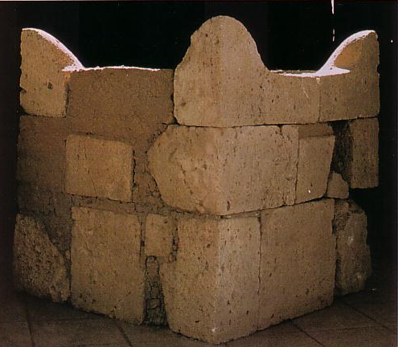
#7 Beersheba Altar
224
Near Beer-Sheba in ancient Israel's far south
750 BC
Huge (63” x 63”) altar with horns (cf. Exod. 29:12; 1 Kings 1:51; 2:28)
Pagan altar of hewn stones prohibited by Exodus 20:25

Slide 56
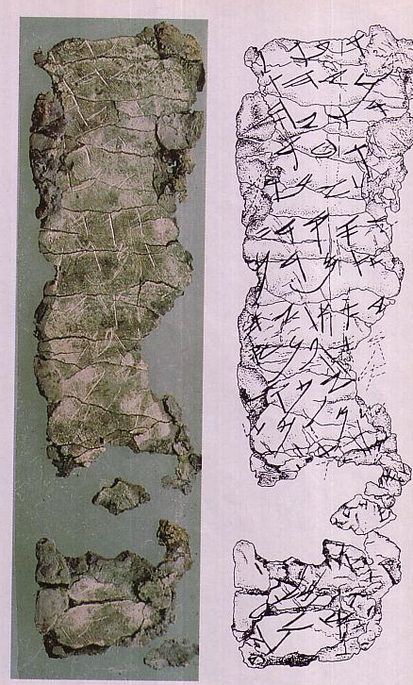
#8 Silver Scroll Amulet
225
Then the LORD spoke to Moses, saying,
"Speak to Aaron and to his sons, saying, 'Thus you shall bless the sons of Israel. You shall say to them:
The LORD bless you, and keep you;
The LORD make His face shine on you, And be gracious to you;
The LORD lift up His countenance on you, And give you peace.'
"So they shall invoke My name on the sons of Israel, and I then will bless them."
(Numbers 6:22-27)
Ketef Hinnom, near Jerusalem
650-400 BC
Earliest inscription of a biblical text

Slide 57
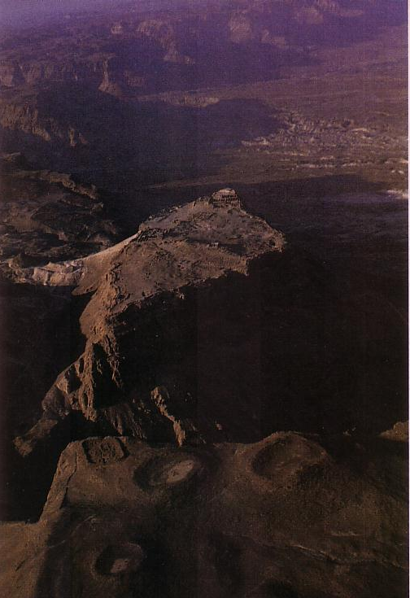
#9 Masada
226
Southwest shore of Dead Sea
150 BC
Probably David's stronghold
(1 Sam. 22:4-5)

Slide 58
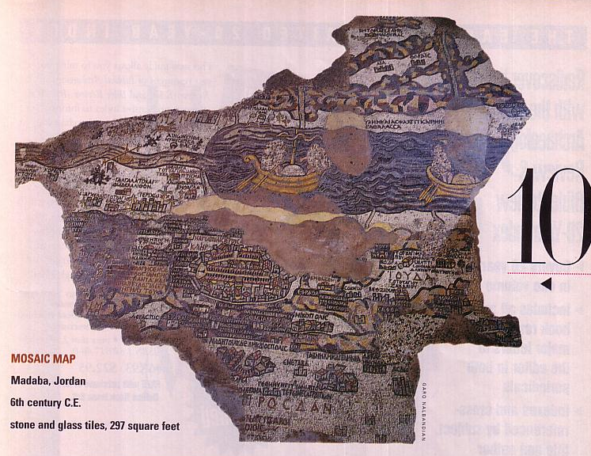
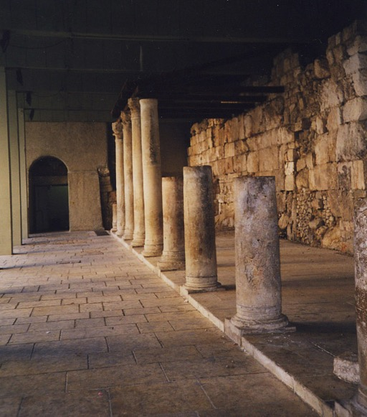
#10 Mosaic Map
227
Madaba, Jordan
AD 550
Largest & oldest map of Jerusalem, with Cardo

Slide 59


NT Backgrounds link at BibleStudyDownloads.org
Get this presentation for free!
Notes:
OT Backgrounds (ob)

Slide 60
Black

