Slide 1

Baptism
Dr. Rick Griffith • Jordan Evangelical Theological Seminary • BibleStudyDownloads.org
Notes:
But is baptism really that important? Why be baptized?

Slide 2
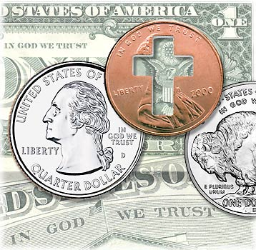
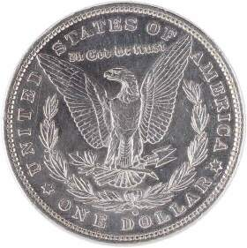
Do you trust in God?
Notes:
For over 200 years America has unashamedly declared trust in God. Since the 1950s by law each currency and coin must say on it, "In God We Trust."

Slide 3
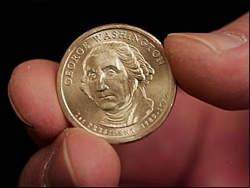
Do we trust in God?
Notes:
But do we really trust in God? (Click) I found it interesting that in 2008 the news broke that our new dollar coin produced the previous month actually doesn't have this phrase on the front or the back. Some have said that it doesn't appear on the coin at all.

Slide 4
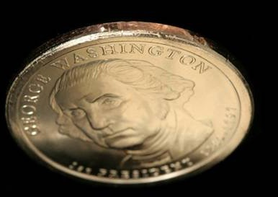
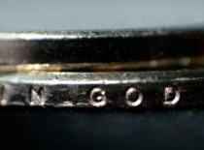
Does your trust in God embarrass you?
Notes:
But the phrase does appear--only it's on the side--at least on most of the 300 million coins minted! The news broke that an unknown amount of coins were missing the phrase totally. Interestingly, these coins are more valuable and at first sold for $600 on eBay. Now that we know there's as many as 100,000 of them, the price has dropped to $50. It seems that we are too embarrassed about Christ to put this phrase on the front or back anymore.

Slide 5

A Cause for Shame?
"Who, me? Well, no, I'm not actually a Christian…"
Notes:
That reminds me of some Christians. Ask them if they are believers and they want to know why you want to know! Worse yet, they won't admit that they trust in Christ.

Slide 6
Paul Had No Shame
¹⁶I am not ashamed of the gospel,
because it is the power of God for the salvation of everyone who believes: first for the Jew, then for the Gentile.
¹⁷For in the gospel a righteousness from God is revealed, a righteousness that is by faith from first to last, just as it is written: "The righteous will live by faith."
Notes:
Not Paul though! Paul wrote a great statement of his trust in Christ in Romans 1. Would you turn there with me in your Bibles to Romans 1:16? Paul wrote (click)…

Slide 7
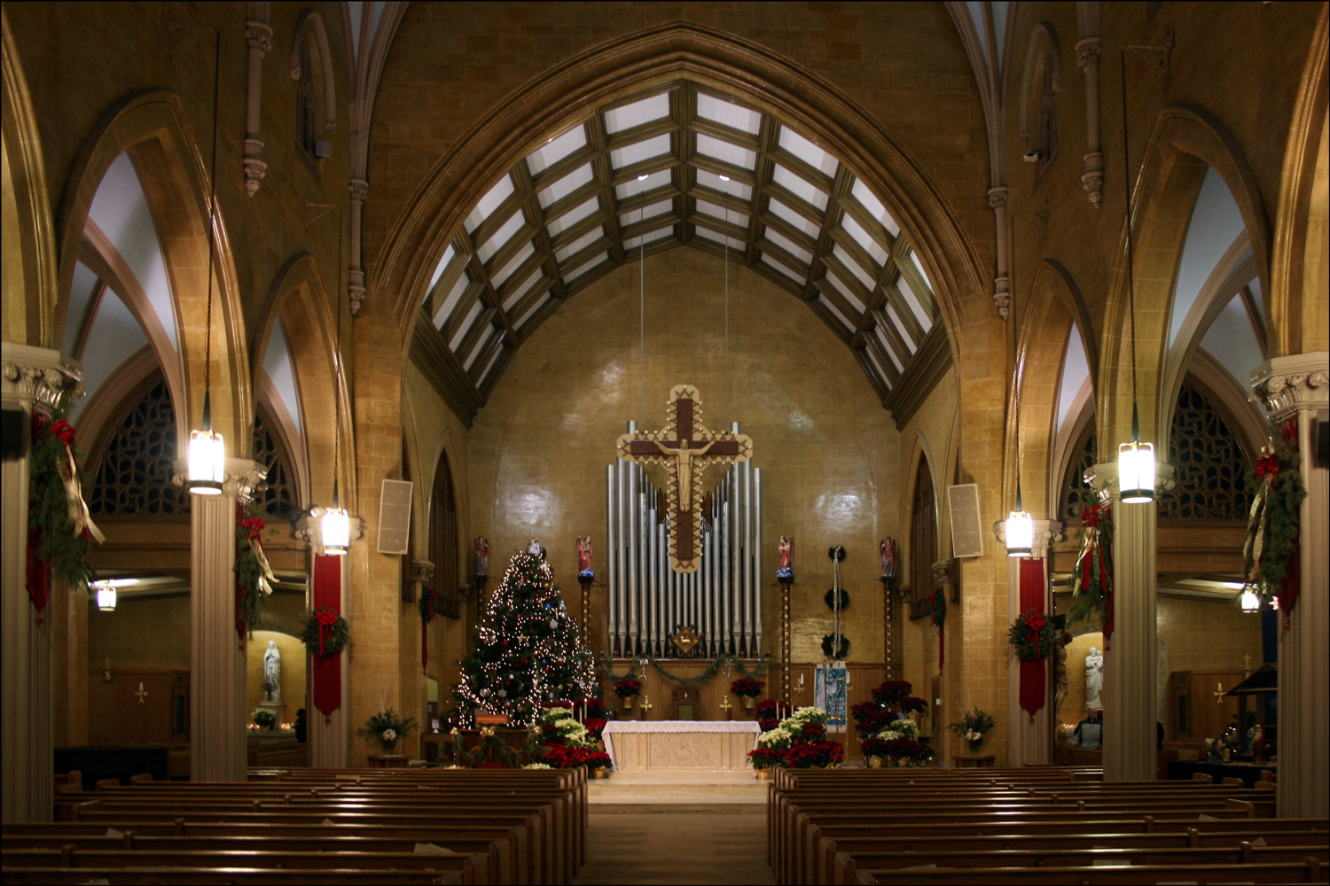
Defining Terms:
104
Sacrament: ritual as a means of grace
Ordinance: practice ordained by Christ
Foot washing

Slide 8
Christian Ordinances
104
Lord's Supper
Baptism
Seven Questions
Notes:
At CIC we unashamedly believe in Christ. We show this in two ordinances or practices instituted by Christ. They are called ordinances because Christ ordered or commanded them. We have spoken a fair amount about the Lord's Supper each first Sunday of the month, but so far we haven't addressed baptism (click).
Today I'm departing from my normal practice of giving an exposition of a single text of Scripture (click). Rather, we will look at many texts that answer seven basic questions about baptism.

Slide 9
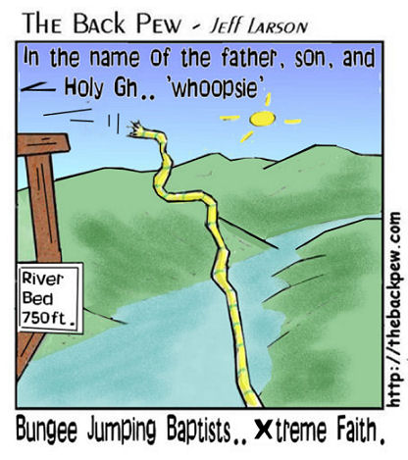
Extreme Faith
In the name of the Father, Son, and the Holy Gh… 'whoopsie'
River Bed 750 ft.
Bungee Jumping Baptists… Xtreme faith
Notes:
Hopefully answering these seven questions will take the fear out of being baptized since some of you haven't yet been baptized!

Slide 10
Ask your neighbor…
Have you been baptized?
Why or why not?
Notes:
To get you thinking about this, I want you to turn to the person next to you and ask two questions: Have you been baptized and why or why not? Take a minute to do this…

Slide 11
































SBC Faculty Members
Lutheran
Infant Sprinkling
Baptist
Anglican
Presbyterian
Believer's Immersion
Bible-Presbyterian
Brethren
Methodist
Independent
Notes:
In 2008 I prefaced my teaching on baptism by telling where I have served since 1991--at Singapore Bible College. At SBC we had:
31 faculty
7 countries
8 denominations
Sprinkling, pouring, immersion (least practiced)
Harmony, love, unity amidst diversity
ICS is a similar story!
By June 2010, of the 31 faculty in 2007, 14 had left and been replaced.
By March 2012, we still had 31 faculty, but 17 of the 31 in 2007 were replaced.
By February 2014, of our 31 faculty, only 11 of these remained as 20 were replaced.

Slide 12
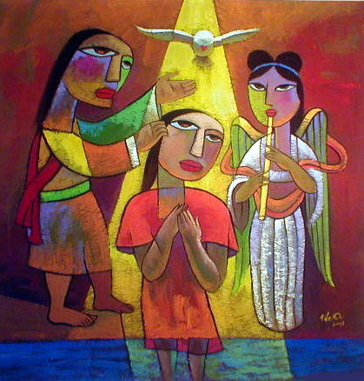
What is Baptism?
Notes:
Let's begin our search of the NT teaching on baptism by asking this simple question: What is baptism?

Slide 13
Meaning of Baptism:
104
Identification
OT: Not practiced
Intertestament: Gentiles identified with Jews
John: Unrepentant identified with repentant
Church: Unbelievers identified with believers
Notes:
The key idea of baptism centers around the word "identification." Anyone baptized identifies with a new group or way of life… (click)

Slide 14

How is Christian Baptism Unique?
Notes:
If all baptisms have the idea of identification, then how is Christian baptism unique?

Slide 15

Intertestamental Baptism
105
For Proselytes (Gentiles who left their pagan life to identify with Israel)
Self-immersion
Probably especially for women as they could not be circumcised
Notes:
Let's contrast Christian baptism with other baptisms that preceded it. The practice of baptism began in the 400 year time period between the OT and NT…

Slide 16
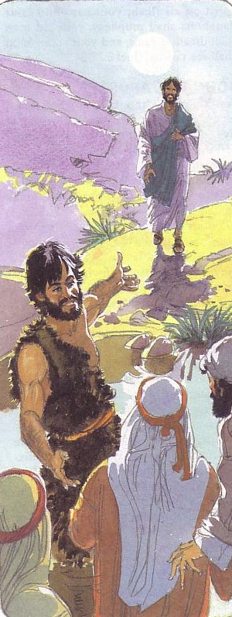
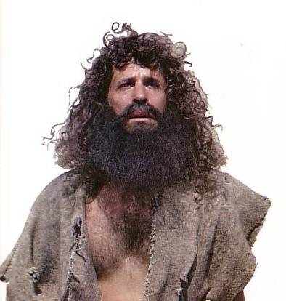
John's Baptism
105
John as agent of immersion
Repentance
Notes:
John the Baptist added a new practice of being the one who baptized rather than people baptizing themselves. He also emphasized repentance.

Slide 17

Summary of Early Church Baptism vs. Baptisms Preceding It
Contrasts (Preceding vs. NT/Christian) | Comparisons (Points in Common)
No formula vs. "Father, Son, & Holy Spirit" | Signified identification with a religious community
Self-immersion vs. performed by another | Practised only on believers
Circumcision prerequisite vs. none | Immersion only in both cases (BC & 1st century)
To Judaism/John vs. to Christianity | Common in both instances
Immersion vs. mode varied (in 3rd century) | Water used

Slide 18
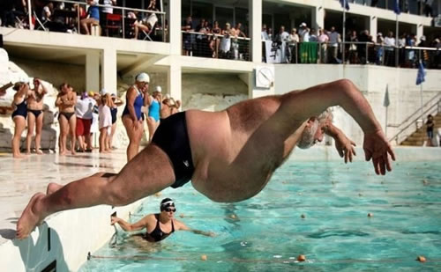
Why Be Baptized?
Notes:
But is baptism really that important? Why be baptized?

Slide 19
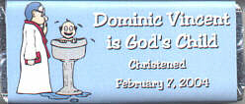
Is baptism needed for salvation?
Dominic Vincent is God's Child
Christened
7 February 2004
"…whoever believes in Him has eternal life"
(John 3:16)
Absolutely not!
Notes:
Some say it is needed for salvation--do you agree? For many parents, there is a feeling of uneasiness until their baby is baptized. They feel that if the baby died without being baptized, the baby would go to hell!

Slide 20
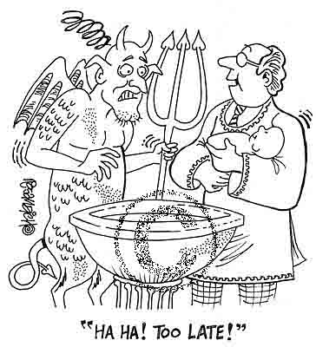
Is baptism needed for salvation?
"HА HА! TOO LATE!"
Notes:
Since the NT says nothing about baptizing a baby to save him, it's a false hope that baptizing a baby will make Satan fear. In fact, the devil wants us to think that anything but faith in Christ will save us from sin.

Slide 21
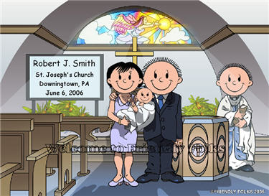
We celebrate each baby's birth
Robert J. Smith
St. Joseph's Church
Downingtown, PA
6 June 2006
Notes:
Now it's good and right to celebrate the birth of every baby…

Slide 22
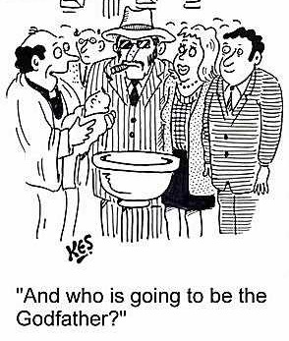
Infant baptism is actually a child & parent dedication
"And who is going to be the Godfather?"
Notes:
But actually, infant baptism is more of a commitment of the parents to raise the baby in the fear of God. In churches where I have been a part, since we don't see biblical support to baptize infants, we typically pray for the baby and the parents in a short dedication ceremony.

Slide 23

Why Be Baptized?
Baptism fulfills the command of Christ
Matthew 28:19-20
Notes:
So if baptism doesn't save us, then what value does it have? Let's look at some reason to be baptized…

Slide 24
The Great Commission
106
Matthew 28:18-20
¹⁸Then Jesus came to them and said, "All authority in heaven and on earth has been given to me. ¹⁹Therefore go and make disciples of all nations, baptizing them in the name of…, ²⁰and teaching them to obey everything I have commanded you. And surely I am with you always, to the very end of the age."
Notes:
Christ has all authority but he extends some of it to us as people under his authority. It may appear that there are four commands here, but "make disciples" is the only command here. This happens by us also obeying the three participles: going, baptizing, and teaching.

Slide 25
Why Be Baptized?
Baptism shows that you want to live under God's authority like Jesus showed when he was baptized.

Slide 26
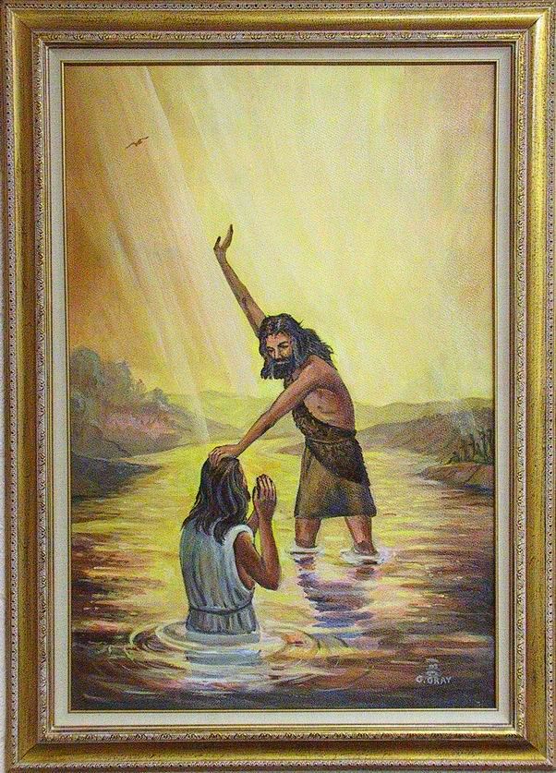
Christ was baptized by John

Slide 27
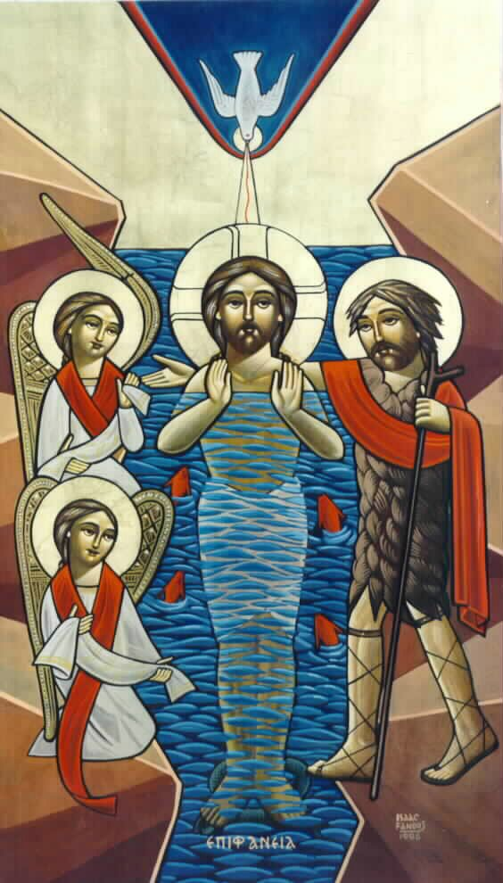
"To fulfill all righteousness"

Slide 28
Why Be Baptized?
Baptism is a sign that God has saved you from your sin (Rom. 6:1-2)

Slide 29

The Rainbow

Slide 30


… This cup is the
NEW COVENANT in my blood, which is POURED OUT for you.
The cup (not baptism) is the new covenant sign
LUKE 22:20

Slide 31
Symbolism
107
Why Be Baptized?
Baptism symbolizes the death, burial, and resurrection of Christ Jesus, and identifies you with Christ (Rom. 6:3-7)

Slide 32
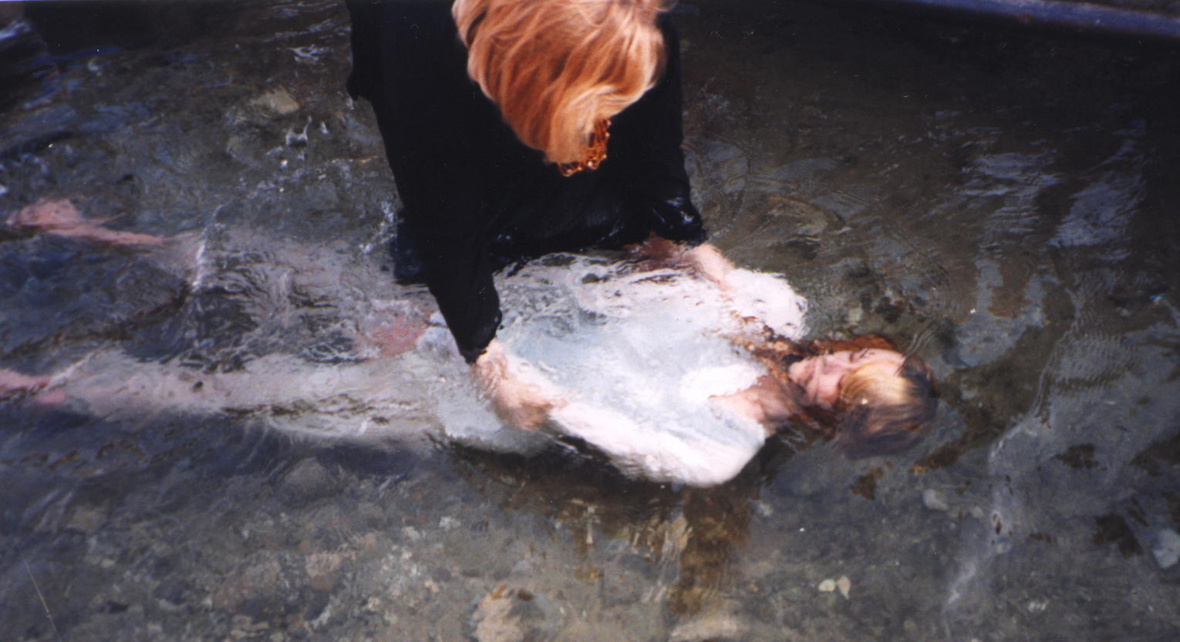
Romans 6:3
Don't you know that all of us who were baptized into Christ Jesus were baptized into his death? (Rom. 6:3)

Slide 33
New Life
Why Be Baptized?
Baptism portrays your new life or rebirth given through the Holy Spirit (Romans 6:4)

Slide 34
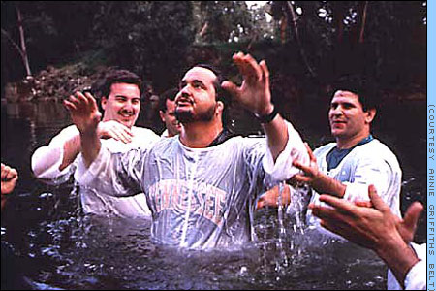
New Life picture

Slide 35
Why Be Baptized?
Baptism symbolizes the washing away and cleansing of a life of sin, into the purity of holiness acceptable to God
(Acts 2:38).

Slide 36

"Because of…"
"Repent and be baptized, every one of you, in the name of Jesus Christ [because of] the forgiveness of your sins."
Acts 2:38

Slide 37
Pouring
Why Be Baptized?
Baptism incorporates you into the body of the church (Gal. 3:26-29; Eph. 2:11-22)
Notes:
A person who gets baptized becomes an official member of the church where he or she is baptized.

Slide 38
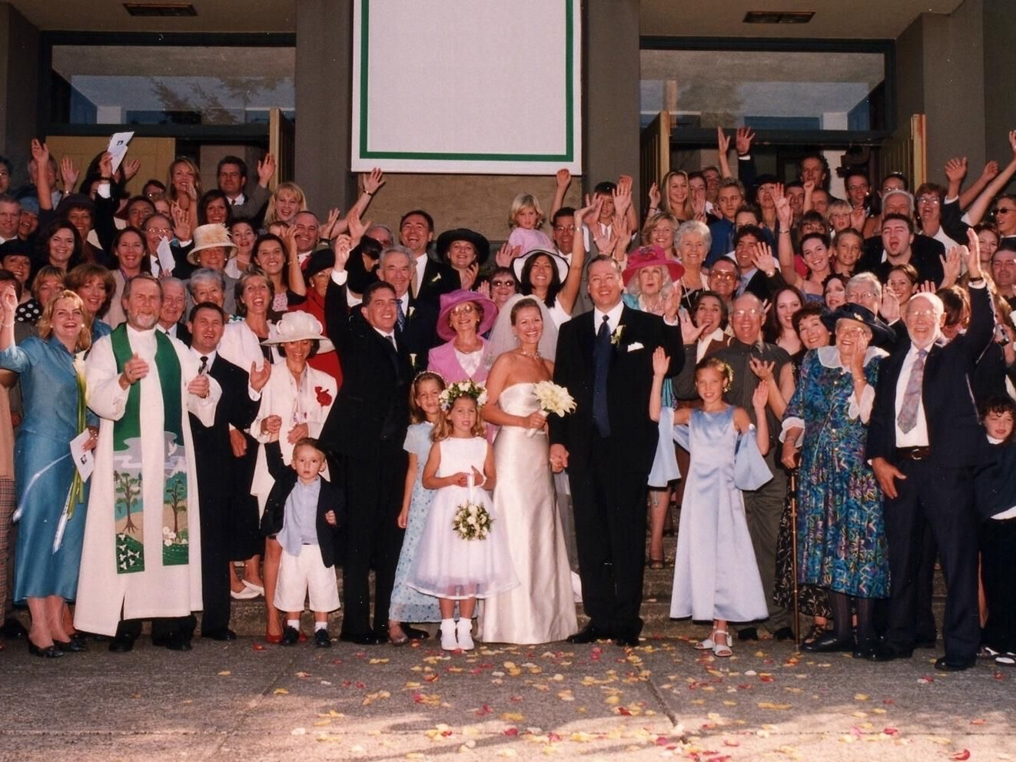
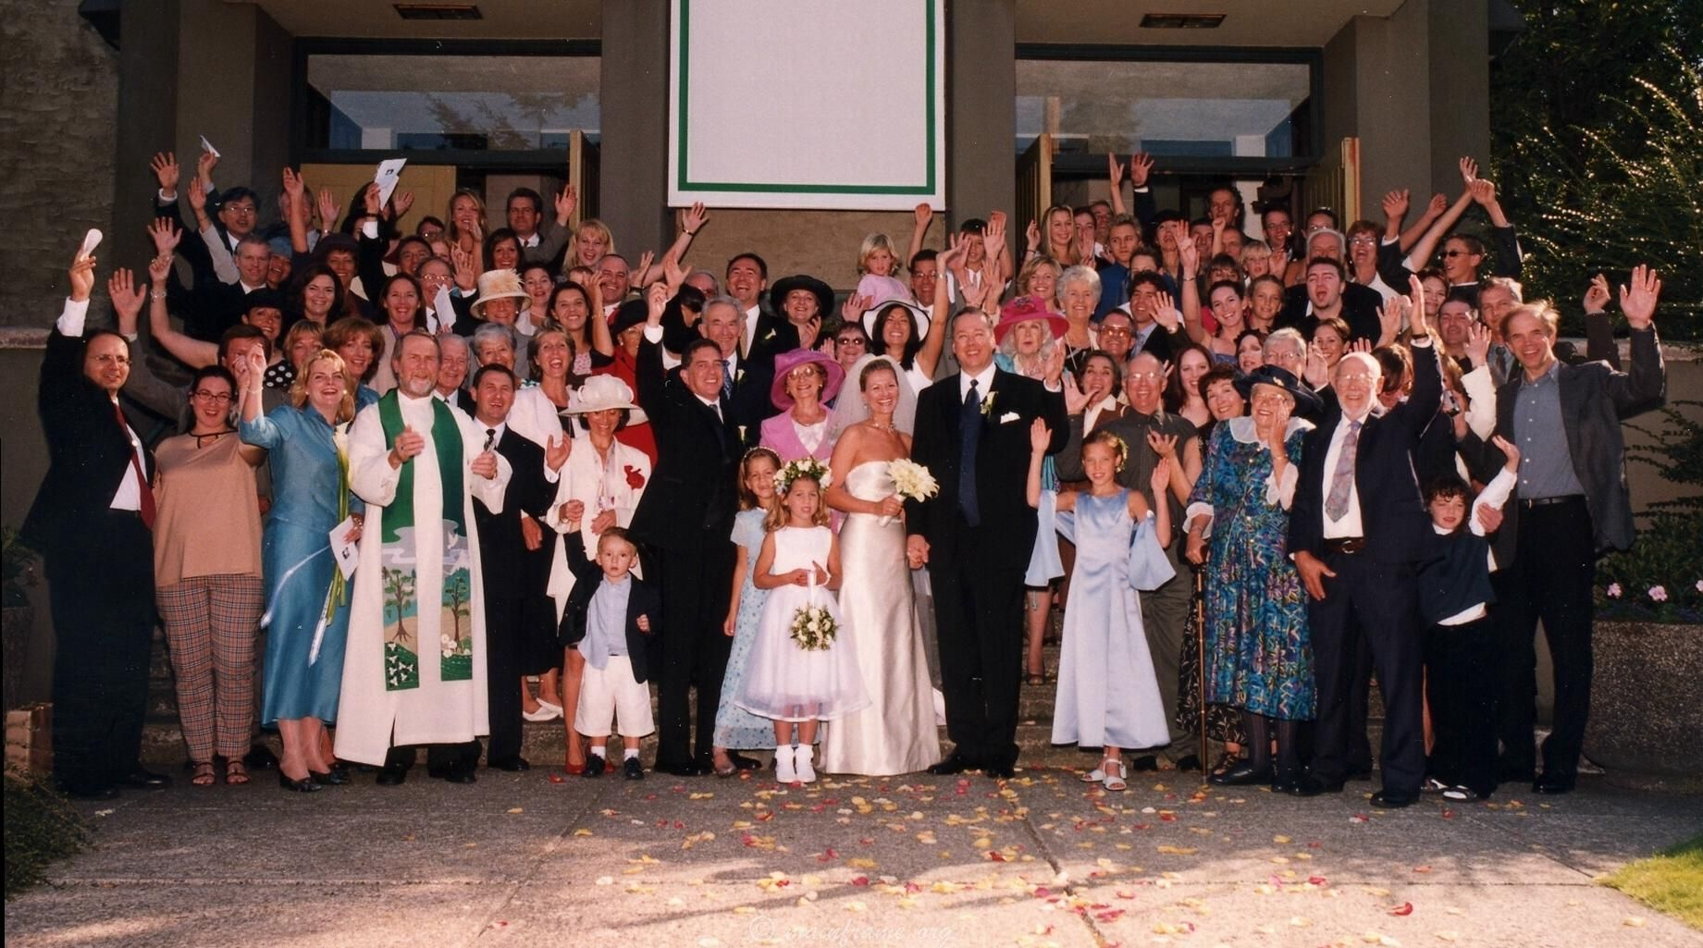
Church Family
Galatians 3:26-29
You are all sons of God through faith in Christ Jesus, for all of you who were baptized into Christ have clothed yourselves with Christ. There is neither Jew nor Greek, slave nor free, male nor female, for you are all one in Christ Jesus. If you belong to Christ, then you are Abraham's seed, and heirs according to the promise.

Slide 39

WHO should be baptized?

Slide 40
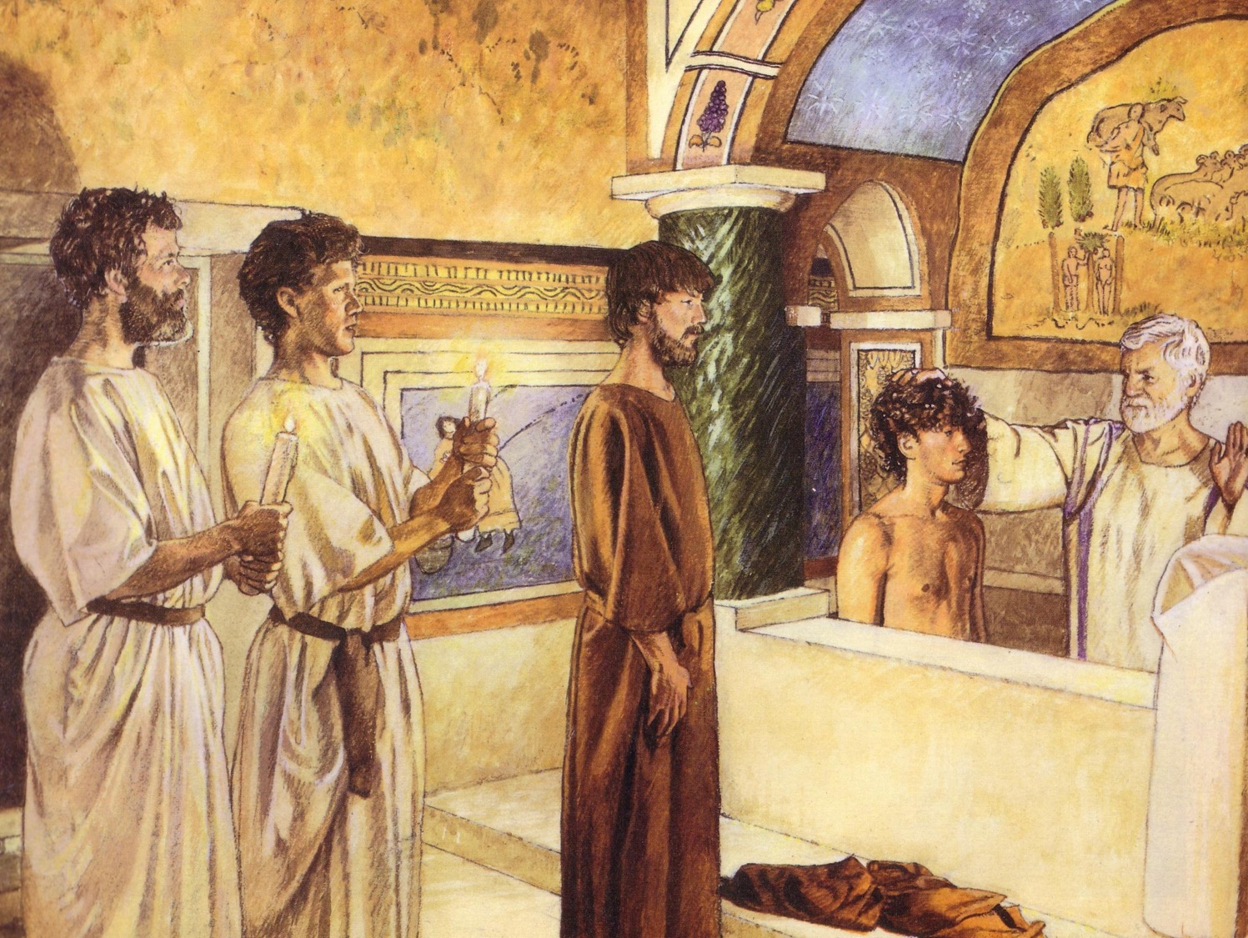
First Century Christian Baptism
140, 4) a)
For Believers Only
By Immersion Only

Slide 41

Recipients
Theoretically, all people should be saved and baptized
Practically, baptism is open to all who earnestly repent of their sins and who, having believed in Christ, seek to follow him

Slide 42
Recipients
Naturally, this includes repentant adults. But…

Slide 43
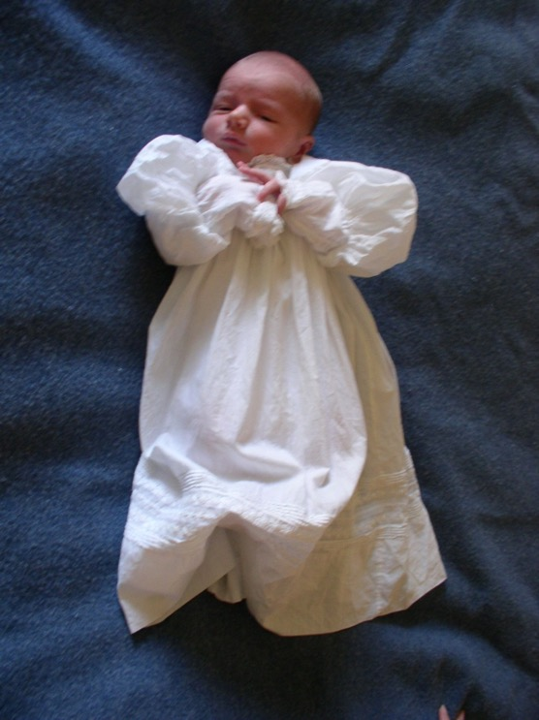
What About the Children?
(Paedobaptism)

Slide 44

"Believed…then Baptized" in Acts
105
Peter: "Repent…3000 baptized" (2:38, 41)
Samaritans "believed…baptized" (8:12)
Eunuch "believed…baptized" (8:36-38)
Paul believed…baptized (9:18)
Cornelius "believed…baptized" (10:47)
Jailer "believed…baptized" (16:14-15, 33)
Crispus "believed…baptized" (18:8)
John's disciples "believed…baptized" (19:5)

Slide 45
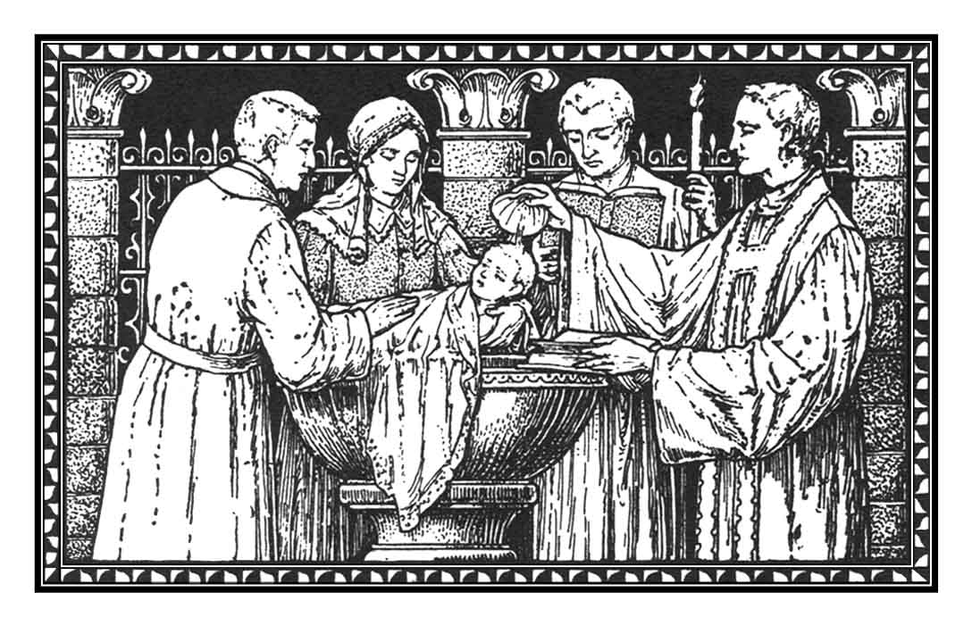
Recipients
(Paedobaptism)
The baptism of infants is recorded no earlier than the 3rd century A.D.

Slide 46
Recipients
(Paedobaptism)
Proponents claim that the "household baptisms" mentioned in Scripture included infants

Slide 47
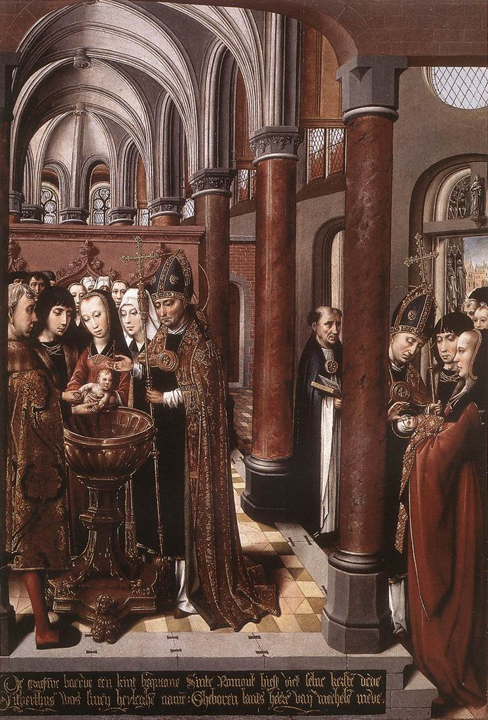
Recipients
(Paedobaptism)
Catholics believe that baptism itself is "the means of grace which brings regeneration. Baptism is the first step of the way of salvation."¹
¹Dorman, A Faith For All Seasons: Historic Christian Beliefs, 317.

Slide 48
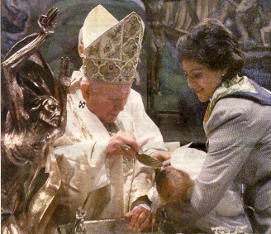
Recipients
(Paedobaptism)
If baptism saves, then it is better to baptize a human as soon as possible!

Slide 49
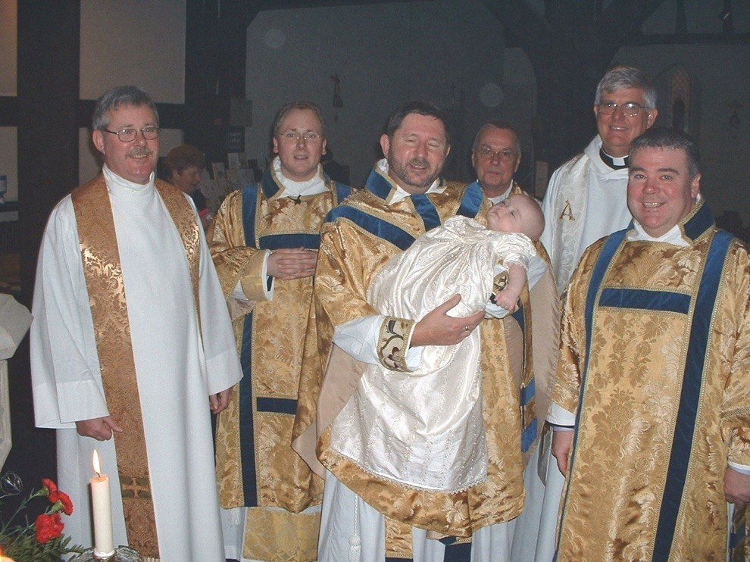
Recipients
Luther felt that faith was necessary for baptism, but he believed that the faith of parents and the church to be sufficient for the infant.

Slide 50
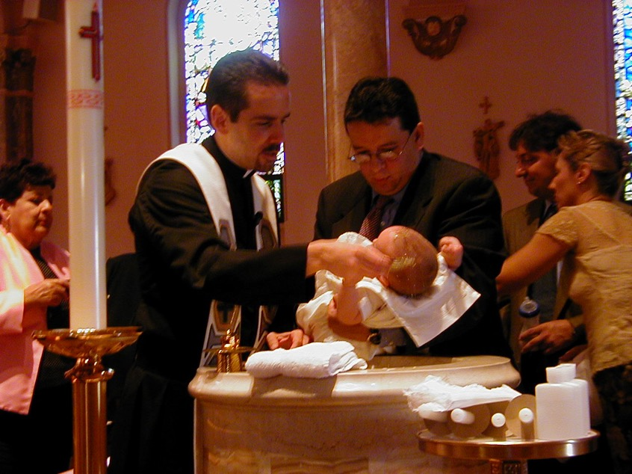
Recipients
Two additional points:
Paedobaptism is said to show that God loved and chose his children before they chose Him (John 15:16)

Slide 51
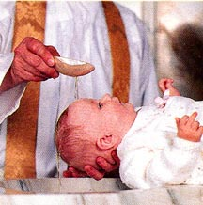
Recipients
Two additional points:
Infant baptism advocates believe Col. 2:11-12 says that baptism is a sign of the new covenant that corresponds to circumcision in the Old Testament.
Jews were circumcised at 8 days old, sooo….

Slide 52
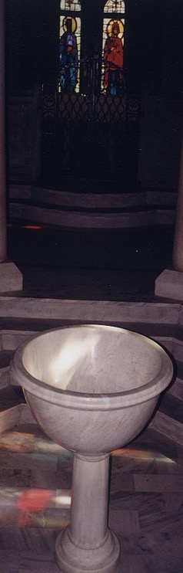
Recipients should not be infants because…
116
Circumcision doesn't parallel baptism
Males
All
Physical life
Spiritual life
Any age
Conscious faith
8th day of life
Right after belief
NT parallel = heart circumcision
New covenant sign = Lord's supper

Slide 53
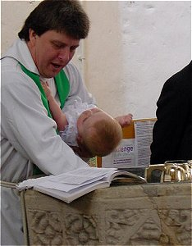
Recipients should not be infants because…
Baptism testifies to what has already taken place in the life of the believer

Slide 54
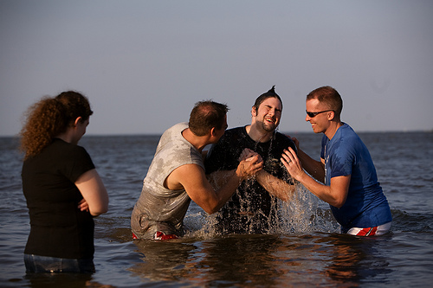
Why is immersion the proper mode?

Slide 55
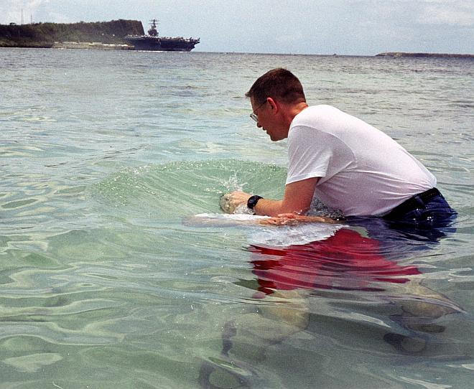

What does "baptize" mean?
106
114
Baptizo (bapti,zw) means "dip, immerse… wash, plunge, sink, drench, overwhelm… soak" (BAGD 131c)

Slide 56
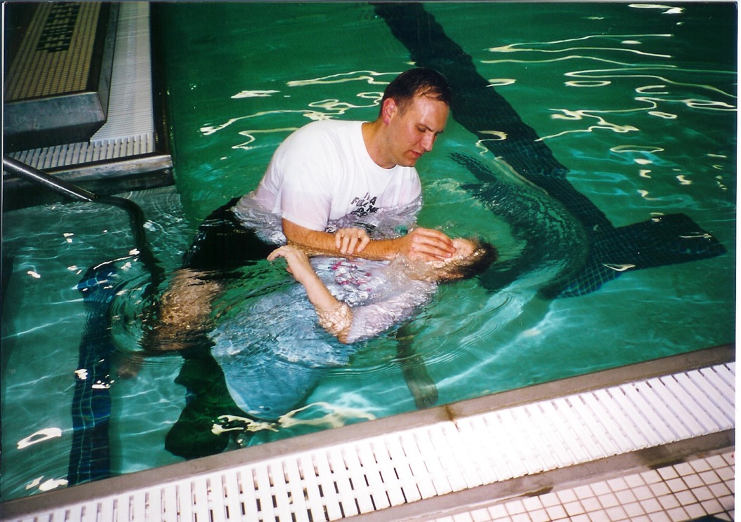
YMCA Pool
The place is not so significant…

Slide 57
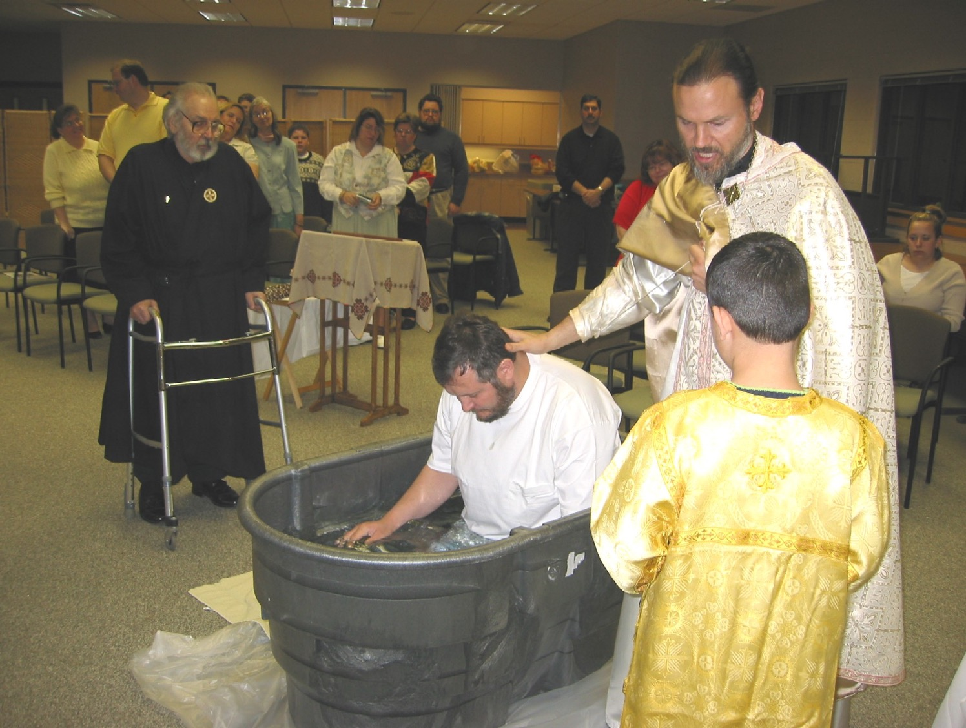
Immersion doesn't take a baptistery

Slide 58
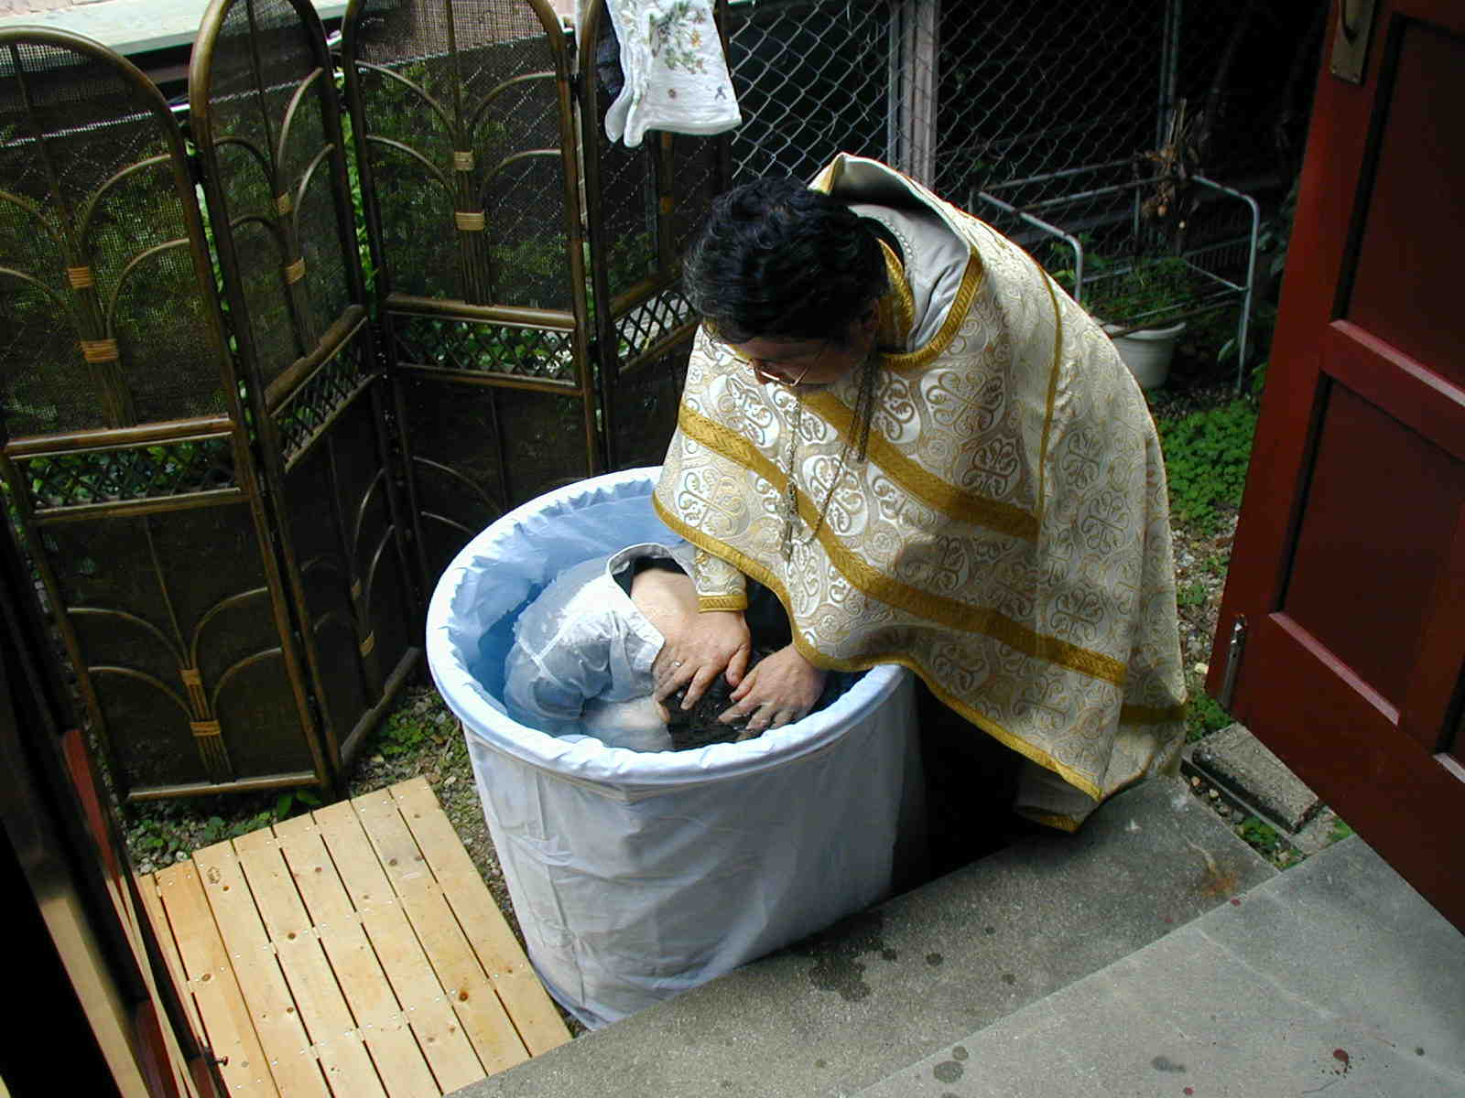
Japanese Orthodox
If they can do it, you can too!

Slide 59
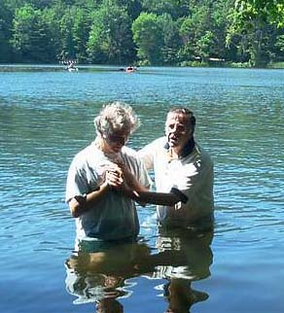
Greek
113
has separate words for:
• sprinkling
• pouring &
• immersion
Only the Greek word for immersion is ever used for baptism in the Bible.

Slide 60
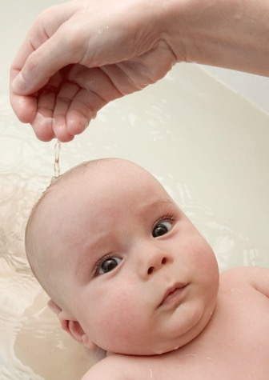
In Other Words…
There are other Greek words which mean other than immersion.
Louo means "to wash" or "to bathe."
Nipto means "to wash the extremities," as in the washing of hands or feet.
Rantizo means "to sprinkle."
Keo means "to pour."
The Greek was fully able to indicate which "mode" of baptism the church was to practice.
Philip D. Sanders, "How We Got the Bible" course, p. 140
Notes:
Philip D. Sanders, "How We Got the Bible" course (Maranatha Baptist Bible College pdf "Conference on Baptist Fundamentalism"), p. 140. www.mbbc.edu/download/PresidentOffice/ Fundamental%2005%20Notes.pdf

Slide 61

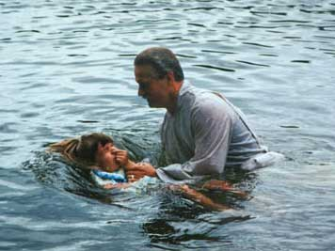
"Baptize" is a Transliteration
Translate bapti,zw = "immerse"
Transliterate bapti,zw = "baptize"
Baptize
Bapti,zw
Notes:
When Luther and the Reformers translated the Greek NT into the common language, they came to the Greek word for "immerse." Rather than translating it, they transliterated it into the new word "baptize."

Slide 62
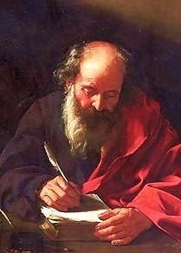
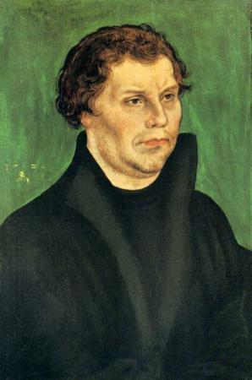

Inventing a Term
Bapti,zw
Jerome
400s
Luther
1500s
translate
transliterate
English:
immerse
baptize
Latin:
immergo
baptizo
German:
tauchen
taufen
Other translations
Notes:
The practice of transliterating baptizo began before Luther, though. It started in the 4th century with Jerome's translation of the NT from Greek into Latin. Jerome could have translated baptizo into the Latin word for "immerse" (immergo). However, he didn't see churches around him immersing, but sprinkling. It would have been mistranslating the Bible for him to mistranslate baptizo as "sprinkle" or "pour," so instead he transliterated the word as "baptize" (baptizo). This became the pattern of subsequent translations in the Romantic languages (languages based on Latin from Rome, such as Italian, French, Romanian, etc.).
A thousand-plus years later, Luther found himself in a similar situation. Luther could have translated baptizo into lower (common) German and rendered it "immerse" (tauchen). However, he also didn't see churches around him immersing, and unwilling to part with his Catholic background, he chose instead to render the Greek term into the more generic word for "baptize" (taufen). This became the pattern of subsequent translations not only into German but into Germanic languages such as English.

Slide 63
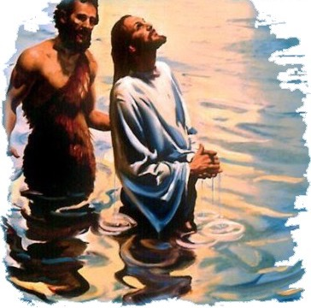
Mode of Baptism: Immersion
The verb "to baptize" means "to immerse"!
Immersion was the only mode of baptism in the New Testament.
Immersion continued as the regular mode until the 13th century!

Slide 64
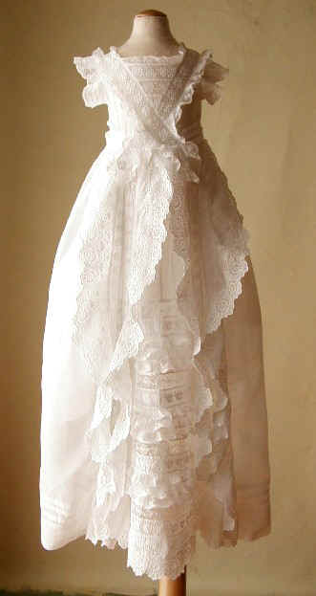
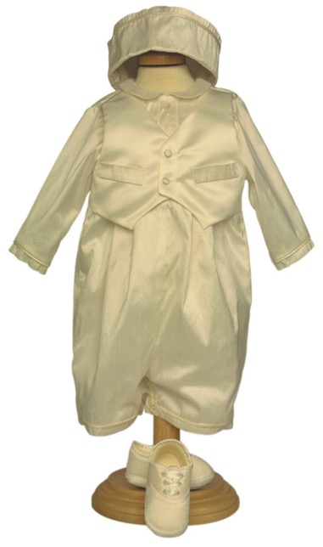
What about the clothes?

Slide 65
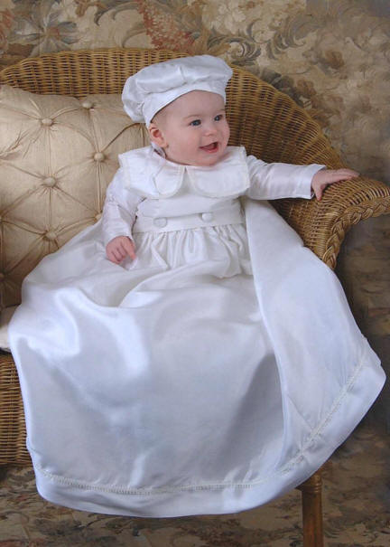
Do you want to dip this baby in water?

Slide 66
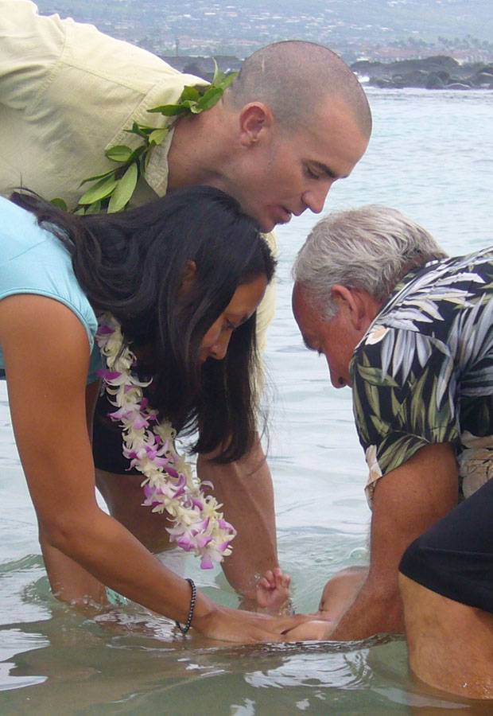
Infant Immersion!

Slide 67
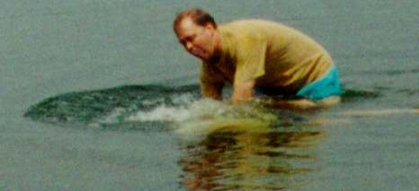

Immersion best signifies…
106
identification with Christ's death and resurrection (Rom. 6:3-5; Col. 2:12)
in order that, just as Christ was raised from the dead through the glory of the Father, we too may live a new life.
Romans 6:4 We were therefore buried with him through baptism into death

Slide 68
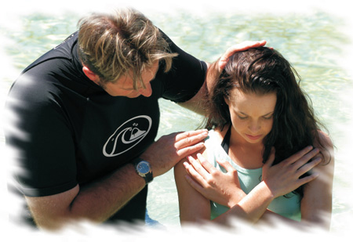
Immersion best signifies…
106
identification with Christ's death and resurrection (Rom. 6:3-5; Col. 2:12)
subjection to Christ's authority (Matt. 28:18-20)
"All authority in heaven and earth has been given to me… therefore go and make disciples…baptizing…"

Slide 69
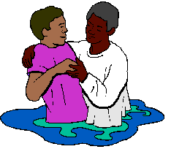
Immersion best signifies…
106
identification with Christ's death and resurrection (Rom. 6:3-5; Col. 2:12)
subjection to Christ's authority (Matt. 28:18-20)
obedience and a good conscience before God (1 Pet. 3:21)

Slide 70
So where did sprinkling and pouring come from?
?
?
?

Slide 71
When was sprinkling invented?
The first recorded case of sprinkling was in
AD 257 to someone on a sick-bed. It was then an exception to the rule and brought about fierce opposition from the whole church.
Not until AD 757 did the church accept sprinkling in such sick-bed cases of necessity.
It wasn't until AD 1311, when the Catholic council of Ravenna, declared that sprinkling was an acceptable substitute for immersion and from that time forward sprinkling replaced immersion in the Roman Catholic church.
www.bible.ca/ cath-overview-false-teaching.htm
Notes:
www.bible.ca/ cath-overview-false-teaching.htm

Slide 72
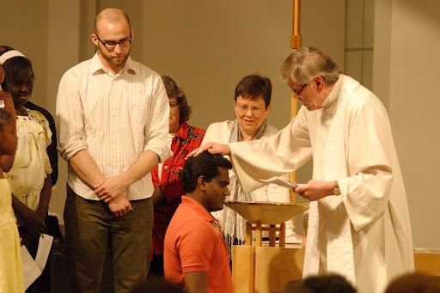
Mode of Baptism
Sprinkling
Some believe it represents the sprinkling of the blood of Christ

Slide 73
Sprinkling?
Exodus 24:6-8
Moses took half of the blood and put it in bowls, and the other half he sprinkled on the altar… Moses then took the blood, sprinkled it on the people and said, "This is the blood of the covenant that the LORD has made with you in accordance with all these words."
107
Ezekiel 36:24-27
"'For I will take you [Israel] out of the nations; I will gather you from all the countries and bring you back into your own land. I will sprinkle clean water on you, and you will be clean; I will cleanse you from all your impurities and from all your idols. I will give you a new heart and put a new spirit in you; I will remove from you your heart of stone and give you a heart of flesh. And I will put my Spirit in you and move you to follow my decrees and be careful to keep my laws.
Numbers 8:7
To purify them, do this: Sprinkle the water of cleansing on them; then have them shave their whole bodies and wash their clothes, and so purify themselves.
Hebrews 9:13-14
The blood of goats and bulls and the ashes of a heifer sprinkled on those who are ceremonially unclean sanctify them so that they are outwardly clean. How much more, then, will the blood of Christ, who through the eternal Spirit offered himself unblemished to God, cleanse our consciences from acts that lead to death, so that we may serve the living God!
Exod. 24:6-8?
Num. 8:7?
Ezek. 36:24-26?
Heb. 9:13-14?
Heb. 10:22?
NIV Hebrews 10:22
Let us draw near to God with a sincere heart in full assurance of faith, having our hearts sprinkled to cleanse us from a guilty conscience and having our bodies washed with pure water.

Slide 74

Modes of Baptism:
Pouring
Some believe it portrays the outpouring of the Holy Spirit on the believer

Slide 75

Pouring?
NIV 1 Corinthians 6:11 And that is what some of you were. But you were washed, you were sanctified, you were justified in the name of the Lord Jesus Christ and by the Spirit of our God.
107
NIV Hebrews 10:22
Let us draw near to God with a sincere heart in full assurance of faith, having our hearts sprinkled to cleanse us from a guilty conscience and having our bodies washed with pure water.
1 Cor. 6:11?
Eph. 5:26?
Heb. 9:10?
Heb. 10:22?
Tit. 3:5?
NIV Ephesians 5:26
to make her holy, cleansing her by the washing with water through the word
NIV Hebrews 9:10
They are only a matter of food and drink and various ceremonial washings-- external regulations applying until the time of the new order.
NIV Titus 3:5
He saved us, not because of righteous things we had done, but because of his mercy. He saved us through the washing of rebirth and renewal by the Holy Spirit.

Slide 76

But does "washing" mean "pouring"?
Modes of Baptism: Sprinkling and Pouring
Zwingli and most of the Reformers agreed that the central sign was washing, not death and resurrection. Pouring then became the norm.

Slide 77

Pouring

Slide 78

When it rains, it pours!

Slide 79
Was immersion possible?
Modes of Baptism: Sprinkling and Pouring
Did the apostles baptize 3000 at the Temple at Pentecost by immersion?
120 disciples each baptize 100 persons
an hour = 12,000 baptized
12 disciples each baptize 100 persons
an hour = 1200 baptized/hour for 3 hours
Notes:
One wonders if he could have sprinkled or poured upon that many either, but the text does not say Peter did the baptising. If one could immerse 100 people per hour (a distinct possibility), the 120 disciples there (Acts 1:15) could have immersed 12,000 in a single hour! Even if only the 12 baptized it would take less than three hours to baptise the 3000 (12 x 100 = 1200/hour).

Slide 80
Baptism at Philippi (Acts 16)
Modes of Baptism: Sprinkling and Pouring
"Did the bleeding Paul and Silas troop through the streets with the Philippian jailer and his family, when they already had water nearby to pour on them?"

Slide 81

The Philippian Jailor (Acts 16)
Notes:
The jailor was sitting quietly one evening...

Slide 82

An earthquake?! Oh, no! The prisoners escaped!
Notes:
Until suddenly there was an earthquake! Fear seized him…

Slide 83

Attempted suicide
Notes:
He thought that Paul and Silas had escaped, so he sought to kill himself

Slide 84
What must I do to be saved?
Notes:
Until suddenly there was an earthquake! Fear seized him…

Slide 85

Believe in the Lord Jesus Christ and you will be saved—you and your entire household!
(Acts 16:31).
Notes:
But Paul told him, "Believe in the Lord Jesus Christ and you will be saved—you and your entire household!" (Acts 16:31). So he trusted Christ and was filled with joy.

Slide 86

Pouring
Notes:
Then he was baptized. The artist wanted to please all, so he has him being baptized by pouring

Slide 87

Immersing the jailow
Notes:
Or immersion!

Slide 88

Why is immersion the proper mode?
115
"plenty of water" (John 3:23)
"coming up out of the water" (Mark 1:10)
"went down into the water"
(Acts 8:38)

Slide 89

Rememberthe Ethiopian eunuch
(Acts 8:26-40)?

Slide 90

How did Philip baptize the Ethiopian eunuch?
As they traveled along the road, they came to some water and the eunuch said, "Look, here is water. Why shouldn't I be baptized?" (Acts 8:36)

Slide 91

Baptism Requirements
Three years instruction
Procedure up to Sunday Baptism
  Thursday: Bath
  Friday: Fasting
  Saturday: Laying on of hands, exorcism
  Saturday night: vigil with instruction
  Sunday: prayed for, anointed with oil, asked three questions, baptized naked (first children, then men, then women)
David F. Wright, "The Baptismal Community," Bib Sac 160 (Jan-Mar 2003): 3-12

Slide 92

The First Church Building
At Dura-Europos on the Euphrates River
AD 240
Had a small room set apart as a baptistry!
David F. Wright, "The Baptismal Community," Bib Sac 160 (Jan-Mar 2003): 3-12
Notes:
http://commons.wikimedia.org/wiki/Image:DuraEuropos-Church.jpg

Slide 93

Attitudes Toward the Unbaptized
Treated almost as if non-Christians
Not actively sought to be baptized
Must leave the church service before the Lord's Supper administered
David F. Wright, "The Baptismal Community," Bib Sac 160
(Jan-Mar 2003): 3-12

Slide 94

First Century Christian Baptism
For Believers Only
By Immersion Only

Slide 95

Why not immerse?
There is little reason to be baptized in any other manner but by immersion
Exceptions include physical, logistic, and economic considerations

Slide 96

If I have been sprinkled before, should I now be immersed?
Let's see how Paul helped 12 previously immersed disciples of John the Baptist in Acts 19:1-7…

Slide 97

If I have been sprinkled before, should I now be immersed?
117
Acts 19:1-7 (NLT): While Apollos was in Corinth, Paul traveled through the interior regions until he reached Ephesus, on the coast, where he found several believers. ²"Did you receive the Holy Spirit when you believed?" he asked them. "No," they replied, "we haven't even heard that there is a Holy Spirit."
³"Then what baptism did you experience?" he asked. And they replied, "The baptism of John."

Slide 98
If I have been sprinkled before, should I now be immersed?
117
⁴Paul said, "John's baptism called for repentance from sin. But John himself told the people to believe in the one who would come later, meaning Jesus."
⁵As soon as they heard this, they were baptized in the name of the Lord Jesus. ⁶Then when Paul laid his hands on them, the Holy Spirit came on them, and they spoke in other tongues and prophesied. ⁷There were about twelve men in all.

Slide 99

My Infant Baptism

Slide 100

The Main Idea
Every Christian should show his or her love for Christ through immersion

Slide 101

Who will follow Christ's example in baptism?

Slide 102

Simon Peter's Enthusiasm
"Jesus answered, 'Unless I wash you, you have no part with me.'
'Then, Lord,' Simon Peter replied, 'not just my feet but my hands and my head as well!'" (John 13:8b-9)

Slide 103

Don't Be Deprived of the Full Experience!

Slide 104

Questions about Baptism?
116-117
Required before Lord's Supper?
Required if sprinkled as infant?
Required if sprinkled as adult?
Required if immersed in unbiblical church?

Slide 105
Baptism Summary
244c
 | Infant | Believer's
Adherents | Catholic, Lutheran, Presbyterian, Reformed, Anglican, Methodist, some Evangelical Free Church | Baptist, Bible, Brethren, Mennonite, Pentecostal, some Evangelical Free Church, most independent churches
Purpose | Three Views: Catholic: Means of saving grace apart from the faith of the baptized (baptismal regeneration) Lutheran: Means of saving grace by assuming faith in infants baptized (baptismal regeneration) 3 Others: Not a means of saving grace but a seal and sign of the covenant | Unified View: Baptism is a symbol of salvation: an outward sign of the inward reality of justification received in Christ with no external efficacy.
Notes:
The many slides following seek to objectively contrast the two major forms of baptism, with a Lutheran professor's input on the infant baptism to make sure that I am representing the view properly. However, within each form, many differences occur due to personalities, history, tradition, and many other factors.
————————————————
CH-05-Baptism-105
NB-13 Religion 4 Baptism-105
NS-17-Titus-278

Slide 106
Baptism Summary
244c
 | Infant | Believer's
Support for Their Purpose | Baptismal regeneration is taught in many verses (Mark 16:16; John 3:5; Acts 2:38; Tit 3:5; 1 Pet 3:21). | Baptism and salvation are linked, but baptism does not cause salvation. Salvation is by faith alone (John 3:16; Rom. 10:9-10; Eph. 2:8-9). NT baptism was often at one's conversion. This close association between salvation and baptism was seen as a single event, yet baptism was not always commanded with conversion (Acts 3:19; 16:31). Baptismal regeneration is refuted by Ronald K. Y. Fung, The Epistle to the Galatians, NICNT, 173-74

Slide 107
Baptism Summary
244c
 | Infant | Believer's
View of Colossians 2:11-12 | "In him you were also circumcised, in the putting off of the sinful nature, not with a circumcision done by the hands of men but with the circumcision done by Christ, ¹² having been buried with him in baptism and raised with him through your faith in the power of God, who raised him from the dead" (Col 2:11-12 NIV). Baptism is the sign of the covenant (Col 2:12). It thus signifies the recipient's initiation into the community of God. | The new covenant sign is not baptism but the Lord's Supper (1 Cor 11:25). Colossians 2:11-12 parallels baptism not with physical circumcision but with "spiritual" circumcision, or salvation. The NT never connects baptism with a covenant (e.g., the Abrahamic Covenant).
Notes:
The infant baptism view of Colossians 2:12 is an argument from silence as Colossians mentions no covenant relating to baptism.

Slide 108
Baptism Summary
244c
 | Infant | Believer's
Seal of the Covenant | Baptism is the seal of the covenant (Acts 15:1; 21:21; Gal 2:3-5). | The verses at the left show only that circumcision is not required in the present age; they say nothing about baptism. The seal of the new covenant is not baptism but the Spirit (Eph 1:13-14).
Key Idea | The central idea associated with baptism is purification from sin (Col 2:11-12). | Baptism signifies forgiveness of sin but also identification with Christ in His death and resurrection (Rom 6:1-7).

Slide 109
Baptism Summary
244c
 | Infant | Believer's
Priority | Assigning to baptism only a symbolic purpose shows a low view of baptism considering the many NT references. | To baptize only Christians shows a high view of baptism—especially since it is so often associated with salvation. The statement at the left assumes that a symbol cannot be important, but this is exactly what we have in the Lord's Supper.
Thief on the Cross | This thief had no opportunity to be baptized so is not a good example since Christ may have made an exception in his case. | Christ promised the repentant thief on the cross salvation without baptism (Luke 23:40-43). This refutes Catholic and Lutheran views requiring baptism for salvation.

Slide 110
Baptism Summary
244c
 | Infant | Believer's
Subjects | Infants who have no personal faith in Christ can be baptized. | Believers alone should be baptized—this excludes infants and the unsaved.
Support for Above Stated Subjects | Baptism is parallel to circumcision; circumcision was done to infants; therefore, baptism should be performed on infants as well. | The logic at the left fails in its first premise—that baptism and circumcision are parallel (see above on Col 2:11-12). Also, only boys can be circumcised.

Slide 111
Baptism Summary
244c
 | Infant | Believer's
Illustration of God's Grace | Infant baptism more powerfully illustrates the grace of God. "How can the new covenant, which supersedes the old, exclude children when they are included in the old? Even animals are included in God's covenant of redemption (Gen 9:10), let alone children, who are definitely more precious to Him!". | How is God's grace towards a baby who has never consciously sinned greater than towards one who has repeatedly sinned? Grace towards adults is the greater marvel. Children of the old covenant were not saved by circumcision but by faith (Gen 15:6). Likewise, all in the new covenant are accepted by faith—not by baptism (Rom 4:1-25). Besides, how does denying infant baptism give priority to animals over humans? Animals are not baptized, so no comparison exists.

Slide 112
Baptism Summary
244c
 | Infant | Believer's
Household Baptisms | Entire households were baptized in the NT, which almost certainly included infants (Acts 10:47-48; 16:15; 18:8; 1 Cor. 1:16). | Each of the household texts declare that the households believed before baptism; that infants were baptized is an assumption that is counter to the stated fact that people believed before baptism.
Baptism in Church History | Infant baptism has been practiced throughout the history of the church from earliest times. | The earliest non-scriptural baptism instructions (early 2nd cent.) requires fasting 1-2 days before baptism, so it implies only adult baptism (Didache 7:4 in J.B. Lightfoot, Apostolic Fathers, 153)

Slide 113
Baptism Summary
244c
 | Infant | Believer's
Jesus & Children | Christ blessed children– probably even infants (Mark 10:13-16), which shows His approval to baptize them. | Blessing children and baptizing them are wholly different. The argument at the left is valid only if the NT shows Christ baptizing children, which it does not.
NT Silence | Infant baptism is not prohibited in the NT and therefore is allowed. | Silence does not argue for approval (e.g., we cannot argue for baptism of the dead simply because the NT does not prohibit it). NT support for believer's baptism automatically prohibits infant baptism since infants cannot believe.

Slide 114
Baptism Summary
244c
 | Infant | Believer's
Matthew 28:19-20 | The text does not give a sequence for baptism: "Therefore go and make disciples of all nations, baptizing them in the name of the Father and of the Son and of the Holy Spirit, ²⁰ and teaching them to obey everything I have commanded you. And surely, I am with you always, to the very end of the age" (NIV). | The Great Commission command is to make disciples—the only imperative in the verses. Going and baptizing and teaching are all participles, in this order. The "going" refers to leading people to faith, so we should baptize only believers, which excludes infants.
Romans 6:1-11 | "Whether the mode of baptism by immersion be alluded to in this verse, as a kind of symbolical burial and resurrection, does not seem to us of much consequence" (Jamieson, Fausset, and Brown, A Commentary, 1871, Accordance electronic ed. on Rom 6:4). | Being "buried with him in baptism" points to immersion only. Baptism also points back to the believer's becoming united with Christ in His death. This cannot be said of infants who have yet to believe.

Slide 115
Baptism Summary
244c
 | Infant | Believer's
Spiritual State of Those Baptized | Baptism is the means of saving infants (Catholic view), means of infants expressing faith in Christ (Lutheran view), or means of bringing infants "into the covenant" (Presbyterian view). | All NT subjects of baptism are clearly believers; one must have very good reason to deviate from this norm. Acts 2:38, 41; 8:12, 36-38; 9:18; 10:47; 16:14-15, 33; 18:8; 19:5 show that repentance preceded baptism in this order: "hearing...believing...being baptized."
Mode | Scripture does not specify any mode of baptism, thus allowing both sprinkling and pouring. It is not method that counts, but the sincerity of the one baptized. | The only scriptural mode is immersion, so how can we say mode is unimportant? While it is true that mode is less important than heart attitude, this does not then imply that mode is irrelevant.

Slide 116
Baptism Summary
244c
 | Infant | Believer's
Pouring in Church History | Baptism by pouring has been practiced throughout the history of the church from earliest times. | Pouring is first stated in the early second century—and only as an exception when immersion in running water or cold water could not or should not be used (Didache 7:1-3 in J. B. Lightfoot, Apostolic Fathers, 153).
Pouring in the NT | Baptism by pouring is mentioned often in the NT (1 Cor 6:11; Eph 5:26; Heb 9:10; 10:22; Tit 3:5). | None of these verses refer to baptism and none refer to pouring. They refer in each case to spiritual cleansing from sin by faith in Christ ("washing") or to Jewish ceremonial washings which were performed numerous times on the same persons (cf. Heb 9:10). Hebrews 10:22 refers not to baptism but to "having our hearts sprinkled to cleanse us from a guilty conscience and having our bodies washed with pure water."

Slide 117
Baptism Summary
244c
 | Infant | Believer's
Pouring Symbolism | Pouring best represents the outpouring of the Holy Spirit upon believers (Matt 3:11; Acts 1:5; 2:3). | Similarities are only implied between pouring water and the outpouring of the Spirit, but the explicit NT symbolism is that baptism shows the believer dying to his old life and rising to a new one (Rom 6:1-4). Thus, immersion is the explicit NT mode and pouring is argued only by implication.
Sprinkling in the NT | Baptism by sprinkling is mentioned often in the Bible (Exod 24:6-8; Num 8:7; Ezek 36:24-26; Heb 9:13-14; 10:22). | These verses refer not to baptism but to purifying priests with sprinkled water (Num 8:7), sprinkling vessels with blood (Exod 24:6-8; Heb 9:13-14), or the Spirit’s saving work (Ezek 36:24-26; Heb 10:22).

Slide 118
Baptism Summary
244c
 | Infant | Believer's
Pentecost Baptism (Acts 2) | Practically speaking, Peter could not have immersed 3000 in a single day on the day of Pentecost (Acts 2:41). This baptism must have been by sprinkling or by pouring. See Robert Jamieson, A. R. Fausset, and David Brown, A Commentary, Critical and Explanatory on the Whole Bible, 1871, Accordance electronic ed. (Altamonte Springs: OakTree Software, 1996), paragraph 19660. | Could Peter have sprinkled or poured on that many either? The text doesn’t say Peter did the baptizing. If one could immerse 100 people per hour (very possible), the 120 disciples (Acts 1:15) could have immersed 12,000 in a single hour! Even if only the 12 baptized it would take less than three hours to baptize the 3000 (12 x 100 = 1200/hr.).

Slide 119
Baptism Summary
244c
 | Infant | Believer's
Philippi Baptism (Acts 16) | The Philippian jailer would not have left his post for immersion but could have momentarily for pouring or sprinkling (Acts 16:33b). | The jailer listened to Paul's preaching (v. 32) and washed Paul and Silas' wounds (v. 33a), which may have taken just as long. He left his post to invite Paul and Silas to his home for a midnight meal (v. 34). Baptism takes less time than eating a full meal. The argument at the left also assumes that he guarded the jail alone rather than delegating his jobs to others.
Lexical Meanings | Lexical meanings are not sufficient to establish theology. | The only NT word for baptism (βαπτίζω) means "dip, immerse…wash, plunge, sink, drench, overwhelm…soak" (BAGD 131c). Other literal uses include "to dip" (Luke 16:24; cf. LXX Jud 2:14; Josh 3:15; Lev 4:6; 11:32) and "to dye" (Rev 19:13), both indicating immersion. Also, baptism is likened to the Flood (1 Pet 3:21). From the lexical data even Luther and Calvin both admitted immersion as the biblical mode.

Slide 120
Baptism Summary
244c
 | Infant | Believer's
John the Baptist Mode | Since sprinkling was practiced in the OT, John the Baptist probably sprinkled as well—especially since he was a Levite (Luke 1:5). | John the Baptist performed his baptisms in the Jordan River. Would sprinkling require people to walk into the water with John? Besides, the type of baptism immediately preceding John's historically was Jewish proselyte immersion.
Pre-NT Immersion | Baptisms preceding Christianity do not absolutely establish that Christian baptism followed the same pattern. | Immersion (βαπτίζω) described not only NT baptism, but also Jewish ritual washings (Mark 7:4; Luke 11:38) by immersion (e.g., Qumran). Both pagan religious washings and Jewish proselyte baptism preceded Christian baptism, the later being by self-immersion (A. Oepke, "bapto, baptizo…" TDNTabr., 92-93).

Slide 121
Baptism Summary
244c
 | Infant | Believer's
Biblical Parallels to Sprinkling & Pouring | Sprinkling and pouring also have OT and NT parallels. | No so-called parallel relates to baptism. Immersion best signifies: • identification with Christ's death and resurrection by going under the water and out again (Rom 6:3-5; Col 2:12) • subjection to Christ's authority (Matt 28:18-19; Acts 19:3-5; 22:16) • obedience and a good conscience before God (1 Pet 3:21).
NT Start of Immersion | Baptism preceded the writing of Romans, so the immersion of Romans 6 could have been new. No evidence prior to Romans indicates that baptism signified Christ's death and resurrection. | Arguments from silence such as the one at the left hold little weight. Only six NT books preceded Romans, so Romans was among the first NT books written (AD 56-57). Among these letters is 1 Corinthians where Paul mentions baptism (1:13-17). He indicated immersion there by using the normal word for immersion (βαπτίζω).

Slide 122
Baptism Summary
244c
 | Infant | Believer's
Amount of Water in Baptism | The passages at the right argue only that baptism took place in water, but this still could have been by pouring or sprinkling while standing in the water. | All NT baptisms best allow for immersion: "plenty of water" (John 3:23), "coming up out of the water" (Mark 1:10), and "went down into the water" (Acts 8:38). This last case concerns the Ethiopian eunuch who could have easily been baptized by pouring or sprinkling anywhere along the journey by using water in the caravan.

Slide 123
Black

Slide 124


NT Backgrounds link at BibleStudyDownloads.org
Get this presentation for free!

