Slide 1

Social-Economic Context
How class and money affected life in the New Testament era and today
Dr. Rick Griffith • Jordan Evangelical Theological Seminary • BibleStudyDownloads.org

Slide 2

REVIEW: Intertestamental Period
This time period is also called the "_____" years.
One prominent family of this period was the _________ or __________.
The biggest challenge of secularization came from ______ culture.
T or F The "synagogue" is another name for the Temple.

Slide 3
REVIEW: Intertestamental Period
This time period is also called the "silent" years.
One prominent family of this period was the _________ or __________.
The biggest challenge of secularization came from ______ culture.
T or F The "synagogue" is another name for the Temple.

Slide 4
REVIEW: Intertestamental Period
REVIEW: Intertestamental Period
This time period is also called the "silent" years.
One prominent family of this period was the Maccabees or Hasmoneans.
The biggest challenge of secularization came from ______ culture.
T or F The "synagogue" is another name for the Temple.

Slide 5
REVIEW: Intertestamental Period
REVIEW: Intertestamental Period
This time period is also called the "silent" years.
One prominent family of this period was the Maccabees or Hasmoneans.
The biggest challenge of secularization came from Greek culture.
T or F The "synagogue" is another name for the Temple.

Slide 6
REVIEW: Intertestamental Period
REVIEW: Intertestamental Period
This time period is also called the "silent" years.
One prominent family of this period was the Maccabees or Hasmoneans.
The biggest challenge of secularization came from Greek culture.
T or F The "synagogue" is another name for the Temple.

Slide 7

Social-Economic Context
97
Population
Languages
Social Life
Notes:
These are the three main subtopics in this session.

Slide 8

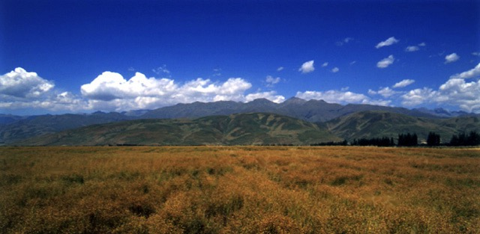
The NT World was Agrarian
97
How would this affect:
social structure, economy, and religious life?
Notes:
I have never met a Singaporean farmer. Most of us cannot relate to the first century AD.

Slide 9
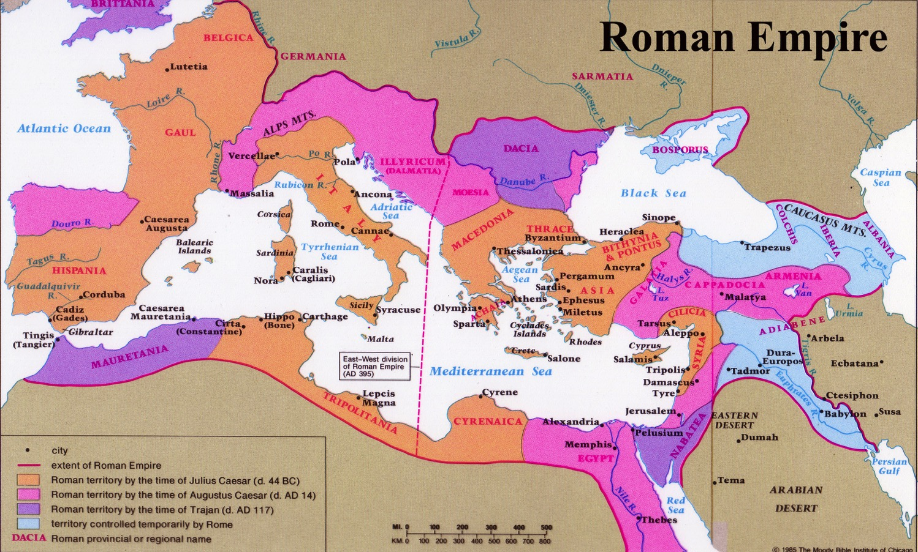

Population of Empire = 55 Million
97
Roman Empire
Gentiles: 51 million
Jews: 4 million

Slide 10
Population Groupings
97
Citizens
Millions of People
Non-Citizens
Slaves
Notes:
To the Roman city of Philippi Paul emphasized their citizenship in heaven (Phil 3:20). Only 4 million of the 51 million in the Empire were citizens with many rights and privileges.
Paul often referred to himself as a slave of Christ Jesus to churches that respected him, for this helped him identify with half of his readers (Phil. 1:1; 1 Thess. 1:1). The Empire had 27.5 million slaves.
To churches doubting his authority, Paul referred to himself as apostle (Gal. 1:1; Col. 1:1).
So, Paul wisely chose his titles based on the needs of his audience.

Slide 11
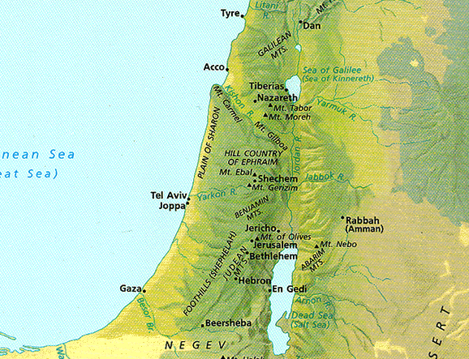
Ethnic Populations of Israel
97
Batanea
Galilee
40%
60%
Samaria
Gentiles
Decapolis
Gentiles
Perea
Jews
Judea
Idumea
Arabia

Slide 12
Languages of the Empire
97
Languages of the Empire
Roman Empire
Latin
Greek
Aramaic
Hebrew
Notes:
• Here is Rome. What language was spoken in Rome?
• Latin was the main administrative language of the Empire.
• Israel was a tiny province on the eastern front. What language?
• Hebrew was historically spoken in Israel.
• But in the Intertestamental Era, Aramaic became the trade language of the Middle East.
• Yet Greek remained the main language spoken throughout the Roman Empire as the Romans did little to change this pattern from the Greek Era.

Slide 13
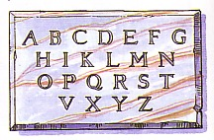
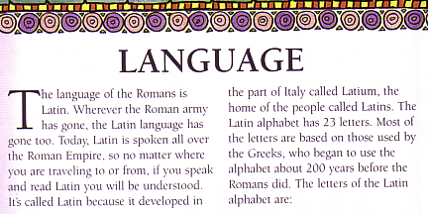
Latin: The Legal Language
23 Letters from Latium, Italy
Numerals Based on Letters
I = 1
V = 5
X = 10
D = 500
L = 50
C = 100
M = 1000
Quiz: Add these numbers:
Latin is a language
As dead as dead can be.
It killed the ancient Britons
And now it's killing me!
(Old British school chant)
88
LXXXVIII
+ 12
+ XII
100
Answer:
C

Slide 14
What does this say?
MR PIGS
MR NOT PIGS!
OSAR
CM PENS?
LIB
MR PIGS!
Them are pigs
Them are not pigs!
Oh, yes they are!
See them pens?
Well I'll be!
Them are pigs!
Peter had an accent too!
Notes:
The left column has to be read with an American Southern accent where "M" means "them" and "S" means "yes."

Slide 15
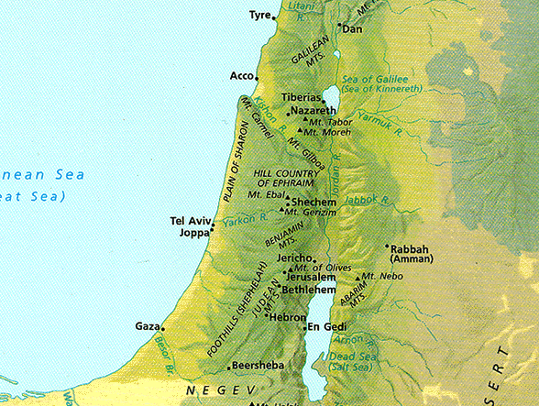
Aramaic in Palestine
97
Batanea
Galilee
"After a little while the bystanders came up and said to Peter, 'Certainly you too are one of them, for your accent betrays you.'"
(Matthew 26:73)
Samaria
Decapolis
Perea
Judea
Idumea
Arabia

Slide 16
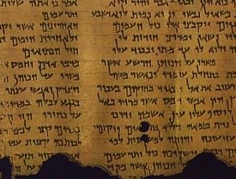
Hebrew in Palestine?
98
Previously thought virtually unknown
Recent studies say it was common

Slide 17
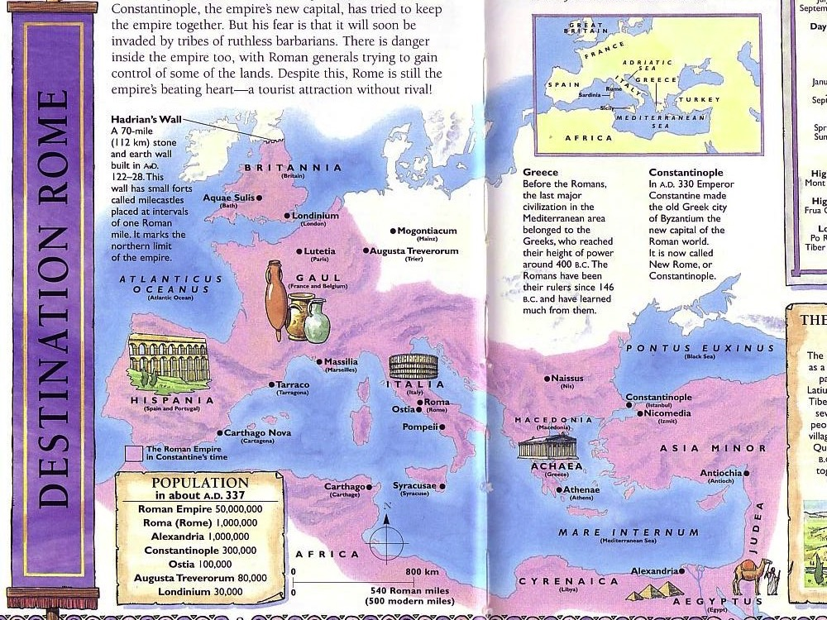
Social Life
98
Social Classes
Roman Social Institutions
Ethnic Groups
Racial Prejudice
Next Class Session

Slide 18
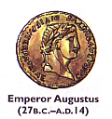

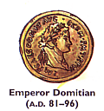
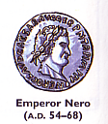
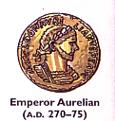

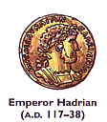
Four Roman Social Classes
98
Equestrians (Patricians)
Plebians
Freedman
Slaves

Slide 19
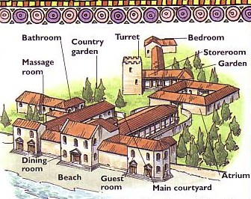
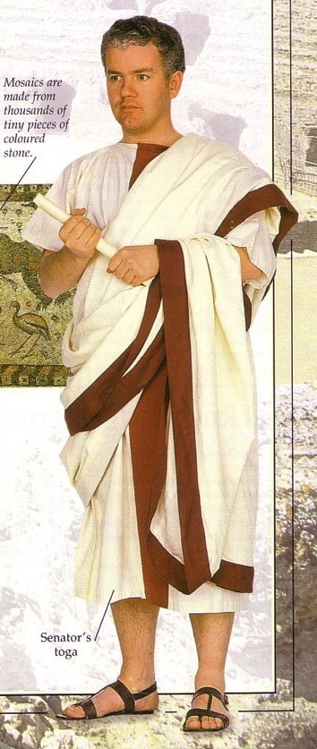
Social Classes
Equestrians (Patricians)
98
Bathroom
Turret
Bedroom
Country Garden
Storeroom
Massage Room
Garden
Dining Room
Beach
Main Courtyard
Atrium
Guest Room

Slide 20
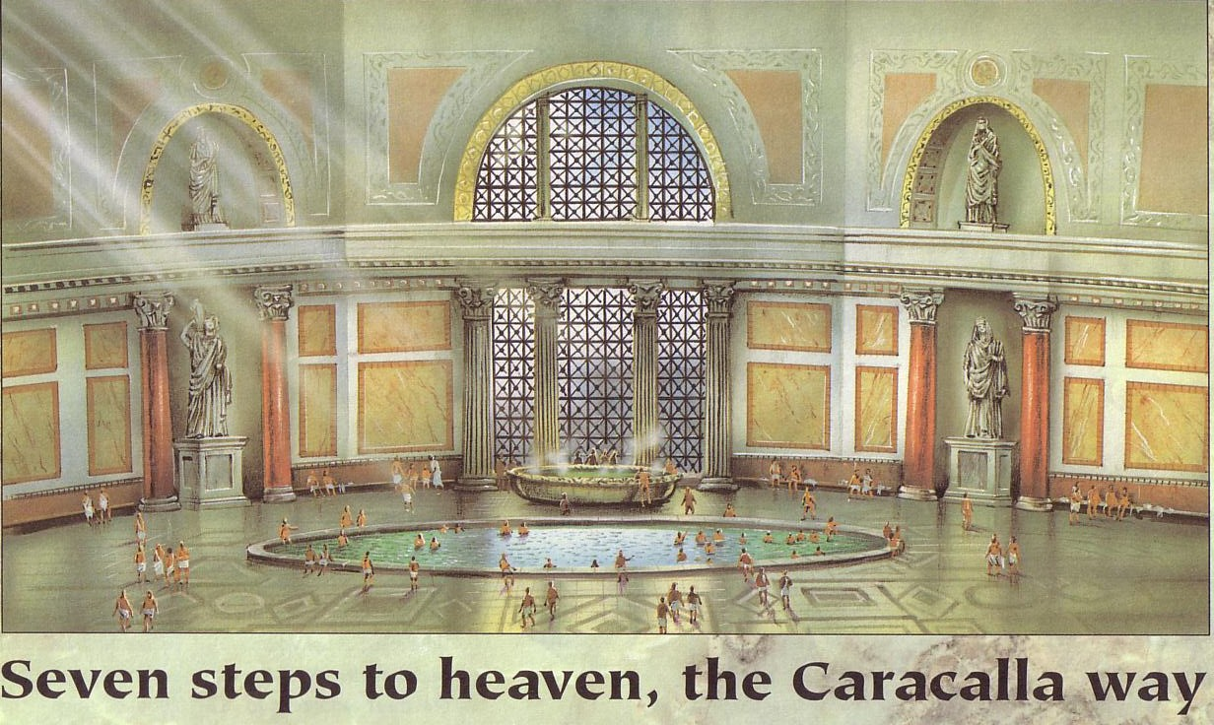
The Caracalla: Roman Luxury
98

Slide 21
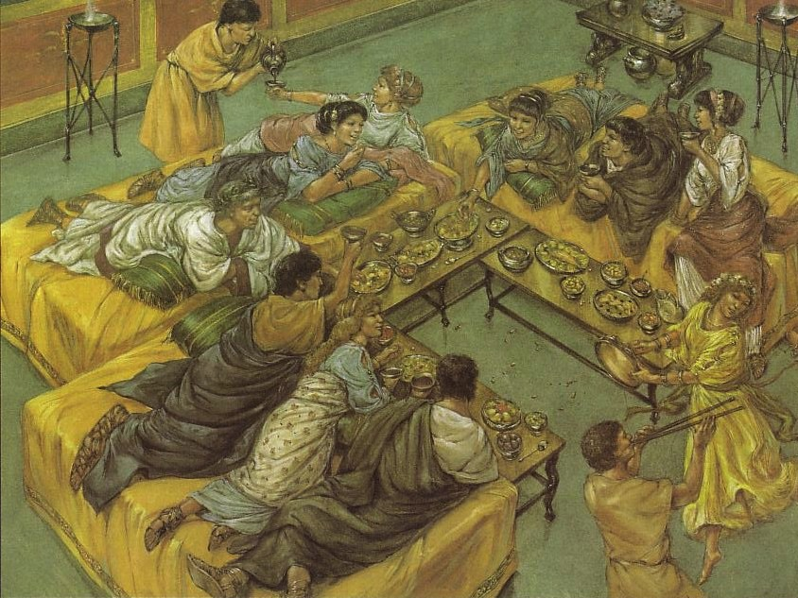
What is Proper Etiquette at a Roman Feast?

Slide 22
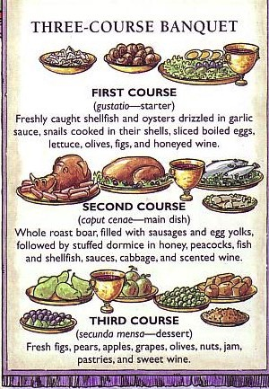
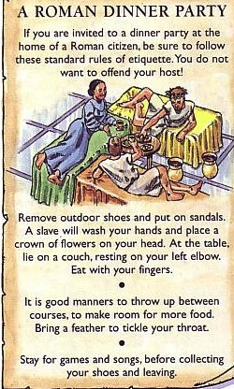
Three-Course Banquet
THREE-COURSE BANQUET
A ROMAN DINNER PARTY
If you are invited…
FIRST COURSE
(gustatio––starter)
Freshly caught shellfish and oysters drizzled in garlic sauce, snails, cooked in their shells, sliced boiled eggs, lettuce, olives, figs, and honeyed wine
SECOND COURSE
(caput cenae––main dish)
Remove outdoor shoes…
Whole roast boar, filled with sausages and egg yolks, followed by stuffed dormice in honey, peacocks, fish and shellfish, sauces, cabbage, and scented wine
It is good…
THIRD COURSE
(secunda mensa––dessert)
Stay for games…
Fresh figs, pears, apples, grapes, olives, nuts, jam, pastries and sweet wine
Notes:
Translators: Translate the text on the right as well as the left then move to the front.

Slide 23
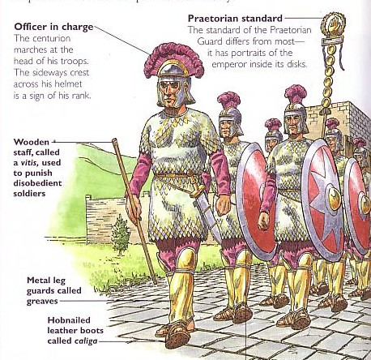
Social Classes
Praetorian Standard
98
Officer in charge
The standard of the Praetorian Guard differs from most––it has portraits of the emperor inside its disks.
The centurion marches at the head of his troops. The sideways crest across his helmet is a sign of his rank.
Wooden staff, called vitis, used to punish disobedient soldiers
Metal leg guards called greaves
Centurions were Wealthy
Hobnailed leather boots called caliga

Slide 24
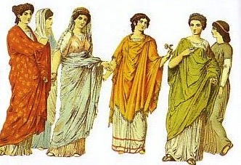
Wealthy Roman Women
98

Slide 25
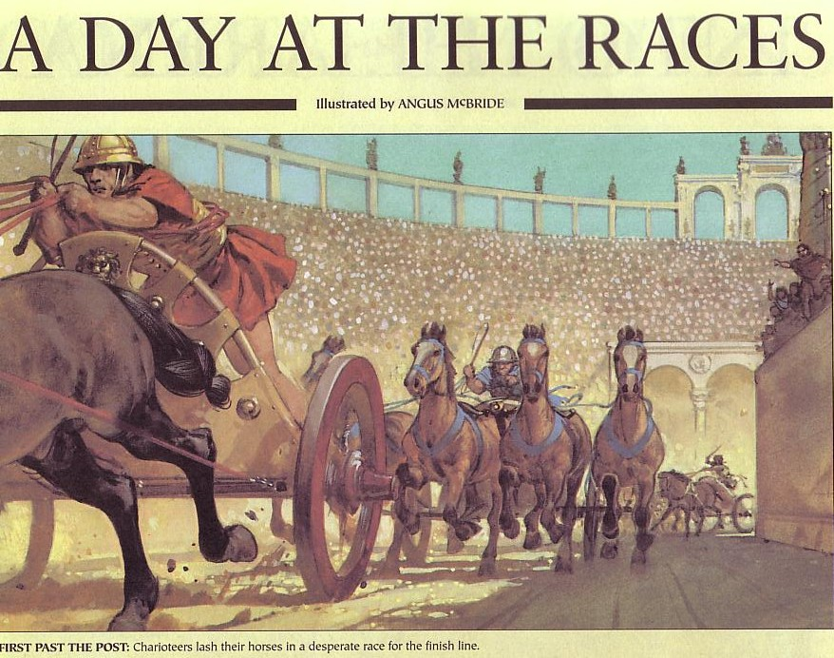
Romans loved the races
A DAY AT THE RACES

Slide 26
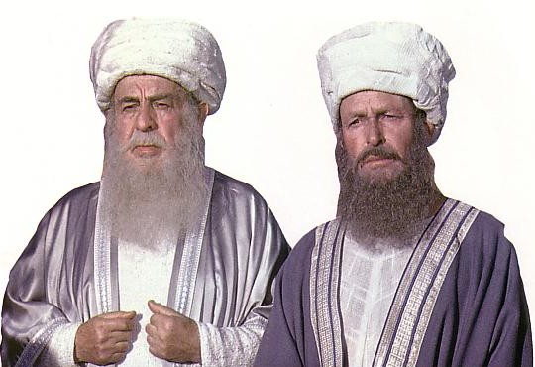
Equestrian High Priests
98
Illegal
Annas
Caiaphas
Sanhedrin
Illegal
Illegal
Annas & Caiaphas both conducted illegal trials of Jesus

Slide 27
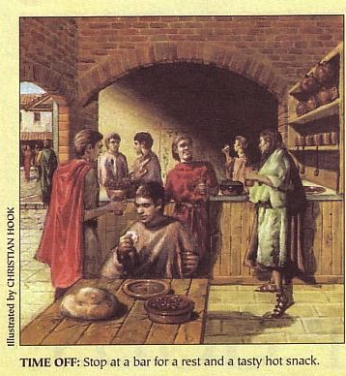

Social Classes
98
Equestrians
Plebians
Freedman
Slaves
TIME OFF: Stop at a bar for a rest and a tasty hot snack.

Slide 28
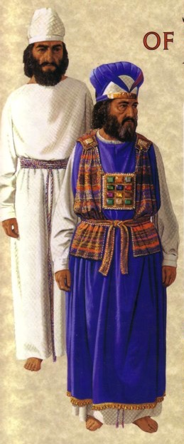
Regular Plebian Priests Wore Plain White Linen
98

Slide 29
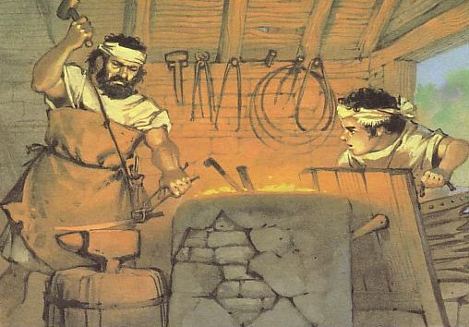
Plebian Artisans (Blacksmith)
98

Slide 30
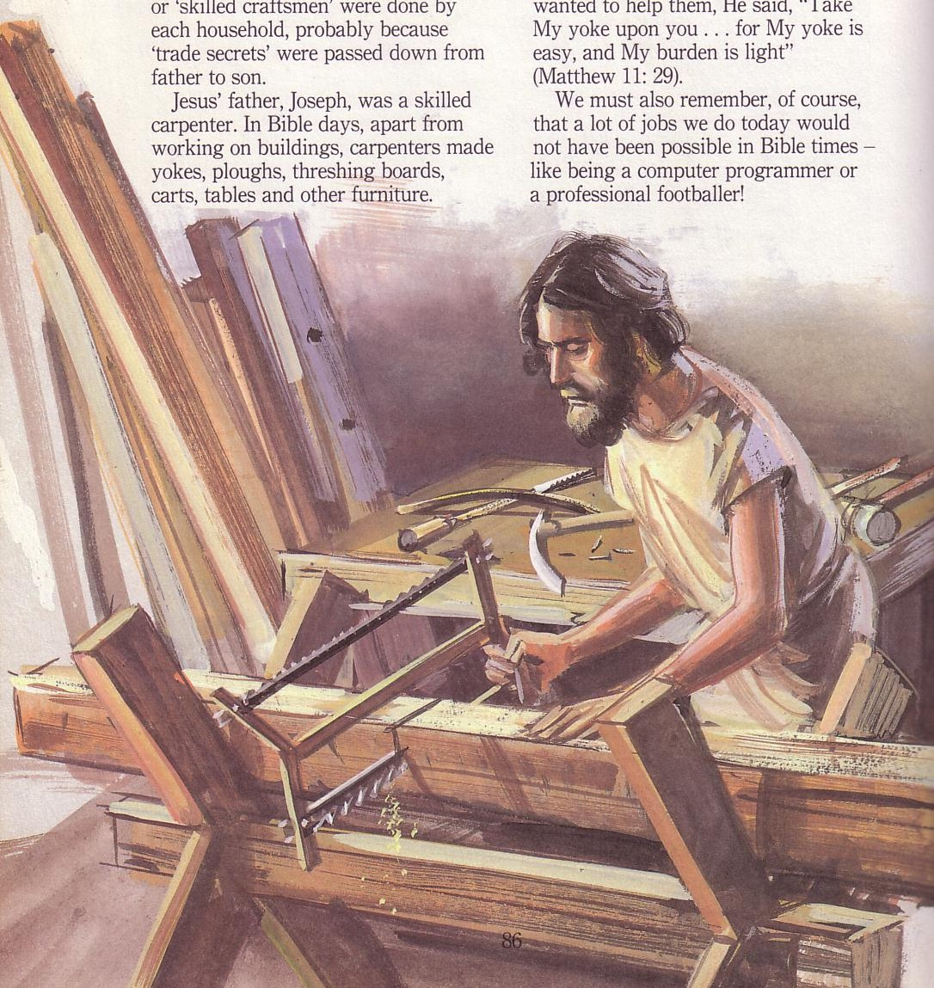
Jewish Carpenters were Plebians
98

Slide 31
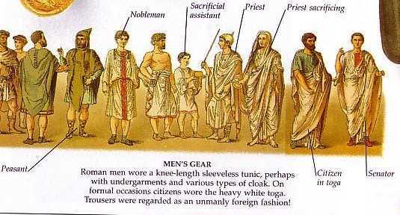
Social Classes
Freedman were former slaves of various classes
98
Equestrians
Plebians
Freedman
"But one day some men from
the Synagogue of Freed Slaves [Freedman, NIV], as it was called, started to debate with [Stephen]."
(Acts 6:9 NTL)
Slaves

Slide 32
Social Classes
Freedman were also called "friends"
98
Equestrians
Plebians
"There is no greater love than to lay down one's life for one's friends. ¹⁴ You are my friends if you do what I command. ¹⁵ I no longer call you slaves, because a master doesn't confide in his slaves. Now you are my friends, since I have told you everything the Father told me"
(John 15:13-15).
Freedman
Slaves

Slide 33
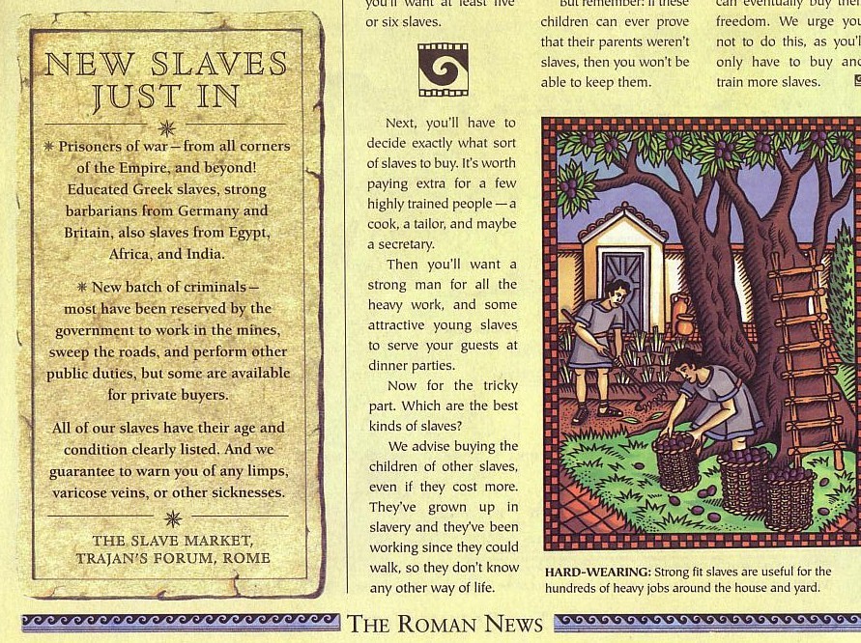
Social Classes
98
New Slaves Just In
Equestrians (Patricians)
Plebians
Freedman
Slaves

Slide 34
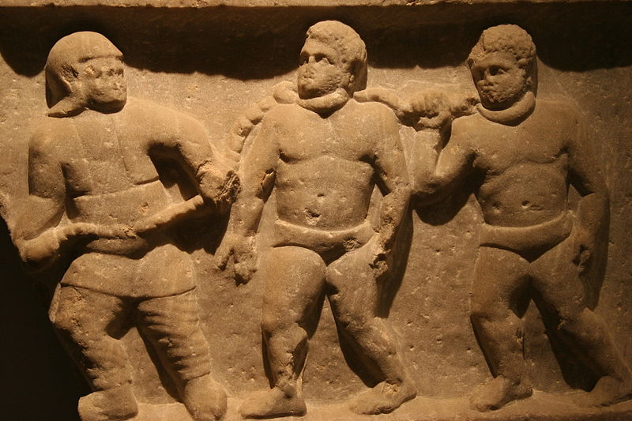
Slavery in the Roman Empire
Notes:
Slaves were considered property in the Roman world and had no rights.

Slide 35
Features of Slavery during Roman Empire
Entry into Slavery
  Roman military conquests
  Natural reproduction
  Rescue from exposure
  International trade
  Piracy
  Sold themselves into slavery for various reasons

Slide 36
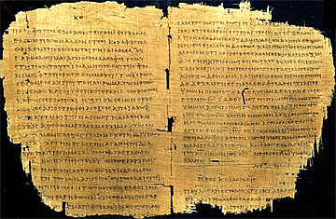
Slavery in the Roman Empire
"The slave was absolutely at his master's disposal; for the smallest offence he might be scourged, mutilated, crucified, [or] thrown to the wild beasts"
(J. B. Lightfoot,
Saint Paul's Epistles to the
Colossians and to Philemon, 321)

Slide 37
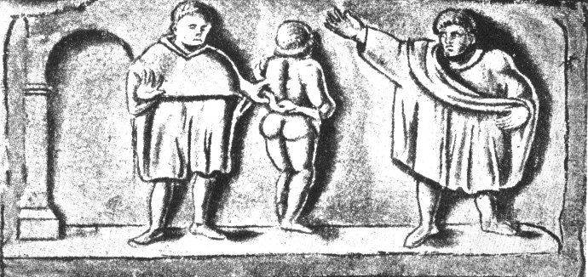
Features of slavery during Roman
Features of Slavery during Roman Empire
When Romans conquered the Mediterranean, they took millions of slaves to Italy. The Italians were major importers of slaves with slaves accounting for 40 percent of the population!
Laws which promoted or restricted the Roman slave system:
Lex Poetelia (326 BC)
Lex Aelia Sentia (AD 4)
Lex Fufia Caninia (AD 2)
Lex lunia Sorbana
Slave sold in Roman
slave trade

Slide 38

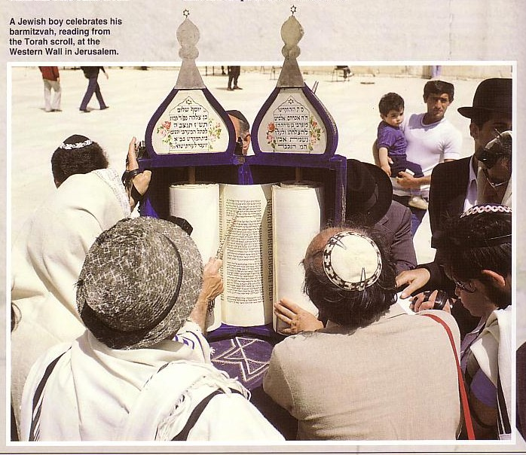
Roman Social Institutions
Koinonia
98
A Jewish boy celebrates his bar mitzvah, reading from the Torah scroll, at the Western Wall in Jerusalem.
Voluntary associations were clubs that anyone could join—unlike the Jewish ones closed to outsiders

Slide 39
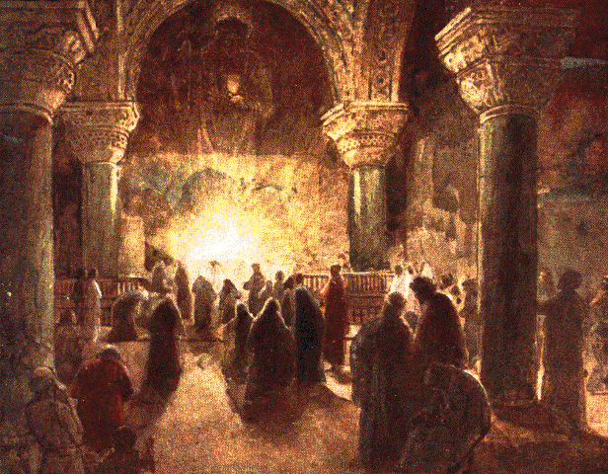
Roman Social Institutions
Koinonia
98
Roman voluntary associations

Slide 40

Roman Social Institutions
Koinonia
98
The house church movement today is reviving some of these NT concepts
Koinonia Small Groups

Slide 41
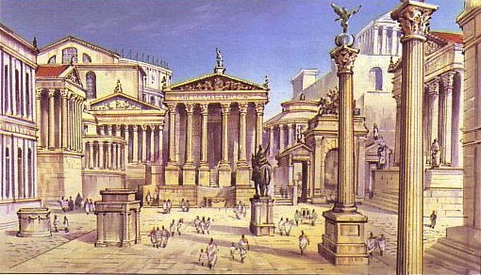
Members of the City Community could appeal to the Forum of Rome
98

Slide 42
Citizenship referred to being a citizen of either Rome or Israel
98
Acts 22:28 (NAU) "The commander answered,
'I acquired this citizenship with a large sum of money.' And Paul said, 'But I was actually born a citizen.'"
Eph. 2:12 (NAU) "Remember that you [Gentiles] were at that time separate from Christ, excluded from the commonwealth [citizenship NLT] of Israel, and strangers to the covenants of promise, having no hope and without God in the world."

Slide 43
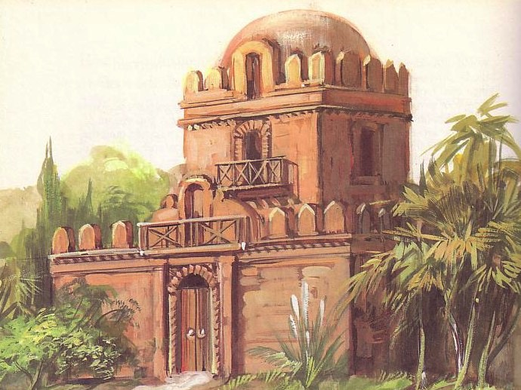
Characteristics of the Household Community
99
Same Biological Source on Same Estate
Hierarchy of Authority
Freedmen and Slaves
Common Religion
Ronald D. Runyon, "Principles & Methods of Household Evangelism," BibSac 142 (Jan-Mar 1985), 64-74
Notes:
Of all the social institutions, the most influential by far was the household community. The same is true today, for the family is the building block of society.

Slide 44
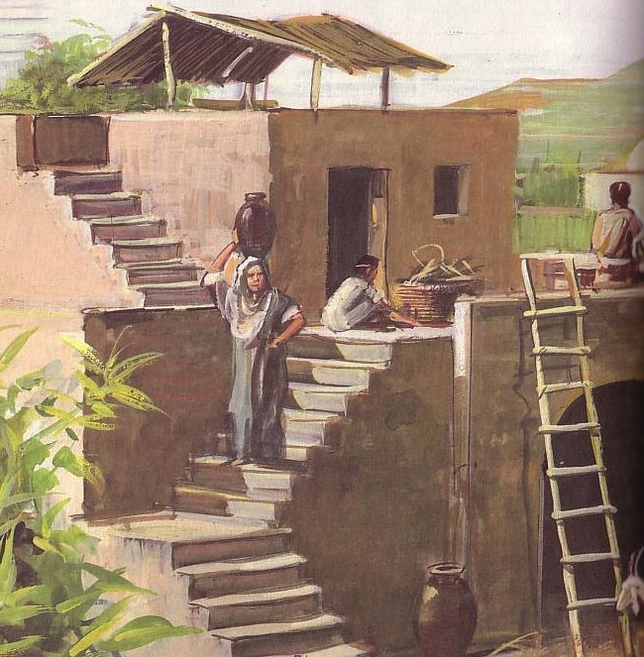
Household Implications
99
Household conversions
Unity of body of Christ
Flexible structure
Ronald D. Runyon, "Principles & Methods of Household Evangelism," BibSac 142 (Jan-Mar 1985), 64-74

Slide 45

The church is an organism more than an organization

Slide 46
Household Implications
99
Household conversions
Unity of body of Christ
Flexible structure
Relationships
Ronald D. Runyon, "Principles & Methods of Household Evangelism," BibSac 142 (Jan-Mar 1985), 64-74

Slide 47
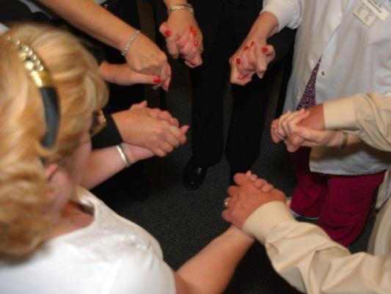
People lack relationships today

Slide 48
Household Implications
99
Household conversions
Unity of body of Christ
Flexible structure
Relationships
Church meeting place
Social variety
Testing ground
Ronald D. Runyon, "Principles & Methods of Household Evangelism," BibSac 142 (Jan-Mar 1985), 64-74

Slide 49
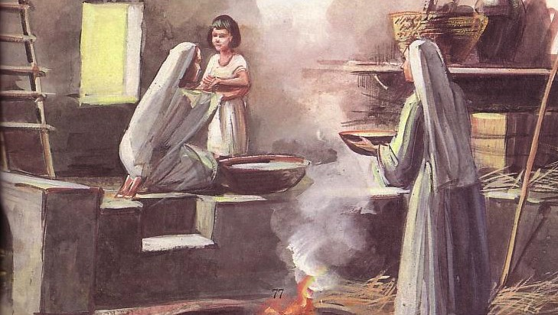
Households Tested Faithfulness
99
Ronald D. Runyon, "Principles & Methods of Household Evangelism," BibSac 142 (Jan-Mar 1985), 64-74

Slide 50
Household Implications
99
Household conversions
Unity of body of Christ
Flexible structure
Relationships
Church meeting place
Social variety
Testing ground
Household evangelism
Ronald D. Runyon, "Principles & Methods of Household Evangelism," BibSac 142 (Jan-Mar 1985), 64-74

Slide 51


Spheres of Influence
100
FAMILY - RELATIVES
Relatives
In summary, a Christian's oikos or personal sphere of influence includes his family, friends, and associates in his neighborhood, work, and recreational activities. This personal sphere of influence is to be a primary target of a believer's personal evangelistic outreach.
Members of clubs, associations, other organizations a person belongs to, people met on a casual or regular basis
Immediate family
NEIGHBORS
AVOCATIONAL CONTACTS
PRIMARY SPHERE
Neighborhood or
subdivision
Other close friends
Next-door neighbors
Close associates, clients
Other people with a similar occupation
SECONDARY SPHERE
Ronald D. Runyon, "Principles & Methods of Household Evangelism," Bib Sac 142 (Jan-Mar 1985), 67
VOCATIONAL CONTACTS

Slide 52
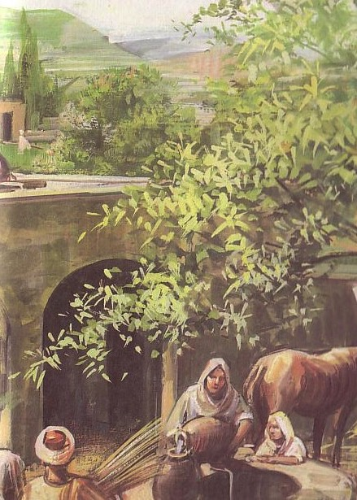
Household Applications
100
Share how Christ transformed your life
Pray for your oikos
Proclaim the Word
Use varied methods
Ronald D. Runyon, "Principles & Methods of Household Evangelism," BibSac 142 (Jan-Mar 1985), 64-74

Slide 53

Vary Your Method!
100
Prepared people need a simple presentation
EVANGELISM
Ronald D. Runyon, "Principles & Methods of Household Evangelism," BibSac 142 (Jan-Mar 1985), 64-74

Slide 54


Vary Your Method!
100
Prepared people need a simple presentation
Secular people need repeated exposures
Ronald D. Runyon, "Principles & Methods of Household Evangelism," BibSac 142 (Jan-Mar 1985), 64-74

Slide 55

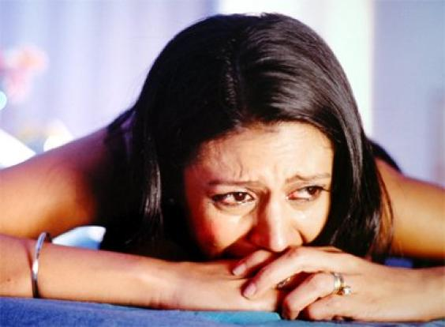
Vary Your Method!
100
Prepared people need a simple presentation
Secular people need repeated exposures
Those in life transitions are especially open
Ronald D. Runyon, "Principles & Methods of Household Evangelism," BibSac 142 (Jan-Mar 1985), 64-74

Slide 56
Household Applications
100
Share how your life was transformed
Pray for your oikos
Proclaim the Word
Use varied methods
Use your home
Ronald D. Runyon, "Principles & Methods of Household Evangelism," BibSac 142 (Jan-Mar 1985), 64-74

Slide 57
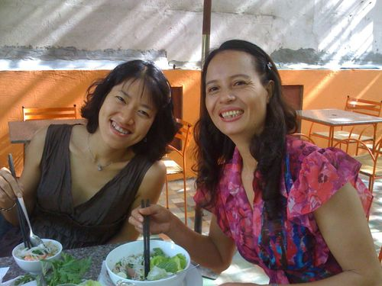
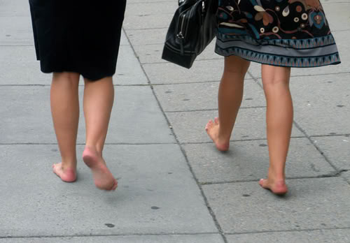
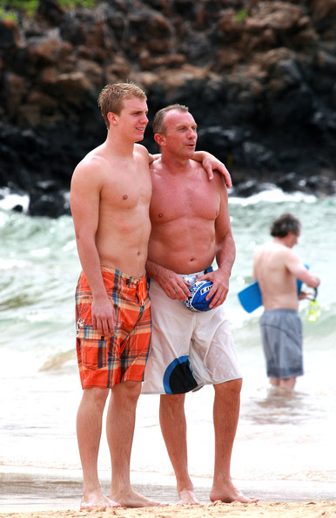

Home Evangelism:
Individual Activities

Slide 58

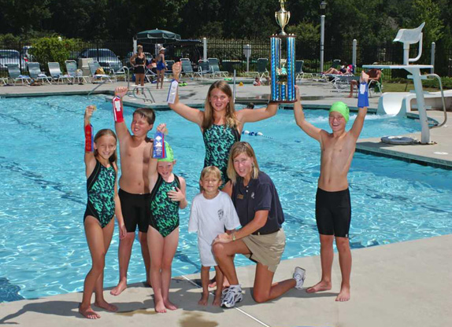
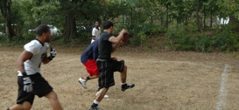
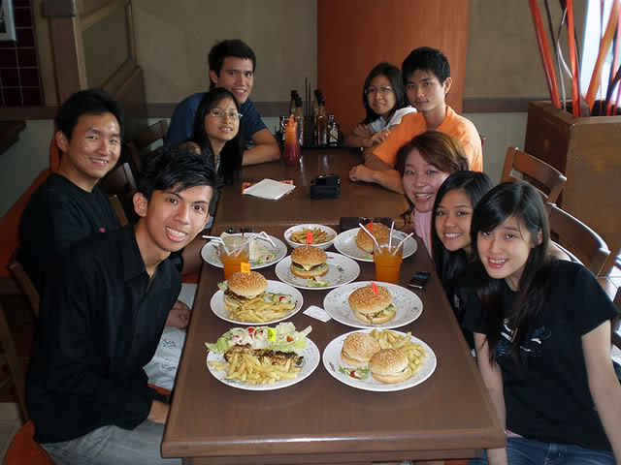
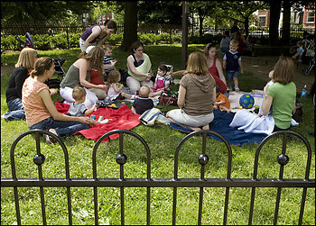
Home Evangelism: Group Activities

Slide 59


NT Backgrounds link at BibleStudyDownloads.org
Get this presentation for free!
Notes:
NT Backgrounds (nb)

Slide 60
Black

