Slide 1
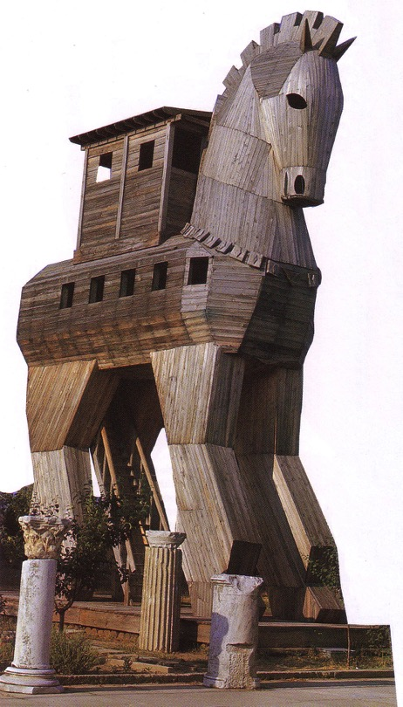
Political Backgrounds: Part 2
8
Ptolemies to 63 BC (Pompey)
Dr. Rick Griffith • Jordan Evangelical Theological Seminary • BibleStudyDownloads.org

Slide 2
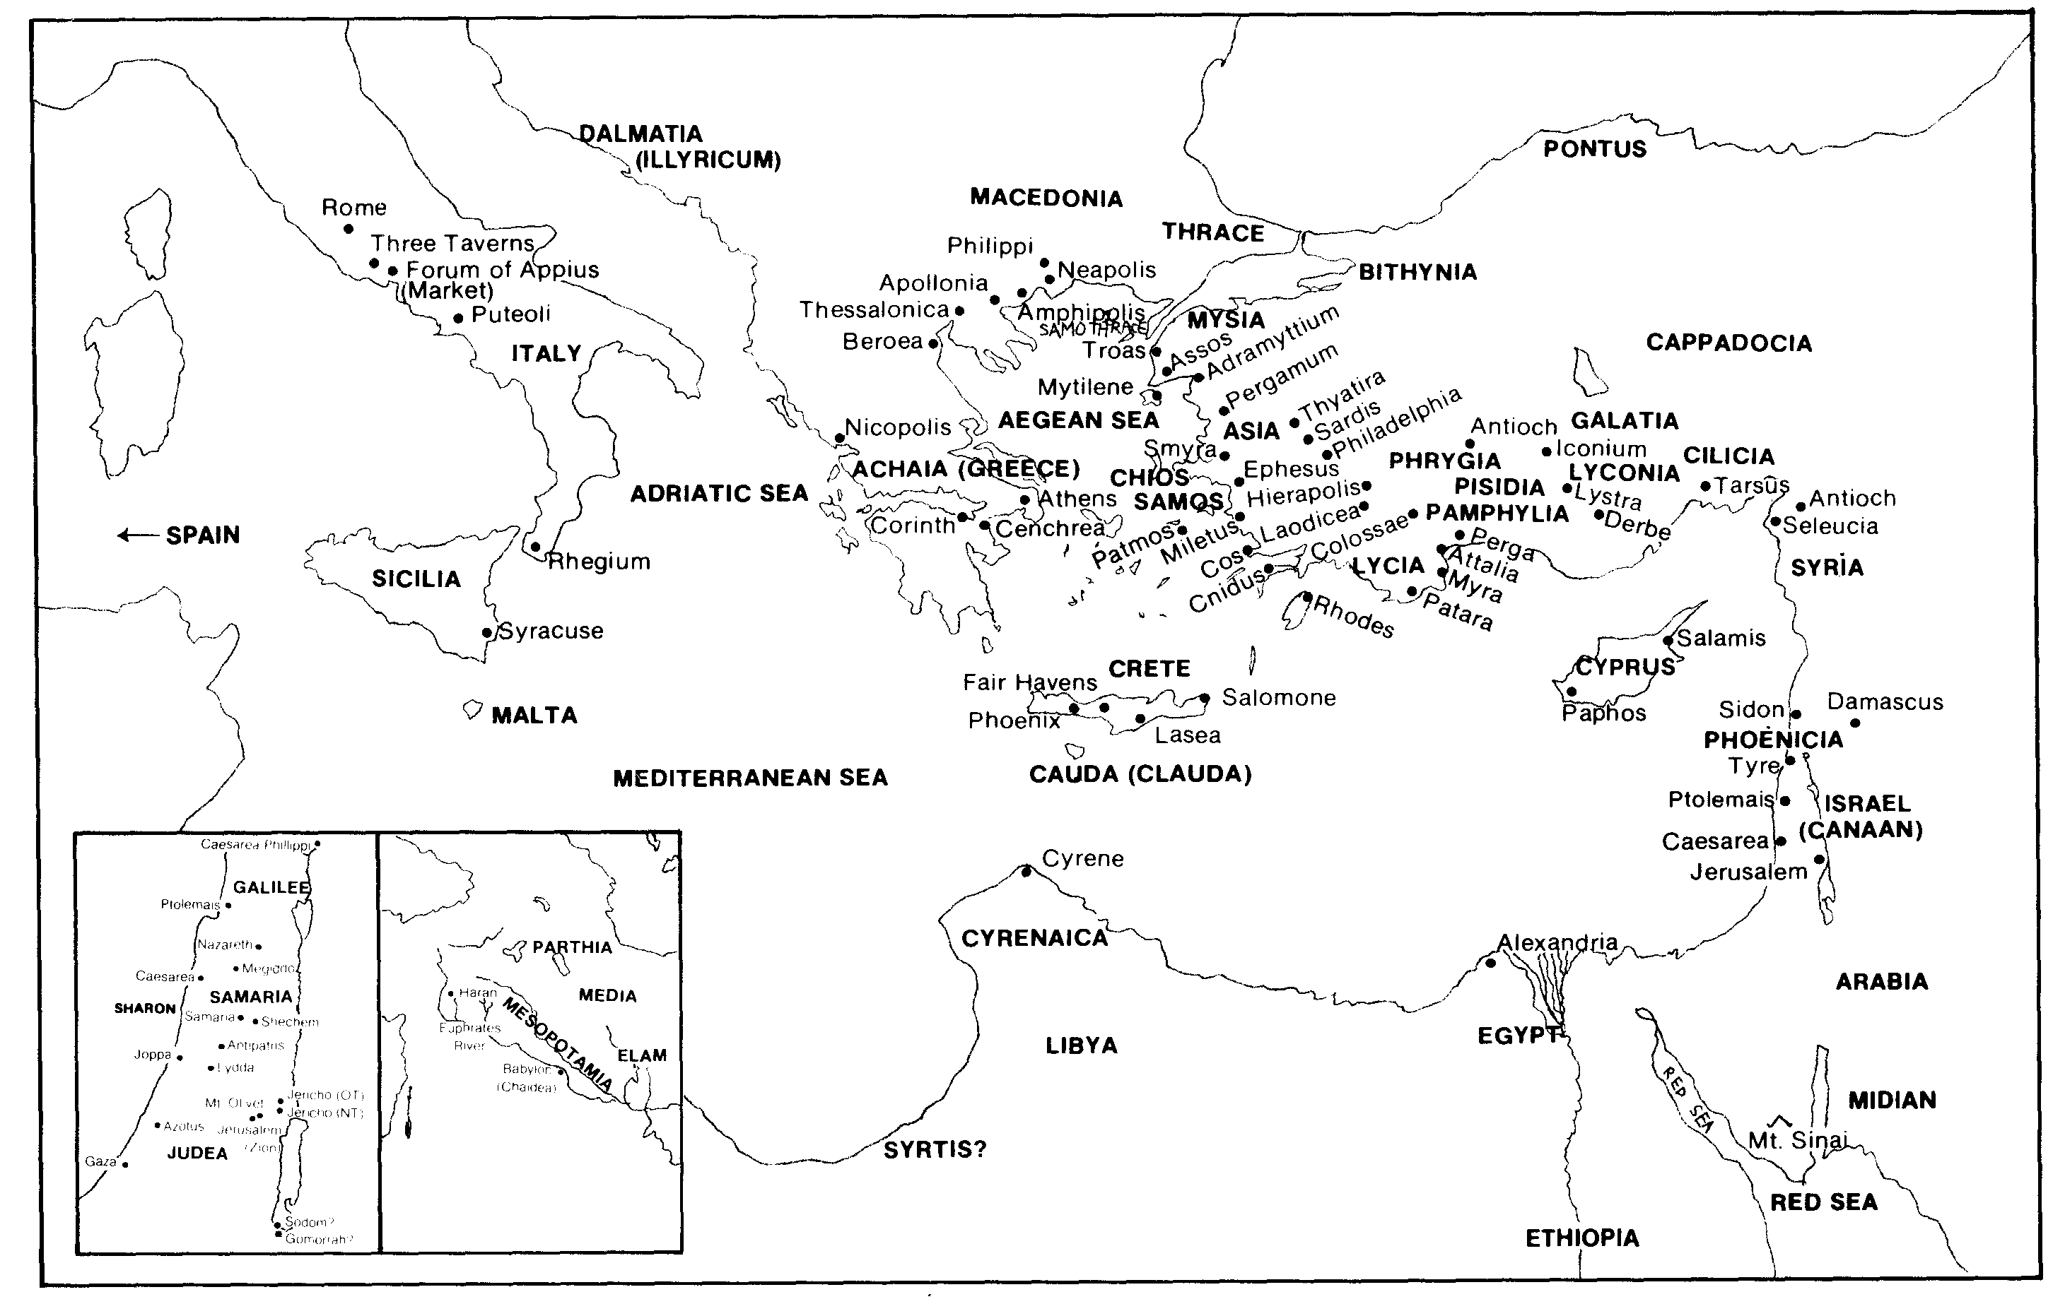
Every Geographical Location in Acts / Epistles (Quiz #2)
5

Slide 3
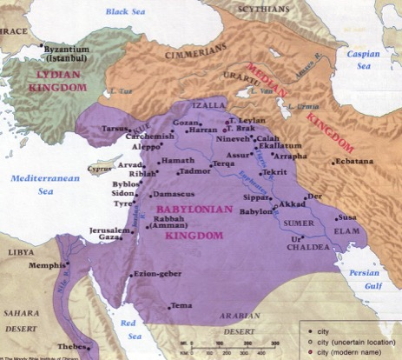
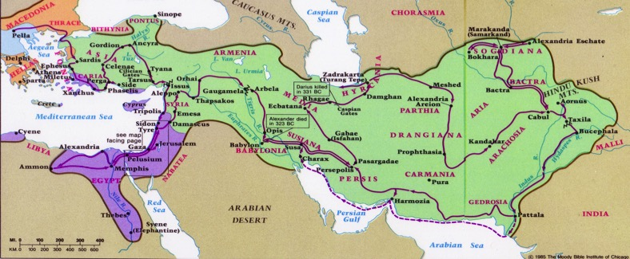
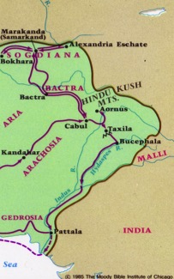
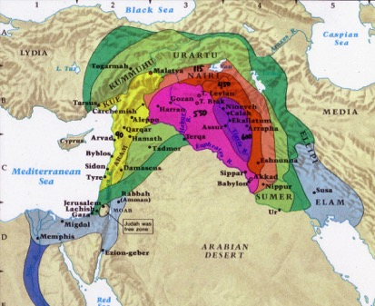
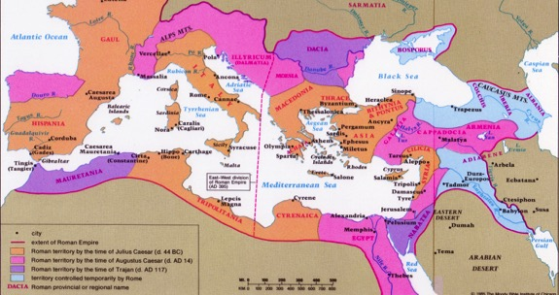
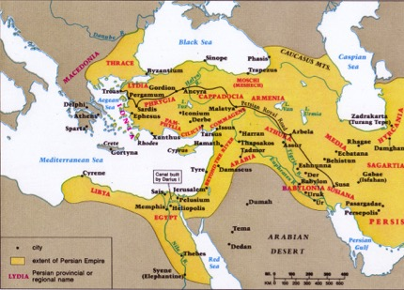
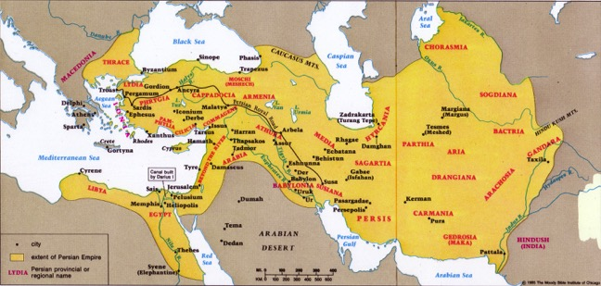
What Empires and What Order?
52
Greek
Babylonian
Assyrian
Roman
Medo-Persian
Beitzel, 1st ed., 139-167
Notes:
In your small group, decide the correct order and the correct empire of these five developments.
______________
OS-12-2 Kings-239
OS-14-2 Chron-315
NB-05 Politics 2 Ptolemies to 63 BC (Pompey)-3

Slide 4
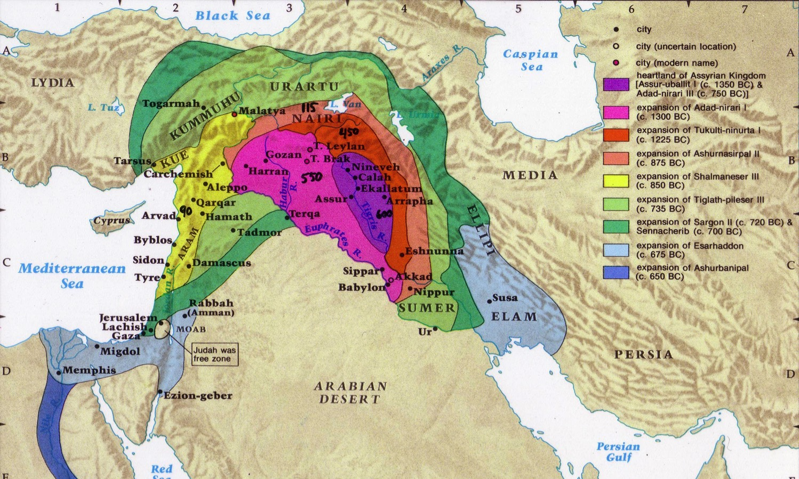
Assyrian Developments
48
Fall of Samaria
Rise of Samaritans
Handwritten numbers show the number of years before Jonah in 760 BC
Beitzel, Moody Atlas of Bible Lands, 1st ed., 139
Notes:
• Assyria conquered in all directions, but especially westward, including Israel when Samaria fell in 722 BC. Most of the people were deported to other lands, but a few remained.
• Assyrians brought other conquered peoples into Israel’s territory, and intermarriage between the few who were left and these pagan peoples brought about a mixed race of half-Jews, half-Gentiles. They were named after the former capital and thus called Samaritans. Full-bloodied Jews despised them.
______________
OS-12-2 Kings-240
OS-14-2 Chron-316
NB-05 Politics 2 Ptolemies to 63 BC (Pompey)-4

Slide 5
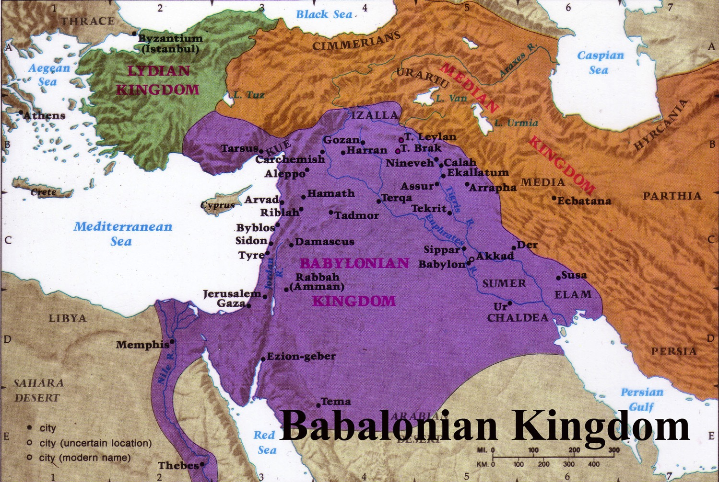
Babylonian Rule over Palestine
56
Deportations
Developments
Separation
Synagogue
No more idolatry
Beitzel, Moody Atlas of Bible Lands, 1st ed., 145
Notes:
• Babylonians deported those left in Jerusalem to Babylon (cf. Dan 1).
• Jews in Babylon resulted in the term “Judaism,” with three key developments:
• They resisted intermarriage with the pagan peoples.
• They established local places of teaching (but no sacrifices) called synagogues (=“together marketplace”)
• Despite living in the most idolatrous city ever, they were cured of idol worship!
______________
OS-12-2 Kings-241
OS-14-2 Chron-317
NB-05 Politics 2 Ptolemies to 63 BC (Pompey)-5

Slide 6
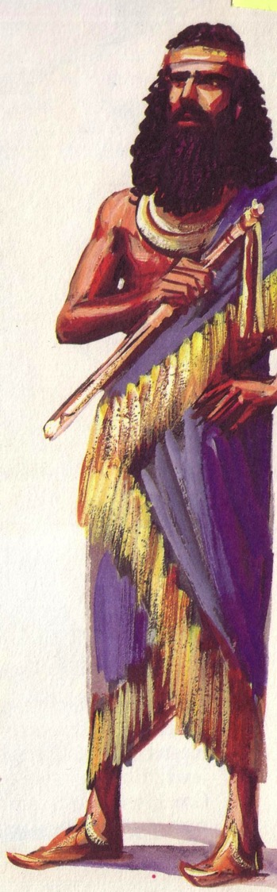

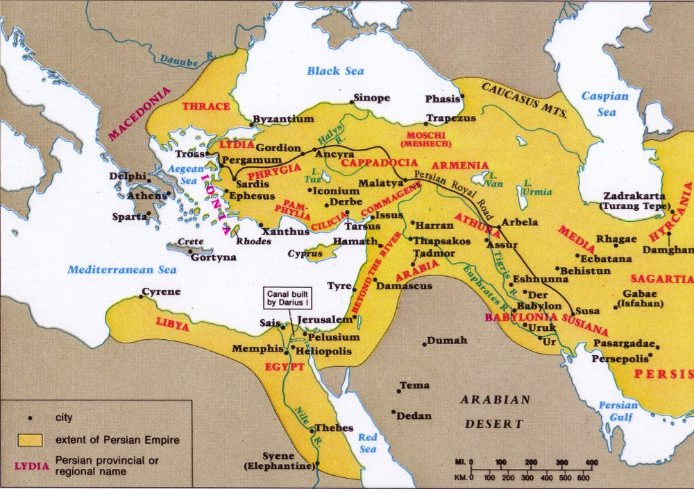
The Persian Era
57, 59
Returns
Developments
Temple
People
Walls
Beitzel, Moody Atlas of Bible Lands, 1st ed., 150
Notes:
Babylon had three major deportations, but Persia did the opposite with three major returns to the land.
______________
OS-12-2 Kings-242
OS-14-2 Chron-318
NB-05 Politics 2 Ptolemies to 63 BC (Pompey)-6

Slide 7

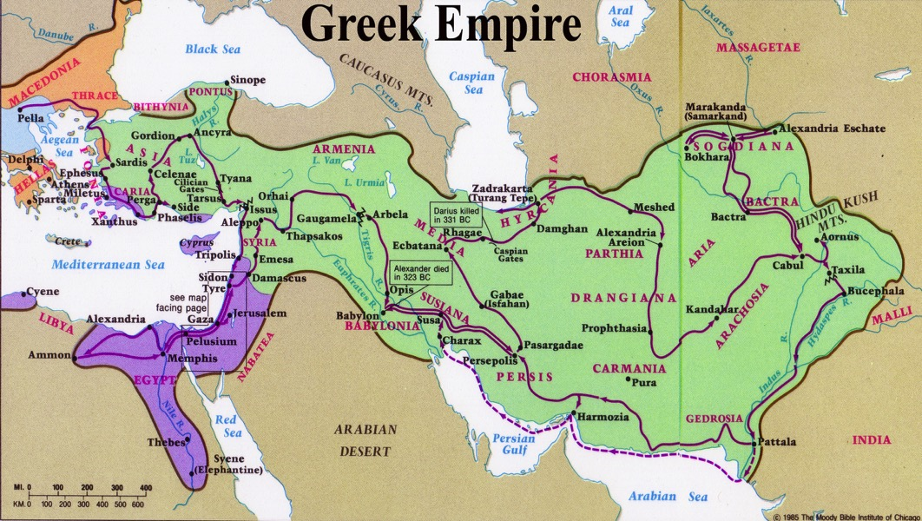
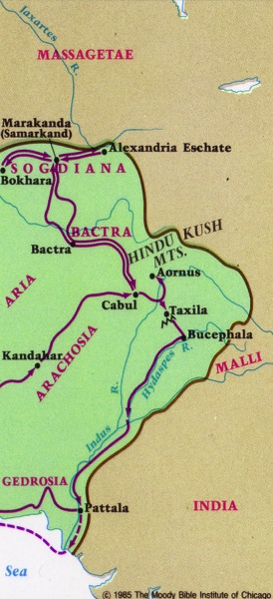


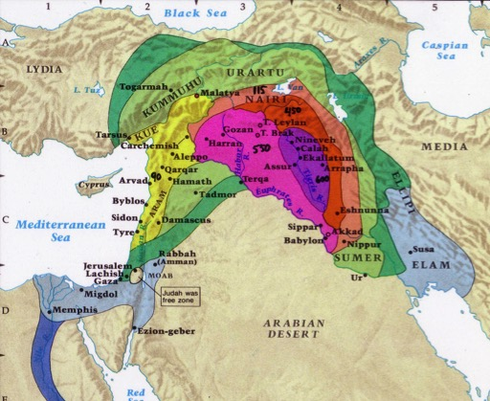
Maps of Intertestamental Empires
52
Beitzel, Moody Atlas of Bible Lands, 1st ed., 152
Notes:
The Greeks conquered to the east—while the Romans conquered in all four directions. Put the two together, and you have the known world at that time.
______________
OS-12-2 Kings-243
OS-14-2 Chron-319
NB-05 Politics 2 Ptolemies to 63 BC (Pompey)-6

Slide 8
Intertestament Timeline
96
Persian 539-331
Greek 331-143
Hasmonean 143-63
Roman 63-330
Ptolemaic 323-198
Seleucid 198-143
Maccabean 167-143
450
400
350
300
2 5 0
2 0 0
150
100
1
Alexander 331-323

Slide 9
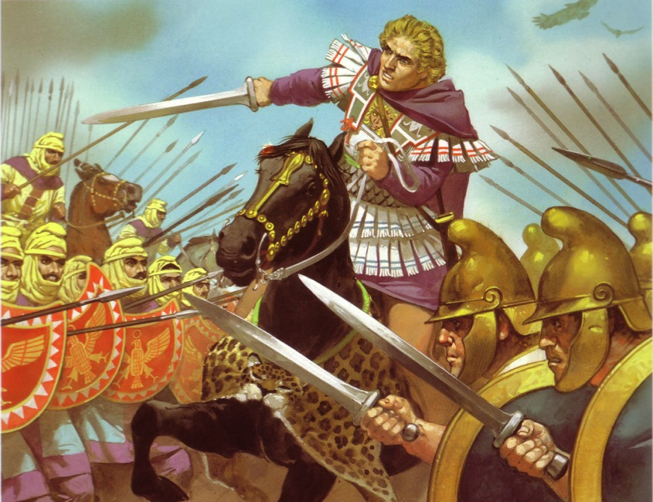
Greek Rule over Israel
60
Alexander
Struggle for Supremacy
Hellenistic Empire Developments

Slide 10
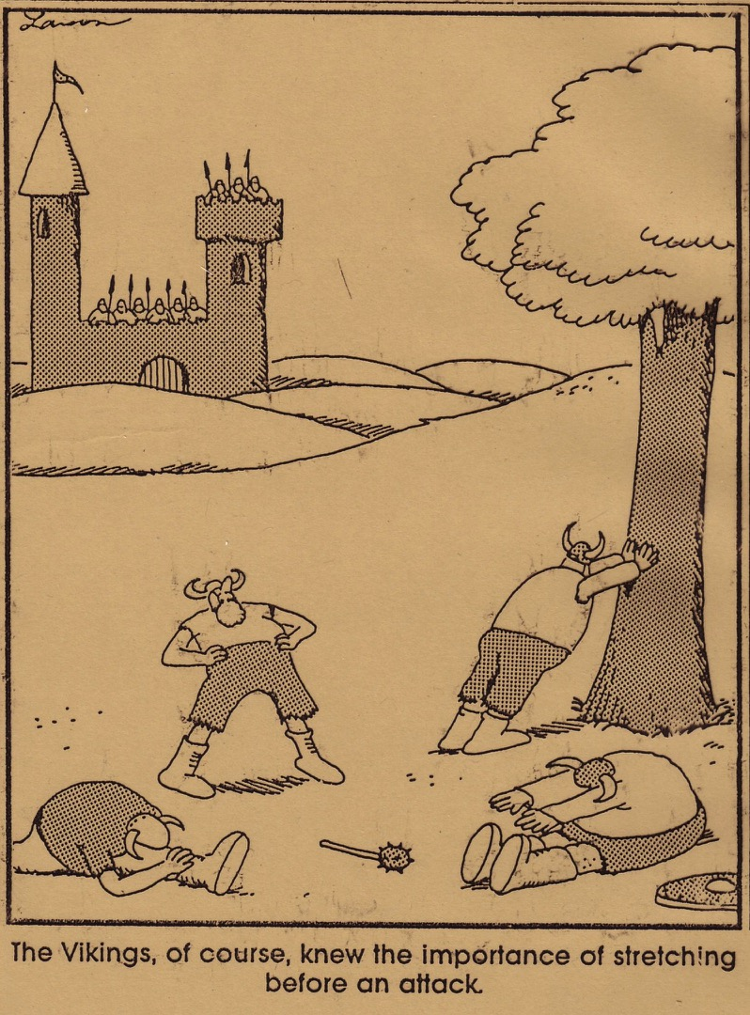
The Vikings, of course, knew the importance of stretching before an attack. Greeks too!

Slide 11
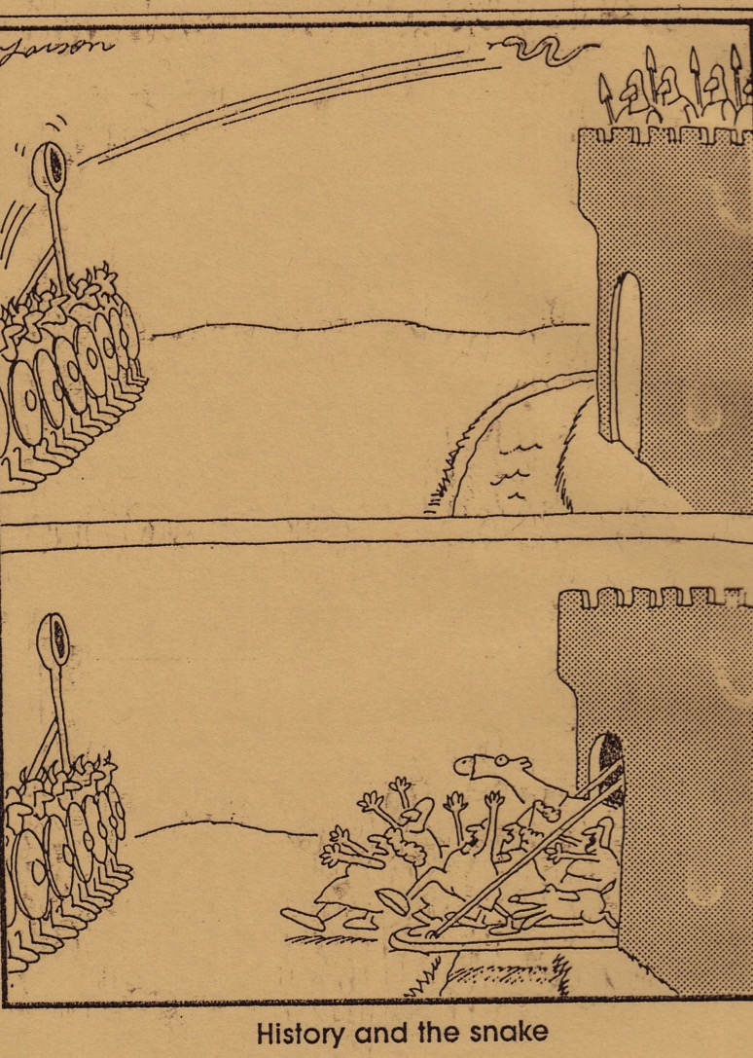
History and the snake

Slide 12
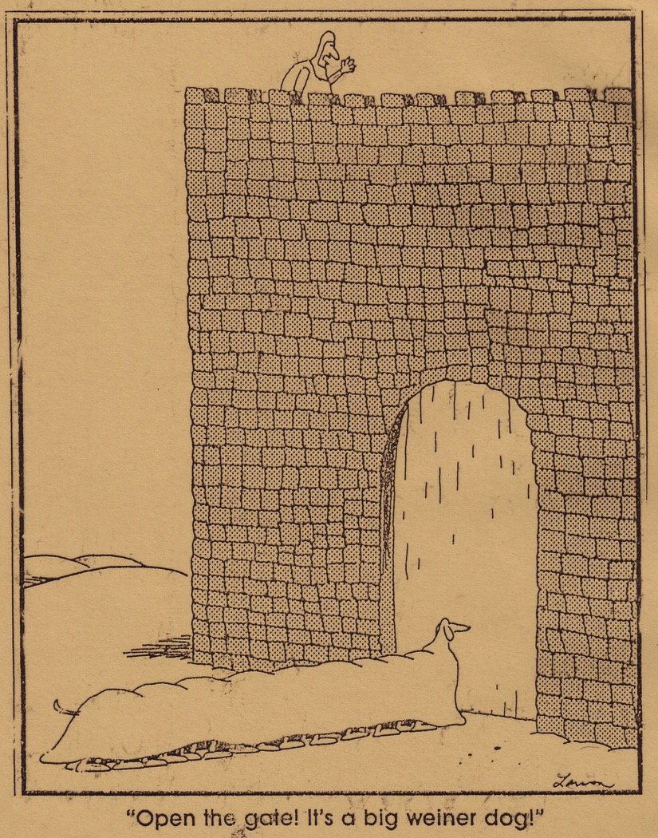
“Open the gate! It's a big wiener dog!”

Slide 13
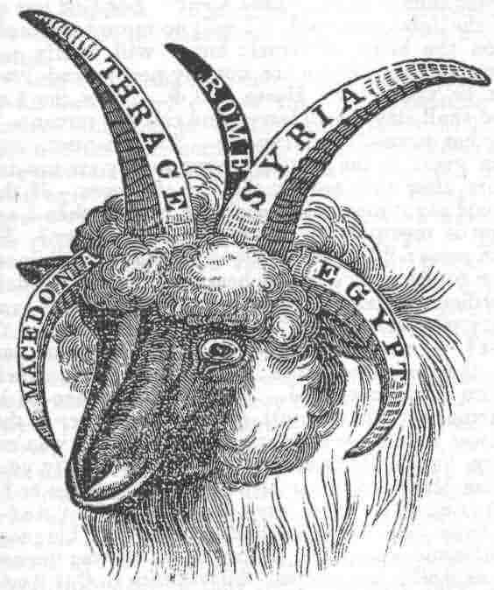


After Alexander…
64
Greek Empire
Cassander
Lysimacus
Seleucus
Ptolemy
"And the he-goat is the king of Greece; and the great horn between his eyes is the first king. As for the horn that was broken, in place of which four others arose, four kingdoms shall arise from his nation but not with his power" (Daniel 8:21-22 RSV)

Slide 14
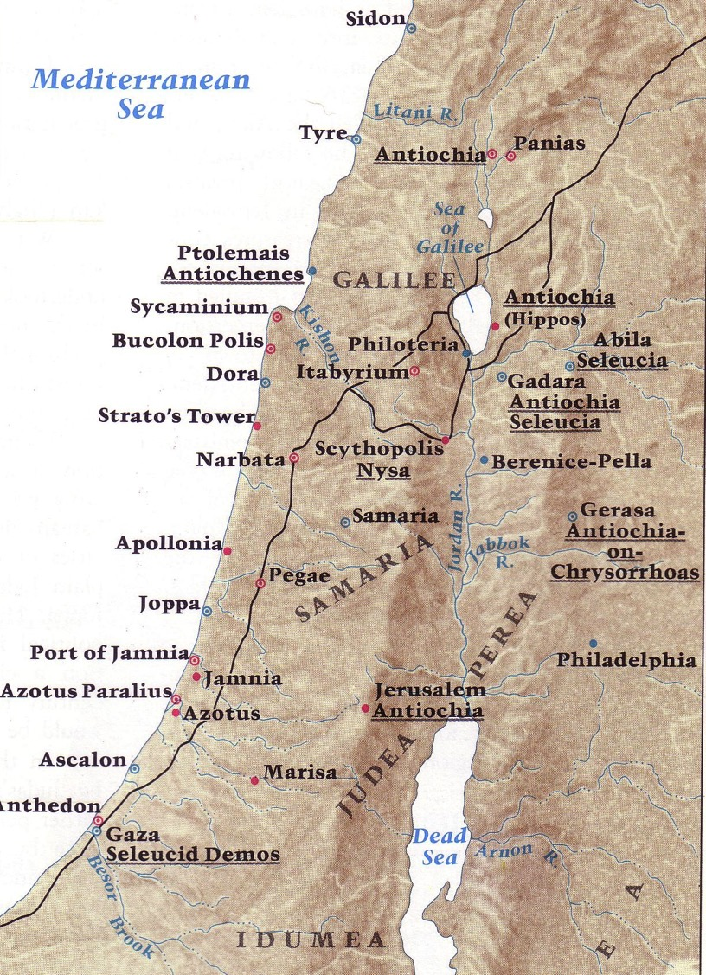
Greek Cities in Israel
Beitzel, 1st edition, 153

Slide 15
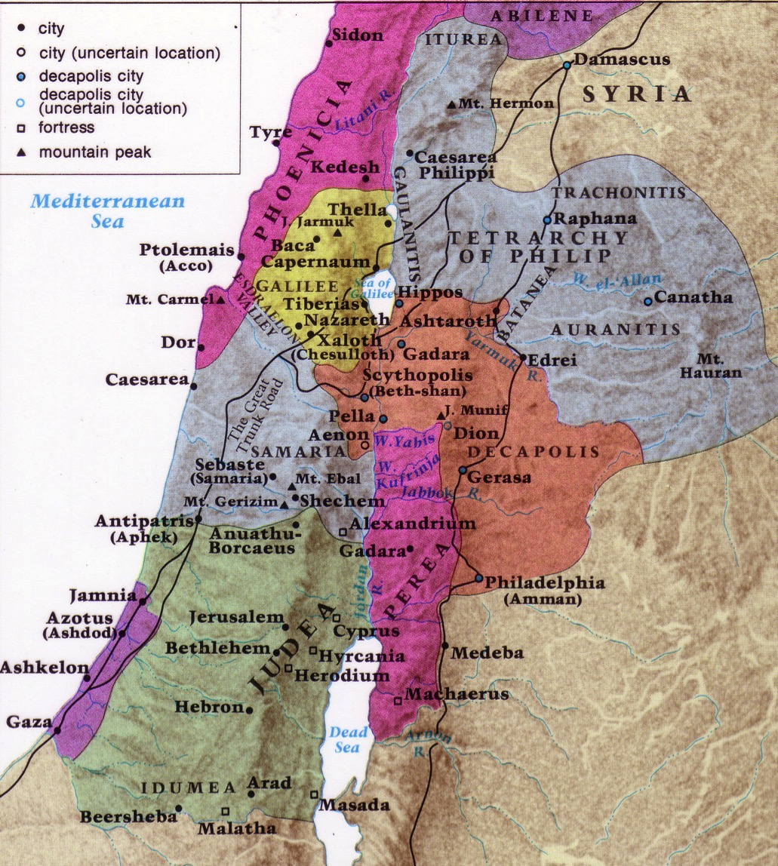
NT Boundaries in Israel
Beitzel,
1st edition, 19

Slide 16
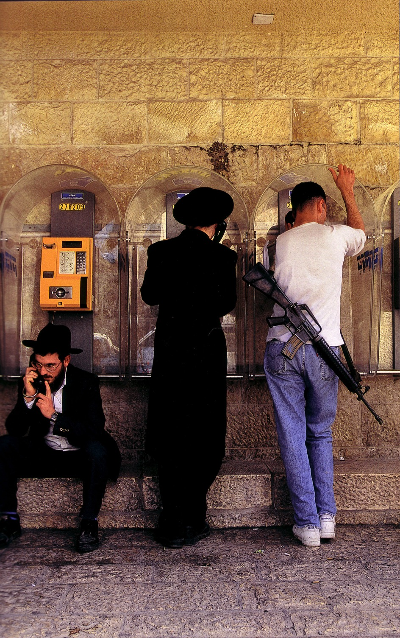
Cultural Variety Today

Slide 17
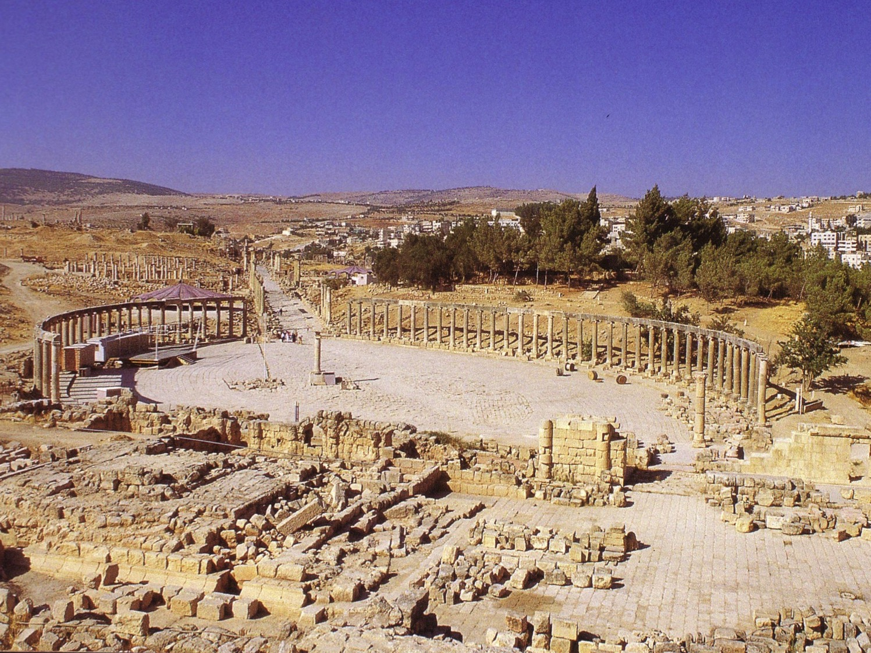
Jerash of the Decapolis

Slide 18
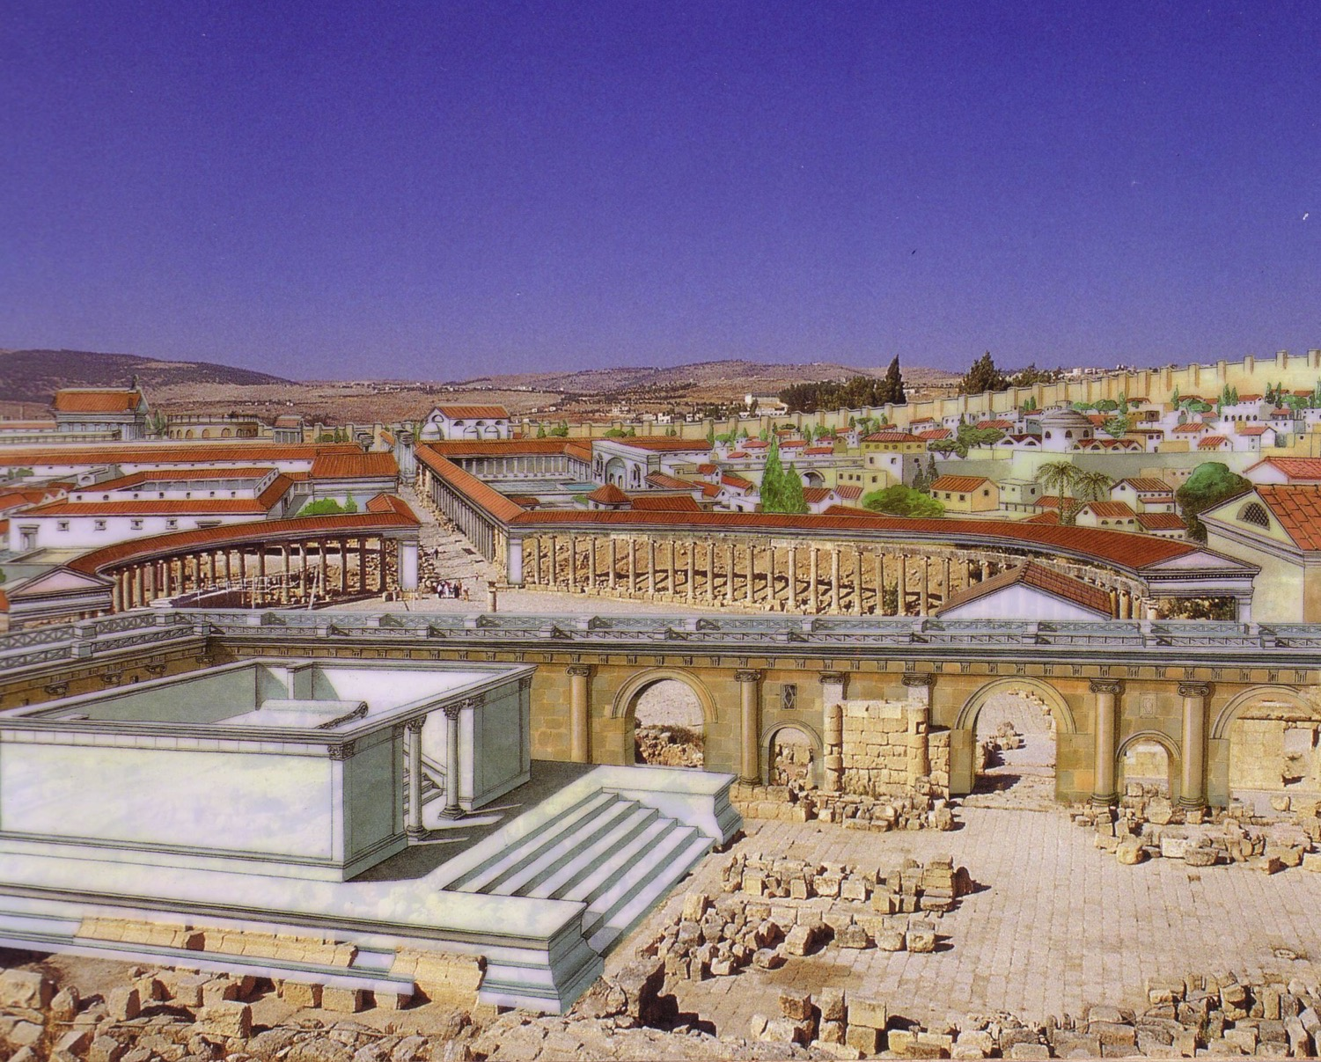
Jerash in Its Glory Days

Slide 19
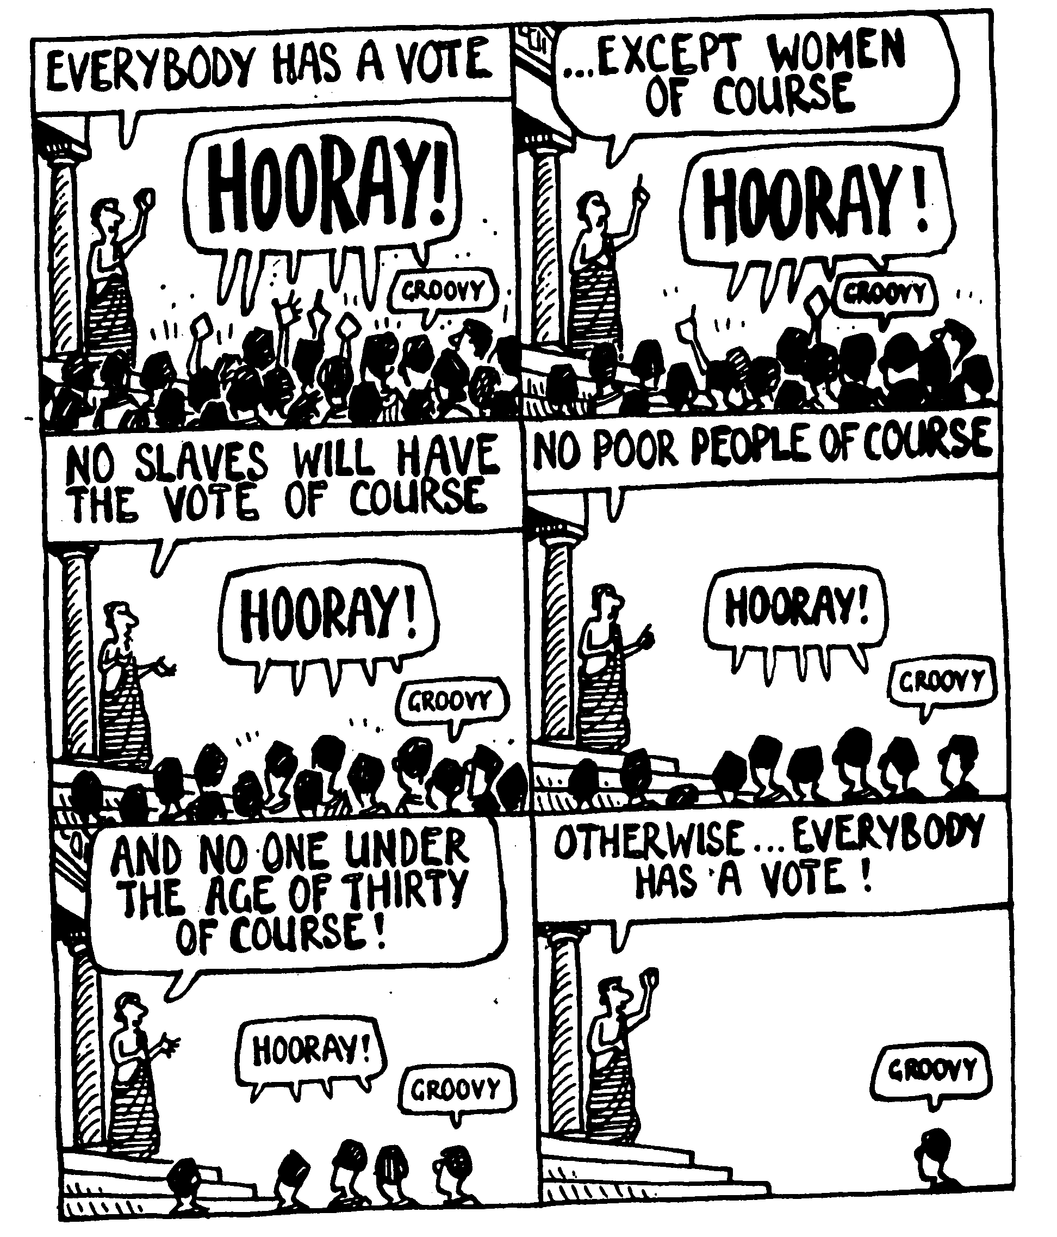
Greeks Experimented with Democracy
EVERYBODY HAS A VOTE
…EXCEPT WOMEN
OF COURSE
HOORAY!
HOORAY!
GROOVY
GROOVY
NO POOR PEOPLE OF COURSE
NO SLAVES WILL HAVE THE VOTE OF COURSE
HOORAY!
HOORAY!
GROOVY
GROOVY
OTHERWISE… EVERYBODY HAS A VOTE!
AND NO ONE UNDER AGE THIRTY OF COURSE!
HOORAY!
GROOVY
GROOVY

Slide 20


Ptolemies & Seleucids Over Israel
63
Peace
Sword
Beitzel, 1st edition, 152
Seleucus
Ptolemy

Slide 21
Greek Era Significance
62, 65, 95
Ptolemaic (301-198)
Seleucid (198-143)
Religious Freedom
Rise of Sanhedrin
Peaceful Hellenization
Greek Language
Septuagint (LXX)
High Priesthood
Rise of Hasidim

Slide 22
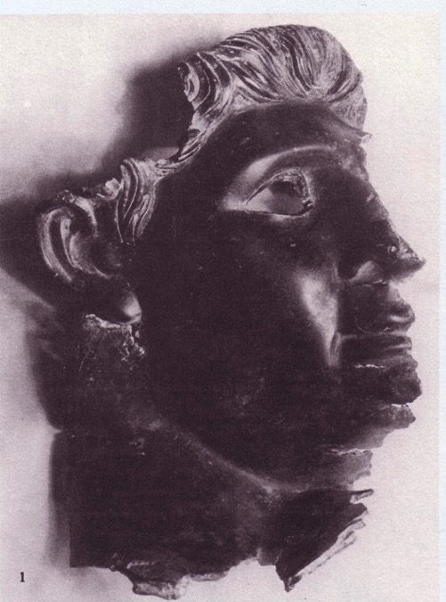

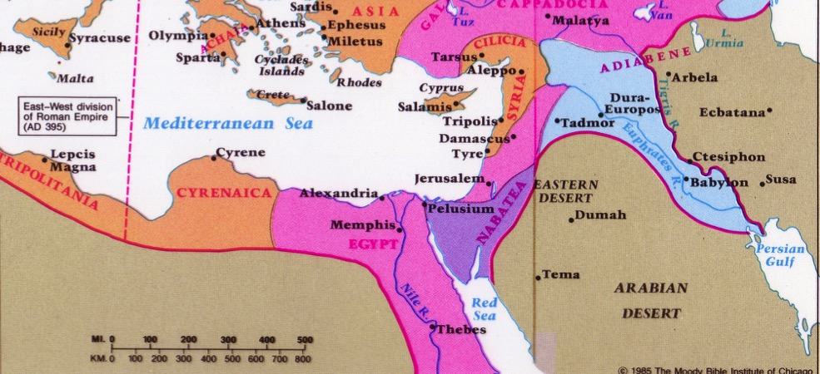
Antiochus IV
65
Daniel 11:29-30 "At the time appointed he shall return and come into the south, but it shall not be this time as it was before. For ships of Kittim shall come against him, and he shall be afraid and withdraw, and shall turn back and be enraged and take action against the holy covenant. He shall turn back and pay attention to those who forsake the holy covenant.”
Beitzel,
1st edition, 166

Slide 23

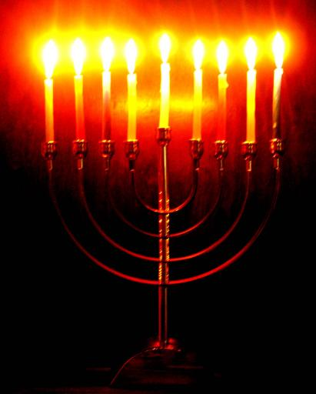

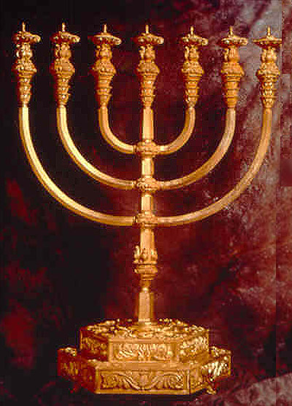
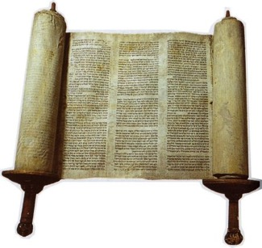
Jerusalem Hellenization
65
Dec 167- Dec 164
Hanukkiah
Menorah
The Feast of Lights (Dedication)
Notes:
Greek rule over Israel came to a height when Antiochus IV vented his anger at being defeated by Rome upon the Jews of Jerusalem.
• Jews had long considered the Torah sacred...
• But Antiochus prohibited Scripture readings.
• He even sacrificed a pig on the Jerusalem altar to desecrate it.
• For three years, the temple became a pagan altar (Dec 167-Dec 164).
• Finally, Jews took back the temple when the one-day supply of lampstand oil miraculously lasted 8 days!
• This led to victory over the Greeks and the commemoration of their victory with 8 lampstand arms (hanukkiah) instead of the normal 7-branched menorah.
• Each December, Jews celebrate their victory at the Feast of Lights or Dedication (or Rededication) to remember their oppression by the Greeks.
_______________
ES-29-Antisemitism-28
NB-05-Politics2 Ptolemies to 63 BC (Pompei)-23

Slide 24
Greek Era Significance
62, 65, 95
Ptolemaic (301-198)
Seleucid (198-143)
Religious Freedom
Rise of Sanhedrin
Peaceful Hellenization
Greek Language
Septuagint (LXX)
High Priesthood
Rise of Hasidim
Temple desecration
Maccabean Revolt

Slide 25
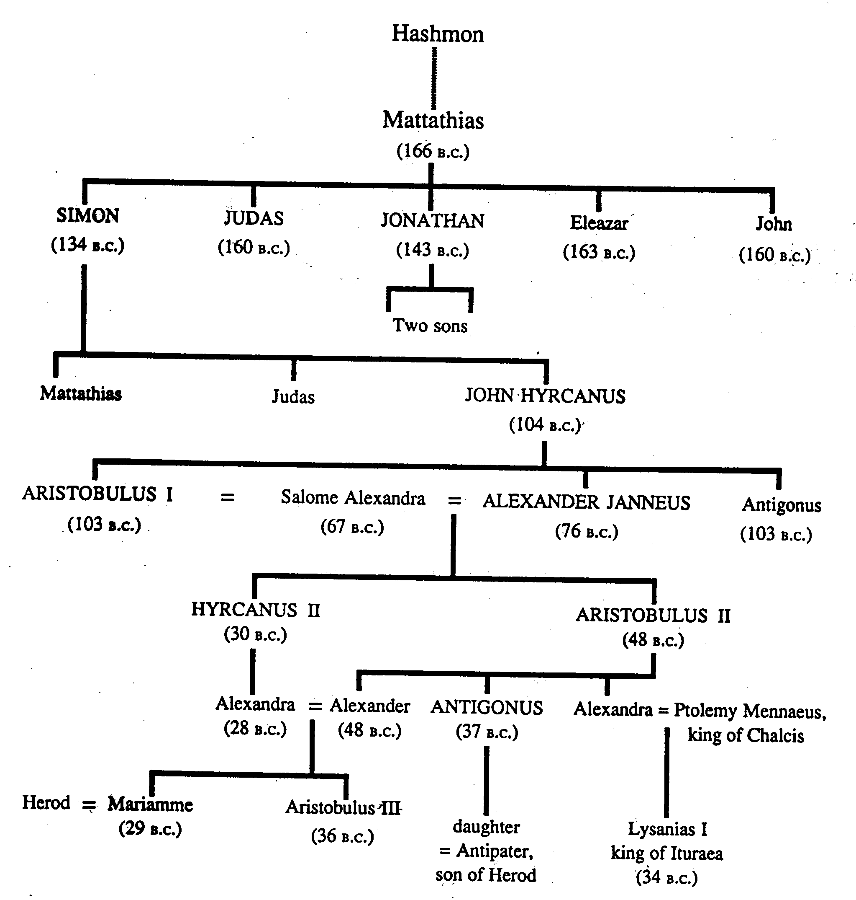
The Maccabees (Hasmoneans)
68
Jewish Rule Over Palestine (143-63 BC)

Slide 26
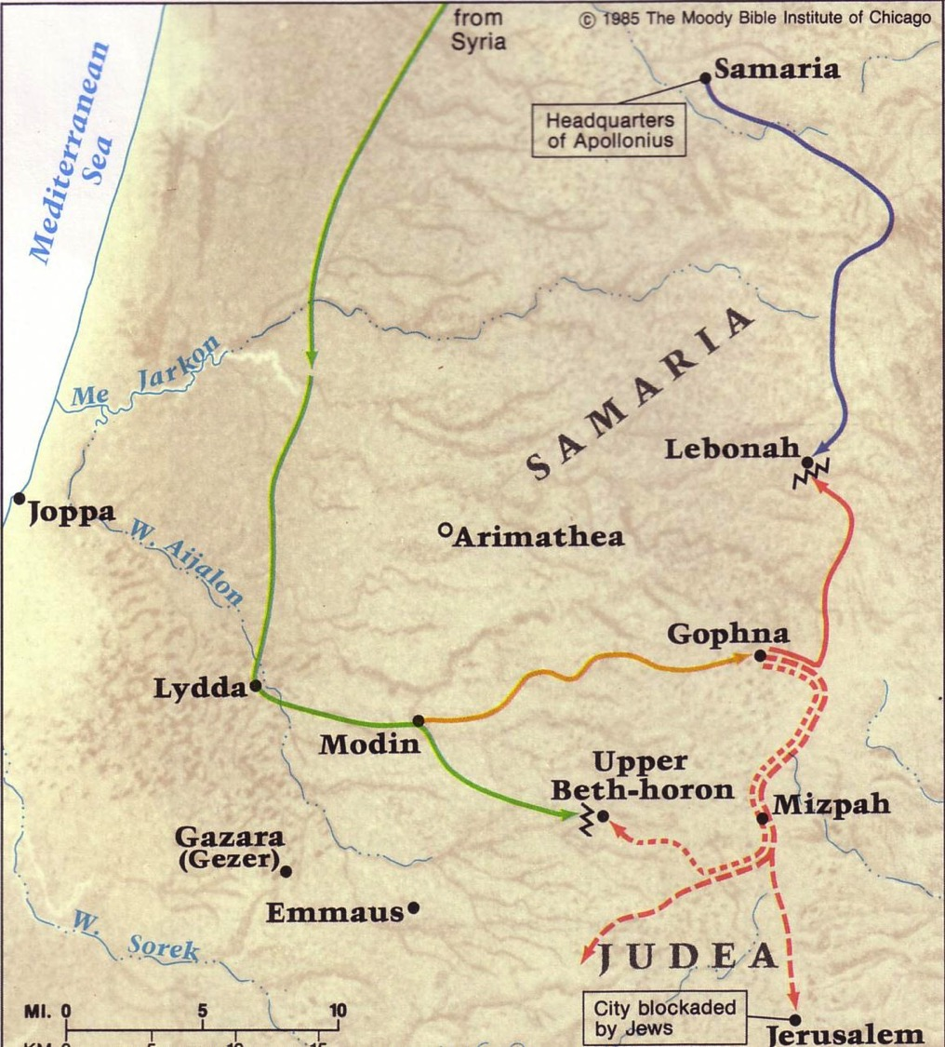
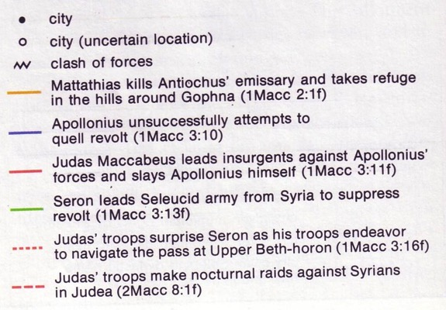
Early Maccabean Revolt
66
Judas Defeats Apollonius
Judas Raids Syrians
Mattathias & Sons Flee to Hills
Mattathias Kills Jew & Official
Judas Defeats Seron

Slide 27
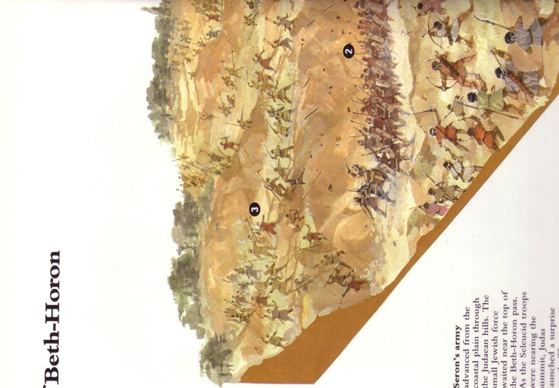
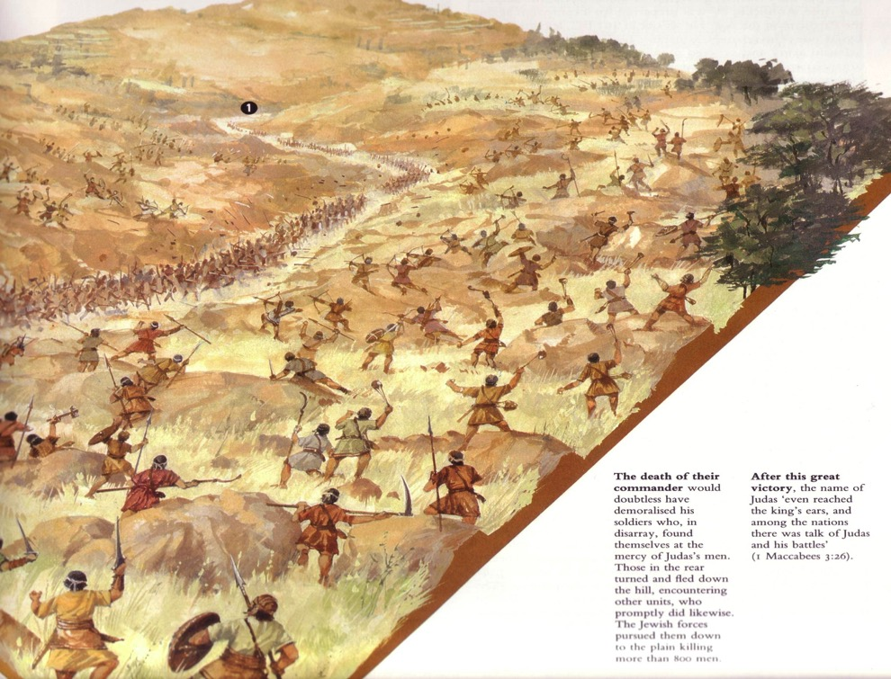
The Battle of Beth Horon
A Key Battle of the Maccabean Revolt (166 BC)

Slide 28
Greek Era Significance
62, 65, 95
Ptolemaic (301-198)
Seleucid (198-143)
Religious Freedom
Rise of Sanhedrin
Peaceful Hellenization
Greek Language
Septuagint (LXX)
High Priesthood
Rise of Hasidim
Temple desecration
Maccabean Revolt
Rise of Sadducees

Slide 29
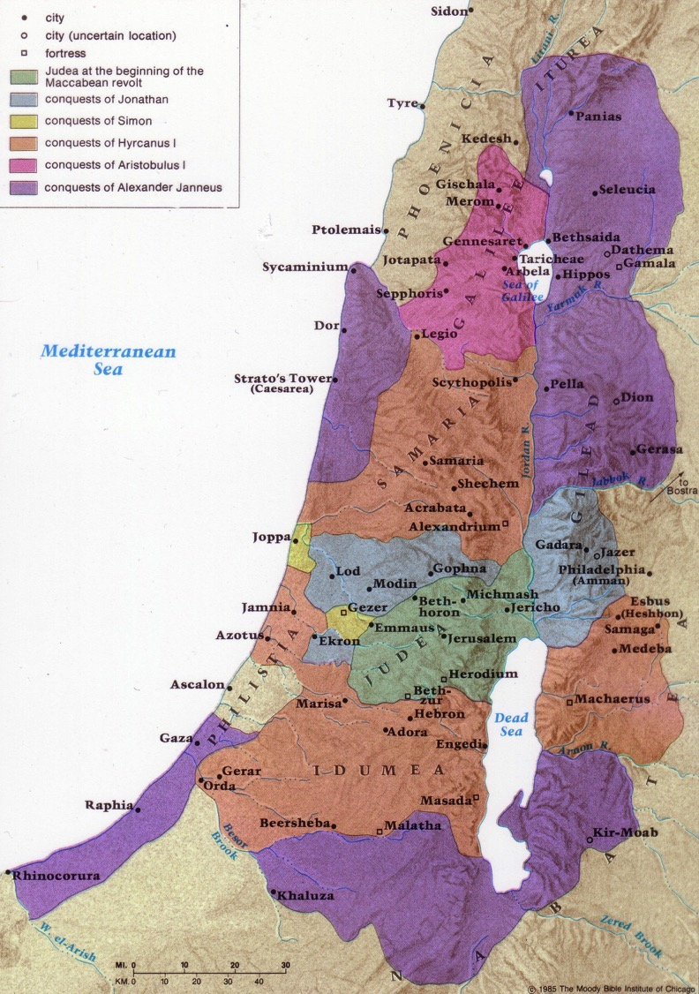
Hasmonean Expansion
69
Beitzel, 1st edition, 155

Slide 30
Hasmonean Significance
66-67, 95
Expansion of Borders
Alliance with Rome
Enforced Judaism
John Hyrcanus

Slide 31
Hasmonean Expansion
69
?
?
Beitzel, 1st edition, 155

Slide 32
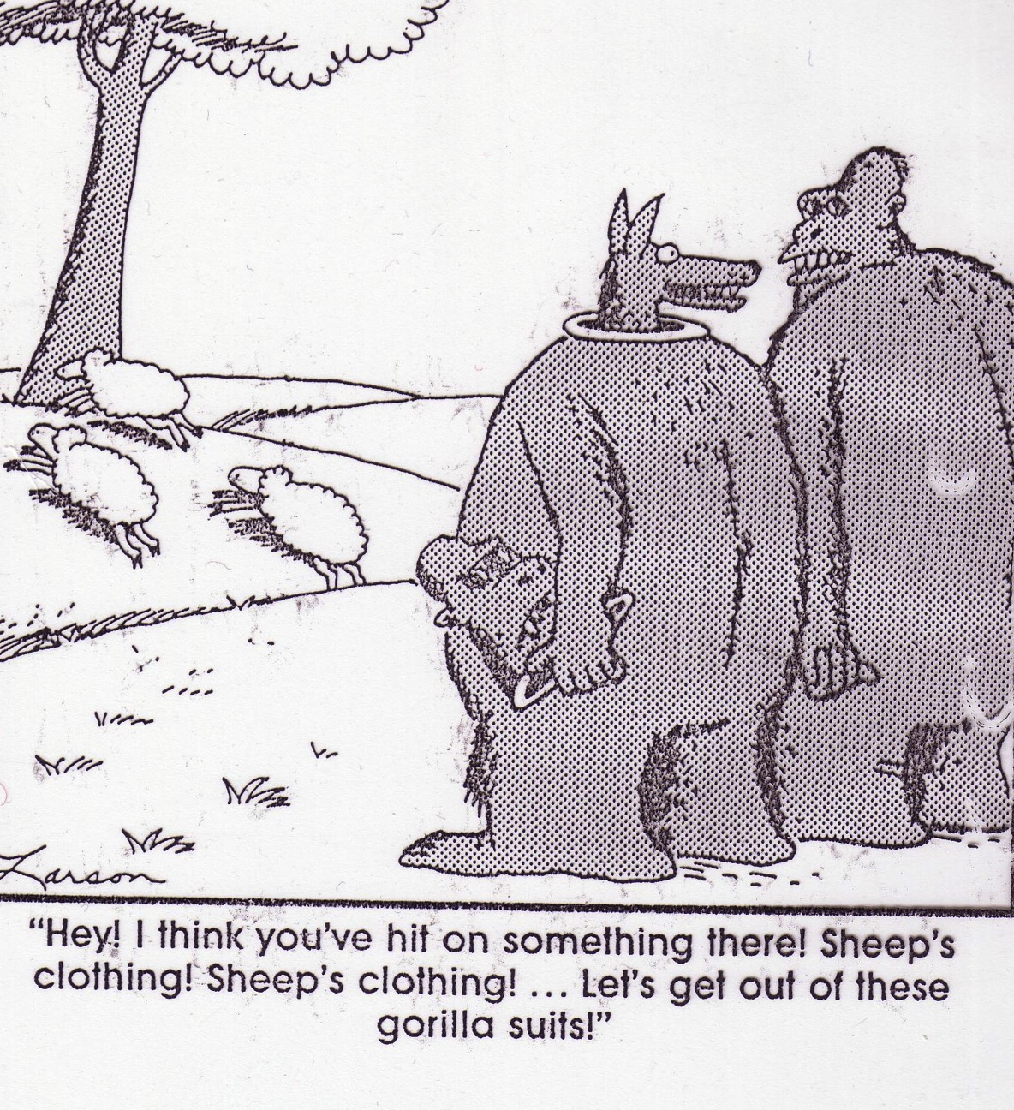
“Hey! I think you've hit on something there! Sheep's clothing! . . . Let's get out of these gorilla suits!”

Slide 33
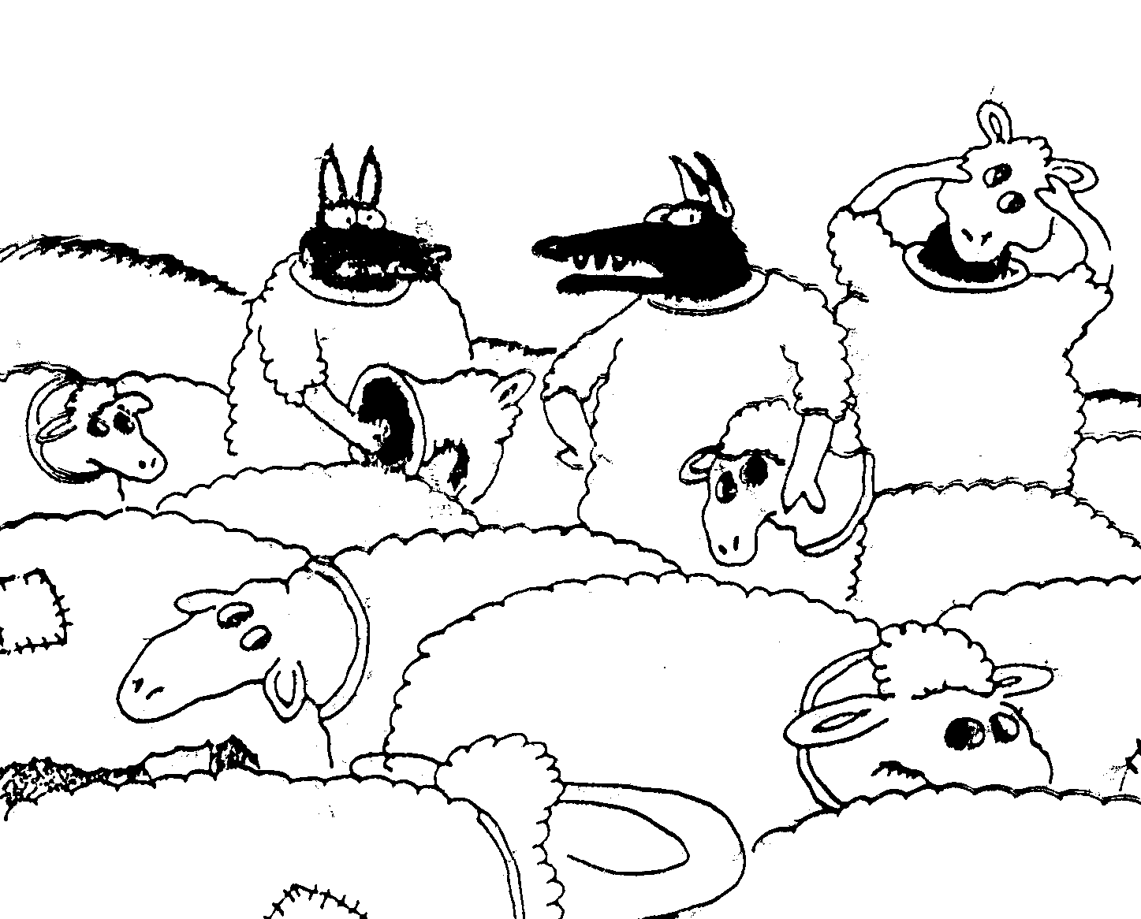
“Wait a minute! Isn't anyone here a real sheep?”

Slide 34
Hasmonean Significance
66-67, 95
Religious Independence (Pharisees)
Hanukkah (Feast of Lights)
Political Independence (Judas, Sadducees)
Priest & King in One Person (Jonathan)
Rise of Essenes (Simon)
Expansion of Borders
Alliance with Rome
Enforced Judaism
John Hyrcanus

Slide 35

Roman Territories (50 BC-AD 100)
94c
Roman Empire

Slide 36
Do you know these terms now?
Hellenization
Decapolis
Purim
Samaritans
Septuagint

Slide 37


NT Backgrounds link at BibleStudyDownloads.org
Get this presentation for free!
Notes:
NT Backgrounds (nb)

Slide 38
Black

