Slide 1
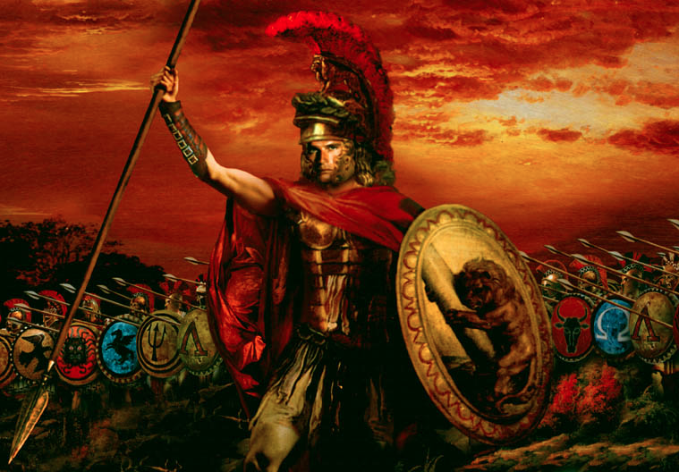
Political Backgrounds to the New Testament
8
Assyrians to Alexander
Part 1
Dr. Rick Griffith • Jordan Evangelical Theological Seminary • BibleStudyDownloads.org

Slide 2
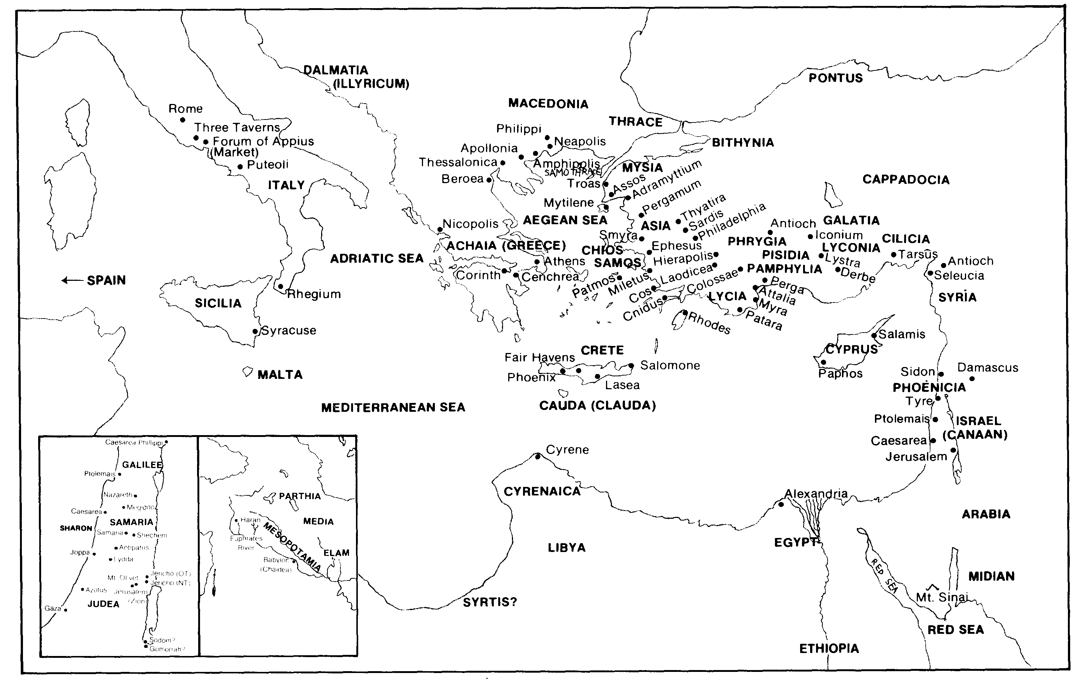
Every Geographical Location in Acts / Epistles (Quiz #2)
5

Slide 3


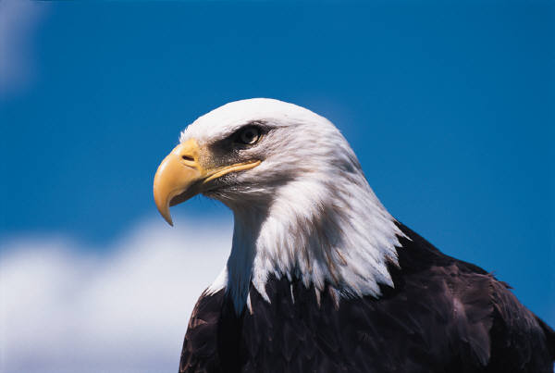
A Bird's Eye View of This Course
We're studying these backgrounds to the NT:
Geography (& Archaeology)
Politics (History)
Social-Economic Life
Religion
Literature

Slide 4
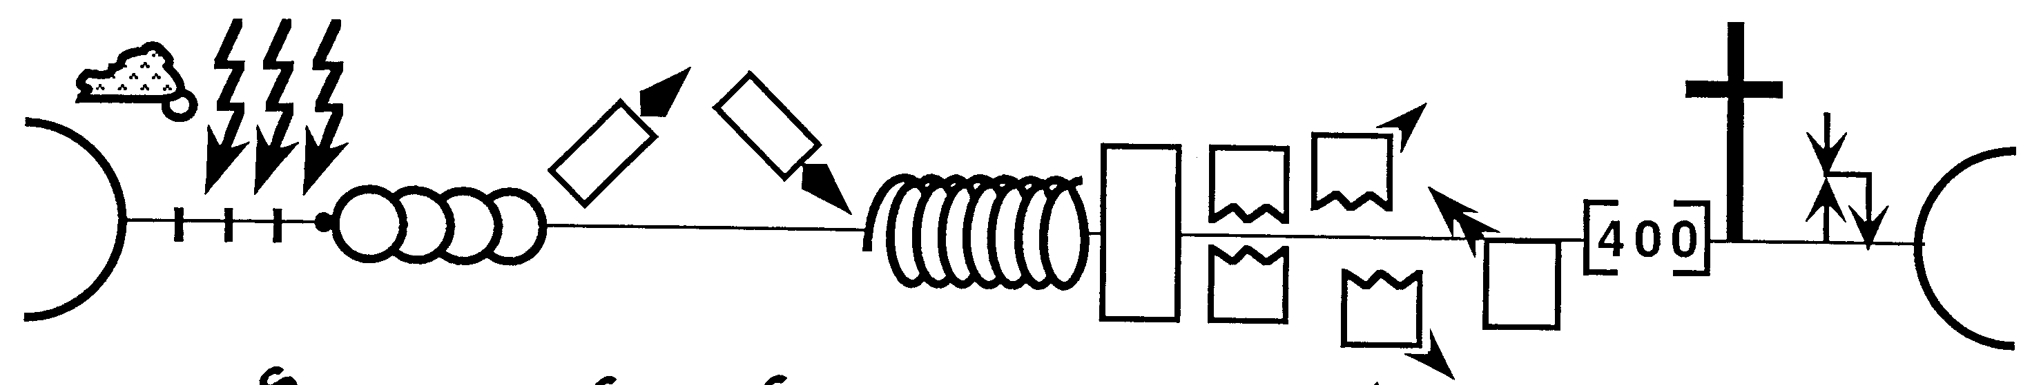
Stages of God's Plan in History
34
I (A) & J (B)
P • G • H • R
2nd Coming
Creation
Abraham
S • D • S
I (J) & J (R)
Z • E • N
1st Coming
Eternity
Eternity
Joseph
Moses
Joshua
Cycles
Flood
Jacob
Fall
Babel
Isaac
1000
Exodus
Judges
Captivity
Church
Patriarchs
Conquests
Kingdom
Beginnings
Restoration
Silent Years
United Kingdom
Divided Kingdom
Dr. Max Anders • Dallas Theological Seminary • Course 725 (Summer 1984)

Slide 5
The Intertestamental Era
(425 BC—5 BC)
35
Issue /
Time Period
Malachi
(close of OT)
Intertestamental Era
Advent of Christ
Rulers Over Israel
Persia
(208 yrs.)
Greeks (188 yrs.)
Hasmoneans (80 yrs.)
Rome
(58 yrs.)
Political Stability
Peace / autonomy
Many wars
(Dan. 11:1-35)
Peace (but via Rome!)
Expectation of Messiah & Kingdom
Moderate
Increasing
“Two Messiahs”
High
Language in Israel
Hebrew / Aramaic
Greek (Septuagint)
Aramaic / Greek / Latin

Slide 6
The Intertestamental Era (3 slides)
The Intertestamental Era
(425 BC—5 BC)
35
Issue /
Time Period
Malachi
(close of OT)
Intertestament Era
Advent of Christ
Ability to Evangelize
Limited
Increased
Extensive
Road System
Very Limited
Expanded
Extensive
Places of Worship
Temple only
Rise of Synagogues
Synagogues / Temple
Religious Leaders
Priests/Levites
Rise of Jewish Sects
Pharisees / Sadducees

Slide 7
The Intertestamental Era
The Intertestamental Era
(425 BC—5 BC)
35
Issue /
Time Period
Malachi
(close of OT)
Intertestament Era
Advent of Christ
Priesthood achieved by . . .
Genealogy
Fighting illegitimate high priest
Bribes / Executions
Extent of Power
Local Jurisdiction
Rise of Sanhedrin
Corrupt Sanhedrin
Hermeneutic
Literal
Instable + Apocalyptic
Letterism
Authority
OT Law
Rise of Oral Law
Pharisees

Slide 8
The "Kingdom Stage" is Set!
36
The time was right:
Galatians 4:4 NIV
“But when the time had fully come, God sent his Son, born of a woman, born under law, to redeem those under law, that we might receive the full rights of sons.”
Politically
Prophetically
(Dan. 9:25-26)
Linguistically
Emotionally
Religiously
Transportationally

Slide 9
The Gospel of Matthew
36
(probably written in the 40s)
answers the two questions all Jews were asking:
Q: Non-Christian Jews asked, “How do we know Jesus is the Messiah?” (Matt. 1-10)
Answer:
His advent (1–2) and approvals (3:1–4:11) show Jesus fulfilled OT Messianic prophecies
His early ministry (4:12-25) and Sermon on Mount (5–7) reveal He has the prophetic office
He shows messianic power by healing (8:1–9:34) and authority by delegation (9:35–10:35)
Q: Christian Jews asked, “Yes, He's Messiah, but where's the promised kingdom?” (Matt. 11-28)
Answer:
Israel rejected the kingdom offer by Christ as Messiah so He now has authority over the church (11–16)
Jesus prepared the disciples for church issues since the kingdom is delayed (17–20)
Israel rejected Him as Messiah but God sovereignly used this to pay for man's sin (21–27)
Christ defeated death to show His messianic authority & ability to bring in the kingdom (28)
So how has God prepared your background for you to minister effectively?

Slide 10
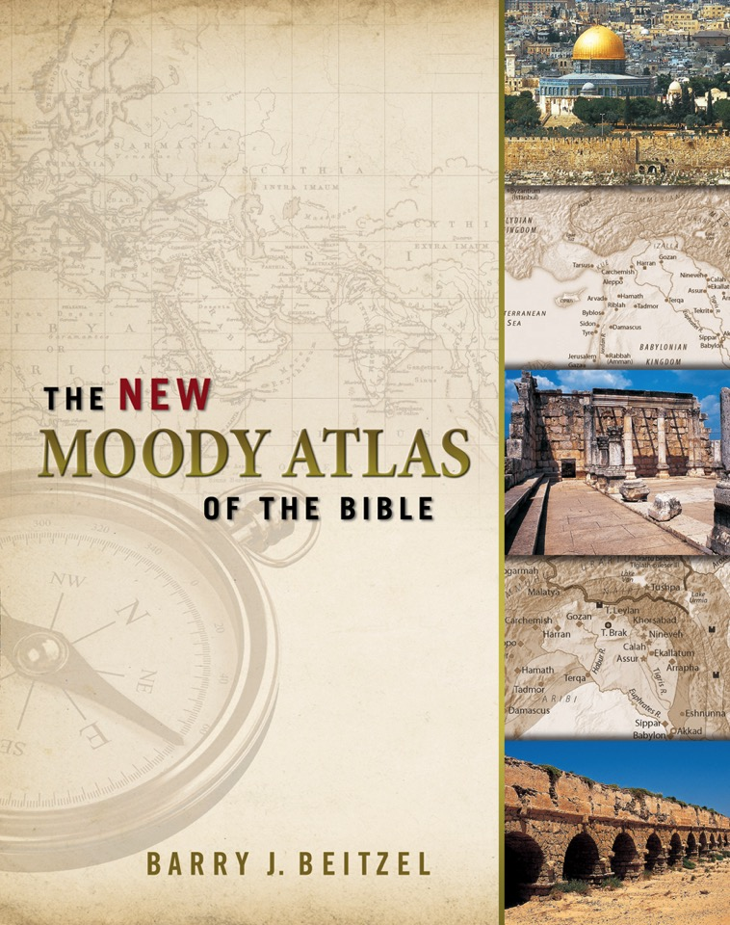
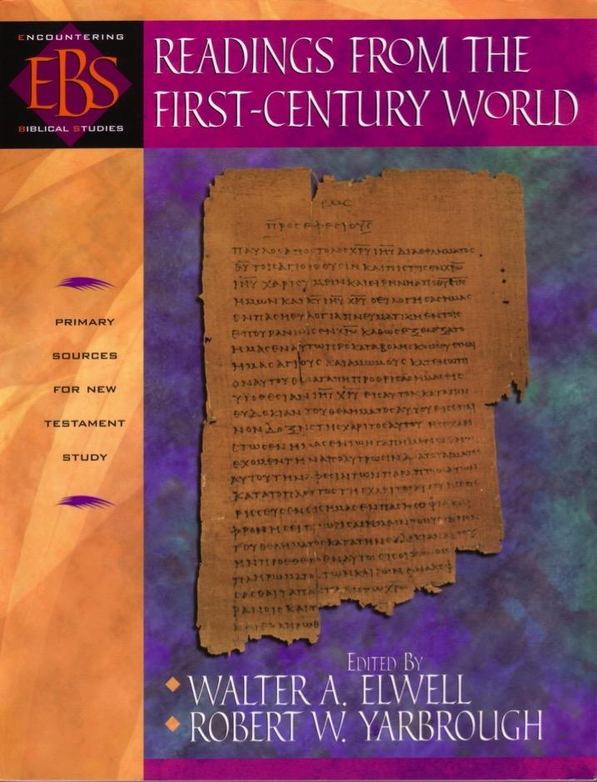
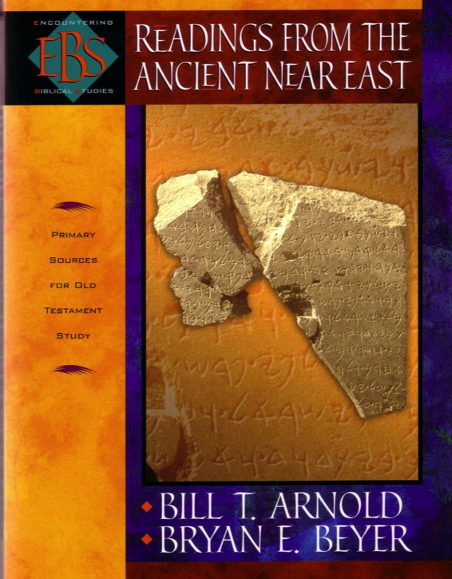
Sources for Political History
48
Primary
Secondary

Slide 11
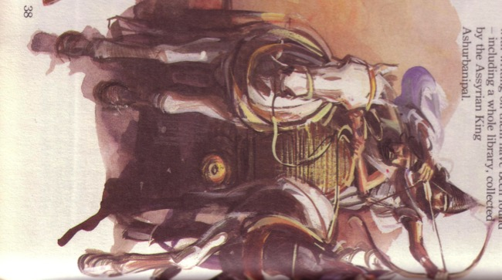
The Assyrian Empire
48
Assyrian Expansion
Nineveh
Mediterranean
Sea
Aram
Israel
Judah
Persian
Gulf
Egypt

Slide 12
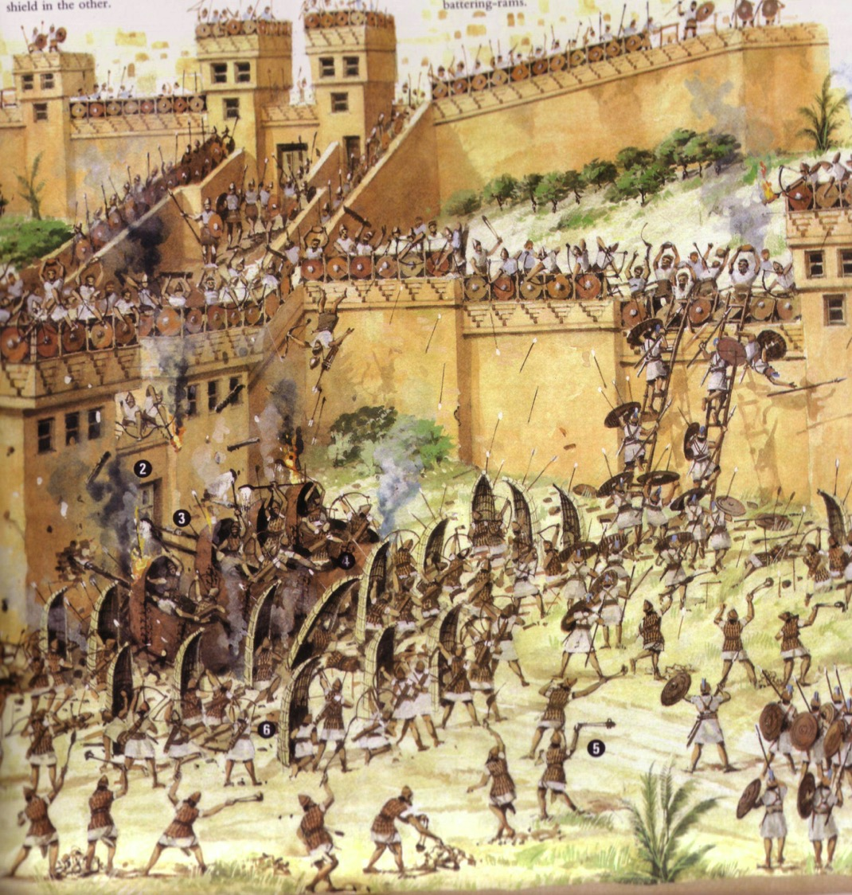
Assyrian Siege of Lachish

Slide 13
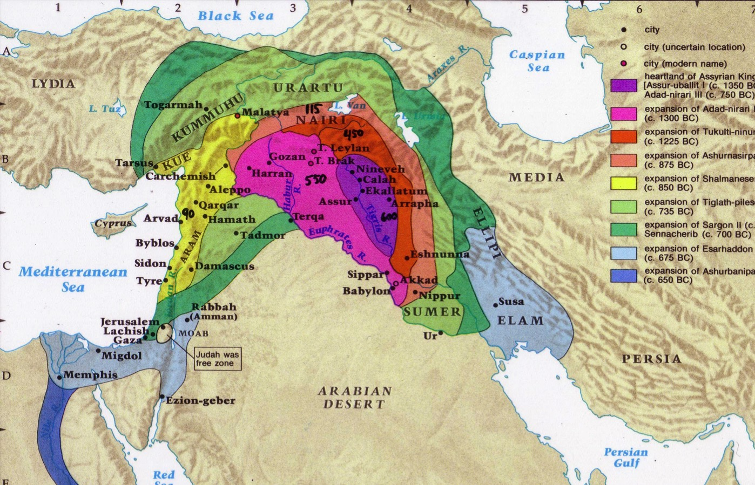
Assyrian Developments
And the king of Assyria transported groups of people from Babylon, Cuthah, Avva, Hamath, and Sepharvaim and resettled them in the towns of Samaria, replacing the people of Israel. So the Assyrians took over Samaria and the other towns of Israel
(2 Kings 17:24).
Finally, in the ninth year of King Hoshea's reign, Samaria fell, and the people of Israel were exiled to Assyria. They were settled in colonies in Halah, along the banks of the Habor River in Gozan, and among the cities of the Medes
(2 Kings 17:6).
48
Fall of Samaria
Rise of Samaritans
Beitzel, Moody Atlas of Bible Lands, 1st ed., 139

Slide 14
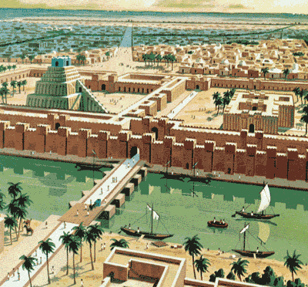





Prophecies in Daniel
48
Context: Written during the Exile (605-536 BC)
The City of Babylon
Notes:
Why the Exile?

Slide 15
The Babylonian Kingdom
50
Babylonian Expansion
Nineveh
Mediterranean
Sea
Syria
Babylon
Israel
Judah
586 BC
Persian
Gulf
Egypt

Slide 16
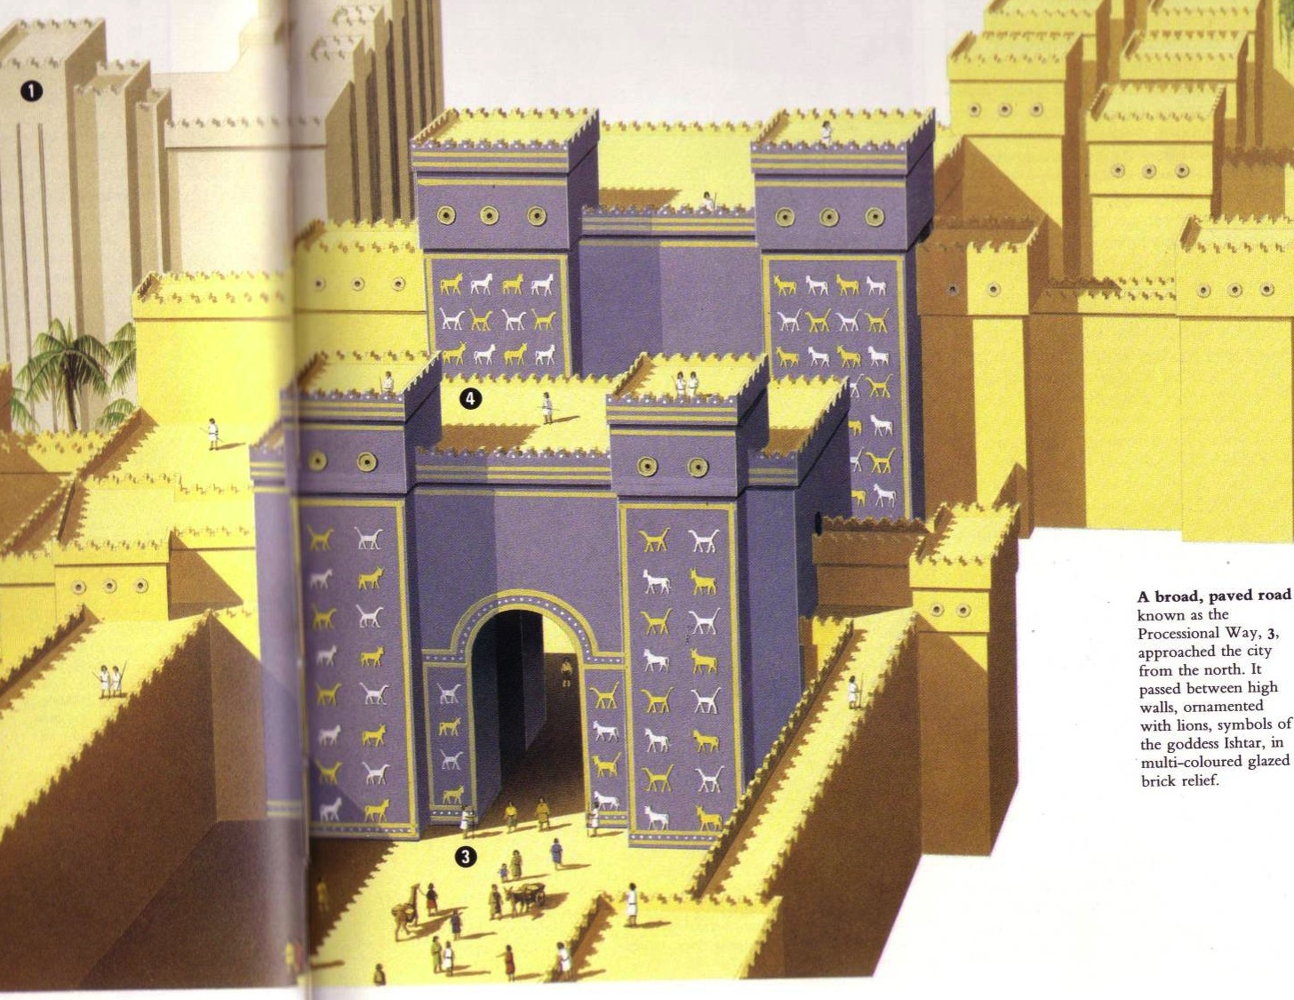
Daniel's Prophecies in Babylon
50
Context: Written during the Exile (605-536 BC)
Content: Foretells 4 kingdoms (605 BC-
AD 476)

Slide 17
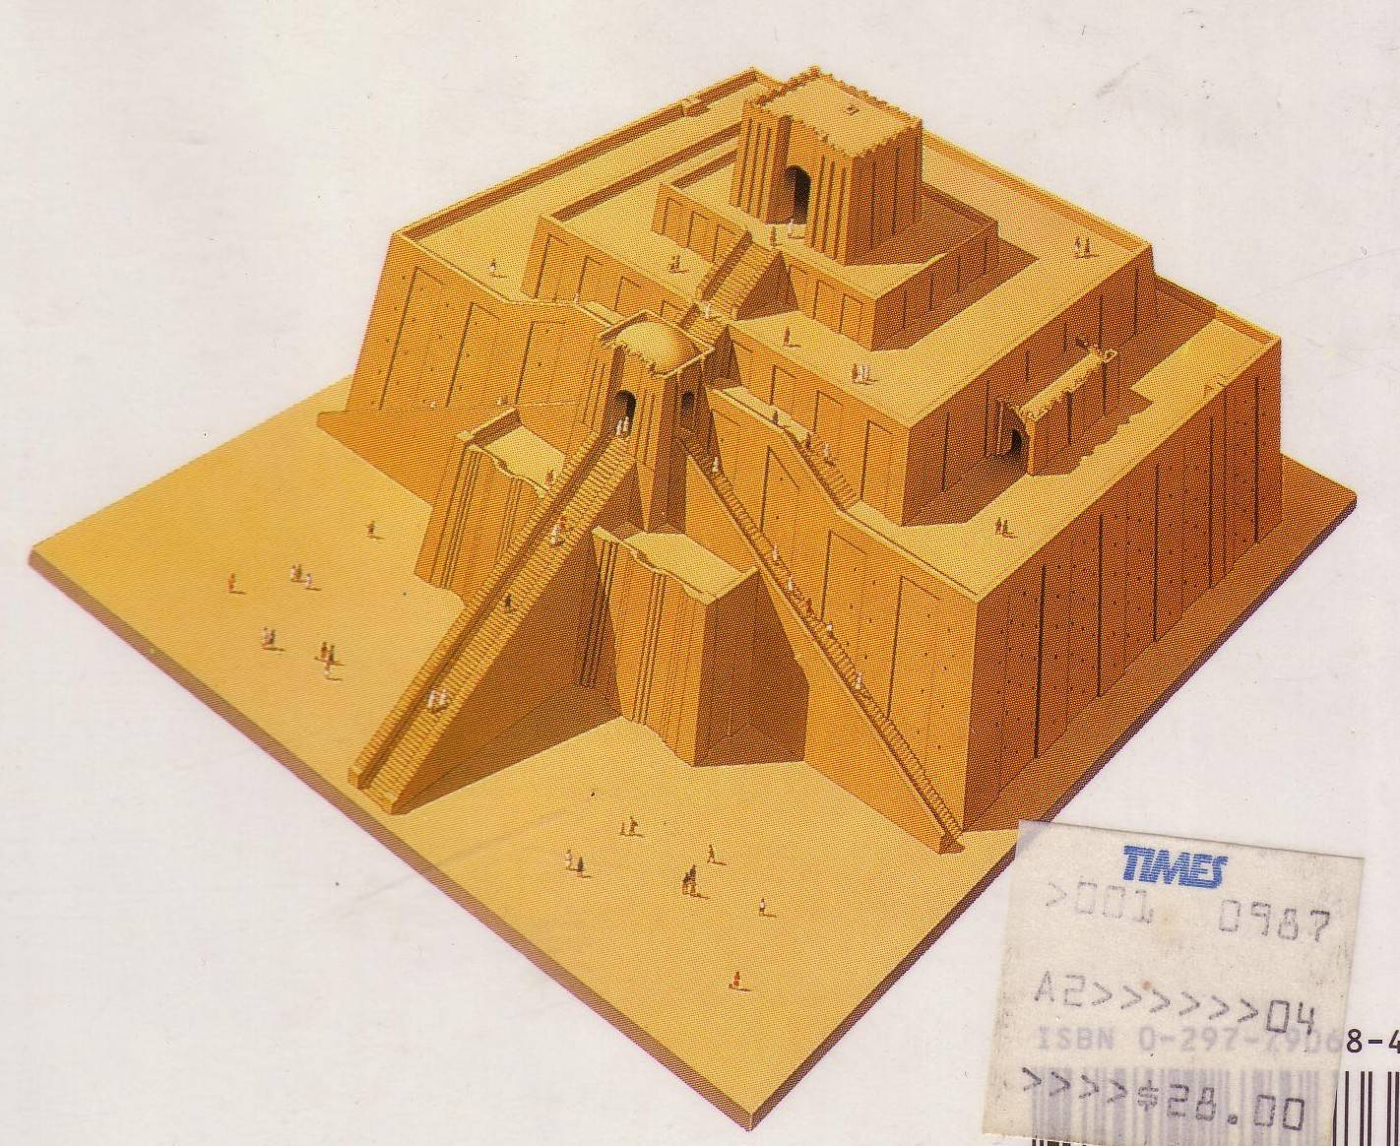
What would happen to Judah amidst the world's the oldest religion?

Slide 18
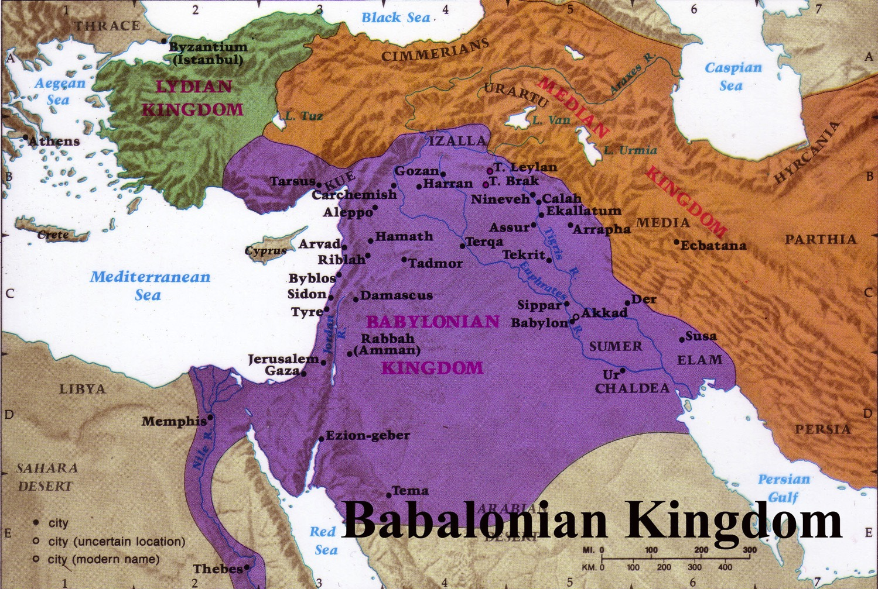
Babylonian Rule over Palestine
56
Deportations
Developments
Separation
Synagogue
No more idolatry
Beitzel, Moody Atlas of Bible Lands, 1st ed., 145

Slide 19

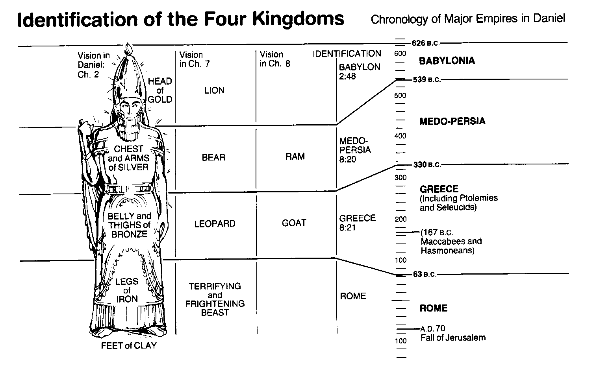
World Empires in Daniel
50
Bible Visual Resource Book, 133

Slide 20
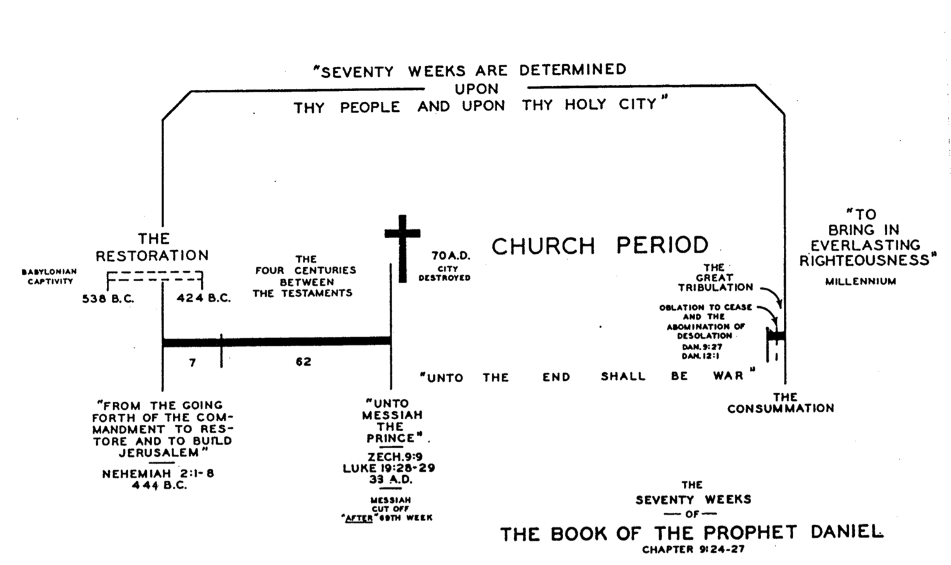
Daniel's 70 Weeks
(Dan. 9:24-27)
50
69 Weeks
444 BC
AD 33

Slide 21
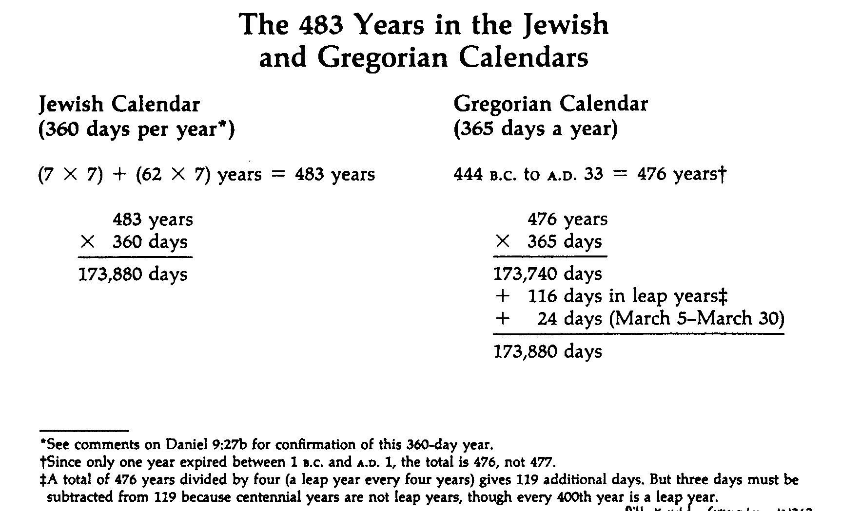
Determinations of the Seventy Weeks
49
Harold Hoehner, Chronological Aspects of the Life of Christ

Slide 22

Belshazzar Humbled
Rembrandt

Slide 23


Fall of Babylon
Fall of Babylon
BABYLON FELL (539 BC)
Cyrus entered under the water gates
Daniel 5
(Belshazzar's Feast)
Babylon Today

Slide 24
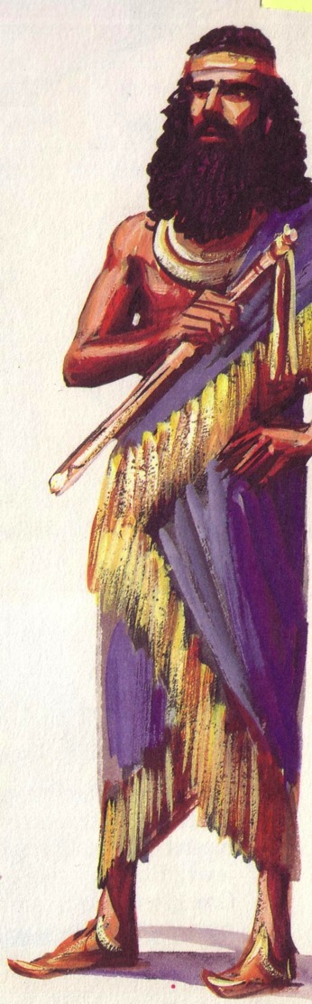
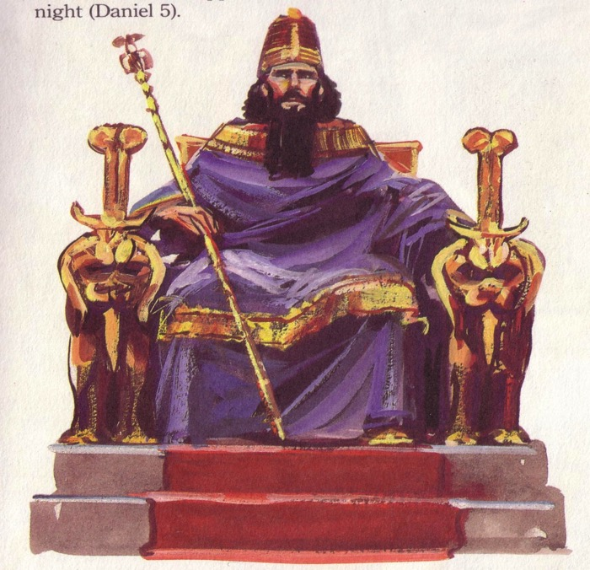
Persian Rule over Israel
56
Cyrus of Persia
Belshazzar of Babylon

Slide 25
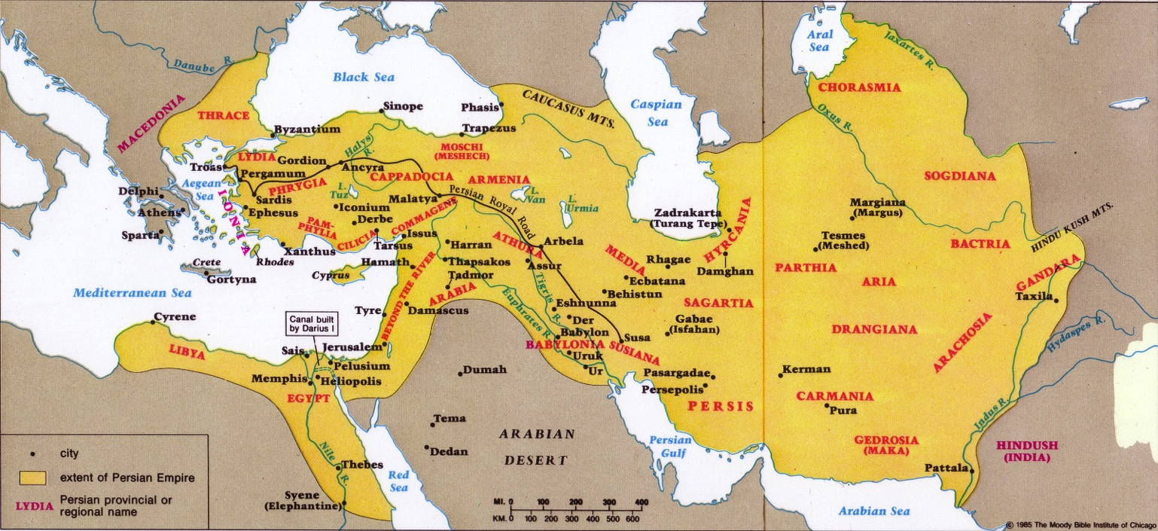
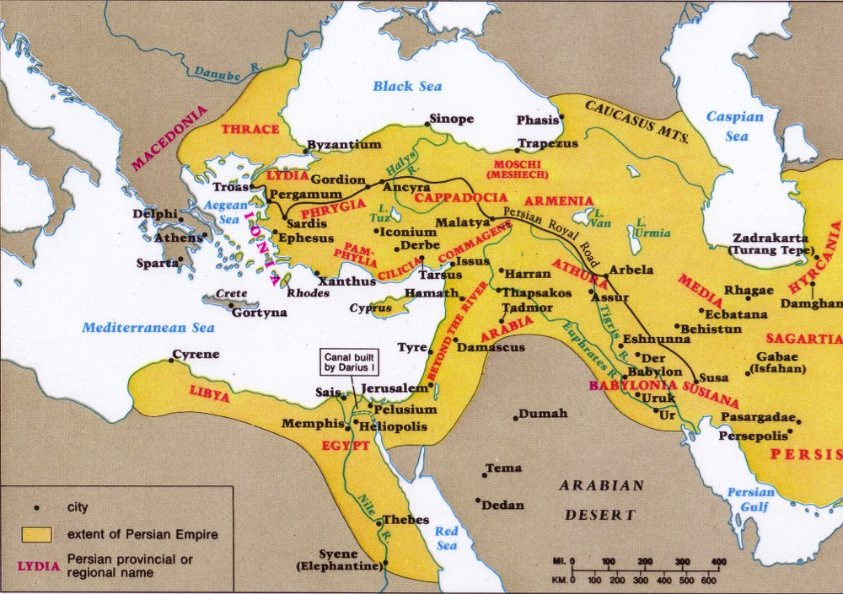
The Persian Era
57, 59
Returns
Developments
Temple
People
Walls

Slide 26
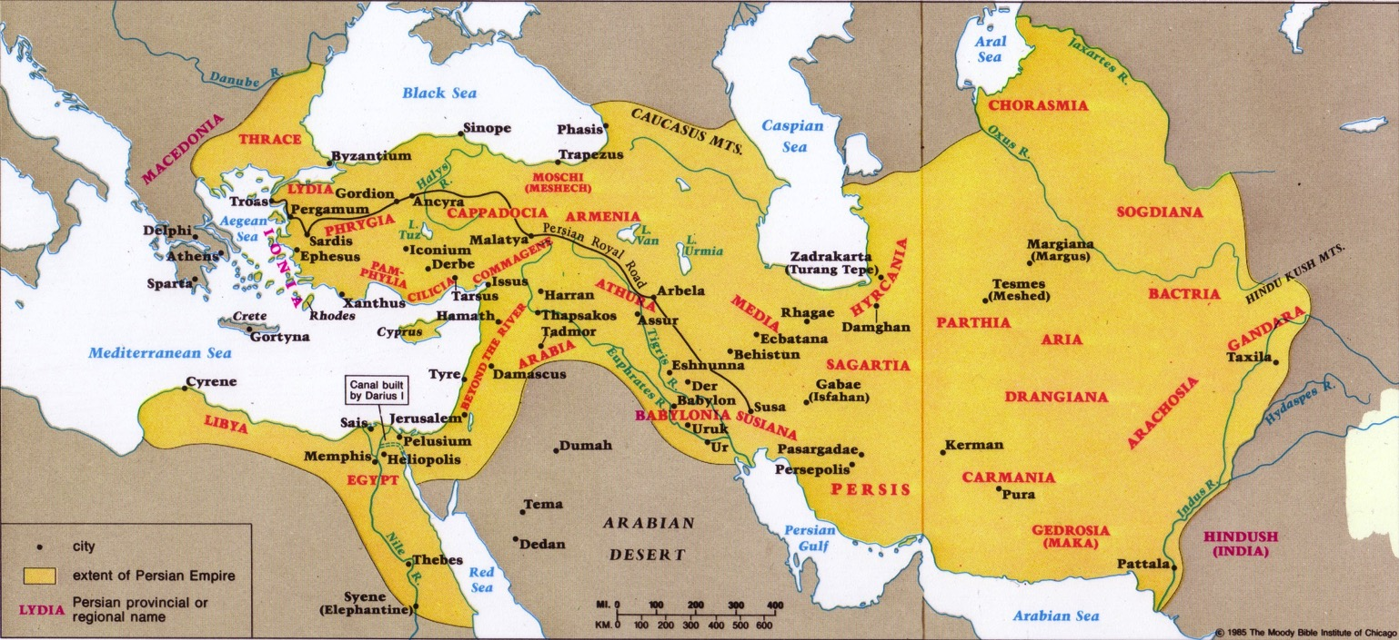

Key Developments with Israel Under Persia
59

Slide 27
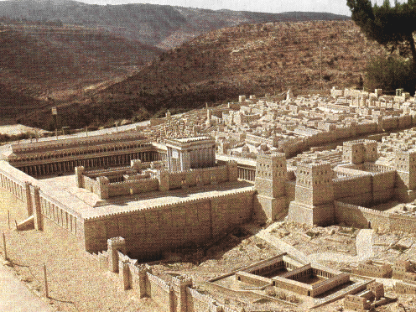
1. Restoration of Temple Worship
59
The Second Temple Era Began (first return under Zerubbabel): Initially only the sacrifices were reestablished, but after the temple rebuilding the entire temple system was reinstituted.

Slide 28
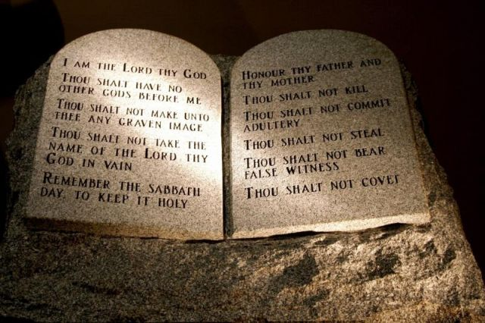
2. Law of Moses Reestablished
59
Ezra the priest and scribe (1 Chron. 6:3-15; Ezra 7:6-7) taught the law and enforced it by order of the king (Ezra 7:14, 25-26), especially in respect to prohibiting intermarriage (Ezra 9-10; Neh. 10:30; 13:23-31) This led to copying scrolls of the OT used even in the time of Jesus.

Slide 29
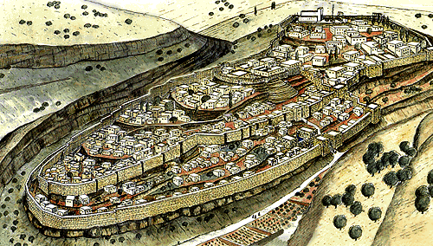
3. Economic and Spiritual Life Revived
59
After Nehemiah’s third return saw the restoration of the walls, repopulating of Jerusalem, reinstitution of the Sabbath, spiritual revival among the people, and renewal of the intermarriage prohibition. These placed Israel more firmly in the land.

Slide 30
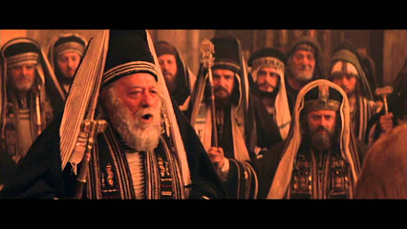
4. Rise of the Temple State
59
Though Judah was still a vassal state, Persia allowed the people a great deal of autonomy (especially in cultural & religious matters) to win their allegiance. This resulted in peace, prosperity, and security. Eventually the Persian governor was replaced by a council of elders closely allied with leading priestly families and directly accountable to the Persian king.

Slide 31
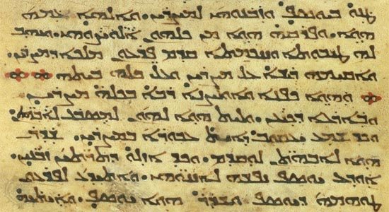
5. Aramaic Language
59
The language of Aram became the official language of the empire so that Hebrew began to die out as the everyday language of the Jews. By the time of Christ few Jews knew Hebrew & Aramaic was the common language of Palestinian Jews.

Slide 32
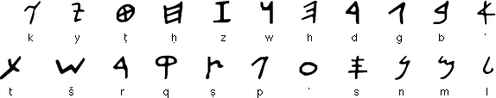
The Key Aramean Influence During Persian Rule
Aramaic Alphabet (Alep-beet)
A consonant alphabet with no vowel indication
Written from right to left in horizontal lines

Slide 33
Aramaic in the Persian Era
57, 59
Aram
Aramaic
Aramaic became the Ancient Mid-East trade language due to Aram's location and language

Slide 34
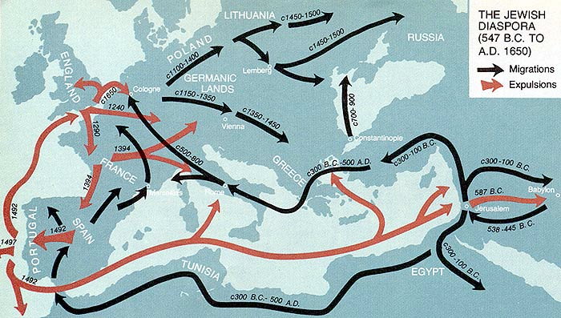
6. Jewish Diaspora
59
Persians allowed the Jews to return to Israel and reestablish their religion & customs, but very few did so. Those remaining in foreign lands became known as the Diaspora so that many Jewish settlements could be found around the empire. Paul later used the Synagogues of these groups as points of contact in evangelising the Roman world.

Slide 35
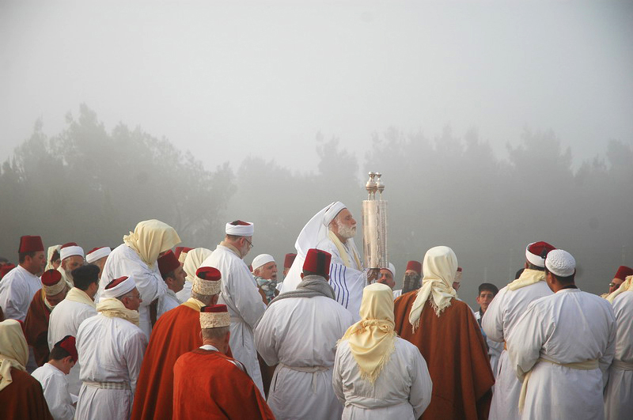
7. Samaritans
59
Inhabitants of Samaria to the north of Jerusalem had earlier resulted from intermarriage with pagans during Israel’s Assyrian exile. Jews rejected them as true Israelites due to their “mixed blood” (2 Kings 17). Therefore, the Jerusalem community separated from them (Ezra 4:1-12) and this alienation & rivalry finally led to political provinces (Samaria and Judea) and two sanctuaries of worship (Mt. Gerizim and Jerusalem) later under Alexander the Great. Years later the Samaritan woman spoke with Jesus at the well about these two sanctuaries (John 4:20).

Slide 36
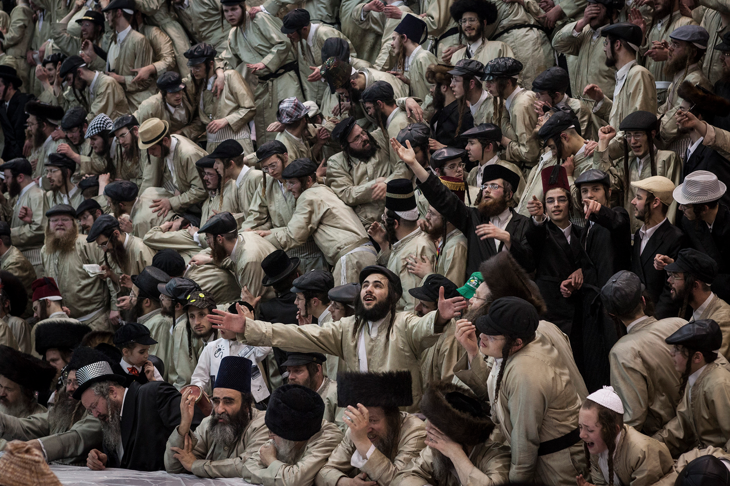
8. Purim
59
Purim joined the feasts of Israel during the reign of King Xerxes I (486-465 BC). Esther records how Haman, Xerxe’s prime minister and an enemy of the Jews, sought to annihilate all Jews on a certain day (14th of Adar), but his plan was foiled by the courage of Queen Esther, a Jewess. Xerxes reversed Haman’s diabolical scheme and permitted the Jews to defend themselves. Because Haman had selected the day by throwing of purim (“lots”), the 14th and 15th of Adar (Feb/March) was chosen for a memorial festival called the Feast of Purim.

Slide 37
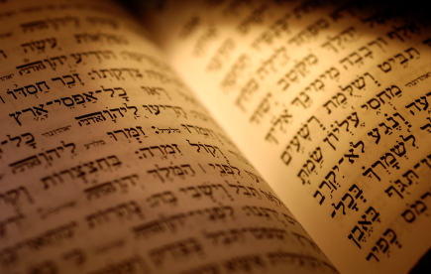
9. Close of the OT Canon
59
The prophet Malachi preached during the Persian rule (432-425 BC). As the last of the prophets, the end of his ministry began what is now known as the “400 silent years” (425-5 BC) when no prophets spoke until the time of John the Baptist.

Slide 38
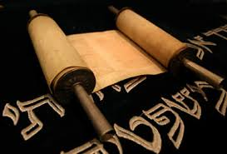
10. Judaism
59
Judaism became the term depicting the Jewish way of life in both its cultural and religious aspects from the post-exilic period onward. Orthodox Judaism strictly resisted outside influences that would seek to absorb or change it.

Slide 39
Key Developments with Israel Under Persia
59
Restoration of Temple Worship
Law of Moses Reestablished
Economic & Spiritual Life Revived
Rise of the Temple State
Aramaic Language

Slide 40
Key Developments with Israel Under Persia
59
Jewish Diaspora
Samaritans
Purim
Close of the OT Canon
Judaism

Slide 41
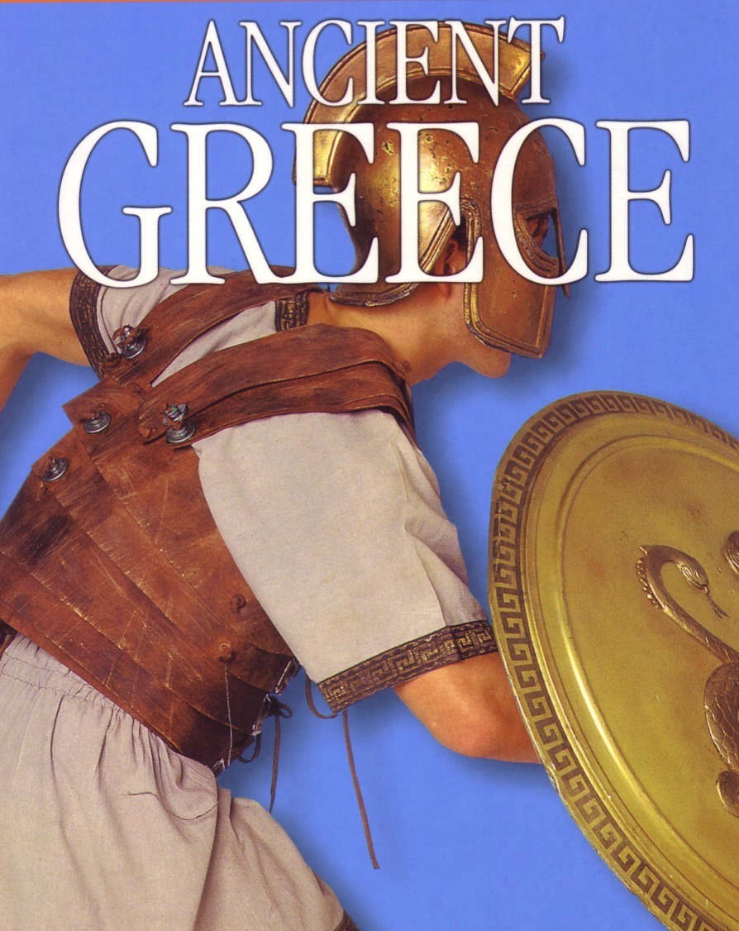
Greek Rule over Israel
60
Alexander
Struggle for Supremacy
Hellenistic Empire Developments

Slide 42
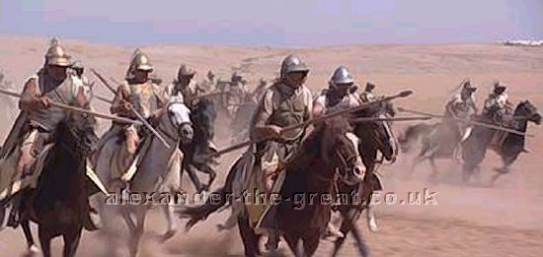
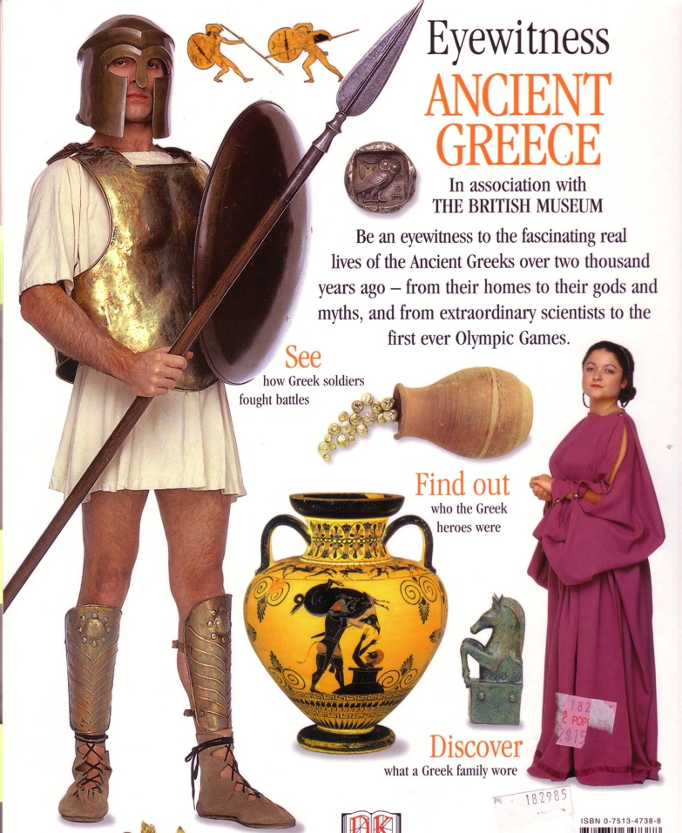
What was so Great about Alexander?
60
Colonization (Hellenization)
Conquest
Consolidation (Greek Language)

Slide 43
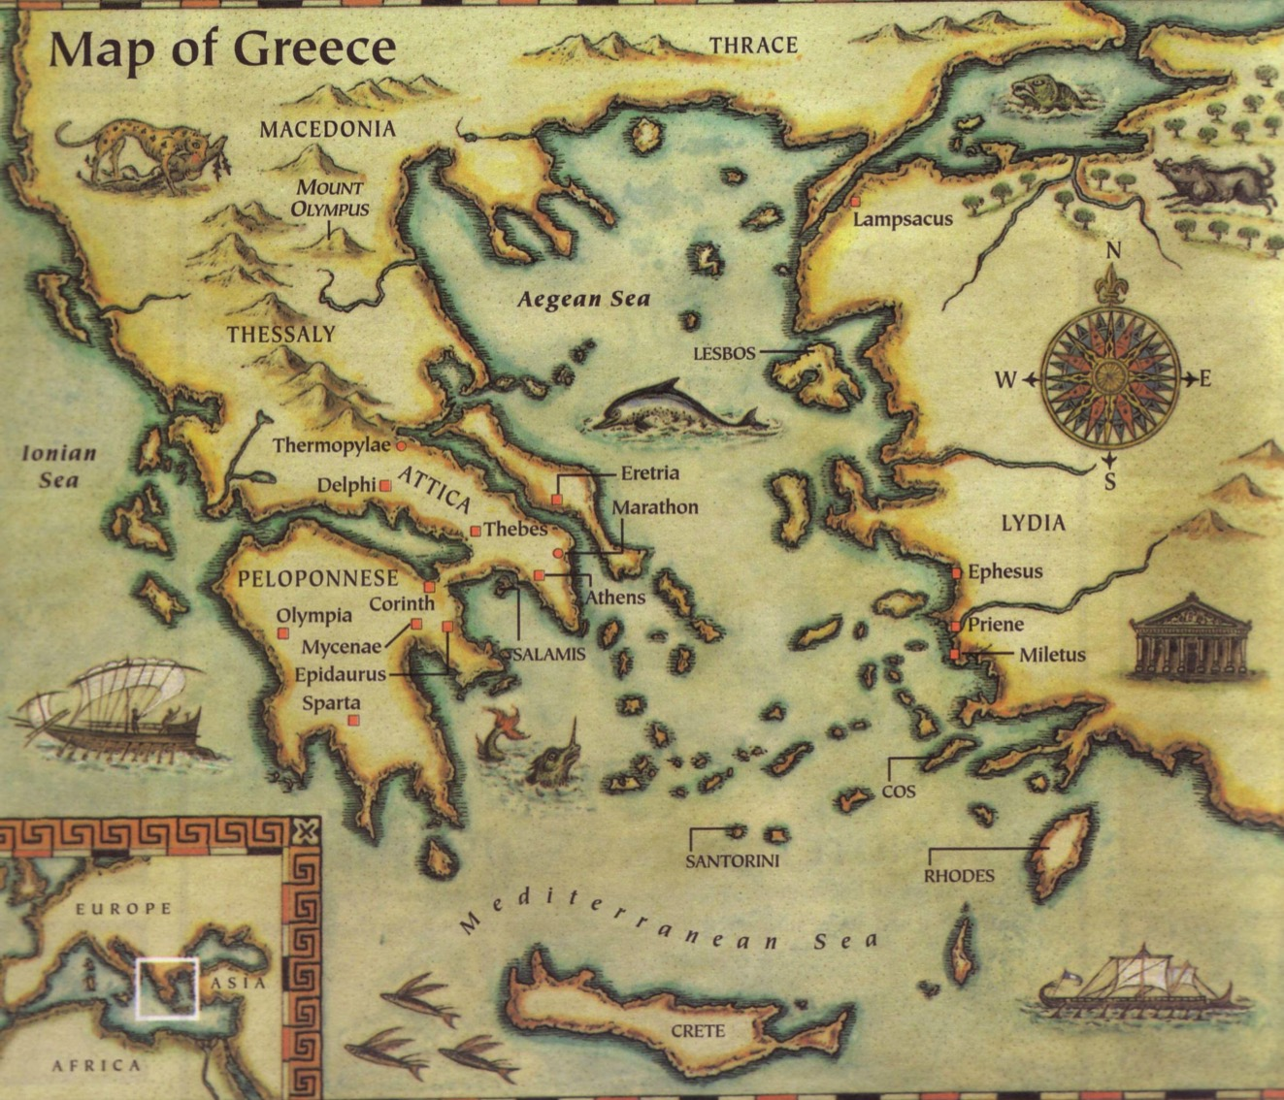
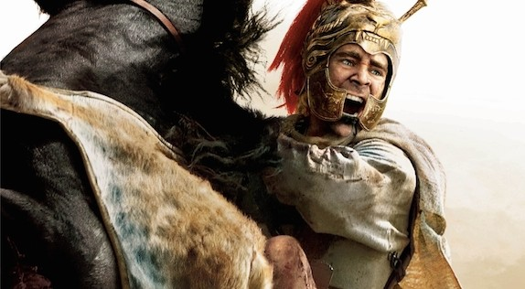
Map of Greece
60

Slide 44
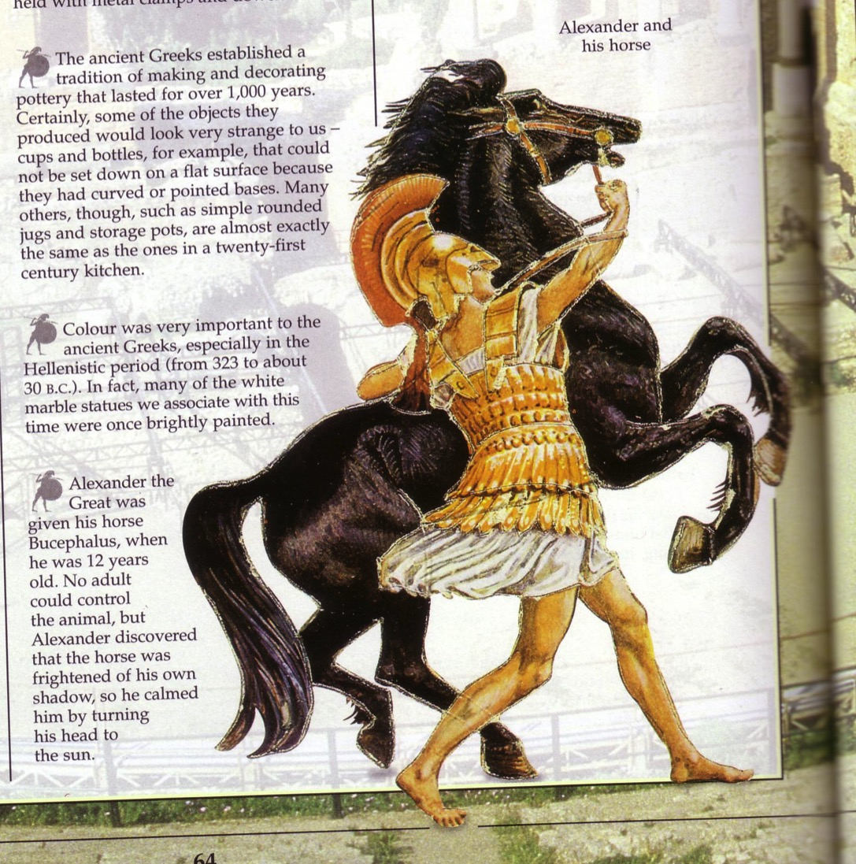
Alexander & His Horse
60

Slide 45
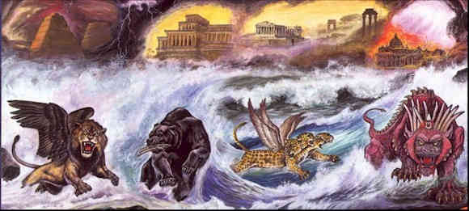
Four Beasts of Daniel 7

Slide 46
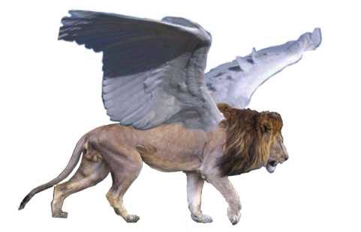
Beast 1: Winged Lion (Babylon)

Slide 47
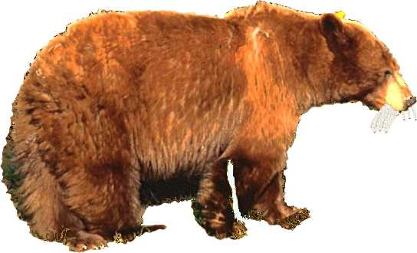
Beast 2: Bear (Medo-Persia)

Slide 48

Beast 3: Leopard (Greece)

Slide 49
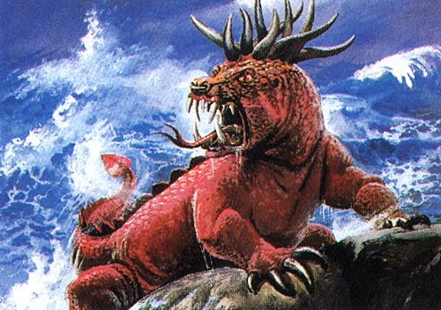
Beast 4: Terrifying (Rome)

Slide 50

Little Horn on Beast 4 (Antichrist)

Slide 51

Daniel 8
Can God know the future almost 300 years in advance?
Well, of course He can!

Slide 52

The Date of Daniel
Daniel's Ministry (1:1; 10:1)
605-536
Daniel's Prophecies (Dan. 2–11)
605-AD 70
Antiochus Desecrates Temple
167-164
Critics see historical events recorded as “prophecies”
600
550
500
450
400
350
300
2 5 0
2 0 0
150
100
50
BC/AD
50
Alexander the Great
Critics Date Daniel after 164

Slide 53
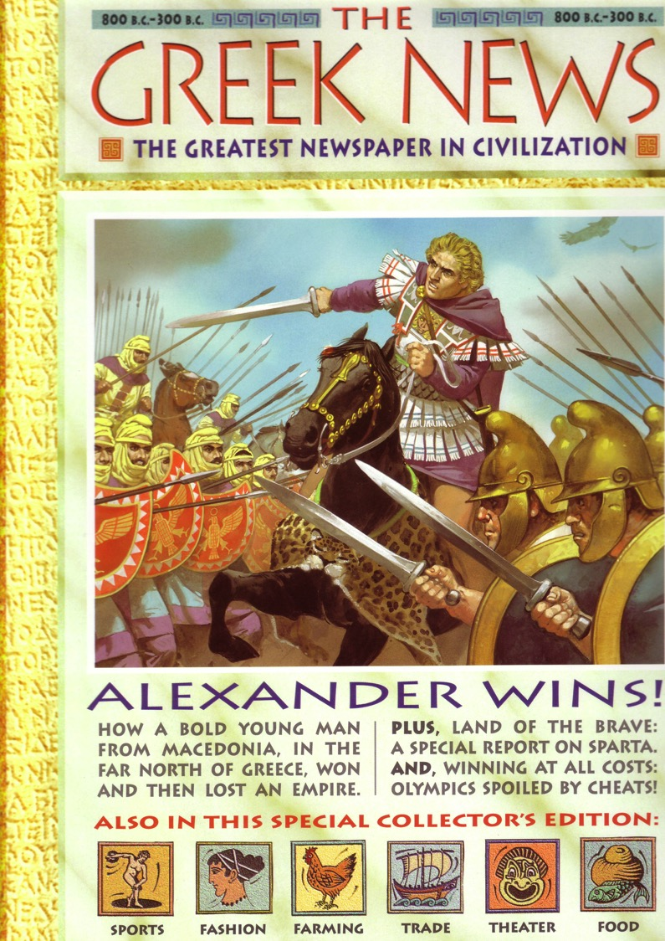
Alexander
Made Headlines…
61

Slide 54
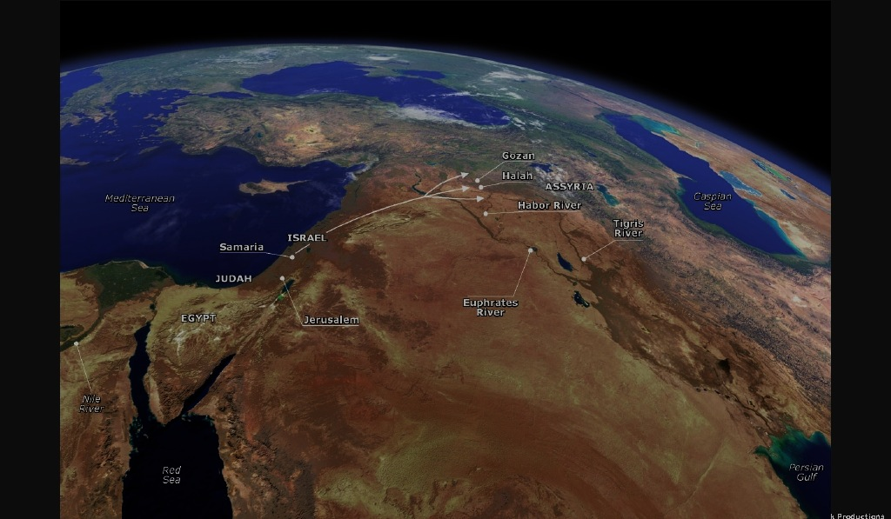
Flow of Daniel 8
61
Chapter 8
vv. 3-4 The powerful ram with two horns (Persia)
5-7 A goat defeats a ram (Alex over Persians)
8 Horn replaced by four horns (Alex's generals)
9-12 The small horn (Antiochus IV Epiphanes)
        His Career
        His Defeat
        His Fury
        His death (cf. v. 25)
13-14 The Maccabees and Hanukkah (167-164 BC)
15-27 The interpretation

Slide 55
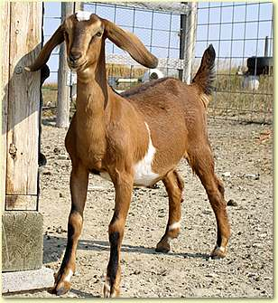
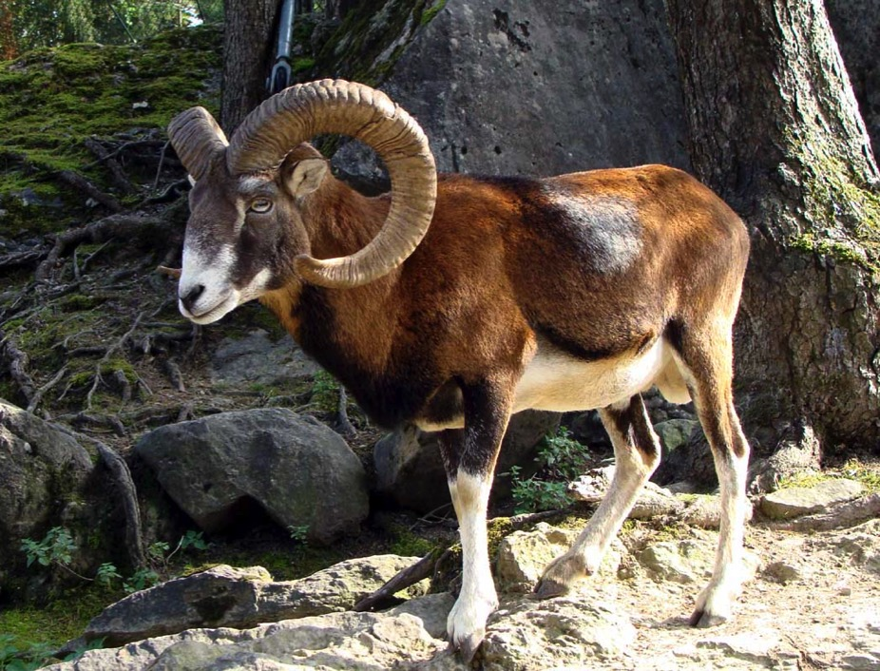
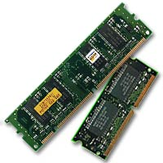
Which is stronger & faster?
61
Goat?
Ram?

Slide 56
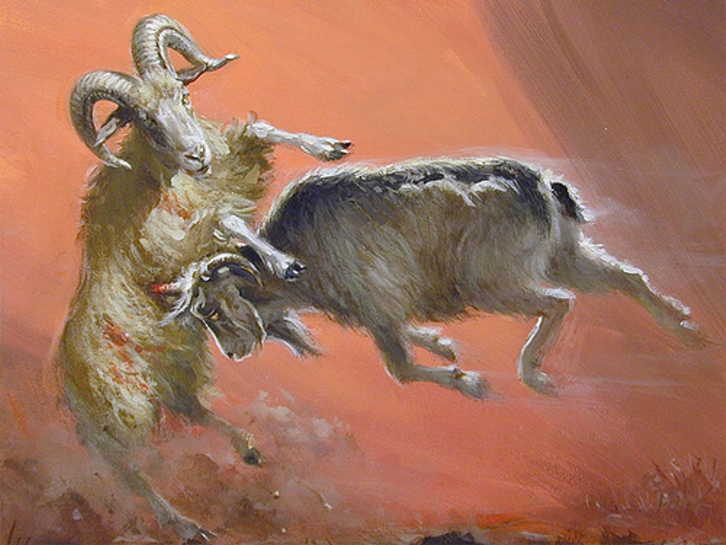
Goat Beats Ram (Dan. 8)?
61

Slide 57
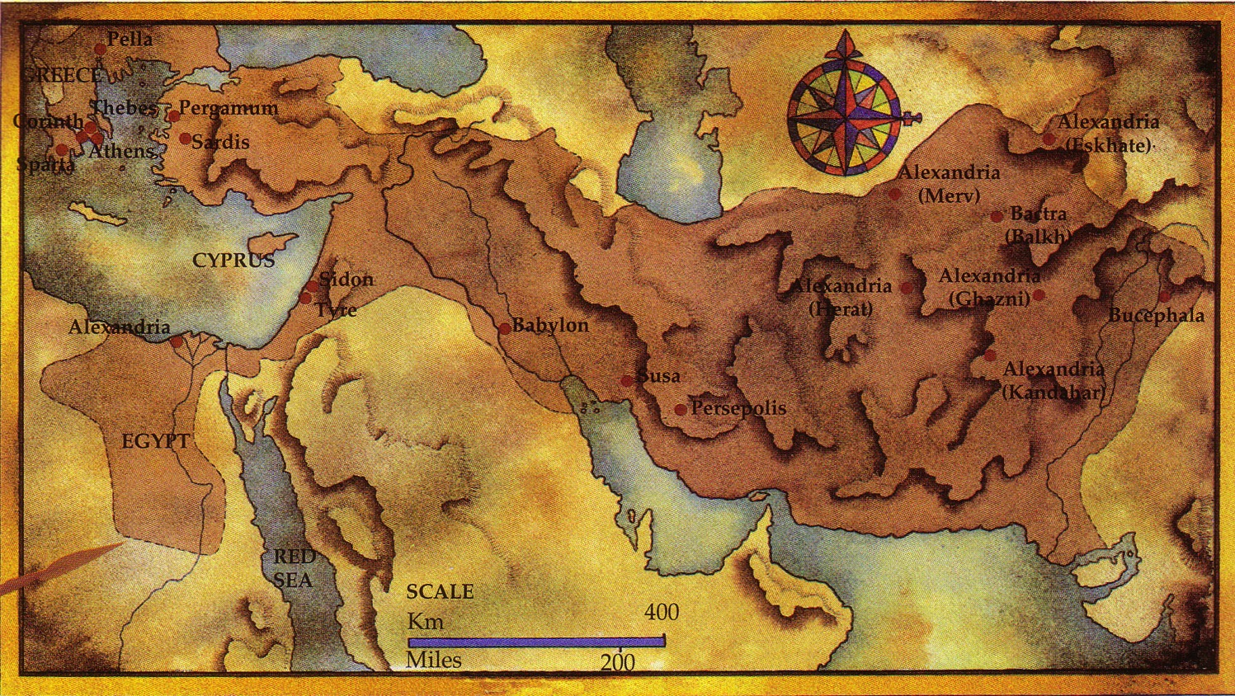




The Ram and Goat (Dan. 8)
61

Slide 58

The mad frenzy of Alexander riding in the front lines with his men endeared their support rather than riding behind thousands of them at the rear.

Slide 59

His long lance pierced victims before they had a chance

Slide 60

Alexander Fulfilled Daniel 8
61

Slide 61

Alexander's Conquests
61

Slide 62



His Downfall
Due to Pride:
Desire for worship
Wine
Women
Song

Slide 63

Alexander fell ill at Babylon
Notes:
Art Now and Then: Henryk Siemiradzki
Alexander The Great And Physician Philip of Arcarnania
1870, Henryk Siemiradzki

Slide 64

Alexander died at Babylon at age 32
Notes:
Art Now and Then: Henryk Siemiradzki
Alexander The Great And Physician Philip of Arcarnania
1870, Henryk Siemiradzki

Slide 65

He was married to Roxane for 10 years but never had a child

Slide 66



After Alexander…
64
Greek Empire
Cassander
Lysimacus
Seleucus
Ptolemy
"And the he-goat is the king of Greece; and the great horn between his eyes is the first king. As for the horn that was broken, in place of which four others arose, four kingdoms shall arise from his nation but not with his power" (Daniel 8:21-22 RSV)

Slide 67

Jerash of the Decapolis

Slide 68

Jerash in Its Glory Days

Slide 69


NT Backgrounds link at BibleStudyDownloads.org
Get this presentation for free!
Notes:
NT Backgrounds (nb)

Slide 70
Black

