Slide 1
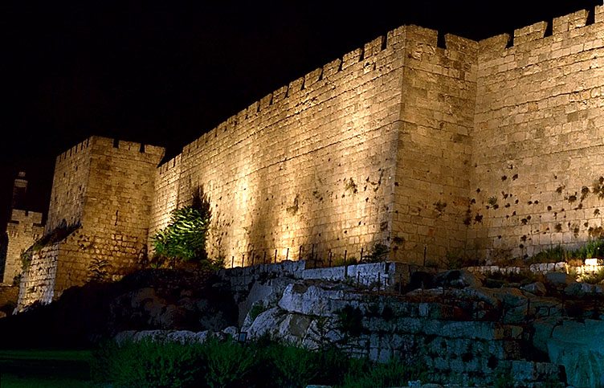
Jerusalem
Geography of NT
Dr. Rick Griffith • Jordan Evangelical Theological Seminary • BibleStudyDownloads.org

Slide 2

The World Today

Slide 3

Modern Middle East
9

Slide 4

Left Stage
Travel in Ancient Israel
Right Stage
West & North
East & South

Slide 5

Jerusalem
21
Disadvantages
Advantages
Stages
Significance

Slide 6
Jerusalem
21
Disadvantages

Slide 7
Left Stage
12
Travel in Ancient Israel
Right Stage

Slide 8
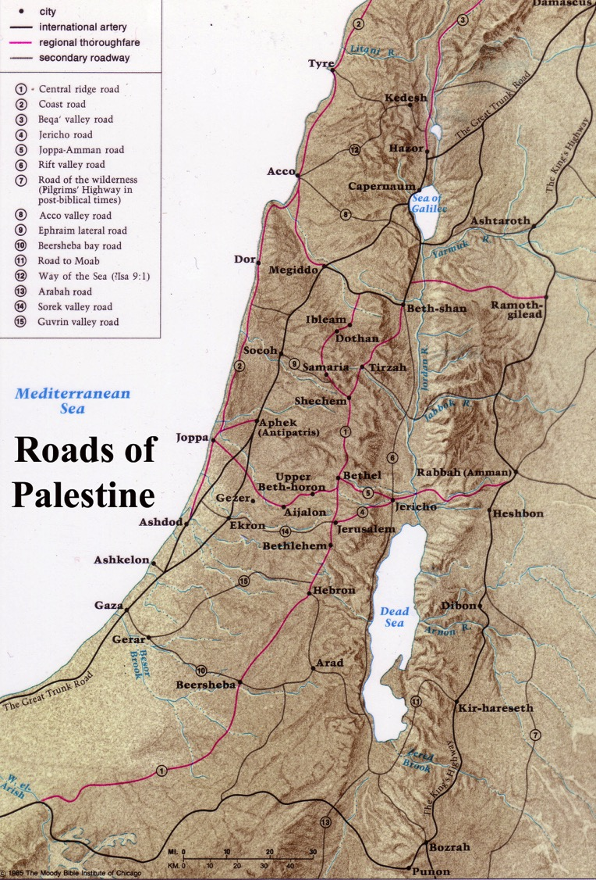
Jerusalem was off the main highway
12
Roads of Israel
Beitzel, Moody Atlas of Bible Lands, 68

Slide 9
Jerusalem
21
Disadvantages
Advantages

Slide 10
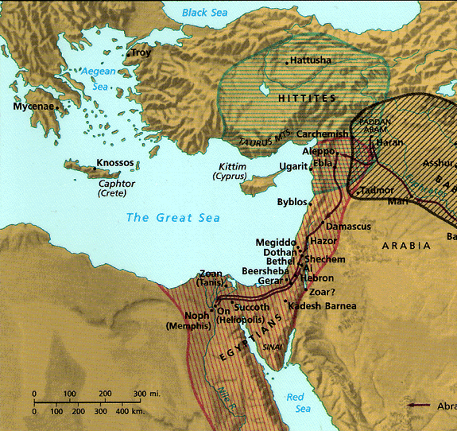
Jerusalem's Strategic Location
9
Thought Question:
How has God placed you in a strategic place for His purposes?
“Thus says the LORD God: This is Jerusalem; I have set her in the center of the nations, with countries round about her”
Ezekiel 5:5

Slide 11
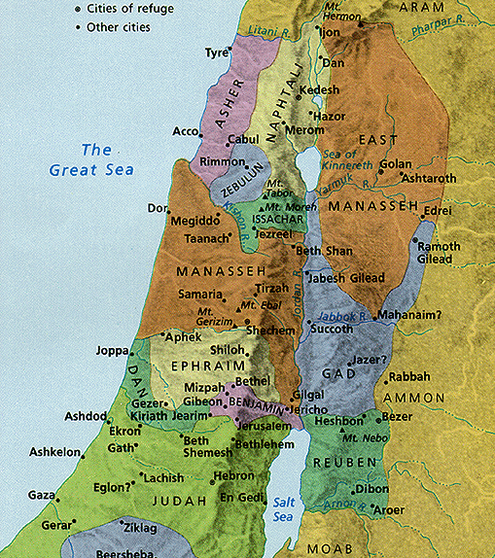
Central Location
14
Jerusalem was known as the “navel of Israel.”
Jerusalem
Notes:
Some say Jerusalem was in the “navel” of Israel, meaning the center!

Slide 12
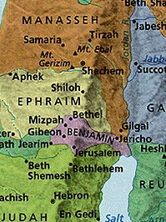
Central Location
14
Jerusalem was in Benjamin next to Judah but close to the northern tribes
Jerusalem
Notes:
12
Some say Jerusalem was in the “navel” of Israel, meaning the center!

Slide 13
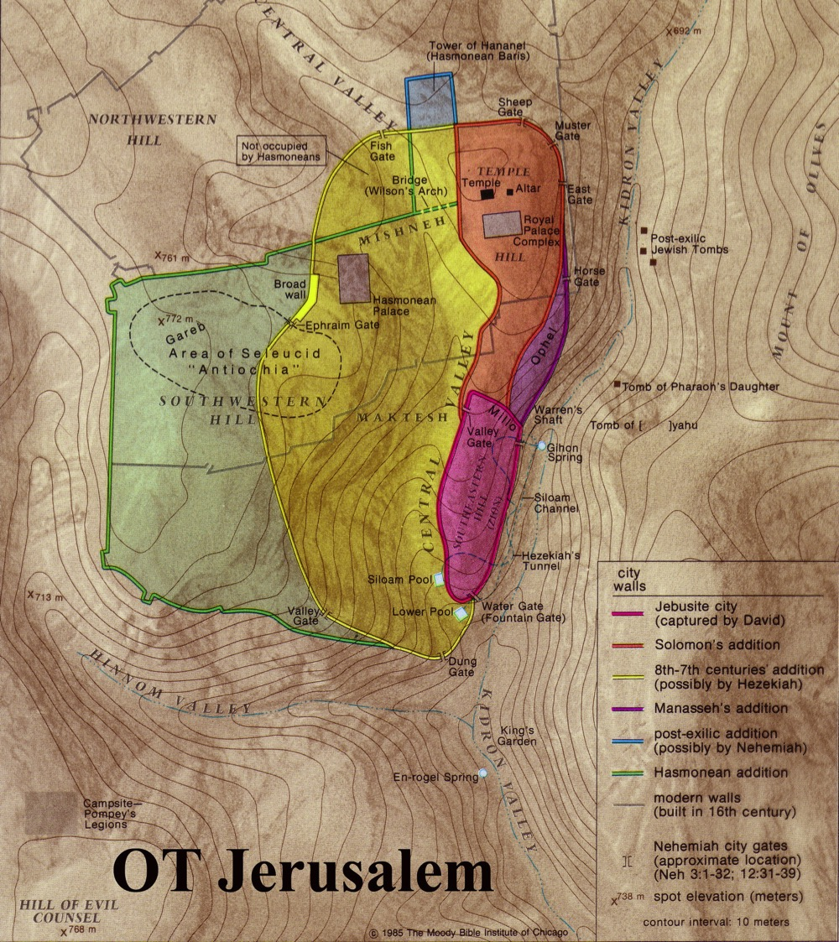
Jerusalem was a Border City
23
The border between Benjamin and Judah ran just south of the city
Benjamin
Judah

Slide 14
Jerusalem
20
Disadvantages
Advantages
Protective valleys
Tyropoeon Valley
Tyropoeon
Hinnom
Kidron
Kidron Valley
Hinnom Valley
Notes:
Because Jerusalem has steep valleys on the sides, it was always attacked from the north.

Slide 15
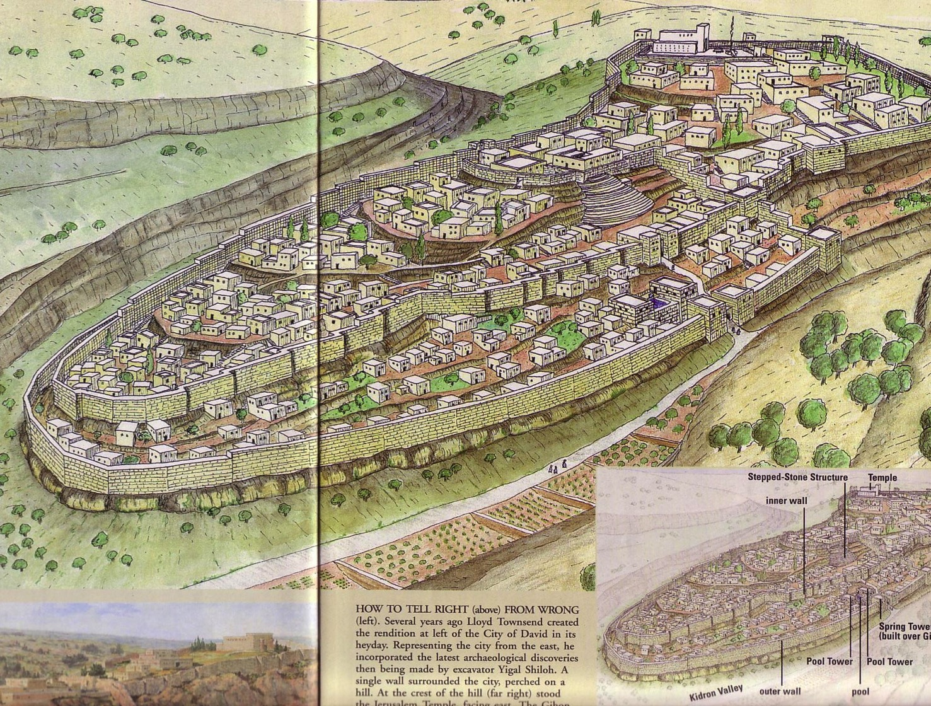
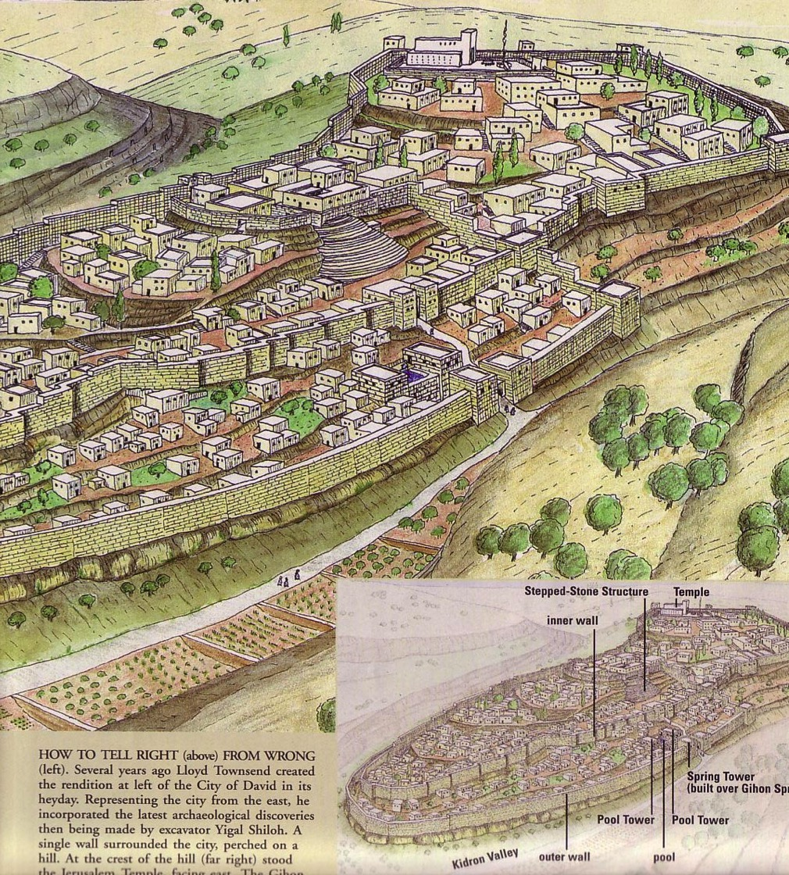
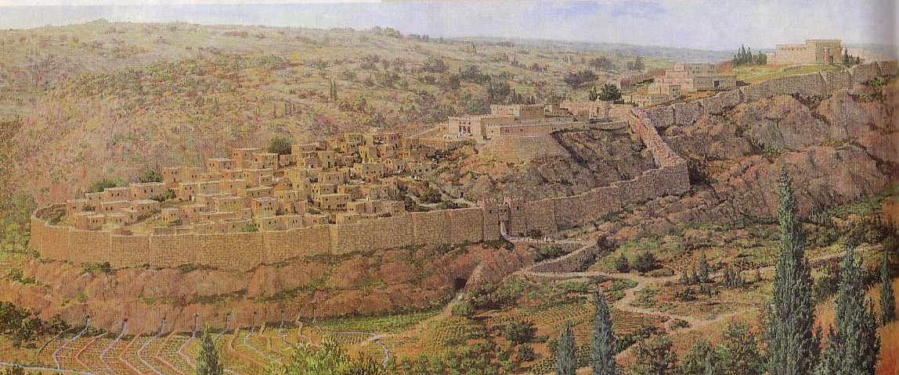
Eastern City of David
“Then [Hezekiah] worked hard repairing all the broken sections of the wall and building towers on it. He built another wall outside that one and reinforced the supporting terraces of the City of David.
(2 Chron. 32:5)
24d
“Afterward [Manasseh] rebuilt the outer wall of the City of David, west of the Gihon spring in the valley, as far as the entrance to the Fish Gate and encircling the Ophel; he also made it much higher…
(2 Chron. 33:14)

Slide 16
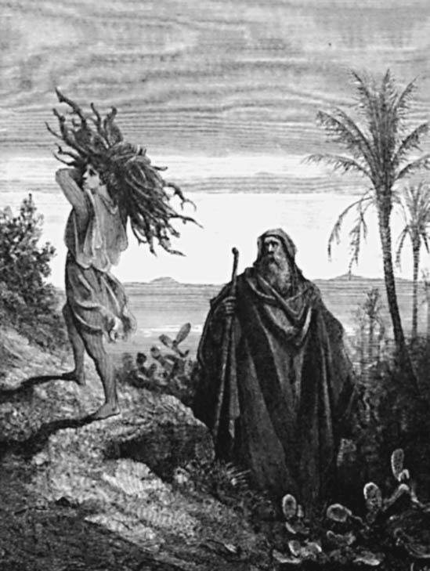
Genesis 22

Slide 17
Jerusalem
21
Disadvantages
Advantages
Protective hills
Water source

Slide 18
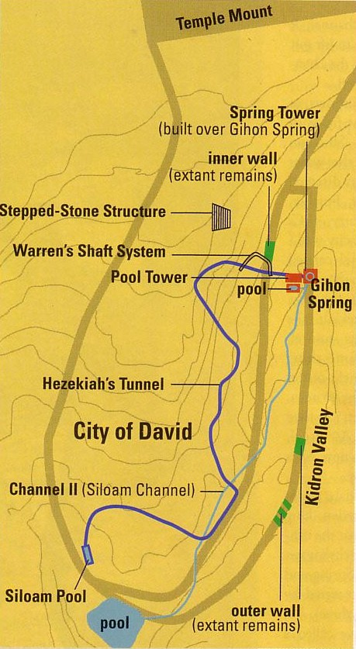

Hezekiah's Tunnel
24e

Slide 19

Hezekiah's Tunnel
24e
Siloam Inscription

Slide 20
Siloam Inscription
24e
“[...when] (the tunnel) was driven through. And this was the way in which it was cut through: While [...] (were) still [...] axe(s), each man toward his fellow, and while there were still three cubits to be cut through, [there was heard] the voice of a man calling to his fellow, for there was an overlap in the rock on the right [and on the left]. And when the tunnel was driven through, the quarrymen hewed (the rock), each man toward his fellow, axe against axe; and the water flowed from the spring toward the reservoir for 1,200 cubits, and the height of the rock above the head(s) of the quarrymen was 100 cubits.”

Slide 21
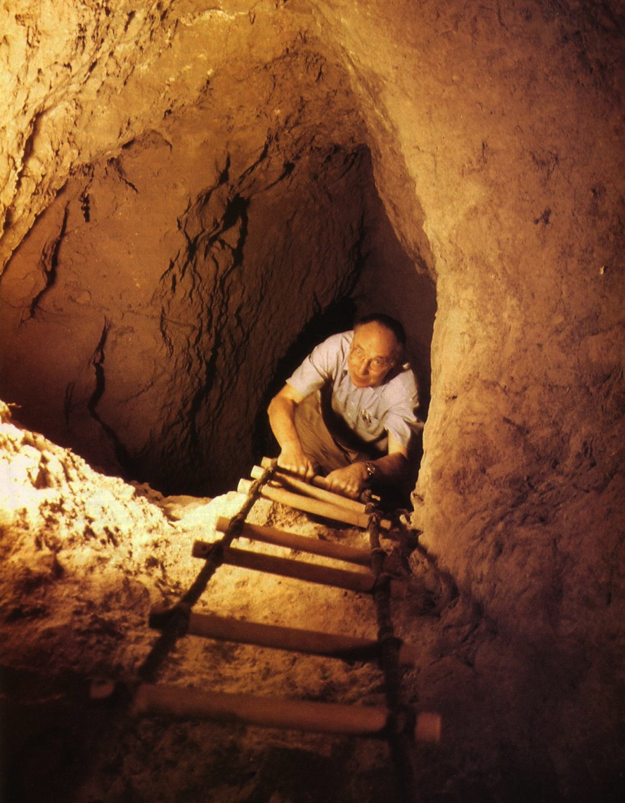
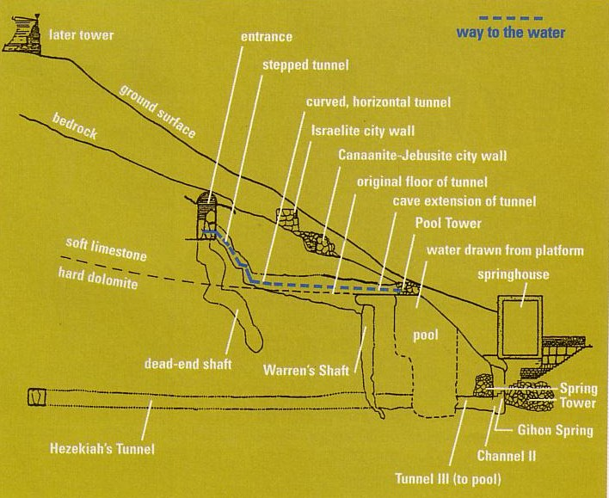
Warren's Shaft
24c
Notes:
BAR Nov/Dec 1999

Slide 22
Jerusalem
23
Disadvantages
Advantages
Stages
Jebusite (1500 BC)

Slide 23
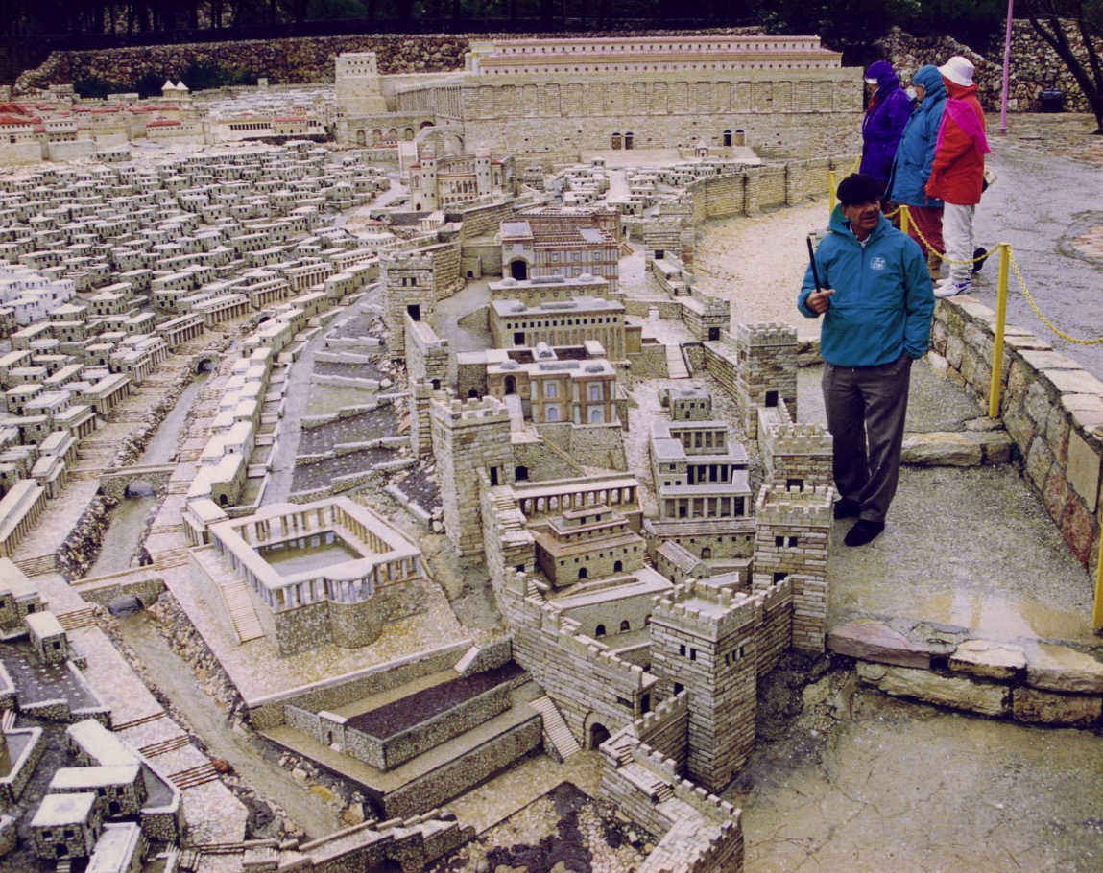
Model of the City of David (AD 66)
(Rebuilt Old Jebusite City)
23

Slide 24
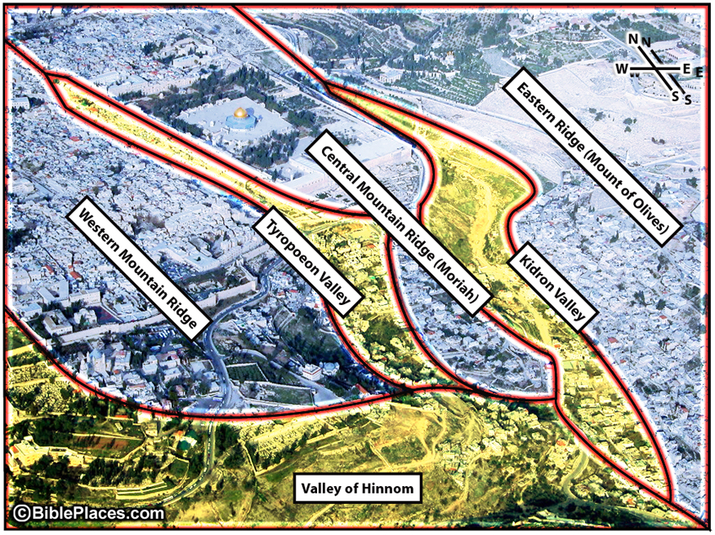
Jerusalem Valleys & Ridges
Eastern Ridge (Mount of Olives)
Central Mountain Ridge (Moriah)
Kidron Valley
Tyropoeon Valley
Western Mountain Ridge
Valley of Hinnom

Slide 25
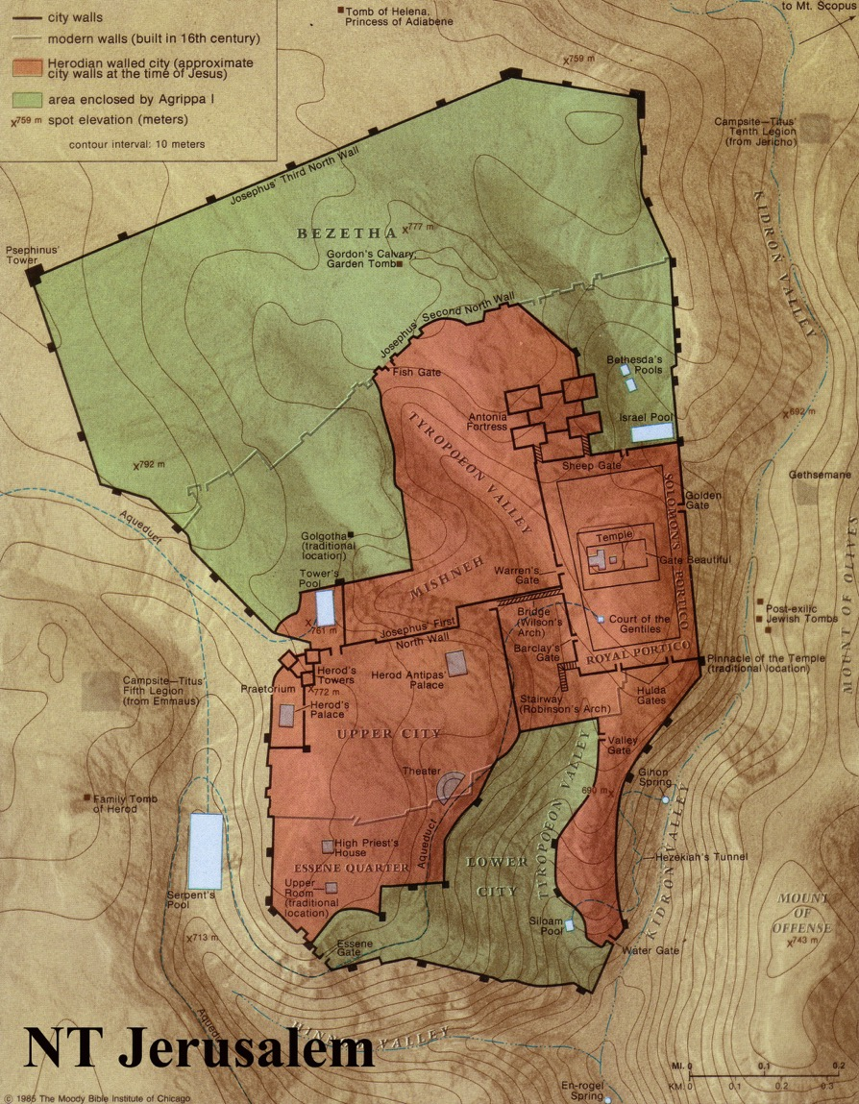
Hills of Jerusalem
24
Northeast
Temple
Ophal
Upper City
Lower City
NT Jerusalem

Slide 26
Jerusalem
23
Disadvantages
Advantages
Stages
Jebusite (1500 BC)
Solomon (971 BC)
Hezekiah (700 BC)
Hezekiah (700 BC)
586 BC
Nehemiah (444 BC)
Hasmonean (100 BC)
Herod the Great (20 BC)
Modern Walls

Slide 27
Jerusalem
23
Disadvantages
Advantages
Stages
Significance
Jewish
Christian
Muslim
All Nations

Slide 28
What was Israel's Attitude about the Nations?
Readings From the First-Century World, 23
Notes:
Elwood & Yarbrough, Readings from the First Century World, 23

Slide 29
Ten Jewish Levels of Holiness in the Land
Israel vs. Other Nations
“There are ten degrees of holiness. The land of Israel is holier than any other land… in that from it they may bring the Firstfruits and the Two Loaves…”
10th Most Holy Place
Notes:
Elwood & Yarbrough, Readings from the First Century World, 23

Slide 30
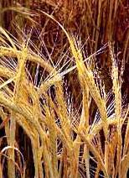
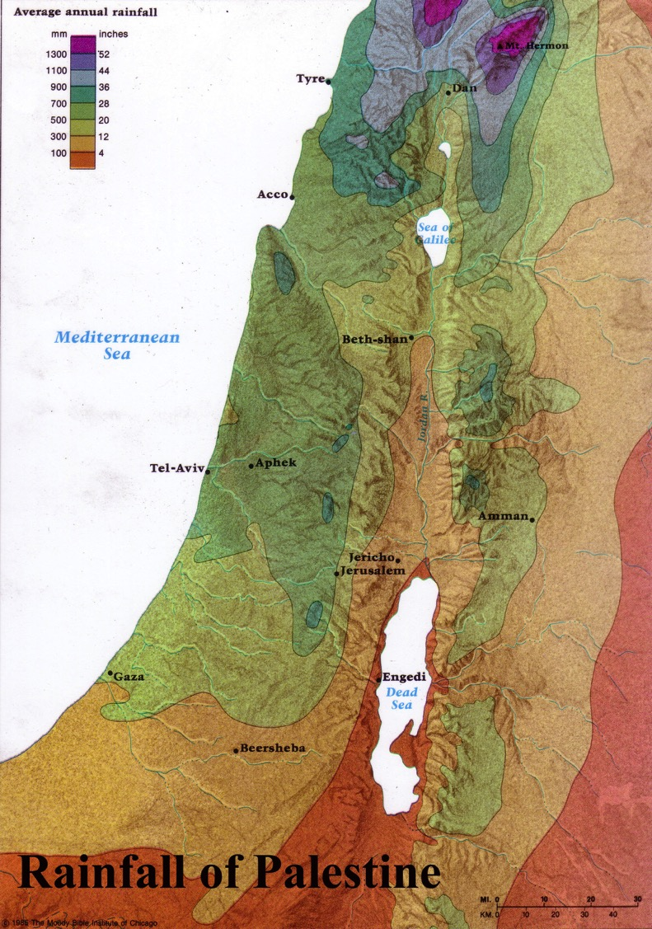
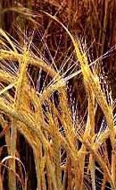
Firstfruits: Wave Sheaf Offering
Harvested in the far north of Israel
Brought down to Jerusalem
Beitzel, Moody Atlas of Bible Lands, 50

Slide 31
Urban vs.
Rural Areas
Ten Jewish Levels of Holiness in the Land
“The walled cities are still more holy in that they must send forth the lepers [and corpses] from their midst”
9th Most Holy Place
Notes:
Mishnah Tractate Kelim 1.6-9 in Elwood & Yarbrough, Readings from the First Century World, 23

Slide 32
Jerusalem vs. Other Cities
Ten Jewish Levels of Holiness in the Land
“Within the wall [of Jerusalem] is still more holy for there [only] they will eat [the holy food].”
Jerusalem
8th Most Holy Place
Notes:
Mishnah Tractate Kelim 1.6-9 in Elwood & Yarbrough, Readings from the First Century World, 23

Slide 33
Temple Mount
Ten Jewish Levels of Holiness in the Land
Temple Mount vs. Other Sections
“No man or woman that has a flux, no menstruant, and no woman after childbirth may enter therein.”
7th Most Holy Place
Notes:
Mishnah Tractate Kelim 1.6-9 in Elwood & Yarbrough, Readings from the First Century World, 23

Slide 34
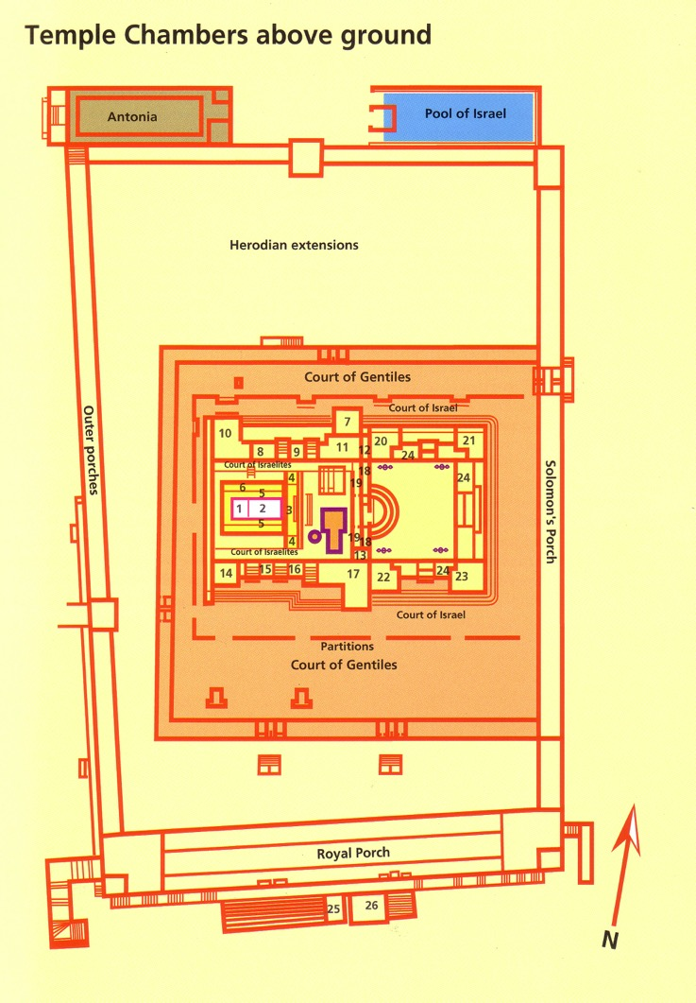
The Rampart
Ten Jewish Levels of Holiness in the Land
The Rampart vs. the Rest of Temple Mount
“No Gentiles and none that have contracted uncleanness from a corpse may enter”
6th Most Holy Place
Notes:
Mishnah Tractate Kelim 1.6-9 in Elwood & Yarbrough, Readings from the First Century World, 23

Slide 35
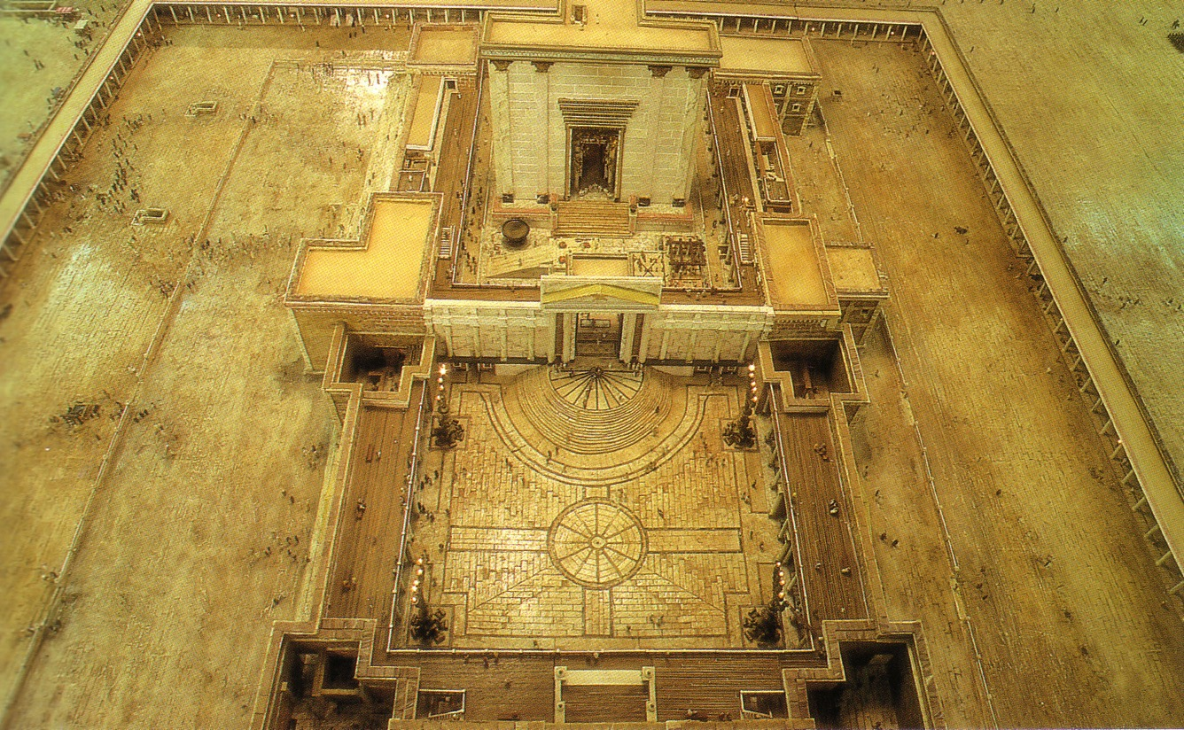
Court of Women
Ten Jewish Levels of Holiness in the Land
Court of Women
This closest place for women also excluded men who had immersed themselves the same day
Priests
Women?/Gentiles
Israelites
Israelites
5th Most Holy Place
Notes:
Mishnah Tractate Kelim 1.6-9 in Elwood & Yarbrough, Readings from the First Century World, 23

Slide 36
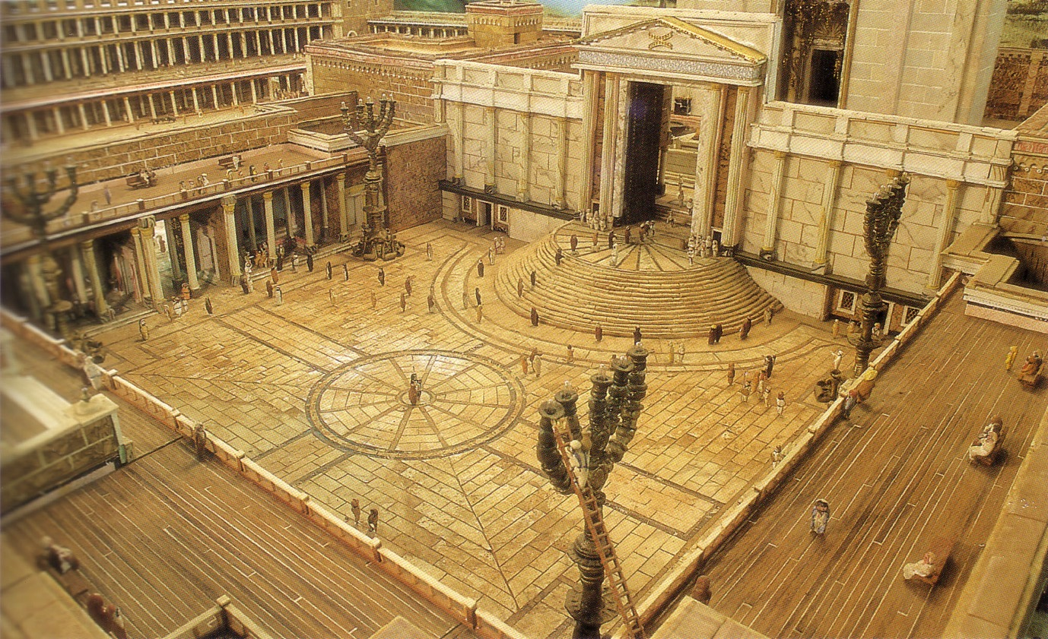
Court of Israelites
Ten Jewish Levels of Holiness in the Land
Court of Israelites
Only men whose atonement was complete could enter (otherwise they needed a sin offering)
4th Most Holy Place
Notes:
Mishnah Tractate Kelim 1.6-9 in Elwood & Yarbrough, Readings from the First Century World, 23

Slide 37
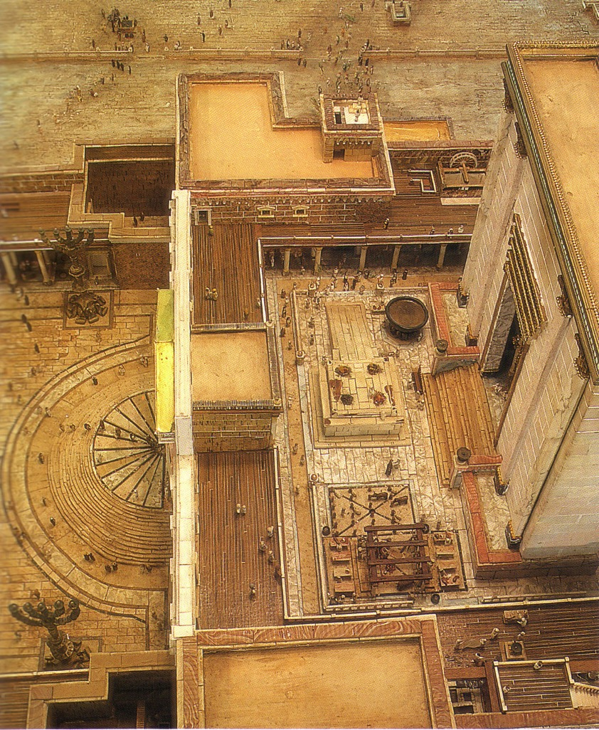
The Inner Temple Court and the steps leading to the Nicanor Gate
Ten Jewish Levels of Holiness in the Land
Court of Priests
Only for priests and men who “must perform the laying on our hands, slaughtering, and waving”
3rd Most Holy Place
Notes:
Mishnah Tractate Kelim 1.6-9 in Elwood & Yarbrough, Readings from the First Century World, 23

Slide 38
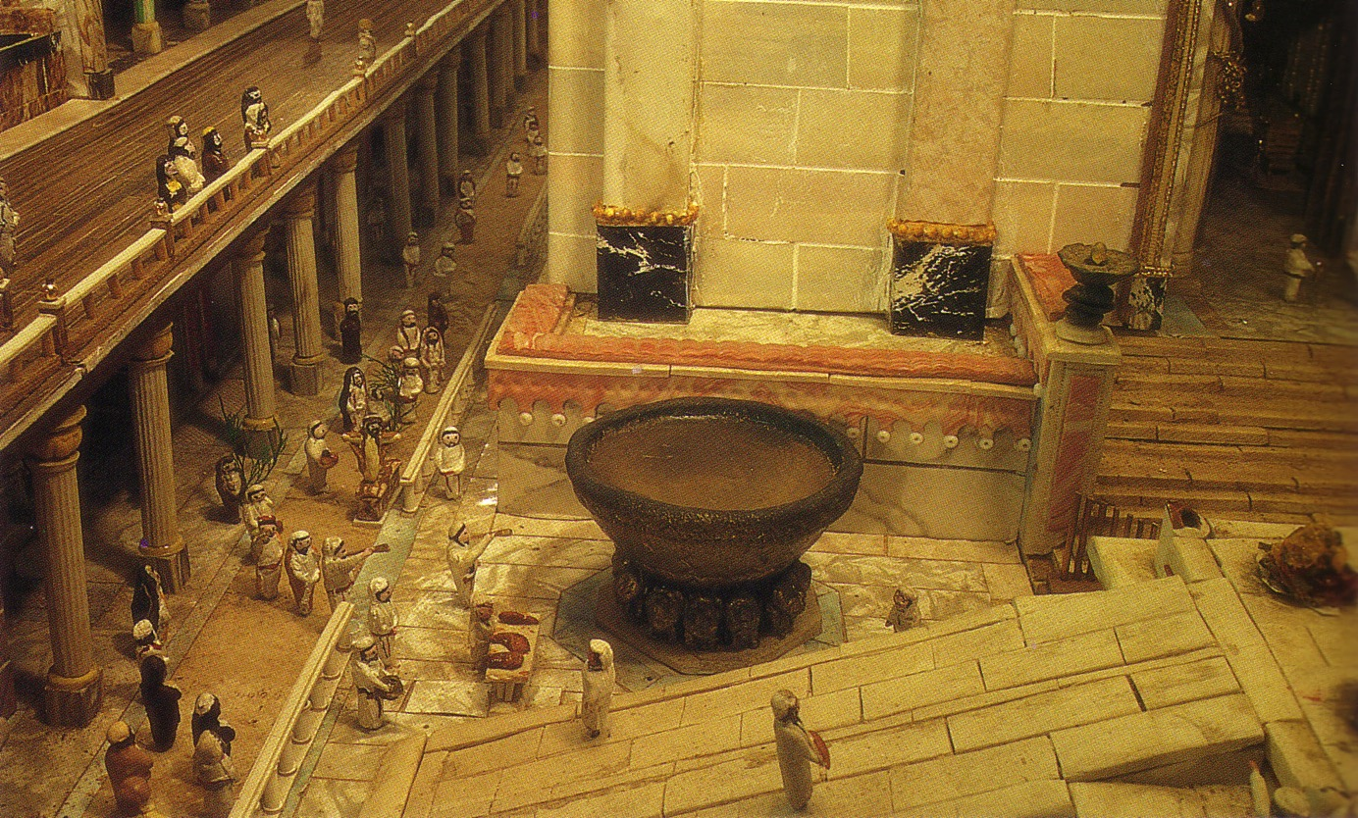
The Great Basin in the Court of the Priests.
Ten Jewish Levels of Holiness in the Land
Between
Porch & Altar
Only priests without blemishes and hair tied could enter here to wash their hands and feet
Porch
Altar
2nd Most Holy Place
Notes:
Mishnah Tractate Kelim 1.6-9 in Elwood & Yarbrough, Readings from the First Century World, 23

Slide 39
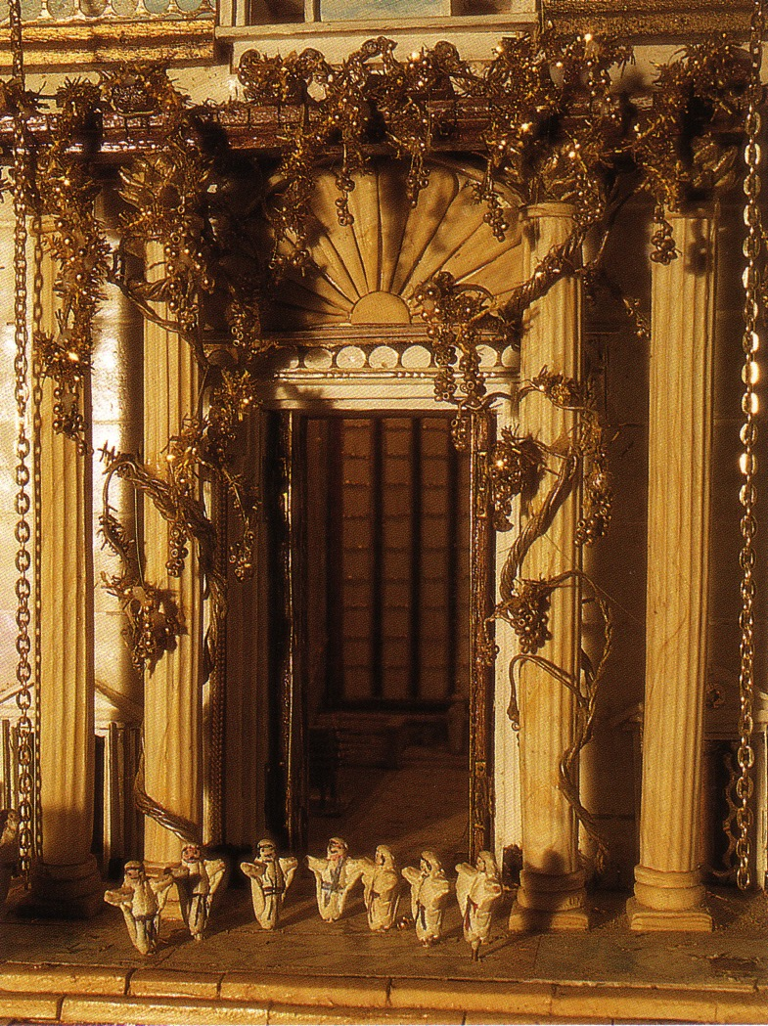
The Great Gates
These lead to the temple sanctuary. Only priests with hands and feet washed could enter here.

Slide 40
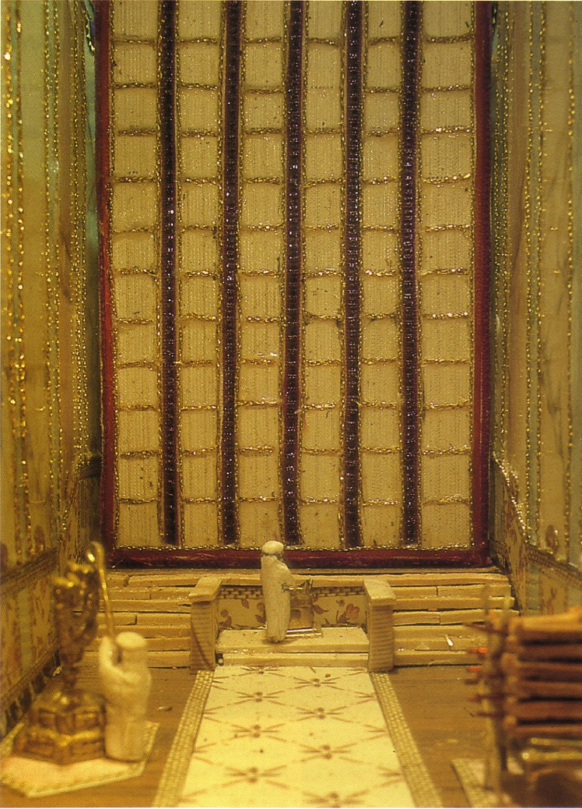
The Holy Place
Ten Jewish Levels of Holiness in the Land
Ten Jewish Levels of Holiness in the Land
The Holy Place
Only priests with hands and feet washed can enter here
Most Holy Place
Notes:
Mishnah Tractate Kelim 1.6-9 in Elwood & Yarbrough, Readings from the First Century World, 23

Slide 41
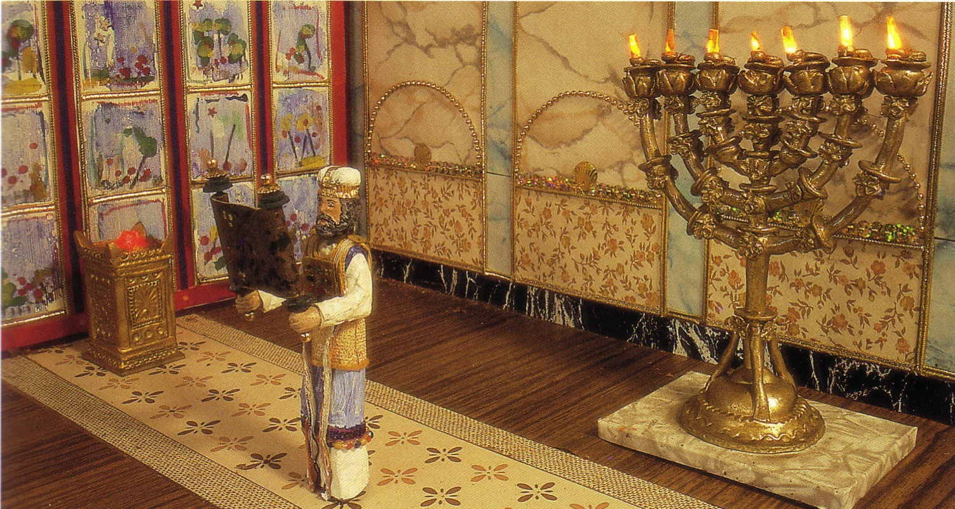
The Holy Place
Ten Jewish Levels of Holiness in the Land
Ten Jewish Levels of Holiness in the Land
The Holy Place
Only priests with hands and feet washed can enter here
Most Holy Place
Notes:
Mishnah Tractate Kelim 1.6-9 in Elwood & Yarbrough, Readings from the First Century World, 23

Slide 42
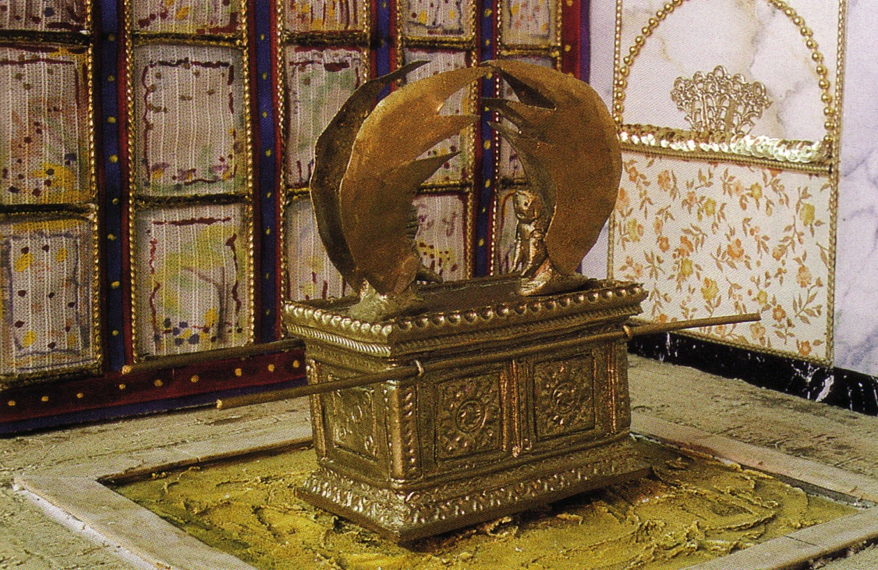
The Holy of Holies
Ten Jewish Levels of Holiness in the Land
Holy of Holies
Only the High Priest could enter behind the veil and only once yearly on the Day of Atonement
Holiest Place of All
Notes:
Mishnah Tractate Kelim 1.6-9 in Elwood & Yarbrough, Readings from the First Century World, 23

Slide 43
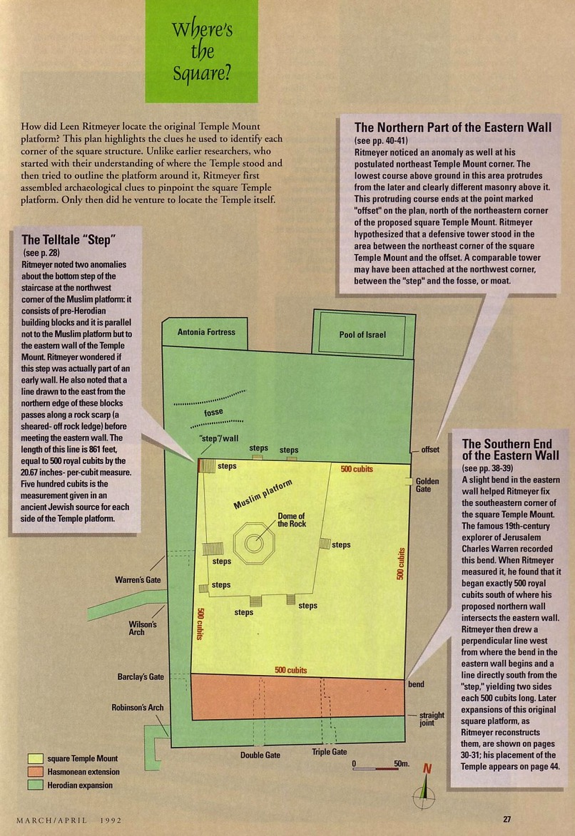
Where's the Square?
25
Leen Ritmeyer, “Locating the Original Temple Mount,” Biblical Archaeology Review 18 (March/April 1992): 27
Notes:
Leen Ritmeyer, “Locating the Original Temple Mount,” BAR 18 (March/April 1992): 27

Slide 44
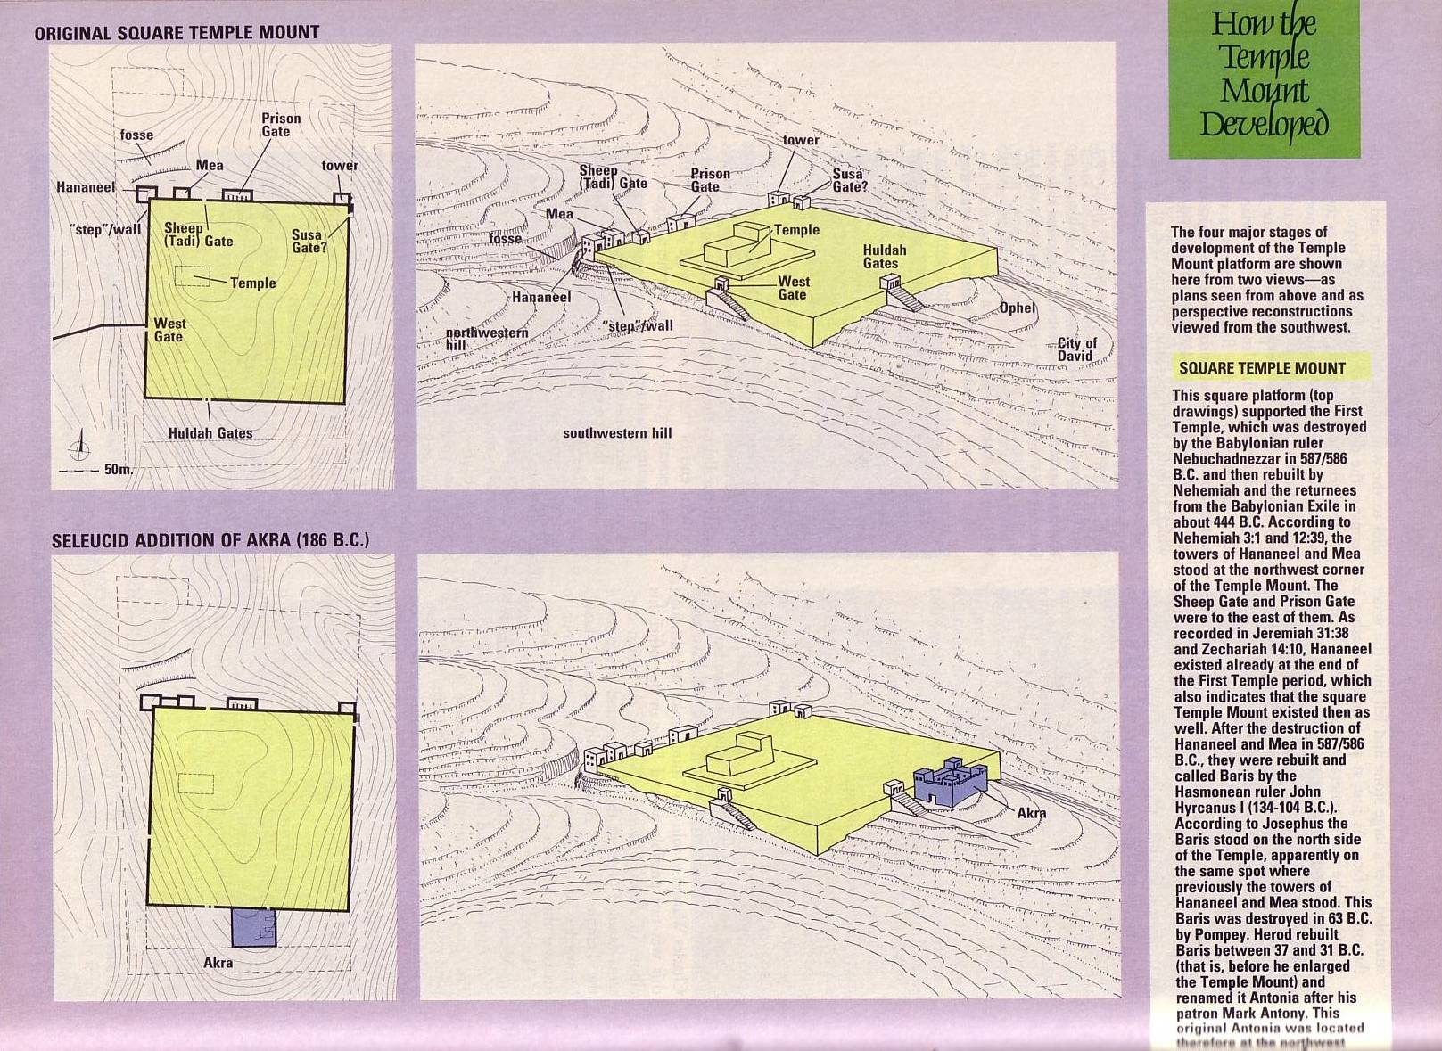
Temple Mount Stages 1-2
25
Notes:
Leen Ritmeyer, “Locating the Original Temple Mount,” BAR 18 (March/April 1992): 30

Slide 45
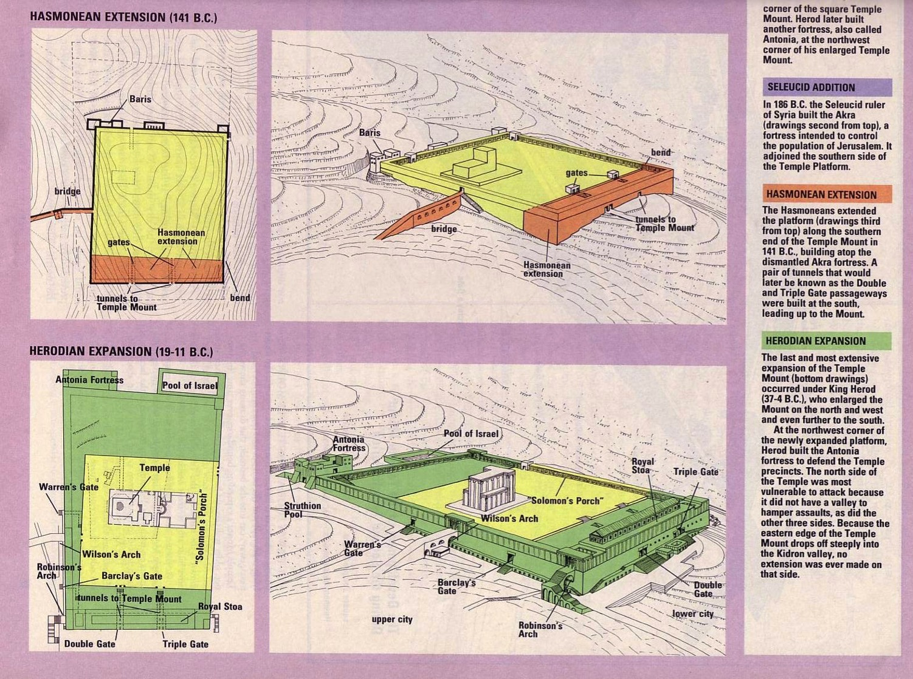
Temple Mount Stages 3-4
25
Notes:
Leen Ritmeyer, “Locating the Original Temple Mount,” BAR 18 (March/April 1992): 31

Slide 46
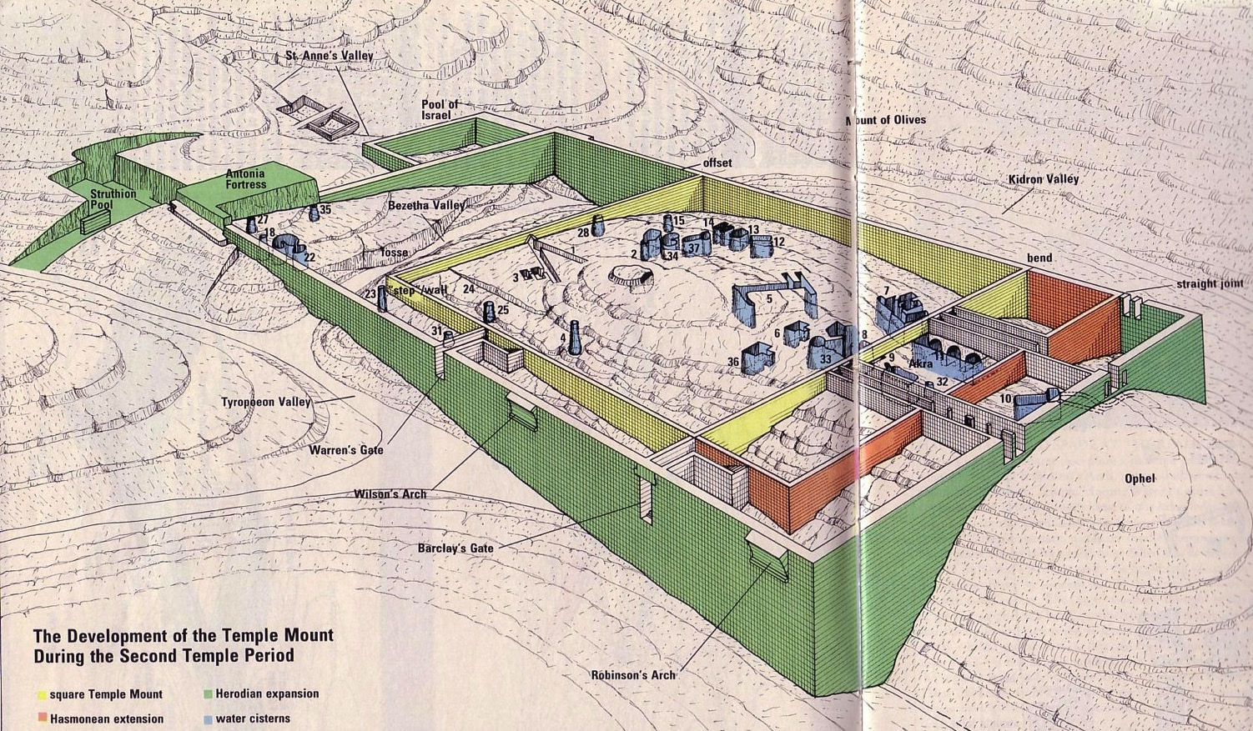
Temple Mount Development
25
Notes:
Leen Ritmeyer, “Locating the Original Temple Mount,” BAR 18 (March/April 1992): 32-33

Slide 47
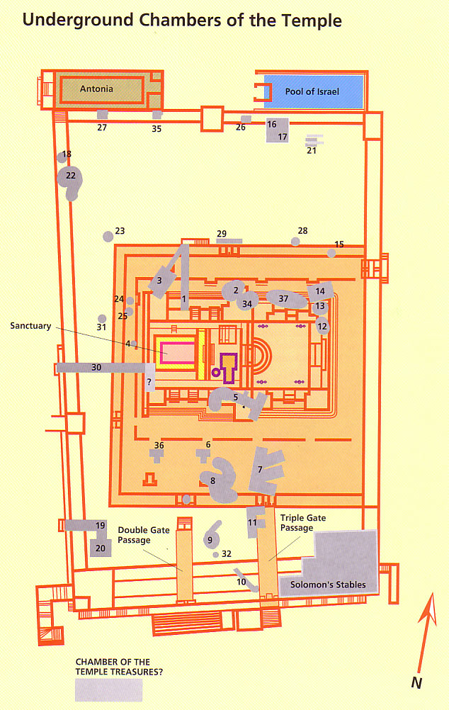
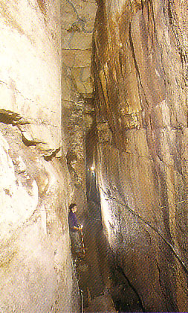
Underground Temple Chambers

Slide 48


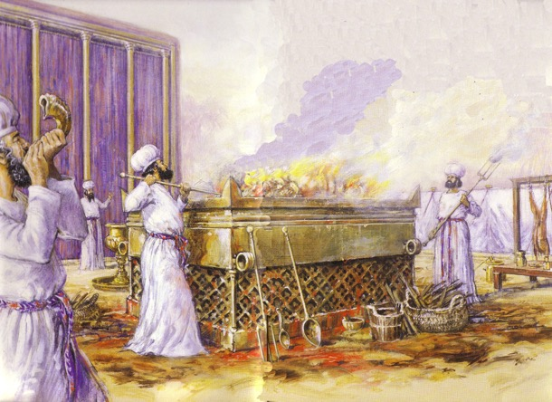
Jewish Western Wall
25

Slide 49

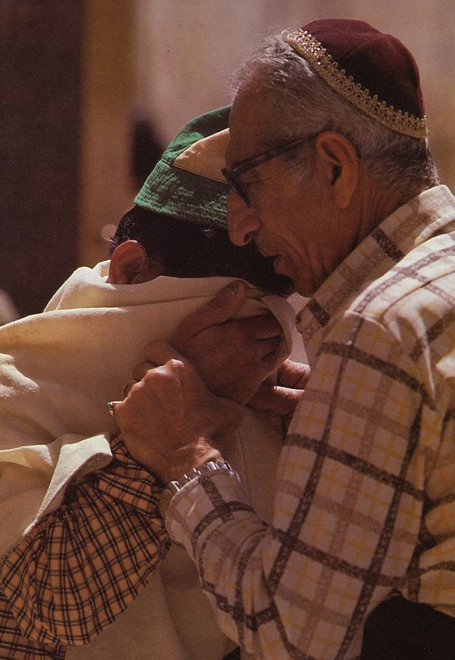
Prayers for the Third Temple

Slide 50

Modern Temple Mount
25
? ? ? ?

Slide 51
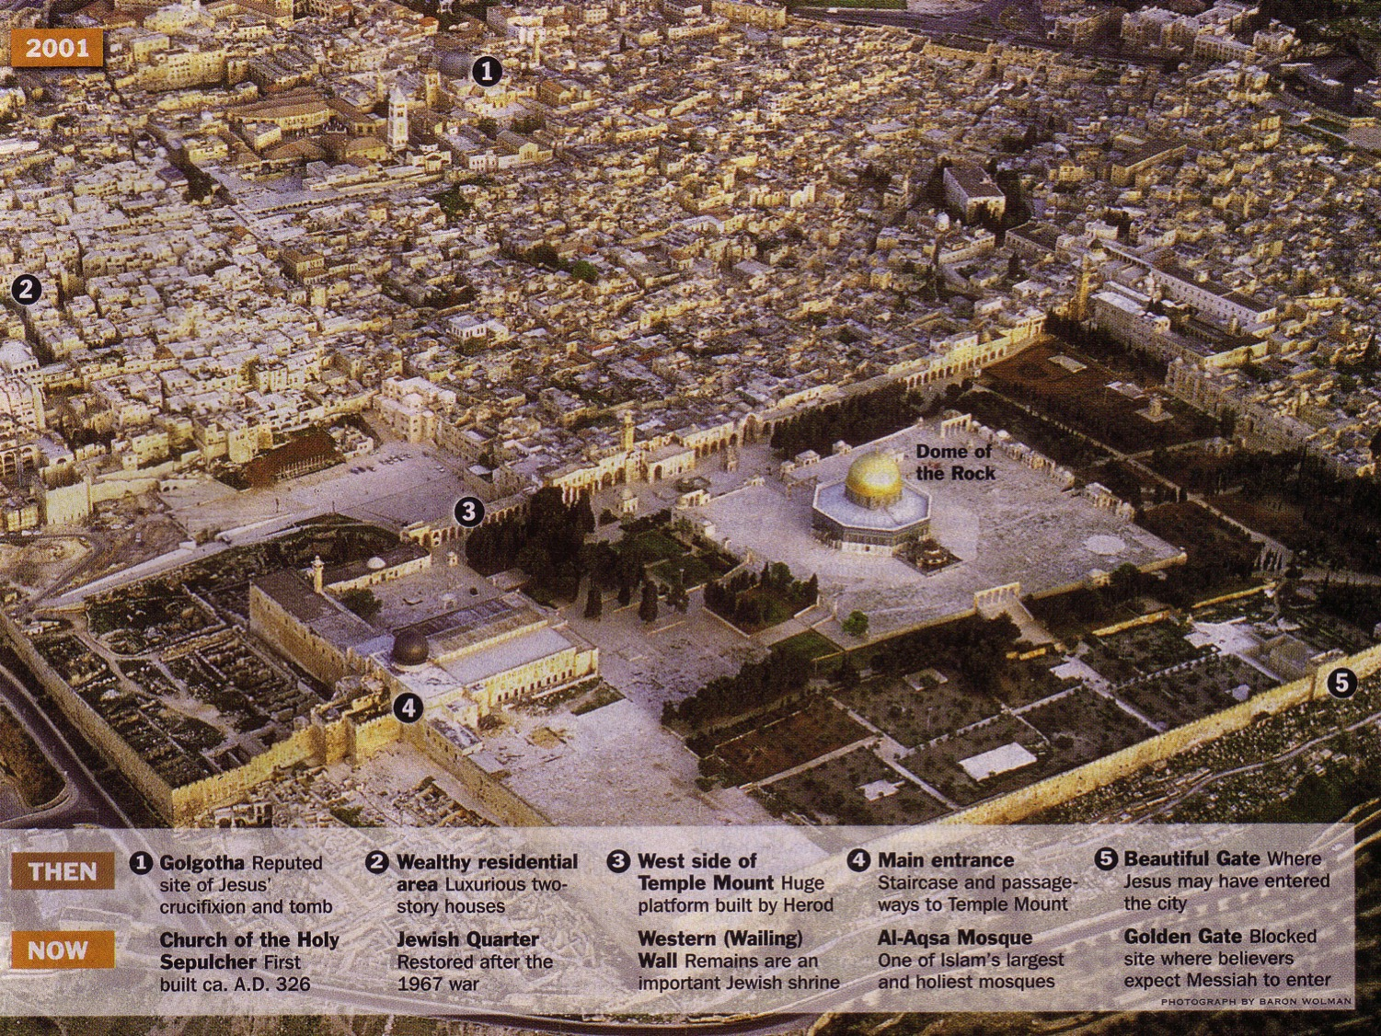

Jerusalem Today

Slide 52
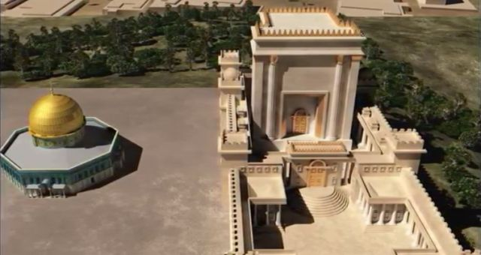
Antichrist will make a 7-year treaty with Israel
79 B
This will likely enable the rebuilding of the Jerusalem temple (Third Temple Era)
Artwork by Sunny Chandra

Slide 53
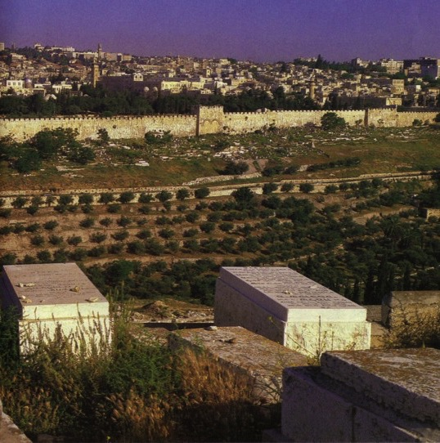
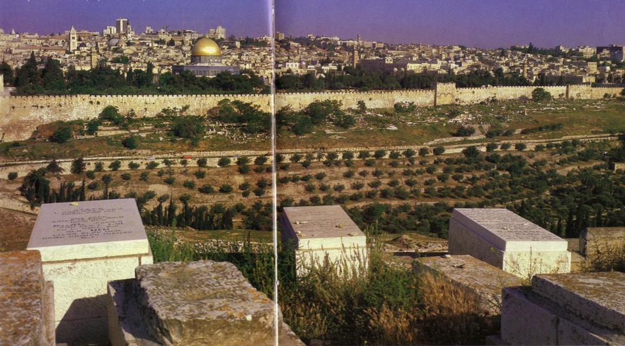
Jewish Hope of Resurrection
Jews buried on the Mt. of Olives hope to be the first to enter the Eastern Gate with Messiah when He comes

Slide 54
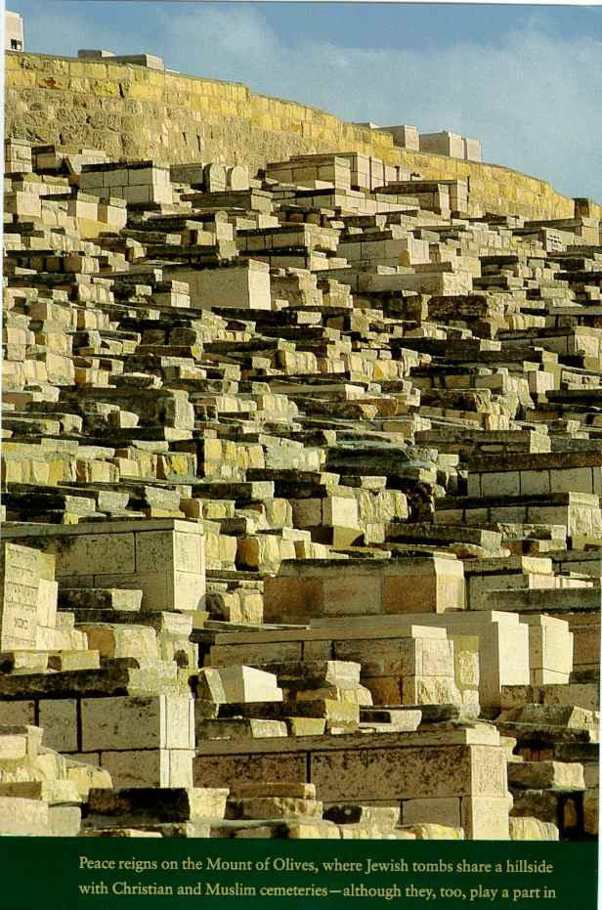
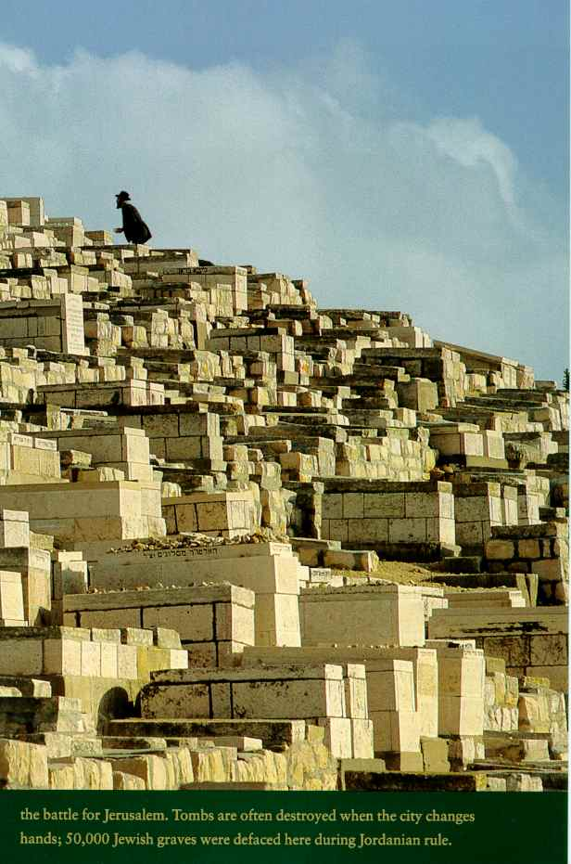
First to Rise?
Notes:
Jews buried on the Mount of Olives feel they will be the cloaest to the Eastern Gate to enter it with Messiah upon his return.

Slide 55
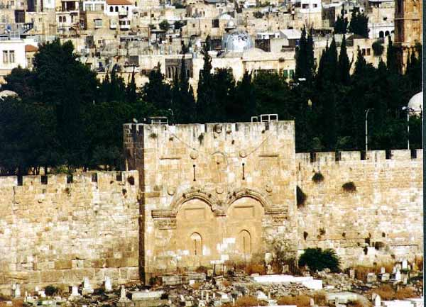
Muslims Sealed the Eastern Gate
Notes:
This gate was blocked after the Turkish conquest of Jerusalem in AD 1517.

Slide 56
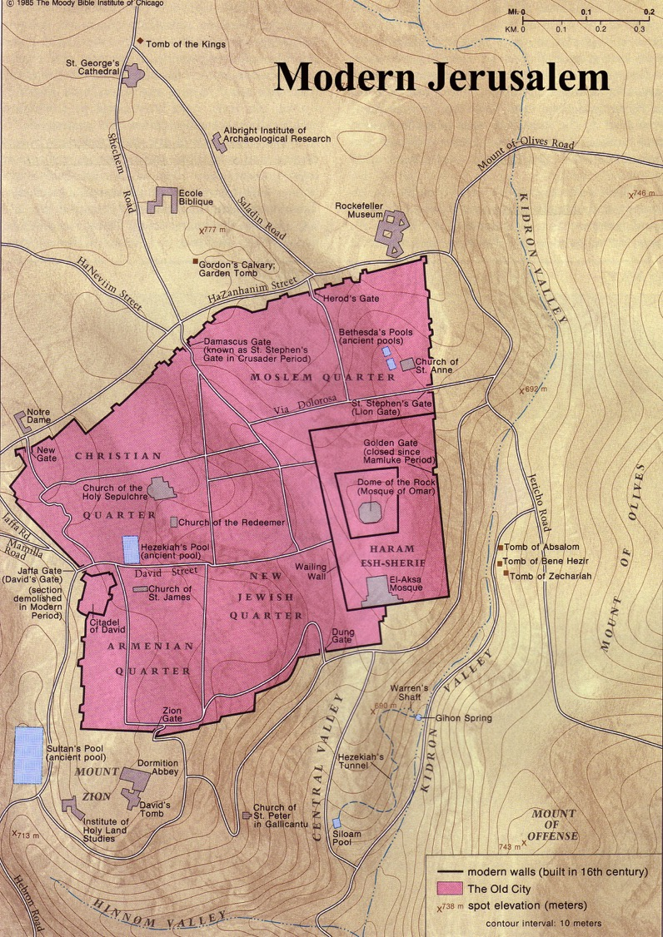
Modern Jerusalem

Slide 57
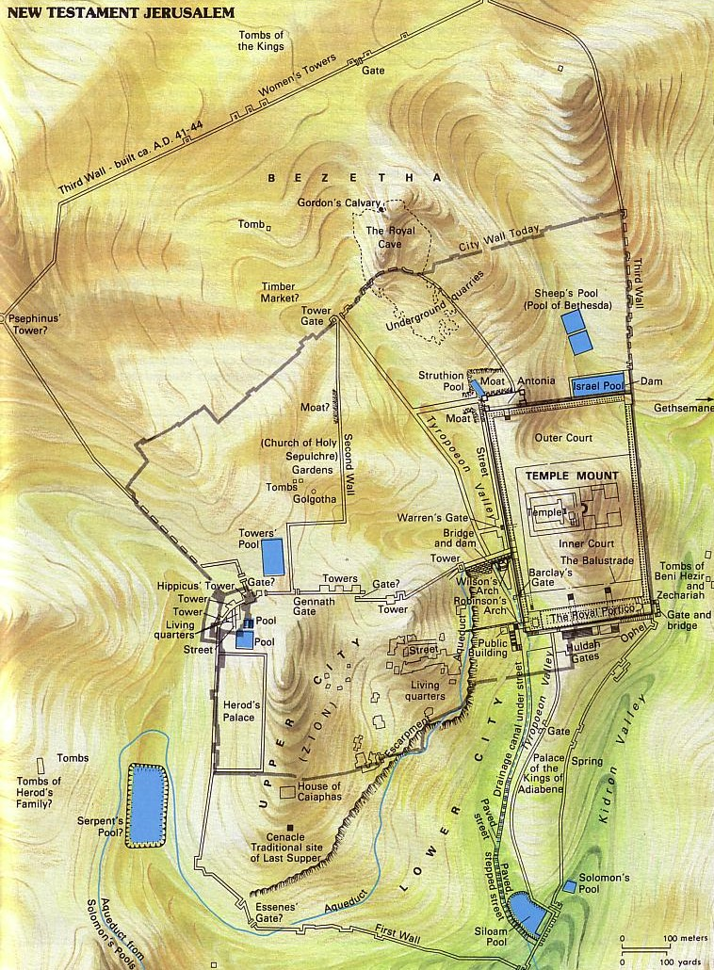
Gethsemane
Mark 14:32 “And they went to a place called Gethsemane. And he said to his disciples, 'Sit here while I pray'” (ESV)
This cave lay within a garden on the Mount of Olives across from the Temple Mount

Slide 58
Significance to Christians
Christ's Death
Resurrection
Church Born
Mother Church
Christ's Return
NT Jerusalem

Slide 59

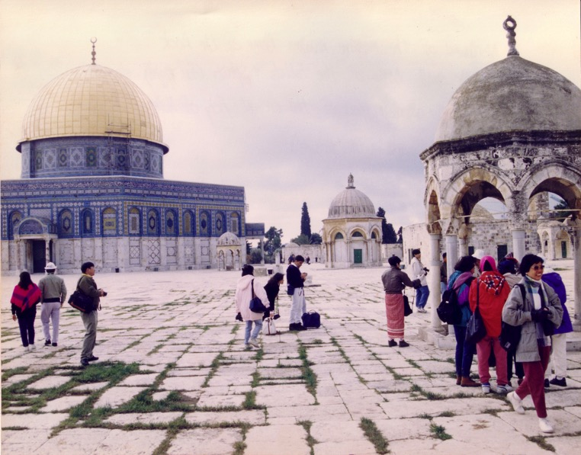

Muslim Control
Mosque of Omar
(Dome of the Rock)
Al-Aksa Mosque

Slide 60
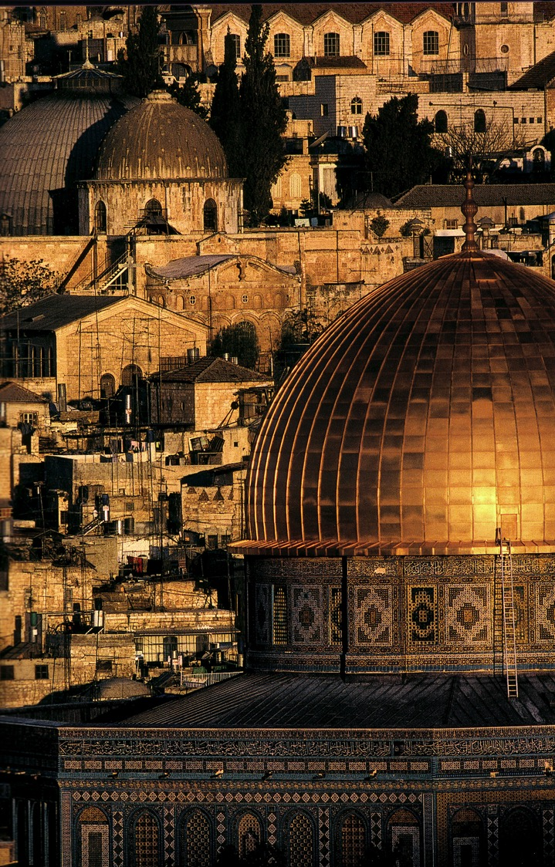
A Dome to Outshine the Dome

Slide 61
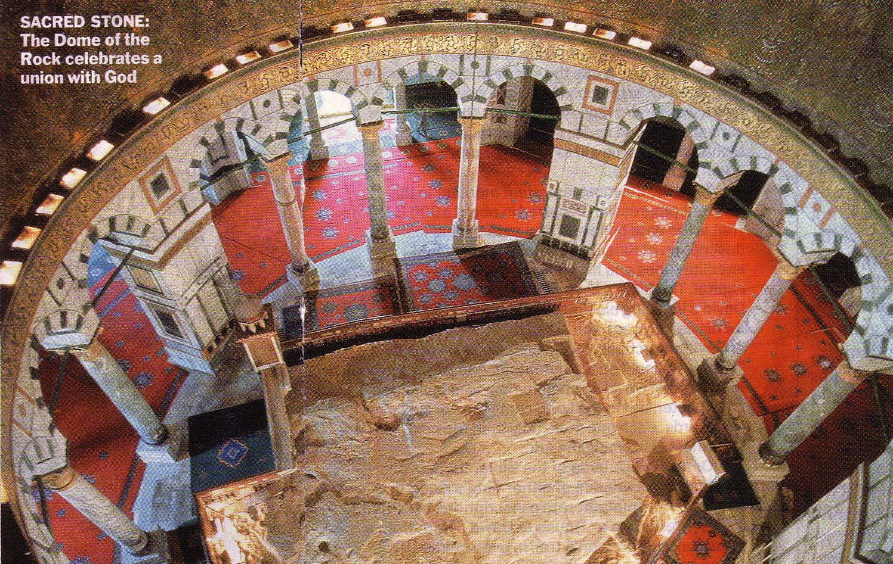
The Rock Inside
SACRED STONE:
The Dome of the Rock celebrates a union with God

Slide 62
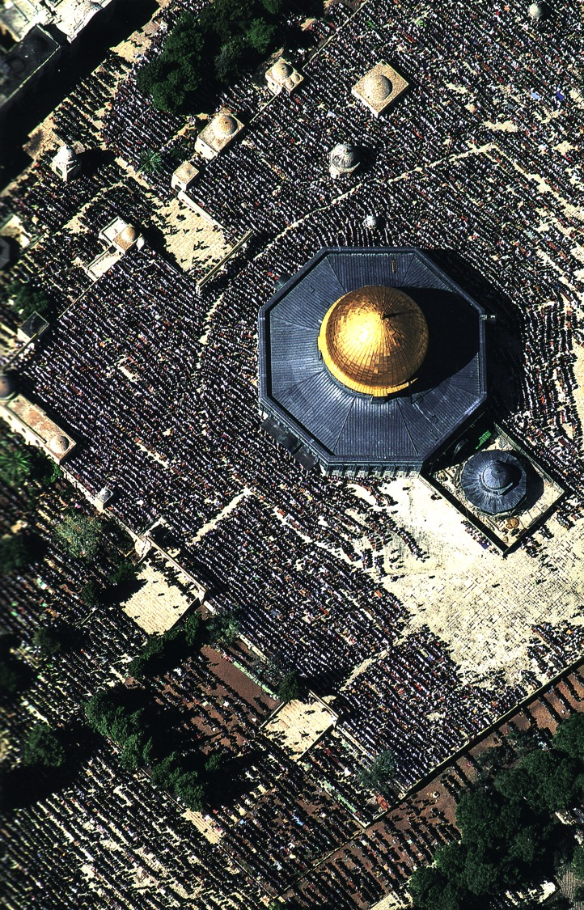
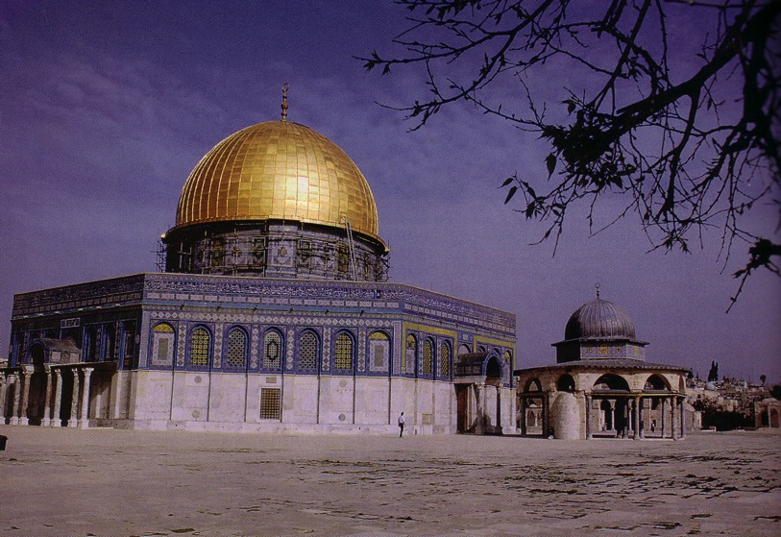
Muslim Prayers at the Dome

Slide 63

Present Jerusalem Population
West = Jews
East = Arabs

Slide 64
Jerusalem (2002)
Foundation for Middle East Peace
(March 2002)

Slide 65



Modern Jerusalem Surroundings

Slide 66




Quarters of Old Jerusalem
147g
• Christian
• Muslim
• Jewish
• Armenian

Slide 67

Christian Quarter
147g

Slide 68

Christian Quarter
147g

Slide 69
A New Model of Temple Mount

Slide 70

Muslim Quarter
147g

Slide 71

Muslim Quarter
147g

Slide 72

Jewish Quarter
147g

Slide 73

Jewish Quarter
147g

Slide 74

Armenian Quarter
147g

Slide 75

Armenian Quarter
147g

Slide 76

What's the Future for the Dome?

Slide 77
Millennial Jerusalem
“The law will go out from Zion,
the word of the LORD from Jerusalem”
—Isaiah 2:3
Notes:
77

Slide 78


NT Backgrounds link at BibleStudyDownloads.org
Get this presentation for free!
Notes:
NT Backgrounds (nb)

Slide 79
Black

