Slide 1
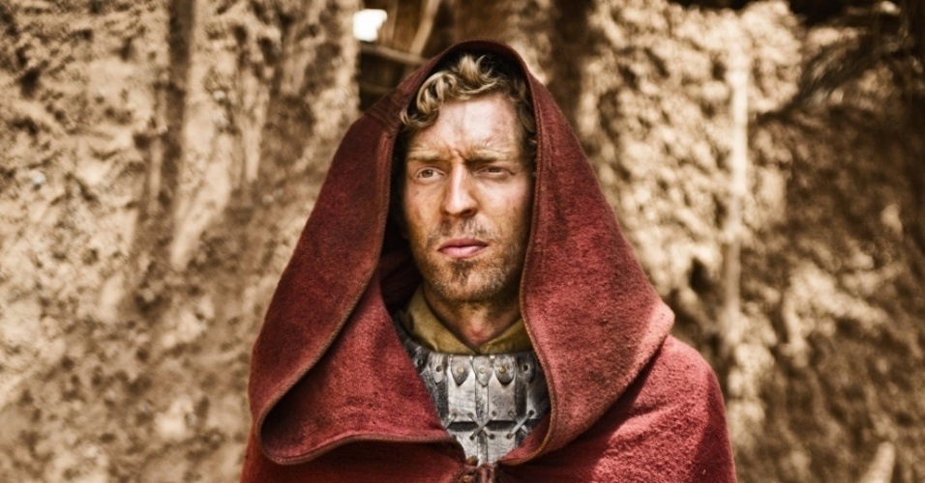
Christmas Through the Eyes of Joseph
(Matthew 1:18-25)
Dr Rick Griffith • Crossroads International Church Singapore • BibleStudyDownloads.org

Slide 2

Mary Silhouette

Slide 3
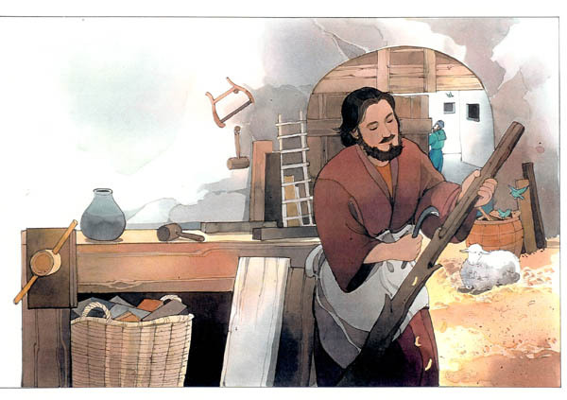
Jesus came miraculously yet simply.
So simply trust Him for a miracle in your life.
Joseph Monologue Part 2 - Pastor Rick

Slide 4
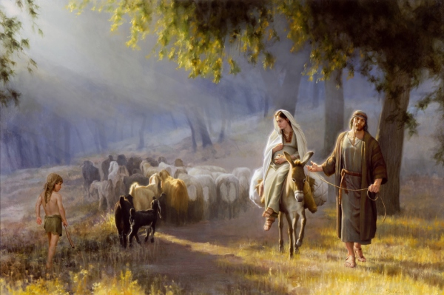
Journey to Bethlehem

Slide 5
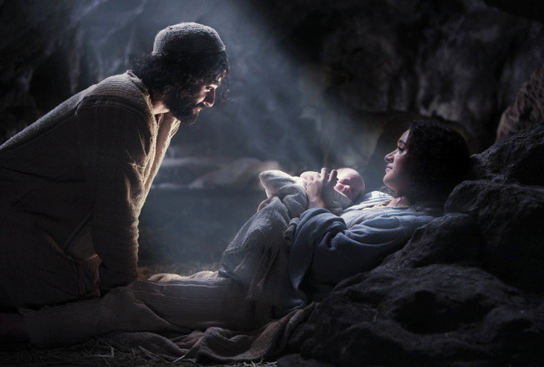
Joseph Monologue Part 4 - Pastor Rick

Slide 6

Christmas Through the Eyes of Joseph

Slide 8


Monologues PPT link at BibleStudyDownloads.org
Get this presentation for free!
Notes:
MO Monologues

