Slide 1
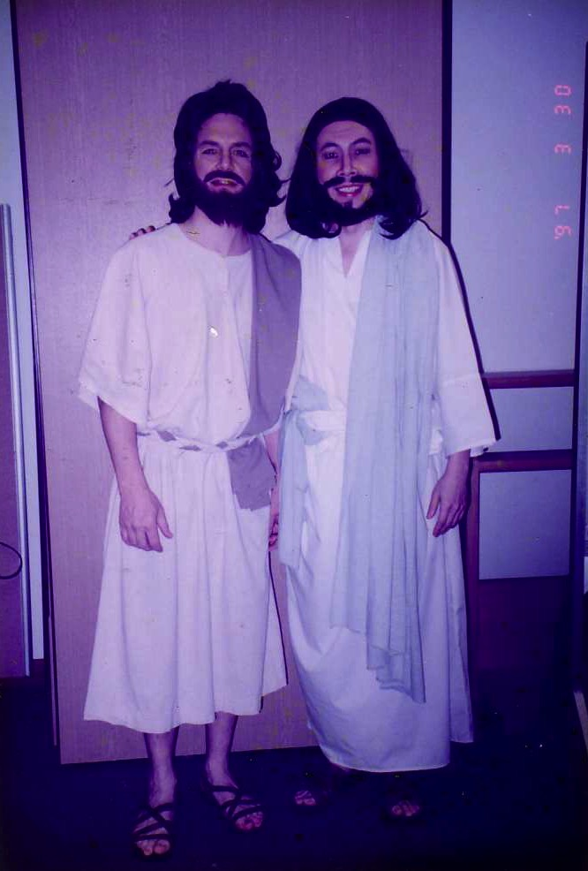
Preaching through Monologues
Bringing your people back in time to communicate God's message
Dr. Rick Griffith • Jordan Evangelical Theological Seminary • BibleStudyDownloads.org

Slide 2
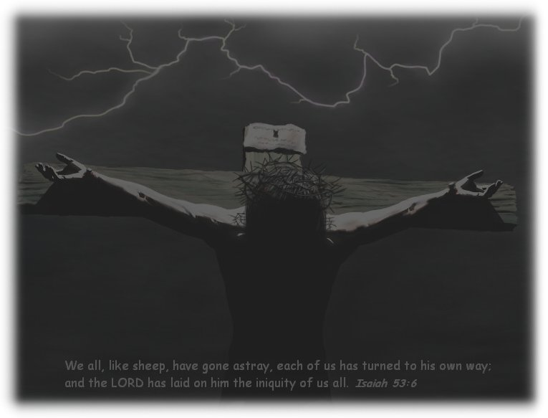
"I did this for you"
Notes:
2
How can we express familiar concepts like the death of Christ for us? Sometimes teaching them is better done by assuming in the role of biblical characters who experienced these events. This is not entertaining but rather entering into the story and bringing the listeners with you into the story.

Slide 3

A monologue is…
158
a first-person dramatic depiction of a biblical character which conveys a scriptural central idea and application to the listeners

Slide 4

Monologue Advantages
158
Interest
Variety
Delivery

Slide 5
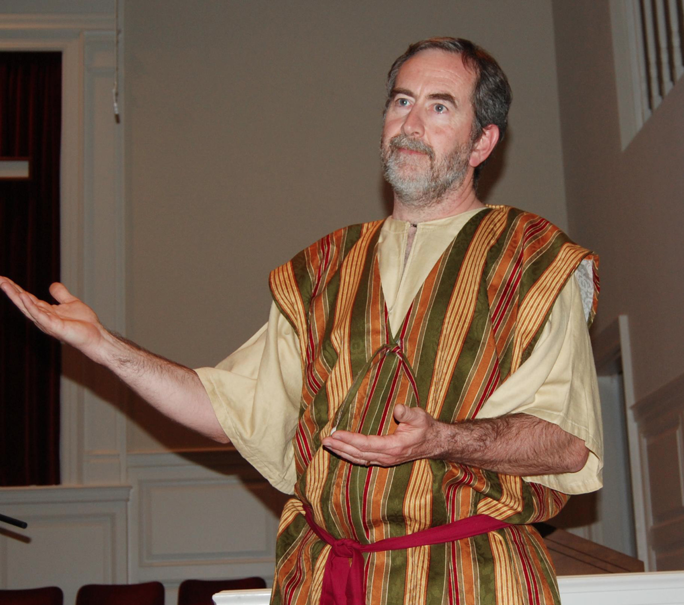
Monologue Dangers
158
Exegesis
Trivializing
Embarrassment
Entertainment-mentality
Notes:
These potential problems exist with doing monologues:
Exegesis must be even more in depth. We have to make sure our research is very accurate to properly play the role of a biblical character. Monologues must add background information and feelings not actually within the text of the Bible, so we must be careful that these are within the authorial intent.
Trivializing means there can be a temptation to preach a shallow message (moralizing) instead of the theology of the text that tells us much about God.
Embarrassment is also possible is the speaker cannot remember the lines. No one can use notes in monologues, but this is more difficult than a professional actor's job who can take many "takes" of the same scene until he gets it right on film. In contrast, the one who does the monologue must internalize the script well. If he doesn't, he could be embarrassed that, as a biblical character, he can't even tell his own story.
Entertainment-mentality is the danger of people seeing this as a performance instead of a sermon with a message. The goal is not for the listeners to clap at the end. It is for them to be transformed by the message of the monologue.

Slide 6
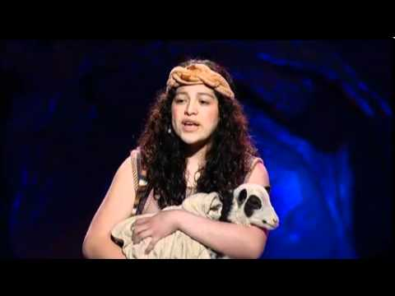
When Monologues Work Best
158
New series
Fresh lift
Familiar texts

Slide 7
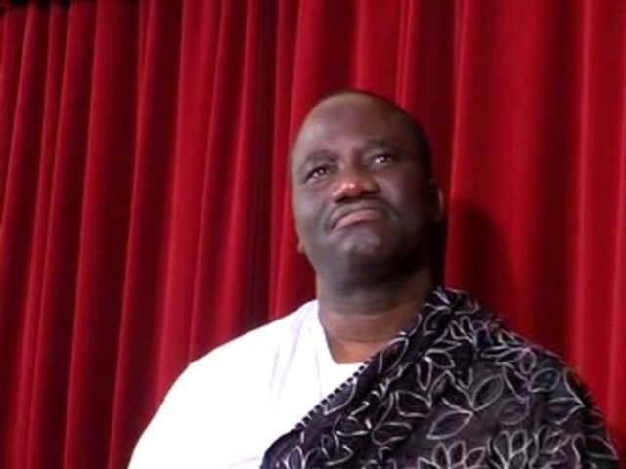
But how do you do a monologue?
158

Slide 8
The Preparing Expository Sermons Process
27-28, 251
Based on Ramesh Richard's text, Preparing Expository Sermons
TEXT
SERMON
5 Desired Listener Response
Brain
4 The Three
Developmental
Questions
Purpose Bridge
3.2 Exegetical Idea
CPT
Heart
CPS
6 Homiletical Idea
7 Homiletical
Outline
8 Clarity
9 Intro/Concl
3.1 Exegetical
Outline
Structure
Skeleton
Structure
2 Analyze Text
Study
Flesh
Preach
10 MSS &
Preach
1 Choose Text
White text shows 10 steps adapted from Haddon Robinson, Biblical Preaching (notes, 105)
Notes:
Here is the overview of the course which follows Ramesh Richard's 7-step process of preparing expository sermons. This includes the body analogy in the center where the "flesh" parallels the words of the text with the words of the sermon—that is, what people actually see/hear on the "outside" in both text and sermon. Likewise, the "skeleton" reveals the outline or structure of both text and sermon, as does the "heart" summing up the CPT (Central Proposition of the Text) and the CPS (Central Proposition of the Sermon) in a single sentence that reflects either what the text or sermon is about. Finally, the "brain" refers to the need to really think about how to bridge the CPT to the CPS. This is best worded as a specific purpose statement that indicates the Desired Listener Response in terms of what the hearer should think, feel, or do after the sermon is finished. It is best to word this goal as "The listener will…"
The white text shows how the 10-step sermon process of Haddon Robinson relates to the 7-step process of Ramesh Richard. At the "Structure/CPT" steps it breaks Richard's steps into one step (EO and EI), whereas at the "Structure" step 6 it makes into 3 steps.
This slide presents pages 27-28 of the notes in visual form.
This slide is a stand-alone presentation 28. If that is already translated, please just copy it and paste it here.

Slide 9
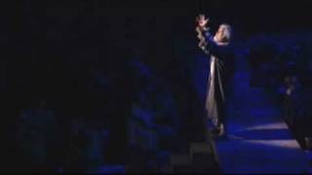
How Do I Do a Monologue?
158-159
Follow steps 1-5 (pp. 27-28)
Determine your character
Outline based on your MI
Replace oral clarity with biblical illustrations (not modern world)
Wear Bible clothes, introduce yourself in character, apply in conclusion
MSS and practice without notes

Slide 10
Monologue Characters
p. 160—Harbona: "A Night in Persia"
(Book of Esther)
p. 170—Ezra: "My family is God's Business"
(Ezra 9)
p. 179—Joseph: "Christmas Through the Eyes of Joseph" (Luke 1:26-33)
p. 183—Wise Man: "Christmas Reflections from a Wise Man" (Matthew 2)
p. 189—Mark: "Introducing Mark!"
(Gospel of Mark)
p. 192—Paul: "I Just Love Those Thessalonians!"
(1 Thessalonians)
p. 196—Onesimus: "Testimony of Onesimus"
(Book of Philemon)

Slide 11
BLOCKING DIAGRAM
113
Front of Stage or Platform
AREA 4 | AREA 1 | AREA 3
AREA 6 | AREA 2 | AREA 5
Grant & Reed, Telling Stories to Touch the Heart, 68

Slide 12
BLOCKING DIAGRAM
113
Front of Stage or Platform
AREA 4 Cool Distress, Conflict (David arguing) | AREA 1 Medium Confrontational (David's fight with Goliath) | AREA 3 Warm Intimate (David prays, picks stones)
AREA 6 Cold Extreme Alienation (Goliath dies) | AREA 2 Medium Distant, Aloof (David arrives at camp) | AREA 5 Warm More "Distant" (David's scene with Jesse)
5
4
3
2
1
Grant & Reed, Telling Stories to Touch the Heart, 69-70

Slide 13
Black

Slide 14


Monologues PPT link at BibleStudyDownloads.org
Get this presentation for free!
Notes:
MO Monologues

