Slide 1
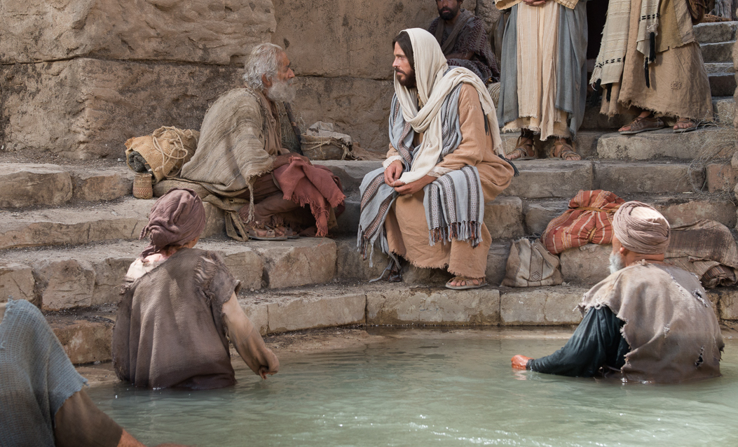
Healing a Paralytic John 5:1-17
Preached by Manik Corea at Crossroads International Church Singapore • CICFamily.com Uploaded by Dr. Rick Griffith • Jordan Evangelical Theological Seminary Files in many languages for free download at BibleStudyDownloads.org

Slide 2
The Miracles
of Jesus
Notes:
This will be the final part of our 10-part series on some of the Miracles of Jesus.

Slide 3
The Big Picture
Signs (miracles) of Jesus illustrate and authenticate the person of Jesus.
John presents them alongside the dialogue with the Jews who challenge the identity and work of Jesus.
Miracle of John 5:1-17 leads to discussion on the authority and claims of Jesus to be the Son of God.

Slide 4
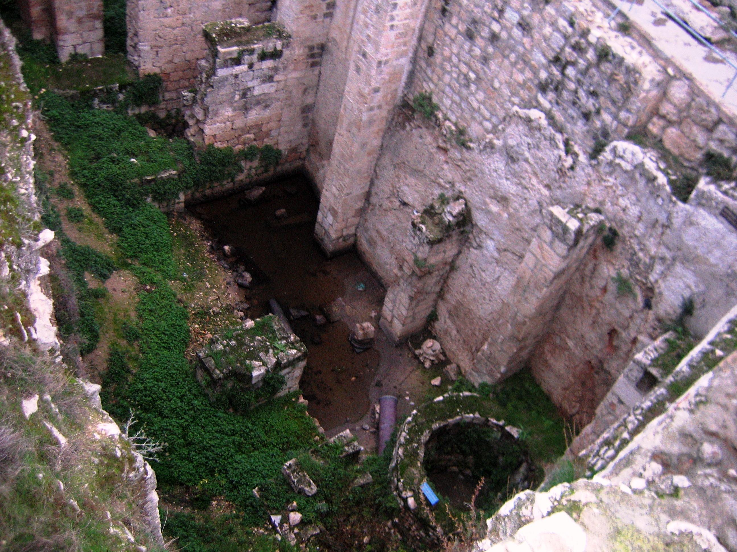
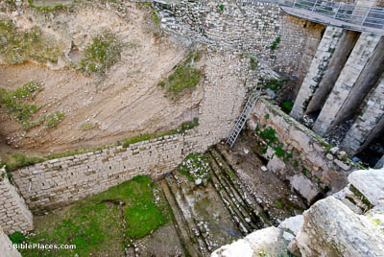
Pool of Bethesda
Uncovered in 19th Centery, under the ruins of a Byzantine church.There are two sizable rectangular reservoirs to collect rainwater, with four colonnaded porticos around the sides and one opposite it, confirming John’s account of five colonnades.

Slide 5
John 5:1-17: Zooming in
Vs 2-5 – A multitude of the sick and disabled – helpless and hopeless.
Vs 4 – A later addition by a scribe – explains the ‘healing’ belief.
Vs 6 – Jesus didn’t heal everyone. “When Jesus saw him there and knew that he had already been there a long time…”

Slide 6
John 5:1-17: Zooming in
Vs 6b: “Do you want to be healed?”

Slide 7
Jesus asked 307 questions in the Gospels.

Slide 8
John 5:1-17: Zooming in
Vs 6b – “Do you want to be healed?”
- Why did he ask this question?
Does the invalid have a desire to be whole, or does he want to stay in his miserable state? (NOTE: It’s a question not just for the sick, but for sinners.)
Vs 7 – Sick man is full of self-pity.
Vs 8 – Jesus is not daunted. Gives him 3 commands – ‘get up’, ‘take up your bed’, ’walk’

Slide 9
John 5:1-17: Zooming in
Vs9 – At once, man is healed and does all 3 things Jesus said, on this Sabbath.
Vs 10 - The TWIST – Religious leaders upset that the Sabbath laws are broken!
Vs 11-13 – Healed man claims ignorance. Jesus has left the scene.

Slide 10
John 5:1-17: Zooming in
Vs 14: Jesus finds him in the temple. “See, you are well! Sin no more, that nothing worse may happen to you.”
2 possible meanings
A) His sin caused his sickness – and Jesus was warning him to repent and change his ways.
B) He is well physically, but needs more so to be well spiritually – or he will also be judged!

Slide 11
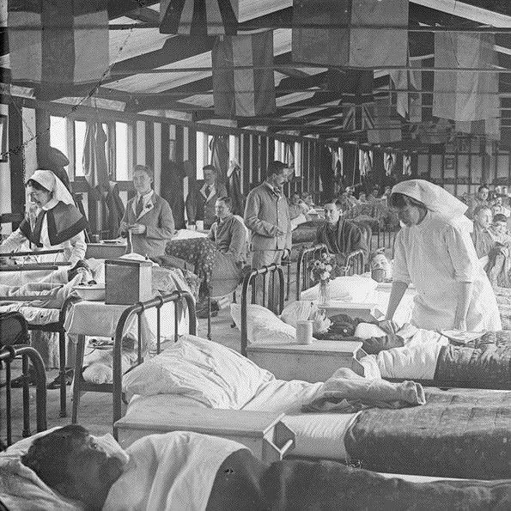
Is sickness always the result of sin?
Yes – because we live in a sin-plagued, broken world – our own sin, the sins of others and the works of the enemy result in sickness and disease. (Deut. 28:59; 29:22;1 Sam. 25:38; 2 Kings 5:27; 2 Chron. 26:19-20; Luke 13:10-13,16; Acts 13:6-11).
No – Not all sickness is the result of our personal sin (John 9:1-13)

Slide 12
Is sickness always the result of sin?
Vs 15 – Man tells Jews that Jesus healed him.
Vs 16 – Jews persecuted Jesus.

Slide 13
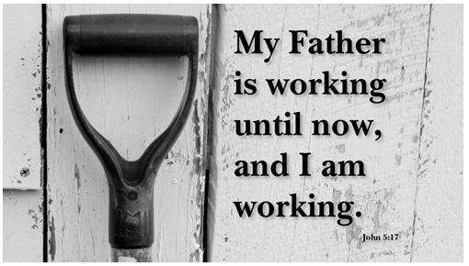

Slide 14
David J. Ellis
Sabbath observance was not intended as a rest of inactivity, but rest which comes from spiritual communion with God, who is ceaselessly active as Creator and sustainer of the universe.
(Gospel of John, New International Bible Commentary, Zondervan:1979)

Slide 15
Application
3 things Jesus says:
1) “Do you want to be healed?” – Invitation (Matthew 11:28-29, John 1:12).
2) “Sin no more, that nothing worse may happen to you.” – Salvation/sanctification (John 8:36; 17:17).
3) “My Father is working until now, and I am working.” – Mission (John 17:18, 20:21).

Slide 16
Black

Slide 17
NT Preaching link at BibleStudyDownloads.org
Get this presentation and script for free!
Notes:
NT Preaching (np)

