Slide 1
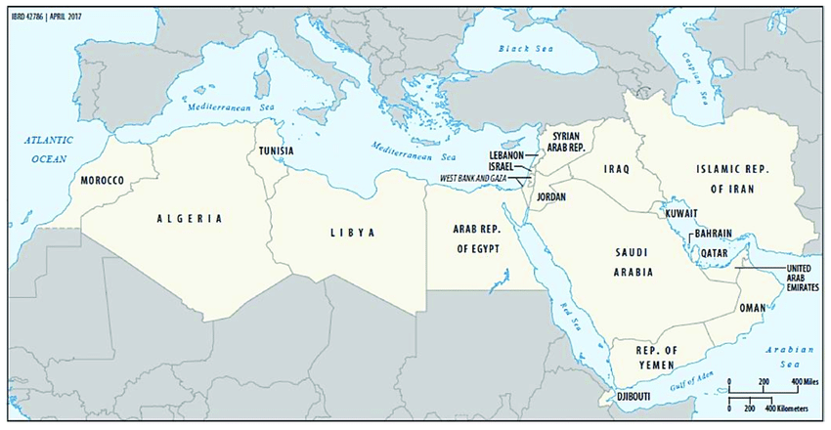
Middle East Update 2024
Dr Rick & Susan Griffith • JETS
Notes:
South Bay Mission Pastors Presentation, San Jose, CA (5 Aug 2024)

Slide 2
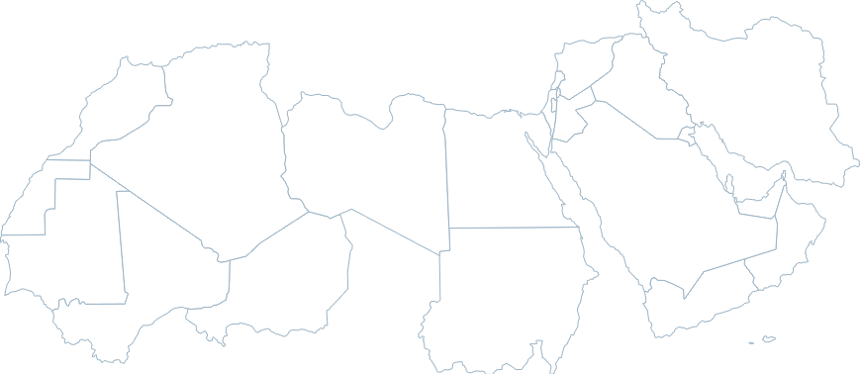
Do you know the countries of MENA?
MENA = Middle East/ North Africa

Slide 3
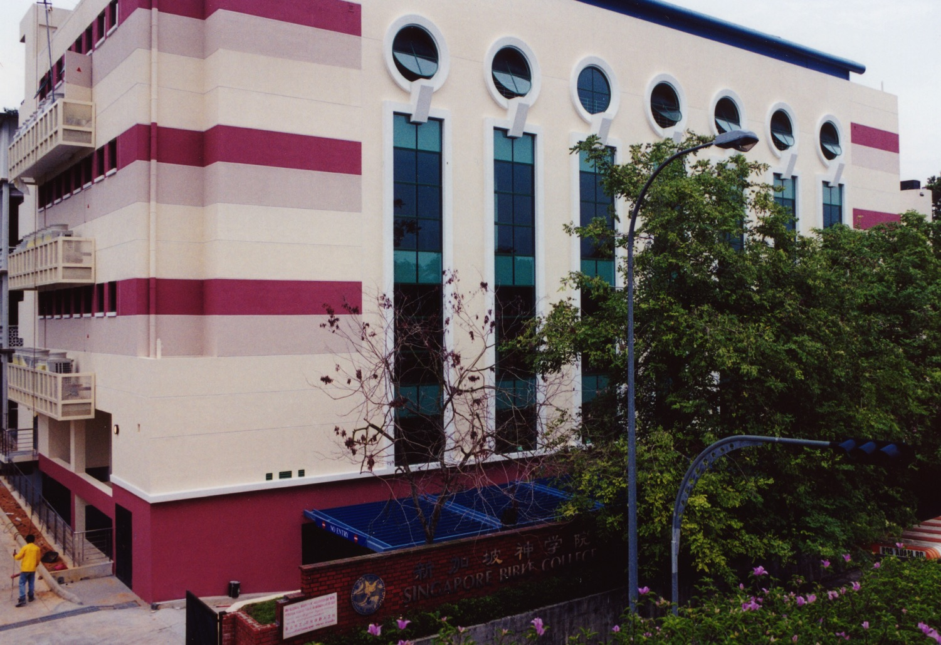
SINGAPORE BIBLE COLLEGE
9
Notes:
I served for 30 years as a seminary professor with 30 other faculty at Singapore's largest training school: Singapore Bible College

Slide 4
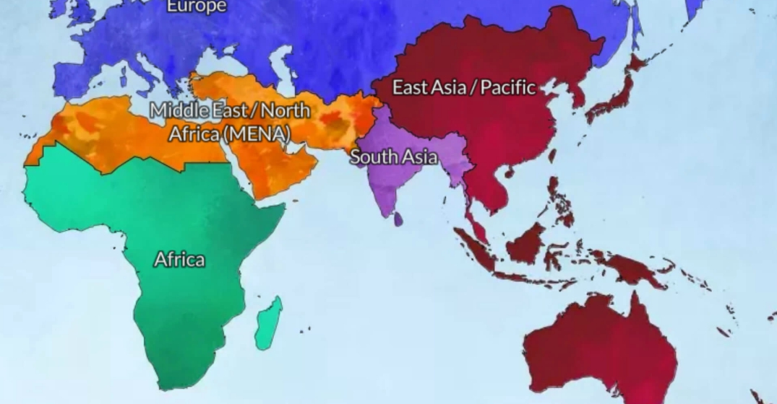
God led us from Asia to MENA in 2021
Jordan
Singapore
Notes:
So, in 2021 we shifted from Singapore to Jordan.

Slide 5
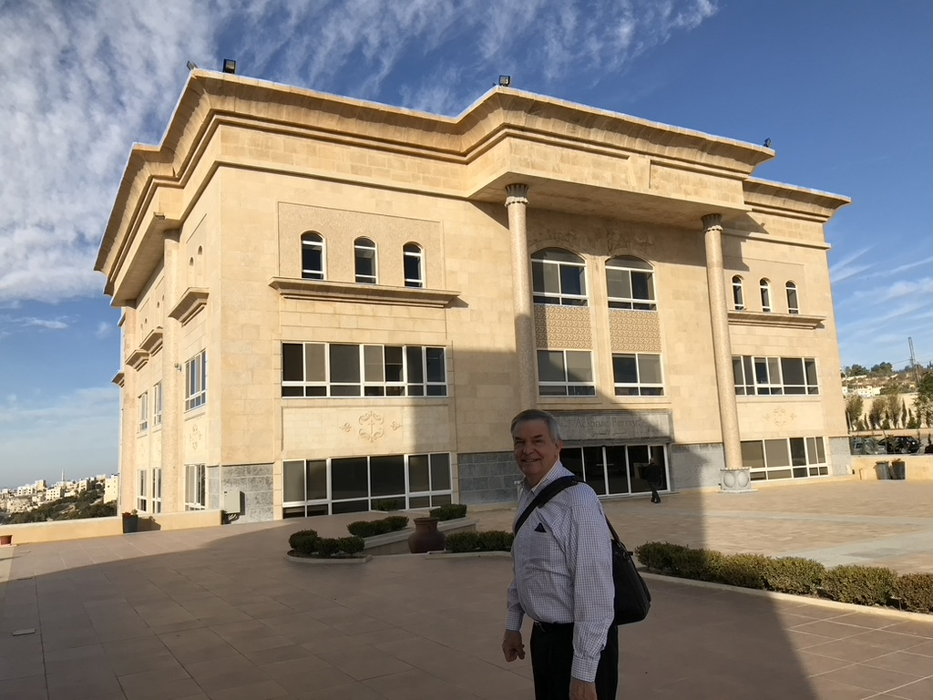
Jordan Evangelical Theological Seminary (JETS)
Notes:
I teach Bible through translation into Arabic.
______
Common-524
NS-05-Acts9-14—slide 143

Slide 6
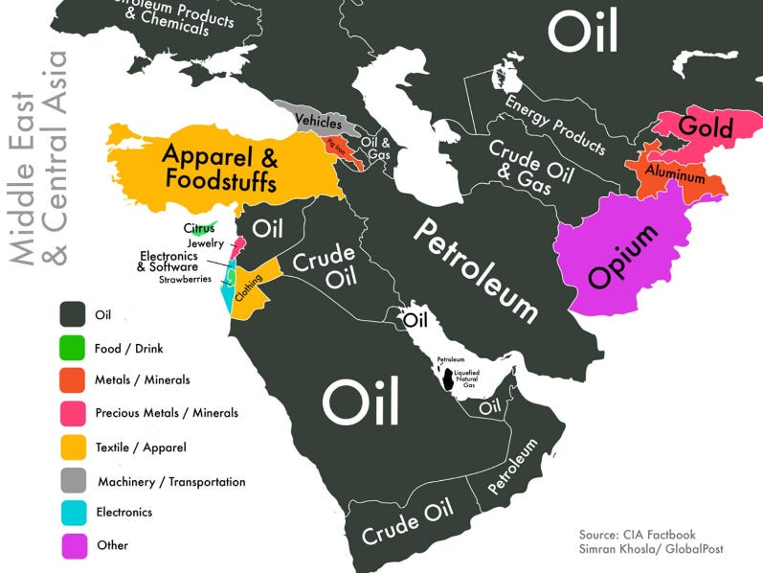
Products

Slide 7
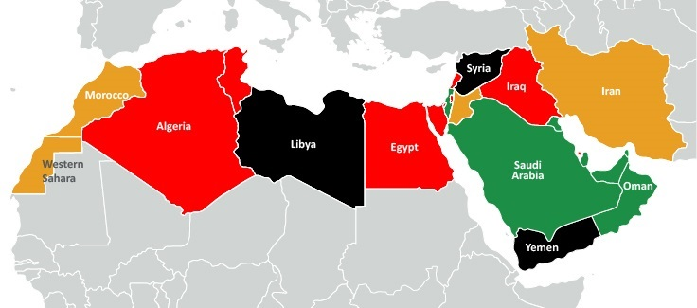
Do you know the countries of MENA?
Jordan
MENA = Middle East/ North Africa
Notes:
Generally speaking, they have in common Arabic and Islam.

Slide 8
My Students from 11 Nations
Spain
Iraq
Israel
Syria
Morocco
Jordan
Egypt
Dubai
Sudan
Eritrea
Chad
Notes:
My students are now from 11 different nations based at JETS.
____________
Isaiah: Rami (Bible prof in Amman), Jackson (ST prof in Sudan), Jonathan (pastor in Chad), Habil (Hebrew prof? from Sudan in Amman), Amir (Sudanese translator in Amman), Nassef (Egypt), Ayoub (planting church and Bible college as lawyer in Casa Blanca, Morocco), Basem (Egypt), Nassar (Ramallah), Ramzi (Iraq), Dibora (Eritrea)
OT3: Osama (Jordan), Fadi (Syrian trained in Jordan at JETS but translating from Sweden while writing dissertation on Russian theologian for seminary in Belgium), Sara (English teacher in Jordan), Nagat (Egyptian Cru in Spain), Randa (CFO boarding school in Jordan), Jacklin (Jordanian reaching Syrian refugees), Adeeb (Egyptian international church in Dubai), Dani (Arabic apologist in Jordan)
Where serving:
1 Chad—Jonathan
1 Morocco—Ayoub
1 Spain—Nagat
1 Syria—Fadi
1 Dubai—Adeeb
2 Egypt—Nassef, Basem
3 Sudan—Jackson, Habil, Amir
6 Jordan—Rami, Osama, Sara, Randa, Jacklin, Dani
16

Slide 9
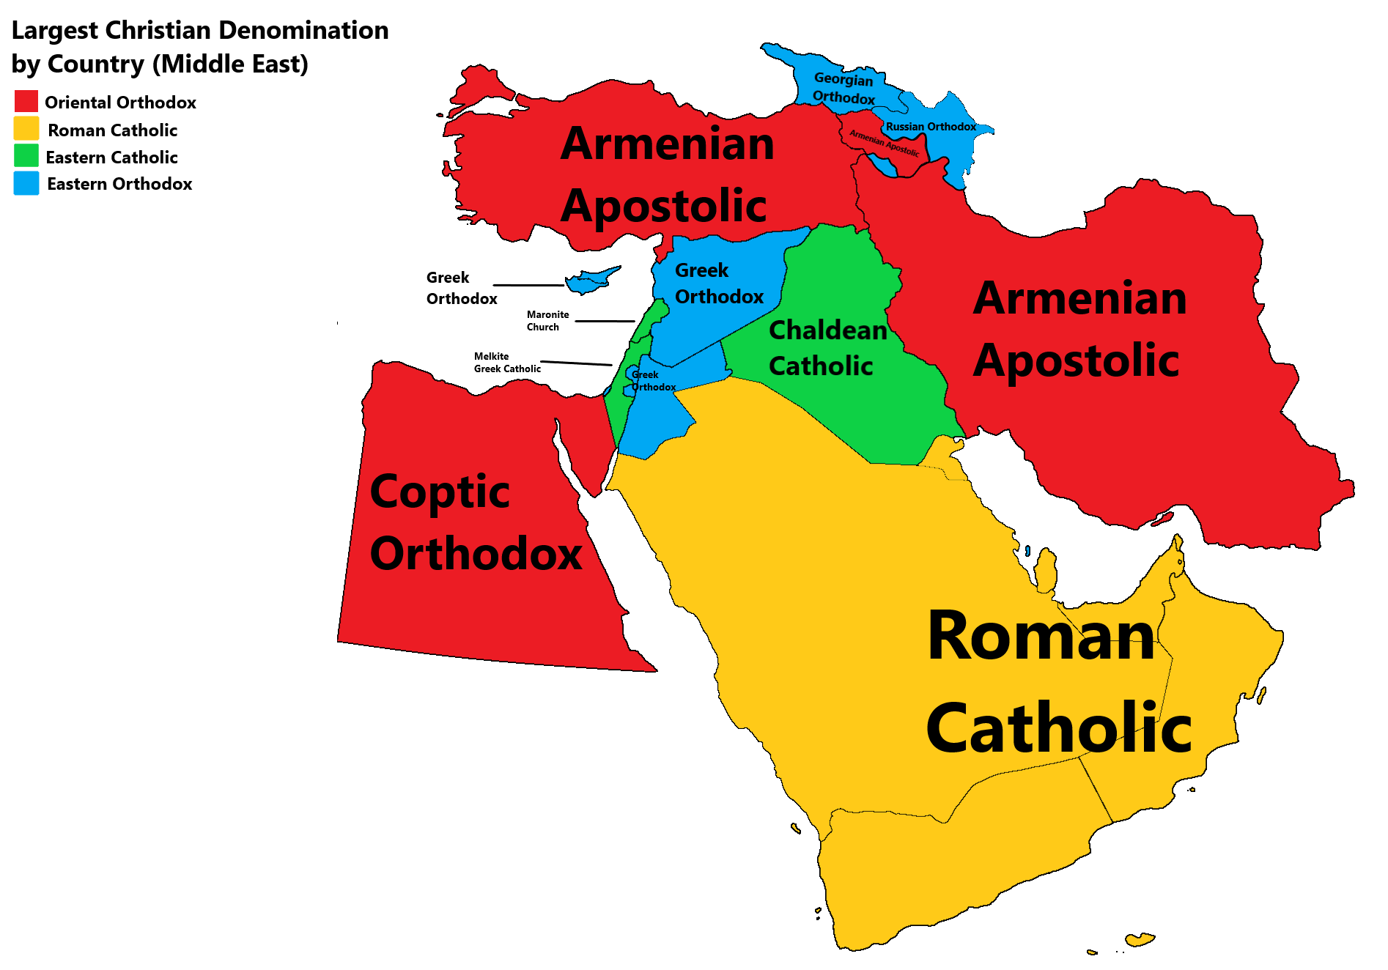
The Middle East is the Origin and End of History
Notes:
"The makeup of Christian communities in the MENA region is diverse and rich in history, reflecting centuries of coexistence and interaction with various cultures and religions. While the specific demographics vary from country to country, here is a general overview of the Christian presence:
Armenian Christians: Concentrated in countries like Armenia, Iran, Lebanon, Syria, and Turkey, Armenian Christians have a rich cultural heritage and have faced historical challenges, including genocide and displacement.
Coptic Christians: Primarily concentrated in Egypt, Coptic Christians are one of the oldest Christian communities in the world, tracing their roots back to the early days of Christianity. They have a distinctive cultural and religious identity within Egypt.
Chaldean, Assyrian, and Syriac Christians: These communities are mainly found in Iraq and Syria, with smaller populations in other countries in the region. They have faced significant challenges due to conflicts and persecution in recent years.
Eastern Orthodox Christians: Beyond Greece and Cyprus, Eastern Orthodox Christians are also found in countries like Syria, Lebanon, and Jordan, where they have longstanding historical roots.
Greek Orthodox and Greek Catholic: These communities have a presence in various countries across the MENA region, including Syria, Jordan, Palestine, and Lebanon.
Maronite Christians: Predominantly found in Lebanon, Maronite Christians have a significant presence in Lebanese society and have historically played a key role in the country’s politics and culture.
Protestant and Evangelical Christians: In recent decades, there has been a growth in Protestant and Evangelical Christian communities in various countries across the MENA region. Perhaps numbering over half a million in Egypt, influential communities exist also in Lebanon and Jordan. In some countries like Iraq, however, they might be only a few hundred in population.
There are a number of Anglican Christians in the region. There are also expatriate Christian communities in many of the MENA countries, especially the Gulf states."
Middle East and North Africa (MENA) Regional Report
Lausanne Movement Authors Rafik Wagdy Barsoum, Salim J. Munayer, and Jack Sara
https://lausanne.org/report/mena
Accessed 2 Aug 2024

Slide 10
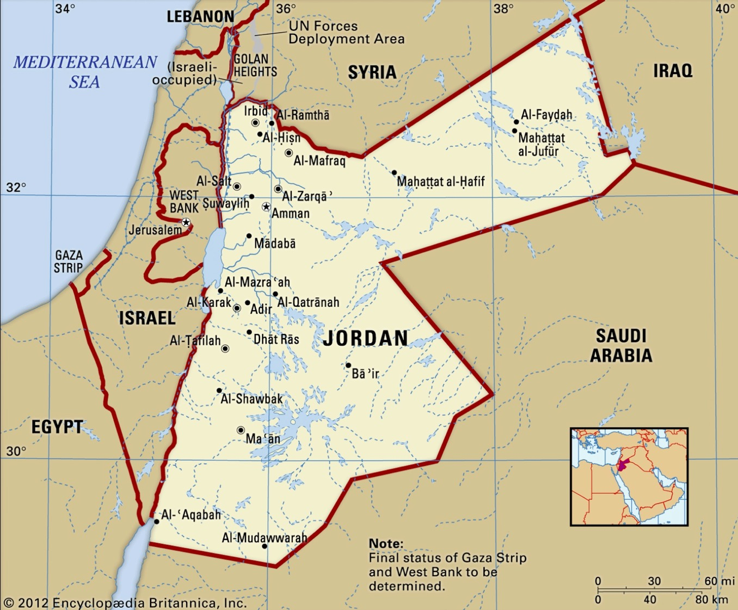
60 Jordan Evangelical Churches
JETS Lead Pastors
Other Seminaries
Notes:
But now we believe that is timing is right to make this shift before we get too old to shift to another culture. Jordan also gives us the potential to serve as long as we wish!

Slide 11
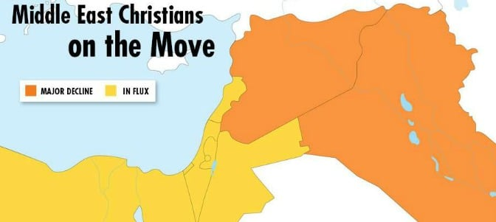
Middle East Challenges
"A century ago Christians comprised 20% of the population in the Middle East and north Africa, but since then the proportion has fallen to less than 4%, or roughly 15 million people."—The Guardian, 2019
Iraq
Syria
Notes:
Persecution of Christians 'coming close to genocide' in Middle East – report
Millions uprooted from homes, says UK-commissioned report, with many jailed and killed
Patrick Wintour in Addis Ababa
Thu 2 May 2019 17.00 EDT
The Guardian
https://www.theguardian.com/world/2019/may/02/persecution-driving-christians-out-of-middle-east-report#:~:text=The%20report%20shows%20that%20a,or%20roughly%2015%20million%20people.
______
"But the outlook for all Christian communities is negative. Paul Vallely’s book, The Vanishing: The Twilight of Christianity in the Middle East [which I cannot verify or find on the Internet], proves poignant evidence. Here are some indicative quotes:
For the first time in nearly two millennia, Iraq may soon be bereft of Christians.
The Christian faith and its followers were an integral part of the Middle East since the religion’s earliest days. Now, they are facing extinction in many of their ancient homelands.
The ancient churches of the Middle East face a mortal threat. In Iraq, Syria, Egypt, and Palestine, the crucible of Christianity is being extinguished.
The exodus of Christians from the region is unprecedented in modern times, leading to fears that Christianity in the very lands of its birth is becoming a vanishing religion."
Middle East and North Africa (MENA) Regional Report
Lausanne Movement Authors Rafik Wagdy Barsoum, Salim J. Munayer, and Jack Sara
https://lausanne.org/report/mena
Accessed 2 Aug 2024

Slide 12
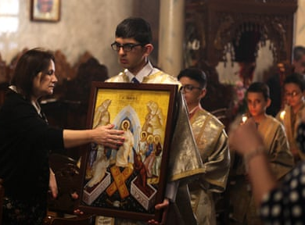
Middle East Challenges
"The Arab-Israeli conflict has caused the majority of Palestinian Christians to leave their homeland. The population of Palestinian Christians has dropped from 15% to 2%." —The Guardian, 2019
Notes:
Persecution of Christians 'coming close to genocide' in Middle East – report
Millions uprooted from homes, says UK-commissioned report, with many jailed and killed
Patrick Wintour in Addis Ababa
Thu 2 May 2019 17.00 EDT
The Guardian
https://www.theguardian.com/world/2019/may/02/persecution-driving-christians-out-of-middle-east-report#:~:text=The%20report%20shows%20that%20a,or%20roughly%2015%20million%20people.
______
"But the outlook for all Christian communities is negative. Paul Vallely’s book, The Vanishing: The Twilight of Christianity in the Middle East [which I cannot verify or find on the Internet], proves poignant evidence. Here are some indicative quotes:
For the first time in nearly two millennia, Iraq may soon be bereft of Christians.
The Christian faith and its followers were an integral part of the Middle East since the religion’s earliest days. Now, they are facing extinction in many of their ancient homelands.
The ancient churches of the Middle East face a mortal threat. In Iraq, Syria, Egypt, and Palestine, the crucible of Christianity is being extinguished.
The exodus of Christians from the region is unprecedented in modern times, leading to fears that Christianity in the very lands of its birth is becoming a vanishing religion."
Middle East and North Africa (MENA) Regional Report
Lausanne Movement Authors Rafik Wagdy Barsoum, Salim J. Munayer, and Jack Sara
https://lausanne.org/report/mena
Accessed 2 Aug 2024

Slide 13
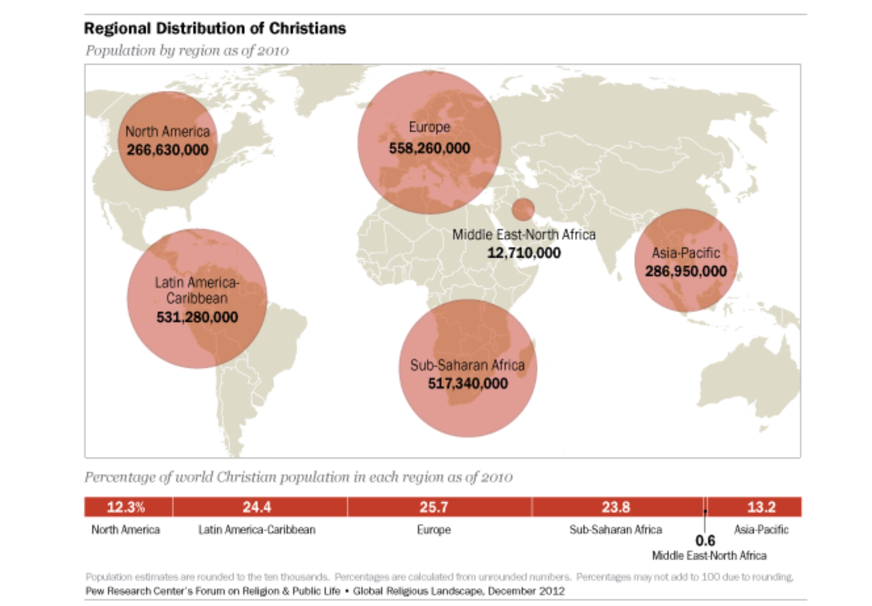
Distribution of Christians in 2010
Notes:
This map depicts the number of people on each continent who claim to be Christians. What sticks out to me is that MENA is far behind the other regions, even though it is where Christianity began.

Slide 14
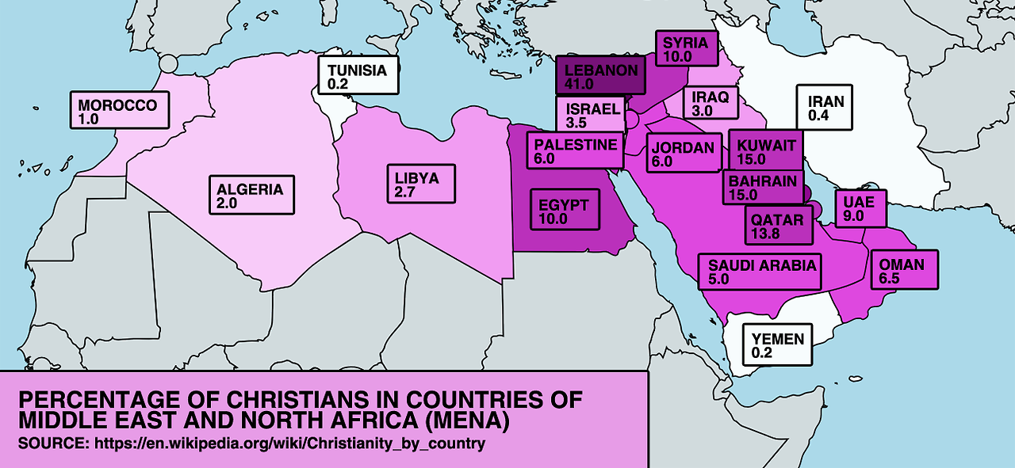
Most MENA Christians are Expats
PERCENTAGE OF CHRISTIANS IN COUNTRIES OF MIDDLE EAST AND NORTH AFRICA (MENA)
Notes:
Besides Lebanon, Syria, and Egypt, the only nations with more than 10% Christians are those with high levels of expatriates.

Slide 15
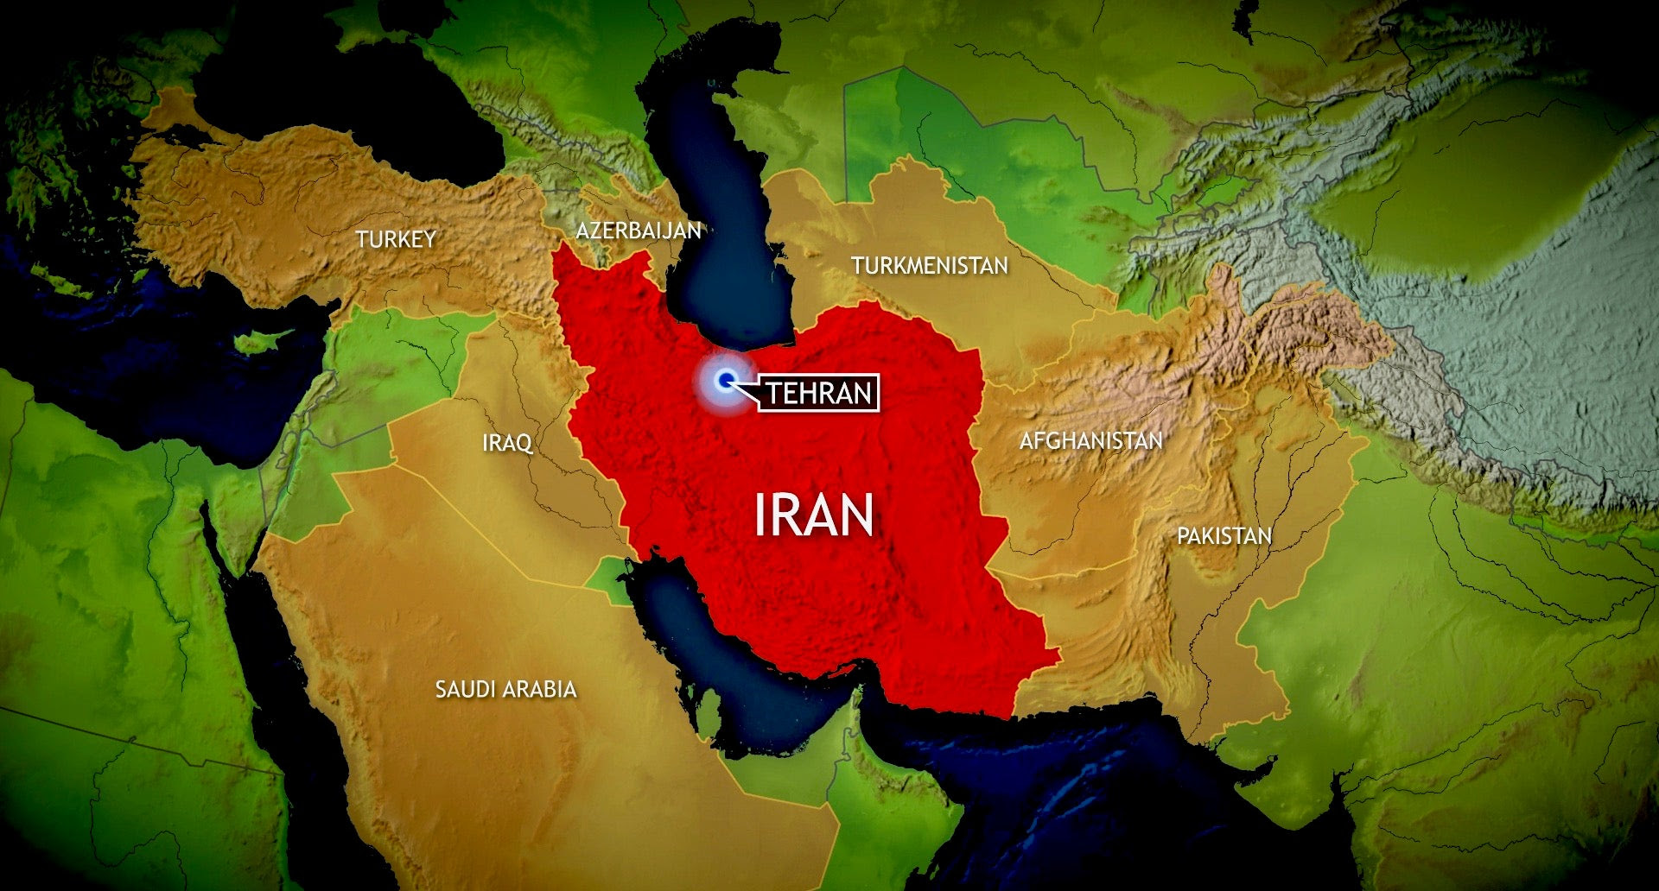
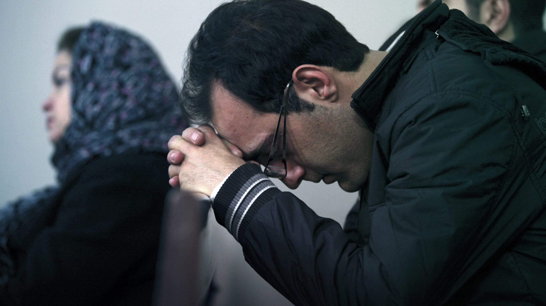
Iranian Christian Explosion
Internet evangelism & discipleship
20 million illegal satellite dishes
Need for 10 million Bibles
Notes:
"The Christian Broadcasting Network found, also in 2018, that 'Christianity is growing faster in the Islamic Republic of Iran than in any other country. 'Jun 15, 2023."

Slide 16
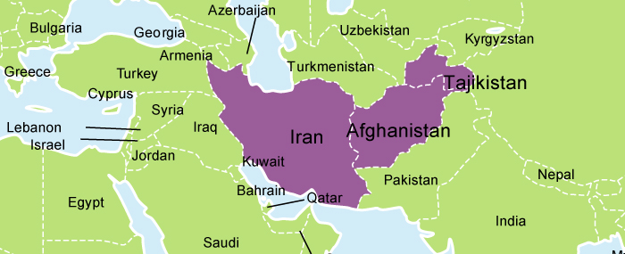
Church Growth Worldwide: #1 Iran + #2 Afghanistan
CBN 2018, The Gospel Coalition 2021
Notes:
"In the last 20 years, more Iranians have become Christians than in the previous 13 centuries—since Islam came to Iran. In 1979, there were an estimated 500 Christians from a Muslim background in Iran. Today, there are hundreds of thousands—some estimate more than 1 million. According to the research organization Operation World, Iran has the fastest-growing evangelical movement in the world. The second-fastest-growing church is in Afghanistan—where Afghans are being reached in large part by Iranians."
Day 2: The Fastest-Growing Church in the World
April 7, 2021 | Staff
https://www.thegospelcoalition.org/article/fastest-growing-church-world/
Accessed 2 Aug 2024

Slide 17
Israel Gives Up Land for Peace
Israel's Land Concessions & Land Offers for Peace (1967- present)
1967: Israel offers 100% of:
• West Bank to Jordan
• Sinai & Gaza to Egypt
• Golan to Syria
1982: Israel gives up 100% of Sinai to Egypt for peace
1993: Israel gives up land to Palestinian Authority
1994: Israel gives up land to Jordan for peace
2005: Israel gives up 100% of Gaza to Palestinians
2008: Israel offers 95% of West Bank to Palestinians
Israel Wants Peace!

Slide 18
6th Grade Map Test (Curriculum of UN Rights Watch Association, 2021)
Notes:
Notice how the word "Israel" does not even appear on this UN Map test.

Slide 19
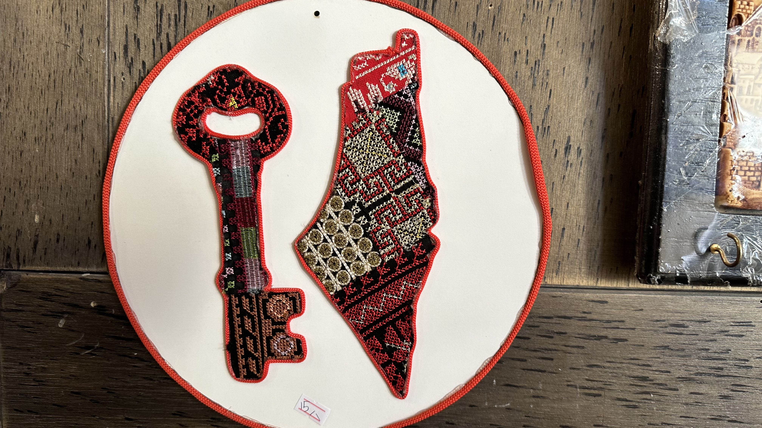
Arabs Have No Room for Israel

Slide 20
October 7 Celebrated on Palestinian Restaurant

Slide 21
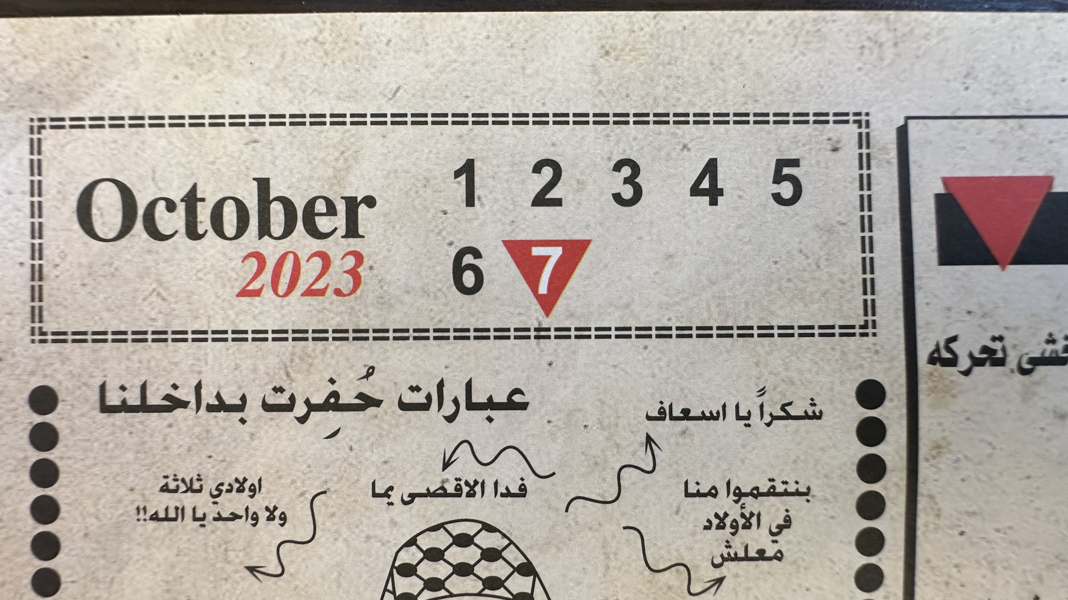
October 7 Celebrated on Palestinian Restaurant

Slide 22
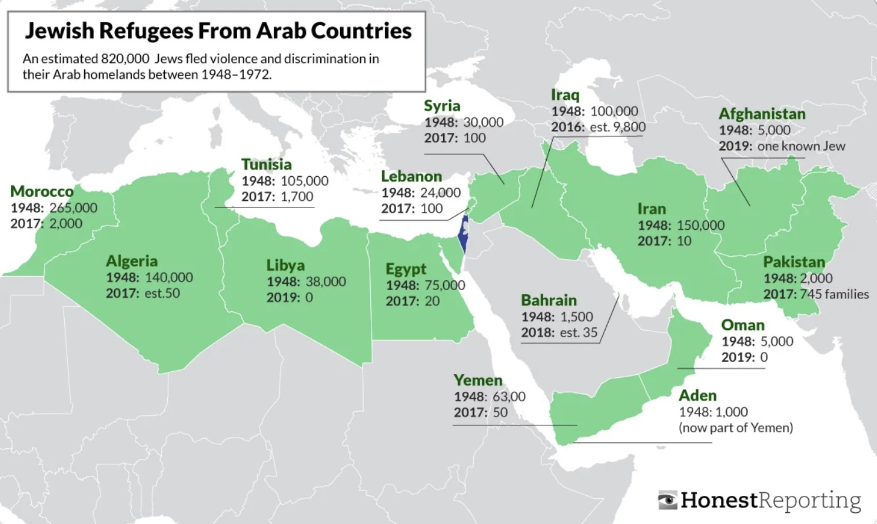
Jewish Refugees From Arab Countries (1948-2019)
https://www.reddit.com/r/MapPorn/comments/wzfk94/jewish_refugees_from_muslim_countries/?rdt=37455

Slide 23
Decline of Christianity in Western Countries
https://www.threads.net/@civixplorer/post/C6KI3dBsqmw

Slide 24
Decline of Christianity in Some Middle Eastern Countries
72%
32%
Lebanon
In 1932
In 2024
23%
1%
Syria
In 1943
In 2024
25%
2%
Jordan
In 1950
In 2024
16%
0.2%
Iraq
In 1950
In 2024
https://x.com/AzatAlsalim/status/1835988201590145515

Slide 25
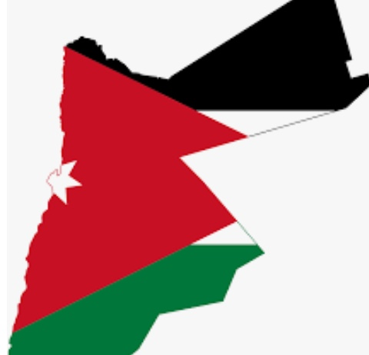
Life for Jordanian Christians
CBBs
MBBs
Freedom of Worship
No Change of Religion
Reduced Jobs
Further Reduced Jobs
Family Rejection
Emigration

Slide 26
Please Pray for the Jordanian Arabs

Slide 27
Pray for the Middle East

Slide 29
Missions link at BibleStudyDownloads.org
Get this presentation for free!

