Slide 1


Developing Leadership through Mentoring
and Coaching
Ken Horton, Ph.D.
& Ron Horton, Th.M.
SL315 Unit 1
Taught at Singapore Bible College's DMin Program in October 2019
Uploaded by Dr. Rick Griffith • Jordan Evangelical Theological Seminary
All files in 54 languages for free download at BibleStudyDownloads.org

Slide 2
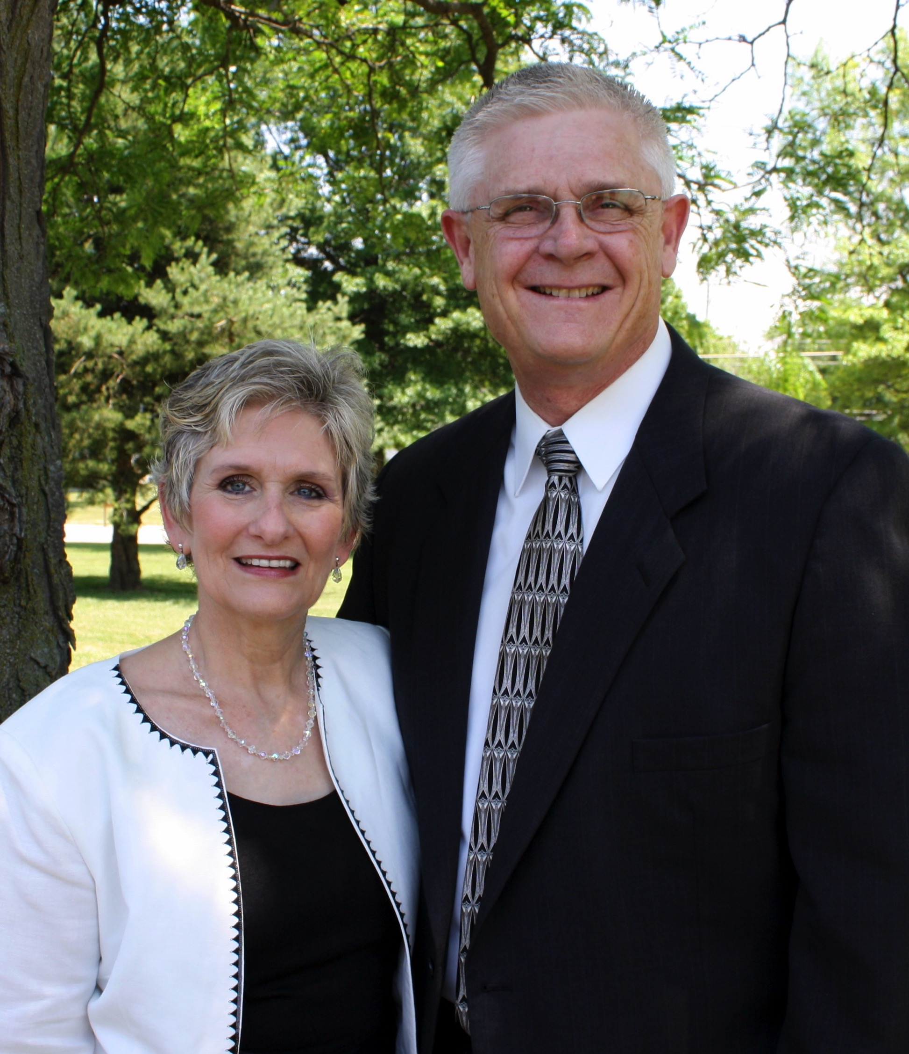
Ron & Terri Horton

Slide 3
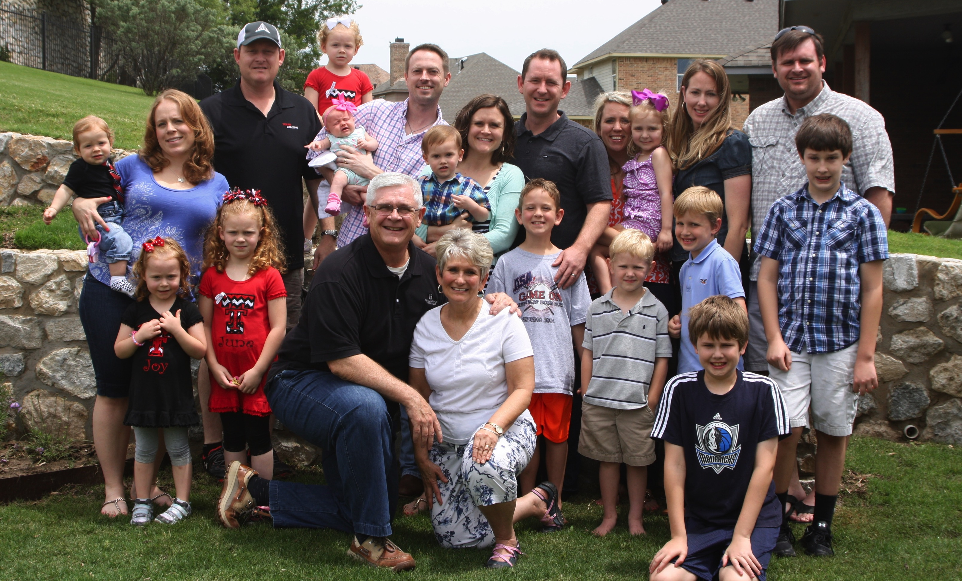
The Horton Family

Slide 4

The Newest Horton

Slide 5
Stanley and Clinton, Connecting, 33
"Mentoring is a relational experience in which one person empowers another by sharing God-given resources."

Slide 6
Adapted from Carson Pue, Mentoring Leaders
Mentoring
Leaders
VISIONEERING
Discovering purpose
IMPLEMENTING
Being
purposeful
Self-Awareness
FREEING UP
Satisfying needs
SUSTAINING
Realizing purpose

Slide 7
Bill Hull, The Complete Book of Discipleship, loc. 263-346
A disciple is a “reborn follower of Christ.” Discipleship is the “process of following Christ,” and disciple-making involves “deliverance, development, and deployment.”

Slide 8
“Coaching is unlocking a person’s potential to maximize their growth”
John Whitmore, Coaching for Performance, 8

Slide 9
Developing Leadership through Mentoring
and Coaching
Ken Horton, Ph.D.
& Ron Horton, Th.M.
SL315 Unit 1

Slide 10
A Life of Credibility
Character
Great
Credibility
Competence
Credibility
(Crisis)
Consistency
Adapted from a concept by Steve Bateman

Slide 11
Developing Leadership through Mentoring
and Coaching
Ken Horton, Ph.D.
& Ron Horton, Th.M.
SL315 Unit 1

Slide 12
Humility, Christ’s primary character trait, is ground zero for personal transformation. Without humility, Christ wouldn’t have submitted Himself to the Father or made sacrifice of his own life for the whole world.
One reason even the very best discipleship plans don’t result in transformation is they don’t start with humility. Humility forms the environment and relationships that make transformation possible.
Bill Hull, The Complete Book of Discipleship:
On Being and Making Followers of Christ, 157

Slide 13
A Heart for God’s Will
³⁴ “A new commandment I give to you, that you love one another, even as I have loved you, that you also love one another.”
³⁵ “By this all men will know that you are My disciples, if you have love for one another.”
John 13:34-35 (NASB95)

Slide 14
A Heart for God’s Purpose
18 And Jesus came up and spoke to them, saying, “All authority has been given to me in heaven and on earth.”
19 “Go therefore and make disciples of all nations, baptizing them in the name of the Father and the Son and the Holy Spirit, 20 teaching them to observe all that I commanded you; and lo, I am with you always, even to the end of the age."
Matthew 28:18-20 (NASB95)

Slide 15
Developing Leadership through Mentoring
and Coaching
Ken Horton, Ph.D.
& Ron Horton, Th.M.
SL315 Unit 1

Slide 16
"This you know, my beloved brethren. But everyone must be quick to hear, slow to speak and slow to anger."
James 1:19
NASB95
SL315 Unit 4

Slide 17
“One of the most sincere forms of respect is actually listening to what another has to say.”
Bryant H. McGill
SL315 Unit 4

Slide 18
“Listening is a magnetic and strange thing, a creative force. The friends who listen to us are the ones we move toward. When we are listened to, it creates us, makes us unfold and expand.”
Karl A. Menniger
SL315 Unit 4

Slide 19
“The most important thing in communication is hearing what isn’t said.”
Peter Drucker
SL315 Unit 4

Slide 20
“When people talk, listen completely. Most people never listen.”
Ernest Hemingway
SL315 Unit 4

Slide 21
“Most people do not listen with the intent to understand; they listen with the intent to reply.”
Steven R. Covey
SL315 Unit 4

Slide 22
“You cannot truly listen to anyone and do anything else at the same time.”
M. Scott Peck
SL315 Unit 4

Slide 23
Developing Leadership through Mentoring
and Coaching
Ken Horton, Ph.D.
& Ron Horton, Th.M.
SL315 Unit 1

Slide 24
Putnam Cycle of Spiritual Development
LEADERS
SEARCHING
Is this for real?
Is this for me?
REPRODUCING
DISCOVERING
SERVANTS
BORN AGAIN
Faith in Christ
NEW
TRUTHS
PARENT
Sacrificial
Intentional
Flexible
NEW
HABITS
INFANT
Vulnerable
Confused
Needy
BELIEVERS
THE
GOSPEL
NEW
RELATIONSHIPS
IN
WISDOM
IN
FAITH
YOUNG ADULT
Responsible to God
Other-Oriented
Trustworthy
CHILD
Self-Focused
Impressionable
Unstable
IN
LOVE
IN
COMMUNITY
GROWING
MATURING
IN
HUMILITY
IN
SERVICE

Slide 25
Developing Leadership through Mentoring
and Coaching
Ken Horton, Ph.D.
& Ron Horton, Th.M.
SL315 Unit 1

Slide 26
Strategic Focus
Matthew 28:18-20
Launch
Meet/Share Ministry
Wise Selection
Personal Preparation
SL315 Unit 6

Slide 27
Strategic Focus
Matthew 28:18-20
Launch
Meet/Share Ministry
Wise Selection
Personal Preparation
SL315 Unit 6

Slide 28
Developing Leadership through Mentoring
and Coaching
Ken Horton, Ph.D.
& Ron Horton, Th.M.
SL315 Unit 1

Slide 29
Bruce’s Analysis
Stage #1 - Come and see
Stage # 2 - Come and follow me
Stage # 3 - Come and be with me
A. B. Bruce,
The Training of the Twelve, 11
SL315 Unit 7

Slide 30
“The twelve arrived at their final intimate relation to Jesus only by degrees, three stages in the history of their fellowship with him being distinguishable.”
A. B. Bruce,
The Training of the Twelve, 11
SL315 Unit 7

Slide 31
Hull’s Analysis
(See chapter 6)
Stage #1 - Come and see
Stage # 2 - Come and follow me
Stage # 3 - Come and be with me
Stage # 4 - Remain in me
Bill Hull, The Complete Book of Discipleship:
On Being and Making Followers of Christ
SL315 Unit 7

Slide 32
Developing Leadership through Mentoring
and Coaching
Ken Horton, Ph.D.
& Ron Horton, Th.M.
SL315 Unit 1

Slide 33
“Whatever your hand finds do, do it with all your might; for there is no activity, or planning or knowledge or wisdom in Sheol where you are going.”
Ecclesiastes 9:10
NASB95
SL315 Unit 8

Slide 34
“Prescribe and teach these things. Let no one look down on your youthfulness, but rather in speech, conduct, love, faith, and purity, show yourself an example of those who believe.”
1 Timοthy 4:11-12
NASB95
SL315 Unit 8

Slide 35
“Therefore, we do not lose heart, but though our outer man is decaying, yet our inner man is being renewed day by day.”
2 Corinthians 4:16
NASB95
SL315 Unit 8

Slide 36
“If the axe is dull and he does not sharpen its edge, then he must exert more strength. Wisdom has the advantage of giving success.”
Ecclesiastes 10:10
NASB95
SL315 Unit 8

Slide 37
“The hard-working farmer ought to be the first to receive his share of the crops.”
2 Timothy 2:6
NASB95
SL315 Unit 8

Slide 38
Developing Leadership through Mentoring
and Coaching
Ken Horton, Ph.D.
& Ron Horton, Th.M.
SL315 Unit 1

Slide 39
“Coaching is the art and practice of enabling individuals and groups to move from where they are to where they want to be.”
Gary Collins
Christian Coaching,
2nd ed., loc. 205 in Kindle
SL315 Unit 9

Slide 40
"Coaches are change experts who help leaders take responsibility for their lives and act to maximize their own potential."
Tony Stoltzfus
Leadership Coaching,
loc. 252 in Kindle
SL315 Unit 9

Slide 41
"Coaching is unlocking a person’s potential to maximize their growth."
John Whitmore, Coaching for Performance,
cited by Tony Stoltzfus, Leadership Coaching,
loc 205 in Kindle
SL315 Unit 9

Slide 42
"A coach helps to assess their situation then improve their skills, disciplines, and knowledge so that they can make the necessary big picture changes..."
Daniel Harkavy
Becoming a Coaching Leader, 38-39
SL315 Unit 9

Slide 43
"In contrast to the emphasis on imparting information through tutoring and instruction, coaching is unlocking a person’s potential to maximize his or her own performance."
John Whitmore, Coaching for Performance,
cited by Gary Collins, Christian Coaching,
loc 139-140 in Kindle
SL315 Unit 9

Slide 44
(Coaching) … "is a form of servant leadership that involves encouraging people to pursue their goals and fulfill their potential."
Gary Collins
Christian Coaching, loc. 431 in Kindle
SL315 Unit 9

Slide 45
"Each of these roles – counselor, teacher, trainer, consultant, mentor, coach – is unique, and a good coach needs to have some skill in each area. Sometimes a coach will be a teacher. Sometimes a mentor. Sometimes a counselor. Sometimes a trainer, but always a coach."
Daniel Harkavy
Becoming a Coaching Leader, 38-39
SL315 Unit 9

Slide 46
"When I’m mentoring, I’m teaching a person, letting him draw from me or learn from my experience. When I’m coaching, I’m pushing a person to draw from his or her own resources and experiences. Coaching is helping people learn instead of teaching them."
Tony Stoltzfus
Leadership Coaching, loc. 298 in Kindle
SL315 Unit 9

Slide 47
Developing Leadership through Mentoring
and Coaching
Ken Horton, Ph.D.
& Ron Horton, Th.M.
SL315 Unit 1

Slide 48
Manager’s Perspective
Pursues Quick Solutions To Complete Tasks
Mediates Staff Differences
Tells Team What To Do / How To Manage
Adapted from Hudson Institute
SL315 Unit 11

Slide 49
Coaching Mindset
Discusses Issues With Team Members
Empowers Team Members To Develop Solutions
Celebrates Collaborative Interaction
Adapted from Hudson Institute
SL315 Unit 11

Slide 50
Developing Leadership through Mentoring
and Coaching
Ken Horton, Ph.D.
& Ron Horton, Th.M.
SL315 Unit 1

Slide 51
SL315 Unit 12
Christian
Coaching
Awareness
Where are we now?
Gary Collins
Obstacles
What gets
in the way?
Jesus
Christ
Vision
Where do we want to go?
Strategy/Action
How do we want to get there?

Slide 52
Coach
Leadership Systems
Jim Smith
Client
Connect
Discuss
Assess
Clarity
Discover
Articulate
Confirm
Decide
Action
SL315 Unit 12

Slide 53
Goal
Driven
Leadership Coaching
Tony Stoltzfus
Listen
Client
Oriented
Ask
Client oriented
Support
Act
Relationship Based
SL315 Unit 12

Slide 54
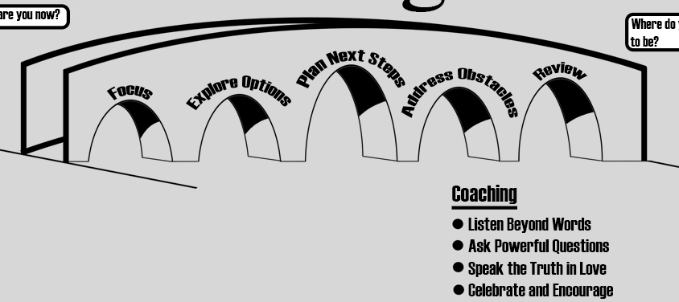
The Coaching Process
Where are you now?
Plan Next Steps
Where do you want to be?
Explore Options
Address Obstacles
Review
Focus
Coaching:
Listen Beyond Words
Ask Powerful Questions
Speak the Truth in Love
Celebrate and Encourage
SL315 Unit 12

Slide 55
Black

Slide 56


Leadership • BibleStudyDownloads.org
Get this presentation for free!
Notes:
Holy Spirit (hs)

