Slide 1
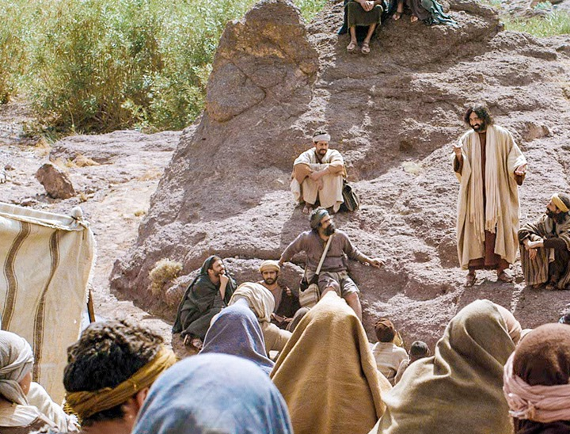
The Theology of Jesus
An adapted 2006 Class Presentation by Susan Ashoka Debnath for Dr. Rick Griffith • Singapore Bible College • BibleStudyDownloads.org

Slide 2
Theology of Jesus
We accept the general trustworthiness of the major contours of the Synoptic Gospels.
This presentation addresses more narrowly the sayings and themes of Jesus' ministry.
Jesus is the most significant person in history, yet even many Christians cannot summarize his teachings concisely.
What was the core component of the theology of Jesus?
Notes:
We do not the space or adequate comparative data to argue for the authenticity of every part of the gospel tradition.

Slide 3
Theology of the Kingdom
Jesus' message centered on the kingdom of God.
The kingdom of God addressed:
reign more than realm
power more than place
Notes:
Never appears in the OT but the concept of God as king and sovereign we see in OT.

Slide 4
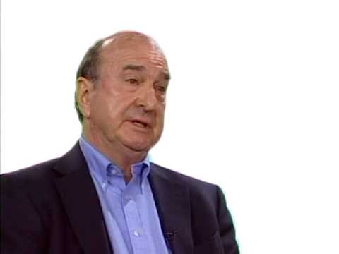
E. P. Sanders on the Kingdom of God
A covenant into which one enters
A future entry yet to be fully established
An unexpected coming event separating the righteous from the wicked
The establishment of a recognizable social order
A present experience of Jesus' words and deeds.
A characteristic of God and his reign as King

Slide 5
Jewish Eschatology
Old Age New Age
________________________________________
Messiah
comes as king
Christian Eschatology
New Age
_______________________________________________________________________________________________________________
Old Age
________________________________________
Messiah crucified Messiah returns as king
Notes:
The Jewish view of the future was quite simple: The Messiah would come to turn the Old Age into a New Age by ruling over Israel and the world.
However, Christians have the advantage now of looking back to see that the New Age did not begin with Messiah's rule, but with his crucifixion. In a sense, the Old Age remains with sin, the world experiencing decay (Rom 8:13-14), and with Israel still not believing and redeemed. Yet, on the other hand, we are in the New Age at present with forgiveness of sin and the advent of the Spirit. This New Age will be more fully in effect only at the return of Jesus. Thus, we exist now in a transitional time with elements of both the Old Age and New Age. Such a time (the Church Age) was not forseen in the Old Testament, and age "which was not made known to men in other generations as it has now been revealed by the Spirit to God's holy apostles and prophets. 6 This mystery is that through the gospel the Gentiles are heirs together with Israel, members together of one body, and sharers together in the promise in Christ Jesus" (Ephesians 3:5 NIV).

Slide 6
Kingdom is Future & Present
The Future Dimension
The messianic banquet in Isaiah 25:6-9 is future
Jesus' parables on feasting (Matt. 22:1-14; Luke 14:15-24)
Jesus teaches his disciples to pray for the coming kingdom (Matt. 6:10)
The Present Dimension
The call to repent because the kingdom of God is at hand or has drawn near (Mark 1:15; Matt. 4:23; Luke 4:23)
It is bound up with Jesus ministry of exorcism and vanquishing of Satan (Luke 9:1; 10:18-19)
Notes:
The present dimension of Jesus teaching on the kingdom, which would have stood against his Jewish background

Slide 7
Kingdom is Future & Present
Jesus promises to give his "little flock" a kingdom when they will judge the twelve tribes of Israel (Luke 12:32; 22:28-30)
Warns the crowds against a belief in its immediate appearance (19:11)
Showed that the kingdom had come upon those in Jesus' audience (Matt. 12:28)
In Jesus' person, God's reign appears even in the midst of his enemies (Luke 17:20-21)

Slide 8
Kingdom is Future & Present
He contrasts entering the kingdom with being thrown into hell as two possible future destinies (Mark 9:47)
Enjoying God's reign is likened to an inheritance (Matt 5:20)
One can enter it, at least in part, already in the present (Luke 16:16)
One can enter it by humbling oneself as a child (Mark 10:15)

Slide 9
Kingdom is Future & Present
A future state into which one enters (Matt 25:31-46)
Part of what happens at Christ's return (Matt. 7:21-23; 25:1-13; Luke 21:31)
The kingdom has been presented since the ministry of John the Baptist (Matt 11:11-12)
The fulfillment of prophecy in the ministry of Jesus points to the arrival of a new era (Luke 4:21; Matt.11:4-6)

Slide 10
Understanding the future and present elements of kingdom
Gives us hope and certain realism about the Christian life and task
Makes us an outpost or colony of heaven
We live individually and corporately now
We are salt of the earth and light of the world (Matt 5:14-15)

Slide 11
Ethics
General Principle
In the Lord's Prayer we pray "Thy kingdom come, thy will be done."

Slide 12
How should we live now in light of this future kingdom?
Kingdom and ethics are related.
God's kingly rule will be fully established on earth, but his righteous standards are commanded now.
The ethics of the kingdom refer to doing God's will in every area of life.
The believers' task is to first seek his kingdom and his righteousness (Matt. 6:33a).
The result is that all of their needs will be met (Matt. 6:33b)

Slide 13
How should we live now in light of this future kingdom?
A disciple lives a life of faith
Believe the good news that Jesus preached (Mark 1:15)
Confess this belief publicly (Luke 12:3)
Receive God's kingdom as a gift (Luke 12:32)

Slide 14
Does faith apply only to trusting Him for salvation?
No. Jesus also mentioned having faith in a different way. See the example of the centurion (Matt. 8:10).

Slide 15
"Your faith has made you whole" in four different contexts refers to physical and spiritual healing (Mark 5:34; 10:52; Luke 7:50; 17:19).
The little parable of the unprofitable servant is a theology of grace (Luke 17:7-10)
The story of the Pharisee and tax collector anticipates justification by faith (Luke 18:9-14)

Slide 16
The parable of the laborers in the vineyard makes it clear that believers do not work for salvation. The equality of perfection comes to all based on God's grace.
The thief on the cross stands as the great example that salvation is not by good works but by simple trust in Christ.
Notes:
That heavenly reward is the great equalizer.

Slide 17
How to resolve the tension of these two standards from Jesus
Recognize the context
Recognize that character precedes conduct

Slide 18
The centerpiece of Jesus' ethic is love
His twofold command (Mark 12:29-31):
Love God
Love your neighbor

Slide 19
Teaching from Jesus about family and personal values
Life-long loyalty and faithfulness to one's spouse and children
On the other hand, love for families should seem like hate compared to love for God
Personal integrity, humility, persistence, faith-filled prayer
Notes:
Jesus gives wives and children a dignity in their life.

Slide 20
Social Concern
Jesus was not a social revolutionary.
He was not a reformer.
His mission was to die for the sins of the world

Slide 21
Jesus called his followers servants (Luke 22:25-27)
He taught stewardship of material things (Matt. 6:19-34)
Mercy and justice were key concerns throughout Jesus' life.
His holistic ministry to heal both spirit and body focused on the social outcast.

Slide 22
Social Concern in Today's World
Implementing Jesus' kingdom ethics requires sensitivity and sophistication
We must seek a completely pro-life agenda trying to prevent abortion, sexual sin, and glamorizing a dysfunctional family life.

Slide 23
Law and Gospel
Mt. Sinai
We must understand Jesus' teaching in its historical context.
Yet Jesus' teaching content has timeless principles.
Jesus is the sovereign and authoritative interpreter of God's Law.
He exemplified how to follow the Law (Matt 5:21-48).

Slide 24
The Application of OT Law in NT Times
Fulfillment in Christ
Theological
Principle
involved
Corresponding
NT
principle
"I have not come to abolish [the Law] but to fulfill it" (Matt 5:17)
Specific
application
for today
Specific OT
command

Slide 25
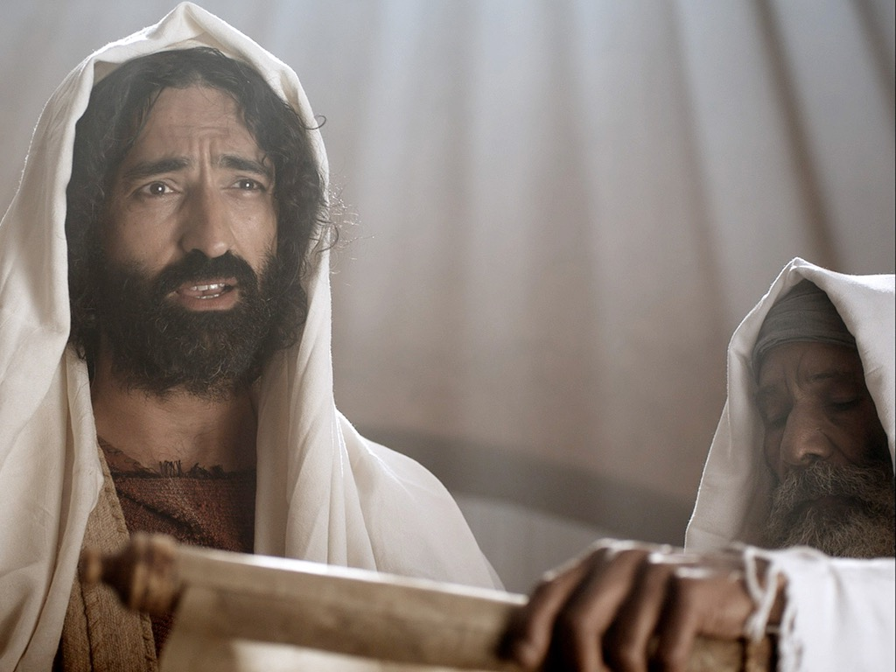
Jesus & Judaism
"Jesus the Jew"
Today shows a renewed scrutiny of ancient Jewish literature and archaeological discoveries.
It has demonstrated the diversity of Judaism in the time of Jesus.
It made clear that Jesus and his disciples were thoroughly Jewish.
Jesus used Hebrew and Aramaic idioms in his teaching.
These teaching methods parallel other teachers and customs of his culture.
Jesus' teaching can be found in other Jewish literature.

Slide 26
Redemption & Vindication
Jesus' death and resurrection are the key elements of his life.
His fulfilled predictions of his own death and resurrection show the trustworthiness of the Gospels.
They were long anticipated from the outset of his ministry—from his temptation to the cross.
His use of "the cup" was a common OT metaphor for judgment and God's wrath (Mark 10:38).

Slide 27
The Lord Supper repeats many of these concepts.
As a Passover meal it suggest the theology of Jesus as the lamb.
The broken bread alludes to death bringing life and God's wrath being placated.
The "blood" symbolizes a life for a life.
Jesus' death inaugurates a new covenant with forgiveness of sin.
The Lord's Supper also looks forward to the coming of the kingdom in all its fullness.

Slide 28
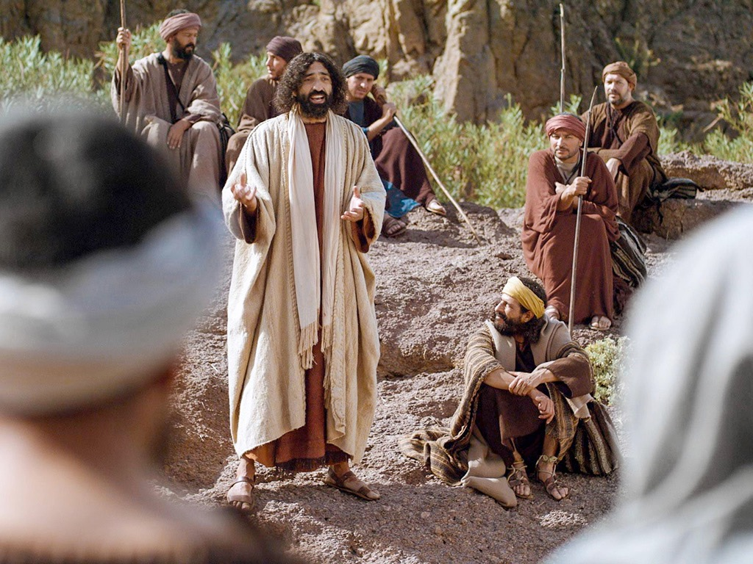
Christology
What was Jesus' self-understanding?

Slide 29
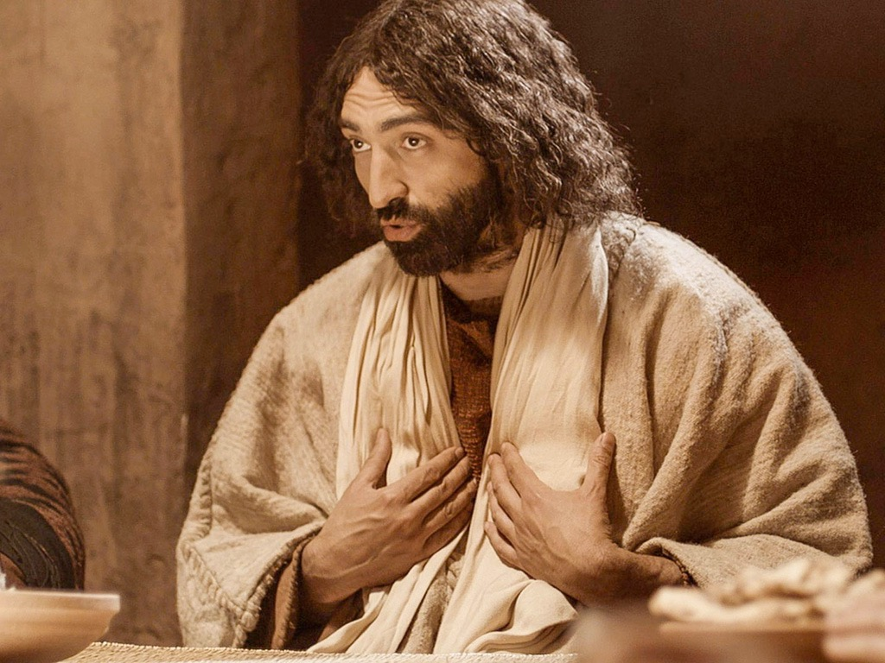
Jesus' Mission
Some question whether Jesus ever knew himself to be the Messiah or to be divine.
But Luke 2:49 ("Don't you know I had to be in my Father's house?") helps us to understand Christ's special relationship with God.
Otherwise very little information about his childhood and young adulthood suggests there was nothing too special about these years.
Jesus' baptism by John marked a dramatic new stage in his life. But how?

Slide 30
God himself commissioned Jesus for his ministry (Mark 1:9-11)
Peter confessed him as Messiah in Caesarea-Philippi
The "Triumphal" entry began the last phase of Jesus' mission
The pilgrim crowd's anticipation contrasted with the leader's hostility leading to crucifixion
Jesus' clearest public self-disclosure came before the Sanhedrin (Mark 14:62)

Slide 31
Jesus' most extensive private self-disclosure came in the Upper Room (John 13:17-18).
Both take place on the last night of his life, and in both cases He was misunderstood.
Christ's identity was only truly understood after the resurrection (Mark 9:9; John 2:22).

Slide 32
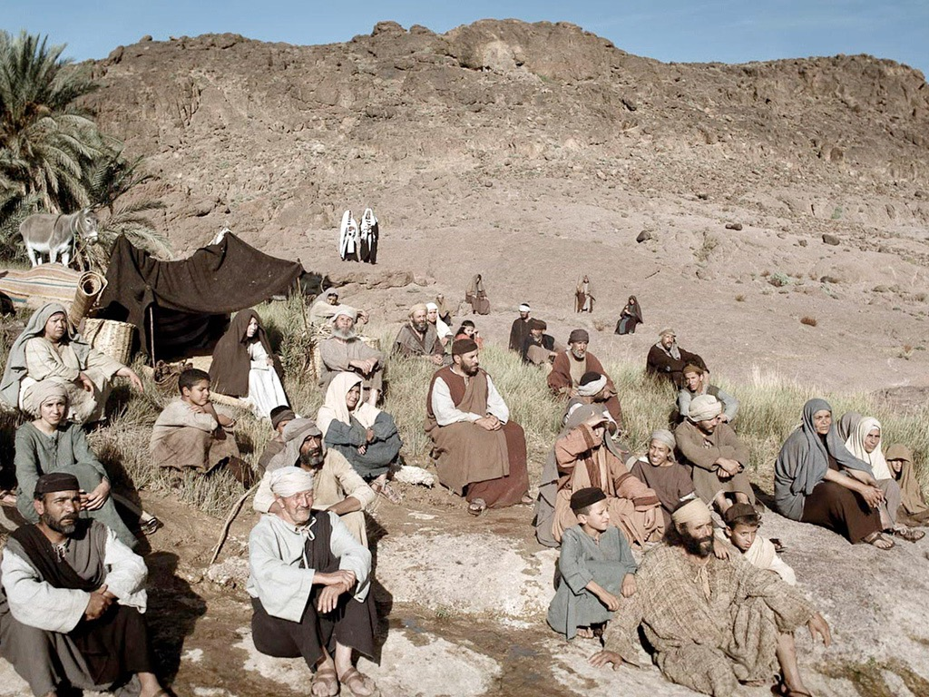
Indirect Evidence
Relationships: The way Jesus interacted with and spoke about others showed that he was "in charge"
Accepted worship, prayer and faith from others
God's Final Eschatological Agent
Authority to forgive sin
Metaphors applied only to Yahweh in the OT

Slide 33
Miracles and the Kingdom
Abba
Amen
The Messianic demonstration of the Final Week
Something Greater
Jesus' supernatural insight

Slide 34
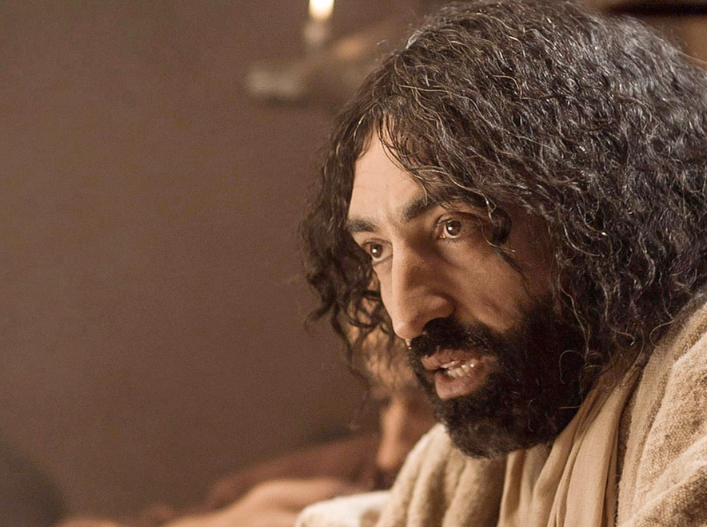
Son of Man
From implicit Christology, we turn to the explicit title used of Jesus.
"Son of Man" was used 82 times in the four Gospels and Acts.
But what did Jesus mean by it?
Bultmann noted, based on Daniel 7:14, that Jesus is the coming Son of Man or Messiah

Slide 35
Ezekiel was called "son of man" in the sense of "mortal human."
Yet "son of man" in Daniel 7:14 does not primarily focus on his true humanity but on his heavenly enthronement as the messianic, suffering Son of Man.

Slide 36
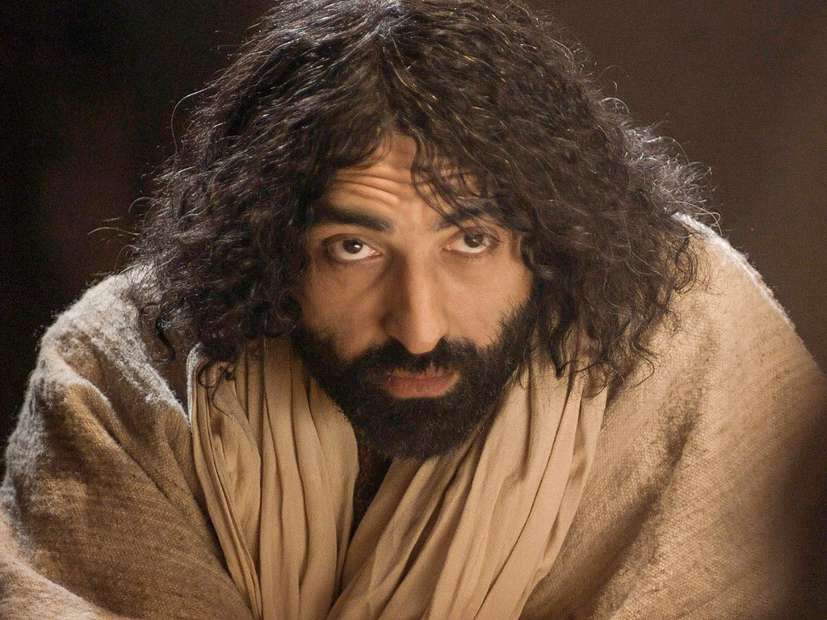
Son of God
"Son of God" is common in the Gospels
Angels predicted that Jesus would be "Son of the Highest" or "Son of God" (Luke 1:32, 35)
After Jesus walked on the water the disciples called Him "the Son of God" (Matt 14:33)

Slide 37
Jesus declared, "All things have been committed to me by my Father. No one knows the Son except the Father, and no one knows the Father except the Son and those to whom the Son chooses to reveal him" (Luke 10:22).
This shows his unique, intimate relationship with God as his heavenly Father.

Slide 38
Lord
In the Roman world, "lord" was a title applied to gods, emperors and human masters.
In the Jewish world, it was one title for Yahweh, God Himself.
Therefore, Jesus as "Lord" was a title of respect that recognized his charisma or authority as God (Mark 11:3)

Slide 39
Messiah
"Messiah" means "anointed one."
Prophets, priests and kings were all anointed at various times throughout the OT.
The OT concept of Messiah came to apply to the kingly line since Nathan had promised David's throne in perpetuity (2 Sam 7:14).
Old Testament kings (present and future) were regularly called "the LORD's anointed."
Even a pagan Persian ruler could be called God's meshiach (Cyrus in Isa 45:1) .

Slide 40
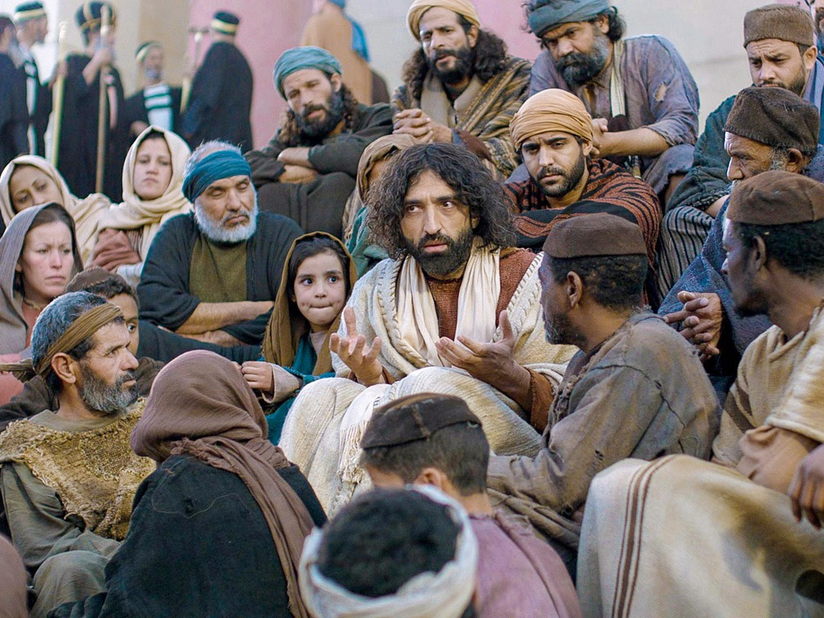
Other Titles
"King of the Jews" (Matt 2:2; 21:5)
"Servant of the Lord" (Mark 10:45; Matt. 12:18-21)
"Teacher" ("rabbi")
"Son of David"
"Savior"
"Lamb of God"

Slide 41
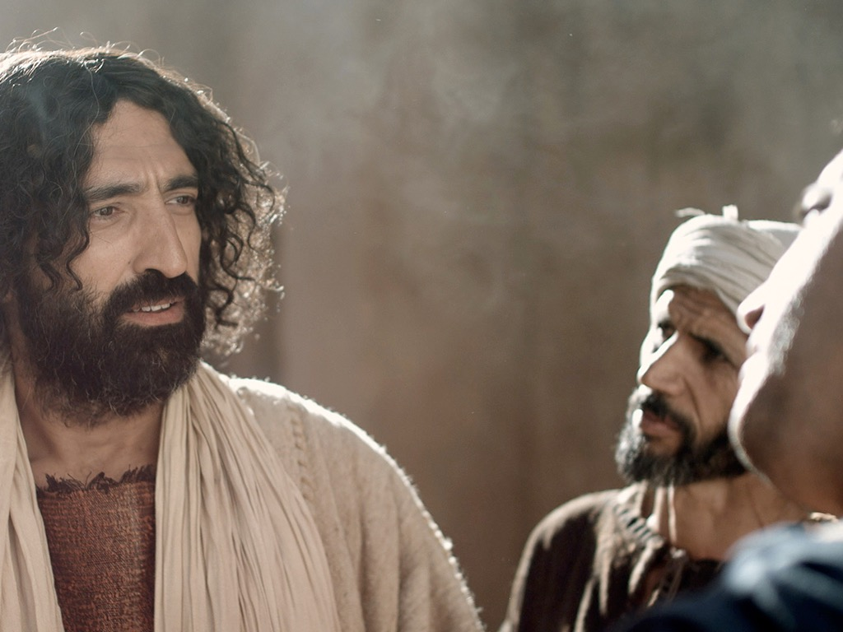
Conclusion
No matter how one views the Gospels…
One impression remains the same: Jesus is the most amazing man ever to live.
Thus, our response to Him is the most important decision we can make in our life.

Slide 42
This response determines our eternal destiny.
We dare not turn his teaching into a new law or legalism.
Rather, we must prepare to carry our own cross, experiencing rejection, hostility, and even martyrdom if necessary.
Simply admiring and imitating Jesus is rejecting him.

Slide 43
THE WORD IN PICTURES
Free Bible images

Slide 44
Used with Permission
THE GOSPEL ——OF—— MATTHEW
THE GOSPEL ——OF—— MARK
THE GOSPEL ——OF—— LUKE
THE GOSPEL ——OF—— JOHN
Due to the Lumo Project producing its own publishing material we regret to inform you that we cannot license our photos to other clients outside of freebibleimages.org.
These images are not licensed for reuse in video, epublishing or other media. Downloaded pictures and files cannot be redistributed through any other website than freebibleimages.org or used in any context where the accompanying message is undermining of the Christian faith and gospel.
Photos can only be used on educational presentations, blogs and social media, all of which should be accompanied with reference to www.LumoProject.com.
Picture courtesy of BBM © All Rights Reserved.
www.bigbookmedia.com

Slide 45
Black

Slide 46
Gospels link at BibleStudyDownloads.org
Get this presentation for free!
Notes:
NT Survey (ns)

