Slide 1
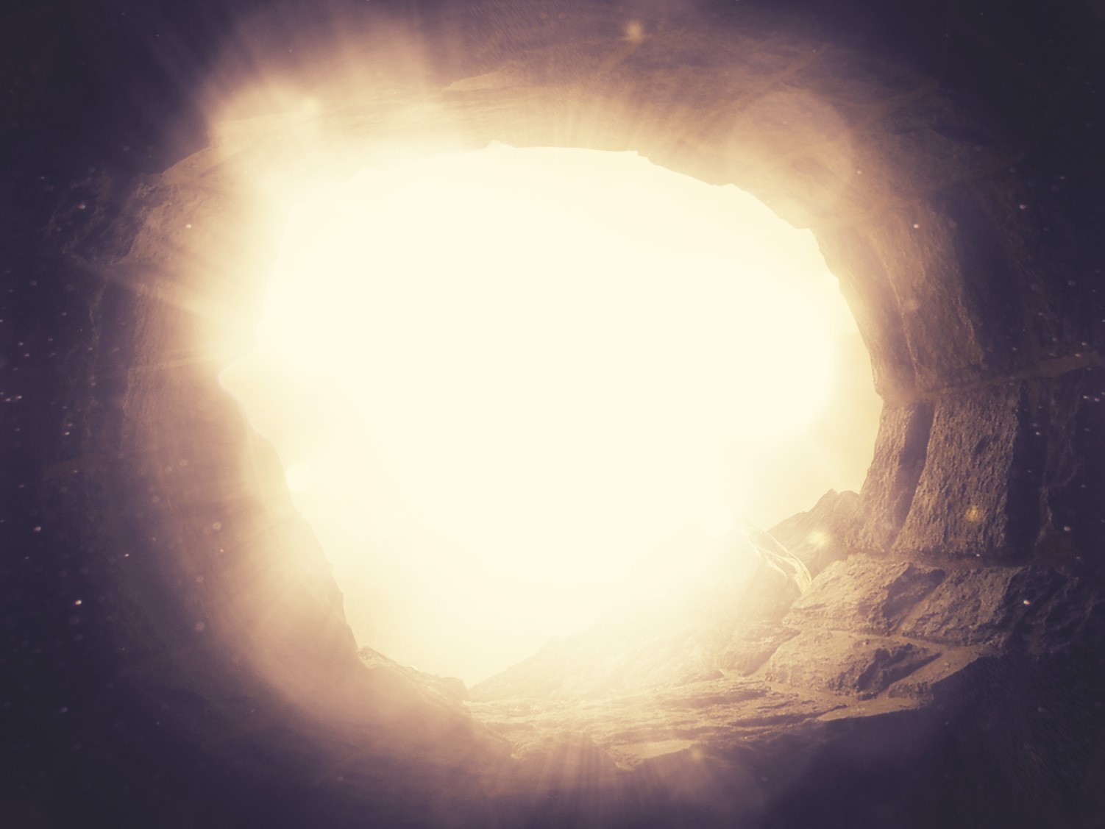
The Resurrection
of the King
§§ 184-198
Section summaries based on J. Dwight Pentecost, A Harmony of the Words and Works of Jesus Christ (Grand Rapids: Zondervan, 1981)
Dr. Rick Griffith • Jordan Evangelical Theological Seminary • BibleStudyDownloads.org

Slide 2
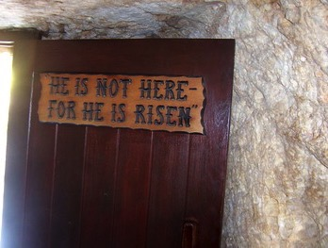
He is not here – for he is risen
What's so important about Christ's resurrection?
Notes:
Small Group Discussion: Why is the resurrection important to you? What is the most important reason?
Rom 1:4 NLT and he was shown to be the Son of God when he was raised from the dead by the power of the Holy Spirit. He is Jesus Christ our Lord.
1Cor. 15:12 But tell me this—since we preach that Christ rose from the dead, why are some of you saying there will be no resurrection of the dead? 13 For if there is no resurrection of the dead, then Christ has not been raised either. 14 And if Christ has not been raised, then all our preaching is useless, and your faith is useless. 15 And we apostles would all be lying about God—for we have said that God raised Christ from the grave. But that can’t be true if there is no resurrection of the dead. 16 And if there is no resurrection of the dead, then Christ has not been raised. 17 And if Christ has not been raised, then your faith is useless and you are still guilty of your sins. 18 In that case, all who have died believing in Christ are lost! 19 And if our hope in Christ is only for this life, we are more to be pitied than anyone in the world.
Anyone who resurrects is greater than Jesus if Jesus did not rise!
Acts 1:1 In my first book, I told you, Theophilus, about everything Jesus began to do and teach 2 until the day he was taken up to heaven after giving his chosen apostles further instructions through the Holy Spirit. 3 During the forty days after he suffered and died, he appeared to the apostles from time to time, and he proved to them in many ways that he was actually alive. And he talked to them about the Kingdom of God.

Slide 3
The Resurrection
of the King
§§ 184-198
Jesus rises to life again as Victor over death to prove his deity and the disciples' proclamation of the gospel to all nations
Section summaries based on J. Dwight Pentecost, A Harmony of the Words and Works of Jesus Christ (Grand Rapids: Zondervan, 1981)
Dr. Rick Griffith • Jordan Evangelical Theological Seminary • BibleStudyDownloads.org
Notes:
Small Group Discussion: Why is the resurrection important to you? What is the most important reason?
Rom 1:4 NLT and he was shown to be the Son of God when he was raised from the dead by the power of the Holy Spirit. He is Jesus Christ our Lord.
1Cor. 15:12 But tell me this—since we preach that Christ rose from the dead, why are some of you saying there will be no resurrection of the dead? 13 For if there is no resurrection of the dead, then Christ has not been raised either. 14 And if Christ has not been raised, then all our preaching is useless, and your faith is useless. 15 And we apostles would all be lying about God—for we have said that God raised Christ from the grave. But that can’t be true if there is no resurrection of the dead. 16 And if there is no resurrection of the dead, then Christ has not been raised. 17 And if Christ has not been raised, then your faith is useless and you are still guilty of your sins. 18 In that case, all who have died believing in Christ are lost! 19 And if our hope in Christ is only for this life, we are more to be pitied than anyone in the world.
Anyone who resurrects is greater than Jesus if Jesus did not rise!
Acts 1:1 In my first book, I told you, Theophilus, about everything Jesus began to do and teach 2 until the day he was taken up to heaven after giving his chosen apostles further instructions through the Holy Spirit. 3 During the forty days after he suffered and died, he appeared to the apostles from time to time, and he proved to them in many ways that he was actually alive. And he talked to them about the Kingdom of God.

Slide 4
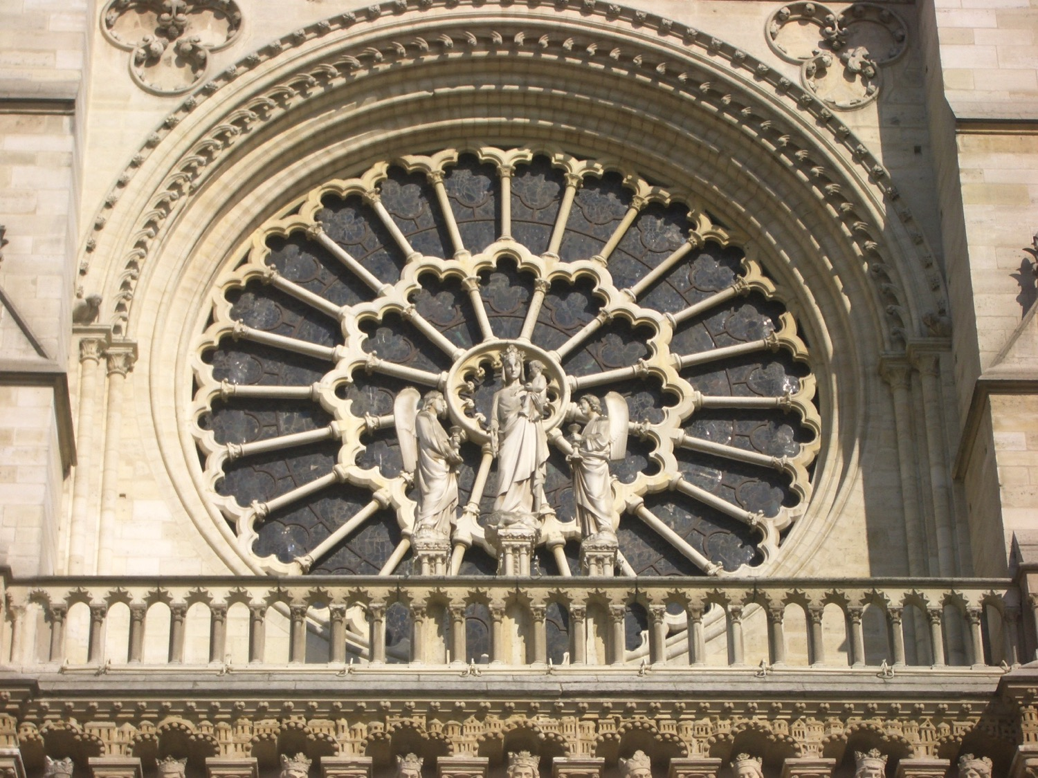
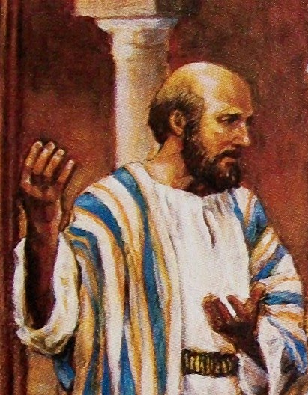
Key Characteristics of Acts
123
  Kingdom
  Significance
  Interpretation
  Superb Style
  Universal message
  Holy Spirit
  Gentile
  Comprehensive
  Sermons
Notes:
Sermons play a very important role in the chronology, with 24 of the 28 chapters including a sermon or a portion of one.

Slide 5
Sermons in the Book of Acts
136
Acts 2:14-39
Acts 13:16-41
Acts 17:21-31
Speaker
Peter
Paul
Paul
Audience
Jews
Jews and God-fearing Gentiles
Pagan Gentiles
City
Jerusalem
Antioch
Athens
Place
House (v. 2) at the Temple (Luke 24:53)?
Synagogue
Aeropause Meeting
Type of Place
Religious
Religious
Secular
Time
Day of Pentecost
1st Missionary Journey
2nd Missionary Journey
Subject (theme)
Why do some miraculously speak unknown languages?
The fulfillment of Israel's national history
The reason idolatry is unreasonable
Complement
The Spirit indwells them through Jesus, their living Messiah
is in Jesus as our risen Savior who is worthy of our trust
is because the unknown God is Creator & Judge

Slide 6
Sermons in the Book of Acts
136
Short Idea
Jesus is Messiah (36)
Believe in Jesus (39)
Flee idolatry (30)
Application Structure
Simple–application at the end (38-39)
Cyclical–application in centre (26) & end (38-41)
Simple–application at the end (30-31)
Main Idea Structure
Inductive (36)
Inductive (23)-Deductive (24-37)
Deductive (24)
Type
Topical-Biblical
Expositional
Topical-Secular
Style
Extemporaneous
Narrative
Reasoned polemic
Introduction
"Ho Hum!"
(How he gets attention)
Cites a recent event: Spirit baptism
(14-15)
Tells a familiar story: This identifies with listeners (16-22)
Notes local interest item: altar to an unknown god (22-23)
Thrust of Introduction
"Why do you think these people appear drunk?"
"I'm an informed Jew who also has longed for the Messiah"
"I have been observing your town"
How the Speaker Draws in His Listeners
Raises curiosity re: miraculous speaking in other languages
Raises curiosity re: how his Judaism differs from theirs
Raises curiosity about who the unknown God is

Slide 7
Sermons in the Book of Acts
136
Body
"The Spirit descended from the risen Messiah Jesus" (16-36)
"Jesus is Israel's risen Messiah"
(23-37)
"Idolatry is incompatible with the living creator God" (24-28)
Illustration Sources
Scripture (Joel 2:28-32; Ps. 16:8-11; 110:1)
Scripture (Ps. 2:7; 16:10; Isa. 55:3;
Hab. 1:5)
Secular (v. 28: poets Epimenides & Aratus)
Resurrection of Christ Noted
Extensive with scriptural support (24-32)
Extensive with scriptural support (30-37)
Brief & no mention of Jesus' name (31)
Conclusion
Main Idea: Jesus is the Messiah (36)
Scripture: Habakkuk 1:5 quoted: "I will do something that you won't believe" (41)
Burning questions: "Who will judge us?" and "Who is it who was raised?" (31)
Application
Indirect: Implications left to them: "How can we be saved?" (37)
Direct: "You can be forgiven" so "don't scoff" (38, 40)
Direct: God "commands all... everywhere to repent [of idolatry]" (30)
Result
3000 saved
(41)
Invited again, some believed, he turned to Gentiles
(42-48)
Many believed but others sneered
(32-34)

Slide 8
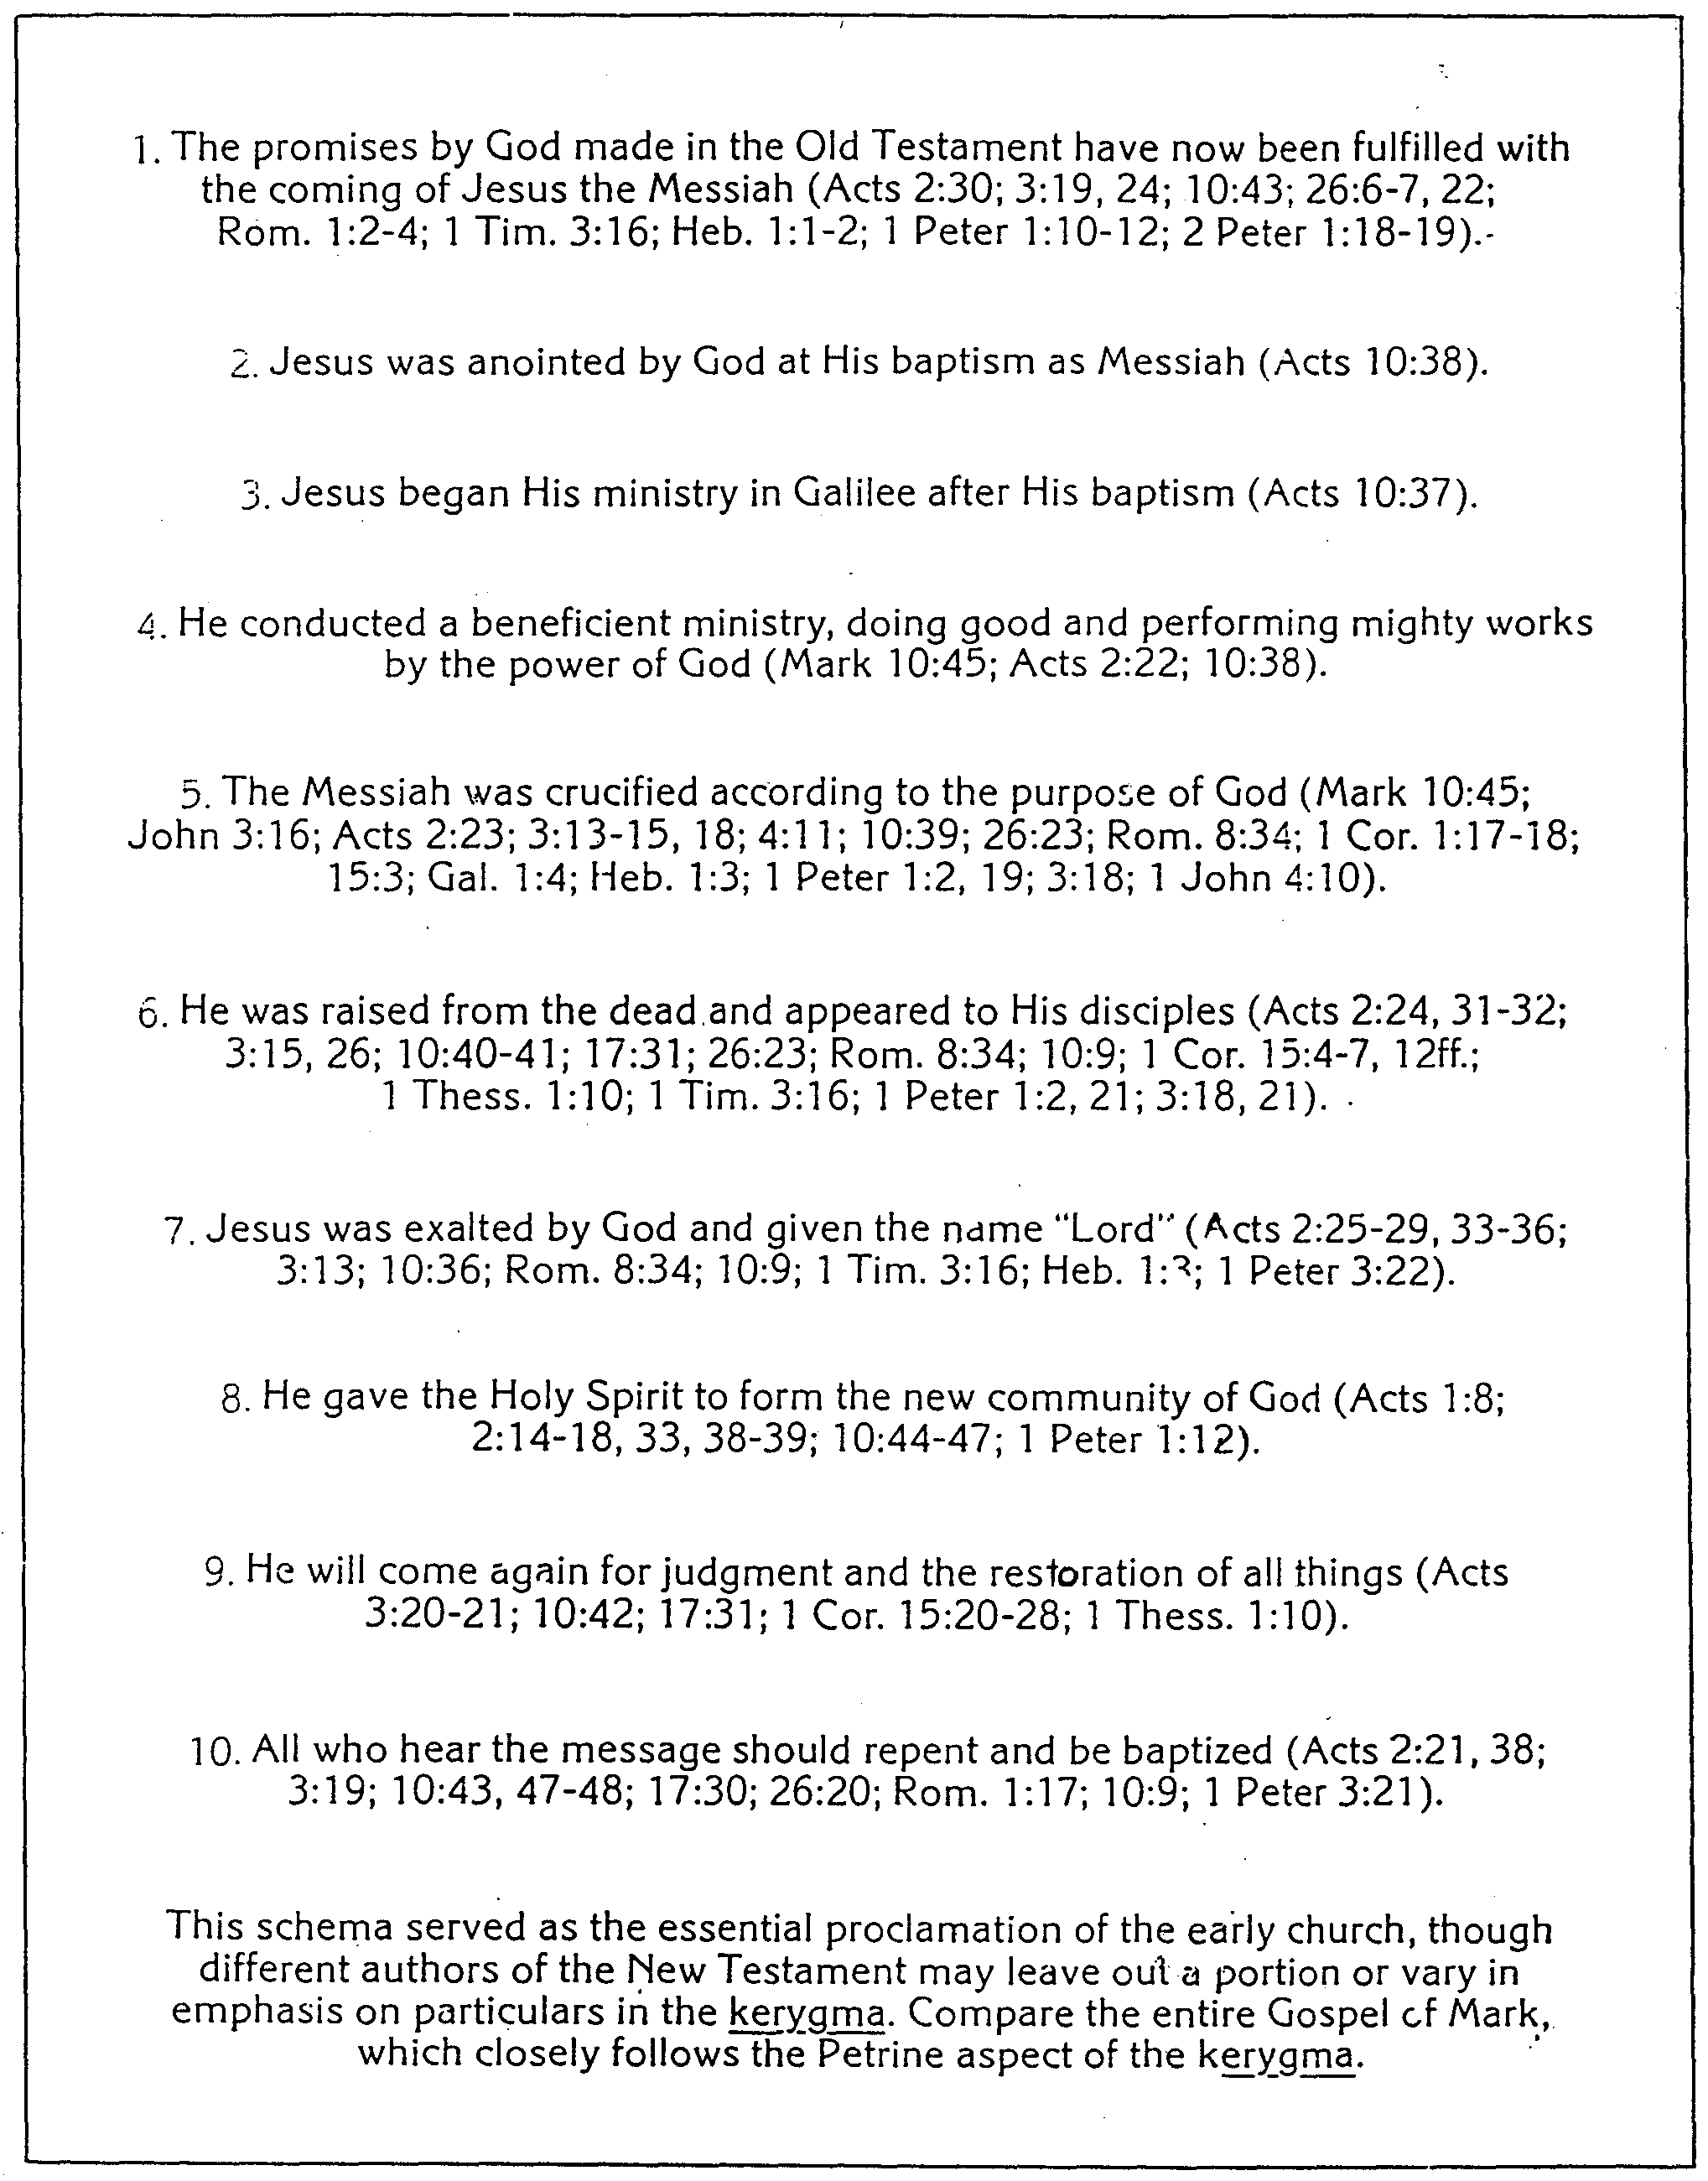
The Kerygma ("Proclamation") of the Early Church
137
Resurrection!
H. Wayne House, Chronological Charts of the NT
Notes:
The Kerygma* of the Early Church
H. Wayne House, Chronological Charts of the NT
* Kerygma (Gr. κήρυγμα) is a noun that means “what is preached, message, proclamation.”

Slide 9
Pentecost Outline
Introduction of the King
Authentication of the King
Controversy over the King
Instruction of the Twelve by the King
Opposition to the King
Preparation of the Disciples by the King
Official Presentation of the King
Preparation for the Death of the King
Rejection of the King
Resurrection of the King

Slide 10

Increasing Polarization
Resurrection
Preparation
for Death
Preparation
of Disciples
Instruction
Authentication
Introduction
Controversy
Opposition
Presentation
Rejection
Notes:
The Life of Christ brought increasing polarization. The more Jesus showed about himself, the greater the resistance to him and his message. Also, the more intense the controversy leading to opposition, the higher priority Christ placed on preparing his men for when he would be gone. The climactic rejection when he presented himself as king of Israel at the Triumphal Entry resulted in rejection to the point of crucifixion followed by the victory of resurrection.
Introduction of the King
Authentication of the King
Controversy over the King
Instruction of the Twelve by the King
Opposition to the King
Preparation of the Disciples by the King
Official Presentation of the King
Preparation for the Death of the King
Rejection of the King
Resurrection of the King

Slide 11
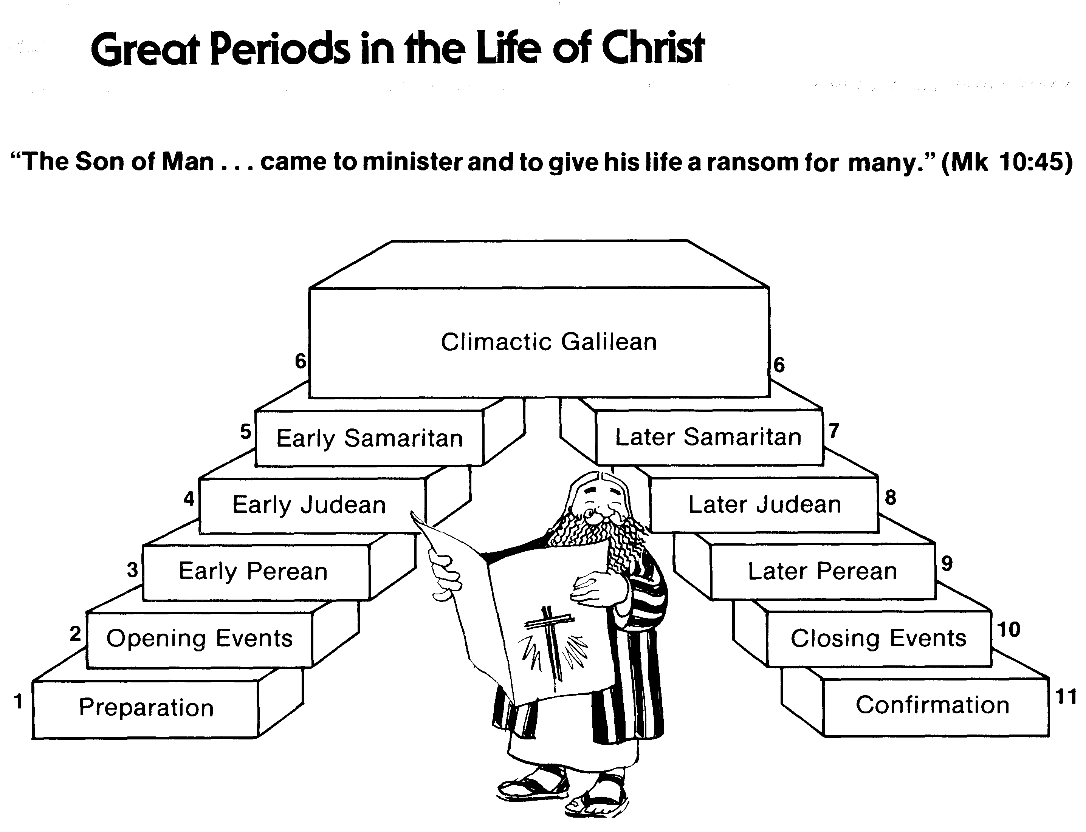
Great Periods in the Life of Christ
55
“The Son of Man… came to minister and to give his life a ransom for many” (Mark 10:45)
Climactic Galilean
Early Samaritan
Later Samaritan
Early Judean
Later Judean
Early Perean
Later Perean
Opening Events
Closing Events
Preparation
Confirmation
Walk Thru the New Testament seminar (used with permission)
Notes:
The Walk Thru outline of the life of Christ forms a chiasm or literary arrangement with repeating elements in the opposite order. This structure makes Confirmation parallel to Preparation, Closing Events parallel to Opening Events, etc. until the only event without parallel becomes the focus: Climatic Galilean. Such an arrangement of material was common in antiquity and is seen in both the OT (e.g., Zephaniah) and the NT (1 Thess) where the central teaching appears in the middle of each writing.
Small Group Assignment: Explain this slide to your group member(s) and have the others explain it back.
After the beginning events of stages 1-3, Jesus also gets farther away from his Jewish roots in Judea (4), to go to the Samaritans (5), and even farther to Galilee (6), where most Gentiles lived. He ministered to Jews in Galilee, of course, but this climatic period was the focus of his ministry.
_______
LC-00-Syllabus-63
LC-01-Introduction-265
LC-05-Opposition-4

Slide 12
Resurrection Appearances of Jesus
105
To… | Time | Matt | Mark | Luke | John | Acts | 1 Cor
Roman guards at tomb | Sunday morning | 28:4, 11-15
Women at the tomb | Sunday morning | 28:1-10 | 16:1-8 | 24:1-12 | 20:1-9
Mary Magdalene alone | Sunday morning |  | 16:9-11 |  | 20:11-18
2 Emmaus Road Travelers | Sunday midday |  |  | 24:13-35
Peter in Jerusalem | Sunday daytime |  |  | 24:34 |  |  | 15:5
10 Disciples in the upper room (excluding Thomas) | Sunday evening |  | 16:14 | 24:36-43 | 20:19-25
11 Disciples in the upper room (including Thomas) | One week later |  |  |  | 10:26-31 |  | 15:5
7 Disciples fishing on the Sea of Galilee | One day at daybreak |  |  |  | 21:1-23
11 Disciples on the mountain in Galilee | Later | 28:16-20 | 16:15-18
More than 500 believers | Later |  |  |  |  |  | 15:6
James, Brother of Jesus | Later |  |  |  |  |  | 15:7
11 Disciples at the Ascension on Mt. Olives | 40 days after resurrection |  |  | 24:44-49 |  | 1:3-8
Notes:
Should we consider the guards witnesses of the resurrection? The text does not say that they saw Jesus, but they certainly saw many things that no one else saw!
_______
The Resurrection
Matt. 28:1 Early on Sunday morning, as the new day was dawning, Mary Magdalene and the other Mary went out to visit the tomb.
Matt. 28:2 Suddenly there was a great earthquake! For an angel of the Lord came down from heaven, rolled aside the stone, and sat on it. ³ His face shone like lightning, and his clothing was as white as snow. ⁴ The guards shook with fear when they saw him, and they fell into a dead faint.
Matt. 28:5 Then the angel spoke to the women. “Don’t be afraid!” he said. “I know you are looking for Jesus, who was crucified. ⁶ He isn’t here! He is risen from the dead, just as he said would happen. Come, see where his body was lying. ⁷ And now, go quickly and tell his disciples that he has risen from the dead, and he is going ahead of you to Galilee. You will see him there. Remember what I have told you.”
Matt. 28:8 The women ran quickly from the tomb. They were very frightened but also filled with great joy, and they rushed to give the disciples the angel’s message. ⁹ And as they went, Jesus met them and greeted them. And they ran to him, grasped his feet, and worshiped him. ¹⁰ Then Jesus said to them, “Don’t be afraid! Go tell my brothers to leave for Galilee, and they will see me there.”
The Report of the Guard
Matt. 28:11 As the women were on their way, some of the guards went into the city and told the leading priests what had happened. ¹² A meeting with the elders was called, and they decided to give the soldiers a large bribe. ¹³ They told the soldiers, “You must say, ‘Jesus’ disciples came during the night while we were sleeping, and they stole his body.’ ¹⁴ If the governor hears about it, we’ll stand up for you so you won’t get in trouble.” ¹⁵ So the guards accepted the bribe and said what they were told to say. Their story spread widely among the Jews, and they still tell it today.

Slide 13
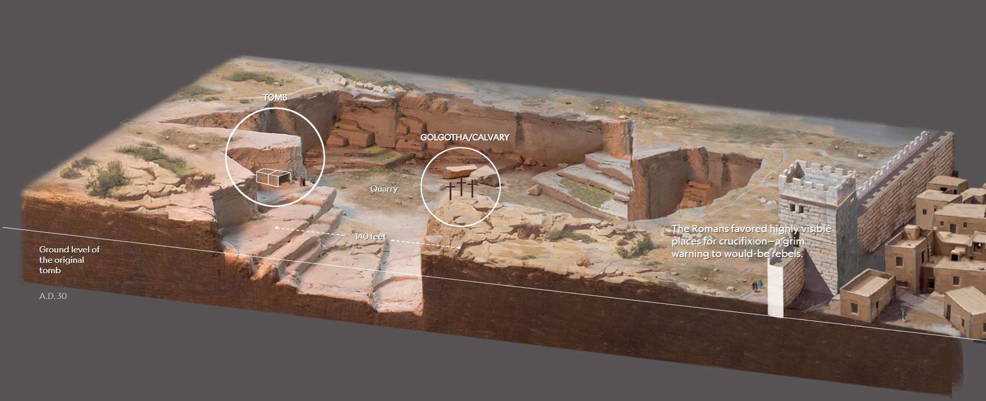
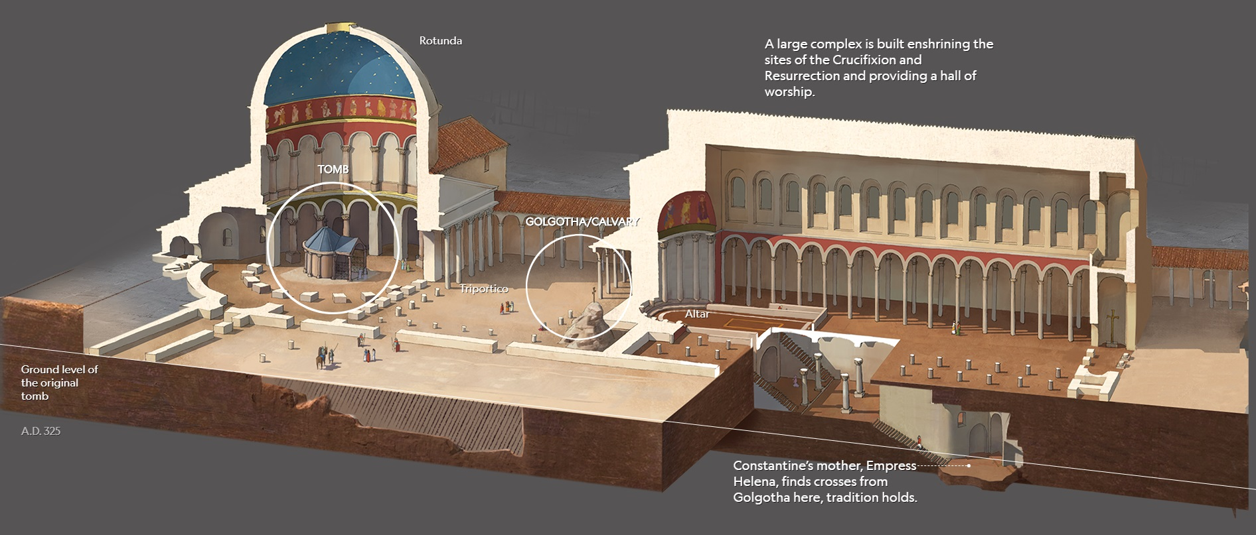
Tomb
Golgotha/Calvary
Quarry
---------------140 feet-------------
The Romans favored highly visible places for crucifixion—a grim warning to would-be rebels.
Ground level of the original tomb
AD 33
Rotunda
A large complex is built enshrining the sites of the Crucifixion and Resurrection and providing a hall of worship
AD 325
Tomb
Golgotha/Calvary
Triportico
Altar
Ground level of the original tomb
AD 325
Tradition holds Constantine's mother, Empress Helena, found crosses from Golgotha here.
Notes:
Jesus died at a public execution spot near the north-south road outside the western city wall. He was buried on the opposite end of a stone quarry, yet only 140 feet away. Until AD 44 when another wall on the west enclosed them, these locations lay outside the walls at the time of the Crucifixion.
In the following 300 years, various buildings identified Golgotha, including Emperor Hadrian's marble statue of Venus. These developments confirmed the real location of the crucifixion. See the Expedition Bible video by Joel Kramer at https://www.youtube.com/watch?v=ufVXZBrbSsU
After Constantine professed Christianity, his mother Helena visited Jerusalem and was disappointed to see such a small memorial to Jesus's death and resurrection.
• So, Queen Mother Helena embarked on a significant building project. She filled in the quarry to make the Triportico enclosed the tomb under a massive rotunda, as well as constructed a large worship hall extending to Golgotha, a hil which was cut away up to the crucifixion spot itself. The Triportico enabled people at Golgotha to see across a flat area to the tomb on what had been the opposite hill for centuries.
reasonandscience.catsboard.com

Slide 14
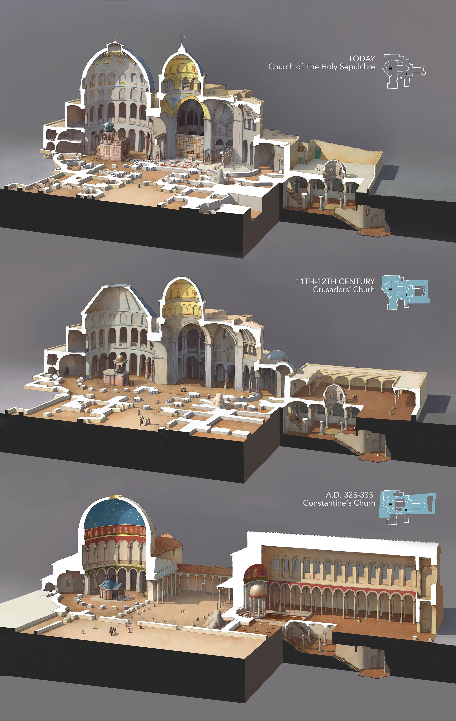
The Tomb & Golgotha Over Time
TODAY
Church of the Holy Sepulchre
Today
11TH-12TH CENTURY
Crusader Church
11th-12th Centuries
AD 325-335
Constantine's Church
AD 325
Notes:
The Holy Sepulchre through the time
Collaboration for National Geographic magazine, December 2017.
Three of the four buildings which have been built through the time on the Holy Sepulchre.
(This article's illustrations were prizewinning by the SND39 and Malofiej26 contests with silver medals)
https://rocioespin.artstation.com/projects/Q58nZ
Accessed 18 May 2024

Slide 15
AD 325-335 Constantine's Church
(Open air Triportico)
Floor Plan
Notes:
The Holy Sepulchre through the time
Collaboration for National Geographic magazine, December 2017.
Three of the four buildings which have been built through the time on the Holy Sepulchre.
(This article's illustrations were prizewinning by the SND39 and Malofiej26 contests with silver medals)
https://rocioespin.artstation.com/projects/Q58nZ
Accessed 18 May 2024

Slide 16
11th-12th Cent. Crusader Church
(Enclosed Triportico)
Floor Plan
Notes:
The Holy Sepulchre through the time
Collaboration for National Geographic magazine, December 2017.
Three of the four buildings which have been built through the time on the Holy Sepulchre.
(This article's illustrations were prizewinning by the SND39 and Malofiej26 contests with silver medals)
https://rocioespin.artstation.com/projects/Q58nZ
Accessed 18 May 2024

Slide 17
Church of the Holy Sepulchre
(Embellished Domes Today)
Floor Plan
Notes:
The Holy Sepulchre through the time
Collaboration for National Geographic magazine, December 2017.
Three of the four buildings which have been built through the time on the Holy Sepulchre.
(This article's illustrations were prizewinning by the SND39 and Malofiej26 contests with silver medals)
https://rocioespin.artstation.com/projects/Q58nZ
Accessed 18 May 2024

Slide 18
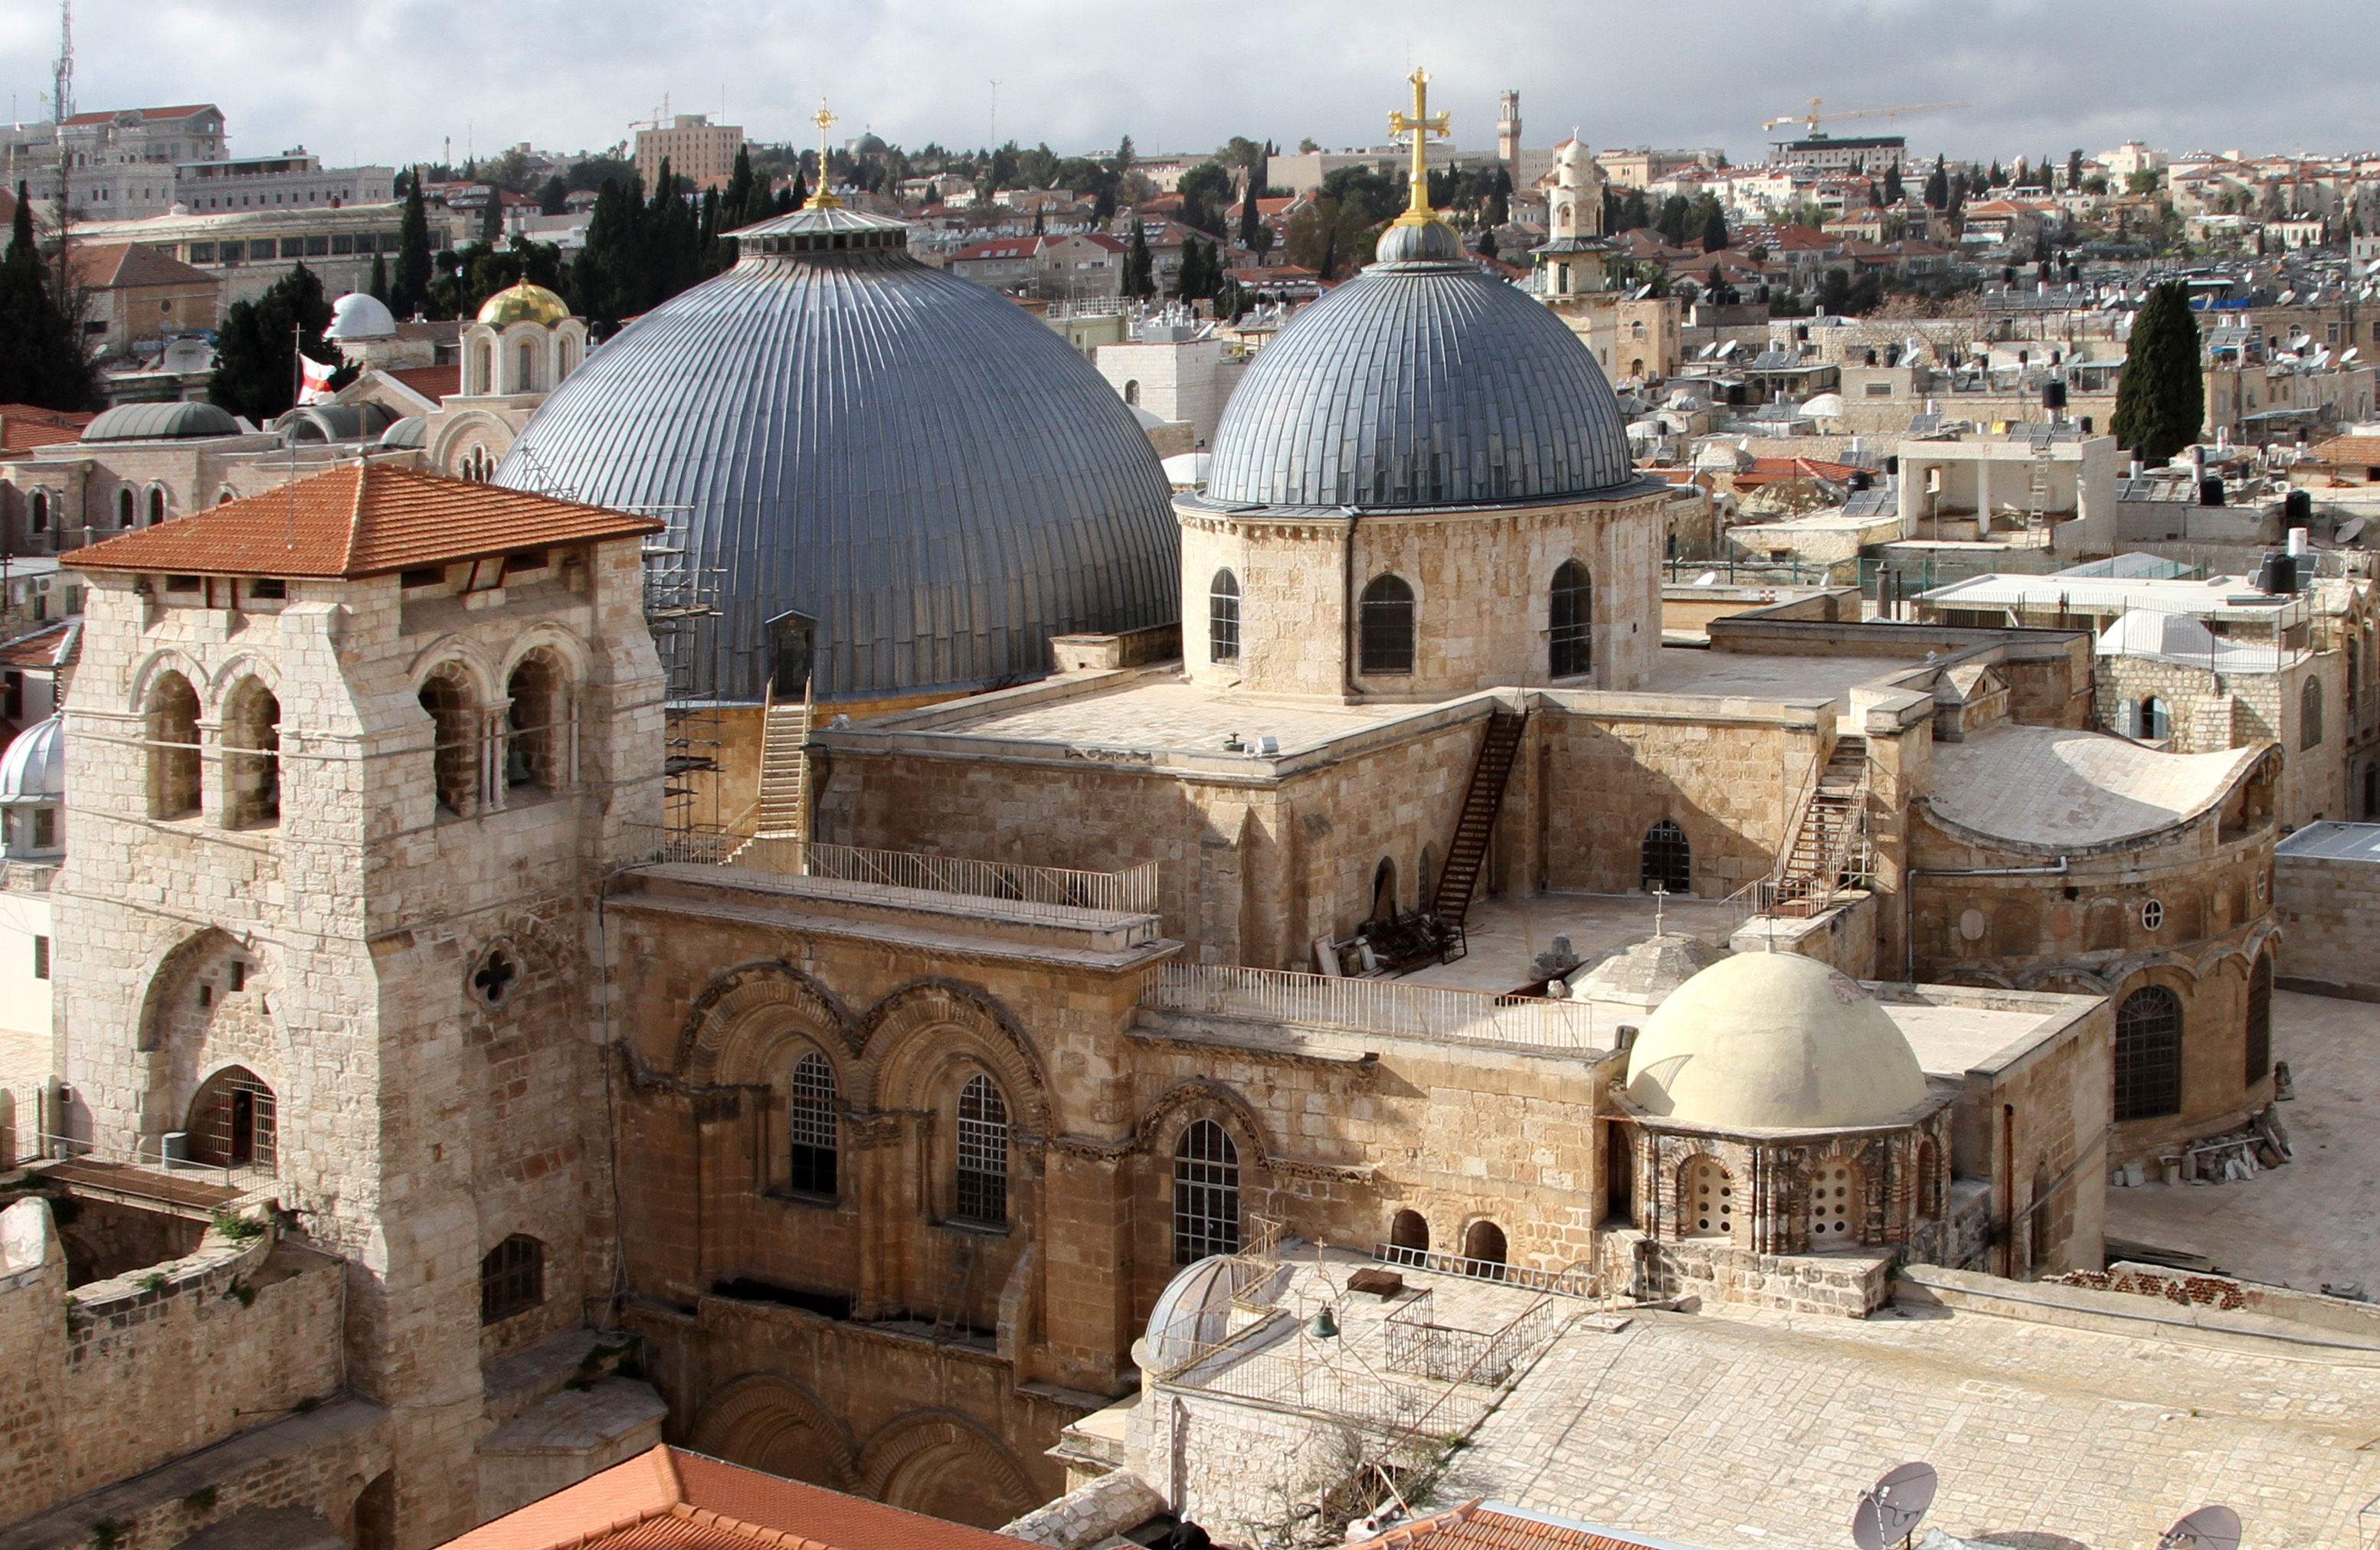
Church of the Holy Sepulchre
(Embellished Domes Today)
Notes:
The Holy Sepulchre through the time
Collaboration for National Geographic magazine, December 2017.
Three of the four buildings which have been built through the time on the Holy Sepulchre.
(This article's illustrations were prizewinning by the SND39 and Malofiej26 contests with silver medals)
https://rocioespin.artstation.com/projects/Q58nZ
Accessed 18 May 2024

Slide 19
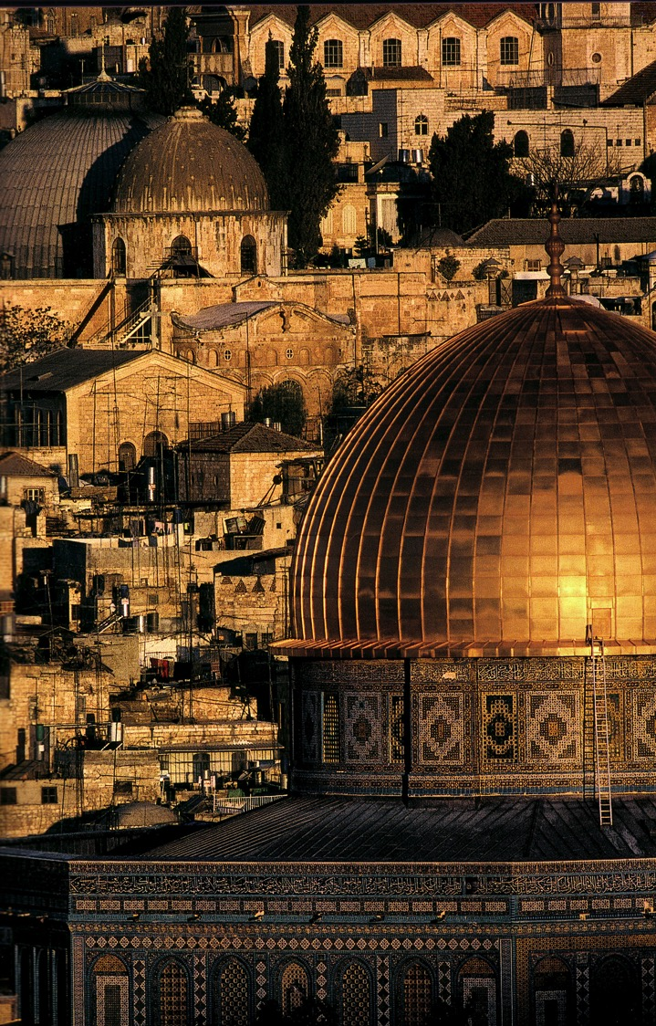
A Dome to Outshine the Dome
Notes:
In the 1990s, King Hussein of Jordan had the Dome of the Rock covered in gold to shimmer in the sun, especially compared to the double-domed Church of the Holy Sepulchre.

Slide 20
A. The Preparation by the Women
§ 184
Matthew 28:1; Mark 16:1
After the Sabbath, early Sunday morning Mary Magdalene, Mary the mother of James, and Salome go to the tomb to anoint Jesus' body
Notes:
Matt. 28:1 Early on Sunday morning, as the new day was dawning, Mary Magdalene and the other Mary went out to visit the tomb.
Mark 16:1 Saturday evening, when the Sabbath ended, Mary Magdalene, Mary the mother of James, and Salome went out and purchased burial spices so they could anoint Jesus’ body.
Mary of Bethany had already anointed Jesus for burial, but these women wanted to show respect for Jesus.

Slide 21
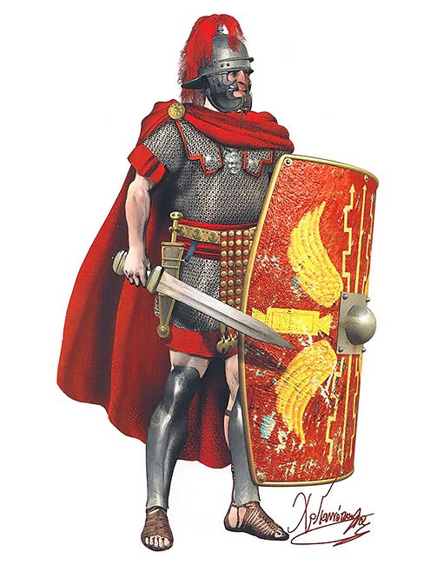
Roman Soldier
Notes:
We have feminized Roman soldiers in our day to the extent that those guarding the tomb are reduced to two men in miniskirts. Nothing could be further from the truth! A single Roman soldier was trained to repel an oncoming army by holding his ground at any cost.

Slide 22
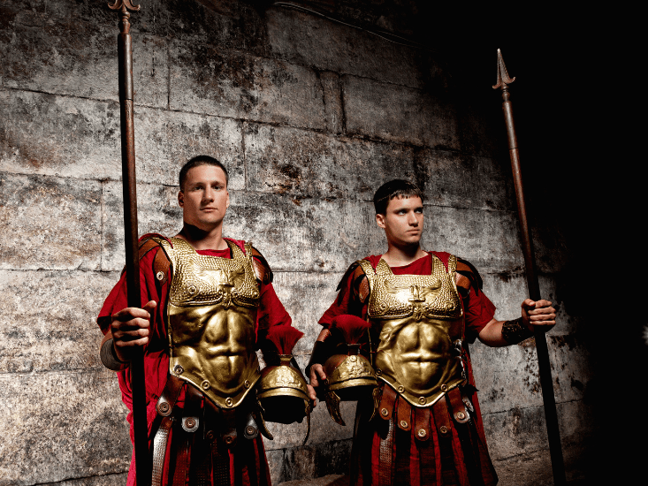
The Roman seal prevented tampering
Notes:
22
22
Guards at the tomb were threatened with death for allowing anyone to touch the body.

Slide 23
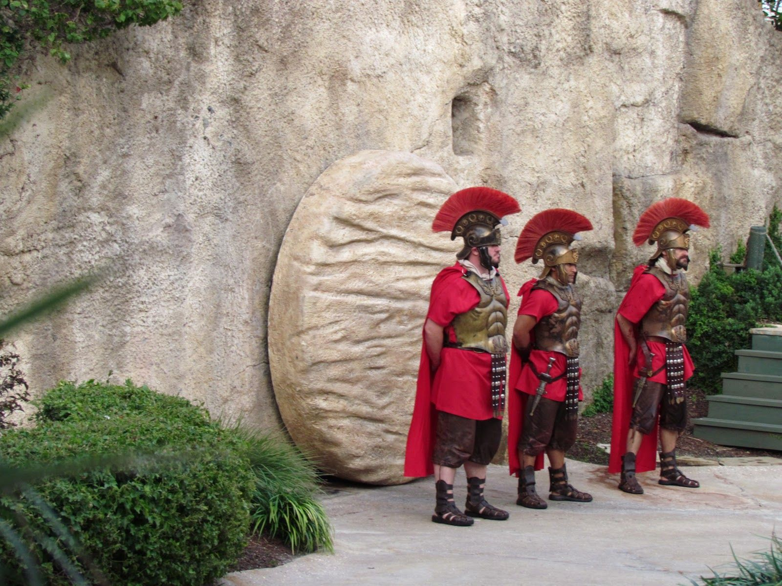
The Roman seal prevented tampering
Notes:
23
23
They would also be killed for falling asleep on duty, so you can be sure they did not allow a single one among them to fall asleep.

Slide 24
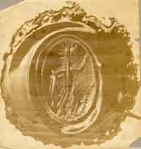
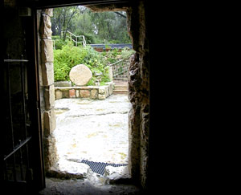
The Roman seal prevented tampering
Notes:
24
24
Death would ensue if the Roman seal were allowed to be broken.

Slide 25
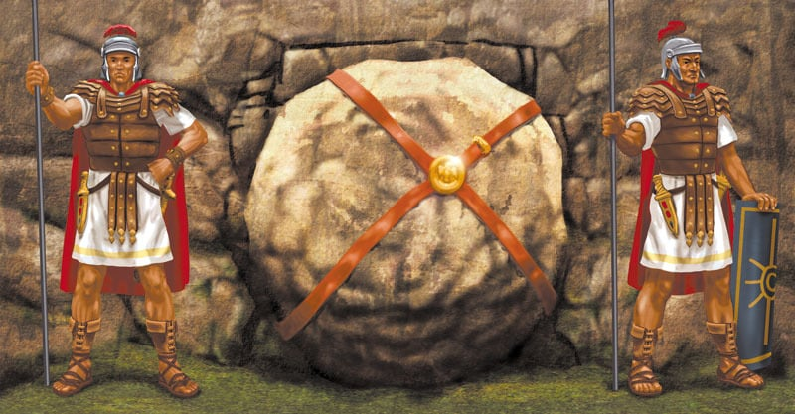
The Roman seal prevented tampering
Notes:
25
25
The seal stretched tightly over the stone so that any movement of the stone would break the wax seal.

Slide 26
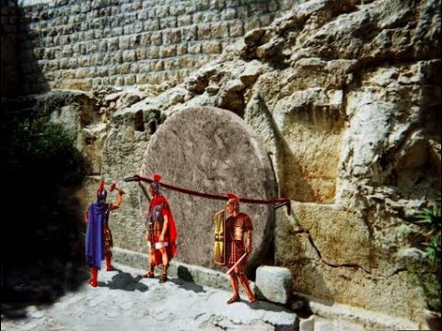
The Roman seal prevented tampering
Notes:
26
26
Acts 12 shows 16 guards over Peter, and all were executed after he escaped. It is likely that there also were 16 men guarding the tomb of Jesus.

Slide 27
B. The Opening of the Tomb
§ 185
Matthew 28:2-4
Christ resurrects with an earthquake, an angel rolling back the stone to show the tomb empty, and Roman guards as witnesses
Notes:
Christ resurrects when in a violent earthquake an angel rolls back the stone and sits upon it so that witnesses may see that Christ's body is gone, the angel's glory scaring the Roman guard so that they at first shook, then became as corpses, then left the site
_____________
Matt. 28:2 Suddenly there was a great earthquake! For an angel of the Lord came down from heaven, rolled aside the stone, and sat on it. ³ His face shone like lightning, and his clothing was as white as snow. ⁴ The guards shook with fear when they saw him, and they fell into a dead faint.

Slide 28
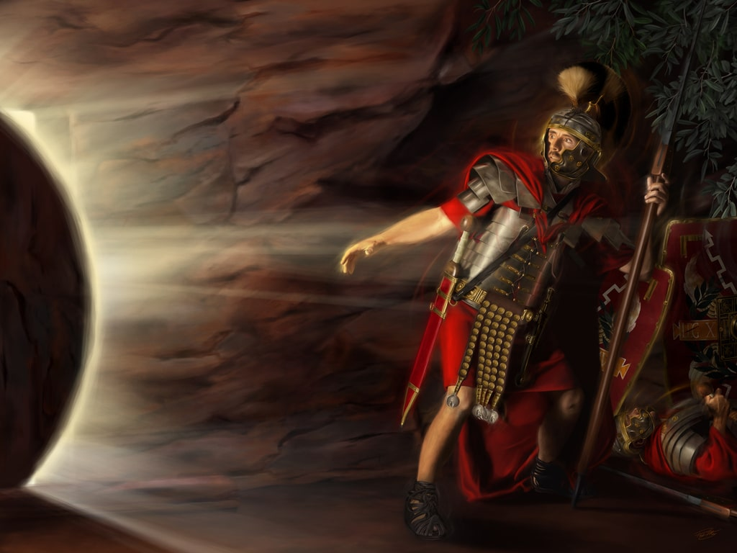
The Roman seal prevented tampering
Notes:
28
28
Matt. 28:1 Early on Sunday morning, as the new day was dawning, Mary Magdalene and the other Mary went out to visit the tomb.
Matt. 28:2 Suddenly, there was a great earthquake! For an angel of the Lord came down from heaven, rolled aside the stone, and sat on it. ³ His face shone like lightning, and his clothing was as white as snow. ⁴ The guards shook with fear when they saw him, and they fell into a dead faint.
They saw the angel, but we don’t know if they saw Jesus.

Slide 29
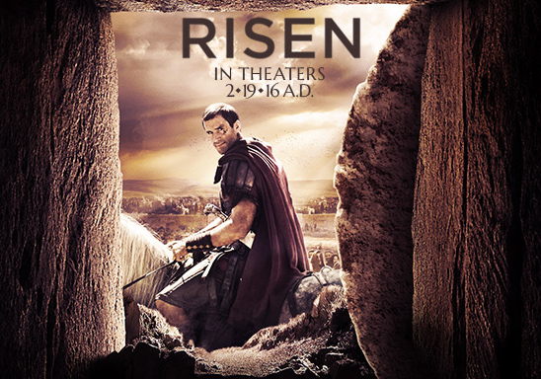
The 2016 movie Risen highlights the plight of the centurion over the soldiers looking for the body
Notes:
29
29
He receives the truth from the soldiers but cannot believe that Jesus rose from the dead, so he also interviews disciples who saw Jesus alive. Eventually, he, too, believes in Jesus, as he cannot explain away the overwhelming evidence for the resurrection.
See https://www.youtube.com/watch?v=pL2viqqJ26U
Turn on Arabic subtitles
The questioner concludes by asking the centurion, "What frightens you?"
His response: "Being wrong, and wagering eternity on it."
But God did not have any resurrection appearances to unbelievers. Why not?
Just as in Matthew 2, neither the Romans nor the Jews looked for the body of Jesus.
Acts 10:40 but God raised him to life on the third day. Then God allowed him to appear, 41 not to the general public, but to us whom God had chosen in advance to be his witnesses. We were those who ate and drank with him after he rose from the dead. 42 And he ordered us to preach everywhere and to testify that Jesus is the one appointed by God to be the judge of all—the living and the dead.
Luke 16:30 “The rich man replied, ‘No, Father Abraham! But if someone is sent to them from the dead, then they will repent of their sins and turn to God.’
Luke 16:31 “But Abraham said, ‘If they won’t listen to Moses and the prophets, they won’t be persuaded even if someone rises from the dead.’”
John 11—They also had witnesses to the rising of Lazarus but tried to kill him!

Slide 30
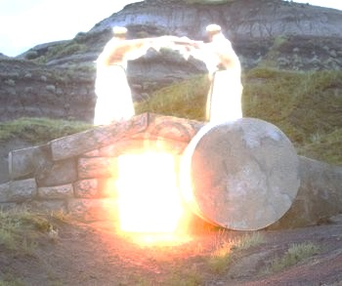
I. The empty tomb shows that Christ is alive today
(John 20:1-9).
Notes:
No one but God can bring the dead back to life. Jesus even repeatedly predicted in advance that he would die and rise again so that his followers would believe.

Slide 31
“The Gospel of John” ® Movie
John 20:1-9
Notes:
31

Slide 32
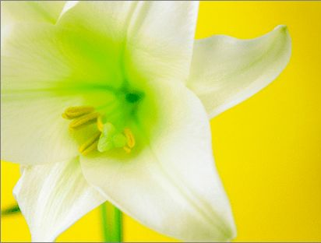
Three Initial Witnesses
(John 20)
Mary (1-2)
John (3-5)
Peter (6-9)

Slide 33
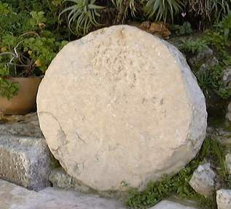
The stone was rolled away…
Notes:
33
33

Slide 34
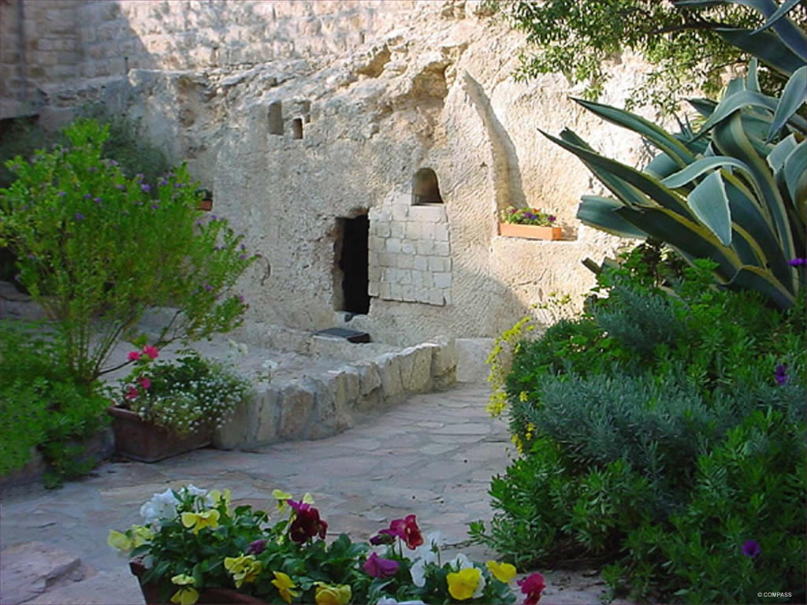
The Garden Tomb
Notes:
34
34

Slide 35
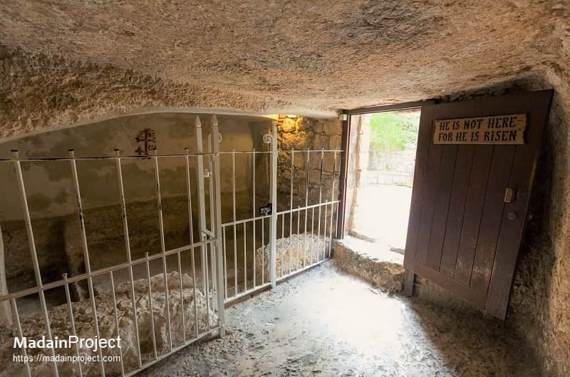
The Garden Tomb
Notes:
Inside the tomb, we see that it is small, with bars constructed to keep people from the slab that holds the body.

Slide 36
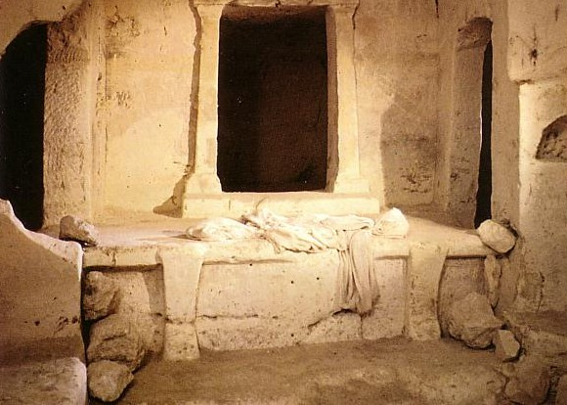
Empty linens

Slide 37
C. The Visit of the Women
§ 186
Matthew 28:5-8; Mark 16:2-8; Luke 24:1-8; John 20:1
The women see an open tomb and angels who herald Christ's resurrection, commanding them for the disciples to meet Jesus in Galilee

Slide 38
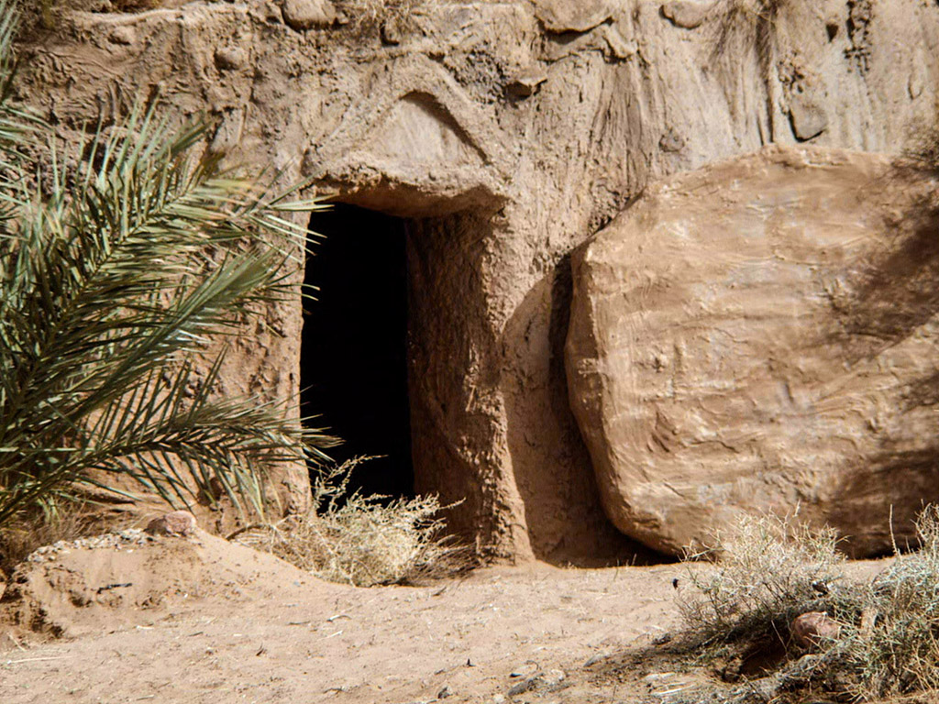

Matthew 28:1-15
Mark 16:1-20
Luke 24:1-47
John 20:1-29
Free
Bible
images
THE EASTER STORY
JESUS IS ALIVE

Slide 39
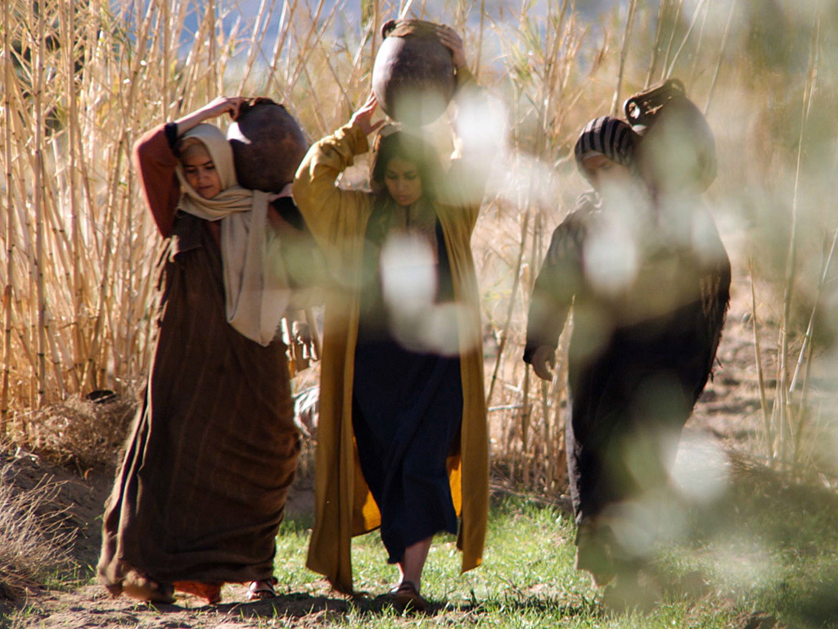
Notes:
The three women did not expect a resurrection. They expected a dead body that needed spices that they could not anoint on Friday night. They probably wondered how to convince the Roman guard to break the seal to give them access to the body.

Slide 40
Notes:
They certainly did not expect the stone rolled away and nobody there!

Slide 41
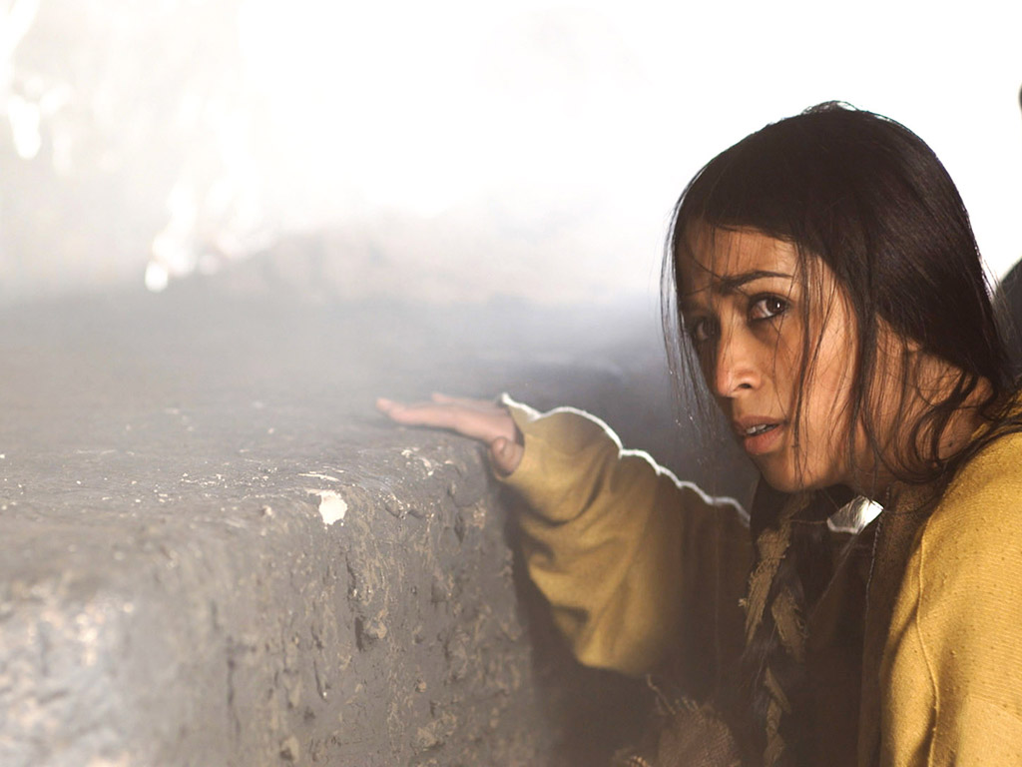

Slide 42
THE WORD IN PICTURES
Free
Bible
images

Slide 43
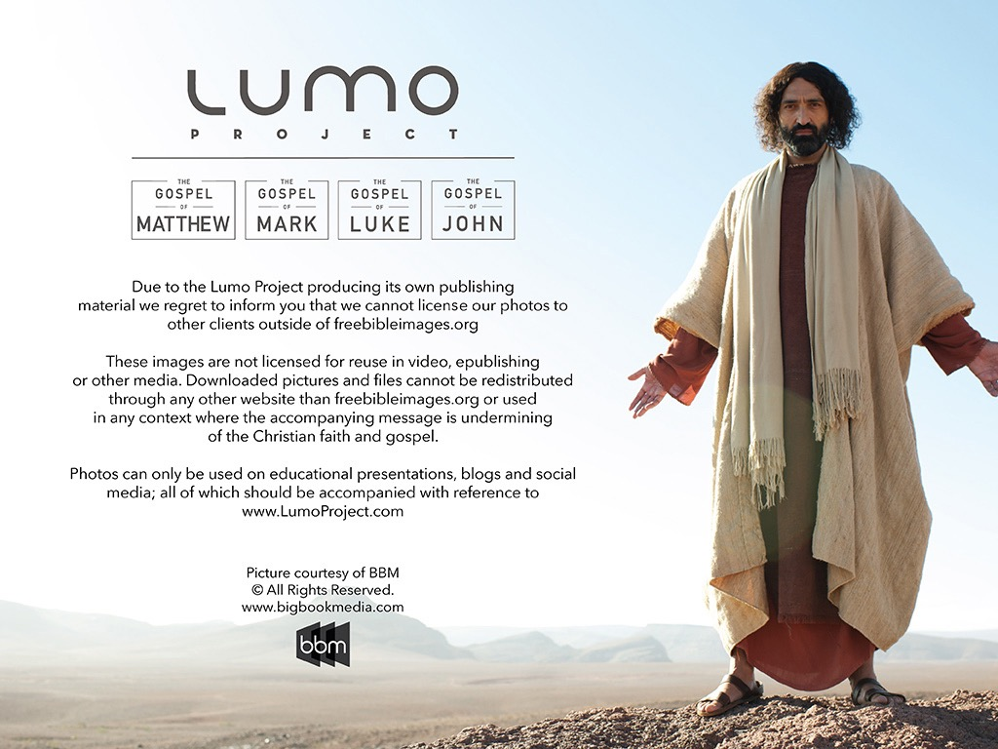
Used with Permission
THE
GOSPEL
——OF—— MATTHEW
THE
GOSPEL
——OF—— MARK
THE
GOSPEL
——OF—— LUKE
THE
GOSPEL
——OF—— JOHN
Due to the Lumo Project producing its own publishing material we regret to inform you that we cannot license our photos to other clients outside of freebibleimages.org.
These images are not licensed for reuse in video, epublishing or other media. Downloaded pictures and files cannot be redistributed through any other website than freebibleimages.org or used in any context where the accompanying message is undermining of the Christian faith and gospel.
Photos can only be used on educational presentations, blogs and social media, all of which should be accompanied with reference to www.LumoProject.com.
Picture courtesy of BBM
© All Rights Reserved.
www.bigbookmedia.com

Slide 44
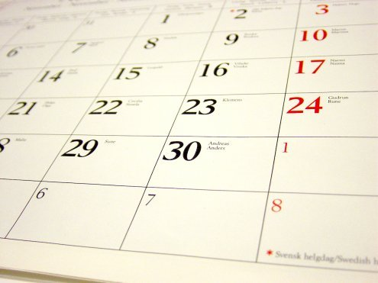
A Prophetic Weekend
Thursday
Friday
Saturday
Sunday
Galilean
Passover
Unleavened Bread
Firstfruits
Judean
Passover
Unleavened Bread
Firstfruits
Last Supper
Crucifixion
Resurrection
2 April 33
3 April 33
5 April 33
“But now Christ has been raised from the dead, the first fruits of those who are asleep” (1 Cor 15:20 NAU).
Christ is the only one ever resurrected, but as such, he is also the first among many who will join a resurrected body.
Notes:
Leviticus 23 gives the order of Israel's three key feasts: • Passover, • Unleavened Bread, and • Firstfruits.
• But how could Jesus have the Passover on Thursday night but then die at 3 PM the next day on Friday when the Passover lambs were being slaughtered? And why did the Jewish leaders want the bodies off the cross quickly as Passover was approaching when Jesus had already celebrated Passover the night before?
• The answer is that Galilean Jews celebrated Passover the day before • Judean Jews. Since his disciples were Galileans, Jesus naturally celebrated on their timetable.
• The Feast of Unleavened Bread always began the day after Passover (Lev 23:5-6).
• Then Firstfruits followed sometime later on the first Sabbath after the first crops began to ripen (Lev 23:11). It indicated that millions of additional sheaves would follow until the entire harvest came in at Pentecost. In AD 33, these three celebrations occurred one after another on three consecutive days!
The significance is astonishing. • Christ predicted his death at the Last Supper Thursday night. • Then Jesus died on the Judean Passover • so that believers can live a life without yeast (Unleavened Bread), • which immediately followed with his resurrection on Firstfruits as he is the first and only human ever to obtain a glorified body as an installment for millions more to follow (1 Cor 15:20)!
We know these dates to be • 2 April 33 for the Thursday night Passover, • 3 April 33 was the day of his crucifixion, and • Jesus rose from the dead on the Feast of Firstfruits on 5 April 33.
Another view by Mark Moore:
"§ 143 Preparation for the Passover Meal (Mt 26:17–19; Mk 14:12–16; Lk 22:7–13)
The Synoptics indicate that Jesus ate the actual Passover meal on Nisan 14 before he was crucified on Nisan 15 (roughly equivalent to our April). Some, however, have interpreted John 18:28 and 19:14 to say that Jesus died at the very time the Passover lambs were being slain on Nisan 14. If that is true then we have an obvious contradiction between John and the Synoptics.
Though some are always eager to charge the Evangelists with theological editing or outright error, a better solution seems to be the suggestion that two separate calendars were followed. For example, Jaubert argues that Jesus followed the Essene solar calendar,²¹ or that the Passover sacrifices and meals were spread over two days because of the flood of visitors to Jerusalem.²² This would put the Passover on Thursday for the disciples but on Friday for the Sadducees. Hoehner argues that there was a difference in how the Galileans and Judeans reckoned their days (from sunrise or sunset).²³ Hence Jesus and the other Galileans ate the Passover a day before the Judeans did. Others have suggested that the discrepancy stemmed from an argument between the Pharisees and Sadducees. However, none of these arguments based on a calendar have strong documentary support.
There is a third solution that is better still and much simpler. Jesus and his disciples celebrated the actual Passover. John knew that. After all, he was familiar with synoptic chronology. In fact, John 13 also describes the Passover Jesus celebrated. (1) It was in Jerusalem rather than Bethany, which had been their haunt the entire week. (2) They are pictured as reclining at the table at night, which is indicative of a festival meal. And (3) when the disciples saw Judas exit urgently they believed he was going out to get last minute supplies for the Passover meal or to give alms to the poor. These are indications of a Passover meal. Consequently, what John calls the Passover (18:28), is actually the chagigah (Num 28:18–19), which opened the Feast of Unleavened Bread. Was John confused about what it was actually called? No. In John’s day, there was little distinction between the Passover (Nisan 14) and the Feast of Unleavened Bread (Nisan 15–21). Both terms were used interchangeably (Mt 26:17; Mk 14:1, 12; Lk 2:41; 22:1; Josephus, Ant 2.317; JW 5.98). So it was perfectly acceptable for John to identify this special meal as the Passover. Besides, every other time John uses the term “Passover” he refers to the entire feast, not the single meal (Jn 2:13, 23; 6:4; 11:55; 12:1; 13:1). Therefore, we suggest that Jesus and the disciples ate the actual Passover meal, celebrated on Nisan 14. Furthermore, the Jews of John 18:12 refused to enter Pilate’s praetorium so they would not be disqualified from the rest of the seven day Feast of Unleavened Bread, not the actual Passover meal.²⁴
²¹ Annie Jaubert, The Date of the Last Supper (New York: Alba House, 1965). One great weakness of her view is that her evidence for the Essene solar calendar comes from a third century document.
²² Cf. Maurice Casey, “The Date of the Passover Sacrifices and Mark 14:12,” TB 48/2 (1997): 245–247.
²³ H.W. Hoehner, Chronological Aspects of the Life of Christ (Grand Rapids: Zondervan, 1977).
Ant Antiquities of the Jews
JW Jewish Wars
²⁴ Cf. Carson, pp. 528–532; and B. Smith, “The Chronology of the Last Supper,” WTJ 53 (1991): 29–45. F. Chenderlin, “Distributed Observance of the Passover: A Preliminary Test of the Hypothesis,” Biblica 57 (1976): 1–24, adds a couple of additional keen points. First, there were probably too many Passover participants to have all the lambs killed and eaten in a single day. Hence, he argues for a “distributed observance” in which the Passover would be celebrated on successive days. Second, if that were the case, the Jewish leaders may have preferred to eat the Passover on the holy high Sabbath during Passover week rather than strictly on Nisan 14."
— Mark E. Moore, The Chronological Life of Christ (Joplin, MO: College Press Publishing Company, 2011), 557–558.
————————————
Common-435
OB-25-Feasts-35
OS-03-Leviticus-303
OS-26-Ezek40-43-Slide105
LC-00-Chronology of Christ-8
LC-08-Preparation-98
LC-09-Rejection-227
LC-10-Resurrection-34
NB-11-Feasts-35
NC-10-Reliability of Acts-13
NS-00-NTS Chronology-slide 40
NS-00-Chronology of Christ-8
NS-01-Matt15-28-slide 315
NS-02-Mark9-16-slide 262
NS-03-Luke13-24-slide 292
NS-04-John12-21-slide 390

Slide 45

Passover: Pilgrimage Feast #1
180
1 Nisan
2 Iyar
3 Sivan
4 Tammuz
5 Av
6 Elul
7 Tishri
8 Cheshvan
9 Kislev
10 Tevet
11 Shevat
12 Adar
Passover
Redemption
Unleavened Bread
Separation
Firstfruits
Resurrection
3 Pilgrimage Feasts

Slide 46
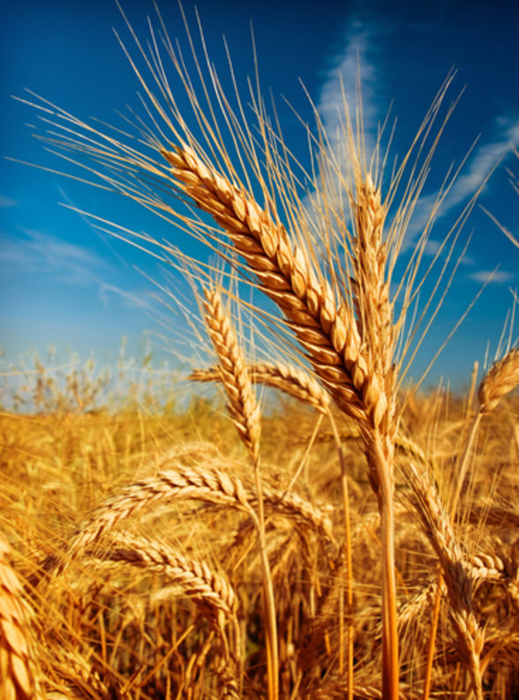
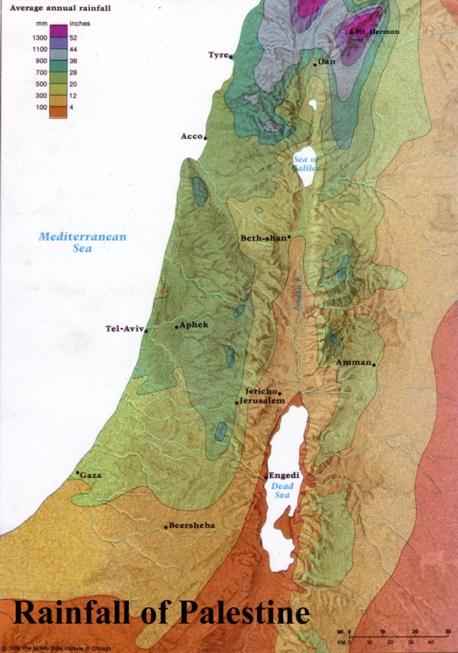
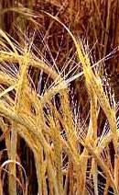
Firstfruits: Wave Sheaf Offering
184
Harvested in the far north of Israel
Brought down to Jerusalem

Slide 47
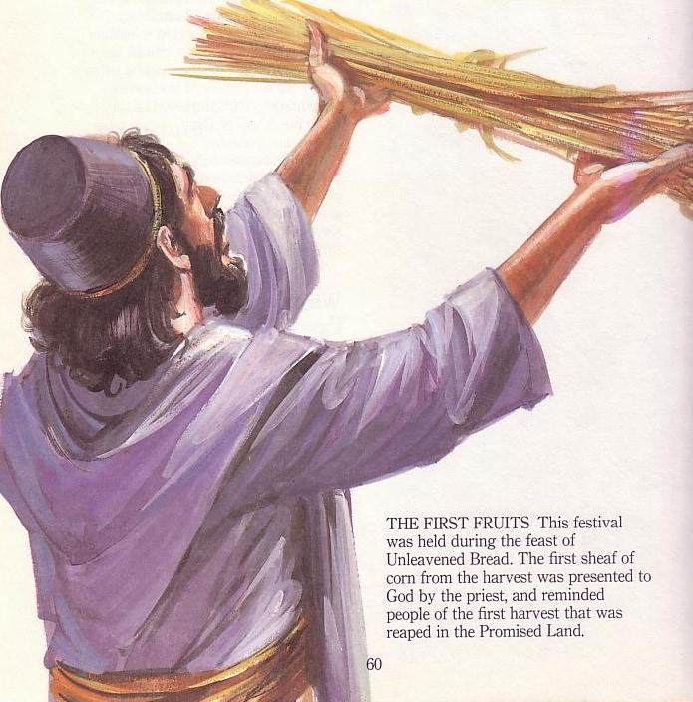
Firstfruits
Temple Offering
184
Harvested far north in Israel
Brought down to Jerusalem
Waved before the LORD

Slide 48
D. The Report to the Disciples
§ 187
Luke 24:9-12; John 20:2-10
The women tell the disciples about the empty tomb, so Peter and John run to the tomb to investigate the matter themselves, resulting in John's belief
Notes:
Like the men, these women do not see the meaning of the resurrection. Jesus alive doesn't even seem to be an option that they consider.

Slide 49
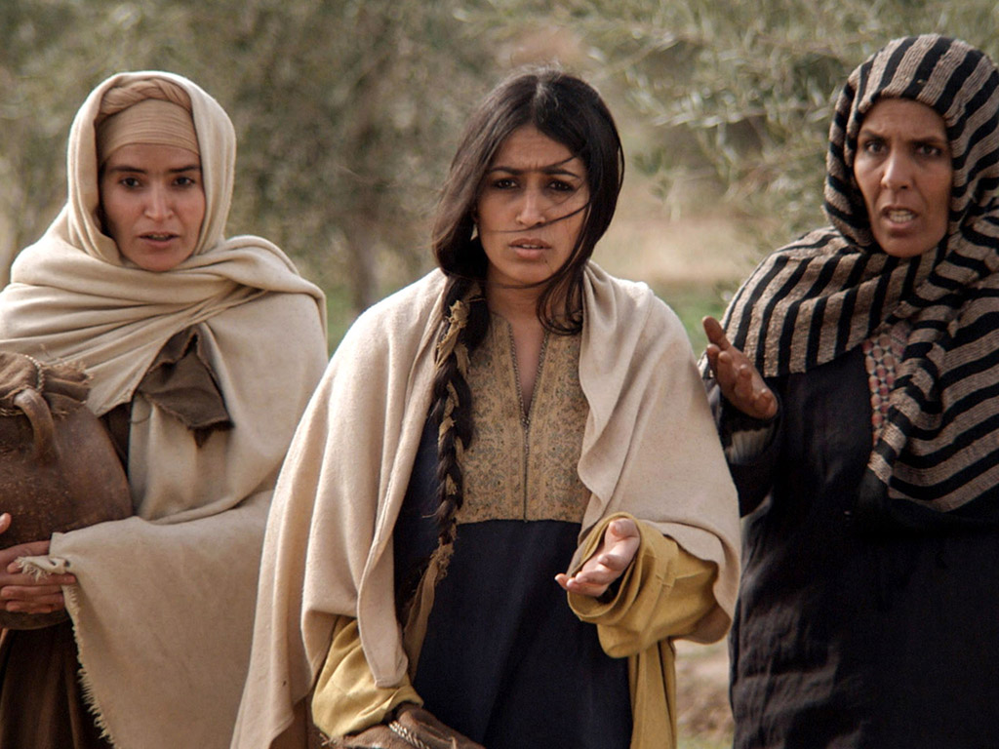
Notes:
They wondered what happened. After all, there had never been anyone who resurrected himself into a glorified body before then—or even since then!

Slide 50
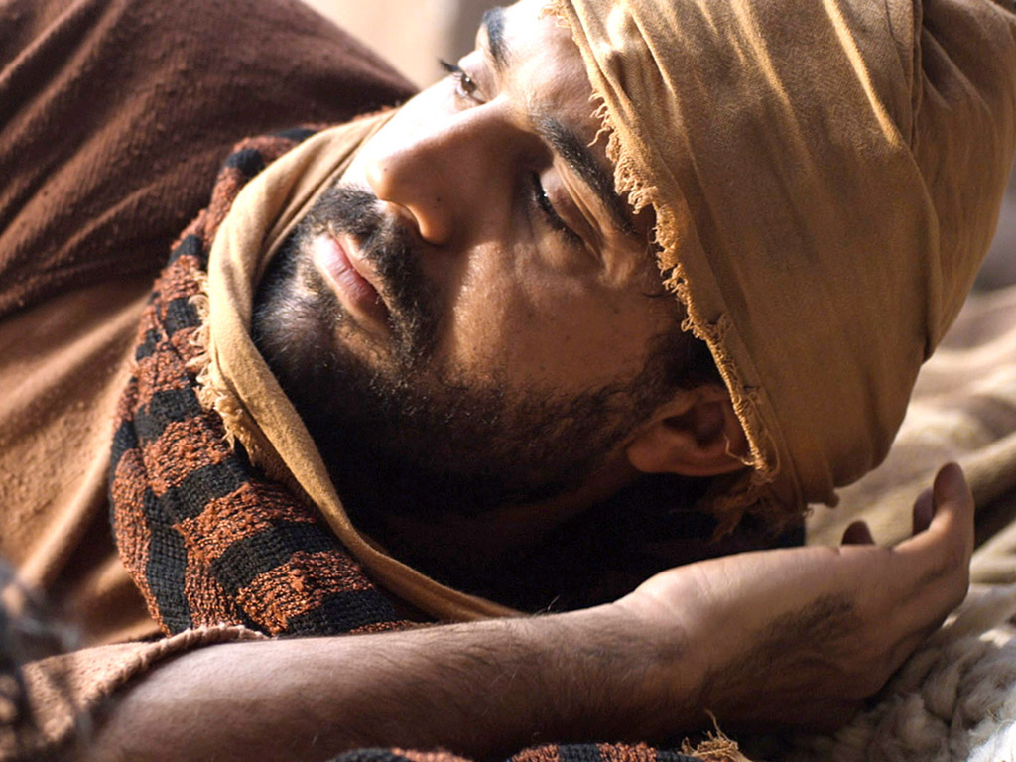

Slide 51
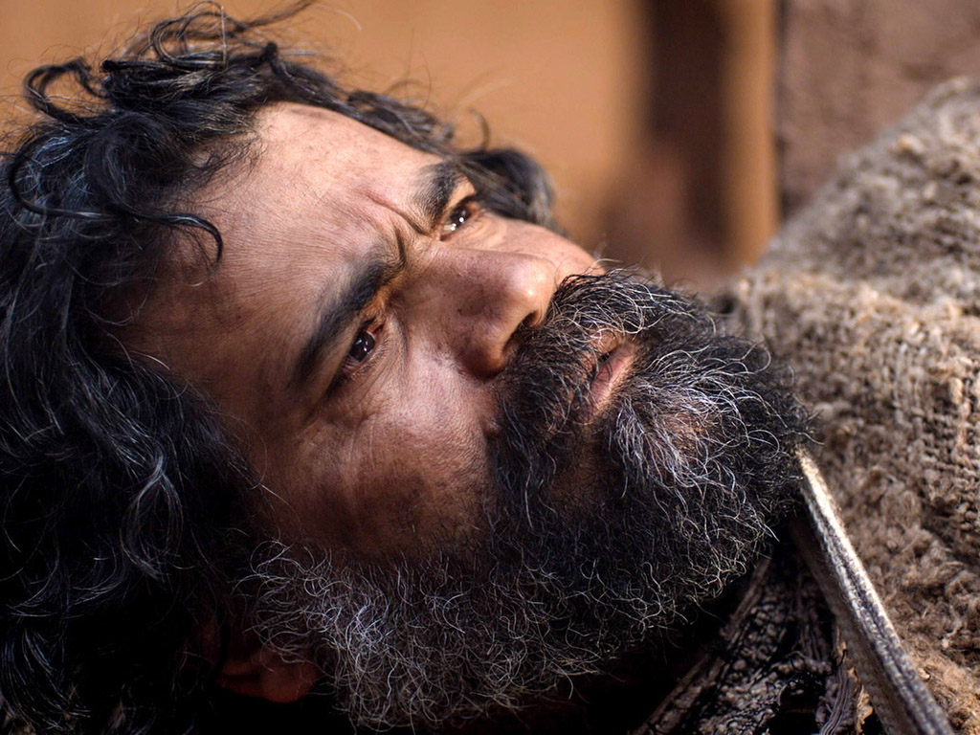

Slide 52
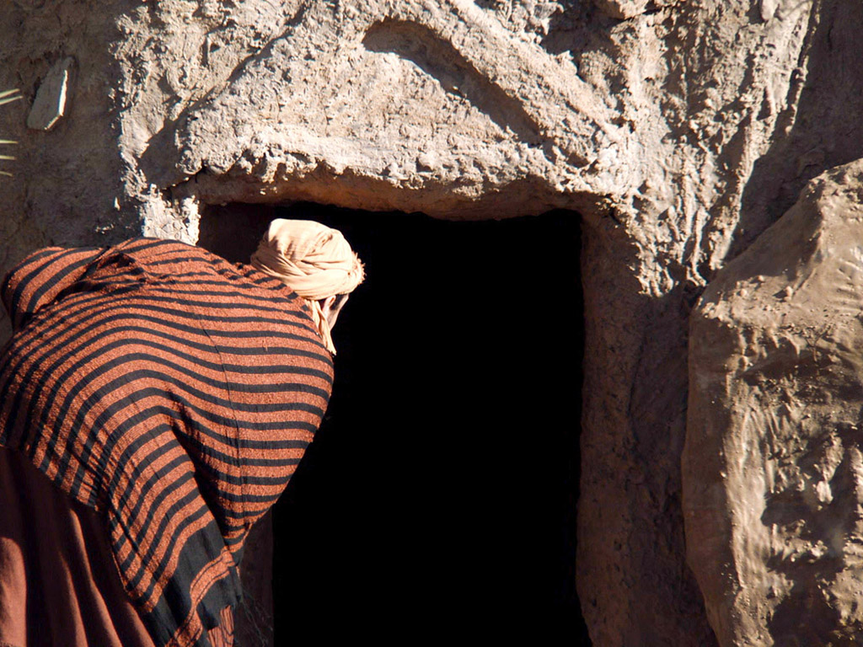

Slide 53
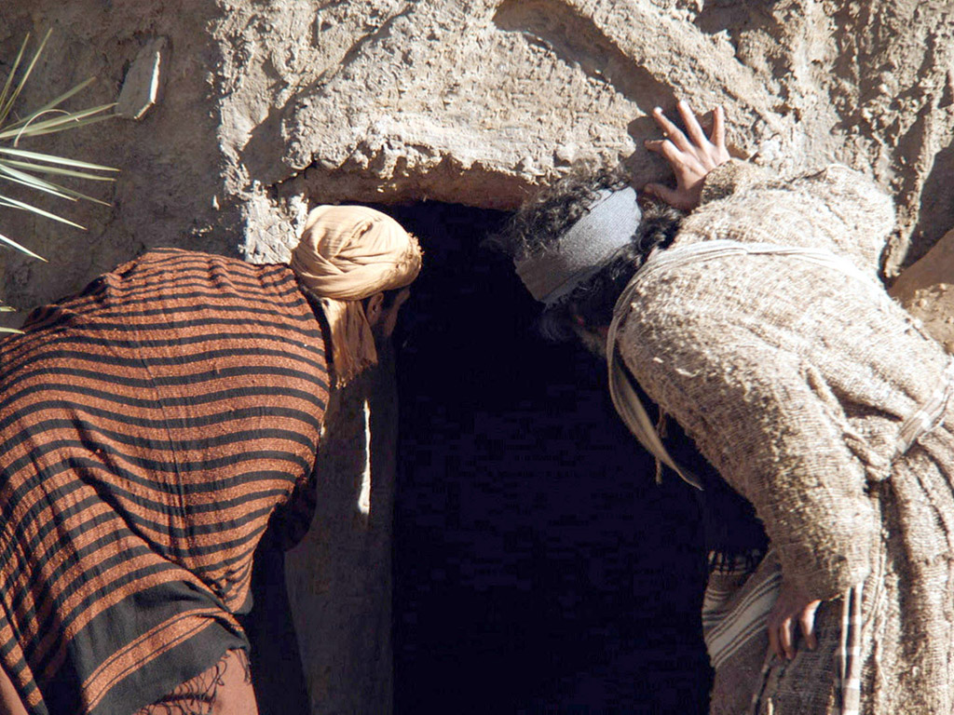

Slide 54
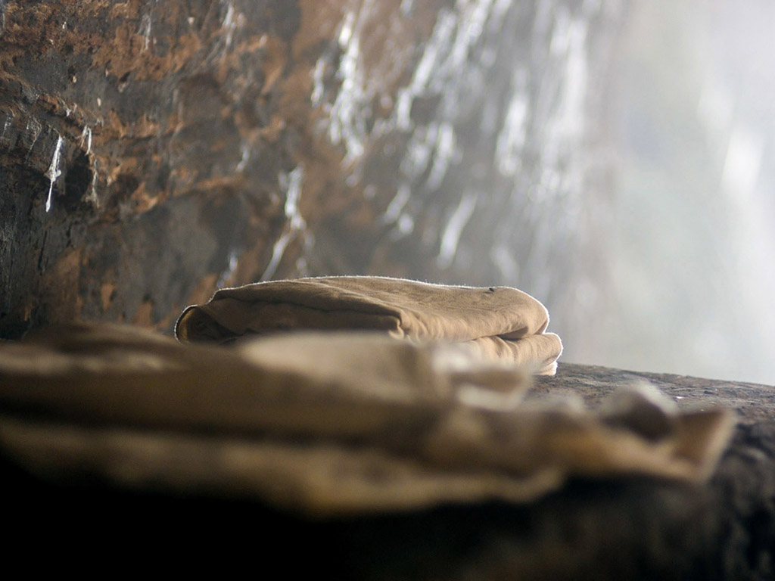

Slide 55
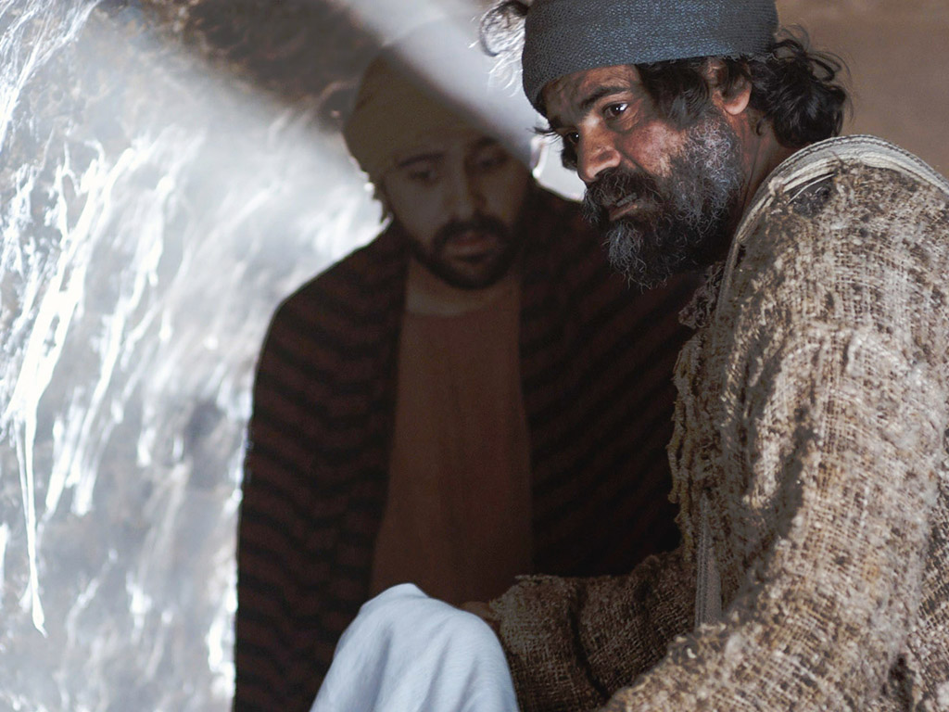
Notes:
How did Peter and John react differently to what they experienced at the tomb?

Slide 56
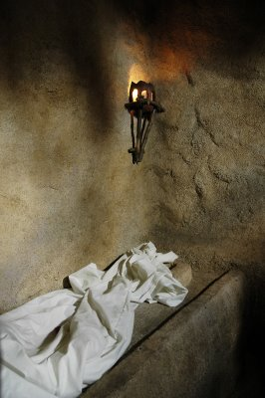
“Seeing” in John 20:5-8
John
“looked”
v. 5
John
“saw”
v. 8
“peeped”
“perceived”
Peter
“saw”
v. 6
“beheld attentively”
Notes:
56
56
The Greek text uses three different words to describe what Peter and John saw:
• John "peeped" (blepei) into the tomb, wondering if the body was really gone.
• Peter "beheld attentively" (theorei) in that he saw more than John saw as Peter entered the tomb.
• But John "perceived" (eiden) or understood the significance of the empty tomb, "and believed" in the resurrection

Slide 57
E. The Appearance to Mary
§ 188
Mark 16:9-11; John 20:11-18
Mary Magdalene sees the resurrected Jesus at the tomb and tells the disciples, but they do not believe even this eyewitness account

Slide 58
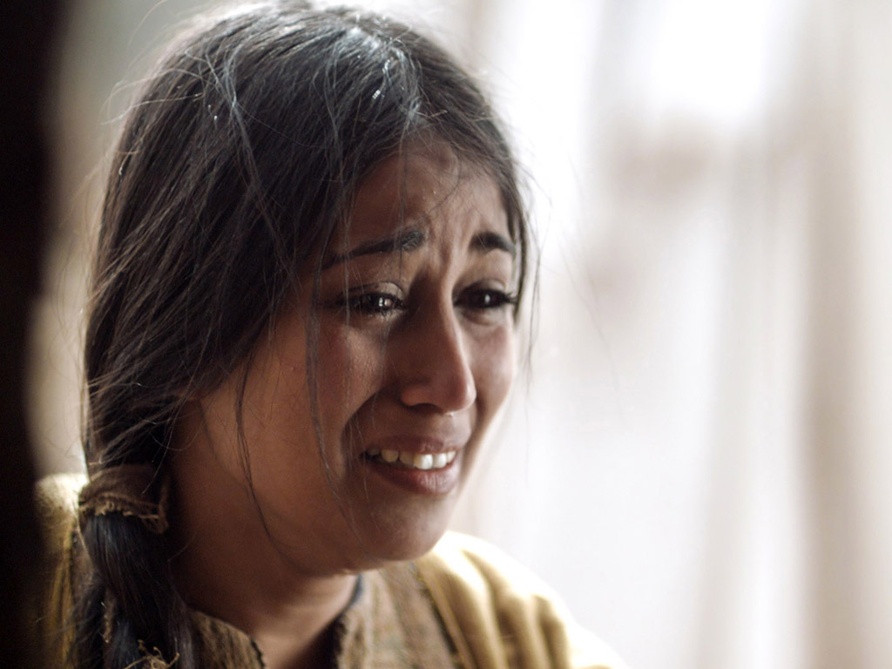
Notes:
Mary Magdalene returned to the tomb alone in her despair.

Slide 59
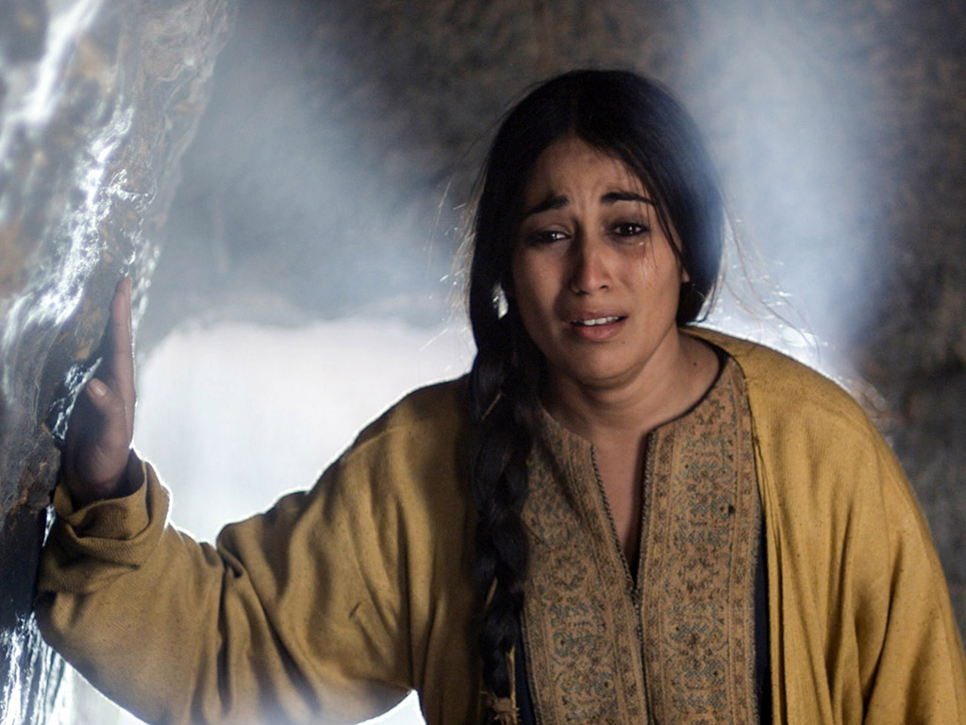

Slide 60
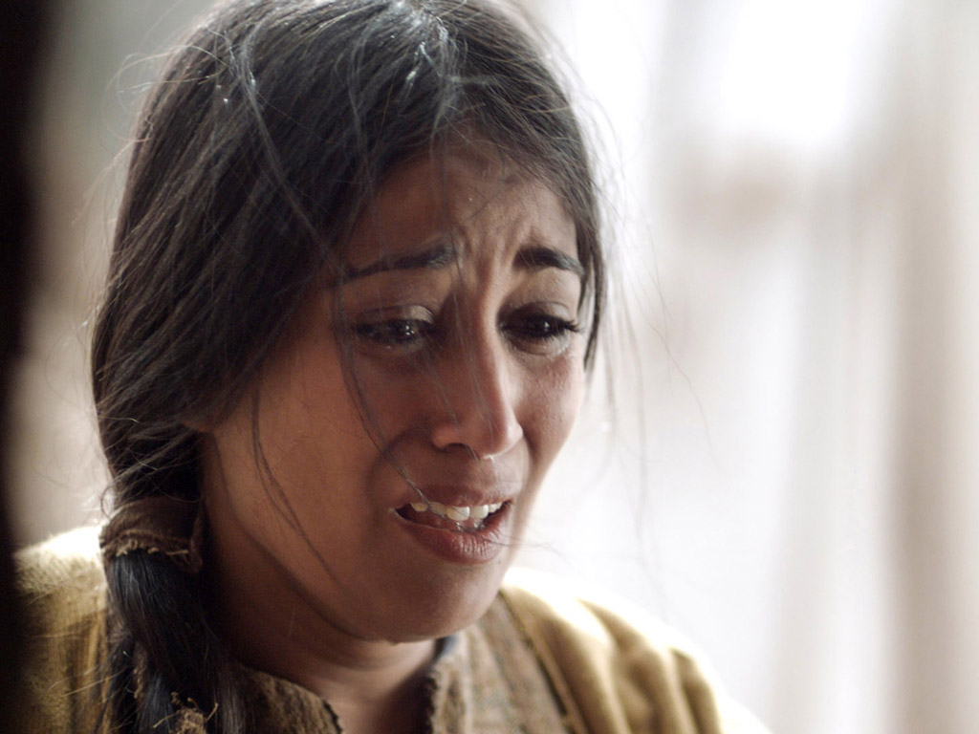

Slide 61
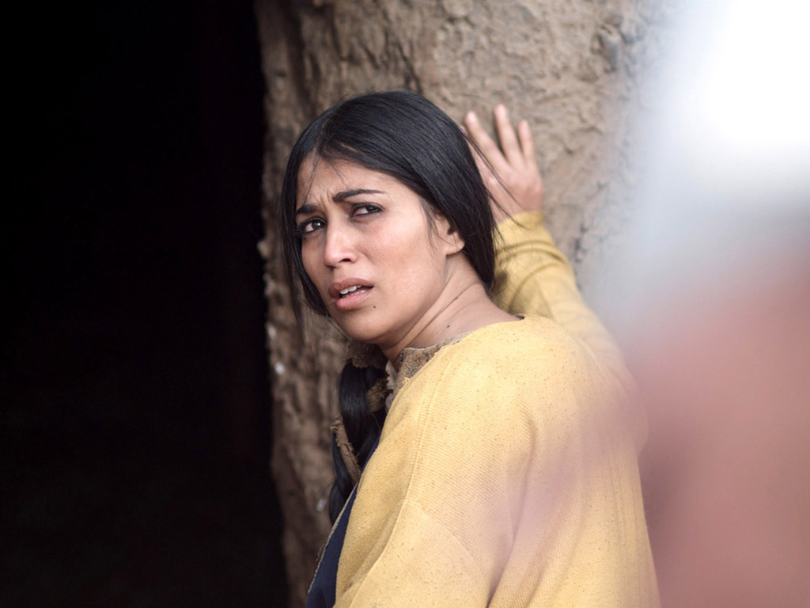

Slide 62
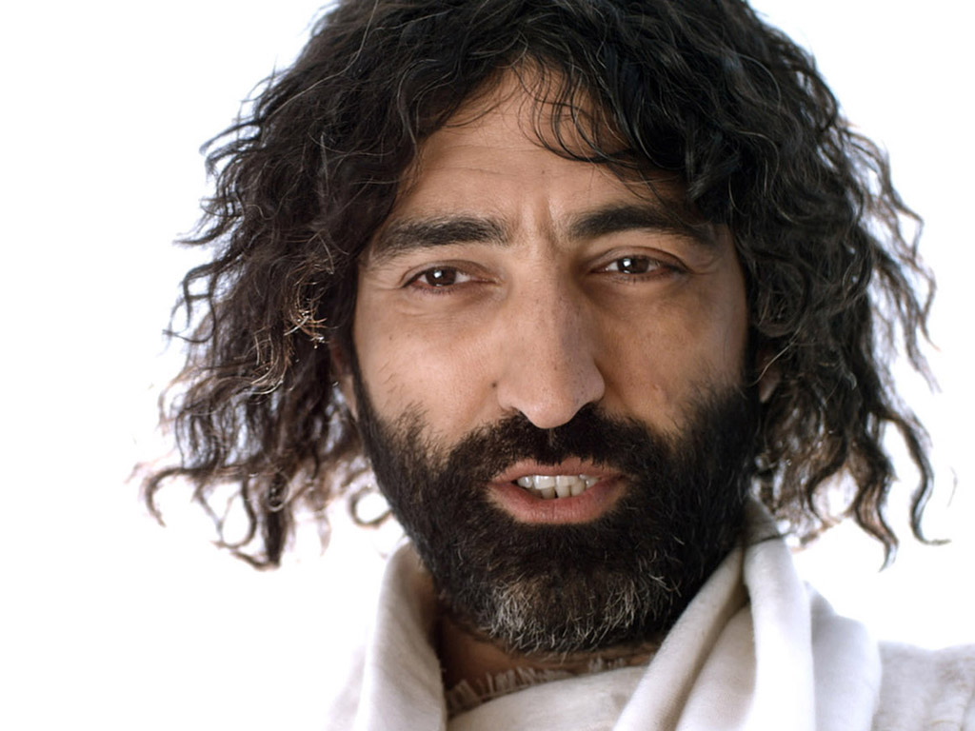

Slide 63
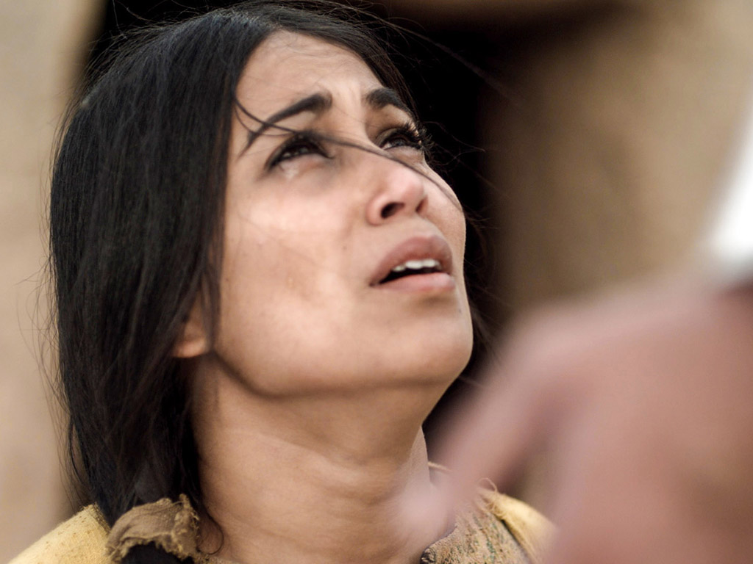

Slide 64
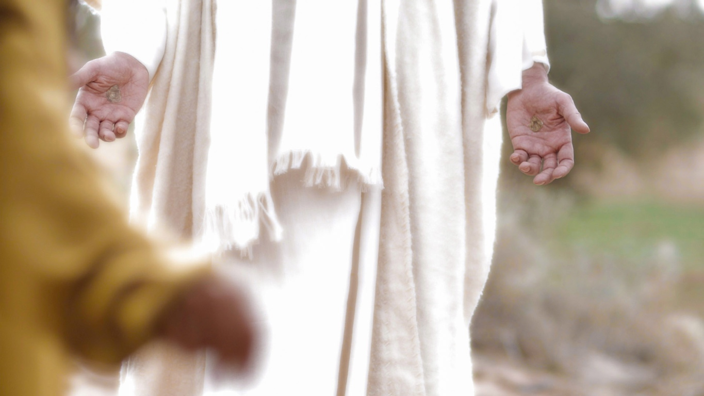

Slide 65


Slide 66

II. Christ's resurrection meets you at your need
(John 20:10-29)
Comforts the despairing
Mary (10-18)
Notes:
66
66

Slide 67
F. The Appearance to the Women
§ 189
Matthew 28:9-10
The other women see Jesus at the tomb, and He tells them to tell the disciples to meet Him in Galilee for teaching and a final commission
Notes:
Matt. 28:9 And as they went, Jesus met them and greeted them. And they ran to him, grasped his feet, and worshiped him. ¹⁰ Then Jesus said to them, “Don’t be afraid! Go tell my brothers to leave for Galilee, and they will see me there.”
They had already been to the tomb earlier, but they did not see the meaning of it being empty.

Slide 68

Women at the Tomb
Matthew 28:1 | Mark 16:1-2 | Luke 24:10 | John 20:1
Early on Sunday morning, as the new day was dawning, Mary Magdalene and the other Mary went out to visit the tomb. | Mary Magdalene, Mary the mother of James, and Salome…went to the tomb. | It was Mary Magdalene, Joanna, Mary the mother of James, and several other women who told the apostles what had happened. | Early on Sunday morning, while it was still dark, Mary Magdalene came to the tomb.
Notes:
All four gospels note that Mary Magdalene went to the tomb.
Matthew says that the "other Mary" went, which Mark and Luke clarify as Mary, the mother of James.
Mark adds Salome, who is not noted by the other gospel writers by name.
Luke initially notes, "As his body was taken away, the women from Galilee followed…But very early on Sunday morning, the women went to the tomb" (Luke 23:55; 24:1), but he later gives their names. Luke adds Joanna and several other women.
John focuses his account on Mary alone.
Some may say that these were different visits by different women, but each Synoptic writer notes that they came to anoint the body, and John certainly would not note an earlier visit by Mary Magdalene, who would arrive later to anoint the body after she had already seen the Lord. It is better to postulate that each writer focused on the women who would best contribute to his purpose in writing. Then, after the other women had left, Mary Magdalene lingered behind and became the first person to see the resurrected Jesus.

Slide 69

Who moved the stone?
He never died?
Jesus' strength?
Romans?
Jewish Leaders?
Disciples?
Notes:
There are only a few options to this question:
• If Jesus never died, then the Romans failed to execute Him
• But this would mean that, after tremendous blood loss through flogging, an arduous walk to Golgotha, nails in his extremities, and a spear in his side, without any food or water in the cold blackness for two nights, Jesus miraculously revived, escaped his cocoon encasement of burial cloths, rolled away a 2-ton stone, and fought off a detachment of 16 Roman guards who were trained to hold back an invading army! Wouldn't this be a greater miracle than a resurrection?!
• Others claim that the Roman guard stole the body—but they had the death penalty for failure of duty, so they are the least feasible option.
• Another theory is that the Jewish leaders stole the body. Yet they would not want to fake a resurrection for fear that this would steal their power.
• Other skeptics surmise that the disciples stole the body. Yet these men were the most disillusioned of all about Christ's death and did not even recall His prophecy about rising from the dead. Ten of the 12 disciples also died as martyrs, so it is highly unlikely that they would give their lives for what they knew was a lie.

Slide 70
G. The Report of the Guard
§ 190
Matthew 28:11-15
The guards report the resurrection to the Jewish leaders, who pay them to lie that the disciples stole Christ's body while they slept
Notes:
The guards report the resurrection to the chief priests, who, with the Sanhedrin, bribe them to lie that the disciples stole Christ's body while they were asleep as a futile attempt to discredit the disciples based on the religious leaders’ stubborn unbelief
Here would be the first time in history that people knew what happened while they slept!

Slide 71


Guards Bribed (Matt 28:12)
Notes:
The guards were motivated to lie as they were paid to do it.
Matt. 28:11 As the women were on their way, some of the guards went into the city and told the leading priests what had happened. 12 A meeting with the elders was called, and they decided to give the soldiers a large bribe. 13 They told the soldiers, “You must say, ‘Jesus’ disciples came during the night while we were sleeping, and they stole his body.’ 14 If the governor hears about it, we’ll stand up for you so you won’t get in trouble.” 15 So the guards accepted the bribe and said what they were told to say. Their story spread widely among the Jews, and they still tell it today.

Slide 72
H. The Appearance to the Two on the Emmaus Road
§ 191
Mark 16:12-13; Luke 24:13-32
Jesus appears to two men on the Emmaus Road to reveal that His suffering precedes His glory, but this makes sense only when He disappears at dinner

Slide 73

Could mortals and those in glorified bodies really live together?
435
Jesus did this on the Emmaus Road
(Luke 24)

Slide 74

Could mortals and those in glorified bodies really live together?
435
Remember when Jesus glowed?
Notes:
Do the Gospel accounts teach this?

Slide 75

Could mortals and those in glorified bodies really live together?
435
No, he looked like the rest of us!
Notes:
They walked six miles with Jesus, so they would have seen a glow if there was one!

Slide 76

Only at dinner did they recognize Jesus
435

Slide 77
Could mortals and those in glorified bodies really live together?
"And beginning with Moses and all the Prophets, he explained to them what was said in all the Scriptures concerning himself"
(Luke 24:27 NIV)
Notes:
Only at dinner did the men see that the OT teaches suffering before glory for the Messiah (and for us!)

Slide 78
I. The Report of the Two to the Disciples
§ 192
Luke 24:33-35
These two disciples report to the Eleven that they have seen the Lord, thus verifying the earlier report of the women

Slide 79
J. The Appearance to Several Disciples
§ 193
Mark 16:14; Luke 24:36-43; John 20:19-25
Jesus appears to ten disciples who later tell the disbelieving Thomas, showing that faith alone is insufficient for some to believe

Slide 80

Free
Bible
images
THE EASTER STORY
JESUS APPEARS TO THE DISCIPLES
Luke 24:36-49
John 20:19-23

Slide 81


Slide 82

Notes:
Luke 24:35 Then the two from Emmaus told their story of how Jesus had appeared to them as they were walking along the road, and how they had recognized him as he was breaking the bread.

Slide 83
Notes:
^{Luke 24:36} And just as they were telling about it, Jesus himself was suddenly standing there among them. “Peace be with you,” he said. ³⁷ But the whole group was startled and frightened, thinking they were seeing a ghost!

Slide 84

Notes:
Luke 24:38 “Why are you frightened?” he asked. “Why are your hearts filled with doubt?

Slide 85

Notes:
³⁹ Look at my hands. Look at my feet. You can see that it’s really me. Touch me and make sure that I am not a ghost, because ghosts don’t have bodies, as you see that I do.”

Slide 86

Notes:
Luke 24:41 Still they stood there in disbelief, filled with joy and wonder. Then he asked them, “Do you have anything here to eat?” ⁴² They gave him a piece of broiled fish, ⁴³ and he ate it as they watched.

Slide 87

Notes:
Luke 24:44 Then he said, “When I was with you before, I told you that everything written about me in the law of Moses and the prophets and in the Psalms must be fulfilled.”

Slide 88

Notes:
⁴⁵ Then he opened their minds to understand the Scriptures.

Slide 89

Notes:
⁴⁶ And he said, “Yes, it was written long ago that the Messiah would suffer and die and rise from the dead on the third day. ⁴⁷ It was also written that this message would be proclaimed in the authority of his name to all the nations, beginning in Jerusalem: ‘There is forgiveness of sins for all who repent.’ ⁴⁸ You are witnesses of all these things.
Luke 24:49 “And now I will send the Holy Spirit, just as my Father promised. But stay here in the city until the Holy Spirit comes and fills you with power from heaven.”

Slide 90

Notes:
John 20:24 One of the twelve disciples, Thomas (nicknamed the Twin), was not with the others when Jesus came.

Slide 91

Notes:
25 They told him, “We have seen the Lord!”

Slide 92

Notes:
But he replied, “I won’t believe it unless I see the nail wounds in his hands, put my fingers into them, and place my hand into the wound in his side.”

Slide 93
THE WORD IN PICTURES
Free
Bible
images

Slide 94
Used with Permission
THE
GOSPEL
——OF—— MATTHEW
THE
GOSPEL
——OF—— MARK
THE
GOSPEL
——OF—— LUKE
THE
GOSPEL
——OF—— JOHN
Due to the Lumo Project producing its own publishing material we regret to inform you that we cannot license our photos to other clients outside of freebibleimages.org.
These images are not licensed for reuse in video, epublishing or other media. Downloaded pictures and files cannot be redistributed through any other website than freebibleimages.org or used in any context where the accompanying message is undermining of the Christian faith and gospel.
Photos can only be used on educational presentations, blogs and social media, all of which should be accompanied with reference to www.LumoProject.com.
Picture courtesy of BBM
© All Rights Reserved.
www.bigbookmedia.com

Slide 95
K. The Appearance to the Eleven
§ 194
John 20:26-31
Jesus appears to all 11 disciples a week later, and Thomas submits to Him as Lord and deity so these men can preach what they witnessed to the nations
Notes:
John 20:26 Eight days later the disciples were together again, and this time Thomas was with them. The doors were locked; but suddenly, as before, Jesus was standing among them. “Peace be with you,” he said. ²⁷ Then he said to Thomas, “Put your finger here, and look at my hands. Put your hand into the wound in my side. Don’t be faithless any longer. Believe!”
John 20:28 “My Lord and my God!” Thomas exclaimed.
John 20:29 Then Jesus told him, “You believe because you have seen me. Blessed are those who believe without seeing me.”
Purpose of the Book
John 20:30 The disciples saw Jesus do many other miraculous signs in addition to the ones recorded in this book. ³¹ But these are written so that you may continue to believe that Jesus is the Messiah, the Son of God, and that by believing in him you will have life by the power of his name.

Slide 96
II. Christ's resurrection meets you at your need
(20:10-29)
Comforts the despairing
Mary (10-18)
Encourages the discouraged disciples (19-23)
Gives proof to the doubting Thomas (24-29)
Notes:
96
96

Slide 97

John 20:24-29
Free
Bible
images
THE EASTER STORY
JESUS APPEARS TO THOMAS

Slide 98

Notes:
John 20:26 Eight days later the disciples were together again, and this time Thomas was with them.

Slide 99

Notes:
The doors were locked; but suddenly, as before, Jesus was standing among them.

Slide 100

Notes:
“Peace be with you,” he said.

Slide 101

Notes:
27 Then he said to Thomas, “Put your finger here, and look at my hands."

Slide 102

Notes:
Put your hand into the wound in my side. Don’t be faithless any longer. Believe!”

Slide 103
Notes:
[Jesus then waited for his response.]

Slide 104

Notes:
John 20:28 “My Lord and my God!” Thomas exclaimed.
Peter also declared the deity of Jesus in Matt 18.
When Jesus proves our doubts wrong, we need to response accordingly.

Slide 105

Notes:
John 20:29 Then Jesus told him, “You believe because you have seen me."

Slide 106

Notes:
"Blessed are those who believe without seeing me.”
How can we be assured that the disciples were credible witnesses?
• Do you know any examples of people who died for what they knew was a lie?
• The reliability of the NT shows us the credibility of what it says.
Read "More Than a Carpenter" by Josh McDowell in Arabic.

Slide 107
THE WORD IN PICTURES
Free
Bible
images

Slide 108
Used with Permission
THE
GOSPEL
——OF—— MATTHEW
THE
GOSPEL
——OF—— MARK
THE
GOSPEL
——OF—— LUKE
THE
GOSPEL
——OF—— JOHN
Due to the Lumo Project producing its own publishing material we regret to inform you that we cannot license our photos to other clients outside of freebibleimages.org.
These images are not licensed for reuse in video, epublishing or other media. Downloaded pictures and files cannot be redistributed through any other website than freebibleimages.org or used in any context where the accompanying message is undermining of the Christian faith and gospel.
Photos can only be used on educational presentations, blogs and social media, all of which should be accompanied with reference to www.LumoProject.com.
Picture courtesy of BBM
© All Rights Reserved.
www.bigbookmedia.com

Slide 109
L. The Appearance to Seven Disciples
§ 195
John 21:1-25
Christ appears to seven disciples at the Sea of Galilee to confirm His resurrection and reinstate Peter thrice in his love and devotion

Slide 110

Free
Bible
images
John 21:1-14
THE EASTER STORY
JESUS APPEARS TO DISCIPLES IN GALILEE
Notes:
John 21:1 Later, Jesus appeared again to the disciples beside the Sea of Galilee. This is how it happened.

Slide 111

Notes:
John 20:2 Several of the disciples were there—Simon Peter, Thomas (nicknamed the Twin), Nathanael from Cana in Galilee, the sons of Zebedee, and two other disciples.

Slide 112

Notes:
John 21:3 Simon Peter said, “I’m going fishing.”
“We’ll come, too,” they all said. So they went out in the boat, but they caught nothing all night.

Slide 113

Notes:
John 21:4 At dawn Jesus was standing on the beach, but the disciples couldn’t see who he was. 5 He called out, “Fellows,ª have you caught any fish?”

Slide 114

Notes:
John 21:6 Then he said, “Throw out your net on the right-hand side of the boat, and you’ll get some!”

Slide 115


Slide 116

Notes:
So they did, and they couldn’t haul in the net because there were so many fish in it.

Slide 117


Slide 118
Notes:
John 21:7 Then the disciple Jesus loved said to Peter, “It’s the Lord!” When Simon Peter heard that it was the Lord, he put on his tunic (for he had stripped for work), jumped into the water, and headed to shore.

Slide 119

Notes:
8 The others stayed with the boat and pulled the loaded net to the shore, for they were only about a hundred yardsª from shore.

Slide 120

Notes:
9 When they got there, they found breakfast waiting for them—fish cooking over a charcoal fire, and some bread.

Slide 121

Notes:
John 21:10 “Bring some of the fish you’ve just caught,” Jesus said. 11 So Simon Peter went aboard and dragged the net to the shore. There were 153 large fish, and yet the net hadn’t torn.

Slide 122

Notes:
There were 153 large fish, and yet the net hadn’t torn.

Slide 123

Notes:
John 21:12 “Now come and have some breakfast!” Jesus said. None of the disciples dared to ask him, “Who are you?” They knew it was the Lord. 13 Then Jesus served them the bread and the fish. 14 This was the third time Jesus had appeared to his disciples since he had been raised from the dead.

Slide 124


Slide 125
THE WORD IN PICTURES
Free
Bible
images

Slide 126
Used with Permission
THE
GOSPEL
——OF—— MATTHEW
THE
GOSPEL
——OF—— MARK
THE
GOSPEL
——OF—— LUKE
THE
GOSPEL
——OF—— JOHN
Due to the Lumo Project producing its own publishing material we regret to inform you that we cannot license our photos to other clients outside of freebibleimages.org.
These images are not licensed for reuse in video, epublishing or other media. Downloaded pictures and files cannot be redistributed through any other website than freebibleimages.org or used in any context where the accompanying message is undermining of the Christian faith and gospel.
Photos can only be used on educational presentations, blogs and social media, all of which should be accompanied with reference to www.LumoProject.com.
Picture courtesy of BBM
© All Rights Reserved.
www.bigbookmedia.com

Slide 127
II. Christ's resurrection meets you at your need
(20:10-29)
Comforts the despairing
Mary (10-18)
Encourages the discouraged disciples (19-23)
Notes:
127
127

Slide 128

What would it take to turn the despondent Peter around?

Slide 129

Free
Bible
images
John 21:15-25
THE EASTER STORY
JESUS QUESTIONS PETER

Slide 130

Notes:
John 21:15 After breakfast Jesus asked Simon Peter,

Slide 131

Notes:
“Simon, son of John, do you love me more than these?”
THESE:
• More than fishing
• More than Peter loved the other disciples
• More than the other disciples loved him (Peter had said earlier that he would die for him)

Slide 132
Notes:
“Yes, Lord,” Peter replied, “you know I love you.”

Slide 133

Notes:
“Then feed my lambs,” Jesus told him.

Slide 134

Notes:
Not:
• If you love me, then die for me
• If you love me, then leave everything behind
But:
• If you love me, then make disciples

Slide 135

Notes:
John 21:16 Jesus repeated the question: “Simon son of John, do you love me?”

Slide 136


Slide 137


Slide 138


Slide 139


Slide 140


Slide 141
THE WORD IN PICTURES
Free
Bible
images

Slide 142
Used with Permission
THE
GOSPEL
——OF—— MATTHEW
THE
GOSPEL
——OF—— MARK
THE
GOSPEL
——OF—— LUKE
THE
GOSPEL
——OF—— JOHN
Due to the Lumo Project producing its own publishing material we regret to inform you that we cannot license our photos to other clients outside of freebibleimages.org.
These images are not licensed for reuse in video, epublishing or other media. Downloaded pictures and files cannot be redistributed through any other website than freebibleimages.org or used in any context where the accompanying message is undermining of the Christian faith and gospel.
Photos can only be used on educational presentations, blogs and social media, all of which should be accompanied with reference to www.LumoProject.com.
Picture courtesy of BBM
© All Rights Reserved.
www.bigbookmedia.com

Slide 143

How does Jesus restore us after we really mess things up?

Slide 144

A Regretful Peter

Slide 145

A Resurrected Savior

Slide 146

The Sea of Tiberias (John 21)

Slide 147
Movements
3 ways that Christ restores us after failure
Miraculous catch
Peter's Reinstatement
John's Death
Conclusion

Slide 148

I. Admit you need Christ even where you feel competent (21:1-14).

Slide 149

“Have you caught anything?”
Notes:
http://perso.wanadoo.fr/saint.pierre/pagesan/alapparition_au_lac.html

Slide 150

“No.”
“Cast your net on the right side.”
“Whoa!”
Notes:
http://perso.wanadoo.fr/saint.pierre/pagesan/alapparition_au_lac.html

Slide 151

John: “It's the Lord!”
Peter: “Jump!”
Notes:
http://perso.wanadoo.fr/saint.pierre/pagesan/alapparition_au_lac.html

Slide 152

What's the point of this miracle?
Notes:
http://perso.wanadoo.fr/saint.pierre/pagesan/alapparition_au_lac.html

Slide 153

Fish Déjà Vu
Is John alluding to the earlier account?
Luke 5:1-11
John 21:1-14
Calling
Reinstatement
Jesus in boat
Jesus on shore
“Follow me”
“Feed my lambs”
Evangelize
Shepherd
Jesus' Message Repeated: “You need me to be truly competent!”

Slide 154

Do you admit that you need Christ even in your area of competence?
Notes:
http://perso.wanadoo.fr/saint.pierre/pagesan/alapparition_au_lac.html

Slide 155
“Have you sold anything?”
"No, Lord"
Notes:
http://perso.wanadoo.fr/saint.pierre/pagesan/alapparition_au_lac.html

Slide 156

What's your area of competence?

Slide 157
I. Admit you need Christ even where you feel competent
(John 21:1-14).

Slide 158

II. Show your love for Christ by loving people (John 21:15-17).

Slide 159
“Do you love me more than these?”
What are “these”?
“Do you love me more than you love fishing?”
“Do you love me more than you love these disciples?”
“Do you love me more than the rest of these disciples love me?”
Notes:
John 13:37 “I will lay down my life you” (even if the others fail you)

Slide 160
Three Questions
Do you agape me?
I phileo you.
Do you agape me?
I phileo you.
Do you phileo me?
I phileo you.

Slide 161

Three Reinstatements
Do you agape me?
Feed my lambs
Do you agape me?
Take care of my sheep
Do you phileo me?
Feed my sheep

Slide 162

"Feed my sheep."

Slide 163

Teaching Responsibility

Slide 164

Don’t feed sheep junk food!

Slide 165

Don’t abuse sheep!

Slide 166

"Feed my sheep."

Slide 167

How to get Peter out of his tunnel…
Step 1: Do the same miracle again
Step 2: Reinstate him three times

Slide 168
Do You Agape Others?
Do you agape others?
I phileo them.
Do you agape others?
I phileo them.
Do you agape others?
I phileo them.

Slide 169

Loving people is loving Christ

Slide 170
Categories of Gifts (1 Peter 4:11)
Speaking | Serving
Teaching | Administering
Evangelism | Faith
Pastor-Teacher | Giving
Encouraging | Service
 | Mercy

Slide 171

“…When you are old, you will stretch out your hands, and someone else will dress you and lead you where you do not want to go” (21:18)
Peter's Crucifixion
"Follow me!"
Notes:
John 21:19 Jesus said this to let him know by what kind of death he would glorify God. Then Jesus told him, “Follow me.”
John 21:20 Peter turned around and saw behind them the disciple Jesus loved—the one who had leaned over to Jesus during supper and asked, “Lord, who will betray you?”

Slide 172

Peter asked Jesus, “What about him, Lord?"
(John 21:21).

Slide 173

Jesus replied, “If I want him to remain alive until I return, what is that to you? As for you, follow me" (John 21:22).

Slide 174
Jesus also commands us not to question his calling for others

Slide 175

How does Jesus restore us?

Slide 176

Jesus restores us to the calling He has for us!
Main Idea

Slide 177

How do you find the calling He has for you?

Slide 178
I. Admit you need Christ even where you feel competent
(John 21:1-14).

Slide 179
II. Show your love for Christ by loving people (John 21:15-17).

Slide 180

III. Don't worry about Christ’s plan for others (John 21:18-23).

Slide 181

John's Conclusion (21:24-25)
“I'm an eyewitness!” (21:24)
“I haven't told half the story!” (21:25)

Slide 182

Believe in Jesus
³⁰ The disciples saw Jesus do many other miraculous signs in addition to the ones recorded in this book. ³¹ But these are written so that you may believe that Jesus is the Messiah, the Son of God, and that by believing in him you will have life by the power of his name" (20:30-31).

Slide 183


Textual Variants of John 20:31
110
Evangelistic
"…these are written that you may believe that
Jesus is the Christ, the Son
of God, and that by
believing you may have life
in his name"
Edification
"…these are written that you may go on believing that
Jesus is the Christ, the Son of God, and that by believing you may have life in his name"
Aorist Subjunctive
i-na pisteu,shte
37 manuscripts
Many but later manuscripts
Present Subjunctive
i-na pisteu,hte
p⁶⁶ & a*
Few but early manuscripts
Notes:
Most of the manuscripts have the little sigma (= English "s") that makes the verb for "believe" in an undefined sense (evangelistic sense of "may believe"). However, a few early MSS lack this sigma, which turns it into a present tense (an edification sense of "go on believing"). This course follows the first sense as the book has an evangelistic thrust.
________
LC-10-Resurrection-156
NS-04-John1-12-slide 90
NS-04-John 13-24-slide 398

Slide 184

"Follow me"
"Feed my sheep"
Notes:
Here is our calling to live the truth and then teach the truth to others.

Slide 185
M. The Commission to the Disciples
§ 196
Matthew 28:16-20; Mark 16:15-18
Christ commissions the apostles to make disciples everywhere with the Spirit's authority and power to be His witnesses
Notes:
Matt. 28:16 Then the eleven disciples left for Galilee, going to the mountain where Jesus had told them to go. ¹⁷ When they saw him, they worshiped him—but some of them doubted!
Matt. 28:18 Jesus came and told his disciples, “I have been given all authority in heaven and on earth. ¹⁹ Therefore, go and make disciples of all the nations, baptizing them in the name of the Father and the Son and the Holy Spirit. ²⁰ Teach these new disciples to obey all the commands I have given you. And be sure of this: I am with you always, even to the end of the age.”
Mark 16:15 And then he told them, “Go into all the world and preach the Good News to everyone. ¹⁶ Anyone who believes and is baptized will be saved. But anyone who refuses to believe will be condemned. ¹⁷ These miraculous signs will accompany those who believe: They will cast out demons in my name, and they will speak in new languages. ¹⁸ They will be able to handle snakes with safety, and if they drink anything poisonous, it won’t hurt them. They will be able to place their hands on the sick, and they will be healed.”

Slide 186

Matthew 28:18-20 NLT
"Jesus came and told his disciples, 'I have been given all authority in heaven and on earth. ¹⁹Therefore, go and make disciples of all the nations, baptizing them in the name of the Father and the Son and the Holy Spirit. ²⁰Teach these new disciples to obey all the commands I have given you. And be sure of this: I am with you always, even to the end of the age.'"
Notes:
Neither the English nor the Arabic clearly state the Greek where "make disciples" is the command here. We do this by going, baptizing, and teaching.

Slide 187


The Great Commission
Matthew 28:18-20
¹⁸Then Jesus came to them and said, "All authority in heaven and on earth has been given to me. ¹⁹Therefore go and make disciples of all nations, baptizing them in the name of…, ²⁰and teaching them to obey everything I have commanded you. And surely I am with you always, to the very end of the age."
Notes:
Christ has all authority but he extends some of it to us as people under his authority. It may appear that there are four commands here, but "make disciples" is the only command here. This happens by us also obeying the three participles: going, baptizing, and teaching.

Slide 188
The Great Commission
Make Disciples
Going
Baptizing
Teaching
Salvation
Identification
Sanctification
Evangelism
Assimilation
Education
Believing
Bonding
Maturing
Find Them
Keep Them
Build Them
Adapted from Dr. Gary McIntosh, Church Growth Network 2014
Notes:
Most churches emphasize the third column and think only of teaching as discipleship; However, it includes going, baptizing, and teaching.
List the ministries in your church under their appropriate column. If it can't be listed under one of these, then eliminate that ministry.
Which of the three columns is weakest in your church? What can you do to strengthen this weak area?

Slide 189

Since Jesus is king, then believers will rule with him!

Slide 190


Believers will rule the earth
(Rev. 5:10 NLT).
"And you have caused them to become a Kingdom of priests for our God.
And they will reign on the earth."

Slide 191


Revelation 20:4-6 Diagrammed
424
^{4b}and they came to life and reigned with Christ for a thousand years.
^{4a}Then I saw thrones, and they sat on them, and judgment was given to them. And I saw the souls of those who had been beheaded because of their testimony of Jesus and because of the word of God, and those who had not worshiped the beast or his image, and had not received the mark on their forehead and on their hand…
1000 years
^{5b}This is the first resurrection. ^{6a}Blessed and holy is the one who has a part in the first resurrection; over these the second death has no power…
^{6b}but they will be priests of God and of Christ and will reign with Him for a thousand years.
^{5a}The rest of the dead did not come to life until the thousand years were completed.

Slide 192

Since Jesus fulfilled all the requirements to be Israel's king, we will rule with him!
Main Idea

Slide 193


Do you trust the King right now?
Before we can pray, "Lord, Thy kingdom come," we must be willing to pray, "My kingdom go."

Slide 194

Will you stand?

Slide 195

Jesus is both Lamb and Lion
Jesus Christ
Lamb of
God
Lion of
Judah
Notes:
LC-10-Resurrection-167
NS-01-Matt15-28-slide 337

Slide 196

"I trust in your death for me."

Slide 197

Are you ready to rule?

Slide 198

Be faithful NOW

Slide 199

Mark 16:9-20
One of the most difficult textual problems in the NT
88
90-92
Notes:
[Longer Ending of Mark]
Mark 16:9 After Jesus rose from the dead early on Sunday morning, the first person who saw him was Mary Magdalene, the woman from whom he had cast out seven demons. ¹⁰ She went to the disciples, who were grieving and weeping, and told them what had happened. ¹¹ But when she told them that Jesus was alive and she had seen him, they didn’t believe her.
Mark 16:12 Afterward he appeared in a different form to two of his followers who were walking from Jerusalem into the country. ¹³ They rushed back to tell the others, but no one believed them.
Mark 16:14 Still later he appeared to the eleven disciples as they were eating together. He rebuked them for their stubborn unbelief because they refused to believe those who had seen him after he had been raised from the dead.
Mark 16:15 And then he told them, “Go into all the world and preach the Good News to everyone. ¹⁶ Anyone who believes and is baptized will be saved. But anyone who refuses to believe will be condemned. ¹⁷ These miraculous signs will accompany those who believe: They will cast out demons in my name, and they will speak in new languages. ¹⁸ They will be able to handle snakes with safety, and if they drink anything poisonous, it won’t hurt them. They will be able to place their hands on the sick, and they will be healed.”
Mark 16:19 When the Lord Jesus had finished talking with them, he was taken up into heaven and sat down in the place of honor at God’s right hand. ²⁰ And the disciples went everywhere and preached, and the Lord worked through them, confirming what they said by many miraculous signs.
__________
Mark 16:20 NASB 1996
²A few late mss and versions contain this paragraph, usually after v 8; a few have it at the end of ch
[²And they promptly reported all these instructions to Peter and his companions. And after that, Jesus Himself sent out through them from east to west the sacred and imperishable proclamation of eternal salvation.]

Slide 200

3 Manuscript Text Types
Western
90
Byzantine
Alexandrian
Notes:
The NT manuscripts of the early centuries of the church were copied in three main regions:
Rome gave us the Western text type which has many manuscripts from the 8th-10th centuries, supported by the Roman Catholic church.
The city of Constantinople became the capital of the Eastern Orthodox church with its Byzantine manuscripts (or majority text, since they copied so many of them). While considerably varying, it also underlies the Textus Receptus Greek text used for most Reformation-era translations of the New Testament into vernacular languages, and
A large community of Christians gathered in Alexandria, Egypt. This Alexandrian texts were the earliest, going back to about AD 200. Modern translations mainly use Eclectic editions that conform more often to the Alexandrian text-type.

Slide 201
What about Mark 16:9-20?
Western
90
Byzantine
All Have 16:9-20
Many Manuscripts
But 5th-7th century
All Have 16:9-20
Many Manuscripts
But 9th-15th century
Some Omit 16:9-20
Only 5 Manuscripts
4th century include it
5th-9th century exclude it
Alexandrian
Notes:
The NT manuscripts of the early centuries of the church were copied in three main regions:
Rome gave us the Western text type, which has many manuscripts from the 8th to 10th centuries, supported by the Roman Catholic church.
The city of Constantinople became the capital of the Eastern Orthodox Church, with its Byzantine manuscripts (or the majority text, since they copied many of them). While considerably varying, it also underlies the Textus Receptus Greek text used for most Reformation-era translations of the New Testament into vernacular languages, and
A large community of Christians gathered in Alexandria, Egypt. The earliest Alexandrian texts date back to about AD 200. Modern translations mainly use Eclectic editions that conform more often to the Alexandrian text type.
___________________
LC-10-Resurrection-192
NS-02-Mark9-16—slide 292

Slide 202

Application
Mark
82
Are you a disciple who willingly suffers after Jesus' example?

Slide 203
N. The Final Commission
§ 197
Luke 24:44-49
After time with the apostles in Galilee, Jesus leads them to Jerusalem where He encourages them to stay until the Spirit empowers them for ministry
Notes:
Luke 24:44 Then he said, “When I was with you before, I told you that everything written about me in the law of Moses and the prophets and in the Psalms must be fulfilled.” ⁴⁵ Then he opened their minds to understand the Scriptures. ⁴⁶ And he said, “Yes, it was written long ago that the Messiah would suffer and die and rise from the dead on the third day. ⁴⁷ It was also written that this message would be proclaimed in the authority of his name to all the nations, beginning in Jerusalem: ‘There is forgiveness of sins for all who repent.’ ⁴⁸ You are witnesses of all these things.
Luke 24:49 “And now I will send the Holy Spirit, just as my Father promised. But stay here in the city until the Holy Spirit comes and fills you with power from heaven.”

Slide 204

Four Great Commissions
Matthew 28:18-20 | Mark 16:1-2 | Luke 24:46-47 | John 20:21
Make disciples by… going… baptizing… teaching them to obey all the commands I have given you. | Go into all the world and preach the gospel to all creation. | The Messiah would suffer and die and rise from the dead…[and] proclaimed in the authority of his name to all the nations, beginning in Jerusalem. | Peace be with you. As the Father has sent me, so I am sending you.
Notes:
The four gospels record four different times that Jesus commissions his disciples to reach the world with the gospel. Each has a particular emphasis. Acts 1 gives a fifth commission that relates to being witnesses until Israel’s kingdom is restored.

Slide 205
O. The Ascension of Christ
§ 198
Mark 16:19-20; Luke 24:50-53; Acts 1:1-11
Jesus blesses His disciples on the Mount of Olives and rises to heaven to sit at God's right hand for His present ministry for the saints
Notes:
Mark 16:19 When the Lord Jesus had finished talking with them, he was taken up into heaven and sat down in the place of honor at God’s right hand. 20 And the disciples went everywhere and preached, and the Lord worked through them, confirming what they said by many miraculous signs.
The Ascension
Luke 24:50 Then Jesus led them to Bethany, and lifting his hands to heaven, he blessed them. 51 While he was blessing them, he left them and was taken up to heaven. 52 So they worshiped him and then returned to Jerusalem filled with great joy. 53 And they spent all of their time in the Temple, praising God.
The Promise of the Holy Spirit
Acts 1:1 In my first book I told you, Theophilus, about everything Jesus began to do and teach ² until the day he was taken up to heaven after giving his chosen apostles further instructions through the Holy Spirit. ³ During the forty days after he suffered and died, he appeared to the apostles from time to time, and he proved to them in many ways that he was actually alive. And he talked to them about the Kingdom of God.
Acts 1:4 Once when he was eating with them, he commanded them, “Do not leave Jerusalem until the Father sends you the gift he promised, as I told you before. ⁵ John baptized with water, but in just a few days you will be baptized with the Holy Spirit.”
The Ascension of Jesus
Acts 1:6 So when the apostles were with Jesus, they kept asking him, “Lord, has the time come for you to free Israel and restore our kingdom?”
Acts 1:7 He replied, “The Father alone has the authority to set those dates and times, and they are not for you to know. ⁸ But you will receive power when the Holy Spirit comes upon you. And you will be my witnesses, telling people about me everywhere—in Jerusalem, throughout Judea, in Samaria, and to the ends of the earth.”
Acts 1:9 After saying this, he was taken up into a cloud while they were watching, and they could no longer see him. ¹⁰ As they strained to see him rising into heaven, two white-robed men suddenly stood among them. ¹¹ “Men of Galilee,” they said, “why are you standing here staring into heaven? Jesus has been taken from you into heaven, but someday he will return from heaven in the same way you saw him go!”
Note that Acts 1:1-11 was added to the Pentecost outline.

Slide 206

Notes:
We open up his book and see…

Slide 207

"In my first book I told you, Theophilus, about everything Jesus began to do and teach ² until the day he was taken up to heaven after giving his chosen apostles further instructions through the Holy Spirit"
(Acts 1:1–2 NLT).
Notes:
Jesus had fully trained the disciples for three years and they were ready to go—or at least they thought so (Acts 1:1-3).
Who was Theophilus (1)?
This is the only time he is noted in the NT, but his name means “loves God” and so he obviously was a believer.
He likely was a wealthy man who financed Luke to write this two-volume work on Jesus and the Church

Slide 208

"During the forty days after he suffered and died, he appeared to the apostles from time to time, and he proved to them in many ways that he was actually alive"
(Acts 1:3a NLT).
Notes:
Theophilus believed in the risen Jesus

Slide 209


Slide 210


Slide 212


Slide 213


Slide 214

"During the forty days after he suffered and died, he appeared to the apostles from time to time, and he proved to them in many ways that he was actually alive. And he talked to them about the Kingdom of God"
(Acts 1:3 NLT).
Notes:
What was the “kingdom of God” (3)?
The Psalms tell us God has always ruled over the universe and always will.

Slide 215
A Dispensational Timeline
OT Survey page 437
Rapture
(1 Thess 4:13-18)
2nd Advent
(Zech 14:3-5)
Great White Throne
(Rev 20:11-14)
Day of the LORD
Church Age
Tribulation
(Zech 14:1-2)
Millennium
(Zech 14:6-21)
Gog & Magog
(Armageddon)
(Ezek 38–39)
Gog and Magog
Revisited
(Rev 20:7-10)
"How awful that day will be! None will be like it. It will be a time of Jacob's trouble, but he will be saved out of it"
(Jer 30:7)
Notes:
215
The next event on God's prophetic calendar is for the church age to end with the Rapture. Shortly after this, the Day of the Lord will begin with the Antichrist signing a covenant with Israel (Dan 9:27; 2 Thess 2:1-12). Jeremiah 30:7 called this "Day" or period the "time of Jacob's trouble" or era of great persecution of Jews. Yet the second coming will bring in phase 2 of the "Day of the Lord" where all Israel at that time will be saved (Rom 11:26-27). This 1000 years of blessing on earth will be preceded and followed by two major battles and ending in the Great White Throne Judgment.
So how does this give you hope?
Does it affect how you use your money? Do you"lay up for yourself treasures in heaven” as a result?
How does it impact your use of time? Do you say,"That movie isn’t necessarily wrong, but I could use my time much better by investing God’s Word into others!”
Fear God by realizing that the future day of the LORD (Tribulation and Millennium) will exclude the wicked but heal the righteous (Mal 4:1-3).
______
Common-342
BG-13-Present & Future Geography-57
ES-16-Kingdom & Millennialism Part 2—slides 15, 72
ES-25-Shared Land Theology-18
ES-26-Restoration of Israel-284
JE-09-Return of Christ-36
JE-10-Christ's Rule-40
LC-09-Preparation-29
LC-Resurrection-198
OS-23-Isaiah 1-12-Slide 87
OS-24-Jeremiah-161
OS-26-Ezekiel 1-39-Slide 247
OS-26-Ezekiel_33-39—slide 102
OS-26-Ezekiel 40-43-Slide 24
OS-27-Exile-22, 25
OS-29-Joel-87
OS-31-Obadiah-154
OS-36-Zephaniah-86
OS-38-Zechariah-158, 167, 184
OS-39-Malachi-137
NS-22-Rev4-6-slide 117
NS-22-Rev20-22-slide 137

Slide 216

A Literal, Political Kingdom
"Jesus replied, 'I assure you that when the world is made new and the Son of Man sits upon his glorious throne, you who have been my followers will also sit on twelve thrones, judging the twelve tribes of Israel'"
(Matt. 19:28 NLT)
Notes:
It will be ruled by the Messiah, with Israel having prominence over the entire world that will follow the Lord.
________
LC-10-Resurrection-212
NS-01-Matt1-14-slide 113
NS-01-Matt15-28-slide 85
NS-05-Acts1-2-slide 191

Slide 217


United Nations Building, New York
Notes:
The UN even has the kingdom text of Isa 1.

Slide 218
Incredibly Long Life (NIV)!
NTS 424
NIV Isaiah 65:20 "Never again will there be in [Jerusalem] an infant who lives but a few days, or an old man who does not live out his years; he who dies at a hundred will be thought a mere youth; he who fails to reach a hundred will be considered accursed."
Notes:
218
People will live past 100 again—and Jesus refers to this in Acts 1:6.

Slide 219

A Great Question (Acts 1:6)
So when they met together, they asked him, “Lord, are you at this time going to restore the kingdom to Israel?”
Notes:
We should witness to everyone until Israel is restored (1:6-8).

Slide 220
Key Characteristics of Acts
122
  Kingdom
Start
"So when the apostles were with Jesus, they kept asking him, "Lord, has the time come for you to free Israel and restore our kingdom?"
(Acts 1:6 NLT)
End
"For the next two years, Paul lived in Rome at his own expense. He welcomed all who visited him, ³¹boldly proclaiming the Kingdom of God and teaching about the Lord Jesus Christ. And no one tried to stop him" (Acts 28:30-31 NLT).
Notes:
What does this kingdom for Israel mean (6)?
Israel had kings for over 400 years from 1000-600 BC, but it had been over 600 years since the kingdom had ended.
We should use the normal language for “Israel” here and also for “kingdom” as they would have understood it. In fact, the kingdom for Israel is a key theme of Acts—seen here in the first chapter and also in the last few verses!

Slide 221
Will you at this time restore the kingdom to yourself?
Acts 1:6
Notes:
Why do the disciples ask about a kingdom restored to Israel (6)?
They knew from many OT texts that Messiah would rule over Israel—and they knew that Jesus was that Messiah—so they reasoned that the now resurrected Jesus would restore that kingdom.
One scholar notes, “In the disciples’ minds the outpouring of the Holy Spirit and the coming of the promised kingdom were closely associated. And well they should be, because the Old Testament frequently joined the two (cf. Isa. 32:15–20; 44:3–5; Ezek. 39:28–29; Joel 2:28–3:1; Zech. 12:8–10). When Christ told the disciples of the soon-coming Spirit baptism, they immediately concluded that the restoration of Israel’s kingdom was near in time.”
_______
Stanley D. Toussaint, “Acts,” in The Bible Knowledge Commentary: An Exposition of the Scriptures, ed. J. F. Walvoord and R. B. Zuck, vol. 2 (Wheaton, IL: Victor Books, 1985), 354.

Slide 222

A Great Answer (Acts 1:7)
He said to them: “It is not for you to know the times or dates the Father has set by his own authority.”
Notes:
How does Jesus correct their understanding of Israel’s restoration (7)?
Does Jesus say that they had the wrong idea about the kingdom?
Does Jesus say, “Oh, you stiff-necked and dull disciples? When are you going to see that my kingdom is not a political one. It’s spiritual only!”
But he doesn’t say that it is only spiritual. He affirms their understanding of what the kingdom is. He just corrects the timing of that kingdom. It wasn’t going to happen then but only when the Father determines. They just needed to wait.
But in verse 8 he tells them what to do until the kingdom for Israel arrives: WITNESS!

Slide 223

“…you shall be my witnesses”
Notes:
So what was the commission for the disciples (8)?
They were NOT to preach.
They were NOT to teach.
They were simply to WITNESS what they experienced. Isn’t that freeing?

Slide 224

The Witness Stand
Notes:
It’s not hard to witness to what you have seen—
Wiersbe notes, “’Witness’ is a key word in the Book of Acts and is used twenty-nine times as either a verb or a noun. A witness is somebody who tells what he has seen and heard (Acts 4:19–20). When you are on the witness stand in court, the judge is not interested in your ideas or opinions; he only wants to hear what you know. Our English word Witness...martyr comes from the Greek word translated ‘witness,’ and many of God’s people have sealed their witness by laying down their lives.”
____________
Warren W. Wiersbe, The Bible Exposition Commentary, vol. 1 (Wheaton, IL: Victor Books, 1996), 403.

Slide 225

Acts 1:8 NAU
"remotest part"
"But you shall receive power when the Holy Spirit has come upon you; and you shall be My witnesses both in Jerusalem, and in all Judea and Samaria, and even to the remotest part of the earth."
Samaria
Jerusalem
Judea
Notes:
What is the significance of the threefold regions (8)?
Geographically, they go from the near to the far.
By size, it begins with a city, goes to regions and then beyond regions.
Culturally, they begin with the familiar and stretch to the unfamiliar.
Chronologically, it begins in AD 33 and finishes in AD 62—as well as to today.

Slide 226

Bible Lands Blank Map
The Roman Empire
"But you shall receive power when the Holy Spirit has come upon you; and you shall be My witnesses both in Jerusalem, and in all Judea and Samaria, and even to the remotest part of the earth" (Acts 1:8 NAU).
"remotest part"
Samaria
Jerusalem
Judea
© https://www.deviantart.com/sharklord1/art/Alt-Roman-Empire-Provinces-701148110
Notes:
Linguistically, Hebrew/Aramaic moves to Greek/Latin/others.
In Romans 15, Paul anticipates sharing Jesus in Spain.

Slide 227

Notes:
“After saying this…

Slide 228

Notes:
he was taken up into a cloud while they were watching…

Slide 229

Notes:
… and they could no longer see him” (1:9 NLT).

Slide 230

Notes:
“As they strained to see him rising into heaven, two white-robed men suddenly stood among them.”

Slide 231

Notes:
Acts 1:11 “Men of Galilee,” they said, “why are you standing here staring into heaven? Jesus has been taken from you into heaven, but someday he will return from heaven in the same way you saw him go!”

Slide 232

Notes:
God began the Church right at home for the first believers (Acts 1–2).

Slide 233

Notes:
He prepared Jews first to reach Jews (Acts 1).

Slide 234
Used with permission

Slide 235






The Spirit Leaves & Returns
Mt. of Olives
656
Ezek. 8:4; 9:3; 10:4; 10:18-19; 11:23
Luke 19:37; 24:50; Acts 1:10
Acts 1:11; Zech. 14:4; Ezek. 43:1-5
Notes:
The Mount of Olives plays a significant role in history. It is the last place the Spirit is present in Ezekiel 11:23, the last place Christ was honored as king in Luke 19:37, the last place Christ was seen by his disciples in Acts 1:10, and the NEXT place Christ will appear on earth to fulfill Acts 1:11!
The Kidron Valley below the mount is likely the Valley of Jehoshaphat where Jesus will judge the nations (Joel 3).
_____________
Common Slides English-197
OS-26-Ezek1-39-slide 178
OS-38-Zechariah-179
NS-03-Luke13-24-slide 111
NS-Acts1-2-slide 215

Slide 236

Jesus ascended to the Father
This means he is alive now!

Slide 237
P. The Parables of Christ

Slide 238

GALILEAN MINISTRY
JESUS'
LATER STAGES

Slide 239

Introduction
Jesus’ Galilean Ministry- Later Stages
Parables
Miracles
Withdrawal

Slide 240

Intro to Parable
Parables
Parable is:
- a brief metaphorical narrative
- a narrative of imagined events used to illustrate a
moral or spiritual lesson (Oxford Dictionary)
GREEK
“parabole” comes from two words that mean “to throw along side”

Slide 241

Parables: Views
Each parable makes only one main point and the details within the parables are not to be allegorized.
(Adolf Julicher, 19th Century)
A valuable working hypothesis for interpreting the parables may be to look for one main point associated with each main character or group of characters in the parables.
(Craig L. Blomberg)
Parables are generally lifelike

Slide 242
COMMON PARABLE STRUCTURES
Triadic Parables
Good
Example
Unifier
Bad
Example
Master
Good
Subordinate
Wicked
Subordinate
Samaritan
Man in
ditch
Priest/
Levite
Father
Master
King
Prodigal
Son
Older
Brother
Subordinate
Servant forgiven large debt
Sub-Subordinate
Servant owing small debt
MONARCHIC
NON MONARCHIC
Blomberg, Jesus and the Gospels

Slide 243
COMMON PARABLE STRUCTURES
Dyadic Parables
Master
Farmer
Good
Example
Bad
Example
Servant
Seed Growing
Secretly
Tax
Collector
Pharisee
Monadic Parables
One
Main
Character
Treasure
Hunter
Blomberg, Jesus and the Gospels

Slide 244


MINISTRY OF VARIOUS WOMEN
(Luke 7:36-8:3)
Jesus compared the woman with the forgiven debtor and declared her sins forgiven. The final word of the passage overall is a declaration of the woman’s salvation.
“for she loved much,” was later used by traditional Catholic thought to justify works-righteousness.
Parables

Slide 245


Historicity
form the very
core of the
teaching of Jesus
Parables
illustrate the kingdom of God

Slide 246
Theological Distinctives
Mark
Matthew
Luke
Understanding the parable is the key to discern the gospel’s meaning
Transition from Jesus’ self-disclosure to Israel
How to hear and obey the Word of God

Slide 247
Q. The Miracles of Christ

Slide 248

Why did John write about Jesus' miracles?
III. All of Christ's miracles are to bring us to faith in Him (20:30-31)
These [signs] are written so that you may believe that Jesus is the Christ, the Son of God, and that by believing you may have life in his name (John 20:31).

Slide 249
MIRACLES
Background Considerations

Slide 250


MIRACLES
Background Considerations
KINGDOM OF GOD

Slide 251


Historicity
KINGDOM OF GOD

Slide 252
Each Gospel Has a Theological Distinctive
Matthew
Luke
John
Christological Issues
Magical View & Stress on Satan’s Power
Signs to Encourage Faith
  The primary focus is CHRISTOLOGICAL to demonstrate that Jesus is the divine Messiah and that the kingdom of God is now breaking into human history with new force.
Mark
Suffering Messiah

Slide 253



Withdrawal from Galilee
Third main period of ministry
REJECTION!
Galilee
Jerusalem

Slide 254
Withdrawal from Galilee
Third main period of ministry
REJECTION!
Withdrawal

Slide 255

Withdrawal from Galilee
Third main period of ministry
REJECTION!
Peter’s Confession & Aftermath

Slide 256
Theological Distinctives
Mark
Matthew
Luke
Jesus the Suffering Servant
Ministry among Jews & Gentiles
Jesus as Eschatological Prophet and Discipleship

Slide 257


Conclusion

Slide 258
1 Corinthians 15

Slide 259

His Body,
Our Bodies
1 Corinthians 15
Dr. Rick Griffith • Amman International Church
AmmanChurch.com & BibleStudyDownloads.org

Slide 260

Friday, 22 April 2022
Notes:
Happy Earth Day 2022!
OK, well, that was yesterday—and you thought it was Eastern Good Friday!

Slide 261

Give Up God
(2022 NY Times)
—Passover Issue
(= Good Friday)
Notes:
Blessed Easter to you! Not so for Shalom Auslander at the New York Times. His Passover article—same day as Western Good Friday this year—tells us to “Give Up God.” Ironicly, his name, Shalom, means "peace," but he has no peace.

Slide 262

March 2013 at FAU
Notes:
Did you hear about March 2013 at Florida Atlantic University?

Slide 263

March 2013 at FAU
Notes:
Communications Professor Deandre Poole required students…

Slide 264


March 2013 at FAU
Notes:
…to stomp on a piece of paper with “Jesus” written on it to supposedly "discuss the importance of symbols in culture," but junior Ryan Rotela refused as it violated his religious beliefs. Dr. Poole immediately suspended him and a big to-do resulted. The school finally backed down after threats of legal action from the Christian Liberty Institute.

Slide 265
March 2013 at FAUX
PAUX
Notes:
The FAU became a FAUX PAUX.

Slide 266




The month of March…
Notes:
Have you noticed that nearly every year there is an attack on Jesus in March? The Da Vinci Code rolled off the presses in March, then years later the film came out in March. The Gospel of Judas attacked Jesus in March too. All of these are attacks on the death and resurrection of Jesus Christ.

Slide 267

“The Bones of Jesus”
James Cameron
26 February 2007
REUTERS/Mike Segar
Notes:
In 2007 the media at a news conference in New York photographed two ossuaries—these are chests made for human bones. Why? Filmmaker James Cameron claimed that these ossuaries were found in a 2,000-year-old tomb in Jerusalem in 1980 and they may have held the bones of Jesus and “his wife,” Mary Magdalene. He claims that Jesus and Mary Magdalene may have even had a son named Judah.
26 Feb 2007 REUTERS/Mike Segar

Slide 268

What difference does it make to you?
Notes:
I wonder if this concerns you. Would it really matter to you personally if they did find Jesus’ body? What would change in your life if this report was true?
Would a dead Jesus change how you spend your time?
Does the resurrection of Christ affect how you spend your money?
Would it affect your marriage?
What would change—for you—if anything?

Slide 269

The Garden Tomb
Notes:
Of course, we know that Jesus did rise from the dead—like He said He would!
Did you hear that someone asked the owner of the tomb, Joseph of Arimathea, “That was a great tomb. Why did you give it to someone else to be buried in?”
“Oh,” Joseph said, “He only needed it for the weekend.”
The resurrection is a fact! But…

Slide 270
He is not here – for he is risen
What's so important about Christ's resurrection?
Notes:
What’s so important about Christ’s resurrection? Why should it matter to you and me that Jesus arose?

Slide 271

The Aegean Area
Athens
Corinth
Notes:
Paul addressed this issue to some people who doubted the resurrection.

Slide 272

The Corinthian Isthmus
Athens
Corinth
Cenchrea
Notes:
They lived in ancient Corinth—a seaport city where a lot of ideas floated around.

Slide 273



Epicureans & Stoics at the Parthenon
"Eat, drink, and be merry
—for tomorrow we die!"
Notes:
Nearby philosophies like Epicureanism and Stoicism influenced many people in Corinth to scoff at the idea of bodily existence after death, so some of the Corinthian Christians had even followed this line of doubt.
• Epicurus was known to have said, "Eat, drink, and be merry—for tomorrow we die!" He was saying that after death there is no accounting for our lives on earth—no resurrection.

Slide 274

Why is it important?
3 reasons
Notes:
But Paul took this denial of the resurrection very seriously! So let’s see
• three reasons Paul says Christ’s resurrection is important in 1 Corinthians 15. First…

Slide 275

I. Christ's resurrection is a key part of the gospel
(1 Cor. 15:1-11).
Notes:
[You don’t have the true message of salvation without a living Jesus!]

Slide 276

"Now, brothers, I want to remind you of the gospel
I preached to you…
For what I received I passed on to you of first importance…"
(1 Cor 15:1a, 3a NIV)
Notes:
The gospel is so vital that our faith is founded on it (1-3a).
The Corinthians, like us, received the gospel for salvation (1-2).
The gospel was the most vital doctrine they knew (3a; NLT “I passed on to you what was most important”).

Slide 277

What's the Gospel?
Notes:
Is "gospel" a type of music?

Slide 278


The Full Gospel
“Let me now remind you… of the Good News [Gospel] I preached to you before…” (NLT)
Burial
Risen
Death
“Christ died for our sins…”
“He was raised from the dead on the third day…”
“He was buried…”
1 Cor. 15:3-4
Notes:
The gospel has three key elements (3b-8):
Christ’s death fulfilled Isaiah 53 to show He bore our sins rather than His own (3b).
Christ’s burial proved He really died (4a).
Christ’s resurrection and appearances proved Him to be the Messiah prophesied by the OT (4b-8).

Slide 279


What's the Difference?
Dead
Alive
Notes:
The resurrection makes Jesus unique among the world’s religious leaders—not even ONE of them died and rose again! All are either alive today or still dead.

Slide 280
What's the Difference?
⁵He was seen by Peter and then by the Twelve. ⁶After that, he was seen by more than 500 of his followers at one time, most of whom are still alive, though some have died. ⁷Then he was seen by James and later by all the apostles.
Dead
Jesus
Alive
Notes:
Paul confesses, "Last of all, as though I had been born at the wrong time, I also saw him" (15:8). In fact, Jesus proved his resurrection with at least 11 appearances.
OPTIONAL:
Also, the gospel of Christ being alive today brings salvation to all who believe (9-11).
1Cor. 15:9-11 NLT ⁹ For I am the least of all the apostles. In fact, I’m not even worthy to be called an apostle after the way I persecuted God’s church. ¹⁰ But whatever I am now, it is all because God poured out his special favor on me—and not without results. For I have worked harder than any of the other apostles; yet it was not I but God who was working through me by his grace. ¹¹ So it makes no difference whether I preach or they preach, for we all preach the same message you have already believed.

Slide 281
He is not here – for he is risen
What's so important about Christ's resurrection?
Notes:
What’s so important about Christ’s resurrection? Why should it matter to you and me that Jesus arose?

Slide 282
I. Christ's resurrection is a key part of the gospel
(1 Cor. 15:1-11).
Notes:
[You don’t have the true message of salvation without a living Jesus!]

Slide 283

II. Christ's resurrection will resurrect us in new bodies later (1 Cor 15:12-57).
Notes:
[Since Christ rose, you will too!]

Slide 284

We teach…
Notes:
His resurrection gives us hope in our own resurrection (12-34).
Some Corinthians believed that Christ rose but believers won’t (12).

Slide 285


Doubting the resurrection leads to hopelessness (12-19)
• Both resurrections stand or fall together (12-13)
• Preaching/faith useless (14)
• Preachers are liars (15-16)
• No forgiveness (17)
• No heaven (18)
Notes:
If Christ didn’t rise, then we have no hope (13-19).
• Our resurrection and Christ’s resurrection stand or fall together (13).
• If Christ didn’t rise, then Christian preaching and faith are useless (14).
Why? Because Christians have always preached a living relationship with the person of Christ.
Have you ever had a relationship with a dead man? So if Jesus is still dead, it would be useless to preach about knowing Him.
• If Christ didn’t rise, then preachers are liars (15a-16).
No other religion claims an empty tomb for its founder.
If this is false then Christians have deceived over a billion people to believe a lie.
• If Christ didn’t rise, then you aren’t forgiven (17). Why not? Because the resurrection proves that Christ died for our sin rather than for His own.
• If Christ didn’t rise, then dead believers are doomed to hell—because they never were forgiven (18).

Slide 286


Black
Notes:
If Christ didn’t rise, then our hope lasts only for this life—because if our founder didn’t defeat death, then neither will we (19a)!
As a young man, D. L. Moody was called upon suddenly to preach a funeral sermon. (Tan 5021)
He hunted through all four gospels to find one of Christ’s funeral sermons—only to discover that Christ broke up every funeral He ever attended! He raised each corpse back to life!

Slide 287
Doubting the resurrection leads to hopelessness (12-19)
• Both resurrections stand or fall together (12-13)
833 martyrs daily!
• Preaching/faith useless (14)
• Preachers are liars (15-16)
• No forgiveness (17)
• No heaven (18)
• Most pitiful creatures (19)
Notes:
If Christ didn’t rise, then we should be pitied more than anyone else (19b).
Nowadays 833 people are killed daily for believing in a risen Christ!
What a tragedy if there’s no bodily afterlife!

Slide 288

Notes:
(So the risen Jesus gives us HOPE instead of hopelessness. But what other results come since Christ did rise?)

Slide 289

Believing the resurrection leads to hope (20-28)
• Hope for resurrection (20-23)
• Will reign with Christ (24-27a)
• Kingdom over all (27b-28)
Let's see each of these…
Notes:
Since Christ did rise, we will rise and reign with Him (20-28).

Slide 290

Hope for our resurrection comes from His victory over the cross (20-23)
Notes:
His resurrection gives hope that millions more will also rise at His return (20-23)—

Slide 291



Firstfruits: Wave Sheaf Offering
Harvested in the far north of Israel
Brought down to Jerusalem
Notes:
—as the first fruit sheafs brought to Jerusalem…

Slide 292

Firstfruits
Temple Offering
Harvested in the far north of Israel
Brought down
to Jerusalem
Waved before
the LORD
Notes:
…so Jesus is the first raised!

Slide 293

• We will reign with Christ
(24-27a)!
Notes:
His return will result in His reign until He subdues every power (24-27a).

Slide 294

His kingdom will be over all (27b-28)
Notes:
Christ will then hand His kingdom over to the Father so that the Triune God will be shown sovereign over everything (27b-28).

Slide 295

First Century Christian Baptism
In memory of believers who had died
Notes:
More dismal things result if Christ’s resurrection is false (29-32).
New Christians baptized in the name of believers who died did so in vain (29). This probably refers to baptizing Christians for believers who had died—not to save them, but to take their places in the church.
Persecuted Christians should live for pleasure—if no resurrection (30-32).

Slide 296


Resurrection?
or…
Notes:
We should be ashamed to believe false teachers who deny the resurrection (33-34).
We have all kinds of people around us who don’t believe in resurrection—they hold to reincarnation!

Slide 297




Silk Air MI 185 Crash
19 December 1997
Notes:
This struck me in 1997 when reading a website on how one’s religion helps him or her deal with a recent SilkAir MI185 crash. One respondent—president of the Singapore Buddhist Foundation—noted…
_______
On 19 December 1997, a SilkAir Boeing 737- 300 en route from Jakarta to Singapore crashed near Palembang, Sumatra. All 97 passengers on board, the five cabin crew, Captain Tsu Way Ming and co- pilot Duncan Ward died in the crash. The Jakarta to Singapore flight never made it—and no one can say for sure why it crashed in Indonesia.

Slide 298

“Hope” in reincarnations…
"What is in store in your next life depends on what you do in this one… If [you don’t share your wealth with others], you could be born into the world of the hungry ghosts or be reborn as an animal….At times of tragedies and sudden deaths, it helps to regard death as escape from this imperfect world to a possibly better next life, so surviving relatives can find peace in their loss."
—President of the Singapore Buddhist Foundation
Notes:
This viewpoint is filled with admirable compassion, but ultimately little hope—perhaps you'll be an animal or human and possibly have a better next life? Not much comfort indeed…

Slide 299

What does hope in Christ offer us instead?
Notes:
(But what does the resurrection of Christ offer us instead? Verses 35-57 show where it really gets good! It says that…)

Slide 300

Christ's resurrection will give us bodies that far outshine our earthly bodies (35-57).
Notes:
Jesus had a superior body after his resurrection—and so will we!

Slide 301

Perfect Bodies!
Notes:
Since the resurrection is true, the next question is what kind of body it will be (35).

Slide 302
1 Corinthians 15
The Resurrection
Christ rose from the dead
Therefore we will also rise from the dead
15:35
15:36
15:45
15:50
Two Questions
Three answers: The resurrection body is…
How raised?
What body?
Illustrated in nature
Necessary from Old Testament
Experienced at the Second Coming
Stephen J. Bramer, DTS

Slide 303

Three Illustrations of Our New Bodies:
• Plant Life (36-38)
• Animal Life (39)
• Inanimate Objects (40-41)
Notes:
Paul illustrates the superiority of the resurrected body three ways from nature (36-41)…

Slide 304

• Plant Life (36-38)
How a plant grows from a seed
Notes:
Plant life shows that the first body (the seed) is far inferior to the second body—the grown plant (36-38).

Slide 305



• Plant Life (36-38)
Built
AD 1120
856
years old!
Found
AD 1976
Notes:
• In 1976 a seed was found inside an abbey wall in England
• from the year 1120.
• That made it an 856-year old seed! Someone planted it,
• and it grew into a beautiful rose bush! Think of all that potential preserved in that dead seed!
Now think of our bodies as seeds. Despite our age or form, at the resurrection we will “bloom” into the most beautiful bodies ever seen!
—Tan 5037

Slide 306




• Animal Life (39)
Notes:
Animal life shows that the flesh of each species differs from the others (39).
In 1999 a dove flew into our yard with crippled wings and our dog devastated its back, pulling out about 50 feathers.
• It looked like a chicken ready for roasting!
• One of our boys rescued it, though, and we nursed it back to health in a cage. Within two weeks all the feathers grew back and we saw it fly away to freedom.
• God knows just what kind of skin to give the bird and the fish and us.

Slide 307


• Inanimate Objects (40-41)
Earthly bodies
Heavenly bodies
Notes:
Inanimate objects of the earth (mountains, canyons, seas?) are inferior in glory to heavenly bodies—sun, moon, stars (40-41).

Slide 308

The Resurrected Body (42-57)
Notes:
Paul elaborates on the superiority of the resurrected body over the earthly body (42-57).

Slide 309

Resurrection is better (42-44a)!
42—die…
…to never die!
43a—sin…
…to never sin!
43b—weak…
…to powerful!
44a—physical…
…to spiritual!
Notes:
• Bodies that can die now will be raised as bodies that will never die (42).
• Sinful bodies will be raised as bodies that will never sin (43a).
• Weak bodies will be raised as powerful bodies—like the ant lifting many times its body weight (43b)!
• Physical bodies will be raised as spiritual bodies (44a).

Slide 310



Black
Notes:
Imagine grieving caterpillars carrying a cocoon shell to its resting place.
The poor, distressed caterpillars, clad in black raiment, weep as they trudge on, mourning the loss of their beloved friend.
• Yet above them flies the beautiful butterfly fluttering happily above the muck and mire of the earth—forever freed from its earthly shell! Tan 5035
That’s what it will be like to get these new bodies!

Slide 311

LORD of Lords
Notes:
(How quickly will you trade your earthly for your heavenly body? Instantly!)

Slide 312

We shall not all sleep…
Notes:
Sometimes babies have this verse on their clothes which is their promise in the church nursery: "We shall not all sleep—but we all shall be changed!"

Slide 313

The Rapture
Notes:
In reality…death will be defeated at the Rapture so we can live with God eternally (50-52).

Slide 314

We will join him in the clouds

Slide 315

Black
Notes:
And we shall instantly be changed!

Slide 316

1 Cor 15:55 Text
Notes:
The sting of death finally will be defeated.

Slide 317

III. Our future resurrection should spur us to serve Him confidently now
(1 Cor 15:58).
• Stand firm in the resurrection
• Don't let anyone shake your faith
• Serve Christ wholeheartedly
• You'll be rewarded
Notes:
[Since we know we’ll rise then, we should rise to service now!]
NIV 1Cor. 15:58 Therefore, my dear brothers, stand firm. Stand firm in what? In the resurrection!
• Let nothing move you. Does this mean to be stubborn about everything? No. Don't let anyone shake your belief in the risen Jesus.
• Always give yourselves fully to the work of the Lord—don't be half-hearted in serving Jesus.
• because you know that your labor in the Lord is not in vain. You support a truth—the resurrection of Jesus and your future resurrection—so you are not wasting your life to serve Christ. You will be rewarded.

Slide 318
He is not here – for he is risen
What's so important about Christ's resurrection?
Notes:
What’s so important about Christ’s resurrection? Why should it matter to you and me that Jesus arose?

Slide 319

Since Christ rose, you will too! So live like it!
The Main Idea…
Notes:
Jesus is alive today—since he also will make us alive again after death, serve him now until death.

Slide 320


Resurrection life!
"…stand firm…give yourself fully to the work of the Lord, because you know that your labor in the Lord is not in vain" (15:58 NIV)
Notes:
But what does a “resurrection life” look like?
Verse 58 says to “give yourself fully to the work of the Lord”! Do you serve Him with all of your might?
“Resurrection life” has hope too. Don’t be like these Corinthians who lost hope (Gospel presentation).

Slide 321
Black

Slide 322


Life of Christ link at BibleStudyDownloads.org
Get this presentation for free!
Notes:
NT Survey (ns)

