Slide 1
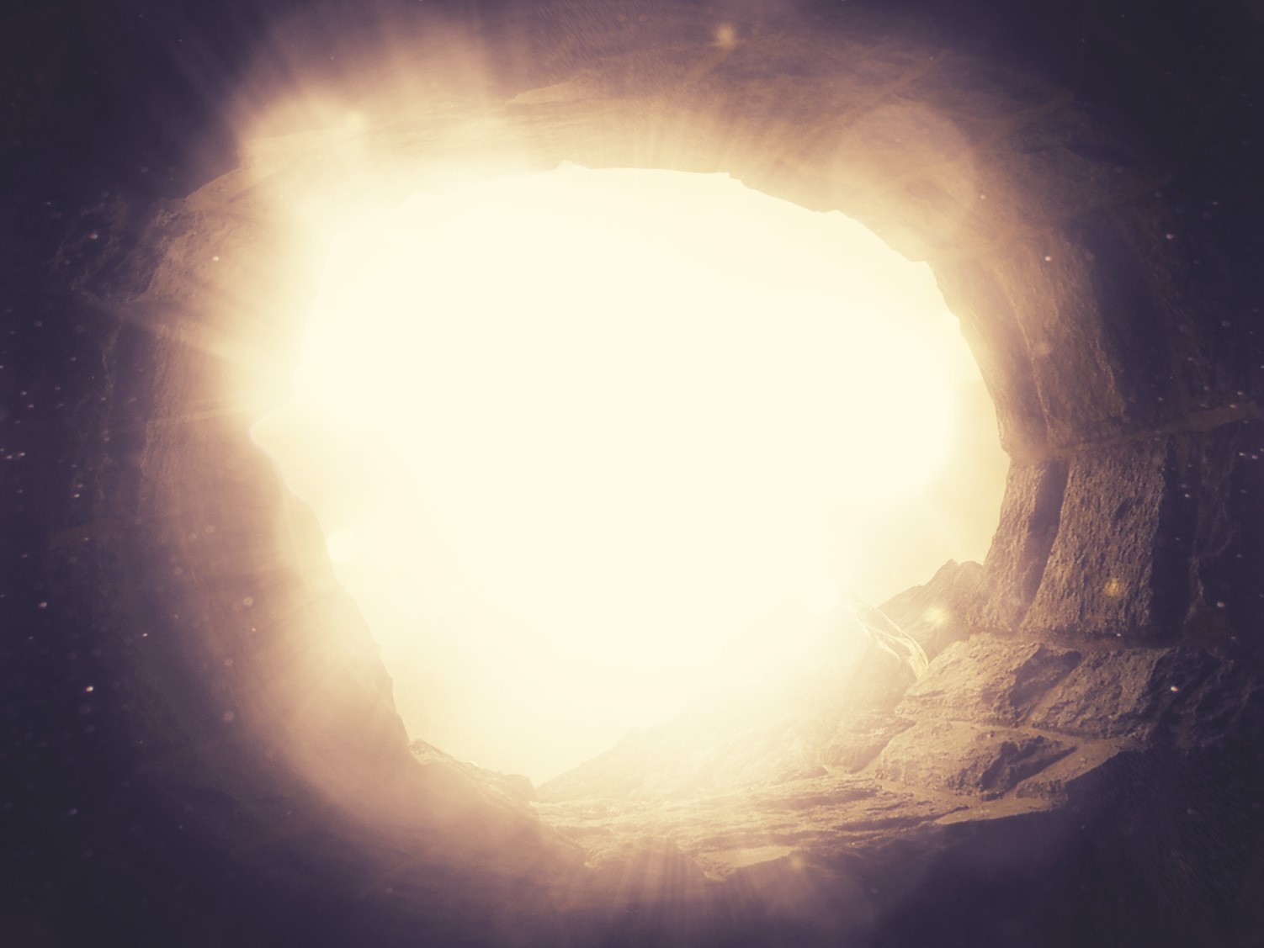
The Resurrection
of the King
§§ 184-198
Jesus rises to life again as Victor over death to prove his deity and the disciples' proclamation of the gospel to all nations
Section summaries based on J. Dwight Pentecost, A Harmony of the Words and Works of Jesus Christ (Grand Rapids: Zondervan, 1981)
Dr. Rick Griffith • Jordan Evangelical Theological Seminary • BibleStudyDownloads.org

Slide 2
Pentecost Outline
Introduction of the King
Authentication of the King
Controversy over the King
Instruction of the Twelve by the King
Opposition to the King
Preparation of the Disciples by the King
Official Presentation of the King
Preparation for the Death of the King
Rejection of the King
Resurrection of the King

Slide 3

Increasing Polarization
Resurrection
Preparation
for Death
Preparation
of Disciples
Instruction
Authentication
Introduction
Controversy
Opposition
Presentation
Rejection
Notes:
The Life of Christ brought increasing polarization. The more Jesus showed about himself, the greater the resistance to him and his message. Also, the more intense the controversy leading to opposition, the higher priority Christ placed on preparing his men for when he would be gone. The climactic rejection when he presented himself as king of Israel at the Triumphal Entry resulted in rejection to the point of crucifixion followed by the victory of resurrection.
Introduction of the King
Authentication of the King
Controversy over the King
Instruction of the Twelve by the King
Opposition to the King
Preparation of the Disciples by the King
Official Presentation of the King
Preparation for the Death of the King
Rejection of the King
Resurrection of the King

Slide 4

Great Periods in the Life of Christ
55
“The Son of Man… came to minister and to give his life a ransom for many” (Mark 10:45)
Climactic Galilean
Early Samaritan
Later Samaritan
Early Judean
Later Judean
Early Perean
Later Perean
Opening Events
Closing Events
Preparation
Confirmation
Walk Thru the New Testament seminar (used with permission)
Notes:
The Walk Thru outline of the life of Christ forms a chiasm or literary arrangement with repeating elements in the opposite order. This structure makes Confirmation parallel to Preparation, Closing Events parallel to Opening Events, etc. until the only event without parallel becomes the focus: Climatic Galilean. Such an arrangement of material was common in antiquity and is seen in both the OT (e.g., Zephaniah) and the NT (1 Thess) where the central teaching appears in the middle of each writing.
Small Group Assignment: Explain this slide to your group member(s) and have the others explain it back.
After the beginning events of stages 1-3, Jesus also gets farther away from his Jewish roots in Judea (4), to go to the Samaritans (5), and even farther to Galilee (6), where most Gentiles lived. He ministered to Jews in Galilee, of course, but this climatic period was the focus of his ministry.
_______
LC-00-Syllabus-63
LC-01-Introduction-265
LC-05-Opposition-4

Slide 5
Resurrection Appearances of Jesus
105
To… | Time | Matt | Mark | Luke | John | Acts | 1 Cor
Roman guards at tomb | Sunday morning | 28:4, 11-15
Women at the tomb | Sunday morning | 28:1-10 | 16:1-8 | 24:1-12 | 20:1-9
Mary Magdalene alone | Sunday morning |  | 16:9-11 |  | 20:11-18
2 Emmaus Road Travelers | Sunday midday |  |  | 24:13-35
Peter in Jerusalem | Sunday daytime |  |  | 24:34 |  |  | 15:5
10 Disciples in the upper room (excluding Thomas) | Sunday evening |  | 16:14 | 24:36-43 | 20:19-25
11 Disciples in the upper room (including Thomas) | One week later |  |  |  | 10:26-31 |  | 15:5
7 Disciples fishing on the Sea of Galilee | One day at daybreak |  |  |  | 21:1-23
11 Disciples on the mountain in Galilee | Later | 28:16-20 | 16:15-18
More than 500 believers | Later |  |  |  |  |  | 15:6
James, Brother of Jesus | Later |  |  |  |  |  | 15:7
11 Disciples at the Ascension on Mt. Olives | 40 days after resurrection |  |  | 24:44-49 |  | 1:3-8
Notes:
Should we consider the guards witnesses of the resurrection? The text does not say that they saw Jesus, but they certainly saw many things that no one else saw!
_______
The Resurrection
Matt. 28:1 Early on Sunday morning, as the new day was dawning, Mary Magdalene and the other Mary went out to visit the tomb.
Matt. 28:2 Suddenly there was a great earthquake! For an angel of the Lord came down from heaven, rolled aside the stone, and sat on it. ³ His face shone like lightning, and his clothing was as white as snow. ⁴ The guards shook with fear when they saw him, and they fell into a dead faint.
Matt. 28:5 Then the angel spoke to the women. “Don’t be afraid!” he said. “I know you are looking for Jesus, who was crucified. ⁶ He isn’t here! He is risen from the dead, just as he said would happen. Come, see where his body was lying. ⁷ And now, go quickly and tell his disciples that he has risen from the dead, and he is going ahead of you to Galilee. You will see him there. Remember what I have told you.”
Matt. 28:8 The women ran quickly from the tomb. They were very frightened but also filled with great joy, and they rushed to give the disciples the angel’s message. ⁹ And as they went, Jesus met them and greeted them. And they ran to him, grasped his feet, and worshiped him. ¹⁰ Then Jesus said to them, “Don’t be afraid! Go tell my brothers to leave for Galilee, and they will see me there.”
The Report of the Guard
Matt. 28:11 As the women were on their way, some of the guards went into the city and told the leading priests what had happened. ¹² A meeting with the elders was called, and they decided to give the soldiers a large bribe. ¹³ They told the soldiers, “You must say, ‘Jesus’ disciples came during the night while we were sleeping, and they stole his body.’ ¹⁴ If the governor hears about it, we’ll stand up for you so you won’t get in trouble.” ¹⁵ So the guards accepted the bribe and said what they were told to say. Their story spread widely among the Jews, and they still tell it today.

Slide 6
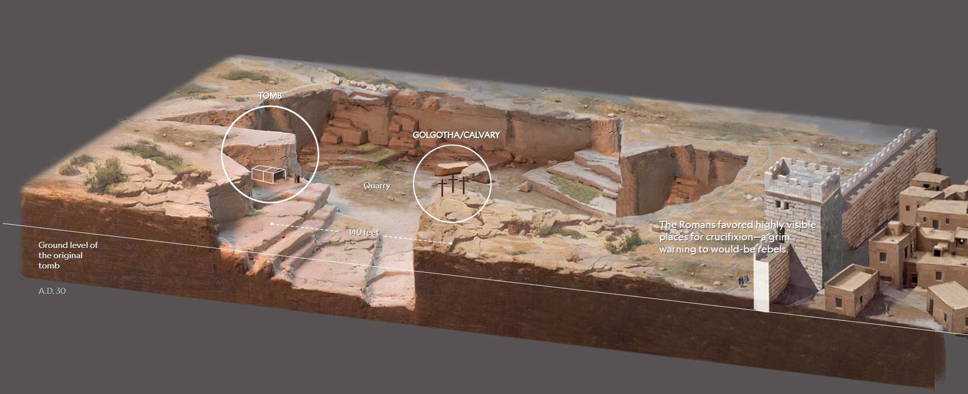
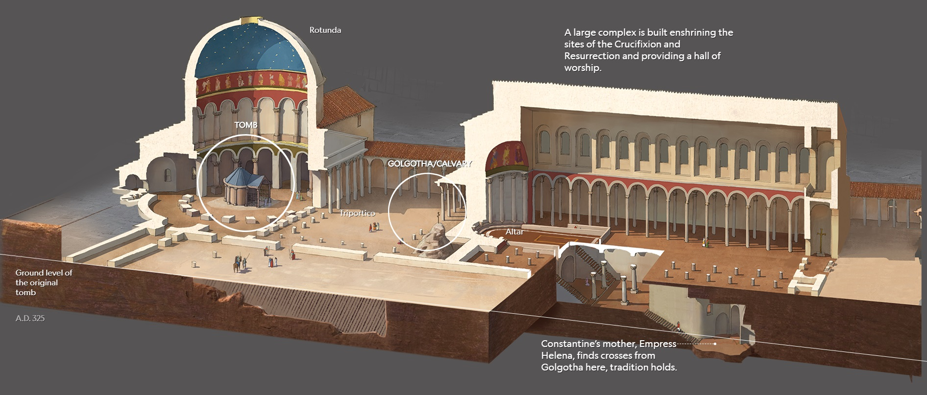
AD 33
AD 325
Notes:
reasonandscience.catsboard.com

Slide 7
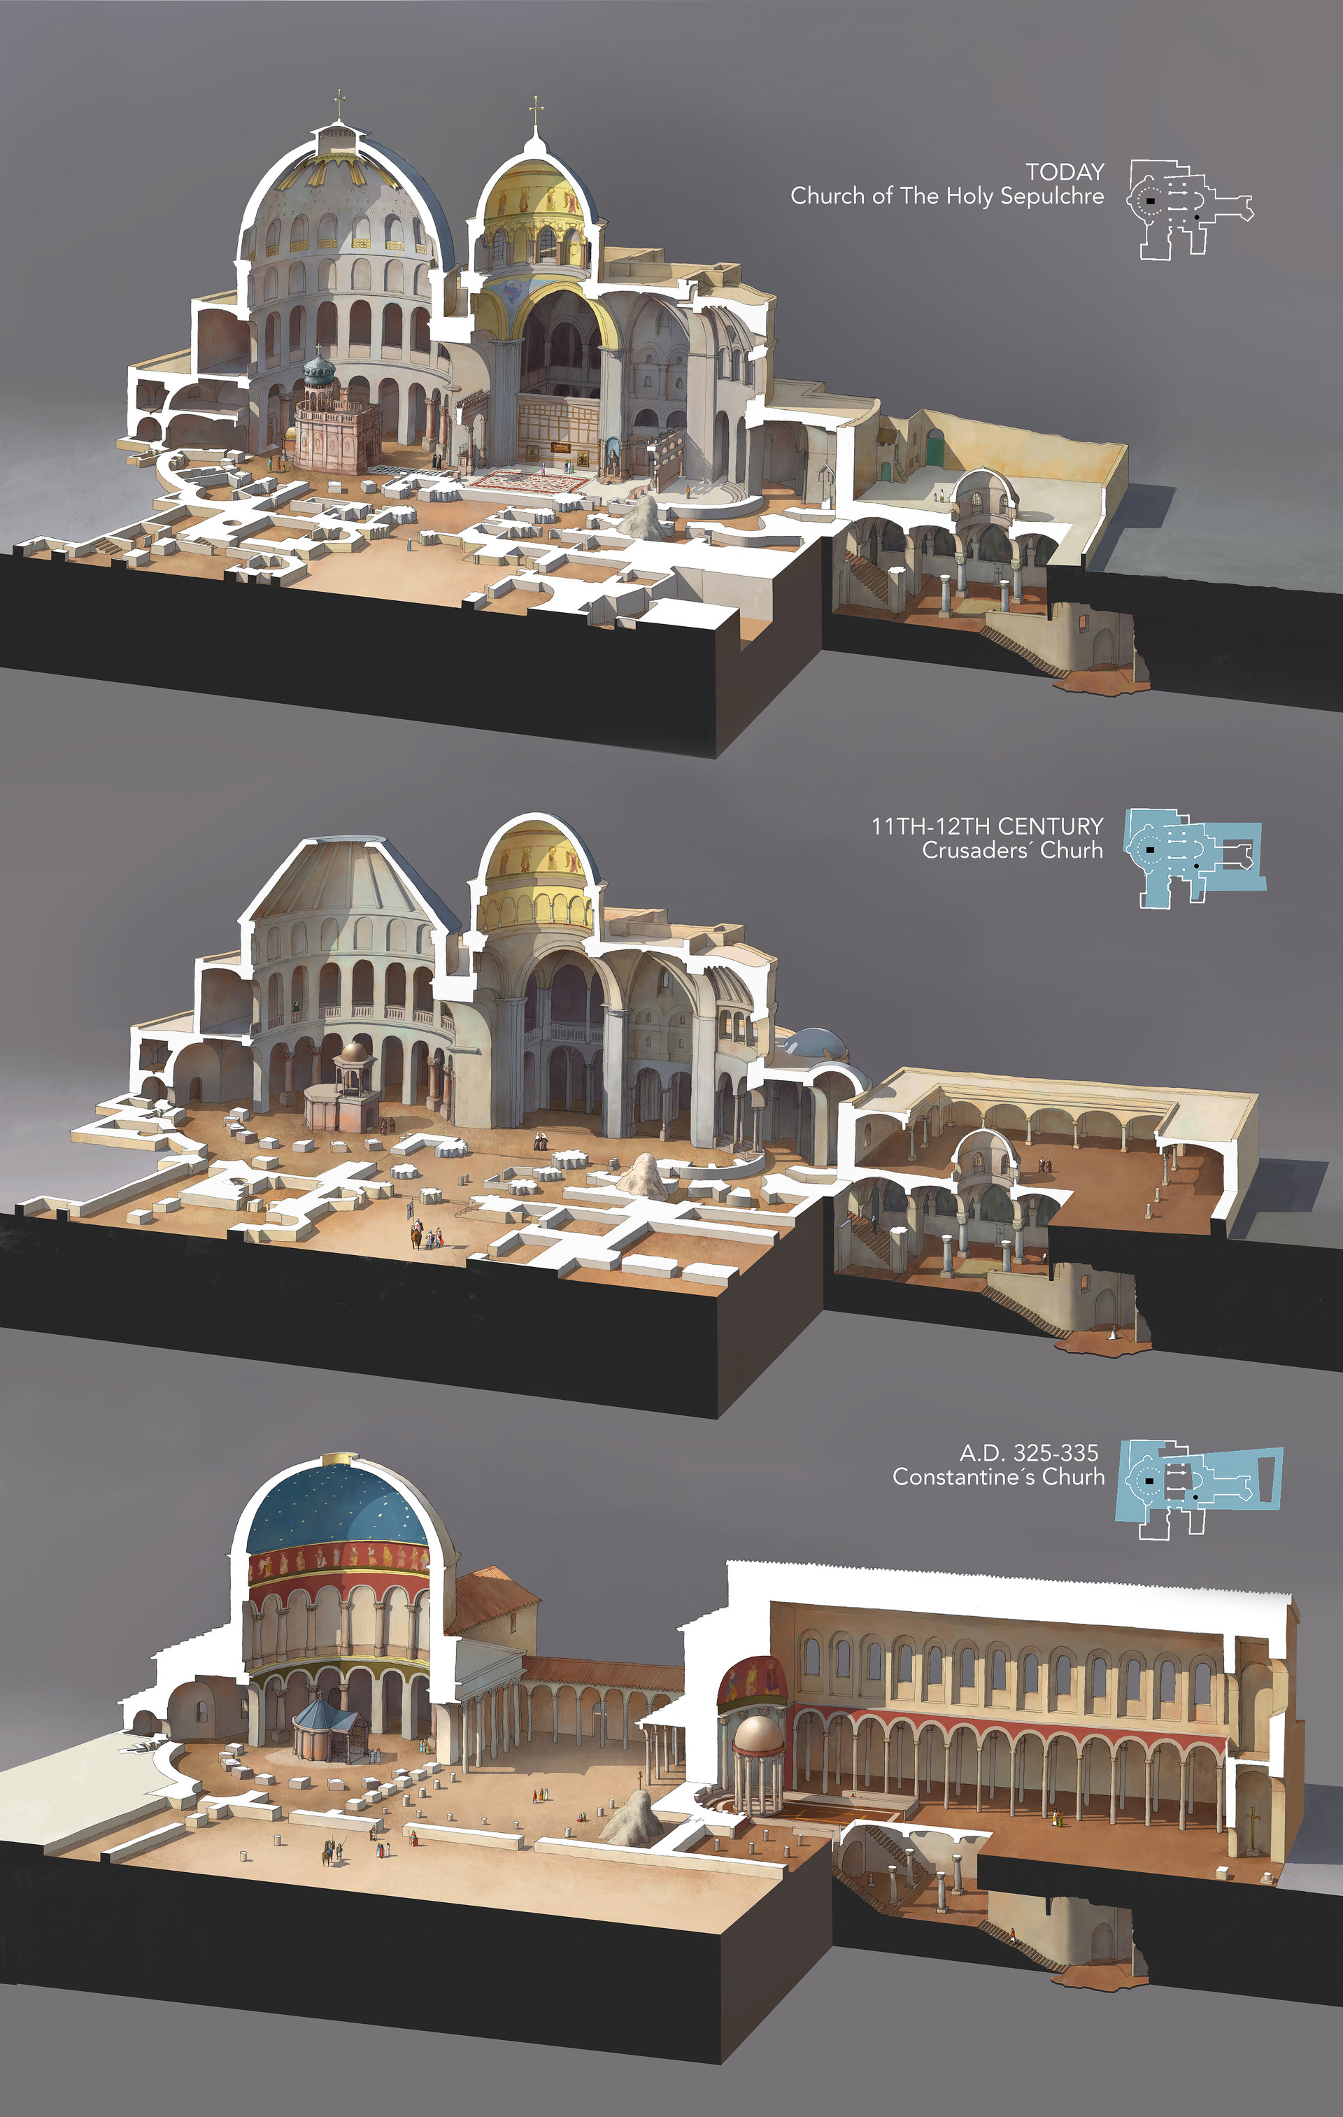
The Tomb & Golgotha Over Time
Today
11th-12th Centuries
AD 325
Notes:
The Holy Sepulchre through the time
Collaboration for National Geographic magazine, December 2017.
Three of the four buildings which have been built through the time on the Holy Sepulchre.
(This article's illustrations were prizewinning by the SND39 and Malofiej26 contests with silver medals)
https://rocioespin.artstation.com/projects/Q58nZ
Accessed 18 May 2024

Slide 8
AD 325-335 Constantine's Church
(Open air Triportico)
Floor Plan
Notes:
The Holy Sepulchre through the time
Collaboration for National Geographic magazine, December 2017.
Three of the four buildings which have been built through the time on the Holy Sepulchre.
(This article's illustrations were prizewinning by the SND39 and Malofiej26 contests with silver medals)
https://rocioespin.artstation.com/projects/Q58nZ
Accessed 18 May 2024

Slide 9
11th-12th Cent. Crusader Church
(Enclosed Triportico)
Floor Plan
Notes:
The Holy Sepulchre through the time
Collaboration for National Geographic magazine, December 2017.
Three of the four buildings which have been built through the time on the Holy Sepulchre.
(This article's illustrations were prizewinning by the SND39 and Malofiej26 contests with silver medals)
https://rocioespin.artstation.com/projects/Q58nZ
Accessed 18 May 2024

Slide 10
Church of the Holy Sepulchre
(Embellished Domes Today)
Floor Plan
Notes:
The Holy Sepulchre through the time
Collaboration for National Geographic magazine, December 2017.
Three of the four buildings which have been built through the time on the Holy Sepulchre.
(This article's illustrations were prizewinning by the SND39 and Malofiej26 contests with silver medals)
https://rocioespin.artstation.com/projects/Q58nZ
Accessed 18 May 2024

Slide 11
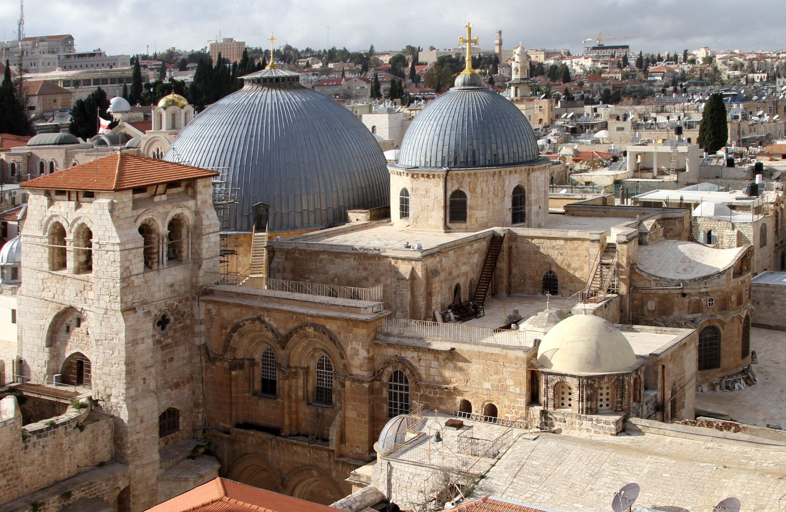
Church of the Holy Sepulchre
(Embellished Domes Today)
Notes:
The Holy Sepulchre through the time
Collaboration for National Geographic magazine, December 2017.
Three of the four buildings which have been built through the time on the Holy Sepulchre.
(This article's illustrations were prizewinning by the SND39 and Malofiej26 contests with silver medals)
https://rocioespin.artstation.com/projects/Q58nZ
Accessed 18 May 2024

Slide 12
A. The Preparation by the Women
§ 184
Matthew 28:1; Mark 16:1
After the Sabbath, early Sunday morning Mary Magdalene, Mary the mother of James, and Salome go to the tomb to anoint Jesus' body
Notes:
Matt. 28:1 Early on Sunday morning, as the new day was dawning, Mary Magdalene and the other Mary went out to visit the tomb.
Mark 16:1 Saturday evening, when the Sabbath ended, Mary Magdalene, Mary the mother of James, and Salome went out and purchased burial spices so they could anoint Jesus’ body.

Slide 13
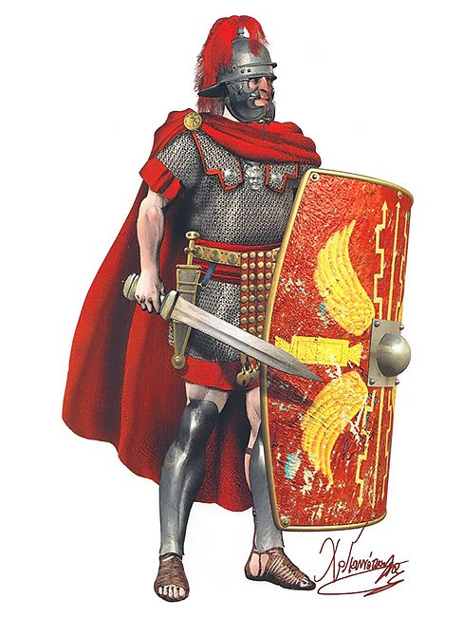
Roman Soldier

Slide 14
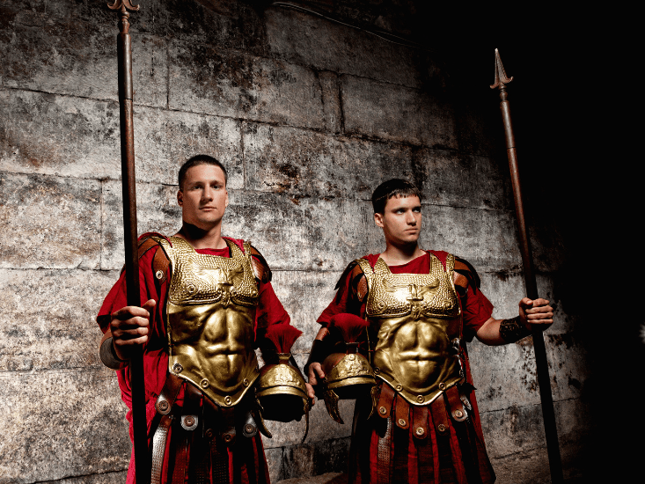
The Roman seal prevented tampering
Notes:
14
14

Slide 15
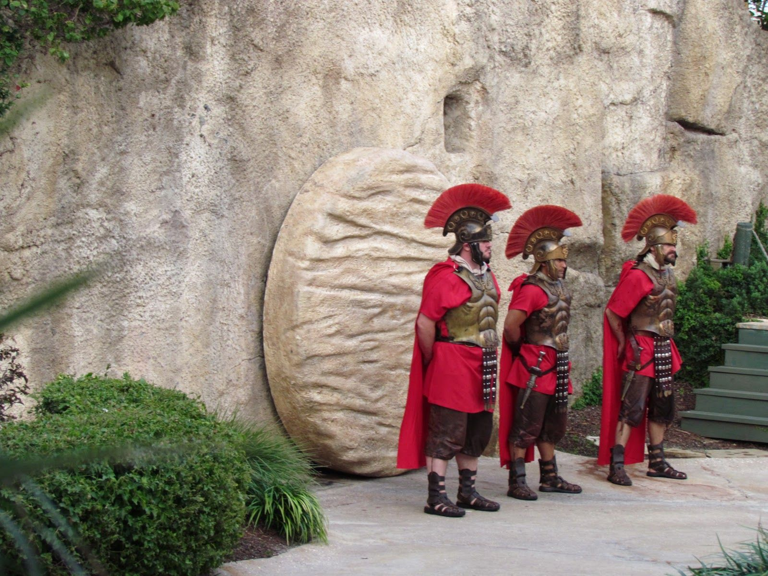
The Roman seal prevented tampering
Notes:
15
15

Slide 16
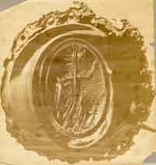
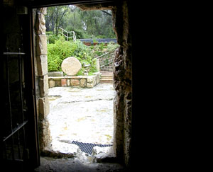
The Roman seal prevented tampering
Notes:
16
16

Slide 17
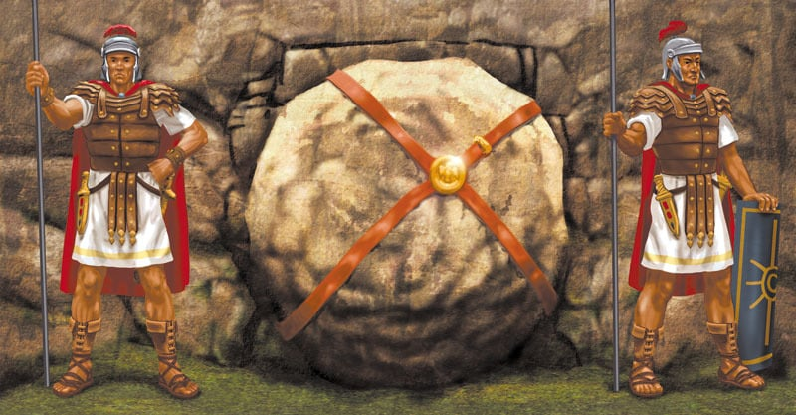
The Roman seal prevented tampering
Notes:
17
17

Slide 18
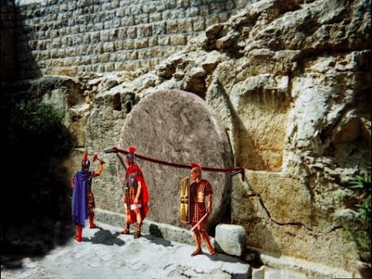
The Roman seal prevented tampering
Notes:
18
18

Slide 19
B. The Opening of the Tomb
§ 185
Matthew 28:2-4
Christ resurrects with an earthquake, an angel rolling back the stone to show the tomb empty, and Roman guards as witnesses
Notes:
Christ resurrects when in a violent earthquake an angel rolls back the stone and sits upon it so that witnesses may see that Christ's body is gone, the angel's glory scaring the Roman guard so that they at first shook, then became as corpses, then left the site
_____________
Matt. 28:2 Suddenly there was a great earthquake! For an angel of the Lord came down from heaven, rolled aside the stone, and sat on it. ³ His face shone like lightning, and his clothing was as white as snow. ⁴ The guards shook with fear when they saw him, and they fell into a dead faint.

Slide 20
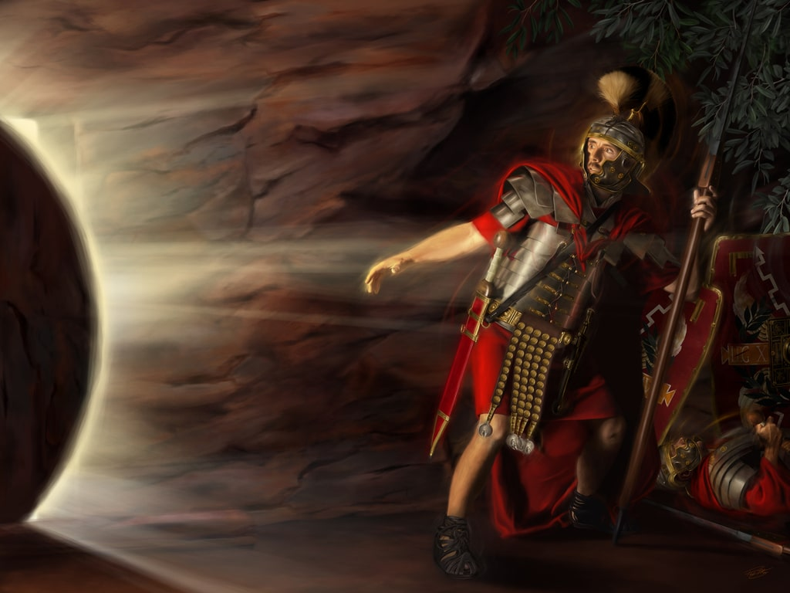
The Roman seal prevented tampering
Notes:
20
20
Matt. 28:1 Early on Sunday morning, as the new day was dawning, Mary Magdalene and the other Mary went out to visit the tomb.
Matt. 28:2 Suddenly, there was a great earthquake! For an angel of the Lord came down from heaven, rolled aside the stone, and sat on it. ³ His face shone like lightning, and his clothing was as white as snow. ⁴ The guards shook with fear when they saw him, and they fell into a dead faint.

Slide 21
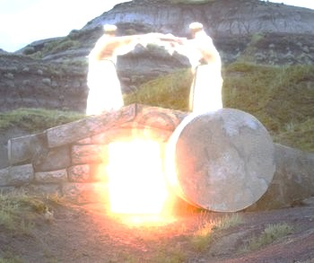
I. The empty tomb shows that Christ is alive today
(John 20:1-9).

Slide 22
“The Gospel of John” ® Movie
John 20:1-9
Notes:
22

Slide 23
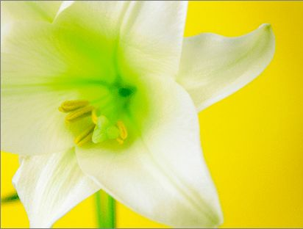
Three Initial Witnesses
Mary (1-2)
John (3-5)
Peter (6-9)

Slide 24
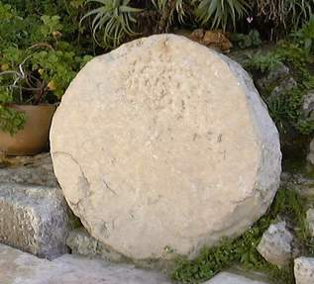
The stone was rolled away…
Notes:
24
24

Slide 25
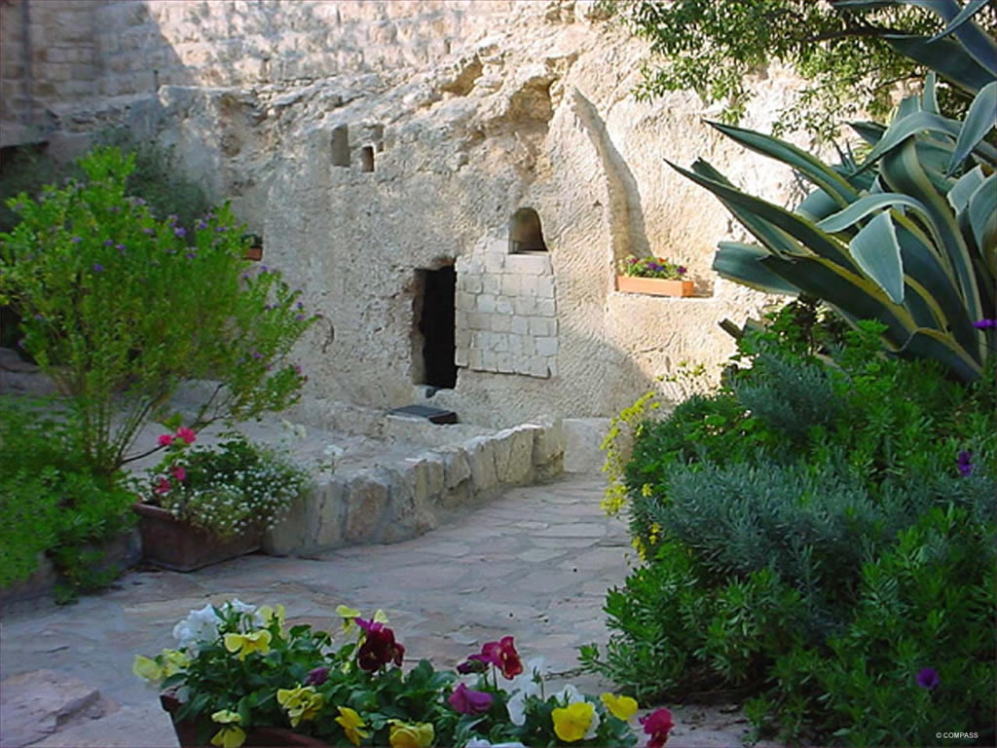
The Garden Tomb
Notes:
25
25

Slide 26
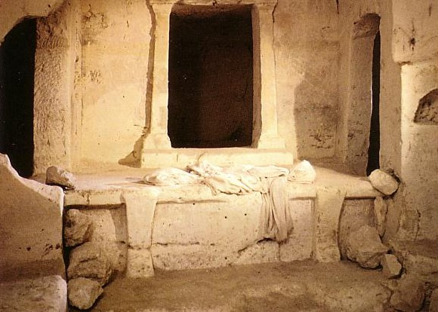
Empty linens

Slide 27
C. The Visit of the Women
§ 186
Matthew 28:5-8; Mark 16:2-8; Luke 24:1-8; John 20:1
The women see an open tomb and angels who herald Christ's resurrection, commanding them for the disciples to meet Jesus in Galilee

Slide 28


Matthew 28:1-15
Mark 16:1-20
Luke 24:1-47
John 20:1-29
Free
Bible
images
THE EASTER STORY
JESUS IS ALIVE

Slide 29

Notes:
The three women did not expect a resurrection. They expected a dead body that needed spices that they could not anoint on Friday night. They probably wondered how to convince the Roman guard to break the seal to give them access to the body.

Slide 30
Notes:
They certainly did not expect the stone rolled away and nobody there!

Slide 31


Slide 32
THE WORD IN PICTURES
Free
Bible
images

Slide 33

Used with Permission
THE
GOSPEL
——OF—— MATTHEW
THE
GOSPEL
——OF—— MARK
THE
GOSPEL
——OF—— LUKE
THE
GOSPEL
——OF—— JOHN
Due to the Lumo Project producing its own publishing material we regret to inform you that we cannot license our photos to other clients outside of freebibleimages.org.
These images are not licensed for reuse in video, epublishing or other media. Downloaded pictures and files cannot be redistributed through any other website than freebibleimages.org or used in any context where the accompanying message is undermining of the Christian faith and gospel.
Photos can only be used on educational presentations, blogs and social media, all of which should be accompanied with reference to www.LumoProject.com.
Picture courtesy of BBM
© All Rights Reserved.
www.bigbookmedia.com

Slide 34

A Prophetic Weekend
Thursday
Friday
Saturday
Sunday
Galilean
Passover
Unleavened Bread
Firstfruits
Judean
Passover
Unleavened Bread
Firstfruits
Last Supper
Crucifixion
Resurrection
2 April 33
3 April 33
5 April 33
“But now Christ has been raised from the dead, the first fruits of those who are asleep” (1 Cor 15:20 NAU).
Christ is the only one ever resurrected, but as such, he is also the first among many who will join a resurrected body.
Notes:
Leviticus 23 gives the order of three key feasts of Israel: • Passover, • Unleavened Bread, and • Firstfruits.
• But how could Jesus have Passover Thursday night but then die at 3 PM the next day on Friday when the Passover lambs were being slaughtered? And why did the Jewish leaders want the bodies off the cross quickly as Passover was approaching when Jesus had already celebrated Passover the night before?
• The answer is that Galilean Jews celebrated Passover the day before • Judean Jews. Since his disciples were Galileans, Jesus naturally celebrated on their timetable.
• The Feast of Unleavened Bread always began the day after Passover (Lev 23:5-6).
• Then Firstfruits followed sometime later on the first Sabbath after the first crops began to ripen (Lev 23:11). It indicated that millions of additional sheaves would follow until the entire harvest came in at Pentecost. In AD 33, these three celebrations occurred one after another on three consecutive days!
The significance is astonishing. • Christ predicted his death at the Last Supper Thursday night. • Then Jesus died on the Judean Passover • so that believers can live a life without yeast (Unleavened Bread), • which immediately followed with his resurrection on Firstfruits as he is the first and only human ever to obtain a glorified body as an installment for millions more to follow (1 Cor 15:20)!
We know these dates to be • 2 April 33 for the Thursday night Passover, • 3 April 33 was the day of his crucifixion, and • Jesus rose from the dead on the Feast of Firstfruits on 5 April 33.
————————————
Common English-217
Common Arabic-327
OB-25-Feasts-35
OS-03-Leviticus-303
OS-26-Ezek40-43-Slide105
LC-00-Chronology of Christ-8
LC-10-Resurrection-35
NB-11-Feasts-35
NS-00-NTS Chronology-slide 40
NS-00-Chronology of Christ-8
NS-01-Matt15-28-slide 315
NS-02-Mark9-16-slide 262
NS-03-Luke13-24-slide 292
NS-04-John12-21-slide 390

Slide 35
D. The Report to the Disciples
§ 187
Luke 24:9-12; John 20:2-10
The women tell the disciples about the empty tomb, so Peter and John run to the tomb to investigate the matter themselves, resulting in John's belief
Notes:
Like the men, these women do not see the meaning of the resurrection. Jesus alive doesn't even seem to be an option that they consider.

Slide 36

Notes:
They wondered what happened. After all, there had never been anyone who resurrected himself into a glorified body before then—or even since then!

Slide 37


Slide 38


Slide 39


Slide 40


Slide 41


Slide 42

Notes:
How did Peter and John react differently to what they experienced at the tomb?

Slide 43
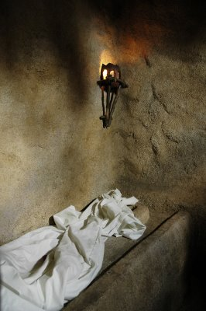
“Seeing” in John 20:5-8
John
“looked”
v. 5
John
“saw”
v. 8
“peeped”
“perceived”
Peter
“saw”
v. 6
“beheld attentively”
Notes:
43
43
The Greek text uses three different words to describe what Peter and John saw:
• John "peeped" (blepei) into the tomb, wondering if the body was really gone.
• Peter "beheld attentively" (theorei) in that he saw more than John saw as Peter entered the tomb.
• But John "perceived" (eiden) or understood the significance of the empty tomb, "and believed" in the resurrection

Slide 44
E. The Appearance to Mary
§ 188
Mark 16:9-11; John 20:11-18
Mary Magdalene sees the resurrected Jesus at the tomb and tells the disciples, but they do not believe even this eyewitness account

Slide 45

Notes:
Mary Magdalene returned to the tomb alone in her despair.

Slide 46


Slide 47


Slide 48


Slide 49


Slide 50


Slide 51


Slide 52
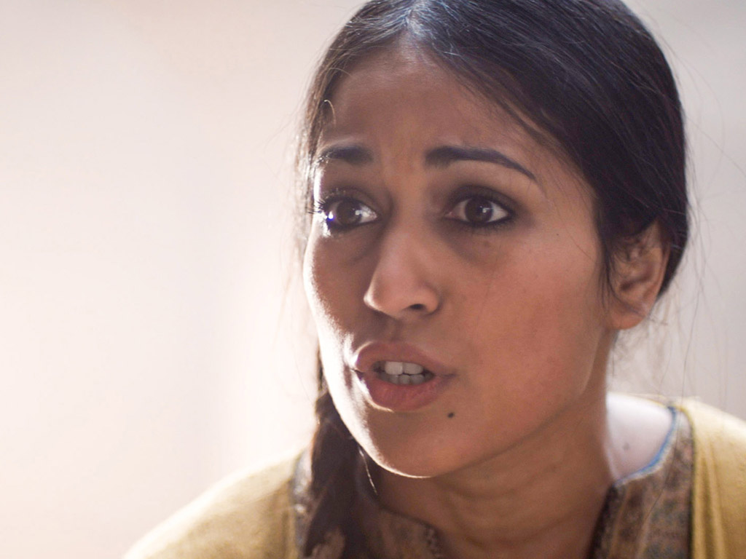

Slide 53
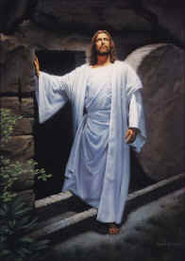
II. Christ's resurrection meets you at your need
(John 20:10-29)
Comforts the despairing
Mary (10-18)
Notes:
53
53

Slide 54
F. The Appearance to the Women
§ 189
Matthew 28:9-10
The other women see Jesus at the tomb, and He tells them to tell the disciples to meet Him in Galilee for teaching and a final commission
Notes:
Matt. 28:9 And as they went, Jesus met them and greeted them. And they ran to him, grasped his feet, and worshiped him. ¹⁰ Then Jesus said to them, “Don’t be afraid! Go tell my brothers to leave for Galilee, and they will see me there.”
They had already been to the tomb earlier, but they did not see the meaning of it being empty.

Slide 55
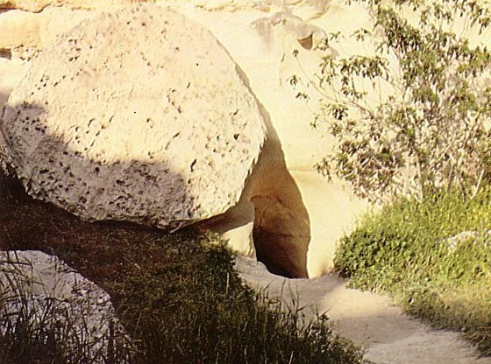
Who moved the stone?
He never died?
Jesus' strength?
Romans?
Jewish Leaders?
Disciples?
Notes:
There are only a few options to this question:
• If Jesus never died, then the Romans failed to execute Him
• But this would mean that, after tremendous blood loss through flogging, an arduous walk to Golgotha, nails in his extremities, and a spear in his side, without any food or water in the cold blackness for two nights, Jesus miraculously revived, escaped his cocoon encasement of burial cloths, rolled away a 2-ton stone, and fought off a detachment of 16 Roman guards who were trained to hold back an invading army! Wouldn't this be a greater miracle than a resurrection?!
• Others claim that the Roman guard stole the body—but they had the death penalty for failure of duty, so they are the least feasible option.
• Another theory is that the Jewish leaders stole the body. Yet they would not want to fake a resurrection for fear that this would steal their power.
• Other skeptics surmise that the disciples stole the body. Yet these men were the most disillusioned of all about Christ's death and did not even recall His prophecy about rising from the dead. Ten of the 12 disciples also died as martyrs, so it is highly unlikely that they would give their lives for what they knew was a lie.

Slide 56
G. The Report of the Guard
§ 190
Matthew 28:11-15
The guards report the resurrection to the Jewish leaders, who pay them to lie that the disciples stole Christ's body while they slept
Notes:
The guards report the resurrection to the chief priests, who, with the Sanhedrin, bribe them to lie that the disciples stole Christ's body while they were asleep as a futile attempt to discredit the disciples based on the religious leaders’ stubborn unbelief
Here would be the first time in history that people knew what happened while they slept!

Slide 57
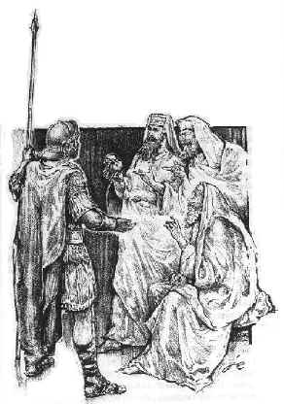
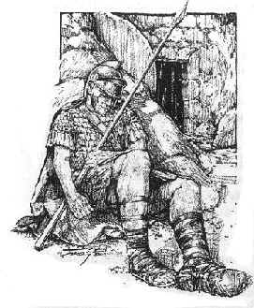
Guards Bribed (Matt 28:12)
Notes:
The guards were motivated to lie as they were paid to do it.

Slide 58
H. The Appearance to the Two on the Emmaus Road
§ 191
Mark 16:12-13; Luke 24:13-32
Jesus appears to two men on the Emmaus Road to reveal that His suffering precedes His glory, but this makes sense only when He disappears at dinner

Slide 59
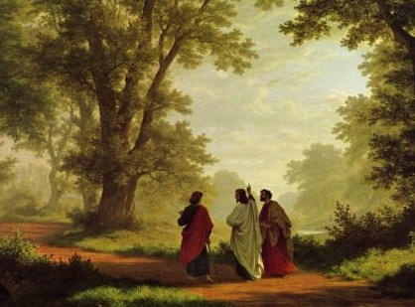
Could mortals and those in glorified bodies really live together?
435
Jesus did this on the Emmaus Road
(Luke 24)

Slide 60
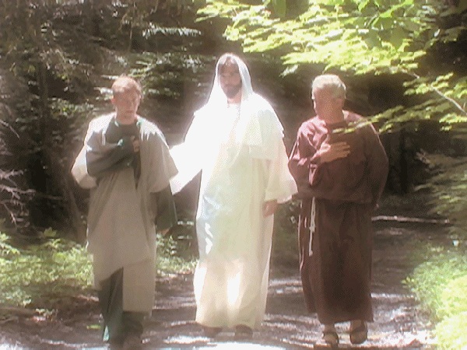
Could mortals and those in glorified bodies really live together?
435
Remember when Jesus glowed?
Notes:
Do the Gospel accounts teach this?

Slide 61
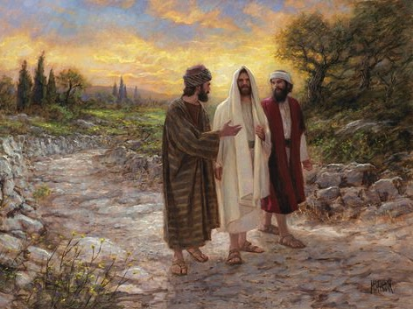
Could mortals and those in glorified bodies really live together?
435
No, he looked like the rest of us!

Slide 62
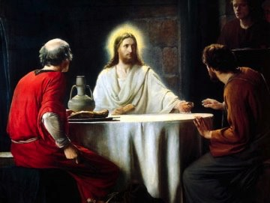
Only at dinner did they recognize Jesus
435

Slide 63
Could mortals and those in glorified bodies really live together?
"And beginning with Moses and all the Prophets, he explained to them what was said in all the Scriptures concerning himself"
(Luke 24:27 NIV)
Notes:
Only at dinner did the men see that the OT teaches suffering before glory for the Messiah (and for us!)

Slide 64
I. The Report of the Two to the Disciples
§ 192
Luke 24:33-35
These two disciples report to the Eleven that they have seen the Lord, thus verifying the earlier report of the women

Slide 65
J. The Appearance to Several Disciples
§ 193
Mark 16:14; Luke 24:36-43; John 20:19-25
Jesus appears to ten disciples who later tell the disbelieving Thomas, showing that faith alone is insufficient for some to believe

Slide 66
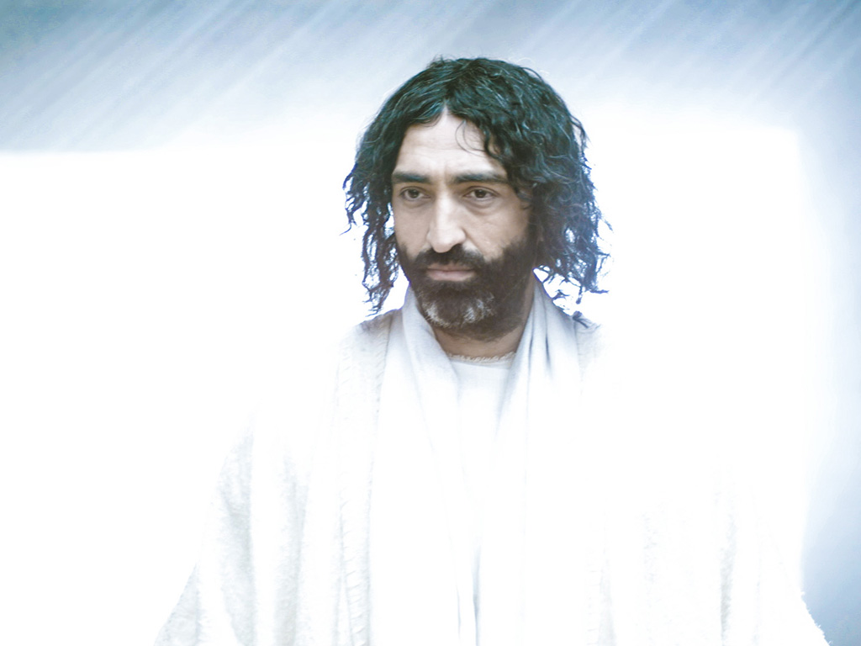
Free
Bible
images
THE EASTER STORY
JESUS APPEARS TO THE DISCIPLES
Luke 24:36-49
John 20:19-23

Slide 67
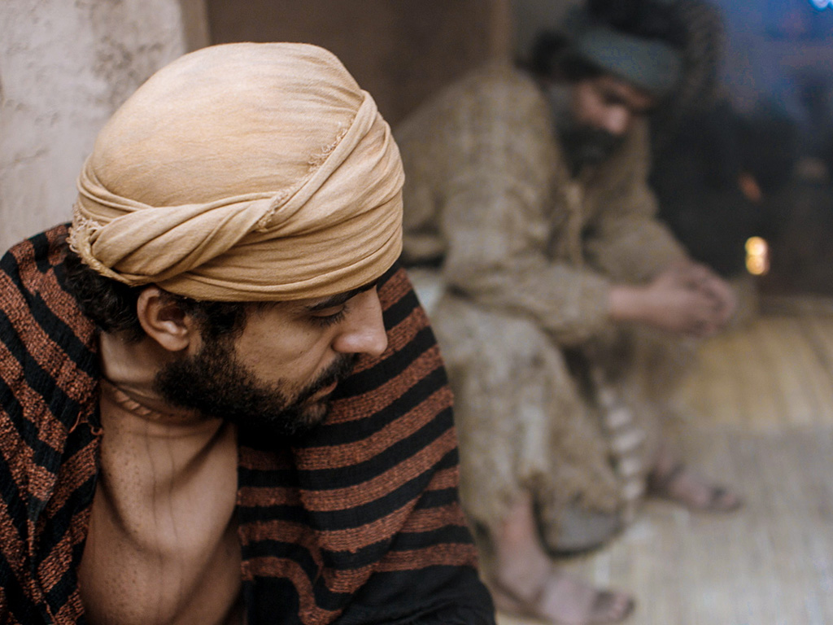

Slide 68
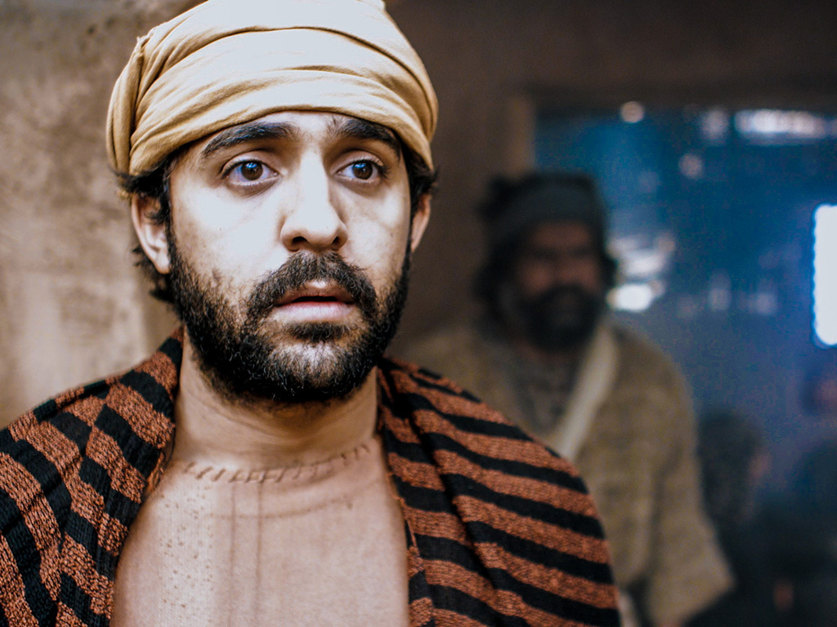
Notes:
Luke 24:35 Then the two from Emmaus told their story of how Jesus had appeared to them as they were walking along the road, and how they had recognized him as he was breaking the bread.

Slide 69
Notes:
^{Luke 24:36} And just as they were telling about it, Jesus himself was suddenly standing there among them. “Peace be with you,” he said. ³⁷ But the whole group was startled and frightened, thinking they were seeing a ghost!

Slide 70
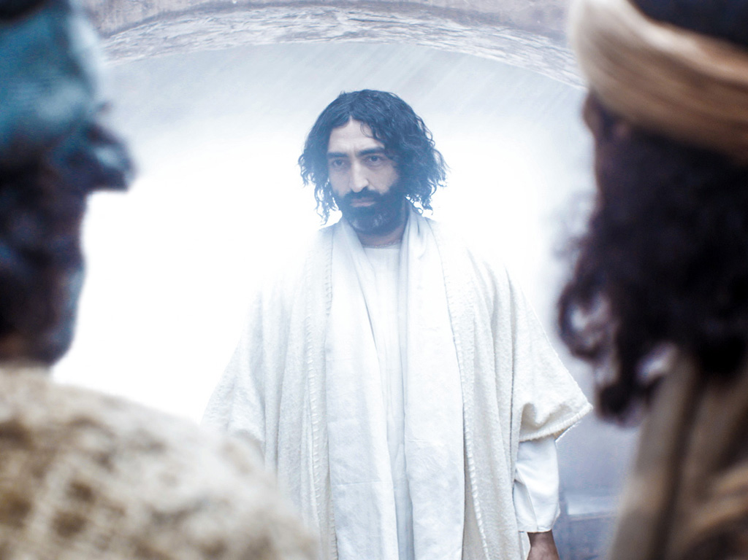
Notes:
Luke 24:38 “Why are you frightened?” he asked. “Why are your hearts filled with doubt?

Slide 71
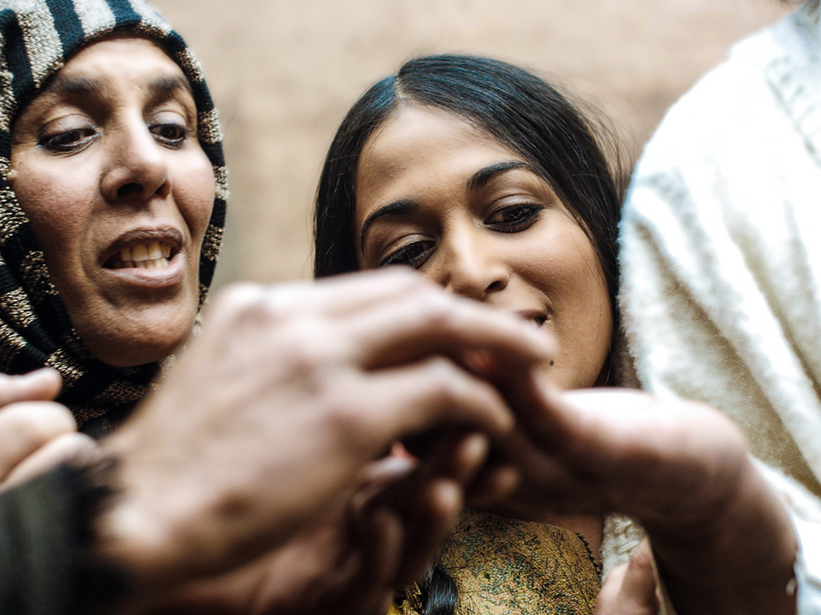
Notes:
³⁹ Look at my hands. Look at my feet. You can see that it’s really me. Touch me and make sure that I am not a ghost, because ghosts don’t have bodies, as you see that I do.”

Slide 72
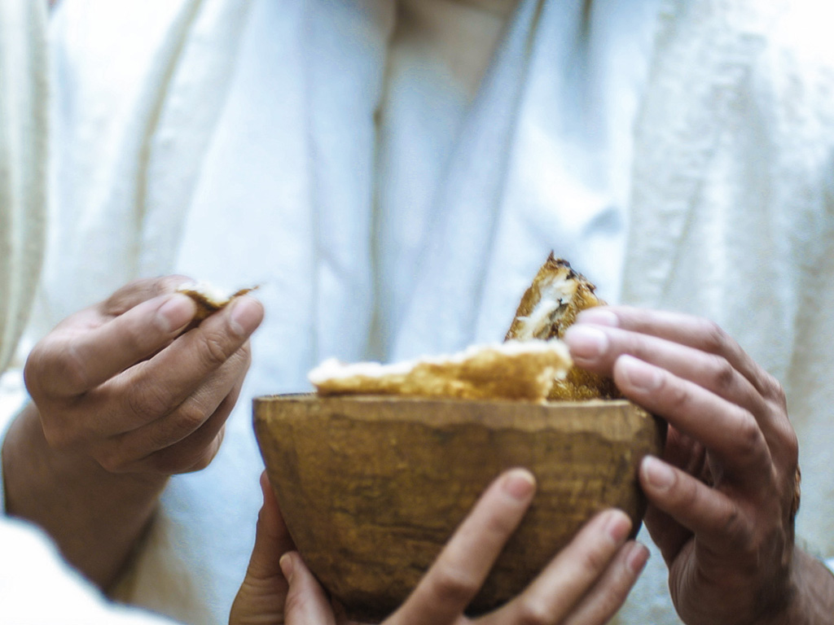
Notes:
Luke 24:41 Still they stood there in disbelief, filled with joy and wonder. Then he asked them, “Do you have anything here to eat?” ⁴² They gave him a piece of broiled fish, ⁴³ and he ate it as they watched.

Slide 73
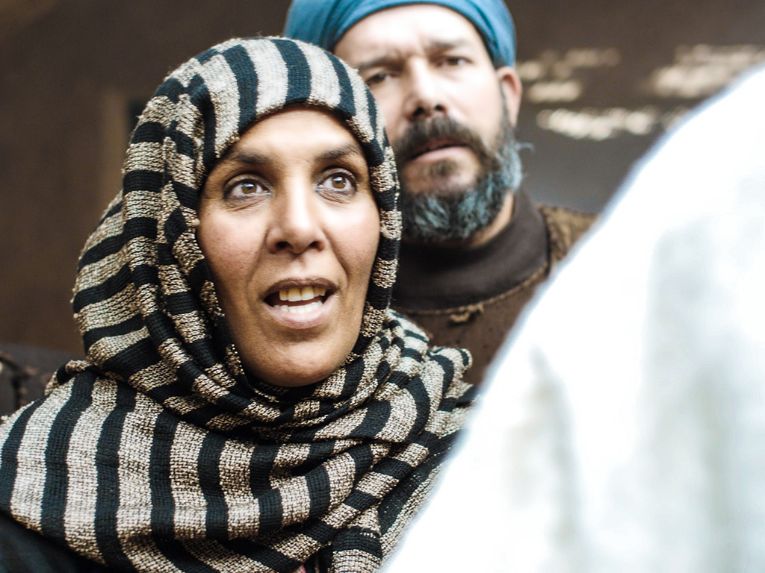
Notes:
Luke 24:44 Then he said, “When I was with you before, I told you that everything written about me in the law of Moses and the prophets and in the Psalms must be fulfilled.”

Slide 74
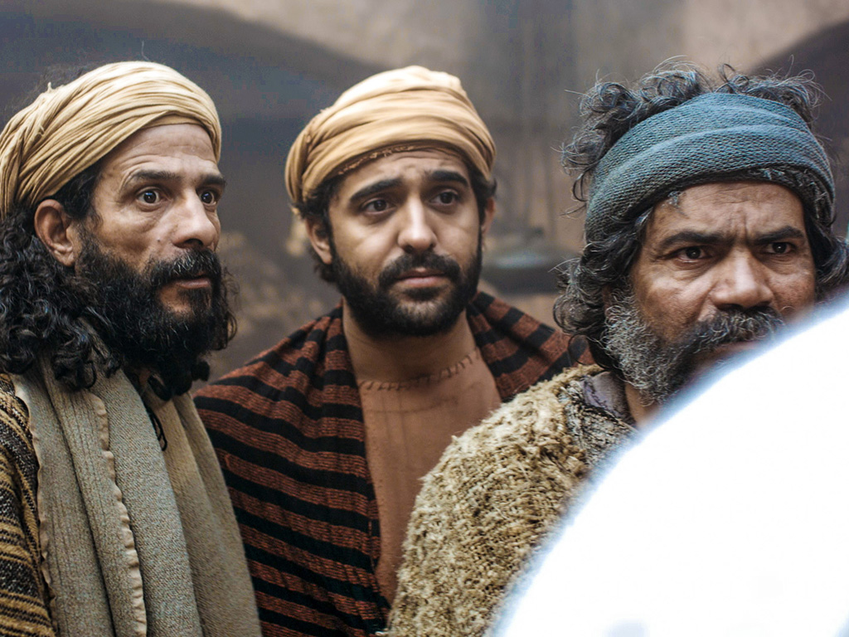
Notes:
⁴⁵ Then he opened their minds to understand the Scriptures.

Slide 75
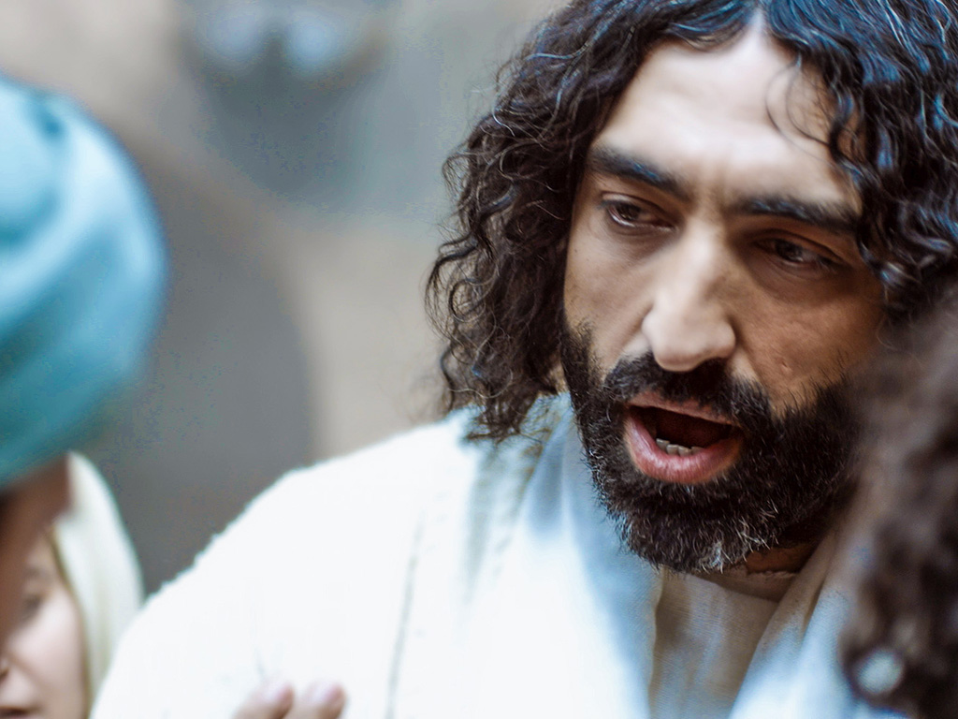
Notes:
⁴⁶ And he said, “Yes, it was written long ago that the Messiah would suffer and die and rise from the dead on the third day. ⁴⁷ It was also written that this message would be proclaimed in the authority of his name to all the nations, beginning in Jerusalem: ‘There is forgiveness of sins for all who repent.’ ⁴⁸ You are witnesses of all these things.
Luke 24:49 “And now I will send the Holy Spirit, just as my Father promised. But stay here in the city until the Holy Spirit comes and fills you with power from heaven.”

Slide 76
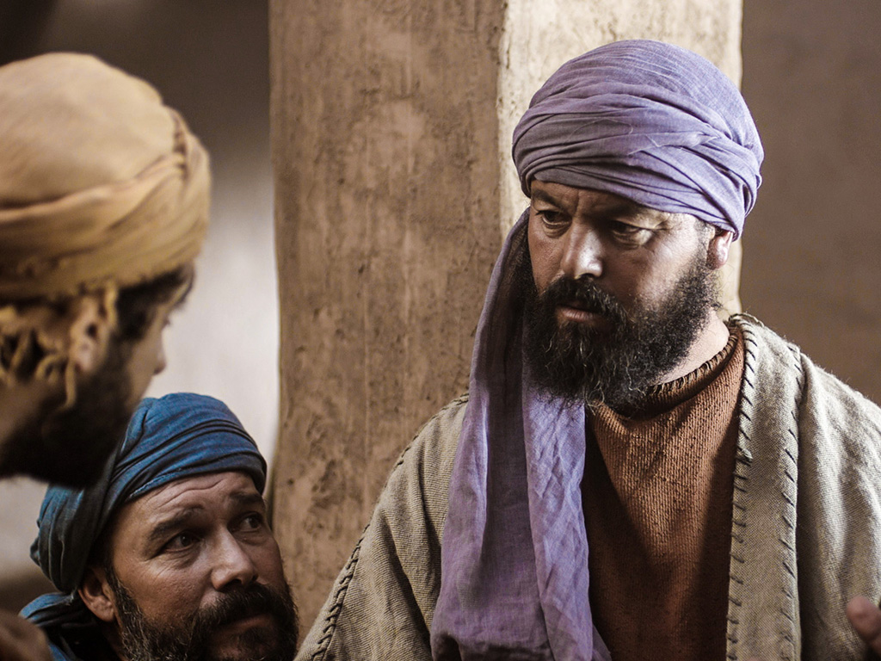
Notes:
John 20:24 One of the twelve disciples, Thomas (nicknamed the Twin), was not with the others when Jesus came.

Slide 77
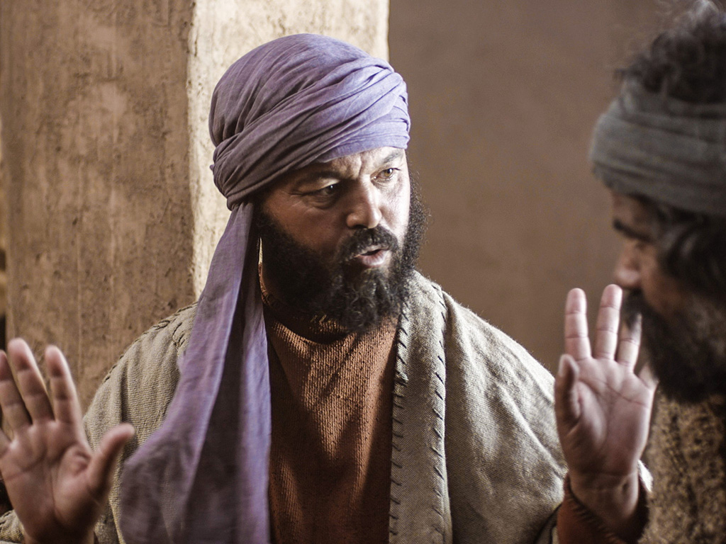
Notes:
25 They told him, “We have seen the Lord!”

Slide 78
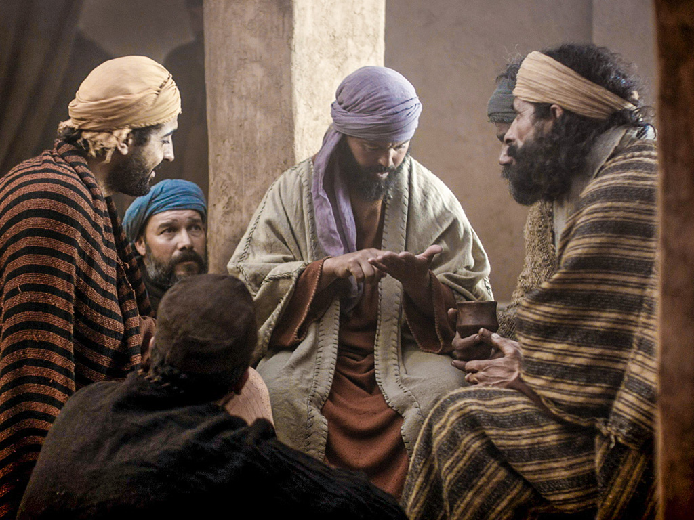
Notes:
But he replied, “I won’t believe it unless I see the nail wounds in his hands, put my fingers into them, and place my hand into the wound in his side.”

Slide 79
THE WORD IN PICTURES
Free
Bible
images

Slide 80
Used with Permission
THE
GOSPEL
——OF—— MATTHEW
THE
GOSPEL
——OF—— MARK
THE
GOSPEL
——OF—— LUKE
THE
GOSPEL
——OF—— JOHN
Due to the Lumo Project producing its own publishing material we regret to inform you that we cannot license our photos to other clients outside of freebibleimages.org.
These images are not licensed for reuse in video, epublishing or other media. Downloaded pictures and files cannot be redistributed through any other website than freebibleimages.org or used in any context where the accompanying message is undermining of the Christian faith and gospel.
Photos can only be used on educational presentations, blogs and social media, all of which should be accompanied with reference to www.LumoProject.com.
Picture courtesy of BBM
© All Rights Reserved.
www.bigbookmedia.com

Slide 81
K. The Appearance to the Eleven
§ 194
John 20:26-31
Jesus appears to all 11 disciples a week later, and Thomas submits to Him as Lord and deity so these men can preach what they witnessed to the nations
Notes:
John 20:26 Eight days later the disciples were together again, and this time Thomas was with them. The doors were locked; but suddenly, as before, Jesus was standing among them. “Peace be with you,” he said. ²⁷ Then he said to Thomas, “Put your finger here, and look at my hands. Put your hand into the wound in my side. Don’t be faithless any longer. Believe!”
John 20:28 “My Lord and my God!” Thomas exclaimed.
John 20:29 Then Jesus told him, “You believe because you have seen me. Blessed are those who believe without seeing me.”
Purpose of the Book
John 20:30 The disciples saw Jesus do many other miraculous signs in addition to the ones recorded in this book. ³¹ But these are written so that you may continue to believe that Jesus is the Messiah, the Son of God, and that by believing in him you will have life by the power of his name.

Slide 82
II. Christ's resurrection meets you at your need
(20:10-29)
Comforts the despairing
Mary (10-18)
Encourages the discouraged disciples (19-23)
Gives proof to the doubting Thomas (24-29)
Notes:
82
82

Slide 83
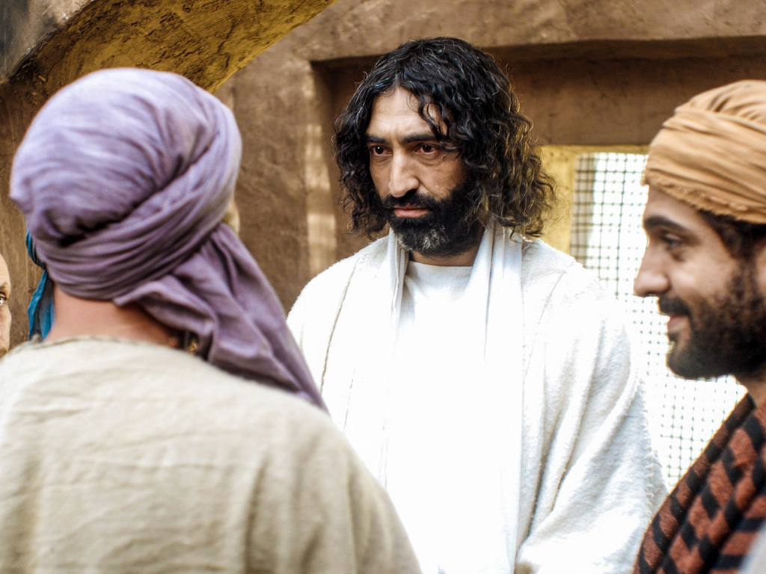
John 20:24-29
Free
Bible
images
THE EASTER STORY
JESUS APPEARS TO THOMAS

Slide 84
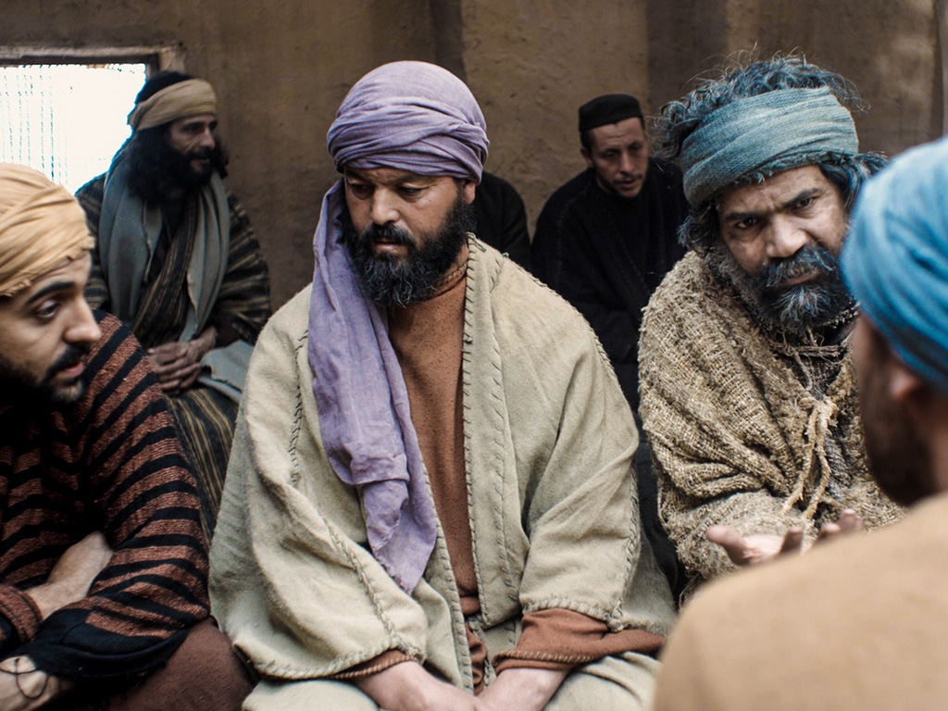
Notes:
John 20:26 Eight days later the disciples were together again, and this time Thomas was with them.

Slide 85
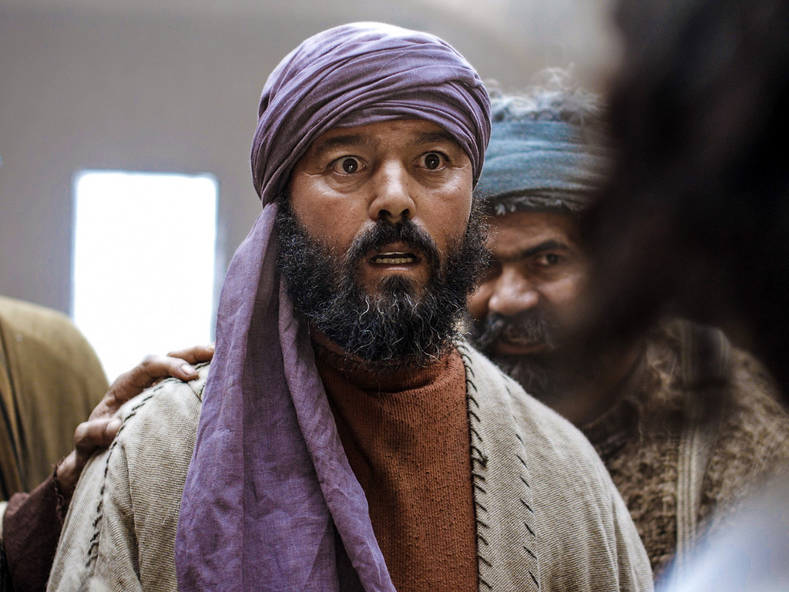
Notes:
The doors were locked; but suddenly, as before, Jesus was standing among them.

Slide 86
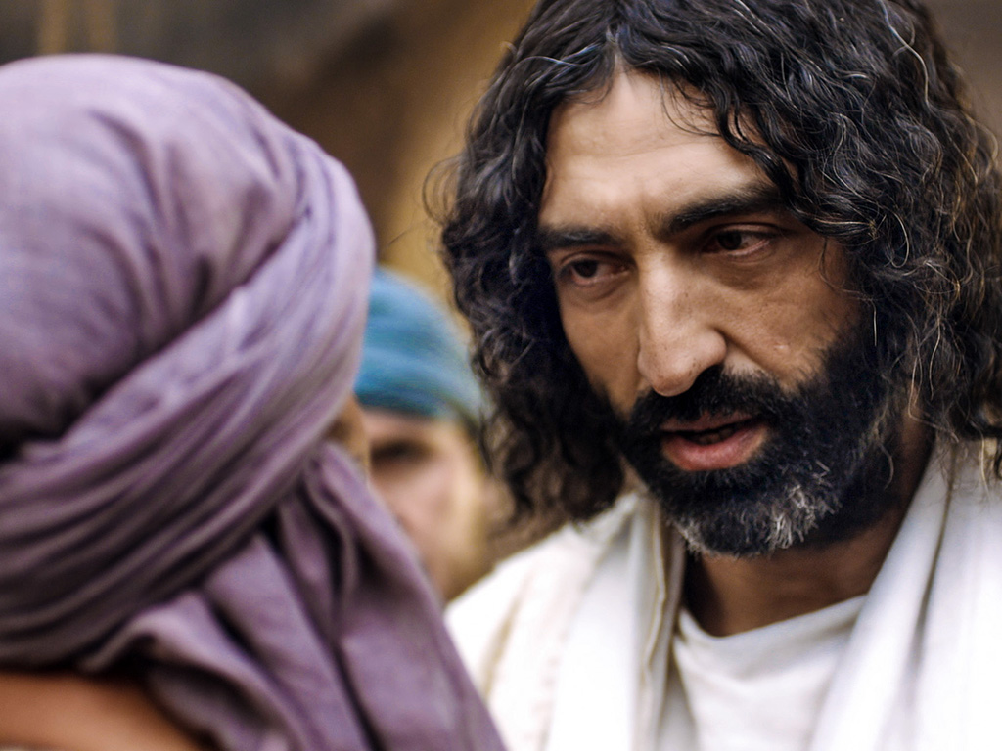
Notes:
“Peace be with you,” he said.

Slide 87
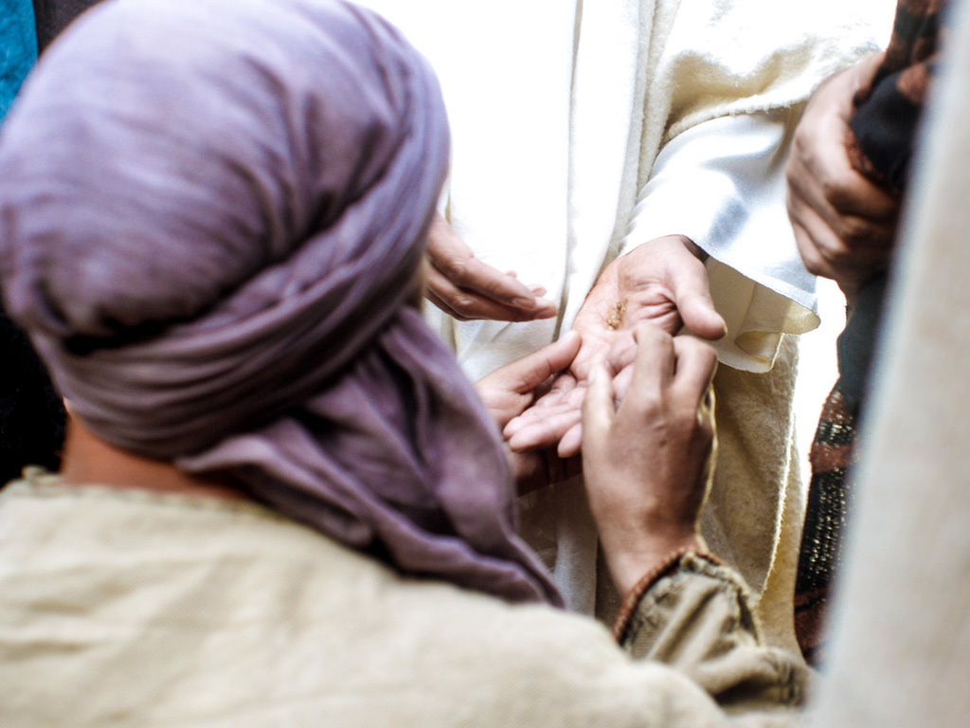
Notes:
27 Then he said to Thomas, “Put your finger here, and look at my hands."

Slide 88
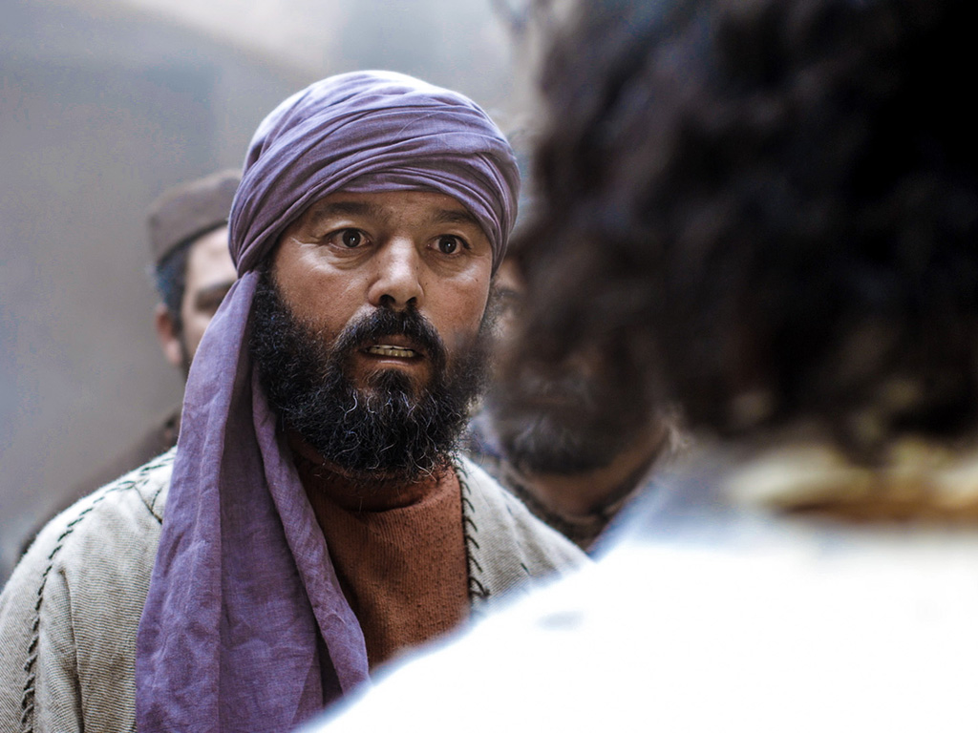
Notes:
Put your hand into the wound in my side. Don’t be faithless any longer. Believe!”

Slide 89
Notes:
[Jesus then waited for his response.]

Slide 90
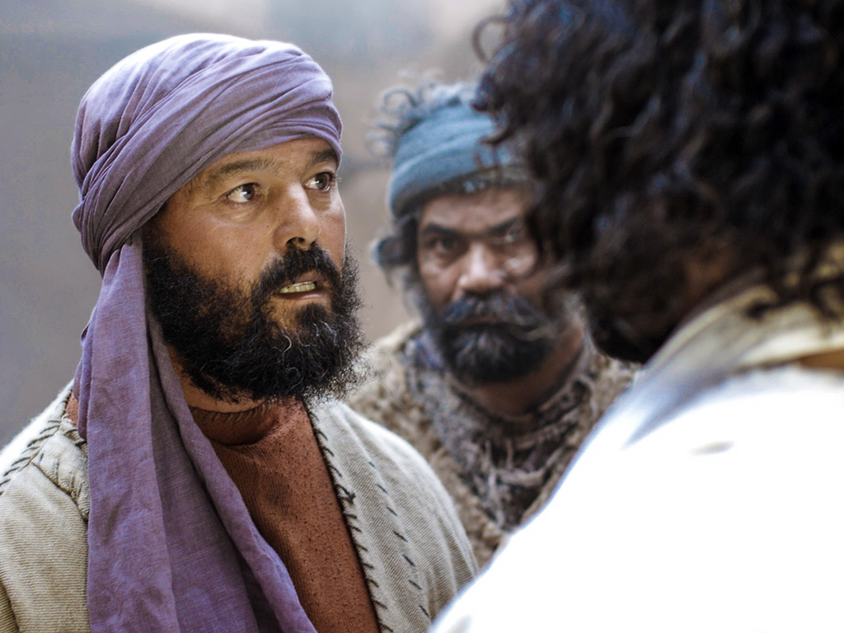
Notes:
John 20:28 “My Lord and my God!” Thomas exclaimed.
Peter also declared the deity of Jesus in Matt 18.
When Jesus proves our doubts wrong, we need to response accordingly.

Slide 91
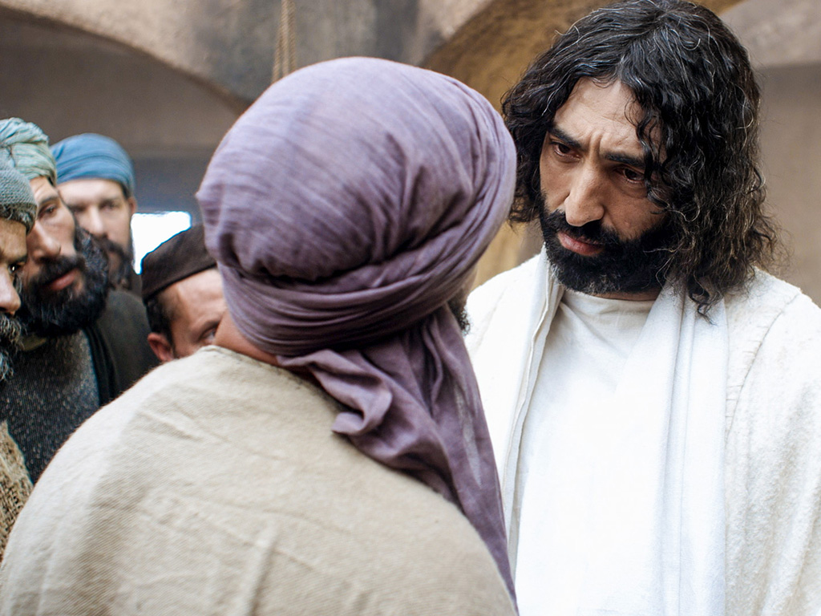
Notes:
John 20:29 Then Jesus told him, “You believe because you have seen me."

Slide 92
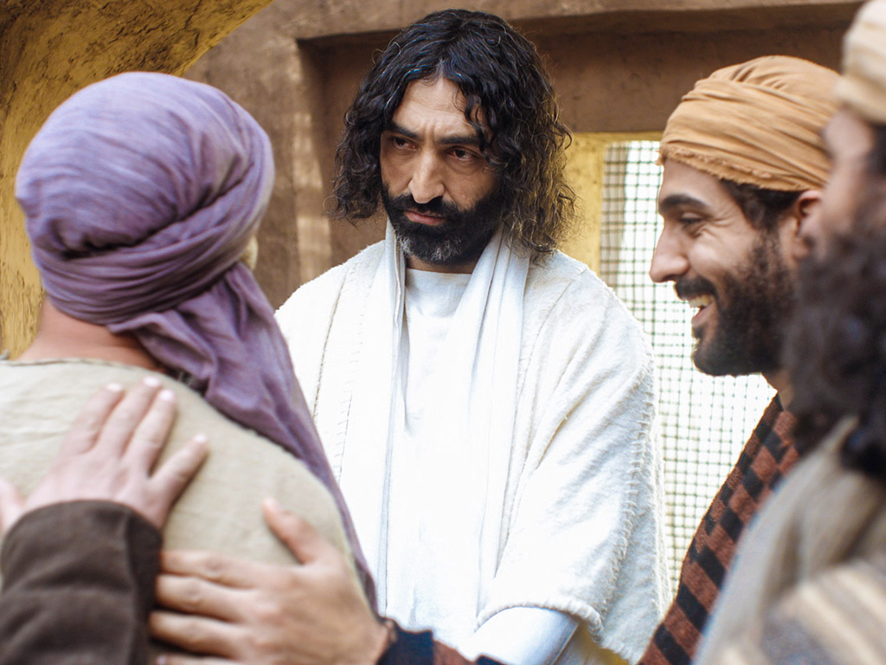
Notes:
"Blessed are those who believe without seeing me.”
How can we be assured that the disciples were credible witnesses?
• Do you know any examples of people who died for what they knew was a lie?
• The reliability of the NT shows us the credibility of what it says.
Read "More Than a Carpenter" by Josh McDowell in Arabic.

Slide 93
THE WORD IN PICTURES
Free
Bible
images

Slide 94
Used with Permission
THE
GOSPEL
——OF—— MATTHEW
THE
GOSPEL
——OF—— MARK
THE
GOSPEL
——OF—— LUKE
THE
GOSPEL
——OF—— JOHN
Due to the Lumo Project producing its own publishing material we regret to inform you that we cannot license our photos to other clients outside of freebibleimages.org.
These images are not licensed for reuse in video, epublishing or other media. Downloaded pictures and files cannot be redistributed through any other website than freebibleimages.org or used in any context where the accompanying message is undermining of the Christian faith and gospel.
Photos can only be used on educational presentations, blogs and social media, all of which should be accompanied with reference to www.LumoProject.com.
Picture courtesy of BBM
© All Rights Reserved.
www.bigbookmedia.com

Slide 95
L. The Appearance to Seven Disciples
§ 195
John 21:1-25
Christ appears to seven disciples at the Sea of Galilee to confirm His resurrection and reinstate Peter thrice in his love and devotion

Slide 96
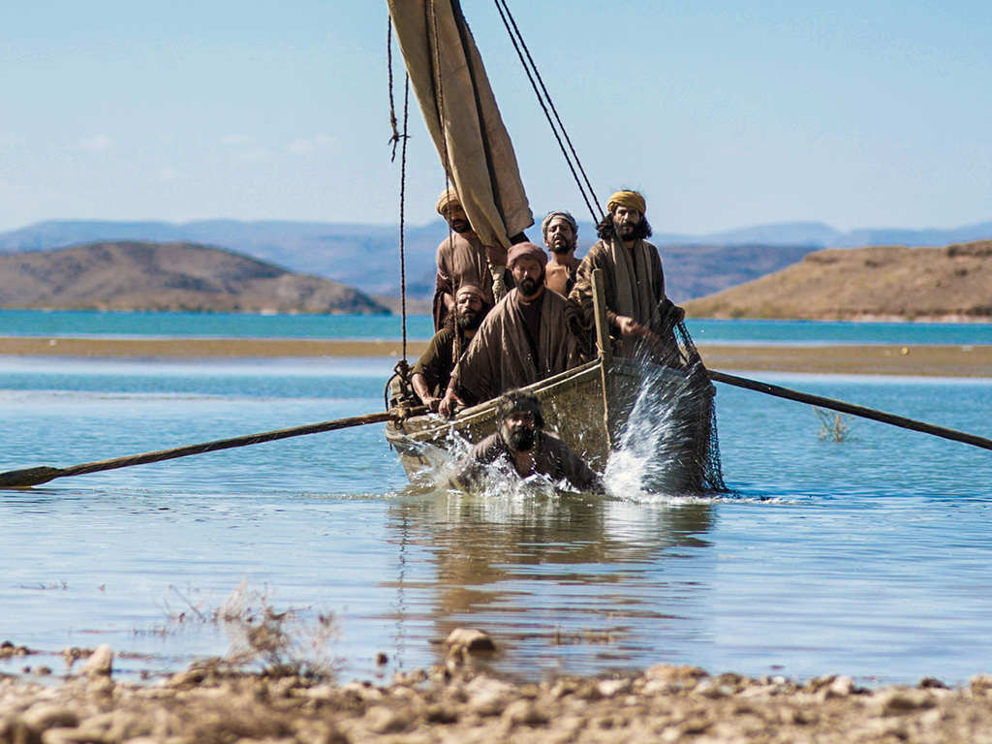
Free
Bible
images
John 21:1-14
THE EASTER STORY
JESUS APPEARS TO DISCIPLES IN GALILEE
Notes:
John 21:1 Later, Jesus appeared again to the disciples beside the Sea of Galilee. This is how it happened.

Slide 97

Notes:
John 20:2 Several of the disciples were there—Simon Peter, Thomas (nicknamed the Twin), Nathanael from Cana in Galilee, the sons of Zebedee, and two other disciples.

Slide 98

Notes:
John 21:3 Simon Peter said, “I’m going fishing.”
“We’ll come, too,” they all said. So they went out in the boat, but they caught nothing all night.

Slide 99

Notes:
John 21:4 At dawn Jesus was standing on the beach, but the disciples couldn’t see who he was. 5 He called out, “Fellows,ª have you caught any fish?”

Slide 100

Notes:
John 21:6 Then he said, “Throw out your net on the right-hand side of the boat, and you’ll get some!”

Slide 101


Slide 102

Notes:
So they did, and they couldn’t haul in the net because there were so many fish in it.

Slide 103


Slide 104
Notes:
John 21:7 Then the disciple Jesus loved said to Peter, “It’s the Lord!” When Simon Peter heard that it was the Lord, he put on his tunic (for he had stripped for work), jumped into the water, and headed to shore.

Slide 105

Notes:
8 The others stayed with the boat and pulled the loaded net to the shore, for they were only about a hundred yardsª from shore.

Slide 106

Notes:
9 When they got there, they found breakfast waiting for them—fish cooking over a charcoal fire, and some bread.

Slide 107

Notes:
John 21:10 “Bring some of the fish you’ve just caught,” Jesus said. 11 So Simon Peter went aboard and dragged the net to the shore. There were 153 large fish, and yet the net hadn’t torn.

Slide 108

Notes:
There were 153 large fish, and yet the net hadn’t torn.

Slide 109

Notes:
John 21:12 “Now come and have some breakfast!” Jesus said. None of the disciples dared to ask him, “Who are you?” They knew it was the Lord. 13 Then Jesus served them the bread and the fish. 14 This was the third time Jesus had appeared to his disciples since he had been raised from the dead.

Slide 110


Slide 111
THE WORD IN PICTURES
Free
Bible
images

Slide 112
Used with Permission
THE
GOSPEL
——OF—— MATTHEW
THE
GOSPEL
——OF—— MARK
THE
GOSPEL
——OF—— LUKE
THE
GOSPEL
——OF—— JOHN
Due to the Lumo Project producing its own publishing material we regret to inform you that we cannot license our photos to other clients outside of freebibleimages.org.
These images are not licensed for reuse in video, epublishing or other media. Downloaded pictures and files cannot be redistributed through any other website than freebibleimages.org or used in any context where the accompanying message is undermining of the Christian faith and gospel.
Photos can only be used on educational presentations, blogs and social media, all of which should be accompanied with reference to www.LumoProject.com.
Picture courtesy of BBM
© All Rights Reserved.
www.bigbookmedia.com

Slide 113
II. Christ's resurrection meets you at your need
(20:10-29)
Comforts the despairing
Mary (10-18)
Encourages the discouraged disciples (19-23)
Notes:
113
113

Slide 114

What would it take to turn the despondent Peter around?

Slide 115

Free
Bible
images
John 21:15-25
THE EASTER STORY
JESUS QUESTIONS PETER

Slide 116

Notes:
John 21:15 After breakfast Jesus asked Simon Peter,

Slide 117

Notes:
“Simon, son of John, do you love me more than these?”
THESE:
• More than fishing
• More than Peter loved the other disciples
• More than the other disciples loved him (Peter had said earlier that he would die for him)

Slide 118
Notes:
“Yes, Lord,” Peter replied, “you know I love you.”

Slide 119

Notes:
“Then feed my lambs,” Jesus told him.

Slide 120

Notes:
Not:
• If you love me, then die for me
• If you love me, then leave everything behind
But:
• If you love me, then make disciples

Slide 121

Notes:
John 21:16 Jesus repeated the question: “Simon son of John, do you love me?”

Slide 122


Slide 123


Slide 124


Slide 125


Slide 126


Slide 127
THE WORD IN PICTURES
Free
Bible
images

Slide 128
Used with Permission
THE
GOSPEL
——OF—— MATTHEW
THE
GOSPEL
——OF—— MARK
THE
GOSPEL
——OF—— LUKE
THE
GOSPEL
——OF—— JOHN
Due to the Lumo Project producing its own publishing material we regret to inform you that we cannot license our photos to other clients outside of freebibleimages.org.
These images are not licensed for reuse in video, epublishing or other media. Downloaded pictures and files cannot be redistributed through any other website than freebibleimages.org or used in any context where the accompanying message is undermining of the Christian faith and gospel.
Photos can only be used on educational presentations, blogs and social media, all of which should be accompanied with reference to www.LumoProject.com.
Picture courtesy of BBM
© All Rights Reserved.
www.bigbookmedia.com

Slide 129

How does Jesus restore us after we really mess things up?

Slide 130

A Regretful Peter

Slide 131

A Resurrected Savior

Slide 132

The Sea of Tiberias (John 21)

Slide 133
Movements
3 ways that Christ restores us after failure
Miraculous catch
Peter's Reinstatement
John's Death
Conclusion

Slide 134

I. Admit you need Christ even where you feel competent (21:1-14).

Slide 135

“Have you caught anything?”
Notes:
http://perso.wanadoo.fr/saint.pierre/pagesan/alapparition_au_lac.html

Slide 136

“No.”
“Cast your net on the right side.”
“Whoa!”
Notes:
http://perso.wanadoo.fr/saint.pierre/pagesan/alapparition_au_lac.html

Slide 137

John: “It's the Lord!”
Peter: “Jump!”
Notes:
http://perso.wanadoo.fr/saint.pierre/pagesan/alapparition_au_lac.html

Slide 138

What's the point of this miracle?
Notes:
http://perso.wanadoo.fr/saint.pierre/pagesan/alapparition_au_lac.html

Slide 139

Fish Déjà Vu
Is John alluding to the earlier account?
Luke 5:1-11
John 21:1-14
Calling
Reinstatement
Jesus in boat
Jesus on shore
“Follow me”
“Feed my lambs”
Evangelize
Shepherd
Jesus' Message Repeated: “You need me to be truly competent!”

Slide 140

Do you admit that you need Christ even in your area of competence?
Notes:
http://perso.wanadoo.fr/saint.pierre/pagesan/alapparition_au_lac.html

Slide 141
“Have you sold anything?”
"No, Lord"
Notes:
http://perso.wanadoo.fr/saint.pierre/pagesan/alapparition_au_lac.html

Slide 142

What's your area of competence?

Slide 143
I. Admit you need Christ even where you feel competent (21:1-14).

Slide 144

II. Show your love for Christ by loving people (21:15-17).

Slide 145
“Do you love me more than these?”
What are “these”?
“Do you love me more than you love fishing?”
“Do you love me more than you love these disciples?”
“Do you love me more than the rest of these disciples love me?”
Notes:
John 13:37 “I will lay down my life you” (even if the others fail you)

Slide 146
Three Questions
Do you agape me?
I phileo you.
Do you agape me?
I phileo you.
Do you phileo me?
I phileo you.

Slide 147

Three Reinstatements
Do you agape me?
Feed my lambs
Do you agape me?
Take care of my sheep
Do you phileo me?
Feed my sheep

Slide 148

"Feed my sheep."

Slide 149

Teaching Responsibility

Slide 150

Don’t feed sheep junk food!

Slide 151

Don’t abuse sheep!

Slide 152

"Feed my sheep."

Slide 153

How to get Peter out of his tunnel…
Step 1: Do the same miracle again
Step 2: Reinstate him three times

Slide 154
Do You Agape Others?
Do you agape others?
I phileo them.
Do you agape others?
I phileo them.
Do you agape others?
I phileo them.

Slide 155

Loving people is loving Christ

Slide 156
Categories of Gifts (1 Peter 4:11)
Speaking | Serving
Teaching | Administering
Evangelism | Faith
Pastor-Teacher | Giving
Encouraging | Service
 | Mercy

Slide 157
I. Admit you need Christ even where you feel competent (21:1-14).

Slide 158
II. Show your love for Christ by loving people (21:15-17).

Slide 159

III. Don't worry about Christ’s plan for others (21:18-23).

Slide 160

“…When you are old, you will stretch out your hands, and someone else will dress you and lead you where you do not want to go” (21:18)
Peter's Crucifixion
"Follow me!"
Notes:
John 21:19 Jesus said this to let him know by what kind of death he would glorify God. Then Jesus told him, “Follow me.”
John 21:20 Peter turned around and saw behind them the disciple Jesus loved—the one who had leaned over to Jesus during supper and asked, “Lord, who will betray you?”

Slide 161

Peter asked Jesus, “What about him, Lord?"
(John 21:21).

Slide 162

Jesus replied, “If I want him to remain alive until I return, what is that to you? As for you, follow me" (John 21:22).

Slide 163
Jesus also commands us not to question his calling for others

Slide 164

How does Jesus restore us?

Slide 165

Jesus restores us to the calling He has for us!
Main Idea

Slide 166

How do you find the calling He has for you?

Slide 167
I. Admit you need Christ even where you feel competent (21:1-14).

Slide 168
II. Show your love for Christ by loving people (21:15-17).

Slide 169
III. Don't worry about Christ’s plan for others (21:18-23).

Slide 170

John's Conclusion (21:24-25)
“I'm an eyewitness!” (21:24)
“I haven't told half the story!” (21:25)

Slide 171

Believe in Jesus
³⁰ The disciples saw Jesus do many other miraculous signs in addition to the ones recorded in this book. ³¹ But these are written so that you may believe that Jesus is the Messiah, the Son of God, and that by believing in him you will have life by the power of his name" (20:30-31).

Slide 172


Textual Variants of John 20:31
110
Evangelistic
"…these are written that you may believe that
Jesus is the Christ, the Son
of God, and that by
believing you may have life
in his name"
Edification
"…these are written that you may go on believing that
Jesus is the Christ, the Son of God, and that by believing you may have life in his name"
Aorist Subjunctive
i-na pisteu,shte
37 manuscripts
Many but later manuscripts
Present Subjunctive
i-na pisteu,hte
p⁶⁶ & a*
Few but early manuscripts
Notes:
Most of the manuscripts have the little sigma (= English "s") that makes the verb for "believe" in an undefined sense (evangelistic sense of "may believe"). However, a few early MSS lack this sigma, which turns it into a present tense (an edification sense of "go on believing"). This course follows the first sense as the book has an evangelistic thrust.
________
LC-10-Resurrection-156
NS-04-John1-12-slide 90
NS-04-John 13-24-slide 398

Slide 173

"Follow me"
"Feed my sheep"
Notes:
Here is our calling to live the truth and then teach the truth to others.

Slide 174
M. The Commission to the Disciples
§ 196
Matthew 28:16-20; Mark 16:15-18
Christ commissions the apostles to make disciples everywhere with the Spirit's authority and power to be His witnesses
Notes:
Matt. 28:16 Then the eleven disciples left for Galilee, going to the mountain where Jesus had told them to go. ¹⁷ When they saw him, they worshiped him—but some of them doubted!
Matt. 28:18 Jesus came and told his disciples, “I have been given all authority in heaven and on earth. ¹⁹ Therefore, go and make disciples of all the nations, baptizing them in the name of the Father and the Son and the Holy Spirit. ²⁰ Teach these new disciples to obey all the commands I have given you. And be sure of this: I am with you always, even to the end of the age.”
Mark 16:15 And then he told them, “Go into all the world and preach the Good News to everyone. ¹⁶ Anyone who believes and is baptized will be saved. But anyone who refuses to believe will be condemned. ¹⁷ These miraculous signs will accompany those who believe: They will cast out demons in my name, and they will speak in new languages. ¹⁸ They will be able to handle snakes with safety, and if they drink anything poisonous, it won’t hurt them. They will be able to place their hands on the sick, and they will be healed.”

Slide 175

Matthew 28:18-20 NLT
"Jesus came and told his disciples, 'I have been given all authority in heaven and on earth. ¹⁹Therefore, go and make disciples of all the nations, baptizing them in the name of the Father and the Son and the Holy Spirit. ²⁰Teach these new disciples to obey all the commands I have given you. And be sure of this: I am with you always, even to the end of the age.'"
Notes:
Neither the English nor the Arabic clearly state the Greek where "make disciples" is the command here. We do this by going, baptizing, and teaching.

Slide 176

Since Jesus is king, then believers will rule with him!

Slide 177


Believers will rule the earth
(Rev. 5:10 NLT).
"And you have caused them to become a Kingdom of priests for our God.
And they will reign on the earth."

Slide 178


Revelation 20:4-6 Diagrammed
424
^{4b}and they came to life and reigned with Christ for a thousand years.
^{4a}Then I saw thrones, and they sat on them, and judgment was given to them. And I saw the souls of those who had been beheaded because of their testimony of Jesus and because of the word of God, and those who had not worshiped the beast or his image, and had not received the mark on their forehead and on their hand…
1000 years
^{5b}This is the first resurrection. ^{6a}Blessed and holy is the one who has a part in the first resurrection; over these the second death has no power…
^{6b}but they will be priests of God and of Christ and will reign with Him for a thousand years.
^{5a}The rest of the dead did not come to life until the thousand years were completed.

Slide 179

Since Jesus fulfilled all the requirements to be Israel's king, we will rule with him!
Main Idea

Slide 180


Do you trust the King right now?
Before we can pray, "Lord, Thy kingdom come," we must be willing to pray, "My kingdom go."

Slide 181

Will you stand?

Slide 182

Jesus is both Lamb and Lion
Jesus Christ
Lamb of
God
Lion of
Judah
Notes:
LC-10-Resurrection-167
NS-01-Matt15-28-slide 337

Slide 183

"I trust in your death for me."

Slide 184

Are you ready to rule?

Slide 185

Be faithful NOW

Slide 186

Mark 16:9-20
One of the most difficult textual problems in the NT
88
90-92
Notes:
[Longer Ending of Mark]
Mark 16:9 After Jesus rose from the dead early on Sunday morning, the first person who saw him was Mary Magdalene, the woman from whom he had cast out seven demons. ¹⁰ She went to the disciples, who were grieving and weeping, and told them what had happened. ¹¹ But when she told them that Jesus was alive and she had seen him, they didn’t believe her.
Mark 16:12 Afterward he appeared in a different form to two of his followers who were walking from Jerusalem into the country. ¹³ They rushed back to tell the others, but no one believed them.
Mark 16:14 Still later he appeared to the eleven disciples as they were eating together. He rebuked them for their stubborn unbelief because they refused to believe those who had seen him after he had been raised from the dead.
Mark 16:15 And then he told them, “Go into all the world and preach the Good News to everyone. ¹⁶ Anyone who believes and is baptized will be saved. But anyone who refuses to believe will be condemned. ¹⁷ These miraculous signs will accompany those who believe: They will cast out demons in my name, and they will speak in new languages. ¹⁸ They will be able to handle snakes with safety, and if they drink anything poisonous, it won’t hurt them. They will be able to place their hands on the sick, and they will be healed.”
Mark 16:19 When the Lord Jesus had finished talking with them, he was taken up into heaven and sat down in the place of honor at God’s right hand. ²⁰ And the disciples went everywhere and preached, and the Lord worked through them, confirming what they said by many miraculous signs.
__________
Mark 16:20 NASB 1996
²A few late mss and versions contain this paragraph, usually after v 8; a few have it at the end of ch
[²And they promptly reported all these instructions to Peter and his companions. And after that, Jesus Himself sent out through them from east to west the sacred and imperishable proclamation of eternal salvation.]

Slide 187

3 Manuscript Text Types
Western
90
Byzantine
Alexandrian
Notes:
The NT manuscripts of the early centuries of the church were copied in three main regions:
Rome gave us the Western text type which has many manuscripts from the 8th-10th centuries, supported by the Roman Catholic church.
The city of Constantinople became the capital of the Eastern Orthodox church with its Byzantine manuscripts (or majority text, since they copied so many of them). While considerably varying, it also underlies the Textus Receptus Greek text used for most Reformation-era translations of the New Testament into vernacular languages, and
A large community of Christians gathered in Alexandria, Egypt. This Alexandrian texts were the earliest, going back to about AD 200. Modern translations mainly use Eclectic editions that conform more often to the Alexandrian text-type.

Slide 188
What about Mark 16:9-20?
Western
90
Byzantine
All Have 16:9-20
Many Manuscripts
But 5th-7th century
All Have 16:9-20
Many Manuscripts
But 9th-15th century
Some Omit 16:9-20
Only 5 Manuscripts
4th century include it
5th-9th century exclude it
Alexandrian
Notes:
The NT manuscripts of the early centuries of the church were copied in three main regions:
Rome gave us the Western text type, which has many manuscripts from the 8th to 10th centuries, supported by the Roman Catholic church.
The city of Constantinople became the capital of the Eastern Orthodox church with its Byzantine manuscripts (or majority text, since they copied so many of them). While considerably varying, it also underlies the Textus Receptus Greek text used for most Reformation-era translations of the New Testament into vernacular languages, and
A large community of Christians gathered in Alexandria, Egypt. The earliest Alexandrian texts date back to about AD 200. Modern translations mainly use Eclectic editions that conform more often to the Alexandrian text type.

Slide 189

Application
Mark
82
Are you a disciple who willingly suffers after Jesus' example?

Slide 190
N. The Final Commission
§ 197
Luke 24:44-49
After time with the apostles in Galilee, Jesus leads them to Jerusalem where He encourages them to stay until the Spirit empowers them for ministry
Notes:
Luke 24:44 Then he said, “When I was with you before, I told you that everything written about me in the law of Moses and the prophets and in the Psalms must be fulfilled.” ⁴⁵ Then he opened their minds to understand the Scriptures. ⁴⁶ And he said, “Yes, it was written long ago that the Messiah would suffer and die and rise from the dead on the third day. ⁴⁷ It was also written that this message would be proclaimed in the authority of his name to all the nations, beginning in Jerusalem: ‘There is forgiveness of sins for all who repent.’ ⁴⁸ You are witnesses of all these things.
Luke 24:49 “And now I will send the Holy Spirit, just as my Father promised. But stay here in the city until the Holy Spirit comes and fills you with power from heaven.”

Slide 191
O. The Ascension of Christ
§ 198
Mark 16:19-20; Luke 24:50-53
Jesus blesses His disciples on the Mount of Olives and rises to heaven to sit at God's right hand for His present ministry for the saints
Notes:
Mark 16:19 When the Lord Jesus had finished talking with them, he was taken up into heaven and sat down in the place of honor at God’s right hand. 20 And the disciples went everywhere and preached, and the Lord worked through them, confirming what they said by many miraculous signs.
The Ascension
Luke 24:50 Then Jesus led them to Bethany, and lifting his hands to heaven, he blessed them. 51 While he was blessing them, he left them and was taken up to heaven. 52 So they worshiped him and then returned to Jerusalem filled with great joy. 53 And they spent all of their time in the Temple, praising God.

Slide 192

Notes:
We open up his book and see…

Slide 193

"In my first book I told you, Theophilus, about everything Jesus began to do and teach ² until the day he was taken up to heaven after giving his chosen apostles further instructions through the Holy Spirit"
(Acts 1:1–2 NLT).
Notes:
Jesus had fully trained the disciples for three years and they were ready to go—or at least they thought so (Acts 1:1-3).
Who was Theophilus (1)?
This is the only time he is noted in the NT, but his name means “loves God” and so he obviously was a believer.
He likely was a wealthy man who financed Luke to write this two-volume work on Jesus and the Church

Slide 194

"During the forty days after he suffered and died, he appeared to the apostles from time to time, and he proved to them in many ways that he was actually alive"
(Acts 1:3a NLT).
Notes:
Theophilus believed in the risen Jesus

Slide 195


Slide 196


Slide 198


Slide 199


Slide 200

"During the forty days after he suffered and died, he appeared to the apostles from time to time, and he proved to them in many ways that he was actually alive. And he talked to them about the Kingdom of God"
(Acts 1:3 NLT).
Notes:
What was the “kingdom of God” (3)?
The Psalms tell us God has always ruled over the universe and always will.

Slide 201
A Look at the Future
473
Great
White
Throne
(Rev. 20:11-14)
Rapture
(1 Thess. 4:13-18)
2nd Advent
(Zech. 14:3-5)
Church Age
Tribulation
(Zech. 14:1-2)
Millennium
(Zech. 14:6-21)
Gog & Magog
(Armageddon)
(Ezek. 38–39)
Gog and Magog
Revisited
(Rev. 20:7-10)
Notes:
201
But the OT prophets had spoken much about the kingdom after Messiah’s return.

Slide 202

A Literal, Political Kingdom
"Jesus replied, 'I assure you that when the world is made new and the Son of Man sits upon his glorious throne, you who have been my followers will also sit on twelve thrones, judging the twelve tribes of Israel'"
(Matt. 19:28 NLT)
Notes:
It will be ruled by Messiah where Israel will have prominence over the entire world that will follow the Lord.

Slide 203


United Nations Building, New York
Notes:
The UN even has the kingdom text of Isa 1.

Slide 204
Incredibly Long Life (NIV)!
NTS 424
NIV Isaiah 65:20 "Never again will there be in [Jerusalem] an infant who lives but a few days, or an old man who does not live out his years; he who dies at a hundred will be thought a mere youth; he who fails to reach a hundred will be considered accursed."
Notes:
204
People will live past 100 again—and Jesus refers to this in Acts 1:6.

Slide 205

A Great Question (Acts 1:6)
So when they met together, they asked him, “Lord, are you at this time going to restore the kingdom to Israel?”
Notes:
We should witness to everyone until Israel is restored (1:6-8).

Slide 206

Key Characteristics of Acts
122
  Kingdom
Start
"So when the apostles were with Jesus, they kept asking him, "Lord, has the time come for you to free Israel and restore our kingdom?"
(Acts 1:6 NLT)
End
"For the next two years, Paul lived in Rome at his own expense. He welcomed all who visited him, ³¹boldly proclaiming the Kingdom of God and teaching about the Lord Jesus Christ. And no one tried to stop him" (Acts 28:30-31 NLT).
Notes:
What does this kingdom for Israel mean (6)?
Israel had kings for over 400 years from 1000-600 BC, but it had been over 600 years since the kingdom had ended.
We should use the normal language for “Israel” here and also for “kingdom” as they would have understood it. In fact, the kingdom for Israel is a key theme of Acts—seen here in the first chapter and also in the last few verses!

Slide 207
Will you at this time restore the kingdom to yourself?
Acts 1:6
Notes:
Why do the disciples ask about a kingdom restored to Israel (6)?
They knew from many OT texts that Messiah would rule over Israel—and they knew that Jesus was that Messiah—so they reasoned that the now resurrected Jesus would restore that kingdom.
One scholar notes, “In the disciples’ minds the outpouring of the Holy Spirit and the coming of the promised kingdom were closely associated. And well they should be, because the Old Testament frequently joined the two (cf. Isa. 32:15–20; 44:3–5; Ezek. 39:28–29; Joel 2:28–3:1; Zech. 12:8–10). When Christ told the disciples of the soon-coming Spirit baptism, they immediately concluded that the restoration of Israel’s kingdom was near in time.”
_______
Stanley D. Toussaint, “Acts,” in The Bible Knowledge Commentary: An Exposition of the Scriptures, ed. J. F. Walvoord and R. B. Zuck, vol. 2 (Wheaton, IL: Victor Books, 1985), 354.

Slide 208

A Great Answer (Acts 1:7)
He said to them: “It is not for you to know the times or dates the Father has set by his own authority.”
Notes:
How does Jesus correct their understanding of Israel’s restoration (7)?
Does Jesus say that they had the wrong idea about the kingdom?
Does Jesus say, “Oh, you stiff-necked and dull disciples? When are you going to see that my kingdom is not a political one. It’s spiritual only!”
But he doesn’t say that it is only spiritual. He affirms their understanding of what the kingdom is. He just corrects the timing of that kingdom. It wasn’t going to happen then but only when the Father determines. They just needed to wait.
But in verse 8 he tells them what to do until the kingdom for Israel arrives: WITNESS!

Slide 209

“…you shall be my witnesses”
Notes:
So what was the commission for the disciples (8)?
They were NOT to preach.
They were NOT to teach.
They were simply to WITNESS what they experienced. Isn’t that freeing?

Slide 210

The Witness Stand
Notes:
It’s not hard to witness to what you have seen—
Wiersbe notes, “’Witness’ is a key word in the Book of Acts and is used twenty-nine times as either a verb or a noun. A witness is somebody who tells what he has seen and heard (Acts 4:19–20). When you are on the witness stand in court, the judge is not interested in your ideas or opinions; he only wants to hear what you know. Our English word Witness
martyr comes from the Greek word translated ‘witness,’ and many of God’s people have sealed their witness by laying down their lives.”
____________
Warren W. Wiersbe, The Bible Exposition Commentary, vol. 1 (Wheaton, IL: Victor Books, 1996), 403.

Slide 211

Acts 1:8 NAU
"remotest part"
"But you shall receive power when the Holy Spirit has come upon you; and you shall be My witnesses both in Jerusalem, and in all Judea and Samaria, and even to the remotest part of the earth."
Samaria
Jerusalem
Judea
Notes:
What is the significance of the threefold regions (8)?
Geographically, they go from the near to the far.
By size, it begins with a city, goes to regions and then beyond regions.
Culturally, they begin with the familiar and stretch to the unfamiliar.
Chronologically, it begins in AD 33 and finishes in AD 62—as well as to today.

Slide 212

Bible Lands Blank Map
The Roman Empire
"But you shall receive power when the Holy Spirit has come upon you; and you shall be My witnesses both in Jerusalem, and in all Judea and Samaria, and even to the remotest part of the earth" (Acts 1:8 NAU).
"remotest part"
Samaria
Jerusalem
Judea
© https://www.deviantart.com/sharklord1/art/Alt-Roman-Empire-Provinces-701148110
Notes:
Linguistically, Hebrew/Aramaic moves to Greek/Latin/others.
Paul Romans 15 that he was anticipating sharing Jesus in Spain.

Slide 213

Notes:
“After saying this…

Slide 214

Notes:
he was taken up into a cloud while they were watching…

Slide 215

Notes:
… and they could no longer see him” (1:9 NLT).

Slide 216

Notes:
“As they strained to see him rising into heaven, two white-robed men suddenly stood among them.”

Slide 217

Notes:
Acts 1:9 After saying this, he was taken up into a cloud while they were watching, and they could no longer see him. ¹⁰ As they strained to see him rising into heaven, two white-robed men suddenly stood among them. ¹¹ “Men of Galilee,” they said, “why are you standing here staring into heaven? Jesus has been taken from you into heaven, but someday he will return from heaven in the same way you saw him go!”

Slide 218


Slide 219

Notes:
God began the Church right at home for the first believers (Acts 1–2).
He prepared Jews to first reach Jews (Acts 1).

Slide 220
Used with permission

Slide 221






The Spirit Leaves & Returns
Mt. of Olives
656
Ezek. 8:4; 9:3; 10:4; 10:18-19; 11:23
Luke 19:37; 24:50; Acts 1:10
Acts 1:11; Zech. 14:4; Ezek. 43:1-5
Notes:
The Mount of Olives plays a significant role in history. It is the last place the Spirit is present in Ezekiel 11:23, the last place Christ was honored as king in Luke 19:37, the last place Christ was seen by his disciples in Acts 1:10, and the NEXT place Christ will appear on earth to fulfill Acts 1:11!
The Kidron Valley below the mount is likely the Valley of Jehoshaphat where Jesus will judge the nations (Joel 3).
_____________
Common Slides English-197
OS-26-Ezek1-39-slide 178
OS-38-Zechariah-179
NS-03-Luke13-24-slide 111
NS-Acts1-2-slide 215

Slide 222

Jesus ascended to the Father
This means he is alive now!

Slide 223
P. The Parables of Christ
Passages
Summary

Slide 224

GALILEAN MINISTRY
JESUS'
LATER STAGES

Slide 225

Introduction
Jesus’ Galilean Ministry- Later Stages
Parables
Miracles
Withdrawal

Slide 226

Intro to Parable
Parables
Parable is:
- a brief metaphorical narrative
- a narrative of imagined events used to illustrate a
moral or spiritual lesson (Oxford Dictionary)
GREEK
“parabole” comes from two words that mean “to throw along side”

Slide 227

Parables: Views
Each parable makes only one main point and the details within the parables are not to be allegorized.
(Adolf Julicher, 19th Century)
A valuable working hypothesis for interpreting the parables may be to look for one main point associated with each main character or group of characters in the parables.
(Craig L. Blomberg)
Parables are generally lifelike

Slide 228
COMMON PARABLE STRUCTURES
Triadic Parables
Good
Example
Unifier
Bad
Example
Master
Good
Subordinate
Wicked
Subordinate
Samaritan
Man in
ditch
Priest/
Levite
Father
Master
King
Prodigal
Son
Older
Brother
Subordinate
Servant forgiven large debt
Sub-Subordinate
Servant owing small debt
MONARCHIC
NON MONARCHIC
Blomberg, Jesus and the Gospels

Slide 229
COMMON PARABLE STRUCTURES
Dyadic Parables
Master
Farmer
Good
Example
Bad
Example
Servant
Seed Growing
Secretly
Tax
Collector
Pharisee
Monadic Parables
One
Main
Character
Treasure
Hunter
Blomberg, Jesus and the Gospels

Slide 230


MINISTRY OF VARIOUS WOMEN
(Luke 7:36-8:3)
Jesus compared the woman with the forgiven debtor and declared her sins forgiven. The final word of the passage overall is a declaration of the woman’s salvation.
“for she loved much,” was later used by traditional Catholic thought to justify works-righteousness.
Parables

Slide 231


Historicity
form the very
core of the
teaching of Jesus
Parables
illustrate the kingdom of God

Slide 232
Theological Distinctives
Mark
Matthew
Luke
Understanding the parable is the key to discern the gospel’s meaning
Transition from Jesus’ self-disclosure to Israel
How to hear and obey the Word of God

Slide 233
Q. The Miracles of Christ
Passages
Summary

Slide 234

Why did John write about Jesus' miracles?
III. All of Christ's miracles are to bring us to faith in Him (20:30-31)
These [signs] are written so that you may believe that Jesus is the Christ, the Son of God, and that by believing you may have life in his name (John 20:31).

Slide 235
MIRACLES
Background Considerations

Slide 236


MIRACLES
Background Considerations
KINGDOM OF GOD

Slide 237


Historicity
KINGDOM OF GOD

Slide 238
Each Gospel Has a Theological Distinctive
Matthew
Luke
John
Christological Issues
Magical View & Stress on Satan’s Power
Signs to Encourage Faith
  The primary focus is CHRISTOLOGICAL to demonstrate that Jesus is the divine Messiah and that the kingdom of God is now breaking into human history with new force.
Mark
Suffering Messiah

Slide 239



Withdrawal from Galilee
Third main period of ministry
REJECTION!
Galilee
Jerusalem

Slide 240
Withdrawal from Galilee
Third main period of ministry
REJECTION!
Withdrawal

Slide 241

Withdrawal from Galilee
Third main period of ministry
REJECTION!
Peter’s Confession & Aftermath

Slide 242
Theological Distinctives
Mark
Matthew
Luke
Jesus the Suffering Servant
Ministry among Jews & Gentiles
Jesus as Eschatological Prophet and Discipleship

Slide 243


Conclusion

Slide 244
Black

Slide 245


Life of Christ link at BibleStudyDownloads.org
Get this presentation for free!
Notes:
NT Survey (ns)

