Slide 1
Rejection of the King
§§ 168-183
Israel rejects the Messiah in His arrest, trials, procession to Calvary, crucifixion, burial, and sealing of the tomb to bear the world’s sins
Section summaries based on J. Dwight Pentecost, A Harmony of the Words and Works of Jesus Christ (Grand Rapids: Zondervan, 1981)
Dr. Rick Griffith • Jordan Evangelical Theological Seminary • BibleStudyDownloads.org
Notes:
Edited in 2025 up to slide 94 with Moore's book.

Slide 2
Pentecost Outline
Introduction of the King
Authentication of the King
Controversy over the King
Instruction of the Twelve by the King
Opposition to the King
Preparation of the Disciples by the King
Official Presentation of the King
Preparation for the Death of the King
Rejection of the King
Resurrection of the King

Slide 3

Increasing Polarization
Resurrection
Preparation
for Death
Preparation
of Disciples
Instruction
Authentication
Introduction
Controversy
Opposition
Presentation
Rejection
Notes:
The Life of Christ brought increasing polarization. The more Jesus showed about himself, the greater the resistance to him and his message. Also, the more intense the controversy leading to opposition, the higher priority Christ placed on preparing his men for when he would be gone. The climactic rejection when he presented himself as king of Israel at the Triumphal Entry resulted in rejection to the point of crucifixion followed by the victory of resurrection.
Introduction of the King
Authentication of the King
Controversy over the King
Instruction of the Twelve by the King
Opposition to the King
Preparation of the Disciples by the King
Official Presentation of the King
Preparation for the Death of the King
Rejection of the King
Resurrection of the King

Slide 4
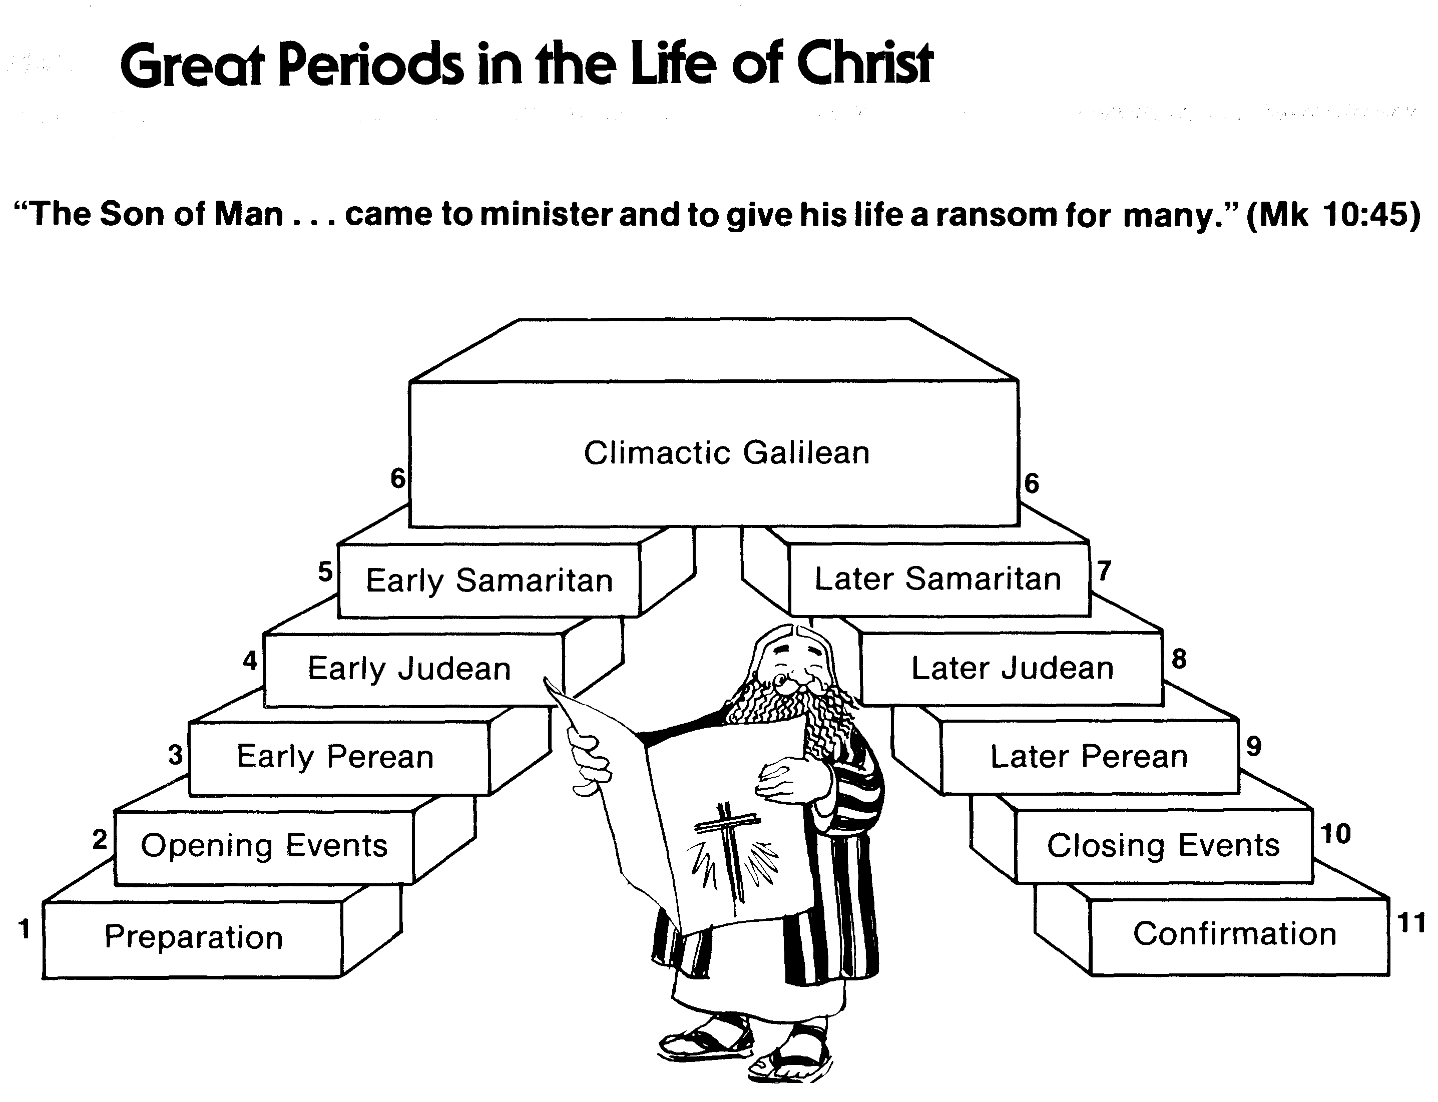
Great Periods in the Life of Christ
55
“The Son of Man… came to minister and to give his life a ransom for many” (Mark 10:45)
Climactic Galilean
Early Samaritan
Later Samaritan
Early Judean
Later Judean
Early Perean
Later Perean
Opening Events
Closing Events
Preparation
Confirmation
Walk Thru the New Testament seminar (used with permission)
Notes:
The Walk Thru outline of the life of Christ forms a chiasm or literary arrangement with repeating elements in the opposite order. This structure makes Confirmation parallel to Preparation, Closing Events parallel to Opening Events, etc. until the only event without parallel becomes the focus: Climatic Galilean. Such an arrangement of material was common in antiquity and is seen in both the OT (e.g., Zephaniah) and the NT (1 Thess) where the central teaching appears in the middle of each writing.
Small Group Assignment: Explain this slide to your group member(s) and have the others explain it back.
After the beginning events of stages 1-3, Jesus also gets farther away from his Jewish roots in Judea (4), to go to the Samaritans (5), and even farther to Galilee (6), where most Gentiles lived. He ministered to Jews in Galilee, of course, but this climatic period was the focus of his ministry.
_______
LC-00-Syllabus-63
LC-01-Introduction-265
LC-05-Opposition-4

Slide 5
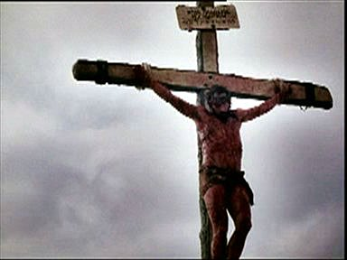
The Suffering Christ

Slide 6
Contents
Experience Jesus’ 7 Last Days
Experience Jesus’ 6 Last Trials
Experience Jesus’ 7 Last Tortures
Experience Jesus’ 7 Last Words

Slide 7
Objectives
Experience God’s love
See the seriousness of sin
Be grateful for what Christ had done
Follow the example of Christ

Slide 8
The Movements of Passion Week

Slide 9
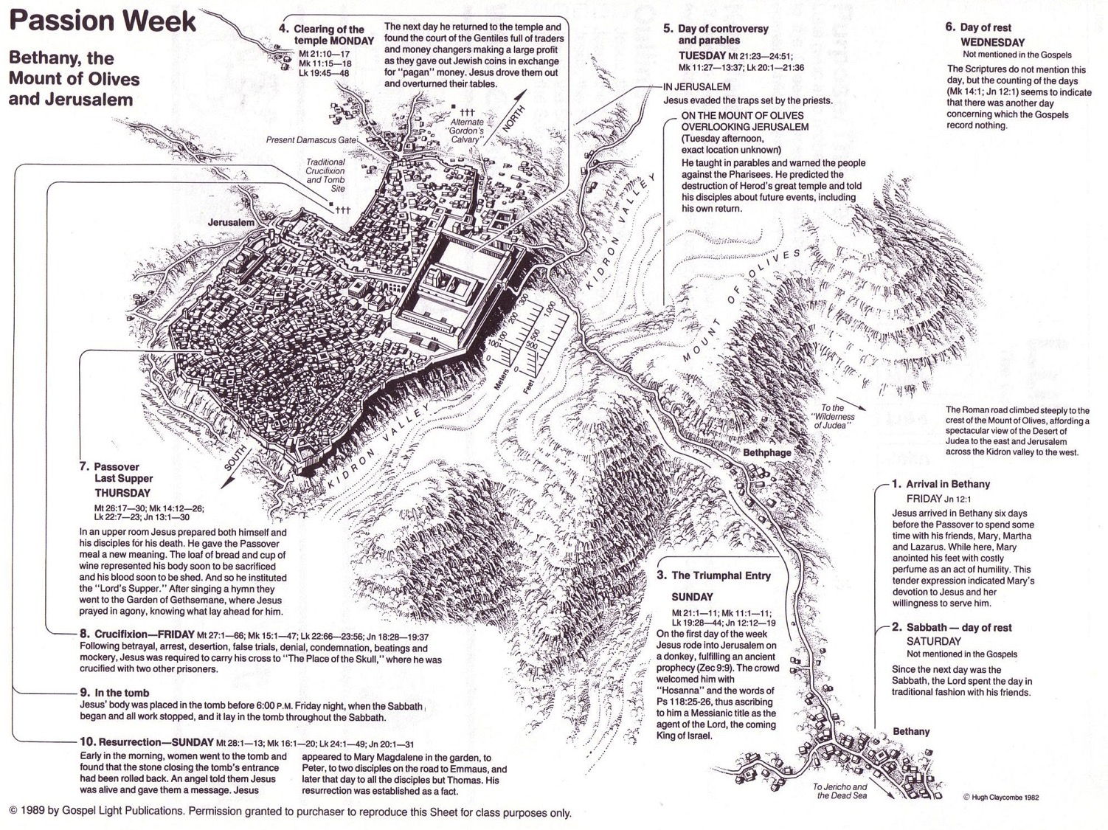
Passion Week
64
Mon
Wed
Tues
Fri
Thurs
Fri
Sun
Sat
Sat
Sun

Slide 10
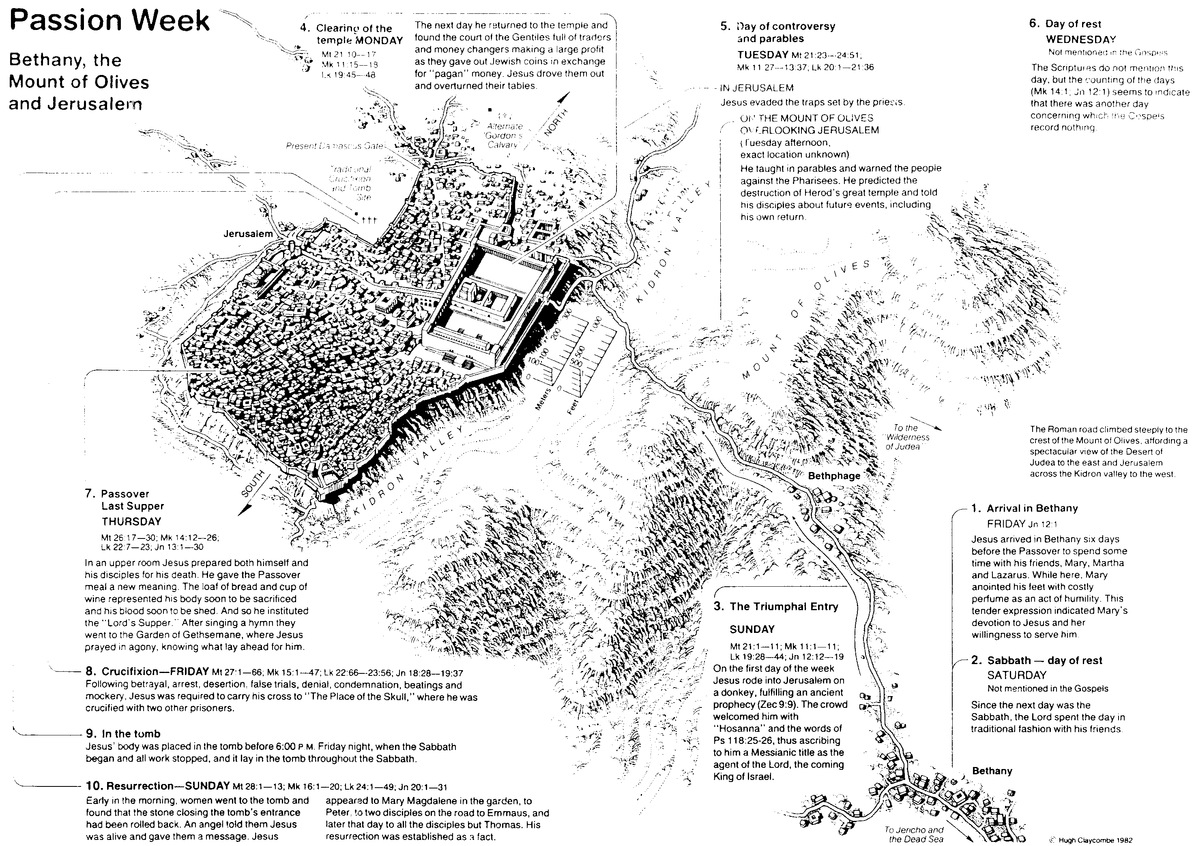
Jesus’ 7 Last Days
64
Day 1 Friday
Jesus Arrived in Bethany Jn 12:1
Day 2 Saturday
Sabbath

Slide 11
Sunday
Day 3 Sunday
The Triumphal Entry
MT 21:1-11; Mk 11:1-11; LK 19:28-44; Jn 12:12-19

Slide 12
Monday
Day 4 Monday
Jesus Clearing the Temple
Mt 21:10-17; Mk 11:15-18 Lk 19:45-48

Slide 13
Tuesday & Wednesday
Day 5 Tuesday
Controversy & Parables
MT 21:23-24:51; Mk 11:27-13:37; Lk 20:1-21:36
Day 6 Wednesday
Day of Rest

Slide 14
Thursday
Day 7 Thursday
Passover Last Supper
Mt 26: 17-30; Mk 14:12-26;Lk 22:7-23; Jn 13:1-30

Slide 15
Friday
Day 8 Friday
Crucifixion/ Tomb
Mt27:1-66; Mk 15:1-47; Lk 22:66-23:56; Jn 18:28-19:37

Slide 16
Jesus’ Final Week
Sat: Anointing in Bethany
Sun: Triumphal Entry
Mon: Temple cleansing
Tue: Teaching
Wed: ?
Thu: Passover
Fri: Trials & execution
Blomberg, 315

Slide 17
Jesus’ Final Hours
Thursday--------------
After sundown
Thurs-Friday----------
Nighttime
Last supper
Prayer in Garden
Betrayal
Custody
Hearing Before Annas
Trial Before Caiaphas
Peter’s denial
Blomberg, 342

Slide 18
Jesus’ Final hours
Friday------------------
Early morning
Late Morning----------
Midafternoon----------
Near Sundown--------
Sanhedrin Ends Deliberations
Jesus Sent To Pilate
Hearing Before Pilate
Jesus Sent To Herod
Return To Pilate
Jesus Nailed To Cross
Jesus Dies
Jesus Buried
Blomberg, 342

Slide 19
Crucifixion
Cruelest form of execution
Most shameful way to die
Roman citizens exempted
Reserved for worst criminals
Tied with a rope or nailed through
X-shaped or t-shaped cross
Death by suffocation

Slide 20
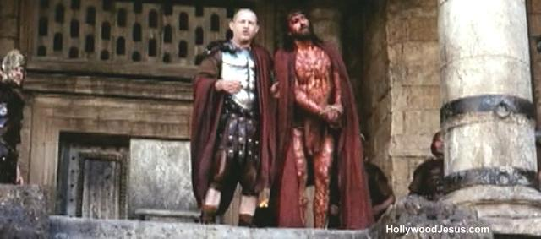
Why Did Jesus Choose To Die?

Slide 21
A. The Arrest
§ 168
Matthew 26:47-56; Mark 14:43-52; Luke 22:47-53; John 18:2-12a
Christ willingly allows His betrayal and arrest in Gethsemane, while remaining in complete control with authority over His adversaries
Notes:
Jesus Is Betrayed and Arrested
Matt. 26:47 And even as Jesus said this, Judas, one of the twelve disciples, arrived with a crowd of men armed with swords and clubs. They had been sent by the leading priests and elders of the people. ⁴⁸ The traitor, Judas, had given them a prearranged signal: “You will know which one to arrest when I greet him with a kiss.” ⁴⁹ So Judas came straight to Jesus. “Greetings, Rabbi!” he exclaimed and gave him the kiss.
Matt. 26:50 Jesus said, “My friend, go ahead and do what you have come for.”
Then the others grabbed Jesus and arrested him.
⁵¹ But one of the men with Jesus pulled out his sword and struck the high priest’s slave, slashing off his ear.
Matt. 26:52 “Put away your sword,” Jesus told him. “Those who use the sword will die by the sword. ⁵³ Don’t you realize that I could ask my Father for thousandsª of angels to protect us, and he would send them instantly? ⁵⁴ But if I did, how would the Scriptures be fulfilled that describe what must happen now?”
Matt. 26:55 Then Jesus said to the crowd, “Am I some dangerous revolutionary, that you come with swords and clubs to arrest me? Why didn’t you arrest me in the Temple? I was there teaching every day. ⁵⁶ But this is all happening to fulfill the words of the prophets as recorded in the Scriptures.” At that point, all the disciples deserted him and fled.
Jesus Is Betrayed and Arrested
Mark 14:43 And immediately, even as Jesus said this, Judas, one of the twelve disciples, arrived with a crowd of men armed with swords and clubs. They had been sent by the leading priests, the teachers of religious law, and the elders. ⁴⁴ The traitor, Judas, had given them a prearranged signal: “You will know which one to arrest when I greet him with a kiss. Then you can take him away under guard.” ⁴⁵ As soon as they arrived, Judas walked up to Jesus. “Rabbi!” he exclaimed, and gave him the kiss.
Mark 14:46 Then the others grabbed Jesus and arrested him. ⁴⁷ But one of the men with Jesus pulled out his sword and struck the high priest’s slave, slashing off his ear.
Mark 14:48 Jesus asked them, “Am I some dangerous revolutionary, that you come with swords and clubs to arrest me? ⁴⁹ Why didn’t you arrest me in the Temple? I was there among you teaching every day. But these things are happening to fulfill what the Scriptures say about me.”
Mark 14:50 Then all his disciples deserted him and ran away. ⁵¹ One young man following behind was clothed only in a long linen shirt. When the mob tried to grab him, ⁵² he slipped out of his shirt and ran away naked.
Jesus Is Betrayed and Arrested
Luke 22:47 But even as Jesus said this, a crowd approached, led by Judas, one of the twelve disciples. Judas walked over to Jesus to greet him with a kiss. ⁴⁸ But Jesus said, “Judas, would you betray the Son of Man with a kiss?”
Luke 22:49 When the other disciples saw what was about to happen, they exclaimed, “Lord, should we fight? We brought the swords!” ⁵⁰ And one of them struck at the high priest’s slave, slashing off his right ear.
Luke 22:51 But Jesus said, “No more of this.” And he touched the man’s ear and healed him.
Luke 22:52 Then Jesus spoke to the leading priests, the captains of the Temple guard, and the elders who had come for him. “Am I some dangerous revolutionary,” he asked, “that you come with swords and clubs to arrest me? ⁵³ Why didn’t you arrest me in the Temple? I was there every day. But this is your moment, the time when the power of darkness reigns.”
John 18:2 Judas, the betrayer, knew this place, because Jesus had often gone there with his disciples. ³ The leading priests and Pharisees had given Judas a contingent of Roman soldiers and Temple guards to accompany him. Now with blazing torches, lanterns, and weapons, they arrived at the olive grove.
John 18:4 Jesus fully realized all that was going to happen to him, so he stepped forward to meet them. “Who are you looking for?” he asked.
John 18:5 “Jesus the Nazarene,”ª they replied.
“I AM he,”^{b} Jesus said. (Judas, who betrayed him, was standing with them.)
⁶ As Jesus said “I AM he,” they all drew back and fell to the ground! ⁷ Once more he asked them, “Who are you looking for?”
And again they replied, “Jesus the Nazarene.”
John 18:8 “I told you that I AM he,” Jesus said. “And since I am the one you want, let these others go.” ⁹ He did this to fulfill his own statement: “I did not lose a single one of those you have given me.”ª
John 18:10 Then Simon Peter drew a sword and slashed off the right ear of Malchus, the high priest’s slave. ¹¹ But Jesus said to Peter, “Put your sword back into its sheath. Shall I not drink from the cup of suffering the Father has given me?”
Jesus at the High Priest’s House
John 18:12 So the soldiers, their commanding officer, and the Temple guards arrested Jesus and tied him up.

Slide 22
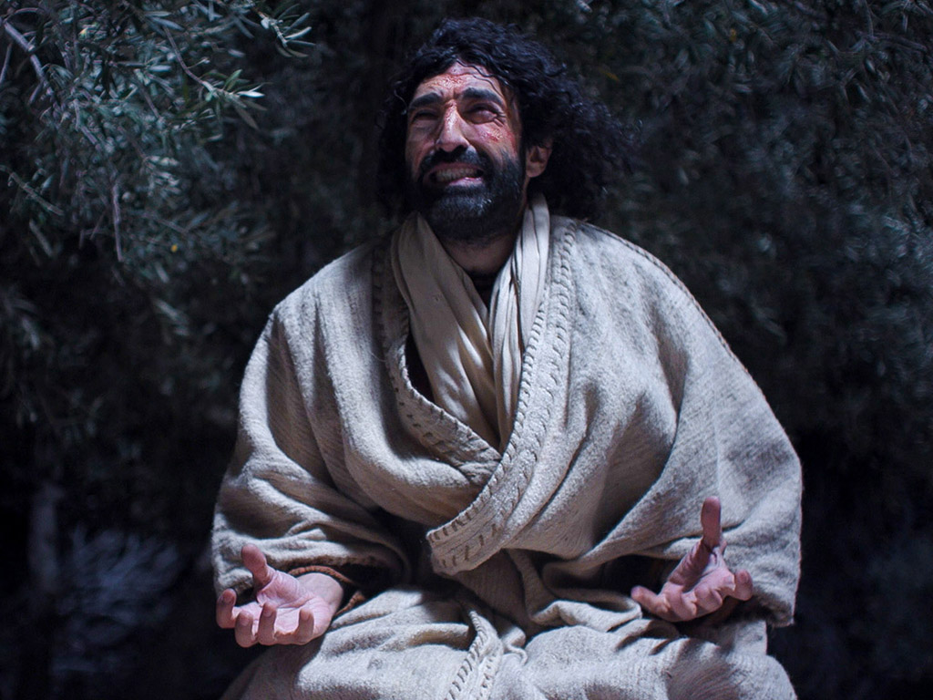

Free
Bible
images
Matthew 26:36-56
Mark 14:32-52
Luke 22:39-53
John 18:1-12
THE EASTER STORY
JESUS PRAYS IN GETHSEMANE

Slide 23
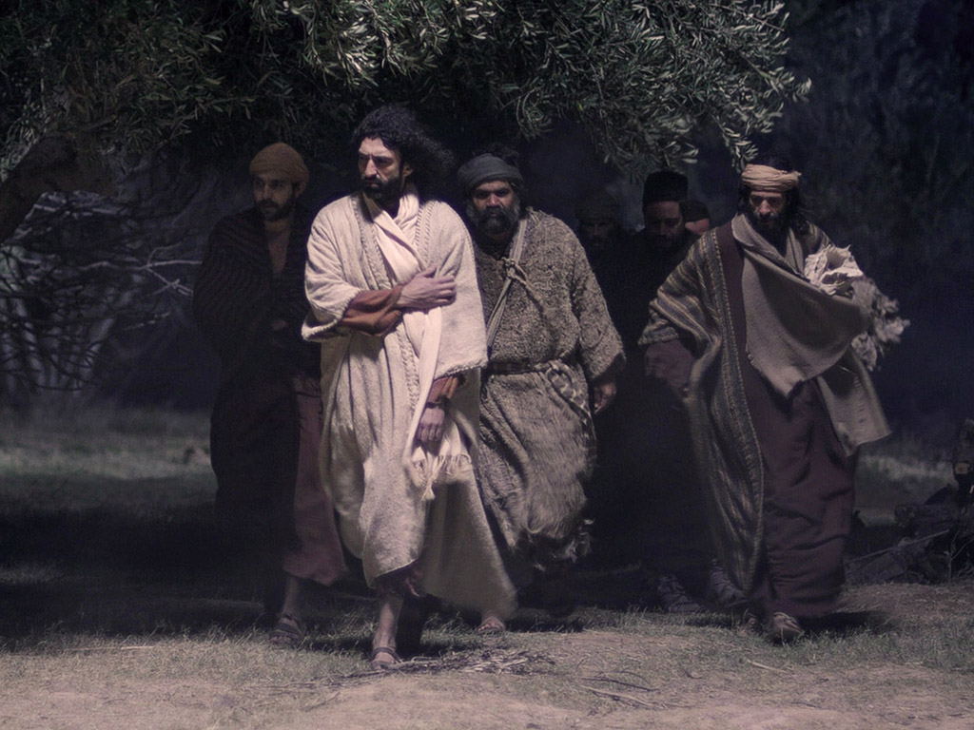

Slide 24
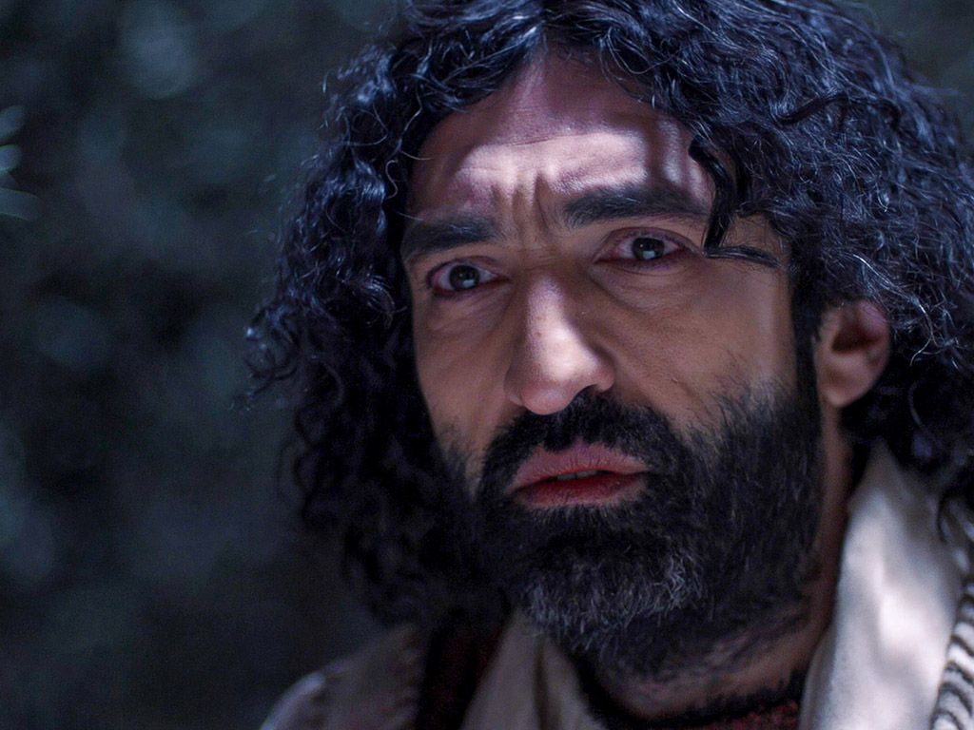

Slide 25
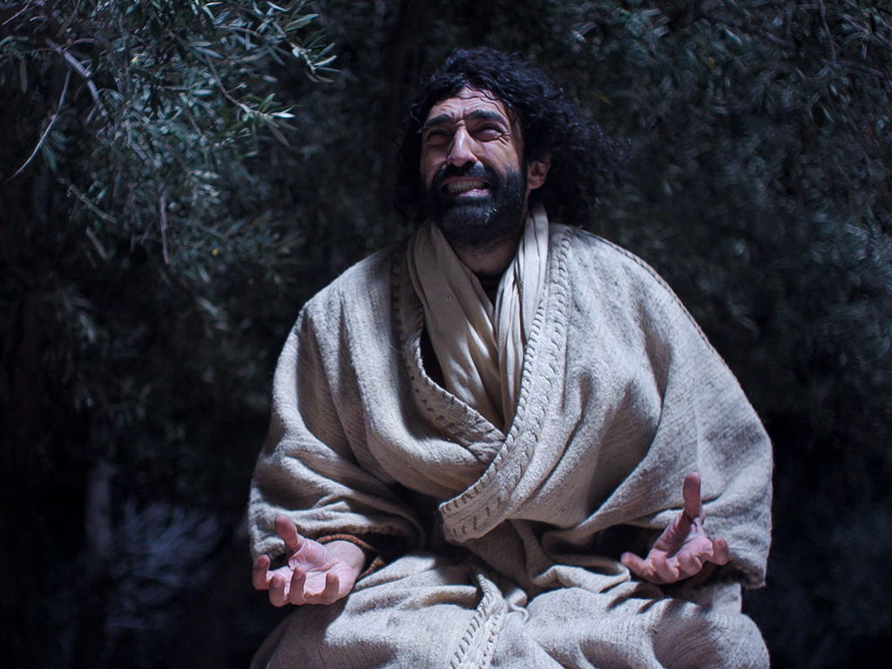

Slide 26
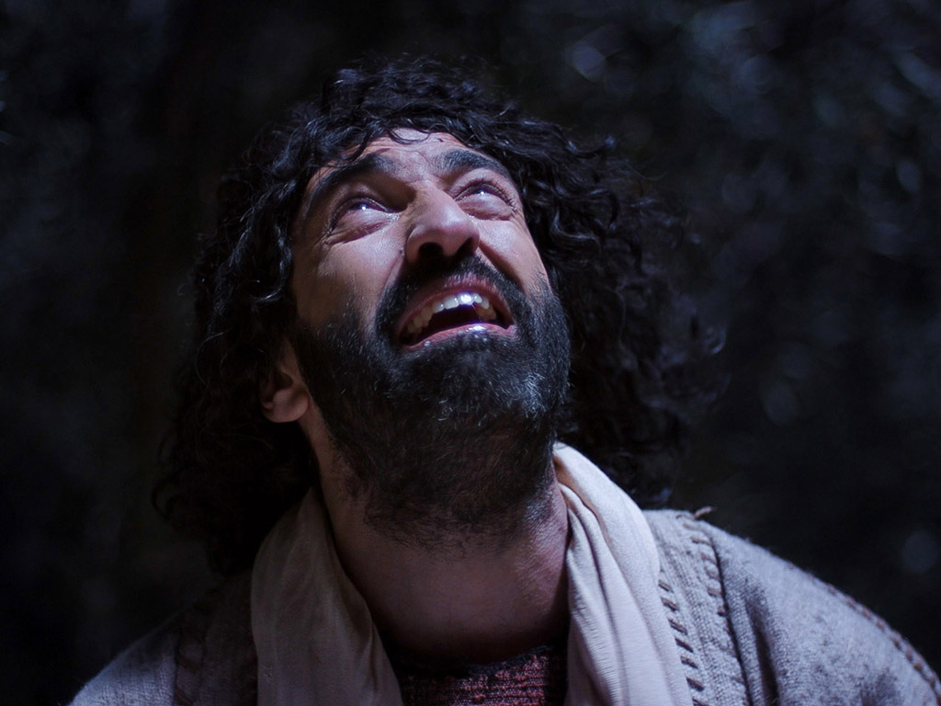

Slide 27
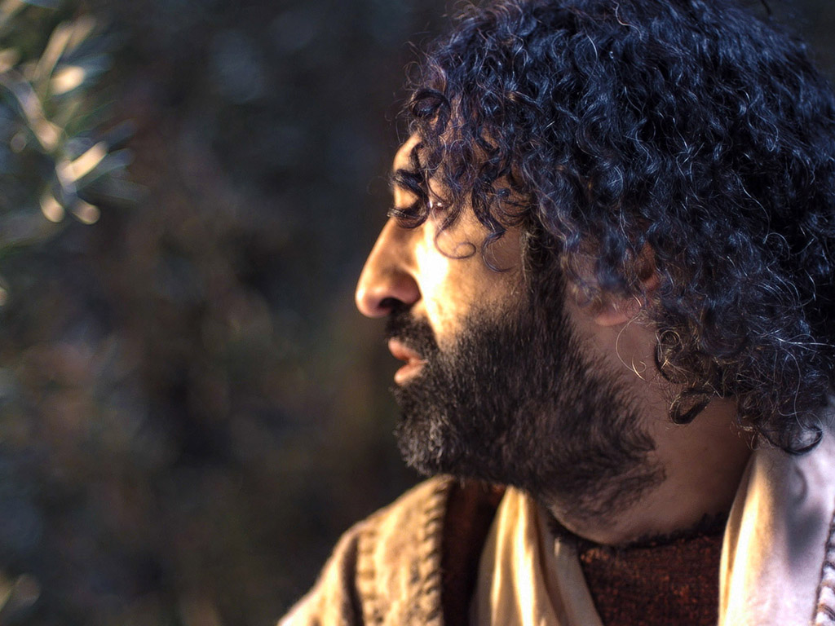

Slide 29
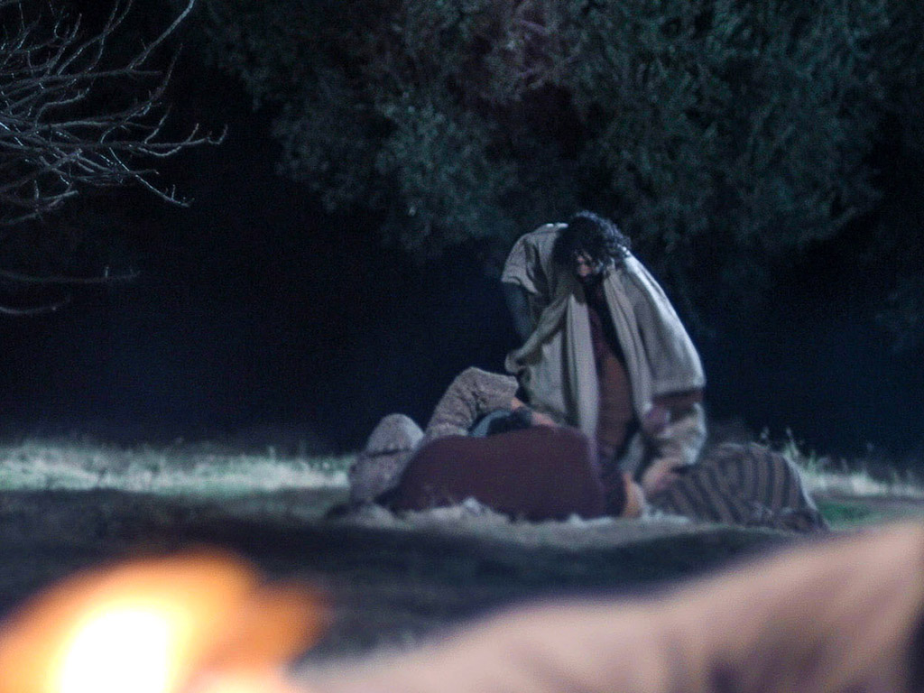

Slide 30
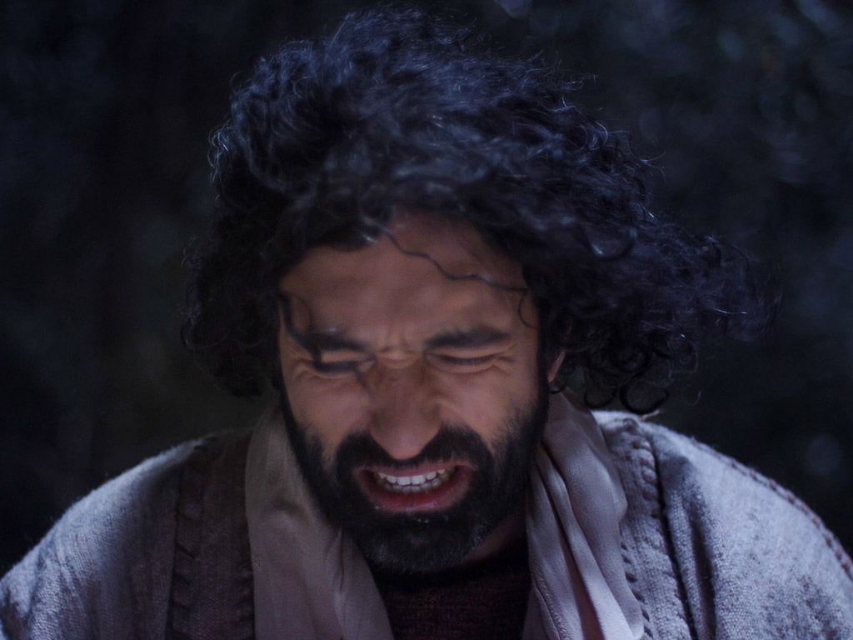

Slide 31
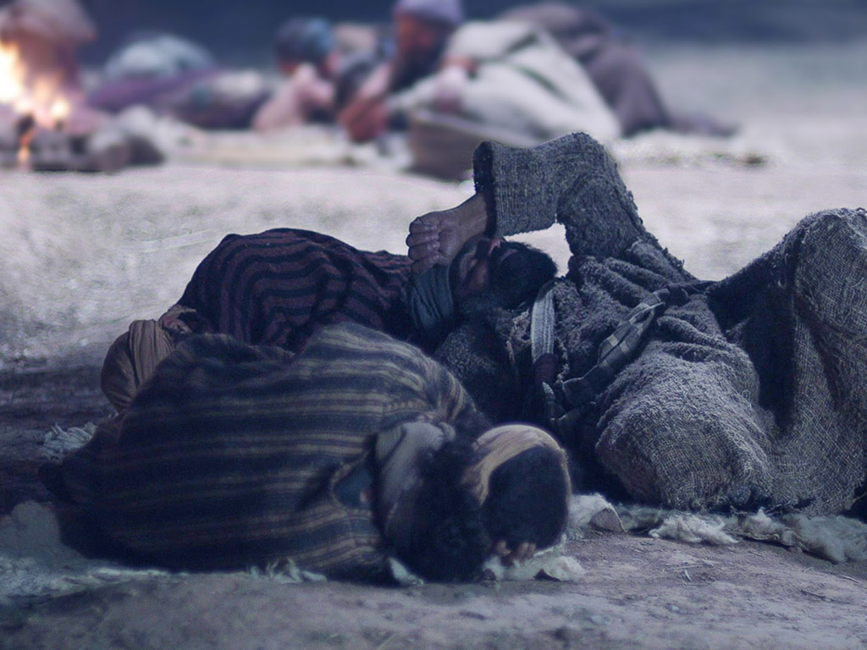

Slide 32
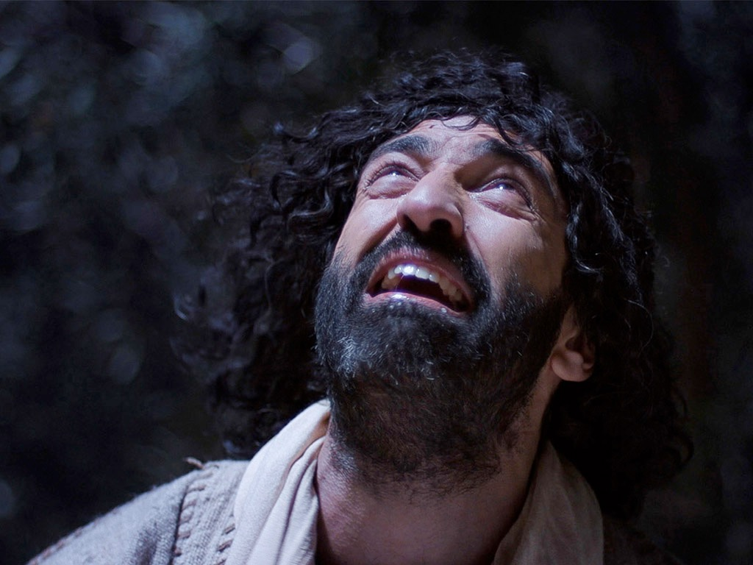

Slide 33
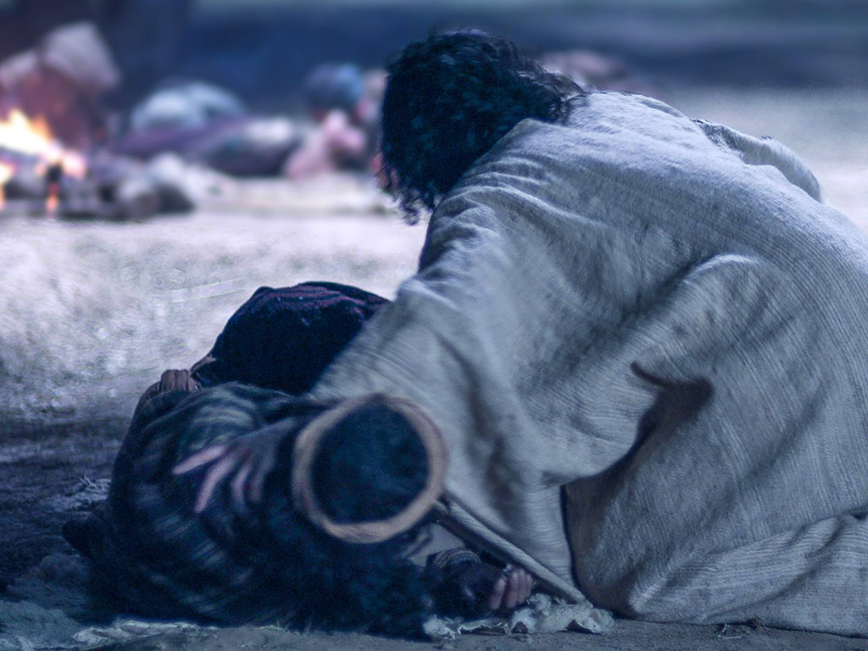

Slide 34
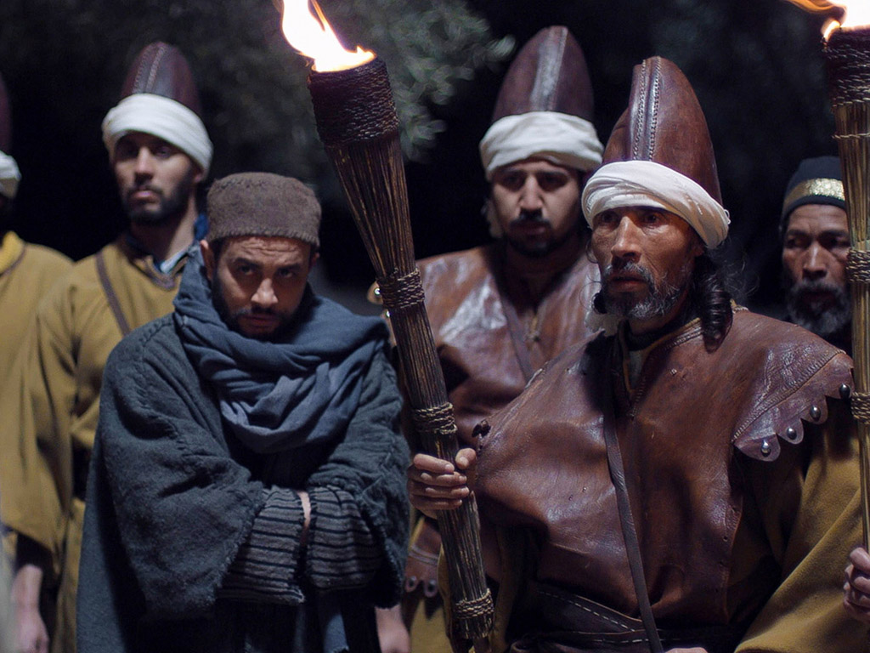
Notes:
Matt. 26:36 Then Jesus went with them to the olive grove called Gethsemane, and he said, “Sit here while I go over there to pray.”
Mark 14:32 They went to the olive grove called Gethsemane, and Jesus said, “Sit here while I go and pray.”

Slide 35
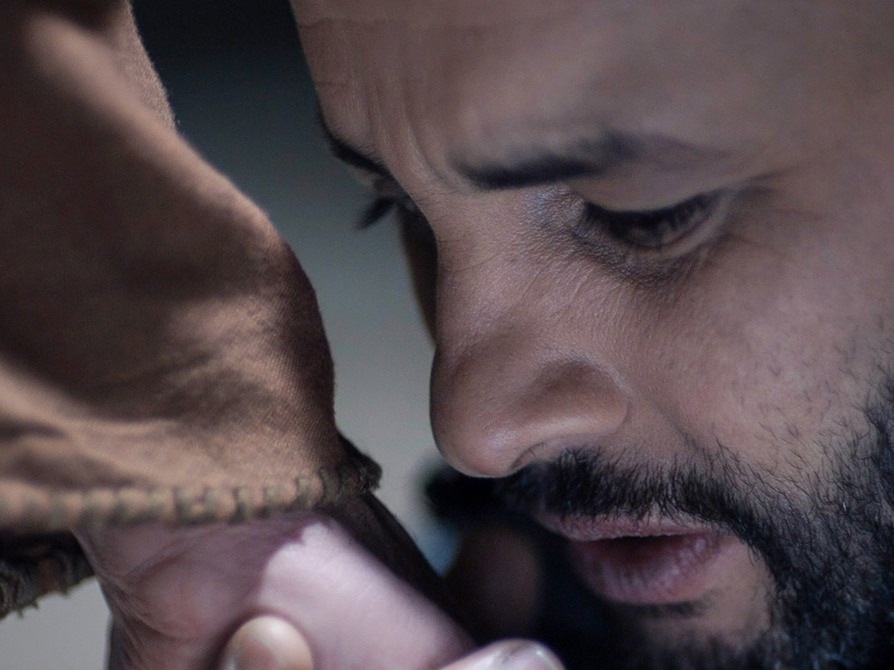

Slide 36
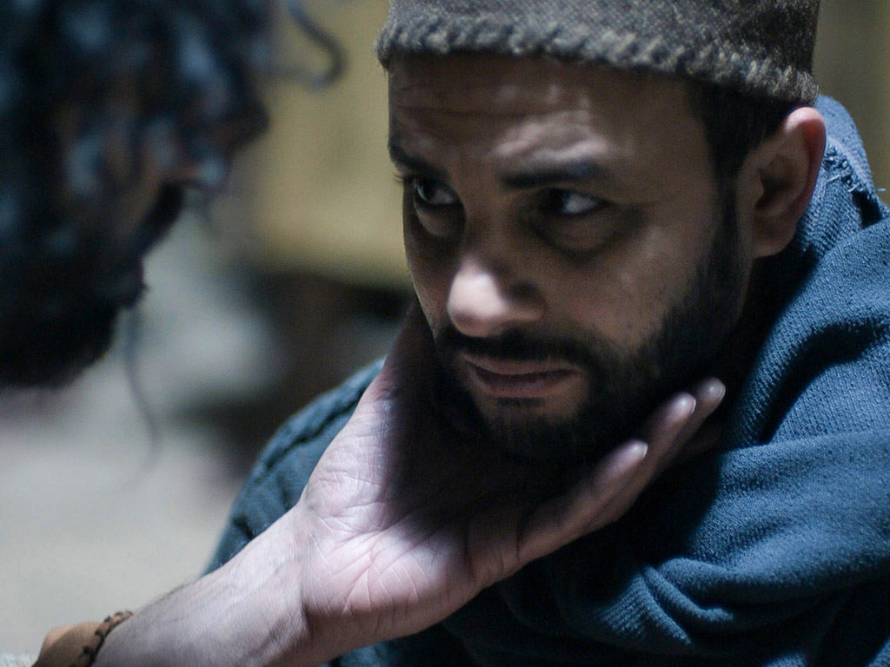

Slide 37
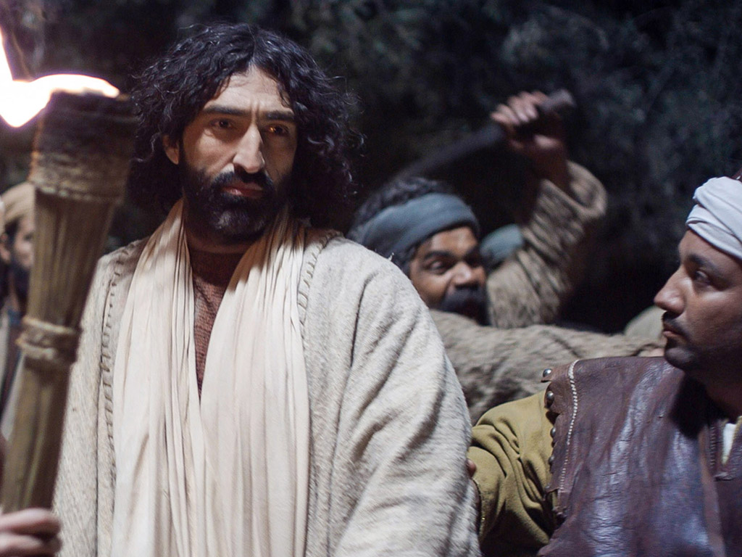

Slide 38
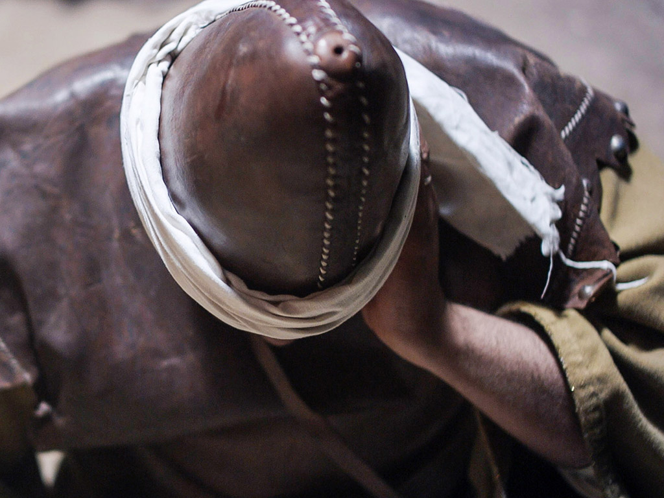

Slide 39
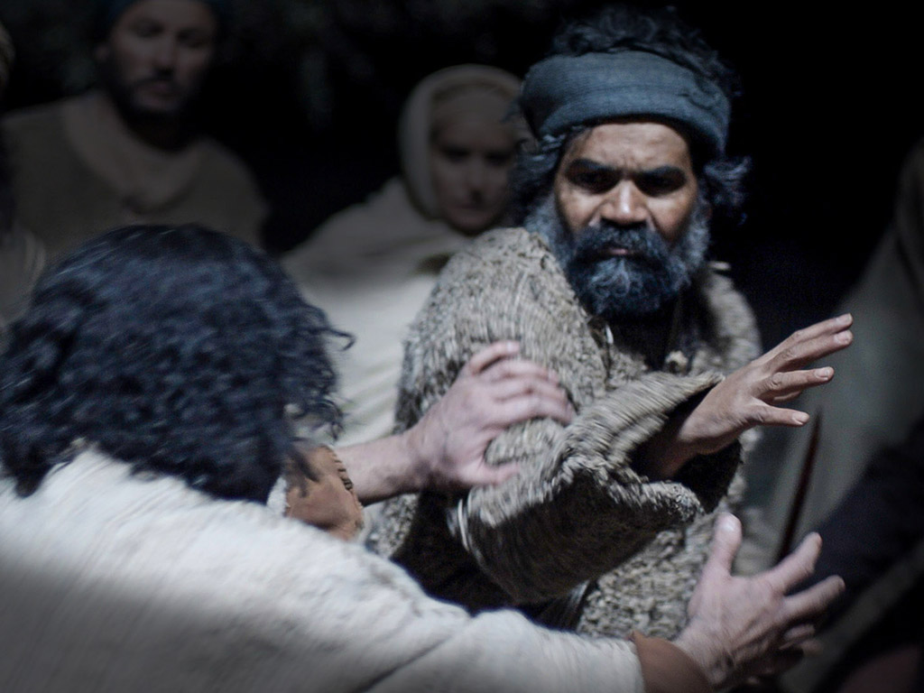

Slide 40
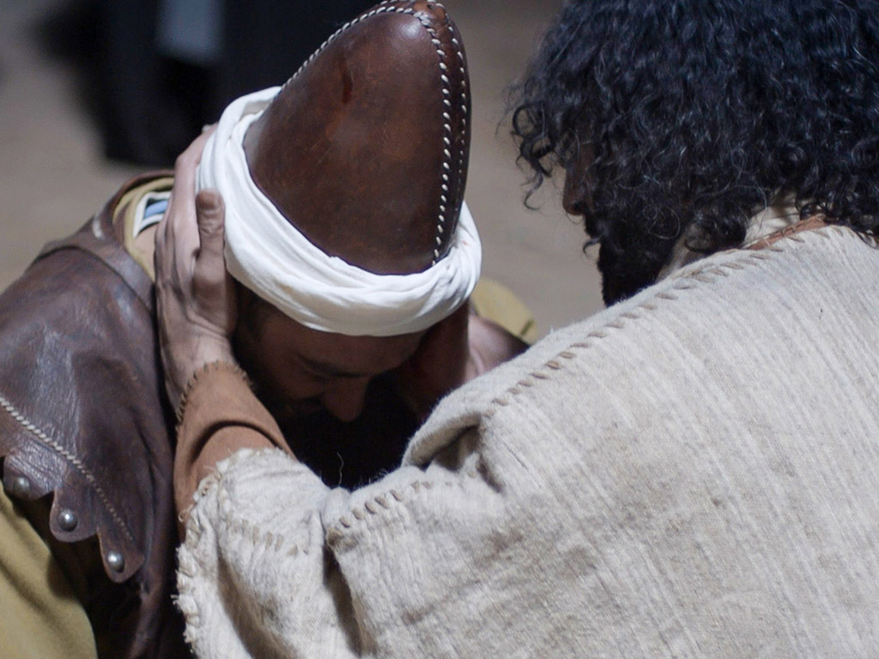

Slide 41
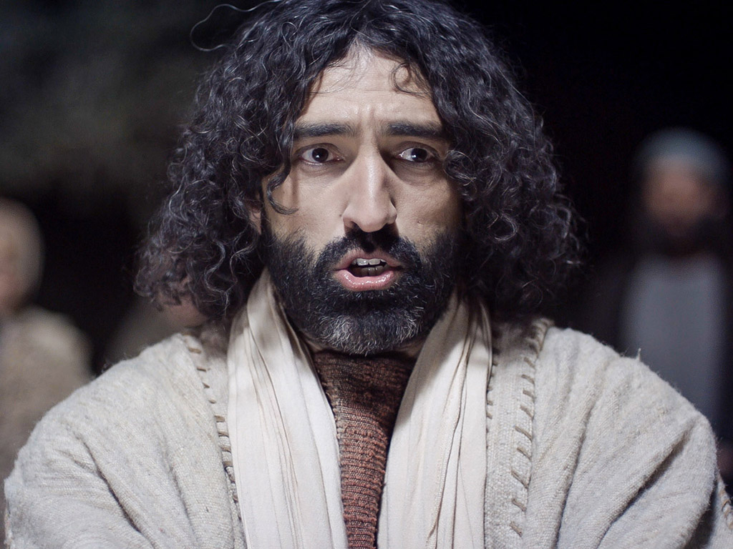

Slide 42
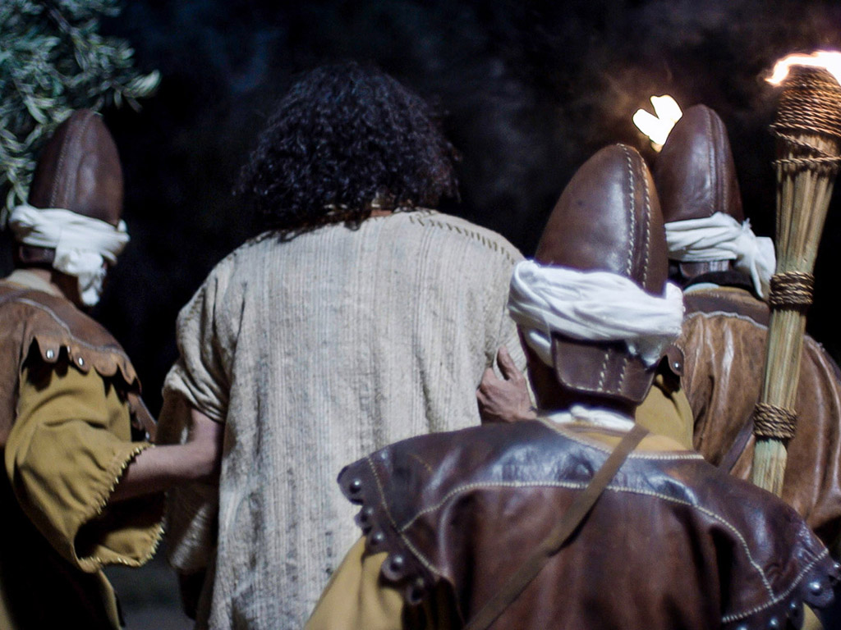

Slide 43
THE WORD IN PICTURES
Free
Bible
images

Slide 44
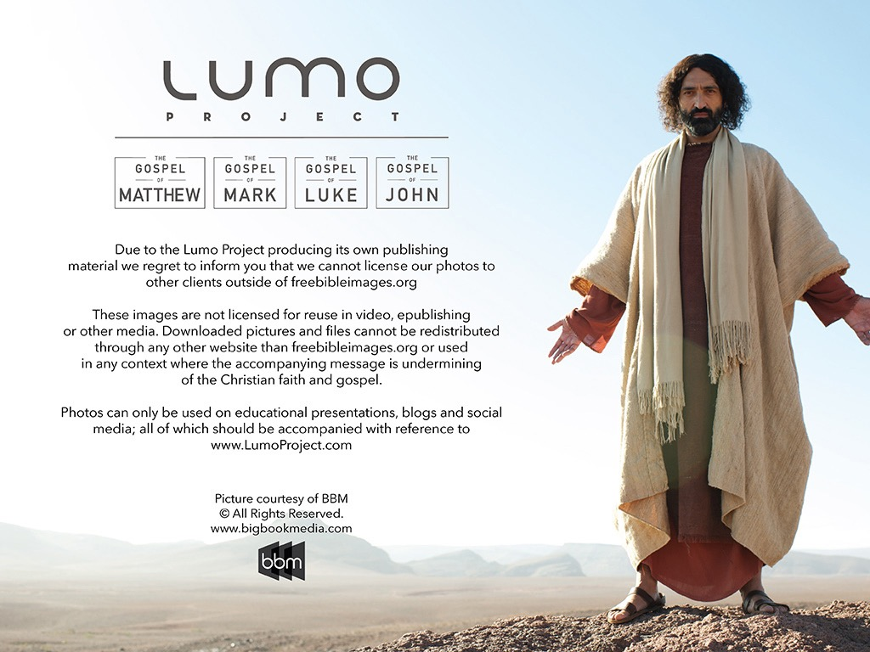
Used with Permission
THE
GOSPEL
——OF—— MATTHEW
THE
GOSPEL
——OF—— MARK
THE
GOSPEL
——OF—— LUKE
THE
GOSPEL
——OF—— JOHN
Due to the Lumo Project producing its own publishing material we regret to inform you that we cannot license our photos to other clients outside of freebibleimages.org.
These images are not licensed for reuse in video, epublishing or other media. Downloaded pictures and files cannot be redistributed through any other website than freebibleimages.org or used in any context where the accompanying message is undermining of the Christian faith and gospel.
Photos can only be used on educational presentations, blogs and social media, all of which should be accompanied with reference to www.LumoProject.com.
Picture courtesy of BBM
© All Rights Reserved.
www.bigbookmedia.com

Slide 45
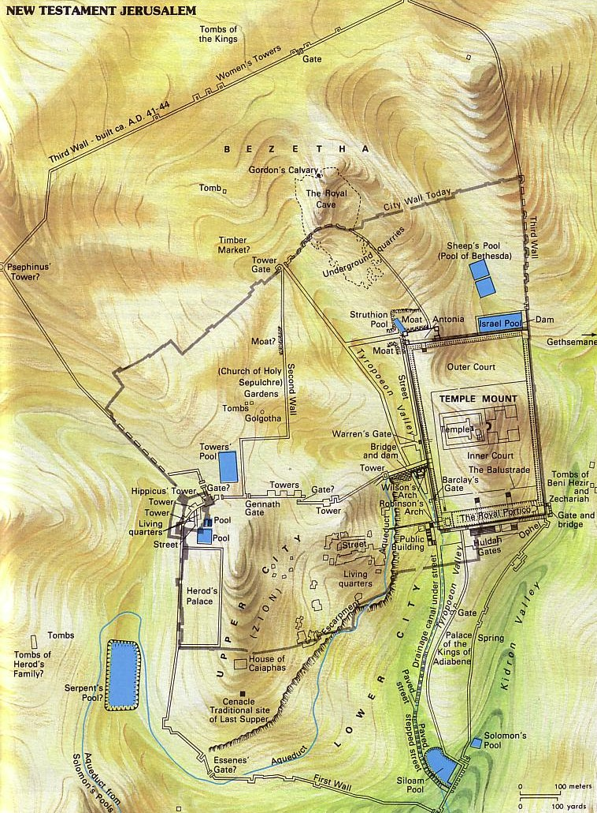
The Last 24 Hours
115
Notes:
• Last Supper (blue)
• Gethsemane prayer and arrest (orange)
• Caiaphas House imprisonment and 3 Jewish trials (red)
• Pavement 3 Roman trials before Pilate & Annas (black)
• Golgotha death and Joseph's tomb resurrection (purple)

Slide 46
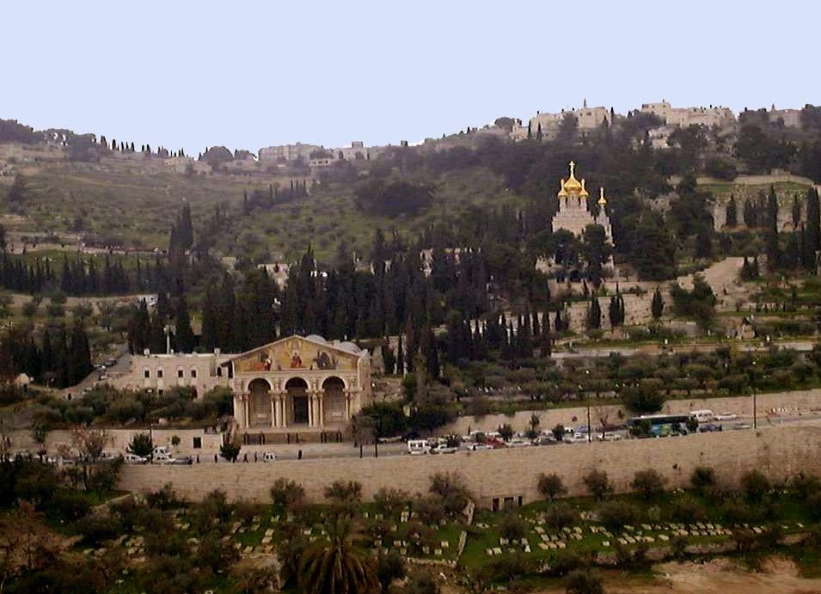
The Mount of Olives

Slide 47
Gethsemane
122
149-151
Mark 14:32 "And they went to a place called Gethsemane. And he said to his disciples, 'Sit here while I pray'" (ESV)
This cave lays within a garden on the Mount of Olives across from the Temple Mount

Slide 48
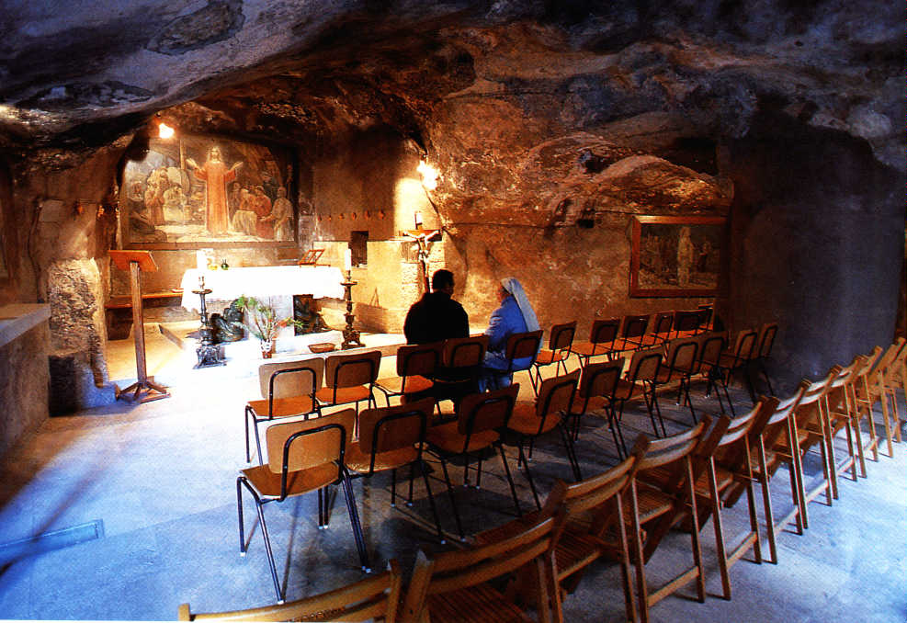
Gethsemane Grotto
122
149-151

Slide 49
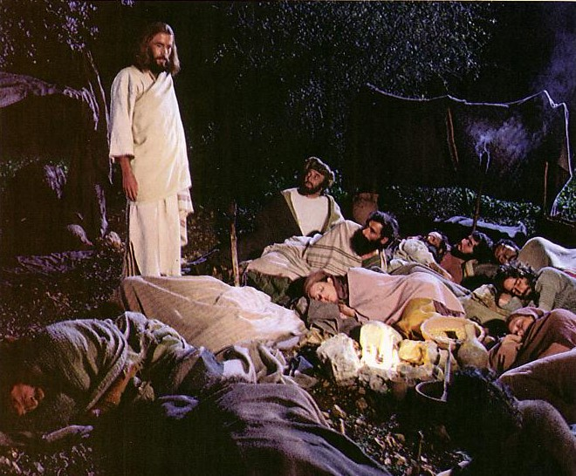
Jesus controlled His own arrest (John 18:1-11).
Notes:
Jesus was and is the one with ultimate authority.

Slide 50
B. The Religious Trial
§§ 169-173
The Jewish leaders illegally try Jesus on religious blasphemy that this unjust treatment would end at the cross as the sacrifice for sin

Slide 51
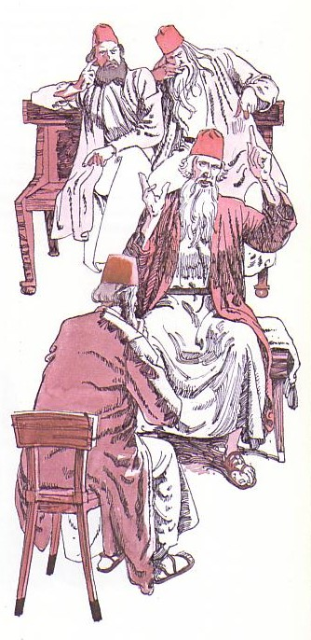
Jesus' illegal trials proved Him innocent (John 18:12–19:16a).
Notes:
Then his six illegal trials proved him innocent!

Slide 52
Jesus’ 6 Last Trials
Annas, the ex-high priest
Caiaphas and Sanhedrin
Sanhedrin and 70 ruling leaders of Israel
Pilate, governor of Judea
Herod Antipas of Galilee
Return To Pilate

Slide 53
The Jewish Trials of Jesus
65
TRIAL | LEADER | TEXTS | ACCUSATIONS | LEGALITY | TYPE | RESULT
1. | Annas, ex-high priest of Jews (A.D. 6-15) | John 18:13-23 | Trumped-up charges of irreverence to Annas. General questioning, nothing specific. | ILLEGAL! Held at night Prejudice No specific charges Violence | Jewish and Religious | Found "guilty” of irreverence and rushed to Caiaphas
2. | Caiaphas and Sanhedrin (Caiaphas was Annas' son-in-law) (A.D. 18-36) | Matt. 26:57-68 Mark 14:53-65 Luke 22:54, 63-65 John 18:24 | Claimed to be the Messiah, Son of God … blasphemy! | ILLEGAL! Held at night False witnesses Violence Prejudice | Jewish and Religious | Declared guilty of blasphemy and rushed to Sanhedrin (Jewish supreme court)
3. | Sanhedrin (70 Jewish rulers) whose word was needed before He could be taken to Romans | Matt. 27:1 Mark 15:1 Luke 22:66-71 | Claimed to be Son of God Charged with blasphemy! (Worthy of death under Jewish law) | ILLEGAL! Kangaroo Court Accusation switched No witnesses Improper voting | Jewish and Religious | Declared guilty of blasphemy and rushed to Roman official, Pilate
Notes:
The Six Trials of Jesus were divided into three Jewish and three Roman trials. All six were illegal.
They began with illegal religious trials before the Jewish authorities with the charge of blasphemy.
But Jews could not execute anyone under Roman law, so they needed Romans to do it.
_____________________
LC-09-Rejection-84
NS-00-NTS Chronology-44

Slide 54
The Roman Trials of Jesus
65
TRIALS | LEADERS | TEXTS | ACCUSATIONS | LEGALITY | TYPE | RESULT
4. | Pilate, governor of Judea (already in "hot water" with Rome) (A.D. 26-36) | Matt. 21:11-14 Mark 15:2-5 Luke 23:1-7 John 18:28-38 | Accused Him of treason. Changed accusation, since reason was worthy of capital punishment in Rome. | ILLEGAL! Kept under arrest, though found innocent. No defense attorney. Violence. | Roman and Civil | Found to be INNOCENT . . . but rushed to Herod Antipas. Mob overruled Pilate . . .
5. | Herod Antipas, governor of Galilee (4 B.C.-A.D. 39) | Luke 23:8-12 | No accusation made. Mock trial. Mob violence. | ILLEGAL! No grounds. Mockery in court-room. Violence. No defense attorney | Roman and Civil | Mistreated and mocked, returned to Pilate without decision made by Herod
6. | Pilate (Second time) | Matt. 27:15-26 Mark 15:6-15 Luke 23:18-25 John 18:39-19:16 | Treason (but not proven) Bargain with mob . . . put on level with Barabbas, a criminal. | ILLEGAL! Pilate, without proof of guilt, allowed innocent man to be condemned | Roman and Civil | Flogged without evidence; Found innocent but Pilate "washed hands" and allowed Him to be CRUCIFIED.
Notes:
A key problem for the Jews was that Romans did not consider blasphemy worthy of death, so the Sanhedrin deceptively changed the charge to treason.
The final three trials thus charged Jesus with treason or seeking to overthrow Roman rule.
However, even this was not proven, and each Roman trial was also illegal in various ways.
_____________________
LC-09-Rejection-85
NS-00-NTS Chronology-45

Slide 55
Jesus’ Unjust Trials
Held at night
No specific charge
No witness
No defense attorney
No proof of guilt
This was not a trial but a planned murder

Slide 56
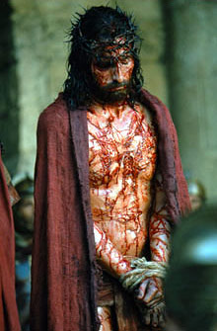
Why did Jesus keep silent?

Slide 57
1. The Examination before Annas
§ 169
John 18:12b-14, 19:23
The deposed high priest Annas sends Jesus to Caiaphas to continue the religious trial after illegally evaluating His teaching

Slide 58
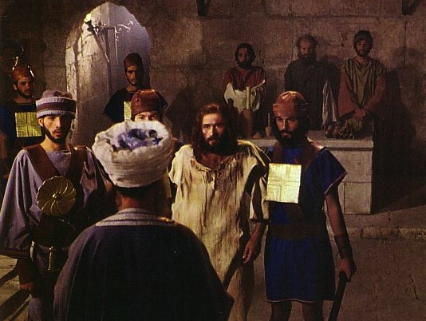
The Jewish Trials: Annas
Illegal
No longer high priest
At night
In a home
No witnesses
No actual charge
Violence
Illegal
Illegal
Illegal
Illegal
Illegal
Notes:
The trial by Annas was illegal.
"In A.D. 6, Quirinius, governor of Syria, appointed Annas as high priest (Josephus, Antiquities 18.2.1).
According to Jewish law, he should have held this position for life. However, he was deposed in A.D. 15 by Valerius Gratus, Roman procurator of Judea (Jos., Ant. 18.2.2). Nevertheless, Annas continued to hold a great deal of power among the religious leaders (see Lk 3:2; Acts 4:6). At the time of Jesus’ trial, Caiaphas (the son-in-law of Annas) was serving as high priest. He had been appointed as high priest around the year A.D. 18 by Valerius Gratus (eventually removed from office around the year A.D. 36; Jos., Ant. 18.4.3). Yet Annas was the patriarch of the high priestly family, and many still considered him the proper high priest, even though the Romans recognized Caiaphas as high priest."
—Paul Tanner, Following the Master, 22, n. 9

Slide 59
2. Examination before Caiaphas
§ 170
Matthew 26:57, 59-68; Mark 14:53, 55-65; Luke 22:54a, 63-65; John 18:24
The high priest Caiaphas and the Sanhedrin illegally convict Christ of blasphemy based on His confession and sentence Him to death

Slide 60
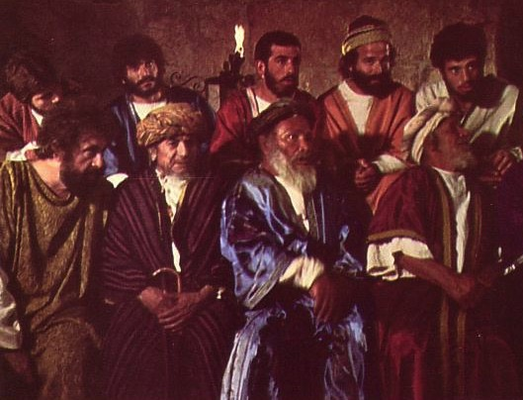
The Illegal Trial by Caiaphas
Closed meeting
At house of Caiaphas
Held at night
No specific charges
Accusations changed
No defense attorney
Verdict already determined
Bribe
No waiting period
Illegal
Notes:
The trial by Caiaphas was also illegal.
————————————
"The following points catalogue the major breaches of justice in regard to Jesus’ trials (especially according to the Mishnaic tractate Sanhedrin):²
1. He was arrested through a bribe (i.e., blood money).
2. He was arrested without a clear charge.
3. Trials could not be held at night or on feast days.
4. They used physical force to try to intimidate Jesus during the trial.
5. False witnesses offered conflicting testimony against him.
6. Witnesses were not supposed to testify in the presence of each other.
7. Jesus was asked to incriminate himself, which he really didn’t do!
8. Jesus was not given the opportunity to cross-examine the witnesses.
9. The high priest never asked for a vote from the Sanhedrin, which should have started with the youngest and gone to the oldest.
10. He was charged with blasphemy and temple violation at his Jewish trial but the charges were changed at his civil trial to claiming to be king, causing disturbances, and refusing to pay taxes.
11. He was convicted and executed the same day as his trial."
² Cf. D. Foreman, “Crucify Him: A Lawyer Looks at the Trial of Jesus (Grand Rapids: Zondervan, 1990), pp. 116–120. Also C.S. Keener, The Mistrial of the Millennium,” ChHist 17/3 (1998): 38–40.
—Mark E. Moore, The Chronological Life of Christ (Joplin, MO: College Press Publishing Company, 2011), 608–609.

Slide 61
3. Denial by Peter
§ 171
Matthew 26:58, 69-75; Mark 14:54, 66-72;
Luke 22:54b-62; John 18:15-18, 25-27
Peter thrice denies Jesus, thus proving Christ's prediction and his inadequacy apart from Jesus amidst His adversaries

Slide 62
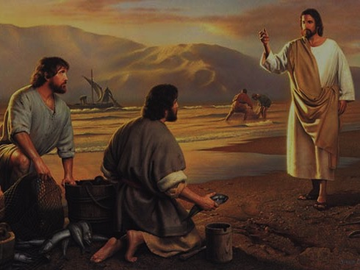
Peter's Calling
(Mark's source for his gospel)

Slide 63
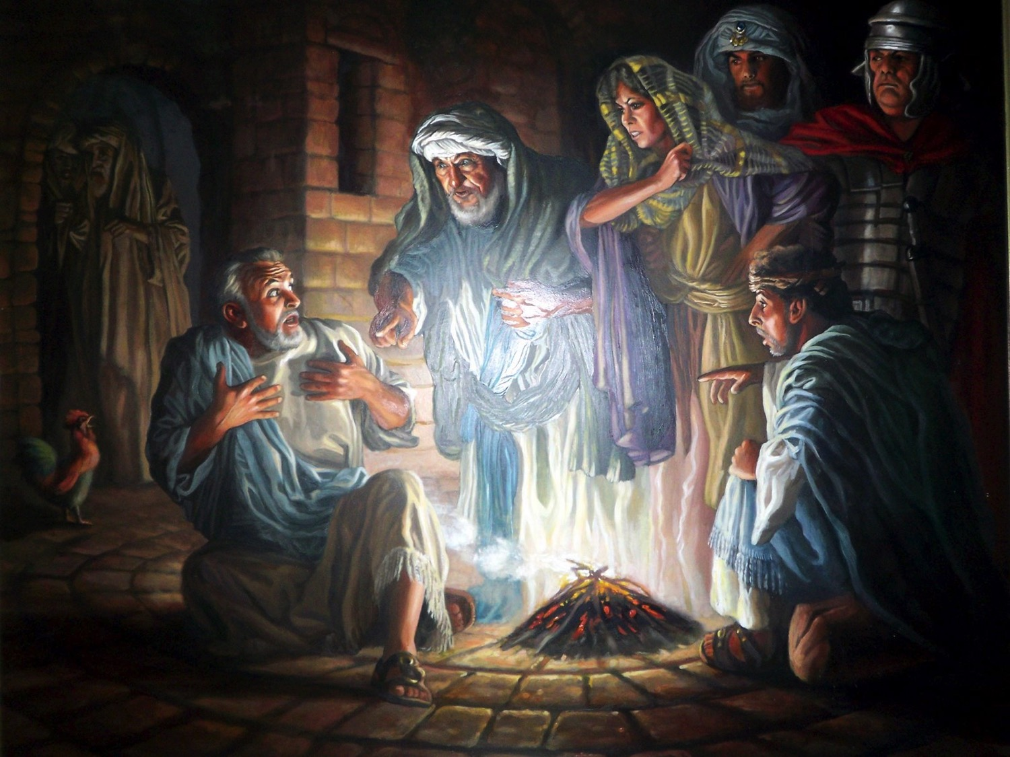
Peter's Denials
Notes:
Jn 18:18 with Mt 26:58, 69; Mk 14:54, 66; Lk 22:55
¹⁸ It was cold, and the servants and officials stood {sat^{MT, MK, LK}} around a fire they had made to keep warm. Peter also was standing {sitting^{MT}/seated^{LK}} with them, warming himself.
Mk 14:66–68 with Lk 22:56–57; Mt 26:70
⁶⁶ While Peter was below in the courtyard, one of the servant girls of the high priest came by. ⁶⁷ When she saw Peter {in the firelight^{LK}} warming himself, she looked closely at him.
“{This man was with him.^{LK}} You also were with that Nazarene, Jesus,” she said.
⁶⁸ But he denied it {before them all.^{MT}} “{Woman, I don’t know him.^{LK}} I don’t know or understand what you’re talking about,” he said, and went out into the entryway.ª
ª Some early manuscripts entryway and the rooster crowed
Mark E. Moore, The Chronological Life of Christ (Joplin, MO: College Press Publishing Company, 2011), 615–616.

Slide 64

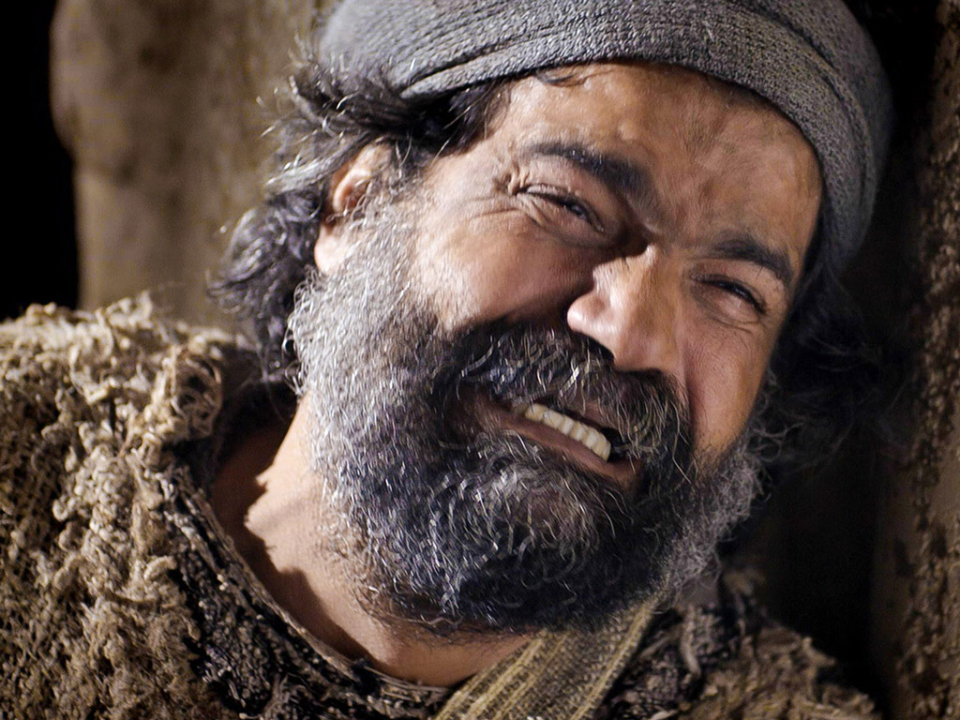
Free
Bible
images
Matthew 26:69-75
Mark 14:66-72
Luke 22:54-62
John 18:15-27
THE EASTER STORY
PETER DENIES JESUS
Notes:
"§ 156 Peter’s Denials (Mt 26:58, 69–75; Mk 14:54, 66–72; Lk 22:54b–62; Jn 18:15–18, 25–27)
Trying to harmonize this event is a mess! All four Gospels represent different people talking to Peter. And all four evangelists intermix the narrative of Jesus’ trial inside the palace and Peter’s trial in the courtyard. As a result many of the verses describing Peter’s denial are separated from each other.¹³ This does not mean, however, that this story is merely a literary product nor does it mean that all four evangelists do not represent the events accurately. Consider these things: (1) There are two major events taking place here at the same time, one with Jesus and one with Peter. Thus one might expect a “soap-opera effect” when retelling the story. That is, they switch from one scene to another and then back again. (2) Out in the courtyard there was little light. Aside from the Passover moon all you had was the dim light of a charcoal fire with perhaps a few torches off to the side. It was difficult for the servants to see Peter. In fact, they finally identify him clearly not by sight but by his Galilean accent. If they find it difficult to see Peter surely he and John would find it difficult to clearly identify who exactly was speaking. (3) Furthermore, there were likely several people speaking at once. Thus, two evangelists might identify two different speakers and both be right.¹⁴ For instance, Luke says a man made the second accusation while Matthew and Mark identify a slave girl. And Mark says it was the same girl who made the second accusation while Matthew says it was a different one. John identifies a relative of Malchus who made the third accusation while Matthew and Mark say the whole group charged him. It is entirely possible that they are all correct. (4) This incident was an embarrassment to Peter and his friend John. It is not the kind of thing they would want to talk about in great detail. Perhaps their reticence to talk about it resulted in the paucity of details we now have."
¹³ C.A. Evans, “ ‘Peter Warming Himself’: The Problem of an Editorial ‘Seam,’ ” JBL 101/2 (1982) 245–249, shows how this literary device of swapping between scenes is also used by ancient Greek writers. Consequently, we don’t need to assume literary dependence among the Gospels because they share this method of reporting Peter’s denials.
¹⁴ N.J. McEleney, “Peter’s Denials—How Many? To Whom?” CBQ 52 (1990): 467–472, lists six different groups or individuals to whom Peter denied knowing Jesus. Furthermore, he suggests that each of the evangelists describe three denials in terms that are characteristic of their own particular style. Thus, each of the evangelists show their own emphasis in reporting Peter’s denials.
— Mark E. Moore, The Chronological Life of Christ (Joplin, MO: College Press Publishing Company, 2011), 614.

Slide 65
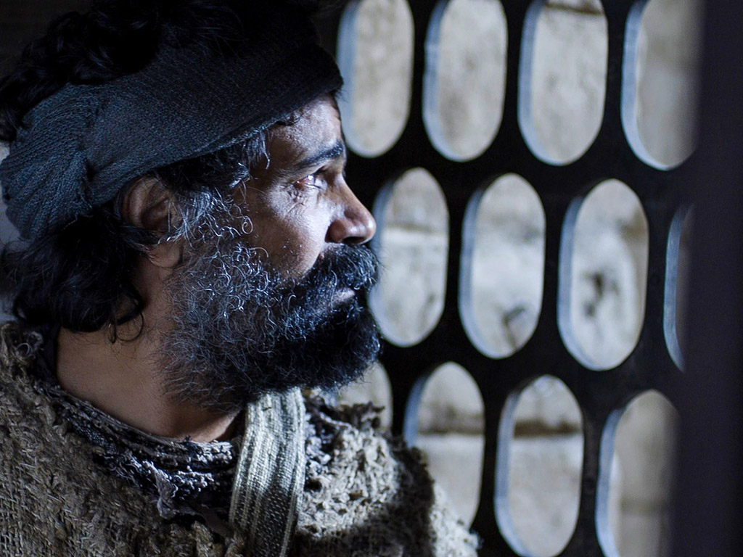
Notes:
"We do have divergent (but not contradictory) details. The fact that this event was an embarrassment to Peter, and thus the church at large, lends credibility to its historicity. In other words, who is going to invent a story like this?! Furthermore, the confusion of detail is just what one would expect from an event on such a night as this, filled with tragedy, veiled in darkness and bathed in tears."
— Mark E. Moore, The Chronological Life of Christ (Joplin, MO: College Press Publishing Company, 2011), 614.

Slide 66
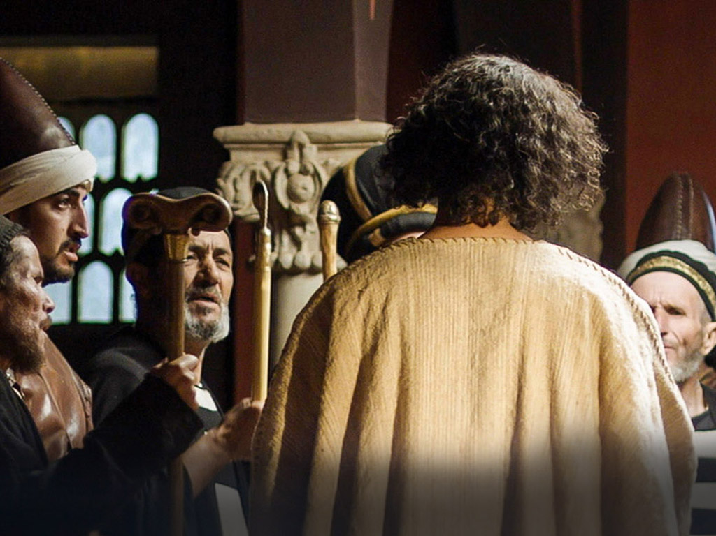
Notes:
"Yet we must not overlook the details that are consistent through each of the four Gospels. First, the confrontation with Peter began with a slave girl. The great Apostle, the manly fisherman, fell prey to fear, intimidated by a teenybopper doorkeeper. Second, there is Jesus. While he is on trial inside, getting beat up by diabolical men, Peter, out in the courtyard, is being sifted by Satan. Both trials are going badly but for very different reasons. Third, there is the fire. Specifically it was a heap of burning charcoal. Hence, it gave little light. There were dark shadows cast across the courtyard of the high priest that night. It was quite symbolic of the spiritual condition shrouding that palace. Finally, there is the rooster, a clarion reminder that Jesus is still in control. Although his crows were a horrific sound for Peter, they echo the sovereignty of God."
— Mark E. Moore, The Chronological Life of Christ (Joplin, MO: College Press Publishing Company, 2011), 614–615.

Slide 67
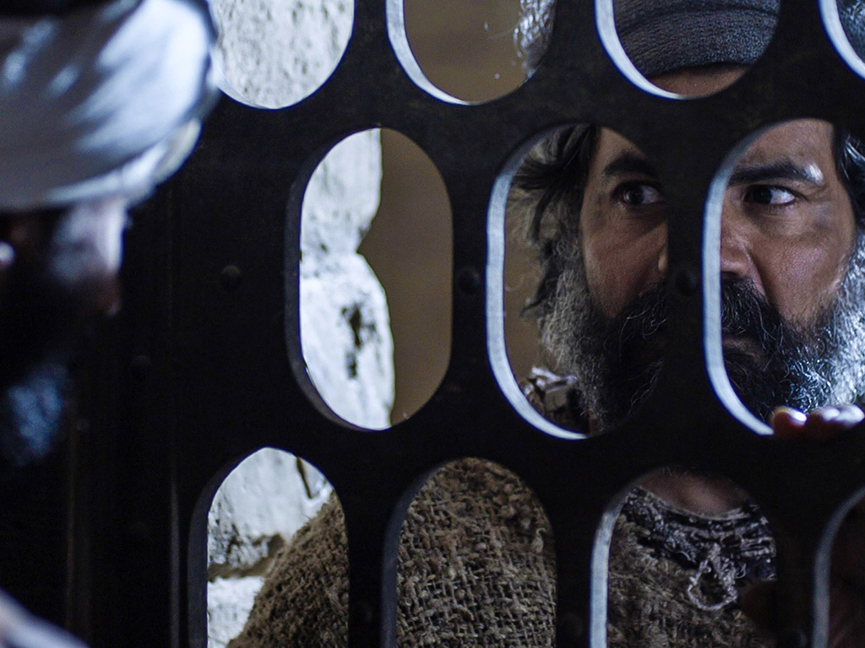

Slide 68
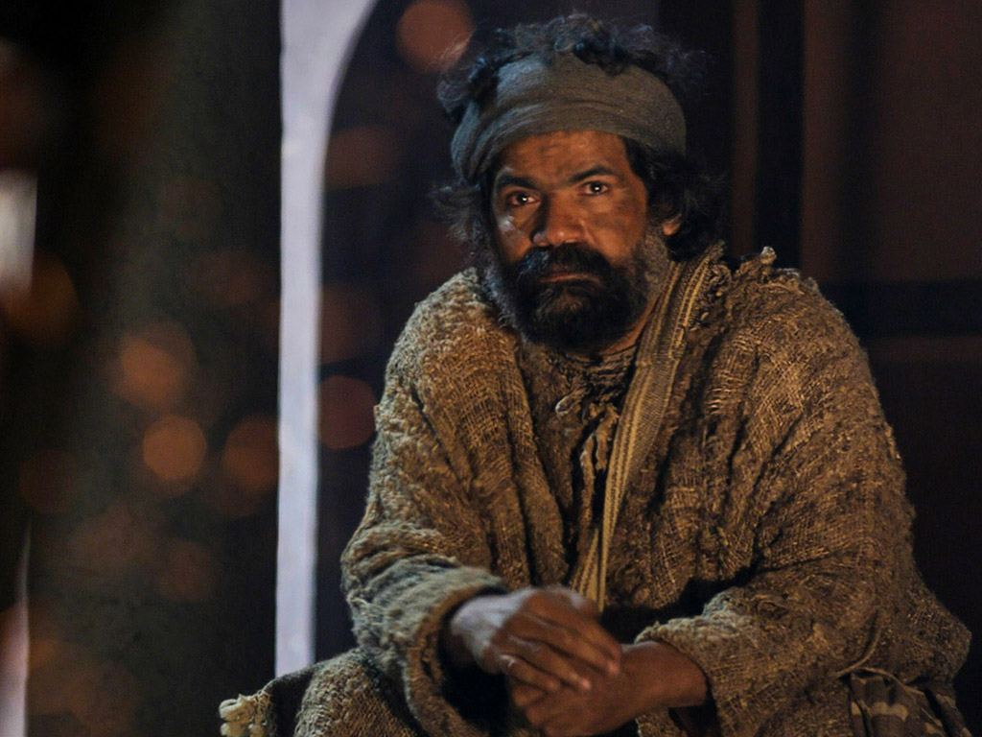
Notes:
"Jn 18:15–17 with Mt 26:58; Mk 14:54; Lk 22:54
¹⁵ Simon Peter and another disciple were following Jesus {at a distance.^{MT, MK, LK}} Because this disciple was known to the high priest, he went with Jesus into the high priest’s courtyard, ¹⁶ but Peter had to wait outside at the door. The other disciple, who was known to the high priest, came back, spoke to the girl on duty there and brought Peter in.
¹⁷ “You are not one of his disciples, are you?” the girl at the door asked Peter. He replied, “I am not.”
Although Peter flees from Gethsemane he doesn’t go far. Ducking behind buildings and shrubs, Peter follows at a distance with another disciple. It is almost certainly John. (1) Peter and John were known to spend a lot of time together (Jn 13:23–24; 20:2–3; Acts 3:1–2; 8:14). (2) John characteristically doesn’t mention himself in his Gospel. Surely he is the “disciple whom Jesus loved” (Jn 13:23; 19:26; 20:2–3; 21:20, 24). (3) There were likely priestly ties in his family which may have allowed him access to the high priest’s house.¹⁵
While John is able to march right in, Peter is held up outside the gate. John goes out, talks to the girl at the door and then ushers Peter in. On his way inside she gets a good, up-close look at him and asks if he was one of Jesus’ disciples. She thinks she recognizes him; besides, he is with John. That’s a dead giveaway. The NIV has translated her question well. This English phrase (v. 17), like the Greek original, expects a negative answer. Although the question calls for Peter to say “No,” she knows better and refuses to let it go. At this point, Peter’s motives may not be to save his own skin but to gain access to the palace in order to be near Jesus or perhaps even to effect his escape."
¹⁵ “Salome, the mother of John, was a sister of Mary, Jesus’ mother (cf. Jn 19:25 with Mk 15:40), and would have been equally related to Elizabeth, whose husband, Zechariah, was a priest (Lk 1:36). The evidence is tenuous, but the author does exhibit a considerable knowledge of Jerusalem and the events that took place there” (Tenney, p. 172).
— Mark E. Moore, The Chronological Life of Christ (Joplin, MO: College Press Publishing Company, 2011), 615.
John 19:25 Standing near the cross were Jesus’ mother, and his mother’s sister, Mary (the wife of Clopas), and Mary Magdalene.
Mark 15:40 Some women were there, watching from a distance, including Mary Magdalene, Mary (the mother of James the younger and of Josephª), and Salome.

Slide 69
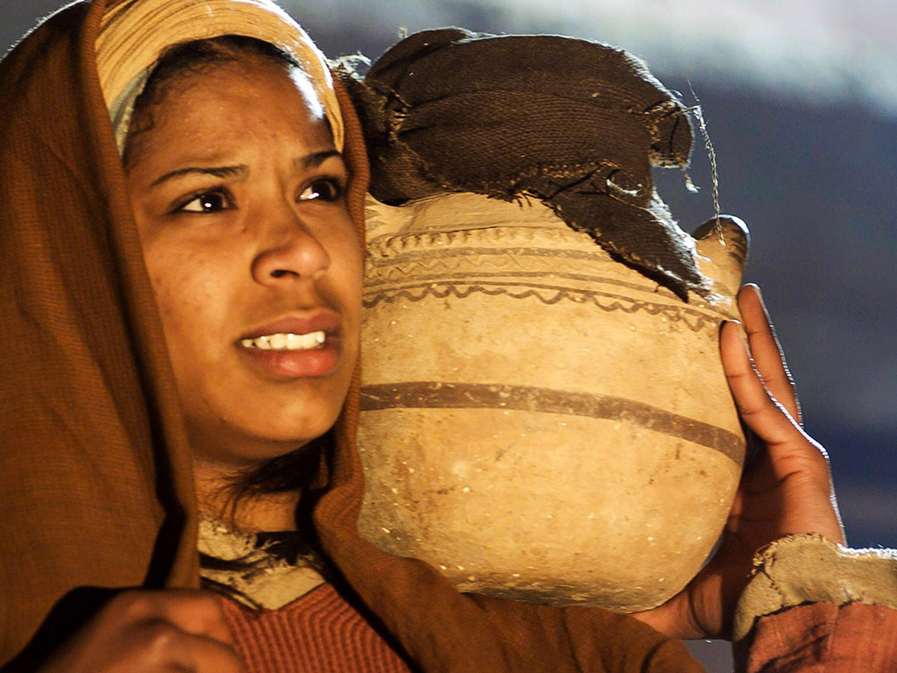
Notes:
The first to accuse Peter is a slave girl.
—————————————
Jn 18:18 with Mt 26:58, 69; Mk 14:54, 66; Lk 22:55
¹⁸ It was cold, and the servants and officials stood {sat^{MT, MK, LK}} around a fire they had made to keep warm. Peter also was standing {sitting^{MT}/seated^{LK}} with them, warming himself.
Mk 14:66–68 with Lk 22:56–57; Mt 26:70
⁶⁶ While Peter was below in the courtyard, one of the servant girls of the high priest came by. ⁶⁷ When she saw Peter {in the firelight^{LK}} warming himself, she looked closely at him.
“{This man was with him.^{LK}} You also were with that Nazarene, Jesus,” she said.
⁶⁸ But he denied it {before them all.^{MT}} “{Woman, I don’t know him.^{LK}} I don’t know or understand what you’re talking about,” he said, and went out into the entryway.^{a"}
ª Some early manuscripts entryway and the rooster crowed
— Mark E. Moore, The Chronological Life of Christ (Joplin, MO: College Press Publishing Company, 2011), 615–616.

Slide 70
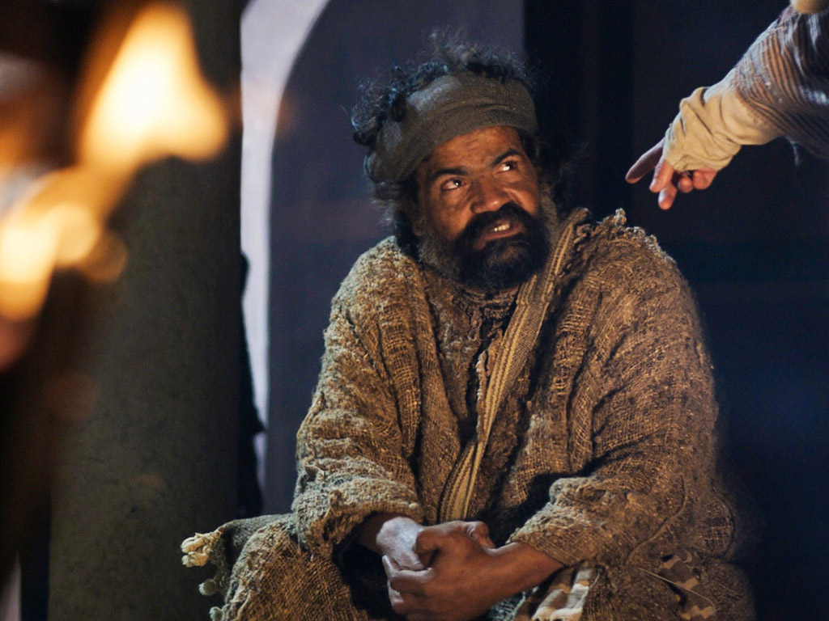
Notes:
Mk 14:69 with Mt 26:71; Lk 22:58
⁶⁹ When the {another^{MT}} servant girl saw him there {a little later,^{LK}} she said again to those standing around, “This fellow is one of them {with Jesus of Nazareth.^{MT}}”
Mt 26:72
⁷² He denied it again, with an oath: “I don’t know the man!”
Mark E. Moore, The Chronological Life of Christ (Joplin, MO: College Press Publishing Company, 2011), 616.

Slide 71
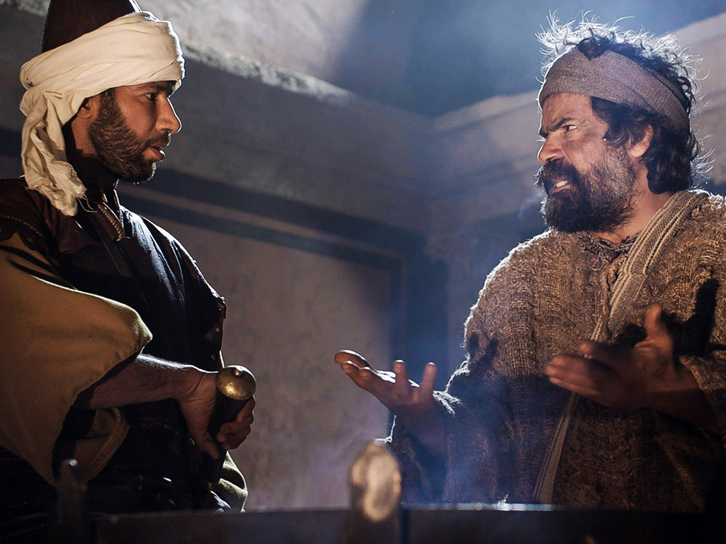
Notes:
Lk 22:59 with Mt 26:73
⁵⁹ About an hour later another {those standing near went up to Peter and^{MT}} asserted, “Certainly this fellow was with him, for he is a Galilean. {Your accent gives you away.^{MT}}”
Jn 18:26
²⁶ One of the high priest’s servants, a relative of the man whose ear Peter had cut off, challenged him, “Didn’t I see you with him in the olive grove?”
— Mark E. Moore, The Chronological Life of Christ (Joplin, MO: College Press Publishing Company, 2011), 616.

Slide 72
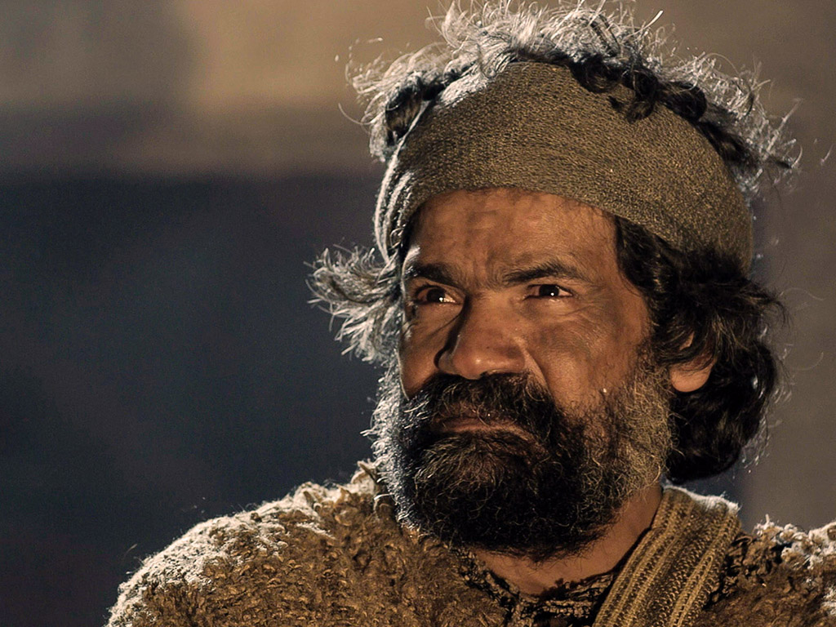
Notes:
Mk 14:71–72
⁷¹ He began to call down curses on himself, and he swore to them, “I don’t know this man you’re talking about.”
⁷² Immediately the rooster crowed the second time.ª
ª Some early manuscripts do not have the second time
Mark E. Moore, The Chronological Life of Christ (Joplin, MO: College Press Publishing Company, 2011), 616.

Slide 73
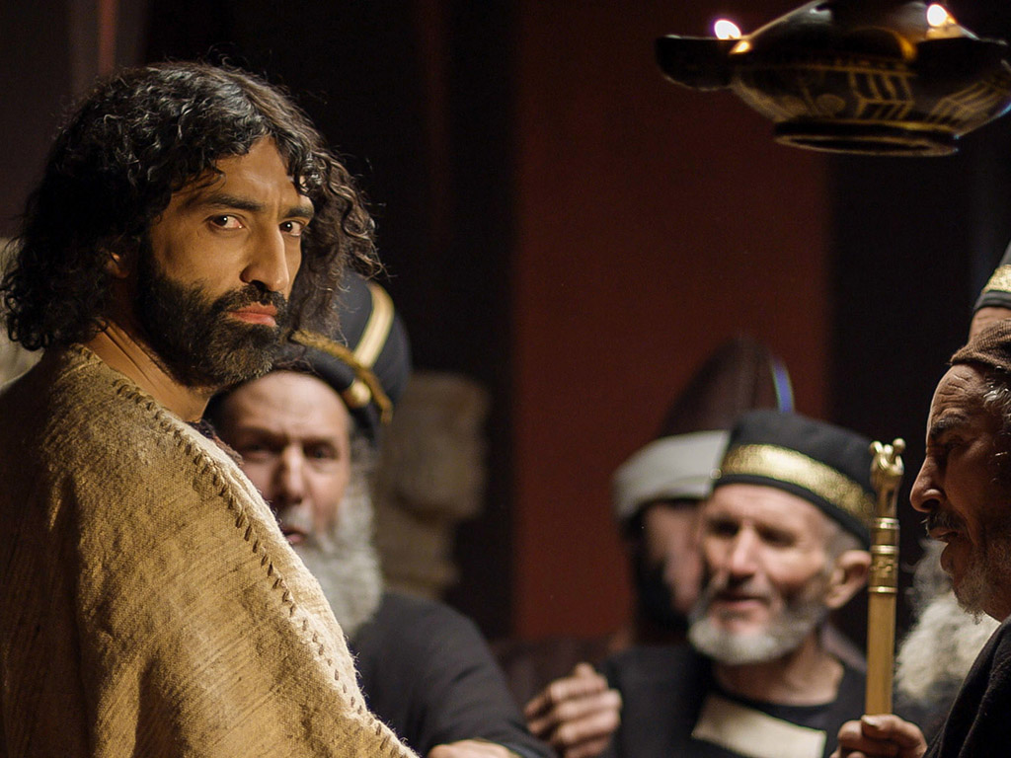
Notes:
Lk 22:61–62 with Mk 14:72
⁶¹ The Lord turned and looked straight at Peter. Then Peter remembered the word the Lord had spoken to him: “Before the rooster crows today {twice^{b}, ^{MK}} you will disown me three times.” ⁶² And he went outside, {broke down^{MK}} and wept bitterly.
^{b} Some early manuscripts do not have twice
— Mark E. Moore, The Chronological Life of Christ (Joplin, MO: College Press Publishing Company, 2011), 617.
————————
Things are now looking rather desperate. His cover is blown. This calls for drastic measures. Peter calls down curses on himself [anathematizō]!¹⁹ Essentially he swears on the penalty of hell that he doesn’t know Jesus. But he is interrupted by a rooster … just two crows.²⁰ It snaps Peter out of his hypnotic desertion. At that moment he glances inside the room where Jesus is being tried. Their eyes lock. He sees Jesus’ swollen and bloodied face. But by the look in his eyes, Peter knows that none of those blows hurt quite so deeply as what Peter has just done to him. Then, like a cannon blast, the words of Jesus ring inside his head, “Before the rooster crows today, you will disown me three times.” He has denied his Lord! He has fallen, and is a broken man. He runs out into the darkness, breaks down and weeps bitterly.²¹ This marks the end for Peter. In a way, it is. He will never again be the same.
¹⁹ Grammatically it is also possible that Peter called down curses on Jesus. But this is a less attractive option. Basically this is a false oath to protect himself. This is specifically prohibited by the rabbis (m. Shabuot 8.6).
²⁰ Mark 14:72 says this was the second time the rooster crowed. It seems strange that Peter would not have remembered Jesus’ words after the first crowing of the rooster and abandon ship before it was too late. This oddity has led to some interesting explanations of this passage. For example, J.W. Wenham argues that each mention of the second crowing is an interpolation into the text and should be removed (“How Many Cock-Crowings? The Problem of Harmonistic Text-Variants,” NTS 25 [1978–79]: 523–525). J.D.M. Derrett, on the other hand, looks for a cultural explanation. He suggests that the Jews believed that evil spirits stayed out at night until the third cock-crowing. Since Peter’s third denial (full and final according to Deut 17:6; 19:15) took place between the first and second cock-crow, the demons have not yet fully left the scene. In other words, the gospel presentation of Peter’s denial would suggest demonic involvement to the Jewish mind (cf. “The Reason for the Cock-crowings,” NTS 29 [1983]: 142–144).
²¹ The meaning of Mark’s phrase [epibalon eklaien] is unclear. Wessel (p. 772) offers several possible translations: “He began to cry,” “He burst into tears,” “He thought on it and wept,” “He covered his head and wept,” “He threw himself on the ground,” “He dashed out.” Perhaps the NIV’s “broke down” leaves as much leeway for the English reader as did the original Greek phrase.
— Mark E. Moore, The Chronological Life of Christ (Joplin, MO: College Press Publishing Company, 2011), 617–618.

Slide 74
Notes:
"Lk 22:61–62 with Mk 14:72
⁶¹ The Lord turned and looked straight at Peter. Then Peter remembered the word the Lord had spoken to him: “Before the rooster crows today {twice^{b}, ^{MK}} you will disown me three times.” ⁶² And he went outside, {broke down^{MK}} and wept bitterly.
^{b} Some early manuscripts do not have twice
— Mark E. Moore, The Chronological Life of Christ (Joplin, MO: College Press Publishing Company, 2011), 617.
"Yet we must not overlook the details that are consistent through each of the four Gospels. First, the confrontation with Peter began with a slave girl. The great Apostle, the manly fisherman, fell prey to fear, intimidated by a teenybopper doorkeeper. Second, there is Jesus. While he is on trial inside, getting beat up by diabolical men, Peter, out in the courtyard, is being sifted by Satan. Both trials are going badly but for very different reasons. Third, there is the fire. Specifically it was a heap of burning charcoal. Hence, it gave little light. There were dark shadows cast across the courtyard of the high priest that night. It was quite symbolic of the spiritual condition shrouding that palace. Finally, there is the rooster, a clarion reminder that Jesus is still in control. Although his crows were a horrific sound for Peter, they echo the sovereignty of God."
— Mark E. Moore, The Chronological Life of Christ (Joplin, MO: College Press Publishing Company, 2011), 614–615.

Slide 75

Pictures courtesy of Big Book Media
© All Rights Reserved.
Used with permission
BIG BOOK MEDIA

Slide 76
THE WORD IN PICTURES
Free
Bible
images

Slide 77
4. Condemnation by the Sanhedrin
§ 172
Matthew 27:1; Mark 15:1a; Luke 22:66-71
The Sanhedrin illegally decrees Jesus must die for blasphemy before dawn to ratify their illegal partial court trial at Caiaphas’s home
Notes:
"§ 157 Phase #3: The Sanhedrin (Mt 27:1; Mk 15:1a; Lk 22:66–71)
Luke is the only Gospel to record this third phase in detail. In fact, Matthew 27:1 and Mark 15:1 could easily be seen as the conclusion to phase two rather than a separate third phase. Furthermore, Luke does not record the first two phases of the trial at all. This has led some to say that phase 2 (Matthew & Mark) and phase 3 (Luke) are one and the same (compare Lk 22:67–71 & Mt 26:63–66), and that there are only five phases rather than six. While this is possible, it still appears that Jesus was led before the whole council at daybreak, probably in their official meeting place, the hall of Gazith.²² They wanted to try and make this whole messy business look as proper as possible before they led Jesus to Pilate."
²² Luke hints at this by placing Jesus’ beating before being led to the Sanhedrin (Lk 22:63–65). From the other Gospels we realize that the beating was part of phase #2 and the Sanhedrin verdict was part of phase three.
— Mark E. Moore, The Chronological Life of Christ (Joplin, MO: College Press Publishing Company, 2011), 618.

Slide 78
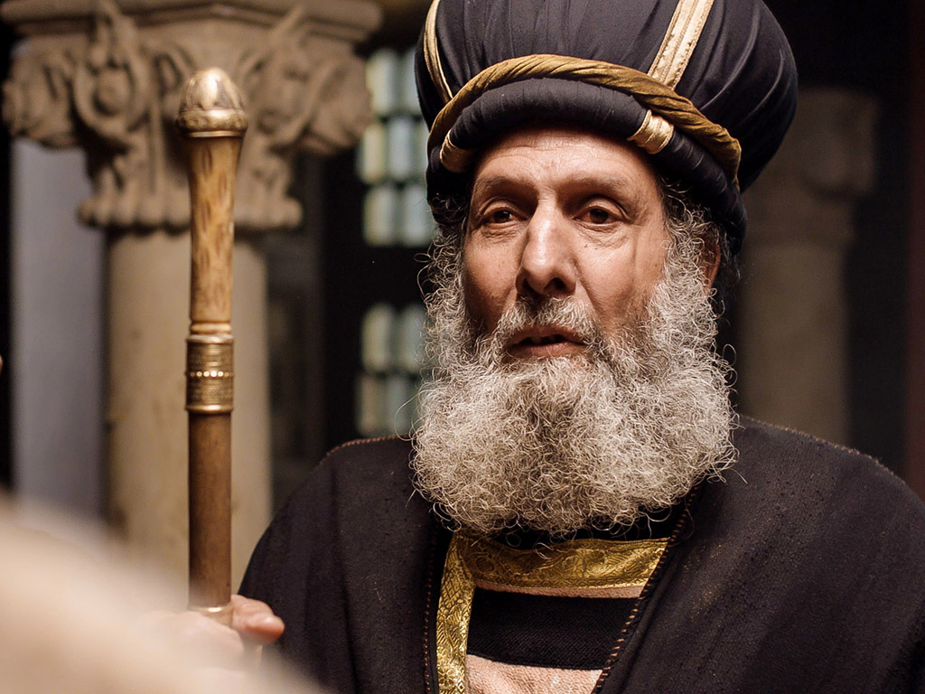
Free
Bible
images
Matthew 26:57-67
Mark 14:53-65
Luke 22:66-71
John 18:15-27
THE EASTER STORY
JESUS BEFORE
THE SANHEDRIN
Notes:
The verses here expand on verses noted on the previous slide where Matthew and Mark have but a phrase or two. This slide also adds 13 verses from John.

Slide 79
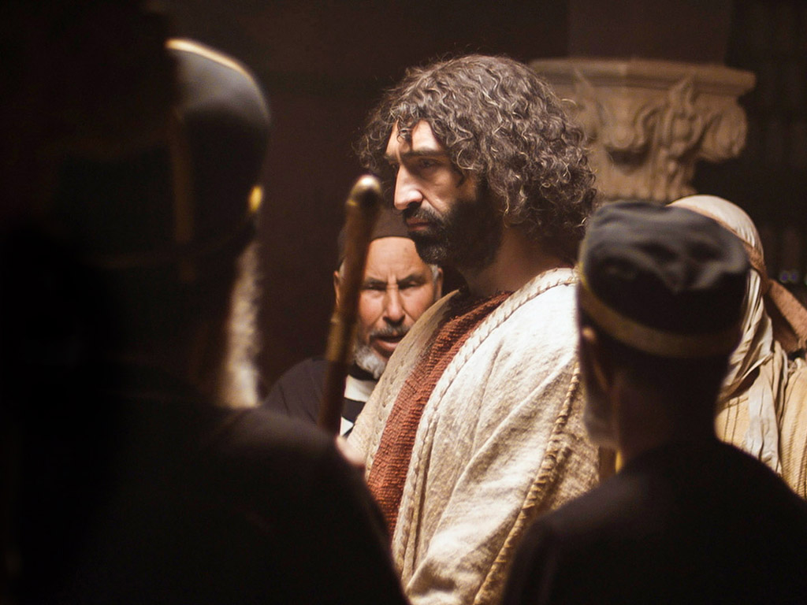
Notes:
Jesus is now before the entire Sanhedrin in this third religious trial.

Slide 80
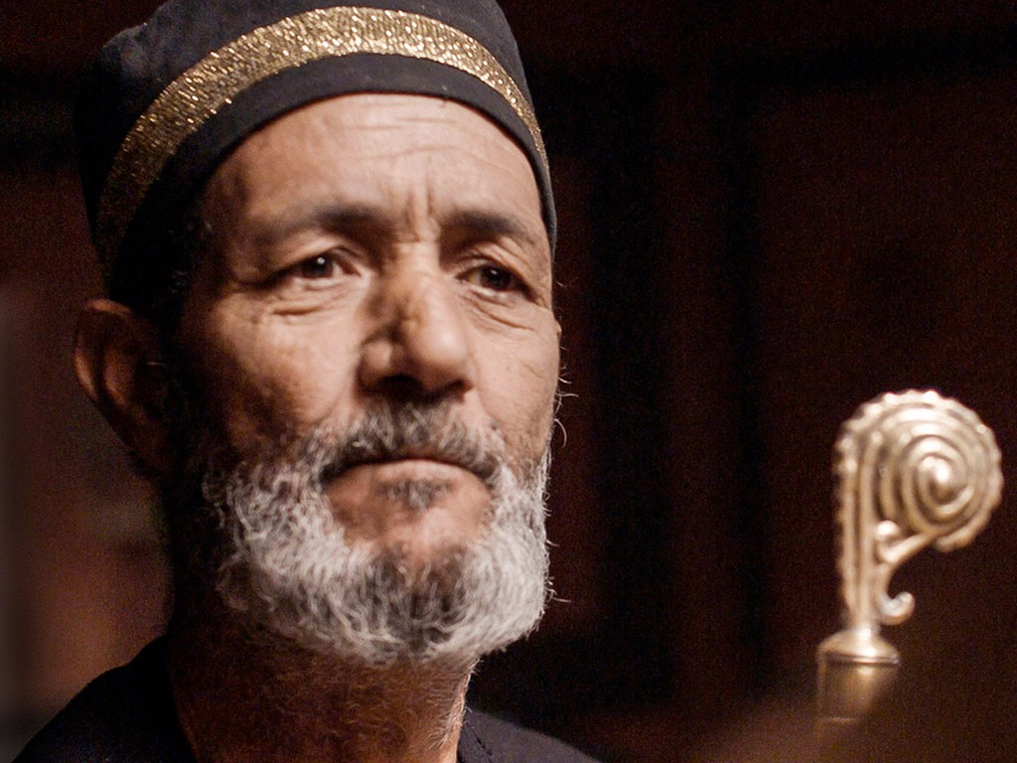
Notes:
⁶⁶ At daybreak the council of the elders of the people, both the chief priests and teachers of the law, {the whole Sanhedrin,^{MK}} met together, and Jesus was led before them. {[They] came to the decision to put Jesus to death.^{MT}} ⁶⁷ “If you are the Christ,ª” they said, “tell us.”
ª Or Messiah
— Mark E. Moore, The Chronological Life of Christ (Joplin, MO: College Press Publishing Company, 2011), 618.

Slide 81
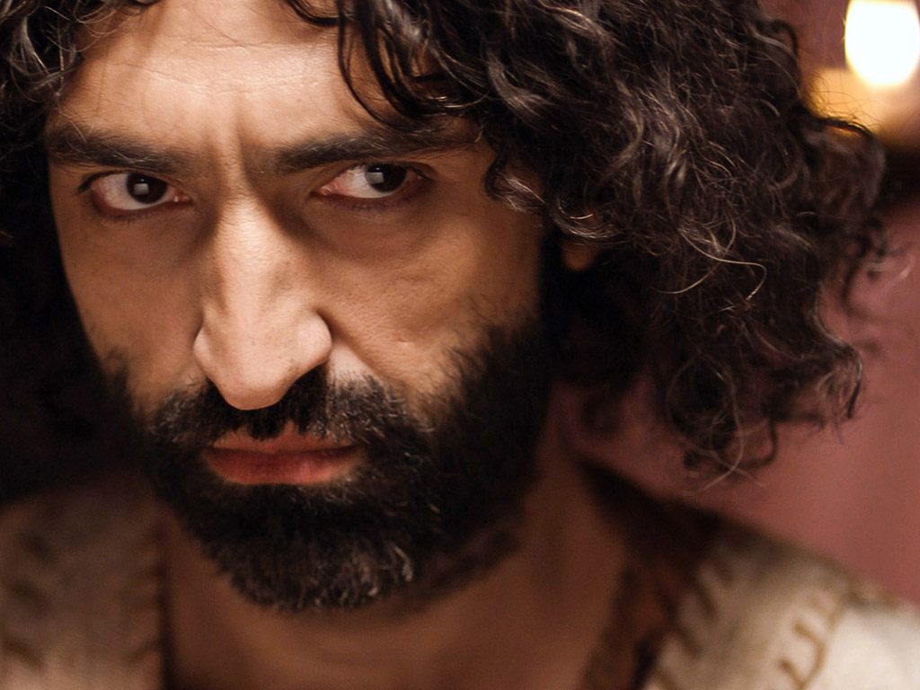
Notes:
Jesus answered, “If I tell you, you will not believe me, ⁶⁸ and if I asked you, you would not answer. ⁶⁹ But from now on, the Son of Man will be seated at the right hand of the mighty God.”
— Mark E. Moore, The Chronological Life of Christ (Joplin, MO: College Press Publishing Company, 2011), 618.

Slide 82
Notes:
⁷⁰ They all asked, “Are you then the Son of God?”
— Mark E. Moore, The Chronological Life of Christ (Joplin, MO: College Press Publishing Company, 2011), 618.

Slide 83

Notes:
He replied, “You are right in saying I am.”
— Mark E. Moore, The Chronological Life of Christ (Joplin, MO: College Press Publishing Company, 2011), 618.

Slide 84

Notes:
⁷¹ Then they said, “Why do we need any more testimony? We have heard it from his own lips.”
— Mark E. Moore, The Chronological Life of Christ (Joplin, MO: College Press Publishing Company, 2011), 618.

Slide 85

Notes:
"Unlike Caiaphas’ earlier question (Mt 26:63), the Sanhedrin asks separately if Jesus believes he is the Messiah and if he believes he is the Son of God. Instead of just coming right out and saying “Yes,” Jesus says, “You’ll see.” When the Christ comes in the clouds with all his angels, there will be no doubt that he is who he claims to be. From this point on (v. 69) Jesus’ enemies will no longer see the incarnate Christ. Any glimpse they get of him, whether in visions (Acts 9:1–5; Rev 1:12–16) or in vindication (Lk 21:27), will be of the glorified Christ. This is a bold assertion.
This leads to their second question: “Are you the Son of God?” Jesus responds boldly and clearly: “It is as you say.” Their response is predictable; we’ve already seen it in Caiaphas. They all decide to have Jesus put to death. What an irony! The Sanhedrin finally procures the evidence needed to condemn Jesus. Yet this is also the evidence needed to believe in him. By condemning Jesus to death, the Sanhedrin condemns itself to ultimate unbelief.^{25"}
²⁵ J.P. Heil, “Reader-Response and the Irony of Jesus before the Sanhedrin in Luke 22:66–71,” CBQ 51 (1989): 271–284.
— Mark E. Moore, The Chronological Life of Christ (Joplin, MO: College Press Publishing Company, 2011), 619.

Slide 86

Notes:
"Jesus must now be handed over to Pilate. The problem is that Pilate is uninterested in their accusation of blasphemy. That is not enough to get Jesus executed by the Romans. So the last bit of business for the Sanhedrin is to trump up some Roman charges that are serious enough to get Pilate’s attention. They come up with three: (1) He subverts the nation (i.e., causes riots), (2) refuses to pay taxes, and (3) claims to be a king (Lk 23:2)."
— Mark E. Moore, The Chronological Life of Christ (Joplin, MO: College Press Publishing Company, 2011), 619–620.

Slide 87
THE WORD IN PICTURES
Free
Bible
images

Slide 88
Used with Permission
THE
GOSPEL
——OF—— MATTHEW
THE
GOSPEL
——OF—— MARK
THE
GOSPEL
——OF—— LUKE
THE
GOSPEL
——OF—— JOHN
Due to the Lumo Project producing its own publishing material we regret to inform you that we cannot license our photos to other clients outside of freebibleimages.org.
These images are not licensed for reuse in video, epublishing or other media. Downloaded pictures and files cannot be redistributed through any other website than freebibleimages.org or used in any context where the accompanying message is undermining of the Christian faith and gospel.
Photos can only be used on educational presentations, blogs and social media, all of which should be accompanied with reference to www.LumoProject.com.
Picture courtesy of BBM
© All Rights Reserved.
www.bigbookmedia.com

Slide 89
5. Death of Judas
§ 173
Matthew 27:3-10
Judas's returned thirty coins and suicide give a burial plot for foreigners to fulfill Zechariah (11:12-13) and Jeremiah (18:1-4; 19:1-3)
Notes:
Matt. 27:3 When Judas, who had betrayed him, realized that Jesus had been condemned to die, he was filled with remorse. So he took the thirty pieces of silver back to the leading priests and the elders. 4 “I have sinned,” he declared, “for I have betrayed an innocent man.”
“What do we care?” they retorted. “That’s your problem.”
Matt. 27:5 Then Judas threw the silver coins down in the Temple and went out and hanged himself.
Matt. 27:6 The leading priests picked up the coins. “It wouldn’t be right to put this money in the Temple treasury,” they said, “since it was payment for murder.”ª 7 After some discussion they finally decided to buy the potter’s field, and they made it into a cemetery for foreigners. 8 That is why the field is still called the Field of Blood. 9 This fulfilled the prophecy of Jeremiah that says,
“They took the thirty pieces of silver—
the price at which he was valued by the people of Israel,
10 and purchased the potter’s field,
as the LORD directed.”
Zech. 11:12 And I said to them, “If you like, give me my wages, whatever I am worth; but only if you want to.” So they counted out for my wages thirty pieces of silver.
Zech. 11:13 And the LORD said to me, “Throw it to the potter”—this magnificent sum at which they valued me! So I took the thirty coins and threw them to the potter in the Temple of the LORD.
The Potter and the Clay
Jer. 18:1 The LORD gave another message to Jeremiah. He said, 2 “Go down to the potter’s shop, and I will speak to you there.” 3 So I did as he told me and found the potter working at his wheel. 4 But the jar he was making did not turn out as he had hoped, so he crushed it into a lump of clay again and started over.
Jeremiah’s Shattered Jar
Jer. 19:1 This is what the LORD said to me: “Go and buy a clay jar. Then ask some of the leaders of the people and of the priests to follow you. 2 Go out through the Gate of Broken Pots to the garbage dump in the valley of Ben-Hinnom and give them this message. 3 Say to them, ‘Listen to this message from the LORD, you kings of Judah and citizens of Jerusalem! This is what the LORD of Heaven’s Armies, the God of Israel, says: I will bring a terrible disaster on this place, and the ears of those who hear about it will ring!'"
________
"Mt 27:9–10
⁹ Then what was spoken by Jeremiah the prophet was fulfilled: “They took the thirty silver coins, the price set on him by the people of Israel, ¹⁰ and they used them to buy the potter’s field, as the Lord commanded me.”ª
This prophecy presents some difficulty. The words most closely resemble Zechariah 11:12–13. But Matthew attributes the prophecy to Jeremiah. Now, there are some verbal similarities to Jeremiah 32:6–16 and 18:2–3, but these passages aren’t talking about the same thing. So how are we to understand this prophetic fulfillment? A number of “solutions” have been proposed (cf. Carson, pp. 562–566). (1) Matthew made a mistake. (2) Matthew is citing the OT section which is headed by Jeremiah rather than the specific book from which the prophecy comes. (3) There is a textual variant, with weak support, which uses “Zechariah” rather than “Jeremiah.” (4) Some have gone so far as to say that Matthew followed a lost portion of Jeremiah or that Jeremiah was actually the author of Zechariah 9–11. None of these solutions, however, are satisfying.
Carson presents a more reasonable solution.²⁷ Instead of looking for verbal correspondence (word by word), we should look for correspondence of ideas (thought by thought).²⁸ Furthermore, we should analyze Matthew’s use of these ideas through typological exegesis so common in Matthew’s work. Here’s what we find. The thoughts of Matthew 27:9–10 correspond to Jeremiah 19:1–13. Here Jeremiah is ordered by the Lord to purchase a clay jar from the potter. He is to take it, along with the priests and elders, to the valley of Hinnom. There he is to smash the jar on the ground as a symbol of what God was about to do to Jerusalem because of its idolatry and disobedience. Furthermore, Matthew not only uses the ideas of Jeremiah 19:1–13 but the words of Zechariah 11:12–13. When he combines the two passages he only gives credit to the more prominent one (cf. Mk 1:2 citing Isa 40:3 & Mal 3:1). This comes as no great surprise.
Now for the meaning of the prophecy. When we take the ideas from Jeremiah 19, couched in the words from Zechariah 11, and apply them typologically in Matthew 27, we come up with something like this: The shepherds of God’s people were corrupt. In fact, they devalued God’s true shepherd to thirty pieces of silver, the price of a slave (Exod 21:32). Instead of purchasing independence, their “dirty money” purchased punishment and death. What’s worse, not only did the leaders of Israel reject God, so did the people. Instead of following the ones God sent to them (Jeremiah, Zechariah, and Jesus), they followed corrupt leaders and paid dearly for that mistake."
ª See Zech. 11:12, 13; Jer. 19:1–13; 32:6–9
²⁷ See also D.J. Moo, “Tradition and Old Testament in Matt 27:3–10,” in Gospel Perspectives, vol. 3, ed. R.T. France and D. Wenham (Sheffield: JSOT, 1983), 157–175; and J. A. Upton, “The Potter’s Field and the Death of Judas,” CJ 8 (1982): 213–219.
²⁸ Blomberg (p. 409) catalogues a number of parallel thoughts here: “Blood of the innocent” (v. 4), the “potter” (vv. 1, 11), the renaming of a place in the Valley of Hinnom (v. 6), violence (v. 11), and the judgment and burial by God of the Jewish leaders (v. 11).
— Mark E. Moore, The Chronological Life of Christ (Joplin, MO: College Press Publishing Company, 2011), 621–622.

Slide 90
The Jewish Trials of Jesus
65
TRIAL | LEADER | TEXTS | ACCUSATIONS | LEGALITY | TYPE | RESULT
1. | Annas, ex-high priest of Jews (A.D. 6-15) | John 18:13-23 | Trumped-up charges of irreverence to Annas. General questioning, nothing specific. | ILLEGAL! Held at night Prejudice No specific charges Violence | Jewish and Religious | Found "guilty” of irreverence and rushed to Caiaphas
2. | Caiaphas and Sanhedrin (Caiaphas was Annas' son-in-law) (A.D. 18-36) | Matt. 26:57-68 Mark 14:53-65 Luke 22:54, 63-65 John 18:24 | Claimed to be the Messiah, Son of God … blasphemy! | ILLEGAL! Held at night False witnesses Violence Prejudice | Jewish and Religious | Declared guilty of blasphemy and rushed to Sanhedrin (Jewish supreme court)
3. | Sanhedrin (70 Jewish rulers) whose word was needed before He could be taken to Romans | Matt. 27:1 Mark 15:1 Luke 22:66-71 | Claimed to be Son of God Charged with blasphemy! (Worthy of death under Jewish law) | ILLEGAL! Kangaroo Court Accusation switched No witnesses Improper voting | Jewish and Religious | Declared guilty of blasphemy and rushed to Roman official, Pilate
Notes:
The Six Trials of Jesus were divided into three Jewish and three Roman trials. All six were illegal.
They began with illegal religious trials before the Jewish authorities with the charge of blasphemy.
But Jews could not execute anyone under Roman law, so they needed Romans to do it.
_____________________
LC-09-Rejection-84
NS-00-NTS Chronology-44

Slide 91
The Roman Trials of Jesus
65
TRIALS | LEADERS | TEXTS | ACCUSATIONS | LEGALITY | TYPE | RESULT
4. | Pilate, governor of Judea (already in "hot water" with Rome) (A.D. 26-36) | Matt. 21:11-14 Mark 15:2-5 Luke 23:1-7 John 18:28-38 | Accused Him of treason. Changed accusation, since reason was worthy of capital punishment in Rome. | ILLEGAL! Kept under arrest, though found innocent. No defense attorney. Violence. | Roman and Civil | Found to be INNOCENT . . . but rushed to Herod Antipas. Mob overruled Pilate . . .
5. | Herod Antipas, governor of Galilee (4 B.C.-A.D. 39) | Luke 23:8-12 | No accusation made. Mock trial. Mob violence. | ILLEGAL! No grounds. Mockery in court-room. Violence. No defense attorney | Roman and Civil | Mistreated and mocked, returned to Pilate without decision made by Herod
6. | Pilate (Second time) | Matt. 27:15-26 Mark 15:6-15 Luke 23:18-25 John 18:39-19:16 | Treason (but not proven) Bargain with mob . . . put on level with Barabbas, a criminal. | ILLEGAL! Pilate, without proof of guilt, allowed innocent man to be condemned | Roman and Civil | Flogged without evidence; Found innocent but Pilate "washed hands" and allowed Him to be CRUCIFIED.
Notes:
A key problem for the Jews was that Romans did not consider blasphemy worthy of death, so the Sanhedrin deceptively changed the charge to treason.
The final three trials thus charged Jesus with treason or seeking to overthrow Roman rule.
However, even this was not proven, and each Roman trial was also illegal in various ways.
_____________________
LC-09-Rejection-85
NS-00-NTS Chronology-45

Slide 92
C. The Civil Trial
§§ 174-177
Jews could not execute Jesus, so they get the Romans to try, mock, and sentence Jesus to crucifixion for the political charge of treason
Notes:
Jews could not legally execute anyone, so the religious leaders bring Jesus before the Romans and change the religious charge of blasphemy to the political charge of treason, which, after three trials, succeeds in having Him mocked and led away for crucifixion.

Slide 93


The Roman Trials
Notes:
The trials by Romans were also illegal, just as those by the Jews.

Slide 94

Three Roman Mockeries
Illegal
Pilate
Antipas
Pilate (second time)
Illegal
Illegal
Charge:
Treason
Notes:
The Roman trials were illegal. They also charged Jesus with a claim (this time treason) but never proved their claim.

Slide 95
1. Trial Before Pilate
§ 174
Matthew 27:2, 11-14; Mark 15:1b-5; Luke 23:1-5; John 18:28-38
Pilate exonerates Jesus of ambiguous charges and tries to save Him from the cross as he deems his kingdom no threat to Rome
Notes:
Matt. 27:2 Then they bound him, led him away, and took him to Pilate, the Roman governor.
Jesus’ Trial before Pilate
Matt. 27:11 Now Jesus was standing before Pilate, the Roman governor. “Are you the king of the Jews?” the governor asked him.
Jesus replied, “You have said it.”
Matt. 27:12 But when the leading priests and the elders made their accusations against him, Jesus remained silent. ¹³ “Don’t you hear all these charges they are bringing against you?” Pilate demanded. ¹⁴ But Jesus made no response to any of the charges, much to the governor’s surprise.
Jesus’ Trial before Pilate
Mark 15:1 Very early in the morning the leading priests, the elders, and the teachers of religious law—the entire high councilª—met to discuss their next step. They bound Jesus, led him away, and took him to Pilate, the Roman governor.
Mark 15:2 Pilate asked Jesus, “Are you the king of the Jews?”
Jesus replied, “You have said it.”
Mark 15:3 Then the leading priests kept accusing him of many crimes, ⁴ and Pilate asked him, “Aren’t you going to answer them? What about all these charges they are bringing against you?” ⁵ But Jesus said nothing, much to Pilate’s surprise.
Jesus’ Trial before Pilate
Luke 23:1 Then the entire council took Jesus to Pilate, the Roman governor. ² They began to state their case: “This man has been leading our people astray by telling them not to pay their taxes to the Roman government and by claiming he is the Messiah, a king.”
Luke 23:3 So Pilate asked him, “Are you the king of the Jews?”
Jesus replied, “You have said it.”
Luke 23:4 Pilate turned to the leading priests and to the crowd and said, “I find nothing wrong with this man!”
Luke 23:5 Then they became insistent. “But he is causing riots by his teaching wherever he goes—all over Judea, from Galilee to Jerusalem!”
Jesus’ Trial before Pilate
John 18:28 Jesus’ trial before Caiaphas ended in the early hours of the morning. Then he was taken to the headquarters of the Roman governor.ª His accusers didn’t go inside because it would defile them, and they wouldn’t be allowed to celebrate the Passover. ²⁹ So Pilate, the governor, went out to them and asked, “What is your charge against this man?”
John 18:30 “We wouldn’t have handed him over to you if he weren’t a criminal!” they retorted.
John 18:31 “Then take him away and judge him by your own law,” Pilate told them.
“Only the Romans are permitted to execute someone,” the Jewish leaders replied.
³² (This fulfilled Jesus’ prediction about the way he would die.ª)
John 18:33 Then Pilate went back into his headquarters and called for Jesus to be brought to him. “Are you the king of the Jews?” he asked him.
John 18:34 Jesus replied, “Is this your own question, or did others tell you about me?”
John 18:35 “Am I a Jew?” Pilate retorted. “Your own people and their leading priests brought you to me for trial. Why? What have you done?”
John 18:36 Jesus answered, “My Kingdom is not an earthly kingdom. If it were, my followers would fight to keep me from being handed over to the Jewish leaders. But my Kingdom is not of this world.”
John 18:37 Pilate said, “So you are a king?”
Jesus responded, “You say I am a king. Actually, I was born and came into the world to testify to the truth. All who love the truth recognize that what I say is true.”
John 18:38 “What is truth?” Pilate asked. Then he went out again to the people and told them, “He is not guilty of any crime.

Slide 96
2. Trial Before Herod
§ 175
Luke 23:6-12
Pilate does not judge Jesus but sends Him to Galilee’s ruler Herod, who also declares Him innocent of treason
Notes:
Lk 23:6–12
⁶ On hearing this, Pilate asked if the man was a Galilean. ⁷ When he learned that Jesus was under Herod’s jurisdiction, he sent him to Herod, who was also in Jerusalem at that time.
⁸ When Herod saw Jesus, he was greatly pleased, because for a long time he had been wanting to see him. From what he had heard about him, he hoped to see him perform some miracle. ⁹ He plied him with many questions, but Jesus gave him no answer. ¹⁰ The chief priests and the teachers of the law were standing there, vehemently accusing him. ¹¹ Then Herod and his soldiers ridiculed and mocked him. Dressing him in an elegant robe, they sent him back to Pilate. ¹² That day Herod and Pilate became friends—before this they had been enemies.
Mark E. Moore, The Chronological Life of Christ (Joplin, MO: College Press Publishing Company, 2011), 627.

Slide 97
3. Trial Before Pilate
§ 176
Matthew 27:15-26; Mark 15:6-15; Luke 23:13-25;
John 18:39–19:1, 4-16a
Pilate exonerates Jesus of treason but approves his crucifixion instead of Barabbas due to fear of Rome and the crowd
Notes:
Pilate declares Jesus innocent of treason but releases Barabbas, flogs Jesus, seeks to absolve himself from blame, and sends him for crucifixion, fearing Rome, the crowd, and possible judgment from a deity if Jesus is indeed God.
The irony is in the name of Barabbas. Bar means "son" and "abbas" means "daddy." So, the crowd wants the "son of daddy" killed and the "Son of God" killed!
Jesus not only a substitute for a murderer, but for us.
————————
Matt. 27:15 Now it was the governor’s custom each year during the Passover celebration to release one prisoner to the crowd—anyone they wanted. ¹⁶ This year there was a notorious prisoner, a man named Barabbas.ª ¹⁷ As the crowds gathered before Pilate’s house that morning, he asked them, “Which one do you want me to release to you—Barabbas, or Jesus who is called the Messiah?” ¹⁸ (He knew very well that the religious leaders had arrested Jesus out of envy.)
Matt. 27:19 Just then, as Pilate was sitting on the judgment seat, his wife sent him this message: “Leave that innocent man alone. I suffered through a terrible nightmare about him last night.”
Matt. 27:20 Meanwhile, the leading priests and the elders persuaded the crowd to ask for Barabbas to be released and for Jesus to be put to death. ²¹ So the governor asked again, “Which of these two do you want me to release to you?”
The crowd shouted back, “Barabbas!”
Matt. 27:22 Pilate responded, “Then what should I do with Jesus who is called the Messiah?”
They shouted back, “Crucify him!”
Matt. 27:23 “Why?” Pilate demanded. “What crime has he committed?”
But the mob roared even louder, “Crucify him!”
Matt. 27:24 Pilate saw that he wasn’t getting anywhere and that a riot was developing. So he sent for a bowl of water and washed his hands before the crowd, saying, “I am innocent of this man’s blood. The responsibility is yours!”
Matt. 27:25 And all the people yelled back, “We will take responsibility for his death—we and our children!”ª
Matt. 27:26 So Pilate released Barabbas to them. He ordered Jesus flogged with a lead-tipped whip, then turned him over to the Roman soldiers to be crucified.
Mark 15:6 Now it was the governor’s custom each year during the Passover celebration to release one prisoner—anyone the people requested. ⁷ One of the prisoners at that time was Barabbas, a revolutionary who had committed murder in an uprising. ⁸ The crowd went to Pilate and asked him to release a prisoner as usual.
Mark 15:9 “Would you like me to release to you this ‘King of the Jews’?” Pilate asked. ¹⁰ (For he realized by now that the leading priests had arrested Jesus out of envy.) ¹¹ But at this point the leading priests stirred up the crowd to demand the release of Barabbas instead of Jesus. ¹² Pilate asked them, “Then what should I do with this man you call the king of the Jews?”
Mark 15:13 They shouted back, “Crucify him!”
Mark 15:14 “Why?” Pilate demanded. “What crime has he committed?”
But the mob roared even louder, “Crucify him!”
Mark 15:15 So to pacify the crowd, Pilate released Barabbas to them. He ordered Jesus flogged with a lead-tipped whip, then turned him over to the Roman soldiers to be crucified.
Luke 23:13 Then Pilate called together the leading priests and other religious leaders, along with the people, ¹⁴ and he announced his verdict. “You brought this man to me, accusing him of leading a revolt. I have examined him thoroughly on this point in your presence and find him innocent. ¹⁵ Herod came to the same conclusion and sent him back to us. Nothing this man has done calls for the death penalty. ¹⁶ So I will have him flogged, and then I will release him.”ª
Luke 23:18 Then a mighty roar rose from the crowd, and with one voice they shouted, “Kill him, and release Barabbas to us!” ¹⁹ (Barabbas was in prison for taking part in an insurrection in Jerusalem against the government, and for murder.) ²⁰ Pilate argued with them, because he wanted to release Jesus. ²¹ But they kept shouting, “Crucify him! Crucify him!”
Luke 23:22 For the third time he demanded, “Why? What crime has he committed? I have found no reason to sentence him to death. So I will have him flogged, and then I will release him.”
Luke 23:23 But the mob shouted louder and louder, demanding that Jesus be crucified, and their voices prevailed. ²⁴ So Pilate sentenced Jesus to die as they demanded. ²⁵ As they had requested, he released Barabbas, the man in prison for insurrection and murder. But he turned Jesus over to them to do as they wished.
John 18:39 But you have a custom of asking me to release one prisoner each year at Passover. Would you like me to release this ‘King of the Jews’?”
John 18:40 But they shouted back, “No! Not this man. We want Barabbas!” (Barabbas was a revolutionary.)
Jesus Sentenced to Death
John 19:1 Then Pilate had Jesus flogged with a lead-tipped whip.
John 19:4 Pilate went outside again and said to the people, “I am going to bring him out to you now, but understand clearly that I find him not guilty.” ⁵ Then Jesus came out wearing the crown of thorns and the purple robe. And Pilate said, “Look, here is the man!”
John 19:6 When they saw him, the leading priests and Temple guards began shouting, “Crucify him! Crucify him!”
“Take him yourselves and crucify him,” Pilate said. “I find him not guilty.”
John 19:7 The Jewish leaders replied, “By our law he ought to die because he called himself the Son of God.”
John 19:8 When Pilate heard this, he was more frightened than ever. ⁹ He took Jesus back into the headquarters again and asked him, “Where are you from?” But Jesus gave no answer. ¹⁰ “Why don’t you talk to me?” Pilate demanded. “Don’t you realize that I have the power to release you or crucify you?”
John 19:11 Then Jesus said, “You would have no power over me at all unless it were given to you from above. So the one who handed me over to you has the greater sin.”
John 19:12 Then Pilate tried to release him, but the Jewish leaders shouted, “If you release this man, you are no ‘friend of Caesar.’ Anyone who declares himself a king is a rebel against Caesar.”
John 19:13 When they said this, Pilate brought Jesus out to them again. Then Pilate sat down on the judgment seat on the platform that is called the Stone Pavement (in Hebrew, Gabbatha). ¹⁴ It was now about noon on the day of preparation for the Passover. And Pilate said to the people,ª “Look, here is your king!”
John 19:15 “Away with him,” they yelled. “Away with him! Crucify him!”
“What? Crucify your king?” Pilate asked.
“We have no king but Caesar,” the leading priests shouted back.
The Crucifixion
John 19:16 Then Pilate turned Jesus over to them to be crucified.
So they took Jesus away.

Slide 98
4. Mockery
§ 177
Matthew 27:27-30; Mark 15:16-19; John 19:2-3
Roman soldiers mock Jesus as a king and repeatedly beat and spit on Him before leading Him to crucifixion
Notes:
The Soldiers Mock Jesus
Matt. 27:27 Some of the governor’s soldiers took Jesus into their headquartersª and called out the entire regiment. ²⁸ They stripped him and put a scarlet robe on him. ²⁹ They wove thorn branches into a crown and put it on his head, and they placed a reed stick in his right hand as a scepter. Then they knelt before him in mockery and taunted, “Hail! King of the Jews!” ³⁰ And they spit on him and grabbed the stick and struck him on the head with it.
The Soldiers Mock Jesus
Mark 15:16 The soldiers took Jesus into the courtyard of the governor’s headquarters (called the Praetorium) and called out the entire regiment. ¹⁷ They dressed him in a purple robe, and they wove thorn branches into a crown and put it on his head. ¹⁸ Then they saluted him and taunted, “Hail! King of the Jews!” ¹⁹ And they struck him on the head with a reed stick, spit on him, and dropped to their knees in mock worship.
John 19:2 The soldiers wove a crown of thorns and put it on his head, and they put a purple robe on him. ³ “Hail! King of the Jews!” they mocked, as they slapped him across the face.

Slide 99
Jesus’ Seven Last Tortures
Sleepless Night
Fists
Scourging
Thorn Crown
Wooden Cross
Nails
Spear

Slide 100

Sleepless night

Slide 101

Jesus was Beaten By Guards

Slide 102

Scourging
Notes:
Many died of the scourging alone!

Slide 103

Crown of Thorns
Notes:
They mocked him as Lord. They will do it in reality in the future:
Phil 2:10 that at the name of Jesus every knee should bow,
in heaven and on earth and under the earth,
11 and every tongue declare that Jesus Christ is Lord,
to the glory of God the Father.

Slide 104

Free
Bible
images
Matthew 27:27-37
Mark 15:16-25
Luke 23:26-34
John 19:16-27
THE EASTER STORY
JESUS IS CRUCIFIED

Slide 105


Slide 106

Notes:
"Flogging was such a horrible punishment that it was illegal to flog Roman citizens without a direct edict from the Caesar. The victim was tied to a post or hung from a wall. Either method drew the muscles taut across the victim’s back. The soldier would then use a flagellum, also called a “cat of nine tails.”⁴⁰ It was a short wooden stick with (often) nine thong strands attached to it. At the end of each strand was tied something sharp (e.g., bone, metal, glass), or metal balls. The purpose was not to lash out quickly so as to inflict welts. Rather, the soldier would attempt to rake the victim’s back with the sharp objects, literally shredding the muscles of the back, buttocks and legs. The Jews limited the lashes to thirty-nine. The Romans, however, were hindered only by their animosity and endurance. So much muscle was left shredded and hanging that the victim’s vertebrae were exposed and sometimes even his intestines. Often the “tails” would whip around the victim’s face, gouging out his eyes. It is not surprising then, that flogging alone was lethal about six out of ten times. Those that survived were usually carried out on a stretcher with permanent mutilation."
⁴⁰ For a physiological description of flogging see W.D. Edwards, W.J. Gabel, & F.E. Hosmer, “On the Physical Death of Jesus Christ,” JAMA 255/11 (1986): 1455–1463.
—Mark E. Moore, The Chronological Life of Christ (Joplin, MO: College Press Publishing Company, 2011), 631–632.

Slide 107


Slide 108


Slide 109


Slide 110


Slide 111
THE WORD IN PICTURES
Free
Bible
images

Slide 112
Used with Permission
THE
GOSPEL
——OF—— MATTHEW
THE
GOSPEL
——OF—— MARK
THE
GOSPEL
——OF—— LUKE
THE
GOSPEL
——OF—— JOHN
Due to the Lumo Project producing its own publishing material we regret to inform you that we cannot license our photos to other clients outside of freebibleimages.org.
These images are not licensed for reuse in video, epublishing or other media. Downloaded pictures and files cannot be redistributed through any other website than freebibleimages.org or used in any context where the accompanying message is undermining of the Christian faith and gospel.
Photos can only be used on educational presentations, blogs and social media, all of which should be accompanied with reference to www.LumoProject.com.
Picture courtesy of BBM
© All Rights Reserved.
www.bigbookmedia.com

Slide 113
D. Procession to Calvary
§ 178
Matthew 27:31-34; Mark 15:20-23; Luke 23:26-33;
John 19:16b-17
Christ’s inability to carry His cross to Calvary forces it upon Simon of Cyrene due to the guards severely beating Jesus

Slide 114

Today: Jesus' death paid for our sin (19:16b-42)
Notes:
Today, in John 19:16b-42, we finish the passion account, which shows how Christ voluntarily gave his life for us.

Slide 115

Two Movements
Death
Burial
Notes:
Today we’ll see true love in two movements—Christ’s death and burial—that they support the concept of his atonement.
The first evidence that Jesus genuinely took our sin upon him was that…

Slide 116

I. Christ fulfilled Scripture in his selfless death (John 19:16b-37).
Selflessness
Fulfillments
Carried cross
Notes:
Jesus paid for our sin by dying to fulfill prophecy and with utmost care for others.
• Jesus showed selflessness by carrying his own cross (19:16b-17).
The typical criminal had to do this—even those crucified on either side of Christ.

Slide 117

Carrying His Own Cross
Notes:
Jesus didn’t have to carry his own cross. Matt. 26:53 says he had the power to get out of arrest when he could have called 72,000 angels! That’s 12 legions of angels to defend Him. A Roman legion numbered about 6,000 soldiers.
——————
"Like most victims of crucifixion, Jesus is forced to carry the patibulum, the horizontal beam of the cross (perhaps reminiscent of Gen 22:6). Estimates vary, but it weighed a minimum of about seventy-five pounds. A raw beam of this size would cause excruciating pain on Jesus’ open wounds, especially as he staggers and gets jostled along the Via Dolorosa (“the Way of Suffering”). We are not surprised that Jesus falls beneath its weight, unable to carry it all the way to Golgotha. Simon, from Cyrene, on the North Shore of Africa, is coming into the city while the procession makes its way to the site of the execution. He is pressed into service, forced to carry Jesus’ cross."
—Mark E. Moore, The Chronological Life of Christ (Joplin, MO: College Press Publishing Company, 2011), 636.

Slide 118

Wooden Cross
Notes:
The movie The Passion of Christ shows him carrying the entire cross.

Slide 119


Slide 120

Notes:
Two "robbers" also sentenced to death also carried their crosses.
———————–
"Jesus isn’t alone as he walks the Via Dolorosa. Two other criminals are executed alongside him. The crime they are charged with is “robbery,” hardly a crime worthy of capital punishment, especially the extreme execution of crucifixion. However, Barabbas is also called a robber [lēstēs], which is understood to mean “an insurrectionist.” Therefore, we see these men as Jewish rebels against Rome. Furthermore, it is possible that they are partners of Barabbas and scheduled already, along with Barabbas, to die this day. Now they find their leader free and this famed peasant standing in his place. They are probably unaware, however, that this has been ordained for centuries (Isa 53:12). It is part of Jesus’ shame to be numbered with transgressors."
—Mark E. Moore, The Chronological Life of Christ (Joplin, MO: College Press Publishing Company, 2011), 638.

Slide 121


Slide 122


Slide 123


Slide 124

Notes:
"Like most victims of crucifixion, Jesus is forced to carry the patibulum, the horizontal beam of the cross (perhaps reminiscent of Gen 22:6). Estimates vary, but it weighed a minimum of about seventy-five pounds. A raw beam of this size would cause excruciating pain on Jesus’ open wounds, especially as he staggers and gets jostled along the Via Dolorosa (“the Way of Suffering”). We are not surprised that Jesus falls beneath its weight, unable to carry it all the way to Golgotha. Simon, from Cyrene, on the North Shore of Africa, is coming into the city while the procession makes its way to the site of the execution. He is pressed into service, forced to carry Jesus’ cross."
—Mark E. Moore, The Chronological Life of Christ (Joplin, MO: College Press Publishing Company, 2011), 636.

Slide 125


Slide 126


Slide 127

Notes:
The international nature of his death is seen in the trilingual sign.
——————————
"The centurion in charge of the execution marches ahead of the victim. An “assistant” marches next to him, carrying a placard which states the crimes of the victim (called a titulus).⁴⁸ Jesus’ sign, which would later be nailed to the cross above his head, simply reads, “This is Jesus of Nazareth, King of the Jews”; no charge, no crime, simply a statement of fact."
⁴⁸ V. Tzaferis, “Crucifixion—The Archaeological Evidence,” BAR 11 (1985): 44–53.
—Mark E. Moore, The Chronological Life of Christ (Joplin, MO: College Press Publishing Company, 2011), 636–637.

Slide 128
E. The Crucifixion
§§ 179-181
Christ is crucified for the sins of the world with signs at His death to show that the people had executed their own Messiah

Slide 129

Free
Bible
images
Matthew 27:38-66
Mark 15:25-47
Luke 23:35-56
John 19:28-42
THE EASTER STORY
JESUS DIES ON THE CROSS
Notes:
NLT Text:
Matt. 27:38 Two revolutionaries were crucified with him, one on his right and one on his left.
Matt. 27:39 The people passing by shouted abuse, shaking their heads in mockery. ⁴⁰ “Look at you now!” they yelled at him. “You said you were going to destroy the Temple and rebuild it in three days. Well then, if you are the Son of God, save yourself and come down from the cross!”
Matt. 27:41 The leading priests, the teachers of religious law, and the elders also mocked Jesus. ⁴² “He saved others,” they scoffed, “but he can’t save himself! So he is the King of Israel, is he? Let him come down from the cross right now, and we will believe in him! ⁴³ He trusted God, so let God rescue him now if he wants him! For he said, ‘I am the Son of God.’” ⁴⁴ Even the revolutionaries who were crucified with him ridiculed him in the same way.
The Death of Jesus
Matt. 27:45 At noon, darkness fell across the whole land until three o’clock. ⁴⁶ At about three o’clock, Jesus called out with a loud voice, “Eli, Eli, lema sabachthani?” which means “My God, my God, why have you abandoned me?”^{b}
Matt. 27:47 Some of the bystanders misunderstood and thought he was calling for the prophet Elijah. ⁴⁸ One of them ran and filled a sponge with sour wine, holding it up to him on a reed stick so he could drink. ⁴⁹ But the rest said, “Wait! Let’s see whether Elijah comes to save him.”
Matt. 27:50 Then Jesus shouted out again, and he released his spirit. ⁵¹ At that moment the curtain in the sanctuary of the Temple was torn in two, from top to bottom. The earth shook, rocks split apart, ⁵² and tombs opened. The bodies of many godly men and women who had died were raised from the dead. ⁵³ They left the cemetery after Jesus’ resurrection, went into the holy city of Jerusalem, and appeared to many people.
Matt. 27:54 The Roman officerª and the other soldiers at the crucifixion were terrified by the earthquake and all that had happened. They said, “This man truly was the Son of God!”
Matt. 27:55 And many women who had come from Galilee with Jesus to care for him were watching from a distance. ⁵⁶ Among them were Mary Magdalene, Mary (the mother of James and Joseph), and the mother of James and John, the sons of Zebedee.
The Burial of Jesus
Matt. 27:57 As evening approached, Joseph, a rich man from Arimathea who had become a follower of Jesus, ⁵⁸ went to Pilate and asked for Jesus’ body. And Pilate issued an order to release it to him. ⁵⁹ Joseph took the body and wrapped it in a long sheet of clean linen cloth. ⁶⁰ He placed it in his own new tomb, which had been carved out of the rock. Then he rolled a great stone across the entrance and left. ⁶¹ Both Mary Magdalene and the other Mary were sitting across from the tomb and watching.
The Guard at the Tomb
Matt. 27:62 The next day, on the Sabbath,ª the leading priests and Pharisees went to see Pilate. ⁶³ They told him, “Sir, we remember what that deceiver once said while he was still alive: ‘After three days I will rise from the dead.’ ⁶⁴ So we request that you seal the tomb until the third day. This will prevent his disciples from coming and stealing his body and then telling everyone he was raised from the dead! If that happens, we’ll be worse off than we were at first.”
Matt. 27:65 Pilate replied, “Take guards and secure it the best you can.” ⁶⁶ So they sealed the tomb and posted guards to protect it.
Mark 15:25 It was nine o’clock in the morning when they crucified him. ²⁶ A sign announced the charge against him. It read, “The King of the Jews.” ²⁷ Two revolutionariesª were crucified with him, one on his right and one on his left.^{b}
Mark 15:29 The people passing by shouted abuse, shaking their heads in mockery. “Ha! Look at you now!” they yelled at him. “You said you were going to destroy the Temple and rebuild it in three days. ³⁰ Well then, save yourself and come down from the cross!”
Mark 15:31 The leading priests and teachers of religious law also mocked Jesus. “He saved others,” they scoffed, “but he can’t save himself! ³²Let this Messiah, this King of Israel, come down from the cross so we can see it and believe him!” Even the men who were crucified with Jesus ridiculed him.
The Death of Jesus
Mark 15:33 At noon, darkness fell across the whole land until three o’clock. ³⁴ Then at three o’clock Jesus called out with a loud voice, “Eloi, Eloi, lema sabachthani?” which means “My God, my God, why have you abandoned me?”ª
Mark 15:35 Some of the bystanders misunderstood and thought he was calling for the prophet Elijah. ³⁶ One of them ran and filled a sponge with sour wine, holding it up to him on a reed stick so he could drink. “Wait!” he said. “Let’s see whether Elijah comes to take him down!”
Mark 15:37 Then Jesus uttered another loud cry and breathed his last. ³⁸ And the curtain in the sanctuary of the Temple was torn in two, from top to bottom.
Mark 15:39 When the Roman officerª who stood facing him^{b} saw how he had died, he exclaimed, “This man truly was the Son of God!”
Mark 15:40 Some women were there, watching from a distance, including Mary Magdalene, Mary (the mother of James the younger and of Josephª), and Salome. ⁴¹ They had been followers of Jesus and had cared for him while he was in Galilee. Many other women who had come with him to Jerusalem were also there.
The Burial of Jesus
Mark 15:42 This all happened on Friday, the day of preparation,ª the day before the Sabbath. As evening approached, ⁴³ Joseph of Arimathea took a risk and went to Pilate and asked for Jesus’ body. (Joseph was an honored member of the high council, and he was waiting for the Kingdom of God to come.) ⁴⁴ Pilate couldn’t believe that Jesus was already dead, so he called for the Roman officer and asked if he had died yet. ⁴⁵ The officer confirmed that Jesus was dead, so Pilate told Joseph he could have the body. ⁴⁶ Joseph bought a long sheet of linen cloth. Then he took Jesus’ body down from the cross, wrapped it in the cloth, and laid it in a tomb that had been carved out of the rock. Then he rolled a stone in front of the entrance. ⁴⁷ Mary Magdalene and Mary the mother of Joseph saw where Jesus’ body was laid.
Luke 23:35 The crowd watched and the leaders scoffed. “He saved others,” they said, “let him save himself if he is really God’s Messiah, the Chosen One.” ³⁶ The soldiers mocked him, too, by offering him a drink of sour wine. ³⁷ They called out to him, “If you are the King of the Jews, save yourself!” ³⁸ A sign was fastened above him with these words: “This is the King of the Jews.”
Luke 23:39 One of the criminals hanging beside him scoffed, “So you’re the Messiah, are you? Prove it by saving yourself—and us, too, while you’re at it!”
Luke 23:40 But the other criminal protested, “Don’t you fear God even when you have been sentenced to die? ⁴¹ We deserve to die for our crimes, but this man hasn’t done anything wrong.” ⁴² Then he said, “Jesus, remember me when you come into your Kingdom.”
Luke 23:43 And Jesus replied, “I assure you, today you will be with me in paradise.”
The Death of Jesus
Luke 23:44 By this time it was about noon, and darkness fell across the whole land until three o’clock. ⁴⁵ The light from the sun was gone. And suddenly, the curtain in the sanctuary of the Temple was torn down the middle. ⁴⁶ Then Jesus shouted, “Father, I entrust my spirit into your hands!”ª And with those words he breathed his last.
Luke 23:47 When the Roman officerª overseeing the execution saw what had happened, he worshiped God and said, “Surely this man was innocent.^{b}” ⁴⁸ And when all the crowd that came to see the crucifixion saw what had happened, they went home in deep sorrow.ª ⁴⁹ But Jesus’ friends, including the women who had followed him from Galilee, stood at a distance watching.
The Burial of Jesus
Luke 23:50 Now there was a good and righteous man named Joseph. He was a member of the Jewish high council, ⁵¹ but he had not agreed with the decision and actions of the other religious leaders. He was from the town of Arimathea in Judea, and he was waiting for the Kingdom of God to come. ⁵² He went to Pilate and asked for Jesus’ body. ⁵³ Then he took the body down from the cross and wrapped it in a long sheet of linen cloth and laid it in a new tomb that had been carved out of rock. ⁵⁴ This was done late on Friday afternoon, the day of preparation,ª as the Sabbath was about to begin.
Luke 23:55 As his body was taken away, the women from Galilee followed and saw the tomb where his body was placed. ⁵⁶ Then they went home and prepared spices and ointments to anoint his body. But by the time they were finished the Sabbath had begun, so they rested as required by the law.
The Death of Jesus
John 19:28 Jesus knew that his mission was now finished, and to fulfill Scripture he said, “I am thirsty.”ª ²⁹ A jar of sour wine was sitting there, so they soaked a sponge in it, put it on a hyssop branch, and held it up to his lips. ³⁰ When Jesus had tasted it, he said, “It is finished!” Then he bowed his head and gave up his spirit.
John 19:31 It was the day of preparation, and the Jewish leaders didn’t want the bodies hanging there the next day, which was the Sabbath (and a very special Sabbath, because it was the Passover). So they asked Pilate to hasten their deaths by ordering that their legs be broken. Then their bodies could be taken down. ³² So the soldiers came and broke the legs of the two men crucified with Jesus. ³³ But when they came to Jesus, they saw that he was already dead, so they didn’t break his legs. ³⁴ One of the soldiers, however, pierced his side with a spear, and immediately blood and water flowed out. ³⁵ (This report is from an eyewitness giving an accurate account. He speaks the truth so that you also may continue to believe.ª) ³⁶ These things happened in fulfillment of the Scriptures that say, “Not one of his bones will be broken,”ª ³⁷ and “They will look on the one they pierced.”ª
The Burial of Jesus
John 19:38 Afterward Joseph of Arimathea, who had been a secret disciple of Jesus (because he feared the Jewish leaders), asked Pilate for permission to take down Jesus’ body. When Pilate gave permission, Joseph came and took the body away. ³⁹ With him came Nicodemus, the man who had come to Jesus at night. He brought about seventy-five poundsª of perfumed ointment made from myrrh and aloes. ⁴⁰ Following Jewish burial custom, they wrapped Jesus’ body with the spices in long sheets of linen cloth. ⁴¹ The place of crucifixion was near a garden, where there was a new tomb, never used before. ⁴² And so, because it was the day of preparation for the Jewish Passoverª and since the tomb was close at hand, they laid Jesus there.

Slide 130

Notes:
Ps 22:18 They divide my garments… and throw dice for my clothing.

Slide 131

Notes:
Matt. 27:55 And many women who had come from Galilee with Jesus to care for him were watching from a distance. ⁵⁶ Among them were Mary Magdalene, Mary (the mother of James and Joseph), and the mother of James and John, the sons of Zebedee.

Slide 132

Notes:
Jesus spoke seven times while on the cross. (See near slide 175.)
He first asked God to forgive his tormenters for their ignorance.
Later is his fourth statement of feeling abandoned by God…
Matt. 27:45 At noon, darkness fell across the whole land until three o’clock. ⁴⁶ At about three o’clock, Jesus called out with a loud voice, “Eli, Eli, lema sabachthani?” which means “My God, my God, why have you abandoned me?”

Slide 133

Notes:
Matt. 27:47 Some of the bystanders misunderstood and thought he was calling for the prophet Elijah. ⁴⁸ One of them ran and filled a sponge with sour wine, holding it up to him on a reed stick so he could drink. ⁴⁹ But the rest said, “Wait! Let’s see whether Elijah comes to save him.”

Slide 134
Notes:
Matt. 27:38 Two revolutionaries were crucified with him, one on his right and one on his left.
The men on both sides of Jesus committed the same crimes of robbing others (Matt 27:38; Mark 15:27), while passersby hurled insults at him (Matt 27:39; Mark 15:29; Luke 23:35).
Mark 15:31 The leading priests and teachers of religious law also mocked Jesus. “He saved others,” they scoffed, “but he can’t save himself! ³²Let this Messiah, this King of Israel, come down from the cross so we can see it and believe him!” Even the men who were crucified with Jesus ridiculed him.

Slide 135

Notes:
Luke 23:39 One of the criminals hanging beside him scoffed, “So you’re the Messiah, are you? Prove it by saving yourself—and us, too, while you’re at it!”

Slide 136

Notes:
Luke 23:40 But the other criminal protested, “Don’t you fear God even when you have been sentenced to die? ⁴¹ We deserve to die for our crimes, but this man hasn’t done anything wrong.” ⁴² Then he said, “Jesus, remember me when you come into your Kingdom.”
Initially, BOTH men insulted Jesus:
Matt 27:44 In the same way, the robbers who were crucified with him also heaped insults on him.
Mark 15:31 The leading priests and teachers of religious law also mocked Jesus. “He saved others,” they scoffed, “but he can’t save himself! ³² Let this Messiah, this King of Israel, come down from the cross so we can see it and believe him!” Even the men who were crucified with Jesus ridiculed him.
But it appears that this second man repented of his initial mocking when he saw Jesus respond in love to the unjust treatment that he suffered.
—————
"While the first criminal speaks with impressive passion, it is his comrade on the other side who speaks with impressive reason and faith. Looking beyond Jesus, he rebukes his friend. While his first statement is a bit ambiguous, we can still determine at least three things from his comments: (1) The two of them are sinners and deserve to die. (2) Jesus is righteous and doesn’t deserve to die. (3) God’s hand is involved in the sentence they shared with Jesus—he is the key figure and the two of them are merely along for the ride. This calls for fear of God shown by respecting Jesus rather than ridiculing him."
Mark E. Moore, The Chronological Life of Christ (Joplin, MO: College Press Publishing Company, 2011), 645.

Slide 137

Notes:
Luke 23:43 And Jesus replied, “I assure you, today you will be with me in paradise.”

Slide 138



The Transfer to Paradise
"That is why the Scriptures say, 'When he ascended to the heights, he led a crowd of captives and gave gifts to his people.'
⁹Notice that it says 'he ascended.' This clearly means that Christ also descended to our lowly world. ¹⁰And the same one who descended is the one who ascended higher than all the heavens, so that he might fill the entire universe with himself."
14 & 16
NLT
HEAVEN
Eph. 4:8-10
"…today you will be with me in paradise."
"I was caught up to the third heaven…I was caught up to paradise"
Luke 23:43
2 Cor. 12:2-4
S
H
E
O
L
"Christ suffered for our sins once for all time. He never sinned, but he died for sinners to bring you safely home to God. He suffered physical death, but he was raised to life in the Spirit.
¹⁹So he went and preached to the spirits in prison— ²⁰those who disobeyed God long ago when God waited patiently while Noah was building his boat. Only eight people were saved from drowning in that terrible flood."
Bliss
HADES
1 Pet. 3:18-20
HADES
Rev. 20:14-15
Luke 16:26
Hell
Gehenna
Lake of Fire
Lake of Burning Sulfur
Second Death
"…there is a great chasm separating us. No one can cross over to you from here, and no one can cross over to us from there."
"Then death and [Hades] were thrown into the lake of fire... ¹⁵And anyone whose name was not found recorded in the Book of Life was thrown into the lake of fire."
Notes:
Before Christ's death, all the dead went to OT Sheol or the underworld of the dead—both saved and unsaved. But Jesus brought believers to Paradise after his resurrection. Also, Hades is different from Hell in that Hades is a temporary place of punishment now, while Hell is the future and eternal place of torment.
___________________
Common-472
ES-03-Reincarnation&SpiritsInPrison-45
LC-06-Preparation of the Disciples by the King-104
LC-09-Rejection-138
OB-38-Salvation-45
OP-Eccles9:1-18—slide 28
NS-08-2Cor-268
NS-10-Ephesians-270
NS-21-1Peter-235
NS-22-Rev20-22-slide 155

Slide 139

Notes:
Matt. 27:47 Some of the bystanders misunderstood and thought he was calling for the prophet Elijah.

Slide 140

Notes:
Matt 27:18 One of them ran and filled a sponge with sour wine, holding it up to him on a reed stick so he could drink. ⁴⁹ But the rest said, “Wait! Let’s see whether Elijah comes to save him.”
Mark 15:35 Some of the bystanders misunderstood and thought he was calling for the prophet Elijah. ³⁶ One of them ran and filled a sponge with sour wine, holding it up to him on a reed stick so he could drink. “Wait!” he said. “Let’s see whether Elijah comes to take him down!”
Luke 23:35 The crowd watched, and the leaders scoffed. “He saved others,” they said, “let him save himself if he is really God’s Messiah, the Chosen One.” ³⁶ The soldiers mocked him, too, by offering him a drink of sour wine.

Slide 142

Notes:
Offering wine may seem like an act of compassion, but providing liquid postponed death and prolonged the pain of crucifixion.

Slide 143

Notes:
Matt. 27:51 At that moment, the curtain in the sanctuary of the Temple was torn in two, from top to bottom. The earth shook, rocks split apart, ⁵² and tombs opened. The bodies of many godly men and women who had died were raised from the dead. ⁵³ They left the cemetery after Jesus’ resurrection, went into the holy city of Jerusalem, and appeared to many people.

Slide 144

Notes:
John 19:31 It was the day of preparation, and the Jewish leaders didn’t want the bodies hanging there the next day, which was the Sabbath (and a very special Sabbath, because it was the Passover). So they asked Pilate to hasten their deaths by ordering that their legs be broken. Then their bodies could be taken down. ³² So the soldiers came and broke the legs of the two men crucified with Jesus.

Slide 145

Notes:
John 19:33 But when they came to Jesus, they saw that he was already dead, so they didn’t break his legs.

Slide 146

Notes:
John 19:38 Afterward, Joseph of Arimathea, who had been a secret disciple of Jesus (because he feared the Jewish leaders), asked Pilate for permission to take down Jesus’ body. When Pilate gave permission, Joseph came and took the body away.

Slide 147

Notes:
John 19:39-40 ³⁹ With him came Nicodemus, the man who had come to Jesus at night. He brought about seventy-five pounds of perfumed ointment made from myrrh and aloes. ⁴⁰ Following Jewish burial custom, they wrapped Jesus’ body with the spices in long sheets of linen cloth.

Slide 148

Notes:
John 19:41 The place of crucifixion was near a garden, where there was a new tomb, never used before. ⁴² And so, because it was the day of preparation for the Jewish Passover and since the tomb was close at hand, they laid Jesus there.

Slide 149
THE WORD IN PICTURES
Free
Bible
images

Slide 150
Used with Permission
THE
GOSPEL
——OF—— MATTHEW
THE
GOSPEL
——OF—— MARK
THE
GOSPEL
——OF—— LUKE
THE
GOSPEL
——OF—— JOHN
Due to the Lumo Project producing its own publishing material we regret to inform you that we cannot license our photos to other clients outside of freebibleimages.org.
These images are not licensed for reuse in video, epublishing or other media. Downloaded pictures and files cannot be redistributed through any other website than freebibleimages.org or used in any context where the accompanying message is undermining of the Christian faith and gospel.
Photos can only be used on educational presentations, blogs and social media, all of which should be accompanied with reference to www.LumoProject.com.
Picture courtesy of BBM
© All Rights Reserved.
www.bigbookmedia.com

Slide 151

Nailed
Notes:
"The cross is now lifted to display its spectacle. The victims hang helplessly, welcoming death to deliver them from this agony. Dr. Pierre Barbet popularized the idea that victims of crucifixion died of asphixiation.⁵⁷ His conclusions were drawn from World War II prisoners in Austro-Germany who were strung up by their hands. From this position, the victim is unable to exhale. Carbon dioxide builds up in the lungs. The blood becomes thick and sluggish. This sends the contorted muscles into severe cramps and intermittent convulsions. Eventually the pericardium fills with serum resulting in intense pressure on the heart and lungs causing deep chest pains for the victim. Finally, when all strength is gone, the victim can’t exhale the carbon dioxide in his lungs and he dies of asphyxiation. Zugibe, however, disagrees. He is also a medical doctor who did experiments of his own. Instead of hanging subjects with their hands straight above their head, he created a device that simulated the position of a crucifixion victim. He found little or no evidence to suggest that a person hung by their arms at a sixty to seventy degree angle would suffer asphixiation.⁵⁸ Rather, he suggests that crucifixion victims died of shock. Jesus, in particular, died of shock resulting from multiple abuses which ultimately led to coronary failure.^{59"}
⁵⁷ P. Barbet, A Doctor at Calvary (New York: P.J. Kennedy, 1953).
⁵⁸ F.T. Zugibe, “Two Questions About Crucifixion,” BR 5 (1989): 34–43. D.J. Halperin, however, based on linguistic evidence, asserts that crucifixion was considered a form of strangulation in Jewish jurisprudence, “Crucifixion, the Nahum Pesher, and the Rabbinic Penalty of Strangulation,” JJS 32 (1981): 32–46. IF his analysis is correct, it might demonstrate that crucifixion victims had difficulty breathing even if that was not the primary cause of death.
⁵⁹ G. Bare, “A Doctor Looks at the Crucifixion,” The Lookout (April 4, 1982): 2–3, 6.
Mark E. Moore, The Chronological Life of Christ (Joplin, MO: College Press Publishing Company, 2011), 641.

Slide 152

Speared
Spear
Spear

Slide 153

Why He chose to suffer…

Slide 154
I. Christ fulfilled Scripture in his selfless death (John 19:16b-37).
Selflessness
Fulfillments
Carried cross
Crucifixion
Notes:
Jesus died selflessly in public crucifixion amidst contempt by the Jews (19:18-22).

Slide 155



Crucified Naked
Notes:
We can’t imagine the shame of crucifixion today as we execute criminals clothed. But, despite what the movies show, Jesus was totally naked—no loincloth!

Slide 156

Jesus' Final Movements
Notes:
Jesus’ crucifixion was public—on a main road, either at the Garden Tomb or the Church of the Holy Sepulcher.
———————
"There are two suggested sites of Golgotha. The one often preferred by Protestants is “Gordon’s Calvary” identified in 1883 by Gen. Charles Gordon just outside the Damascus Gate on the north side of the city. It is a lonesome cliff that looks like a skull, though erosion over the past 100 years is diminishing its cranial appearance. It is outside the present city walls, which would be a necessity for a kosher killing (Lev 24:14; Num 15:36; Deut 17:5; 1 Kgs 21:13; Acts 7:58; Heb 13:12). A second suggestion, which appears to have stronger ancient tradition, is a site very near the Church of the Holy Sepulchre. It is inside the present city, but outside the city walls of the first century. There is no way to be certain of the exact location of Jesus’ death. Both suggestions are reasonable, and it probably makes little difference since both sites are within a third of a mile of each other."
—Mark E. Moore, The Chronological Life of Christ (Joplin, MO: College Press Publishing Company, 2011), 638.

Slide 157

The Placard
Notes:
To intensify the shame, a sign above Jesus was in three languages so the many who passed by on this key road just outside the city could read it. Passover was the biggest holiday of the year, with about 90,000 people in Jerusalem.
"This placard accompanies Jesus to Golgotha. It is now affixed to the top of the cross above his head. It is his official sentence and paradoxically a profound statement of truth. According to this accusation, Jesus is guilty as charged. Pilate, while attempting to irk the Jews with this statement, actually answered his own question: “What is truth?”
While all four Gospels record the sentence in a slightly different way, each of them accurately records the essence of the sentence without recording it verbatim. Part of this variance may be accounted for by the differences in translation. The sentence was written in three languages: Aramaic (the spoken language of Palestine), Greek (the universal language of the day), and Latin (the official language of Rome). How fitting that the savior of the world would be sentenced in such a way that all people of the Roman Empire could have understood.
The chief priests are furious with the sign. They demand that Pilate change the wording to read, “This man claimed to be the king of the Jews.” They want no misunderstandings. They don’t want any of the passersby to mistakenly think that the Romans are executing a potential ruler of the Sanhedrin. No, this is a Jewish execution of an “impostor,” not a Roman execution of a rebel. But Pilate has backed down for the last time. The sign stands as written."
—Mark E. Moore, The Chronological Life of Christ (Joplin, MO: College Press Publishing Company, 2011), 642.

Slide 158

Where was Christ's Death & Resurrection?
114
Two Proposed Sites:
Garden Tomb (1867)
Holy Sepulcher (320)
Notes:
• The tradition of the early church preserved the site with various monuments until Constantine's mother Helena built the Church of the Holy Sepulcher in AD 320. In honor of Jesus, she had the hill cut away to build the massive structure.
• But Charles Gordon in 1867 found another first-century tomb also outside the city that fit some of the descriptions of the gospel accounts. It is called The Garden Tomb as it preserves much of its original form.

Slide 159


Golgotha & the Church of the Holy Sepulcher
125
Painting by Werner, 1862

Slide 160


A Look Inside…
126

Slide 161

The Tomb of Christ

Slide 162

Golgotha

Slide 163

The Jesus Slab

Slide 164

Gordon's Calvary
Notes:
The holes in the rocks appear like a human skull.

Slide 165

Gordon's Calvary
Notes:
Jesus was crucified in a public place at a road exiting the city. Likewise, the Garden Tomb is still next to a popular place—a bus station!

Slide 166


The Garden Tomb
154
Notes:
Protestants prefer the Garden Tomb over the elaborate Church of the Holy Sepulchre due to its simple nature. The volunteers there also are godly believers.

Slide 167

Small doorway
Trough for rolling stone
Notes:
This is a First Temple (pre-586 BC) tomb with a window to let in light and a trough, though no stone remains. This means that the tomb is six centuries before Christ, while the NT claims that Joseph had recently cut the tomb!

Slide 168


A peek inside…

Slide 169

Garden Tomb Surroundings
Tombs
Olive Press

Slide 170

Support for the Garden Tomb as Christ's…
155
Notes:
The traditional site of the crucifixion has for centuries been at the Church of the Holy Sepulchre, just east of Temple Mount at what has been thought to be Golgotha.
However, the Garden Tomb was discovered to the north outside the city wall by the British in 1867 and excavated in 1891. The British general Charles Gordon (1882) believed this to be the actual tomb of Joseph of Arimathea (John 19:41-42). Several evidences may support this as the place of both the crucifixion and Christ’s former tomb:
(1) It lies west of a rocky hill which looks like a skull with deep eye sockets (Matt. 27:33; Mark 15:22; Luke 23:33; John 19:17).
(2) It is outside the city (Heb. 13:12).
(3) It is close to the city wall (John 19:20).
(4) It is close to the highway (modern Derek Shekhem, i.e., the Road to the city of Shechem) where passersby could hurl insults (Mark 15:29).
(5) This was a public execution spot. The historian Quintillian noted it was by a busy road. Even now it is a busy spot for the Arabs have built the Jerusalem bus station just to the right of the skull in the rocks.
(6) The place of crucifixion had a garden with a tomb (John 19:41), so the cross and burial site were very close to each other.
(7) The wine press in front of the tomb a few meters is like those of Christ’s time and gives evidence of the place being a vineyard during the first century; while John 19:41 notes that it was only a “garden” (not specifically a vineyard), the correlation here is most unusual.
(8) The tombstone is three times the size of a normal stone—a fact significant to the gospel writer Matthew (“big stone,” Matt. 27:60). Unfortunately, the stone is gone, perhaps having been chipped apart by worshippers or those who would like to deny the resurrection.
(9) The tomb is obviously that of a wealthy man (Mark 15:43), given its beautiful structure and large size.
(10) This is the only tomb ever discovered in Jerusalem which is not a natural cave, but rather has been hewn out of the rock—an unusual type of grave which brought particular notice by the Gospel writers (Matt. 27:60; Mark 1546; Luke 23:53).
(11) Despite the wealth of the owner, the tomb has but one burial couch, which is consistent with Christ’s “tomb in which no one had ever been laid” (Luke 23:53; John 19:41).
(12) This tomb is still not finished, giving evidence of a hasty burial such as took place with Christ just before the Sabbath (Luke 23:54; John 19:42).
(13) Another unique feature of this tomb is its small window high above the right side, presumably to allow the smell of a decomposing body to escape through the window while mourners can stay inside the tomb at the left. This window provides enough light to be able to see the burial couch from the outside (John 20:5, 8). This is the only tomb ever discovered where one has enough light to see the wrapped body without entering.
(14) Upon excavation, the doorway was only 3-4 feet high, causing one to need to stoop down upon entering (cf. John 20:5, “he bent over” NIV).
(15) Evidence exists here for an early church: a hewn area for a beam, an arch over the tomb’s entrance, and an anchor carved on the wall, a baptistery with a trench for running water, and an area for foot washing.
The most notable problem for this being the actual site of Christ’s resurrection is that the tomb style is of the first temple period (pre-586 BC), which is far too early.
Notice that no admission is charged for this site. Should anyone have to pay to witness the resurrection?! However, a group of British believers maintain the garden beautifully—and they even guide the tour groups themselves to assure that each group will be lead by a believer. Groups typically take up an offering during their communion service to help with maintaining the place. If you go, please give generously so that others might see that He is alive! Give what you consider the resurrection to be worth to you.
Whatever the place or whatever it looked like, let’s all rejoice that “He is not here! He has risen!” (Luke 24:6a).

Slide 171
Significance to Christians
Jerusalem's Significance to Christians:
114
Christ's Death
Resurrection
Church Born
Mother Church
Christ's Return

Slide 172
I. Christ fulfilled Scripture in his selfless death (John 19:16b-37).
Selflessness
Fulfillments
Carried cross
Clothes divided
Crucifixion
Notes:
Jesus fulfilled Scripture by allowing His clothes to be divided and bargained for (19:23-24).
One might think that Jesus would, at the least, have his mother take his clothes—but no, he was not spared the indignity of even having his clothes taken from him.

Slide 173

5 Items to Divide
Turban–Sandals–Robe–Outer Garment–Girdle
Notes:
Wiersbe notes, “At most Roman executions, a centurion would be assigned with four soldiers to assist him… It was the privilege of the soldiers to share whatever personal belongings the victims had; so they divided up all that Jesus owned—His personal clothing. He would have had a turban, a pair of sandals, an undergarment (the seamless robe), an outer garment, and a girdle. The four men each took a piece of clothing, and then they gambled for the seamless robe.”
Warren W. Wiersbe, The Bible Exposition Commentary (Wheaton, Ill.: Victor Books, 1996, c1989), Jn 19:17.
————————
"It was common for the executioners to confiscate the clothes of their victims for personal profit. The soldiers apparently divide up Jesus’ sandals, head-gear, sash and cloak between the four of them. But that leaves the valuable seamless tunic. If they cut it up it will depreciate in value. So they decide to gamble for it (one of the favorite pastimes of Roman soldiers). Likely they draw straws or cast dice to determine who will get it. They think this is just sport, part of the mundane duties of peace-keeping forces. But their little game was recorded by God a thousand years earlier in Psalm 22:18. The soldiers imagine they are in charge of this execution. So they sit there and watch Jesus die, making sure that no rebels attempt to rescue him. But this prophecy reminds us that God is really in control. He too sits and watches from the heavens as his own Son dies."
—Mark E. Moore, The Chronological Life of Christ (Joplin, MO: College Press Publishing Company, 2011), 643.

Slide 174

"They divided my garments among themselves and threw dice for my clothing" (Ps. 22:18)
Notes:
Psalm 22:18 was fulfilled in, “They divided my garments among themselves and threw dice for my clothing” (19:24 NLT).

Slide 175
1. First Three Hours
§ 179
Matthew 27:35-44; Mark 15:24-32; Luke 23:34-43; John 19:18-27
Christ’s crucifixion assertions from 9 AM to noon selflessly forgive his persecutors, save a murderer, and care for his mother
Notes:
Matt. 27:35 After they had nailed him to the cross, the soldiers gambled for his clothes by throwing dice. 36 Then they sat around and kept guard as he hung there. 37 A sign was fastened above Jesus’ head, announcing the charge against him. It read: “This is Jesus, the King of the Jews.” 38 Two revolutionaries were crucified with him, one on his right and one on his left.
Matt. 27:39 The people passing by shouted abuse, shaking their heads in mockery. 40 “Look at you now!” they yelled at him. “You said you were going to destroy the Temple and rebuild it in three days. Well then, if you are the Son of God, save yourself and come down from the cross!”
Matt. 27:41 The leading priests, the teachers of religious law, and the elders also mocked Jesus. 42 “He saved others,” they scoffed, “but he can’t save himself! So he is the King of Israel, is he? Let him come down from the cross right now, and we will believe in him! 43 He trusted God, so let God rescue him now if he wants him! For he said, ‘I am the Son of God.’” 44 Even the revolutionaries who were crucified with him ridiculed him in the same way.
Mark 15:24 Then the soldiers nailed him to the cross. They divided his clothes and threw dice to decide who would get each piece. 25 It was nine o’clock in the morning when they crucified him. 26 A sign announced the charge against him. It read, “The King of the Jews.” 27 Two revolutionaries were crucified with him, one on his right and one on his left.
Mark 15:29 The people passing by shouted abuse, shaking their heads in mockery. “Ha! Look at you now!” they yelled at him. “You said you were going to destroy the Temple and rebuild it in three days. 30 Well then, save yourself and come down from the cross!”
Mark 15:31 The leading priests and teachers of religious law also mocked Jesus. “He saved others,” they scoffed, “but he can’t save himself! 32 Let this Messiah, this King of Israel, come down from the cross so we can see it and believe him!” Even the men who were crucified with Jesus ridiculed him.
Luke 23:34 Jesus said, “Father, forgive them, for they don’t know what they are doing.” And the soldiers gambled for his clothes by throwing dice.
Luke 23:35 The crowd watched and the leaders scoffed. “He saved others,” they said, “let him save himself if he is really God’s Messiah, the Chosen One.” 36 The soldiers mocked him, too, by offering him a drink of sour wine. 37 They called out to him, “If you are the King of the Jews, save yourself!” 38 A sign was fastened above him with these words: “This is the King of the Jews.”
Luke 23:39 One of the criminals hanging beside him scoffed, “So you’re the Messiah, are you? Prove it by saving yourself—and us, too, while you’re at it!”
Luke 23:40 But the other criminal protested, “Don’t you fear God even when you have been sentenced to die? 41 We deserve to die for our crimes, but this man hasn’t done anything wrong.” 42 Then he said, “Jesus, remember me when you come into your Kingdom.”
Luke 23:43 And Jesus replied, “I assure you, today you will be with me in paradise.”
John 19:18 There they nailed him to the cross. Two others were crucified with him, one on either side, with Jesus between them. 19 And Pilate posted a sign on the cross that read, “Jesus of Nazareth, the King of the Jews.” 20 The place where Jesus was crucified was near the city, and the sign was written in Hebrew, Latin, and Greek, so that many people could read it.
John 19:21 Then the leading priests objected and said to Pilate, “Change it from ‘The King of the Jews’ to ‘He said, I am King of the Jews.’”
John 19:22 Pilate replied, “No, what I have written, I have written.”
John 19:23 When the soldiers had crucified Jesus, they divided his clothes among the four of them. They also took his robe, but it was seamless, woven in one piece from top to bottom. 24 So they said, “Rather than tearing it apart, let’s throw dice for it.” This fulfilled the Scripture that says, “They divided my garments among themselves and threw dice for my clothing.” So that is what they did.
John 19:25 Standing near the cross were Jesus’ mother, and his mother’s sister, Mary (the wife of Clopas), and Mary Magdalene. 26 When Jesus saw his mother standing there beside the disciple he loved, he said to her, “Dear woman, here is your son.” 27 And he said to this disciple, “Here is your mother.” And from then on this disciple took her into his home.

Slide 176
Jesus’ Seven Last Words
“Father, forgive them, for they do not know what they are doing” (Luke 23:34)
“I tell you the truth, today you will be with me in paradise” (Luke 23:43)
“Dear woman, here is your son,” and “Here is your mother” (John 19:27)
Blomberg, 347-48
Notes:
Who are the "they" of "they do not know what they are doing"?
Did God forgive them?
It can't be the Jewish leaders, as they did not believe.
But God must answer every prayer of Jesus, who always acted in accord with the will of the Father.
So, Jesus must have prayed for the soldiers, who later believed.
"As Jesus takes it all in, he grapples for the breath to speak the first of seven sayings from the cross⁶⁰: 'Father, forgive them for they do not know what they are doing.” While this can hardly be understood as a king’s pardon, it stresses two critical features of this event. First, those who participated were ignorant of just what they were doing (Acts 3:17; 1 Cor 2:8). To that extent, their judgment will be lighter. Second, the cross is all about forgiveness. It is through this substitutionary sacrifice that our debt is paid. We are free because Jesus took on himself our punishment (Isa 53:5; Jn 3:17; Rom 4:25; 6:23; 1 Cor 15:3; Heb 9:28; 1 Pet 2:24; 1 Jn 2:2). In light of Jesus’ first words from the cross, we find no justification for personal grudges, slander, or gossip in the church. Those with their noses bent out of shape should remember the contorted body of Christ and his initial response to his persecutors."
⁶⁰ The seven sayings of the cross are as follows: (1) “Father, forgive them for they do not know what they are doing” (Lk 23:34); (2) “I tell you the truth, today you will be with me in paradise” (Lk 23:43); (3) “Dear woman, here is your son.” “Here is your mother.” (Jn 19:26–27); (4) “My God, My God, why have you forsaken me? (Mt 27:46; Mk 15:34); (5) “I am thirsty” (Jn 19:28); (6) “It is finished” (Jn 19:30); (7) “Father, into your hands I commit my spirit” (Lk 23:46).
—Mark E. Moore, The Chronological Life of Christ (Joplin, MO: College Press Publishing Company, 2011), 641–642.

Slide 177
I. Christ fulfilled Scripture in his selfless death (John 19:16b-37).
Selflessness
Fulfillments
Carried cross
Clothes divided
Crucifixion
Cared for Mary
Notes:
Jesus died selflessly by committing care for His mother to His disciple John (19:25-27).
Most crucified men could not endure such shame and pain, so they heaped abuse on their tormenters. Instead, Jesus prayed that God would forgive them! Rather than concern for himself, Christ also thought about the future care of his mother.

Slide 178

Care for His Mother Mary
Notes:
He cared even after his death through John, to whom he says, “Here is your mother” (19:27).
Why John instead of Jesus’ siblings?
Remember in John 7:5 that his brothers did not even believe in Christ, unlike the beloved disciple John (13:23). But Jesus, as the Good Shepherd (10:4), cares for his mother like the rest of his sheep.
_____________
"In Jesus’ third recorded statement from the cross, he commits his mother into the care of John, his beloved friend. This makes sense when you understand that Jesus’ “family” consists of faithful believers and Jesus’ half-brothers don’t fit that category until after his resurrection. Furthermore, John is likely Jesus’ cousin… Therefore, he is the closest believing relative. John takes her home and gently cares for this dear saint who had a “sword wound” in her soul (Lk 2:35).⁶²
⁶² John 19:27 may indicate that John had some kind of residence in Jerusalem. If so, that may explain how he was family friends with the high priest and had access to his home.
⁶³ There was an ancient tradition which states that Clopas (i.e., Alphaeus) was the brother of Joseph (Hegesippus in Eusebius, H.E. 3.11 and 4.22). This would make James the less Jesus’ step-cousin. Edersheim (II:602–3) also suggests that Judas (Thaddeus) and Simon the Zealot were sons of Clopas but not of Mary, based on their position in the list of Apostles (Mt 10:3–4; Acts 1:13, etc.) and on statements of Hegesippus. Hence, they too would be step-cousins of Jesus.
—Mark E. Moore, The Chronological Life of Christ (Joplin, MO: College Press Publishing Company, 2011), 645–646.

Slide 179
Jesus' Family Persecuted Him
Holy
Spirit
Men in white
Mary
Joseph
Women in yellow
Jesus
Joseph
Simon
Sister 2
James
Judas
Sister 1
"Then they scoffed, 'He's just a carpenter, the son of Mary and the brother of James, Joseph, Judas, and Simon. And his sisters live right here among us.' They were deeply offended and refused to believe in him" (Mark 6:3 NLT).
Notes:
Luke 1:35 The angel replied [to Mary], “The Holy Spirit will come upon you, and the power of the Most High will overshadow you. So the baby to be born will be holy, and he will be called the Son of God.
There existed no sexual union between Mary and the Holy Spirit, but instead it was God's power "overshadowing" her. Such was not the case with the four brothers and at least two sisters of Jesus, conceived and born in the natural manner. Yet these siblings evidently did not believe even as adults that their mother Mary was a virgin at the birth of Jesus. John brings out their unbelief in John 7:1-5…
John 7:1 After this, Jesus traveled around Galilee. He wanted to stay out of Judea, where the Jewish leaders were plotting his death. ² But soon it was time for the Jewish Festival of Shelters, ³ and Jesus’ brothers said to him, “Leave here and go to Judea, where your followers can see your miracles! ⁴ You can’t become famous if you hide like this! If you can do such wonderful things, show yourself to the world!” ⁵ For even his brothers didn’t believe in him (NLT).
But God worked on these brothers. After the resurrection, they believed and were in the Upper Room with the disciples: "These all with one mind were continually devoting themselves to prayer, along with the women, and Mary the mother of Jesus, and with His brothers" (Acts 1:14 NLT). In fact, both James and Jude went on to each record a General Epistle!
__________
LC-03-Opposition-114
LC-09-Rejection-179
NS-02-Mark1-9-slide 246
NS-04-John1-11—slide 387
NS-20-James1-2—slide 61
NS-26-Jude-90

Slide 180
2. Second Three Hours
§ 180
Matthew 27:45-50; Mark 15:33-37; Luke 23:44, 46; John 19:28-30
Christ’s crucifixion from 12-3 PM shows substitutionary atonement, thirst to fulfill Ps 22:15, sacrifice for all, and power over death

Slide 181
Jesus’ Seven Last Words
“My God, my God, why have you forsaken me?” (Mark 15:34)
“I am thirsty” (John 19:28)
Blomberg, 347-48

Slide 182
I. Christ fulfilled Scripture in his selfless death (John 19:16b-37).
Selflessness
Fulfillments
Carried cross
Clothes divided
Crucifixion
Thirsted
Cared for Mary
Notes:
Jesus fulfilled Scripture as the living water who thirsted (19:28-29).

Slide 183

"I am thirsty"
(19:28; cf. Psalm 22:15; 69:21)
Notes:
Psalm 22:15; 69:21 was fulfilled with Christ declaring, “I am thirsty” (John 19:28).
“I am thirsty” (John 19:28) shows irony, for the One who gives living water (John 4:14; 7:38-39) willingly allowed himself to thirst. Christ quotes Psalm 69:21 here—a psalm that ends with triumph in fulfilling this prophecy.

Slide 184
Jesus’ Seven Last Words
“My God, my God, why have you forsaken me?” (Mark 15:34)
“I am thirsty” (John 19:28)
“It is finished” (John 19:30)
“Father, into your hands I commit my spirit” (Luke 23:46)
Blomberg, 347-48

Slide 185
Significance of Jesus’ Words
Forgiveness is available for those who repent.
Heaven is available to believers.
Jesus modeled His love by loving His enemies and family.
Jesus experienced pain and separation from God.
Jesus has both humanity and divinity.
His mission is accomplished.
Jesus had authority over His death.
Notes:
“Father, forgive them, for they do not know what they are doing” (Luke 23:34)
“I tell you the truth, today you will be with me in paradise” (Luke 23:43)
“Dear woman, here is your son,” and “Here is your mother” (John 19:27)
“My God, my God, why have you forsaken me?” (Mark 15:34)
“I am thirsty” (John 19:28)
“It is finished” (John 19:30)
“Father, into your hands I commit my spirit” (Luke 23:46)

Slide 186
Why Must Jesus Suffer And Die?
For even the Son of Man did not come to be served, but to serve, and to give his life as a ransom for many.
Mark 10:45

Slide 187

The Paradox of Authority and Servanthood in Mark
 | Authority | Servanthood
Themes | Christ's Leadership | Discipleship
Strategy | Gentiles lord it over others (10:42) | Disciples serve (10:43)
Motivation | "Save his life" (8:35a) | "Lose his life" (8:35b)
Priority | "First" (9:35a; 10:31a) | "Last" (9:35b; 10:31b)
Reputation | "Great" (10:43a) | "Servant" (10:43b)
Position | "First" (10:44a) | "Slave of all" (10:44b)
Authority Examples | Authority without Serving: • Religious leaders • Rich man • Judas | Authority & Served: • John the Baptist • Joseph of Arimathea
Servanthood Examples | Authority but Struggled to Serve: • Disciples | No Authority & Served • Bartimaeus • Woman who anointed Jesus
1st Section (1:1–8:26) | Authority of Christ
2nd Section (8:27–10:52) | Authority- Servanthood Tension
3rd Section (11–16) |  | Servanthood of Christ
89a
Summary of Narry F. Santos, Bibliotheca Sacra 154 (Oct.-Dec. 1997): 452-60
Notes:
LC-09-Rejection of the King-184
NS-02-Mark1-8-slide 128

Slide 188
Philippians 2:5-11
Your attitude should be the same as that of Christ Jesus:
Who being in very nature God,
Did not consider equality with God something to be grasped,
But made himself nothing, taking the very nature of a servant,
Being made in human likeness.
And being found in appearance as a man, he humble himself
And became obedient to death—even death on the cross!
Therefore, God exalted him to the highest place
And give him the name that is above every name,
That at the name of Jesus every knee should bow
In heaven and on earth, and every tongue confess that Jesus Christ is Lord, to the glory of God the Father.

Slide 189
I. Christ fulfilled Scripture in his selfless death (19:16b-37).
Selflessness
Fulfillments
Carried cross
Clothes divided
Crucifixion
Thirsted
Cared for Mary
Paid for sin
Notes:
Jesus fulfilled Scripture as the One who paid for all sin (19:30).

Slide 190

The Heavy Debt of Sin
Notes:
You and I have a tremendous debt to God.
Ray Comfort illustrates it this way: Have you ever broken God’s commandment by lying? What does that make you? Yes, a liar!
Have you ever prioritized something else ahead of God? What does that make you? Yes, an idolater!

Slide 191

The Debt of Sin
DEBT
Notes:
Suppose you only sinned three times a day—a word, action, or thought less than God—that’s 1000 sins a year! And that’s a good year! How many thousands of your sins separate you from God?
We can plead that God is merciful—and he is—but his mercy is balanced with his justice, which requires payment for our sins—not just token payment, but death!

Slide 192


"It is finished"
Legal
Paid
in Full
Notes:
When Jesus declared, “It is finished” (19:30), it was a legal term meaning “paid in full.” Our sin on him recalls the many times in John when Christ claimed that his “hour” had not yet come (2:4; 13:1, etc.). Now his “hour” had come to pay the redemption for which He had come.

Slide 193
I. Christ fulfilled Scripture in his selfless death (John 19:16b-37).
Selflessness
Fulfillments
Carried cross
Clothes divided
Crucifixion
Thirsted
Cared for Mary
Paid for sin
Pierced side
Notes:
Jesus fulfilled Scripture with the piercing of his side instead of breaking his legs (John 19:31-37).

Slide 194

Why break the legs?
Notes:
How would the breaking of a victim’s legs bring death (19:31)? The way to hasten death was to prevent the crucified man from pushing up to take a breath—so breaking the legs prevented breathing. The shock and loss of more blood by having the legs broken with a heavy mallet also hastened death.

Slide 195

Passover lambs were unblemished
Notes:
The Passover lamb was to be without a defect, even after death. “Not one of his bones will be broken” (John 19:36 NLT) fulfilled two OT texts:

Slide 196

Passover lambs were roasted whole without any legs broken
"Each Passover lamb must be eaten in one house. Do not carry any of its meat outside, and do not break any of its bones"
Exodus 12:46; cf. Num. 9:12
Notes:
Exodus 12:46 commanded, “Each Passover lamb must be eaten in one house. Do not carry any of its meat outside, and do not break any of its bones.”

Slide 197

Passover lambs are still roasted whole without any legs broken
Notes:
1 Cor 5:9

Slide 198

Psalm 34:20 NLT
"For the Lord protects the bones of the righteous;
not one of them is broken!"
Notes:
Ps. 34:20 prophesied, “For the Lord protects the bones of the righteous; not one of them is broken!”

Slide 199

Zechariah 12:10 NLT
"Then I will pour out a spirit of grace and prayer on the family of David and on the people of Jerusalem. They will look on me whom they have pierced and mourn for him as for an only son. They will grieve bitterly for him as for a firstborn son who has died."
Notes:
“They will look on the one they pierced” (Zech. 12:10) was fulfilled in John 19:37 with the soldier thrusting a spear into his side.

Slide 200

"Blood & Water"
Heart failure?
New temple (2:19)?
Life through his blood (1:13)?
Death (1 John 1:1)?
Notes:
Why does John mention water and blood from Jesus's side wound?

Slide 201

"(This report is from an eyewitness giving an accurate account. He speaks the truth so that you also can believe.)" (John 19:35 NLT)
Notes:
To sum up, John’s purpose in verse 35 was so you and I can believe in Jesus.

Slide 202
Slides on
Isaiah 53

Slide 203

THE SUFFERING SERVANT
WHO IS HE?
____________
THE MYSTERY OF ISAIAH 53

Slide 204

THE SUFFERING SERVANT
ISAIAH 53
Messiah or Israel?

Slide 205

THE SUFFERING SERVANT
HE WAS PIERCED FOR
OUR TRANSGRESSIONS
HE WAS CRUSHED FOR
OUR INIQUITIES
THE PUNISHMENT THAT BROUGHT US
PEACE
WAS UPON HIM
AND BY HIS WOUNDS
WE ARE
HEALED
ISAIAH 53:5
Notes:
Translators should delete the image of the verse and move the editable text over onto the slide.

Slide 206

"The Forbidden Chapter" in the Hebrew Bible
Isaiah 53
Notes:
23-Isaiah 53 'The Forbidden Chapter' in the Hebrew Bible.mp4 (https://www.youtube.com/watch?v=cGz9BVJ_k6s)

Slide 207

Isa 53:4-5 Surely he has borne our griefs and carried our sorrows; yet we esteemed him stricken, smitten by God, and afflicted. But he was wounded for our transgressions; he was crushed for our iniquities; upon him was the chastisement that brought us peace, and with his stripes we are healed.
Notes:
Job and Jesus are parallel in terms of innocent suffering.
_______________
OB-28-Healing-50
OS-19-Job-34
OS-23-Isaiah49-59—slide 54

Slide 208


The Same Messiah?
"He will rule with fairness and justice from the throne of his ancestor David for all eternity"
(Isaiah 9:7)
"He was despised and rejected—a man of sorrows, acquainted with deepest grief…"
(Isaiah 53:3)
Notes:
208
Jewish scholars of the intertestamental period could not reconcile Isaiah's two seemingly contradictory depictions of the Messiah. Therefore, some thought there existed two Messiahs—one to rule and one to suffer. Others said Isaiah 53 depicted not the Messiah but the suffering Jewish people.

Slide 209


“And it will come about in that day that I will set about to destroy all the nations that come against Jerusalem. And I will pour out on the house of David and on the inhabitants of Jerusalem, the Spirit of grace and of supplication, and they shall look upon Me whom they have pierced, and shall mourn for Him, as one mourns for his only son.”
Zechariah 12:9-10

Slide 210

The Repentance of Israel
"Then I will pour out a spirit of grace and prayer on the family of David and on the people of Jerusalem. They will look on me whom they have pierced and mourn for him as for an only son. They will grieve bitterly for him as for a firstborn son who has died"
(Zechariah 12:10 NLT).
Notes:
"I will pour out on the house of David and on the inhabitants of Jerusalem, the Spirit of grace and of supplication, so that they will look on Me whom they have pierced, and they will
mourn for Him, as one mourns for an only son, and they will weep bitterly over Him like the bitter weeping over a firstborn. Zech. 12:10 Some Jewish interpreters see this verse as a reference to Gentile nations who will look to God for forgiveness for having “pierced” Him by
their inflicting suffering on the Jewish people. But the subject of each of the verbs in this sentence is clearly the people of Israel. So the most natural way to understand this verse is to see it as a reference to the Holy Spirit’s moving on the nation Israel to see the One they had pierced as though He was their own firstborn son, and to seek God’s gracious forgiveness and cleansing.
What is striking about this verse is that the One whom they had pierced, and for whom they will
mourn is the Lord Himself—a not too subtle reference to the deity of Christ."
—Rick Rood email 5 December 2023

Slide 211

"Look!
He comes with the clouds of heaven.
And everyone will see him— even those who pierced him.
And all the nations of the world will mourn for him. Yes! Amen!"
Rev. 1:7 NLT
cf. Zech. 12:10

Slide 212
3. Accompanying Signs
§ 181
Matthew 27:51-56; Mark 15:38-41; Luke 23:45, 47-49
Christ’s death tears the veil for all to come to God, shakes the earth to redeem creation, and raises saints to show believers’ resurrection
Notes:
Matt. 27:51 At that moment, the curtain in the sanctuary of the Temple was torn in two, from top to bottom. The earth shook, rocks split apart, ⁵² and tombs opened. The bodies of many godly men and women who had died were raised from the dead. ⁵³ They left the cemetery after Jesus’ resurrection, went into the holy city of Jerusalem, and appeared to many people.
Matt. 27:54 The Roman officer and the other soldiers at the crucifixion were terrified by the earthquake and all that had happened. They said, “This man truly was the Son of God!”
Matt. 27:55 And many women who had come from Galilee with Jesus to care for him were watching from a distance. ⁵⁶ Among them were Mary Magdalene, Mary (the mother of James and Joseph), and the mother of James and John, the sons of Zebedee.
Mark 15:38 And the curtain in the sanctuary of the Temple was torn in two, from top to bottom.
Mark 15:39 When the Roman officer who stood facing him saw how he had died, he exclaimed, “This man truly was the Son of God!”
Mark 15:40 Some women were there, watching from a distance, including Mary Magdalene, Mary (the mother of James the younger and of Joseph), and Salome. ⁴¹ They had been followers of Jesus and had cared for him while he was in Galilee. Many other women who had come with him to Jerusalem were also there.
Luke 23:45 The light from the sun was gone. And suddenly, the curtain in the sanctuary of the Temple was torn down the middle.
Luke 23:47 When the Roman officer overseeing the execution saw what had happened, he worshiped God and said, “Surely this man was innocent.” ⁴⁸ And when all the crowd that came to see the crucifixion saw what had happened, they went home in deep sorrow. ⁴⁹ But Jesus’ friends, including the women who had followed him from Galilee, stood at a distance watching.

Slide 213

The Temple Veil
Notes:
The veil was an enormous double-knit cloth far higher than anyone could reach to tear it from the top.

Slide 214

The Temple Veil Torn (Matt 27:51)
Notes:
Matt. 27:50 Then Jesus shouted again, releasing his spirit. ⁵¹ At that moment, the curtain in the sanctuary of the Temple was torn in two, from top to bottom. The earth shook, rocks split apart, ⁵² and tombs opened. The bodies of many godly men and women who had died were raised from the dead. ⁵³ They left the cemetery after Jesus’ resurrection, went into the holy city of Jerusalem, and appeared to many people.
Why did the veil tear? (People now had access to God's presence.)
Why did it tear from top to bottom? (It was a miraculous tear, not from priests pulling at the bottom.)
Sadly, temple worship continued for 37 more years (AD 33-70) until Titus destroyed the temple. It seems likely that priests sewed the veil back together, thus rejecting God's open access to His presence!
–––––––––––
"At the moment Jesus dies, the curtain of the temple is torn in two. It would have been more public if the torn curtain was the one between the temple courts and holy place.⁶⁸ But Hebrews 4:16; 6:19–20; 9:11–28; 10:19–22 seems to indicate that the torn curtain was between the holy place and the holy of holies.⁶⁹ Even though this would not have been seen by the general populace, it could hardly be kept a secret, especially by the priests who were later converted to Christianity (Acts 6:7). Edersheim says this curtain was sixty feet wide, thirty feet high, and as thick as the breadth of the palm of a hand (II:611). The fact that it was torn from top to bottom indicates that it was rent by the hand of God rather than human sabotage. Furthermore, while this tear probably happened simultaneously with the earthquake, we would be mistaken to think that the earthquake caused the tear. The entire building would collapse from an earthquake sooner than that curtain could be torn in two. No, this is a supernatural event which probably points in two directions. First, it symbolizes the impending destruction of the temple and the obliteration of all other sacrifices. Second, it marks the open access of God’s people to his holy presence.
⁶⁸ D. Ulansey, “The Heavenly Veil Torn: Mark’s Cosmic Inclusio,” JBL 110 (1991): 123–125, notes that Josephus describes the outer veil (JW, 5.212–214). It was decorated to look like “a panorama of the entire heavens.” This tapestry, which looked like the sky, was torn in two (Mk 15:38). Ulansey suggests that this would call Mark’s readers back to 1:10. This would create an inclusio of the beginning and ending points of Jesus’ ministry.
⁶⁹ See M. de Jonge, “Matthew 27:51 in Early Christian Exegesis,” HTR 79 (1986): 67–79 & D.D. Sylva, “The Temple Curtain and Jesus’ Death in the Gospel of Luke,” JBL 105/2 (1986): 239–250."
Mark E. Moore, The Chronological Life of Christ (Joplin, MO: College Press Publishing Company, 2011), 649.

Slide 215
F. The Burial of Christ
§ 182
Matthew 27:57-61; Mark 15:42-47; Luke 23:50-56;
John 19:31-42
Due to the Sabbath approaching and to prevent defilement from a corpse, Christ is quickly buried in Joseph of Arimathea's tomb

Slide 216
I. Christ fulfilled Scripture in his selfless death (19:16b-37).
Selflessness
Fulfillments
Carried cross
Clothes divided
Crucifixion
Thirsted
Cared for Mary
Paid for sin
Pierced side
Notes:
John 19:16b-37 shows the evidence of Christ’s selfless nature and the fulfillment of many OT prophecies. These show us that his death was unlike any other in that it was a sacrificial death for our sins. A second way we know he died for us is in verses 38-42, which show that…

Slide 217

II. Christ's burial proved he was dead (John 19:38-42).
Notes:
We know Jesus really did pay for our sin by the fact that he truly died, which sets the stage for the resurrection in John 20.

Slide 218

Joseph of Arimathea
Notes:
The previously secret believers, Joseph and Nicodemus, prepared his body for burial in 33 kilos of spices (19:38-40).

Slide 219


33 Kilos of Spices
Notes:
Where could they get so many spices quickly and a new tomb so close by? We don’t know, but what we do know is that…

Slide 220

Closing the Tomb
Notes:
The appearance of these men reminds us that many people exist even today who are secret believers—men and women who feel they cannot openly declare Christ.

Slide 221

Why was a tomb burial vital?
Notes:
The body was laid in a new, expensive, rock-hewn garden tomb rather than the Potter’s Field (19:41-42).
Why was it so important that Jesus was buried in a tomb?
The meticulous wrapping and the use of a staggering 33 kilos of spices in the burial process served as undeniable proof of his death.

Slide 222

Hinnom Valley
Notes:
Usually, a criminal’s body was thrown into the Valley of Hinnom and burned or eaten by dogs. But if his body were burned there, the claim of a resurrection would be absurd. Therefore, his enemies protected his body for credibility purposes!

Slide 223

Joseph & Nicodemus
Notes:
The tomb burial allowed secret believers Nicodemus and Joseph to come forward.

Slide 224

He was truly dead
Notes:
But what was the main reason the burial of Christ is significant? It proved that Christ was indeed dead. You can’t have a resurrection unless you first have a dead man!

Slide 225

He Died for You!
But how do we know that Christ's death actually paid for our sin?
Notes:
We began with the question, “How do we know that Christ’s death actually paid for our sins?” So, how can we be sure his death was unlike any other? I sum up the whole passage in this way…

Slide 226

Main Idea
Christ must have died for our sin since it was so prophetic, selfless and certain.
Notes:
Jesus’ death was a selfless fulfillment of Scripture ending in tomb burial (restated MI).

Slide 227
I. Christ fulfilled Scripture in his selfless death (19:16b-37).
Selflessness
Fulfillments
Carried cross
Clothes divided
Crucifixion
Thirsted
Cared for Mary
Paid for sin
Pierced side
Notes:
How do we know that Christ’s death actually paid for our sin?

Slide 228
II. Christ's burial proved he was dead (John 19:38-42).

Slide 229

To End All Wars

Slide 230

To End All Wars

Slide 231

Golgotha, in The Church of the Holy Sepulcher
Notes:
Visiting the tomb of Jesus can get us all caught up in the gaudy display—

Slide 232

Golgotha, in The Church of the Holy Sepulcher
Notes:
—so that we miss the key point that Christ actually died for our sin.

Slide 233

Golgotha, in The Church of the Holy Sepulcher
Notes:
The rock of Golgotha is barely seen!

Slide 234

Who crucified Jesus?
Notes:
Let me leave you to answer one of two questions…

Slide 235


It is
FINISHED
Notes:
Pre-believers: Will you trust in Christ’s death that paid for your sin?

Slide 236














Cross Too Heavy?
Notes:
Believers: What cost could you pay that is too much for the one who died for you? Please watch this sequence of pictures…

Slide 237
G. The Sealing of the Tomb
§ 183
Matthew 27:62-66
The Sanhedrin secures Roman guards at the tomb to prevent a fake resurrection, which only increases resurrection witnesses

Slide 238

The Sealing of the Tomb
Notes:
This depicts only three soldiers, but typically four formed a guard.

Slide 239

The Chronology of Christ
Dr. Rick Griffith • Jordan Evangelical Theological Seminary • BibleStudyDownloads.org

Slide 240

A Definitive Work

Slide 241
Dating the Birth of Christ
56
Date of Birth: ca. December 5 BC/January 4 BC
Jesus was born between these two dates:
Census of Quirinius/Cyrenius (Luke 2:1-5)
Death of
Herod the Great
(Matt. 2:1; Luke 1:5)
6 BC
29 March-11 April
4 BC
Harold W. Hoehner, Chronological Aspects of the Life of Christ (Zondervan, 1977), 114
Notes:
The historian Josephus records an eclipse of the moon associated with Herod's death, placing it between the above two dates.
_______________
Common-421
BE-42-Luke-34
LC-00-Chronology of Christ-4
LC-09-Rejection-221
NC-10-Reliability of Acts-8
NS-00-NT Introduction-62
NS-01-Matt1-14-slide
NS-03-Luke1-12-slide 162

Slide 242
Dating the Start of Christ's Ministry
56
Commencement of Ministry: ca. Autumn AD 29
Jesus probably began his ministry between these two dates:
15th YEAR OF THE REIGN OF TIBERIUS*
(Luke 3:1-3)
19 August
AD 28
31 December
AD 29
*Reckoned from either the Julian Calendar or Tiberius Regnal Year
Harold W. Hoehner, Chronological Aspects of the Life of Christ (Zondervan, 1977), 114
Notes:
The emperor Tiberius succeeded the emperor Augustus upon the latter's death in AD 14. Luke adds 15 years to AD 14 to reveal a 1.5-year window of time for John to commence his ministry in the Judean wilderness.
_________
Common-422
LC-00-Chronology of Christ-5
LC-09-Rejection-222
NC-10-Reliability of Acts-9
NS-00-NT Introduction-66
NS-01-Matt1-14-slide
NS-03-Luke1-12-slide 197

Slide 243

The Duration of Christ's Ministry
56
Autumn AD 29 – 3 April AD 33 (3.5 Years)
John alone notes three Passovers
Therefore, Christ's ministry was at least 2.5 years
Commencement of Christ's Ministry
Passover #1
April 7,
AD 30
Passover #2
Passover #3
April 25,
AD 32
Passover #4
April 3,
AD 33
Autumn
AD 29
John 2:13, 23
Unstated by John
Mark 2:23-28
Luke 6:1-5
Matthew 12:1-8
John 6:4
John 11:55–12:1
Harold W. Hoehner, Chronological Aspects of the Life of Christ (Zondervan, 1977), 114
Notes:
Christ's 3½-year-ministry spanned four Passovers. However, the Synoptics mention only one Passover (#2 on this timeline), which could give the impression of only a year-old ministry. John fills in the details, though, by showing three other Passovers not mentioned by Matthew, Mark, or Luke.
_________
Common-423
LC-00-Chronology of Christ-6
LC-09-Rejection-223
NC-10-Reliability of Acts-10
NS-00-NT Introduction-66
NS-01-Matt1-14-slide
NS-03-Luke1-12-slide 198

Slide 244
Chronology of Jesus in Luke
38a
4 BC
1 BC
AD 1
14
29
30
33
35
Jesus
Born
–1 year–
Tiberius
Crowned
15th Yr.
Tiberius
–
John &
Jesus
Jesus
Died
Paul
Believed
"In the 15th year of Tiberius… John preached" (Luke 3:1, 3)
32-33 years
"Now Jesus himself was about 30 years old when he began his ministry" (Luke 3:23)
Notes:
Scholars debate whether Jesus died in AD 30 or AD 33. Both years had Passover on a Friday, but John's ministry had to begin in AD 29 as this was the 15th year of Tiberius in Rome (Luke 3:1). John's gospel has three Passovers in the ministry of Jesus, putting his crucifixion in AD 33.
But two questions arise:
Didn't Jesus begin his ministry at age 30? His birth in 4 BC would then favor a crucifixion in AD 30. Yet note that Luke wrote that Jesus was about age 30. This type of general wording is unusual in Luke's gospel which records many exact dates. Perhaps Luke is saying that Jesus was like the normal man of the time who began work on his own at age 30, yet with a twist in that Jesus was "about" 30 instead exactly 30, so an age of 32 would do.
Didn't Jesus die at age 33? This has been often taught but no verse of Scripture supports it. Rather, it is a deduction assuming a 4 BC birth and an AD 30 death. Instead, Luke 3:1 leads us to the conclusion that Jesus was more around age 36 or 37.
_________
Common-424
BE-42-Luke-41
LC-00-Chronology of Christ-7
LC-09-Rejection-224
NC-10-Reliability of Acts-11
NS-00-NT Introduction-66
NS-01-Matt1-14-slide
NS-03-Luke1-12-slide 167, 199

Slide 245
Age of Jesus
When He Began His Ministry
38a
"Now Jesus himself was about 30 years old when he began his ministry" (Luke 3:23)
1yr
3 yrs
28 / 29 years
4 3 2 1 1 2 3 4 5 6 7 8 ……………………………………………….…………………… 26 27 28 29
BC AD
3 + 1 + 28 = 32 years (Non-inclusive of AD 29)
3 + 1 + 29 = 33 years (Inclusive of AD 29)
Adapted from Michele Ang (NT Survey student, SBC, 2006)
Notes:
Luke states the age of Jesus upon his ministry in an ambiguous way, giving room for a few years before or after age 30.
_________
Common-425
LC-00-Chronology of Christ-8
LC-09-Rejection-225
NC-10-Reliability of Acts-12
NS-00-NT Introduction-66
NS-01-Matt1-14-slide
NS-03-Luke1-12-slide 200

Slide 246

A Prophetic Weekend
Thursday
Friday
Saturday
Sunday
Galilean
Passover
Unleavened Bread
Firstfruits
Judean
Passover
Unleavened Bread
Firstfruits
Last Supper
Crucifixion
Resurrection
2 April 33
3 April 33
5 April 33
“But now Christ has been raised from the dead, the first fruits of those who are asleep” (1 Cor 15:20 NAU).
Christ is the only one ever resurrected, but as such, he is also the first among many who will join a resurrected body.
Notes:
Leviticus 23 gives the order of Israel's three key feasts: • Passover, • Unleavened Bread, and • Firstfruits.
• But how could Jesus have the Passover on Thursday night but then die at 3 PM the next day on Friday when the Passover lambs were being slaughtered? And why did the Jewish leaders want the bodies off the cross quickly as Passover was approaching when Jesus had already celebrated Passover the night before?
• The answer is that Galilean Jews celebrated Passover the day before • Judean Jews. Since his disciples were Galileans, Jesus naturally celebrated on their timetable.
• The Feast of Unleavened Bread always began the day after Passover (Lev 23:5-6).
• Then Firstfruits followed sometime later on the first Sabbath after the first crops began to ripen (Lev 23:11). It indicated that millions of additional sheaves would follow until the entire harvest came in at Pentecost. In AD 33, these three celebrations occurred one after another on three consecutive days!
The significance is astonishing. • Christ predicted his death at the Last Supper Thursday night. • Then Jesus died on the Judean Passover • so that believers can live a life without yeast (Unleavened Bread), • which immediately followed with his resurrection on Firstfruits as he is the first and only human ever to obtain a glorified body as an installment for millions more to follow (1 Cor 15:20)!
We know these dates to be • 2 April 33 for the Thursday night Passover, • 3 April 33 was the day of his crucifixion, and • Jesus rose from the dead on the Feast of Firstfruits on 5 April 33.
Another view by Mark Moore:
"§ 143 Preparation for the Passover Meal (Mt 26:17–19; Mk 14:12–16; Lk 22:7–13)
The Synoptics indicate that Jesus ate the actual Passover meal on Nisan 14 before he was crucified on Nisan 15 (roughly equivalent to our April). Some, however, have interpreted John 18:28 and 19:14 to say that Jesus died at the very time the Passover lambs were being slain on Nisan 14. If that is true then we have an obvious contradiction between John and the Synoptics.
Though some are always eager to charge the Evangelists with theological editing or outright error, a better solution seems to be the suggestion that two separate calendars were followed. For example, Jaubert argues that Jesus followed the Essene solar calendar,²¹ or that the Passover sacrifices and meals were spread over two days because of the flood of visitors to Jerusalem.²² This would put the Passover on Thursday for the disciples but on Friday for the Sadducees. Hoehner argues that there was a difference in how the Galileans and Judeans reckoned their days (from sunrise or sunset).²³ Hence Jesus and the other Galileans ate the Passover a day before the Judeans did. Others have suggested that the discrepancy stemmed from an argument between the Pharisees and Sadducees. However, none of these arguments based on a calendar have strong documentary support.
There is a third solution that is better still and much simpler. Jesus and his disciples celebrated the actual Passover. John knew that. After all, he was familiar with synoptic chronology. In fact, John 13 also describes the Passover Jesus celebrated. (1) It was in Jerusalem rather than Bethany, which had been their haunt the entire week. (2) They are pictured as reclining at the table at night, which is indicative of a festival meal. And (3) when the disciples saw Judas exit urgently they believed he was going out to get last minute supplies for the Passover meal or to give alms to the poor. These are indications of a Passover meal. Consequently, what John calls the Passover (18:28), is actually the chagigah (Num 28:18–19), which opened the Feast of Unleavened Bread. Was John confused about what it was actually called? No. In John’s day, there was little distinction between the Passover (Nisan 14) and the Feast of Unleavened Bread (Nisan 15–21). Both terms were used interchangeably (Mt 26:17; Mk 14:1, 12; Lk 2:41; 22:1; Josephus, Ant 2.317; JW 5.98). So it was perfectly acceptable for John to identify this special meal as the Passover. Besides, every other time John uses the term “Passover” he refers to the entire feast, not the single meal (Jn 2:13, 23; 6:4; 11:55; 12:1; 13:1). Therefore, we suggest that Jesus and the disciples ate the actual Passover meal, celebrated on Nisan 14. Furthermore, the Jews of John 18:12 refused to enter Pilate’s praetorium so they would not be disqualified from the rest of the seven day Feast of Unleavened Bread, not the actual Passover meal.²⁴
²¹ Annie Jaubert, The Date of the Last Supper (New York: Alba House, 1965). One great weakness of her view is that her evidence for the Essene solar calendar comes from a third century document.
²² Cf. Maurice Casey, “The Date of the Passover Sacrifices and Mark 14:12,” TB 48/2 (1997): 245–247.
²³ H.W. Hoehner, Chronological Aspects of the Life of Christ (Grand Rapids: Zondervan, 1977).
Ant Antiquities of the Jews
JW Jewish Wars
²⁴ Cf. Carson, pp. 528–532; and B. Smith, “The Chronology of the Last Supper,” WTJ 53 (1991): 29–45. F. Chenderlin, “Distributed Observance of the Passover: A Preliminary Test of the Hypothesis,” Biblica 57 (1976): 1–24, adds a couple of additional keen points. First, there were probably too many Passover participants to have all the lambs killed and eaten in a single day. Hence, he argues for a “distributed observance” in which the Passover would be celebrated on successive days. Second, if that were the case, the Jewish leaders may have preferred to eat the Passover on the holy high Sabbath during Passover week rather than strictly on Nisan 14."
— Mark E. Moore, The Chronological Life of Christ (Joplin, MO: College Press Publishing Company, 2011), 557–558.
————————————
Common-435
OB-25-Feasts-35
OS-03-Leviticus-303
OS-26-Ezek40-43-Slide105
LC-00-Chronology of Christ-8
LC-08-Preparation-98
LC-09-Rejection-227
LC-10-Resurrection-35
NB-11-Feasts-35
NC-10-Reliability of Acts-13
NS-00-NTS Chronology-slide 40
NS-00-Chronology of Christ-8
NS-01-Matt15-28-slide 315
NS-02-Mark9-16-slide 262
NS-03-Luke13-24-slide 292
NS-04-John12-21-slide 390

Slide 247
Black

Slide 248


Life of Christ link at BibleStudyDownloads.org
Get this presentation for free!
Notes:
NT Survey (ns)

