Slide 1
Rejection of the King
§§ 168-183
Israel rejects the Messiah in His arrest, trials, procession to Calvary, crucifixion, burial, and sealing of the tomb to bear the world’s sins
Section summaries based on J. Dwight Pentecost, A Harmony of the Words and Works of Jesus Christ (Grand Rapids: Zondervan, 1981)
Dr. Rick Griffith • Jordan Evangelical Theological Seminary • BibleStudyDownloads.org

Slide 2
Pentecost Outline
Introduction of the King
Authentication of the King
Controversy over the King
Instruction of the Twelve by the King
Opposition to the King
Preparation of the Disciples by the King
Official Presentation of the King
Preparation for the Death of the King
Rejection of the King
Resurrection of the King

Slide 3

Increasing Polarization
Resurrection
Preparation
for Death
Preparation
of Disciples
Instruction
Authentication
Introduction
Controversy
Opposition
Presentation
Rejection
Notes:
The Life of Christ brought increasing polarization. The more Jesus showed about himself, the greater the resistance to him and his message. Also, the more intense the controversy leading to opposition, the higher priority Christ placed on preparing his men for when he would be gone. The climactic rejection when he presented himself as king of Israel at the Triumphal Entry resulted in rejection to the point of crucifixion followed by the victory of resurrection.
Introduction of the King
Authentication of the King
Controversy over the King
Instruction of the Twelve by the King
Opposition to the King
Preparation of the Disciples by the King
Official Presentation of the King
Preparation for the Death of the King
Rejection of the King
Resurrection of the King

Slide 4

Great Periods in the Life of Christ
55
“The Son of Man… came to minister and to give his life a ransom for many” (Mark 10:45)
Climactic Galilean
Early Samaritan
Later Samaritan
Early Judean
Later Judean
Early Perean
Later Perean
Opening Events
Closing Events
Preparation
Confirmation
Walk Thru the New Testament seminar (used with permission)
Notes:
The Walk Thru outline of the life of Christ forms a chiasm or literary arrangement with repeating elements in the opposite order. This structure makes Confirmation parallel to Preparation, Closing Events parallel to Opening Events, etc. until the only event without parallel becomes the focus: Climatic Galilean. Such an arrangement of material was common in antiquity and is seen in both the OT (e.g., Zephaniah) and the NT (1 Thess) where the central teaching appears in the middle of each writing.
Small Group Assignment: Explain this slide to your group member(s) and have the others explain it back.
After the beginning events of stages 1-3, Jesus also gets farther away from his Jewish roots in Judea (4), to go to the Samaritans (5), and even farther to Galilee (6), where most Gentiles lived. He ministered to Jews in Galilee, of course, but this climatic period was the focus of his ministry.
_______
LC-00-Syllabus-63
LC-01-Introduction-265
LC-05-Opposition-4

Slide 5
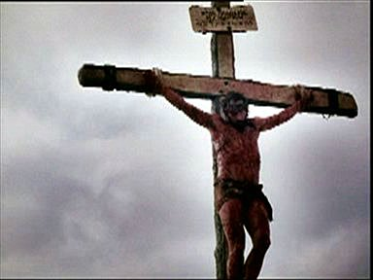
The Suffering Christ

Slide 6
Contents
Experience Jesus’ 7 Last Days
Experience Jesus’ 6 Last Trials
Experience Jesus’ 7 Last Tortures
Experience Jesus’ 7 Last Words

Slide 7
Objectives
Experience God’s love
See the seriousness of sin
Be grateful for what Christ had done
Follow the example of Christ

Slide 8
The Movements of Passion Week

Slide 9

Passion Week
64
Mon
Wed
Tues
Fri
Thurs
Fri
Sun
Sat
Sat
Sun

Slide 10
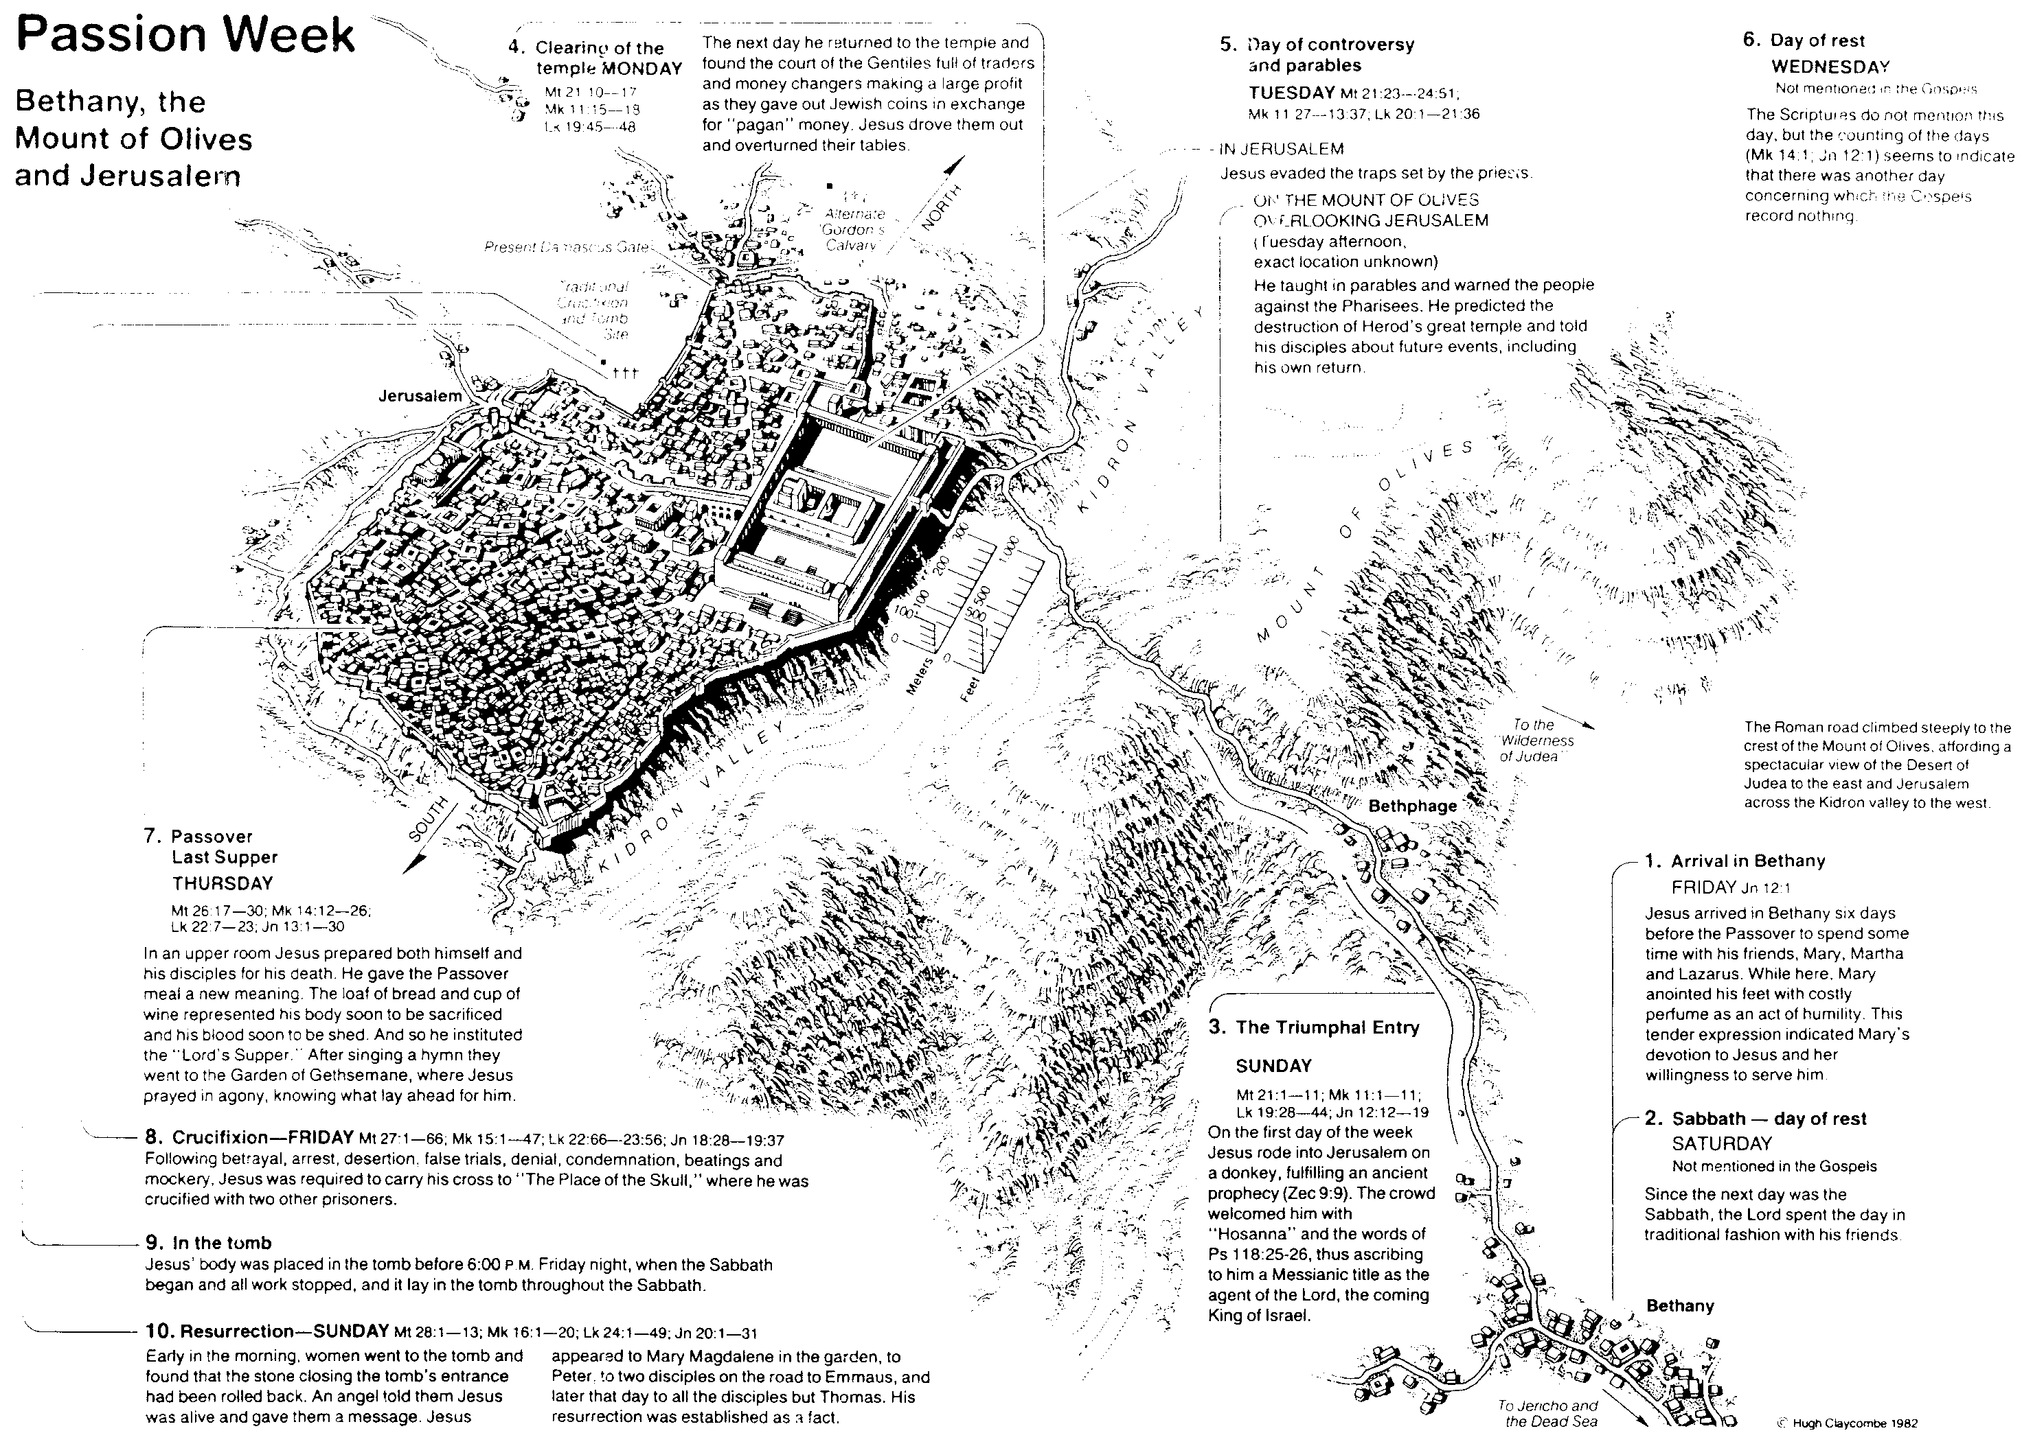
Jesus’ 7 Last Days
64
Day 1 Friday
Jesus Arrived in Bethany Jn 12:1
Day 2 Saturday
Sabbath

Slide 11
Sunday
Day 3 Sunday
The Triumphal Entry
MT 21:1-11; Mk 11:1-11; LK 19:28-44; Jn 12:12-19

Slide 12
Monday
Day 4 Monday
Jesus Clearing the Temple
Mt 21:10-17; Mk 11:15-18 Lk 19:45-48

Slide 13
Tuesday & Wednesday
Day 5 Tuesday
Controversy & Parables
MT 21:23-24:51; Mk 11:27-13:37; Lk 20:1-21:36
Day 6 Wednesday
Day of Rest

Slide 14
Thursday
Day 7 Thursday
Passover Last Supper
Mt 26: 17-30; Mk 14:12-26;Lk 22:7-23; Jn 13:1-30

Slide 15
Friday
Day 8 Friday
Crucifixion/ Tomb
Mt27:1-66; Mk 15:1-47; Lk 22:66-23:56; Jn 18:28-19:37

Slide 16
Jesus’ Final Week
Sat: Anointing in Bethany
Sun: Triumphal Entry
Mon: Temple cleansing
Tue: Teaching
Wed: ?
Thu: Passover
Fri: Trials & execution
Blomberg, 315

Slide 17
Jesus’ Final Hours
Thursday--------------
After sundown
Thurs-Friday----------
Nighttime
Last supper
Prayer in Garden
Betrayal
Custody
Hearing Before Annas
Trial Before Caiaphas
Peter’s denial
Blomberg, 342

Slide 18
Jesus’ Final hours
Friday------------------
Early morning
Late Morning----------
Midafternoon----------
Near Sundown--------
Sanhedrin Ends Deliberations
Jesus Sent To Pilate
Hearing Before Pilate
Jesus Sent To Herod
Return To Pilate
Jesus Nailed To Cross
Jesus Dies
Jesus Buried
Blomberg, 342

Slide 19
Crucifixion
Cruelest form of execution
Most shameful way to die
Roman citizens exempted
Reserved for worst criminals
Tied with a rope or nailed through
X-shaped or t-shaped cross
Death by suffocation

Slide 20
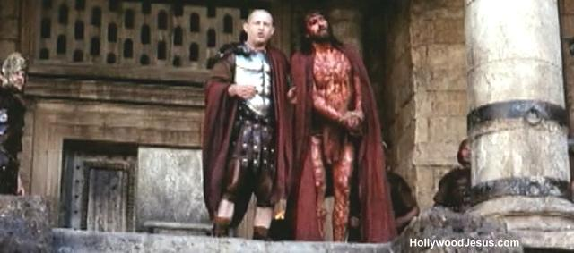
Why Did Jesus Choose To Die?

Slide 21
A. The Arrest
§ 168
Matthew 26:47-56; Mark 14:43-52; Luke 22:47-53; John 18:2-12a
Christ willingly allows His betrayal and arrest in Gethsemane, while remaining in complete control with authority over His adversaries

Slide 22


Free
Bible
images
Matthew 26:36-56
Mark 14:32-52
Luke 22:39-53
John 18:1-12
THE EASTER STORY
JESUS PRAYS IN GETHSEMANE

Slide 23


Slide 24


Slide 25


Slide 26


Slide 27


Slide 29


Slide 30


Slide 31


Slide 32


Slide 33


Slide 34

Notes:
Matt. 26:36 Then Jesus went with them to the olive grove called Gethsemane, and he said, “Sit here while I go over there to pray.”
Mark 14:32 They went to the olive grove called Gethsemane, and Jesus said, “Sit here while I go and pray.”

Slide 35


Slide 36


Slide 37


Slide 38


Slide 39


Slide 40


Slide 41


Slide 42


Slide 43
THE WORD IN PICTURES
Free
Bible
images

Slide 44

Used with Permission
THE
GOSPEL
——OF—— MATTHEW
THE
GOSPEL
——OF—— MARK
THE
GOSPEL
——OF—— LUKE
THE
GOSPEL
——OF—— JOHN
Due to the Lumo Project producing its own publishing material we regret to inform you that we cannot license our photos to other clients outside of freebibleimages.org.
These images are not licensed for reuse in video, epublishing or other media. Downloaded pictures and files cannot be redistributed through any other website than freebibleimages.org or used in any context where the accompanying message is undermining of the Christian faith and gospel.
Photos can only be used on educational presentations, blogs and social media, all of which should be accompanied with reference to www.LumoProject.com.
Picture courtesy of BBM
© All Rights Reserved.
www.bigbookmedia.com

Slide 45
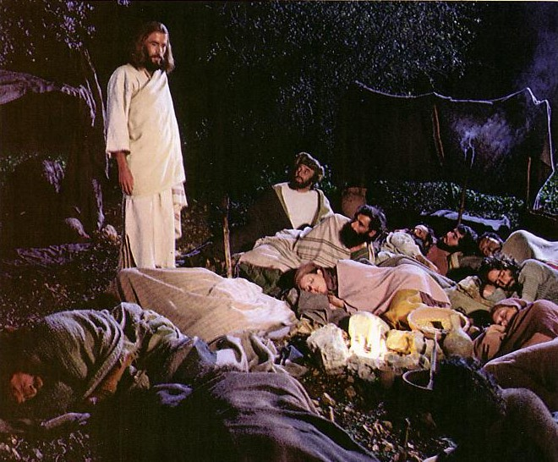
Jesus controlled His own arrest (John 18:1-11).
Notes:
Jesus was and is the one with ultimate authority.

Slide 46
B. The Religious Trial
§§ 169-173
The Jewish leaders illegally try Jesus on religious blasphemy that this unjust treatment would end at the cross as the sacrifice for sin

Slide 47
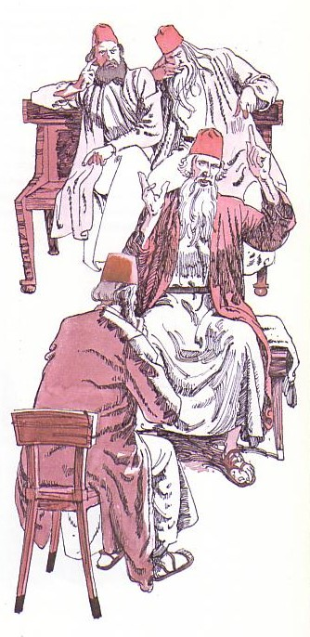
Jesus' illegal trials proved Him innocent (John 18:12–19:16a).
Notes:
Then his six illegal trials proved him innocent!

Slide 48
Jesus’ 6 Last Trials
Annas, the ex-high priest
Caiaphas and Sanhedrin
Sanhedrin and 70 ruling leaders of Israel
Pilate, governor of Judea
Herod Antipas of Galilee
Return To Pilate

Slide 49
Jesus’ Unjust Trials
Held at night
No specific charge
No witness
No defense attorney
No proof of guilt
This was not a trial but a planned murder

Slide 50
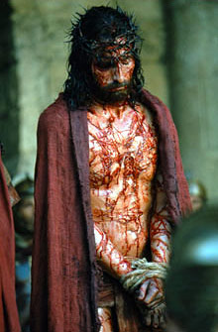
Why did Jesus keep silent?

Slide 51
1. The Examination before Annas
§ 169
John 18:12b-14, 19:23
The deposed high priest Annas sends Jesus to Caiaphas to continue the religious trial after illegally evaluating His teaching

Slide 52
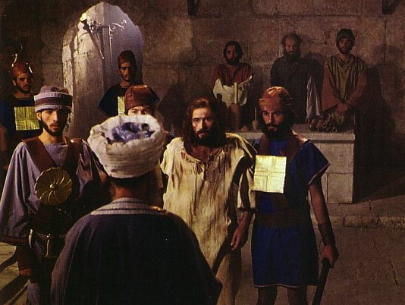
The Jewish Trials: Annas
Illegal
No longer high priest
At night
In a home
No witnesses
No actual charge
Violence
Illegal
Illegal
Illegal
Illegal
Illegal
Notes:
The trial by Annas was illegal.
"In A.D. 6, Quirinius, governor of Syria, appointed Annas as high priest (Josephus, Antiquities 18.2.1).
According to Jewish law, he should have held this position for life. However, he was deposed in A.D. 15 by Valerius Gratus, Roman procurator of Judea (Jos., Ant. 18.2.2). Nevertheless, Annas continued to hold a great deal of power among the religious leaders (see Lk 3:2; Acts 4:6). At the time of Jesus’ trial, Caiaphas (the son-in-law of Annas) was serving as high priest. He had been appointed as high priest around the year A.D. 18 by Valerius Gratus (eventually removed from office around the year A.D. 36; Jos., Ant. 18.4.3). Yet Annas was the patriarch of the high priestly family, and many still considered him the proper high priest, even though the Romans recognized Caiaphas as high priest."
—Paul Tanner, Following the Master, 22, n. 9

Slide 53
2. Examination before Caiaphas
§ 170
Matthew 26:57, 59-68; Mark 14:53, 55-65; Luke 22:54a, 63-65; John 18:24
The high priest Caiaphas and the Sanhedrin illegally convict Christ of blasphemy based on His confession and sentence Him to death

Slide 54

The Illegal Trial by Caiaphas
Closed meeting
At house of Caiaphas
Held at night
No specific charges
Accusations changed
No defense attorney
Verdict already determined
Bribe
No waiting period
Illegal
Notes:
The trial by Caiaphas was also illegal.

Slide 55
3. Denial by Peter
§ 171
Matthew 26:58, 69-75; Mark 14:54, 66-72;
Luke 22:54b-62; John 18:15-18, 25-27
Peter thrice denies Jesus, thus proving Christ's prediction and his inadequacy apart from Jesus amidst His adversaries

Slide 56
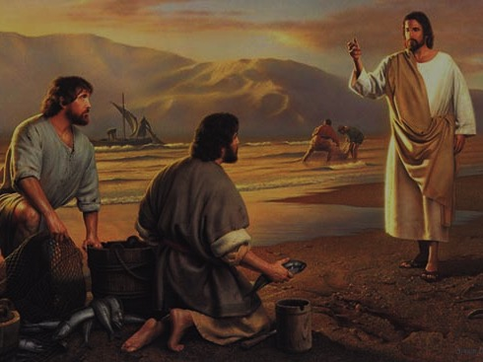
Peter's Calling
(Mark's source for his gospel)

Slide 57
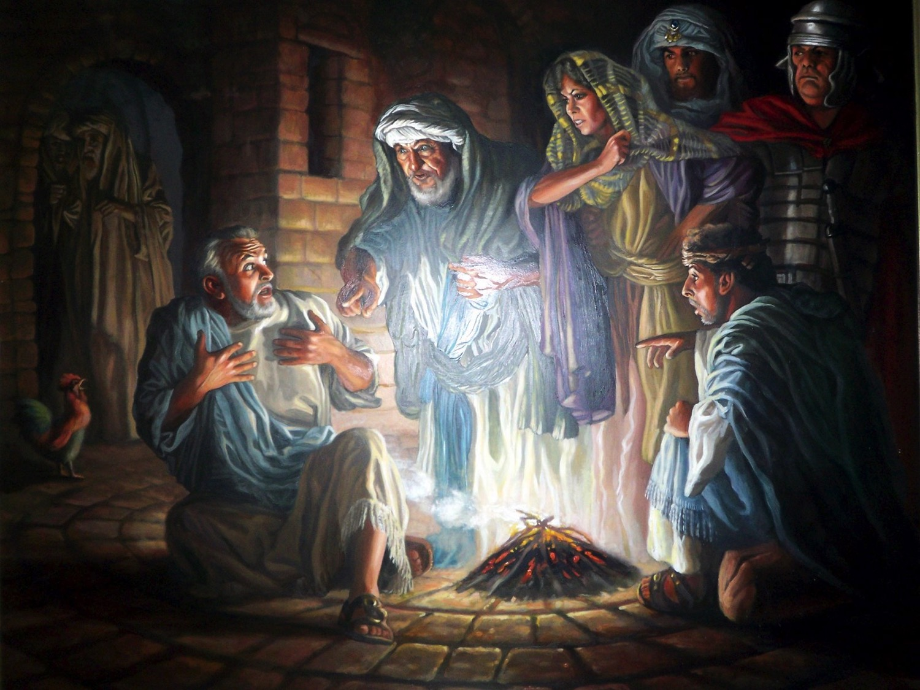
Peter's Denials

Slide 58


Free
Bible
images
Matthew 26:69-75
Mark 14:66-72
Luke 22:54-62
John 18:15-27
THE EASTER STORY
PETER DENIES JESUS

Slide 59


Slide 60


Slide 61


Slide 62


Slide 63


Slide 64


Slide 65


Slide 66


Slide 67


Slide 69

Pictures courtesy of Big Book Media
© All Rights Reserved.
Used with permission
BIG BOOK MEDIA

Slide 70
THE WORD IN PICTURES
Free
Bible
images

Slide 71
4. Condemnation by the Sanhedrin
§ 172
Matthew 27:1; Mark 15:1a; Luke 22:66-71
The Sanhedrin illegally decrees Jesus must die for blasphemy before dawn to ratify their illegal partial court trial at Caiaphas’s home

Slide 72

Free
Bible
images
Matthew 26:57-67
Mark 14:53-65
Luke 22:66-71
John 18:15-27
THE EASTER STORY
JESUS BEFORE
THE SANHEDRIN

Slide 73


Slide 74


Slide 75


Slide 77


Slide 78


Slide 79


Slide 80


Slide 81
THE WORD IN PICTURES
Free
Bible
images

Slide 82
Used with Permission
THE
GOSPEL
——OF—— MATTHEW
THE
GOSPEL
——OF—— MARK
THE
GOSPEL
——OF—— LUKE
THE
GOSPEL
——OF—— JOHN
Due to the Lumo Project producing its own publishing material we regret to inform you that we cannot license our photos to other clients outside of freebibleimages.org.
These images are not licensed for reuse in video, epublishing or other media. Downloaded pictures and files cannot be redistributed through any other website than freebibleimages.org or used in any context where the accompanying message is undermining of the Christian faith and gospel.
Photos can only be used on educational presentations, blogs and social media, all of which should be accompanied with reference to www.LumoProject.com.
Picture courtesy of BBM
© All Rights Reserved.
www.bigbookmedia.com

Slide 83
5. Death of Judas
§ 173
Matthew 27:3-10
Judas's returned thirty coins and suicide give a burial plot for foreigners to fulfill Zechariah (11:12-13) and Jeremiah (18:1-4; 19:1-3)
Notes:
Matt. 27:3 When Judas, who had betrayed him, realized that Jesus had been condemned to die, he was filled with remorse. So he took the thirty pieces of silver back to the leading priests and the elders. 4 “I have sinned,” he declared, “for I have betrayed an innocent man.”
“What do we care?” they retorted. “That’s your problem.”
Matt. 27:5 Then Judas threw the silver coins down in the Temple and went out and hanged himself.
Matt. 27:6 The leading priests picked up the coins. “It wouldn’t be right to put this money in the Temple treasury,” they said, “since it was payment for murder.”ª 7 After some discussion they finally decided to buy the potter’s field, and they made it into a cemetery for foreigners. 8 That is why the field is still called the Field of Blood. 9 This fulfilled the prophecy of Jeremiah that says,
“They took the thirty pieces of silver—
the price at which he was valued by the people of Israel,
10 and purchased the potter’s field,
as the LORD directed.”
Zech. 11:12 And I said to them, “If you like, give me my wages, whatever I am worth; but only if you want to.” So they counted out for my wages thirty pieces of silver.
Zech. 11:13 And the LORD said to me, “Throw it to the potter”—this magnificent sum at which they valued me! So I took the thirty coins and threw them to the potter in the Temple of the LORD.
The Potter and the Clay
Jer. 18:1 The LORD gave another message to Jeremiah. He said, 2 “Go down to the potter’s shop, and I will speak to you there.” 3 So I did as he told me and found the potter working at his wheel. 4 But the jar he was making did not turn out as he had hoped, so he crushed it into a lump of clay again and started over.
Jeremiah’s Shattered Jar
Jer. 19:1 This is what the LORD said to me: “Go and buy a clay jar. Then ask some of the leaders of the people and of the priests to follow you. 2 Go out through the Gate of Broken Pots to the garbage dump in the valley of Ben-Hinnom and give them this message. 3 Say to them, ‘Listen to this message from the LORD, you kings of Judah and citizens of Jerusalem! This is what the LORD of Heaven’s Armies, the God of Israel, says: I will bring a terrible disaster on this place, and the ears of those who hear about it will ring!'"

Slide 84
The Jewish Trials of Jesus
65
TRIAL | LEADER | TEXTS | ACCUSATIONS | LEGALITY | TYPE | RESULT
1. | Annas, ex-high priest of Jews (A.D. 6-15) | John 18:13-23 | Trumped-up charges of irreverence to Annas. General questioning, nothing specific. | ILLEGAL! Held at night Prejudice No specific charges Violence | Jewish and Religious | Found "guilty” of irreverence and rushed to Caiaphas
2. | Caiaphas and Sanhedrin (Caiaphas was Annas' son-in-law) (A.D. 18-36) | Matt. 26:57-68 Mark 14:53-65 Luke 22:54, 63-65 John 18:24 | Claimed to be the Messiah, Son of God … blasphemy! | ILLEGAL! Held at night False witnesses Violence Prejudice | Jewish and Religious | Declared guilty of blasphemy and rushed to Sanhedrin (Jewish supreme court)
3. | Sanhedrin (70 Jewish rulers) whose word was needed before He could be taken to Romans | Matt. 27:1 Mark 15:1 Luke 22:66-71 | Claimed to be Son of God Charged with blasphemy! (Worthy of death under Jewish law) | ILLEGAL! Kangaroo Court Accusation switched No witnesses Improper voting | Jewish and Religious | Declared guilty of blasphemy and rushed to Roman official, Pilate
Notes:
The Six Trials of Jesus were divided into three Jewish and three Roman trials. All six were illegal.
They began with illegal religious trials before the Jewish authorities with the charge of blasphemy.
But Jews could not execute anyone under Roman law, so they needed Romans to do it.
_____________________
LC-09-Rejection-84
NS-00-NTS Chronology-44

Slide 85
The Roman Trials of Jesus
65
TRIALS | LEADERS | TEXTS | ACCUSATIONS | LEGALITY | TYPE | RESULT
4. | Pilate, governor of Judea (already in "hot water" with Rome) (A.D. 26-36) | Matt. 21:11-14 Mark 15:2-5 Luke 23:1-7 John 18:28-38 | Accused Him of treason. Changed accusation, since reason was worthy of capital punishment in Rome. | ILLEGAL! Kept under arrest, though found innocent. No defense attorney. Violence. | Roman and Civil | Found to be INNOCENT . . . but rushed to Herod Antipas. Mob overruled Pilate . . .
5. | Herod Antipas, governor of Galilee (4 B.C.-A.D. 39) | Luke 23:8-12 | No accusation made. Mock trial. Mob violence. | ILLEGAL! No grounds. Mockery in court-room. Violence. No defense attorney | Roman and Civil | Mistreated and mocked, returned to Pilate without decision made by Herod
6. | Pilate (Second time) | Matt. 27:15-26 Mark 15:6-15 Luke 23:18-25 John 18:39-19:16 | Treason (but not proven) Bargain with mob . . . put on level with Barabbas, a criminal. | ILLEGAL! Pilate, without proof of guilt, allowed innocent man to be condemned | Roman and Civil | Flogged without evidence; Found innocent but Pilate "washed hands" and allowed Him to be CRUCIFIED.
Notes:
A key problem for the Jews was that Romans did not consider blasphemy worthy of death, so the Sanhedrin deceptively changed the charge to treason.
The final three trials thus charged Jesus with treason or seeking to overthrow Roman rule.
However, even this was not proven, and each Roman trial was also illegal in various ways.
_____________________
LC-09-Rejection-85
NS-00-NTS Chronology-45

Slide 86
C. The Civil Trial
§§ 174-177
Jews could not execute Jesus, so they get the Romans to try, mock, and sentence Jesus to crucifixion for the political charge of treason
Notes:
Jews could not legally execute anyone, so the religious leaders bring Jesus before the Romans and change the religious charge of blasphemy to the political charge of treason, which, after three trials, succeeds in having Him mocked and led away for crucifixion

Slide 87

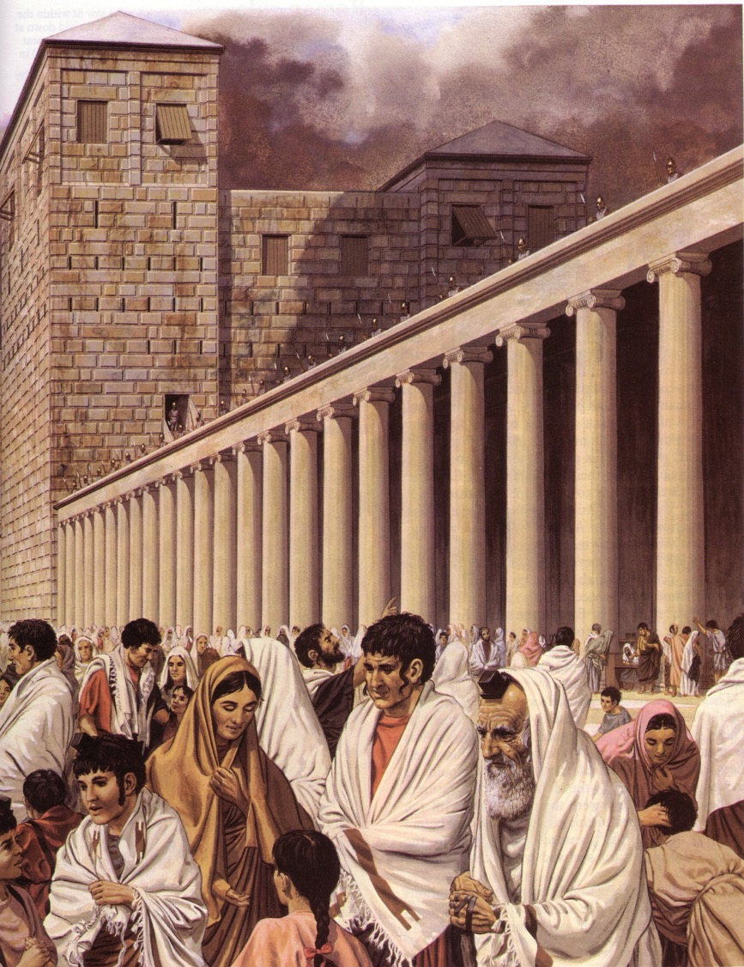
The Roman Trials
Notes:
Then, the trials by Romans were illegal.

Slide 88
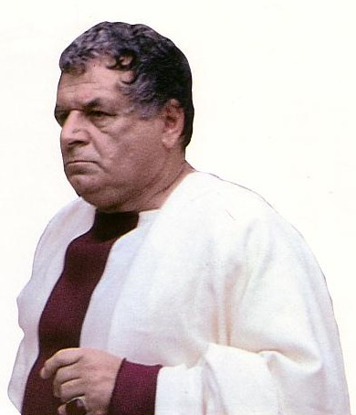
Three Roman Mockeries
Illegal
Pilate
Antipas
Pilate (second time)
Illegal
Illegal
Charge:
Treason
Notes:
Then trials by Romans were illegal. They also charged Jesus with treason but never proved their claim.

Slide 89
1. Trial Before Pilate
§ 174
Matthew 27:2, 11-14; Mark 15:1b-5; Luke 23:1-5; John 18:28-38
Pilate exonerates Jesus of ambiguous charges and tries to save Him from the cross as he deems his kingdom no threat to Rome

Slide 90
2. Trial Before Herod
§ 175
Luke 23:6-12
Pilate does not judge Jesus but sends Him to Galilee’s ruler Herod, who also declares Him innocent of treason

Slide 91
3. Trial Before Pilate
§ 176
Matthew 27:15-26; Mark 15:6-15; Luke 23:13-25;
John 18:39–19:1, 4-16a
Pilate exonerates Jesus of treason but approves his crucifixion instead of Barabbas due to fear of Rome and the crowd
Notes:
Pilate declares Jesus innocent of treason but releases Barabbas, flogs Jesus, seeks to absolve himself from blame, and sends him for crucifixion, fearing Rome, the crowd, and possible judgment from a deity if Jesus is indeed God.
The irony is in the name of Barabbas. Bar means "son" and "abbas" means "daddy." So, the crowd wants the "son of daddy" killed and the "Son of God" killed!
Jesus not only a substitute for a murderer, but for us.

Slide 92
4. Mockery
§ 177
Matthew 27:27-30; Mark 15:16-19; John 19:2-3
Roman soldiers mock Jesus as a king and repeatedly beat and spit on Him before leading Him to crucifixion

Slide 93
Jesus’ Seven Last Tortures
Sleepless Night
Fists
Scourging
Thorn Crown
Wooden Cross
Nails
Spear

Slide 94
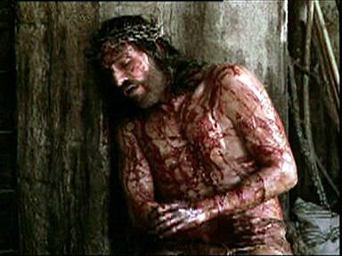
Sleepless night

Slide 95
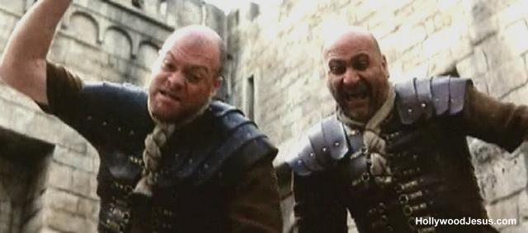
Jesus was Beaten By Guards

Slide 96
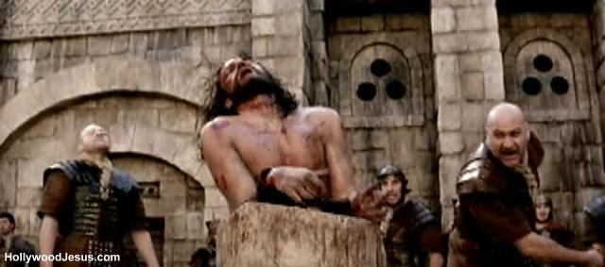
Scourging
Notes:
Many died of the scourging alone!

Slide 97
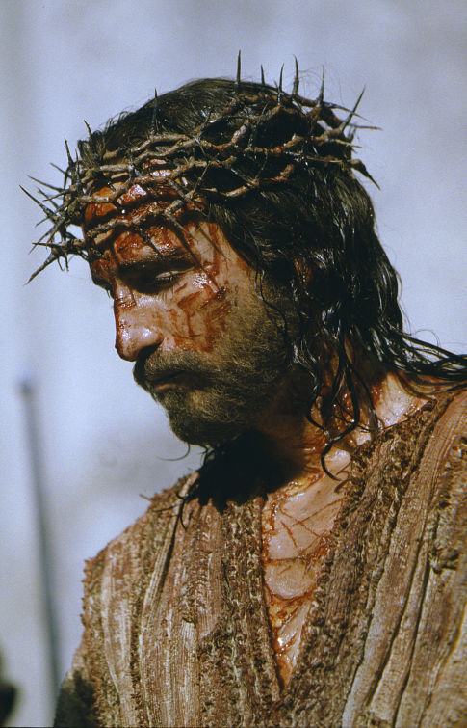
Crown of Thorns
Notes:
They mocked him as Lord. They will do it in reality in the future:
Phil 2:10 that at the name of Jesus every knee should bow,
in heaven and on earth and under the earth,
11 and every tongue declare that Jesus Christ is Lord,
to the glory of God the Father.

Slide 98

Free
Bible
images
Matthew 27:27-37
Mark 15:16-25
Luke 23:26-34
John 19:16-27
THE EASTER STORY
JESUS IS CRUCIFIED

Slide 99


Slide 100


Slide 101


Slide 102


Slide 103


Slide 104


Slide 105
THE WORD IN PICTURES
Free
Bible
images

Slide 106
Used with Permission
THE
GOSPEL
——OF—— MATTHEW
THE
GOSPEL
——OF—— MARK
THE
GOSPEL
——OF—— LUKE
THE
GOSPEL
——OF—— JOHN
Due to the Lumo Project producing its own publishing material we regret to inform you that we cannot license our photos to other clients outside of freebibleimages.org.
These images are not licensed for reuse in video, epublishing or other media. Downloaded pictures and files cannot be redistributed through any other website than freebibleimages.org or used in any context where the accompanying message is undermining of the Christian faith and gospel.
Photos can only be used on educational presentations, blogs and social media, all of which should be accompanied with reference to www.LumoProject.com.
Picture courtesy of BBM
© All Rights Reserved.
www.bigbookmedia.com

Slide 107
D. Procession to Calvary
§ 178
Matthew 27:31-34; Mark 15:20-23; Luke 23:26-33;
John 19:16b-17
Christ’s inability to carry His cross to Calvary forces it upon Simon of Cyrene due to the guards severely beating Jesus

Slide 108

Today: Jesus' death paid for our sin (19:16b-42)
Notes:
Today, in John 19:16b-42, we finish the passion account, which shows how Christ voluntarily gave his life for us.

Slide 109

Two Movements
Death
Burial
Notes:
Today we’ll see true love in two movements—Christ’s death and burial—that they support the concept of his atonement.
The first evidence that Jesus genuinely took our sin upon him was that…

Slide 110

I. Christ fulfilled Scripture in his selfless death (John 19:16b-37).
Selflessness
Fulfillments
Carried cross
Notes:
Jesus paid for our sin by dying to fulfill prophecy and with utmost care for others.
• Jesus showed selflessness by carrying his own cross (19:16b-17).
The typical criminal had to do this—even those crucified on either side of Christ.

Slide 111
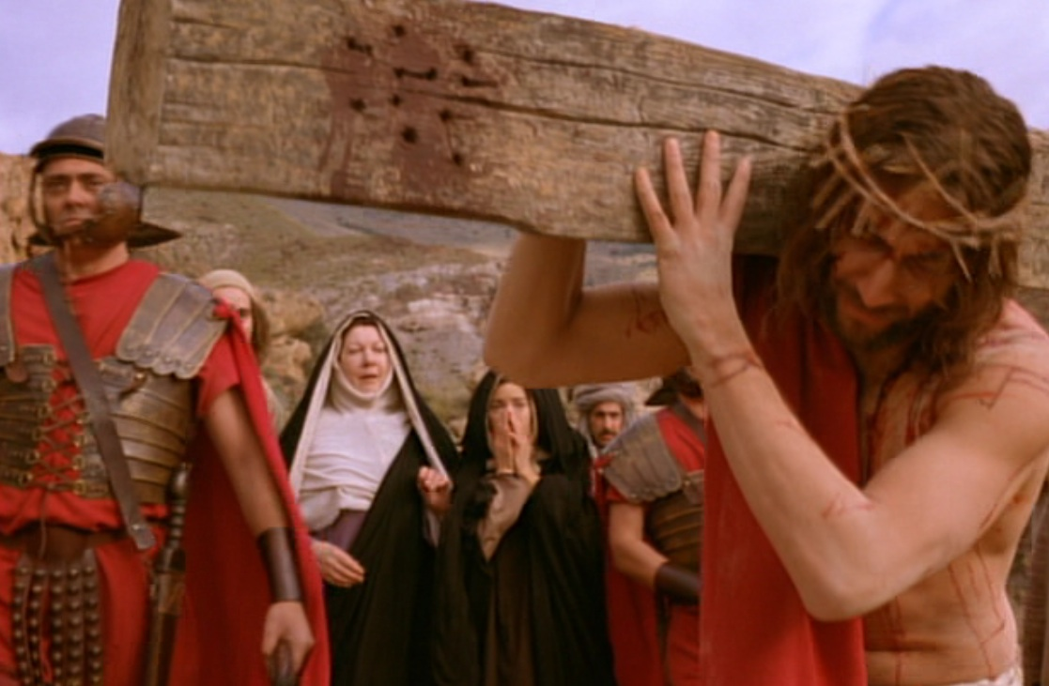
Carrying His Own Cross
Notes:
Jesus didn’t have to carry his own cross. Matt. 26:53 says he had the power to get out of arrest when he could have called 72,000 angels! That’s 12 legions of angels to defend Him. A Roman legion numbered about 6,000 soldiers.

Slide 112
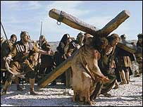
Wooden Cross
Notes:
The movie The Passion of Christ shows him carrying the entire cross.

Slide 113


Slide 114

Notes:
The other murderers also sentenced to death also carried their crosses.

Slide 115


Slide 116


Slide 117


Slide 118


Slide 119


Slide 120


Slide 121


Slide 122


Slide 123
E. The Crucifixion
§§ 179-181
Christ is crucified for the sins of the world with signs at His death to show that the people had executed their own Messiah

Slide 124

Free
Bible
images
Matthew 27:38-66
Mark 15:25-47
Luke 23:35-56
John 19:28-42
THE EASTER STORY
JESUS DIES ON THE CROSS

Slide 125


Slide 126


Slide 127


Slide 128


Slide 129


Slide 130


Slide 131


Slide 133


Slide 134


Slide 136


Slide 137
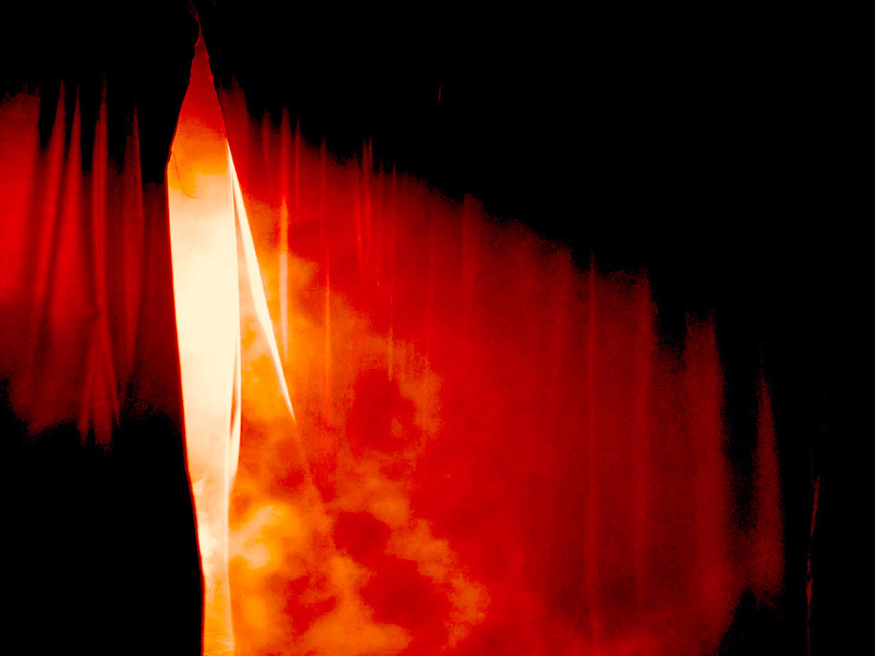

Slide 138


Slide 139


Slide 140


Slide 141


Slide 142


Slide 143
THE WORD IN PICTURES
Free
Bible
images

Slide 144
Used with Permission
THE
GOSPEL
——OF—— MATTHEW
THE
GOSPEL
——OF—— MARK
THE
GOSPEL
——OF—— LUKE
THE
GOSPEL
——OF—— JOHN
Due to the Lumo Project producing its own publishing material we regret to inform you that we cannot license our photos to other clients outside of freebibleimages.org.
These images are not licensed for reuse in video, epublishing or other media. Downloaded pictures and files cannot be redistributed through any other website than freebibleimages.org or used in any context where the accompanying message is undermining of the Christian faith and gospel.
Photos can only be used on educational presentations, blogs and social media, all of which should be accompanied with reference to www.LumoProject.com.
Picture courtesy of BBM
© All Rights Reserved.
www.bigbookmedia.com

Slide 145
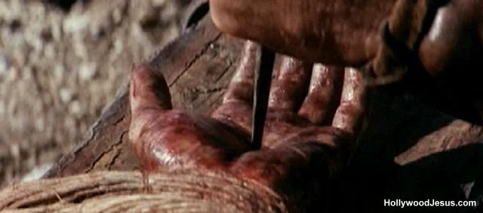
Nailed

Slide 146
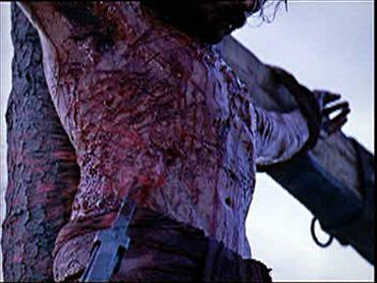
Speared
Spear
Spear

Slide 147
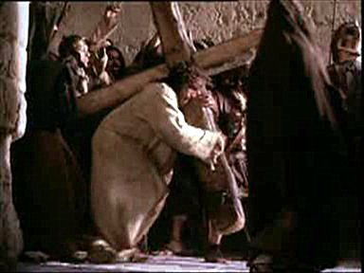
Why He chose to suffer…

Slide 148
I. Christ fulfilled Scripture in his selfless death (John 19:16b-37).
Selflessness
Fulfillments
Carried cross
Crucifixion
Notes:
Jesus died selflessly in public crucifixion amidst contempt by the Jews (19:18-22).

Slide 149
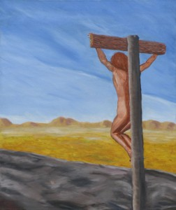
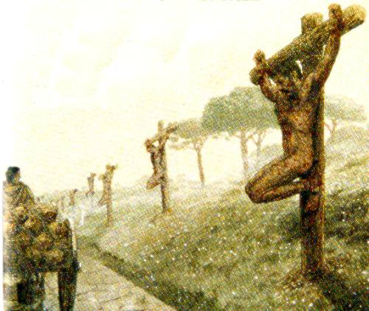
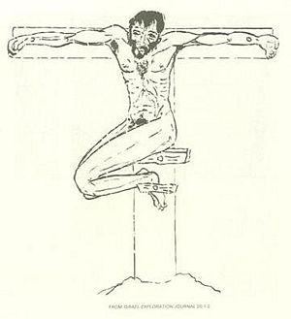
Crucified Naked
Notes:
We can’t imagine the shame of crucifixion today as we execute criminals clothed. But, despite what the movies show, Jesus was totally naked—no loincloth!

Slide 150
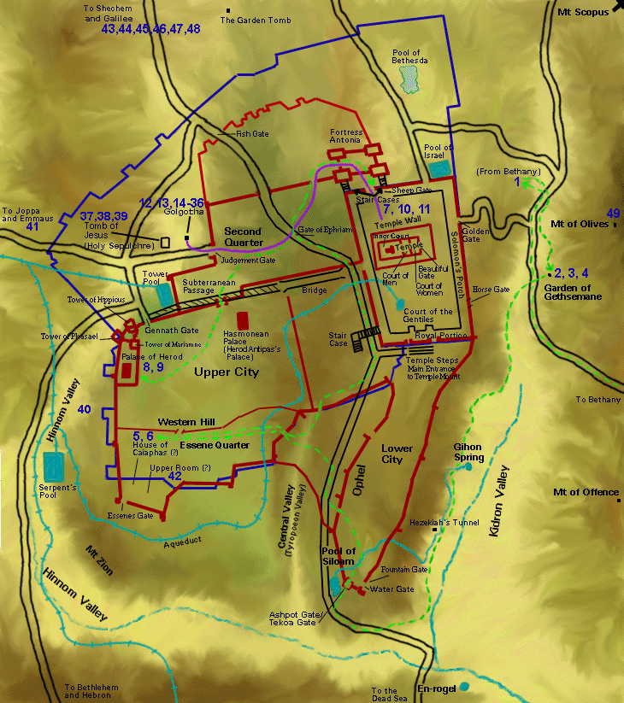
Jesus' Final Movements
Notes:
Jesus’ crucifixion was public—on a main road either at the Garden Tomb or Church of the Holy Sepulcher.

Slide 151
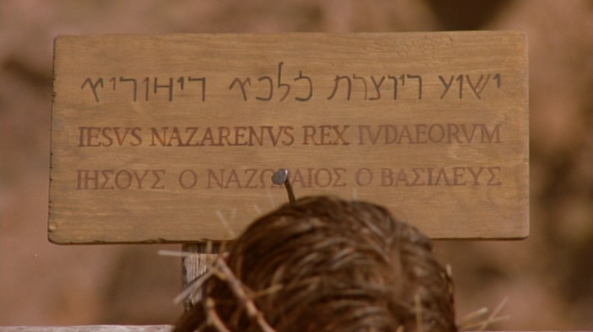
The Placard
Notes:
To intensify the shame, a sign above Jesus was in three languages so the many who passed by on this key road just outside the city could read it. Passover was the biggest holiday of the year, with about 90,000 people in Jerusalem.

Slide 152
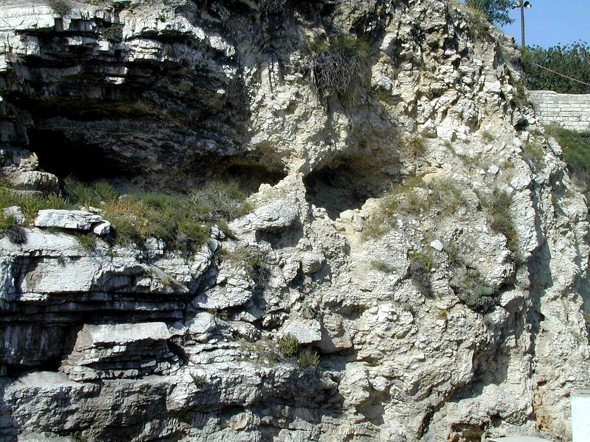
Gordon's Calvary
Notes:
Interestingly, the northern site for the crucifixion of Christ is the outcropping that looks like a skull at Gordon’s Calvary—

Slide 153
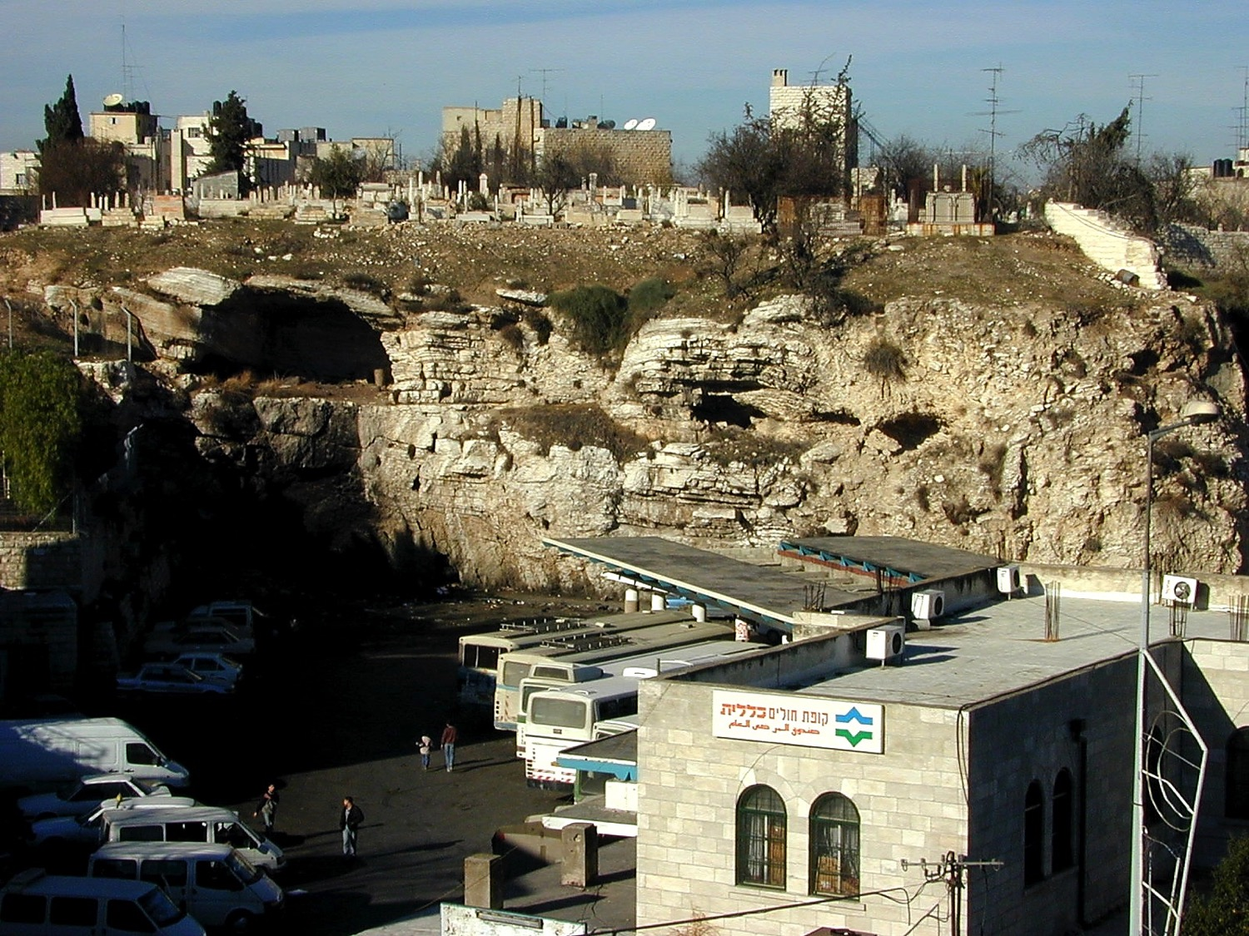
Gordon's Calvary
Notes:
—which is still next to a popular place—a bus station!

Slide 154
I. Christ fulfilled Scripture in his selfless death (John 19:16b-37).
Selflessness
Fulfillments
Carried cross
Clothes divided
Crucifixion
Notes:
Jesus fulfilled Scripture by allowing His clothes to be divided and bargained for (19:23-24).
One might think that Jesus would, at the least, have his mother take his clothes—but no, he was not spared the indignity of even having his clothes taken from him.

Slide 155
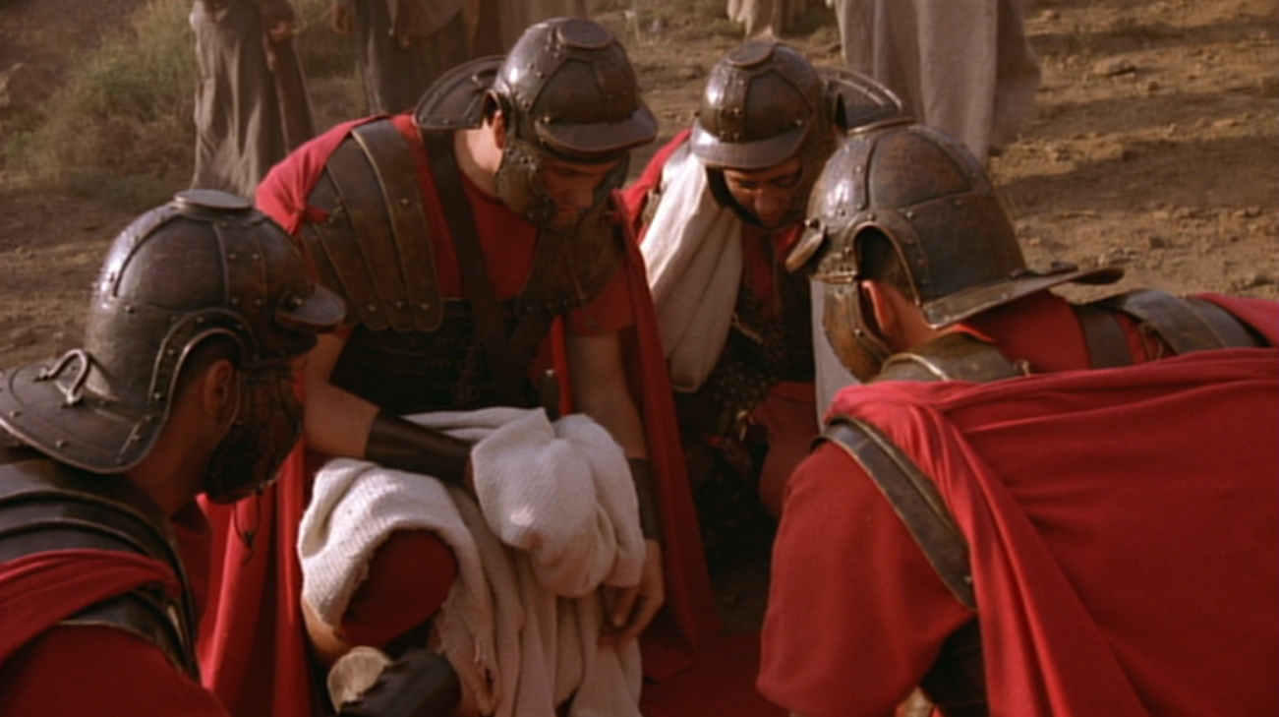
5 Items to Divide
Turban–Sandals–Robe–Outer Garment–Girdle
Notes:
Wiersbe notes, “At most Roman executions, a centurion would be assigned with four soldiers to assist him… It was the privilege of the soldiers to share whatever personal belongings the victims had; so they divided up all that Jesus owned—His personal clothing. He would have had a turban, a pair of sandals, an undergarment (the seamless robe), an outer garment, and a girdle. The four men each took a piece of clothing, and then they gambled for the seamless robe.”
Warren W. Wiersbe, The Bible Exposition Commentary (Wheaton, Ill.: Victor Books, 1996, c1989), Jn 19:17.

Slide 156
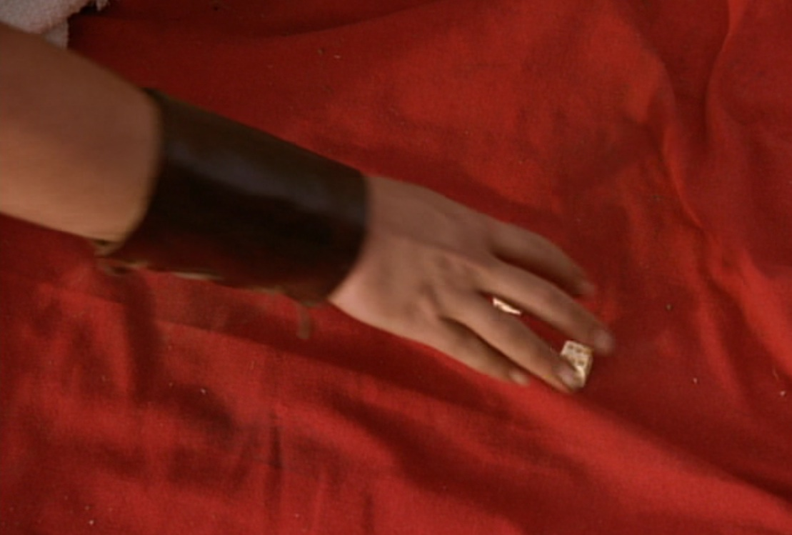
"They divided my garments among themselves and threw dice for my clothing" (Ps. 22:18)
Notes:
Psalm 22:18 was fulfilled in, “They divided my garments among themselves and threw dice for my clothing” (19:24 NLT).

Slide 157
1. First Three Hours
§ 179
Matthew 27:35-44; Mark 15:24-32; Luke 23:34-43; John 19:18-27
Christ’s crucifixion assertions from 9 AM to noon selflessly forgive his persecutors, save a murderer, and care for his mother

Slide 158
Jesus’ Seven Last Words
“Father, forgive them, for they do not know what they are doing” (Luke 23:34)
“I tell you the truth, today you will be with me in paradise” (Luke 23:43)
“Dear woman here is your son,” and “Here is your mother” (John 19:27)
Blomberg, 347-48

Slide 159
I. Christ fulfilled Scripture in his selfless death (19:16b-37).
Selflessness
Fulfillments
Carried cross
Clothes divided
Crucifixion
Cared for Mary
Notes:
Jesus died selflessly by committing care for His mother to His disciple John (19:25-27).
Most crucified men could not endure such shame and pain, so they heaped abuse on their tormenters. Instead, Jesus prayed that God would forgive them! Rather than concern for himself, Christ also thought about the future care of his mother.

Slide 160
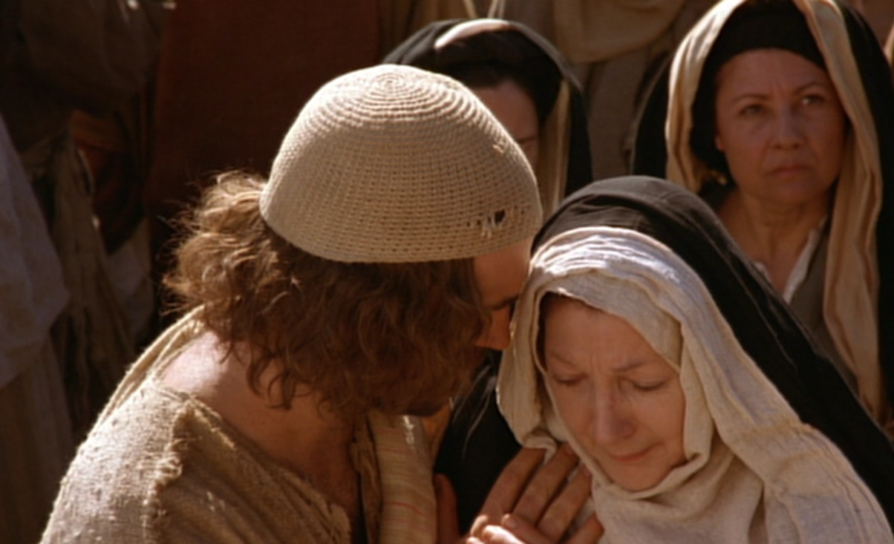
Care for His Mother Mary
Notes:
He cared even after his death through John, to whom he says, “Here is your mother” (19:27).
Why John instead of Jesus’ siblings?
Remember in John 7:5 that his brothers did not even believe in Christ, unlike the beloved disciple John (13:23). But Jesus, as the Good Shepherd (10:4), cares for his mother like the rest of his sheep.

Slide 161
2. Second Three Hours
§ 180
Matthew 27:45-50; Mark 15:33-37; Luke 23:44, 46; John 19:28-30
Christ’s crucifixion from 12-3 PM shows substitutionary atonement, thirst to fulfill Ps 22:15, sacrifice for all, and power over death

Slide 162
I. Christ fulfilled Scripture in his selfless death (19:16b-37).
Selflessness
Fulfillments
Carried cross
Clothes divided
Crucifixion
Thirsted
Cared for Mary
Notes:
Jesus fulfilled Scripture as the living water who thirsted (19:28-29).

Slide 163
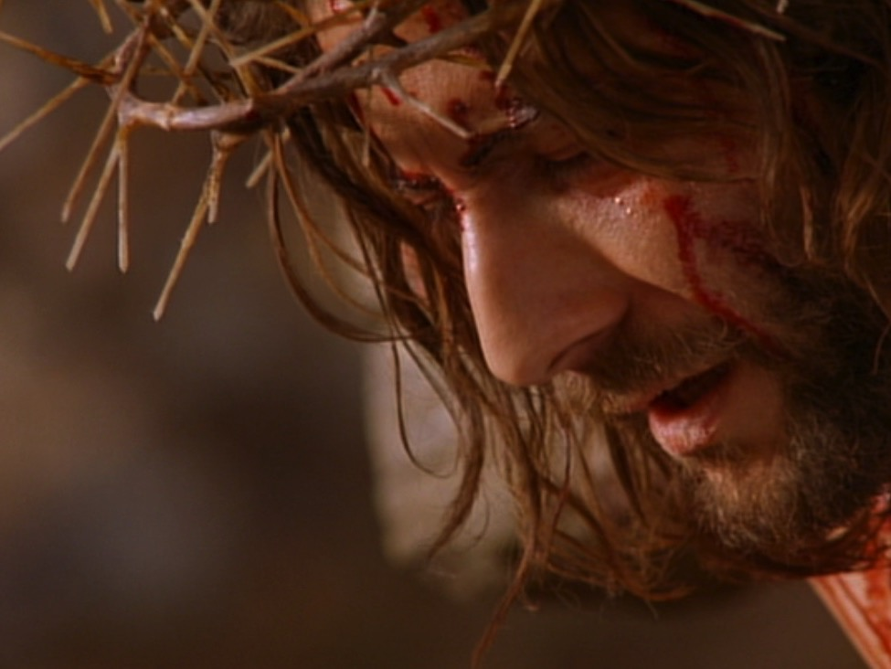
"I am thirsty"
(19:28; cf. Psalm 22:15; 69:21)
Notes:
Psalm 22:15; 69:21 was fulfilled with Christ declaring, “I am thirsty” (John 19:28).
“I am thirsty” (John 19:28) shows irony, for the One who gives living water (John4:14; 7:38-39) willingly allowed himself to thirst. Christ quotes Psalm 69:21 here—a psalm that ends with triumph in fulfilling this prophecy.

Slide 164
Jesus’ Seven Last Words
“My God, my God, why have you forsaken me?” (Mark 15:34)
“I am thirsty” (John 19:28)
“It is finished” (John 19:30)
“Father into your hands I commit my spirit” (Luke 23:46)
Blomberg, 347-48

Slide 165
Significance of Jesus’ Words
Forgiveness is available for those who repent.
Heaven is available to believers.
Jesus modeled His love by loving His enemies and family.
Jesus experienced pain and separation from God.
Jesus has both humanity and divinity.
His mission is accomplished.
Jesus had authority over His death.

Slide 166
Why Must Jesus Suffer And Die?
For even the Son of Man did not come to be served, but to serve, and to give his life as a ransom for many.
Mark 10:45

Slide 167
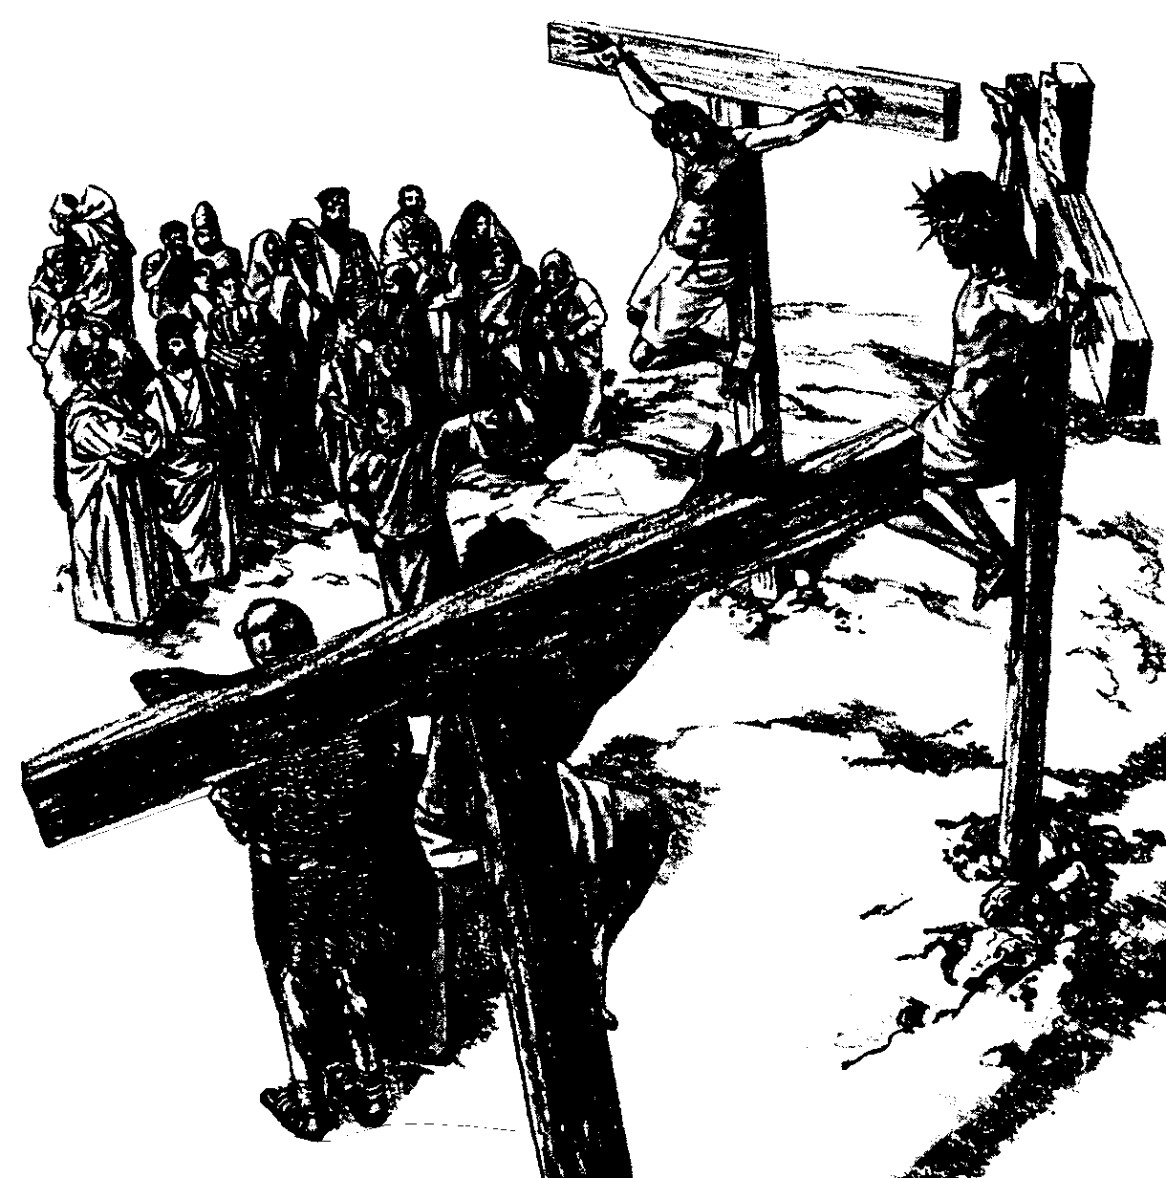
The Paradox of Authority and Servanthood in Mark
 | Authority | Servanthood
Themes | Christ's Leadership | Discipleship
Strategy | Gentiles lord it over others (10:42) | Disciples serve (10:43)
Motivation | "Save his life" (8:35a) | "Lose his life" (8:35b)
Priority | "First" (9:35a; 10:31a) | "Last" (9:35b; 10:31b)
Reputation | "Great" (10:43a) | "Servant" (10:43b)
Position | "First" (10:44a) | "Slave of all" (10:44b)
Authority Examples | Authority without Serving: • Religious leaders • Rich man • Judas | Authority & Served: • John the Baptist • Joseph of Arimathea
Servanthood Examples | Authority but Struggled to Serve: • Disciples | No Authority & Served • Bartimaeus • Woman who anointed Jesus
1st Section (1:1–8:26) | Authority of Christ
2nd Section (8:27–10:52) | Authority- Servanthood Tension
3rd Section (11–16) |  | Servanthood of Christ
89a
Summary of Narry F. Santos, Bibliotheca Sacra 154 (Oct.-Dec. 1997): 452-60
Notes:
LC-09-Rejection of the King-167
NS-02-Mark1-8-slide 128

Slide 168
Philippians 2:5-11
Your attitude should be the same as that of Christ Jesus:
Who being in very nature God,
Did not consider equality with God something to be grasped,
But made himself nothing, taking the very nature of a servant,
Being made in human likeness.
And being found in appearance as a man, he humble himself
And became obedient to death-even death on the cross!
Therefore, God exalted him to the highest place
And give him the name that is above every name,
That at the name of Jesus every knee should bow
In heaven and on earth, and every tongue confess that Jesus Christ is Lord, to the glory of God the Father.

Slide 169
I. Christ fulfilled Scripture in his selfless death (19:16b-37).
Selflessness
Fulfillments
Carried cross
Clothes divided
Crucifixion
Thirsted
Cared for Mary
Paid for sin
Notes:
Jesus fulfilled Scripture as the One who paid for all sin (19:30).

Slide 170

The Heavy Debt of Sin
Notes:
You and I have a tremendous debt to God.
Ray Comfort illustrates it this way: Have you ever broken God’s commandment by lying? What does that make you? Yes, a liar!
Have you ever prioritized something else ahead of God? What does that make you? Yes, an idolater!

Slide 171

The Debt of Sin
DEBT
Notes:
Suppose you only sinned three times a day—a word, action, or thought less than God—that’s 1000 sins a year! And that’s a good year! How many thousands of your sins separate you from God?
We can plead that God is merciful—and he is—but his mercy is balanced with his justice, which requires payment for our sins—not just token payment, but death!

Slide 172


"It is finished"
Legal
Paid
in Full
Notes:
When Jesus declared, “It is finished” (19:30), it was a legal term meaning “paid in full.” Our sin on him recalls the many times in John when Christ claimed that his “hour” had not yet come (2:4; 13:1, etc.). Now his “hour” had come to pay the redemption for which He had come.

Slide 173
I. Christ fulfilled Scripture in his selfless death (19:16b-37).
Selflessness
Fulfillments
Carried cross
Clothes divided
Crucifixion
Thirsted
Cared for Mary
Paid for sin
Pierced side
Notes:
Jesus fulfilled Scripture with the piercing of his side instead of breaking his legs (19:31-37).

Slide 174
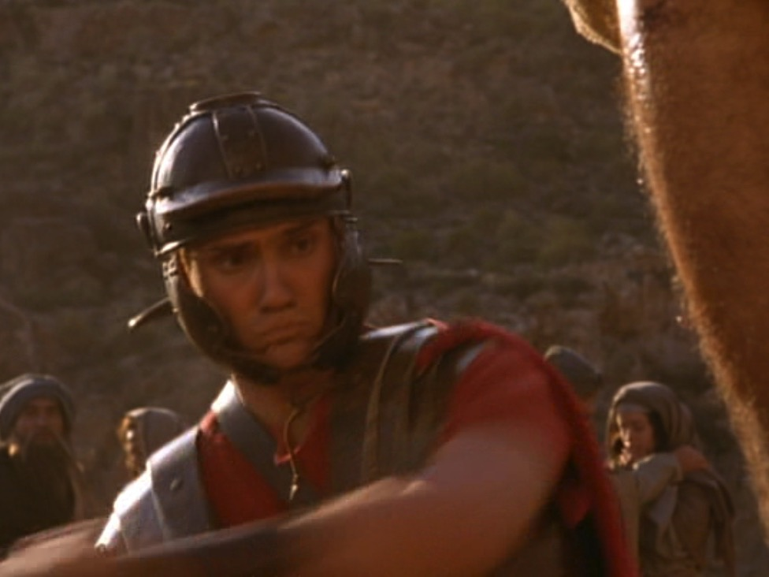
Why break the legs?
Notes:
How would the breaking of a victim’s legs bring death (19:31)? The way to hasten death was to prevent the crucified man from pushing up to take a breath—so breaking the legs prevented breathing. The shock and loss of more blood by having the legs broken with a heavy mallet also hastened death.

Slide 175
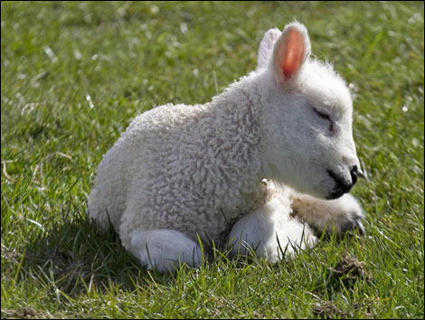
Passover lambs were unblemished
Notes:
The Passover lamb was to be without a defect, even after death. “Not one of his bones will be broken” (John 19:36 NLT) fulfilled two OT texts:

Slide 176
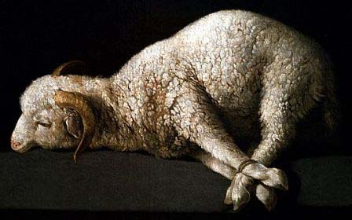
Passover lambs were roasted whole without any legs broken
"Each Passover lamb must be eaten in one house. Do not carry any of its meat outside, and do not break any of its bones"
Exodus 12:46; cf. Num. 9:12
Notes:
Exodus 12:46 commanded, “Each Passover lamb must be eaten in one house. Do not carry any of its meat outside, and do not break any of its bones.”

Slide 177
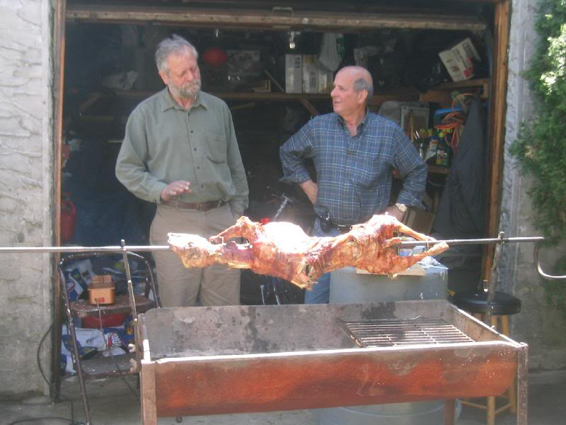
Passover lambs are still roasted whole without any legs broken

Slide 178
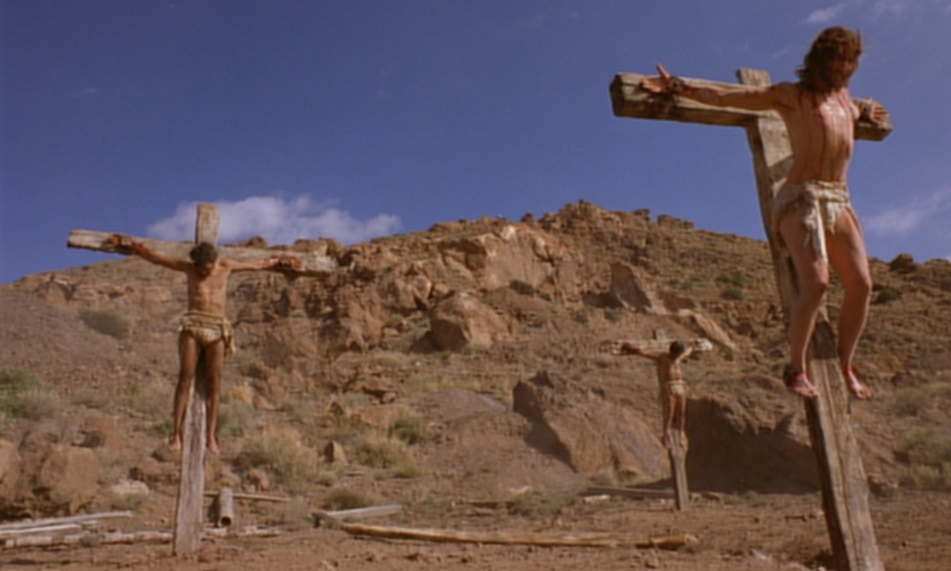
Psalm 34:20 NLT
"For the Lord protects the bones of the righteous;
not one of them is broken!"
Notes:
Ps. 34:20 prophesied, “For the Lord protects the bones of the righteous; not one of them is broken!”

Slide 179
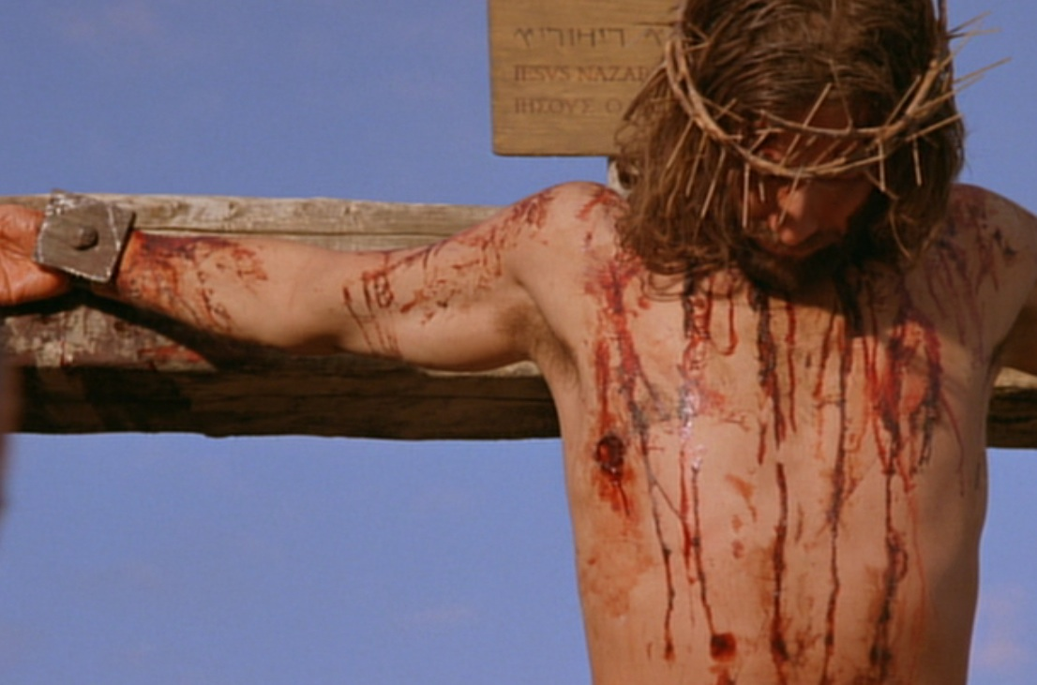
Zechariah 12:10 NLT
"Then I will pour out a spirit of grace and prayer on the family of David and on the people of Jerusalem. They will look on me whom they have pierced and mourn for him as for an only son. They will grieve bitterly for him as for a firstborn son who has died."
Notes:
“They will look on the one they pierced” (Zech. 12:10) was fulfilled in John 19:37 with the soldier thrusting a spear into his side.

Slide 180
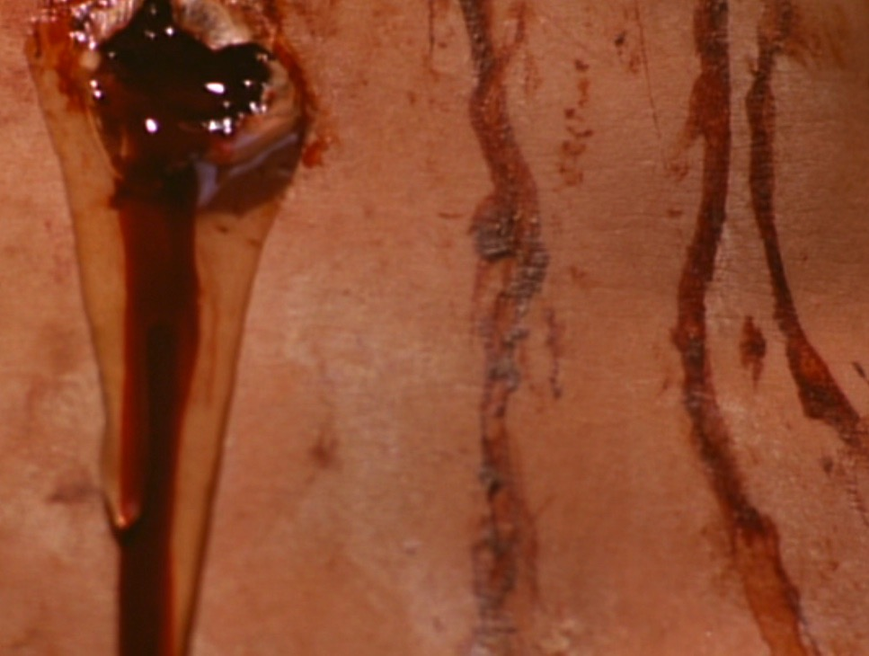
"Blood & Water"
Heart failure?
New temple (2:19)?
Life through his blood (1:13)?
Death (1 John 1:1)?
Notes:
Why does John mention water and blood from Jesus's side wound?

Slide 181
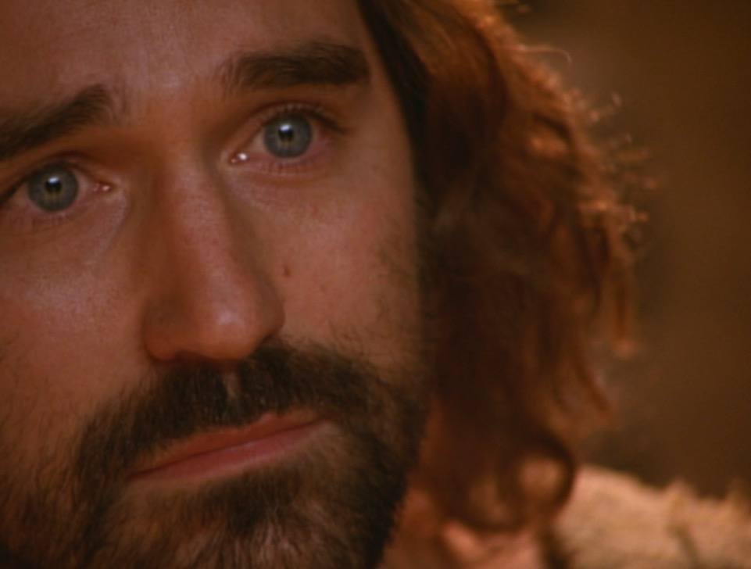
"(This report is from an eyewitness giving an accurate account. He speaks the truth so that you also can believe.)" (John 19:35 NLT)
Notes:
To sum up, John’s purpose in verse 35 was so you and I can believe in Jesus.

Slide 182
Slides on
Isaiah 53

Slide 183
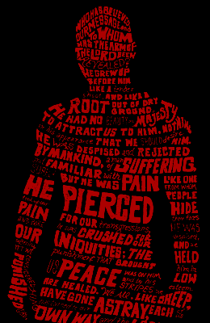
THE SUFFERING SERVANT
WHO IS HE?
____________
THE MYSTERY OF ISAIAH 53

Slide 184

THE SUFFERING SERVANT
ISAIAH 53
Messiah or Israel?

Slide 185
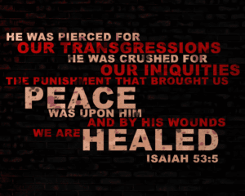
THE SUFFERING SERVANT
HE WAS PIERCED FOR
OUR TRANSGRESSIONS
HE WAS CRUSHED FOR
OUR INIQUITIES
THE PUNISHMENT THAT BROUGHT US
PEACE
WAS UPON HIM
AND BY HIS WOUNDS
WE ARE
HEALED
ISAIAH 53:5
Notes:
Translators should delete the image of the verse and move the editable text over onto the slide.

Slide 186
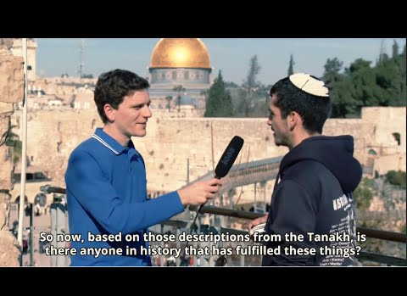
"The Forbidden Chapter" in the Hebrew Bible
Isaiah 53
Notes:
23-Isaiah 53 'The Forbidden Chapter' in the Hebrew Bible.mp4 (https://www.youtube.com/watch?v=cGz9BVJ_k6s)

Slide 187
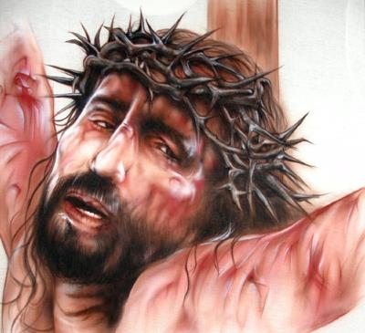
Isa 53:4-5 Surely he has borne our griefs and carried our sorrows; yet we esteemed him stricken, smitten by God, and afflicted. But he was wounded for our transgressions; he was crushed for our iniquities; upon him was the chastisement that brought us peace, and with his stripes we are healed.
Notes:
Job and Jesus are parallel in terms of innocent suffering.
_______________
OB-28-Healing-50
OS-19-Job-34
OS-23-Isaiah49-59—slide 54

Slide 188
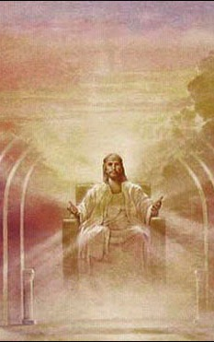
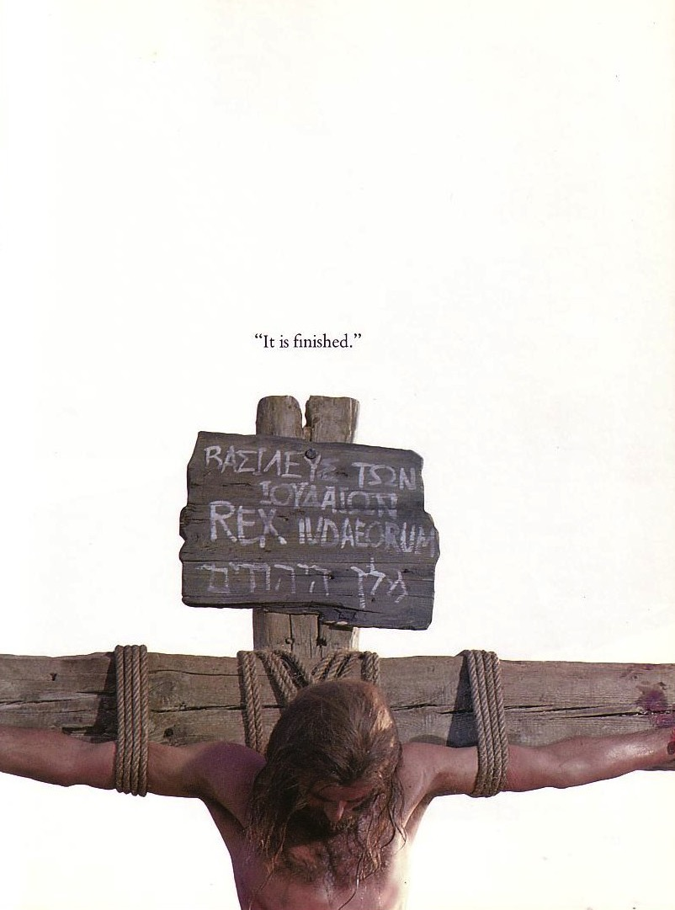
The Same Messiah?
"He will rule with fairness and justice from the throne of his ancestor David for all eternity"
(Isaiah 9:7)
"He was despised and rejected—a man of sorrows, acquainted with deepest grief…"
(Isaiah 53:3)
Notes:
188
Jewish scholars of the intertestamental period could not reconcile Isaiah's two seemingly contradictory depictions of the Messiah. Therefore, some thought there existed two Messiahs—one to rule and one to suffer. Others said Isaiah 53 depicted not the Messiah but the suffering Jewish people.

Slide 189
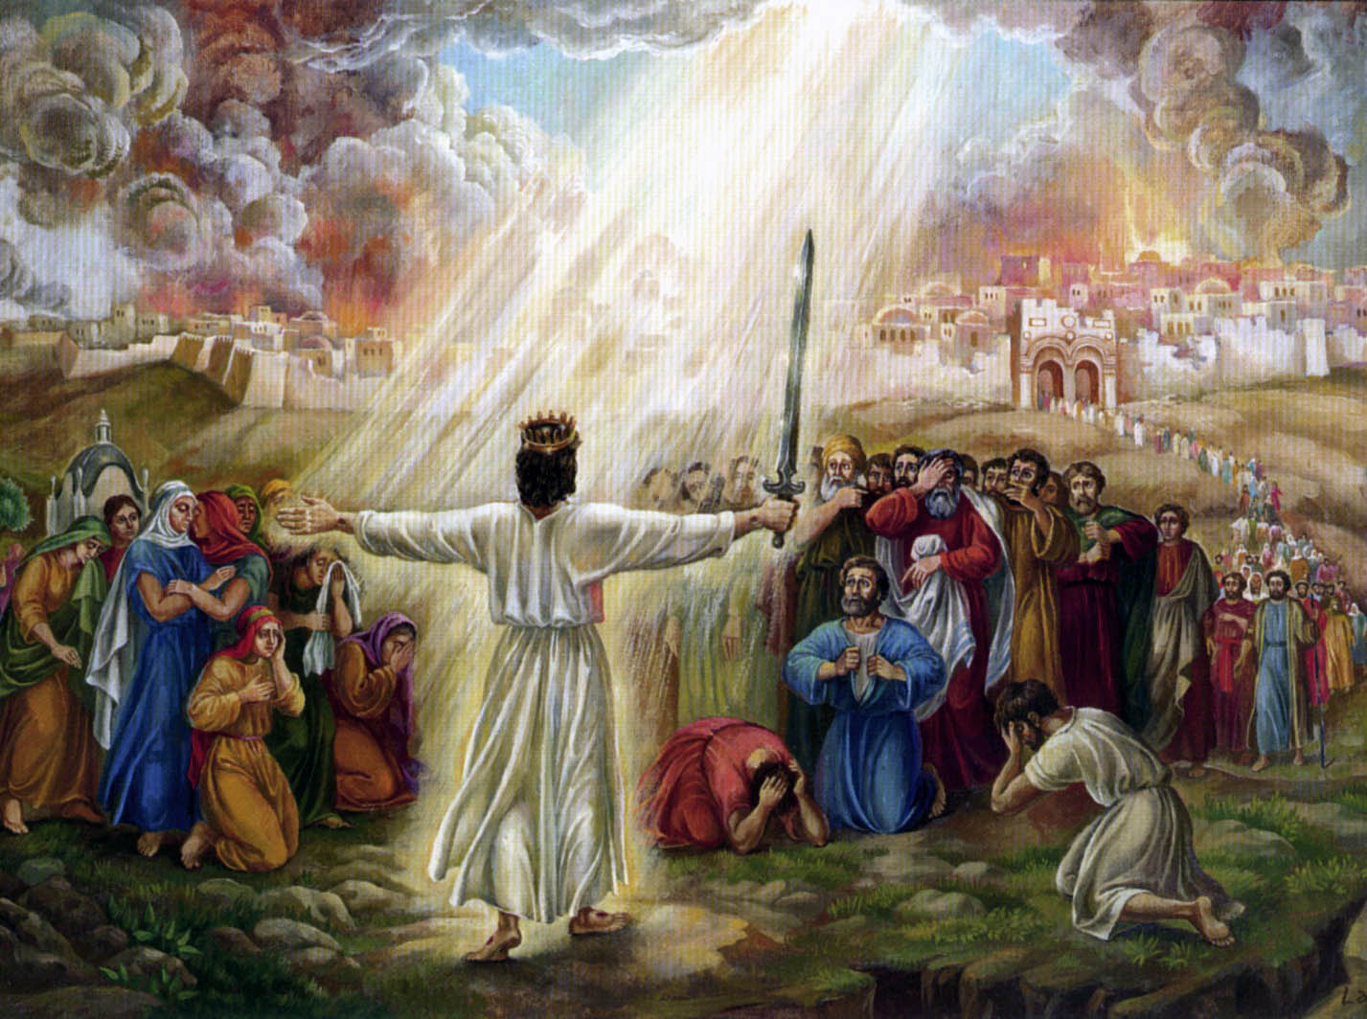
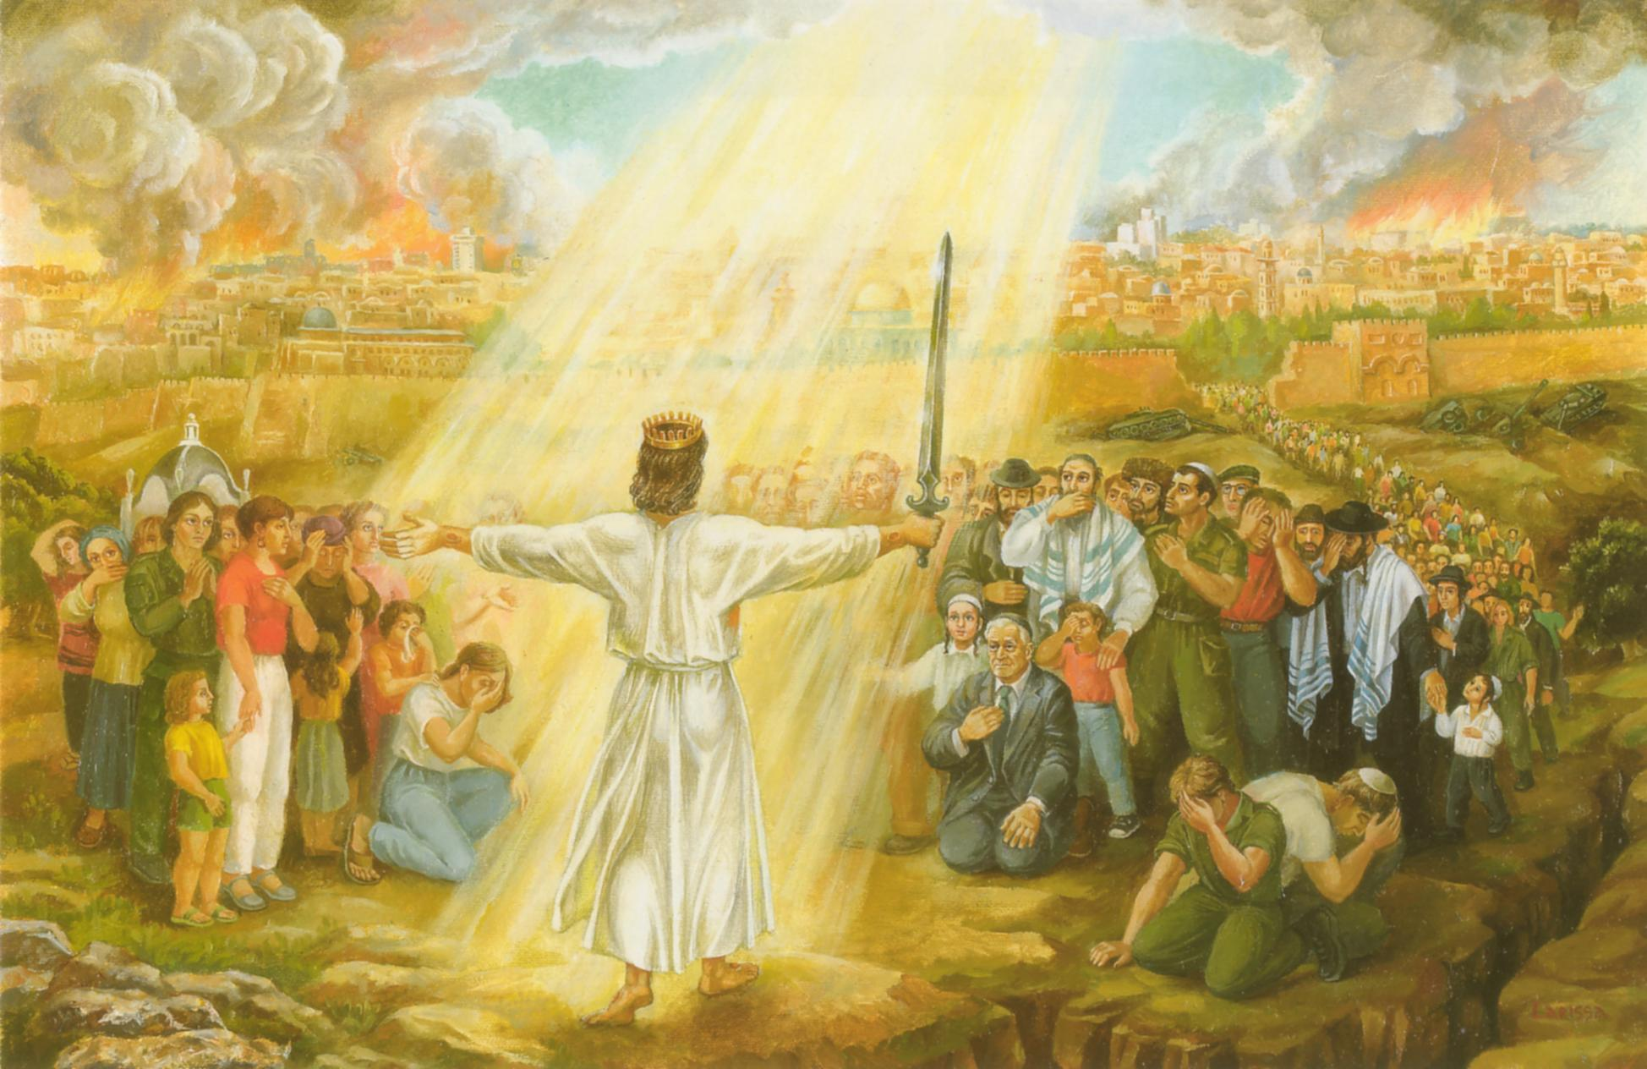
“And it will come about in that day that I will set about to destroy all the nations that come against Jerusalem. And I will pour out on the house of David and on the inhabitants of Jerusalem, the Spirit of grace and of supplication, and they shall look upon Me whom they have pierced, and shall mourn for Him, as one mourns for his only son.”
Zechariah 12:9-10

Slide 190
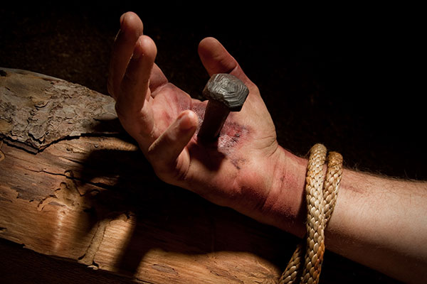
The Repentance of Israel
"Then I will pour out a spirit of grace and prayer on the family of David and on the people of Jerusalem. They will look on me whom they have pierced and mourn for him as for an only son. They will grieve bitterly for him as for a firstborn son who has died"
(Zechariah 12:10 NLT).
Notes:
"I will pour out on the house of David and on the inhabitants of Jerusalem, the Spirit of grace and of supplication, so that they will look on Me whom they have pierced, and they will
mourn for Him, as one mourns for an only son, and they will weep bitterly over Him like the bitter weeping over a firstborn. Zech. 12:10 Some Jewish interpreters see this verse as a reference to Gentile nations who will look to God for forgiveness for having “pierced” Him by
their inflicting suffering on the Jewish people. But the subject of each of the verbs in this sentence is clearly the people of Israel. So the most natural way to understand this verse is to see it as a reference to the Holy Spirit’s moving on the nation Israel to see the One they had pierced as though He was their own firstborn son, and to seek God’s gracious forgiveness and cleansing.
What is striking about this verse is that the One whom they had pierced, and for whom they will
mourn is the Lord Himself—a not too subtle reference to the deity of Christ."
—Rick Rood email 5 December 2023

Slide 191

"Look!
He comes with the clouds of heaven.
And everyone will see him— even those who pierced him.
And all the nations of the world will mourn for him. Yes! Amen!"
Rev. 1:7 NLT
cf. Zech. 12:10

Slide 192
3. Accompanying Signs
§ 181
Matthew 27:51-56; Mark 15:38-41; Luke 23:45, 47-49
Christ’s death tears the veil for all to come to God, shakes the earth to redeem creation, and raises saints to show believers’ resurrection

Slide 193

The Temple Veil

Slide 194

The Temple Veil Torn (Matt 27:51)
Notes:
Matt. 27:50 Then Jesus shouted again, releasing his spirit. ⁵¹ At that moment, the curtain in the sanctuary of the Temple was torn in two, from top to bottom. The earth shook, rocks split apart, ⁵² and tombs opened. The bodies of many godly men and women who had died were raised from the dead. ⁵³ They left the cemetery after Jesus’ resurrection, went into the holy city of Jerusalem, and appeared to many people.
Why did the veil tear? (People now had access to God's presence.)
Why did it tear from top to bottom? (It was a miraculous tear, not from priests pulling at the bottom.)
Sadly, temple worship continued for 37 more years (AD 33-70) until Titus destroyed the temple. It seems likely that priests sewed the veil back together, thus rejecting God's open access to His presence!

Slide 195
F. The Burial of Christ
§ 182
Matthew 27:57-61; Mark 15:42-47; Luke 23:50-56;
John 19:31-42
Due to the Sabbath approaching and to prevent defilement from a corpse, Christ is quickly buried in Joseph of Arimathea's tomb

Slide 196
I. Christ fulfilled Scripture in his selfless death (19:16b-37).
Selflessness
Fulfillments
Carried cross
Clothes divided
Crucifixion
Thirsted
Cared for Mary
Paid for sin
Pierced side
Notes:
John 19:16b-37 shows the evidence of Christ’s selfless nature and the fulfillment of many OT prophecies. These show us that his death was unlike any other in that it was a sacrificial death for our sins. A second way we know he died for us is in verses 38-42, which show that…

Slide 197

II. Christ's burial proved he was truly dead (19:38-42).
Notes:
We know Jesus really did pay for our sin by the fact that he truly died, which sets the stage for the resurrection in John 20.

Slide 198

Joseph of Arimathea
Notes:
The previously secret believers, Joseph and Nicodemus, prepared his body for burial in 33 kilos of spices (19:38-40).

Slide 199


33 Kilos of Spices
Notes:
Where could they get so many spices quickly and a new tomb so close by? We don’t know, but what we do know is that…

Slide 200

Closing the Tomb
Notes:
The appearance of these men reminds us that many people exist even today who are secret believers—men and women who feel they cannot openly declare Christ.

Slide 201

Why was a tomb burial vital?
Notes:
The body was laid in a new, expensive, rock-hewn garden tomb rather than the Potter’s Field (19:41-42).
Why was it so important that Jesus was buried in a tomb?
The meticulous wrapping and the use of a staggering 33 kilos of spices in the burial process served as undeniable proof of his death.

Slide 202

Hinnom Valley
Notes:
Usually, a criminal’s body was thrown into the Valley of Hinnom and burned or eaten by dogs. But if his body were burned there, the claim of a resurrection would be absurd. Therefore, his enemies protected his body for credibility purposes!

Slide 203

Joseph & Nicodemus
Notes:
The tomb burial allowed secret believers Nicodemus and Joseph to come forward.

Slide 204

He was truly dead
Notes:
But what was the main reason the burial of Christ is significant? It proved that Christ was indeed dead. You can’t have a resurrection unless you first have a dead man!

Slide 205

He Died for You!
But how do we know that Christ's death actually paid for our sin?
Notes:
We began with the question, “How do we know that Christ’s death actually paid for our sins?” So, how can we be sure his death was unlike any other? I sum up the whole passage in this way…

Slide 206

Main Idea
Christ must have died for our sin since it was so prophetic, selfless and certain.
Notes:
Jesus’ death was a selfless fulfillment of Scripture ending in tomb burial (restated MI).

Slide 207
I. Christ fulfilled Scripture in his selfless death (19:16b-37).
Selflessness
Fulfillments
Carried cross
Clothes divided
Crucifixion
Thirsted
Cared for Mary
Paid for sin
Pierced side
Notes:
How do we know that Christ’s death actually paid for our sin?

Slide 208
II. Christ's burial proved he was truly dead (John 19:38-42).

Slide 209

To End All Wars

Slide 210

To End All Wars

Slide 211

Golgotha, in The Church of the Holy Sepulcher
Notes:
Visiting the tomb of Jesus can get us all caught up in the gaudy display—

Slide 212

Golgotha, in The Church of the Holy Sepulcher
Notes:
—so that we miss the key point that Christ actually died for our sin.

Slide 213

Golgotha, in The Church of the Holy Sepulcher
Notes:
The rock of Golgotha is barely seen!

Slide 214

Who crucified Jesus?
Notes:
Let me leave you to answer one of two questions…

Slide 215


It is
FINISHED
Notes:
Pre-believers: Will you trust in Christ’s death that paid for your sin?

Slide 216














Cross Too Heavy?
Notes:
Believers: What cost could you pay that is too much for the one who died for you? Please watch this sequence of pictures…

Slide 217
G. The Sealing of the Tomb
§ 183
Matthew 27:62-66
The Sanhedrin secures Roman guards at the tomb to prevent a fake resurrection, which only increases resurrection witnesses

Slide 218

The Sealing of the Tomb
Notes:
This depicts only three soldiers, but typically four formed a guard.

Slide 219

The Chronology of Christ
Dr. Rick Griffith • Jordan Evangelical Theological Seminary • BibleStudyDownloads.org

Slide 220

A Definitive Work

Slide 221
Dating the Birth of Christ
56
Date of Birth: ca. December 5 BC/January 4 BC
Jesus was born between these two dates:
Census of Quirinius/Cyrenius (Luke 2:1-5)
Death of
Herod the Great
(Matt. 2:1; Luke 1:5)
6 BC
29 March-11 April
4 BC
Harold W. Hoehner, Chronological Aspects of the Life of Christ (Zondervan, 1977), 114
Notes:
The historian Josephus records an eclipse of the moon associated with Herod's death, placing it between the above two dates.
_______________
Common-421
BE-42-Luke-34
LC-00-Chronology of Christ-4
LC-09-Rejection-221
NC-10-Reliability of Acts-8
NS-00-NT Introduction-62
NS-01-Matt1-14-slide
NS-03-Luke1-12-slide 162

Slide 222
Dating the Start of Christ's Ministry
56
Commencement of Ministry: ca. Autumn AD 29
Jesus probably began his ministry between these two dates:
15th YEAR OF THE REIGN OF TIBERIUS*
(Luke 3:1-3)
19 August
AD 28
31 December
AD 29
*Reckoned from either the Julian Calendar or Tiberius Regnal Year
Harold W. Hoehner, Chronological Aspects of the Life of Christ (Zondervan, 1977), 114
Notes:
The emperor Tiberius succeeded the emperor Augustus upon the latter's death in AD 14. Luke adds 15 years to AD 14 to reveal a 1.5-year window of time for John to commence his ministry in the Judean wilderness.
_________
Common-422
LC-00-Chronology of Christ-5
LC-09-Rejection-222
NC-10-Reliability of Acts-9
NS-00-NT Introduction-66
NS-01-Matt1-14-slide
NS-03-Luke1-12-slide 197

Slide 223

The Duration of Christ's Ministry
56
Autumn AD 29 – 3 April AD 33 (3.5 Years)
John alone notes three Passovers
Therefore, Christ's ministry was at least 2.5 years
Commencement of Christ's Ministry
Passover #1
April 7,
AD 30
Passover #2
Passover #3
April 25,
AD 32
Passover #4
April 3,
AD 33
Autumn
AD 29
John 2:13, 23
Unstated by John
Mark 2:23-28
Luke 6:1-5
Matthew 12:1-8
John 6:4
John 11:55–12:1
Harold W. Hoehner, Chronological Aspects of the Life of Christ (Zondervan, 1977), 114
Notes:
Christ's 3½-year-ministry spanned four Passovers. However, the Synoptics mention only one Passover (#2 on this timeline), which could give the impression of only a year-old ministry. John fills in the details, though, by showing three other Passovers not mentioned by Matthew, Mark, or Luke.
_________
Common-423
LC-00-Chronology of Christ-6
LC-09-Rejection-223
NC-10-Reliability of Acts-10
NS-00-NT Introduction-66
NS-01-Matt1-14-slide
NS-03-Luke1-12-slide 198

Slide 224
Chronology of Jesus in Luke
38a
4 BC
1 BC
AD 1
14
29
30
33
35
Jesus
Born
–1 year–
Tiberius
Crowned
15th Yr.
Tiberius
–
John &
Jesus
Jesus
Died
Paul
Believed
"In the 15th year of Tiberius… John preached" (Luke 3:1, 3)
32-33 years
"Now Jesus himself was about 30 years old when he began his ministry" (Luke 3:23)
Notes:
Scholars debate whether Jesus died in AD 30 or AD 33. Both years had Passover on a Friday, but John's ministry had to begin in AD 29 as this was the 15th year of Tiberius in Rome (Luke 3:1). John's gospel has three Passovers in the ministry of Jesus, putting his crucifixion in AD 33.
But two questions arise:
Didn't Jesus begin his ministry at age 30? His birth in 4 BC would then favor a crucifixion in AD 30. Yet note that Luke wrote that Jesus was about age 30. This type of general wording is unusual in Luke's gospel which records many exact dates. Perhaps Luke is saying that Jesus was like the normal man of the time who began work on his own at age 30, yet with a twist in that Jesus was "about" 30 instead exactly 30, so an age of 32 would do.
Didn't Jesus die at age 33? This has been often taught but no verse of Scripture supports it. Rather, it is a deduction assuming a 4 BC birth and an AD 30 death. Instead, Luke 3:1 leads us to the conclusion that Jesus was more around age 36 or 37.
_________
Common-424
BE-42-Luke-41
LC-00-Chronology of Christ-7
LC-09-Rejection-224
NC-10-Reliability of Acts-11
NS-00-NT Introduction-66
NS-01-Matt1-14-slide
NS-03-Luke1-12-slide 167, 199

Slide 225
Age of Jesus
When He Began His Ministry
38a
"Now Jesus himself was about 30 years old when he began his ministry" (Luke 3:23)
1yr
3 yrs
28 / 29 years
4 3 2 1 1 2 3 4 5 6 7 8 ……………………………………………….…………………… 26 27 28 29
BC AD
3 + 1 + 28 = 32 years (Non-inclusive of AD 29)
3 + 1 + 29 = 33 years (Inclusive of AD 29)
Adapted from Michele Ang (NT Survey student, SBC, 2006)
Notes:
Luke states the age of Jesus upon his ministry in an ambiguous way, giving room for a few years before or after age 30.
_________
Common-425
LC-00-Chronology of Christ-8
LC-09-Rejection-225
NC-10-Reliability of Acts-12
NS-00-NT Introduction-66
NS-01-Matt1-14-slide
NS-03-Luke1-12-slide 200

Slide 226

A Prophetic Weekend
Thursday
Friday
Saturday
Sunday
Galilean
Passover
Unleavened Bread
Firstfruits
Judean
Passover
Unleavened Bread
Firstfruits
Last Supper
Crucifixion
Resurrection
2 April 33
3 April 33
5 April 33
“But now Christ has been raised from the dead, the first fruits of those who are asleep” (1 Cor 15:20 NAU).
Christ is the only one ever resurrected, but as such, he is also the first among many who will join a resurrected body.
Notes:
Leviticus 23 gives the order of three key feasts of Israel: • Passover, • Unleavened Bread, and • Firstfruits.
• But how could Jesus have Passover Thursday night but then die at 3 PM the next day on Friday when the Passover lambs were being slaughtered? And why did the Jewish leaders want the bodies off the cross quickly as Passover was approaching when Jesus had already celebrated Passover the night before?
• The answer is that Galilean Jews celebrated Passover the day before • Judean Jews. Since his disciples were Galileans, Jesus naturally celebrated on their timetable.
• The Feast of Unleavened Bread always began the day after Passover (Lev 23:5-6).
• Then Firstfruits followed sometime later on the first Sabbath after the first crops began to ripen (Lev 23:11). It indicated that millions of additional sheaves would follow until the entire harvest came in at Pentecost. In AD 33, these three celebrations occurred one after another on three consecutive days!
The significance is astonishing. • Christ predicted his death at the Last Supper Thursday night. • Then Jesus died on the Judean Passover • so that believers can live a life without yeast (Unleavened Bread), • which immediately followed with his resurrection on Firstfruits as he is the first and only human ever to obtain a glorified body as an installment for millions more to follow (1 Cor 15:20)!
We know these dates to be • 2 April 33 for the Thursday night Passover, • 3 April 33 was the day of his crucifixion, and • Jesus rose from the dead on the Feast of Firstfruits on 5 April 33.
————————————
Common-435
OB-25-Feasts-35
OS-03-Leviticus-303
OS-26-Ezek40-43-Slide105
LC-00-Chronology of Christ-8
LC-09-Rejection-226
LC-10-Resurrection-35
NB-11-Feasts-35
NC-10-Reliability of Acts-13
NS-00-NTS Chronology-slide 40
NS-00-Chronology of Christ-8
NS-01-Matt15-28-slide 315
NS-02-Mark9-16-slide 262
NS-03-Luke13-24-slide 292
NS-04-John12-21-slide 390

Slide 227
Black

Slide 228


Life of Christ link at BibleStudyDownloads.org
Get this presentation for free!
Notes:
NT Survey (ns)

