Slide 1
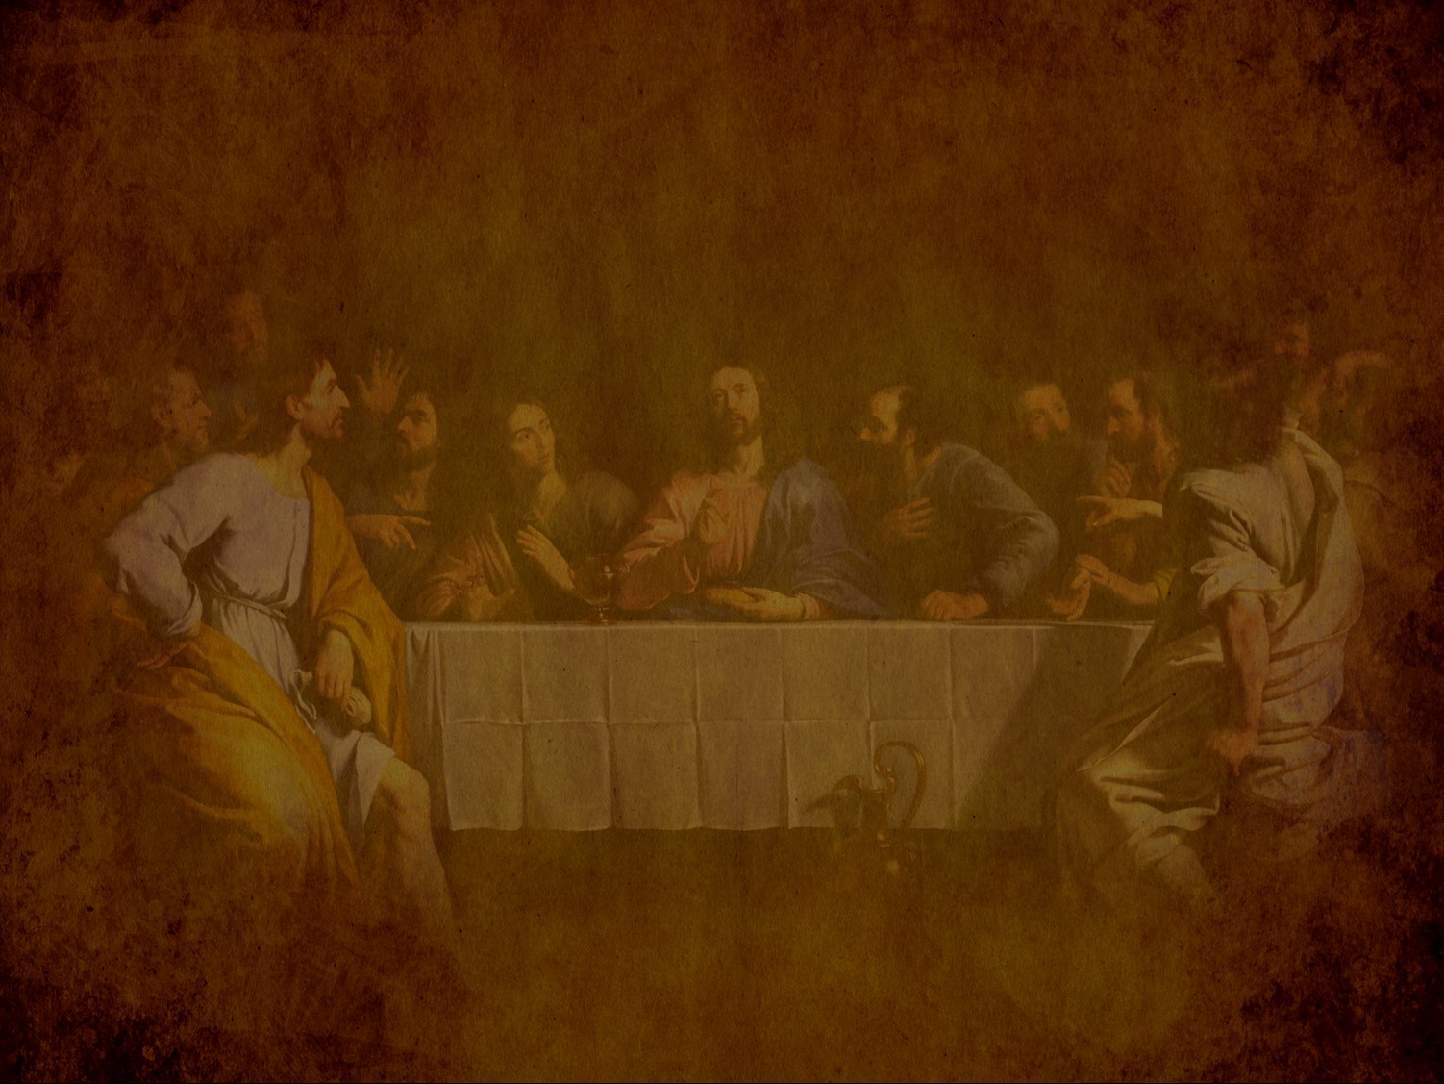
Preparation for the Death of the King
§§ 150-167
Christ prepares for his death by predicting both Israel's future and his final days and giving precepts and prayers
Section summaries based on J. Dwight Pentecost, A Harmony of the Words and Works of Jesus Christ (Grand Rapids: Zondervan, 1981)
Dr. Rick Griffith • Jordan Evangelical Theological Seminary • BibleStudyDownloads.org
Notes:
Small Group Discussion: If you knew that you were going to die in a week, what would you do?

Slide 2
Pentecost Outline
Introduction of the King
Authentication of the King
Controversy over the King
Instruction of the Twelve by the King
Opposition to the King
Preparation of the Disciples by the King
Official Presentation of the King
Preparation for the Death of the King
Rejection of the King
Resurrection of the King

Slide 3

Increasing Polarization
Resurrection
Preparation for Death
Preparation of Disciples
Instruction
Authentication
Introduction
Controversy
Opposition
Presentation
Rejection
Notes:
The Life of Christ brought increasing polarization. The more Jesus showed about himself, the greater the resistance to him and his message. Also, the more intense the controversy leading to opposition, the higher priority Christ placed on preparing his men for when he would be gone. The climactic rejection when he presented himself as king of Israel at the Triumphal Entry resulted in rejection to the point of crucifixion followed by the victory of resurrection.
Introduction of the King
Authentication of the King
Controversy over the King
Instruction of the Twelve by the King
Opposition to the King
Preparation of the Disciples by the King
Official Presentation of the King
Preparation for the Death of the King
Rejection of the King
Resurrection of the King

Slide 4
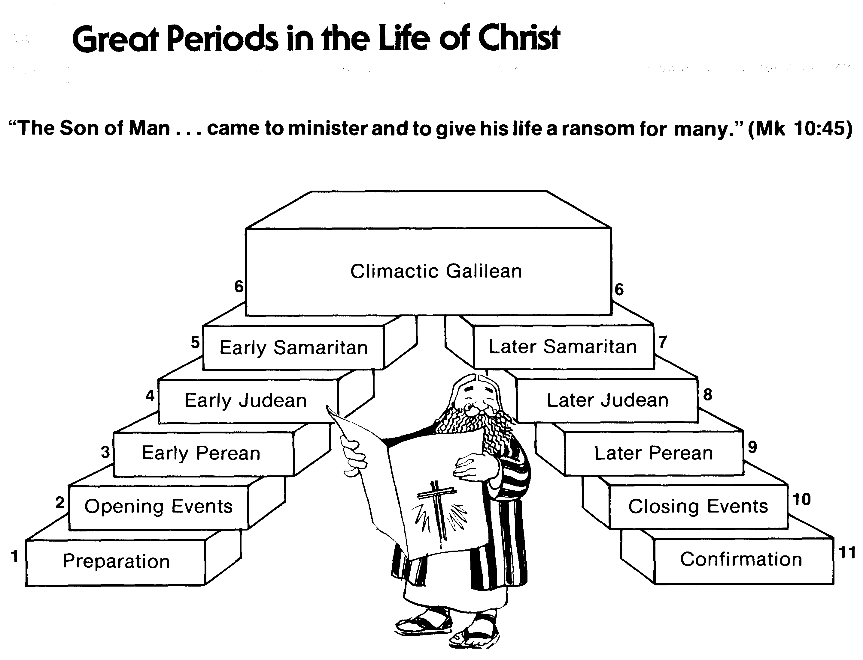
Great Periods in the Life of Christ
55
“The Son of Man… came to minister and to give his life a ransom for many” (Mark 10:45)
Climactic Galilean
Early Samaritan
Later Samaritan
Early Judean
Later Judean
Early Perean
Later Perean
Opening Events
Closing Events
Preparation
Confirmation
Walk Thru the New Testament seminar (used with permission)
Notes:
The Walk Thru outline of the life of Christ forms a chiasm or literary arrangement with repeating elements in the opposite order. This structure makes Confirmation parallel to Preparation, Closing Events parallel to Opening Events, etc. until the only event without parallel becomes the focus: Climatic Galilean. Such an arrangement of material was common in antiquity and is seen in both the OT (e.g., Zephaniah) and the NT (1 Thess) where the central teaching appears in the middle of each writing.
Small Group Assignment: Explain this slide to your group member(s) and have the others explain it back.
After the beginning events of stages 1-3, Jesus also gets farther away from his Jewish roots in Judea (4), to go to the Samaritans (5), and even farther to Galilee (6), where most Gentiles lived. He ministered to Jews in Galilee, of course, but this climatic period was the focus of his ministry.
_______
LC-00-Syllabus-63
LC-01-Introduction-265
LC-05-Opposition-4

Slide 5
Preparation for the Death of the King
Predictions
Preparation
Precepts
Prayer by Christ for Believers
Prayer in the Garden
Notes:
Jesus knew he would die on Passover, the event that we call Good Friday. Therefore, he did these five important things:
Predictions: He told his men that he would return (Olivet Discourse)
Preparation: Ten events reaffirmed that he was in control even of his death.
Precepts: His Upper Room Discourse assured them that the Spirit would help them depend on him.
Prayer by Christ for Believers: He requested the Father that the church would remain united until his return.
Prayer in the Garden: He prayed that he would be faithful to die for humanity despite his will to escape it.

Slide 6
A. Predictions by Christ
§ 150
Matthew 24:1–25:46; Mark 13:1-37; Luke 21:5-36
Christ foretells the events that will accompany his Second Advent so that Israel might know that he will appear as Judge

Slide 7
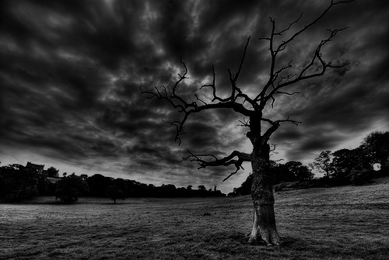
The Olivet Discourse (Matthew 24–25)
78
Adapted from Mark L. Bailey, DTS class notes, 1986
Second Coming (27-31):
Signs in the Heavens (29-30)
Coming of the Son of Man (27, 30)
Bird Supper (28)
Salvation of Elect (31)
Abomination of Desolation (15-20)
False Christs & Prophets (23-26)
Beginning of Birth Pangs (4-8)
Great Tribulation (9-14, 21-22)
Judgment of the Nations
Sheep
Goats
Correlation with Revelation
12:7-12 13:14
12:8-17 8:1–19:10
(Matt. 25:31-46)
6:1–8:5
19:11-21

Slide 8
1. The Question
Matthew 24:1-3; Mark 13:1-4; Luke 21:5-7
Jesus predicts the temple’s destruction after the disciples ask when it will be destroyed, and when Jesus will return to end the age
Notes:
Matt. 24:1 As Jesus was leaving the Temple grounds, his disciples pointed out to him the various Temple buildings. ² But he responded, “Do you see all these buildings? I tell you the truth, they will be completely demolished. Not one stone will be left on top of another!”
Matt. 24:3 Later, Jesus sat on the Mount of Olives. His disciples came to him privately and said, “Tell us, when will all this happen? What sign will signal your return and the end of the world?”
_________
Mark 13:1 As Jesus was leaving the Temple that day, one of his disciples said, “Teacher, look at these magnificent buildings! Look at the impressive stones in the walls.”
Mark 13:2 Jesus replied, “Yes, look at these great buildings. But they will be completely demolished. Not one stone will be left on top of another!”
Mark 13:3 Later, Jesus sat on the Mount of Olives across the valley from the Temple. Peter, James, John, and Andrew came to him privately and asked him, ⁴ “Tell us, when will all this happen? What sign will show us that these things are about to be fulfilled?”
___________
Luke 21:5 Some of his disciples began talking about the majestic stonework of the Temple and the memorial decorations on the walls. But Jesus said, ⁶ “The time is coming when all these things will be completely demolished. Not one stone will be left on top of another!”
Luke 21:7 “Teacher,” they asked, “when will all this happen? What sign will show us that these things are about to take place?”

Slide 9
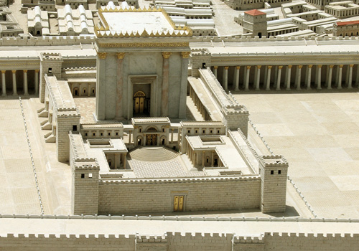
Disciples: What a fantastic temple! (Matt 24:1)
Jesus: "Not one stone here will be left on another" (24:2)
Disciples: When? What sign? (24:3)
Notes:
Was Jesus speaking of the temple complex with its walls or only the buildings comprising the temple itself? Mark shows that it must be only the temple, though Matthew and Luke are unclear.
NLT Mark 13:1 As He was going out of the temple, one of His disciples *said to Him, “Teacher, behold ¹what wonderful stones and ¹what wonderful buildings!” ² And Jesus said to him, “Do you see these great buildings? Not one stone will be left upon another which will not be torn down.”

Slide 10
MARK 13:1-37
yapkimfah Singapore Bible College 23 feb 2006

Slide 11
THE OLIVET DISCOURSE

Slide 12
JESUS’ PROPHECY OF THE DESTRUCTION OF THE TEMPLE
AND HIS RETURN

Slide 13
The Olivet Discourse
Matt. 24–25 | Mark 13 |  | Luke 21:5-38
signs but the end is not yet
the desolating sacrilege (AD 70) |  |  |  | Jerusalem surrounded by armies
great tribulation (Church age) |  |  |  | times of Gentiles
second coming of Christ
command to alert faithfulness
Craig L. Blomberg, Jesus and the Gospels, 324

Slide 14

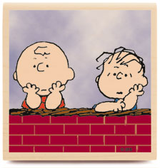

When will the temple be destroyed?
What will be the sign that it is the end?
Notes:
Mark Moore sees Matthew 24:1-28 events fulfilled before AD 70:
"The “Abomination that Causes Desolation” is some action or entity which causes both sacrilege and destruction. Daniel predicted that this terrible thing would be in the holy place (i.e., the temple). The Jews of the intertestamental period applied this appropriately to Antiochus Epiphanes who entered the temple with his Syrian armies in 167 B.C. He murdered a number of worshipers, allowed his troops to fornicate in the temple, slaughtered a pig on the altar of God and then ransacked the edifice (1 Macc. 1:54–61; 6:7). That is a good example of the “abomination that causes desolation.” The “Abomination that Causes Desolation” was also applied to 63 B.C., when the Roman general Pompey ransacked the city and actually entered the Holy of Holies. Yet Jesus looks for a still future fulfillment. Certainly the destruction of A.D. 70 fits that description. This is especially true considering that Luke describes this event as “Jerusalem being surrounded by armies” (21:20). Josephus (JW) describes the horrors of that desolating sacrilege:
5.31
People’s cries were louder than the fighting.
5.429–438
Jewish soldiers tormented citizens for food. Children stole food from elderly parents and mothers stole food from their infants.
5.446–451
Thousands of crucifixions.
6.1–2
Horrid descriptions of the famine and piles of dead bodies.
6.201–213
Cannibalism within the city—a mother consumed her own baby.
6.271–280
Burning of Jerusalem.
6.285–288
False prophets said that God would save them.
6.406
Fire quenched by blood.
6.420
1,100,000 died and 97,000 taken captives and sold into slavery.
7.1–3
Every stone torn down except for a few notable towers.
These predictions surely must refer to A.D. 70. If they refer to the Second Coming, why were the people commanded to flee to the Judean hills? Are they really going to escape Jesus’ coming? And why would Christians want to run from Jesus? Verses 16–18 have no relevance to the Second Coming in this context. But they have great relevance to the destruction of Jerusalem. During the siege that culminated in A.D. 70, Cestius Gallus made a mysterious retreat from the city in A.D. 68 (Josephus, JW 2.538–539).
But the people of the church in Jerusalem had been commanded by a revelation, vouchsafed to approved men there before the war, to leave the city and to dwell in a certain town of Perea called Pella. And when those that believed in Christ had come thither from Jerusalem, then, as if the royal city of the Jews and the whole land of Judea were entirely destitute of holy men … (Eusebius, Ecclesiastical History, 3.5.3)
Jesus was talking about a literal flight out of the city once the Roman armies had surrounded it. It would be easier to escape if the women were not pregnant, if the flight was not in winter, or on Saturday when it would be more difficult to travel because of Sabbath restrictions (cf. Mt 24:19–20). The blessing of barren women is extremely rare, found only in apocalyptic texts of disaster (Wis. 3:13–14; 2 Bar. 10:13b–16). Pregnant women and little children were especially susceptible to the ravages of war (2 Kgs 8:12; 15:16; Psa 137:9; Isa 13:16–18; Amos 1:13; Hos 9:11–14; 10:14; 13:16).⁷ The Christians a generation later took Jesus at his word and did, in fact, escape the massacre of Jerusalem, saving their lives and their families.
Luke claims that all these sufferings were in fulfillment of that which had been written. He is speaking, of course, of OT prophecies such as Daniel 9:27; 11:31; 12:11. But Jesus himself predicted these events on more than one occasion: Lk 13:35; 19:43–44; 23:28–31; Mt 23:35–38. These verses add important details about the specific sufferings during the siege of Jerusalem. They also clarify the fact that this was not a result of poor politics or the natural cruelty of men. This was God’s divine judgment on the city for killing the Messiah, God’s very own Son.
But does this text only refer to A.D. 70? Many Bible students look for another future fulfillment in connection with the “Man of Sin” standing in the Holy Place (2 Thess 2:1–9; Rev 13:3–10).⁸ While that may be true (time will certainly tell), the clear parallel of Luke 21:20 & 24 points to the armies surrounding Jerusalem in A.D. 70. These words were literally and completely fulfilled in the fall of Jerusalem. A future event is not needed to adequately fulfill this prophecy.
JW Jewish Wars
JW Jewish Wars
⁷ Grant J. Pitre, “Blessing the Barren and Warning the Fecund: Jesus’ Message for Women Concerning Pregnancy and Childbirth,” JSNT 81 (2001): 59–80.
⁸ E.g., Lewis Chafer, The Kingdom in History and Prophecy (Philadelphia: Sunday School Times, 1922) and John Walvoord, Matthew—Thy Kingdom Come (Chicago: Moody Press, 1974).
— Mark E. Moore, The Chronological Life of Christ (Joplin, MO: College Press Publishing Company, 2011), 540–541.

Slide 15
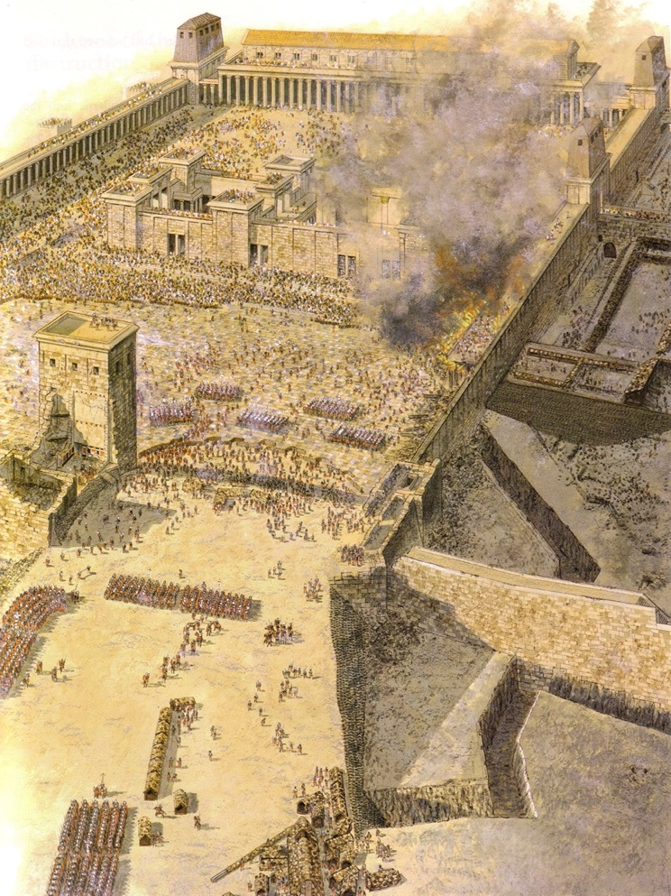
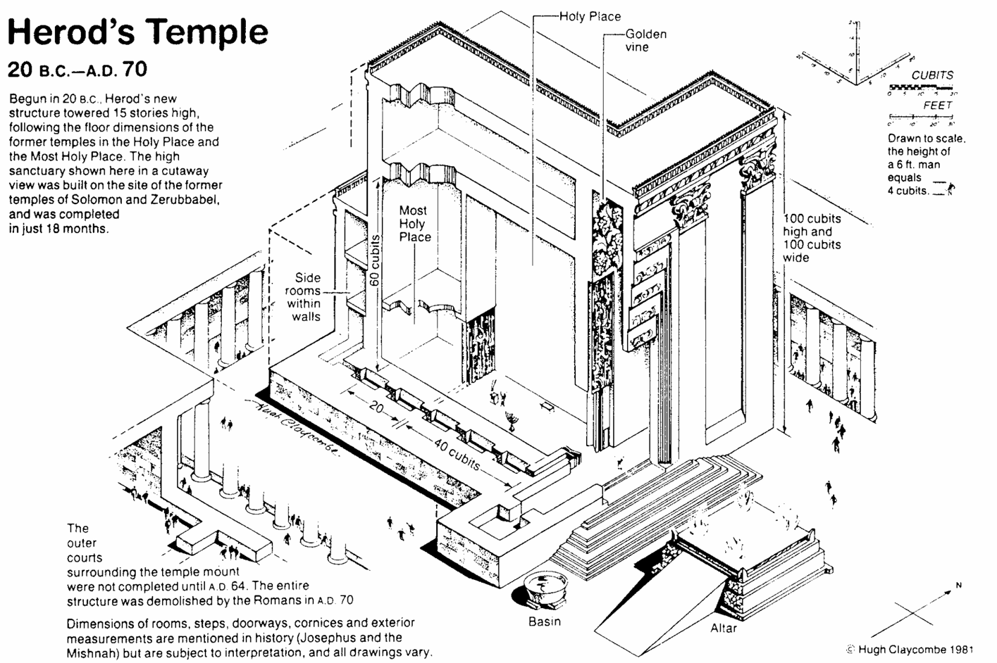
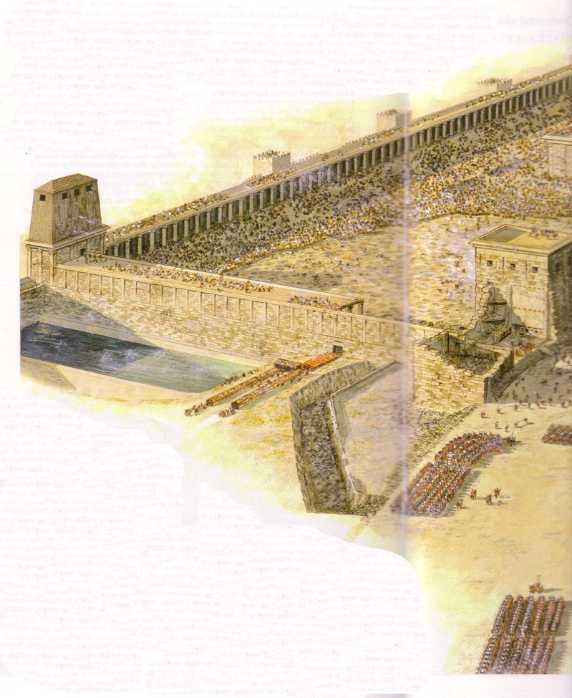
Notes:
"3 But the people of the church in Jerusalem had been commanded by a revelation, vouchsafed to approved men there before the war, to leave the city and to dwell in a certain town of Perea called Pella.^{11"}
¹¹ Pella was a town situated beyond the Jordan, in the north of Perea, within the dominions of Herod Agrippa II. The surrounding population was chiefly Gentile. See Pliny V. I8, and Josephus, B. J. III. 3. 3, and I. 4. 8. Epiphanius (De pond. et mens. 15) also records this flight of the Christians to Pella.
—Source: Eusebius of Caesaria, “The Church History of Eusebius,” in Eusebius: Church History, Life of Constantine the Great, and Oration in Praise of Constantine, ed. Philip Schaff and Henry Wace, trans. Arthur Cushman McGiffert, vol. 1, A Select Library of the Nicene and Post-Nicene Fathers of the Christian Church, Second Series (New York: Christian Literature Company, 1890), 138.

Slide 16
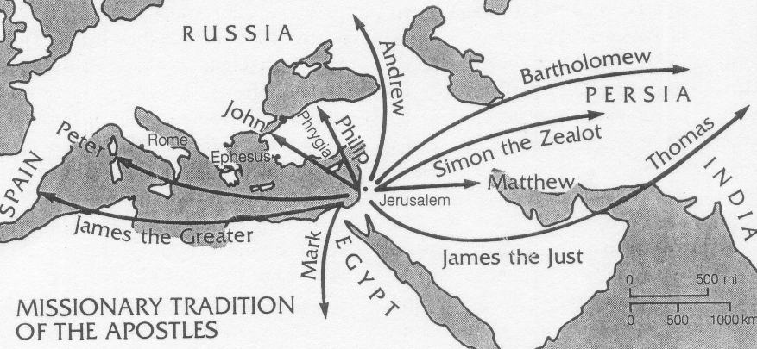
And the story continued…
129
Ruth A. Tucker, From Jerusalem to Irian Jaya, 26

Slide 17
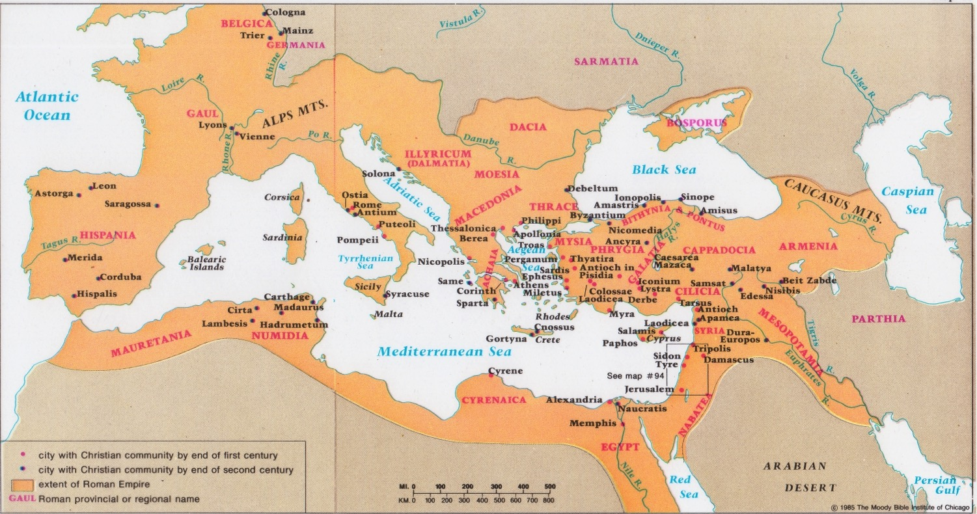
Spread of Early Christianity

Slide 18
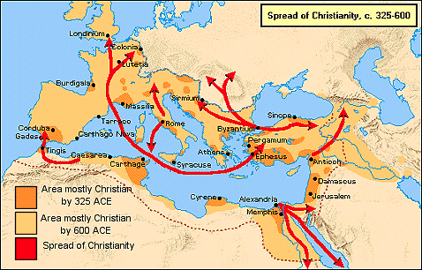
Spread of Early Christianity

Slide 19
2. The Tribulation
Matthew 24:4-26; Mark 13:5-23; Luke 21:8-26
The 70th week of Daniel 9:27 will be a seven-year tribulation before Jesus returns so Israel should prepare for His coming and judgments

Slide 20
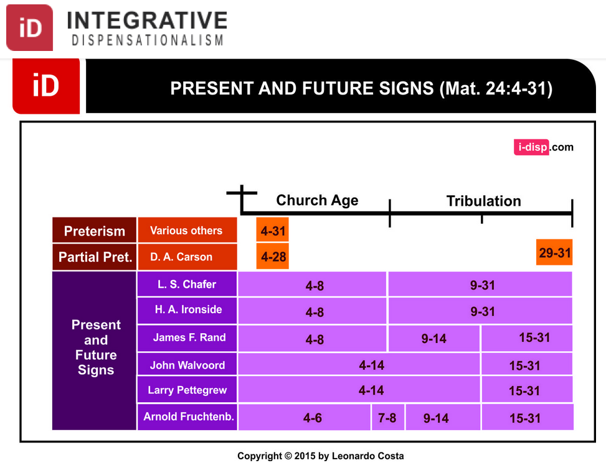
Dispensational Views on Matthew 24
Notes:
Leonardo Costa, "The Fulfillment of Matthew 24:4-31 in Dispensational Tradition," Integrative Dispensationalism website
http://i-disp.com/the-fulfillment-of-matthew-244-31-in-dispensational-tradition/ accessed 24 July 2015

Slide 21
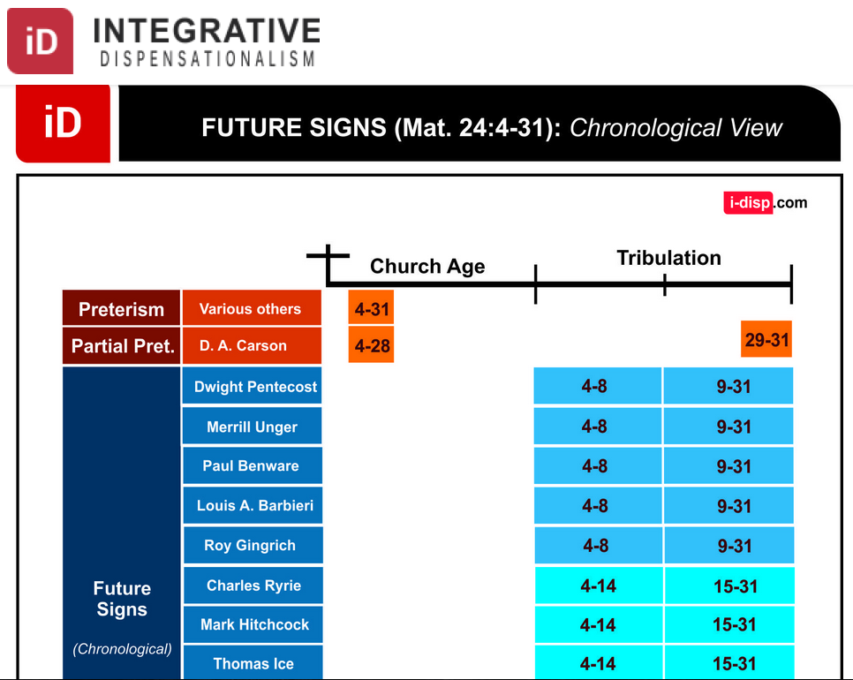
Dispensational Views on Matthew 24
Notes:
Leonardo Costa, "The Fulfillment of Matthew 24:4-31 in Dispensational Tradition," Integrative Dispensationalism website
http://i-disp.com/the-fulfillment-of-matthew-244-31-in-dispensational-tradition/ accessed 24 July 2015

Slide 22
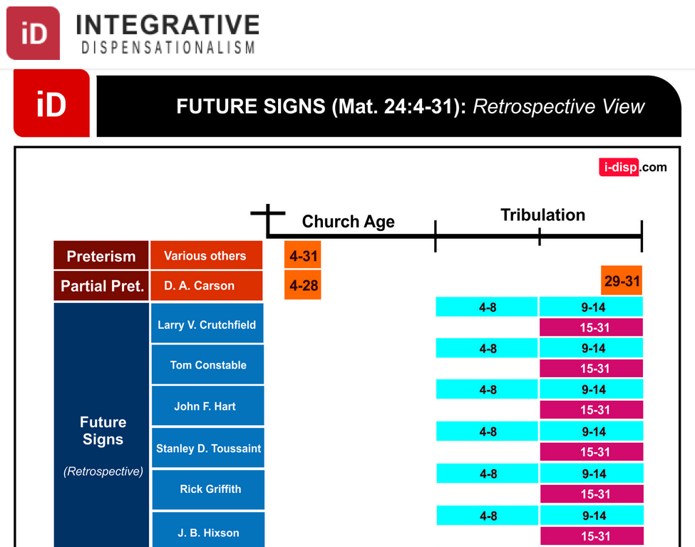
Dispensational Views on Matthew 24
Notes:
Leonardo Costa, "The Fulfillment of Matthew 24:4-31 in Dispensational Tradition," Integrative Dispensationalism website
http://i-disp.com/the-fulfillment-of-matthew-244-31-in-dispensational-tradition/ accessed 24 July 2015

Slide 23
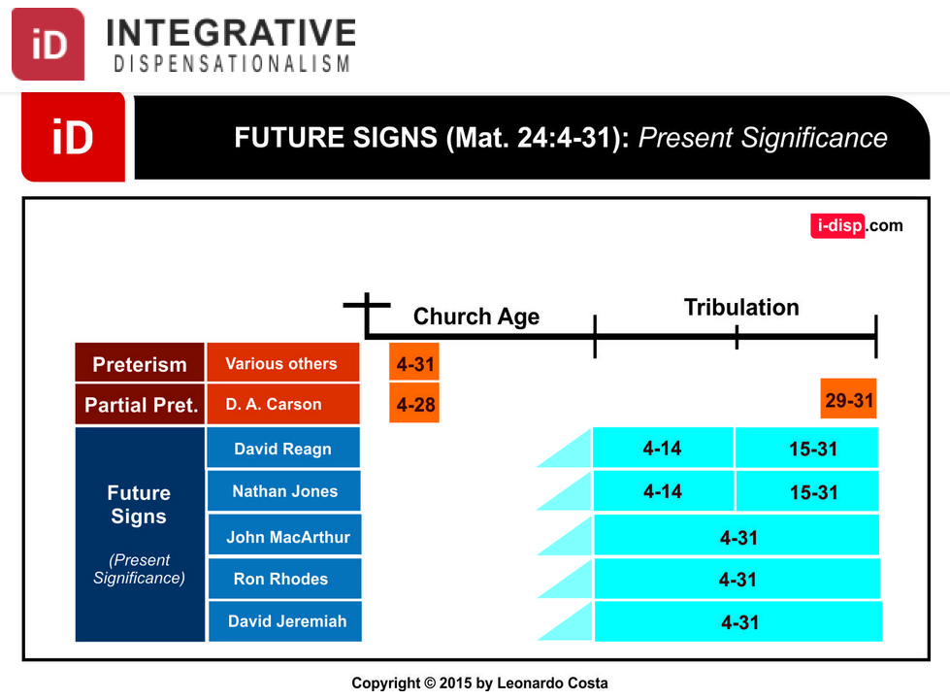
Dispensational Views on Matthew 24
Notes:
Leonardo Costa, "The Fulfillment of Matthew 24:4-31 in Dispensational Tradition," Integrative Dispensationalism website
http://i-disp.com/the-fulfillment-of-matthew-244-31-in-dispensational-tradition/ accessed 24 July 2015

Slide 24


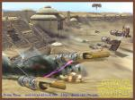





signs (v. 5-8)
deceive many
wars and rumours of wars
not yet the end
famine
persecutions

Slide 25
Keep Alert—Do Not Be Alarmed (Mark 13:1-13)
The Gospel must be preached to all nations (10)
Do not worry about what to say as the Holy Spirit will help (11)
Persecution – family members (12)
Stand firm (13)

Slide 26
“the abomination that causes desolation” (Mark 13:14; cf. Matt 24:15)
It is the detestable thing (Dan 9:24-27)
The Antichrist will claim deity
Believers must flee immediately (14b)
Leave belongings (15-16)
Dreadful for mothers (17)
Pray for good weather (18)

Slide 27
a. The First Half
Matthew 24:4-8; Mark 13:5-8; Luke 21:8-11
The signs of the first 3.5 years of the Tribulation forewarn Israel of the coming judgment at Christ's Second Advent
Notes:
Matt. 24:4 Jesus told them, “Don’t let anyone mislead you, ⁵ for many will come in my name, claiming, ‘I am the Messiah.’ They will deceive many. ⁶ And you will hear of wars and threats of wars, but don’t panic. Yes, these things must take place, but the end won’t follow immediately. ⁷ Nation will go to war against nation, and kingdom against kingdom. There will be famines and earthquakes in many parts of the world. ⁸ But all this is only the first of the birth pains, with more to come.
Mark 13:5 Jesus replied, “Don’t let anyone mislead you, ⁶ for many will come in my name, claiming, ‘I am the Messiah.’ They will deceive many. ⁷ And you will hear of wars and threats of wars, but don’t panic. Yes, these things must take place, but the end won’t follow immediately. ⁸ Nation will go to war against nation, and kingdom against kingdom. There will be earthquakes in many parts of the world, as well as famines. But this is only the first of the birth pains, with more to come.
Luke 21:8 He replied, “Don’t let anyone mislead you, for many will come in my name, claiming, ‘I am the Messiah,’ and saying, ‘The time has come!’ But don’t believe them. ⁹ And when you hear of wars and insurrections, don’t panic. Yes, these things must take place first, but the end won’t follow immediately.” ¹⁰ Then he added, “Nation will go to war against nation, and kingdom against kingdom. ¹¹ There will be great earthquakes, and there will be famines and plagues in many lands, and there will be terrifying things and great miraculous signs from heaven.

Slide 28
b. The Second Half
Matthew 24:9-14; Mark 13:9-13; Luke 21:12-19
The signs of the second 3.5 years of the Tribulation forewarn Israel of the coming judgment at Christ's Second Advent
Notes:
Matt. 24:9 “Then you will be arrested, persecuted, and killed. You will be hated all over the world because you are my followers. ¹⁰ And many will turn away from me and betray and hate each other. ¹¹ And many false prophets will appear and will deceive many people. ¹² Sin will be rampant everywhere, and the love of many will grow cold. ¹³ But the one who endures to the end will be saved. ¹⁴ And the Good News about the Kingdom will be preached throughout the whole world, so that all nations will hear it; and then the end will come.
Mark 13:9 “When these things begin to happen, watch out! You will be handed over to the local councils and beaten in the synagogues. You will stand trial before governors and kings because you are my followers. But this will be your opportunity to tell them about me. ¹⁰ For the Good News must first be preached to all nations. ¹¹ But when you are arrested and stand trial, don’t worry in advance about what to say. Just say what God tells you at that time, for it is not you who will be speaking, but the Holy Spirit.
Mark 13:12 “A brother will betray his brother to death, a father will betray his own child, and children will rebel against their parents and cause them to be killed. ¹³ And everyone will hate you because you are my followers. But the one who endures to the end will be saved.
Luke 21:12 “But before all this occurs, there will be a time of great persecution. You will be dragged into synagogues and prisons, and you will stand trial before kings and governors because you are my followers. ¹³ But this will be your opportunity to tell them about me. ¹⁴ So don’t worry in advance about how to answer the charges against you, ¹⁵ for I will give you the right words and such wisdom that none of your opponents will be able to reply or refute you! ¹⁶ Even those closest to you—your parents, brothers, relatives, and friends—will betray you. They will even kill some of you. ¹⁷ And everyone will hate you because you are my followers. ¹⁸ But not a hair of your head will perish! ¹⁹ By standing firm, you will win your souls.

Slide 29
c. Repetition and Explanation
Matthew 24:15-26; Mark 13:14-23; Luke 21:20-26
The Tribulation terror focuses on the Antichrist as the sign to forewarn Israel of the approaching Second Advent
Notes:
Matt. 24:15 “The day is coming when you will see what Daniel the prophet spoke about—the sacrilegious object that causes desecration standing in the Holy Place.” (Reader, pay attention!) ¹⁶ “Then those in Judea must flee to the hills. ¹⁷ A person out on the deck of a roof must not go down into the house to pack. ¹⁸ A person out in the field must not return even to get a coat. ¹⁹ How terrible it will be for pregnant women and for nursing mothers in those days. ²⁰ And pray that your flight will not be in winter or on the Sabbath. ²¹ For there will be greater anguish than at any time since the world began. And it will never be so great again. ²² In fact, unless that time of calamity is shortened, not a single person will survive. But it will be shortened for the sake of God’s chosen ones.
Matt. 24:23 “Then if anyone tells you, ‘Look, here is the Messiah,’ or ‘There he is,’ don’t believe it. ²⁴ For false messiahs and false prophets will rise up and perform great signs and wonders so as to deceive, if possible, even God’s chosen ones. ²⁵ See, I have warned you about this ahead of time.
Matt. 24:26 “So if someone tells you, ‘Look, the Messiah is out in the desert,’ don’t bother to go and look. Or, ‘Look, he is hiding here,’ don’t believe it!
Mark 13:14 “The day is coming when you will see the sacrilegious object that causes desecration standing where he should not be.” (Reader, pay attention!) “Then those in Judea must flee to the hills. ¹⁵ A person out on the deck of a roof must not go down into the house to pack. ¹⁶ A person out in the field must not return even to get a coat. ¹⁷ How terrible it will be for pregnant women and for nursing mothers in those days. ¹⁸ And pray that your flight will not be in winter. ¹⁹ For there will be greater anguish in those days than at any time since God created the world. And it will never be so great again. ²⁰ In fact, unless the Lord shortens that time of calamity, not a single person will survive. But for the sake of his chosen ones he has shortened those days.
Mark 13:21 “Then if anyone tells you, ‘Look, here is the Messiah,’ or ‘There he is,’ don’t believe it. ²² For false messiahs and false prophets will rise up and perform signs and wonders so as to deceive, if possible, even God’s chosen ones. ²³ Watch out! I have warned you about this ahead of time!
Luke 21:20 “And when you see Jerusalem surrounded by armies, then you will know that the time of its destruction has arrived. ²¹ Then those in Judea must flee to the hills. Those in Jerusalem must get out, and those out in the country should not return to the city. ²² For those will be days of God’s vengeance, and the prophetic words of the Scriptures will be fulfilled. ²³ How terrible it will be for pregnant women and for nursing mothers in those days. For there will be disaster in the land and great anger against this people. ²⁴ They will be killed by the sword or sent away as captives to all the nations of the world. And Jerusalem will be trampled down by the Gentiles until the period of the Gentiles comes to an end.
Luke 21:25 “And there will be strange signs in the sun, moon, and stars. And here on earth the nations will be in turmoil, perplexed by the roaring seas and strange tides. ²⁶ People will be terrified at what they see coming upon the earth, for the powers in the heavens will be shaken.

Slide 30
Olivet Discourse Overview (Matt. 24–25)
27
First Fall of Jerusalem
586 BC
Second Fall of Jerusalem
AD 70
Rapture
1 Thess.
4:14-17
Third Fall of Jerusalem
Second Coming with the Saints
Matt. 23:39; 24:30
Israel
Church Age
Tribulation
Millennium
The Great Tribulation
Dan. 9:27
Matt. 24:15
Israel Scattered Luke 21:24
Return to the Land
606 B.C.
Times of the Gentiles Luke 21:24
Judgment of the Gentile Nations
Matt. 25:31-46
Adapted from Salem Kirban Charts on Revelation (1979), 48
Notes:
Matthew and Luke provide a good overview of details on Israel's restoration, as well as Daniel and 1 Thess.
_________
Common-436
ES-26-Restoration of Israel-376
LC-06-Preparation of the Disciples-168
LC-08-Preparation for the Death of the King-30, 70
NS-01-Matt14-28-slide 157
NS-03-Luke13-24-slide 136

Slide 31
Times of the Gentiles (Luke 21:24)
106
"TIMES OF THE GENTILES"
Luke 21:24
KINGDOM OF JUDAH
THE RESTORATION PERIOD
THE 4 CENTURIES BETWEEN THE TESTAMENTS
CHURCH PERIOD
Acts 15:14-18
Rom. 11:25
"The Throne of the LORD"
Jer. 3:17
Isa. 62:6-7
586 BC
AD 70
BABYLON
PERSIA
GREECE
ROME
538 BC
333 BC
63 BC
"AMONG MANY NATIONS"
"Her sun is gone down while it was yet day" Jer. 15:9
"Because they have forsaken the covenant of the Lord" Jer. 22:8-9
2 Kings 25:8-12
Jer. 15:4, 22:29-30, 30:24
Ezek. 10:4, 28. 11:22-25, 14:22-23
Ezekiel 6:8
Hosea 3:4-5
Hosea 8:8
Amos 9:8-9
Jer. 31:35-37
Jer. 46: 27-28
Jer. 51:5
"I will perform the good thing that I have promised to the house of Israel and to the house of Judah"
Jer. 33:7-14
Isa. 4:2-6
Ezek. 43:1-9
Zech. 2:10-13
Zech. 8:1-8
“Jerusalem will be trampled on by the Gentiles until the times of the Gentiles are fulfilled” (Jesus in Luke 21:24 NIV)
Adapted from Raymond Ludwigson, A Survey of Bible Prophecy (Grand Rapids: Zondervan, 1975), 181
Notes:
The phrase “times of the Gentiles” is not in Daniel. But the concept is throughout his prophecy. It refers to the period when Israel would have no king over its land—beginning around the time of Jerusalem’s destruction and lasting until Jesus rules over the nation after his return.
Jesus alone referred to "the times of the Gentiles" in Luke 21:24. But the entire book of Daniel refers to this period of Gentile rule over Israel that interrupts the nation's rule by a son of David, though not by this phrase.
______
Common-434
BE-42-Luke-80
LC-08-Preparation for the Death of the King-27
OS-27-Daniel-21, 383
NS-03-Luke 13-24-slide 137

Slide 32
A Dispensational Timeline
OT Survey page 437
Rapture (1 Thess 4:13-18)
2nd Advent
(Zech 14:3-5)
Great White Throne
(Rev 20:11-14)
Day of the LORD
Church Age
Tribulation
(Zech 14:1-2)
Millennium
(Zech 14:6-21)
Gog & Magog (Armageddon) (Ezek 38–39)
Gog and Magog Revisited
(Rev 20:7-10)
"How awful that day will be! None will be like it. It will be a time of Jacob's trouble, but he will be saved out of it" (Jer 30:7)
Notes:
32
The next event on God's prophetic calendar is for the church age to end with the Rapture. Shortly after this, the Day of the Lord will begin with the Antichrist signing a covenant with Israel (Dan 9:27; 2 Thess 2:1-12). Jeremiah 30:7 called this "Day" or period the "time of Jacob's trouble" or era of great persecution of Jews. Yet the second coming will bring in phase 2 of the "Day of the Lord" where all Israel at that time will be saved (Rom 11:26-27). This 1000 years of blessing on earth will be preceded and followed by two major battles and ending in the Great White Throne Judgment.
So how does this give you hope?
Does it affect how you use your money? Do you"lay up for yourself treasures in heaven” as a result?
How does it impact your use of time? Do you say,"That movie isn’t necessarily wrong, but I could use my time much better by investing God’s Word into others!”
Fear God by realizing that the future day of the LORD (Tribulation and Millennium) will exclude the wicked but heal the righteous (Mal 4:1-3).
______
Common-342
BG-13-Present & Future Geography-57
ES-16-Kingdom & Millennialism Part 2—slides 15, 72
ES-25-Shared Land Theology-18
ES-26-Restoration of Israel-284
JE-09-Return of Christ-36
JE-10-Christ's Rule-40
LC-09-Preparation-29
OS-23-Isaiah 1-12-Slide 87
OS-24-Jeremiah-161
OS-26-Ezekiel 1-39-Slide 247
OS-26-Ezekiel_33-39—slide 102
OS-26-Ezekiel 40-43-Slide 24
OS-27-Exile-22, 25
OS-29-Joel-87
OS-31-Obadiah-154
OS-36-Zephaniah-86
OS-38-Zechariah-158, 167, 184
OS-39-Malachi-137
NS-22-Rev4-6-slide 117
NS-22-Rev20-22-slide 137

Slide 33

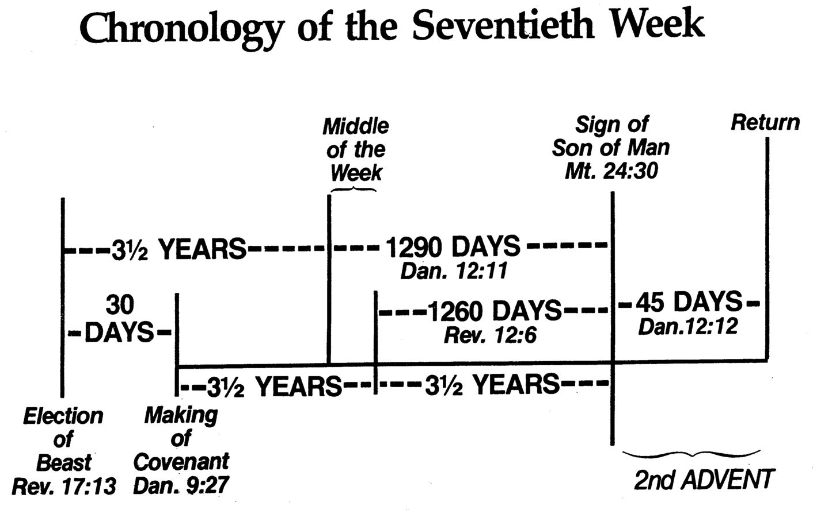
Chronology of the 70th "Week"
556
Adapted from J. Dwight Pentecost, Dallas Theological Seminary, 1988
Middle of the Week
Sign of Son of Man Matt. 24:30
Christ's Return Complete
3½ YEARS
1290 DAYS
Dan. 12:11
30 DAYS
30 DAYS
1260 DAYS
45 DAYS
Rev. 12:6
Dan. 12:12
3½ YEARS
3½ YEARS
Election of Beast Rev. 17:13
Covenant Made Dan. 9:27a
Covenant Broken Dan. 9:27b
The Great Tribulation
2nd ADVENT
The Tribulation
"He will confirm a covenant with many for one 'seven.' In the middle of the 'seven' he will put an end to sacrifice and offering. And on a wing [of the temple] he will set up an abomination that causes desolation, until the end that is decreed is poured out on him" (Daniel 9:27 NIV).
Notes:
The final of the 70 "weeks" also will last seven years and is the focus of Daniel's prophecies more than any other period. Revelation later builds on the foundation that Daniel established.
Daniel 12:11-13 “From the time that the regular sacrifice is abolished and the ^{1a}abomination of desolation is set up, there will be 1,290 days. ¹² “How blessed is he who keeps waiting and attains to the ^{b}1,335 days! ¹³ “But as for you, go your way to the ¹end; then you will enter into rest and rise again for your allotted portion at the end of the ²age.”
______________
Common-404
BE-27-Daniel-117
LC-09-Preparation-30
OS-27-Daniel-407, 499
NS-27-Rev1-slide 170
NS-22-Rev7-12-slide 99

Slide 34
“the abomination that causes desolation” (Mark 13:14)
The great tribulation of unparalleled affliction (v. 19)
God shortens the days (v. 20)
False messiahs, prophets, signs and miracles (vv. 21-22)
The great tribulation sign is so terrible it requires being foretold (v. 23)

Slide 35
3. The Second Advent
Matthew 24:27-30; Mark 13:24-27; Luke 21:27-28
Jesus predicts that He will return to the earth in power and glory to rule the earth with believers as their destiny
Notes:
Matt. 24:27 For as the lightning flashes in the east and shines to the west, so it will be when the Son of Manª comes. ²⁸ Just as the gathering of vultures shows there is a carcass nearby, so these signs indicate that the end is near.
Matt. 24:29 “Immediately after the anguish of those days,
the sun will be darkened,
the moon will give no light,
the stars will fall from the sky,
and the powers in the heavens will be shaken.
Matt. 24:30 And then at last, the sign that the Son of Man is coming will appear in the heavens, and there will be deep mourning among all the peoples of the earth. And they will see the Son of Man coming on the clouds of heaven with power and great glory.
Mark 13:24 “At that time, after the anguish of those days,
the sun will be darkened,
the moon will give no light,
²⁵ the stars will fall from the sky,
and the powers in the heavens will be shaken.
Mark 13:26 Then everyone will see the Son of Manª coming on the clouds with great power and glory. ²⁷ And he will send out his angels to gather his chosen ones from all over the world—from the farthest ends of the earth and heaven.
Luke 21:27 Then everyone will see the Son of Manª coming on a cloud with power and great glory. ²⁸ So when all these things begin to happen, stand and look up, for your salvation is near!”

Slide 36
Keep watch, Jesus is coming, but the time is unknown (Mark 13:24-37)
Jesus will return after that distress [tribulation] (v. 24)
When Jesus returns
The sun will be darkened, and the moon will not give its light (v. 24)
The stars will fall from the sky, and the heavenly bodies (Isaiah 13:10) will be shaken (v. 25)
Men will see Jesus’ return (v. 26)

Slide 37
4. The Regathering of Israel
Matthew 24:31
Jesus predicts Israel's supernatural restoration to its land after having been scattered by military invasions
Notes:
Matt 24:31 “And He will send forth His angels with A GREAT TRUMPET and THEY WILL GATHER TOGETHER His elect from the four winds, from one end of the sky to the other."

Slide 38
5. Parenthetical Exhortations
Matthew 24:32-51; Mark 13:28-37; Luke 21:29-36
Jesus gives practical exhortations given His coming as Judge to stress further our need to be watchful, prepared, and faithful
Notes:
Matt. 24:32 “Now learn a lesson from the fig tree. When its branches bud and its leaves begin to sprout, you know that summer is near. ³³ In the same way, when you see all these things, you can know his return is very near, right at the door. ³⁴ I tell you the truth, this generation will not pass from the scene until all these things take place. ³⁵ Heaven and earth will disappear, but my words will never disappear.
Matt. 24:36 “However, no one knows the day or hour when these things will happen, not even the angels in heaven or the Son himself. Only the Father knows.
Matt. 24:37 “When the Son of Man returns, it will be like it was in Noah’s day. ³⁸ In those days before the flood, the people were enjoying banquets and parties and weddings right up to the time Noah entered his boat. ³⁹ People didn’t realize what was going to happen until the flood came and swept them all away. That is the way it will be when the Son of Man comes.
Matt. 24:40 “Two men will be working together in the field; one will be taken, the other left. ⁴¹ Two women will be grinding flour at the mill; one will be taken, the other left.
Matt. 24:42 “So you, too, must keep watch! For you don’t know what day your Lord is coming. ⁴³ Understand this: If a homeowner knew exactly when a burglar was coming, he would keep watch and not permit his house to be broken into. ⁴⁴ You also must be ready all the time, for the Son of Man will come when least expected.
Matt. 24:45 “A faithful, sensible servant is one to whom the master can give the responsibility of managing his other household servants and feeding them. ⁴⁶ If the master returns and finds that the servant has done a good job, there will be a reward. ⁴⁷ I tell you the truth, the master will put that servant in charge of all he owns. ⁴⁸ But what if the servant is evil and thinks, ‘My master won’t be back for a while,’ ⁴⁹ and he begins beating the other servants, partying, and getting drunk? ⁵⁰ The master will return unannounced and unexpected, ⁵¹ and he will cut the servant to pieces and assign him a place with the hypocrites. In that place there will be weeping and gnashing of teeth.
Mark 13:28 “Now learn a lesson from the fig tree. When its branches bud and its leaves begin to sprout, you know that summer is near. ²⁹ In the same way, when you see all these things taking place, you can know that his return is very near, right at the door. ³⁰ I tell you the truth, this generation will not pass from the scene before all these things take place. ³¹ Heaven and earth will disappear, but my words will never disappear.
Mark 13:32 “However, no one knows the day or hour when these things will happen, not even the angels in heaven or the Son himself. Only the Father knows. ³³ And since you don’t know when that time will come, be on guard! Stay alert!
Mark 13:34 “The coming of the Son of Man can be illustrated by the story of a man going on a long trip. When he left home, he gave each of his slaves instructions about the work they were to do, and he told the gatekeeper to watch for his return. ³⁵ You, too, must keep watch! For you don’t know when the master of the household will return—in the evening, at midnight, before dawn, or at daybreak. ³⁶ Don’t let him find you sleeping when he arrives without warning. ³⁷ I say to you what I say to everyone: Watch for him!”
Luke 21:29 Then he gave them this illustration: “Notice the fig tree, or any other tree. ³⁰ When the leaves come out, you know without being told that summer is near. ³¹ In the same way, when you see all these things taking place, you can know that the Kingdom of God is near. ³² I tell you the truth, this generation will not pass from the scene until all these things have taken place. ³³ Heaven and earth will disappear, but my words will never disappear.
Luke 21:34 “Watch out! Don’t let your hearts be dulled by carousing and drunkenness, and by the worries of this life. Don’t let that day catch you unaware, ³⁵ like a trap. For that day will come upon everyone living on the earth. ³⁶ Keep alert at all times. And pray that you might be strong enough to escape these coming horrors and stand before the Son of Man.”

Slide 39
Keep watch, Jesus is coming, but the time is unknown (Mark 13:24-37)
He will gather his people (elect) from all over the earth (v. 27)
The signs pointing to the end for his return occur within a generation (vv. 28-30)
Jesus' return is sure (v. 31)
Heaven and earth will pass away (v. 31a)
His word will never pass away (v. 31b)

Slide 40
Keep watch, Jesus is coming, but the time is unknown (Mark 13:24-37)
No one knows the exact time of Jesus’ return so be on guard and keep watch (vv. 32-37)
Notes:
Moore sees the "generation" as the first-century people before AD 70 BUT "no one knows the day or hour" refers to the Second Coming. This is inconsistent, in my opinion!
"Those standing before Jesus would see the fulfillment of everything written between verses 4 and 35 of Matthew 24, even if verses 27–31 also apply to the Second Coming.
§ 139e (cont.) No One Knows the Time of His Coming (Mt 24:36–41; Mk 13:32)
^{[MT 24:]36} “No one knows about that day or hour, not even the angels in heaven, nor the Son, but only the Father. ³⁷ As it was in the days of Noah, so it will be at the coming of the Son of Man. ³⁸ For in the days before the flood, people were eating and drinking, marrying and giving in marriage, up to the day Noah entered the ark; ³⁹ and they knew nothing about what would happen until the flood came and took them all away. That is how it will be at the coming of the Son of Man. ⁴⁰ Two men will be in the field; one will be taken and the other left. ⁴¹ Two women will be grinding with a hand mill; one will be taken and the other left.”
[vv. 37–41 = Lk 17:26–27, 34–35, see comments on § 120b]
Everything from here on out refers to the Second Coming. Jesus lays out three important truths about his return. First, he tells us, in no uncertain terms, that we cannot know when it is. The angels don’t even know when it is. In fact, Jesus, himself, did not know when he would return. And we think we will figure it out?! "
— Mark E. Moore, The Chronological Life of Christ (Joplin, MO: College Press Publishing Company, 2011), 547.

Slide 41
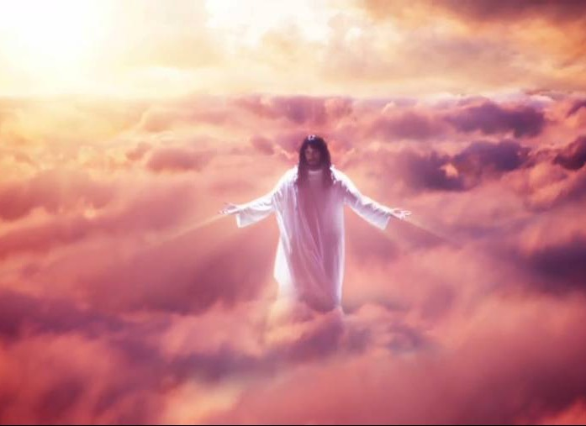
Summary
Disciples asked Jesus, “When will these things happen?” and “What will be the sign of your coming?”
He returns after the great tribulation
Event 1: Signs in the skies (vv. 24-25)
Event 2: Jesus will come in the clouds
Event 3: Jesus will gather the elect

Slide 42
What We Can Do to Prepare
Keep alert and do not be alarmed at the signs of the End Time
Keep watch for the coming of the Son of Man because the exact time is unknown

Slide 43

“Come Lord Jesus”

Slide 44
a. The Fig Tree
Matthew 24:32-44; Mark 13:28-37; Luke 21:29-36
A fig tree’s budding shows that Israel will see signs that Christ's judgment is imminent to be watchful and prepared
Notes:
Matt. 24:32 “Now learn a lesson from the fig tree. When its branches bud and its leaves begin to sprout, you know that summer is near. ³³ In the same way, when you see all these things, you can know his return is very near, right at the door. ³⁴ I tell you the truth, this generation will not pass from the scene until all these things take place. ³⁵ Heaven and earth will disappear, but my words will never disappear.
Matt. 24:36 “However, no one knows the day or hour when these things will happen, not even the angels in heaven or the Son himself. Only the Father knows.
Matt. 24:37 “When the Son of Man returns, it will be like it was in Noah’s day. ³⁸ In those days before the flood, the people were enjoying banquets and parties and weddings right up to the time Noah entered his boat. ³⁹ People didn’t realize what was going to happen until the flood came and swept them all away. That is the way it will be when the Son of Man comes.
Matt. 24:40 “Two men will be working together in the field; one will be taken, the other left. ⁴¹ Two women will be grinding flour at the mill; one will be taken, the other left.
Matt. 24:42 “So you, too, must keep watch! For you don’t know what day your Lord is coming. ⁴³ Understand this: If a homeowner knew exactly when a burglar was coming, he would keep watch and not permit his house to be broken into. ⁴⁴ You also must be ready all the time, for the Son of Man will come when least expected.
Mark 13:28 “Now learn a lesson from the fig tree. When its branches bud and its leaves begin to sprout, you know that summer is near. ²⁹ In the same way, when you see all these things taking place, you can know that his return is very near, right at the door. ³⁰ I tell you the truth, this generation will not pass from the scene before all these things take place. ³¹ Heaven and earth will disappear, but my words will never disappear.
Mark 13:32 “However, no one knows the day or hour when these things will happen, not even the angels in heaven or the Son himself. Only the Father knows. ³³ And since you don’t know when that time will come, be on guard! Stay alert!
Mark 13:34 “The coming of the Son of Man can be illustrated by the story of a man going on a long trip. When he left home, he gave each of his slaves instructions about the work they were to do, and he told the gatekeeper to watch for his return. ³⁵ You, too, must keep watch! For you don’t know when the master of the household will return—in the evening, at midnight, before dawn, or at daybreak. ³⁶ Don’t let him find you sleeping when he arrives without warning. ³⁷ I say to you what I say to everyone: Watch for him!”
Luke 21:29 Then he gave them this illustration: “Notice the fig tree, or any other tree. ³⁰ When the leaves come out, you know without being told that summer is near. ³¹ In the same way, when you see all these things taking place, you can know that the Kingdom of God is near. ³² I tell you the truth, this generation will not pass from the scene until all these things have taken place. ³³ Heaven and earth will disappear, but my words will never disappear.
Luke 21:34 “Watch out! Don’t let your hearts be dulled by carousing and drunkenness, and by the worries of this life. Don’t let that day catch you unaware, ³⁵ like a trap. For that day will come upon everyone living on the earth. ³⁶ Keep alert at all times. And pray that you might be strong enough to escape these coming horrors and stand before the Son of Man.”

Slide 45
b. The Faithful Servant
Matthew 24:45-51
The illustration of the faithful servant warns Israel to be faithful since the nation will not know when Christ will return
Notes:
Matt. 24:45 “A faithful, sensible servant is one to whom the master can give the responsibility of managing his other household servants and feeding them. ⁴⁶ If the master returns and finds that the servant has done a good job, there will be a reward. ⁴⁷ I tell you the truth, the master will put that servant in charge of all he owns. ⁴⁸ But what if the servant is evil and thinks, ‘My master won’t be back for a while,’ ⁴⁹ and he begins beating the other servants, partying, and getting drunk? ⁵⁰ The master will return unannounced and unexpected, ⁵¹ and he will cut the servant to pieces and assign him a place with the hypocrites. In that place there will be weeping and gnashing of teeth.

Slide 46
6. Judgment on Israel
Matthew 25:1-30
Two parables of judgment on living Israel prepare Jews for the Millennium by faith and predict Israel failing as a light to Gentiles
Notes:
Parable of the Ten Bridesmaids
Matt. 25:1 “Then the Kingdom of Heaven will be like ten bridesmaids who took their lamps and went to meet the bridegroom. ² Five of them were foolish, and five were wise. ³ The five who were foolish didn’t take enough olive oil for their lamps, ⁴ but the other five were wise enough to take along extra oil. ⁵ When the bridegroom was delayed, they all became drowsy and fell asleep.
Matt. 25:6 “At midnight they were roused by the shout, ‘Look, the bridegroom is coming! Come out and meet him!’
Matt. 25:7 “All the bridesmaids got up and prepared their lamps. ⁸ Then the five foolish ones asked the others, ‘Please give us some of your oil because our lamps are going out.’
Matt. 25:9 “But the others replied, ‘We don’t have enough for all of us. Go to a shop and buy some for yourselves.’
Matt. 25:10 “But while they were gone to buy oil, the bridegroom came. Then those who were ready went in with him to the marriage feast, and the door was locked. ¹¹ Later, when the other five bridesmaids returned, they stood outside, calling, ‘Lord! Lord! Open the door for us!’
Matt. 25:12 “But he called back, ‘Believe me, I don’t know you!’
Matt. 25:13 “So you, too, must keep watch! For you do not know the day or hour of my return.
Parable of the Three Servants
Matt. 25:14 “Again, the Kingdom of Heaven can be illustrated by the story of a man going on a long trip. He called together his servants and entrusted his money to them while he was gone. ¹⁵ He gave five bags of silver to one, two bags of silver to another, and one bag of silver to the last—dividing it in proportion to their abilities. He then left on his trip.
Matt. 25:16 “The servant who received the five bags of silver began to invest the money and earned five more. ¹⁷ The servant with two bags of silver also went to work and earned two more. ¹⁸ But the servant who received the one bag of silver dug a hole in the ground and hid the master’s money.
Matt. 25:19 “After a long time their master returned from his trip and called them to give an account of how they had used his money. ²⁰ The servant to whom he had entrusted the five bags of silver came forward with five more and said, ‘Master, you gave me five bags of silver to invest, and I have earned five more.’
Matt. 25:21 “The master was full of praise. ‘Well done, my good and faithful servant. You have been faithful in handling this small amount, so now I will give you many more responsibilities. Let’s celebrate together!’
Matt. 25:22 “The servant who had received the two bags of silver came forward and said, ‘Master, you gave me two bags of silver to invest, and I have earned two more.’
Matt. 25:23 “The master said, ‘Well done, my good and faithful servant. You have been faithful in handling this small amount, so now I will give you many more responsibilities. Let’s celebrate together!’
Matt. 25:24 “Then the servant with the one bag of silver came and said, ‘Master, I knew you were a harsh man, harvesting crops you didn’t plant and gathering crops you didn’t cultivate. ²⁵ I was afraid I would lose your money, so I hid it in the earth. Look, here is your money back.’
Matt. 25:26 “But the master replied, ‘You wicked and lazy servant! If you knew I harvested crops I didn’t plant and gathered crops I didn’t cultivate, ²⁷ why didn’t you deposit my money in the bank? At least I could have gotten some interest on it.’
Matt. 25:28 “Then he ordered, ‘Take the money from this servant, and give it to the one with the ten bags of silver. ²⁹ To those who use well what they are given, even more will be given, and they will have an abundance. But from those who do nothing, even what little they have will be taken away. ³⁰ Now throw this useless servant into outer darkness, where there will be weeping and gnashing of teeth.’

Slide 47
a. The Ten Virgins
Matthew 25:1-13
The parable of the ten virgins teaches that only those prepared through faith in Jesus will enter the millennial feast
Notes:
Parable of the Ten Bridesmaids
Matt. 25:1 “Then the Kingdom of Heaven will be like ten bridesmaids who took their lamps and went to meet the bridegroom. ² Five of them were foolish, and five were wise. ³ The five who were foolish didn’t take enough olive oil for their lamps, ⁴ but the other five were wise enough to take along extra oil. ⁵ When the bridegroom was delayed, they all became drowsy and fell asleep.
Matt. 25:6 “At midnight they were roused by the shout, ‘Look, the bridegroom is coming! Come out and meet him!’
Matt. 25:7 “All the bridesmaids got up and prepared their lamps. ⁸ Then the five foolish ones asked the others, ‘Please give us some of your oil because our lamps are going out.’
Matt. 25:9 “But the others replied, ‘We don’t have enough for all of us. Go to a shop and buy some for yourselves.’
Matt. 25:10 “But while they were gone to buy oil, the bridegroom came. Then those who were ready went in with him to the marriage feast, and the door was locked. ¹¹ Later, when the other five bridesmaids returned, they stood outside, calling, ‘Lord! Lord! Open the door for us!’
Matt. 25:12 “But he called back, ‘Believe me, I don’t know you!’
Matt. 25:13 “So you, too, must keep watch! For you do not know the day or hour of my return.

Slide 48
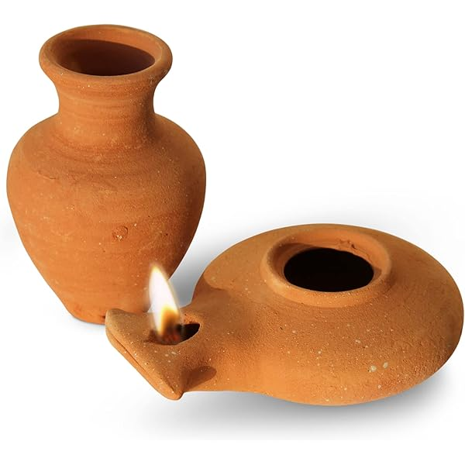
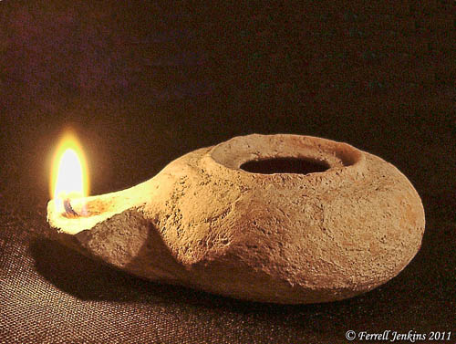
Herodian Lamp

Slide 49
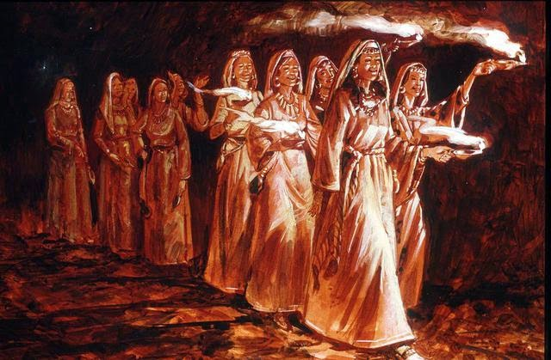
The Ten Virgins
Matthew 25:1-13

Slide 50
b. Talents
Matthew 25:14-30
The parable of the talents teaches that Jesus will judge living Israel for not being a light to the Gentiles
Notes:
What in this parable indicates that living Jews are in view?
Parable of the Three Servants
Matt. 25:14 “Again, the Kingdom of Heaven can be illustrated by the story of a man going on a long trip. He called together his servants and entrusted his money to them while he was gone. ¹⁵ He gave five bags of silver to one, two bags of silver to another, and one bag of silver to the last—dividing it in proportion to their abilities. He then left on his trip.
Matt. 25:16 “The servant who received the five bags of silver began to invest the money and earned five more. ¹⁷ The servant with two bags of silver also went to work and earned two more. ¹⁸ But the servant who received the one bag of silver dug a hole in the ground and hid the master’s money.
Matt. 25:19 “After a long time their master returned from his trip and called them to give an account of how they had used his money. ²⁰ The servant to whom he had entrusted the five bags of silver came forward with five more and said, ‘Master, you gave me five bags of silver to invest, and I have earned five more.’
Matt. 25:21 “The master was full of praise. ‘Well done, my good and faithful servant. You have been faithful in handling this small amount, so now I will give you many more responsibilities. Let’s celebrate together!’
Matt. 25:22 “The servant who had received the two bags of silver came forward and said, ‘Master, you gave me two bags of silver to invest, and I have earned two more.’
Matt. 25:23 “The master said, ‘Well done, my good and faithful servant. You have been faithful in handling this small amount, so now I will give you many more responsibilities. Let’s celebrate together!’
Matt. 25:24 “Then the servant with the one bag of silver came and said, ‘Master, I knew you were a harsh man, harvesting crops you didn’t plant and gathering crops you didn’t cultivate. ²⁵ I was afraid I would lose your money, so I hid it in the earth. Look, here is your money back.’
Matt. 25:26 “But the master replied, ‘You wicked and lazy servant! If you knew I harvested crops I didn’t plant and gathered crops I didn’t cultivate, ²⁷ why didn’t you deposit my money in the bank? At least I could have gotten some interest on it.’
Matt. 25:28 “Then he ordered, ‘Take the money from this servant, and give it to the one with the ten bags of silver. ²⁹ To those who use well what they are given, even more will be given, and they will have an abundance. But from those who do nothing, even what little they have will be taken away. ³⁰ Now throw this useless servant into outer darkness, where there will be weeping and gnashing of teeth.’"

Slide 51
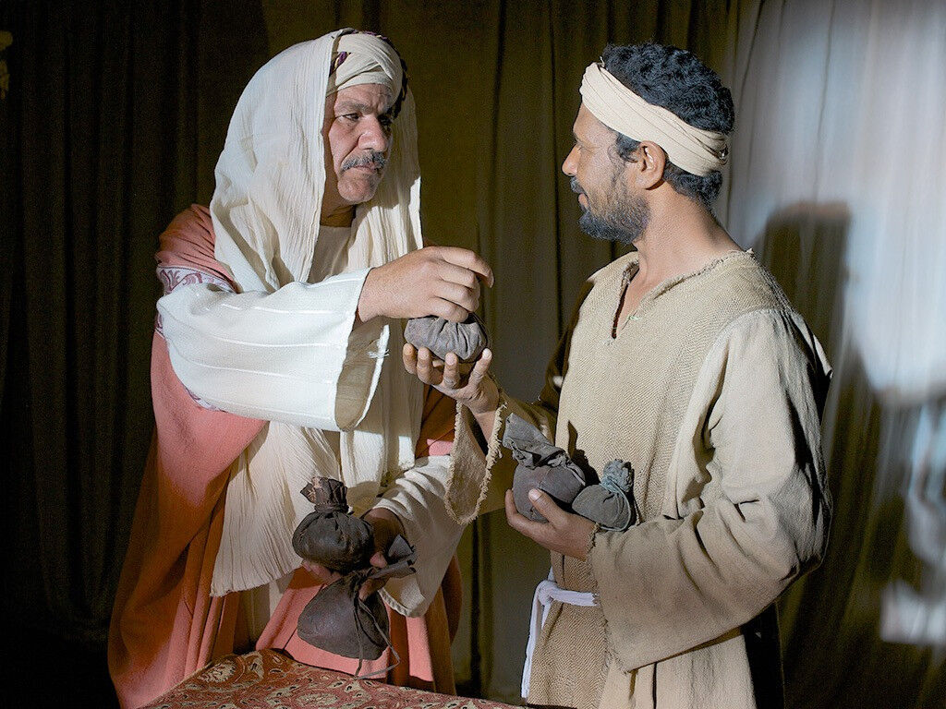
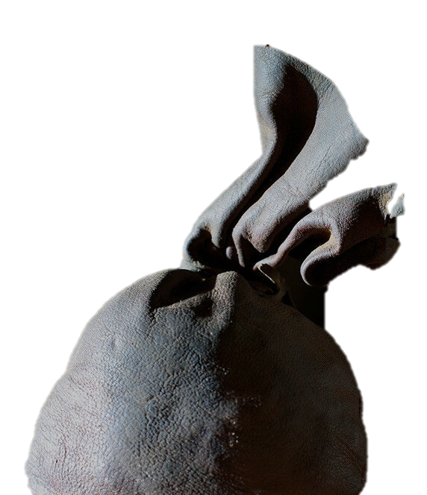
The Parable of the Talents
Matthew 25:14-30
Dr. David Martin • Amman International Church AmmanChurch.org • BibleStudyDownloads.org

Slide 52
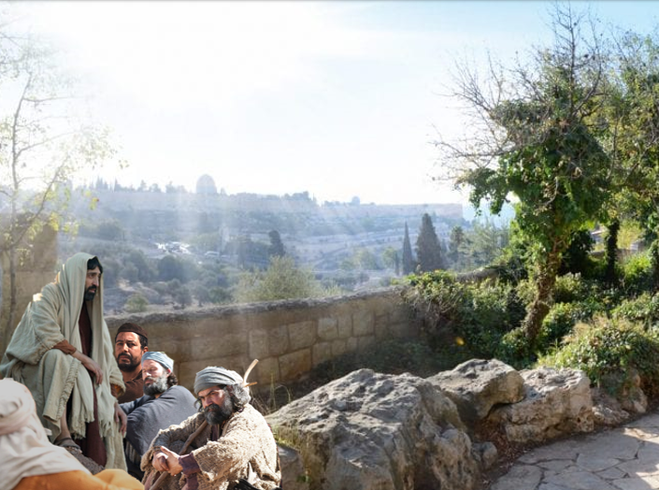
Setting:
The Olivet Discourse (Matt. 24-25) Two days before Jesus’ crucifixion
The disciples have 3 questions (Matt. 24:3)
Jesus repeatedly warned that He will return unannounced (Matt. 24:27, 36, 42, 44, 50; 25:13)
The Issue: What are disciples’ responsibilities until Christ returns?

Slide 53
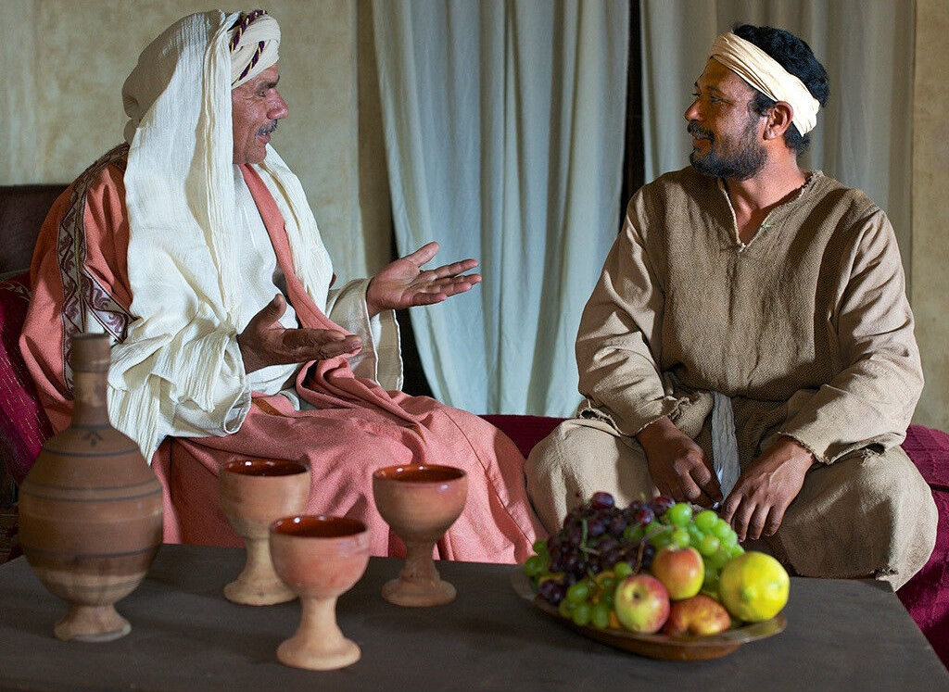
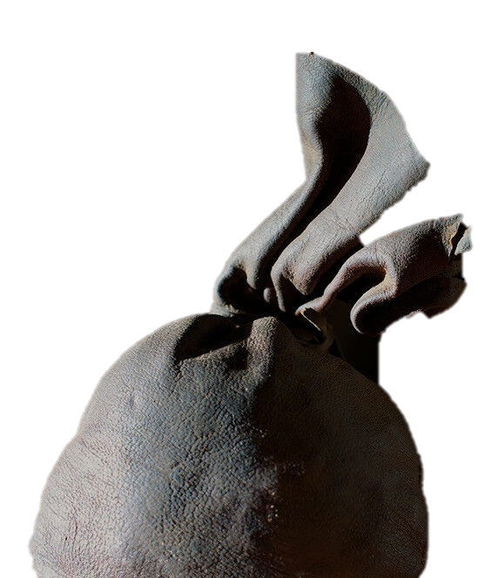
Matthew 25:14-30
The Master
Jesus
Servants
Disciples
Distributed according to ability
Talents
God-given resources and opportunities for service

Slide 54
Notes:
Matt. 25:14 “Again, the Kingdom of Heaven can be illustrated by the story of a man going on a long trip. He called together his servants and entrusted his money to them while he was gone. ¹⁵ He gave five bags of silver to one…

Slide 55
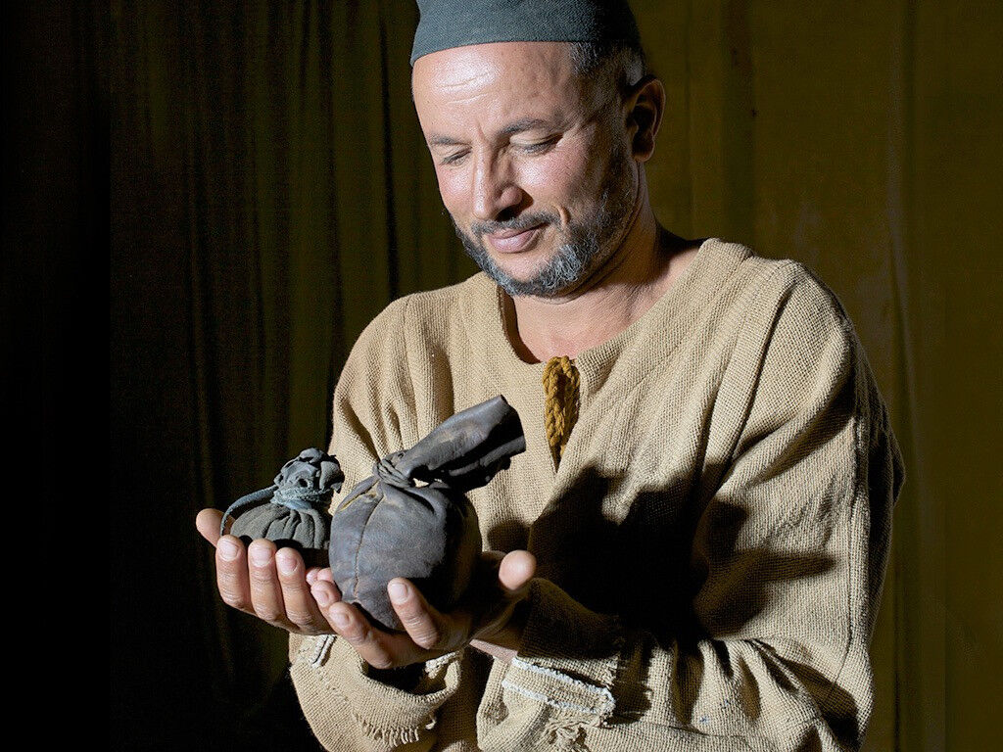
Notes:
…two bags of silver to another…

Slide 56
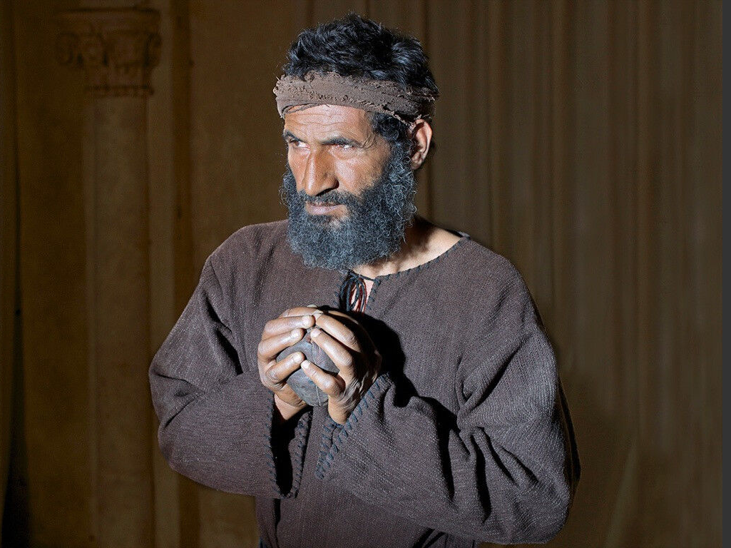
Notes:
…and one bag of silver to the last—dividing it in proportion to their abilities. He then left on his trip.
Matt. 25:16 “The servant who received the five bags of silver began to invest the money and earned five more. ¹⁷ The servant with two bags of silver also went to work and earned two more. ¹⁸ But the servant who received the one bag of silver dug a hole in the ground and hid the master’s money.
—————————
Does this last servant depict a Christian or an unbeliever? Some facts support his saved state:
The context of Jesus speaking to his disciples.
It would seem strange for Jesus to speak of an unbeliever as a servant of the master.
The remorse of the servant after confrontation by the master is better understood as by one saved.
He is deemed a hypocrite, which can be used a believers who lead carnal lives.
The opposite of the first two servants being "faithful" is to be "unfaithful," not unbelieving.
From Joseph Dillow, Final Destiny, 791:
"Like Bock, those holding this view that Luke 12:46 refers to “unbelievers,” point to Matthew 24:51 where the “unfaithful” are called “hypocrites.” Luke calls them “unfaithful” and Matthew calls them “hypocrites.” The word “hypocrisy” (Matthew 24:51) was used of a play actor.²⁵⁵⁴ The wicked servant claims to be a servant of his master, but his hypocrisy is that he does not live like it, he is acting. Bock is correct that it is normally used of non-Christians,²⁵⁵⁵ but it is also used by Christ of true Christians who judge others (their “brother”), while ignoring their own sin (Matthew 7:5). Barnabas and Peter were charged with hypocrisy by Paul (Galatians 2:13), and Peter speaks of “newborn babes” who are to put hypocrisy aside (1 Peter 2:1-2). The servant in Matthew 24:51 is the opposite of a “faithful and sensible” steward (v. 45). The opposite of “faithful and sensible” is “unfaithful,” or, as Jesus puts it, he “did not get ready or act in accord with his will” (v. 47).
This man was not an unbeliever; he believed in his “master” and that his master was coming back. The fact that Luke’s apiston is replaced by hypokriton (hypocrisy) in the parallel passage in Matthew suggests that apiston in Luke 12:46 should not be translated as “unbeliever” but as “unfaithful.” His hypocrisy was not that he professed Christ outwardly but did not “truly” believe, but that even though he was assigned the role of a servant, he did not take care of the other servants and ended up serving only himself. The servant was not a non-Christian; he was an unfaithful Christian. It is for this that he will be judged and given a place with the other “unfaithful” believers.
²⁵⁵⁴ Ulrich Wilckens, “hypokrinomai,” in TDNTA, 1235.
²⁵⁵⁵ Matthew 6:2, 5, 16.
²⁵⁵⁶ Roy B. Zuck, Darrell L. Bock, and Dallas Theological Seminary, A Biblical Theology of the New Testament (Chicago: Moody Press, 1994), 1183.

Slide 57
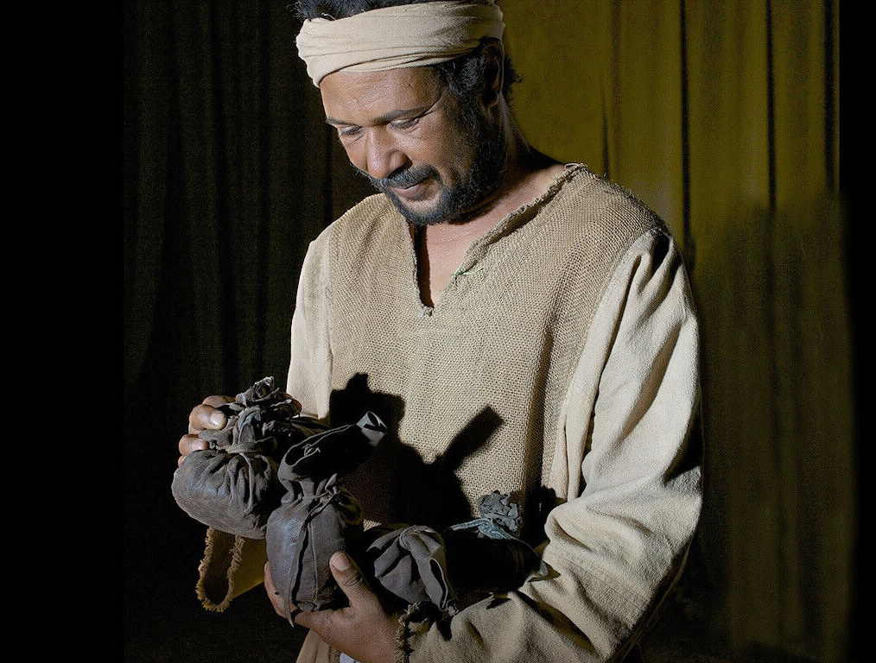




Depicts final day of reckoning
Rewards for faithfulness
Approval
Praise
Privileges granted
Rewarded
The Master Returns to Settle Accounts (Matt. 25:20-21)
Notes:
Matt. 25:19 “After a long time their master returned from his trip and called them to give an account of how they had used his money. ²⁰ The servant to whom he had entrusted the five bags of silver came forward with five more and said, ‘Master, you gave me five bags of silver to invest, and I have earned five more.’
Matt. 25:21 “The master was full of praise. ‘Well done, my good and faithful servant. You have been faithful in handling this small amount, so now I will give you many more responsibilities. Let’s celebrate together!’

Slide 58
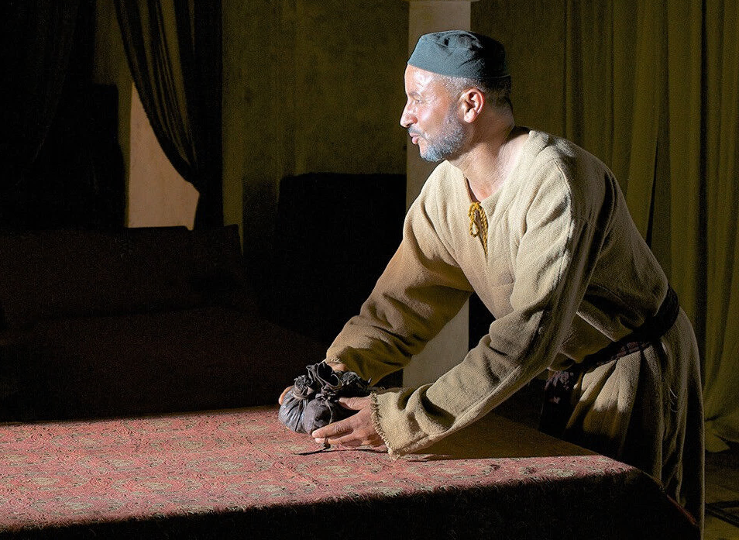
Matthew 25:22-23
The Master focused on faithfulness, not quantity
Approval
Praise
Privileges granted
Rewarded
Notes:
Matt. 25:22 “The servant who had received the two bags of silver came forward and said, ‘Master, you gave me two bags of silver to invest, and I have earned two more.’
Matt. 25:23 “The master said, ‘Well done, my good and faithful servant. You have been faithful in handling this small amount, so now I will give you many more responsibilities. Let’s celebrate together!’

Slide 59
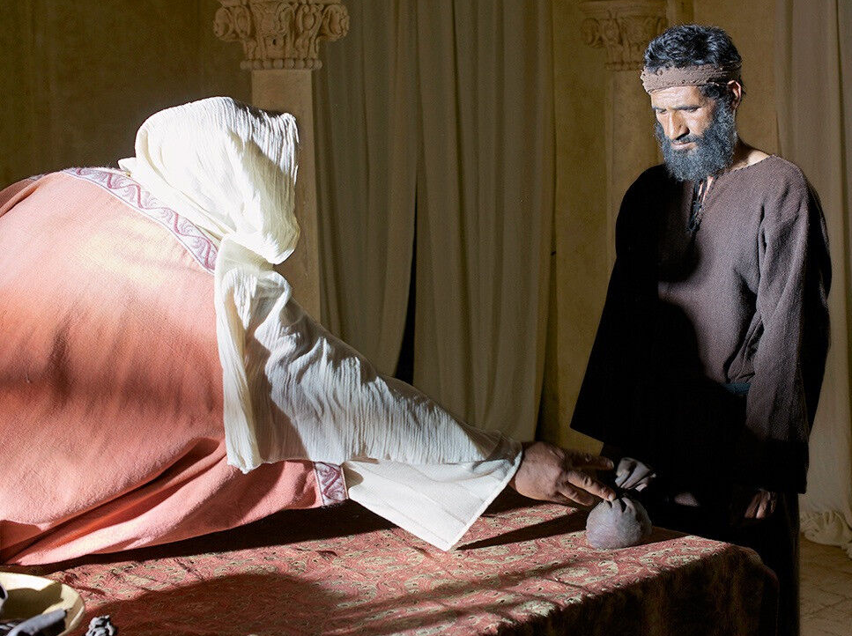
Matthew 25:24-30
Not a true slave (hypocrite)
Condemned
Corrected
Privileges removed
Punished
Notes:
Matt. 25:24 “Then the servant with the one bag of silver came and said, ‘Master, I knew you were a harsh man, harvesting crops you didn’t plant and gathering crops you didn’t cultivate. ²⁵ I was afraid I would lose your money, so I hid it in the earth. Look, here is your money back.’
Matt. 25:26 “But the master replied, ‘You wicked and lazy servant! If you knew I harvested crops I didn’t plant and gathered crops I didn’t cultivate, ²⁷ why didn’t you deposit my money in the bank? At least I could have gotten some interest on it.’
Matt. 25:28 “Then he ordered, ‘Take the money from this servant, and give it to the one with the ten bags of silver. ²⁹ To those who use well what they are given, even more will be given, and they will have an abundance. But from those who do nothing, even what little they have will be taken away.

Slide 60
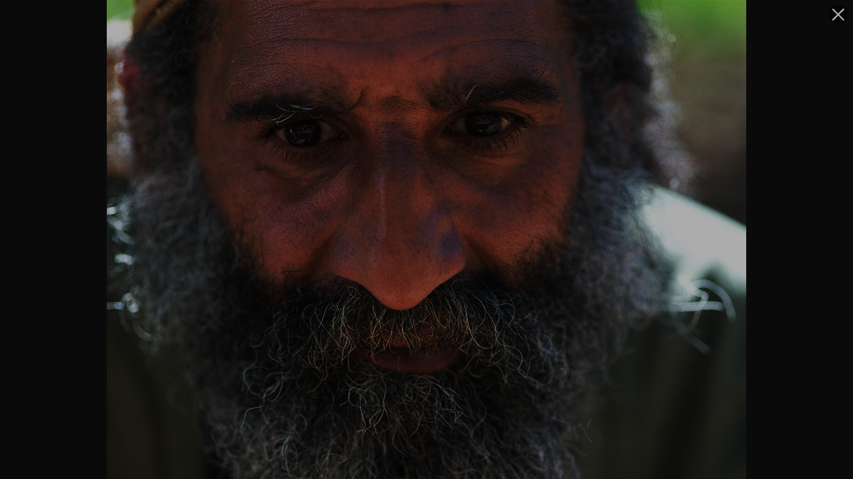
He was cast into outer darkness
✓Separated from everyone and everything (alone!)
✓Weeping (regret for bad choices)
✓Gnashing of teeth (eternal punishment)?
Notes:
Matt. 25:30 Now throw this useless servant into outer darkness, where there will be weeping and gnashing of teeth.’
—————————————
The Hebrew noun (bĕkî) means “a lamentation” or “weeping” cf. Jeremiah 31:15. The Hebrew verb (bākâ)²⁵¹⁶ means “‘to weep, cry, shed tears”²⁵¹⁷ (cf. Deuteronomy 34:8).”²⁵¹⁸ Isaiah wept bitterly (Heb bākâ) over Israel (Isaiah 22:4). Peter wept bitterly (same expression) over his denial of Christ (Matthew 26:70). If God can weep bitterly, violently, and with tears over our sin (Jeremiah 10:10),²⁵¹⁹ why cannot the carnal Christian do the same at the Judgment Seat of Christ? Bitter weeping is not confined to remorse in the lake of fire. After denying the Lord three times, Peter, full of shame and remorse, “went out and wept bitterly” (Luke 22:61–62).
While there is an understandable tendency among many commentators to assume that these sobering words could not possibly describe the experience of true believers, we must ask, “Why not?” To assume that this phrase speaks of damnation is an assumption imported into the passage. Spiros Zodhiates correctly observes, “These terms may be applied to believers who have failed the Lord in their service. ‘Outer darkness’ may be a reference to a place or position of far less rewards for the servants who proved themselves less diligent than those who used and exercised their talents to the fullest.”²⁵²⁰
²⁵¹⁶ Qal imperfect verb.
²⁵¹⁷ TWOT, 107.
²⁵¹⁸ HAL, 130.
²⁵¹⁹ “The concept of a God who suffers is rejected by many because it implies that He is weak and finite. The impossibility of God suffering is a central teaching in some of the great world religions and is even advocated in some Christian circles. However, the notion of a God who cannot suffer, while perhaps making theology more manageable, nevertheless leaves it placid and spiritless. If the love of God is more than an empty metaphor, then the suffering of God must also be regarded as real. This passage has traditionally been emended in such a way as to make the prophet, and not God, the sufferer. It seems best, however, to leave the text as it is and to interpret it as the response of God to the unyielding stubbornness of his people.” See Peter C. Craigie, Kelly Page H., and Joel F. Drinkard, Jeremiah 1-26, Word Biblical Commentary (Dallas: Word Books, 1991), 145.
²⁵²⁰ Spiros Zodhiates, The Complete Word Study New Testament: King James Version (Chattanooga: AMG Publishers, 1991), 25. This writer does not agree that “outer darkness” is a place, but it may be a metaphor for a “position.”
—Joseph Dillow, Final Destiny, 780

Slide 61
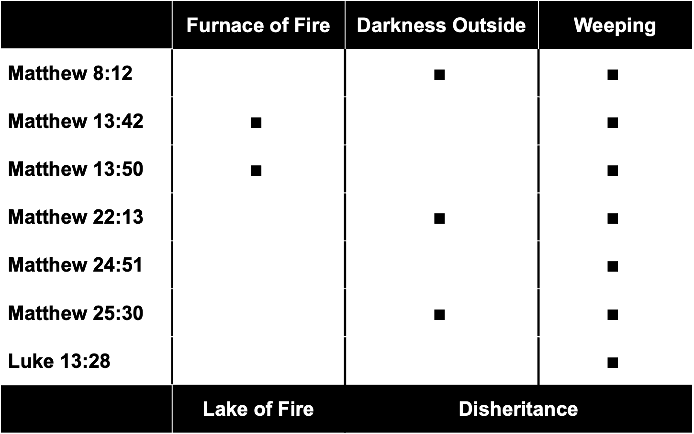
The Darkness Outside
 | Furnace of Fire | Darkness Outside | Weeping
Matthew 8:12 |  | $$∎$$ | $$∎$$
Matthew 13:42 | $$∎$$ |  | $$∎$$
Matthew 13:50 | $$∎$$ |  | $$∎$$
Matthew 22:13 |  | $$∎$$ | $$∎$$
Matthew 24:51 |  |  | $$∎$$
Matthew 25:30 |  | $$∎$$ | $$∎$$
Luke 13:28 |  |  | $$∎$$
 | Lake of Fire | Disheritance
Joseph Dillow, Final Destiny, 774
Notes:
Must all of these passages refer to the same judgment of eternal hell? While they all mention weeping, note that the descriptions are not identical and that only the Matthew 13 passages clearly refer to hellfire.
Matt. 8:12 But many Israelites—those for whom the Kingdom was prepared—will be thrown into outer darkness, where there will be weeping and gnashing of teeth.
Matt. 13:42 And the angels will throw them into the fiery furnace, where there will be weeping and gnashing of teeth.
Matt. 13:50 throwing the wicked into the fiery furnace, where there will be weeping and gnashing of teeth.
Matt. 22:13 Then the king said to his aides, ‘Bind his hands and feet and throw him into the outer darkness, where there will be weeping and gnashing of teeth.’
Matt. 24:51 and he will cut the servant to pieces and assign him a place with the hypocrites. In that place there will be weeping and gnashing of teeth.
Matt. 25:30 Now throw this useless servant into outer darkness, where there will be weeping and gnashing of teeth.’
Luke 13:28 “There will be weeping and gnashing of teeth, for you will see Abraham, Isaac, Jacob, and all the prophets in the Kingdom of God, but you will be thrown out.
Does the "darkness outside" imply hell? Not necessarily, as even Christians can live in darkness:
Anyone who claims to be in the light but hates his brother is still in the darkness. Whoever loves his brother lives in the light, and there is nothing in him to make him stumble. But whoever hates his brother is in the darkness and walks around in the darkness; he does not know where he is going, because the darkness has blinded him (1 John 2:9-11, NIV).
This is clearly distinguished from the "furnance of fire" that parallels the "lake of fire" for unbelievers in Matthew 13:42, 50…
Matt. 13:42 And the angels will throw them into the fiery furnace, where there will be weeping and gnashing of teeth.
Matt. 13:50 throwing the wicked into the fiery furnace, where there will be weeping and gnashing of teeth.
———————————
Joseph Dillow, Final Destiny, 773-777, notes the following:
But where are they sent? The term, “the darkness outside” is often associated in Experimental Predestinarian thinking with final damnation and torture.²⁴⁸⁹ The phrase is associated with eschatological judgment in three places (Matthew 8:12; 22:13; 25:30).
A related phrase, “weeping and gnashing of teeth,” is used seven times; the phrase “darkness outside” is used three times. The phrase “furnace of fire,” which does refer to damnation, is used only twice and never in association with the darkness outside. Why? The simplest suggestion is that they refer to two different experiences. The furnace of fire is clearly the experience of eternal separation from God, which will be the fate of the “sons of the devil” (the tares, Matthew 13:48) and of the bad fish (the wicked, Matthew 13:47-50). The darkness that is outside is a metaphor for exclusion from the joy of the light of the wedding festivities which occur in the New Jerusalem during the tribulation (Matthew 22:13; 25:30), or from the Messianic Banquet at the beginning of the millennium (Matthew 8:12).²⁴⁹⁰
Banquets in the Middle East were held at night. The key phrase in Greek is to skotos to exōteron, simply translated “the darkness outside.” If there is anything to be made of the word order, it would be that the adjective “outside” is specifying either the kind or the location of the darkness. This is not the farthest darkness, that is, the lake of fire. John Nolland is correct in saying, “‘The darkness outside [the building which has the banquet hall]’ fits the imagery better than ‘the farthest darkness.’ We are to think of an evening banquet well lit inside but surrounded by darkness outside.”²⁴⁹¹
Experimental Predestinarians translate it “outermost darkness,” in order to emphasize damnation. In this discussion we choose to render the phrase as “the darkness outside,” rather than “outer darkness,” for two reasons. One is to keep this specifying aspect before us. The second relates to the connotation of the phrase “the outer darkness.” Because it has come to be strongly associated with judgment in the lake of fire, it makes an objective consideration of this passage more difficult.
“Darkness” (skotos) can simply refer to physical darkness (Luke 23:44-45).²⁴⁹² The notion of “judgment in the lake of fire” is not part of the semantic value of the word. The phrase is used thee times in the New Testament and it is never associated with the “furnace of fire.” In Matthew 22:13, it is associated with the relative darkness outside of a banquet hall.²⁴⁹³ It is clear that genuine believers, “the sons of the Kingdom,” might be cast into the “outer darkness.” In Matthew 8:12, these “the sons of the Kingdom, are defined as saved people, “the wheat,” (13:38).
Some argue against the above interpretation by suggesting that there is an incongruity between a true believer who is a “son of light” and who no longer remains in darkness (John 12:46; cf. Matt 5:14; 16; Luke 16:8) and the scene in the parable.²⁴⁹⁴ This is a classic usage of the illegitimate identify transfer where the term “darkness” in John 12:46, meaning a lost state, is imported into the meaning of the word and then brought into a completely unrelated context by a different author who wrote 30 or 40 years earlier. John himself understands that true believers, when they are angry with their brothers, are “in the darkness” and walk around “in the darkness” (1 John 2:9-11). He says,
Anyone who claims to be in the light but hates his brother is still in the darkness. Whoever loves his brother lives in the light, and there is nothing in him to make him stumble. But whoever hates his brother is in the darkness and walks around in the darkness; he does not know where he is going, because the darkness has blinded him (1 John 2:9-11, NIV).
To be in darkness is used here as a metaphor for exclusion from fellowship with the Lord.²⁴⁹⁵
By using the phrase “the darkness outside” rather than “outer darkness,” we are freed from traditional usage that might color our thinking, enabling us to more easily discern what the phrase means in context. When we do that, it becomes highly probable that this phrase refers to the darkness outside the relative light of the banquet hall.²⁴⁹⁶
Presumably, in the story this is a local area immediately outside the banquet hall. The phrase is a metaphor for an experience of exclusion from the joy. If it has a spatial inference, it refers to a region in the New Jerusalem in heaven which is outside the banquet hall where the wedding festivities occur. This does not mean they are on the “edge of the kingdom,” but they are outside the celebration.²⁴⁹⁷ This is a parable and it is inappropriate to speculate regarding all the details and then draw inferences from them. The present writer doubts there is a spatial inference. Rather this is a metaphor for the experience of exclusion.
If one chooses to take all the details literally, significant problems arise. For example, it is difficult to imagine that there is a literal table with food set for a hundred million faithful believers (or however many millions) in some gigantic banquet hall. Imagine ten people at each table. This would require ten million tables! Yet if one chooses to press for spatial inferences to the outer darkness in this parable, it would be inconsistent to deny that spatial inferences regarding the banquet can lead to absurdities. This parable is a story with two main points – exclusion/regret or joy/celebration. In my opinion one over interprets by insisting a literal spatial location for the darkness outside. That said, it is a metaphor for an experience and any spatial reference is an incidental inference. As Walvoord has stressed, “It should be remembered that this will not be a literal feast with millions of people attending, but it is a symbolic concept where the guests, or friends, of the bride and the bridegroom will join in on the celebration of the marriage of the bridegroom and the bride.”²⁴⁹⁸
Experimental Predestinarians say this man is being tortured in the lake of fire.²⁴⁹⁹ We disagree. The expression implies nothing about the damnation of the one who “weeps and wails.” Charles Stanley correctly states, “To be in the ‘outer darkness’ is to be in the kingdom of God but outside the circle of men and women whose faithfulness on this earth earned them a special rank or position of authority.” ²⁵⁰⁰
Karl Pagenkemper rejects the Partner interpretation of this parable, in part, on the grounds that if the punishment is experienced by the carnal Christian, it is not severe enough. He asserts, “To suggest that the expulsion from the banquet into the ‘outer darkness’ refers only to missing the initial banquet at the beginning of the [millennial] kingdom is to suggest that such a lack of faith simply is a temporary inconvenience.”²⁵⁰¹
“Only” missing the initial banquet!? Simply a “temporary inconvenience”!? Behind this shocking perspective is the notion that only a threat of the lake of fire is adequate to motivate a Christian who does not live up to the demands of discipleship. Apparently, having the Savior dismiss the totality, or even the majority of one’s life work as worthless is a matter of little consequence. Is it really reasonable to think that to face rebuke by Christ, to be excluded from the Marriage Banquet of the Lamb and then to be denied the privilege of co-reigning with Him throughout the thousand year millennium and eternity are only temporary inconveniences? Eternity is not temporary! Nor are such privileges merely conveniences! Would Pagenkemper actually have us believe that hearing Christ say, “Well done” and granting us rulership with Him are insignificant results? He slights the Savior’s promises when he loses sight of their significance by calling their loss nothing more than temporary inconveniences. The Scripture says that it will be a time of “weeping and gnashing of teeth,” that is, profound regret.²⁵⁰² There is something strangely disturbing about a viewpoint of eternity that can dismiss as unimportant, greater capacity for intimacy with God and opportunities to serve Him, simply because, by the grace of God there will be no regrets or comparison in the new heavens and the new earth.²⁵⁰³
Matthew therefore leads us to imagine a feast of great rejoicing. All the faithful Christians of the church are there to celebrate their wedding feast with their King. This joyful banquet is portrayed by the Lord as occurring in the evening in a brightly lit banquet hall. Outside the banquet, where the shining lights of the feast are not present, into that place, where the evening darkness prevails, the unfaithful will be led. This darkness is not literal, but is a metaphor for the exclusion of the carnal Christian from the glorious reign of the Metochoi. It is not the darkness of eternal exclusion from heaven.
—————————————————
²⁴⁸⁷ BDAG, 16. This text, however, may refer to Jesus’ being led around in the wilderness after he arrived there.
²⁴⁸⁸ Louw-Nida, 51-56.
²⁴⁸⁹ For the most comprehensive study of the “outer darkness” in print, see Marty Cauley’s extensive 1220 page treatment of the subject that decisively rejects the notion that it always refers to damnation. Cauley, The Outer Darkness, 1220.
LORD and rely on his God” (Isaiah 50:10, NIV). This passage appears to be a call to a true believer to cease from walking in the dark and to start trusting in God and rely on Him.
²⁴⁹⁰ The Partner interpretation of the “outer darkness,” while not common, is found among a number of evangelicals. Warren Wiersbe, for example, says, “Some feel that this unprofitable servant was not a true believer. But it seems that he was a true servant, even though he proved to be unprofitable. The “outer darkness” of Matthew 25:30 need not refer to hell, even though that is often the case in the Gospels (Matt. 8:12; 22:13). It is dangerous to build theology on parables, for parables illustrate truth in vivid ways. The man was dealt with by the Lord, he lost his opportunity for service, and he gained no praise or reward. To me, that is outer darkness.” See Warren W. Wiersbe, The Bible Exposition Commentary (Wheaton: Victor Books, 1996), s.v. "Matthew 24:25". Spiros Zodhiates says, “In the first two instances, ‘outer darkness’ refers to the place of suffering for the unbelievers contrasted to the light where the believers dwell. The expression ‘outer darkness’ in Matthew 25:30 occurs at the end of the
parable of the talents, a parable to show the necessity of serving Christ faithfully according to His investment in us. Therefore, in this instance, the ‘outer darkness’ must mean a place of far less reward for the servants who proved themselves less diligent than those who used and exercise their talents to the fullest.” See Spiros Zodhiates, Hebrew-Greek Key Word Study Bible (Chattanooga: AMG Publishers, 2008), 1270-71. Marty Cauley alerted me to these two citations. See Cauley, The Outer Darkness, 453.
²⁴⁹¹ Nolland, The Gospel of Matthew: A Commentary on the Greek Text, 357. However, Nolland equates this darkness with damnation. To prove this Nolland cites references to darkness in the Pseudepigrapha, Wis. 17:21; Pss. Sol. 14:9; and the Apocrypha, Tob. 14:10 with possible allusions to 2 Peter 2:17; Jude 13. The only justification is that when one sees the word “darkness,” it must mean final damnation. Is this not reading one’s theology into the passages?
²⁴⁹² See also Matthew 27:45; Mark 15:33; Acts 13:11.
²⁴⁹³ Only Christ uses the term, and it is found only in Matthew 8:12; 22:13; 25:30. The region in view is simply outside some other region, contiguous to it. As Matthew puts it, it is in “that place.” In two of the references, a house of feasting is in view. In these passages the King comes into the banquet hall, and then some guests are sent out of it. The banquet hall is brilliantly lit up, but, by contrast, the gardens around them are in black darkness. All that is meant is “darkness which is without, outside the house.”
²⁴⁹⁴ Pagenkemper, "An Analysis of the Rejection Motif in the Synoptic Parables and Its Relationship to Pauline Soteriology", 114.
²⁴⁹⁵ No doubt Isaiah had the same idea in mind when he said, “Who among you fears the LORD and obeys the word of his servant? Let him who walks in the dark, who has no light, trust in the name of the LORD and rely on his God” (Isaiah 50:10, NIV). This passage appears to be a call to a true believer to cease from walking in the dark and to start trusting in God and rely on Him.
²⁴⁹⁶ Thayer seems to agree when he says the phrase refers to “the darkness outside the limits of the lighted palace.” Joseph H. Thayer, Thayer's Greek-English Lexicon of the Greek New Testament (Grand Rapids: Associate Publishers and Authors, 1889), 226.
²⁴⁹⁷ Darrell Bock, in his commentary on Luke, misunderstands this when he says, “Outer darkness does not mean being on the edge of the kingdom or on the edge of light, excluded only from participating in kingdom administration. It means totally outside. The kingdom is light, so one cannot be in darkness and in the kingdom at the same time, much less in outer darkness!” Darrell L Bock, Luke 9:51-24:53, Baker Exegetical Commentary on the New Testament (Grand Rapids: Baker Books, 1996) 1183. Also, sinful people who are lawless can certainly be “in” the kingdom; see Matthew 5:19, Revelation 20:7-10. They are not “totally outside” in a geographical sense, but they are certainly totally outside the company of the Metochoi and co-heirship with Christ.
²⁴⁹⁸ John F. Walvoord, The Prophecy Knowledge Handbook (Dallas: Dallas Seminary Press, 1990), 618. Similarly Marty Cauley places this supper on earth after the revelation and opines that it lasts “throughout the millennial age,” Cauley, The Outer Darkness, 970.
²⁴⁹⁹ Leon Morris cannot bring himself to say “final damnation,” so he describes this as a place of “uncomfortable lodging of those who are rejected.” Morris, The Gospel According to Matthew, 552.
²⁵⁰⁰ Charles Stanley, Eternal Security: Can You Be Sure?" (Nashville: Oliver Nelson, 1990), 126.
²⁵⁰¹ Pagenkemper, "An Analysis of the Rejection Motif in the Synoptic Parables and Its Relationship to Pauline Soteriology", 113. In the interpretation given in this chapter, we do not suggest that this exclusion is from “the initial banquet at the beginning of the [millennial] kingdom.” There is no literal banquet in the kingdom. Instead, the entire kingdom era is called a banquet, a Messianic Banquet. The unfaithful believer is being exluded from the Marriage Banquet of the Lamb in the New Jerusalem prior to the second coming.
²⁵⁰² See the section on the Duration of Remorse in chapter 48, pp. 761 ff. Also p. 322.
²⁵⁰³ For example, Craig Blomberg says, “If such gradations are not perceptible or do not matter, why introduce them in the first place? And if they are imperceptible and do not matter, then how can they be motivation for a life that pleases God now?” Blomberg, "Degrees of Reward in the Kingdom of Heaven?," 162.
—Joseph Dillow, Final Destiny, 773-777
___________________
LC-07-Official Presentation-104
LC-08-Preparation for Death-59
NS-01-Matt15-28—slide 209

Slide 62

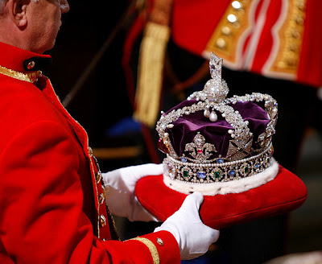
The Reign of the Servant Kings
Jody Dillow is the key author of the Partakers View
Final Destiny
The Future Reign of the Servant Kings
Joseph Dillow
Notes:
• There is a future reign of the Servant Kings—you and me!
• Joseph Dillow articulates our future inheritance in his massive book, Final Destiny
• Dillow is the key author of what he calls the Partakers View.
This view explains inheritance in the OT.
Inheritance in the OT was of two types:
All Israelites who believed in the LORD would have God as their inheritance, or be saved.
But only those Israelites who obeyed the LORD wholeheartedly would inherit Canaan, or be rewarded.
Dillow calls this view the Partakers View based on Hebrews 3:14 that promises believers who persevere to be partakers or sharers with Jesus in his future rule.
___________
Common-257
LC-05-Opposition-196
LC-07-Presentation-99
LC-08-Preparation-61
OS-04-Numbers-148
OS-06-Joshua-175
NP-Rev3v7-13—slide 70
NS-19-Hebrews-58, 186, 448
NS-27-Rev3—slide 157
SA-15-Inheritance-35, 173
TP-01-Our Inheritance OT Summary-35
TP-03-Our Inheritance Hebrews Warnings-56

Slide 63



Jesus would be going away for an unspecified amount of time . . . but He will certainly return (Matt. 25:14,19)
What is He doing while He’s away? (John 14:2,3; Hebrews 7:25)
What do we learn?

Slide 64
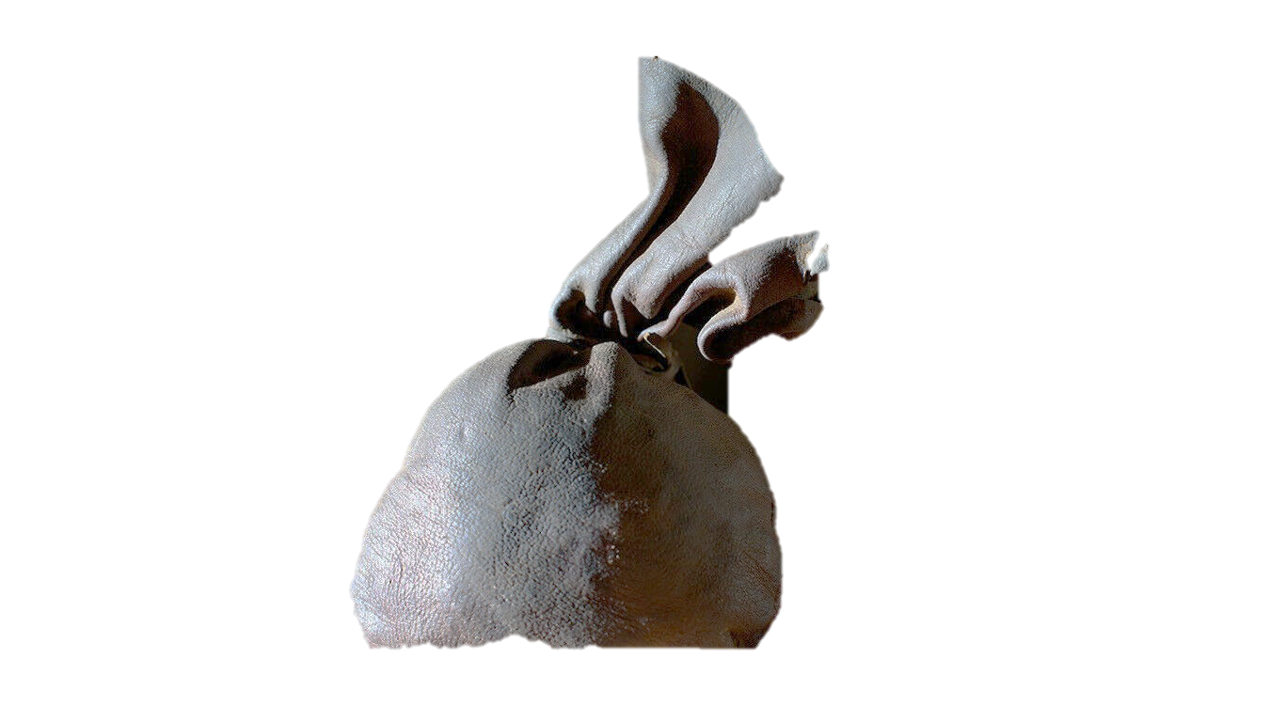
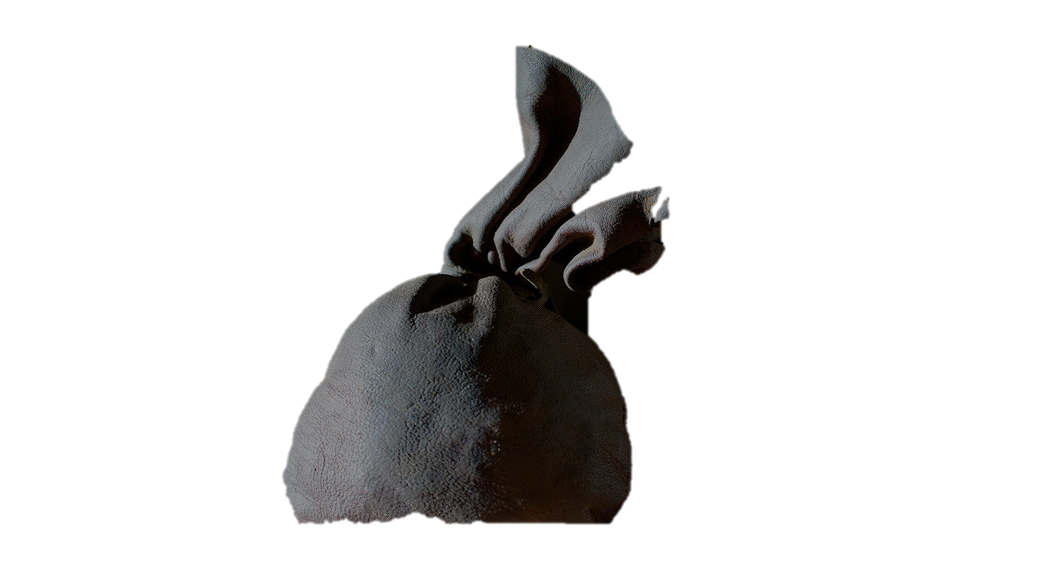

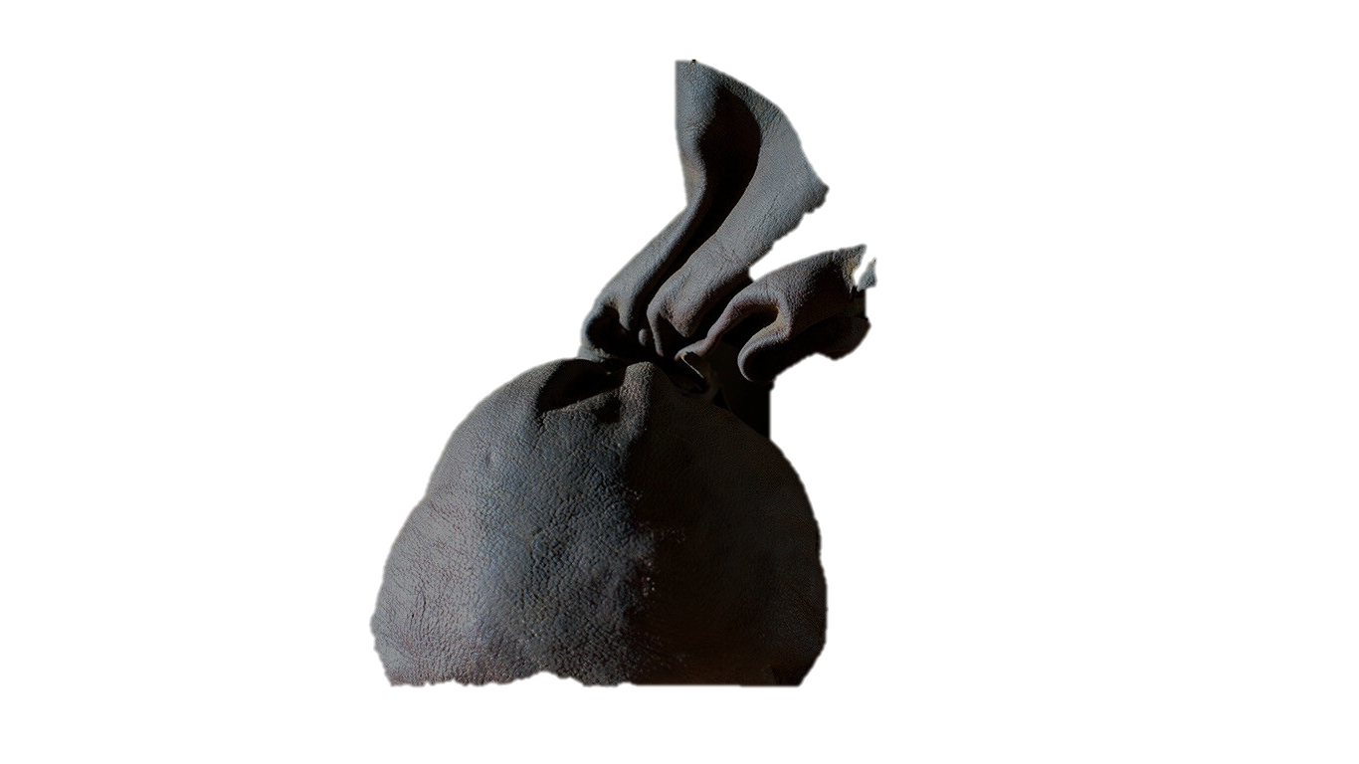
God entrusts each disciple with varying amounts of resources to invest in kingdom
building (Rom. 12:3-8)
Use it or lose it!
What do we learn about the master?
Ministry
Witness opportunity
$ Possessions
Spiritual gift(s)
Music ability
Education
Time

Slide 65
You need to be diligent and faithful in Kingdom work (1 Cor. 4:2)
Live as if Jesus is coming today!
Plan as if Jesus is coming in 50 years
What do we learn from the good servants?

Slide 66

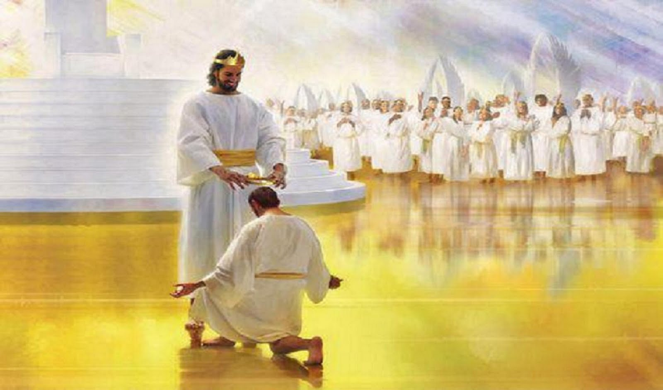
Well done, good and faithful servant
To whom much is given, much is required (Lk 12:48)
All faithfulness will be rewarded (1 Cor. 4:2)
There are heavenly rewards for using all your “talents”
✓Responsible positions of service (Rev. 7:15)
✓Crowns (2 Tim. 4:8)
✓The joy of the Lord (Matt. 25:21, 23; 8:11)

Slide 67
Failure to use the resources God has given you reveals:
✓You are a disobedient disciple (1 Cor. 3:13-15)
✓You are not a true disciple and will be cast into hell (Matt. 7:21)?
Be ready to meet Jesus! Rev. 22:12
What do we learn from the wicked/lazy servant??
Notes:
The preacher of this sermon sees the lazy servant as either a believer or an unbeliever, but does the text give us that much latitude? Has God provided for and gifted the non-Christian for service? It makes better sense that each servant was indeed

Slide 68
7. Judgment on Gentiles
Matthew 25:31-46
Jesus predicts judgment on living Gentiles based on their treatment of Israel to determine their entrance into the millennial kingdom

Slide 69
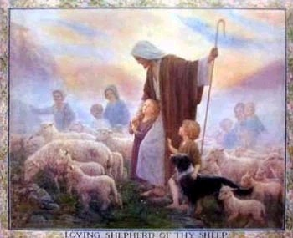
Judgment of the the Nations (Sheep & Goats)
160
NLT Matthew 25:31 "But when the Son of Man comes in his glory, and all the angels with him, then he will sit upon his glorious throne. ³²All the nations will be gathered in his presence, and he will separate them as a shepherd separates the sheep from the goats. ³³He will place the sheep at his right hand and the goats at his left. ³⁴Then the King will say to those on the right, 'Come, you who are blessed by my Father, inherit the Kingdom prepared for you from the foundation of the world.'"

Slide 70
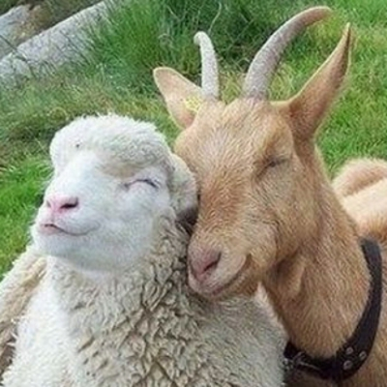
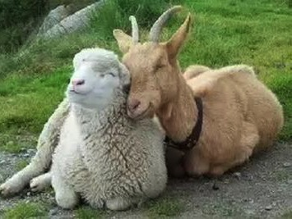
Aren't Sheep & Goats the Same?
Notes:
Why sheep for believers? They are dependent and believe in the shepherd! Think Psalm 23.
Why goats for unbelievers? They depend on their ingenuity for food, even climbing trees. Canaanites worshipped goat idols and do so today.

Slide 71
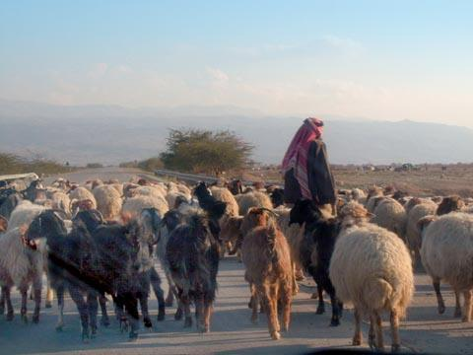
Judgment of the Nations
"All the nations will be gathered in his presence, and he will separate the people as a shepherd separates the sheep from the goats. ³³He will place the sheep at his right hand and the goats at his left" (Matt. 25:31-32).

Slide 72
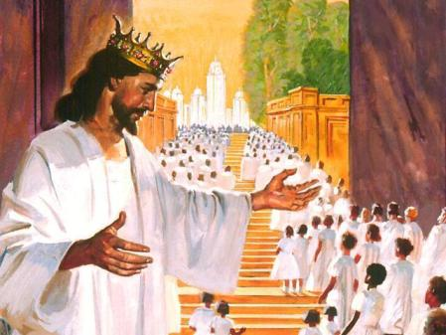
Judgment of Living Gentiles
³¹ "But when the Son of Man comes in his glory, and all the angels with him, then he will sit upon his glorious throne.
³² All the nations will be gathered in his presence, and he will separate the people as a shepherd separates the sheep from the goats. ³³ He will place the sheep at his right hand and the goats at his left.
³⁴ "Then the King will say to those on his right, 'Come, you who are blessed by my Father, inherit the Kingdom prepared for you from the creation of the world" (Matt. 25:31-34 NLT).

Slide 73
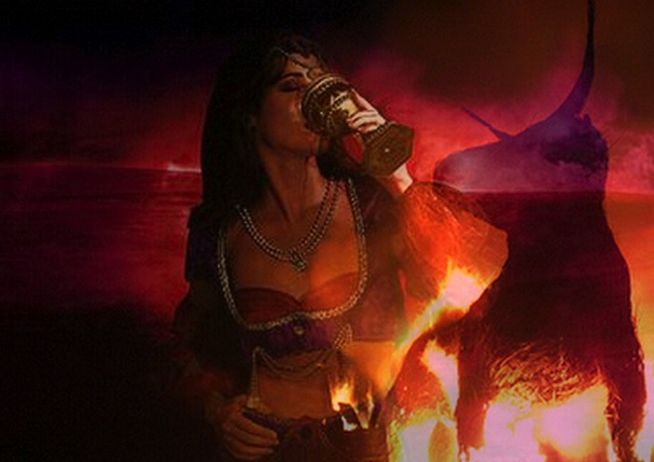
Judgment of Living Gentiles
⁴¹ "Then the King will turn to those on the left and say, 'Away with you, you cursed ones, into the eternal fire prepared for the devil and his demons. ⁴² For I was hungry, and you didn't feed me. I was thirsty, and you didn't give me a drink.
⁴³ I was a stranger, and you didn't invite me into your home. I was naked, and you didn't give me clothing. I was sick and in prison, and you didn't visit me.'
⁴⁴ "Then they will reply, 'Lord, when did we ever see you hungry or thirsty or a stranger or naked or sick or in prison, and not help you?'
⁴⁵ "And he will answer, 'I tell you the truth, when you refused to help the least of these my brothers and sisters, you were refusing to help me.' ⁴⁶ "And they will go away into eternal punishment, but the righteous will go into eternal life" (Matt. 25:41-46 NLT).

Slide 74
Olivet Discourse Overview
27
First Fall of Jerusalem
586 BC
Second Fall of Jerusalem
AD 70
Rapture
1 Thessalonians
4:14-17
Third Fall of Jerusalem
Second Coming with the Saints
Matt. 23:39; 24:30
Israel
Church Age
Tribulation
Millennium
The Great Tribulation
Daniel 9:27
Matt. 24:15
Israel Scattered Luke 21:24
Return to the Land
606 BC
Times of the Gentiles Luke 21:24
Judgment of the Gentile Nations
Matt. 25:31-46
Adapted from Salem Kirban Charts on Revelation (1979), 48
Notes:
Matthew and Luke provide a good overview of details on Israel's restoration, as well as Daniel and 1 Thess.
_________
Common-436
ES-26-Restoration of Israel-376
LC-06-Preparation of the Disciples-168
LC-08-Preparation for the Death of the King-30, 70
NS-01-Matt14-28-slide 157
NS-03-Luke13-24-slide 136

Slide 75
B. Preparation for Christ's Death
§§ 151-160
Various events follow their divinely prescribed order to prepare for the death of the Messiah as a sacrifice for the world's sin

Slide 76
B. Preparation for Christ's Death
The Prediction of His Death
The Plan of the Rulers
The Pouring of the Ointment
The Promise to Betray
The Preparation of the Passover
The Passover Observance
The Provision of an Example
8. The Prediction of Judas' Betrayal
9. The Prediction of Peter's Denial
10. The Provision of a Memorial

Slide 77
1. The Prediction of His Death
§ 151
Matthew 26:1-2; Mark 14:1a; Luke 22:1
Christ predicts His death on Passover to show that He would fulfill prophecy as God's sacrificial Lamb on that very day
Notes:
The Plot to Kill Jesus
Matt. 26:1 When Jesus had finished saying all these things, he said to his disciples, 2 “As you know, Passover begins in two days, and the Son of Man will be handed over to be crucified.”
Jesus Anointed at Bethany
Mark 14:1 It was now two days before Passover and the Festival of Unleavened Bread. The leading priests and the teachers of religious law were still looking for an opportunity to capture Jesus secretly and kill him.
Judas Agrees to Betray Jesus
Luke 22:1 The Festival of Unleavened Bread, which is also called Passover, was approaching.

Slide 78
2. The Plan of the Rulers
§ 152
Matthew 26:3-5; Mark 14:1b-2; Luke 22:2
The Sanhedrin takes Caiaphas' advice to kill Jesus at some time other than during the feast to prevent a riot
Notes:
Matt. 26:3 At that same time the leading priests and elders were meeting at the residence of Caiaphas, the high priest, ⁴ plotting how to capture Jesus secretly and kill him. ⁵ “But not during the Passover celebration,” they agreed, “or the people may riot.”
Jesus Anointed at Bethany
Mark 14:1 It was now two days before Passover and the Festival of Unleavened Bread. The leading priests and the teachers of religious law were still looking for an opportunity to capture Jesus secretly and kill him. ² “But not during the Passover celebration,” they agreed, “or the people may riot.”
Luke 22:2 The leading priests and teachers of religious law were plotting how to kill Jesus, but they were afraid of the people’s reaction.

Slide 79
3. The Pouring of the Ointment
§ 153
Matthew 26:6-13; Mark 14:3-9; John 12:2-8
Mary anoints Christ as King but Jesus states that her anointing anticipated His upcoming death

Slide 80
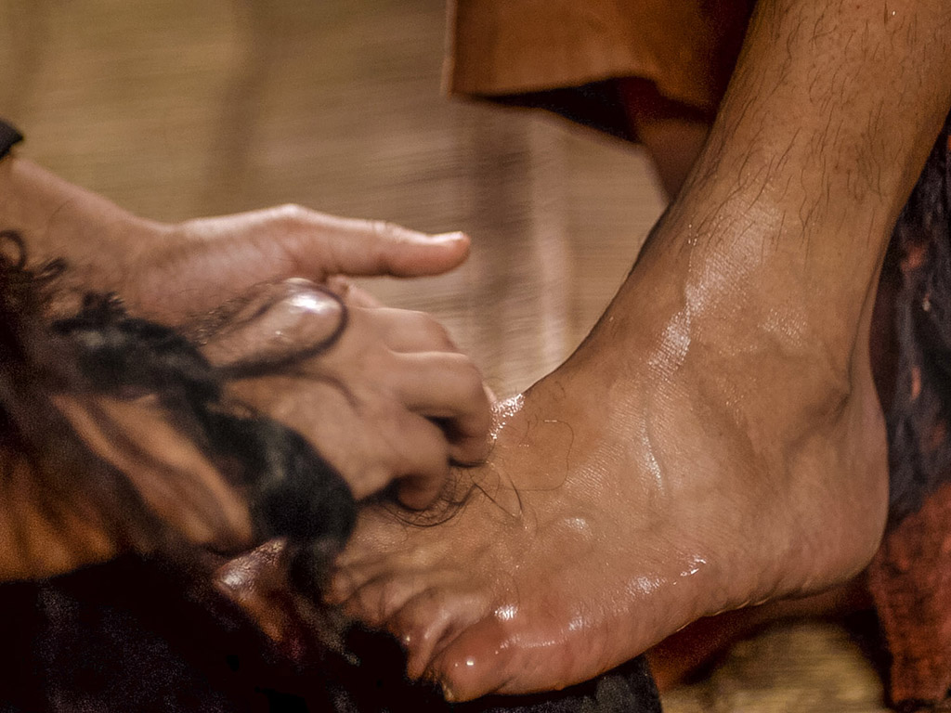
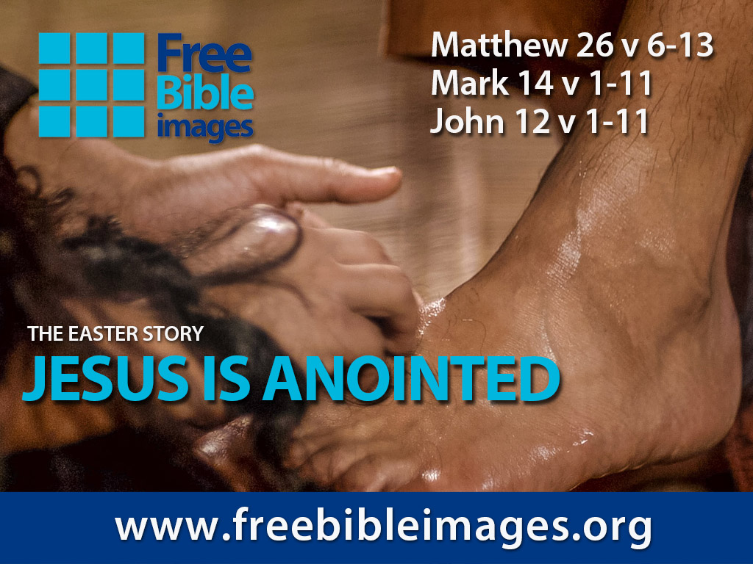

Broken & Spilled Out
Matthew 26:6-13
Mark 14:1-11
John 12:1-11
Free Bible images
Performed By Steve Green
JESUS IS ANOINTED
Notes:
Jesus Anointed at Bethany
Matt. 26:6 Meanwhile, Jesus was in Bethany at the home of Simon, a man who had previously had leprosy. ⁷ While he was eating,ª a woman came in with a beautiful alabaster jar of expensive perfume and poured it over his head.
Matt. 26:8 The disciples were indignant when they saw this. “What a waste!” they said. ⁹ “It could have been sold for a high price and the money given to the poor.”
Matt. 26:10 But Jesus, aware of this, replied, “Why criticize this woman for doing such a good thing to me? ¹¹ You will always have the poor among you, but you will not always have me. ¹² She has poured this perfume on me to prepare my body for burial. ¹³ I tell you the truth, wherever the Good News is preached throughout the world, this woman’s deed will be remembered and discussed.”
Jesus Anointed at Bethany
Mark 14:1 It was now two days before Passover and the Festival of Unleavened Bread. The leading priests and the teachers of religious law were still looking for an opportunity to capture Jesus secretly and kill him. ² “But not during the Passover celebration,” they agreed, “or the people may riot.”
Mark 14:3 Meanwhile, Jesus was in Bethany at the home of Simon, a man who had previously had leprosy. While he was eating,ª a woman came in with a beautiful alabaster jar of expensive perfume made from essence of nard. She broke open the jar and poured the perfume over his head.
Mark 14:4 Some of those at the table were indignant. “Why waste such expensive perfume?” they asked. ⁵ “It could have been sold for a year’s wagesª and the money given to the poor!” So they scolded her harshly.
Mark 14:6 But Jesus replied, “Leave her alone. Why criticize her for doing such a good thing to me? ⁷ You will always have the poor among you, and you can help them whenever you want to. But you will not always have me. ⁸ She has done what she could and has anointed my body for burial ahead of time. ⁹ I tell you the truth, wherever the Good News is preached throughout the world, this woman’s deed will be remembered and discussed.”
Judas Agrees to Betray Jesus
Mark 14:10 Then Judas Iscariot, one of the twelve disciples, went to the leading priests to arrange to betray Jesus to them. ¹¹ They were delighted when they heard why he had come, and they promised to give him money. So he began looking for an opportunity to betray Jesus.
Jesus Anointed at Bethany
John 12:1 Six days before the Passover celebration began, Jesus arrived in Bethany, the home of Lazarus—the man he had raised from the dead. ² A dinner was prepared in Jesus’ honor. Martha served, and Lazarus was among those who ateª with him. ³ Then Mary took a twelve-ounce jarª of expensive perfume made from essence of nard, and she anointed Jesus’ feet with it, wiping his feet with her hair. The house was filled with the fragrance.
John 12:4 But Judas Iscariot, the disciple who would soon betray him, said, ⁵ “That perfume was worth a year’s wages.ª It should have been sold and the money given to the poor.” ⁶ Not that he cared for the poor—he was a thief, and since he was in charge of the disciples’ money, he often stole some for himself.
John 12:7 Jesus replied, “Leave her alone. She did this in preparation for my burial. ⁸ You will always have the poor among you, but you will not always have me.”
John 12:9 When all the peopleª heard of Jesus’ arrival, they flocked to see him and also to see Lazarus, the man Jesus had raised from the dead. ¹⁰ Then the leading priests decided to kill Lazarus, too, ¹¹ for it was because of him that many of the people had deserted themª and believed in Jesus.

Slide 81
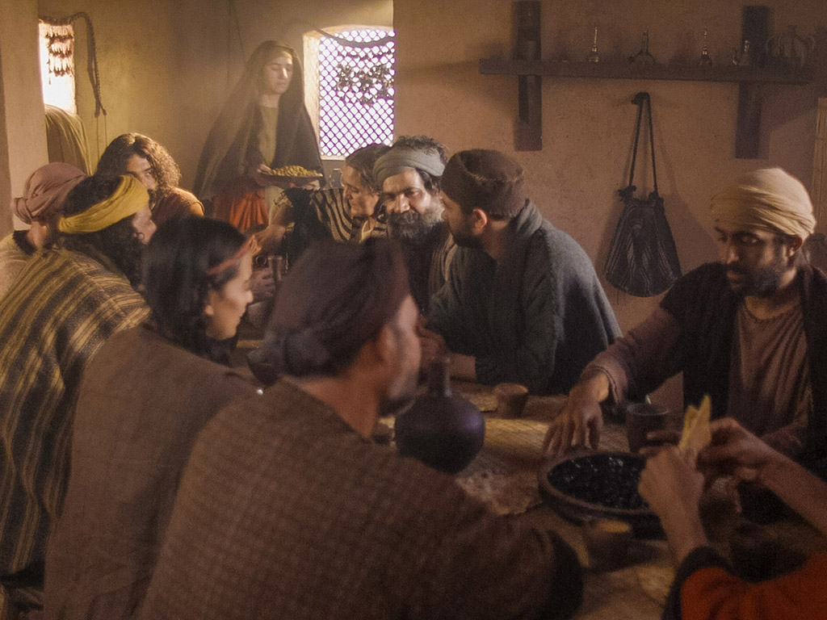
Notes:
Music background 1 of 2

Slide 82
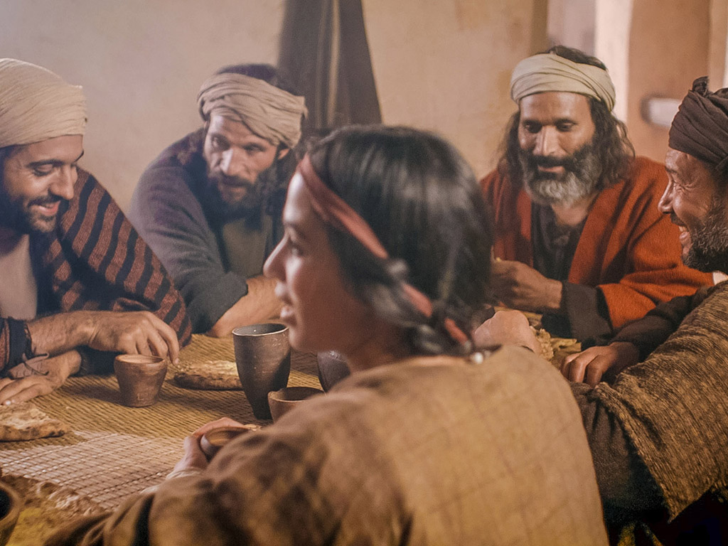
Notes:
Music background 1 of 2

Slide 83

One day a plain village woman, driven by love for her Lord

Slide 84
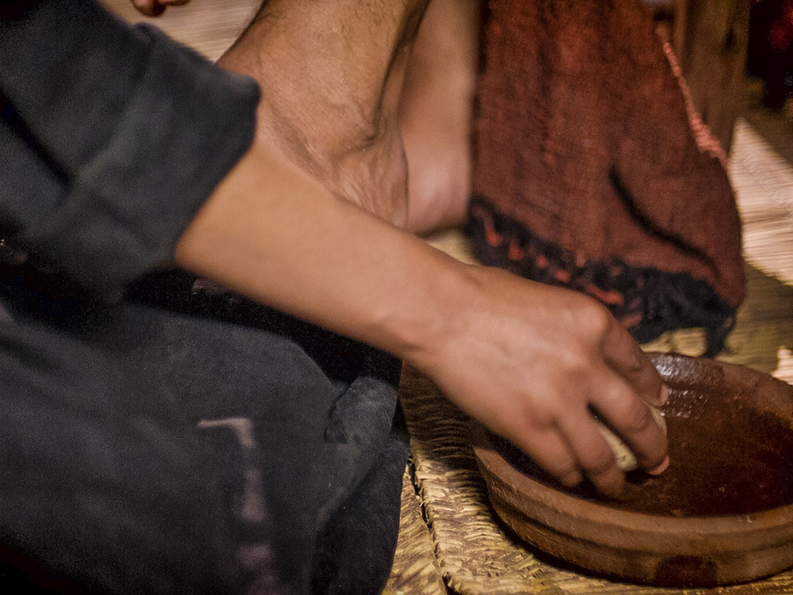
Recklessly poured out a valuable essence, disregarding the scorn

Slide 85
And once it was broken and spilled out A fragrance filled all the room. Like a prisoner released from his shackles Like a spirit set free from the tomb

Slide 86
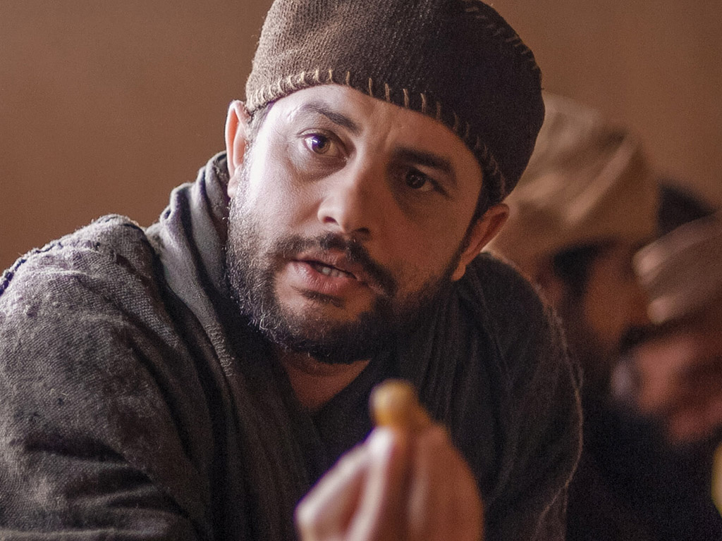
Broken and spilled out, just for love of you, Jesus
Life's most precious treasure, lavished on Thee

Slide 87

Broken and spilled out, and poured at Your feet
In sweet abandon let me be spilled out and used up for Thee

Slide 88

Lord, You were God's precious treasure, His loved and His own perfect Son
Sent here to show me the love of the Father, just for love it was done

Slide 89

And though You were perfect and holy You gave up Yourself willingly
You spared no expense for my pardon You were used up and wasted for me

Slide 90

Broken and spilled out Just for love of me, Jesus–– God's most precious treasure lavished on me

Slide 91

Broken and spilled out and poured at my feet.
In sweet abandon, Lord, You were spilled out and used up for me

Slide 92

In sweet abandon, let me be spilled out and used up for Thee

Slide 93

Pictures courtesy of Big Book Media © All Rights Reserved.
Used with permission
BIG BOOK MEDIA

Slide 94

THE WORD IN PICTURES
Free Bible images

Slide 95


Was Mary Magdalene the Woman with the Alabaster Jar?
The WOMAN with the ALABASTER JAR
Mary Magdalen and the Holy Grail
No. In Luke she is not named but in the other gospels she is clearly Mary of Bethany
As featured in The Da Vinci Code

Slide 96

John 12 Events
64
656
Unbelief Summary
12:37-50
Predicts Death
12:21-36
Triumphal Entry
12:12-20
Anointing at Bethany
12:1-11

Slide 97

Luke 7:36-50 Jesus and the Sinful Woman

Slide 98

Anointings of Jesus
Common to all four gospel accounts:
Unannounced visit by woman
Anointed Jesus' head and/or feet
Wiped his feet with her hair
Complaint of waste by disciples/Judas
Disciples rebuked by Jesus
In a home
Alabaster jar (except in John)
Home owned by man called Simon

Slide 99

The Two Anointings of Jesus
Luke 7:36-50
Early in Ministry
Weeping
For worship, woman's sins forgiven (Luke 7:48)
By unnamed harlot at
home of Simon the Pharisee (Luke 7:40) in an unknown town
Matt. 26:6-13
Mark 14:3-9
John 12:1-11
During Passion Week
No weeping noted
For burial, woman needed no forgiveness
By Lazarus' sister Mary at home of Simon the Leper
(Matt. 26:6; Mark 14:3) in Lazarus' hometown of Bethany (John 12:1)

Slide 100
4. The Promise to Betray
§ 154
Matthew 26:14-16; Mark 14:10-11; Luke 22:3-6
Judas agrees to betray Jesus to the Sanhedrin in His trial, showing his bitterness and disappointment with the Lord
Notes:
Why did Judas betray Jesus?
Judas loved money
He wanted power
It needed to happen to fulfill the prophecy of betraying Jesus
"There have been numerous suggestions as to what motivated Judas to betray Jesus. Perhaps he was jealous of Jesus or disgruntled over the Mary incident. Perhaps he was impatient and wanted to force Jesus to institute the kingdom through a final conflict with the Sanhedrin. Perhaps he was disillusioned that Jesus did not turn out to be the political Messiah that Judas expected. Perhaps Judas was trying to turn a fast buck to replace the money he pilfered from the funds. Perhaps he was trying to save himself as he saw the inevitable and ugly conflict between Jesus and the religious hierarchy coming to a head. We will probably never know the motive, only the result, both for Jesus and Judas. We do know, however, that Judas was operating under the heavy hand of predestination (Ps 41:9; Zech 11:7–14). That is not to say that he had no control over what he did. But it is to say that he, like Jesus, worked out exactly what God had ordained from long ago.
He was promised thirty pieces of silver, the price of a common slave (Exod 21:32). In return, Judas promised to hand over Jesus at an opportune time, away from the crowds."
Mark E. Moore, The Chronological Life of Christ (Joplin, MO: College Press Publishing Company, 2011), 557.

Slide 101
5. The Preparation of the Passover
§ 155
Matthew 26:17-19; Mark 14:12-16; Luke 22:7-13
Jesus sends Peter and John to prepare the Passover supper so that they may fully obey the law's demands to observe the feast
Notes:
The Last Supper
Matt. 26:17 On the first day of the Festival of Unleavened Bread, the disciples came to Jesus and asked, “Where do you want us to prepare the Passover meal for you?”
Matt. 26:18 “As you go into the city,” he told them, “you will see a certain man. Tell him, ‘The Teacher says: My time has come, and I will eat the Passover meal with my disciples at your house.’” ¹⁹ So the disciples did as Jesus told them and prepared the Passover meal there.
The Last Supper
Mark 14:12 On the first day of the Festival of Unleavened Bread, when the Passover lamb is sacrificed, Jesus’ disciples asked him, “Where do you want us to go to prepare the Passover meal for you?”
Mark 14:13 So Jesus sent two of them into Jerusalem with these instructions: “As you go into the city, a man carrying a pitcher of water will meet you. Follow him. ¹⁴ At the house he enters, say to the owner, ‘The Teacher asks: Where is the guest room where I can eat the Passover meal with my disciples?’ ¹⁵ He will take you upstairs to a large room that is already set up. That is where you should prepare our meal.” ¹⁶ So the two disciples went into the city and found everything just as Jesus had said, and they prepared the Passover meal there.
The Last Supper
Luke 22:7 Now the Festival of Unleavened Bread arrived, when the Passover lamb is sacrificed. ⁸ Jesus sent Peter and John ahead and said, “Go and prepare the Passover meal, so we can eat it together.”
Luke 22:9 “Where do you want us to prepare it?” they asked him.
Luke 22:10 He replied, “As soon as you enter Jerusalem, a man carrying a pitcher of water will meet you. Follow him. At the house he enters, ¹¹ say to the owner, ‘The Teacher asks: Where is the guest room where I can eat the Passover meal with my disciples?’ ¹² He will take you upstairs to a large room that is already set up. That is where you should prepare our meal.” ¹³ They went off to the city and found everything just as Jesus had said, and they prepared the Passover meal there.

Slide 102

A Prophetic Weekend
Thursday
Friday
Saturday
Sunday
Galilean
Passover
Unleavened Bread
Firstfruits
Judean
Passover
Unleavened Bread
Firstfruits
Last Supper
Crucifixion
Resurrection
2 April 33
3 April 33
5 April 33
“But now Christ has been raised from the dead, the first fruits of those who are asleep” (1 Cor 15:20 NAU).
Christ is the only one ever resurrected, but as such, he is also the first among many who will join a resurrected body.
Notes:
Leviticus 23 gives the order of three key feasts of Israel: • Passover, • Unleavened Bread, and • Firstfruits.
• But how could Jesus have Passover Thursday night but then die at 3 PM the next day on Friday when the Passover lambs were being slaughtered? And why did the Jewish leaders want the bodies off the cross quickly as Passover was approaching when Jesus had already celebrated Passover the night before?
• The answer is that Galilean Jews celebrated Passover the day before • Judean Jews. Since his disciples were Galileans, Jesus naturally celebrated on their timetable.
• The Feast of Unleavened Bread always began the day after Passover (Lev 23:5-6).
• Then Firstfruits followed sometime later on the first Sabbath after the first crops began to ripen (Lev 23:11). It indicated that millions of additional sheaves would follow until the entire harvest came in at Pentecost. In AD 33, these three celebrations occurred one after another on three consecutive days!
The significance is astonishing. • Christ predicted his death at the Last Supper Thursday night. • Then Jesus died on the Judean Passover • so that believers can live a life without yeast (Unleavened Bread), • which immediately followed with his resurrection on Firstfruits as he is the first and only human ever to obtain a glorified body as an installment for millions more to follow (1 Cor 15:20)!
We know these dates to be • 2 April 33 for the Thursday night Passover, • 3 April 33 was the day of his crucifixion, and • Jesus rose from the dead on the Feast of Firstfruits on 5 April 33.
Another view by Mark Moore:
"§ 143 Preparation for the Passover Meal (Mt 26:17–19; Mk 14:12–16; Lk 22:7–13)
The Synoptics indicate that Jesus ate the actual Passover meal on Nisan 14 before he was crucified on Nisan 15 (roughly equivalent to our April). Some, however, have interpreted John 18:28 and 19:14 to say that Jesus died at the very time the Passover lambs were being slain on Nisan 14. If that is true then we have an obvious contradiction between John and the Synoptics.
Though some are always eager to charge the Evangelists with theological editing or outright error, a better solution seems to be the suggestion that two separate calendars were followed. For example, Jaubert argues that Jesus followed the Essene solar calendar,²¹ or that the Passover sacrifices and meals were spread over two days because of the flood of visitors to Jerusalem.²² This would put the Passover on Thursday for the disciples but on Friday for the Sadducees. Hoehner argues that there was a difference in how the Galileans and Judeans reckoned their days (from sunrise or sunset).²³ Hence Jesus and the other Galileans ate the Passover a day before the Judeans did. Others have suggested that the discrepancy stemmed from an argument between the Pharisees and Sadducees. However, none of these arguments based on a calendar have strong documentary support.
There is a third solution that is better still and much simpler. Jesus and his disciples celebrated the actual Passover. John knew that. After all, he was familiar with synoptic chronology. In fact, John 13 also describes the Passover Jesus celebrated. (1) It was in Jerusalem rather than Bethany, which had been their haunt the entire week. (2) They are pictured as reclining at the table at night, which is indicative of a festival meal. And (3) when the disciples saw Judas exit urgently they believed he was going out to get last minute supplies for the Passover meal or to give alms to the poor. These are indications of a Passover meal. Consequently, what John calls the Passover (18:28), is actually the chagigah (Num 28:18–19), which opened the Feast of Unleavened Bread. Was John confused about what it was actually called? No. In John’s day, there was little distinction between the Passover (Nisan 14) and the Feast of Unleavened Bread (Nisan 15–21). Both terms were used interchangeably (Mt 26:17; Mk 14:1, 12; Lk 2:41; 22:1; Josephus, Ant 2.317; JW 5.98). So it was perfectly acceptable for John to identify this special meal as the Passover. Besides, every other time John uses the term “Passover” he refers to the entire feast, not the single meal (Jn 2:13, 23; 6:4; 11:55; 12:1; 13:1). Therefore, we suggest that Jesus and the disciples ate the actual Passover meal, celebrated on Nisan 14. Furthermore, the Jews of John 18:12 refused to enter Pilate’s praetorium so they would not be disqualified from the rest of the seven day Feast of Unleavened Bread, not the actual Passover meal.²⁴
²¹ Annie Jaubert, The Date of the Last Supper (New York: Alba House, 1965). One great weakness of her view is that her evidence for the Essene solar calendar comes from a third century document.
²² Cf. Maurice Casey, “The Date of the Passover Sacrifices and Mark 14:12,” TB 48/2 (1997): 245–247.
²³ H.W. Hoehner, Chronological Aspects of the Life of Christ (Grand Rapids: Zondervan, 1977).
Ant Antiquities of the Jews
JW Jewish Wars
²⁴ Cf. Carson, pp. 528–532; and B. Smith, “The Chronology of the Last Supper,” WTJ 53 (1991): 29–45. F. Chenderlin, “Distributed Observance of the Passover: A Preliminary Test of the Hypothesis,” Biblica 57 (1976): 1–24, adds a couple of additional keen points. First, there were probably too many Passover participants to have all the lambs killed and eaten in a single day. Hence, he argues for a “distributed observance” in which the Passover would be celebrated on successive days. Second, if that were the case, the Jewish leaders may have preferred to eat the Passover on the holy high Sabbath during Passover week rather than strictly on Nisan 14."
— Mark E. Moore, The Chronological Life of Christ (Joplin, MO: College Press Publishing Company, 2011), 557–558.
————————————
Common-435
OB-25-Feasts-35
OS-03-Leviticus-303
OS-26-Ezek40-43-Slide105
LC-00-Chronology of Christ-8
LC-08-Preparation-98
LC-09-Rejection-226
LC-10-Resurrection-35
NB-11-Feasts-35
NC-10-Reliability of Acts-13
NS-00-NTS Chronology-slide 40
NS-00-Chronology of Christ-8
NS-01-Matt15-28-slide 315
NS-02-Mark9-16-slide 262
NS-03-Luke13-24-slide 292
NS-04-John12-21-slide 390

Slide 103
6. The Passover Observance
§ 156
Matthew 26:20; Mark 14:17; Luke 22:14-16, 24-30
Jesus notes that the Passover will be fulfilled in the Millennium, so his disciples argue for their greatness based on their table positions
Notes:
The Last Passover
Matt. 26:20 Now when evening came, Jesus was reclining at the table with the twelve disciples.
Mark 14:17 When it was evening, He *came with the twelve.
The Lord’s Supper
Luke 22:14 When the hour had come, He reclined at the table, and the apostles with Him. ¹⁵ And He said to them, “I have earnestly desired to eat this Passover with you before I suffer; ¹⁶ for I say to you, I shall never again eat it until it is fulfilled in the kingdom of God.”
Who Is Greatest
Luke 22:24 And there arose also ªa dispute among them as to which one of them was regarded to be greatest. ²⁵ And He said to them, “The kings of the Gentiles lord it over them; and those who have authority over them are called ‘Benefactors.’ ²⁶ “But it is not this way with you, ªbut the one who is the greatest among you must become like the youngest, and the leader like the servant. ²⁷ “For who is greater, the one who reclines at the table or the one who serves? Is it not the one who reclines at the table? But I am among you as the one who serves.
Luke 22:28 “You are those who have stood by Me in My trials; ²⁹ and just as My Father has granted Me a kingdom, I grant you ³⁰ that you may eat and drink at My table in My kingdom, and you will sit on thrones judging the twelve tribes of Israel.

Slide 104

A Literal, Political Kingdom
"Jesus replied, 'I assure you that when the world is made new and the Son of Man sits upon his glorious throne, you who have been my followers will also sit on twelve thrones, judging the twelve tribes of Israel'" (Matt. 19:28 NLT)
Notes:
The Messiah will rule the millennial kingdom with the saints, including the disciples, and Israel will be prominent over a believing world.
________
LC-08-Preparation-100
NS-01-Matt1-14-slide 113
NS-01-Matt15-28-slide 106
NS-05-Acts1-2-slide 191

Slide 105

Jerusalem from the East, AD 33
John 13–14 Passover at Mark’s House
Notes:
Today, we finish what has often been called the Upper Room Discourse—the last time Jesus taught his disciples. This isn’t a good term to describe all of John 13–17 because, at the end of John 14, Jesus noted, “Come, let’s be going.”
So they left the upper room of the Passover and began walking east to the Mt. of Olives, where he would be betrayed. This likely brought him through a vineyard where he taught in John 15 that he was the vine and, as branches, they needed a connection to him.
In John 18:1, they would cross the Kidron Valley, so they are still on the west side of the Kidron Brook. In this ravine lay a channel that led from the temple—not a waterway like an aqueduct—but rather a channel that led from the temple altar where an estimated 256,000 lambs were slaughtered during the Passover. When Jesus crossed it, no doubt the smell of blood was ominously hanging in the air—a picture of what was to happen the next day with Jesus as our Passover Lamb.
________________
LC-08-Preparation-101, 205, 226, 289
NS-04-John12-21—slide 66, 187

Slide 106
7. The Provision of an Example
§ 157
John 13:1-20
Christ loves the disciples as their servant by washing their feet to show that the one who rules must become one who serves
Notes:
Jesus Washes His Disciples’ Feet
John 13:1 Before the Passover celebration, Jesus knew that his hour had come to leave this world and return to his Father. He had loved his disciples during his ministry on earth, and now he loved them to the very end. ² It was time for supper, and the devil had already prompted Judas, son of Simon Iscariot, to betray Jesus. ³ Jesus knew that the Father had given him authority over everything and that he had come from God and would return to God. ⁴ So he got up from the table, took off his robe, wrapped a towel around his waist, ⁵ and poured water into a basin. Then he began to wash the disciples’ feet, drying them with the towel he had around him.
John 13:6 When Jesus came to Simon Peter, Peter said to him, “Lord, are you going to wash my feet?”
John 13:7 Jesus replied, “You don’t understand now what I am doing, but someday you will.”
John 13:8 “No,” Peter protested, “you will never ever wash my feet!”
Jesus replied, “Unless I wash you, you won’t belong to me.”
John 13:9 Simon Peter exclaimed, “Then wash my hands and head as well, Lord, not just my feet!”
John 13:10 Jesus replied, “A person who has bathed all over does not need to wash, except for the feet, to be entirely clean. And you disciples are clean, but not all of you.” ¹¹ For Jesus knew who would betray him. That is what he meant when he said, “Not all of you are clean.”
John 13:12 After washing their feet, he put on his robe again and sat down and asked, “Do you understand what I was doing? ¹³ You call me ‘Teacher’ and ‘Lord,’ and you are right, because that’s what I am. ¹⁴ And since I, your Lord and Teacher, have washed your feet, you ought to wash each other’s feet. ¹⁵ I have given you an example to follow. Do as I have done to you. ¹⁶ I tell you the truth, slaves are not greater than their master. Nor is the messenger more important than the one who sends the message. ¹⁷ Now that you know these things, God will bless you for doing them.
Jesus Predicts His Betrayal
John 13:18 “I am not saying these things to all of you; I know the ones I have chosen. But this fulfills the Scripture that says, ‘The one who eats my food has turned against me.’ ¹⁹ I tell you this beforehand, so that when it happens you will believe that I AM the Messiah. ²⁰ I tell you the truth, anyone who welcomes my messenger is welcoming me, and anyone who welcomes me is welcoming the Father who sent me.”

Slide 107

John 13:1-17
Free Bible images
THE EASTER STORY
JESUS WASHES THE DISCIPLES' FEET

Slide 108


Slide 109


Slide 110


Slide 111


Slide 112


Slide 113


Slide 114


Slide 115


Slide 116


Slide 117


Slide 119


Slide 120
THE WORD IN PICTURES
Free Bible images

Slide 121

Used with Permission
THE GOSPEL ——OF—— MATTHEW
THE GOSPEL ——OF—— MARK
THE GOSPEL ——OF—— LUKE
THE GOSPEL ——OF—— JOHN
Due to the Lumo Project producing its own publishing material we regret to inform you that we cannot license our photos to other clients outside of freebibleimages.org.
These images are not licensed for reuse in video, epublishing or other media. Downloaded pictures and files cannot be redistributed through any other website than freebibleimages.org or used in any context where the accompanying message is undermining of the Christian faith and gospel.
Photos can only be used on educational presentations, blogs and social media, all of which should be accompanied with reference to www.LumoProject.com.
Picture courtesy of BBM © All Rights Reserved.
www.bigbookmedia.com

Slide 122


Washing of Hands

Slide 123

Feet instead of hands

Slide 124

Upper Room Seating

Slide 125

"U" Shaped Table

Slide 126

Seating at Jesus' Passover

Slide 127

Passover Seating
Head
Notes:
Where did the head of the table sit?
Christ loves the disciples as their servant by washing their feet to show that the one who rules must become one who serves

Slide 128

The Head of the Table
Jesus
John
Judas
Notes:
Others say Christ "reclined on the middle divan" (see http://www.spiritjournals.com/Bible%20Studies/Passover/passoverseatingarrin.htm accessed 27 Oct 2013)

Slide 129
Dirty Saints
John 13:1-17

Slide 130


Why get dirty for others?
3 reasons

Slide 131

I. Getting dirty shows your love.

Slide 132
Love Exemplified
“... He showed them the full extent of his love” (1).

Slide 133

II. Getting dirty shows your humility.

Slide 134

Jesus showed humility

Slide 135

Jesus washed the feet of Judas too!

Slide 136

Jesus retained his authority but took on a servant’s role

Slide 137

“Lord, are you going to wash my feet?” (13:6)
“Unless I wash you, have no part with me” (13:8)

Slide 138

“Then wash my hands and head as well, not just my feet!” (13:9)
Two washings:
Body = salvation (once)
Feet = confession (repeated)
Notes:
13:9-10. “Peter continued to miss the spiritual lesson, but he was certain of his desire to be joined to Jesus. Therefore he asked Jesus to wash his hands and head as well as his feet. Jesus answered, A person who has had a bath needs only to wash his feet; his whole body is clean. (Some Gr. mss. omit the words “his feet.”) Roman Catholics sometimes have interpreted verse 10 to mean that after infant baptism only penance is needed. A preferable interpretation is that after salvation all one needs is confession of sins, the continual application of Jesus’ death to cleanse one’s daily sins (cf. 1 John 1:7; 2:1-2). When Jesus added that not every one of you is clean, He was referring to Judas (cf. John 13:11, 18). This suggests that Judas was not converted” (Ibid).

Slide 139

Humble service curbs pride
1. Voluntary
2. No complaining
3. Unconventional

Slide 140

“When a man forgets himself, he usually does something everybody else remembers.”

Slide 141

III. Getting dirty shows you imitate Christ.

Slide 142

“I have given you an example to follow. Do as I have done to you” (John 13:15)

Slide 143

Main Idea
When you love people like Jesus, you don’t mind dirt.

Slide 144

Why Get Dirty?
1. To show love
2. To show humility
3. To imitate Jesus

Slide 145
8. The Prediction of Judas' Betrayal
§ 158
Matthew 26:21-25; Mark 14:18-21; Luke 22:21-23
Christ predicts Judas' betrayal by passing the sop to offer forgiveness to Judas if he believes in Jesus

Slide 146
9. The Prediction of Peter's Denial
§ 159
Matthew 26:31-35; Mark 14:27-31; Luke 22:31-38
Jesus predicts Peter's denial and prays that the Twelve would all be restored after denying Him as Lord

Slide 147

Jesus predicted that Peter would deny him that very night (Mark 14:30)
Notes:
Peter would deny him (13:38)…

Slide 148
10. The Provision of a Memorial
§ 160
Matthew 26:26-30; Mark 14:22-26; Luke 22:17-20
Jesus establishes memorials of His person in the cup and bread so that they would help His followers remember His sacrificial death

Slide 149

Free Bible images
Matthew 26:17-35
Mark 14:12-31
Luke 22:7-38
John 13:18-38
THE EASTER STORY
THE LAST SUPPER

Slide 150


Slide 151


Slide 152


Slide 153


Slide 154


Slide 155


Slide 156


Slide 157


Slide 159


Slide 160


Slide 161


Slide 162


Slide 163


Slide 164


Slide 165
THE WORD IN PICTURES
Free Bible images

Slide 166


PESACH
The Passover Meal
Notes:
Translators, do NOT translate PESACH as this is Hebrew but translate “The Passover Meal”

Slide 167
The Four Cups (Exod. 6:6-7)
145
"Therefore, say to the Israelites:
'I am the Lord, and I will bring you out from under the yoke of the Egyptians.
Sanctification
Plagues
I will free you from being slaves to them,
and I will redeem you with an outstretched arm and with mighty acts of judgment.
Redemption

Slide 168


… This is my body GIVEN FOR YOU do this in REMEMBRANCE of me.
LUKE 22:19

Slide 169
… This cup is the NEW COVENANT in my blood, which is POURED OUT for you.
The cup (not baptism) is the new covenant sign
LUKE 22:20

Slide 170
C. Precepts By Christ
§§ 161-165
John 13:31–16:33
Christ's final teaching at the Last Supper prepares them for His departure and for their ministry apart from His bodily presence

Slide 171
1. Prologue
§ 161
John 13:31-35
Jesus commands His men to love each other with His same love to identify themselves to the world as His followers
Notes:
Jesus Predicts Peter’s Denial
John 13:31 As soon as Judas left the room, Jesus said, “The time has come for the Son of Man to enter into his glory, and God will be glorified because of him. ³² And since God receives glory because of the Son, he will give his own glory to the Son, and he will do so at once. ³³ Dear children, I will be with you only a little longer. And as I told the Jewish leaders, you will search for me, but you can’t come where I am going. ³⁴ So now I am giving you a new commandment: Love each other. Just as I have loved you, you should love each other. ³⁵ Your love for one another will prove to the world that you are my disciples.”

Slide 172
2. Problems
§ 162
John 13:36, 14:1-24
Jesus promises His troubled disciples a new intimacy with the Trinity as He was the only way to God, who would soon be replaced by the Spirit
Notes:
John 13:36 Simon Peter asked, “Lord, where are you going?”
And Jesus replied, “You can’t go with me now, but you will follow me later.”
Jesus, the Way to the Father
John 14:1 “Don’t let your hearts be troubled. Trust in God, and trust also in me. ² There is more than enough room in my Father’s home.ª If this were not so, would I have told you that I am going to prepare a place for you?^{b} ³ When everything is ready, I will come and get you, so that you will always be with me where I am. ⁴ And you know the way to where I am going.”
John 14:5 “No, we don’t know, Lord,” Thomas said. “We have no idea where you are going, so how can we know the way?”
John 14:6 Jesus told him, “I am the way, the truth, and the life. No one can come to the Father except through me. ⁷ If you had really known me, you would know who my Father is.ª From now on, you do know him and have seen him!”
John 14:8 Philip said, “Lord, show us the Father, and we will be satisfied.”
John 14:9 Jesus replied, “Have I been with you all this time, Philip, and yet you still don’t know who I am? Anyone who has seen me has seen the Father! So why are you asking me to show him to you? ¹⁰ Don’t you believe that I am in the Father and the Father is in me? The words I speak are not my own, but my Father who lives in me does his work through me. ¹¹ Just believe that I am in the Father and the Father is in me. Or at least believe because of the work you have seen me do.
John 14:12 “I tell you the truth, anyone who believes in me will do the same works I have done, and even greater works, because I am going to be with the Father. ¹³ You can ask for anything in my name, and I will do it, so that the Son can bring glory to the Father. ¹⁴ Yes, ask me for anything in my name, and I will do it!
Jesus Promises the Holy Spirit
John 14:15 “If you love me, obeyª my commandments. ¹⁶ And I will ask the Father, and he will give you another Advocate,ª who will never leave you. ¹⁷ He is the Holy Spirit, who leads into all truth. The world cannot receive him, because it isn’t looking for him and doesn’t recognize him. But you know him, because he lives with you now and later will be in you.ª ¹⁸ No, I will not abandon you as orphans—I will come to you. ¹⁹ Soon the world will no longer see me, but you will see me. Since I live, you also will live. ²⁰ When I am raised to life again, you will know that I am in my Father, and you are in me, and I am in you. ²¹ Those who accept my commandments and obey them are the ones who love me. And because they love me, my Father will love them. And I will love them and reveal myself to each of them.”
John 14:22 Judas (not Judas Iscariot, but the other disciple with that name) said to him, “Lord, why are you going to reveal yourself only to us and not to the world at large?”
John 14:23 Jesus replied, “All who love me will do what I say. My Father will love them, and we will come and make our home with each of them. ²⁴ Anyone who doesn’t love me will not obey me. And remember, my words are not my own. What I am telling you is from the Father who sent me.

Slide 173


Confusion
3 ways to replace confusion with comfort
Comfort

Slide 174

I. Life: Realize that Jesus is preparing a wonderful life in heaven for you (John 14:1-4).

Slide 175

“Don’t let your hearts be troubled. Trust in God, and trust also in me” (John 14:1 NLT)

Slide 176

Your Heart
“Trust in the Lord with all your heart; do not depend on your own understanding” (Prov. 3:5)
“Guard your heart above all else, for it determines the course of your life” (Prov. 4:23)

Slide 177

“Don’t let your hearts be troubled. Trust in God, and trust also in me” (John 14:1 NLT)

Slide 178

John 14:2 Mansions (KJV)
“In my Father’s house are many mansions...” (KJV)
“In my Father’s house are many mansions...” (KJV)

Slide 179

In my Father’s house are many rooms; if it were not so, I would have told you. I am going there to prepare a place for you.
John 14:2 NIV

Slide 180

Marriage Backgrounds in Jewish Literature
Marriage depicts Christ's love for the church (Eph. 5)

Slide 181

The First Century Wedding Procession
Groom’s House (in Father’s House)
The procession parallels Christ's return for His Bride, the Church
Bride’s House

Slide 182

“We will be caught up (“raptured”) in the clouds to meet the Lord in the air” (1 Thess. 4:17)

Slide 183
I. Life: Realize that Jesus is preparing a wonderful life in heaven for you (John 14:1-4).

Slide 184

II. Way: Trust Christ as the only way you can reach God (14:5-14).
ONE WAY

Slide 185
John 14:6
"I am the way the truth and the life
No one comes to the Father except through me"
Jesus

Slide 186

Dr. Steve McSwain
“Therefore, I now know that when Jesus said, ‘I am the way, the truth...no one comes to the Father but by me,’ he was not saying, as Christian history has mistakenly thought, ‘There is no other way to God but by me.’ He was simply saying instead, ‘The way I live is the way to know God--it's also the way to live happily in this world. If you want to know God, follow my way...emulate how I live, how I think, the way I treat myself, others, and the world.’"
http://www.selfgrowth.com/articles/is-jesus-the-only-way-to-god

Slide 187
Dr. Steve McSwain
“Therefore, I now know that when Jesus said, ‘I am the way, the truth...no one comes to the Father but by me,’ he was not saying, as Christian history has mistakenly thought, ‘There is no other way to God but by me.’ He was simply saying instead, ‘The way I live is the way to know God—it's also the way to live happily in this world. If you want to know God, follow my way...emulate how I live, how I think, the way I treat myself, others, and the world.’"
http://www.selfgrowth.com/articles/is-jesus-the-only-way-to-god

Slide 188

Other texts say the same...
"Nor is there salvation in any other, for there is no other name under heaven given among men by which we must be saved" (Acts 4:12).
"He who does not believe the Son shall not see life, but the wrath of God abides on him" (John 3:36).

Slide 189

Other texts say the same...
"For there is one God and one Mediator between God and men, the Man Christ Jesus" (1 Timothy 2:5).
"And this is the testimony: that God has given us eternal life, and this life is in His Son. He who has the Son has life; he who does not have the Son of God does not have life" (1 John 5:11-12)
Notes:
Only Christ can atone for sin, and therefore only Christ can provide salvation.

Slide 190

Is there really only one way?

Slide 191

The ONE Way
JESUS THE WAY THE TRUTH THE LIFE JOHN 14:6

Slide 192

Lee Strobel
jesuschristonly.com
Notes:
http://www.jesuschristonly.com/sermons/lee-strobel/jesus-the-only-way-to-god.html

Slide 193
I. Life: Realize that Jesus is preparing a wonderful life in heaven for you (John 14:1-4).

Slide 194
II. Way: Trust Christ as the only way you can reach God (14:5-14).
ONE WAY

Slide 195
Black

Slide 196
3. Promises
§ 163
John 14:25-31
Jesus would send the Spirit to teach what still did not make sense so the disciples could proclaim His words with His peace, not fear

Slide 197
The Holy Spirit!
How could the disciples cope once Jesus left them to return to heaven?

Slide 198

III. Truth: Submit to the Spirit's teaching (14:15-31).

Slide 199

Spirit Ministries (John 14:15-31)
Counsels & teaches (15-21)

Slide 200

The Spirit Advocate

Slide 201

John 14:15-17
xvi II. D.
¹⁵"If you love me, you will obey what I command. ¹⁶And I will ask the Father, and he will give you another Counselor to be with you forever — ¹⁷the Spirit of truth. The world cannot accept him, because it neither sees him nor knows him. But you know him, for he lives with you and will be in you."
Notes:
201
This indwelling is PERMANENT (forever) and for ALL believers!
________
BE-26-Ezekiel-40
OS-26-Ezek1-39-slide 152
NS-04-John12-21-slide 100

Slide 202

The Paraclete (John 14:16)
Advocate = Counselor = Comforter
Greek = “one who comes alongside”
Greek options for “another”:
Heteros = “another of a different kind”
Allos = “another of the same kind”
The Spirit will come alongside us in the same way as Jesus Himself!

Slide 203


"…those who do not have the Spirit of Christ living in them do not belong to him at all… The Spirit of God, who raised Jesus from the dead, lives in you" (Romans 8:9, 11)

Slide 204
Spirit Ministries (John 14:15-31)
Counsels & teaches (15-21)
Enables obedience & grants peace (22-31)

Slide 205

John 14:27 NIV
Peace I leave with you; my peace I give you. I do not give to you as the world gives. Do not let your hearts be troubled and do not be afraid.

Slide 206
Confusion
Comfort

Slide 207

How can you replace your confusion with Christ's comfort?
Main Idea
Main Idea
Trust the one way, one truth, and one life!
One Life (1-4)
One Way (5-14)
One Truth (15-31)

Slide 208
4. Instruction Concerning Their Present Experience
§ 164
John 15:1–16:4
Jesus promises the Spirit to connect his followers to Him for ministry success and to prepare them for spiritual conflict

Slide 209
Jerusalem from the East, AD 33
John 13–14 Passover at Mark’s House
John 15–16 Vineyard
Notes:
Today, we finish what has often been called the Upper Room Discourse—the last time Jesus taught his disciples. This isn’t a good term to describe all of John 13–17 because, at the end of John 14, Jesus noted, “Come, let’s be going.”
So they left the upper room of the Passover and began walking east to the Mt. of Olives, where he would be betrayed. This likely brought him through a vineyard where he taught in John 15 that he was the vine and, as branches, they needed a connection to him.
In John 18:1, they would cross the Kidron Valley, so they are still on the west side of the Kidron Brook. In this ravine lay a channel that led from the temple—not a waterway like an aqueduct—but rather a channel that led from the temple altar where an estimated 256,000 lambs were slaughtered during the Passover. When Jesus crossed it, no doubt the smell of blood was ominously hanging in the air—a picture of what was to happen the next day with Jesus as our Passover Lamb.
________________
LC-08-Preparation-101, 205, 226, 289
NS-04-John12-21—slide 66, 187

Slide 210
a. Fruit bearing
John 15:1-17
Christ likens Himself a vine with disciples as connected branches as Christ-like character and ministry success are sourced in Him
Notes:
Jesus, the True Vine
John 15:1 “I am the true grapevine, and my Father is the gardener. ² He cuts off every branch of mine that doesn’t produce fruit, and he prunes the branches that do bear fruit so they will produce even more. ³ You have already been pruned and purified by the message I have given you. ⁴ Remain in me, and I will remain in you. For a branch cannot produce fruit if it is severed from the vine, and you cannot be fruitful unless you remain in me.
John 15:5 “Yes, I am the vine; you are the branches. Those who remain in me, and I in them, will produce much fruit. For apart from me you can do nothing. ⁶ Anyone who does not remain in me is thrown away like a useless branch and withers. Such branches are gathered into a pile to be burned. ⁷ But if you remain in me and my words remain in you, you may ask for anything you want, and it will be granted! ⁸ When you produce much fruit, you are my true disciples. This brings great glory to my Father.
John 15:9 “I have loved you even as the Father has loved me. Remain in my love. ¹⁰ When you obey my commandments, you remain in my love, just as I obey my Father’s commandments and remain in his love. ¹¹ I have told you these things so that you will be filled with my joy. Yes, your joy will overflow! ¹² This is my commandment: Love each other in the same way I have loved you. ¹³ There is no greater love than to lay down one’s life for one’s friends. ¹⁴ You are my friends if you do what I command. ¹⁵ I no longer call you slaves, because a master doesn’t confide in his slaves. Now you are my friends, since I have told you everything the Father told me. ¹⁶ You didn’t choose me. I chose you. I appointed you to go and produce lasting fruit, so that the Father will give you whatever you ask for, using my name. ¹⁷ This is my command: Love each other.

Slide 211

I am the Vine
You are the branches
15
Those who remain in me, and I in them, will produce much fruit. For apart from me you can do nothing.
John 15:5 NLT
Notes:
"One question remains: How do we “abide in Jesus?” The two part answer is given in verse 7. We hang onto the words of Jesus and we pray. Although this is easier said than done, the concept is really very simple. Through Bible study, memorization and preaching/teaching, we fill our minds with the Word of Christ. Through faithful petitions to God we are granted the faith and endurance we need to cling to the Vine. [For comments on v. 7, cf. 14:13, § 149, p. 577]. In his first letter, John adds a third step: Obeying God’s commands (1 Jn 2:3–6, 27; 5:1–4). While there may be other ways which help us cling to Christ, these three remain the God-given staples of our spiritual sustenance. Thus, in this context, the words “faith,” “love,” and “obedience” are practical synonyms."
— Mark E. Moore, The Chronological Life of Christ (Joplin, MO: College Press Publishing Company, 2011), 582.

Slide 212

John 15:2
15
"He cuts off (lifts up) every branch in me that bears no fruit
while every branch that does bear fruit he prunes so that it will be even more fruitful."

Slide 213

Interpretations of John 15:1-6
119e
Christians who lose their salvation
Professing "Christians" who are actually unbelievers
Christians who are lifted up & encouraged
but later disciplined by death
Christians cared for by God until judgment came
on those not used by God

Slide 214
b. The Foe of the Disciples
John 15:18–16:4
Christ warns of opposition from the world, even to death, for his followers to depend on the Spirit and prepare for spiritual conflict
Notes:
The World’s Hatred
John 15:18 “If the world hates you, remember that it hated me first. ¹⁹ The world would love you as one of its own if you belonged to it, but you are no longer part of the world. I chose you to come out of the world, so it hates you. ²⁰ Do you remember what I told you? ‘A slave is not greater than the master.’ Since they persecuted me, naturally they will persecute you. And if they had listened to me, they would listen to you. ²¹ They will do all this to you because of me, for they have rejected the one who sent me. ²² They would not be guilty if I had not come and spoken to them. But now they have no excuse for their sin. ²³ Anyone who hates me also hates my Father. ²⁴ If I hadn’t done such miraculous signs among them that no one else could do, they would not be guilty. But as it is, they have seen everything I did, yet they still hate me and my Father. ²⁵ This fulfills what is written in their Scriptures: ‘They hated me without cause.’
John 15:26 “But I will send you the Advocate—the Spirit of truth. He will come to you from the Father and will testify all about me. ²⁷ And you must also testify about me because you have been with me from the beginning of my ministry.
John 16:1 “I have told you these things so that you won’t abandon your faith. ² For you will be expelled from the synagogues, and the time is coming when those who kill you will think they are doing a holy service for God. ³ This is because they have never known the Father or me. ⁴ Yes, I’m telling you these things now, so that when they happen, you will remember my warning. I didn’t tell you earlier because I was going to be with you for a while longer.

Slide 215
5. Instruction Concerning the Future
§ 165
John 16:5-33
Jesus instructs on the future ministry of the Spirit, the resurrection, and His presence to empower for ministry, prayer, and peace

Slide 216
a. The Ministry of the Holy Spirit
John 16:5-15
The coming of the Spirit depends upon His departure so that the Holy Spirit might indwell them for an effective ministry
Notes:
The Work of the Holy Spirit
John 16:5 “But now I am going away to the one who sent me, and not one of you is asking where I am going. ⁶ Instead, you grieve because of what I’ve told you. ⁷ But in fact, it is best for you that I go away, because if I don’t, the Advocate won’t come. If I do go away, then I will send him to you. ⁸ And when he comes, he will convict the world of its sin, and of God’s righteousness, and of the coming judgment. ⁹ The world’s sin is that it refuses to believe in me. ¹⁰ Righteousness is available because I go to the Father, and you will see me no more. ¹¹ Judgment will come because the ruler of this world has already been judged.
John 16:12 “There is so much more I want to tell you, but you can’t bear it now. ¹³ When the Spirit of truth comes, he will guide you into all truth. He will not speak on his own but will tell you what he has heard. He will tell you about the future. ¹⁴ He will bring me glory by telling you whatever he receives from me. ¹⁵ All that belongs to the Father is mine; this is why I said, ‘The Spirit will tell you whatever he receives from me.’

Slide 217

John 16:5-33
Jesus Continues Preparing the Disciples for His Absence
Last Discourse Part 3

Slide 218

Preparing the Disciples in Christ's Last Discourse (John 13:31–16:33)

Slide 219

How could the disciples cope without Jesus with them anymore?

Slide 220

The Holy Spirit!
How could the disciples cope without Jesus with them anymore?

Slide 221

Key Ministries of the Spirit (16:5-15)
To Unbelievers 8-11
To Believers 12-15
Conviction
Teaching

Slide 222
How does the Spirit convict unbelievers (16:8-11)?
Conviction summary (8)
Guilt in regard to sin (9)
Guilt in regard to righteousness (10)
Guilt in regard to judgment (11)

Slide 223

The Spirit Speaks Through the Word
"But when he, the Spirit of truth, comes, he will guide you into all truth…" (John 16:14)

Slide 224

How does the Spirit teach believers God's Word (16:12-15)?

Slide 225

How can you be more open to the Spirit's teaching ministry in your life?

Slide 226
b. The Result of the Resurrection
John 16:16-28
Jesus will be resurrected with great joy after his men grieve, but they will have unlimited access to the Father in prayer through Christ
Notes:
Sadness Will Be Turned to Joy
John 16:16 “In a little while you won’t see me anymore. But a little while after that, you will see me again.”
John 16:17 Some of the disciples asked each other, “What does he mean when he says, ‘In a little while you won’t see me, but then you will see me,’ and ‘I am going to the Father’? ¹⁸ And what does he mean by ‘a little while’? We don’t understand.”
John 16:19 Jesus realized they wanted to ask him about it, so he said, “Are you asking yourselves what I meant? I said in a little while you won’t see me, but a little while after that you will see me again. ²⁰ I tell you the truth, you will weep and mourn over what is going to happen to me, but the world will rejoice. You will grieve, but your grief will suddenly turn to wonderful joy. ²¹ It will be like a woman suffering the pains of labor. When her child is born, her anguish gives way to joy because she has brought a new baby into the world. ²² So you have sorrow now, but I will see you again; then you will rejoice, and no one can rob you of that joy. ²³ At that time you won’t need to ask me for anything. I tell you the truth, you will ask the Father directly, and he will grant your request because you use my name. ²⁴ You haven’t done this before. Ask, using my name, and you will receive, and you will have abundant joy.
John 16:25 “I have spoken of these matters in figures of speech, but soon I will stop speaking figuratively and will tell you plainly all about the Father. ²⁶ Then you will ask in my name. I’m not saying I will ask the Father on your behalf, ²⁷ for the Father himself loves you dearly because you love me and believe that I came from God. ²⁸ Yes, I came from the Father into the world, and now I will leave the world and return to the Father.”

Slide 227
c. Conclusion
John 16:29-33
Christ will not abandon the disciples, but they will know His peace as they wait for Him to fulfill His promise to overcome the world
Notes:
John 16:29 Then his disciples said, “At last you are speaking plainly and not figuratively. ³⁰ Now we understand that you know everything, and there’s no need to question you. From this we believe that you came from God.”
John 16:31 Jesus asked, “Do you finally believe? ³² But the time is coming—indeed it’s here now—when you will be scattered, each one going his own way, leaving me alone. Yet I am not alone because the Father is with me. ³³ I have told you all this so that you may have peace in me. Here on earth you will have many trials and sorrows. But take heart, because I have overcome the world.”

Slide 228
D. Prayer by Christ for Believers
§ 166
John 17:1-26
Christ prays for Himself, His disciples, and future believers so they can minister successfully on His behalf after He leaves

Slide 229
Overview of John’s Gospel
107
Deity Made Man for Eternal Life
Deity of the Son of God | Revelation of the Son of God |  | Preparation of the Son’s Disciples | Passion & Resurrection of the Son of God | Adequacy of the Son of God
1:1-18 | 1:19–12:50 |  | 13–17 | 18–20 | 21
Prologue | Public |  | Private | Public | Private
Incarnation | 2 Signs Received 1:19–4:54 | 5 Signs Rejected 5–12 | Upper Room Discourse (no signs) | Ultimate Sign | Last Sign
Eternity Past | Fall AD 29- Monday, 30 March 33 |  | Thursday, 2 April 33 | Friday, 3 April 33- Sunday, 5 April 33 | May, AD 33
Ephesus (AD 65-69)
Notes:
In an "upper room," Jesus poured into his disciples the most valuable teaching he could.
This is Jesus' longest sermon in the gospels. He tells them be connected to him while hated by the world (13:1–16:4), be encouraged by another Comforter coming after Jesus in the person of the Holy Spirit (16:5-16), and be peaceful since their grief will turn to joy (16:17-33). Finally he prays for them (John 17).

Slide 230
Jerusalem from the East, AD 33
John 13–14 Passover at Mark’s House
John 15–16 Vineyard
John 17 Prayer
Notes:
Today, we finish what has often been called the Upper Room Discourse—the last time Jesus taught his disciples. This isn’t a good term to describe all of John 13–17 because, at the end of John 14, Jesus noted, “Come, let’s be going.”
So they left the upper room of the Passover and began walking east to the Mt. of Olives, where he would be betrayed. This likely brought him through a vineyard where he taught in John 15 that he was the vine and, as branches, they needed a connection to him.
In John 18:1, they would cross the Kidron Valley, so they are still on the west side of the Kidron Brook. In this ravine lay a channel that led from the temple—not a waterway like an aqueduct—but rather a channel that led from the temple altar where an estimated 256,000 lambs were slaughtered during the Passover. When Jesus crossed it, no doubt the smell of blood was ominously hanging in the air—a picture of what was to happen the next day with Jesus as our Passover Lamb.
________________
LC-08-Preparation-100, 204, 225, 289
NS-04-John12-21—slide 187

Slide 231

Christ’s Prayer in John 17
“There is no voice which has ever been heard, either in heaven or in earth, more exalted, more holy, more fruitful, more sublime, than the prayer offered up by the Son to God Himself.”
––Philip Melanchthon
Notes:
The Discourse ends with Jesus' longest prayer in the gospels. Melanchthon says…

Slide 232
























Widening Circle of Christ's Prayer
James
Thaddeus
John
Peter
Andrew
For Himself
Bartholomew
James bar Alphaeus
For Disciples
Thomas
Simon the Zealot
Philip
Matthew
For All Believers
Notes:
Here Jesus prays a threefold prayer for Himself, His disciples, and for all believers.
• In verses 1-5 Christ prays for Himself that God would glorify Him in His completion of His mission through His vicarious death.
• In verses 6-19 Christ prays that His disciples might have God's protection and sanctification while they remain in the world.
• Today's text in verses 20-26 concerns the last section of Christ's prayer that relates to us as a part of all believers.

Slide 233

A Pattern for Prayer
Finally pray for those outside your influence
Then pray for those in your closest sphere of influence
First pray that you are in God’s will
Notes:
What was most important to Jesus as he anticipated the cross?
Prayer! I take it as a pattern for how we also should pray.

Slide 234
1. His Prayer for Himself
John 17:1-5
Jesus prays for His resurrection and glorification, showing His subjection to God and confidence in God for His resurrection
Notes:
Jesus prays for the reunion of His soul and body after death (resurrection) and that He would be brought out of spiritual death (glorification), revealing His subjection to God in His approaching death and His confidence in God for His resurrection.
________________
The Prayer of Jesus
John 17:1 After saying all these things, Jesus looked up to heaven and said, “Father, the hour has come. Glorify your Son so he can give glory back to you. ² For you have given him authority over everyone. He gives eternal life to each one you have given him. ³ And this is the way to have eternal life—to know you, the only true God, and Jesus Christ, the one you sent to earth. ⁴ I brought glory to you here on earth by completing the work you gave me to do. ⁵ Now, Father, bring me into the glory we shared before the world began.

Slide 235
A Pattern for Prayer
I. Pray that you will glorify God by fulfilling his calling for you.

Slide 236
Widening Circle of Christ's Prayer
For Himself

Slide 237

“The time has come. Glorify your Son…” (17:1)
“You granted him authority… [to] give eternal life” (17:2)
“I have brought you glory by completing the work you gave me to do” (17:4)
Notes:
All throughout John's gospel Jesus repeatedly says, "The time has NOT come…" or "The hour has not yet come…"
Now, finally, he says the opposite: "The time HAS come…"

Slide 238

Our Father in Heaven
Notes:
Jesus had taught his men to pray to the Father

Slide 239

Hallowed Be Your Name
Notes:
… that the Father's name would be held sacred

Slide 240

Your Kingdom Come
Notes:
…and that this rule would arrive…

Slide 241

Your Will Be Done
Notes:
…and his plan be accomplished.

Slide 242
2. His Prayer for His Disciples
John 17:6-19
Jesus prays for the protection and joy of his men and then ordains them for ministry to make the Father known to the world
Notes:
John 17:6 “I have revealed you to the ones you gave me from this world. They were always yours. You gave them to me, and they have kept your word. ⁷ Now they know that everything I have is a gift from you, ⁸ for I have passed on to them the message you gave me. They accepted it and know that I came from you, and they believe you sent me.
John 17:9 “My prayer is not for the world, but for those you have given me, because they belong to you. ¹⁰ All who are mine belong to you, and you have given them to me, so they bring me glory. ¹¹ Now I am departing from the world; they are staying in this world, but I am coming to you. Holy Father, you have given me your name; now protect them by the power of your name so that they will be united just as we are. ¹² During my time here, I protected them by the power of the name you gave me. I guarded them so that not one was lost, except the one headed for destruction, as the Scriptures foretold.
John 17:13 “Now I am coming to you. I told them many things while I was with them in this world so they would be filled with my joy. ¹⁴ I have given them your word. And the world hates them because they do not belong to the world, just as I do not belong to the world. ¹⁵ I’m not asking you to take them out of the world, but to keep them safe from the evil one. ¹⁶ They do not belong to this world any more than I do. ¹⁷ Make them holy by your truth; teach them your word, which is truth. ¹⁸ Just as you sent me into the world, I am sending them into the world. ¹⁹ And I give myself as a holy sacrifice for them so they can be made holy by your truth.

Slide 243
A Pattern for Prayer
II. Pray for those you influence to be protected and holy.
I. Pray that you will glorify God by fulfilling his calling for you.

Slide 244
Widening Circle of Christ's Prayer
1. Protect them (6-16)
2. Sanctify them (17-19)
James
Thaddeus
John
Peter
Andrew
For Himself
Bartholomew
James bar Alphaeus
For Disciples
Thomas
Simon the Zealot
Philip
Matthew

Slide 245










Widening Circle of Your Prayers
1. Protect them
2. Sanctify them

Slide 246
Light represents good over darkness (= evil)

Slide 247

Solid food is for those who are mature, who through training have the skill to recognize the difference between right and wrong.
Hebrews 5:14 NLT

Slide 248
Light dispels darkness every time!

Slide 249
"I’m not asking you to take them out of the world, but to keep them safe from the evil one" (John 17:15)

Slide 250
3. His Prayer for the Family of Believers
John 17:20-26
Jesus prays for future believers to have unity, glorification, and love for one another to match the love of the Father for the Son
Notes:
John 17:20 “I am praying not only for these disciples but also for all who will ever believe in me through their message. ²¹ I pray that they will all be one, just as you and I are one—as you are in me, Father, and I am in you. And may they be in us so that the world will believe you sent me.
John 17:22 “I have given them the glory you gave me, so they may be one as we are one. ²³ I am in them and you are in me. May they experience such perfect unity that the world will know that you sent me and that you love them as much as you love me. ²⁴ Father, I want these whom you have given me to be with me where I am. Then they can see all the glory you gave me because you loved me even before the world began!
John 17:25 “O righteous Father, the world doesn’t know you, but I do; and these disciples know you sent me. ²⁶ I have revealed you to them, and I will continue to do so. Then your love for me will be in them, and I will be in them.”

Slide 251
Widening Circle of Christ's Prayer
James
Thaddeus
John
Peter
Andrew
For Himself
Bartholomew
James bar Alphaeus
For Disciples
Thomas
Simon the Zealot
Philip
Matthew
For All Believers

Slide 252

What was most important to Jesus as he anticipated the cross?
Notes:
What was most important to Jesus as he anticipated the cross?

Slide 253

Jesus prayed for our unity (John 17)
Notes:
John 17 will focus on the end of his prayer where he prays for our unity.

Slide 254

What is Unity?
Notes:
But what does unity look like?

Slide 255

Uniformity
Notes:
Well, unity is not the same as uniformity. Many of us have worn uniforms at work, in the military, on sports teams, or on some other team.
We are too painfully aware that just looking the same doesn't mean unity!

Slide 256

Why Unity?
Three reasons for unity…
Notes:
But why is unity so important that Christ would make it His final prayer for the saints? (Subject).
Today we will see three reasons Jesus gives for us to be united.
Verses 20-23 tell us that first motivation for unity is because…

Slide 257
I. Unity grows the church (20-23).
Unity
Notes:
When believers get along with one another, the church increases.

Slide 258

"My prayer is not for them alone. I pray also for those who will believe in me through their message" (17:20 NIV)

Slide 259

"that all of them may be one, Father, just as you are in me and I am in you" (17:21a NIV)

Slide 260
The Trinity
Father
is
is not
is not
GOD
is
is
Son
Spirit
is not
H. Wayne House, Charts of Christian Theology and Doctrine, p. 45
Notes:
Our model for unity is the first and second members of the Trinity (20-21a).
Can you imagine the Father and the Son arguing over roles and responsibilities?
"Hey Father! I don't like this idea of dying on a cross. Count me out. If you think it's necessary, then you do it yourself!"
The Father replies, "No way!" and the Spirit agrees, adding, "And what this stuff about me having to give everyone gifts? What a hassle! I hate shopping!"
• In fact, "Trinity" really means "three-unity." Three persons of the Godhead have differing roles but work together in complete unity.

Slide 261



"that all of them may be one, Father, just as you are in me and I am in you. May they also be in us so that the world may believe that you have sent me. ²²I have given them the glory that you gave me, that they may be one as we are one: ²³I in them and you in me. May they be brought to complete unity to let the world know that you sent me and have loved them even as you have loved me" (21b-23 NIV).
Notes:
Likewise, our unity shows the world that Christ is from God (21b-23).
In my NIV text verses 20-23 comprise 5 sentences, which makes it hard to tell where the emphasis is in this section. But actually, the Greek text has only 2 sentences—verses 20-21 and verses 22-23, both of which have as their final idea "that the world may believe" and "to let the world know." The result of unity is evangelism!

Slide 262

Interview of a Catholic Leader
Notes:
Some years back [1993], a British reporter asked a Catholic leader on the growth of evangelicals in the UK, "Are you concerned about this incredible growth among the evangelicals?" "No," came the firm reply. "Why not?" the reporter pressed. "I'm not concerned that the evangelicals have grown to 17 million here," the Catholic leader said. "I won't be concerned—that is, unless they decide to unite."

Slide 263


The City-State of Singapore
Notes:
In contrast, where there is unity, the world believes—like verses 21b and 23b say.
I think one reason the church in Singapore has grown in recent years is because it has learned something about unity despite race and language groups. Of the 4 major language groups in Singapore, 3 have been effectively reached: English, Mandarin, and Tamil.

Slide 264


Multi-cultural • Multi-ethnic • Multi-religious
99% of Hindus are Indian
99% of Buddhists are Chinese
99% of Muslims are Malay
Only Christians effectively cross racial lines though Malays are still unreached
Notes:
• Did you know that 99% of Hindus are Indian
• 99% of Buddhists here are Chinese, and
• 99% of Muslims are Malay?
• In contrast, only Christians have reached across ethnic lines with 79% Chinese, 8% Indian, a half percent Malay, and 13% other groups.
Sure, we have a way to go, but I can't help but think that non-Christians have taken a more serious look at Christianity given the unity amidst diversity across racial and language lines.

Slide 265
Unity
Three reasons for unity
Notes:
I said Christ addresses three reasons for unity in today's text.

Slide 266
I. Unity grows the church (20-23).
Unity

Slide 267

II. We'll be united in heaven forever —so let's start agreeing now (24).
Notes:
We'll be in glory together—so let's show some of that glory now.

Slide 268

"Father, I want those you have given me to be with me where I am, and to see my glory, the glory you have given me because you loved me before the creation of the world" (17:24 NIV).
Notes:
Christ prayed that true Christians would "be with me where I am." What does He mean? He was right there, wasn't He? And weren't the disciples already there? Of course.
Here we see Jesus using the present tense to refer to something actually future. He does the same thing in verse 11 which literally reads, "I am in the world no longer," even though He was still there.
Christ is looking to the future with such certainty that He speaks of it in the present. The disciples hadn't seen His glory yet, in that He was confined to a human body. But they would see it—they'd all see it together.

Slide 269

Finding Directions in Heaven?
Notes:
I think the implication here is that since we'll be united forever in heaven, this should show down here as well.
Can you imagine in heaven trying to find your way around: "Let's see, here we are in the Presbyterian precinct. But where's Assemblies Avenue? Oh, OK, I see it here on the map—after Baptist Boulevard, Lutheran Lane, Reformed Road, Charismatic Crescent, and on the tip of Pentecostal Point!"
No way! We're all one family there. We'll keep our same race—you'll still be Chinese—but we won't be separated by a denominational distinctive!

Slide 270

SINGAPORE BIBLE COLLEGE
Notes:
One of the best tastes of earthly unity before heavenly bliss is Singapore Bible College. Once I was teaching at SBC on the Book of Job. As I shared how different cultures explained the reasons for suffering, I asked a Pakistani student to share how Pakistani Muslims explain pain, then I asked an Indian student, "How do Indians view suffering?"

Slide 271

SBC Schools
Chinese
Music
Counseling
English
Established 1952
31 Full-time Faculty
500 Students
25 Denominations
25 Countries
29 Languages
Notes:
It suddenly occurred to me that our class not only had students from Pakistan and India, but also from Malaysia, Philippines, Myanmar, Korea, Indonesia, Hong Kong, and Singapore—in one class! SBC has 500 students from 25 nations and 20 denominations and functions as a genuinely diverse but equally genuinely united fellowship.

Slide 272
Church Unity
When should we not work together?
Notes:
But I should give one word of caution.
Genuine spiritual unity is possible only with genuine believers.

Slide 273

What does 2 Cor. 6:14-7:1 mean?
“
136
“Don't team up with those who are unbelievers. How can righteousness be a partner with wickedness? How can light live with darkness? ¹⁵What harmony can there be between Christ and the devil? How can a believer be a partner with an unbeliever? ¹⁶And what union can there be between God's temple and idols? For we are the temple of the living God.”

Slide 274
What does 2 Cor. 6:14-7:1 mean?
“
136
“As God said:
'I will live in them
and walk among them.
I will be their God,
and they will be my people.
¹⁷Therefore, come out from among unbelievers, and separate yourselves from them, says the Lord'
(2 Cor. 6:16-17)

Slide 275
What does 2 Cor. 6:14-7:1 mean?
“
136
“Don't touch their filthy things,
and I will welcome you. ¹⁸And I will be your Father, and you will be my sons and daughters, says the Lord Almighty.”
¹Because we have these promises, dear friends, let us cleanse ourselves from everything that can defile our body or spirit. And let us work toward complete holiness because we fear God”
(2 Cor. 6:17–7:1)

Slide 276

What does 2 Cor. 6:14-7:1 mean?
“
136
“The direct commands to separate from other people are always commands to separate from unbelievers, not from Christians with whom one disagrees… The are no direct New Testament commands to separate from Christians with whom one has doctrinal differences (unless those differences involve such serious heresies that the Christian faith itself is denied).”
Wayne Grudem, Systematic Theology, 877

Slide 277




World Council of Churches
Notes:
The WCC has over 250 Protestant, Catholic, Anglican, and Eastern Orthodox churches—but does it have biblical unity? No, it has organizational, external unity—but no spiritual, internal unity in the biblical sense. In fact, at the World Parliament of Religions in Chicago in 1993 the WCC encouraged its member denominations to open its arms to African shamans, Hindus, Muslims, Buddhists, and witch doctors!
• Another leader correctly noted, "It is better to be divided by truth than to be united by error."

Slide 278
Unity
Three reasons for unity
Notes:
Christ's prayer up to this point highlighted two reasons He considered unity vital…

Slide 279
I. Unity grows the church (20-23).
Unity

Slide 280
II. We'll be united in heaven forever —so let's start agreeing now (24).
Notes:
We'll be in glory together—so let's show some of that glory now.

Slide 281

III. Unity shows love that attracts unbelievers (25-26).
Notes:
United Christians draw others into the family through their love.

Slide 282

"Righteous Father, though the world does not know you, I know you, and they know that you have sent me. ²⁶I have made you known to them, and will continue to make you known in order that the love you have for me may be in them and that I myself may be in them" (17:25-26 NIV).

Slide 283


Two Boys
Notes:
A young boy grew up in a family where his mother prayed regularly to various gods, attended the festivals, went to the temple regularly. However, his father was more philosophical. Once the boy asked his father who God was, and his dad took him outside, pointed to the sky and said, "There—that's god. And beyond that is god too!" The mother's ritualistic beliefs and father's philosophical musings caused many arguments between them—so much so that the boy decided to abandon their religion for Christianity because he saw love among believers. Lack of unity ruins one's testimony!
Another young boy grew up in a "free thinker" family. His mother and father divorced when he was four, his mother remarried, and his stepfather and mother fought continually. They too divorced, and a third marriage began that was equally traumatic. One day the boy visited a school friend's house. The difference was amazing! No one threw things, the parents didn't argue, the father was a spiritual leader in the home, they all prayed together, and there was a genuine peace and unity that made this boy want to visit that home time and again. He did. He ended up going to church with the family and soon accepted Christ. He even became a missionary for 44 years so far. And he's speaking to you right now.
• I have seen what Christian unity can do in my own life. I've also seen the devastating effects of disunity over the silliest issue.

Slide 284
Unity
Why is unity important?
Notes:
So why is unity so important that Christ would make it His final prayer for the saints?

Slide 285












Main Idea
Christian unity is evangelistic!
Thaddeus
James
John
Peter
Andrew
Bartholomew
James bar Alphaeus
Thomas
Matthew
Simon the Zealot
Philip
Notes:
Here is the key idea of what Jesus said: Christian unity is evangelistic (MI). When believers stick together, non-believers want to stick with them. Jesus said people that will come to Christ when they see that believers can get along.

Slide 286

Mahatma Gandhi (1869-1948)
"I would become a Christian
—if it weren't for Christians."
Notes:
Unbelievers are also repulsed by disunity. Mahatma Gandhi was tremendously drawn to Jesus Christ and His teachings, but after seeing how Christians treated each other he said,
• "I would become a Christian
• —if it weren't for Christians."

Slide 287

"In essentials, unity; In non-essentials, liberty; In all things, charity."
––Philip Melanchthon
Notes:
The great reformer, Philip Melanchthon, put it this way…

Slide 288

The Great Redwood Sequoias
Notes:
I grew up in Northern California with great redwood sequoia forests, the largest trees in the world. One scholar notes of them, "Redwoods are noted for age, beauty, and fine wood.

Slide 289

The Great Redwood Sequoias
Notes:
But one unusual characteristic of the redwoods is their tendency toward unity. Two redwoods may grow up together several feet apart, and then after 50 or 100 years the trees begin to touch.

Slide 290

The Great Redwood Sequoias
Notes:
Quite often the bark begins to overlap and fill out so that the two trees ultimately become one!

Slide 291

The Great Redwood Sequoias
Notes:
There are cases where a dozen trees have sprung up from the outer roots of a tree that has fallen and have formed a perfect circle. After several centuries these trees have grown together so that outwardly they appear as a single giant tree!"
"In keeping with Christ's prayer, the goal of the body of Christ should be to grow into such a unity that the world will recognize us as one. The display of such unity in our individualistic society will be a testimony to the world of the divine Person and work of Christ."
J. Carl Laney, Marching Orders, 156, emphasis his

Slide 292
E. Prayer in the Garden
§ 167
Matthew 26:36-46; Mark 14:32-42; Luke 22:39-46;
John 18:1
Christ prays for the Father to accept His death as payment for the world's sins and to raise Him to fellowship with the Father for eternity
Notes:
Jesus Prays in Gethsemane
Matt. 26:36 Then Jesus went with them to the olive grove called Gethsemane, and he said, “Sit here while I go over there to pray.” ³⁷ He took Peter and Zebedee’s two sons, James and John, and he became anguished and distressed. ³⁸ He told them, “My soul is crushed with grief to the point of death. Stay here and keep watch with me.”
Matt. 26:39 He went on a little farther and bowed with his face to the ground, praying, “My Father! If it is possible, let this cup of suffering be taken away from me. Yet I want your will to be done, not mine.”
Matt. 26:40 Then he returned to the disciples and found them asleep. He said to Peter, “Couldn’t you watch with me even one hour? ⁴¹ Keep watch and pray, so that you will not give in to temptation. For the spirit is willing, but the body is weak!”
Matt. 26:42 Then Jesus left them a second time and prayed, “My Father! If this cup cannot be taken away unless I drink it, your will be done.” ⁴³ When he returned to them again, he found them sleeping, for they couldn’t keep their eyes open.
Matt. 26:44 So he went to pray a third time, saying the same things again. ⁴⁵ Then he came to the disciples and said, “Go ahead and sleep. Have your rest. But look—the time has come. The Son of Man is betrayed into the hands of sinners. ⁴⁶ Up, let’s be going. Look, my betrayer is here!”
Jesus Prays in Gethsemane
Mark 14:32 They went to the olive grove called Gethsemane, and Jesus said, “Sit here while I go and pray.” ³³ He took Peter, James, and John with him, and he became deeply troubled and distressed. ³⁴ He told them, “My soul is crushed with grief to the point of death. Stay here and keep watch with me.”
Mark 14:35 He went on a little farther and fell to the ground. He prayed that, if it were possible, the awful hour awaiting him might pass him by. ³⁶ “Abba, Father,” he cried out, “everything is possible for you. Please take this cup of suffering away from me. Yet I want your will to be done, not mine.”
Mark 14:37 Then he returned and found the disciples asleep. He said to Peter, “Simon, are you asleep? Couldn’t you watch with me even one hour? ³⁸ Keep watch and pray, so that you will not give in to temptation. For the spirit is willing, but the body is weak.”
Mark 14:39 Then Jesus left them again and prayed the same prayer as before. ⁴⁰ When he returned to them again, he found them sleeping, for they couldn’t keep their eyes open. And they didn’t know what to say.
Mark 14:41 When he returned to them the third time, he said, “Go ahead and sleep. Have your rest. But no—the time has come. The Son of Man is betrayed into the hands of sinners. ⁴² Up, let’s be going. Look, my betrayer is here!”
Jesus Prays on the Mount of Olives
Luke 22:39 Then, accompanied by the disciples, Jesus left the upstairs room and went as usual to the Mount of Olives. ⁴⁰ There he told them, “Pray that you will not give in to temptation.”
Luke 22:41 He walked away, about a stone’s throw, and knelt down and prayed, ⁴² “Father, if you are willing, please take this cup of suffering away from me. Yet I want your will to be done, not mine.” ⁴³ Then an angel from heaven appeared and strengthened him. ⁴⁴ He prayed more fervently, and he was in such agony of spirit that his sweat fell to the ground like great drops of blood.
Luke 22:45 At last he stood up again and returned to the disciples, only to find them asleep, exhausted from grief. ⁴⁶ “Why are you sleeping?” he asked them. “Get up and pray, so that you will not give in to temptation.”
Jesus Is Betrayed and Arrested
John 18:1 After saying these things, Jesus crossed the Kidron Valley with his disciples and entered a grove of olive trees.

Slide 293
Jerusalem from the East, AD 33
John 13–14 Passover at Mark’s House
John 15–16 Vineyard
John 17 Prayer
Kidron Brook
John 18 Mt. of Olives
Notes:
Today, we finish what has often been called the Upper Room Discourse—the last time Jesus taught his disciples. This isn’t a good term to describe all of John 13–17 because, at the end of John 14, Jesus noted, “Come, let’s be going.”
So they left the upper room of the Passover and began walking east to the Mt. of Olives, where he would be betrayed. This likely brought him through a vineyard where he taught in John 15 that he was the vine and, as branches, they needed a connection to him.
In John 18:1, they would cross the Kidron Valley, so they are still on the west side of the Kidron Brook. In this ravine lay a channel that led from the temple—not a waterway like an aqueduct—but rather a channel that led from the temple altar where an estimated 256,000 lambs were slaughtered during the Passover. When Jesus crossed it, no doubt the smell of blood was ominously hanging in the air—a picture of what was to happen the next day with Jesus as our Passover Lamb.
________________
LC-08-Preparation-100, 204, 225, 289
NS-04-John12-21—slide 66, 158, 189, 256

Slide 294

Free Bible images
Matthew 26:36-56
Mark 14:32-52
Luke 22:39-53
John 18:1-12
THE EASTER STORY
JESUS PRAYS IN GETHSEMANE

Slide 295


Slide 296


Slide 297


Slide 298


Slide 299


Slide 301


Slide 302


Slide 303


Slide 304


Slide 305


Slide 306


Slide 307


Slide 308


Slide 309


Slide 310


Slide 311


Slide 312


Slide 313


Slide 314


Slide 315
THE WORD IN PICTURES
Free Bible images

Slide 316
Used with Permission
THE GOSPEL ——OF—— MATTHEW
THE GOSPEL ——OF—— MARK
THE GOSPEL ——OF—— LUKE
THE GOSPEL ——OF—— JOHN
Due to the Lumo Project producing its own publishing material we regret to inform you that we cannot license our photos to other clients outside of freebibleimages.org.
These images are not licensed for reuse in video, epublishing or other media. Downloaded pictures and files cannot be redistributed through any other website than freebibleimages.org or used in any context where the accompanying message is undermining of the Christian faith and gospel.
Photos can only be used on educational presentations, blogs and social media, all of which should be accompanied with reference to www.LumoProject.com.
Picture courtesy of BBM © All Rights Reserved.
www.bigbookmedia.com

Slide 317
Black

Slide 318


Life of Christ link at BibleStudyDownloads.org
Get this presentation for free!
Notes:
NT Survey (ns)

