Slide 1
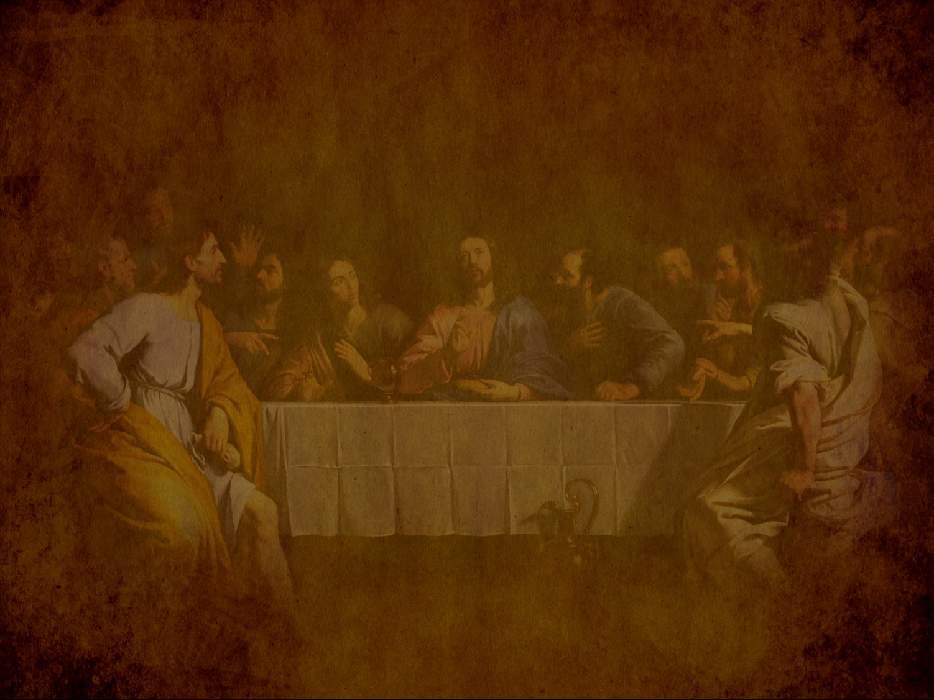
Preparation for the Death of the King
§§ 150-167
Christ prepares for his death by predicting both Israel's future and his final days and giving precepts and prayers
Section summaries based on J. Dwight Pentecost, A Harmony of the Words and Works of Jesus Christ (Grand Rapids: Zondervan, 1981)
Dr. Rick Griffith • Jordan Evangelical Theological Seminary • BibleStudyDownloads.org
Notes:
Small Group Discussion: If you knew that you were going to die in a week, what would you do?

Slide 2
Pentecost Outline
Introduction of the King
Authentication of the King
Controversy over the King
Instruction of the Twelve by the King
Opposition to the King
Preparation of the Disciples by the King
Official Presentation of the King
Preparation for the Death of the King
Rejection of the King
Resurrection of the King

Slide 3

Increasing Polarization
Resurrection
Preparation
for Death
Preparation
of Disciples
Instruction
Authentication
Introduction
Controversy
Opposition
Presentation
Rejection
Notes:
The Life of Christ brought increasing polarization. The more Jesus showed about himself, the greater the resistance to him and his message. Also, the more intense the controversy leading to opposition, the higher priority Christ placed on preparing his men for when he would be gone. The climactic rejection when he presented himself as king of Israel at the Triumphal Entry resulted in rejection to the point of crucifixion followed by the victory of resurrection.
Introduction of the King
Authentication of the King
Controversy over the King
Instruction of the Twelve by the King
Opposition to the King
Preparation of the Disciples by the King
Official Presentation of the King
Preparation for the Death of the King
Rejection of the King
Resurrection of the King

Slide 4

Great Periods in the Life of Christ
55
“The Son of Man… came to minister and to give his life a ransom for many” (Mark 10:45)
Climactic Galilean
Early Samaritan
Later Samaritan
Early Judean
Later Judean
Early Perean
Later Perean
Opening Events
Closing Events
Preparation
Confirmation
Walk Thru the New Testament seminar (used with permission)
Notes:
The Walk Thru outline of the life of Christ forms a chiasm or literary arrangement with repeating elements in the opposite order. This structure makes Confirmation parallel to Preparation, Closing Events parallel to Opening Events, etc. until the only event without parallel becomes the focus: Climatic Galilean. Such an arrangement of material was common in antiquity and is seen in both the OT (e.g., Zephaniah) and the NT (1 Thess) where the central teaching appears in the middle of each writing.
Small Group Assignment: Explain this slide to your group member(s) and have the others explain it back.
After the beginning events of stages 1-3, Jesus also gets farther away from his Jewish roots in Judea (4), to go to the Samaritans (5), and even farther to Galilee (6), where most Gentiles lived. He ministered to Jews in Galilee, of course, but this climatic period was the focus of his ministry.
_______
LC-00-Syllabus-63
LC-01-Introduction-265
LC-05-Opposition-4

Slide 5
Preparation for the Death of the King
Predictions
Preparation
Precepts
Prayer by Christ for Believers
Prayer in the Garden
Notes:
Jesus knew he would die on Passover, the event that we call Good Friday. Therefore, he did these five important things:
Predictions: He told his men that he would return.
Preparation: Ten events reaffirmed that he was in control even of his death.
Precepts: His Upper Room Discourse assured them that the Spirit would help them depend on him.
Prayer by Christ for Believers: He requested the Father that the church would remain united until his return.
Prayer in the Garden: He prayed that he would be faithful to die for humanity despite his will to escape it.

Slide 6
A. Predictions by Christ
§ 150
Matthew 24:1–25:46; Mark 13:1-37; Luke 21:5-36
Christ foretells the events that will accompany his Second Advent so that Israel might know that he will appear as Judge

Slide 7
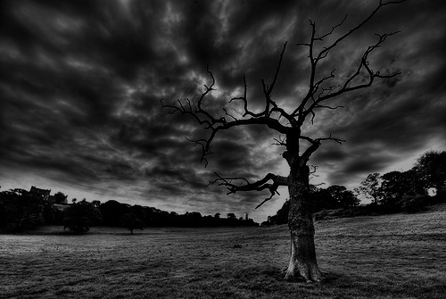
The Olivet Discourse (Matthew 24–25)
78
Adapted from Mark L. Bailey, DTS class notes, 1986
Second Coming (27-31):
Signs in the Heavens (29-30)
Coming of the Son of Man (27, 30)
Bird Supper (28)
Salvation of Elect (31)
Abomination of Desolation
(15-20)
False Christs
& Prophets
(23-26)
Beginning of Birth Pangs
(4-8)
Great Tribulation
(9-14, 21-22)
Judgment of the Nations
Sheep
Goats
Correlation with Revelation
12:7-12
13:14
12:8-17
8:1–19:10
(Matt. 25:31-46)
6:1–8:5
19:11-21

Slide 8
1. The Question
Matthew 24:1-3; Mark 13:1-4; Luke 21:5-7
Jesus predicts the temple’s destruction after the disciples ask when it will be destroyed, and when Jesus will return to end the age
Notes:
Matt. 24:1 As Jesus was leaving the Temple grounds, his disciples pointed out to him the various Temple buildings. ² But he responded, “Do you see all these buildings? I tell you the truth, they will be completely demolished. Not one stone will be left on top of another!”
Matt. 24:3 Later, Jesus sat on the Mount of Olives. His disciples came to him privately and said, “Tell us, when will all this happen? What sign will signal your return and the end of the world?”
_________
Mark 13:1 As Jesus was leaving the Temple that day, one of his disciples said, “Teacher, look at these magnificent buildings! Look at the impressive stones in the walls.”
Mark 13:2 Jesus replied, “Yes, look at these great buildings. But they will be completely demolished. Not one stone will be left on top of another!”
Mark 13:3 Later, Jesus sat on the Mount of Olives across the valley from the Temple. Peter, James, John, and Andrew came to him privately and asked him, ⁴ “Tell us, when will all this happen? What sign will show us that these things are about to be fulfilled?”
___________
Luke 21:5 Some of his disciples began talking about the majestic stonework of the Temple and the memorial decorations on the walls. But Jesus said, ⁶ “The time is coming when all these things will be completely demolished. Not one stone will be left on top of another!”
Luke 21:7 “Teacher,” they asked, “when will all this happen? What sign will show us that these things are about to take place?”

Slide 9
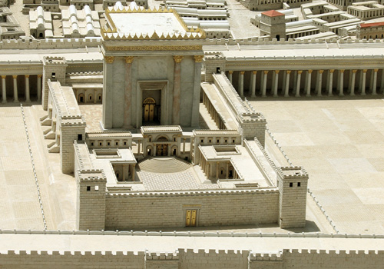
Disciples: What a fantastic temple! (Matt 24:1)
Jesus: "Not one stone here will be left on another" (24:2)
Disciples: When? What sign? (24:3)
Notes:
Was Jesus speaking of the temple complex with its walls or only the buildings comprising the temple itself? Mark shows that it must be only the temple, though Matthew and Luke are unclear.
NLT Mark 13:1 As He was going out of the temple, one of His disciples *said to Him, “Teacher, behold ¹what wonderful stones and ¹what wonderful buildings!” ² And Jesus said to him, “Do you see these great buildings? Not one stone will be left upon another which will not be torn down.”

Slide 10
MARK 13: 1-37
yapkimfah Singapore Bible College 23 feb 2006

Slide 11
THE OLIVET DISCOURSE

Slide 12
JESUS’ PROPHECY OF THE DESTRUCTION OF THE TEMPLE
AND HIS RETURN

Slide 13
The Olivet Discourse
Matt. 24–25 | Mark 13 |  | Luke 21:5-38
signs but the end is not yet
the desolating sacrilege (AD 70) |  |  |  | Jerusalem surrounded by armies
great tribulation (Church age) |  |  |  | times of Gentiles
second coming of Christ
command to alert faithfulness
Craig L. Blomberg, Jesus and the Gospels, 324

Slide 14

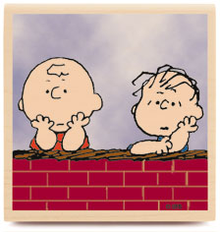

When will the temple be destroyed?
What will be the sign that it is the end?

Slide 15
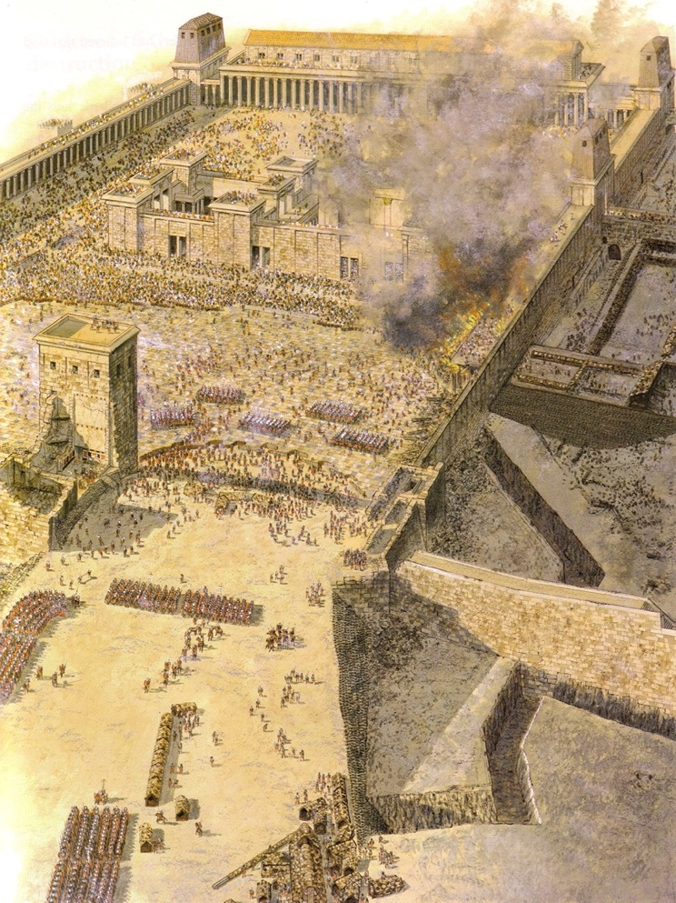
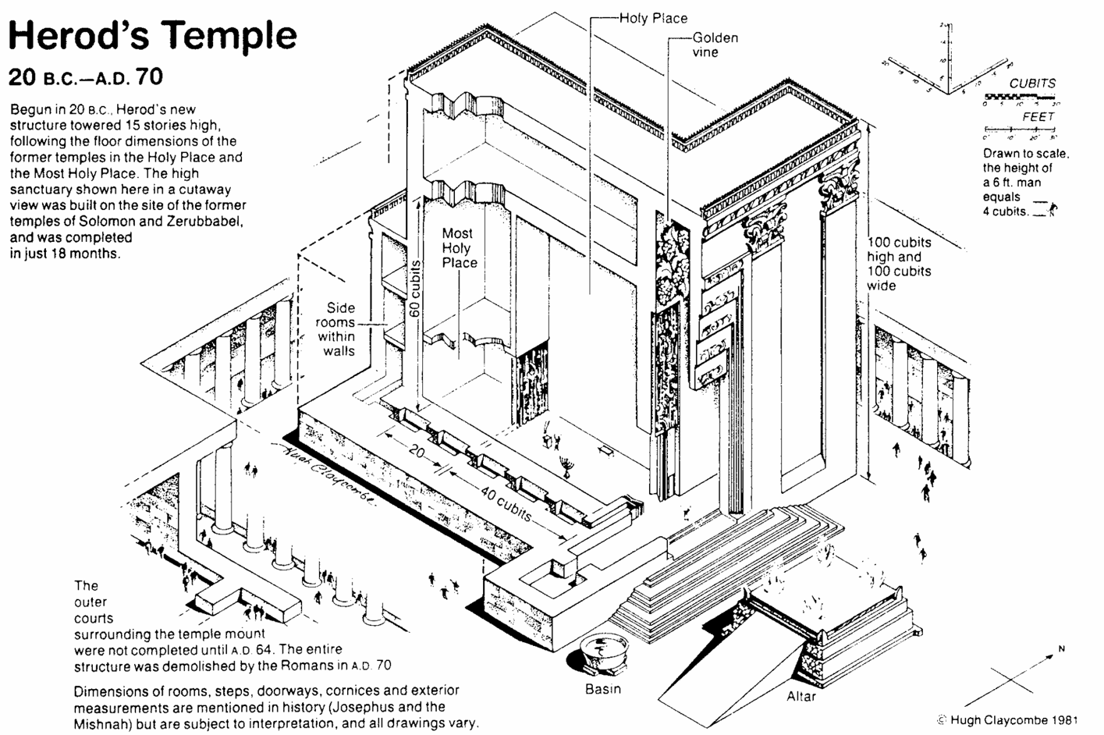
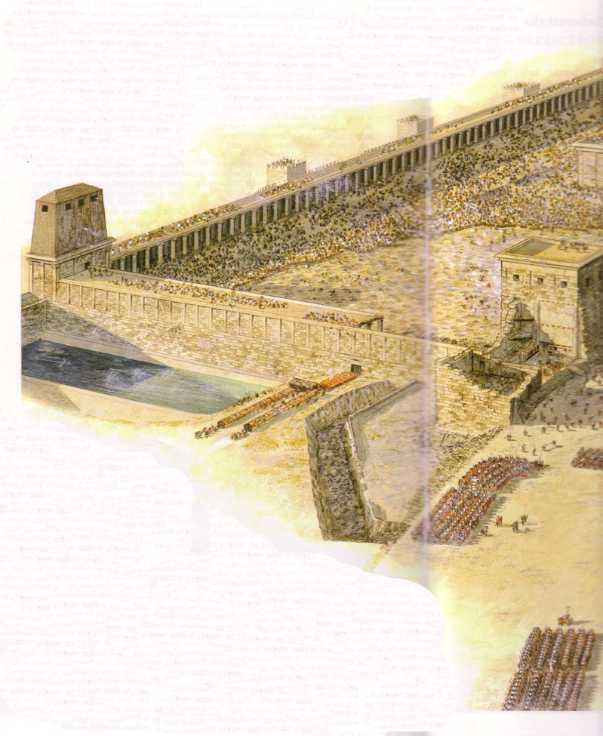

Slide 16
2. The Tribulation
Matthew 24:4-26; Mark 13:5-23; Luke 21:8-26
The 70th week of Daniel 9:27 will be a seven-year tribulation before Jesus returns so Israel should prepare for His coming and judgments

Slide 17
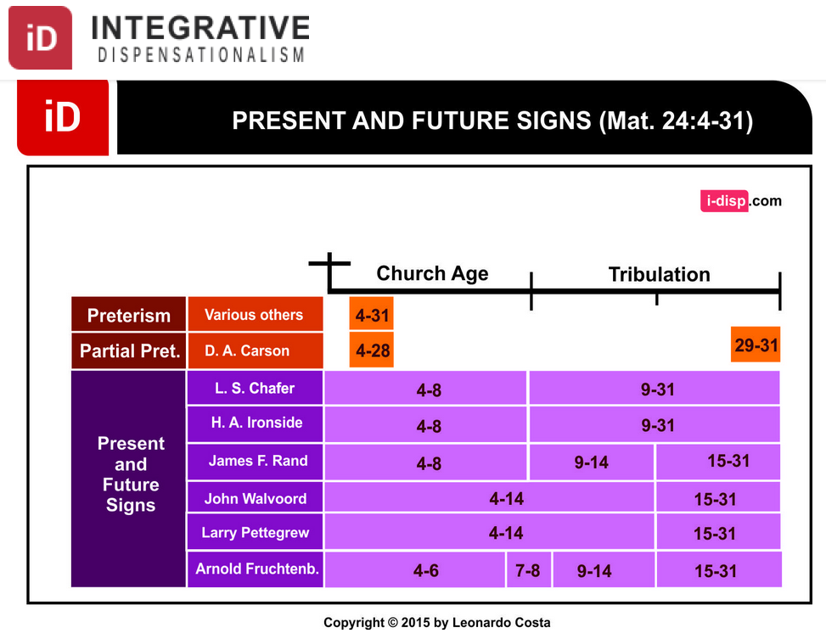
Dispensational Views on Matthew 24
Notes:
Leonardo Costa, "The Fulfillment of Matthew 24:4-31 in Dispensational Tradition," Integrative Dispensationalism website
http://i-disp.com/the-fulfillment-of-matthew-244-31-in-dispensational-tradition/ accessed 24 July 2015

Slide 18
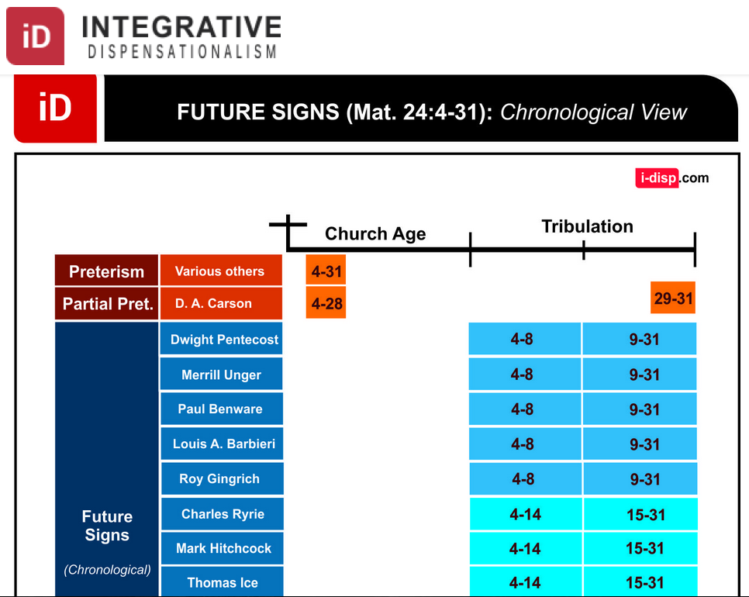
Dispensational Views on Matthew 24
Notes:
Leonardo Costa, "The Fulfillment of Matthew 24:4-31 in Dispensational Tradition," Integrative Dispensationalism website
http://i-disp.com/the-fulfillment-of-matthew-244-31-in-dispensational-tradition/ accessed 24 July 2015

Slide 19
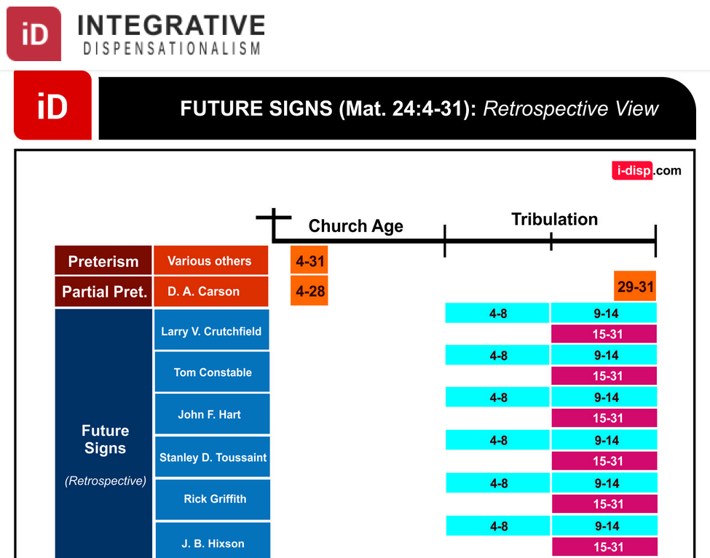
Dispensational Views on Matthew 24
Notes:
Leonardo Costa, "The Fulfillment of Matthew 24:4-31 in Dispensational Tradition," Integrative Dispensationalism website
http://i-disp.com/the-fulfillment-of-matthew-244-31-in-dispensational-tradition/ accessed 24 July 2015

Slide 20
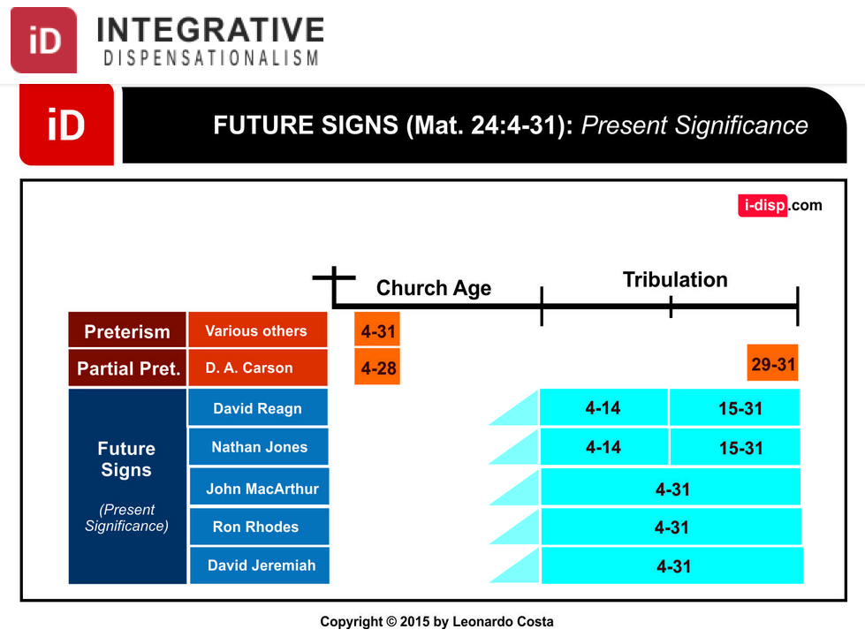
Dispensational Views on Matthew 24
Notes:
Leonardo Costa, "The Fulfillment of Matthew 24:4-31 in Dispensational Tradition," Integrative Dispensationalism website
http://i-disp.com/the-fulfillment-of-matthew-244-31-in-dispensational-tradition/ accessed 24 July 2015

Slide 21


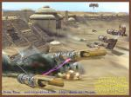





signs (v. 5-8)
deceive many
wars and rumours of wars
not yet the end
famine
persecutions

Slide 22
Keep Alert—Do Not Be Alarmed
(Mark 13:1-13)
The Gospel must be preached to all nations (10)
Do not worry about what to say as the Holy Spirit will help (11)
Persecution – family members (12)
Stand firm (13)

Slide 23
“the abomination that causes desolation”
(Mark 13:14; cf. Matt 24:15)
It is the detestable thing (Dan 9:24-27)
The Antichrist will claim deity
Believers must flee immediately (14b)
Leave belongings (15-16)
Dreadful for mothers (17)
Pray for good weather (18)

Slide 24
a. The First Half
Matthew 24:4-8; Mark 13:5-8; Luke 21:8-11
The signs of the first 3.5 years of the Tribulation forewarn Israel of the coming judgment at Christ's Second Advent

Slide 25
b. The Second Half
Matthew 24:9-14; Mark 13:9-13; Luke 21:12-19
The signs of the second 3.5 years of the Tribulation forewarn Israel of the coming judgment at Christ's Second Advent

Slide 26
c. Repetition and Explanation
Matthew 24:15-26; Mark 13:14-23; Luke 21:20-26
The Tribulation terror focuses on the Antichrist as the sign to forewarn Israel of the approaching Second Advent

Slide 27
Olivet Discourse Overview
(Matt. 24–25)
27
First
Fall of Jerusalem
586 BC
Second
Fall of Jerusalem
AD 70
Rapture
1 Thess.
4:14-17
Third
Fall of Jerusalem
Second Coming with the Saints
Matt. 23:39; 24:30
Israel
Church Age
Tribulation
Millennium
The Great Tribulation
Dan. 9:27
Matt. 24:15
Israel Scattered Luke 21:24
Return to the Land
606 B.C.
Times of the Gentiles
Luke 21:24
Judgment
of the Gentile Nations
Matt. 25:31-46
Adapted from Salem Kirban
Charts on Revelation (1979), 48

Slide 28
Times of the Gentiles (Luke 21:24)
106
"TIMES OF THE GENTILES"
Luke 21:24
KINGDOM OF JUDAH
THE RESTORATION PERIOD
THE 4 CENTURIES BETWEEN THE TESTAMENTS
CHURCH PERIOD
Acts 15:14-18
Rom. 11:25
"The Throne of the LORD"
Jer. 3:17
Isa. 62:6-7
586 BC
AD 70
BABYLON
PERSIA
GREECE
ROME
538 BC
333 BC
63 BC
"AMONG MANY NATIONS"
"Her sun is gone down while it was yet day" Jer. 15:9
"Because they have forsaken the covenant of the Lord" Jer. 22:8-9
2 Kings 25:8-12
Jer. 15:4, 22:29-30, 30:24
Ezek. 10:4, 28. 11:22-25, 14:22-23
Ezekiel 6:8
Hosea 3:4-5
Hosea 8:8
Amos 9:8-9
Jer. 31:35-37
Jer. 46: 27-28
Jer. 51:5
"I will perform the good thing that I have promised to the house of Israel and to the house of Judah"
Jer. 33:7-14
Isa. 4:2-6
Ezek. 43:1-9
Zech. 2:10-13
Zech. 8:1-8
“Jerusalem will be trampled on by the Gentiles until the times of the Gentiles are fulfilled” (Jesus in Luke 21:24 NIV)
Adapted from Raymond Ludwigson, A Survey of Bible Prophecy (Grand Rapids: Zondervan, 1975), 181
Notes:
The phrase “times of the Gentiles” is not in Daniel. But the concept is throughout his prophecy. It refers to the period when Israel would have no king over its land—beginning around the time of Jerusalem’s destruction and lasting until Jesus rules over the nation after his return.
Jesus alone referred to "the times of the Gentiles" in Luke 21:24. But the entire book of Daniel refers to this period of Gentile rule over Israel that interrupts the nation's rule by a son of David, though not by this phrase.
______
Common-434
BE-42-Luke-80
LC-08-Preparation for the Death of the King-27
OS-27-Daniel-21, 383
NS-03-Luke 13-24-slide 137

Slide 29
A Dispensational Timeline
OT Survey page 437
Rapture
(1 Thess 4:13-18)
2nd Advent
(Zech 14:3-5)
Great White Throne
(Rev 20:11-14)
Day of the LORD
Church Age
Tribulation
(Zech 14:1-2)
Millennium
(Zech 14:6-21)
Gog & Magog
(Armageddon)
(Ezek 38–39)
Gog and Magog
Revisited
(Rev 20:7-10)
"How awful that day will be! None will be like it. It will be a time of Jacob's trouble, but he will be saved out of it"
(Jer 30:7)
Notes:
29
The next event on God's prophetic calendar is for the church age to end with the Rapture. Shortly after this, the Day of the Lord will begin with the Antichrist signing a covenant with Israel (Dan 9:27; 2 Thess 2:1-12). Jeremiah 30:7 called this "Day" or period the "time of Jacob's trouble" or era of great persecution of Jews. Yet the second coming will bring in phase 2 of the "Day of the Lord" where all Israel at that time will be saved (Rom 11:26-27). This 1000 years of blessing on earth will be preceded and followed by two major battles and ending in the Great White Throne Judgment.
So how does this give you hope?
Does it affect how you use your money? Do you"lay up for yourself treasures in heaven” as a result?
How does it impact your use of time? Do you say,"That movie isn’t necessarily wrong, but I could use my time much better by investing God’s Word into others!”
Fear God by realizing that the future day of the LORD (Tribulation and Millennium) will exclude the wicked but heal the righteous (Mal 4:1-3).
______
Common-342
BG-13-Present & Future Geography-57
ES-16-Kingdom & Millennialism Part 2—slides 15, 72
ES-25-Shared Land Theology-18
ES-26-Restoration of Israel-284
JE-09-Return of Christ-36
JE-10-Christ's Rule-40
LC-09-Preparation-29
OS-23-Isaiah 1-12-Slide 87
OS-24-Jeremiah-161
OS-26-Ezekiel 1-39-Slide 247
OS-26-Ezekiel_33-39—slide 102
OS-26-Ezekiel 40-43-Slide 24
OS-27-Exile-22, 25
OS-29-Joel-87
OS-31-Obadiah-154
OS-36-Zephaniah-86
OS-38-Zechariah-158, 167, 184
OS-39-Malachi-137
NS-22-Rev4-6-slide 117
NS-22-Rev20-22-slide 137

Slide 30

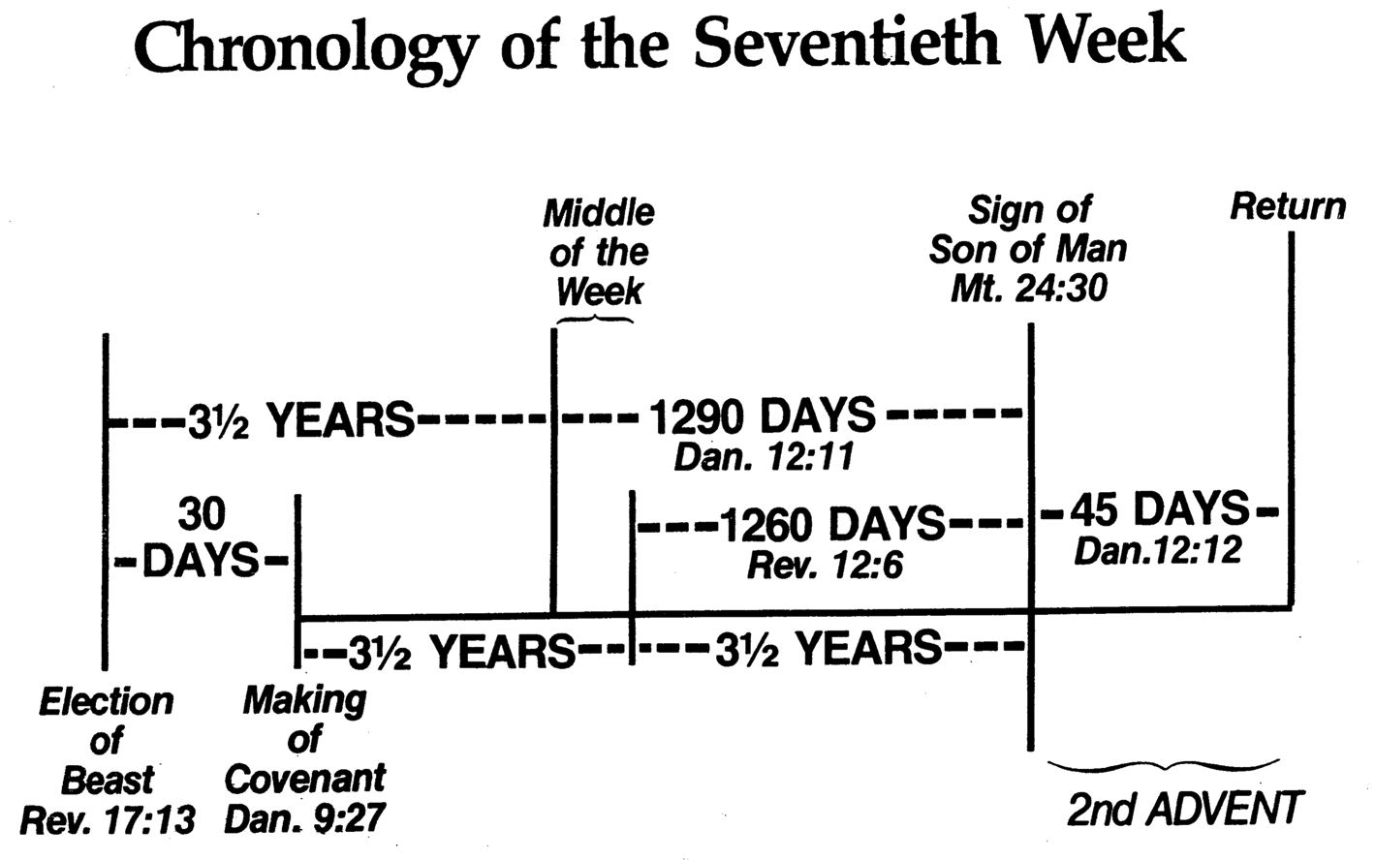
Chronology of the 70th "Week"
556
Adapted from J. Dwight Pentecost, Dallas Theological Seminary, 1988
Middle of the Week
Sign of
Son of Man
Matt. 24:30
Christ's Return Complete
3½ YEARS
1290 DAYS
Dan. 12:11
30 DAYS
30 DAYS
1260 DAYS
45 DAYS
Rev. 12:6
Dan. 12:12
3½ YEARS
3½ YEARS
Election
of Beast
Rev. 17:13
Covenant Made
Dan. 9:27a
Covenant Broken
Dan. 9:27b
The Great Tribulation
2nd ADVENT
The Tribulation
"He will confirm a covenant with many for one 'seven.' In the middle of the 'seven' he will put an end to sacrifice and offering. And on a wing [of the temple] he will set up an abomination that causes desolation, until the end that is decreed is poured out on him" (Daniel 9:27 NIV).
Notes:
The final of the 70 "weeks" also will last seven years and is the focus of Daniel's prophecies more than any other period. Revelation later builds on the foundation that Daniel established.
Daniel 12:11-13 “From the time that the regular sacrifice is abolished and the ^{1a}abomination of desolation is set up, there will be 1,290 days. ¹² “How blessed is he who keeps waiting and attains to the ^{b}1,335 days! ¹³ “But as for you, go your way to the ¹end; then you will enter into rest and rise again for your allotted portion at the end of the ²age.”
______________
Common-404
BE-27-Daniel-117
LC-09-Preparation-30
OS-27-Daniel-407, 499
NS-27-Rev1-slide 170
NS-22-Rev7-12-slide 99

Slide 31
“the abomination that causes desolation” (Mark 13:14)
The great tribulation of unparalleled affliction (v. 19)
God shortens the days (v. 20)
False messiahs, prophets, signs and miracles (vv. 21-22)
The great tribulation sign is so terrible it requires being foretold (v. 23)

Slide 32
3. The Second Advent
Matthew 24:27-30; Mark 13:24-27; Luke 21:27-28
Jesus predicts that He will return to the earth in power and glory to rule the earth with believers as their destiny
Notes:
Matt. 24:27 For as the lightning flashes in the east and shines to the west, so it will be when the Son of Manª comes. ²⁸ Just as the gathering of vultures shows there is a carcass nearby, so these signs indicate that the end is near.
Matt. 24:29 “Immediately after the anguish of those days,
the sun will be darkened,
the moon will give no light,
the stars will fall from the sky,
and the powers in the heavens will be shaken.
Matt. 24:30 And then at last, the sign that the Son of Man is coming will appear in the heavens, and there will be deep mourning among all the peoples of the earth. And they will see the Son of Man coming on the clouds of heaven with power and great glory.
Mark 13:24 “At that time, after the anguish of those days,
the sun will be darkened,
the moon will give no light,
²⁵ the stars will fall from the sky,
and the powers in the heavens will be shaken.
Mark 13:26 Then everyone will see the Son of Manª coming on the clouds with great power and glory. ²⁷ And he will send out his angels to gather his chosen ones from all over the world—from the farthest ends of the earth and heaven.
Luke 21:27 Then everyone will see the Son of Manª coming on a cloud with power and great glory. ²⁸ So when all these things begin to happen, stand and look up, for your salvation is near!”

Slide 33
Keep watch, Jesus is coming, but the time is unknown (Mark 13:24-37)
Jesus will return after that distress [tribulation] (v. 24)
When Jesus returns
  The sun will be darkened, and the moon will not give its light (v. 24)
  The stars will fall from the sky, and the heavenly bodies (Isaiah 13:10) will be shaken (v. 25)
Men will see Jesus’ return (v. 26)

Slide 34
4. The Regathering of Israel
Matthew 24:31
Jesus predicts Israel's supernatural restoration to its land after having been scattered by military invasions
Notes:
Matt 24:31 “And He will send forth His angels with A GREAT TRUMPET and THEY WILL GATHER TOGETHER His elect from the four winds, from one end of the sky to the other.

Slide 35
5. Parenthetical Exhortations
Matthew 24:32-51; Mark 13:28-37; Luke 21:29-36
Jesus gives practical exhortations given His coming as Judge to stress further our need to be watchful, prepared, and faithful
Notes:
Matt. 24:32 “Now learn a lesson from the fig tree. When its branches bud and its leaves begin to sprout, you know that summer is near. ³³ In the same way, when you see all these things, you can know his return is very near, right at the door. ³⁴ I tell you the truth, this generation will not pass from the scene until all these things take place. ³⁵ Heaven and earth will disappear, but my words will never disappear.
Matt. 24:36 “However, no one knows the day or hour when these things will happen, not even the angels in heaven or the Son himself. Only the Father knows.
Matt. 24:37 “When the Son of Man returns, it will be like it was in Noah’s day. ³⁸ In those days before the flood, the people were enjoying banquets and parties and weddings right up to the time Noah entered his boat. ³⁹ People didn’t realize what was going to happen until the flood came and swept them all away. That is the way it will be when the Son of Man comes.
Matt. 24:40 “Two men will be working together in the field; one will be taken, the other left. ⁴¹ Two women will be grinding flour at the mill; one will be taken, the other left.
Matt. 24:42 “So you, too, must keep watch! For you don’t know what day your Lord is coming. ⁴³ Understand this: If a homeowner knew exactly when a burglar was coming, he would keep watch and not permit his house to be broken into. ⁴⁴ You also must be ready all the time, for the Son of Man will come when least expected.
Matt. 24:45 “A faithful, sensible servant is one to whom the master can give the responsibility of managing his other household servants and feeding them. ⁴⁶ If the master returns and finds that the servant has done a good job, there will be a reward. ⁴⁷ I tell you the truth, the master will put that servant in charge of all he owns. ⁴⁸ But what if the servant is evil and thinks, ‘My master won’t be back for a while,’ ⁴⁹ and he begins beating the other servants, partying, and getting drunk? ⁵⁰ The master will return unannounced and unexpected, ⁵¹ and he will cut the servant to pieces and assign him a place with the hypocrites. In that place there will be weeping and gnashing of teeth.
Mark 13:28 “Now learn a lesson from the fig tree. When its branches bud and its leaves begin to sprout, you know that summer is near. ²⁹ In the same way, when you see all these things taking place, you can know that his return is very near, right at the door. ³⁰ I tell you the truth, this generation will not pass from the scene before all these things take place. ³¹ Heaven and earth will disappear, but my words will never disappear.
Mark 13:32 “However, no one knows the day or hour when these things will happen, not even the angels in heaven or the Son himself. Only the Father knows. ³³ And since you don’t know when that time will come, be on guard! Stay alert!
Mark 13:34 “The coming of the Son of Man can be illustrated by the story of a man going on a long trip. When he left home, he gave each of his slaves instructions about the work they were to do, and he told the gatekeeper to watch for his return. ³⁵ You, too, must keep watch! For you don’t know when the master of the household will return—in the evening, at midnight, before dawn, or at daybreak. ³⁶ Don’t let him find you sleeping when he arrives without warning. ³⁷ I say to you what I say to everyone: Watch for him!”
Luke 21:29 Then he gave them this illustration: “Notice the fig tree, or any other tree. ³⁰ When the leaves come out, you know without being told that summer is near. ³¹ In the same way, when you see all these things taking place, you can know that the Kingdom of God is near. ³² I tell you the truth, this generation will not pass from the scene until all these things have taken place. ³³ Heaven and earth will disappear, but my words will never disappear.
Luke 21:34 “Watch out! Don’t let your hearts be dulled by carousing and drunkenness, and by the worries of this life. Don’t let that day catch you unaware, ³⁵ like a trap. For that day will come upon everyone living on the earth. ³⁶ Keep alert at all times. And pray that you might be strong enough to escape these coming horrors and stand before the Son of Man.”

Slide 36
Keep watch, Jesus is coming, but the time is unknown (Mark 13:24-37)
He will gather his people (elect) from all over the earth (v. 27)
The signs pointing to the end for his return occur within a generation (vv. 28-30)
Jesus' return is sure (v. 31)
  Heaven and earth will pass away (v. 31a)
  His word will never pass away (v. 31b)

Slide 37
Keep watch, Jesus is coming, but the time is unknown (Mark 13:24-37)
  No one knows the exact time of Jesus’ return
  so be on guard and keep watch (vv. 32-37)

Slide 38
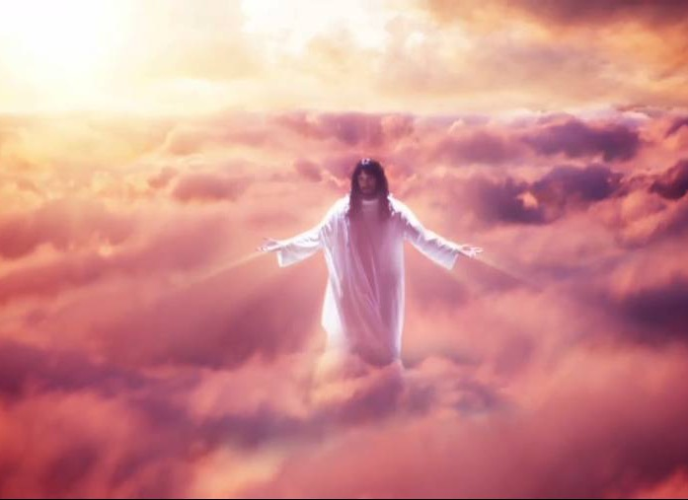
Summary
Disciples asked Jesus,
“When will these things happen?” and “What will be the sign of your coming?”
He returns after the great tribulation
Event 1: Signs in the skies (vv. 24-25)
Event 2: Jesus will come in the clouds
Event 3: Jesus will gather the elect

Slide 39
What We Can Do to Prepare
Keep alert and do not be alarmed at the signs of the End Time
Keep watch for the coming of the Son of Man because the exact time is unknown

Slide 40

“Come Lord Jesus”

Slide 41
a. The Fig Tree
Matthew 24:32-44; Mark 13:28-37; Luke 21:29-36
A fig tree’s budding shows that Israel will see signs that Christ's judgment is imminent to be watchful and prepared
Notes:
Matt. 24:32 “Now learn a lesson from the fig tree. When its branches bud and its leaves begin to sprout, you know that summer is near. ³³ In the same way, when you see all these things, you can know his return is very near, right at the door. ³⁴ I tell you the truth, this generation will not pass from the scene until all these things take place. ³⁵ Heaven and earth will disappear, but my words will never disappear.
Matt. 24:36 “However, no one knows the day or hour when these things will happen, not even the angels in heaven or the Son himself. Only the Father knows.
Matt. 24:37 “When the Son of Man returns, it will be like it was in Noah’s day. ³⁸ In those days before the flood, the people were enjoying banquets and parties and weddings right up to the time Noah entered his boat. ³⁹ People didn’t realize what was going to happen until the flood came and swept them all away. That is the way it will be when the Son of Man comes.
Matt. 24:40 “Two men will be working together in the field; one will be taken, the other left. ⁴¹ Two women will be grinding flour at the mill; one will be taken, the other left.
Matt. 24:42 “So you, too, must keep watch! For you don’t know what day your Lord is coming. ⁴³ Understand this: If a homeowner knew exactly when a burglar was coming, he would keep watch and not permit his house to be broken into. ⁴⁴ You also must be ready all the time, for the Son of Man will come when least expected.
Mark 13:28 “Now learn a lesson from the fig tree. When its branches bud and its leaves begin to sprout, you know that summer is near. ²⁹ In the same way, when you see all these things taking place, you can know that his return is very near, right at the door. ³⁰ I tell you the truth, this generation will not pass from the scene before all these things take place. ³¹ Heaven and earth will disappear, but my words will never disappear.
Mark 13:32 “However, no one knows the day or hour when these things will happen, not even the angels in heaven or the Son himself. Only the Father knows. ³³ And since you don’t know when that time will come, be on guard! Stay alert!
Mark 13:34 “The coming of the Son of Man can be illustrated by the story of a man going on a long trip. When he left home, he gave each of his slaves instructions about the work they were to do, and he told the gatekeeper to watch for his return. ³⁵ You, too, must keep watch! For you don’t know when the master of the household will return—in the evening, at midnight, before dawn, or at daybreak. ³⁶ Don’t let him find you sleeping when he arrives without warning. ³⁷ I say to you what I say to everyone: Watch for him!”
Luke 21:29 Then he gave them this illustration: “Notice the fig tree, or any other tree. ³⁰ When the leaves come out, you know without being told that summer is near. ³¹ In the same way, when you see all these things taking place, you can know that the Kingdom of God is near. ³² I tell you the truth, this generation will not pass from the scene until all these things have taken place. ³³ Heaven and earth will disappear, but my words will never disappear.
Luke 21:34 “Watch out! Don’t let your hearts be dulled by carousing and drunkenness, and by the worries of this life. Don’t let that day catch you unaware, ³⁵ like a trap. For that day will come upon everyone living on the earth. ³⁶ Keep alert at all times. And pray that you might be strong enough to escape these coming horrors and stand before the Son of Man.”

Slide 42
b. The Faithful Servant
Matthew 24:45-51
The illustration of the faithful servant warns Israel to be faithful since the nation will not know when Christ will return
Notes:
Matt. 24:45 “A faithful, sensible servant is one to whom the master can give the responsibility of managing his other household servants and feeding them. ⁴⁶ If the master returns and finds that the servant has done a good job, there will be a reward. ⁴⁷ I tell you the truth, the master will put that servant in charge of all he owns. ⁴⁸ But what if the servant is evil and thinks, ‘My master won’t be back for a while,’ ⁴⁹ and he begins beating the other servants, partying, and getting drunk? ⁵⁰ The master will return unannounced and unexpected, ⁵¹ and he will cut the servant to pieces and assign him a place with the hypocrites. In that place there will be weeping and gnashing of teeth.

Slide 43
6. Judgment on Israel
Matthew 25:1-30
Two parables of judgment on living Israel prepare Jews for the Millennium by faith and predict Israel failing as a light to Gentiles
Notes:
Parable of the Ten Bridesmaids
Matt. 25:1 “Then the Kingdom of Heaven will be like ten bridesmaids who took their lamps and went to meet the bridegroom. ² Five of them were foolish, and five were wise. ³ The five who were foolish didn’t take enough olive oil for their lamps, ⁴ but the other five were wise enough to take along extra oil. ⁵ When the bridegroom was delayed, they all became drowsy and fell asleep.
Matt. 25:6 “At midnight they were roused by the shout, ‘Look, the bridegroom is coming! Come out and meet him!’
Matt. 25:7 “All the bridesmaids got up and prepared their lamps. ⁸ Then the five foolish ones asked the others, ‘Please give us some of your oil because our lamps are going out.’
Matt. 25:9 “But the others replied, ‘We don’t have enough for all of us. Go to a shop and buy some for yourselves.’
Matt. 25:10 “But while they were gone to buy oil, the bridegroom came. Then those who were ready went in with him to the marriage feast, and the door was locked. ¹¹ Later, when the other five bridesmaids returned, they stood outside, calling, ‘Lord! Lord! Open the door for us!’
Matt. 25:12 “But he called back, ‘Believe me, I don’t know you!’
Matt. 25:13 “So you, too, must keep watch! For you do not know the day or hour of my return.
Parable of the Three Servants
Matt. 25:14 “Again, the Kingdom of Heaven can be illustrated by the story of a man going on a long trip. He called together his servants and entrusted his money to them while he was gone. ¹⁵ He gave five bags of silver to one, two bags of silver to another, and one bag of silver to the last—dividing it in proportion to their abilities. He then left on his trip.
Matt. 25:16 “The servant who received the five bags of silver began to invest the money and earned five more. ¹⁷ The servant with two bags of silver also went to work and earned two more. ¹⁸ But the servant who received the one bag of silver dug a hole in the ground and hid the master’s money.
Matt. 25:19 “After a long time their master returned from his trip and called them to give an account of how they had used his money. ²⁰ The servant to whom he had entrusted the five bags of silver came forward with five more and said, ‘Master, you gave me five bags of silver to invest, and I have earned five more.’
Matt. 25:21 “The master was full of praise. ‘Well done, my good and faithful servant. You have been faithful in handling this small amount, so now I will give you many more responsibilities. Let’s celebrate together!’
Matt. 25:22 “The servant who had received the two bags of silver came forward and said, ‘Master, you gave me two bags of silver to invest, and I have earned two more.’
Matt. 25:23 “The master said, ‘Well done, my good and faithful servant. You have been faithful in handling this small amount, so now I will give you many more responsibilities. Let’s celebrate together!’
Matt. 25:24 “Then the servant with the one bag of silver came and said, ‘Master, I knew you were a harsh man, harvesting crops you didn’t plant and gathering crops you didn’t cultivate. ²⁵ I was afraid I would lose your money, so I hid it in the earth. Look, here is your money back.’
Matt. 25:26 “But the master replied, ‘You wicked and lazy servant! If you knew I harvested crops I didn’t plant and gathered crops I didn’t cultivate, ²⁷ why didn’t you deposit my money in the bank? At least I could have gotten some interest on it.’
Matt. 25:28 “Then he ordered, ‘Take the money from this servant, and give it to the one with the ten bags of silver. ²⁹ To those who use well what they are given, even more will be given, and they will have an abundance. But from those who do nothing, even what little they have will be taken away. ³⁰ Now throw this useless servant into outer darkness, where there will be weeping and gnashing of teeth.’

Slide 44
a. The Ten Virgins
Matthew 25:1-13
The parable of the ten virgins teaches that only those prepared through faith in Jesus will enter the millennial feast

Slide 45
b. Talents
Matthew 25:14-30
The parable of the talents teaches that Jesus will judge living Israel for not being a light to the Gentiles
Notes:
Parable of the Three Servants
Matt. 25:14 “Again, the Kingdom of Heaven can be illustrated by the story of a man going on a long trip. He called together his servants and entrusted his money to them while he was gone. ¹⁵ He gave five bags of silver to one, two bags of silver to another, and one bag of silver to the last—dividing it in proportion to their abilities. He then left on his trip.
Matt. 25:16 “The servant who received the five bags of silver began to invest the money and earned five more. ¹⁷ The servant with two bags of silver also went to work and earned two more. ¹⁸ But the servant who received the one bag of silver dug a hole in the ground and hid the master’s money.
Matt. 25:19 “After a long time their master returned from his trip and called them to give an account of how they had used his money. ²⁰ The servant to whom he had entrusted the five bags of silver came forward with five more and said, ‘Master, you gave me five bags of silver to invest, and I have earned five more.’
Matt. 25:21 “The master was full of praise. ‘Well done, my good and faithful servant. You have been faithful in handling this small amount, so now I will give you many more responsibilities. Let’s celebrate together!’
Matt. 25:22 “The servant who had received the two bags of silver came forward and said, ‘Master, you gave me two bags of silver to invest, and I have earned two more.’
Matt. 25:23 “The master said, ‘Well done, my good and faithful servant. You have been faithful in handling this small amount, so now I will give you many more responsibilities. Let’s celebrate together!’
Matt. 25:24 “Then the servant with the one bag of silver came and said, ‘Master, I knew you were a harsh man, harvesting crops you didn’t plant and gathering crops you didn’t cultivate. ²⁵ I was afraid I would lose your money, so I hid it in the earth. Look, here is your money back.’
Matt. 25:26 “But the master replied, ‘You wicked and lazy servant! If you knew I harvested crops I didn’t plant and gathered crops I didn’t cultivate, ²⁷ why didn’t you deposit my money in the bank? At least I could have gotten some interest on it.’
Matt. 25:28 “Then he ordered, ‘Take the money from this servant, and give it to the one with the ten bags of silver. ²⁹ To those who use well what they are given, even more will be given, and they will have an abundance. But from those who do nothing, even what little they have will be taken away. ³⁰ Now throw this useless servant into outer darkness, where there will be weeping and gnashing of teeth.’

Slide 46
7. Judgment on Gentiles
Matthew 25:31-46
Jesus predicts judgment on living Gentiles based on their treatment of Israel to determine their entrance into the millennial kingdom

Slide 47
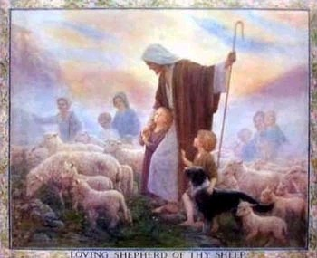
Judgment of the the Nations
(Sheep & Goats)
160
NLT Matthew 25:31 "But when the Son of Man comes in his glory, and all the angels with him, then he will sit upon his glorious throne. ³²All the nations will be gathered in his presence, and he will separate them as a shepherd separates the sheep from the goats. ³³He will place the sheep at his right hand and the goats at his left. ³⁴Then the King will say to those on the right, 'Come, you who are blessed by my Father, inherit the Kingdom prepared for you from the foundation of the world.'"

Slide 48
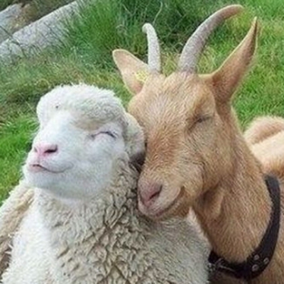
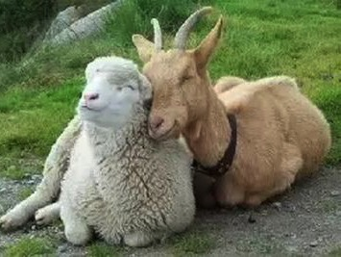
Aren't Sheep & Goats the Same?
Notes:
Why sheep for believers? They are dependent and believe in the shepherd! Think Psalm 23.
Why goats for unbelievers? They depend on their ingenuity for food, even climbing trees. Canaanites worshipped goat idols and do so today.

Slide 49
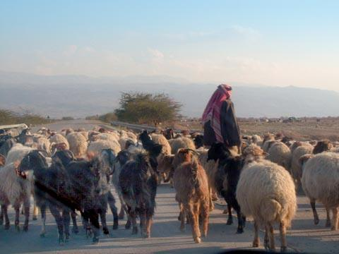
Judgment of the Nations
"All the nations will be gathered in his presence, and he will separate the people as a shepherd separates the sheep from the goats. ³³He will place the sheep at his right hand and the goats at his left"
(Matt. 25:31-32).

Slide 50

Judgment of Living Gentiles
³¹ "But when the Son of Man comes in his glory, and all the angels with him, then he will sit upon his glorious throne.
³² All the nations will be gathered in his presence, and he will separate the people as a shepherd separates the sheep from the goats. ³³ He will place the sheep at his right hand and the goats at his left.
³⁴ "Then the King will say to those on his right, 'Come, you who are blessed by my Father, inherit the Kingdom prepared for you from the creation of the world" (Matt. 25:31-34 NLT).

Slide 51
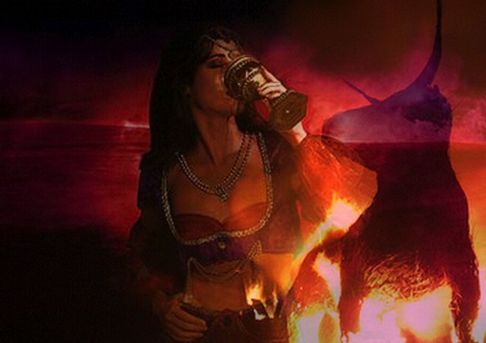
Judgment of Living Gentiles
⁴¹ "Then the King will turn to those on the left and say, 'Away with you, you cursed ones, into the eternal fire prepared for the devil and his demons. ⁴² For I was hungry, and you didn't feed me. I was thirsty, and you didn't give me a drink.
⁴³ I was a stranger, and you didn't invite me into your home. I was naked, and you didn't give me clothing. I was sick and in prison, and you didn't visit me.'
⁴⁴ "Then they will reply, 'Lord, when did we ever see you hungry or thirsty or a stranger or naked or sick or in prison, and not help you?'
⁴⁵ "And he will answer, 'I tell you the truth, when you refused to help the least of these my brothers and sisters, you were refusing to help me.' ⁴⁶ "And they will go away into eternal punishment, but the righteous will go into eternal life" (Matt. 25:41-46 NLT).

Slide 52
Olivet Discourse Overview
(Matthew 24–25)
27
First
Fall of Jerusalem
586 BC
Second
Fall of Jerusalem
AD 70
Rapture
1 Thess.
4:14-17
Third
Fall of Jerusalem
Second Coming with the Saints
Matt. 23:39; 24:30
Israel
Church Age
Tribulation
Millennium
The Great Tribulation
Dan. 9:27
Matt. 24:15
Israel Scattered Luke 21:24
Return to the Land
606 B.C.
Times of the Gentiles
Luke 21:24
Judgment
of the Gentile Nations
Matt. 25:31-46
Adapted from Salem Kirban
Charts on Revelation (1979), 48

Slide 53
B. Preparation for Christ's Death
§§ 151-160
Various events follow their divinely prescribed order to prepare for the death of the Messiah as a sacrifice for the world's sin

Slide 54
B. Preparation for Christ's Death
The Prediction of His Death
The Plan of the Rulers
The Pouring of the Ointment
The Promise to Betray
The Preparation of the Passover
The Passover Observance
The Provision of an Example
8. The Prediction of Judas' Betrayal
9. The Prediction of Peter's Denial
10. The Provision of a Memorial

Slide 55
1. The Prediction of His Death
§ 151
Matthew 26:1-2; Mark 14:1a; Luke 22:1
Christ predicts His death on Passover to show that He would fulfill prophecy as God's sacrificial Lamb on that very day
Notes:
The Plot to Kill Jesus
Matt. 26:1 When Jesus had finished saying all these things, he said to his disciples, 2 “As you know, Passover begins in two days, and the Son of Man will be handed over to be crucified.”
Jesus Anointed at Bethany
Mark 14:1 It was now two days before Passover and the Festival of Unleavened Bread. The leading priests and the teachers of religious law were still looking for an opportunity to capture Jesus secretly and kill him.
Judas Agrees to Betray Jesus
Luke 22:1 The Festival of Unleavened Bread, which is also called Passover, was approaching.

Slide 56
2. The Plan of the Rulers
§ 152
Matthew 26:3-5; Mark 14:1b-2; Luke 22:2
The Sanhedrin takes Caiaphas' advice to kill Jesus at some time other than during the feast to prevent a riot

Slide 57
3. The Pouring of the Ointment
§ 153
Matthew 26:6-13; Mark 14:3-9; John 12:2-8
Mary anoints Christ as King but Jesus states that her anointing anticipated His upcoming death

Slide 58
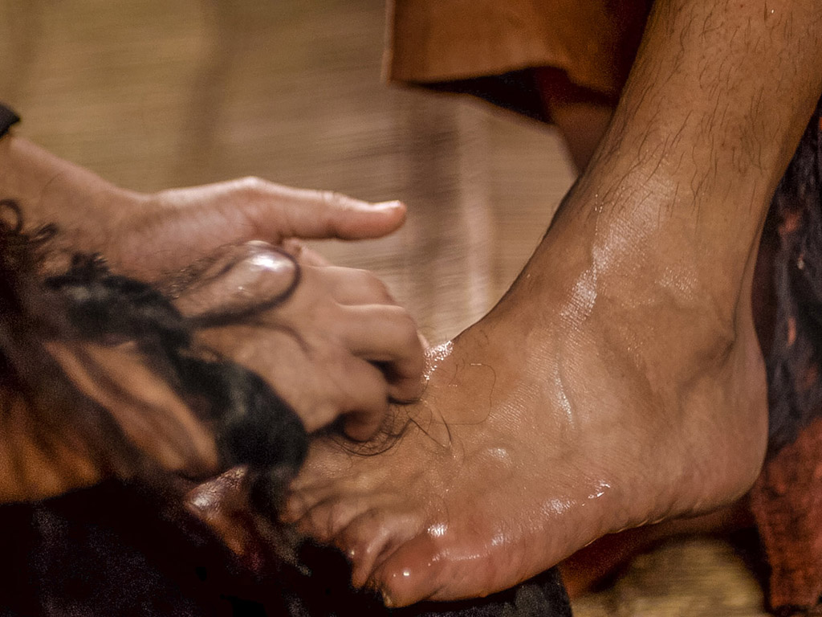
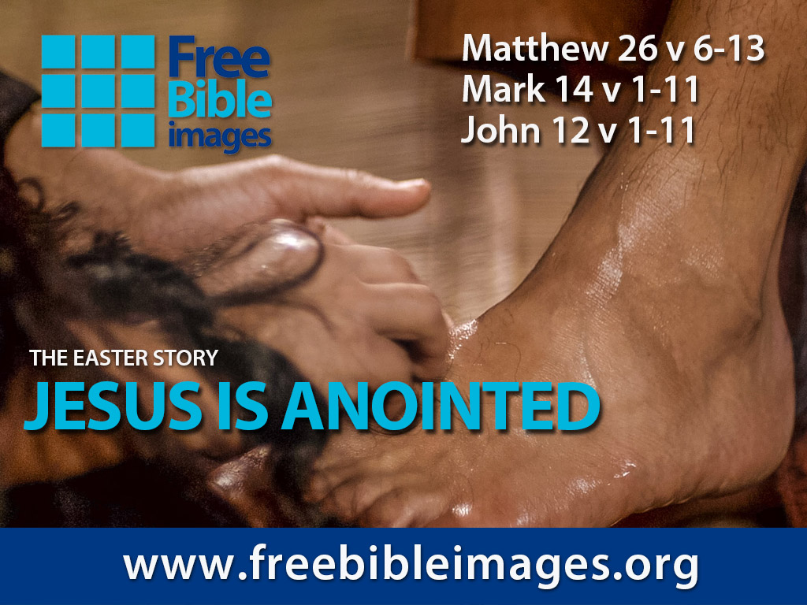

Broken & Spilled Out
Matthew 26:6-13
Mark 14:1-11
John 12:1-11
Free
Bible
images
Performed By Steve Green
JESUS IS ANOINTED

Slide 59
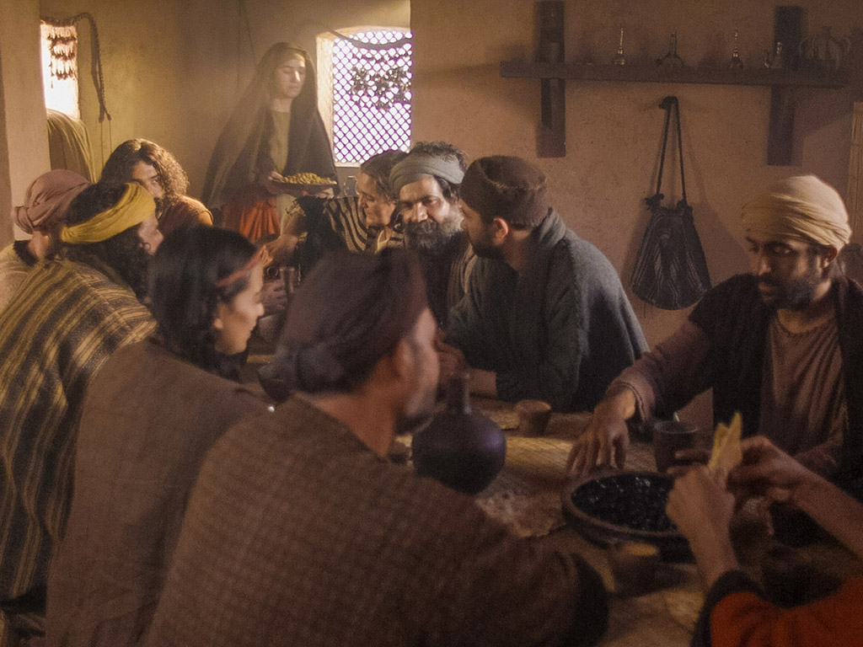
Notes:
Music background 1 of 2

Slide 60

Notes:
Music background 1 of 2

Slide 61

One day a plain village woman, driven by love for her Lord

Slide 62
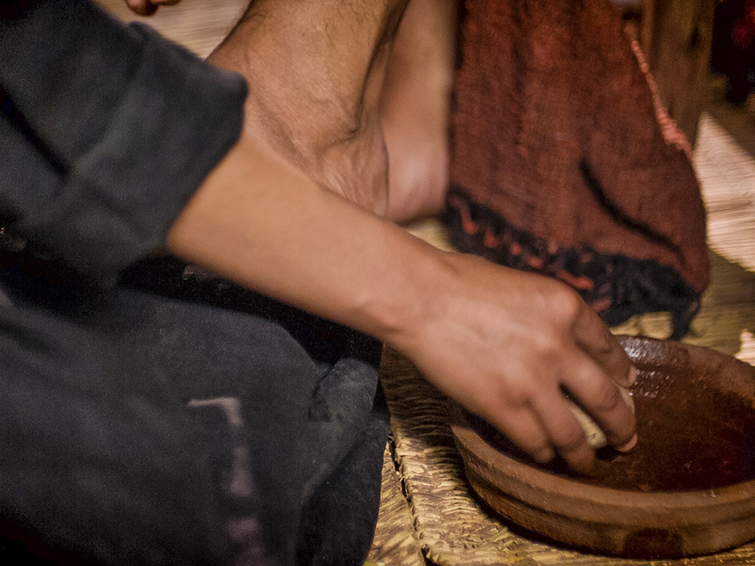
Recklessly poured out a valuable essence, disregarding the scorn

Slide 63
And once it was broken and spilled out
A fragrance filled all the room.
Like a prisoner released from his shackles
Like a spirit set free from the tomb

Slide 64
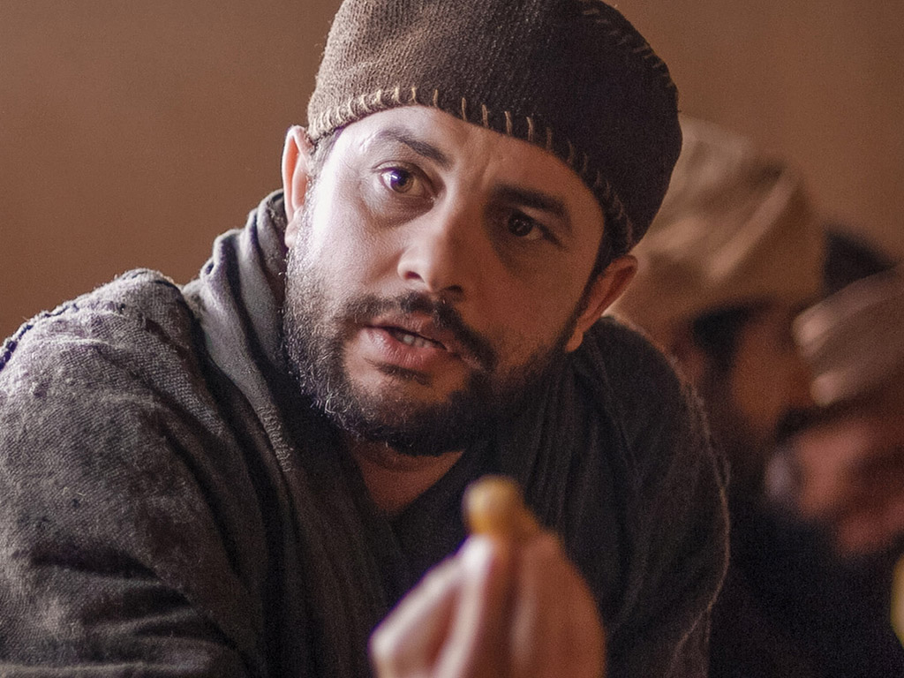
Broken and spilled out, just for love of you, Jesus
Life's most precious treasure, lavished on Thee

Slide 65
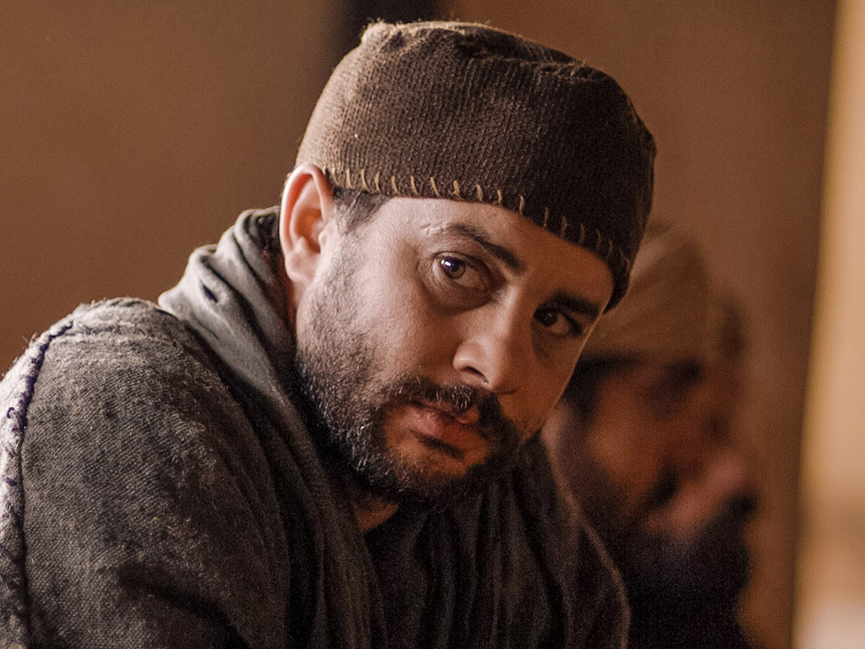
Broken and spilled out, and poured at Your feet
In sweet abandon
let me be spilled out
and used up for Thee

Slide 66
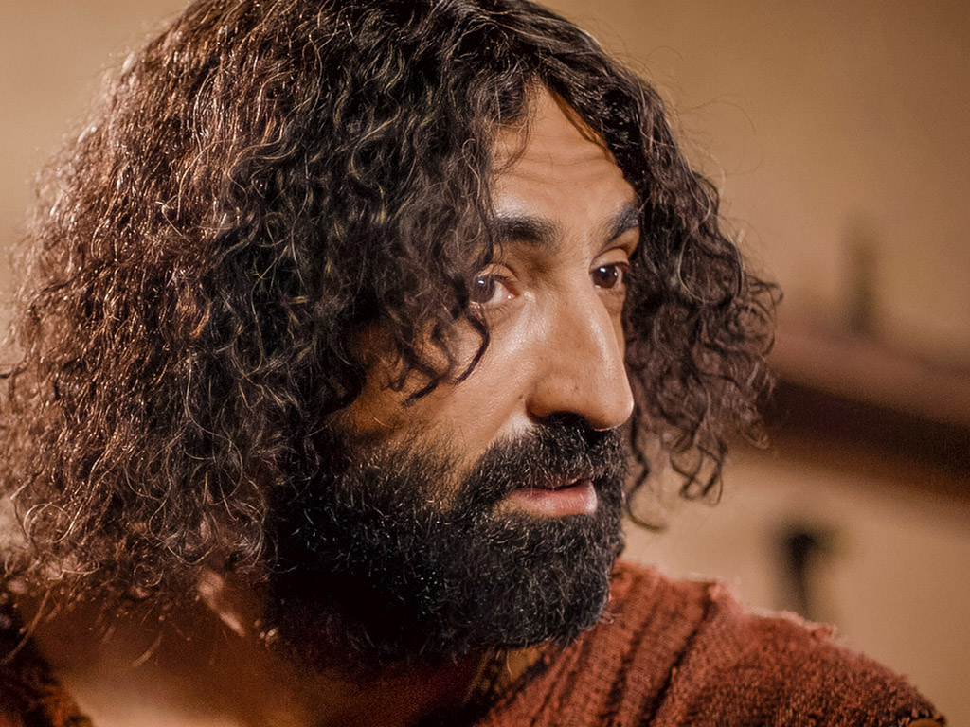
Lord, You were God's precious treasure,
His loved and His own perfect Son
Sent here to show me
the love of the Father,
just for love it was done

Slide 67
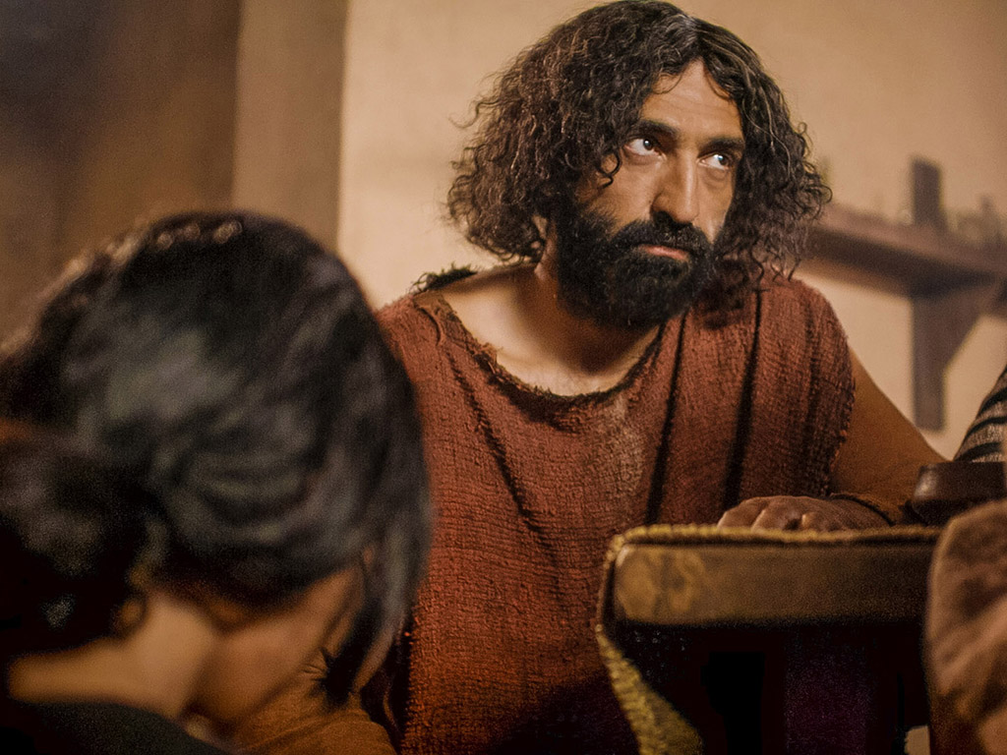
And though You were perfect and holy
You gave up Yourself willingly
You spared no expense for my pardon
You were used up and wasted for me

Slide 68
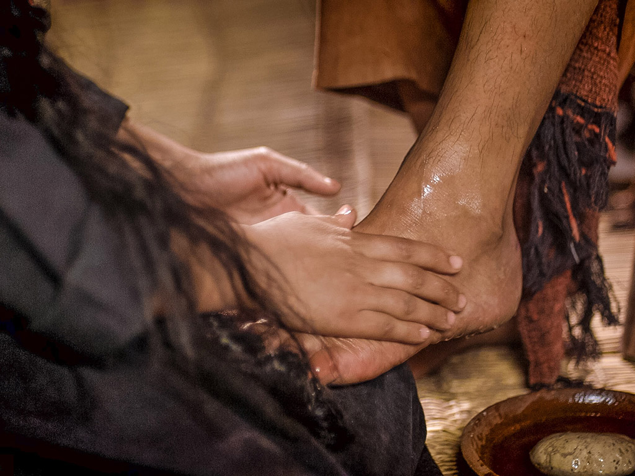
Broken and spilled out
Just for love of me, Jesus––
God's most precious treasure lavished on me

Slide 69
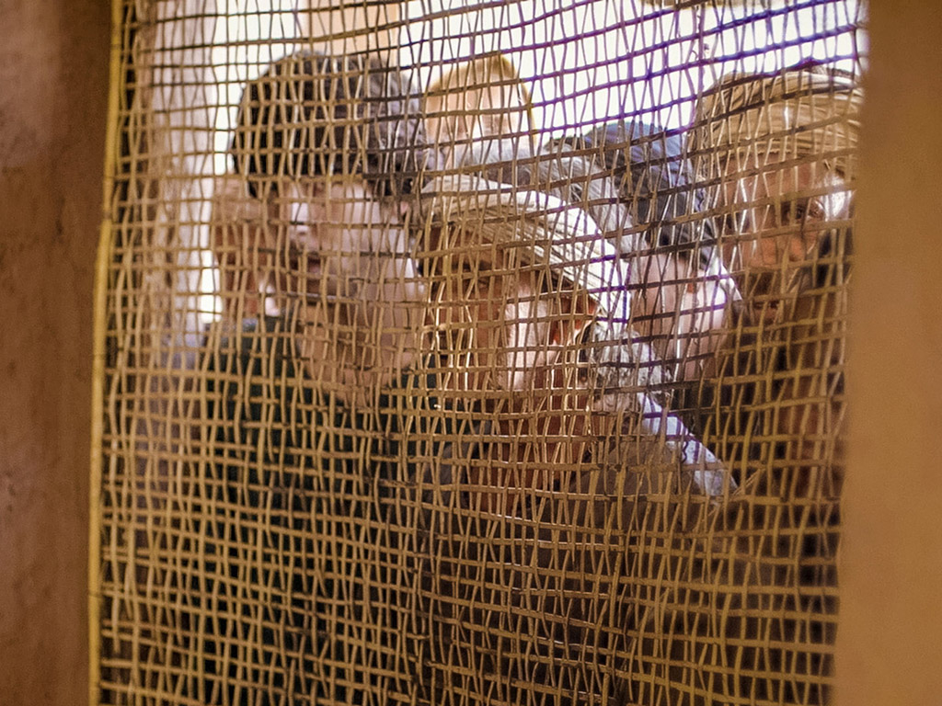
Broken and spilled out and poured at my feet.
In sweet abandon,
Lord, You were spilled out
and used up for me

Slide 70
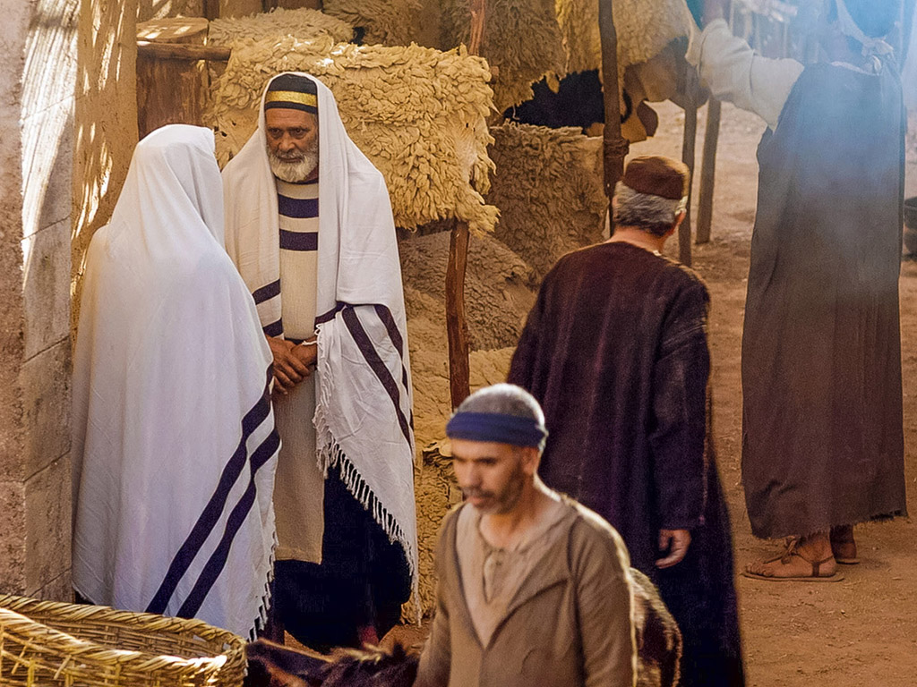
In sweet abandon, let me be spilled out and used up for Thee

Slide 71

Pictures courtesy of Big Book Media
© All Rights Reserved.
Used with permission
BIG BOOK MEDIA

Slide 72

THE WORD IN PICTURES
Free
Bible
images

Slide 73


Was Mary Magdalene the Woman with the Alabaster Jar?
The WOMAN
with the
ALABASTER JAR
Mary Magdalen and the Holy
Grail
No. In Luke she is not named but in the other gospels she is clearly Mary of Bethany
As featured in The
Da Vinci Code

Slide 74

John 12 Events
64
656
Unbelief Summary
12:37-50
Predicts Death
12:21-36
Triumphal Entry
12:12-20
Anointing at Bethany
12:1-11

Slide 75

Luke 7:36-50
Jesus and the Sinful Woman

Slide 76

Anointings of Jesus
Common to all four gospel accounts:
Unannounced visit by woman
Anointed Jesus' head and/or feet
Wiped his feet with her hair
Complaint of waste by disciples/Judas
Disciples rebuked by Jesus
In a home
Alabaster jar (except in John)
Home owned by man called Simon

Slide 77

The Two Anointings of Jesus
Luke 7:36-50
Early in Ministry
Weeping
For worship, woman's
sins forgiven (Luke 7:48)
By unnamed harlot at
home of Simon the
Pharisee (Luke 7:40) in
an unknown town
Matt. 26:6-13
Mark 14:3-9
John 12:1-11
During Passion Week
No weeping noted
For burial, woman needed
no forgiveness
By Lazarus' sister Mary at home of Simon the Leper
(Matt. 26:6; Mark 14:3) in Lazarus' hometown of Bethany (John 12:1)

Slide 78
4. The Promise to Betray
§ 154
Matthew 26:14-16; Mark 14:10-11; Luke 22:3-6
Judas agrees to betray Jesus to the Sanhedrin in His trial, showing his bitterness and disappointment with the Lord
Notes:
Why did Judas betray Jesus?
Judas loved money
He wanted power
It needed to happen to fulfill the prophecy of betraying Jesus

Slide 79
5. The Preparation of the Passover
§ 155
Matthew 26:17-19; Mark 14:12-16; Luke 22:7-13
Jesus sends Peter and John to prepare the Passover supper so that they may fully obey the law's demands to observe the feast

Slide 80
6. The Passover Observance
§ 156
Matthew 26:20; Mark 14:17; Luke 22:14-16, 24-30
Jesus notes that the Passover will be fulfilled in the Millennium, so his disciples argue for their greatness based on their table positions
Notes:
The Last Passover
Matt. 26:20 Now when evening came, Jesus was reclining at the table with the twelve disciples.
Mark 14:17 When it was evening, He *came with the twelve.
The Lord’s Supper
Luke 22:14 When the hour had come, He reclined at the table, and the apostles with Him. ¹⁵ And He said to them, “I have earnestly desired to eat this Passover with you before I suffer; ¹⁶ for I say to you, I shall never again eat it until it is fulfilled in the kingdom of God.”
Who Is Greatest
Luke 22:24 And there arose also ªa dispute among them as to which one of them was regarded to be greatest. ²⁵ And He said to them, “The kings of the Gentiles lord it over them; and those who have authority over them are called ‘Benefactors.’ ²⁶ “But it is not this way with you, ªbut the one who is the greatest among you must become like the youngest, and the leader like the servant. ²⁷ “For who is greater, the one who reclines at the table or the one who serves? Is it not the one who reclines at the table? But I am among you as the one who serves.
Luke 22:28 “You are those who have stood by Me in My trials; ²⁹ and just as My Father has granted Me a kingdom, I grant you ³⁰ that you may eat and drink at My table in My kingdom, and you will sit on thrones judging the twelve tribes of Israel.

Slide 81
7. The Provision of an Example
§ 157
John 13:1-20
Christ loves the disciples as their servant by washing their feet to show that the one who rules must become one who serves

Slide 82
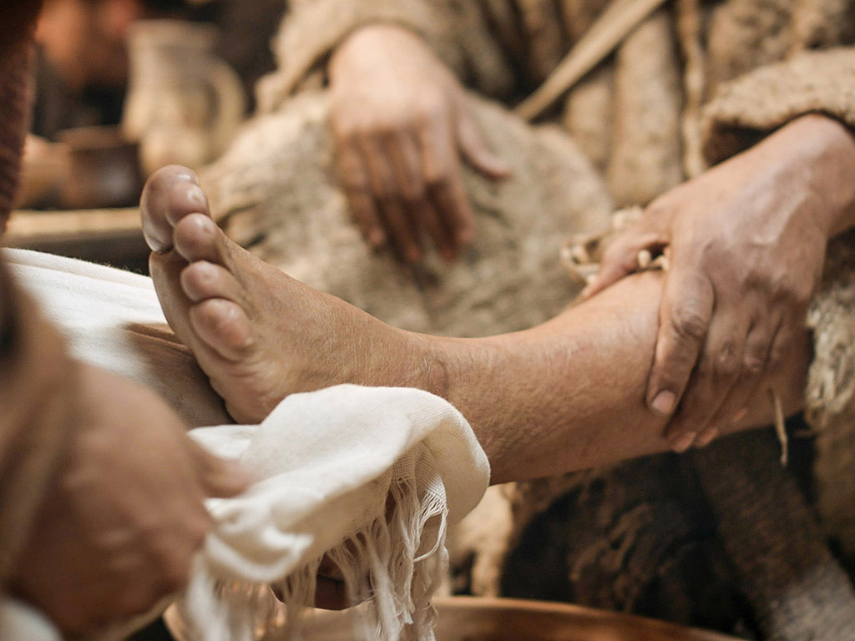
John 13:1-17
Free
Bible
images
THE EASTER STORY
JESUS WASHES THE DISCIPLES' FEET

Slide 83
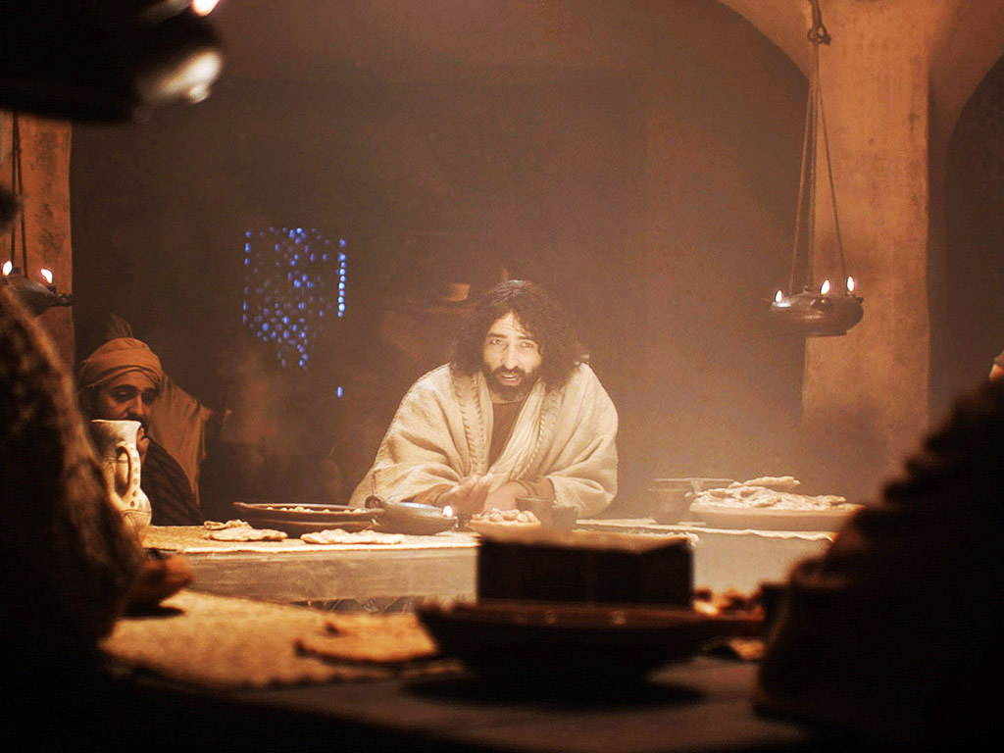

Slide 84
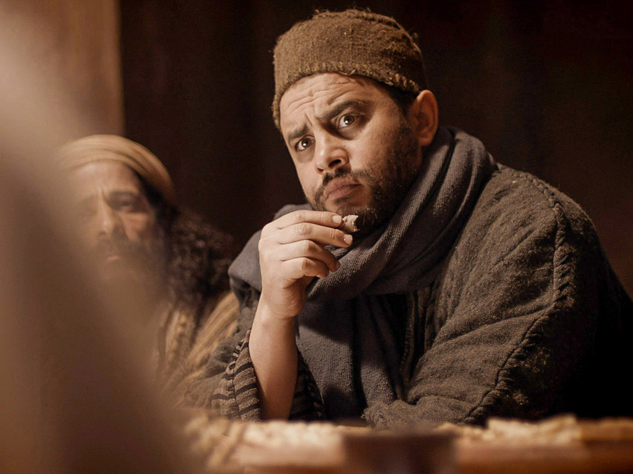

Slide 85
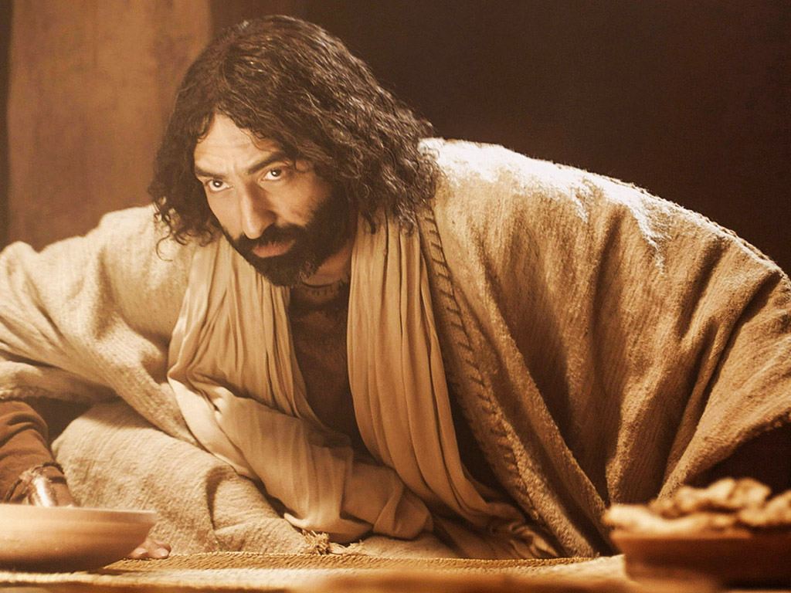

Slide 86
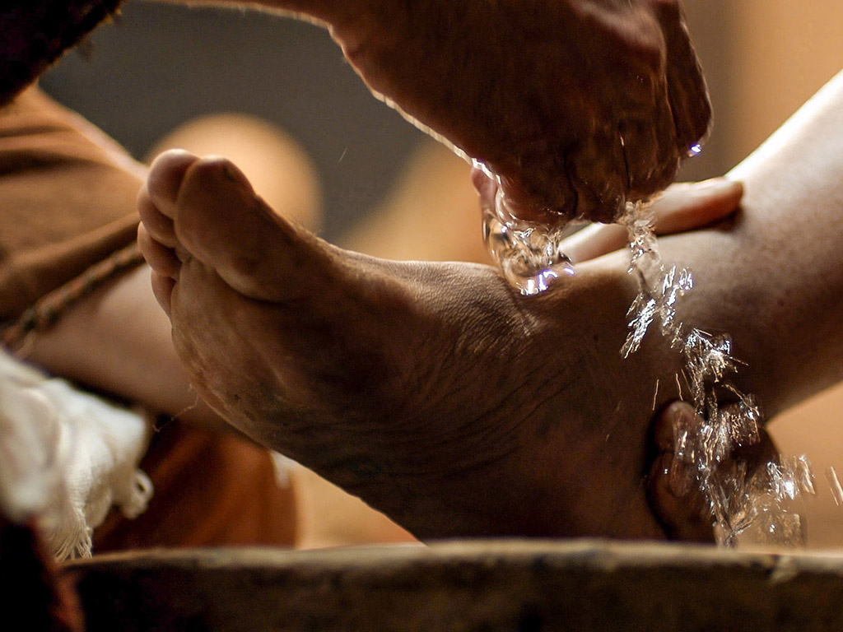

Slide 87
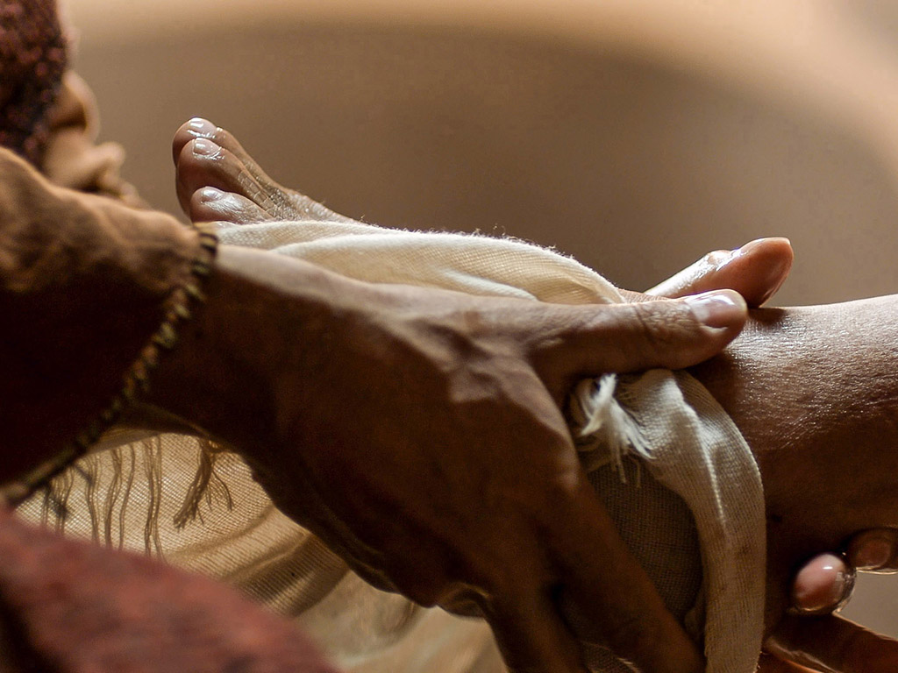

Slide 88
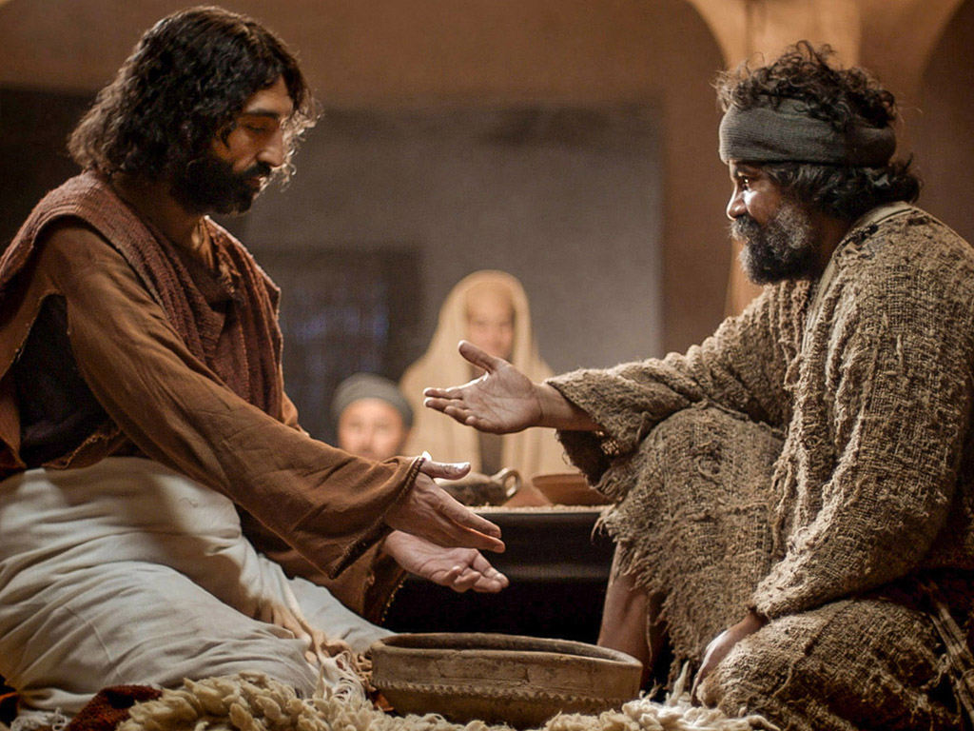

Slide 89
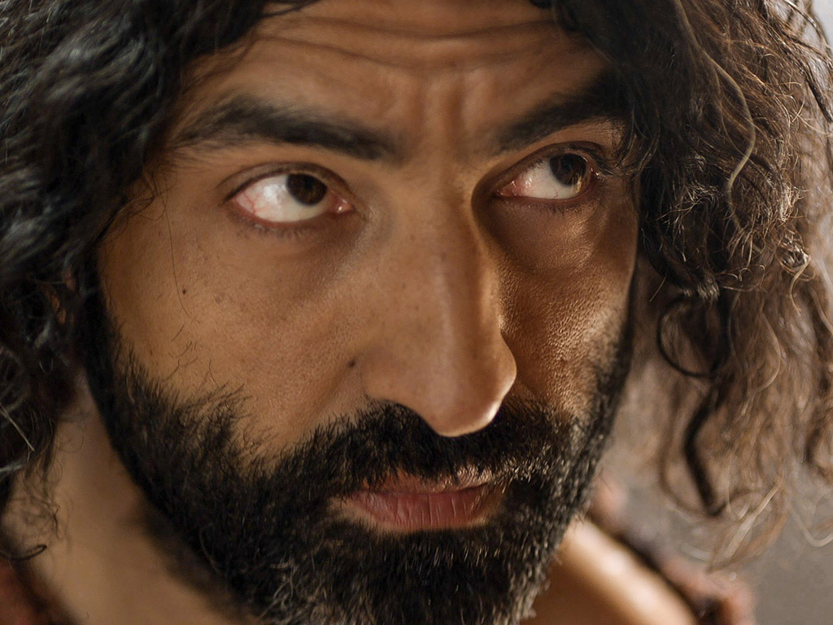

Slide 90
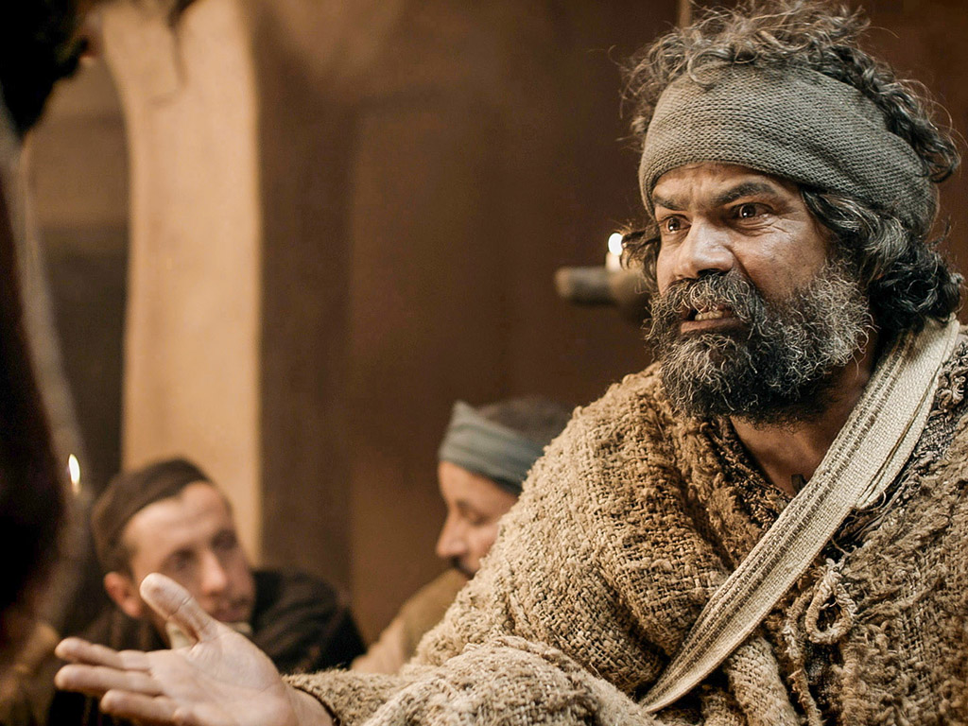

Slide 91
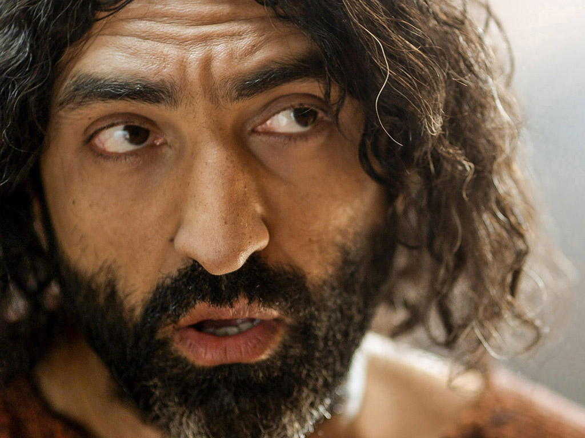

Slide 92
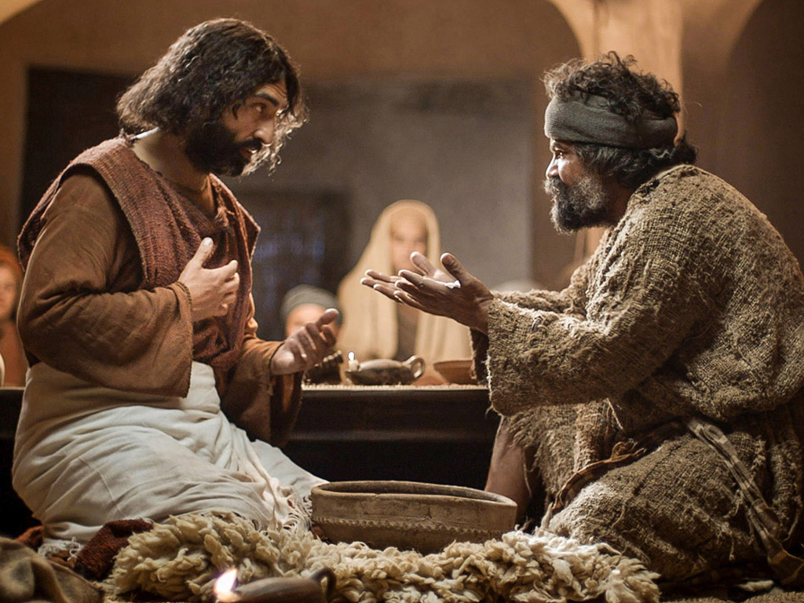

Slide 94
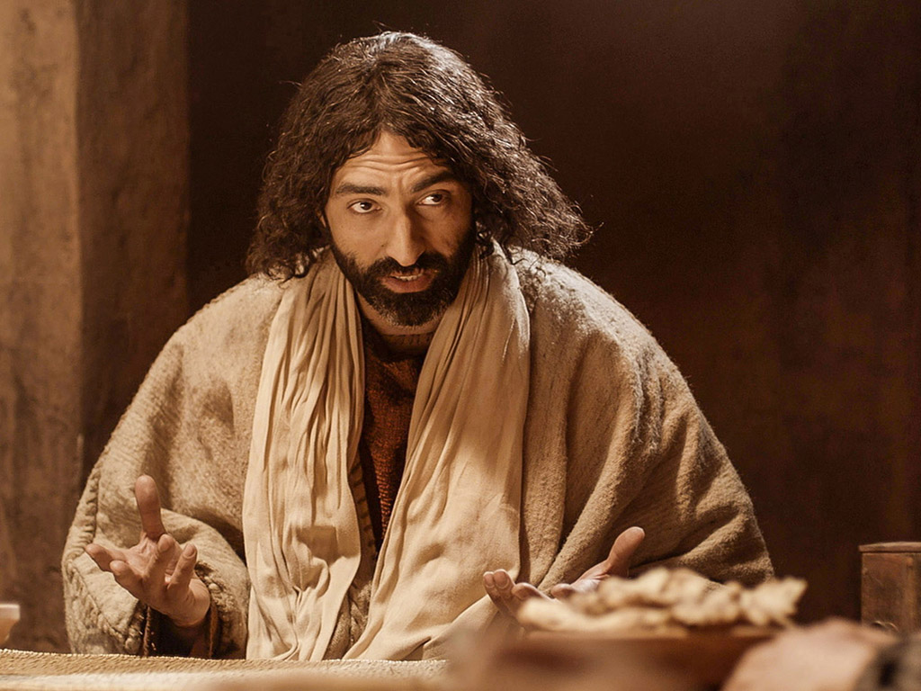

Slide 95
THE WORD IN PICTURES
Free
Bible
images

Slide 96

Used with Permission
THE
GOSPEL
——OF—— MATTHEW
THE
GOSPEL
——OF—— MARK
THE
GOSPEL
——OF—— LUKE
THE
GOSPEL
——OF—— JOHN
Due to the Lumo Project producing its own publishing material we regret to inform you that we cannot license our photos to other clients outside of freebibleimages.org.
These images are not licensed for reuse in video, epublishing or other media. Downloaded pictures and files cannot be redistributed through any other website than freebibleimages.org or used in any context where the accompanying message is undermining of the Christian faith and gospel.
Photos can only be used on educational presentations, blogs and social media, all of which should be accompanied with reference to www.LumoProject.com.
Picture courtesy of BBM
© All Rights Reserved.
www.bigbookmedia.com

Slide 97

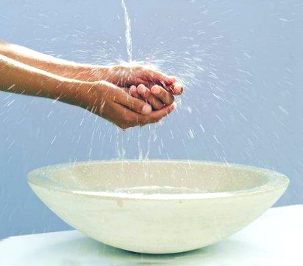
Washing of Hands

Slide 98
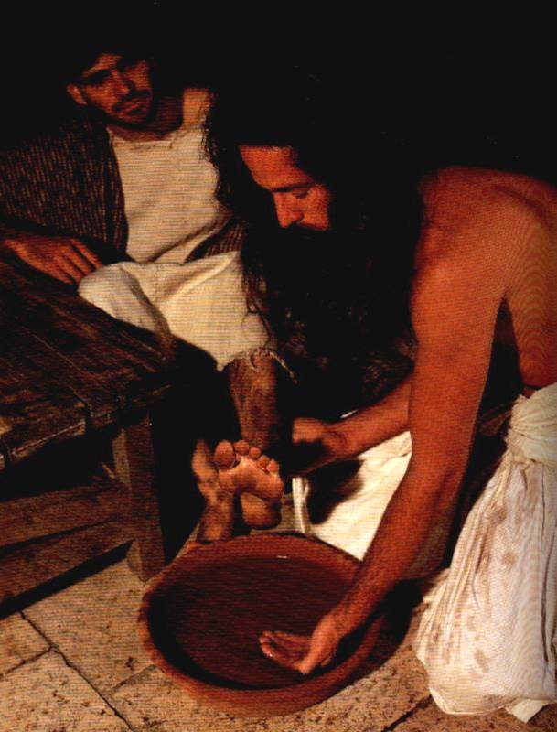
Feet instead of hands

Slide 99
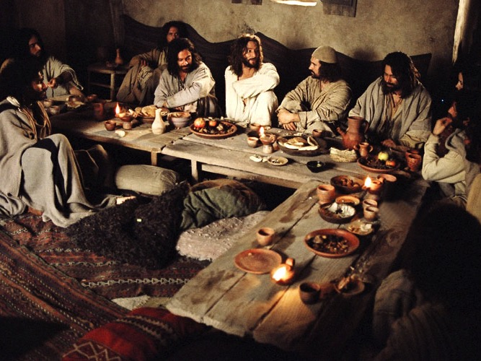
Upper Room Seating

Slide 100
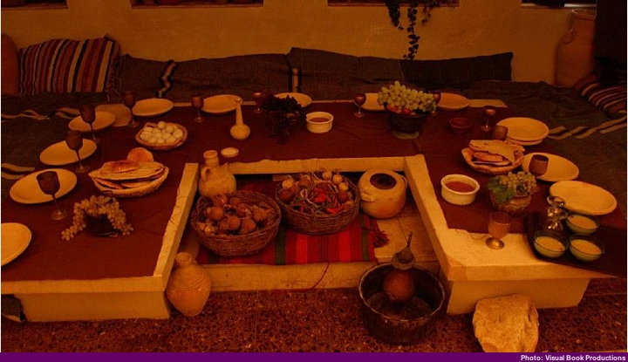
"U" Shaped Table

Slide 101
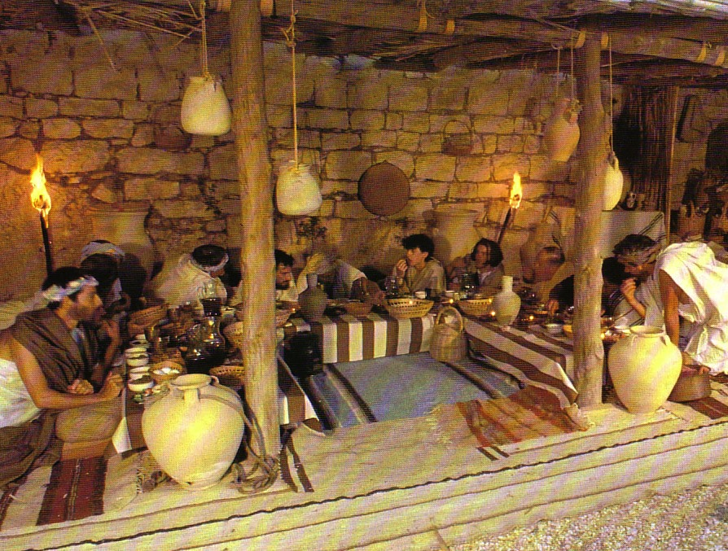
Seating at Jesus' Passover

Slide 102
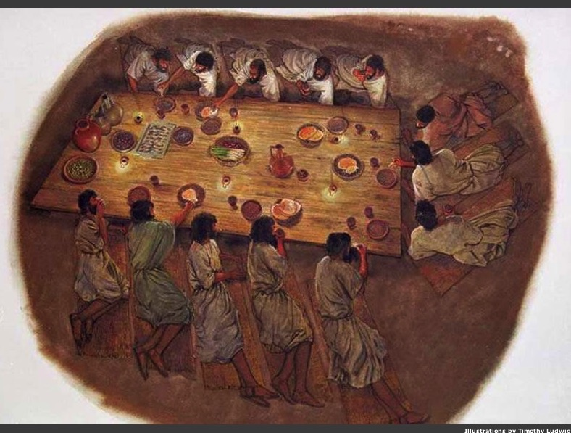
Passover Seating
Head
Notes:
Where did the head of the table sit?
Christ loves the disciples as their servant by washing their feet to show that the one who rules must become one who serves

Slide 103
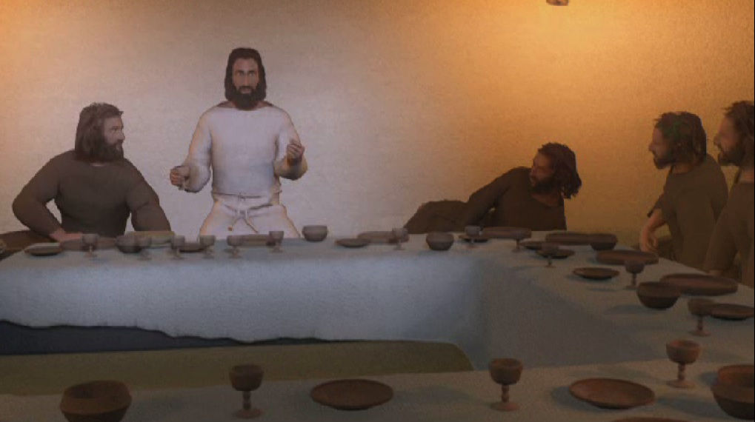
The Head of the Table
Jesus
John
Judas
Notes:
Others say Christ "reclined on the middle divan" (see http://www.spiritjournals.com/Bible%20Studies/Passover/passoverseatingarrin.htm accessed 27 Oct 2013)

Slide 104
Dirty Saints
John 13:1-17

Slide 105

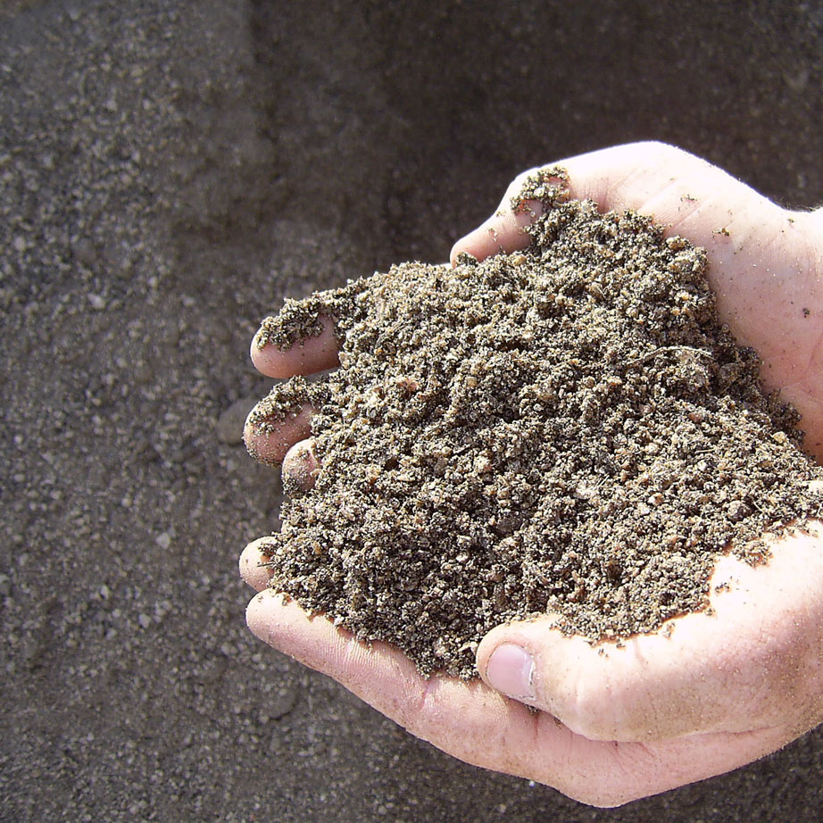
Why get dirty for others?
3 reasons

Slide 106

I. Getting dirty shows your love.

Slide 107
Love Exemplified
“... He showed them the full extent of his love” (1).

Slide 108

II. Getting dirty shows your humility.

Slide 109

Jesus showed humility

Slide 110

Jesus washed the feet of Judas too!

Slide 111

Jesus retained his authority but took on a servant’s role

Slide 112

“Lord, are you going to wash my feet?” (13:6)
“Unless I wash you, have no part with me” (13:8)

Slide 113

“Then wash my hands and head as well, not just my feet!” (13:9)
Two washings:
Body = salvation (once)
Feet = confession (repeated)
Notes:
13:9-10. “Peter continued to miss the spiritual lesson, but he was certain of his desire to be joined to Jesus. Therefore he asked Jesus to wash his hands and head as well as his feet. Jesus answered, A person who has had a bath needs only to wash his feet; his whole body is clean. (Some Gr. mss. omit the words “his feet.”) Roman Catholics sometimes have interpreted verse 10 to mean that after infant baptism only penance is needed. A preferable interpretation is that after salvation all one needs is confession of sins, the continual application of Jesus’ death to cleanse one’s daily sins (cf. 1 John 1:7; 2:1-2). When Jesus added that not every one of you is clean, He was referring to Judas (cf. John 13:11, 18). This suggests that Judas was not converted” (Ibid).

Slide 114

Humble service curbs pride
1. Voluntary
2. No complaining
3. Unconventional

Slide 115

“When a man forgets himself, he usually does something everybody else remembers.”

Slide 116

III. Getting dirty shows you imitate Christ.

Slide 117

“I have given you an example to follow. Do as I have done to you” (John 13:15)

Slide 118

Main Idea
When you love people like Jesus, you don’t mind dirt.

Slide 119

Why Get Dirty?
1. To show love
2. To show humility
3. To imitate Jesus

Slide 120
8. The Prediction of Judas' Betrayal
§ 158
Matthew 26:21-25; Mark 14:18-21; Luke 22:21-23
Christ predicts Judas' betrayal by passing the sop to offer forgiveness to Judas if he believes in Jesus

Slide 121
9. The Prediction of Peter's Denial
§ 159
Matthew 26:31-35; Mark 14:27-31; Luke 22:31-38
Jesus predicts Peter's denial and prays that the Twelve would all be restored after denying Him as Lord

Slide 122

Jesus predicted that Peter would deny him that very night
(Mark 14:30)
Notes:
Peter would deny him (13:38)…

Slide 123
10. The Provision of a Memorial
§ 160
Matthew 26:26-30; Mark 14:22-26; Luke 22:17-20
Jesus establishes memorials of His person in the cup and bread so that they would help His followers remember His sacrificial death

Slide 124

Free
Bible
images
Matthew 26:17-35
Mark 14:12-31
Luke 22:7-38
John 13:18-38
THE EASTER STORY
THE LAST SUPPER

Slide 125


Slide 126


Slide 127


Slide 128


Slide 129


Slide 130


Slide 131


Slide 132


Slide 134


Slide 135


Slide 136


Slide 137


Slide 138


Slide 139


Slide 140
THE WORD IN PICTURES
Free
Bible
images

Slide 141


PESACH
The Passover Meal
Notes:
Translators, do NOT translate PESACH as this is Hebrew but translate “The Passover Meal”

Slide 142
The Four Cups (Exod. 6:6-7)
145
"Therefore, say to the Israelites:
'I am the Lord, and I will bring you out from under the yoke of the Egyptians.
Sanctification
Plagues
I will free you from being slaves to them,
and I will redeem you with an outstretched arm and with mighty acts of judgment.
Redemption

Slide 143


… This is my body
GIVEN FOR YOU do this in
REMEMBRANCE of me.
LUKE 22:19

Slide 144
… This cup is the
NEW COVENANT in my blood, which is POURED OUT for you.
The cup (not baptism) is the new covenant sign
LUKE 22:20

Slide 145
C. Precepts By Christ
§§ 161-165
John 13:31–16:33
Christ's final teaching at the Last Supper prepares them for His departure and for their ministry apart from His bodily presence

Slide 146
1. Prologue
§ 161
John 13:31-35
Jesus commands His men to love each other with His same love to identify themselves to the world as His followers

Slide 147
2. Problems
§ 162
John 13:36, 14:1-24
Jesus promises His troubled disciples a new intimacy with the Trinity as He was the only way to God, who would soon be replaced by the Spirit

Slide 148


Confusion
3 ways to replace confusion with comfort
Comfort

Slide 149

I. Life: Realize that Jesus is preparing a wonderful life in heaven for you (John 14:1-4).

Slide 150

“Don’t let your hearts be troubled. Trust in God, and trust also in me” (John 14:1 NLT)

Slide 151

Your Heart
“Trust in the Lord with all your heart; do not depend on your own understanding” (Prov. 3:5)
“Guard your heart above all else, for it determines the course of your life” (Prov. 4:23)

Slide 152

“Don’t let your hearts be troubled. Trust in God, and trust also in me” (John 14:1 NLT)

Slide 153

John 14:2 Mansions (KJV)
“In my Father’s house are many mansions...” (KJV)
“In my Father’s house are many mansions...” (KJV)

Slide 154

In my Father’s house are many rooms; if it were not so, I would have told you.
I am going there to prepare a place for you.
John 14:2 NIV

Slide 155

Marriage Backgrounds in Jewish Literature
Marriage depicts Christ's love for the church (Eph. 5)

Slide 156

The First Century Wedding Procession
Groom’s House (in Father’s House)
The procession parallels Christ's return for His Bride, the Church
Bride’s House

Slide 157

“We will be caught up (“raptured”) in the clouds to meet the Lord in the air”
(1 Thess. 4:17)

Slide 158
I. Life: Realize that Jesus is preparing a wonderful life in heaven for you (John 14:1-4).

Slide 159

II. Way: Trust Christ as the only way you can reach God (14:5-14).
ONE
WAY

Slide 160
John 14:6
"I am the way
the truth and the life
No one comes to the Father
except through me"
Jesus

Slide 161

Dr. Steve McSwain
“Therefore, I now know that when Jesus said, ‘I am the way, the truth...no one comes to the Father but by me,’ he was not saying, as Christian history has mistakenly thought, ‘There is no other way to God but by me.’ He was simply saying instead, ‘The way I live is the way to know God--it's also the way to live happily in this world. If you want to know God, follow my way...emulate how I live, how I think, the way I treat myself, others, and the world.’"
http://www.selfgrowth.com/articles/is-jesus-the-only-way-to-god

Slide 162
Dr. Steve McSwain
“Therefore, I now know that when Jesus said, ‘I am the way, the truth...no one comes to the Father but by me,’ he was not saying, as Christian history has mistakenly thought, ‘There is no other way to God but by me.’ He was simply saying instead, ‘The way I live is the way to know God—it's also the way to live happily in this world. If you want to know God, follow my way...emulate how I live, how I think, the way I treat myself, others, and the world.’"
http://www.selfgrowth.com/articles/is-jesus-the-only-way-to-god

Slide 163

Other texts say the same...
"Nor is there salvation in any other, for there is no other name under heaven given among men by which we must be saved" (Acts 4:12).
"He who does not believe the Son shall not see life, but the wrath of God abides on him" (John 3:36).

Slide 164

Other texts say the same...
"For there is one God and one Mediator between God and men, the Man Christ Jesus" (1 Timothy 2:5).
"And this is the testimony: that God has given us eternal life, and this life is in His Son. He who has the Son has life; he who does not have the Son of God does not have life" (1 John 5:11-12)
Notes:
Only Christ can atone for sin, and therefore only Christ can provide salvation.

Slide 165

Is there really only one way?

Slide 166

The ONE Way
JESUS
THE WAY
THE TRUTH THE LIFE
JOHN 14:6

Slide 167

Lee Strobel
jesuschristonly.com
Notes:
http://www.jesuschristonly.com/sermons/lee-strobel/jesus-the-only-way-to-god.html

Slide 168
I. Life: Realize that Jesus is preparing a wonderful life in heaven for you (John 14:1-4).

Slide 169
II. Way: Trust Christ as the only way you can reach God (14:5-14).
ONE
WAY

Slide 170
Black

Slide 171
3. Promises
§ 163
John 14:25-31
Jesus would send the Spirit to teach what still did not make sense so the disciples could proclaim His words with His peace, not fear

Slide 172
The Holy Spirit!
How could the disciples cope once Jesus left them to return to heaven?

Slide 173

III. Truth: Submit to the Spirit's teaching (14:15-31).

Slide 174

Spirit Ministries
(John 14:15-31)
Counsels & teaches
(15-21)

Slide 175

The Spirit Advocate

Slide 176

John 14:15-17
xvi
II. D.
¹⁵"If you love me, you will obey what I command. ¹⁶And I will ask the Father, and he will give you another Counselor to be with you forever — ¹⁷the Spirit of truth. The world cannot accept him, because it neither sees him nor knows him. But you know him, for he lives with you and will be in you."
Notes:
176
This indwelling is PERMANENT (forever) and for ALL believers!
________
BE-26-Ezekiel-40
OS-26-Ezek1-39-slide 152
NS-04-John12-21-slide 100

Slide 177

The Paraclete (John 14:16)
Advocate = Counselor = Comforter
Greek = “one who comes alongside”
Greek options for “another”:
Heteros = “another of a different kind”
Allos = “another of the same kind”
The Spirit will come alongside us in the same way as Jesus Himself!

Slide 178


"…those who do not have the Spirit of Christ living in them do not belong to him at all… The Spirit of God, who raised Jesus from the dead, lives in you"
(Romans 8:9, 11)

Slide 179
Spirit Ministries
(John 14:15-31)
Counsels & teaches
(15-21)
Enables obedience & grants peace
(22-31)

Slide 180

John 14:27 NIV
Peace I leave with you; my peace I give you.
I do not give to you as the world gives. Do not let your hearts be troubled and do not be afraid.

Slide 181
Confusion
Comfort

Slide 182

How can you replace your confusion with Christ's comfort?
Main Idea
Main Idea
Trust the one way, one truth, and one life!
One Life
(1-4)
One Way
(5-14)
One Truth
(15-31)

Slide 183
4. Instruction Concerning Their Present Experience
§ 164
John 15:1-16:4
Jesus promises the Spirit to connect his followers to Him for ministry success and to prepare them for spiritual conflict

Slide 184
a. Fruit bearing
John 15:1-17
Christ likens Himself a vine with disciples as connected branches as Christ-like character and ministry success are sourced in Him

Slide 185

I am the Vine
You are the branches
15
Those who remain in me, and I in them, will produce much fruit. For apart from me you can do nothing.
John 15:5 NLT

Slide 186

John 15:2
15
"He cuts off (lifts up) every branch in me that bears no fruit
while every branch that does bear fruit he prunes so that it will be even more fruitful."

Slide 187

Interpretations of John 15:1-6
119e
Christians who lose their salvation
Professing "Christians" who are actually unbelievers
Christians who are lifted up & encouraged
but later disciplined by death
Christians cared for by God until judgment came
on those not used by God

Slide 188
b. The Foe of the Disciples
John 15:18-16:4
Christ warns of opposition from the world, even to death, for his followers to depend on the Spirit and prepare for spiritual conflict

Slide 189
5. Instruction Concerning the Future
§ 165
John 16:5-33
Jesus instructs on the future ministry of the Spirit, the resurrection, and His presence to empower for ministry, prayer, and peace

Slide 190
a. The Ministry of the Holy Spirit
John 16:5-15
The coming of the Spirit depends upon His departure so that the Holy Spirit might indwell them for an effective ministry

Slide 191

John 16:5-33
Jesus Continues Preparing the Disciples for His Absence
Last Discourse
Part 3

Slide 192

Preparing the Disciples in Christ's Last Discourse
(John 13:31–16:33)

Slide 193

How could the disciples cope without Jesus with them anymore?

Slide 194

The Holy Spirit!
How could the disciples cope without Jesus with them anymore?

Slide 195

Key Ministries of the Spirit (16:5-15)
To Unbelievers
8-11
To Believers
12-15
Conviction
Teaching

Slide 196
How does the Spirit convict unbelievers (16:8-11)?
Conviction summary (8)
Guilt in regard to sin (9)
Guilt in regard to righteousness (10)
Guilt in regard to judgment (11)

Slide 197

The Spirit Speaks Through the Word
"But when he, the Spirit of truth, comes, he will guide you into all truth…" (John 16:14)

Slide 198

How does the Spirit teach believers God's Word (16:12-15)?

Slide 199

How can you be more open to the Spirit's teaching ministry in your life?

Slide 200
b. The Result of the Resurrection
John 16:16-28
Jesus will be resurrected with great joy after his men grieve, but they will have unlimited access to the Father in prayer through Christ

Slide 201
c. Conclusion
John 16:29-33
Christ will not abandon the disciples, but they will know His peace as they wait for Him to fulfill His promise to overcome the world

Slide 202
D. Prayer by Christ for Believers
§ 166
John 17:1-26
Christ prays for Himself, His disciples, and future believers so they can minister successfully on His behalf after He leaves

Slide 203
Overview of John’s Gospel
107
Deity Made Man for Eternal Life
Deity of the Son of God | Revelation of the Son of God |  | Preparation of the Son’s Disciples | Passion & Resurrection of the Son of God | Adequacy of the Son of God
1:1-18 | 1:19–12:50 |  | 13–17 | 18–20 | 21
Prologue | Public |  | Private | Public | Private
Incarnation | 2 Signs Received 1:19–4:54 | 5 Signs Rejected 5–12 | Upper Room Discourse (no signs) | Ultimate Sign | Last Sign
Eternity Past | Fall AD 29- Monday, 30 March 33 |  | Thursday, 2 April 33 | Friday, 3 April 33- Sunday, 5 April 33 | May, AD 33
Ephesus (AD 65-69)
Notes:
In an "upper room," Jesus poured into his disciples the most valuable teaching he could.
This is Jesus' longest sermon in the gospels. He tells them be connected to him while hated by the world (13:1–16:4), be encouraged by another Comforter coming after Jesus in the person of the Holy Spirit (16:5-16), and be peaceful since their grief will turn to joy (16:17-33). Finally he prays for them (John 17).

Slide 204

Jerusalem from the East, AD 33
John 13–14
Passover at Mark’s House
John 15–16
Vineyard
John 17
Prayer
Kidron Brook
John 18 Mt. of Olives
Notes:
Today we finish what has often been called the Upper Room Discourse—the last time Jesus taught his disciples. This actually isn’t a good term to describe all of John 13–17 because at the end of John 14, Jesus noted, “Come, let’s be going.”
So they left the upper room of the Passover and began walking east to the Mt. of Olives where he would be betrayed. This likely brought him through a vineyard where he taught in John 15 that he was the vine and, as branches, they needed connection to him.
In John 18:1, they would cross the Kidron Valley, so they are still on the west side of the Kidron Brook. In this ravine lay a channel that led from the temple—not a waterway like an aqueduct—but rather a channel that led from the temple altar where an estimated 256,000 lambs were slaughtered during the Passover. When Jesus crossed it, no doubt the smell of blood was ominously hanging in the air—a picture of what was to happen the next day with Jesus as our Passover Lamb.

Slide 205

Christ’s Prayer in John 17
“There is no voice which has ever been heard, either in heaven or in earth, more exalted, more holy, more fruitful, more sublime, than the prayer offered up by the Son to God Himself.”
––Philip Melanchthon
Notes:
The Discourse ends with Jesus' longest prayer in the gospels. Melanchthon says…

Slide 206
























Widening Circle of Christ's Prayer
James
Thaddeus
John
Peter
Andrew
For
Himself
Bartholomew
James bar Alphaeus
For
Disciples
Thomas
Simon the Zealot
Philip
Matthew
For
All Believers
Notes:
Here Jesus prays a threefold prayer for Himself, His disciples, and for all believers.
• In verses 1-5 Christ prays for Himself that God would glorify Him in His completion of His mission through His vicarious death.
• In verses 6-19 Christ prays that His disciples might have God's protection and sanctification while they remain in the world.
• Today's text in verses 20-26 concerns the last section of Christ's prayer that relates to us as a part of all believers.

Slide 207

A Pattern for Prayer
Finally pray for those outside your influence
Then pray for those in your closest sphere of influence
First pray that
you are in
God’s will
Notes:
What was most important to Jesus as he anticipated the cross?
Prayer! I take it as a pattern for how we also should pray.

Slide 208
1. His Prayer for Himself
John 17:1-5
Jesus prays for His resurrection and glorification, showing His subjection to God and confidence in God for His resurrection
Notes:
Jesus prays for the reunion of His soul and body after death (resurrection) and that He would be brought out of spiritual death (glorification), revealing His subjection to God in His approaching death and His confidence in God for His resurrection.

Slide 209
A Pattern for Prayer
I. Pray that you will glorify God by fulfilling his calling for you.

Slide 210
Widening Circle of Christ's Prayer
For
Himself

Slide 211

“The time has come. Glorify your Son…” (17:1)
“You granted him authority…
[to] give eternal life” (17:2)
“I have brought you glory by completing the work
you gave me to do” (17:4)
Notes:
All throughout John's gospel Jesus repeatedly says, "The time has NOT come…" or "The hour has not yet come…"
Now, finally, he says the opposite: "The time HAS come…"

Slide 212

Our Father in Heaven
Notes:
Jesus had taught his men to pray to the Father

Slide 213

Hallowed Be Your Name
Notes:
… that the Father's name would be held sacred

Slide 214

Your Kingdom Come
Notes:
…and that this rule would arrive…

Slide 215

Your Will Be Done
Notes:
…and his plan be accomplished.

Slide 216
2. His Prayer for His Disciples
John 17:6-19
Jesus prays for the protection and joy of his men and then ordains them for ministry to make the Father known to the world

Slide 217
A Pattern for Prayer
II. Pray for those you influence to be protected and holy.
I. Pray that you will glorify God by fulfilling his calling for you.

Slide 218
Widening Circle of Christ's Prayer
1. Protect them (6-16)
2. Sanctify them (17-19)
James
Thaddeus
John
Peter
Andrew
For
Himself
Bartholomew
James bar Alphaeus
For
Disciples
Thomas
Simon the Zealot
Philip
Matthew

Slide 219










Widening Circle of Your Prayers
1. Protect them
2. Sanctify them

Slide 220
Light represents good over darkness (= evil)

Slide 221

Solid food is for those who are mature, who through training have the skill to recognize the difference between right and wrong.
Hebrews 5:14 NLT

Slide 222
Light dispels darkness every time!

Slide 223
"I’m not asking you to take them out of the world, but to keep them safe from the evil one"
(John 17:15)

Slide 224
3. His Prayer for the Family of Believers
John 17:20-26
Jesus prays for future believers to have unity, glorification, and love for one another to match the love of the Father for the Son

Slide 225
Widening Circle of Christ's Prayer
James
Thaddeus
John
Peter
Andrew
For
Himself
Bartholomew
James bar Alphaeus
For
Disciples
Thomas
Simon the Zealot
Philip
Matthew
For
All Believers

Slide 226

What was most important to Jesus as he anticipated the cross?
Notes:
What was most important to Jesus as he anticipated the cross?

Slide 227

Jesus prayed for our unity (John 17)
Notes:
John 17 will focus on the end of his prayer where he prays for our unity.

Slide 228

What is Unity?
Notes:
But what does unity look like?

Slide 229

Uniformity
Notes:
Well, unity is not the same as uniformity. Many of us have worn uniforms at work, in the military, on sports teams, or on some other team.
We are too painfully aware that just looking the same doesn't mean unity!

Slide 230

Why Unity?
Three reasons for unity…
Notes:
But why is unity so important that Christ would make it His final prayer for the saints? (Subject).
Today we will see three reasons Jesus gives for us to be united.
Verses 20-23 tell us that first motivation for unity is because…

Slide 231
I. Unity grows the church (20-23).
Unity
Notes:
When believers get along with one another, the church increases.

Slide 232

"My prayer is not for them alone. I pray also for those who will believe in me through their message"
(17:20 NIV)

Slide 233

"that all of them may be one, Father, just as you are in me and I am in you"
(17:21a NIV)

Slide 234
The Trinity
Father
is
is not
is not
GOD
is
is
Son
Spirit
is not
H. Wayne House, Charts of Christian Theology and Doctrine, p. 45
Notes:
Our model for unity is the first and second members of the Trinity (20-21a).
Can you imagine the Father and the Son arguing over roles and responsibilities?
"Hey Father! I don't like this idea of dying on a cross. Count me out. If you think it's necessary, then you do it yourself!"
The Father replies, "No way!" and the Spirit agrees, adding, "And what this stuff about me having to give everyone gifts? What a hassle! I hate shopping!"
• In fact, "Trinity" really means "three-unity." Three persons of the Godhead have differing roles but work together in complete unity.

Slide 235



"that all of them may be one, Father, just as you are in me and I am in you. May they also be in us so that the world may believe that you have sent me. ²²I have given them the glory that you gave me, that they may be one as we are one: ²³I in them and you in me. May they be brought to complete unity to let the world know that you sent me and have loved them even as you have loved me" (21b-23 NIV).
Notes:
Likewise, our unity shows the world that Christ is from God (21b-23).
In my NIV text verses 20-23 comprise 5 sentences, which makes it hard to tell where the emphasis is in this section. But actually, the Greek text has only 2 sentences—verses 20-21 and verses 22-23, both of which have as their final idea "that the world may believe" and "to let the world know." The result of unity is evangelism!

Slide 236

Interview of a Catholic Leader
Notes:
Some years back [1993], a British reporter asked a Catholic leader on the growth of evangelicals in the UK, "Are you concerned about this incredible growth among the evangelicals?" "No," came the firm reply. "Why not?" the reporter pressed. "I'm not concerned that the evangelicals have grown to 17 million here," the Catholic leader said. "I won't be concerned—that is, unless they decide to unite."

Slide 237


The City-State of Singapore
Notes:
In contrast, where there is unity, the world believes—like verses 21b and 23b say.
I think one reason the church in Singapore has grown in recent years is because it has learned something about unity despite race and language groups. Of the 4 major language groups in Singapore, 3 have been effectively reached: English, Mandarin, and Tamil.

Slide 238


Multi-cultural • Multi-ethnic • Multi-religious
99% of Hindus are Indian
99% of Buddhists are Chinese
99% of Muslims are Malay
Only Christians effectively cross racial lines though Malays are still unreached
Notes:
• Did you know that 99% of Hindus are Indian
• 99% of Buddhists here are Chinese, and
• 99% of Muslims are Malay?
• In contrast, only Christians have reached across ethnic lines with 79% Chinese, 8% Indian, a half percent Malay, and 13% other groups.
Sure, we have a way to go, but I can't help but think that non-Christians have taken a more serious look at Christianity given the unity amidst diversity across racial and language lines.

Slide 239
Unity
Three reasons for unity
Notes:
I said Christ addresses three reasons for unity in today's text.

Slide 240
I. Unity grows the church (20-23).
Unity

Slide 241

II. We'll be united in heaven forever
—so let's start agreeing now (24).
Notes:
We'll be in glory together—so let's show some of that glory now.

Slide 242

"Father, I want those you have given me to be with me where I am, and to see my glory, the glory you have given me because you loved me before the creation of the world" (17:24 NIV).
Notes:
Christ prayed that true Christians would "be with me where I am." What does He mean? He was right there, wasn't He? And weren't the disciples already there? Of course.
Here we see Jesus using the present tense to refer to something actually future. He does the same thing in verse 11 which literally reads, "I am in the world no longer," even though He was still there.
Christ is looking to the future with such certainty that He speaks of it in the present. The disciples hadn't seen His glory yet, in that He was confined to a human body. But they would see it—they'd all see it together.

Slide 243

Finding Directions in Heaven?
Notes:
I think the implication here is that since we'll be united forever in heaven, this should show down here as well.
Can you imagine in heaven trying to find your way around: "Let's see, here we are in the Presbyterian precinct. But where's Assemblies Avenue? Oh, OK, I see it here on the map—after Baptist Boulevard, Lutheran Lane, Reformed Road, Charismatic Crescent, and on the tip of Pentecostal Point!"
No way! We're all one family there. We'll keep our same race—you'll still be Chinese—but we won't be separated by a denominational distinctive!

Slide 244

SINGAPORE BIBLE COLLEGE
Notes:
One of the best tastes of earthly unity before heavenly bliss is Singapore Bible College. Once I was teaching at SBC on the Book of Job. As I shared how different cultures explained the reasons for suffering, I asked a Pakistani student to share how Pakistani Muslims explain pain, then I asked an Indian student, "How do Indians view suffering?"

Slide 245

SBC Schools
Chinese
Music
Counseling
English
Established 1952
31 Full-time Faculty
500 Students
25 Denominations
25 Countries
29 Languages
Notes:
It suddenly occurred to me that our class not only had students from Pakistan and India, but also from Malaysia, Philippines, Myanmar, Korea, Indonesia, Hong Kong, and Singapore—in one class! SBC has 500 students from 25 nations and 20 denominations and functions as a genuinely diverse but equally genuinely united fellowship.

Slide 246
Church Unity
When should we not work together?
Notes:
But I should give one word of caution.
Genuine spiritual unity is possible only with genuine believers.

Slide 247

What does 2 Cor. 6:14-7:1 mean?
“
136
“Don't team up with those who are unbelievers. How can righteousness be a partner with wickedness? How can light live with darkness? ¹⁵What harmony can there be between Christ and the devil? How can a believer be a partner with an unbeliever? ¹⁶And what union can there be between God's temple and idols? For we are the temple of the living God.”

Slide 248
What does 2 Cor. 6:14-7:1 mean?
“
136
“As God said:
'I will live in them
and walk among them.
I will be their God,
and they will be my people.
¹⁷Therefore, come out from among unbelievers, and separate yourselves from them, says the Lord'
(2 Cor. 6:16-17)

Slide 249
What does 2 Cor. 6:14-7:1 mean?
“
136
“Don't touch their filthy things,
and I will welcome you. ¹⁸And I will be your Father, and you will be my sons and daughters, says the Lord Almighty.”
¹Because we have these promises, dear friends, let us cleanse ourselves from everything that can defile our body or spirit. And let us work toward complete holiness because we fear God”
(2 Cor. 6:17–7:1)

Slide 250

What does 2 Cor. 6:14-7:1 mean?
“
136
“The direct commands to separate from other people are always commands to separate from unbelievers, not from Christians with whom one disagrees… The are no direct New Testament commands to separate from Christians with whom one has doctrinal differences (unless those differences involve such serious heresies that the Christian faith itself is denied).”
Wayne Grudem, Systematic Theology, 877

Slide 251




World Council of Churches
Notes:
The WCC has over 250 Protestant, Catholic, Anglican, and Eastern Orthodox churches—but does it have biblical unity? No, it has organizational, external unity—but no spiritual, internal unity in the biblical sense. In fact, at the World Parliament of Religions in Chicago in 1993 the WCC encouraged its member denominations to open its arms to African shamans, Hindus, Muslims, Buddhists, and witch doctors!
• Another leader correctly noted, "It is better to be divided by truth than to be united by error."

Slide 252
Unity
Three reasons for unity
Notes:
Christ's prayer up to this point highlighted two reasons He considered unity vital…

Slide 253
I. Unity grows the church (20-23).
Unity

Slide 254
II. We'll be united in heaven forever
—so let's start agreeing now (24).
Notes:
We'll be in glory together—so let's show some of that glory now.

Slide 255

III. Unity shows love that attracts unbelievers (25-26).
Notes:
United Christians draw others into the family through their love.

Slide 256

"Righteous Father, though the world does not know you, I know you, and they know that you have sent me. ²⁶I have made you known to them, and will continue to make you known in order that the love you have for me may be in them and that I myself may be in them" (17:25-26 NIV).

Slide 257


Two Boys
Notes:
A young boy grew up in a family where his mother prayed regularly to various gods, attended the festivals, went to the temple regularly. However, his father was more philosophical. Once the boy asked his father who God was, and his dad took him outside, pointed to the sky and said, "There—that's god. And beyond that is god too!" The mother's ritualistic beliefs and father's philosophical musings caused many arguments between them—so much so that the boy decided to abandon their religion for Christianity because he saw love among believers. Lack of unity ruins one's testimony!
Another young boy grew up in a "free thinker" family. His mother and father divorced when he was four, his mother remarried, and his stepfather and mother fought continually. They too divorced, and a third marriage began that was equally traumatic. One day the boy visited a school friend's house. The difference was amazing! No one threw things, the parents didn't argue, the father was a spiritual leader in the home, they all prayed together, and there was a genuine peace and unity that made this boy want to visit that home time and again. He did. He ended up going to church with the family and soon accepted Christ. He even became a missionary for 44 years so far. And he's speaking to you right now.
• I have seen what Christian unity can do in my own life. I've also seen the devastating effects of disunity over the silliest issue.

Slide 258
Unity
Why is unity important?
Notes:
So why is unity so important that Christ would make it His final prayer for the saints?

Slide 259












Main Idea
Christian unity is evangelistic!
Thaddeus
James
John
Peter
Andrew
Bartholomew
James bar Alphaeus
Thomas
Matthew
Simon the Zealot
Philip
Notes:
Here is the key idea of what Jesus said: Christian unity is evangelistic (MI). When believers stick together, non-believers want to stick with them. Jesus said people that will come to Christ when they see that believers can get along.

Slide 260

Mahatma Gandhi (1869-1948)
"I would become a Christian
—if it weren't for Christians."
Notes:
Unbelievers are also repulsed by disunity. Mahatma Gandhi was tremendously drawn to Jesus Christ and His teachings, but after seeing how Christians treated each other he said,
• "I would become a Christian
• —if it weren't for Christians."

Slide 261

"In essentials, unity;
In non-essentials, liberty;
In all things, charity."
––Philip Melanchthon
Notes:
The great reformer, Philip Melanchthon, put it this way…

Slide 262

The Great Redwood Sequoias
Notes:
I grew up in Northern California with great redwood sequoia forests, the largest trees in the world. One scholar notes of them, "Redwoods are noted for age, beauty, and fine wood.

Slide 263

The Great Redwood Sequoias
Notes:
But one unusual characteristic of the redwoods is their tendency toward unity. Two redwoods may grow up together several feet apart, and then after 50 or 100 years the trees begin to touch.

Slide 264

The Great Redwood Sequoias
Notes:
Quite often the bark begins to overlap and fill out so that the two trees ultimately become one!

Slide 265

The Great Redwood Sequoias
Notes:
There are cases where a dozen trees have sprung up from the outer roots of a tree that has fallen and have formed a perfect circle. After several centuries these trees have grown together so that outwardly they appear as a single giant tree!"
"In keeping with Christ's prayer, the goal of the body of Christ should be to grow into such a unity that the world will recognize us as one. The display of such unity in our individualistic society will be a testimony to the world of the divine Person and work of Christ."
J. Carl Laney, Marching Orders, 156, emphasis his

Slide 266
E. Prayer in the Garden
§ 167
Matthew 26:36-46; Mark 14:32-42; Luke 22:39-46;
John 18:1
Christ prays for the Father to accept His death as payment for the world's sins and to raise Him to fellowship with the Father for eternity

Slide 267

Free
Bible
images
Matthew 26:36-56
Mark 14:32-52
Luke 22:39-53
John 18:1-12
THE EASTER STORY
JESUS PRAYS IN GETHSEMANE

Slide 268


Slide 269


Slide 270


Slide 271


Slide 272


Slide 274


Slide 275


Slide 276


Slide 277


Slide 278


Slide 279


Slide 280


Slide 281


Slide 282


Slide 283


Slide 284


Slide 285


Slide 286


Slide 287


Slide 288
THE WORD IN PICTURES
Free
Bible
images

Slide 289
Used with Permission
THE
GOSPEL
——OF—— MATTHEW
THE
GOSPEL
——OF—— MARK
THE
GOSPEL
——OF—— LUKE
THE
GOSPEL
——OF—— JOHN
Due to the Lumo Project producing its own publishing material we regret to inform you that we cannot license our photos to other clients outside of freebibleimages.org.
These images are not licensed for reuse in video, epublishing or other media. Downloaded pictures and files cannot be redistributed through any other website than freebibleimages.org or used in any context where the accompanying message is undermining of the Christian faith and gospel.
Photos can only be used on educational presentations, blogs and social media, all of which should be accompanied with reference to www.LumoProject.com.
Picture courtesy of BBM
© All Rights Reserved.
www.bigbookmedia.com

Slide 290
Black

Slide 291


Life of Christ link at BibleStudyDownloads.org
Get this presentation for free!
Notes:
NT Survey (ns)

