Slide 1

Official Presentation
of the King
§§ 138-149
Jesus presents Himself to Israel as Messiah, but Jews reject His authority, and He declares judgment upon Israel for rejecting Him
Section summaries based on J. Dwight Pentecost, A Harmony of the Words and Works of Jesus Christ (Grand Rapids: Zondervan, 1981)
Dr. Rick Griffith • Jordan Evangelical Theological Seminary • BibleStudyDownloads.org
Notes:
Why is this event important? What would be missing in the Bible if there was no Triumphal Entry?
• Zech 9:9 would have gone unfulfilled
• The nation would not have had opportunity to believe
• Judgment required an offer to be rejected

Slide 2
Pentecost Outline
Introduction of the King
Authentication of the King
Controversy over the King
Instruction of the Twelve by the King
Opposition to the King
Preparation of the Disciples by the King
Official Presentation of the King
Preparation for the Death of the King
Rejection of the King
Resurrection of the King

Slide 3

Increasing Polarization
Resurrection
Preparation
for Death
Preparation
of Disciples
Instruction
Authentication
Introduction
Controversy
Opposition
Presentation
Rejection
Notes:
The Life of Christ brought increasing polarization. The more Jesus showed about himself, the greater the resistance to him and his message. Also, the more intense the controversy leading to opposition, the higher priority Christ placed on preparing his men for when he would be gone. The climactic rejection when he presented himself as king of Israel at the Triumphal Entry resulted in rejection to the point of crucifixion followed by the victory of resurrection.
Introduction of the King
Authentication of the King
Controversy over the King
Instruction of the Twelve by the King
Opposition to the King
Preparation of the Disciples by the King
Official Presentation of the King
Preparation for the Death of the King
Rejection of the King
Resurrection of the King

Slide 4

Great Periods in the Life of Christ
55
“The Son of Man… came to minister and to give his life a ransom for many” (Mark 10:45)
Climactic Galilean
Early Samaritan
Later Samaritan
Early Judean
Later Judean
Early Perean
Later Perean
Opening Events
Closing Events
Preparation
Confirmation
Walk Thru the New Testament seminar (used with permission)
Notes:
The Walk Thru outline of the life of Christ forms a chiasm or literary arrangement with repeating elements in the opposite order. This structure makes Confirmation parallel to Preparation, Closing Events parallel to Opening Events, etc. until the only event without parallel becomes the focus: Climatic Galilean. Such an arrangement of material was common in antiquity and is seen in both the OT (e.g., Zephaniah) and the NT (1 Thess) where the central teaching appears in the middle of each writing.
Small Group Assignment: Explain this slide to your group member(s) and have the others explain it back.
After the beginning events of stages 1-3, Jesus also gets farther away from his Jewish roots in Judea (4), to go to the Samaritans (5), and even farther to Galilee (6), where most Gentiles lived. He ministered to Jews in Galilee, of course, but this climatic period was the focus of his ministry.
_______
LC-00-Syllabus-63
LC-01-Introduction-265
LC-05-Opposition-4

Slide 5
A. The Arrival in Bethany
§ 138
John 11:55–12:1, 9-11
As Christ arrives in Bethany before Passover, Jewish leaders plan to kill Him and Lazarus to try to protect Israel from a Roman invasion
Notes:
John 11:55 It was now almost time for the Jewish Passover celebration, and many people from all over the country arrived in Jerusalem several days early so they could go through the purification ceremony before Passover began. ⁵⁶ They kept looking for Jesus, but as they stood around in the Temple, they said to each other, “What do you think? He won’t come for Passover, will he?” ⁵⁷ Meanwhile, the leading priests and Pharisees had publicly ordered that anyone seeing Jesus must report it immediately so they could arrest him.
John 12:1 Six days before the Passover celebration began, Jesus arrived in Bethany, the home of Lazarus—the man he had raised from the dead.
John 12:9 When all the people heard of Jesus’ arrival, they flocked to see him and also to see Lazarus, the man Jesus had raised from the dead. ¹⁰ Then the leading priests decided to kill Lazarus, too, ¹¹ for it was because of him that many of the people had deserted them and believed in Jesus.
Jesus Anointed at Bethany (covered in LC-08-Preparation for the Death of the King) as Pentecost places the anointing AFTER the Triumphal Entry.
• Matthew 21 records the Triumphal Entry, but Mary does not anoint Jesus until Matt 26:6-13.
• Mark 11 records the Triumphal Entry, but Mary does not anoint Jesus until Mark 14:3-9.
• Luke 19:29-44 records the Triumphal Entry, but Mary does not anoint Jesus in Luke's gospel. Only the sinful unnamed women anoints Jesus much before the Passion Week in Luke 7.

Slide 6

Two 70-Year Exiles
560
People Exile
605
586
539
536
516
Temple Exile
"This entire land will become a desolate wasteland. Israel and her neighboring lands will serve the king of Babylon for seventy years. ¹²Then, after the seventy years of captivity are over, I will punish the king of Babylon and his people for their sins," says the Lord. I will make the country of the Babylonians a wasteland forever"
(Jeremiah 25:11-12).
Notes:
In 539 BC under the rule of Darius, Daniel read Jeremiah 25:11-12 that limited the exile to 70 years (605-536 BC), or only three years away (9:1-2). But another way to see the 70 years is that the temple lay in ruins from 586 until 516 when the second temple was completed.
Jeremiah does not tell us the exact years that begin and end the 70-year exile.
But we can actually determine this in two ways—either the exile of the people beginning with Daniel’s deportation (605) to the people fully returning in 536, or the exile of the temple from its destruction in 586 to its rebuilding in 516.
_____________________
Common English Slides-194
BE-27-Daniel-89
ES-26-Restoration of Israel-186
OS-00-OT Book Overviews-294
OS-12-Kings & Prophets Charts-26
OS-12-2Kings-287
OS-14-2Chron-287
OS-15-Ezra-14
OS-Esther
OS-24-Jeremiah-53, 140
OS-27-Daniel-150, 362, 364
OS-37-Haggai-32
OS-Zechariah-14

Slide 7
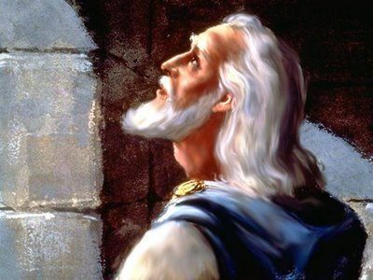
Chapter 9 Outline
539
Daniel's prayer: How long? (9:1-19)
Notes:
The nearness of restoration compelled Daniel to confess God’s just judgment of Israel's sins and ask God to restore Jerusalem’s temple (9:3-19).

Slide 8
The 70-Year Exile
560
People Exile
605
586
539
536
516
Daniel taken captive
(Dan. 1:1-6)
1st year of Darius the Mede (Dan. 9:1)

Slide 9
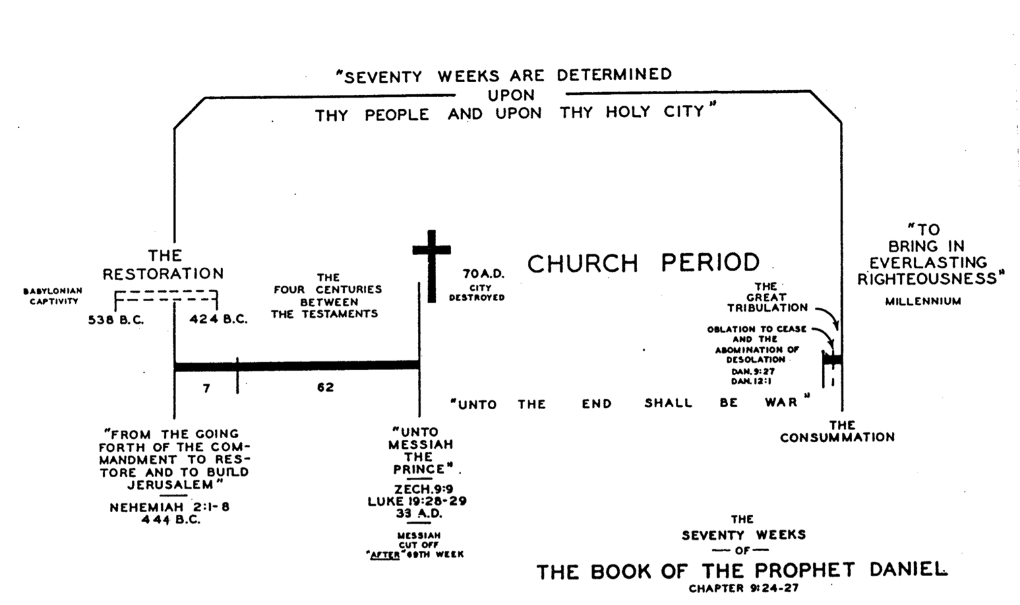
Daniel's 70 Weeks
(Dan. 9:24-27)
332
R. Ludwigson, A Survey of Bible Prophecy (Grand Rapids: Zondervan, 1975), 49
69 Weeks
444 BC
AD 33
Notes:
Many clues in Daniel 9:24-27 indicate a gap between the 69th and 70th weeks. This is our present church age.
_________
Common-474
LC-07-Presentation-9
OS-27-Daniel-406
NS-27-Rev1-2-slide 168

Slide 10
Before the Curtain Closes (9:24 NLT)
540
“A period of seventy sets of seven has been decreed for your people and your holy city
to finish their rebellion,
to put an end to their sin,
to atone for their guilt,
to bring in everlasting righteousness,
to confirm the prophetic vision, and
to anoint the Most Holy Place."
Tribulation
Millennium
These were NOT fulfilled in the first century––so the 70th week must have a future fulfillment
Notes:
Gabriel brought to Daniel the 70 "sevens" vision where God revealed that the full restoration would need Messiah to come twice (9:20-27).

Slide 11
Times of the Gentiles (Luke 21:24)
551
"TIMES OF THE GENTILES"
Luke 21:24
KINGDOM OF JUDAH
THE RESTORATION PERIOD
THE 4 CENTURIES BETWEEN THE TESTAMENTS
CHURCH PERIOD
Acts 15:14-18
Rom. 11:25
"The Throne of the LORD"
Jer. 3:17
Isa. 62:6-7
586 BC
AD 70
BABYLON
PERSIA
GREECE
ROME
538 BC
333 BC
63 BC
"AMONG MANY NATIONS"
"Her sun is gone down while it was yet day" Jer. 15:9
"Because they have forsaken the covenant of the Lord" Jer. 22:8-9
2 Kings 25:8-12
Jer. 15:4, 22:29-30, 30:24
Ezek. 10:4, 28. 11:22-25, 14:22-23
Ezekiel 6:8
Hosea 3:4-5
Hosea 8:8
Amos 9:8-9
Jer. 31:35-37
Jer. 46: 27-28
Jer. 51:5
"I will perform the good thing that I have promised to the house of Israel and to the house of Judah"
Jer. 33:7-14
Isa. 4:2-6
Ezek. 43:1-9
Zech. 2:10-13
Zech. 8:1-8
“Jerusalem will be trampled on by the Gentiles until the times of the Gentiles are fulfilled” (Jesus in Luke 21:24 NIV)
Adapted from Raymond Ludwigson, A Survey of Bible Prophecy
Notes:
The phrase “times of the Gentiles” is not in Daniel. But the concept is throughout his prophecy. It refers to the period when Israel would have no king over its land—beginning around the time of Jerusalem’s destruction and lasting until Jesus rules over the nation after his return.

Slide 12
Daniel 9:25-27 (NLT)
86b-d
²⁵ Now listen and understand! Seven sets of seven plus sixty-two sets of seven will pass from the time the command is given to rebuild Jerusalem until a ruler—the Anointed One—comes. Jerusalem will be rebuilt with streets and strong defenses, despite the perilous times.
²⁶ "After this period of sixty-two sets of seven, the Anointed One will be killed, appearing to have accomplished nothing, and a ruler will arise whose armies will destroy the city and the Temple. The end will come with a flood, and war and its miseries are decreed from that time to the very end. ²⁷ The ruler will make a treaty with the people for a period of one set of seven, but after half this time, he will put an end to the sacrifices and offerings. And as a climax to all his terrible deeds, he will set up a sacrilegious object that causes desecration, until the fate decreed for this defiler is finally poured out on him."
Notes:
Who is the Anointed One? Jesus!
Who is the ruler of verse 26? Titus!
Who is the ruler of verse 27? Antichrist!

Slide 13
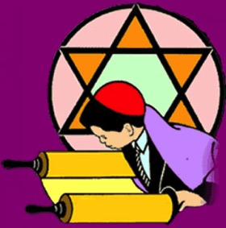

An Astonishing Prediction!
553
The Jewish calendar has 360 days per year
69 Jewish "weeks" of 483 years = 476 solar years
Issue of the decree on 5 March 444 BC after 476 solar years ends on 30 March 33. This is the exact date of Christ's Triumphant Entry!
Compare Daniel 9:27 with Revelation 13:5, 14-15 where half of a "7" is 3 and ½ years or 42 months

Slide 14
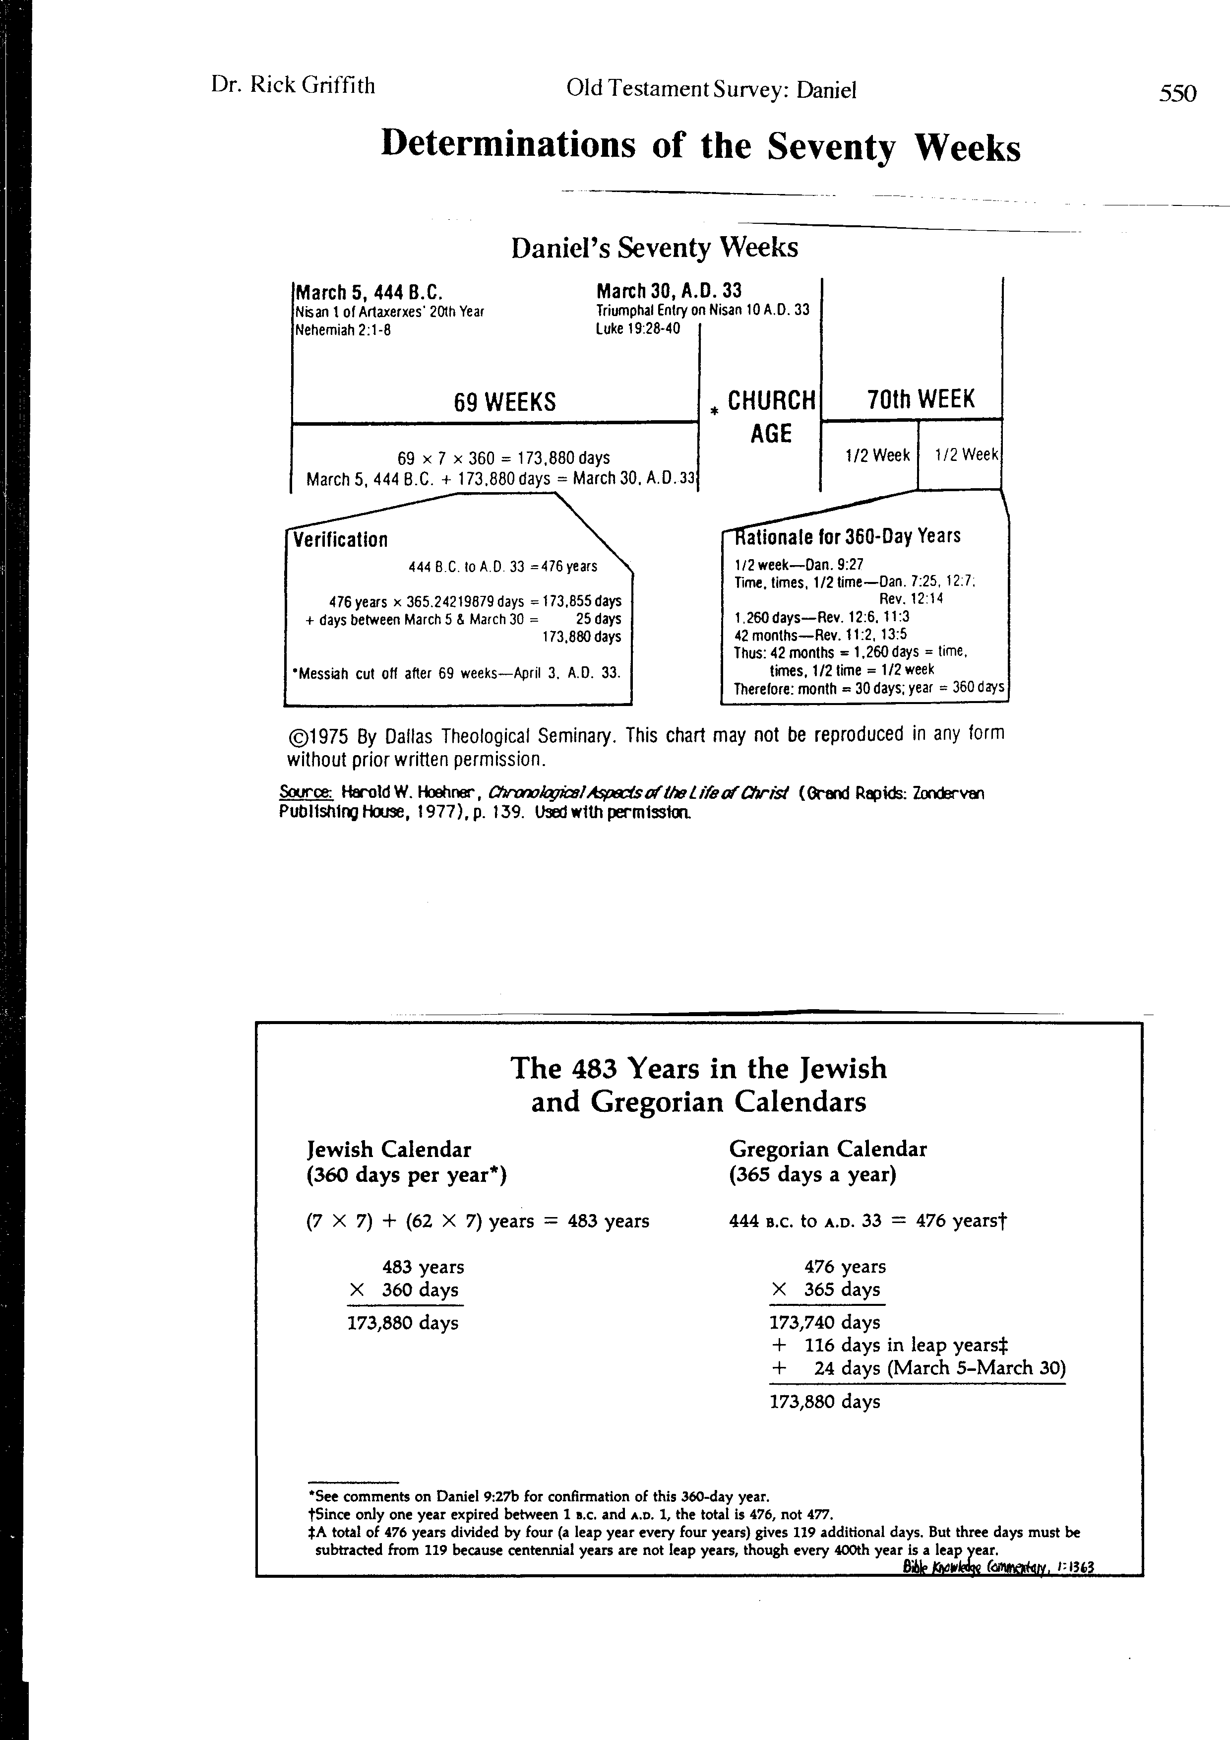
Determinations of the Seventy Weeks
553
Harold Hoehner, Chronological Aspects of the Life of Christ,139

Slide 15
Determinations of the Seventy Weeks
553
J. Dwight Pentecost, “Daniel,” in The Bible Knowledge Commentary, 1:1363

Slide 16

An Ominous Day:
Luke 19:41-42 NAU
"When He approached Jerusalem, He saw the city and wept over it, ⁴²saying, 'If you had known in this day, even you, the things which make for peace! But now they have been hidden from your eyes.'"

Slide 17
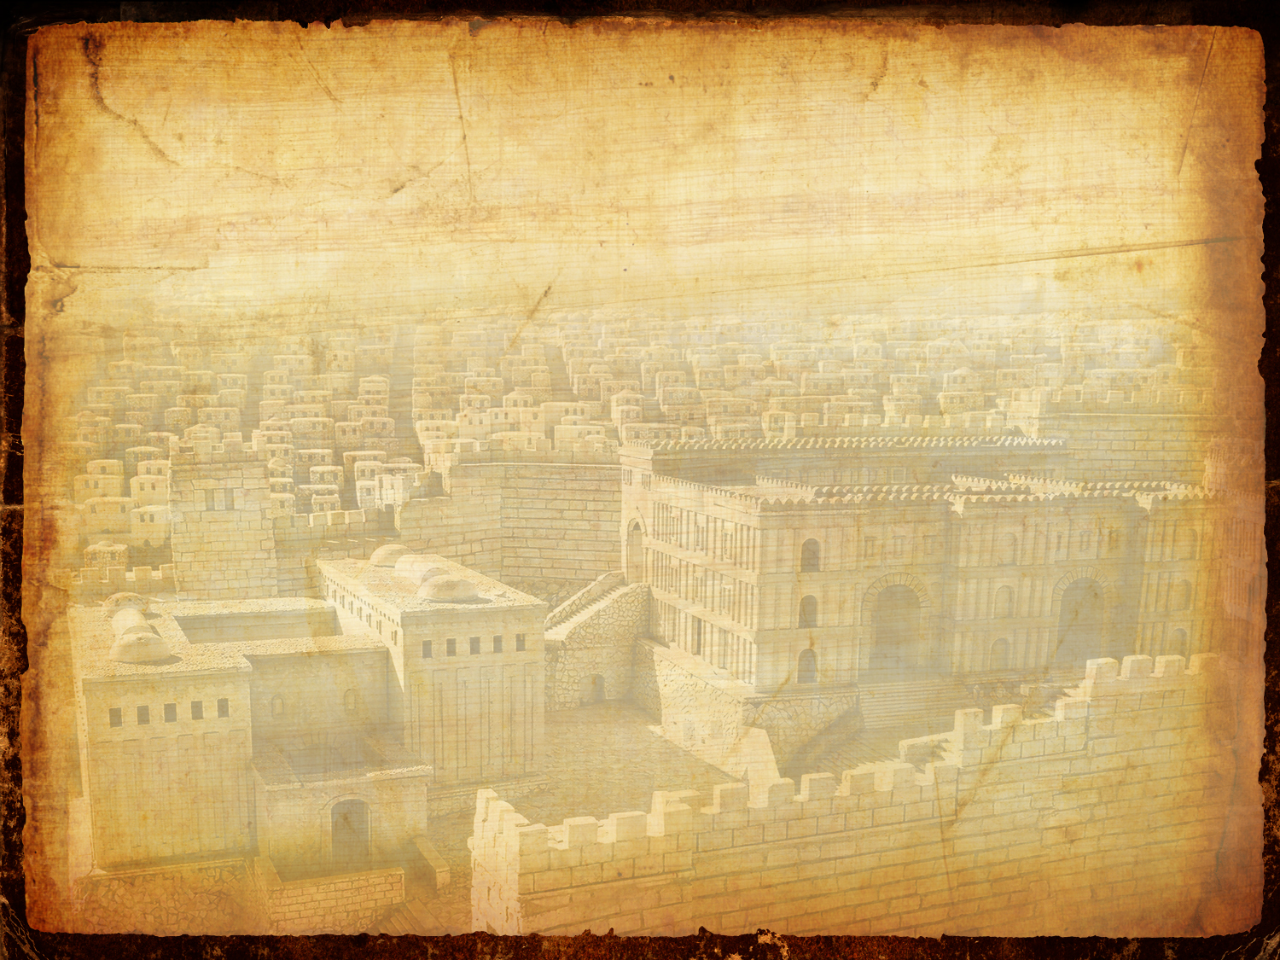
An Ominous Day:
Luke 10:43-44 NAU
"For the days will come upon you when your enemies will throw up a barricade against you, and surround you and hem you in on every side, ⁴⁴and they will level you to the ground and your children within you, and they will not leave in you one stone upon another, because you did not recognize the time of your visitation."

Slide 18

John 12 Events
64
656
Unbelief Summary
12:37-50
Predicts Death
12:21-36
Triumphal Entry
12:12-20
Anointing at Bethany
12:1-11
Notes:
John leaves out the many details of Passion Week noted in the Synoptics except his anointing and Triumphal Entry, choosing instead to highlight the prediction of his death and the unbelief of the leaders. He also places the anointing BEFORE the Triumphal Entry whereas Matthew and Mark place it afterwards.
____________
Common-438
LC-07-Official Presentation-3
NS-01-Matt15-28-slide 183
NS-02-Mark9-16-slide 130
NS-03-Luke13-24-slide 104
NS-04-John12-21-slide 4

Slide 19
B. The Triumphal Entry
§ 139
Matthew 21:1-11, 14-17; Mark 11:1-11; Luke 19:29-44; John 12:12-19
Christ enters Jerusalem to officially present Himself to the nation as Messiah to fulfill the OT prophecies
Notes:
Daniel 9:27 notes that Jesus will be presented to the nation and then cut off or die.

Slide 20
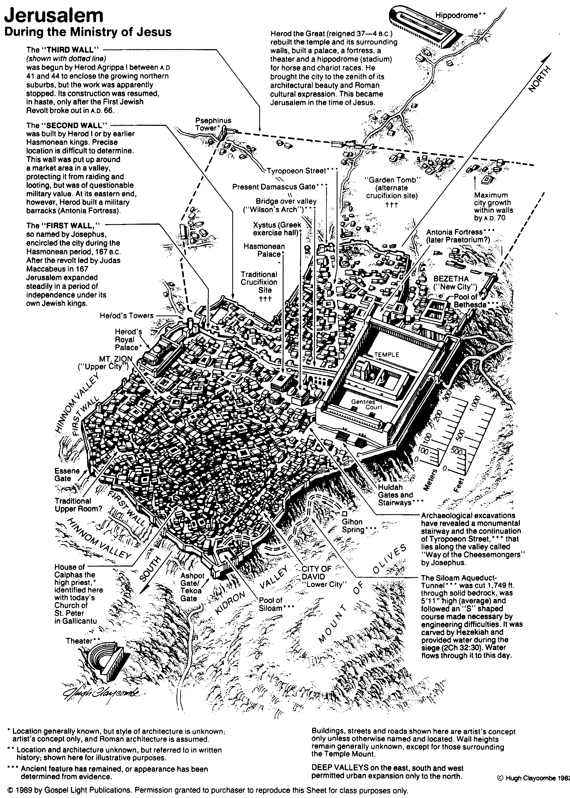
Jerusalem During the Ministry of Jesus
80

Slide 21


Matthew 21:1-11
Mark 11:1-11
Luke 19:28-44
John 12:12-19
THE EASTER STORY
TRIUMPHAL ENTRY (Palm Sunday)

Slide 22

Mark 11:1-11
As Jesus and his disciples approached Jerusalem, they came to the towns of Bethphage and Bethany on the Mount of Olives.

Slide 23

Jesus sent two of them on ahead. ² “Go into that village over there,” he told them.

Slide 24

“As soon as you enter it, you will see a young donkey tied there that no one has ever ridden. Untie it and bring it here.
³ If anyone asks, ‘What are you doing?’ just say, ‘The Lord needs it and will return it soon.’”

Slide 25

⁴ The two disciples left and found the colt standing in the street, tied outside the front door.

Slide 26

⁵ As they were untying it, some bystanders demanded…

Slide 27

“What are you doing, untying that colt?” ⁶ They said what Jesus had told them to say, and they were permitted to take it.

Slide 28

⁷ Then they brought the colt to Jesus...

Slide 29

…and threw their garments over it, and he sat on it.

Slide 30

⁸ Many in the crowd spread their garments on the road ahead of him, and others spread leafy branches they had cut in the fields.

Slide 31
⁹ Jesus was in the center of the procession, and the people all around him were shouting…

Slide 32

“Praise God!
Blessings on the one who comes in the name of the LORD!
Notes:
Psalm 118:26

Slide 33

¹⁰ Blessings on the coming Kingdom of our ancestor David!

Slide 34

"Praise God in highest heaven!"

Slide 35

Luke 19:39
But some of the Pharisees among the crowd said, “Teacher, rebuke your followers for saying things like that!”

Slide 36

Luke 19:40
He replied, “If they kept quiet, the stones along the road would burst into cheers!”

Slide 37

Luke 19:41
But as he came closer to Jerusalem and saw the city ahead…

Slide 38

Luke 19:41-42
…he began to weep. ⁴² “How I wish today that you of all people would understand the way to peace. But now it is too late, and peace is hidden from your eyes.

Slide 39

Luke 19:43
Before long your enemies will build ramparts against your walls and encircle you and close in on you from every side.

Slide 40

Luke 19:44
They will crush you into the ground, and your children with you. Your enemies will not leave a single stone in place, because you did not recognize it when God visited you.”

Slide 41

THE WORD IN PICTURES
Free
Bible
images

Slide 42

Used with Permission
THE
GOSPEL
——OF—— MATTHEW
THE
GOSPEL
——OF—— MARK
THE
GOSPEL
——OF—— LUKE
THE
GOSPEL
——OF—— JOHN
Due to the Lumo Project producing its own publishing material we regret to inform you that we cannot license our photos to other clients outside of freebibleimages.org.
These images are not licensed for reuse in video, epublishing or other media. Downloaded pictures and files cannot be redistributed through any other website than freebibleimages.org or used in any context where the accompanying message is undermining of the Christian faith and gospel.
Photos can only be used on educational presentations, blogs and social media, all of which should be accompanied with reference to www.LumoProject.com.
Picture courtesy of BBM
© All Rights Reserved.
www.bigbookmedia.com

Slide 43

Palm Sunday
Notes:
Palm Sunday is an interesting name for the day, isn't it?

Slide 44


Palm Sunday
Notes:
We know that today recalls the palm branches waved at Jesus as he entered Jerusalem at the beginning of his last week of his life. Yet the focus really isn't the tree palms, but the hand palms of Jesus that would stretch out on a cross but a few days later.

Slide 45

Palms to Cross
Notes:
Tree palms were but a prelude to the cross.

Slide 46

Triumphant Entry
Matthew 21:9
Notes:
Even the alternate name—Triumphant Entry—is also perplexing.

Slide 47

Triumphal Entry
Notes:
True, Jesus rode into Jesus and the crowds cheered his arrival.

Slide 48

Triumphant Entry
Jesus was in the center of the procession, and the people all around him were shouting,
“Praise God for the Son of David!
Blessings on the one who comes in the name of the LORD!
Praise God in highest heaven!”
Matthew 21:9
Notes:
Matthew 21:9 says the crowds that went ahead of him and those that followed shouted, "Hosanna to the Song of David!" "Blessed is he who comes in the name of the Lord!" "Hosanna in the highest!"
Psa. 118:22 The stone that the builders rejected
has now become the cornerstone.
²³ This is the LORD’s doing,
and it is wonderful to see.
²⁴ This is the day the LORD has made.
We will rejoice and be glad in it.
²⁵ Please, LORD, please save us.
Please, LORD, please give us success.
²⁶ Bless the one who comes in the name of the LORD.
We bless you from the house of the LORD.
²⁷ The LORD is God, shining upon us.
Take the sacrifice and bind it with cords on the altar.
²⁸ You are my God, and I will praise you!
You are my God, and I will exalt you!
Psa. 118:29 Give thanks to the LORD, for he is good!
His faithful love endures forever.

Slide 49






The Spirit Leaves & Returns
Mt. of Olives
656
Ezek. 8:4; 9:3; 10:4; 10:18-19; 11:23
Luke 19:37; 24:50; Acts 1:10
Acts 1:11; Zech. 14:4; Ezek. 43:1-5
Notes:
The Mount of Olives repeatedly plays a vital role in biblical prophecy. Ezekiel last saw the glory of God leave the temple and land on this mount. More than 500 years later, some Galilean Jews last proclaimed Jesus as Messiah on the Mount of Olives at the Triumphal Entry (Luke 19:37) days before Jerusalem's leaders had him crucified, but Christ rose and returned to the Mount of Olives and ascended from there (Acts 1:10). The next time Jesus will be seen on earth is at this same Mount of Olives (Acts 1:11)!
The Kidron Valley below the mount is likely the Valley of Jehoshaphat where Jesus will judge the nations (Joel 3).
_____________
Common-400
BE-38-Zechariah-126
ES-13-Tribulation-19
ES-26-Restoration of Israel-299
OS-26-Ezek1-39-slide 178
OS-26-Ezek40-43-slide 86
OS-38-Zechariah-179
LC-06-Official Presentation-49
NS-01-Matt15-28-slide 112
NS-03-Luke13-24-slide 111
NS-Acts1-2-slide 215

Slide 50

Palms to Palms
Notes:
Normally a king rode into the city as the victor over his enemies, while that very week would culminate in Jesus' death on Friday, which we call Good Friday.

Slide 51

What's so good about Good Friday?
Notes:
But that name is equally puzzling. Why is Good Friday called "good"?
Our leader died on that day, so it seems strange to call the day "good." No other religion refers to the death of their leader as "good."
We believe that his death was good. How was that?

Slide 52

How is Christ's death better than any sacrifice?

Slide 53
C. The Authority of the King
§ 140
Matthew 21:12-13, 18-19; Mark 11:12-18;
Luke 19:45-48
Jesus curses a fig tree to signify Israel's hypocritical profession of fruit for God and clears the temple to judge as the Messiah
Notes:
Cleansing the Temple
Matt. 21:12 ªAnd Jesus entered the temple and drove out all those who were buying and selling in the temple, and overturned the tables of the ^{b}money changers and the seats of those who were selling ^{c}doves. ¹³ And He *said to them, “It is written, ‘ªMY HOUSE SHALL BE CALLED A HOUSE OF PRAYER’; but you are making it a ^{b}ROBBERS’ ¹DEN.”
The Barren Fig Tree
Matt. 21:18 ªNow in the morning, when He was returning to the city, He became hungry. ¹⁹ Seeing a lone ªfig tree by the road, He came to it and found nothing on it except leaves only; and He *said to it, “No longer shall there ever be any fruit from you.” And at once the fig tree withered.
Mark 11:12 ªOn the next day, when they had left Bethany, He became hungry. ¹³ Seeing at a distance a fig tree in leaf, He went to see if perhaps He would find anything on it; and when He came to it, He found nothing but leaves, for it was not the season for figs. ¹⁴ He said to it, “May no one ever eat fruit from you again!” And His disciples were listening.
Jesus Drives Money Changers from the Temple
Mark 11:15 ªThen they *came to Jerusalem. And He entered the temple and began to drive out those who were buying and selling in the temple, and overturned the tables of the money changers and the seats of those who were selling ¹doves; ¹⁶ and He would not permit anyone to carry ¹merchandise through the temple. ¹⁷ And He began to teach and say to them, “Is it not written, ‘ªMY HOUSE SHALL BE CALLED A HOUSE OF PRAYER FOR ALL THE NATIONS’? ^{b}But you have made it a ROBBERS’ ¹DEN.” ¹⁸ The chief priests and the scribes heard this, and ªbegan seeking how to destroy Him; for they were afraid of Him, for ^{b}the whole crowd was astonished at His teaching.
Traders Driven from the Temple
Luke 19:45 ªJesus entered the temple and began to drive out those who were selling, ⁴⁶ saying to them, “It is written, ‘ªAND MY HOUSE SHALL BE A HOUSE OF PRAYER,’ ^{b}but you have made it a ROBBERS’ ¹DEN.”
Luke 19:47 And ªHe was teaching daily in the temple; but the chief priests and the scribes and the leading men among the people ^{b}were trying to destroy Him, ⁴⁸ and they could not find ¹anything that they might do, for all the people were hanging on to ²every word He said.

Slide 54

Matthew 21:12-17
Mark 11:15-19
Luke 19:45-48
John 2:13-24
THE EASTER STORY
CLEANSING THE TEMPLE
Free
Bible
images
Notes:
Jesus cleansed the temple twice:
(1) Only John's gospel notes first time at the beginning of his ministry (John 2:13-24). This text is in the following slides.
(2) Three years later, Jesus had to do it all over once again, as noted in the Synoptics above.
___________
LC-07-Official Presentation-39
NS-01-Matt15-28—slide 134
NS-02-Mark9-16—slide 74
NS-03-Luke13-24—slide 123
NS-04-John1-11—slide 226

Slide 55

It was nearly time for the Jewish Passover celebration, so Jesus went to Jerusalem.
John 2:13-24

Slide 56

In the Temple area he saw merchants selling cattle, sheep, and doves for sacrifices.

Slide 57

He also saw dealers at tables exchanging foreign money.

Slide 58


Slide 59

Jesus made a whip from some ropes and chased them all out of the Temple.

Slide 60
He drove out the sheep and cattle, scattered the money changers’ coins over the floor

Slide 61

and turned over their tables.

Slide 62

Then, going over to the people who sold doves, he told them...

Slide 63

“Get these things out of here.
Stop turning my Father’s house into a marketplace!”
Notes:
John emphasizes the marketplace idea.
But the Synoptics note the purpose of the temple:
Mark 11:17 He said to them, “The Scriptures declare, ‘My Temple will be called a house of prayer for all nations,’ but you have turned it into a den of thieves.”
Mark 11:18 When the leading priests and teachers of religious law heard what Jesus had done, they began planning how to kill him. But they were afraid of him because the people were so amazed at his teaching.
Why this addition? What has changed in these three years?
He had not presented himself as king in John at the beginning of his ministry.
But at the end (Synoptics), Jesus had been rejected by the nation and spoke about reaching Gentiles.
This was to fulfill Solomon's prayer for the temple to reach Gentiles (1 Kings 8), which Isa 56:7; Jer 7:11 also prophesy.
Is. 56:7 I will bring them to my holy mountain of Jerusalem
and will fill them with joy in my house of prayer.
I will accept their burnt offerings and sacrifices,
because my Temple will be called a house of prayer for all nations.
Jer. 7:11 Don’t you yourselves admit that this Temple, which bears my name, has become a den of thieves? Surely I see all the evil going on there. I, the LORD, have spoken!

Slide 64

Then his disciples remembered this prophecy from the Scriptures: “Passion for God’s house will consume me.”

Slide 65


Slide 66

But the Jewish leaders demanded, “What are you doing? If God gave you authority to do this, show us a miraculous sign to prove it.”

Slide 67

“All right,” Jesus replied. “Destroy this temple, and in three days I will raise it up.”

Slide 68

“What!” they exclaimed. “It has taken forty-six years to build this Temple, and you can rebuild it in three days?”

Slide 69

But when Jesus said “this temple,” he meant his own body.

Slide 70

After he was raised from the dead, his disciples remembered he had said this, and they believed both the Scriptures and what Jesus had said.

Slide 71
THE WORD IN PICTURES
Free
Bible
images

Slide 72
D. Invitations by the King
§ 141
John 12:20-50
After Christ's death, all can believe in His death and resurrection as Gentiles will approach Him apart from Israel
Notes:
NLT:
John 12:20 Some Greeks who had come to Jerusalem for the Passover celebration ²¹ paid a visit to Philip, who was from Bethsaida in Galilee. They said, “Sir, we want to meet Jesus.” ²² Philip told Andrew about it, and they went together to ask Jesus.
John 12:23 Jesus replied, “Now the time has come for the Son of Manª to enter into his glory. ²⁴ I tell you the truth, unless a kernel of wheat is planted in the soil and dies, it remains alone. But its death will produce many new kernels—a plentiful harvest of new lives. ²⁵ Those who love their life in this world will lose it. Those who care nothing for their life in this world will keep it for eternity. ²⁶ Anyone who wants to serve me must follow me, because my servants must be where I am. And the Father will honor anyone who serves me.
John 12:27 “Now my soul is deeply troubled. Should I pray, ‘Father, save me from this hour’? But this is the very reason I came! ²⁸ Father, bring glory to your name.”
Then a voice spoke from heaven, saying, “I have already brought glory to my name, and I will do so again.”
²⁹ When the crowd heard the voice, some thought it was thunder, while others declared an angel had spoken to him.
John 12:30 Then Jesus told them, “The voice was for your benefit, not mine. ³¹ The time for judging this world has come, when Satan, the ruler of this world, will be cast out. ³² And when I am lifted up from the earth, I will draw everyone to myself.” ³³ He said this to indicate how he was going to die.
John 12:34 The crowd responded, “We understood from Scripture that the Messiah would live forever. How can you say the Son of Man will die? Just who is this Son of Man, anyway?”
John 12:35 Jesus replied, “My light will shine for you just a little longer. Walk in the light while you can, so the darkness will not overtake you. Those who walk in the darkness cannot see where they are going. ³⁶ Put your trust in the light while there is still time; then you will become children of the light.”
After saying these things, Jesus went away and was hidden from them.
The Unbelief of the People
John 12:37 But despite all the miraculous signs Jesus had done, most of the people still did not believe in him. ³⁸ This is exactly what Isaiah the prophet had predicted:
“LORD, who has believed our message?
To whom has the LORD revealed his powerful arm?”
John 12:39 But the people couldn’t believe, for as Isaiah also said,
John 12:40 “The Lord has blinded their eyes
and hardened their hearts—
so that their eyes cannot see,
and their hearts cannot understand,
and they cannot turn to me
and have me heal them.”
John 12:41 Isaiah was referring to Jesus when he said this, because he saw the future and spoke of the Messiah’s glory. ⁴² Many people did believe in him, however, including some of the Jewish leaders. But they wouldn’t admit it for fear that the Pharisees would expel them from the synagogue. ⁴³ For they loved human praise more than the praise of God.
John 12:44 Jesus shouted to the crowds, “If you trust me, you are trusting not only me, but also God who sent me. ⁴⁵ For when you see me, you are seeing the one who sent me. ⁴⁶ I have come as a light to shine in this dark world, so that all who put their trust in me will no longer remain in the dark. ⁴⁷ I will not judge those who hear me but don’t obey me, for I have come to save the world and not to judge it. ⁴⁸ But all who reject me and my message will be judged on the day of judgment by the truth I have spoken. ⁴⁹ I don’t speak on my own authority. The Father who sent me has commanded me what to say and how to say it. ⁵⁰ And I know his commands lead to eternal life; so I say whatever the Father tells me to say.”
______
Gentiles in the OT came to faith via Israel:
Ruth 1:16 But Ruth replied, “Don’t ask me to leave you and turn back. Wherever you go, I will go; wherever you live, I will live. Your people will be my people, and your God will be my God. ¹⁷ Wherever you die, I will die, and there I will be buried. May the LORD punish me severely if I allow anything but death to separate us!”

Slide 73
E. Proof of the King's Authority
§ 142
Matthew 21:20-22; Mark 11:19-25; Luke 21:37-38
The fig tree that Christ cursed withers to show that His judgment on the nation would fall quickly and to call for faith in His person

Slide 74
F. The King's Authority Challenged
§§ 143-146
Religious and political leaders challenge the messianic authority of Jesus to show their rejection of Him and His message

Slide 75
1. By the Priests and Elders
§ 143
Matthew 21:23–22:14; Mark 11:27–12:12; Luke 20:1-19
Jesus shows His authority through parables of Israel's rejection, bringing Gentile entrance despite centuries of divinely sent prophets
Notes:
Authority Challenged
Matt. 21:23 ªWhen He entered the temple, the chief priests and the elders of the people came to Him ^{b}while He was teaching, and said, “By what authority are You doing these things, and who gave You this authority?” ²⁴ Jesus said to them, “I will also ask you one ¹thing, which if you tell Me, I will also tell you by what authority I do these things. ²⁵ “The baptism of John was from what source, from heaven or from men?” And they began reasoning among themselves, saying, “If we say, ‘From heaven,’ He will say to us, ‘Then why did you not believe him?’ ²⁶ “But if we say, ‘From men,’ we fear the ¹people; for they all regard John as ªa prophet.” ²⁷ And answering Jesus, they said, “We do not know.” He also said to them, “Neither will I tell you by what authority I do these things.
Parable of Two Sons
Matt. 21:28 “But what do you think? A man had two ¹sons, and he came to the first and said, ‘²Son, go work today in the ªvineyard.’ ²⁹ “And he answered, ‘I will not’; but afterward he regretted it and went. ³⁰ “The man came to the second and said the same thing; and he answered, ‘I will, sir’; but he did not go. ³¹ “Which of the two did the will of his father?” They *said, “The first.” Jesus *said to them, “Truly I say to you that ªthe tax collectors and prostitutes ¹will get into the kingdom of God before you. ³² “For John came to you in the way of righteousness and you did not believe him; but ªthe tax collectors and prostitutes did believe him; and you, seeing this, did not even feel remorse afterward so as to believe him."
Parable of the Landowner
Matt. 21:33 “Listen to another parable. ªThere was a ¹landowner who ^{b}PLANTED A ^{c}VINEYARD AND PUT A WALL AROUND IT AND DUG A WINE PRESS IN IT, AND BUILT A TOWER, and rented it out to ²vine-growers and ^{d}went on a journey. ³⁴ “When the ¹harvest time approached, he ªsent his slaves to the vine-growers to receive his produce. ³⁵ “The vine-growers took his slaves and beat one, and killed another, and stoned a third. ³⁶ “Again he ªsent another group of slaves larger than the first; and they did the same thing to them. ³⁷ “But afterward he sent his son to them, saying, ‘They will respect my son.’ ³⁸ “But when the vine-growers saw the son, they said among themselves, ‘This is the heir; come, let us kill him and seize his inheritance.’ ³⁹ “They took him, and threw him out of the vineyard and killed him. ⁴⁰ “Therefore when the ¹owner of the vineyard comes, what will he do to those vine-growers?” ⁴¹ They *said to Him, “He will bring those wretches to a wretched end, and ªwill rent out the vineyard to other vine-growers who will pay him the proceeds at the proper seasons.”
Matt. 21:42 Jesus *said to them, “Did you never read in the Scriptures,
‘ªTHE STONE WHICH THE BUILDERS REJECTED,
THIS BECAME THE CHIEF CORNER stone;
THIS CAME ABOUT FROM THE LORD,
AND IT IS MARVELOUS IN OUR EYES’?
⁴³ “Therefore I say to you, the kingdom of God will be taken away from you and given to a ¹people, producing the fruit of it. ⁴⁴ “And ªhe who falls on this stone will be broken to pieces; but on whomever it falls, it will scatter him like dust.”
Matt. 21:45 When the chief priests and the Pharisees heard His parables, they understood that He was speaking about them. ⁴⁶ When they sought to seize Him, they ªfeared the ¹people, because they considered Him to be a ^{b}prophet.
Parable of the Marriage Feast
Matt. 22:1 Jesus spoke to them again in parables, saying, ² “ªThe kingdom of heaven ¹may be compared to ²a king who ³gave a ^{b}wedding feast for his son. ³ “And he ªsent out his slaves to call those who had been invited to the wedding feast, and they were unwilling to come. ⁴ “Again he ªsent out other slaves saying, ‘Tell those who have been invited, “Behold, I have prepared my dinner; my oxen and my fattened livestock are all butchered and everything is ready; come to the wedding feast.”’ ⁵ “But they paid no attention and went their way, one to his own ¹farm, another to his business, ⁶ and the rest seized his slaves and mistreated them and killed them. ⁷ “But the king was enraged, and he sent his armies and destroyed those murderers and set their city on fire. ⁸ “Then he *said to his slaves, ‘The wedding is ready, but those who were invited were not worthy. ⁹ ‘Go therefore to ªthe main highways, and as many as you find there, invite to the wedding feast.’ ¹⁰ “Those slaves went out into the streets and gathered together all they found, both evil and good; and the wedding hall was filled with ¹dinner guests.
Matt. 22:11 “But when the king came in to look over the dinner guests, he saw ªa man there who was not dressed in wedding clothes, ¹² and he *said to him, ‘ªFriend, how did you come in here without wedding clothes?’ And the man was speechless. ¹³ “Then the king said to the servants, ‘Bind him hand and foot, and throw him into ªthe outer darkness; in that place there will be weeping and gnashing of teeth.’ ¹⁴ “For many are ^{1a}called, but few are ªchosen.”
Jesus’ Authority Questioned
Mark 11:27 They *came again to Jerusalem. ªAnd as He was walking in the temple, the chief priests and the scribes and the elders *came to Him, ²⁸ and began saying to Him, “By what authority are You doing these things, or who gave You this authority to do these things?” ²⁹ And Jesus said to them, “I will ask you one question, and you answer Me, and then I will tell you by what authority I do these things. ³⁰ “Was the baptism of John from heaven, or from men? Answer Me.” ³¹ They began reasoning among themselves, saying, “If we say, ‘From heaven,’ He will say, ‘Then why did you not believe him?’ ³² “But ¹shall we say, ‘From men’?” — they were afraid of the people, for everyone considered John to have been a real prophet. ³³ Answering Jesus, they *said, “We do not know.” And Jesus *said to them, “Nor ¹will I tell you by what authority I do these things.”
Parable of the Vine-growers
Mark 12:1 ªAnd He began to speak to them in parables: “^{b}A man ^{c}PLANTED A VINEYARD AND PUT A ¹WALL AROUND IT, AND DUG A VAT UNDER THE WINE PRESS AND BUILT A TOWER, and rented it out to ²vine-growers and went on a journey. ² “At the harvest time he sent a slave to the vine-growers, in order to receive some of the produce of the vineyard from the vine-growers. ³ “They took him, and beat him and sent him away empty-handed. ⁴ “Again he sent them another slave, and they wounded him in the head, and treated him shamefully. ⁵ “And he sent another, and that one they killed; and so with many others, beating some and killing others. ⁶ “He had one more to send, a beloved son; he sent him last of all to them, saying, ‘They will respect my son.’ ⁷ “But those vine-growers said to one another, ‘This is the heir; come, let us kill him, and the inheritance will be ours!’ ⁸ “They took him, and killed him and threw him out of the vineyard. ⁹ “What will the ¹owner of the vineyard do? He will come and destroy the vine-growers, and will give the vineyard to others. ¹⁰ “Have you not even read this Scripture:
‘ªTHE STONE WHICH THE BUILDERS REJECTED,
THIS BECAME THE CHIEF CORNER stone;
¹¹ ªTHIS CAME ABOUT FROM THE LORD,
AND IT IS MARVELOUS IN OUR EYES’?”
Mark 12:12 ªAnd they were seeking to seize Him, and yet they feared the ¹people, for they understood that He spoke the parable against them. And so ^{b}they left Him and went away.
Jesus’ Authority Questioned
Luke 20:1 ªOn one of the days while ^{b}He was teaching the people in the temple and ^{c}preaching the gospel, the chief priests and the scribes with the elders ^{d}confronted Him, ² and they spoke, saying to Him, “Tell us by what authority You are doing these things, or who is the one who gave You this authority?” ³ Jesus answered and said to them, “I will also ask you a ¹question, and you tell Me: ⁴ “Was the baptism of John from heaven or from men?” ⁵ They reasoned among themselves, saying, “If we say, ‘From heaven,’ He will say, ‘Why did you not believe him?’ ⁶ “But if we say, ‘From men,’ all the people will stone us to death, for they are convinced that John was a ªprophet.” ⁷ So they answered that they did not know where it came from. ⁸ And Jesus said to them, “Nor ¹will I tell you by what authority I do these things.”
Parable of the Vine-growers
Luke 20:9 ªAnd He began to tell the people this parable: “A man planted a vineyard and rented it out to ¹vine-growers, and went on a journey for a long time. ¹⁰ “At the harvest time he sent a slave to the vine-growers, so that they would give him some of the produce of the vineyard; but the vine-growers beat him and sent him away empty-handed. ¹¹ “And he proceeded to send another slave; and they beat him also and treated him shamefully and sent him away empty-handed. ¹² “And he proceeded to send a third; and this one also they wounded and cast out. ¹³ “The ¹owner of the vineyard said, ‘What shall I do? I will send my beloved son; perhaps they will ªrespect him.’ ¹⁴ “But when the vine-growers saw him, they reasoned with one another, saying, ‘This is the heir; let us kill him so that the inheritance will be ours.’ ¹⁵ “So they threw him out of the vineyard and killed him. What, then, will the ¹owner of the vineyard do to them? ¹⁶ “He will come and ªdestroy these vine-growers and will give the vineyard to others.” When they heard it, they said, “^{b}May it never be!”
¹⁷ But ¹Jesus looked at them and said, “What then is this that is written:
‘ªTHE STONE WHICH THE BUILDERS REJECTED,
THIS BECAME ^{b}THE CHIEF CORNER stone’?
¹⁸ “ªEveryone who falls on that stone will be broken to pieces; but on whomever it falls, it will scatter him like dust.”
Tribute to Caesar
Luke 20:19 The scribes and the chief priests ªtried to lay hands on Him that very hour, and they feared the people; for they understood that He spoke this parable against them.
___________________
"By way of application Jesus said the kingdom of God was being taken away from those who heard Him, and it would be given to the people who would produce its fruit. The word for “people” (e¶qnei) is usually translated “nation.” (It appears here without an article.) Two interpretations of this verse are often presented. One is that Jesus was saying the kingdom had been taken from the Jewish nation and would be given to Gentile nations who would produce the proper fruit of genuine faith. It is argued that since e¶qnei is singular, not plural, the word refers to the church which is called a nation in Romans 10:19 and 1 Peter 2:9-10. But the kingdom has not been taken completely away from Israel forever (Rom. 11:15, 25). And the church is not now inheriting the kingdom.
A better interpretation is that Jesus was simply saying the kingdom was being taken away from the nation Israel at that time, but it would be given back to the nation in a future day when that nation would demonstrate true [Vol. 2, p. 71] repentance and faith. In this view Jesus was using the term “nation” in the sense of generation (cf. Matt. 23:36). Because of their rejection, that generation of Israel would never be able to experience the kingdom of God (cf. comments on 21:18-22). But a future generation in Israel will respond in saving faith to this same Messiah (Rom. 11:26-27), and to that future generation the kingdom will be given. By rejecting Jesus the Stone, these builders (Matt. 21:42) suffered judgment (he on whom it [the Stone] falls will be crushed). The religious leaders (then the chief priests and the Pharisees, v. 45; cf. v. 23) realized Jesus’ remarks were directed toward them, and they tried their best to arrest Him. But they were afraid of the ... people (cf. v. 26), who thought Jesus was a Prophet (cf. v. 11), so they were unable to act."
Louis A. Barbieri Jr., Matthew *(The Bible Knowledge Commentary; eds. John F. Walvoord and Roy B. Zuck; Accordance electronic ed. 2 vols.; Wheaton: Victor Books, 1983), 2:70-71.

Slide 76
2. By the Pharisees and Herodians
§ 144
Matthew 22:15-22; Mark 12:13-17; Luke 20:20-26
Jesus teaches allegiance first to God but also to the Romans, thus not alienating him from Israel nor inciting rebellion against Rome

Slide 77
3. By the Sadducees
§ 145
Matthew 22:23-33; Mark 12:18-27; Luke 20:27-40
Jesus affirms the resurrection of patriarchs to take part in the Abrahamic promises to defeat the disbelieving and cunning Sadducees

Slide 78
4. By the Pharisees
§ 146
Matthew 22:34-40; Mark 12:28-34
Jesus requires perfect love for both God and man to convince the Pharisees that one must instead receive His salvation by faith
Notes:
The Most Important Commandment
Matt. 22:34 But when the Pharisees heard that he had silenced the Sadducees with his reply, they met together to question him again. ³⁵ One of them, an expert in religious law, tried to trap him with this question: ³⁶ “Teacher, which is the most important commandment in the law of Moses?”
Matt. 22:37 Jesus replied, “‘You must love the LORD your God with all your heart, all your soul, and all your mind.’ ³⁸ This is the first and greatest commandment. ³⁹ A second is equally important: ‘Love your neighbor as yourself.’ ⁴⁰ The entire law and all the demands of the prophets are based on these two commandments.”
The Most Important Commandment
Mark 12:28 One of the teachers of religious law was standing there listening to the debate. He realized that Jesus had answered well, so he asked, “Of all the commandments, which is the most important?”
Mark 12:29 Jesus replied, “The most important commandment is this: ‘Listen, O Israel! The LORD our God is the one and only LORD. ³⁰ And you must love the LORD your God with all your heart, all your soul, all your mind, and all your strength.’ ³¹ The second is equally important: ‘Love your neighbor as yourself.’ No other commandment is greater than these.”
Mark 12:32 The teacher of religious law replied, “Well said, Teacher. You have spoken the truth by saying that there is only one God and no other. ³³ And I know it is important to love him with all my heart and all my understanding and all my strength, and to love my neighbor as myself. This is more important than to offer all of the burnt offerings and sacrifices required in the law.”
Mark 12:34 Realizing how much the man understood, Jesus said to him, “You are not far from the Kingdom of God.” And after that, no one dared to ask him any more questions.

Slide 79
G. Challenge by the King
§ 147
Matthew 22:41-46; Mark 12:35-37; Luke 20:41-44
Jesus shows from Psalm 110 that the Messiah is human as David's Son and God as David's Lord so the Pharisees would see that He was no son of hell
Notes:
Matt. 22:41 Now while the Pharisees were gathered together, Jesus asked them a question: ⁴² “What do you think about ¹the Christ, whose son is He?” They *said to Him, “The son of David.” ⁴³ He *said to them, “Then how does David ^{1a}in the Spirit call Him ‘Lord,’ saying,
⁴⁴ ‘THE LORD SAID TO MY LORD,
“SIT AT MY RIGHT HAND,
UNTIL I PUT YOUR ENEMIES BENEATH YOUR FEET”’?
⁴⁵ “If David then calls Him ‘Lord,’ how is He his son?” ⁴⁶ No one was able to answer Him a word, nor did anyone dare from that day on to ask Him ¹another question.
Mark 12:35 And Jesus began to say, as He taught in the temple, “How is it that the scribes say that ¹the Christ is the son of David? ³⁶ “David himself said ¹in the Holy Spirit,
‘THE LORD SAID TO MY LORD,
“SIT AT MY RIGHT HAND,
UNTIL I PUT YOUR ENEMIES BENEATH YOUR FEET.”’
³⁷ “David himself calls Him ‘Lord’; so in what sense is He his son?” And the large crowd ¹enjoyed listening to Him.
Luke 20:41 Then He said to them, “How is it that they say ¹the Christ is David’s son? ⁴² “For David himself says in the book of Psalms,
‘THE LORD SAID TO MY LORD,
“SIT AT MY RIGHT HAND,
⁴³ UNTIL I MAKE YOUR ENEMIES A FOOTSTOOL FOR YOUR FEET.”’
Luke 20:44 “Therefore David calls Him ‘Lord,’ and how is He his son?”

Slide 80
H. Judgment by the King
§ 148
Matthew 23:1-39; Mark 12:38-40; Luke 20:45-47
Christ denounces the Pharisees to show why God's judgment will fall on them and their hypocritical system
Notes:
Pharisaism Exposed
Matt. 23:1 ªThen Jesus spoke to the crowds and to His disciples, ² saying: “ªThe scribes and the Pharisees have seated themselves in the chair of Moses; ³ therefore all that they tell you, do and observe, but do not do according to their deeds; for they say things and do not do them. ⁴ “ªThey tie up heavy burdens and lay them on men’s shoulders, but they themselves are unwilling to move them with so much as a finger. ⁵ “But they do all their deeds ªto be noticed by men; for they ^{b}broaden their ¹phylacteries and lengthen ^{c}the tassels of their garments. ⁶ “They ªlove the place of honor at banquets and the chief seats in the synagogues, ⁷ and respectful greetings in the marketplaces, and being called ªRabbi by men. ⁸ “But ªdo not be called ^{b}Rabbi; for One is your Teacher, and you are all brothers. ⁹ “Do not call anyone on earth your father; for ªOne is your Father, He who is in heaven. ¹⁰ “Do not be called ¹leaders; for One is your Leader, that is, Christ. ¹¹ “ªBut the greatest among you shall be your servant. ¹² “ªWhoever exalts himself shall be humbled; and whoever humbles himself shall be exalted.
Eight Woes
Matt. 23:13 “ªBut woe to you, scribes and Pharisees, hypocrites, ^{b}because you shut off the kingdom of heaven ¹from ²people; for you do not enter in yourselves, nor do you allow those who are entering to go in. Matt. 23:15 “Woe to you, scribes and Pharisees, hypocrites, because you travel around on sea and land to make one ^{1a}proselyte; and when he becomes one, you make him twice as much a son of ^{2b}hell as yourselves.
Matt. 23:16 “Woe to you, ªblind guides, who say, ‘^{b}Whoever swears by the ¹temple, that is nothing; but whoever swears by the gold of the ¹temple is obligated.’ ¹⁷ “You fools and blind men! ªWhich is ¹more important, the gold or the ²temple that sanctified the gold? ¹⁸ “And, ‘Whoever swears by the altar, that is nothing, but whoever swears by the ¹offering on it, he is obligated.’ ¹⁹ “You blind men, ªwhich is ¹more important, the ²offering, or the altar that sanctifies the ²offering? ²⁰ “Therefore, ¹whoever swears by the altar, swears both by ²the altar and by everything on it. ²¹ “And ¹whoever swears by the ²temple, swears both by ³the temple and by Him who ªdwells within it. ²² “And ¹whoever swears by heaven, ªswears both by the throne of God and by Him who sits upon it.
Matt. 23:23 “ªWoe to you, scribes and Pharisees, hypocrites! For you tithe mint and dill and ¹cummin, and have neglected the weightier provisions of the law: justice and mercy and faithfulness; but these are the things you should have done without neglecting the others. ²⁴ “You ªblind guides, who strain out a gnat and swallow a camel!
Matt. 23:25 “Woe to you, scribes and Pharisees, hypocrites! For ªyou clean the outside of the cup and of the dish, but inside they are full ¹of robbery and self-indulgence. ²⁶ “You blind Pharisee, first ªclean the inside of the cup and of the dish, so that the outside of it may become clean also.
Matt. 23:27 “ªWoe to you, scribes and Pharisees, hypocrites! For you are like whitewashed tombs which on the outside appear beautiful, but inside they are full of dead men’s bones and all uncleanness. ²⁸ “So you, too, outwardly appear righteous to men, but inwardly you are full of hypocrisy and lawlessness.
Matt. 23:29 “ªWoe to you, scribes and Pharisees, hypocrites! For you build the tombs of the prophets and adorn the monuments of the righteous, ³⁰ and say, ‘If we had been living in the days of our fathers, we would not have been partners with them in shedding the blood of the prophets.’ ³¹ “So you testify against yourselves, that you ªare ¹sons of those who murdered the prophets. ³² “Fill up, then, the measure of the guilt of your fathers. ³³ “You serpents, ªyou brood of vipers, how ¹will you escape the ²sentence of ^{3b}hell?
Matt. 23:34 “ªTherefore, behold, ^{b}I am sending you prophets and wise men and scribes; some of them you will kill and crucify, and some of them you will ^{c}scourge in your synagogues, and ^{d}persecute from city to city, ³⁵ so that upon you may fall the guilt of all the righteous blood shed on earth, from the blood of righteous ªAbel to the blood of Zechariah, the ^{b}son of Berechiah, whom ^{c}you murdered between the ¹temple and the altar. ³⁶ “Truly I say to you, all these things will come upon ªthis generation.
Lament over Jerusalem
Matt. 23:37 “ªJerusalem, Jerusalem, who ^{b}kills the prophets and stones those who are sent to her! How often I wanted to gather your children together, ^{c}the way a hen gathers her chicks under her wings, and you were unwilling. ³⁸ “Behold, ªyour house is being left to you desolate! ³⁹ “For I say to you, from now on you will not see Me until you say, ‘ªBLESSED IS HE WHO COMES IN THE NAME OF THE LORD!’”
Mark 12:38 ªIn His teaching He was saying: “Beware of the scribes who like to walk around in long robes, and like ^{b}respectful greetings in the marketplaces, ³⁹ and chief seats in the synagogues and places of honor at banquets, ⁴⁰ ªwho devour widows’ houses, and for appearance’s sake offer long prayers; these will receive greater condemnation.”
Luke 20:45 ªAnd while all the people were listening, He said to the disciples, ⁴⁶ “Beware of the scribes, ªwho like to walk around in long robes, and love respectful greetings in the marketplaces, and chief seats in the synagogues and places of honor at banquets, ⁴⁷ who devour widows’ houses, and for appearance’s sake offer long prayers. These will receive greater condemnation.”

Slide 81
I. Instruction at the Treasury
§ 149
Mark 12:41-44; Luke 21:1-4
Christ shames the hypocrisy of the Pharisees by the sacrificial giving of a poor widow to show her as the true disciple of the kingdom
Notes:
The Widow’s Mites
Mark 12:41 And He sat down opposite the treasury, and began observing how the people were putting money into the treasury; and many rich people were putting in large sums. ⁴² A poor widow came and put in two ¹small copper coins, which amount to a cent. ⁴³ Calling His disciples to Him, He said to them, “Truly I say to you, this poor widow put in more than all ¹the contributors to the treasury; ⁴⁴ for they all put in out of their ¹surplus, but she, out of her poverty, put in all she owned, ²all she had to live on.”
The Widow’s Gift
Luke 21:1 And He looked up and saw the rich putting their gifts into the treasury. ² And He saw a poor widow putting in two small copper coins. ³ And He said, “Truly I say to you, this poor widow put in more than all of them; ⁴ for they all out of their ¹surplus put into the ²offering; but she out of her poverty put in all ³that she had to live on.”

Slide 82
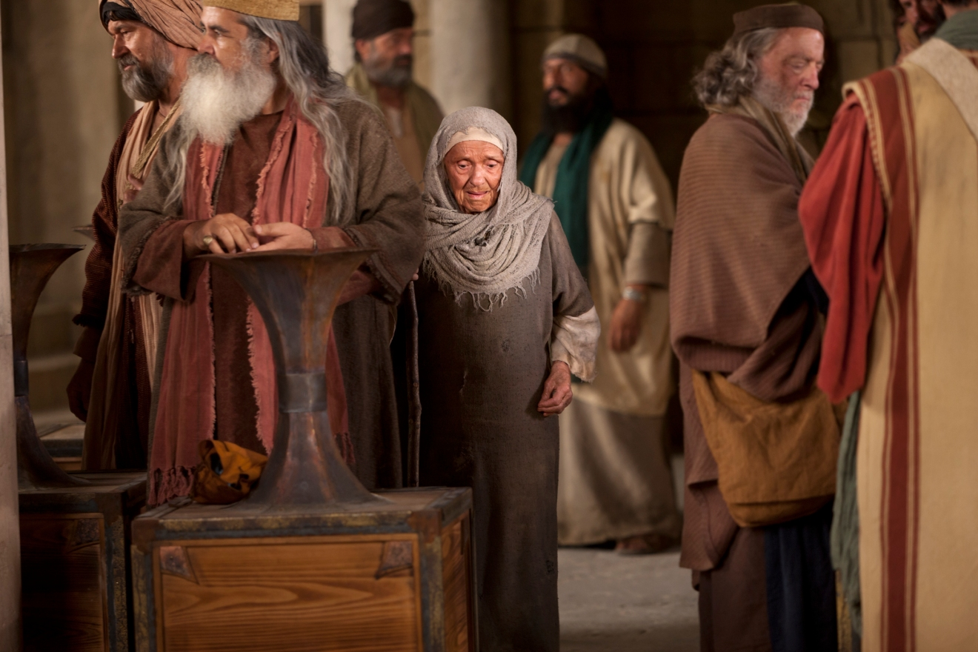
The Widow's Mites
Mark 12:41-44; Luke 21:1-4

Slide 83
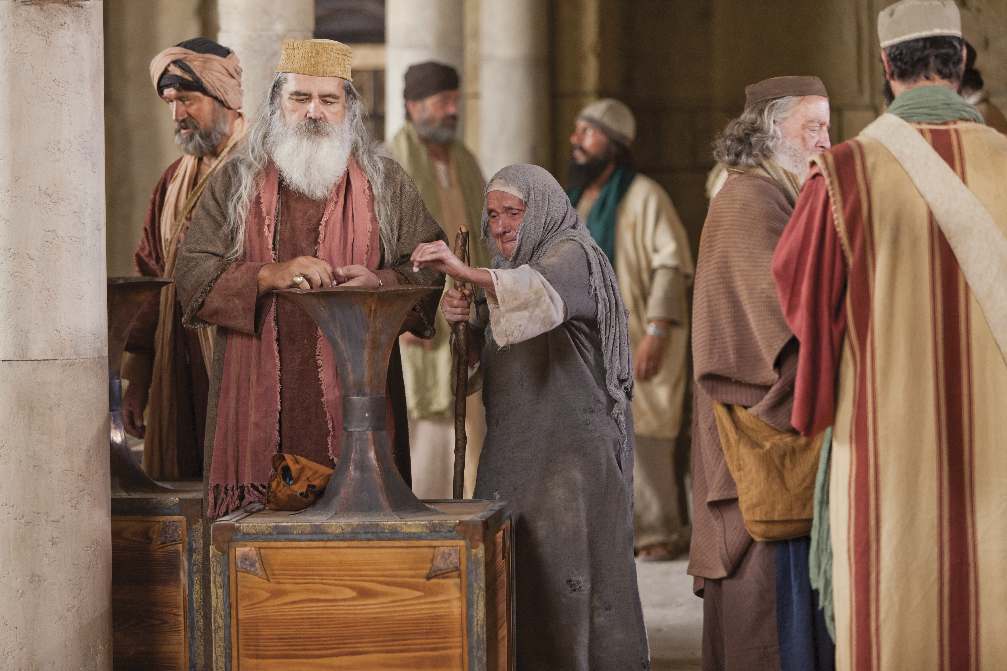
The Widow's Mites
Mark 12:41-44; Luke 21:1-4

Slide 84
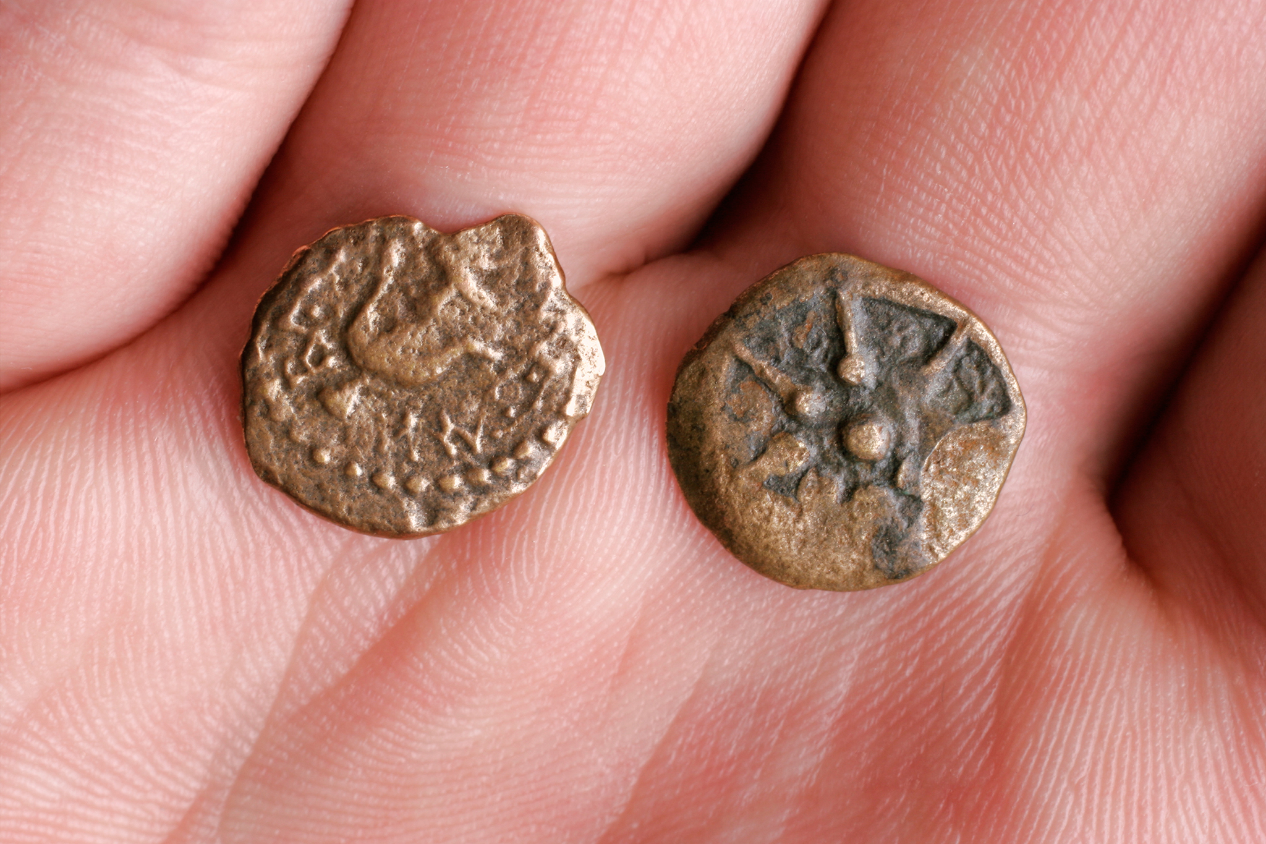
The Widow's Mites
Mark 12:41-44; Luke 21:1-4

Slide 85
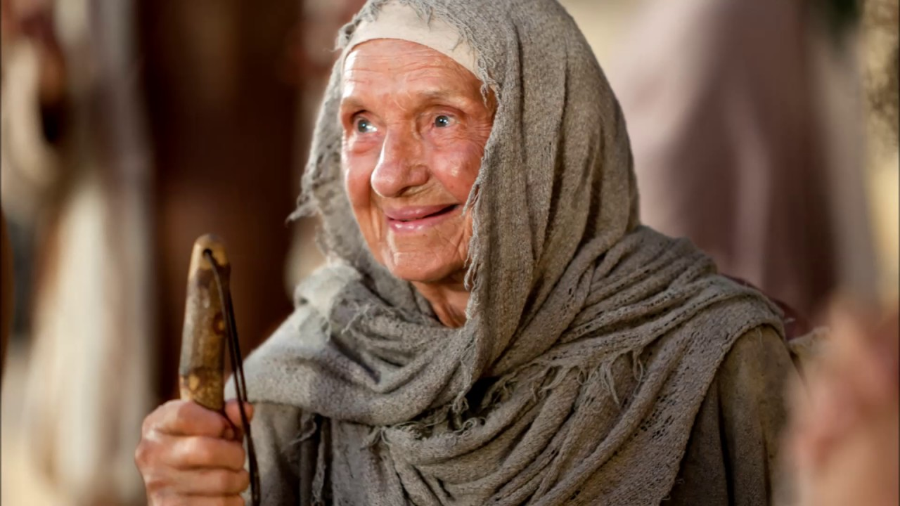
The Widow's Mites
Mark 12:41-44; Luke 21:1-4

Slide 86
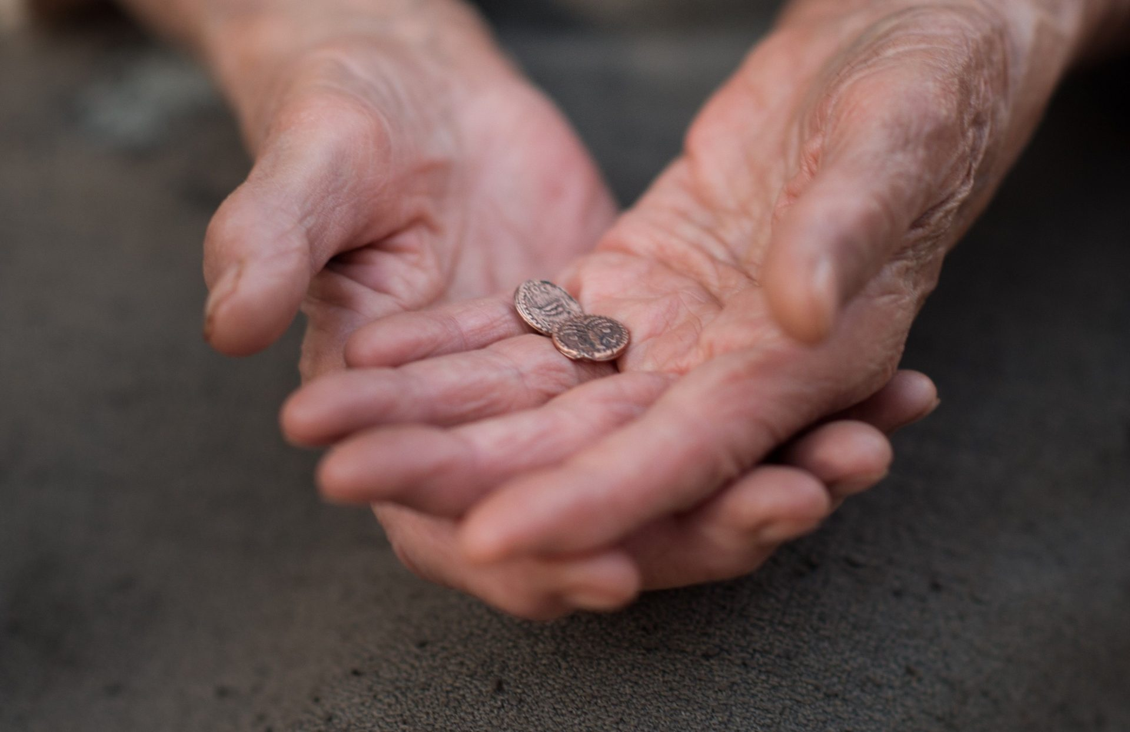
What is in your hand?
Mark 12:41-44; Luke 21:1-4

Slide 87
Black

Slide 88


Life of Christ link at BibleStudyDownloads.org
Get this presentation for free!
Notes:
NT Survey (ns)

