Slide 1
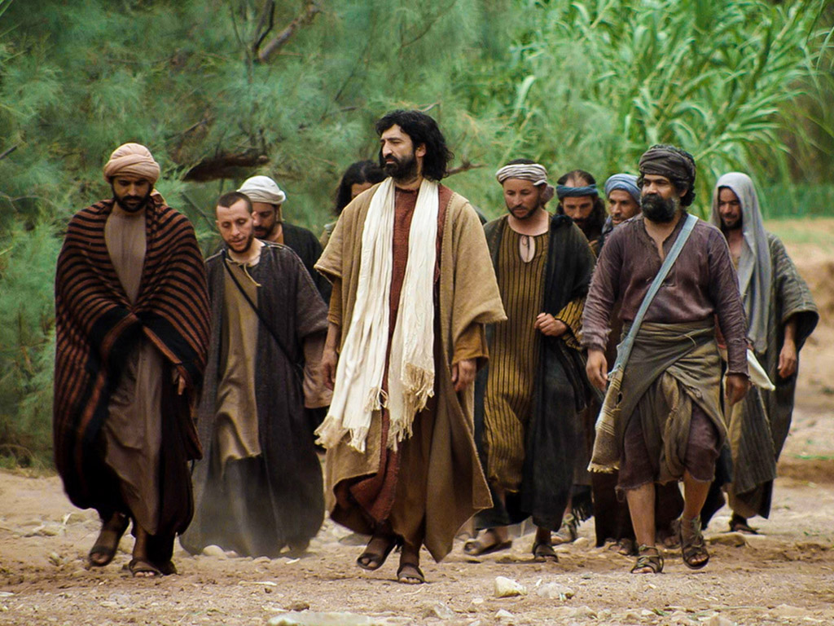
Preparation of the Disciples
by the King
§§ 120-137
Christ ministers privately to the twelve disciples to prepare them for their ministries after His departure
Section summaries based on J. Dwight Pentecost, A Harmony of the Words and Works of Jesus Christ (Grand Rapids: Zondervan, 1981)
Dr. Rick Griffith • Jordan Evangelical Theological Seminary • BibleStudyDownloads.org

Slide 2
Pentecost Outline
Introduction of the King
Authentication of the King
Controversy over the King
Instruction of the Twelve by the King
Opposition to the King
Preparation of the Disciples by the King
Official Presentation of the King
Preparation for the Death of the King
Rejection of the King
Resurrection of the King

Slide 3

Increasing Polarization
Resurrection
Preparation
for Death
Preparation
of Disciples
Instruction
Authentication
Introduction
Controversy
Opposition
Presentation
Rejection
Notes:
Today we discuss how Jesus prepared his men for his rejection and their future rejection too—so share with your group your own need to prepare those whom you lead to for future rejection, then pray about it together.
____________
The Life of Christ brought increasing polarization. The more Jesus showed about himself, the greater the resistance to him and his message. Also, the more intense the controversy leading to opposition, the higher priority Christ placed on preparing his men for when he would be gone. The climactic rejection when he presented himself as king of Israel at the Triumphal Entry resulted in rejection to the point of crucifixion followed by the victory of resurrection.
Introduction of the King
Authentication of the King
Controversy over the King
Instruction of the Twelve by the King
Opposition to the King
Preparation of the Disciples by the King
Official Presentation of the King
Preparation for the Death of the King
Rejection of the King
Resurrection of the King

Slide 4
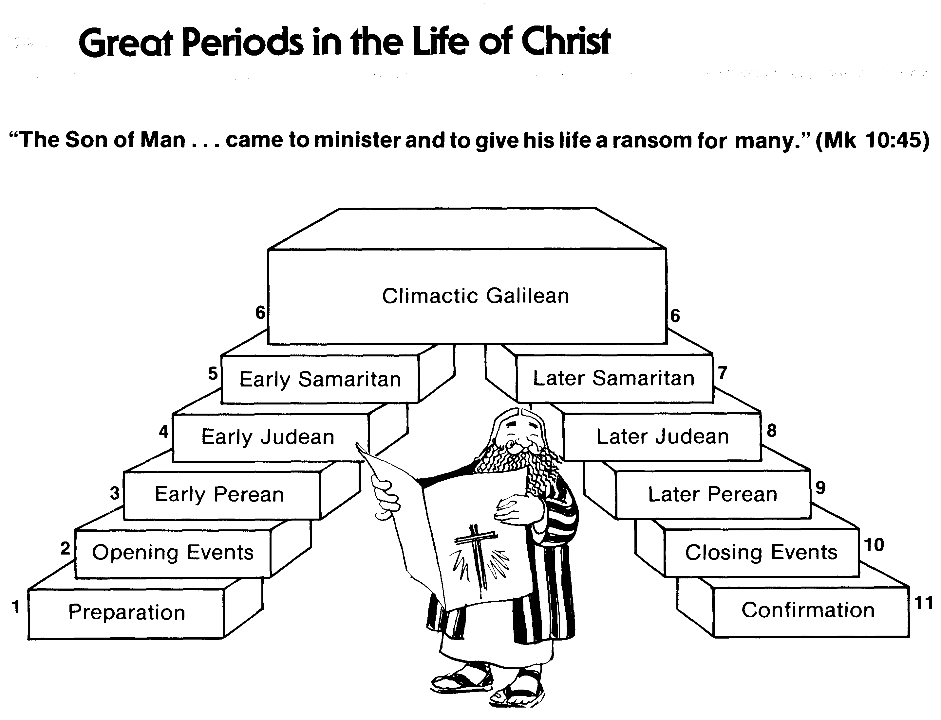
Great Periods in the Life of Christ
55
“The Son of Man… came to minister and to give his life a ransom for many” (Mark 10:45)
Climactic Galilean
Early Samaritan
Later Samaritan
Early Judean
Later Judean
Early Perean
Later Perean
Opening Events
Closing Events
Preparation
Confirmation
Walk Thru the New Testament seminar (used with permission)
Notes:
The Walk Thru outline of the life of Christ forms a chiasm or literary arrangement with repeating elements in the opposite order. This structure makes Confirmation parallel to Preparation, Closing Events parallel to Opening Events, etc. until the only event without parallel becomes the focus: Climatic Galilean. Such an arrangement of material was common in antiquity and is seen in both the OT (e.g., Zephaniah) and the NT (1 Thess) where the central teaching appears in the middle of each writing.
Small Group Assignment: Explain this slide to your group member(s) and have the others explain it back.
After the beginning events of stages 1-3, Jesus also gets farther away from his Jewish roots in Judea (4), to go to the Samaritans (5), and even farther to Galilee (6), where most Gentiles lived. He ministered to Jews in Galilee, of course, but this climatic period was the focus of his ministry.
_______
LC-00-Syllabus-63
LC-01-Introduction-265
LC-05-Opposition-4

Slide 5
A. Withdrawal from Judea
§ 120
John 10:40-42
Christ withdraws from Judea to prevent premature death so he can instruct His disciples how to minister on His behalf
Notes:
Jesus had to die in Jerusalem at God's appointed time of Passover when the other Passover lambs were being slaughtered. To accomplish this, He withdrew from Judea as his men were also not ready for his departure.
__________
John 10:40 NLT He went beyond the Jordan River near the place where John was first baptizing and stayed there awhile. 41 And many followed him. “John didn’t perform miraculous signs,” they remarked to one another, “but everything he said about this man has come true.” 42 And many who were there believed in Jesus.

Slide 6
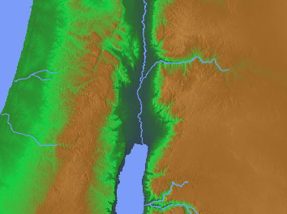
Withdrawal from Judea (John 10:40-42)
SAMARIA
PEREA
River Jordan
Jerusalem
Bethany
0 5 MILES
JUDEA
Salt Sea
0 8 KM
Notes:
Jesus invested His final six months in Perea with his disciples, with the exception of eight days in Jerusalem at the Festival of Tabernacles that we saw in the last lesson 2 (Opposition to the King).
Title adapted from slide 111.

Slide 7
B. Instruction on Entrance Into the Kingdom
§ 121
Luke 13:22-35
After Israel rejects Christ, He encourages the fearful to still enjoy the kingdom and prepares the apostles for future ministry
Notes:
Small Groups: What do you learn about the kingdom from Luke 13:22-35?
Luke 13:22 Jesus went through the towns and villages, teaching as he went, always pressing on toward Jerusalem. 23 Someone asked him, “Lord, will only a few be saved?”
He replied,
24 “Work hard to enter the narrow door to God’s Kingdom, for many will try to enter but will fail. 25 When the master of the house has locked the door, it will be too late. You will stand outside knocking and pleading, ‘Lord, open the door for us!’ But he will reply, ‘I don’t know you or where you come from.’ 26 Then you will say, ‘But we ate and drank with you, and you taught in our streets.’ 27 And he will reply, ‘I tell you, I don’t know you or where you come from. Get away from me, all you who do evil.’
Luke 13:28 “There will be weeping and gnashing of teeth, for you will see Abraham, Isaac, Jacob, and all the prophets in the Kingdom of God, but you will be thrown out. 29 And people will come from all over the world—from east and west, north and south—to take their places in the Kingdom of God. 30 And note this: Some who seem least important now will be the greatest then, and some who are the greatest now will be least important then.”
Luke 13:31 At that time some Pharisees said to him, “Get away from here if you want to live! Herod Antipas wants to kill you!”
Luke 13:32 Jesus replied, “Go tell that fox that I will keep on casting out demons and healing people today and tomorrow; and the third day I will accomplish my purpose. 33 Yes, today, tomorrow, and the next day I must proceed on my way. For it wouldn’t do for a prophet of God to be killed except in Jerusalem!
Luke 13:34 “O Jerusalem, Jerusalem, the city that kills the prophets and stones God’s messengers! How often I have wanted to gather your children together as a hen protects her chicks beneath her wings, but you wouldn’t let me. 35 And now, look, your house is abandoned. And you will never see me again until you say, ‘Blessings on the one who comes in the name of the LORD!’”
Jesus quotes Psalm 118:26 after rejection by Israel to indicate that he would come back to a believing nation. In answer to the question how many will be saved (v. 22), Jesus said that few Jews would be saved but many Gentiles would accept him.
_____________________
"So in Luke 13:24, instead of answering their question about the number of being saved from the coming national catastrophe, Jesus’ exhorted his disciples to “strive to enter by the narrow door.” Strive to enter through the narrow door; for many, I tell you, will seek to
enter and will not be able (Luke 13:24). Notice the tense of the verbs. They are to strive now (present tense). Then at the Messianic Banquet they will seek (future tense) to enter. Their striving now apparently determines what will happen when they stand outside the door seeking entrance. The image to follow describes a large group of believers who are in the kingdom and who also seek entrance into the festive celebration that will launch the
reign of David’s Greater Son.¹¹⁰⁶
Stauffer notes that this goal, which is entrance into the Messianic Banquet, “can be reached only with the full expenditure of all one’s energies.”¹¹⁰⁷ However, this would be a decidedly novel way of obtaining the free gift of eternal life without cost (Revelation 21:6) and by faith alone apart from works (Ephesians 2:8-9)!¹¹⁰⁸
The imagery suggests that entering the Messianic Banquet by the narrow door is not the same as “going to heaven when one dies.” Clearly the banquet is not the millennium, but is a metaphor for an aspect of the millennium which is obtained by striving and work. This is a parable which is a vehicle for carrying a central truth.¹¹⁰⁹
Experimentalists equate the entrance into the banquet, which is obtained by “striving,” with entrance into the kingdom in the sense of personal salvation, which is obtained by faith alone. In their commentaries they usually pass over the problem that their view requires: that works are therefore a condition for salvation."
—Joseph Dillow, Final Destiny, 329

Slide 8
C. Instruction in a Pharisee's House
§ 122
Luke 14:1-24
Pharisees will miss the kingdom by trusting their descent from Abraham, while "unworthy Jews" and Gentiles enter by faith
Notes:
Jesus Heals on the Sabbath
Luke 14:1 NLT One Sabbath day Jesus went to eat dinner in the home of a leader of the Pharisees, and the people were watching him closely. ² There was a man there whose arms and legs were swollen. ³ Jesus asked the Pharisees and experts in religious law, “Is it permitted in the law to heal people on the Sabbath day, or not?” ⁴ When they refused to answer, Jesus touched the sick man and healed him and sent him away. ⁵ Then he turned to them and said, “Which of you doesn’t work on the Sabbath? If your son or your cow falls into a pit, don’t you rush to get him out?” ⁶ Again they could not answer.
Jesus Teaches about Humility
Luke 14:7 When Jesus noticed that all who had come to the dinner were trying to sit in the seats of honor near the head of the table, he gave them this advice: ⁸ “When you are invited to a wedding feast, don’t sit in the seat of honor. What if someone who is more distinguished than you has also been invited? ⁹ The host will come and say, ‘Give this person your seat.’ Then you will be embarrassed, and you will have to take whatever seat is left at the foot of the table!
Luke 14:10 “Instead, take the lowest place at the foot of the table. Then when your host sees you, he will come and say, ‘Friend, we have a better place for you!’ Then you will be honored in front of all the other guests. ¹¹ For those who exalt themselves will be humbled, and those who humble themselves will be exalted.”
Luke 14:12 Then he turned to his host. “When you put on a luncheon or a banquet,” he said, “don’t invite your friends, brothers, relatives, and rich neighbors. For they will invite you back, and that will be your only reward. ¹³ Instead, invite the poor, the crippled, the lame, and the blind. ¹⁴ Then at the resurrection of the righteous, God will reward you for inviting those who could not repay you.”
Parable of the Great Feast
Luke 14:15 Hearing this, a man sitting at the table with Jesus exclaimed, “What a blessing it will be to attend a banquet in the Kingdom of God!”
Luke 14:16 Jesus replied with this story: “A man prepared a great feast and sent out many invitations. ¹⁷ When the banquet was ready, he sent his servant to tell the guests, ‘Come, the banquet is ready.’ ¹⁸ But they all began making excuses. One said, ‘I have just bought a field and must inspect it. Please excuse me.’ ¹⁹ Another said, ‘I have just bought five pairs of oxen, and I want to try them out. Please excuse me.’ ²⁰ Another said, ‘I just got married, so I can’t come.’
Luke 14:21 “The servant returned and told his master what they had said. His master was furious and said, ‘Go quickly into the streets and alleys of the town and invite the poor, the crippled, the blind, and the lame.’ ²² After the servant had done this, he reported, ‘There is still room for more.’ ²³ So his master said, ‘Go out into the country lanes and behind the hedges and urge anyone you find to come, so that the house will be full. ²⁴ For none of those I first invited will get even the smallest taste of my banquet.’”
__________
"Throughout this section the theme of entering into the kingdom is often symbolized as taking part in a feast or banquet (13:29; 14:7-24; 15:23; 17:7-10)." —BKC
__________
"Three excuses are given.¹⁸ The first two are similar. What idiot would buy a piece of property without first checking it out?! The fact is, both of these men have already checked out their purchases. They are using them as excuses not to come. To make matters worse, this is an evening banquet, which started at sundown. They could not have checked out their purchases in the dark. This makes their excuses even more feeble and offensive. The third fellow seems to have a valid excuse. He just got married and wants to spend time with his wife.¹⁹ Normally, these feasts were not integrated, and so these newlyweds could not be together. Deuteronomy 24:5 offers some support for his excuse. There it says that a newly married man is exempt from military service for a year so that he can stay at home and please his wife (see also 1 Cor 7:33). His excuse is the most valid; yet it is also the most curt."
¹⁸ The word “make excuses” can also mean, “To shun, reject, or refuse.”
¹⁹ The phrase “I must go check it out,” which applied to the oxen and the land, is omitted with the wife. B. Longenecker in a fabulous article on the humor of Jesus, suggests this omission would have been accompanied by a pregnant silence followed by appropriate chuckles; “A Humorous Jesus? Orality, Structure and Characterization in Luke 14:15–24, and Beyond,” BI 16 (2008): 179–204.
—Mark E. Moore, The Chronological Life of Christ (Joplin, MO: College Press Publishing Company, 2011), 421.

Slide 9
D. Instruction on Discipleship
§ 123
Luke 14:25-35
Christ seeks disciples with Him as their highest priority, given Israel's rejection—not professing discipleship and later defecting
Notes:
The Cost of Being a Disciple
Luke 14:25 NLT A large crowd was following Jesus. He turned around and said to them, ²⁶ “If you want to be my disciple, you must, by comparison, hate everyone else—your father and mother, wife and children, brothers and sisters—yes, even your own life. Otherwise, you cannot be my disciple. ²⁷ And if you do not carry your own cross and follow me, you cannot be my disciple.
Luke 14:28 “But don’t begin until you count the cost. For who would begin construction of a building without first calculating the cost to see if there is enough money to finish it? ²⁹ Otherwise, you might complete only the foundation before running out of money, and then everyone would laugh at you. ³⁰ They would say, ‘There’s the person who started that building and couldn’t afford to finish it!’
Luke 14:31 “Or what king would go to war against another king without first sitting down with his counselors to discuss whether his army of 10,000 could defeat the 20,000 soldiers marching against him? ³² And if he can’t, he will send a delegation to discuss terms of peace while the enemy is still far away. ³³ So you cannot become my disciple without giving up everything you own.
Luke 14:34 “Salt is good for seasoning. But if it loses its flavor, how do you make it salty again? ³⁵ Flavorless salt is good neither for the soil nor for the manure pile. It is thrown away. Anyone with ears to hear should listen and understand!”
Thought question: Is Jesus speaking of counting the cost to trust him for salvation or discipleship of those who already believed?
—————————
Moore sees this as a call to salvation:
"In the world, we ask, “Does he have what it takes to win?” In the church, God asks, “Has he given up everything to be saved?” The world calls us to gain; Christ call us to die…
[vv. 34–35 = Mt 5:13, see comments on § 54c; also Mk 9:50, § 91]
This is a famous saying of Jesus.²² Only here, verse 35 adds an extra detail about being thrown on the manure pile. Sodium chloride (i.e., salt) is an extremely stable chemical. It cannot actually “lose its saltiness.” Therefore, we must be talking about some kind of counterfeit salt. It looks like salt but has none of its properties. It was so worthless that it did not even have chemical nutrients which could be useful on a compost pile.²³ It is totally useless filler."
²² W. Nauck interprets the major “salt” sayings of the NT (Mk 9:49–50; Lk 14:34–35; Mt 5:13; Col 4:6) against the backdrop of a proverb on salt from the Rabbinic treatise Derek ‘Erec Zuta. He proposes that each text is best understood by interpreting the metaphor of salt as wisdom and industriousness in the context of discipleship. This fits well our present context of judiciously counting the cost of following Jesus and wisely listening to (i.e., obeying) Jesus’ words (W. Nauck, “Salt as a Metaphor,” ST [1952]: 165–178).
²³ E.P. Deatrick, “Salt, Soil, Savior,” BA 25 (1962): 41–48, gives helpful scientific details."
—Mark E. Moore, The Chronological Life of Christ (Joplin, MO: College Press Publishing Company, 2011), 424.
_______________________
DI-01-DiscipleshipInTheGospels-3
LC-06-Preparation-9

Slide 10
E. Instruction on God's Attitude Toward Sinners
§ 124
Luke 15
Instead of hating sinners like the Pharisees, Jesus tells three parables of God's love to seek them out and rejoice in their repentance
Notes:
LOST SHEEP—LOST COIN—LOST SON (Luke 15)
1—Something of value is lost
2—One who sees this value searches tirelessly to recover it
3—Once found, the owner rejoices and asks others also to rejoice
The focus is on God, whose attitude is to rejoice over the lost.

Slide 11
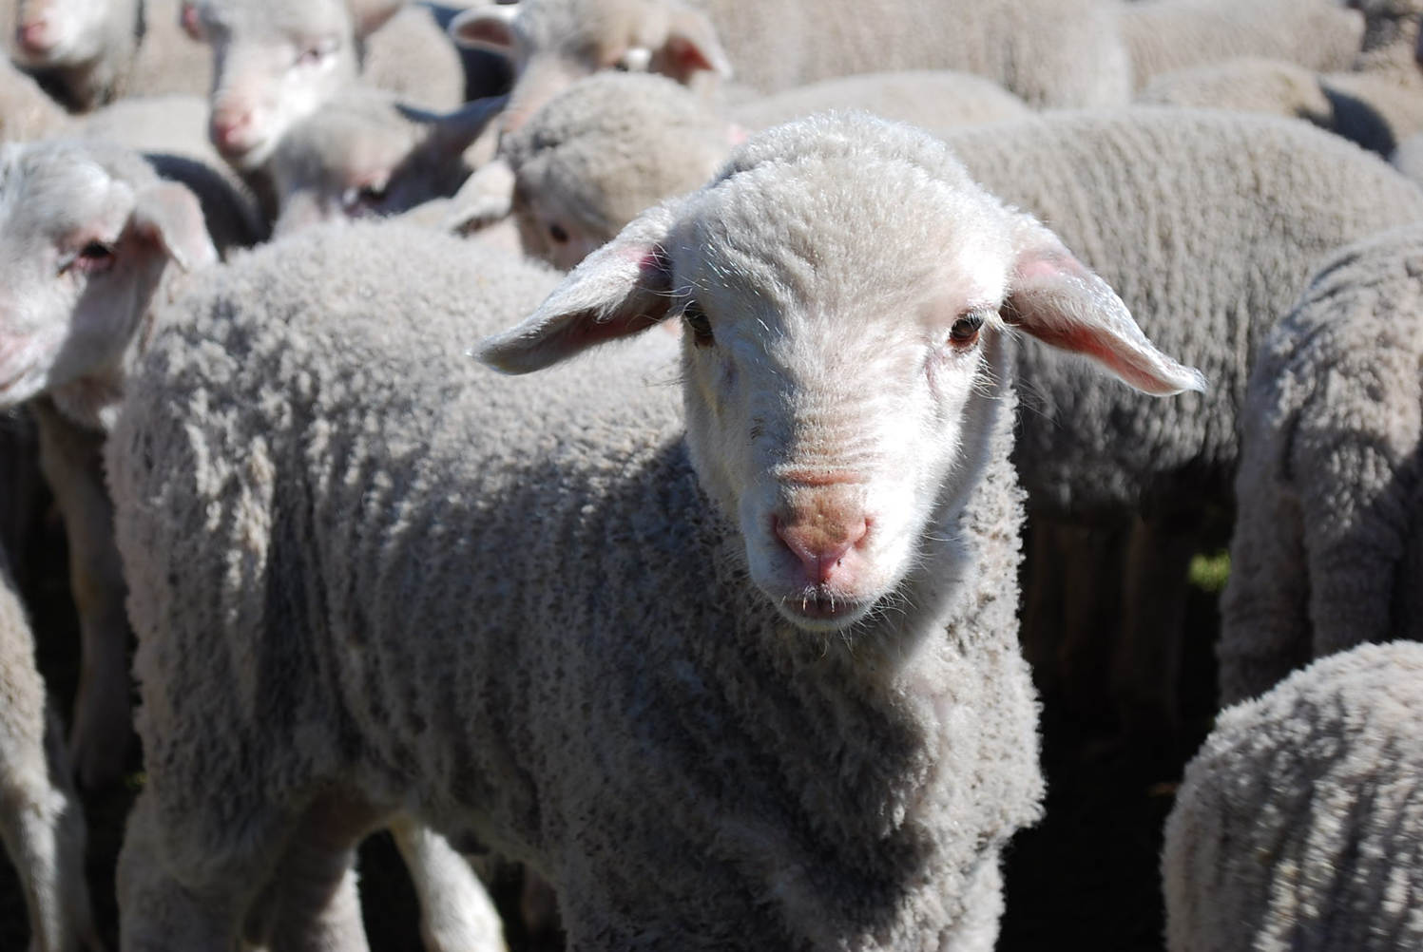
We are sheep.
Notes:
The animal that the Bible compares us to most is the sheep. Why do you think that is so?

Slide 12
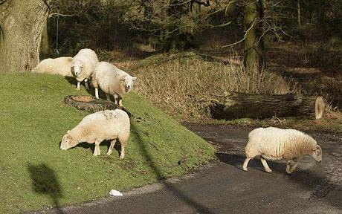
Sheep tend to stray.
Notes:
It’s because sheep easily lose their way—like us!

Slide 13
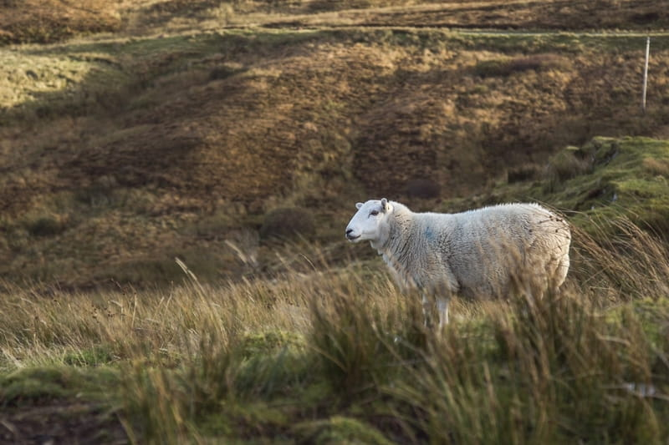
Lost sheep get lonely.
Notes:
Sheep are relational animals, so being away from the flock is lonely.

Slide 14
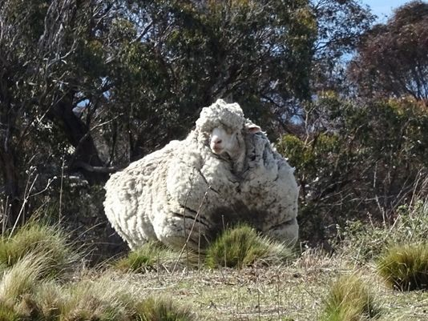
Sheep tend to return.
Notes:
Here is one sheep named Chris who was lost in Australia. He was found in 2015 by bushwalkers after about 6 years of wandering—as you can see from the heavy coat of 90 pounds (45 kilos)!

Slide 15
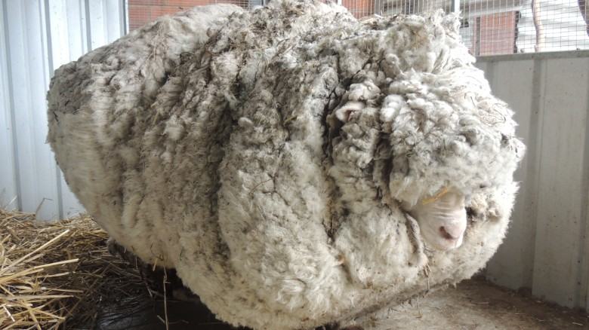
But straying has a price.
Notes:
The baggage from being away is quite a burden—for sheep as well as for people!
————————
Chris, the famously woolly sheep, has died
By Elizabeth Wolfe and Saeed Ahmed, CNN
Updated 1623 GMT (0023 HKT) October 22, 2019
Chris the sheep died in his home at the Little Oak Sanctuary.
(CNN)Chris the sheep lived a, shall we say, full and fluffy life, beloved by fans worldwide for his singular woolliness.
He died at his home at the Little Oak Sanctuary, where he had been living since his rise to fame in 2015.
While Chris should be appreciated for his many lovable qualities -- consider his kind eyes and gently sloping nose -- he became internationally celebrated after becoming the unofficial world record holder for having grown the heaviest fleece.
He was found outside of Australia's capital, Canberra, so overgrown with fleece that he could barely walk. Almost 90 lbs!
When he was found, Chris was carrying years worth of wool on his body, making it difficult for him to walk.
Little Oak Sanctuary, announced the legendary sheep's death on Tuesday in a Facebook post.
"We are heartbroken at the loss of this sweet, wise, friendly soul," said the post.
Little Oak Sanctuary made a point of looking at Chris as more than a spectacle and respecting him as a companion.
"He was so much more than this, so very much more," it said in the post. "And we will remember him for all that he was - someone, not something - here with us, not for us. RIP dear Chris."
Those wishing to mourn Chris's passing may visit his famous fleece on display at the National Museum of Australia.

Slide 16
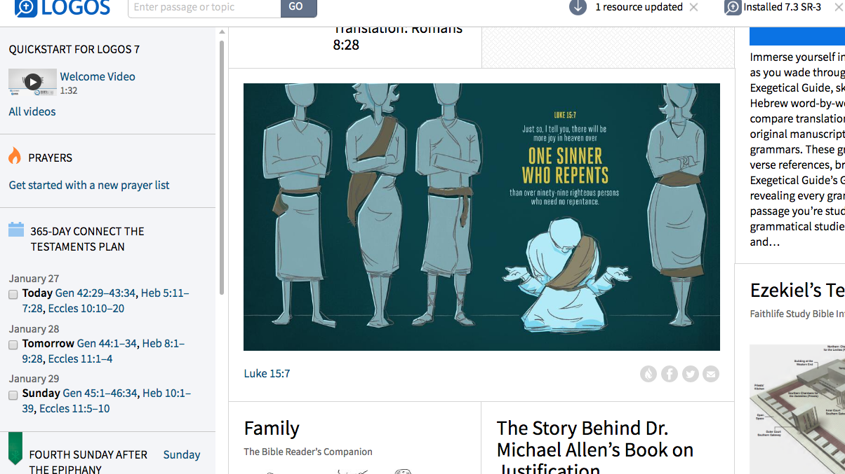
Luke 15:7
Just so, I tell you, there will be more joy in heaven over
ONE SINNER WHO REPENTS
than over 99 righteous persons who need no repentance.
Adapted from Logos Bible Software
Notes:
God values what people despise.

Slide 17
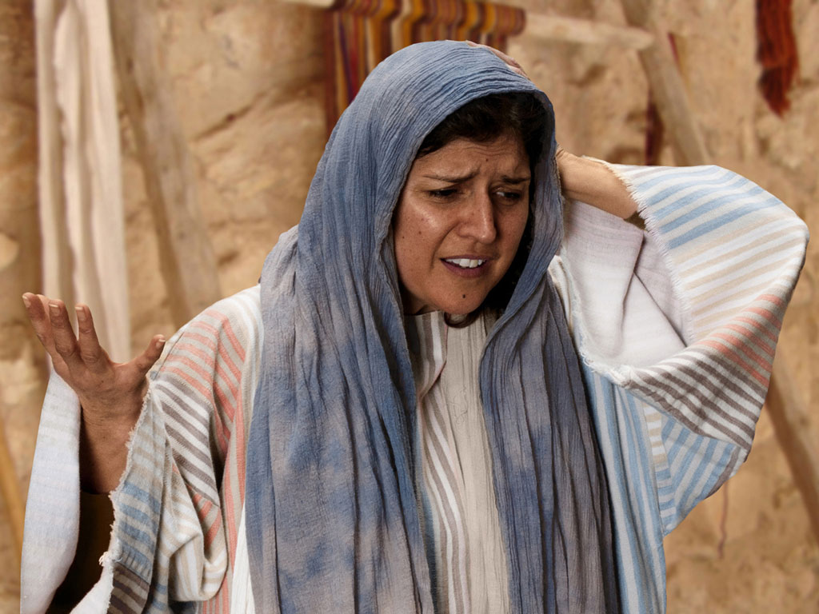

Free
Bible
images
THE PARABLE OF THE LOST COIN
Luke 15:8-10
Notes:
Luke's gospel is known for its many parables by Jesus.

Slide 18
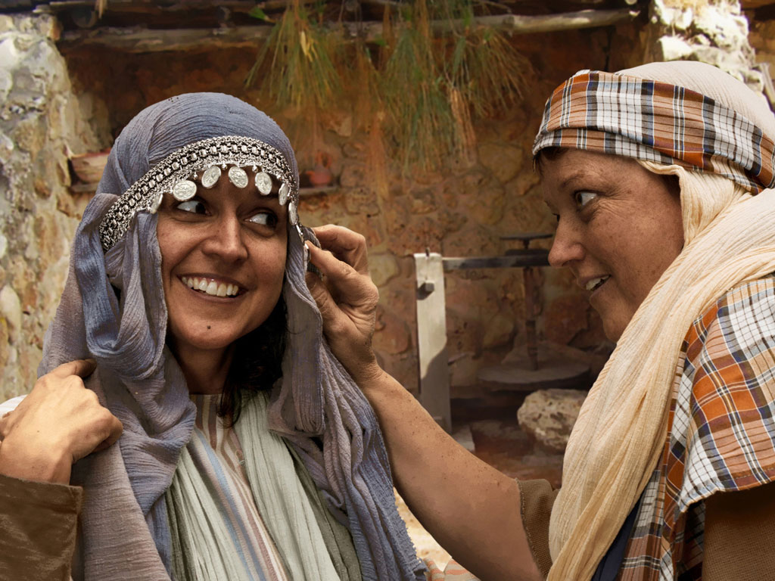
Notes:
Luke 15:8 Woman with 10 silver coins.
Most think that the silver coin (drachma) the woman lost was from the adornment of coins that women wore around her head and would have been her dowry. If so, it was a poor woman's dowry as a drachma was a day's salary for a peasant working for someone else. In the culture of the time, the loss of a coin from a dowry could represent unfaithfulness and this would bring real shame and disgrace to her family and husband.

Slide 19
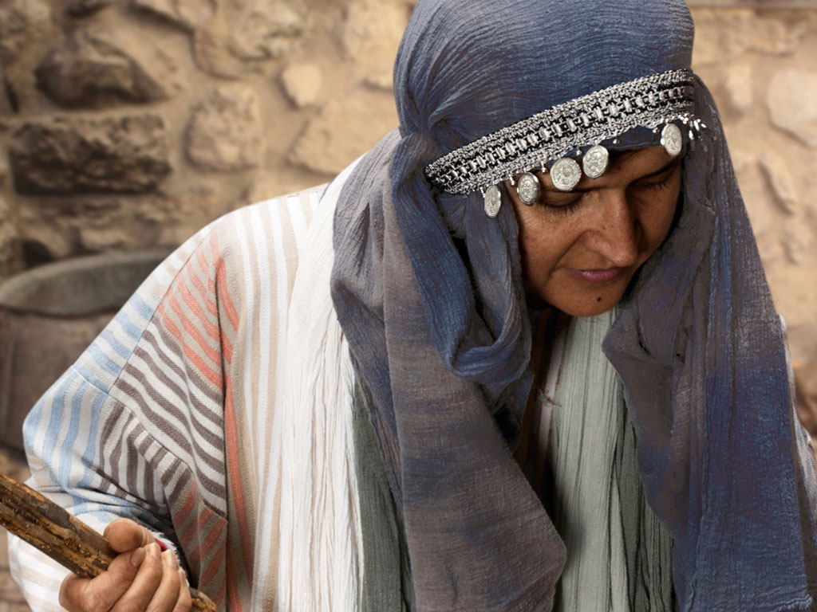
Notes:
Luke 15 v 8: Woman shown with coin missing.

Slide 20
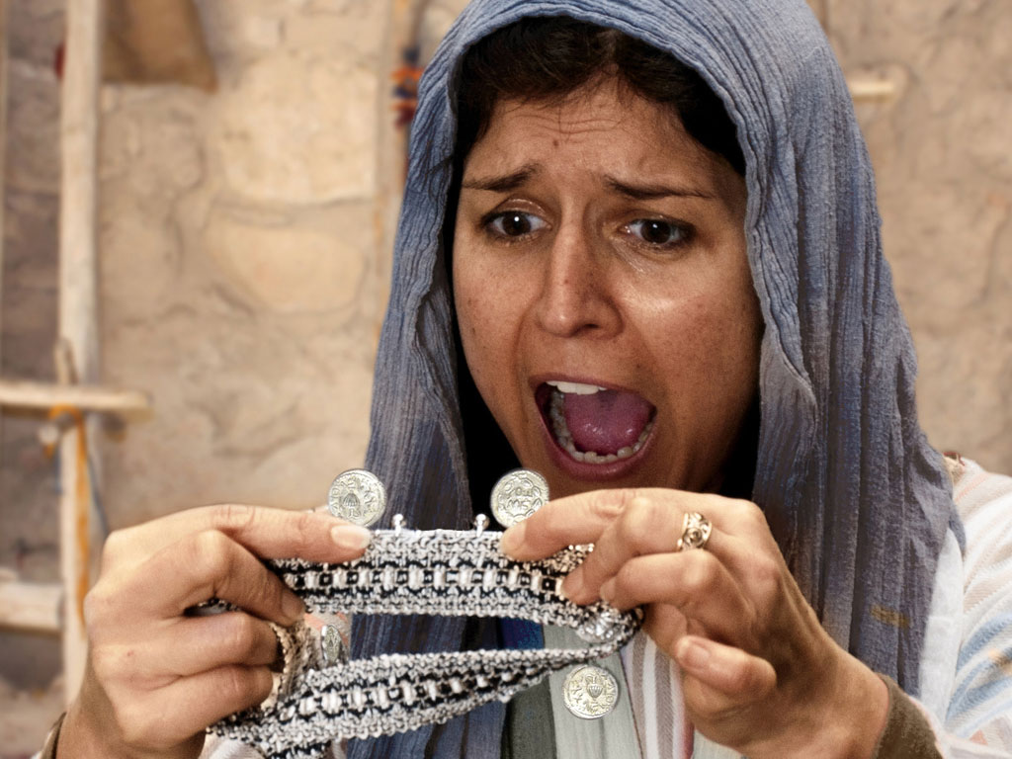
Notes:
Luke 15 v 8: Woman discovers a silver coin is missing.

Slide 21
Notes:
Luke 15 v 8: Woman wonders where she may have lost it.

Slide 22
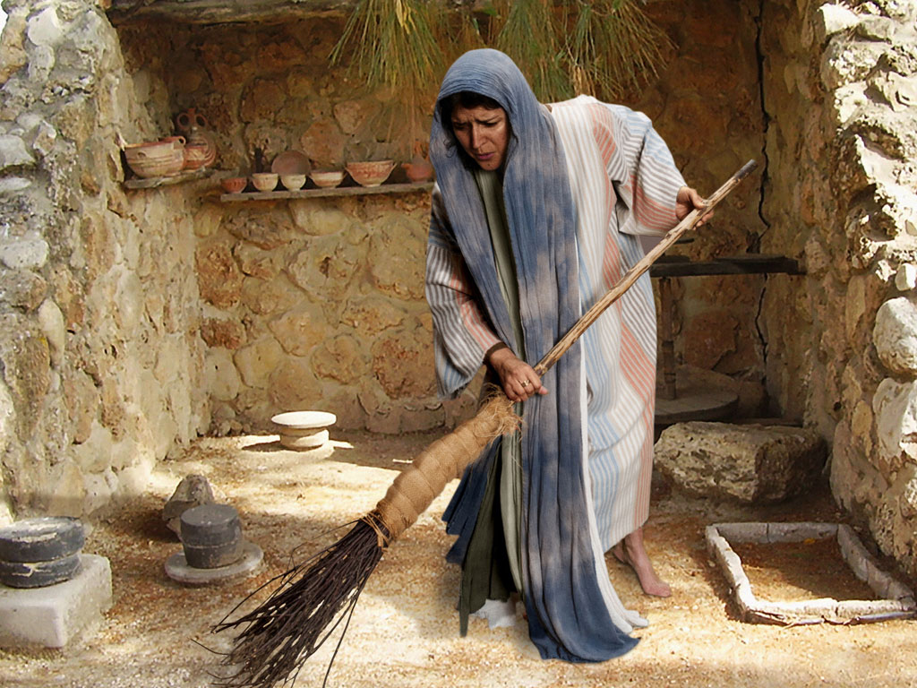
Notes:
Luke 15 v 8: Woman searches using broom.

Slide 23
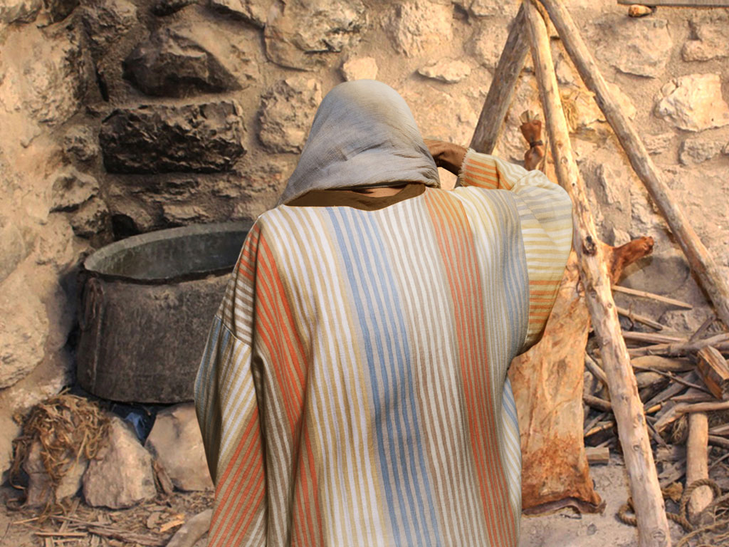
Notes:
Luke 15 v 8: Woman searches in courtyard.

Slide 24
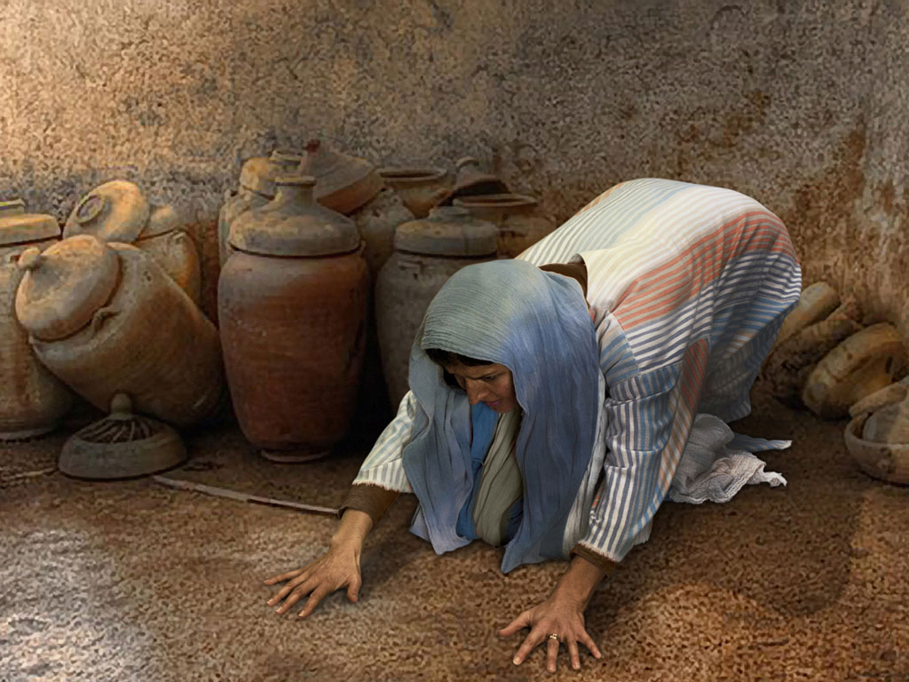
Notes:
Luke 15 v 8: Woman searches floor.

Slide 25
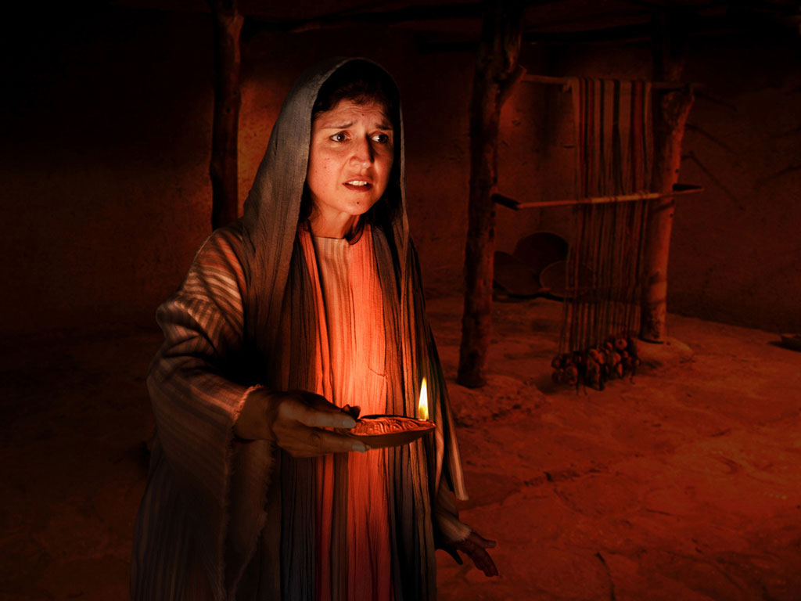
Notes:
Luke 15 v 8: Woman lights lamp and searches house. Many poor homes had very small windows and rooms were dark.

Slide 26
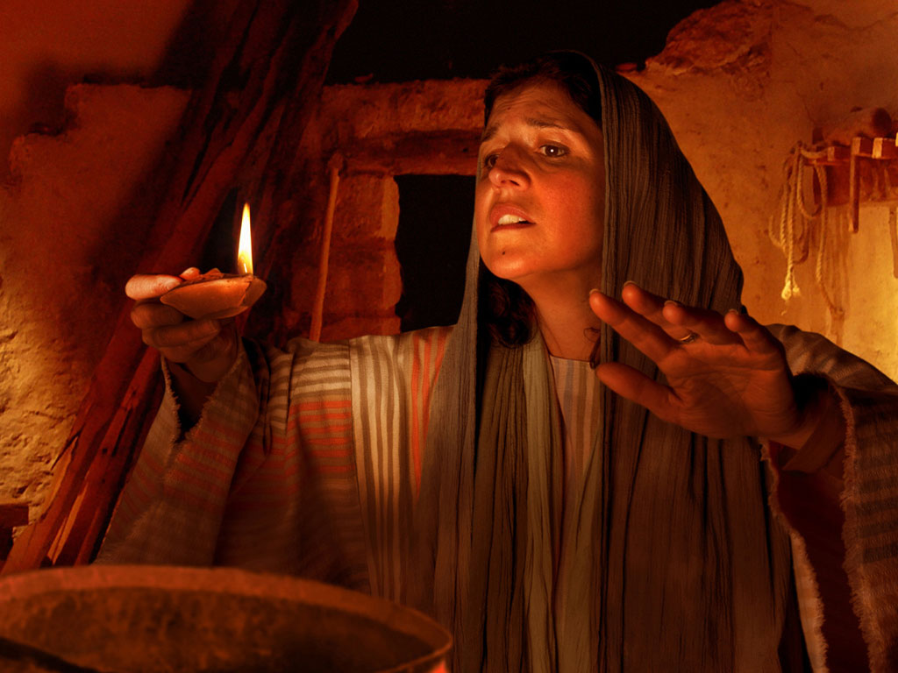
Notes:
Luke 15 v 8: Woman searches house by lamp light.

Slide 27
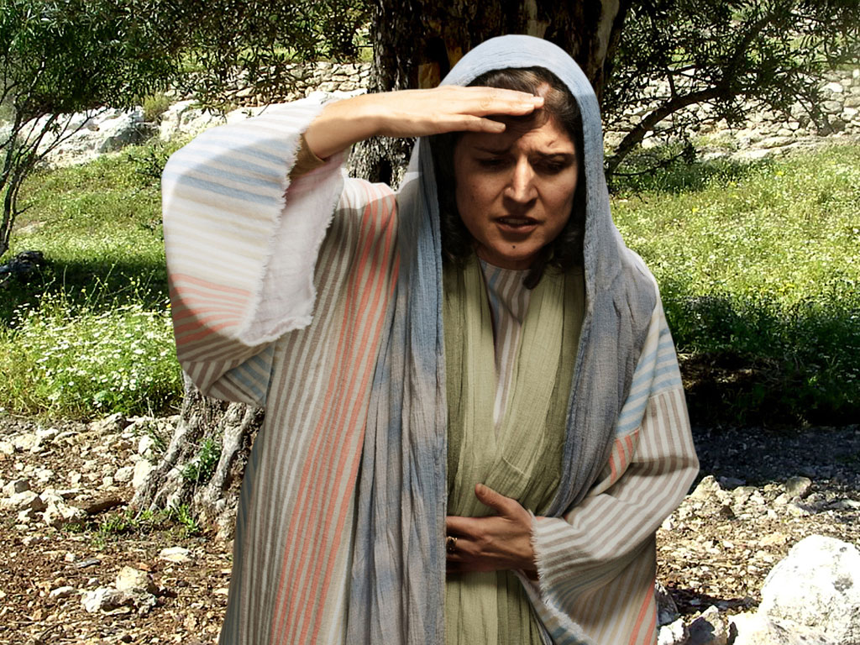
Notes:
Luke 15 v 8: Woman continues search.

Slide 28
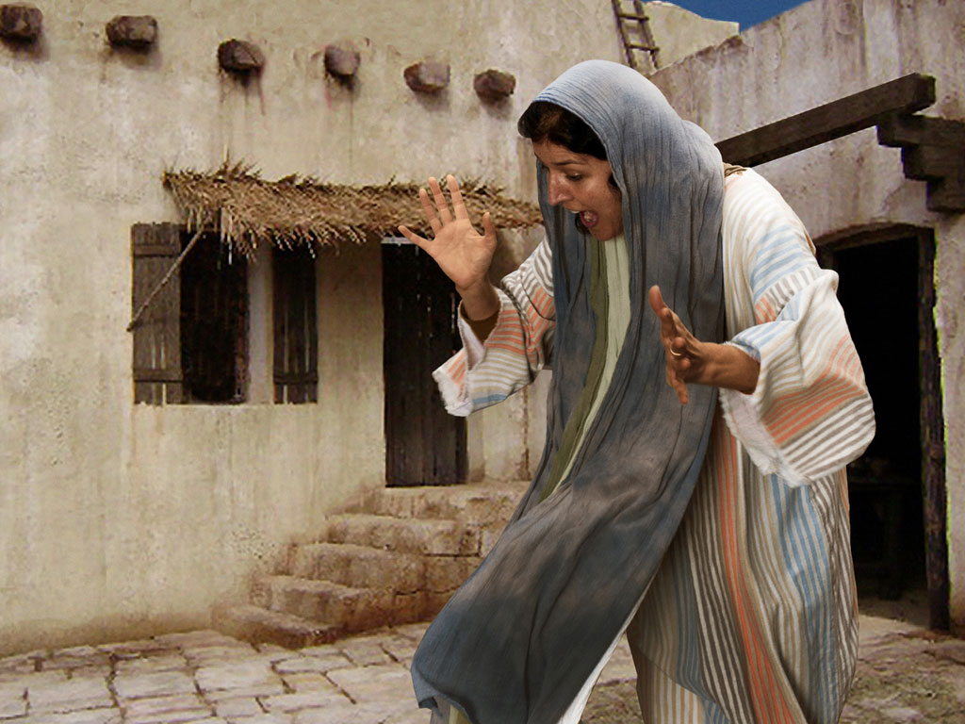
Notes:
Luke 15 v 9: Woman search is rewarded as she sees silver coin.

Slide 29
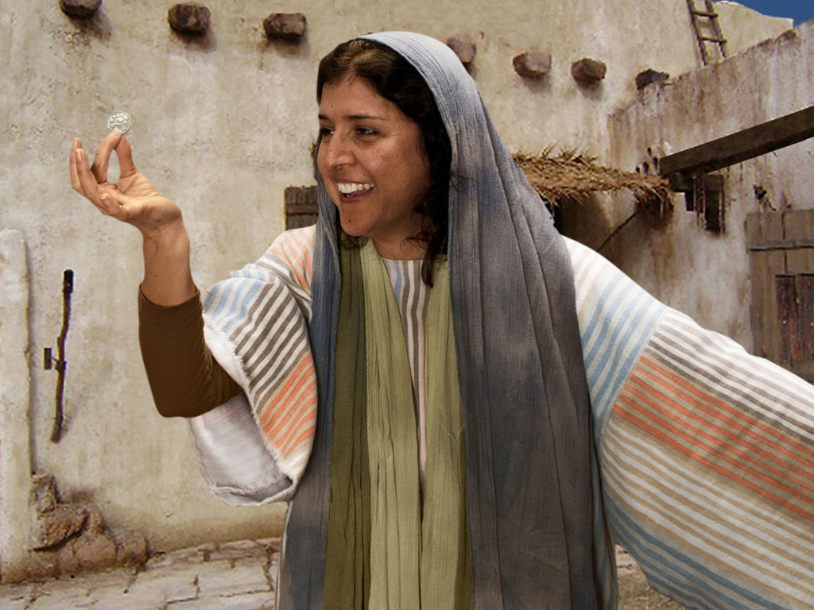
Notes:
Luke 15 v 9: Woman is full of joy as she finds coin.

Slide 30
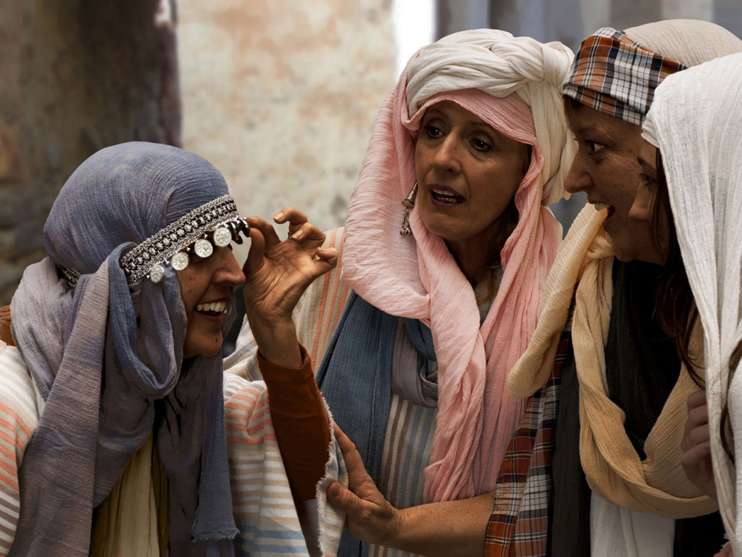
Notes:
Luke 15 v 9: Woman shares her good news with neighbours and friends.
The coin was clearly a precious resource to her and a large embarrassment if she lost it. She lights a lamp to look for it. Either her house had few windows, or she is not willing to wait for the morning light—she must find it now! Besides, when you are living on dirt floors, the longer something is lost, the more likely it is to stay that way. We also notice that the Greek word for “friends” is feminine. We can’t be sure that she ever told her husband, but she does tell her sewing circle. Jesus has thus put the “lost and found” in terms that both men and women can understand.
— Mark E. Moore, The Chronological Life of Christ (Joplin, MO: College Press Publishing Company, 2011), 427.

Slide 31
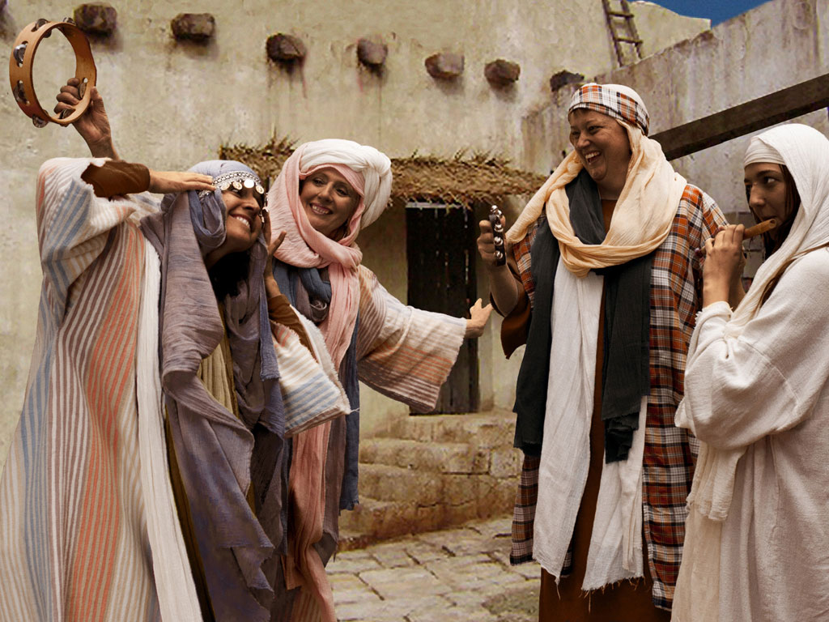
Notes:
Luke 15 v 9: Woman celebrates her good news with neighbours and friends. 'Rejoice with me; I have found my lost coin.'

Slide 32
THE WORD IN PICTURES
Free
Bible
images

Slide 33

FreeBibleimages would like to thank Peter Hutley and Wintershall Players for the use of their cast, costumes and facilities in creating these images.

Slide 34
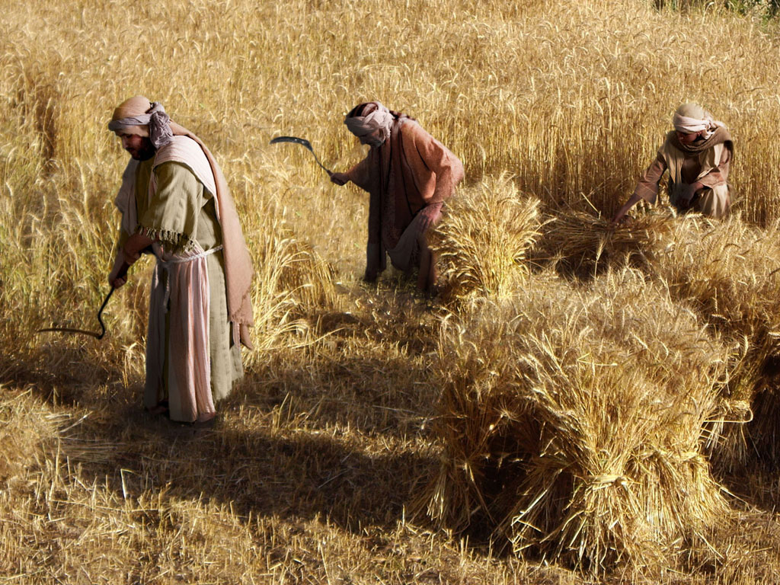
THE PARABLE OF THE TWO SONS (Prodigal Son)
Free
Bible
images
Luke 15:11-32
Notes:
"Charles Dickens said, of this parable, 'It is the finest short story ever written.' This is the most famous parable of the trilogy and the climax of the series. It is also the longest parable Jesus ever told. It has two parts. The first is about the son who wanders and the second is about the son who doesn’t. The first son gets lost abroad, the second gets lost at home. The second son is equally important because it brings us back to vv. 1–2 where the Pharisees (the sons who did not wander) complain about Jesus socializing with the lost sons."
— Mark E. Moore, The Chronological Life of Christ (Joplin, MO: College Press Publishing Company, 2011), 427.

Slide 35
Notes:
Sons were valued highly in ancient Jewish culture.

Slide 36
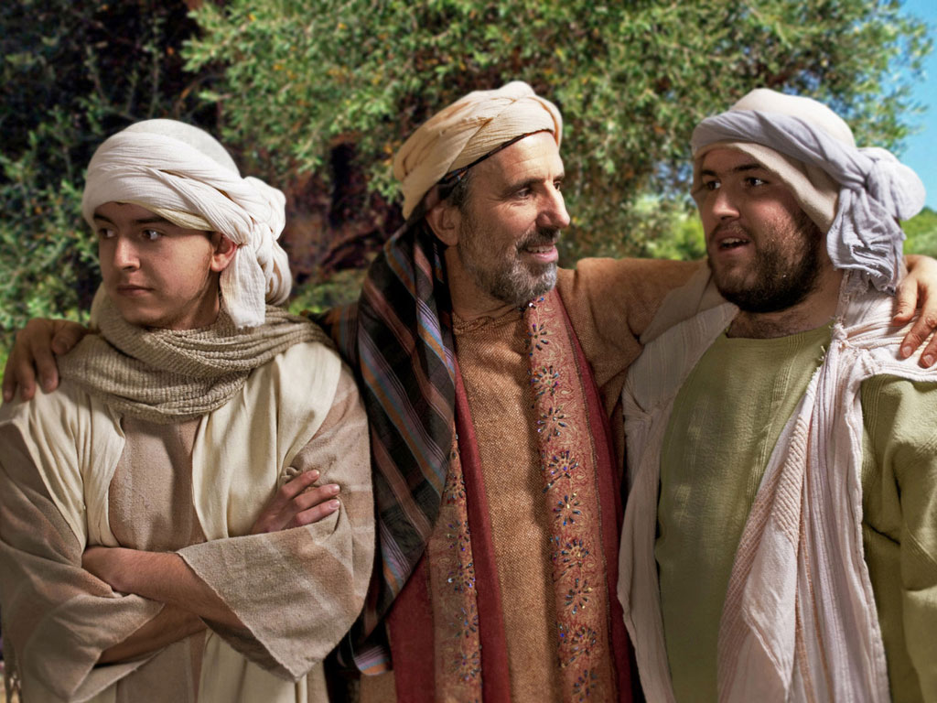
Notes:
Jesus told the parable of a man with two sons—the older son who brought him pride on the right, and the younger son who was hard to please on the left.

Slide 37
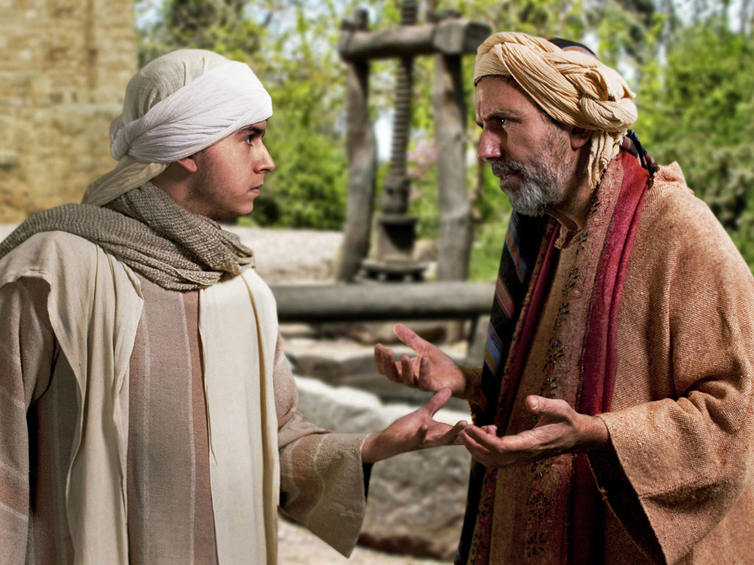
Notes:
This younger son was so ungrateful that he demanded his inheritance while his father still lived.

Slide 38
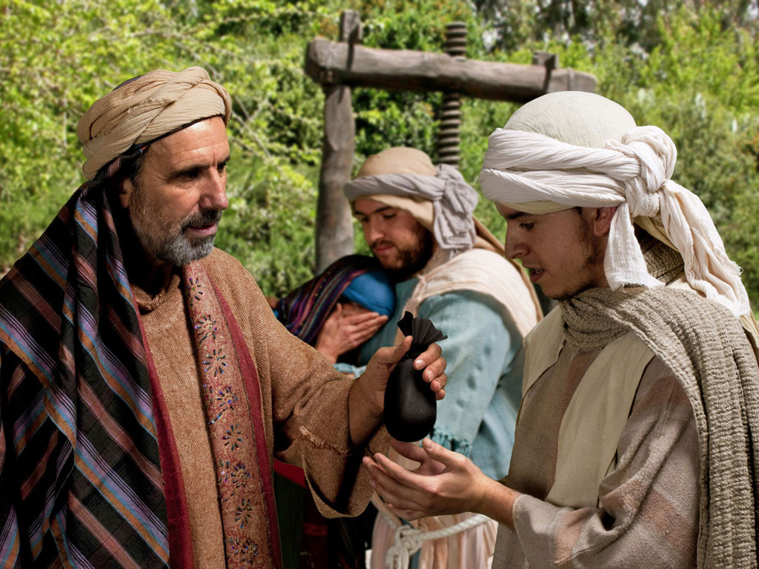
Notes:
At great cost to the father, he agreed to give his younger son one third of his wealth as the older son got the double portion of two thirds.

Slide 39
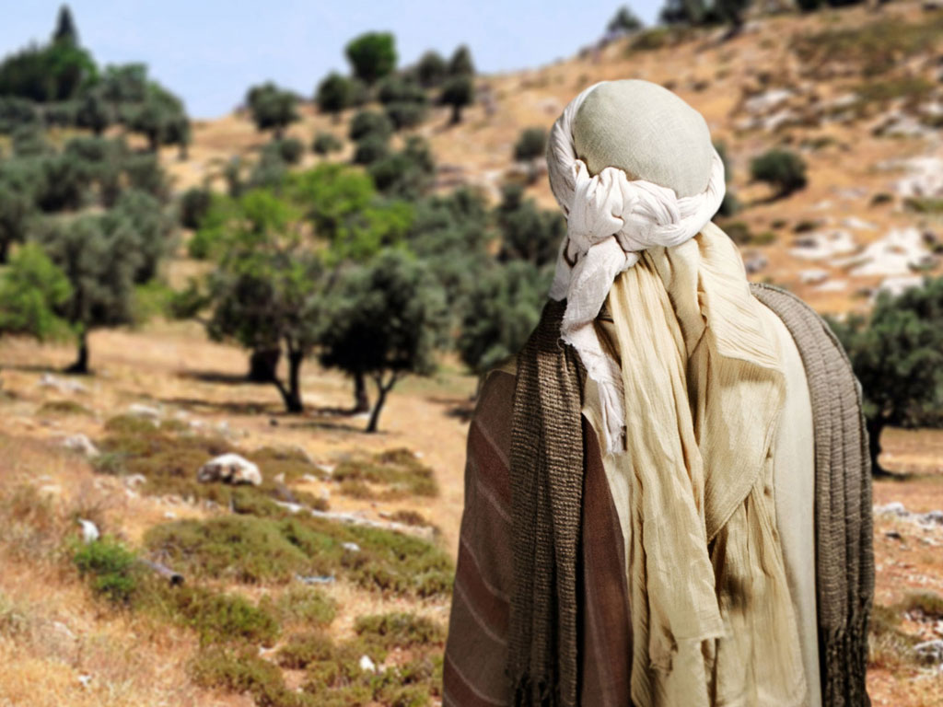
Notes:
Off the son went to pursue his dreams.

Slide 40
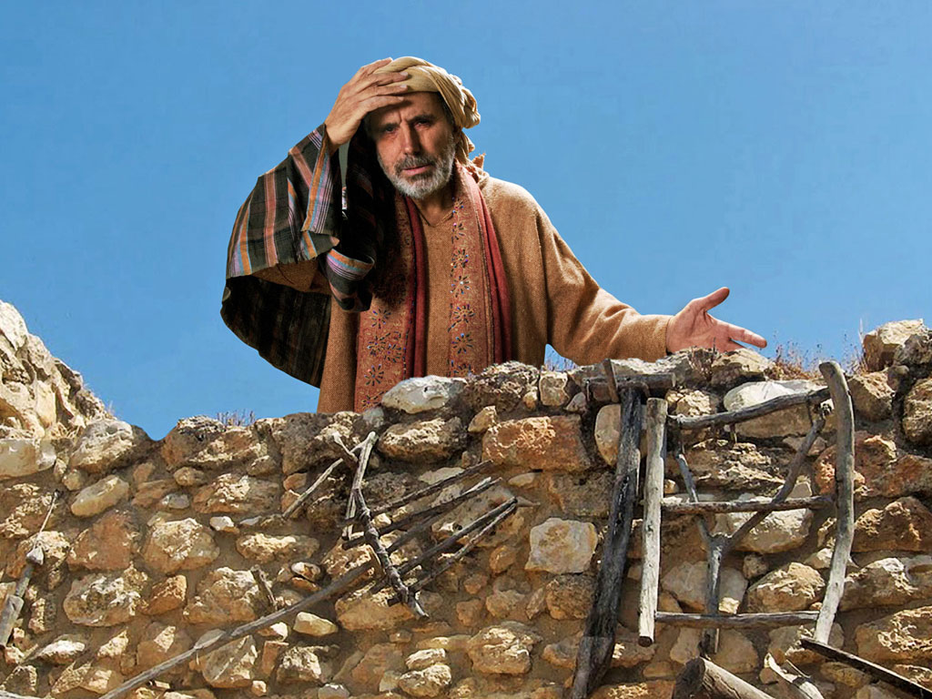
Notes:
The father mourned the loss, but he didn't prevent his son from experiencing the results of his greed. He instead longed for him to return.

Slide 41
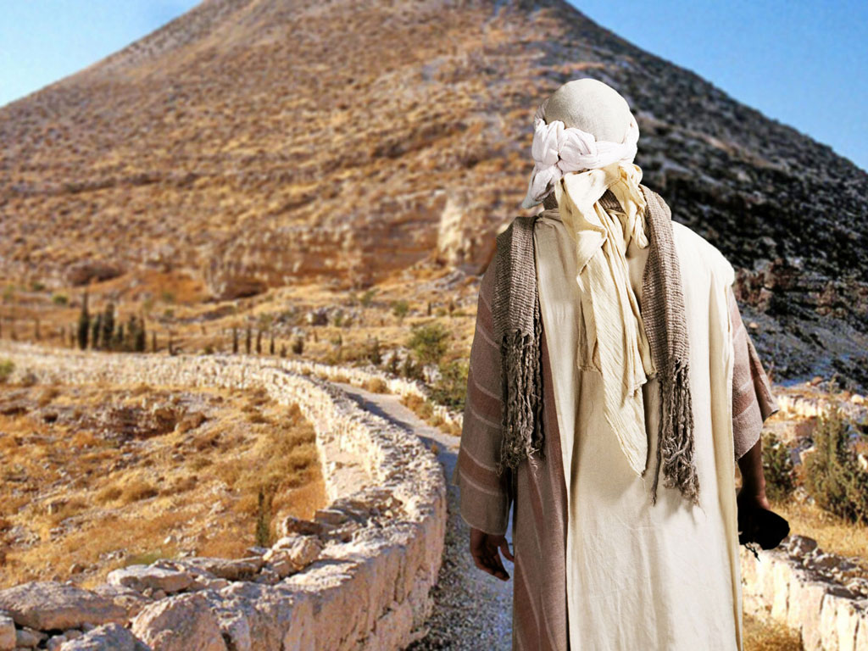
Notes:
Village life is deemed boring to those pursuing pleasure, so the younger son traveled out of the region.

Slide 42
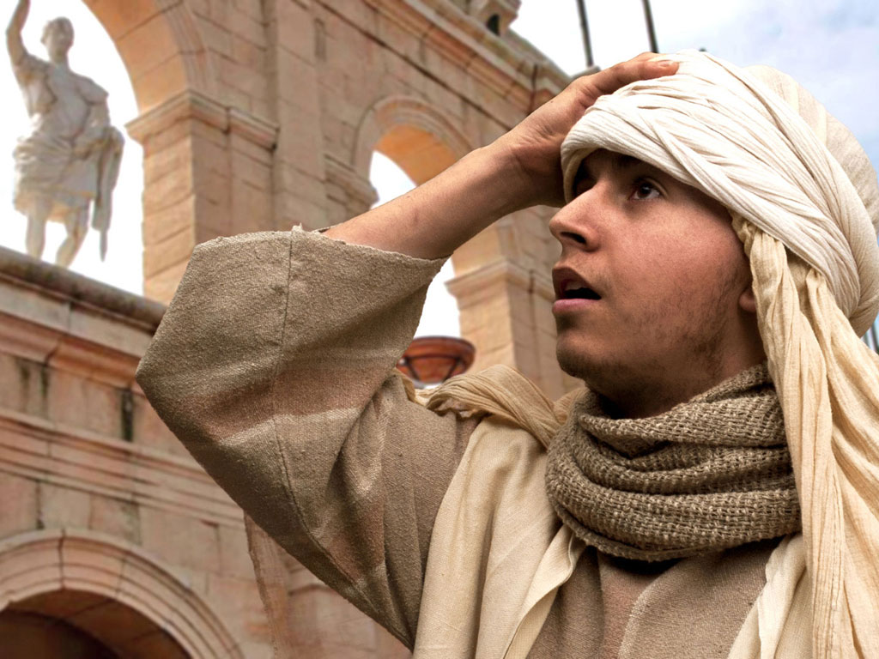
Notes:
His bad heart lured him to the city.

Slide 43
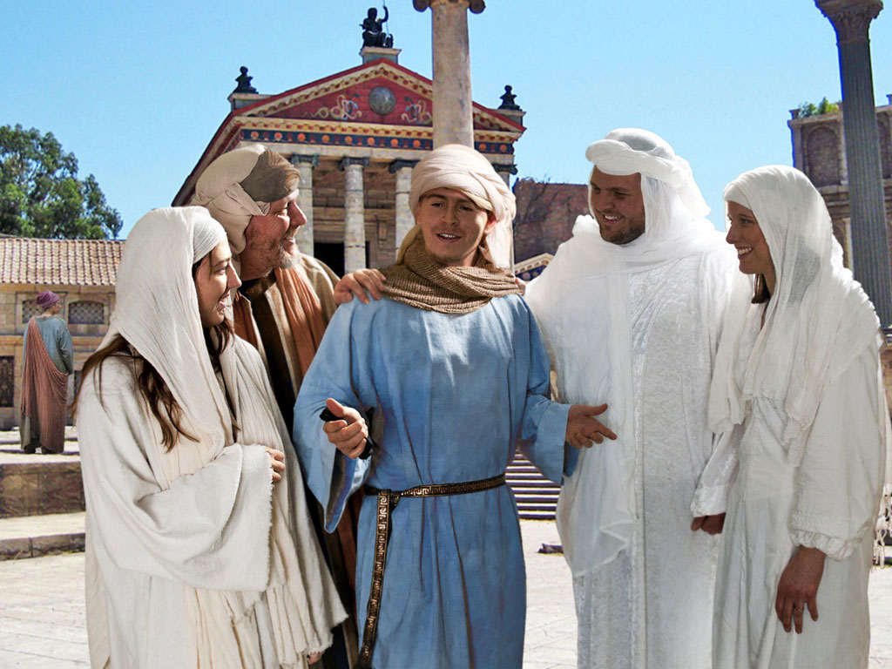
Notes:
Wealthy people typically find lots of "friends," defined as people willing to help spend the money of fools.

Slide 44
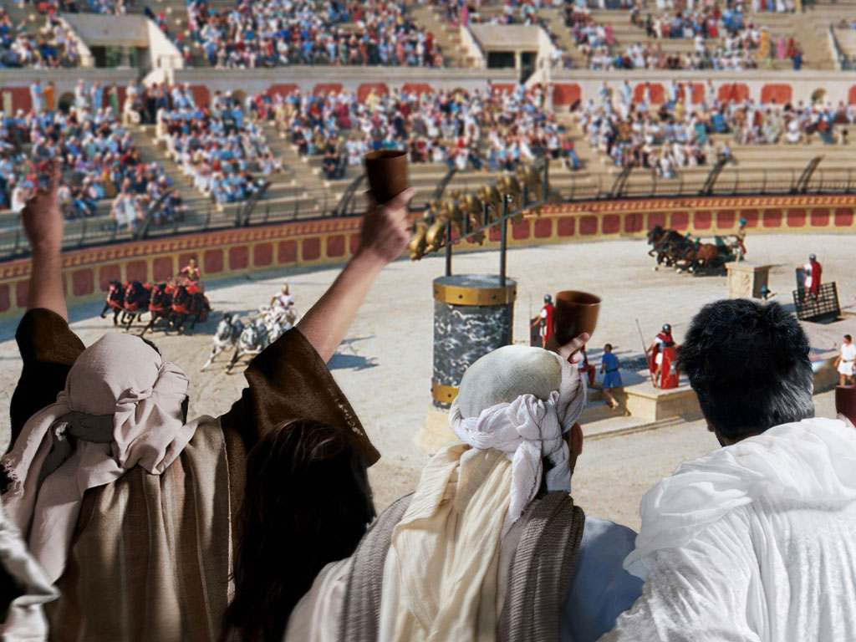
Notes:
There was no end to places to waste money then—and now.

Slide 45
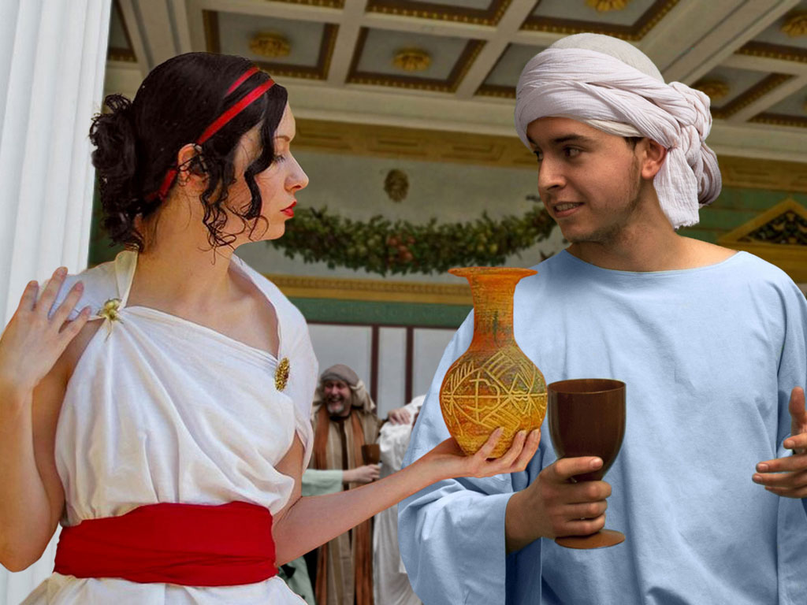
Notes:
Fools also attract gold diggers who prefer the finer things of life like an etched vase instead of a simple cup.

Slide 46
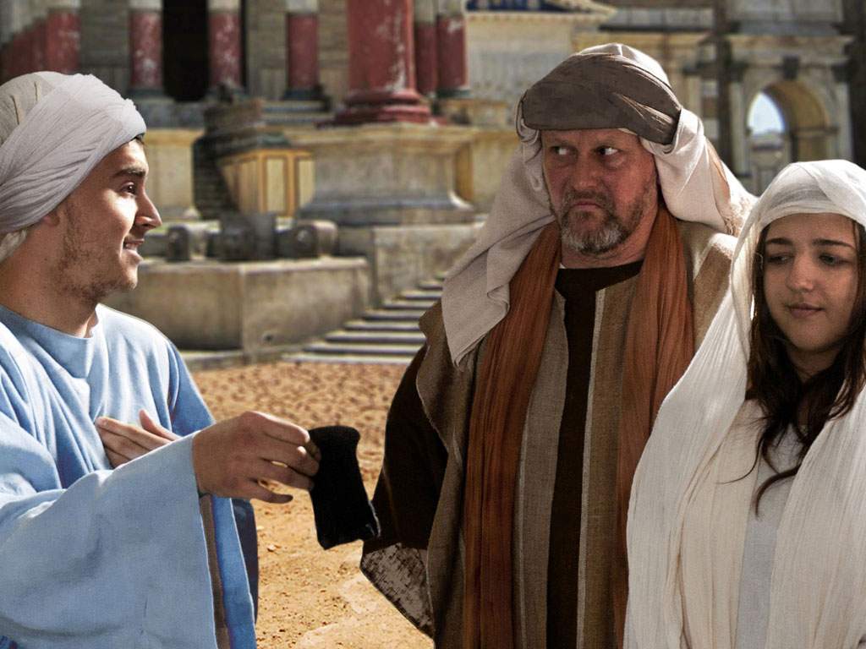
Notes:
Soon, the money ran out, and so did the friends.

Slide 47
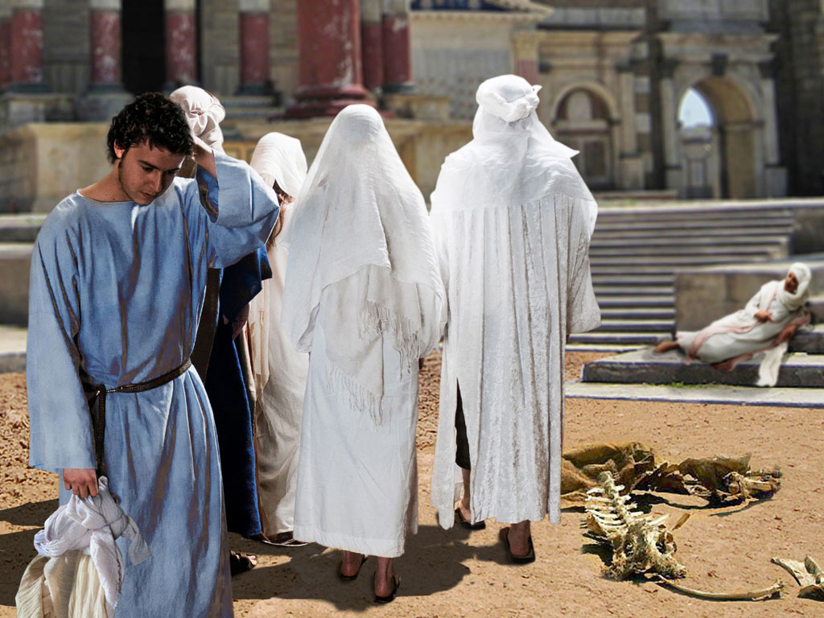
Notes:
The young son found himself without companions.

Slide 48
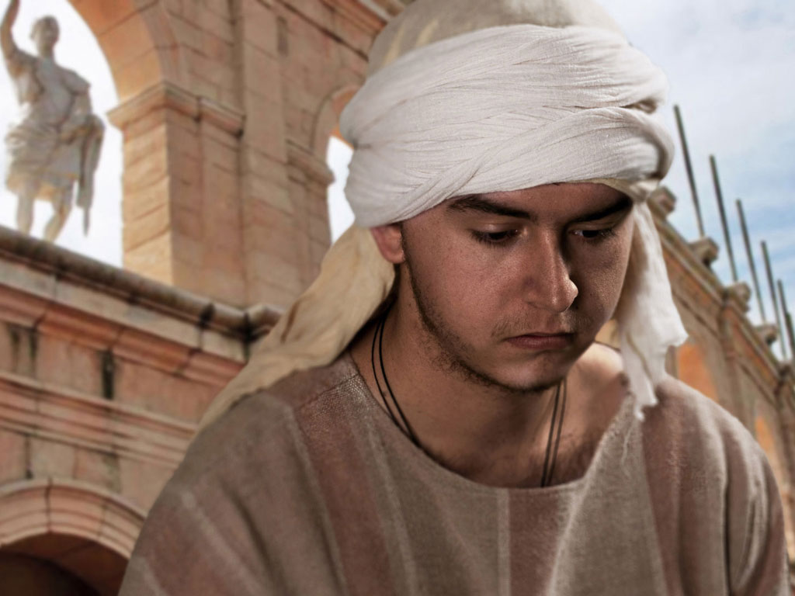
Notes:
City life without money is incredibly hard, so he had to leave the city.

Slide 49
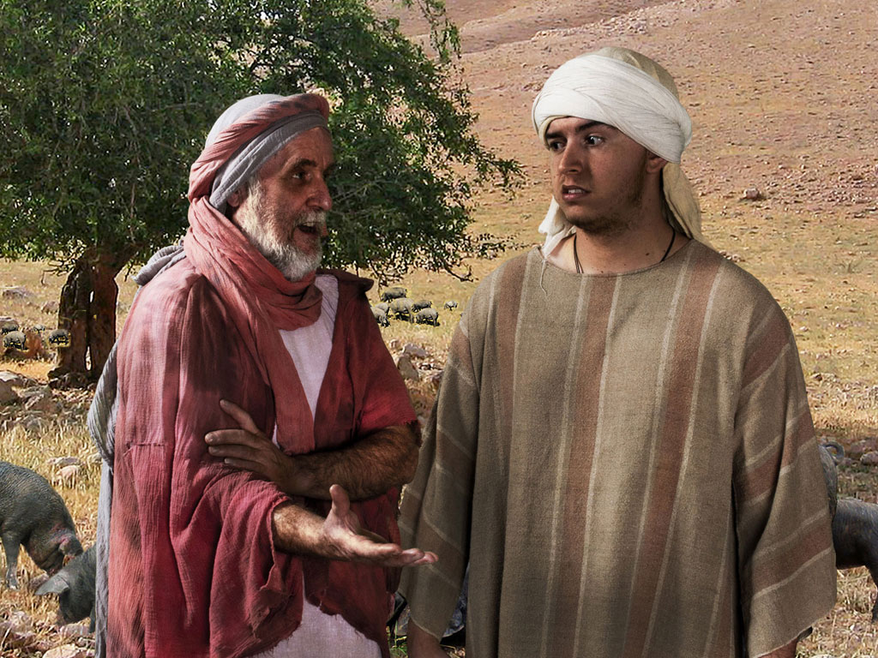
Notes:
Farmwork is good for the soul and the body. But he found work to alleviate his hunger from a man raising pigs.

Slide 50
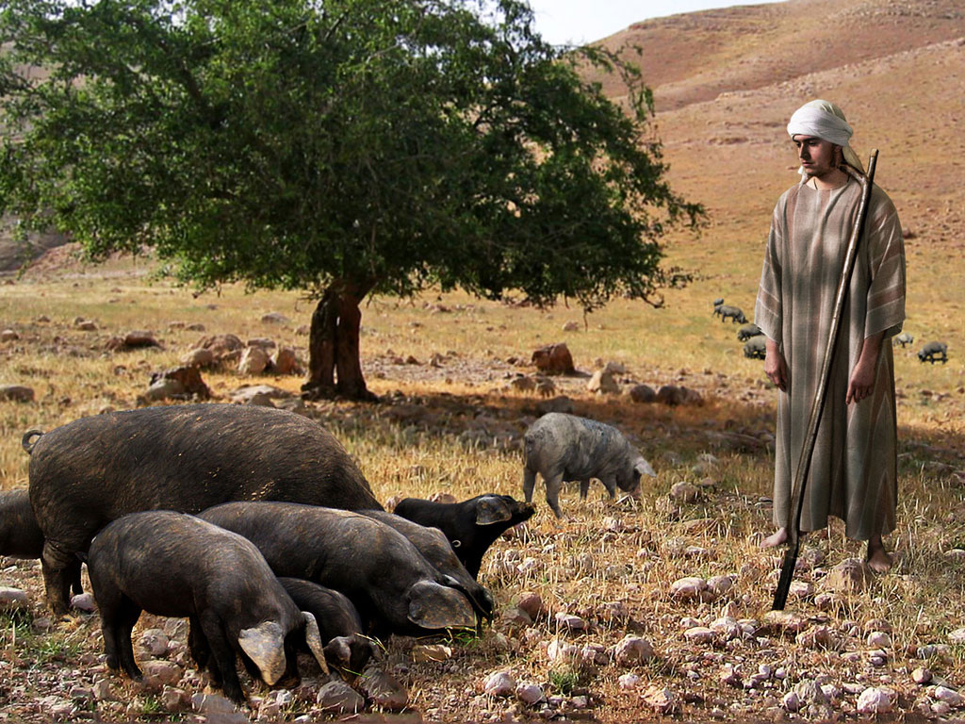
Notes:
Raising pigs is as low as a man from a wealthy Jewish family can get. Pigs were not allowed to be sacrificed, nor eaten.

Slide 51
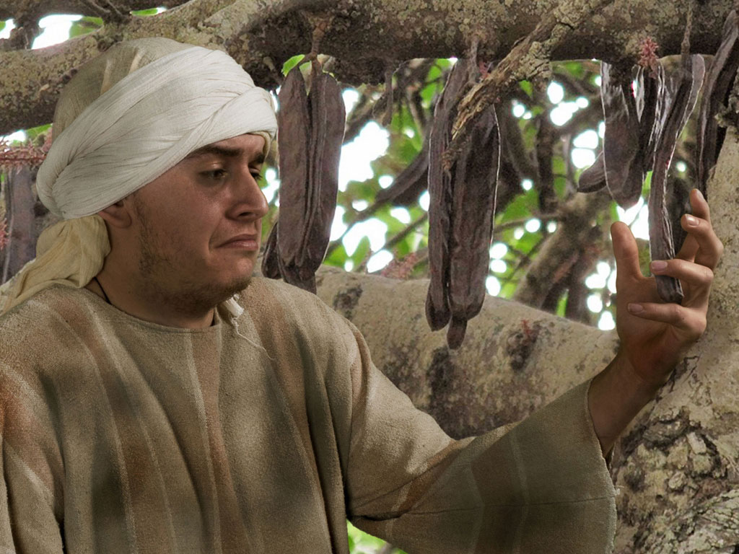
Notes:
Even the pods to feed the pigs became tempting.

Slide 52
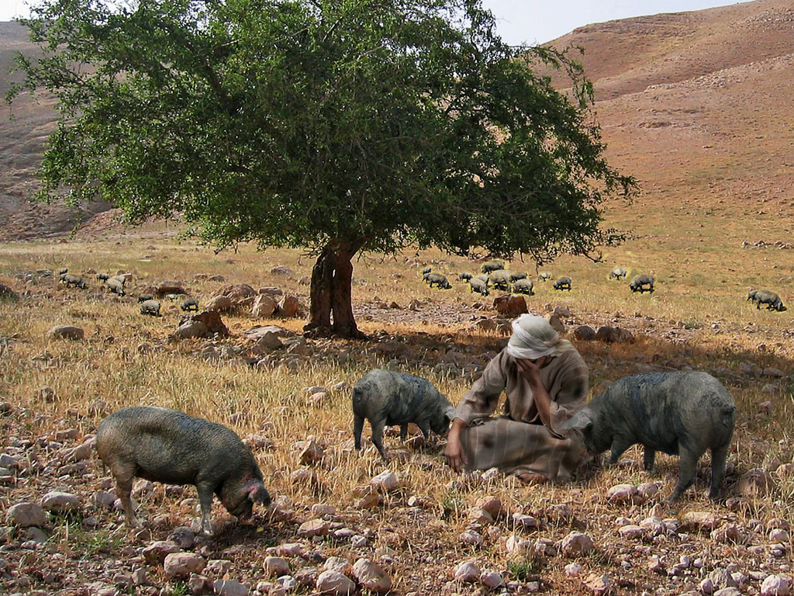
Notes:
The young son finally got to his lowest point and recalled that his father's servants were in better shape than him.

Slide 53
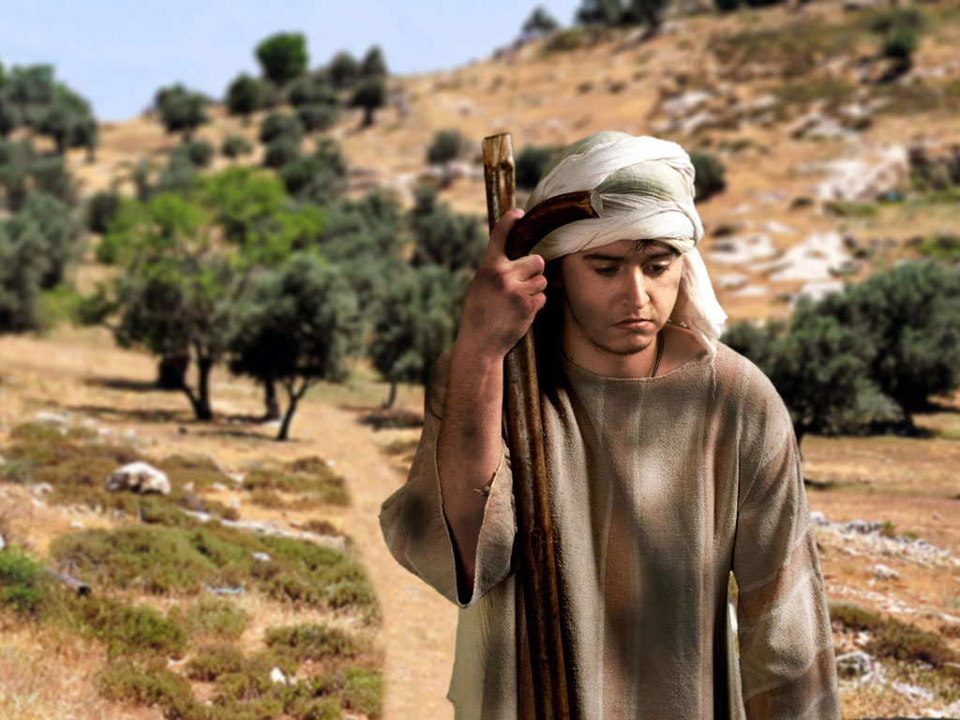
Notes:
So he returned home with a rehearsed speech of confession to his father.

Slide 54
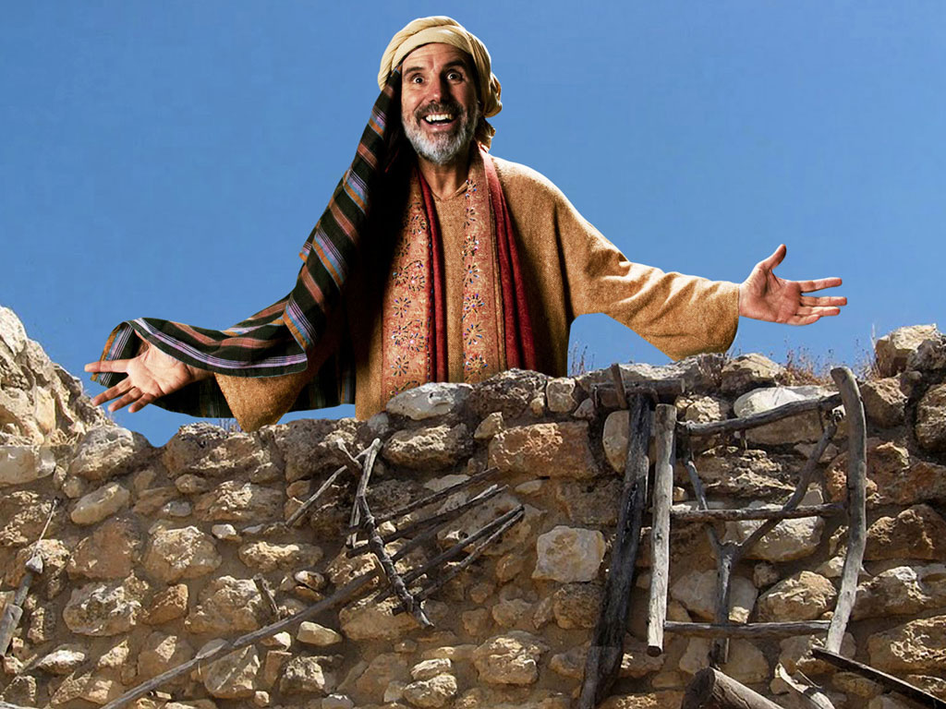
Notes:
The father saw him as soon as he came into view.

Slide 55
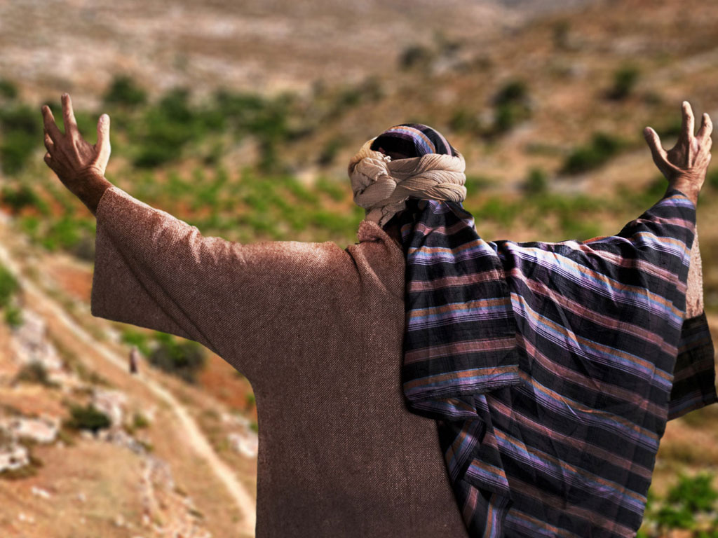
Notes:
This was because the father continued looking for him each day, praying for his return.

Slide 56
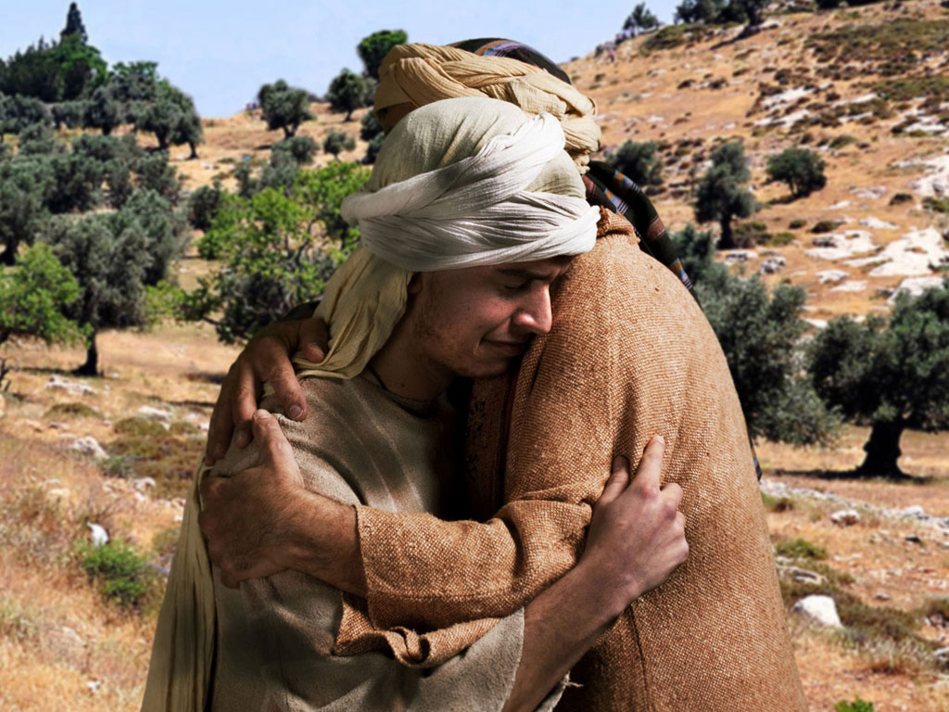
Notes:
The father ran to meet him, which fathers did not do as it appeared undignified to lift up one's robe to run.

Slide 57
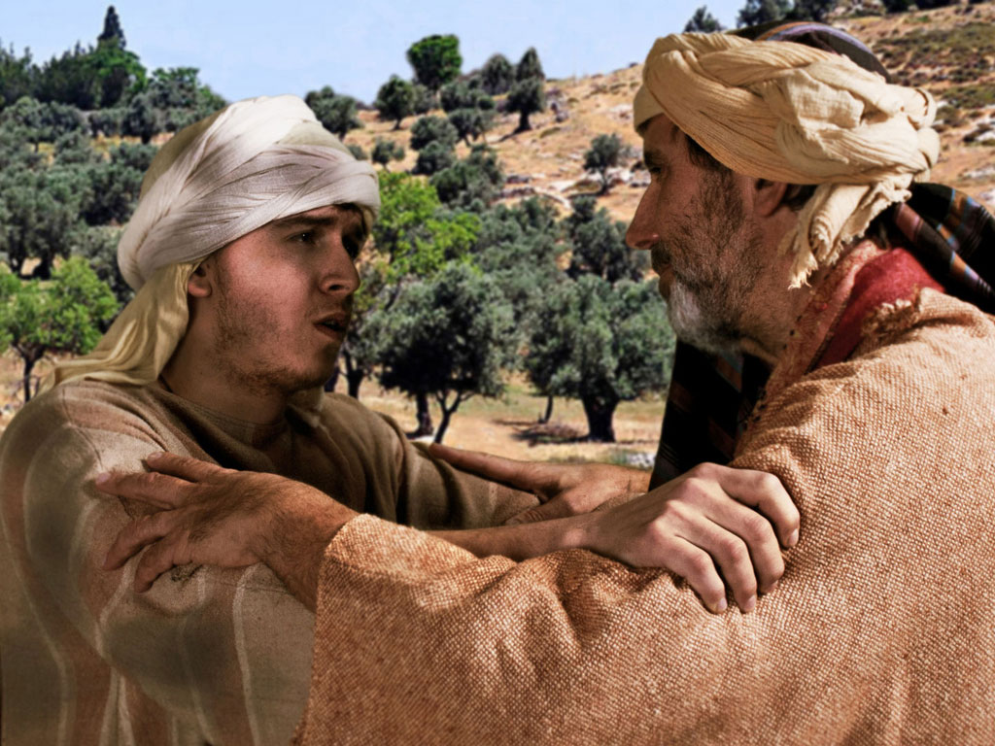
Notes:
The son began his confession but was interrupted by his father to tell his servants to bring him new clothes.

Slide 58
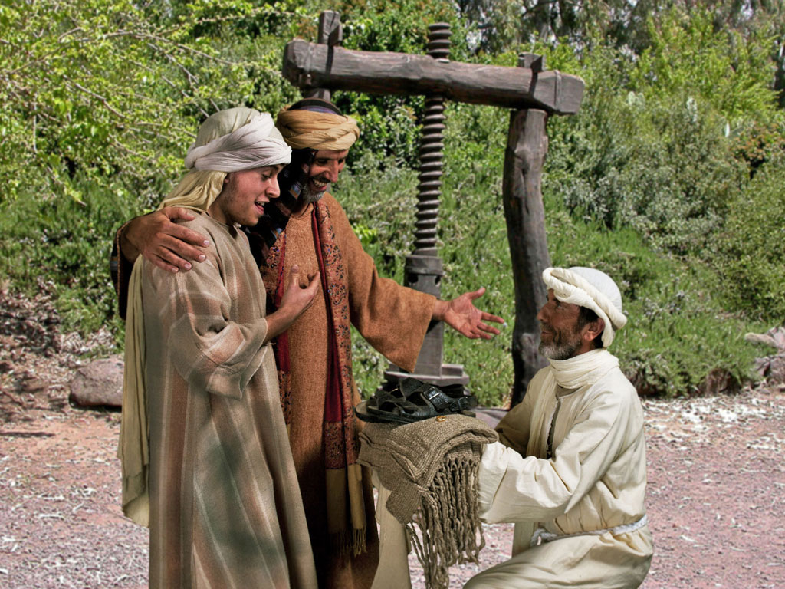
Notes:
A new robe and sandals were not earned by the son through any deed but only because of his status as a son.
"Originally the son thought of becoming a servant in his father’s house. He has his whole speech memorized verbatim (vv. 18–19). But before he is able to get even half of it out of his mouth (v. 21), his father starts barking out orders to the servants and lavishes on the boy all the trappings of an honored son.
The robe, ring, and sandals are more than signs of comfort, they are signs of sonship and freedom. The robe was such as would be given to an honored guest. The ring is a sign of authority. And the sandals represent freedom since slaves went about barefoot. His father clearly restores him to the place of an honored son. In short, he is 'alive again.' This word for 'resurrection' is an obvious allusion to the effects of sin. This parable has the seeds of NT theology—being dead in sin but alive in Christ (Rom 6:4, 9, 11; 7:4; 8:10–11; Eph 2:5; Col 2:13)."
— Mark E. Moore, The Chronological Life of Christ (Joplin, MO: College Press Publishing Company, 2011), 429.

Slide 59
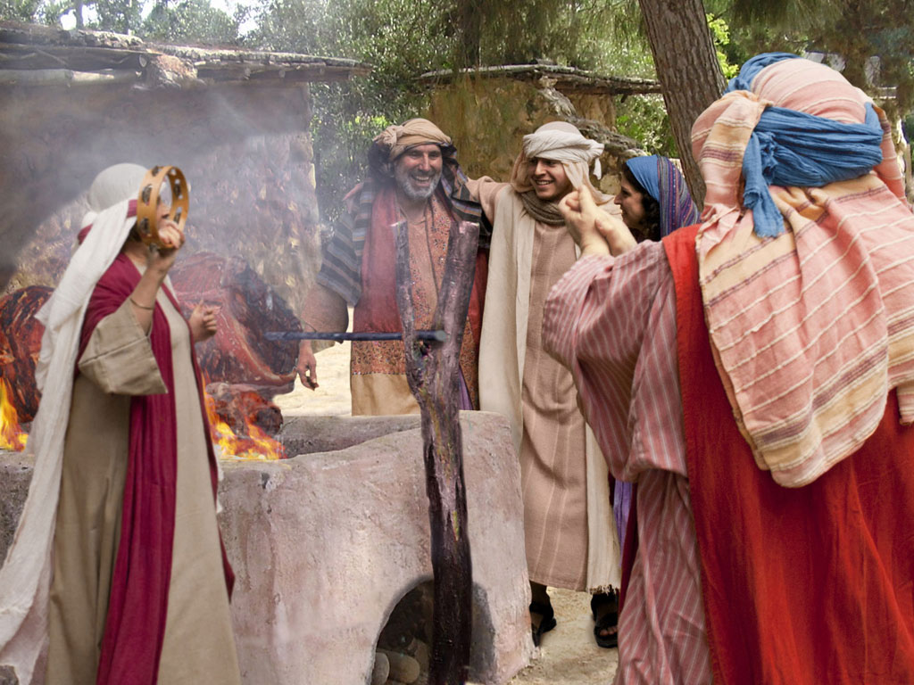
Notes:
The calf that had been saved for a celebration was roasted for a feast.

Slide 60
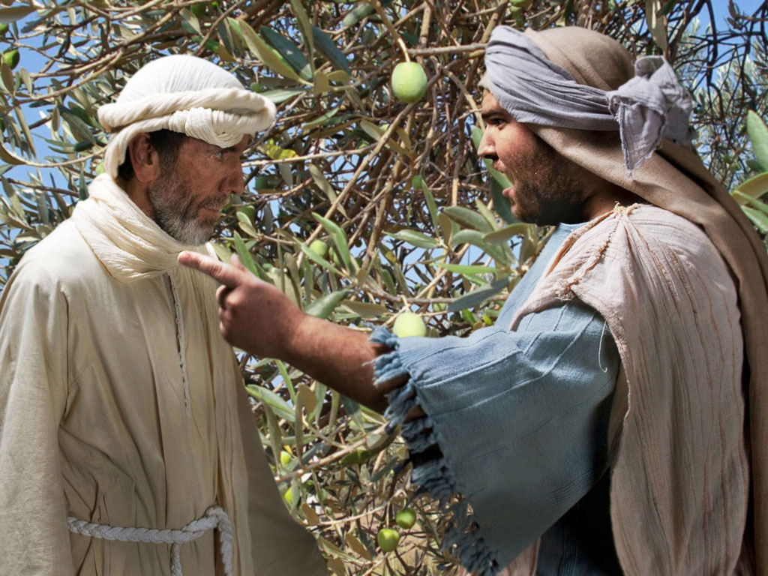
Notes:
The older son working in the fields asked a servant why he could hear a celebration. The servant told him that his brother had returned to a feast.

Slide 61
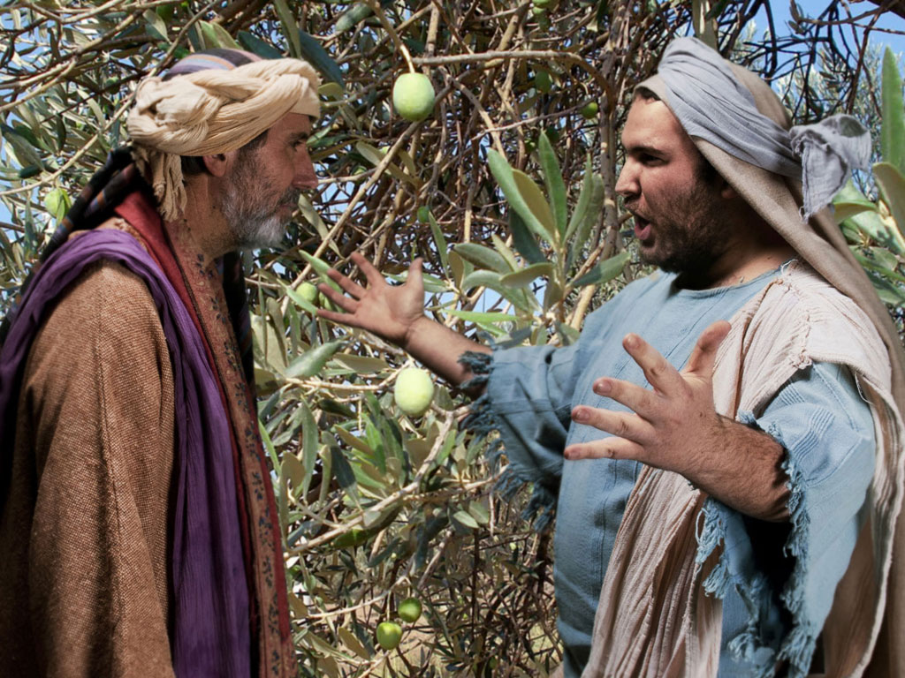
Notes:
The older son would not attend the feast, so his father went out to plead for him to return and celebrate—but to no avail.
Deuteronomy 21:18-21 says to kill a rebellious son—
Deut. 21:18 “Suppose a man has a stubborn and rebellious son who will not obey his father or mother, even though they discipline him. 19 In such a case, the father and mother must take the son to the elders as they hold court at the town gate. 20 The parents must say to the elders, ‘This son of ours is stubborn and rebellious and refuses to obey. He is a glutton and a drunkard.’ 21 Then all the men of his town must stone him to death. In this way, you will purge this evil from among you, and all Israel will hear about it and be afraid."
The father would not let this happen, so he ran to the Pharisees to protect him!

Slide 62

Notes:
This older, faithful son thought only of himself, declaring him as a slave of the father and one who could not celebrate with his friends. But the father reminded him that this older son owned the estate. The father said that they HAD to rejoice because his brother was alive.

Slide 63

Notes:
The older son never joined the feast.
What do you think is the main point of this parable? (Small groups for 4 minutes)
Jesus was telling the Pharisees that they were invited to the kingdom feast, but, like the older son, they refused to come.
Do not be like the older brother who thinks he deserves God's grace.
God does not keep any of us from the feast (salvation), but if we refuse to come, then he regretfully accepts our decision to prefer hell over heaven.

Slide 64
THE WORD IN PICTURES
Free
Bible
images

Slide 65
FreeBibleimages would like to thank Peter Hutley and Wintershall Players for the use of their cast, costumes and facilities in creating these images.

Slide 66
F. Instruction on Wealth
§ 125
Luke 16:1-31
Invest in eternity as servants of God instead of temporal ventures like Pharisees who trust money as a basis for eternal security
Notes:
Parable of the Shrewd Manager
Luke 16:1 NLT Jesus told this story to his disciples: “There was a certain rich man who had a manager handling his affairs. One day a report came that the manager was wasting his employer’s money. ² So the employer called him in and said, ‘What’s this I hear about you? Get your report in order, because you are going to be fired.’
Luke 16:3 “The manager thought to himself, ‘Now what? My boss has fired me. I don’t have the strength to dig ditches, and I’m too proud to beg. ⁴ Ah, I know how to ensure that I’ll have plenty of friends who will give me a home when I am fired.’
Luke 16:5 “So he invited each person who owed money to his employer to come and discuss the situation. He asked the first one, ‘How much do you owe him?’ ⁶ The man replied, ‘I owe him 800 gallons of olive oil.’ So the manager told him, ‘Take the bill and quickly change it to 400 gallons.ª’
Luke 16:7 “‘And how much do you owe my employer?’ he asked the next man. ‘I owe him 1,000 bushels of wheat,’ was the reply. ‘Here,’ the manager said, ‘take the bill and change it to 800 bushels.ª’
Luke 16:8 “The rich man had to admire the dishonest rascal for being so shrewd. And it is true that the children of this world are more shrewd in dealing with the world around them than are the children of the light. ⁹ Here’s the lesson: Use your worldly resources to benefit others and make friends. Then, when your possessions are gone, they will welcome you to an eternal home.
Luke 16:10 “If you are faithful in little things, you will be faithful in large ones. But if you are dishonest in little things, you won’t be honest with greater responsibilities. ¹¹ And if you are untrustworthy about worldly wealth, who will trust you with the true riches of heaven? ¹² And if you are not faithful with other people’s things, why should you be trusted with things of your own?
Luke 16:13 “No one can serve two masters. For you will hate one and love the other; you will be devoted to one and despise the other. You cannot serve God and be enslaved to money.”
Luke 16:14 The Pharisees, who dearly loved their money, heard all this and scoffed at him. ¹⁵ Then he said to them, “You like to appear righteous in public, but God knows your hearts. What this world honors is detestable in the sight of God.
Luke 16:16 “Until John the Baptist, the law of Moses and the messages of the prophets were your guides. But now the Good News of the Kingdom of God is preached, and everyone is eager to get in. ¹⁷ But that doesn’t mean that the law has lost its force. It is easier for heaven and earth to disappear than for the smallest point of God’s law to be overturned.
Luke 16:18 “For example, a man who divorces his wife and marries someone else commits adultery. And anyone who marries a woman divorced from her husband commits adultery.”
Parable of the Rich Man and Lazarus
Luke 16:19 Jesus said, “There was a certain rich man who was splendidly clothed in purple and fine linen and who lived each day in luxury. ²⁰ At his gate lay a poor man named Lazarus who was covered with sores. ²¹ As Lazarus lay there longing for scraps from the rich man’s table, the dogs would come and lick his open sores.
Luke 16:22 “Finally, the poor man died and was carried by the angels to sit beside Abraham at the heavenly banquet.ª The rich man also died and was buried, ²³ and he went to the place of the dead.ª There, in torment, he saw Abraham in the far distance with Lazarus at his side.
Luke 16:24 “The rich man shouted, ‘Father Abraham, have some pity! Send Lazarus over here to dip the tip of his finger in water and cool my tongue. I am in anguish in these flames.’
Luke 16:25 “But Abraham said to him, ‘Son, remember that during your lifetime you had everything you wanted, and Lazarus had nothing. So now he is here being comforted, and you are in anguish. ²⁶ And besides, there is a great chasm separating us. No one can cross over to you from here, and no one can cross over to us from there.’
Luke 16:27 “Then the rich man said, ‘Please, Father Abraham, at least send him to my father’s home. ²⁸ For I have five brothers, and I want him to warn them so they don’t end up in this place of torment.’
Luke 16:29 “But Abraham said, ‘Moses and the prophets have warned them. Your brothers can read what they wrote.’
Luke 16:30 “The rich man replied, ‘No, Father Abraham! But if someone is sent to them from the dead, then they will repent of their sins and turn to God.’
Luke 16:31 “But Abraham said, ‘If they won’t listen to Moses and the prophets, they won’t be persuaded even if someone rises from the dead.’”

Slide 67


The Shrewd Manager
Luke 16:1-13
Dr. David Martin • Amman International Church
AmmanChurch.org • BibleStudyDownloads.org

Slide 68




Notes:
Good ways exist to teach the value of money. One effective means of savings in America in the 1960s was the Defense Stamp Album.
• Boys saved 187 10-cent stamps with a value of $18.75 that grew to $25 after 10 years.

Slide 69



Luke 16:1-13
The Issue:
A disciple’s role as a steward
Jesus addresses key misunderstandings:
Luke 15: Wrong attitudes towards people
Luke 16: Wrong attitudes towards “mammon”

Slide 70
Parable on Stewardship

Slide 71

✓He was very wealthy
✓He was a big land owner
✓He delegated complete management
(cf. Gen. 39:1,4-6)
✓He heard bad reports
✓He held the steward
accountable
Luke 16:2

Slide 72

✓He had full legal authority
✓He was supposed to use
assets to benefit the master
✓He squandered his master’s
resources
✓He saw the end coming
✓He considered his options
Luke 16:1,3-4

Slide 73


Luke 16:5-7
✓The steward summoned all creditors
✓He significantly reduced each contract

Slide 74




Contract
I owe 100 measures of olive oil
Signed:
Deuteronomy 23:19
50
“You shall not charge interest to your countrymen.”
+100%
interest
=
50 measures borrowed
100 measures debt
Notes:
"By reducing the debts, he would certainly make friends. As the household manager, he still had the authority to do that. This 'bill' was actually a written document, signed by both parties as a contract for payment. Once it was turned back over to the debtor, he was free from his obligation. The account was 'paid in full.' This may not have been ethical, but it was legal.
Derrett suggests that he was not reducing the actual debt owed but simply knocking off the interest (i.e., 'usury') that had accrued on the loan. If this were the case, he would have been rightly following OT law (Exod 22:25; Lev 25:36–37; Deut 15:7–8; 23:19–20).³⁶ Although this act would have lowered the master’s income, it would have raised his reputation. To that extent, it would have been a wise move for both the manager and the master."
³⁶ J.D.M. Derrett, “Fresh Light on St Luke 16:1, The Parable of the Unjust Steward,” NTS 7 (1961): 198–219. However, Derrett’s deductions are based on the Mishnah tractates which were not codified until the third century. Furthermore, the parable does not suggest that the servant reduced the usury from the payment. In fact, the term “unrighteous manager” [ton oikonomon tēs adikias] seems to speak against the view that the manager was a noble character. J. A. Fitzmyer, “The Story of the Dishonest Manager,” TS 25 (1964): 23–42, offers an alternate explanation. He suggests that the steward reduced the debt by the amount of his commission. Both Fitzmeyer and Derrett would thus interpret the steward’s actions as legal and commendable. This alleviates the tension of a master praising a dishonest deed. But both theories appear to go beyond the evidence available concerning ancient contracts and the job of managers. Like Derrett and Fitzmyer, D. Landry and B. May argue that the steward actually did a good thing. They suggest that the real issue is not money but honor. By pilfering funds he shamed his master who would be ridiculed for not being able to control his servant. When the servant reduced the debts, however, he would cause the master to be seen as magnanimous. Thus the steward undid the damage to his master’s reputation. “Honor Restored: New Light on the Parable of the Prudent Steward (Lk. 16:1–8a),” JBL 119/2 (2000): 287–309.
—Mark E. Moore, The Chronological Life of Christ (Joplin, MO: College Press Publishing Company, 2011), 431–432.

Slide 75



Nazareth Village
Contract
I owe 00 measures of wheat
Signed:
80
+20%
interest
=
80 measures borrowed
100 measures debt

Slide 76

The Steward cancelled
the interest
He was
praised for being
shrewd
✓He had the authority
✓It was completely legal
✓He made many friends that day
✓His future comfort was assured
✓He also made the master look generous
✓His quick planning/action changed his fate

Slide 77





Evaluate your stewardship
while there is still time to make changes

Slide 78

2 Cor. 5:10
You will leave this all behind!
(Ecclesiastes 5:15; 2:19)

Slide 79



Recognize that you are only a “steward” and not the “owner” of all that God puts in your hands (1 Chron. 29:14).
What do we learn?

Slide 80



2. Invest your money, possessions, and time
to enhance your welcome into heaven
(Luke 16:9; Matt. 6:19-21).
Will anyone be in heaven because of you?
What do we learn?

Slide 81

3. Faithfulness in stewardship begins now
with little things (Luke 16:10; 1 Cor. 4:2).
Giving seldom increases proportionally with income
What do we learn?

Slide 82
4. Wasting your money and opportunities
limits how much God will use you now and
reward you later (Luke 16:11; 19:17).
What do we learn?

Slide 83

5. Become “shrewd.” Act quickly to maximize
your treasures in heaven by the way you
invest your resources in God’s work on
earth (Phil. 4:15-17).
What do we learn?

Slide 84




The Rich Man and Lazarus
Luke 16:19-31
Dr. David Martin • Amman International Church
AmmanChurch.org • BibleStudyDownloads.org

Slide 85


JESUS’ TEACHING ON MAMMON
(Luke 16)
The Shrewd Steward
The Rich Man/Lazarus
Future oriented
Here & now oriented

Slide 86


THE CONTEXT OF THE PARABLE
Luke 16:13-15
Matthew
19:23-25
The Issue: Is wealth a sign of God’s acceptance and poverty a sign of His rejection?
Notes:
• The context of the story of the rich man and Lazarus is found in Matthew 19:23-25.
• Matt. 19:23 Then Jesus said to his disciples, “I tell you the truth, it is very hard for a rich person to enter the Kingdom of Heaven. 24 I’ll say it again—it is easier for a camel to go through the eye of a needle than for a rich person to enter the Kingdom of God!”
• Matt. 19:25 The disciples were astounded. “Then who in the world can be saved?” they asked.
• The Issue….
Pharisees said YES!
Pharisees applied the blessings and curses passages (Lev 26; Deut 28) to every individual. They hadn't read Job! They were prosperity gospel teachers.
Luke 16:14 The Pharisees, who dearly loved their money, heard all this and scoffed at him.

Slide 87
The Rich Man
✓He was extremely wealthy
✓He dressed as royalty
✓He feasted sumptuously
every day
✓He lived in a gated mansion
✓He appeared to be religious
✓He knew Lazarus but
he ignored his needs
✓He was unnamed

Slide 88
LAZARUS
✓He was a destitute beggar
✓His name means
“The one whom God helps”
✓He was physically helpless,
and covered with open sores
✓He longed for table scraps

Slide 89

Notes:
Jordan has the delicious masef dish with bread. The rich man had even more!

Slide 90
LAZARUS
✓He was a destitute beggar
✓His name means
“The one whom God helps”
✓He was physically helpless,
and covered with open sores
✓He longed for table scraps
✓Wild dogs licked his wounds

Slide 91
Notes:
The contrast between these men could hardly be more exaggerated!

Slide 92

The Rich Man
✓He died and was buried
(in splendor and pomp)
Notes:
An ossuary was a stone burial box that protected the bones of a body after the flesh had decayed, typically after a year in the tomb.
The rich man had such a burial.

Slide 93


LAZARUS
✓He died and was not even buried
Valley of Gehenna
Notes:
The Valley of Gehenna is a beautiful park SW of Jerusalem's Old City.
• Yet, in the time of Jesus, bodies of criminals were thrown there to be burned up.
Such was the fate of Lazarus.

Slide 94

The Rich Man
Riches did NOT indicate God’s acceptance
✓He woke up in Hades/Hell

Slide 95

LAZARUS
Poverty did not indicate God’s rejection
✓He died and was carried by angels to
“Abraham’s bosom” (Bliss)

Slide 96
The Rich Man
✓He woke up in Hades/Hell
✓He was in torment

Slide 97
LAZARUS
✓He died and was carried by angels to
“Abraham’s bosom” (paradise; heaven)
✓He feasted in a place of honor (Matt. 8:11)

Slide 98

The Rich Man
✓He woke up in Hades/Hell
✓He was in torment
✓He cried to “Father Abraham” for mercy

Slide 99
LAZARUS
✓He died and was carried by angels to
“Abraham’s bosom” (paradise; heaven)
✓He feasted in a place of honor (Matt. 8:11)
✓He was in comfort

Slide 100
The Rich Man
✓He woke up in Hades/Hell
✓He was in torment
✓He cried to “Father Abraham” for mercy
✓He had received good things in life, but his
failure to repent resulted in eternal agony

Slide 101
LAZARUS
✓He died and was carried by angels to
“Abraham’s bosom” (paradise; heaven)
✓He feasted in a place of honor (Matt. 8:11)
✓He was in comfort
✓He had received bad things in life, but his
trust in God resulted in eternal comfort

Slide 102

Most never expected to end up there
None want friends/family to join them there
All realize there is no second chance
None will claim they are there by mistake
What do we learn about hell?

Slide 103

Luke 16:31
They were warned!
✓The Scriptures are a sufficient warning
✓Even miracles won’t convince a hard heart
John 11:43-46,53 (Lazarus)
Matthew 28:11-15 (Jesus)

Slide 104
✓Matthew 3:2 (John the Baptist)
✓Matthew 4:17 (Jesus)
Hebrews
9:27
✓Acts 2:38 (Peter)
✓Acts 17:30-31 (The Apostle Paul)
1) Repentance is a change of mind . . .
about sin and its consequences
about who Jesus is and what He did
2) Repentance results in a change in behavior
What do we learn about repentance/faith?

Slide 105



The Transfer to Paradise
"That is why the Scriptures say, 'When he ascended to the heights, he led a crowd of captives and gave gifts to his people.'
⁹Notice that it says 'he ascended.' This clearly means that Christ also descended to our lowly world. ¹⁰And the same one who descended is the one who ascended higher than all the heavens, so that he might fill the entire universe with himself."
14 & 16
NLT
HEAVEN
Eph. 4:8-10
"…today you will be with me in paradise."
"I was caught up to the third heaven…I was caught up to paradise"
Luke 23:43
2 Cor. 12:2-4
S
H
E
O
L
"Christ suffered for our sins once for all time. He never sinned, but he died for sinners to bring you safely home to God. He suffered physical death, but he was raised to life in the Spirit.
¹⁹So he went and preached to the spirits in prison— ²⁰those who disobeyed God long ago when God waited patiently while Noah was building his boat. Only eight people were saved from drowning in that terrible flood."
Bliss
HADES
1 Pet. 3:18-20
HADES
Rev. 20:14-15
Luke 16:26
Hell
Gehenna
Lake of Fire
Lake of Burning Sulfur
Second Death
"…there is a great chasm separating us. No one can cross over to you from here, and no one can cross over to us from there."
"Then death and [Hades] were thrown into the lake of fire... ¹⁵And anyone whose name was not found recorded in the Book of Life was thrown into the lake of fire."
Notes:
Before Christ's death, all the dead went to OT Sheol or the underworld of the dead—both saved and unsaved. But Jesus brought believers to Paradise after his resurrection. Also, Hades is different from Hell in that Hades is a temporary place of punishment now, while Hell is the future and eternal place of torment.
___________________
Common-472
ES-03-Reincarnation&SpiritsInPrison-45
LC-06-Preparation of the Disciples by the King-104
OB-38-Salvation-45
OP-Eccles9:1-18—slide 28
NS-08-2Cor-268
NS-10-Ephesians-270
NS-21-1Peter-235
NS-22-Rev20-22-slide 155

Slide 106
G. Instruction on Forgiveness
§ 126
Luke 17:1-6
Disciples can hate the teachings of Pharisees without hating them, so they can come to Christ and forgive other believers
Notes:
Teachings about Forgiveness and Faith
Luke 17:1 NLT One day Jesus said to his disciples, “There will always be temptations to sin, but what sorrow awaits the person who does the tempting! ² It would be better to be thrown into the sea with a millstone hung around your neck than to cause one of these little ones to fall into sin. ³ So watch yourselves!
“If another believer sins, rebuke that person; then if there is repentance, forgive.
⁴ Even if that person wrongs you seven times a day and each time turns again and asks forgiveness, you must forgive.”
Luke 17:5 The apostles said to the Lord, “Show us how to increase our faith.”
Luke 17:6 The Lord answered, “If you had faith even as small as a mustard seed, you could say to this mulberry tree, ‘May you be uprooted and be planted in the sea,’ and it would obey you!

Slide 107
H. Instruction on Service
§ 127
Luke 17:7-10
Christ reminded His disciples that service for Him is never fulfilled so they would see that obedience is their minimal duty
Notes:
Luke 17:7 NLT “When a servant comes in from plowing or taking care of sheep, does his master say, ‘Come in and eat with me’? ⁸ No, he says, ‘Prepare my meal, put on your apron, and serve me while I eat. Then you can eat later.’ ⁹ And does the master thank the servant for doing what he was told to do? Of course not. ¹⁰ In the same way, when you obey me you should say, ‘We are unworthy servants who have simply done our duty.’”

Slide 108
I. The Raising of Lazarus
§ 128
John 11:1-54
Christ raises Lazarus from the dead to teach that resurrection and life are found only in Him, not in some program of God

Slide 109
1. The Miracle of Restoration
John 11:1-44
Christ restores life to Lazarus to confirm the faith of those who had already believed in Him

Slide 110

Free
Bible
images
John 11:1–12:2
JESUS RAISES LAZARUS

Slide 111
Notes:
Lazarus was the brother of Mary and Martha.

Slide 112
JESUS RAISES LAZARUS
(JOHN 11)
SAMARIA
PEREA
River Jordan
Jerusalem
Bethany
0 5 MILES
JUDEA
Salt Sea
0 8 KM
Notes:
Lazarus lived in Bethany just east of Jerusalem, but Jesus was on the other side of the Jordan River.
Jews at the time of Jesus hated the Samaritans so much that they did not travel northward from Jerusalem through Samaria to get to the north. Instead, they traveled east through Bethany on the other side of the Mount of Olives and straight across the Jordan River to bypass Samaria. Bethany was the hometown of Lazarus and his sisters, Mary and Martha.
_______
LC-06-Preparation of the Disciples-111
NS-04-John1-11-slide 467

Slide 113

Notes:
Word came to Jesus that Lazarus was sick.

Slide 114

Notes:
But Jesus kept teaching his disciples instead of going to Lazarus.

Slide 115

Notes:
He seemed to have no urgency to heal Lazarus to keep him from dying.

Slide 116

Notes:
This perplexed many who had seen Jesus heal others.

Slide 117

Notes:
John 11:4 But when Jesus heard about it he said, “Lazarus’s sickness will not end in death. No, it happened for the glory of God so that the Son of God will receive glory from this.”

Slide 118

Notes:
⁵ So although Jesus loved Martha, Mary, and Lazarus, ⁶ he stayed where he was for the next two days.

Slide 119

Notes:
Finally, he said to his disciples, “Let’s go back to Judea.”
John 11:8 But his disciples objected. “Rabbi,” they said, “only a few days ago the peopleª in Judea were trying to stone you. Are you going there again?”
John 11:9 Jesus replied, “There are twelve hours of daylight every day. During the day people can walk safely. They can see because they have the light of this world. ¹⁰ But at night there is danger of stumbling because they have no light.” ¹¹ Then he said, “Our friend Lazarus has fallen asleep, but now I will go and wake him up.”
John 11:12 The disciples said, “Lord, if he is sleeping, he will soon get better!” ¹³ They thought Jesus meant Lazarus was simply sleeping, but Jesus meant Lazarus had died.
John 11:14 So he told them plainly, “Lazarus is dead. ¹⁵ And for your sakes, I’m glad I wasn’t there, for now you will really believe. Come, let’s go see him.”

Slide 120

Notes:
John 11:16 Thomas, nicknamed the Twin, said to his fellow disciples, “Let’s go, too—and die with Jesus.”

Slide 121
JESUS RAISES LAZARUS
(JOHN 11)
SAMARIA
PEREA
River Jordan
Jerusalem
Bethany
0 5 MILES
JUDEA
Salt Sea
0 8 KM
Notes:
After he waited four days, he then headed toward Bethany.
_______
LC-06-Preparation of the Disciples-75
NS-04-John1-11-slide 476, 478

Slide 122

Notes:
John 11:17 When Jesus arrived at Bethany, he was told that Lazarus had already been in his grave for four days. ¹⁸ Bethany was only a few miles down the road from Jerusalem, ¹⁹ and many of the people had come to console Martha and Mary in their loss.

Slide 123
JESUS RAISES LAZARUS
(JOHN 11)
SAMARIA
PEREA
River Jordan
Jerusalem
Bethany
0 5 MILES
JUDEA
Salt Sea
0 8 KM
Notes:
After he waited four days, he then headed toward Bethany.
_______
LC-06-Preparation of the Disciples-75
NS-04-John1-11-slide 476, 478

Slide 124

Notes:
²⁰ When Martha got word that Jesus was coming, she went to meet him. But Mary stayed in the house.

Slide 125

Notes:
²¹ Martha said to Jesus, “Lord, if only you had been here, my brother would not have died.

Slide 126

Notes:
²² But even now I know that God will give you whatever you ask.”

Slide 127

Notes:
John 11:23 Jesus told her, “Your brother will rise again.”

Slide 128

Notes:
John 11:24 “Yes,” Martha said, “he will rise when everyone else rises, at the last day.”
John 11:25 Jesus told her, “I am the resurrection and the life. Anyone who believes in me will live, even after dying. ²⁶ Everyone who lives in me and believes in me will never ever die. Do you believe this, Martha?”
John 11:27 “Yes, Lord,” she told him. “I have always believed you are the Messiah, the Son of God, the one who has come into the world from God.”

Slide 129

Notes:
²⁸ Then she returned to Mary. She called Mary aside from the mourners and told her, “The Teacher is here and wants to see you.” ²⁹ So Mary immediately went to him.

Slide 130

Notes:
John 11:30 Jesus had stayed outside the village, at the place where Martha met him. ³¹ When the people who were at the house consoling Mary saw her leave so hastily, they assumed she was going to Lazarus’s grave to weep. So they followed her there. ³² When Mary arrived and saw Jesus, she fell at his feet and said, “Lord, if only you had been here, my brother would not have died.”

Slide 131

Notes:
John 11:33 When Jesus saw her weeping and saw the other people wailing with her, a deep anger welled up within him, and he was deeply troubled. ³⁴ “Where have you put him?” he asked them.
They told him, “Lord, come and see.”

Slide 132

Notes:
³⁵ Then Jesus wept. ³⁶ The people who were standing nearby said, “See how much he loved him!” ³⁷ But some said, “This man healed a blind man. Couldn’t he have kept Lazarus from dying?”

Slide 133

Notes:
John 11:38 Jesus was still angry as he arrived at the tomb, a cave with a stone rolled across its entrance. ³⁹ “Roll the stone aside,” Jesus told them.

Slide 134

Notes:
John 11:39 But Martha, the dead man’s sister, protested, “Lord, he has been dead for four days. The smell will be terrible.”

Slide 135

Notes:
John 11:40 Jesus responded, “Didn’t I tell you that you would see God’s glory if you believe?”

Slide 136

Notes:
⁴¹ So they rolled the stone aside.

Slide 137

Notes:
Then Jesus looked up to heaven and said, “Father, thank you for hearing me. ⁴² You always hear me, but I said it out loud for the sake of all these people standing here, so that they will believe you sent me.” ⁴³ Then Jesus shouted, “Lazarus, come out!”

Slide 138

Notes:
⁴⁴ And the dead man came out, his hands and feet bound in graveclothes, his face wrapped in a headcloth.

Slide 139

Notes:
Jesus told them, “Unwrap him and let him go!”

Slide 140
2. Conflict Over the Miracle
John 11:45-54
The miracle of Lazarus' restoration confirms the disciples' faith, adds new believers, and moves the religious leaders to plan His death
Notes:
The Plot to Kill Jesus
John 11:45 Many of the people who were with Mary believed in Jesus when they saw this happen. ⁴⁶ But some went to the Pharisees and told them what Jesus had done. ⁴⁷ Then the leading priests and Pharisees called the high council together. “What are we going to do?” they asked each other. “This man certainly performs many miraculous signs. ⁴⁸ If we allow him to go on like this, soon everyone will believe in him. Then the Roman army will come and destroy both our Temple and our nation.”
John 11:49 Caiaphas, who was high priest at that time, said, “You don’t know what you’re talking about! ⁵⁰ You don’t realize that it’s better for you that one man should die for the people than for the whole nation to be destroyed.”
John 11:51 He did not say this on his own; as high priest at that time he was led to prophesy that Jesus would die for the entire nation. ⁵² And not only for that nation, but to bring together and unite all the children of God scattered around the world.
John 11:53 So from that time on, the Jewish leaders began to plot Jesus’ death. ⁵⁴ As a result, Jesus stopped his public ministry among the people and left Jerusalem. He went to a place near the wilderness, to the village of Ephraim, and stayed there with his disciples.

Slide 141

Notes:
The Plot to Kill Jesus
John 11:45 Many of the people who were with Mary believed in Jesus when they saw this happen.

Slide 142

Notes:
Some told their friends.

Slide 143

Notes:
Others told their business associates that Jesus raised Lazarus.

Slide 144

Notes:
⁴⁶ But some went to the Pharisees and told them what Jesus had done.

Slide 145

Notes:
⁴⁷ Then the leading priests and Pharisees called the high council together. “What are we going to do?” they asked each other. “This man certainly performs many miraculous signs."

Slide 146

Notes:
⁴⁸ If we allow him to go on like this, soon everyone will believe in him. Then the Roman army will come and destroy both our Temple and our nation.”
——————
The Jewish leaders had recent history of so-called Messiahs who had deceived the Jews into following them and eventually were killed. They feared that the same would happen again, leading to the destruction of their nation.

Slide 147

Notes:
John 11:49 Caiaphas, who was high priest at that time,ª said, “You don’t know what you’re talking about! ⁵⁰ You don’t realize that it’s better for you that one man should die for the people than for the whole nation to be destroyed.”

Slide 148

Notes:
Caiaphas was a self-serving leader of the nation, like the thief and robber that Jesus spoke about in John 10.

Slide 149

Notes:
John 11:51 He did not say this on his own; as high priest at that time he was led to prophesy that Jesus would die for the entire nation. ⁵² And not only for that nation, but to bring together and unite all the children of God scattered around the world.

Slide 150

Notes:
John 11:53 So from that time on, the Jewish leaders began to plot Jesus’ death.

Slide 151

JESUS RAISES LAZARUS
SAMARIA
PEREA
Ephraim
River
Jordan
Jerusalem
Bethany
JUDEA
0
5 MILES
Dead Sea
0
8 KM
Notes:
⁵⁴ As a result, Jesus stopped his public ministry among the people and left Jerusalem. He went to a place near the wilderness, to the village of Ephraim, and stayed there with his disciples.
———
The town of Ephraim was named after the OT region of the tribe of Ephraim, some 15 miles (20 km.) north of Jerusalem.
_______
LC-06-Preparation of the Disciples-102
NS-04-John1-11-slide 505

Slide 152

Notes:
John 11:55 It was now almost time for the Jewish Passover celebration, and many people from all over the country arrived in Jerusalem several days early so they could go through the purification ceremony before Passover began.

Slide 153

Notes:
⁵⁶ They kept looking for Jesus, but as they stood around in the Temple, they said to each other, “What do you think? He won’t come for Passover, will he?” ⁵⁷ Meanwhile, the leading priests and Pharisees had publicly ordered that anyone seeing Jesus must report it immediately so they could arrest him.

Slide 154

Notes:
John 12:1 Six days before the Passover celebration began, Jesus arrived in Bethany, the home of Lazarus—the man he had raised from the dead.

Slide 155

JESUS RAISES LAZARUS
SAMARIA
PEREA
Ephraim
River
Jordan
Jerusalem
Bethany
JUDEA
0
5 MILES
Dead Sea
0
8 KM
Notes:
This means that Jesus and his men traveled south to Bethany, near the capital city of Jerusalem.
_______
LC-06-Preparation of the Disciples-106
NS-04-John1-11-slide 509

Slide 156

Notes:
² A dinner was prepared in Jesus’ honor…

Slide 157

Notes:
…Martha served, and Lazarus was among those who ate with him.

Slide 158

Used with Permission
THE
GOSPEL
——OF—— MATTHEW
THE
GOSPEL
——OF—— MARK
THE
GOSPEL
——OF—— LUKE
THE
GOSPEL
——OF—— JOHN
Due to the Lumo Project producing its own publishing material we regret to inform you that we cannot license our photos to other clients outside of freebibleimages.org.
These images are not licensed for reuse in video, epublishing or other media. Downloaded pictures and files cannot be redistributed through any other website than freebibleimages.org or used in any context where the accompanying message is undermining of the Christian faith and gospel.
Photos can only be used on educational presentations, blogs and social media, all of which should be accompanied with reference to www.LumoProject.com.
Picture courtesy of BBM
© All Rights Reserved.
www.bigbookmedia.com

Slide 159

Jesus, Mary & Martha (John 11)
Jesus loved these two sisters who lived in Bethany, close to Jerusalem (11:5).
They had already believed in Him
("Lord" in 11:3; cf. 11:27).
Mary later anointed Him for his burial in worship (11:2; cf. 12:1-8).

Slide 160

Martha (John 11)

Slide 161

Mary (John 11)

Slide 162

Martha & Mary (John 11)

Slide 163
Martha Contrasted with Mary in John 11
##
Issue | Martha | Mary
Approach to Jesus | Immediately went to find Jesus (20a)–private as a "doer" | Delayed and stayed at home (20b)–soon public (29) with more emotion
Words to Jesus | Blame but faith (21) | Blame but prostrate (32)
Words of doubt | Saw no hope of immediate rising (24, 39) | None
Notes:
Translators: Select all the black panels at once and move them to the side to translate the text underneath. Once translated, then move all the panels back as a group.

Slide 164
Martha Contrasted with Mary in John 11
##
Issue | Martha | Mary
Jesus' response | Tested her faith whether He could raise Lazarus (23), claimed to be the resurrection and life (25), and asked if she believed (26) | No testing her faith—He asks where the body was (34) then weeps (35)
Declarations of faith in Christ | Twice: Christ could heal (21) and "You are the Messiah… Son of God… from God" (27) | No declarations
Proof of faith | Still doubted by complaining of the smell of the body (39) while reaction of those consoling her not noted | Brought many with her who believed (45) but even some of them betrayed Jesus to the Pharisees (46)
Notes:
Translators: Select all the black panels at once and move them to the side to translate the text underneath. Once translated, then move all the panels back as a group.

Slide 165


Was Mary Magdalene the Woman with the Alabaster Jar?
The WOMAN
with the
ALABASTER JAR
Mary Magdalen and the Holy
Grail
No. In Luke she is not named but in the other gospels she is clearly Mary of Bethany
As featured in The
Da Vinci Code

Slide 166
J. Instruction on Thankfulness
§ 129
Luke 17:11-19
Thankfulness of a cleansed leper against nine others exhorts gratitude in the disciples against Israel’s rejection despite blessings
Notes:
Ten Healed of Leprosy
Luke 17:11 As Jesus continued on toward Jerusalem, he reached the border between Galilee and Samaria. ¹² As he entered a village there, ten men with leprosy stood at a distance, ¹³ crying out, “Jesus, Master, have mercy on us!”
Luke 17:14 He looked at them and said, “Go show yourselves to the priests.” And as they went, they were cleansed of their leprosy.
Luke 17:15 One of them, when he saw that he was healed, came back to Jesus, shouting, “Praise God!” ¹⁶ He fell to the ground at Jesus’ feet, thanking him for what he had done. This man was a Samaritan.
Luke 17:17 Jesus asked, “Didn’t I heal ten men? Where are the other nine? ¹⁸ Has no one returned to give glory to God except this foreigner?” ¹⁹ And Jesus said to the man, “Stand up and go. Your faith has healed you.”

Slide 167
K. Instruction on His Coming
§ 130
Luke 17:20-37
Israel rejecting the kingdom and King would lead to His sudden return to judge Israel at the Second Advent to take away the unsaved
Notes:
NLT Luke 17:20 One day the Pharisees asked Jesus, “When will the Kingdom of God come?”
Jesus replied, “The Kingdom of God can’t be detected by visible signs.
²¹ You won’t be able to say, ‘Here it is!’ or ‘It’s over there!’ For the Kingdom of God is already among you.”
Luke 17:22 Then he said to his disciples, “The time is coming when you will long to see the day when the Son of Man returns, but you won’t see it. ²³ People will tell you, ‘Look, there is the Son of Man,’ or ‘Here he is,’ but don’t go out and follow them. ²⁴ For as the lightning flashes and lights up the sky from one end to the other, so it will be on the day when the Son of Man comes. ²⁵ But first the Son of Man must suffer terribly and be rejected by this generation.
Luke 17:26 “When the Son of Man returns, it will be like it was in Noah’s day. ²⁷ In those days, the people enjoyed banquets and parties and weddings right up to the time Noah entered his boat and the flood came and destroyed them all.
Luke 17:28 “And the world will be as it was in the days of Lot. People went about their daily business—eating and drinking, buying and selling, farming and building— ²⁹ until the morning Lot left Sodom. Then fire and burning sulfur rained down from heaven and destroyed them all. ³⁰ Yes, it will be ‘business as usual’ right up to the day when the Son of Man is revealed. ³¹ On that day a person out on the deck of a roof must not go down into the house to pack. A person out in the field must not return home. ³² Remember what happened to Lot’s wife! ³³ If you cling to your life, you will lose it, and if you let your life go, you will save it. ³⁴ That night two people will be asleep in one bed; one will be taken, the other left. ³⁵ Two women will be grinding flour together at the mill; one will be taken, the other left.”
Luke 17:37 “Where will this happen, Lord?” the disciples asked.
Jesus replied, “Just as the gathering of vultures shows there is a carcass nearby, so these signs indicate that the end is near.”
————
The Second Coming will occur at the end of the 7-year Tribulation period.

Slide 168
Olivet Discourse Overview
27
First Fall of Jerusalem
586 BC
Second Fall of Jerusalem
AD 70
Rapture
1 Thessalonians
4:14-17
Third Fall of Jerusalem
Second Coming with the Saints
Matt. 23:39; 24:30
Israel
Church Age
Tribulation
Millennium
The Great Tribulation
Daniel 9:27
Matt. 24:15
Israel Scattered Luke 21:24
Return to the Land
606 BC
Times of the Gentiles Luke 21:24
Judgment
of the Gentile Nations
Matt. 25:31-46
Adapted from Salem Kirban
Charts on Revelation (1979), 48
Notes:
Matthew and Luke provide a good overview of details on Israel's restoration, as well as Daniel and 1 Thess.
_________
Common-436
ES-26-Restoration of Israel-376
LC-06-Preparation of the Disciples-168
LC-08-Preparation for the Death of the King-23, 48
NS-01-Matt14-28-slide 157
NS-03-Luke13-24-slide 136

Slide 169
L. Instruction on Prayer
§ 131
Luke 18:1-14
Pray for the millennial kingdom despite its political aspects being delayed and because God forgave sin in Jesus as the Lamb of God
Notes:
Parable of the Persistent Widow
Luke 18:1 One day Jesus told his disciples a story to show that they should always pray and never give up. ² “There was a judge in a certain city,” he said, “who neither feared God nor cared about people. ³ A widow of that city came to him repeatedly, saying, ‘Give me justice in this dispute with my enemy.’ ⁴ The judge ignored her for a while, but finally he said to himself, ‘I don’t fear God or care about people, ⁵ but this woman is driving me crazy. I’m going to see that she gets justice, because she is wearing me out with her constant requests!’”
Luke 18:6 Then the Lord said, “Learn a lesson from this unjust judge. ⁷ Even he rendered a just decision in the end. So don’t you think God will surely give justice to his chosen people who cry out to him day and night? Will he keep putting them off? ⁸ I tell you, he will grant justice to them quickly! But when the Son of Man returns, how many will he find on the earth who have faith?”
Parable of the Pharisee and Tax Collector
Luke 18:9 Then Jesus told this story to some who had great confidence in their own righteousness and scorned everyone else: ¹⁰ “Two men went to the Temple to pray. One was a Pharisee, and the other was a despised tax collector. ¹¹ The Pharisee stood by himself and prayed this prayer: ‘I thank you, God, that I am not like other people—cheaters, sinners, adulterers. I’m certainly not like that tax collector! ¹² I fast twice a week, and I give you a tenth of my income.’
Luke 18:13 “But the tax collector stood at a distance and dared not even lift his eyes to heaven as he prayed. Instead, he beat his chest in sorrow, saying, ‘O God, be merciful to me, for I am a sinner.’ ¹⁴ I tell you, this sinner, not the Pharisee, returned home justified before God. For those who exalt themselves will be humbled, and those who humble themselves will be exalted.”

Slide 170
M. Instruction on Divorce
§ 132
Matthew 19:1-12; Mark 10:1-12
Jesus prohibits divorce except for adultery, avoiding the Jewish divorce debate and slander of Herod's marrying his brother's wife
Notes:
Discussion about Divorce and Marriage
Matt. 19:1 When Jesus had finished saying these things, he left Galilee and went down to the region of Judea east of the Jordan River. ² Large crowds followed him there, and he healed their sick.
Matt. 19:3 Some Pharisees came and tried to trap him with this question: “Should a man be allowed to divorce his wife for just any reason?”
Matt. 19:4 “Haven’t you read the Scriptures?” Jesus replied. “They record that from the beginning ‘God made them male and female.’” ⁵ And he said, “‘This explains why a man leaves his father and mother and is joined to his wife, and the two are united into one.’ ⁶ Since they are no longer two but one, let no one split apart what God has joined together.”
Matt. 19:7 “Then why did Moses say in the law that a man could give his wife a written notice of divorce and send her away?” they asked.
Matt. 19:8 Jesus replied, “Moses permitted divorce only as a concession to your hard hearts, but it was not what God had originally intended. ⁹ And I tell you this, whoever divorces his wife and marries someone else commits adultery—unless his wife has been unfaithful.”
Matt. 19:10 Jesus’ disciples then said to him, “If this is the case, it is better not to marry!”
Matt. 19:11 “Not everyone can accept this statement,” Jesus said. “Only those whom God helps. ¹² Some are born as eunuchs, some have been made eunuchs by others, and some choose not to marry for the sake of the Kingdom of Heaven. Let anyone accept this who can.”
Discussion about Divorce and Marriage
Mark 10:1 Then Jesus left Capernaum and went down to the region of Judea and into the area east of the Jordan River. Once again crowds gathered around him, and as usual he was teaching them.
Mark 10:2 Some Pharisees came and tried to trap him with this question: “Should a man be allowed to divorce his wife?”
Mark 10:3 Jesus answered them with a question: “What did Moses say in the law about divorce?”
Mark 10:4 “Well, he permitted it,” they replied. “He said a man can give his wife a written notice of divorce and send her away.”
Mark 10:5 But Jesus responded, “He wrote this commandment only as a concession to your hard hearts. ⁶ But ‘God made them male and female’ from the beginning of creation. ⁷ ‘This explains why a man leaves his father and mother and is joined to his wife, ⁸ and the two are united into one.’ Since they are no longer two but one, ⁹ let no one split apart what God has joined together.”
Mark 10:10 Later, when he was alone with his disciples in the house, they brought up the subject again. ¹¹ He told them, “Whoever divorces his wife and marries someone else commits adultery against her. ¹² And if a woman divorces her husband and marries someone else, she commits adultery.”

Slide 171


Four Views…
1. No divorce, no remarriage
2. Divorce, no remarriage
3. Both divorce & remarriage after adultery or desertion
4. Both divorce & remarriage after various circumstances
Notes:
Four basic views on divorce and remarriage are held by evangelical Christians. See the 8-page summary of the strengths and weaknesses of each of these within the 1 Corinthians notes on pages 161gg-nn or download the separate document called 07-NTS161gg-nn 1 Cor 7 Divorce & Remarriage-8p_eng_ns_v2s.docx at https://biblestudydownloads.org/resource/new-testament-survey/.
The above book edited by H. Wayne House presents all four views with the four authors interacting with each other.
————————
LC-06-Preparation of the Disciples-170
NS-07-1Cor1-7-slide 223

Slide 172
N. Instruction on Entrance Into the Kingdom
§ 133
Matt 19:13-15; Mark 10:13-16; Luke 18:15-17
Jesus blesses little children to illustrate to the disciples that people need confidence and trust in Christ to enter the kingdom
Notes:
Jesus Blesses the Children
Matt. 19:13 One day some parents brought their children to Jesus so he could lay his hands on them and pray for them. But the disciples scolded the parents for bothering him.
Matt. 19:14 But Jesus said, “Let the children come to me. Don’t stop them! For the Kingdom of Heaven belongs to those who are like these children.” ¹⁵ And he placed his hands on their heads and blessed them before he left.
Jesus Blesses the Children
Mark 10:13 One day some parents brought their children to Jesus so he could touch and bless them. But the disciples scolded the parents for bothering him.
Mark 10:14 When Jesus saw what was happening, he was angry with his disciples. He said to them, “Let the children come to me. Don’t stop them! For the Kingdom of God belongs to those who are like these children. ¹⁵ I tell you the truth, anyone who doesn’t receive the Kingdom of God like a child will never enter it.” ¹⁶ Then he took the children in his arms and placed his hands on their heads and blessed them.
Jesus Blesses the Children
Luke 18:15 One day some parents brought their little children to Jesus so he could touch and bless them. But when the disciples saw this, they scolded the parents for bothering him.
Luke 18:16 Then Jesus called for the children and said to the disciples, “Let the children come to me. Don’t stop them! For the Kingdom of God belongs to those who are like these children. ¹⁷ I tell you the truth, anyone who doesn’t receive the Kingdom of God like a child will never enter it.”

Slide 173
O. Instruction on Eternal Life
§ 134
Matthew 19:16–20:16; Mark 10:17-31;
Luke 18:18-30
One cannot enter the kingdom life through riches, so the Pharisee’s belief that material wealth shows God's approval is wrong
Notes:
The Rich Man
Matt. 19:16 Someone came to Jesus with this question: “Teacher, what good deed must I do to have eternal life?”
Matt. 19:17 “Why ask me about what is good?” Jesus replied. “There is only One who is good. But to answer your question—if you want to receive eternal life, keep the commandments.”
Matt. 19:18 “Which ones?” the man asked.
And Jesus replied: “‘You must not murder. You must not commit adultery. You must not steal. You must not testify falsely. ¹⁹ Honor your father and mother. Love your neighbor as yourself.’”
Matt. 19:20 “I’ve obeyed all these commandments,” the young man replied. “What else must I do?”
Matt. 19:21 Jesus told him, “If you want to be perfect, go and sell all your possessions and give the money to the poor, and you will have treasure in heaven. Then come, follow me.”
Matt. 19:22 But when the young man heard this, he went away sad, for he had many possessions.
Matt. 19:23 Then Jesus said to his disciples, “I tell you the truth, it is very hard for a rich person to enter the Kingdom of Heaven. ²⁴ I’ll say it again—it is easier for a camel to go through the eye of a needle than for a rich person to enter the Kingdom of God!”
Matt. 19:25 The disciples were astounded. “Then who in the world can be saved?” they asked.
Matt. 19:26 Jesus looked at them intently and said, “Humanly speaking, it is impossible. But with God everything is possible.”
Matt. 19:27 Then Peter said to him, “We’ve given up everything to follow you. What will we get?”
Matt. 19:28 Jesus replied, “I assure you that when the world is made new and the Son of Man sits upon his glorious throne, you who have been my followers will also sit on twelve thrones, judging the twelve tribes of Israel. ²⁹ And everyone who has given up houses or brothers or sisters or father or mother or children or property, for my sake, will receive a hundred times as much in return and will inherit eternal life. ³⁰ But many who are the greatest now will be least important then, and those who seem least important now will be the greatest then.
Parable of the Vineyard Workers
Matt. 20:1 “For the Kingdom of Heaven is like the landowner who went out early one morning to hire workers for his vineyard. ² He agreed to pay the normal daily wage and sent them out to work.
Matt. 20:3 “At nine o’clock in the morning he was passing through the marketplace and saw somepeople standing around doing nothing. ⁴ So he hired them, telling them he would pay them whatever was right at the end of the day. ⁵ So they went to work in the vineyard. At noon and again at three o’clock he did the same thing.
Matt. 20:6 “At five o’clock that afternoon he was in town again and saw some more people standing around. He asked them, ‘Why haven’t you been working today?’
Matt. 20:7 “They replied, ‘Because no one hired us.’
“The landowner told them, ‘Then go out and join the others in my vineyard.’
Matt. 20:8 “That evening he told the foreman to call the workers in and pay them, beginning with the last workers first. ⁹ When those hired at five o’clock were paid, each received a full day’s wage. ¹⁰ When those hired first came to get their pay, they assumed they would receive more. But they, too, were paid a day’s wage. ¹¹ When they received their pay, they protested to the owner, ¹² ‘Those people worked only one hour, and yet you’ve paid them just as much as you paid us who worked all day in the scorching heat.’
Matt. 20:13 “He answered one of them, ‘Friend, I haven’t been unfair! Didn’t you agree to work all day for the usual wage? ¹⁴ Take your money and go. I wanted to pay this last worker the same as you. ¹⁵ Is it against the law for me to do what I want with my money? Should you be jealous because I am kind to others?’
Matt. 20:16 “So those who are last now will be first then, and those who are first will be last.”
The Rich Man
Mark 10:17 As Jesus was starting out on his way to Jerusalem, a man came running up to him, knelt down, and asked, “Good Teacher, what must I do to inherit eternal life?”
Mark 10:18 “Why do you call me good?” Jesus asked. “Only God is truly good. ¹⁹ But to answer your question, you know the commandments: ‘You must not murder. You must not commit adultery. You must not steal. You must not testify falsely. You must not cheat anyone. Honor your father and mother.’”
Mark 10:20 “Teacher,” the man replied, “I’ve obeyed all these commandments since I was young.”
Mark 10:21 Looking at the man, Jesus felt genuine love for him. “There is still one thing you haven’t done,” he told him. “Go and sell all your possessions and give the money to the poor, and you will have treasure in heaven. Then come, follow me.”
Mark 10:22 At this the man’s face fell, and he went away sad, for he had many possessions.
Mark 10:23 Jesus looked around and said to his disciples, “How hard it is for the rich to enter the Kingdom of God!” ²⁴ This amazed them. But Jesus said again, “Dear children, it is very hard to enter the Kingdom of God. ²⁵ In fact, it is easier for a camel to go through the eye of a needle than for a rich person to enter the Kingdom of God!”
Mark 10:26 The disciples were astounded. “Then who in the world can be saved?” they asked.
Mark 10:27 Jesus looked at them intently and said, “Humanly speaking, it is impossible. But not with God. Everything is possible with God.”
Mark 10:28 Then Peter began to speak up. “We’ve given up everything to follow you,” he said.
Mark 10:29 “Yes,” Jesus replied, “and I assure you that everyone who has given up house or brothers or sisters or mother or father or children or property, for my sake and for the Good News, ³⁰ will receive now in return a hundred times as many houses, brothers, sisters, mothers, children, and property—along with persecution. And in the world to come that person will have eternal life. ³¹ But many who are the greatest now will be least important then, and those who seem least important now will be the greatest then.”
The Rich Man
Luke 18:18 Once a religious leader asked Jesus this question: “Good Teacher, what should I do to inherit eternal life?”
Luke 18:19 “Why do you call me good?” Jesus asked him. “Only God is truly good. ²⁰ But to answer your question, you know the commandments: ‘You must not commit adultery. You must not murder. You must not steal. You must not testify falsely. Honor your father and mother.’”
Luke 18:21 The man replied, “I’ve obeyed all these commandments since I was young.”
Luke 18:22 When Jesus heard his answer, he said, “There is still one thing you haven’t done. Sell all your possessions and give the money to the poor, and you will have treasure in heaven. Then come, follow me.”
Luke 18:23 But when the man heard this he became very sad, for he was very rich.
Luke 18:24 When Jesus saw this, he said, “How hard it is for the rich to enter the Kingdom of God! ²⁵ In fact, it is easier for a camel to go through the eye of a needle than for a rich person to enter the Kingdom of God!”
Luke 18:26 Those who heard this said, “Then who in the world can be saved?”
Luke 18:27 He replied, “What is impossible for people is possible with God.”
Luke 18:28 Peter said, “We’ve left our homes to follow you.”
Luke 18:29 “Yes,” Jesus replied, “and I assure you that everyone who has given up house or wife or brothers or parents or children, for the sake of the Kingdom of God, ³⁰ will be repaid many times over in this life, and will have eternal life in the world to come.”

Slide 174

Free
Bible
images
A RICH YOUNG MAN QUESTIONS JESUS
Matthew 19:16-30; Mark 10:17-31; Luke 18:18-30
Notes:
"This man’s question indicated that he viewed eternal life as something to be achieved by doing good (in contrast with Mark 10:15; cf. Matt. 19:16) and also that he felt insecure about his future destiny. References to eternal life (mentioned in Mark only in 10:17, 30), “entering God’s kingdom” (vv. 23-25), and being “saved” (v. 26) all focus on the future possession of life with God, though a person enters it now by accepting God’s rule in his earthly life. John’s Gospel emphasizes the present possession of eternal life."
—John D. Grassmick, Mark (The Bible Knowledge Commentary; eds. John F. Walvoord and Roy B. Zuck; Accordance electronic ed. 2 vols.; Wheaton: Victor Books, 1983), 2:150.

Slide 175

Notes:
Mark 10:17 As Jesus was starting out on his way to Jerusalem, a man came running up to him, knelt down, and asked, “Good Teacher, what must I do to inherit eternal life?”
———————
"His question was specifically, “What must I do to inherit eternal life?” In Jewish understanding, to “inherit eternal life” was to be resurrected and accepted for entrance into the messianic kingdom of the future (cf. Dan 12:2; 2 Macc 7:9).
5 Notice Mark 10:30 in which Jesus spoke of “eternal life” in the “age to come.” So “to inherit eternal life” was an equivalent expression for entering the kingdom of God, referred to elsewhere as “inheriting the kingdom” (cf. Mt 25:34; 1 Cor 6:9, 10; 15:50; Gal 5:21). The NT is very clear that one can only do this by humbly coming to Jesus with a child-like faith in order to be born again (Mk 10:15; John 3:3; Col 1:13-14). The young man’s question in Mark 10:17, however, gives him away that he does not understand the right approach, for he asks, “What must I do?” The NT is clear that there is not anything we can “do” to merit eternal life. Receiving God’s forgiveness and eternal life do not come because of what we “do,” but only as a free gift of God’s grace."
—Paul Tanner, Following the Master (BEE World), 144

Slide 176

Notes:
Mark 10:18 “Why do you call me good?” Jesus asked. “Only God is truly good.

Slide 177

Notes:
Mark 10:19 But to answer your question, you know the commandments: ‘You must not murder. You must not commit adultery. You must not steal. You must not testify falsely. You must not cheat anyone. Honor your father and mother.’"
————————
Jesus sought to show him that he was not good after all by having him evaluate himself by the Ten Commandments.

Slide 178

Notes:
Mark 10:20 “Teacher,” the man replied, “I’ve obeyed all these commandments since I was young.”
——————————
This shows that the man was self-deluded into thinking that he was the only person in the world who was good! He should have known Isa 64:6, “All our so-called righteous acts are like a menstrual rag in your sight.”

Slide 179

Notes:
Mark 10:21 Looking at the man, Jesus felt genuine love for him.

Slide 180
Notes:
Mark 10:21 “There is still one thing you haven’t done,” he told him.

Slide 181

Notes:
Mark 10:21 “Go and sell all your possessions and give the money to the poor, and you will have treasure in heaven. Then come, follow me.”

Slide 182

Notes:
Mark 10:22 At this the man’s face fell, and he went away sad, for he had many possessions.

Slide 183

Notes:
Mark 10:23 Jesus looked around and said to his disciples, “How hard it is for the rich to enter the Kingdom of God!”

Slide 184

A camel
The eye of a needle
Notes:
Mark 10:24 This amazed them. But Jesus said again, “Dear children, it is very hard to enter the Kingdom of God. ²⁵ In fact, it is easier for a camel to go through the eye of a needle than for a rich person to enter the Kingdom of God!”
Mark 10:26 The disciples were astounded. “Then who in the world can be saved?” they asked.
—————————
LC-06-Preparation-184
NS-01-Matt15-28—slide 102
NS-02-Mark9-16—slide 25
NS-03-Luke13-14—slide 115

Slide 185

Notes:
Q: Is Jesus explaining something difficult or impossible?
A: Humanly speaking, a camel cannot fit through a normal-sized needle, so it is impossible. Some understand this to mean that a wealthy person cannot enter heaven through their wealth (an impossibility).
Others say that riches often prevent the wealthy from seeing their need for Jesus (a difficulty).
Which is correct? Both are theologically sound, but which view best fits the context?
—————————
LC-06-Preparation-185
NS-01-Matt15-28—slide 103
NS-02-Mark9-16—slide 26
NS-03-Luke13-14—slide 116

Slide 186

Notes:
Joseph Dillow presents an alternate view:
"Are Works a Condition for Entering the Kingdom?
The New Testament includes 23 references to entering the kingdom, entering into “life,” seeking “life,” or seeking the kingdom.⁷³¹ These passages, commonly called the “entry sayings,” are usually understood to refer to entrance into personal salvation either now or in the eschatological future. However, in many of these passages, entry into the kingdom or into “life” appears to be predicated on works.⁷³² If the traditional idea that “the kingdom” always refers to individual salvation and that “entrance into the kingdom” always refers to “getting saved” or going to heaven when one dies is accepted, as Bill did, then there emerges an apparent conflict with the faith-alone gospel of the New Testament.
For example, to “enter the kingdom”⁷³³ requires a righteousness that is greater than that of the scribes and Pharisees (Matthew 5:20).⁷³⁴ Those who enter the kingdom must do so through the path of discipleship, the narrow gate (Matthew 7:13, 14). In order to enter the kingdom, one must do the “will of the Father,” that is, obey the precepts taught in the Sermon on the Mount (Matthew 7:21).⁷³⁵ To “enter into life,” which is an equivalent phrase, one must deal radically with sin, reject it, and remove it from one’s lifestyle (Matthew 18:3, 9).⁷³⁶ To enter the kingdom, one must be “converted” (Matthew 18:3, 9). Jesus tells the rich young ruler that to “enter into life” (which he equates with entering the kingdom, v. 23) one must “keep the commandments” (Matthew 19:17).⁷³⁷ Strenuous moral effort is required if one is to enter the kingdom (Mark 10:24, “how hard”).
It should be obvious to any unbiased reader that the calls to enter the kingdom are conditioned upon works. Neonomian writers, believing that entering the kingdom means “going to heaven,” simply call a spade a spade and in agreement with the Catholics boldly assert that salvation is secured by non-meritorious, God-produced works in the believer. It is disappointing that the Evangelical Theological Society, is now publishing books and articles advocating this viewpoint. A recent example from the pen of Edmund Neufeld says, “Each [beatitude] is an aspect of the condition by which the follower of Christ receives salvation from God.”⁷³⁸
In the following discussion I will argue that the calls to enter the kingdom in the Gospel of Matthew are all addressed to those who are already born again. They are challenges to live out one’s faith, not always invitations to personal salvation, entrance into heaven, or entrance into the Millennial Kingdom. The next three chapters will be devoted to establishing this understanding of the “entry” sayings."
731 The “entry sayings” refer to these phrases: (1) “enter the kingdom of heaven” (Matthew 5:20; 7:21; 18:3; 19:23, 24; 23:13; Mark 9:47; 10:15, 25; Luke 18:17, 24, 25; John 3:5; Acts 14:22); (2) “entering into life” (Matthew 18:8, 9; 19:17; Mark 9:43; (3) “seeking life” (Luke 17:33; Romans 2:7); (4)
“seeking the kingdom” (Matthew 6:33; 13:45; Luke 12:31). These seem to be parallel and explain one another.
732 See G. Todd Wilson, "Conditions for Entering the Kingdom," Perspectives in Religious Studies 5 (Spring 1978): 40.
733 Equivalent expressions to “enter the kingdom” are “enter into life” and “enter into joy” and in some cases “inherit the kingdom” (see Schneider, “eiserchomai,” TDNT, 2.677).
734 Some understand this “greater righteousness” to refer to either forensic justification or a characteristic of all who are saved. However, as will be demonstrated later, both these options are inconsistent with the context. See pp. 233 ff.
735 To obey the will of the Father seems to refer to good works in Matthew 12:50. And it is highly unlikely that the “will of the Father” in the context of the Sermon on the Mount is to believe on Christ of
salvation as it is in John 6:40. For discussion of this phrase, see pp. 306 ff.
736 “This unconditional orientation to the coming kingdom demands sacrifice, namely, a clean break with everything that would hinder or prejudice the newly established existence of man before God (cf. the sayings about offences in Matthew 18:8 ff.),”ibid., 2.677
737 True, the disciples ask, “Who then can be saved?” As already demonstrated, “saved” does not have to refer to soteriological entrance into heaven. As has been shown earlier, the salvation in view is the deliverance of the soul by self-denying discipleship to Christ, leading to high honor and reward in the kingdom, see pp. 202 ff.
738 Edmund K. Neufeld, "The Gospel in the Gospels: Answering the Question 'What must I do to be saved?' From the Synoptics," JETS 51, no. 2 (June 2008): 273.
—Joseph Dillow, Final Destiny, 230-31
—————————
LC-06-Preparation-186
NS-01-Matt15-28—slide 104
NS-02-Mark9-16—slide 27
NS-03-Luke13-14—slide 117

Slide 187

Notes:
Mark 10:27 Jesus looked at them intently and said, “Humanly speaking, it is impossible. But not with God. Everything is possible with God.”
Mark 10:28 Then Peter began to speak up. “We’ve given up everything to follow you,” he said.
Mark 10:29 “Yes,” Jesus replied, “and I assure you that everyone who has given up house or brothers or sisters or mother or father or children or property, for my sake and for the Good News, ³⁰ will receive now in return a hundred times as many houses, brothers, sisters, mothers, children, and property—along with persecution. And in the world to come that person will have eternal life. ³¹ But many who are the greatest now will be least important then, and those who seem least important now will be the greatest then.”

Slide 188
Used with Permission
THE
GOSPEL
——OF—— MATTHEW
THE
GOSPEL
——OF—— MARK
THE
GOSPEL
——OF—— LUKE
THE
GOSPEL
——OF—— JOHN
Due to the Lumo Project producing its own publishing material we regret to inform you that we cannot license our photos to other clients outside of freebibleimages.org.
These images are not licensed for reuse in video, epublishing or other media. Downloaded pictures and files cannot be redistributed through any other website than freebibleimages.org or used in any context where the accompanying message is undermining of the Christian faith and gospel.
Photos can only be used on educational presentations, blogs and social media, all of which should be accompanied with reference to www.LumoProject.com.
Picture courtesy of BBM
© All Rights Reserved.
www.bigbookmedia.com

Slide 189
P. Instruction on His Death
§ 135
Matt 20:17-28; Mark 10:32-45; Luke 18:31-34
Christ tells of His coming death and resurrection to instruct His disciples on the importance of being servants instead of lords
Notes:
Jesus Again Predicts His Death
Matt. 20:17 As Jesus was going up to Jerusalem, he took the twelve disciples aside privately and told them what was going to happen to him. ¹⁸ “Listen,” he said, “we’re going up to Jerusalem, where the Son of Man will be betrayed to the leading priests and the teachers of religious law. They will sentence him to die. ¹⁹ Then they will hand him over to the Romans to be mocked, flogged with a whip, and crucified. But on the third day he will be raised from the dead.”
Jesus Teaches about Serving Others
Matt. 20:20 Then the mother of James and John, the sons of Zebedee, came to Jesus with her sons. She knelt respectfully to ask a favor. ²¹ “What is your request?” he asked.
She replied, “In your Kingdom, please let my two sons sit in places of honor next to you, one on your right and the other on your left.”
Matt. 20:22 But Jesus answered by saying to them, “You don’t know what you are asking! Are you able to drink from the bitter cup of suffering I am about to drink?”
“Oh yes,” they replied, “we are able!”
Matt. 20:23 Jesus told them, “You will indeed drink from my bitter cup. But I have no right to say who will sit on my right or my left. My Father has prepared those places for the ones he has chosen.”
Matt. 20:24 When the ten other disciples heard what James and John had asked, they were indignant. ²⁵ But Jesus called them together and said, “You know that the rulers in this world lord it over their people, and officials flaunt their authority over those under them. ²⁶ But among you it will be different. Whoever wants to be a leader among you must be your servant, ²⁷ and whoever wants to be first among you must become your slave. ²⁸ For even the Son of Man came not to be served but to serve others and to give his life as a ransom for many.”
Jesus Again Predicts His Death
Mark 10:32 They were now on the way up to Jerusalem, and Jesus was walking ahead of them. The disciples were filled with awe, and the people following behind were overwhelmed with fear. Taking the twelve disciples aside, Jesus once more began to describe everything that was about to happen to him. ³³ “Listen,” he said, “we’re going up to Jerusalem, where the Son of Man will be betrayed to the leading priests and the teachers of religious law. They will sentence him to die and hand him over to the Romans. ³⁴ They will mock him, spit on him, flog him with a whip, and kill him, but after three days he will rise again.”
Jesus Teaches about Serving Others
Mark 10:35 Then James and John, the sons of Zebedee, came over and spoke to him. “Teacher,” they said, “we want you to do us a favor.”
Mark 10:36 “What is your request?” he asked.
Mark 10:37 They replied, “When you sit on your glorious throne, we want to sit in places of honor next to you, one on your right and the other on your left.”
Mark 10:38 But Jesus said to them, “You don’t know what you are asking! Are you able to drink from the bitter cup of suffering I am about to drink? Are you able to be baptized with the baptism of suffering I must be baptized with?”
Mark 10:39 “Oh yes,” they replied, “we are able!”
Then Jesus told them, “You will indeed drink from my bitter cup and be baptized with my baptism of suffering.
⁴⁰ But I have no right to say who will sit on my right or my left. God has prepared those places for the ones he has chosen.”
Mark 10:41 When the ten other disciples heard what James and John had asked, they were indignant. ⁴² So Jesus called them together and said, “You know that the rulers in this world lord it over their people, and officials flaunt their authority over those under them. ⁴³ But among you it will be different. Whoever wants to be a leader among you must be your servant, ⁴⁴ and whoever wants to be first among you must be the slave of everyone else. ⁴⁵ For even the Son of Man came not to be served but to serve others and to give his life as a ransom for many.”
Jesus Again Predicts His Death
Luke 18:31 Taking the twelve disciples aside, Jesus said, “Listen, we’re going up to Jerusalem, where all the predictions of the prophets concerning the Son of Man will come true. ³² He will be handed over to the Romans, and he will be mocked, treated shamefully, and spit upon. ³³ They will flog him with a whip and kill him, but on the third day he will rise again.”
Luke 18:34 But they didn’t understand any of this. The significance of his words was hidden from them, and they failed to grasp what he was talking about.

Slide 190
Q. Instruction on Israel's Need
§ 136
Matt 20:29-34; Mark 10:46-52; Luke 18:35-43
Jesus heals two blind men to show Israel's spiritual blindness and His ability to help the nation see if it would turn to Him in faith
Notes:
Jesus Heals Two Blind Men
Matt. 20:29 As Jesus and the disciples left the town of Jericho, a large crowd followed behind. ³⁰ Two blind men were sitting beside the road. When they heard that Jesus was coming that way, they began shouting, “Lord, Son of David, have mercy on us!”
Matt. 20:31 “Be quiet!” the crowd yelled at them.
But they only shouted louder, “Lord, Son of David, have mercy on us!”
Matt. 20:32 When Jesus heard them, he stopped and called, “What do you want me to do for you?”
Matt. 20:33 “Lord,” they said, “we want to see!” ³⁴ Jesus felt sorry for them and touched their eyes. Instantly they could see! Then they followed him.
Jesus Heals Blind Bartimaeus
Mark 10:46 Then they reached Jericho, and as Jesus and his disciples left town, a large crowd followed him. A blind beggar named Bartimaeus (son of Timaeus) was sitting beside the road. ⁴⁷ When Bartimaeus heard that Jesus of Nazareth was nearby, he began to shout, “Jesus, Son of David, have mercy on me!”
Mark 10:48 “Be quiet!” many of the people yelled at him.
But he only shouted louder, “Son of David, have mercy on me!”
Mark 10:49 When Jesus heard him, he stopped and said, “Tell him to come here.”
So they called the blind man. “Cheer up,” they said. “Come on, he’s calling you!”
⁵⁰ Bartimaeus threw aside his coat, jumped up, and came to Jesus.
Mark 10:51 “What do you want me to do for you?” Jesus asked.
“My Rabbi,” the blind man said, “I want to see!”
Mark 10:52 And Jesus said to him, “Go, for your faith has healed you.” Instantly the man could see, and he followed Jesus down the road.
Jesus Heals a Blind Beggar
Luke 18:35 As Jesus approached Jericho, a blind beggar was sitting beside the road. ³⁶ When he heard the noise of a crowd going past, he asked what was happening. ³⁷ They told him that Jesus the Nazarene was going by. ³⁸ So he began shouting, “Jesus, Son of David, have mercy on me!”
Luke 18:39 “Be quiet!” the people in front yelled at him.
But he only shouted louder, “Son of David, have mercy on me!”
Luke 18:40 When Jesus heard him, he stopped and ordered that the man be brought to him. As the man came near, Jesus asked him, ⁴¹ “What do you want me to do for you?”
“Lord,” he said, “I want to see!”
Luke 18:42 And Jesus said, “All right, receive your sight! Your faith has healed you.” ⁴³ Instantly the man could see, and he followed Jesus, praising God. And all who saw it praised God, too.

Slide 191
R. Instruction on the Kingdom Program
§ 137
Luke 9:1-28
The millennial kingdom is delayed, but eternal life is guaranteed for any individual trusting in His person
Notes:
These 28 verses are in the following slides.
Many have problems with the concept of the "delay" or "postponement" of the millennial kingdom. However, Israel's rejection of the kingdom does not mean that God was surprised or uninformed any more than he was unaware that Jesus would die. Such matters are certainly known to God in advance, yet humans are still responsible for rejecting God. The offer of the kingdom was also genuine even though Christ knew that it would be rejected.
_____________
LC-06-Preparation of the Disciples-188
NS-03-Luke13-24—slide 74

Slide 192
1. A Lesson in Personal Faith
Luke 19:1-10
Christ accepts the corrupt but repentant Zacchaeus to show that He forgives anyone who places simple faith in Him
Notes:
Free Bible Images Video Link: https://youtu.be/AzEBskCa0pg
Jesus and Zacchaeus
Luke 19:1 Jesus entered Jericho and made his way through the town. ² There was a man there named Zacchaeus. He was the chief tax collector in the region, and he had become very rich. ³ He tried to get a look at Jesus, but he was too short to see over the crowd. ⁴ So he ran ahead and climbed a sycamore-fig tree beside the road, for Jesus was going to pass that way.
Luke 19:5 When Jesus came by, he looked up at Zacchaeus and called him by name. “Zacchaeus!” he said. “Quick, come down! I must be a guest in your home today.”
Luke 19:6 Zacchaeus quickly climbed down and took Jesus to his house in great excitement and joy. ⁷ But the people were displeased. “He has gone to be the guest of a notorious sinner,” they grumbled.
Luke 19:8 Meanwhile, Zacchaeus stood before the Lord and said, “I will give half my wealth to the poor, Lord, and if I have cheated people on their taxes, I will give them back four times as much!”
Luke 19:9 Jesus responded, “Salvation has come to this home today, for this man has shown himself to be a true son of Abraham. ¹⁰ For the Son of Man came to seek and save those who are lost.”

Slide 193

Zacchaeus
Notes:
Luke 19:1 Jesus entered Jericho and made his way through the town [of Jericho]. ² There was a man there named Zacchaeus. He was the chief tax collector in the region, and he had become very rich.
_________
As the chief tax collector of the region, Zacchaeus would first collect the required money for Rome. Anything after that would be considered his commission. One can imagine that the crowds avoided him as they flocked around Jesus. They thought that one like him who betrayed his own people to the enemy would never receive God's forgiveness—or theirs!

Slide 194

Zacchaeus
Notes:
Luke 19:3 He tried to get a look at Jesus, but he was too short to see over the crowd.

Slide 195

Zacchaeus
Notes:
Luke 19:4 So he ran ahead and climbed a sycamore-fig tree beside the road, for Jesus was going to pass that way.

Slide 196

Zacchaeus
Notes:
Zacchaeus reasoned that he could see Jesus from this higher vantage point.

Slide 197

Zacchaeus
Notes:
Luke 19:5a When Jesus came by, he looked up at Zacchaeus and called him by name. “Zacchaeus!” he said.

Slide 198

Zacchaeus
Notes:
Zacchaeus must have wondered what Jesus would say to a corrupt tax collector and how the large crow would treat him.

Slide 199

Zacchaeus
Notes:
Luke 19:5b Jesus said, “Quick, come down!”

Slide 200

Zacchaeus
Notes:
Luke 19:5c "I must be a guest in your home today.”

Slide 201

Zacchaeus
Notes:
Luke 19:6 Zacchaeus quickly climbed down and took Jesus to his house in great excitement and joy.

Slide 202

Zacchaeus
Notes:
When he reached the ground, Zacchaeus welcomed Jesus and Jesus welcomed him.

Slide 203

Zacchaeus
Notes:
Luke 19:7 But the people were displeased. “He has gone to be the guest of a notorious sinner,” they grumbled.

Slide 204

Zacchaeus
Notes:
Luke 19:8 Meanwhile, Zacchaeus stood before the Lord and said, “I will give half my wealth to the poor, Lord, and if I have cheated people on their taxes, I will give them back four times as much!”

Slide 205

Zacchaeus
Notes:
Luke 19:9 Jesus responded, “Salvation has come to this home today, for this man has shown himself to be a true son of Abraham. ¹⁰ For the Son of Man came to seek and save those who are lost.”

Slide 206

Free Bible Images
Notes:
Free Bible Images has permitted BibleStudyDownloads.org to freely copy and distribute these PPT slides

Slide 207
2. Instruction on the Delayed Kingdom
Luke 19:11-28
The parable of the man of noble birth teaches the delay of the millennium until Christ returns at the Second Advent to judge Israel
Notes:
Parable of the Ten Servants
Luke 19:11 The crowd was listening to everything Jesus said. And because he was nearing Jerusalem, he told them a story to correct the impression that the Kingdom of God would begin right away. ¹² He said, “A nobleman was called away to a distant empire to be crowned king and then return. ¹³ Before he left, he called together ten of his servants and divided among them ten pounds of silver, saying, ‘Invest this for me while I am gone.’ ¹⁴ But his people hated him and sent a delegation after him to say, ‘We do not want him to be our king.’
Luke 19:15 “After he was crowned king, he returned and called in the servants to whom he had given the money. He wanted to find out what their profits were. ¹⁶ The first servant reported, ‘Master, I invested your money and made ten times the original amount!’
Luke 19:17 “‘Well done!’ the king exclaimed. ‘You are a good servant. You have been faithful with the little I entrusted to you, so you will be governor of ten cities as your reward.’
Luke 19:18 “The next servant reported, ‘Master, I invested your money and made five times the original amount.’
Luke 19:19 “‘Well done!’ the king said. ‘You will be governor over five cities.’
Luke 19:20 “But the third servant brought back only the original amount of money and said, ‘Master, I hid your money and kept it safe. ²¹ I was afraid because you are a hard man to deal with, taking what isn’t yours and harvesting crops you didn’t plant.’
Luke 19:22 “‘You wicked servant!’ the king roared. ‘Your own words condemn you. If you knew that I’m a hard man who takes what isn’t mine and harvests crops I didn’t plant, ²³ why didn’t you deposit my money in the bank? At least I could have gotten some interest on it.’
Luke 19:24 “Then, turning to the others standing nearby, the king ordered, ‘Take the money from this servant, and give it to the one who has ten pounds.’
Luke 19:25 “‘But, master,’ they said, ‘he already has ten pounds!’
Luke 19:26 “‘Yes,’ the king replied, ‘and to those who use well what they are given, even more will be given. But from those who do nothing, even what little they have will be taken away. ²⁷ And as for these enemies of mine who didn’t want me to be their king—bring them in and execute them right here in front of me.’”
Jesus’ Triumphant Entry
Luke 19:28 After telling this story, Jesus went on toward Jerusalem, walking ahead of his disciples.

Slide 208


Time Periods of the Prophets
Isaiah:
442
7–8
39–40
52–53
2, 11
25:8
New Heavens & New Earth
Christ's Second Coming to Reign in Millennium
Christ's First Coming to Suffer
Exile & Return
Prophet's Own Time
Adapted significantly from Salem Kirban, Charts on Revelation (1979), 49
Notes:
The prophets often looked to the future but did not know how far their prophecies referred. It is like a person standing on a mountain looking into the distance and seeing what appears to be the same mountain. However, the person standing at these same mountains from the side can see significant gaps between the peaks. Such is the viewpoint that we have thousands of years later. There generally existed five time periods, including the prophet’s era. Isaiah especially prophesied of each of these periods in the chapters above.
During the ministry of Jesus, like Isaiah, his hearers understandably could not see that the kingdom would come in stages. Israel rejected Jesus and the kingdom at his first coming, thus delaying the full benefits of the kingdom by initiating only its spiritual aspects in our present Church Age. But at the return of Christ, the nation of Israel will finally believe in him (Rom 11:26-27) and reign in the millennium (Rev 5:9; 20:4-6).
____________
Common-334
BE-31-Obadiah-64
LC-06-Preparation of the Disciples-147
NS-03-Luke13-24—slide 75
OS-OT_Book_Overviews-782_pp42a_and_347a-613
OS-23-Prophets_Introduction-19
OS-23-Isaiah1-12—slide 362
OS-31-Obadiah-13

Slide 209
Premillennialism
473
Second Coming
Second Advent
=
Tribulation
Millennium
Church Age
Eternal Kingdom
7 years
1000 years
Judgment
Judgment
Notes:
209
Premillennialism teaches that Jesus will return BEFORE the millennium. This means that there will be at least TWO judgments before and after these 1000 years. All Premillennialists teach a Tribulation Period just before his Second Coming.
_________
Common-328
NS-03-Luke13-24—slide 76
LC-06-Preparation of the Disciples-149
OS-23-Isaiah1-12-slide 50

Slide 210
Black

Slide 211


Life of Christ link at BibleStudyDownloads.org
Get this presentation for free!
Notes:
NT Survey (ns)

