Slide 1

Preparation of the Disciples
by the King
§§ 120-137
Christ ministers privately to the twelve disciples to prepare them for their ministries after His departure
Section summaries based on J. Dwight Pentecost, A Harmony of the Words and Works of Jesus Christ (Grand Rapids: Zondervan, 1981)
Dr. Rick Griffith • Jordan Evangelical Theological Seminary • BibleStudyDownloads.org

Slide 2
Pentecost Outline
Introduction of the King
Authentication of the King
Controversy over the King
Instruction of the Twelve by the King
Opposition to the King
Preparation of the Disciples by the King
Official Presentation of the King
Preparation for the Death of the King
Rejection of the King
Resurrection of the King

Slide 3

Increasing Polarization
Resurrection
Preparation
for Death
Preparation
of Disciples
Instruction
Authentication
Introduction
Controversy
Opposition
Presentation
Rejection
Notes:
The Life of Christ brought increasing polarization. The more Jesus showed about himself, the greater the resistance to him and his message. Also, the more intense the controversy leading to opposition, the higher priority Christ placed on preparing his men for when he would be gone. The climactic rejection when he presented himself as king of Israel at the Triumphal Entry resulted in rejection to the point of crucifixion followed by the victory of resurrection.
Introduction of the King
Authentication of the King
Controversy over the King
Instruction of the Twelve by the King
Opposition to the King
Preparation of the Disciples by the King
Official Presentation of the King
Preparation for the Death of the King
Rejection of the King
Resurrection of the King

Slide 4

Great Periods in the Life of Christ
55
“The Son of Man… came to minister and to give his life a ransom for many” (Mark 10:45)
Climactic Galilean
Early Samaritan
Later Samaritan
Early Judean
Later Judean
Early Perean
Later Perean
Opening Events
Closing Events
Preparation
Confirmation
Walk Thru the New Testament seminar (used with permission)
Notes:
The Walk Thru outline of the life of Christ forms a chiasm or literary arrangement with repeating elements in the opposite order. This structure makes Confirmation parallel to Preparation, Closing Events parallel to Opening Events, etc. until the only event without parallel becomes the focus: Climatic Galilean. Such an arrangement of material was common in antiquity and is seen in both the OT (e.g., Zephaniah) and the NT (1 Thess) where the central teaching appears in the middle of each writing.
Small Group Assignment: Explain this slide to your group member(s) and have the others explain it back.
After the beginning events of stages 1-3, Jesus also gets farther away from his Jewish roots in Judea (4), to go to the Samaritans (5), and even farther to Galilee (6), where most Gentiles lived. He ministered to Jews in Galilee, of course, but this climatic period was the focus of his ministry.
_______
LC-00-Syllabus-63
LC-01-Introduction-265
LC-05-Opposition-4

Slide 5
A. Withdrawal from Judea
§ 120
John 10:40-42
Christ withdraws from Judea to prevent premature death so he can instruct His disciples how to minister on His behalf
Notes:
Jesus had to die in Jerusalem at God's appointed time of Passover when the other Passover lambs were being slaughtered. To accomplish this, He withdrew from Judea as his men were also not ready for his departure.

Slide 6
B. Instruction Concerning Entrance Into the Kingdom
§ 121
Luke 13:22-35
After Israel rejects Christ, He invites individuals to enjoy the kingdom to encourage those fearful due to His rejection and to prepare the apostles for future ministry
Notes:
Jesus Grieves over Jerusalem
Luke 13:31 At that time some Pharisees said to him, “Get away from here if you want to live! Herod Antipas wants to kill you!”
Luke 13:32 Jesus replied, “Go tell that fox that I will keep on casting out demons and healing people today and tomorrow; and the third day I will accomplish my purpose. ³³ Yes, today, tomorrow, and the next day I must proceed on my way. For it wouldn’t do for a prophet of God to be killed except in Jerusalem!
Luke 13:34 “O Jerusalem, Jerusalem, the city that kills the prophets and stones God’s messengers! How often I have wanted to gather your children together as a hen protects her chicks beneath her wings, but you wouldn’t let me. ³⁵ And now, look, your house is abandoned. And you will never see me again until you say, ‘Blessings on the one who comes in the name of the LORD!’
Jesus quotes Psalm 118:26 after rejection by Israel to indicate that he would come back to a believing nation.

Slide 7
C. Instruction in a Pharisee's House
§ 122
Luke 14:1-24
Christ invites Pharisees to be blessed instead of missing the kingdom by trusting their descent from Abraham while "unworthy Jews" and Gentiles enter by faith

Slide 8
D. Instruction Concerning Discipleship
§ 123
Luke 14:25-35
Christ invites followers to be disciples by making Him priority over every other relationship given Israel's rejection so as not to profess discipleship and later defect

Slide 9
E. Instruction Concerning God's Attitude Toward Sinners
§ 124
Luke 15:1-32
Instead of hating sinners like the Pharisees, Jesus tells three parables of God's love to seek them out and rejoice in their repentance
Notes:
LOST SHEEP—LOST COIN—LOST SON
1—Something of value is lost
2—One who sees this value searches tirelessly to recover it
3—Once found, the owner rejoices and asks others also to rejoice
The focus is on God whose attitude is one of rejoicing over the lost.

Slide 10
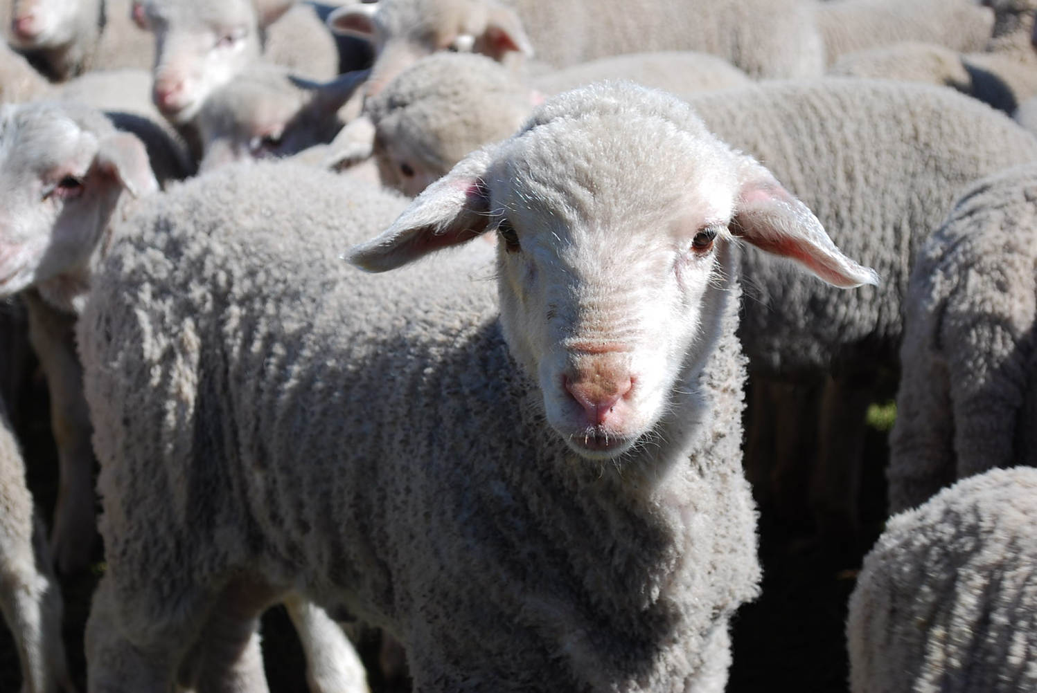
We are sheep.
Notes:
The animal that the Bible compares us to most is the sheep. Why do you think that is so?

Slide 11
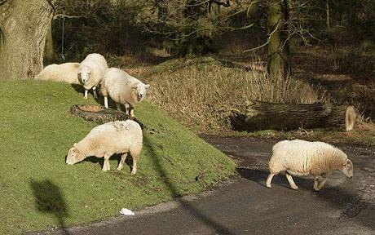
Sheep tend to stray.
Notes:
It’s because sheep easily lose their way—like us!

Slide 12
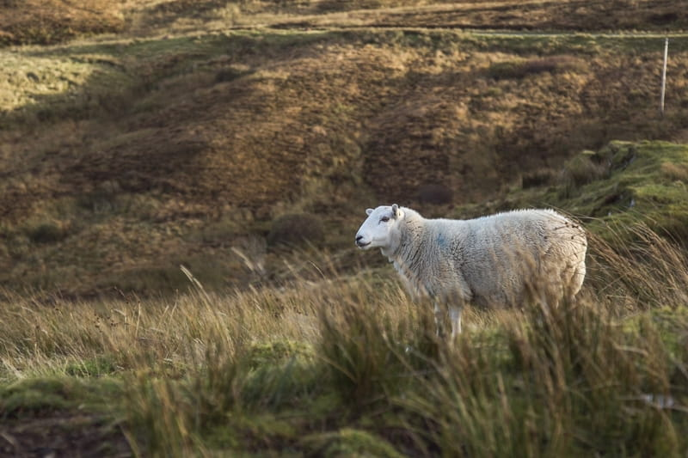
Lost sheep get lonely.
Notes:
Sheep are relational animals, so being away from the flock is lonely.

Slide 13
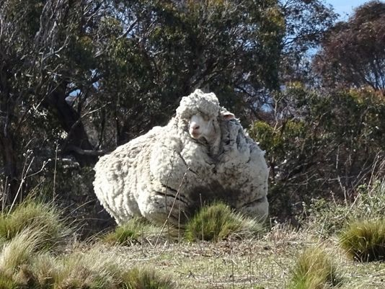
Sheep tend to return.
Notes:
Here is one sheep named Chris who was lost in Australia. He was found in 2015 by bushwalkers after about 6 years of wandering. As you can see from the heavy coat of 90 pounds (45 kilos)!

Slide 14
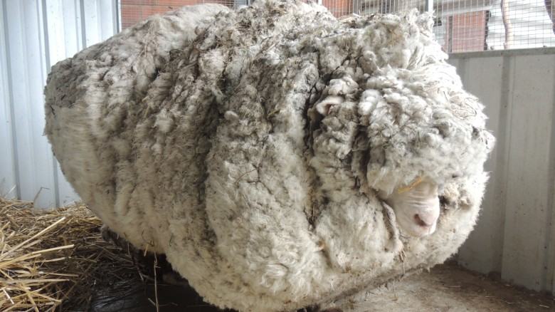
But straying has a price.
Notes:
The baggage from being away is quite a burden—for sheep as well as for people!
————————
Chris, the famously woolly sheep, has died
By Elizabeth Wolfe and Saeed Ahmed, CNN
Updated 1623 GMT (0023 HKT) October 22, 2019
Chris the sheep died in his home at the Little Oak Sanctuary.
(CNN)Chris the sheep lived a, shall we say, full and fluffy life, beloved by fans worldwide for his singular woolliness.
He died at his home at the Little Oak Sanctuary, where he had been living since his rise to fame in 2015.
While Chris should be appreciated for his many lovable qualities -- consider his kind eyes and gently sloping nose -- he became internationally celebrated after becoming the unofficial world record holder for having grown the heaviest fleece.
He was found outside of Australia's capital, Canberra, so overgrown with fleece that he could barely walk. Almost 90 lbs!
When he was found, Chris was carrying years worth of wool on his body, making it difficult for him to walk.
Little Oak Sanctuary, announced the legendary sheep's death on Tuesday in a Facebook post.
"We are heartbroken at the loss of this sweet, wise, friendly soul," said the post.
Little Oak Sanctuary made a point of looking at Chris as more than a spectacle and respecting him as a companion.
"He was so much more than this, so very much more," it said in the post. "And we will remember him for all that he was - someone, not something - here with us, not for us. RIP dear Chris."
Those wishing to mourn Chris's passing may visit his famous fleece on display at the National Museum of Australia.

Slide 15
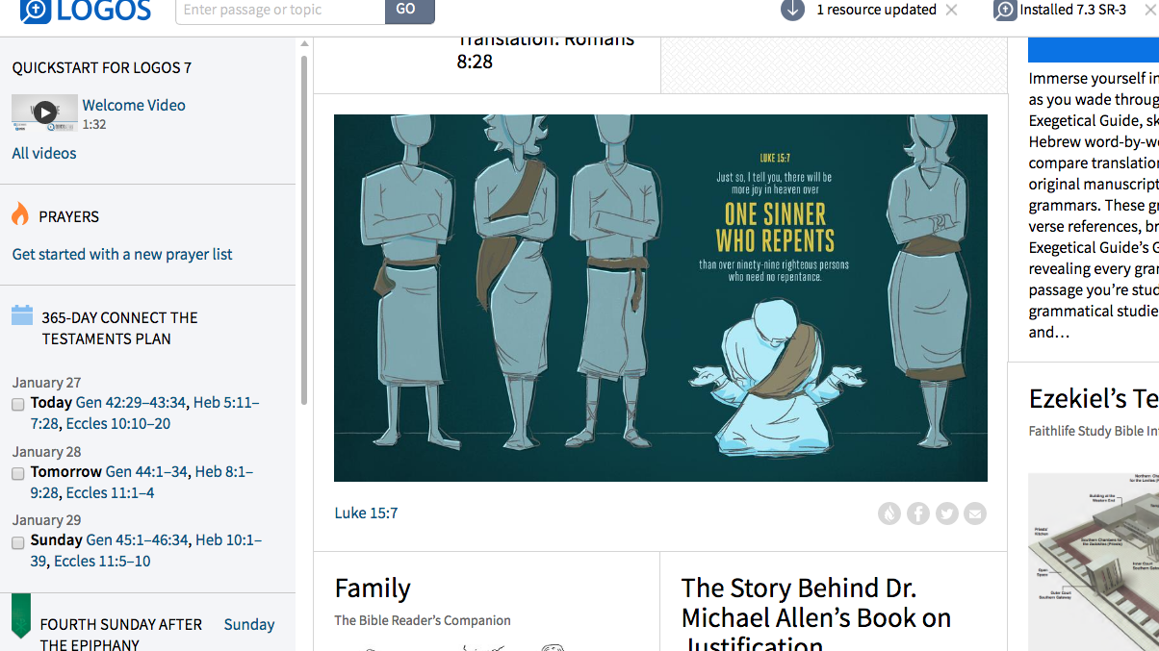
Luke 15:7
Just so, I tell you, there will be more joy in heaven over
ONE SINNER WHO REPENTS
than over 99 righteous persons who need no repentance.
Adapted from Logos Bible Software
Notes:
God values what people despise.

Slide 16
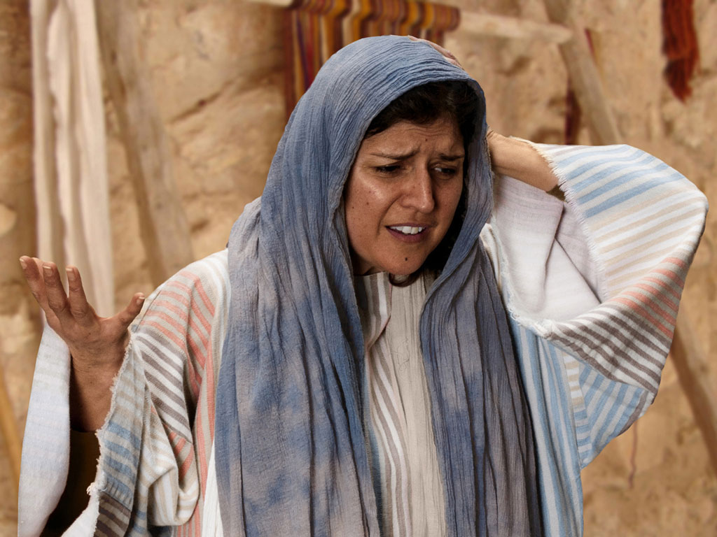

Free
Bible
images
THE PARABLE OF THE LOST COIN
Luke 15:8-10
Notes:
Luke's gospel is known for its many parables by Jesus.

Slide 17
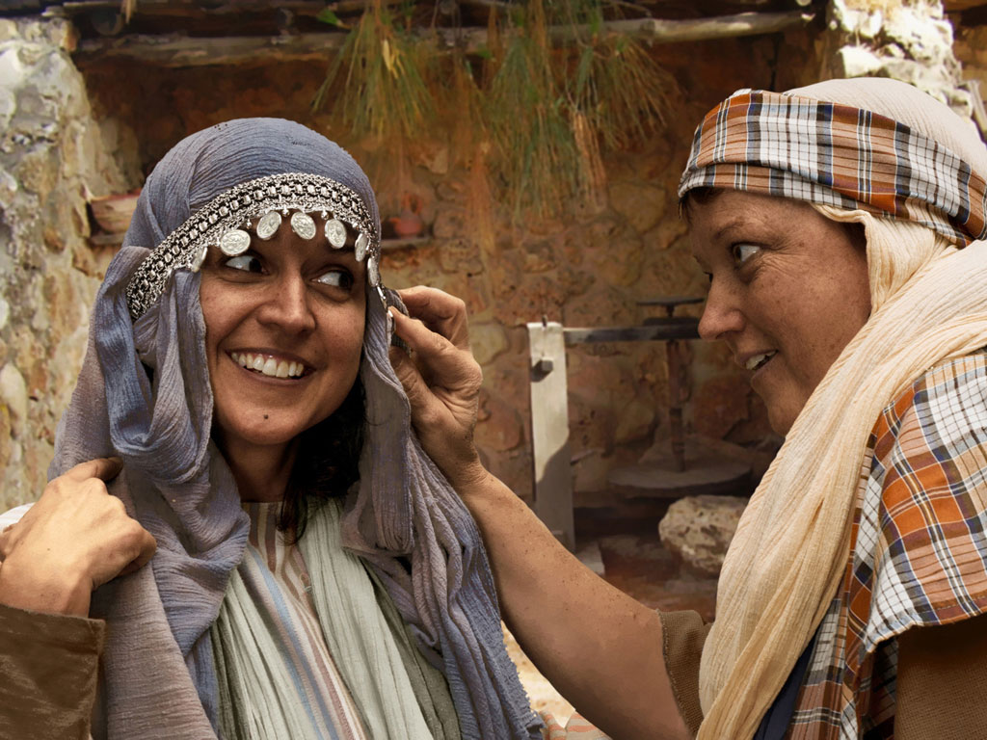
Notes:
Luke 15:8 Woman with 10 silver coins.
Most think that the silver coin (drachma) the woman lost was from the adornment of coins that women wore around her head and would have been her dowry. If so, it was a poor woman's dowry as a drachma was a day's salary for a peasant working for someone else. In the culture of the time, the loss of a coin from a dowry could represent unfaithfulness and this would bring real shame and disgrace to her family and husband.

Slide 18
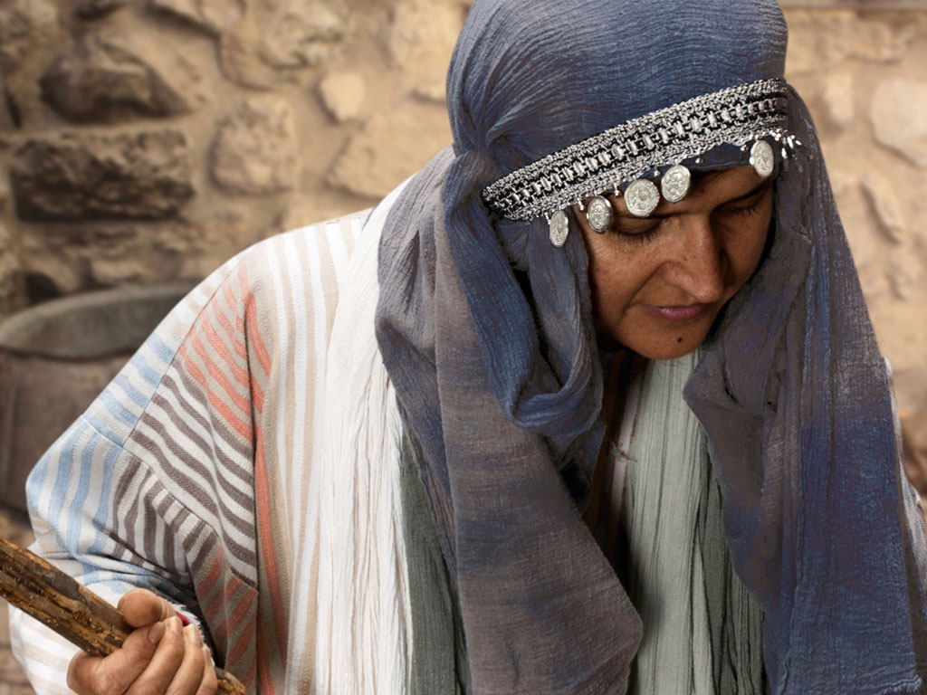
Notes:
Luke 15 v 8: Woman shown with coin missing.

Slide 19
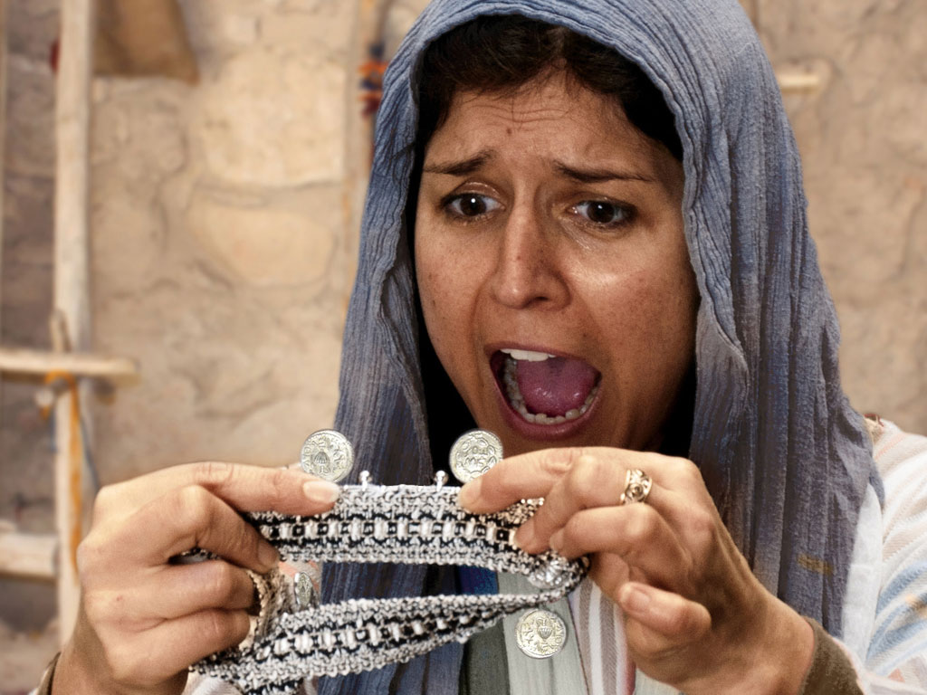
Notes:
Luke 15 v 8: Woman discovers a silver coin is missing.

Slide 20
Notes:
Luke 15 v 8: Woman wonders where she may have lost it.

Slide 21
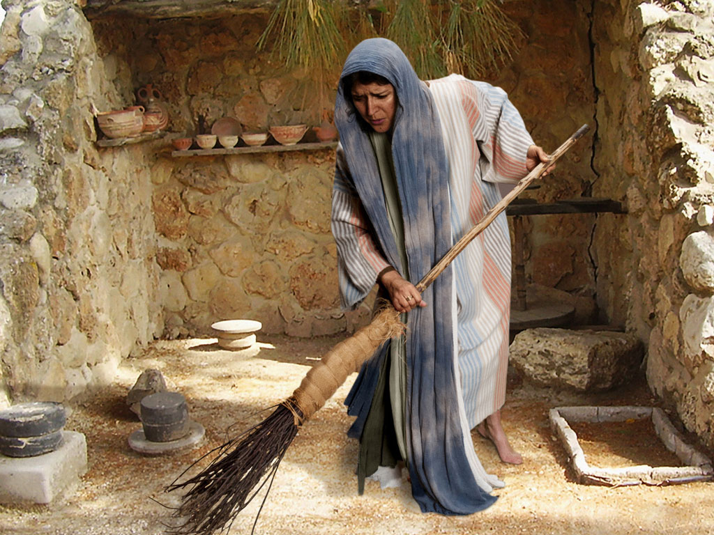
Notes:
Luke 15 v 8: Woman searches using broom.

Slide 22
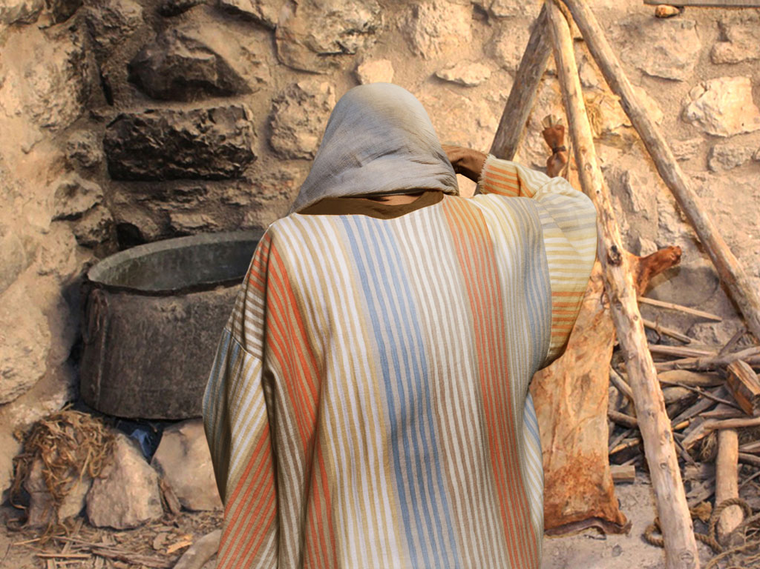
Notes:
Luke 15 v 8: Woman searches in courtyard.

Slide 23
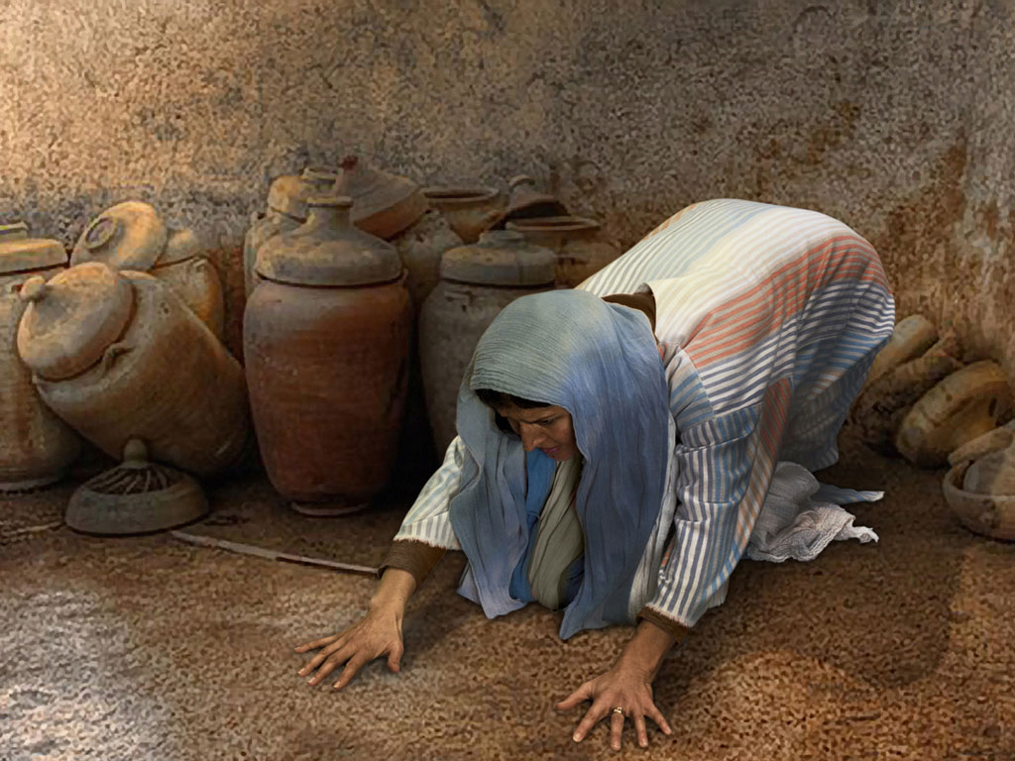
Notes:
Luke 15 v 8: Woman searches floor.

Slide 24
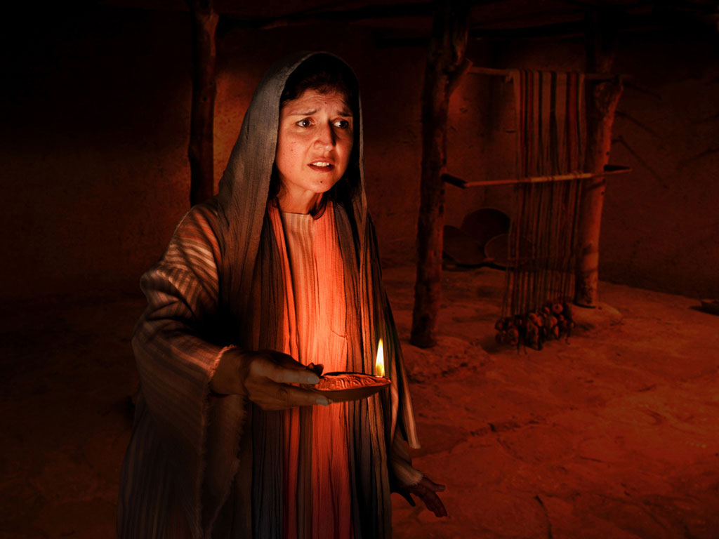
Notes:
Luke 15 v 8: Woman lights lamp and searches house. Many poor homes had very small windows and rooms were dark.

Slide 25
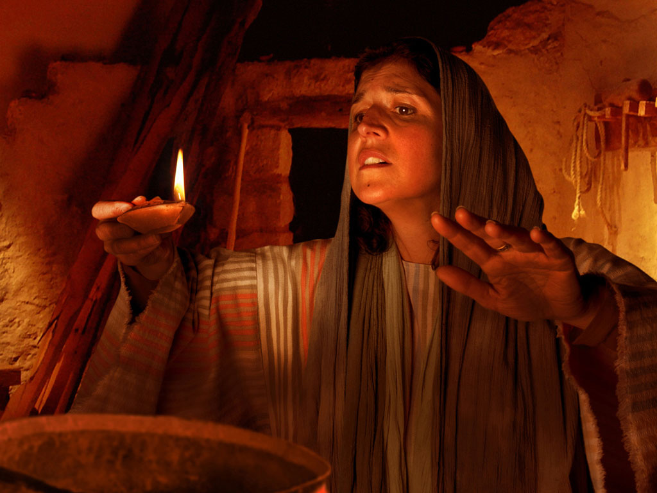
Notes:
Luke 15 v 8: Woman searches house by lamp light.

Slide 26
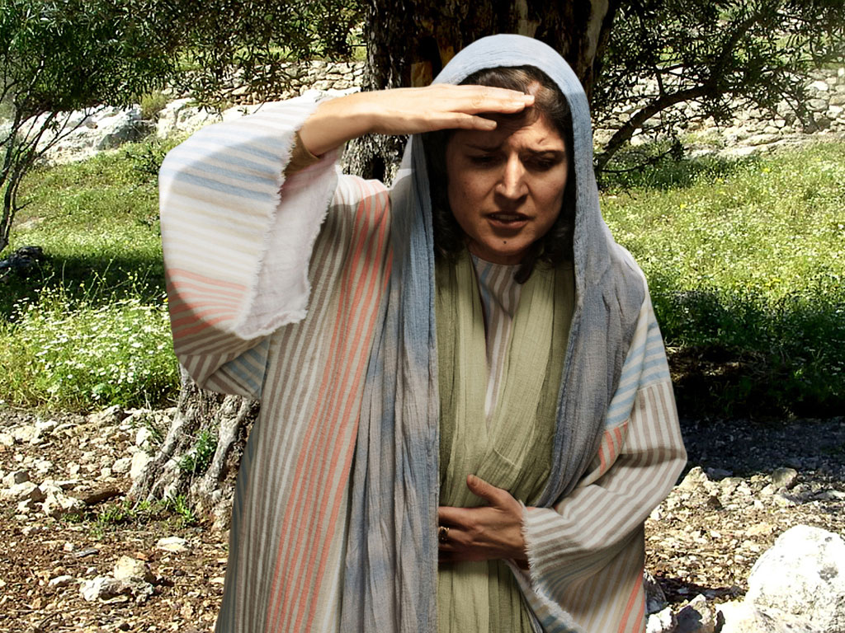
Notes:
Luke 15 v 8: Woman continues search.

Slide 27
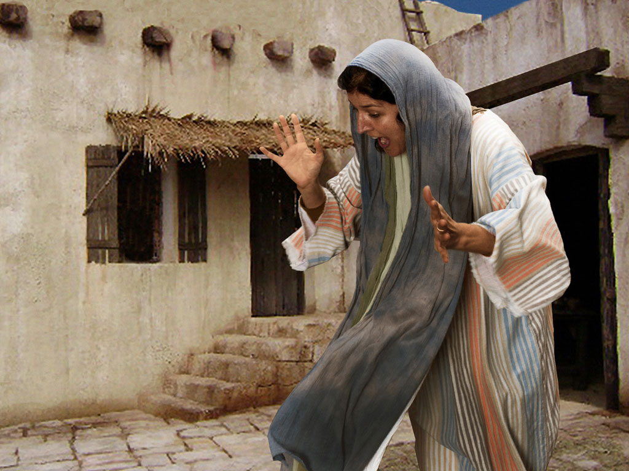
Notes:
Luke 15 v 9: Woman search is rewarded as she sees silver coin.

Slide 28
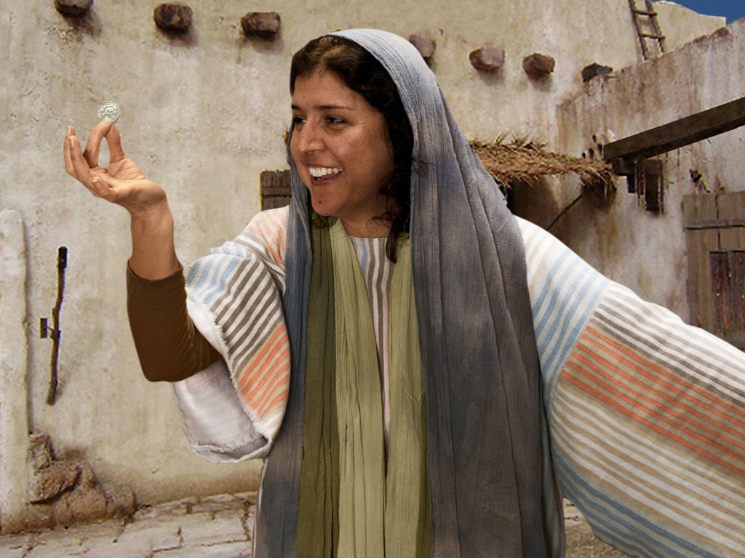
Notes:
Luke 15 v 9: Woman is full of joy as she finds coin.

Slide 29
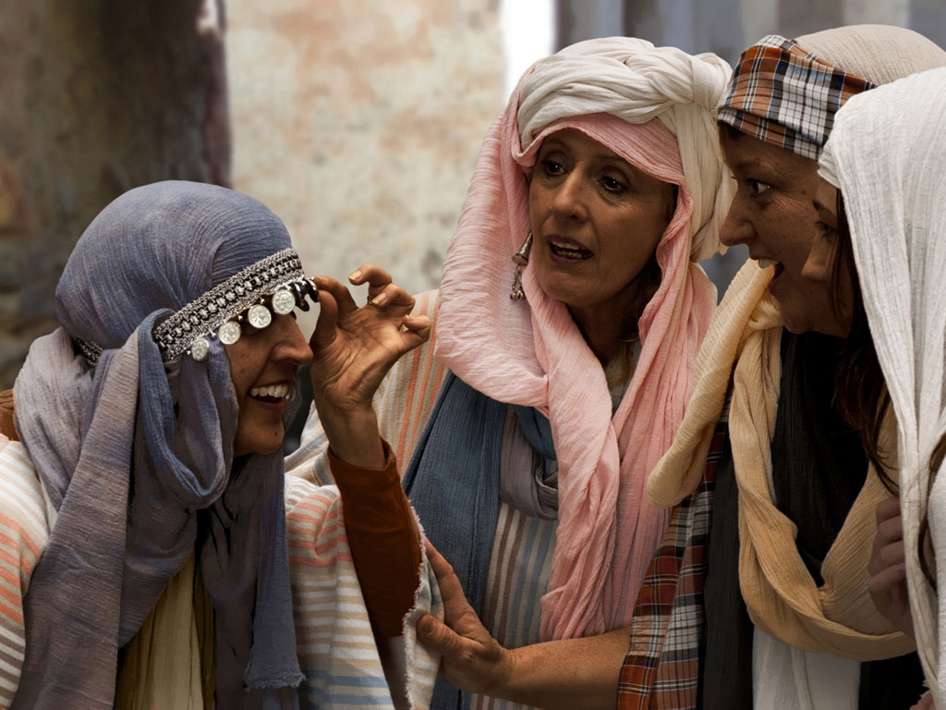
Notes:
Luke 15 v 9: Woman shares her good news with neighbours and friends.

Slide 30
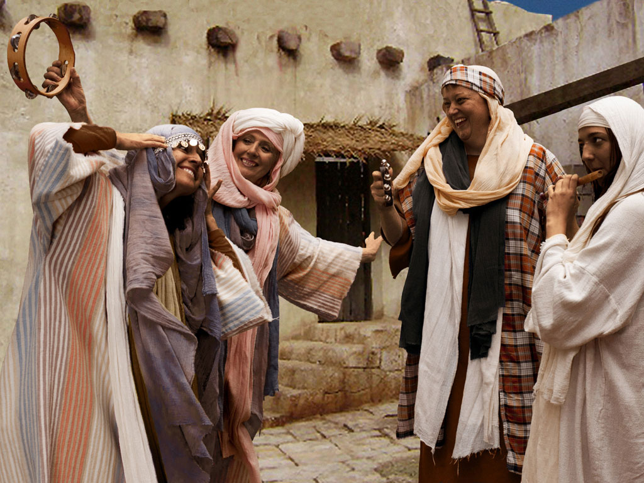
Notes:
Luke 15 v 9: Woman celebrates her good news with neighbours and friends. 'Rejoice with me; I have found my lost coin.'

Slide 31
THE WORD IN PICTURES
Free
Bible
images

Slide 32

FreeBibleimages would like to thank Peter Hutley and Wintershall Players for the use of their cast, costumes and facilities in creating these images.

Slide 33
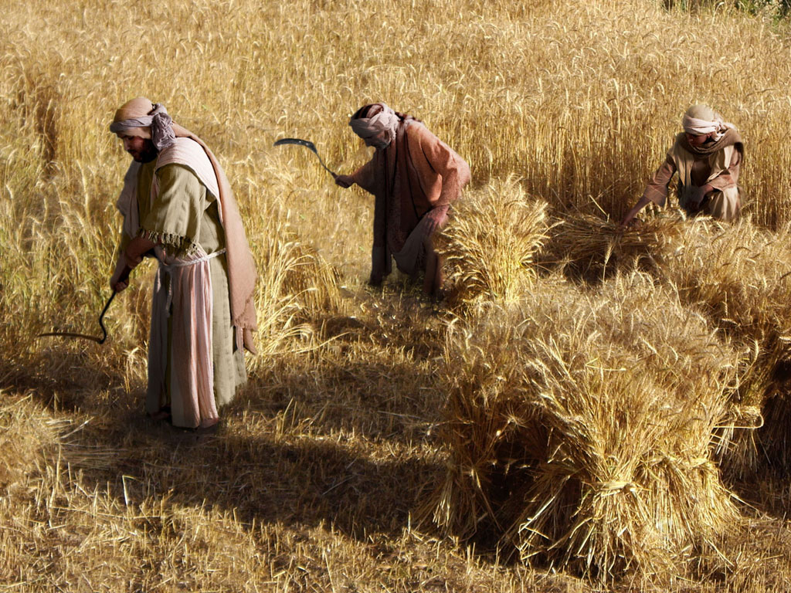
THE PARABLE OF THE TWO SONS (Prodigal Son)
Free
Bible
images
Luke 15:11-32

Slide 35
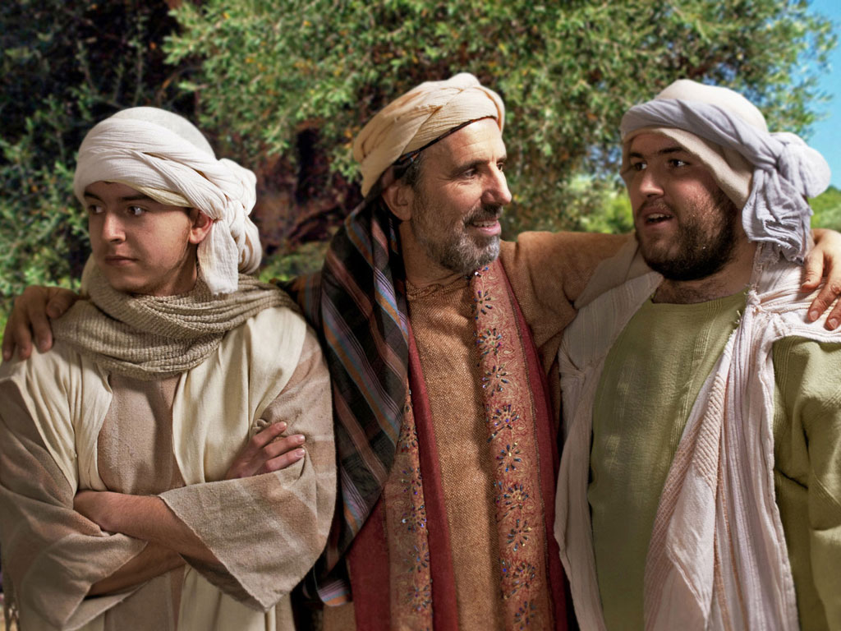

Slide 36
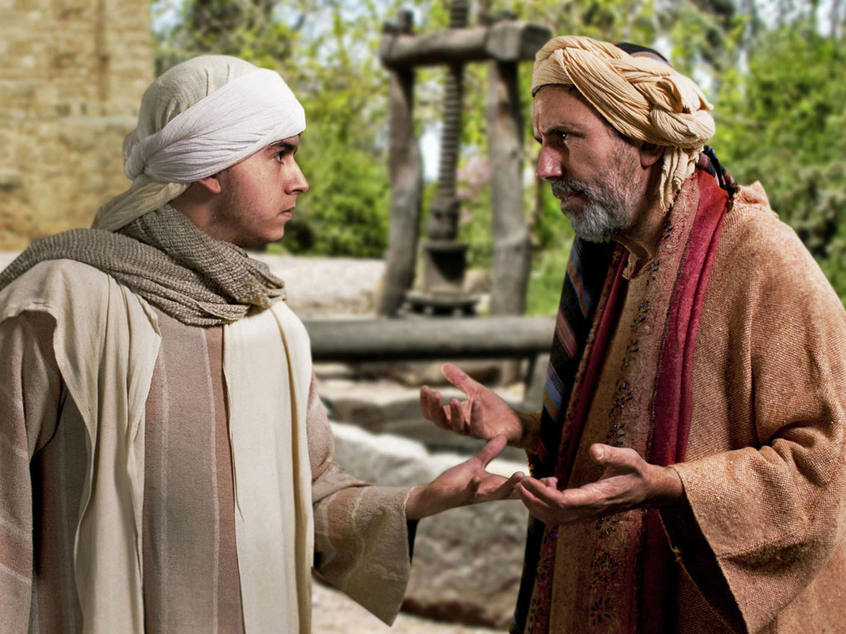

Slide 37
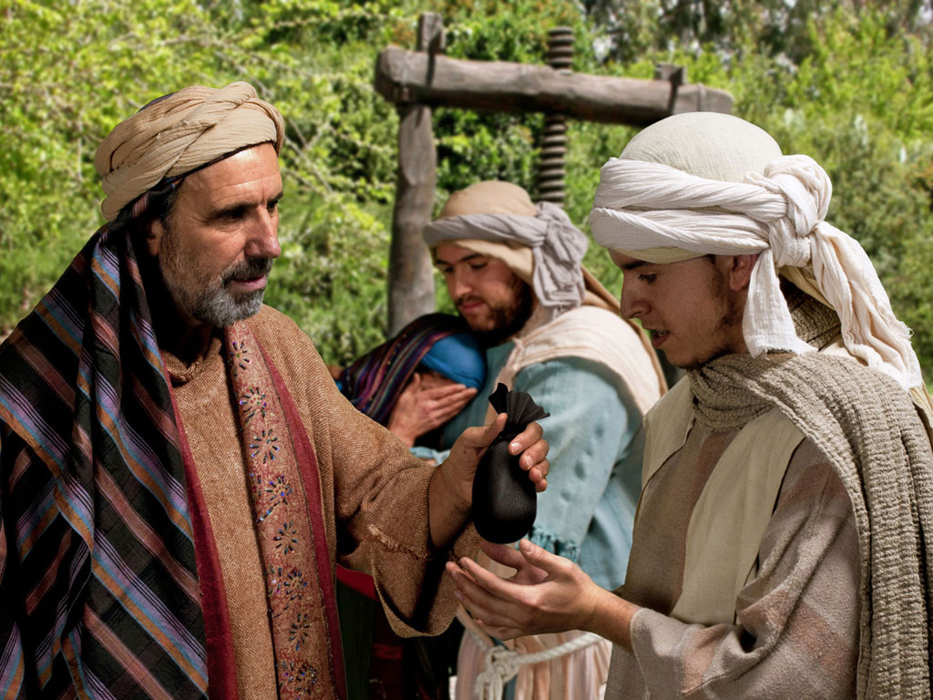

Slide 38
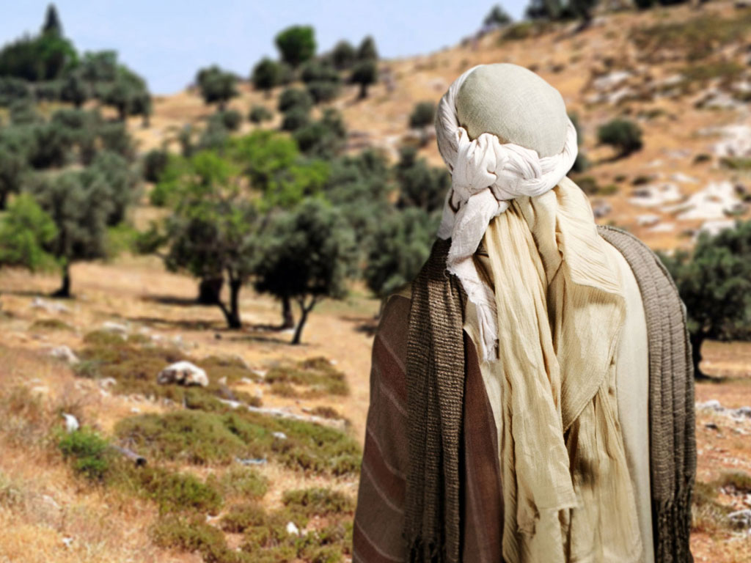

Slide 39
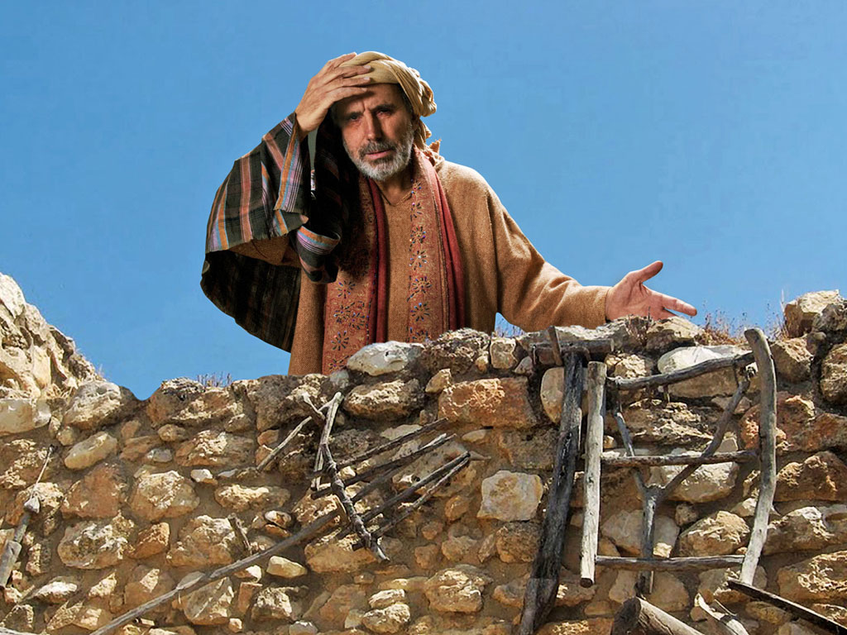

Slide 40
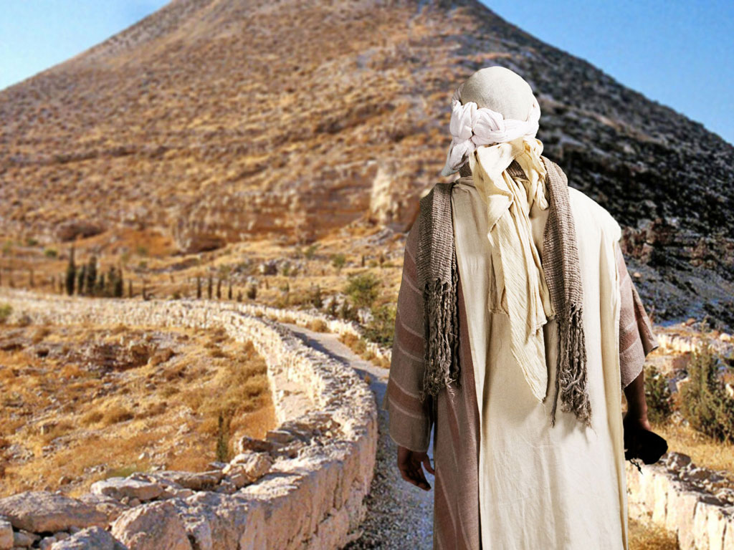

Slide 41
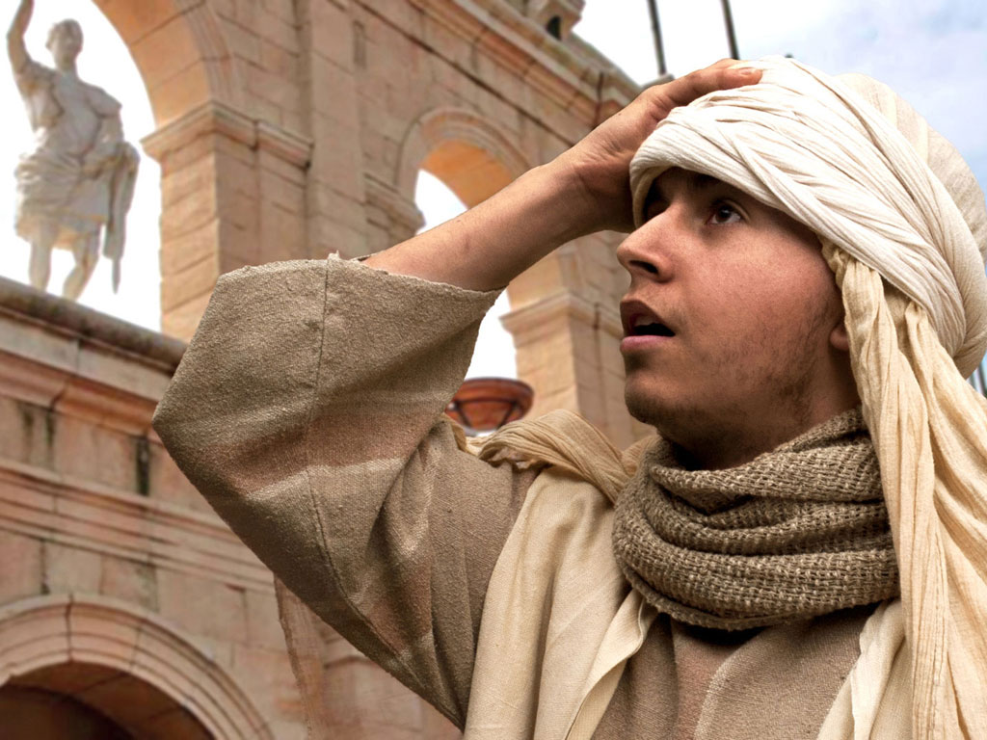

Slide 42
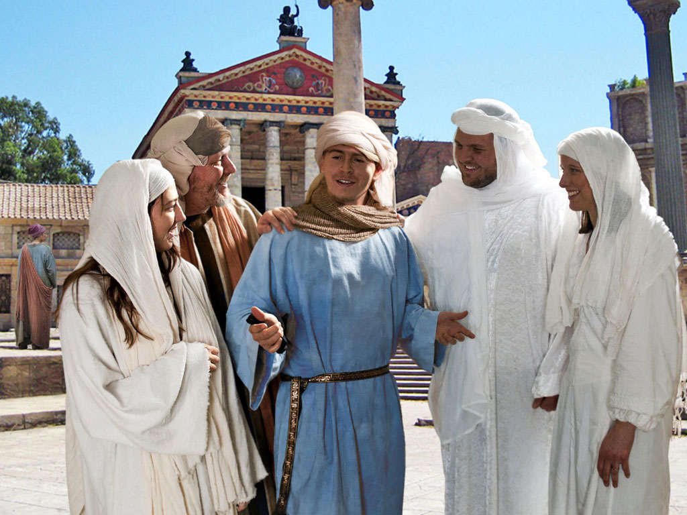

Slide 43
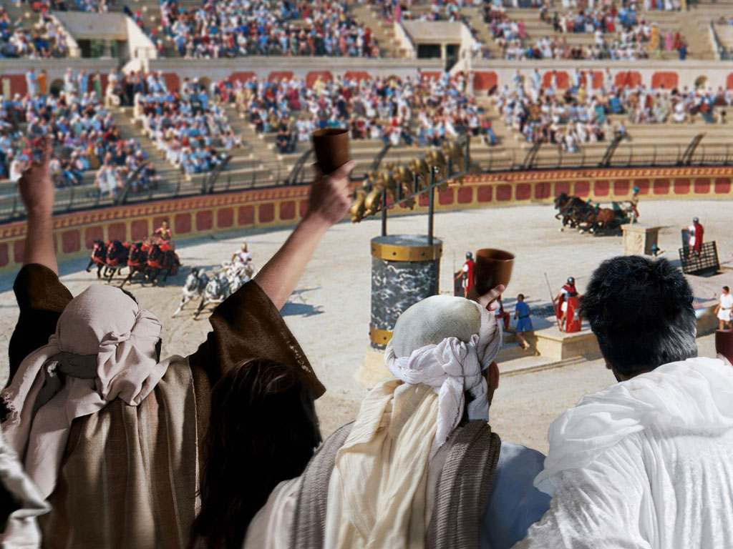

Slide 44
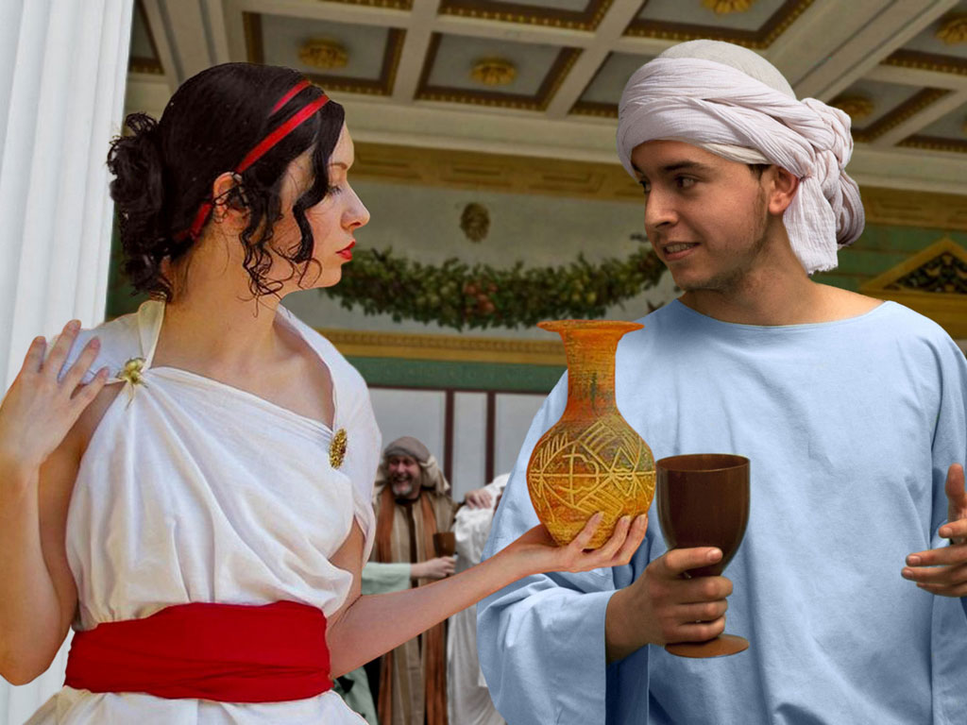

Slide 45
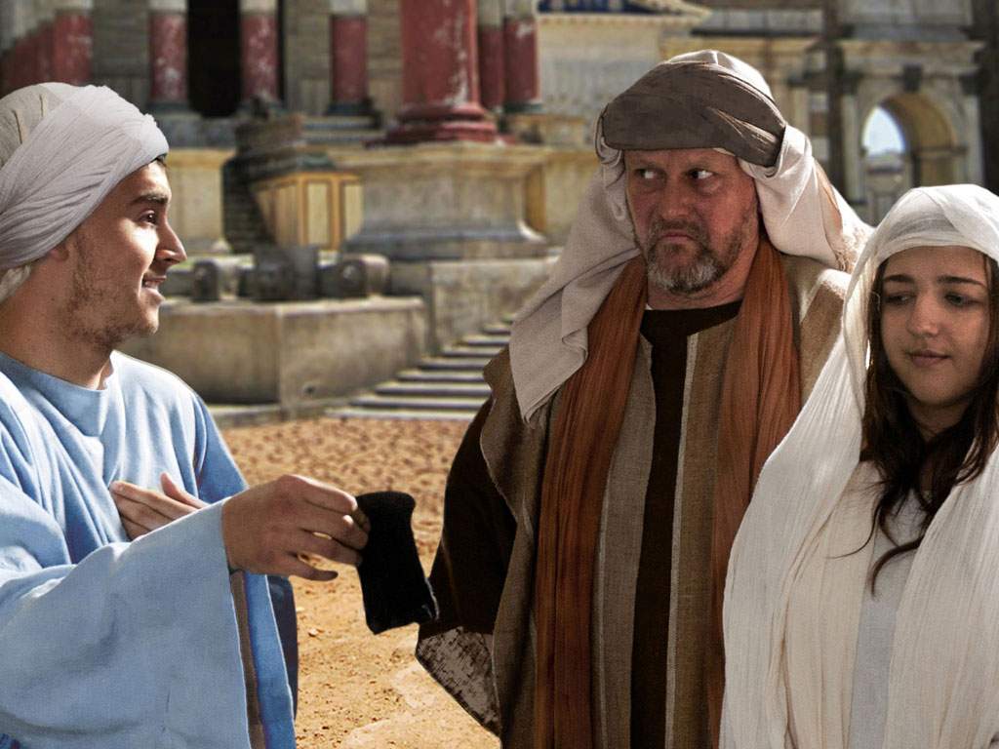

Slide 46
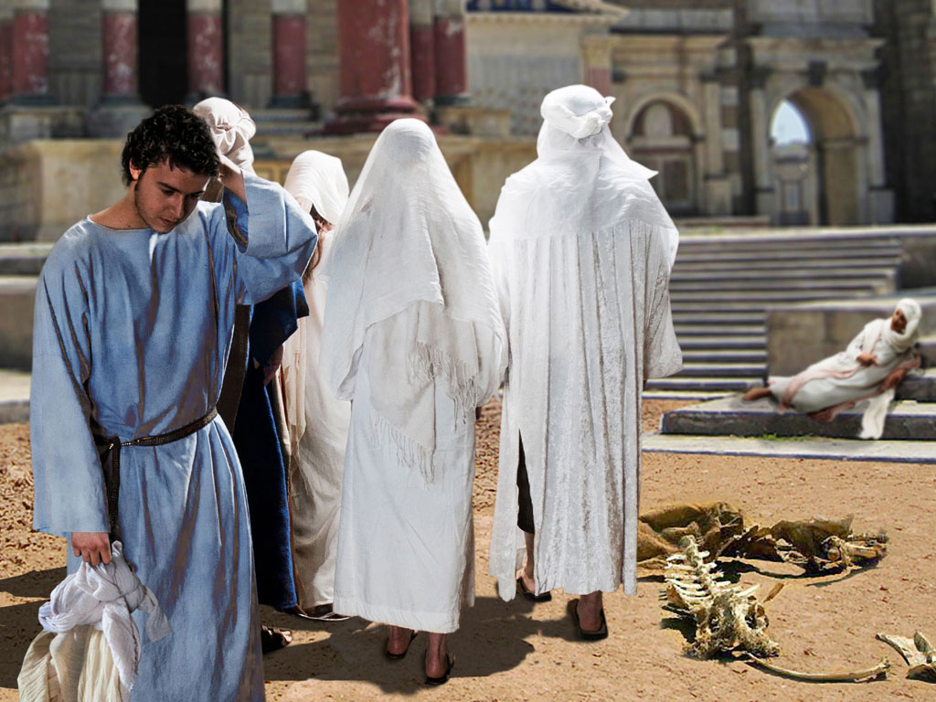

Slide 47
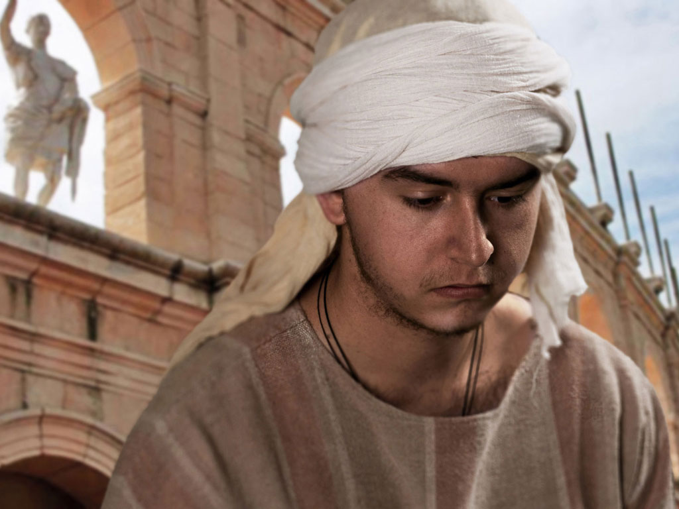

Slide 48
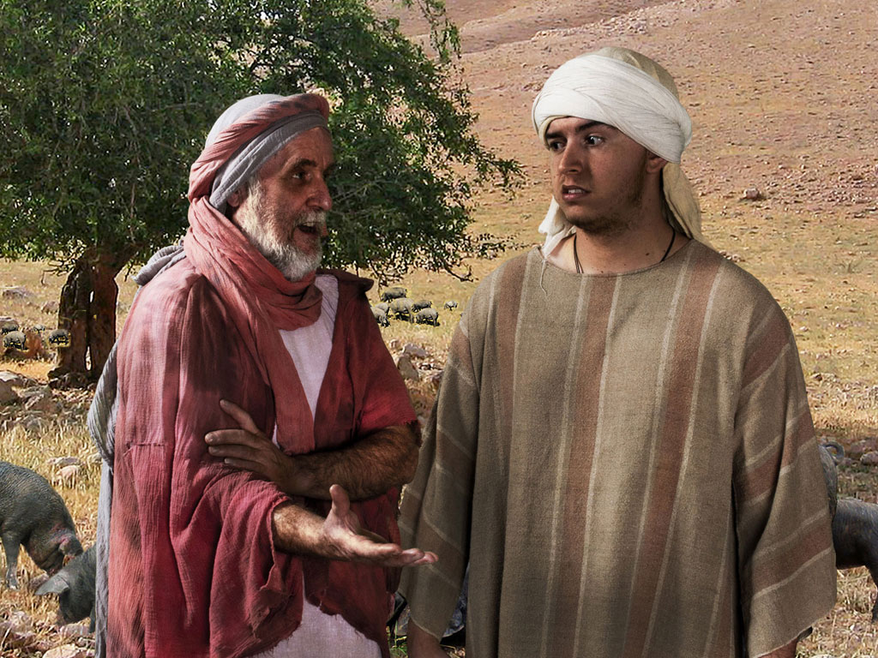

Slide 49
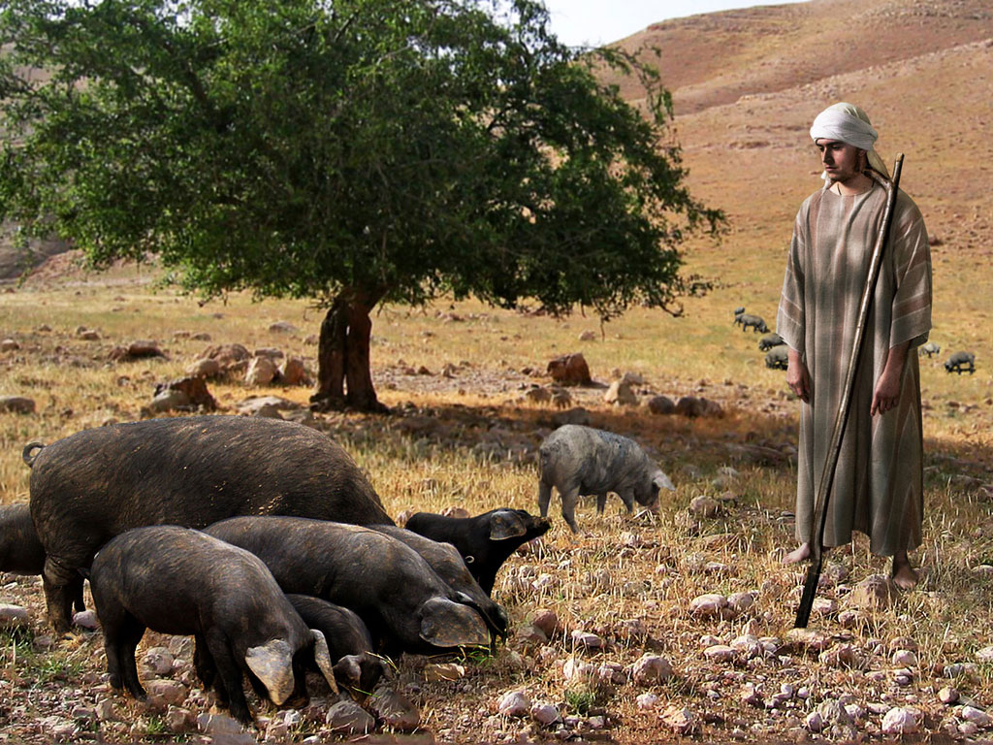

Slide 50
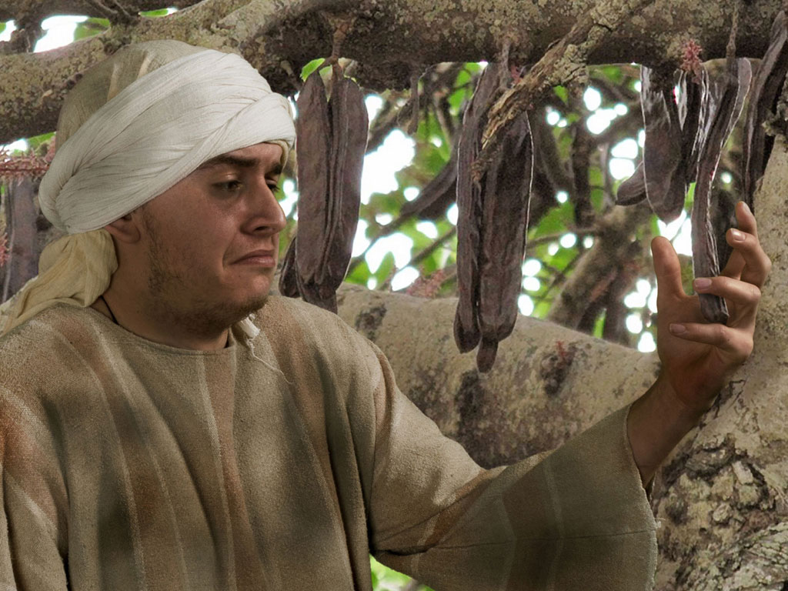

Slide 51
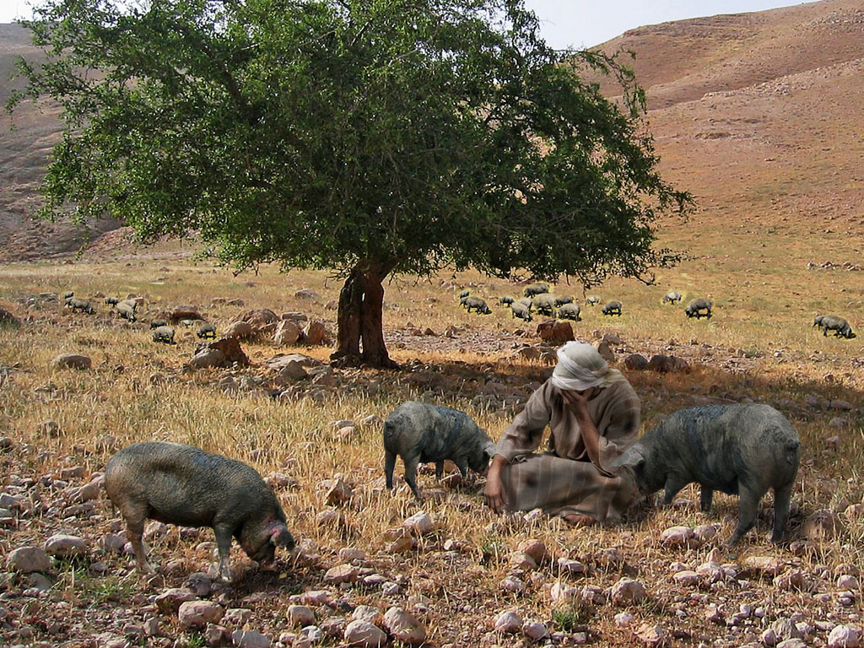

Slide 52
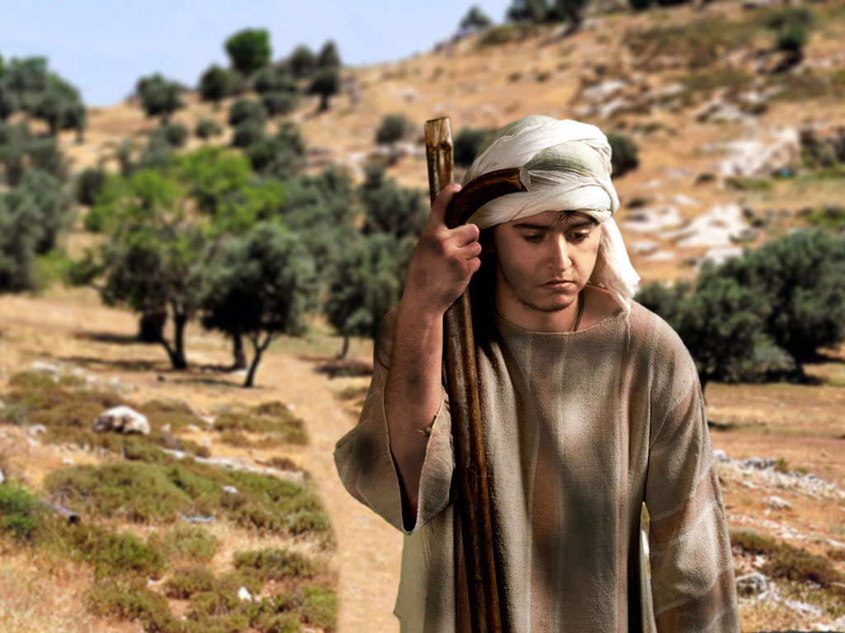

Slide 53
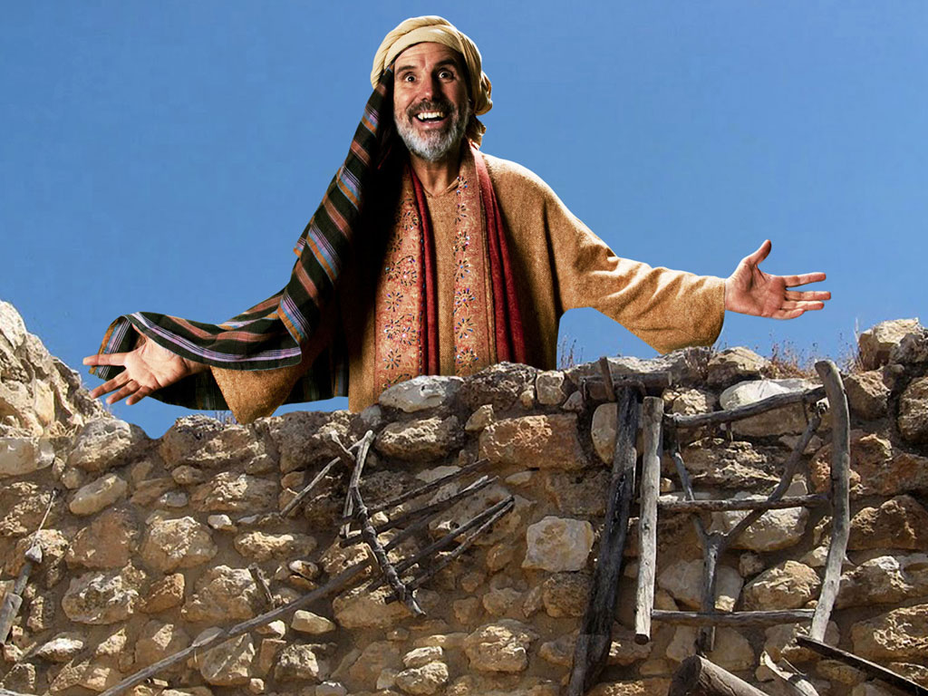

Slide 54
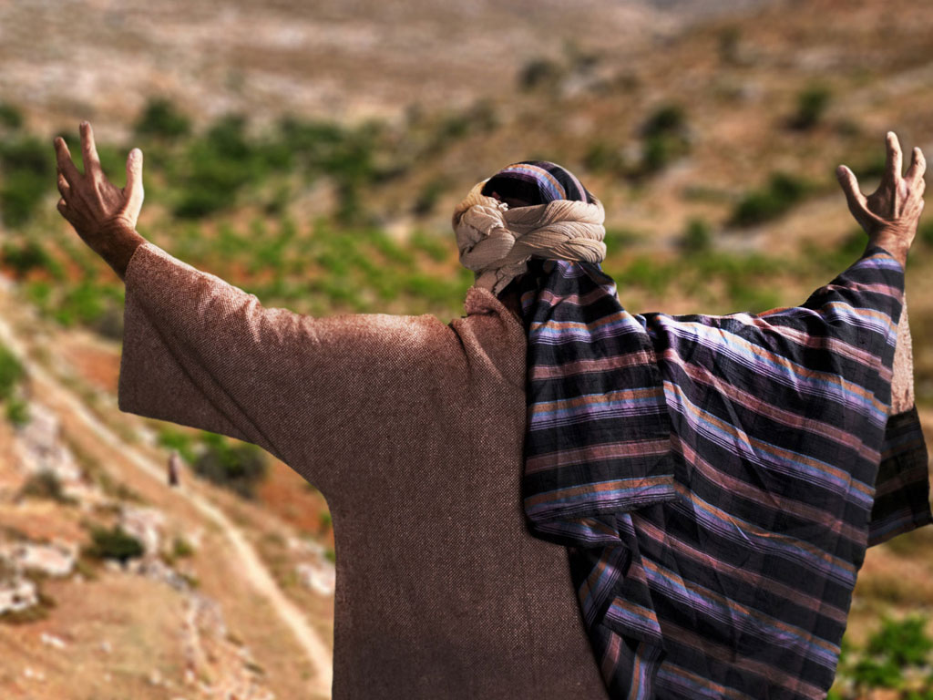

Slide 55
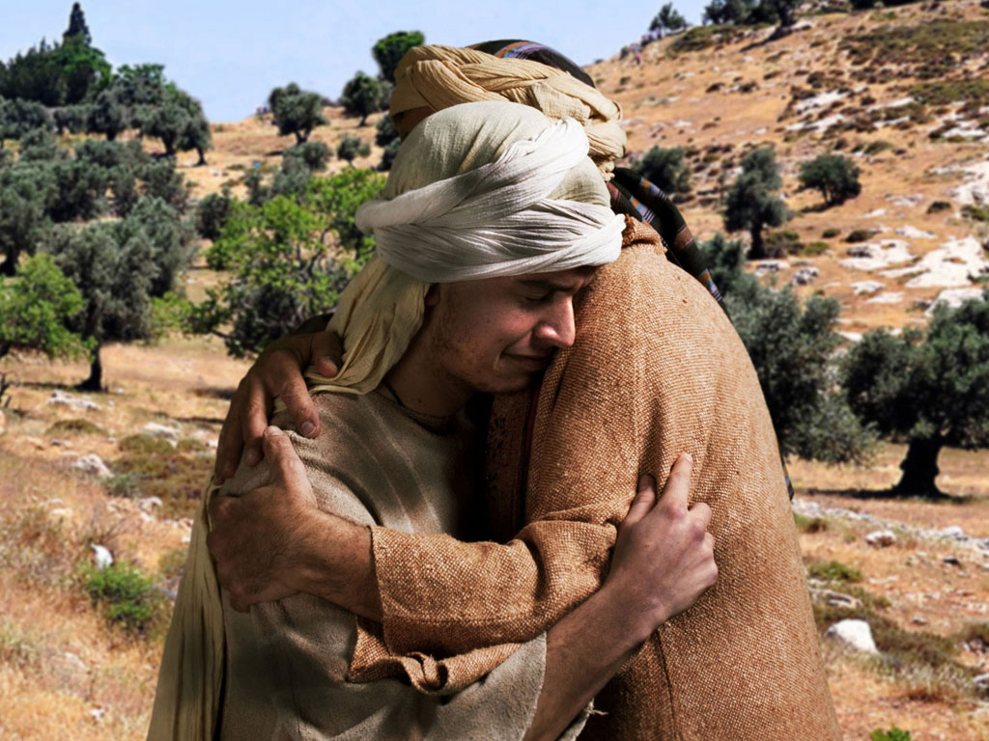

Slide 56
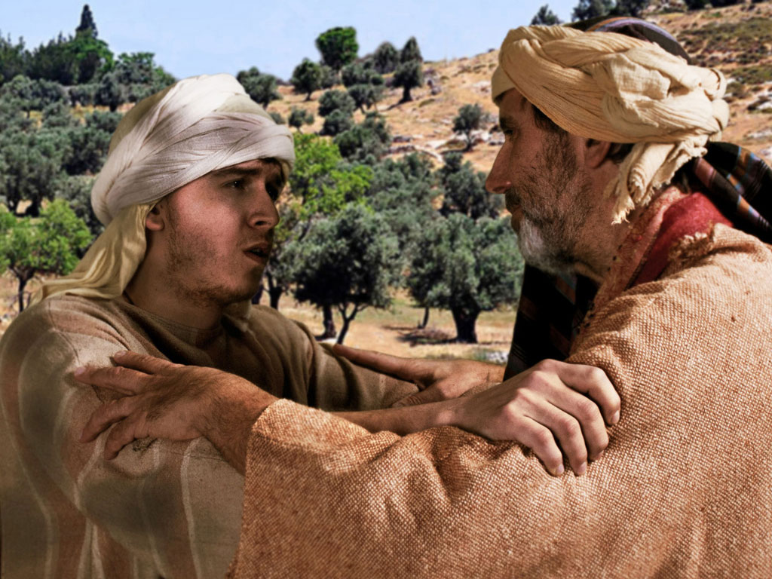

Slide 57
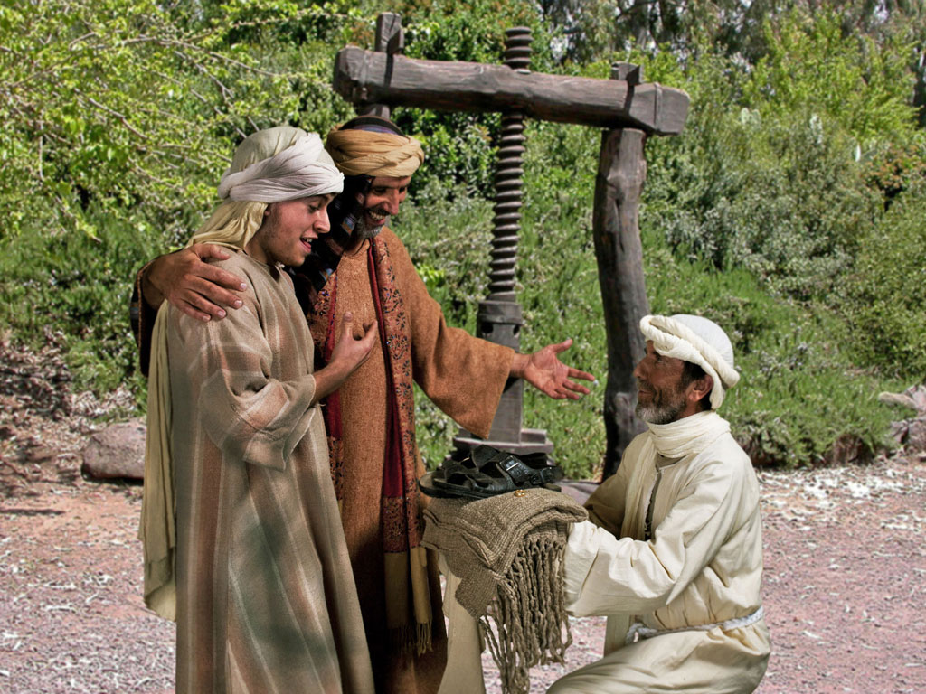

Slide 58
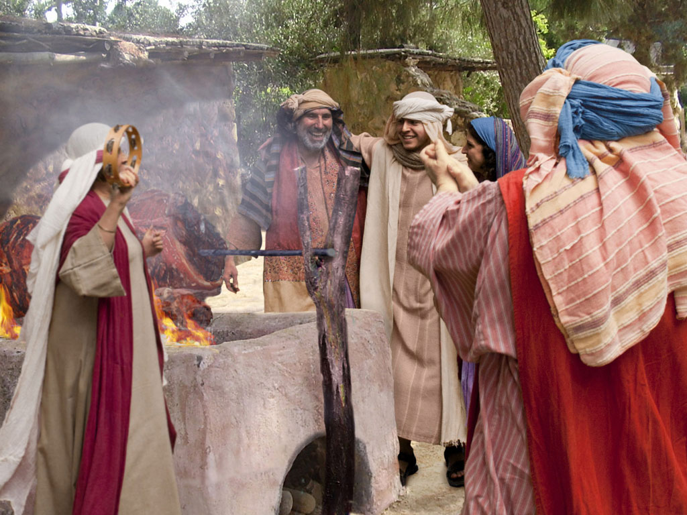

Slide 59
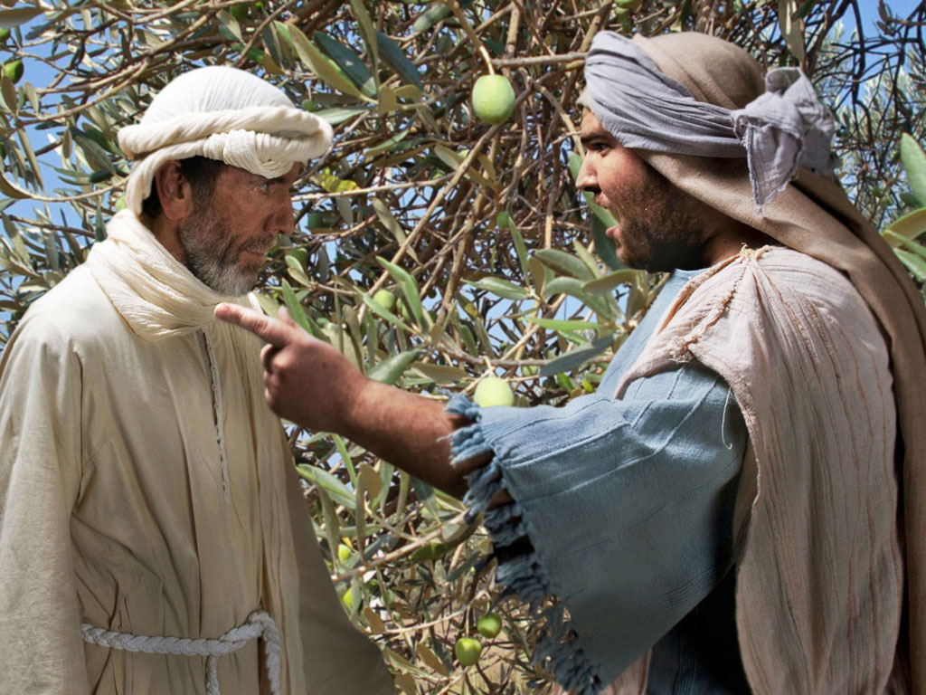

Slide 60
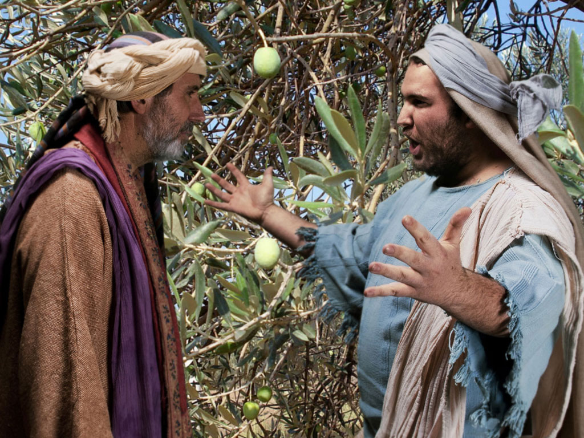

Slide 61
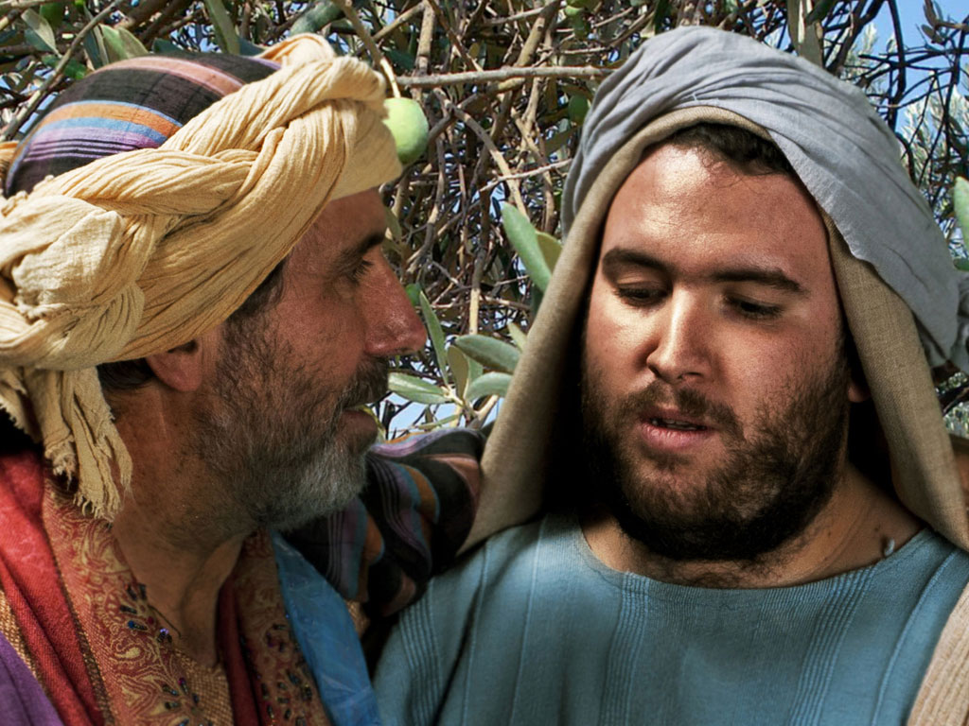

Slide 62
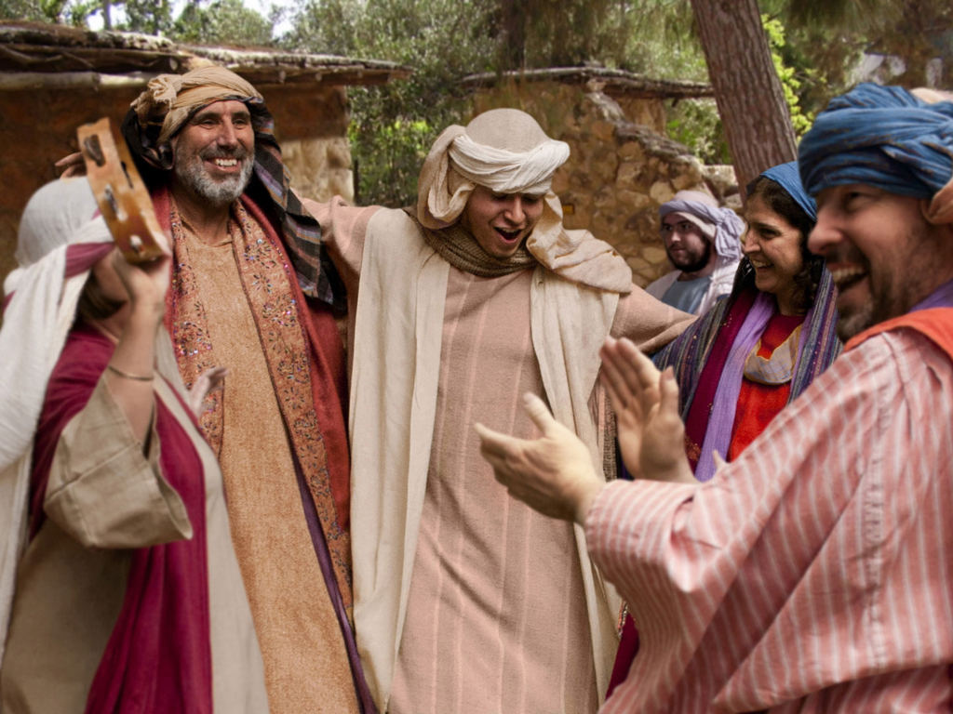

Slide 63
THE WORD IN PICTURES
Free
Bible
images

Slide 64
FreeBibleimages would like to thank Peter Hutley and Wintershall Players for the use of their cast, costumes and facilities in creating these images.

Slide 65
F. Instruction Concerning Wealth
§ 125
Luke 16:1-31
Invest in eternity rather than in temporal ventures as servants of God instead of imitating Pharisees who trust money as a basis for eternal security

Slide 66
G. Instruction Concerning Forgiveness
§ 126
Luke 17:1-6
Christ teaches that disciples can hate the teachings of Pharisees without hating these teachers themselves to help them come to Christ and also forgive other believers

Slide 67
H. Instruction Concerning Service
§ 127
Luke 17:7-10
Christ reminded His disciples that service for Him is never fulfilled so they would see that obedience is their minimal duty

Slide 68
I. The Raising of Lazarus
§ 128
John 11:1-54
Christ raises Lazarus from the dead to teach that resurrection and life are found only in Him, not in some program of God

Slide 69
1. The Miracle of Restoration
John 11:1-44
Christ restores life to Lazarus to confirm the faith of those who had already believed in Him

Slide 70
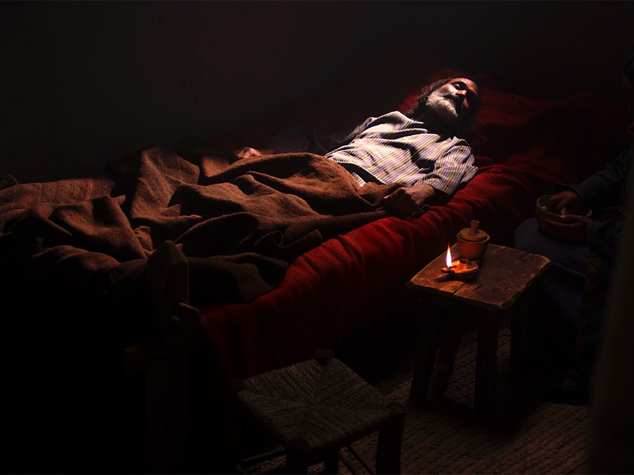
Free
Bible
images
John 11:1–12:2
JESUS RAISES LAZARUS

Slide 72

JESUS RAISES LAZARUS
(JOHN 11)
SAMARIA
PEREA
River Jordan
Jerusalem
Bethany
0 5 MILES
JUDEA
Salt Sea
0 8 KM
Notes:
Jews at the time of Jesus hated the Samaritans so much that they did not travel northward from Jerusalem through Samaria to get to the north. Instead, they traveled east through Bethany on the other side of the Mount of Olives and straight across the Jordan River to bypass Samaria. Bethany was the hometown of Lazarus and his sisters, Mary and Martha.
_______
LC-06-Preparation of the Disciples-73
NS-04-John1-11-slide 467

Slide 73


Slide 74


Slide 75


Slide 76


Slide 77


Slide 78


Slide 79


Slide 80


Slide 81
JESUS RAISES LAZARUS
(JOHN 11)
SAMARIA
PEREA
River Jordan
Jerusalem
Bethany
0 5 MILES
JUDEA
Salt Sea
0 8 KM
Notes:
Jesus received news that Lazarus was sick while Jesus was across the River Jordan. After he waited four days, he then headed toward Bethany.
_______
LC-06-Preparation of the Disciples-75
NS-04-John1-11-slide 476, 478

Slide 82


Slide 83
JESUS RAISES LAZARUS
(JOHN 11)
SAMARIA
PEREA
River Jordan
Jerusalem
Bethany
0 5 MILES
JUDEA
Salt Sea
0 8 KM
Notes:
Jesus received news that Lazarus was sick while Jesus was across the River Jordan. After he waited four days, he then headed toward Bethany.
_______
LC-06-Preparation of the Disciples-75
NS-04-John1-11-slide 476, 478

Slide 84


Slide 85


Slide 86


Slide 87


Slide 88


Slide 89


Slide 90


Slide 91


Slide 92


Slide 93


Slide 94


Slide 95


Slide 96


Slide 97


Slide 98


Slide 99


Slide 100


Slide 101


Slide 102


Slide 103


Slide 104


Slide 105


Slide 106


Slide 107


Slide 108


Slide 109


Slide 110

JESUS RAISES LAZARUS
SAMARIA
PEREA
Ephraim
River
Jordan
Jerusalem
Bethany
JUDEA
0
5 MILES
Dead Sea
0
8 KM
Notes:
_______
LC-06-Preparation of the Disciples-102
NS-04-John1-11-slide 505

Slide 111


Slide 112


Slide 113


Slide 114

JESUS RAISES LAZARUS
SAMARIA
PEREA
Ephraim
River
Jordan
Jerusalem
Bethany
JUDEA
0
5 MILES
Dead Sea
0
8 KM
Notes:
_______
LC-06-Preparation of the Disciples-106
NS-04-John1-11-slide 509

Slide 115


Slide 116


Slide 117

Used with Permission
THE
GOSPEL
——OF—— MATTHEW
THE
GOSPEL
——OF—— MARK
THE
GOSPEL
——OF—— LUKE
THE
GOSPEL
——OF—— JOHN
Due to the Lumo Project producing its own publishing material we regret to inform you that we cannot license our photos to other clients outside of freebibleimages.org.
These images are not licensed for reuse in video, epublishing or other media. Downloaded pictures and files cannot be redistributed through any other website than freebibleimages.org or used in any context where the accompanying message is undermining of the Christian faith and gospel.
Photos can only be used on educational presentations, blogs and social media, all of which should be accompanied with reference to www.LumoProject.com.
Picture courtesy of BBM
© All Rights Reserved.
www.bigbookmedia.com

Slide 118

Jesus, Mary & Martha (John 11)
Jesus loved these two sisters who lived in Bethany, close to Jerusalem (11:5).
They had already believed in Him
("Lord" in 11:3; cf. 11:27).
Mary later anointed Him for his burial in worship (11:2; cf. 12:1-8).

Slide 119

Martha (John 11)

Slide 120

Mary (John 11)

Slide 121

Martha & Mary (John 11)

Slide 122
Martha Contrasted with Mary in John 11
##
Issue | Martha | Mary
Approach to Jesus | Immediately went to find Jesus (20a)–private as a "doer" | Delayed and stayed at home (20b)–soon public (29) with more emotion
Words to Jesus | Blame but faith (21) | Blame but prostrate (32)
Words of doubt | Saw no hope of immediate rising (24, 39) | None
Notes:
Translators: Select all the black panels at once and move them to the side to translate the text underneath. Once translated, then move all the panels back as a group.

Slide 123
Martha Contrasted with Mary in John 11
##
Issue | Martha | Mary
Jesus' response | Tested her faith whether He could raise Lazarus (23), claimed to be the resurrection and life (25), and asked if she believed (26) | No testing her faith—He asks where the body was (34) then weeps (35)
Declarations of faith in Christ | Twice: Christ could heal (21) and "You are the Messiah… Son of God… from God" (27) | No declarations
Proof of faith | Still doubted by complaining of the smell of the body (39) while reaction of those consoling her not noted | Brought many with her who believed (45) but even some of them betrayed Jesus to the Pharisees (46)
Notes:
Translators: Select all the black panels at once and move them to the side to translate the text underneath. Once translated, then move all the panels back as a group.

Slide 124


Was Mary Magdalene the Woman with the Alabaster Jar?
The WOMAN
with the
ALABASTER JAR
Mary Magdalen and the Holy
Grail
No. In Luke she is not named but in the other gospels she is clearly Mary of Bethany
As featured in The
Da Vinci Code

Slide 125
2. Conflict Over the Miracle
John 11:45-54
The miracle of Lazarus' restoration confirms the disciples' faith, adds new believers, and moves the religious leaders to plan His death

Slide 126
J. Instruction Concerning Thankfulness
§ 129
Luke 17:11-19
Thankfulness of a cleansed leper against nine others exhorts gratitude in the disciples against Israel’s rejection despite blessings

Slide 127
K. Instruction Concerning His Coming
§ 130
Luke 17:20-37
Israel’s rejection of the kingdom and King among them would lead to Him suddenly returning to judge Israel at the Second Advent to take away the unsaved from the earth
Notes:
NLT Luke 17:20 One day the Pharisees asked Jesus, “When will the Kingdom of God come?”
Jesus replied, “The Kingdom of God can’t be detected by visible signs.
²¹ You won’t be able to say, ‘Here it is!’ or ‘It’s over there!’ For the Kingdom of God is already among you.”
Luke 17:22 Then he said to his disciples, “The time is coming when you will long to see the day when the Son of Man returns, but you won’t see it. ²³ People will tell you, ‘Look, there is the Son of Man,’ or ‘Here he is,’ but don’t go out and follow them. ²⁴ For as the lightning flashes and lights up the sky from one end to the other, so it will be on the day when the Son of Man comes. ²⁵ But first the Son of Man must suffer terribly and be rejected by this generation.
Luke 17:26 “When the Son of Man returns, it will be like it was in Noah’s day. ²⁷ In those days, the people enjoyed banquets and parties and weddings right up to the time Noah entered his boat and the flood came and destroyed them all.
Luke 17:28 “And the world will be as it was in the days of Lot. People went about their daily business—eating and drinking, buying and selling, farming and building— ²⁹ until the morning Lot left Sodom. Then fire and burning sulfur rained down from heaven and destroyed them all. ³⁰ Yes, it will be ‘business as usual’ right up to the day when the Son of Man is revealed. ³¹ On that day a person out on the deck of a roof must not go down into the house to pack. A person out in the field must not return home. ³² Remember what happened to Lot’s wife! ³³ If you cling to your life, you will lose it, and if you let your life go, you will save it. ³⁴ That night two people will be asleep in one bed; one will be taken, the other left. ³⁵ Two women will be grinding flour together at the mill; one will be taken, the other left.”
Luke 17:37 “Where will this happen, Lord?” the disciples asked.
Jesus replied, “Just as the gathering of vultures shows there is a carcass nearby, so these signs indicate that the end is near.”

Slide 128
L. Instruction Concerning Prayer
§ 131
Luke 18:1-14
Pray for the millennial kingdom despite its political aspects being delayed and because God forgave sin in Jesus as the Lamb of God

Slide 129
M. Instruction Concerning Divorce
§ 132
Matthew 19:1-12; Mark 10:1-12
Jesus says that God prohibits divorce except for adultery, and so avoids the Pharisee divorce debate and slandering Herod for marrying his brother's wife

Slide 130
N. Instruction Concerning Entrance Into the Kingdom
§ 133
Matt 19:13-15; Mark 10:13-16; Luke 18:15-17
Jesus blesses little children to illustrate to the disciples that confidence and trust in Christ are necessary to enter the kingdom

Slide 131
O. Instruction Concerning Eternal Life
§ 134
Matthew 19:16-20; 16; Mark 10:17-31;
Luke 18:18-30
Christ shows the impossibility of entering the kingdom through riches to refute the Pharisaical belief that material wealth indicates divine approval and eternal life

Slide 132

Free
Bible
images
A RICH YOUNG MAN QUESTIONS JESUS
Matthew 19:16-30; Mark 10:17-31; Luke 18:18-30
Notes:
"This man’s question indicated that he viewed eternal life as something to be achieved by doing good (in contrast with Mark 10:15; cf. Matt. 19:16) and also that he felt insecure about his future destiny. References to eternal life (mentioned in Mark only in 10:17, 30), “entering God’s kingdom” (vv. 23-25), and being “saved” (v. 26) all focus on the future possession of life with God, though a person enters it now by accepting God’s rule in his earthly life. John’s Gospel emphasizes the present possession of eternal life."
John D. Grassmick, Mark *(The Bible Knowledge Commentary; eds. John F. Walvoord and Roy B. Zuck; Accordance electronic ed. 2 vols.; Wheaton: Victor Books, 1983), 2:150.

Slide 133

Notes:
Mark 10:17 As Jesus was starting out on his way to Jerusalem, a man came running up to him, knelt down, and asked, “Good Teacher, what must I do to inherit eternal life?”
———————
"His question was specifically, “what must I do to inherit eternal life?” In Jewish understanding,
to “inherit eternal life” was to be resurrected and accepted for entrance into the messianic kingdom
of the future (cf. Dan 12:2; 2 Macc 7:9).
5 Notice Mark 10:30 in which Jesus spoke of “eternal life”
in the “age to come.” So “to inherit eternal life” was an equivalent expression for entering the
kingdom of God, referred to elsewhere as “inheriting the kingdom” (cf. Mt 25:34; 1 Cor 6:9, 10;
15:50; Gal 5:21). The NT is very clear that one can only do this by humbly coming to Jesus with a
child-like faith in order to be born again (Mk 10:15; John 3:3; Col 1:13-14). The young man’s
question in Mark 10:17, however, gives him away that he does not understand the right approach,
for he asks, “what must I do?” The NT is clear that there is not anything we can “do” to merit
eternal life. Receiving God’s forgiveness and eternal life do not come because of what we “do,” but
only as a free gift of God’s grace."
—Paul Tanner, Following the Master (BEE World), 144

Slide 134

Notes:
Mark 10:18 “Why do you call me good?” Jesus asked. “Only God is truly good.

Slide 135

Notes:
Mark 10:19 But to answer your question, you know the commandments: ‘You must not murder. You must not commit adultery. You must not steal. You must not testify falsely. You must not cheat anyone. Honor your father and mother.’"
————————
Jesus sought to show him that he was not good after all by having him evaluate himself by the Ten Commandments.

Slide 136

Notes:
Mark 10:20 “Teacher,” the man replied, “I’ve obeyed all these commandments since I was young.”
——————————
This shows that the man was self-deluded that he was the only person in the world who was good! He should have known Isa 64:6, “all our so-called righteous acts are like a menstrual rag in your sight.”

Slide 137

Notes:
Mark 10:21 Looking at the man, Jesus felt genuine love for him.

Slide 138
Notes:
Mark 10:21 “There is still one thing you haven’t done,” he told him.

Slide 139

Notes:
Mark 10:21 “Go and sell all your possessions and give the money to the poor, and you will have treasure in heaven. Then come, follow me.”

Slide 140

Notes:
Mark 10:22 At this the man’s face fell, and he went away sad, for he had many possessions.

Slide 141

Notes:
Mark 10:23 Jesus looked around and said to his disciples, “How hard it is for the rich to enter the Kingdom of God!” ²⁴ This amazed them. But Jesus said again, “Dear children, it is very hard to enter the Kingdom of God. ²⁵ In fact, it is easier for a camel to go through the eye of a needle than for a rich person to enter the Kingdom of God!”
Mark 10:26 The disciples were astounded. “Then who in the world can be saved?” they asked.

Slide 142

Notes:
Mark 10:27 Jesus looked at them intently and said, “Humanly speaking, it is impossible. But not with God. Everything is possible with God.”
Mark 10:28 Then Peter began to speak up. “We’ve given up everything to follow you,” he said.
Mark 10:29 “Yes,” Jesus replied, “and I assure you that everyone who has given up house or brothers or sisters or mother or father or children or property, for my sake and for the Good News, ³⁰ will receive now in return a hundred times as many houses, brothers, sisters, mothers, children, and property—along with persecution. And in the world to come that person will have eternal life. ³¹ But many who are the greatest now will be least important then, and those who seem least important now will be the greatest then.”

Slide 143
Used with Permission
THE
GOSPEL
——OF—— MATTHEW
THE
GOSPEL
——OF—— MARK
THE
GOSPEL
——OF—— LUKE
THE
GOSPEL
——OF—— JOHN
Due to the Lumo Project producing its own publishing material we regret to inform you that we cannot license our photos to other clients outside of freebibleimages.org.
These images are not licensed for reuse in video, epublishing or other media. Downloaded pictures and files cannot be redistributed through any other website than freebibleimages.org or used in any context where the accompanying message is undermining of the Christian faith and gospel.
Photos can only be used on educational presentations, blogs and social media, all of which should be accompanied with reference to www.LumoProject.com.
Picture courtesy of BBM
© All Rights Reserved.
www.bigbookmedia.com

Slide 144
P. Instruction Concerning His Death
§ 135
Matt 20:17-28; Mark 10:32-45; Luke 18:31-34
Christ announces His coming death and resurrection to His disciples to instruct them about the importance of being servants rather than lords

Slide 145
Q. Instruction Concerning Israel's Need
§ 136
Matt 20:29-34; Mark 10:46-52; Luke 18:35-43
Jesus heals two blind men as illustrations of Israel's spiritual blindness and His ability to help the nation see if it would turn to Him in faith

Slide 146
R. Instruction Concerning the Kingdom Program
§ 137
Luke 9:1-28
Christ reiterates the delay of the millennial kingdom but also encourages any individual trusting in His person that his entrance into eternal life is guaranteed
Notes:
_____________
LC-06-Preparation of the Disciples-146
NS-03-Luke13-24—slide 74

Slide 147
1. A Lesson in Personal Faith
Luke 19:1-10
Christ accepts the corrupt but repentant Zacchaeus to show that He would forgive anyone who places faith in Him, thus allowing them to enter the kingdom by simple faith

Slide 148
2. Instruction Concerning the Delayed Kingdom
Luke 19:11-28
The parable of the man of noble birth teaches the delay of the millennial kingdom until Christ returns at the Second Advent to judge Israel

Slide 149


Time Periods of the Prophets
Isaiah:
442
7–8
39–40
52–53
2, 11
25:8
New Heavens & New Earth
Christ's Second Coming to Reign in Millennium
Christ's First Coming to Suffer
Exile & Return
Prophet's Own Time
Adapted significantly from Salem Kirban, Charts on Revelation (1979), 49
Notes:
The prophets often looked to the future but did not know how far their prophecies referred. It is like a person standing on a mountain looking into the distance and seeing what appears to be the same mountain. However, the person standing at these same mountains from the side can see significant gaps between the peaks. Such is the viewpoint that we have thousands of years later. There generally existed five time periods, including the prophet’s era. Isaiah especially prophesied of each of these periods in the chapters above.
During the ministry of Jesus, like Isaiah, his hearers understandably could not see that the kingdom would come in stages. Israel rejected Jesus and the kingdom at his first coming, thus delaying the full benefits of the kingdom by initiating only its spiritual aspects in our present Church Age. But at the return of Christ, the nation of Israel will finally believe in him (Rom 11:26-27) and reign in the millennium (Rev 5:9; 20:4-6).
____________
Common-334
BE-31-Obadiah-64
LC-06-Preparation of the Disciples-147
NS-03-Luke13-24—slide 75
OS-OT_Book_Overviews-782_pp42a_and_347a-613
OS-23-Prophets_Introduction-19
OS-23-Isaiah1-12—slide 362
OS-31-Obadiah-13

Slide 150
Premillennialism
473
Second Coming
Second Advent
=
Tribulation
Millennium
Church Age
Eternal Kingdom
7 years
1000 years
Judgment
Judgment
Notes:
150
Premillennialism teaches that Jesus will return BEFORE the millennium. This means that there will be at least TWO judgments before and after these 1000 years. All Premillennialists teach a Tribulation Period just before his Second Coming.
_________
Common-328
NS-03-Luke13-24—slide 76
LC-06-Preparation of the Disciples-149
OS-23-Isaiah1-12-slide 50

Slide 151
Black

Slide 152


Life of Christ link at BibleStudyDownloads.org
Get this presentation for free!
Notes:
NT Survey (ns)

