Slide 1
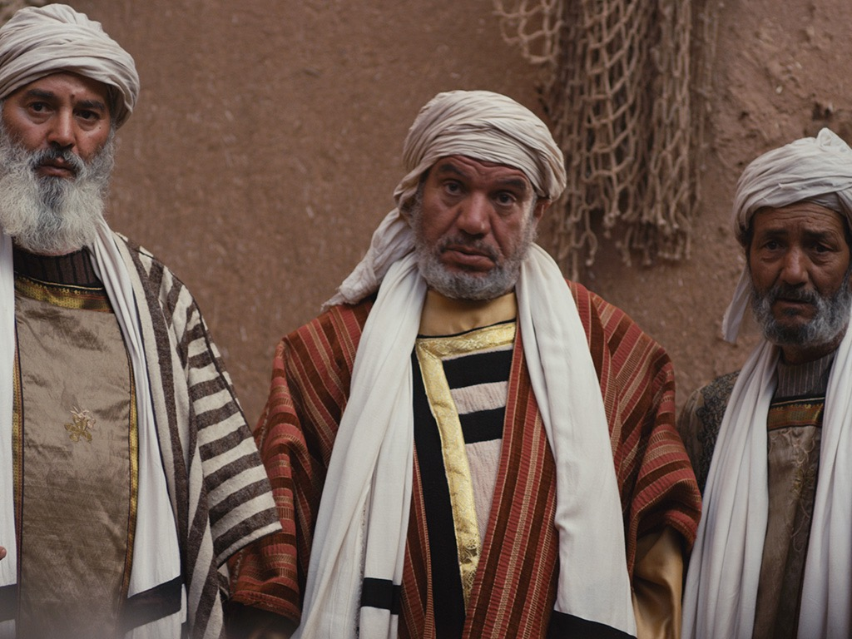
Opposition
to the King
§§ 98-119
The Jewish leaders resist Jesus in many conflicts over his person and miracles as they question his authority as God
Section summaries based on J. Dwight Pentecost, A Harmony of the Words and Works of Jesus Christ (Grand Rapids: Zondervan, 1981)
Dr. Rick Griffith • Jordan Evangelical Theological Seminary • BibleStudyDownloads.org

Slide 2
Pentecost Outline
Introduction of the King
Authentication of the King
Controversy over the King
Instruction of the Twelve by the King
Opposition to the King
Preparation of the Disciples by the King
Official Presentation of the King
Preparation for the Death of the King
Rejection of the King
Resurrection of the King

Slide 3

Increasing Polarization
Resurrection
Preparation
for Death
Preparation
of Disciples
Instruction
Authentication
Introduction
Controversy
Opposition
Presentation
Rejection
Notes:
The Life of Christ brought increasing polarization. The more Jesus showed about himself, the greater the resistance to him and his message. Also, the more intense the controversy leading to opposition, the higher priority Christ placed on preparing his men for when he would be gone. The climactic rejection when he presented himself as king of Israel at the Triumphal Entry resulted in rejection to the point of crucifixion followed by the victory of resurrection.
Introduction of the King
Authentication of the King
Controversy over the King
Instruction of the Twelve by the King
Opposition to the King
Preparation of the Disciples by the King
Official Presentation of the King
Preparation for the Death of the King
Rejection of the King
Resurrection of the King

Slide 4
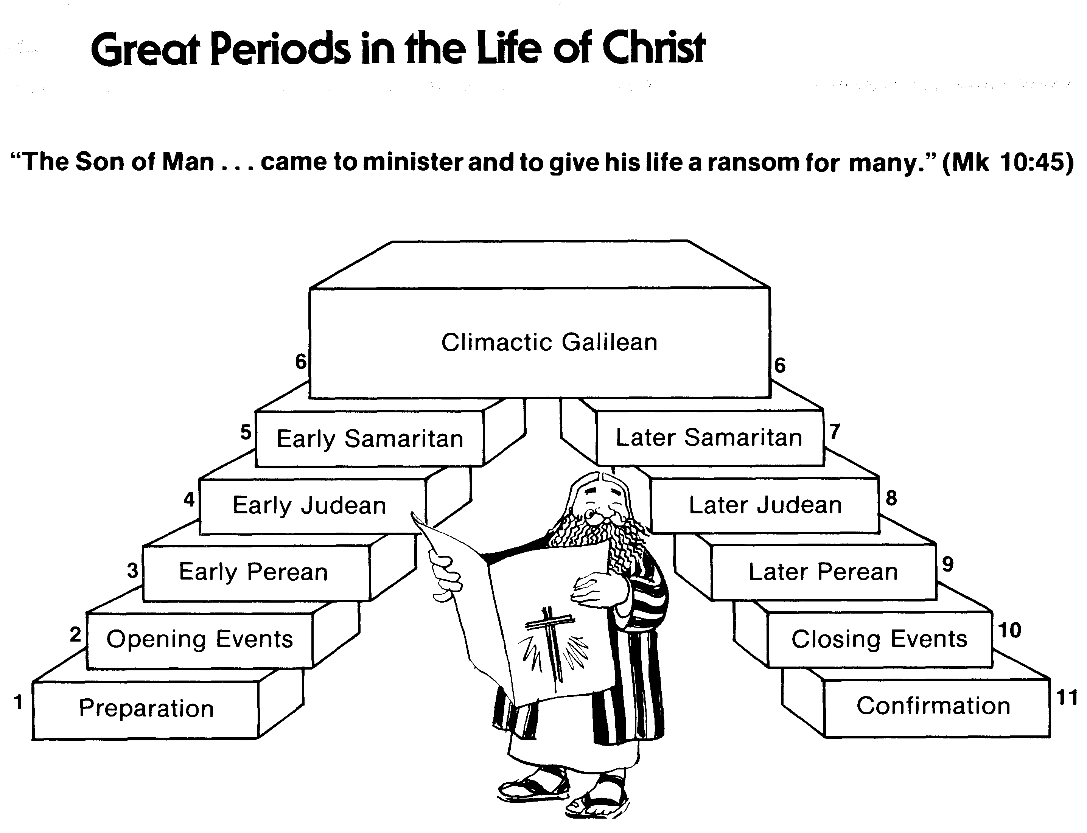
Great Periods in the Life of Christ
55
“The Son of Man… came to minister and to give his life a ransom for many” (Mark 10:45)
Climactic Galilean
Early Samaritan
Later Samaritan
Early Judean
Later Judean
Early Perean
Later Perean
Opening Events
Closing Events
Preparation
Confirmation
Walk Thru the New Testament seminar (used with permission)
Notes:
The Walk Thru outline of the life of Christ forms a chiasm or literary arrangement with repeating elements in the opposite order. This structure makes Confirmation parallel to Preparation, Closing Events parallel to Opening Events, etc. until the only event without parallel becomes the focus: Climatic Galilean. Such an arrangement of material was common in antiquity and is seen in both the OT (e.g., Zephaniah) and the NT (1 Thess) where the central teaching appears in the middle of each writing.
Small Group Assignment: Explain this slide to your group member(s) and have the others explain it back.
After the beginning events of stages 1-3, Jesus also gets farther away from his Jewish roots in Judea (4), to go to the Samaritans (5), and even farther to Galilee (6), where most Gentiles lived. He ministered to Jews in Galilee, of course, but this climatic period was the focus of his ministry.
_______
LC-00-Syllabus-63
LC-01-Introduction-265
LC-05-Opposition-4

Slide 5

A. Conflict At the Feast of Tabernacles
§ 98
John 7:11-52
Jesus defends His authority and person at the Feast of Tabernacles, giving the unbelieving Jews further motivation to kill Him
Notes:
Q: What do you know about the Feast of Tabernacles?
A: It was the final feast when Jews went to Jerusalem during the olive harvest and lived inn tents for a week.
John 7:11 The Jewish leaders tried to find him at the festival and kept asking if anyone had seen him. ¹² There was a lot of grumbling about him among the crowds. Some argued, “He’s a good man,” but others said, “He’s nothing but a fraud who deceives the people.” ¹³ But no one had the courage to speak favorably about him in public, for they were afraid of getting in trouble with the Jewish leaders.
John 7:14 Then, midway through the festival, Jesus went up to the Temple and began to teach. ¹⁵ The peopleª were surprised when they heard him. “How does he know so much when he hasn’t been trained?” they asked.
John 7:16 So Jesus told them, “My message is not my own; it comes from God who sent me. ¹⁷ Anyone who wants to do the will of God will know whether my teaching is from God or is merely my own. ¹⁸ Those who speak for themselves want glory only for themselves, but a person who seeks to honor the one who sent him speaks truth, not lies. ¹⁹ Moses gave you the law, but none of you obeys it! In fact, you are trying to kill me.”
John 7:20 The crowd replied, “You’re demon possessed! Who’s trying to kill you?”
John 7:21 Jesus replied, “I did one miracle on the Sabbath, and you were amazed. ²² But you work on the Sabbath, too, when you obey Moses’ law of circumcision. (Actually, this tradition of circumcision began with the patriarchs, long before the law of Moses.) ²³ For if the correct time for circumcising your son falls on the Sabbath, you go ahead and do it so as not to break the law of Moses. So why should you be angry with me for healing a man on the Sabbath? ²⁴ Look beneath the surface so you can judge correctly.”
Is Jesus the Messiah?
John 7:25 Some of the people who lived in Jerusalem started to ask each other, “Isn’t this the man they are trying to kill? ²⁶ But here he is, speaking in public, and they say nothing to him. Could our leaders possibly believe that he is the Messiah? ²⁷ But how could he be? For we know where this man comes from. When the Messiah comes, he will simply appear; no one will know where he comes from.”
John 7:28 While Jesus was teaching in the Temple, he called out, “Yes, you know me, and you know where I come from. But I’m not here on my own. The one who sent me is true, and you don’t know him. ²⁹ But I know him because I come from him, and he sent me to you.” ³⁰ Then the leaders tried to arrest him; but no one laid a hand on him, because his timeª had not yet come.
John 7:31 Many among the crowds at the Temple believed in him. “After all,” they said, “would you expect the Messiah to do more miraculous signs than this man has done?”
John 7:32 When the Pharisees heard that the crowds were whispering such things, they and the leading priests sent Temple guards to arrest Jesus. ³³ But Jesus told them, “I will be with you only a little longer. Then I will return to the one who sent me. ³⁴ You will search for me but not find me. And you cannot go where I am going.”
John 7:35 The Jewish leaders were puzzled by this statement. “Where is he planning to go?” they asked. “Is he thinking of leaving the country and going to the Jews in other lands?ª Maybe he will even teach the Greeks! ³⁶ What does he mean when he says, ‘You will search for me but not find me,’ and ‘You cannot go where I am going’?”
Jesus Promises Living Water
John 7:37 On the last day, the climax of the festival, Jesus stood and shouted to the crowds, “Anyone who is thirsty may come to me! ³⁸ Anyone who believes in me may come and drink! For the Scriptures declare, ‘Rivers of living water will flow from his heart.’”ª ³⁹ (When he said “living water,” he was speaking of the Spirit, who would be given to everyone believing in him. But the Spirit had not yet been given,ª because Jesus had not yet entered into his glory.)
Division and Unbelief
John 7:40 When the crowds heard him say this, some of them declared, “Surely this man is the Prophet we’ve been expecting.”ª ⁴¹ Others said, “He is the Messiah.” Still others said, “But he can’t be! Will the Messiah come from Galilee? ⁴² For the Scriptures clearly state that the Messiah will be born of the royal line of David, in Bethlehem, the village where King David was born.”ª ⁴³ So the crowd was divided about him. ⁴⁴ Some even wanted him arrested, but no one laid a hand on him.
John 7:45 When the Temple guards returned without having arrested Jesus, the leading priests and Pharisees demanded, “Why didn’t you bring him in?”
John 7:46 “We have never heard anyone speak like this!” the guards responded.
John 7:47 “Have you been led astray, too?” the Pharisees mocked. ⁴⁸ “Is there a single one of us rulers or Pharisees who believes in him? ⁴⁹ This foolish crowd follows him, but they are ignorant of the law. God’s curse is on them!”
John 7:50 Then Nicodemus, the leader who had met with Jesus earlier, spoke up. ⁵¹ “Is it legal to convict a man before he is given a hearing?” he asked.
John 7:52 They replied, “Are you from Galilee, too? Search the Scriptures and see for yourself—no prophet ever comesª from Galilee!”

Slide 6
1. Christ's Authority Questioned
John 7:11-15
Jerusalem crowds wonder how Christ could teach with authority without rabbinic training to prepare for Him to reveal His true nature
Notes:
John 7:11 The Jewish leaders tried to find him at the festival and kept asking if anyone had seen him. ¹² There was a lot of grumbling about him among the crowds. Some argued, “He’s a good man,” but others said, “He’s nothing but a fraud who deceives the people.” ¹³ But no one had the courage to speak favorably about him in public, for they were afraid of getting in trouble with the Jewish leaders.
John 7:14 Then, midway through the festival, Jesus went up to the Temple and began to teach. ¹⁵ The people were surprised when they heard him. “How does he know so much when he hasn’t been trained?” they asked.

Slide 7

Divided Opinions
JOHN 7
Notes:
Small Group Discussion:
Why were people so divided about Jesus during his life?
Is there a different reason that Jesus is so controversial today?

Slide 8
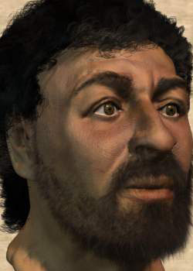
Who is this?
Notes:
This is Jesus—or at least one of the most recent depictions of him by bone specialists who studied first-century skeletons.

Slide 9
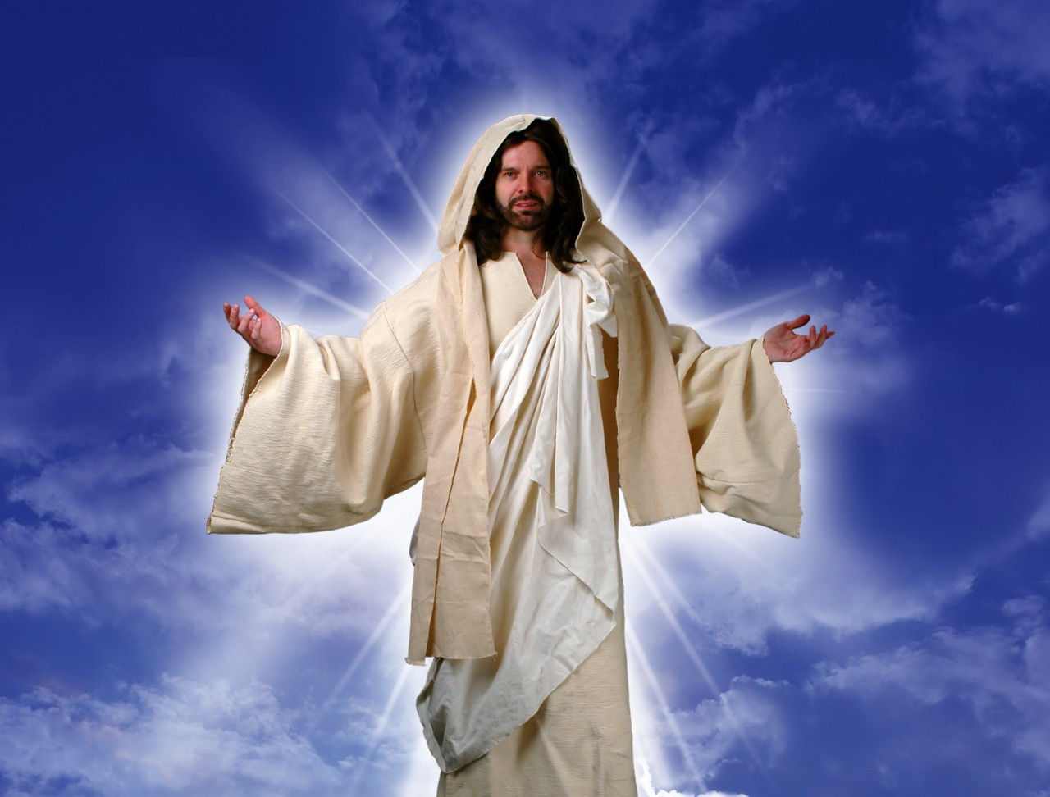
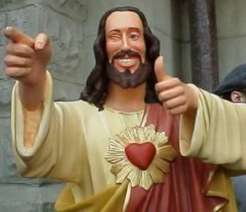
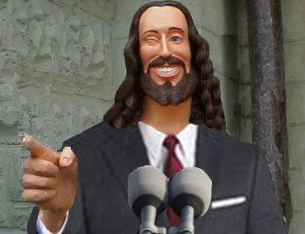
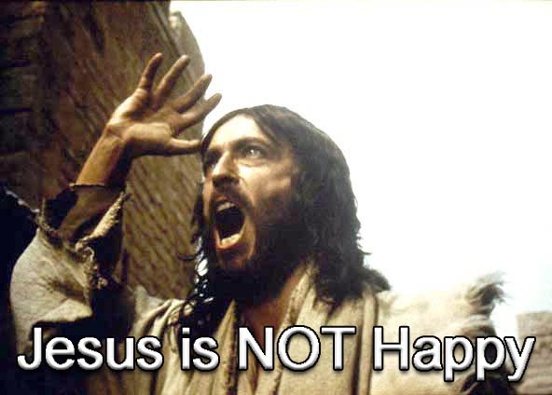
What do you think of Jesus?
Notes:
Some of us think Jesus is not very cool—so we make him out to be according to our preferences.

Slide 10
Black

Slide 11

The popular TV series "Touched by an Angel" is filled with spirituality but never mentions Jesus

Slide 12
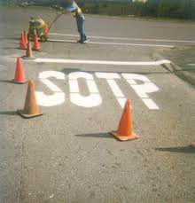
And Christians are considered stupid?!

Slide 13

Four Christmases
Notes:
Jesus is also NEVER noted in the popular movie "Four Christmases"

Slide 14
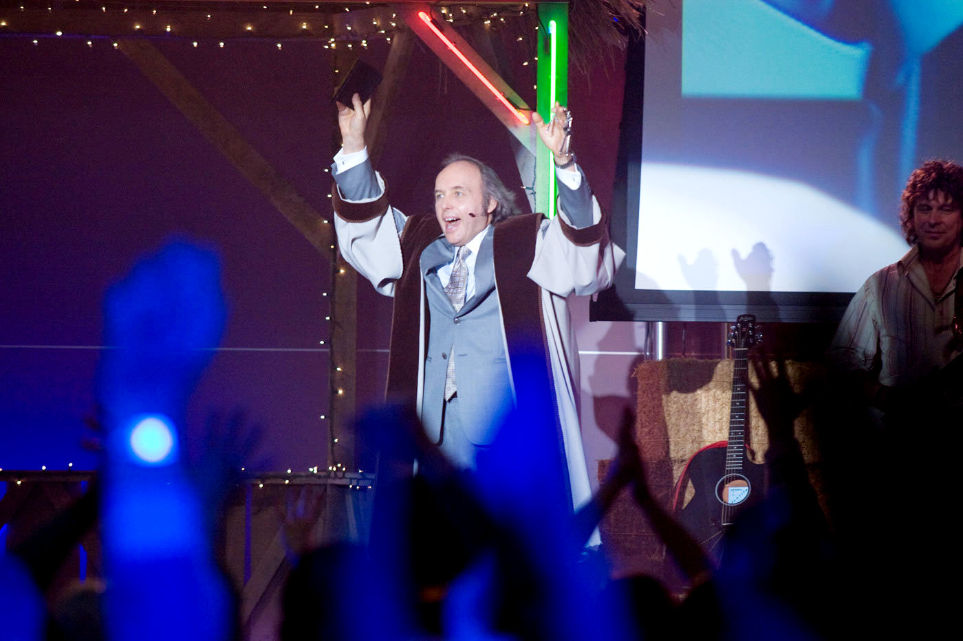
“Four Christmases” Pastor Phil
Notes:
But Christianity is mocked with the disrespectful appearance of Pastor Phil.

Slide 15
Black

Slide 16

Our Subject Today
Why do people have such divided opinions about Christ?

Slide 17
A Controversial Figure in John 1–6
Believers in
John 1–4:
Galileans
Samaritan Woman
John the Baptist
Nicodemus
Passover Jews
Disciples
The line of faith
Unbelievers in
John 5–6:
Jerusalem Leaders
Galilean People
Disciples desert Jesus

Slide 18
Our Subject Today
Why do people have such divided opinions about Christ?
3 reasons!

Slide 19
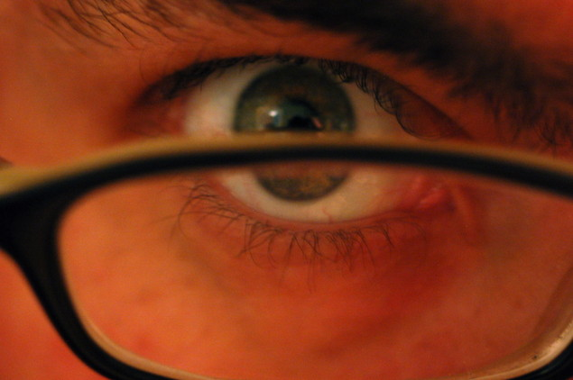
I. Everyone makes his or her own decision about Christ (7:1-13).
Why do people have such divided opinions about Christ?

Slide 20
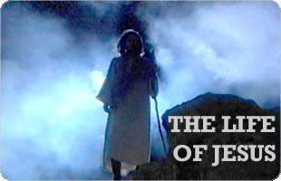
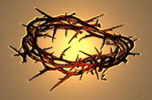
Brothers of Jesus
Transition between Galilean ministry
and Feast of Tabernacles in Jerusalem
“No one who wants to become a public figure acts in secret. Since you are doing these things, show yourself to the world” (7:4).
But when the Jewish Feast of Tabernacles
was near…
(7:2)
My time is not yet come; for you any time is right
...because for me the right time has not yet come.
Notes:
"For even his brothers didn’t believe in him" (John 7:5).
They feared his failure might disgrace the family.

Slide 21

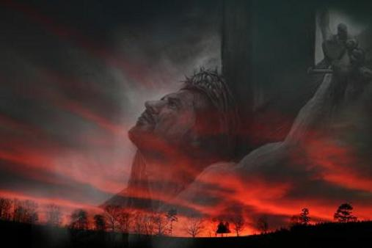
“Hour” in John’s Gospel
NASB Occurrences (Greek are all hora except 7:6, 8):
2:4 “My hour has not yet come”
7:6 “My time (Gr. kairos) is not yet here”
7:8 “My time (Gr. kairos) has not yet fully come”
7:30 “His hour had not yet come”

Slide 22
Black
Notes:
Jerusalem crowds also divided (10-13)

Slide 23
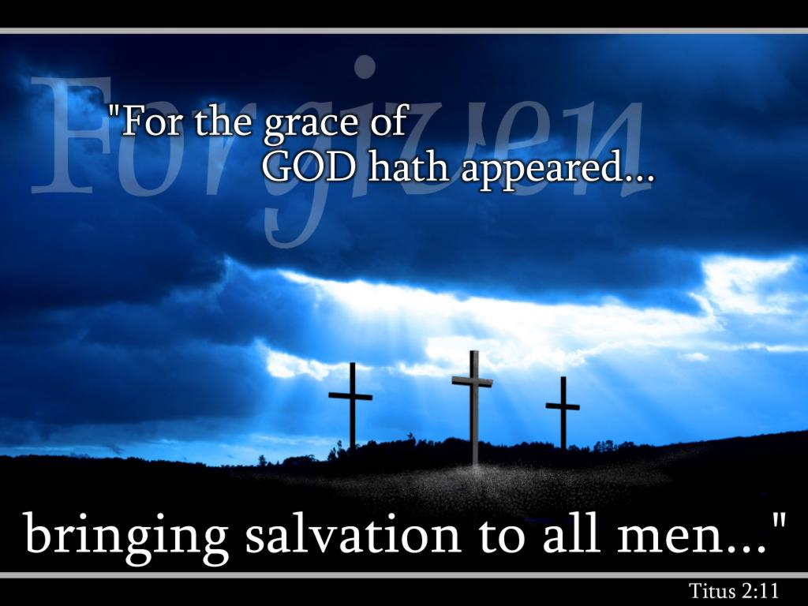
We must each decide who Christ is— and also give that choice to others.

Slide 24
I. Everyone makes his or her own decision about Christ (7:1-13).
Why do people have such divided opinions about Christ?

Slide 25
2. Christ's Explanation
John 7:16-24
Christ tells the Pharisees to submit to his teaching as authoritative as was Moses since the Father (not rabbis) taught Jesus
Notes:
John 7:11 The Jewish leaders tried to find him at the festival and kept asking if anyone had seen him. ¹² There was a lot of grumbling about him among the crowds. Some argued, “He’s a good man,” but others said, “He’s nothing but a fraud who deceives the people.” ¹³ But no one had the courage to speak favorably about him in public, for they were afraid of getting in trouble with the Jewish leaders.
John 7:14 Then, midway through the festival, Jesus went up to the Temple and began to teach. ¹⁵ The peopleª were surprised when they heard him. “How does he know so much when he hasn’t been trained?” they asked.
John 7:16 So Jesus told them, “My message is not my own; it comes from God who sent me. ¹⁷ Anyone who wants to do the will of God will know whether my teaching is from God or is merely my own. ¹⁸ Those who speak for themselves want glory only for themselves, but a person who seeks to honor the one who sent him speaks truth, not lies. ¹⁹ Moses gave you the law, but none of you obeys it! In fact, you are trying to kill me.”
John 7:20 The crowd replied, “You’re demon possessed! Who’s trying to kill you?”
John 7:21 Jesus replied, “I did one miracle on the Sabbath, and you were amazed. ²² But you work on the Sabbath, too, when you obey Moses’ law of circumcision. (Actually, this tradition of circumcision began with the patriarchs, long before the law of Moses.) ²³ For if the correct time for circumcising your son falls on the Sabbath, you go ahead and do it so as not to break the law of Moses. So why should you be angry with me for healing a man on the Sabbath? ²⁴ Look beneath the surface so you can judge correctly.”
Is Jesus the Messiah?
John 7:25 Some of the people who lived in Jerusalem started to ask each other, “Isn’t this the man they are trying to kill? ²⁶ But here he is, speaking in public, and they say nothing to him. Could our leaders possibly believe that he is the Messiah? ²⁷ But how could he be? For we know where this man comes from. When the Messiah comes, he will simply appear; no one will know where he comes from.”
John 7:28 While Jesus was teaching in the Temple, he called out, “Yes, you know me, and you know where I come from. But I’m not here on my own. The one who sent me is true, and you don’t know him. ²⁹ But I know him because I come from him, and he sent me to you.” ³⁰ Then the leaders tried to arrest him; but no one laid a hand on him, because his timeª had not yet come.
John 7:31 Many among the crowds at the Temple believed in him. “After all,” they said, “would you expect the Messiah to do more miraculous signs than this man has done?”
John 7:32 When the Pharisees heard that the crowds were whispering such things, they and the leading priests sent Temple guards to arrest Jesus. ³³ But Jesus told them, “I will be with you only a little longer. Then I will return to the one who sent me. ³⁴ You will search for me but not find me. And you cannot go where I am going.”
John 7:35 The Jewish leaders were puzzled by this statement. “Where is he planning to go?” they asked. “Is he thinking of leaving the country and going to the Jews in other lands?ª Maybe he will even teach the Greeks! ³⁶ What does he mean when he says, ‘You will search for me but not find me,’ and ‘You cannot go where I am going’?”
Jesus Promises Living Water
John 7:37 On the last day, the climax of the festival, Jesus stood and shouted to the crowds, “Anyone who is thirsty may come to me! ³⁸ Anyone who believes in me may come and drink! For the Scriptures declare, ‘Rivers of living water will flow from his heart.’”ª ³⁹ (When he said “living water,” he was speaking of the Spirit, who would be given to everyone believing in him. But the Spirit had not yet been given,ª because Jesus had not yet entered into his glory.)
Division and Unbelief
John 7:40 When the crowds heard him say this, some of them declared, “Surely this man is the Prophet we’ve been expecting.”ª ⁴¹ Others said, “He is the Messiah.” Still others said, “But he can’t be! Will the Messiah come from Galilee? ⁴² For the Scriptures clearly state that the Messiah will be born of the royal line of David, in Bethlehem, the village where King David was born.”ª ⁴³ So the crowd was divided about him. ⁴⁴ Some even wanted him arrested, but no one laid a hand on him.
John 7:45 When the Temple guards returned without having arrested Jesus, the leading priests and Pharisees demanded, “Why didn’t you bring him in?”
John 7:46 “We have never heard anyone speak like this!” the guards responded.
John 7:47 “Have you been led astray, too?” the Pharisees mocked. ⁴⁸ “Is there a single one of us rulers or Pharisees who believes in him? ⁴⁹ This foolish crowd follows him, but they are ignorant of the law. God’s curse is on them!”
John 7:50 Then Nicodemus, the leader who had met with Jesus earlier, spoke up. ⁵¹ “Is it legal to convict a man before he is given a hearing?” he asked.
John 7:52 They replied, “Are you from Galilee, too? Search the Scriptures and see for yourself—no prophet ever comesª from Galilee!”

Slide 26
3. Christ's Person Questioned
John 7:25-27
The crowds disbelieve Jesus is Messiah since the Pharisees do not arrest Him and since they assume he was born in Nazareth
Notes:
Is Jesus the Messiah?
John 7:25 Some of the people who lived in Jerusalem started to ask each other, “Isn’t this the man they are trying to kill? ²⁶ But here he is, speaking in public, and they say nothing to him. Could our leaders possibly believe that he is the Messiah? ²⁷ But how could he be? For we know where this man comes from. When the Messiah comes, he will simply appear; no one will know where he comes from.”

Slide 27
4. Christ's Explanation
John 7:28-30
Christ claims that his origin is heaven (not Nazareth) and God is His Father (not Joseph) so that His identity is the Son of God
Notes:
John 7:28 While Jesus was teaching in the Temple, he called out, “Yes, you know me, and you know where I come from. But I’m not here on my own. The one who sent me is true, and you don’t know him. ²⁹ But I know him because I come from him, and he sent me to you.” ³⁰ Then the leaders tried to arrest him; but no one laid a hand on him, because his timeª had not yet come.

Slide 28
5. Response
John 7:31-36
The response to Christ is that while some believe, the leaders commit even more to kill Him for blasphemy, even if He tries to escape
Notes:
John 7:31 Many among the crowds at the Temple believed in him. “After all,” they said, “would you expect the Messiah to do more miraculous signs than this man has done?”
John 7:32 When the Pharisees heard that the crowds were whispering such things, they and the leading priests sent Temple guards to arrest Jesus. ³³ But Jesus told them, “I will be with you only a little longer. Then I will return to the one who sent me. ³⁴ You will search for me but not find me. And you cannot go where I am going.”
John 7:35 The Jewish leaders were puzzled by this statement. “Where is he planning to go?” they asked. “Is he thinking of leaving the country and going to the Jews in other lands?ª Maybe he will even teach the Greeks! ³⁶ What does he mean when he says, ‘You will search for me but not find me,’ and ‘You cannot go where I am going’?”

Slide 29
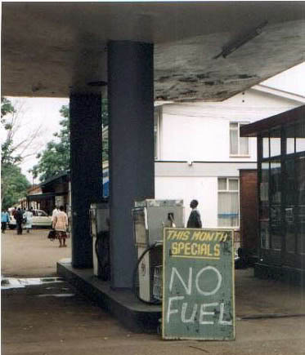

II. People reject Christ’s teaching because they reject God (7:14-36).

Slide 30
Black

Slide 31
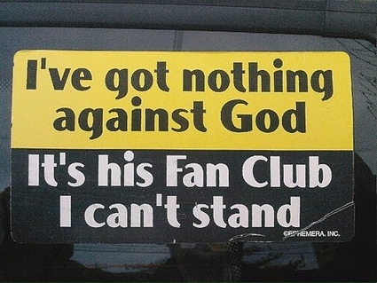
I've got nothing against God
It's his Fan Club I can't stand

Slide 32
I. Everyone makes his or her own decision about Christ (7:1-13).
Why do people have such divided opinions about Christ?

Slide 33
II. People reject Christ’s teaching because they reject God (7:14-36).

Slide 34
6. Christ's Invitation
John 7:37-52
Jesus' use of the Feast's golden pitcher ceremony (= God giving water to Israel) shows that he can satisfy their spiritual thirst
Notes:
Jesus Promises Living Water
John 7:37 On the last day, the climax of the festival, Jesus stood and shouted to the crowds, “Anyone who is thirsty may come to me! ³⁸ Anyone who believes in me may come and drink! For the Scriptures declare, ‘Rivers of living water will flow from his heart.’”ª ³⁹ (When he said “living water,” he was speaking of the Spirit, who would be given to everyone believing in him. But the Spirit had not yet been given,ª because Jesus had not yet entered into his glory.)
Division and Unbelief
John 7:40 When the crowds heard him say this, some of them declared, “Surely this man is the Prophet we’ve been expecting.”ª ⁴¹ Others said, “He is the Messiah.” Still others said, “But he can’t be! Will the Messiah come from Galilee? ⁴² For the Scriptures clearly state that the Messiah will be born of the royal line of David, in Bethlehem, the village where King David was born.”ª ⁴³ So the crowd was divided about him. ⁴⁴ Some even wanted him arrested, but no one laid a hand on him.
John 7:45 When the Temple guards returned without having arrested Jesus, the leading priests and Pharisees demanded, “Why didn’t you bring him in?”
John 7:46 “We have never heard anyone speak like this!” the guards responded.
John 7:47 “Have you been led astray, too?” the Pharisees mocked. ⁴⁸ “Is there a single one of us rulers or Pharisees who believes in him? ⁴⁹ This foolish crowd follows him, but they are ignorant of the law. God’s curse is on them!”
John 7:50 Then Nicodemus, the leader who had met with Jesus earlier, spoke up. ⁵¹ “Is it legal to convict a man before he is given a hearing?” he asked.
John 7:52 They replied, “Are you from Galilee, too? Search the Scriptures and see for yourself—no prophet ever comesª from Galilee!”

Slide 35

III. Jesus’ claim to give eternal life always has mixed responses (7:37-52).
Why do people have such divided opinions about Christ?

Slide 36
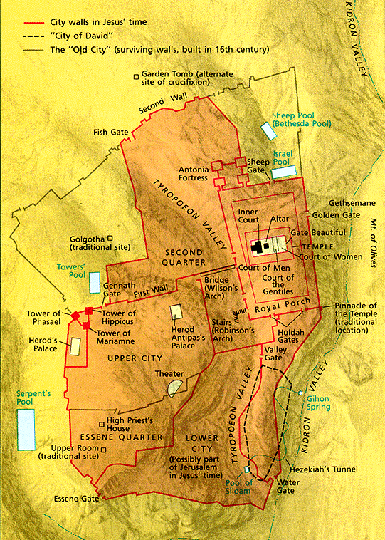
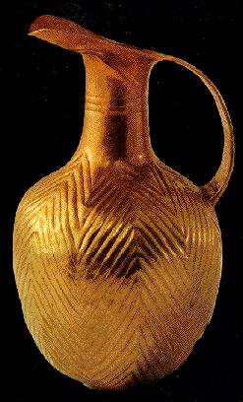
Jerusalem
21
The Feast of Tabernacles
Notes:
On the last day of the feast, Jesus offered people the Spirit by believing in Him (7:37-39). The feast always ended with a procession of people who walked down the hill to the Gihon Spring, where the priest filled up a gold pitcher of water, then made their way back up to the temple at the top.

Slide 37
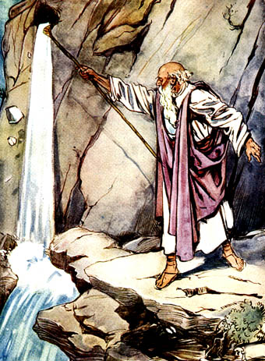
Water from a Rock
Numbers 20:8-11
Notes:
The priest poured out the water as a remembrance of saying thanks to God for bringing water from a rock and giving the people water for 40 years in the desert.

Slide 38

“Anyone who is thirsty may come to me! ³⁸ Anyone who believes in me may come and drink! For the Scriptures declare, ‘Rivers of living water will flow from his heart.’”
(John 7:37-38 NLT)
Notes:
"When Jesus added, As the Scripture has said, He did not identify the Old Testament passage(s) He had in mind. But He may have thought of Psalm 78:15-16 and Zechariah 14:8 (cf. Ezek. 47:1-11; Rev. 22:1-2)."
Psa. 78:15 He split open the rocks in the wilderness
to give them water, as from a gushing spring.
¹⁶ He made streams pour from the rock,
making the waters flow down like a river!
Zech. 14:8 On that day life-giving waters will flow out from Jerusalem, half toward the Dead Sea and half toward the Mediterranean,ª flowing continuously in both summer and winter.
Ezek. 47:1 In my vision, the man brought me back to the entrance of the Temple. There I saw a stream flowing east from beneath the door of the Temple and passing to the right of the altar on its south side. ² The man brought me outside the wall through the north gateway and led me around to the eastern entrance. There I could see the water flowing out through the south side of the east gateway.
Ezek. 47:3 Measuring as he went, he took me along the stream for 1,750 feetª and then led me across. The water was up to my ankles. ⁴ He measured off another 1,750 feet and led me across again. This time the water was up to my knees. After another 1,750 feet, it was up to my waist. ⁵ Then he measured another 1,750 feet, and the river was too deep to walk across. It was deep enough to swim in, but too deep to walk through.
Ezek. 47:6 He asked me, “Have you been watching, son of man?” Then he led me back along the riverbank. ⁷ When I returned, I was surprised by the sight of many trees growing on both sides of the river. ⁸ Then he said to me, “This river flows east through the desert into the valley of the Dead Sea.ª The waters of this stream will make the salty waters of the Dead Sea fresh and pure. ⁹ There will be swarms of living things wherever the water of this river flows.ª Fish will abound in the Dead Sea, for its waters will become fresh. Life will flourish wherever this water flows. ¹⁰ Fishermen will stand along the shores of the Dead Sea. All the way from En-gedi to En-eglaim, the shores will be covered with nets drying in the sun. Fish of every kind will fill the Dead Sea, just as they fill the Mediterranean.ª ¹¹ But the marshes and swamps will not be purified; they will still be salty.
Rev. 22:1 Then the angel showed me a river with the water of life, clear as crystal, flowing from the throne of God and of the Lamb. ² It flowed down the center of the main street. On each side of the river grew a tree of life, bearing twelve crops of fruit,ª with a fresh crop each month. The leaves were used for medicine to heal the nations.
John F. Walvoord, Roy B. Zuck, and Dallas Theological Seminary, The Bible Knowledge Commentary: An Exposition of the Scriptures (Wheaton, IL: Victor Books, 1983-c1985), 2:301.

Slide 39
Black

Slide 40

Black

Slide 41

Q & A
Curious: “Where did he get all this knowledge?” (14-15).
Jesus’ Answer: “God gave it to me.”
Offended: “You’re demon possessed! Who’s trying to kill you?” (20).
Jesus’ Answer: “Hypocrites care more for circumcision than for people.”

Slide 42
Q & A
Uninformed: “Isn’t this the man they are trying to kill? But the Messiah will simply appear…” (25).
Jesus’ Answer: “You know where I’m from—but you don’t know God!”
Believing: “Will the Messiah do more miracles than Jesus?” (31).
Jesus’ Answer: “I will be with you only for a short time more [about 6 months] but you won’t find me and can’t follow me.”

Slide 43
Which are You?
Curious?
Offended?
Uninformed?
Believing?

Slide 44

Main Idea of John 7
People reject Christ because they don’t accept God’s authority over their lives.

Slide 45

Jesus Paid It All

Slide 46
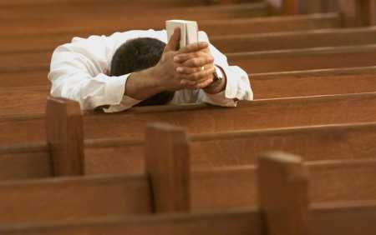
Why not believe today?

Slide 47
B. Conflict Over the Law
§ 99
John 7:53–8:11
Jesus avoids a Pharisee trap by not judging an adulterous woman to judge the Law too stringent or accept their disdain for the Law
Notes:
John 7:53 [[ªThen the meeting broke up, and everybody went home.
A Woman Caught in Adultery
John 8:1 Jesus returned to the Mount of Olives, ² but early the next morning he was back again at the Temple. A crowd soon gathered, and he sat down and taught them. ³ As he was speaking, the teachers of religious law and the Pharisees brought a woman who had been caught in the act of adultery. They put her in front of the crowd.
John 8:4 “Teacher,” they said to Jesus, “this woman was caught in the act of adultery. ⁵ The law of Moses says to stone her. What do you say?”
John 8:6 They were trying to trap him into saying something they could use against him, but Jesus stooped down and wrote in the dust with his finger. ⁷ They kept demanding an answer, so he stood up again and said, “All right, but let the one who has never sinned throw the first stone!” ⁸ Then he stooped down again and wrote in the dust.
John 8:9 When the accusers heard this, they slipped away one by one, beginning with the oldest, until only Jesus was left in the middle of the crowd with the woman. ¹⁰ Then Jesus stood up again and said to the woman, “Where are your accusers? Didn’t even one of them condemn you?”
John 8:11 “No, Lord,” she said.
And Jesus said, “Neither do I. Go and sin no more.”]]

Slide 48
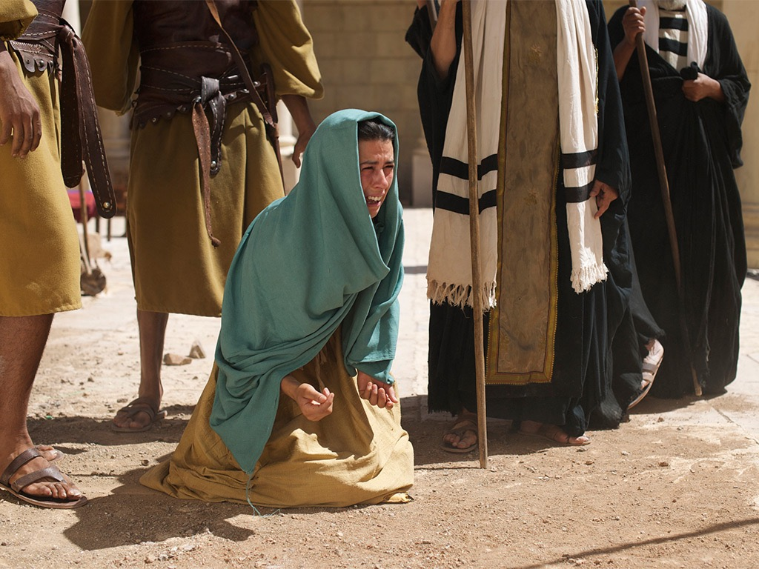

Free
Bible
images
John 8:2-11
JESUS AND THE WOMAN ACCUSED OF ADULTERY

Slide 49
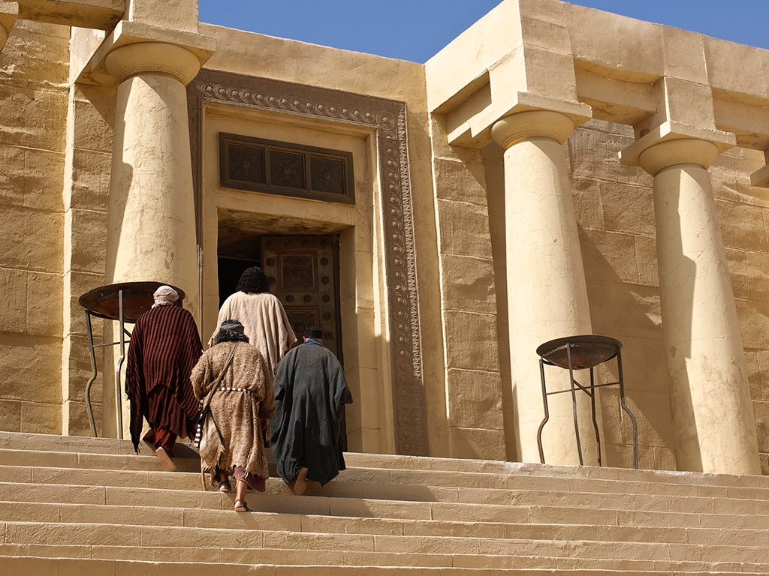
Notes:
John 8:1 Jesus returned to the Mount of Olives

Slide 50
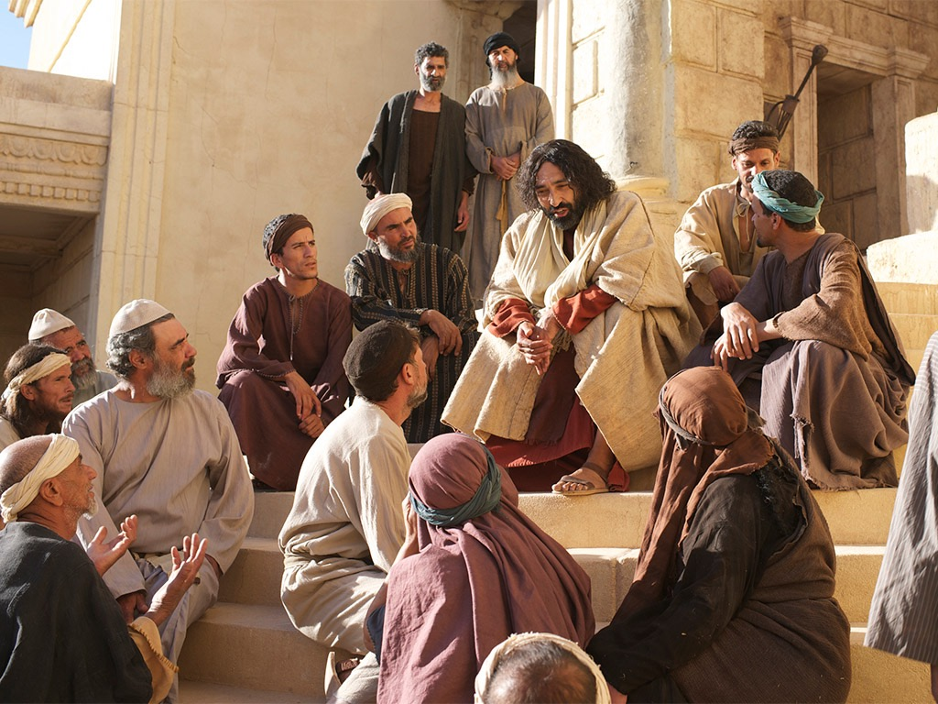
Notes:
² but early the next morning he was back again at the Temple. A crowd soon gathered, and he sat down and taught them.

Slide 51
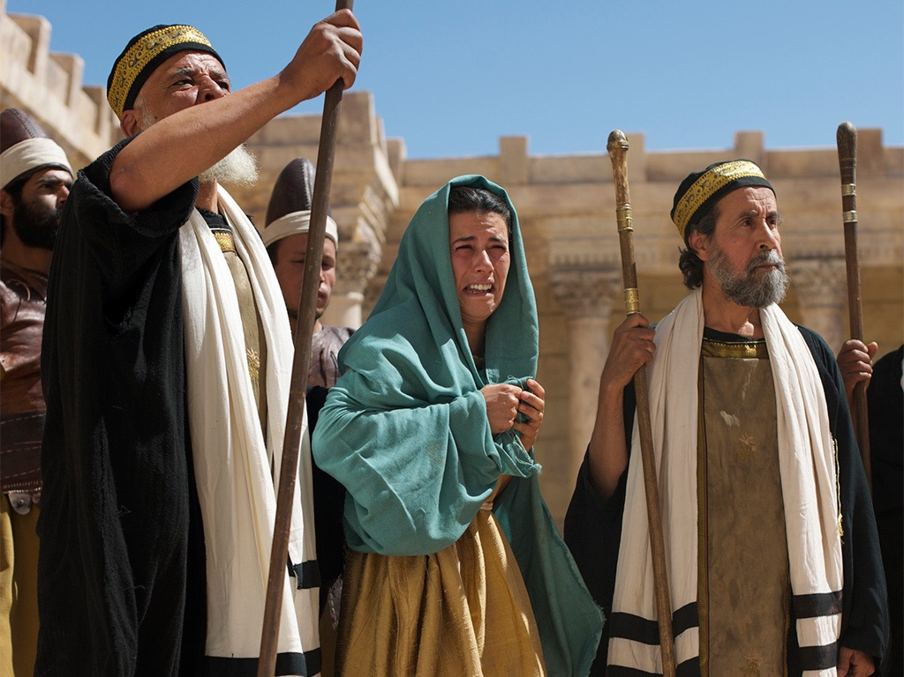
Notes:
³ As he was speaking, the teachers of religious law and the Pharisees brought a woman who had been caught in the act of adultery. They put her in front of the crowd.

Slide 52
Notes:
John 8:4 “Teacher,” they said to Jesus, “this woman was caught in the act of adultery. ⁵ The law of Moses says to stone her. What do you say?”

Slide 53
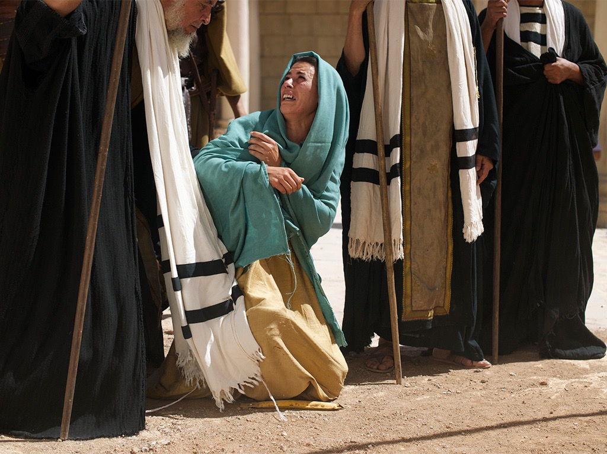
Notes:
John 8:6 They were trying to trap him into saying something they could use against him, but Jesus stooped down and wrote in the dust with his finger.

Slide 54
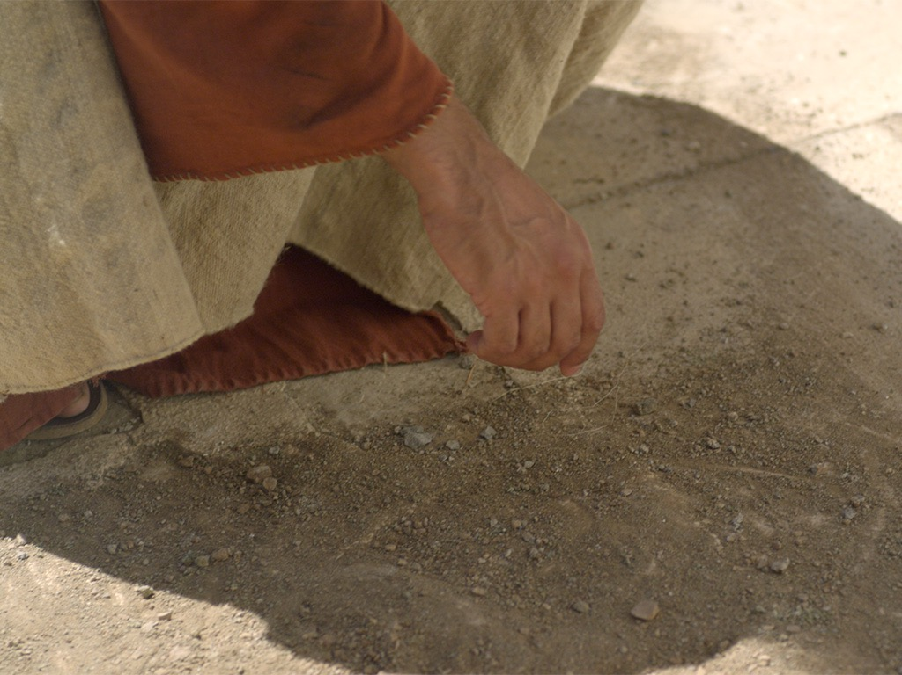
Notes:
John 16:5 “But now I am going away to the one who sent me, and not one of you is asking where I am going. ⁶ Instead, you grieve because of what I’ve told you. ⁷ But in fact, it is best for you that I go away, because if I don’t, the Advocateª won’t come. If I do go away, then I will send him to you. ⁸ And when he comes, he will convict the world of its sin, and of God’s righteousness, and of the coming judgment. ⁹ The world’s sin is that it refuses to believe in me. ¹⁰ Righteousness is available because I go to the Father, and you will see me no more. ¹¹ Judgment will come because the ruler of this world has already been judged.

Slide 55
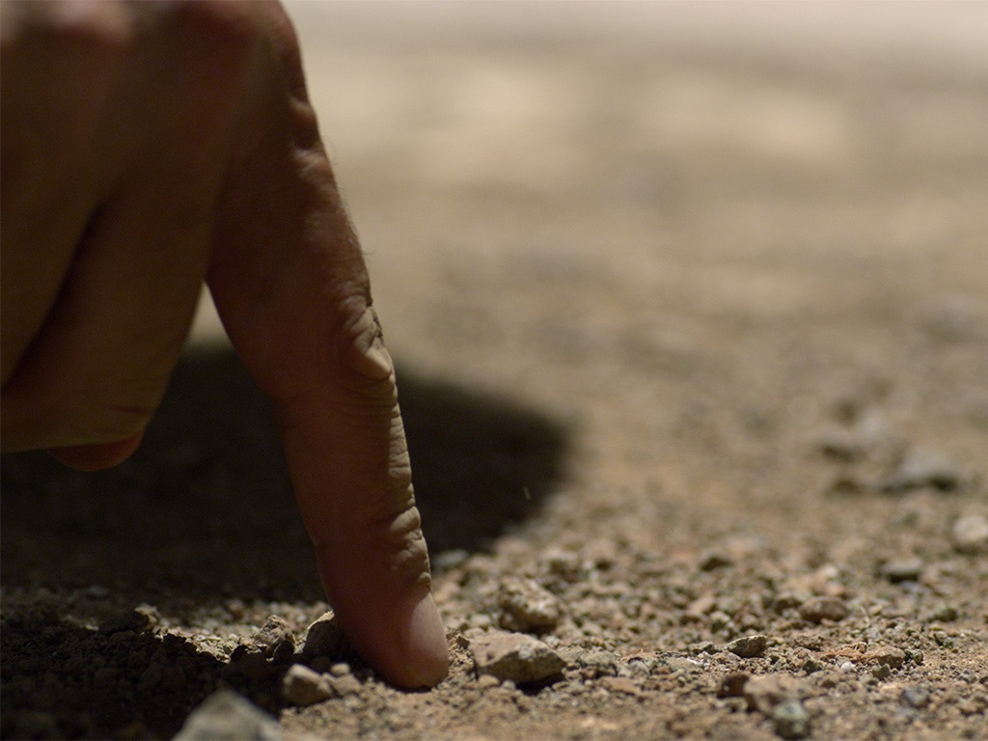
Notes:
John 8:6 They were trying to trap him into saying something they could use against him, but Jesus stooped down and wrote in the dust with his finger.

Slide 56
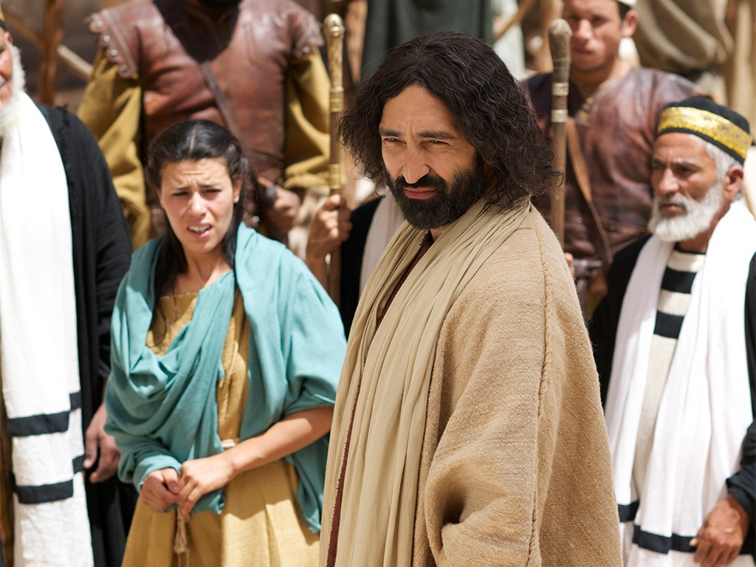
Notes:
⁷ They kept demanding an answer, so he stood up again and said, “All right, but let the one who has never sinned throw the first stone!”

Slide 57
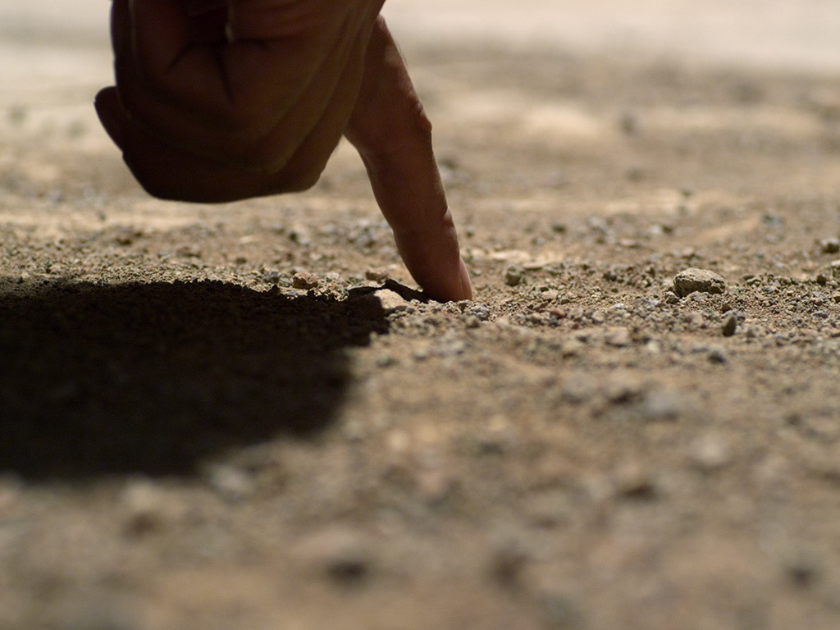
Notes:
⁸ Then he stooped down again and wrote in the dust.
John 8:9 When the accusers heard this, they slipped away one by one, beginning with the oldest, until only Jesus was left in the middle of the crowd with the woman.

Slide 58
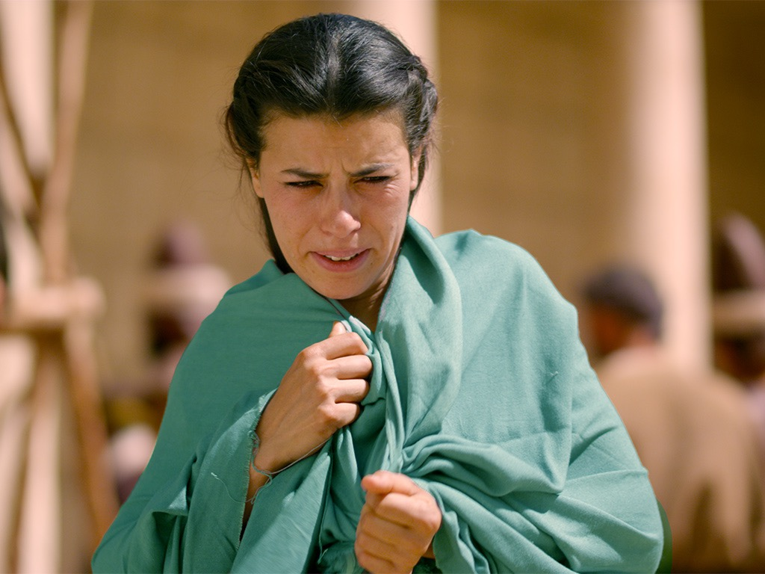
Notes:
¹⁰ Then Jesus stood up again and said to the woman, “Where are your accusers? Didn’t even one of them condemn you?”

Slide 59
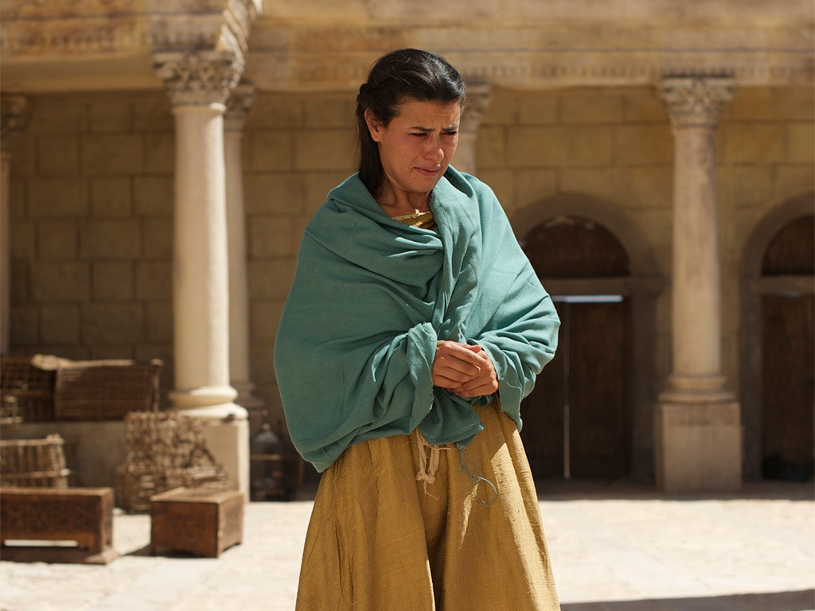
Notes:
John 8:11 “No, Lord,” she said.

Slide 60
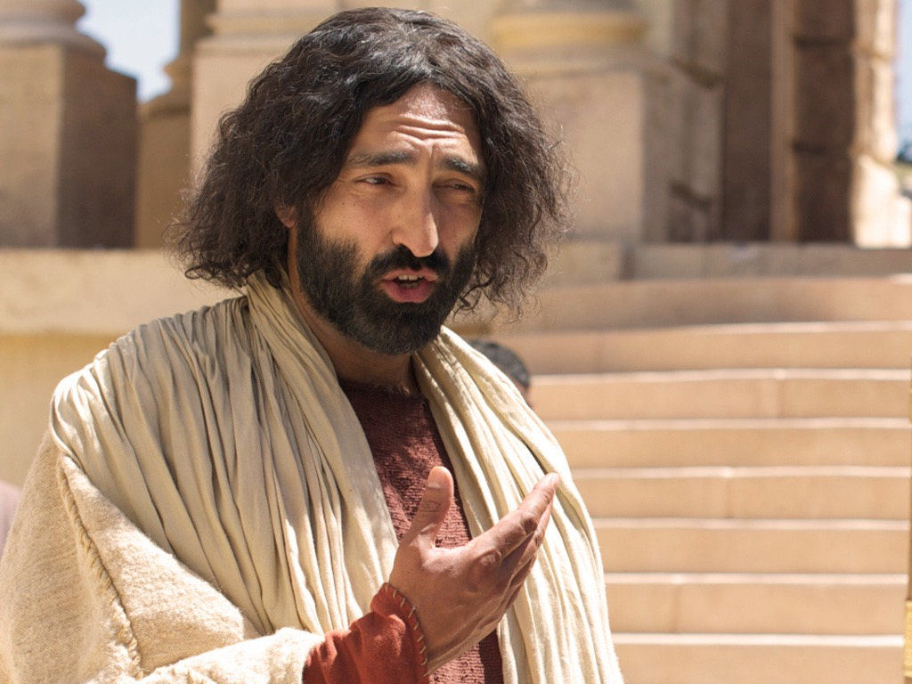
Notes:
And Jesus said, “Neither do I. Go and sin no more.”]]

Slide 61

Used with Permission
THE
GOSPEL
——OF—— MATTHEW
THE
GOSPEL
——OF—— MARK
THE
GOSPEL
——OF—— LUKE
THE
GOSPEL
——OF—— JOHN
Due to the Lumo Project producing its own publishing material we regret to inform you that we cannot license our photos to other clients outside of freebibleimages.org.
These images are not licensed for reuse in video, epublishing or other media. Downloaded pictures and files cannot be redistributed through any other website than freebibleimages.org or used in any context where the accompanying message is undermining of the Christian faith and gospel.
Photos can only be used on educational presentations, blogs and social media, all of which should be accompanied with reference to www.LumoProject.com.
Picture courtesy of BBM
© All Rights Reserved.
www.bigbookmedia.com

Slide 62

How can we show God’s compassion in a world where people think Christianity only judges us?

Slide 63
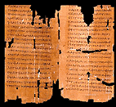
The Text of John 7:53–8:11
Inspired or Not?

Slide 64
Divided Opinions
“Most scholars seem to agree that the passage is a part of inspired Scripture [e.g., F. F. Bruce]. In fact, the development of the entire chapter can easily be seen to grow out of this striking event in the temple... The transition from John 7:52 to 8:12 would be too abrupt without a transitional section.”
–Warren Wiersbe, The Bible Exposition Commentary
“Almost all textual scholars agree that these verses were not part of the original... The style and vocabulary of this passage differ from the rest of the Gospel, and the passage interrupts the sequence from 7:52–8:12. It is probably a part of true oral tradition which was added to later Greek manuscripts by copyists.”
–Edwin A. Blum, in The Bible Knowledge Commentary
Notes:
Wiersbe notes, “Is the story of the woman taken in adultery a part of Scripture? If it is, where does it belong in the Gospel record? John 7:53–8:11 is not found in some of the ancient manuscripts; where it is found, it is not always in this location in John’s Gospel. Most scholars seem to agree that the passage is a part of inspired Scripture (“a fragment of authentic Gospel material,” says Dr. F. F. Bruce) regardless of where it is placed.
“To many of us, the story fits right here! In fact, the development of the entire chapter can easily be seen to grow out of this striking event in the temple. Our Lord’s declaration on His being the Light of the world (John 8:12) certainly fits, and so do His words about true and false judgment (John 8:15–16, 26). The repeated phrase “die in your sins” (John 8:21, 24) would clearly relate to the judgment of the woman; and the fact that the chapter ends with an attempt to stone Jesus shows a perfect parallel to the opening story. The transition from John 7:52 to 8:12 would be too abrupt without a transitional section.”
Warren W. Wiersbe, The Bible Exposition Commentary (Wheaton, Ill.: Victor Books, 1996, c1989), Jn 7:37.

Slide 65
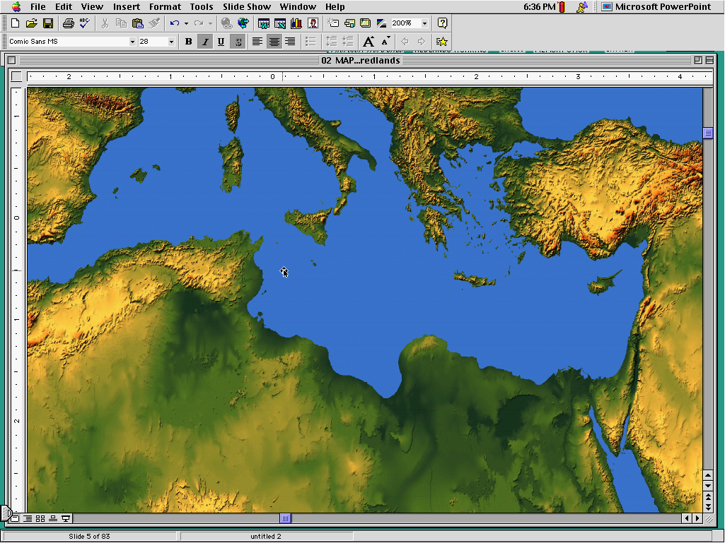
Western
Byzantine
Later (AD 600) manuscripts keep it
Latest (AD 1000) manuscripts keep it
3 Text Types
Alexandrian
Earliest (AD 200-400) manuscripts omit it
Notes:
The NT manuscripts of the early centuries of the church were copied in three main regions: Rome gave us the Western text type, the city of Constantinople became the capital of the Eastern Orthodox church with its Byzantine manuscripts (or majority text, since they copied so many of them), and a large community of Christians gathered in Alexandria, Egypt. This Alexandrian texts were the earliest, going back to about AD 200.

Slide 66
Note the Flow...
Jesus exposes evil intent of the Pharisees (8:10)
Jesus is the Light of the World (8:12)
Pharisees made a false judgment (8:15)
Jesus makes a right judgment (8:16)
Pharisees tried to stone her (8:5)
Pharisees tried to stone Jesus (8:59)

Slide 67

Where we’re going today...
Passage
Applications

Slide 68

What’s the Point?
Show mercy to the repentant!
Don't let people trap you!
Be smart when you commit adultery, so you don’t get caught!
Jesus didn’t really follow the Law.
Forgive people before they repent—that's what Jesus does!
Don’t be too quick to throw stones.
God isn’t serious about sin after all.

Slide 69
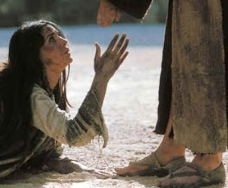
I. Jesus showed the true compassion of the Law by forgiving an adulterous woman (John 7:53–8:11).

Slide 70
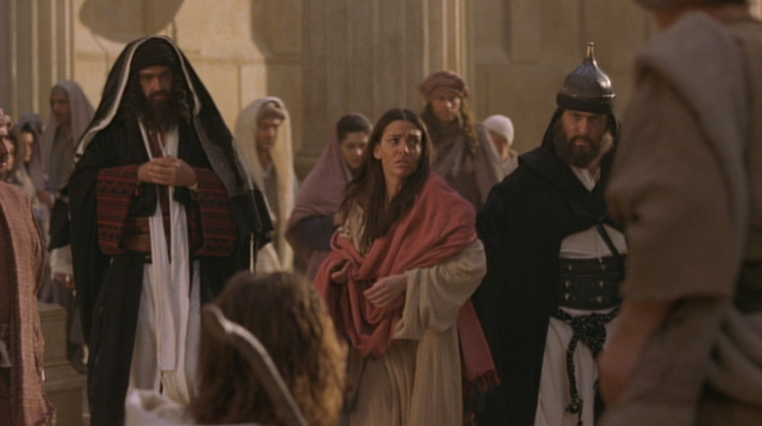
A. Pharisees brought an adulterous woman to Jesus to retain their power by having Jesus condemn Himself (John 7:53–8:6a).

Slide 71
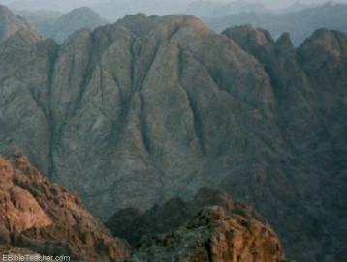
B. Jesus showed the Pharisee’s sin by following the true compassion of the Law to condemn sinners and redeem the repentant (John 8:6b-11).
Why did God give the Law on Mount Sinai?
Notes:
John 3:16 “For this is how God loved the world: He gaveª his one and only Son, so that everyone who believes in him will not perish but have eternal life. ¹⁷ God sent his Son into the world not to judge the world, but to save the world through him.

Slide 72

II. Show God’s compassion by helping people repent
(Main Idea of John 7:53–8:11).

Slide 73
C. Conflict Over the Light
§ 100
John 8:12-20
The Pharisees reject Jesus as the Light of the World as witnessing of himself, so He says that Tabernacles and the Father testify of him
Notes:
Does anyone prefer darkness over light?
Jesus, the Light of the World
John 8:12 Jesus spoke to the people once more and said, “I am the light of the world. If you follow me, you won’t have to walk in darkness, because you will have the light that leads to life.”
John 8:13 The Pharisees replied, “You are making those claims about yourself! Such testimony is not valid.”
John 8:14 Jesus told them, “These claims are valid even though I make them about myself. For I know where I came from and where I am going, but you don’t know this about me. ¹⁵ You judge me by human standards, but I do not judge anyone. ¹⁶ And if I did, my judgment would be correct in every respect because I am not alone. The Fatherª who sent me is with me. ¹⁷ Your own law says that if two people agree about something, their witness is accepted as fact.ª ¹⁸ I am one witness, and my Father who sent me is the other.”
John 8:19 “Where is your father?” they asked.
Jesus answered, “Since you don’t know who I am, you don’t know who my Father is. If you knew me, you would also know my Father.”
²⁰ Jesus made these statements while he was teaching in the section of the Temple known as the Treasury. But he was not arrested, because his timeª had not yet come.

Slide 74

The Light of the World
John 8:12-59
Notes:
John 8:12 Jesus spoke to the people once more and said, “I am the light of the world. If you follow me, you won’t have to walk in darkness, because you will have the light that leads to life.”
John 8:13 The Pharisees replied, “You are making those claims about yourself! Such testimony is not valid.”

Slide 75

Can people tell the difference
between
and light?
darkness
Notes:
John 2:23 Because of the miraculous signs Jesus did in Jerusalem at the Passover celebration, many began to trust in him. ²⁴ But Jesus didn’t trust them, because he knew all about people. ²⁵ No one needed to tell him about human nature, for he knew what was in each person’s heart.

Slide 76
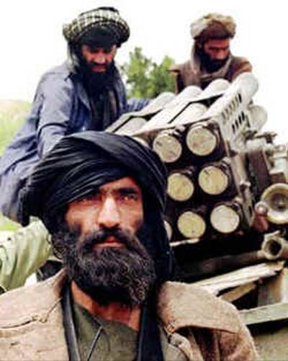
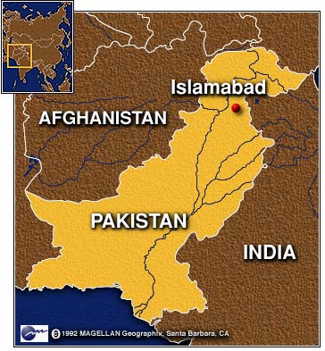
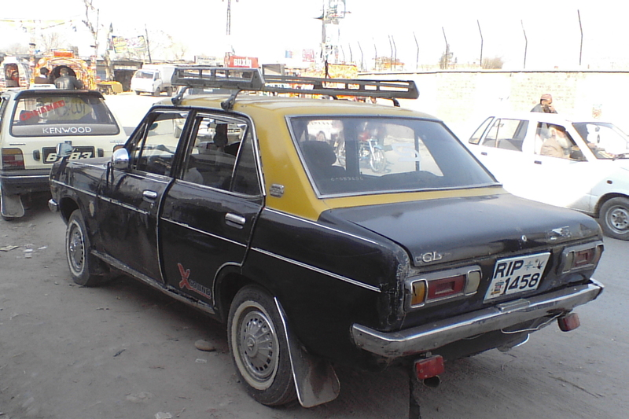
Edwin Paul
28 Sep 2010
Notes:
A Christian lawyer in Pakistan named Edwin Paul lived in the light.
• He gave legal counsel to a Christian taxi driver who bought a taxi for about $2000.
• But then the Taliban-associated lenders discovered he was a Christian, so they demanded $12,000 instead!
• After Edwin brought the case to the police, the lenders murdered him in his home on September 28, 2010—along with his wife Ruby and their five children. His murderers obviously could not see that Edwin lived in the light—and they were in darkness.

Slide 77

Jesus has always been God
"In the beginning
was the Word,
and the Word was with God,
and the Word was God"
(John 1:1)
Notes:
Scripture is very clear that Jesus is God. Christians have always believed this key doctrine called the deity of Christ.

Slide 78
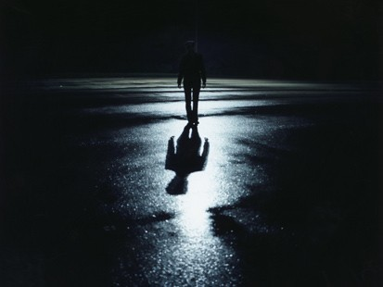
The Great Transfer
For he has rescued us from the kingdom of darkness
and transferred us into the Kingdom of his dear Son
¹⁴ who purchased our freedom and forgave our sins (Col 1:13-14)

Slide 79

How should we expect people to respond to Christ’s claim to be eternal God?

Slide 80


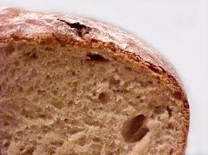
John 6–8
Bread
6
Water
7
Light
8

Slide 81
How should we expect people to respond to Christ’s claim to be eternal God?
3 responses...

Slide 82
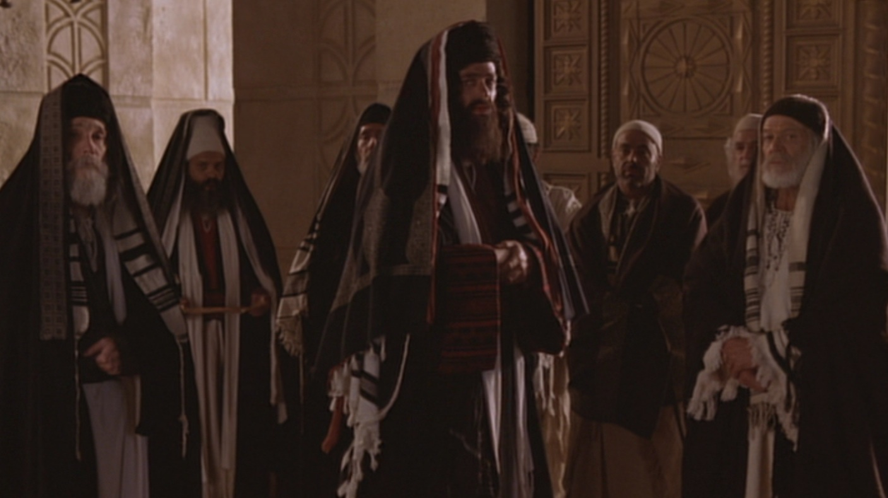
I. Some are hostile to Christ as the way of salvation (8:12-20).

Slide 83
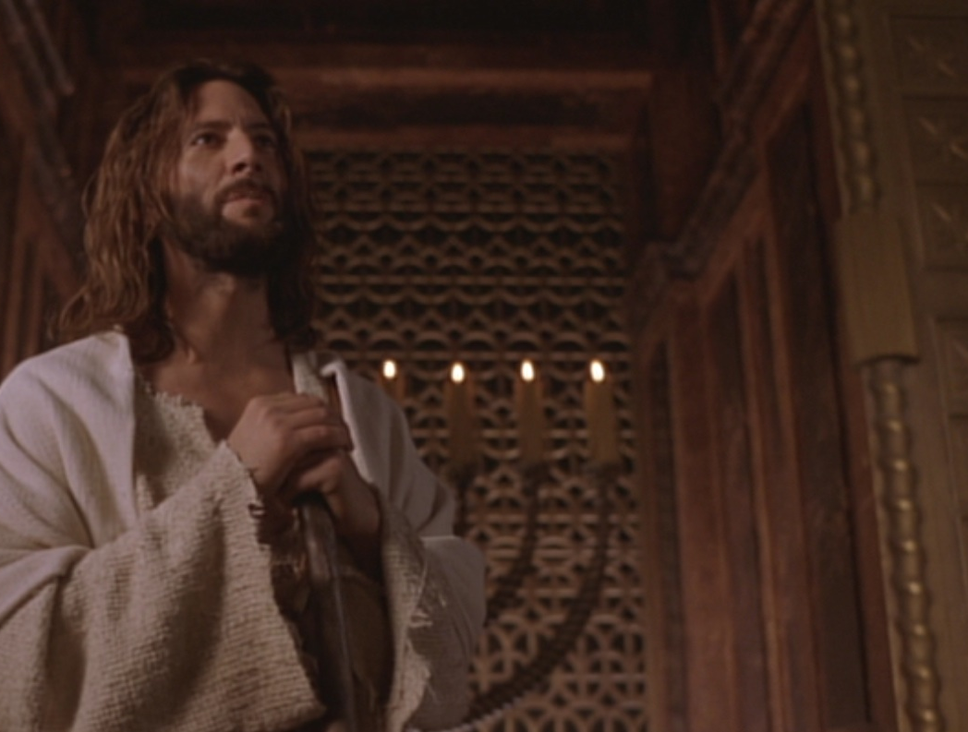
“I am the light of the world”
John 8:12

Slide 84
“The claim is exclusive, one only God could make. Note that Jesus claimed to the light of the world, not a light. Although the claim is exclusive, the offer is inclusive—an offer any and all could respond to.”
Charles Swindoll, Following Christ…
The Man of God, 33, emphasis his

Slide 85
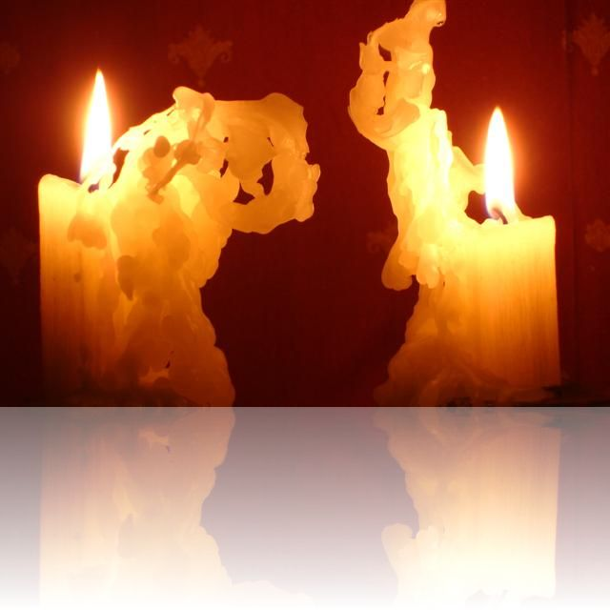
Two Witnesses (Deut 17:6)
“But never put a person to death on the testimony of only one witness. There must always be two or three witnesses.”

Slide 86
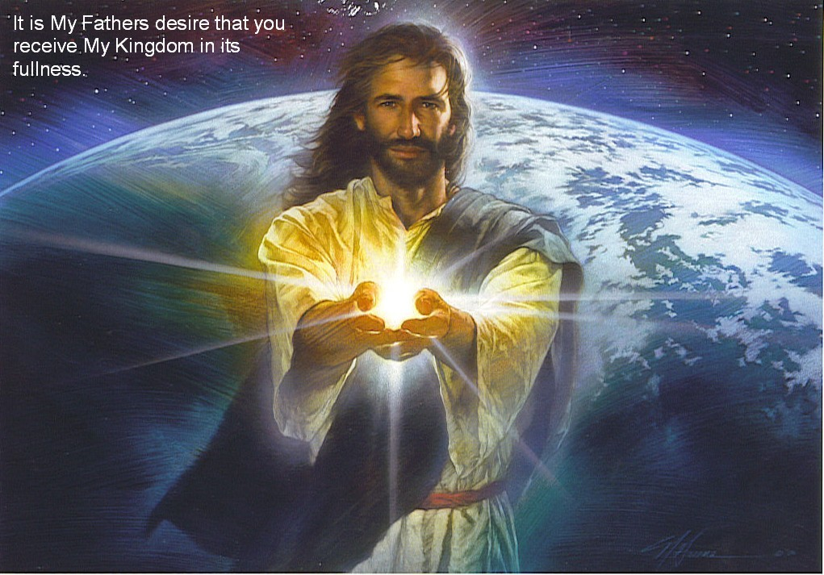
Jesus is the light of life (12-20)
Light
Life
Darkness
Death
Hostility!

Slide 87
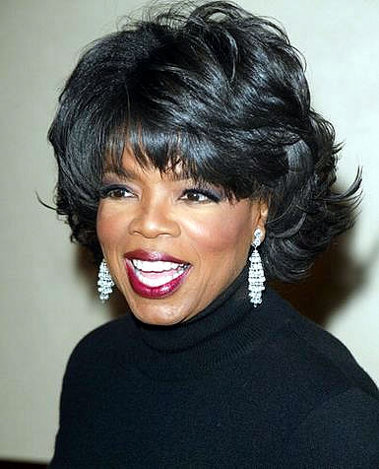
Oprah Winfrey
“Does God care about your heart... Or does God care that you call his son ‘Jesus’?”
Notes:
http://www.youtube.com/watch?v=ETeI6i5oqh4&feature=related

Slide 88
I. Some are hostile to Christ as the way of salvation (8:12-20).

Slide 89
D. Conflict Over His Person
§ 101
John 8:21-59
Jesus claims to be Messiah and deity, and the Jewish leaders unsuccessful try to kill Him by stoning for blasphemy
Notes:
The Unbelieving People Warned
John 8:21 Later Jesus said to them again, “I am going away. You will search for me but will die in your sin. You cannot come where I am going.”
John 8:22 The peopleª asked, “Is he planning to commit suicide? What does he mean, ‘You cannot come where I am going’?”
John 8:23 Jesus continued, “You are from below; I am from above. You belong to this world; I do not. ²⁴ That is why I said that you will die in your sins; for unless you believe that I AM who I claim to be,ª you will die in your sins.”
John 8:25 “Who are you?” they demanded.
Jesus replied, “The one I have always claimed to be.ª
²⁶ I have much to say about you and much to condemn, but I won’t. For I say only what I have heard from the one who sent me, and he is completely truthful.” ²⁷ But they still didn’t understand that he was talking about his Father.
John 8:28 So Jesus said, “When you have lifted up the Son of Man on the cross, then you will understand that I AM he.ª I do nothing on my own but say only what the Father taught me. ²⁹ And the one who sent me is with me—he has not deserted me. For I always do what pleases him.” ³⁰ Then many who heard him say these things believed in him.
Jesus and Abraham
John 8:31 Jesus said to the people who believed in him, “You are truly my disciples if you remain faithful to my teachings. ³² And you will know the truth, and the truth will set you free.”
John 8:33 “But we are descendants of Abraham,” they said. “We have never been slaves to anyone. What do you mean, ‘You will be set free’?”
John 8:34 Jesus replied, “I tell you the truth, everyone who sins is a slave of sin. ³⁵ A slave is not a permanent member of the family, but a son is part of the family forever. ³⁶ So if the Son sets you free, you are truly free. ³⁷ Yes, I realize that you are descendants of Abraham. And yet some of you are trying to kill me because there’s no room in your hearts for my message. ³⁸ I am telling you what I saw when I was with my Father. But you are following the advice of your father.”
John 8:39 “Our father is Abraham!” they declared.
“No,” Jesus replied, “for if you were really the children of Abraham, you would follow his example.ª
⁴⁰ Instead, you are trying to kill me because I told you the truth, which I heard from God. Abraham never did such a thing. ⁴¹ No, you are imitating your real father.”
They replied, “We aren’t illegitimate children! God himself is our true Father.”
John 8:42 Jesus told them, “If God were your Father, you would love me, because I have come to you from God. I am not here on my own, but he sent me. ⁴³ Why can’t you understand what I am saying? It’s because you can’t even hear me! ⁴⁴ For you are the children of your father the devil, and you love to do the evil things he does. He was a murderer from the beginning. He has always hated the truth, because there is no truth in him. When he lies, it is consistent with his character; for he is a liar and the father of lies. ⁴⁵ So when I tell the truth, you just naturally don’t believe me! ⁴⁶ Which of you can truthfully accuse me of sin? And since I am telling you the truth, why don’t you believe me? ⁴⁷ Anyone who belongs to God listens gladly to the words of God. But you don’t listen because you don’t belong to God.”
John 8:48 The people retorted, “You Samaritan devil! Didn’t we say all along that you were possessed by a demon?”
John 8:49 “No,” Jesus said, “I have no demon in me. For I honor my Father—and you dishonor me. ⁵⁰ And though I have no wish to glorify myself, God is going to glorify me. He is the true judge. ⁵¹ I tell you the truth, anyone who obeys my teaching will never die!”
John 8:52 The people said, “Now we know you are possessed by a demon. Even Abraham and the prophets died, but you say, ‘Anyone who obeys my teaching will never die!’ ⁵³ Are you greater than our father Abraham? He died, and so did the prophets. Who do you think you are?”
John 8:54 Jesus answered, “If I want glory for myself, it doesn’t count. But it is my Father who will glorify me. You say, ‘He is our God,’ª ⁵⁵ but you don’t even know him. I know him. If I said otherwise, I would be as great a liar as you! But I do know him and obey him. ⁵⁶ Your father Abraham rejoiced as he looked forward to my coming. He saw it and was glad.”
John 8:57 The people said, “You aren’t even fifty years old. How can you say you have seen Abraham?ª”
John 8:58 Jesus answered, “I tell you the truth, before Abraham was even born, I AM!ª” ⁵⁹ At that point they picked up stones to throw at him. But Jesus was hidden from them and left the Temple.

Slide 90
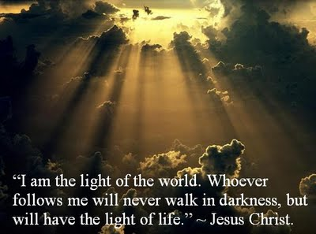
II. Many believe that the Father sent Jesus from heaven
(8:21-30).

Slide 91
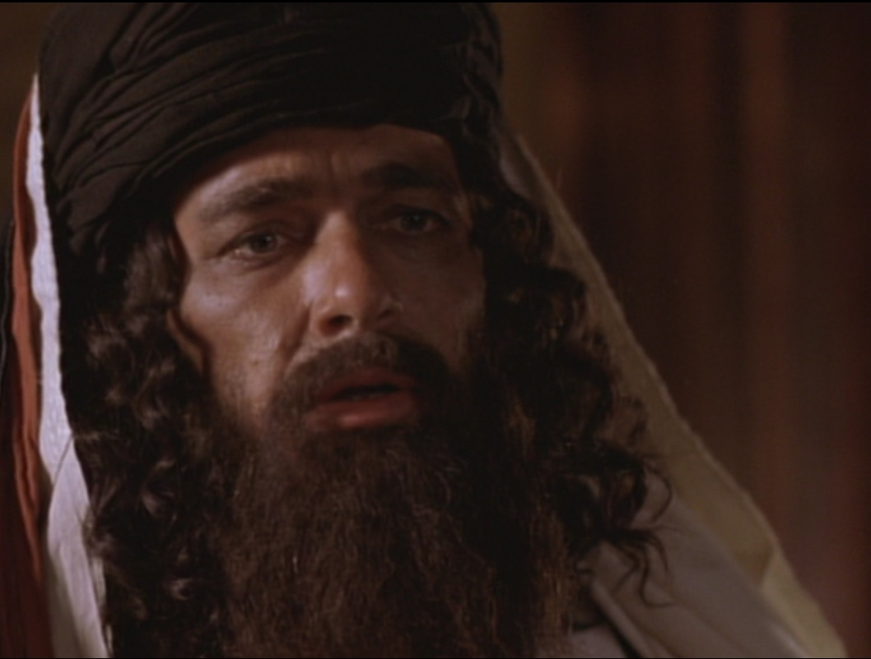
Who are you?!
John 8:25

Slide 92
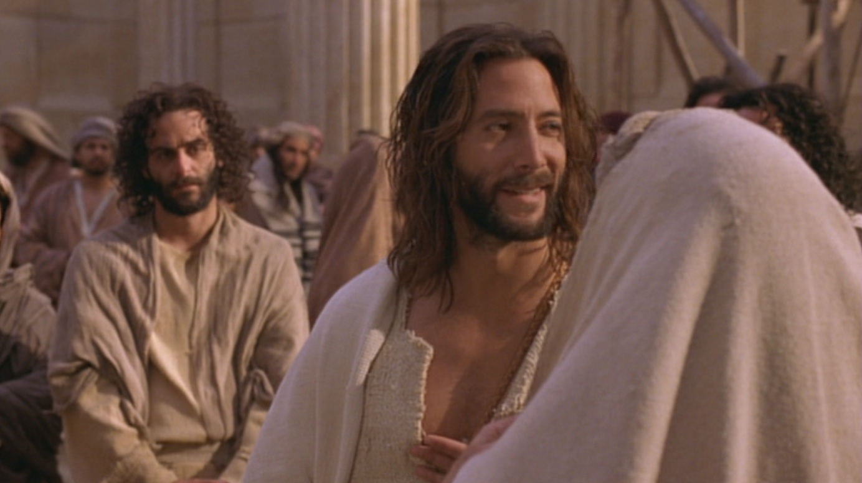
“My identity? I am God!” (8:25-30)
Above
Eternal life
Below
Die in sins
Jesus continued, “You are from below; I am from above. You belong to this world; I do not. ²⁴ That is why I said that you will die in your sins; for unless you believe that I Am who I claim to be, you will die in your sins” (John 8:23-24).

Slide 93

Many people there placed their faith in him (8:30).

Slide 94
I. Some are hostile to Christ as the way of salvation (8:12-20).

Slide 95
II. Many believe that the Father sent Jesus from heaven
(8:21-30).

Slide 96

III. All are revealed as of God or Satan (31-59).

Slide 97

A. Believers in Jesus are freed from slavery to be the spiritual descendants of Abraham (31-38).
Child of God

Slide 98

“Believe” in John’s Gospel
“Then many who heard him say these things believed in him. ³¹ Jesus said to the people who believed in him, ‘You are truly my disciples if you remain faithful to my teachings. ³² And you will know the truth, and the truth will set you free’” (8:30-32).

Slide 99

John 8:34 text

Slide 100

Life’s Journey

Slide 101

Freedom

Slide 102

Freedom (John 8:34)

Slide 103

B. Those who reject Jesus identify the devil as their father even to the point of trying to kill the messenger (8:39-59).

Slide 104

1. Those who reject Jesus identify the devil as their father (8:39-47).

Slide 105

“You belong to your father, the devil... He was a murderer from the beginning... When he lies, he speaks his native language...” (8:44)
YOU KNOW HOW I CAN TELL WHEN YOU LYING? … YOUR LIPS ARE MOVING

Slide 106

2. Some reject God to the point that they even try to kill the messenger (8:48-59).
Somali Christian Beheaded for his Faith

Slide 107

“Before Abraham was born, I Am!”
John 8:58

Slide 108

Christ’s “I Am…” Claims in John’s Gospel
“Light of the World”
“Before Abraham”
“Good Shepherd”
“Door”
“I & Father are one”
“Resurrection & Life”
“Way, Truth, & Life”
“True Vine”

Slide 109

“They picked up stones to throw at him”
John 8:59

Slide 110

Main Idea
How should we expect people to respond to Christ’s claim to be eternal God who saves us from sin?
Christ’s claim to be God elicits the best & worst in us.

Slide 111

Who is Jesus?
Jesus is the Light of life (12-20)
Jesus is sent from heaven by God the Father (21-30)
Jesus can make you God’s child (31-38)
Jesus is God eternal (39-59)

Slide 112

3 responses:
• Some are hostile (12-20).
• Many believe (21-30).
• All are revealed as of God or Satan (31-59).

Slide 113

Walk to the light!

Slide 114

Liar–Lunatic–Lord
Jesus said
I AM GOD
If True
If False
If Insincere
If Sincere
Jesus is God
Jesus is a
Jesus is a
LORD
LIAR
LUNATIC
Notes:
C.S. Lewis, a popular British theologian, wrote, "I am trying here to prevent anyone saying the really foolish thing that people often say about Him: 'I'm ready to accept Jesus as a great moral teacher, but I don't accept His claim to be God.' That is the one thing we must not say. A man who was merely a man and said the sort of things Jesus said would not be a great moral teacher. He would either be a lunatic - on the level with the man who says he is a poached egg - or else he would be the Devil of Hell. You must make your choice. Either this man was, and is, the Son of God: or else a madman or something worse. You can shut Him up for a fool, you can spit at Him and kill Him as a demon; or you can fall at His feet and call Him Lord and God. But let us not come with any patronising nonsense about His being a great human teacher. He has not left that open to us. He did not intend to." (C.S. Lewis, Mere Christianity, The MacMillan Company, 1960, pp. 40-41.)

Slide 115


D.L. Moody

Slide 116
E. Conflict Over the Healing of the Blind Man
§ 102
John 9:1-41
By healing a man born blind on the Sabbath, Christ authenticates His claim as Light to those in darkness and is worshipped as God
Notes:
Jesus Heals a Man Born Blind
John 9:1 As Jesus was walking along, he saw a man who had been blind from birth. ² “Rabbi,” his disciples asked him, “why was this man born blind? Was it because of his own sins or his parents’ sins?”
John 9:3 “It was not because of his sins or his parents’ sins,” Jesus answered. “This happened so the power of God could be seen in him. ⁴ We must quickly carry out the tasks assigned us by the one who sent us. The night is coming, and then no one can work. ⁵ But while I am here in the world, I am the light of the world.”
John 9:6 Then he spit on the ground, made mud with the saliva, and spread the mud over the blind man’s eyes. ⁷ He told him, “Go wash yourself in the pool of Siloam” (Siloam means “sent”). So the man went and washed and came back seeing!
John 9:8 His neighbors and others who knew him as a blind beggar asked each other, “Isn’t this the man who used to sit and beg?” ⁹ Some said he was, and others said, “No, he just looks like him!”
But the beggar kept saying, “Yes, I am the same one!”
John 9:10 They asked, “Who healed you? What happened?”
John 9:11 He told them, “The man they call Jesus made mud and spread it over my eyes and told me, ‘Go to the pool of Siloam and wash yourself.’ So I went and washed, and now I can see!”
John 9:12 “Where is he now?” they asked.
“I don’t know,” he replied.
John 9:13 Then they took the man who had been blind to the Pharisees, ¹⁴ because it was on the Sabbath that Jesus had made the mud and healed him. ¹⁵ The Pharisees asked the man all about it. So he told them, “He put the mud over my eyes, and when I washed it away, I could see!”
John 9:16 Some of the Pharisees said, “This man Jesus is not from God, for he is working on the Sabbath.” Others said, “But how could an ordinary sinner do such miraculous signs?” So there was a deep division of opinion among them.
John 9:17 Then the Pharisees again questioned the man who had been blind and demanded, “What’s your opinion about this man who healed you?”
The man replied, “I think he must be a prophet.”
John 9:18 The Jewish leaders still refused to believe the man had been blind and could now see, so they called in his parents. ¹⁹ They asked them, “Is this your son? Was he born blind? If so, how can he now see?”
John 9:20 His parents replied, “We know this is our son and that he was born blind, ²¹ but we don’t know how he can see or who healed him. Ask him. He is old enough to speak for himself.” ²² His parents said this because they were afraid of the Jewish leaders, who had announced that anyone saying Jesus was the Messiah would be expelled from the synagogue. ²³ That’s why they said, “He is old enough. Ask him.”
John 9:24 So for the second time they called in the man who had been blind and told him, “God should get the glory for this, because we know this man Jesus is a sinner.”
John 9:25 “I don’t know whether he is a sinner,” the man replied. “But I know this: I was blind, and now I can see!”
John 9:26 “But what did he do?” they asked. “How did he heal you?”
John 9:27 “Look!” the man exclaimed. “I told you once. Didn’t you listen? Why do you want to hear it again? Do you want to become his disciples, too?”
John 9:28 Then they cursed him and said, “You are his disciple, but we are disciples of Moses! ²⁹ We know God spoke to Moses, but we don’t even know where this man comes from.”
John 9:30 “Why, that’s very strange!” the man replied. “He healed my eyes, and yet you don’t know where he comes from? ³¹ We know that God doesn’t listen to sinners, but he is ready to hear those who worship him and do his will. ³² Ever since the world began, no one has been able to open the eyes of someone born blind. ³³ If this man were not from God, he couldn’t have done it.”
John 9:34 “You were born a total sinner!” they answered. “Are you trying to teach us?” And they threw him out of the synagogue.
Spiritual Blindness
John 9:35 When Jesus heard what had happened, he found the man and asked, “Do you believe in the Son of Man?”
John 9:36 The man answered, “Who is he, sir? I want to believe in him.”
John 9:37 “You have seen him,” Jesus said, “and he is speaking to you!”
John 9:38 “Yes, Lord, I believe!” the man said. And he worshiped Jesus.
John 9:39 Then Jesus told him, “I entered this world to render judgment—to give sight to the blind and to show those who think they see that they are blind.”
John 9:40 Some Pharisees who were standing nearby heard him and asked, “Are you saying we’re blind?”
John 9:41 “If you were blind, you wouldn’t be guilty,” Jesus replied. “But you remain guilty because you claim you can see.

Slide 117


Don’t the Blind Know They’re Blind?
John 9

Slide 118
Spiritual Blindness
Notes:
What is spiritual blindness?
Do the spiritually blind know or care if they are spiritually blind?

Slide 119



Healing from Spiritual Blindness
satisfying life
forgiveness
eternal life

Slide 120

What must we see to prevent spiritual blindness— in ourselves & others?

Slide 121
John 6–8
Bread
6
Water
7
Light
8

Slide 122
What must we see to prevent spiritual blindness— in ourselves & others?
3 views:
miracle
controversy
decision

Slide 123

I. Jesus makes the blind see.

Slide 124

A. Jesus’ healing a blind man proved he gives spiritual sight too (9:1-7).

Slide 125

1. This man was born blind to show that God empowered Jesus to give eternal life (9:1-5).

Slide 126

Why this blindness?

Slide 127

Exodus 20:4-5
Sin
“You must not make for yourself an idol.... ⁵ You must not bow down to them or worship them, for ... I lay the sins of the parents upon their children; the entire family is affected—even children in the third and fourth generations of those who reject me.’”
Suffering

Slide 128

2. Jesus proved He was the way for eternal life by miraculously healing the man (9:6-7).

Slide 129

Why did Christ put mud on the man’s eyes (9:6)?

Slide 130

Jesus formed Adam from the dust (John 1:3; Gen. 2:7).

Slide 131
Washing developed his faith

Slide 132

Journey to the Pool of Siloam
Temple
Pool of Siloam

Slide 133

B. Do you believe that God sent Jesus to cure your own blindness?

Slide 134


Signs in John’s Gospel
Signs unique to John's Gospel in yellow (6 of the 9 miracles)
WATER
TO WINE
2:1-11
HEALING
OFFICIAL’S
SON
4:46-54
HEALING
PARALYTIC
5:1-18
FEEDING
5000
6:1-15
WALKING
ON WATER
6:16-24
HEALING
BLIND MAN
9:1-7
RAISING
LAZARUS
11:1-45
CHRIST’S
RESURRECTION
20:1-31
FISH
CATCH
21:1-3

Slide 135
I. Jesus makes the blind see.

Slide 136

II. Jesus changes people’s lives (9:8-34).

Slide 137


A. The blind man increasingly gained spiritual insight...
... while the Pharisees increasingly rejected his testimony and became more spiritually blind (8-34).

Slide 138

Evidence of Spiritual Blindness
Trusting rules over God’s work (8-16)
“This man Jesus is not from God, for he is working on the Sabbath” (16a).
Notes:
Read 13-16a: “¹³ Then they took the man who had been blind to the Pharisees, ¹⁴ because it was on the Sabbath that Jesus had made the mud and healed him. ¹⁵ The Pharisees asked the man all about it. So he told them, “He put the mud over my eyes, and when I washed it away, I could see!”
¹⁶ Some of the Pharisees said, “This man Jesus is not from God, for he is working on the Sabbath.”
Tyndale House Publishers., Holy Bible : New Living Translation., 2nd ed. (Wheaton, Ill.: Tyndale House Publishers, 2004), Jn 9:13-16.

Slide 139

Evidence of Spiritual Blindness
Persecuting God’s witnesses (17-23)

Slide 140

Evidence of Spiritual Blindness
Rejecting Christ despite evidence (24-34)

Slide 141

"Ever since the world began, no one has been able to open the eyes of someone born blind. ³³ If this man were not from God, he couldn’t have done it" (32-33).
No OT sight restored
No disciples healed blindness
Healing blindness was Christ’s most common miracle!
Evidence of being Messiah

Slide 142

B. Does seeing evidence for Jesus help you gain or lose spiritual insight?

Slide 143

HUMILITY
I'm not so arrogant to think I've arrived at the truth about anything, but I'm pretty sure everything you say is not only dead wrong, but really, really stupid, too.

Slide 144

Did life originate as an accident?
“There are only two possible explanations as to how life arose: Spontaneous generation arising to evolution or a supernatural creative act of God…. There is no other possibility. Spontaneous generation was scientifically disproved 120 years ago by Louis Pasteur and others, but that just leaves us with only one other possibility… that life came as an act of supernatural creation by God, but I can’t accept that philosophy because I do not want to believe in God. Therefore, I choose to believe that which I know is scientifically impossible, spontaneous generation leading to evolution.”
Dr. George Wald
Professor Emeritus of Biology, Harvard
Nobel Prize winner in Biology, 1971
Notes:
The same applies to hearing others testify that Jesus offers eternal life—we must act on the evidence by believing it to prevent spiritual blindness.
George Wald, “Origin, Lie and Evolution,” Scientific American 1978); cited by Joe White and Nicholas Comninellis, Darwin’s Demise (Green Forest, AR: Master Books, 2001), 46.

Slide 145
I. Jesus makes the blind see.

Slide 146
II. Jesus changes people’s lives(8-34).

Slide 147


III. Jesus deserves worship as God (35-41).

Slide 148


Opposite Responses

Slide 149

The former blind man confesses Jesus as God (35-38).

Slide 150

Jesus condemns the Pharisees for rejecting him as God (39-41).

Slide 151

John 9:39-41 NLT
³⁹ Then Jesus told him, “I entered this world to render judgment—to give sight to the blind and to show those who think they see (Greek: “those who see”) that they are blind.”
⁴⁰ Some Pharisees who were standing nearby heard him and asked, “Are you saying we’re blind?”
⁴¹ “If you were blind, you wouldn’t be guilty,” Jesus replied. “But you remain guilty because you claim you can see”

Slide 152

How should we respond when we see that Jesus is truly God Himself?

Slide 153
???????
Who’s the real blind man?

Slide 154

The blind man sees!
Who’s the real blind man?
• God: “worshipped Jesus” (38)
• “A man from God” (33)
• “A prophet” (17)
• “A man called Jesus” (7)

Slide 155

The Pharisees are blind!
Who’s the real blind man?
• Jesus is a con man (15, 18)
• Jesus is a Sabbath breaker (16)
• Blind man was deceived (17)
• Parents will discredit him (19)
• Excommunication threat (22)
• Curse in God’s name (24a)

Slide 156
The Pharisees are blind!
Who’s the real blind man?
• Jesus is a sinner (24b)
• Jesus is a deceiver (26)
• Blind man was deceived (26)
• Cursed the blind man (28)
• Lied about Jesus’ origin (29)
• Excommunicated blind man (34)

Slide 157

The Main Idea of John 9
How can you avoid spiritual blindness? Respond in faith to what you know now about Jesus!

Slide 158


Are you color blind?
I. Jesus makes the blind see.
II. Jesus changes people’s lives.
III. Jesus deserves worship as God.

Slide 159


Helen Keller (1880-1968)

Slide 160

Whoever wants healing from spiritual blindness must believe that Jesus is God.

Slide 161
Purpose #1
Jesus Healed the Blind Man
Reveal the Truth
9:1-7

Slide 162
Deity of Christ
9:1 Man born blind
We are blind spiritually at birth thus need rebirth which only God can provide
9:2-4a “Rabbi, who sinned.…? God might be displayed in Him.”
Christ’s ability to cure our spiritual blindness shows him to be God
9:4b-5 Day and Night
He was sent by God to work but his work ceased during His crucifixion-resurrection

Slide 163
Deity of Christ
9:6 Mud and saliva
Irenaeus believed the action was to show Christ is the Creator (cf. Gen. 2:7)
9:7 Siloam means “Sent”
Jesus was “Sent” by God
Water symbolized the Holy Spirit so that the blind man was born of water and the Spirit (cf. 3:5)

Slide 164
What is the Truth of Verses 1-7?
Jesus is the Son of God because He was sent by God to give Spiritual Truth to the blind
“There was the true Light which coming into the world, enlightens every man” (1:9)
“Truly, truly, I say to you, unless one is born again he cannot see the kingdom of God” (3:3)

Slide 165
Purpose #2
Jesus Healed the Blind Man
Reveal the Blind
9:8-34

Slide 166
Black

Slide 167
Black

Slide 168


WHO WAS TRULY BLIND?
Pharisees? or the Blind Man?

Slide 169
Steps in the Blind Man’s Belief
Blind man interrogated
by neighbors (8-12)
Blind man and parents interrogated
by Pharisees (13-23)
Blind man interrogated
by Pharisees again (24-34)
“The man they call Jesus” (11)
“He is a prophet” (17)
“Whether he is a sinner or not, I don’t know. One thing I do know. I was blind but now I see!” (25)
“If this man were
not from God,
He could do
nothing”(33)

Slide 170
Steps in the Pharisees’ Unbelief
“This man is not from God” (17)
“This man is a sinner” (25)
“You are His disciples but we are disciples of Moses” (29)
“You were born entirely in sin, and are you teaching us?” (34)

Slide 171

Contrasts
Blind Man
Had not seen Jesus before being healed
Knew little about the Mosaic Law
Beggar
Received Spiritual Truth
(Spiritual Sight)
Pharisees
Witnessed Jesus’ miracles & teaching
Claimed to know God’s Word
Religious
Rejected Spiritual Truth
(Spiritual Blindness)

Slide 172
What Caused the Blindness?
His parents were afraid of the Jews; for the Jews had already decided that anyone who acknowledged Jesus was the Christ would be put out of the synagogue (22)
“If we let him go on like this, all men will come and take away both our place and our nation” (John 11:48)
REPUTATION, PRIDE and WEALTH
caused their spiritual blindness

Slide 173
Pharisees Lived in Darkness
He came to his own but those who were His own did not receive Him.
John 1:11
For everyone who does evil hates the Light, and does not come to the Light for fear that his deeds will be exposed.
John 3:20

Slide 174
Why Were They Blind?
Pharisees were spiritually blind because they rejected the testimony of the blind man and the Deity of Christ.

Slide 175
THE
OUTCOME
(35-41)

Slide 176
Outcome for the Blind Man (35-38)
The blind man could see the kingdom of God because he became born again.
The blind beggar become a child of God.
The blind man worshiped the Son of God.

Slide 177
Outcome for the Pharisees (39-41)
The Pharisees would be judged and condemned because they willfully rejected Jesus as the Son of God (39a)
The Pharisees’ ability to see spiritual truth degenerated (39b)
The Pharisees continued with their guilt upon them (41b)

Slide 178
John 3:17-18
For God did not send the Son into the world to judge the world, but that the world might be saved through Him. He who believes in Him is not judged; he who does not believe has been judged already, because he has not believed in the name of the only begotten Son of God.

Slide 179
John’s Message
Jesus is the Truth. Therefore…
Those who believe in Jesus shall know the truth and the truth will set them free.
But those who reject Jesus as the Son of God shall be judged.

Slide 180
Application
Let’s not follow in the footsteps of the Pharisees--blinded by their pride, reputation and wealth.
Let’s follow the example of the blind man--humbly obey and believe His Word.

Slide 181
The Great Transfer
For he has rescued us from the kingdom of darkness
and transferred us into the Kingdom of his dear Son
¹⁴ who purchased our freedom and forgave our sins (Col 1:13-14)

Slide 182
F. Conflict Over the Shepherd
§ 103
John 10:1-21
Israel's remnant follows Jesus as the true, good, and obedient Shepherd, so He calls Pharisee followers from their false shepherds
Notes:
The Good Shepherd and His Sheep
John 10:1 “I tell you the truth, anyone who sneaks over the wall of a sheepfold, rather than going through the gate, must surely be a thief and a robber! ² But the one who enters through the gate is the shepherd of the sheep. ³ The gatekeeper opens the gate for him, and the sheep recognize his voice and come to him. He calls his own sheep by name and leads them out. ⁴ After he has gathered his own flock, he walks ahead of them, and they follow him because they know his voice. ⁵ They won’t follow a stranger; they will run from him because they don’t know his voice.”
John 10:6 Those who heard Jesus use this illustration didn’t understand what he meant, ⁷ so he explained it to them: “I tell you the truth, I am the gate for the sheep. ⁸ All who came before meª were thieves and robbers. But the true sheep did not listen to them. ⁹ Yes, I am the gate. Those who come in through me will be saved.ª They will come and go freely and will find good pastures. ¹⁰ The thief’s purpose is to steal and kill and destroy. My purpose is to give them a rich and satisfying life.
John 10:11 “I am the good shepherd. The good shepherd sacrifices his life for the sheep. ¹² A hired hand will run when he sees a wolf coming. He will abandon the sheep because they don’t belong to him and he isn’t their shepherd. And so the wolf attacks them and scatters the flock. ¹³ The hired hand runs away because he’s working only for the money and doesn’t really care about the sheep.
John 10:14 “I am the good shepherd; I know my own sheep, and they know me, ¹⁵ just as my Father knows me and I know the Father. So I sacrifice my life for the sheep. ¹⁶ I have other sheep, too, that are not in this sheepfold. I must bring them also. They will listen to my voice, and there will be one flock with one shepherd.
John 10:17 “The Father loves me because I sacrifice my life so I may take it back again. ¹⁸ No one can take my life from me. I sacrifice it voluntarily. For I have the authority to lay it down when I want to and also to take it up again. For this is what my Father has commanded.”
John 10:19 When he said these things, the peopleª were again divided in their opinions about him. ²⁰ Some said, “He’s demon possessed and out of his mind. Why listen to a man like that?” ²¹ Others said, “This doesn’t sound like a man possessed by a demon! Can a demon open the eyes of the blind?”

Slide 183

Who or what are you listening to?

Slide 184


How does Jesus look at sheep?

Slide 185

"After he has gathered his own flock, he walks ahead of them, and they follow him because they know his voice"—John 10:4 NLT

Slide 186

So he explained it to them:
“I tell you the truth, I am the gate for the sheep."
—John 10:7 NLT

Slide 187


Slide 188
C. S. Lewis, Mere Christianity, 55-56
“I am here trying to prevent anyone saying the really foolish thing that people often say about Him: ‘I’m ready to accept Jesus as a great moral teacher, but I don’t accept His claim to be God.’ That is the one thing we must not say. A man who was merely a man and said the sort of things Jesus said would not be a great moral teacher. He would either be a lunatic—on a level with the man who says he is a poached egg—or else he would be the Devil of Hell. You must make your choice. Either this man was, and is, the Son of God: or else a madman or something worse. You can shut Him up for a fool, you can spit at Him and kill Him as a demon; or you can fall at His feet and call Him Lord and God. But let us not come with any patronising nonsense about His being a great human teacher. He has not left that open to us. He did not intend to.”

Slide 189
G. Witness of the
Seventy-Two
§ 104
Luke 10: 1-24
Christ sends 72 men to tell the crowds that He is Messiah who offers the kingdom to show debate about Him from the leaders and people
Notes:
Jesus Sends Out His Disciples
Luke 10:1 The Lord now chose seventy-twoª other disciples and sent them ahead in pairs to all the towns and places he planned to visit. ² These were his instructions to them: “The harvest is great, but the workers are few. So pray to the Lord who is in charge of the harvest; ask him to send more workers into his fields. ³ Now go, and remember that I am sending you out as lambs among wolves. ⁴ Don’t take any money with you, nor a traveler’s bag, nor an extra pair of sandals. And don’t stop to greet anyone on the road.
Luke 10:5 “Whenever you enter someone’s home, first say, ‘May God’s peace be on this house.’ ⁶ If those who live there are peaceful, the blessing will stand; if they are not, the blessing will return to you. ⁷ Don’t move around from home to home. Stay in one place, eating and drinking what they provide. Don’t hesitate to accept hospitality, because those who work deserve their pay.
Luke 10:8 “If you enter a town and it welcomes you, eat whatever is set before you. ⁹ Heal the sick, and tell them, ‘The Kingdom of God is near you now.’ ¹⁰ But if a town refuses to welcome you, go out into its streets and say, ¹¹ ‘We wipe even the dust of your town from our feet to show that we have abandoned you to your fate. And know this—the Kingdom of God is near!’ ¹² I assure you, even wicked Sodom will be better off than such a town on judgment day.
Luke 10:13 “What sorrow awaits you, Korazin and Bethsaida! For if the miracles I did in you had been done in wicked Tyre and Sidon, their people would have repented of their sins long ago, clothing themselves in burlap and throwing ashes on their heads to show their remorse. ¹⁴ Yes, Tyre and Sidon will be better off on judgment day than you. ¹⁵ And you people of Capernaum, will you be honored in heaven? No, you will go down to the place of the dead.ª”
Luke 10:16 Then he said to the disciples, “Anyone who accepts your message is also accepting me. And anyone who rejects you is rejecting me. And anyone who rejects me is rejecting God, who sent me.”
Luke 10:17 When the seventy-two disciples returned, they joyfully reported to him, “Lord, even the demons obey us when we use your name!”
Luke 10:18 “Yes,” he told them, “I saw Satan fall from heaven like lightning! ¹⁹ Look, I have given you authority over all the power of the enemy, and you can walk among snakes and scorpions and crush them. Nothing will injure you. ²⁰ But don’t rejoice because evil spirits obey you; rejoice because your names are registered in heaven.”
Jesus’ Prayer of Thanksgiving
Luke 10:21 At that same time Jesus was filled with the joy of the Holy Spirit, and he said, “O Father, Lord of heaven and earth, thank you for hiding these things from those who think themselves wise and clever, and for revealing them to the childlike. Yes, Father, it pleased you to do it this way.
Luke 10:22 “My Father has entrusted everything to me. No one truly knows the Son except the Father, and no one truly knows the Father except the Son and those to whom the Son chooses to reveal him.”
Luke 10:23 Then when they were alone, he turned to the disciples and said, “Blessed are the eyes that see what you have seen. ²⁴ I tell you, many prophets and kings longed to see what you see, but they didn’t see it. And they longed to hear what you hear, but they didn’t hear it.”

Slide 190
H. Conflict Over the Question of Eternal Life
§ 105
Luke 10:25-37
Christ tells the Good Samaritan parable to a self-justifying lawyer that he must help all in need to be rewarded kingdom blessings
Notes:
The Most Important Commandment
Luke 10:25 One day an expert in religious law stood up to test Jesus by asking him this question: “Teacher, what should I do to inherit eternal life?”
Luke 10:26 Jesus replied, “What does the law of Moses say? How do you read it?”
Luke 10:27 The man answered, “‘You must love the LORD your God with all your heart, all your soul, all your strength, and all your mind.’ And, ‘Love your neighbor as yourself.’”ª
Luke 10:28 “Right!” Jesus told him. “Do this and you will live!”
Luke 10:29 The man wanted to justify his actions, so he asked Jesus, “And who is my neighbor?”
Parable of the Good Samaritan
Luke 10:30 Jesus replied with a story: “A Jewish man was traveling from Jerusalem down to Jericho, and he was attacked by bandits. They stripped him of his clothes, beat him up, and left him half dead beside the road.
Luke 10:31 “By chance a priest came along. But when he saw the man lying there, he crossed to the other side of the road and passed him by. ³² A Temple assistantª walked over and looked at him lying there, but he also passed by on the other side.
Luke 10:33 “Then a despised Samaritan came along, and when he saw the man, he felt compassion for him. ³⁴ Going over to him, the Samaritan soothed his wounds with olive oil and wine and bandaged them. Then he put the man on his own donkey and took him to an inn, where he took care of him. ³⁵ The next day he handed the innkeeper two silver coins,ª telling him, ‘Take care of this man. If his bill runs higher than this, I’ll pay you the next time I’m here.’
Luke 10:36 “Now which of these three would you say was a neighbor to the man who was attacked by bandits?” Jesus asked.
Luke 10:37 The man replied, “The one who showed him mercy.”
Then Jesus said, “Yes, now go and do the same.”

Slide 191

The Good Samaritan (Luke 10)
99

Slide 192
Augustine's Allegorical Interpretation of the Good Samaritan Parable (Luke 15)
Text Interpretation
A "certain man"… Adam
Thieves… the devil and demons
Stripped him… took his immortality
Beat him… tempted him to sin
The priest and the Levite… the ministry of the OT
which does nothing for Adam
The Good Samaritan… Christ
Binds wounds with oil and wine… restrains sin with hope and
an exhortation to work with a
fervent spirit
The inn… the Church
The innkeeper… the Apostle Paul
Really?!

Slide 193

God's Compassion
Luke 10:25-37

Slide 194
I. An Example of Fellowship
§ 106
Luke 10:38-42
Christ favors Mary's fellowship over Martha's service to show that occupation with Christ is more important than occupation for Christ
Notes:
Jesus Visits Martha and Mary
Luke 10:38 As Jesus and the disciples continued on their way to Jerusalem, they came to a certain village where a woman named Martha welcomed him into her home. ³⁹ Her sister, Mary, sat at the Lord’s feet, listening to what he taught. ⁴⁰ But Martha was distracted by the big dinner she was preparing. She came to Jesus and said, “Lord, doesn’t it seem unfair to you that my sister just sits here while I do all the work? Tell her to come and help me.”
Luke 10:41 But the Lord said to her, “My dear Martha, you are worried and upset over all these details! ⁴² There is only one thing worth being concerned about. Mary has discovered it, and it will not be taken away from her.”

Slide 195
J. Instruction in Prayer
§ 107
Luke 11:1-13
Jesus teaches persistence in praying to God who alone can meet our needs to exhort prayer for the Spirit after His departure
Notes:
Teaching about Prayer
Luke 11:1 Once Jesus was in a certain place praying. As he finished, one of his disciples came to him and said, “Lord, teach us to pray, just as John taught his disciples.”
Luke 11:2 Jesus said, “This is how you should pray:
“Father, may your name be kept holy.
May your Kingdom come soon.
³ Give us each day the food we need,
⁴ and forgive us our sins,
as we forgive those who sin against us.
And don’t let us yield to temptation.”
Luke 11:5 Then, teaching them more about prayer, he used this story: “Suppose you went to a friend’s house at midnight, wanting to borrow three loaves of bread. You say to him, ⁶ ‘A friend of mine has just arrived for a visit, and I have nothing for him to eat.’ ⁷ And suppose he calls out from his bedroom, ‘Don’t bother me. The door is locked for the night, and my family and I are all in bed. I can’t help you.’ ⁸ But I tell you this—though he won’t do it for friendship’s sake, if you keep knocking long enough, he will get up and give you whatever you need because of your shameless persistence.
Luke 11:9 “And so I tell you, keep on asking, and you will receive what you ask for. Keep on seeking, and you will find. Keep on knocking, and the door will be opened to you. ¹⁰ For everyone who asks, receives. Everyone who seeks, finds. And to everyone who knocks, the door will be opened.
Luke 11:11 “You fathers—if your children ask for a fish, do you give them a snake instead? ¹² Or if they ask for an egg, do you give them a scorpion? Of course not! ¹³ So if you sinful people know how to give good gifts to your children, how much more will your heavenly Father give the Holy Spirit to those who ask him.”

Slide 196
K. Conflict Over the Healing of the Dumb Man
§ 108
Luke 11:14-36
After claims of exorcism by Satan, Jesus says that God will judge Israel's unbelief, so it is worse than before John's ministry
Notes:
Jesus and the Prince of Demons
Luke 11:14 One day Jesus cast out a demon from a man who couldn’t speak, and when the demon was gone, the man began to speak. The crowds were amazed, ¹⁵ but some of them said, “No wonder he can cast out demons. He gets his power from Satan,ª the prince of demons.” ¹⁶ Others, trying to test Jesus, demanded that he show them a miraculous sign from heaven to prove his authority.
Luke 11:17 He knew their thoughts, so he said, “Any kingdom divided by civil war is doomed. A family splintered by feuding will fall apart. ¹⁸ You say I am empowered by Satan. But if Satan is divided and fighting against himself, how can his kingdom survive? ¹⁹ And if I am empowered by Satan, what about your own exorcists? They cast out demons, too, so they will condemn you for what you have said. ²⁰ But if I am casting out demons by the power of God,ª then the Kingdom of God has arrived among you. ²¹ For when a strong man is fully armed and guards his palace, his possessions are safe— ²² until someone even stronger attacks and overpowers him, strips him of his weapons, and carries off his belongings.
Luke 11:23 “Anyone who isn’t with me opposes me, and anyone who isn’t working with me is actually working against me.
Luke 11:24 “When an evilª spirit leaves a person, it goes into the desert, searching for rest. But when it finds none, it says, ‘I will return to the person I came from.’ ²⁵ So it returns and finds that its former home is all swept and in order. ²⁶ Then the spirit finds seven other spirits more evil than itself, and they all enter the person and live there. And so that person is worse off than before.”
Luke 11:27 As he was speaking, a woman in the crowd called out, “God bless your mother—the womb from which you came, and the breasts that nursed you!”
Luke 11:28 Jesus replied, “But even more blessed are all who hear the word of God and put it into practice.”
The Sign of Jonah
Luke 11:29 As the crowd pressed in on Jesus, he said, “This evil generation keeps asking me to show them a miraculous sign. But the only sign I will give them is the sign of Jonah. ³⁰ What happened to him was a sign to the people of Nineveh that God had sent him. What happens to the Son of Manª will be a sign to these people that he was sent by God.
Luke 11:31 “The queen of Shebaª will stand up against this generation on judgment day and condemn it, for she came from a distant land to hear the wisdom of Solomon. Now someone greater than Solomon is here—but you refuse to listen. ³² The people of Nineveh will also stand up against this generation on judgment day and condemn it, for they repented of their sins at the preaching of Jonah. Now someone greater than Jonah is here—but you refuse to repent.
Receiving the Light
Luke 11:33 “No one lights a lamp and then hides it or puts it under a basket.ª Instead, a lamp is placed on a stand, where its light can be seen by all who enter the house.
Luke 11:34 “Your eye is like a lamp that provides light for your body. When your eye is healthy, your whole body is filled with light. But when it is unhealthy, your body is filled with darkness. ³⁵ Make sure that the light you think you have is not actually darkness. ³⁶ If you are filled with light, with no dark corners, then your whole life will be radiant, as though a floodlight were filling you with light.”

Slide 197

Free
Bible
images
Matthew 9:32-34; Luke 11:14-23
JESUS DELIVERS A MUTE MAN

Slide 198

Notes:
Luke 11:14 One day Jesus cast out a demon from a man who couldn’t speak…

Slide 199
Notes:
…and when the demon was gone…

Slide 200


Slide 201

Notes:
…the man began to speak.

Slide 202

Notes:
The crowds were amazed…

Slide 203

Notes:
¹⁵ but some of them said, “No wonder he can cast out demons. He gets his power from Satan,ª the prince of demons.”

Slide 204

Notes:
¹⁶ Others, trying to test Jesus, demanded that he show them a miraculous sign from heaven to prove his authority.

Slide 205

Notes:
Luke 11:17 He knew their thoughts, so he said, “Any kingdom divided by civil war is doomed. A family splintered by feuding will fall apart.

Slide 206

Notes:
¹⁸ You say I am empowered by Satan. But if Satan is divided and fighting against himself, how can his kingdom survive? ¹⁹ And if I am empowered by Satan, what about your own exorcists? They cast out demons, too, so they will condemn you for what you have said.

Slide 207
Notes:
²⁰ But if I am casting out demons by the power of God,ª then the Kingdom of God has arrived among you. ²¹ For when a strong man is fully armed and guards his palace, his possessions are safe— ²² until someone even stronger attacks and overpowers him, strips him of his weapons, and carries off his belongings.

Slide 208

Notes:
Luke 11:23 “Anyone who isn’t with me opposes me, and anyone who isn’t working with me is actually working against me."

Slide 209
Used with Permission
THE
GOSPEL
——OF—— MATTHEW
THE
GOSPEL
——OF—— MARK
THE
GOSPEL
——OF—— LUKE
THE
GOSPEL
——OF—— JOHN
Due to the Lumo Project producing its own publishing material we regret to inform you that we cannot license our photos to other clients outside of freebibleimages.org.
These images are not licensed for reuse in video, epublishing or other media. Downloaded pictures and files cannot be redistributed through any other website than freebibleimages.org or used in any context where the accompanying message is undermining of the Christian faith and gospel.
Photos can only be used on educational presentations, blogs and social media, all of which should be accompanied with reference to www.LumoProject.com.
Picture courtesy of BBM
© All Rights Reserved.
www.bigbookmedia.com

Slide 210
L. Conflict Over Pharisaic Ritualism
§ 109
Luke 11:37-54
Christ claims that Pharisee traditions mislead from the Law's true intent so that He and the Pharisees cannot be reconciled
Notes:
Jesus Criticizes the Religious Leaders
Luke 11:37 As Jesus was speaking, one of the Pharisees invited him home for a meal. So he went in and took his place at the table.ª ³⁸ His host was amazed to see that he sat down to eat without first performing the hand-washing ceremony required by Jewish custom. ³⁹ Then the Lord said to him, “You Pharisees are so careful to clean the outside of the cup and the dish, but inside you are filthy—full of greed and wickedness! ⁴⁰ Fools! Didn’t God make the inside as well as the outside? ⁴¹ So clean the inside by giving gifts to the poor, and you will be clean all over.
Luke 11:42 “What sorrow awaits you Pharisees! For you are careful to tithe even the tiniest income from your herb gardens,ª but you ignore justice and the love of God. You should tithe, yes, but do not neglect the more important things.
Luke 11:43 “What sorrow awaits you Pharisees! For you love to sit in the seats of honor in the synagogues and receive respectful greetings as you walk in the marketplaces. ⁴⁴ Yes, what sorrow awaits you! For you are like hidden graves in a field. People walk over them without knowing the corruption they are stepping on.”
Luke 11:45 “Teacher,” said an expert in religious law, “you have insulted us, too, in what you just said.”
Luke 11:46 “Yes,” said Jesus, “what sorrow also awaits you experts in religious law! For you crush people with unbearable religious demands, and you never lift a finger to ease the burden. ⁴⁷ What sorrow awaits you! For you build monuments for the prophets your own ancestors killed long ago. ⁴⁸ But in fact, you stand as witnesses who agree with what your ancestors did. They killed the prophets, and you join in their crime by building the monuments! ⁴⁹ This is what God in his wisdom said about you:ª ‘I will send prophets and apostles to them, but they will kill some and persecute the others.’
Luke 11:50 “As a result, this generation will be held responsible for the murder of all God’s prophets from the creation of the world— ⁵¹ from the murder of Abel to the murder of Zechariah, who was killed between the altar and the sanctuary. Yes, it will certainly be charged against this generation.
Luke 11:52 “What sorrow awaits you experts in religious law! For you remove the key to knowledge from the people. You don’t enter the Kingdom yourselves, and you prevent others from entering.”
Luke 11:53 As Jesus was leaving, the teachers of religious law and the Pharisees became hostile and tried to provoke him with many questions. ⁵⁴ They wanted to trap him into saying something they could use against him.

Slide 211
M. Instruction of the Disciples
§§ 110-118
Luke 12–13
Christ teaches believers among the multitude about Pharisaic practices and God's program, given Israel's rejection

Slide 212
1. Hypocrisy
§110
Luke 12:1-12
The crowd should break with the hypocritical Pharisees to secure their eternal destiny by putting their faith in Him
Notes:
NLT Luke 12:1 Meanwhile, the crowds grew until thousands were milling about and stepping on each other. Jesus turned first to his disciples and warned them, “Beware of the yeast of the Pharisees—their hypocrisy. ² The time is coming when everything that is covered up will be revealed, and all that is secret will be made known to all. ³ Whatever you have said in the dark will be heard in the light, and what you have whispered behind closed doors will be shouted from the housetops for all to hear!
Luke 12:4 “Dear friends, don’t be afraid of those who want to kill your body; they cannot do any more to you after that. ⁵ But I’ll tell you whom to fear. Fear God, who has the power to kill you and then throw you into hell.ª Yes, he’s the one to fear.
Luke 12:6 “What is the price of five sparrows—two copper coinsª? Yet God does not forget a single one of them. ⁷ And the very hairs on your head are all numbered. So don’t be afraid; you are more valuable to God than a whole flock of sparrows.
Luke 12:8 “I tell you the truth, everyone who acknowledges me publicly here on earth, the Son of Manª will also acknowledge in the presence of God’s angels. ⁹ But anyone who denies me here on earth will be denied before God’s angels. ¹⁰ Anyone who speaks against the Son of Man can be forgiven, but anyone who blasphemes the Holy Spirit will not be forgiven.
Luke 12:11 “And when you are brought to trial in the synagogues and before rulers and authorities, don’t worry about how to defend yourself or what to say, ¹² for the Holy Spirit will teach you at that time what needs to be said.”

Slide 213

Luke 12:2
NOTHING IS COVERED UP
that will not be revealed,
OR HIDDEN
that will not be known.
LUKE 12:2

Slide 214
2. Covetousness
§ 111
Luke 12:13-34
The Pharisees who trust in riches as proof of their acceptance before God stemmed from greed, so disciples should trust Jesus alone
Notes:
Parable of the Rich Fool
NLT Luke 12:13 Then someone called from the crowd, “Teacher, please tell my brother to divide our father’s estate with me.”
Luke 12:14 Jesus replied, “Friend, who made me a judge over you to decide such things as that?” ¹⁵ Then he said, “Beware! Guard against every kind of greed. Life is not measured by how much you own.”
Luke 12:16 Then he told them a story: “A rich man had a fertile farm that produced fine crops. ¹⁷ He said to himself, ‘What should I do? I don’t have room for all my crops.’ ¹⁸ Then he said, ‘I know! I’ll tear down my barns and build bigger ones. Then I’ll have room enough to store all my wheat and other goods. ¹⁹ And I’ll sit back and say to myself, “My friend, you have enough stored away for years to come. Now take it easy! Eat, drink, and be merry!”’
Luke 12:20 “But God said to him, ‘You fool! You will die this very night. Then who will get everything you worked for?’
Luke 12:21 “Yes, a person is a fool to store up earthly wealth but not have a rich relationship with God.”
Teaching about Money and Possessions
Luke 12:22 Then, turning to his disciples, Jesus said, “That is why I tell you not to worry about everyday life—whether you have enough food to eat or enough clothes to wear. ²³ For life is more than food, and your body more than clothing. ²⁴ Look at the ravens. They don’t plant or harvest or store food in barns, for God feeds them. And you are far more valuable to him than any birds! ²⁵ Can all your worries add a single moment to your life? ²⁶ And if worry can’t accomplish a little thing like that, what’s the use of worrying over bigger things?
Luke 12:27 “Look at the lilies and how they grow. They don’t work or make their clothing, yet Solomon in all his glory was not dressed as beautifully as they are. ²⁸ And if God cares so wonderfully for flowers that are here today and thrown into the fire tomorrow, he will certainly care for you. Why do you have so little faith?
Luke 12:29 “And don’t be concerned about what to eat and what to drink. Don’t worry about such things. ³⁰ These things dominate the thoughts of unbelievers all over the world, but your Father already knows your needs. ³¹ Seek the Kingdom of God above all else, and he will give you everything you need.
Luke 12:32 “So don’t be afraid, little flock. For it gives your Father great happiness to give you the Kingdom.
Luke 12:33 “Sell your possessions and give to those in need. This will store up treasure for you in heaven! And the purses of heaven never get old or develop holes. Your treasure will be safe; no thief can steal it and no moth can destroy it. ³⁴ Wherever your treasure is, there the desires of your heart will also be.

Slide 215

LESSONS FROM THE RICH FOOL
Notes:
Luke 12:21 “Yes, a person is a fool to store up earthly wealth but not have a rich relationship with God.”

Slide 216
3. Watchfulness
§ 112
Luke 12:35-41
The delay of the kingdom should motivate the disciples to prepare for His return to establish the kingdom
Notes:
Be Ready for the Lord’s Coming
Luke 12:35 “Be dressed for service and keep your lamps burning, ³⁶ as though you were waiting for your master to return from the wedding feast. Then you will be ready to open the door and let him in the moment he arrives and knocks. ³⁷ The servants who are ready and waiting for his return will be rewarded. I tell you the truth, he himself will seat them, put on an apron, and serve them as they sit and eat! ³⁸ He may come in the middle of the night or just before dawn.ª But whenever he comes, he will reward the servants who are ready.
Luke 12:39 “Understand this: If a homeowner knew exactly when a burglar was coming, he would not permit his house to be broken into. ⁴⁰ You also must be ready all the time, for the Son of Man will come when least expected.”
Luke 12:41 Peter asked, “Lord, is that illustration just for us or for everyone?”

Slide 217

Luke 12:35-38 NLT
³⁵"Be dressed for service and keep your lamps burning, ³⁶as though you were waiting for your master to return from the wedding feast. Then you will be ready to open the door and let him in the moment he arrives and knocks. ³⁷The servants who are ready and waiting for his return will be rewarded. I tell you the truth, he himself will seat them, put on an apron, and serve them as they sit and eat! ³⁸He may come in the middle of the night or just before dawn. But whenever he comes, he will reward the servants who are ready."

Slide 218
4. Faithfulness
§ 113
Luke 12:42-48
Those who are watchful must also be faithful since it will determine the degrees of both rewards and punishments
Notes:
NLT Luke 12:42 And the Lord replied, “A faithful, sensible servant is one to whom the master can give the responsibility of managing his other household servants and feeding them. ⁴³ If the master returns and finds that the servant has done a good job, there will be a reward. ⁴⁴ I tell you the truth, the master will put that servant in charge of all he owns. ⁴⁵ But what if the servant thinks, ‘My master won’t be back for a while,’ and he begins beating the other servants, partying, and getting drunk? ⁴⁶ The master will return unannounced and unexpected, and he will cut the servant in pieces and banish him with the unfaithful.
Luke 12:47 “And a servant who knows what the master wants, but isn’t prepared and doesn’t carry out those instructions, will be severely punished. ⁴⁸ But someone who does not know, and then does something wrong, will be punished only lightly. When someone has been given much, much will be required in return; and when someone has been entrusted with much, even more will be required.

Slide 219
5. The Effect of His Coming
§ 114
Luke 12:49-53
At the return of Jesus, a judgment will bring division over the person of Christ, so the people should reject Pharisaism for Jesus
Notes:
NLT Luke 12:49 “I have come to set the world on fire, and I wish it were already burning! ⁵⁰ I have a terrible baptism of suffering ahead of me, and I am under a heavy burden until it is accomplished. ⁵¹ Do you think I have come to bring peace to the earth? No, I have come to divide people against each other! ⁵² From now on families will be split apart, three in favor of me, and two against—or two in favor and three against.
Luke 12:53 ‘Father will be divided against son
and son against father;
mother against daughter
and daughter against mother;
and mother-in-law against daughter-in-law
and daughter-in-law against mother-in-law.’”

Slide 220
6. The Signs of the Times
§ 115
Luke 12: 54-59
People can interpret the weather but not the signs authenticating Jesus, so they must seek reconciliation with the Judge
Notes:
Luke 12:54 Then Jesus turned to the crowd and said, “When you see clouds beginning to form in the west, you say, ‘Here comes a shower.’ And you are right. ⁵⁵ When the south wind blows, you say, ‘Today will be a scorcher.’ And it is. ⁵⁶ You fools! You know how to interpret the weather signs of the earth and sky, but you don’t know how to interpret the present times.
Luke 12:57 “Why can’t you decide for yourselves what is right? ⁵⁸ When you are on the way to court with your accuser, try to settle the matter before you get there. Otherwise, your accuser may drag you before the judge, who will hand you over to an officer, who will throw you into prison. ⁵⁹ And if that happens, you won’t be free again until you have paid the very last penny.ª”

Slide 221
7. Concerning Repentance
§ 116
Luke 13:1-9
The belief that tragedy only befalls sinners is false, so God will judge that entire generation unless they repent
Notes:
A Call to Repentance
Luke 13:1 About this time Jesus was informed that Pilate had murdered some people from Galilee as they were offering sacrifices at the Temple. ² “Do you think those Galileans were worse sinners than all the other people from Galilee?” Jesus asked. “Is that why they suffered? ³ Not at all! And you will perish, too, unless you repent of your sins and turn to God. ⁴ And what about the eighteen people who died when the tower in Siloam fell on them? Were they the worst sinners in Jerusalem? ⁵ No, and I tell you again that unless you repent, you will perish, too.”
Parable of the Barren Fig Tree
Luke 13:6 Then Jesus told this story: “A man planted a fig tree in his garden and came again and again to see if there was any fruit on it, but he was always disappointed. ⁷ Finally, he said to his gardener, ‘I’ve waited three years, and there hasn’t been a single fig! Cut it down. It’s just taking up space in the garden.’
Luke 13:8 “The gardener answered, ‘Sir, give it one more chance. Leave it another year, and I’ll give it special attention and plenty of fertilizer. ⁹ If we get figs next year, fine. If not, then you can cut it down.’”

Slide 222
8. Concerning Israel's Need
§ 117
Luke 13:10-17
Christ heals a crippled woman on the Sabbath to show Israel needs Him as Messiah and to show His blessings if the nation trusts Him
Notes:
NLT Luke 13:10 One Sabbath day as Jesus was teaching in a synagogue, ¹¹ he saw a woman who had been crippled by an evil spirit. She had been bent double for eighteen years and was unable to stand up straight. ¹² When Jesus saw her, he called her over and said, “Dear woman, you are healed of your sickness!” ¹³ Then he touched her, and instantly she could stand straight. How she praised God!
Luke 13:14 But the leader in charge of the synagogue was indignant that Jesus had healed her on the Sabbath day. “There are six days of the week for working,” he said to the crowd. “Come on those days to be healed, not on the Sabbath.”
Luke 13:15 But the Lord replied, “You hypocrites! Each of you works on the Sabbath day! Don’t you untie your ox or your donkey from its stall on the Sabbath and lead it out for water? ¹⁶ This dear woman, a daughter of Abraham, has been held in bondage by Satan for eighteen years. Isn’t it right that she be released, even on the Sabbath?”
Luke 13:17 This shamed his enemies, but all the people rejoiced at the wonderful things he did.

Slide 223
9. Concerning the Kingdom Program
§ 118
Luke 13:18-21
Despite unbelief, Jesus taught the kingdom's small start would grow quietly, pervasively, and irreversibly into a large, new form
Notes:
Parable of the Mustard Seed
Luke 13:18 Then Jesus said, “What is the Kingdom of God like? How can I illustrate it? ¹⁹ It is like a tiny mustard seed that a man planted in a garden; it grows and becomes a tree, and the birds make nests in its branches.”
Parable of the Yeast
Luke 13:20 He also asked, “What else is the Kingdom of God like? ²¹ It is like the yeast a woman used in making bread. Even though she put only a little yeast in three measures of flour, it permeated every part of the dough.”

Slide 224
N. Conflict at the Feast of Dedication
§ 119
John 10:22-39
Jesus shows that the Jews reject Him as the Messiah of God despite His words and works, not for lack of evidence
Notes:
Jesus shows that the Jews reject him as Messiah of God, despite his words and works—not for lack of evidence.
Jesus Claims to Be the Son of God
John 10:22 It was now winter, and Jesus was in Jerusalem at the time of Hanukkah, the Festival of Dedication. ²³ He was in the Temple, walking through the section known as Solomon’s Colonnade. ²⁴ The people surrounded him and asked, “How long are you going to keep us in suspense? If you are the Messiah, tell us plainly.”
John 10:25 Jesus replied, “I have already told you, and you don’t believe me. The proof is the work I do in my Father’s name. ²⁶ But you don’t believe me because you are not my sheep. ²⁷ My sheep listen to my voice; I know them, and they follow me. ²⁸ I give them eternal life, and they will never perish. No one can snatch them away from me, ²⁹ for my Father has given them to me, and he is more powerful than anyone else.ª No one can snatch them from the Father’s hand. ³⁰ The Father and I are one.”
John 10:31 Once again the people picked up stones to kill him. ³² Jesus said, “At my Father’s direction I have done many good works. For which one are you going to stone me?”
John 10:33 They replied, “We’re stoning you not for any good work, but for blasphemy! You, a mere man, claim to be God.”
John 10:34 Jesus replied, “It is written in your own Scripturesª that God said to certain leaders of the people, ‘I say, you are gods!’^{b} ³⁵ And you know that the Scriptures cannot be altered. So if those people who received God’s message were called ‘gods,’ ³⁶ why do you call it blasphemy when I say, ‘I am the Son of God’? After all, the Father set me apart and sent me into the world. ³⁷ Don’t believe me unless I carry out my Father’s work. ³⁸ But if I do his work, believe in the evidence of the miraculous works I have done, even if you don’t believe me. Then you will know and understand that the Father is in me, and I am in the Father.”
John 10:39 Once again they tried to arrest him, but he got away and left them.

Slide 225



Antiochus IV
65
Daniel 11:29-30 "At the time appointed he shall return and come into the south, but it shall not be this time as it was before. For ships of Kittim shall come against him, and he shall be afraid and withdraw, and shall turn back and be enraged and take action against the holy covenant. He shall turn back and pay attention to those who forsake the holy covenant.”
Beitzel,
1st edition, 166

Slide 226


Early Maccabean Revolt
(167-164 BC)
66
Judas Defeats Apollonius
Judas Raids Syrians
Mattathias & Sons Flee to Hills
Mattathias Kills Jew & Official
Judas Defeats Seron

Slide 227




Hanukkah (Feast of Lights) commemorates the victory of Judas Maccabeus over the Seleucids in 164 BC
184
7-Branch Menorah (Regular)
9-Branch Lampstand (Hanukkiah)

Slide 228
Black

Slide 229


Life of Christ link at BibleStudyDownloads.org
Get this presentation for free!
Notes:
NT Survey (ns)

