Slide 1
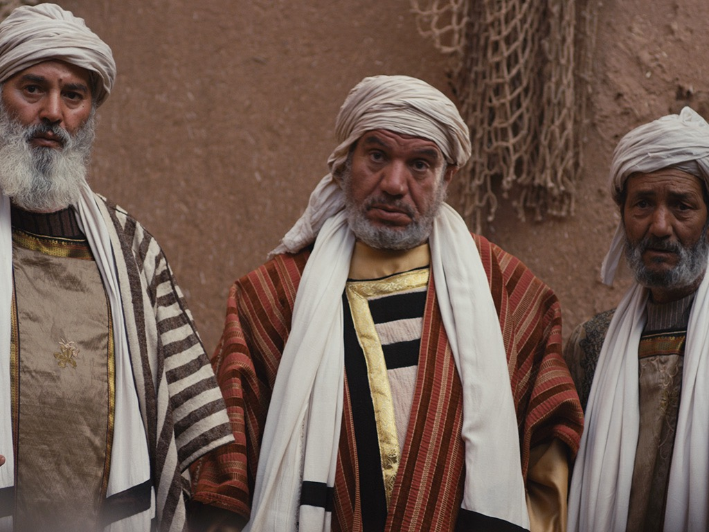
Opposition
to the King
§§ 98-119
The Jewish leaders resist Jesus in many conflicts over his person and miracles as they question his authority as God
Section summaries based on J. Dwight Pentecost, A Harmony of the Words and Works of Jesus Christ (Grand Rapids: Zondervan, 1981)
Dr. Rick Griffith • Jordan Evangelical Theological Seminary • BibleStudyDownloads.org

Slide 2
Pentecost Outline
Introduction of the King
Authentication of the King
Controversy over the King
Instruction of the Twelve by the King
Opposition to the King
Preparation of the Disciples by the King
Official Presentation of the King
Preparation for the Death of the King
Rejection of the King
Resurrection of the King

Slide 3

Increasing Polarization
Resurrection
Preparation
for Death
Preparation
of Disciples
Instruction
Authentication
Introduction
Controversy
Opposition
Presentation
Rejection
Notes:
The Life of Christ brought increasing polarization. The more Jesus showed about himself, the greater the resistance to him and his message. Also, the more intense the controversy leading to opposition, the higher priority Christ placed on preparing his men for when he would be gone. The climactic rejection when he presented himself as king of Israel at the Triumphal Entry resulted in rejection to the point of crucifixion followed by the victory of resurrection.
Introduction of the King
Authentication of the King
Controversy over the King
Instruction of the Twelve by the King
Opposition to the King
Preparation of the Disciples by the King
Official Presentation of the King
Preparation for the Death of the King
Rejection of the King
Resurrection of the King

Slide 4

Great Periods in the Life of Christ
55
“The Son of Man… came to minister and to give his life a ransom for many” (Mark 10:45)
Climactic Galilean
Early Samaritan
Later Samaritan
Early Judean
Later Judean
Early Perean
Later Perean
Opening Events
Closing Events
Preparation
Confirmation
Walk Thru the New Testament seminar (used with permission)
Notes:
The Walk Thru outline of the life of Christ forms a chiasm or literary arrangement with repeating elements in the opposite order. This structure makes Confirmation parallel to Preparation, Closing Events parallel to Opening Events, etc. until the only event without parallel becomes the focus: Climatic Galilean. Such an arrangement of material was common in antiquity and is seen in both the OT (e.g., Zephaniah) and the NT (1 Thess) where the central teaching appears in the middle of each writing.
Small Group Assignment: Explain this slide to your group member(s) and have the others explain it back.
After the beginning events of stages 1-3, Jesus also gets farther away from his Jewish roots in Judea (4), to go to the Samaritans (5), and even farther to Galilee (6), where most Gentiles lived. He ministered to Jews in Galilee, of course, but this climatic period was the focus of his ministry.
_______
LC-00-Syllabus-63
LC-01-Introduction-265
LC-05-Opposition-4

Slide 5

A. Conflict At the Feast of Tabernacles
§ 98
John 7:11-52
Jesus defends His authority and person at the Feast of Tabernacles, giving the unbelieving Jews further motivation to kill Him

Slide 6
1. Christ's Authority Questioned
John 7:11-15
Jerusalem crowds wonder how Christ could teach with authority without rabbinic training to prepare for Him to reveal His true nature

Slide 7
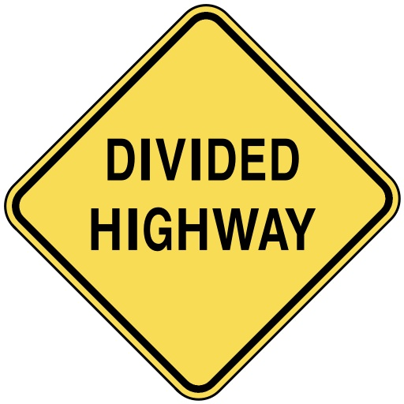
Divided Opinions
JOHN 7

Slide 8
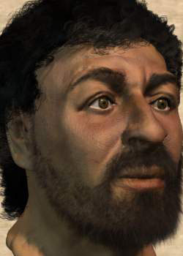
Who is this?
Notes:
This is Jesus—or at least one of the most recent depictions of him by bone specialists who studied first-century skeletons.

Slide 9
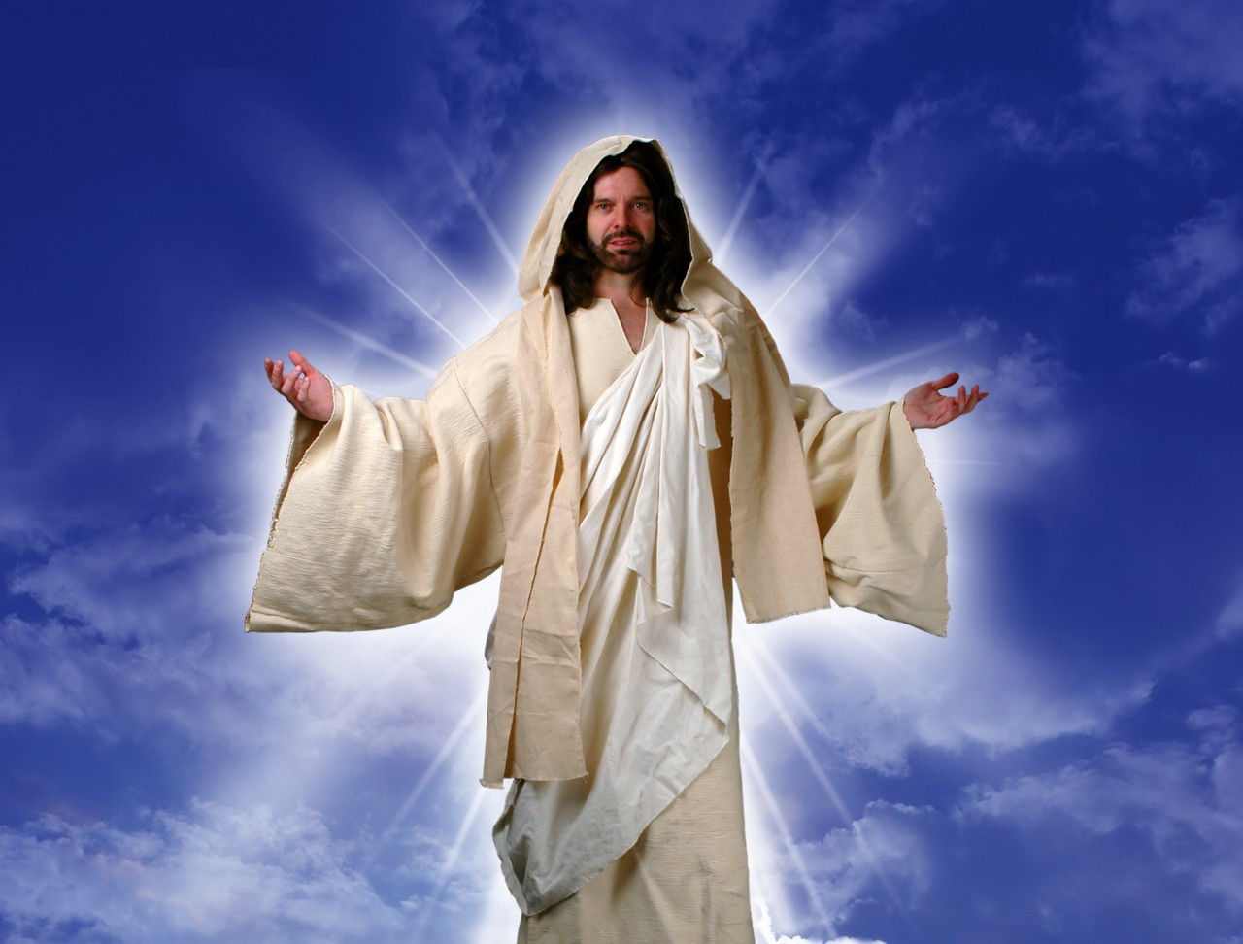
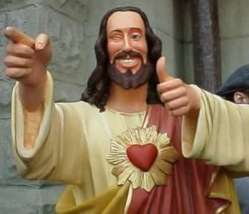
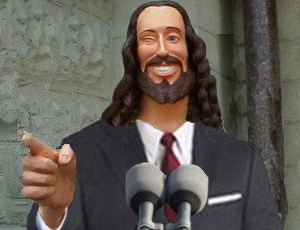
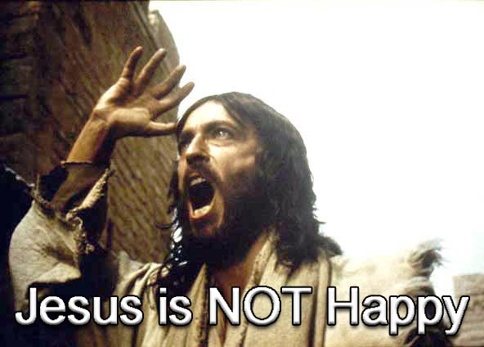
What do you think of Jesus?
Notes:
Some of us think Jesus is not very cool—so we make him out to be according to our preferences.

Slide 10
Black

Slide 11

The popular TV series "Touched by an Angel" is filled with spirituality but never mentions Jesus

Slide 12
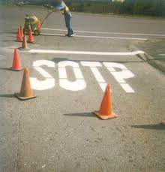
And Christians are considered stupid?!

Slide 13

Four Christmases
Notes:
Jesus is also NEVER noted in the popular movie "Four Christmases"

Slide 14
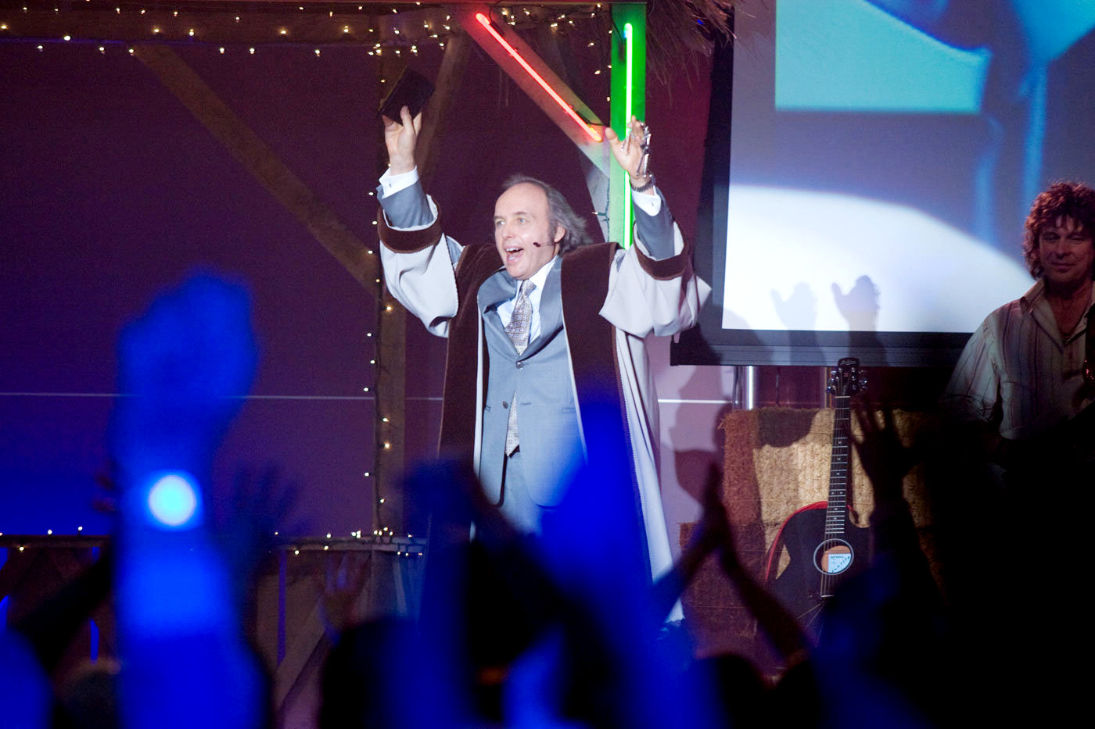
“Four Christmases” Pastor Phil
Notes:
But Christianity is mocked with the disrespectful appearance of Pastor Phil.

Slide 15
Black

Slide 16

Our Subject Today
Why do people have such divided opinions about Christ?

Slide 17
A Controversial Figure in John 1–6
Believers in
John 1–4:
Galileans
Samaritan Woman
John the Baptist
Nicodemus
Passover Jews
Disciples
The line of faith
Unbelievers in
John 5–6:
Jerusalem Leaders
Galilean People
Disciples desert Jesus

Slide 18
Our Subject Today
Why do people have such divided opinions about Christ?
3 reasons!

Slide 19
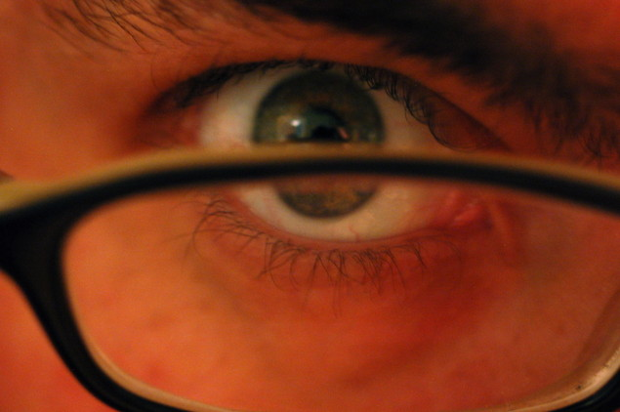
I. Everyone makes his or her own decision about Christ (7:1-13).
Why do people have such divided opinions about Christ?

Slide 20
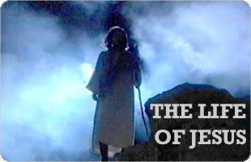
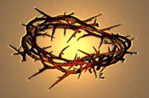
Brothers of Jesus
Transition between Galilean ministry
and Feast of Tabernacles in Jerusalem
“No one who wants to become a public figure acts in secret. Since you are doing these things, show yourself to the world” (7:4).
But when the Jewish Feast of Tabernacles
was near…
(7:2)
My time is not yet come; for you any time is right
...because for me the right time has not yet come.
Notes:
"For even his brothers didn’t believe in him" (John 7:5).

Slide 21

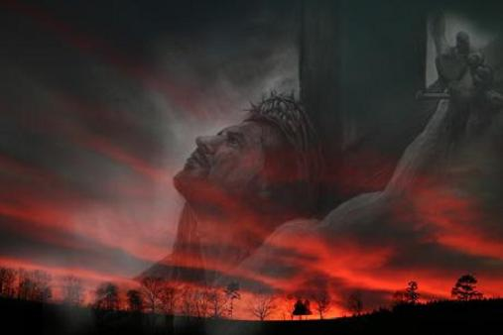
“Hour” in John’s Gospel
NASB Occurrences (Greek are all hora except 7:6, 8):
2:4 “My hour has not yet come”
7:6 “My time (Gr. kairos) is not yet here”
7:8 “My time (Gr. kairos) has not yet fully come”
7:30 “His hour had not yet come”

Slide 22
Black
Notes:
Jerusalem crowds also divided (10-13)

Slide 23
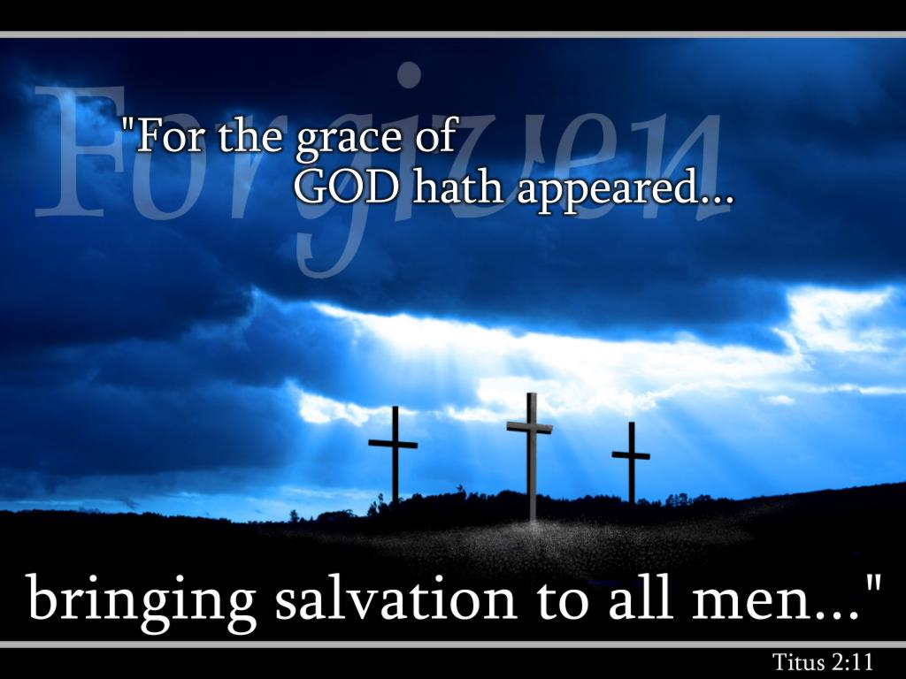
We must each decide who Christ is— and also give that choice to others.

Slide 24
I. Everyone makes his or her own decision about Christ (7:1-13).
Why do people have such divided opinions about Christ?

Slide 25
2. Christ's Explanation
John 7:16-24
Christ tells the Pharisees to submit to his teaching as authoritative as was Moses since the Father (not rabbis) taught Jesus

Slide 26
3. Christ's Person Questioned
John 7:25-27
The crowds disbelieve Jesus is Messiah since the Pharisees do not arrest Him and since they assume he was born in Nazareth

Slide 27
4. Christ's Explanation
John 7:28-30
Christ claims that his origin is heaven (not Nazareth) and God is His Father (not Joseph) so that His identity is the Son of God

Slide 28
5. Response
John 7:31-36
The response to Christ is that while some believe, the leaders commit even more to kill Him for blasphemy, even if He tries to escape

Slide 29
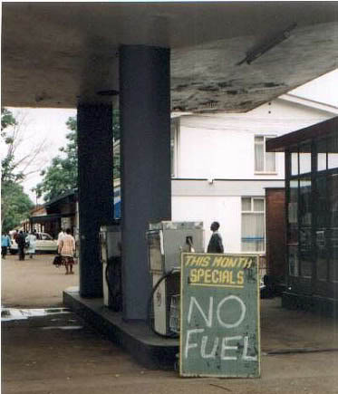

II. People reject Christ’s teaching because they reject God (7:14-36).

Slide 30
Black

Slide 31
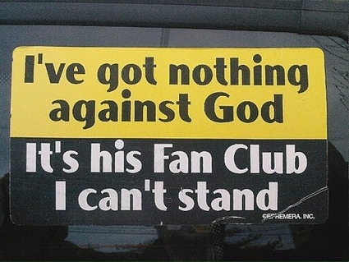
I've got nothing against God
It's his Fan Club I can't stand

Slide 32
I. Everyone makes his or her own decision about Christ (7:1-13).
Why do people have such divided opinions about Christ?

Slide 33
II. People reject Christ’s teaching because they reject God (7:14-36).

Slide 34
6. Christ's Invitation
John 7:37-52
Jesus' use of the Feast's golden pitcher ceremony (= God giving water to Israel) shows that he can satisfy their spiritual thirst

Slide 35

III. Jesus’ claim to give eternal life always has mixed responses (7:37-52).
Why do people have such divided opinions about Christ?

Slide 36

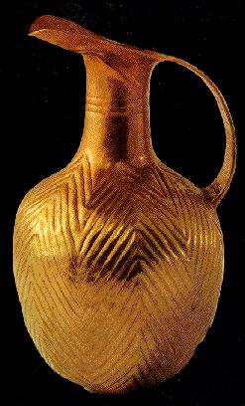
Jerusalem
21
The Feast of Tabernacles
Notes:
On the last day of the feast, Jesus offered people the Spirit by believing in Him (7:37-39). The feast always ended with a procession of people who walked down the hill to the Gihon Spring, where the priest filled up a gold pitcher of water, then made their way back up to the temple at the top.

Slide 37
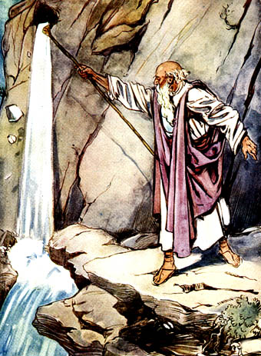
Water from a Rock
Numbers 20:8-11
Notes:
The priest poured out the water as a remembrance of saying thanks to God for bringing water from a rock and giving the people water for 40 years in the desert.

Slide 38

“Anyone who is thirsty may come to me! ³⁸ Anyone who believes in me may come and drink! For the Scriptures declare, ‘Rivers of living water will flow from his heart.’”
(John 7:37-38 NLT)
Notes:
Seizing this opportune time, Christ shouted, “If anyone is thirsty, let him come to me! Anyone who believes in me will have rivers of living water flow from his heart!”
"When Jesus added, As the Scripture has said, He did not identify the Old Testament passage(s) He had in mind. But He may have thought of Psalm 78:15-16 and Zechariah 14:8 (cf. Ezek. 47:1-11; Rev. 22:1-2)."
John F. Walvoord, Roy B. Zuck and Dallas Theological Seminary., The Bible Knowledge Commentary : An Exposition of the Scriptures (Wheaton, IL: Victor Books, 1983-c1985), 2:301.

Slide 39
Black

Slide 40

Black

Slide 41

Q & A
Curious: “Where did he get all this knowledge?” (14-15).
Jesus’ Answer: “God gave it to me.”
Offended: “You’re demon possessed! Who’s trying to kill you?” (20).
Jesus’ Answer: “Hypocrites care more for circumcision than for people.”

Slide 42
Q & A
Uninformed: “Isn’t this the man they are trying to kill? But the Messiah will simply appear…” (25).
Jesus’ Answer: “You know where I’m from—but you don’t know God!”
Believing: “Will the Messiah do more miracles than Jesus?” (31).
Jesus’ Answer: “I will be with you only for a short time more [about 6 months] but you won’t find me and can’t follow me.”

Slide 43
Which are You?
Curious?
Offended?
Uninformed?
Believing?

Slide 44
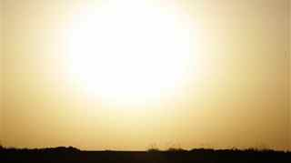
Main Idea of John 7
People reject Christ because they don’t accept God’s authority over their lives.

Slide 45

Jesus Paid It All

Slide 46
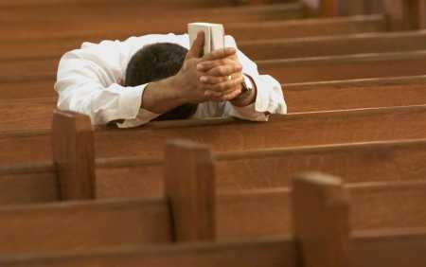
Why not believe today?

Slide 47
B. Conflict Over the Law
§ 99
John 7:53–8:11
Jesus avoids a Pharisee trap by not judging an adulterous woman to judge the Law too stringent or accept their disdain for the Law

Slide 48
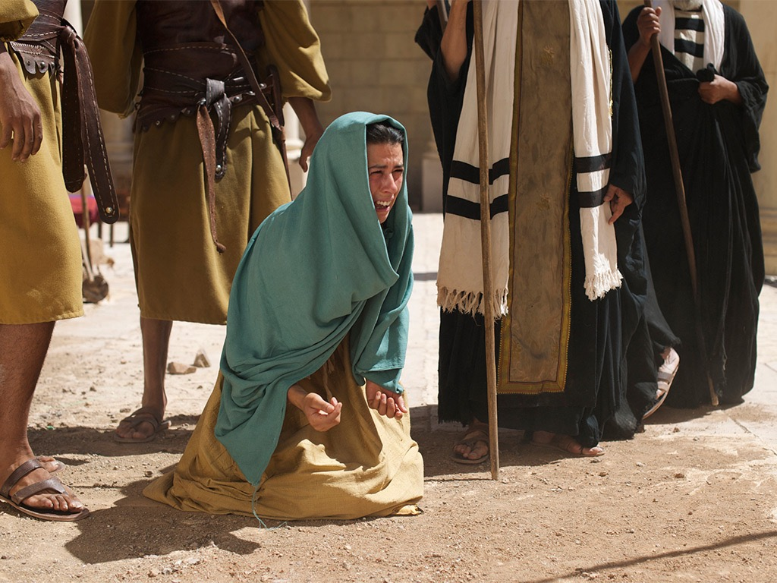

Free
Bible
images
John 8:2-11
JESUS AND THE WOMAN ACCUSED OF ADULTERY

Slide 49
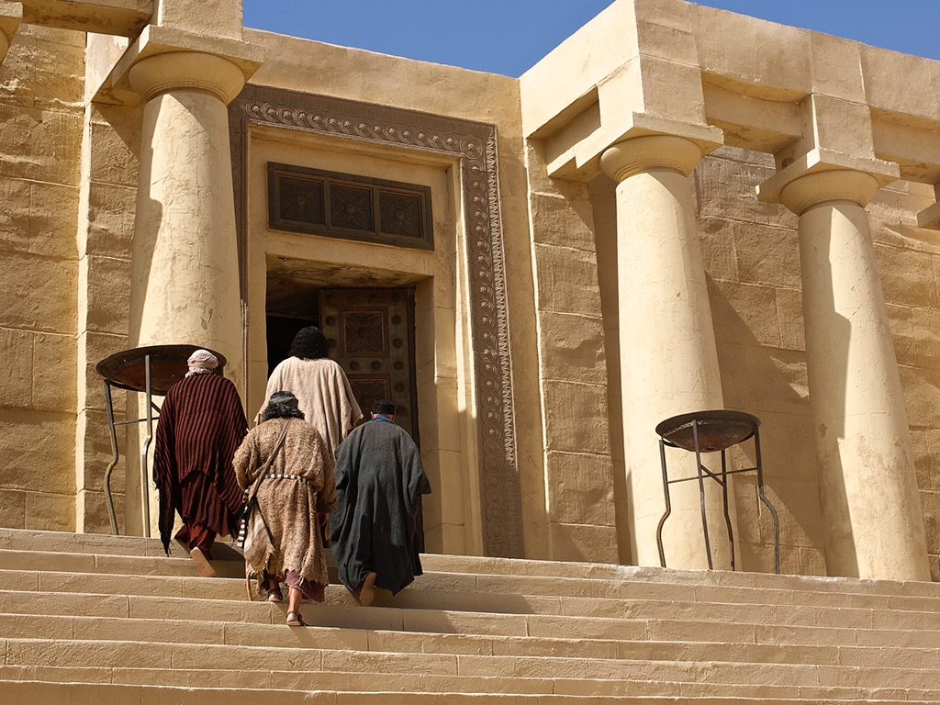
Notes:
John 8:1 Jesus returned to the Mount of Olives

Slide 50
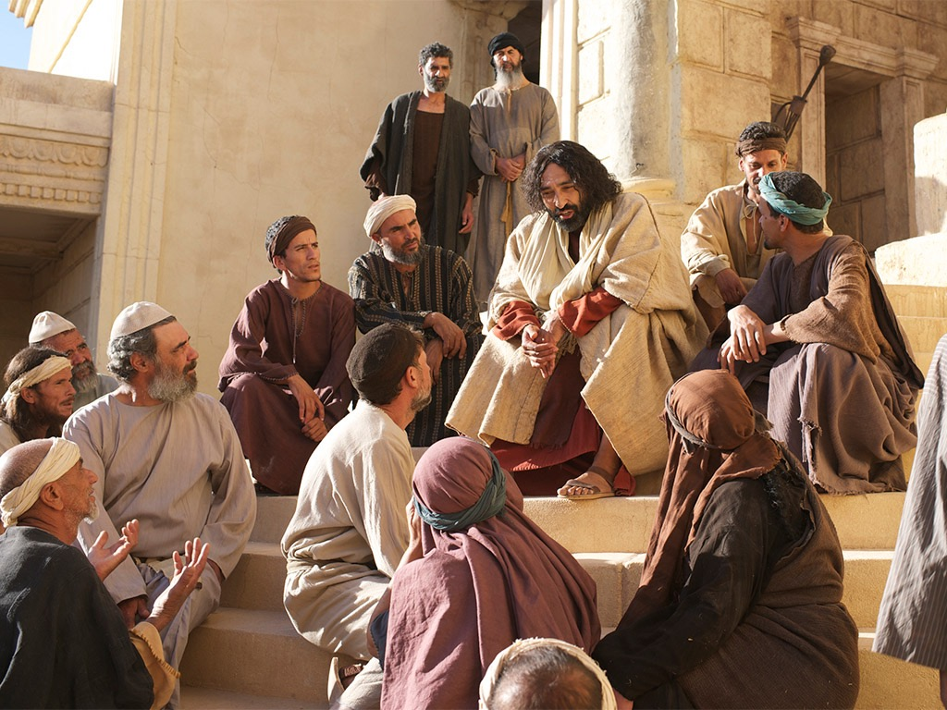
Notes:
² but early the next morning he was back again at the Temple. A crowd soon gathered, and he sat down and taught them.

Slide 51
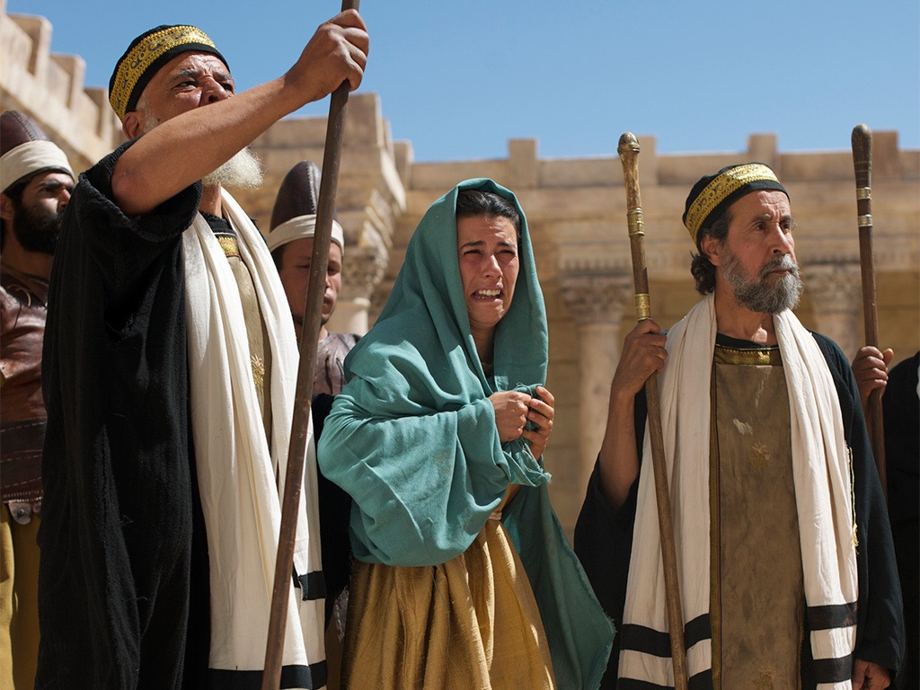
Notes:
³ As he was speaking, the teachers of religious law and the Pharisees brought a woman who had been caught in the act of adultery. They put her in front of the crowd.

Slide 52
Notes:
John 8:4 “Teacher,” they said to Jesus, “this woman was caught in the act of adultery. ⁵ The law of Moses says to stone her. What do you say?”

Slide 53
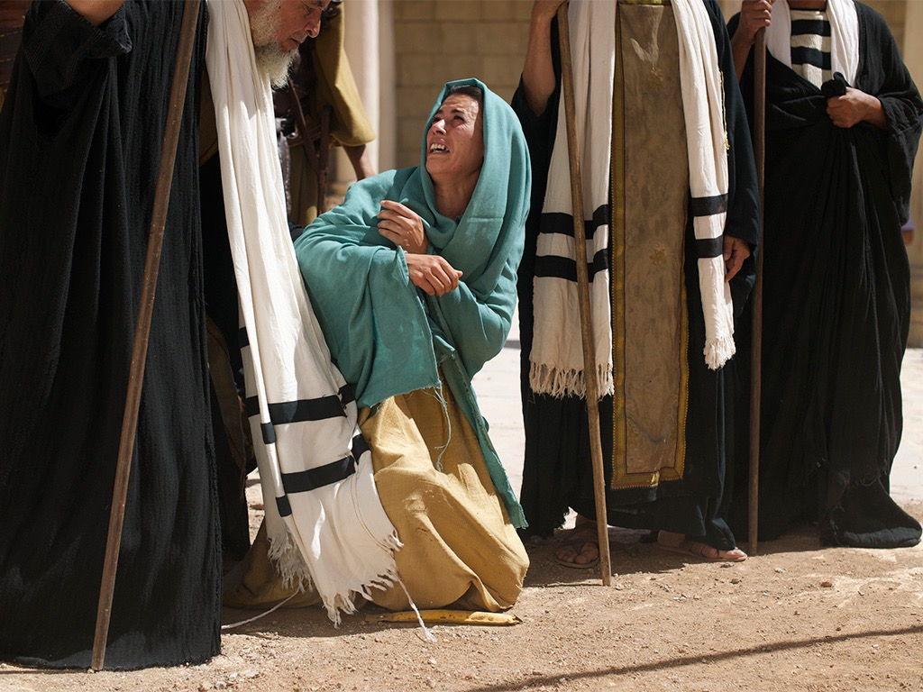
Notes:
John 8:6 They were trying to trap him into saying something they could use against him, but Jesus stooped down and wrote in the dust with his finger.

Slide 54
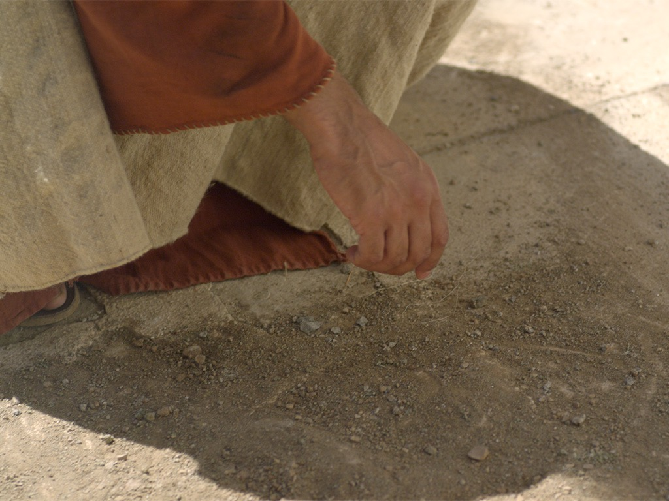
Notes:
John 16:5 “But now I am going away to the one who sent me, and not one of you is asking where I am going. ⁶ Instead, you grieve because of what I’ve told you. ⁷ But in fact, it is best for you that I go away, because if I don’t, the Advocateª won’t come. If I do go away, then I will send him to you. ⁸ And when he comes, he will convict the world of its sin, and of God’s righteousness, and of the coming judgment. ⁹ The world’s sin is that it refuses to believe in me. ¹⁰ Righteousness is available because I go to the Father, and you will see me no more. ¹¹ Judgment will come because the ruler of this world has already been judged.

Slide 55
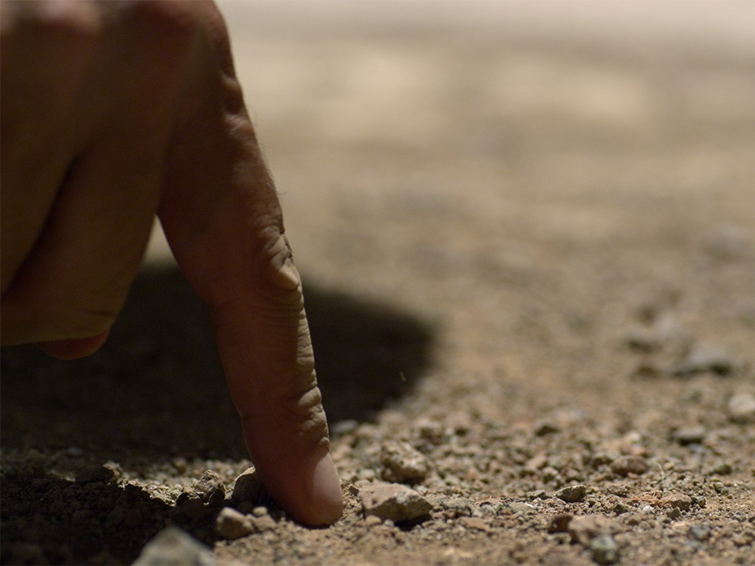
Notes:
John 8:6 They were trying to trap him into saying something they could use against him, but Jesus stooped down and wrote in the dust with his finger.

Slide 56
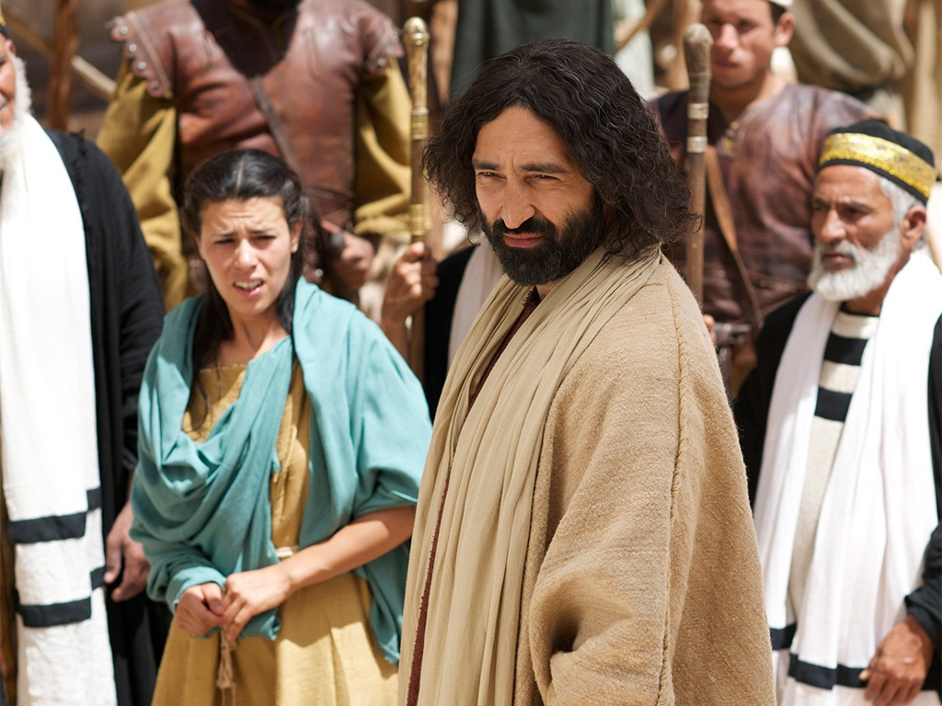
Notes:
⁷ They kept demanding an answer, so he stood up again and said, “All right, but let the one who has never sinned throw the first stone!”

Slide 57
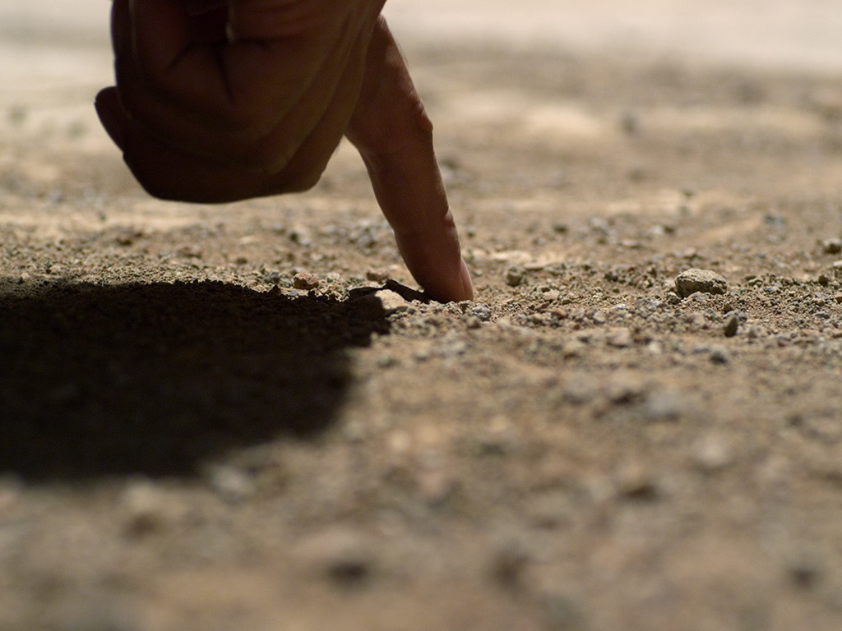
Notes:
⁸ Then he stooped down again and wrote in the dust.
John 8:9 When the accusers heard this, they slipped away one by one, beginning with the oldest, until only Jesus was left in the middle of the crowd with the woman.

Slide 58
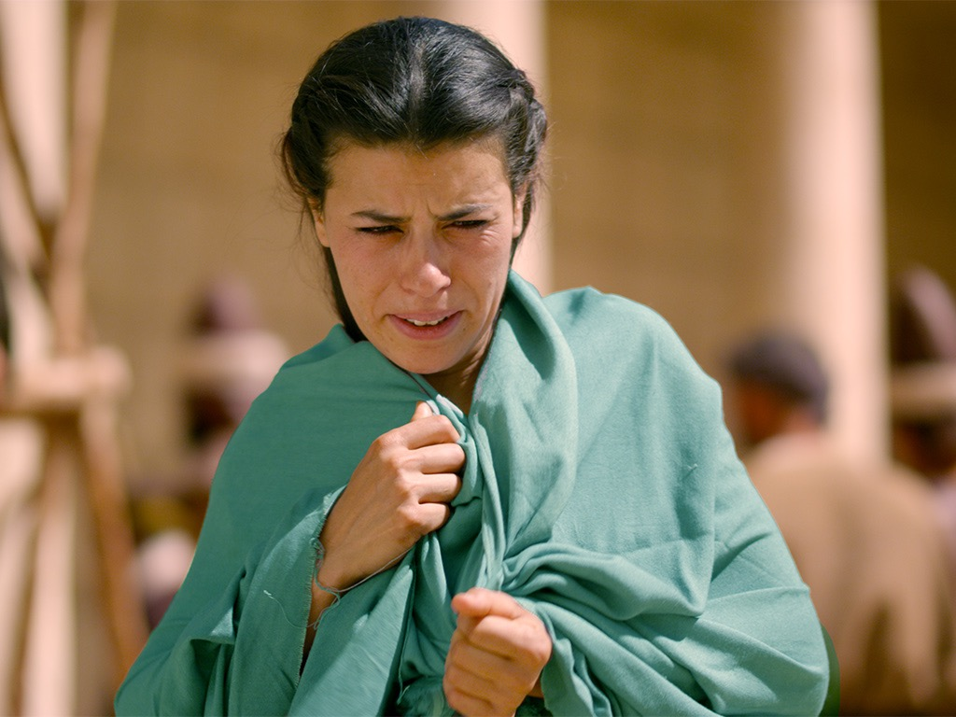
Notes:
¹⁰ Then Jesus stood up again and said to the woman, “Where are your accusers? Didn’t even one of them condemn you?”

Slide 59
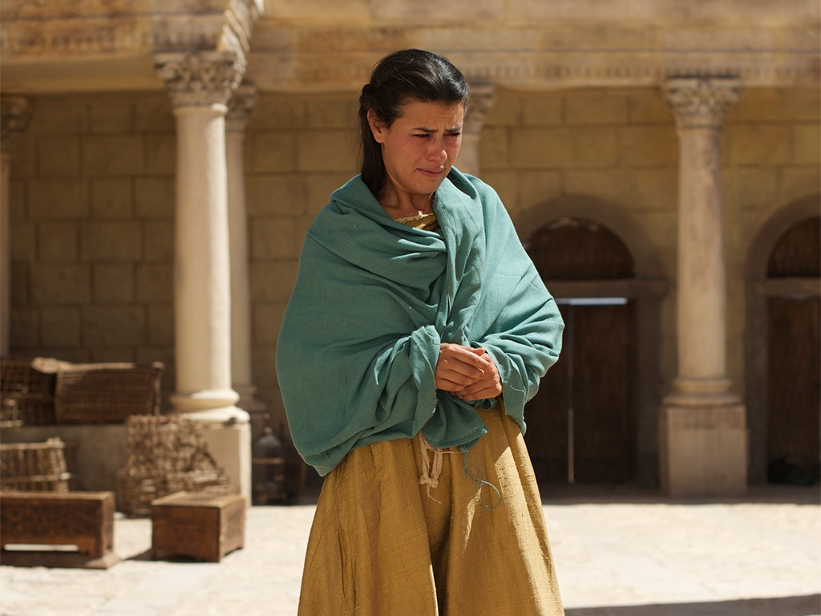
Notes:
John 8:11 “No, Lord,” she said.

Slide 60
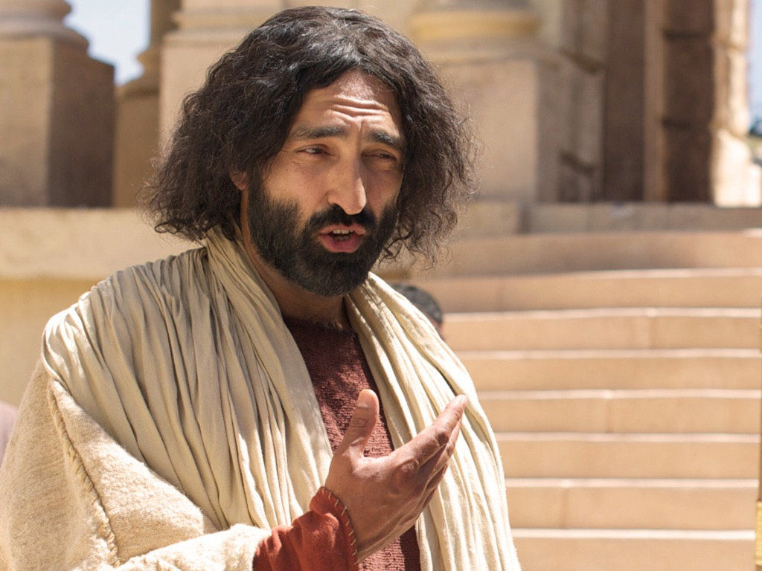
Notes:
And Jesus said, “Neither do I. Go and sin no more.”]]

Slide 61

Used with Permission
THE
GOSPEL
——OF—— MATTHEW
THE
GOSPEL
——OF—— MARK
THE
GOSPEL
——OF—— LUKE
THE
GOSPEL
——OF—— JOHN
Due to the Lumo Project producing its own publishing material we regret to inform you that we cannot license our photos to other clients outside of freebibleimages.org.
These images are not licensed for reuse in video, epublishing or other media. Downloaded pictures and files cannot be redistributed through any other website than freebibleimages.org or used in any context where the accompanying message is undermining of the Christian faith and gospel.
Photos can only be used on educational presentations, blogs and social media, all of which should be accompanied with reference to www.LumoProject.com.
Picture courtesy of BBM
© All Rights Reserved.
www.bigbookmedia.com

Slide 62
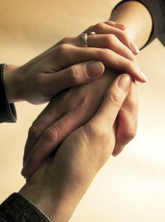
How can we show God’s compassion in a world where people think Christianity only judges us?

Slide 63

The Text of John 7:53–8:11
Inspired or Not?

Slide 64
Divided Opinions
“Most scholars seem to agree that the passage is a part of inspired Scripture [e.g., F.F. Bruce]. In fact, the development of the entire chapter can easily be seen to grow out of this striking event in the temple... The transition from John 7:52 to 8:12 would be too abrupt without a transitional section.”
–Warren Wiersbe, The Bible Exposition Commentary
“Almost all textual scholars agree that these verses were not part of the original... The style and vocabulary of this passage differ from the rest of the Gospel, and the passage interrupts the sequence from 7:52-8:12. It is probably a part of true oral tradition which was added to later Greek manuscripts by copyists.”
–Edwin A. Blum, in The Bible Knowledge Commentary
Notes:
Wiersbe notes, “Is the story of the woman taken in adultery a part of Scripture? If it is, where does it belong in the Gospel record? John 7:53–8:11 is not found in some of the ancient manuscripts; where it is found, it is not always in this location in John’s Gospel. Most scholars seem to agree that the passage is a part of inspired Scripture (“a fragment of authentic Gospel material,” says Dr. F.F. Bruce) regardless of where it is placed.
“To many of us, the story fits right here! In fact, the development of the entire chapter can easily be seen to grow out of this striking event in the temple. Our Lord’s declaration on His being the Light of the world (John 8:12) certainly fits, and so do His words about true and false judgment (John 8:15–16, 26). The repeated phrase “die in your sins” (John 8:21, 24) would clearly relate to the judgment of the woman; and the fact that the chapter ends with an attempt to stone Jesus shows a perfect parallel to the opening story. The transition from John 7:52 to 8:12 would be too abrupt without a transitional section.”
Warren W. Wiersbe, The Bible Exposition Commentary (Wheaton, Ill.: Victor Books, 1996, c1989), Jn 7:37.

Slide 65
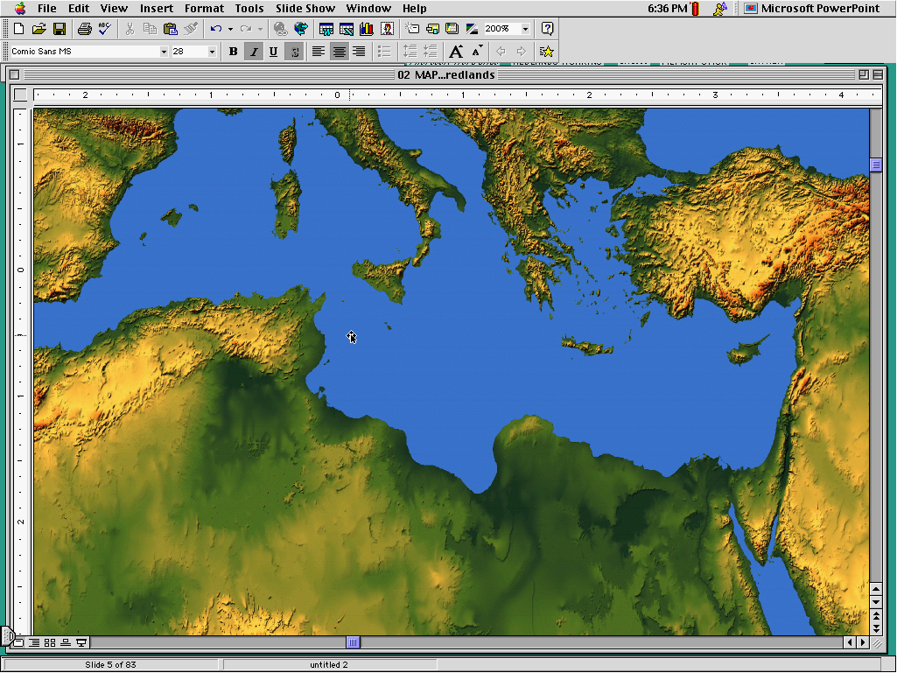
Western
Byzantine
Later (AD 600) manuscripts keep it
Latest (AD 1000) manuscripts keep it
3 Text Types
Alexandrian
Earliest (AD 200-400) manuscripts omit it
Notes:
The NT manuscripts of the early centuries of the church were copied in three main regions: Rome gave us the Western text type, the city of Constantinople became the capital of the Eastern Orthodox church with its Byzantine manuscripts (or majority text, since they copied so many of them), and a large community of Christians gathered in Alexandria, Egypt. This Alexandrian texts were the earliest, going back to about AD 200.

Slide 66
Note the Flow...
Jesus exposes evil intent of the Pharisees (8:10)
Jesus is the Light of the World (8:12)
Pharisees made a false judgment (8:15)
Jesus makes a right judgment (8:16)
Pharisees tried to stone her (8:5)
Pharisees tried to stone Jesus (8:59)

Slide 67

Where we’re going today...
Passage
Applications

Slide 68

What’s the Point?
Show mercy to the repentant!
Don't let people trap you!
Be smart when you commit adultery, so you don’t get caught!
Jesus didn’t really follow the Law.
Forgive people before they repent—that's what Jesus does!
Don’t be too quick to throw stones.
God isn’t serious about sin after all.

Slide 69
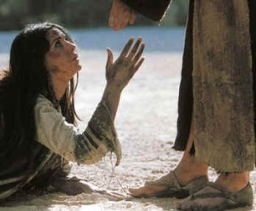
I. Jesus showed the true compassion of the Law by forgiving an adulterous woman (John 7:53–8:11).

Slide 70
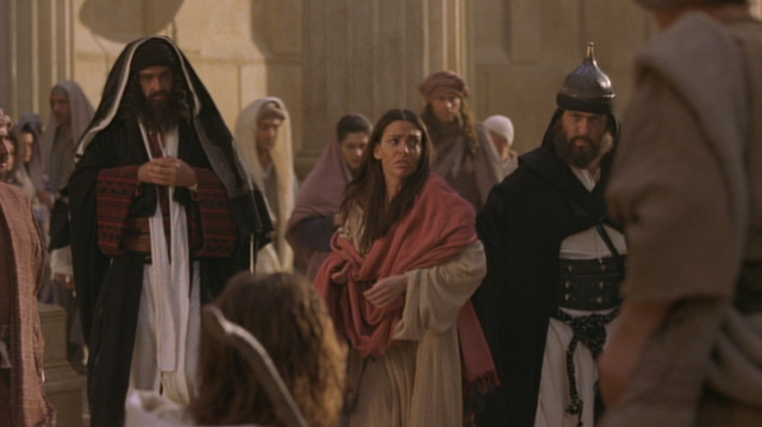
A. Pharisees brought an adulterous woman to Jesus to retain their power by having Jesus condemn Himself (John 7:53–8:6a).

Slide 71
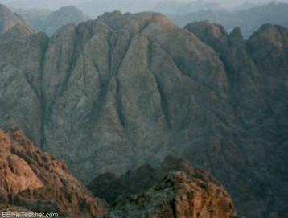
B. Jesus showed the Pharisee’s sin by following the true compassion of the Law to condemn sinners and redeem the repentant (John 8:6b-11).
Why did God give the Law on Mount Sinai?
Notes:
John 3:16 “For this is how God loved the world: He gaveª his one and only Son, so that everyone who believes in him will not perish but have eternal life. ¹⁷ God sent his Son into the world not to judge the world, but to save the world through him.

Slide 72

II. Show God’s compassion by helping people repent
(Main Idea of John 7:53–8:11).

Slide 73
C. Conflict Over the Light
§ 100
John 8:12-20
The Pharisees reject Jesus as the Light of the World as witnessing of himself, so He says that Tabernacles and the Father testify of him
Notes:
Does anyone prefer darkness over light?
John 3:19 And the judgment is based on this fact: God’s light came into the world, but people loved the darkness more than the light, for their actions were evil.

Slide 74

The Light of the World
John 8:12-59
Notes:
John 8:12 Jesus spoke to the people once more and said, “I am the light of the world. If you follow me, you won’t have to walk in darkness, because you will have the light that leads to life.”
John 8:13 The Pharisees replied, “You are making those claims about yourself! Such testimony is not valid.”

Slide 75

Can people tell the difference
between
and light?
darkness
Notes:
John 2:23 Because of the miraculous signs Jesus did in Jerusalem at the Passover celebration, many began to trust in him. ²⁴ But Jesus didn’t trust them, because he knew all about people. ²⁵ No one needed to tell him about human nature, for he knew what was in each person’s heart.

Slide 76
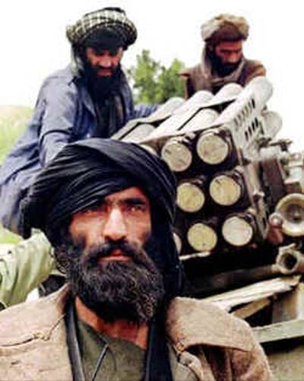
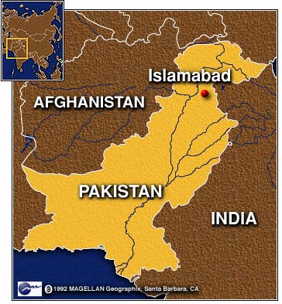
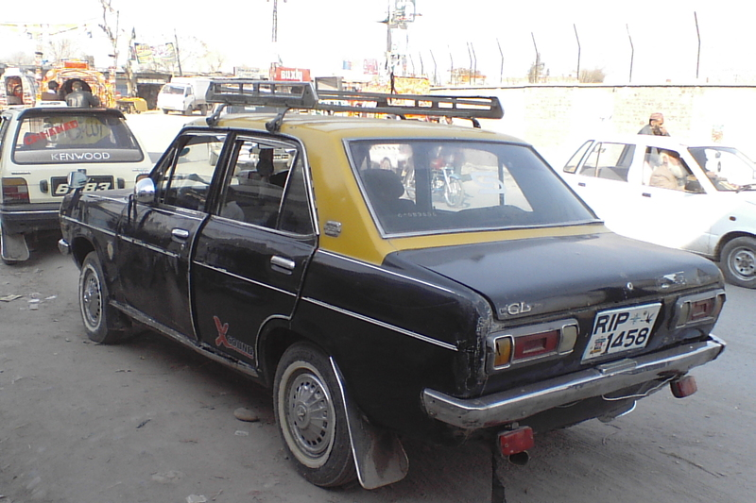
Edwin Paul
28 Sep 2010
Notes:
A Christian lawyer in Pakistan named Edwin Paul lived in the light. He gave legal counsel to a Christian taxi driver who bought a taxi for about $2000, but then the Taliban-associated lenders discovered he was a Christian, so they demanded $12,000 instead! After Edwin brought the case to the police, the lenders murdered him in his home on September 28, 2010—just three weeks ago along with his wife Ruby and their five children. His murderers obviously could not see that Edwin lived in the light—and they were in darkness.

Slide 77

Jesus has always been God
"In the beginning
was the Word,
and the Word was with God,
and the Word was God"
(John 1:1)
Notes:
Scripture is very clear that Jesus is God. Christians have always believed this key doctrine called the deity of Christ.

Slide 78
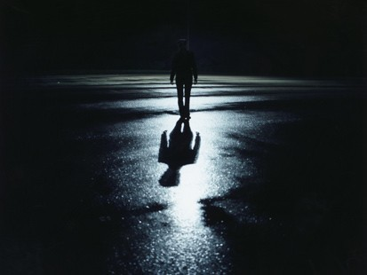
The Great Transfer
For he has rescued us from the kingdom of darkness
and transferred us into the Kingdom of his dear Son
¹⁴ who purchased our freedom and forgave our sins (Col 1:13-14)

Slide 79

How should we expect people to respond to Christ’s claim to be eternal God?

Slide 80


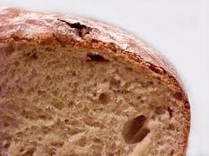
John 6–8
Bread
6
Water
7
Light
8

Slide 81
How should we expect people to respond to Christ’s claim to be eternal God?
3 responses...

Slide 82
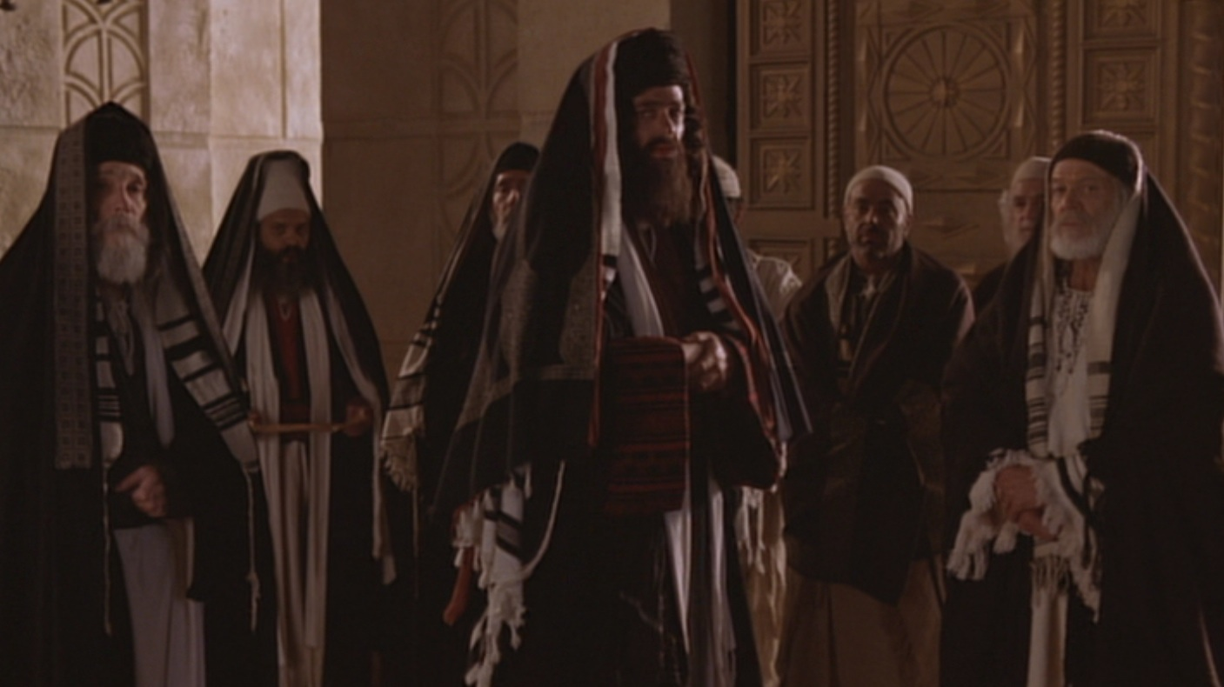
I. Some are hostile to Christ as the way of salvation (8:12-20).

Slide 83
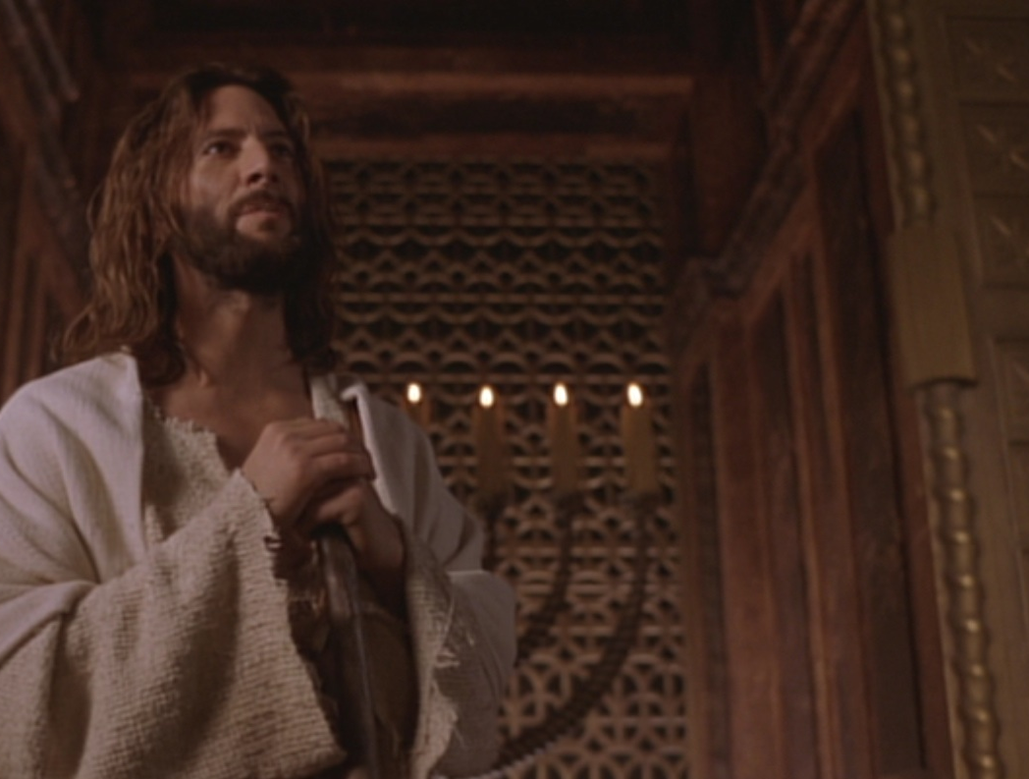
“I am the light of the world”
John 8:12

Slide 84
“The claim is exclusive, one only God could make. Note that Jesus claimed to the light of the world, not a light. Although the claim is exclusive, the offer is inclusive—an offer any and all could respond to.”
Charles Swindoll, Following Christ…
The Man of God, 33, emphasis his

Slide 85
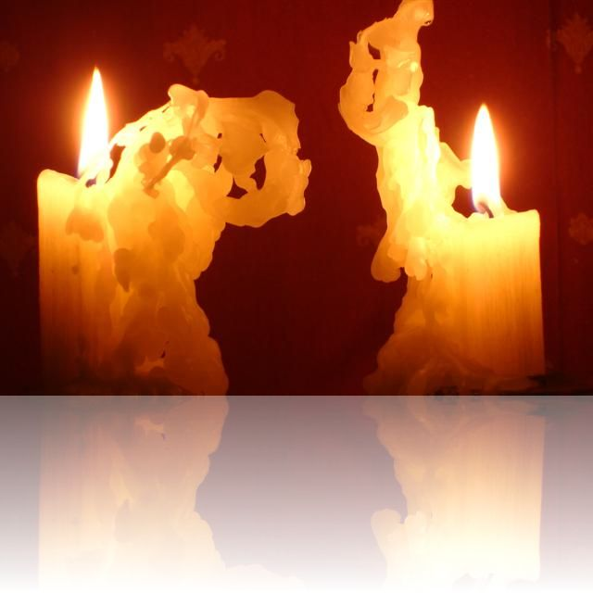
Two Witnesses (Deut 17:6)
“But never put a person to death on the testimony of only one witness. There must always be two or three witnesses.”

Slide 86
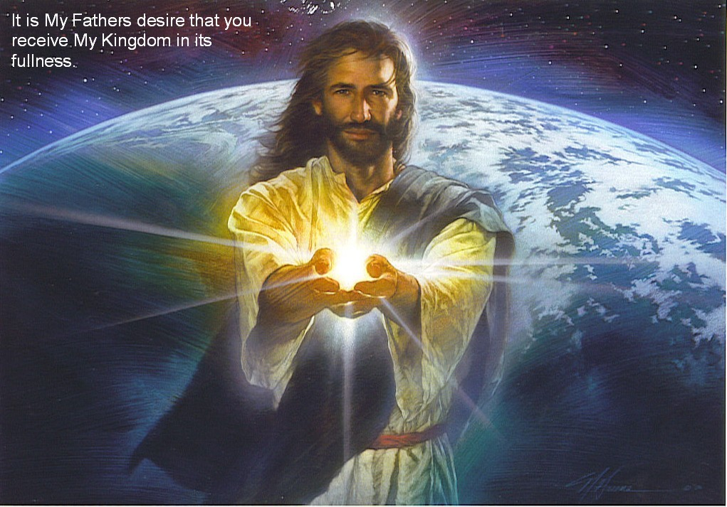
Jesus is the light of life (12-20)
Light
Life
Darkness
Death
Hostility!

Slide 87
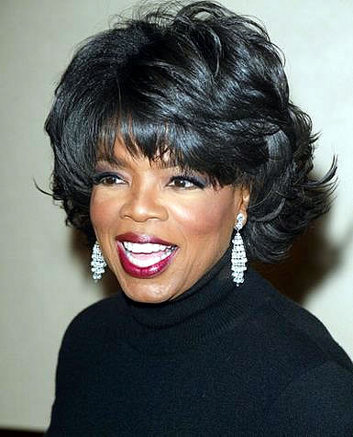
Oprah Winfrey
“Does God care about your heart... Or does God care that you call his son ‘Jesus’?”
Notes:
http://www.youtube.com/watch?v=ETeI6i5oqh4&feature=related

Slide 88
I. Some are hostile to Christ as the way of salvation (8:12-20).

Slide 89
D. Conflict Over His Person
§ 101
John 8:21-59
Jesus claims to be Messiah and deity, and the Jewish leaders unsuccessful try to kill Him by stoning for blasphemy

Slide 90
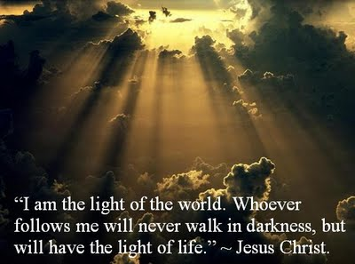
II. Many believe that the Father sent Jesus from heaven
(8:21-30).

Slide 91
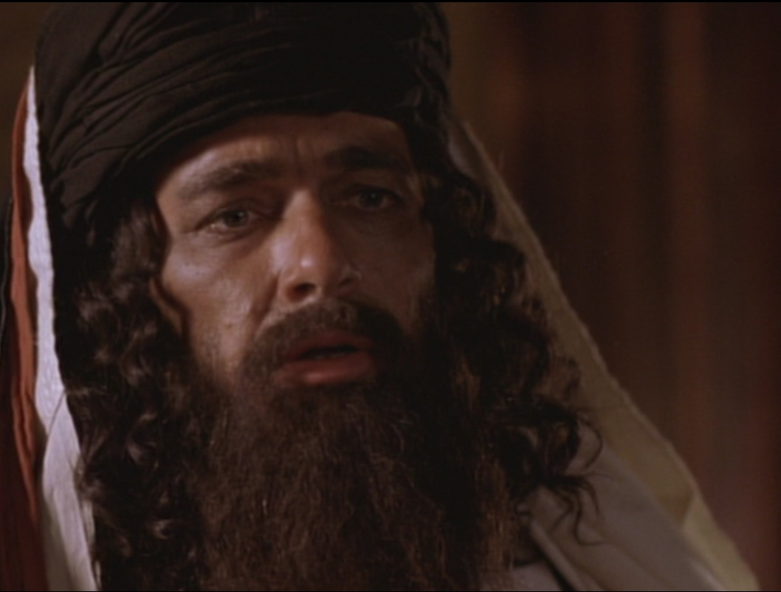
Who are you?!
John 8:25

Slide 92
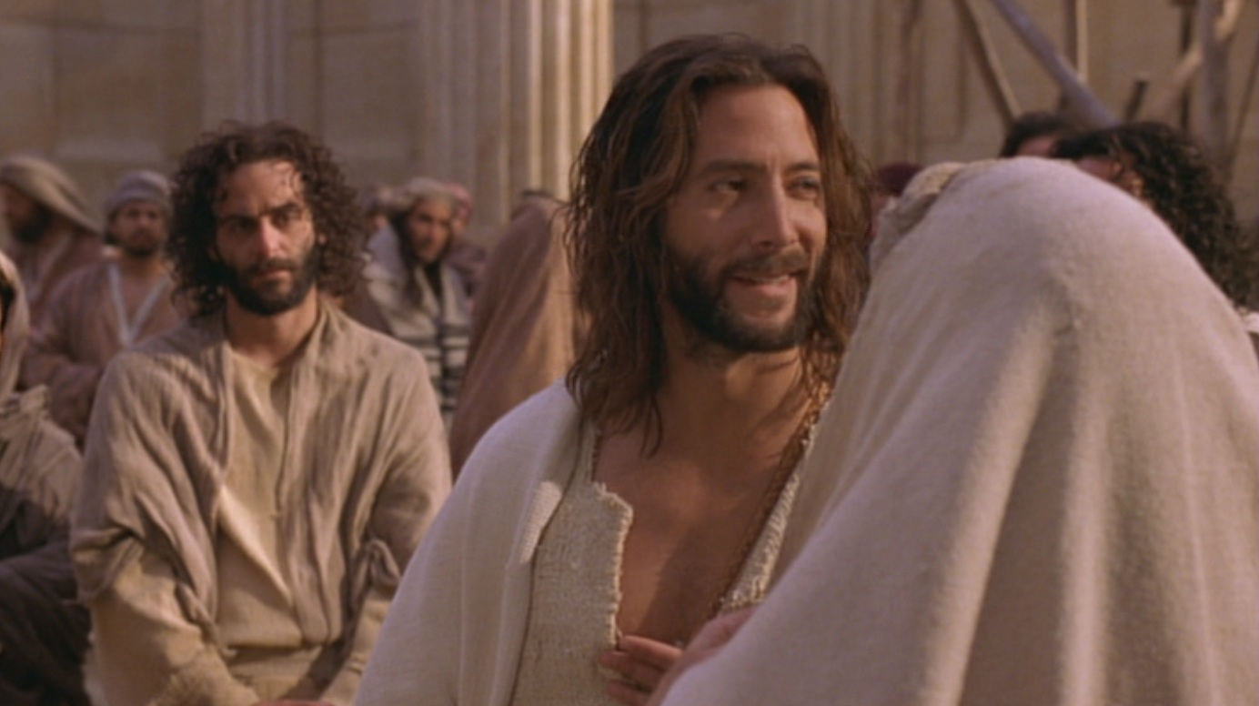
“My identity? I am God!” (8:25-30)
Above
Eternal life
Below
Die in sins
Jesus continued, “You are from below; I am from above. You belong to this world; I do not. ²⁴ That is why I said that you will die in your sins; for unless you believe that I Am who I claim to be, you will die in your sins” (John 8:23-24).

Slide 93

Many people there placed their faith in him (8:30).

Slide 94
I. Some are hostile to Christ as the way of salvation (8:12-20).

Slide 95
II. Many believe that the Father sent Jesus from heaven
(8:21-30).

Slide 96

III. All are revealed as of God or Satan (31-59).

Slide 97

A. Believers in Jesus are freed from slavery to be the spiritual descendants of Abraham (31-38).
Child of God

Slide 98

“Believe” in John’s Gospel
“Then many who heard him say these things believed in him. ³¹ Jesus said to the people who believed in him, ‘You are truly my disciples if you remain faithful to my teachings. ³² And you will know the truth, and the truth will set you free’” (8:30-32).

Slide 99

John 8:34 text

Slide 100

Life’s Journey

Slide 101

Freedom

Slide 102

Freedom (John 8:34)

Slide 103

B. Those who reject Jesus identify the devil as their father even to the point of trying to kill the messenger (8:39-59).

Slide 104

1. Those who reject Jesus identify the devil as their father (8:39-47).

Slide 105

“You belong to your father, the devil... He was a murderer from the beginning... When he lies, he speaks his native language...” (8:44)
YOU KNOW HOW I CAN TELL WHEN YOU LYING? … YOUR LIPS ARE MOVING

Slide 106

2. Some reject God to the point that they even try to kill the messenger (8:48-59).
Somali Christian Beheaded for his Faith

Slide 107

“Before Abraham was born, I Am!”
John 8:58

Slide 108

Christ’s “I Am…” Claims in John’s Gospel
“Light of the World”
“Before Abraham”
“Good Shepherd”
“Door”
“I & Father are one”
“Resurrection & Life”
“Way, Truth, & Life”
“True Vine”

Slide 109

“They picked up stones to throw at him”
John 8:59

Slide 110

Main Idea
How should we expect people to respond to Christ’s claim to be eternal God who saves us from sin?
Christ’s claim to be God elicits the best & worst in us.

Slide 111

Who is Jesus?
Jesus is the Light of life (12-20)
Jesus is sent from heaven by God the Father (21-30)
Jesus can make you God’s child (31-38)
Jesus is God eternal (39-59)

Slide 112

3 responses:
• Some are hostile (12-20).
• Many believe (21-30).
• All are revealed as of God or Satan (31-59).

Slide 113

Walk to the light!

Slide 114

Liar–Lunatic–Lord
Jesus said
I AM GOD
If True
If False
If Insincere
If Sincere
Jesus is God
Jesus is a
Jesus is a
LORD
LIAR
LUNATIC
Notes:
C.S. Lewis, a popular British theologian, wrote, "I am trying here to prevent anyone saying the really foolish thing that people often say about Him: 'I'm ready to accept Jesus as a great moral teacher, but I don't accept His claim to be God.' That is the one thing we must not say. A man who was merely a man and said the sort of things Jesus said would not be a great moral teacher. He would either be a lunatic - on the level with the man who says he is a poached egg - or else he would be the Devil of Hell. You must make your choice. Either this man was, and is, the Son of God: or else a madman or something worse. You can shut Him up for a fool, you can spit at Him and kill Him as a demon; or you can fall at His feet and call Him Lord and God. But let us not come with any patronising nonsense about His being a great human teacher. He has not left that open to us. He did not intend to." (C.S. Lewis, Mere Christianity, The MacMillan Company, 1960, pp. 40-41.)

Slide 115


D.L. Moody

Slide 116
E. Conflict Over the Healing of the Blind Man
§ 102
John 9:1-41
By healing a man born blind on the Sabbath, Christ authenticates His claim as Light to those in darkness and is worshipped as God

Slide 117


Don’t the Blind Know They’re Blind?
John 9

Slide 118
Spiritual Blindness
Notes:
What is spiritual blindness?
Do the spiritually blind know or care if they are spiritually blind?

Slide 119



Healing from Spiritual Blindness
satisfying life
forgiveness
eternal life

Slide 120

What must we see to prevent spiritual blindness— in ourselves & others?

Slide 121
John 6–8
Bread
6
Water
7
Light
8

Slide 122
What must we see to prevent spiritual blindness— in ourselves & others?
3 views:
miracle
controversy
decision

Slide 123

I. Jesus makes the blind see.

Slide 124

A. Jesus’ healing a blind man proved he gives spiritual sight too (9:1-7).

Slide 125

1. This man was born blind to show that God empowered Jesus to give eternal life (9:1-5).

Slide 126

Why this blindness?

Slide 127

Exodus 20:4-5
Sin
“You must not make for yourself an idol.... ⁵ You must not bow down to them or worship them, for ... I lay the sins of the parents upon their children; the entire family is affected—even children in the third and fourth generations of those who reject me.’”
Suffering

Slide 128

2. Jesus proved He was the way for eternal life by miraculously healing the man (9:6-7).

Slide 129

Why did Christ put mud on the man’s eyes (9:6)?

Slide 130

Jesus formed Adam from the dust (John 1:3; Gen. 2:7).

Slide 131
Washing developed his faith

Slide 132

Journey to the Pool of Siloam
Temple
Pool of Siloam

Slide 133

B. Do you believe that God sent Jesus to cure your own blindness?

Slide 134


Signs in John’s Gospel
Signs unique to John's Gospel in yellow (6 of the 9 miracles)
WATER
TO WINE
2:1-11
HEALING
OFFICIAL’S
SON
4:46-54
HEALING
PARALYTIC
5:1-18
FEEDING
5000
6:1-15
WALKING
ON WATER
6:16-24
HEALING
BLIND MAN
9:1-7
RAISING
LAZARUS
11:1-45
CHRIST’S
RESURRECTION
20:1-31
FISH
CATCH
21:1-3

Slide 135
I. Jesus makes the blind see.

Slide 136

II. Jesus changes people’s lives (9:8-34).

Slide 137


A. The blind man increasingly gained spiritual insight...
... while the Pharisees increasingly rejected his testimony and became more spiritually blind (8-34).

Slide 138

Evidence of Spiritual Blindness
Trusting rules over God’s work (8-16)
“This man Jesus is not from God, for he is working on the Sabbath” (16a).
Notes:
Read 13-16a: “¹³ Then they took the man who had been blind to the Pharisees, ¹⁴ because it was on the Sabbath that Jesus had made the mud and healed him. ¹⁵ The Pharisees asked the man all about it. So he told them, “He put the mud over my eyes, and when I washed it away, I could see!”
¹⁶ Some of the Pharisees said, “This man Jesus is not from God, for he is working on the Sabbath.”
Tyndale House Publishers., Holy Bible : New Living Translation., 2nd ed. (Wheaton, Ill.: Tyndale House Publishers, 2004), Jn 9:13-16.

Slide 139

Evidence of Spiritual Blindness
Persecuting God’s witnesses (17-23)

Slide 140

Evidence of Spiritual Blindness
Rejecting Christ despite evidence (24-34)

Slide 141

"Ever since the world began, no one has been able to open the eyes of someone born blind. ³³ If this man were not from God, he couldn’t have done it" (32-33).
No OT sight restored
No disciples healed blindness
Healing blindness was Christ’s most common miracle!
Evidence of being Messiah

Slide 142

B. Does seeing evidence for Jesus help you gain or lose spiritual insight?

Slide 143

HUMILITY
I'm not so arrogant to think I've arrived at the truth about anything, but I'm pretty sure everything you say is not only dead wrong, but really, really stupid, too.

Slide 144

Did life originate as an accident?
“There are only two possible explanations as to how life arose: Spontaneous generation arising to evolution or a supernatural creative act of God…. There is no other possibility. Spontaneous generation was scientifically disproved 120 years ago by Louis Pasteur and others, but that just leaves us with only one other possibility… that life came as an act of supernatural creation by God, but I can’t accept that philosophy because I do not want to believe in God. Therefore, I choose to believe that which I know is scientifically impossible, spontaneous generation leading to evolution.”
Dr. George Wald
Professor Emeritus of Biology, Harvard
Nobel Prize winner in Biology, 1971
Notes:
The same applies to hearing others testify that Jesus offers eternal life—we must act on the evidence by believing it to prevent spiritual blindness.
George Wald, “Origin, Lie and Evolution,” Scientific American 1978); cited by Joe White and Nicholas Comninellis, Darwin’s Demise (Green Forest, AR: Master Books, 2001), 46.

Slide 145
I. Jesus makes the blind see.

Slide 146
II. Jesus changes people’s lives(8-34).

Slide 147


III. Jesus deserves worship as God (35-41).

Slide 148


Opposite Responses

Slide 149

The former blind man confesses Jesus as God (35-38).

Slide 150

Jesus condemns the Pharisees for rejecting him as God (39-41).

Slide 151

John 9:39-41 NLT
³⁹ Then Jesus told him, “I entered this world to render judgment—to give sight to the blind and to show those who think they see (Greek: “those who see”) that they are blind.”
⁴⁰ Some Pharisees who were standing nearby heard him and asked, “Are you saying we’re blind?”
⁴¹ “If you were blind, you wouldn’t be guilty,” Jesus replied. “But you remain guilty because you claim you can see”

Slide 152

How should we respond when we see that Jesus is truly God Himself?

Slide 153
???????
Who’s the real blind man?

Slide 154

The blind man sees!
Who’s the real blind man?
• God: “worshipped Jesus” (38)
• “A man from God” (33)
• “A prophet” (17)
• “A man called Jesus” (7)

Slide 155

The Pharisees are blind!
Who’s the real blind man?
• Jesus is a con man (15, 18)
• Jesus is a Sabbath breaker (16)
• Blind man was deceived (17)
• Parents will discredit him (19)
• Excommunication threat (22)
• Curse in God’s name (24a)

Slide 156
The Pharisees are blind!
Who’s the real blind man?
• Jesus is a sinner (24b)
• Jesus is a deceiver (26)
• Blind man was deceived (26)
• Cursed the blind man (28)
• Lied about Jesus’ origin (29)
• Excommunicated blind man (34)

Slide 157

The Main Idea of John 9
How can you avoid spiritual blindness? Respond in faith to what you know now about Jesus!

Slide 158


Are you color blind?
I. Jesus makes the blind see.
II. Jesus changes people’s lives.
III. Jesus deserves worship as God.

Slide 159


Helen Keller (1880-1968)

Slide 160

Whoever wants healing from spiritual blindness must believe that Jesus is God.

Slide 161
Purpose #1
Jesus Healed the Blind Man
Reveal the Truth
9:1-7

Slide 162
Deity of Christ
9:1 Man born blind
We are blind spiritually at birth thus need rebirth which only God can provide
9:2-4a “Rabbi, who sinned.…? God might be displayed in Him.”
Christ’s ability to cure our spiritual blindness shows him to be God
9:4b-5 Day and Night
He was sent by God to work but his work ceased during His crucifixion-resurrection

Slide 163
Deity of Christ
9:6 Mud and saliva
Irenaeus believed the action was to show Christ is the Creator (cf. Gen. 2:7)
9:7 Siloam means “Sent”
Jesus was “Sent” by God
Water symbolized the Holy Spirit so that the blind man was born of water and the Spirit (cf. 3:5)

Slide 164
What is the Truth of Verses 1-7?
Jesus is the Son of God because He was sent by God to give Spiritual Truth to the blind
“There was the true Light which coming into the world, enlightens every man” (1:9)
“Truly, truly, I say to you, unless one is born again he cannot see the kingdom of God” (3:3)

Slide 165
Purpose #2
Jesus Healed the Blind Man
Reveal the Blind
9:8-34

Slide 166
Black

Slide 167
Black

Slide 168


WHO WAS TRULY BLIND?
Pharisees? or the Blind Man?

Slide 169
Steps in the Blind Man’s Belief
Blind man interrogated
by neighbors (8-12)
Blind man and parents interrogated
by Pharisees (13-23)
Blind man interrogated
by Pharisees again (24-34)
“The man they call Jesus” (11)
“He is a prophet” (17)
“Whether he is a sinner or not, I don’t know. One thing I do know. I was blind but now I see!” (25)
“If this man were
not from God,
He could do
nothing”(33)

Slide 170
Steps in the Pharisees’ Unbelief
“This man is not from God” (17)
“This man is a sinner” (25)
“You are His disciples but we are disciples of Moses” (29)
“You were born entirely in sin, and are you teaching us?” (34)

Slide 171

Contrasts
Blind Man
Had not seen Jesus before being healed
Knew little about the Mosaic Law
Beggar
Received Spiritual Truth
(Spiritual Sight)
Pharisees
Witnessed Jesus’ miracles & teaching
Claimed to know God’s Word
Religious
Rejected Spiritual Truth
(Spiritual Blindness)

Slide 172
What Caused the Blindness?
His parents were afraid of the Jews; for the Jews had already decided that anyone who acknowledged Jesus was the Christ would be put out of the synagogue (22)
“If we let him go on like this, all men will come and take away both our place and our nation” (John 11:48)
REPUTATION, PRIDE and WEALTH
caused their spiritual blindness

Slide 173
Pharisees Lived in Darkness
He came to his own but those who were His own did not receive Him.
John 1:11
For everyone who does evil hates the Light, and does not come to the Light for fear that his deeds will be exposed.
John 3:20

Slide 174
Why Were They Blind?
Pharisees were spiritually blind because they rejected the testimony of the blind man and the Deity of Christ.

Slide 175
THE
OUTCOME
(35-41)

Slide 176
Outcome for the Blind Man (35-38)
The blind man could see the kingdom of God because he became born again.
The blind beggar become a child of God.
The blind man worshiped the Son of God.

Slide 177
Outcome for the Pharisees (39-41)
The Pharisees would be judged and condemned because they willfully rejected Jesus as the Son of God (39a)
The Pharisees’ ability to see spiritual truth degenerated (39b)
The Pharisees continued with their guilt upon them (41b)

Slide 178
John 3:17-18
For God did not send the Son into the world to judge the world, but that the world might be saved through Him. He who believes in Him is not judged; he who does not believe has been judged already, because he has not believed in the name of the only begotten Son of God.

Slide 179
John’s Message
Jesus is the Truth. Therefore…
Those who believe in Jesus shall know the truth and the truth will set them free.
But those who reject Jesus as the Son of God shall be judged.

Slide 180
Application
Let’s not follow in the footsteps of the Pharisees--blinded by their pride, reputation and wealth.
Let’s follow the example of the blind man--humbly obey and believe His Word.

Slide 181
The Great Transfer
For he has rescued us from the kingdom of darkness
and transferred us into the Kingdom of his dear Son
¹⁴ who purchased our freedom and forgave our sins (Col 1:13-14)

Slide 182
F. Conflict Over the Shepherd
§ 103
John 10:1-21
Israel's remnant follows Jesus as the true, good, and obedient Shepherd, so He calls Pharisee followers from their false shepherds

Slide 183

Who or what are you listening to?

Slide 184


How does Jesus look at sheep?

Slide 185

"After he has gathered his own flock, he walks ahead of them, and they follow him because they know his voice"—John 10:4 NLT

Slide 186

So he explained it to them:
“I tell you the truth, I am the gate for the sheep."
—John 10:7 NLT

Slide 187


Slide 188
C. S. Lewis, Mere Christianity, 55-56
“I am here trying to prevent anyone saying the really foolish thing that people often say about Him: ‘I’m ready to accept Jesus as a great moral teacher, but I don’t accept His claim to be God.’ That is the one thing we must not say. A man who was merely a man and said the sort of things Jesus said would not be a great moral teacher. He would either be a lunatic—on a level with the man who says he is a poached egg—or else he would be the Devil of Hell. You must make your choice. Either this man was, and is, the Son of God: or else a madman or something worse. You can shut Him up for a fool, you can spit at Him and kill Him as a demon; or you can fall at His feet and call Him Lord and God. But let us not come with any patronising nonsense about His being a great human teacher. He has not left that open to us. He did not intend to.”

Slide 189
G. Witness of the
Seventy-Two
§ 104
Luke 10: 1-24
Christ sends 72 men to tell the crowds that He is Messiah who offers the kingdom to show debate about Him from the leaders and people

Slide 190
H. Conflict Over the Question of Eternal Life
§ 105
Luke 10:25-37
Christ tells the Good Samaritan parable to a self-justifying lawyer that he must help all in need to be rewarded kingdom blessings

Slide 191

The Good Samaritan (Luke 10)
99

Slide 192
Augustine's Allegorical Interpretation of the Good Samaritan Parable (Luke 15)
Text Interpretation
A "certain man"… Adam
Thieves… the devil and demons
Stripped him… took his immortality
Beat him… tempted him to sin
The priest and the Levite… the ministry of the OT
which does nothing for Adam
The Good Samaritan… Christ
Binds wounds with oil and wine… restrains sin with hope and
an exhortation to work with a
fervent spirit
The inn… the Church
The innkeeper… the Apostle Paul
Really?!

Slide 193

God's Compassion
Luke 10:25-37

Slide 194
I. An Example of Fellowship
§ 106
Luke 10:38-42
Christ favors Mary's fellowship over Martha's service to show that occupation with Christ is more important than occupation for Christ

Slide 195
J. Instruction in Prayer
§ 107
Luke 11:1-13
Jesus teaches persistence in praying to God who alone can meet our needs to exhort prayer for the Spirit after His departure

Slide 196
K. Conflict Over the Healing of the Dumb Man
§ 108
Luke 11:14-36
After claims of exorcism by Satan, Jesus says that God will judge Israel's unbelief, so it is worse than before John's ministry

Slide 197

Free
Bible
images
Matthew 9:32-34; Luke 11:14-23
JESUS DELIVERS A MUTE MAN

Slide 198


Slide 200


Slide 201


Slide 202


Slide 203


Slide 204


Slide 205


Slide 207


Slide 208


Slide 209
Used with Permission
THE
GOSPEL
——OF—— MATTHEW
THE
GOSPEL
——OF—— MARK
THE
GOSPEL
——OF—— LUKE
THE
GOSPEL
——OF—— JOHN
Due to the Lumo Project producing its own publishing material we regret to inform you that we cannot license our photos to other clients outside of freebibleimages.org.
These images are not licensed for reuse in video, epublishing or other media. Downloaded pictures and files cannot be redistributed through any other website than freebibleimages.org or used in any context where the accompanying message is undermining of the Christian faith and gospel.
Photos can only be used on educational presentations, blogs and social media, all of which should be accompanied with reference to www.LumoProject.com.
Picture courtesy of BBM
© All Rights Reserved.
www.bigbookmedia.com

Slide 210
L. Conflict Over Pharisaic Ritualism
§ 109
Luke 11:37-54
Christ claims that Pharisee traditions mislead from the Law's true intent so that He and the Pharisees cannot be reconciled

Slide 211
M. Instruction of the Disciples
§§ 110-118
Christ teaches believers among the multitude about Pharisaic practices and the program of God given Israel's rejection

Slide 212
1. Hypocrisy
§110
Luke 12:1-12
The crowd should break with the hypocritical Pharisees to secure their eternal destiny by putting their faith in Him

Slide 213
2. Covetousness
§ 111
Luke 12:13-34
The Pharisees who trust in riches as proof of their acceptance before God stemmed from greed, so disciples should trust Jesus alone

Slide 214
3. Watchfulness
§ 112
Luke 12:35-41
The delay of the kingdom should motivate the disciples to prepare for His return to establish the kingdom

Slide 215

Luke 12:35-38 NLT
³⁵"Be dressed for service and keep your lamps burning, ³⁶as though you were waiting for your master to return from the wedding feast. Then you will be ready to open the door and let him in the moment he arrives and knocks. ³⁷The servants who are ready and waiting for his return will be rewarded. I tell you the truth, he himself will seat them, put on an apron, and serve them as they sit and eat! ³⁸He may come in the middle of the night or just before dawn. But whenever he comes, he will reward the servants who are ready.

Slide 216
4. Faithfulness
§ 113
Luke 12:42-48
Those who are watchful must also be faithful since it will determine the degrees of both rewards and punishments

Slide 217
5. The Effect of His Coming
§ 114
Luke 12:49-53
At the return of Jesus, a judgment will bring division over the person of Christ, so the people should reject Pharisaism for Jesus

Slide 218
6. The Signs of the Times
§ 115
Luke 12: 54-59
People can interpret the weather but not the signs authenticating Jesus, so they must seek reconciliation with the Judge

Slide 219
7. Concerning Repentance
§ 116
Luke 13:1-9
The belief that tragedy only befalls sinners is false, so God will judge that entire generation unless they repent

Slide 220
8. Concerning Israel's Need
§ 117
Luke 13:10-17
Christ heals a crippled woman on the Sabbath to show Israel needs Him as Messiah and to show His blessings if the nation trusts Him

Slide 221
9. Concerning the Kingdom Program
§ 118
Luke 13:18-21
Despite unbelief, Jesus taught the kingdom's small start would grow quietly, pervasively, and irreversibly into a large, new form

Slide 222
N. Conflict at the Feast of Dedication
§ 119
John 10:22-39
Jesus shows that the Jews reject Him as the Messiah of God despite His words and works, not for lack of evidence
Notes:
Jesus shows that the Jews reject him as Messiah of God despite his words and works—not for lack of evidence

Slide 223



Antiochus IV
65
Daniel 11:29-30 "At the time appointed he shall return and come into the south, but it shall not be this time as it was before. For ships of Kittim shall come against him, and he shall be afraid and withdraw, and shall turn back and be enraged and take action against the holy covenant. He shall turn back and pay attention to those who forsake the holy covenant.”
Beitzel,
1st edition, 166

Slide 224


Early Maccabean Revolt
(167-164 BC)
66
Judas Defeats Apollonius
Judas Raids Syrians
Mattathias & Sons Flee to Hills
Mattathias Kills Jew & Official
Judas Defeats Seron

Slide 225




Hanukkah (Feast of Lights) commemorates the victory of Judas Maccabeus over the Seleucids in 164 BC
184
7-Branch Menorah (Regular)
9-Branch Lampstand (Hanukkiah)

Slide 226
Black

Slide 227


Life of Christ link at BibleStudyDownloads.org
Get this presentation for free!
Notes:
NT Survey (ns)

