Slide 1
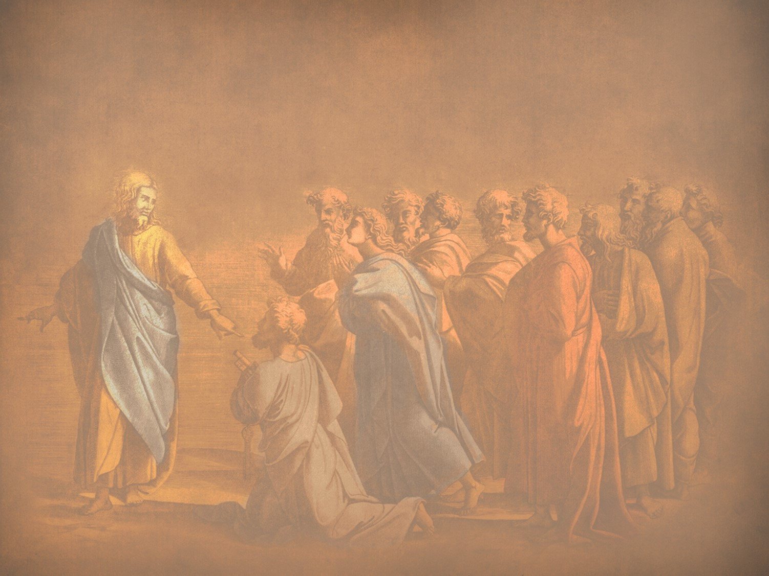
Instruction of the Twelve by the King
§§ 74-97
Jesus switches from public ministry to teaching the apostles to continue His ministry since His rejection would soon end in death
Section summaries based on J. Dwight Pentecost, A Harmony of the Words and Works of Jesus Christ (Grand Rapids: Zondervan, 1981)
Dr. Rick Griffith • Jordan Evangelical Theological Seminary • BibleStudyDownloads.org

Slide 2
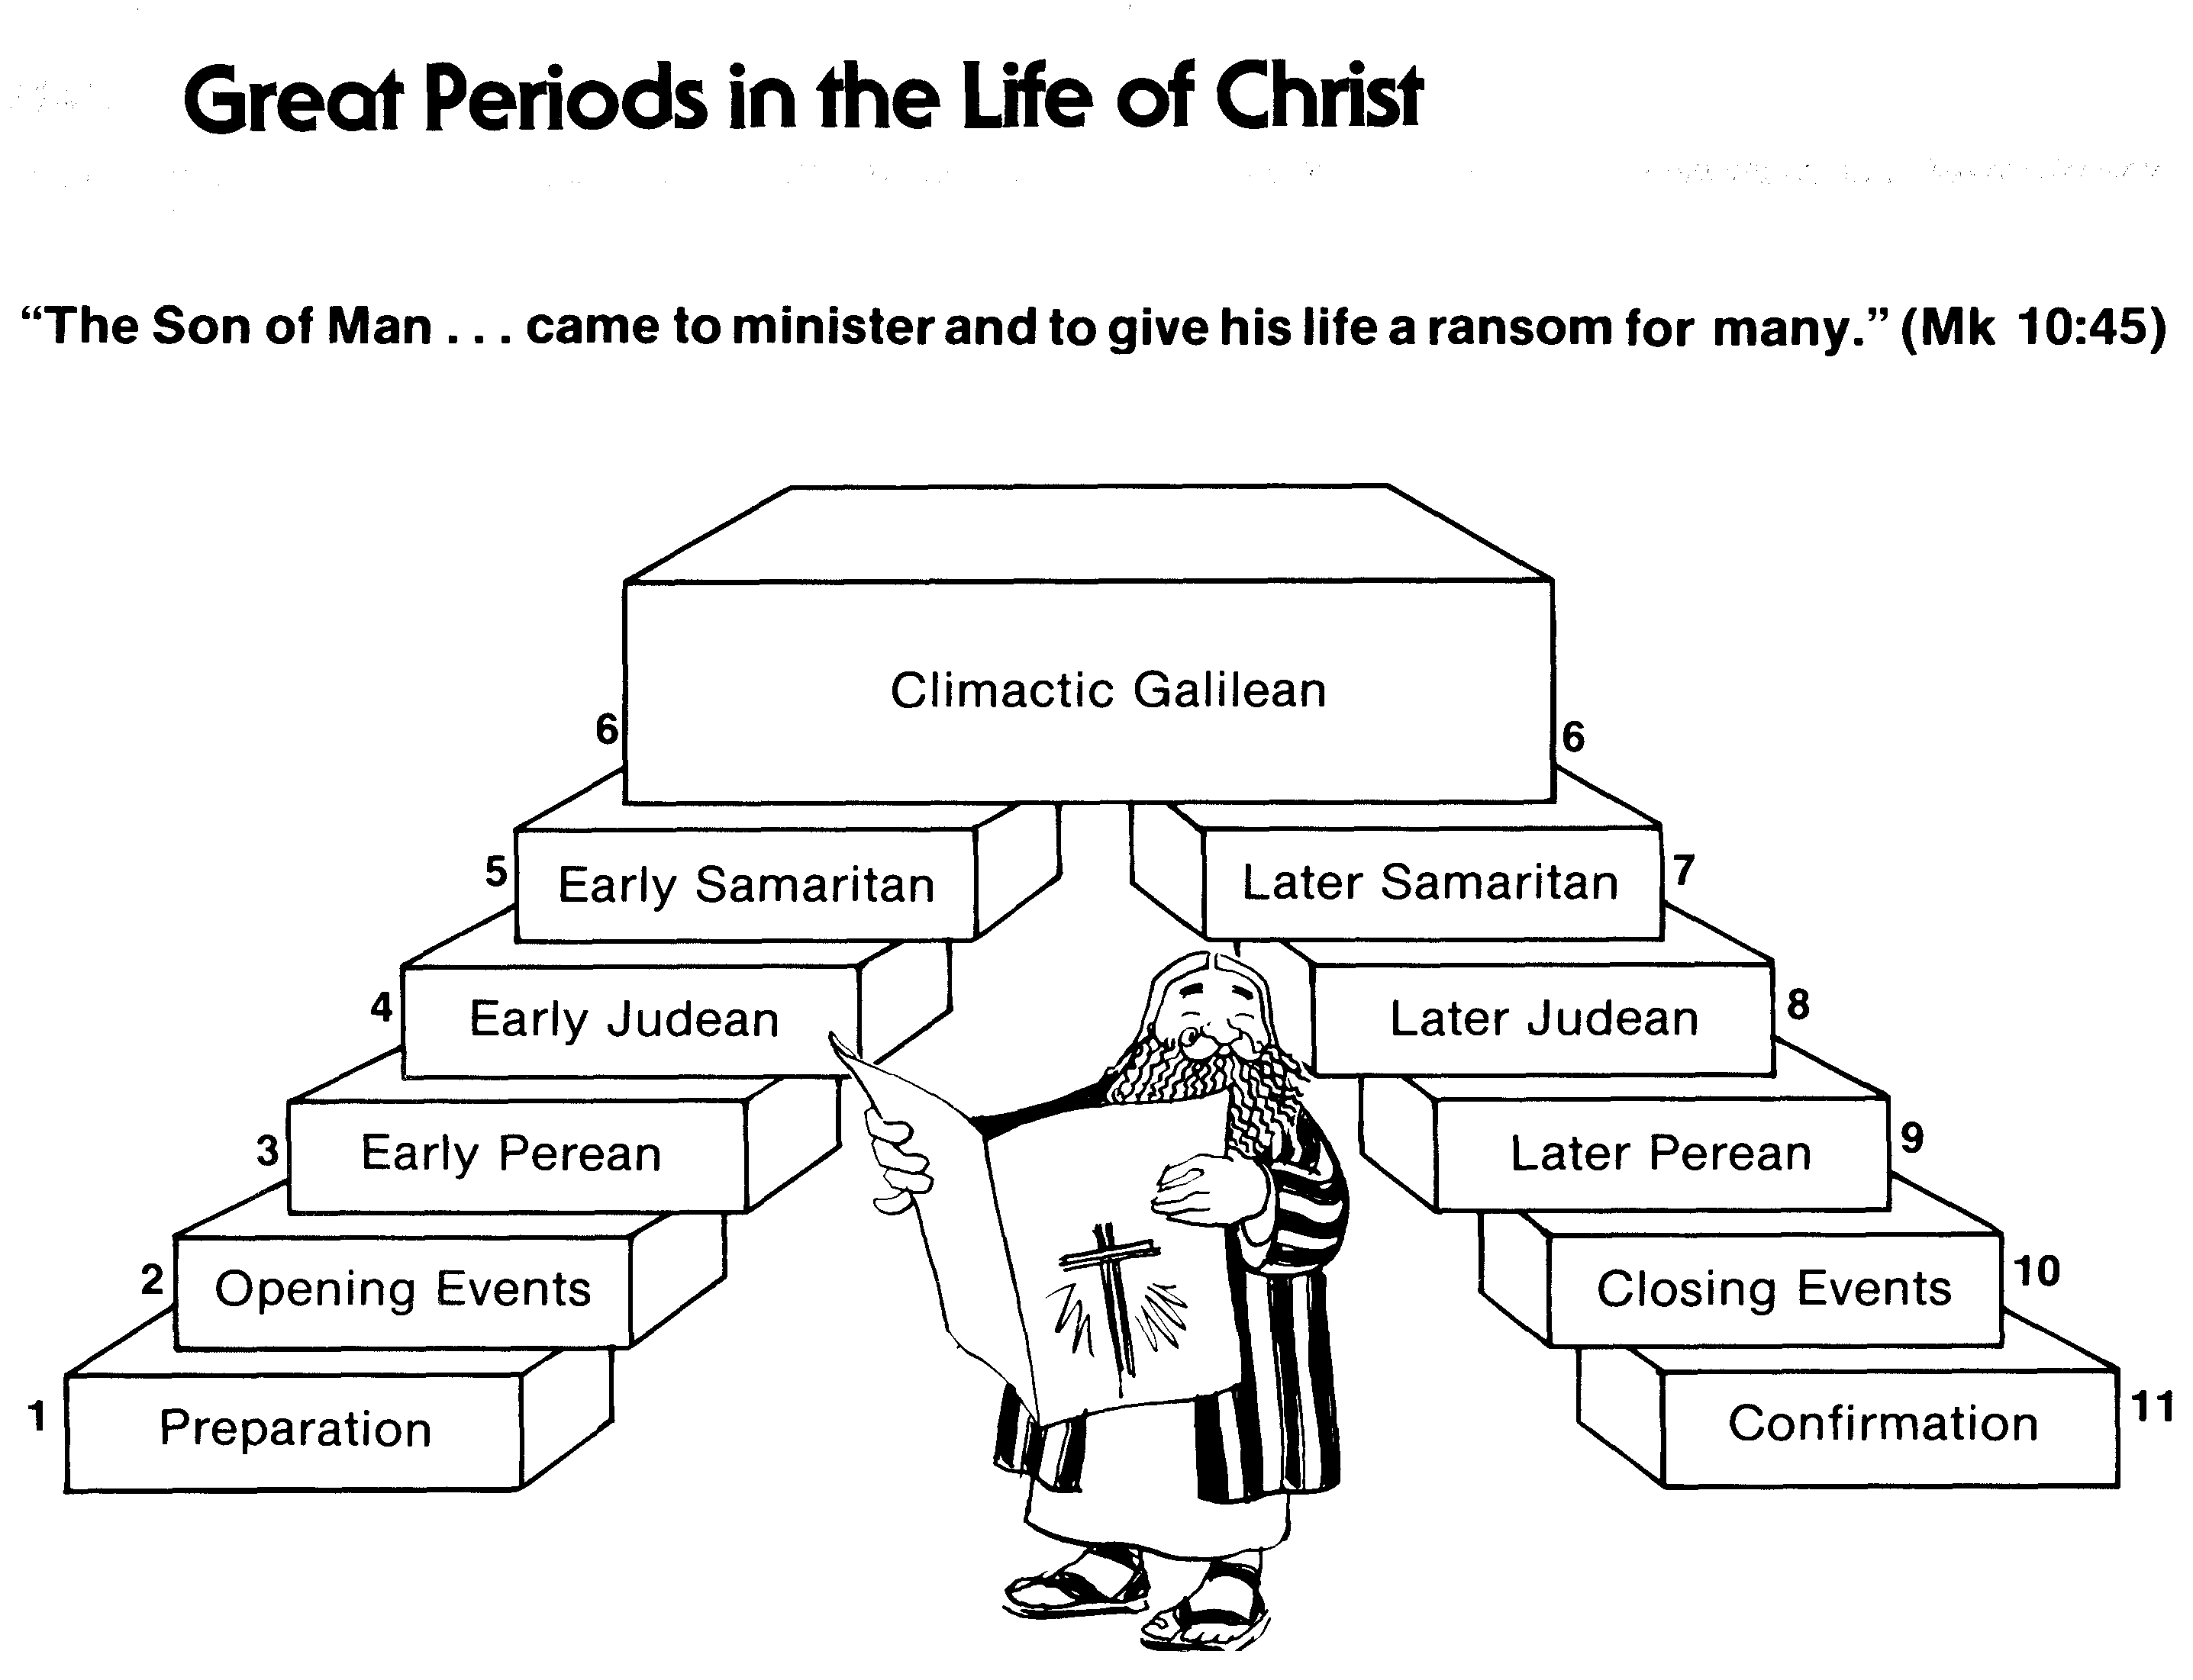
Great Periods in the Life of Christ
55
“The Son of Man… came to minister and to give his life a ransom for many” (Mark 10:45)
Climactic Galilean
Early Samaritan
Later Samaritan
Early Judean
Later Judean
Early Perean
Later Perean
Opening Events
Closing Events
Preparation
Confirmation
Walk Thru the New Testament seminar (used with permission)
Notes:
The Walk Thru outline of the life of Christ forms a chiasm or literary arrangement with repeating elements in the opposite order. This structure makes Confirmation parallel to Preparation, Closing Events parallel to Opening Events, etc. until the only event without parallel becomes the focus: Climatic Galilean. Such an arrangement of material was common in ancient antiquity and is seen in both the OT (e.g., Zephaniah) and the NT (1 Thess) where the central teaching appears in the middle of each writing.
_______
LC-00-Syllabus-63
LC-01-Introduction-265
LC-05-Opposition-4

Slide 3
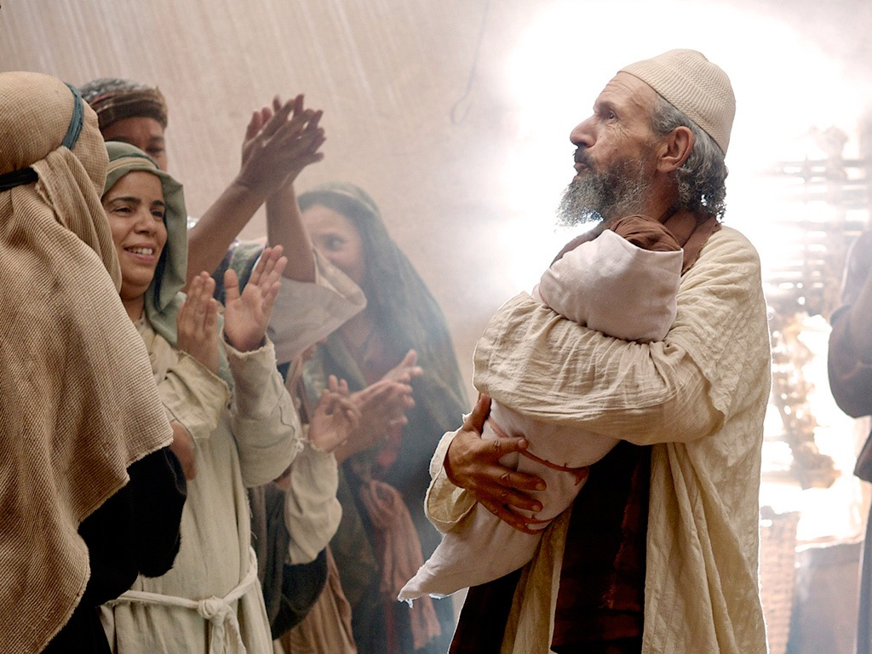

Introduction of the King
§§ 1-27
Arrival
Ambassador
Approval
Ancestry
Advent
Infancy/
Childhood
Baptism
Temptation
Herald
Notes:
Jesus did all that we should expect of the Messiah (King) from the start:
1—He arrived in the proper lineage of David, born of a virgin, and knew his deity even at age 12
2—His forerunner John knew his role in preparing Israel for her king
3—He had the best witnesses possible in the Father (baptism), Spirit (temptation), and John (prophesied herald)

Slide 4

The Authentication
of the King
§§ 28-59
The Acceptance
of His Person
§§ 28-36
The Authority
of the King
§§ 37-59
Notes:
Many people of various places (Judea, Samaria, Galilee) and types (Nicodemus, Samaritan woman, common Jews) initially believed in him.
Jesus also showed in 19 incidents the power expected of the Messiah to interpret the Law to preach and with authority over men, defilement, Sabbath, nature, sickness, and even death.

Slide 5

Controversy over the King
Rejection
Acceptance
Herod Antipas
Galilee Cities
Pharisees
Nation of Israel
Nazareth
Woman at Simon's home
Wealthy women supporting Jesus
Israel after the Interadvent Age
World, Sea, disease, death, & blindness
Notes:
OVERVIEW OF THIS SESSION: The Controversy Over the King means that Jesus was debated by those who rejected and accepted Him. Sadly, the nation's leaders who disbelieved had greater authority than women who believed, but Jesus promised many believers after the time between his two comings (Interadvent Age). In the meantime, even the Sea of Galilee, death, blindness, etc., submitted to His power.

Slide 6
Pentecost Outline
Introduction of the King
Authentication of the King
Controversy over the King
Instruction of the Twelve by the King
Opposition to the King
Preparation of the Disciples by the King
Official Presentation of the King
Preparation for the Death of the King
Rejection of the King
Resurrection of the King

Slide 7

Increasing Polarization
Resurrection
Preparation
for Death
Preparation
of Disciples
Instruction
Authentication
Introduction
Controversy
Opposition
Presentation
Rejection
Notes:
The Life of Christ brought increasing polarization. The more Jesus showed about himself, the greater the resistance to him and his message. Also, the more intense the controversy leading to opposition, the higher priority Christ placed on preparing his men for when he would be gone. The climactic rejection when he presented himself as king of Israel at the Triumphal Entry resulted in rejection to the point of crucifixion followed by the victory of resurrection.
Introduction of the King
Authentication of the King
Controversy over the King
Instruction of the Twelve by the King
Opposition to the King
Preparation of the Disciples by the King
Official Presentation of the King
Preparation for the Death of the King
Rejection of the King
Resurrection of the King

Slide 8
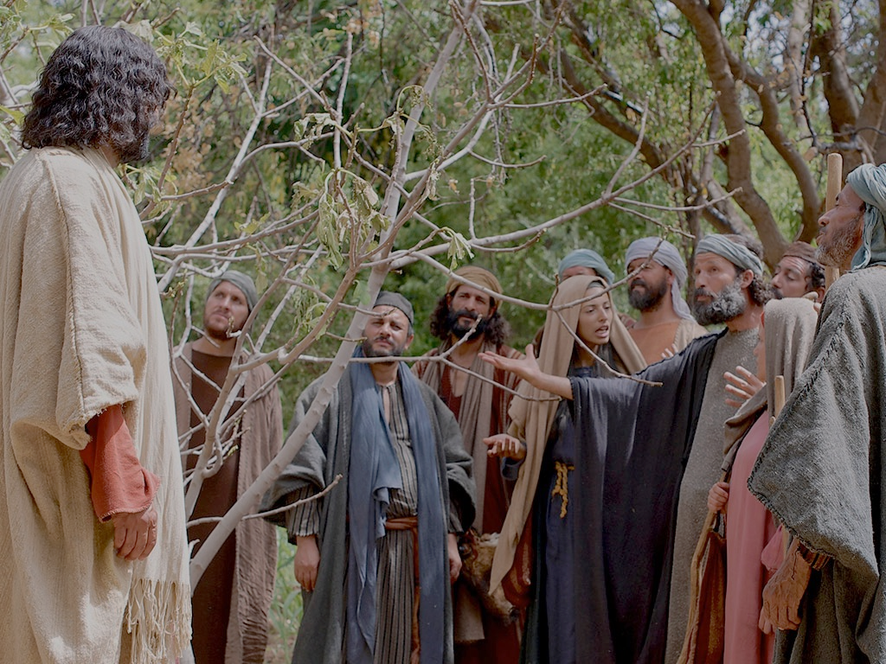
Instruction of the Twelve by the King
Character
(Who to Be)
Jesus Identity
Humility
Sonship
Sufficiency
Bread
Journey
Resurrection
Defilement
Brothers
Pride
Marching Orders (What to Do)
Trust
Instruction
Hypocrisy
Decapolis
Kingdom Plan
Death
Discipleship
Rejection
Gentiles
Dependance
Elijah
Discipleship
Signs
Healing
Forgiveness
Church
Kingdom
Notes:
Despite the King being authenticated (02), controversy erupted (03), so Jesus saw his need to prepare his men by teaching them (04) because soon the opposition (05) would result in his death (09). Our present stage (04) on the Instruction of the Twelve by the King covers 24 areas of the King's curriculum for his men. The code before each shows their category, sequence, and letter in the outline. For example, "J1A" means the Jesus Identity, first event, and letter A in the outline on slide 8 where a fuller explanation of this point is found.
J1A-Sufficiency (to feed 5000 as New Moses despite spiritually blind)—slide 9
K2B-Rejection (of kingship over only Galilee as leaders disbelieve)—slide 58
M3C-Trust (Jesus over obstacles by walking on water)—slide 60
K4D-Healing (physical represents the more important spiritual)—slide 71
J5E-Bread (Jesus is true bread of eternal life)—slide 72
C6F-Defilement (internal, not external)—slide 87
K7G-Gentiles (saved in Tyre and Sidon before Israel repents)—slide 88
M8H-Decapolis (to feed 4000 Gentiles)—slide 102
K9I-Signs (not needed for belief, so Jesus refuses to give a sign)—slide 105
C10J-Hypocrisy (warn of Pharisee hypocrisy for potential in oneself)—slide 107
K11K-Church (founded on Christ's deity shown in Peter's confession)—slide 108
K12L-Death (as the sacrifice for sin followed by resurrection)—slide 114
M13M-Discipleship (submits not to Pharisees but Jesus as Israel's judge/ruler)—slide 116
K14N-Kingdom (Transfigured glory foretells reign of Jesus worthy to obey)—slide 117
K15O-Elijah (must precede the kingdom as John's sacrifice preceded glory)—slide 128
M16P-Dependence (on Jesus for exorcism required to deliver Israel)—slide 139
J17Q-Resurrection (after death in same Messiah, not two Messiahs)—slide 140
C18R-Sonship (emphasizes the high value of the disciples to Jesus)—slide 141
C19S-Humility (shows true greatness in the Kingdom)—slide 142
C20T-Pride (should not be shown towards others who cannot exorcise)—slide 143
M21U-Forgiveness (unconditionally and entirely like God does)—slide 144
M22V-Discipleship (costs everything, unlike three men who made excuses)—slide 161
J23W-Brothers (often give tainted counsel, but Jesus keeps God's timing)—slide 162
J24X-Journey (to Jerusalem rejected in Samaria but Sons of Thunder rebuked)—slide 166
These 24 teaching moments fall into four broad areas of instruction:
• CHARACTER (WHO TO BE)—5 incidents focus on heart issues for the disciples
• JESUS IDENTITY—5 events instruct about the nature of Christ
• KINGDOM PLAN—8 opportunities came when Jesus showed aspects of God's plan
• MARCHING ORDERS (WHAT TO DO)—6 teachable moments highlighted actions the disciples should prioritize

Slide 9
A. Feeding the Five Thousand
§ 74
Matthew 14:13-21; Mark 6:30-44; Luke 9:10-17;
John 6:1-13
Christ feeds 5000 as the New Moses of Deut 18:15, teaching the believers sufficiency in Him and unbelievers their spiritual blindness

Slide 10
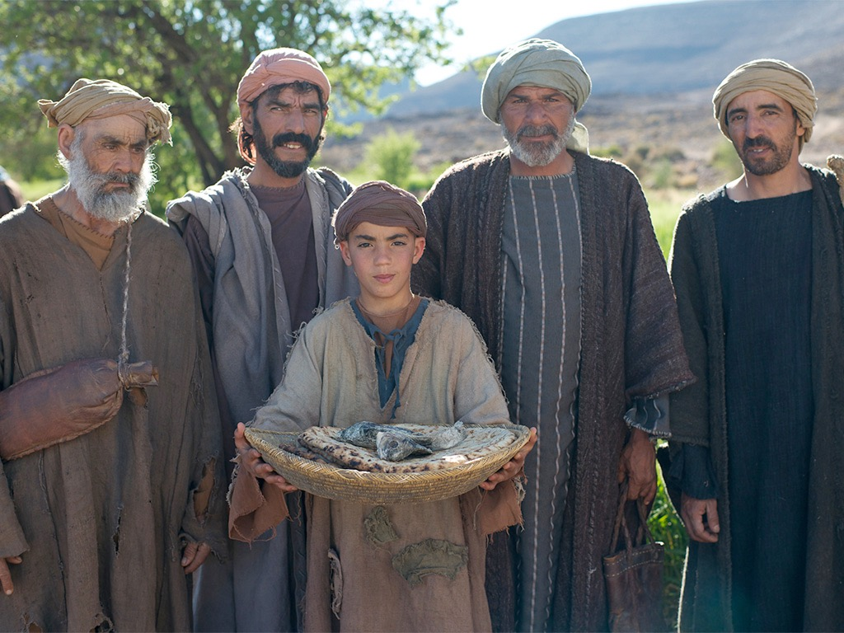

JESUS FEEDS 5000
Free
Bible
images
Matthew 14:13-22
Mark 6:31-46
Luke 9:10-17
John 6:1-13

Slide 11
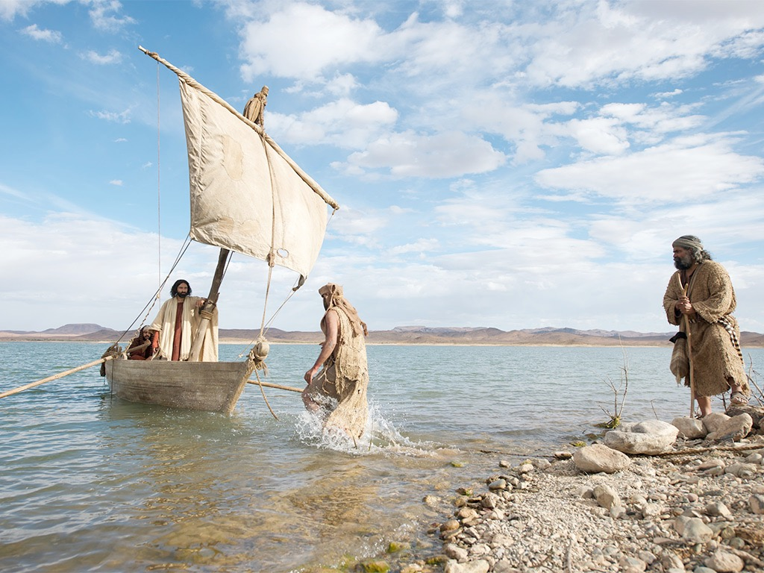

Slide 12
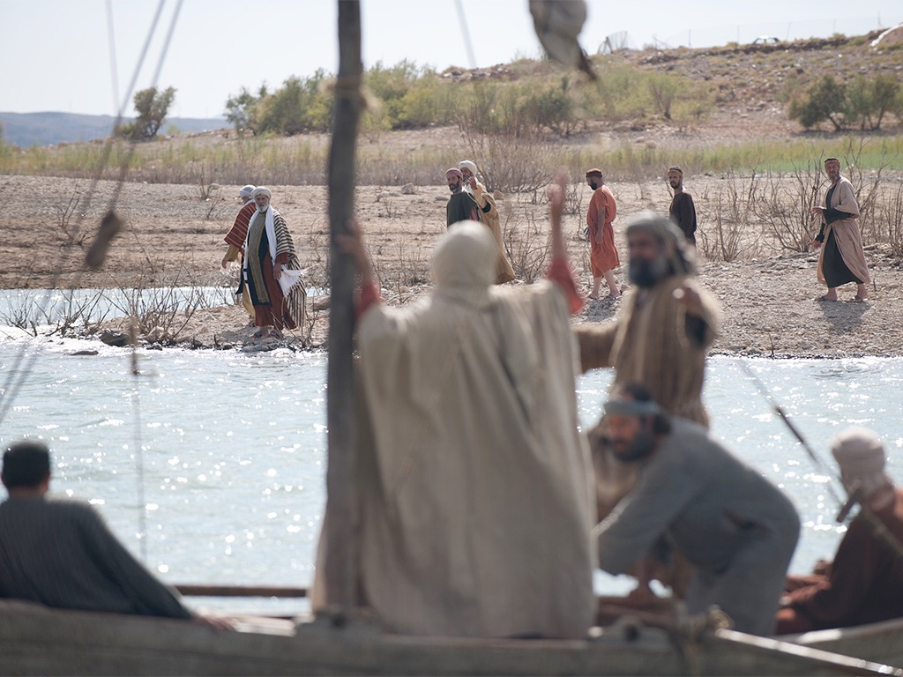

Slide 13
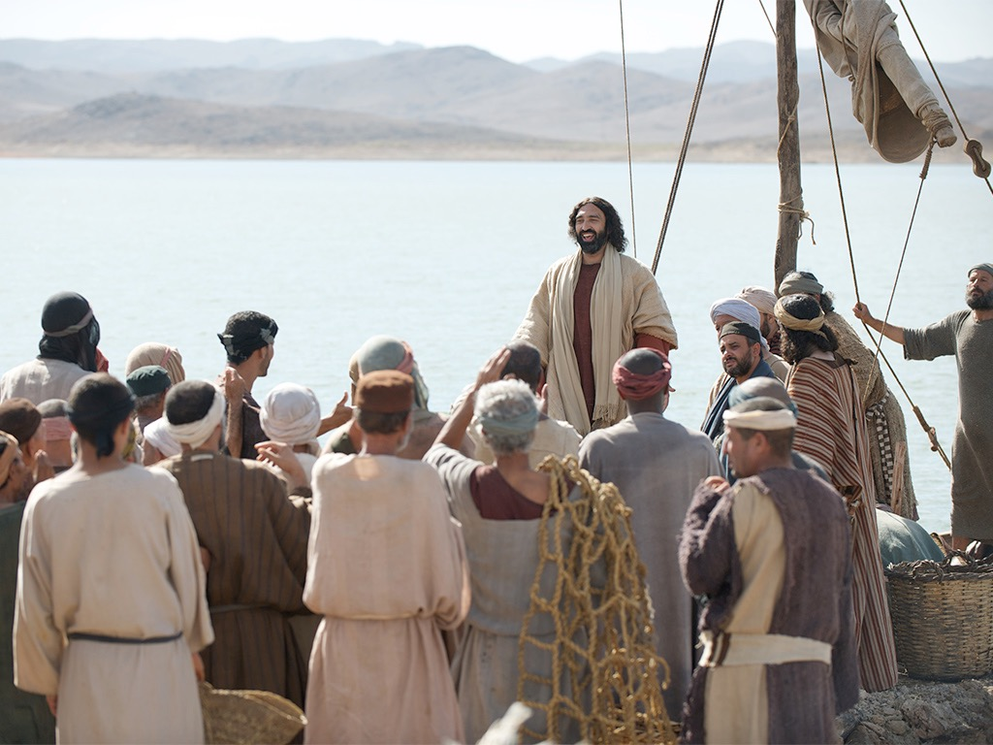

Slide 14
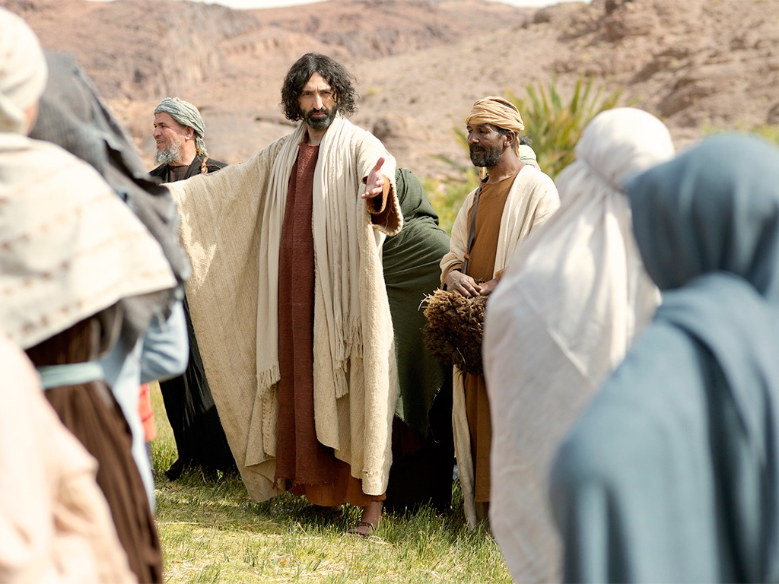

Slide 15
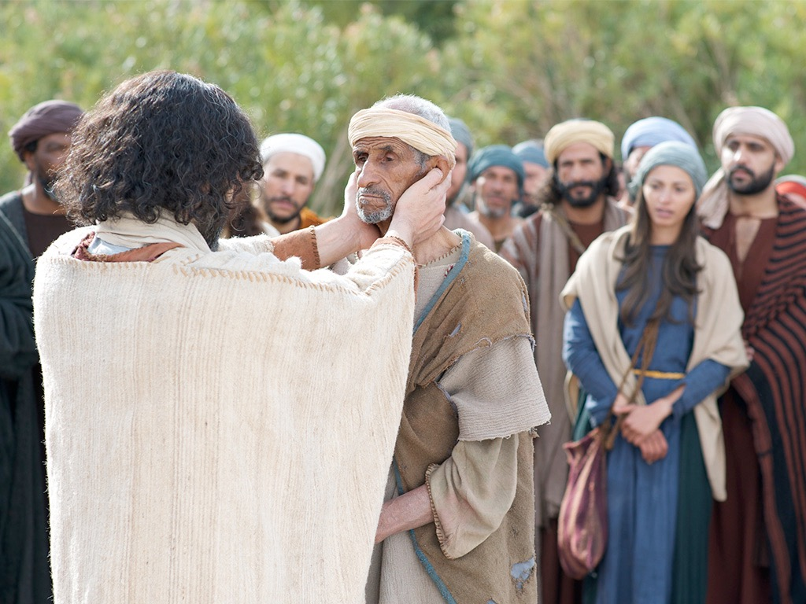

Slide 16
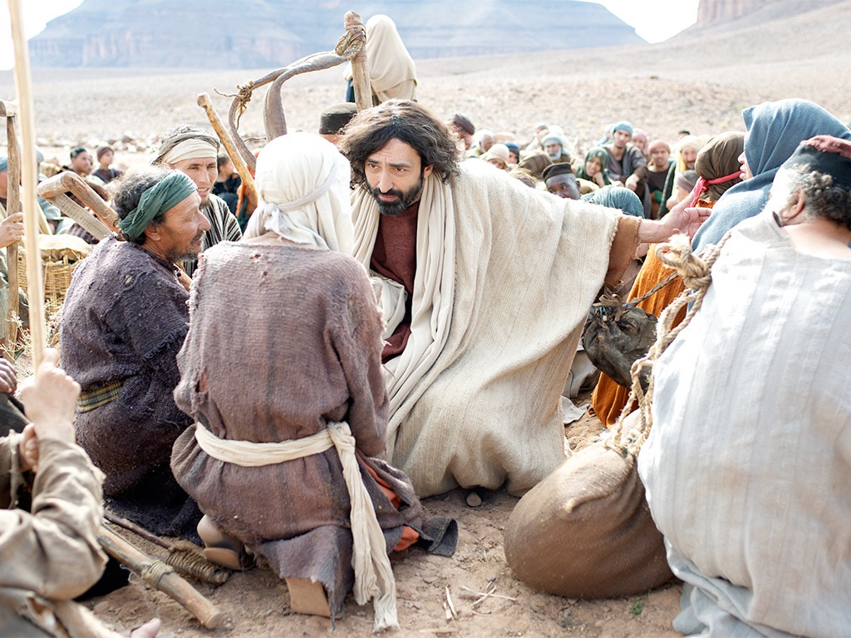

Slide 17
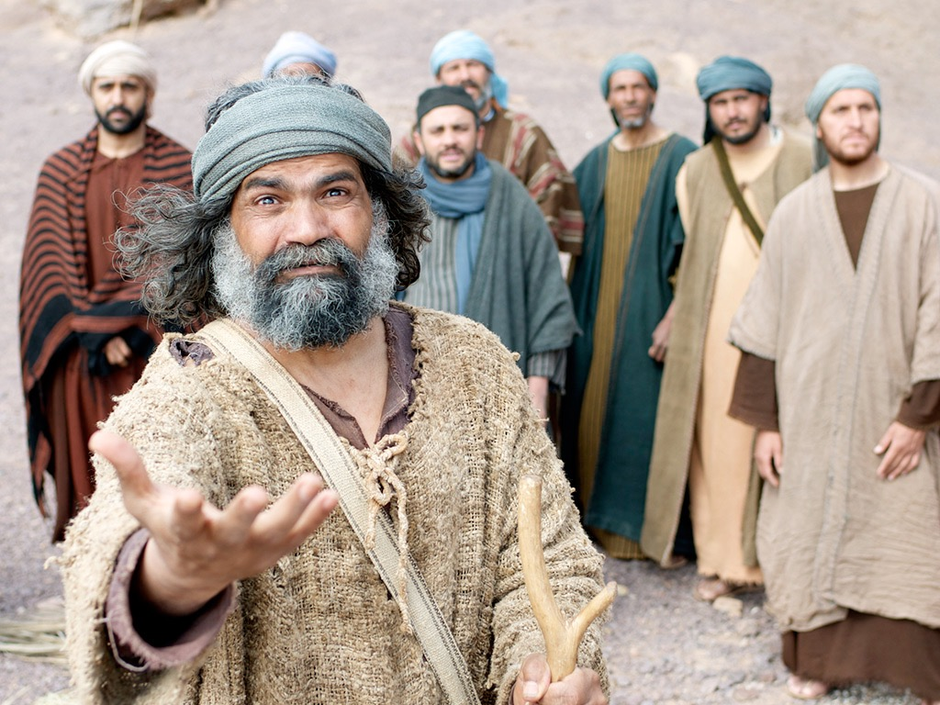

Slide 18
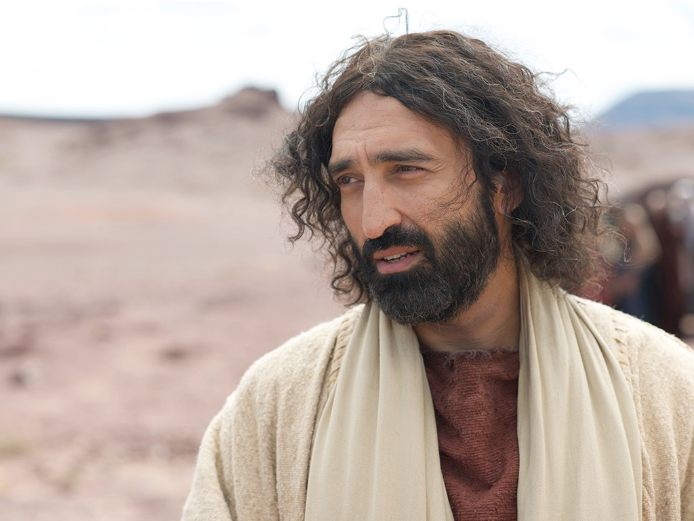

Slide 19
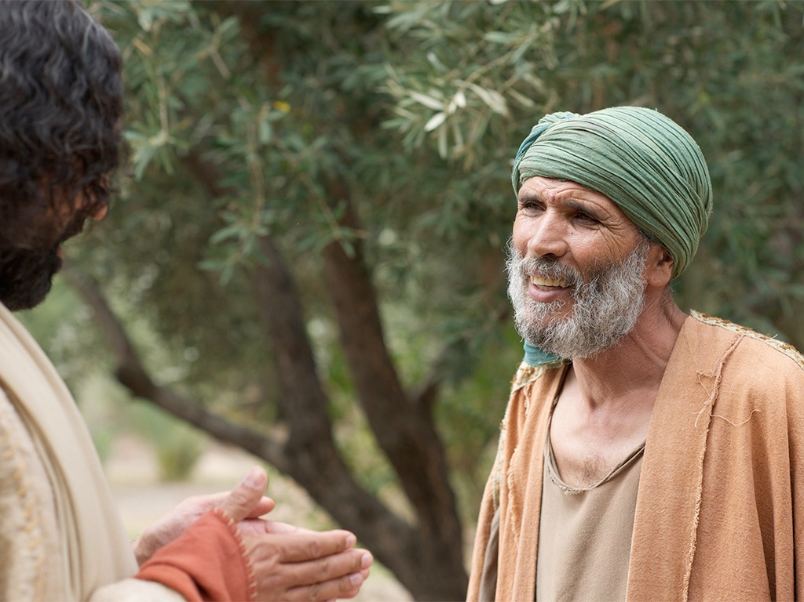

Slide 20
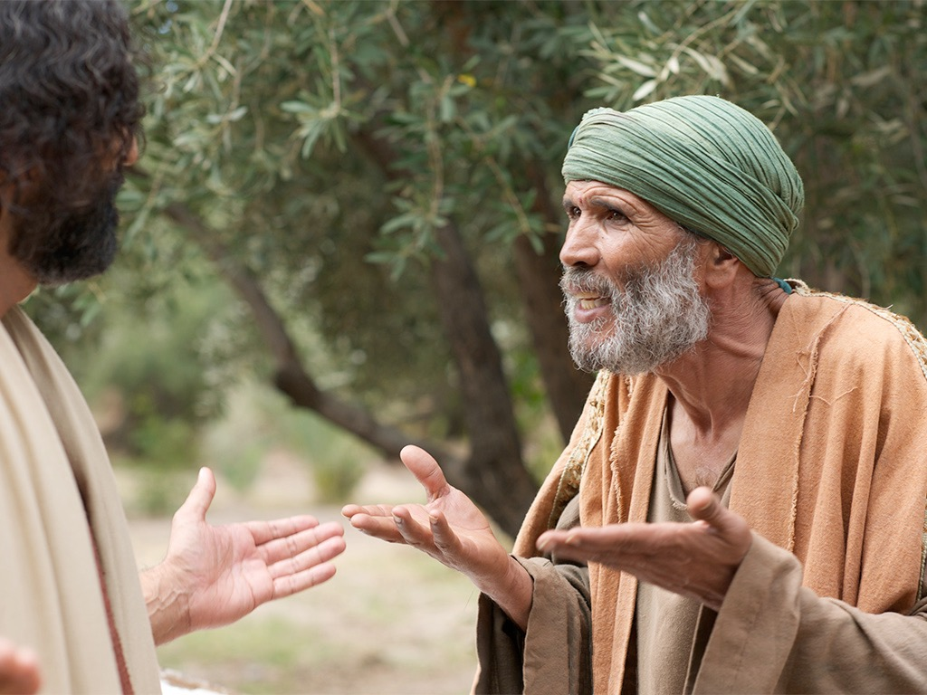

Slide 22
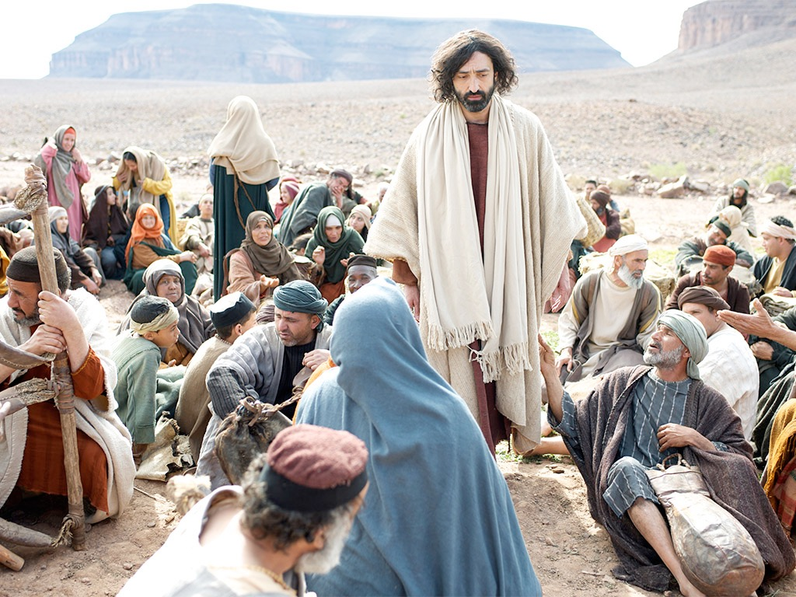

Slide 23
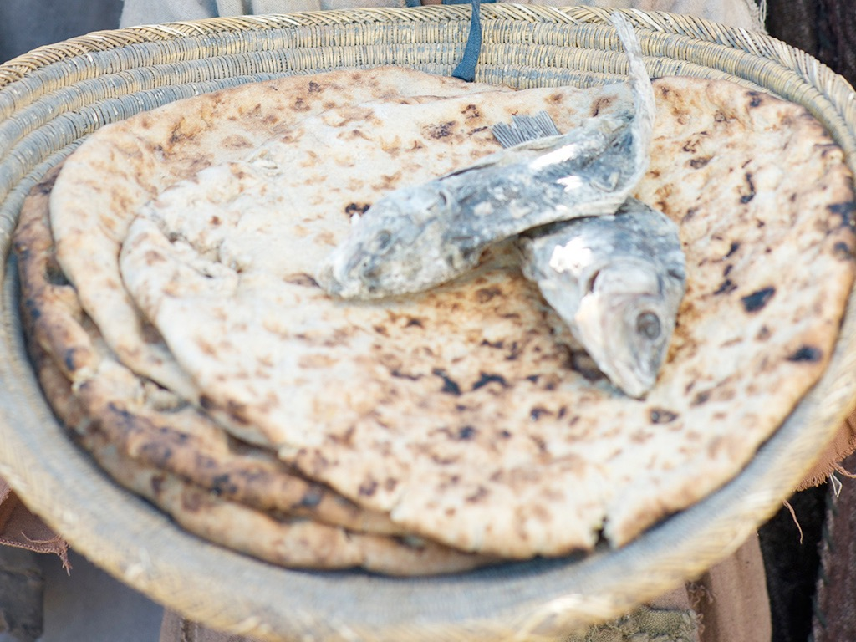

Slide 24
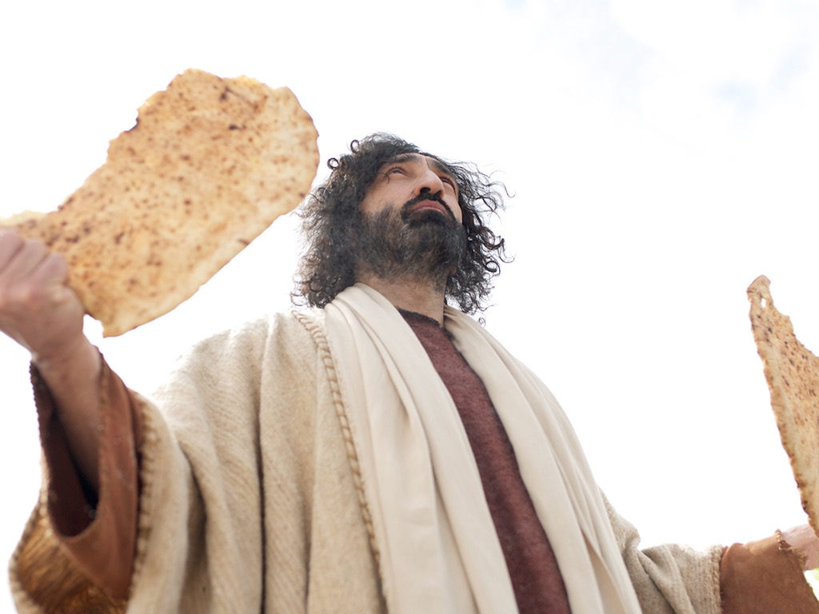

Slide 25
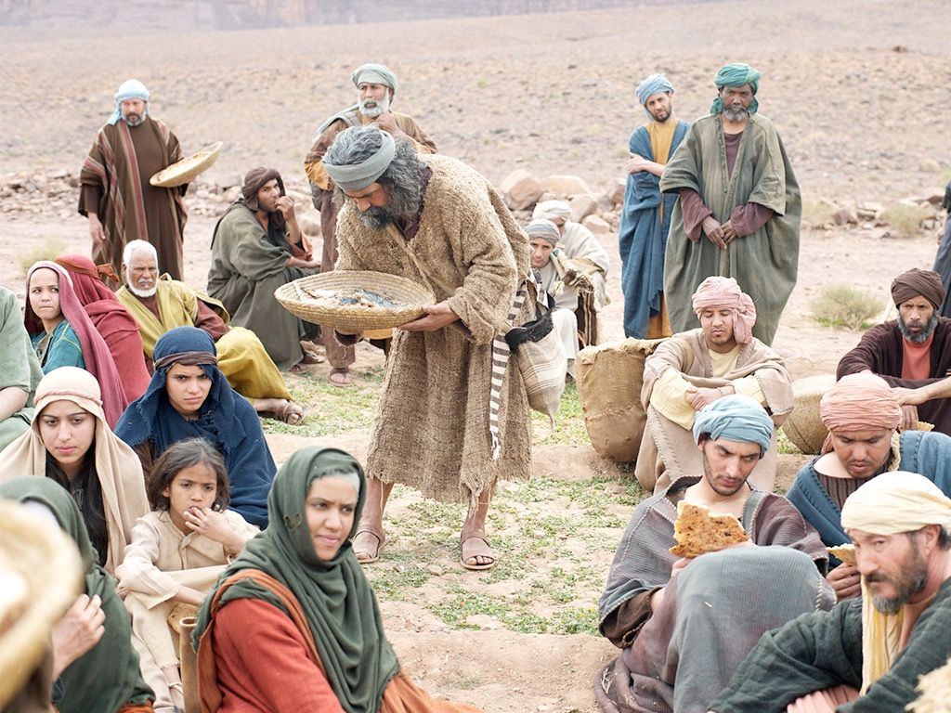

Slide 26
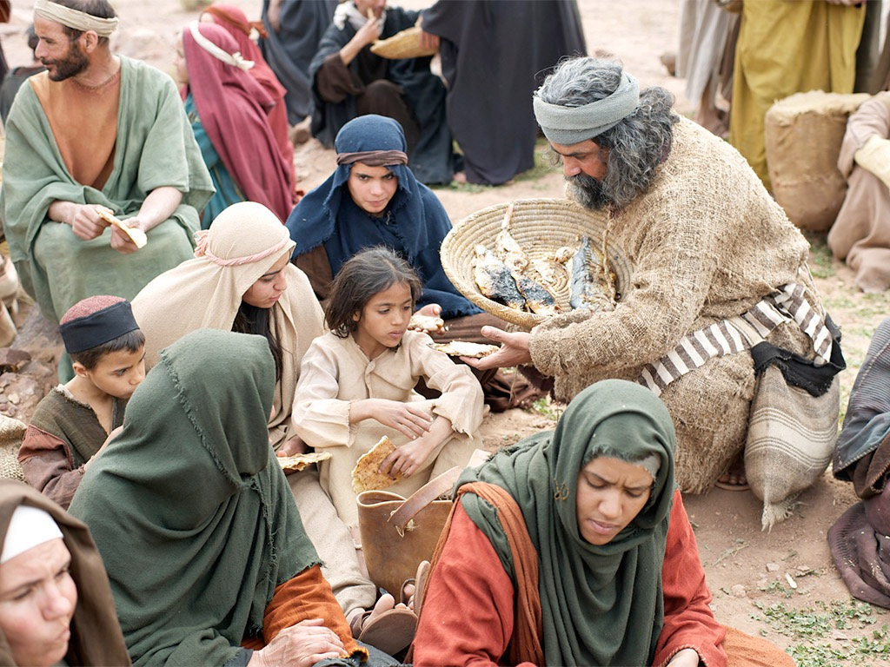

Slide 27
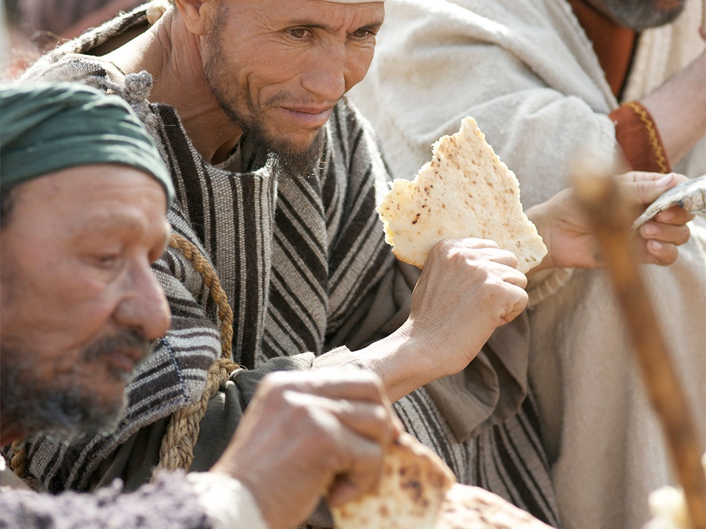

Slide 28
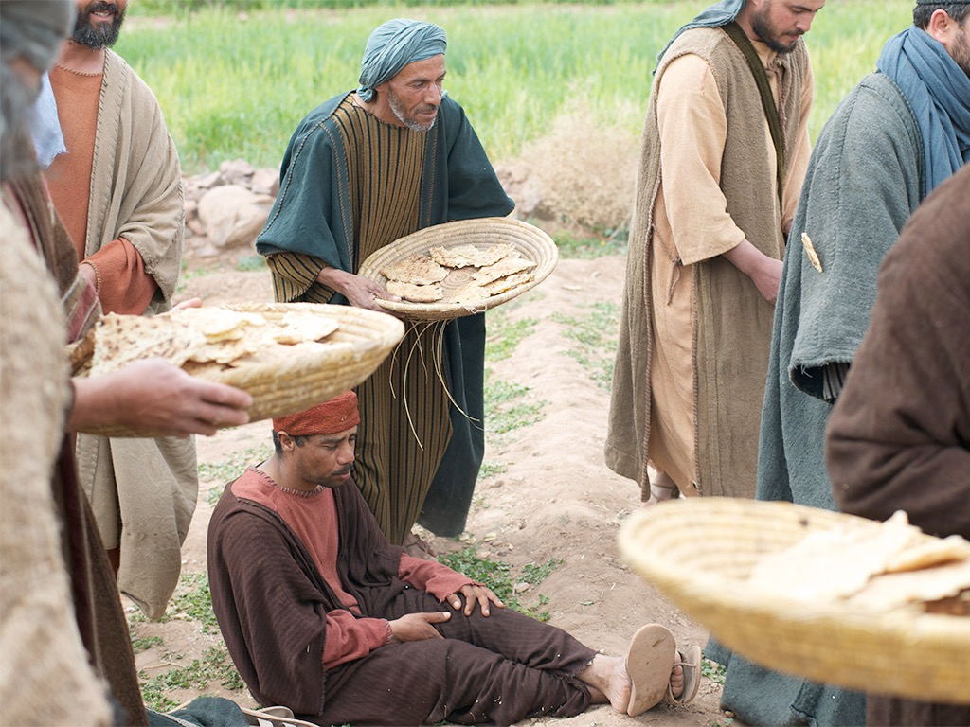

Slide 29
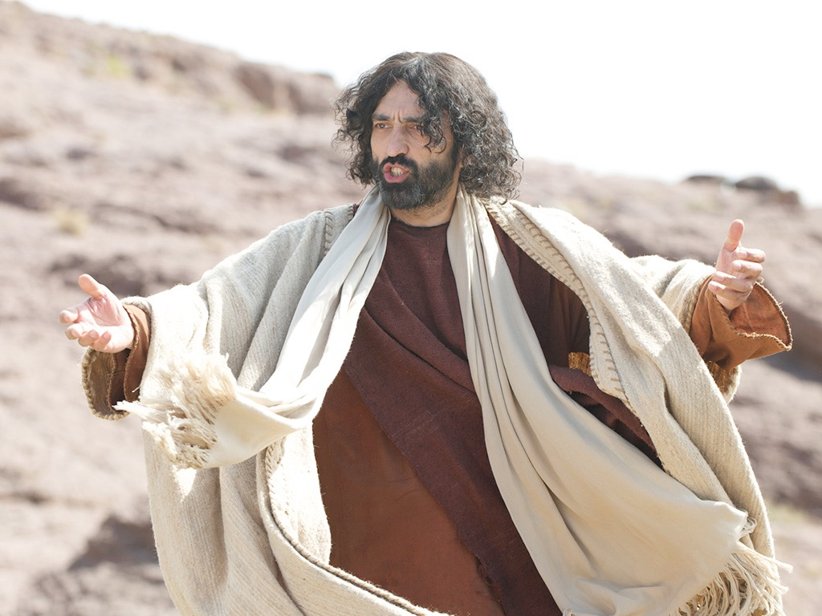

Slide 30
THE WORD IN PICTURES
Free
Bible
images

Slide 31
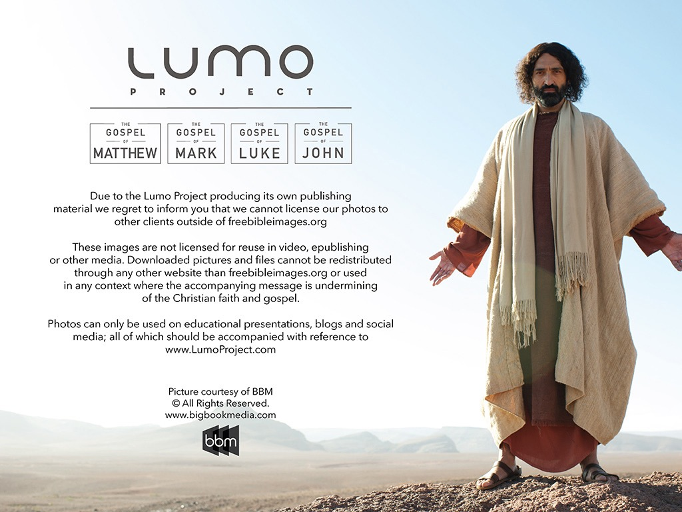
Used with Permission
THE
GOSPEL
——OF—— MATTHEW
THE
GOSPEL
——OF—— MARK
THE
GOSPEL
——OF—— LUKE
THE
GOSPEL
——OF—— JOHN
Due to the Lumo Project producing its own publishing material we regret to inform you that we cannot license our photos to other clients outside of freebibleimages.org.
These images are not licensed for reuse in video, epublishing or other media. Downloaded pictures and files cannot be redistributed through any other website than freebibleimages.org or used in any context where the accompanying message is undermining of the Christian faith and gospel.
Photos can only be used on educational presentations, blogs and social media, all of which should be accompanied with reference to www.LumoProject.com.
Picture courtesy of BBM
© All Rights Reserved.
www.bigbookmedia.com

Slide 32

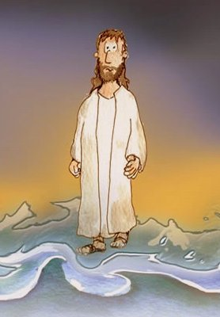
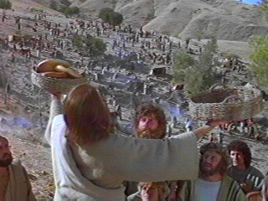
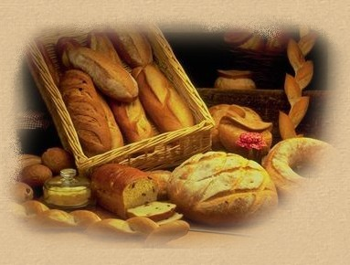
Can Jesus Prove It?
JOHN 6

Slide 33
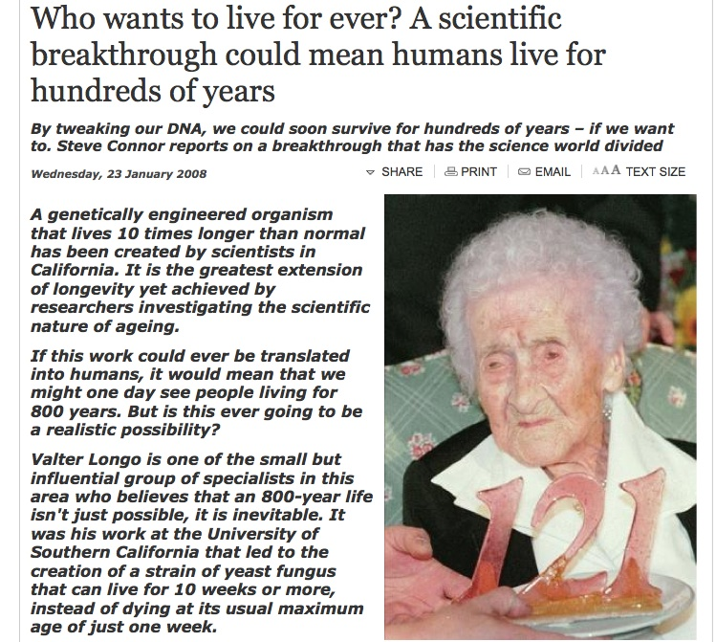
DNA Breakthrough!
Born in 1875, Jeanne Calment died in 1997 aged 122 years and 164 days

Slide 34
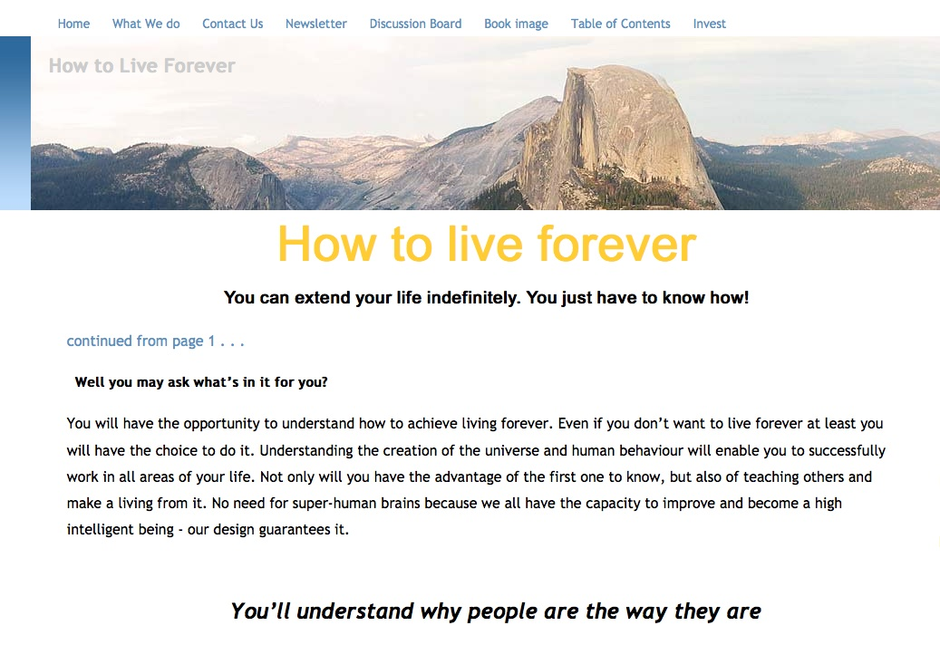
Howtoliveforever.net
You can have “youthful looks, improved appearance and attractiveness, and health and vitality well into your 70s, 80s, 90s, 100s, 1,000s . . . as long as you want.”

Slide 35

An Astonishing Claim!
“I tell you the truth, those who listen to my message and believe in God who sent me have eternal life. They will never be condemned for their sins, but they have already passed from death into life”
–– John 5:24
Notes:
Verse 26
Why did the crowd search for Jesus?
The crowd wants follow a prophet who will provide free food and political deliverance.

Slide 36
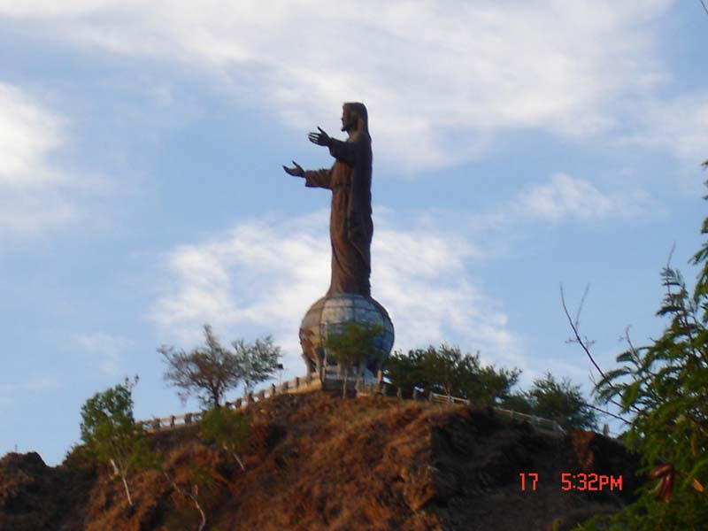

Subject
How do we know Jesus can give eternal life?
JOHN 6

Slide 37

3 MOVEMENTS:
Showing his Authority (1-21)
The Bread of Life (22-59)
Disciples desert Jesus (60-71)

Slide 38

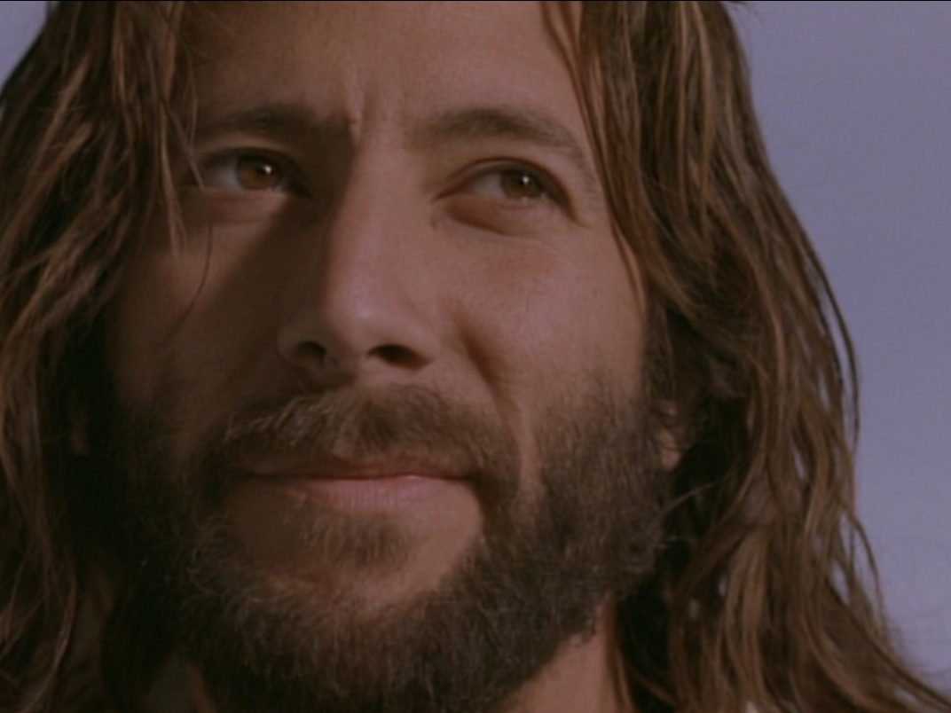

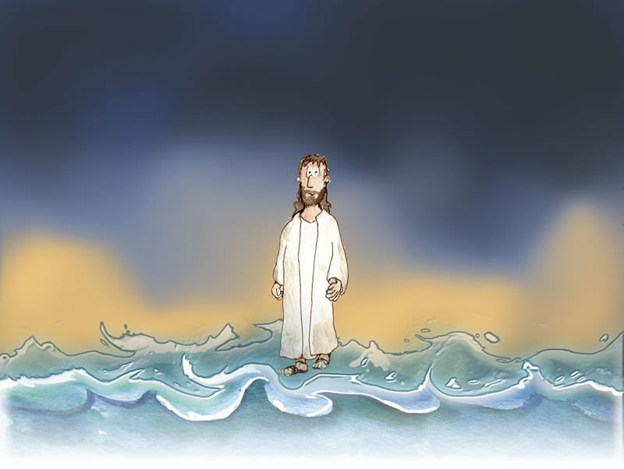
I. Jesus showed His authority over Moses and creation (6:1-21).
1-15
16-21

Slide 39
Feeding the 5000
Feeding the 5000
1-15

Slide 40
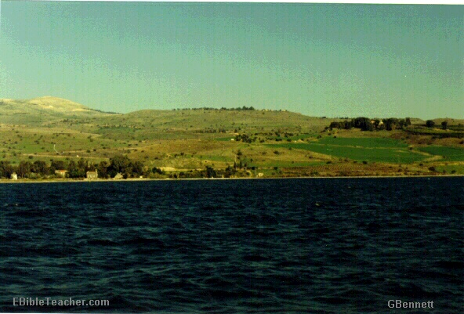
The Setting
Near Sea of Galilee
Notes:
Jesus went up to the mountain & Sat down to teach the disciples

Slide 41
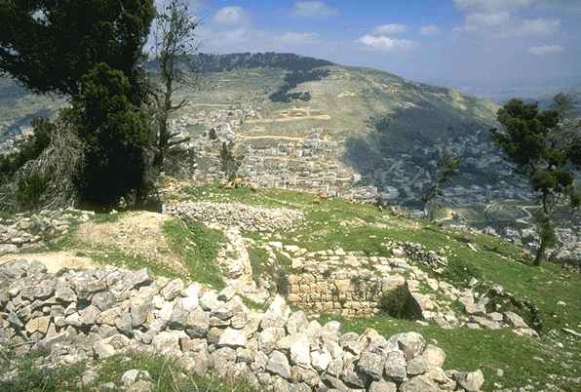
Verse 5-7
Notes:
Verse 5-7
Do you have faith in God?

Slide 42
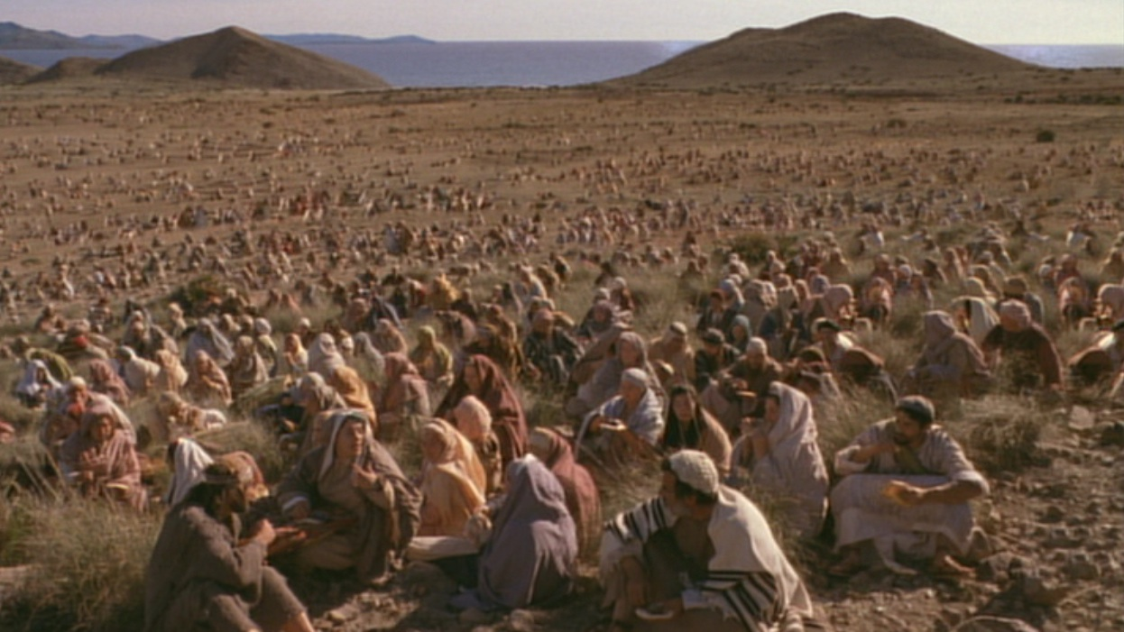
A huge crowd in a remote place
Notes:
Verse 5-7
Do you have faith in God?

Slide 43
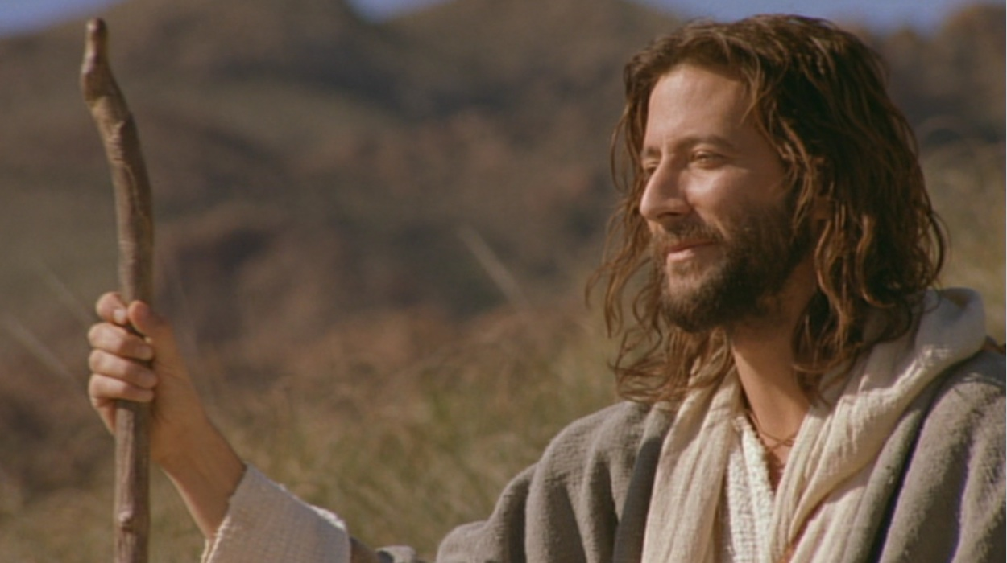
Verse 5-7
Where shall we buy bread for these people to eat?
Notes:
Verse 5-7
Do you have faith in God?

Slide 44
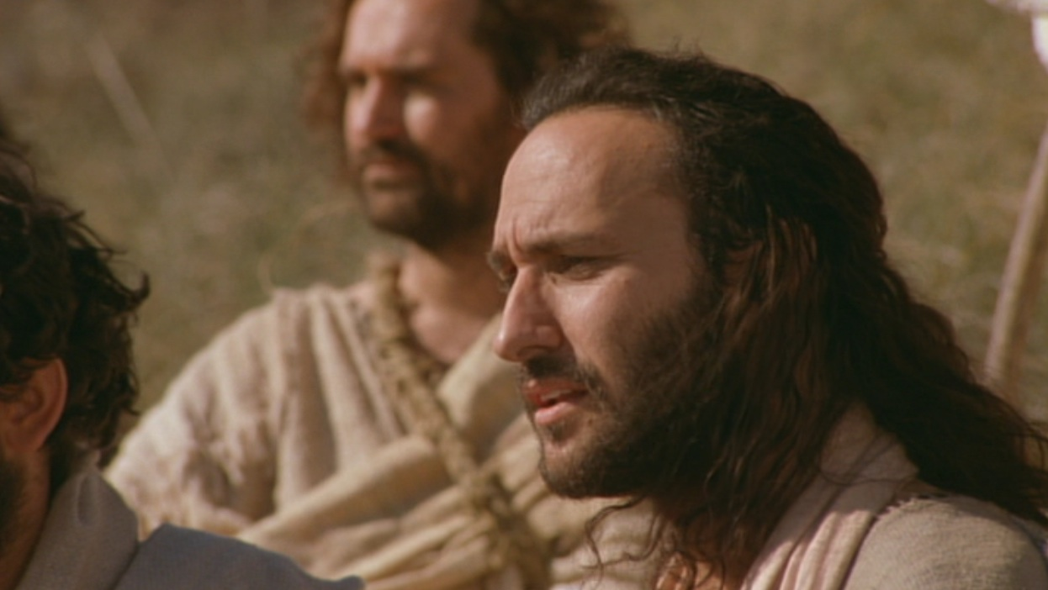
Verse 5-7
8 months’ wages would not buy enough bread for each one to have a bite!!
Notes:
Verse 5-7
Do you have faith in God?

Slide 45
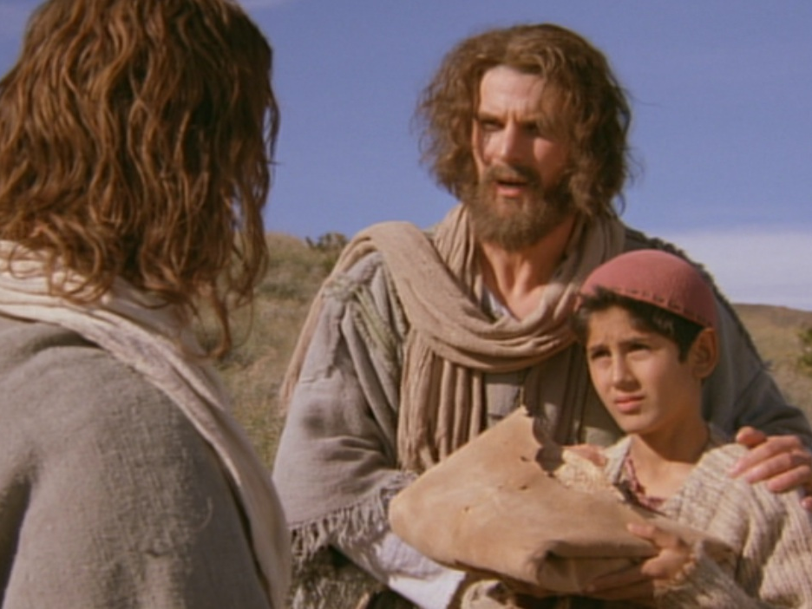
Andrew being helpful
“There’s a young boy here with five barley loaves and two fish. But what good is that with this huge crowd?”

Slide 46
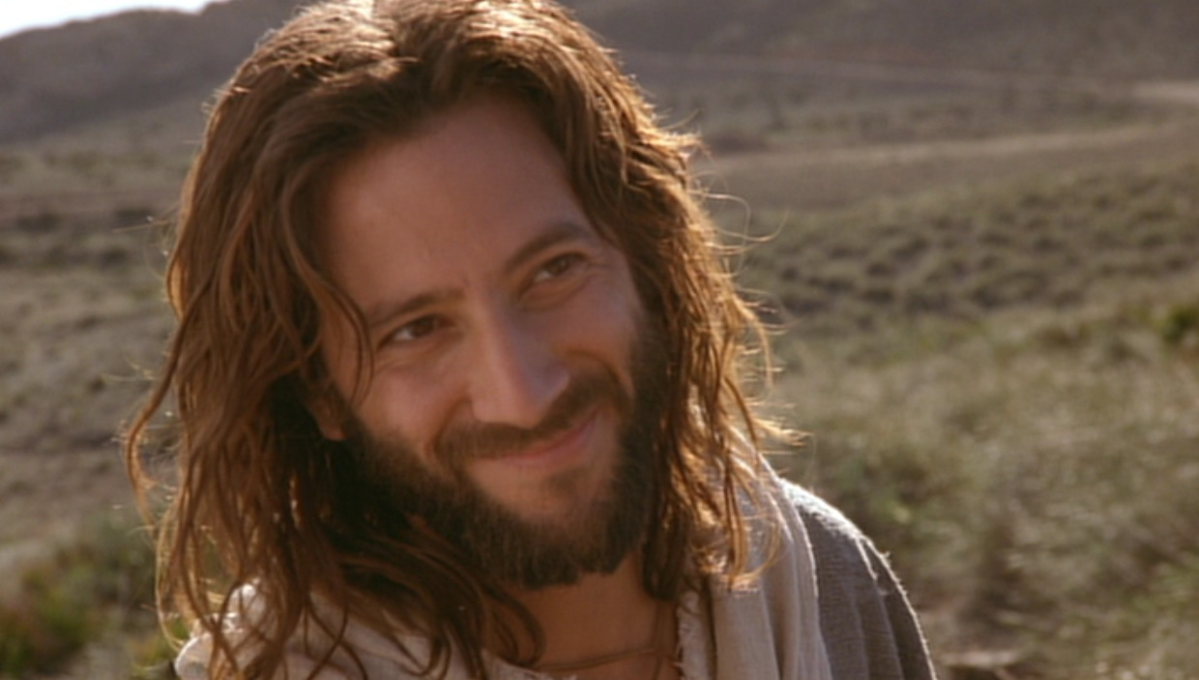
Verse 5-7
Tell everyone to sit down.
Notes:
Verse 5-7
Do you have faith in God?

Slide 47
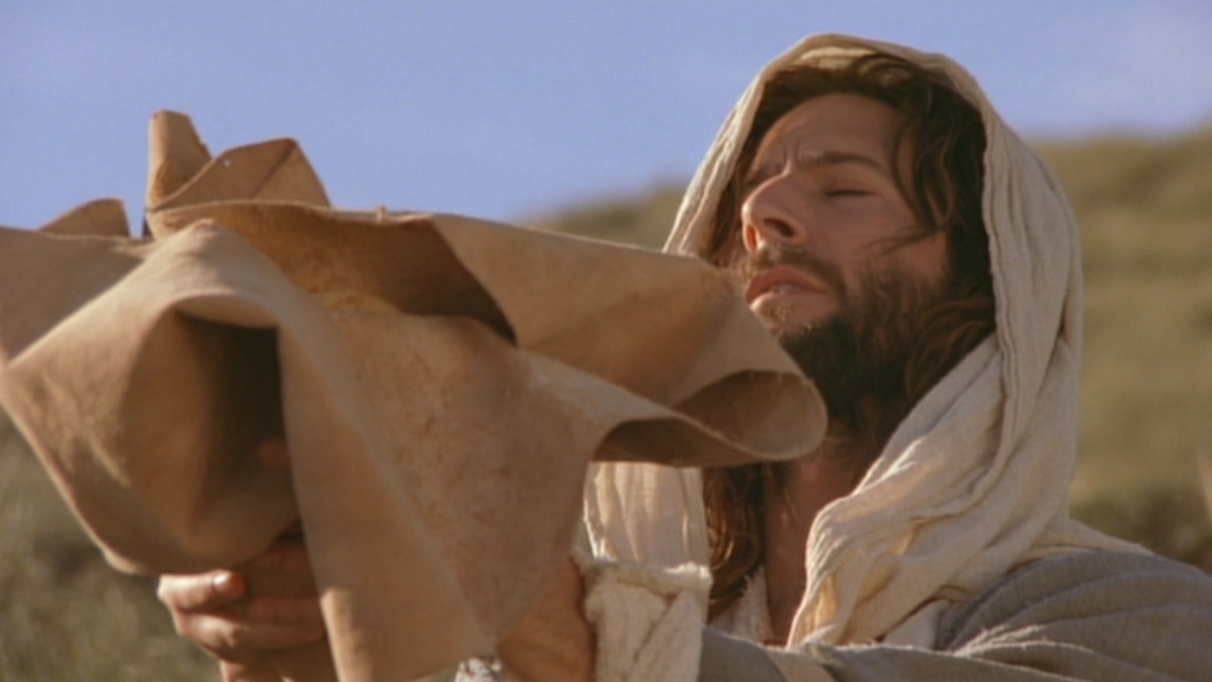
Verse 9-11
Jesus then took the loaves, gave thanks...
Notes:
Do you believe that God can use what you have and multiply it?

Slide 48
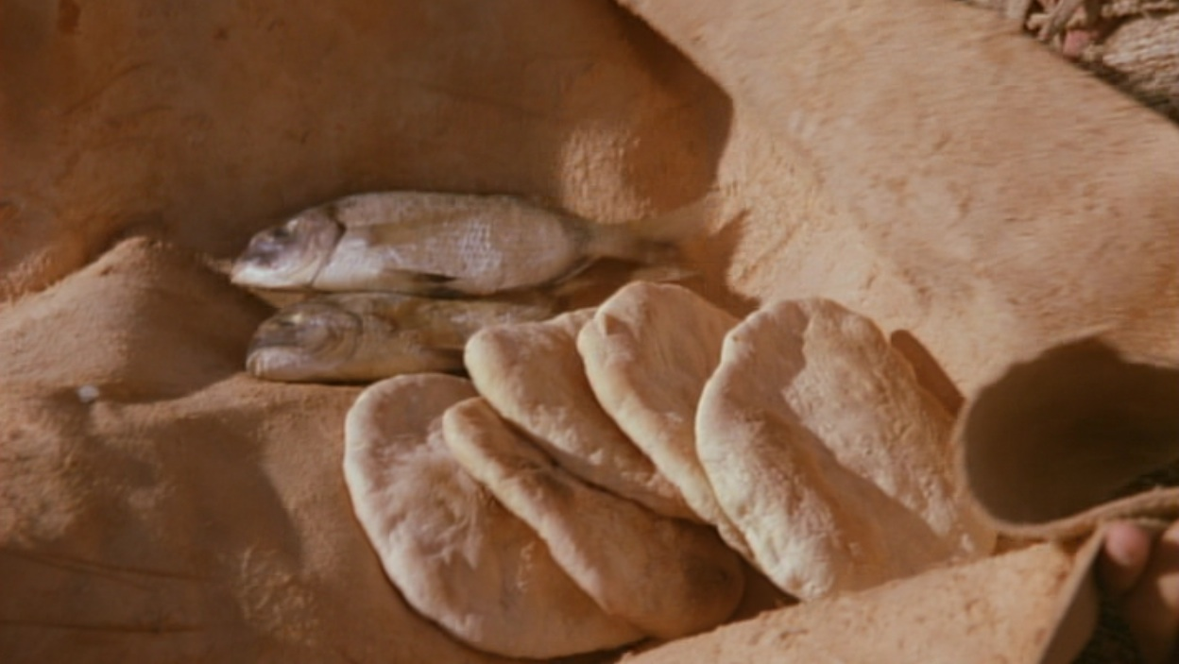
Verse 9-11
Jesus then took the loaves, gave thanks, and distributed to those who were seated as much as they wanted...
Notes:
Do you believe that God can use what you have and multiply it?

Slide 49
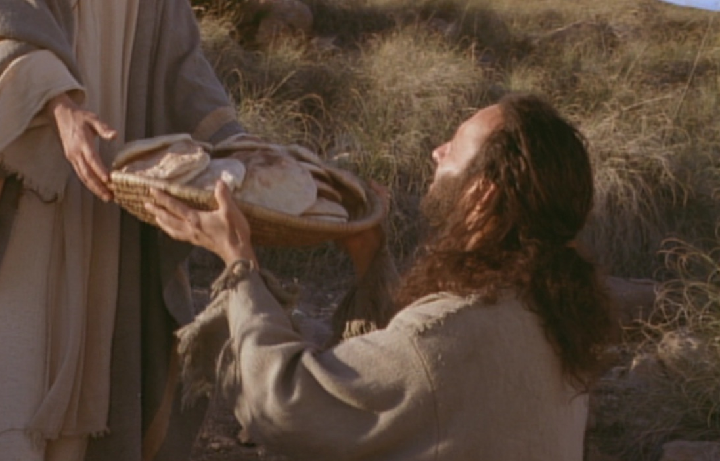
Bread Multiplied!

Slide 50
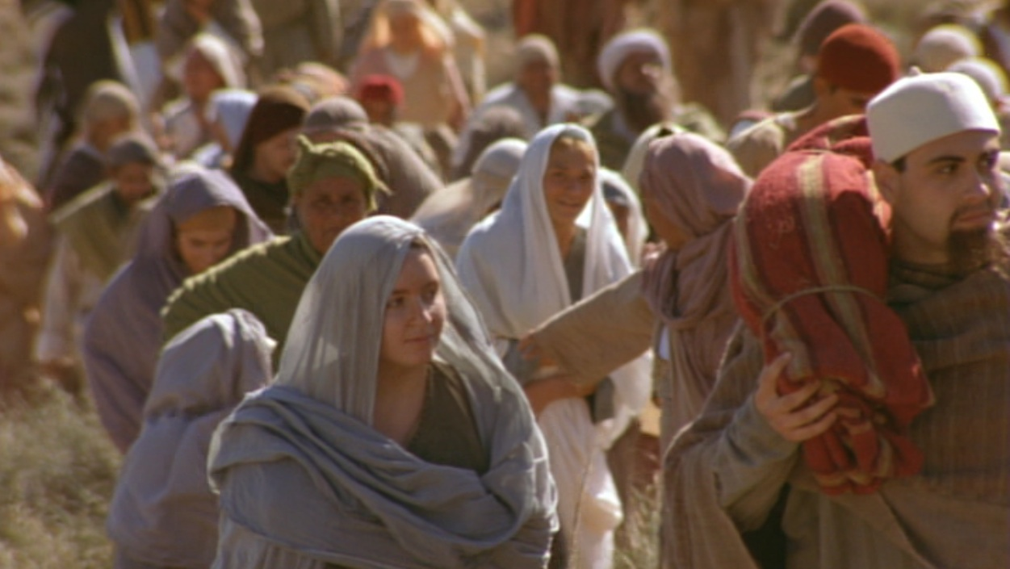
What’s the Point?
The crowd is the key!

Slide 51
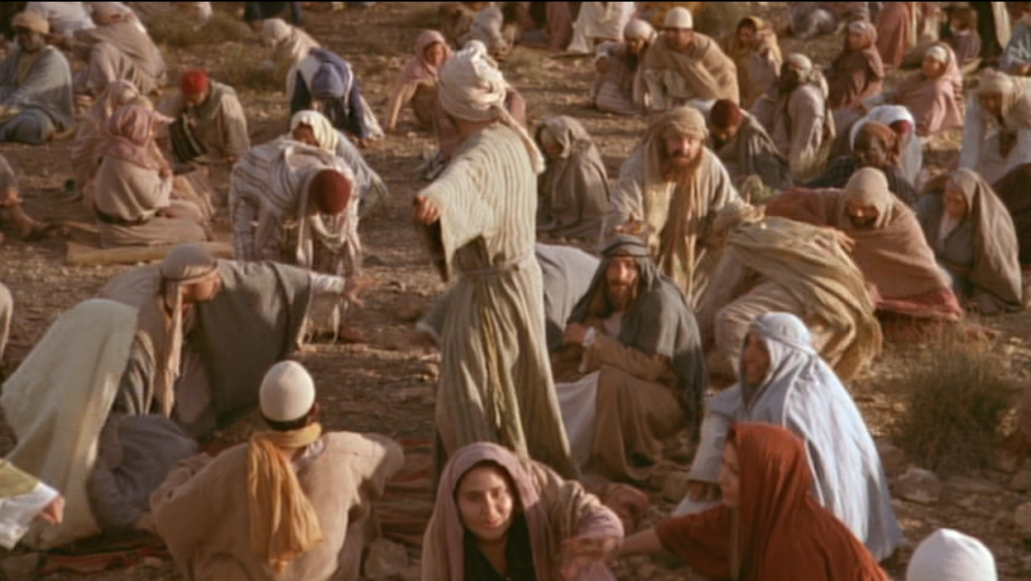
When the people saw him do this miraculous sign, they exclaimed,
“Surely, he is the Prophet we have been expecting!”
(6:24 NLT)

Slide 52
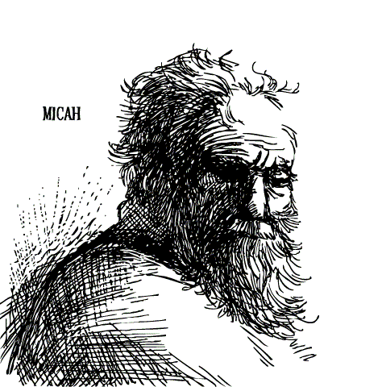
Prophecy of a Prophet given through Moses
(Deut. 18:15)
“I will raise up a Prophet like you from among their fellow Israelites. I will put my words in his mouth, and he will tell the people everything I command him.”

Slide 53
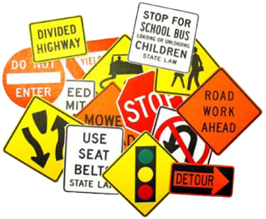

Signs in John’s Gospel
111
Signs unique to John's Gospel in yellow (6 of the 9 miracles)
WATER
TO WINE
2:1-11
HEALING
OFFICIAL’S
SON
4:46-54
HEALING
PARALYTIC
5:1-18
FEEDING
5000
6:1-15
WALKING
ON WATER
6:16-24
HEALING
BLIND MAN
9:1-7
RAISING
LAZARUS
11:1-45
CHRIST’S
RESURRECTION
20:1-31
FISH
CATCH
21:1-3

Slide 54
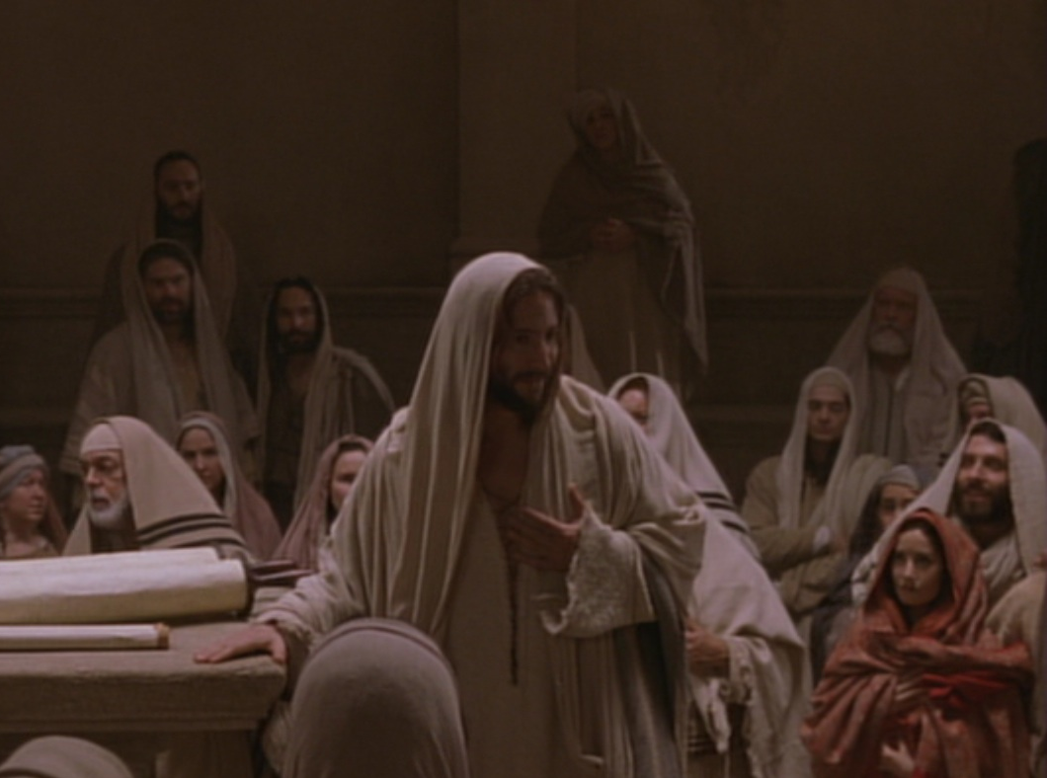
Key Word Believe
John
Key Verse
“Jesus did many other miraculous signs in the presence of his disciples, which are not recorded in this book. But these are written that you may believe that Jesus is the Christ, the Son of God, and that by believing
you may have life in his name” (20:30-31).

Slide 55
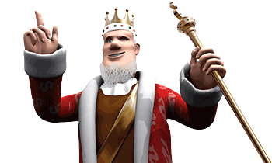
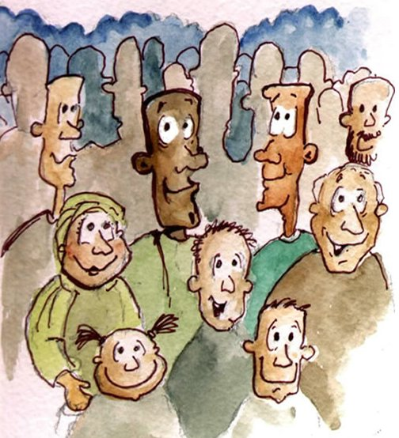
Verse 15
Notes:
Verse 15
who is this ‘prophet’ that the people are referring to?
“The Prophet” is the one prophesied by Moses (Deu 18:15). They acknowledge that Jesus was the Prophet who would come into the world to deliver them from the control of the Roman Empire.
Jesus knew that they want to make him king but he withdrew again to the mountains.

Slide 56
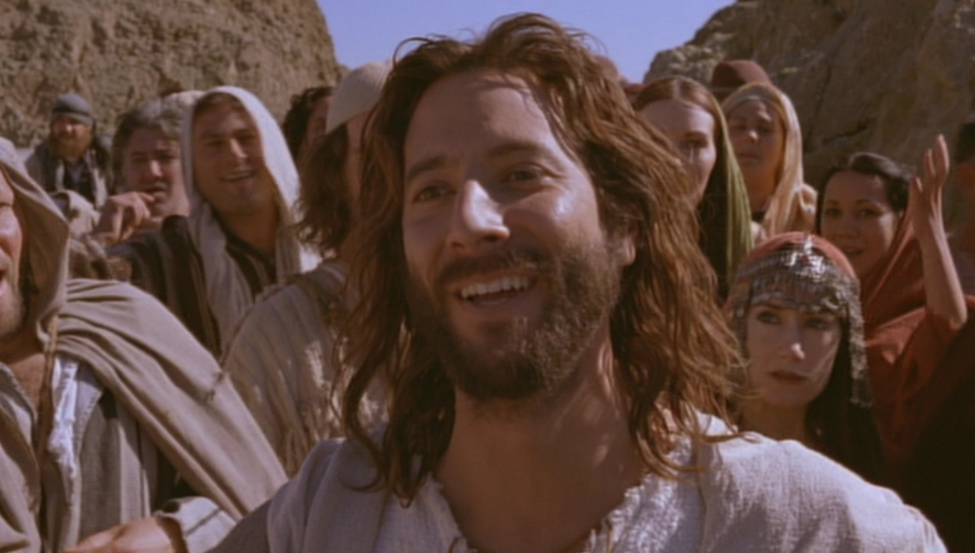
What’s the Point?
Jesus is the New Moses!
Jesus is even better than Moses!
MOSES
Predicted a Prophet
Gave manna from God
Sustained physical life
JESUS
Fulfilled the prediction
Is manna who IS God
Gives eternal life

Slide 57

Jesus proved himself greater than Moses as the giver of eternal life by miraculously feeding 5000 Jews (6:1-15).

Slide 58
B. Rejection of an Offer to Make Christ King
§ 75
Matthew 14:22-23; Mark 6:45-46; John 6:14-15
Jesus refuses to rule over the 5000 in Galilee as the New Moses of Deuteronomy 18:15 must rule over all Israel, but the leaders disbelieve

Slide 59


Slide 60
C. Instruction Through the Storm
§ 76
Matthew 14:24-33; Mark 6:47-52; John 6:16-21
Jesus rescues His disciples by walking on stormy water to teach them that they can trust Him to overcome obstacles by faith
Notes:
"This incident was designed to reveal to these men that obedience to Christ does not remove all obstacles to the completion of His will. When the obstacles come, even though disciples may do their utmost, they cannot overcome the obstacles themselves. But Christ is cognizant of all difficulties. He is present with His own in their problems. Trials must be born faith. The faith that first prompted a disciple to obedience must persist throughout the course of events involved in obedience to the will of God" (Pentecost, The Word and Works of Jesus Christ, 235)

Slide 61

Walking on Water (16-24)
WALKING ON WATER
16-21

Slide 62


Moses Parting the Sea

Slide 63

Jesus Walked on the Sea

Slide 64

ALTHOUGH LATER DISQUALIFIED, JESUS IS SPECTACULAR IN WINNING HIS FIRST SCHOOL SWIM RACE.

Slide 65

Jesus: “Don’t be afraid! It is I” (6:20)
KJV
NAS
NCV
NET
NIV
NKJV
NRSV

Slide 66
“Don’t be afraid! I am here” (6:20)
NLT

Slide 67

“Don’t be afraid! I Am!” (6:20)
Greek:

Slide 68


JOHN’S “I AM” STATEMENTS
111
1
MATTHEW
2
MARK
JEWS
ROMANS
“I am the Messiah” (4:26)
“Don’t be afraid. I am!” (6:20)
“I am the bread of life” (6:35)
“I am the light of the world” (8:12)
“Before Abraham was, I am” (8:58)
“I am the door [of the sheep]” (10:7)
“I am the good shepherd” (10:11, 14)
“I am the resurrection and the life” (11:25)
“I am the way, the truth, and the life” (14:6)
“I am the true vine” (15:1)
TO:
TO:
AS:
KING
AS:
SERVANT
WHAT
HE:
SAID
WHAT
HE:
DID
3
LUKE
TO:
GREEKS
AS:
GOD/MAN
WHAT
HE:
FELT
Notes:
John uses “I Am” 24 times—and only once is is NOT spoken by Jesus. In John 9:9 the formerly blind man says to those who doubt that it is really him, “I am he.” Otherwise, this is clearly a divine title for Christ used by John, with the direct quote of God to Moses in Exodus 3:14.

Slide 69

The Burning Bush
Exodus 3:1–4:17

Slide 70


EXCUSES
God replied to Moses, “I Am Who I Am. Say this to the people of Israel: I Am has sent me to you”
(Exodus 3:14 NLT).
1. Who am I (3:11)?
2. Who are You (3:13)?
3. What if I fail (4:1)?
4. I’m not gifted (4:10)
5. I don’t want to get involved (4:13)

Slide 71

D. Reception in Gennesaret
§ 77
Matthew 14:34-36; Mark 6:53-56
Christ teaches through physical healings that He can do the same in the spiritual realm if they trust Him in faith
Notes:
Matt. 14:34 NLT After they had crossed the lake, they landed at Gennesaret. ³⁵ When the people recognized Jesus, the news of his arrival spread quickly throughout the whole area, and soon people were bringing all their sick to be healed. ³⁶ They begged him to let the sick touch at least the fringe of his robe, and all who touched him were healed.
Mark 6:53 After they had crossed the lake, they landed at Gennesaret. They brought the boat to shore ⁵⁴ and climbed out. The people recognized Jesus at once, ⁵⁵ and they ran throughout the whole area, carrying sick people on mats to wherever they heard he was. ⁵⁶ Wherever he went—in villages, cities, or the countryside—they brought the sick out to the marketplaces. They begged him to let the sick touch at least the fringe of his robe, and all who touched him were healed.

Slide 72
E. Instruction Concerning the Bread of Life
§ 78
John 6:22-71
As the true bread from heaven, Jesus teaches that He came not to give physical bread but the new heavenly bread of eternal life

Slide 73
I. Jesus showed His authority over Moses and creation (6:1-21).
1-15
16-21

Slide 74

II. Jesus satisfies our spiritual hunger by giving us eternal life (6:22-59).

Slide 75

Two Foods
Unlike food that spoils,
Jesus gives eternal life (6:22-27).

Slide 76

Verse 26
Jesus answered, “I tell you the truth, you are looking for me, not because you saw miraculous signs but because you ate the loaves and had your fill” (John 6:26)
Notes:
Verse 26
Why did the crowd search for Jesus?
The crowd wants follow a prophet who will provide free food and political deliverance.

Slide 77

Verse 27
Do not work for food that spoils,
Do not work for food that spoils, but for food that endures to eternal life, which the Son of Man will give you.
Notes:
Verse 27
What is the meaning behind these verses?
The people’s work should have been directed to a food that endures. Jesus explains the meaning of preservation, namely eternal life. The source of eternal life is the Son of Man. He is the one who gives eternal life, the food that does not perish. Jesus turned the concern of the Jews on its head and defined the assuring work not as usual labor but as believing Him. Both believing and obeying are parallel ways one acknowledges dependence on God.

Slide 78

Two Works
Unlike human effort,
Jesus enables us to do God’s work by believing in Him (6:28-29).
Notes:
They replied, “We want to perform God’s works, too. What should we do?” Jn 6:28 NLT

Slide 79

Two Breads
Unlike manna God gave via Moses, Jesus is the true “Bread” from heaven that gives eternal life
(6:30-33).

Slide 80

Two Results
Unlike bread that only sustains physical life, belief in Christ gives eternal life (6:34-59).

Slide 81

III. Jesus’ claim to be the only source of life forces a decision (6:60-71).

Slide 82


Disciples desert Jesus (60-71)
Disciples desert Jesus (61-71)
“At this point many of his disciples turned away and deserted him”
(John 6:66).

Slide 83

The Twelve stayed because 11 of them believed He was God’s Son (6:67-71).

Slide 84

The Main Idea of John 6
Since Christ has authority over creation, trust Him to give you eternal life!

Slide 85

Disbelief?

Slide 86

Or Belief?
“You are the holy one of God!”

Slide 87
F. Instruction Concerning Defilement
§ 79
Matthew 15:1-20; Mark 7:1-23; John 7:1
Christ teaches that defilement is internal to show that Pharisees violate the law with their traditions in the uncleanness of their heart
Notes:
Pharisees taught that Jews must immerse after visiting the marketplace, lest the contamination of Gentiles remain on them.
Jews also had to wash their hands before eating so the water would run off their wrists instead of their fingers.
These leaders also showed their greed by not supporting their needy parents. They would declare their money corban, or an offering to God. This kept them from giving it to their parents (Mark 7:11). This did not mean that the entire gift had to be given to the temple, but only part of it! The temple leaders encouraged this practice as it profited them.

Slide 88
G. Reception in Tyre and Sidon
§ 80
Matthew 15:21-28; Mark 7:24-30
Jesus heals a Canaanite woman's demon-possessed daughter to teach individual Gentile salvation now before Israel repents

Slide 89

Free
Bible
images
A SYROPHOENICIAN WOMAN
BEGS JESUS FOR HELP
Mark 7:24-30

Slide 90

Tyre
Sidon
Syria
Phoenicia
Capernaum
Galilee
Decapolis
Notes:
Mark 7:24 Then Jesus left Galilee and went north to the region of Tyre. He didn’t want anyone to know which house he was staying in, but he couldn’t keep it a secret.

Slide 91

Notes:
Jews despised Gentiles and few went even as far away as the nearby city of Tyre. This is even the farthest Jesus traveled in his lifetime.

Slide 92
Notes:
Jews considered a woman of Tyre like this lady unclean.

Slide 93

Notes:
Yet Mark 7 (cf. Matt 15:22) records...
²⁵ Right away a woman who had heard about him came and fell at his feet.
^{Matt 15:22 NLT} A Gentile woman who lived there came to him, pleading, “Have mercy on me, O Lord, Son of David! For my daughter is possessed by a demon that torments her severely.”
"We note that this Gentile addressed Christ by a double messianic title, for both 'Lord' and "Son of David' were messianic names (cf. Ps 110:1; 2 Sam. 7:16)" (Pentecost, 244)

Slide 94

Notes:
Her little girl was possessed by an evil spirit, ²⁶ and she begged him to cast out the demon from her daughter.

Slide 95

Notes:
The mother's focus was on her sick daughter, so she was not to be deterred.

Slide 96

Notes:
Since she was a Gentile, born in Syrian Phoenicia,
²⁷ Jesus told her, “First I should feed the children—my own family, the Jews. It isn’t right to take food from the children and throw it to the dogs.”

Slide 97

Notes:
Jesus was telling her not that God did not care for Gentiles but that He designed for Jews to hear the message first and then bring the gospel to the Gentiles as the OT commanded them to be a "light to the Gentiles."
Jesus also knew that Israel would bring his message to the nations, so he did not want extended ministries in a Gentile area such as Tyre that would forever end his efforts to reach the Jews.

Slide 98

Notes:
Mark 7:28 She replied, “That’s true, Lord, but even the dogs under the table are allowed to eat the scraps from the children’s plates.”
The master of the house owned even his dogs!

Slide 99

Notes:
Mark 7:29 “Good answer!” he said. “Now go home, for the demon has left your daughter.”

Slide 100

Notes:
³⁰ And when she arrived home, she found her little girl lying quietly in bed, and the demon was gone.
___________
Some think that Jesus held to the prejudices of his days, but the opposite is true. Jesus healed this Canaanite woman's demon-possessed daughter to teach individual Gentile salvation now before Israel repents later just before His return!

Slide 101
Used with Permission
THE
GOSPEL
——OF—— MATTHEW
THE
GOSPEL
——OF—— MARK
THE
GOSPEL
——OF—— LUKE
THE
GOSPEL
——OF—— JOHN
Due to the Lumo Project producing its own publishing material we regret to inform you that we cannot license our photos to other clients outside of freebibleimages.org.
These images are not licensed for reuse in video, epublishing or other media. Downloaded pictures and files cannot be redistributed through any other website than freebibleimages.org. or used in any context where the accompanying message is undermining of the Christian faith and gospel.
Photos can only be used on educational presentations, blogs and social media, all of which should be accompanied with reference to www.LumoProject.org.
Picture courtesy of BBM
© All Rights Reserved.
www.bigbookmedia.com

Slide 102
H. Reception in Decapolis
§ 81
Matthew 15:29-38; Mark 7:31–8:9a
Jesus heals deaf and dumb man and feeds 4000 Gentiles to teach His men to minister by His power to both Jews and Gentiles
Notes:
The crowd here had 4000 Gentiles, unlike the 5000 Jews near Capernaum.
The disciples had seven loaves but did not consider that Jesus could repeat to Gentiles what he had done for Jews.

Slide 103

Northern Israel:
• Caesarea
• Galilee
• Decapolis
85

Slide 104

Greek Cities in Israel
180
Notes:
Jesus knew that far more Gentiles than Jews would trust him in the future, so he showed his heart for all humanity to his all-Jewish group of disciples. They needed to catch on to his salvation for all.
________
BG-04-Intertestamental-13
LC-04-Instruction-97

Slide 105
I. Rejection in Magadan
§ 82
Matthew 15:39–16:4; Mark 8:9b-12
Jesus refuses to give a sign to unbelieving religious leaders except His resurrection due to their unbelief, not due to a lack of signs
Notes:
Matt. 15:39 Then Jesus sent the people home, and he got into a boat and crossed over to the region of Magadan.
Leaders Demand a Miraculous Sign
Matt. 16:1 One day the Pharisees and Sadducees came to test Jesus, demanding that he show them a miraculous sign from heaven to prove his authority.
Matt. 16:2 He replied, “You know the saying, ‘Red sky at night means fair weather tomorrow; ³ red sky in the morning means foul weather all day.’ You know how to interpret the weather signs in the sky, but you don’t know how to interpret the signs of the times!ª ⁴ Only an evil, adulterous generation would demand a miraculous sign, but the only sign I will give them is the sign of the prophet Jonah.ª” Then Jesus left them and went away.
-——————————
Mark 8:9 There were about 4,000 people in the crowd that day, and Jesus sent them home after they had eaten. ¹⁰ Immediately after this, he got into a boat with his disciples and crossed over to the region of Dalmanutha.
Pharisees Demand a Miraculous Sign
Mark 8:11 When the Pharisees heard that Jesus had arrived, they came and started to argue with him. Testing him, they demanded that he show them a miraculous sign from heaven to prove his authority.
Mark 8:12 When he heard this, he sighed deeply in his spirit and said, “Why do these people keep demanding a miraculous sign? I tell you the truth, I will not give this generation any such sign.”

Slide 106


Tiberias on the Sea of Galilee
88
Notes:
Inset from https://bibleatlas.org/magadan.htm
Accessed 24 Feb 2025
MAGADAN mag'-a-dan, ma-ga'-dan (Magadan; the reading of the Textus Receptus of the New Testament, Magdala (the King James Version), but Magdala is unsupported): This name appears only in Matthew 15:39. In the parallel passage, Mark 8:10, its place is taken by Dalmanutha. From these two passages it is reasonable to infer that "the borders of Magadan" and "the parts of Dalmanutha" were contiguous. We may perhaps gather from the narrative that they lay on the western shore of the Sea of Galilee. After the feeding of the 4,000, Jesus and His disciples came to these parts. Thence they departed to "the other side" (Mark 8:13), arriving at Bethsaida. This is generally believed to have been Bethsaida Julias, Northeast of the sea, whence He set out on His visit to Caesarea Philippi. In this case we might look for Dalmanutha and Magadan somewhere South of the Plain of Gennesaret, at the foot of the western hills. Stanley (SP, 383) quotes Schwarz to the effect that a cave in the face of these precipitous slopes bears the name of Teliman or Talmanutha. If this is true, it points to a site for Dalmanutha near `Ain el-Fuliyeh. Magadan might then be represented by el-Mejdel, a village at the Southwest corner of the Plain of Gennesaret. It is commonly identified with Magdala, the home of Mary Magdalene, but without any evidence. The name suggests that this was the site of an old Hebrew mighdal, "tower" or "fortress." The village with its ruins is now the property of the German Roman Catholics. The land in the plain has been purchased by a colony of Jews, and is once more being brought under cultivation.
The identification with Magdala is made more probable by the frequent interchange of "l" for "n", e.g. Nathan (Hebrew), Nethel (Aramaic).
W. Ewing
MAG'DALA, now el Mejdel on the w. shore of the sea of Tiberias, now a little village. Matt. 15:39.Strong's Greek
G3093: MagadanMagadan, an unidentified place near the Sea of Galilee

Slide 107
J. Warning Against Rejection
§ 83
Matthew 16:5-12; Mark 8:13-26
Christ warns His disciples of the hypocrisy of the Pharisees and Herod that led to unbelief so they would not be hypocrites themselves
Notes:
Yeast works without notice inside the bread, rising quietly until the whole loaf is affected.
Hypocritical teaching is similar. It is an internal attitude of rejection that soon affects all one does.
Yeast of the Pharisees and Sadducees
Matt. 16:5 NLT Later, after they crossed to the other side of the lake, the disciples discovered they had forgotten to bring any bread. ⁶ “Watch out!” Jesus warned them. “Beware of the yeast of the Pharisees and Sadducees.”
Matt. 16:7 At this they began to argue with each other because they hadn’t brought any bread. ⁸ Jesus knew what they were saying, so he said, “You have so little faith! Why are you arguing with each other about having no bread? ⁹ Don’t you understand even yet? Don’t you remember the 5,000 I fed with five loaves, and the baskets of leftovers you picked up? ¹⁰ Or the 4,000 I fed with seven loaves, and the large baskets of leftovers you picked up? ¹¹ Why can’t you understand that I’m not talking about bread? So again I say, ‘Beware of the yeast of the Pharisees and Sadducees.’”
Matt. 16:12 Then at last they understood that he wasn’t speaking about the yeast in bread, but about the deceptive teaching of the Pharisees and Sadducees.
Mark 8:13 So he got back into the boat and left them, and he crossed to the other side of the lake.
Yeast of the Pharisees and Herod
Mark 8:14 NLT But the disciples had forgotten to bring any food. They had only one loaf of bread with them in the boat. ¹⁵ As they were crossing the lake, Jesus warned them, “Watch out! Beware of the yeast of the Pharisees and of Herod.”
Mark 8:16 At this they began to argue with each other because they hadn’t brought any bread. ¹⁷ Jesus knew what they were saying, so he said, “Why are you arguing about having no bread? Don’t you know or understand even yet? Are your hearts too hard to take it in? ¹⁸ ‘You have eyes—can’t you see? You have ears—can’t you hear?’ª Don’t you remember anything at all? ¹⁹ When I fed the 5,000 with five loaves of bread, how many baskets of leftovers did you pick up afterward?”
“Twelve,” they said.
Mark 8:20 “And when I fed the 4,000 with seven loaves, how many large baskets of leftovers did you pick up?”
“Seven,” they said.
Mark 8:21 “Don’t you understand yet?” he asked them.
Jesus Heals a Blind Man
Mark 8:22 When they arrived at Bethsaida, some people brought a blind man to Jesus, and they begged him to touch the man and heal him. ²³ Jesus took the blind man by the hand and led him out of the village. Then, spitting on the man’s eyes, he laid his hands on him and asked, “Can you see anything now?”
Mark 8:24 The man looked around. “Yes,” he said, “I see people, but I can’t see them very clearly. They look like trees walking around.”
Mark 8:25 Then Jesus placed his hands on the man’s eyes again, and his eyes were opened. His sight was completely restored, and he could see everything clearly. ²⁶ Jesus sent him away, saying, “Don’t go back into the village on your way home.”

Slide 108
K. Confession of Peter
§ 84
Matthew 16:13-20; Mark 8:27-30; Luke 9:18-21
Peter affirms Christ's deity, so Jesus reveals for the first time that the Twelve will declare what God said in a new organism, the Church
Notes:
Matthew 16 is on the following slides, but the parallel texts are:
Mark 8:27 Jesus and his disciples left Galilee and went up to the villages near Caesarea Philippi. As they were walking along, he asked them, “Who do people say I am?”
Mark 8:28 “Well,” they replied, “some say John the Baptist, some say Elijah, and others say you are one of the other prophets.”
Mark 8:29 Then he asked them, “But who do you say I am?”
Peter replied, “You are the Messiah.ª”
Mark 8:30 But Jesus warned them not to tell anyone about him.
————————-
Luke 9:18 One day Jesus left the crowds to pray alone. Only his disciples were with him, and he asked them, “Who do people say I am?”
Luke 9:19 “Well,” they replied, “some say John the Baptist, some say Elijah, and others say you are one of the other ancient prophets risen from the dead.”
Luke 9:20 Then he asked them, “But who do you say I am?”
Peter replied, “You are the Messiahª sent from God!”
Jesus Predicts His Death
Luke 9:21 Jesus warned his disciples not to tell anyone who he was.

Slide 109


¹³ When Jesus came to the region of Caesarea Philippi, he asked his disciples, “Who do people say the Son of Man is?”
¹⁴ They replied, “Some say John the Baptist; others say Elijah; and still others, Jeremiah or one of the prophets.”
¹⁵ “But what about you?” he asked. “Who do you say I am?”
¹⁶ Simon Peter answered, “You are the Messiah, the Son of the living God.”
Matthew 16:13-20 (NLT)
Notes:
Herod thought Jesus was John raised from the dead, and their messages of repentance due to the near kingdom were similar (Matt 3:2; 4:17).
Others saw similarities between Jesus and Elijah: itinerate, simple in lifestyle, preaching, having disciples, etc., during days of apostasy in Israel.
Jeremiah also was single and warned the nation of impending doom.
These were all prophets, so the crowds perhaps thought highly of Jesus also to call him a prophet, but Jesus knew that these designations all fell short. He was not only a man, but he was God made man—an insight that did not escape Peter.
_________
"2. THE PROGRAM OF MESSIAH (16:17-26)
16:17-20. Peter’s words brought a word of commendation from the Lord. Peter was blessed because he had come to a correct conclusion about the person of Christ and because great blessing would be brought into his life. The Lord added, however, this was not a conclusion Peter had determined by his own or others’ ability. God, the Father in heaven, had revealed it to him. Peter was living up to his name (it means “rock”) for he was demonstrating himself to be a rock. When the Lord and Peter first met, Jesus had said Simon would be named Cephas (Aram. for “rock”) or Peter (Gr. for “rock”; John 1:41-42).
But his declaration about Messiah’s person led to a declaration of Messiah’s program. Peter (Pe÷troß, masc.) was strong like a rock, but Jesus added that on this rock (pe÷tra, fem.) He would build His church. Because of this change in Greek words, many conservative scholars believe that Jesus is now building His church on Himself. Others hold that the church is built on Peter and the other apostles as the building’s foundation stones (Eph. 2:20; Rev. 21:14). Still other scholars say that the church is built on Peter’s testimony. It seems best to understand that Jesus was praising Peter for his accurate statement about Him, and was introducing His work of building the church on Himself (1 Cor. 3:11).
Building His church was a yet-future work of Jesus Christ, for He had not yet started the process. He said, I will build (future tense) My church, but His program for the nation Israel had to be concluded before another program could be set in motion. This is probably why Jesus said not even the gates of hades would overcome this program. Jews would understand hades’ gates to refer to physical death. Jesus was thus telling the disciples His death would not prevent His work of building the church. Later (Matt. 16:21) He spoke of His imminent death. He was therefore anticipating His death [Vol. 2, p. 58] and His victory over death through the Resurrection.
His church would then begin to be built, starting on the day of Pentecost, and Peter and the other apostles would have important roles in it. He declared that Peter would be given significant authority, the keys of the kingdom of heaven. A “key” was a sign of authority, for a trusted steward kept the keys to his master’s possessions and dispensed them accordingly (cf. “the keys of death and hades” [Rev. 1:18] and “the key of David” [Rev. 3:7], which Jesus possesses). Peter was told he would possess the keys and be able to bind and loose people. These were decisions Peter was to implement as he received instruction from heaven, for the binding and loosing occurred there first. Peter simply carried out God’s directions. This privilege of binding and loosing was seen in Peter’s life as he had the privilege on the day of Pentecost to proclaim the gospel and announce to all those who responded in saving faith that their sins had been forgiven (Acts 2). He was able to do the same thing with the household of Cornelius (Acts 10-11; cf. Acts 15:19-20). The same privilege was given all the disciples (John 20:22-23).
After making this great declaration about His future church program, Jesus told the disciples not to tell anyone that He is the Christ, the Messiah. The Lord knew it was too late for the nation to respond to His offer, and His rejection was drawing near. There was no reason for His disciples to be trying to convince a nation that had already turned from Him."
—Louis A. Barbieri Jr., Matthew (The Bible Knowledge Commentary; eds. John F. Walvoord and Roy B. Zuck; Accordance electronic ed. 2 vols.; Wheaton: Victor Books, 1983), 2:57-58.

Slide 110
¹⁷ Jesus replied, “Blessed are you, Simon son of Jonah, for this was not revealed to you by flesh and blood, but by my Father in heaven.
¹⁸ And I tell you that you are Peter, and on this rock I will build my church, and the gates of Hades will not overcome it.
¹⁹ I will give you the keys of the kingdom of heaven; whatever you bind on earth will be bound in heaven, and whatever you loose on earth will be loosed in heaven.”
²⁰ Then he ordered his disciples not to tell anyone that he was the Messiah.
Matthew 16:13-20 (NLT)
Notes:
What is the significance of "Peter" and "rock"?
What rock will the church be built on?
What is the church?
What are the gates of Hades?
What are the keys of the kingdom?
What is the binding and loosing?

Slide 111
A Better Translation…
NAU is a Better Translation…
NIV "I tell you the truth, whatever you bind on earth
will be {or have been} bound in heaven, and whatever you loose on earth will be {or have been} loosed in heaven."
NAU "Truly I say to you, whatever you bind on earth shall have been bound in heaven; and whatever you loose on earth shall have been loosed in heaven."
Notes:
Too often, today's churches act as if they have no authority under God, yet "binding" here refers to disciplining (a guilty verdict) , and "loosing" refers to releasing from discipline (an innocent verdict).
The Greek tense here is an unusual one—the perfect passive participle. As the word "perfect" implies, it refers to the past tense, meaning that whatever heaven decided on an issue preceded what the church would determine. The NASB best captures the idea that "whatever you bind shall have been bound in heaven." Our decision must be based on the Word of God that shows what heaven has already decreed.

Slide 112

Q: How did God overcome the prejudice in the Church at Jerusalem?
A: Gradually
PETER'S KEYS OF THE KINGDOM
JEWS
SAMARITANS
GENTILES
Acts 2
Acts 8
Acts 10
AD 33
AD 35
AD 40
Notes:
God wisely led that Jerusalem church step-by-step so they could handle his big heart!
I suspect that if Samaritans and Gentiles were forced into the church too soon this would split the early church into three separate groups.

Slide 113

Jesus taught en route to Jerusalem that his disciples will be resisted
(Mark 8:27–10:52).

Slide 114
L. Instruction Concerning His Death
§ 85
Matthew 16:21-23; Mark 8:31-33; Luke 9:22
Peter opposes Christ's declaration that He would soon die and rise again because he did not see the need for His sacrifice for sin
Notes:
Peter sought the throne for Jesus without the cross. But Satan was using Peter to try to circumvent God's plan for Jesus to pay the penalty for our sins.
————
Jesus Predicts His Death
Matt. 16:21 From then on Jesusª began to tell his disciples plainly that it was necessary for him to go to Jerusalem, and that he would suffer many terrible things at the hands of the elders, the leading priests, and the teachers of religious law. He would be killed, but on the third day he would be raised from the dead.
Matt. 16:22 But Peter took him aside and began to reprimand himª for saying such things. “Heaven forbid, Lord,” he said. “This will never happen to you!”
Matt. 16:23 Jesus turned to Peter and said, “Get away from me, Satan! You are a dangerous trap to me. You are seeing things merely from a human point of view, not from God’s.”
Jesus Predicts His Death
Mark 8:31 NLT Then Jesus began to tell them that the Son of Man must suffer many terrible things and be rejected by the elders, the leading priests, and the teachers of religious law. He would be killed, but three days later he would rise from the dead. ³² As he talked about this openly with his disciples, Peter took him aside and began to reprimand him for saying such things.
Mark 8:33 Jesus turned around and looked at his disciples, then reprimanded Peter. “Get away from me, Satan!” he said. “You are seeing things merely from a human point of view, not from God’s.”
Luke 9:22 “The Son of Manª must suffer many terrible things,” he said. “He will be rejected by the elders, the leading priests, and the teachers of religious law. He will be killed, but on the third day he will be raised from the dead.”

Slide 115
Matthew 16:13–20:34
Outline
73
IV. (11:1–16:12) Christ is rejected as Messiah in anticipation of the final crucifixion rejection, so He introduces the Interadvent Age before His future reception and ministers to Gentiles to teach the postponement of the kingdom.
V. (16:13–20:34) Christ prepares His disciples regarding His Person and program in order that His Messianic authority might be delegated to them after His death.

Slide 116
M. Instruction Concerning Discipleship
§ 86
Matthew 6:24-28; Mark 8:34–9:1; Luke 9:23-27
A true disciple must submit not to the Pharisees but to Jesus since He would judge Israel and rule as Messiah
Notes:
Jesus had just predicted his death, making it clear that his followers must also pay a heavy price to follow him.
Pentecost, 254, notes three stages in the development of a disciple:
The Curious: Attracted to Jesus but not believers (John 6:66—verse supplied by Rick Griffith)
The Convinced: Believers who knew Jesus as their Savior (John 2:11)
The Committed: Believers convinced to the point of submitting themselves to the will of Jesus
Matt. 6:24 NLT “No one can serve two masters. For you will hate one and love the other; you will be devoted to one and despise the other. You cannot serve God and be enslaved to money."
Matt. 6:25 “That is why I tell you not to worry about everyday life—whether you have enough food and drink, or enough clothes to wear. Isn’t life more than food, and your body more than clothing? ²⁶ Look at the birds. They don’t plant or harvest or store food in barns, for your heavenly Father feeds them. And aren’t you far more valuable to him than they are? ²⁷ Can all your worries add a single moment to your life?"
Matt. 6:28 “And why worry about your clothing? Look at the lilies of the field and how they grow. They don’t work or make their clothing."
Mark 8:34 Then, calling the crowd to join his disciples, he said, “If any of you wants to be my follower, you must give up your own way, take up your cross, and follow me. ³⁵ If you try to hang on to your life, you will lose it. But if you give up your life for my sake and for the sake of the Good News, you will save it. ³⁶ And what do you benefit if you gain the whole world but lose your own soul?ª ³⁷ Is anything worth more than your soul? ³⁸ If anyone is ashamed of me and my message in these adulterous and sinful days, the Son of Man will be ashamed of that person when he returns in the glory of his Father with the holy angels.”
Mark 9:1 Jesus went on to say, “I tell you the truth, some standing here right now will not die before they see the Kingdom of God arrive in great power!”
Luke 9:23 Then he said to the crowd, “If any of you wants to be my follower, you must give up your own way, take up your cross daily, and follow me. ²⁴ If you try to hang on to your life, you will lose it. But if you give up your life for my sake, you will save it. ²⁵ And what do you benefit if you gain the whole world but are yourself lost or destroyed? ²⁶ If anyone is ashamed of me and my message, the Son of Man will be ashamed of that person when he returns in his glory and in the glory of the Father and the holy angels. ²⁷ I tell you the truth, some standing here right now will not die before they see the Kingdom of God.”

Slide 117
N. Revelation of the Kingdom
§ 87
Matthew 17:1-8; Mark 9:2-8; Luke 9:28-36
Three disciples see Christ’s glory to foretaste His reign at the Second Advent and prove Him as worthy of obedience
Notes:
The three Synoptic Gospels all record the Transfiguration of Jesus. Here is the only glimpse of the true nature of Christ that we find in the gospels as no one sees him in his full glory during his earthly life—and the Transfiguration was only for a few moments. God, in his mercy, did not let people view the glorified Christ lest they die in doing so! But this experience on the mountain (probably Mount Tabor) lifted the veil, as it were, so that at least Peter, James, and John could imagine the glory of Jesus when he reigns in the millennial kingdom.
_____________
LC-04-Instruction of the Twelve-106
NS-01-Matt15-18—slide 12
NS-02-Mark9-16—slide 3
NS-03-Luke1-12—slide 386

Slide 118

Carl Bloch, c. 1865
Transfiguration of Jesus
Mark 9:2-13 (ESV)
Notes:
Today’s scripture, found in Mark chapter 9, vs 2-13 is also about a transformation. This transformation is known as the Transfiguration of Jesus.
Transformation is an important theme in the Bible. The passage we read together earlier was from Paul’s letter to the Romans, ch 8 vs 19-30 was about transformation. As we saw in Romans 8:30, reading now from the ESV, Paul writes that “and those whom he predestined he also called, and those whom he called he also justified, and those whom he justified he also glorified.”
To go from sin and suffering to being called, justified, and glorified is an extreme transformation. So how do we get to that transformation? We look to Jesus. That is what we are going to do today. We will look at Jesus and his “transfiguration” or “transformation.”
We will see how it affected the disciples and how it should affect us.

Slide 119
Why only Peter, James, and John?
Mk 9:2-13 Transfiguration
Mk 14:33 Gethsemane
With Andrew
Mk 1:29-30 Peter’s Mother-in Law
Mk 13:3 Olivet Discourse

Slide 120
² And after six days Jesus took with him Peter and James and John, and led them up a high mountain by themselves.
Mark 9:2-13 (ESV)
Notes:
Now we pick in in Mark ch 9 vs 2

Slide 121

How do you recharge?
Mark 6:30-32
³⁰ The apostles returned to Jesus and told him all that they had done and taught. ³¹ And he said to them, “Come away by yourselves to a desolate place and rest a while.” For many were coming and going, and they had no leisure even to eat. ³² And they went away in the boat to a desolate place by themselves.

Slide 122
² And after six days Jesus took with him Peter and James and John and led them up a high mountain by themselves. And he was transfigured before them, ³ and his clothes became radiant, intensely white, as no one on earth could bleach them. ⁴ And there appeared to them Elijah with Moses, and they were talking with Jesus.
Mark 9:2-13 (ESV)
Notes:
Now we pick in in Mark ch 9 vs 2

Slide 123

What did they see?
John 20:15 . . . Supposing him to be the gardener

Slide 124

Revelation 1
¹² Then I turned to see the voice that was speaking to me, and on turning
I saw seven golden lampstands,
¹³ and in the midst of the lampstands one like a son of man, clothed with a long robe and with a golden sash around
his chest. ¹⁴ The hairs of his head were white, like white wool, like snow. His eyes were like a flame of fire, ¹⁵ his feet were like burnished bronze, refined in a furnace, and his voice was like the roar of many waters
¹⁶ In his right hand he held seven stars, from his mouth came a sharp two-edged sword, and his face was like the sun shining in full strength.
Notes:
The Transfiguration did not shine glory on Jesus from some outside force. Instead, it lifted the veil over Jesus that the Gospels obscured. We see his inherent glory in Revelation 1. John noted this also in John 1:14b, "And we have seen his glory, the glory of the Father’s one and only Son."
"Christ's glory, then, was not surrendered at the Incarnation; instead, it was veiled so that the Holy One might dwell among an unholy people" (Pentecost, 257).

Slide 125
² And after six days Jesus took with him Peter and James and John, and led them up a high mountain by themselves. And he was transfigured before them, ³ and his clothes became radiant, intensely white, as no one on earth could bleach them. ⁴ And there appeared to them Elijah with Moses, and they were talking with Jesus.
Mark 9:2-13 (ESV)
Notes:
Now we pick in in Mark ch 9 vs 2

Slide 126

Jesus
Moses
Elijah
Notes:
Moses represented the Law and Elijah the Prophets. Both testified to Jesus as the One worthy of the glory of an earthly reign.

Slide 127
² And after six days Jesus took with him Peter and James and John, and led them up a high mountain by themselves. And he was transfigured before them, ³ and his clothes became radiant, intensely white, as no one on earth could bleach them. ⁴ And there appeared to them Elijah with Moses, and they were talking with Jesus. ⁵ And Peter said to Jesus, “Rabbi, it is good that we are here. Let us make three tents, one for you and one for Moses and one for Elijah.” ⁶ For he did not know what to say, for they were terrified.
Mark 9:2-13 (ESV)
Notes:
How do the disciples respond?

Slide 128
O. Instruction Concerning Elijah
§ 88
Matthew 17:9-13; Mark 9:9-13
Elijah must precede the kingdom, but John the Baptist fulfilled Malachi's prophecy of his coming since sacrifice precedes glory

Slide 129

The Second Coming
"Look, I am sending you the prophet Elijah before the great and dreadful day of the LORD arrives. ⁶ His preaching will turn the hearts of fathers to their children, and the hearts of children to their fathers. Otherwise, I will come and strike the land with a curse" (Malachi 4:5-6 NLT).
Notes:
Here are the final two verse of the Old Testament that include both blessing and a curse.
__________
LC-04-Instruction of the Twelve-118
OS-39-Malachi-135
NS-01-Matt 15-28-slide 23

Slide 130

The Expectation: Elijah, Messiah, Kingdom
76
MESSIAH
"This Age"
"The Age to Come"
PROPHECY
KINGDOM
Mysteries of the Kingdom
Matthew 13
E
M
"K"
E
M
K
Rejection
Reception
1st Advent
2nd Advent
Judgment on Israel
Blessing to Gentiles
Judgment on Nations
Restoration of Israel
Adapted from Mark L. Bailey, DTS class notes, 1986
Notes:
The key element between the present age and the age to to come (the kingdom age) in Jewish theology was the coming of the Messiah. But he would be preceded by an Elijah figure. John the Baptist could have been that "Elijah" had Israel believed in Messiah, for the millennial kingdom would then have followed with a righteous nation. But since Israel rejected her king, another "Elijah" yet will come—probably one of the two witnesses of Rev 11. In the meantime, this Interadvent Age has the kingdom in but mystery form with spiritual benefits given to the Gentiles until the full number of Gentiles occurs (Rom 11:25-27). Then, instead of judgment on Israel and blessing on the Gentiles, it will reverse. The judgment will be upon the nations opposing Israel (Ezek 38–39) followed by blessing upon Israel (Ezek 40–48).
__________
LC-04-Instruction of the Twelve-119
OS-39-Malachi-136
NS-01-Matt 15-28-slide 24
NS-02-Mark9-16—slide 15

Slide 131
¹¹ And they asked him, “Why do the scribes say that first Elijah must come?” ¹² And he said to them, “Elijah does come first to restore all things. And how is it written of the Son of Man that he should suffer many things and be treated with contempt? ¹³ But I tell you that Elijah has come, and they did to him whatever they pleased, as it is written of him.”
Mark 9:2-13 (ESV)

Slide 132
A Good Question
Q: Why must Elijah come first?
A: The Scriptures say so
Mal 3:1 "Behold, I send my messenger, and he will prepare the way before me."
Mal 4:5 "Behold, I will send you Elijah the prophet before the great and awesome day of the Lord comes."

Slide 133
Having established the authority of Scripture
Q: Why must Messiah suffer?
A: The Scriptures say so
Ps 69:20-21 "Behold, I send my messenger, and he will prepare the way before me."
Isa 53 "But he was pierced for our transgressions;
he was crushed for our iniquities;
upon him was the chastisement that brought us peace,
and with his wounds we are healed."

Slide 134
¹¹ And they asked him, “Why do the scribes say that first Elijah must come?” ¹² And he said to them, “Elijah does come first to restore all things. And how is it written of the Son of Man that he should suffer many things and be treated with contempt? ¹³ But I tell you that Elijah has come, and they did to him whatever they pleased, as it is written of him.”
Mark 9:2-13 (ESV)

Slide 135

By what authority can Jesus proclaim John the Baptist fulfills prophecies about Elijah?

Slide 136
# | Title | Mt | Mk | Lk | Jn
1 | Jesus Heals Many | Mt 4:23–24 | Mk 1:32–34
2 | Jesus Casts Out Demons | Mt 4:24 | Mk 1:39 | Lk 7:18–23
3 | Jesus Cleanses a Leper | Mt 8:1–4 | Mk 1:40–45 | Lk 5:12–16
4 | Jesus Heals a Centurion’s Servant | Mt 8:5–13 |  | Lk 7:1–10
-----------------------------------------
59 | Jesus Appears in a Locked Room |  |  |  | Jn 20:19–23
60 | Jesus Appears in a Locked Room for Thomas |  |  |  | Jn 20:26–29
61 | Jesus Provides a Miraculous Catch of Fish (John) |  |  |  | Jn 21:4–6
61 Miracles

Slide 137
Terrified in the presence of the Lord
Listen to the Lord
The Disciples Listened to the Lord
Disciples' questions answered by the Lord

Slide 138
Be Transformed!
Not Terrified

Slide 139
P. Instruction Concerning Dependence
§ 89
Matthew 17:14-21; Mark 9:14-29; Luke 9:37-43a
The inability of the disciples to exorcise a demon teaches them to depend on Jesus as He could deliver Israel if the nation believed

Slide 140
Q. Additional Instruction Concerning His Death
§ 90
Matthew 17:22-23; Mark 9:30-32; Luke 9:43b-45
Jesus predicts His death and resurrection again to teach that suffering must precede glory in the same Messiah, not two Messiahs

Slide 141
R. Instruction Concerning Sonship
§ 91
Matthew 17:24-27
Jesus has Peter pay their temple tax to avoid accusation despite His disciples being exempt since they are sons of the King

Slide 142
S. Instruction Concerning Humility
§ 92
Matthew 18:1-5; Mark 9:33-37; Luke 9:49-50
After the disciples argue which of them is greatest in the kingdom, Jesus teaches them humility and dependence for true greatness

Slide 143
T. Instruction Concerning Pride
§ 93
Matthew 18:6-14; Mark 9:38-50; Luke 9:49-50
Jesus rebukes his disciples’ pride over the inability of others to exorcise a demon to help them prize the humility that God values
Notes:
English edited

Slide 144
U. Instruction Concerning Forgiveness
§ 94
Matthew 18:15-35
Christ teaches the disciples that they are to forgive both unconditionally and entirely in the same way God has forgiven them
Notes:
English edited

Slide 145


How to Restore Relationships
Matthew 18:15-20
Dr. Rick Griffith
BibleStudyDownloads.org
10 December 2006
6 March 2011

Slide 146

1. (15-17) الطريقة التي ينبغي على الكنيسة أن تعيد بها بشكل صحيح خاطئ مسيحي تكون بالحفاظ على خصوصية الأمر قدر الإمكان.
34ج
أ - (15) يجب التعامل مع الخطية الخاصة فقط مع الأشخاص المتورطين فيها بشكل مباشر لتسهيل استعادة المذنب.
ب - (16) يجب كشف الخطية غير المتاب عنها بمواجهة شخص أو شخصين آخرين لتسهيل استعادة الخاطئ.
ت - (17أ) يجب عرض الخطية غير المتاب عنها، بعد محاولة مجموعة صغيرة للاستعادة، أمام جسد الكنيسة بكامله كرادع للاستمرار بالخطية.
ث - (17ب) يجب أن تؤدي الخطية غير المتاب عنها بعد عرضها أمام الكنيسة لمطالبة كل عضو في الكنيسة أن يتعامل مع الخاطئ أنه غير مؤمن (وهذا يشمل طرده من العضوية).
Notes:
PR 09.33
BS 20.33; 25.09
NS-01-Mt15-28—slide 35

Slide 147
2. (18-20) السبب في استطاعة الكنيسة استعادة أو الاستمرار في السعي لاستعادة المؤمنين الضالين هو أنها تستمد سلطانها من الله نفسه.
34ج
أ – (18-19) الكنائس التي تستعيد بالصلاة أو تستمر في السعي لاستعادة المؤمنين الخطأة تفعل ذلك بدلاً من الآب.
1. (18) يجب على الكنيسة إعلان المذنب أو البريء بناء ما حدده الله بالفعل.
2. (19) يمكن لقادة الكنيسة الذين يصدرون بالصلاة حكمًا، أن يثقوا أنهم تصرفوا حسب مشيئة الله.
ب – (20) الكنائس التي تستعيد أو تواصل سعيها لاستعادة المؤمنين الخطأة تعمل في حضور يسوع.
Notes:
PR 09.34
BS 20.34; 25.10
NS-01-Mt15-28—slide 36

Slide 148

فكرة تفسيرية: السبب لذي يوجب على الكنيسة استعادة مسيحي خاطئ بشكل صحيح هو أنها تمدّ سلطان الله.
34ج
1- (15-17) الطريقة التي ينبغي فيها على الكنيسة إعادة مسيحي خاطئ بشكل صحيح يكون بالمحافظة على خصوصية الأمر قدر الإمكان.
2- (18-20) السبب الذي يمكن الكنيسة من استعادة أو الاستمرار في السعي لاستعادة المؤمنين الضّالين هو أنها تبسط سلطان الله نفسه.
18: 15- 20
Notes:
PR 07.15. 09.35; 11.25; 12.16; 16:11 HO subject only
BS 18.43; 20.31; 25.11
NS-01-Mt15-28—slide 37

Slide 149

The Crossroads (1981-83)
Notes:
Over 40 years ago, I sang on a music team of seven musicians called Crossroads. If you can't tell, I am the guy who is not Japanese.

Slide 150




China, 1981
Notes:
We shared the gospel throughout Asia, and—praise God—we reached over 600 people per concert!

Slide 151

Crossroads Ministry
Korea
China
Japan
Hong Kong
Taiwan
Macau
Thailand
Philippines
Malaysia
Singapore
Indonesia
Notes:
Based in the Philippines, Crossroads shared the gospel in 11 Asian nations and saw over 10,000 people trust Christ, as indicated in comment cards at our 269 concerts.

Slide 152
This is war.
Notes:
If you know anything about spiritual warfare, it is that the enemy of our souls concentrates his efforts on believers having an impact for Christ.
In our team, opposition came from in challengin relationships. On that team was one particular woman named Kay. She was a godly woman but we didn't see eye-to-eye at all. In fact, many times she felt that I just a "mister-know-it-all.” She didn't like my mannerisms, clothes, or insights in our group Bible studies. She avoided being around me and it seemed that I could do nothing right! She saw me as really arrogant.
So what do you do when you are forced to serve with someone who just plain does not like you? I found that I couldn't really avoid Kay. After all, every day we had four hours of music practice with the team. I had to sing in harmony with her—literally! But discord often reigned. Then we had a concert to give and had to work together.

Slide 153

Relational Pillars
Relational Pillars
for believers
Notes:
God ministered to me then through two texts in Matthew that became "relational pillars" that I want to share with you today. These texts literally changed my life.

Slide 154



Romance, 1982
Notes:
They enabled Kay and me to reconcile our differences—so much so that three years after our initial differences Kay actually said "yes" to marrying me!

Slide 155

Susan Kay Griffith
Notes:
Yes, Kay is her middle name. Her full name is now Susan Kay Griffith.

Slide 156

Matthew's Relational Pillars
Matthew's Relational Pillars
5:23-24
You are:
Offender
Issue:
General
Notes:
Have you ever had a problem with another believer? (If you say "no," then I wonder which planet you have been living on!) Are you in fellowship with every Christian that you know now—your family members, your work colleagues, your neighbors and friends? If you're not in harmony, what should you do?
• If you hurt the other person, Matthew 5 tells you what to do in any general issue dividing you.

Slide 157


Matthew 5:23-24
Notes:
Let's read it.
• God places the responsibility to reconcile on you if you are the offender.
• First, reconcile! Then offer your gift.

Slide 158
Matthew 5:23-24
?
"Therefore if you are presenting your offering at the altar, and there remember that your brother has something against you, leave your offering there before the altar and go; first be reconciled to your brother, and then come and present your offering."
Notes:
The last I checked, believers weren't offering up sacrifices at the altar.
• So what does the "altar" refer to today?

Slide 159


The Lord's Supper
Notes:
At the very least, it refers to the Lord's table—a sign of our fellowship & unity—so don't take the Supper when in conflict with another believer.

Slide 160
Matthew's Relational Pillars
Matthew's Relational Pillars
5:23-24
18:15-17
You are:
Offender
Offended
Issue:
General
Sin
Notes:
However, in some situations, you are the offended. The other person is guilty of sin. Every church eventually encounters problems with believers living in sin. In these cases a loving body will restore them to God's holiness.

Slide 161



How do we restore sinning Christians properly?
Our First Question Today (for vv. 15-17)
Notes:
So how do we restore sinning Christians properly? When someone goes astray from God's will, what process do we use to bring that person back?

Slide 162





Other Relationships
Notes:
Why am I talking about resolving relational problems now?
I just know that issues surface in every relationship, including ours. At some point, I will offend you and you will offend me. So what should we do?
This doesn't just refer to marriage or serious sins—it's any kind of sin that can hurt any relationship among believers.

Slide 163
Matthew 18
The Value of
One
1
1
Child (1-9)
1
Sheep
(10-14)
1
Sinner
(15-20)
1
Debtor
(21-35)
Notes:
So our key text today is Matthew 18. The context of Matthew 18 is the value of one—
• one child (1-9), one sheep (10-14), one sinner (15-20), one debtor (21-35).
• At the heart of this chapter is verses 15-20…

Slide 164
Matthew 18:15-20 (NIV 1984 ed.)
If your brother sins against you, go and show him his fault, just between the two of you. If he listens to you, you have won your brother over. ¹⁶But if he will not listen, take one or two others along, so that 'every matter may be established by the testimony of two or three witnesses.' ¹⁷If he refuses to listen to them, tell it to the church; and if he refuses to listen even to the church, treat him as you would a pagan or a tax collector.
¹⁸I tell you the truth, whatever you bind on earth will be bound in heaven, and whatever you loose on earth will be loosed in heaven. ¹⁹Again, I tell you that if two of you on earth agree about anything you ask for, it will be done for you by my Father in heaven. ²⁰For where two or three come together in my name, there am I with them.
How to Restore
15-17
Why to Restore
18-20
Notes:
In Matthew 18:15-20 Jesus provides God's plan for loving church discipline. Let's read it together [read 15-20.] This text has two main teachings on restoring Christians in sin.
• Verses 15-17 give how to restore them and…
• Verses 18-20 give why to restore them.
Let's first see how to restore relationships. God's way to restore believers in sin is to…
__________________
BS-18-Exegetical Idea1-slide 15
BS-19-Exegetical Idea2-slide 32
BS-26-Applications-10 focuses only on verses 15-17
NS-01-Matt15-28-slide 33
PR-08-Exegetical Idea1-slide15
PR-09-Exegetical Idea2-slide 32
PR-16-Applications-12 focuses only on verses 15-17

Slide 165

The Point of Verses 15-17
I. Keep the matter as private as possible
(15-17).
Notes:
God's strategy for bringing sinning Christians back is to involve as few people as possible (restated main point).

Slide 166
Our Goal:
Our Goal:
Restoration!
Notes:
The desired end is...
• restoration, not punishment or excommunication.
The goal of discipline is behavior change to bring the wayward one back. Unfortunately, too many churches "excommunicate" to punish rather than restore).
Restoration is God's goal for a wandering saint in the sheep image of verses 10-14.
Restoration is the explicit teaching of this text in verse 15b.
Restoration is the goal of church discipline in other passages like Galatians 6:1.

Slide 167


Restore People in Sin
Restore People in Sin
"Brothers, if someone is caught in a sin, you who are spiritual should restore him gently."
Galatians 6:1

Slide 168
God's 4-step restoring process…
4
3
2
1
…reveals the issue to more people each step
Notes:
God's restoring process has four steps that progressively tell more and more people about the sin (15-17).

Slide 169
Step 1 to Restoration
Talk to the person by yourself
M
M
M
M
M
M
M
M
M
M
M
M
M
M
M
M
S
M
M
M
M
M
M
M
M
M
M
M
S = Sinner
M = Member
Notes:
What's our human tendency here?
• It is to tell others about the problem instead of the one involved.
• God commands us to keep the issue as private as possible.

Slide 170
Matthew's Relational Pillars
Matthew's Relational Pillars
5:23-24
18:15-17
You are:
Offender
Offended
Issue:
General
Sin
Notes:
This differs from Matthew 5 in that you're not an offender, but the offended.
Note also that in Matthew 5 sin may not be in the picture, but Matthew 18 deals specifically with a believer living in sin. This does not refer simply to differences of opinion on debatable matters.

Slide 171
Matthew's Relational Pillars
Matthew's Relational Pillars
5:23-24
18:15-17
You are:
Offender
Offended
Issue:
General
Sin
Initiative:
You!
You!
Notes:
Earlier we saw from Matthew 5:23-24 that God places the responsibility to reconcile on you if you are the offender. Now whose job is it to initiate if you are the offended?
• Yes, again it is your responsibility again! You say, "That's not fair! Why is it my job in both situations? Whether I am the offender or the offended I still have to make the first move?" Well, if relationships are not resolved between believers, it has to be through the fault of both—as both have the command of God to resolve it!

Slide 172

Go in Person
Not:
• email
• SMS
• letter
• phone
Notes:
While letter writing was very popular in the time of Christ, our Lord specifically says to deal with these sensitive matters face-to-face. Today this means confrontation should never be handled via email, SMS, letters, Facebook posts, or phone calls. It also prohibits the cowardice of anonymous communication.

Slide 173

1996
Notes:
Our family has tried to do this since our three sons were young—not to let them do the "Mom! Dad! So-and-so did such-and-such to me!" We just told him, "Matthew 18, bud. If you can't solve it, we'll be step 2…" They rarely came back to us!

Slide 174

Brothers…
Notes:
Now that they are older, they solve the problems among themselves without our intervention. Some friends were amazed that Kurt and Stephen moved to the US for college and decided to stay as roommates—for 7 years until they married!

Slide 175


Why don't we confront others?
Ignorance
Doubt
Failure
Fear
Excuses
Impurity
Unsocial
Notes:
However, most of the time believers don't keep issues private—or we don't address them at all. Why do you think don't we confront others? Tell the person next to you why! (Small groups for 1 min.) Why not?
• ignorance of what God commands here?
• doubt that it will work?
• failure of past confrontations that didn't work?
• fear that we might look bad?
• excuses that we can't get together?
• impurity in our own life?
• unsocial in that we just don't care enough to risk it?

Slide 176
Step 1 to Restoration
Talk to the person by yourself
M
M
M
M
M
M
M
M
M
M
M
M
M
M
M
M
S
M
M
M
M
M
M
M
M
M
M
M
S = Sinner
M = Member
Notes:
So… you should talk to the person by yourself—even though our tendency is to tell others instead. But what if the offender does not repent? We need step 2 where we…

Slide 177
Step 2 to Restoration
Take 1-2 others along
M
M
M
M
M
M
M
M
M
M
M
M
M
M
M
M
S
M
M
M
M
M
M
M
M
M
M
M
S = Sinner
M = Member
Notes:
Take one or two others along (16).

Slide 178

Questions on Step 2
Who should these people be?
Why take 1-2 others?
Notes:
Who should these 1-2 others be? These persons should be individuals whom the offender respects as they will best help restore him/her. They should not go instead of the offended believer, but along with this person.
• Why take 1-2 others along?

Slide 179
Deut. 19:15
"One witness is not enough to convict a man accused of any crime or offense he may have committed. A matter must be established by the testimony of two or three witnesses."
Notes:
The OT law prohibited conviction of crimes based on only one person's testimony (read Deut. 19:15). The NT teaching is the same, protecting the offender from an easily offended or lying accuser.
What if the offender still does not repent? Go to step 3…

Slide 180
Step 3 to Restoration
Expose the sin to the entire church
M
M
M
M
M
M
M
M
M
M
M
M
M
M
M
M
S
M
M
M
M
M
M
M
M
M
M
M
S = Sinner
M = Member
Notes:
The church leadership certainly must be involved at this point before the matter is brought to the congregation. They also must see the issue isn't just a difference of opinion between two parties; the biblical basis for the offender living in sin must be clearly shown with specific passages.

Slide 181

Why tell the whole church?
Notes:
Bringing the matter to the entire church is vital, since without it the sinning person will be able to find fellowship in other smaller groups within the larger church who do not know of his/her sin. Such gossip situations inevitably bring disunity, which lead to factions that can split the body.
What, then, should the entire church do once discipline has been determined? Step 4…

Slide 182
Step 4 to Restoration
Treat the person as an unbeliever
M
M
M
M
M
M
M
M
M
M
M
M
M
M
M
M
S
M
M
M
M
M
M
M
M
M
M
M
S = Sinner
M = Member
S

Slide 183

Sins Worthy of Discipline
How NOT to Discipline
EXCOMMUNICATE !
Notes:
Sometimes this step has been misinterpreted to mean "excommunication" where the errant person is never contacted again.

Slide 184

Sins Worthy of Discipline
How to Discipline Him/Her
Don't refer to him/her as a Christian.
Evangelize this person.
Don't let him/her take the Lord's Supper.
Remove the person from membership.
Remove this person from church roles.
Unbeliever
"Deliver over to Satan" one in sex sin
(1 Cor. 5:5).
Don't eat with him/her (1 Cor. 5:11).
Prohibit him/her from attending church?
Worse
Notes:
But Jesus said to "treat him as you would a pagan or a tax collector." Jesus treated pagans with love and kindness, but he didn't ask them to evangelize the lost as part of his team. You shouldn't be ugly or ungodly, but…
• Don't refer to him/her as a Christian. (ILL: I have done this with my former brother-in-law who divorced my sister to marry another woman.)
• Evangelize this person.
• Don't let him/her take the Lord's Supper.
• Remove the person from membership.
• Remove this person from church roles (ILL: My friend Paula was asked to leave her church kitchen ministry once her adultery was discovered.)
But in other ways it is more serious than how we treat unbelievers:
• "Deliver over to Satan" one in sex sin (1 Cor. 5:5). Years ago a friend named John left his wife and two small boys for another woman. My church disciplined him, but an elder kept up with him to restore him. After five years, he showed up at church—but he looked 20 years older!
• Don't eat with him/her (1 Cor. 5:11).
• Should we prohibit the person from attending church? Some say they, like unbelievers, should be welcomed in services without taking the Lord's Supper; but in most discipline cases this is not even an issue as few disciplined believers seek to return to the assembly until repentant.

Slide 185
The Point of Verses 15-17
I. Keep the matter as private as possible
(15-17).
Notes:
God's strategy to bring sinning Christians back is to involve as few people as you can.

Slide 186
God's 4-step restoring process…
4
3
2
1
…reveals the issue to more people each step
Notes:
This is the intent in each of the four steps with the goal of restoration.

Slide 187

Our 2nd question is answered in verses 18-20:
Why do we restore sinning Christians properly?
Notes:
But why must we do all this? What right do we have to discipline our members? Why must we restore sinning Christians properly? Because…

Slide 188

The Point of Verses 18-20
II. Our church extends the authority of God Himself!
Notes:
God's right to judge is actually delegated to us!

Slide 189

Why discipline?
When we seek to restore someone…
We act in the place
of the Father
(18-19)
Notes:
We act in the place of the Father when we seek to restore someone (18-19).

Slide 190
A Better Translation…
NAU is a Better Translation…
NIV "I tell you the truth, whatever you bind on earth
will be {or have been} bound in heaven, and whatever you loose on earth will be {or have been} loosed in heaven."
NAU "Truly I say to you, whatever you bind on earth shall have been bound in heaven; and whatever you loose on earth shall have been loosed in heaven."
Notes:
Too often, today's churches act as if they have no authority under God, yet "binding" here refers to disciplining (a guilty verdict) , and "loosing" refers to releasing from discipline (an innocent verdict).
The Greek tense here is an unusual one—the perfect passive participle. As the word "perfect" implies, it refers to the past tense, meaning that whatever heaven decided on an issue preceded what the church would determine. The NASB best captures the idea that "whatever you bind shall have been bound in heaven." Our decision must be based on the Word of God that shows what heaven has already decreed.

Slide 191

Matthew 18:19
"Again, I tell you that if two of you on earth agree about anything you ask for, it will be done for you by my Father in heaven"
(NIV).
Notes:
We should trust that our prayerful judgments are God's will.

Slide 192
Psalm 82:1, 6
(to Israel's rulers/gods)
"I said, 'You are "gods"; you are all sons of the Most High…
but you will die like men…"
Notes:
Ps. 82:6 has a similar idea where Israel's rulers are called "gods" in that they rule others.
Why should we trust this process in discipline situations? Verse 20 says that…

Slide 193
Why discipline?
When we seek to restore someone…
We act in the place
of the Father
(18-19)
We act in the presence & authority of Christ
(20)
Notes:
When we seek to restore someone, we act in the presence and authority of Christ (20).

Slide 194

Matthew 18:20
"For where
two or three come together in my name, there I am with them" (NIV).
Notes:
The "two or three" refers to the witnesses whose testimony enacted discipline (v. 16).
The point of Christ being "in their midst" is that local church discipline acts with the presence and authority of Christ Himself.

Slide 195
Why do we restore sinning Christians properly?
Notes:
So how can we sum up this passage in one sentence? I'd say it this way…

Slide 196

Main Idea:
We must restore sinning members properly since we act on God's behalf
Notes:
When sheep stray, we shepherd them back as loving hands of God's grace.

Slide 197
Matthew's Relational Pillars
Matthew's Relational Pillars
5:23-24
18:15-17
You are:
Offender
Offended
Issue:
General
Sin
Initiative:
You!
You!
Notes:
God expects each of us to take the initiative—

Slide 198

The Overall Principle
"If possible, as far as it depends on you, be at peace with all men"
Romans 12:18
Notes:
—and to do so as far as possible, as Romans 12:18 says [read]. This verse is a great encouragement to do all we can even if others are not responsive.

Slide 199
Matthew's Relational Pillars
Matthew's Relational Pillars
5:23-24
18:15-17
The Overall Principle: Romans 12:18
You are:
Offender
Offended
Issue:
General
Sin
Initiative:
You!
You!
Notes:
This verse is a great overall principle in relationships.

Slide 200

Make us one 3/3
Make us one, Lord,
make us one,
Holy Spirit, make us one.
Let Your love flow
so the world will know
we are one in You.
Notes:
God desires us to truly live out the chorus "Make Us One, Lord"

Slide 201
What's God Saying to You?
a. The Church Body
M
M
M
M
M
M
M
M
M
M
M
M
b. Your Own Life
M
M
M
M
S
M
M
M
M
M
M
M
M
c. Helping Others
M
M
M
Notes:
Matthew 18 relates to us in at least three ways:
• To be in this assembly you must submit to its authority under God. This means that we will lovingly seek to restore you should you fall.
• Is there sin in you worthy of discipline? Clean it up now to avoid pain for us all!
• Do you know anyone who needs a private confrontation? Romans 12:18 encourages you to do everything possible to be at peace with all people, so do it!

Slide 202
V. Instruction Concerning Discipleship
§ 95
Matthew 8:19-22; Luke 9:57-62
Jesus teaches that discipleship costs dearly through three men who value comfort, a father's money, or family more than Christ
Notes:
Matt. 8:19 Then one of the teachers of religious law said to him, “Teacher, I will follow you wherever you go.”
Matt. 8:20 But Jesus replied, “Foxes have dens to live in, and birds have nests, but the Son of Man has no place even to lay his head.”
Matt. 8:21 Another of his disciples said, “Lord, first let me return home and bury my father.”
Matt. 8:22 But Jesus told him, “Follow me now. Let the spiritually dead bury their own dead.”
The Cost of Following Jesus
Luke 9:57 As they were walking along, someone said to Jesus, “I will follow you wherever you go.”
Luke 9:58 But Jesus replied, “Foxes have dens to live in, and birds have nests, but the Son of Man has no place even to lay his head.”
Luke 9:59 He said to another person, “Come, follow me.”
The man agreed, but he said, “Lord, first let me return home and bury my father.”
Luke 9:60 But Jesus told him, “Let the spiritually dead bury their own dead! Your duty is to go and preach about the Kingdom of God.”
Luke 9:61 Another said, “Yes, Lord, I will follow you, but first let me say good-bye to my family.”
Luke 9:62 But Jesus told him, “Anyone who puts a hand to the plow and then looks back is not fit for the Kingdom of God.”

Slide 203
W. Challenge by His Brothers
§ 96
John 7:2-9
Jesus rejects His brothers' tainted counsel to reveal Himself in Jerusalem to keep God's timing for Him to be King and Passover Lamb

Slide 204
A Controversial Figure in John 1–6
Believers in
John 1-4:
Galileans
Samaritan Woman
John the Baptist
Nicodemus
Passover Jews
Disciples
The line of faith
Unbelievers in
John 5–6:
Jerusalem Leaders
Galilean People
Disciples desert Jesus

Slide 205
Jesus' Family Persecuted Him
Holy
Spirit
Men in white
Mary
Joseph
Women in yellow
Jesus
Joseph
Simon
Sister 2
James
Judas
Sister 1
"Then they scoffed, 'He's just a carpenter, the son of Mary and the brother of James, Joseph, Judas, and Simon. And his sisters live right here among us.' They were deeply offended and refused to believe in him" (Mark 6:3 NLT).
Notes:
Luke 1:35 The angel replied [to Mary], “The Holy Spirit will come upon you, and the power of the Most High will overshadow you. So the baby to be born will be holy, and he will be called the Son of God.
There existed no sexual union between Mary and the Holy Spirit, but instead it was God's power "overshadowing" her. Such was not the case with the four brothers and at least two sisters of Jesus, conceived and born in the natural manner. Yet these siblings evidently did not believe even as adults that their mother Mary was a virgin at the birth of Jesus. John brings out their unbelief in John 7:1-5…
John 7:1 After this, Jesus traveled around Galilee. He wanted to stay out of Judea, where the Jewish leaders were plotting his death. ² But soon it was time for the Jewish Festival of Shelters, ³ and Jesus’ brothers said to him, “Leave here and go to Judea, where your followers can see your miracles! ⁴ You can’t become famous if you hide like this! If you can do such wonderful things, show yourself to the world!” ⁵ For even his brothers didn’t believe in him (NLT).
But God worked on these brothers. After the resurrection, they believed and were in the Upper Room with the disciples: "These all with one mind were continually devoting themselves to prayer, along with the women, and Mary the mother of Jesus, and with His brothers" (Acts 1:14 NLT). In fact, both James and Jude went on to each record a General Epistle!
__________
LC-03-Controversy-114
LC-04-Instruction-164
NS-02-Mark1-9-slide 234
NS-04-John1-11—slide 387
NS-20-James1-2—slide 61
NS-26-Jude-90

Slide 206
Jesus' Family Persecuted Him
Holy
Spirit
Men in white
Mary
Joseph
Women in yellow
Jesus
Joseph
Simon
Sister 2
James
Judas
Sister 1
And Jesus’ brothers said to him, “Leave here and go to Judea, where your followers can see your miracles! ⁴ You can’t become famous if you hide like this! If you can do such wonderful things, show yourself to the world!” ⁵ For even his brothers didn’t believe in him (John 7:3-5 NLT).
Notes:
Luke 1:35 The angel replied [to Mary], “The Holy Spirit will come upon you, and the power of the Most High will overshadow you. So the baby to be born will be holy, and he will be called the Son of God.
There existed no sexual union between Mary and the Holy Spirit, but instead, it was God's power "overshadowing" her. Such was not the case with the four brothers and at least two sisters of Jesus, conceived and born naturally. Yet these siblings did not believe even as adults that their mother Mary was a virgin at the birth of Jesus. John brings out their unbelief in John 7:1-5.
But God worked on these brothers. After the resurrection, they believed and were in the Upper Room with the disciples: "These all with one mind were continually devoting themselves to prayer, along with the women, and Mary the mother of Jesus, and with His brothers" (Acts 1:14 NLT). In fact, both James and Jude went on to each record a General Epistle!
__________
LC-04-Instruction-154
NS-04-John1-11—slide 388

Slide 207
X. Journey to Jerusalem
§ 97
Luke 9:51-56; John 7:10
Jesus passes through unrepentant Samaria toward the opposition of Jerusalem's leaders that would end in His death and resurrection
Notes:
Opposition from Samaritans
Luke 9:51 As the time drew near for him to ascend to heaven, Jesus resolutely set out for Jerusalem. ⁵² He sent messengers ahead to a Samaritan village to prepare for his arrival. ⁵³ But the people of the village did not welcome Jesus because he was on his way to Jerusalem. ⁵⁴ When James and John saw this, they said to Jesus, “Lord, should we call down fire from heaven to burn them up?” ⁵⁵ But Jesus turned and rebuked them. ⁵⁶ So they went on to another village.
Jesus Teaches Openly at the Temple
John 7:10 But after his brothers left for the festival, Jesus also went, though secretly, staying out of public view.

Slide 208
Black

Slide 209


Life of Christ link at BibleStudyDownloads.org
Get this presentation for free!
Notes:
NT Survey (ns)

