Slide 1
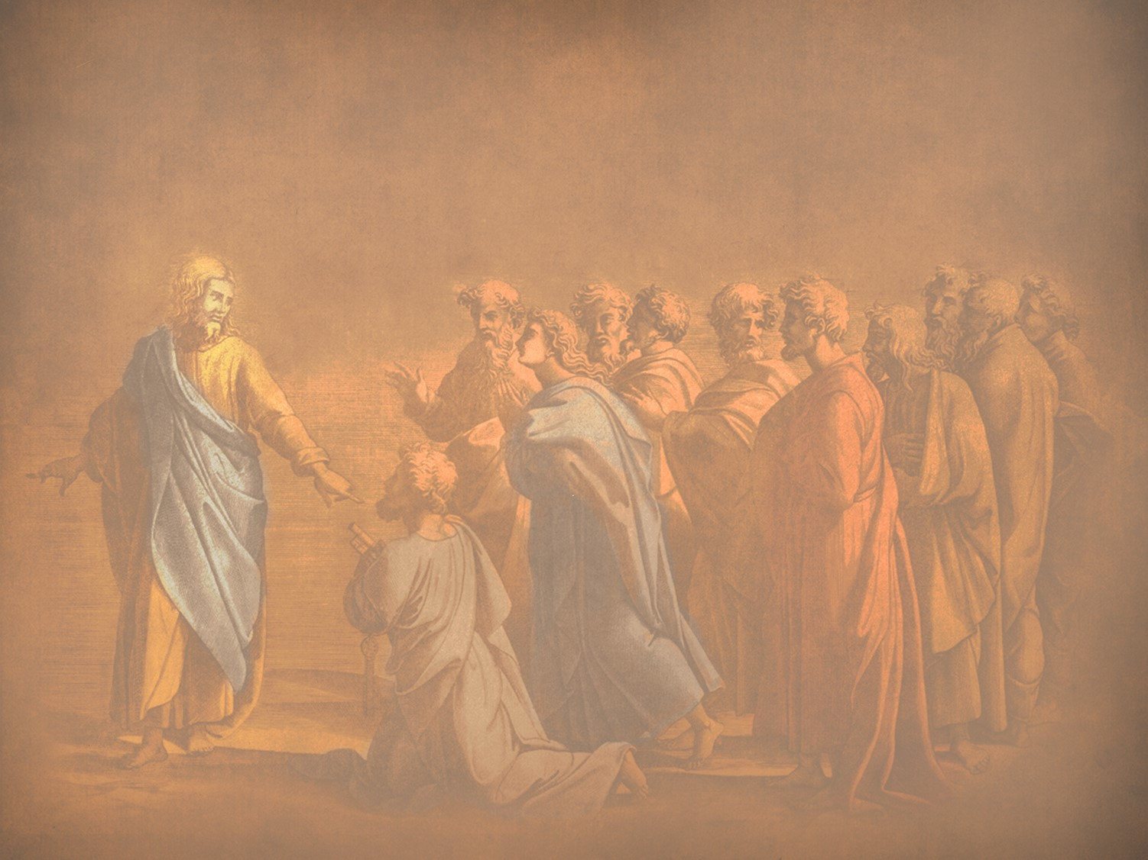
Instruction of the Twelve by the King
§§ 74-97
Jesus switches from public ministry to teaching the apostles to continue His ministry since His rejection would soon end in death
Section summaries based on J. Dwight Pentecost, A Harmony of the Words and Works of Jesus Christ (Grand Rapids: Zondervan, 1981)
Dr. Rick Griffith • Jordan Evangelical Theological Seminary • BibleStudyDownloads.org

Slide 2

Great Periods in the Life of Christ
55
“The Son of Man… came to minister and to give his life a ransom for many” (Mark 10:45)
Climactic Galilean
Early Samaritan
Later Samaritan
Early Judean
Later Judean
Early Perean
Later Perean
Opening Events
Closing Events
Preparation
Confirmation
Walk Thru the New Testament seminar (used with permission)
Notes:
The Walk Thru outline of the life of Christ forms a chiasm or literary arrangement with repeating elements in the opposite order. This structure makes Confirmation parallel to Preparation, Closing Events parallel to Opening Events, etc. until the only event without parallel becomes the focus: Climatic Galilean. Such an arrangement of material was common in ancient antiquity and is seen in both the OT (e.g., Zephaniah) and the NT (1 Thess) where the central teaching appears in the middle of each writing.
_______
LC-00-Syllabus-63
LC-01-Introduction-265
LC-05-Opposition-4

Slide 3
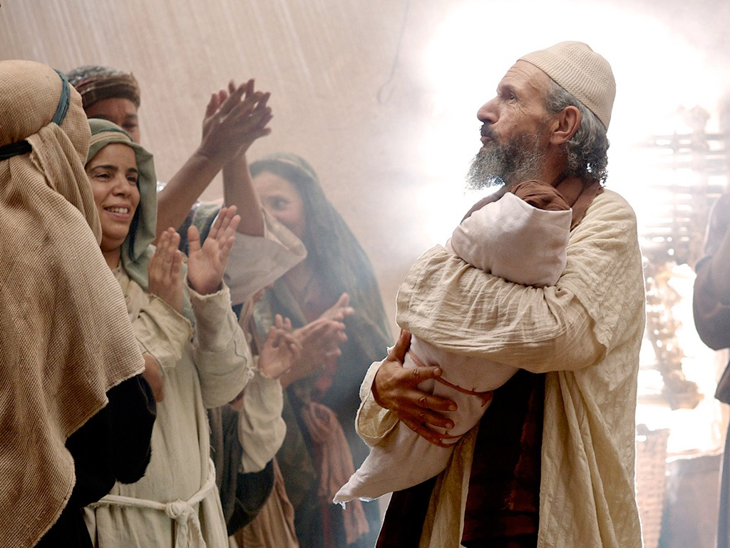

Introduction of the King
§§ 1-27
Arrival
Ambassador
Approval
Ancestry
Advent
Infancy/
Childhood
Baptism
Temptation
Herald
Notes:
Jesus did all that we should expect of the Messiah (King) from the start:
1—He arrived in the proper lineage of David, born of a virgin, and knew his deity even at age 12
2—His forerunner John knew his role in preparing Israel for her king
3—He had the best witnesses possible in the Father (baptism), Spirit (temptation), and John (prophesied herald)

Slide 4

The Authentication
of the King
§§ 28-59
The Acceptance
of His Person
§§ 28-36
The Authority
of the King
§§ 37-59
Notes:
Many people of various places (Judea, Samaria, Galilee) and types (Nicodemus, Samaritan woman, common Jews) initially believed in him.
Jesus also showed in 19 incidents the power expected of the Messiah to interpret the Law to preach and with authority over men, defilement, Sabbath, nature, sickness, and even death.

Slide 5

Controversy over the King
Rejection
Acceptance
Herod Antipas
Galilee Cities
Pharisees
Nation of Israel
Nazareth
Woman at Simon's home
Wealthy women supporting Jesus
Israel after the Interadvent Age
World, Sea, disease, death, & blindness
Notes:
OVERVIEW OF THIS SESSION: The Controversy Over the King means that Jesus was debated by those who rejected and accepted Him. Sadly, the nation's leaders who disbelieved had greater authority than women who believed, but Jesus promised many believers after the time between his two comings (Interadvent Age). In the meantime, even the Sea of Galilee, death, blindness, etc., submitted to His power.

Slide 6
Pentecost Outline
Introduction of the King
Authentication of the King
Controversy over the King
Instruction of the Twelve by the King
Opposition to the King
Preparation of the Disciples by the King
Official Presentation of the King
Preparation for the Death of the King
Rejection of the King
Resurrection of the King

Slide 7

Increasing Polarization
Resurrection
Preparation
for Death
Preparation
of Disciples
Instruction
Authentication
Introduction
Controversy
Opposition
Presentation
Rejection
Notes:
The Life of Christ brought increasing polarization. The more Jesus showed about himself, the greater the resistance to him and his message. Also, the more intense the controversy leading to opposition, the higher priority Christ placed on preparing his men for when he would be gone. The climactic rejection when he presented himself as king of Israel at the Triumphal Entry resulted in rejection to the point of crucifixion followed by the victory of resurrection.
Introduction of the King
Authentication of the King
Controversy over the King
Instruction of the Twelve by the King
Opposition to the King
Preparation of the Disciples by the King
Official Presentation of the King
Preparation for the Death of the King
Rejection of the King
Resurrection of the King

Slide 8
A. Feeding the Five Thousand
§ 74
Matthew 14:13-21; Mark 6:30-44; Luke 9:10-17; John 6:1-13
Christ feeds 5000 as the New Moses of Deut 18:15, teaching the believers sufficiency in Him and unbelievers their spiritual blindness

Slide 9
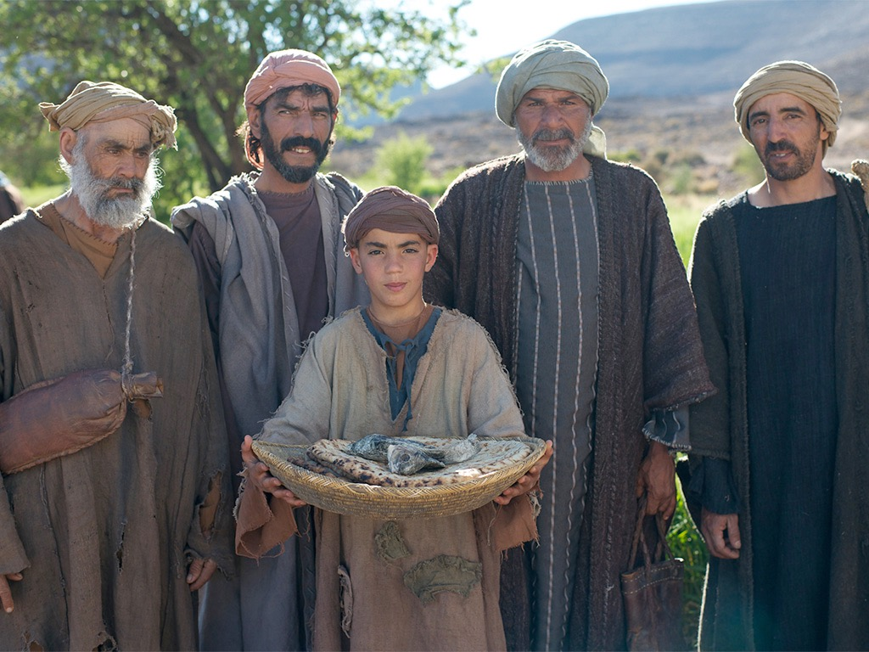

JESUS FEEDS 5000
Free
Bible
images
Matthew 14:13-22
Mark 6:31-46
Luke 9:10-17
John 6:1-13

Slide 10
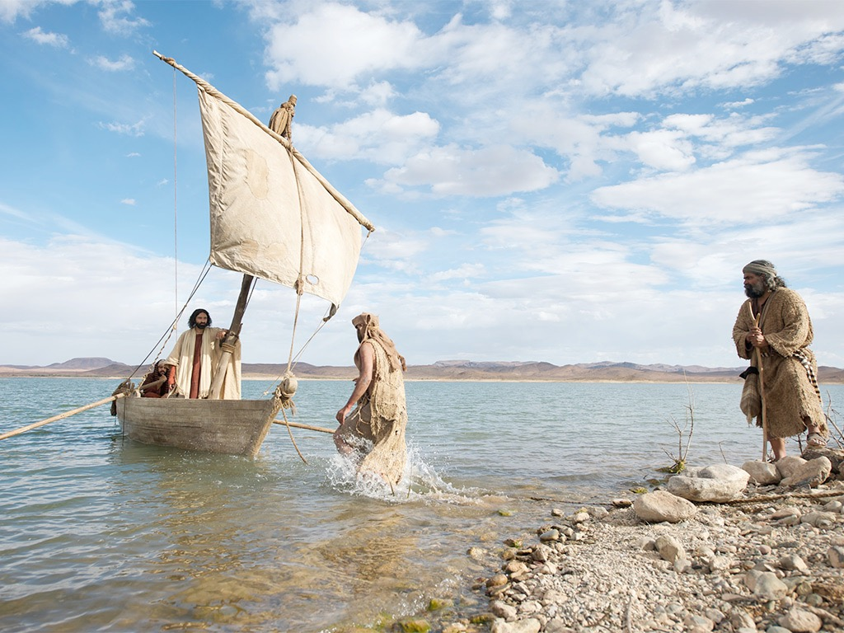

Slide 11
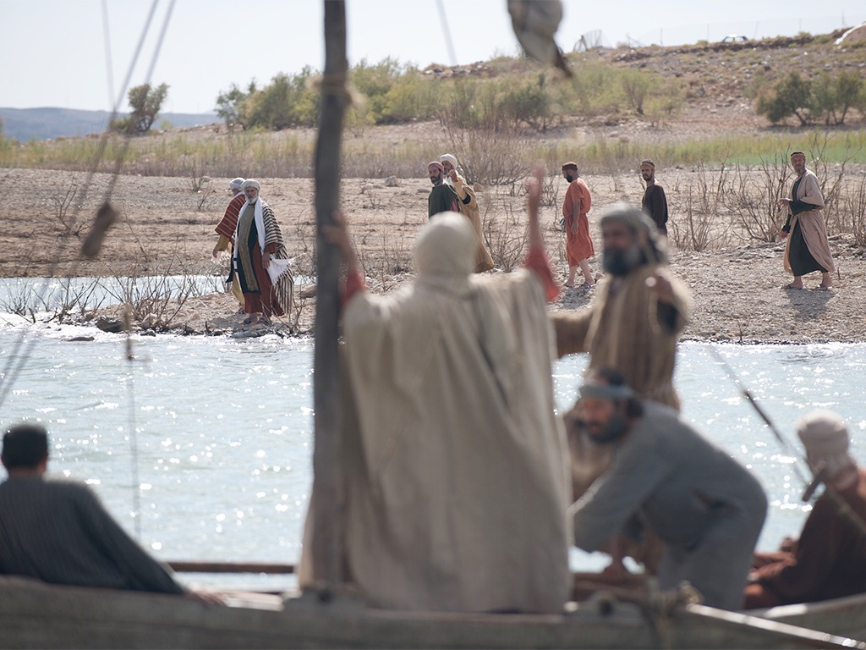

Slide 12
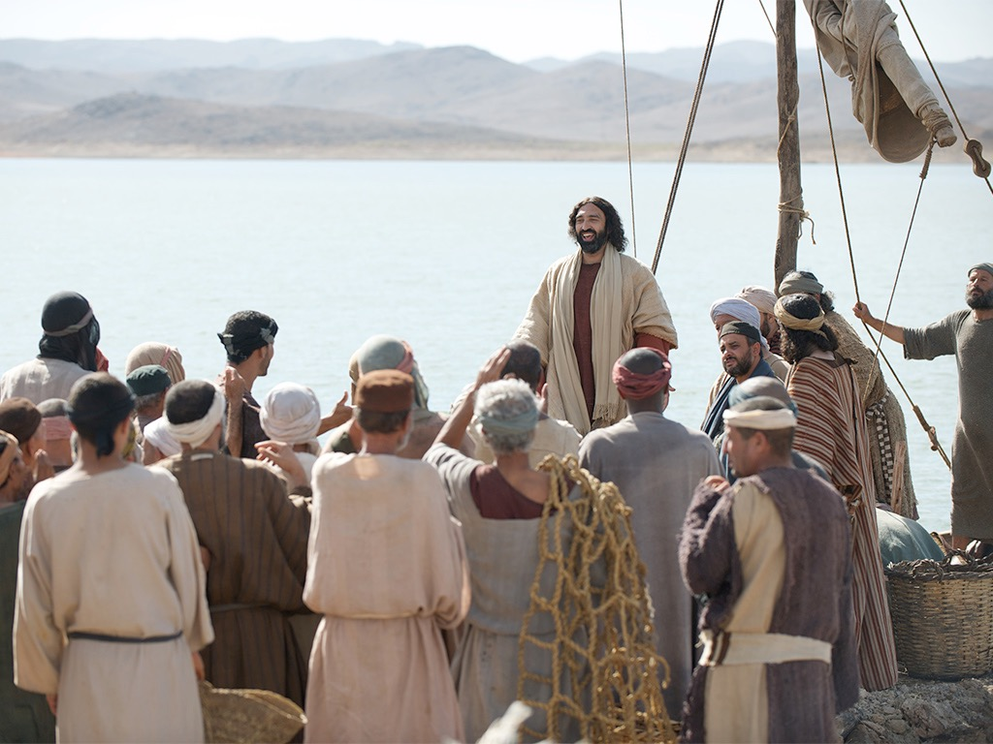

Slide 13
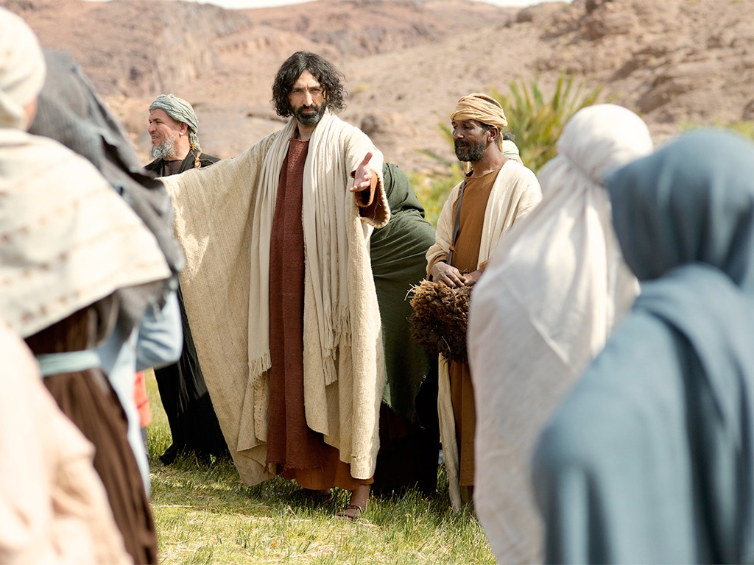

Slide 14
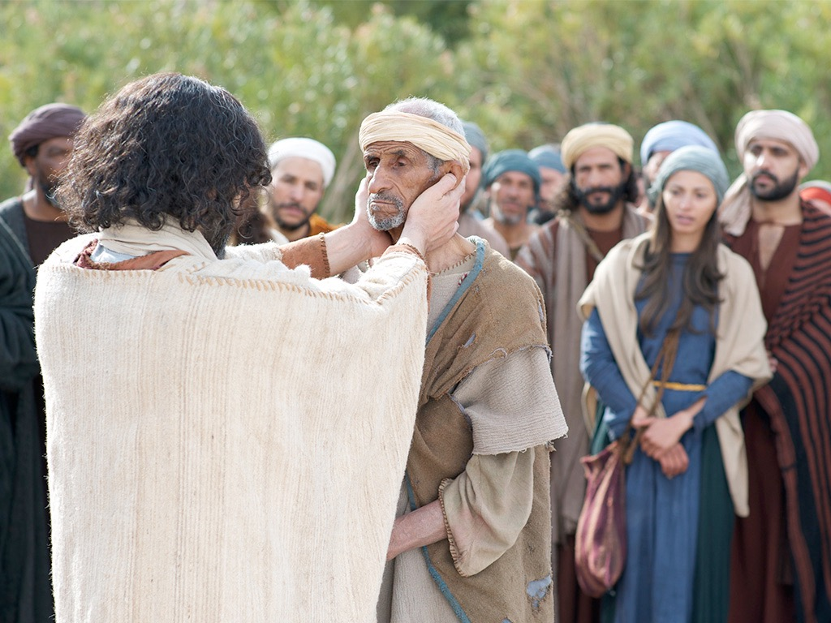

Slide 15
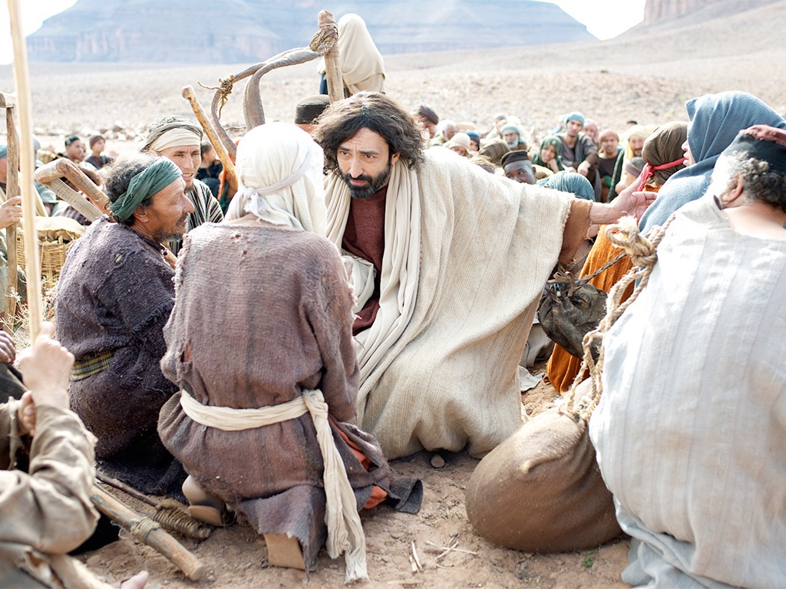

Slide 16
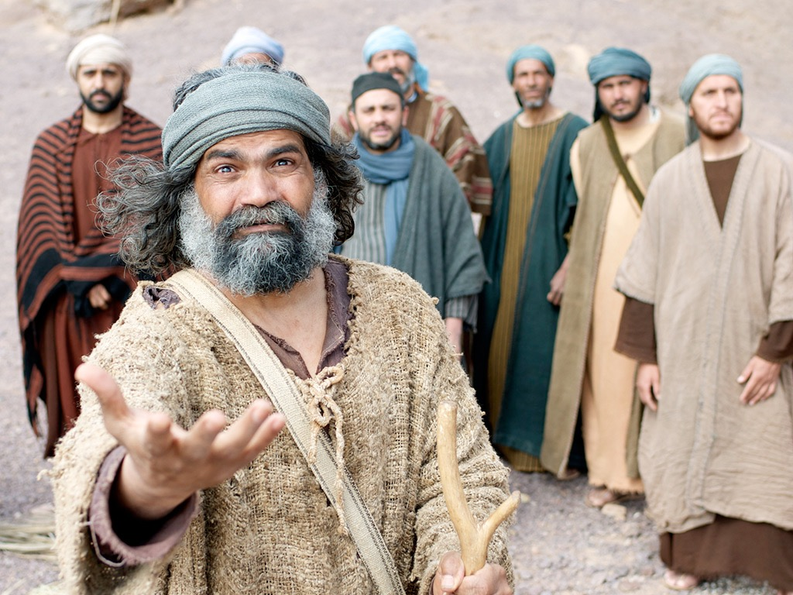

Slide 17
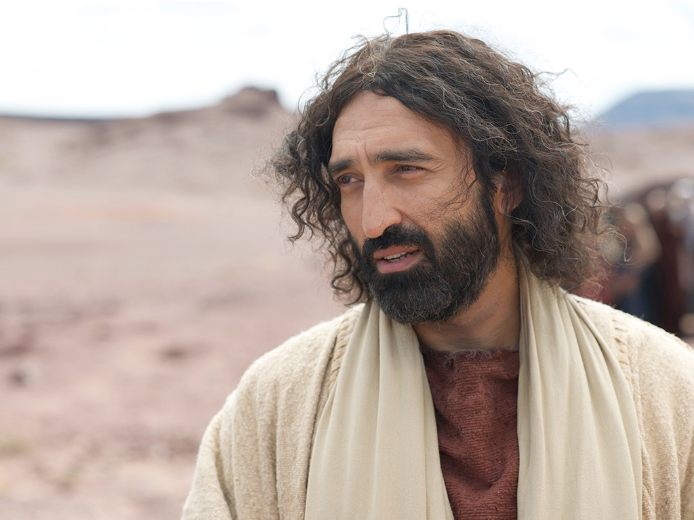

Slide 18
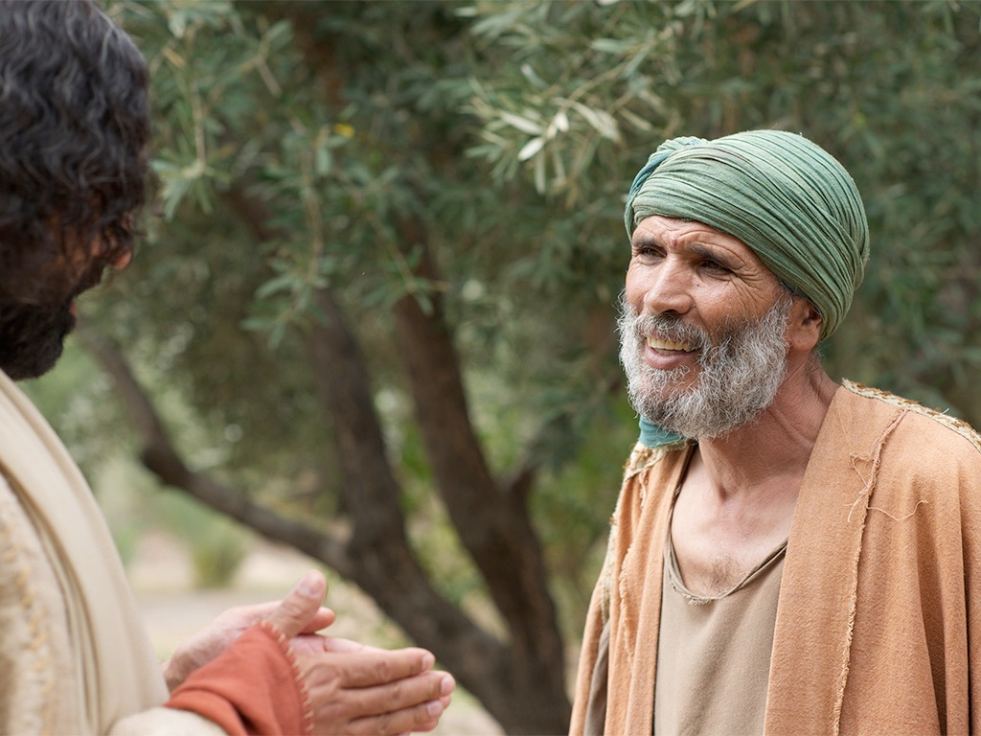

Slide 19
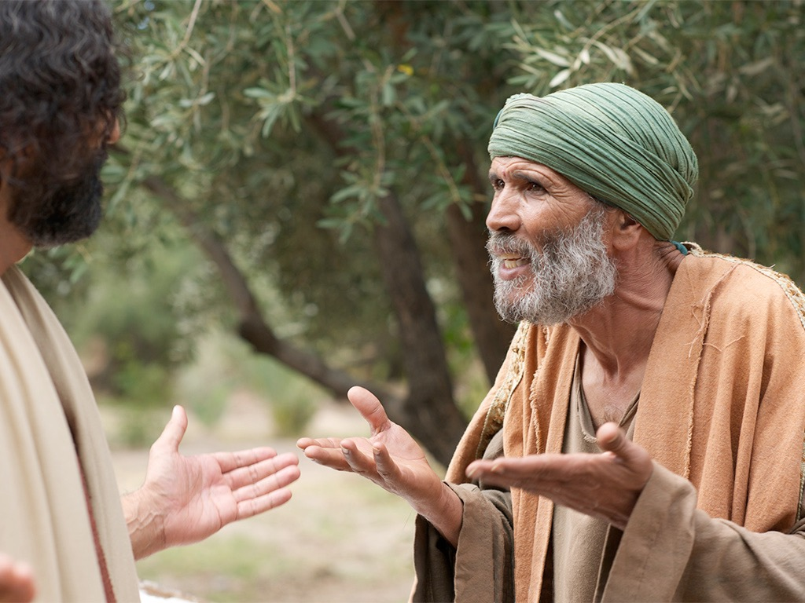

Slide 21
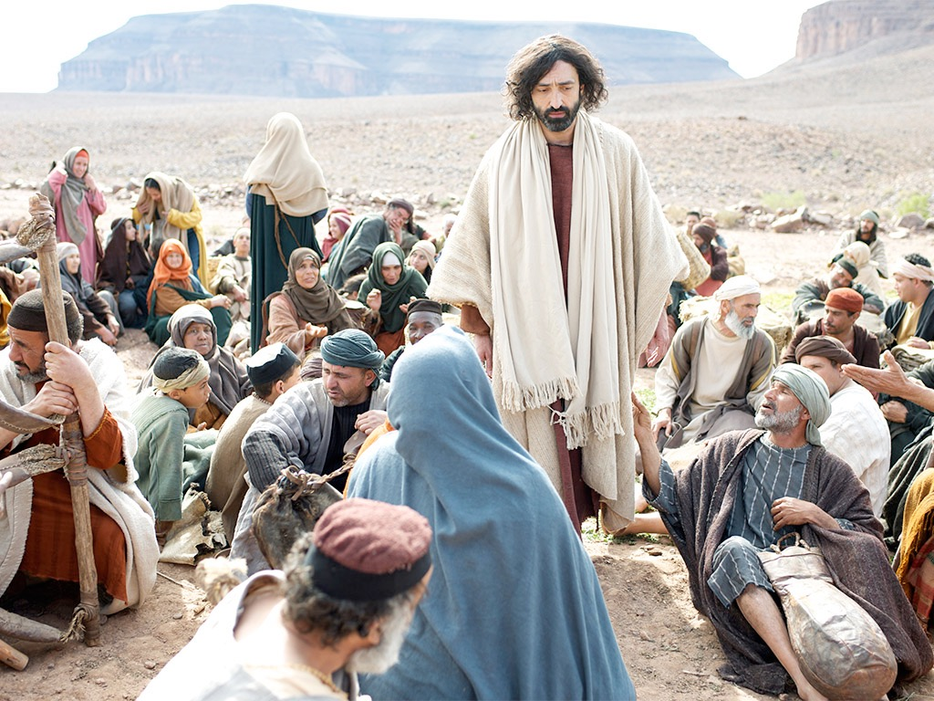

Slide 22
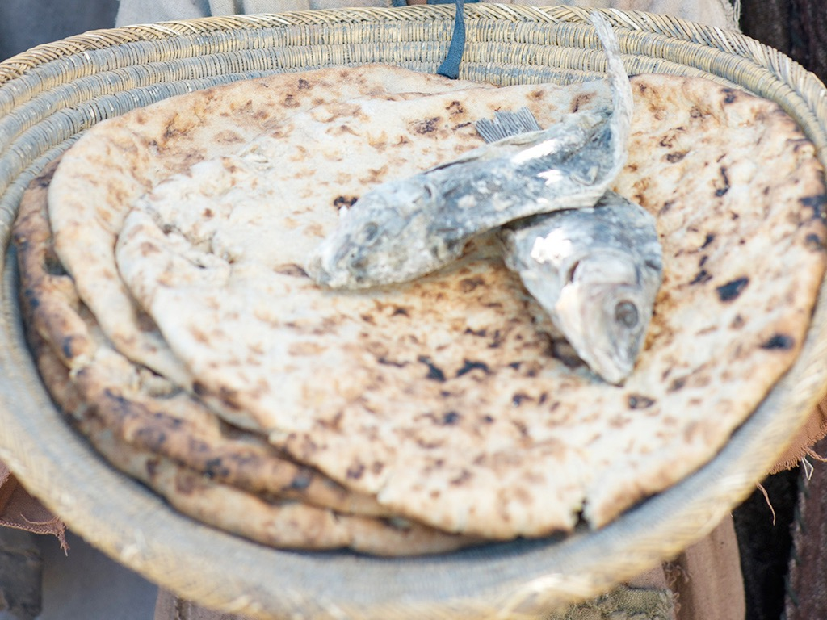

Slide 23
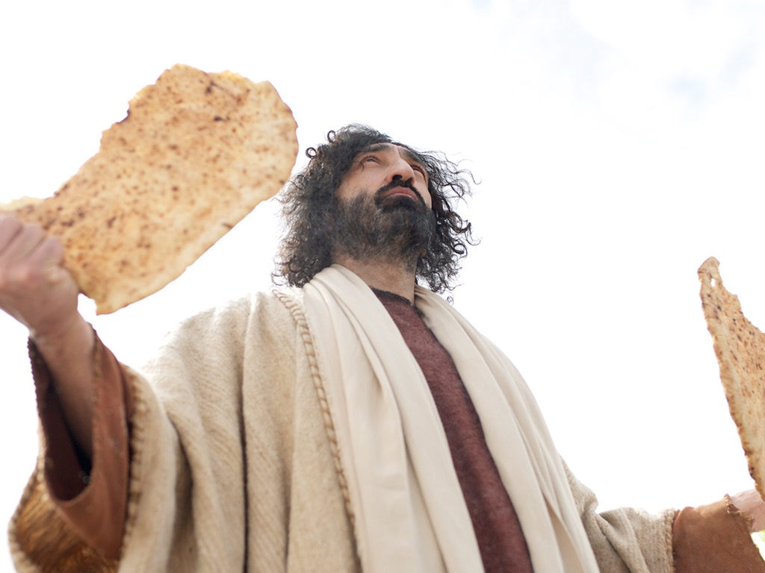

Slide 24
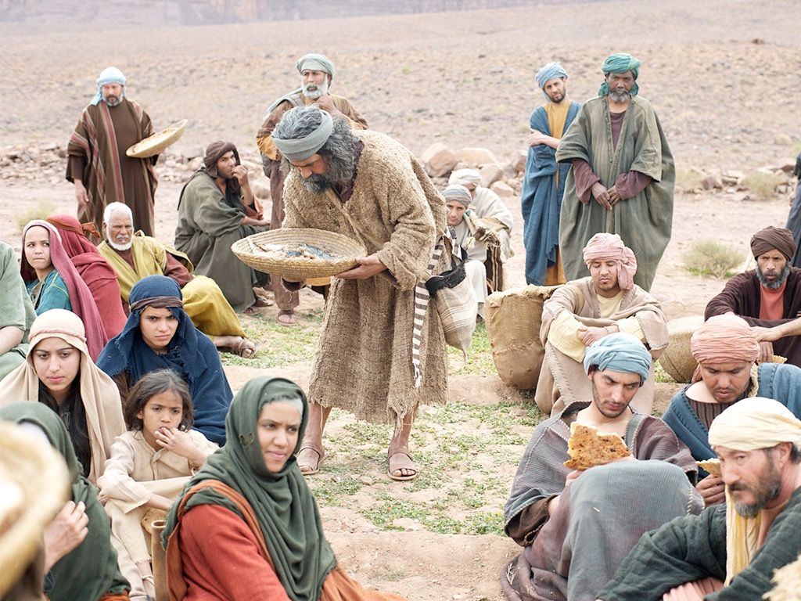

Slide 25
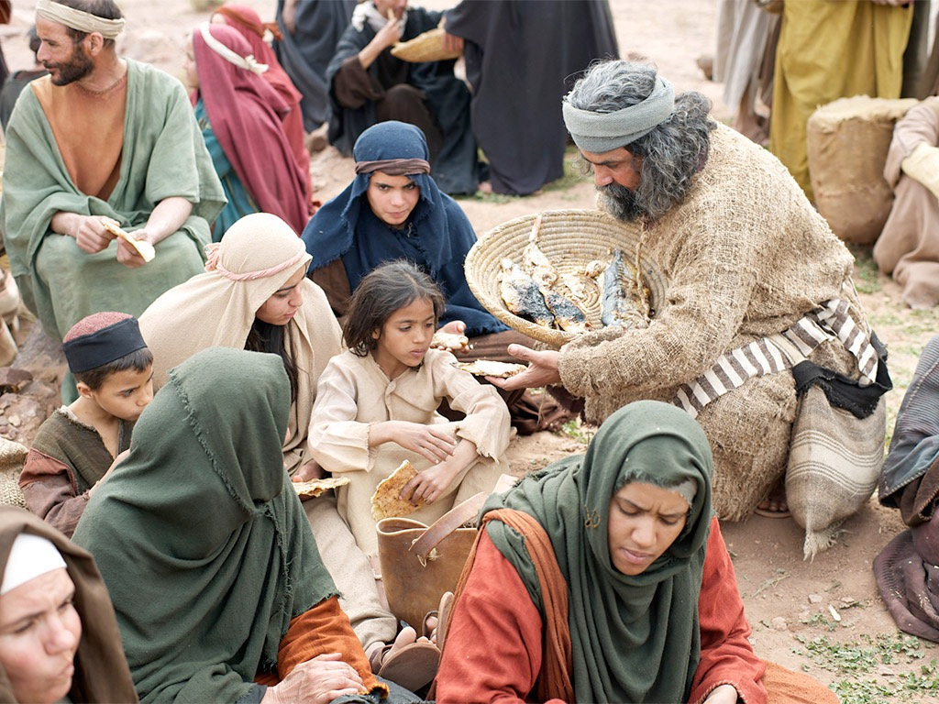

Slide 26
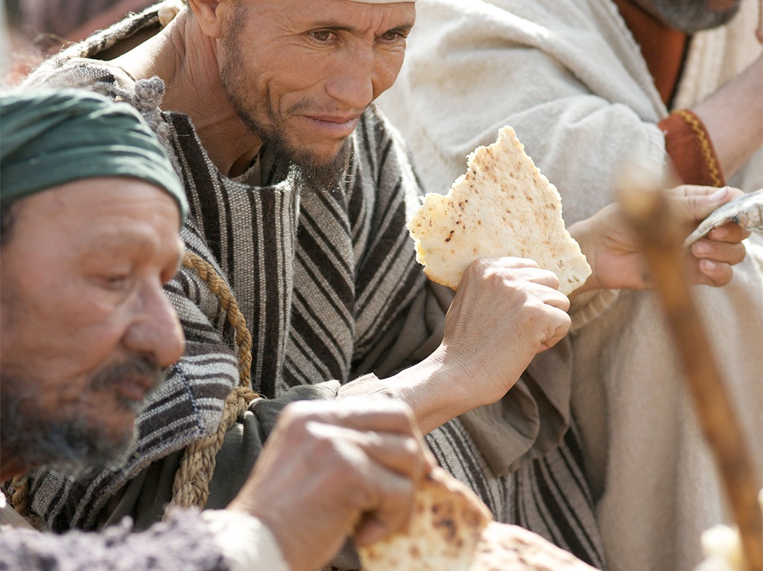

Slide 27
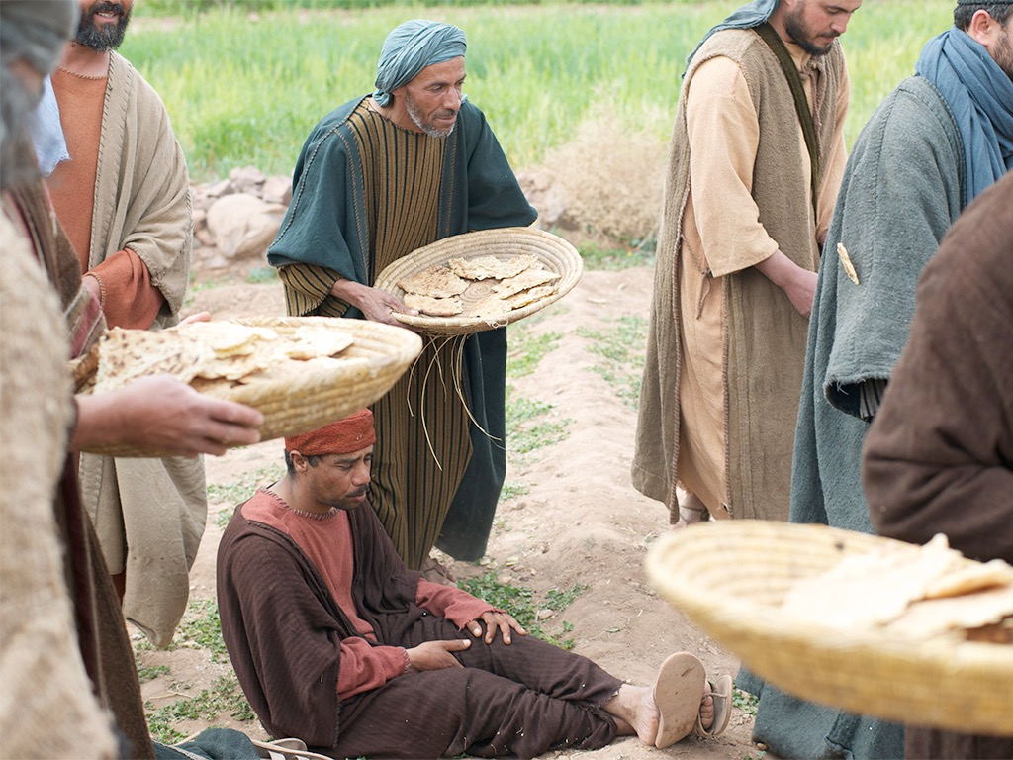

Slide 28
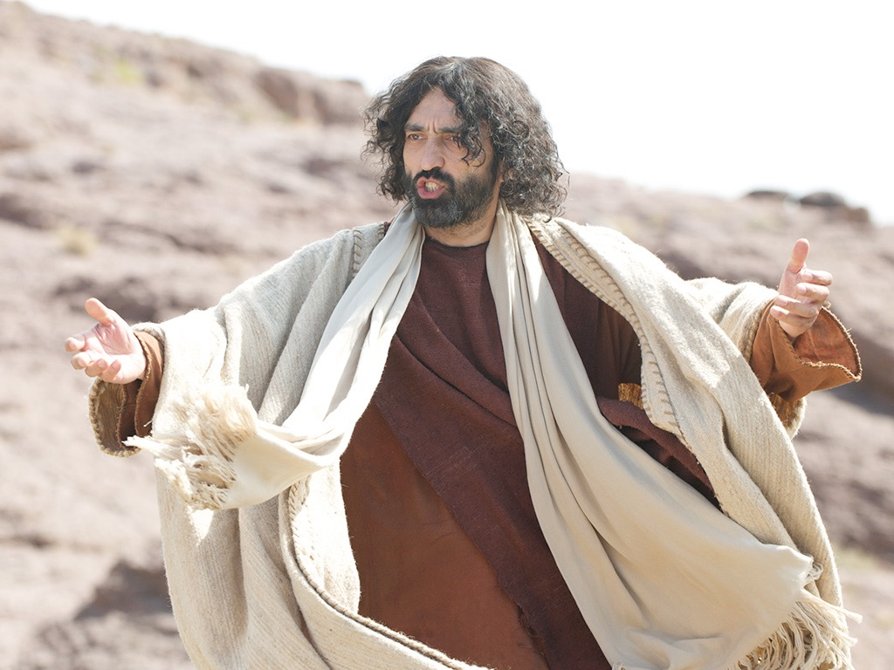

Slide 29
THE WORD IN PICTURES
Free
Bible
images

Slide 30

Used with Permission
THE
GOSPEL
——OF—— MATTHEW
THE
GOSPEL
——OF—— MARK
THE
GOSPEL
——OF—— LUKE
THE
GOSPEL
——OF—— JOHN
Due to the Lumo Project producing its own publishing material we regret to inform you that we cannot license our photos to other clients outside of freebibleimages.org.
These images are not licensed for reuse in video, epublishing or other media. Downloaded pictures and files cannot be redistributed through any other website than freebibleimages.org or used in any context where the accompanying message is undermining of the Christian faith and gospel.
Photos can only be used on educational presentations, blogs and social media, all of which should be accompanied with reference to www.LumoProject.com.
Picture courtesy of BBM
© All Rights Reserved.
www.bigbookmedia.com

Slide 31

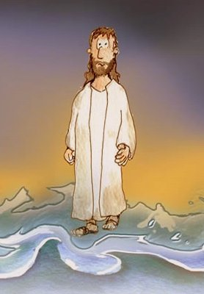
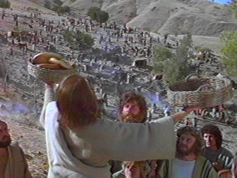
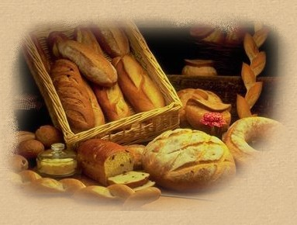
Can Jesus Prove It?
JOHN 6

Slide 32
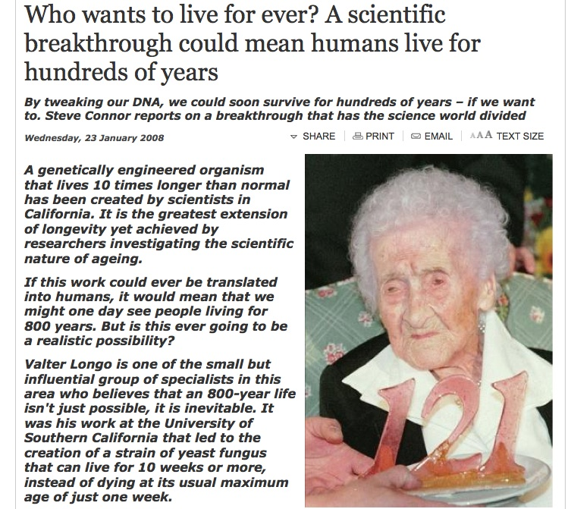
DNA Breakthrough!
Born in 1875, Jeanne Calment died in 1997 aged 122 years and 164 days

Slide 33
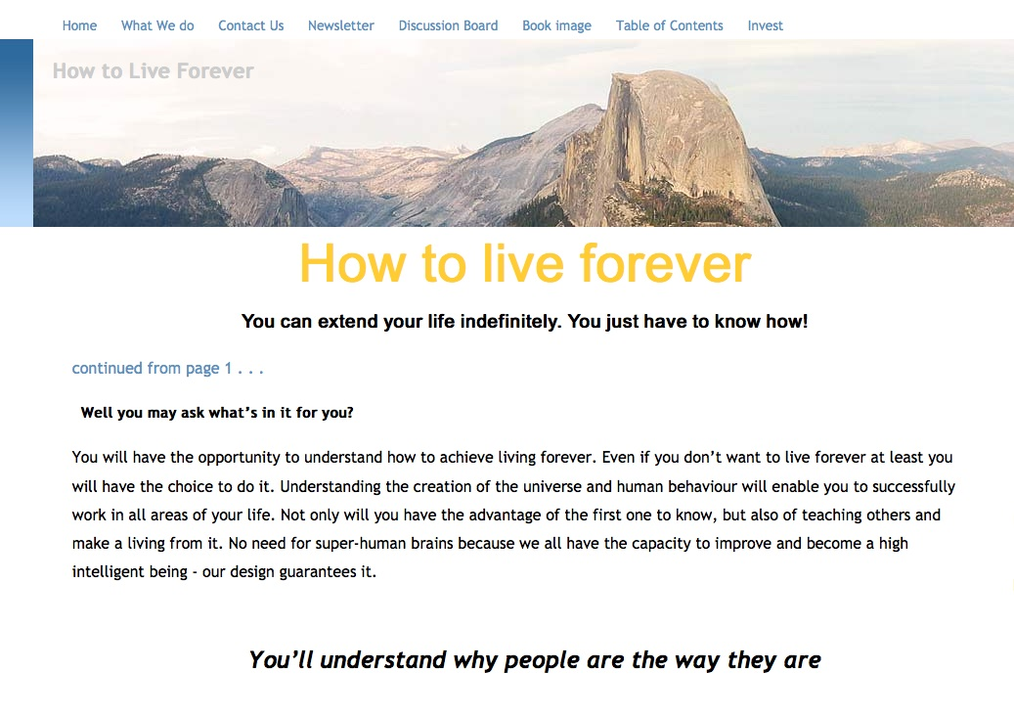
Howtoliveforever.net
You can have “youthful looks, improved appearance and attractiveness, and health and vitality well into your 70s, 80s, 90s, 100s, 1,000s . . . as long as you want.”

Slide 34

An Astonishing Claim!
“I tell you the truth, those who listen to my message and believe in God who sent me have eternal life. They will never be condemned for their sins, but they have already passed from death into life”
–– John 5:24
Notes:
Verse 26
Why did the crowd search for Jesus?
The crowd wants follow a prophet who will provide free food and political deliverance.

Slide 35
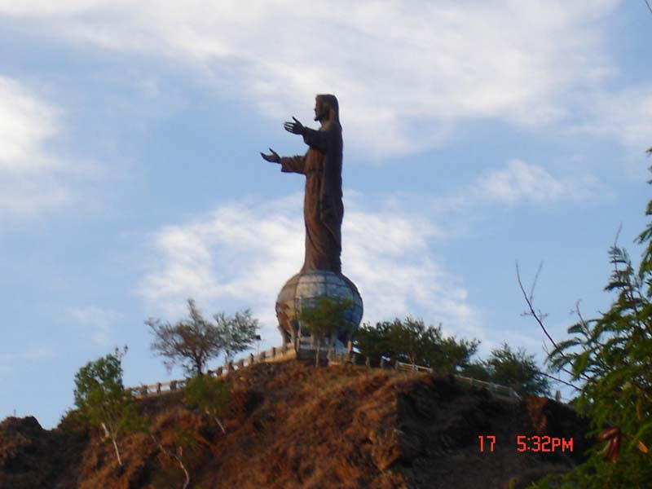

Subject
How do we know Jesus can give eternal life?
JOHN 6

Slide 36

3 MOVEMENTS:
Showing his Authority (1-21)
The Bread of Life (22-59)
Disciples desert Jesus (60-71)

Slide 37

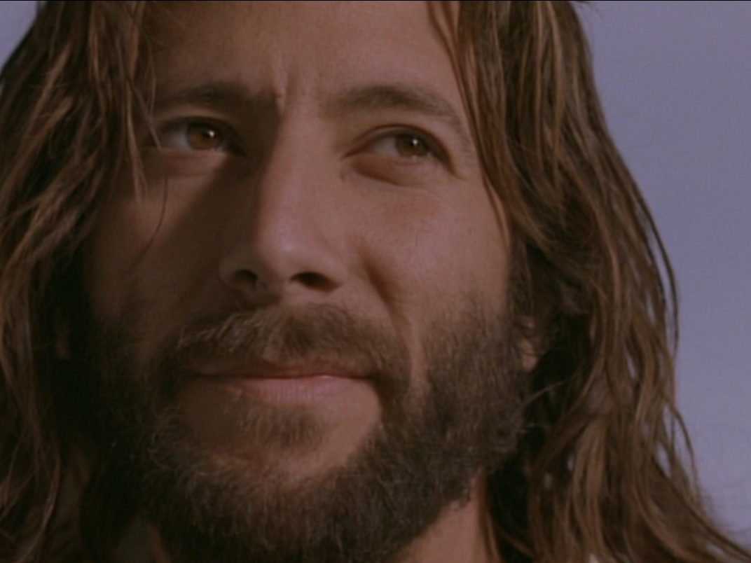

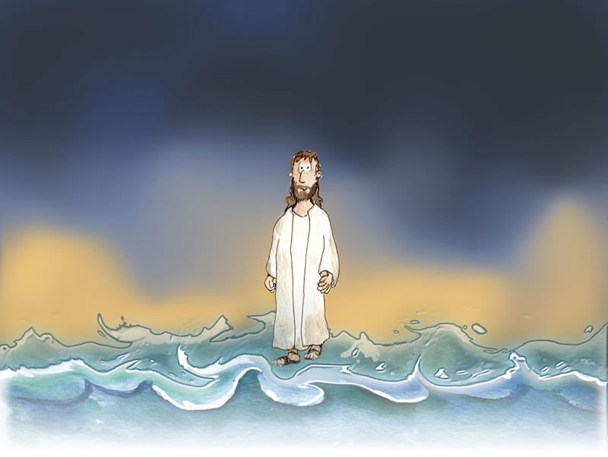
I. Jesus showed His authority over Moses and creation (6:1-21).
1-15
16-21

Slide 38
Feeding the 5000
Feeding the 5000
1-15

Slide 39
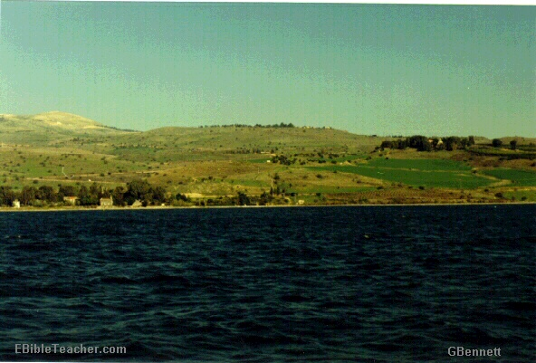
The Setting
Near Sea of Galilee
Notes:
Jesus went up to the mountain & Sat down to teach the disciples

Slide 40
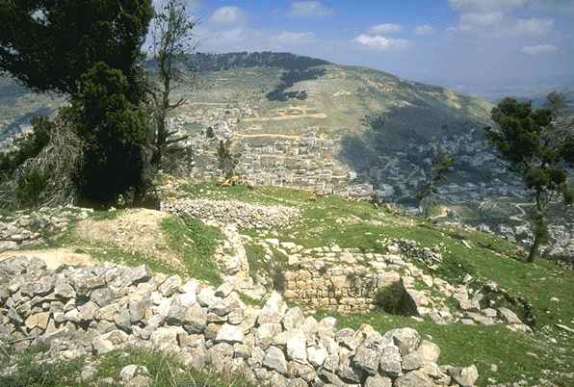
Verse 5-7
Notes:
Verse 5-7
Do you have faith in God?

Slide 41
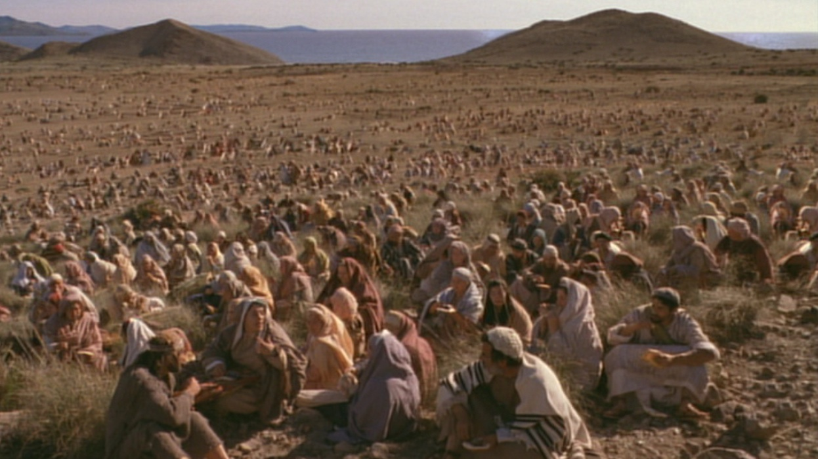
A huge crowd in a remote place
Notes:
Verse 5-7
Do you have faith in God?

Slide 42
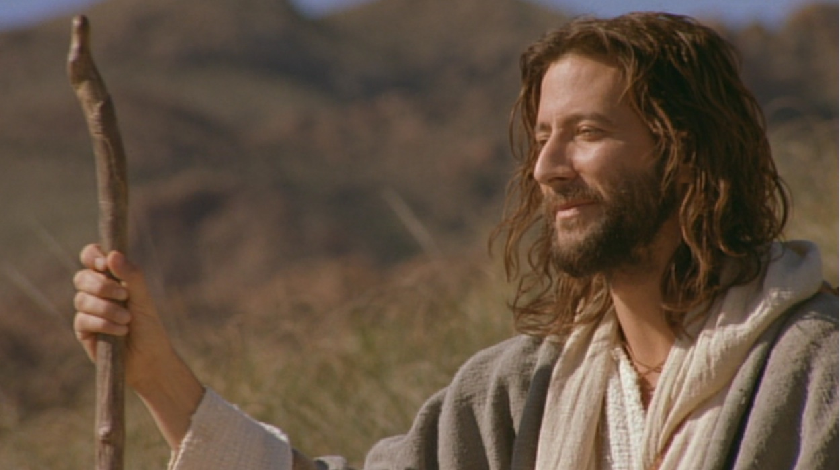
Verse 5-7
Where shall we buy bread for these people to eat?
Notes:
Verse 5-7
Do you have faith in God?

Slide 43
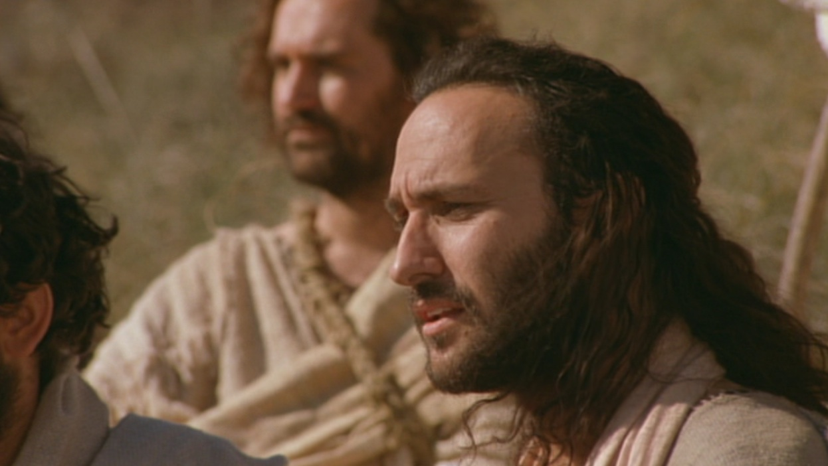
Verse 5-7
8 months’ wages would not buy enough bread for each one to have a bite!!
Notes:
Verse 5-7
Do you have faith in God?

Slide 44
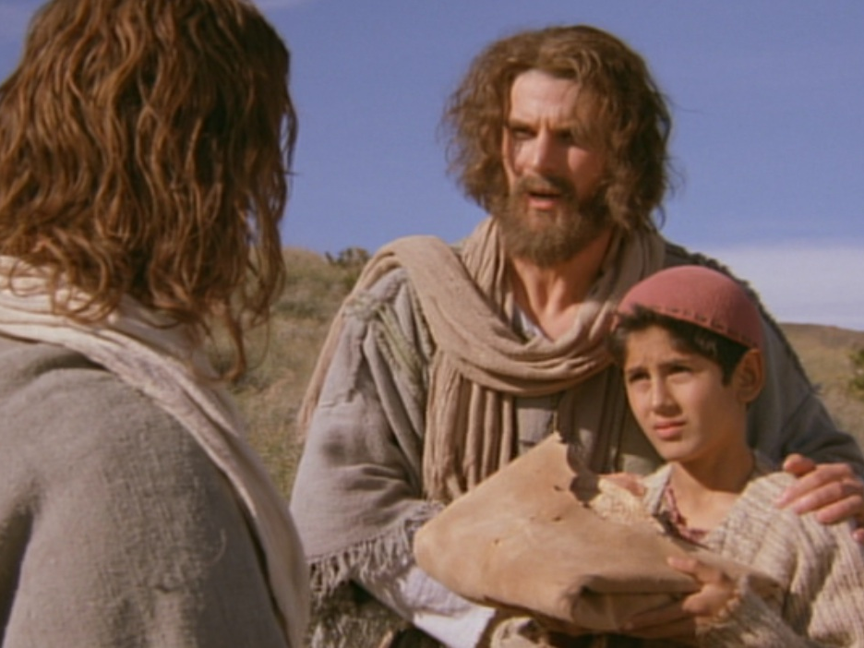
Andrew being helpful
“There’s a young boy here with five barley loaves and two fish. But what good is that with this huge crowd?”

Slide 45
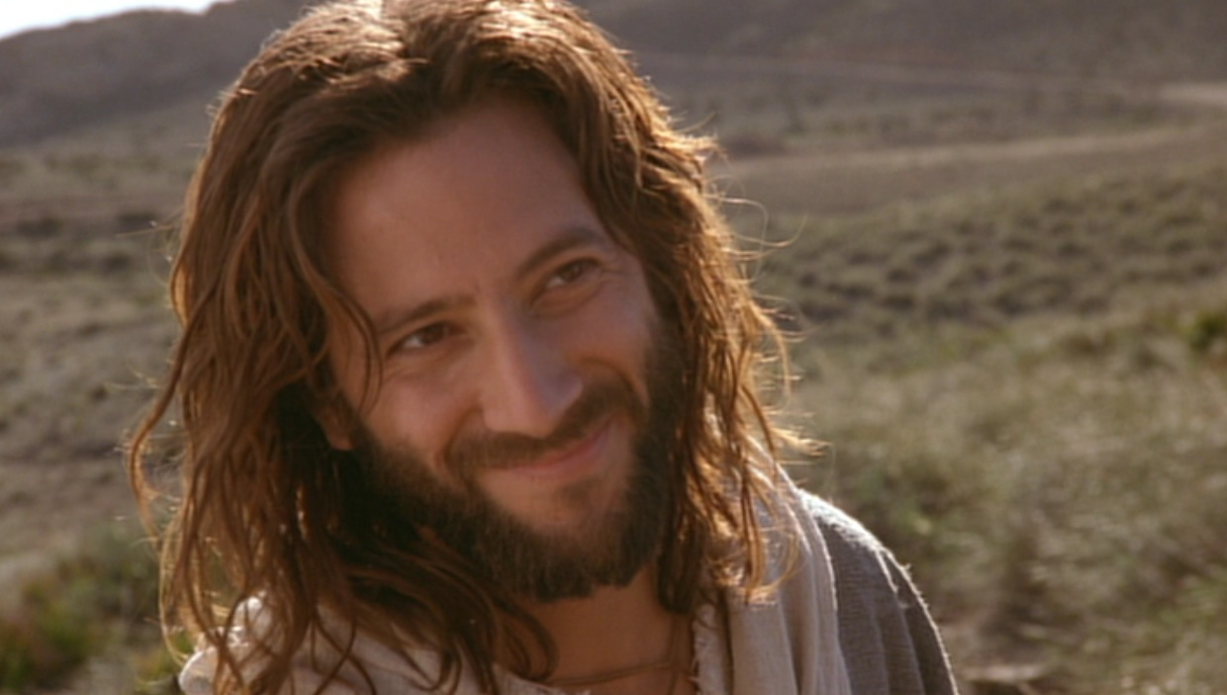
Verse 5-7
Tell everyone to sit down.
Notes:
Verse 5-7
Do you have faith in God?

Slide 46
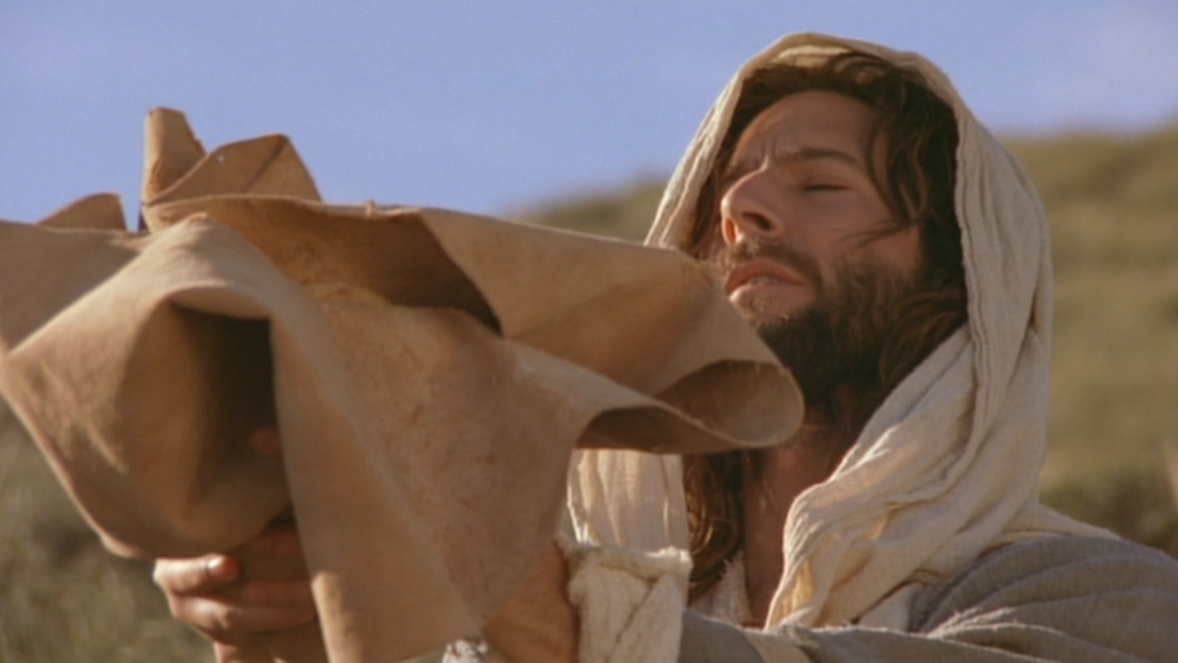
Verse 9-11
Jesus then took the loaves, gave thanks...
Notes:
Do you believe that God can use what you have and multiply it?

Slide 47
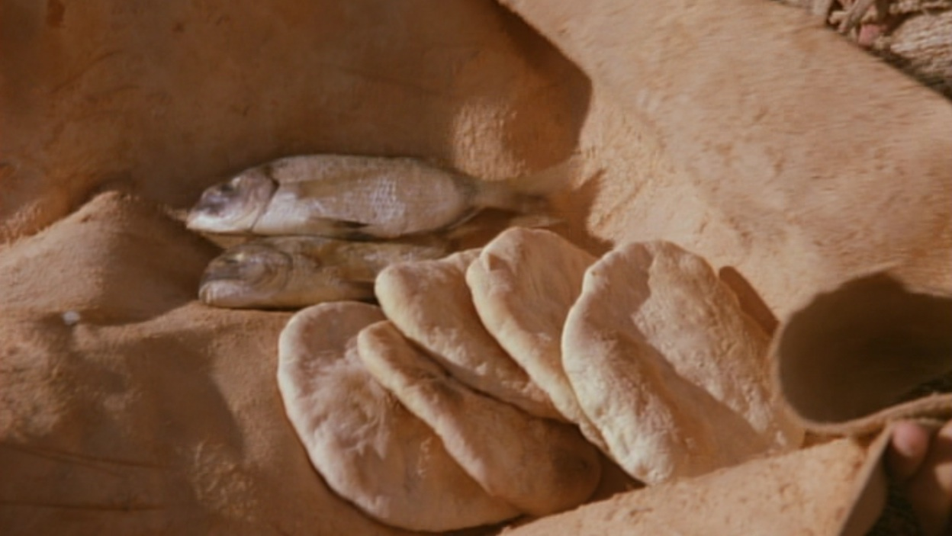
Verse 9-11
Jesus then took the loaves, gave thanks, and distributed to those who were seated as much as they wanted...
Notes:
Do you believe that God can use what you have and multiply it?

Slide 48
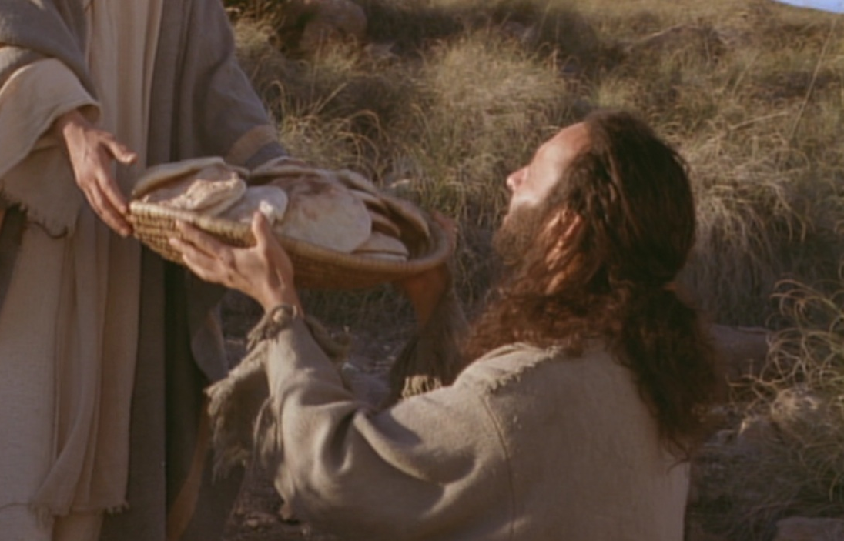
Bread Multiplied!

Slide 49
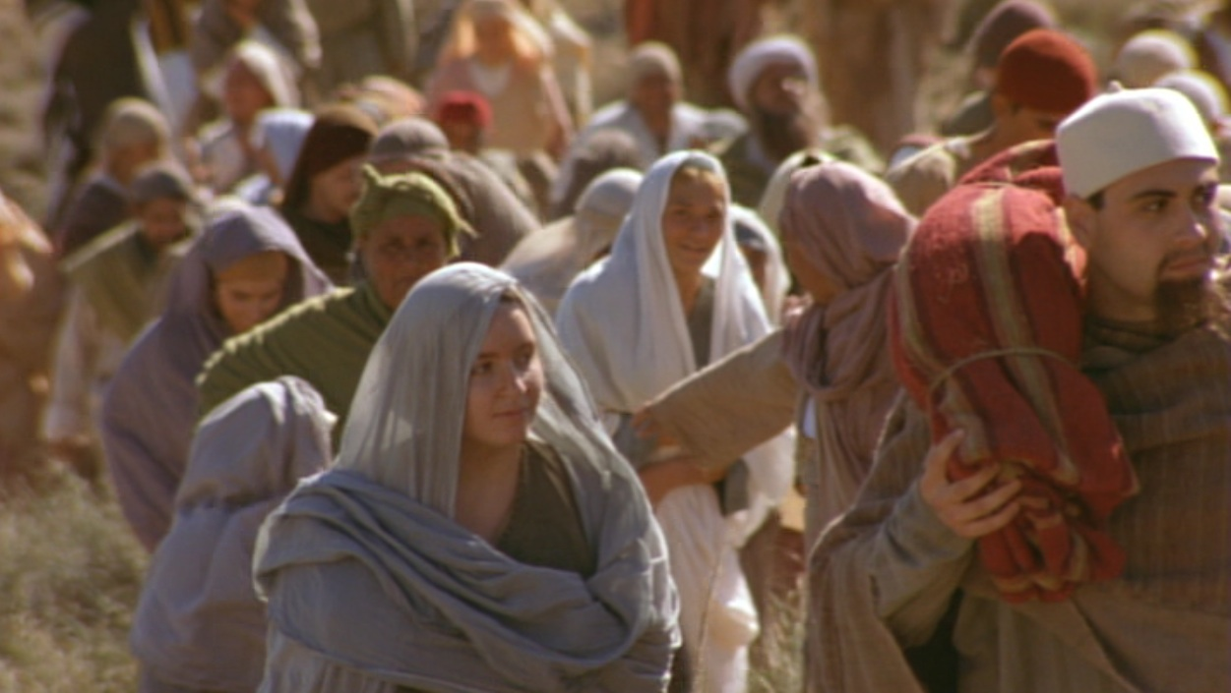
What’s the Point?
The crowd is the key!

Slide 50
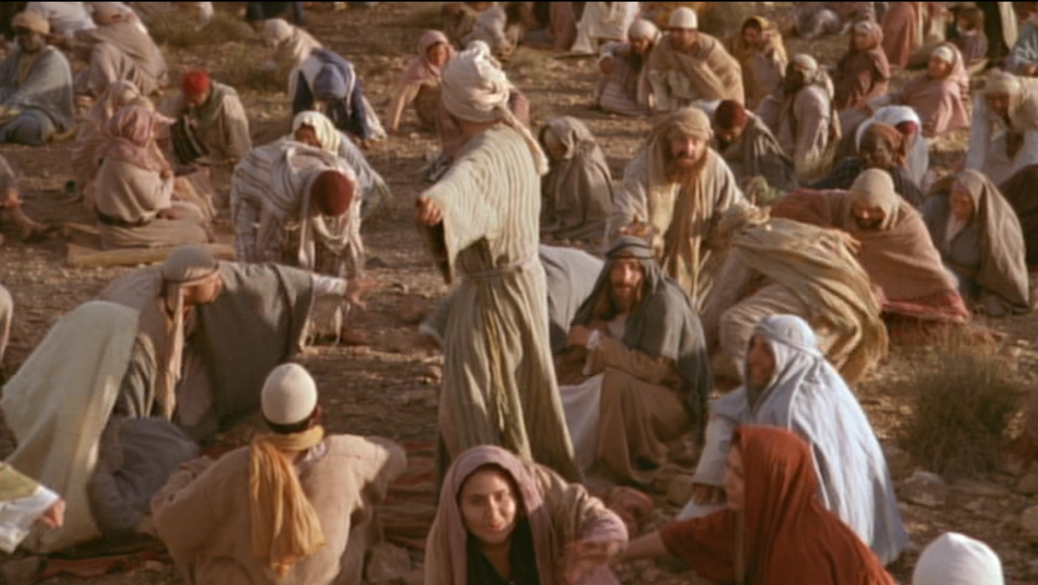
When the people saw him do this miraculous sign, they exclaimed,
“Surely, he is the Prophet we have been expecting!”
(6:24 NLT)

Slide 51

Prophecy of a Prophet given through Moses
(Deut. 18:15)
“I will raise up a Prophet like you from among their fellow Israelites. I will put my words in his mouth, and he will tell the people everything I command him.”

Slide 52
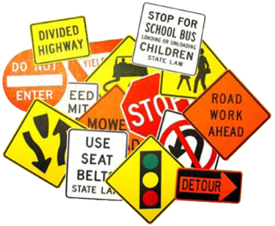

Signs in John’s Gospel
111
Signs unique to John's Gospel in yellow (6 of the 9 miracles)
WATER
TO WINE
2:1-11
HEALING
OFFICIAL’S
SON
4:46-54
HEALING
PARALYTIC
5:1-18
FEEDING
5000
6:1-15
WALKING
ON WATER
6:16-24
HEALING
BLIND MAN
9:1-7
RAISING
LAZARUS
11:1-45
CHRIST’S
RESURRECTION
20:1-31
FISH
CATCH
21:1-3

Slide 53
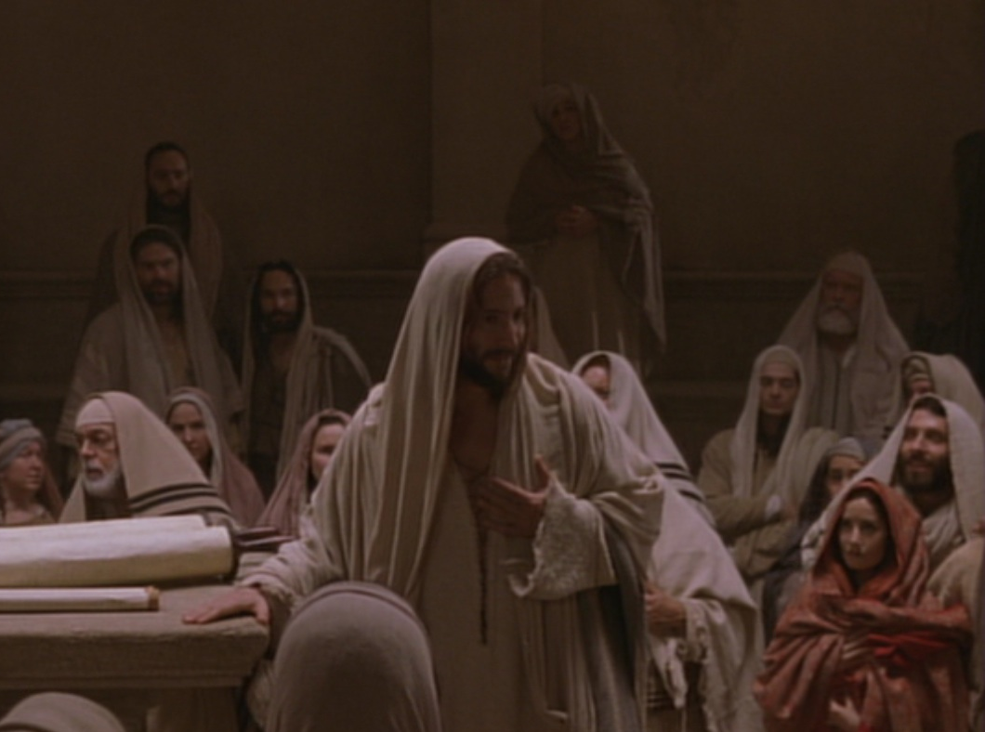
Key Word Believe
John
Key Verse
“Jesus did many other miraculous signs in the presence of his disciples, which are not recorded in this book. But these are written that you may believe that Jesus is the Christ, the Son of God, and that by believing
you may have life in his name” (20:30-31).

Slide 54
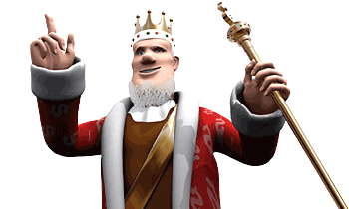
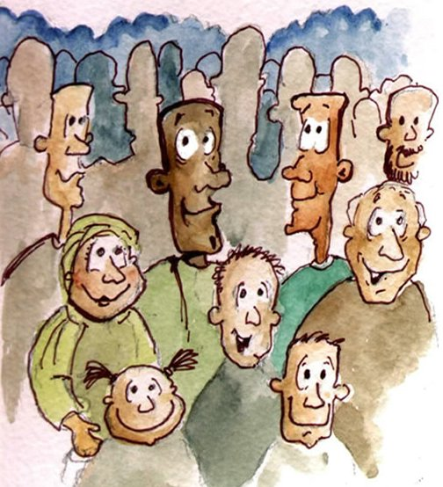
Verse 15
Notes:
Verse 15
who is this ‘prophet’ that the people are referring to?
“The Prophet” is the one prophesied by Moses (Deu 18:15). They acknowledge that Jesus was the Prophet who would come into the world to deliver them from the control of the Roman Empire.
Jesus knew that they want to make him king but he withdrew again to the mountains.

Slide 55
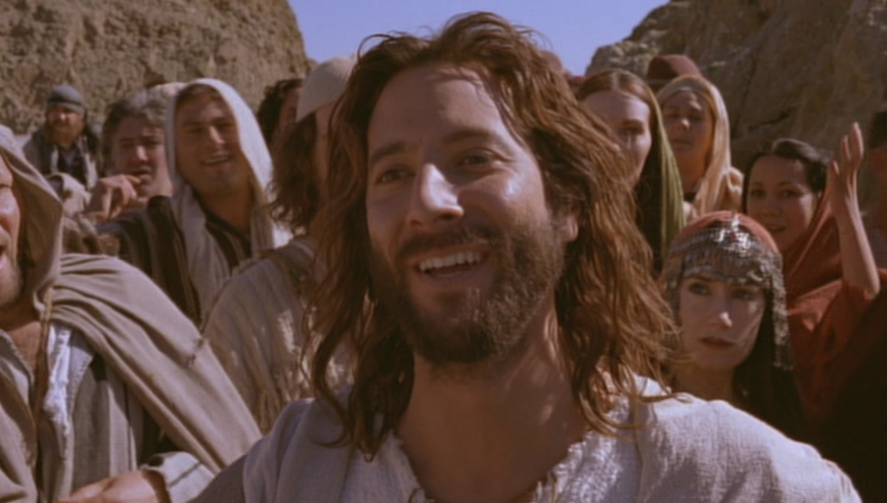
What’s the Point?
Jesus is the New Moses!
Jesus is even better than Moses!
MOSES
Predicted a Prophet
Gave manna from God
Sustained physical life
JESUS
Fulfilled the prediction
Is manna who IS God
Gives eternal life

Slide 56
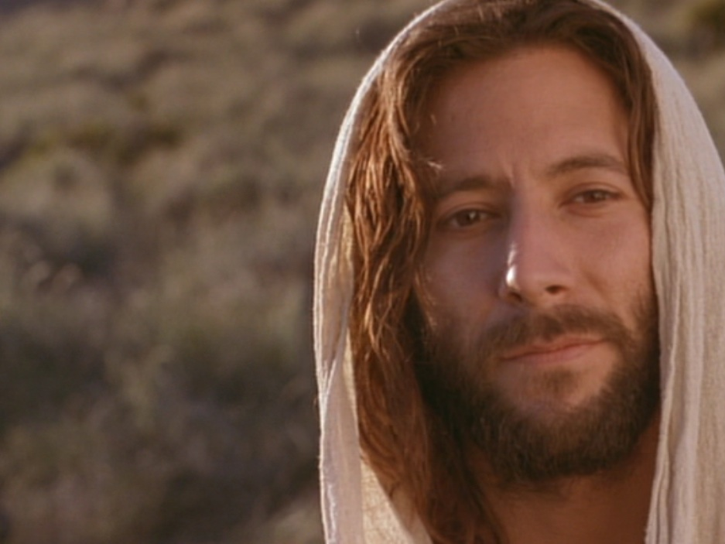
Jesus proved himself greater than Moses as the giver of eternal life by miraculously feeding 5000 Jews (6:1-15).

Slide 57
B. Rejection of an Offer to Make Christ King
§ 75
Matthew 14:22-23; Mark 6:45-46; John 6:14-15
Jesus refuses to rule over the 5000 in Galilee as the New Moses of Deuteronomy 18:15 must rule over all Israel, but the leaders disbelieve

Slide 58
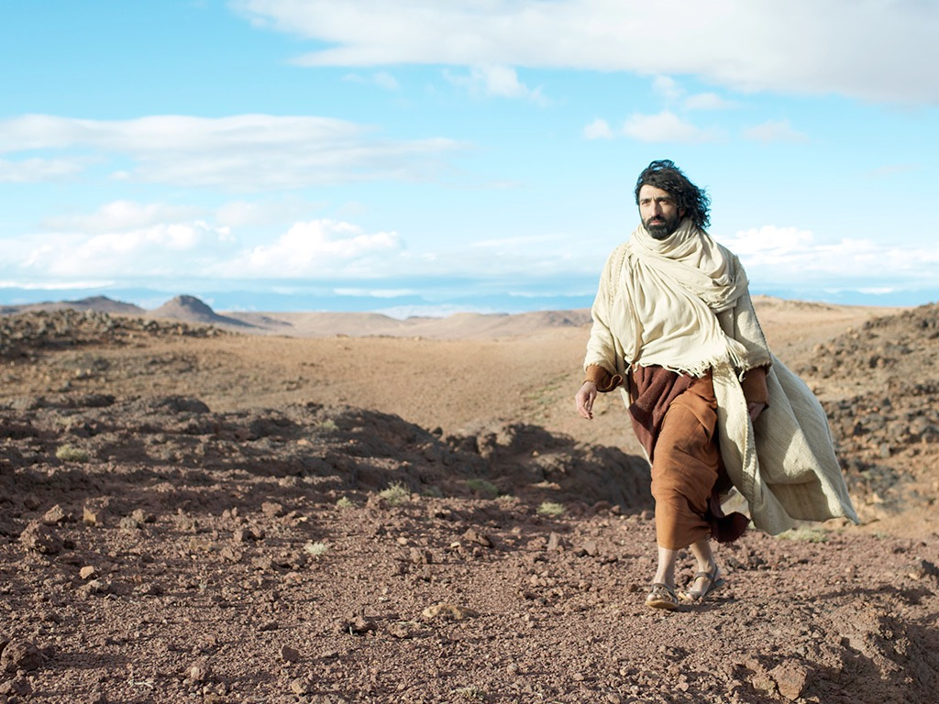

Slide 59
C. Instruction Through the Storm
§ 76
Matthew 14:24-33; Mark 6:47-52; John 6:16-21
Jesus rescues His disciples by walking on stormy water to teach them that they can trust Him to overcome obstacles by faith

Slide 60

Walking on Water (16-24)
WALKING ON WATER
16-21

Slide 61
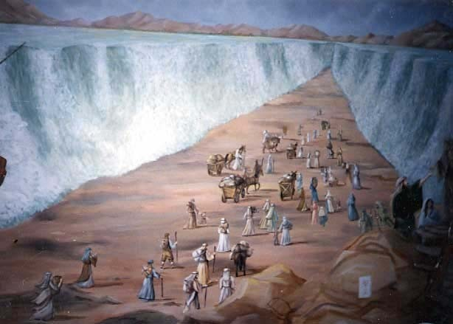
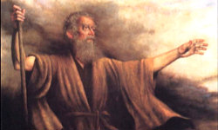
Moses Parting the Sea

Slide 62

Jesus Walked on the Sea

Slide 63

ALTHOUGH LATER DISQUALIFIED, JESUS IS SPECTACULAR IN WINNING HIS FIRST SCHOOL SWIM RACE.

Slide 64

Jesus: “Don’t be afraid! It is I” (6:20)
KJV
NAS
NCV
NET
NIV
NKJV
NRSV

Slide 65
“Don’t be afraid! I am here” (6:20)
NLT

Slide 66

“Don’t be afraid! I Am!” (6:20)
Greek:

Slide 67


JOHN’S “I AM” STATEMENTS
111
1
MATTHEW
2
MARK
JEWS
ROMANS
“I am the Messiah” (4:26)
“Don’t be afraid. I am!” (6:20)
“I am the bread of life” (6:35)
“I am the light of the world” (8:12)
“Before Abraham was, I am” (8:58)
“I am the door [of the sheep]” (10:7)
“I am the good shepherd” (10:11, 14)
“I am the resurrection and the life” (11:25)
“I am the way, the truth, and the life” (14:6)
“I am the true vine” (15:1)
TO:
TO:
AS:
KING
AS:
SERVANT
WHAT
HE:
SAID
WHAT
HE:
DID
3
LUKE
TO:
GREEKS
AS:
GOD/MAN
WHAT
HE:
FELT
Notes:
John uses “I Am” 24 times—and only once is is NOT spoken by Jesus. In John 9:9 the formerly blind man says to those who doubt that it is really him, “I am he.” Otherwise, this is clearly a divine title for Christ used by John, with the direct quote of God to Moses in Exodus 3:14.

Slide 68

The Burning Bush
Exodus 3:1–4:17

Slide 69


EXCUSES
God replied to Moses, “I Am Who I Am. Say this to the people of Israel: I Am has sent me to you”
(Exodus 3:14 NLT).
1. Who am I (3:11)?
2. Who are You (3:13)?
3. What if I fail (4:1)?
4. I’m not gifted (4:10)
5. I don’t want to get involved (4:13)

Slide 70
D. Reception in Gennesaret
§ 77
Matthew 14:34-36; Mark 6:53-56
Christ teaches through physical healings that He can do the same in the spiritual realm if they trust Him in faith

Slide 71
E. Instruction Concerning the Bread of Life
§ 78
John 6:22-71
As the true bread from heaven, Jesus teaches that He came not to give physical bread but the new heavenly bread of eternal life

Slide 72
I. Jesus showed His authority over Moses and creation (6:1-21).
1-15
16-21

Slide 73

II. Jesus satisfies our spiritual hunger by giving us eternal life (6:22-59).

Slide 74

Two Foods
Unlike food that spoils,
Jesus gives eternal life (6:22-27).

Slide 75

Verse 26
Jesus answered, “I tell you the truth, you are looking for me, not because you saw miraculous signs but because you ate the loaves and had your fill” (John 6:26)
Notes:
Verse 26
Why did the crowd search for Jesus?
The crowd wants follow a prophet who will provide free food and political deliverance.

Slide 76

Verse 27
Do not work for food that spoils,
Do not work for food that spoils, but for food that endures to eternal life, which the Son of Man will give you.
Notes:
Verse 27
What is the meaning behind these verses?
The people’s work should have been directed to a food that endures. Jesus explains the meaning of preservation, namely eternal life. The source of eternal life is the Son of Man. He is the one who gives eternal life, the food that does not perish. Jesus turned the concern of the Jews on its head and defined the assuring work not as usual labor but as believing Him. Both believing and obeying are parallel ways one acknowledges dependence on God.

Slide 77

Two Works
Unlike human effort,
Jesus enables us to do God’s work by believing in Him (6:28-29).
Notes:
They replied, “We want to perform God’s works, too. What should we do?” Jn 6:28 NLT

Slide 78

Two Breads
Unlike manna God gave via Moses, Jesus is the true “Bread” from heaven that gives eternal life
(6:30-33).

Slide 79

Two Results
Unlike bread that only sustains physical life, belief in Christ gives eternal life (6:34-59).

Slide 80

III. Jesus’ claim to be the only source of life forces a decision (6:60-71).

Slide 81


Disciples desert Jesus (60-71)
Disciples desert Jesus (61-71)
“At this point many of his disciples turned away and deserted him”
(John 6:66).

Slide 82

The Twelve stayed because 11 of them believed He was God’s Son (6:67-71).

Slide 83

The Main Idea of John 6
Since Christ has authority over creation, trust Him to give you eternal life!

Slide 84

Disbelief?

Slide 85

Or Belief?
“You are the holy one of God!”

Slide 86
F. Instruction Concerning Defilement
§ 79
Matthew 15:1-20; Mark 7:1-23; John 7:1
Christ teaches that defilement is internal to show that Pharisees violate the law with their traditions in the uncleanness of their heart

Slide 87
G. Reception in Tyre and Sidon
§ 80
Matthew 15:21-28; Mark 7:24-30
Jesus heals a Canaanite woman's demon-possessed daughter to teach individual Gentile salvation now before Israel repents

Slide 88

Free
Bible
images
A SYROPHOENICIAN WOMAN
BEGS JESUS FOR HELP
Mark 7:24-30

Slide 89

Tyre
Sidon
Syria
Phoenicia
Capernaum
Galilee
Decapolis
Notes:
Mark 7:24 Then Jesus left Galilee and went north to the region of Tyre. He didn’t want anyone to know which house he was staying in, but he couldn’t keep it a secret.

Slide 90

Notes:
Jews despised Gentiles and few went even as far away as the nearby city of Tyre. This is even the farthest Jesus traveled in his lifetime.

Slide 91
Notes:
Jews considered a woman of Tyre like this lady unclean.

Slide 92

Notes:
Yet Mark 11 records...
²⁵ Right away a woman who had heard about him came and fell at his feet.

Slide 93

Notes:
Her little girl was possessed by an evil spirit, ²⁶ and she begged him to cast out the demon from her daughter.

Slide 94


Slide 95

Notes:
Since she was a Gentile, born in Syrian Phoenicia,
²⁷ Jesus told her, “First I should feed the children—my own family, the Jews. It isn’t right to take food from the children and throw it to the dogs.”

Slide 96

Notes:
Jesus was telling her not that God did not care for Gentiles but that He designed for Jews to hear the message first and then bring the gospel to the Gentiles as the OT commanded them to be a "light to the Gentiles."

Slide 97

Notes:
Mark 7:28 She replied, “That’s true, Lord, but even the dogs under the table are allowed to eat the scraps from the children’s plates.”

Slide 98

Notes:
Mark 7:29 “Good answer!” he said. “Now go home, for the demon has left your daughter.”

Slide 99

Notes:
³⁰ And when she arrived home, she found her little girl lying quietly in bed, and the demon was gone.
___________
Some think that Jesus held to the prejudices of his days, but the opposite is true. Jesus healed this Canaanite woman's demon-possessed daughter to teach individual Gentile salvation now before Israel repents later just before His return!

Slide 100
Used with Permission
THE
GOSPEL
——OF—— MATTHEW
THE
GOSPEL
——OF—— MARK
THE
GOSPEL
——OF—— LUKE
THE
GOSPEL
——OF—— JOHN
Due to the Lumo Project producing its own publishing material we regret to inform you that we cannot license our photos to other clients outside of freebibleimages.org.
These images are not licensed for reuse in video, epublishing or other media. Downloaded pictures and files cannot be redistributed through any other website than freebibleimages.org. or used in any context where the accompanying message is undermining of the Christian faith and gospel.
Photos can only be used on educational presentations, blogs and social media, all of which should be accompanied with reference to www.LumoProject.org.
Picture courtesy of BBM
© All Rights Reserved.
www.bigbookmedia.com

Slide 101
H. Reception in Decapolis
§ 81
Matthew 15:29-38; Mark 7:31–8:9a
Jesus heals deaf and dumb man and feeds 4000 Gentiles to teach His men to minister by His power to both Jews and Gentiles

Slide 102

Northern Israel:
• Caesarea
• Galilee
• Decapolis
85

Slide 103

Greek Cities in Israel
180
Notes:
________
BG-04-Intertestamental-13
LC-04-Instruction-97

Slide 104
I. Rejection in Magadan
§ 82
Matthew 15:39–16:4; Mark 8:9b-12
Jesus refuses to give a sign to unbelieving religious leaders except His resurrection due to their unbelief, not due to a lack of signs

Slide 105

Tiberias on the Sea of Galilee
88

Slide 106
J. Warning Against Rejection
§ 83
Matthew 16:5-12; Mark 8:13-26
Christ warns His disciples of the hypocrisy of the Pharisees and Herod that led to unbelief so they would not be hypocrites themselves

Slide 107
K. Confession of Peter
§ 84
Matthew 16:13-20; Mark 8:27-30; Luke 9:18-21
Peter affirms Christ's deity, so Jesus reveals for the first time that the Twelve will declare what God said in a new organism, the Church

Slide 108


¹³ When Jesus came to the region of Caesarea Philippi, he asked his disciples, “Who do people say the Son of Man is?”
¹⁴ They replied, “Some say John the Baptist; others say Elijah; and still others, Jeremiah or one of the prophets.”
¹⁵ “But what about you?” he asked. “Who do you say I am?”
¹⁶ Simon Peter answered, “You are the Messiah, the Son of the living God.”
Matthew 16:13-20 (NLT)

Slide 109
¹⁷ Jesus replied, “Blessed are you, Simon son of Jonah, for this was not revealed to you by flesh and blood, but by my Father in heaven.
¹⁸ And I tell you that you are Peter, and on this rock I will build my church, and the gates of Hades will not overcome it.
¹⁹ I will give you the keys of the kingdom of heaven; whatever you bind on earth will be bound in heaven, and whatever you loose on earth will be loosed in heaven.”
²⁰ Then he ordered his disciples not to tell anyone that he was the Messiah.
Matthew 16:13-20 (NLT)

Slide 110

Q: How did God overcome the prejudice in the Church at Jerusalem?
A: Gradually
PETER'S KEYS OF THE KINGDOM
JEWS
SAMARITANS
GENTILES
Acts 2
Acts 8
Acts 10
AD 33
AD 35
AD 40
Notes:
God wisely led that Jerusalem church step-by-step so they could handle his big heart!
I suspect that if Samaritans and Gentiles were forced into the church too soon this would split the early church into three separate groups.

Slide 111

Jesus taught en route to Jerusalem that his disciples will be resisted
(Mark 8:27–10:52).

Slide 112
L. Instruction Concerning His Death
§ 85
Matthew 16:21-23; Mark 8:31-33; Luke 9:22
Peter opposes Christ's declaration that He would soon die and rise again because he did not see the need for His sacrifice for sin

Slide 113
Matthew 16:13–20:34
Outline
73
IV. (11:1–16:12) Christ is rejected as Messiah in anticipation of the final crucifixion rejection, so He introduces the Interadvent Age before His future reception and ministers to Gentiles to teach the postponement of the kingdom.
V. (16:13–20:34) Christ prepares His disciples regarding His Person and program in order that His Messianic authority might be delegated to them after His death.

Slide 114
M. Instruction Concerning Discipleship
§ 86
Matthew 6:24-28; Mark 8:34–9:1; Luke 9:23-27
A true disciple must submit not to the Pharisees but to Jesus since He would judge Israel and rule as Messiah
Notes:
English edited

Slide 115
N. Revelation of the Kingdom
§ 87
Matthew 17:1-8; Mark 9:2-8; Luke 9:28-36
Three disciples see Christ’s glory to foretaste His reign at the Second Advent and prove Him as worthy of obedience
Notes:
The three Synoptic Gospels all record the Transfiguration of Jesus. Here is the only glimpse of the true nature of Christ that we find in the gospels as no one sees him in his full glory during his earthly life—and the Transfiguration was only for a few moments. God, in his mercy, did not let people view the glorified Christ lest they die in doing so! But this experience on the mountain (probably Mount Tabor) lifted the veil, as it were, so that at least Peter, James, and John could imagine the glory of Jesus when he reigns in the millennial kingdom.
_____________
LC-04-Instruction of the Twelve-106
NS-01-Matt15-18—slide 12
NS-02-Mark9-16—slide 3
NS-03-Luke1-12—slide 386

Slide 116

Carl Bloch, c. 1865
Transfiguration of Jesus
Mark 9:2-13 (ESV)
Notes:
Today’s scripture, found in Mark chapter 9, vs 2-13 is also about a transformation. This transformation is known as the Transfiguration of Jesus.
Transformation is an important theme in the Bible. The passage we read together earlier was from Paul’s letter to the Romans, ch 8 vs 19-30 was about transformation. As we saw in Romans 8:30, reading now from the ESV, Paul writes that “and those whom he predestined he also called, and those whom he called he also justified, and those whom he justified he also glorified.”
To go from sin and suffering to being called, justified, and glorified is an extreme transformation. So how do we get to that transformation? We look to Jesus. That is what we are going to do today. We will look at Jesus and his “transfiguration” or “transformation.”
We will see how it affected the disciples and how it should affect us.

Slide 117
Why only Peter, James, and John?
Mk 9:2-13 Transfiguration
Mk 14:33 Gethsemane
With Andrew
Mk 1:29-30 Peter’s Mother-in Law
Mk 13:3 Olivet Discourse

Slide 118
² And after six days Jesus took with him Peter and James and John, and led them up a high mountain by themselves.
Mark 9:2-13 (ESV)
Notes:
Now we pick in in Mark ch 9 vs 2

Slide 119

How do you recharge?
Mark 6:30-32
³⁰ The apostles returned to Jesus and told him all that they had done and taught. ³¹ And he said to them, “Come away by yourselves to a desolate place and rest a while.” For many were coming and going, and they had no leisure even to eat. ³² And they went away in the boat to a desolate place by themselves.

Slide 120
² And after six days Jesus took with him Peter and James and John and led them up a high mountain by themselves. And he was transfigured before them, ³ and his clothes became radiant, intensely white, as no one on earth could bleach them. ⁴ And there appeared to them Elijah with Moses, and they were talking with Jesus.
Mark 9:2-13 (ESV)
Notes:
Now we pick in in Mark ch 9 vs 2

Slide 121

What did they see?
John 20:15 . . . Supposing him to be the gardener

Slide 122

Revelation 1
¹² Then I turned to see the voice that was speaking to me, and on turning
I saw seven golden lampstands,
¹³ and in the midst of the lampstands one like a son of man, clothed with a long robe and with a golden sash around
his chest. ¹⁴ The hairs of his head were white, like white wool, like snow. His eyes were like a flame of fire, ¹⁵ his feet were like burnished bronze, refined in a furnace, and his voice was like the roar of many waters
¹⁶ In his right hand he held seven stars, from his mouth came a sharp two-edged sword, and his face was like the sun shining in full strength.

Slide 123
² And after six days Jesus took with him Peter and James and John, and led them up a high mountain by themselves. And he was transfigured before them, ³ and his clothes became radiant, intensely white, as no one on earth could bleach them. ⁴ And there appeared to them Elijah with Moses, and they were talking with Jesus.
Mark 9:2-13 (ESV)
Notes:
Now we pick in in Mark ch 9 vs 2

Slide 124

Jesus
Moses
Elijah

Slide 125
² And after six days Jesus took with him Peter and James and John, and led them up a high mountain by themselves. And he was transfigured before them, ³ and his clothes became radiant, intensely white, as no one on earth could bleach them. ⁴ And there appeared to them Elijah with Moses, and they were talking with Jesus. ⁵ And Peter said to Jesus, “Rabbi, it is good that we are here. Let us make three tents, one for you and one for Moses and one for Elijah.” ⁶ For he did not know what to say, for they were terrified.
Mark 9:2-13 (ESV)
Notes:
How do the disciples respond?

Slide 126
O. Instruction Concerning Elijah
§ 88
Matthew 17:9-13; Mark 9:9-13
Elijah must precede the kingdom, but John the Baptist fulfilled Malachi's prophecy of his coming since sacrifice precedes glory

Slide 127

The Second Coming
"Look, I am sending you the prophet Elijah before the great and dreadful day of the LORD arrives. ⁶ His preaching will turn the hearts of fathers to their children, and the hearts of children to their fathers. Otherwise, I will come and strike the land with a curse" (Malachi 4:5-6 NLT).
Notes:
Here are the final two verse of the Old Testament that include both blessing and a curse.
__________
LC-04-Instruction of the Twelve-118
OS-39-Malachi-135
NS-01-Matt 15-28-slide 23

Slide 128

The Expectation: Elijah, Messiah, Kingdom
76
MESSIAH
"This Age"
"The Age to Come"
PROPHECY
KINGDOM
Mysteries of the Kingdom
Matthew 13
E
M
"K"
E
M
K
Rejection
Reception
1st Advent
2nd Advent
Judgment on Israel
Blessing to Gentiles
Judgment on Nations
Restoration of Israel
Adapted from Mark L. Bailey, DTS class notes, 1986
Notes:
The key element between the present age and the age to to come (the kingdom age) in Jewish theology was the coming of the Messiah. But he would be preceded by an Elijah figure. John the Baptist could have been that "Elijah" had Israel believed in Messiah, for the millennial kingdom would then have followed with a righteous nation. But since Israel rejected her king, another "Elijah" yet will come—probably one of the two witnesses of Rev 11. In the meantime, this Interadvent Age has the kingdom in but mystery form with spiritual benefits given to the Gentiles until the full number of Gentiles occurs (Rom 11:25-27). Then, instead of judgment on Israel and blessing on the Gentiles, it will reverse. The judgment will be upon the nations opposing Israel (Ezek 38–39) followed by blessing upon Israel (Ezek 40–48).
__________
LC-04-Instruction of the Twelve-119
OS-39-Malachi-136
NS-01-Matt 15-28-slide 24
NS-02-Mark9-16—slide 15

Slide 129
¹¹ And they asked him, “Why do the scribes say that first Elijah must come?” ¹² And he said to them, “Elijah does come first to restore all things. And how is it written of the Son of Man that he should suffer many things and be treated with contempt? ¹³ But I tell you that Elijah has come, and they did to him whatever they pleased, as it is written of him.”
Mark 9:2-13 (ESV)

Slide 130
A Good Question
Q: Why must Elijah come first?
A: The Scriptures say so
Mal 3:1 "Behold, I send my messenger, and he will prepare the way before me."
Mal 4:5 "Behold, I will send you Elijah the prophet before the great and awesome day of the Lord comes."

Slide 131
Having established the authority of Scripture
Q: Why must Messiah suffer?
A: The Scriptures say so
Ps 69:20-21 "Behold, I send my messenger, and he will prepare the way before me."
Isa 53 "But he was pierced for our transgressions;
he was crushed for our iniquities;
upon him was the chastisement that brought us peace,
and with his wounds we are healed."

Slide 132
¹¹ And they asked him, “Why do the scribes say that first Elijah must come?” ¹² And he said to them, “Elijah does come first to restore all things. And how is it written of the Son of Man that he should suffer many things and be treated with contempt? ¹³ But I tell you that Elijah has come, and they did to him whatever they pleased, as it is written of him.”
Mark 9:2-13 (ESV)

Slide 133

By what authority can Jesus proclaim John the Baptist fulfills prophecies about Elijah?

Slide 134
# | Title | Mt | Mk | Lk | Jn
1 | Jesus Heals Many | Mt 4:23–24 | Mk 1:32–34
2 | Jesus Casts Out Demons | Mt 4:24 | Mk 1:39 | Lk 7:18–23
3 | Jesus Cleanses a Leper | Mt 8:1–4 | Mk 1:40–45 | Lk 5:12–16
4 | Jesus Heals a Centurion’s Servant | Mt 8:5–13 |  | Lk 7:1–10
-----------------------------------------
59 | Jesus Appears in a Locked Room |  |  |  | Jn 20:19–23
60 | Jesus Appears in a Locked Room for Thomas |  |  |  | Jn 20:26–29
61 | Jesus Provides a Miraculous Catch of Fish (John) |  |  |  | Jn 21:4–6
61 Miracles

Slide 135
Terrified in the presence of the Lord
Listen to the Lord
The Disciples Listened to the Lord
Disciples' questions answered by the Lord

Slide 136
Be Transformed!
Not Terrified

Slide 137
P. Instruction Concerning Dependence
§ 89
Matthew 17:14-21; Mark 9:14-29; Luke 9:37-43a
The inability of the disciples to exorcise a demon teaches them to depend on Jesus as He could deliver Israel if the nation believed

Slide 138
Q. Additional Instruction Concerning His Death
§ 90
Matthew 17:22-23; Mark 9:30-32; Luke 9:43b-45
Jesus predicts His death and resurrection again to teach that suffering must precede glory in the same Messiah, not two Messiahs

Slide 139
R. Instruction Concerning Sonship
§ 91
Matthew 17:24-27
Jesus has Peter pay their temple tax to avoid accusation despite His disciples being exempt since they are sons of the King

Slide 140
S. Instruction Concerning Humility
§ 92
Matthew 18:1-5; Mark 9:33-37; Luke 9:49-50
After the disciples argue which of them is greatest in the kingdom, Jesus teaches them humility and dependence for true greatness

Slide 141
T. Instruction Concerning Pride
§ 93
Matthew 18:6-14; Mark 9:38-50; Luke 9:49-50
Jesus rebukes his disciples’ pride over the inability of others to exorcise a demon to help them prize the humility that God values
Notes:
English edited

Slide 142
U. Instruction Concerning Forgiveness
§ 94
Matthew 18:15-35
Christ teaches the disciples that they are to forgive both unconditionally and entirely in the same way God has forgiven them
Notes:
English edited

Slide 143


How to Restore Relationships
Matthew 18:15-20
Dr. Rick Griffith
Singapore Bible College
BibleStudyDownloads.org
10 December 2006
6 March 2011

Slide 144

I. (15-17) The manner in which the church should correctly restore a sinning Christian is by keeping the matter as private as possible.
34c
  (15) A private sin should be dealt with only between those directly involved so as to make restoration of the offender easier.
  (16) Unrepentant sin after a private confrontation should be exposed only to one or two more persons in order to facilitate restoring the sinner.
  (17a) Unrepentant sin after a small group attempt at restoration should be brought before the entire church body as a deterrent to continued sin.
  (17b) Unrepentant sin after exposure to the church should result in requiring each church member to relate to the sinner as an unbeliever (this includes removal from membership).
Notes:
PR 09.33
BS 20.33; 25.09
NS Mt 15.8

Slide 145
II. (18-20) The reason the church can restore or continue to seek to restore errant believers is because it extends the authority of God Himself.
34c
  (18-19) Churches that prayerfully restore or continue to seek to restore sinful believers act in the place of the Father.
    (18) The church must announce guilt or innocence based upon what God has already determined.
    (19) Church leaders who prayerfully make a judgment can have confidence that they have acted according to God's will.
  (20) Churches that restore or continue to seek to restore sinful believers act in the presence of Jesus.
Notes:
PR 09.34
BS 20.34; 25.10
NS Mt 15.9

Slide 146

Exegetical Idea: The reason the church should restore a sinning Christian correctly is because it extends God's authority.
34c
  (15-17) The manner in which the church should correctly restore a sinning Christian is by keeping the matter as private as possible.
  (18-20) The reason the church can restore or continue to seek to restore errant believers is because it extends the authority of God Himself.
Matthew 18:15-20
Notes:
PR 07.15. 09.35; 11.25; 12.16; 16:11 HO subject only
BS 18.43; 20.31; 25.11
NS Mt 15.10

Slide 147

The Point of Verses 15-17
I. Keep the matter as private as possible (15-17).
Notes:
God's strategy to bring sinning Christians back is to involve as few people as you can.

Slide 148
God's 4-step restoring process…
4
3
2
1
…reveals the issue to more people each step
Notes:
God's restoring process has four steps that progressively tell more and more people about the sin (15-17).

Slide 149
Step 1 to Restoration
Talk to the person by yourself
M
M
M
M
M
M
M
M
M
M
M
M
M
M
M
M
S
M
M
M
M
M
M
M
M
M
M
M
S = Sinner
M = Member
Notes:
What's our human tendency here?
• It is to tell others about the problem instead of the one involved.
• God commands us to keep the issue as private as possible.

Slide 150


Matthew's Relational Pillars
Matthew's Relational Pillars
5:23-24
18:15-17
You are:
Offender
Offended
Issue:
General
Sin
Notes:
This differs from Matthew 5 in that you're not an offender, but the offended.
Note also that in Matthew 5 sin may not be in the picture, but Matthew 18 deals specifically with a believer living in sin. This does not refer simply to differences of opinion on debatable matters.

Slide 151
Matthew's Relational Pillars
Matthew's Relational Pillars
5:23-24
18:15-17
You are:
Offender
Offended
Issue:
General
Sin
Initiative:
You!
You!
Notes:
Earlier we saw from Matthew 5:23-24 that God places the responsibility to reconcile on you if you are the offender. Now whose job is it to initiate if you are the offended?
• Yes, again it is your responsibility again! You say, "That's not fair! Why is it my job in both situations? Whether I am the offender or the offended I still have to make the first move?" Well, if relationships are not resolved between believers, it has to be through the fault of both—as both have the command of God to resolve it!

Slide 152
Step 2 to Restoration
Take 1-2 others along
M
M
M
M
M
M
M
M
M
M
M
M
M
M
M
M
S
M
M
M
M
M
M
M
M
M
M
M
S = Sinner
M = Member
Notes:
Take one or two others along (16).

Slide 153
Step 3 to Restoration
Expose the sin to the entire church
M
M
M
M
M
M
M
M
M
M
M
M
M
M
M
M
S
M
M
M
M
M
M
M
M
M
M
M
S = Sinner
M = Member
Notes:
The church leadership certainly must be involved at this point before the matter is brought to the congregation. They also must see the issue isn't just a difference of opinion between two parties; the biblical basis for the offender living in sin must be clearly shown with specific passages.

Slide 154
Step 4 to Restoration
Treat the person as an unbeliever
M
M
M
M
M
M
M
M
M
M
M
M
M
M
M
M
S
M
M
M
M
M
M
M
M
M
M
M
S = Sinner
M = Member
S

Slide 155

Sins Worthy of Discipline
How to Discipline Him/Her
Don't refer to him/her as a Christian.
Evangelize this person.
Don't let him/her take the Lord's Supper.
Remove the person from membership.
Remove this person from church roles.
Unbeliever
"Deliver over to Satan" one in sex sin
(1 Cor. 5:5).
Don't eat with him/her (1 Cor. 5:11).
Prohibit him/her from attending church?
Worse
Notes:
But Jesus said to "treat him as you would a pagan or a tax collector." Jesus treated pagans with love and kindness, but he didn't ask them to evangelize the lost as part of his team. You shouldn't be ugly or ungodly, but…
• Don't refer to him/her as a Christian. (ILL: I have done this with my former brother-in-law who divorced my sister to marry another woman.)
• Evangelize this person.
• Don't let him/her take the Lord's Supper.
• Remove the person from membership.
• Remove this person from church roles (ILL: My friend Paula was asked to leave her church kitchen ministry once her adultery was discovered.)
But in other ways it is more serious than how we treat unbelievers:
• "Deliver over to Satan" one in sex sin (1 Cor. 5:5). Years ago a friend named John left his wife and two small boys for another woman. My church disciplined him, but an elder kept up with him to restore him. After five years, he showed up at church—but he looked 20 years older!
• Don't eat with him/her (1 Cor. 5:11).
• Should we prohibit the person from attending church? Some say they, like unbelievers, should be welcomed in services without taking the Lord's Supper; but in most discipline cases this is not even an issue as few disciplined believers seek to return to the assembly until repentant.

Slide 156

Our 2nd question is answered in verses 18-20:
Why do we restore sinning Christians properly?
Notes:
But why must we do all this? What right do we have to discipline our members? Why must we restore sinning Christians properly? Because…

Slide 157

The Point of Verses 18-20
II. Our church extends the authority of God Himself!
Notes:
God's right to judge is actually delegated to us!

Slide 158

Why discipline?
When we seek to restore someone…
We act in the place
of the Father
(18-19)
We act in the presence & authority of Christ
(20)
Notes:
When we seek to restore someone, we act in the presence and authority of Christ (20).

Slide 159
V. Instruction Concerning Discipleship
§ 95
Matthew 8:19-22; Luke 9:57-62
Jesus teaches that discipleship costs dearly through three men who value comfort, a father's money, or family more than Christ
Notes:
English edited
Matt. 8:19 Then one of the teachers of religious law said to him, “Teacher, I will follow you wherever you go.”
Matt. 8:20 But Jesus replied, “Foxes have dens to live in, and birds have nests, but the Son of Man has no place even to lay his head.”
Matt. 8:21 Another of his disciples said, “Lord, first let me return home and bury my father.”
Matt. 8:22 But Jesus told him, “Follow me now. Let the spiritually dead bury their own dead.”
The Cost of Following Jesus
Luke 9:57 As they were walking along, someone said to Jesus, “I will follow you wherever you go.”
Luke 9:58 But Jesus replied, “Foxes have dens to live in, and birds have nests, but the Son of Man has no place even to lay his head.”
Luke 9:59 He said to another person, “Come, follow me.”
The man agreed, but he said, “Lord, first let me return home and bury my father.”
Luke 9:60 But Jesus told him, “Let the spiritually dead bury their own dead! Your duty is to go and preach about the Kingdom of God.”
Luke 9:61 Another said, “Yes, Lord, I will follow you, but first let me say good-bye to my family.”
Luke 9:62 But Jesus told him, “Anyone who puts a hand to the plow and then looks back is not fit for the Kingdom of God.”

Slide 160
W. Challenge by His Brothers
§ 96
John 7:2-9
Jesus rejects His brothers' tainted counsel to reveal Himself in Jerusalem to keep God's timing for Him to be King and Passover Lamb

Slide 161
A Controversial Figure in John 1–6
Believers in
John 1-4:
Galileans
Samaritan Woman
John the Baptist
Nicodemus
Passover Jews
Disciples
The line of faith
Unbelievers in
John 5–6:
Jerusalem Leaders
Galilean People
Disciples desert Jesus

Slide 162
Jesus' Family Persecuted Him
Holy
Spirit
Men in white
Mary
Joseph
Women in yellow
Jesus
Joseph
Simon
Sister 2
James
Judas
Sister 1
"Then they scoffed, 'He's just a carpenter, the son of Mary and the brother of James, Joseph, Judas, and Simon. And his sisters live right here among us.' They were deeply offended and refused to believe in him" (Mark 6:3 NLT).
Notes:
Luke 1:35 The angel replied [to Mary], “The Holy Spirit will come upon you, and the power of the Most High will overshadow you. So the baby to be born will be holy, and he will be called the Son of God.
There existed no sexual union between Mary and the Holy Spirit, but instead it was God's power "overshadowing" her. Such was not the case with the four brothers and at least two sisters of Jesus, conceived and born in the natural manner. Yet these siblings evidently did not believe even as adults that their mother Mary was a virgin at the birth of Jesus. John brings out their unbelief in John 7:1-5…
John 7:1 After this, Jesus traveled around Galilee. He wanted to stay out of Judea, where the Jewish leaders were plotting his death. ² But soon it was time for the Jewish Festival of Shelters, ³ and Jesus’ brothers said to him, “Leave here and go to Judea, where your followers can see your miracles! ⁴ You can’t become famous if you hide like this! If you can do such wonderful things, show yourself to the world!” ⁵ For even his brothers didn’t believe in him (NLT).
But God worked on these brothers. After the resurrection, they believed and were in the Upper Room with the disciples: "These all with one mind were continually devoting themselves to prayer, along with the women, and Mary the mother of Jesus, and with His brothers" (Acts 1:14 NLT). In fact, both James and Jude went on to each record a General Epistle!
__________
LC-03-Controversy-114
LC-04-Instruction-152
NS-02-Mark1-9-slide 234
NS-04-John1-11—slide 387
NS-20-James1-2—slide 61
NS-26-Jude-90

Slide 163
Jesus' Family Persecuted Him
Holy
Spirit
Men in white
Mary
Joseph
Women in yellow
Jesus
Joseph
Simon
Sister 2
James
Judas
Sister 1
And Jesus’ brothers said to him, “Leave here and go to Judea, where your followers can see your miracles! 4 You can’t become famous if you hide like this! If you can do such wonderful things, show yourself to the world!” 5 For even his brothers didn’t believe in him (John 7:3-5 NLT).
Notes:
Luke 1:35 The angel replied [to Mary], “The Holy Spirit will come upon you, and the power of the Most High will overshadow you. So the baby to be born will be holy, and he will be called the Son of God.
There existed no sexual union between Mary and the Holy Spirit, but instead it was God's power "overshadowing" her. Such was not the case with the four brothers and at least two sisters of Jesus, conceived and born in the natural manner. Yet these siblings evidently did not believe even as adults that their mother Mary was a virgin at the birth of Jesus. John brings out their unbelief in John 7:1-5…
__________
LC-04-Instruction-154
NS-04-John1-11—slide 388

Slide 164
X. Journey to Jerusalem
§ 97
Luke 9:51-56; John 7:10
Jesus passes through unrepentant Samaria toward the opposition of Jerusalem's leaders that would end in His death and resurrection
Notes:
Opposition from Samaritans
Luke 9:51 As the time drew near for him to ascend to heaven, Jesus resolutely set out for Jerusalem. ⁵² He sent messengers ahead to a Samaritan village to prepare for his arrival. ⁵³ But the people of the village did not welcome Jesus because he was on his way to Jerusalem. ⁵⁴ When James and John saw this, they said to Jesus, “Lord, should we call down fire from heaven to burn them up?” ⁵⁵ But Jesus turned and rebuked them. ⁵⁶ So they went on to another village.
Jesus Teaches Openly at the Temple
John 7:10 But after his brothers left for the festival, Jesus also went, though secretly, staying out of public view.

Slide 165
Black

Slide 166


Life of Christ link at BibleStudyDownloads.org
Get this presentation for free!
Notes:
NT Survey (ns)

