Slide 1
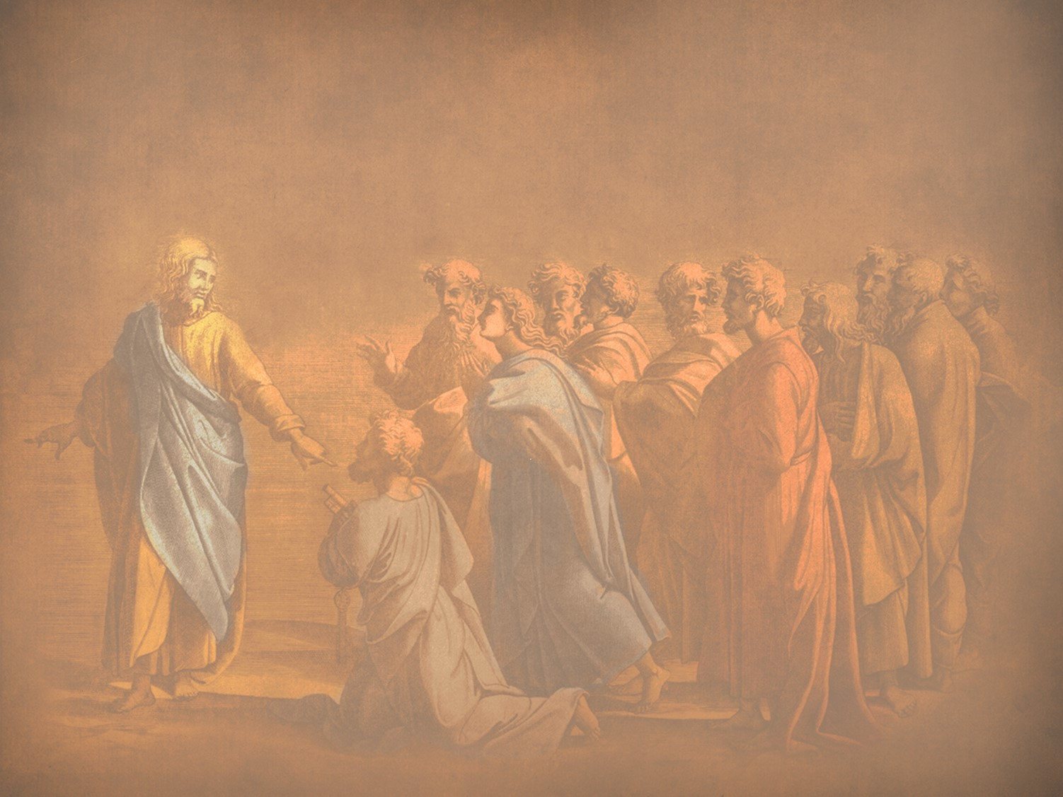
Instruction of the Twelve by the King
§§ 74-97
The Messiah withdraws from public ministry to teach the apostles how to continue the ministry the Father had entrusted to Him since His rejection would soon end in death
Section summaries based on J. Dwight Pentecost, A Harmony of the Words and Works of Jesus Christ (Grand Rapids: Zondervan, 1981)
Dr. Rick Griffith • Jordan Evangelical Theological Seminary • BibleStudyDownloads.org

Slide 2
Pentecost Outline
Introduction of the King
Authentication of the King
Controversy over the King
Instruction of the Twelve by the King
Opposition to the King
Preparation of the Disciples by the King
Official Presentation of the King
Preparation for the Death of the King
Rejection of the King
Resurrection of the King

Slide 3
A. Feeding the Five Thousand
§ 74
Matthew 14:13-21; Mark 6:30-44; Luke 9:10-17; John 6:1-13
Christ feeds 5000 as the New Moses of Deuteronomy 18:15 to teach how to shepherd with sufficiency in him, to confirm the believing, and to establish spiritual blindness of the unbelieving

Slide 4
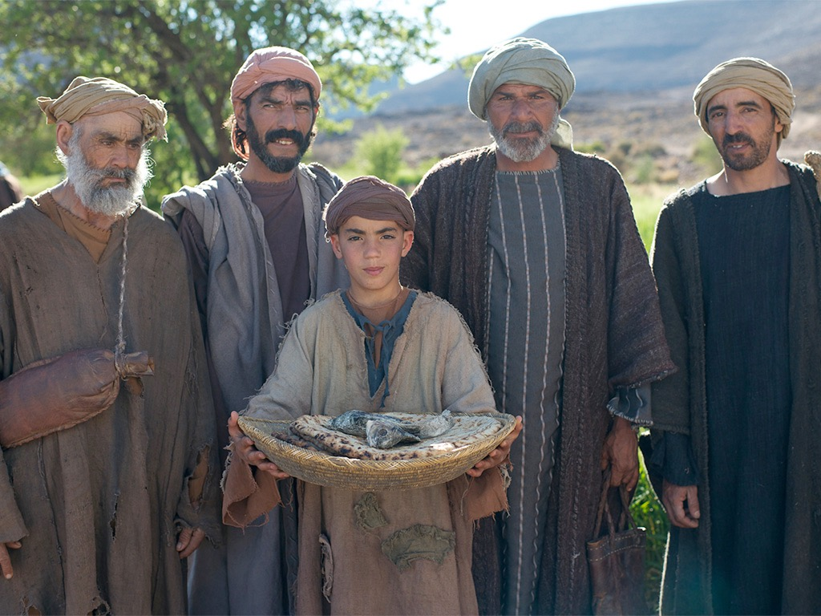

JESUS FEEDS 5000
Free
Bible
images
Matthew 14:13-22
Mark 6:31-46
Luke 9:10-17
John 6:1-13

Slide 5
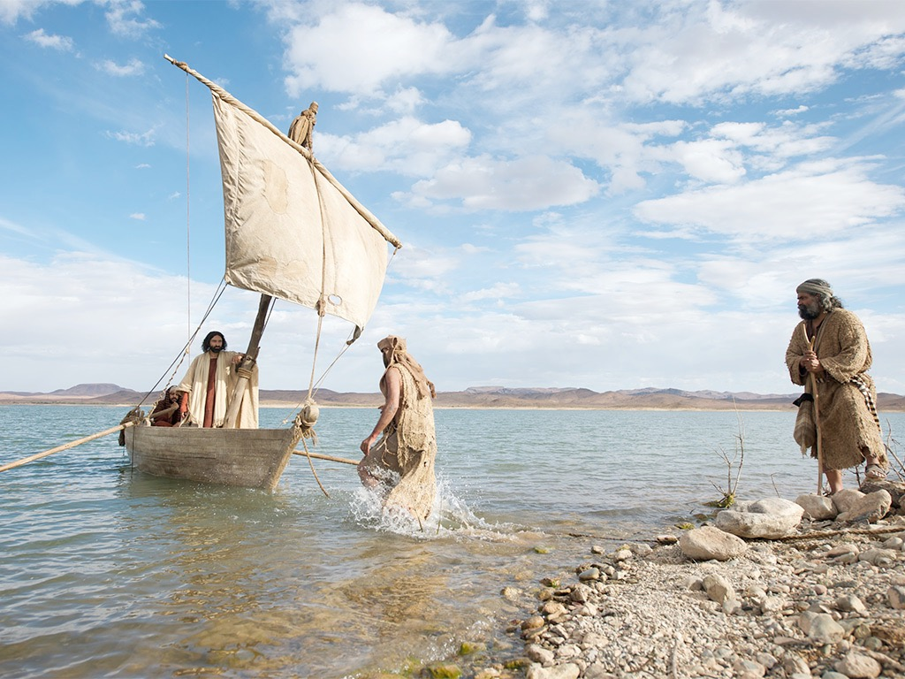

Slide 6
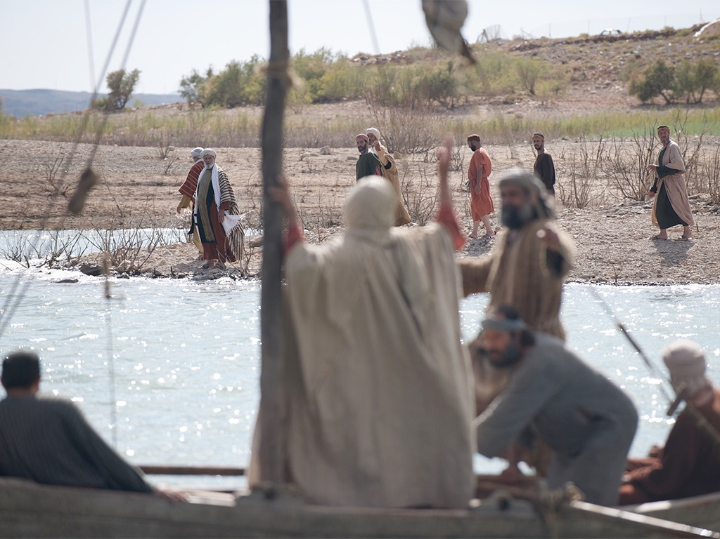

Slide 7
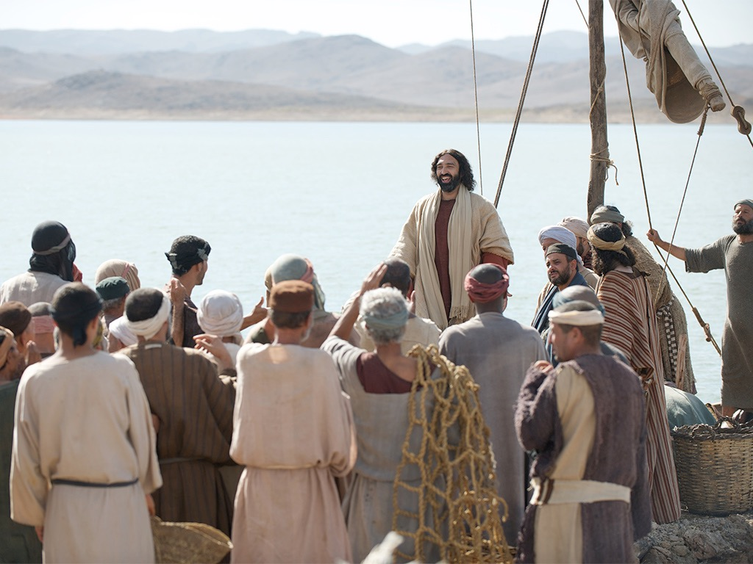

Slide 8
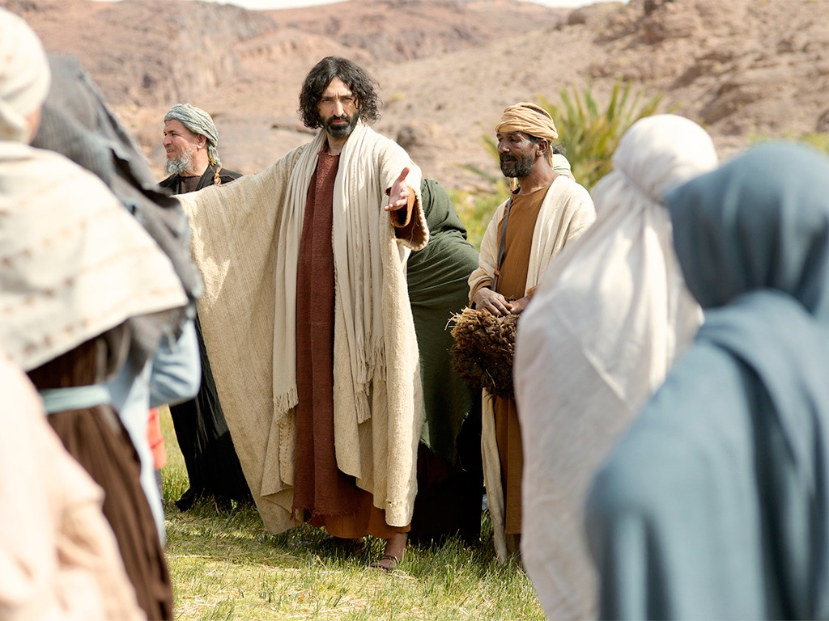

Slide 9
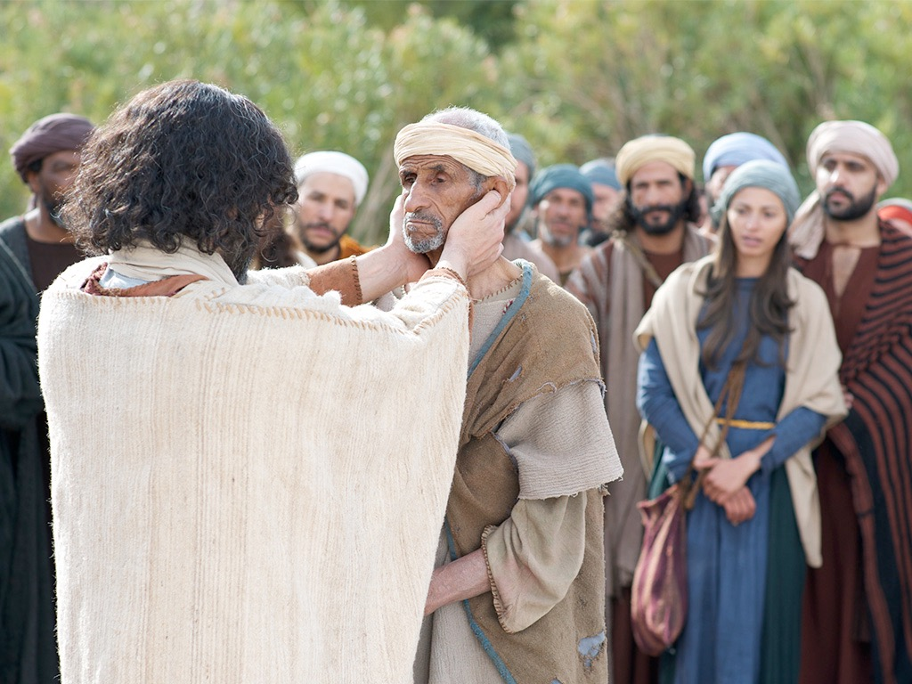

Slide 10
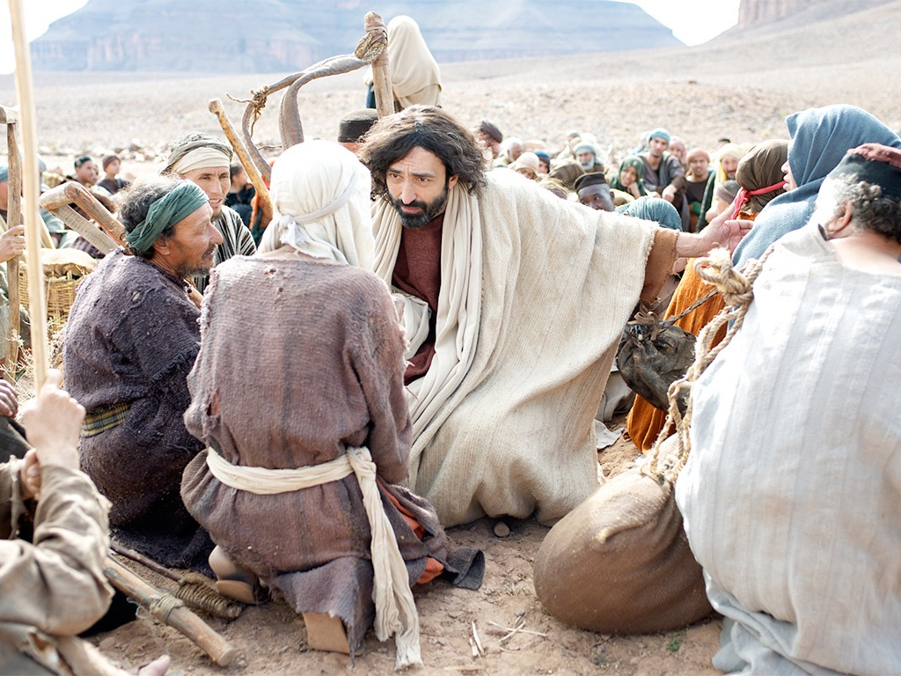

Slide 11
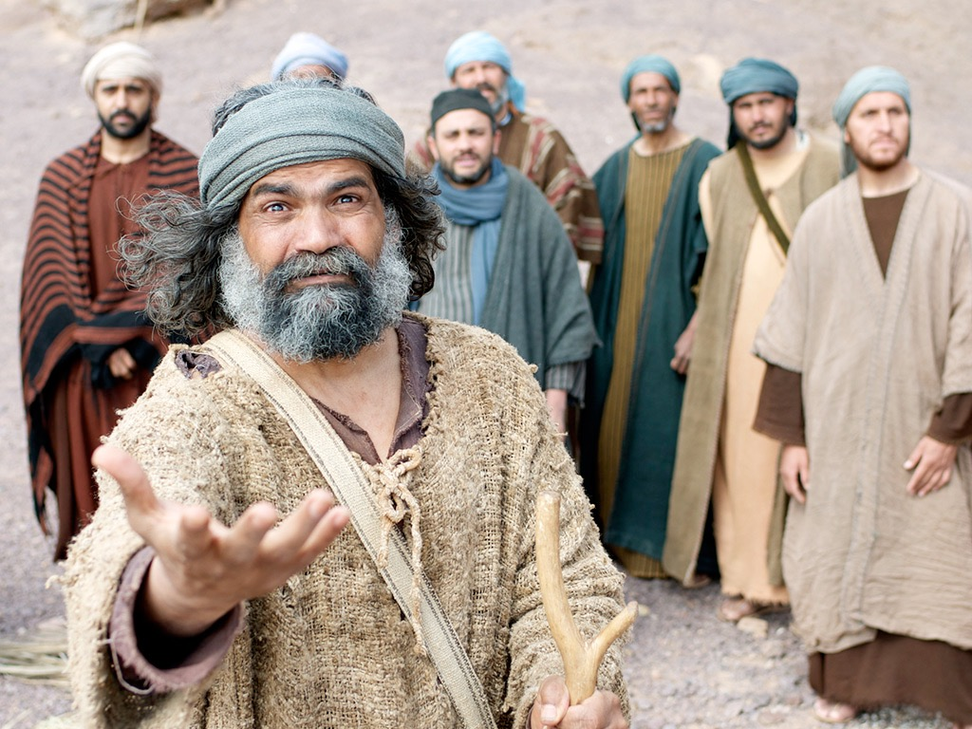

Slide 12
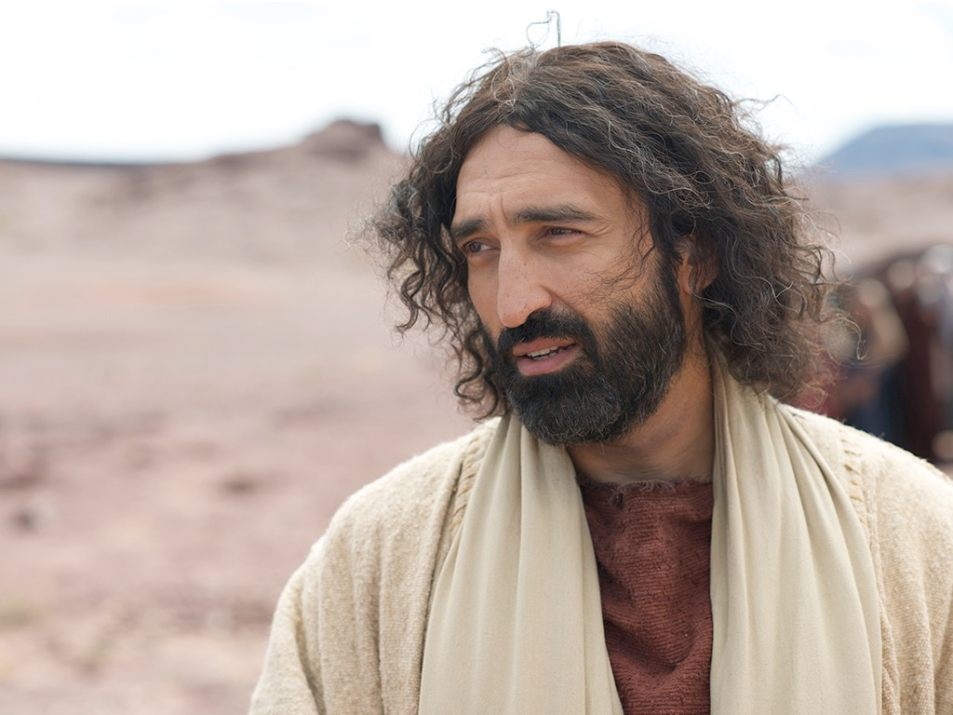

Slide 13
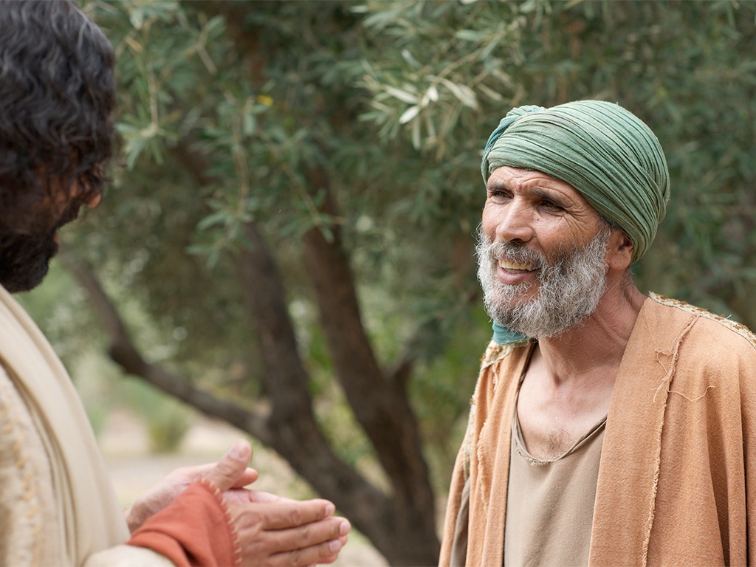

Slide 14
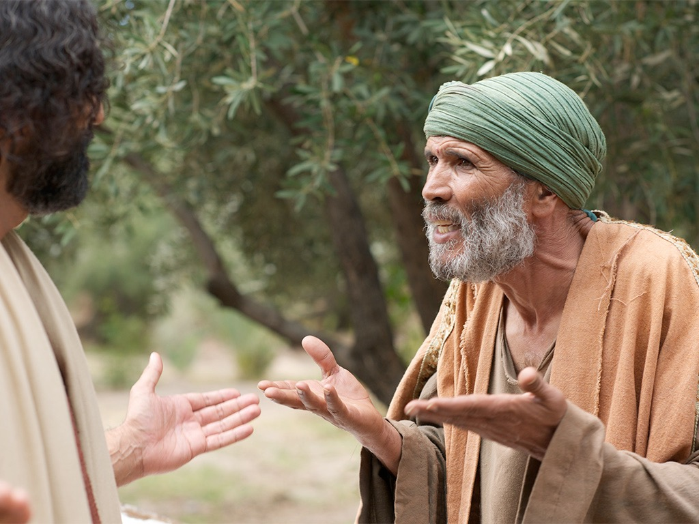

Slide 16
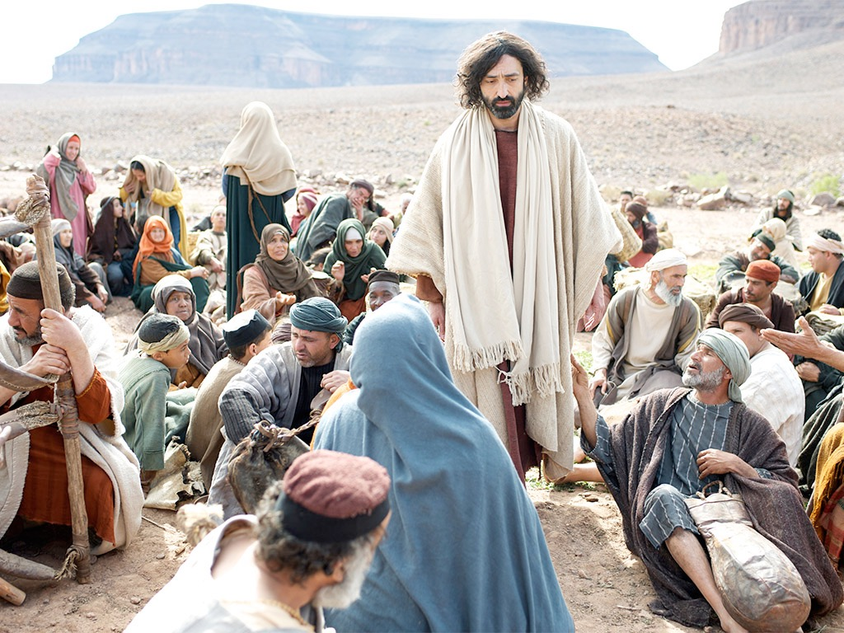

Slide 17
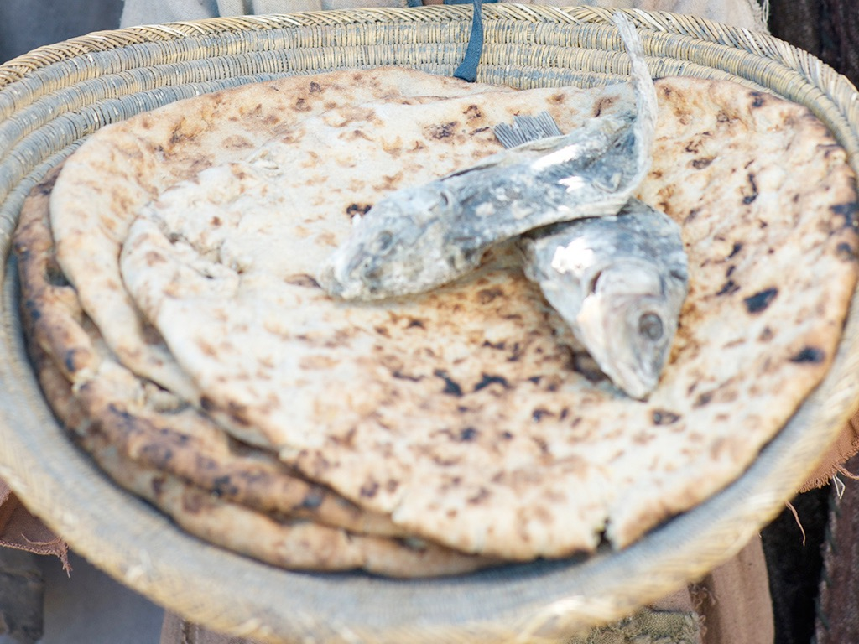

Slide 18
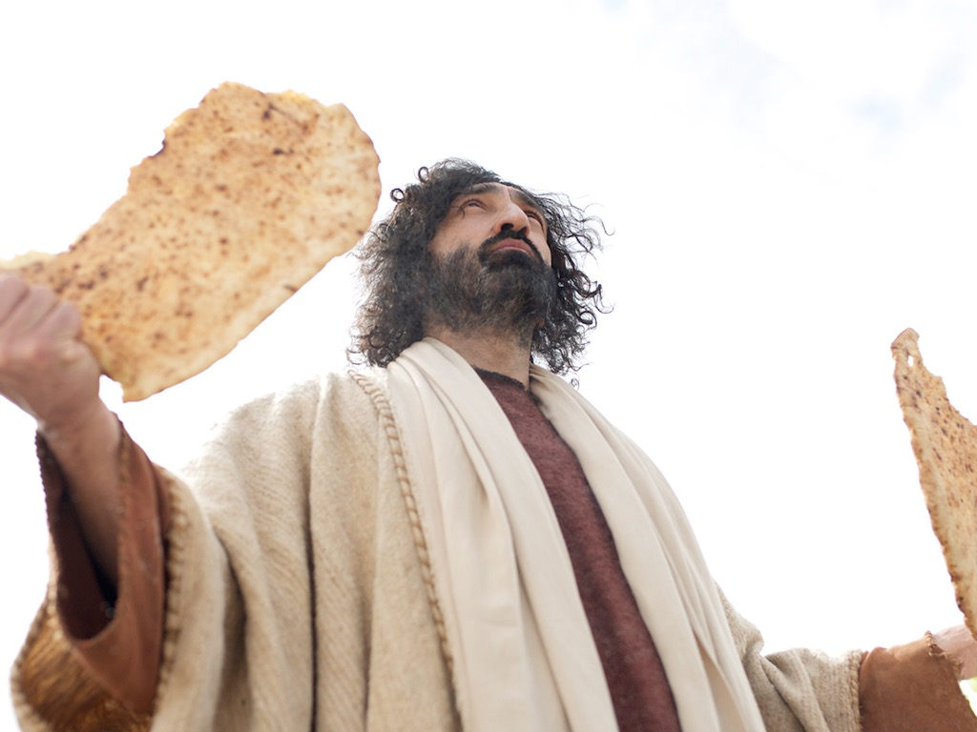

Slide 19
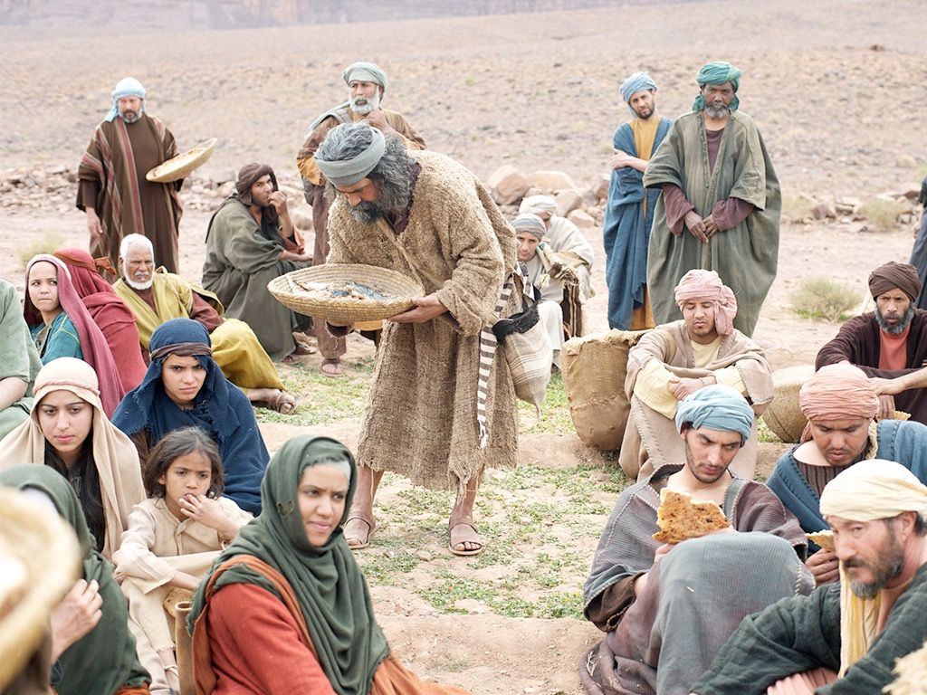

Slide 20
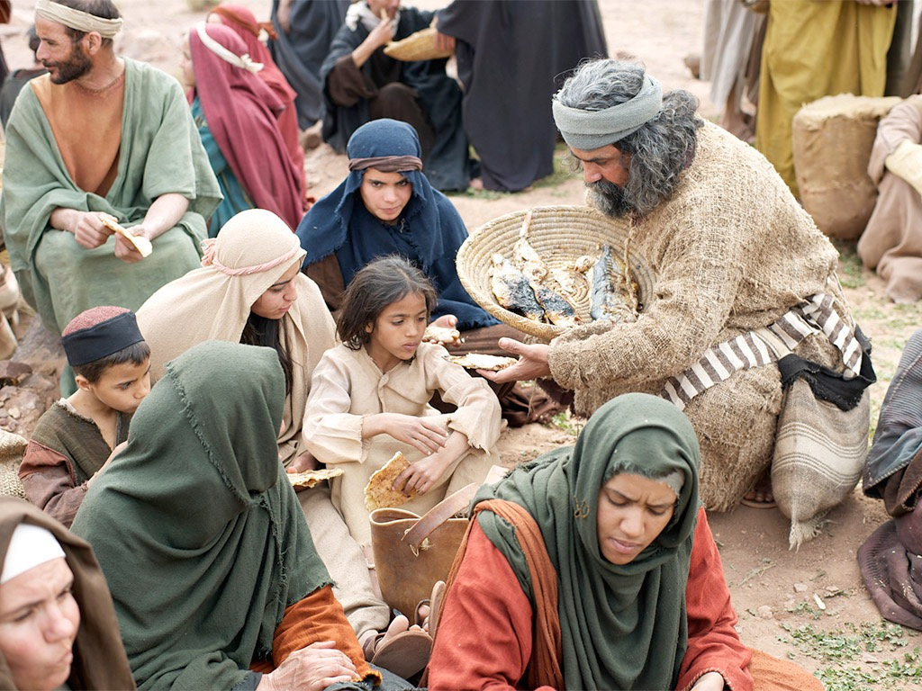

Slide 21
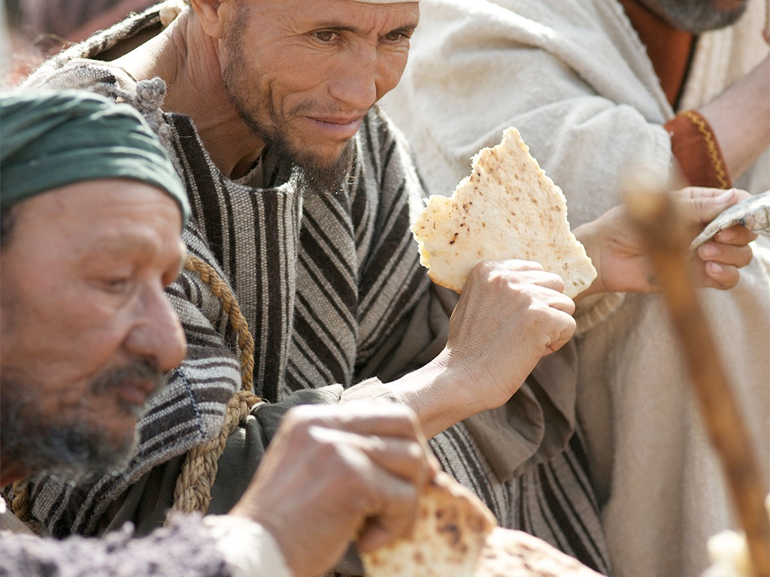

Slide 22
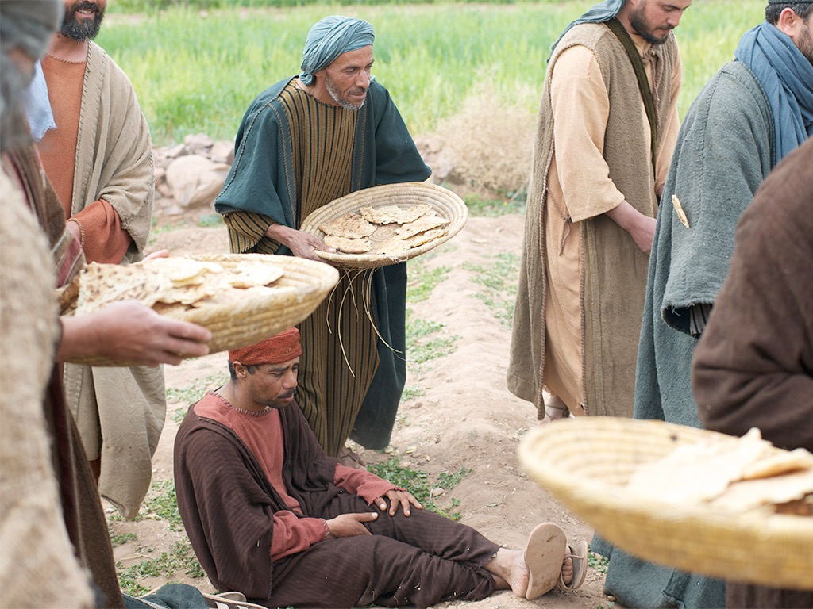

Slide 23
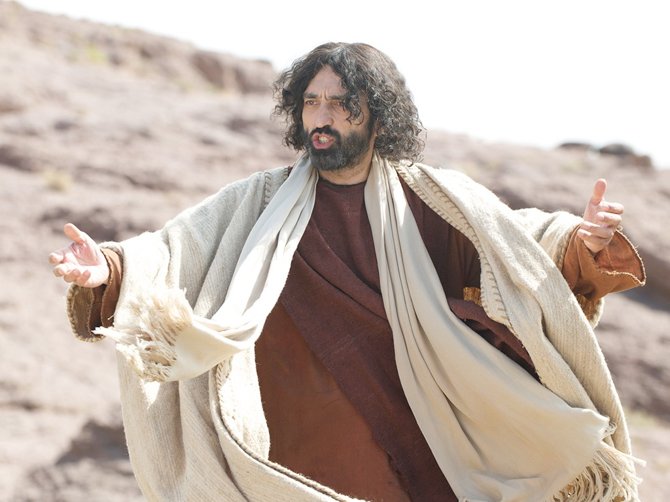

Slide 24
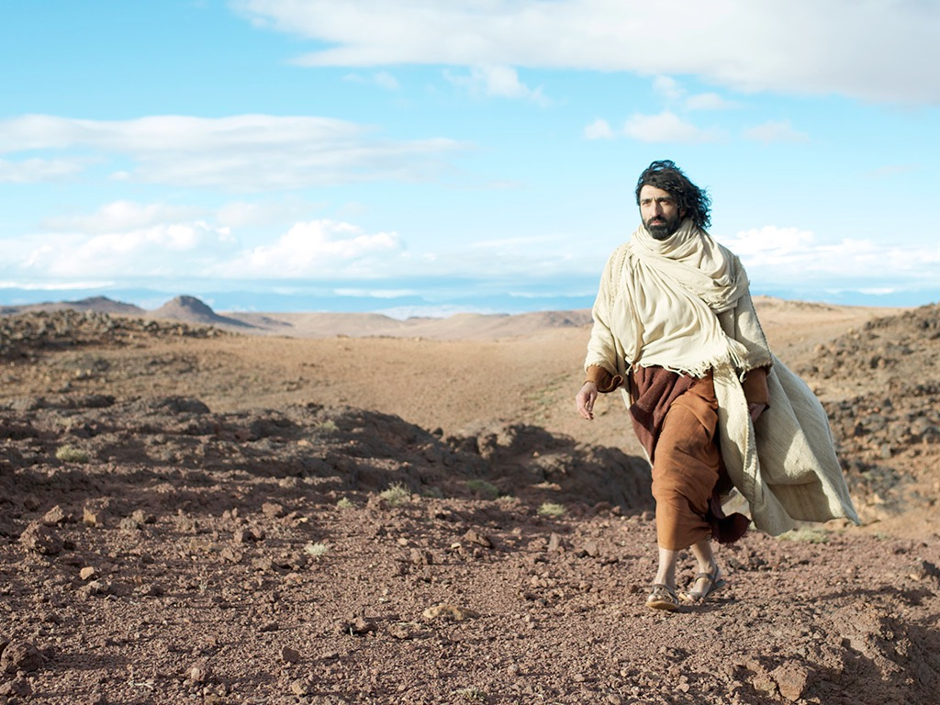

Slide 25
THE WORD IN PICTURES
Free
Bible
images

Slide 26

Used with Permission
THE
GOSPEL
——OF—— MATTHEW
THE
GOSPEL
——OF—— MARK
THE
GOSPEL
——OF—— LUKE
THE
GOSPEL
——OF—— JOHN
Due to the Lumo Project producing its own publishing material we regret to inform you that we cannot license our photos to other clients outside of freebibleimages.org.
These images are not licensed for reuse in video, epublishing or other media. Downloaded pictures and files cannot be redistributed through any other website than freebibleimages.org or used in any context where the accompanying message is undermining of the Christian faith and gospel.
Photos can only be used on educational presentations, blogs and social media, all of which should be accompanied with reference to www.LumoProject.com.
Picture courtesy of BBM
© All Rights Reserved.
www.bigbookmedia.com

Slide 27

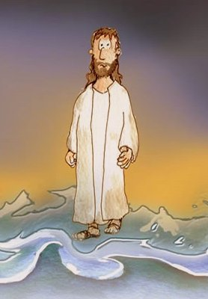
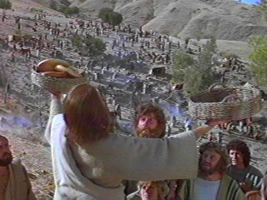
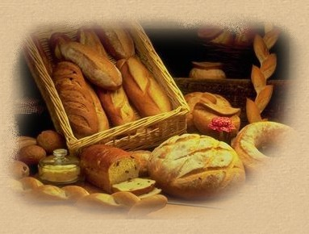
Can Jesus Prove It?
JOHN 6

Slide 28
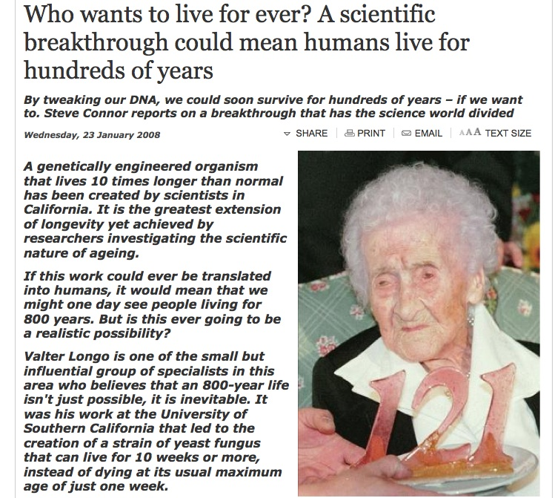
DNA Breakthrough!
Born in 1875, Jeanne Calment died in 1997 aged 122 years and 164 days

Slide 29
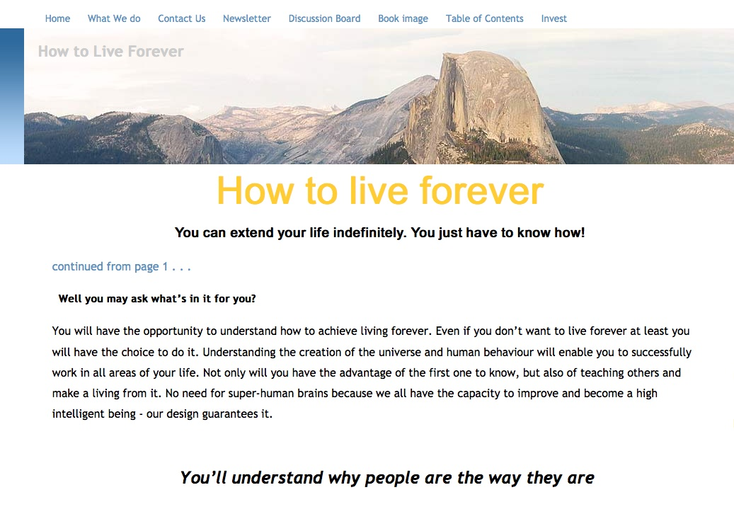
Howtoliveforever.net
You can have “youthful looks, improved appearance and attractiveness, and health and vitality well into your 70s, 80s, 90s, 100s, 1,000s . . . as long as you want.”

Slide 30

An Astonishing Claim!
“I tell you the truth, those who listen to my message and believe in God who sent me have eternal life. They will never be condemned for their sins, but they have already passed from death into life”
–– John 5:24
Notes:
Verse 26
Why did the crowd search for Jesus?
The crowd wants follow a prophet who will provide free food and political deliverance.

Slide 31
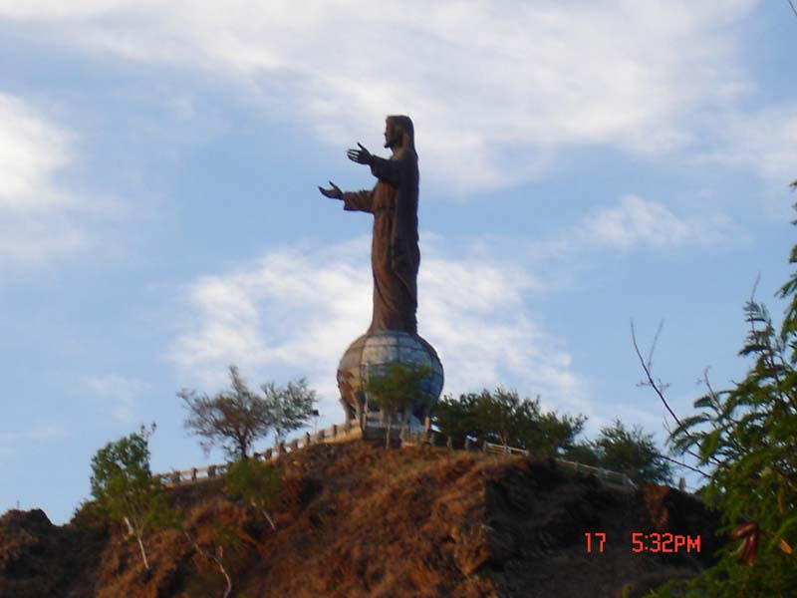

Subject
How do we know Jesus can give eternal life?
JOHN 6

Slide 32

3 MOVEMENTS:
Showing his Authority (1-21)
The Bread of Life (22-59)
Disciples desert Jesus (60-71)

Slide 33

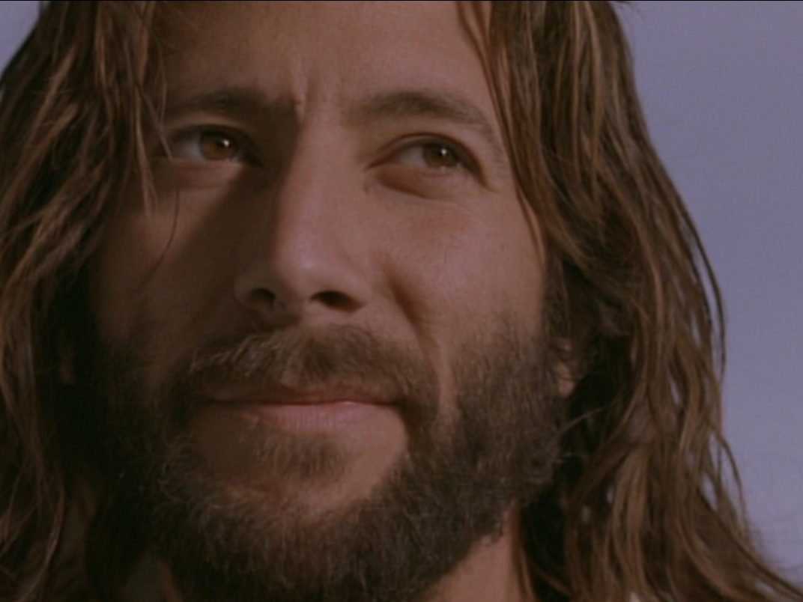

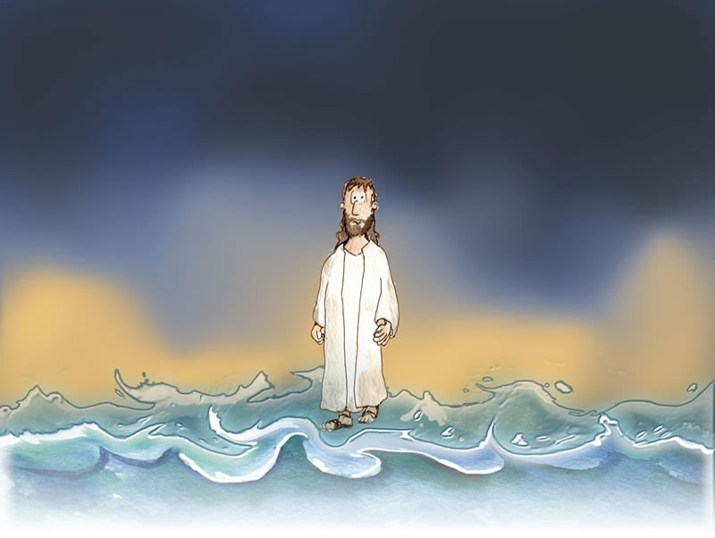
I. Jesus showed His authority over Moses and creation (6:1-21).
1-15
16-21

Slide 34
Feeding the 5000
Feeding the 5000
1-15

Slide 35
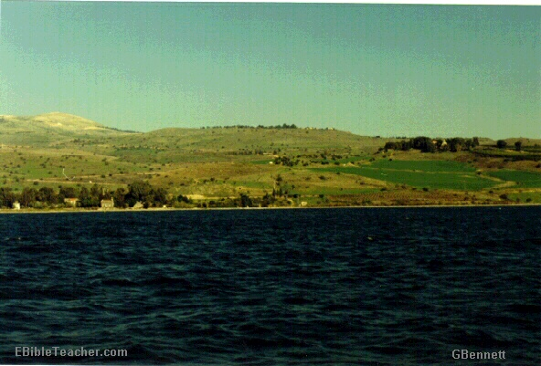
The Setting
Near Sea of Galilee
Notes:
Jesus went up to the mountain & Sat down to teach the disciples

Slide 36
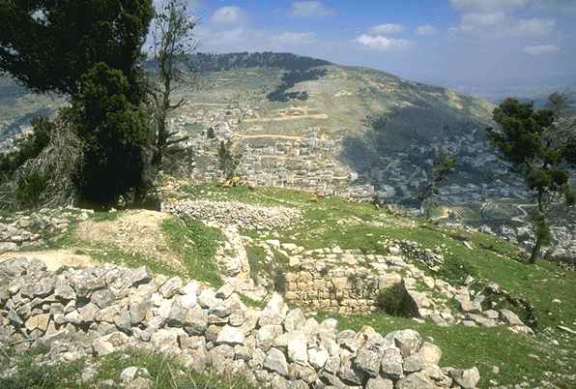
Verse 5-7
Notes:
Verse 5-7
Do you have faith in God?

Slide 37
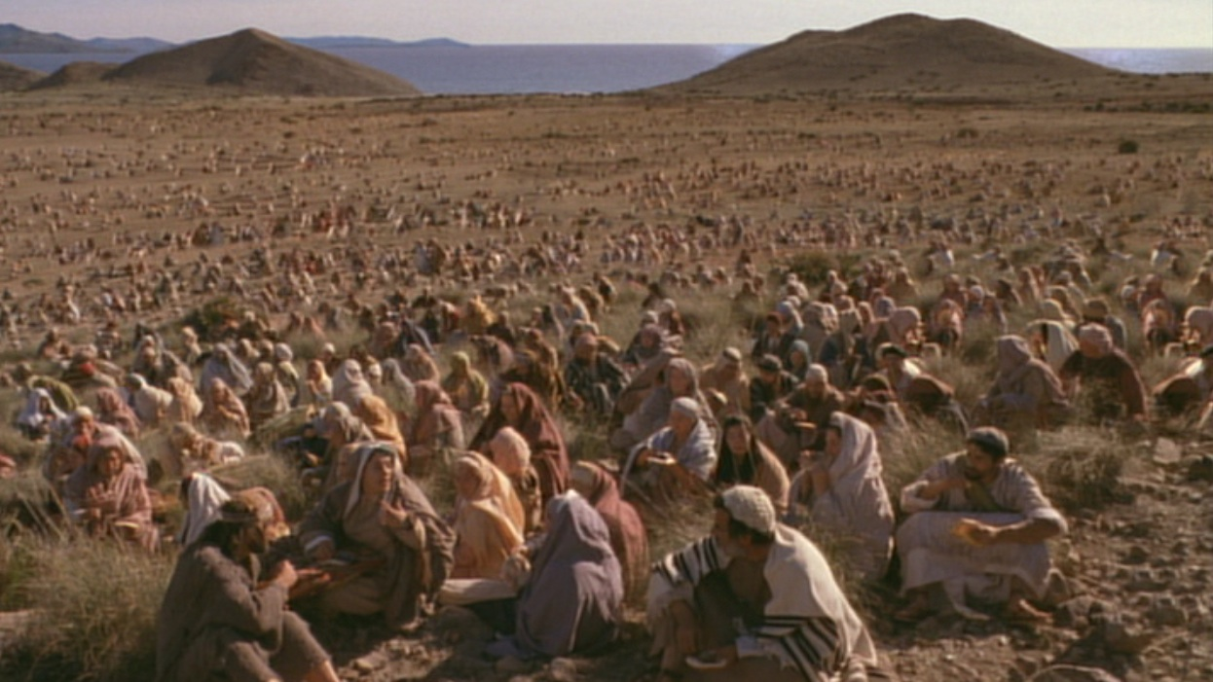
A huge crowd in a remote place
Notes:
Verse 5-7
Do you have faith in God?

Slide 38
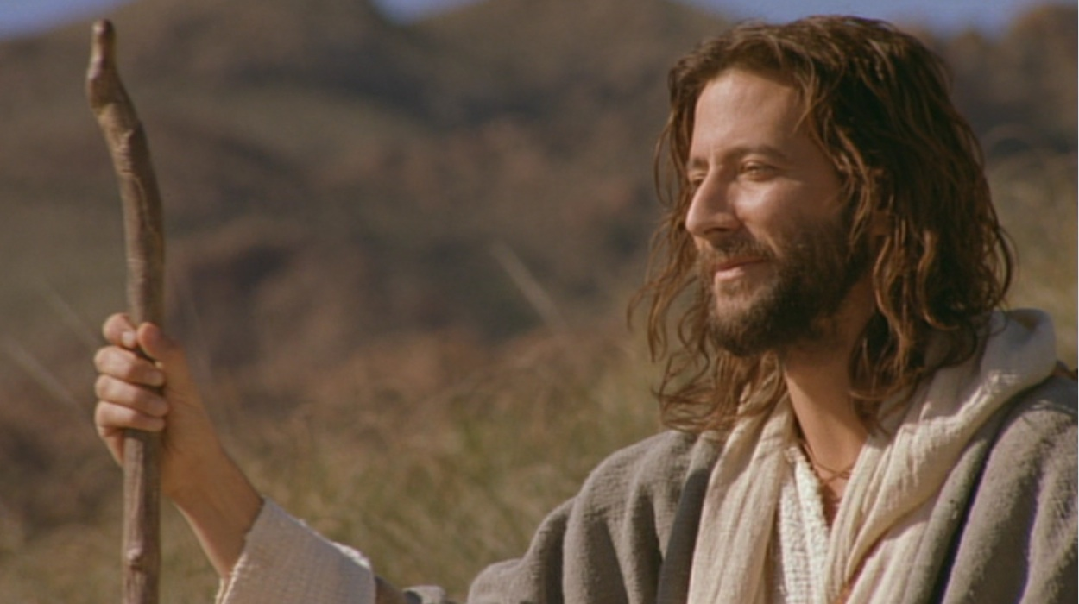
Verse 5-7
Where shall we buy bread for these people to eat?
Notes:
Verse 5-7
Do you have faith in God?

Slide 39
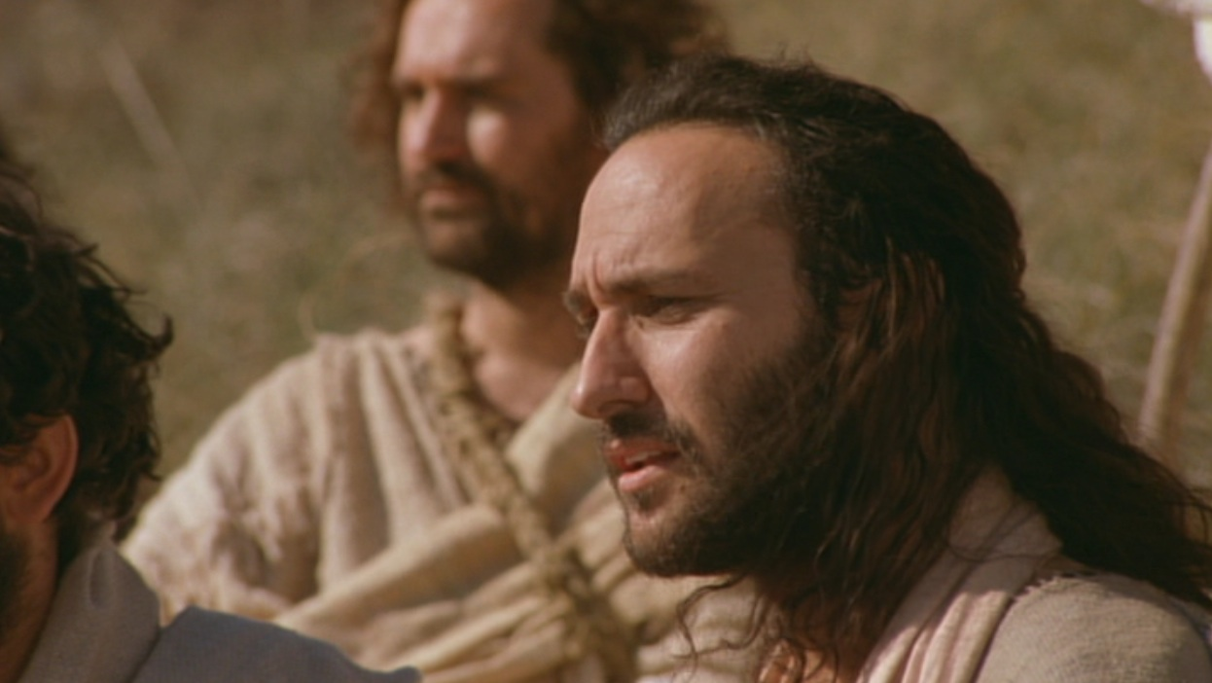
Verse 5-7
8 months’ wages would not buy enough bread for each one to have a bite!!
Notes:
Verse 5-7
Do you have faith in God?

Slide 40
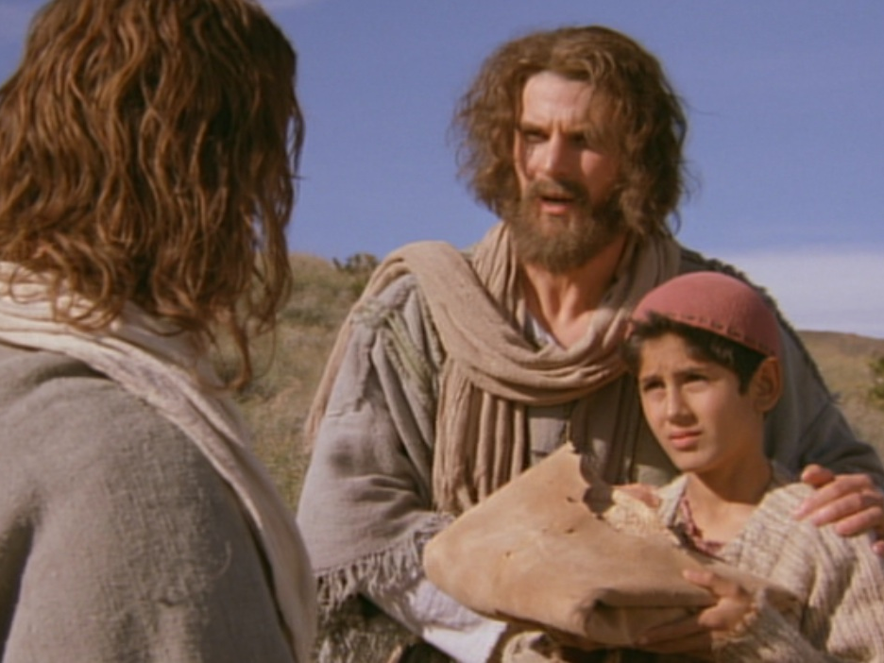
Andrew being helpful
“There’s a young boy here with five barley loaves and two fish. But what good is that with this huge crowd?”

Slide 41
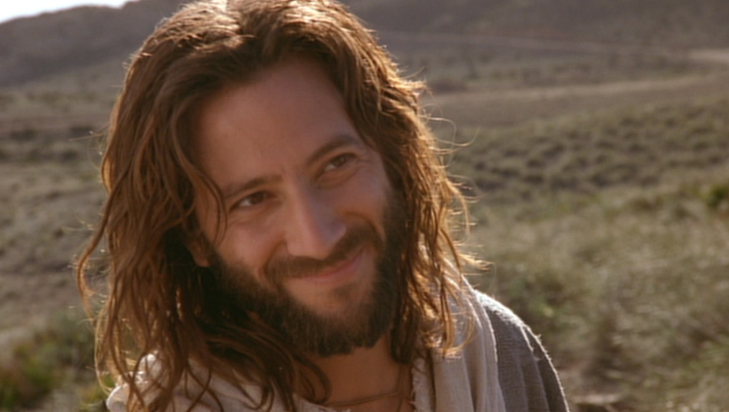
Verse 5-7
Tell everyone to sit down.
Notes:
Verse 5-7
Do you have faith in God?

Slide 42
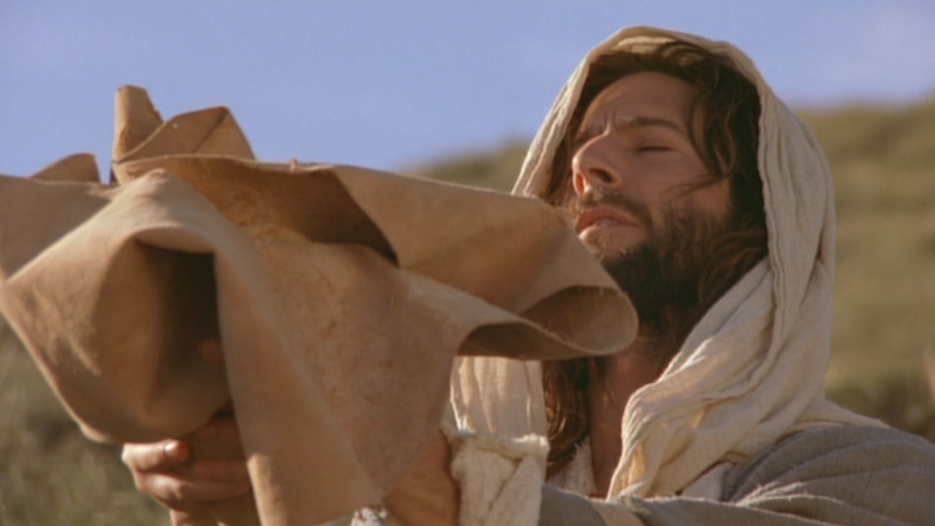
Verse 9-11
Jesus then took the loaves, gave thanks...
Notes:
Do you believe that God can use what you have and multiply it?

Slide 43
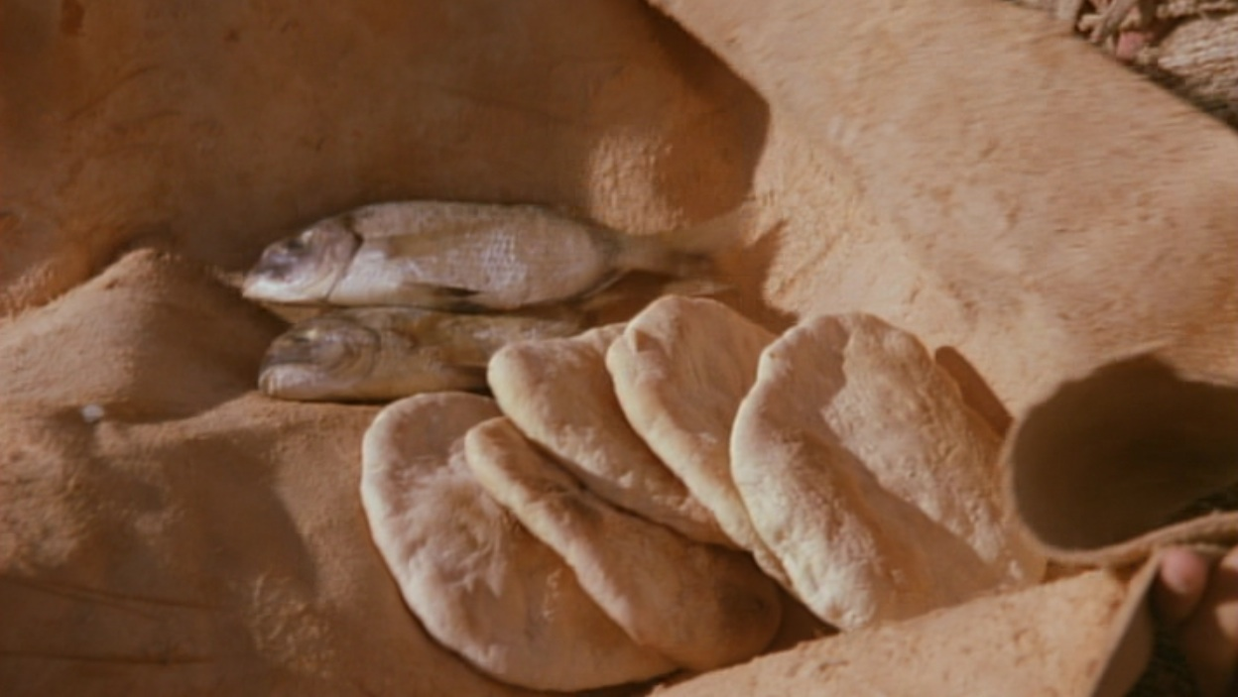
Verse 9-11
Jesus then took the loaves, gave thanks, and distributed to those who were seated as much as they wanted...
Notes:
Do you believe that God can use what you have and multiply it?

Slide 44
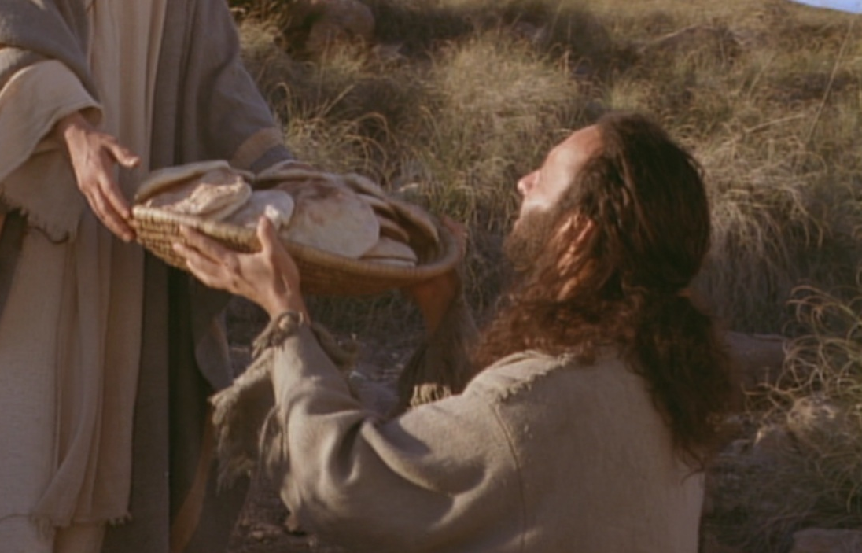
Bread Multiplied!

Slide 45
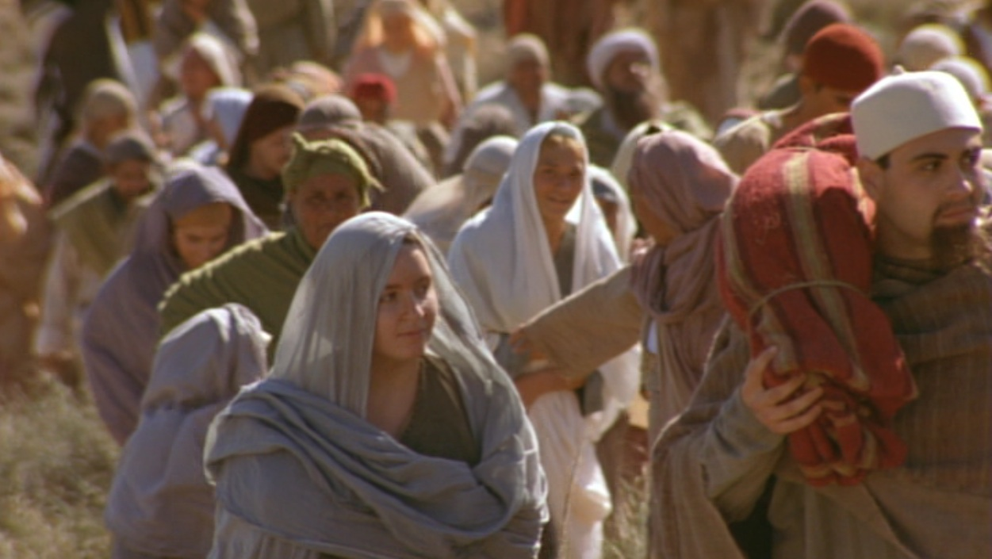
What’s the Point?
The crowd is the key!

Slide 46
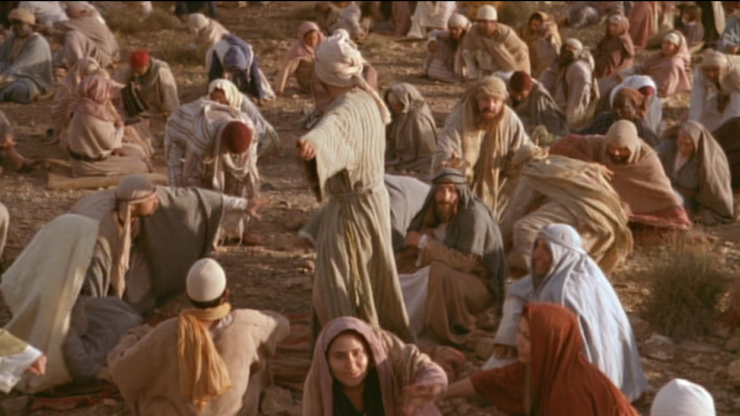
When the people saw him do this miraculous sign, they exclaimed,
“Surely, he is the Prophet we have been expecting!”
(6:24 NLT)

Slide 47

Prophecy of a Prophet given through Moses
(Deut. 18:15)
“I will raise up a Prophet like you from among their fellow Israelites. I will put my words in his mouth, and he will tell the people everything I command him.”

Slide 48
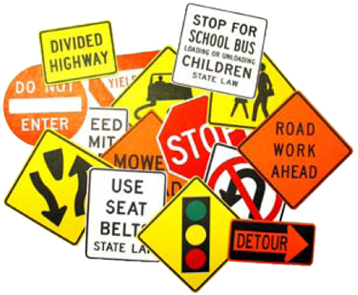

Signs in John’s Gospel
111
Signs unique to John's Gospel in yellow (6 of the 9 miracles)
WATER
TO WINE
2:1-11
HEALING
OFFICIAL’S
SON
4:46-54
HEALING
PARALYTIC
5:1-18
FEEDING
5000
6:1-15
WALKING
ON WATER
6:16-24
HEALING
BLIND MAN
9:1-7
RAISING
LAZARUS
11:1-45
CHRIST’S
RESURRECTION
20:1-31
FISH
CATCH
21:1-3

Slide 49
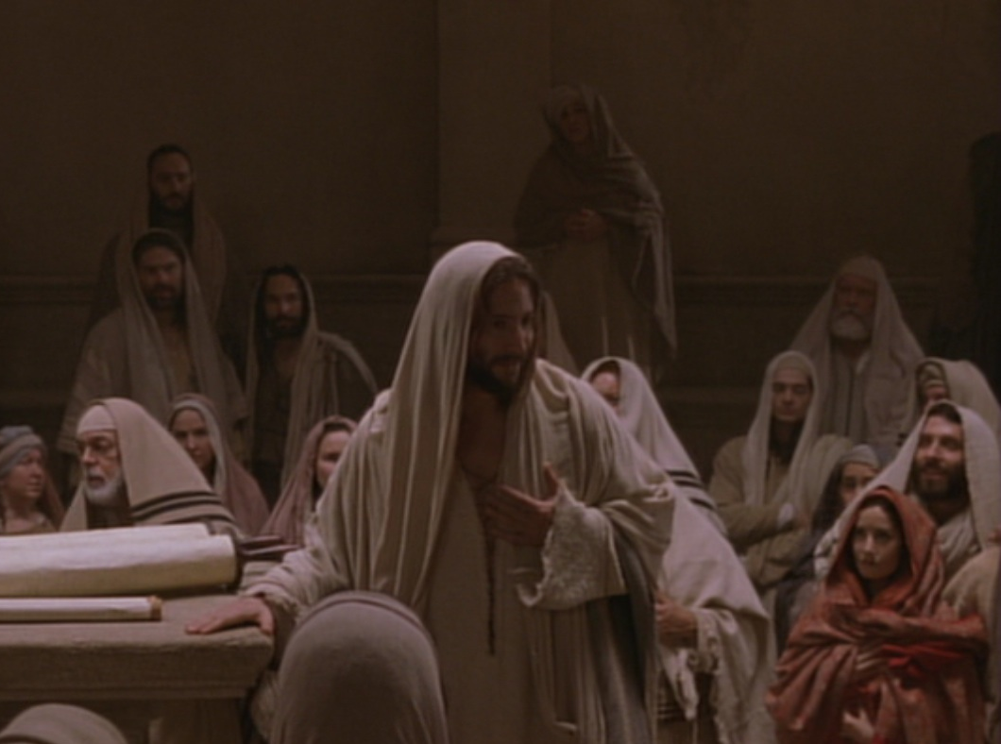
Key Word Believe
John
Key Verse
“Jesus did many other miraculous signs in the presence of his disciples, which are not recorded in this book. But these are written that you may believe that Jesus is the Christ, the Son of God, and that by believing
you may have life in his name” (20:30-31).

Slide 50
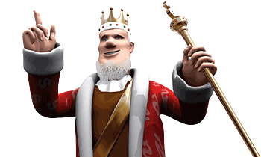
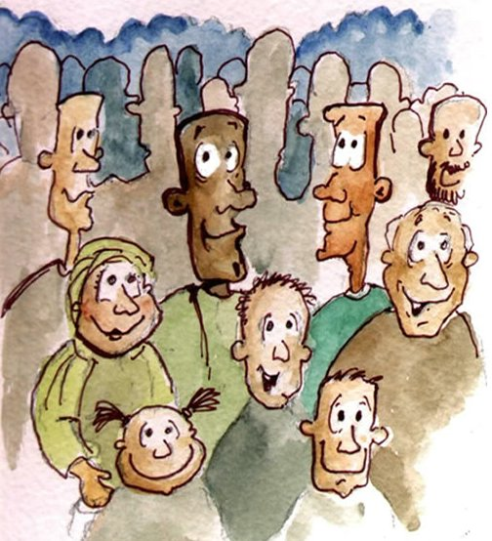
Verse 15
Notes:
Verse 15
who is this ‘prophet’ that the people are referring to?
“The Prophet” is the one prophesied by Moses (Deu 18:15). They acknowledge that Jesus was the Prophet who would come into the world to deliver them from the control of the Roman Empire.
Jesus knew that they want to make him king but he withdrew again to the mountains.

Slide 51
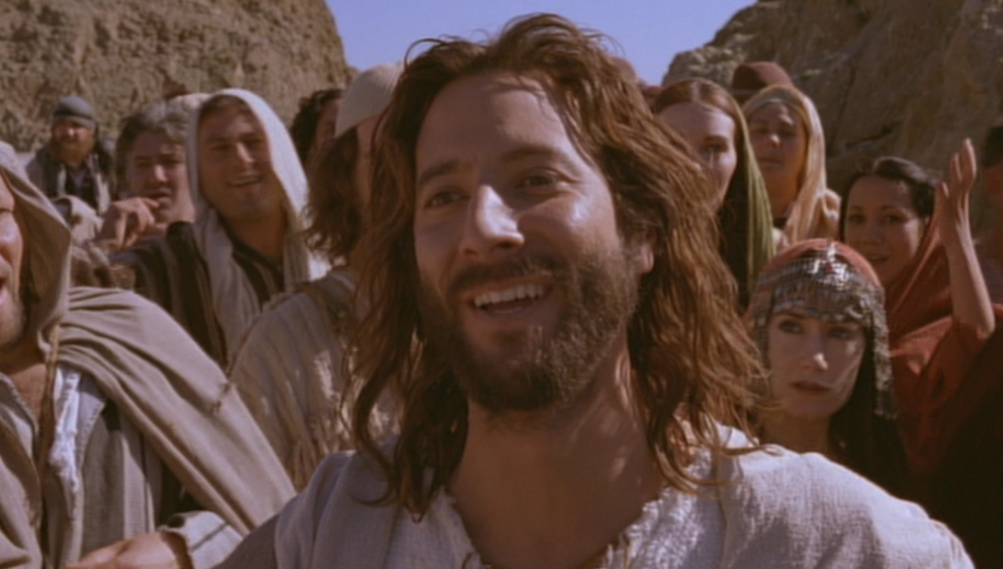
What’s the Point?
Jesus is the New Moses!
Jesus is even better than Moses!
MOSES
Predicted a Prophet
Gave manna from God
Sustained physical life
JESUS
Fulfilled the prediction
Is manna who IS God
Gives eternal life

Slide 52
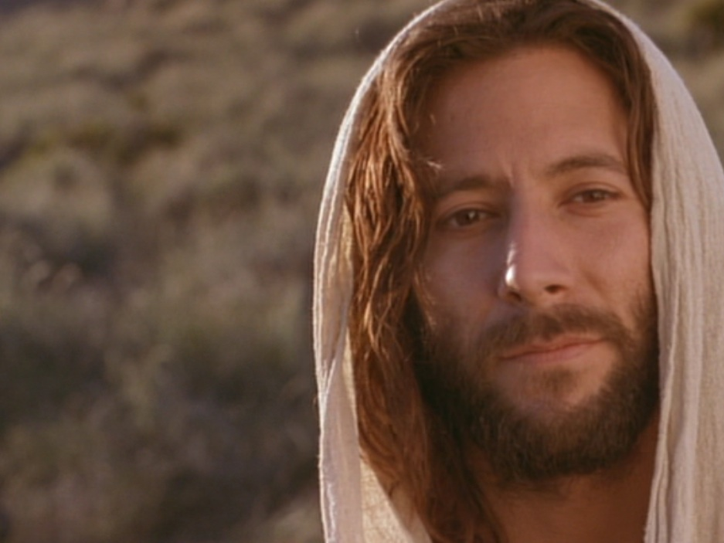
Jesus proved himself greater than Moses as the giver of eternal life by miraculously feeding 5000 Jews (6:1-15).

Slide 53
B. Rejection of an Offer to Make Christ King
§ 75
Matthew 14:22-23; Mark 6:45-46; John 6:14-15
Jesus rejects the offer of the 5000 to make him king as the New Moses of Deuteronomy 18:15 since Israel's leaders remained unbelieving so his rule would be only over Galilee

Slide 54
C. Instruction Through the Storm
§ 76
Matthew 14:24-33; Mark 6:47-52; John 6:16-21
Jesus walks on the water to rescue His disciples on the Sea in order to teach them that when obstacles come as they do His will His help is available and must be claimed by faith

Slide 55

Walking on Water (16-24)
WALKING ON WATER
16-21

Slide 56
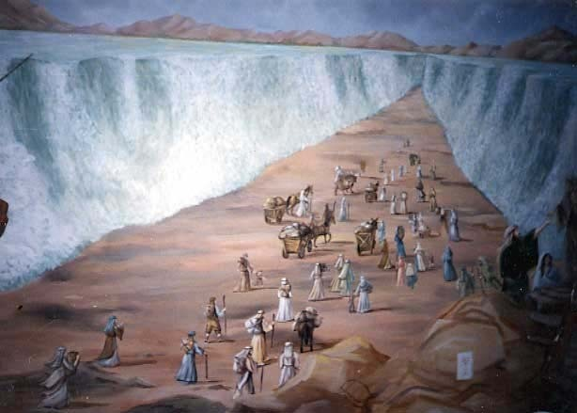
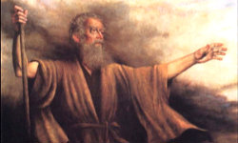
Moses Parting the Sea

Slide 57
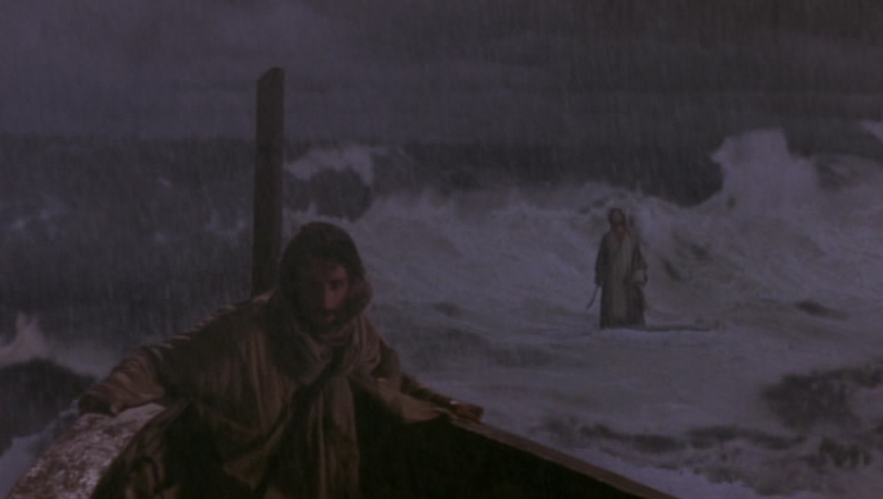
Jesus Walked on the Sea

Slide 58

ALTHOUGH LATER DISQUALIFIED, JESUS IS SPECTACULAR IN WINNING HIS FIRST SCHOOL SWIM RACE.

Slide 59

Jesus: “Don’t be afraid! It is I” (6:20)
KJV
NAS
NCV
NET
NIV
NKJV
NRSV

Slide 60
“Don’t be afraid! I am here” (6:20)
NLT

Slide 61

“Don’t be afraid! I Am!” (6:20)
Greek:

Slide 62


JOHN’S “I AM” STATEMENTS
111
1
MATTHEW
2
MARK
JEWS
ROMANS
“I am the Messiah” (4:26)
“Don’t be afraid. I am!” (6:20)
“I am the bread of life” (6:35)
“I am the light of the world” (8:12)
“Before Abraham was, I am” (8:58)
“I am the door [of the sheep]” (10:7)
“I am the good shepherd” (10:11, 14)
“I am the resurrection and the life” (11:25)
“I am the way, the truth, and the life” (14:6)
“I am the true vine” (15:1)
TO:
TO:
AS:
KING
AS:
SERVANT
WHAT
HE:
SAID
WHAT
HE:
DID
3
LUKE
TO:
GREEKS
AS:
GOD/MAN
WHAT
HE:
FELT
Notes:
John uses “I Am” 24 times—and only once is is NOT spoken by Jesus. In John 9:9 the formerly blind man says to those who doubt that it is really him, “I am he.” Otherwise, this is clearly a divine title for Christ used by John, with the direct quote of God to Moses in Exodus 3:14.

Slide 63

The Burning Bush
Exodus 3:1–4:17

Slide 64


EXCUSES
God replied to Moses, “I Am Who I Am. Say this to the people of Israel: I Am has sent me to you”
(Exodus 3:14 NLT).
1. Who am I (3:11)?
2. Who are You (3:13)?
3. What if I fail (4:1)?
4. I’m not gifted (4:10)
5. I don’t want to get involved (4:13)

Slide 65
D. Reception in Gennesaret
§ 77
Matthew 14:34-36; Mark 6:53-56
Christ instills in His disciples through continued healings that what He accomplished in the physical realm represents what He desired to perform for people in the spiritual realm if they trust Him in faith

Slide 66
E. Instruction Concerning the Bread of Life
§ 78
John 6:22-71
Through His claim to be the true bread from heaven Christ teaches His disciples that He did not come to give physical bread but the new heavenly bread, which is eternal life

Slide 67
I. Jesus showed His authority over Moses and creation (6:1-21).
1-15
16-21

Slide 68

II. Jesus satisfies our spiritual hunger by giving us eternal life (6:22-59).

Slide 69

Two Foods
Unlike food that spoils,
Jesus gives eternal life (6:22-27).

Slide 70

Verse 26
Jesus answered, “I tell you the truth, you are looking for me, not because you saw miraculous signs but because you ate the loaves and had your fill” (John 6:26)
Notes:
Verse 26
Why did the crowd search for Jesus?
The crowd wants follow a prophet who will provide free food and political deliverance.

Slide 71

Verse 27
Do not work for food that spoils,
Do not work for food that spoils, but for food that endures to eternal life, which the Son of Man will give you.
Notes:
Verse 27
What is the meaning behind these verses?
The people’s work should have been directed to a food that endures. Jesus explains the meaning of preservation, namely eternal life. The source of eternal life is the Son of Man. He is the one who gives eternal life, the food that does not perish. Jesus turned the concern of the Jews on its head and defined the assuring work not as usual labor but as believing Him. Both believing and obeying are parallel ways one acknowledges dependence on God.

Slide 72

Two Works
Unlike human effort,
Jesus enables us to do God’s work by believing in Him (6:28-29).
Notes:
They replied, “We want to perform God’s works, too. What should we do?” Jn 6:28 NLT

Slide 73

Two Breads
Unlike manna God gave via Moses, Jesus is the true “Bread” from heaven that gives eternal life
(6:30-33).

Slide 74

Two Results
Unlike bread that only sustains physical life, belief in Christ gives eternal life (6:34-59).

Slide 75

III. Jesus’ claim to be the only source of life forces a decision (6:60-71).

Slide 76


Disciples desert Jesus (60-71)
Disciples desert Jesus (61-71)
“At this point many of his disciples turned away and deserted him”
(John 6:66).

Slide 77

The Twelve stayed because 11 of them believed He was God’s Son (6:67-71).

Slide 78

The Main Idea of John 6
Since Christ has authority over creation, trust Him to give you eternal life!

Slide 79

Disbelief?

Slide 80

Or Belief?
“You are the holy one of God!”

Slide 81
F. Instruction Concerning Defilement
§ 79
Matthew 15:1-20; Mark 7:1-23; John 7:1
Christ trains the disciples in the real, inner source of defilement to reveal how the Pharisees violate the law with their traditions in their uncleanness due to their heart condition

Slide 82
G. Reception in Tyre and Sidon
§ 80
Matthew 15:21-28; Mark 7:24-30
Through the healing of the Canaanite woman's demon-possessed daughter Christ schools His disciples how while it was premature for Gentiles to receive kingdom blessings until Israel repents, personal needs can be met through individual faith in His person

Slide 83

Free
Bible
images
A SYROPHOENICIAN WOMAN
BEGS JESUS FOR HELP
Mark 7:24-30

Slide 84


Slide 85


Slide 87


Slide 88


Slide 89


Slide 90


Slide 91


Slide 92


Slide 93


Slide 94


Slide 95
Used with Permission
THE
GOSPEL
——OF—— MATTHEW
THE
GOSPEL
——OF—— MARK
THE
GOSPEL
——OF—— LUKE
THE
GOSPEL
——OF—— JOHN
Due to the Lumo Project producing its own publishing material we regret to inform you that we cannot license our photos to other clients outside of freebibleimages.org.
These images are not licensed for reuse in video, epublishing or other media. Downloaded pictures and files cannot be redistributed through any other website than freebibleimages.org. or used in any context where the accompanying message is undermining of the Christian faith and gospel.
Photos can only be used on educational presentations, blogs and social media, all of which should be accompanied with reference to www.LumoProject.org.
Picture courtesy of BBM
© All Rights Reserved.
www.bigbookmedia.com

Slide 96
H. Reception in Decapolis
§ 81
Matthew 15:29-38; Mark 7:31-8:9a
By healing the deaf and dumb man and feeding the four thousand Gentiles, Christ instructs His men on the need to minister to Gentiles as well as Jews and, though inadequate for the task, to do this through His power

Slide 97
I. Rejection in Magadan
§ 82
Matthew 15:39–16:4; Mark 8:9b-12
Jesus refuses to give another sign to the unbelieving religious leaders except for His resurrection because they were rejecting Him in unbelief, not because sufficient signs had been lacking

Slide 98
J. Warning Against Rejection
§ 83
Matthew 16:5-12; Mark 8:13-26
Christ warns His disciples against the hypocritical attitude of the Pharisees and Herod that led them to reject Him so His men would be aware of possible attitudes in themselves

Slide 99
K. Confession of Peter
§ 84
Matthew 16:13-20; Mark 8:27-30; Luke 9:18-21
Upon Peter's affirmation of Christ's deity Jesus reveals for the first time that Peter and all the Twelve will exercise authority to make official pronouncements already made by God in a new organism, the Church

Slide 100


¹³ When Jesus came to the region of Caesarea Philippi, he asked his disciples, “Who do people say the Son of Man is?”
¹⁴ They replied, “Some say John the Baptist; others say Elijah; and still others, Jeremiah or one of the prophets.”
¹⁵ “But what about you?” he asked. “Who do you say I am?”
¹⁶ Simon Peter answered, “You are the Messiah, the Son of the living God.”
Matthew 16:13-20 (NLT)

Slide 101
¹⁷ Jesus replied, “Blessed are you, Simon son of Jonah, for this was not revealed to you by flesh and blood, but by my Father in heaven.
¹⁸ And I tell you that you are Peter, and on this rock I will build my church, and the gates of Hades will not overcome it.
¹⁹ I will give you the keys of the kingdom of heaven; whatever you bind on earth will be bound in heaven, and whatever you loose on earth will be loosed in heaven.”
²⁰ Then he ordered his disciples not to tell anyone that he was the Messiah.
Matthew 16:13-20 (NLT)

Slide 102

Jesus taught en route to Jerusalem that his disciples will be resisted
(Mark 8:27–10:52).

Slide 103
L. Instruction Concerning His Death
§ 85
Matthew 16:21-23; Mark 8:31-33; Luke 9:22
Christ tells the disciples that he would soon die in Jerusalem by the religious leaders but would rise the third day, which Peter opposes because he did not see the need for Christ's sacrifice for sin

Slide 104
16:13–20:34
Outline
73
IV. (11:1–16:12) Christ is rejected as Messiah in anticipation of the final crucifixion rejection, so He introduces the Interadvent Age before His future reception and ministers to Gentiles to teach the postponement of the kingdom.
V. (16:13–20:34) Christ prepares His disciples regarding His Person and program in order that His Messianic authority might be delegated to them after His death.

Slide 105
M. Instruction Concerning Discipleship
§ 86
Matthew 6:24-28; Mark 8:34–9:1; Luke 9:23-27
A true disciple must submit not to the Pharisees but to Jesus since he would judge Israel and rule as Messiah
Notes:
English edited

Slide 106
N. Revelation of the Kingdom
§ 87
Matthew 17:1-8; Mark 9:2-8; Luke 9:28-36
Three disciples see Christ’s glory as he promised a week earlier as a foretaste of his reign at the Second Advent and to authenticate Christ as One worthy of obedience
Notes:
The three Synoptic Gospels all record the Transfiguration of Jesus. Here is the only glimpse of the true nature of Christ that we find in the gospels as no one sees him in his full glory during his earthly life—and the Transfiguration was only for a few moments. God, in his mercy, did not let people view the glorified Christ lest they die in doing so! But this experience on the mountain (probably Mount Tabor) lifted the veil, as it were, so that at least Peter, James, and John could imagine the glory of Jesus when he reigns in the millennial kingdom.
_____________
LC-04-Instruction of the Twelve-106
NS-01-Matt15-18—slide 12
NS-02-Mark9-16—slide 3
NS-03-Luke1-12—slide 386

Slide 107

Carl Bloch, c. 1865
Transfiguration of Jesus
Mark 9:2-13 (ESV)
Notes:
Today’s scripture, found in Mark chapter 9, vs 2-13 is also about a transformation. This transformation is known as the Transfiguration of Jesus.
Transformation is an important theme in the Bible. The passage we read together earlier was from Paul’s letter to the Romans, ch 8 vs 19-30 was about transformation. As we saw in Romans 8:30, reading now from the ESV, Paul writes that “and those whom he predestined he also called, and those whom he called he also justified, and those whom he justified he also glorified.”
To go from sin and suffering to being called, justified, and glorified is an extreme transformation. So how do we get to that transformation? We look to Jesus. That is what we are going to do today. We will look at Jesus and his “transfiguration” or “transformation.”
We will see how it affected the disciples and how it should affect us.

Slide 108
Why only Peter, James, and John?
Mk 9:2-13 Transfiguration
Mk 14:33 Gethsemane
With Andrew
Mk 1:29-30 Peter’s Mother-in Law
Mk 13:3 Olivet Discourse

Slide 109
² And after six days Jesus took with him Peter and James and John, and led them up a high mountain by themselves.
Mark 9:2-13 (ESV)
Notes:
Now we pick in in Mark ch 9 vs 2

Slide 110

How do you recharge?
Mark 6:30-32
³⁰ The apostles returned to Jesus and told him all that they had done and taught. ³¹ And he said to them, “Come away by yourselves to a desolate place and rest a while.” For many were coming and going, and they had no leisure even to eat. ³² And they went away in the boat to a desolate place by themselves.

Slide 111
² And after six days Jesus took with him Peter and James and John and led them up a high mountain by themselves. And he was transfigured before them, ³ and his clothes became radiant, intensely white, as no one on earth could bleach them. ⁴ And there appeared to them Elijah with Moses, and they were talking with Jesus.
Mark 9:2-13 (ESV)
Notes:
Now we pick in in Mark ch 9 vs 2

Slide 112

What did they see?
John 20:15 . . . Supposing him to be the gardener

Slide 113

Revelation 1
¹² Then I turned to see the voice that was speaking to me, and on turning
I saw seven golden lampstands,
¹³ and in the midst of the lampstands one like a son of man, clothed with a long robe and with a golden sash around
his chest. ¹⁴ The hairs of his head were white, like white wool, like snow. His eyes were like a flame of fire, ¹⁵ his feet were like burnished bronze, refined in a furnace, and his voice was like the roar of many waters
¹⁶ In his right hand he held seven stars, from his mouth came a sharp two-edged sword, and his face was like the sun shining in full strength.

Slide 114
² And after six days Jesus took with him Peter and James and John, and led them up a high mountain by themselves. And he was transfigured before them, ³ and his clothes became radiant, intensely white, as no one on earth could bleach them. ⁴ And there appeared to them Elijah with Moses, and they were talking with Jesus.
Mark 9:2-13 (ESV)
Notes:
Now we pick in in Mark ch 9 vs 2

Slide 115

Jesus
Moses
Elijah

Slide 116
² And after six days Jesus took with him Peter and James and John, and led them up a high mountain by themselves. And he was transfigured before them, ³ and his clothes became radiant, intensely white, as no one on earth could bleach them. ⁴ And there appeared to them Elijah with Moses, and they were talking with Jesus. ⁵ And Peter said to Jesus, “Rabbi, it is good that we are here. Let us make three tents, one for you and one for Moses and one for Elijah.” ⁶ For he did not know what to say, for they were terrified.
Mark 9:2-13 (ESV)
Notes:
How do the disciples respond?

Slide 117
O. Instruction Concerning Elijah
§ 88
Matthew 17:9-13; Mark 9:9-13
Jesus tells the Transfiguration disciples that Elijah will precede the kingdom but John the Baptist fulfilled Malachi's prophecy of his coming so that they might harmonize the need of Christ's sacrifice before his glorification

Slide 118

The Second Coming
"Look, I am sending you the prophet Elijah before the great and dreadful day of the LORD arrives. ⁶ His preaching will turn the hearts of fathers to their children, and the hearts of children to their fathers. Otherwise, I will come and strike the land with a curse" (Malachi 4:5-6 NLT).
Notes:
Here are the final two verse of the Old Testament that include both blessing and a curse.
__________
LC-04-Instruction of the Twelve-118
OS-39-Malachi-135
NS-01-Matt 15-28-slide 23

Slide 119

The Expectation: Elijah, Messiah, Kingdom
76
MESSIAH
"This Age"
"The Age to Come"
PROPHECY
KINGDOM
Mysteries of the Kingdom
Matthew 13
E
M
"K"
E
M
K
Rejection
Reception
1st Advent
2nd Advent
Judgment on Israel
Blessing to Gentiles
Judgment on Nations
Restoration of Israel
Adapted from Mark L. Bailey, DTS class notes, 1986
Notes:
The key element between the present age and the age to to come (the kingdom age) in Jewish theology was the coming of the Messiah. But he would be preceded by an Elijah figure. John the Baptist could have been that "Elijah" had Israel believed in Messiah, for the millennial kingdom would then have followed with a righteous nation. But since Israel rejected her king, another "Elijah" yet will come—probably one of the two witnesses of Rev 11. In the meantime, this Interadvent Age has the kingdom in but mystery form with spiritual benefits given to the Gentiles until the full number of Gentiles occurs (Rom 11:25-27). Then, instead of judgment on Israel and blessing on the Gentiles, it will reverse. The judgment will be upon the nations opposing Israel (Ezek 38–39) followed by blessing upon Israel (Ezek 40–48).
__________
LC-04-Instruction of the Twelve-119
OS-39-Malachi-136
NS-01-Matt 15-28-slide 24
NS-02-Mark9-16—slide 15

Slide 120
¹¹ And they asked him, “Why do the scribes say that first Elijah must come?” ¹² And he said to them, “Elijah does come first to restore all things. And how is it written of the Son of Man that he should suffer many things and be treated with contempt? ¹³ But I tell you that Elijah has come, and they did to him whatever they pleased, as it is written of him.”
Mark 9:2-13 (ESV)

Slide 121
A Good Question
Q: Why must Elijah come first?
A: The Scriptures say so
Mal 3:1 "Behold, I send my messenger, and he will prepare the way before me."
Mal 4:5 "Behold, I will send you Elijah the prophet before the great and awesome day of the Lord comes."

Slide 122
Having established the authority of Scripture
Q: Why must Messiah suffer?
A: The Scriptures say so
Ps 69:20-21 "Behold, I send my messenger, and he will prepare the way before me."
Isa 53 "But he was pierced for our transgressions;
he was crushed for our iniquities;
upon him was the chastisement that brought us peace,
and with his wounds we are healed."

Slide 123
¹¹ And they asked him, “Why do the scribes say that first Elijah must come?” ¹² And he said to them, “Elijah does come first to restore all things. And how is it written of the Son of Man that he should suffer many things and be treated with contempt? ¹³ But I tell you that Elijah has come, and they did to him whatever they pleased, as it is written of him.”
Mark 9:2-13 (ESV)

Slide 124

By what authority can Jesus proclaim John the Baptist fulfills prophecies about Elijah?

Slide 125
# | Title | Mt | Mk | Lk | Jn
1 | Jesus Heals Many | Mt 4:23–24 | Mk 1:32–34
2 | Jesus Casts Out Demons | Mt 4:24 | Mk 1:39 | Lk 7:18–23
3 | Jesus Cleanses a Leper | Mt 8:1–4 | Mk 1:40–45 | Lk 5:12–16
4 | Jesus Heals a Centurion’s Servant | Mt 8:5–13 |  | Lk 7:1–10
-----------------------------------------
59 | Jesus Appears in a Locked Room |  |  |  | Jn 20:19–23
60 | Jesus Appears in a Locked Room for Thomas |  |  |  | Jn 20:26–29
61 | Jesus Provides a Miraculous Catch of Fish (John) |  |  |  | Jn 21:4–6
61 Miracles

Slide 126
Terrified in the presence of the Lord
Listen to the Lord
The Disciples Listened to the Lord
Disciples' questions answered by the Lord

Slide 127
Be Transformed!
Not Terrified

Slide 128
P. Instruction Concerning Dependence
§ 89
Matthew 17:14-21; Mark 9:14-29; Luke 9:37-43a
When disciples cannot exorcise a demon, Christ shares how he could deliver Israel if the nation believes and to teach the disciples that they will succeed only by trusting in Christ

Slide 129
Q. Additional Instruction Concerning His Death
§ 90
Matthew 17:22-23; Mark 9:30-32; Luke 9:43b-45
Jesus again predicts His death and resurrection to the disciples to enable them to understand that suffering must precede glory in the same Messiah, not two Messiahs

Slide 130
R. Instruction Concerning Sonship
§ 91
Matthew 17:24-27
Jesus directs Peter in paying their voluntary temple tax to prevent cause for accusation from the authorities even though as the authority over the temple Christ and His disciples were exempt from the tax as related to the One to whom the temple was dedicated

Slide 131
S. Instruction Concerning Humility
§ 92
Matthew 18:1-5; Mark 9:33-37; Luke 9:49-50
Following the disciples' argument regarding which of them would be greatest in the kingdom Christ uses a child to tutor them on humility and dependence necessary for positions of greatness in the kingdom

Slide 132
T. Instruction Concerning Pride
§ 93
Matthew 18:6-14; Mark 9:38-50; Luke 9:49-50
Jesus rebukes his disciples’ pride over others trying to exorcise a demon so they would prize humility since God prioritizes what man deems insignificant
Notes:
English edited

Slide 133
U. Instruction Concerning Forgiveness
§ 94
Matthew 18:15-35
Christ teaches the disciples that they are to forgive both unconditionally and completely in the same way God has forgiven them
Notes:
English edited

Slide 134


How to Restore Relationships
Matthew 18:15-20
Dr. Rick Griffith
Singapore Bible College
BibleStudyDownloads.org
10 December 2006
6 March 2011

Slide 135

I. (15-17) The manner in which the church should correctly restore a sinning Christian is by keeping the matter as private as possible.
34c
  (15) A private sin should be dealt with only between those directly involved so as to make restoration of the offender easier.
  (16) Unrepentant sin after a private confrontation should be exposed only to one or two more persons in order to facilitate restoring the sinner.
  (17a) Unrepentant sin after a small group attempt at restoration should be brought before the entire church body as a deterrent to continued sin.
  (17b) Unrepentant sin after exposure to the church should result in requiring each church member to relate to the sinner as an unbeliever (this includes removal from membership).
Notes:
PR 09.33
BS 20.33; 25.09
NS Mt 15.8

Slide 136
II. (18-20) The reason the church can restore or continue to seek to restore errant believers is because it extends the authority of God Himself.
34c
  (18-19) Churches that prayerfully restore or continue to seek to restore sinful believers act in the place of the Father.
    (18) The church must announce guilt or innocence based upon what God has already determined.
    (19) Church leaders who prayerfully make a judgment can have confidence that they have acted according to God's will.
  (20) Churches that restore or continue to seek to restore sinful believers act in the presence of Jesus.
Notes:
PR 09.34
BS 20.34; 25.10
NS Mt 15.9

Slide 137

Exegetical Idea: The reason the church should restore a sinning Christian correctly is because it extends God's authority.
34c
  (15-17) The manner in which the church should correctly restore a sinning Christian is by keeping the matter as private as possible.
  (18-20) The reason the church can restore or continue to seek to restore errant believers is because it extends the authority of God Himself.
Matthew 18:15-20
Notes:
PR 07.15. 09.35; 11.25; 12.16; 16:11 HO subject only
BS 18.43; 20.31; 25.11
NS Mt 15.10

Slide 138

The Point of Verses 15-17
I. Keep the matter as private as possible (15-17).
Notes:
God's strategy to bring sinning Christians back is to involve as few people as you can.

Slide 139
God's 4-step restoring process…
4
3
2
1
…reveals the issue to more people each step
Notes:
God's restoring process has four steps that progressively tell more and more people about the sin (15-17).

Slide 140
Step 1 to Restoration
Talk to the person by yourself
M
M
M
M
M
M
M
M
M
M
M
M
M
M
M
M
S
M
M
M
M
M
M
M
M
M
M
M
S = Sinner
M = Member
Notes:
What's our human tendency here?
• It is to tell others about the problem instead of the one involved.
• God commands us to keep the issue as private as possible.

Slide 141


Matthew's Relational Pillars
Matthew's Relational Pillars
5:23-24
18:15-17
You are:
Offender
Offended
Issue:
General
Sin
Notes:
This differs from Matthew 5 in that you're not an offender, but the offended.
Note also that in Matthew 5 sin may not be in the picture, but Matthew 18 deals specifically with a believer living in sin. This does not refer simply to differences of opinion on debatable matters.

Slide 142
Matthew's Relational Pillars
Matthew's Relational Pillars
5:23-24
18:15-17
You are:
Offender
Offended
Issue:
General
Sin
Initiative:
You!
You!
Notes:
Earlier we saw from Matthew 5:23-24 that God places the responsibility to reconcile on you if you are the offender. Now whose job is it to initiate if you are the offended?
• Yes, again it is your responsibility again! You say, "That's not fair! Why is it my job in both situations? Whether I am the offender or the offended I still have to make the first move?" Well, if relationships are not resolved between believers, it has to be through the fault of both—as both have the command of God to resolve it!

Slide 143
Step 2 to Restoration
Take 1-2 others along
M
M
M
M
M
M
M
M
M
M
M
M
M
M
M
M
S
M
M
M
M
M
M
M
M
M
M
M
S = Sinner
M = Member
Notes:
Take one or two others along (16).

Slide 144
Step 3 to Restoration
Expose the sin to the entire church
M
M
M
M
M
M
M
M
M
M
M
M
M
M
M
M
S
M
M
M
M
M
M
M
M
M
M
M
S = Sinner
M = Member
Notes:
The church leadership certainly must be involved at this point before the matter is brought to the congregation. They also must see the issue isn't just a difference of opinion between two parties; the biblical basis for the offender living in sin must be clearly shown with specific passages.

Slide 145
Step 4 to Restoration
Treat the person as an unbeliever
M
M
M
M
M
M
M
M
M
M
M
M
M
M
M
M
S
M
M
M
M
M
M
M
M
M
M
M
S = Sinner
M = Member
S

Slide 146

Sins Worthy of Discipline
How to Discipline Him/Her
Don't refer to him/her as a Christian.
Evangelize this person.
Don't let him/her take the Lord's Supper.
Remove the person from membership.
Remove this person from church roles.
Unbeliever
"Deliver over to Satan" one in sex sin
(1 Cor. 5:5).
Don't eat with him/her (1 Cor. 5:11).
Prohibit him/her from attending church?
Worse
Notes:
But Jesus said to "treat him as you would a pagan or a tax collector." Jesus treated pagans with love and kindness, but he didn't ask them to evangelize the lost as part of his team. You shouldn't be ugly or ungodly, but…
• Don't refer to him/her as a Christian. (ILL: I have done this with my former brother-in-law who divorced my sister to marry another woman.)
• Evangelize this person.
• Don't let him/her take the Lord's Supper.
• Remove the person from membership.
• Remove this person from church roles (ILL: My friend Paula was asked to leave her church kitchen ministry once her adultery was discovered.)
But in other ways it is more serious than how we treat unbelievers:
• "Deliver over to Satan" one in sex sin (1 Cor. 5:5). Years ago a friend named John left his wife and two small boys for another woman. My church disciplined him, but an elder kept up with him to restore him. After five years, he showed up at church—but he looked 20 years older!
• Don't eat with him/her (1 Cor. 5:11).
• Should we prohibit the person from attending church? Some say they, like unbelievers, should be welcomed in services without taking the Lord's Supper; but in most discipline cases this is not even an issue as few disciplined believers seek to return to the assembly until repentant.

Slide 147

Our 2nd question is answered in verses 18-20:
Why do we restore sinning Christians properly?
Notes:
But why must we do all this? What right do we have to discipline our members? Why must we restore sinning Christians properly? Because…

Slide 148

The Point of Verses 18-20
II. Our church extends the authority of God Himself!
Notes:
God's right to judge is actually delegated to us!

Slide 149

Why discipline?
When we seek to restore someone…
We act in the place
of the Father
(18-19)
We act in the presence & authority of Christ
(20)
Notes:
When we seek to restore someone, we act in the presence and authority of Christ (20).

Slide 150
V. Instruction Concerning Discipleship
§ 95
Matthew 8:19-22; Luke 9:57-62
Christ trains His disciples in the costly nature of true discipleship through three men who wanted only His provision, would not give up his father's authority, or loved family more than Christ
Notes:
English edited

Slide 151
W. Challenge by His Brothers
§ 96
John 7:2-9
Christ rejects the tainted counsel of His brothers to go to Jerusalem and publicly reveal Himself because He needs to move according to God's timetable not only as King but as the Passover Lamb as well

Slide 152
A Controversial Figure in John 1–6
Believers in
John 1-4:
Galileans
Samaritan Woman
John the Baptist
Nicodemus
Passover Jews
Disciples
The line of faith
Unbelievers in
John 5–6:
Jerusalem Leaders
Galilean People
Disciples desert Jesus

Slide 153
Jesus' Family Persecuted Him
Holy
Spirit
Men in white
Mary
Joseph
Women in yellow
Jesus
Joseph
Simon
Sister 2
James
Judas
Sister 1
"Then they scoffed, 'He's just a carpenter, the son of Mary and the brother of James, Joseph, Judas, and Simon. And his sisters live right here among us.' They were deeply offended and refused to believe in him" (Mark 6:3 NLT).
Notes:
Luke 1:35 The angel replied [to Mary], “The Holy Spirit will come upon you, and the power of the Most High will overshadow you. So the baby to be born will be holy, and he will be called the Son of God.
There existed no sexual union between Mary and the Holy Spirit, but instead it was God's power "overshadowing" her. Such was not the case with the four brothers and at least two sisters of Jesus, conceived and born in the natural manner. Yet these siblings evidently did not believe even as adults that their mother Mary was a virgin at the birth of Jesus. John brings out their unbelief in John 7:1-5…
John 7:1 After this, Jesus traveled around Galilee. He wanted to stay out of Judea, where the Jewish leaders were plotting his death. ² But soon it was time for the Jewish Festival of Shelters, ³ and Jesus’ brothers said to him, “Leave here and go to Judea, where your followers can see your miracles! ⁴ You can’t become famous if you hide like this! If you can do such wonderful things, show yourself to the world!” ⁵ For even his brothers didn’t believe in him (NLT).
But God worked on these brothers. After the resurrection, they believed and were in the Upper Room with the disciples: "These all with one mind were continually devoting themselves to prayer, along with the women, and Mary the mother of Jesus, and with His brothers" (Acts 1:14 NLT). In fact, both James and Jude went on to each record a General Epistle!
__________
LC-03-Controversy-114
LC-04-Instruction-152
NS-02-Mark1-9-slide 234
NS-04-John1-11—slide 387
NS-20-James1-2—slide 61
NS-26-Jude-90

Slide 154
Jesus' Family Persecuted Him
Holy
Spirit
Men in white
Mary
Joseph
Women in yellow
Jesus
Joseph
Simon
Sister 2
James
Judas
Sister 1
And Jesus’ brothers said to him, “Leave here and go to Judea, where your followers can see your miracles! 4 You can’t become famous if you hide like this! If you can do such wonderful things, show yourself to the world!” 5 For even his brothers didn’t believe in him (John 7:3-5 NLT).
Notes:
Luke 1:35 The angel replied [to Mary], “The Holy Spirit will come upon you, and the power of the Most High will overshadow you. So the baby to be born will be holy, and he will be called the Son of God.
There existed no sexual union between Mary and the Holy Spirit, but instead it was God's power "overshadowing" her. Such was not the case with the four brothers and at least two sisters of Jesus, conceived and born in the natural manner. Yet these siblings evidently did not believe even as adults that their mother Mary was a virgin at the birth of Jesus. John brings out their unbelief in John 7:1-5…
__________
LC-04-Instruction-154
NS-04-John1-11—slide 388

Slide 155
X. Journey to Jerusalem
§ 97
Luke 9:51-56; John 7:10
Having completed His instruction of the Twelve to carry on His ministry in His absence, Christ passes through unrepentant Samaria to face the opposition of the religious leaders that would culminate in His death and resurrection

Slide 156
Black

Slide 157


Life of Christ link at BibleStudyDownloads.org
Get this presentation for free!
Notes:
NT Survey (ns)

