Slide 1

Controversy
over the King
§§ 60-73
The Messianic identity of Jesus Christ is publicly opposed in preparation for His sacrifice for the nation
Section summaries based on J. Dwight Pentecost, A Harmony of the Words and Works of Jesus Christ (Grand Rapids: Zondervan, 1981)
Dr. Rick Griffith • Jordan Evangelical Theological Seminary • BibleStudyDownloads.org

Slide 2
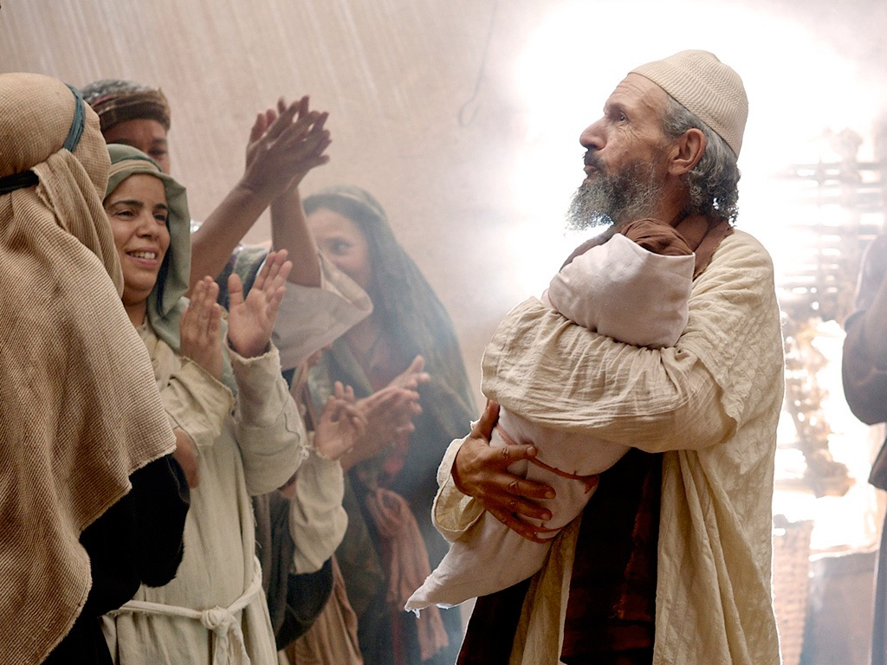
Introduction of the King
§§ 1-27
The Messianic identity of Jesus Christ is proved in his arrival, John's testimony, and approvals at his baptism and temptation
Section summaries based on J. Dwight Pentecost, A Harmony of the Words and Works of Jesus Christ (Grand Rapids: Zondervan, 1981)
Dr. Rick Griffith • Jordan Evangelical Theological Seminary • BibleStudyDownloads.org

Slide 3

Introduction of the King
§§ 1-27
Arrival
Ambassador
Approval
Ancestry
Advent
Infancy/ Childhood
Baptism
Temptation
Herald
Notes:
Jesus did all that we should expect of the Messiah (King) from the start:
1—He arrived in the proper lineage of David, born of a virgin, and knew his deity even at age 12
2—His forerunner John knew his role in preparing Israel for her king
3—He had the best witnesses possible in the Father (baptism), Spirit (temptation), and John (prophesied herald)

Slide 4

The Authentication
of the King
§§ 28-59
The Acceptance
of His Person
§§ 28-36
The Authority
of the King
§§ 37-59
Notes:
Many people of various places (Judea, Samaria, Galilee) and types (Nicodemus, Samaritan woman, common Jews) initially believed in him.
Jesus also showed in 19 incidents the power expected of the Messiah to interpret the Law to preach and with authority over men, defilement, Sabbath, nature, sickness, and even death.

Slide 5
Pentecost Outline
Introduction of the King
Authentication of the King
Controversy over the King
Instruction of the Twelve by the King
Opposition to the King
Preparation of the Disciples by the King
Official Presentation of the King
Preparation for the Death of the King
Rejection of the King
Resurrection of the King
Notes:
Jesus has been introduced and approved (Section 1) and authenticated his claims (Section 2).
Q: If he has proved his messianic identity, why then was there controversy (Section 3)? Discuss this in your small group for 4 minutes.
Q: Why did they reject the offer from Jesus of the kingdom?
A: The leaders didn't have a privileged place in it! They deceived themselves and could not admit that Jesus was from God.

Slide 6

Increasing Polarization
Resurrection
Preparation for Death
Preparation of Disciples
Instruction
Authentication
Introduction
Controversy
Opposition
Presentation
Rejection
Notes:
The Life of Christ brought increasing polarization. The more Jesus showed about himself, the greater the resistance to him and his message. Also, the more intense the controversy leading to opposition, the higher priority Christ placed on preparing his men for when he would be gone. The climactic rejection when he presented himself as king of Israel at the Triumphal Entry resulted in rejection to the point of crucifixion followed by the victory of resurrection.
Introduction of the King
Authentication of the King
Controversy over the King
Instruction of the Twelve by the King
Opposition to the King
Preparation of the Disciples by the King
Official Presentation of the King
Preparation for the Death of the King
Rejection of the King
Resurrection of the King

Slide 7
Controversy over the King
Rejection
Acceptance
Herod Antipas
Galilee Cities
Pharisees
Nation of Israel
Nazareth
Woman at Simon's home
Wealthy women supporting Jesus
Israel after the Interadvent Age
World, Sea, disease, death, & blindness
Notes:
OVERVIEW OF THIS SESSION: The Controversy Over the King means that Jesus was debated by those who rejected and accepted Him. Sadly, the nation's leaders who disbelieved had greater authority than women who believed, but Jesus promised many believers after the time between his two comings (Interadvent Age). In the meantime, even the Sea of Galilee, death, blindness, etc., submitted to His power.

Slide 8
A. The Rejection
of the Herald
§ 60
Matthew 11:2-19; Luke 7:18-35
The rejection of John by Israel's leaders is paralleled in the rising opposition to Christ and His offer of the kingdom
Notes:
Matt. 11:2 John the Baptist, who was in prison, heard about all the things the Messiah was doing. So he sent his disciples to ask Jesus, ³ “Are you the Messiah we’ve been expecting, or should we keep looking for someone else?”
Matt. 11:4 Jesus told them, “Go back to John and tell him what you have heard and seen— ⁵ the blind see, the lame walk, those with leprosy are cured, the deaf hear, the dead are raised to life, and the Good News is being preached to the poor.” ⁶ And he added, “God blesses those who do not fall away because of me.”
Matt. 11:7 As John’s disciples were leaving, Jesus began talking about him to the crowds. “What kind of man did you go into the wilderness to see? Was he a weak reed, swayed by every breath of wind? ⁸ Or were you expecting to see a man dressed in expensive clothes? No, people with expensive clothes live in palaces. ⁹ Were you looking for a prophet? Yes, and he is more than a prophet. ¹⁰ John is the man to whom the Scriptures refer when they say,
‘Look, I am sending my messenger ahead of you,
and he will prepare your way before you.’
Matt. 11:11 “I tell you the truth, of all who have ever lived, none is greater than John the Baptist. Yet even the least person in the Kingdom of Heaven is greater than he is! ¹² And from the time John the Baptist began preaching until now, the Kingdom of Heaven has been forcefully advancing, and violent people are attacking it. ¹³ For before John came, all the prophets and the law of Moses looked forward to this present time. ¹⁴ And if you are willing to accept what I say, he is Elijah, the one the prophets said would come. ¹⁵ Anyone with ears to hear should listen and understand!
Matt. 11:16 “To what can I compare this generation? It is like children playing a game in the public square. They complain to their friends,
Matt. 11:17 ‘We played wedding songs,
and you didn’t dance,
so we played funeral songs,
and you didn’t mourn.’
Matt. 11:18 For John didn’t spend his time eating and drinking, and you say, ‘He’s possessed by a demon.’ ¹⁹ The Son of Man, on the other hand, feasts and drinks, and you say, ‘He’s a glutton and a drunkard, and a friend of tax collectors and other sinners!’ But wisdom is shown to be right by its results.”
Jesus and John the Baptist
Luke 7:18 The disciples of John the Baptist told John about everything Jesus was doing. So John called for two of his disciples, ¹⁹ and he sent them to the Lord to ask him, “Are you the Messiah we’ve been expecting, or should we keep looking for someone else?”
Luke 7:20 John’s two disciples found Jesus and said to him, “John the Baptist sent us to ask, ‘Are you the Messiah we’ve been expecting, or should we keep looking for someone else?’”
Luke 7:21 At that very time, Jesus cured many people of their diseases, illnesses, and evil spirits, and he restored sight to many who were blind. ²² Then he told John’s disciples, “Go back to John and tell him what you have seen and heard—the blind see, the lame walk, the those with leprosy are cured, the deaf hear, the dead are raised to life, and the Good News is being preached to the poor.” ²³ And he added, “God blesses those who do not fall because of me.”
Luke 7:24 After John’s disciples left, Jesus began talking about him to the crowds. “What kind of man did you go into the wilderness to see? Was he a weak reed, swayed by every breath of wind? ²⁵ Or were you expecting to see a man dressed in expensive clothes? No, people who wear beautiful clothes and live in luxury are found in palaces. ²⁶ Were you looking for a prophet? Yes, and he is more than a prophet. ²⁷ John is the man to whom the Scriptures refer when they say,
‘Look, I am sending my messenger ahead of you,
and he will prepare your way before you.’
Luke 7:28 I tell you, of all who have ever lived, none is greater than John. Yet even the least person in the Kingdom of God is greater than he is!”
Luke 7:29 When they heard this, all the people—even the tax collectors—agreed that God’s way was right, for they had been baptized by John. ³⁰ But the Pharisees and experts in religious law rejected God’s plan for them, for they had refused John’s baptism.
Luke 7:31 “To what can I compare the people of this generation?” Jesus asked. “How can I describe them? ³² They are like children playing a game in the public square. They complain to their friends,
‘We played wedding songs,
and you didn’t dance,
so we played funeral songs,
and you didn’t weep.’
Luke 7:33 For John the Baptist didn’t spend his time eating bread or drinking wine, and you say, ‘He’s possessed by a demon.’ ³⁴ The Son of Man, on the other hand, feasts and drinks, and you say, ‘He’s a glutton and a drunkard, and a friend of tax collectors and other sinners!’ ³⁵ But wisdom is shown to be right by the lives of those who follow it.”

Slide 9
Herods of the Bible
Herod (the Great)
Met wise men
Killed babies in Bethlehem
Notes:
Let's go back and look at all the Herods in the New Testament. Here is a quick overview. Since these slides are available on our website so I will go through them quickly.
The first Herod, is known as Herod the Great. He was King when Jesus was born, he met the wise men and killed the babies in Jerusalem.
________
LC-03-Controversy-116
NS-03-Mark1-8—slide 235
NS-05-Acts20-28—slide 153

Slide 10
Herods of the Bible
Herod (the Great)
Herod Antipas
Herod Archelaus
Herod Philip
Caused Joseph to return to Nazareth (when returning from Egypt)
Notes:
When he died, Rome decided that his Kingdom would be split between 3 of his sons.
Herod Archelaus was not a good ruler, he was so bad that Joseph was warned to return to Nazareth after Herod the Great’s death and the family was returning from Egypt. He was eventually fired by the Roman senate. His territory was then ruled by Roman governors.

Slide 11
Herods of the Bible
Herod (the Great)
Herod Antipas
Herod Archelaus
Herod Philip
Wife, Herodias, left him for his brother Antipas
Notes:
Herod Philip was actually a pretty good guy. Unfortunately for him, his wife left him for his brother, Herod Antipas.

Slide 12
Herods of the Bible
Herod (the Great)
Herod Antipas
Herod Archelaus
Herod Philip
Married his brother's wife, Herodias
Executed John the Baptist
Presided over Jesus’ trial
Notes:
Herod Antipas is the Herod that executed John the Baptist and presided of Jesus’ trial, conferring with Pontus Pilate.

Slide 13
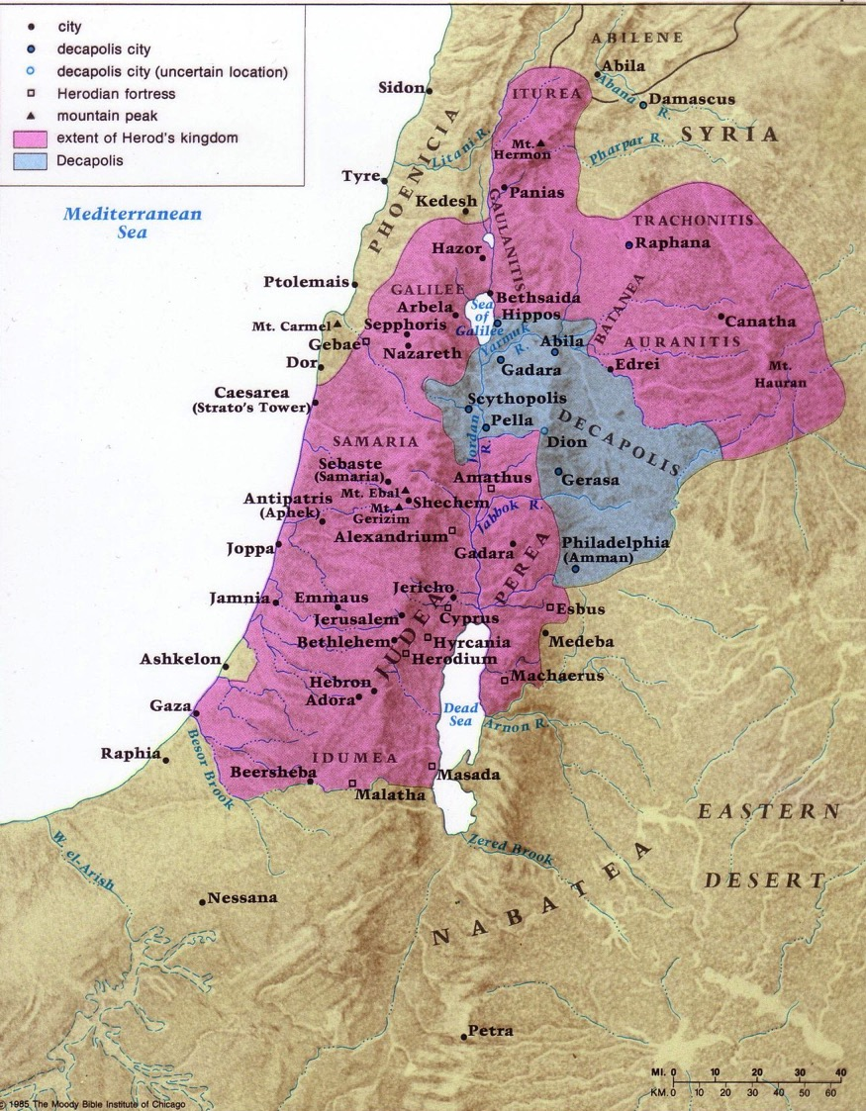
Herod's Three Ruling Sons
80 & 89
Philip Antipas Archelaus
Beitzel, Moody Atlas of Bible Lands, ed. 1
Notes:
________
LC-03-Controversy-123
NB-07-Politics4Herodians-25

Slide 14
Herods of the Bible
Herod (the Great)
Herod Antipas
Aristobulus IV
Herod Philip
Herod Archelaus
Herod Agrippa I
Persecuted Christians (in Acts 12)
Notes:
Herod the Great had many other children. One of them, Aristobulus, was the father of Herod Agrippa.
Agrippa was sent to Rome to hobnob with Roman royalty. He became king by befriending the future emperor Caligula. His death is recorded in Acts 12 because he did not rebuke the people when they stated he has the voice of a God.

Slide 15
Herods of the Bible
Herod (the Great)
Herod Antipas
Aristobulus IV
Herod Philip
Herod Archelaus
Herod Agrippa I
Listened to Paul’s defense (Acts 25–26)
Sisters Bernice and Drusilla (married to Felix)
Herod Agrippa II
Notes:
We finally get to Herod Agrippa II. We already met his sister, Drusilla, who was married to the former governor Roman Felix.

Slide 16
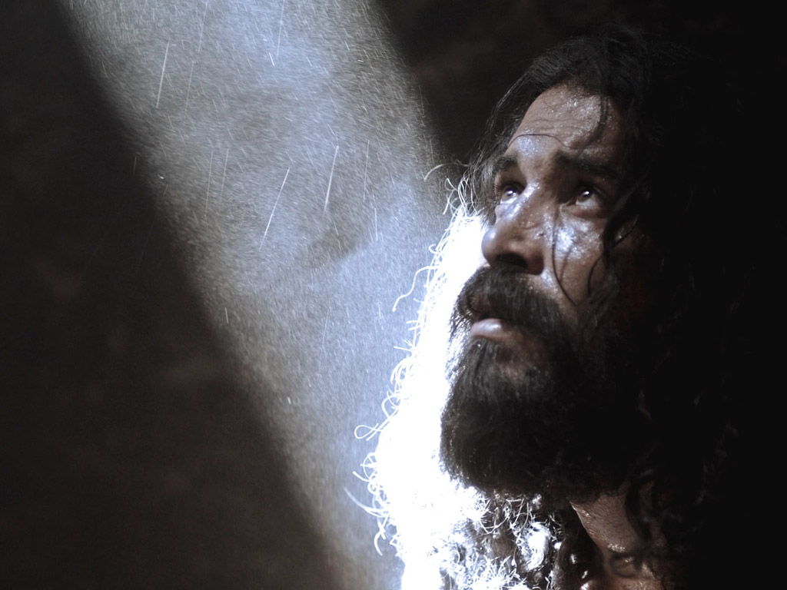

JOHN THE BAPTIST IN PRISON
Matthew 14:1-12
Mark 6:14-29
Free Bible images
Notes:
In several ways, the death of John prefigured Jesus’s own martyrdom:
• Both John and Jesus were executed by political tyrants, who although they feared their victims, vacillated, and finally acquiesced to social pressure (Herod to Herodias, and Pilate to the mob).
• Both John and Jesus died rather passively—as sheep led to slaughter—victims of political intrigue and corruption.
• Both John and Jesus died as righteous and innocent victims.
• In both cases, the political ruler putting them to death knew they did not deserve their fate.
—Paul Tanner, Following the Master (BEE World), 81

Slide 17
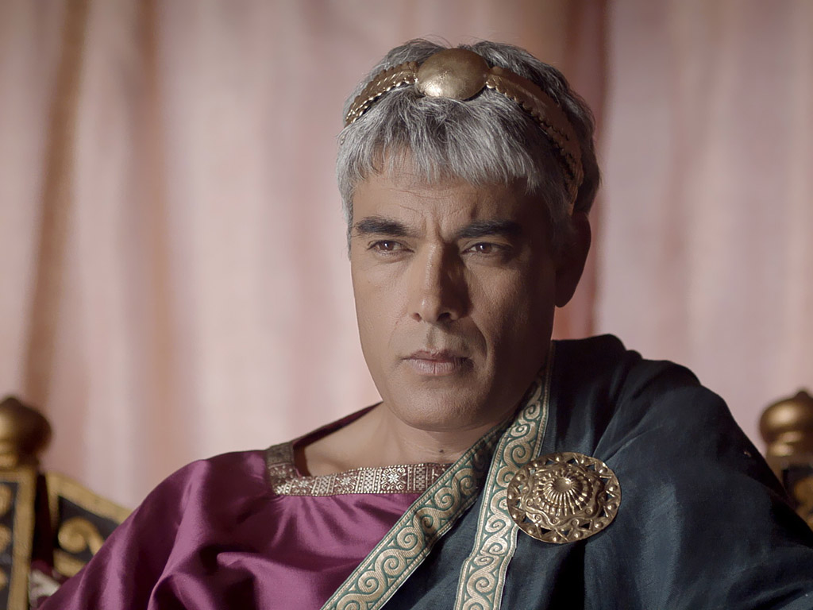
Jesus was opposed by Herod but validated his person through three miracles (Mark 6:14-56).
Notes:
Mark 6:14 Herod Antipas, the king, soon heard about Jesus, because everyone was talking about him. Some were saying, “This must be John the Baptist raised from the dead. That is why he can do such miracles.” 15 Others said, “He’s the prophet Elijah.” Still others said, “He’s a prophet like the other great prophets of the past.”
Mark 6:16 When Herod heard about Jesus, he said, “John, the man I beheaded, has come back from the dead.”

Slide 18
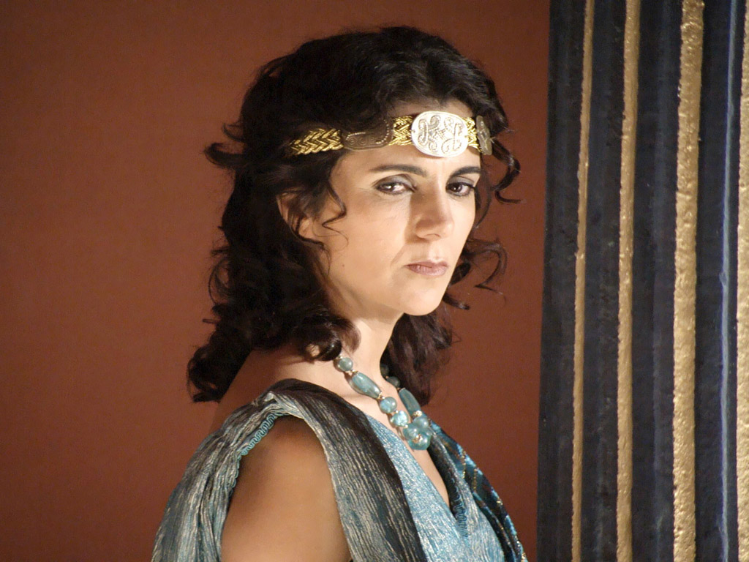
Notes:
Herodias used to be Herod Philip's wife, but his brother Herod Antipas took her from him, evidently with her consent. She was not pleased with John the Baptist.

Slide 19
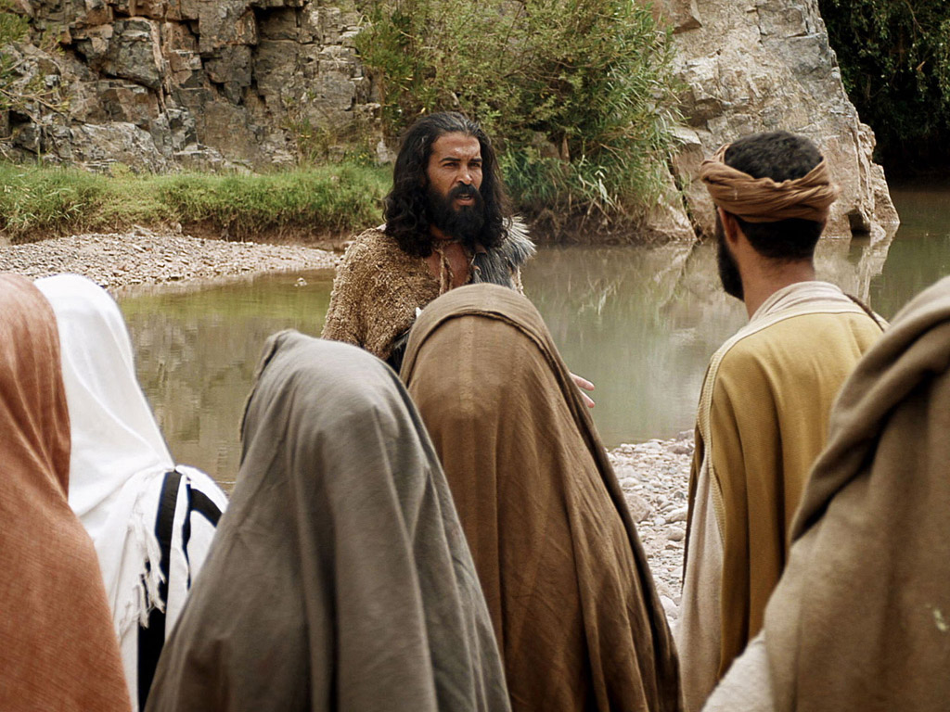
Notes:
John continued to speak out against Antipas for this immorality. "So Herodias bore a grudge against John and wanted to kill him. But without Herod’s approval she was powerless" (Mark 6:19 NLT).

Slide 20
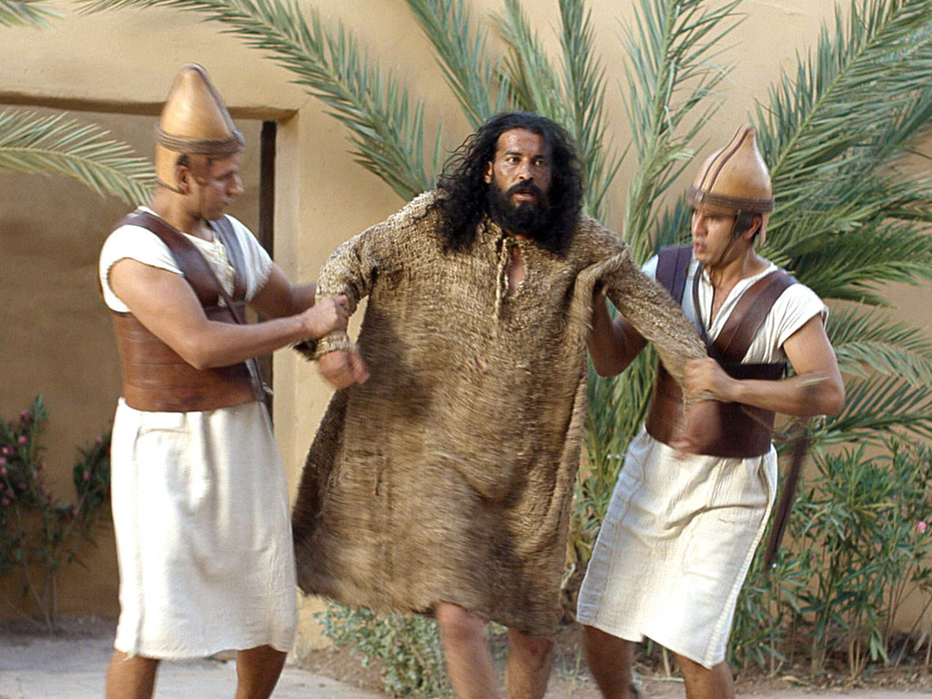
Notes:
Mark 6:17 "For Herod had sent soldiers to arrest and imprison John as a favor to Herodias. She had been his brother Philip’s wife, but Herod had married her. 18 John had been telling Herod, 'It is against God’s law for you to marry your brother’s wife.'”

Slide 21
Notes:
John was imprisoned in the Palace/Fortress of Machaerus on the east side of the Dead Sea in modern-day Jordan.

Slide 22
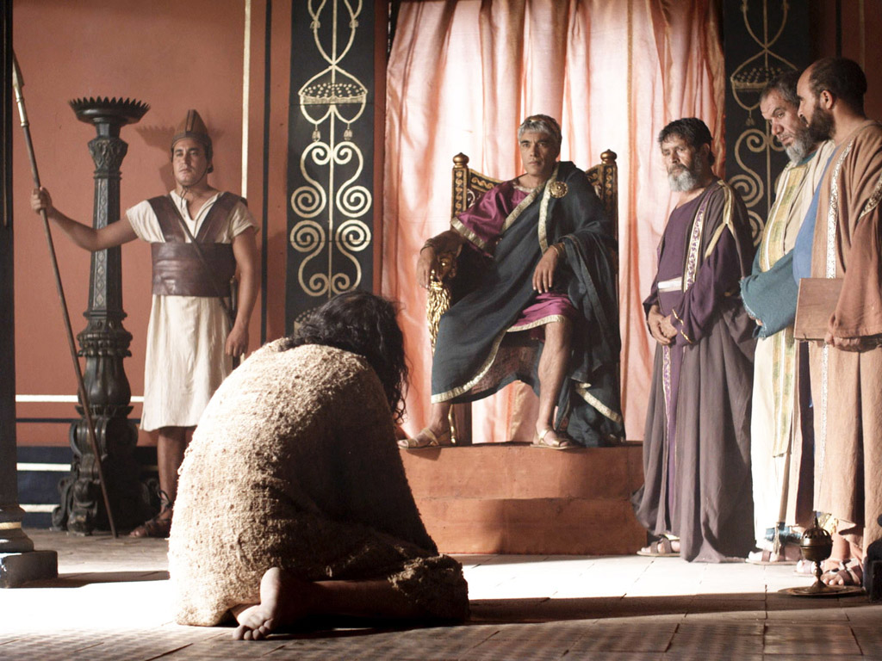
Notes:
"Herod respected John; and knowing that he was a good and holy man, he protected him. Herod was greatly disturbed whenever he talked with John, but even so, he liked to listen to him" (Mark 6:20 NLT).

Slide 23
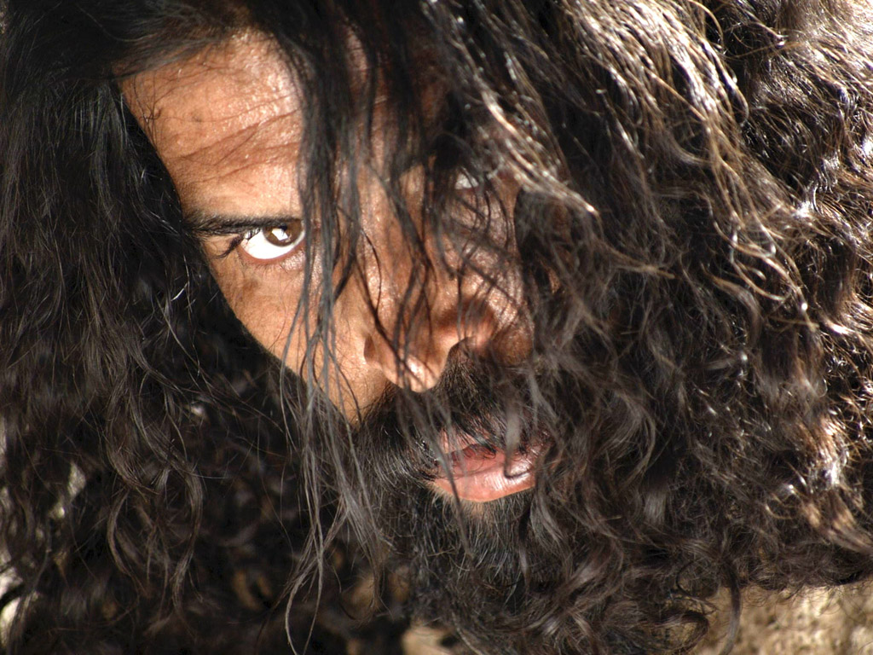
Notes:
John had a very blunt and courageous style that easily offended people. Though the son of a priest, he avoided the temple due to its corruption. He also rejected priestly garb, wearing clothes like Elijah instead. No wonder! He was the NT Elijah and even lived in the Jordan thicket exactly where Elijah had lived 800 years earlier!

Slide 24
B. The Curse
of the Cities of Galilee
§ 61
Matthew 11:20-30
Christ curses Galilean cities that saw his miracles but would not believe to show how Gentiles received him more than the Jews.
Notes:
Judgment for the Unbelievers
Matt. 11:20 Then Jesus began to denounce the towns where he had done so many of his miracles, because they hadn’t repented of their sins and turned to God. ²¹ “What sorrow awaits you, Korazin and Bethsaida! For if the miracles I did in you had been done in wicked Tyre and Sidon, their people would have repented of their sins long ago, clothing themselves in burlap and throwing ashes on their heads to show their remorse. ²² I tell you, Tyre and Sidon will be better off on judgment day than you.
Matt. 11:23 “And you people of Capernaum, will you be honored in heaven? No, you will go down to the place of the dead. For if the miracles I did for you had been done in wicked Sodom, it would still be here today. ²⁴ I tell you, even Sodom will be better off on judgment day than you.”
Jesus’ Prayer of Thanksgiving
Matt. 11:25 At that time Jesus prayed this prayer: “O Father, Lord of heaven and earth, thank you for hiding these things from those who think themselves wise and clever, and for revealing them to the childlike. ²⁶ Yes, Father, it pleased you to do it this way!
Matt. 11:27 “My Father has entrusted everything to me. No one truly knows the Son except the Father, and no one truly knows the Father except the Son and those to whom the Son chooses to reveal him.”
Matt. 11:28 Then Jesus said, “Come to me, all of you who are weary and carry heavy burdens, and I will give you rest. ²⁹ Take my yoke upon you. Let me teach you, because I am humble and gentle at heart, and you will find rest for your souls. ³⁰ For my yoke is easy to bear, and the burden I give you is light.”

Slide 25
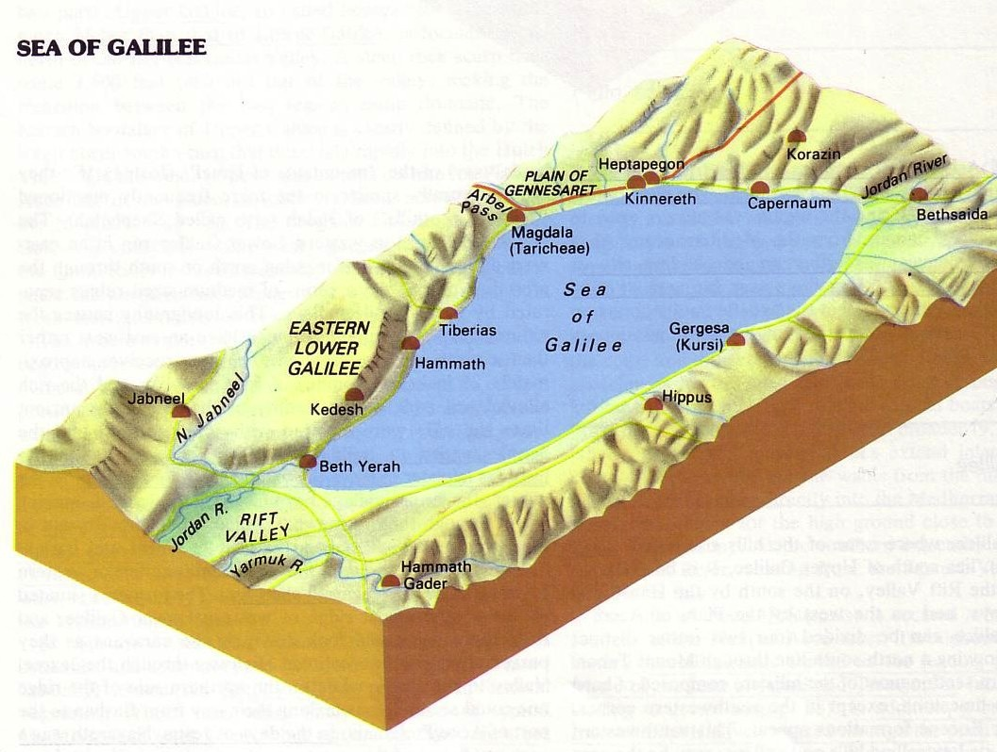

The Tri-City Area
172
Point f
Then Jesus began to denounce the cities in which most of his miracles had been performed, because they did not repent.
"Woe to you, Korazin! Woe to you Bethsaida! If the miracles that were performed in you had been performed in Tyre and Sidon, they would have repented long ago in sackcloth and ashes. But I tell you, it will be more bearable for for Tyre and Sidon on the day of judgment than for you.
And you, Capernaum, will you be lifted up to the skies? … It will be more bearable for Sodom on the day of judgment than for you."
Matthew 11:20-24

Slide 26
1. Condemnation for Unbelief
Matthew 11:20-24
Christ condemns the unbelieving Jewish area of Galilee with greater judgment than Gentiles who saw no signs
Notes:
Judgment for the Unbelievers
Matt. 11:20 Then Jesus began to denounce the towns where he had done so many of his miracles, because they hadn’t repented of their sins and turned to God. ²¹ “What sorrow awaits you, Korazin and Bethsaida! For if the miracles I did in you had been done in wicked Tyre and Sidon, their people would have repented of their sins long ago, clothing themselves in burlap and throwing ashes on their heads to show their remorse. ²² I tell you, Tyre and Sidon will be better off on judgment day than you.
Matt. 11:23 “And you people of Capernaum, will you be honored in heaven? No, you will go down to the place of the dead. For if the miracles I did for you had been done in wicked Sodom, it would still be here today. ²⁴ I tell you, even Sodom will be better off on judgment day than you.”

Slide 27
2. Explanation of Unbelief
Matthew 11:25-27
Galilean cities persist in unbelief because of Israel's spiritual blindness stemming from a history of willful rejection of God's revelation
Notes:
Jesus’ Prayer of Thanksgiving
Matt. 11:25 At that time Jesus prayed this prayer: “O Father, Lord of heaven and earth, thank you for hiding these things from those who think themselves wise and clever, and for revealing them to the childlike. ²⁶ Yes, Father, it pleased you to do it this way!
Matt. 11:27 “My Father has entrusted everything to me. No one truly knows the Son except the Father, and no one truly knows the Father except the Son and those to whom the Son chooses to reveal him.”

Slide 28
3. Invitation to Belief
Matthew 11:28-30
Despite condemning them, Christ offers rest from the taxing submission to Pharisaical regulations by trusting in His person
Notes:
Matt. 11:28 Then Jesus said, “Come to me, all of you who are weary and carry heavy burdens, and I will give you rest. ²⁹ Take my yoke upon you. Let me teach you, because I am humble and gentle at heart, and you will find rest for your souls. ³⁰ For my yoke is easy to bear, and the burden I give you is light.”

Slide 29
C. Reception by a Sinner
§ 62
Luke 7:36-50
Christ reveals the self-righteous Pharisees when they hear Him forgive a repentant woman at Simon the Pharisee's home
Notes:
Jesus Anointed by a Sinful Woman
Luke 7:36 One of the Pharisees asked Jesus to have dinner with him, so Jesus went to his home and sat down to eat. ³⁷ When a certain immoral woman from that city heard he was eating there, she brought a beautiful alabaster jar filled with expensive perfume. ³⁸ Then she knelt behind him at his feet, weeping. Her tears fell on his feet, and she wiped them off with her hair. Then she kept kissing his feet and putting perfume on them.
Luke 7:39 When the Pharisee who had invited him saw this, he said to himself, “If this man were a prophet, he would know what kind of woman is touching him. She’s a sinner!”
Luke 7:40 Then Jesus answered his thoughts. “Simon,” he said to the Pharisee, “I have something to say to you.”
“Go ahead, Teacher,” Simon replied.
Luke 7:41 Then Jesus told him this story: “A man loaned money to two people—500 pieces of silver to one and 50 pieces to the other. ⁴² But neither of them could repay him, so he kindly forgave them both, canceling their debts. Who do you suppose loved him more after that?”
Luke 7:43 Simon answered, “I suppose the one for whom he canceled the larger debt.”
“That’s right,” Jesus said.
⁴⁴ Then he turned to the woman and said to Simon, “Look at this woman kneeling here. When I entered your home, you didn’t offer me water to wash the dust from my feet, but she has washed them with her tears and wiped them with her hair. ⁴⁵ You didn’t greet me with a kiss, but from the time I first came in, she has not stopped kissing my feet. ⁴⁶ You neglected the courtesy of olive oil to anoint my head, but she has anointed my feet with rare perfume.
Luke 7:47 “I tell you, her sins—and they are many—have been forgiven, so she has shown me much love. But a person who is forgiven little shows only little love.” ⁴⁸ Then Jesus said to the woman, “Your sins are forgiven.”
Luke 7:49 The men at the table said among themselves, “Who is this man, that he goes around forgiving sins?”
Luke 7:50 And Jesus said to the woman, “Your faith has saved you; go in peace.”

Slide 30


Was Mary Magdalene the Woman with the Alabaster Jar?
The WOMAN with the ALABASTER JAR
Mary Magdalen and the Holy Grail
No. In Luke she is not named but in the other gospels she is clearly Mary of Bethany
As featured in The Da Vinci Code
Notes:
Over 1000 years ago, Pope Gregory preached a sermon that confused the two anointings of Jesus so that Mary Magdalene ended up being the illicit woman of Luke 7. This mixed her up with Mary of Bethany and also implied that she was a prostitute when, in fact, she had seven demons.
Mark 16:9 After Jesus rose from the dead early on Sunday morning, the first person who saw him was Mary Magdalene, the woman from whom he had cast out seven demons.
Luke 8:2 along with some women who had been cured of evil spirits and diseases. Among them were Mary Magdalene, from whom he had cast out seven demons.
__________
Common-427
LC-03-Controversy-17
NS-01-Matt15-28-slide 212
NS-02-Mark9-16-slide 145
NS-03-Luke13-24-slide 111
NS-04-John12-21-slide 26

Slide 31
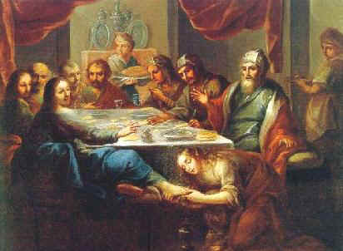
This was NOT like Luke 7:36-50 with Jesus and the Sinful Woman
Notes:
Luke 7 stands alone in the anointings of Jesus as it was much earlier.
__________
Common-428
LC-03-Controversy-18
NS-01-Matt15-28-slide 214
NS-02-Mark9-16-slide 147
NS-03-Luke13-24-slide 113
NS-04-John12-21-slide 27

Slide 32
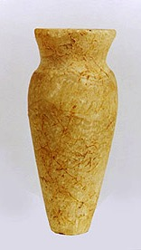
The Two Anointings of Jesus
Common to all four gospel accounts:
Unannounced visit by woman
Anointed Jesus' head and/or feet
Wiped his feet with her hair
Complaint of waste by disciples/Judas
Disciples rebuked by Jesus
In a home
Alabaster jar (except in John)
Home owned by man called Simon
Notes:
Luke 7 has in common with the Passion Week anointing many traits.
__________
Common-429
LC-03-Controversy-17
NS-01-Matt15-28-slide 215
NS-02-Mark9-16-slide 148
NS-03-Luke13-24-slide 114
NS-04-John12-21-slide 28

Slide 33

The Two Anointings of Jesus
Luke 7:36-50
Early in Ministry
Weeping
For worship, woman's sins forgiven (Luke 7:48)
By unnamed harlot at
home of Simon the Pharisee (Luke 7:40) in an unknown town
Matt. 26:6-13
Mark 14:3-9
John 12:1-11
During Passion Week
No weeping noted
For burial, woman needed no forgiveness
By Lazarus' sister Mary at home of Simon the Leper
(Matt. 26:6; Mark 14:3) in Lazarus' hometown of Bethany (John 12:1)
Notes:
Significant differences between these two anointings show them to be two separate but similar events.
__________
Common-430
LC-03-Controversy-18
NS-01-Matt15-28-slide 216
NS-02-Mark9-16-slide 149
NS-03-Luke13-24-slide 115
NS-04-John12-21-slide 29

Slide 34
D. Witness to the King
§ 63
Luke 8:1-3
Several believing women of financial means show in Christ through their witness and material support for His ministry
Notes:
Women Who Followed Jesus
Luke 8:1 Soon afterward, Jesus began a tour of the nearby towns and villages, preaching and announcing the Good News about the Kingdom of God. He took his twelve disciples with him, ² along with some women who had been cured of evil spirits and diseases. Among them were Mary Magdalene, from whom he had cast out seven demons; ³ Joanna, the wife of Chuza, Herod’s business manager; Susanna; and many others who were contributing from their own resources to support Jesus and his disciples.

Slide 35
E. Rejection of Christ and His Offer by the Leaders
§ 64
Matthew 12:22-37; Mark 3:20-30
Jesus defends himself to Pharisees who attribute his exorcisms to Satan since Israel's destiny depended on their response
Notes:
Jesus and the Prince of Demons
Matt. 12:22 Then a demon-possessed man, who was blind and couldn’t speak, was brought to Jesus. He healed the man so that he could both speak and see. ²³ The crowd was amazed and asked, “Could it be that Jesus is the Son of David, the Messiah?”
Matt. 12:24 But when the Pharisees heard about the miracle, they said, “No wonder he can cast out demons. He gets his power from Satan, the prince of demons.”
Matt. 12:25 Jesus knew their thoughts and replied, “Any kingdom divided by civil war is doomed. A town or family splintered by feuding will fall apart. ²⁶ And if Satan is casting out Satan, he is divided and fighting against himself. His own kingdom will not survive. ²⁷ And if I am empowered by Satan, what about your own exorcists? They cast out demons, too, so they will condemn you for what you have said. ²⁸ But if I am casting out demons by the Spirit of God, then the Kingdom of God has arrived among you. ²⁹ For who is powerful enough to enter the house of a strong man and plunder his goods? Only someone even stronger—someone who could tie him up and then plunder his house.
Matt. 12:30 “Anyone who isn’t with me opposes me, and anyone who isn’t working with me is actually working against me.
Matt. 12:31 “So I tell you, every sin and blasphemy can be forgiven—except blasphemy against the Holy Spirit, which will never be forgiven. ³² Anyone who speaks against the Son of Man can be forgiven, but anyone who speaks against the Holy Spirit will never be forgiven, either in this world or in the world to come.
Matt. 12:33 “A tree is identified by its fruit. If a tree is good, its fruit will be good. If a tree is bad, its fruit will be bad. ³⁴ You brood of snakes! How could evil men like you speak what is good and right? For whatever is in your heart determines what you say. ³⁵ A good person produces good things from the treasury of a good heart, and an evil person produces evil things from the treasury of an evil heart. ³⁶ And I tell you this, you must give an account on judgment day for every idle word you speak. ³⁷ The words you say will either acquit you or condemn you.”
Jesus and the Prince of Demons
Mark 3:20 One time Jesus entered a house, and the crowds began to gather again. Soon he and his disciples couldn’t even find time to eat. ²¹ When his family heard what was happening, they tried to take him away. “He’s out of his mind,” they said.
Mark 3:22 But the teachers of religious law who had arrived from Jerusalem said, “He’s possessed by Satan, the prince of demons. That’s where he gets the power to cast out demons.”
Mark 3:23 Jesus called them over and responded with an illustration. “How can Satan cast out Satan?” he asked. ²⁴ “A kingdom divided by civil war will collapse. ²⁵ Similarly, a family splintered by feuding will fall apart. ²⁶ And if Satan is divided and fights against himself, how can he stand? He would never survive. ²⁷ Let me illustrate this further. Who is powerful enough to enter the house of a strong man and plunder his goods? Only someone even stronger—someone who could tie him up and then plunder his house.
Mark 3:28 “I tell you the truth, all sin and blasphemy can be forgiven, ²⁹ but anyone who blasphemes the Holy Spirit will never be forgiven. This is a sin with eternal consequences.” ³⁰ He told them this because they were saying, “He’s possessed by an evil spirit.”

Slide 36
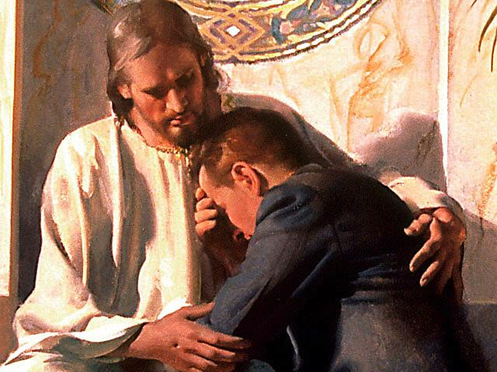
Does Christ Forgive All the Sins of a Believer?

Slide 37
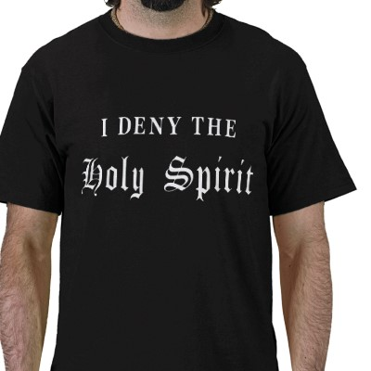
Blasphemy Against the Spirit
In your small group…
xiv
Have you ever known anyone who thought he or she had committed this sin?
What happened?

Slide 38
Blasphemy Verses
xiv
Matt. 12:31-32 "So I tell you, every sin and blasphemy can be forgiven—except blasphemy against the Holy Spirit, which will never be forgiven. ³²Anyone who speaks against the Son of Man can be forgiven, but anyone who speaks against the Holy Spirit will never be forgiven, either in this world or in the world to come.
Mark 3:28-29 "I tell you the truth, all sin and blasphemy can be forgiven, ²⁹but anyone who blasphemes the Holy Spirit will never be forgiven. This is a sin with eternal consequences."

Slide 39
Unacceptable Views of the Blasphemy
xiv
1. Using Christ's name in vain
2. A sinful lifestyle that causes a Christian to lose his salvation forever (not repentable)
Cessationists will not go to heaven

Slide 40
Unacceptable Views of the Blasphemy
xiv
4. This sin could only happen during His earthly ministry and thus cannot happen today. Jesus isn't physically here performing miracles—it must be be committed to His face.
5. A non-Christian's unbelief which lasts until death

Slide 41
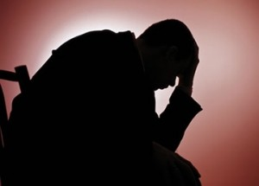
Unacceptable Views of the Blasphemy
xiv
6. Adultery
Divorce
Suicide

Slide 42
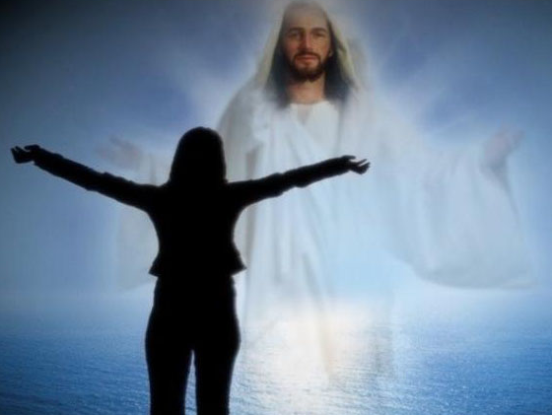
The Problem Solved
xiv
The Context

Slide 43

The Context of the Text
xiv
Christ healed a blind/mute (Matt. 12:22)
The crowds claimed, "He's Messiah!"
The Pharisees said, "He's demonic!"
Jesus gave a threefold response (12:25-29)

Slide 44
The Problem Solved
xiv
The Context
The Nature of the Sin

Slide 45

The Nature of the Sin
xv
Spoken
Against the Spirit
Eternal results (i.e., only committed by unbelievers)
False attribution
Not "sin unto death" (1 John 5:16-17; 1 Cor. 11:30)

Slide 46
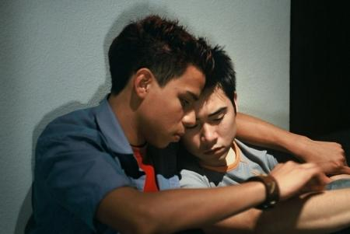
Suggestions for Counseling
xv
Evangelism
Assurance
Repentance
Notes:
John 6:37 However, those the Father has given me will come to me, and I will never reject them (NLT).

Slide 47
F. Request for a Sign
by the Leaders
§ 65
Matthew 12:38-45
Israel's leaders demand a miracle, so Christ reveals their rejection by promising to conquer death which Satan could never do
Notes:
The Sign of Jonah
Matt. 12:38 One day some teachers of religious law and Pharisees came to Jesus and said, “Teacher, we want you to show us a miraculous sign to prove your authority.”
Matt. 12:39 But Jesus replied, “Only an evil, adulterous generation would demand a miraculous sign; but the only sign I will give them is the sign of the prophet Jonah. ⁴⁰ For as Jonah was in the belly of the great fish for three days and three nights, so will the Son of Man be in the heart of the earth for three days and three nights.
Matt. 12:41 “The people of Nineveh will stand up against this generation on judgment day and condemn it, for they repented of their sins at the preaching of Jonah. Now someone greater than Jonah is here—but you refuse to repent. ⁴² The queen of Sheba will also stand up against this generation on judgment day and condemn it, for she came from a distant land to hear the wisdom of Solomon. Now someone greater than Solomon is here—but you refuse to listen.
Matt. 12:43 “When an evil spirit leaves a person, it goes into the desert, seeking rest but finding none. ⁴⁴ Then it says, ‘I will return to the person I came from.’ So it returns and finds its former home empty, swept, and in order. ⁴⁵ Then the spirit finds seven other spirits more evil than itself, and they all enter the person and live there. And so that person is worse off than before. That will be the experience of this evil generation.”

Slide 48
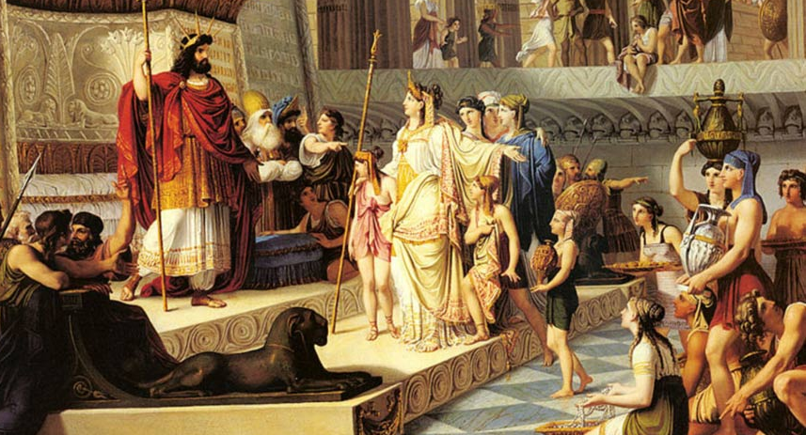
The Queen of Sheba
When the queen of Sheba heard of Solomon's fame, which brought honor to the name of the LORD, she came to test him with hard questions. —1 Kings 10:1 NLT—

Slide 49
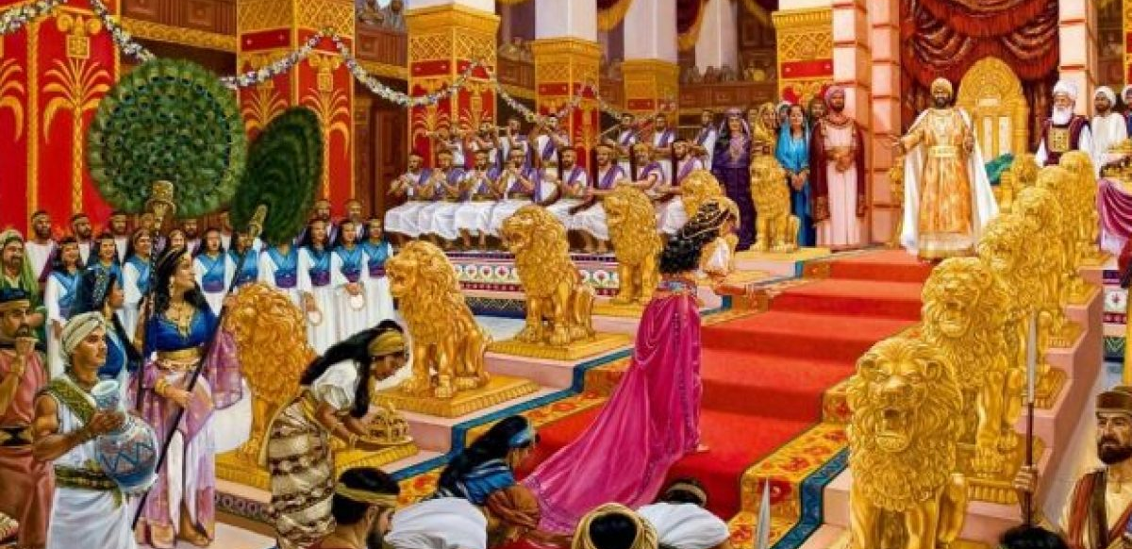
The Queen of Sheba
She arrived in Jerusalem with a large group of attendants and a great caravan of camels loaded with spices, large quantities of gold, and precious jewels. When she met with Solomon, she talked with him about everything she had on her mind —1 Kings 10:2 NLT—

Slide 50

The Queen of Sheba
Notes:
Was she beautiful?
Did Solomon father a child with her as one tradition says? (See the book subtitle: The Loves of King Solomon.)
These questions are not answered in the text—but we should expect rumors to abound.
The key idea of 1 Kings is that Solomon’s fame spread far and wide when he was walking with God.

Slide 51
G. Rejection of the Nation
by Christ
§ 66
Matthew 12:46-50; Mark 3:31-35; Luke 8:19-21
In response to rejection by Israel's leaders, Jesus sets aside Israel for a new form of the kingdom in the Interadvent age
Notes:
The True Family of Jesus
Matt. 12:46 As Jesus was speaking to the crowd, his mother and brothers stood outside, asking to speak to him. ⁴⁷ Someone told Jesus, “Your mother and your brothers are standing outside, and they want to speak to you.”
Matt. 12:48 Jesus asked, “Who is my mother? Who are my brothers?” ⁴⁹ Then he pointed to his disciples and said, “Look, these are my mother and brothers. ⁵⁰ Anyone who does the will of my Father in heaven is my brother and sister and mother!”
The True Family of Jesus
Mark 3:31 Then Jesus’ mother and brothers came to see him. They stood outside and sent word for him to come out and talk with them. ³² There was a crowd sitting around Jesus, and someone said, “Your mother and your brothers are outside asking for you.”
Mark 3:33 Jesus replied, “Who is my mother? Who are my brothers?” ³⁴ Then he looked at those around him and said, “Look, these are my mother and brothers. ³⁵ Anyone who does God’s will is my brother and sister and mother.”
The True Family of Jesus
Luke 8:19 Then Jesus’ mother and brothers came to see him, but they couldn’t get to him because of the crowd. ²⁰ Someone told Jesus, “Your mother and your brothers are standing outside, and they want to see you.”
Luke 8:21 Jesus replied, “My mother and my brothers are all those who hear God’s word and obey it.”

Slide 52
Summary Statement
25
67
Summary Statement
This book:
(1) proves Jesus as Messiah for unbelieving Jews to trust Him, and
(2) explains that the kingdom promised to Israel is delayed due to Israel's rejection of Jesus as King for believing Jews to see His present kingdom authority as residing in the Church.
Matthew
Notes:
Usually, we also offer a single subject-purpose statement for a biblical book. Again, Matthew is exceptional as it teaches about Jesus for both unbelievers (evangelistic purpose) and believers (discipleship purpose).

Slide 53
Matthew
67
Messiah with Authority over the Church
Preliminary Evidence that Jesus is Messiah
Rejections and
Interadvent Age
Final Evidence that
Jesus is Messiah
Chapters 1–10
Chapters 11–27
Chapter 28
The King Rejected
The King Re-offered
The King Offered
Teaches Droves
Teaches Disciples
Topical
Chronological
Notes:
The title includes both the Jewish (Messiah) and Gentile (Church) elements in the book. The outline follows a threefold outline of (1) proofs, (2) responses, and (3) results.

Slide 54
Matthew 11:1–16:12
Outline
73
IV. (11:1–16:12) Christ is rejected as Messiah in anticipation of the final crucifixion rejection, so He introduces the Interadvent Age before His future reception and ministers to Gentiles to teach the postponement of the kingdom.

Slide 55
H. Revelation in View of Rejection
§§ 67-71
Due to Israel's rejection, Christ reveals the nature of the kingdom in the present age in conjunction with displays of His power

Slide 56
1. The Course of the Kingdom in the Present Age
§ 67
Matthew 13:1-53; Mark 4:1-34; Luke 8:4-18
Good and evil coexist in the Interadvent age as God’s Word starts small but reaches the world before judgment and the Millennium
Notes:
Parable of the Farmer Scattering Seed
Matt. 13:1 Later that same day Jesus left the house and sat beside the lake. ² A large crowd soon gathered around him, so he got into a boat. Then he sat there and taught as the people stood on the shore. ³ He told many stories in the form of parables, such as this one:
“Listen! A farmer went out to plant some seeds.
⁴ As he scattered them across his field, some seeds fell on a footpath, and the birds came and ate them. ⁵ Other seeds fell on shallow soil with underlying rock. The seeds sprouted quickly because the soil was shallow. ⁶ But the plants soon wilted under the hot sun, and since they didn’t have deep roots, they died. ⁷ Other seeds fell among thorns that grew up and choked out the tender plants. ⁸ Still other seeds fell on fertile soil, and they produced a crop that was thirty, sixty, and even a hundred times as much as had been planted! ⁹ Anyone with ears to hear should listen and understand.”
Matt. 13:10 His disciples came and asked him, “Why do you use parables when you talk to the people?”
Matt. 13:11 He replied, “You are permitted to understand the secrets of the Kingdom of Heaven, but others are not. ¹² To those who listen to my teaching, more understanding will be given, and they will have an abundance of knowledge. But for those who are not listening, even what little understanding they have will be taken away from them. ¹³ That is why I use these parables,
For they look, but they don’t really see.
They hear, but they don’t really listen or understand.
Matt. 13:14 This fulfills the prophecy of Isaiah that says,
‘When you hear what I say,
you will not understand.
When you see what I do,
you will not comprehend.
¹⁵ For the hearts of these people are hardened,
and their ears cannot hear,
and they have closed their eyes—
so their eyes cannot see,
and their ears cannot hear,
and their hearts cannot understand,
and they cannot turn to me
and let me heal them.’
Matt. 13:16 “But blessed are your eyes, because they see; and your ears, because they hear. ¹⁷ I tell you the truth, many prophets and righteous people longed to see what you see, but they didn’t see it. And they longed to hear what you hear, but they didn’t hear it.
Matt. 13:18 “Now listen to the explanation of the parable about the farmer planting seeds: ¹⁹ The seed that fell on the footpath represents those who hear the message about the Kingdom and don’t understand it. Then the evil one comes and snatches away the seed that was planted in their hearts. ²⁰ The seed on the rocky soil represents those who hear the message and immediately receive it with joy. ²¹ But since they don’t have deep roots, they don’t last long. They fall away as soon as they have problems or are persecuted for believing God’s word. ²² The seed that fell among the thorns represents those who hear God’s word, but all too quickly the message is crowded out by the worries of this life and the lure of wealth, so no fruit is produced. ²³ The seed that fell on good soil represents those who truly hear and understand God’s word and produce a harvest of thirty, sixty, or even a hundred times as much as had been planted!”
Parable of the Wheat and Weeds
Matt. 13:24 Here is another story Jesus told: “The Kingdom of Heaven is like a farmer who planted good seed in his field. ²⁵ But that night as the workers slept, his enemy came and planted weeds among the wheat, then slipped away. ²⁶ When the crop began to grow and produce grain, the weeds also grew.
Matt. 13:27 “The farmer’s workers went to him and said, ‘Sir, the field where you planted that good seed is full of weeds! Where did they come from?’
Matt. 13:28 “‘An enemy has done this!’ the farmer exclaimed.
“‘Should we pull out the weeds?’ they asked.
Matt. 13:29 “‘No,’ he replied, ‘you’ll uproot the wheat if you do. ³⁰ Let both grow together until the harvest. Then I will tell the harvesters to sort out the weeds, tie them into bundles, and burn them, and to put the wheat in the barn.’”
Parable of the Mustard Seed
Matt. 13:31 Here is another illustration Jesus used: “The Kingdom of Heaven is like a mustard seed planted in a field. ³² It is the smallest of all seeds, but it becomes the largest of garden plants; it grows into a tree, and birds come and make nests in its branches.”
Parable of the Yeast
Matt. 13:33 Jesus also used this illustration: “The Kingdom of Heaven is like the yeast a woman used in making bread. Even though she put only a little yeast in three measures of flour, it permeated every part of the dough.”
Matt. 13:34 Jesus always used stories and illustrations like these when speaking to the crowds. In fact, he never spoke to them without using such parables. ³⁵ This fulfilled what God had spoken through the prophet:
“I will speak to you in parables.
I will explain things hidden since the creation of the world.”
Parable of the Wheat and Weeds Explained
Matt. 13:36 Then, leaving the crowds outside, Jesus went into the house. His disciples said, “Please explain to us the story of the weeds in the field.”
Matt. 13:37 Jesus replied, “The Son of Man is the farmer who plants the good seed. ³⁸ The field is the world, and the good seed represents the people of the Kingdom. The weeds are the people who belong to the evil one. ³⁹ The enemy who planted the weeds among the wheat is the devil. The harvest is the end of the world, and the harvesters are the angels.
Matt. 13:40 “Just as the weeds are sorted out and burned in the fire, so it will be at the end of the world. ⁴¹ The Son of Man will send his angels, and they will remove from his Kingdom everything that causes sin and all who do evil. ⁴² And the angels will throw them into the fiery furnace, where there will be weeping and gnashing of teeth. ⁴³ Then the righteous will shine like the sun in their Father’s Kingdom. Anyone with ears to hear should listen and understand!
Parables of the Hidden Treasure and the Pearl
Matt. 13:44 “The Kingdom of Heaven is like a treasure that a man discovered hidden in a field. In his excitement, he hid it again and sold everything he owned to get enough money to buy the field.
Matt. 13:45 “Again, the Kingdom of Heaven is like a merchant on the lookout for choice pearls. ⁴⁶ When he discovered a pearl of great value, he sold everything he owned and bought it!
Parable of the Fishing Net
Matt. 13:47 “Again, the Kingdom of Heaven is like a fishing net that was thrown into the water and caught fish of every kind. ⁴⁸ When the net was full, they dragged it up onto the shore, sat down, and sorted the good fish into crates, but threw the bad ones away. ⁴⁹ That is the way it will be at the end of the world. The angels will come and separate the wicked people from the righteous, ⁵⁰ throwing the wicked into the fiery furnace, where there will be weeping and gnashing of teeth. ⁵¹ Do you understand all these things?”
“Yes,” they said, “we do.”
Matt. 13:52 Then he added, “Every teacher of religious law who becomes a disciple in the Kingdom of Heaven is like a homeowner who brings from his storeroom new gems of truth as well as old.”
Jesus Rejected at Nazareth
Matt. 13:53 When Jesus had finished telling these stories and illustrations, he left that part of the country.
Parable of the Farmer Scattering Seed
Mark 4:1 Once again Jesus began teaching by the lakeshore. A very large crowd soon gathered around him, so he got into a boat. Then he sat in the boat while all the people remained on the shore. ² He taught them by telling many stories in the form of parables, such as this one:
Mark 4:3 “Listen! A farmer went out to plant some seed. ⁴ As he scattered it across his field, some of the seed fell on a footpath, and the birds came and ate it. ⁵ Other seed fell on shallow soil with underlying rock. The seed sprouted quickly because the soil was shallow. ⁶ But the plant soon wilted under the hot sun, and since it didn’t have deep roots, it died. ⁷ Other seed fell among thorns that grew up and choked out the tender plants so they produced no grain. ⁸ Still other seeds fell on fertile soil, and they sprouted, grew, and produced a crop that was thirty, sixty, and even a hundred times as much as had been planted!” ⁹ Then he said, “Anyone with ears to hear should listen and understand.”
Mark 4:10 Later, when Jesus was alone with the twelve disciples and with the others who were gathered around, they asked him what the parables meant.
Mark 4:11 He replied, “You are permitted to understand the secret of the Kingdom of God. But I use parables for everything I say to outsiders, ¹² so that the Scriptures might be fulfilled:
‘When they see what I do,
they will learn nothing.
When they hear what I say,
they will not understand.
Otherwise, they will turn to me
and be forgiven.’”
Mark 4:13 Then Jesus said to them, “If you can’t understand the meaning of this parable, how will you understand all the other parables? ¹⁴ The farmer plants seed by taking God’s word to others. ¹⁵ The seed that fell on the footpath represents those who hear the message, only to have Satan come at once and take it away. ¹⁶ The seed on the rocky soil represents those who hear the message and immediately receive it with joy. ¹⁷ But since they don’t have deep roots, they don’t last long. They fall away as soon as they have problems or are persecuted for believing God’s word. ¹⁸ The seed that fell among the thorns represents others who hear God’s word, ¹⁹ but all too quickly the message is crowded out by the worries of this life, the lure of wealth, and the desire for other things, so no fruit is produced. ²⁰ And the seed that fell on good soil represents those who hear and accept God’s word and produce a harvest of thirty, sixty, or even a hundred times as much as had been planted!”
Parable of the Lamp
Mark 4:21 Then Jesus asked them, “Would anyone light a lamp and then put it under a basket or under a bed? Of course not! A lamp is placed on a stand, where its light will shine. ²² For everything that is hidden will eventually be brought into the open, and every secret will be brought to light. ²³ Anyone with ears to hear should listen and understand.”
Mark 4:24 Then he added, “Pay close attention to what you hear. The closer you listen, the more understanding you will be given—and you will receive even more. ²⁵ To those who listen to my teaching, more understanding will be given. But for those who are not listening, even what little understanding they have will be taken away from them.”
Parable of the Growing Seed
Mark 4:26 Jesus also said, “The Kingdom of God is like a farmer who scatters seed on the ground. ²⁷ Night and day, while he’s asleep or awake, the seed sprouts and grows, but he does not understand how it happens. ²⁸ The earth produces the crops on its own. First a leaf blade pushes through, then the heads of wheat are formed, and finally the grain ripens. ²⁹ And as soon as the grain is ready, the farmer comes and harvests it with a sickle, for the harvest time has come.”
Parable of the Mustard Seed
Mark 4:30 Jesus said, “How can I describe the Kingdom of God? What story should I use to illustrate it? ³¹ It is like a mustard seed planted in the ground. It is the smallest of all seeds, ³² but it becomes the largest of all garden plants; it grows long branches, and birds can make nests in its shade.”
Mark 4:33 Jesus used many similar stories and illustrations to teach the people as much as they could understand. ³⁴ In fact, in his public ministry he never taught without using parables; but afterward, when he was alone with his disciples, he explained everything to them.
Parable of the Farmer Scattering Seed
Luke 8:4 One day Jesus told a story in the form of a parable to a large crowd that had gathered from many towns to hear him: ⁵ “A farmer went out to plant his seed. As he scattered it across his field, some seed fell on a footpath, where it was stepped on, and the birds ate it. ⁶ Other seed fell among rocks. It began to grow, but the plant soon wilted and died for lack of moisture. ⁷ Other seed fell among thorns that grew up with it and choked out the tender plants. ⁸ Still other seed fell on fertile soil. This seed grew and produced a crop that was a hundred times as much as had been planted!” When he had said this, he called out, “Anyone with ears to hear should listen and understand.”
Luke 8:9 His disciples asked him what this parable meant. ¹⁰ He replied, “You are permitted to understand the secrets of the Kingdom of God. But I use parables to teach the others so that the Scriptures might be fulfilled:
‘When they look, they won’t really see.
When they hear, they won’t understand.’
Luke 8:11 “This is the meaning of the parable: The seed is God’s word. ¹² The seeds that fell on the footpath represent those who hear the message, only to have the devil come and take it away from their hearts and prevent them from believing and being saved. ¹³ The seeds on the rocky soil represent those who hear the message and receive it with joy. But since they don’t have deep roots, they believe for a while, then they fall away when they face temptation. ¹⁴ The seeds that fell among the thorns represent those who hear the message, but all too quickly the message is crowded out by the cares and riches and pleasures of this life. And so they never grow into maturity. ¹⁵ And the seeds that fell on the good soil represent honest, good-hearted people who hear God’s word, cling to it, and patiently produce a huge harvest.
Parable of the Lamp
Luke 8:16 “No one lights a lamp and then covers it with a bowl or hides it under a bed. A lamp is placed on a stand, where its light can be seen by all who enter the house. ¹⁷ For all that is secret will eventually be brought into the open, and everything that is concealed will be brought to light and made known to all.
Luke 8:18 “So pay attention to how you hear. To those who listen to my teaching, more understanding will be given. But for those who are not listening, even what they think they understand will be taken away from them.”

Slide 57
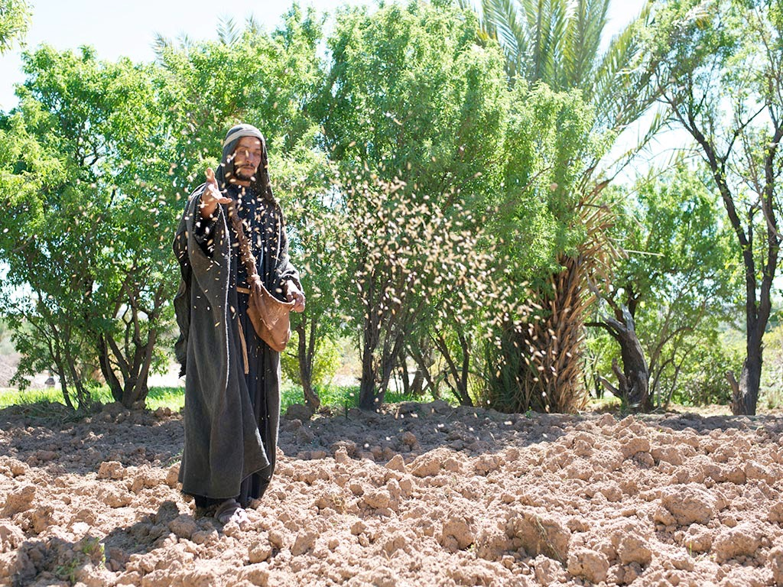

Matthew 13:1-23; Mark 4:1-20; Luke 8:1-15
PARABLE OF THE SOWER

Slide 58
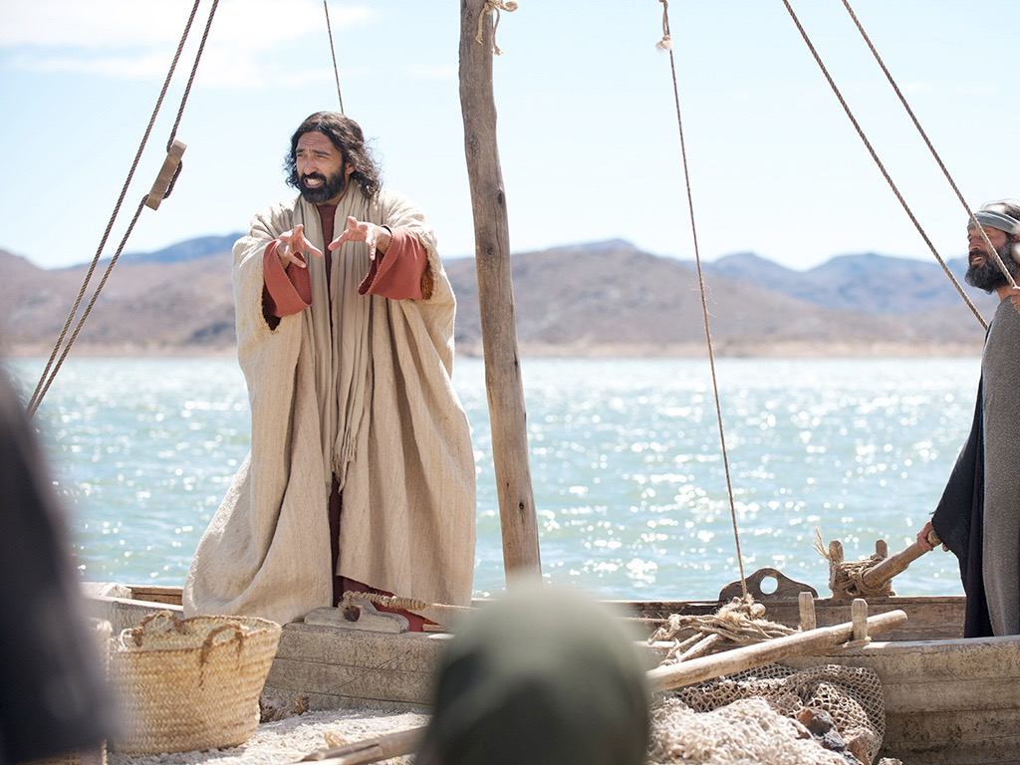
Notes:
Parable of the Farmer Scattering Seed
Matt. 13:1 Later that same day Jesus left the house and sat beside the lake. ² A large crowd soon gathered around him, so he got into a boat. Then he sat there and taught as the people stood on the shore.

Slide 59
Notes:
³ He told many stories in the form of parables, such as this one:
“Listen! A farmer went out to plant some seeds.

Slide 60
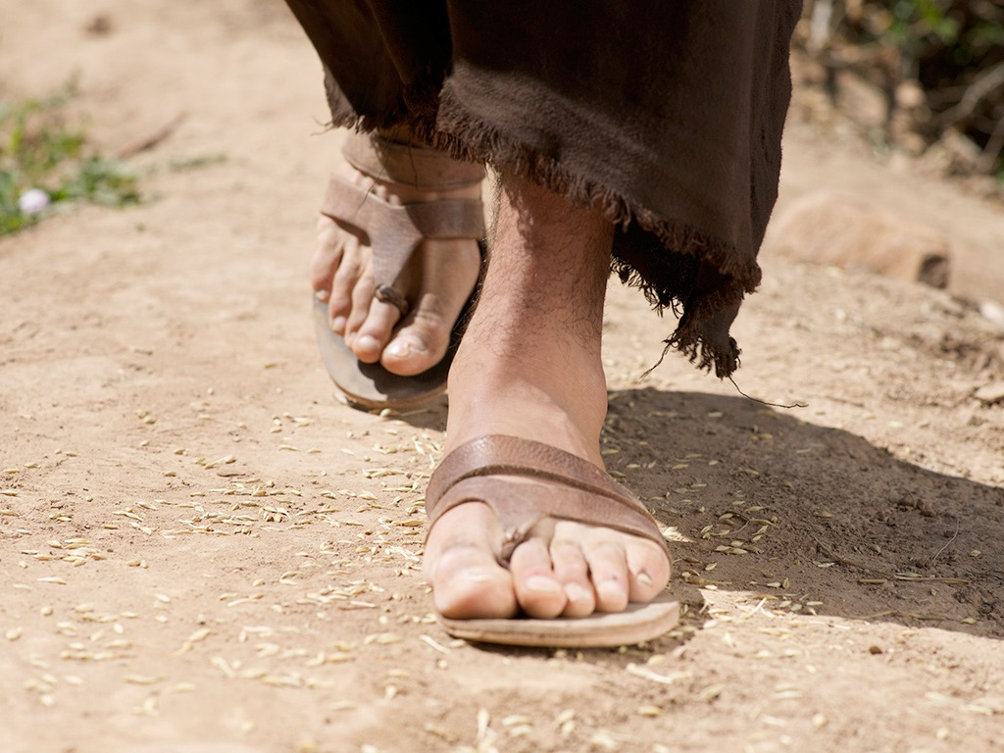
Notes:
⁴ As he scattered them across his field, some seeds fell on a footpath, and the birds came and ate them.

Slide 61
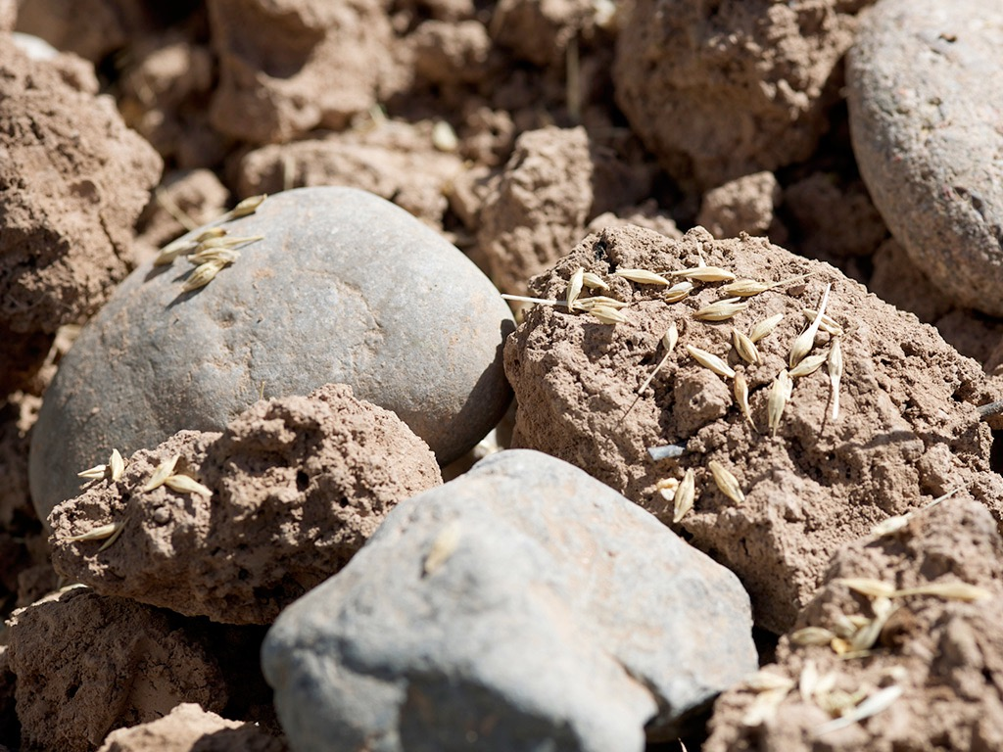
Notes:
⁵ Other seeds fell on shallow soil with underlying rock. The seeds sprouted quickly because the soil was shallow.

Slide 62
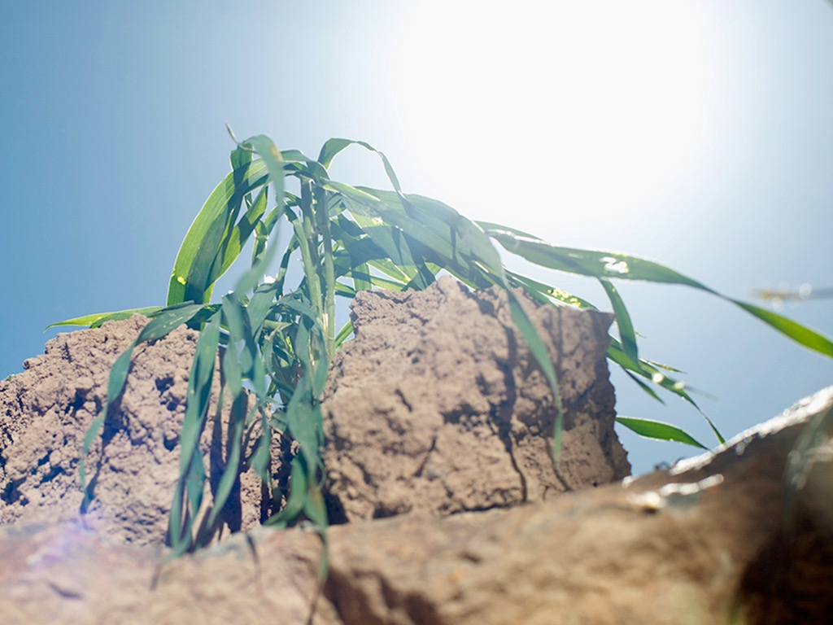
Notes:
⁶ But the plants soon wilted under the hot sun, and since they didn’t have deep roots, they died.

Slide 63
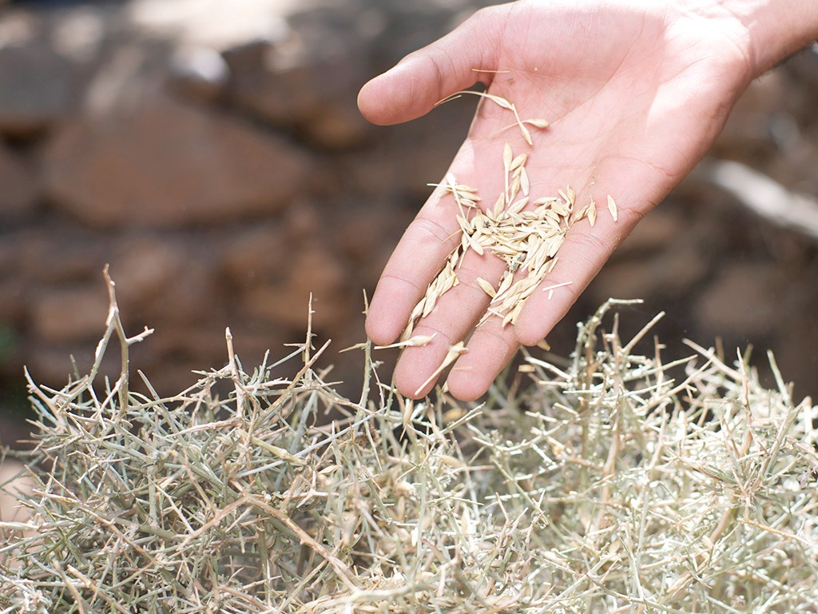
Notes:
⁷ Other seeds fell among thorns that grew up and choked out the tender plants.

Slide 64
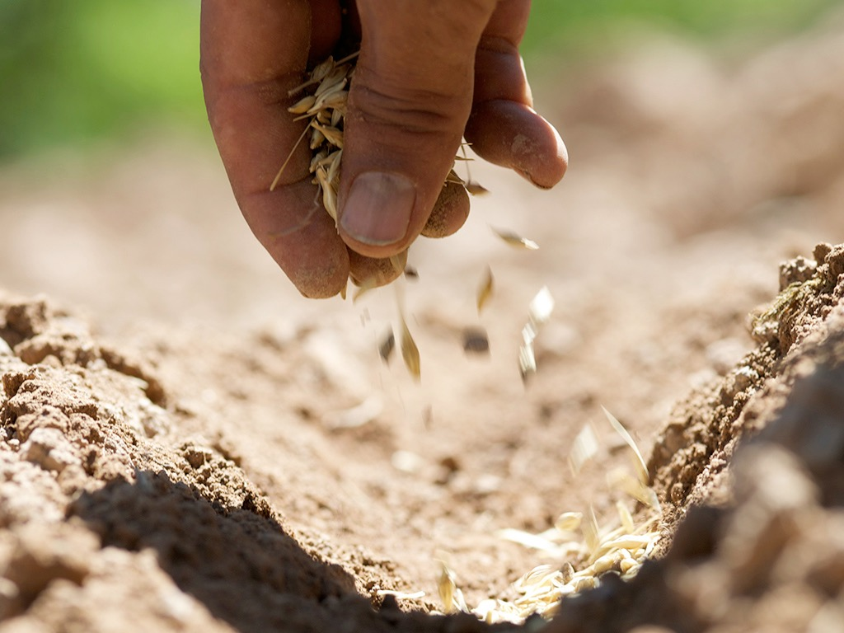
Notes:
⁸ Still other seeds fell on fertile soil…

Slide 65
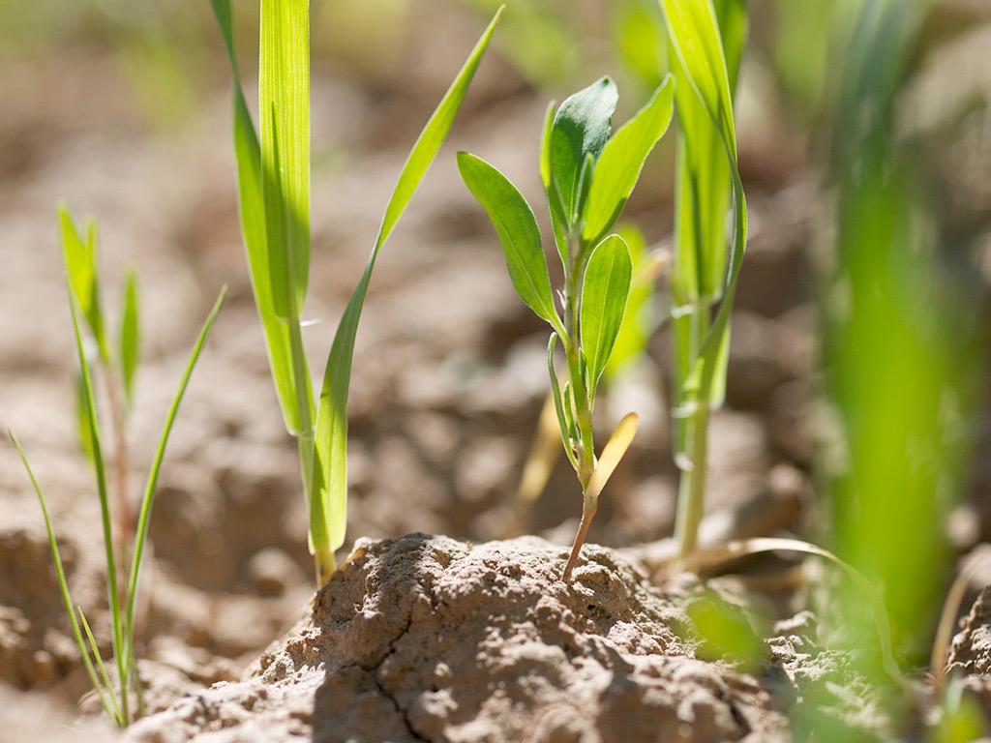
Notes:
…and they produced a crop that was thirty, sixty…

Slide 66
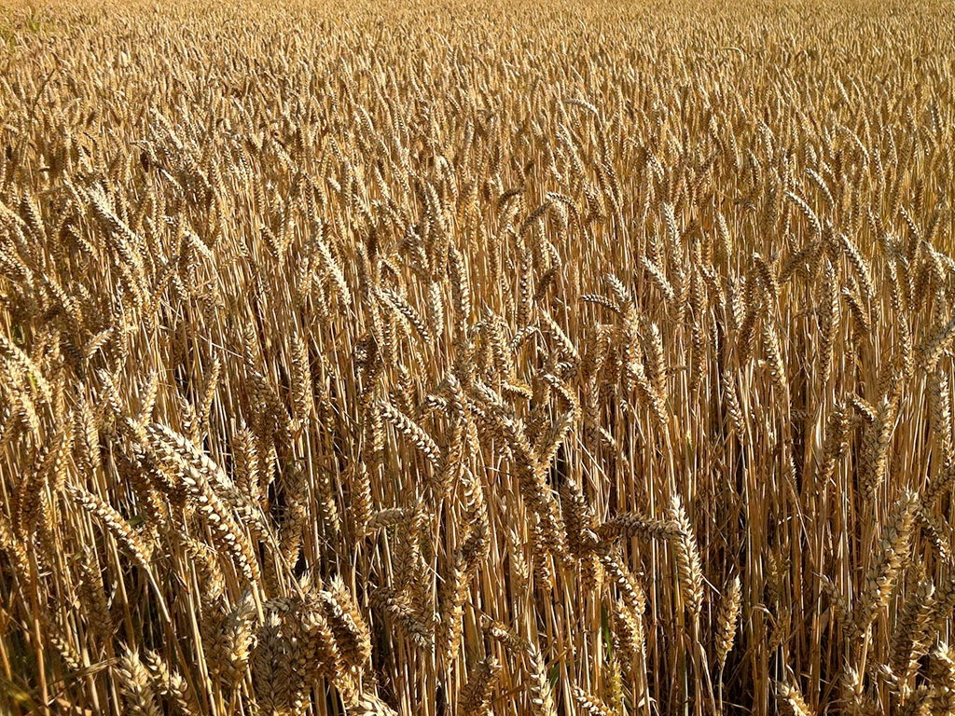
Notes:
…and even a hundred times as much as had been planted! ⁹ Anyone with ears to hear should listen and understand.”

Slide 67
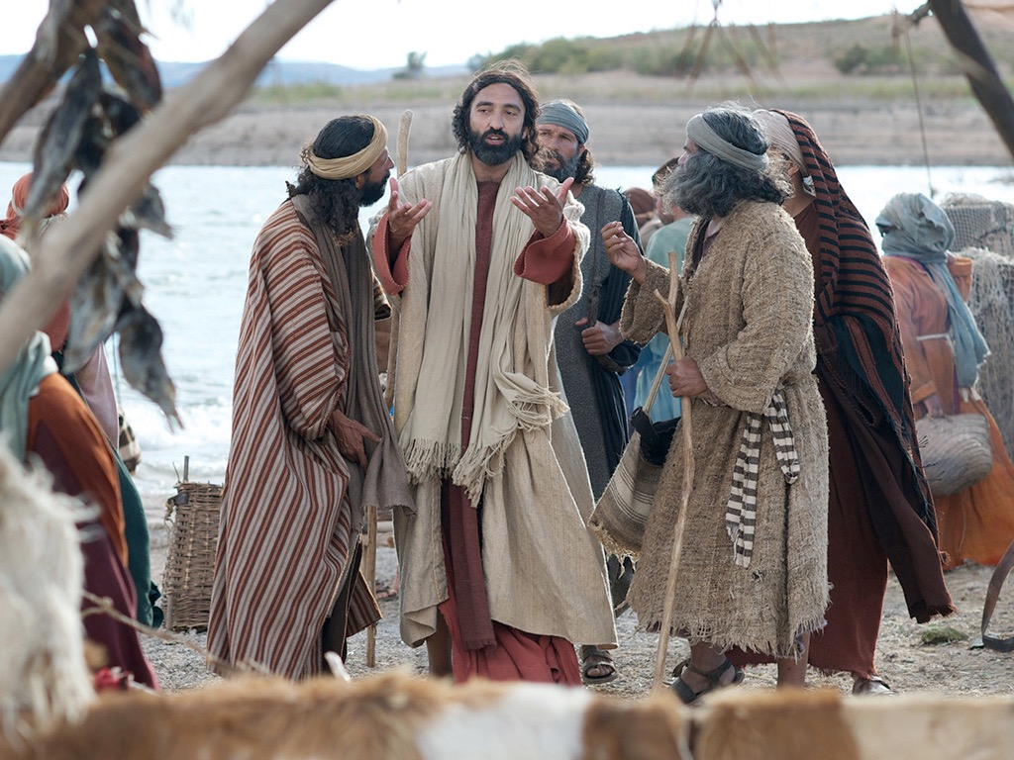
Notes:
Matt. 13:10 His disciples came and asked him, “Why do you use parables when you talk to the people?”

Slide 68
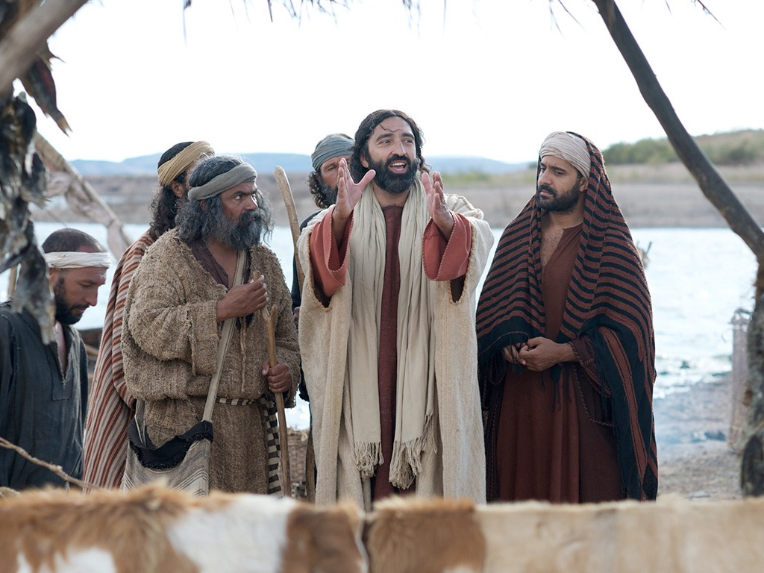
Notes:
Matt. 13:11 He replied, “You are permitted to understand the secretsª of the Kingdom of Heaven, but others are not.

Slide 69
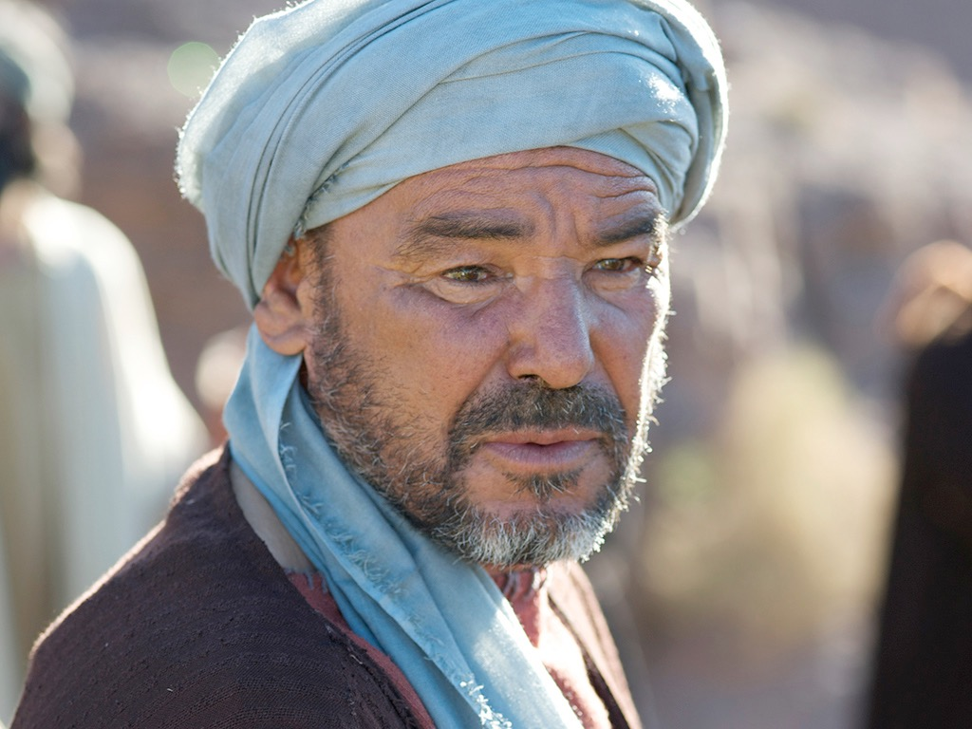
Notes:
¹² To those who listen to my teaching, more understanding will be given, and they will have an abundance of knowledge.

Slide 70
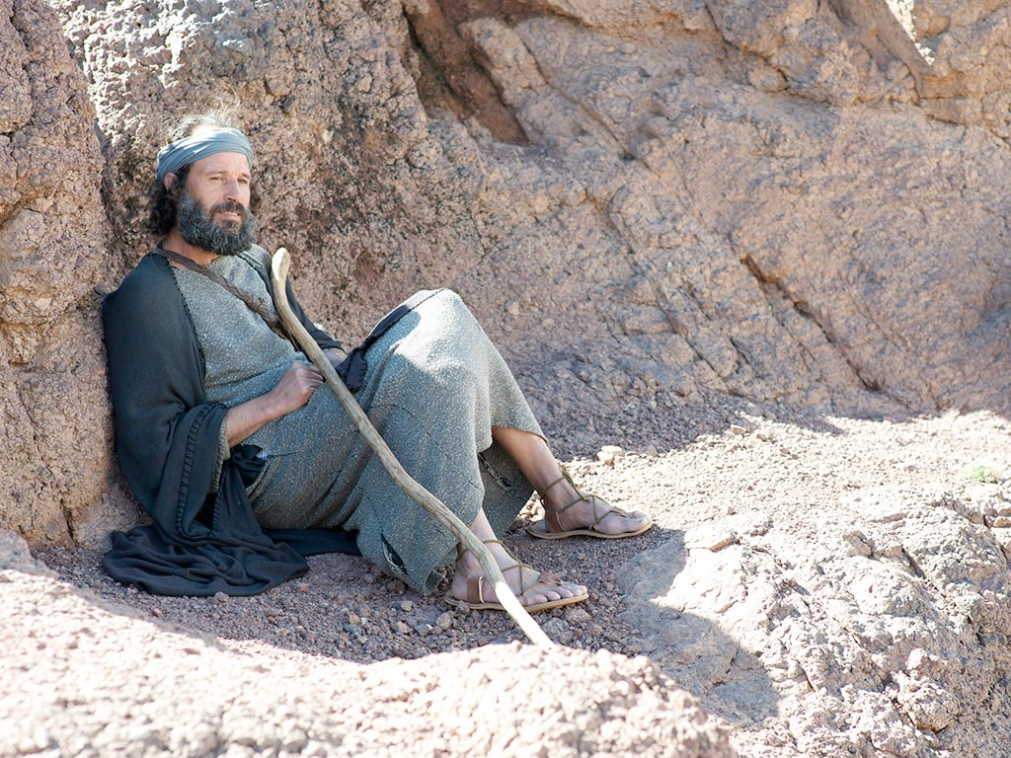
Notes:
But for those who are not listening, even what little understanding they have will be taken away from them.

Slide 71
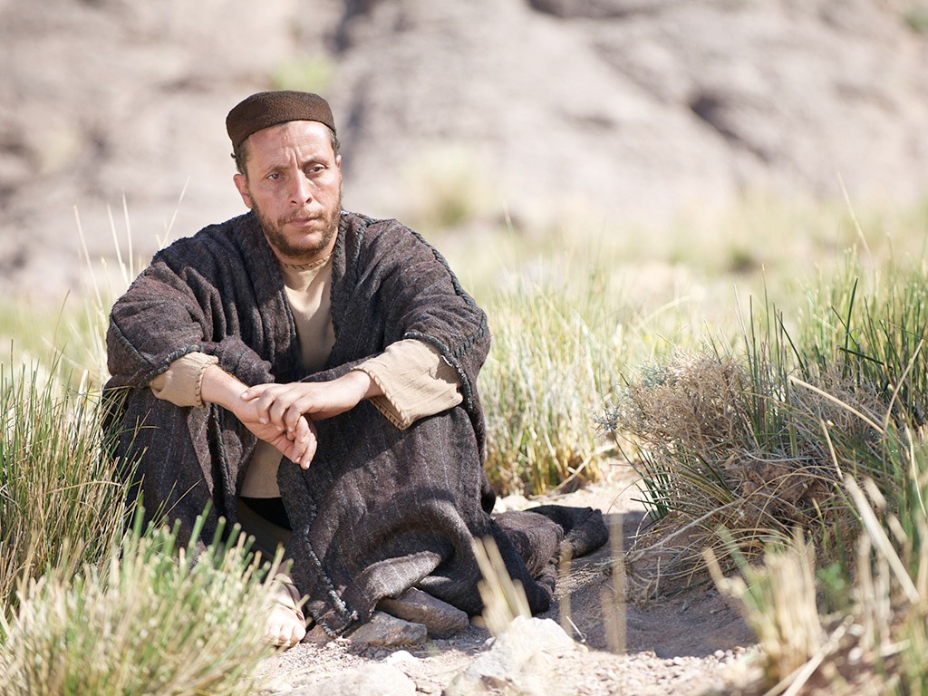
Notes:
¹³ That is why I use these parables,
For they look, but they don’t really see.
They hear, but they don’t really listen or understand.
Matt. 13:14 This fulfills the prophecy of Isaiah that says,
‘When you hear what I say,
you will not understand.
When you see what I do,
you will not comprehend.
¹⁵ For the hearts of these people are hardened,
and their ears cannot hear,
and they have closed their eyes—
so their eyes cannot see,
and their ears cannot hear,
and their hearts cannot understand,
and they cannot turn to me
and let me heal them.’

Slide 72
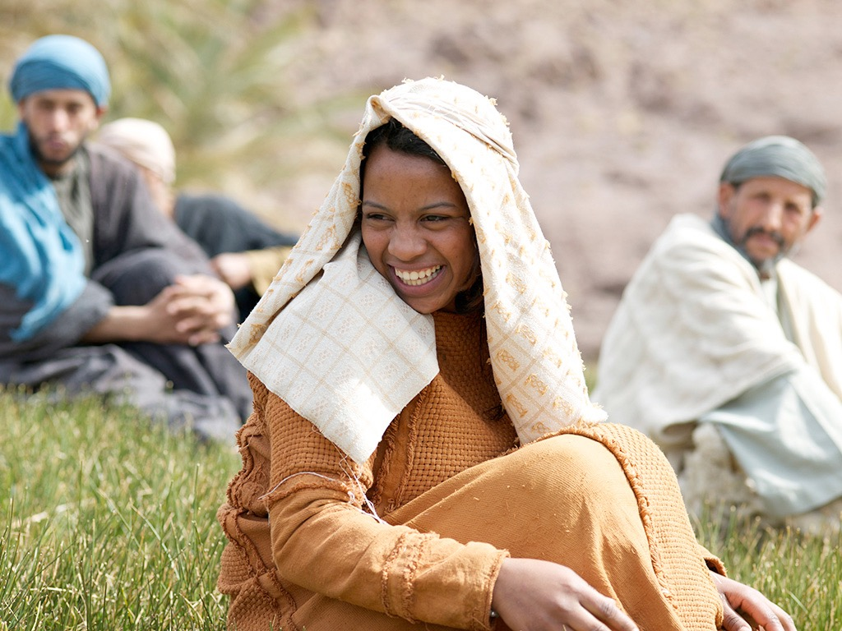
Notes:
Matt. 13:16 “But blessed are your eyes, because they see; and your ears, because they hear. ¹⁷ I tell you the truth, many prophets and righteous people longed to see what you see, but they didn’t see it. And they longed to hear what you hear, but they didn’t hear it.

Slide 73
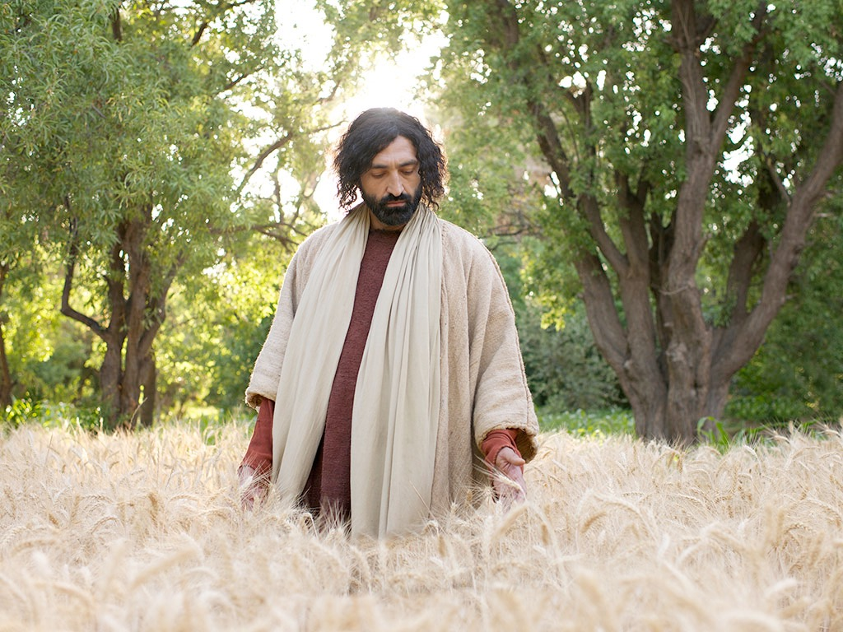
Notes:
Matt. 13:18 “Now listen to the explanation of the parable about the farmer planting seeds: ¹⁹ The seed that fell on the footpath represents those who hear the message about the Kingdom and don’t understand it. Then the evil one comes and snatches away the seed that was planted in their hearts. ²⁰ The seed on the rocky soil represents those who hear the message and immediately receive it with joy. ²¹ But since they don’t have deep roots, they don’t last long. They fall away as soon as they have problems or are persecuted for believing God’s word. ²² The seed that fell among the thorns represents those who hear God’s word, but all too quickly the message is crowded out by the worries of this life and the lure of wealth, so no fruit is produced. ²³ The seed that fell on good soil represents those who truly hear and understand God’s word and produce a harvest of thirty, sixty, or even a hundred times as much as had been planted!”

Slide 74
THE WORD IN PICTURES
Free Bible images

Slide 75

Used with Permission
THE GOSPEL ——OF—— MATTHEW
THE GOSPEL ——OF—— MARK
THE GOSPEL ——OF—— LUKE
THE GOSPEL ——OF—— JOHN
Due to the Lumo Project producing its own publishing material we regret to inform you that we cannot license our photos to other clients outside of freebibleimages.org.
These images are not licensed for reuse in video, epublishing or other media. Downloaded pictures and files cannot be redistributed through any other website than freebibleimages.org or used in any context where the accompanying message is undermining of the Christian faith and gospel.
Photos can only be used on educational presentations, blogs and social media, all of which should be accompanied with reference to www.LumoProject.com.
Picture courtesy of BBM © All Rights Reserved.
www.bigbookmedia.com

Slide 76
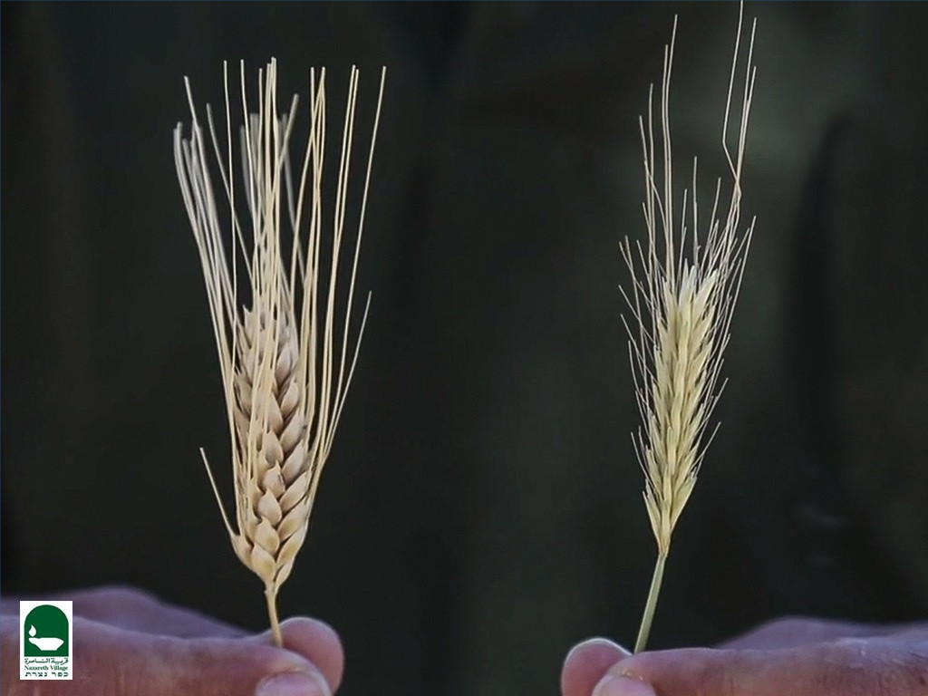
PARABLE OF THE WHEAT AND TARES
Matthew 13:24-30

Slide 77
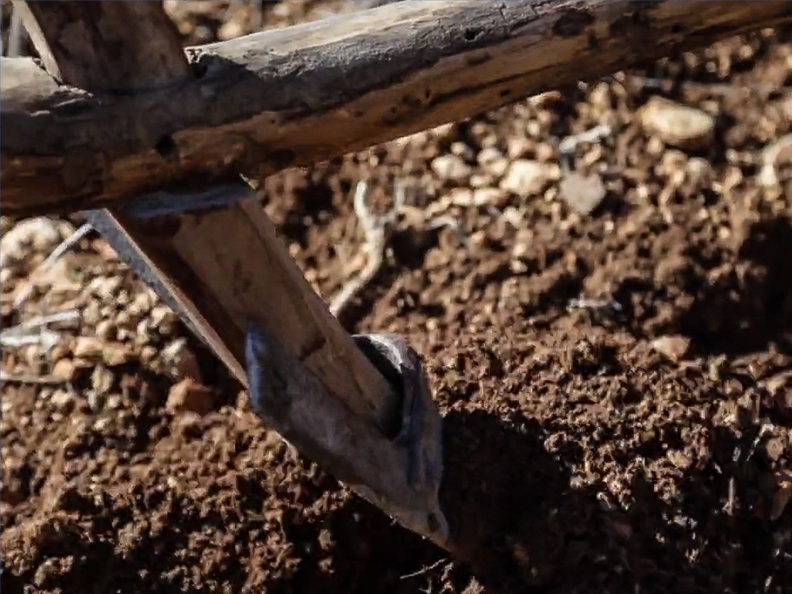
Notes:
Parable of the Wheat and Weeds
Matt. 13:24 Here is another story Jesus told:

Slide 78
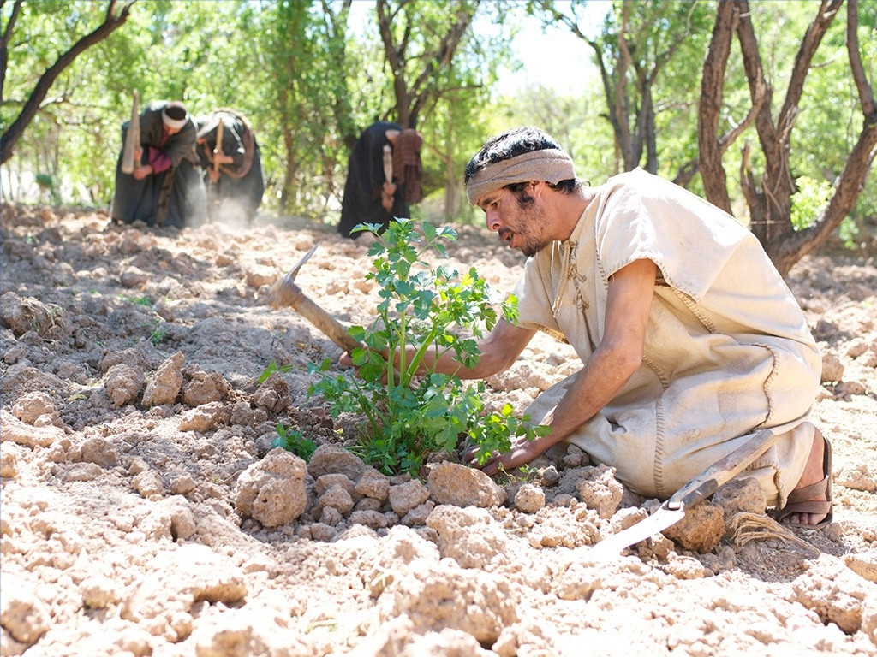
Notes:
“The Kingdom of Heaven is like a farmer who planted good seed in his field.

Slide 79
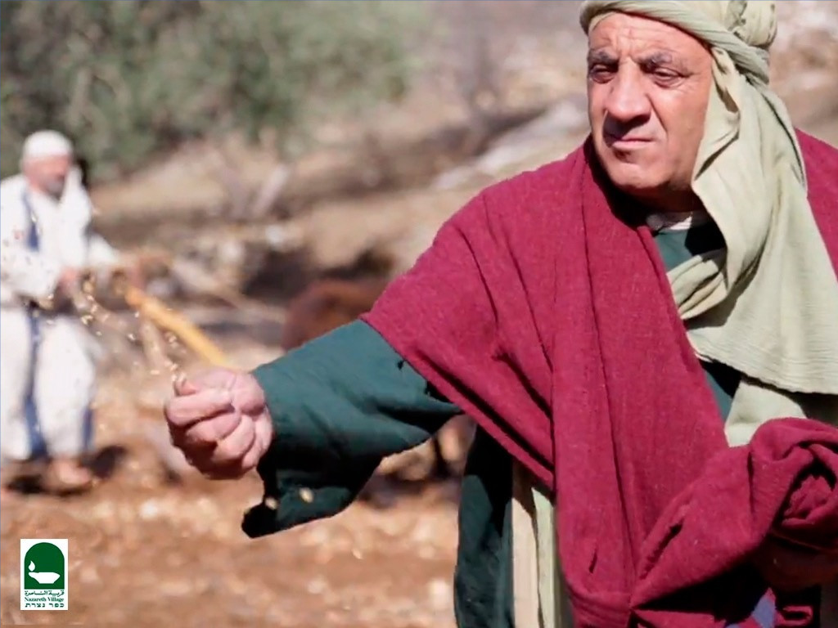

Slide 80
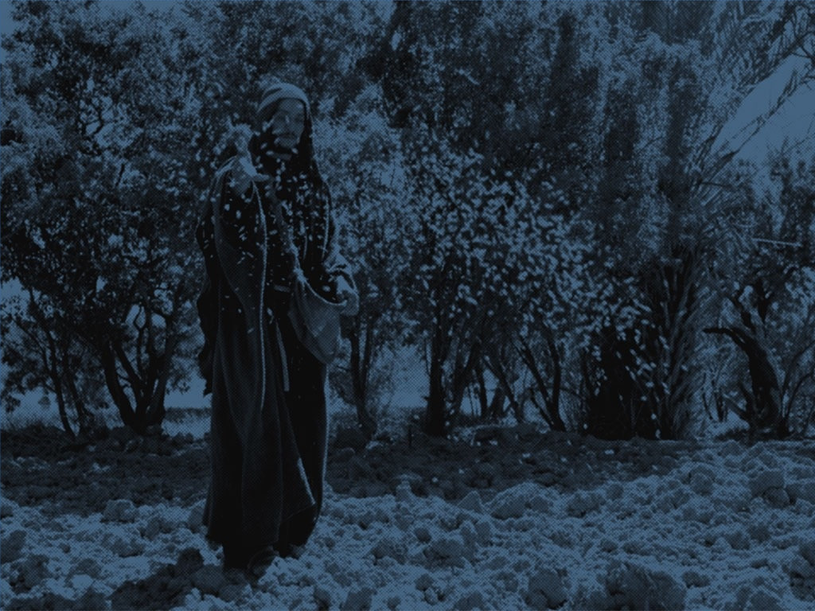
Notes:
²⁵ But that night as the workers slept, his enemy came and planted weeds among the wheat, then slipped away.

Slide 81
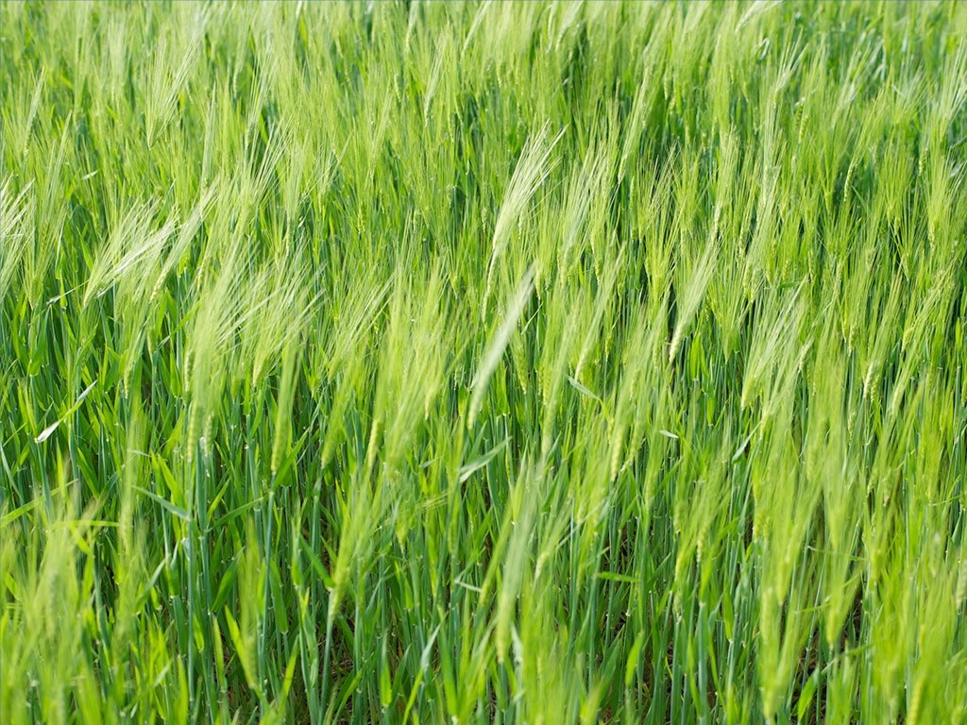
Notes:
²⁶ When the crop began to grow and produce grain, the weeds also grew.

Slide 82
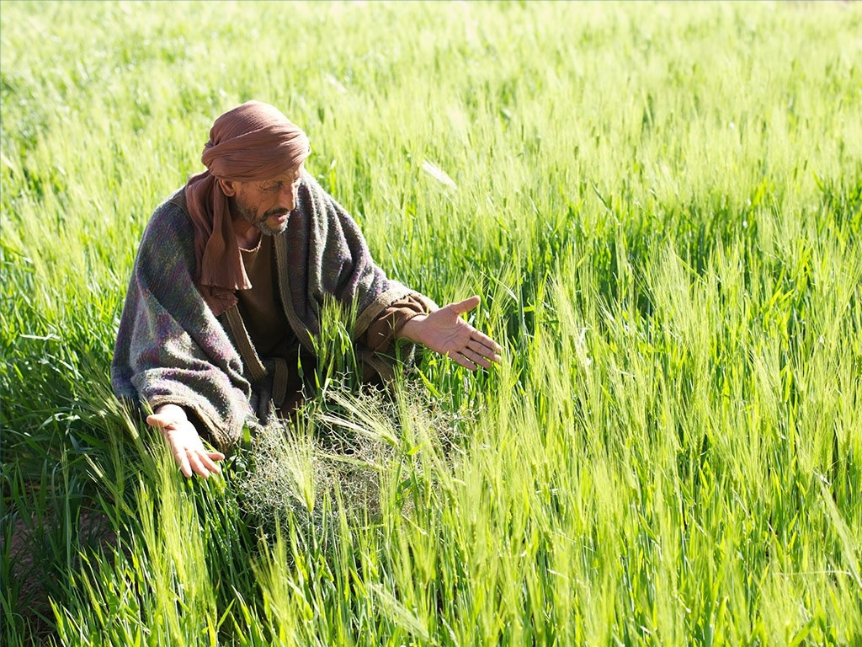
Notes:
Matt. 13:27 “The farmer’s workers went to him and said, ‘Sir, the field where you planted that good seed is full of weeds! Where did they come from?’

Slide 83
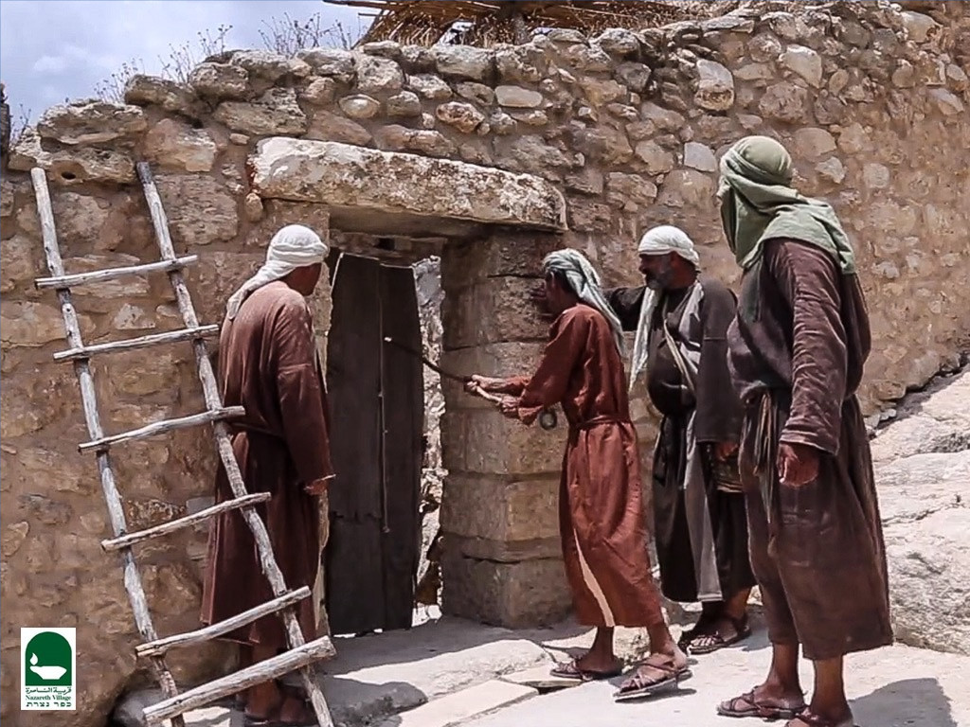
Notes:
Matt. 13:28 “‘An enemy has done this!’ the farmer exclaimed.

Slide 84
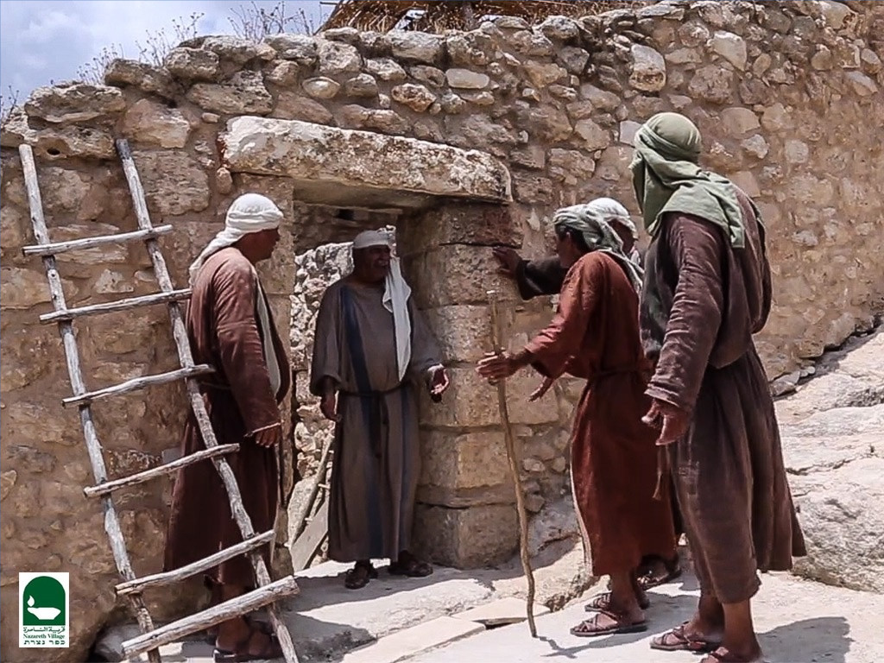
Notes:
“‘Should we pull out the weeds?’ they asked.

Slide 85
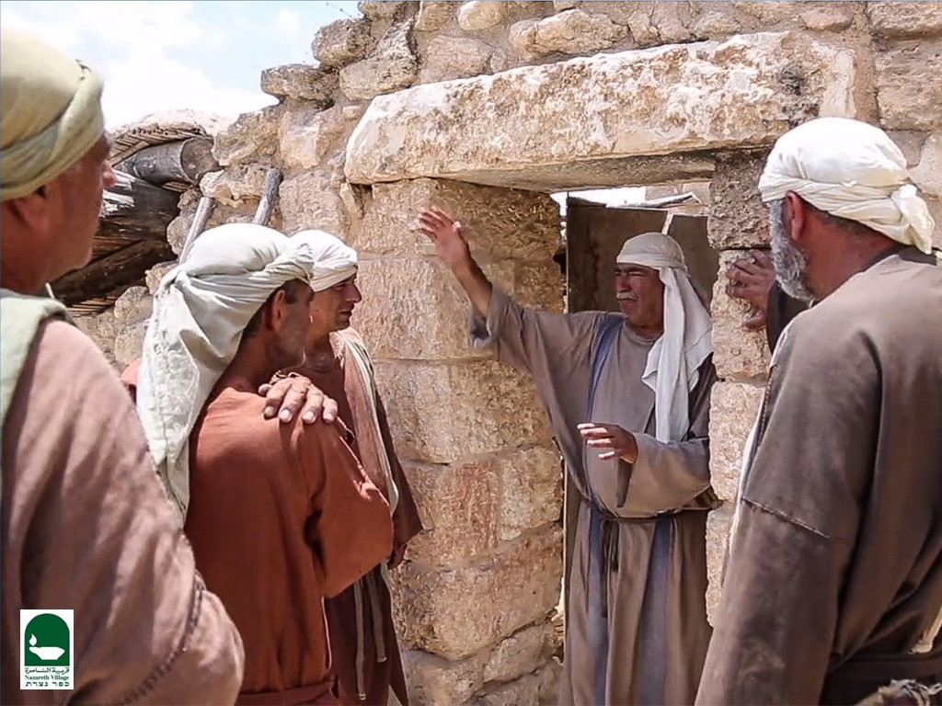
Notes:
Matt. 13:29 “‘No,’ he replied, ‘you’ll uproot the wheat if you do.

Slide 86
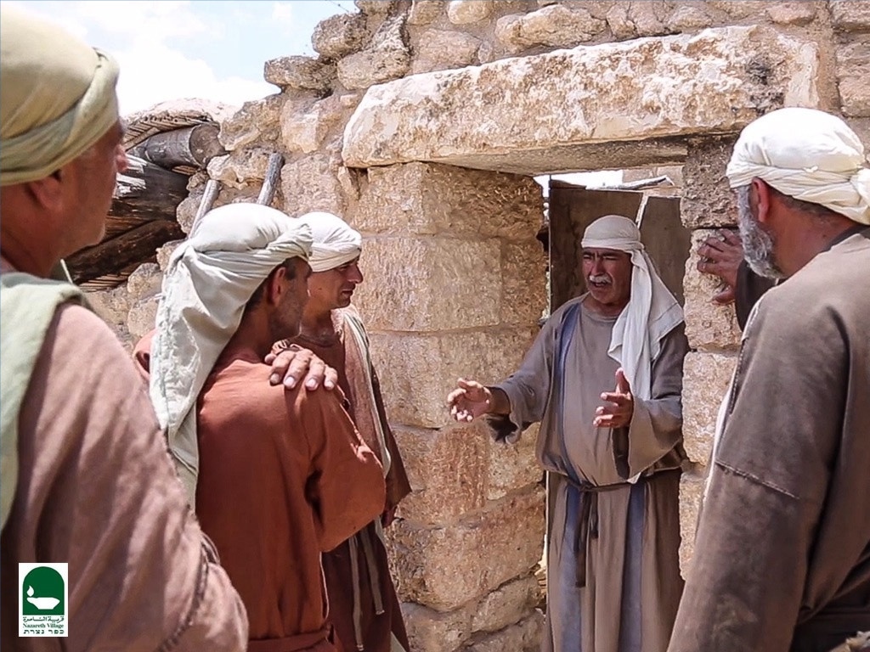
Notes:
³⁰ Let both grow together until the harvest.

Slide 87
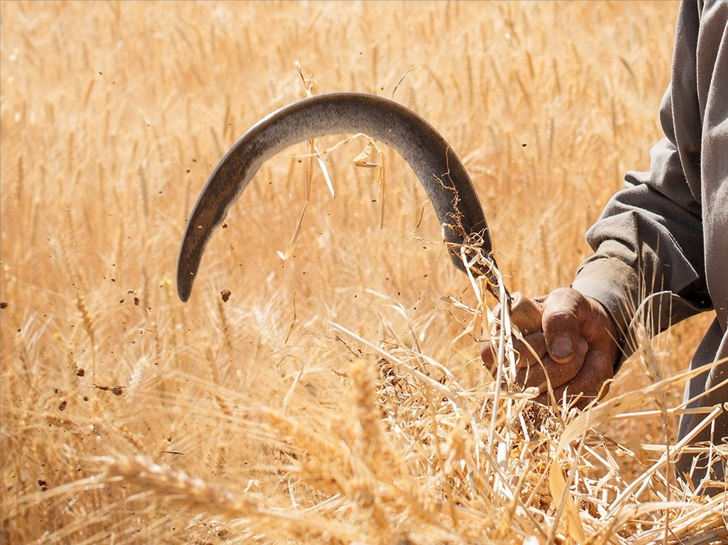
Notes:
Then I will tell the harvesters to sort out the weeds…

Slide 88
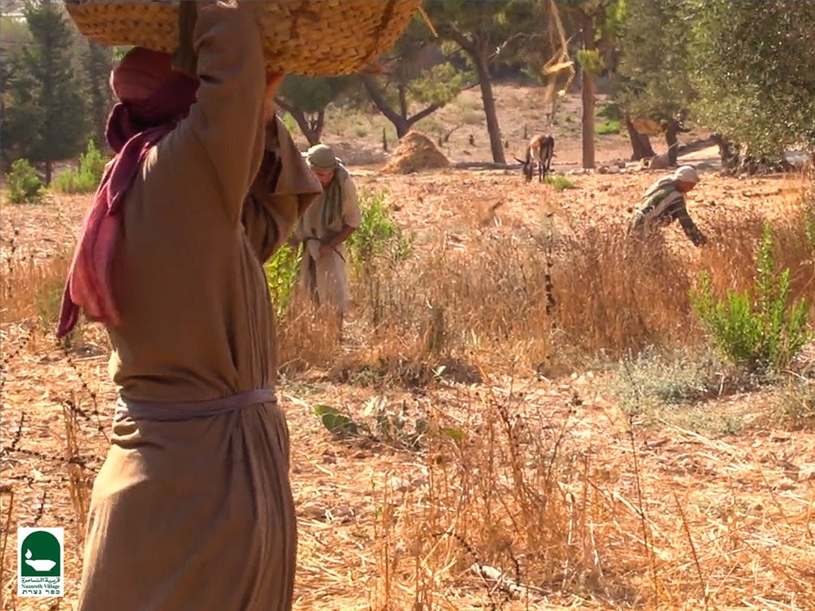
Notes:
…tie them into bundles…

Slide 89
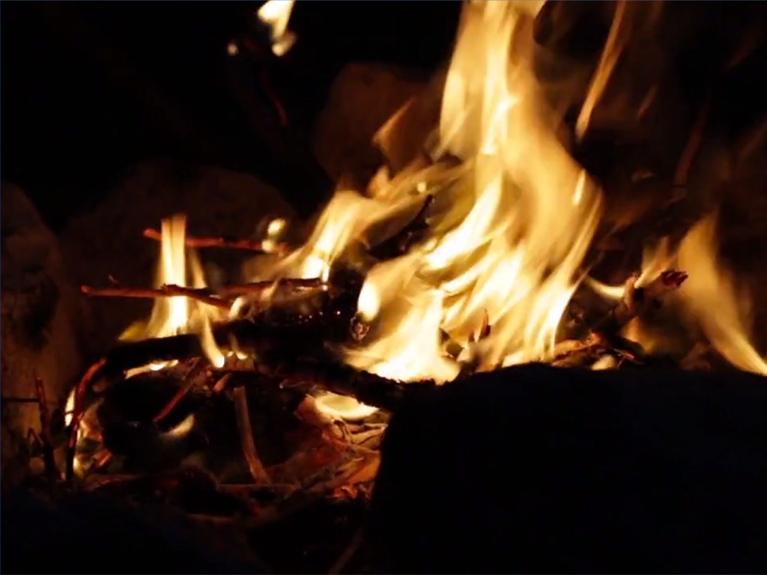
Notes:
…and burn them, and to put the wheat in the barn.’”

Slide 90
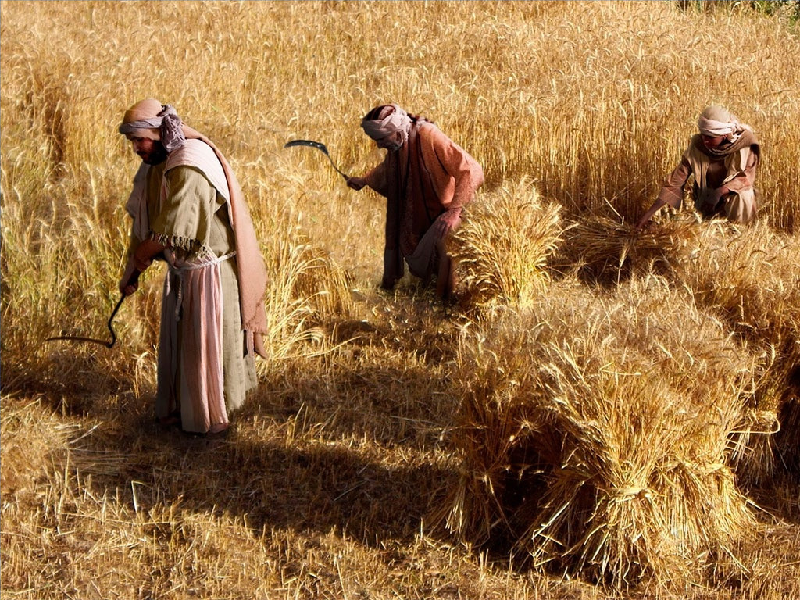

Slide 91


Slide 92


Slide 93

Notes:
The seed is good, as the Word of God is good.

Slide 94
Notes:
But the similarity between wheat and tares can make it difficult to discern which is true wheat.

Slide 95

Notes:
Some people look like true believers but are actually unbelievers among us.

Slide 96

Notes:
But the true believers will be revealed at the judgment by Jesus.

Slide 97


Slide 98
The Parables of Matthew 13
79a
PARABLES BY THE SEA (outside the house to the multitudes)
THE SOILS (13:3-9, 18-23) Planting
Issue: Why have Israel and the leaders rejected the Messiah?
Main Idea: Receptivity determines productivity, which is a heart issue.
2. THE TARES (13:24-30, 36-43) Planting
Issue: What accounts for the false religiosity in the world?
Main Idea: Satan sowed a counterfeit kingdom in the world, which will not be fully revealed until the judgment.
THE MUSTARD SEED (13:31-32) Growth
Issue: Will this Interadvent survive?
Main Idea: It will start small, but the new program will grow worldwide.
THE LEAVENING PROCESS (13:33) Growth
Issue: How will this new kingdom grow?
Main Issue: The kingdom will grow from an internal dynamic (Holy Spirit), not from an external organization (Judaism).
Mark Bailey, DTS
Notes:
Jesus told eight parables in Matthew 13, each of which reveals a certain truth regarding the kingdom of God.

Slide 99
The Parables of Matthew 13
79a
PARABLES IN THE HOUSE (inside the house to the disciples)
THE HID TREASURE (13:44) Value
Issue: How valuable should this new-profound kingdom of God be to us?
Main Idea: God's kingdom is so valuable a man should give up everything to be part of it.
THE PEARL MERCHANT (13:45-46) Value
Issue: How valuable is this kingdom to Christ?
Main Idea: The kingdom was established though Christ's total self sacrifice.
THE DRAGNET (13:47-50) Responsibility
Issue: How wide should the invitation to the kingdom be made?
Main Idea: Evangelism should be done without discrimination.
THE HOUSEHOLDER (13:52) Responsibility
Issue: What are the responsibilities of disciples in the kingdom?
Main Idea: We must teach both old and new truths about God's kingdom program. One key new truth not taught in the OT is the church age of Jews and Gentiles without discrimination (Eph. 3:3-6, 9 vs. Zech. 8:23).
Mark Bailey, DTS

Slide 100
2. Power Over Nature
§ 68
Matthew 8:18, 23-27; Mark 4:35-41; Luke 8:22-25
Jesus calms the Sea of Galilee as Lord over nature so His disciples would trust Him for everything until all creation submits to Him
Notes:
The Cost of Following Jesus
Matt. 8:18 When Jesus saw the crowd around him, he instructed his disciples to cross to the other side of the lake.
Jesus Calms the Storm
Matt. 8:23 Then Jesus got into the boat and started across the lake with his disciples. ²⁴ Suddenly, a fierce storm struck the lake, with waves breaking into the boat. But Jesus was sleeping. ²⁵ The disciples went and woke him up, shouting, “Lord, save us! We’re going to drown!”
Matt. 8:26 Jesus responded, “Why are you afraid? You have so little faith!” Then he got up and rebuked the wind and waves, and suddenly there was a great calm.
Matt. 8:27 The disciples were amazed. “Who is this man?” they asked. “Even the winds and waves obey him!”
Jesus Calms the Storm
Mark 4:35 As evening came, Jesus said to his disciples, “Let’s cross to the other side of the lake.” ³⁶ So they took Jesus in the boat and started out, leaving the crowds behind (although other boats followed). ³⁷ But soon a fierce storm came up. High waves were breaking into the boat, and it began to fill with water.
Mark 4:38 Jesus was sleeping at the back of the boat with his head on a cushion. The disciples woke him up, shouting, “Teacher, don’t you care that we’re going to drown?”
Mark 4:39 When Jesus woke up, he rebuked the wind and said to the waves, “Silence! Be still!” Suddenly the wind stopped, and there was a great calm. ⁴⁰ Then he asked them, “Why are you afraid? Do you still have no faith?”
Mark 4:41 The disciples were absolutely terrified. “Who is this man?” they asked each other. “Even the wind and waves obey him!”
Jesus Calms the Storm
Luke 8:22 One day Jesus said to his disciples, “Let’s cross to the other side of the lake.” So they got into a boat and started out. ²³ As they sailed across, Jesus settled down for a nap. But soon a fierce storm came down on the lake. The boat was filling with water, and they were in real danger.
Luke 8:24 The disciples went and woke him up, shouting, “Master, Master, we’re going to drown!”
When Jesus woke up, he rebuked the wind and the raging waves. Suddenly the storm stopped and all was calm.
²⁵ Then he asked them, “Where is your faith?”
The disciples were terrified and amazed. “Who is this man?” they asked each other. “When he gives a command, even the wind and waves obey him!”

Slide 101

Free Bible images
Matthew 8:23-27
Mark 4:35-41 Luke 8:22-25
JESUS CALMS A STORM
Notes:
The Cost of Following Jesus
Matt. 8:18 When Jesus saw the crowd around him, he instructed his disciples to cross to the other side of the lake.
Jesus Calms the Storm
Matt. 8:23 Then Jesus got into the boat and started across the lake with his disciples. ²⁴ Suddenly, a fierce storm struck the lake, with waves breaking into the boat. But Jesus was sleeping. ²⁵ The disciples went and woke him up, shouting, “Lord, save us! We’re going to drown!”
Matt. 8:26 Jesus responded, “Why are you afraid? You have so little faith!” Then he got up and rebuked the wind and waves, and suddenly there was a great calm.
Matt. 8:27 The disciples were amazed. “Who is this man?” they asked. “Even the winds and waves obey him!”
Jesus Calms the Storm
Mark 4:35 As evening came, Jesus said to his disciples, “Let’s cross to the other side of the lake.” ³⁶ So they took Jesus in the boat and started out, leaving the crowds behind (although other boats followed). ³⁷ But soon a fierce storm came up. High waves were breaking into the boat, and it began to fill with water.
Mark 4:38 Jesus was sleeping at the back of the boat with his head on a cushion. The disciples woke him up, shouting, “Teacher, don’t you care that we’re going to drown?”
Mark 4:39 When Jesus woke up, he rebuked the wind and said to the waves, “Silence! Be still!” Suddenly the wind stopped, and there was a great calm. ⁴⁰ Then he asked them, “Why are you afraid? Do you still have no faith?”
Mark 4:41 The disciples were absolutely terrified. “Who is this man?” they asked each other. “Even the wind and waves obey him!”
Jesus Calms the Storm
Luke 8:22 One day Jesus said to his disciples, “Let’s cross to the other side of the lake.” So they got into a boat and started out. ²³ As they sailed across, Jesus settled down for a nap. But soon a fierce storm came down on the lake. The boat was filling with water, and they were in real danger.
Luke 8:24 The disciples went and woke him up, shouting, “Master, Master, we’re going to drown!”
When Jesus woke up, he rebuked the wind and the raging waves. Suddenly the storm stopped and all was calm.
²⁵ Then he asked them, “Where is your faith?”
The disciples were terrified and amazed. “Who is this man?” they asked each other. “When he gives a command, even the wind and waves obey him!”

Slide 102

Notes:
The Cost of Following Jesus
Matt. 8:18 When Jesus saw the crowd around him, he instructed his disciples to cross to the other side of the lake.
Jesus Calms the Storm
Matt. 8:23 Then Jesus got into the boat…

Slide 103

Notes:
… and started across the lake with his disciples.

Slide 104


Slide 105
Notes:
²⁴ Suddenly, a fierce storm struck the lake…

Slide 106

Notes:
…with waves breaking into the boat…

Slide 107

Notes:
…But Jesus was sleeping.
²⁵ The disciples went and woke him up, shouting, “Lord, save us! We’re going to drown!”

Slide 108

Notes:
Matt. 8:26 Jesus responded, “Why are you afraid? You have so little faith!”

Slide 109

Notes:
…Then he got up and rebuked the wind and waves…

Slide 110

Notes:
…, and suddenly there was…

Slide 111

Notes:
… a great calm.

Slide 112

Notes:
Matt. 8:27 The disciples were amazed. “Who is this man?” they asked…

Slide 113

Notes:
…“Even the winds and waves obey him!”

Slide 114
Used with Permission
THE GOSPEL ——OF—— MATTHEW
THE GOSPEL ——OF—— MARK
THE GOSPEL ——OF—— LUKE
THE GOSPEL ——OF—— JOHN
Due to the Lumo Project producing its own publishing material we regret to inform you that we cannot license our photos to other clients outside of freebibleimages.org.
These images are not licensed for reuse in video, epublishing or other media. Downloaded pictures and files cannot be redistributed through any other website than freebibleimages.org or used in any context where the accompanying message is undermining of the Christian faith and gospel.
Photos can only be used on educational presentations, blogs and social media, all of which should be accompanied with reference to www.LumoProject.com.
Picture courtesy of BBM © All Rights Reserved.
www.bigbookmedia.com

Slide 115
3. Power Over Demons
§ 69
Matthew 8:28-34; Mark 5:1-20; Luke 8:26-39
As Israel's leaders oppose Him, Jesus proves His authority over Satan by showing authority over demons that controlled pigs
Notes:
Jesus Heals Two Demon-Possessed Men
Matt. 8:28 When Jesus arrived on the other side of the lake, in the region of the Gadarenes, two men who were possessed by demons met him. They came out of the tombs and were so violent that no one could go through that area.
Matt. 8:29 They began screaming at him, “Why are you interfering with us, Son of God? Have you come here to torture us before God’s appointed time?”
Matt. 8:30 There happened to be a large herd of pigs feeding in the distance. ³¹ So the demons begged, “If you cast us out, send us into that herd of pigs.”
Matt. 8:32 “All right, go!” Jesus commanded them. So the demons came out of the men and entered the pigs, and the whole herd plunged down the steep hillside into the lake and drowned in the water.
Matt. 8:33 The herdsmen fled to the nearby town, telling everyone what happened to the demon-possessed men. ³⁴ Then the entire town came out to meet Jesus, but they begged him to go away and leave them alone.
Jesus Heals a Demon-Possessed Man
Mark 5:1 So they arrived at the other side of the lake, in the region of the Gerasenes. ² When Jesus climbed out of the boat, a man possessed by an evilª spirit came out from the tombs to meet him. ³ This man lived in the burial caves and could no longer be restrained, even with a chain. ⁴ Whenever he was put into chains and shackles—as he often was—he snapped the chains from his wrists and smashed the shackles. No one was strong enough to subdue him. ⁵ Day and night he wandered among the burial caves and in the hills, howling and cutting himself with sharp stones.
Mark 5:6 When Jesus was still some distance away, the man saw him, ran to meet him, and bowed low before him. ⁷ With a shriek, he screamed, “Why are you interfering with me, Jesus, Son of the Most High God? In the name of God, I beg you, don’t torture me!” ⁸ For Jesus had already said to the spirit, “Come out of the man, you evil spirit.”
Mark 5:9 Then Jesus demanded, “What is your name?”
And he replied, “My name is Legion, because there are many of us inside this man.”
¹⁰ Then the evil spirits begged him again and again not to send them to some distant place.
Mark 5:11 There happened to be a large herd of pigs feeding on the hillside nearby. ¹² “Send us into those pigs,” the spirits begged. “Let us enter them.”
Mark 5:13 So Jesus gave them permission. The evil spirits came out of the man and entered the pigs, and the entire herd of about 2,000 pigs plunged down the steep hillside into the lake and drowned in the water.
Mark 5:14 The herdsmen fled to the nearby town and the surrounding countryside, spreading the news as they ran. People rushed out to see what had happened. ¹⁵ A crowd soon gathered around Jesus, and they saw the man who had been possessed by the legion of demons. He was sitting there fully clothed and perfectly sane, and they were all afraid. ¹⁶ Then those who had seen what happened told the others about the demon-possessed man and the pigs. ¹⁷ And the crowd began pleading with Jesus to go away and leave them alone.
Mark 5:18 As Jesus was getting into the boat, the man who had been demon possessed begged to go with him. ¹⁹ But Jesus said, “No, go home to your family, and tell them everything the Lord has done for you and how merciful he has been.” ²⁰ So the man started off to visit the Ten Townsª of that region and began to proclaim the great things Jesus had done for him; and everyone was amazed at what he told them.
Jesus Heals a Demon-Possessed Man
Luke 8:26 So they arrived in the region of the Gerasenes,ª across the lake from Galilee. ²⁷ As Jesus was climbing out of the boat, a man who was possessed by demons came out to meet him. For a long time he had been homeless and naked, living in the tombs outside the town.
Luke 8:28 As soon as he saw Jesus, he shrieked and fell down in front of him. Then he screamed, “Why are you interfering with me, Jesus, Son of the Most High God? Please, I beg you, don’t torture me!” ²⁹ For Jesus had already commanded the evilª spirit to come out of him. This spirit had often taken control of the man. Even when he was placed under guard and put in chains and shackles, he simply broke them and rushed out into the wilderness, completely under the demon’s power.
Luke 8:30 Jesus demanded, “What is your name?”
“Legion,” he replied, for he was filled with many demons.
³¹ The demons kept begging Jesus not to send them into the bottomless pit.ª
Luke 8:32 There happened to be a large herd of pigs feeding on the hillside nearby, and the demons begged him to let them enter into the pigs.
So Jesus gave them permission.
³³ Then the demons came out of the man and entered the pigs, and the entire herd plunged down the steep hillside into the lake and drowned.
Luke 8:34 When the herdsmen saw it, they fled to the nearby town and the surrounding countryside, spreading the news as they ran. ³⁵ People rushed out to see what had happened. A crowd soon gathered around Jesus, and they saw the man who had been freed from the demons. He was sitting at Jesus’ feet, fully clothed and perfectly sane, and they were all afraid. ³⁶ Then those who had seen what happened told the others how the demon-possessed man had been healed. ³⁷ And all the people in the region of the Gerasenes begged Jesus to go away and leave them alone, for a great wave of fear swept over them.
So Jesus returned to the boat and left, crossing back to the other side of the lake.
³⁸ The man who had been freed from the demons begged to go with him. But Jesus sent him home, saying, ³⁹ “No, go back to your family, and tell them everything God has done for you.” So he went all through the town proclaiming the great things Jesus had done for him.

Slide 116

Free Bible images
Matthew 8:28-34 Mark 5:1-20 Luke 8:26-29
JESUS DELIVERS A WILD MAN
Notes:
Jesus Heals Two Demon-Possessed Men
Matt. 8:28 When Jesus arrived on the other side of the lake, in the region of the Gadarenes, two men who were possessed by demons met him. They came out of the tombs and were so violent that no one could go through that area.
Matt. 8:29 They began screaming at him, “Why are you interfering with us, Son of God? Have you come here to torture us before God’s appointed time?”
Matt. 8:30 There happened to be a large herd of pigs feeding in the distance. ³¹ So the demons begged, “If you cast us out, send us into that herd of pigs.”
Matt. 8:32 “All right, go!” Jesus commanded them. So the demons came out of the men and entered the pigs, and the whole herd plunged down the steep hillside into the lake and drowned in the water.
Matt. 8:33 The herdsmen fled to the nearby town, telling everyone what happened to the demon-possessed men. ³⁴ Then the entire town came out to meet Jesus, but they begged him to go away and leave them alone.
Jesus Heals a Demon-Possessed Man
Mark 5:1 So they arrived at the other side of the lake, in the region of the Gerasenes. ² When Jesus climbed out of the boat, a man possessed by an evil spirit came out from the tombs to meet him. ³ This man lived in the burial caves and could no longer be restrained, even with a chain. ⁴ Whenever he was put into chains and shackles—as he often was—he snapped the chains from his wrists and smashed the shackles. No one was strong enough to subdue him. ⁵ Day and night he wandered among the burial caves and in the hills, howling and cutting himself with sharp stones.
Mark 5:6 When Jesus was still some distance away, the man saw him, ran to meet him, and bowed low before him. ⁷ With a shriek, he screamed, “Why are you interfering with me, Jesus, Son of the Most High God? In the name of God, I beg you, don’t torture me!” ⁸ For Jesus had already said to the spirit, “Come out of the man, you evil spirit.”
Mark 5:9 Then Jesus demanded, “What is your name?”
And he replied, “My name is Legion, because there are many of us inside this man.”
¹⁰ Then the evil spirits begged him again and again not to send them to some distant place.
Mark 5:11 There happened to be a large herd of pigs feeding on the hillside nearby. ¹² “Send us into those pigs,” the spirits begged. “Let us enter them.”
Mark 5:13 So Jesus gave them permission. The evil spirits came out of the man and entered the pigs, and the entire herd of about 2,000 pigs plunged down the steep hillside into the lake and drowned in the water.
Mark 5:14 The herdsmen fled to the nearby town and the surrounding countryside, spreading the news as they ran. People rushed out to see what had happened. ¹⁵ A crowd soon gathered around Jesus, and they saw the man who had been possessed by the legion of demons. He was sitting there fully clothed and perfectly sane, and they were all afraid. ¹⁶ Then those who had seen what happened told the others about the demon-possessed man and the pigs. ¹⁷ And the crowd began pleading with Jesus to go away and leave them alone.
Mark 5:18 As Jesus was getting into the boat, the man who had been demon possessed begged to go with him. ¹⁹ But Jesus said, “No, go home to your family, and tell them everything the Lord has done for you and how merciful he has been.” ²⁰ So the man started off to visit the Ten Townsª of that region and began to proclaim the great things Jesus had done for him; and everyone was amazed at what he told them.
Jesus Heals a Demon-Possessed Man
Luke 8:26 So they arrived in the region of the Gerasenes,ª across the lake from Galilee. ²⁷ As Jesus was climbing out of the boat, a man who was possessed by demons came out to meet him. For a long time he had been homeless and naked, living in the tombs outside the town.
Luke 8:28 As soon as he saw Jesus, he shrieked and fell down in front of him. Then he screamed, “Why are you interfering with me, Jesus, Son of the Most High God? Please, I beg you, don’t torture me!” ²⁹ For Jesus had already commanded the evil spirit to come out of him. This spirit had often taken control of the man. Even when he was placed under guard and put in chains and shackles, he simply broke them and rushed out into the wilderness, completely under the demon’s power.
Luke 8:30 Jesus demanded, “What is your name?”
“Legion,” he replied, for he was filled with many demons.
³¹ The demons kept begging Jesus not to send them into the bottomless pit.
Luke 8:32 There happened to be a large herd of pigs feeding on the hillside nearby, and the demons begged him to let them enter into the pigs.
So Jesus gave them permission.
³³ Then the demons came out of the man and entered the pigs, and the entire herd plunged down the steep hillside into the lake and drowned.
Luke 8:34 When the herdsmen saw it, they fled to the nearby town and the surrounding countryside, spreading the news as they ran. ³⁵ People rushed out to see what had happened. A crowd soon gathered around Jesus, and they saw the man who had been freed from the demons. He was sitting at Jesus’ feet, fully clothed and perfectly sane, and they were all afraid. ³⁶ Then those who had seen what happened told the others how the demon-possessed man had been healed. ³⁷ And all the people in the region of the Gerasenes begged Jesus to go away and leave them alone, for a great wave of fear swept over them.
So Jesus returned to the boat and left, crossing back to the other side of the lake.
³⁸ The man who had been freed from the demons begged to go with him. But Jesus sent him home, saying, ³⁹ “No, go back to your family, and tell them everything God has done for you.” So he went all through the town proclaiming the great things Jesus had done for him.

Slide 117

Notes:
Jesus Heals Two Demon-Possessed Men
Matt. 8:28 When Jesus arrived on the other side of the lake, in the region of the Gadarenes…

Slide 118

Notes:
Matt. 8:28 …two men who were possessed by demons met him…
Mark 5:1 So they arrived at the other side of the lake, in the region of the Gerasenes. ² When Jesus climbed out of the boat, a man possessed by an evil spirit came out from the tombs to meet him. ³ This man lived in the burial caves and could no longer be restrained, even with a chain. ⁴ Whenever he was put into chains and shackles—as he often was—he snapped the chains from his wrists and smashed the shackles. No one was strong enough to subdue him. ⁵ Day and night he wandered among the burial caves and in the hills, howling and cutting himself with sharp stones.

Slide 119

Notes:
…They came out of the tombs and were so violent that no one could go through that area.

Slide 120
Notes:
Matt. 8:29 They began screaming at him, “Why are you interfering with us, Son of God?

Slide 121

Notes:
Have you come here to torture us before God’s appointed time?”

Slide 122

Notes:
Mark 5:9 Then Jesus demanded, “What is your name?”
And he replied, “My name is Legion, because there are many of us inside this man.”
¹⁰ Then the evil spirits begged him again and again not to send them to some distant place.

Slide 123

Notes:
Luke 8:28 As soon as he saw Jesus, he shrieked and fell down in front of him. Then he screamed, “Why are you interfering with me, Jesus, Son of the Most High God? Please, I beg you, don’t torture me!” ²⁹ For Jesus had already commanded the evil spirit to come out of him. This spirit had often taken control of the man. Even when he was placed under guard and put in chains and shackles, he simply broke them and rushed out into the wilderness, completely under the demon’s power.

Slide 124

Notes:
Luke 8:30 Jesus demanded, “What is your name?”
“Legion,” he replied, for he was filled with many demons.
³¹ The demons kept begging Jesus not to send them into the bottomless pit.

Slide 125

Notes:
Matt. 8:30 There happened to be a large herd of pigs feeding in the distance.

Slide 126

Notes:
³¹ So the demons begged, “If you cast us out, send us into that herd of pigs.”

Slide 127

Notes:
Matt. 8:32 “All right, go!” Jesus commanded them.

Slide 128

Notes:
Matt. 8:32b So the demons came out of the men and entered the pigs, and the whole herd plunged down the steep hillside into the lake and drowned in the water.
Mark 5:13 So Jesus gave them permission. The evil spirits came out of the man and entered the pigs, and the entire herd of about 2,000 pigs plunged down the steep hillside into the lake and drowned in the water.

Slide 129

Notes:
Matt. 8:33 The herdsmen fled to the nearby town, telling everyone what happened to the demon-possessed men.

Slide 130

Notes:
³⁴ Then the entire town came out to meet Jesus…

Slide 131

Notes:
…but they begged him to go away and leave them alone.

Slide 132

Notes:
Mark 5:14 The herdsmen fled to the nearby town and the surrounding countryside, spreading the news as they ran. People rushed out to see what had happened. ¹⁵ A crowd soon gathered around Jesus, and they saw the man who had been possessed by the legion of demons. He was sitting there fully clothed and perfectly sane, and they were all afraid. ¹⁶ Then those who had seen what happened told the others about the demon-possessed man and the pigs. ¹⁷ And the crowd began pleading with Jesus to go away and leave them alone.

Slide 133

Notes:
Luke 8:37b So Jesus returned to the boat and left, crossing back to the other side of the lake.
³⁸ The man who had been freed from the demons begged to go with him.

Slide 134

Notes:
But Jesus sent him home, saying, ³⁹ “No, go back to your family, and tell them everything God has done for you.”

Slide 135

Notes:
So he went all through the town proclaiming the great things Jesus had done for him.

Slide 136
Used with Permission
THE GOSPEL ——OF—— MATTHEW
THE GOSPEL ——OF—— MARK
THE GOSPEL ——OF—— LUKE
THE GOSPEL ——OF—— JOHN
Due to the Lumo Project producing its own publishing material we regret to inform you that we cannot license our photos to other clients outside of freebibleimages.org.
These images are not licensed for reuse in video, epublishing or other media. Downloaded pictures and files cannot be redistributed through any other website than freebibleimages.org or used in any context where the accompanying message is undermining of the Christian faith and gospel.
Photos can only be used on educational presentations, blogs and social media, all of which should be accompanied with reference to www.LumoProject.com.
Picture courtesy of BBM © All Rights Reserved.
www.bigbookmedia.com

Slide 137
4. Power Over Disease and Death
§ 70
Matthew 9:18-26; Mark 5:21-43; Luke 8:40-56
Christ shows his messianic authority by healing an unclean woman and raising Jairus' daughter by touching and being touched

Slide 138
5. Power Over Blindness
§ 71
Matthew 9:27-34
Two blind men healed by Jesus prove him as Messiah who can remove Israel's spiritual blindness if the nation believes
Notes:
Jesus Heals the Blind
Matt. 9:27 After Jesus left the girl’s home, two blind men followed along behind him, shouting, “Son of David, have mercy on us!”
Matt. 9:28 They went right into the house where he was staying, and Jesus asked them, “Do you believe I can make you see?”
“Yes, Lord,” they told him, “we do.”
Matt. 9:29 Then he touched their eyes and said, “Because of your faith, it will happen.” ³⁰ Then their eyes were opened, and they could see! Jesus sternly warned them, “Don’t tell anyone about this.” ³¹ But instead, they went out and spread his fame all over the region.
Matt. 9:32 When they left, a demon-possessed man who couldn’t speak was brought to Jesus. ³³ So Jesus cast out the demon, and then the man began to speak. The crowds were amazed. “Nothing like this has ever happened in Israel!” they exclaimed.
Matt. 9:34 But the Pharisees said, “He can cast out demons because he is empowered by the prince of demons.”

Slide 139


Free Bible images
Matthew 9:32-34; Luke 11:14-23
JESUS DELIVERS A MUTE MAN
Notes:
Matt. 9:32 When they left, a demon-possessed man who couldn’t speak was brought to Jesus. ³³ So Jesus cast out the demon, and then the man began to speak. The crowds were amazed. “Nothing like this has ever happened in Israel!” they exclaimed.
Matt. 9:34 But the Pharisees said, “He can cast out demons because he is empowered by the prince of demons.”
Jesus and the Prince of Demons
Luke 11:14 One day Jesus cast out a demon from a man who couldn’t speak, and when the demon was gone, the man began to speak. The crowds were amazed, ¹⁵ but some of them said, “No wonder he can cast out demons. He gets his power from Satan, the prince of demons.” ¹⁶ Others, trying to test Jesus, demanded that he show them a miraculous sign from heaven to prove his authority.
Luke 11:17 He knew their thoughts, so he said, “Any kingdom divided by civil war is doomed. A family splintered by feuding will fall apart. ¹⁸ You say I am empowered by Satan. But if Satan is divided and fighting against himself, how can his kingdom survive? ¹⁹ And if I am empowered by Satan, what about your own exorcists? They cast out demons, too, so they will condemn you for what you have said. ²⁰ But if I am casting out demons by the power of God, then the Kingdom of God has arrived among you. ²¹ For when a strong man is fully armed and guards his palace, his possessions are safe— ²² until someone even stronger attacks and overpowers him, strips him of his weapons, and carries off his belongings.
Luke 11:23 “Anyone who isn’t with me opposes me, and anyone who isn’t working with me is actually working against me.

Slide 140

Notes:
Matt. 9:32 When they left, a demon-possessed man who couldn’t speak was brought to Jesus.

Slide 141
Notes:
³³ So Jesus cast out the demon…

Slide 142

Notes:
Perhaps people wondered what really happened to the man.

Slide 143

Notes:
But this man immediately knew that he was delivered of the demon.

Slide 144

Notes:
Matt 9:33b …and then the man began to speak.

Slide 145

Notes:
Luke 11:15 but some of them said, “No wonder he can cast out demons. He gets his power from Satan, the prince of demons.” ¹⁶ Others, trying to test Jesus, demanded that he show them a miraculous sign from heaven to prove his authority.

Slide 146

Notes:
Luke 11:17 He knew their thoughts, so he said, “Any kingdom divided by civil war is doomed. A family splintered by feuding will fall apart. ¹⁸ You say I am empowered by Satan. But if Satan is divided and fighting against himself, how can his kingdom survive? ¹⁹ And if I am empowered by Satan, what about your own exorcists? They cast out demons, too, so they will condemn you for what you have said.

Slide 147

Notes:
²⁰ But if I am casting out demons by the power of God, then the Kingdom of God has arrived among you. ²¹ For when a strong man is fully armed and guards his palace, his possessions are safe— ²² until someone even stronger attacks and overpowers him, strips him of his weapons, and carries off his belongings.

Slide 148

Notes:
Luke 11:23 “Anyone who isn’t with me opposes me, and anyone who isn’t working with me is actually working against me.

Slide 149

Notes:
Matt 9:33b The crowds were amazed. “Nothing like this has ever happened in Israel!” they exclaimed.

Slide 150


Slide 151
Used with Permission
THE GOSPEL ——OF—— MATTHEW
THE GOSPEL ——OF—— MARK
THE GOSPEL ——OF—— LUKE
THE GOSPEL ——OF—— JOHN
Due to the Lumo Project producing its own publishing material we regret to inform you that we cannot license our photos to other clients outside of freebibleimages.org.
These images are not licensed for reuse in video, epublishing or other media. Downloaded pictures and files cannot be redistributed through any other website than freebibleimages.org or used in any context where the accompanying message is undermining of the Christian faith and gospel.
Photos can only be used on educational presentations, blogs and social media, all of which should be accompanied with reference to www.LumoProject.com.
Picture courtesy of BBM © All Rights Reserved.
www.bigbookmedia.com

Slide 152
I. Rejection in Nazareth
§ 72
Matthew 13:54-58; Mark 6:1-6a
Christ's rejection in His hometown for not being taught by an accredited teacher shows spiritual blindness in these unbelievers

Slide 153
Jesus' Family Persecuted Him
Holy Spirit
Men in white
Mary
Joseph
Women in yellow
Jesus
Joseph
Simon
Sister 2
James
Judas
Sister 1
"Then they scoffed, 'He's just a carpenter, the son of Mary and the brother of James, Joseph, Judas, and Simon. And his sisters live right here among us.' They were deeply offended and refused to believe in him" (Mark 6:3 NLT).
Notes:
Luke 1:35 The angel replied [to Mary], “The Holy Spirit will come upon you, and the power of the Most High will overshadow you. So the baby to be born will be holy, and he will be called the Son of God.
There existed no sexual union between Mary and the Holy Spirit, but instead it was God's power "overshadowing" her. Such was not the case with the four brothers and at least two sisters of Jesus, conceived and born in the natural manner. Yet these siblings evidently did not believe even as adults that their mother Mary was a virgin at the birth of Jesus. John brings out their unbelief in John 7:1-5…
John 7:1 After this, Jesus traveled around Galilee. He wanted to stay out of Judea, where the Jewish leaders were plotting his death. ² But soon it was time for the Jewish Festival of Shelters, ³ and Jesus’ brothers said to him, “Leave here and go to Judea, where your followers can see your miracles! ⁴ You can’t become famous if you hide like this! If you can do such wonderful things, show yourself to the world!” ⁵ For even his brothers didn’t believe in him (NLT).
But God worked on these brothers. After the resurrection, they believed and were in the Upper Room with the disciples: "These all with one mind were continually devoting themselves to prayer, along with the women, and Mary the mother of Jesus, and with His brothers" (Acts 1:14 NLT). In fact, both James and Jude went on to each record a General Epistle!
__________
LC-03-Opposition-114
NS-02-Mark1-9-slide 234
NS-04-John1-11—slide 387
NS-20-James1-2—slide 61
NS-26-Jude-90

Slide 154
J. Death of the Herald
§ 73
Matthew 14:1-12; Mark 6:14-29; Luke 9:7-9
The ultimate rejection of Christ and His kingdom is foreshadowed in Herod's execution of John for righteousness' sake

Slide 155
Herods of the Bible
Herod (the Great)
Met wise men
Killed babies in Bethlehem
Notes:
Let's go back and look at all the Herods in the New Testament. Here is a quick overview. Since these slides are available on our website so I will go through them quickly.
The first Herod, is known as Herod the Great. He was King when Jesus was born, he met the wise men and killed the babies in Jerusalem.
________
LC-03-Controversy-116
NS-03-Mark1-8—slide 235
NS-05-Acts20-28—slide 153

Slide 156
Herods of the Bible
Herod (the Great)
Herod Antipas
Herod Archelaus
Herod Philip
Caused Joseph to return to Nazareth (when returning from Egypt)
Notes:
When he died, Rome decided that his Kingdom would be split between 3 of his sons.
Herod Archelaus was not a good ruler, he was so bad that Joseph was warned to return to Nazareth after Herod the Great’s death and the family was returning from Egypt. He was eventually fired by the Roman senate. His territory was then ruled by Roman governors.

Slide 157
Herods of the Bible
Herod (the Great)
Herod Antipas
Herod Archelaus
Herod Philip
Wife, Herodias, left him for his brother Antipas
Notes:
Herod Philip was actually a pretty good guy. Unfortunately for him, his wife left him for his brother, Herod Antipas.

Slide 158
Herods of the Bible
Herod (the Great)
Herod Antipas
Herod Archelaus
Herod Philip
Married his brother's wife, Herodias
Executed John the Baptist
Presided over Jesus’ trial
Notes:
Herod Antipas is the Herod that executed John the Baptist and presided of Jesus’ trial, conferring with Pontus Pilate.

Slide 159
Herod's Three Ruling Sons
80 & 89
Philip Antipas Archelaus
Beitzel, Moody Atlas of Bible Lands, ed. 1
Notes:
________
LC-03-Controversy-123
NB-07-Politics4Herodians-25

Slide 160
Herods of the Bible
Herod (the Great)
Herod Antipas
Aristobulus IV
Herod Philip
Herod Archelaus
Herod Agrippa I
Persecuted Christians (in Acts 12)
Notes:
Herod the Great had many other children. One of them, Aristobulus, was the father of Herod Agrippa.
Agrippa was sent to Rome to hobnob with Roman royalty. He became king by befriending the future emperor Caligula. His death is recorded in Acts 12 because he did not rebuke the people when they stated he has the voice of a God.

Slide 161
Herods of the Bible
Herod (the Great)
Herod Antipas
Aristobulus IV
Herod Philip
Herod Archelaus
Herod Agrippa I
Listened to Paul’s defense (Acts 25–26)
Sisters Bernice and Drusilla (married to Felix)
Herod Agrippa II
Notes:
We finally get to Herod Agrippa II. We already met his sister, Drusilla, who was married to the former governor Roman Felix.

Slide 162
JOHN THE BAPTIST IN PRISON
Matthew 14:1-12
Mark 6:14-29
Free Bible images
Notes:
In several ways, the death of John prefigured Jesus’s own martyrdom:
• Both John and Jesus were executed by political tyrants, who although they feared their victims, vacillated, and finally acquiesced to social pressure (Herod to Herodias, and Pilate to the mob).
• Both John and Jesus died rather passively—as sheep led to slaughter—victims of political intrigue and corruption.
• Both John and Jesus died as righteous and innocent victims.
• In both cases, the political ruler putting them to death knew they did not deserve their fate.
—Paul Tanner, Following the Master (BEE World), 81

Slide 163
Jesus was opposed by Herod but validated his person through three miracles (Mark 6:14-56).
Notes:
Mark 6:14 Herod Antipas, the king, soon heard about Jesus, because everyone was talking about him. Some were saying, “This must be John the Baptist raised from the dead. That is why he can do such miracles.” 15 Others said, “He’s the prophet Elijah.” Still others said, “He’s a prophet like the other great prophets of the past.”
Mark 6:16 When Herod heard about Jesus, he said, “John, the man I beheaded, has come back from the dead.”

Slide 164
Notes:
Herodias used to be Herod Philip's wife, but his brother Herod Antipas took her from him, evidently with her consent. She was not pleased with John the Baptist.

Slide 165
Notes:
John continued to speak out against Antipas for this immorality. "So Herodias bore a grudge against John and wanted to kill him. But without Herod’s approval she was powerless" (Mark 6:19 NLT).

Slide 166
Notes:
Mark 6:17 "For Herod had sent soldiers to arrest and imprison John as a favor to Herodias. She had been his brother Philip’s wife, but Herod had married her. 18 John had been telling Herod, 'It is against God’s law for you to marry your brother’s wife.'”

Slide 167
Notes:
John was imprisoned in the Palace/Fortress of Machaerus on the east side of the Dead Sea in modern-day Jordan.

Slide 168
Notes:
"Herod respected John; and knowing that he was a good and holy man, he protected him. Herod was greatly disturbed whenever he talked with John, but even so, he liked to listen to him" (Mark 6:20 NLT).

Slide 169
Notes:
John had a very blunt and courageous style that easily offended people. Though the son of a priest, he avoided the temple due to its corruption. He also rejected priestly garb, wearing clothes like Elijah instead. No wonder! He was the NT Elijah and even lived in the Jordan thicket exactly where Elijah had lived 800 years earlier!

Slide 170

Notes:
So Herod was perplexed what to do to John.

Slide 171

Notes:
But Herodias constantly looked for an opportunity for revenge.

Slide 172

Notes:
Mark 6:21 Herodias’s chance finally came on Herod’s birthday. He gave a party for his high government officials, army officers, and the leading citizens of Galilee.

Slide 173

Notes:
"Then his daughter, also named Herodias, came in…" (Mark 6:22)

Slide 174

Notes:
"She performed a dance that greatly pleased Herod and his guests. 'Ask me for anything you like,' the king said to the girl, 'and I will give it to you'" (Mark 6:22-23 NLT).

Slide 175

Notes:
"He even vowed, 'I will give you whatever you ask, up to half my kingdom!'” (Mark 6:23 NLT).

Slide 176

Notes:
"She went out and asked her mother, 'What should I ask for?'” (Mark 6:24a).

Slide 177

Notes:
"Her mother told her, 'Ask for the head of John the Baptist!'” (Mark 6:24a).

Slide 178

Notes:
"So the girl hurried back to the king and told him, 'I want the head of John the Baptist, right now, on a tray!'” (Mark 6:25 NLT).
"Then the king deeply regretted what he had said; but because of the vows he had made in front of his guests, he couldn’t refuse her" (6:26).

Slide 179

Notes:
"So he immediately sent an executioner to the prison to cut off John’s head and bring it to him" (Mark 6:27a).

Slide 180

Notes:
"The soldier beheaded John in the prison" (Mark 6:27b).
Flavius Josephus, Antiquities of the Jews 18.115–119
2. (116) Now, some of the Jews thought that the destruction of Herod’s army came from God, and that very justly, as a punishment of what he did against John, that was called the Baptist; (117) for Herod slew him, who was a good man, and commanded the Jews to exercise virtue, both as to righteousness towards one another, and piety towards God, and so to come to baptism; for that the washing [with water] would be acceptable to him, if they made use of it, not in order to the putting away [or the remission] of some sins [only], but for the purification of the body; supposing still that the soul was thoroughly purified beforehand by righteousness. (118) Now, when [many] others came in crowds about him, for they were greatly moved [or pleased] by hearing his words, Herod, who feared lest the great influence John had over the people might put it into his power and inclination to raise a rebellion (for they seemed ready to do anything he should advise), thought it best, by putting him to death, to prevent any mischief he might cause, and not bring himself into difficulties, by sparing a man who might make him repent of it when it should be too late. (119) Accordingly he was sent a prisoner, out of Herod’s suspicious temper, to Macherus, the castle I before mentioned, and was there put to death. Now the Jews had an opinion that the destruction of this army was sent as a punishment upon Herod, and a mark of God’s displeasure against him.
Flavius Josephus and William Whiston, The Works of Josephus: Complete and Unabridged (Peabody: Hendrickson, 1987), 484.

Slide 181

Fortress of Machaerus (Jordan)

Slide 182

Fortress of Machaerus (Jordan)

Slide 183
Fortress of Machaerus (Jordan)
Cave of John

Slide 184


Cave of John

Slide 185

Notes:
"brought his head on a tray, and gave it to the girl, who took it to her mother" (Mark 6:28 NLT).

Slide 186

Notes:
"When John’s disciples heard what had happened, they came to get his body and buried it in a tomb" (Mark 6:29 NLT).

Slide 187

Chronology of the Herodian Dynasty (37 BC—AD 70)
37 BC
88
Herod the Great King over all Israel
Archelaus Ethnarch of Judea, Samaria, Idumea | Philip Tetrarch of Iturea, Gaulanitis, Trachonitis, Batanea, Auranitis | Antipas Tetrarch of Galilee & Perea
Romans Governors (prefects or procurators)
 | Agrippa I
King eventually over all Israel | Agrippa I
Romans Governors (prefects or procurators)
 | Agrippa II King
 |  | Partially under Herod Agrippa II
Jewish Revolt Against Rome Titus destroyed Jerusalem and Temple on 5 Aug AD 70
4 BC
AD 6
AD 34
AD 37
AD 39
AD 41
AD 44
AD 53
AD 56
Adapted from John Grassmick,
Dallas Seminary
AD 66
AD 70
Notes:
Leadership over the land of Israel changed repeatedly during the first century.
_____________
BG-04-Intertestamental Geography-21
NB-07-Politics 4-Herodians & Rome-21
NS-03-Luke1-12—slide 168

Slide 188

Pictures courtesy of Big Book Media © All Rights Reserved.
Used with permission
BIG BOOK MEDIA

Slide 189
THE WORD IN PICTURES
Free Bible images

Slide 190
Black

Slide 191


Life of Christ link at BibleStudyDownloads.org
Get this presentation for free!
Notes:
NT Survey (ns)

