Slide 1

Controversy
over the King
§§ 60-73
The Messianic identity of Jesus Christ is publicly opposed in preparation for His sacrifice for the nation
Section summaries based on J. Dwight Pentecost, A Harmony of the Words and Works of Jesus Christ (Grand Rapids: Zondervan, 1981)
Dr. Rick Griffith • Jordan Evangelical Theological Seminary • BibleStudyDownloads.org

Slide 2
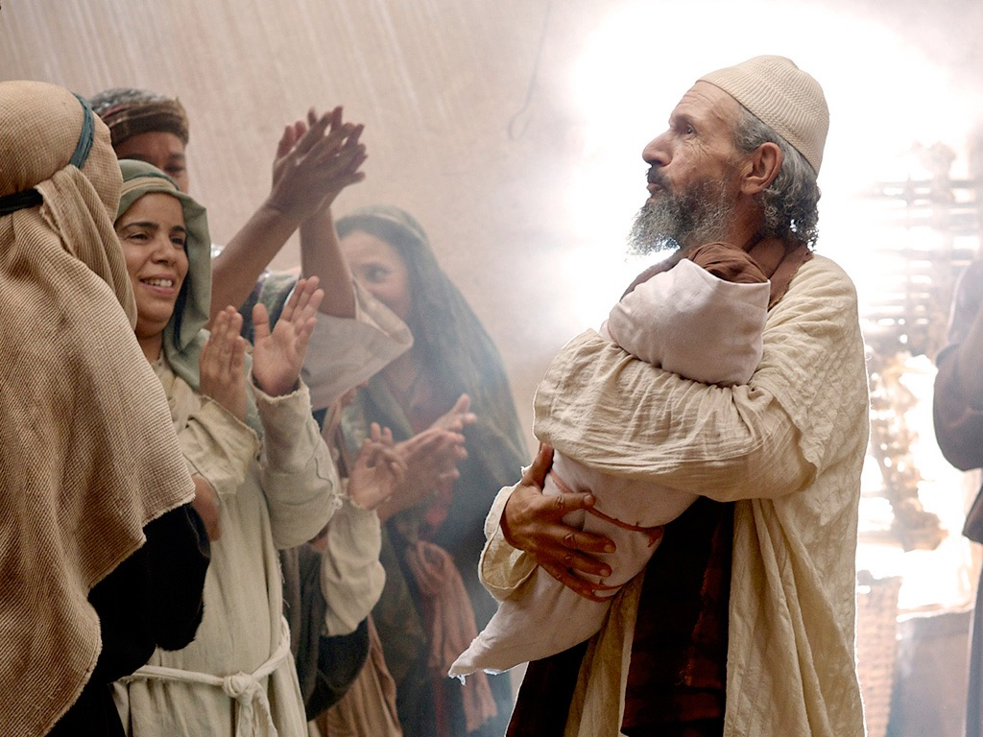
Introduction of the King
§§ 1-27
The Messianic identity of Jesus Christ is proved in his arrival, John's testimony, and approvals at his baptism and temptation
Section summaries based on J. Dwight Pentecost,
A Harmony of the Words and Works of Jesus Christ (Grand Rapids: Zondervan, 1981)
Dr. Rick Griffith • Jordan Evangelical Theological Seminary • BibleStudyDownloads.org

Slide 3

Introduction of the King
§§ 1-27
Arrival
Ambassador
Approval
Ancestry
Advent
Infancy/
Childhood
Baptism
Temptation
Herald
Notes:
Jesus did all that we should expect of the Messiah (King) from the start:
1—He arrived in the proper lineage of David, born of a virgin, and knew his deity even at age 12
2—His forerunner John knew his role in preparing Israel for her king
3—He had the best witnesses possible in the Father (baptism), Spirit (temptation), and John (prophesied herald)

Slide 4

The Authentication
of the King
§§ 28-59
The Acceptance
of His Person
§§ 28-36
The Authority
of the King
§§ 37-59
Notes:
Many people of various places (Judea, Samaria, Galilee) and types (Nicodemus, Samaritan woman, common Jews) initially believed in him.
Jesus also showed in 19 incidents the power expected of the Messiah to interpret the Law to preach and with authority over men, defilement, Sabbath, nature, sickness, and even death.

Slide 5
Pentecost Outline
Introduction of the King
Authentication of the King
Controversy over the King
Instruction of the Twelve by the King
Opposition to the King
Preparation of the Disciples by the King
Official Presentation of the King
Preparation for the Death of the King
Rejection of the King
Resurrection of the King
Notes:
Jesus has been introduced and approved (Section 1) and authenticated his claims (Section 2).
Q: If he has proved his messianic identity, why then was there controversy (Section 3)? Discuss this in your small group for 4 minutes.
Q: Why did they reject the offer from Jesus of the kingdom?
A: The leaders didn't have a privileged place in it! They deceived themselves and could not admit that Jesus was from God.

Slide 6

Increasing Polarization
Resurrection
Preparation
for Death
Preparation
of Disciples
Instruction
Authentication
Introduction
Controversy
Opposition
Presentation
Rejection
Notes:
The Life of Christ brought increasing polarization. The more Jesus showed about himself, the greater the resistance to him and his message. Also, the more intense the controversy leading to opposition, the higher priority Christ placed on preparing his men for when he would be gone. The climactic rejection when he presented himself as king of Israel at the Triumphal Entry resulted in rejection to the point of crucifixion followed by the victory of resurrection.
Introduction of the King
Authentication of the King
Controversy over the King
Instruction of the Twelve by the King
Opposition to the King
Preparation of the Disciples by the King
Official Presentation of the King
Preparation for the Death of the King
Rejection of the King
Resurrection of the King

Slide 7
Controversy over the King
Rejection
Acceptance
Herod Antipas
Galilee Cities
Pharisees
Nation of Israel
Nazareth
Woman at Simon's home
Wealthy women supporting Jesus
Israel after the Interadvent Age
World, Sea, disease, death, & blindness
Notes:
OVERVIEW OF THIS SESSION: The Controversy Over the King means that Jesus was debated by those who rejected and accepted Him. Sadly, the nation's leaders who disbelieved had greater authority than women who believed, but Jesus promised many believers after the time between his two comings (Interadvent Age). In the meantime, even the Sea of Galilee, death, blindness, etc., submitted to His power.

Slide 8
A. The Rejection
of the Herald
§ 60
Matthew 11:2-19; Luke 7:18-35
The rejection of John by Israel's leaders is paralleled in the rising opposition to Christ and His offer of the kingdom

Slide 9
B. The Curse
of the Cities of Galilee
§ 61
Matthew 11:20-30
Christ curses Galilean cities that saw his miracles but would not believe to show how Gentiles received him more than the Jews.

Slide 10
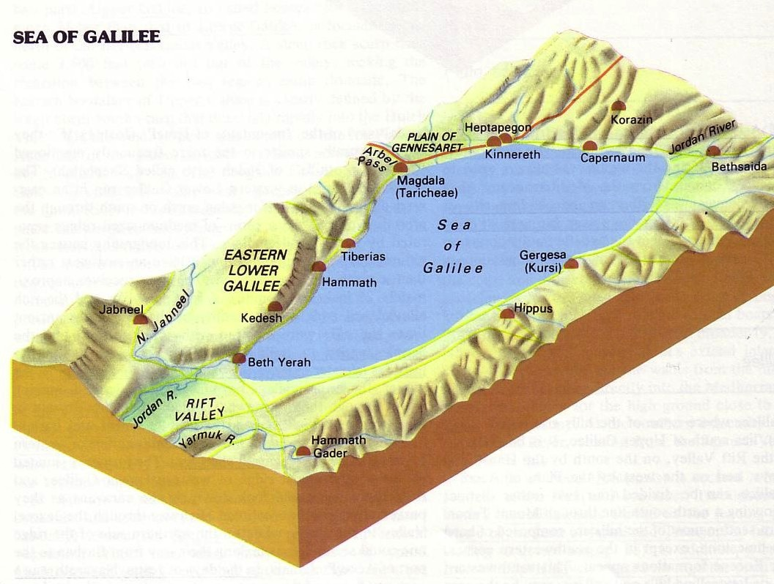

The Tri-City Area
172
Point f
Then Jesus began to denounce the cities in which most of his miracles had been performed, because they did not repent.
"Woe to you, Korazin! Woe to you Bethsaida!
If the miracles that were performed in you had been performed in Tyre and Sidon, they would have repented long ago in sackcloth and ashes. But I tell you, it will be more bearable for for Tyre and Sidon on the day of judgment than for you.
And you, Capernaum, will you be lifted up to the skies? … It will be more bearable for Sodom on the day of judgment than for you."
Matthew 11:20-24

Slide 11
1. Condemnation for Unbelief
Matthew 11:20-24
Christ condemns the unbelieving Jewish area of Galilee with greater judgment than Gentiles who saw no signs

Slide 12
2. Explanation of Unbelief
Matthew 11:25-27
Galilean cities persist in unbelief because of Israel's spiritual blindness stemming from a history of willful rejection of God's revelation

Slide 13
3. Invitation to Belief
Matthew 11:28-30
Despite condemning them, Christ offers rest from the taxing submission to Pharisaical regulations by trusting in His person

Slide 14
C. Reception by a Sinner
§ 62
Luke 7:36-50
Christ reveals the self-righteous Pharisees when they hear Him forgive a repentant woman at Simon the Pharisee's home

Slide 15


Was Mary Magdalene the Woman with the Alabaster Jar?
The WOMAN
with the
ALABASTER JAR
Mary Magdalen and the Holy
Grail
No. In Luke she is not named but in the other gospels she is clearly Mary of Bethany
As featured in The
Da Vinci Code
Notes:
Mark 16:9 After Jesus rose from the dead early on Sunday morning, the first person who saw him was Mary Magdalene, the woman from whom he had cast out seven demons.
Luke 8:2 along with some women who had been cured of evil spirits and diseases. Among them were Mary Magdalene, from whom he had cast out seven demons;

Slide 16

Luke 7:36-50
Jesus and the Sinful Woman
Notes:
In Luke 7,this is neither Mary Magdalene not Mary of Bethany.

Slide 17

Anointings of Jesus
Common to all four gospel accounts:
Unannounced visit by woman
Anointed Jesus' head and/or feet
Wiped his feet with her hair
Complaint of waste by disciples/Judas
Disciples rebuked by Jesus
In a home
Alabaster jar (except in John)
Home owned by man called Simon

Slide 18

The Two Anointings of Jesus
Luke 7:36-50
Early in Ministry
Weeping
For worship, woman's
sins forgiven (Luke 7:48)
By unnamed harlot at
home of Simon the
Pharisee (Luke 7:40) in
an unknown town
Matt. 26:6-13
Mark 14:3-9
John 12:1-11
During Passion Week
No weeping noted
For burial, woman needed
no forgiveness
By Lazarus' sister Mary at home of Simon the Leper
(Matt. 26:6; Mark 14:3) in Lazarus' hometown of Bethany (John 12:1)

Slide 19
D. Witness to the King
§ 63
Luke 8:1-3
Several believing women of financial means show in Christ through their witness and material support for His ministry

Slide 20
E. Rejection of Christ and His Offer by the Leaders
§ 64
Matthew 12:22-37; Mark 3:20-30
Jesus defends himself to Pharisees who attribute his exorcisms to Satan since Israel's destiny depended on their response

Slide 21
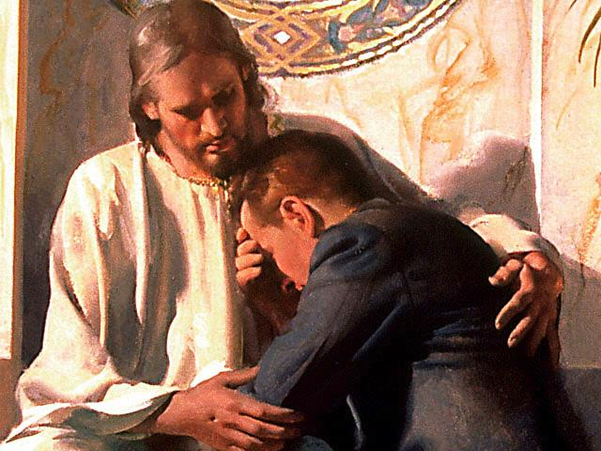
Does Christ Forgive All the Sins of a Believer?

Slide 22
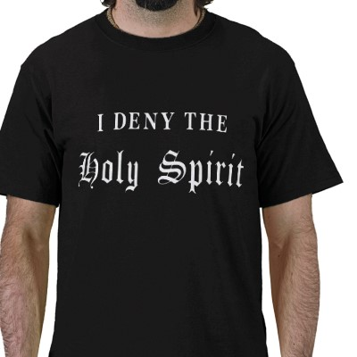
Blasphemy Against the Spirit
In your small group…
xiv
Have you ever known anyone who thought he or she had committed this sin?
What happened?

Slide 23
Blasphemy Verses
xiv
Matt. 12:31-32 "So I tell you, every sin and blasphemy can be forgiven—except blasphemy against the Holy Spirit, which will never be forgiven. ³²Anyone who speaks against the Son of Man can be forgiven, but anyone who speaks against the Holy Spirit will never be forgiven, either in this world or in the world to come.
Mark 3:28-29 "I tell you the truth, all sin and blasphemy can be forgiven, ²⁹but anyone who blasphemes the Holy Spirit will never be forgiven. This is a sin with eternal consequences."

Slide 24
Unacceptable Views of the Blasphemy
xiv
1. Using Christ's name in vain
2. A sinful lifestyle that causes a Christian to lose his salvation forever (not repentable)
Cessationists will not go to heaven

Slide 25
Unacceptable Views of the Blasphemy
xiv
4. This sin could only happen during His earthly ministry and thus cannot happen today. Jesus isn't physically here performing miracles—it must be be committed to His face.
5. A non-Christian's unbelief which lasts until death

Slide 26
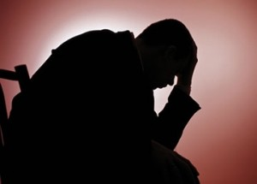
Unacceptable Views of the Blasphemy
xiv
6. Adultery
Divorce
Suicide

Slide 27
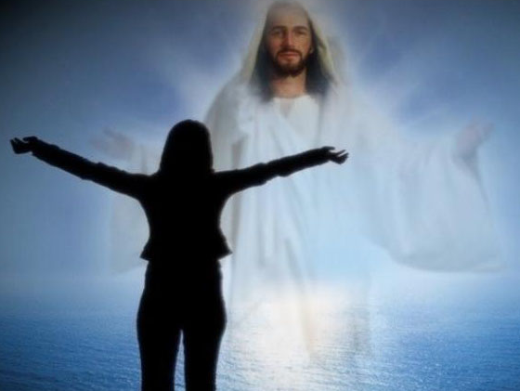
The Problem Solved
xiv
The Context

Slide 28
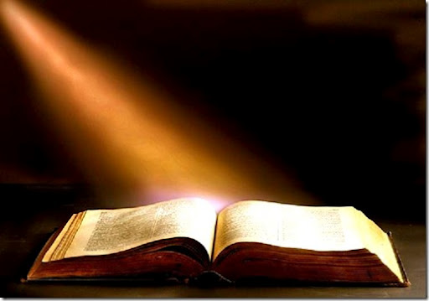
The Context of the Text
xiv
Christ healed a blind/mute (Matt. 12:22)
The crowds claimed, "He's Messiah!"
The Pharisees said, "He's demonic!"
Jesus gave a threefold response (12:25-29)

Slide 29
The Problem Solved
xiv
The Context
The Nature of the Sin

Slide 30

The Nature of the Sin
xv
Spoken
Against the Spirit
Eternal results (i.e., only committed by unbelievers)
False attribution
Not "sin unto death" (1 John 5:16-17; 1 Cor. 11:30)

Slide 31
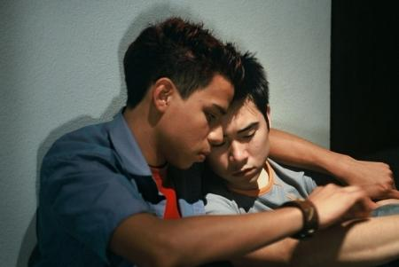
Suggestions for Counseling
xv
Evangelism
Assurance
Repentance
Notes:
John 6:37 However, those the Father has given me will come to me, and I will never reject them (NLT).

Slide 32
F. Request for a Sign
by the Leaders
§ 65
Matthew 12:38-45
Israel's leaders demand a miracle, so Christ reveals their rejection by promising to conquer death which Satan could never do

Slide 33
G. Rejection of the Nation
by Christ
§ 66
Matthew 12:46-50; Mark 3:31-35; Luke 8:19-21
In response to rejection by Israel's leaders, Jesus sets aside Israel for a new form of the kingdom in the Interadvent age

Slide 34
H. Revelation in View of Rejection
§§ 67-71
Due to Israel's rejection, Christ reveals the nature of the kingdom in the present age in conjunction with displays of His power

Slide 35
1. The Course of the Kingdom in the Present Age
§ 67
Matthew 13:1-53; Mark 4:1-34; Luke 8:4-18
Good and evil coexist in the Interadvent age as God’s Word starts small but reaches the world before judgment and the Millennium

Slide 36
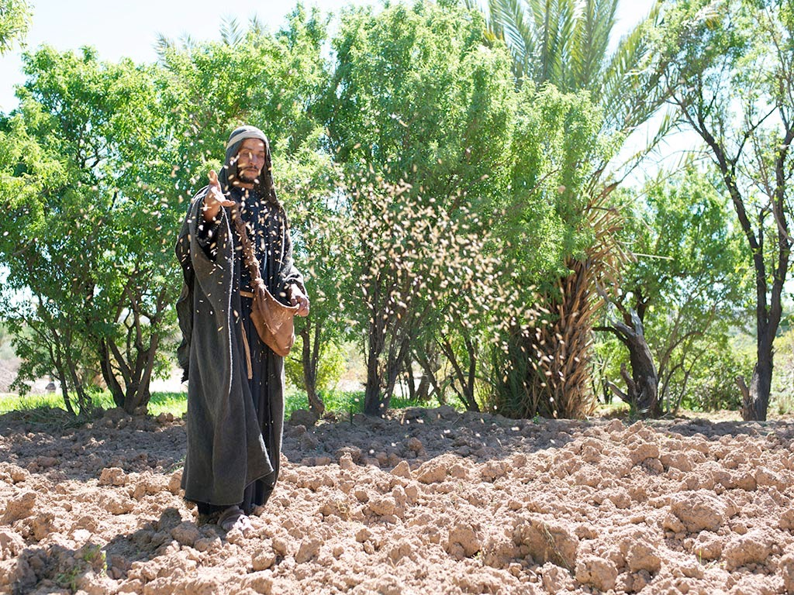

Matthew 13:1-23; Mark 4:1-20; Luke 8:1-15
PARABLE OF THE SOWER

Slide 37
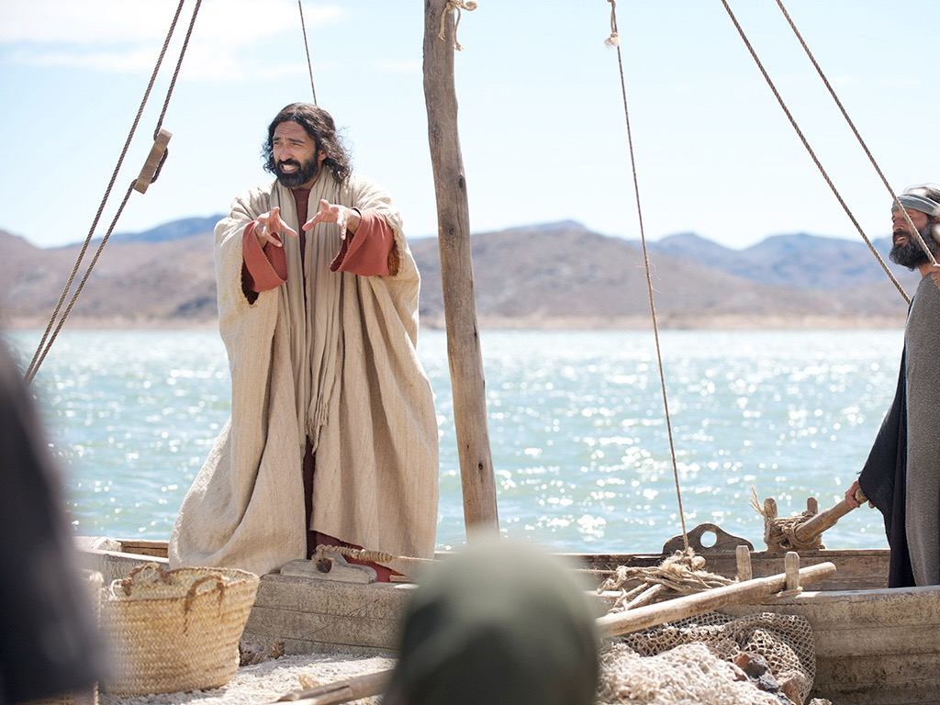

Slide 39
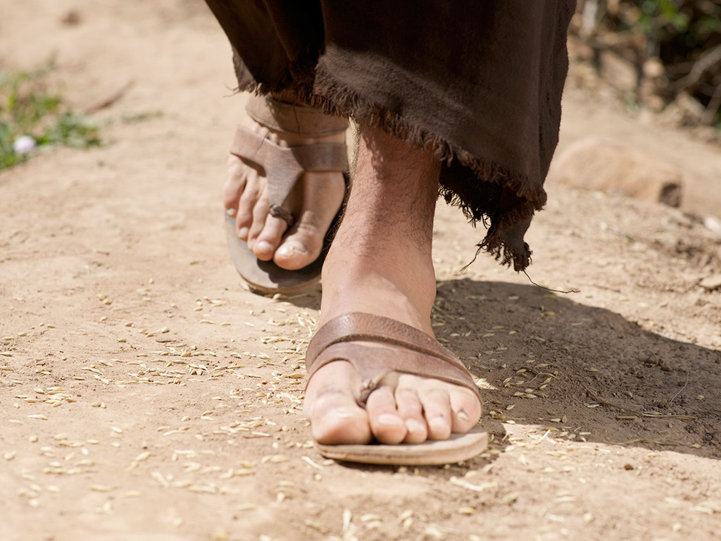

Slide 40
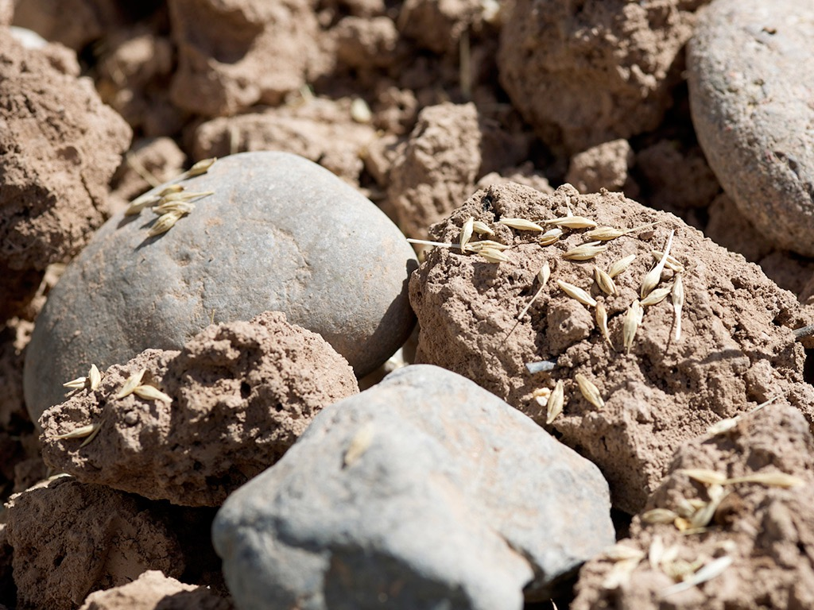

Slide 41
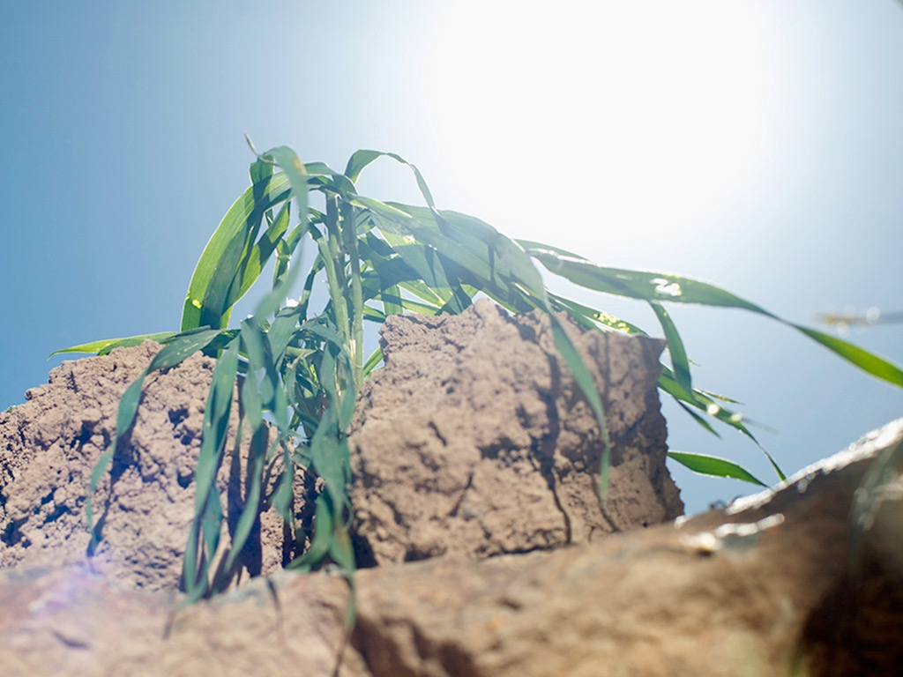

Slide 42
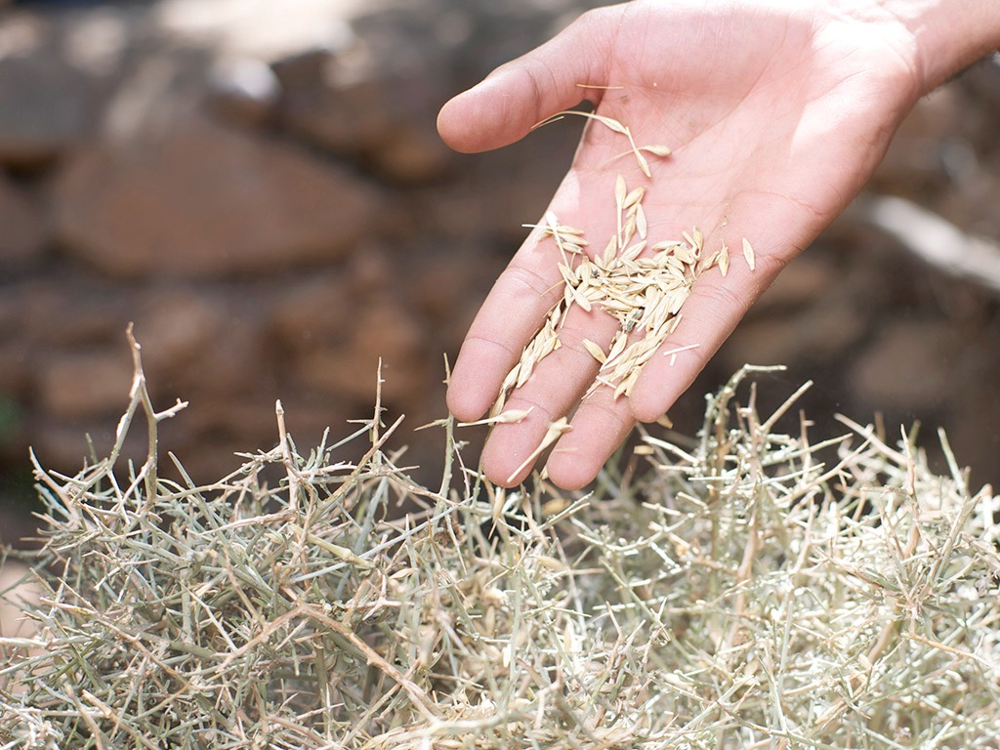

Slide 43
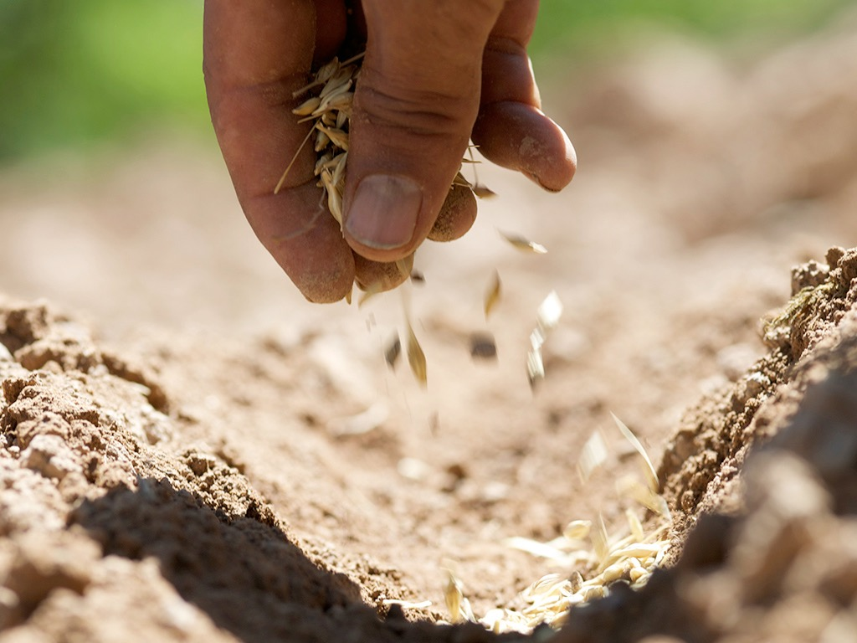

Slide 44
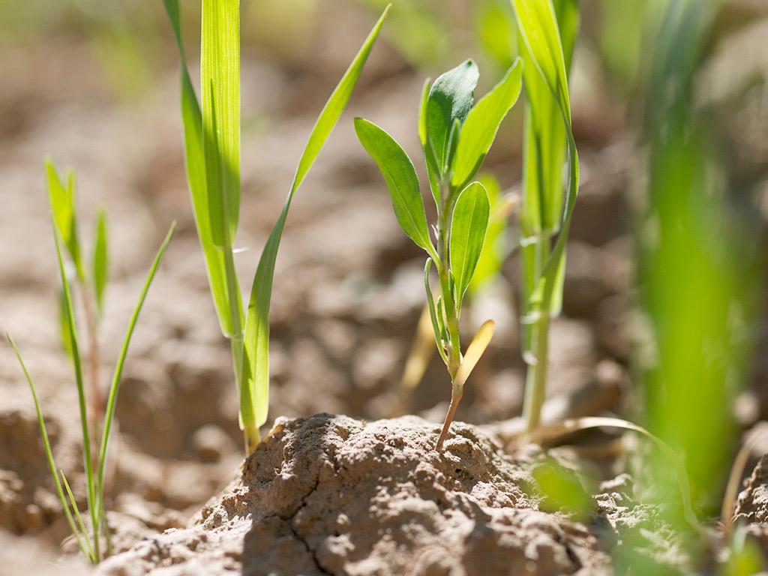

Slide 45
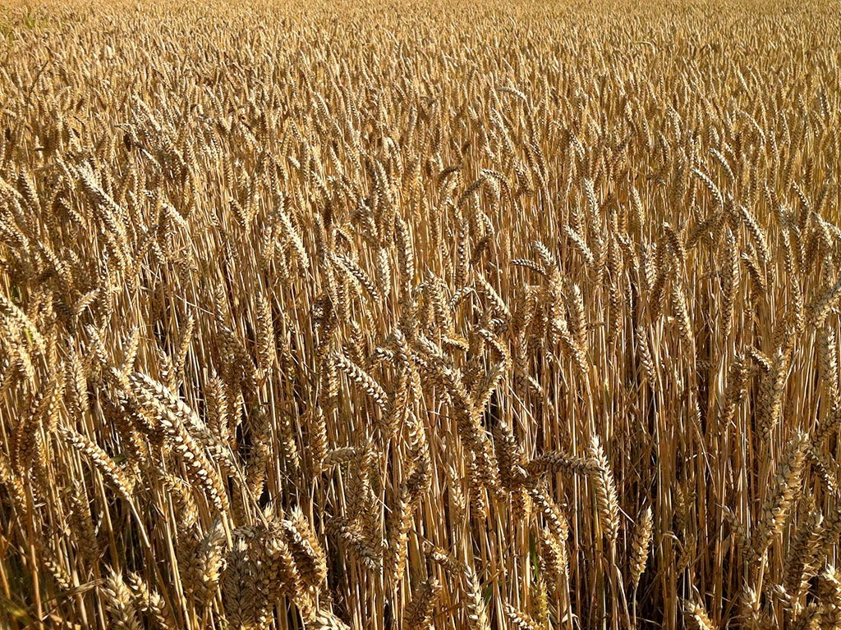

Slide 46
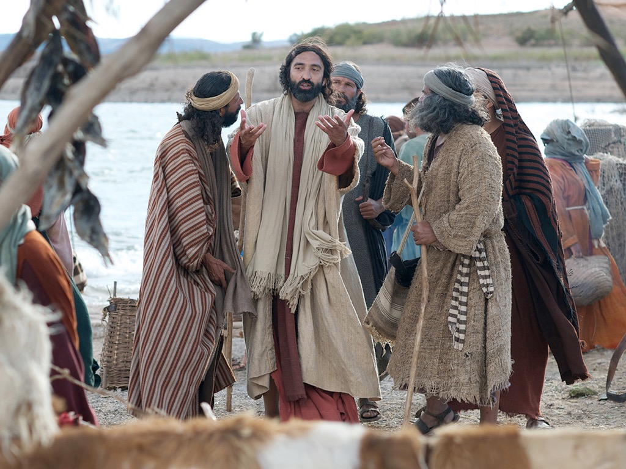

Slide 47
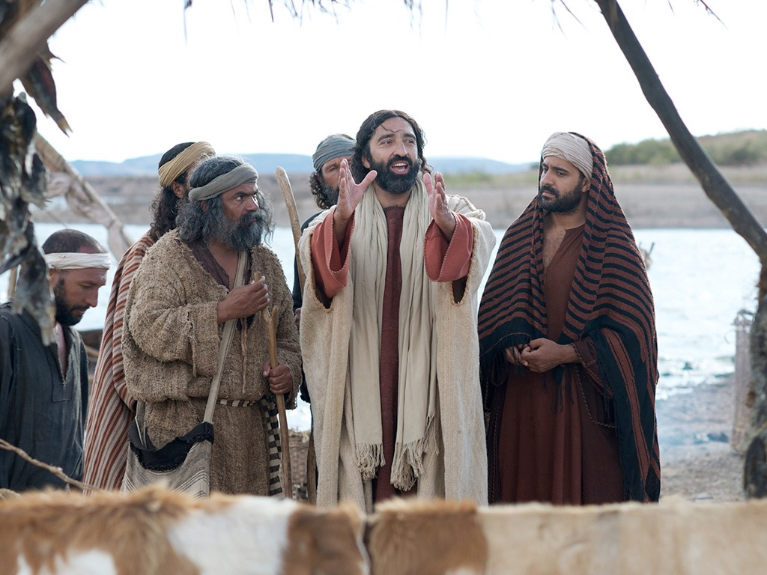

Slide 48
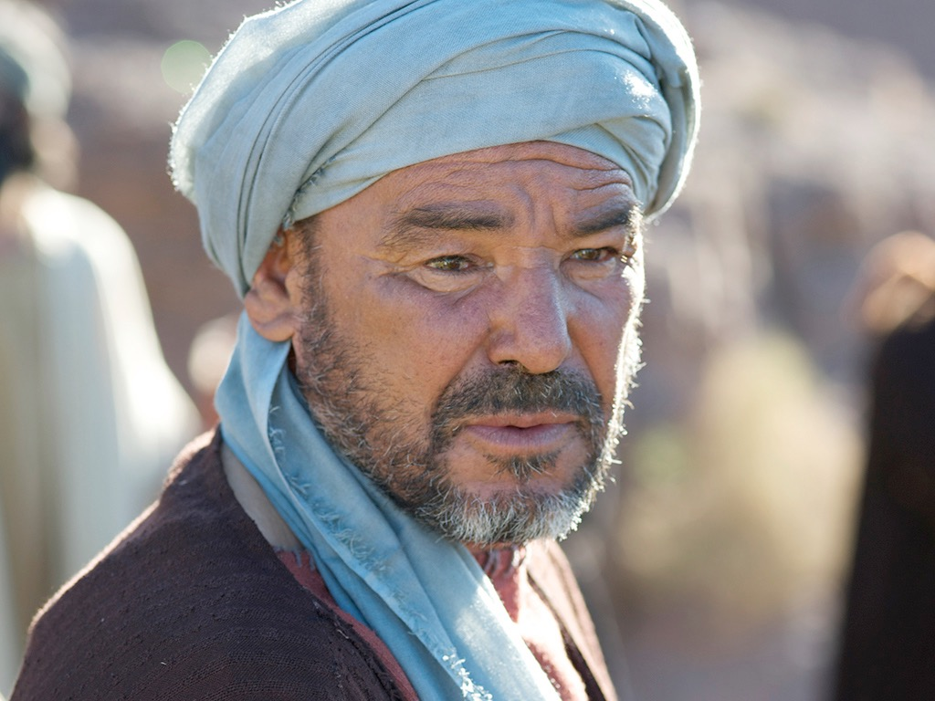

Slide 49
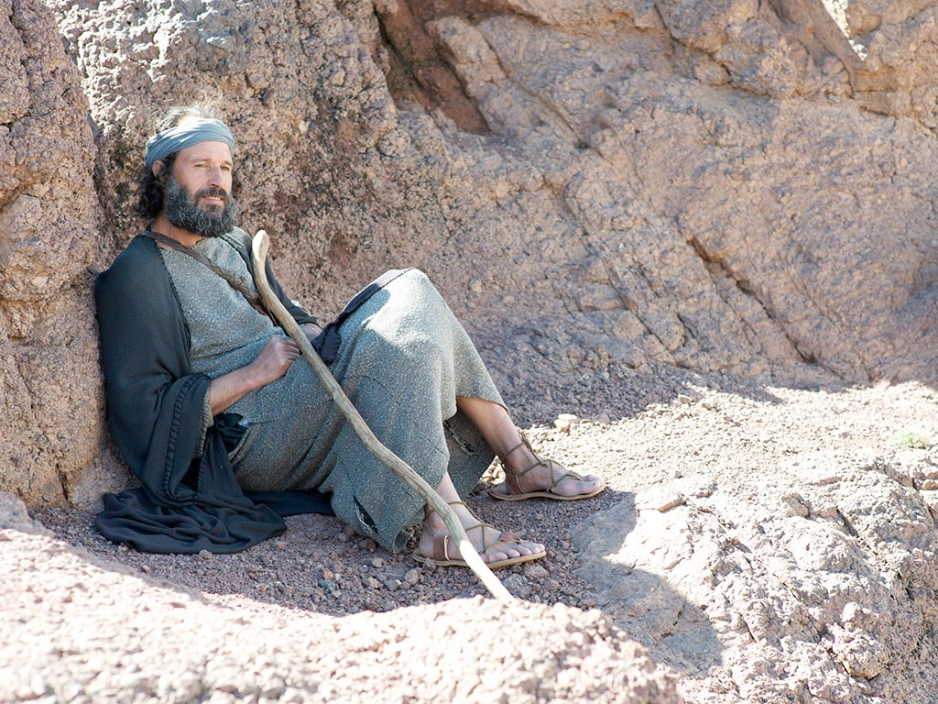

Slide 50
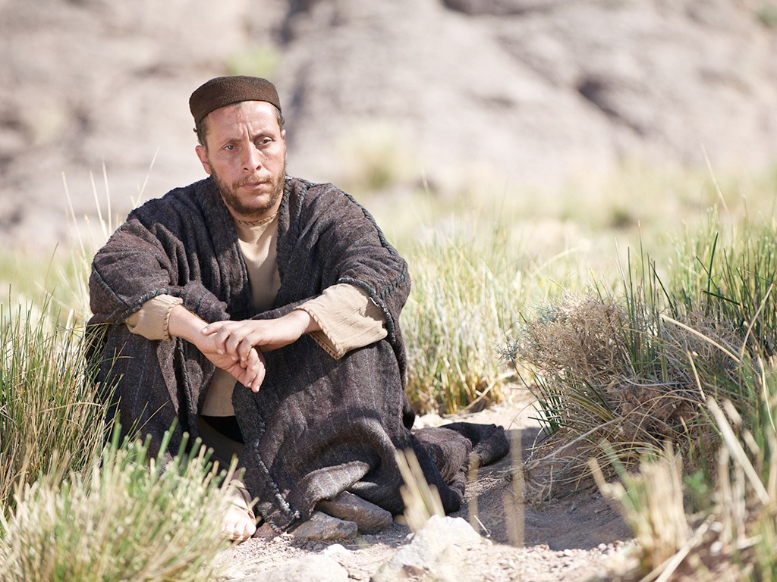

Slide 51
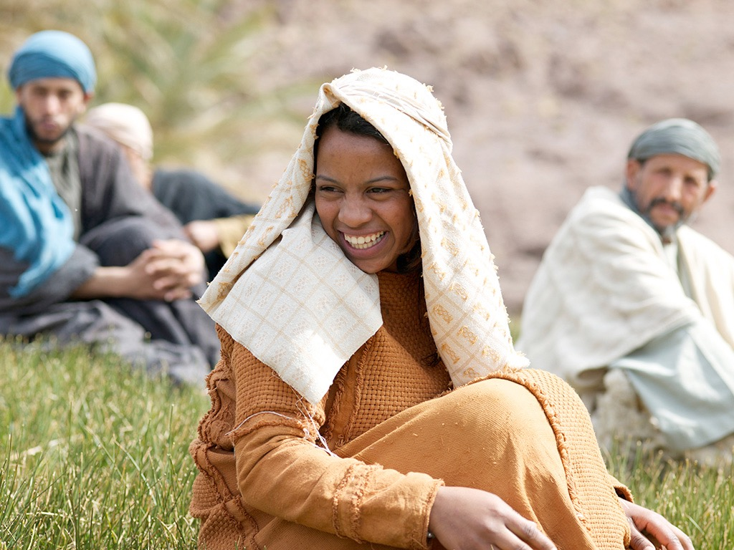

Slide 52
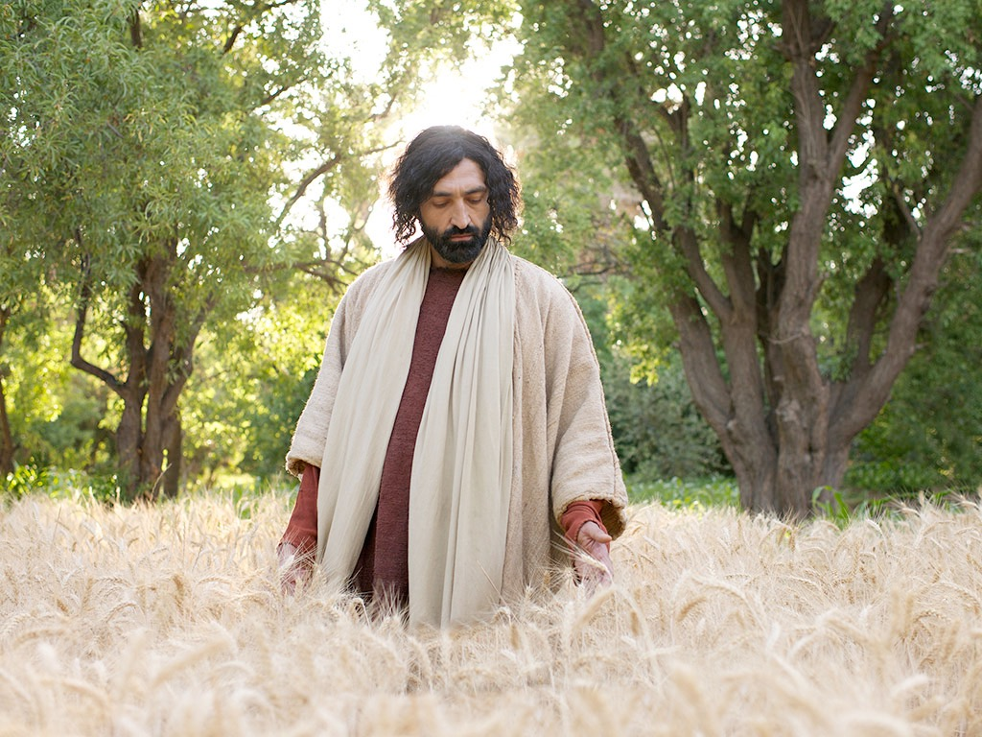

Slide 53

THE WORD IN PICTURES
Free
Bible
images

Slide 54

Used with Permission
THE
GOSPEL
——OF—— MATTHEW
THE
GOSPEL
——OF—— MARK
THE
GOSPEL
——OF—— LUKE
THE
GOSPEL
——OF—— JOHN
Due to the Lumo Project producing its own publishing material we regret to inform you that we cannot license our photos to other clients outside of freebibleimages.org.
These images are not licensed for reuse in video, epublishing or other media. Downloaded pictures and files cannot be redistributed through any other website than freebibleimages.org or used in any context where the accompanying message is undermining of the Christian faith and gospel.
Photos can only be used on educational presentations, blogs and social media, all of which should be accompanied with reference to www.LumoProject.com.
Picture courtesy of BBM
© All Rights Reserved.
www.bigbookmedia.com

Slide 55
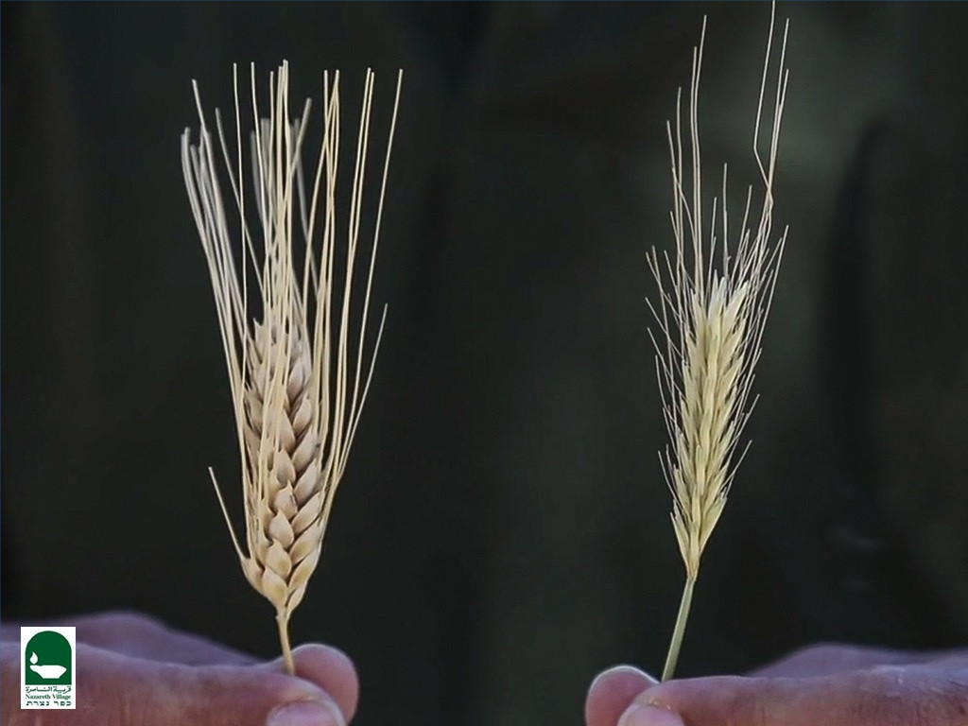
PARABLE OF THE WHEAT AND TARES
Matthew 13:24-30

Slide 56
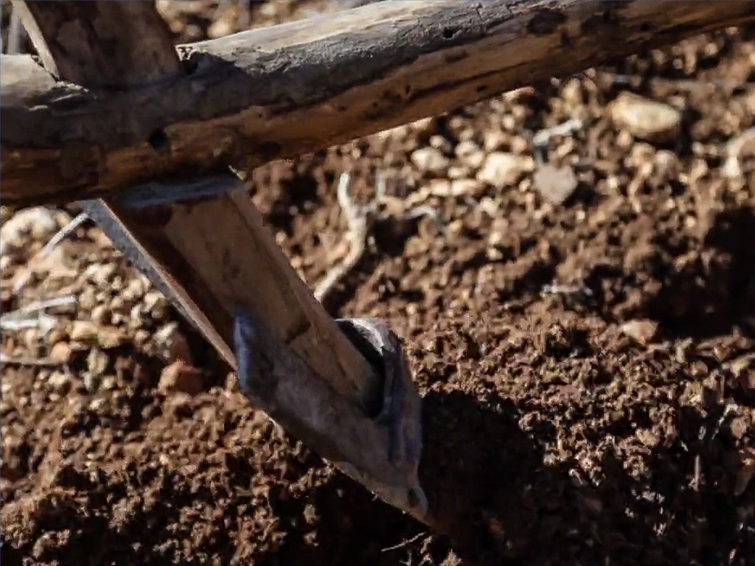

Slide 57
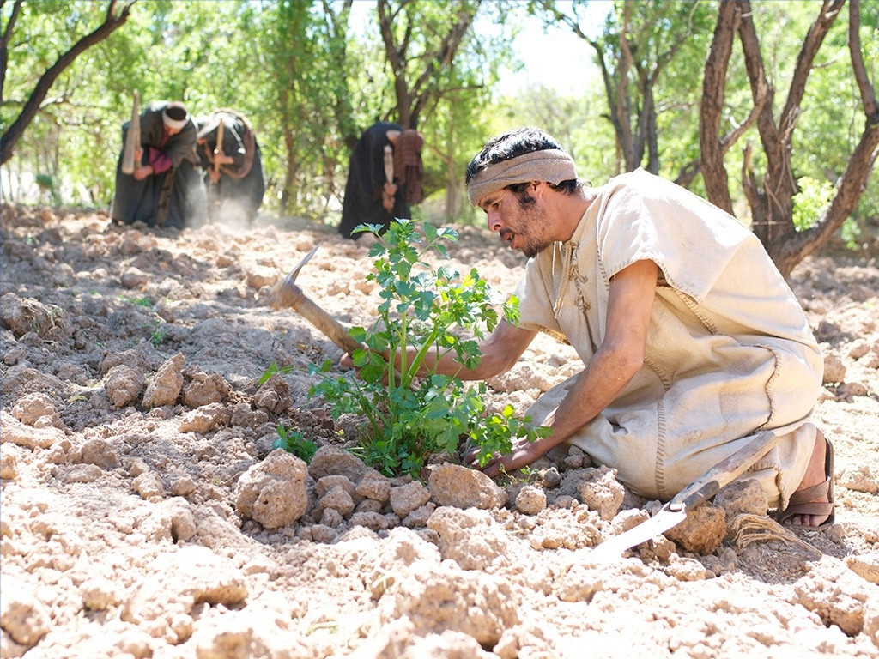

Slide 58
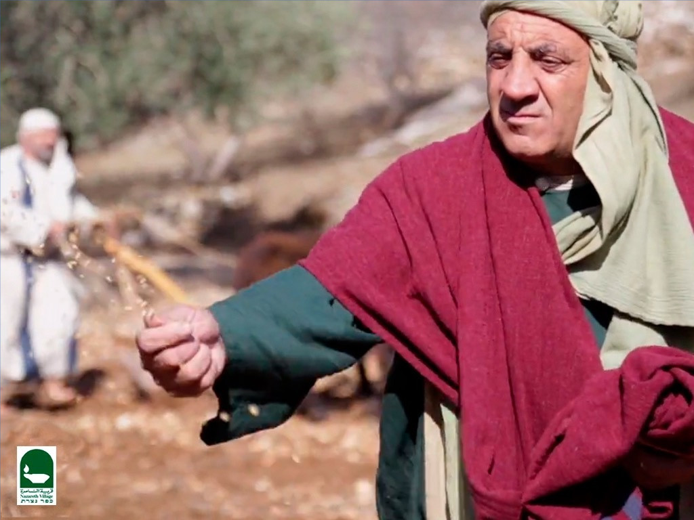

Slide 59
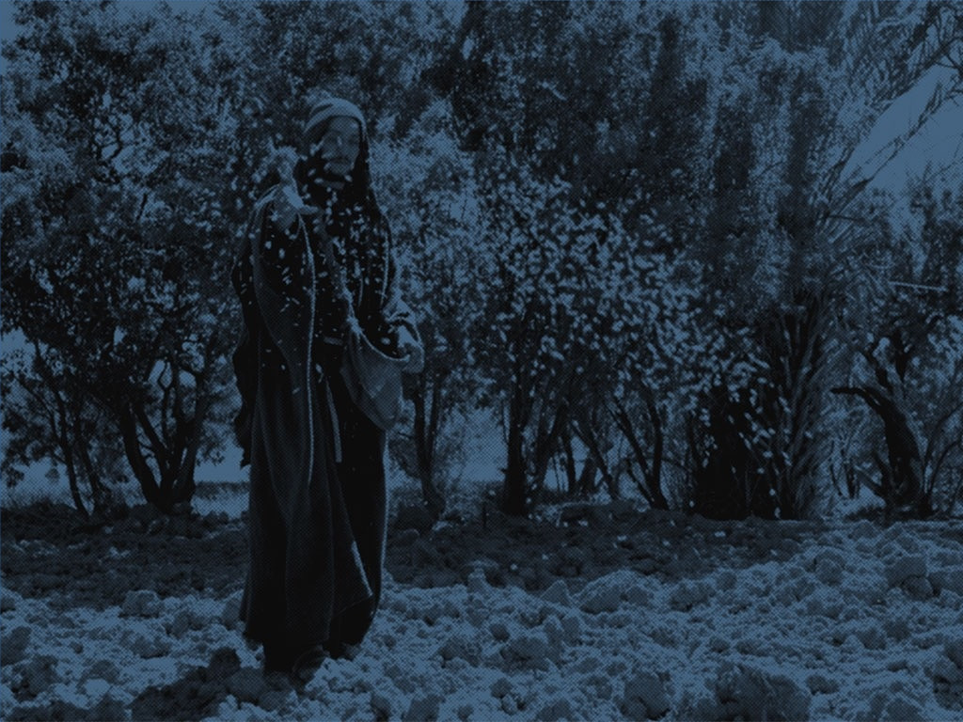

Slide 60
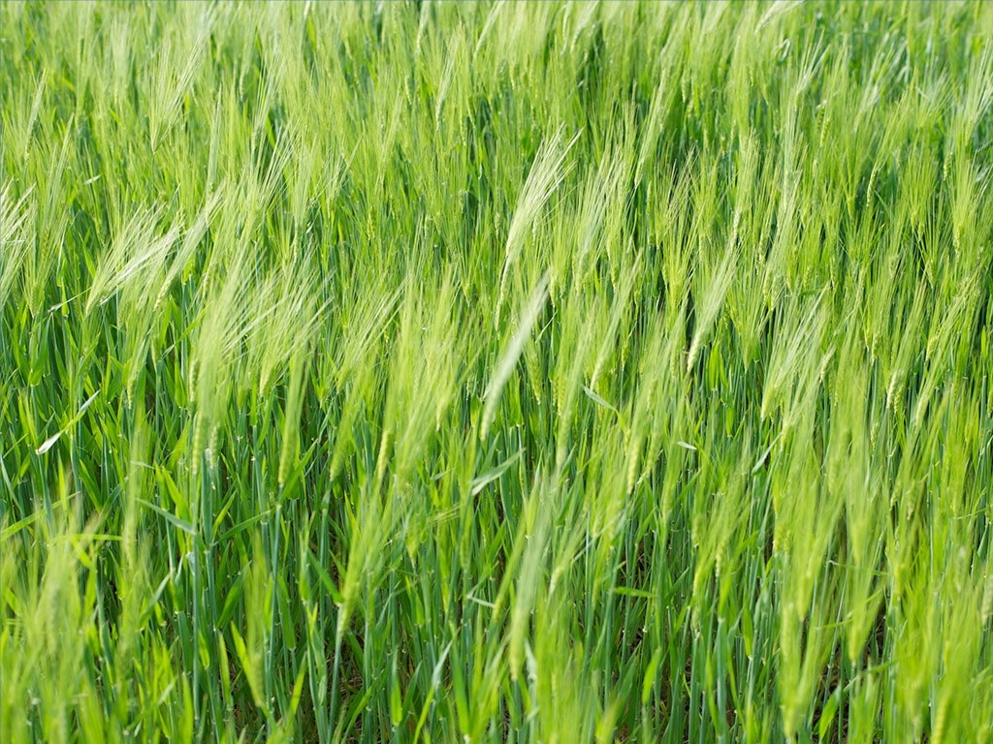

Slide 61
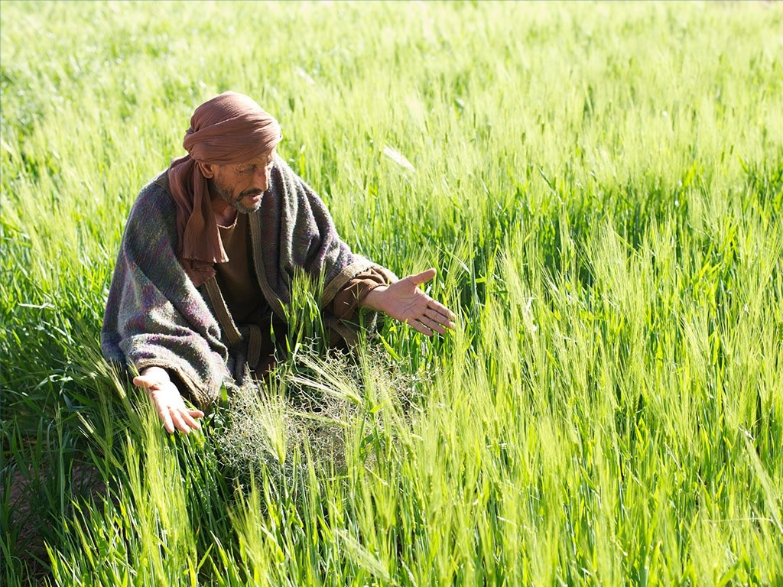

Slide 62
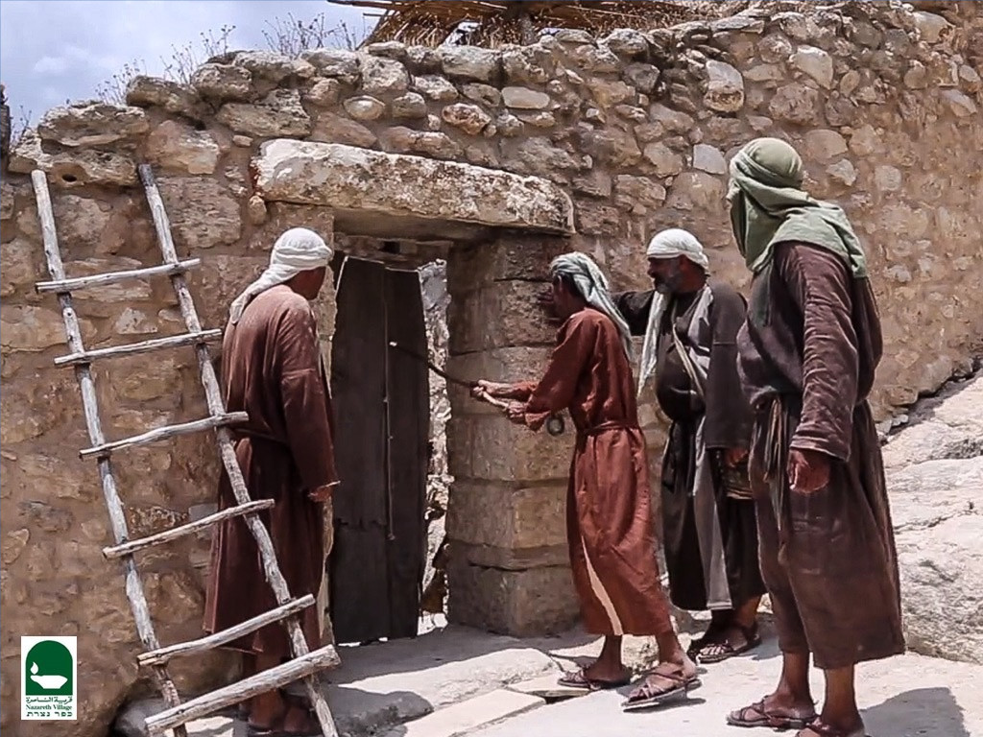

Slide 63
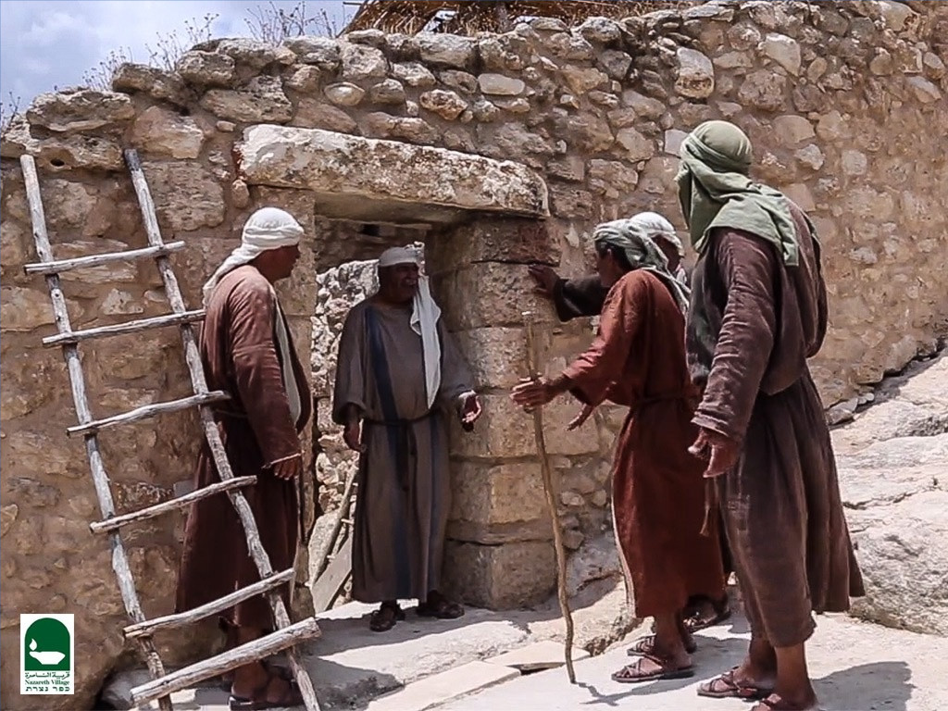

Slide 64
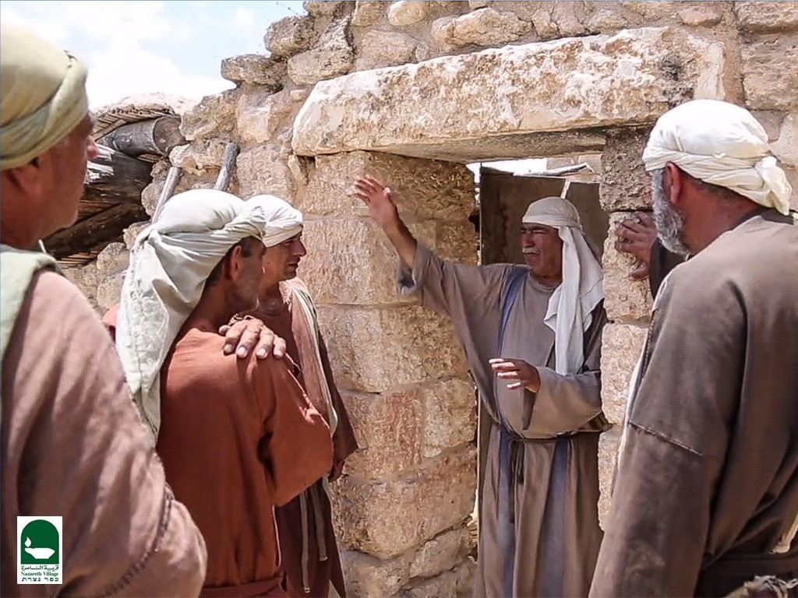

Slide 65
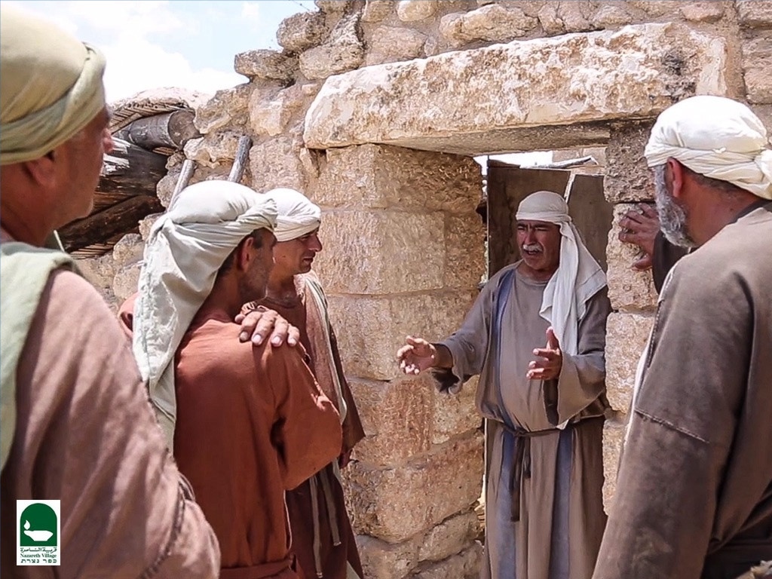

Slide 66
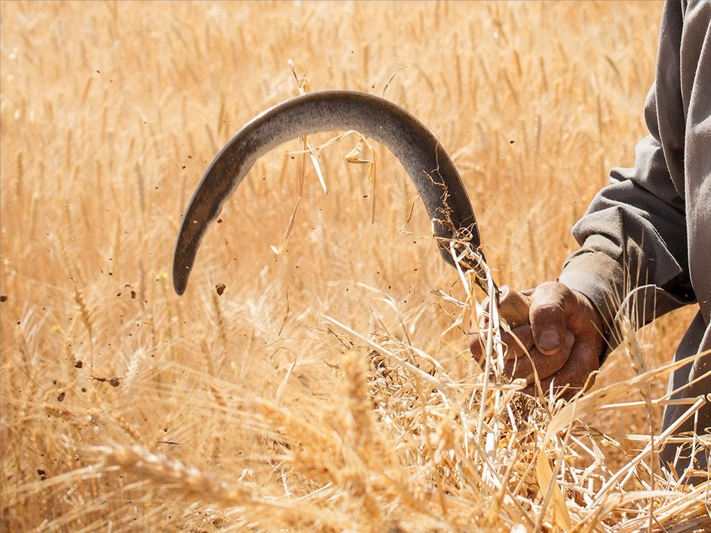

Slide 67
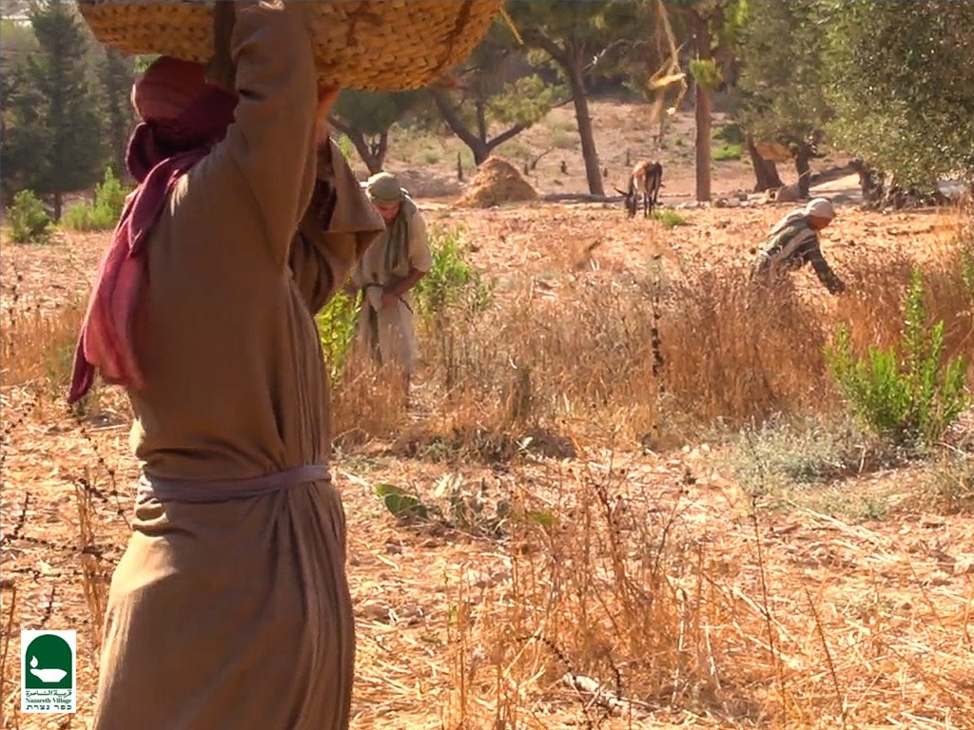

Slide 68
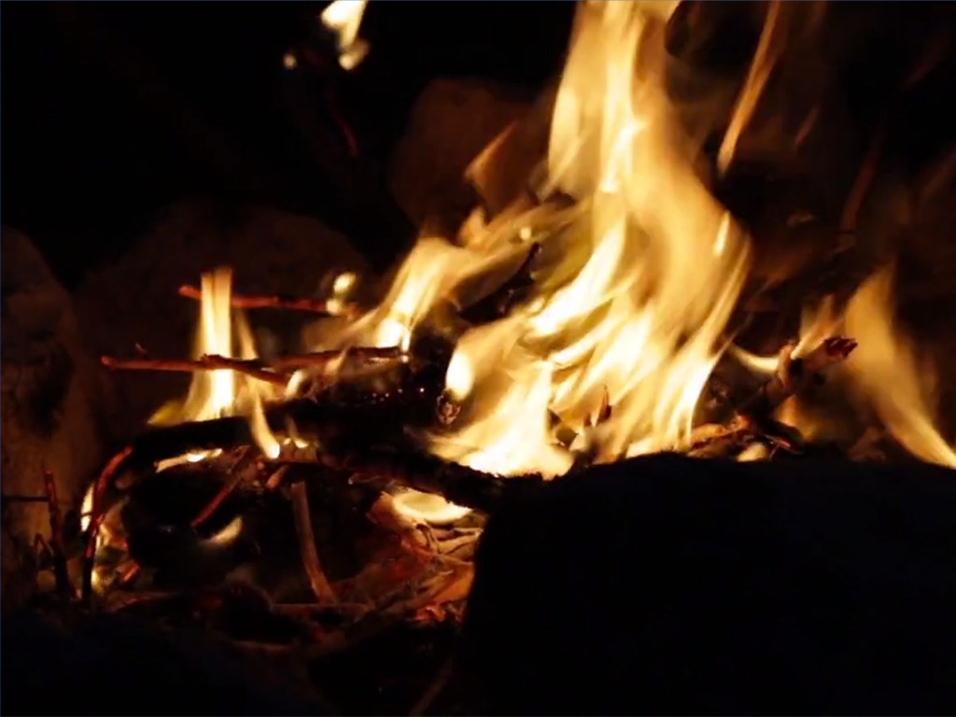

Slide 69
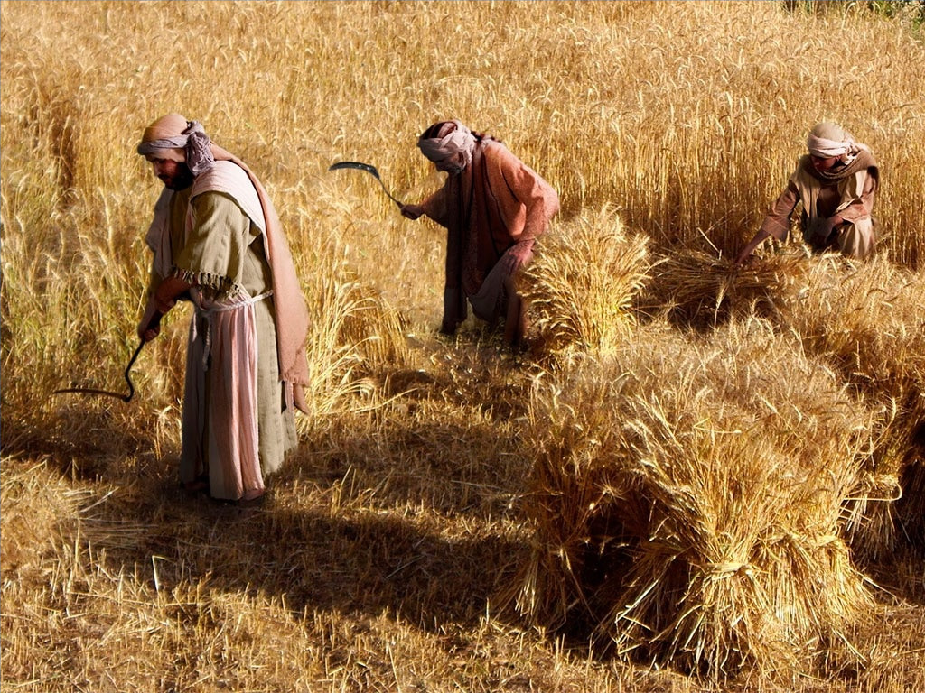

Slide 70
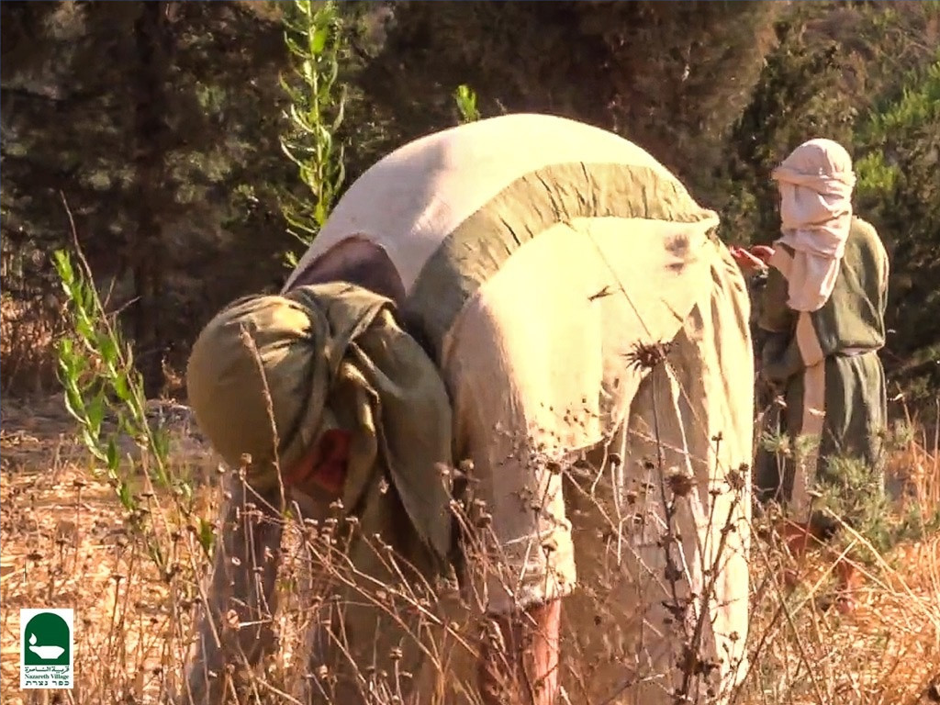

Slide 71
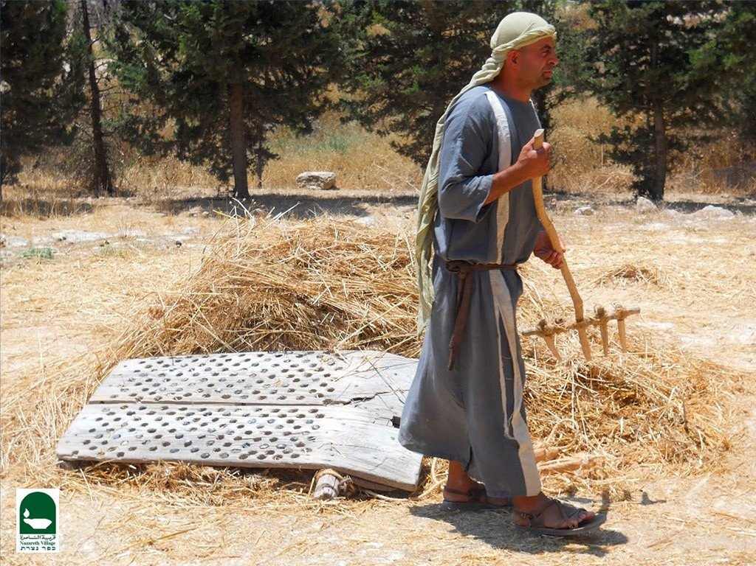

Slide 72
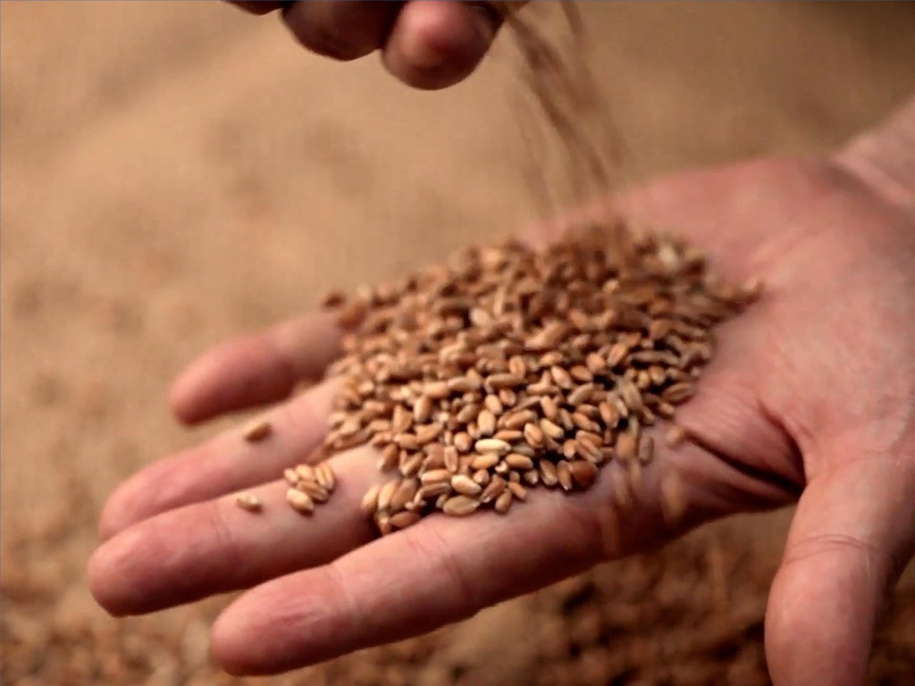

Slide 74
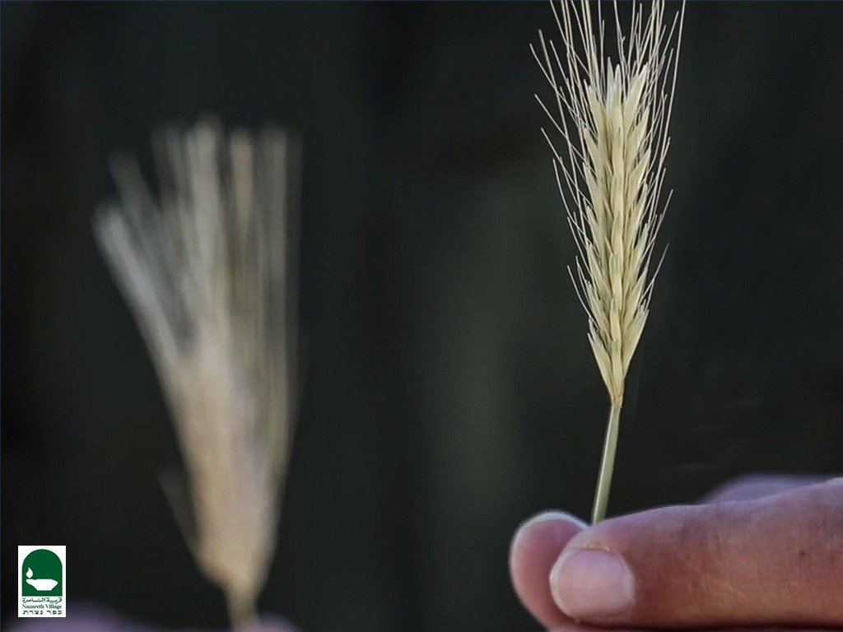

Slide 75
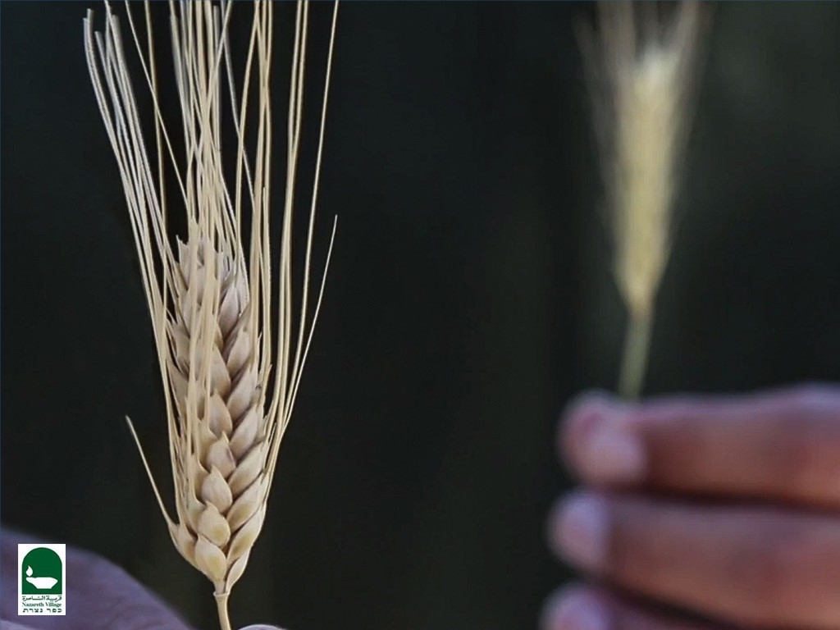

Slide 76


Slide 77
The Parables of Matthew 13
79a
PARABLES BY THE SEA (outside the house to the multitudes)
THE SOILS (13:3-9, 18-23) Planting
Issue: Why have Israel and the leaders rejected the Messiah?
Main Idea: Receptivity determines productivity, which is a heart issue.
2. THE TARES (13:24-30, 36-43) Planting
Issue: What accounts for the false religiosity in the world?
Main Idea: Satan sowed a counterfeit kingdom in the world, which will not be fully revealed until the judgment.
THE MUSTARD SEED (13:31-32) Growth
Issue: Will this Interadvent survive?
Main Idea: It will start small, but the new program will grow worldwide.
THE LEAVENING PROCESS (13:33) Growth
Issue: How will this new kingdom grow?
Main Issue: The kingdom will grow from an internal dynamic (Holy Spirit), not from an external organization (Judaism).
Mark Bailey, DTS

Slide 78
The Parables of Matthew 13
79a
PARABLES IN THE HOUSE (inside the house to the disciples)
THE HID TREASURE (13:44) Value
Issue: How valuable should this new-profound kingdom of God be to us?
Main Idea: God's kingdom is so valuable a man should give up everything to be part of it.
THE PEARL MERCHANT (13:45-46) Value
Issue: How valuable is this kingdom to Christ?
Main Idea: The kingdom was established though Christ's total self sacrifice.
THE DRAGNET (13:47-50) Responsibility
Issue: How wide should the invitation to the kingdom be made?
Main Idea: Evangelism should be done without discrimination.
THE HOUSEHOLDER (13:52) Responsibility
Issue: What are the responsibilities of disciples in the kingdom?
Main Idea: We must teach both old and new truths about God's kingdom program. One key new truth not taught in the OT is the church age of Jews and Gentiles without discrimination (Eph. 3:3-6, 9 vs. Zech. 8:23).
Mark Bailey, DTS

Slide 79
2. Power Over Nature
§ 68
Matthew 8:18, 23-27; Mark 4:35-41; Luke 8:22-25
Jesus calms the Sea of Galilee as Lord over nature so His disciples would trust Him for everything until all creation submits to Him

Slide 80
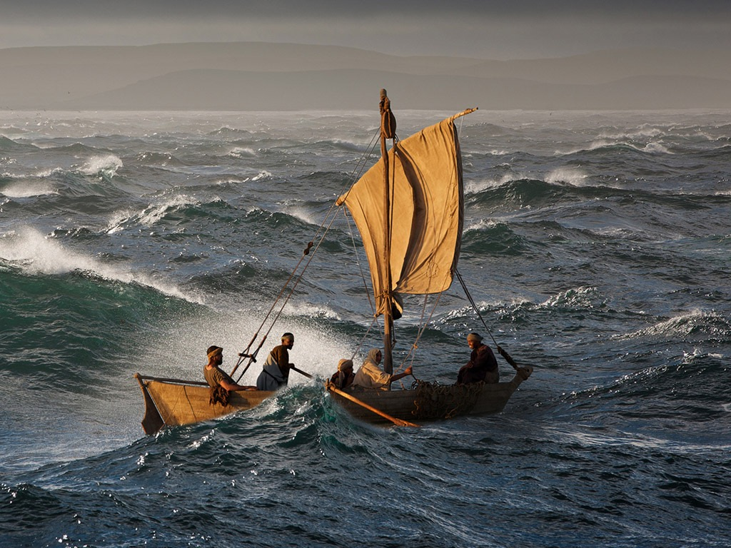
Free
Bible
images
Matthew 8:23-27
Mark 4:35-41
Luke 8:22-25
JESUS CALMS A STORM

Slide 81
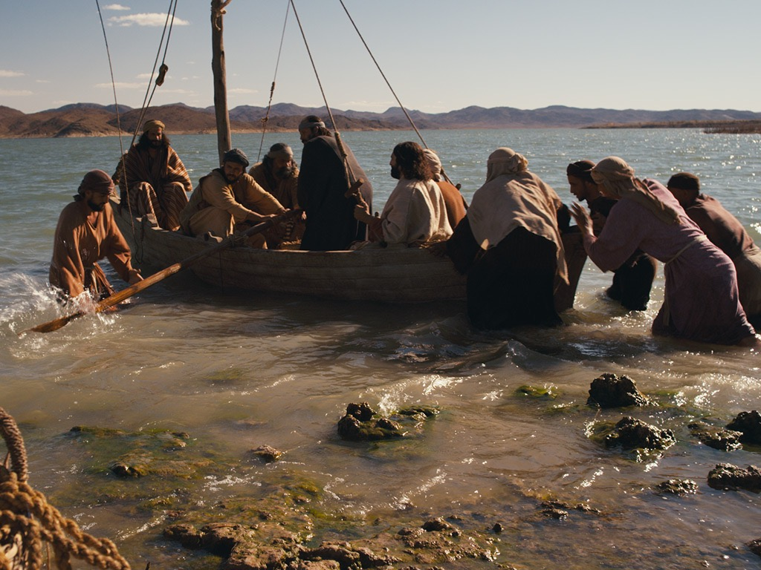

Slide 82
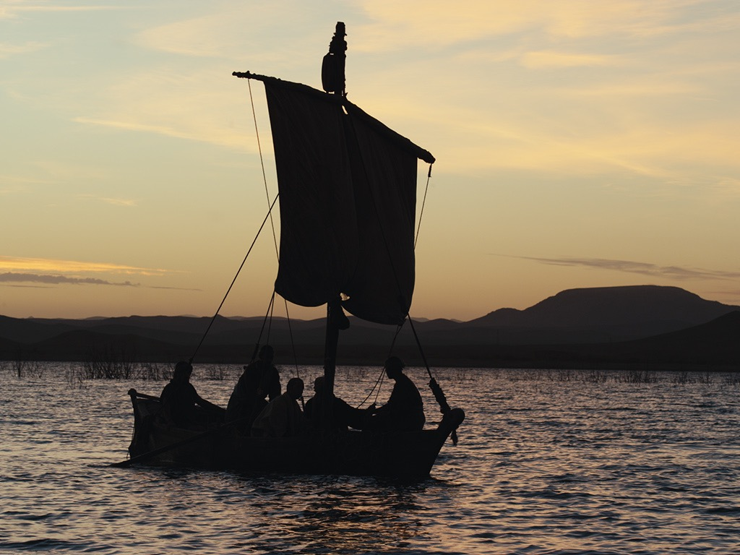

Slide 83
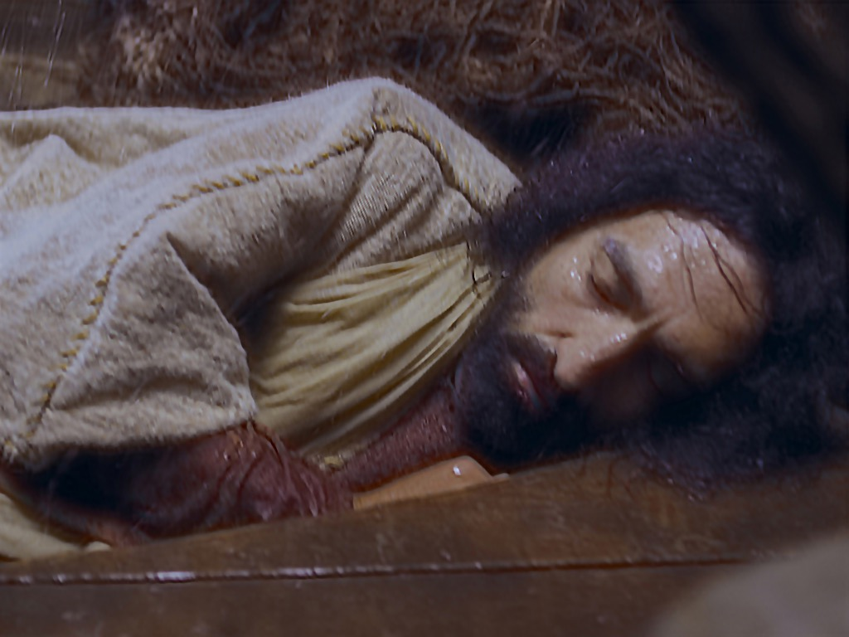

Slide 85
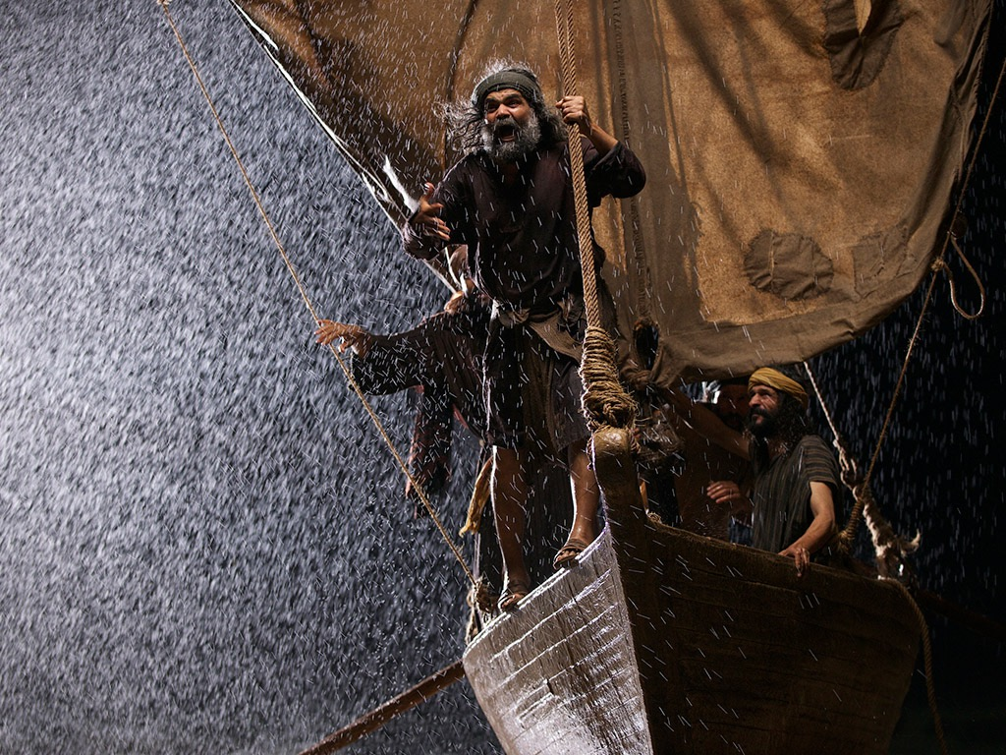

Slide 86
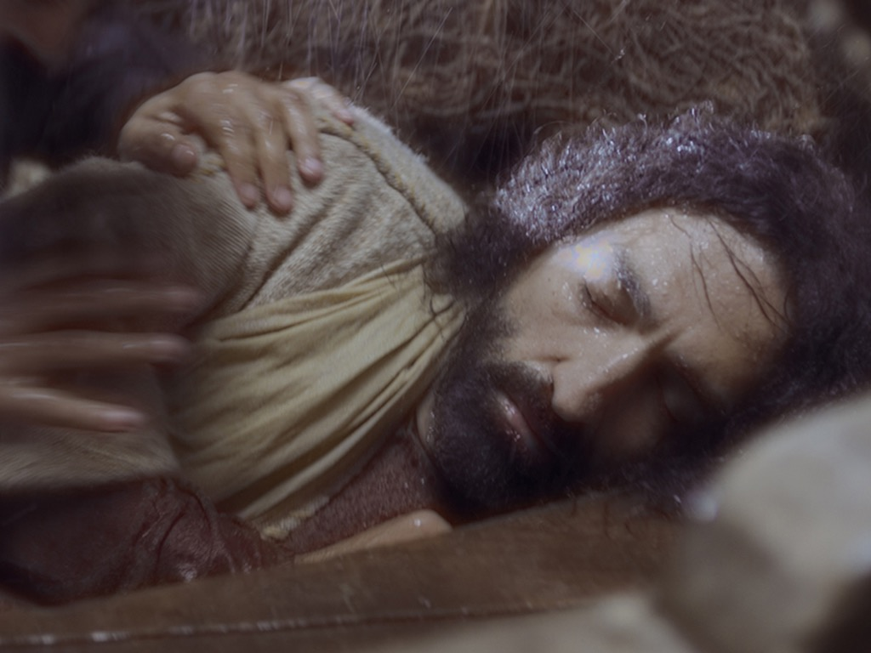

Slide 87


Slide 88


Slide 89


Slide 90


Slide 91


Slide 92


Slide 93
Used with Permission
THE
GOSPEL
——OF—— MATTHEW
THE
GOSPEL
——OF—— MARK
THE
GOSPEL
——OF—— LUKE
THE
GOSPEL
——OF—— JOHN
Due to the Lumo Project producing its own publishing material we regret to inform you that we cannot license our photos to other clients outside of freebibleimages.org.
These images are not licensed for reuse in video, epublishing or other media. Downloaded pictures and files cannot be redistributed through any other website than freebibleimages.org or used in any context where the accompanying message is undermining of the Christian faith and gospel.
Photos can only be used on educational presentations, blogs and social media, all of which should be accompanied with reference to www.LumoProject.com.
Picture courtesy of BBM
© All Rights Reserved.
www.bigbookmedia.com

Slide 94
3. Power Over Demons
§ 69
Matthew 8:28-34; Mark 5:1-20; Luke 8:26-39
As Israel's leaders oppose Him, Jesus proves His authority over Satan by showing authority over demons that controlled pigs

Slide 95

Free
Bible
images
Mark 5:1-20; Luke 8:26-29
JESUS DELIVERS A WILD MAN

Slide 96


Slide 97


Slide 98


Slide 100


Slide 101


Slide 102


Slide 103


Slide 104


Slide 105


Slide 106


Slide 107


Slide 108


Slide 109


Slide 110


Slide 111


Slide 112


Slide 113


Slide 114


Slide 115
Used with Permission
THE
GOSPEL
——OF—— MATTHEW
THE
GOSPEL
——OF—— MARK
THE
GOSPEL
——OF—— LUKE
THE
GOSPEL
——OF—— JOHN
Due to the Lumo Project producing its own publishing material we regret to inform you that we cannot license our photos to other clients outside of freebibleimages.org.
These images are not licensed for reuse in video, epublishing or other media. Downloaded pictures and files cannot be redistributed through any other website than freebibleimages.org or used in any context where the accompanying message is undermining of the Christian faith and gospel.
Photos can only be used on educational presentations, blogs and social media, all of which should be accompanied with reference to www.LumoProject.com.
Picture courtesy of BBM
© All Rights Reserved.
www.bigbookmedia.com

Slide 116
4. Power Over Disease and Death
§ 70
Matthew 9:18-26; Mark 5:21-43; Luke 8:40-56
Christ shows his messianic authority by healing an unclean woman and raising Jairus' daughter by touching and being touched

Slide 117
5. Power Over Blindness
§ 71
Matthew 9:27-34
Two blind men healed by Jesus prove him as Messiah who can remove Israel's spiritual blindness if the nation believes

Slide 118
I. Rejection in Nazareth
§ 72
Matthew 13:54-58; Mark 6:1-6a
Christ's rejection in His hometown for not being taught by an accredited teacher shows spiritual blindness in these unbelievers

Slide 119
Jesus' Family Persecuted Him
Holy
Spirit
Men in white
Mary
Joseph
Women in yellow
Jesus
Joseph
Simon
Sister 2
James
Judas
Sister 1
"Then they scoffed, 'He's just a carpenter, the son of Mary and the brother of James, Joseph, Judas, and Simon. And his sisters live right here among us.' They were deeply offended and refused to believe in him" (Mark 6:3 NLT).
Notes:
Luke 1:35 The angel replied [to Mary], “The Holy Spirit will come upon you, and the power of the Most High will overshadow you. So the baby to be born will be holy, and he will be called the Son of God.
There existed no sexual union between Mary and the Holy Spirit, but instead it was God's power "overshadowing" her. Such was not the case with the four brothers and at least two sisters of Jesus, conceived and born in the natural manner. Yet these siblings evidently did not believe even as adults that their mother Mary was a virgin at the birth of Jesus. John brings out their unbelief in John 7:1-5…
John 7:1 After this, Jesus traveled around Galilee. He wanted to stay out of Judea, where the Jewish leaders were plotting his death. ² But soon it was time for the Jewish Festival of Shelters, ³ and Jesus’ brothers said to him, “Leave here and go to Judea, where your followers can see your miracles! ⁴ You can’t become famous if you hide like this! If you can do such wonderful things, show yourself to the world!” ⁵ For even his brothers didn’t believe in him (NLT).
But God worked on these brothers. After the resurrection, they believed and were in the Upper Room with the disciples: "These all with one mind were continually devoting themselves to prayer, along with the women, and Mary the mother of Jesus, and with His brothers" (Acts 1:14 NLT). In fact, both James and Jude went on to each record a General Epistle!
__________
LC-03-Opposition-114
NS-02-Mark1-9-slide 234
NS-04-John1-11—slide 387
NS-20-James1-2—slide 61
NS-26-Jude-90

Slide 120
J. Death of the Herald
§ 73
Matthew 14:1-12; Mark 6:14-29; Luke 9:7-9
The ultimate rejection of Christ and His kingdom is foreshadowed in Herod's execution of John for righteousness' sake

Slide 121
Herods of the Bible
Herod (the Great)
Met wise men
Killed babies in Bethlehem
Notes:
Let's go back and look at all the Herods in the New Testament. Here is a quick overview. Since these slides are available on our website so I will go through them quickly.
The first Herod, is known as Herod the Great. He was King when Jesus was born, he met the wise men and killed the babies in Jerusalem.
________
LC-03-Controversy-116
NS-03-Mark1-8—slide 235
NS-05-Acts20-28—slide 153

Slide 122
Herods of the Bible
Herod (the Great)
Herod Antipas
Herod Archelaus
Herod Philip
Caused Joseph to return to Nazareth (when returning from Egypt)
Notes:
When he died, Rome decided that his Kingdom would be split between 3 of his sons.
Herod Archelaus was not a good ruler, he was so bad that Joseph was warned to return to Nazareth after Herod the Great’s death and the family was returning from Egypt. He was eventually fired by the Roman senate. His territory was then ruled by Roman governors.

Slide 123
Herods of the Bible
Herod (the Great)
Herod Antipas
Herod Archelaus
Herod Philip
Wife, Herodias, left him for his brother Antipas
Notes:
Herod Philip was actually a pretty good guy. Unfortunately for him, his wife left him for his brother, Herod Antipas.

Slide 124
Herods of the Bible
Herod (the Great)
Herod Antipas
Herod Archelaus
Herod Philip
Married his brother's wife, Herodias
Executed John the Baptist
Presided over Jesus’ trial
Notes:
Herod Antipas is the Herod that executed John the Baptist and presided of Jesus’ trial, conferring with Pontus Pilate.

Slide 125

Herod's Three Ruling Sons
80 & 89
Philip
Antipas
Archelaus
Beitzel, Moody Atlas of Bible Lands, ed. 1
Notes:
________
LC-03-Controversy-123
NB-07-Politics4Herodians-25

Slide 126
Herods of the Bible
Herod (the Great)
Herod Antipas
Aristobulus IV
Herod Philip
Herod Archelaus
Herod Agrippa I
Persecuted Christians (in Acts 12)
Notes:
Herod the Great had many other children. One of them, Aristobulus, was the father of Herod Agrippa.
Agrippa was sent to Rome to hobnob with Roman royalty. He became king by befriending the future emperor Caligula. His death is recorded in Acts 12 because he did not rebuke the people when they stated he has the voice of a God.

Slide 127
Herods of the Bible
Herod (the Great)
Herod Antipas
Aristobulus IV
Herod Philip
Herod Archelaus
Herod Agrippa I
Listened to Paul’s defense (Acts 25–26)
Sisters Bernice and Drusilla (married to Felix)
Herod Agrippa II
Notes:
We finally get to Herod Agrippa II. We already met his sister, Drusilla, who was married to the former governor Roman Felix.

Slide 128

JOHN THE BAPTIST IN PRISON
Matthew 14:1-12
Mark 6:14-29
Free
Bible
images
Notes:
In several ways, the death of John prefigured Jesus’s own martyrdom:
• Both John and Jesus were executed by political tyrants, who although they feared their victims, vacillated, and finally acquiesced to social pressure (Herod to Herodias, and Pilate to the mob).
• Both John and Jesus died rather passively—as sheep led to slaughter—victims of political intrigue and corruption.
• Both John and Jesus died as righteous and innocent victims.
• In both cases, the political ruler putting them to death knew they did not deserve their fate.
—Paul Tanner, Following the Master (BEE World), 81

Slide 129

Jesus was opposed by Herod but validated his person through three miracles (Mark 6:14-56).
Notes:
Mark 6:14 Herod Antipas, the king, soon heard about Jesus, because everyone was talking about him. Some were saying, “This must be John the Baptist raised from the dead. That is why he can do such miracles.” 15 Others said, “He’s the prophet Elijah.” Still others said, “He’s a prophet like the other great prophets of the past.”
Mark 6:16 When Herod heard about Jesus, he said, “John, the man I beheaded, has come back from the dead.”

Slide 130

Notes:
Herodias used to be Herod Philip's wife, but his brother Herod Antipas took her from him, evidently with her consent. She was not pleased with John the Baptist.

Slide 131

Notes:
John continued to speak out against Antipas for this immorality. "So Herodias bore a grudge against John and wanted to kill him. But without Herod’s approval she was powerless" (Mark 6:19 NLT).

Slide 132

Notes:
Mark 6:17 "For Herod had sent soldiers to arrest and imprison John as a favor to Herodias. She had been his brother Philip’s wife, but Herod had married her. 18 John had been telling Herod, 'It is against God’s law for you to marry your brother’s wife.'”

Slide 133
Notes:
John was imprisoned in the Palace/Fortress of Machaerus on the east side of the Dead Sea in modern-day Jordan.

Slide 134

Notes:
"Herod respected John; and knowing that he was a good and holy man, he protected him. Herod was greatly disturbed whenever he talked with John, but even so, he liked to listen to him" (Mark 6:20 NLT).

Slide 135

Notes:
John had a very blunt and courageous style that easily offended people. Though the son of a priest, he avoided the temple due to its corruption. He also rejected priestly garb, wearing clothes like Elijah instead. No wonder! He was the NT Elijah and even lived in the Jordan thicket exactly where Elijah had lived 800 years earlier!

Slide 136

Notes:
So Herod was perplexed what to do to John.

Slide 137

Notes:
But Herodias constantly looked for an opportunity for revenge.

Slide 138

Notes:
Mark 6:21 Herodias’s chance finally came on Herod’s birthday. He gave a party for his high government officials, army officers, and the leading citizens of Galilee.

Slide 139

Notes:
"Then his daughter, also named Herodias, came in…" (Mark 6:22)

Slide 140

Notes:
"She performed a dance that greatly pleased Herod and his guests. 'Ask me for anything you like,' the king said to the girl, 'and I will give it to you'" (Mark 6:22-23 NLT).

Slide 141

Notes:
"He even vowed, 'I will give you whatever you ask, up to half my kingdom!'” (Mark 6:23 NLT).

Slide 142

Notes:
"She went out and asked her mother, 'What should I ask for?'” (Mark 6:24a).

Slide 143

Notes:
"Her mother told her, 'Ask for the head of John the Baptist!'” (Mark 6:24a).

Slide 144

Notes:
"So the girl hurried back to the king and told him, 'I want the head of John the Baptist, right now, on a tray!'” (Mark 6:25 NLT).
"Then the king deeply regretted what he had said; but because of the vows he had made in front of his guests, he couldn’t refuse her" (6:26).

Slide 145

Notes:
"So he immediately sent an executioner to the prison to cut off John’s head and bring it to him" (Mark 6:27a).

Slide 146

Notes:
"The soldier beheaded John in the prison" (Mark 6:27b).
Flavius Josephus, Antiquities of the Jews 18.115–119
2. (116) Now, some of the Jews thought that the destruction of Herod’s army came from God, and that very justly, as a punishment of what he did against John, that was called the Baptist; (117) for Herod slew him, who was a good man, and commanded the Jews to exercise virtue, both as to righteousness towards one another, and piety towards God, and so to come to baptism; for that the washing [with water] would be acceptable to him, if they made use of it, not in order to the putting away [or the remission] of some sins [only], but for the purification of the body; supposing still that the soul was thoroughly purified beforehand by righteousness. (118) Now, when [many] others came in crowds about him, for they were greatly moved [or pleased] by hearing his words, Herod, who feared lest the great influence John had over the people might put it into his power and inclination to raise a rebellion (for they seemed ready to do anything he should advise), thought it best, by putting him to death, to prevent any mischief he might cause, and not bring himself into difficulties, by sparing a man who might make him repent of it when it should be too late. (119) Accordingly he was sent a prisoner, out of Herod’s suspicious temper, to Macherus, the castle I before mentioned, and was there put to death. Now the Jews had an opinion that the destruction of this army was sent as a punishment upon Herod, and a mark of God’s displeasure against him.
Flavius Josephus and William Whiston, The Works of Josephus: Complete and Unabridged (Peabody: Hendrickson, 1987), 484.

Slide 147

Fortress of Machaerus (Jordan)

Slide 148

Fortress of Machaerus (Jordan)

Slide 149
Fortress of Machaerus (Jordan)
Cave of John

Slide 150


Cave of John

Slide 151

Notes:
"brought his head on a tray, and gave it to the girl, who took it to her mother" (Mark 6:28 NLT).

Slide 152

Notes:
"When John’s disciples heard what had happened, they came to get his body and buried it in a tomb" (Mark 6:29 NLT).

Slide 153

Chronology of the
Herodian Dynasty
(37 BC—AD 70)
37 BC
88
Herod the Great King over all Israel
Archelaus Ethnarch of Judea, Samaria, Idumea | Philip Tetrarch of Iturea, Gaulanitis, Trachonitis, Batanea, Auranitis | Antipas Tetrarch of Galilee & Perea
Romans Governors (prefects or procurators)
 | Agrippa I
King eventually over all Israel | Agrippa I
Romans Governors (prefects or procurators)
 | Agrippa II King
 |  | Partially under Herod Agrippa II
Jewish Revolt Against Rome Titus destroyed Jerusalem and Temple on 5 Aug AD 70
4 BC
AD 6
AD 34
AD 37
AD 39
AD 41
AD 44
AD 53
AD 56
Adapted from
John Grassmick,
Dallas Seminary
AD 66
AD 70
Notes:
Leadership over the land of Israel changed repeatedly during the first century.
_____________
BG-04-Intertestamental Geography-21
NB-07-Politics 4-Herodians & Rome-21
NS-03-Luke1-12—slide 168

Slide 154

Pictures courtesy of Big Book Media
© All Rights Reserved.
Used with permission
BIG BOOK MEDIA

Slide 155
THE WORD IN PICTURES
Free
Bible
images

Slide 156
Black

Slide 157


Life of Christ link at BibleStudyDownloads.org
Get this presentation for free!
Notes:
NT Survey (ns)

