Slide 1

The Authentication
of the King
§§ 28-59
Jesus proves to be the Messiah in the initial acceptance of His person and His authority shown in His works and teaching
Section summaries based on J. Dwight Pentecost, A Harmony of the Words and Works of Jesus Christ (Grand Rapids: Zondervan, 1981)
Dr. Rick Griffith • Jordan Evangelical Theological Seminary • BibleStudyDownloads.org

Slide 2
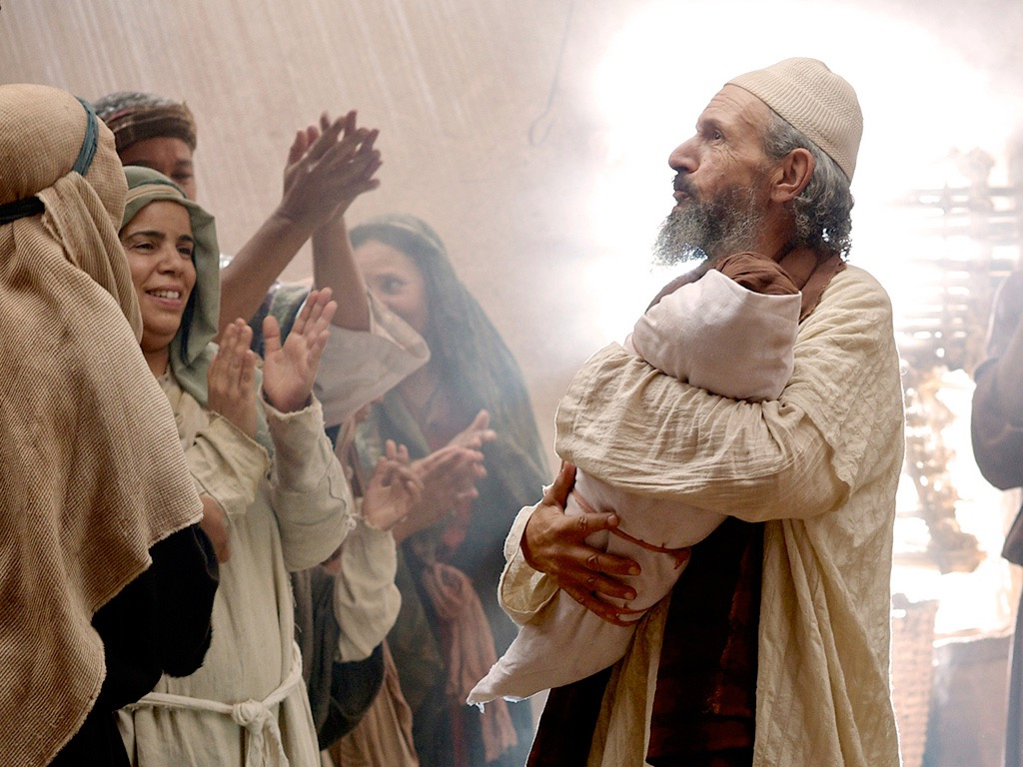
Introduction of the King
§§ 1-27
The Messianic identity of Jesus Christ is proved in his arrival, John's testimony, and approvals at his baptism and temptation
Section summaries based on J. Dwight Pentecost,
A Harmony of the Words and Works of Jesus Christ (Grand Rapids: Zondervan, 1981)
Dr. Rick Griffith • Jordan Evangelical Theological Seminary • BibleStudyDownloads.org

Slide 3

Introduction of the King
§§ 1-27
Arrival
Ambassador
Approval
Ancestry
Advent
Infancy/
Childhood
Baptism
Temptation
Herald
Notes:
Jesus did all that we should expect of the Messiah (King) from the start:
1—He arrived in the proper lineage of David, born of a virgin, and knew his deity even at age 12
2—His forerunner John knew his role in preparing Israel for her king
3—He had the best witnesses possible in the Father (baptism), Spirit (temptation), and John (prophesied herald)

Slide 4
Pentecost Outline
Introduction of the King
Authentication of the King
Controversy over the King
Instruction of the Twelve by the King
Opposition to the King
Preparation of the Disciples by the King
Official Presentation of the King
Preparation for the Death of the King
Rejection of the King
Resurrection of the King

Slide 5

Increasing Polarization
Resurrection
Preparation
for Death
Preparation
of Disciples
Instruction
Authentication
Introduction
Controversy
Opposition
Presentation
Rejection
Notes:
The Life of Christ brought increasing polarization. The more Jesus showed about himself, the greater the resistance to him and his message. Also, the more intense the controversy leading to opposition, the higher priority Christ placed on preparing his men for when he would be gone. The climactic rejection when he presented himself as king of Israel at the Triumphal Entry resulted in rejection to the point of crucifixion followed by the victory of resurrection.
Introduction of the King
Authentication of the King
Controversy over the King
Instruction of the Twelve by the King
Opposition to the King
Preparation of the Disciples by the King
Official Presentation of the King
Preparation for the Death of the King
Rejection of the King
Resurrection of the King

Slide 6
The Authentication
of the King
§§ 28-59
The Acceptance
of His Person
§§ 28-36
The Authority
of the King
§§ 37-59
Notes:
Many people of various places (Judea, Samaria, Galilee) and types (Nicodemus, Samaritan woman, common Jews) initially believed in him.
• Jesus also showed in 19 incidents the power expected of the Messiah to interpret the Law to preach and with authority over men, defilement, Sabbath, nature, sickness, and even death.

Slide 7
The Authentication
of the King
§§ 28-59
The Acceptance
of His Person
§§ 28-36
Notes:
Many people of various places (Judea, Samaria, Galilee) and types (Nicodemus, Samaritan woman, common Jews) initially believed in him.
Jesus also showed in 19 incidents the power expected of the Messiah to interpret the Law to preach and with authority over men, defilement, Sabbath, nature, sickness, and even death.

Slide 8
The Acceptance
of His Person
§§ 28-36
Christ is initially accepted in Judea, Samaria, and Galilee by His new disciples and by the multitudes

Slide 9
1. The Belief of the First Disciples
§ 28
John 1:35-51
Simon Peter, Andrew, John, and Nathaniel confess faith in Christ's person, work, and office as Messiah of Israel

Slide 10
2. The Belief Through the First Miracle
§ 29
John 2:1-11
Jesus confirms John’s disciples and others by turning water into wine to reveal his glory as God's Son and the joy he gives to believers

Slide 11
John 2
Christ can make all things new in your life!
The first miracle
The temple cleansing
Notes:
John 2 encompasses two parts: (1) the first miracle, popularly known as water to wine, and (2) the temple cleansing.

Slide 12
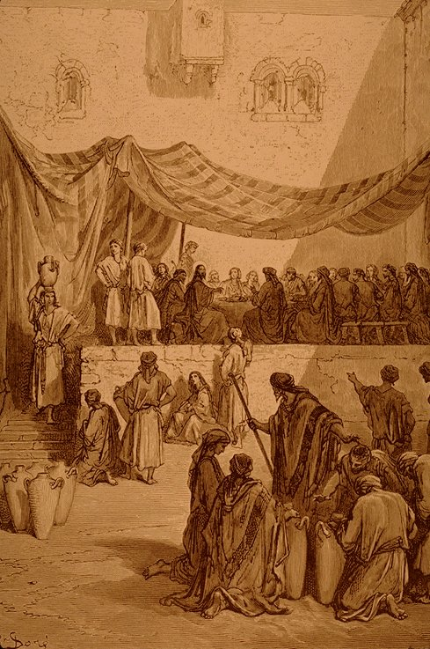
Cana Wedding
The Jewish purification ritual couldn’t cleanse completely and eternally (2:1-6).

Slide 13

Admit that Jesus is better than rituals because he can make all things new.

Slide 14
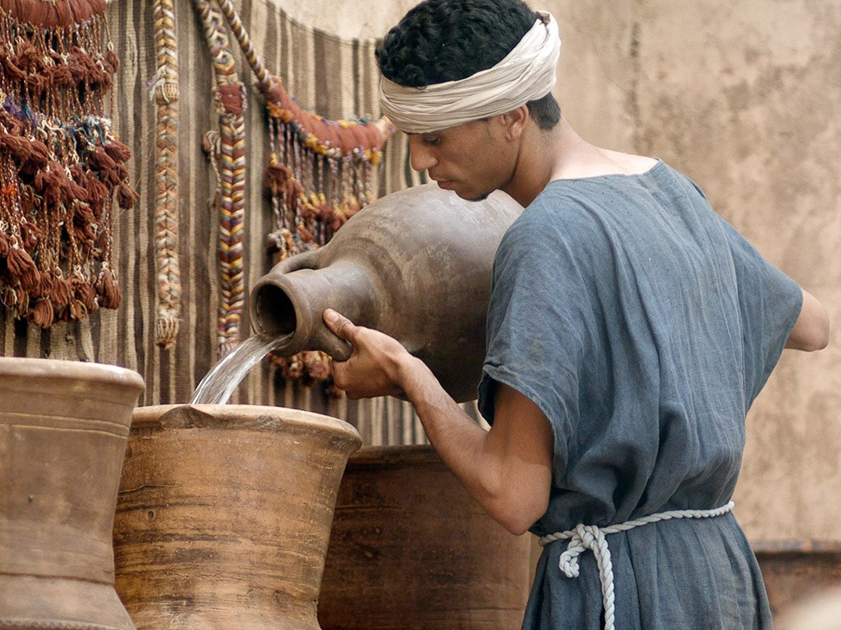

Free
Bible
images
John 2:1-11
WEDDING AT CANA

Slide 15
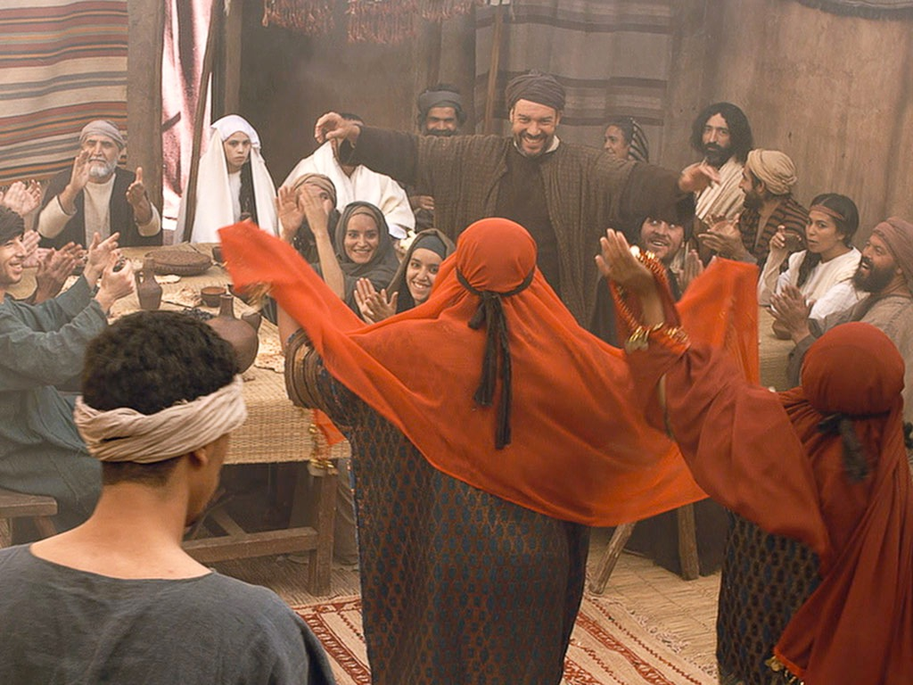
Notes:
Weddings are a time of joy.

Slide 16
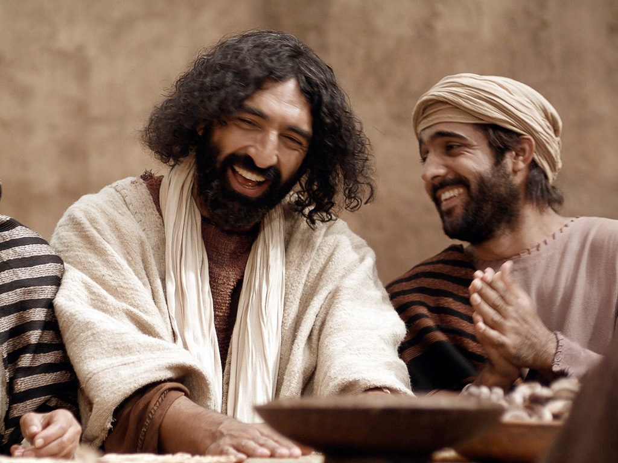
Notes:
Jesus shares our joy as he did at the wedding at Cana.

Slide 17
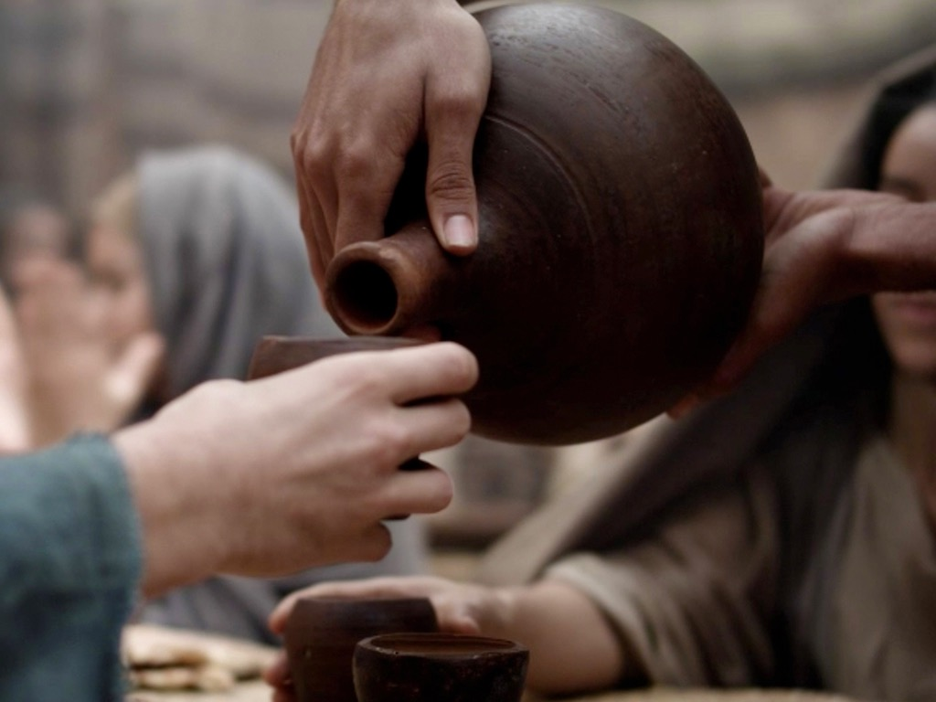
Notes:
But when the wine ran out so early, it potentially caused shame to this family that meant much to Jesus.

Slide 18
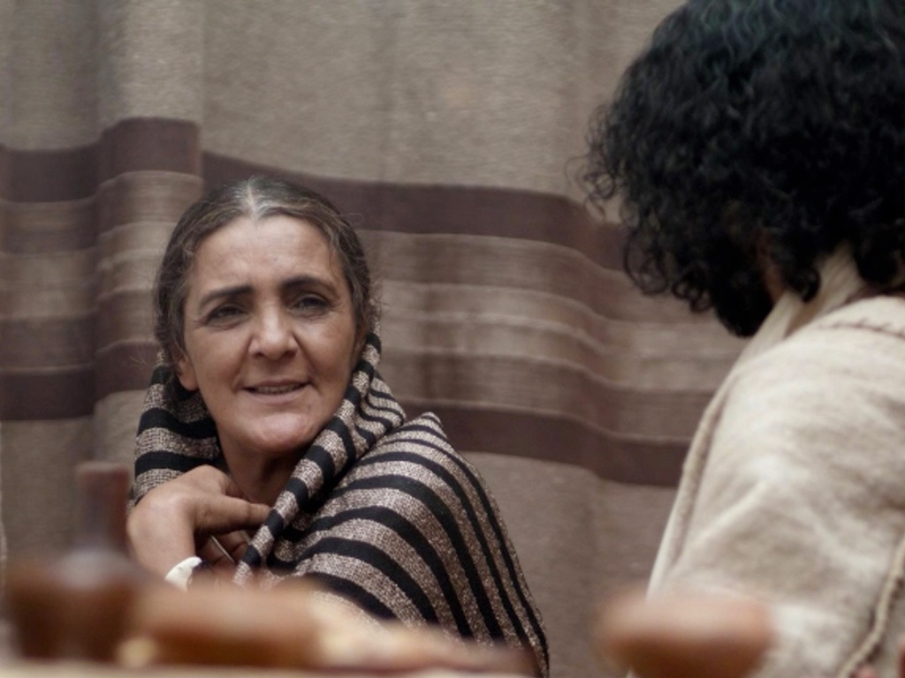
Notes:
Mary has a special relationship to the couple. Jesus initially did not respond to his mother Mary but then agreed to act.

Slide 19
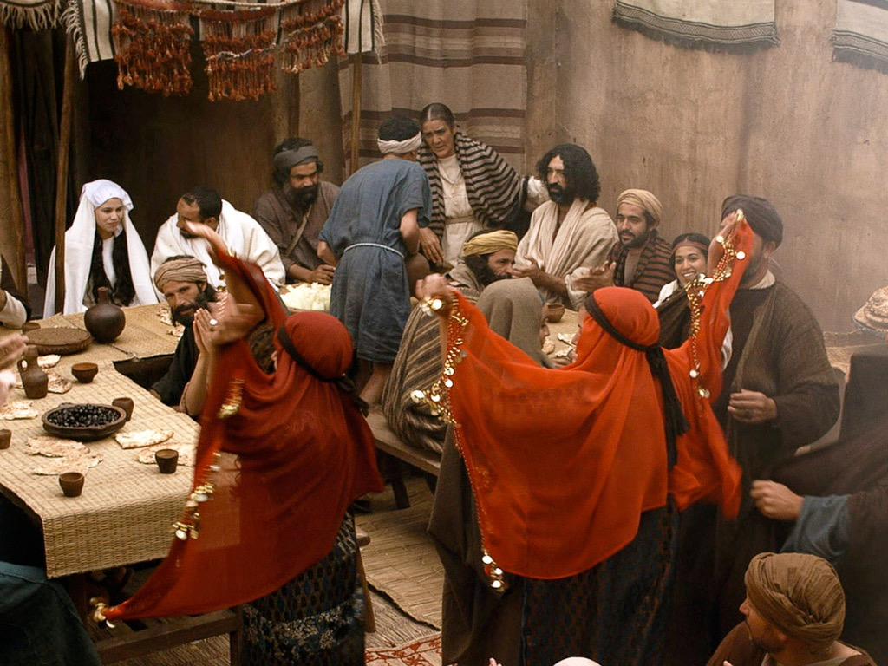
Notes:
Mary told the attendants to do whatever Jesus said.

Slide 20
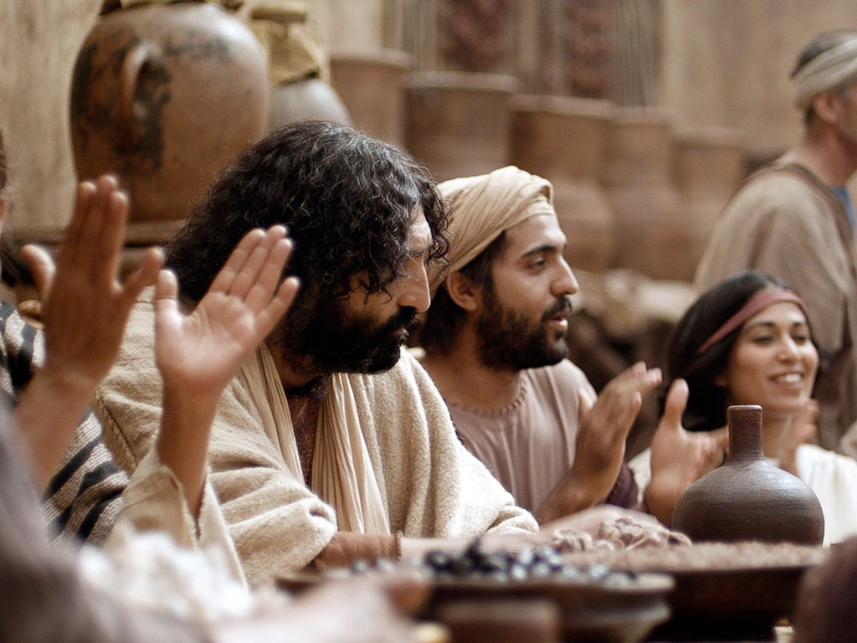
Notes:
Jesus tells them to fill them to fill six pitchers with water. And the wedding went on...

Slide 21
Notes:
The attendants filled six huge water jars the kind for ritual purification.

Slide 22
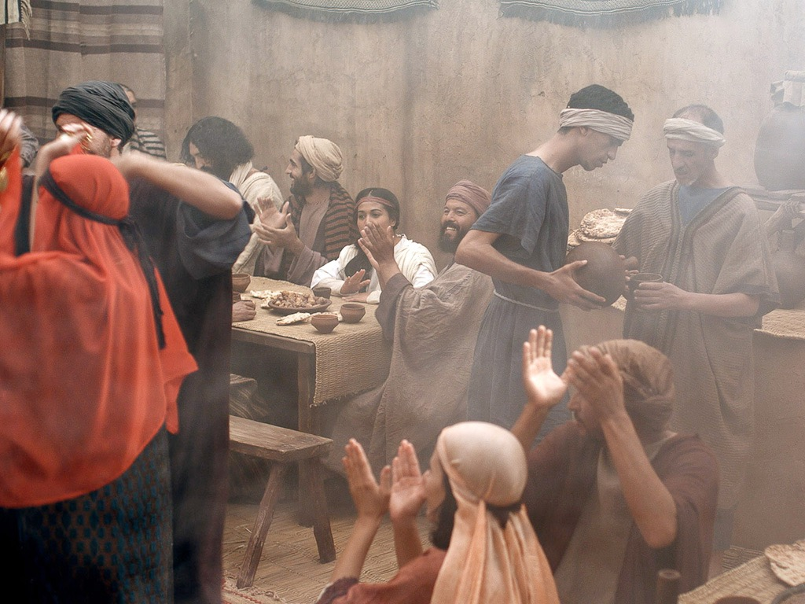
Notes:
And this "water" was given to the leader. Of course, he expected them to put wine.

Slide 23
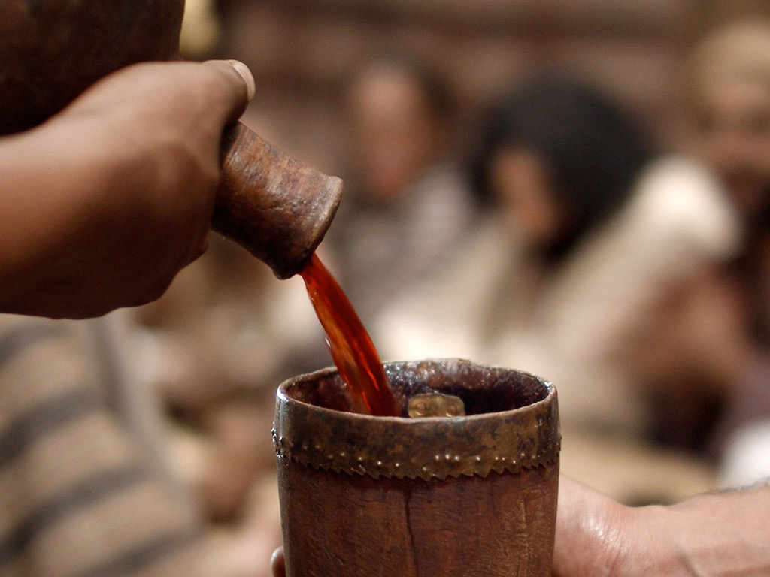
Notes:
So he wasn't disappointed to see wine in his cup.

Slide 24
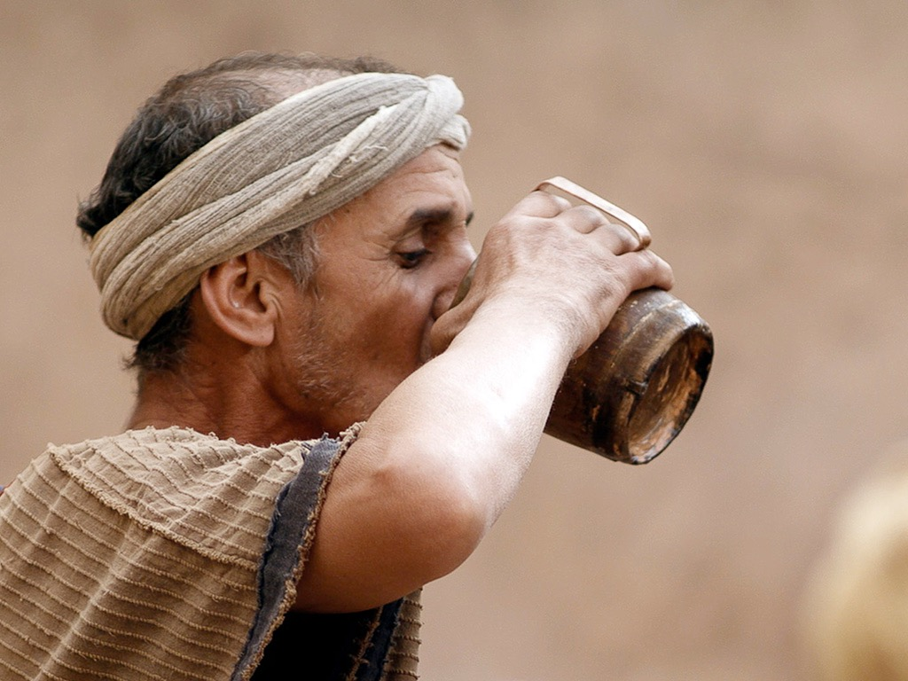
Notes:
The big surprise was how good Jesus can make wine!

Slide 25
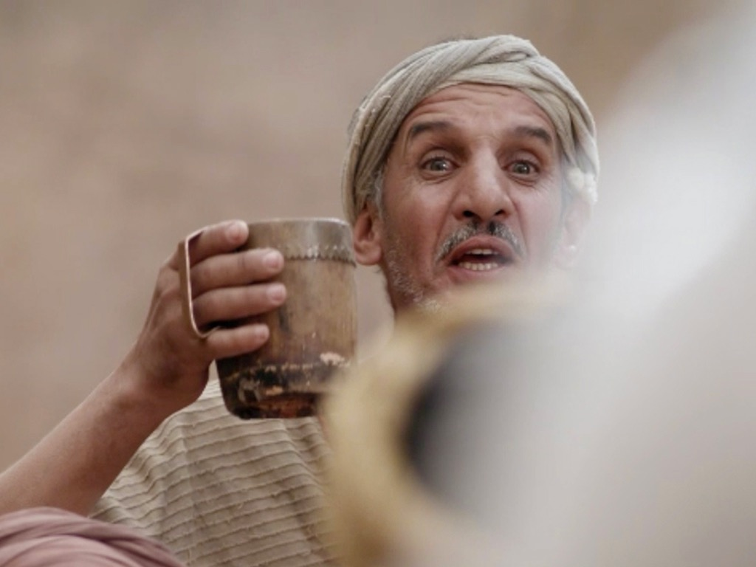
Notes:
So he announced to everyone that the best wine was served last.

Slide 26
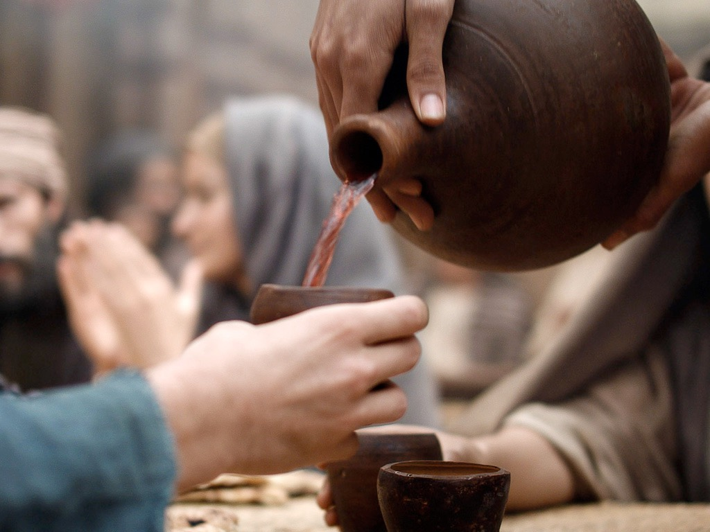
Notes:
In a sense, this was a private miracle as the others did not know where it came from.

Slide 27
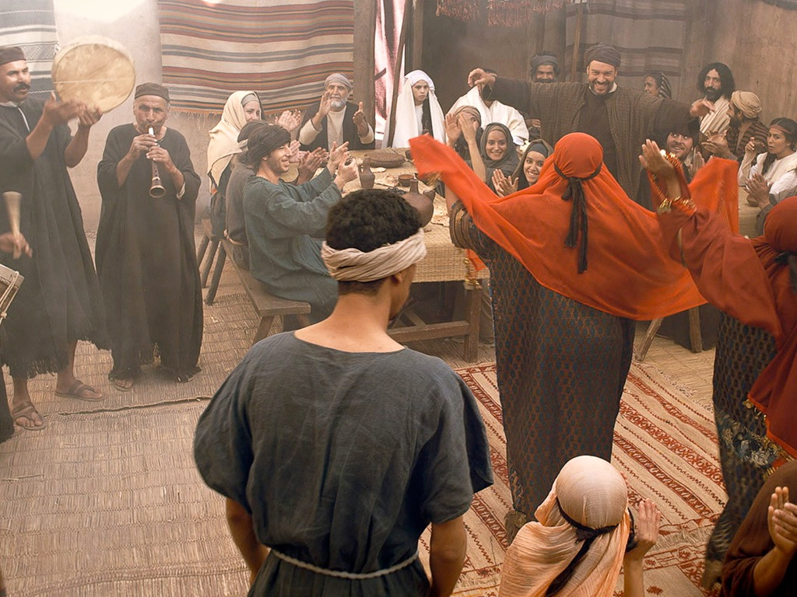
Notes:
So, what's the point of this miracle at Cana?
—that we should help people in difficulty?
—that we should obey our mothers?
—that Jesus can make wine?
—that Jesus has authority over elements?
—that Jesus gives true joy?
—that Jesus began his sign ministry?
Only the disciples believed (John 2:11).
John 2:11 This miraculous sign at Cana in Galilee was the first time Jesus revealed his glory. And his disciples believed in him.

Slide 28
THE WORD IN PICTURES
Free
Bible
images

Slide 29

Used with Permission
THE
GOSPEL
——OF—— MATTHEW
THE
GOSPEL
——OF—— MARK
THE
GOSPEL
——OF—— LUKE
THE
GOSPEL
——OF—— JOHN
Due to the Lumo Project producing its own publishing material we regret to inform you that we cannot license our photos to other clients outside of freebibleimages.org.
These images are not licensed for reuse in video, epublishing or other media. Downloaded pictures and files cannot be redistributed through any other website than freebibleimages.org or used in any context where the accompanying message is undermining of the Christian faith and gospel.
Photos can only be used on educational presentations, blogs and social media, all of which should be accompanied with reference to www.LumoProject.com.
Picture courtesy of BBM
© All Rights Reserved.
www.bigbookmedia.com

Slide 30
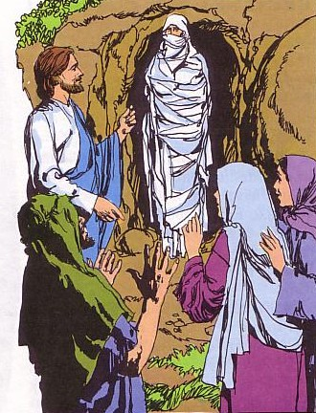
The Significance of John's Seven Signs
119
Sign | Eternal Life Teaching | Application
1. Changing water into wine at Cana (2:1-11)* | The joy of eternal life | If He can transform water, He can change me
2. Healing of official's son in Capernaum (4:46-54)* | The condition of eternal life (faith) | I am never too far away to be in His care
3. Healing the invalid at the Pool of Bethesda (5:1-18)* | The power to live the life | No limitation surpasses His authority
4. Feeding the 5000 near the Sea of Galilee (6:16-21) | The food for eternal life | Jesus can meet our deepest needs
5. Walking on water in the Sea of Galilee (6:5-14) | Guidance for eternal life | Jesus is Lord of life's storms
6. Healing the man born blind (9:1-7)* | Light for eternal life | Jesus offers spiritual and physical sight to the willing
7. Raising Lazarus from the dead in Bethany (11:1-45)* | Victory of life over death | Jesus Christ is Lord of life and death
Notes:
Charles Ryrie, Ryrie Study Bible, 1618 (column 2); Mahlon Friesen, First Baptist Church of Yucaipa, CA (column 3).
* The asterisks indicate signs unique to John's gospel.

Slide 31
3. The Sojourn in Capernaum
§ 30
John 2:12
Jesus further verifies the faith of His disciples in His Messianic identity in Capernaum before starting His first public ministry in Judea
Notes:
John 2:12 After the wedding he went to Capernaum for a few days with his mother, his brothers, and his disciples.

Slide 32
4. The Possession of the Temple
§ 31
John 2:13-22
Jesus shows His Messianic authority in His zeal for the Temple, which He promises to authenticate in His death and resurrection

Slide 33
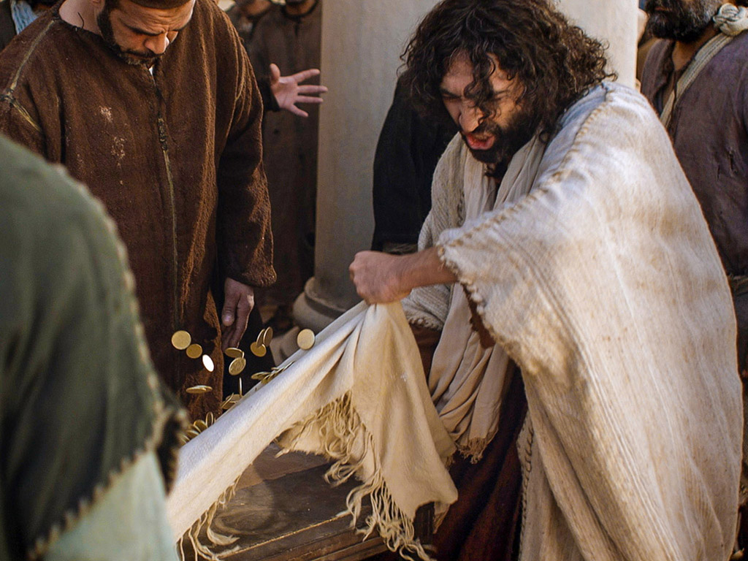
Matthew 21:12-17
Mark 11:15-19
Luke 19:45-48
John 2:13-24
THE EASTER STORY
CLEANSING THE TEMPLE
Free
Bible
images
Notes:
All four gospels mention a cleansing of the temple.
But what do you notice about the Synoptic versus John in their references?
John puts it much earlier and in greater detail.
Why? Jesus had to cleanse the temple twice!
He knew that He would die three years earlier.

Slide 34
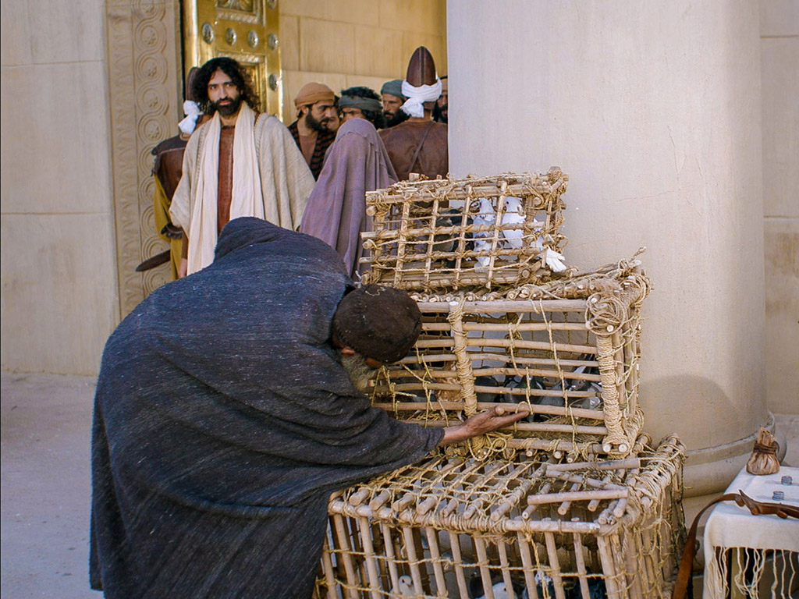
It was nearly time for the Jewish Passover celebration, so Jesus went to Jerusalem (2:13).

Slide 35
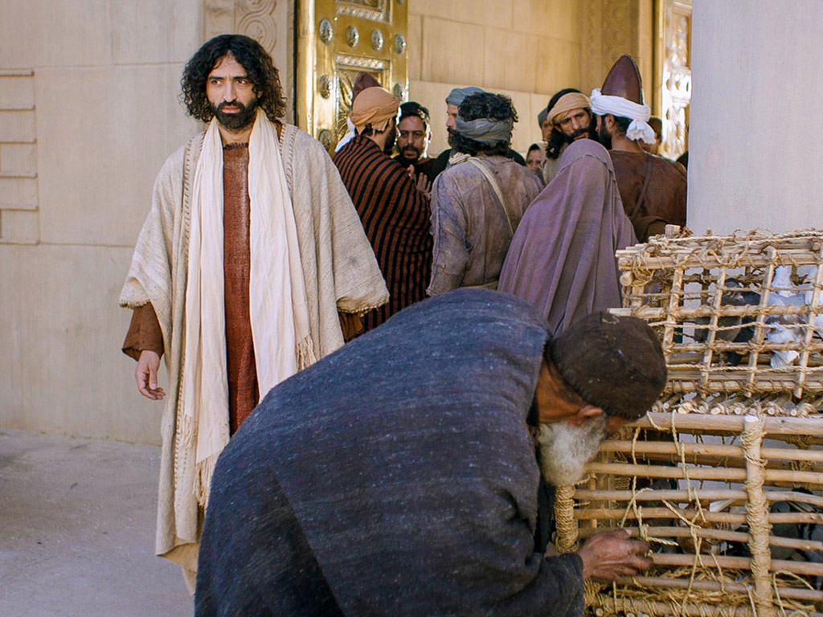
In the Temple area he saw merchants selling cattle, sheep, and doves for sacrifices (2:14a).
Notes:
Jews traveling from afar would not bring their sacrificial animals with them as this was not feasible. This meant that a system of selling animals developed in Jerusalem.

Slide 36
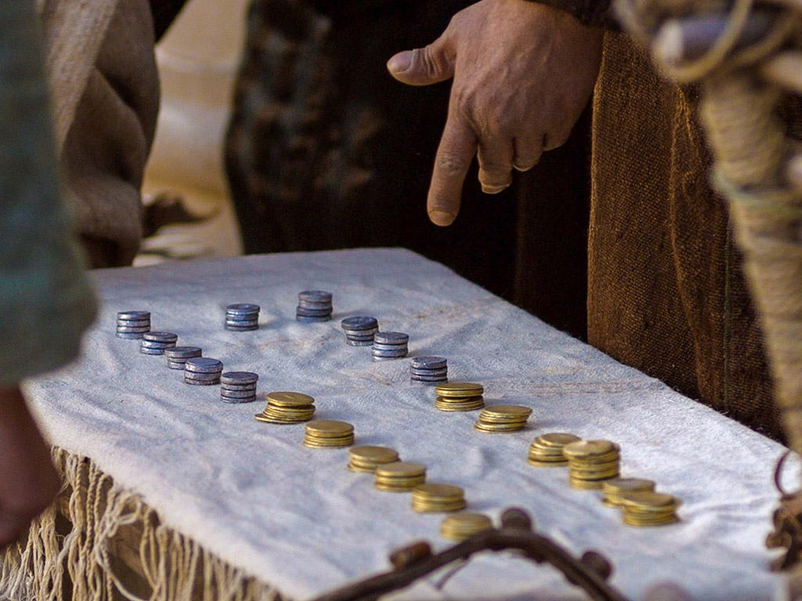
He also saw dealers at tables exchanging foreign money.
Notes:
They also would need the local currency of shekels as we need to today when we travel to another county. Therefore, a money changing system also developed.

Slide 37
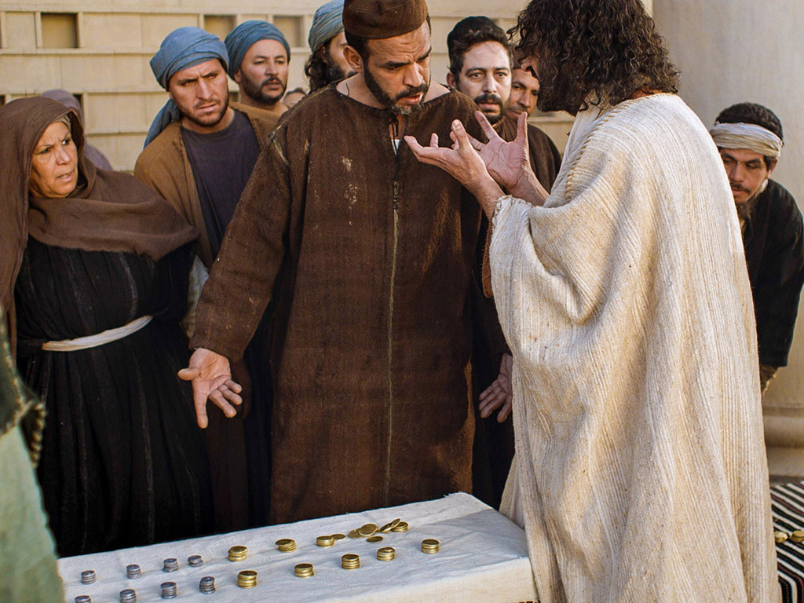

Slide 38
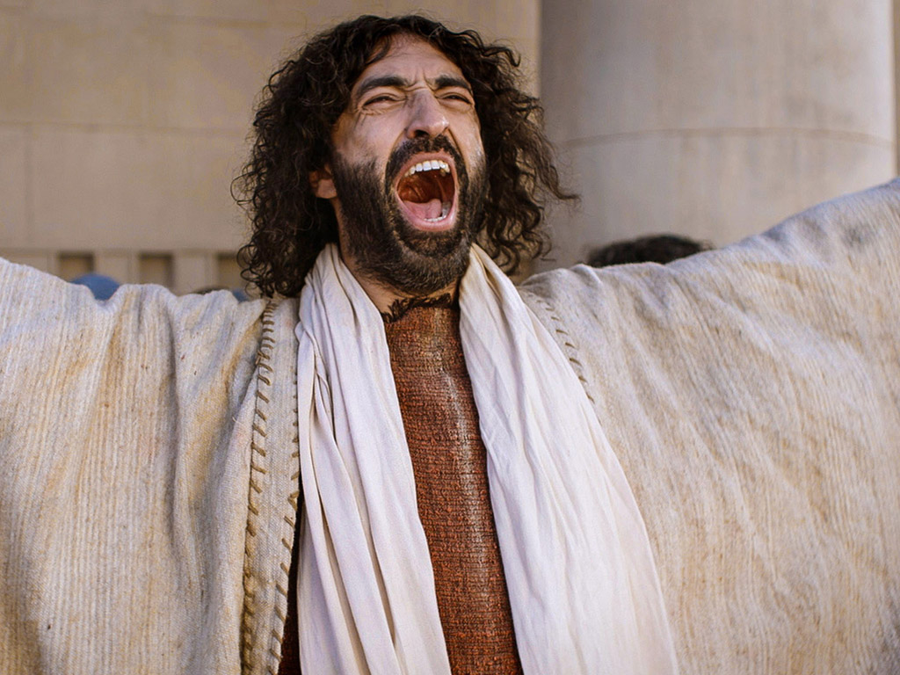
Jesus made a whip from some ropes and chased them all out of the Temple (2:15a).
Notes:
Jesus was upset that this system replaced His Father's House from prayer.

Slide 39
He drove out the sheep and cattle, scattered the money changers’ coins over the floor (2:15b)
Notes:
Jesus had every right to tear this down—even though he would again need to clear the temple three years later!

Slide 40

and turned over their tables (2:15c).
Notes:
Jesus turned over their tables in the way that the Jewish leaders in Jerusalem should have done before him!

Slide 41
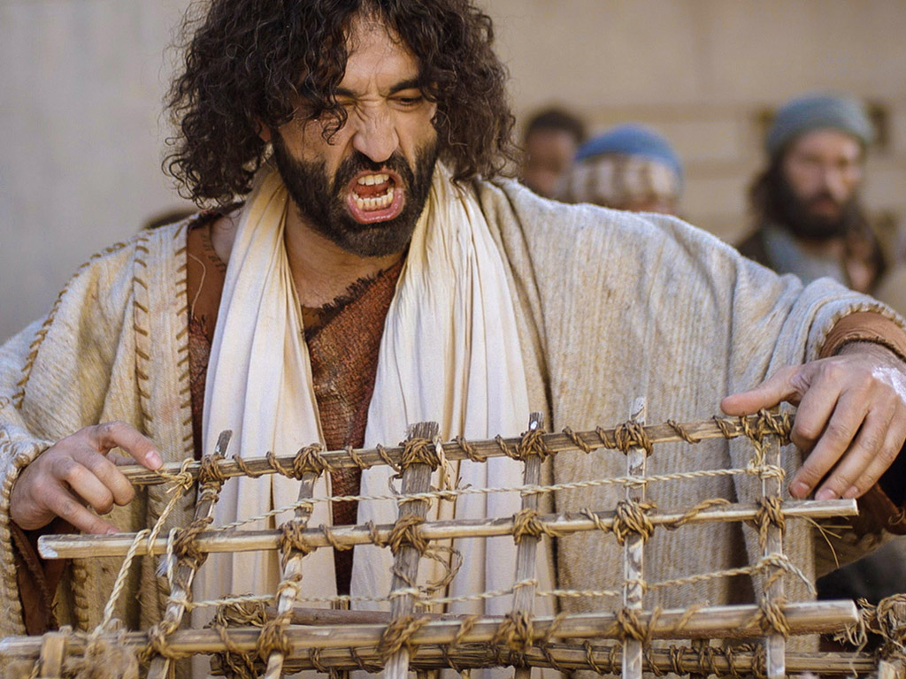
Then, going over to the people who sold doves, he told them... (2:16a)
Notes:
His anger against those selling doves was righteous anger.

Slide 42
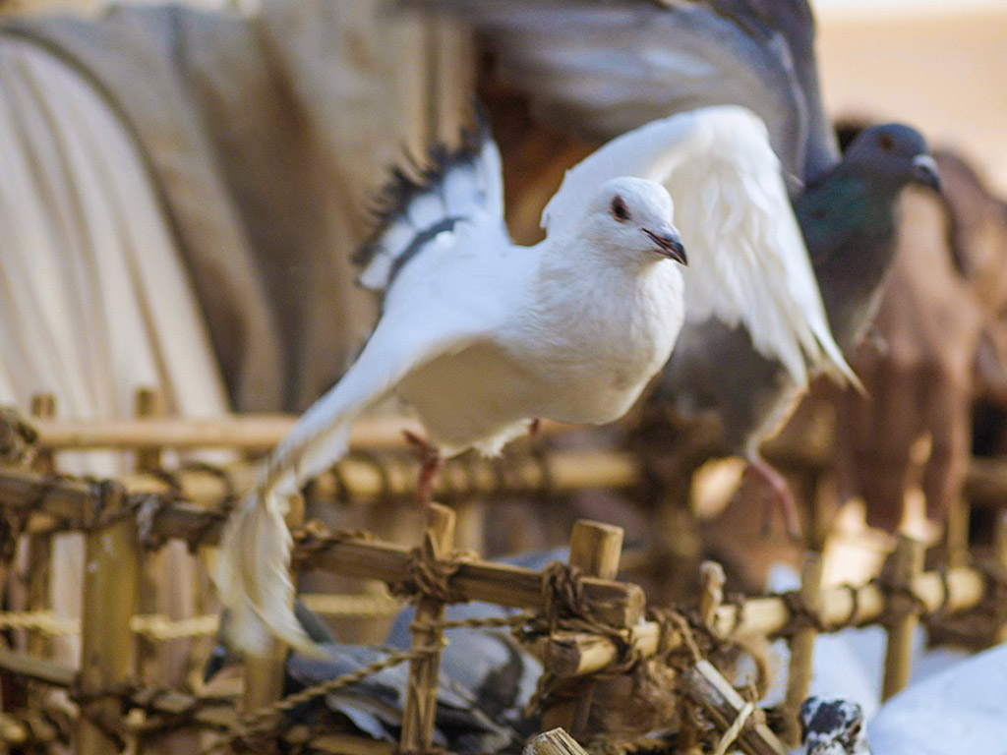
“Get these things out of here. Stop turning my Father’s house into a marketplace!” (2:16b)
Notes:
So he let the sacrificial doves free.

Slide 43
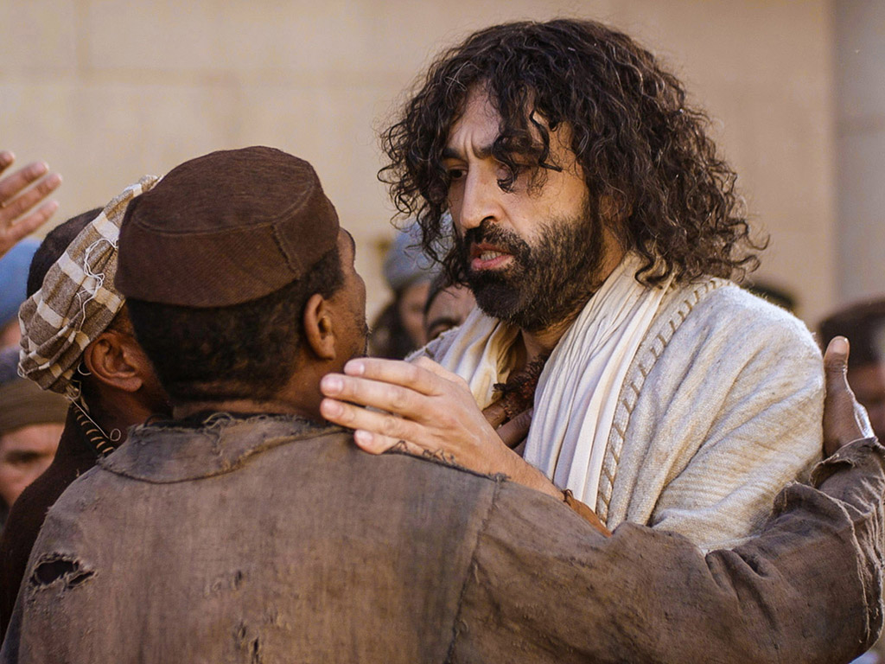
Then his disciples remembered this prophecy from the Scriptures: “Passion for God’s house will consume me” (2:17)
Notes:
"Stop turning my Father's House into a den of thieves!" Jesus retorted.

Slide 44
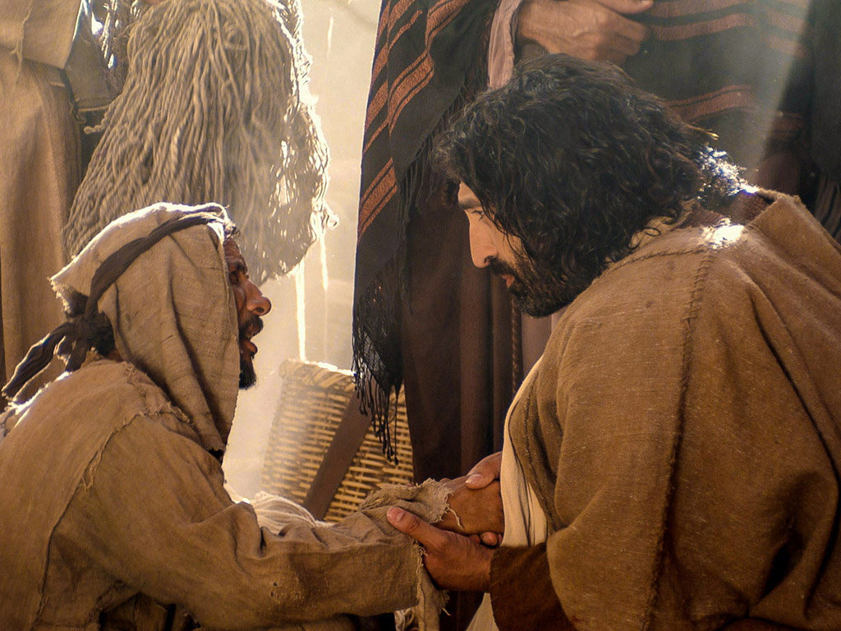
Notes:
The other side of Jesus was to show compassion on those cheated by this system.

Slide 45
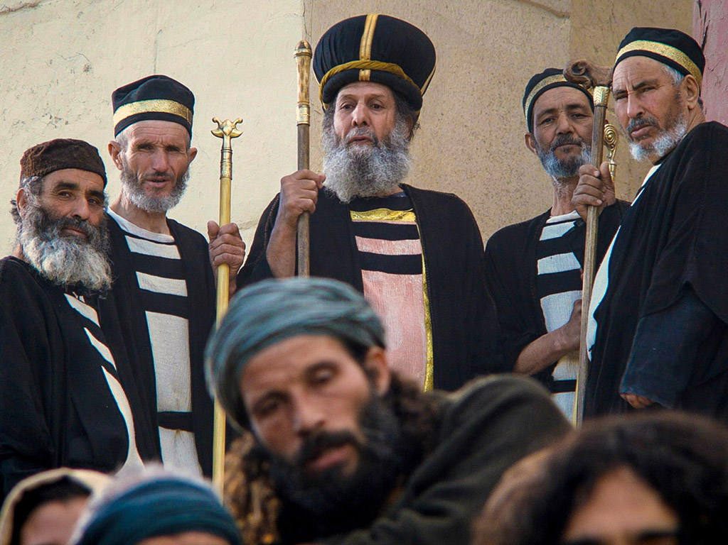
But the Jewish leaders demanded, "What are you doing? If God gave you authority to do this, show us a miraculous sign to prove it" (2:18).
Notes:
But why were the Jewish leaders upset with Jesus?
The Law declared, "In the case of the burnt offering, the priest may keep the hide of the sacrificed animal" (Lev 7:8). The leaders profited much from this system.
They asked him by what authority he could cleanse the temple.

Slide 46
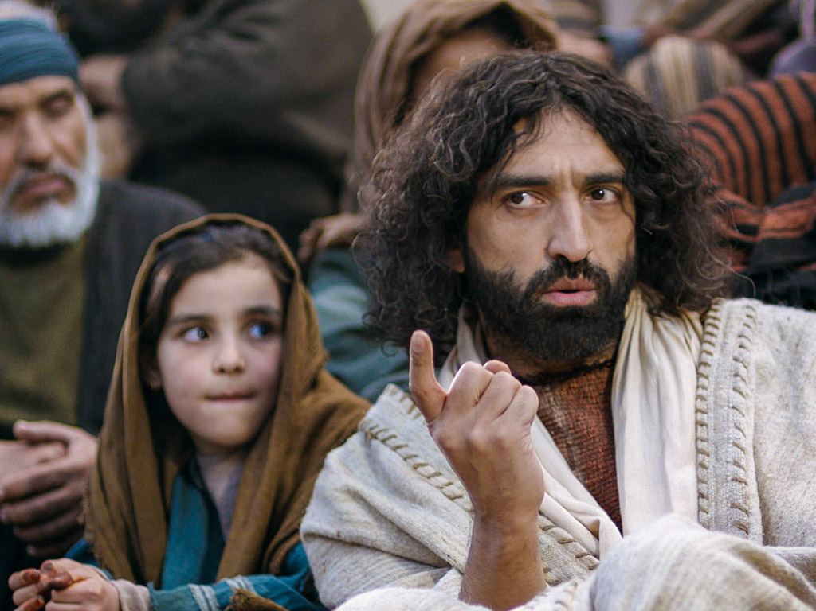
“All right,” Jesus replied. “Destroy this temple, and in three days I will raise it up” (2:19).
Notes:
John 2:19 "Destroy this temple and I will rebuild it in three days," Jesus responded.
Of course, he was referred to his body—but they said that it took 46 years to build the temple.
Bringing himself back to life would be an even greater miracle.

Slide 47
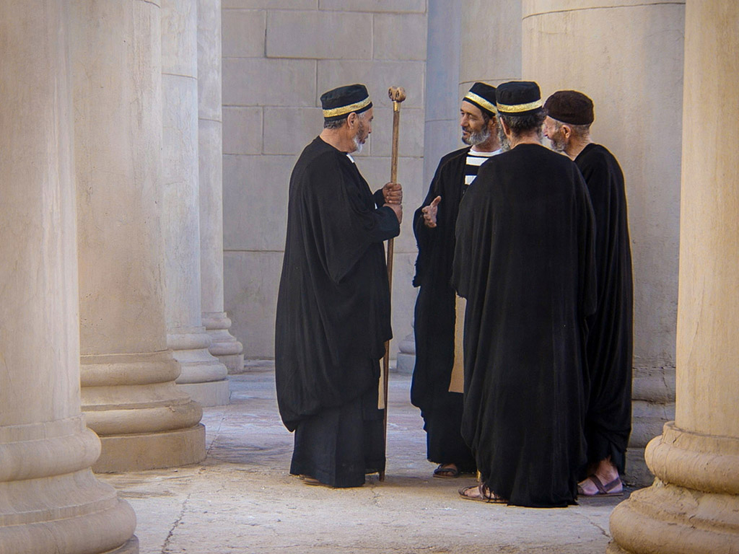
“What!” they exclaimed. “It has taken forty-six years to build this Temple, and you can rebuild it in three days?” (2:20).
Notes:
They never asked Jesus for clarification.

Slide 48
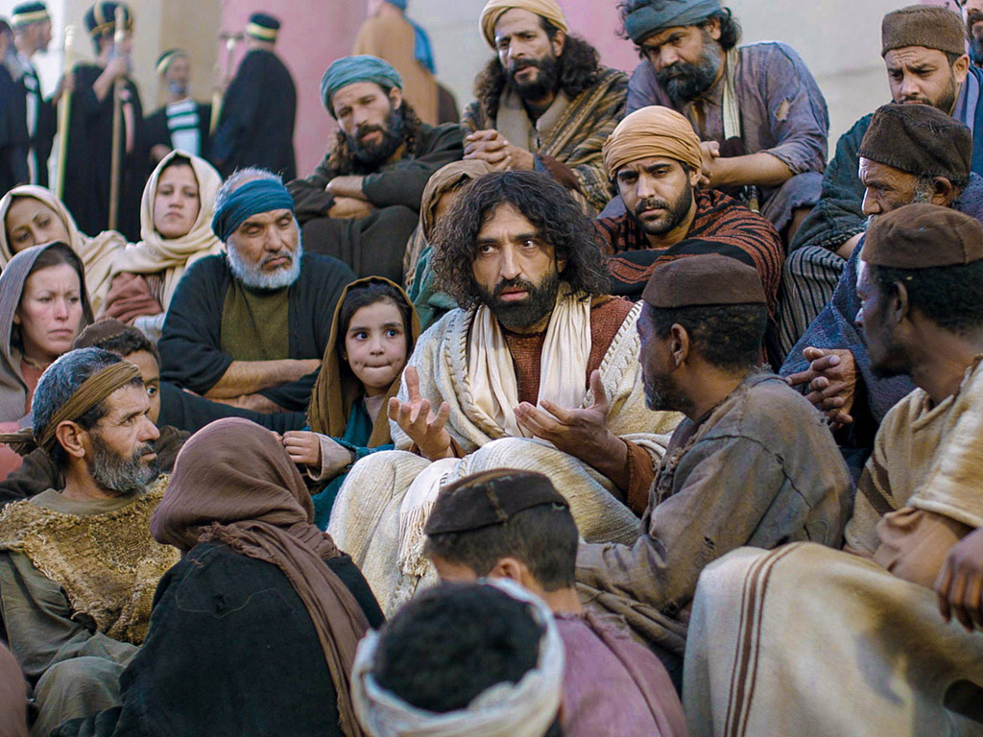
But when Jesus said “this temple,” he meant his own body (2:21).
Notes:
Jesus clarifies himself with the believing but often not the unbelieving. Otherwise, they would incur a stricter judgment.

Slide 49
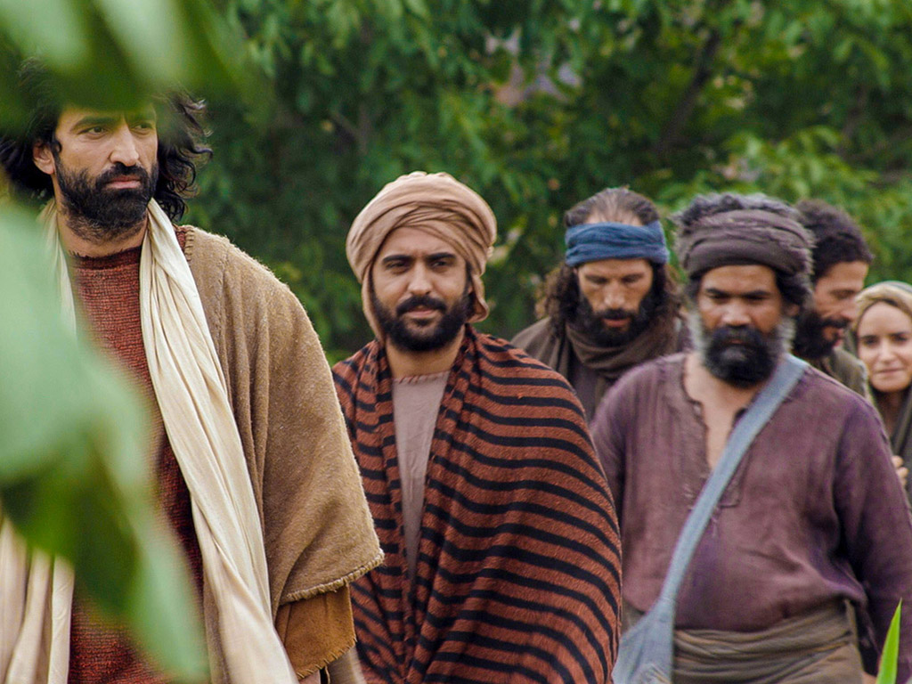
After he was raised from the dead, his disciples remembered he had said this, and they believed both the Scriptures and what Jesus had said (2:22).
Notes:
The disciples believed fully only after the resurrection, according to John 2:22!
John 2:19 “All right,” Jesus replied. “Destroy this temple, and in three days I will raise it up.”
John 2:20 “What!” they exclaimed. “It has taken forty-six years to build this Temple, and you can rebuild it in three days?” ²¹ But when Jesus said “this temple,” he meant his own body. ²² After he was raised from the dead, his disciples remembered he had said this, and they believed both the Scriptures and what Jesus had said.

Slide 50
THE WORD IN PICTURES
Free
Bible
images

Slide 51
5. Acceptance in Judea
§ 32
John 2:23–3:21
Judeans accept Jesus, as does Nicodemus, who sees that Jesus reveals God and gives spiritual birth to enter the kingdom
Notes:
John 2:23 Now when He was in Jerusalem at the Passover, during the feast, many believed in His name, observing His signs which He was doing. ²⁴ But Jesus, on His part, was not entrusting Himself to them, for He knew all men, ²⁵ and because He did not need anyone to testify concerning man, for He Himself knew what was in man" (NLT).
Did these people trust Jesus for salvation? (Small group discussion) Most scholars think not.
James says that there is a belief that is not salvific: "You believe that God is one. You do well; the demons also believe, and shudder" (James 2:19 NASB).
But does John use "believing" in this way? Not really. Every time John uses the term, he refers to trusting for salvation. In fact, Jesus does not fully trust himself to any of us, for he knows what is in our hearts. The belief of John 2:22 is the same as the belief of John 2:23.
But some point to John 8:30-31 to show that belief does not always indicate belief for salvation.
³⁰ Then many who heard him say these things believed in him.
Jesus and Abraham
John 8:31 Jesus said to the people who believed in him, “You are truly my disciples if you remain faithful to my teachings. ³² And you will know the truth, and the truth will set you free.”
John 8:33 “But we are descendants of Abraham,” they said. “We have never been slaves to anyone. What do you mean, ‘You will be set free’?”
Here, Jesus referred to those who "believed" as children of the devil (8:44)!
_________________
Bible Knowledge Commentary:
8:30. In spite of widespread unbelief and official rejection, the ministry of Jesus did bring many to faith (cf. 7:31). Yet this faith would need to be tested and refined. The words many put their faith in Him contrast with the next verse. Though large numbers of people responded to Jesus, many people fell away.
8:31-32. Jews who had believed Him indicates that some paid attention to Jesus’ words without necessarily committing themselves to Him personally (cf. 6:53). It was possible to “believe” in the [Vol. 2, p. 305] message of repentance and the coming kingdom without being born again. Continuing in the truth is the sign of true followers and learners (disciples). If they really grasped His message, they would find salvation truth. Knowing this salvation truth would liberate them from their bondage in sin.

Slide 52
Summary (John 2:23-25 NIV)
What else does “believe” mean in John’s gospel?
  Now while he was in Jerusalem at the Passover Feast, many people saw the miraculous signs he was doing and believed in his name. ²⁴But Jesus would not entrust himself to them, for he knew all men. ²⁵He did not need man's testimony about man, for he knew what was in a man.
Does “believed” mean “believed”?
Notes:
John 2:23-25 is a summary of John 2.
We see that “many people saw… and believed in his name,” so we can safely presume that some saw but did not believe in his name.
• But does "believed" means "believed"?
And to which group did Jesus not give further revelation of himself—to those who believed or to those who didn't believe?
Actually, the text does not even mention those who did NOT believe! We just assume that unbelievers are being referred to!
We also assume that seeing Christ’s miracles and then believing is not true belief, but does the text say that?
• Is this the only time in John’s gospel where “believe” does NOT mean to trust Christ for salvation? I think not!
It simply says that Jesus was smart enough to know which believers could be responsible with more revelation of himself. Jesus also did not need man's approval before revealing himself.
He does the same today, by the way. Even if we know him personally, if our focus is on outward signs, Jesus will not trust us like he will trust truly committed believers.
So do you not think “believed in him” means “believed in him”? I wonder, especially in John’s gospel where signs are given so that we might believe (John 20:21), why this passage would be an exception where the signs led people to believe.

Slide 53
Belief in John 2:23-25
119a
  Most scholars see “believe” here as false. Why is this wrong?
  This is the normal word for “believe” (cf. 1:12).
  Nowhere does the NT say that Jesus “commits himself” to all believers.
  This text actually tells us not to be a secret saint.
Notes:
This handout in the notes explains more about John 2:23-25.

Slide 54
Slides on
John 3

Slide 55

119d
"Jesus replied, 'I assure you, no one can enter the Kingdom of God without being born of water and the Spirit.'"
John 3:5

Slide 56
John 3:5 Interpretations
119d
Baptismal Regeneration
Cleansing Effect of the Word
Water as a Symbol of the Holy Spirit
Repentance Ministry of John
Physical Birth

Slide 57
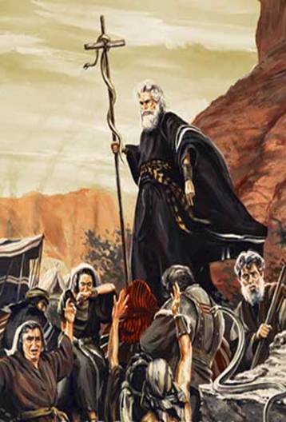
The Bronze Serpent
Numbers 21:8-9
Notes:
Num. 21:8-9 Then the Lord told him, “Make a replica of a poisonous snake and attach it to a pole. All who are bitten will live if they simply look at it!” ⁹ So Moses made a snake out of bronze and attached it to a pole. Then anyone who was bitten by a snake could look at the bronze snake and be healed!

Slide 58
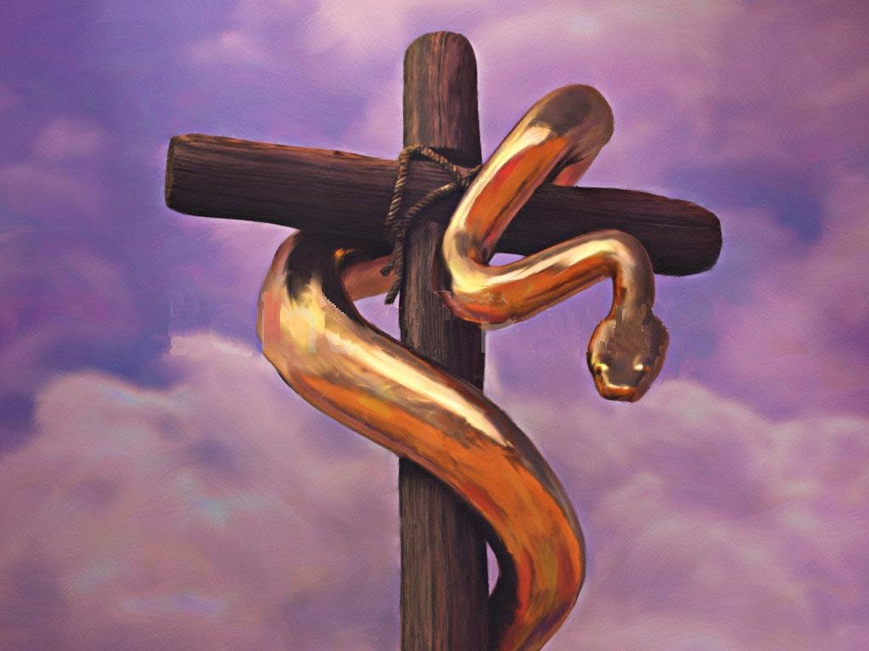

The Bronze Serpent
Numbers 21:8-9
Notes:
• The bronze serpent appears in dual form on the seal of the American Medical Association.

Slide 59
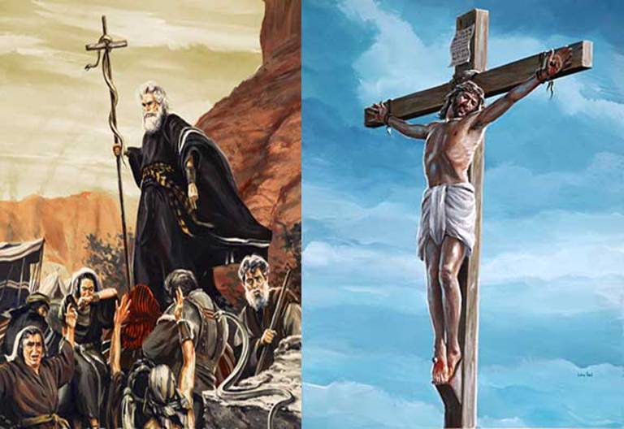
The Bronze Serpent
"And as Moses lifted up the bronze
snake on a pole in the wilderness,
so the Son of Man must be lifted up."
John 3:14 NLT
Notes:
John 3:14 And as Moses lifted up the bronze snake on a pole in the wilderness, so the Son of Man must be lifted up.

Slide 60

"For God loved the world so much that he gave his one and only Son, so that everyone who believes in him will not perish but have eternal life."
John 3:16 NLT

Slide 61
6. The Witness of John
§ 33
John 3:22-36
John declares Christ’s superiority as a heavenly Revealer of the Father for people to have eternal life instead of God’s wrath
Notes:
John the Baptist Exalts Jesus
John 3:22 Then Jesus and his disciples left Jerusalem and went into the Judean countryside. Jesus spent some time with them there, baptizing people.
John 3:23 At this time John the Baptist was baptizing at Aenon, near Salim, because there was plenty of water there; and people kept coming to him for baptism. ²⁴ (This was before John was thrown into prison.) ²⁵ A debate broke out between John’s disciples and a certain Jew over ceremonial cleansing. ²⁶ So John’s disciples came to him and said, “Rabbi, the man you met on the other side of the Jordan River, the one you identified as the Messiah, is also baptizing people. And everybody is going to him instead of coming to us.”
John 3:27 John replied, “No one can receive anything unless God gives it from heaven. ²⁸ You yourselves know how plainly I told you, ‘I am not the Messiah. I am only here to prepare the way for him.’ ²⁹ It is the bridegroom who marries the bride, and the bridegroom’s friend is simply glad to stand with him and hear his vows. Therefore, I am filled with joy at his success. ³⁰ He must become greater and greater, and I must become less and less.
John 3:31 “He has come from above and is greater than anyone else. We are of the earth, and we speak of earthly things, but he has come from heaven and is greater than anyone else. ³² He testifies about what he has seen and heard, but how few believe what he tells them! ³³ Anyone who accepts his testimony can affirm that God is true. ³⁴ For he is sent by God. He speaks God’s words, for God gives him the Spirit without limit. ³⁵ The Father loves his Son and has put everything into his hands. ³⁶ And anyone who believes in God’s Son has eternal life. Anyone who doesn’t obey the Son will never experience eternal life but remains under God’s angry judgment.”

Slide 62
7. The Withdrawal from Judea
§ 34
Matthew 4:12; Mark 1:14; Luke 3:19-20; John 4:1-4
Christ transfers from Judea to Galilee to avoid potential conflict with John and premature death by the Pharisees
Notes:
The Ministry of Jesus Begins
Matt. 4:12 When Jesus heard that John had been arrested, he left Judea and returned to Galilee.
Mark 1:14 Later on, after John was arrested, Jesus went into Galilee, where he preached God’s Good News.
Luke 3:19 John also publicly criticized Herod Antipas, the ruler of Galilee, for marrying Herodias, his brother’s wife, and for many other wrongs he had done. ²⁰ So Herod put John in prison, adding this sin to his many others.
Jesus and the Samaritan Woman
John 4:1 Jesus knew the Pharisees had heard that he was baptizing and making more disciples than John ² (though Jesus himself didn’t baptize them—his disciples did). ³ So he left Judea and returned to Galilee.
John 4:4 He had to go through Samaria on the way.

Slide 63
8. The Acceptance in Samaria
§ 35
John 4:5-42
Samaritans believe in Jesus as Messiah through a woman at the well who accepts His person and the eternal life He came to give
Notes:
NLT John 4:5 Eventually he came to the Samaritan village of Sychar, near the field that Jacob gave to his son Joseph. ⁶ Jacob’s well was there; and Jesus, tired from the long walk, sat wearily beside the well about noontime. ⁷ Soon a Samaritan woman came to draw water, and Jesus said to her, “Please give me a drink.” ⁸ He was alone at the time because his disciples had gone into the village to buy some food.
John 4:9 The woman was surprised, for Jews refuse to have anything to do with Samaritans. She said to Jesus, “You are a Jew, and I am a Samaritan woman. Why are you asking me for a drink?”
John 4:10 Jesus replied, “If you only knew the gift God has for you and who you are speaking to, you would ask me, and I would give you living water.”
John 4:11 “But sir, you don’t have a rope or a bucket,” she said, “and this well is very deep. Where would you get this living water? ¹² And besides, do you think you’re greater than our ancestor Jacob, who gave us this well? How can you offer better water than he and his sons and his animals enjoyed?”
John 4:13 Jesus replied, “Anyone who drinks this water will soon become thirsty again. ¹⁴ But those who drink the water I give will never be thirsty again. It becomes a fresh, bubbling spring within them, giving them eternal life.”
John 4:15 “Please, sir,” the woman said, “give me this water! Then I’ll never be thirsty again, and I won’t have to come here to get water.”
John 4:16 “Go and get your husband,” Jesus told her.
John 4:17 “I don’t have a husband,” the woman replied.
Jesus said, “You’re right! You don’t have a husband—
¹⁸ for you have had five husbands, and you aren’t even married to the man you’re living with now. You certainly spoke the truth!”
John 4:19 “Sir,” the woman said, “you must be a prophet. ²⁰ So tell me, why is it that you Jews insist that Jerusalem is the only place of worship, while we Samaritans claim it is here at Mount Gerizim, where our ancestors worshiped?”
John 4:21 Jesus replied, “Believe me, dear woman, the time is coming when it will no longer matter whether you worship the Father on this mountain or in Jerusalem. ²² You Samaritans know very little about the one you worship, while we Jews know all about him, for salvation comes through the Jews. ²³ But the time is coming—indeed it’s here now—when true worshipers will worship the Father in spirit and in truth. The Father is looking for those who will worship him that way. ²⁴ For God is Spirit, so those who worship him must worship in spirit and in truth.”
John 4:25 The woman said, “I know the Messiah is coming—the one who is called Christ. When he comes, he will explain everything to us.”
John 4:26 Then Jesus told her, “I AM the Messiah!”
John 4:27 Just then his disciples came back. They were shocked to find him talking to a woman, but none of them had the nerve to ask, “What do you want with her?” or “Why are you talking to her?” ²⁸ The woman left her water jar beside the well and ran back to the village, telling everyone, ²⁹ “Come and see a man who told me everything I ever did! Could he possibly be the Messiah?” ³⁰ So the people came streaming from the village to see him.
John 4:31 Meanwhile, the disciples were urging Jesus, “Rabbi, eat something.”
John 4:32 But Jesus replied, “I have a kind of food you know nothing about.”
John 4:33 “Did someone bring him food while we were gone?” the disciples asked each other.
John 4:34 Then Jesus explained: “My nourishment comes from doing the will of God, who sent me, and from finishing his work. ³⁵ You know the saying, ‘Four months between planting and harvest.’ But I say, wake up and look around. The fields are already ripe for harvest. ³⁶ The harvesters are paid good wages, and the fruit they harvest is people brought to eternal life. What joy awaits both the planter and the harvester alike! ³⁷ You know the saying, ‘One plants and another harvests.’ And it’s true. ³⁸ I sent you to harvest where you didn’t plant; others had already done the work, and now you will get to gather the harvest.”
Many Samaritans Believe
John 4:39 Many Samaritans from the village believed in Jesus because the woman had said, “He told me everything I ever did!” ⁴⁰ When they came out to see him, they begged him to stay in their village. So he stayed for two days, ⁴¹ long enough for many more to hear his message and believe. ⁴² Then they said to the woman, “Now we believe, not just because of what you told us, but because we have heard him ourselves. Now we know that he is indeed the Savior of the world.”

Slide 64
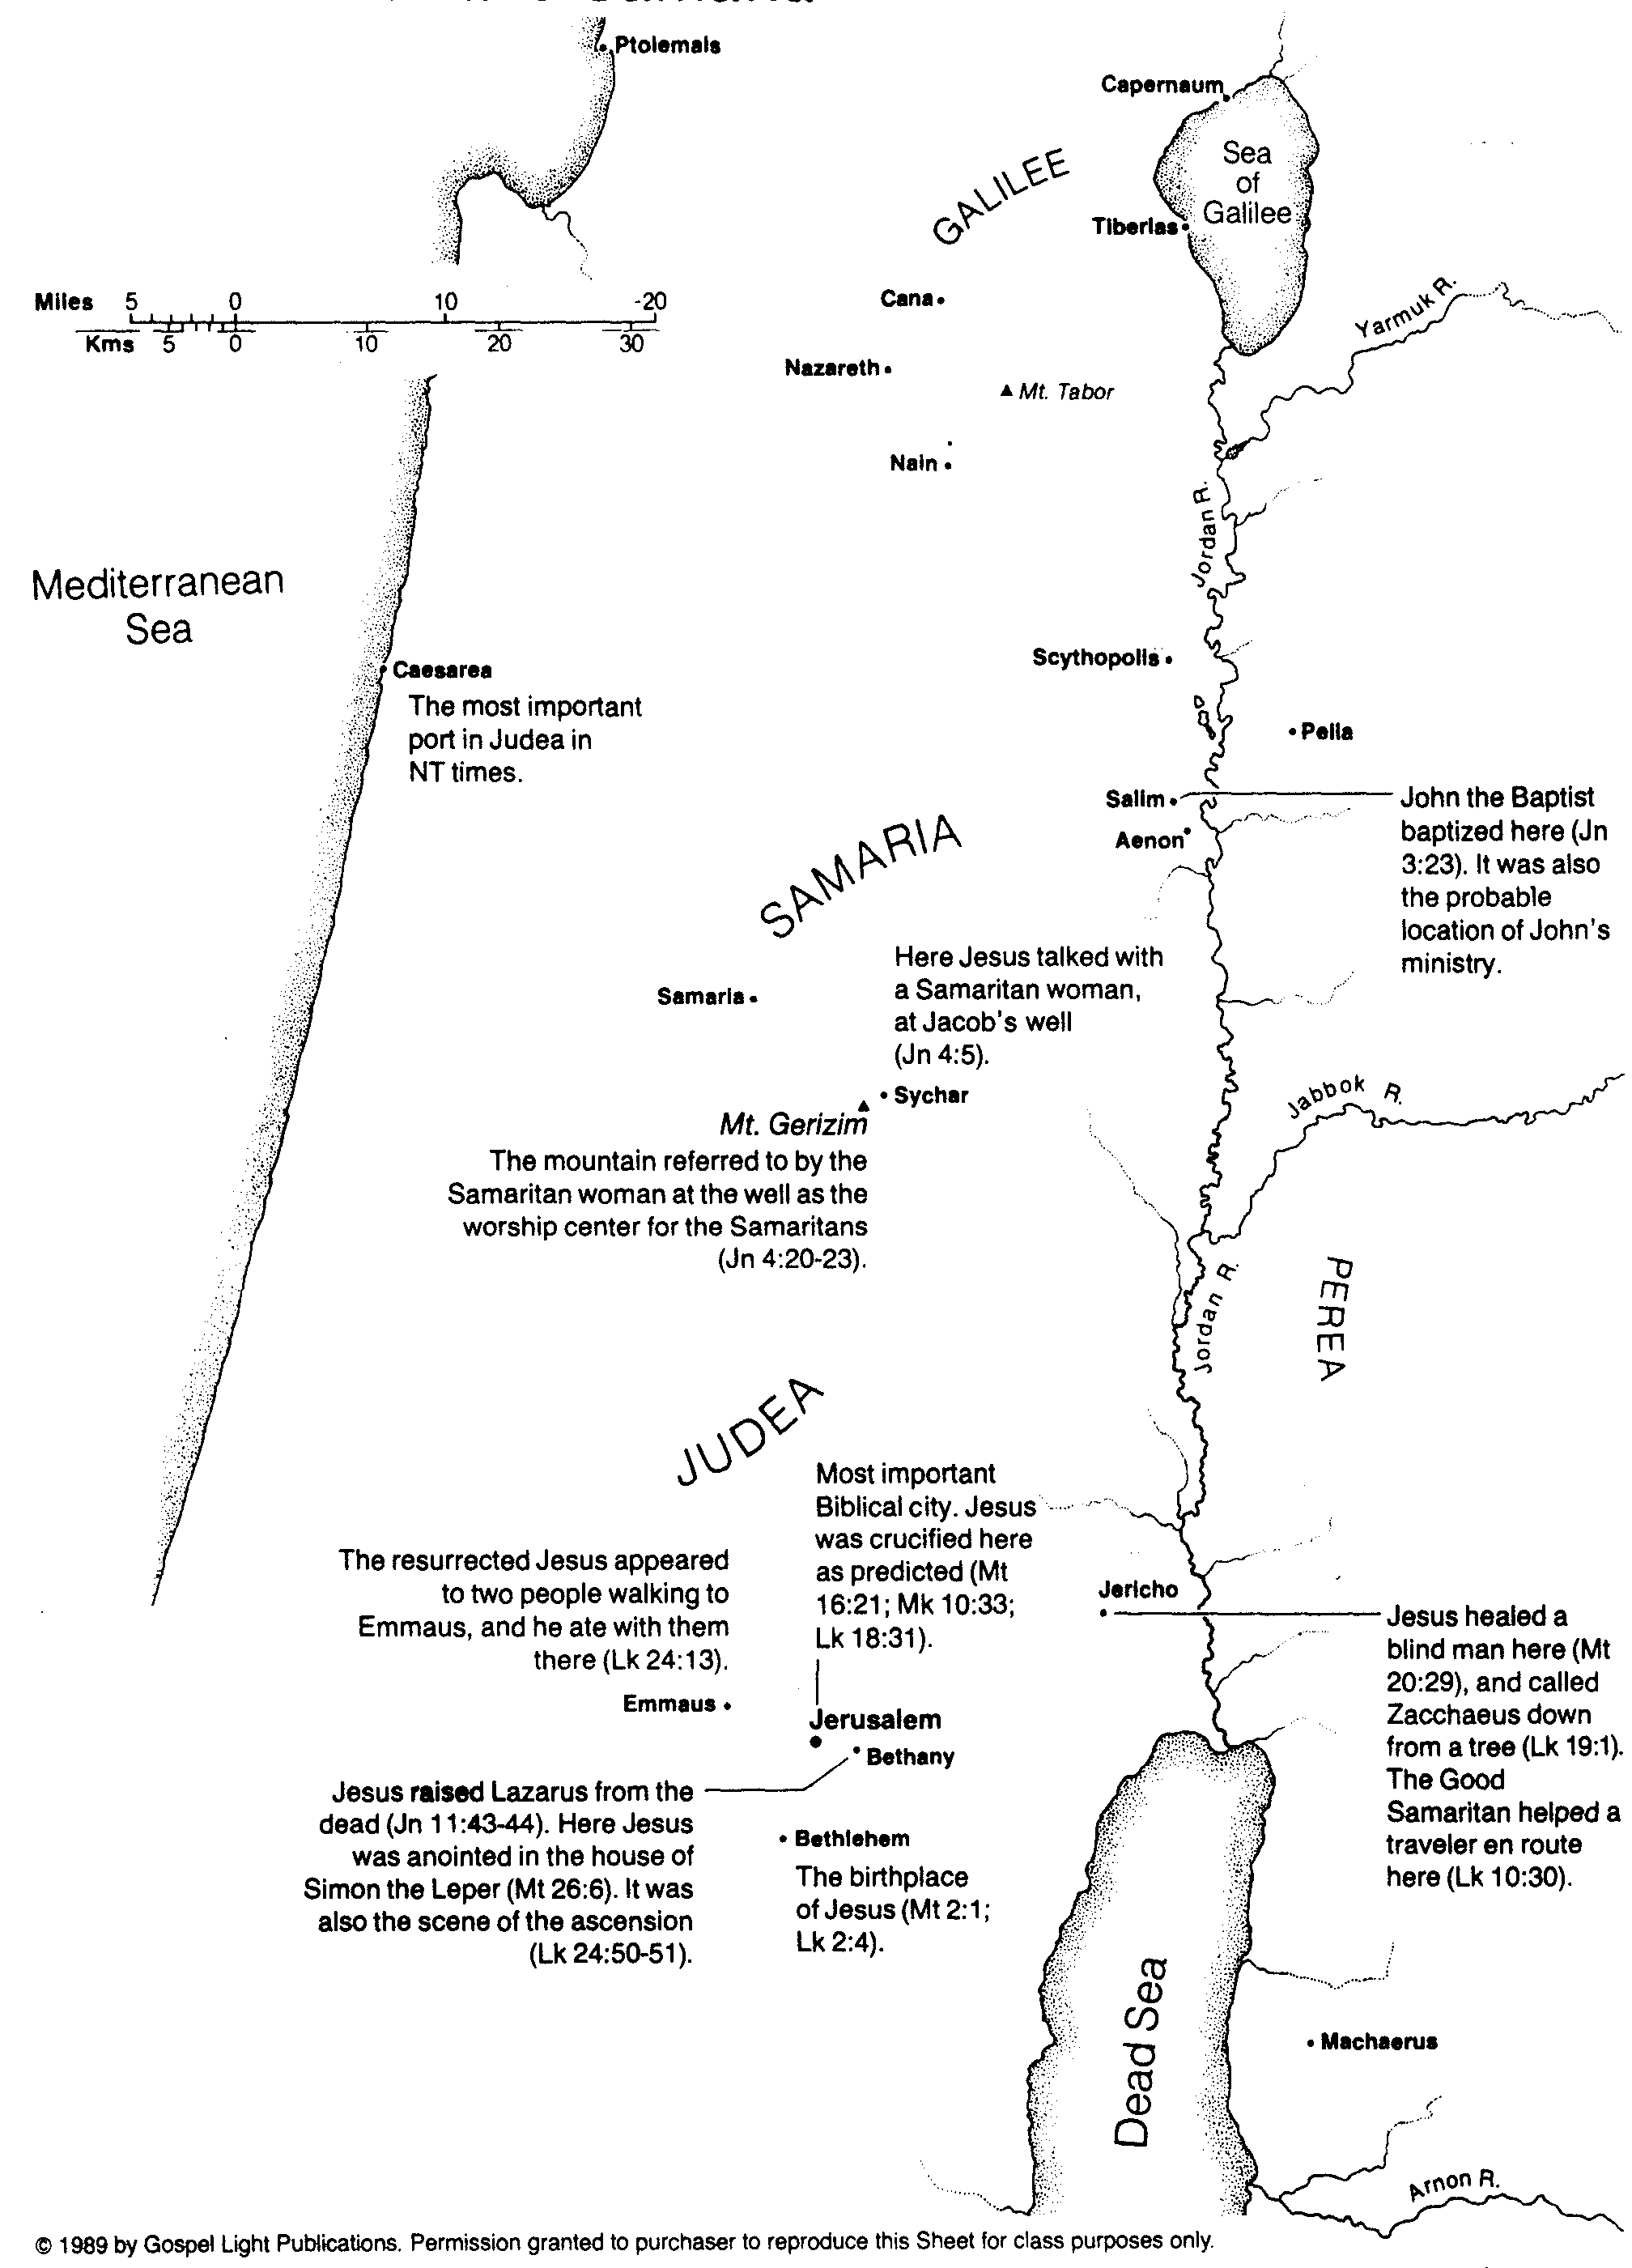
Jesus in Judea and Samaria
107

Slide 65
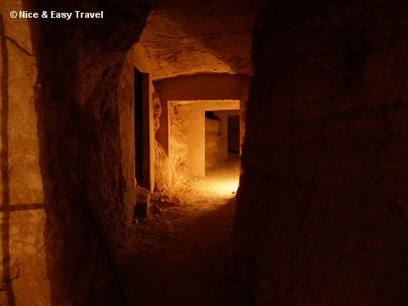
Racial Prejudice
107
Gentiles hated Jews
Jews hated Gentiles
Judean Jews hated Galilean Jews
Galilean Jews hated Judean Jews
Jews hated Samaritans
Does God allow interracial intermarriage?
Jesus ignored prejudices of the times

Slide 66
John 4:4
"Now he had to go through Samaria…"
Jesus took the abnormal route…
Purposely!

Slide 67
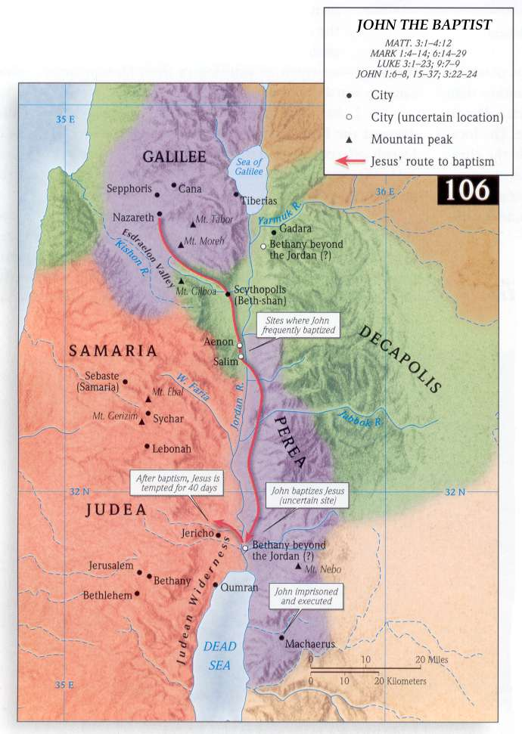
Map
Via Jordan Rift
Purposely!

Slide 68
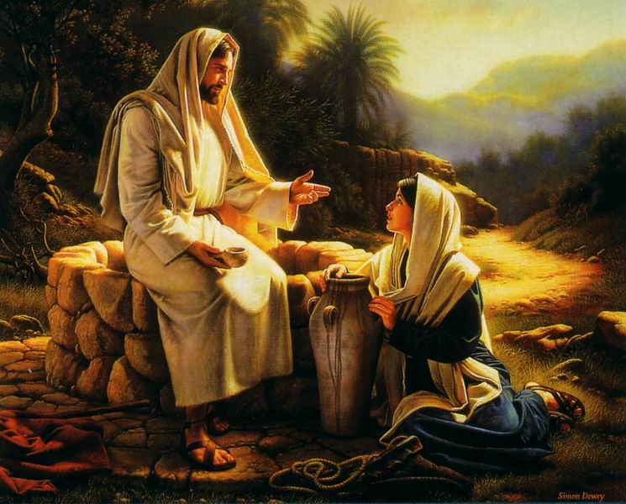
Jesus and the Samaritan woman

Slide 69
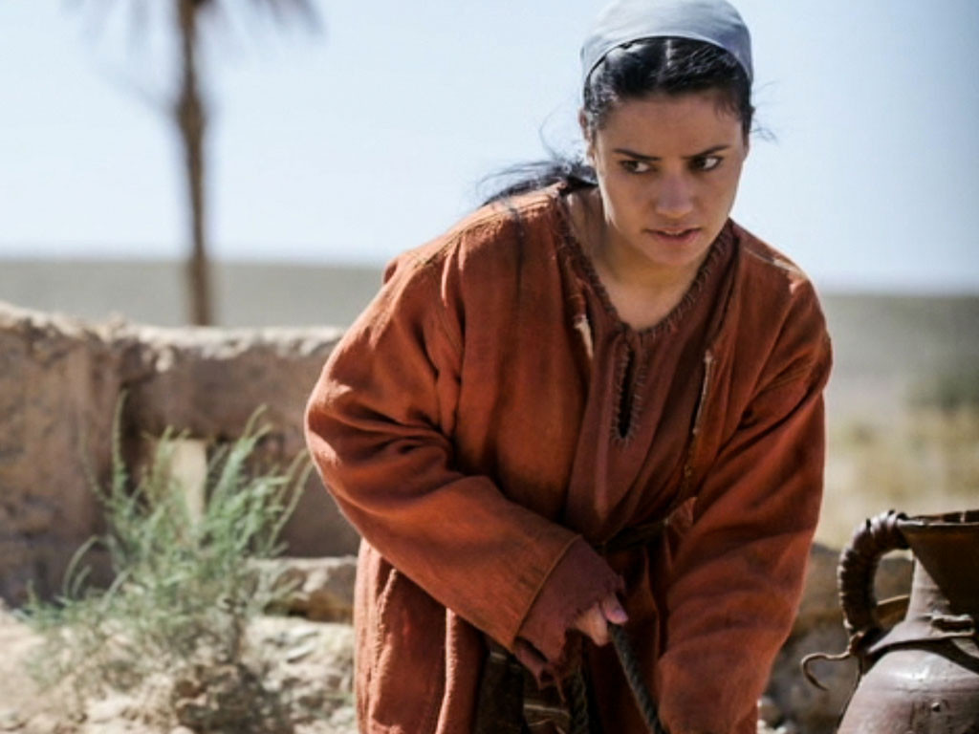

Free
Bible
images
John 4:1-42
JESUS TALKS WITH A SAMARITAN WOMAN
Notes:
What is the point of this story?
Jesus accepts people with checkered pasts!

Slide 70
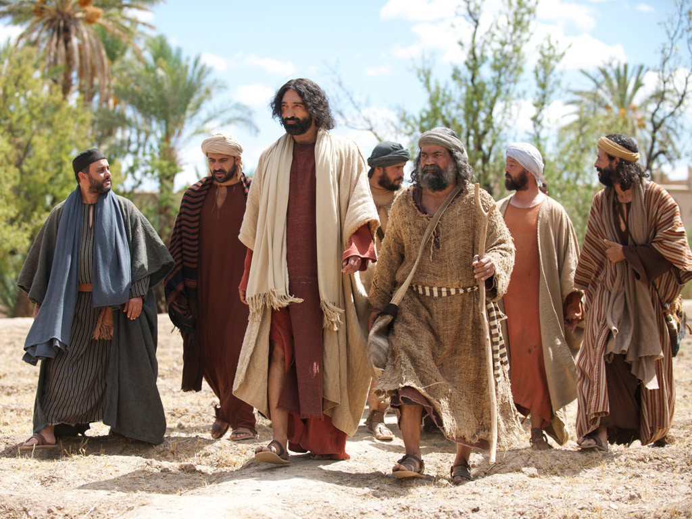
Notes:
Jesus was travelling from Judea back to Galilee and decided to go through the region of Samaria where the Samaritan people lived.

Slide 71
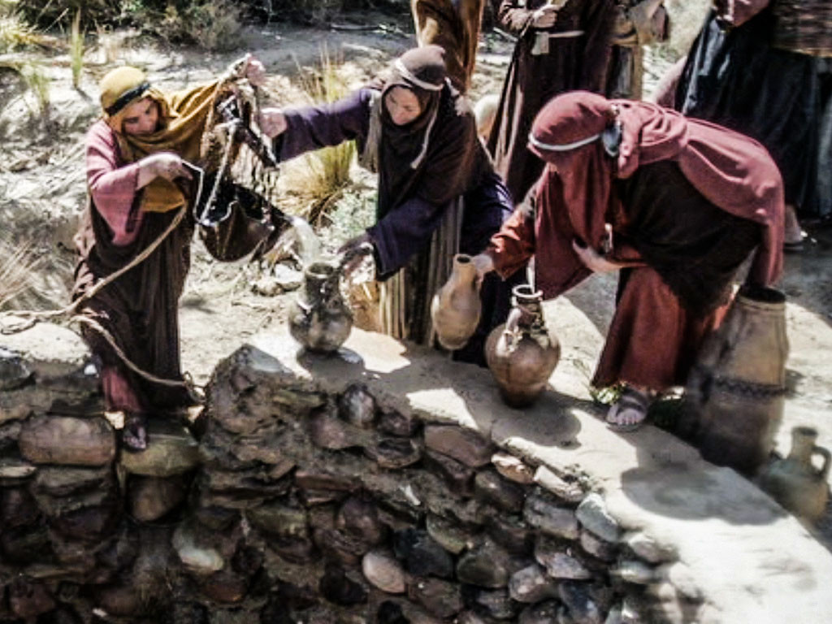
Notes:
The Samaritans were a race of Jews that had in the past inter-married with other races. The Jews did not allow Samaritans to worship with them or have anything to do with them. Jews normally avoided travelling through Samaria. There was a history of feuds and grudges between the Jews and Samaritans and they did not talk to each other.

Slide 72
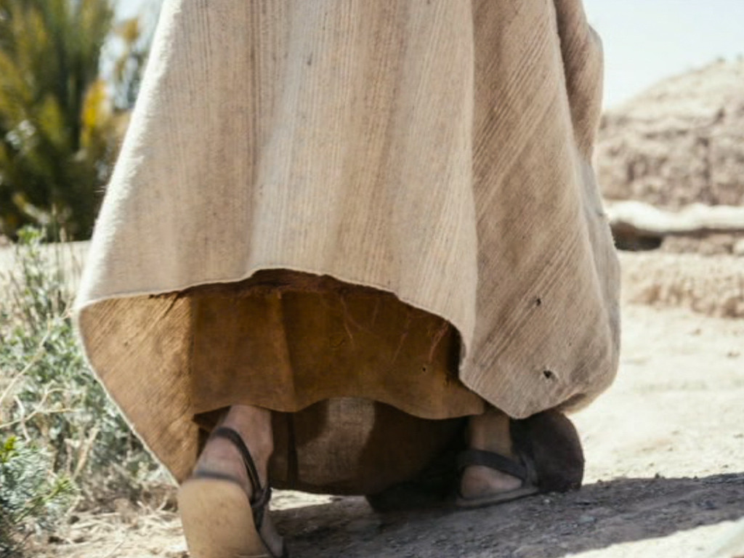
Notes:
At noon, Jesus and His disciples arrived at a well on the edge of a town called Sychar.

Slide 73
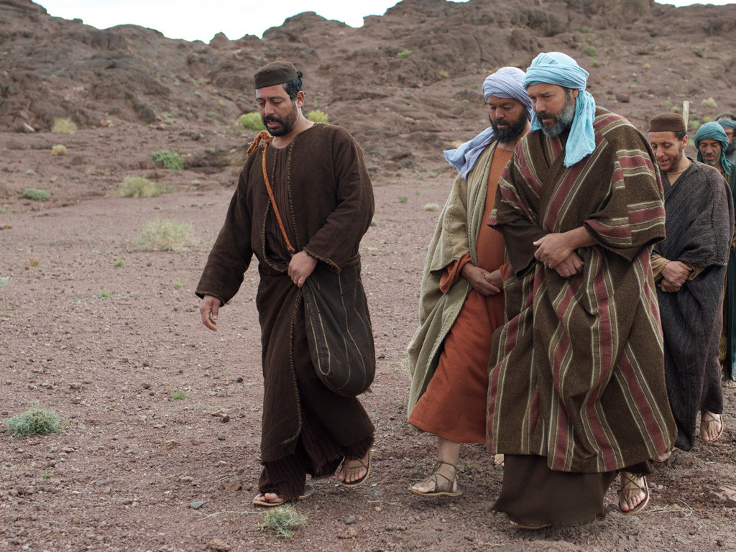
Notes:
Jesus sat by the well to rest while His disciples went into the town to buy food.

Slide 74
Notes:
A Samaritan woman came to draw water from the well. Jesus asked her for a drink of water.

Slide 75
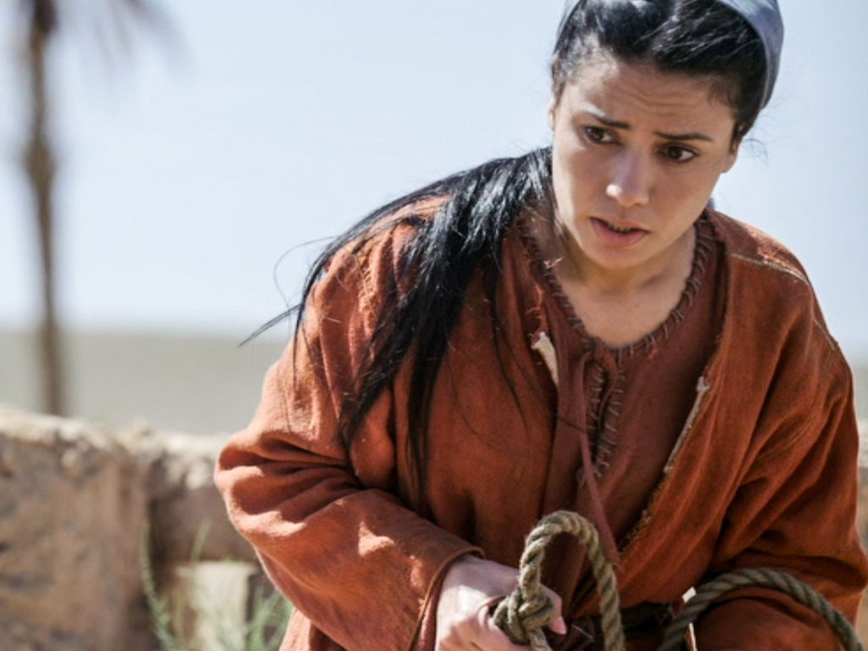
Notes:
‘You are a Jew, and I am a Samaritan,’ she protested. ‘How can you ask me for a drink?’ She knew Jews refused to use the same cups and bowls that Samaritans used.

Slide 76
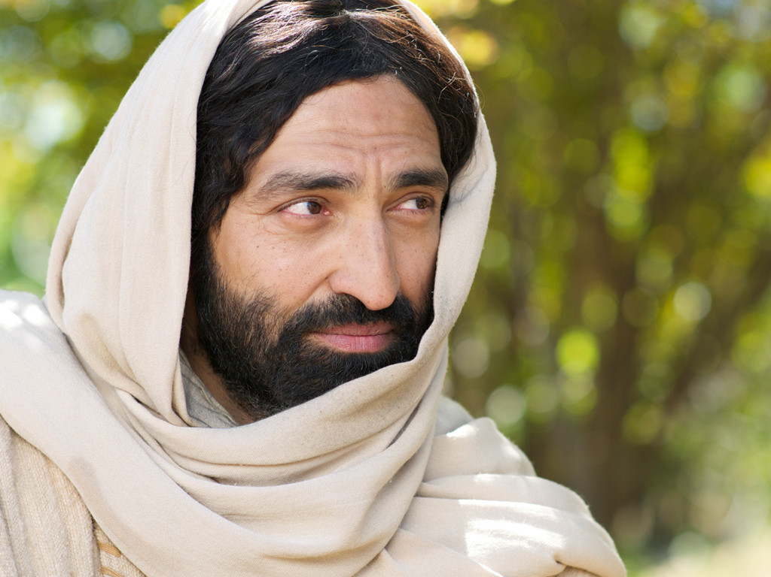
Notes:
Jesus replied, ‘If you knew what God gives and who I am, you would be asking me for lifegiving water.’

Slide 77
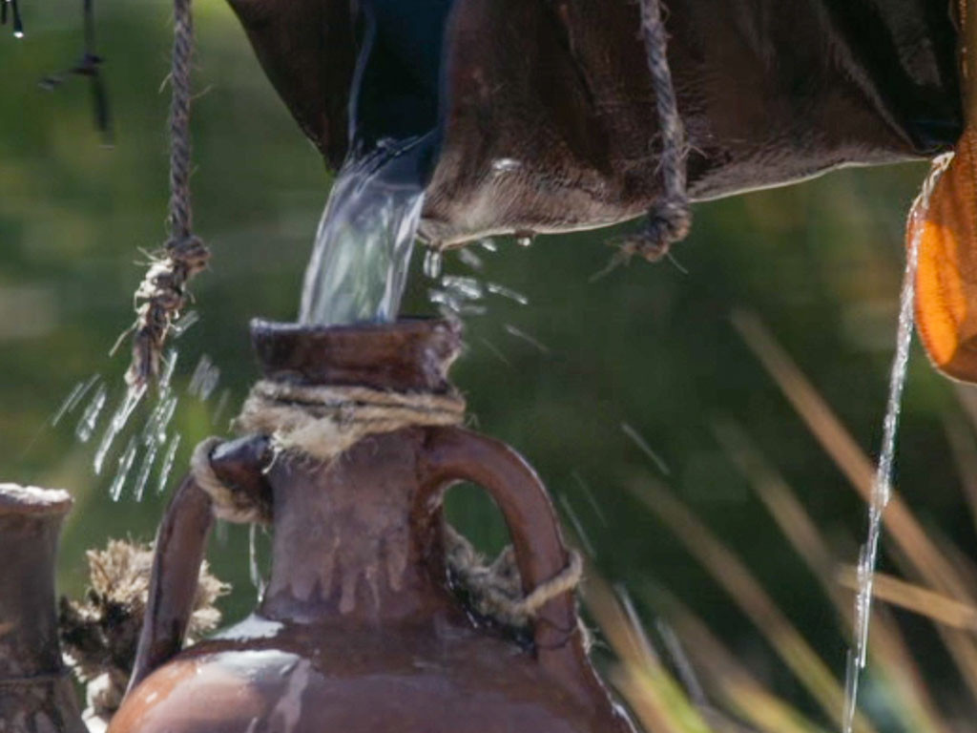
Notes:
'You don’t have anything to draw water from this deep well. Where would you get life-giving water?’ the woman asked.

Slide 78
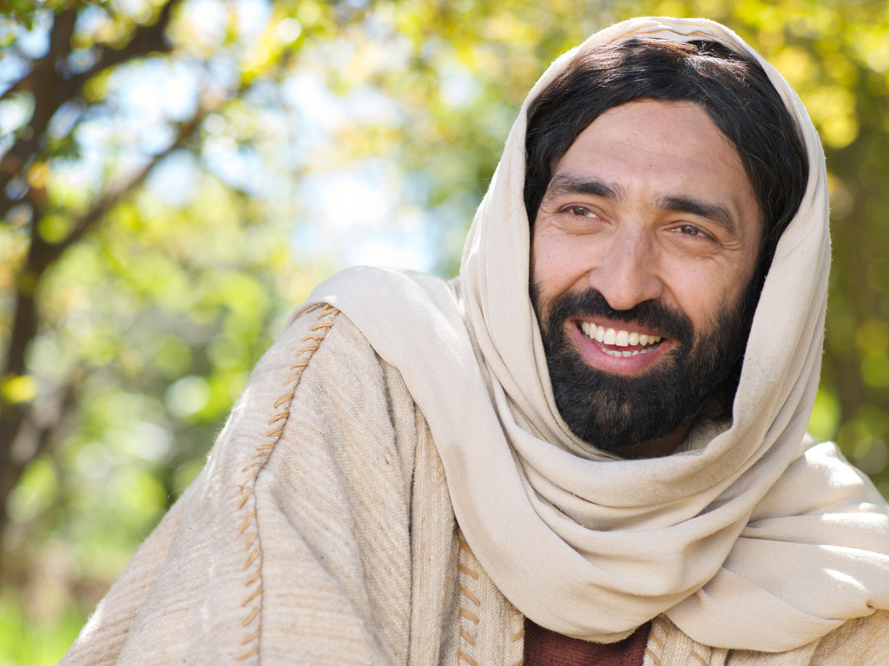
Notes:
Jesus answered, ‘Those who drink ordinary water will get thirsty again, but I am talking about the life-giving water of eternal life.’

Slide 79
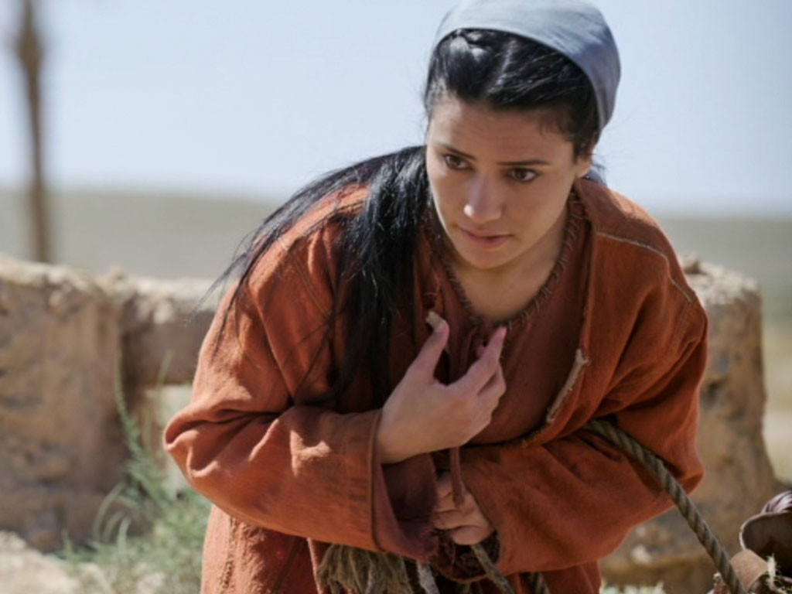
Notes:
‘Give me that water so I will never be thirsty again,’ the woman demanded. ‘

Slide 80
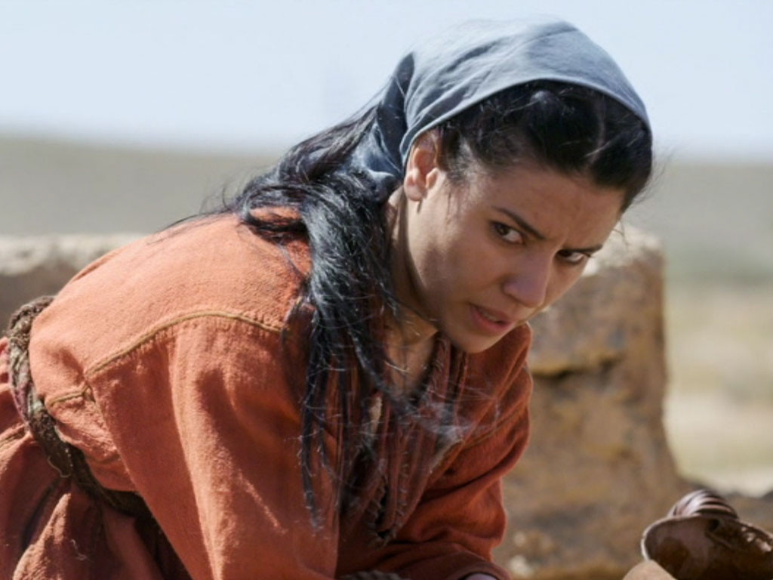
Notes:
'Go and call your husband,’ Jesus told her, ‘and come back.’
‘I don’t have a husband,’ she protested.

Slide 81
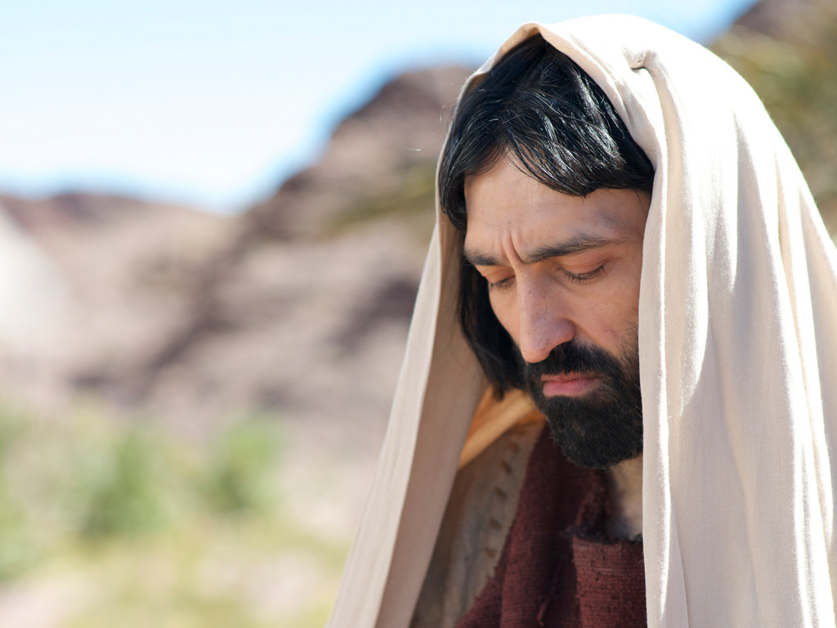
Notes:
‘You are right,’ Jesus told her. ‘You have been married to five men, and the man you live with now is not really your husband.’ The woman was shocked Jesus knew so much about her and exclaimed, ‘You are a prophet.’

Slide 82

Notes:
She continued, ‘Samaritans worship God on this mountain, but you Jews say that Jerusalem is the place where we should worship God.’

Slide 83

Notes:
'It’s not where you worship that’s important but who you worship,’ Jesus explained. 'The time is coming when people will worship God as He really is, offering him true worship. God is Spirit, and only by the power of His Spirit can people worship Him.'

Slide 84

Notes:
‘I know when God’s Saviour, the Messiah comes He will tell us everything,’ she replied. ‘I am the Messiah,’ Jesus announced, ‘you are talking to Him.’

Slide 85

Notes:
At that point the disciples returned and were surprised to find him talking with a Samaritan. The woman left her water jar and raced went back into the town telling everyone, ‘Come and meet the man who told me everything I have ever done. Could He be the Messiah?’

Slide 86

Notes:
The Samaritans came out to meet Jesus and begged Him to stay with them. Jesus stayed there two days and many believed that Jesus was the Messiah.

Slide 87

Notes:
They told the woman, ‘We believe because we too have heard Him, and we know that He really is the Saviour of the world.’

Slide 88
Used with Permission
THE
GOSPEL
——OF—— MATTHEW
THE
GOSPEL
——OF—— MARK
THE
GOSPEL
——OF—— LUKE
THE
GOSPEL
——OF—— JOHN
Due to the Lumo Project producing its own publishing material we regret to inform you that we cannot license our photos to other clients outside of freebibleimages.org.
These images are not licensed for reuse in video, epublishing or other media. Downloaded pictures and files cannot be redistributed through any other website than freebibleimages.org or used in any context where the accompanying message is undermining of the Christian faith and gospel.
Photos can only be used on educational presentations, blogs and social media, all of which should be accompanied with reference to www.LumoProject.com.
Picture courtesy of BBM
© All Rights Reserved.
www.bigbookmedia.com

Slide 89
9. The Acceptance in Galilee
§ 36
John 4:43-45
Galileans welcome and honor Jesus as a Galilean after His Jerusalem Passover miracles, but He predicts their future rejection
Notes:
Jesus Heals an Official’s Son
John 4:43 At the end of the two days, Jesus went on to Galilee. ⁴⁴ He himself had said that a prophet is not honored in his own hometown. ⁴⁵ Yet the Galileans welcomed him, for they had been in Jerusalem at the Passover celebration and had seen everything he did there.

Slide 90

Great Periods in the Life of Christ
55
“The Son of Man… came to minister and to give his life a ransom for many” (Mark 10:45)
Climactic Galilean
Early Samaritan
Later Samaritan
Early Judean
Later Judean
Early Perean
Later Perean
Opening Events
Closing Events
Preparation
Confirmation
Walk Thru the New Testament seminar (used with permission)
Notes:
The Walk Thru outline of the life of Christ forms a chiasm or literary arrangement with repeating elements in the opposite order. This structure makes Confirmation parallel to Preparation, Closing Events parallel to Opening Events, etc., until the only event without parallel becomes the focus: Climatic Galilean. Such an arrangement of material was typical in antiquity and is seen in both the OT (e.g., Zephaniah) and the NT (1 Thess), where the central teaching appears in the middle of each writing.
_______
LC-00-Syllabus-63
LC-01-Introduction-265
LC-02-Authentication-73
LC-05-Opposition-4

Slide 91

Regions of Israel (NT)
10
Batanea
Galilee
Samaria
Some Area
Decapolis
Perea
Judea
Idumea
Arabia

Slide 92
The Authentication
of the King
§§ 28-59
The Acceptance
of His Person
§§ 28-36
The Authority
of the King
§§ 37-59
Notes:
Many people of various places (Judea, Samaria, Galilee) and types (Nicodemus, Samaritan woman, common Jews) initially believed in him.
Jesus also showed in 19 incidents the power expected of the Messiah to interpret the Law to preach and with authority over men, defilement, Sabbath, nature, sickness, and even death.

Slide 93
The Authority
of the King
§§ 37-59
Jesus substantiates His authority as Messiah through His miracles and teachings that authenticate Himself and His message
Notes:
How did the OT say that the Messiah would establish his authority? Was he only to be a military leader? Break into small groups and defend your view from specific OT texts. What was their expectation? What should have been their expectation?
Deut 18:18 prophesies that he would be a prophet—a teacher.
Zech 9:9 says he would ride a donkey—not a horse.
But Zech 14:3-4 shows him as conqueror at his return. At that time he will ride a horse (Rev 19:11)! Also, Is 11:4 notes, "The earth will shake at the force of his word, and one breath from his mouth will destroy the wicked."
Is. 63:1 Who is this who comes from Edom,
from the city of Bozrah,
with his clothing stained red?
Who is this in royal robes,
marching in his great strength?
“It is I, the LORD, announcing your salvation!
It is I, the LORD, who has the power to save!”
Is. 63:2 Why are your clothes so red,
as if you have been treading out grapes?
Is. 63:3 “I have been treading the winepress alone;
no one was there to help me.
In my anger I have trampled my enemies
as if they were grapes.
In my fury I have trampled my foes.
Their blood has stained my clothes.
⁴ For the time has come for me to avenge my people,
to ransom them from their oppressors.
⁵ I was amazed to see that no one intervened
to help the oppressed.
So I myself stepped in to save them with my strong arm,
and my wrath sustained me.
⁶ I crushed the nations in my anger
and made them stagger and fall to the ground,
spilling their blood upon the earth.”

Slide 94
1. Christ's Authority to Preach
§ 37
Matthew 4:17; Mark 1:15; Luke 4:14-15
Christ preaches as a Spirit-appointed teacher and prophet the same repentance to enter the Messianic kingdom that John declared
Notes:
Matt. 4:17 From then on Jesus began to preach, “Repent of your sins and turn to God, for the Kingdom of Heaven is near.”
Mark 1:15 “The time promised by God has come at last!” he announced. “The Kingdom of God is near! Repent of your sins and believe the Good News!”
Luke 4:14 Then Jesus returned to Galilee, filled with the Holy Spirit’s power. Reports about him spread quickly through the whole region. ¹⁵ He taught regularly in their synagogues and was praised by everyone.
This is exact same message that John preached (Matt 3:2).

Slide 95
2. Christ's Authority Over Disease
§ 38
John 4:46-54
Jesus shows His messianic authority by healing a royal official's son based on the official's faith in Christ's word alone
Notes:
John 4:46 As he traveled through Galilee, he came to Cana, where he had turned the water into wine. There was a government official in nearby Capernaum whose son was very sick. ⁴⁷ When he heard that Jesus had come from Judea to Galilee, he went and begged Jesus to come to Capernaum to heal his son, who was about to die.
John 4:48 Jesus asked, “Will you never believe in me unless you see miraculous signs and wonders?”
John 4:49 The official pleaded, “Lord, please come now before my little boy dies.”
John 4:50 Then Jesus told him, “Go back home. Your son will live!” And the man believed what Jesus said and started home.
John 4:51 While the man was on his way, some of his servants met him with the news that his son was alive and well. ⁵² He asked them when the boy had begun to get better, and they replied, “Yesterday afternoon at one o’clock his fever suddenly disappeared!” ⁵³ Then the father realized that that was the very time Jesus had told him, “Your son will live.” And he and his entire household believed in Jesus. ⁵⁴ This was the second miraculous sign Jesus did in Galilee after coming from Judea.

Slide 96
3. Rejection in Nazareth
§ 39
Luke 4:16-30
Jesus cites Isaiah 61:1-2 in Nazareth for His messianic authority to heal and preach to Gentiles, but His hometown rejects Him
Notes:
Luke 4:16 When he came to the village of Nazareth, his boyhood home, he went as usual to the synagogue on the Sabbath and stood up to read the Scriptures. ¹⁷ The scroll of Isaiah the prophet was handed to him. He unrolled the scroll and found the place where this was written:
Luke 4:18 “The Spirit of the LORD is upon me,
for he has anointed me to bring Good News to the poor.
He has sent me to proclaim that captives will be released,
that the blind will see,
that the oppressed will be set free,
¹⁹ and that the time of the LORD’s favor has come.”
Luke 4:20 He rolled up the scroll, handed it back to the attendant, and sat down. All eyes in the synagogue looked at him intently. ²¹ Then he began to speak to them. “The Scripture you’ve just heard has been fulfilled this very day!”
Luke 4:22 Everyone spoke well of him and was amazed by the gracious words that came from his lips. “How can this be?” they asked. “Isn’t this Joseph’s son?”
Luke 4:23 Then he said, “You will undoubtedly quote me this proverb: ‘Physician, heal yourself’—meaning, ‘Do miracles here in your hometown like those you did in Capernaum.’ ²⁴ But I tell you the truth, no prophet is accepted in his own hometown.
Luke 4:25 “Certainly there were many needy widows in Israel in Elijah’s time, when the heavens were closed for three and a half years, and a severe famine devastated the land. ²⁶ Yet Elijah was not sent to any of them. He was sent instead to a foreigner—a widow of Zarephath in the land of Sidon. ²⁷ And many in Israel had leprosy in the time of the prophet Elisha, but the only one healed was Naaman, a Syrian.”
Luke 4:28 When they heard this, the people in the synagogue were furious. ²⁹ Jumping up, they mobbed him and forced him to the edge of the hill on which the town was built. They intended to push him over the cliff, ³⁰ but he passed right through the crowd and went on his way.

Slide 97
4. Residence in Capernaum
§ 40
Matthew 4:13-16
After rejection in Nazareth, Jesus moves to Capernaum to foreshadow His ministry to Gentiles after Israel rejects him as Messiah
Notes:
Matt. 4:13 He went first to Nazareth, then left there and moved to Capernaum, beside the Sea of Galilee, in the region of Zebulun and Naphtali. ¹⁴ This fulfilled what God said through the prophet Isaiah 9:1-2...
Matt. 4:15 “In the land of Zebulun and of Naphtali,
beside the sea, beyond the Jordan River,
in Galilee where so many Gentiles live,
¹⁶ the people who sat in darkness
have seen a great light.
And for those who lived in the land where death casts its shadow,
a light has shined.”

Slide 98
5. Christ's Authority Over Nature
§ 41
Matthew 4:18-22; Mark 1:16-20; Luke 5:1-11
Christ confirms His authority over nature in a miraculous catch of fish, so four fishermen follow His authority instead of their father's
Notes:
The First Disciples
Matt. 4:18 One day as Jesus was walking along the shore of the Sea of Galilee, he saw two brothers—Simon, also called Peter, and Andrew—throwing a net into the water, for they fished for a living. ¹⁹ Jesus called out to them, “Come, follow me, and I will show you how to fish for people!” ²⁰ And they left their nets at once and followed him.
Matt. 4:21 A little farther up the shore he saw two other brothers, James and John, sitting in a boat with their father, Zebedee, repairing their nets. And he called them to come, too. ²² They immediately followed him, leaving the boat and their father behind.
The First Disciples
Mark 1:16 One day as Jesus was walking along the shore of the Sea of Galilee, he saw Simon and his brother Andrew throwing a net into the water, for they fished for a living. ¹⁷ Jesus called out to them, “Come, follow me, and I will show you how to fish for people!” ¹⁸ And they left their nets at once and followed him.
Mark 1:19 A little farther up the shore Jesus saw Zebedee’s sons, James and John, in a boat repairing their nets. ²⁰ He called them at once, and they also followed him, leaving their father, Zebedee, in the boat with the hired men.
The First Disciples
Luke 5:1 One day as Jesus was preaching on the shore of the Sea of Galilee, great crowds pressed in on him to listen to the word of God. ² He noticed two empty boats at the water’s edge, for the fishermen had left them and were washing their nets. ³ Stepping into one of the boats, Jesus asked Simon, its owner, to push it out into the water. So he sat in the boat and taught the crowds from there.
Luke 5:4 When he had finished speaking, he said to Simon, “Now go out where it is deeper, and let down your nets to catch some fish.”
Luke 5:5 “Master,” Simon replied, “we worked hard all last night and didn’t catch a thing. But if you say so, I’ll let the nets down again.” ⁶ And this time their nets were so full of fish they began to tear! ⁷ A shout for help brought their partners in the other boat, and soon both boats were filled with fish and on the verge of sinking.
Luke 5:8 When Simon Peter realized what had happened, he fell to his knees before Jesus and said, “Oh, Lord, please leave me—I’m such a sinful man.” ⁹ For he was awestruck by the number of fish they had caught, as were the others with him. ¹⁰ His partners, James and John, the sons of Zebedee, were also amazed.
Jesus replied to Simon, “Don’t be afraid! From now on you’ll be fishing for people!”
¹¹ And as soon as they landed, they left everything and followed Jesus.

Slide 99

Free
Bible
images
FOUR FISHERMEN FOLLOW JESUS
Matthew 4:18-22
Notes:
Jesus Casts Out an Evil Spirit
Mark 1:21 Jesus and his companions went to the town of Capernaum. When the Sabbath day came, he went into the synagogue and began to teach. ²² The people were amazed at his teaching, for he taught with real authority—quite unlike the teachers of religious law.
Mark 1:23 Suddenly, a man in the synagogue who was possessed by an evil spirit cried out, ²⁴ “Why are you interfering with us, Jesus of Nazareth? Have you come to destroy us? I know who you are—the Holy One of God!”
Mark 1:25 But Jesus reprimanded him. “Be quiet! Come out of the man,” he ordered. ²⁶ At that, the evil spirit screamed, threw the man into a convulsion, and then came out of him.
Mark 1:27 Amazement gripped the audience, and they began to discuss what had happened. “What sort of new teaching is this?” they asked excitedly. “It has such authority! Even evil spirits obey his orders!” ²⁸ The news about Jesus spread quickly throughout the entire region of Galilee.
Jesus Casts Out a Demon
Luke 4:31 Then Jesus went to Capernaum, a town in Galilee, and taught there in the synagogue every Sabbath day. ³² There, too, the people were amazed at his teaching, for he spoke with authority.
Luke 4:33 Once when he was in the synagogue, a man possessed by a demon—an evil spirit—cried out, shouting, ³⁴ “Go away! Why are you interfering with us, Jesus of Nazareth? Have you come to destroy us? I know who you are—the Holy One of God!”
Luke 4:35 But Jesus reprimanded him. “Be quiet! Come out of the man,” he ordered. At that, the demon threw the man to the floor as the crowd watched; then it came out of him without hurting him further.
Luke 4:36 Amazed, the people exclaimed, “What authority and power this man’s words possess! Even evil spirits obey him, and they flee at his command!” ³⁷ The news about Jesus spread through every village in the entire region.

Slide 100

Notes:
Jesus left Nazareth and went to live in Capernaum on the shore of Lake Galilee.

Slide 101

Notes:
As Jesus was walking beside the Sea of Galilee, he saw two brothers, Simon (later called Peter) and his brother Andrew.

Slide 102

Notes:
They both worked as fishermen and were casting a net into the lake.

Slide 103

Notes:
‘Come, follow me,’ Jesus said, ‘and I will send you out to fish for people.’

Slide 104

Notes:
Immediately they left their nets and followed him.

Slide 105

Notes:
Going further along the shore Jesus saw two other brothers, James and John. They too were fishermen, working in their boat.

Slide 106
Notes:
James and John were with their father Zebedee, preparing their nets.

Slide 107

Notes:
Jesus called them leave their jobs to follow Him. Immediately they both left the boat and their father to be with Jesus.

Slide 108

Notes:
The four fishermen followed Jesus as He set off to tour Galilee, teaching in synagogues, proclaiming the good news of the kingdom of God, and healing people of every disease and sickness.

Slide 109


Slide 110
6. Christ's Authority Over Demons
§ 42
Mark 1:21-28; Luke 4:31-37
Christ shows his authority to expel a demon that knew Him as the Messiah, but He would not allow the testimony of demons
Notes:
Jesus Casts Out an Evil Spirit
Mark 1:21 Jesus and his companions went to the town of Capernaum. When the Sabbath day came, he went into the synagogue and began to teach. ²² The people were amazed at his teaching, for he taught with real authority—quite unlike the teachers of religious law.
Mark 1:23 Suddenly, a man in the synagogue who was possessed by an evil spirit cried out, ²⁴ “Why are you interfering with us, Jesus of Nazareth? Have you come to destroy us? I know who you are—the Holy One of God!”
Mark 1:25 But Jesus reprimanded him. “Be quiet! Come out of the man,” he ordered. ²⁶ At that, the evil spirit screamed, threw the man into a convulsion, and then came out of him.
Mark 1:27 Amazement gripped the audience, and they began to discuss what had happened. “What sort of new teaching is this?” they asked excitedly. “It has such authority! Even evil spirits obey his orders!” ²⁸ The news about Jesus spread quickly throughout the entire region of Galilee.
Jesus Casts Out a Demon
Luke 4:31 Then Jesus went to Capernaum, a town in Galilee, and taught there in the synagogue every Sabbath day. ³² There, too, the people were amazed at his teaching, for he spoke with authority.
Luke 4:33 Once when he was in the synagogue, a man possessed by a demon—an evil spirit—cried out, shouting, ³⁴ “Go away! Why are you interfering with us, Jesus of Nazareth? Have you come to destroy us? I know who you are—the Holy One of God!”
Luke 4:35 But Jesus reprimanded him. “Be quiet! Come out of the man,” he ordered. At that, the demon threw the man to the floor as the crowd watched; then it came out of him without hurting him further.
Luke 4:36 Amazed, the people exclaimed, “What authority and power this man’s words possess! Even evil spirits obey him, and they flee at his command!” ³⁷ The news about Jesus spread through every village in the entire region.

Slide 111

Free
Bible
images
Mark 1:21-28; Luke 4:31-37
JESUS DELIVERS A POSSESSED MAN
Notes:
Jesus Casts Out an Evil Spirit
Mark 1:21 Jesus and his companions went to the town of Capernaum. When the Sabbath day came, he went into the synagogue and began to teach. ²² The people were amazed at his teaching, for he taught with real authority—quite unlike the teachers of religious law.
Mark 1:23 Suddenly, a man in the synagogue who was possessed by an evil spirit cried out, ²⁴ “Why are you interfering with us, Jesus of Nazareth? Have you come to destroy us? I know who you are—the Holy One of God!”
Mark 1:25 But Jesus reprimanded him. “Be quiet! Come out of the man,” he ordered. ²⁶ At that, the evil spirit screamed, threw the man into a convulsion, and then came out of him.
Mark 1:27 Amazement gripped the audience, and they began to discuss what had happened. “What sort of new teaching is this?” they asked excitedly. “It has such authority! Even evil spirits obey his orders!” ²⁸ The news about Jesus spread quickly throughout the entire region of Galilee.
Jesus Casts Out a Demon
Luke 4:31 Then Jesus went to Capernaum, a town in Galilee, and taught there in the synagogue every Sabbath day. ³² There, too, the people were amazed at his teaching, for he spoke with authority.
Luke 4:33 Once when he was in the synagogue, a man possessed by a demon—an evil spirit—cried out, shouting, ³⁴ “Go away! Why are you interfering with us, Jesus of Nazareth? Have you come to destroy us? I know who you are—the Holy One of God!”
Luke 4:35 But Jesus reprimanded him. “Be quiet! Come out of the man,” he ordered. At that, the demon threw the man to the floor as the crowd watched; then it came out of him without hurting him further.
Luke 4:36 Amazed, the people exclaimed, “What authority and power this man’s words possess! Even evil spirits obey him, and they flee at his command!” ³⁷ The news about Jesus spread through every village in the entire region.

Slide 112

Notes:
Jesus Casts Out an Evil Spirit
Mark 1:21 Jesus and his companions went to the town of Capernaum. When the Sabbath day came, he went into the synagogue and began to teach. ²² The people were amazed at his teaching, for he taught with real authority—quite unlike the teachers of religious law.

Slide 113

Notes:
Jesus Casts Out a Demon
Luke 4:31 Then Jesus went to Capernaum, a town in Galilee, and taught there in the synagogue every Sabbath day. ³² There, too, the people were amazed at his teaching, for he spoke with authority.

Slide 114

Notes:
Jesus Casts Out an Evil Spirit
Mark 1:22 The people were amazed at his teaching, for he taught with real authority—quite unlike the teachers of religious law.

Slide 115


Slide 116


Slide 117


Slide 118


Slide 119


Slide 120

Notes:
Mark 1:23 Suddenly, a man in the synagogue who was possessed by an evil spirit cried out, ²⁴ “Why are you interfering with us, Jesus of Nazareth? Have you come to destroy us? I know who you are—the Holy One of God!”

Slide 121
Notes:
Mark 1:24 “Why are you interfering with us, Jesus of Nazareth? Have you come to destroy us? I know who you are—the Holy One of God!”

Slide 122

Notes:
Mark 1:25 But Jesus reprimanded him. “Be quiet! Come out of the man,” he ordered.

Slide 123

Notes:
Mark 1:26 At that, the evil spirit screamed, threw the man into a convulsion, and then came out of him.

Slide 124

Notes:
Mark 1:27 Amazement gripped the audience, and they began to discuss what had happened.

Slide 125

Notes:
“What sort of new teaching is this?” they asked excitedly. “It has such authority! Even evil spirits obey his orders!”

Slide 126

Notes:
²⁸ The news about Jesus spread quickly throughout the entire region of Galilee.

Slide 127
Used with Permission
THE
GOSPEL
——OF—— MATTHEW
THE
GOSPEL
——OF—— MARK
THE
GOSPEL
——OF—— LUKE
THE
GOSPEL
——OF—— JOHN
Due to the Lumo Project producing its own publishing material we regret to inform you that we cannot license our photos to other clients outside of freebibleimages.org.
These images are not licensed for reuse in video, epublishing or other media. Downloaded pictures and files cannot be redistributed through any other website than freebibleimages.org or used in any context where the accompanying message is undermining of the Christian faith and gospel.
Photos can only be used on educational presentations, blogs and social media, all of which should be accompanied with reference to www.LumoProject.com.
Picture courtesy of BBM
© All Rights Reserved.
www.bigbookmedia.com

Slide 128
7. Christ's Authority Over Sickness
§ 43
Matthew 8:14-17; Mark 1:29-34; Luke 4:38-41
Christ heals Peter's mother-in-law and others to show his messianic authority over sickness but again rejects the witness of demons
Notes:
Isaiah 53 says we are healed through the stripes of Messiah.
Jesus Heals Many People
Matt. 8:14 When Jesus arrived at Peter’s house, Peter’s mother-in-law was sick in bed with a high fever. ¹⁵ But when Jesus touched her hand, the fever left her. Then she got up and prepared a meal for him.
Matt. 8:16 That evening many demon-possessed people were brought to Jesus. He cast out the evil spirits with a simple command, and he healed all the sick. ¹⁷ This fulfilled the word of the Lord through the prophet Isaiah, who said,
“He took our sicknesses
and removed our diseases.”
Jesus Heals Many People
Mark 1:29 After Jesus left the synagogue with James and John, they went to Simon and Andrew’s home. ³⁰ Now Simon’s mother-in-law was sick in bed with a high fever. They told Jesus about her right away. ³¹ So he went to her bedside, took her by the hand, and helped her sit up. Then the fever left her, and she prepared a meal for them.
Mark 1:32 That evening after sunset, many sick and demon-possessed people were brought to Jesus. ³³ The whole town gathered at the door to watch. ³⁴ So Jesus healed many people who were sick with various diseases, and he cast out many demons. But because the demons knew who he was, he did not allow them to speak.
Jesus Heals Many People
Luke 4:38 After leaving the synagogue that day, Jesus went to Simon’s home, where he found Simon’s mother-in-law very sick with a high fever. “Please heal her,” everyone begged. ³⁹ Standing at her bedside, he rebuked the fever, and it left her. And she got up at once and prepared a meal for them.
Luke 4:40 As the sun went down that evening, people throughout the village brought sick family members to Jesus. No matter what their diseases were, the touch of his hand healed every one. ⁴¹ Many were possessed by demons; and the demons came out at his command, shouting, “You are the Son of God!” But because they knew he was the Messiah, he rebuked them and refused to let them speak.

Slide 129
The Power & Authority of Messiah in Matthew 8–10
75
Miracles & Discipleship
(8:1–9:34)
Delegation of Authority to Disciples
(9:35–10:42)
"That evening many demon-possessed people were brought to Jesus. He cast out the evil spirits with a simple command, and he healed all the sick. This fulfilled the word of the Lord through the prophet Isaiah, who said,
'He took our sicknesses
and removed our diseases'"
(Matt. 8:16-17; cf. Isa. 53:4)
"Jesus called his twelve disciples together and gave them authority to cast out evil spirits and to heal every kind of disease and illness"
(Matt. 10:1).

Slide 130
8. Christ's Authority to Preach
§ 44
Matthew 4:23-25; Mark 1:35-39; Luke 4:42-44
Jesus heals many and preaches that God honored His covenant promises by sending Him, showing His ever-widening ministry
Notes:
Matt. 4:23 Jesus traveled throughout the region of Galilee, teaching in the synagogues and announcing the Good News about the Kingdom. And he healed every kind of disease and illness. ²⁴ News about him spread as far as Syria, and people soon began bringing to him all who were sick. And whatever their sickness or disease, or if they were demon possessed or epileptic or paralyzed—he healed them all. ²⁵ Large crowds followed him wherever he went—people from Galilee, the Ten Towns, Jerusalem, from all over Judea, and from east of the Jordan River.
Mark 1:35 Before daybreak the next morning, Jesus got up and went out to an isolated place to pray. ³⁶ Later Simon and the others went out to find him. ³⁷ When they found him, they said, “Everyone is looking for you.”
Mark 1:38 But Jesus replied, “We must go on to other towns as well, and I will preach to them, too. That is why I came.” ³⁹ So he traveled throughout the region of Galilee, preaching in the synagogues and casting out demons.
Luke 4:42 Early the next morning, Jesus went out to an isolated place. The crowds searched everywhere for him, and when they finally found him, they begged him not to leave them. ⁴³ But he replied, “I must preach the Good News of the Kingdom of God in other towns, too, because that is why I was sent.” ⁴⁴ So he continued to travel around, preaching in synagogues throughout Judea.

Slide 131
9. Christ's Authority Over Defilement
§ 45
Matthew 8:2-4; Mark 1:40-45; Luke 5:12-16
Jesus' healing of a leper shows His authority as Messiah for the Sanhedrin to consider Him when the leper presents himself in Jerusalem
Notes:
Matt. 8:2 Suddenly, a man with leprosy approached him and knelt before him. “Lord,” the man said, “if you are willing, you can heal me and make me clean.”
Matt. 8:3 Jesus reached out and touched him. “I am willing,” he said. “Be healed!” And instantly the leprosy disappeared. ⁴ Then Jesus said to him, “Don’t tell anyone about this. Instead, go to the priest and let him examine you. Take along the offering required in the law of Moses for those who have been healed of leprosy. This will be a public testimony that you have been cleansed.”
Mark 1:40 A man with leprosy came and knelt in front of Jesus, begging to be healed. “If you are willing, you can heal me and make me clean,” he said.
Mark 1:41 Moved with compassion, Jesus reached out and touched him. “I am willing,” he said. “Be healed!” ⁴² Instantly the leprosy disappeared, and the man was healed. ⁴³ Then Jesus sent him on his way with a stern warning: ⁴⁴ “Don’t tell anyone about this. Instead, go to the priest and let him examine you. Take along the offering required in the law of Moses for those who have been healed of leprosy. This will be a public testimony that you have been cleansed.”
Mark 1:45 But the man went and spread the word, proclaiming to everyone what had happened. As a result, large crowds soon surrounded Jesus, and he couldn’t publicly enter a town anywhere. He had to stay out in the secluded places, but people from everywhere kept coming to him.
Luke 5:12 In one of the villages, Jesus met a man with an advanced case of leprosy. When the man saw Jesus, he bowed with his face to the ground, begging to be healed. “Lord,” he said, “if you are willing, you can heal me and make me clean.”
Luke 5:13 Jesus reached out and touched him. “I am willing,” he said. “Be healed!” And instantly the leprosy disappeared. ¹⁴ Then Jesus instructed him not to tell anyone what had happened. He said, “Go to the priest and let him examine you. Take along the offering required in the law of Moses for those who have been healed of leprosy. This will be a public testimony that you have been cleansed.”
Luke 5:15 But despite Jesus’ instructions, the report of his power spread even faster, and vast crowds came to hear him preach and to be healed of their diseases. ¹⁶ But Jesus often withdrew to the wilderness for prayer.

Slide 132


Free
Bible
images
JESUS HEALS A
MAN WITH LEPROSY
Matthew 8:1-4; Mark 1:40-45; Luke 5:12-16

Slide 133

Notes:
When Jesus came down from the mountainside
large crowds followed Him.
________
عندما نزل الرب يسوع من الجبل تبعه جمع كثير.

Slide 134

Notes:
Jesus was moving in and around the local towns.
________
وكان يتنقل بين مدن المنطقة وما حولها.

Slide 135

Notes:
There was a man suffering from leprosy all
over his body. Those with leprosy had to keep away from everyone, even their family, so as not to pass on this terrible disease to them.
___________
وكان يوجد رجل مصاب بالبرص. وكان يجب على
المصابين بالبرص أن يبتعدوا عن الجميع حتى عن عائلتهم حتى لا تنتقل عدوى المرض إليهم.

Slide 136
Notes:
No one wanted to touch a person with leprosy. It
was a contagious disease that caused discoloration and lumps on the skin and, in severe cases, disfigurement and deformities.
ـــــــــ
ولا يريد أحدًا أن يلمس شخصًا مصاب بالبرص. لأنه كان
مرضًا معديًا يتسبب في تغير لون الجلد وتورمه، ويسبب تشوه الجلد في حالات المرض الشديدة.

Slide 137

Notes:
When this man heard that Jesus was nearby, he made his way to see Him. People with leprosy were meant to shout that they were ‘unclean’ to warn others to keep away.
ــــــــــ
.وعندما سمع هذا الرجل بأن الرب يسوع في مكان قريب
ذهب إليه. وكان يجب على المصابين بالبرص أن يصيحوا "نجس" لكي يحذروا الناس من الاقتراب إليهم

Slide 138

Notes:
The man went up to Jesus and knelt down before Him. Jesus did not move away. He begged Jesus, ‘Lord, if you are willing, you can make me clean.’
ــــــــ
ولكنه ذهب إلى الرب يسوع
وركع أمامه ولم يبتعد الرب يسوع عنه. وترجي الرب يسوع قائلاً «يَا سَيَّدُ، إن كُنْتَ تُرِيدُ، فَأَنْتَ قَادِرِ أَنْ تُطَهَّرَنَي!«

Slide 139

Notes:
Jesus did something no- one was expecting Him to do. He reached out and touched the man with leprosy.
ــــــــ
وفعل الرب يسوع شيىًا لا يتوقعه أحد فقد اقترب من
الرجل الأبرص ولمسه

Slide 140

Notes:
‘I am willing,’ Jesus said. ‘Be clean!’
ـــــــــ
وَقَالَ: «أُرِيدُ، فَاطْهُرْ!»

Slide 141

Notes:
Immediately the leprosy left the man. He was healed.
ــــــــــ
وفورًا ترك البرص الرجل. وشفى.

Slide 142

Notes:
Jesus told him not to tell anyone what had happened but go and be examined by a Jewish priest. ‘Offer the sacrifice Moses’ law requires for lepers who are healed,’ he said. ‘This will prove to everyone that you are well.’
ــــــــ
فَقَالَ لَهُ يَسُوعُ: «انْظُرْ أَنْ لاَ تَقُولَ لأَحَدٍ. بَلِ اذْهَبْ أَرِ نَفْسَكَ لِلْكَاهِنِ وَقَدَّمِ الْقُرْبَانَ الَّذِي أَمَرَ بِهِ مُوسَى شَهَادَةً لَهُمْ».

Slide 143

Notes:
However the report of Jesus’ power spread even faster and vast crowds came to hear Him preach and to be healed of their diseases (Luke 5:15).
______
لوقا ٥ : ١٥
١٥ فَذَاعَ الْخَبَرُ عَنْهُ أَكْثَرَ. فَاجْتَمَعَ جُمُوعٌ كَثِيرَةٌ لِكَيْ يَسْمَعُوا وَيُشْفَوْا بِهِ مِنْ أَمْرَاضِهِمْ.

Slide 144

Notes:
“So, Jesus often withdrew from the crowds and went into the wilderness to be alone and pray” (Luke 5:16).
_____
لوقا ٥ : ١٦
١٦ وَأَمَّا هُوَ فَكَانَ يَعْتَزِلُ فِي الْبَرَارِي وَيُصَلِّي.

Slide 145
Used with Permission
THE
GOSPEL
——OF—— MATTHEW
THE
GOSPEL
——OF—— MARK
THE
GOSPEL
——OF—— LUKE
THE
GOSPEL
——OF—— JOHN
Due to the Lumo Project producing its own publishing material we regret to inform you that we cannot license our photos to other clients outside of freebibleimages.org.
These images are not licensed for reuse in video, epublishing or other media. Downloaded pictures and files cannot be redistributed through any other website than freebibleimages.org or used in any context where the accompanying message is undermining of the Christian faith and gospel.
Photos can only be used on educational presentations, blogs and social media, all of which should be accompanied with reference to www.LumoProject.com.
Picture courtesy of BBM
© All Rights Reserved.
www.bigbookmedia.com

Slide 146
10. Christ's Authority to Forgive Sin
§ 46
Matthew 9:1-8; Mark 1:41-45; Luke 5:17-26
Through healing the paralytic, Jesus maintains that as Messiah and God, He has the authority to forgive sin
Notes:
Jesus Heals a Paralyzed Man
Matt. 9:1 Jesus climbed into a boat and went back across the lake to his own town. ² Some people brought to him a paralyzed man on a mat. Seeing their faith, Jesus said to the paralyzed man, “Be encouraged, my child! Your sins are forgiven.”
Matt. 9:3 But some of the teachers of religious law said to themselves, “That’s blasphemy! Does he think he’s God?”
Matt. 9:4 Jesus knew what they were thinking, so he asked them, “Why do you have such evil thoughts in your hearts? ⁵ Is it easier to say ‘Your sins are forgiven,’ or ‘Stand up and walk’? ⁶ So I will prove to you that the Son of Man has the authority on earth to forgive sins.” Then Jesus turned to the paralyzed man and said, “Stand up, pick up your mat, and go home!”
Matt. 9:7 And the man jumped up and went home! ⁸ Fear swept through the crowd as they saw this happen. And they praised God for giving humans such authority.
Mark 1:41 Moved with compassion, Jesus reached out and touched him. “I am willing,” he said. “Be healed!” ⁴² Instantly the leprosy disappeared, and the man was healed. ⁴³ Then Jesus sent him on his way with a stern warning: ⁴⁴ “Don’t tell anyone about this. Instead, go to the priest and let him examine you. Take along the offering required in the law of Moses for those who have been healed of leprosy. This will be a public testimony that you have been cleansed.”
Mark 1:45 But the man went and spread the word, proclaiming to everyone what had happened. As a result, large crowds soon surrounded Jesus, and he couldn’t publicly enter a town anywhere. He had to stay out in the secluded places, but people from everywhere kept coming to him.
Jesus Heals a Paralyzed Man
Luke 5:17 One day while Jesus was teaching, some Pharisees and teachers of religious law were sitting nearby. (It seemed that these men showed up from every village in all Galilee and Judea, as well as from Jerusalem.) And the Lord’s healing power was strongly with Jesus.
Luke 5:18 Some men came carrying a paralyzed man on a sleeping mat. They tried to take him inside to Jesus, ¹⁹ but they couldn’t reach him because of the crowd. So they went up to the roof and took off some tiles. Then they lowered the sick man on his mat down into the crowd, right in front of Jesus. ²⁰ Seeing their faith, Jesus said to the man, “Young man, your sins are forgiven.”
Luke 5:21 But the Pharisees and teachers of religious law said to themselves, “Who does he think he is? That’s blasphemy! Only God can forgive sins!”
Luke 5:22 Jesus knew what they were thinking, so he asked them, “Why do you question this in your hearts? ²³ Is it easier to say ‘Your sins are forgiven,’ or ‘Stand up and walk’? ²⁴ So I will prove to you that the Son of Man has the authority on earth to forgive sins.” Then Jesus turned to the paralyzed man and said, “Stand up, pick up your mat, and go home!”
Luke 5:25 And immediately, as everyone watched, the man jumped up, picked up his mat, and went home praising God. ²⁶ Everyone was gripped with great wonder and awe, and they praised God, exclaiming, “We have seen amazing things today!”

Slide 147

Free
Bible
images
Mark 2:2-12; Luke 5:17-26
JESUS FORGIVES AND
HEALS A PARALYZED MAN
Notes:
Mark 2:2 Soon the house where he was staying was so packed with visitors that there was no more room, even outside the door. While he was preaching God’s word to them, ³ four men arrived carrying a paralyzed man on a mat. ⁴ They couldn’t bring him to Jesus because of the crowd, so they dug a hole through the roof above his head. Then they lowered the man on his mat, right down in front of Jesus. ⁵ Seeing their faith, Jesus said to the paralyzed man, “My child, your sins are forgiven.”
Mark 2:6 But some of the teachers of religious law who were sitting there thought to themselves, ⁷ “What is he saying? This is blasphemy! Only God can forgive sins!”
Mark 2:8 Jesus knew immediately what they were thinking, so he asked them, “Why do you question this in your hearts? ⁹ Is it easier to say to the paralyzed man ‘Your sins are forgiven,’ or ‘Stand up, pick up your mat, and walk’? ¹⁰ So I will prove to you that the Son of Man has the authority on earth to forgive sins.” Then Jesus turned to the paralyzed man and said, ¹¹ “Stand up, pick up your mat, and go home!”
Mark 2:12 And the man jumped up, grabbed his mat, and walked out through the stunned onlookers. They were all amazed and praised God, exclaiming, “We’ve never seen anything like this before!”
Jesus Heals a Paralyzed Man
Luke 5:17 One day while Jesus was teaching, some Pharisees and teachers of religious law were sitting nearby. (It seemed that these men showed up from every village in all Galilee and Judea, as well as from Jerusalem.) And the Lord’s healing power was strongly with Jesus.
Luke 5:18 Some men came carrying a paralyzed man on a sleeping mat. They tried to take him inside to Jesus, ¹⁹ but they couldn’t reach him because of the crowd. So they went up to the roof and took off some tiles. Then they lowered the sick man on his mat down into the crowd, right in front of Jesus. ²⁰ Seeing their faith, Jesus said to the man, “Young man, your sins are forgiven.”
Luke 5:21 But the Pharisees and teachers of religious law said to themselves, “Who does he think he is? That’s blasphemy! Only God can forgive sins!”
Luke 5:22 Jesus knew what they were thinking, so he asked them, “Why do you question this in your hearts? ²³ Is it easier to say ‘Your sins are forgiven,’ or ‘Stand up and walk’? ²⁴ So I will prove to you that the Son of Man has the authority on earth to forgive sins.” Then Jesus turned to the paralyzed man and said, “Stand up, pick up your mat, and go home!”
Luke 5:25 And immediately, as everyone watched, the man jumped up, picked up his mat, and went home praising God. ²⁶ Everyone was gripped with great wonder and awe, and they praised God, exclaiming, “We have seen amazing things today!”

Slide 148


Slide 149


Slide 150


Slide 151


Slide 152


Slide 153


Slide 154


Slide 156


Slide 157


Slide 158


Slide 159


Slide 160


Slide 161


Slide 162


Slide 163


Slide 164


Slide 165


Slide 166


Slide 167


Slide 168


Slide 169
Used with Permission
THE
GOSPEL
——OF—— MATTHEW
THE
GOSPEL
——OF—— MARK
THE
GOSPEL
——OF—— LUKE
THE
GOSPEL
——OF—— JOHN
Due to the Lumo Project producing its own publishing material we regret to inform you that we cannot license our photos to other clients outside of freebibleimages.org.
These images are not licensed for reuse in video, epublishing or other media. Downloaded pictures and files cannot be redistributed through any other website than freebibleimages.org or used in any context where the accompanying message is undermining of the Christian faith and gospel.
Photos can only be used on educational presentations, blogs and social media, all of which should be accompanied with reference to www.LumoProject.com.
Picture courtesy of BBM
© All Rights Reserved.
www.bigbookmedia.com

Slide 170
11. Christ's Authority Over Men
§ 47
Matthew 9:9-13; Mark 2:13-17; Luke 5:27-32
Jesus calls Matthew from his tax-collector booth due to His Messianic authority over and His acceptance of all repentant sinners
Notes:
Jesus Calls Matthew
Matt. 9:9 As Jesus was walking along, he saw a man named Matthew sitting at his tax collector’s booth. “Follow me and be my disciple,” Jesus said to him. So Matthew got up and followed him.
Matt. 9:10 Later, Matthew invited Jesus and his disciples to his home as dinner guests, along with many tax collectors and other disreputable sinners. ¹¹ But when the Pharisees saw this, they asked his disciples, “Why does your teacher eat with such scum?”
Matt. 9:12 When Jesus heard this, he said, “Healthy people don’t need a doctor—sick people do.” ¹³ Then he added, “Now go and learn the meaning of this Scripture: ‘I want you to show mercy, not offer sacrifices.’ For I have come to call not those who think they are righteous, but those who know they are sinners.”
Jesus Calls Levi (Matthew)
Mark 2:13 Then Jesus went out to the lakeshore again and taught the crowds that were coming to him. ¹⁴ As he walked along, he saw Levi son of Alphaeus sitting at his tax collector’s booth. “Follow me and be my disciple,” Jesus said to him. So Levi got up and followed him.
Mark 2:15 Later, Levi invited Jesus and his disciples to his home as dinner guests, along with many tax collectors and other disreputable sinners. (There were many people of this kind among Jesus’ followers.) ¹⁶ But when the teachers of religious law who were Pharisees saw him eating with tax collectors and other sinners, they asked his disciples, “Why does he eat with such scum?”
Mark 2:17 When Jesus heard this, he told them, “Healthy people don’t need a doctor—sick people do. I have come to call not those who think they are righteous, but those who know they are sinners.”
Jesus Calls Levi (Matthew)
Luke 5:27 Later, as Jesus left the town, he saw a tax collector named Levi sitting at his tax collector’s booth. “Follow me and be my disciple,” Jesus said to him. ²⁸ So Levi got up, left everything, and followed him.
Luke 5:29 Later, Levi held a banquet in his home with Jesus as the guest of honor. Many of Levi’s fellow tax collectors and other guests also ate with them. ³⁰ But the Pharisees and their teachers of religious law complained bitterly to Jesus’ disciples, “Why do you eat and drink with such scum?”
Luke 5:31 Jesus answered them, “Healthy people don’t need a doctor—sick people do. ³² I have come to call not those who think they are righteous, but those who know they are sinners and need to repent.”

Slide 171
12. Christ's Authority Over Tradition
§ 48
Matthew 9:14-17; Mark 2:18-22; Luke 5:33-39
Jesus declares that His disciples do not fast due to His authority as Messiah over tradition in a new system, contrary to the Pharisees
Notes:
A Discussion about Fasting
Matt. 9:14 One day the disciples of John the Baptist came to Jesus and asked him, “Why don’t your disciples fast like we do and the Pharisees do?”
Matt. 9:15 Jesus replied, “Do wedding guests mourn while celebrating with the groom? Of course not. But someday the groom will be taken away from them, and then they will fast.
Matt. 9:16 “Besides, who would patch old clothing with new cloth? For the new patch would shrink and rip away from the old cloth, leaving an even bigger tear than before.
Matt. 9:17 “And no one puts new wine into old wineskins. For the old skins would burst from the pressure, spilling the wine and ruining the skins. New wine is stored in new wineskins so that both are preserved.”
A Discussion about Fasting
Mark 2:18 Once when John’s disciples and the Pharisees were fasting, some people came to Jesus and asked, “Why don’t your disciples fast like John’s disciples and the Pharisees do?”
Mark 2:19 Jesus replied, “Do wedding guests fast while celebrating with the groom? Of course not. They can’t fast while the groom is with them. ²⁰ But someday the groom will be taken away from them, and then they will fast.
Mark 2:21 “Besides, who would patch old clothing with new cloth? For the new patch would shrink and rip away from the old cloth, leaving an even bigger tear than before.
Mark 2:22 “And no one puts new wine into old wineskins. For the wine would burst the wineskins, and the wine and the skins would both be lost. New wine calls for new wineskins.”
A Discussion about Fasting
Luke 5:33 One day some people said to Jesus, “John the Baptist’s disciples fast and pray regularly, and so do the disciples of the Pharisees. Why are your disciples always eating and drinking?”
Luke 5:34 Jesus responded, “Do wedding guests fast while celebrating with the groom? Of course not. ³⁵ But someday the groom will be taken away from them, and then they will fast.”
Luke 5:36 Then Jesus gave them this illustration: “No one tears a piece of cloth from a new garment and uses it to patch an old garment. For then the new garment would be ruined, and the new patch wouldn’t even match the old garment.
Luke 5:37 “And no one puts new wine into old wineskins. For the new wine would burst the wineskins, spilling the wine and ruining the skins. ³⁸ New wine must be stored in new wineskins. ³⁹ But no one who drinks the old wine seems to want the new wine. ‘The old is just fine,’ they say.”

Slide 172
13. Christ's Authority Over the Sabbath
§§ 49-51
Jesus shows that He is over the Sabbath by two healings and by defending his disciples with God's view of the Sabbath

Slide 173
a. Through the Healing of the Paralytic
§ 49
John 5:1-47
Jesus heals a paralytic to verify His authority over the Sabbath as Messiah (Son of Man) and deity (Son of God)
Notes:
Jesus Heals a Lame Man
John 5:1 Afterward Jesus returned to Jerusalem for one of the Jewish holy days. ² Inside the city, near the Sheep Gate, was the pool of Bethesda, with five covered porches. ³ Crowds of sick people—blind, lame, or paralyzed—lay on the porches.
--
John 5:5 One of the men lying there had been sick for thirty-eight years. ⁶ When Jesus saw him and knew he had been ill for a long time, he asked him, “Would you like to get well?”
John 5:7 “I can’t, sir,” the sick man said, “for I have no one to put me into the pool when the water bubbles up. Someone else always gets there ahead of me.”
John 5:8 Jesus told him, “Stand up, pick up your mat, and walk!”
John 5:9 Instantly, the man was healed! He rolled up his sleeping mat and began walking! But this miracle happened on the Sabbath, ¹⁰ so the Jewish leaders objected. They said to the man who was cured, “You can’t work on the Sabbath! The law doesn’t allow you to carry that sleeping mat!”
John 5:11 But he replied, “The man who healed me told me, ‘Pick up your mat and walk.’”
John 5:12 “Who said such a thing as that?” they demanded.
John 5:13 The man didn’t know, for Jesus had disappeared into the crowd. ¹⁴ But afterward Jesus found him in the Temple and told him, “Now you are well; so stop sinning, or something even worse may happen to you.” ¹⁵ Then the man went and told the Jewish leaders that it was Jesus who had healed him.
Jesus Claims to Be the Son of God
John 5:16 So the Jewish leaders began harassing Jesus for breaking the Sabbath rules. ¹⁷ But Jesus replied, “My Father is always working, and so am I.” ¹⁸ So the Jewish leaders tried all the harder to find a way to kill him. For he not only broke the Sabbath, he called God his Father, thereby making himself equal with God.
John 5:19 So Jesus explained, “I tell you the truth, the Son can do nothing by himself. He does only what he sees the Father doing. Whatever the Father does, the Son also does. ²⁰ For the Father loves the Son and shows him everything he is doing. In fact, the Father will show him how to do even greater works than healing this man. Then you will truly be astonished. ²¹ For just as the Father gives life to those he raises from the dead, so the Son gives life to anyone he wants. ²² In addition, the Father judges no one. Instead, he has given the Son absolute authority to judge, ²³ so that everyone will honor the Son, just as they honor the Father. Anyone who does not honor the Son is certainly not honoring the Father who sent him.
John 5:24 “I tell you the truth, those who listen to my message and believe in God who sent me have eternal life. They will never be condemned for their sins, but they have already passed from death into life.
John 5:25 “And I assure you that the time is coming, indeed it’s here now, when the dead will hear my voice—the voice of the Son of God. And those who listen will live. ²⁶ The Father has life in himself, and he has granted that same life-giving power to his Son. ²⁷ And he has given him authority to judge everyone because he is the Son of Man. ²⁸ Don’t be so surprised! Indeed, the time is coming when all the dead in their graves will hear the voice of God’s Son, ²⁹ and they will rise again. Those who have done good will rise to experience eternal life, and those who have continued in evil will rise to experience judgment. ³⁰ I can do nothing on my own. I judge as God tells me. Therefore, my judgment is just, because I carry out the will of the one who sent me, not my own will.
Witnesses to Jesus
John 5:31 “If I were to testify on my own behalf, my testimony would not be valid. ³² But someone else is also testifying about me, and I assure you that everything he says about me is true. ³³ In fact, you sent investigators to listen to John the Baptist, and his testimony about me was true. ³⁴ Of course, I have no need of human witnesses, but I say these things so you might be saved. ³⁵ John was like a burning and shining lamp, and you were excited for a while about his message. ³⁶ But I have a greater witness than John—my teachings and my miracles. The Father gave me these works to accomplish, and they prove that he sent me. ³⁷ And the Father who sent me has testified about me himself. You have never heard his voice or seen him face to face, ³⁸ and you do not have his message in your hearts, because you do not believe me—the one he sent to you.
John 5:39 “You search the Scriptures because you think they give you eternal life. But the Scriptures point to me! ⁴⁰ Yet you refuse to come to me to receive this life.
John 5:41 “Your approval means nothing to me, ⁴² because I know you don’t have God’s love within you. ⁴³ For I have come to you in my Father’s name, and you have rejected me. Yet if others come in their own name, you gladly welcome them. ⁴⁴ No wonder you can’t believe! For you gladly honor each other, but you don’t care about the honor that comes from the one who alone is God.
John 5:45 “Yet it isn’t I who will accuse you before the Father. Moses will accuse you! Yes, Moses, in whom you put your hopes. ⁴⁶ If you really believed Moses, you would believe me, because he wrote about me. ⁴⁷ But since you don’t believe what he wrote, how will you believe what I say?”

Slide 174

Free
Bible
images
John 5:1-30
JESUS AND THE LAME MAN
AT THE POOL OF BETHESDA

Slide 175


Slide 176


Slide 177


Slide 179


Slide 180


Slide 181


Slide 182


Slide 183


Slide 184


Slide 185


Slide 186


Slide 187


Slide 188


Slide 189


Slide 190


Slide 191


Slide 192
Used with Permission
THE
GOSPEL
——OF—— MATTHEW
THE
GOSPEL
——OF—— MARK
THE
GOSPEL
——OF—— LUKE
THE
GOSPEL
——OF—— JOHN
Due to the Lumo Project producing its own publishing material we regret to inform you that we cannot license our photos to other clients outside of freebibleimages.org.
These images are not licensed for reuse in video, epublishing or other media. Downloaded pictures and files cannot be redistributed through any other website than freebibleimages.org or used in any context where the accompanying message is undermining of the Christian faith and gospel.
Photos can only be used on educational presentations, blogs and social media, all of which should be accompanied with reference to www.LumoProject.com.
Picture courtesy of BBM
© All Rights Reserved.
www.bigbookmedia.com

Slide 193
The Significance of John's Seven Signs
119
Sign | Eternal Life Teaching | Application
1. Changing water into wine at Cana (2:1-11)* | The joy of eternal life | If He can transform water, He can change me
2. Healing of official's son in Capernaum (4:46-54)* | The condition of eternal life (faith) | I am never too far away to be in His care
3. Healing the invalid at the Pool of Bethesda (5:1-18)* | The power to live the life | No limitation surpasses His authority
4. Feeding the 5000 near the Sea of Galilee (6:16-21) | The food for eternal life | Jesus can meet our deepest needs
5. Walking on water in the Sea of Galilee (6:5-14) | Guidance for eternal life | Jesus is Lord of life's storms
6. Healing the man born blind (9:1-7)* | Light for eternal life | Jesus offers spiritual and physical sight to the willing
7. Raising Lazarus from the dead in Bethany (11:1-45)* | Victory of life over death | Jesus Christ is Lord of life and death
Notes:
Charles Ryrie, Ryrie Study Bible, 1618 (column 2); Mahlon Friesen, First Baptist Church of Yucaipa, CA (column 3).
* The asterisks indicate signs unique to John's gospel.

Slide 194
b. Through the Controversy Over Grain
§ 50
Matthew 12:1-8; Mark 2:23-28; Luke 6:1-5
Christ says His disciples may pick Sabbath grain by exceptions of necessity to show authority over it as God to be trusted
Notes:
A Discussion about the Sabbath
Matt. 12:1 At about that time Jesus was walking through some grainfields on the Sabbath. His disciples were hungry, so they began breaking off some heads of grain and eating them. ² But some Pharisees saw them do it and protested, “Look, your disciples are breaking the law by harvesting grain on the Sabbath.”
Matt. 12:3 Jesus said to them, “Haven’t you read in the Scriptures what David did when he and his companions were hungry? ⁴ He went into the house of God, and he and his companions broke the law by eating the sacred loaves of bread that only the priests are allowed to eat. ⁵ And haven’t you read in the law of Moses that the priests on duty in the Temple may work on the Sabbath? ⁶ I tell you, there is one here who is even greater than the Temple! ⁷ But you would not have condemned my innocent disciples if you knew the meaning of this Scripture: ‘I want you to show mercy, not offer sacrifices.’ ⁸ For the Son of Man is Lord, even over the Sabbath!”
A Discussion about the Sabbath
Mark 2:23 One Sabbath day as Jesus was walking through some grainfields, his disciples began breaking off heads of grain to eat. ²⁴ But the Pharisees said to Jesus, “Look, why are they breaking the law by harvesting grain on the Sabbath?”
Mark 2:25 Jesus said to them, “Haven’t you ever read in the Scriptures what David did when he and his companions were hungry? ²⁶ He went into the house of God (during the days when Abiathar was high priest) and broke the law by eating the sacred loaves of bread that only the priests are allowed to eat. He also gave some to his companions.”
Mark 2:27 Then Jesus said to them, “The Sabbath was made to meet the needs of people, and not people to meet the requirements of the Sabbath. ²⁸ So the Son of Man is Lord, even over the Sabbath!”
A Discussion about the Sabbath
Luke 6:1 One Sabbath day as Jesus was walking through some grainfields, his disciples broke off heads of grain, rubbed off the husks in their hands, and ate the grain. ² But some Pharisees said, “Why are you breaking the law by harvesting grain on the Sabbath?”
Luke 6:3 Jesus replied, “Haven’t you read in the Scriptures what David did when he and his companions were hungry? ⁴ He went into the house of God and broke the law by eating the sacred loaves of bread that only the priests can eat. He also gave some to his companions.” ⁵ And Jesus added, “The Son of Man is Lord, even over the Sabbath.”

Slide 195
c. Through Healing the Man With the Withered Hand
§ 51
Matthew 12:9-14; Mark 3:1-6; Luke 6:6-11
Jesus shows his authority over the Sabbath by healing a withered hand to model doing good on it and reveal Pharisaical hypocrisy
Notes:
The Pharisees try to trick Christ into breaking the Sabbath, but he shows his authority over the day by healing a man's withered hand as an act of mercy to reveal the Pharisees' hypocrisy and to model the legality of doing good on the Sabbath.
—————————
Jesus Heals on the Sabbath
Matt. 12:9 Then Jesus went over to their synagogue, ¹⁰ where he noticed a man with a deformed hand. The Pharisees asked Jesus, “Does the law permit a person to work by healing on the Sabbath?” (They were hoping he would say yes, so they could bring charges against him.)
Matt. 12:11 And he answered, “If you had a sheep that fell into a well on the Sabbath, wouldn’t you work to pull it out? Of course you would. ¹² And how much more valuable is a person than a sheep! Yes, the law permits a person to do good on the Sabbath.”
Matt. 12:13 Then he said to the man, “Hold out your hand.” So the man held out his hand, and it was restored, just like the other one! ¹⁴ Then the Pharisees called a meeting to plot how to kill Jesus.
Jesus Heals on the Sabbath
Mark 3:1 Jesus went into the synagogue again and noticed a man with a deformed hand. ² Since it was the Sabbath, Jesus’ enemies watched him closely. If he healed the man’s hand, they planned to accuse him of working on the Sabbath.
Mark 3:3 Jesus said to the man with the deformed hand, “Come and stand in front of everyone.” ⁴ Then he turned to his critics and asked, “Does the law permit good deeds on the Sabbath, or is it a day for doing evil? Is this a day to save life or to destroy it?” But they wouldn’t answer him.
Mark 3:5 He looked around at them angrily and was deeply saddened by their hard hearts. Then he said to the man, “Hold out your hand.” So the man held out his hand, and it was restored! ⁶ At once the Pharisees went away and met with the supporters of Herod to plot how to kill Jesus.
Jesus Heals on the Sabbath
Luke 6:6 On another Sabbath day, a man with a deformed right hand was in the synagogue while Jesus was teaching. ⁷ The teachers of religious law and the Pharisees watched Jesus closely. If he healed the man’s hand, they planned to accuse him of working on the Sabbath.
Luke 6:8 But Jesus knew their thoughts. He said to the man with the deformed hand, “Come and stand in front of everyone.” So the man came forward. ⁹ Then Jesus said to his critics, “I have a question for you. Does the law permit good deeds on the Sabbath, or is it a day for doing evil? Is this a day to save life or to destroy it?”
Luke 6:10 He looked around at them one by one and then said to the man, “Hold out your hand.” So the man held out his hand, and it was restored! ¹¹ At this, the enemies of Jesus were wild with rage and began to discuss what to do with him.

Slide 196
"Jesus went into the synagogue again and noticed a man with a deformed hand.
² Since it was the Sabbath, Jesus’ enemies watched him closely. If he healed the man’s hand, they planned to accuse him of working on the Sabbath" (Mark 3:1-2 NLT).
Notes:
Jewish religious leaders initially opposed Jesus over various issues (2:13–3:35).

Slide 197
Mark 3:20-21 NLT
One time Jesus entered a house, and the crowds began to gather again. Soon he and his disciples couldn’t even find time to eat. ²¹When his family heard what was happening, they tried to take him away.
“He’s out of his mind,” they said.

Slide 198
Jesus' Own Hometown Persecuted Him
Holy
Spirit
Men in white
Mary
Joseph
Women in yellow
Jesus
Joseph
Simon
Sister 2
James
Judas
Sister 1
"Then they scoffed, 'He's just a carpenter, the son of Mary and the brother of James, Joseph, Judas, and Simon. And his sisters live right here among us.' They were deeply offended and refused to believe in him" (Mark 6:3 NLT).

Slide 199
14. Christ's Authority to Heal
§ 52
Matthew 12:15-21; Mark 3:7-12
Christ shows his authority to heal both Jews and Gentiles as Messiah with compassion, gentleness, and mercy to fulfill Isaiah 42:1-4
Notes:
Jesus, God’s Chosen Servant
Matt. 12:15 But Jesus knew what they were planning. So he left that area, and many people followed him. He healed all the sick among them, ¹⁶ but he warned them not to reveal who he was. ¹⁷ This fulfilled the prophecy of Isaiah concerning him:
Matt. 12:18 “Look at my Servant, whom I have chosen.
He is my Beloved, who pleases me.
I will put my Spirit upon him,
and he will proclaim justice to the nations.
¹⁹ He will not fight or shout
or raise his voice in public.
²⁰ He will not crush the weakest reed
or put out a flickering candle.
Finally he will cause justice to be victorious.
²¹ And his name will be the hope
of all the world.”
Crowds Follow Jesus
Mark 3:7 Jesus went out to the lake with his disciples, and a large crowd followed him. They came from all over Galilee, Judea, ⁸ Jerusalem, Idumea, from east of the Jordan River, and even from as far north as Tyre and Sidon. The news about his miracles had spread far and wide, and vast numbers of people came to see him.
Mark 3:9 Jesus instructed his disciples to have a boat ready so the crowd would not crush him. ¹⁰ He had healed many people that day, so all the sick people eagerly pushed forward to touch him. ¹¹ And whenever those possessed by evil spirits caught sight of him, the spirits would throw them to the ground in front of him shrieking, “You are the Son of God!” ¹² But Jesus sternly commanded the spirits not to reveal who he was.

Slide 200
15. Commissioning of the Twelve
§ 53
Mark 3:13-19; Luke 6:12-16
After a night in prayer, Christ chooses from among the disciples twelve apostles to be His authoritative representatives in His work
Notes:
Jesus Chooses the Twelve Apostles
Mark 3:13 Afterward Jesus went up on a mountain and called out the ones he wanted to go with him. And they came to him. ¹⁴ Then he appointed twelve of them and called them his apostles. They were to accompany him, and he would send them out to preach, ¹⁵ giving them authority to cast out demons. ¹⁶ These are the twelve he chose:
Simon (whom he named Peter),
¹⁷ James and John (the sons of Zebedee, but Jesus nicknamed them “Sons of Thunder”),
¹⁸ Andrew,
Philip,
Bartholomew,
Matthew,
Thomas,
James (son of Alphaeus),
Thaddaeus,
Simon (the zealot),
¹⁹ Judas Iscariot (who later betrayed him).
Jesus Chooses the Twelve Apostles
Luke 6:12 One day soon afterward Jesus went up on a mountain to pray, and he prayed to God all night. ¹³ At daybreak he called together all of his disciples and chose twelve of them to be apostles. Here are their names:
Luke 6:14 Simon (whom he named Peter),
Andrew (Peter’s brother),
James,
John,
Philip,
Bartholomew,
¹⁵ Matthew,
Thomas,
James (son of Alphaeus),
Simon (who was called the zealot),
¹⁶ Judas (son of James),
Judas Iscariot (who later betrayed him).

Slide 201

Commissioning of the Twelve
Notes:
We laugh to see a picture like this, but hopefully it helps us better see how to change the world.

Slide 202
16. Christ's Authority to Interpret the Law
§§ 54-56
Matthew 5:1-7:29; Luke 6:17-42
Jesus' Sermon on the Mount shows God’s holiness in His subjects, His fulfilling the Law, and kingdom entrance in Jesus, not Pharisees
Notes:
Christ preaches the Sermon on the Mount to describe God’s holiness in the characteristics of the kingdom's subjects, his fulfillment of the Law, and kingdom entrance only through him to discredit Pharisaic righteousness
__________
The Sermon on the Mount
Matt. 5:1 One day as he saw the crowds gathering, Jesus went up on the mountainside and sat down. His disciples gathered around him, ² and he began to teach them.
The Beatitudes
Matt. 5:3 “God blesses those who are poor and realize their need for him,
for the Kingdom of Heaven is theirs.
⁴ God blesses those who mourn,
for they will be comforted.
⁵ God blesses those who are humble,
for they will inherit the whole earth.
⁶ God blesses those who hunger and thirst for justice,
for they will be satisfied.
⁷ God blesses those who are merciful,
for they will be shown mercy.
⁸ God blesses those whose hearts are pure,
for they will see God.
⁹ God blesses those who work for peace,
for they will be called the children of God.
¹⁰ God blesses those who are persecuted for doing right,
for the Kingdom of Heaven is theirs.
Matt. 5:11 “God blesses you when people mock you and persecute you and lie about you and say all sorts of evil things against you because you are my followers. ¹² Be happy about it! Be very glad! For a great reward awaits you in heaven. And remember, the ancient prophets were persecuted in the same way.
Teaching about Salt and Light
Matt. 5:13 “You are the salt of the earth. But what good is salt if it has lost its flavor? Can you make it salty again? It will be thrown out and trampled underfoot as worthless.
Matt. 5:14 “You are the light of the world—like a city on a hilltop that cannot be hidden. ¹⁵ No one lights a lamp and then puts it under a basket. Instead, a lamp is placed on a stand, where it gives light to everyone in the house. ¹⁶ In the same way, let your good deeds shine out for all to see, so that everyone will praise your heavenly Father.
Teaching about the Law
Matt. 5:17 “Don’t misunderstand why I have come. I did not come to abolish the law of Moses or the writings of the prophets. No, I came to accomplish their purpose. ¹⁸ I tell you the truth, until heaven and earth disappear, not even the smallest detail of God’s law will disappear until its purpose is achieved. ¹⁹ So if you ignore the least commandment and teach others to do the same, you will be called the least in the Kingdom of Heaven. But anyone who obeys God’s laws and teaches them will be called great in the Kingdom of Heaven.
Matt. 5:20 “But I warn you—unless your righteousness is better than the righteousness of the teachers of religious law and the Pharisees, you will never enter the Kingdom of Heaven!
Teaching about Anger
Matt. 5:21 “You have heard that our ancestors were told, ‘You must not murder. If you commit murder, you are subject to judgment.’ ²² But I say, if you are even angry with someone, you are subject to judgment! If you call someone an idiot, you are in danger of being brought before the court. And if you curse someone, you are in danger of the fires of hell.
Matt. 5:23 “So if you are presenting a sacrifice at the altar in the Temple and you suddenly remember that someone has something against you, ²⁴ leave your sacrifice there at the altar. Go and be reconciled to that person. Then come and offer your sacrifice to God.
Matt. 5:25 “When you are on the way to court with your adversary, settle your differences quickly. Otherwise, your accuser may hand you over to the judge, who will hand you over to an officer, and you will be thrown into prison. ²⁶ And if that happens, you surely won’t be free again until you have paid the last penny.
Teaching about Adultery
Matt. 5:27 “You have heard the commandment that says, ‘You must not commit adultery.’ ²⁸ But I say, anyone who even looks at a woman with lust has already committed adultery with her in his heart. ²⁹ So if your eye—even your good eye—causes you to lust, gouge it out and throw it away. It is better for you to lose one part of your body than for your whole body to be thrown into hell. ³⁰ And if your hand—even your stronger hand—causes you to sin, cut it off and throw it away. It is better for you to lose one part of your body than for your whole body to be thrown into hell.
Teaching about Divorce
Matt. 5:31 “You have heard the law that says, ‘A man can divorce his wife by merely giving her a written notice of divorce.’ ³² But I say that a man who divorces his wife, unless she has been unfaithful, causes her to commit adultery. And anyone who marries a divorced woman also commits adultery.
Teaching about Vows
Matt. 5:33 “You have also heard that our ancestors were told, ‘You must not break your vows; you must carry out the vows you make to the LORD.’ ³⁴ But I say, do not make any vows! Do not say, ‘By heaven!’ because heaven is God’s throne. ³⁵ And do not say, ‘By the earth!’ because the earth is his footstool. And do not say, ‘By Jerusalem!’ for Jerusalem is the city of the great King. ³⁶ Do not even say, ‘By my head!’ for you can’t turn one hair white or black. ³⁷ Just say a simple, ‘Yes, I will,’ or ‘No, I won’t.’ Anything beyond this is from the evil one.
Teaching about Revenge
Matt. 5:38 “You have heard the law that says the punishment must match the injury: ‘An eye for an eye, and a tooth for a tooth.’ ³⁹ But I say, do not resist an evil person! If someone slaps you on the right cheek, offer the other cheek also. ⁴⁰ If you are sued in court and your shirt is taken from you, give your coat, too. ⁴¹ If a soldier demands that you carry his gear for a mile, carry it two miles. ⁴² Give to those who ask, and don’t turn away from those who want to borrow.
Teaching about Love for Enemies
Matt. 5:43 “You have heard the law that says, ‘Love your neighbor’ and hate your enemy. ⁴⁴ But I say, love your enemies! Pray for those who persecute you! ⁴⁵ In that way, you will be acting as true children of your Father in heaven. For he gives his sunlight to both the evil and the good, and he sends rain on the just and the unjust alike. ⁴⁶ If you love only those who love you, what reward is there for that? Even corrupt tax collectors do that much. ⁴⁷ If you are kind only to your friends, how are you different from anyone else? Even pagans do that. ⁴⁸ But you are to be perfect, even as your Father in heaven is perfect.
Teaching about Giving to the Needy
Matt. 6:1 “Watch out! Don’t do your good deeds publicly, to be admired by others, for you will lose the reward from your Father in heaven. ² When you give to someone in need, don’t do as the hypocrites do—blowing trumpets in the synagogues and streets to call attention to their acts of charity! I tell you the truth, they have received all the reward they will ever get. ³ But when you give to someone in need, don’t let your left hand know what your right hand is doing. ⁴ Give your gifts in private, and your Father, who sees everything, will reward you.
Teaching about Prayer and Fasting
Matt. 6:5 “When you pray, don’t be like the hypocrites who love to pray publicly on street corners and in the synagogues where everyone can see them. I tell you the truth, that is all the reward they will ever get. ⁶ But when you pray, go away by yourself, shut the door behind you, and pray to your Father in private. Then your Father, who sees everything, will reward you.
Matt. 6:7 “When you pray, don’t babble on and on as the Gentiles do. They think their prayers are answered merely by repeating their words again and again. ⁸ Don’t be like them, for your Father knows exactly what you need even before you ask him! ⁹ Pray like this:
Our Father in heaven,
may your name be kept holy.
¹⁰ May your Kingdom come soon.
May your will be done on earth,
as it is in heaven.
¹¹ Give us today the food we need,
¹² and forgive us our sins,
as we have forgiven those who sin against us.
¹³ And don’t let us yield to temptation,
but rescue us from the evil one.
Matt. 6:14 “If you forgive those who sin against you, your heavenly Father will forgive you. ¹⁵ But if you refuse to forgive others, your Father will not forgive your sins.
Matt. 6:16 “And when you fast, don’t make it obvious, as the hypocrites do, for they try to look miserable and disheveled so people will admire them for their fasting. I tell you the truth, that is the only reward they will ever get. ¹⁷ But when you fast, comb your hair and wash your face. ¹⁸ Then no one will notice that you are fasting, except your Father, who knows what you do in private. And your Father, who sees everything, will reward you.
Teaching about Money and Possessions
Matt. 6:19 “Don’t store up treasures here on earth, where moths eat them and rust destroys them, and where thieves break in and steal. ²⁰ Store your treasures in heaven, where moths and rust cannot destroy, and thieves do not break in and steal. ²¹ Wherever your treasure is, there the desires of your heart will also be.
Matt. 6:22 “Your eye is like a lamp that provides light for your body. When your eye is healthy, your whole body is filled with light. ²³ But when your eye is unhealthy, your whole body is filled with darkness. And if the light you think you have is actually darkness, how deep that darkness is!
Matt. 6:24 “No one can serve two masters. For you will hate one and love the other; you will be devoted to one and despise the other. You cannot serve God and be enslaved to money.
Matt. 6:25 “That is why I tell you not to worry about everyday life—whether you have enough food and drink, or enough clothes to wear. Isn’t life more than food, and your body more than clothing? ²⁶ Look at the birds. They don’t plant or harvest or store food in barns, for your heavenly Father feeds them. And aren’t you far more valuable to him than they are? ²⁷ Can all your worries add a single moment to your life?
Matt. 6:28 “And why worry about your clothing? Look at the lilies of the field and how they grow. They don’t work or make their clothing, ²⁹ yet Solomon in all his glory was not dressed as beautifully as they are. ³⁰ And if God cares so wonderfully for wildflowers that are here today and thrown into the fire tomorrow, he will certainly care for you. Why do you have so little faith?
Matt. 6:31 “So don’t worry about these things, saying, ‘What will we eat? What will we drink? What will we wear?’ ³² These things dominate the thoughts of unbelievers, but your heavenly Father already knows all your needs. ³³ Seek the Kingdom of God above all else, and live righteously, and he will give you everything you need.
Matt. 6:34 “So don’t worry about tomorrow, for tomorrow will bring its own worries. Today’s trouble is enough for today.
Do Not Judge Others
Matt. 7:1 “Do not judge others, and you will not be judged. ² For you will be treated as you treat others. The standard you use in judging is the standard by which you will be judged.
Matt. 7:3 “And why worry about a speck in your friend’s eye when you have a log in your own? ⁴ How can you think of saying to your friend, ‘Let me help you get rid of that speck in your eye,’ when you can’t see past the log in your own eye? ⁵ Hypocrite! First get rid of the log in your own eye; then you will see well enough to deal with the speck in your friend’s eye.
Matt. 7:6 “Don’t waste what is holy on people who are unholy. Don’t throw your pearls to pigs! They will trample the pearls, then turn and attack you.
Effective Prayer
Matt. 7:7 “Keep on asking, and you will receive what you ask for. Keep on seeking, and you will find. Keep on knocking, and the door will be opened to you. ⁸ For everyone who asks, receives. Everyone who seeks, finds. And to everyone who knocks, the door will be opened.
Matt. 7:9 “You parents—if your children ask for a loaf of bread, do you give them a stone instead? ¹⁰ Or if they ask for a fish, do you give them a snake? Of course not! ¹¹ So if you sinful people know how to give good gifts to your children, how much more will your heavenly Father give good gifts to those who ask him.
The Golden Rule
Matt. 7:12 “Do to others whatever you would like them to do to you. This is the essence of all that is taught in the law and the prophets.
The Narrow Gate
Matt. 7:13 “You can enter God’s Kingdom only through the narrow gate. The highway to hell is broad, and its gate is wide for the many who choose that way. ¹⁴ But the gateway to life is very narrow and the road is difficult, and only a few ever find it.
The Tree and Its Fruit
Matt. 7:15 “Beware of false prophets who come disguised as harmless sheep but are really vicious wolves. ¹⁶ You can identify them by their fruit, that is, by the way they act. Can you pick grapes from thornbushes, or figs from thistles? ¹⁷ A good tree produces good fruit, and a bad tree produces bad fruit. ¹⁸ A good tree can’t produce bad fruit, and a bad tree can’t produce good fruit. ¹⁹ So every tree that does not produce good fruit is chopped down and thrown into the fire. ²⁰ Yes, just as you can identify a tree by its fruit, so you can identify people by their actions.
True Disciples
Matt. 7:21 “Not everyone who calls out to me, ‘Lord! Lord!’ will enter the Kingdom of Heaven. Only those who actually do the will of my Father in heaven will enter. ²² On judgment day many will say to me, ‘Lord! Lord! We prophesied in your name and cast out demons in your name and performed many miracles in your name.’ ²³ But I will reply, ‘I never knew you. Get away from me, you who break God’s laws.’
Building on a Solid Foundation
Matt. 7:24 “Anyone who listens to my teaching and follows it is wise, like a person who builds a house on solid rock. ²⁵ Though the rain comes in torrents and the floodwaters rise and the winds beat against that house, it won’t collapse because it is built on bedrock. ²⁶ But anyone who hears my teaching and doesn’t obey it is foolish, like a person who builds a house on sand. ²⁷ When the rains and floods come and the winds beat against that house, it will collapse with a mighty crash.”
Matt. 7:28 When Jesus had finished saying these things, the crowds were amazed at his teaching, ²⁹ for he taught with real authority—quite unlike their teachers of religious law.
Crowds Follow Jesus
Luke 6:17 When they came down from the mountain, the disciples stood with Jesus on a large, level area, surrounded by many of his followers and by the crowds. There were people from all over Judea and from Jerusalem and from as far north as the seacoasts of Tyre and Sidon. ¹⁸ They had come to hear him and to be healed of their diseases; and those troubled by evil spirits were healed. ¹⁹ Everyone tried to touch him, because healing power went out from him, and he healed everyone.
The Beatitudes
Luke 6:20 Then Jesus turned to his disciples and said,
“God blesses you who are poor,
for the Kingdom of God is yours.
²¹ God blesses you who are hungry now,
for you will be satisfied.
God blesses you who weep now,
for in due time you will laugh.
Luke 6:22 What blessings await you when people hate you and exclude you and mock you and curse you as evil because you follow the Son of Man. ²³ When that happens, be happy! Yes, leap for joy! For a great reward awaits you in heaven. And remember, their ancestors treated the ancient prophets that same way.
Sorrows Foretold
Luke 6:24 “What sorrow awaits you who are rich,
for you have your only happiness now.
²⁵ What sorrow awaits you who are fat and prosperous now,
for a time of awful hunger awaits you.
What sorrow awaits you who laugh now,
for your laughing will turn to mourning and sorrow.
²⁶ What sorrow awaits you who are praised by the crowds,
for their ancestors also praised false prophets.
Love for Enemies
Luke 6:27 “But to you who are willing to listen, I say, love your enemies! Do good to those who hate you. ²⁸ Bless those who curse you. Pray for those who hurt you. ²⁹ If someone slaps you on one cheek, offer the other cheek also. If someone demands your coat, offer your shirt also. ³⁰ Give to anyone who asks; and when things are taken away from you, don’t try to get them back. ³¹ Do to others as you would like them to do to you.
Luke 6:32 “If you love only those who love you, why should you get credit for that? Even sinners love those who love them! ³³ And if you do good only to those who do good to you, why should you get credit? Even sinners do that much! ³⁴ And if you lend money only to those who can repay you, why should you get credit? Even sinners will lend to other sinners for a full return.
Luke 6:35 “Love your enemies! Do good to them. Lend to them without expecting to be repaid. Then your reward from heaven will be very great, and you will truly be acting as children of the Most High, for he is kind to those who are unthankful and wicked. ³⁶ You must be compassionate, just as your Father is compassionate.
Do Not Judge Others
Luke 6:37 “Do not judge others, and you will not be judged. Do not condemn others, or it will all come back against you. Forgive others, and you will be forgiven. ³⁸ Give, and you will receive. Your gift will return to you in full—pressed down, shaken together to make room for more, running over, and poured into your lap. The amount you give will determine the amount you get back.”
Luke 6:39 Then Jesus gave the following illustration: “Can one blind person lead another? Won’t they both fall into a ditch? ⁴⁰ Students are not greater than their teacher. But the student who is fully trained will become like the teacher.
Luke 6:41 “And why worry about a speck in your friend’s eye when you have a log in your own? ⁴² How can you think of saying, ‘Friend, let me help you get rid of that speck in your eye,’ when you can’t see past the log in your own eye? Hypocrite! First get rid of the log in your own eye; then you will see well enough to deal with the speck in your friend’s eye.

Slide 203

The Sermon on the Mount
(An Introduction to Matthew 5–7)
See the 21 PPT presentations of 1133 slides at NT Preaching

Slide 204

The Sermon on the Mount
(Matthew 5–7)
Notes:
You may have noticed that my series is called "The Best Sermon Ever." Maybe you thought I had totally lost any sense of humility—but actually, I was referring to Christ's message in Matthew 5–7, which is called "The Sermon on the Mount."

Slide 205

Mount of Beatitudes (Matthew 5–7)
Notes:
You can visit this actual location today if you visit Israel. It is a beautiful setting.

Slide 206


Mount of Beatitudes (Matthew 5–7)
Notes:
Israel calls it the "Mount of Beatitudes" even though this describes only the first 12 verses of this sermon.
• Likewise, a chapel to commemorate the event is called the "Mount Beatitudes Church."

Slide 207

Heaven on Earth (Matthew 5–7)
Notes:
But what was Jesus actually saying in these three chapters?

Slide 208

Purpose of the Sermon (Matthew 5–7)
How to be saved?
An ethic for those saved?
Notes:
But what was Jesus actually saying in these three chapters?

Slide 209

When Jesus is King…
(Matthew 5–7)
What would your life look like if Christ was truly the boss of your life?
Notes:
All of these things support the main teaching of the Sermon that shows what life looks like when Jesus is King of our lives.

Slide 210
Back to Basics (Matthew 5:21-48)
"You have heard that it was said…"
6 Issues:
"But I tell you…"
Murder
Adultery
Divorce
Vows
Revenge
Enemies
God's True Intent
Pharisee Teaching
External purity won't enter the kingdom (20)
Notes:
Here we see how "Jesus rejected the traditions of the Pharisees (vv. 21-48) … Six times Jesus said, "You have heard that it was said. ... But I tell you" (5:21-22, 27-28, 31-32, 33-34, 38-39, 43-44). These words make it clear that Jesus was presenting (a) what the Pharisees and teachers of the Law were saying to the people and, by contrast, (b) what God's true intent of the Law was. This spelled out His statement (v. 20) that Pharisaic righteousness is not enough to gain entrance into the coming kingdom" (Barbieri, BKC, 2:30).
___________
Teaching about Anger
Matt. 5:21 “You have heard that our ancestors were told, ‘You must not murder. If you commit murder, you are subject to judgment.’ ²² But I say, if you are even angry with someone, you are subject to judgment! If you call someone an idiot, you are in danger of being brought before the court. And if you curse someone, you are in danger of the fires of hell.
Matt. 5:23 “So if you are presenting a sacrifice at the altar in the Temple and you suddenly remember that someone has something against you, ²⁴ leave your sacrifice there at the altar. Go and be reconciled to that person. Then come and offer your sacrifice to God.
Matt. 5:25 “When you are on the way to court with your adversary, settle your differences quickly. Otherwise, your accuser may hand you over to the judge, who will hand you over to an officer, and you will be thrown into prison. ²⁶ And if that happens, you surely won’t be free again until you have paid the last penny.
Teaching about Adultery
Matt. 5:27 “You have heard the commandment that says, ‘You must not commit adultery.’ ²⁸ But I say, anyone who even looks at a woman with lust has already committed adultery with her in his heart. ²⁹ So if your eye—even your good eye—causes you to lust, gouge it out and throw it away. It is better for you to lose one part of your body than for your whole body to be thrown into hell. ³⁰ And if your hand—even your stronger hand—causes you to sin, cut it off and throw it away. It is better for you to lose one part of your body than for your whole body to be thrown into hell.
Teaching about Divorce
Matt. 5:31 “You have heard the law that says, ‘A man can divorce his wife by merely giving her a written notice of divorce.’ ³² But I say that a man who divorces his wife, unless she has been unfaithful, causes her to commit adultery. And anyone who marries a divorced woman also commits adultery.
Teaching about Vows
Matt. 5:33 “You have also heard that our ancestors were told, ‘You must not break your vows; you must carry out the vows you make to the LORD.’ ³⁴ But I say, do not make any vows! Do not say, ‘By heaven!’ because heaven is God’s throne. ³⁵ And do not say, ‘By the earth!’ because the earth is his footstool. And do not say, ‘By Jerusalem!’ for Jerusalem is the city of the great King. ³⁶ Do not even say, ‘By my head!’ for you can’t turn one hair white or black. ³⁷ Just say a simple, ‘Yes, I will,’ or ‘No, I won’t.’ Anything beyond this is from the evil one.
Teaching about Revenge
Matt. 5:38 “You have heard the law that says the punishment must match the injury: ‘An eye for an eye, and a tooth for a tooth.’ ³⁹ But I say, do not resist an evil person! If someone slaps you on the right cheek, offer the other cheek also. ⁴⁰ If you are sued in court and your shirt is taken from you, give your coat, too. ⁴¹ If a soldier demands that you carry his gear for a mile, carry it two miles. ⁴² Give to those who ask, and don’t turn away from those who want to borrow.
Teaching about Love for Enemies
Matt. 5:43 “You have heard the law that says, ‘Love your neighbor’ and hate your enemy. ⁴⁴ But I say, love your enemies! Pray for those who persecute you! ⁴⁵ In that way, you will be acting as true children of your Father in heaven. For he gives his sunlight to both the evil and the good, and he sends rain on the just and the unjust alike. ⁴⁶ If you love only those who love you, what reward is there for that? Even corrupt tax collectors do that much. ⁴⁷ If you are kind only to your friends, how are you different from anyone else? Even pagans do that. ⁴⁸ But you are to be perfect, even as your Father in heaven is perfect.

Slide 211
a. The Subjects of the Kingdom
§ 54
Matthew 5:1-16; Luke 6:17-26
Those entering Messiah's kingdom should show godly character beyond Pharisaical rites befitting the righteous kingdom Christ offered
Notes:
Teaching about Anger
Matt. 5:21 “You have heard that our ancestors were told, ‘You must not murder. If you commit murder, you are subject to judgment.’ ²² But I say, if you are even angry with someone, you are subject to judgment! If you call someone an idiot, you are in danger of being brought before the court. And if you curse someone, you are in danger of the fires of hell.
Matt. 5:23 “So if you are presenting a sacrifice at the altar in the Temple and you suddenly remember that someone has something against you, ²⁴ leave your sacrifice there at the altar. Go and be reconciled to that person. Then come and offer your sacrifice to God.
Matt. 5:25 “When you are on the way to court with your adversary, settle your differences quickly. Otherwise, your accuser may hand you over to the judge, who will hand you over to an officer, and you will be thrown into prison. ²⁶ And if that happens, you surely won’t be free again until you have paid the last penny.
Teaching about Adultery
Matt. 5:27 “You have heard the commandment that says, ‘You must not commit adultery.’ ²⁸ But I say, anyone who even looks at a woman with lust has already committed adultery with her in his heart. ²⁹ So if your eye—even your good eye—causes you to lust, gouge it out and throw it away. It is better for you to lose one part of your body than for your whole body to be thrown into hell. ³⁰ And if your hand—even your stronger hand—causes you to sin, cut it off and throw it away. It is better for you to lose one part of your body than for your whole body to be thrown into hell.
Teaching about Divorce
Matt. 5:31 “You have heard the law that says, ‘A man can divorce his wife by merely giving her a written notice of divorce.’ ³² But I say that a man who divorces his wife, unless she has been unfaithful, causes her to commit adultery. And anyone who marries a divorced woman also commits adultery.
Teaching about Vows
Matt. 5:33 “You have also heard that our ancestors were told, ‘You must not break your vows; you must carry out the vows you make to the LORD.’ ³⁴ But I say, do not make any vows! Do not say, ‘By heaven!’ because heaven is God’s throne. ³⁵ And do not say, ‘By the earth!’ because the earth is his footstool. And do not say, ‘By Jerusalem!’ for Jerusalem is the city of the great King. ³⁶ Do not even say, ‘By my head!’ for you can’t turn one hair white or black. ³⁷ Just say a simple, ‘Yes, I will,’ or ‘No, I won’t.’ Anything beyond this is from the evil one.
Teaching about Revenge
Matt. 5:38 “You have heard the law that says the punishment must match the injury: ‘An eye for an eye, and a tooth for a tooth.’ ³⁹ But I say, do not resist an evil person! If someone slaps you on the right cheek, offer the other cheek also. ⁴⁰ If you are sued in court and your shirt is taken from you, give your coat, too. ⁴¹ If a soldier demands that you carry his gear for a mile, carry it two miles. ⁴² Give to those who ask, and don’t turn away from those who want to borrow.
Teaching about Love for Enemies
Matt. 5:43 “You have heard the law that says, ‘Love your neighbor’ and hate your enemy. ⁴⁴ But I say, love your enemies! Pray for those who persecute you! ⁴⁵ In that way, you will be acting as true children of your Father in heaven. For he gives his sunlight to both the evil and the good, and he sends rain on the just and the unjust alike. ⁴⁶ If you love only those who love you, what reward is there for that? Even corrupt tax collectors do that much. ⁴⁷ If you are kind only to your friends, how are you different from anyone else? Even pagans do that. ⁴⁸ But you are to be perfect, even as your Father in heaven is perfect.

Slide 212

"For I tell you that unless your righteousness surpasses that of the Pharisees and the teachers of the law, you will certainly not enter the kingdom of heaven"
(5:20 NIV).
Notes:
This spelled out His statement (v. 20) that Pharisaic righteousness is not enough to gain entrance into the coming kingdom" (Barbieri, BKC, 2:30).

Slide 213
(1) Introduction
Matthew 5:1-2; Luke 6:17-19
Christ instructs his disciples on the righteousness expected of those in his kingdom while the crowd begins to gather
Notes:
The Sermon on the Mount
Matt. 5:1 One day as he saw the crowds gathering, Jesus went up on the mountainside and sat down. His disciples gathered around him, ² and he began to teach them.
Crowds Follow Jesus
Luke 6:17 When they came down from the mountain, the disciples stood with Jesus on a large, level area, surrounded by many of his followers and by the crowds. There were people from all over Judea and from Jerusalem and from as far north as the seacoasts of Tyre and Sidon. ¹⁸ They had come to hear him and to be healed of their diseases; and those troubled by evil spirits were healed. ¹⁹ Everyone tried to touch him, because healing power went out from him, and he healed everyone.

Slide 214
(2) The subjects
Matthew 5:3-16; Luke 6:20-26
Christ describes the characteristics and influence of a righteous man to show the type of person blessed in the kingdom
Notes:
The Beatitudes
Matt. 5:3 “God blesses those who are poor and realize their need for him,
for the Kingdom of Heaven is theirs.
⁴ God blesses those who mourn,
for they will be comforted.
⁵ God blesses those who are humble,
for they will inherit the whole earth.
⁶ God blesses those who hunger and thirst for justice,
for they will be satisfied.
⁷ God blesses those who are merciful,
for they will be shown mercy.
⁸ God blesses those whose hearts are pure,
for they will see God.
⁹ God blesses those who work for peace,
for they will be called the children of God.
¹⁰ God blesses those who are persecuted for doing right,
for the Kingdom of Heaven is theirs.
Matt. 5:11 “God blesses you when people mock you and persecute you and lie about you and say all sorts of evil things against you because you are my followers. ¹² Be happy about it! Be very glad! For a great reward awaits you in heaven. And remember, the ancient prophets were persecuted in the same way.
Teaching about Salt and Light
Matt. 5:13 “You are the salt of the earth. But what good is salt if it has lost its flavor? Can you make it salty again? It will be thrown out and trampled underfoot as worthless.
Matt. 5:14 “You are the light of the world—like a city on a hilltop that cannot be hidden. ¹⁵ No one lights a lamp and then puts it under a basket. Instead, a lamp is placed on a stand, where it gives light to everyone in the house. ¹⁶ In the same way, let your good deeds shine out for all to see, so that everyone will praise your heavenly Father.
The Beatitudes
Luke 6:20 Then Jesus turned to his disciples and said,
“God blesses you who are poor,
for the Kingdom of God is yours.
²¹ God blesses you who are hungry now,
for you will be satisfied.
God blesses you who weep now,
for in due time you will laugh.
Luke 6:22 What blessings await you when people hate you and exclude you and mock you and curse you as evil because you follow the Son of Man. ²³ When that happens, be happy! Yes, leap for joy! For a great reward awaits you in heaven. And remember, their ancestors treated the ancient prophets that same way.
Sorrows Foretold
Luke 6:24 “What sorrow awaits you who are rich,
for you have your only happiness now.
²⁵ What sorrow awaits you who are fat and prosperous now,
for a time of awful hunger awaits you.
What sorrow awaits you who laugh now,
for your laughing will turn to mourning and sorrow.
²⁶ What sorrow awaits you who are praised by the crowds,
for their ancestors also praised false prophets.

Slide 215
(a) Their character
Matthew 5:3-12; Luke 6:20-26
The Beatitudes describe the holy traits of the righteous person based on Jesus to experience a blessed life
Notes:
The Beatitudes
Matt. 5:3 “God blesses those who are poor and realize their need for him,
for the Kingdom of Heaven is theirs.
⁴ God blesses those who mourn,
for they will be comforted.
⁵ God blesses those who are humble,
for they will inherit the whole earth.
⁶ God blesses those who hunger and thirst for justice,
for they will be satisfied.
⁷ God blesses those who are merciful,
for they will be shown mercy.
⁸ God blesses those whose hearts are pure,
for they will see God.
⁹ God blesses those who work for peace,
for they will be called the children of God.
¹⁰ God blesses those who are persecuted for doing right,
for the Kingdom of Heaven is theirs.
Matt. 5:11 “God blesses you when people mock you and persecute you and lie about you and say all sorts of evil things against you because you are my followers. ¹² Be happy about it! Be very glad! For a great reward awaits you in heaven. And remember, the ancient prophets were persecuted in the same way.
Teaching about Salt and Light
Matt. 5:13 “You are the salt of the earth. But what good is salt if it has lost its flavor? Can you make it salty again? It will be thrown out and trampled underfoot as worthless.
Matt. 5:14 “You are the light of the world—like a city on a hilltop that cannot be hidden. ¹⁵ No one lights a lamp and then puts it under a basket. Instead, a lamp is placed on a stand, where it gives light to everyone in the house. ¹⁶ In the same way, let your good deeds shine out for all to see, so that everyone will praise your heavenly Father.
The Beatitudes
Luke 6:20 Then Jesus turned to his disciples and said,
“God blesses you who are poor,
for the Kingdom of God is yours.
²¹ God blesses you who are hungry now,
for you will be satisfied.
God blesses you who weep now,
for in due time you will laugh.
Luke 6:22 What blessings await you when people hate you and exclude you and mock you and curse you as evil because you follow the Son of Man. ²³ When that happens, be happy! Yes, leap for joy! For a great reward awaits you in heaven. And remember, their ancestors treated the ancient prophets that same way.
Sorrows Foretold
Luke 6:24 “What sorrow awaits you who are rich,
for you have your only happiness now.
²⁵ What sorrow awaits you who are fat and prosperous now,
for a time of awful hunger awaits you.
What sorrow awaits you who laugh now,
for your laughing will turn to mourning and sorrow.
²⁶ What sorrow awaits you who are praised by the crowds,
for their ancestors also praised false prophets.

Slide 216

How to Be Happy in the Beatitudes
Notes:
Published on Apr 7, 2015
We all want to be happy. The question is, “How do we make that happen?” Explore a nonconventional path to true happiness.
Time elapsed is 2:26
https://www.youtube.com/watch?v=wxWCspyE7lg
Accessed 24 Jan 2016

Slide 217

The Revelation of the King (Matt 1–10)
His
Person
(Matt 1–4)
His Principles
(Matt 5–7)
His
Power
(Matt 8–10)
Warren W. Wiersbe, Be Loyal: Following the King of Kings, 15
Notes:
Matt 5–7 gives His principles—the Sermon on the Mount shows the lifestyle that his subjects should show.
• Matt 8–10 reveals His power—the authority of King Jesus over nature, sickness, demons, and actually everything!

Slide 218

Are Beatitudes LAWS on how you get into the kingdom (eternal life)?
Notes:
The purpose of the Sermon on the Mount has been debated. What are these chapters about?

Slide 219


Purpose of the Sermon (Matthew 5–7)
A way to be saved?
A charter for world peace?
A model for the millennium?
An ethic for believers now?
Notes:
For these 20 Sundays we're digging into this most significant sermon ever. But what was Jesus actually saying in these three chapters?

Slide 220
When Jesus is King…
(Matthew 5–7)
What would your life look like if Christ was truly the boss of your life?
Notes:
The Sermon on the Mount (Matt 5–7) show what it looks like when someone has changed his thinking about Christ—the "fruits" of repentance.

Slide 221
Beatitudes
POOR IN SPIRIT
MOURN
MEEK
HUNGER & THIRST FOR RIGHTEOUSNESS
MERCIFUL
PURE OF HEART
PEACEMAKERS
PERSECUTED
Notes:
Each first statement has these traits:
It shows a condition in which God blesses—when God adds a special measure of his grace so that we are better off than before.
That condition is an undesirable state—something people typically avoid.
Each first statement relates to character traits—something people typically also do not seek. Instead, we seek money, happiness, health, influence or power and so-called success.
"The qualities Jesus mentioned in this list, 'the poor in spirit,' 'those who mourn,' 'the meek,' etc., obviously could not be products of Pharisaic righteousness. The Pharisees were concerned primarily with external qualities, but the qualities Jesus mentioned are internal. These come only when one is properly related to God through faith, when one places his complete trust in God" (Louis A. Barbieri, Jr., "Matthew," in BKC, 2:29).

Slide 222

Beatitudes
Notes:
Each second statement also is parallel with one another in some ways:
Each second statement is the way God blesses us in a way parallel to the first statement—but it is upside down in nature—not what you'd expect!

Slide 223
…for they will…
…for theirs is the kingdom of heaven
be comforted
inherit the earth
be filled
be shown mercy
see God
be called sons of God
…for theirs is the kingdom of heaven
Notes:
It is also something we typically do not seek—
However, this condition is what we really need!
In fact, it's also what we really want.

Slide 224

Results of believing in Christ (1-11)
What to do about these results (12)
Notes:
With that introduction, today we'll see the benefits or results of believing in Christ, followed by what to do about these results.
So how can you get blessed in life? It is found by faith or trust in God. In other words…

Slide 225

How can you get blessed in life?
Website
Notes:
How can we sum up the way to be blessed in 5:1-12?

Slide 226

Believer attitudes bring blessing
(Main Idea).
Notes:
God rewards us not for our actions but first in our attitudes that produce good deeds.

Slide 227
When Jesus is King…
(Matthew 5–7)
What would your life look like if Christ was truly the boss of your life?
Notes:
The Sermon on the Mount (Matt 5–7) show what it looks like when someone has changed his thinking about Christ—the "fruits" of repentance.

Slide 228

I. You get blessed by believing (5:1-11)!
Notes:
Those who trust Christ as King experience many rewards.

Slide 229

II. Be glad to suffer for Christ (5:12)!
Notes:
Rejoice over being persecuted.

Slide 230
(b) Their influence
Matthew 5:13-16
A righteous person creates a thirst for God in others by revealing God's righteousness, exposing sin, and attracting them to the Lord
Notes:
Matt. 5:13 “You are the salt of the earth. But what good is salt if it has lost its flavor? Can you make it salty again? It will be thrown out and trampled underfoot as worthless.
Matt. 5:14 “You are the light of the world—like a city on a hilltop that cannot be hidden. ¹⁵ No one lights a lamp and then puts it under a basket. Instead, a lamp is placed on a stand, where it gives light to everyone in the house. ¹⁶ In the same way, let your good deeds shine out for all to see, so that everyone will praise your heavenly Father.

Slide 231

How can we bless others?
Salt & Light

Slide 232

Direct others to God.
Main Idea

Slide 233

Direct others to God.
Main Idea
Notes:
Influence people to follow God (MI restated).
Impact others for good (MI restated).
Show people God (MI restated).

Slide 234

I. Help people hunger for God (13).
Subtitle
Notes:
Like salt, help people hunger for God (5:13).

Slide 235

II. Lead people to God so they'll praise him (5:14-16).
Subtitle
Notes:
Like light, lead people to God so they’ll praise him (5:14-16).

Slide 236

Be involved…
"Both metaphors of salt and light raise important questions about Christian involvement in society regarding all forms of separatism or withdrawal. We are not called to control secular power structures; neither are we promised that we can Christianize the legislation and values of the world. But we must remain active preservative agents, indeed irritants, in calling the world to heed God's standards. We dare not form isolated Christian enclaves to which the world pays no attention."
Craig Blomberg, Matthew, NAC (Nashville: Broadman, 1992), 103

Slide 237
b. The Relation of the King to the Law
§ 55
Matthew 5:17–7:6; Luke 6:27-42
Jesus fulfills the Law by replacing Pharisaic views and practices with kingdom entrance in Christ's righteousness rather than in the Law
Notes:
Edited in English but not Arabic
See slides below

Slide 238
(1) The Fulfiller
Matthew 5:17-20
Christ fulfills all that the Law and prophets required, so Pharisaic righteousness cannot save as it misconstrues the Law's true intent
Notes:
Teaching about the Law
Matt. 5:17 “Don’t misunderstand why I have come. I did not come to abolish the law of Moses or the writings of the prophets. No, I came to accomplish their purpose. ¹⁸ I tell you the truth, until heaven and earth disappear, not even the smallest detail of God’s law will disappear until its purpose is achieved. ¹⁹ So if you ignore the least commandment and teach others to do the same, you will be called the least in the Kingdom of Heaven. But anyone who obeys God’s laws and teaches them will be called great in the Kingdom of Heaven.
Matt. 5:20 “But I warn you—unless your righteousness is better than the righteousness of the teachers of religious law and the Pharisees, you will never enter the Kingdom of Heaven!

Slide 239
(2) Rejection of traditional interpretation of the law
Matthew 5:21-48
Pharisees misinterpreted the Law, so it saved no one and neglected the second table of the law about proper conduct toward others
Notes:
See below

Slide 240
(a) Murder
Matthew 5:21-26
Exceeding Pharisaic righteousness preserves life and avoids the anger, hatred, and unreconciled relationships that lead to murder
Notes:
Teaching about Anger
Matt. 5:21 “You have heard that our ancestors were told, ‘You must not murder. If you commit murder, you are subject to judgment.’ ²² But I say, if you are even angry with someone, you are subject to judgment! If you call someone an idiot, you are in danger of being brought before the court. And if you curse someone, you are in danger of the fires of hell.
Matt. 5:23 “So if you are presenting a sacrifice at the altar in the Temple and you suddenly remember that someone has something against you, ²⁴ leave your sacrifice there at the altar. Go and be reconciled to that person. Then come and offer your sacrifice to God.
Matt. 5:25 “When you are on the way to court with your adversary, settle your differences quickly. Otherwise, your accuser may hand you over to the judge, who will hand you over to an officer, and you will be thrown into prison. ²⁶ And if that happens, you surely won’t be free again until you have paid the last penny.

Slide 241

How can you sustain great relationships?

Slide 242

I. Watch your anger (21-22).

Slide 243

II. Watch your worship (23-24).

Slide 244

III. Watch your money (25-26).
Notes:
The one hurt for not resolving a financial relationship is you

Slide 245
(b) Adultery
Matthew 5:27-30
Exceeding Pharisaic righteousness will be faithful to one's spouse but also remove lust and its causes that lead to adultery
Notes:
Teaching about Adultery
Matt. 5:27 “You have heard the commandment that says, ‘You must not commit adultery.’ ²⁸ But I say, anyone who even looks at a woman with lust has already committed adultery with her in his heart. ²⁹ So if your eye—even your good eye—causes you to lust, gouge it out and throw it away. It is better for you to lose one part of your body than for your whole body to be thrown into hell. ³⁰ And if your hand—even your stronger hand—causes you to sin, cut it off and throw it away. It is better for you to lose one part of your body than for your whole body to be thrown into hell.

Slide 246
(c) Divorce
Matthew 5:31-32
Exceeding Pharisaic righteousness avoids not only legal divorce but all divorce lest the divorcee commit adultery when she remarries
Notes:
Teaching about Divorce
Matt. 5:31 “You have heard the law that says, ‘A man can divorce his wife by merely giving her a written notice of divorce.’ ³² But I say that a man who divorces his wife, unless she has been unfaithful, causes her to commit adultery. And anyone who marries a divorced woman also commits adultery.

Slide 247

How can you defend marriage?
• 2 ways
Notes:
We know that God has a high view of marriage, but how can you defend marriage?
So what's the first way that you can defend marriage?

Slide 248

I. Don't let marriage be devalued (Matt 5:31).
Notes:
Don't let it be devalued, but now we see one of the most important ways to preserve it in the next verse…

Slide 249

II. Defend marriage against adultery (Matt 5:32).
Notes:
The way to preserve the marital union is by keeping sex within marriage.

Slide 250
(d) Oaths
Matthew 5:33-37
Exceeding Pharisaic righteousness avoids not only taking ambiguous oaths but also speaks so oath-taking is unnecessary
Notes:
Teaching about Vows
Matt. 5:33 “You have also heard that our ancestors were told, ‘You must not break your vows; you must carry out the vows you make to the LORD.’ ³⁴ But I say, do not make any vows! Do not say, ‘By heaven!’ because heaven is God’s throne. ³⁵ And do not say, ‘By the earth!’ because the earth is his footstool. And do not say, ‘By Jerusalem!’ for Jerusalem is the city of the great King. ³⁶ Do not even say, ‘By my head!’ for you can’t turn one hair white or black. ³⁷ Just say a simple, ‘Yes, I will,’ or ‘No, I won’t.’ Anything beyond this is from the evil one.

Slide 251
(e) Retaliation
Matthew 5:38-42
Exceeding Pharisaic righteousness not only avoids retaliation but also gives up rights in godliness
Notes:
Teaching about Revenge
Matt. 5:38 “You have heard the law that says the punishment must match the injury: ‘An eye for an eye, and a tooth for a tooth.’ ³⁹ But I say, do not resist an evil person! If someone slaps you on the right cheek, offer the other cheek also. ⁴⁰ If you are sued in court and your shirt is taken from you, give your coat, too. ⁴¹ If a soldier demands that you carry his gear for a mile, carry it two miles. ⁴² Give to those who ask, and don’t turn away from those who want to borrow.

Slide 252
(f) Love
Matthew 5:43-48; Luke 6:27-30, 32-36
Exceeding Pharisaic righteousness not only loves a neighbor who repays favors but loves his enemy who will never repay favors
Notes:
Teaching about Love for Enemies
Matt. 5:43 “You have heard the law that says, ‘Love your neighbor’ and hate your enemy. ⁴⁴ But I say, love your enemies! Pray for those who persecute you! ⁴⁵ In that way, you will be acting as true children of your Father in heaven. For he gives his sunlight to both the evil and the good, and he sends rain on the just and the unjust alike. ⁴⁶ If you love only those who love you, what reward is there for that? Even corrupt tax collectors do that much. ⁴⁷ If you are kind only to your friends, how are you different from anyone else? Even pagans do that. ⁴⁸ But you are to be perfect, even as your Father in heaven is perfect.
Love for Enemies
Luke 6:27 “But to you who are willing to listen, I say, love your enemies! Do good to those who hate you. ²⁸ Bless those who curse you. Pray for those who hurt you. ²⁹ If someone slaps you on one cheek, offer the other cheek also. If someone demands your coat, offer your shirt also. ³⁰ Give to anyone who asks; and when things are taken away from you, don’t try to get them back.
Luke 6:32 “If you love only those who love you, why should you get credit for that? Even sinners love those who love them! ³³ And if you do good only to those who do good to you, why should you get credit? Even sinners do that much! ³⁴ And if you lend money only to those who can repay you, why should you get credit? Even sinners will lend to other sinners for a full return.
Luke 6:35 “Love your enemies! Do good to them. Lend to them without expecting to be repaid. Then your reward from heaven will be very great, and you will truly be acting as children of the Most High, for he is kind to those who are unthankful and wicked. ³⁶ You must be compassionate, just as your Father is compassionate.

Slide 253

Enemies: The How and Why
How to treat your enemy (43-44)
Why treat your enemy like that (45-48)
Notes:
Today we’ll see how to treat your enemy and then why you should treat this person that way.

Slide 254

I. Love and pray for your enemy (5:43-44).
Notes:
In verses 43-44, Jesus said to love and pray for that enemy of yours! But why bless your enemy? What could be the reason for blessing your enemy like that? Why would you follow such a counterintuitive practice to actually treat your enemy with a blessing? This is because…

Slide 255

II. Blessing your enemy shows Christ's higher law (5:45-48).
Notes:
Loving and praying for that rival shows God’s doing his good work in you.

Slide 256
(3) Rejection of the Pharisaic practices of the law
Matthew 6:1–7:6; Luke 6:37-42
Pharisees misinterpreted the Law, so they led no one into the kingdom but only had hypocritical practices for show rather than true righteousness
Notes:
Teaching about Giving to the Needy
Matt. 6:1 “Watch out! Don’t do your good deeds publicly, to be admired by others, for you will lose the reward from your Father in heaven. ² When you give to someone in need, don’t do as the hypocrites do—blowing trumpets in the synagogues and streets to call attention to their acts of charity! I tell you the truth, they have received all the reward they will ever get. ³ But when you give to someone in need, don’t let your left hand know what your right hand is doing. ⁴ Give your gifts in private, and your Father, who sees everything, will reward you.
Teaching about Prayer and Fasting
Matt. 6:5 “When you pray, don’t be like the hypocrites who love to pray publicly on street corners and in the synagogues where everyone can see them. I tell you the truth, that is all the reward they will ever get. ⁶ But when you pray, go away by yourself, shut the door behind you, and pray to your Father in private. Then your Father, who sees everything, will reward you.
Matt. 6:7 “When you pray, don’t babble on and on as the Gentiles do. They think their prayers are answered merely by repeating their words again and again. ⁸ Don’t be like them, for your Father knows exactly what you need even before you ask him! ⁹ Pray like this:
Our Father in heaven,
may your name be kept holy.
¹⁰ May your Kingdom come soon.
May your will be done on earth,
as it is in heaven.
¹¹ Give us today the food we need,
¹² and forgive us our sins,
as we have forgiven those who sin against us.
¹³ And don’t let us yield to temptation,
but rescue us from the evil one.
Matt. 6:14 “If you forgive those who sin against you, your heavenly Father will forgive you. ¹⁵ But if you refuse to forgive others, your Father will not forgive your sins.
Matt. 6:16 “And when you fast, don’t make it obvious, as the hypocrites do, for they try to look miserable and disheveled so people will admire them for their fasting. I tell you the truth, that is the only reward they will ever get. ¹⁷ But when you fast, comb your hair and wash your face. ¹⁸ Then no one will notice that you are fasting, except your Father, who knows what you do in private. And your Father, who sees everything, will reward you.
Teaching about Money and Possessions
Matt. 6:19 “Don’t store up treasures here on earth, where moths eat them and rust destroys them, and where thieves break in and steal. ²⁰ Store your treasures in heaven, where moths and rust cannot destroy, and thieves do not break in and steal. ²¹ Wherever your treasure is, there the desires of your heart will also be.
Matt. 6:22 “Your eye is like a lamp that provides light for your body. When your eye is healthy, your whole body is filled with light. ²³ But when your eye is unhealthy, your whole body is filled with darkness. And if the light you think you have is actually darkness, how deep that darkness is!
Matt. 6:24 “No one can serve two masters. For you will hate one and love the other; you will be devoted to one and despise the other. You cannot serve God and be enslaved to money.
Matt. 6:25 “That is why I tell you not to worry about everyday life—whether you have enough food and drink, or enough clothes to wear. Isn’t life more than food, and your body more than clothing? ²⁶ Look at the birds. They don’t plant or harvest or store food in barns, for your heavenly Father feeds them. And aren’t you far more valuable to him than they are? ²⁷ Can all your worries add a single moment to your life?
Matt. 6:28 “And why worry about your clothing? Look at the lilies of the field and how they grow. They don’t work or make their clothing, ²⁹ yet Solomon in all his glory was not dressed as beautifully as they are. ³⁰ And if God cares so wonderfully for wildflowers that are here today and thrown into the fire tomorrow, he will certainly care for you. Why do you have so little faith?
Matt. 6:31 “So don’t worry about these things, saying, ‘What will we eat? What will we drink? What will we wear?’ ³² These things dominate the thoughts of unbelievers, but your heavenly Father already knows all your needs. ³³ Seek the Kingdom of God above all else, and live righteously, and he will give you everything you need.
Matt. 6:34 “So don’t worry about tomorrow, for tomorrow will bring its own worries. Today’s trouble is enough for today.
Do Not Judge Others
Matt. 7:1 “Do not judge others, and you will not be judged. ² For you will be treated as you treat others. The standard you use in judging is the standard by which you will be judged.
Matt. 7:3 “And why worry about a speck in your friend’s eye when you have a log in your own? ⁴ How can you think of saying to your friend, ‘Let me help you get rid of that speck in your eye,’ when you can’t see past the log in your own eye? ⁵ Hypocrite! First get rid of the log in your own eye; then you will see well enough to deal with the speck in your friend’s eye.
Matt. 7:6 “Don’t waste what is holy on people who are unholy. Don’t throw your pearls to pigs! They will trample the pearls, then turn and attack you.
Do Not Judge Others
Luke 6:37 “Do not judge others, and you will not be judged. Do not condemn others, or it will all come back against you. Forgive others, and you will be forgiven. ³⁸ Give, and you will receive. Your gift will return to you in full—pressed down, shaken together to make room for more, running over, and poured into your lap. The amount you give will determine the amount you get back.”
Luke 6:39 Then Jesus gave the following illustration: “Can one blind person lead another? Won’t they both fall into a ditch? ⁴⁰ Students are not greater than their teacher. But the student who is fully trained will become like the teacher.
Luke 6:41 “And why worry about a speck in your friend’s eye when you have a log in your own? ⁴² How can you think of saying, ‘Friend, let me help you get rid of that speck in your eye,’ when you can’t see past the log in your own eye? Hypocrite! First get rid of the log in your own eye; then you will see well enough to deal with the speck in your friend’s eye.

Slide 257
Parallel Structure (Matt 6)
GIVING
(1-4)
PRAYER
(5-15)
FASTING
(16-18)
Hypocrites (2)
Hypocrites (5)
Hypocrites (16)
Public show (1-2)
Public show (5)
Public show (16)
Human
Reward (2)
Human
Reward (5)
Human
Reward (16)
Secret (4)
Secret (6)
Secret (18)
Father sees (4)
Father sees (6, 8)
Father sees (18)
Notes:
Barbieri notes, "In all three examples of Pharisaic 'righteousness'—almsgiving (vv. 1-4), praying (vv. 5-15), and fasting (vv. 16-18)—Jesus spoke of hypocrites (vv. 2, 5, 16), public ostentation (vv. 1-2, 5, 16), receiving their reward in full when their actions are done before men (vv. 2, 5, 16), acting in secret (vv. 4, 6, 18), and being rewarded by the Father, who sees or 'knows,' when one's actions are done secretly (vv. 4, 6, 8, 18)" (Barbieri, BKC, 2:33).
___________
Teaching about Giving to the Needy
Matt. 6:1 “Watch out! Don’t do your good deeds publicly, to be admired by others, for you will lose the reward from your Father in heaven. ² When you give to someone in need, don’t do as the hypocrites do—blowing trumpets in the synagogues and streets to call attention to their acts of charity! I tell you the truth, they have received all the reward they will ever get. ³ But when you give to someone in need, don’t let your left hand know what your right hand is doing. ⁴ Give your gifts in private, and your Father, who sees everything, will reward you.
Teaching about Prayer and Fasting
Matt. 6:5 “When you pray, don’t be like the hypocrites who love to pray publicly on street corners and in the synagogues where everyone can see them. I tell you the truth, that is all the reward they will ever get. ⁶ But when you pray, go away by yourself, shut the door behind you, and pray to your Father in private. Then your Father, who sees everything, will reward you.
Matt. 6:7 “When you pray, don’t babble on and on as the Gentiles do. They think their prayers are answered merely by repeating their words again and again. ⁸ Don’t be like them, for your Father knows exactly what you need even before you ask him! ⁹ Pray like this:
Our Father in heaven,
may your name be kept holy.
¹⁰ May your Kingdom come soon.
May your will be done on earth,
as it is in heaven.
¹¹ Give us today the food we need,
¹² and forgive us our sins,
as we have forgiven those who sin against us.
¹³ And don’t let us yield to temptation,
but rescue us from the evil one.
Matt. 6:14 “If you forgive those who sin against you, your heavenly Father will forgive you. ¹⁵ But if you refuse to forgive others, your Father will not forgive your sins.
Matt. 6:16 “And when you fast, don’t make it obvious, as the hypocrites do, for they try to look miserable and disheveled so people will admire them for their fasting. I tell you the truth, that is the only reward they will ever get. ¹⁷ But when you fast, comb your hair and wash your face. ¹⁸ Then no one will notice that you are fasting, except your Father, who knows what you do in private. And your Father, who sees everything, will reward you.
Teaching about Money and Possessions
Matt. 6:19 “Don’t store up treasures here on earth, where moths eat them and rust destroys them, and where thieves break in and steal. ²⁰ Store your treasures in heaven, where moths and rust cannot destroy, and thieves do not break in and steal. ²¹ Wherever your treasure is, there the desires of your heart will also be.
Matt. 6:22 “Your eye is like a lamp that provides light for your body. When your eye is healthy, your whole body is filled with light. ²³ But when your eye is unhealthy, your whole body is filled with darkness. And if the light you think you have is actually darkness, how deep that darkness is!
Matt. 6:24 “No one can serve two masters. For you will hate one and love the other; you will be devoted to one and despise the other. You cannot serve God and be enslaved to money.
Matt. 6:25 “That is why I tell you not to worry about everyday life—whether you have enough food and drink, or enough clothes to wear. Isn’t life more than food, and your body more than clothing? ²⁶ Look at the birds. They don’t plant or harvest or store food in barns, for your heavenly Father feeds them. And aren’t you far more valuable to him than they are? ²⁷ Can all your worries add a single moment to your life?
Matt. 6:28 “And why worry about your clothing? Look at the lilies of the field and how they grow. They don’t work or make their clothing, ²⁹ yet Solomon in all his glory was not dressed as beautifully as they are. ³⁰ And if God cares so wonderfully for wildflowers that are here today and thrown into the fire tomorrow, he will certainly care for you. Why do you have so little faith?
Matt. 6:31 “So don’t worry about these things, saying, ‘What will we eat? What will we drink? What will we wear?’ ³² These things dominate the thoughts of unbelievers, but your heavenly Father already knows all your needs. ³³ Seek the Kingdom of God above all else, and live righteously, and he will give you everything you need.
Matt. 6:34 “So don’t worry about tomorrow, for tomorrow will bring its own worries. Today’s trouble is enough for today.

Slide 258
Rewards for Righteousness (Matt. 6:1–7:6)
Don't do this…
6 More Issues:
Do this instead…
Giving
Prayer
Fasting
Investing
Trust
Judging
Pharisee Practice
Pure Practice
"Watch out! Don't do your good deeds publicly, to be admired by others, for you will lose the reward from your Father in heaven" (6:1 NLT)
Notes:
• In contrast to the hypocritical teaching of the Pharisees…
• Jesus gave his own humble teaching that was backed by his life example.
• In Matthew 7:1–7:6, Jesus addresses six areas of life: giving, prayer, fasting, investing, trust (not worry), and humility (not judging).
• Each of these areas shows that the religious leaders did their good works only for public show just like 7:1 warns against.
____
Teaching about Giving to the Needy
Matt. 6:1 “Watch out! Don’t do your good deeds publicly, to be admired by others, for you will lose the reward from your Father in heaven. ² When you give to someone in need, don’t do as the hypocrites do—blowing trumpets in the synagogues and streets to call attention to their acts of charity! I tell you the truth, they have received all the reward they will ever get. ³ But when you give to someone in need, don’t let your left hand know what your right hand is doing. ⁴ Give your gifts in private, and your Father, who sees everything, will reward you.
Teaching about Prayer and Fasting
Matt. 6:5 “When you pray, don’t be like the hypocrites who love to pray publicly on street corners and in the synagogues where everyone can see them. I tell you the truth, that is all the reward they will ever get. ⁶ But when you pray, go away by yourself, shut the door behind you, and pray to your Father in private. Then your Father, who sees everything, will reward you.
Matt. 6:7 “When you pray, don’t babble on and on as the Gentiles do. They think their prayers are answered merely by repeating their words again and again. ⁸ Don’t be like them, for your Father knows exactly what you need even before you ask him! ⁹ Pray like this:
Our Father in heaven,
may your name be kept holy.
¹⁰ May your Kingdom come soon.
May your will be done on earth,
as it is in heaven.
¹¹ Give us today the food we need,
¹² and forgive us our sins,
as we have forgiven those who sin against us.
¹³ And don’t let us yield to temptation,
but rescue us from the evil one.
Matt. 6:14 “If you forgive those who sin against you, your heavenly Father will forgive you. ¹⁵ But if you refuse to forgive others, your Father will not forgive your sins.
Matt. 6:16 “And when you fast, don’t make it obvious, as the hypocrites do, for they try to look miserable and disheveled so people will admire them for their fasting. I tell you the truth, that is the only reward they will ever get. ¹⁷ But when you fast, comb your hair and wash your face. ¹⁸ Then no one will notice that you are fasting, except your Father, who knows what you do in private. And your Father, who sees everything, will reward you.
Teaching about Money and Possessions
Matt. 6:19 “Don’t store up treasures here on earth, where moths eat them and rust destroys them, and where thieves break in and steal. ²⁰ Store your treasures in heaven, where moths and rust cannot destroy, and thieves do not break in and steal. ²¹ Wherever your treasure is, there the desires of your heart will also be.
Matt. 6:22 “Your eye is like a lamp that provides light for your body. When your eye is healthy, your whole body is filled with light. ²³ But when your eye is unhealthy, your whole body is filled with darkness. And if the light you think you have is actually darkness, how deep that darkness is!
Matt. 6:24 “No one can serve two masters. For you will hate one and love the other; you will be devoted to one and despise the other. You cannot serve God and be enslaved to money.
Matt. 6:25 “That is why I tell you not to worry about everyday life—whether you have enough food and drink, or enough clothes to wear. Isn’t life more than food, and your body more than clothing? ²⁶ Look at the birds. They don’t plant or harvest or store food in barns, for your heavenly Father feeds them. And aren’t you far more valuable to him than they are? ²⁷ Can all your worries add a single moment to your life?
Matt. 6:28 “And why worry about your clothing? Look at the lilies of the field and how they grow. They don’t work or make their clothing, ²⁹ yet Solomon in all his glory was not dressed as beautifully as they are. ³⁰ And if God cares so wonderfully for wildflowers that are here today and thrown into the fire tomorrow, he will certainly care for you. Why do you have so little faith?
Matt. 6:31 “So don’t worry about these things, saying, ‘What will we eat? What will we drink? What will we wear?’ ³² These things dominate the thoughts of unbelievers, but your heavenly Father already knows all your needs. ³³ Seek the Kingdom of God above all else, and live righteously, and he will give you everything you need.
Matt. 6:34 “So don’t worry about tomorrow, for tomorrow will bring its own worries. Today’s trouble is enough for today.
Do Not Judge Others
Matt. 7:1 “Do not judge others, and you will not be judged. ² For you will be treated as you treat others. The standard you use in judging is the standard by which you will be judged.
Matt. 7:3 “And why worry about a speck in your friend’s eye when you have a log in your own? ⁴ How can you think of saying to your friend, ‘Let me help you get rid of that speck in your eye,’ when you can’t see past the log in your own eye? ⁵ Hypocrite! First get rid of the log in your own eye; then you will see well enough to deal with the speck in your friend’s eye.
Matt. 7:6 “Don’t waste what is holy on people who are unholy. Don’t throw your pearls to pigs! They will trample the pearls, then turn and attack you.
Do Not Judge Others
Luke 6:37 “Do not judge others, and you will not be judged. Do not condemn others, or it will all come back against you. Forgive others, and you will be forgiven. ³⁸ Give, and you will receive. Your gift will return to you in full—pressed down, shaken together to make room for more, running over, and poured into your lap. The amount you give will determine the amount you get back.”
Luke 6:39 Then Jesus gave the following illustration: “Can one blind person lead another? Won’t they both fall into a ditch? ⁴⁰ Students are not greater than their teacher. But the student who is fully trained will become like the teacher.
Luke 6:41 “And why worry about a speck in your friend’s eye when you have a log in your own? ⁴² How can you think of saying, ‘Friend, let me help you get rid of that speck in your eye,’ when you can’t see past the log in your own eye? Hypocrite! First get rid of the log in your own eye; then you will see well enough to deal with the speck in your friend’s eye.

Slide 259
(a) Almsgiving
Matthew 6:1-4
The Pharisaical practice of public almsgiving only showed piety rather than the love of God by meeting a need
Notes:
Teaching about Giving to the Needy
Matt. 6:1 “Watch out! Don’t do your good deeds publicly, to be admired by others, for you will lose the reward from your Father in heaven. ² When you give to someone in need, don’t do as the hypocrites do—blowing trumpets in the synagogues and streets to call attention to their acts of charity! I tell you the truth, they have received all the reward they will ever get. ³ But when you give to someone in need, don’t let your left hand know what your right hand is doing. ⁴ Give your gifts in private, and your Father, who sees everything, will reward you.

Slide 260
(b) Prayer
Matthew 6:5-15
The Pharisaical practice of public prayer should be private prayer of worship, requests, confession, protection, and forgiveness
Notes:
Teaching about Prayer and Fasting
Matt. 6:5 “When you pray, don’t be like the hypocrites who love to pray publicly on street corners and in the synagogues where everyone can see them. I tell you the truth, that is all the reward they will ever get. ⁶ But when you pray, go away by yourself, shut the door behind you, and pray to your Father in private. Then your Father, who sees everything, will reward you.
Matt. 6:7 “When you pray, don’t babble on and on as the Gentiles do. They think their prayers are answered merely by repeating their words again and again. ⁸ Don’t be like them, for your Father knows exactly what you need even before you ask him! ⁹ Pray like this:
Our Father in heaven,
may your name be kept holy.
¹⁰ May your Kingdom come soon.
May your will be done on earth,
as it is in heaven.
¹¹ Give us today the food we need,
¹² and forgive us our sins,
as we have forgiven those who sin against us.
¹³ And don’t let us yield to temptation,
but rescue us from the evil one.
Matt. 6:14 “If you forgive those who sin against you, your heavenly Father will forgive you. ¹⁵ But if you refuse to forgive others, your Father will not forgive your sins.

Slide 261
(c) Fasting
Matthew 6:16-18
The Pharisaical practice of public fasting should be done privately before God to receive a reward only from Him
Notes:
Matt. 6:16 “And when you fast, don’t make it obvious, as the hypocrites do, for they try to look miserable and disheveled so people will admire them for their fasting. I tell you the truth, that is the only reward they will ever get. ¹⁷ But when you fast, comb your hair and wash your face. ¹⁸ Then no one will notice that you are fasting, except your Father, who knows what you do in private. And your Father, who sees everything, will reward you.

Slide 262
(d) Attitude toward wealth
Matthew 6:19-24
The Pharisaical practice of gaining riches as a sign of God's approval should be replaced with eternal investments that cannot be lost
Notes:
Teaching about Money and Possessions
Matt. 6:19 “Don’t store up treasures here on earth, where moths eat them and rust destroys them, and where thieves break in and steal. ²⁰ Store your treasures in heaven, where moths and rust cannot destroy, and thieves do not break in and steal. ²¹ Wherever your treasure is, there the desires of your heart will also be.
Matt. 6:22 “Your eye is like a lamp that provides light for your body. When your eye is healthy, your whole body is filled with light. ²³ But when your eye is unhealthy, your whole body is filled with darkness. And if the light you think you have is actually darkness, how deep that darkness is!
Matt. 6:24 “No one can serve two masters. For you will hate one and love the other; you will be devoted to one and despise the other. You cannot serve God and be enslaved to money.

Slide 263
(e) Lack of faith
Matthew 6:25-34
The Pharisaical practice of despising faith by greed should become trust in God to provide food and clothing as one seeks the kingdom
Notes:
Matt. 6:25 “That is why I tell you not to worry about everyday life—whether you have enough food and drink, or enough clothes to wear. Isn’t life more than food, and your body more than clothing? ²⁶ Look at the birds. They don’t plant or harvest or store food in barns, for your heavenly Father feeds them. And aren’t you far more valuable to him than they are? ²⁷ Can all your worries add a single moment to your life?
Matt. 6:28 “And why worry about your clothing? Look at the lilies of the field and how they grow. They don’t work or make their clothing, ²⁹ yet Solomon in all his glory was not dressed as beautifully as they are. ³⁰ And if God cares so wonderfully for wildflowers that are here today and thrown into the fire tomorrow, he will certainly care for you. Why do you have so little faith?
Matt. 6:31 “So don’t worry about these things, saying, ‘What will we eat? What will we drink? What will we wear?’ ³² These things dominate the thoughts of unbelievers, but your heavenly Father already knows all your needs. ³³ Seek the Kingdom of God above all else, and live righteously, and he will give you everything you need.
Matt. 6:34 “So don’t worry about tomorrow, for tomorrow will bring its own worries. Today’s trouble is enough for today.

Slide 264
(f) Judging
Matthew 7:1-6; Luke 6:37-42
The Pharisaical practice of judging others by one’s morals that assumed motives should not judge others until his own life is pure
Notes:
Do Not Judge Others
Matt. 7:1 “Do not judge others, and you will not be judged. ² For you will be treated as you treat others. The standard you use in judging is the standard by which you will be judged.
Matt. 7:3 “And why worry about a speck in your friend’s eye when you have a log in your own? ⁴ How can you think of saying to your friend, ‘Let me help you get rid of that speck in your eye,’ when you can’t see past the log in your own eye? ⁵ Hypocrite! First get rid of the log in your own eye; then you will see well enough to deal with the speck in your friend’s eye.
Matt. 7:6 “Don’t waste what is holy on people who are unholy. Don’t throw your pearls to pigs! They will trample the pearls, then turn and attack you.
Do Not Judge Others
Luke 6:37 “Do not judge others, and you will not be judged. Do not condemn others, or it will all come back against you. Forgive others, and you will be forgiven. ³⁸ Give, and you will receive. Your gift will return to you in full—pressed down, shaken together to make room for more, running over, and poured into your lap. The amount you give will determine the amount you get back.”
Luke 6:39 Then Jesus gave the following illustration: “Can one blind person lead another? Won’t they both fall into a ditch? ⁴⁰ Students are not greater than their teacher. But the student who is fully trained will become like the teacher.
Luke 6:41 “And why worry about a speck in your friend’s eye when you have a log in your own? ⁴² How can you think of saying, ‘Friend, let me help you get rid of that speck in your eye,’ when you can’t see past the log in your own eye? Hypocrite! First get rid of the log in your own eye; then you will see well enough to deal with the speck in your friend’s eye.

Slide 265
c. Instruction to Those Who Would Enter the Kingdom
§ 56
Matthew 7:7-29
Despite the Pharisees' rejection, Jesus teaches God's ethics to those who want to experience a full life in His kingdom
Notes:
Edited significantly from the original edition that might be seen as works needed for salvation:
"Christ knew that, despite the Pharisees' rejection, some would receive His teaching and would want to know how to enter the kingdom, so He instructed those wanting to enter the kingdom."
_________
Effective Prayer
Matt. 7:7 “Keep on asking, and you will receive what you ask for. Keep on seeking, and you will find. Keep on knocking, and the door will be opened to you. ⁸ For everyone who asks, receives. Everyone who seeks, finds. And to everyone who knocks, the door will be opened.
Matt. 7:9 “You parents—if your children ask for a loaf of bread, do you give them a stone instead? ¹⁰ Or if they ask for a fish, do you give them a snake? Of course not! ¹¹ So if you sinful people know how to give good gifts to your children, how much more will your heavenly Father give good gifts to those who ask him.
The Golden Rule
Matt. 7:12 “Do to others whatever you would like them to do to you. This is the essence of all that is taught in the law and the prophets.
The Narrow Gate
Matt. 7:13 “You can enter God’s Kingdom only through the narrow gate. The highway to hell is broad, and its gate is wide for the many who choose that way. ¹⁴ But the gateway to life is very narrow and the road is difficult, and only a few ever find it.
The Tree and Its Fruit
Matt. 7:15 “Beware of false prophets who come disguised as harmless sheep but are really vicious wolves. ¹⁶ You can identify them by their fruit, that is, by the way they act. Can you pick grapes from thornbushes, or figs from thistles? ¹⁷ A good tree produces good fruit, and a bad tree produces bad fruit. ¹⁸ A good tree can’t produce bad fruit, and a bad tree can’t produce good fruit. ¹⁹ So every tree that does not produce good fruit is chopped down and thrown into the fire. ²⁰ Yes, just as you can identify a tree by its fruit, so you can identify people by their actions.
True Disciples
Matt. 7:21 “Not everyone who calls out to me, ‘Lord! Lord!’ will enter the Kingdom of Heaven. Only those who actually do the will of my Father in heaven will enter. ²² On judgment day many will say to me, ‘Lord! Lord! We prophesied in your name and cast out demons in your name and performed many miracles in your name.’ ²³ But I will reply, ‘I never knew you. Get away from me, you who break God’s laws.’
Building on a Solid Foundation
Matt. 7:24 “Anyone who listens to my teaching and follows it is wise, like a person who builds a house on solid rock. ²⁵ Though the rain comes in torrents and the floodwaters rise and the winds beat against that house, it won’t collapse because it is built on bedrock. ²⁶ But anyone who hears my teaching and doesn’t obey it is foolish, like a person who builds a house on sand. ²⁷ When the rains and floods come and the winds beat against that house, it will collapse with a mighty crash.”
Matt. 7:28 When Jesus had finished saying these things, the crowds were amazed at his teaching, ²⁹ for he taught with real authority—quite unlike their teachers of religious law.

Slide 266
(1) Prayer
Matthew 7:7-11
God answers persistent prayer as a Father who meets His children's needs, not due to endless repetitions like the Pharisees did
Notes:
Effective Prayer
Matt. 7:7 “Keep on asking, and you will receive what you ask for. Keep on seeking, and you will find. Keep on knocking, and the door will be opened to you. ⁸ For everyone who asks, receives. Everyone who seeks, finds. And to everyone who knocks, the door will be opened.
Matt. 7:9 “You parents—if your children ask for a loaf of bread, do you give them a stone instead? ¹⁰ Or if they ask for a fish, do you give them a snake? Of course not! ¹¹ So if you sinful people know how to give good gifts to your children, how much more will your heavenly Father give good gifts to those who ask him.

Slide 267
(2) True righteousness
Matthew 7:12; Luke 6:31, 43-45
Treating others as one desires to be treated himself demonstrates true righteousness
Notes:
The Golden Rule
Matt. 7:12 “Do to others whatever you would like them to do to you. This is the essence of all that is taught in the law and the prophets.
Luke 6:31 Do to others as you would like them to do to you.
The Tree and Its Fruit
Luke 6:43 “A good tree can’t produce bad fruit, and a bad tree can’t produce good fruit. ⁴⁴ A tree is identified by its fruit. Figs are never gathered from thornbushes, and grapes are not picked from bramble bushes. ⁴⁵ A good person produces good things from the treasury of a good heart, and an evil person produces evil things from the treasury of an evil heart. What you say flows from what is in your heart.

Slide 268
(3) The way of access
Matthew 7:13-14
Christ invites kingdom entrance through Him as the only way instead of the false, broad way of the Pharisees that brings destruction
Notes:
The Narrow Gate
Matt. 7:13 “You can enter God’s Kingdom only through the narrow gate. The highway to hell is broad, and its gate is wide for the many who choose that way. ¹⁴ But the gateway to life is very narrow and the road is difficult, and only a few ever find it.

Slide 269
(4) Warning to false teachers
Matthew 7:15-23
Pharisees are false prophets with godless lives whom God will judge for external piety without knowing Jesus for kingdom entrance
Notes:
The Narrow Gate
Matt. 7:13 “You can enter God’s Kingdom only through the narrow gate. The highway to hell is broad, and its gate is wide for the many who choose that way. ¹⁴ But the gateway to life is very narrow and the road is difficult, and only a few ever find it.
The Tree and Its Fruit
Matt. 7:15 “Beware of false prophets who come disguised as harmless sheep but are really vicious wolves. ¹⁶ You can identify them by their fruit, that is, by the way they act. Can you pick grapes from thornbushes, or figs from thistles? ¹⁷ A good tree produces good fruit, and a bad tree produces bad fruit. ¹⁸ A good tree can’t produce bad fruit, and a bad tree can’t produce good fruit. ¹⁹ So every tree that does not produce good fruit is chopped down and thrown into the fire. ²⁰ Yes, just as you can identify a tree by its fruit, so you can identify people by their actions.
True Disciples
Matt. 7:21 “Not everyone who calls out to me, ‘Lord! Lord!’ will enter the Kingdom of Heaven. Only those who actually do the will of my Father in heaven will enter. ²² On judgment day many will say to me, ‘Lord! Lord! We prophesied in your name and cast out demons in your name and performed many miracles in your name.’ ²³ But I will reply, ‘I never knew you. Get away from me, you who break God’s laws.’

Slide 270
(5) The two foundations
Matthew 7:24-8:1; Luke 6:46-49
Jesus contrasts trust in Pharisaism with faith in the King to show that one’s destiny is determined by their response to His message
Notes:
Building on a Solid Foundation
Matt. 7:24 “Anyone who listens to my teaching and follows it is wise, like a person who builds a house on solid rock. ²⁵ Though the rain comes in torrents and the floodwaters rise and the winds beat against that house, it won’t collapse because it is built on bedrock. ²⁶ But anyone who hears my teaching and doesn’t obey it is foolish, like a person who builds a house on sand. ²⁷ When the rains and floods come and the winds beat against that house, it will collapse with a mighty crash.”
Matt. 7:28 When Jesus had finished saying these things, the crowds were amazed at his teaching, ²⁹ for he taught with real authority—quite unlike their teachers of religious law.
Jesus Heals a Man with Leprosy
Matt. 8:1 Large crowds followed Jesus as he came down the mountainside.
Building on a Solid Foundation
Luke 6:46 “So why do you keep calling me ‘Lord, Lord!’ when you don’t do what I say? ⁴⁷ I will show you what it’s like when someone comes to me, listens to my teaching, and then follows it. ⁴⁸ It is like a person building a house who digs deep and lays the foundation on solid rock. When the floodwaters rise and break against that house, it stands firm because it is well built. ⁴⁹ But anyone who hears and doesn’t obey is like a person who builds a house right on the ground, without a foundation. When the floods sweep down against that house, it will collapse into a heap of ruins.”

Slide 271
17. Recognition of Christ's Authority in Capernaum
§ 57
Matthew 8:5-13; Luke 7:1-10
Jesus heals a centurion's servant at a distance to picture salvation extended to Gentiles in response to Israel's rejection
Notes:
The Faith of a Roman Officer
Matt. 8:5 When Jesus returned to Capernaum, a Roman officer came and pleaded with him, ⁶ “Lord, my young servant lies in bed, paralyzed and in terrible pain.”
Matt. 8:7 Jesus said, “I will come and heal him.”
Matt. 8:8 But the officer said, “Lord, I am not worthy to have you come into my home. Just say the word from where you are, and my servant will be healed. ⁹ I know this because I am under the authority of my superior officers, and I have authority over my soldiers. I only need to say, ‘Go,’ and they go, or ‘Come,’ and they come. And if I say to my slaves, ‘Do this,’ they do it.”
Matt. 8:10 When Jesus heard this, he was amazed. Turning to those who were following him, he said, “I tell you the truth, I haven’t seen faith like this in all Israel! ¹¹ And I tell you this, that many Gentiles will come from all over the world—from east and west—and sit down with Abraham, Isaac, and Jacob at the feast in the Kingdom of Heaven. ¹² But many Israelites—those for whom the Kingdom was prepared—will be thrown into outer darkness, where there will be weeping and gnashing of teeth.”
Matt. 8:13 Then Jesus said to the Roman officer, “Go back home. Because you believed, it has happened.” And the young servant was healed that same hour.
The Faith of a Roman Officer
Luke 7:1 When Jesus had finished saying all this to the people, he returned to Capernaum. ² At that time the highly valued slave of a Roman officer was sick and near death. ³ When the officer heard about Jesus, he sent some respected Jewish elders to ask him to come and heal his slave. ⁴ So they earnestly begged Jesus to help the man. “If anyone deserves your help, he does,” they said, ⁵ “for he loves the Jewish people and even built a synagogue for us.”
Luke 7:6 So Jesus went with them. But just before they arrived at the house, the officer sent some friends to say, “Lord, don’t trouble yourself by coming to my home, for I am not worthy of such an honor. ⁷ I am not even worthy to come and meet you. Just say the word from where you are, and my servant will be healed. ⁸ I know this because I am under the authority of my superior officers, and I have authority over my soldiers. I only need to say, ‘Go,’ and they go, or ‘Come,’ and they come. And if I say to my slaves, ‘Do this,’ they do it.”
Luke 7:9 When Jesus heard this, he was amazed. Turning to the crowd that was following him, he said, “I tell you, I haven’t seen faith like this in all Israel!” ¹⁰ And when the officer’s friends returned to his house, they found the slave completely healed.

Slide 272
The Power & Authority of Messiah in Matthew 8–10
75
Miracles & Discipleship
(8:1–9:34)
Delegation of Authority to Disciples
(9:35–10:42)
"That evening many demon-possessed people were brought to Jesus. He cast out the evil spirits with a simple command, and he healed all the sick. This fulfilled the word of the Lord through the prophet Isaiah, who said,
'He took our sicknesses
and removed our diseases'"
(Matt. 8:16-17; cf. Isa. 53:4)
"Jesus called his twelve disciples together and gave them authority to cast out evil spirits and to heal every kind of disease and illness"
(Matt. 10:1).

Slide 273
18. Recognition of Christ's Authority in Nain
§ 58
Luke 7:11-17
Christ proves His authority over death by restoring life to the widow of Nain's son, once again proving that He is the Messiah
Notes:
Jesus Raises a Widow’s Son
Luke 7:11 Soon afterward Jesus went with his disciples to the village of Nain, and a large crowd followed him. ¹² A funeral procession was coming out as he approached the village gate. The young man who had died was a widow’s only son, and a large crowd from the village was with her. ¹³ When the Lord saw her, his heart overflowed with compassion. “Don’t cry!” he said. ¹⁴ Then he walked over to the coffin and touched it, and the bearers stopped. “Young man,” he said, “I tell you, get up.” ¹⁵ Then the dead boy sat up and began to talk! And Jesus gave him back to his mother.
Luke 7:16 Great fear swept the crowd, and they praised God, saying, “A mighty prophet has risen among us,” and “God has visited his people today.” ¹⁷ And the news about Jesus spread throughout Judea and the surrounding countryside.

Slide 274
19. Witness of the Twelve
§ 59
Matthew 9:35–11:1; Mark 6:6b-13; Luke 9:1-6
Jesus delegates to 12 apostles His Messianic authority over demons, sickness, and disease so they can preach that the kingdom is near
Notes:
The Need for Workers
Matt. 9:35 Jesus traveled through all the towns and villages of that area, teaching in the synagogues and announcing the Good News about the Kingdom. And he healed every kind of disease and illness. ³⁶ When he saw the crowds, he had compassion on them because they were confused and helpless, like sheep without a shepherd. ³⁷ He said to his disciples, “The harvest is great, but the workers are few. ³⁸ So pray to the Lord who is in charge of the harvest; ask him to send more workers into his fields.”
Jesus Sends Out the Twelve Apostles
Matt. 10:1 Jesus called his twelve disciples together and gave them authority to cast out evil spirits and to heal every kind of disease and illness. ² Here are the names of the twelve apostles:
first, Simon (also called Peter),
then Andrew (Peter’s brother),
James (son of Zebedee),
John (James’s brother),
³ Philip,
Bartholomew,
Thomas,
Matthew (the tax collector),
James (son of Alphaeus),
Thaddaeus,
⁴ Simon (the zealot),
Judas Iscariot (who later betrayed him).
Matt. 10:5 Jesus sent out the twelve apostles with these instructions: “Don’t go to the Gentiles or the Samaritans, ⁶ but only to the people of Israel—God’s lost sheep. ⁷ Go and announce to them that the Kingdom of Heaven is near. ⁸ Heal the sick, raise the dead, cure those with leprosy, and cast out demons. Give as freely as you have received!
Matt. 10:9 “Don’t take any money in your money belts—no gold, silver, or even copper coins. ¹⁰ Don’t carry a traveler’s bag with a change of clothes and sandals or even a walking stick. Don’t hesitate to accept hospitality, because those who work deserve to be fed.
Matt. 10:11 “Whenever you enter a city or village, search for a worthy person and stay in his home until you leave town. ¹² When you enter the home, give it your blessing. ¹³ If it turns out to be a worthy home, let your blessing stand; if it is not, take back the blessing. ¹⁴ If any household or town refuses to welcome you or listen to your message, shake its dust from your feet as you leave. ¹⁵ I tell you the truth, the wicked cities of Sodom and Gomorrah will be better off than such a town on the judgment day.
Matt. 10:16 “Look, I am sending you out as sheep among wolves. So be as shrewd as snakes and harmless as doves. ¹⁷ But beware! For you will be handed over to the courts and will be flogged with whips in the synagogues. ¹⁸ You will stand trial before governors and kings because you are my followers. But this will be your opportunity to tell the rulers and other unbelievers about me. ¹⁹ When you are arrested, don’t worry about how to respond or what to say. God will give you the right words at the right time. ²⁰ For it is not you who will be speaking—it will be the Spirit of your Father speaking through you.
Matt. 10:21 “A brother will betray his brother to death, a father will betray his own child, and children will rebel against their parents and cause them to be killed. ²² And all nations will hate you because you are my followers. But everyone who endures to the end will be saved. ²³ When you are persecuted in one town, flee to the next. I tell you the truth, the Son of Man will return before you have reached all the towns of Israel.
Matt. 10:24 “Students are not greater than their teacher, and slaves are not greater than their master. ²⁵ Students are to be like their teacher, and slaves are to be like their master. And since I, the master of the household, have been called the prince of demons, the members of my household will be called by even worse names!
Matt. 10:26 “But don’t be afraid of those who threaten you. For the time is coming when everything that is covered will be revealed, and all that is secret will be made known to all. ²⁷ What I tell you now in the darkness, shout abroad when daybreak comes. What I whisper in your ear, shout from the housetops for all to hear!
Matt. 10:28 “Don’t be afraid of those who want to kill your body; they cannot touch your soul. Fear only God, who can destroy both soul and body in hell. ²⁹ What is the price of two sparrows—one copper coin? But not a single sparrow can fall to the ground without your Father knowing it. ³⁰ And the very hairs on your head are all numbered. ³¹ So don’t be afraid; you are more valuable to God than a whole flock of sparrows.
Matt. 10:32 “Everyone who acknowledges me publicly here on earth, I will also acknowledge before my Father in heaven. ³³ But everyone who denies me here on earth, I will also deny before my Father in heaven.
Matt. 10:34 “Don’t imagine that I came to bring peace to the earth! I came not to bring peace, but a sword.
Matt. 10:35 ‘I have come to set a man against his father,
a daughter against her mother,
and a daughter-in-law against her mother-in-law.
³⁶ Your enemies will be right in your own household!’
Matt. 10:37 “If you love your father or mother more than you love me, you are not worthy of being mine; or if you love your son or daughter more than me, you are not worthy of being mine. ³⁸ If you refuse to take up your cross and follow me, you are not worthy of being mine. ³⁹ If you cling to your life, you will lose it; but if you give up your life for me, you will find it.
Matt. 10:40 “Anyone who receives you receives me, and anyone who receives me receives the Father who sent me. ⁴¹ If you receive a prophet as one who speaks for God, you will be given the same reward as a prophet. And if you receive righteous people because of their righteousness, you will be given a reward like theirs. ⁴² And if you give even a cup of cold water to one of the least of my followers, you will surely be rewarded.”
Jesus and John the Baptist
Matt. 11:1 When Jesus had finished giving these instructions to his twelve disciples, he went out to teach and preach in towns throughout the region.
Mark 6:6 And he was amazed at their unbelief.
Jesus Sends Out the Twelve Disciples
Then Jesus went from village to village, teaching the people.
⁷ And he called his twelve disciples together and began sending them out two by two, giving them authority to cast out evil spirits. ⁸ He told them to take nothing for their journey except a walking stick—no food, no traveler’s bag, no money. ⁹ He allowed them to wear sandals but not to take a change of clothes.
Mark 6:10 “Wherever you go,” he said, “stay in the same house until you leave town. ¹¹ But if any place refuses to welcome you or listen to you, shake its dust from your feet as you leave to show that you have abandoned those people to their fate.”
Mark 6:12 So the disciples went out, telling everyone they met to repent of their sins and turn to God. ¹³ And they cast out many demons and healed many sick people, anointing them with olive oil.
Jesus Sends Out the Twelve Disciples
Luke 9:1 One day Jesus called together his twelve disciples and gave them power and authority to cast out all demons and to heal all diseases. ² Then he sent them out to tell everyone about the Kingdom of God and to heal the sick. ³ “Take nothing for your journey,” he instructed them. “Don’t take a walking stick, a traveler’s bag, food, money, or even a change of clothes. ⁴ Wherever you go, stay in the same house until you leave town. ⁵ And if a town refuses to welcome you, shake its dust from your feet as you leave to show that you have abandoned those people to their fate.”
Luke 9:6 So they began their circuit of the villages, preaching the Good News and healing the sick.

Slide 275
The Power & Authority of Messiah in Matthew 8–10
75
Miracles & Discipleship
(8:1–9:34)
Delegation of Authority to Disciples
(9:35–10:42)
"That evening many demon-possessed people were brought to Jesus. He cast out the evil spirits with a simple command, and he healed all the sick. This fulfilled the word of the Lord through the prophet Isaiah, who said,
'He took our sicknesses
and removed our diseases'"
(Matt. 8:16-17; cf. Isa. 53:4)
"Jesus called his twelve disciples together and gave them authority to cast out evil spirits and to heal every kind of disease and illness"
(Matt. 10:1).

Slide 276

Matthew 10
Commissioning
12 Disciples
Adapted from a Class Presentation by No Pum for
Dr. Rick Griffith • Singapore Bible College • BibleStudyDownloads.org

Slide 277
Outline
I. Themes of the Book
II. Context of the Passage
III. An Exposition of the Passage
IV. Homiletical Conclusion

Slide 278
I. Themes of the Book
A. Jesus in Matthew
B. The Kingship of Jesus
in Matthew 10

Slide 279

Jesus in Matthew
The Hope of Israel,
long-awaited Messiah
Blessing for Gentiles alike
The Legitimate King & Ruler
Craig L. Blomberg, 202

Slide 280
The Kingship of Jesus in Matthew 10
Jesus
Matt 10:1,
“…gave them
authority to…”
?
The right to control or command, authority, absolute power, warrant.
Power exercised by rulers or others in high position by virtue of their office, ruling power, official power.
Craig S. Keener, Bible Background Commentary: New Testament. Downers Grove, InterVarsity Press, 1993.

Slide 281
II. Context of the passage
The Bridge
The Immediate Context
of the Passage
Division of the Passage

Slide 282


The Bridge (Matt. 9:36–10:4)
The harvest
is
plentiful
But the workers are few
Craig L. Blomberg, Jesus and the Gospels: Additional Teaching of Jesus, 285

Slide 283
The Immediate Context of the Passage
9:36: But when he saw the multitudes, he was moved with compassion for them, because they were distressed and scattered, as sheep not having a shepherd.
9:37: Then saith he unto his disciples, The harvest indeed is plenteous, but the laborers are few.
9:38: Pray ye, therefore, the Lord of the harvest, that he send forth laborers into his harvest.
10:1 And he called unto him his twelve disciples, and gave them authority over unclean spirits, to cast them out, and to heal all manner of disease and all manner of sickness. (ASV)

Slide 284
The Immediate Context of the Passage
9:36
But when he saw the multitudes, he was moved with compassion
for them because they were distressed and scattered, as sheep
not having a shepherd.
9:37
Then saith he unto his disciples,
The harvest indeed is plenteous, but the laborers are few.
9:38
Pray ye therefore the Lord of the harvest,
that he send forth laborers into his harvest.
Chapter Ten
10:1
And he called unto him his twelve disciples, and gave them
authority over unclean spirits, to cast them out, and to
heal all manner of disease and all manner of sickness. (ASV)

Slide 285
Division of the Passage:
10:5-42
10:5-16
10:17-42
Instructions
For
Ministry
During
Jesus'
Lifetime
Looking ahead toward coming persecution,
circumstances
after His death
and
resurrection
Craig L. Blomberg, Jesus and the Gospels: Additional Teaching of Jesus, 285

Slide 286
III. An Exposition of the Passage
The Previous Call of Disciples
The re-gathering of disciples for urgent needs
Comparing between Synoptics
Definite Target Group
Instructions regarding with the future
Principles

Slide 287

The Previous Call of Disciples: Matt. 4:19-22
Disciples were chosen earlier. Matt. 4:19-22
“Jesus called them, and immediately they left the boat and their father and follow him” (vs. 21b-22).

Slide 288

The re-gathering of disciples for urgent needs (Matthew 10:1-4).
Now the names of the twelve
apostles are listed
The first, Simon, who is called Peter, and Andrew his brother;
James the son of Zebedee, and John his brother;
Philip, and Bartholomew;
Thomas, and Matthew the publican;
James the son of Alphaeus, and Thaddaeus;
Simon the Cananaean, zealot, and Judas Iscariot, who also betrayed him.

Slide 289
Comparing the Synoptics
Matthew 10
“…the harvest indeed is
plenteous, but the laborers are few…
And He called unto him his twelve disciples, and gave them authority…
These twelve Jesus sent forth, and charged them,…”
Mark 6:7ff
“…And he calleth
Unto him the
twelve, and began
to send them forth
by two and two
and he gave them
authority over the
unclean spirits;…
and he charged them
that they…”
Luke 10
“Now after these
things the Lord
appointed
seventy others,
and sent them
two and two…
The harvest indeed is plenteous, but the laborers are few:
Go your ways; behold, I send you forth…”

Slide 290
Definite Target Group
Matthew 10:6
Go
rather to
the lost sheep
of Israel
You will not finish going
through the cities of Israel (vv. 23)

Slide 291




Instructions regarding the future
Matthew 10:17-42
1) 17-25
The prospect of future
hostility: Persecution
2) 26-31
The proper reaction to
hostility is:
“to fear God”
3) 32-42
Personal Choice:
Acknowledge Jesus or
Reject Jesus
Craig L. Blomberg. Jesus and the Gospels: Additional Teaching of Jesus, 286

Slide 292

Principle
Jesus never guaranteed disciples (or us)
that there would not be hardship, difficulties,
problems, and persecution etc. in their ministry, rather
B
U
T
You will be…
“…but the Spirit of your Father speaking through you”
Matthew 10:20 (NIV)

Slide 293

Jesus promised family opposition
³⁴"Don't imagine that I came to bring peace to the earth!
I came not to bring peace, but a sword.
³⁵I have come to set
a man against his father,
a daughter against her mother,
and a daughter-in-law against her mother-in-law.
³⁶Your enemies will be right in your own household!" (Matt. 10:34-36 NLT)
Notes:
OS-19-Nehemiah-318
NS-01-Matt1-10-slide 352

Slide 294
Message: Matt. 10:5-42
As you go, preach this message:
“The kingdom of God is near” (vs. 7)
Kingdom of God means
The components of a kingdom
1. the act of ruling
kingship, royal power, royal rule
kingdom
the royal reign of God
(usually rendered ‘kingdom of God)
2. territory ruled by a king, kingdom
Country
King
People
Be prepared! The reign and
ruling power of God is
near because the King
(Jesus) is coming soon.
BibleWorks 6

Slide 295
Homiletical
Conclusion

Slide 296
How could Jesus use the men He had chosen?
After all…
>None of them occupied a prominent place in the synagogue
But
they all were
in their Master’s hands
who could make them sharp and
mold them better
>They did not belong to the Levitical priesthood
>They probably had no professional training
>None of them were wealthy except maybe the sons of Zebedee
>They were raised in the poor section of the country around Galilee and with probably only one synagogue school
>At least one of them was a Zealot (robbers and troublemakers)
Robert E. Coleman, The Master Plan of Evangelism, 22-23

Slide 297



Personal Response
“...I besought Him to give me
some work to do for Him, as an
outlet for love and gratitude;
some self-denying service,
no matter what it might be,
however trying or however
trivial; something with which
He would be pleased, and that
I might do for Him who had done
so much for me...”
J. Hudson Taylor, A Retrospect: The Call to Serve (Overseas Missionary Fellowship, n.d.), 300
“…He was uneducated,
unordained, unconnected
(with a mission society),
and uncouth. And if that
was not enough, he was
short (Maria was tall), and he wore Chinese clothes.”
Ruth A. Tucker, From Jerusalem to
Irian Jaya, 191
(A letter from Miss. Aldersey to Maria’s uncle)
“…
J. Hudson Taylor became known as the founder of China Inland Mission.

Slide 298

How about me or you?
I Love to Tell the Story
1. I love to tell the story
of unseen things above
Of Jesus and His glory,
Of Jesus and His love
I love to tell the story,
because I know ‘tis true;
It satisfies my longings
as nothing else can do.
I love to tell the story,
‘twill be my theme in glory.
To tell the old, old story,
of Jesus and His Love.

Slide 299

2. I love to tell the story,
‘tis pleasant to repeat.
What seems, each time I tell it,
more wonderfully sweet.
I love to tell the story,
for some had never heard.
The message of Salvation,
from God’s own holy Word.
I love to tell the story,
‘twill be my theme in glory.
To tell the old, old story,
of Jesus and His Love.

Slide 300
Black

Slide 301


Life of Christ link at BibleStudyDownloads.org
Get this presentation for free!
Notes:
NT Survey (ns)

