Slide 1

The Authentication
of the King
§§ 28-59
The Messianic identity of Jesus is evident in the initial acceptance of His person and his authority shown in His works and teaching
Section summaries based on J. Dwight Pentecost, A Harmony of the Words and Works of Jesus Christ (Grand Rapids: Zondervan, 1981)
Dr. Rick Griffith • Jordan Evangelical Theological Seminary • BibleStudyDownloads.org

Slide 2
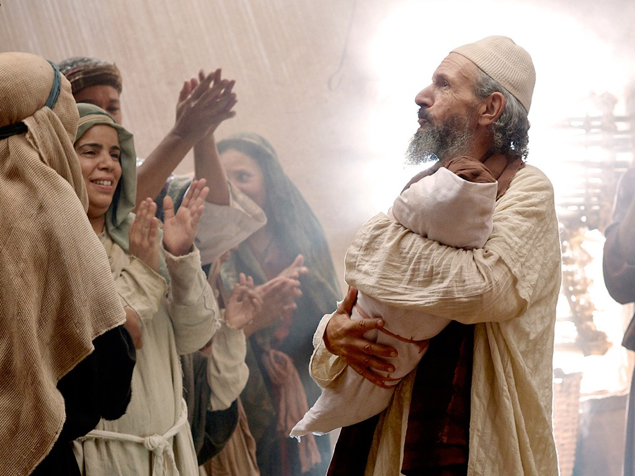
Introduction of the King
§§ 1-27
The Messianic identity of Jesus Christ is evident in his arrival, the testimony by John, and his approval in his baptism and temptation
Section summaries based on J. Dwight Pentecost,
A Harmony of the Words and Works of Jesus Christ (Grand Rapids: Zondervan, 1981)
Dr. Rick Griffith • Jordan Evangelical Theological Seminary • BibleStudyDownloads.org
Notes:
Intro: Fact or Fiction...

Slide 3

Introduction of the King
§§ 1-27
Arrival
Ambassador
Approval
Ancestry
Advent
Infancy/
Childhood
Baptism
Temptation
Herald
Notes:
Jesus did all that we should expect of the Messiah (King) from the start:
1—He arrived in the proper lineage of David, born of a virgin, and knew his deity even at age 12
2—His forerunner John knew his role in preparing Israel for her king
3—He had the best witnesses possible in the Father (baptism), Spirit (temptation), and John (prophesied herald)

Slide 4
Pentecost Outline
Introduction of the King
Authentication of the King
Controversy over the King
Instruction of the Twelve by the King
Opposition to the King
Preparation of the Disciples by the King
Official Presentation of the King
Preparation for the Death of the King
Rejection of the King
Resurrection of the King

Slide 5
The Authentication
of the King
§§ 28-59
The Acceptance
of His Person
§§ 28-36
The Authority
of the King
§§ 37-59
Notes:
Many people of various places (Judea, Samaria, Galilee) and types (Nicodemus, Samaritan woman, common Jews) initially believed in him.
Jesus also showed in 19 incidents the power expected of the Messiah to interpret the Law to preach and with authority over men, defilement, Sabbath, nature, sickness, and even death.

Slide 6
The Authentication
of the King
§§ 28-59
The Acceptance
of His Person
§§ 28-36
Notes:
Many people of various places (Judea, Samaria, Galilee) and types (Nicodemus, Samaritan woman, common Jews) initially believed in him.
Jesus also showed in 19 incidents the power expected of the Messiah to interpret the Law to preach and with authority over men, defilement, Sabbath, nature, sickness, and even death.

Slide 7
The Acceptance
of His Person
§§ 28-36
Christ is initially accepted in Judea, Samaria, and Galilee by His new disciples and by the multitudes

Slide 8
1. The Belief of the First Disciples
§ 28
John 1:35-51
Simon Peter, Andrew, John, and Nathaniel confess faith in Christ's person, work, and office as Messiah of Israel

Slide 9
2. The Belief Through the First Miracle
§ 29
John 2:1-11
Jesus confirms the faith of John’s disciples who came to him and those whom they brought to Jesus by turning water into wine, which revealed his glory as the Son of God and the joy he would give to those who accepted his message

Slide 10
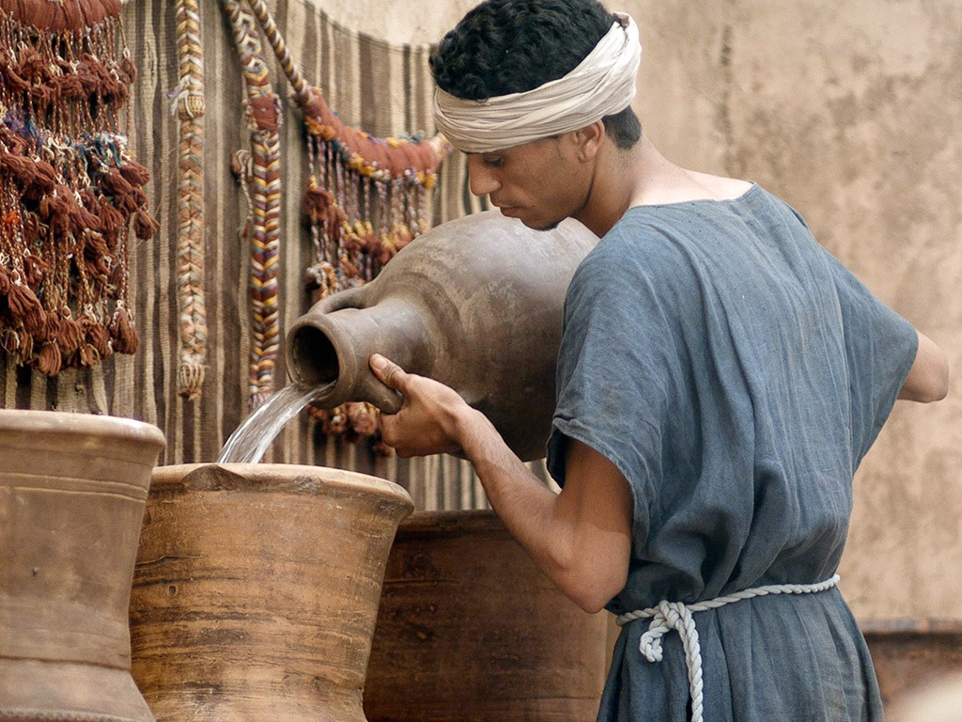

Free
Bible
images
John 2:1-11
WEDDING AT CANA

Slide 11
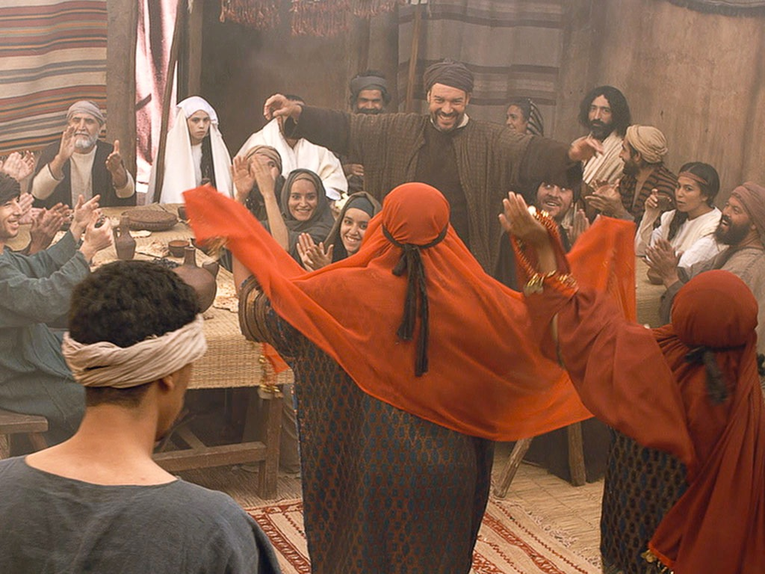
Notes:
Weddings are a time of joy.

Slide 12
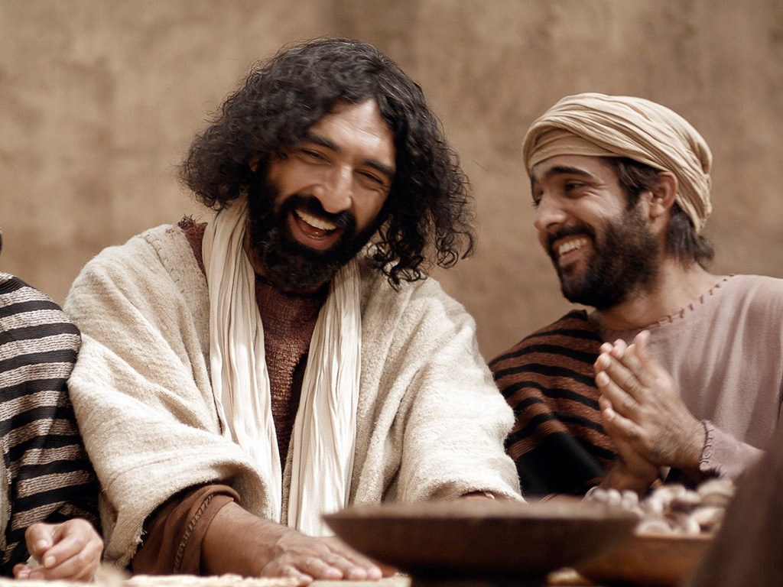
Notes:
Jesus shares our joy as he did at the wedding at Cana.

Slide 13
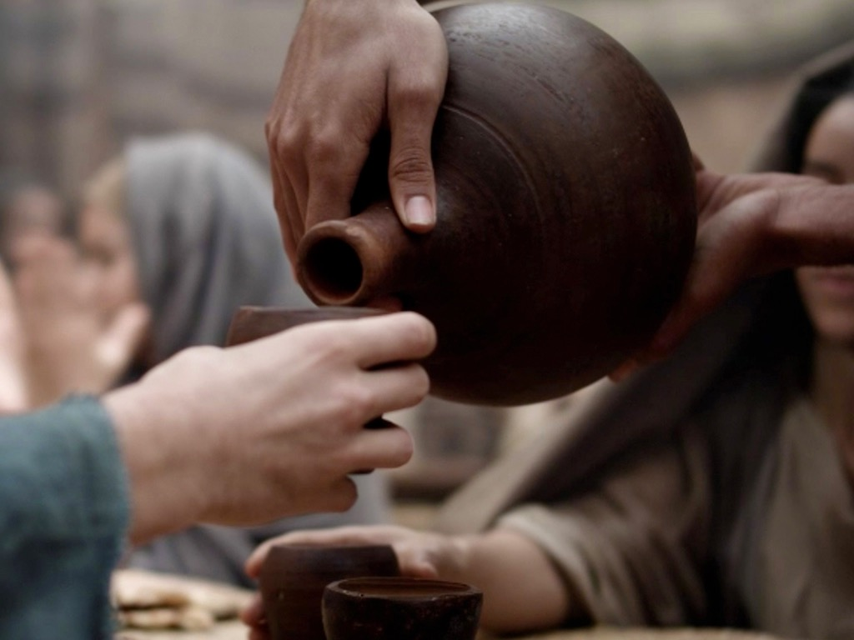
Notes:
But when the wine ran out so early, it potentially caused shame to this family that meant much to Jesus.

Slide 14
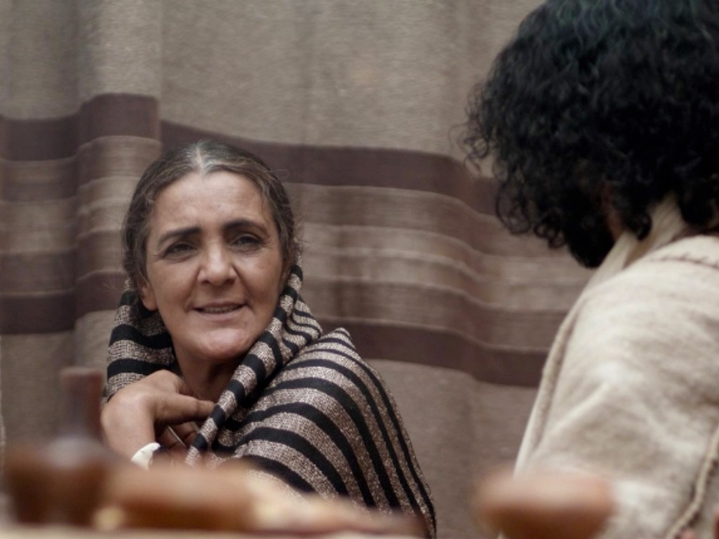
Notes:
Mary has a special relationship to the couple. Jesus initially did not respond to his mother Mary but then agreed to act.

Slide 15
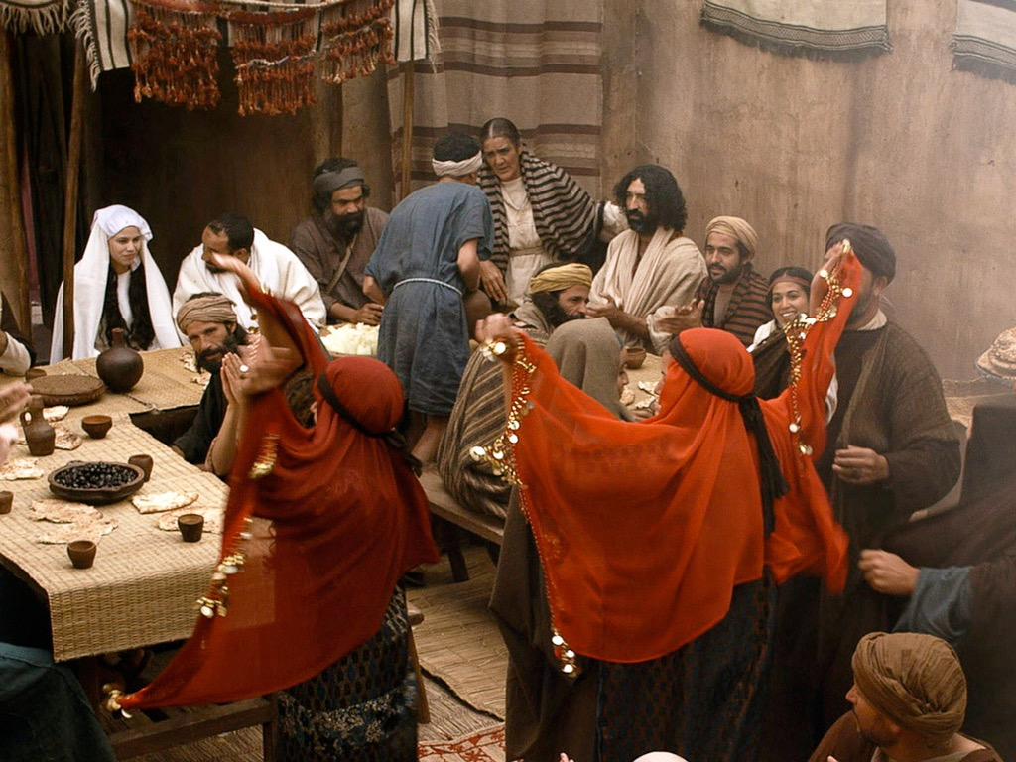
Notes:
Mary told the attendants to do whatever Jesus said.

Slide 16
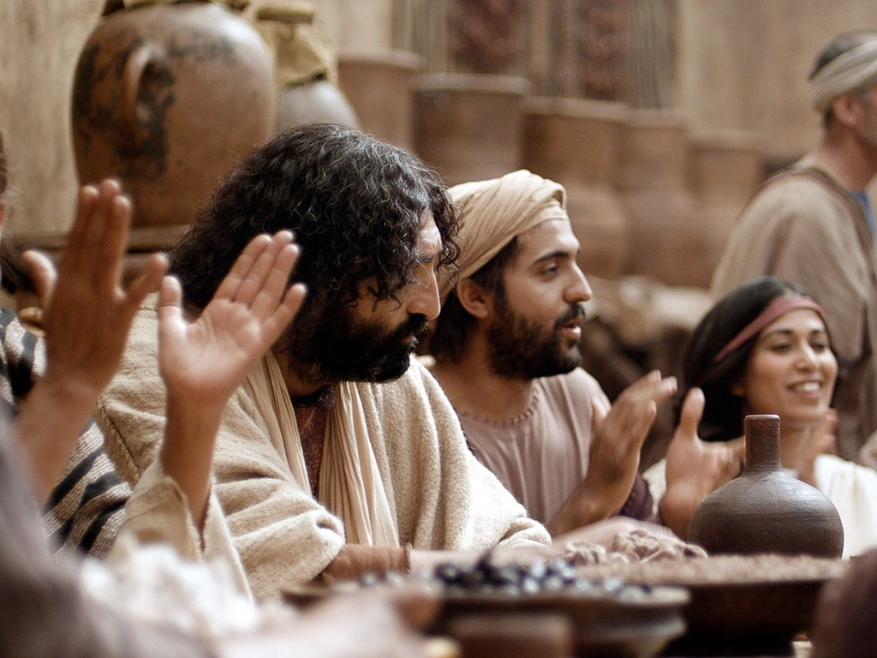
Notes:
And the wedding went on...

Slide 17
Notes:
The attendants filled six huge water jars the kind for ritual purification.

Slide 18
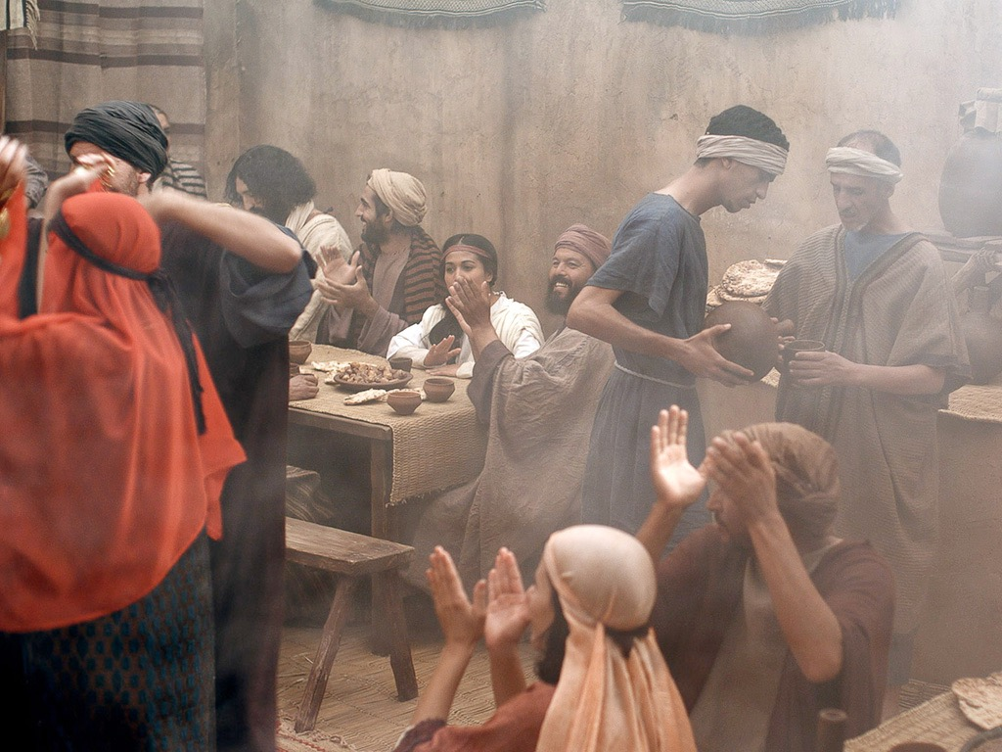
Notes:
And this "water" was given to the leader. Of course, he expected them to put wine.

Slide 19
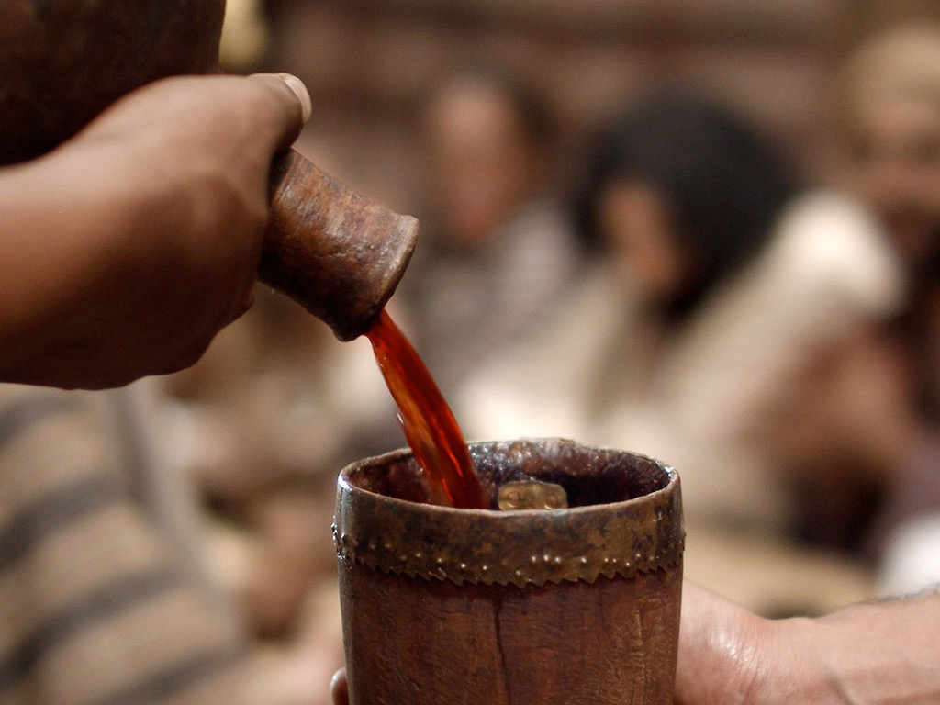
Notes:
So he wasn't disappointed to see wine in his cup.

Slide 20
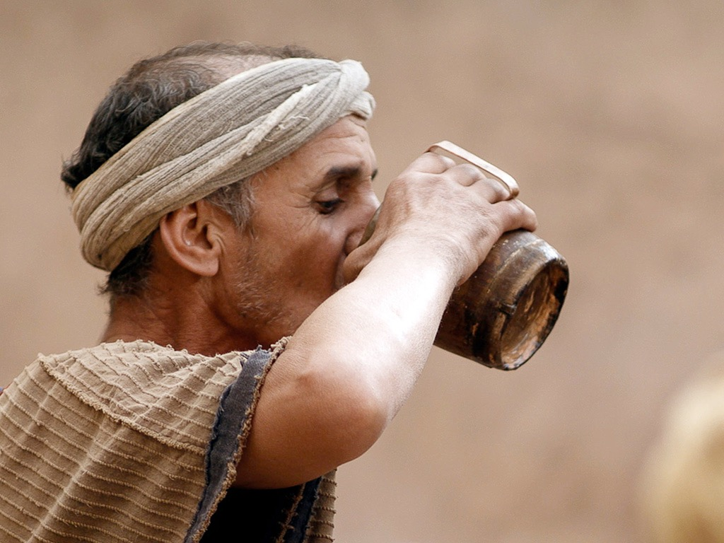
Notes:
The big surprise was how good Jesus can make wine!

Slide 21
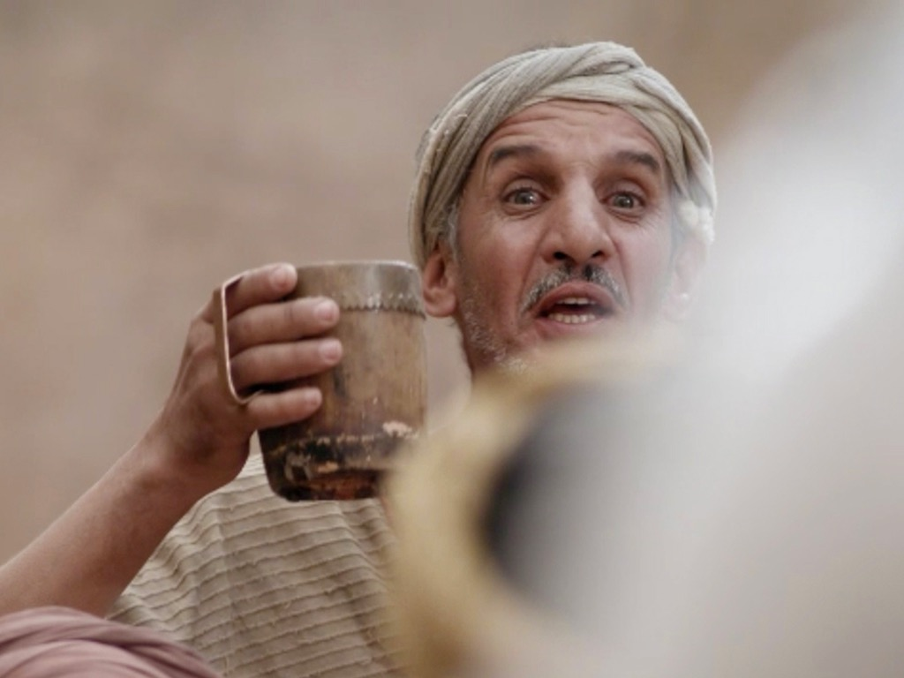
Notes:
So he announced to everyone that the best wine was served last.

Slide 22
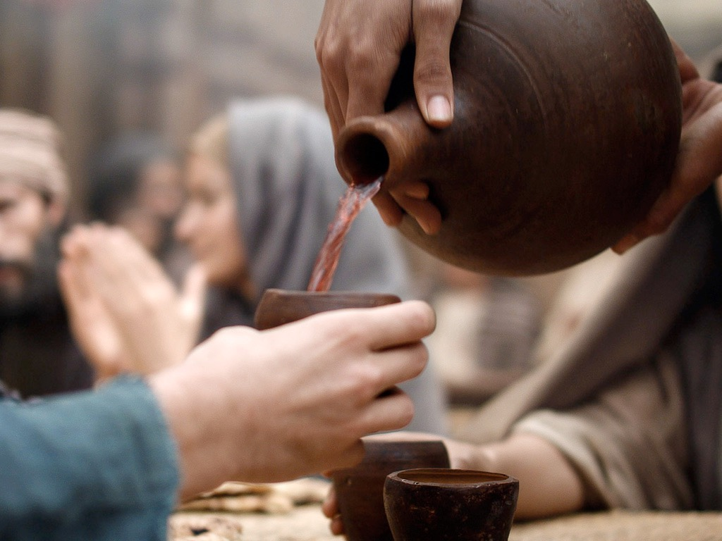
Notes:
In a sense, this was a private miracle as the others did not know where it came from.

Slide 23
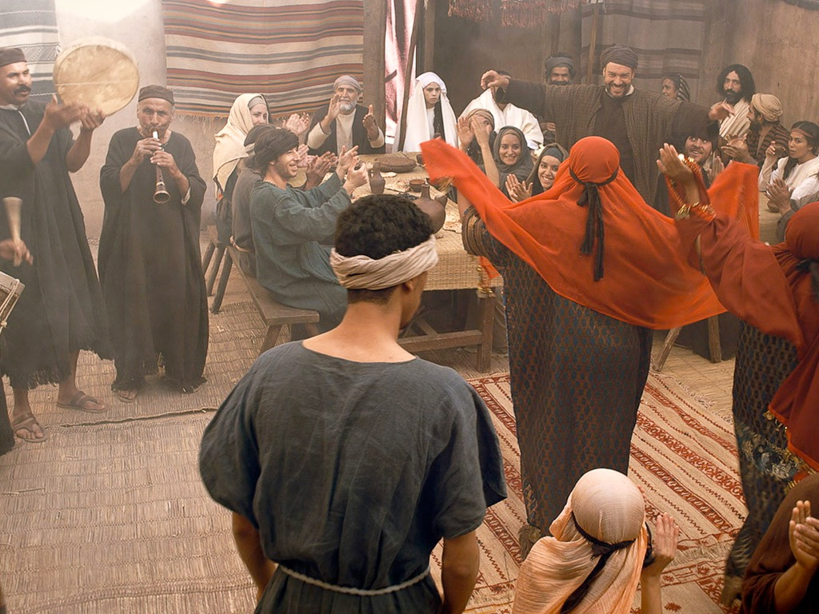
Notes:
Only the disciples believed (John 2:11).

Slide 24
THE WORD IN PICTURES
Free
Bible
images

Slide 25

Used with Permission
THE
GOSPEL
——OF—— MATTHEW
THE
GOSPEL
——OF—— MARK
THE
GOSPEL
——OF—— LUKE
THE
GOSPEL
——OF—— JOHN
Due to the Lumo Project producing its own publishing material we regret to inform you that we cannot license our photos to other clients outside of freebibleimages.org.
These images are not licensed for reuse in video, epublishing or other media. Downloaded pictures and files cannot be redistributed through any other website than freebibleimages.org or used in any context where the accompanying message is undermining of the Christian faith and gospel.
Photos can only be used on educational presentations, blogs and social media, all of which should be accompanied with reference to www.LumoProject.com.
Picture courtesy of BBM
© All Rights Reserved.
www.bigbookmedia.com

Slide 26
3. The Sojourn in Capernaum
§ 30
John 2:12
Christ further establishes the faith of His disciples in His Messianic identity in Capernaum before commencing His first great public ministry in Judea

Slide 27
4. The Possession of the Temple
§ 31
John 2:13-22
Christ demonstrates His authority as Messiah in His zeal for the Temple purification which, when challenged by His opponents, He promises to authenticate in His death and resurrection

Slide 28

Matthew 21:12-17
Mark 11:15-19
Luke 19:45-48
John 2:13-24
THE EASTER STORY
CLEANSING THE TEMPLE
Free
Bible
images

Slide 29

Notes:
Jews traveling from afar would not bring their sacrificial animals with them as this was not feasible. This meant that a system of selling animals developed in Jerusalem

Slide 30

Notes:
They also would need the local currency of shekels as we need to today when we travel to another county. Therefore, a money changing system also developed.

Slide 31

Notes:
But where did the money changing need to occur? Certainly not in the temple courtyards! Yet this was deemed most convenient.

Slide 32

Notes:
But Jesus was upset that this system replaced His Father's House from prayer.

Slide 33

Notes:
Others disagreed, for they made a great deal of money from the system.

Slide 34
Notes:
Jesus had every right to tear this down—even though he would again need to clear the temple three years later!

Slide 35

Notes:
Jesus turned over their tables in the way that the Jewish leaders in Jerusalem should have done before him!

Slide 36

Notes:
His anger against those selling doves was righteous anger.

Slide 37

Notes:
So he let the sacrificial doves free.

Slide 38

Notes:
"Stop turning my Father's House into a den of thieves!" Jesus retorted.

Slide 39

Notes:
The other side of Jesus was to show compassion on those cheated by this system.

Slide 40

Notes:
But why were the Jewish leaders upset with Jesus?
The Law declared, "In the case of the burnt offering, the priest may keep the hide of the sacrificed animal" (Lev 7:80. The leaders profited much from this system.
They asked him by what authority he could cleanse the temple.

Slide 41

Notes:
"Destroy this temple and I will rebuild it in three days," Jesus responded.
Of course, he was referred to his body—but they said that it took 46 years to build the temple.

Slide 42

Notes:
They never asked Jesus for clarification.

Slide 43

Notes:
Jesus clarifies himself with the believing but often not the unbelieving. Otherwise, they would incur a stricter judgment.

Slide 44

Notes:
The disciples believed fully only after the resurrection, according to John 2:22!

Slide 45
THE WORD IN PICTURES
Free
Bible
images

Slide 46
5. Acceptance in Judea
§ 32
John 2:23–3:21
Christ's acceptance by Judeans is confirmed by miracles and by Nicodemus who believes that Jesus reveals God and gives spiritual birth to enter the kingdom
Notes:
"So when He was raised from the dead, His disciples remembered that He said this; and they believed the Scripture and the word which Jesus had spoken.
John 2:23 Now when He was in Jerusalem at the Passover, during the feast, many believed in His name, observing His signs which He was doing. ²⁴ But Jesus, on His part, was not entrusting Himself to them, for He knew all men, ²⁵ and because He did not need anyone to testify concerning man, for He Himself knew what was in man" (NLT).
Did these people trust Jesus for salvation? Most scholars think not.
James says that there is a believing that is not salvific: "You believe that God is one. You do well; the demons also believe, and shudder" (James 2:19 NASB).
But does John use "believing" in this way? Not really. Every time John uses the term, he refers to trusting for salvation. In fact, Jesus does not fully trust himself to any of us, for he knows what is in our hearts. The believing of John 2:22 is the same as the believing of John 2:23.

Slide 47
6. The Witness of John
§ 33
John 3:22-36
John declares Christ’s superiority as a heavenly Revealer of the Father for people to have eternal life instead of God’s wrath

Slide 48
7. The Withdrawal from Judea
§ 34
Matthew 4:12; Mark 1:14; Luke 3:19-20; John 4:1-4
Christ transfers from Judea to Galilee to avoid potential conflict with John and premature death by the Pharisees

Slide 49
8. The Acceptance in Samaria
§ 35
John 4:5-42
Christ is accepted as Messiah by some Samaritans through a woman at the well who accepts His person and the eternal life He came to give

Slide 50
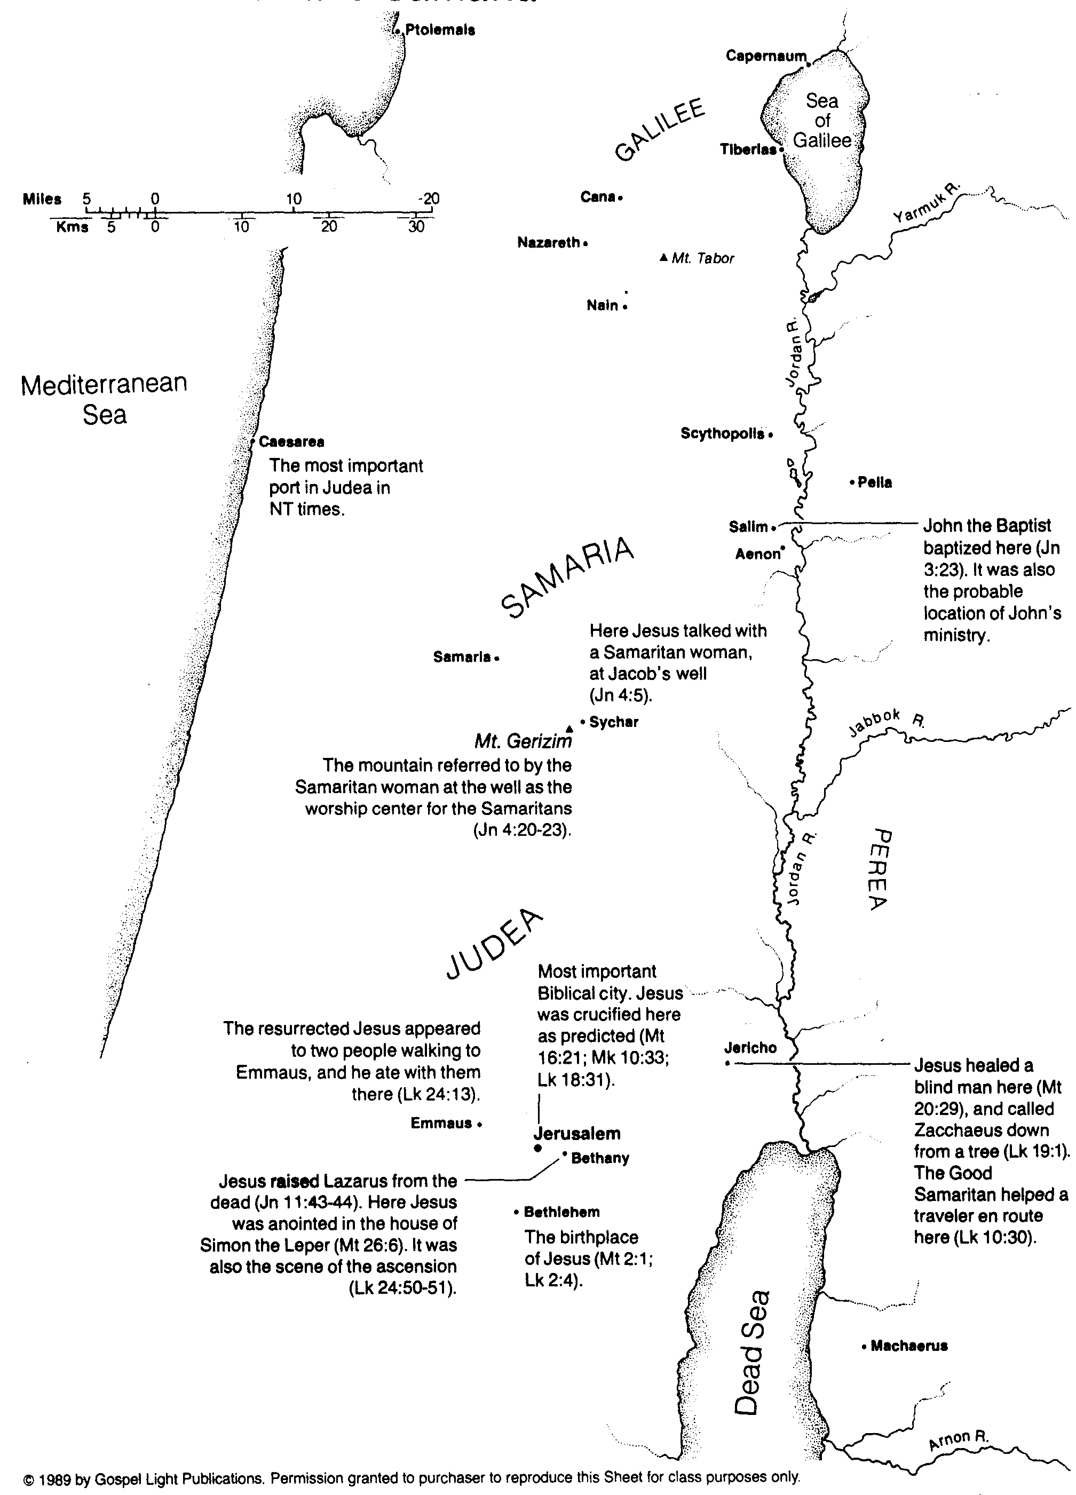
Jesus in Judea and Samaria
107

Slide 51
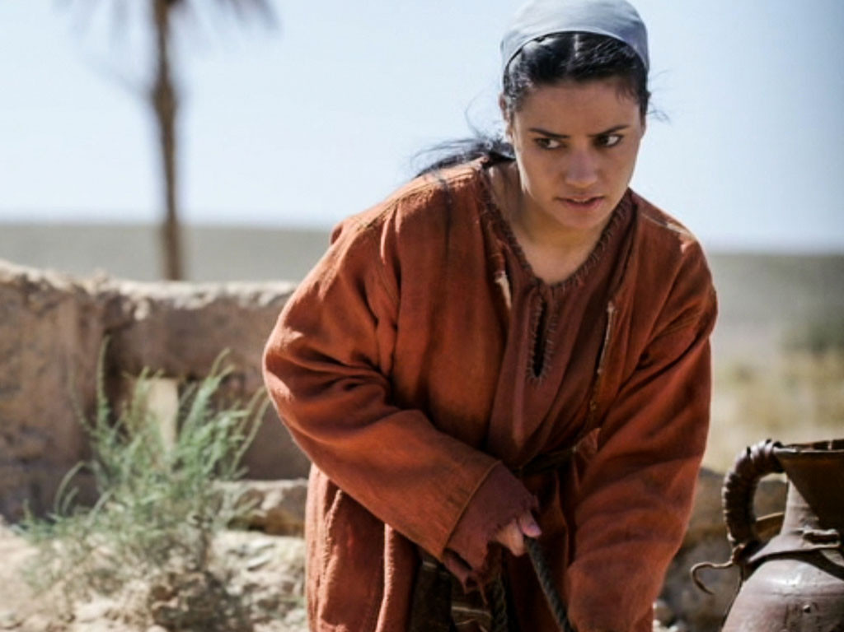

Free
Bible
images
John 4:1-42
JESUS TALKS WITH A SAMARITAN WOMAN
Notes:
What is the point of this story?

Slide 52
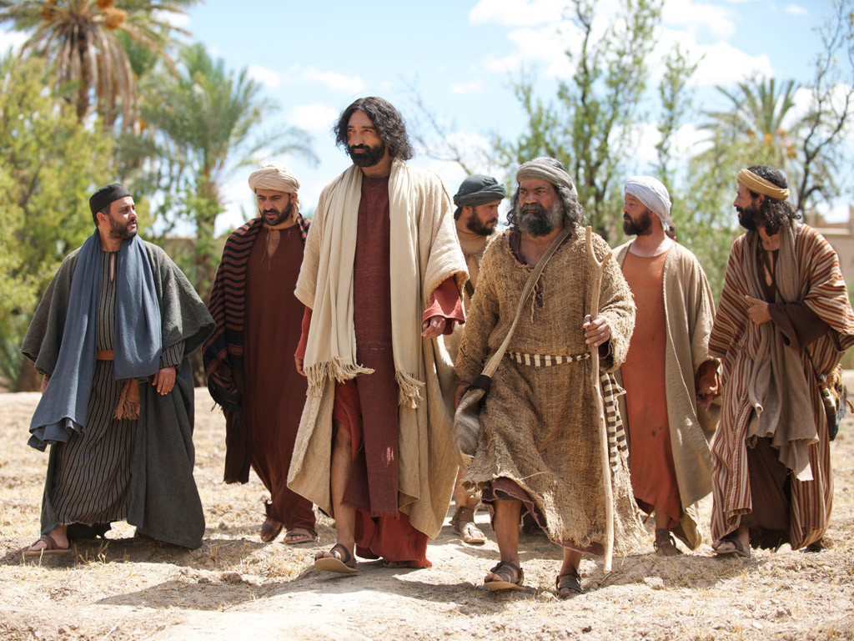
Notes:
Jesus was travelling from Judea back to Galilee and decided to go through the region of Samaria where the Samaritan people lived.

Slide 53
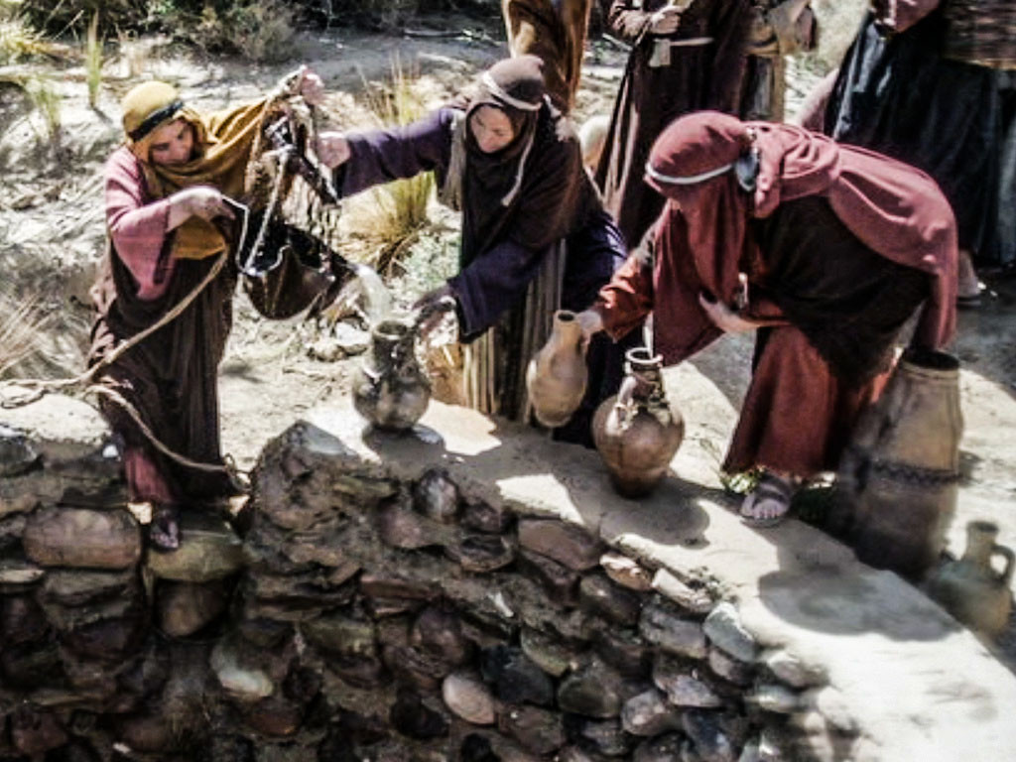
Notes:
The Samaritans were a race of Jews that had in the past inter-married with other races. The Jews did not allow Samaritans to worship with them or have anything to do with them. Jews normally avoided travelling through Samaria. There was a history of feuds and grudges between the Jews and Samaritans and they did not talk to each other.

Slide 54
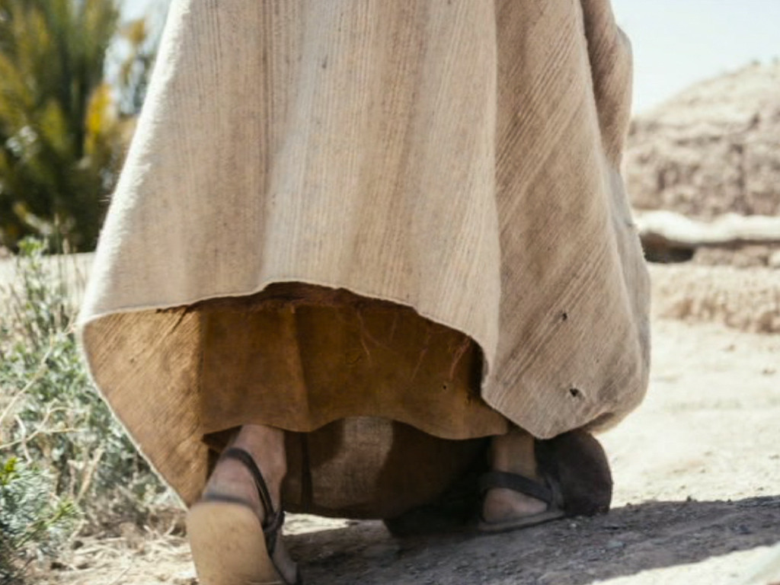
Notes:
At noon, Jesus and His disciples arrived at a well on the edge of a town called Sychar.

Slide 55
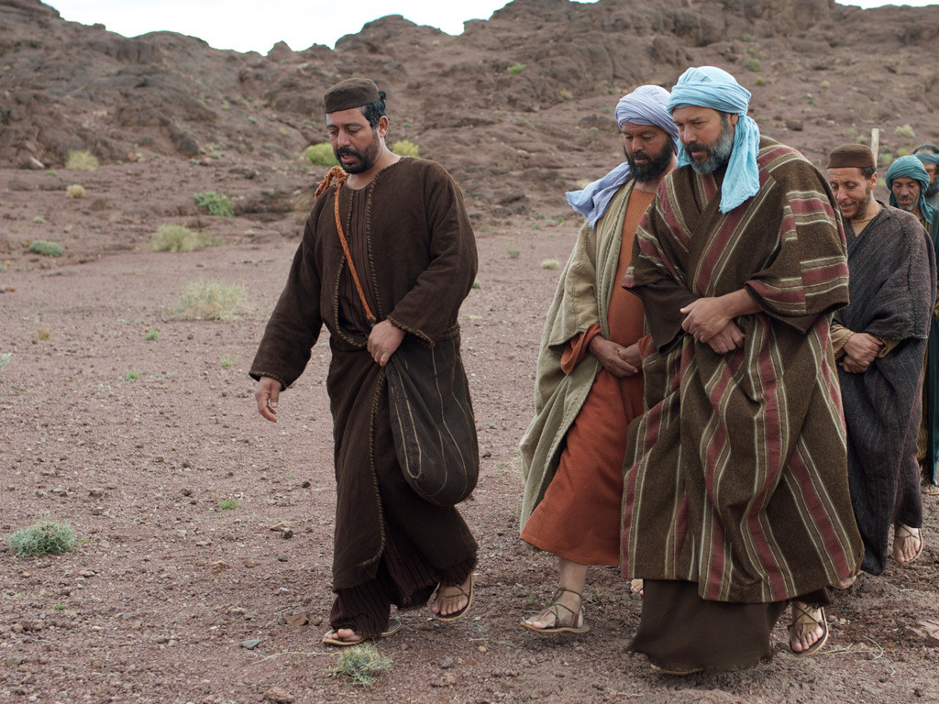
Notes:
Jesus sat by the well to rest while His disciples went into the town to buy food.

Slide 56
Notes:
A Samaritan woman came to draw water from the well. Jesus asked her for a drink of water.

Slide 57
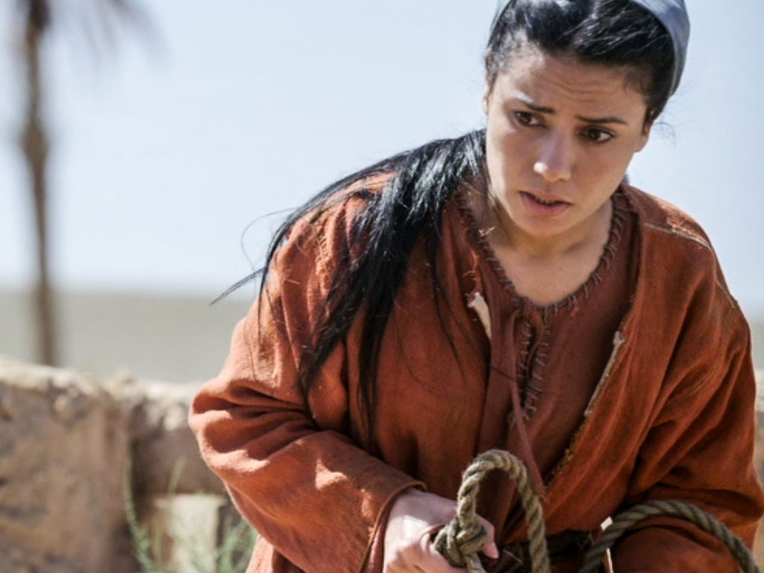
Notes:
‘You are a Jew, and I am a Samaritan,’ she protested. ‘How can you ask me for a drink?’ She knew Jews refused to use the same cups and bowls that Samaritans used.

Slide 58
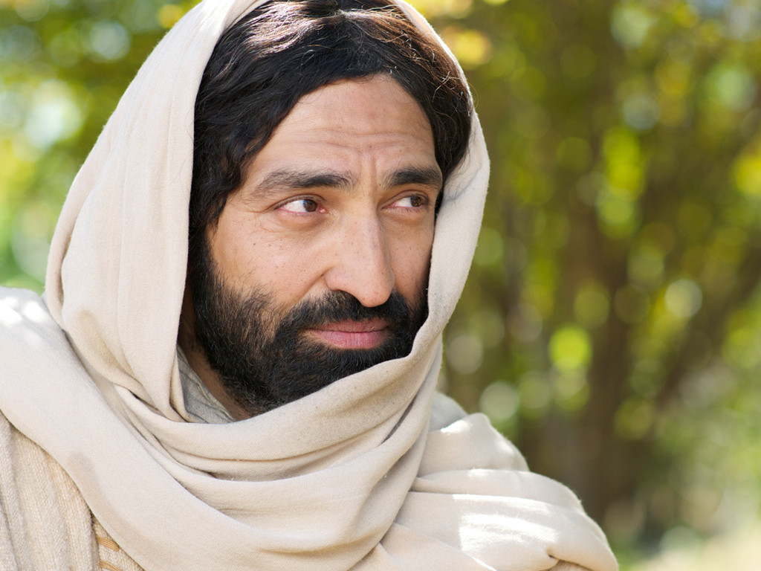
Notes:
Jesus replied, ‘If you knew what God gives and who I am, you would be asking me for lifegiving water.’

Slide 59
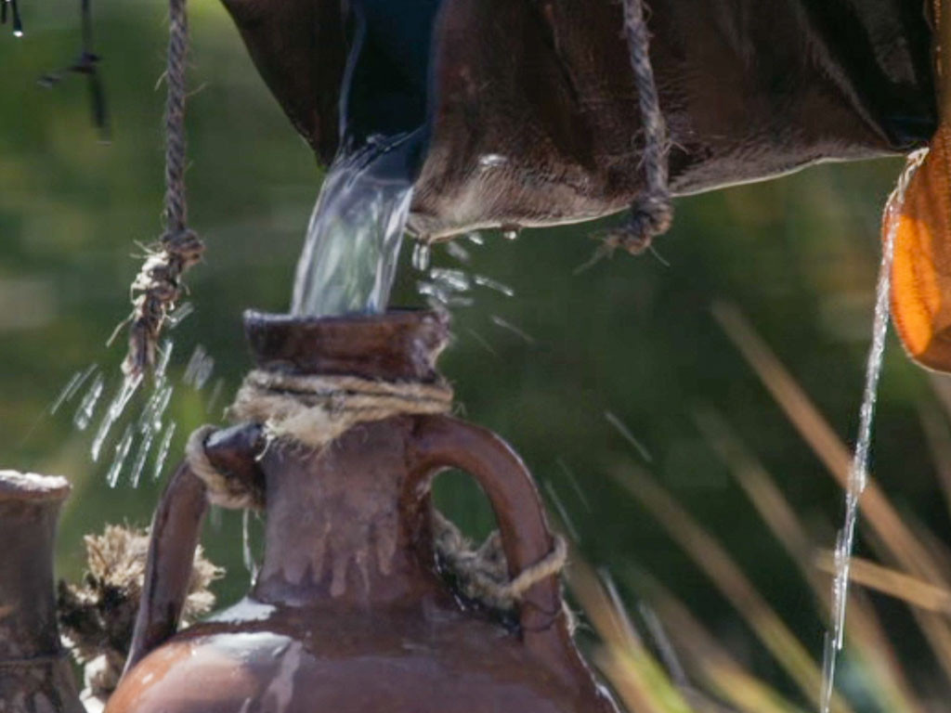
Notes:
'You don’t have anything to draw water from this deep well. Where would you get life-giving water?’ the woman asked.

Slide 60
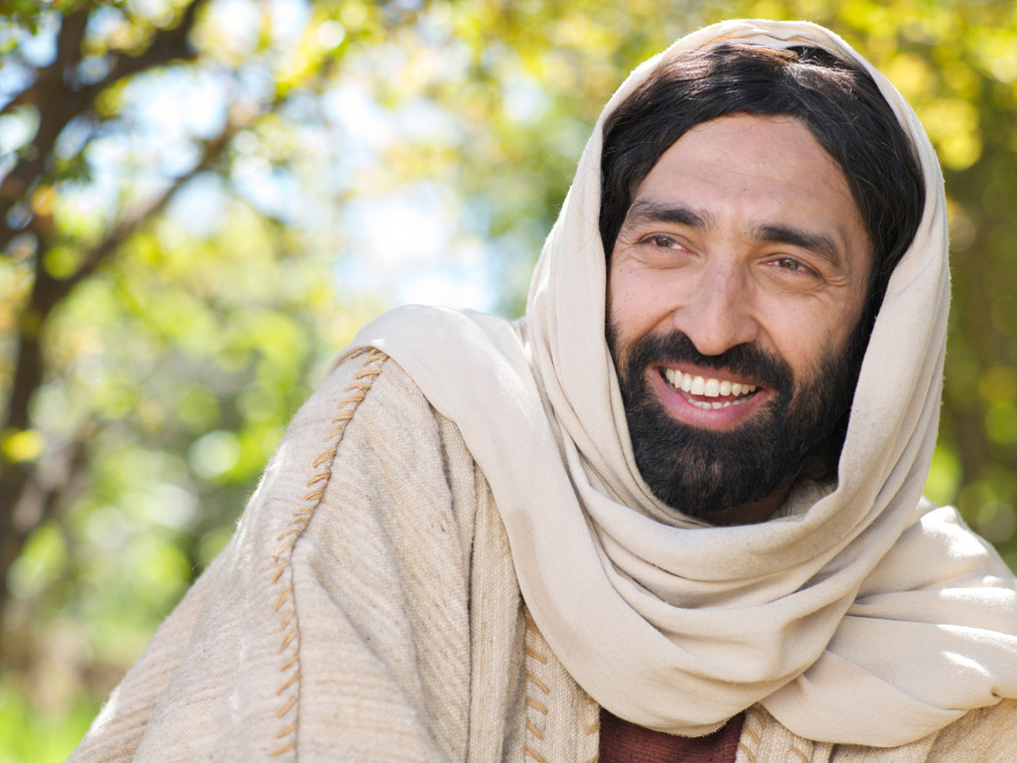
Notes:
Jesus answered, ‘Those who drink ordinary water will get thirsty again, but I am talking about the life-giving water of eternal life.’

Slide 61
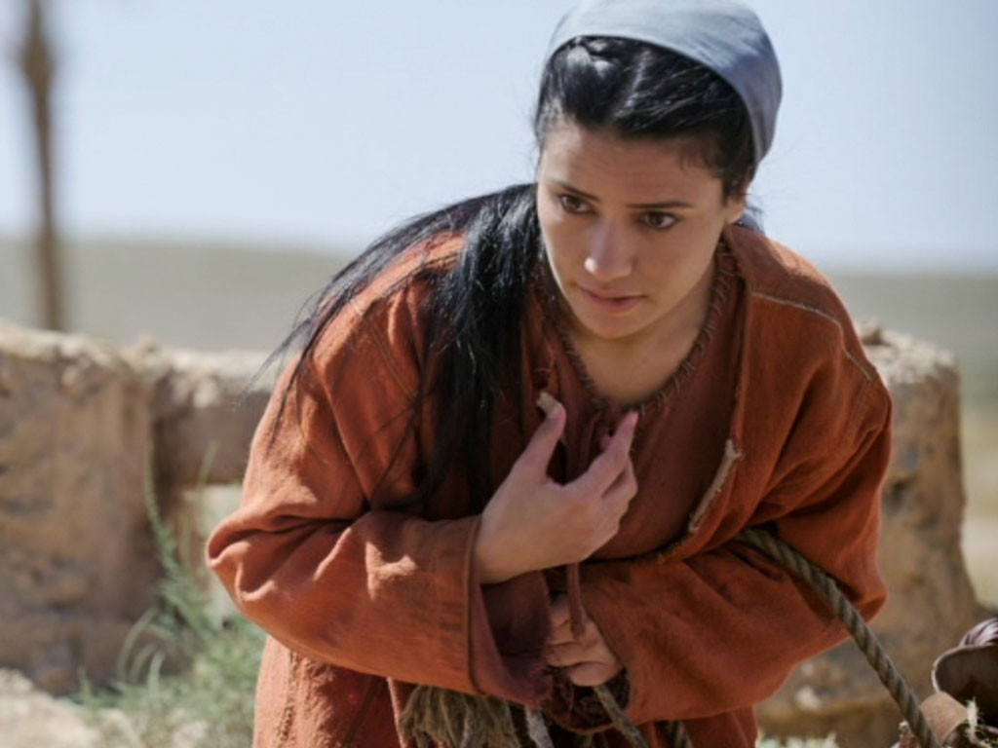
Notes:
‘Give me that water so I will never be thirsty again,’ the woman demanded. ‘

Slide 62
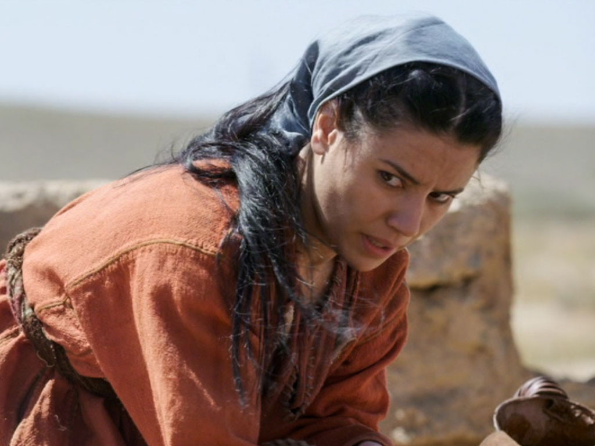
Notes:
'Go and call your husband,’ Jesus told her, ‘and come back.’
‘I don’t have a husband,’ she protested.

Slide 63
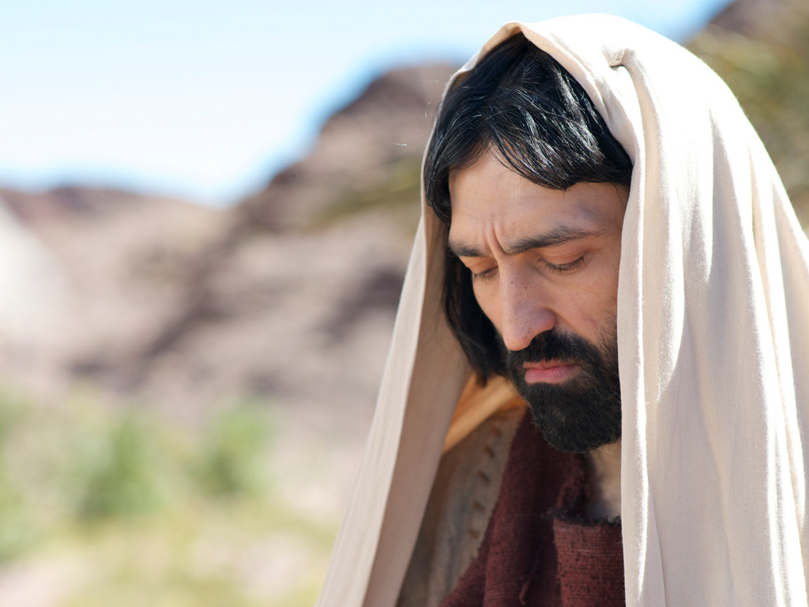
Notes:
‘You are right,’ Jesus told her. ‘You have been married to five men, and the man you live with now is not really your husband.’ The woman was shocked Jesus knew so much about her and exclaimed, ‘You are a prophet.’

Slide 64
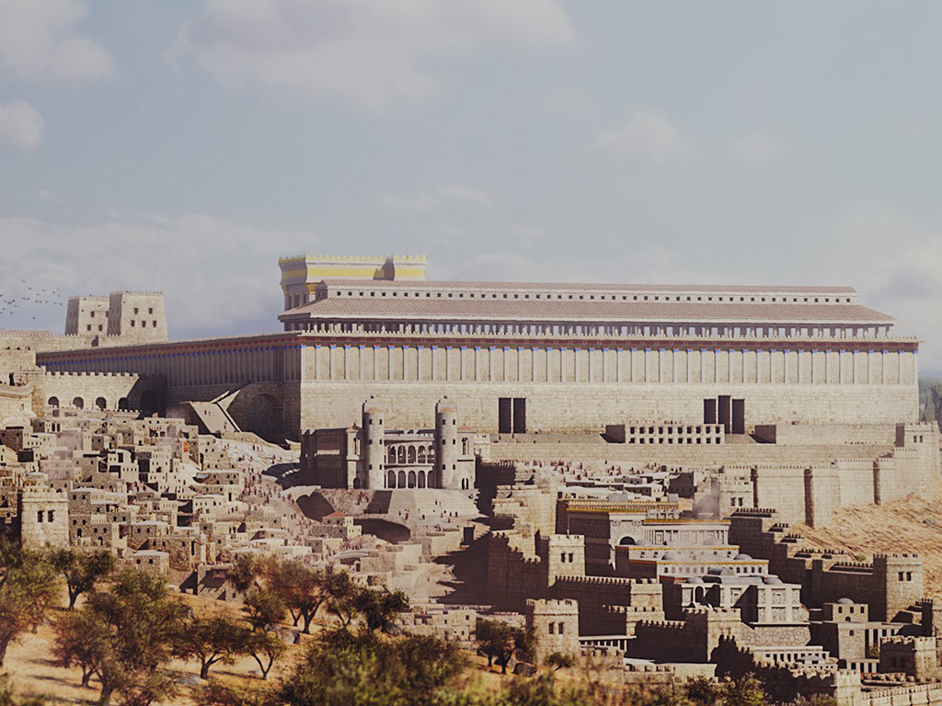
Notes:
She continued, ‘Samaritans worship God on this mountain, but you Jews say that Jerusalem is the place where we should worship God.’

Slide 65
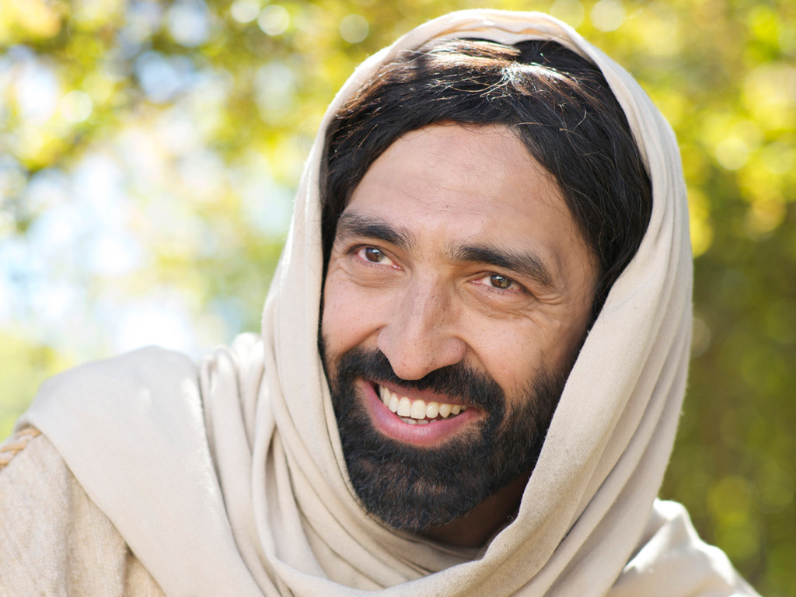
Notes:
'It’s not where you worship that’s important but who you worship,’ Jesus explained. 'The time is coming when people will worship God as He really is, offering him true worship. God is Spirit, and only by the power of His Spirit can people worship Him.'

Slide 66
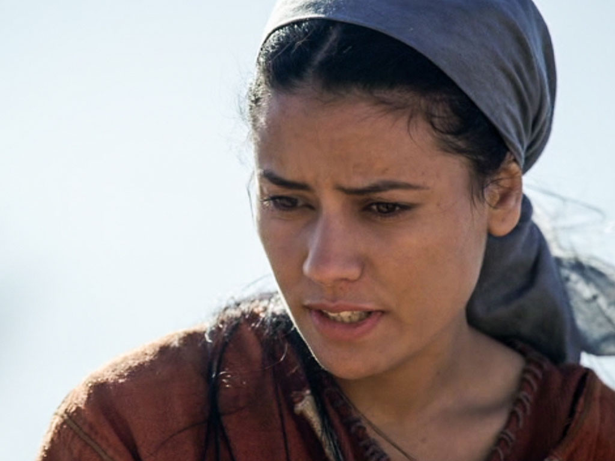
Notes:
‘I know when God’s Saviour, the Messiah comes He will tell us everything,’ she replied. ‘I am the Messiah,’ Jesus announced, ‘you are talking to Him.’

Slide 67
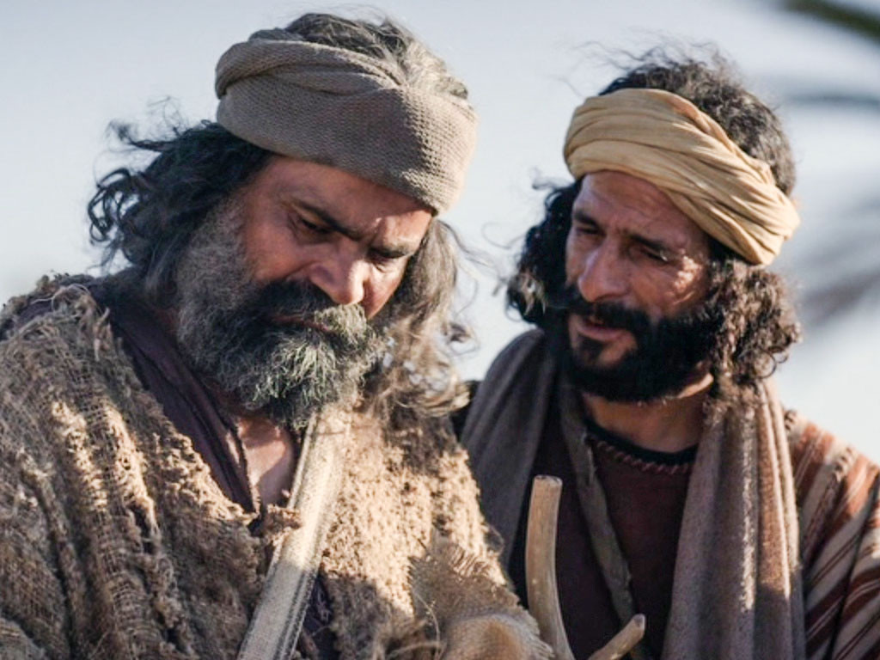
Notes:
At that point the disciples returned and were surprised to find him talking with a Samaritan. The woman left her water jar and raced went back into the town telling everyone, ‘Come and meet the man who told me everything I have ever done. Could He be the Messiah?’

Slide 68
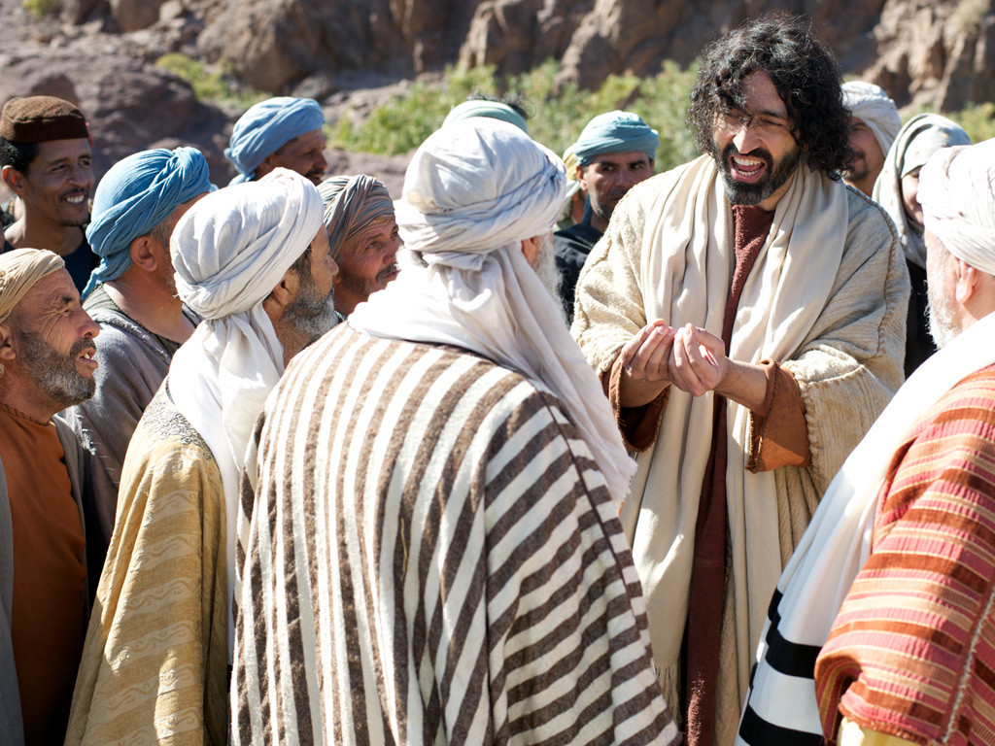
Notes:
The Samaritans came out to meet Jesus and begged Him to stay with them. Jesus stayed there two days and many believed that Jesus was the Messiah.

Slide 69
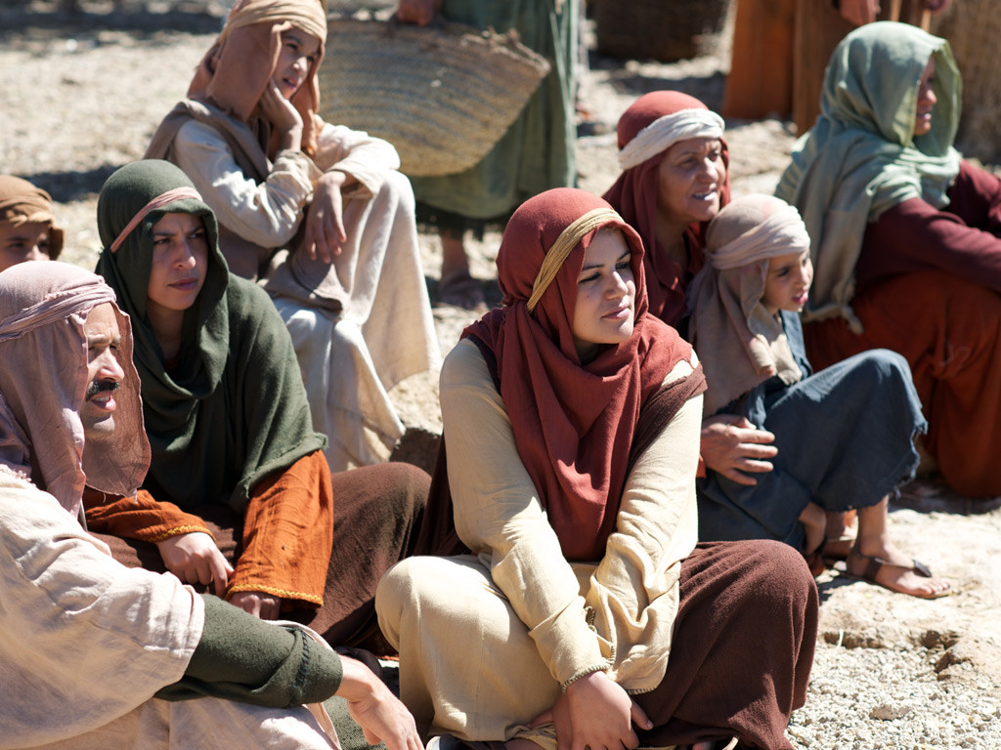
Notes:
They told the woman, ‘We believe because we too have heard Him, and we know that He really is the Saviour of the world.’

Slide 70
Used with Permission
THE
GOSPEL
——OF—— MATTHEW
THE
GOSPEL
——OF—— MARK
THE
GOSPEL
——OF—— LUKE
THE
GOSPEL
——OF—— JOHN
Due to the Lumo Project producing its own publishing material we regret to inform you that we cannot license our photos to other clients outside of freebibleimages.org.
These images are not licensed for reuse in video, epublishing or other media. Downloaded pictures and files cannot be redistributed through any other website than freebibleimages.org or used in any context where the accompanying message is undermining of the Christian faith and gospel.
Photos can only be used on educational presentations, blogs and social media, all of which should be accompanied with reference to www.LumoProject.com.
Picture courtesy of BBM
© All Rights Reserved.
www.bigbookmedia.com

Slide 71
9. The Acceptance in Galilee
§ 36
John 4:43-45
Christ is welcomed by Galileans who saw His Passover miracles in Jerusalem and honor Him as a Galilean, yet Jesus predicts their future rejection

Slide 72

Great Periods in the Life of Christ
55
“The Son of Man… came to minister and to give his life a ransom for many” (Mark 10:45)
Climactic Galilean
Early Samaritan
Later Samaritan
Early Judean
Later Judean
Early Perean
Later Perean
Opening Events
Closing Events
Preparation
Confirmation
Walk Thru the New Testament seminar (used with permission)

Slide 73
The Authentication
of the King
§§ 28-59
The Acceptance
of His Person
§§ 28-36
The Authority
of the King
§§ 37-59
Notes:
Many people of various places (Judea, Samaria, Galilee) and types (Nicodemus, Samaritan woman, common Jews) initially believed in him.
Jesus also showed in 19 incidents the power expected of the Messiah to interpret the Law to preach and with authority over men, defilement, Sabbath, nature, sickness, and even death.

Slide 74
The Authority
of the King
§§ 37-59
Jesus substantiates His authority as Messiah through His miracles and teachings which authenticate Himself and His message
Notes:
How did the OT say that the Messiah would establish his authority? Was he only to be a military leader? Break into small groups and defend your view from specific OT texts. What was their expectation? What should have been their expectation?
Deut 18:18 prophesies that he would be a prophet—a teacher.
Zech 9:9 says he would ride a donkey—not a horse.
But Zech 14:3-4 shows him as conqueror at his return. At that time he will ride a horse (Rev 19:11)! Also, Is 11:4 notes, "The earth will shake at the force of his word, and one breath from his mouth will destroy the wicked."
Is. 63:1 Who is this who comes from Edom,
from the city of Bozrah,
with his clothing stained red?
Who is this in royal robes,
marching in his great strength?
“It is I, the LORD, announcing your salvation!
It is I, the LORD, who has the power to save!”
Is. 63:2 Why are your clothes so red,
as if you have been treading out grapes?
Is. 63:3 “I have been treading the winepress alone;
no one was there to help me.
In my anger I have trampled my enemies
as if they were grapes.
In my fury I have trampled my foes.
Their blood has stained my clothes.
⁴ For the time has come for me to avenge my people,
to ransom them from their oppressors.
⁵ I was amazed to see that no one intervened
to help the oppressed.
So I myself stepped in to save them with my strong arm,
and my wrath sustained me.
⁶ I crushed the nations in my anger
and made them stagger and fall to the ground,
spilling their blood upon the earth.”

Slide 75
1. Christ's Authority to Preach
§ 37
Matthew 4:17; Mark 1:15; Luke 4:14-15
Christ preaches by the Spirit as a self-appointed teacher and prophet the same repentance to enter the Messianic kingdom that John declared to show God’s authority on him

Slide 76
2. Christ's Authority Over Disease
§ 38
John 4:46-54
Jesus shows His authority as Messiah by healing the son of a royal official based upon the faith of the official in Christ's word alone without any outward evidence of its truth

Slide 77
3. Rejection in Nazareth
§ 39
Luke 4:16-30
Jesus claims to fulfill Isaiah 61:1-2 with messianic authority to heal and includes his Nazareth hearers among Israel’s apostates in his first public rejection to end in his death

Slide 78
4. Residence in Capernaum
§ 40
Matthew 4:13-16
After rejection in Nazareth, Jesus moves to the mostly Gentile Capernaum to foreshadow his authority to minister to Gentiles after Israel rejects him as Messiah

Slide 79
5. Christ's Authority Over Nature
§ 41
Matthew 4:18-22; Mark 1:16-20; Luke 5:1-11
Christ confirms His authority over nature in a miraculous catch of fish before four fishermen who follow His authority instead of their father's authority

Slide 80
6. Christ's Authority Over Demons
§ 42
Mark 1:21-28; Luke 4:31-37
Christ shows his authority to expel a demon that knew his person and work as the Messiah but would not allow his testimony of Christ since his authority rested in his person rather than the testimony of demons

Slide 81
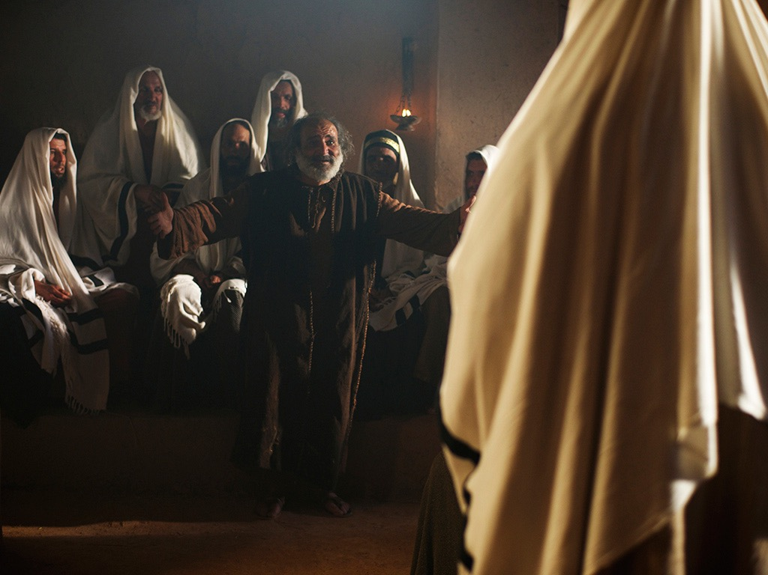
Free
Bible
images
Mark 1:21-28; Luke 4:31-37
JESUS DELIVERS A POSSESSED MAN

Slide 82
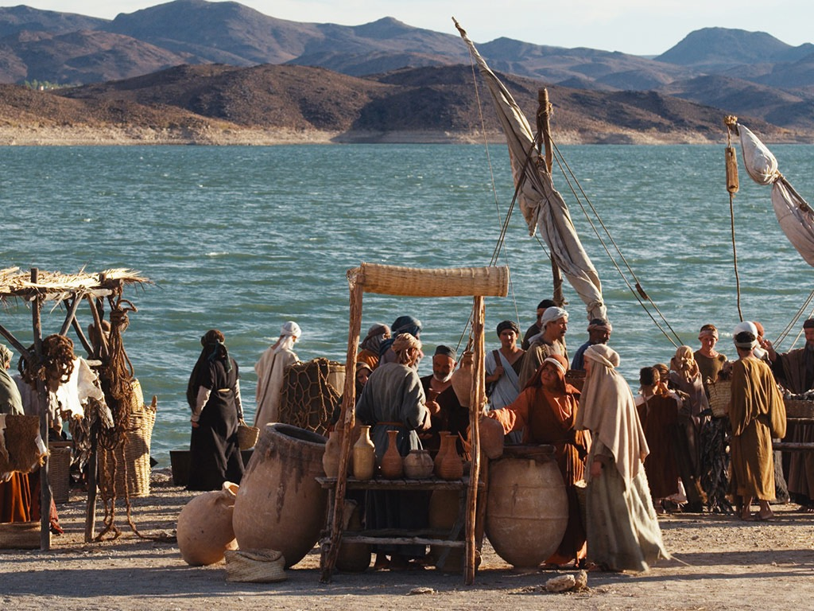

Slide 83
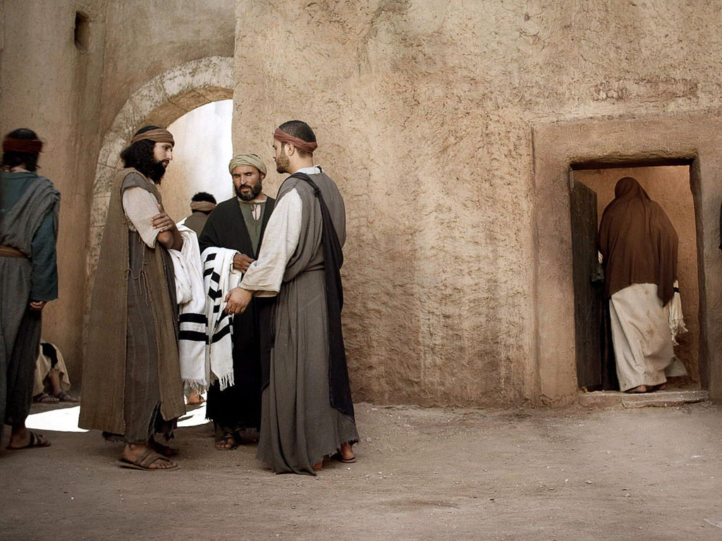

Slide 84
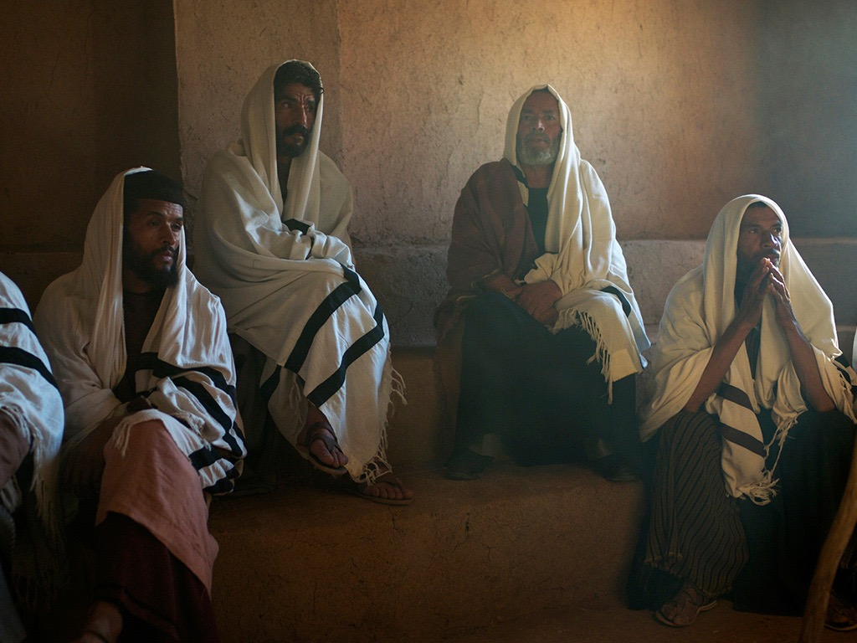

Slide 85
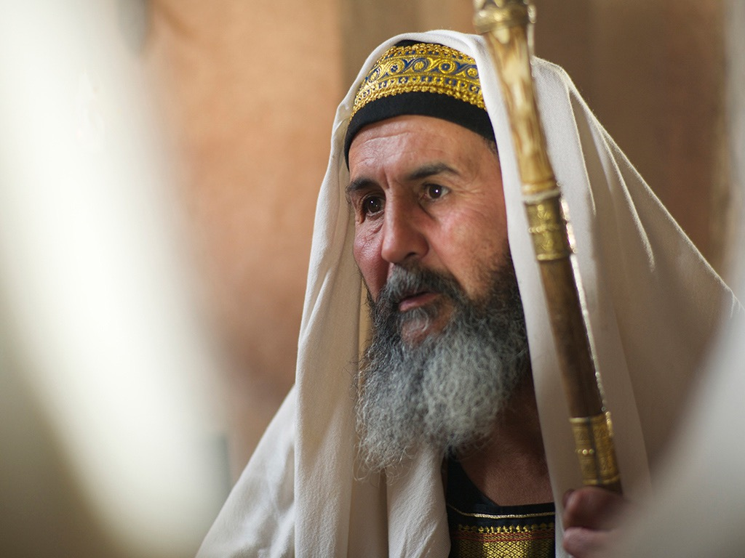

Slide 86
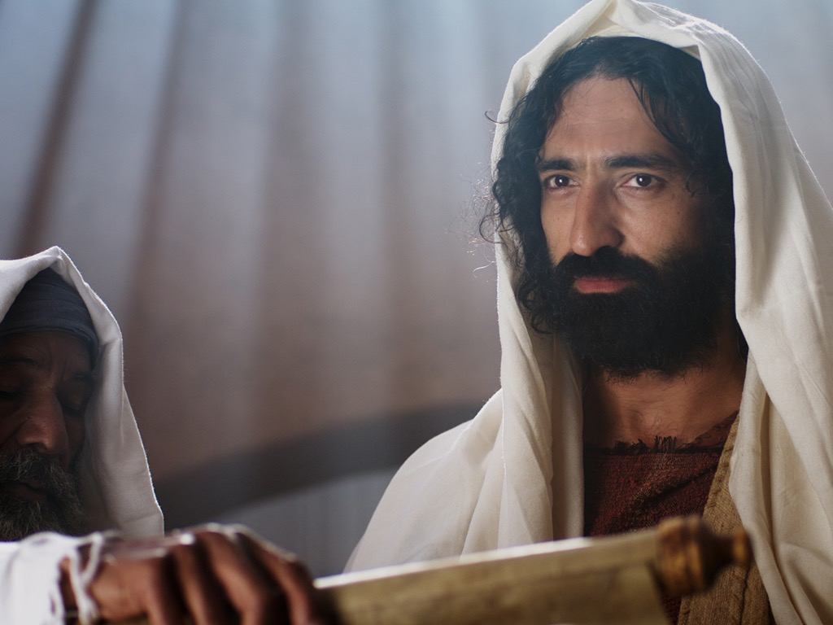

Slide 87
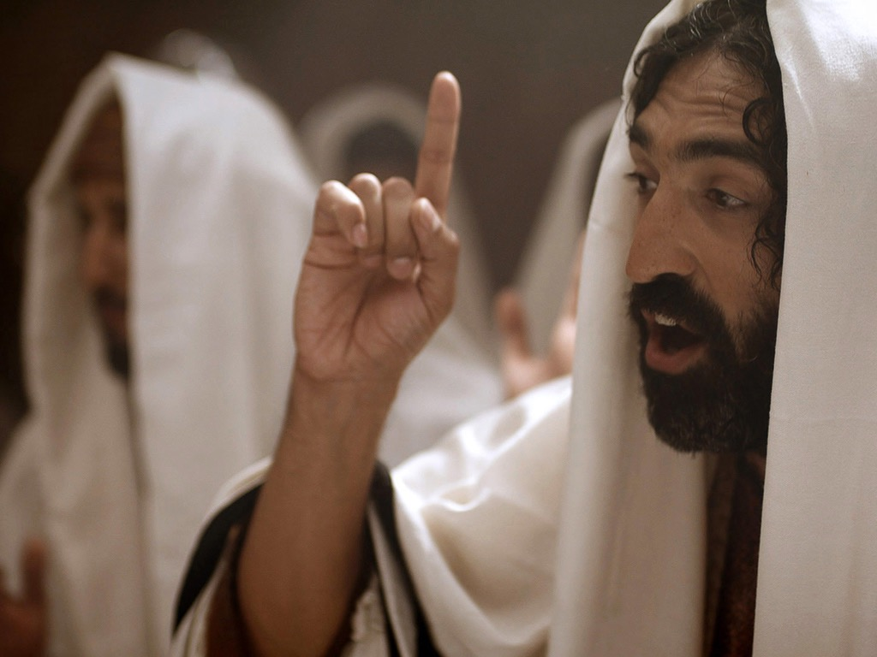

Slide 88
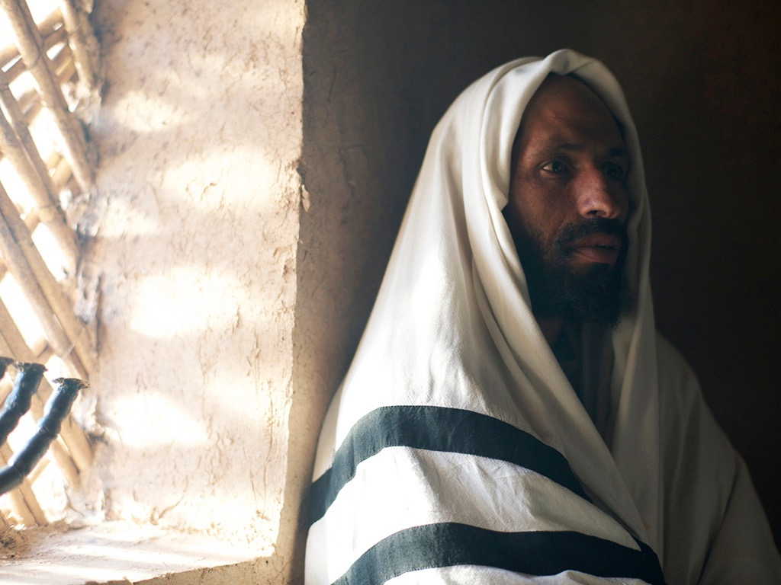

Slide 89
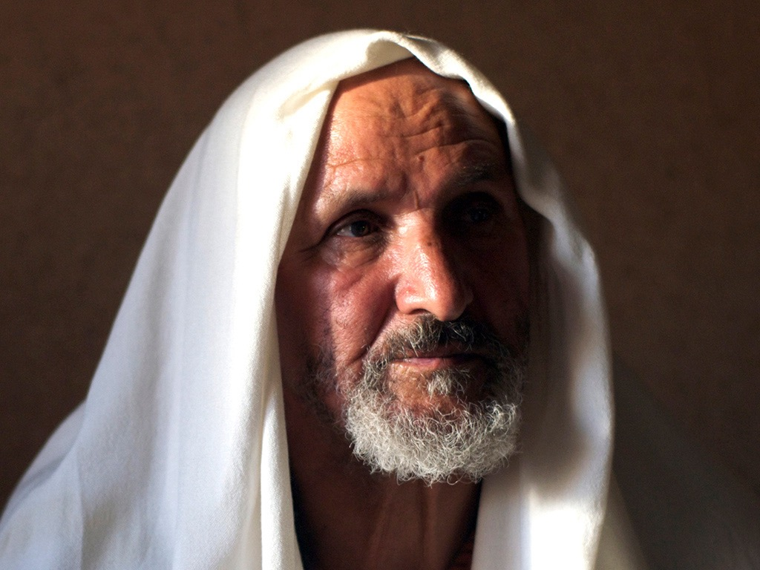

Slide 90
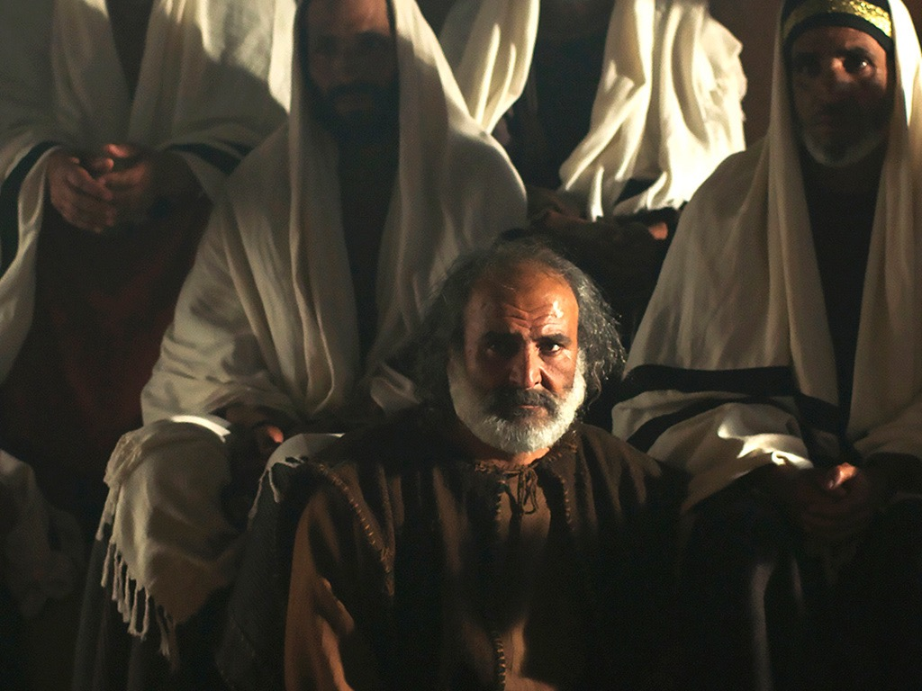

Slide 92
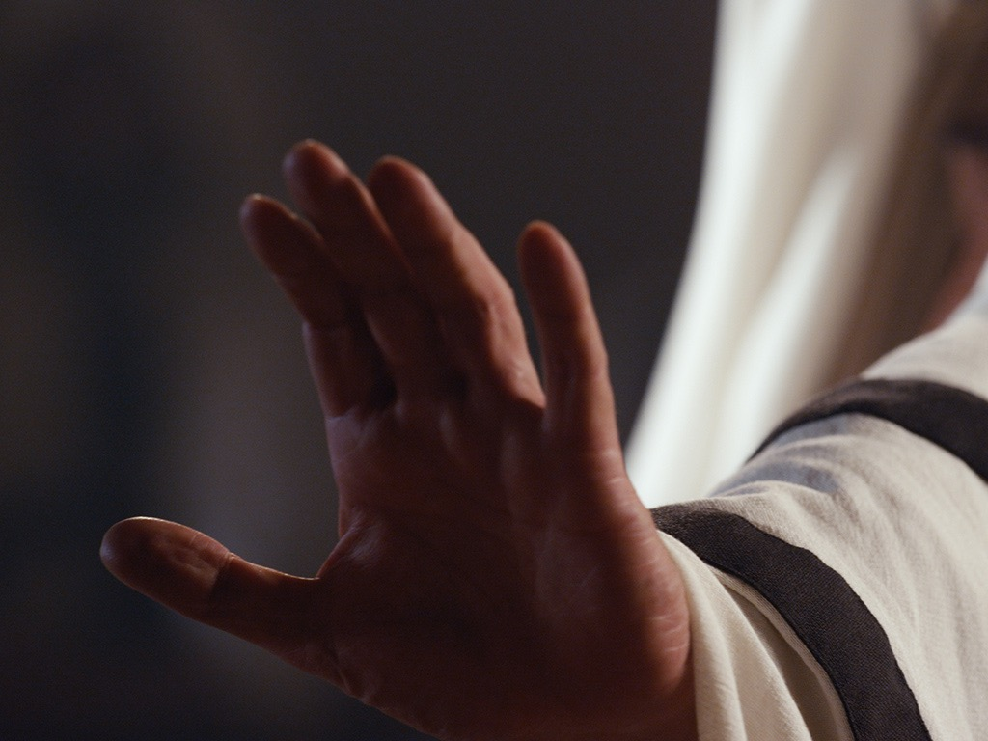

Slide 93
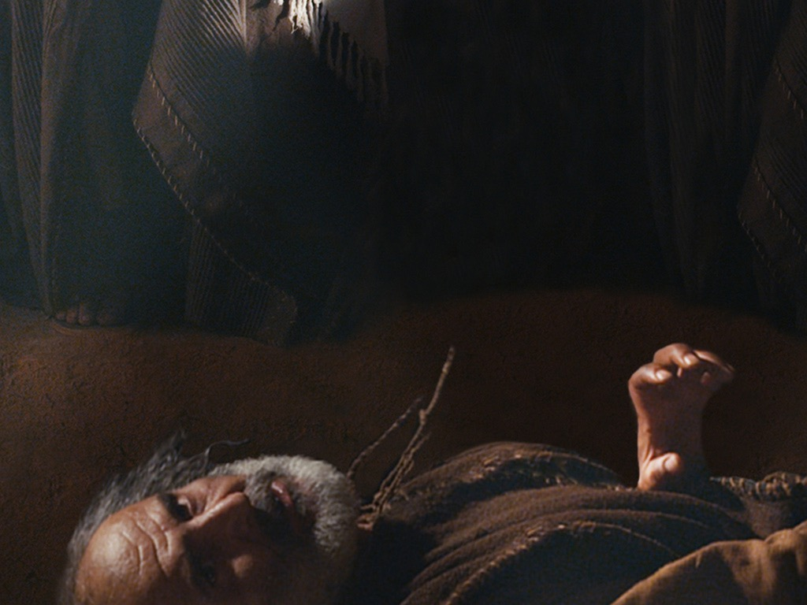

Slide 94
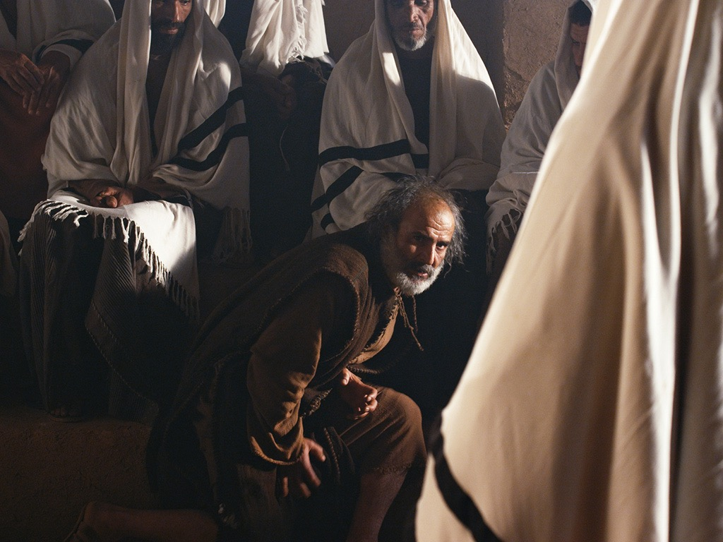

Slide 95
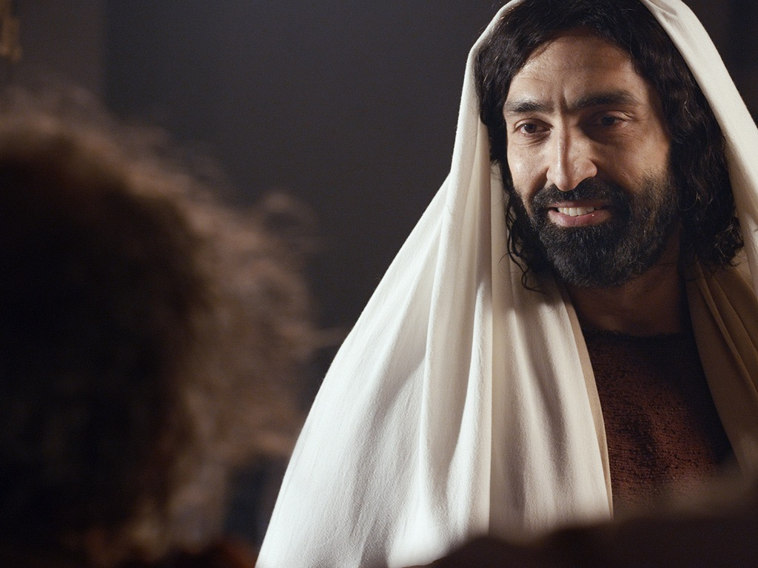

Slide 96
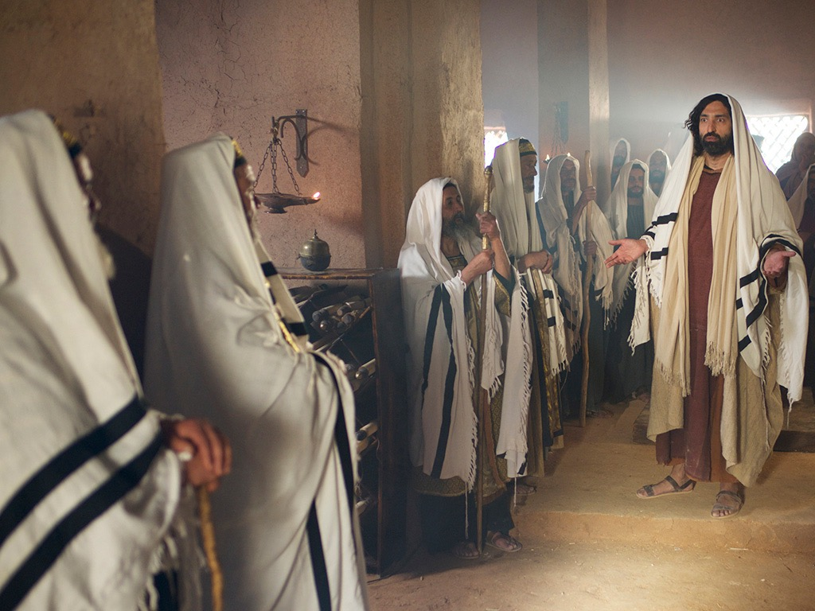

Slide 97
Used with Permission
THE
GOSPEL
——OF—— MATTHEW
THE
GOSPEL
——OF—— MARK
THE
GOSPEL
——OF—— LUKE
THE
GOSPEL
——OF—— JOHN
Due to the Lumo Project producing its own publishing material we regret to inform you that we cannot license our photos to other clients outside of freebibleimages.org.
These images are not licensed for reuse in video, epublishing or other media. Downloaded pictures and files cannot be redistributed through any other website than freebibleimages.org or used in any context where the accompanying message is undermining of the Christian faith and gospel.
Photos can only be used on educational presentations, blogs and social media, all of which should be accompanied with reference to www.LumoProject.com.
Picture courtesy of BBM
© All Rights Reserved.
www.bigbookmedia.com

Slide 98
7. Christ's Authority Over Sickness
§ 43
Matthew 8:14-17; Mark 1:29-34; Luke 4:38-41
Christ heals Peter's mother-in-law and other ill and demon-possessed persons to show his authority over sickness as Messiah but again rejects the witness from demons

Slide 99
The Power & Authority of Messiah in Matthew 8–10
75
Miracles & Discipleship
(8:1–9:34)
Delegation of Authority to Disciples
(9:35–10:42)
"That evening many demon-possessed people were brought to Jesus. He cast out the evil spirits with a simple command, and he healed all the sick. This fulfilled the word of the Lord through the prophet Isaiah, who said,
'He took our sicknesses
and removed our diseases'"
(Matt. 8:16-17; cf. Isa. 53:4)
"Jesus called his twelve disciples together and gave them authority to cast out evil spirits and to heal every kind of disease and illness"
(Matt. 10:1).

Slide 100
8. Christ's Authority to Preach
§ 44
Matthew 4:23-25; Mark 1:35-39; Luke 4:42-44
Christ's healings and compulsion to preach the good news that God had honored his covenant promises by sending him to Israel shows God’s commission on him as Messiah with an ever-widening ministry

Slide 101
9. Christ's Authority Over Defilement
§ 45
Matthew 8:2-4; Mark 1:40-45; Luke 5:12-16
Christ's instant healing of a hopeless leper proves his authority as Messiah to encourage the Sanhedrin to investigate his person and claims by the leper presenting his healing to a priest in Jerusalem

Slide 102
10. Christ's Authority to Forgive Sin
§ 46
Matthew 9:1-8; Mark 1:41-45; Luke 5:17-26
Through healing the paralytic, Jesus maintains that as Messiah and God He has the authority to forgive sin

Slide 103
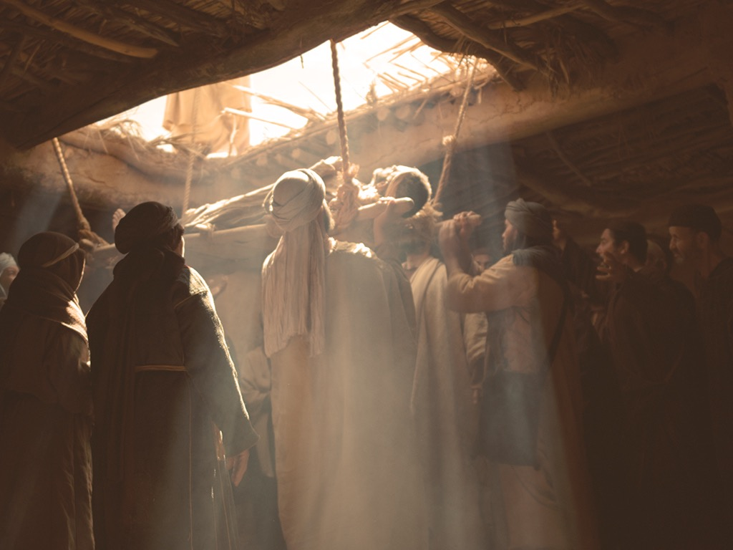
Free
Bible
images
Mark 2:2-12; Luke 5:17-26
JESUS FORGIVES AND
HEALS A PARALYZED MAN

Slide 104
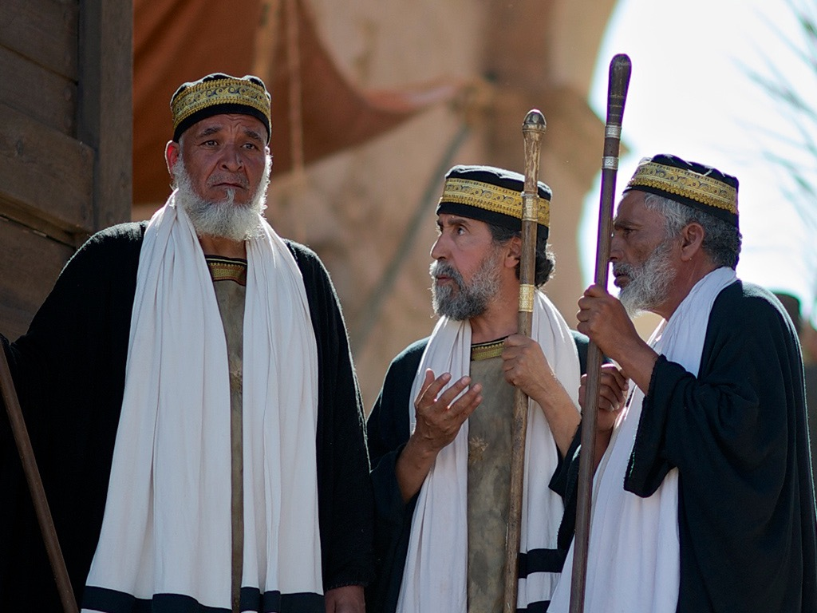

Slide 105


Slide 106


Slide 107


Slide 108


Slide 109


Slide 110


Slide 112


Slide 113


Slide 114


Slide 115


Slide 116


Slide 117


Slide 118


Slide 119


Slide 120


Slide 121


Slide 122


Slide 123


Slide 124


Slide 125
Used with Permission
THE
GOSPEL
——OF—— MATTHEW
THE
GOSPEL
——OF—— MARK
THE
GOSPEL
——OF—— LUKE
THE
GOSPEL
——OF—— JOHN
Due to the Lumo Project producing its own publishing material we regret to inform you that we cannot license our photos to other clients outside of freebibleimages.org.
These images are not licensed for reuse in video, epublishing or other media. Downloaded pictures and files cannot be redistributed through any other website than freebibleimages.org or used in any context where the accompanying message is undermining of the Christian faith and gospel.
Photos can only be used on educational presentations, blogs and social media, all of which should be accompanied with reference to www.LumoProject.com.
Picture courtesy of BBM
© All Rights Reserved.
www.bigbookmedia.com

Slide 126
11. Christ's Authority Over Men
§ 47
Matthew 9:9-13; Mark 2:13-17; Luke 5:27-32
Jesus calls Matthew from his tax-collector's booth due to His Messianic authority over men and His acceptance of repentant sinners made righteous by faith in His person despite being rejected by society

Slide 127
12. Christ's Authority Over Tradition
§ 48
Matthew 9:14-17; Mark 2:18-22; Luke 5:33-39
In reply to why His disciples do not fast, Christ declares His authority as Messiah over tradition by commencing a new system incompatible with the Pharisees

Slide 128
13. Christ's Authority Over the Sabbath
§§ 49-51
Jesus proves that He is over the Sabbath in two healings and in defending his disciples as Israel's Messiah by showing God’s view of Sabbath work

Slide 129
a. Through the Healing of the Paralytic
§ 49
John 5:1-47
Jesus heals a paralytic to verify His authority over the Sabbath as Messiah (Son of Man) and deity (Son of God), co-equal with the Father who had conferred His authority

Slide 130

Free
Bible
images
John 5:1-30
JESUS AND THE LAME MAN
AT THE POOL OF BETHESDA

Slide 131


Slide 132


Slide 133


Slide 135


Slide 136


Slide 137


Slide 138


Slide 139


Slide 140


Slide 141


Slide 142


Slide 143


Slide 144


Slide 145


Slide 146


Slide 147


Slide 148
Used with Permission
THE
GOSPEL
——OF—— MATTHEW
THE
GOSPEL
——OF—— MARK
THE
GOSPEL
——OF—— LUKE
THE
GOSPEL
——OF—— JOHN
Due to the Lumo Project producing its own publishing material we regret to inform you that we cannot license our photos to other clients outside of freebibleimages.org.
These images are not licensed for reuse in video, epublishing or other media. Downloaded pictures and files cannot be redistributed through any other website than freebibleimages.org or used in any context where the accompanying message is undermining of the Christian faith and gospel.
Photos can only be used on educational presentations, blogs and social media, all of which should be accompanied with reference to www.LumoProject.com.
Picture courtesy of BBM
© All Rights Reserved.
www.bigbookmedia.com

Slide 149

The Significance of John's Seven Signs
119
Sign | Eternal Life Teaching | Application
1. Changing water into wine at Cana (2:1-11)* | The joy of eternal life | If He can transform water, He can change me
2. Healing of official's son in Capernaum (4:46-54)* | The condition of eternal life (faith) | I am never too far away to be in His care
3. Healing the invalid at the Pool of Bethesda (5:1-18)* | The power to live the life | No limitation surpasses His authority
4. Feeding the 5000 near the Sea of Galilee (6:16-21) | The food for eternal life | Jesus can meet our deepest needs
5. Walking on water in the Sea of Galilee (6:5-14) | Guidance for eternal life | Jesus is Lord of life's storms
6. Healing the man born blind (9:1-7)* | Light for eternal life | Jesus offers spiritual and physical sight to the willing
7. Raising Lazarus from the dead in Bethany (11:1-45)* | Victory of life over death | Jesus Christ is Lord of life and death
Charles Ryrie, Ryrie Study Bible, 1618 (column 2); Mahlon Friesen, First Baptist Church of Yucaipa, CA (column 3).
* The asterisks indicate signs unique to John's gospel.

Slide 150
b. Through the Controversy Over Grain
§ 50
Matthew 21:1-8; Mark 2:23-28; Luke 6:1-5
Christ defends His disciples' right to pick grain on the Sabbath by exceptions of necessity to prove His authority over it as God since Israel must trust in Him as God

Slide 151
c. Through Healing the Man With the Withered Hand
§ 51
Matthew 12:9-14; Mark 3:1-6; Luke 6:6-11
The Pharisees try to trick Christ into breaking the Sabbath, but he shows his authority over the day by healing a man's withered hand as an act of mercy to reveal the Pharisees' hypocrisy and to model the legality of doing good on the Sabbath

Slide 152
14. Christ's Authority to Heal
§ 52
Matthew 12:15-21; Mark 3:7-12
Christ shows his authority to heal both Jews and Gentiles in His ministry as Messiah as one of compassion, gentleness, and mercy to Gentiles to fulfill Isaiah 42:1-4

Slide 153
15. Commissioning of the Twelve
§ 53
Mark 3:13-19; Luke 6:12-16
Following a night in prayer, Christ chooses from among the disciples twelve apostles to act as His authoritative representatives in His work

Slide 154

Commissioning of the Twelve

Slide 155
16. Christ's Authority to Interpret the Law
§§ 54-56
Matthew 5:1-7:29; Luke 6:17-42
Christ preaches the Sermon on the Mount to describe God’s holiness in the characteristics of the kingdom's subjects, his fulfillment of the Law, and kingdom entrance only through him to discredit Pharisaic righteousness

Slide 156

The Sermon on the Mount
(An Introduction to Matthew 5–7)
See the 21 PPT presentations of 1133 slides at NT Preaching

Slide 157

The Sermon on the Mount
(Matthew 5–7)
Notes:
You may have noticed that my series is called "The Best Sermon Ever." Maybe you thought I had totally lost any sense of humility—but actually, I was referring to Christ's message in Matthew 5–7, which is called "The Sermon on the Mount."

Slide 158

Mount of Beatitudes (Matthew 5–7)
Notes:
You can visit this actual location today if you visit Israel. It is a beautiful setting.

Slide 159


Mount of Beatitudes (Matthew 5–7)
Notes:
Israel calls it the "Mount of Beatitudes" even though this describes only the first 12 verses of this sermon.
• Likewise, a chapel to commemorate the event is called the "Mount Beatitudes Church."

Slide 160

Heaven on Earth (Matthew 5–7)
Notes:
But what was Jesus actually saying in these three chapters?

Slide 161

Purpose of the Sermon (Matthew 5–7)
How to be saved?
An ethic for those saved?
Notes:
But what was Jesus actually saying in these three chapters?

Slide 162

When Jesus is King…
(Matthew 5–7)
What would your life look like if Christ was truly the boss of your life?
Notes:
All of these things support the main teaching of the Sermon that shows what life looks like when Jesus is King of our lives.

Slide 163
Back to Basics (Matthew 5:21-48)
"You have heard that it was said…"
6 Issues:
"But I tell you…"
Murder
Adultery
Divorce
Vows
Revenge
Enemies
God's True Intent
Pharisee Teaching
External purity won't enter the kingdom (20)
Notes:
Here we see how "Jesus rejected the traditions of the Pharisees (vv. 21-48) … Six times Jesus said, "You have heard that it was said. ... But I tell you" (5:21-22, 27-28, 31-32, 33-34, 38-39, 43-44). These words make it clear that Jesus was presenting (a) what the Pharisees and teachers of the Law were saying to the people and, by contrast, (b) what God's true intent of the Law was. This spelled out His statement (v. 20) that Pharisaic righteousness is not enough to gain entrance into the coming kingdom" (Barbieri, BKC, 2:30).

Slide 164
a. The Subjects of the Kingdom
§ 54
Matthew 5:1-16; Luke 6:17-26
Those entering Messiah's kingdom should show godly character beyond Pharisaical observances with influence befitting the righteous kingdom Christ offered

Slide 165

"For I tell you that unless your righteousness surpasses that of the Pharisees and the teachers of the law, you will certainly not enter the kingdom of heaven"
(5:20 NIV).
Notes:
This spelled out His statement (v. 20) that Pharisaic righteousness is not enough to gain entrance into the coming kingdom" (Barbieri, BKC, 2:30).

Slide 166
(1) Introduction
Matthew 5:1-2; Luke 6:17-19
Christ instructs his disciples on the righteousness expected of those in his kingdom while the crowd begins to gather

Slide 167
(2) The subjects
Matthew 5:3-16; Luke 6:20-26
Christ describes the characteristics and influence of a righteous man so that His hearers might know the type of person who would enter the kingdom

Slide 168
(a) Their character
Matthew 5:3-12; Luke 6:20-26
The Beatitudes describe the holy characteristics of the righteous person based on Jesus for blessing so that the hearers might follow these to experience a full life

Slide 169

How to Be Happy in the Beatitudes
Notes:
Published on Apr 7, 2015
We all want to be happy. The question is, “How do we make that happen?” Explore a nonconventional path to true happiness.
Time elapsed is 2:26
https://www.youtube.com/watch?v=wxWCspyE7lg
Accessed 24 Jan 2016

Slide 170

The Revelation of the King (Matt 1–10)
His
Person
(Matt 1–4)
His Principles
(Matt 5–7)
His
Power
(Matt 8–10)
Warren W. Wiersbe, Be Loyal: Following the King of Kings, 15
Notes:
Matt 5–7 gives His principles—the Sermon on the Mount shows the lifestyle that his subjects should show.
• Matt 8–10 reveals His power—the authority of King Jesus over nature, sickness, demons, and actually everything!

Slide 171

Are Beatitudes LAWS on how you get into the kingdom (eternal life)?
Notes:
The purpose of the Sermon on the Mount has been debated. What are these chapters about?

Slide 172


Purpose of the Sermon (Matthew 5–7)
A way to be saved?
A charter for world peace?
A model for the millennium?
An ethic for believers now?
Notes:
For these 20 Sundays we're digging into this most significant sermon ever. But what was Jesus actually saying in these three chapters?

Slide 173
When Jesus is King…
(Matthew 5–7)
What would your life look like if Christ was truly the boss of your life?
Notes:
The Sermon on the Mount (Matt 5–7) show what it looks like when someone has changed his thinking about Christ—the "fruits" of repentance.

Slide 174
Beatitudes
POOR IN SPIRIT
MOURN
MEEK
HUNGER & THIRST FOR RIGHTEOUSNESS
MERCIFUL
PURE OF HEART
PEACEMAKERS
PERSECUTED
Notes:
Each first statement has these traits:
It shows a condition in which God blesses—when God adds a special measure of his grace so that we are better off than before.
That condition is an undesirable state—something people typically avoid.
Each first statement relates to character traits—something people typically also do not seek. Instead, we seek money, happiness, health, influence or power and so-called success.
"The qualities Jesus mentioned in this list, 'the poor in spirit,' 'those who mourn,' 'the meek,' etc., obviously could not be products of Pharisaic righteousness. The Pharisees were concerned primarily with external qualities, but the qualities Jesus mentioned are internal. These come only when one is properly related to God through faith, when one places his complete trust in God" (Louis A. Barbieri, Jr., "Matthew," in BKC, 2:29).

Slide 175

Beatitudes
Notes:
Each second statement also is parallel with one another in some ways:
Each second statement is the way God blesses us in a way parallel to the first statement—but it is upside down in nature—not what you'd expect!

Slide 176
…for they…
…for theirs is the kingdom of heaven
will be comforted
will inherit the earth
will be filled
will be shown mercy
will see God
will be called sons of God
…for theirs is the kingdom of heaven
Notes:
It is also something we typically do not seek—
However, this condition is what we really need!
In fact, it's also what we really want.

Slide 177

Results of believing in Christ (1-11)
What to do about these results (12)
Notes:
With that introduction, today we'll see the benefits or results of believing in Christ, followed by what to do about these results.
So how can you get blessed in life? It is found by faith or trust in God. In other words…

Slide 178

How can you get blessed in life?
Website
Notes:
How can we sum up the way to be blessed in 5:1-12?

Slide 179

Believer attitudes bring blessing
(Main Idea).
Notes:
God rewards us not for our actions but first in our attitudes that produce good deeds.

Slide 180
When Jesus is King…
(Matthew 5–7)
What would your life look like if Christ was truly the boss of your life?
Notes:
The Sermon on the Mount (Matt 5–7) show what it looks like when someone has changed his thinking about Christ—the "fruits" of repentance.

Slide 181

I. You get blessed by believing (5:1-11)!
Notes:
Those who trust Christ as King experience many rewards.

Slide 182

II. Be glad to suffer for Christ (5:12)!
Notes:
Rejoice over being persecuted.

Slide 183
(b) Their influence
Matthew 5:13-16
The influence of a righteous person creates a thirst for God in others by revealing God's righteousness, exposing sin and attracting them to the Lord

Slide 184

How can we bless others?
Salt & Light

Slide 185

Direct others to God.
Main Idea

Slide 186

Direct others to God.
Main Idea
Notes:
Influence people to follow God (MI restated).
Impact others for good (MI restated).
Show people God (MI restated).

Slide 187

I. Help people hunger for God (13).
Subtitle
Notes:
Like salt, help people hunger for God (5:13).

Slide 188

II. Lead people to God so they'll praise him (5:14-16).
Subtitle
Notes:
Like light, lead people to God so they’ll praise him (5:14-16).

Slide 189

Be involved…
"Both metaphors of salt and light raise important questions about Christian involvement in society regarding all forms of separatism or withdrawal. We are not called to control secular power structures; neither are we promised that we can Christianize the legislation and values of the world. But we must remain active preservative agents, indeed irritants, in calling the world to heed God's standards. We dare not form isolated Christian enclaves to which the world pays no attention."
Craig Blomberg, Matthew, NAC (Nashville: Broadman, 1992), 103

Slide 190
b. The Relation of the King to the Law
§ 55
Matthew 5:17-7:6; Luke 6:27-42
As fulfiller of the law, Christ rejects the Pharisaic interpretations of the law so that the disciples might know that the righteousness to enter the kingdom was in Christ rather than by doing the works of the law or the Pharisaic practices
Notes:
Edited in English but not Arabic

Slide 191
(1) The Fulfiller
Matthew 5:17-20
Christ declares Himself as the fulfiller of all that the law and prophets required and denies that Pharisaic righteousness has any saving value since the Pharisees misconstrued the law's original intent

Slide 192
(2) Rejection of traditional interpretation of the law
Matthew 5:21-48
Pharisees misinterpreted the law so that their righteousness brought no one into the kingdom and neglected the second table of the law about proper conduct towards others

Slide 193
(a) Murder
Matthew 5:21-26
One surpassing Pharisaic righteousness will not only preserve life but will avoid the anger, hatred, and unreconciled relationships which eventually lead to murder

Slide 194

How can you sustain great relationships?

Slide 195

I. Watch your anger (21-22).

Slide 196

II. Watch your worship (23-24).

Slide 197

III. Watch your money (25-26).
Notes:
The one hurt for not resolving a financial relationship is you

Slide 198
(b) Adultery
Matthew 5:27-30
One surpassing Pharisaic righteousness will not only be faithful to his spouse but avoid the lustful desires which cause adultery and will remove the causes of lust in his life

Slide 199
(c) Divorce
Matthew 5:31-32
One surpassing Pharisaic righteousness will not only never divorce his wife without legal documentation but will never divorce his wife at all lest this cause her and her future husband to both commit adultery when she remarries

Slide 200

How can you defend marriage?
• 2 ways
Notes:
We know that God has a high view of marriage, but how can you defend marriage?
So what's the first way that you can defend marriage?

Slide 201

I. Don't let marriage be devalued (Matt 5:31).
Notes:
Don't let it be devalued, but now we see one of the most important ways to preserve it in the next verse…

Slide 202

II. Defend marriage against adultery (Matt 5:32).
Notes:
The way to preserve the marital union is by keeping sex within marriage.

Slide 203
(d) Oaths
Matthew 5:33-37
One surpassing Pharisaic righteousness will not only take oaths when affirming something which could be taken in more than one way but will have trustworthy speech at all times so oath-taking becomes unnecessary

Slide 204
(e) Retaliation
Matthew 5:38-42
One surpassing Pharisaic righteousness will not demand his right for retaliation but give up such rights as a characteristic of righteousness and godliness

Slide 205
(f) Love
Matthew 5: 43-48; Luke 6:27-30, 32-36
One surpassing Pharisaic righteousness will not only love his neighbor who will repay favors but will love his enemy as well who will never repay favors

Slide 206

Enemies: The How and Why
How to treat your enemy (43-44)
Why treat your enemy like that (45-48)
Notes:
Today we’ll see how to treat your enemy and then why you should treat this person that way.

Slide 207

I. Love and pray for your enemy (5:43-44).
Notes:
In verses 43-44, Jesus said to love and pray for that enemy of yours! But why bless your enemy? What could be the reason for blessing your enemy like that? Why would you follow such a counterintuitive practice to actually treat your enemy with a blessing? This is because…

Slide 208

II. Blessing your enemy shows Christ's higher law (5:45-48).
Notes:
Loving and praying for that rival shows God’s doing his good work in you.

Slide 209
(3) Rejection of the Pharisaic practices of the law
Matthew 6:1–7:6; Luke 6:37-42
Pharisees misinterpreted the law so that their righteousness brought no one into the kingdom and had hypocritical practices directed man-ward for a reputation of piety rather than God-ward in true righteousness

Slide 210
Parallel Structure (Matt 6)
GIVING
(1-4)
PRAYER
(5-15)
FASTING
(16-18)
Hypocrites (2)
Hypocrites (5)
Hypocrites (16)
Public show (1-2)
Public show (5)
Public show (16)
Human
Reward (2)
Human
Reward (5)
Human
Reward (16)
Secret (4)
Secret (6)
Secret (18)
Father sees (4)
Father sees (6, 8)
Father sees (18)
Notes:
Barbieri notes, "In all three examples of Pharisaic 'righteousness'—almsgiving (vv. 1-4), praying (vv. 5-15), and fasting (vv. 16-18)—Jesus spoke of hypocrites (vv. 2, 5, 16), public ostentation (vv. 1-2, 5, 16), receiving their reward in full when their actions are done before men (vv. 2, 5, 16), acting in secret (vv. 4, 6, 18), and being rewarded by the Father, who sees or 'knows,' when one's actions are done secretly (vv. 4, 6, 8, 18)" (Barbieri, BKC, 2:33).

Slide 211
Rewards for Righteousness (Matt. 6:1–7:6)
Don't do this…
6 More Issues:
Do this instead…
Giving
Prayer
Fasting
Investing
Trust
Judging
Pharisee Practice
Pure Practice
"Watch out! Don't do your good deeds publicly, to be admired by others, for you will lose the reward from your Father in heaven" (6:1 NLT)
Notes:
• In contrast to the hypocritical teaching of the Pharisees…
• Jesus gave his own humble teaching that was backed by his life example.
• In Matthew 7:1–7:6, Jesus addresses six areas of life: giving, prayer, fasting, investing, trust (not worry), and humility (not judging).
• Each of these areas shows that the religious leaders did their good works only for public show just like 7:1 warns against.

Slide 212
(a) Almsgiving
Matthew 6:1-4
The Pharisaical practice of public almsgiving is repudiated for being performed to demonstrate piety rather than to demonstrate the love of God by meeting a need

Slide 213
(b) Prayer
Matthew 6:5-15
The Pharisaical practice of public prayer for show should instead be private prayer for worship, supplication for God's work and personal needs, confession, protection, and a forgiving spirit

Slide 214
(c) Fasting
Matthew 6:16-18
The Pharisaical practice of public fasting is repudiated for being performed to demonstrate piety rather than done privately before God to receive reward only from Him

Slide 215
(d) Attitude toward wealth
Matthew 6:19-24
The Pharisaical practice of gaining temporal wealth as a sign of God's approval should be replaced with making eternal investments that cannot be lost

Slide 216
(e) Lack of faith
Matthew 6:25-34
The Pharisaical practice of lack of faith by hoarding money should be replaced with trust in God's daily provisions of food and clothing as one seeks the kingdom's arrival

Slide 217
(f) Judging
Matthew 7:1-6; Luke 6:37-42
The Pharisaical practice of judging others by one’s standards is repudiated for assuming knowledge of others’ motives whereas God's righteousness demands that one not judge until his own life has been purified

Slide 218
c. Instruction to Those Who Would Enter the Kingdom
§ 56
Matthew 7:7-29
Christ knew that, despite the Pharisees' rejection, some would receive His teaching and would want to know how to enter the kingdom so He instructs those who desire to enter the kingdom

Slide 219
(1) Prayer
Matthew 7:7-11
Persistent prayer will be answered because of God's nature as a Father whose responsibility it is to make sure His children's needs are met, not because of the endless repetitions characteristic of the Pharisees

Slide 220
(2) True righteousness
Matthew 7:12; Luke 6:31, 43-45
Treating others as one desires to be treated himself demonstrates true righteousness

Slide 221
(3) The way of access
Matthew 7:13-14
Christ gives the invitation to receive him to enter the kingdom as the only true, narrow way of access, not the false, broad way of the Pharisees that excludes from the kingdom and brings destruction

Slide 222
(4) Warning to false teachers
Matthew 7:15-23
The Pharisees are false prophets seen in their unrighteous lifestyles and will be judged for outwardly fulfilling the law but inwardly lacking the required relationship with the King to enter the kingdom

Slide 223
(5) The two foundations
Matthew 7:24-8:1; Luke 6:46-49
Another invitation to reject Pharisaism and accept Christ contrasts one who trusts the King's word and person with one who rejects them to show that one’s destiny is determined by their response to his message

Slide 224
17. Recognition of Christ's Authority in Capernaum
§ 57
Matthew 8:5-13; Luke 7:1-10
Christ's authority over sickness shown in healing a centurion's servant at a distance merely by speaking illustrates salvation extended to Gentiles in response to Israel's rejection

Slide 225
The Power & Authority of Messiah in Matthew 8–10
75
Miracles & Discipleship
(8:1–9:34)
Delegation of Authority to Disciples
(9:35–10:42)
"That evening many demon-possessed people were brought to Jesus. He cast out the evil spirits with a simple command, and he healed all the sick. This fulfilled the word of the Lord through the prophet Isaiah, who said,
'He took our sicknesses
and removed our diseases'"
(Matt. 8:16-17; cf. Isa. 53:4)
"Jesus called his twelve disciples together and gave them authority to cast out evil spirits and to heal every kind of disease and illness"
(Matt. 10:1).

Slide 226
18. Recognition of Christ's Authority in Nain
§ 58
Luke 7:11-17
Christ proves His authority over death in the restoration of life to the son of a widow in Nain, bearing additional testimony to His Messianic identity

Slide 227
19. Witness of the Twelve
§ 59
Matthew 9:35–11:1; Mark 6:6b-13; Luke 9:1-6
Christ delegates His Messianic authority by sending out the twelve apostles with authority over demons, sickness, and disease and a commission to preach that the kingdom is near

Slide 228
The Power & Authority of Messiah in Matthew 8–10
75
Miracles & Discipleship
(8:1–9:34)
Delegation of Authority to Disciples
(9:35–10:42)
"That evening many demon-possessed people were brought to Jesus. He cast out the evil spirits with a simple command, and he healed all the sick. This fulfilled the word of the Lord through the prophet Isaiah, who said,
'He took our sicknesses
and removed our diseases'"
(Matt. 8:16-17; cf. Isa. 53:4)
"Jesus called his twelve disciples together and gave them authority to cast out evil spirits and to heal every kind of disease and illness"
(Matt. 10:1).

Slide 229

Matthew 10
Commissioning
12 Disciples
Adapted from a Class Presentation by No Pum for
Dr. Rick Griffith • Singapore Bible College • BibleStudyDownloads.org

Slide 230
Outline
I. Themes of the Book
II. Context of the Passage
III. An Exposition of the Passage
IV. Homiletical Conclusion

Slide 231
I. Themes of the Book
A. Jesus in Matthew
B. The Kingship of Jesus
in Matthew 10

Slide 232

Jesus in Matthew
The Hope of Israel,
long-awaited Messiah
Blessing for Gentiles alike
The Legitimate King & Ruler
Craig L. Blomberg, 202

Slide 233
The Kingship of Jesus in Matthew 10
Jesus
Matt 10:1,
“…gave them
authority to…”
?
The right to control or command, authority, absolute power, warrant.
Power exercised by rulers or others in high position by virtue of their office, ruling power, official power.
Craig S. Keener, Bible Background Commentary: New Testament. Downers Grove, InterVarsity Press, 1993.

Slide 234
II. Context of the passage
The Bridge
The Immediate Context
of the Passage
Division of the Passage

Slide 235


The Bridge (Matt. 9:36–10:4)
The harvest
is
plentiful
But the workers are few
Craig L. Blomberg, Jesus and the Gospel: Additional Teaching of Jesus, 285

Slide 236
The Immediate Context of the Passage
9:36: But when he saw the multitudes, he was moved with compassion for them, because they were distressed and scattered, as sheep not having a shepherd.
9:37: Then saith he unto his disciples, The harvest indeed is plenteous, but the laborers are few.
9:38: Pray ye, therefore, the Lord of the harvest, that he send forth laborers into his harvest.
10:1 And he called unto him his twelve disciples, and gave them authority over unclean spirits, to cast them out, and to heal all manner of disease and all manner of sickness. (ASV)

Slide 237
The Immediate Context of the Passage
9:36
But when he saw the multitudes, he was moved with compassion
for them because they were distressed and scattered, as sheep
not having a shepherd.
9:37
Then saith he unto his disciples,
The harvest indeed is plenteous, but the laborers are few.
9:38
Pray ye therefore the Lord of the harvest,
that he send forth laborers into his harvest.
Chapter Ten
10:1
And he called unto him his twelve disciples, and gave them
authority over unclean spirits, to cast them out, and to
heal all manner of disease and all manner of sickness. (ASV)

Slide 238
Division of the Passage:
10:5-42
10:5-16
10:17-42
Instructions
For
Ministry
During
Jesus'
Lifetime
Looking ahead toward coming persecution,
circumstances
after His death
and
resurrection
Craig L. Blomberg, Jesus and the Gospel: Additional Teaching of Jesus, 285

Slide 239
III. An Exposition of the Passage
The Previous Call of Disciples
The re-gathering of disciples for urgent needs
Comparing between Synoptics
Definite Target Group
Instructions regarding with the future
Principles

Slide 240

The Previous Call of Disciples: Matt. 4:19-22
Disciples were chosen earlier. Matt. 4:19-22
“Jesus called them, and immediately they left the boat and their father and follow him” (vs. 21b-22).

Slide 241

The re-gathering of disciples for urgent needs (Matthew 10:1-4).
Now the names of the twelve
apostles are listed
The first, Simon, who is called Peter, and Andrew his brother;
James the son of Zebedee, and John his brother;
Philip, and Bartholomew;
Thomas, and Matthew the publican;
James the son of Alphaeus, and Thaddaeus;
Simon the Cananaean, zealot, and Judas Iscariot, who also betrayed him.

Slide 242
Comparing the Synoptics
Matthew 10
“…the harvest indeed is
plenteous, but the laborers are few…
And He called unto him his twelve disciples, and gave them authority…
These twelve Jesus sent forth, and charged them,…”
Mark 6:7ff
“…And he calleth
Unto him the
twelve, and began
to send them forth
by two and two
and he gave them
authority over the
unclean spirits;…
and he charged them
that they…”
Luke 10
“Now after these
things the Lord
appointed
seventy others,
and sent them
two and two…
The harvest indeed is plenteous, but the laborers are few:
Go your ways; behold, I send you forth…”

Slide 243
Definite Target Group
Matthew 10:6
Go
rather to
the lost sheep
of Israel
You will not finish going
through the cities of Israel (vv. 23)

Slide 244




Instructions regarding the future
Matthew 10:17-42
1) 17-25
The prospect of future
hostility: Persecution
2) 26-31
The proper reaction to
hostility is:
“to fear God”
3) 32-42
Personal Choice:
Acknowledge Jesus or
Reject Jesus
Craig L. Blomberg. Jesus and the Gospels: Additional Teaching of Jesus, 286

Slide 245

Principle
Jesus never guaranteed disciples (or us)
that there would not be hardship, difficulties,
problems, and persecution etc. in their ministry, rather
B
U
T
You will be…
“…but the Spirit of your Father speaking through you”
Matthew 10:20 (NIV)

Slide 246

Jesus promised family opposition
³⁴"Don't imagine that I came to bring peace to the earth!
I came not to bring peace, but a sword.
³⁵I have come to set
a man against his father,
a daughter against her mother,
and a daughter-in-law against her mother-in-law.
³⁶Your enemies will be right in your own household!" (Matt. 10:34-36 NLT)
Notes:
OS-19-Nehemiah-318
NS-01-Matt1-10-slide 352

Slide 247
Message: Matt. 10:5-42
As you go, preach this message:
“The kingdom of God is near” (vs. 7)
Kingdom of God means
The components of a kingdom
1. the act of ruling
kingship, royal power, royal rule
kingdom
the royal reign of God
(usually rendered ‘kingdom of God)
2. territory ruled by a king, kingdom
Country
King
People
Be prepared! The reign and
ruling power of God is
near because the King
(Jesus) is coming soon.
BibleWorks 6

Slide 248
Homiletical
Conclusion

Slide 249
How could Jesus use the men He had chosen?
After all…
>None of them occupied a prominent place in the synagogue
But
they all were
in their Master’s hands
who could make them sharp and
mold them better
>They did not belong to the Levitical priesthood
>They probably had no professional training
>None of them were wealthy except maybe the sons of Zebedee
>They were raised in the poor section of the country around Galilee and with probably only one synagogue school
>At least one of them was a Zealot (robbers and troublemakers)
Robert E. Coleman, The Master Plan of Evangelism, 22-23

Slide 250



Personal Response
“...I besought Him to give me
some work to do for Him, as an
outlet for love and gratitude;
some self-denying service,
no matter what it might be,
however trying or however
trivial; something with which
He would be pleased, and that
I might do for Him who had done
so much for me...”
J. Hudson Taylor, A Retrospect: The Call to Serve (Overseas Missionary Fellowship, n.d.), 300
“…He was uneducated,
unordained, unconnected
(with a mission society),
and uncouth. And if that
was not enough, he was
short (Maria was tall), and he wore Chinese clothes.”
Ruth A. Tucker, From Jerusalem to
Irian Jaya, 191
(A letter from Miss. Aldersey to Maria’s uncle)
“…
J. Hudson Taylor became known as the founder of China Inland Mission.

Slide 251

How about me or you?
I Love to Tell the Story
1. I love to tell the story
of unseen things above
Of Jesus and His glory,
Of Jesus and His love
I love to tell the story,
because I know ‘tis true;
It satisfies my longings
as nothing else can do.
I love to tell the story,
‘twill be my theme in glory.
To tell the old, old story,
of Jesus and His Love.

Slide 252

2. I love to tell the story,
‘tis pleasant to repeat.
What seems, each time I tell it,
more wonderfully sweet.
I love to tell the story,
for some had never heard.
The message of Salvation,
from God’s own holy Word.
I love to tell the story,
‘twill be my theme in glory.
To tell the old, old story,
of Jesus and His Love.

Slide 253
Black

Slide 254


Life of Christ link at BibleStudyDownloads.org
Get this presentation for free!
Notes:
NT Survey (ns)

